Slide 1

Prehospital: Emergency Care
Eleventh Edition
Chapter 11
Baseline Vital Signs, Monitoring Devices, and History Taking
Slides in this presentation contain hyperlinks. JAWS users should be able to get a list of links by using INSERT+F7
Copyright © 2018, 2014, 2010 Pearson Education, Inc. All Rights Reserved
Notes:
If this PowerPoint presentation contains mathematical equations, you may need to check that your computer has the following installed:
1) MathType Plugin
2) Math Player (free versions available)
3) NVDA Reader (free versions available)
Advance Preparation
Student Readiness
Assign the associated section of MyBRADYLab and review student scores.
Review the chapter material in the Instructor Resources, which includes Student Handouts, PowerPoint slides and the MyTest Program.
Prepare
Make copies of handouts from the Instructor Resources, and other materials for distribution or post them in your learning management system.
Preview the media resources and Master Teaching Notes in this lesson.
Preview the case study presented in the PowerPoint slides.
The total teaching time recommended is only a guideline. Take into consideration factors such as the pace at which students learn, the size of the class, breaks, and classroom activities. The actual time devoted to teaching objectives is the responsibility of the instructor.

Slide 2
Learning Readiness
E M S Education Standards, text p. 286.
Chapter Objectives, text p. 286.
Key Terms, text p. 287.
Purpose of lecture presentation versus textbook reading assignments.
Notes:
Explain to students what the National EMS Education Standards are. The National EMS Education Standards communicate the expectations of entry-level EMS providers. As EMTs, students will be expected to be competent in these areas. Acknowledge that the standards are broad, general statements. Although this lesson addresses the listed competencies, the competencies are often complex and require completion of more than one lesson to accomplish. The student is also expected to review the chapter objectives to foreshadow what will be in the chapter. By mastering the key terms the EMT student will better understand the learning and be able to communicate more clearly.
Additionally, explain to the students that the purpose of using these slides is to help keep the instructor focused on highlighting important portions of the material, explain interrelationships of topics, and discuss how to apply this information. It’s not the intent of the presentation (or slides alone) to include every component in the chapter. This presentation still requires the student to thoroughly read the chapter.

Slide 3
Setting the Stage
Overview of Lesson Topics
  Gathering Patient Information
  Vital Signs
  Monitoring Equipment
  Preparing to Take the History
  Taking the History
Notes:
These bulleted points are the major headings from the chapter, in order. The purpose is to provide a basic lecture navigation for the student.

Slide 4
Case Study Introduction
Chuck Mahon rubs his chest, trying to relieve the discomfort he feels there as two E M Ts walk toward him. “Hi, I’m Bill,” says the taller of the two, “and this is Dawn. We are E M Ts, and we are here to help. What seems to be the problem today?”
Notes:
Case Study
Present the Case Study Introduction provided in the PowerPoint slide set.
Lead a discussion using the case study questions provided on the subsequent slide(s).
The Case Study with discussion questions continues throughout the PowerPoint presentation.
Case Study Discussion
Use the case study content and questions to foreshadow the upcoming lesson content.

Slide 5
Case Study (1 of 3)
What information will be important to Bill and Yolanda in deciding what is wrong with Mr. Mahon?
What procedures and equipment will the E M Ts use to obtain this information?
Notes:
Case Study Discussion
Use the case study content and questions to foreshadow the upcoming lesson content. Gauge the student’s responses as a guide of how well versed they are in this topic.

Slide 6
Introduction (1 of 2)
Patient assessment is a skill the E M T must provide to every patient.
Patient assessment helps you find out what is wrong with the patient and decide what care should be provided.
Measuring vital signs over time reveals trends in the patient’s condition.
The patient’s history helps you understand their underlying problems.
Notes:
Introduction
During this lesson, students will learn about taking vital signs, monitoring devices, and gathering patient history.
Always be aware of feelings, such as anxiety or embarrassment, that a patient may experience during assessment. Continually reassure the patient and respect their dignity.

Slide 7
Introduction (2 of 2)
Gathering Patient Information
  When you arrive at the scene of an emergency call, you must gather information about the patient’s condition.
  Some information is readily available; other information takes “detective work.”
  Always respect the patient’s dignity.
Notes:
Much of the information you gain during assessment is readily obvious or available. An open bottle of bleach may provide the clue to a poisoning. The patient or a family member may tell you the chief complaint—for example, “I can’t catch my breath,” or “I hurt my leg when I fell.” The fact that the patient is answering questions clearly may tell you that they are alert, have an open airway, are breathing adequately, and have a pulse.
Teaching Tips
Ask how students feel when asked medical questions by a health care provider
Critical Thinking Discussion
What are actions that show a health care provider respects a patient's dignity?

Slide 8
Vital Signs (1 of 25)
  Vital signs are outward clues about what is happening in the body. They include:
    Respiration
    Pulse
    Skin
    Pupils
    Blood pressure
    Pulse oximetry
Notes:
Correctly reading and interpreting the vital signs significantly affects the success of prehospital emergency care and the critical information you provide the hospital staff. Taking two or more sets of vital signs and comparing them will reveal changes in the patient’s condition and may indicate how effectively you are managing the patient’s injury or illness, or if the patient is deteriorating.
Points to Emphasize
Vital signs are a noninvasive way of finding out what is going on in the patient's body.

Slide 9
Vital Signs (2 of 25)
  Baseline vital signs are the first set of measurements taken.
    Later findings are compared to the baseline to detect trends.
  Some vitals signs are detected by looking, listening, and feeling.
  Other vital signs are measured using special equipment.
Notes:
As an example, a blood pressure that continues to decrease and a heart rate that continues to increase are significant findings in a patient who you suspect is losing blood.
Review the equipment carried and routinely used for patient monitoring.

Slide 10
Vital Signs (3 of 25)
Respiration
  Respiratory Rate
    For adults, the range is 12 to 20 breaths per minute.
    Respiratory rates that are less than 8 or greater than 24 are of concern.
    Interpret findings based on the patient’s overall presentation.
Notes:
First, look at the patient and determine whether they look to be in respiratory distress; second, assess their mental status and pay attention to their speech pattern. The respiratory rate is then assessed by observing the patient’s chest rise and fall. If you encounter a patient with a respiratory rate of 8 who is alert, oriented, and able to answer your questions without gasping for a breath or showing a struggle to breathe, 8 may be their normal respiratory rate, and no intervention is necessary. On the other hand, if the patient has their eyes closed, needs to be aroused with verbal stimuli, appears fatigued, appears to be struggling to breathe, or speaks only a couple of words before gasping for a breath, you would consider assisting the patient’s ventilation.

Slide 11
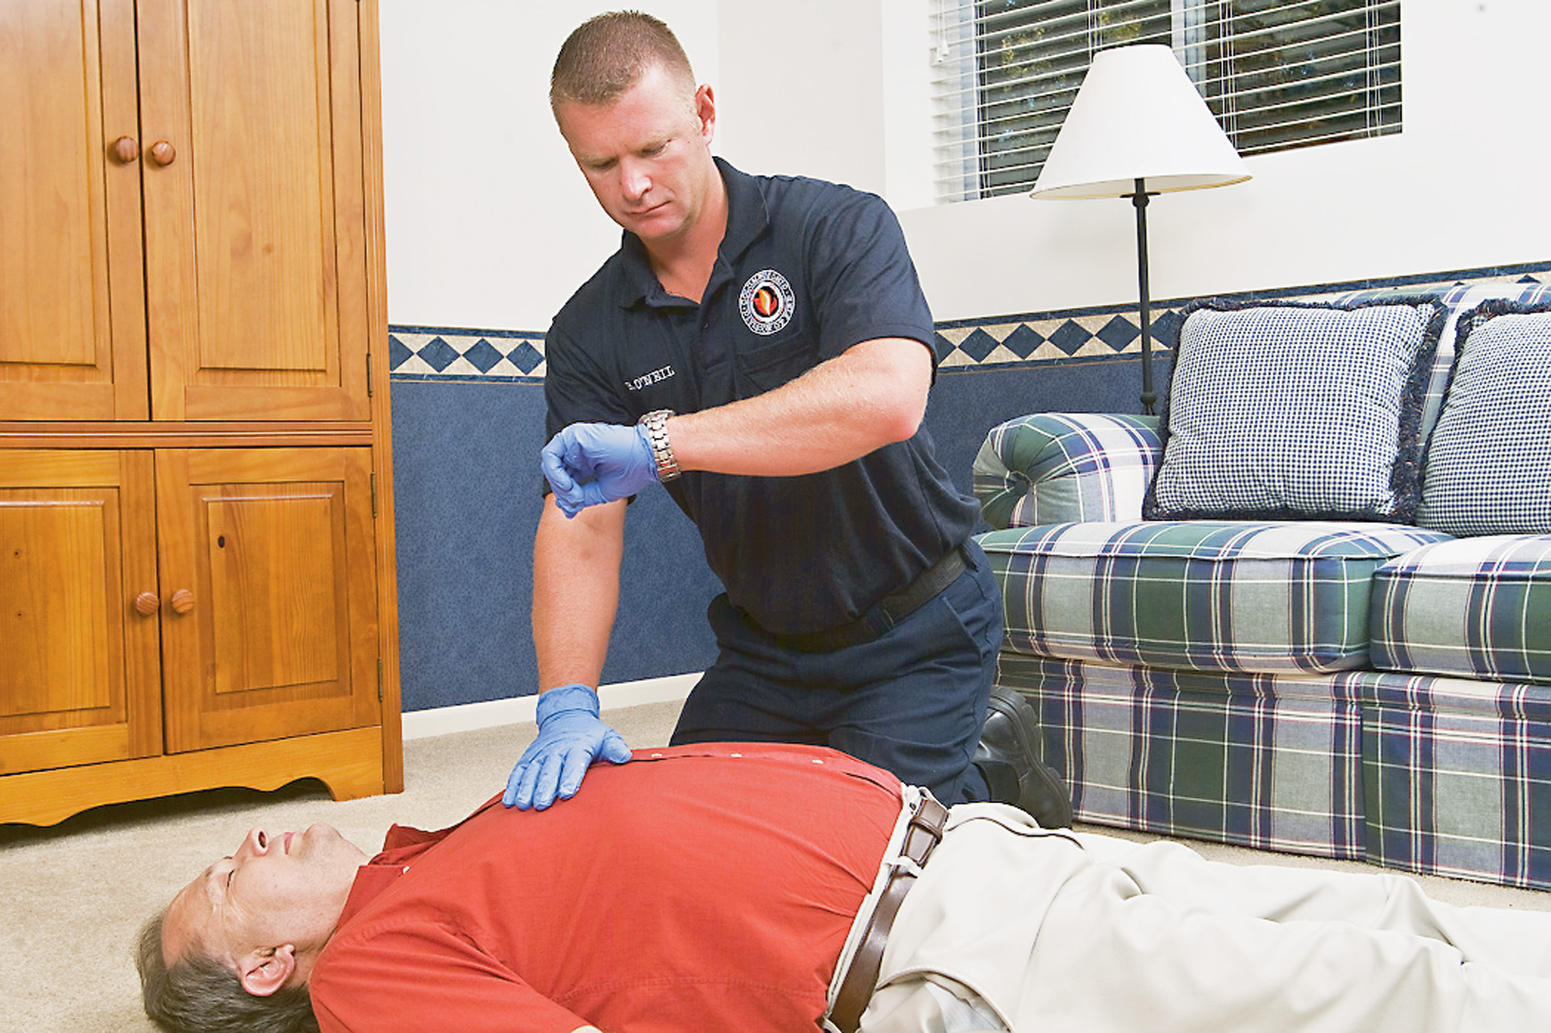
Assess the Breathing (Respiratory) Rate, Quality, and Rhythm
Notes:
Look at the respiratory rate in relation to the presentation of the patient. If you encounter a patient with a respiratory rate of 8 who is alert, oriented, and able to answer your questions without gasping for a breath or showing a struggle to breathe, 8 may be their normal respiratory rate, and no intervention is necessary.
Count the breaths in 30 seconds and multiply by two. A breath is one inhalation + one exhalation.
Keep in mind that the resting respiratory rate of the elderly is typically higher, with an average of 20 breaths per minute.

Slide 12
Table 11-1 Normal Respiratory Rates
Patient | Normal Breathing Rate per Minute
Adult | 12–20
Adolescent 12–15 years | 12–20
School-age child 6–11 years | 18–25
Preschooler 3–5 years | 20–28
Toddler 1–2 years | 22–37
Infant <1 year | 30–53
Neonate birth–1 month | 40–60
Notes:
The normal ranges for respirations per minute for pediatrics, according to the American Heart Association and American Academy of Pediatrics Pediatric Advanced Life Support 2016, and for adults are shown in Table 11-1.

Slide 13
Vital Signs (4 of 25)
Respiration
  Respiratory Rate
    Ventilate an adult patient breathing at a rate greater than 40 per minute or an infant or young child breathing at a rate greater than 60 per minute.
    Fatigue occurs and the rate cannot be maintained.
    The rate is too fast to allow adequate tidal volume.
Notes:
If the patient knows you are counting, it can influence the rate. Instead, pretend to check the radial pulse and cross the patient’s arm over the lower chest while counting respirations.

Slide 14
Vital Signs (5 of 25)
  Respiration
  Respiratory Quality
    Normal
    Shallow
    Labored
    Noisy
  Respiratory rhythm is the regularity or irregularity of respirations.
Notes:
Determining quality of respiration, or breathing, is as important as determining rate. It tells you the volume of air moving in and out of the lungs with each breath, the volume per minute, and how well it is moving. If either the respiratory rate or the tidal volume is found to be inadequate, then the patient’s respiratory status is inadequate and positive pressure ventilation must be initiated.
You can assess the quality of respiration while you are counting the rate. Explain the various abnormal respiratory qualities.

Slide 15
Vital Signs (6 of 25)
  Respiration
  Respiratory Rhythm
    Cheyne Stokes
    Biot
    Apneustic
    Ataxic
    Agonal
    Kussmaul
    Central neurogenic hyperventilation
Notes:
An abnormal regularity (pattern) in a patient with an altered mental status is a serious concern.
Abnormal respiratory patterns include the following (explain differences to the students):
Cheyne Stokes- The respiratory rate and tidal volume gradually increase and gradually decrease followed by a period of apnea for up to ten seconds. The pattern then repeats itself.
Biot - Similar to Cheyne Stokes except that the tidal volume doesn’t change, but the respiratory pattern is interrupted by a period of apnea.
Apneustic - Is characterized by prolonged periods of inhalation.
Ataxic - An irregularly irregular pattern of rate and tidal volume.
Agonal - Long periods of apnea with a gasping breath interposed.
Kussmaul - A rapid respiratory rate with a deep and labored tidal volume.
Central neurogenic hyperventilation - A sustained deep and rapid respiratory rate of at least 25 breaths per minute but with a regular pattern.

Slide 16
Table 11-2 Noisy Respiration
Sounds Audible Without a Stethoscope | Potential Cause
Snoring | Tongue partially blocking the upper airway at the level of the pharynx
Gurgling | Fluid in the upper airway
Stridor or crowing | Partial obstruction of the upper airway at the level of the larynx
Sounds Audible with a Stethoscope | Potential Cause
Wheezing | Constriction (narrowing) and inflammation reducing the internal diameter of the bronchioles in the lungs
Crackles (Rales) | Fluid surrounding and filling the alveoli
Rhonchi | Mucus blocking the larger bronchioles
Notes:
Spend time in class as a group listening to examples of various types of labored and noisy respirations.

Slide 17
Vital Signs (7 of 25)
Pulse
  Location of Pulses
    Pressure wave generated by the contraction of the left ventricle
    Directly reflects heart function
Notes:
Explain how taking the pulse provides a measurement of heart rate and an assessment of pulse quality and rhythm.

Slide 18
Vital Signs (8 of 25)
Pulse
  Location of Pulses
    Carotid
    Femoral
    Brachial
    Popliteal
    Posterior tibial
    Dorsalis pedis
Notes:
Carotid artery- The pulses can be found on either side of the neck in the groove between the trachea and the muscle mass.
Femoral artery- The pulses can be found in the crease between the lower abdomen and the upper thigh (groin).
Radial artery- The pulses can be found proximal to the thumb on the palmar surface of the wrist.
Brachial artery- The pulses can be found on the medial aspect of the arm, midway between the shoulder and the elbow between the biceps and triceps muscles.
Popliteal artery- The pulses can be found in the crease behind the knee.
Posterior tibial artery- The pulses can be found behind the medial malleolus (ankle bone).
Dorsalis pedis artery- The pulses can be found on the top of the foot on the great-toe side.
Teaching Tips
Have students locate their radial, brachial, carotid, and dorsalis pedis pulses.

Slide 19
Vital Signs (9 of 25)
Pulse
  Location of Pulses
    If a patient is:
      One year or older, check the radial pulse
      One year or older without a peripheral pulse, check the carotid pulse
      Less than one year, check the brachial pulse
Notes:
When palpating the carotid pulse, take care not to compress too hard, which may impede circulation to the brain. Never assess the carotid pulse on both sides at the same time, and avoid excessive pressure in elderly patients.
Discussion Question
When should the carotid pulse be assessed?

Slide 20
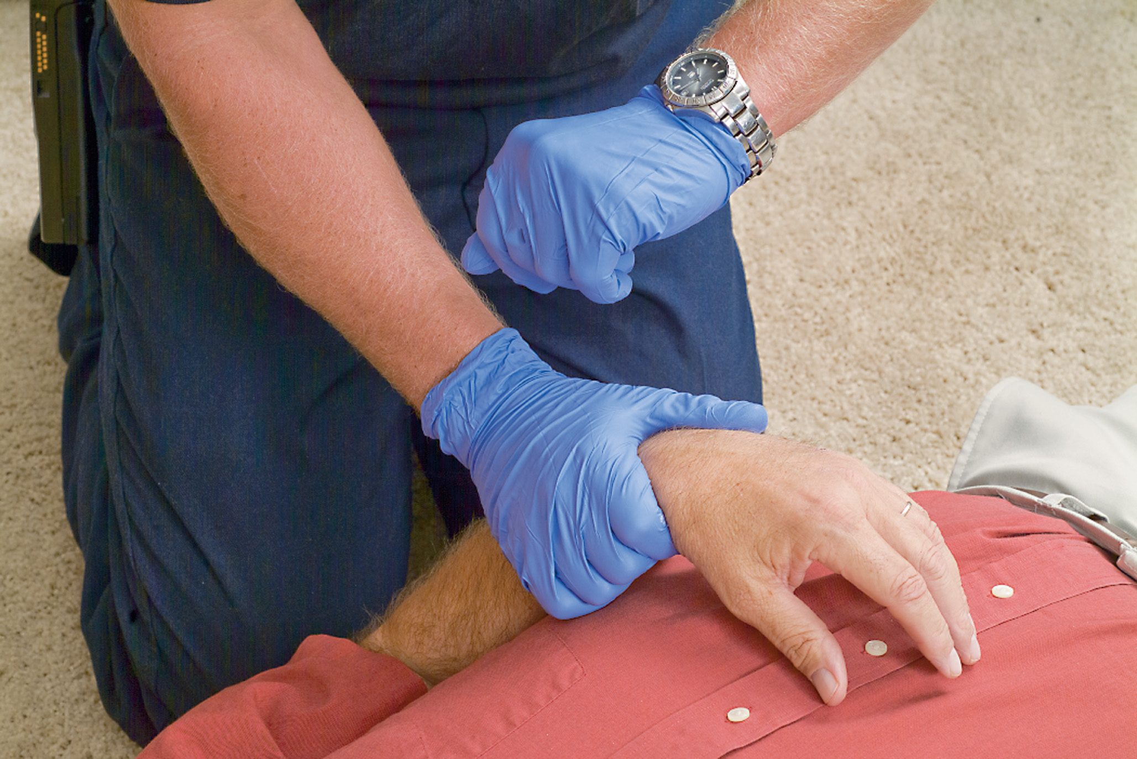
Assess the Pulse Rate, Quality, and Rhythm. the Radial Pulse Is Assessed in Patients Older Than One Year of Age
Notes:
Class Activity:
Have students practice locating and assessing the pulse.

Slide 21
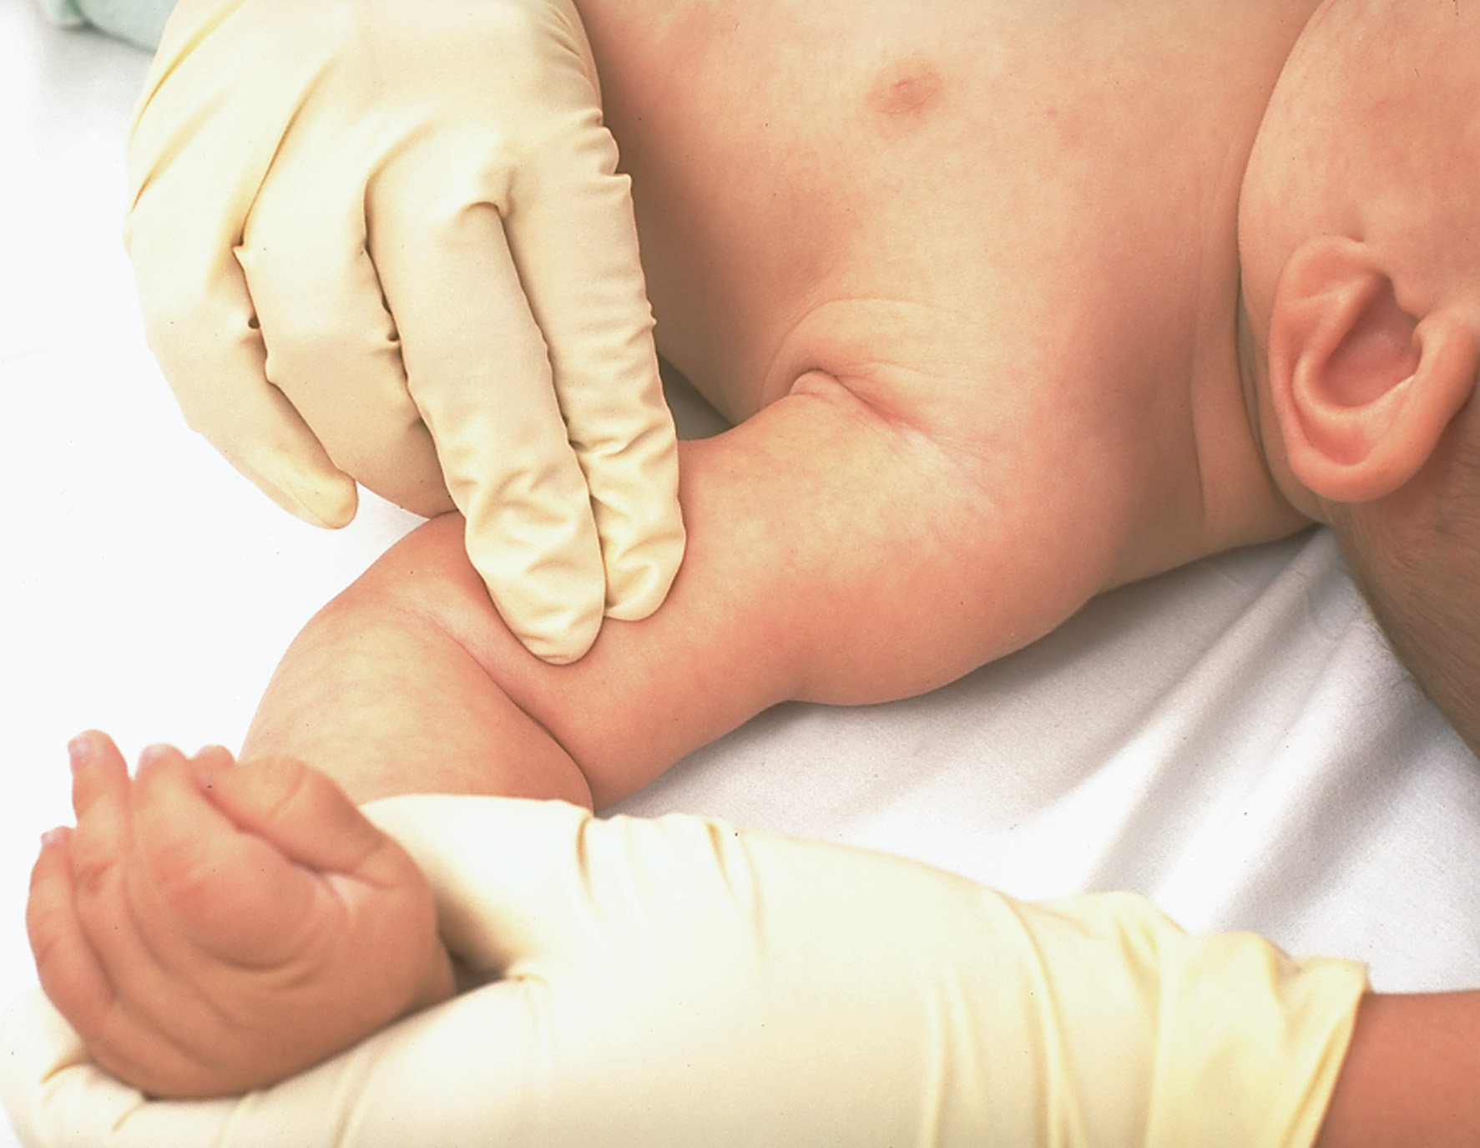
Assess the Brachial Pulse in Patients Who Are Less Than One Year of Age
Notes:
Class Activity:
Have students practice locating and assessing the brachial pulse.

Slide 22
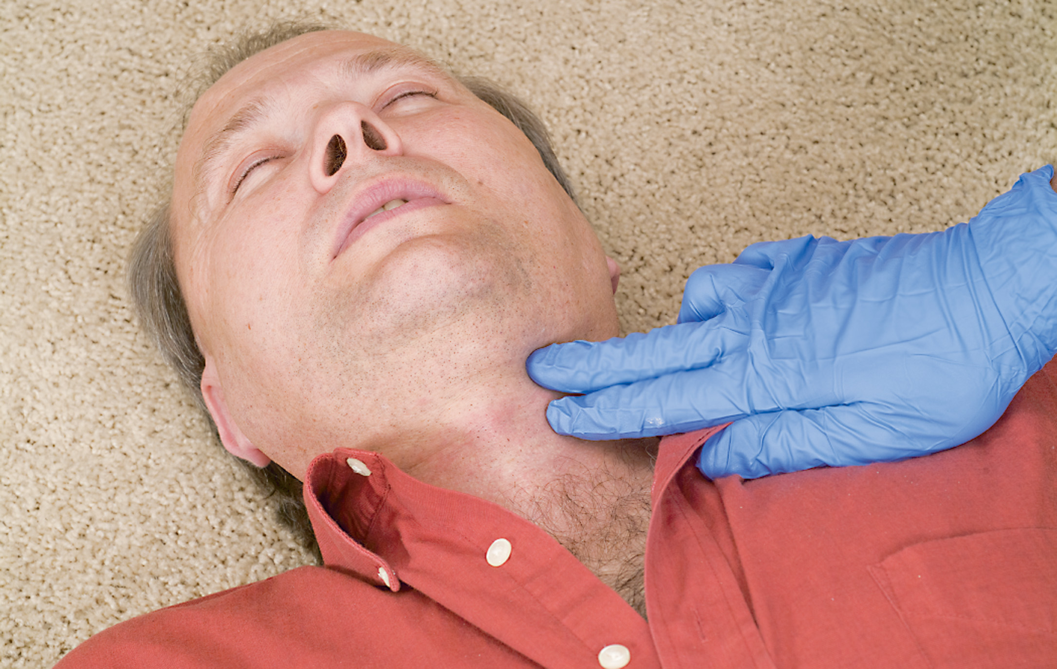
Assess the Carotid Pulse
Notes:
Class Activity:
Have students practice locating and assessing the carotid pulse.

Slide 23
Vital Signs (10 of 25)
Pulse
  Heart Rate
    For adults, the average range is 60 to 80 beats per minute (resting).
    Infants’ and children’s heart rates are faster.
Notes:
In the adult patient, a heart rate greater than 100 bpm is termed tachycardia and a heart rate less than 60 bpm is called bradycardia. Any adult heart rate that is less than 45 beats per minute or greater than 130 beats per minute is typically an indication of a serious illness or injury. A heart rate less than 100 beats per minute in the neonate is neonatal bradycardia.

Slide 24
Vital Signs (11 of 25)
Pulse
  Heart Rate
    Tachycardia is a heart rate >100 beatsperminute.
    Bradycardia is a heart rate <60 beatsperminute.
    Interpret findings based on the patient’s overall presentation.
Notes:
The heart rate must be considered in relation to the patient’s presentation and assessment findings. A heart rate that falls within the limits of 60–100 bpm could be considered abnormal for some patients, whereas a heart rate falling outside of these limits could be considered normal. As an example, a resting heart rate of 42 bpm is obtained for a 34-year-old male patient who injured his ankle. The patient appears to be physically fit and presents as alert, oriented, and showing no signs of poor perfusion. Although the heart rate is only 42 bpm and would be reported as bradycardic, it would not be cause for alarm based on the patient presentation.
As another example, a heart rate of 92 bpm in an elderly patient at rest would be considered normal; however, a heart rate of 92 bpm in a 20-year-old at rest may be a cause for concern, even though it falls within the definition of a normal range and is not tachycardic.

Slide 25
Table 11-3 Normal Pulse Rates
Age | Awake Heart Rate Range per Minute
Adult | 60–100
Adolescent (12–15 years) | 60–100
School-aged Child (6–11 years) | 75–118
Preschooler (3–5 years) | 80–120
Toddler (1–2 years) | 98–140
Infant (1 month–12 months) | 100–180
Neonate (birth–1 month) | 100–205
Notes:
The normal ranges for heart rate per minute, which is determined by feeling the pulse, for pediatrics (according to the American Heart Association and American Academy of Pediatrics Pediatric Advanced Life Support 2016) and adults are listed in Table 11-3.

Slide 26
Vital Signs (12 of 25)
Pulse
  Heart Rate: To obtain the rate
    Palpate the pulse with the tips of two or three fingers.
    Count the beats in 30 seconds and multiply by two.
Notes:
To take the pulse rate:
Position the patient. He should be sitting or lying down.
Using the tips of two or three fingers, palpate the artery (feel it gently). Avoid using your thumb, because it has a prominent pulse of its own.
Count the number of beats in a 30-second period. Then, multiply by two. An irregular pulse should be taken for a full minute.
The pulse can help you gauge the patient’s condition. For example, a rapid pulse may indicate shock (hypoperfusion). Absence of a pulse indicates that the heart has stopped beating, the blood pressure is extremely low, or the artery has been blocked or injured. Absence of a pulse in a single extremity may indicate obstruction to the artery in that extremity and may be associated with bone or joint injuries.

Slide 27
Vital Signs (13 of 25)
  Pulse
  Pulse Quality and Rhythm (Remember to record the pulse quality.)
    Strong
    Weak
    Regular
    Irregular
Notes:
Pulse characteristics are defined as follows:
Strong pulse- Refers to a pulse that is both full and normally strong. A “bounding” pulse is one that is abnormally strong.
Weak pulse- Is a pulse that doesn’t feel full or may be difficult to find and palpate. A weak pulse may also be quite rapid. The general term for a weak, rapid pulse is “thready.”
Regular pulse- Is usually a normal pulse that occurs at regular intervals with a smooth rhythm.
Irregular pulse. This pulse occurs at irregular intervals, which may indicate a cardiac disease. An irregular pulse can be regularly irregular or irregularly irregular. A regularly irregular pulse is one in which the irregular beat occurs at a regular interval and has a pattern. An example is an abnormal beat that occurs early after each fourth regular beat. An irregularly irregular pulse has no predictable pattern and presents as a chaotic rhythm.

Slide 28
Table 11-4 Pulse Rate, Quality, Rhythm, and Related Problems
Pulse | Possible Problem
Rapid, regular, and full | Exertion, fright, fever, high blood pressure, or very early stage of blood loss
Rapid, regular, and thready | Reliable sign of shock, often evident in early stage of blood loss
Slow | Head injury, barbiturate or narcotic use, some poisons, possible cardiac problem or other medical conditions such as Hypothyroidism
No pulse | Cardiac arrest, profound hypotension
Notes:
The quality of the pulse can be characterized as strong or weak, the rhythm regular or irregular, see Table 11-4.

Slide 29
Click on Any Heart Rate That Would Be Outside the Normal Range for An Eight-Year-Old Child
130
56
116
76
Click here after you have checked your answers.

Slide 30
Vital Signs (14 of 25)
Skin
    Assess the appearance and condition of the skin, looking for:
      Color
      Temperature
      Condition
      Capillary refill

Slide 31
Assess Relative Skin Temperature
Notes:
Class Activity:
Have students practice obtaining skin temperature.

Slide 32
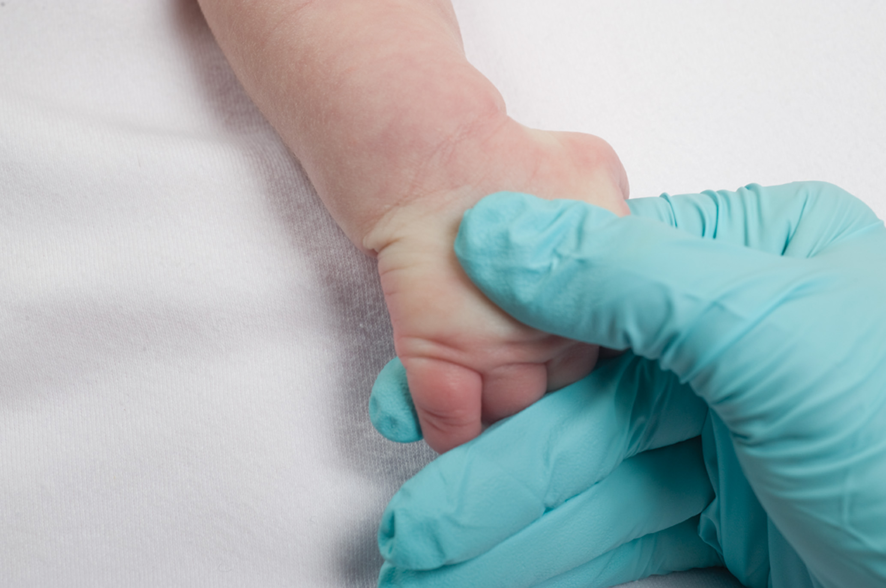
Assess Capillary Refill in Infants and Children. Press on the Nail or Skin
Notes:
Class Activity:
Have students practice obtaining and evaluating a capillary refill.

Slide 33
Vital Signs (15 of 25)
Skin
  Skin Color
    check the color of the nail beds, oral mucosa, and conjunctiva
    Pink is normal
    Paleness or pallor
    Blue-gray color or cyanosis
    Red color or flushing
    Yellow color or jaundice
    Mottling
Notes:
Paleness, or pallor- This may be a sign of extreme vasoconstriction, blood loss, or both. It may indicate shock (hypoperfusion), heart attack, fright, anemia, fainting, or emotional distress. Pale, cool, and clammy skin may be an early skin sign of inadequate oxygenation, hypoxia, and hypoxemia.
Blue-gray color, or cyanosis- This indicates inadequate oxygenation or poor perfusion. It often appears first in the fingertips and around the mouth, which is referred to as circumoral cyanosis. It can indicate conditions such as suffocation, inadequate respirations, hypoxia, hypoxemia, heart attack, or poisoning. Cyanosis always indicates a serious problem but often is seen very late.
Red color, or flushing- This may be a sign of heat exposure, peripheral vasodilation, or a very late finding in carbon monoxide poisoning.
Yellow color, or jaundice- This may indicate liver disease.
Mottling- This is a discoloration similar to cyanosis; however, it occurs as a blotchy pattern. Mottled skin may be seen in some shock patients or patients with blood pooling in the extremities for a long period of time.

Slide 34
Vital Signs (16 of 25)
  Skin
  Skin Temperature
    Lift the patient’s shirt and place the back of your bare hand on the abdominal skin.
    Hot may indicate a fever or exposure to heat.
    Cool may be a sign of inadequate circulation, shock, or exposure to cold.
    Cold indicates extreme exposure to cold.
Notes:
Changes in skin temperature over a period of time, or different temperatures in various parts of the body, can be significant. For example, circulatory problems can result in a cold foot, whereas an isolated “hot” area may indicate a localized infection.

Slide 35
Vital Signs (17 of 25)
  Skin
  Skin Condition - Normally skin is dry.
    Moist skin may indicate shock; poisoning; heat-related, cardiac, or diabetic emergency; or many other conditions.
    Skin that is both cool and moist is often described as clammy.
    Diaphoresis is the term used to describe profuse sweating.
    Skin that is abnormally dry may be a sign of spinal injury or severe dehydration.
Notes:
Direct sympathetic nervous stimulation and circulating epinephrine and norepinephrine will cause the vessels in the skin to constrict, shunting the warm, red blood away from the skin, which causes the skin to become cool and pale. The nerves and alpha properties of epinephrine and norepinephrine will stimulate the sweat glands, making the skin clammy (moist) or making the patient diaphoretic.

Slide 36
Vital Signs (18 of 25)
  Skin
  Capillary Refill - The time it takes for compressed capillaries to fill up again with blood
    The upper limits of normal capillary refill times are two seconds for infants, children, and male adults.
    Three seconds for females;
    Four seconds in the elderly.
Notes:
The time it takes for compressed capillaries to fill up again with blood is called capillary refill time. It is a more reliable sign in infants and younger children than in older children or adults, because younger children usually have very little existing disease that might affect the perfusion in the capillaries.

Slide 37
Table 11-5 Skin Color, Temperature, and Condition
Color | Possible Problem
Pallor (white) | Vasoconstriction, blood loss, shock, heart attack, fright, anemia, fainting, or emotional distress
Cyanosis (blue-gray) | Inadequate oxygenation or perfusion (shock), inadequate respiration, or heart attack
Flushing (red) | Heat exposure or carbon monoxide poisoning (late)
Jaundice (yellow) | Liver disease
Mottling (gray-blue) | Blotchy pattern
Temperature | Possible Problem
Hot | Fever or heat exposure
Cool | Poor perfusion (shock) or cold exposure
Cold | Extreme cold exposure
Condition | Possible Problem
Wet or moist | Shock, heat emergency, or diabetic emergency
Abnormally dry | Spinal injury, dehydration, heat stroke, poisoning, or hypothyroidism
Notes:
The appearance and condition of the skin is another important indicator of the body’s perfusion status. In assessing the skin, you should check color, temperature, condition, and capillary refill.

Slide 38
Vital Signs (19 of 25)
      Pupils (when assessing for pupillary reaction, use only a penlight, not an extremely bright flashlight.)
      Check the pupils for:
      Size
      Equality
      Reactivity to light
Notes:
Size - Pupils that are dilated (large) may indicate the use of certain drugs, including LSD, amphetamines, atropine, and cocaine. Pupils that are constricted (small) may indicate a central nervous system disorder, the use of narcotics, glaucoma medications, or a brightly lit environment.
Equality - Pupils of unequal size may indicate a stroke, head injury, an artificial eye, disease of the eye, use of certain eye drops, or injury to the eye or nerve that controls the pupil. Some people normally have unequal pupils; if it is a normal condition, however, the pupils remain reactive to light and the size difference is not great (62 mm). This condition is termed anisocoria. It may be due to a congenital defect or an ophthalmic injury. Many patients with a difference of 1 mm or less between pupil sizes are simply considered normal without underlying disease or injury.
Reactivity - Reactivity refers to the pupil changing in size in response to light shined in the eye. The pupils, which are normally midsize, constrict when light is shined in them. The pupils dilate when shaded or in a dark environment. Both pupils have the same response, even when the light is shined in only one eye. This is called a consensual reflex. For example, you shine a light in the right eye and the right and left pupil constrict simultaneously. Pupils that remain midsize may indicate cranial nerve damage.

Slide 39
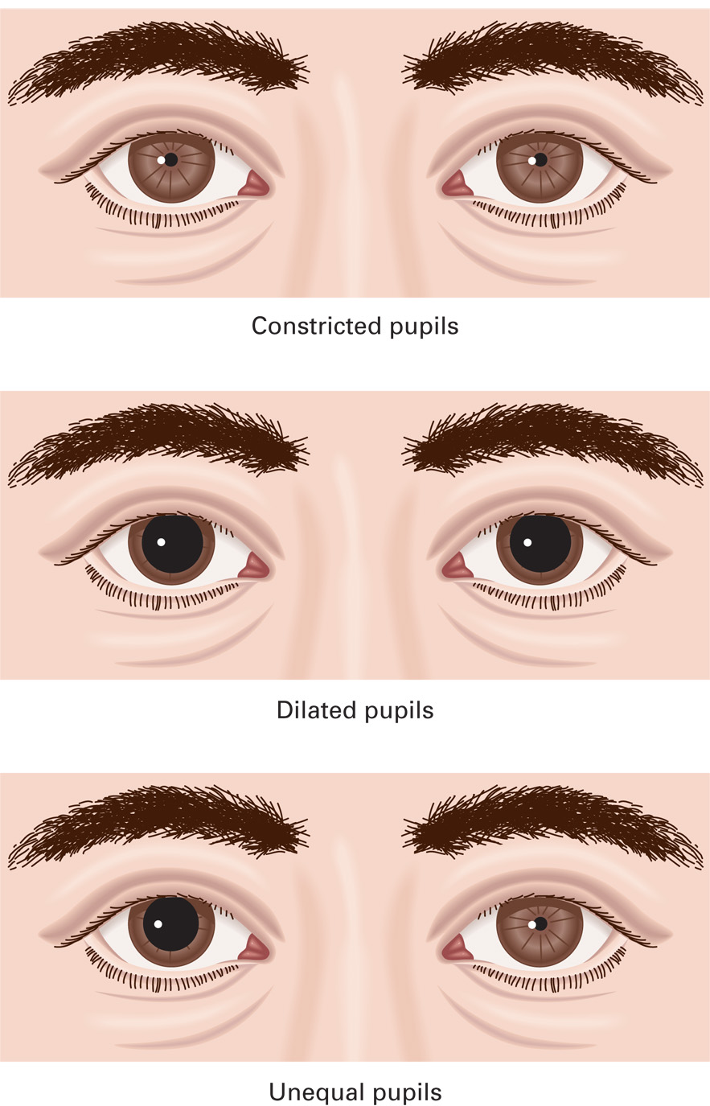
Assess Pupils for Size, Equality, and Reactivity
Notes:
Class Activity:
Have students practice using a penlight to obtain pupillary findings.

Slide 40
Table 11-6 Pupil Size, Equality, and Reactivity
Factor | Possible Problem
Dilated | Cardiac arrest (pupils will also be fixed), drug use such as L S D, amphetamines, or cocaine
Constricted | Central nervous system disorder or narcotics use
Unequal | Stroke, head injury, artificial eye (occasionally a normal finding), eye drops, or eye trauma
Nonreactive | Cardiac arrest, brain injury, eye drops, or drug intoxication or overdose
Notes:
To assess the pupils, briefly shine a penlight into the patient’s eyes (Table 11-6 and Figure 11-7).

Slide 41
Vital Signs (20 of 25)
Blood pressure
    Blood pressure is the force of blood against arterial walls.
    Systolic blood pressure is the higher pressure present during contraction of the left ventricle.
    Diastolic blood pressure reflects vascular resistance and blood volume. It is the pressure present during relaxation of the left ventricle.
Notes:
When the left ventricle of the heart contracts, it ejects blood into the aorta and throughout the arteries of the body. The pressure that is exerted on the walls of the arteries by the blood flowing through them is referred to as the blood pressure. The blood pressure normally includes two readings: the systolic blood pressure and the diastolic blood pressure measured in millimeters of mercury (mmHg).

Slide 42
Table 11-7 Normal Blood Pressures in Adults, Children, and Infants
Age | Systolic B P (mmHg) | Diastolic B P (mmHg)
Adult | 120 or less | 80 or less
Adolescent (12–15 years)* | 110–131 | 64–83
Preadolescent (10–12 years)* | 102–120 | 61–80
School-aged (6–9 years)* | 97–115 | 57–76
Preschooler (3–5 years)* | 89–112 | 46–72
Toddler (1–2 years)* | 86–106 | 42–63
Infant (1–12 months)* | 72–104 | 37–56
Neonate (Birth–1 month)* | 67–84 | 35–53
* According to the American Heart Association and American Academy of Pediatrics Pediatric Advanced Life Support, 2016
Notes:
Blood pressures vary widely for different patients (Table 11-7). A normal systolic blood pressure in an adult is less than 120 mmHg. A normal diastolic blood pressure is less than 80. Quick guidelines to determine whether the systolic blood pressure falls within a normal range are as follows (Table 11-8).
Adult - In the adult patient at rest, the normal systolic blood pressure is 120 mmHg or less. A systolic blood pressure that is 121–139 mmHg would be considered prehypertension (high blood pressure). A systolic blood pressure of 140 mmHg or greater is systolic hypertension. The normal adult diastolic blood pressure is 80 mmHg or less. Any diastolic blood pressure between 81–89 mmHg is considered prehypertension. Any adult diastolic blood pressure greater than 90 mmHg is referred to as diastolic hypertension.
Child or adolescent greater than age 10 years - Children greater than 10 years of age would have a minimum systolic blood pressure of 90 mmHg. A blood pressure less than the minimum expected blood pressure would be a possible indication of shock.
Child age 1–10 years - In children 1–10 years of age, the lower limit of a normal systolic blood pressure would be calculated by taking 70 + (2 * years in age). The lower limit of a normal systolic blood pressure in the 6-year-old would be 82 mmHg (70 + (2 * 6 years) = 82). As a rough estimation, the diastolic blood pressure is normally two-thirds the systolic blood pressure. As an example, a child with a systolic blood pressure of 90 mmHg would have an expected diastolic blood pressure of 60 mmHg.

Slide 43
Table 11-8 Blood Pressures Indicating Hypotension by Age
Age | Systolic B P in mmHg Indicating Hypotension
Adult | <90
Children >10 years of age* | <90
Children 1–10 years of age* | <70 + (2 × Years in age)
Infants (1–12 months)* | <60
* According to the American Heart Association and American Academy of Pediatrics Pediatric Advanced Life Support, 2016
Notes:
Blood pressures vary widely for different patients (Table 11-7). A normal systolic blood pressure in an adult is less than 120 mmHg. A normal diastolic blood pressure is less than 80. Quick guidelines to determine whether the systolic blood pressure falls within a normal range are as follows (Table 11-8).
Adult - In the adult patient at rest, the normal systolic blood pressure is 120 mmHg or less. A systolic blood pressure that is 121–139 mmHg would be considered prehypertension (high blood pressure). A systolic blood pressure of 140 mmHg or greater is systolic hypertension. The normal adult diastolic blood pressure is 80 mmHg or less. Any diastolic blood pressure between 81–89 mmHg is considered prehypertension. Any adult diastolic blood pressure greater than 90 mmHg is referred to as diastolic hypertension.
Child or adolescent greater than age 10 years - Children greater than 10 years of age would have a minimum systolic blood pressure of 90 mmHg. A blood pressure less than the minimum expected blood pressure would be a possible indication of shock.
Child age 1–10 years - In children 1–10 years of age, the lower limit of a normal systolic blood pressure would be calculated by taking 70 + (2 * years in age). The lower limit of a normal systolic blood pressure in the 6-year-old would be 82 mmHg (70 + (2 * 6 years) = 82). As a rough estimation, the diastolic blood pressure is normally two-thirds the systolic blood pressure. As an example, a child with a systolic blood pressure of 90 mmHg would have an expected diastolic blood pressure of 60 mmHg.

Slide 44
Vital Signs (21 of 25)
Blood Pressure
    The difference between systolic blood pressure and diastolic blood pressure is the pulse pressure.
    Pulse pressure should be between 25 percent and 50 percent of the systolic blood pressure.
Notes:
As an example, if the patient’s blood pressure is 124/80, the pulse pressure would be 44 mmHg (124 - 80 = 44 mmHg). If the pulse pressure is less than 25 percent of the systolic blood pressure, it would be considered a narrow pulse pressure. If the pulse pressure is greater than 50 percent of the systolic blood pressure, it would be considered a widened pulse pressure.
Using the example just given, a narrow pulse pressure would be less than 31 mmHg (124 * .25 = 31 mmHg) and a widened pulse pressure would be greater than 62 mmHg (124 * .50 = 62 mmHg).
Discussion Question
What are the expected vital signs for adults?
Class Activity
Have pairs of students assess each others' pulse, breathing, blood pressure, and pupils and record the values on a piece of paper.

Slide 45
Vital Signs (22 of 25)
    Blood Pressure
    Low blood pressure is an indicator of hypoperfusion.
    High blood pressure can damage the heart and vessels.
    Take a blood pressure in all patients 3 years and older.
Notes:
A low blood pressure indicates that there is not enough pressure in the arteries to keep the organs supplied with an adequate amount of blood. In an adult patient, a systolic blood pressure of less than 90 mmHg is typically considered to be low, although this is somewhat variable and should be considered in the context of the patient’s condition.
High blood pressure, also known as hypertension, can result from a variety of causes. The abnormally high blood pressure can cause damage to the heart and blood vessels, leading to heart damage and failure, stroke, ruptured blood vessels, and kidney disease.
It is difficult to assess blood pressure in infants and children less than three years of age. Therefore, the EMT may need to rely on the skin temperature, color, and condition; the patient’s mental status; and quality and location of pulses to determine the perfusion status.

Slide 46
Vital Signs (23 of 25)
  Blood Pressure
  Methods of Measuring Blood Pressure
    There are two methods of measuring blood pressure with a sphygmomanometer:
      Auscultation is listening for the systolic and diastolic sounds through a stethoscope.
      Palpation is feeling for the return of the pulse as the cuff is deflated.
Notes:
To assess blood pressure by auscultation:
Choose the proper size sphygmomanometer cuff. It should completely encircle the patient’s bare arm about one inch above the antecubital space and should cover two-thirds of the upper arm. Its bladder should be centered over the brachial artery, and cover half the arm’s circumference. The cuff should fit snugly, but you should still be able to place one finger easily under its bottom edge.
Position the arm. If the patient is seated, position the arm so that the brachial artery at the antecubital fossa is at the level of the heart, if the patient is standing, position the arm at the mid-chest level. Regardless if standing or sitting, do not allow the patient to support their own arm by holding it up. The strain on the arm may change the blood pressure reading.
Palpate the radial pulse. Inflate the cuff rapidly to 70 mmHg and then increase by 10-mmHg increments until the radial pulse is no longer felt. Note the number on the dial and deflate the cuff.
Place the stethoscope in your ears with the earpieces facing forward. Locate the brachial artery on the medial (inner) aspect of the antecubital fossa (front of the elbow). Position the head of the stethoscope over the brachial artery. Be careful not to place the stethoscope under the cuff, because it distorts sounds when listening through the stethoscope.
Close the thumb valve and squeeze the bulb to inflate the cuff. Inflate the cuff to 30 mmHg above the level noted in step 3.
Slowly turn the thumb valve counterclockwise or press the release mechanism to release air. Deflate the cuff at approximately 2 mmHg per second, watching the pressure gauge as it slowly decreases.
As soon as you hear the first sound (clear but dull tapping or swooshing sound), record the pressure. This is the systolic pressure.
Continue releasing air from the bulb. At the point where you hear the last sound, record the diastolic pressure. Continue to deflate slowly for at least 10 mmHg. With children and some adults, you may hear sounds all the way to zero. In those cases, record the pressure when the sound changes from a clear tapping to a soft, muffled tapping.
After you have recorded the blood pressure, leave the cuff deflated but in place so you can take more blood pressure readings during treatment and transport. Carefully record the blood pressure each time you take it. Changes can be significant.
To measure the blood pressure by palpation:
Inflate the cuff rapidly with the rubber bulb while palpating the radial pulse until you can no longer feel it. (Make a mental note of that reading.) Without stopping, continue to inflate the cuff to 30 mmHg above the level where the radial pulse could no longer be felt.
Slowly deflate the cuff. Make a note of the pressure at which the radial pulse returns. This is the systolic pressure as measured by palpation. In a noisy situation where you cannot hear well enough to measure the blood pressure by auscultation, this is the only blood pressure measurement you can make. You will not be able to measure the diastolic pressure by palpation. Record the palpated blood pressure as, for example, 120/P.

Slide 47
E M T Skills 11-1
Taking Blood Pressure by Auscultation

Slide 48
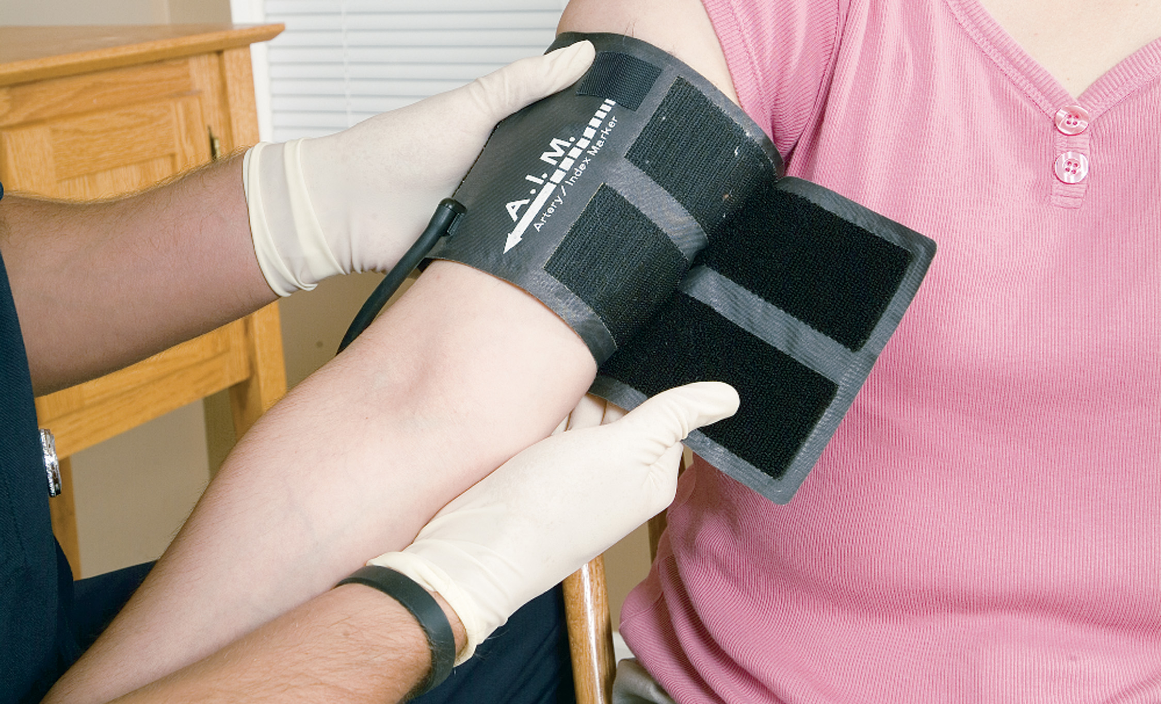
Apply the Cuff

Slide 49
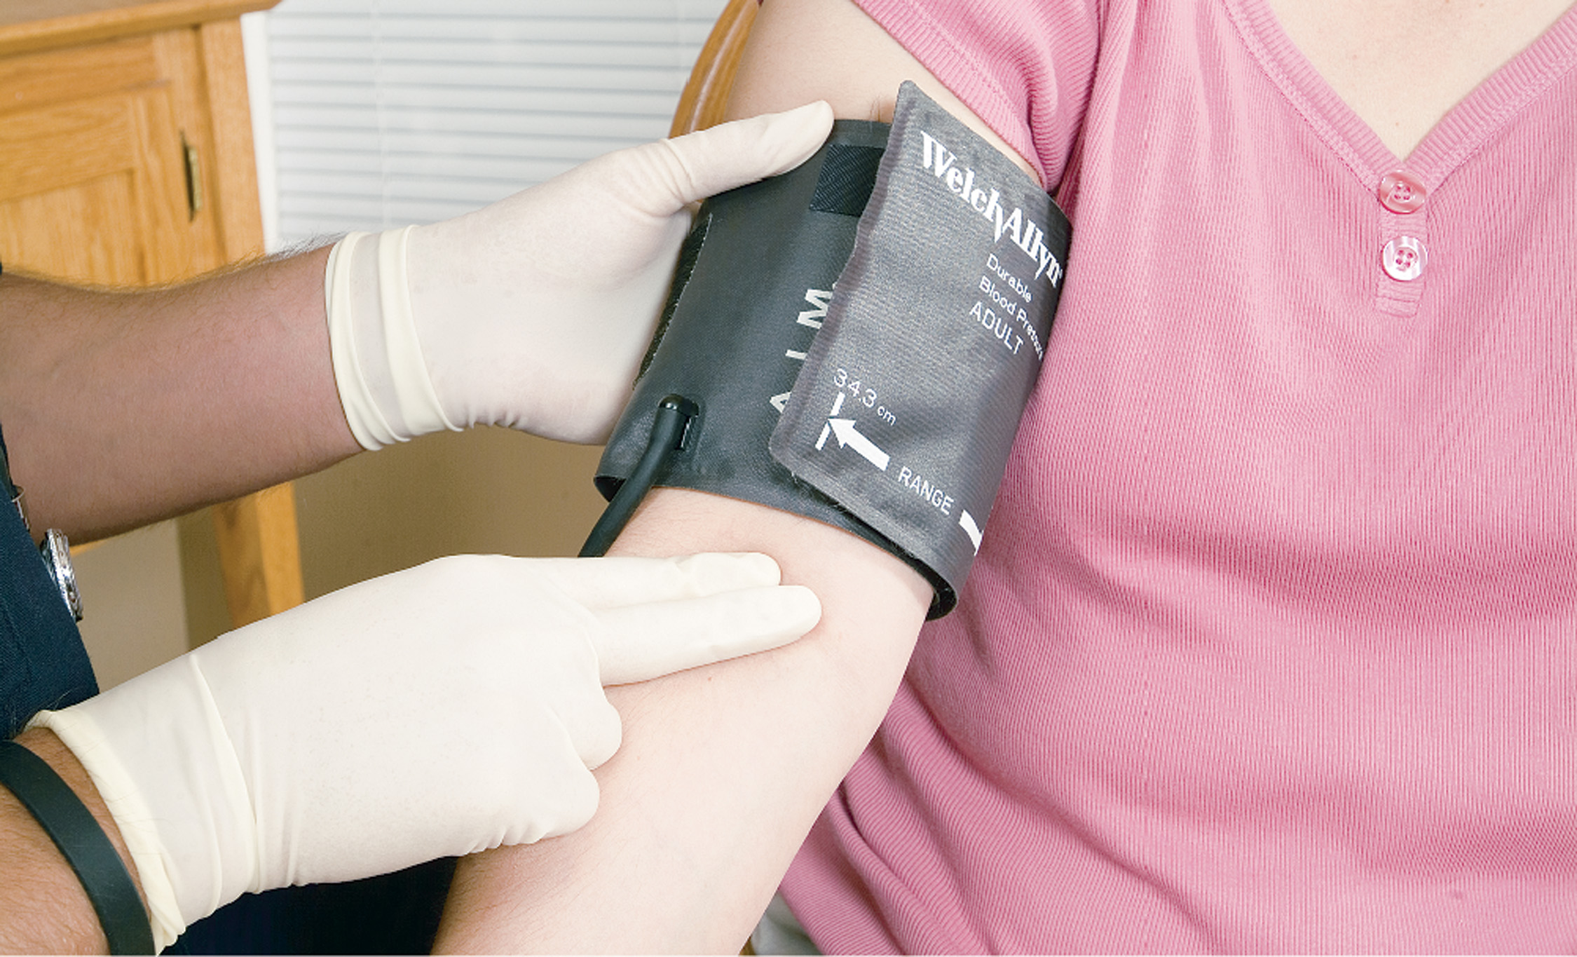
Palpate the Brachial Artery

Slide 50
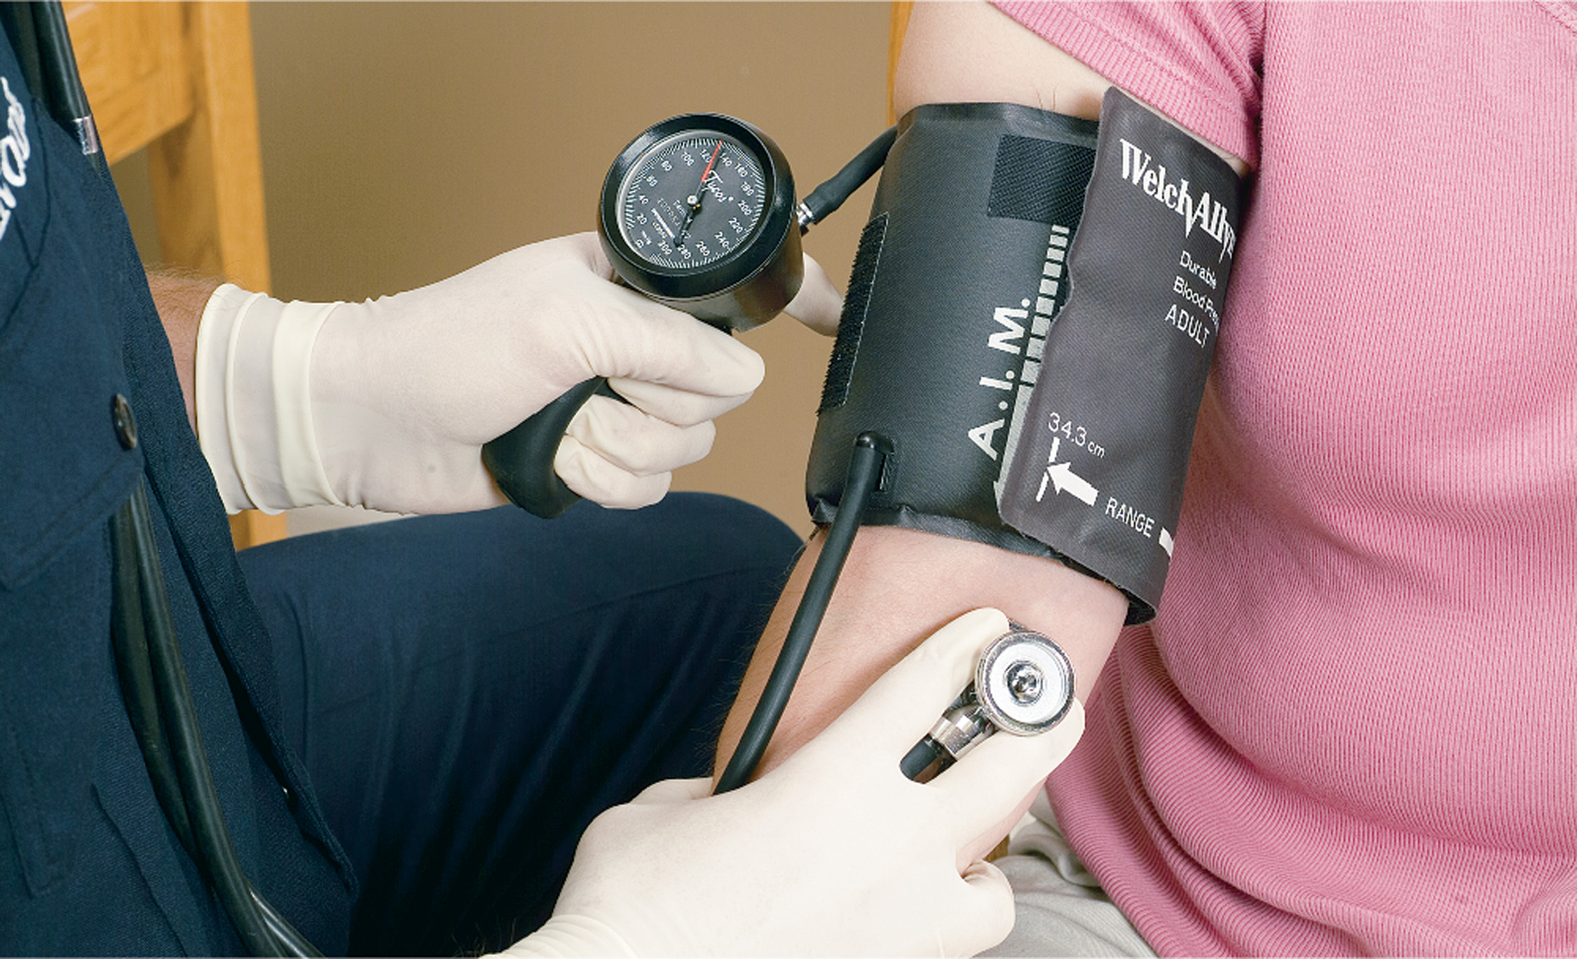
Close the Valve and Pump until the Radial Pulse is No Longer Felt
Note the number and deflate the cuff. Position the stethoscope over the brachial artery and inflate the cuff to 30 m m H g above the level where you previously stopped feeling the radial pulse.

Slide 51
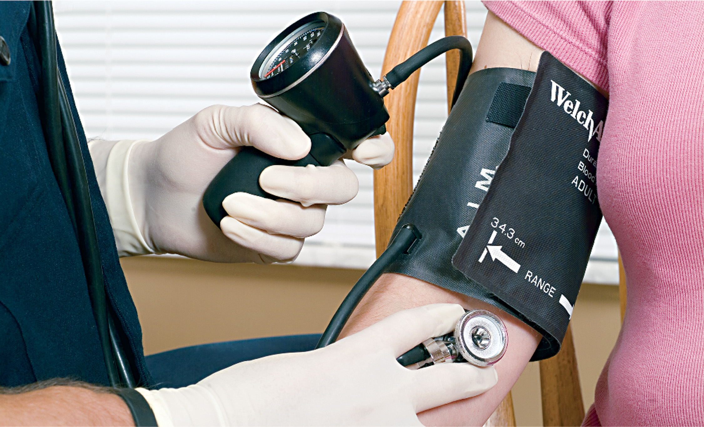
Deflate the Cuff at About 2 m m h g per Second. When You Hear the First Sound, Record the Pressure (Systolic)
Continue releasing air. When you hear the last sound, record the pressure (diastolic).

Slide 52
E M T Skills 11-2
Taking Blood Pressure by Palpation

Slide 53
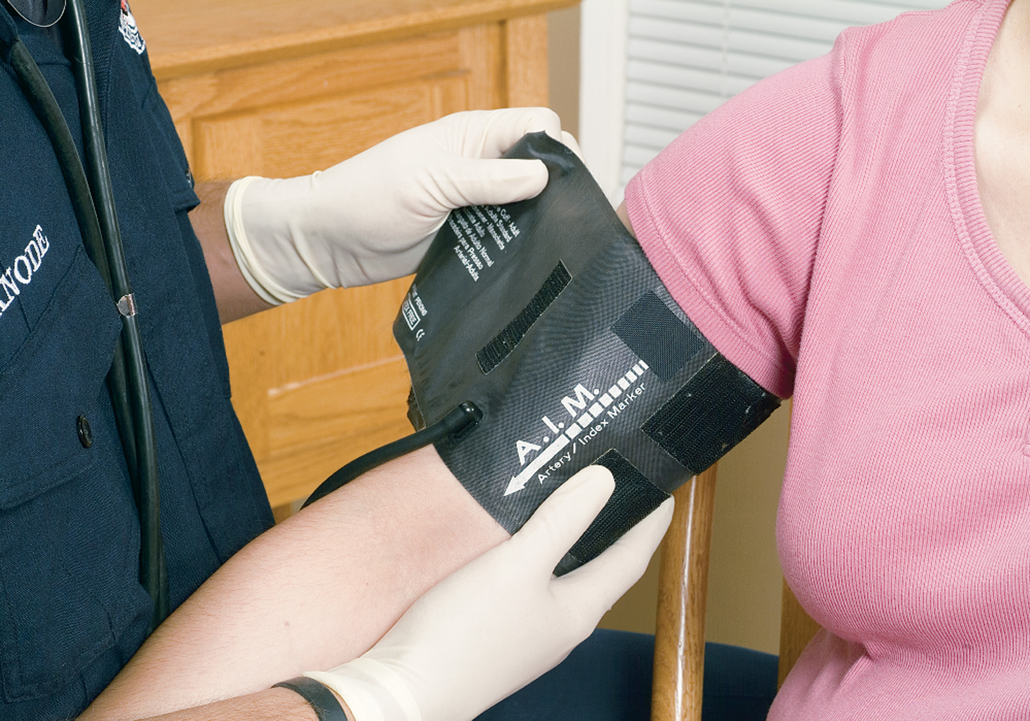
Apply the Cuff and Inflate Rapidly to 30 Mmhg above the Level Where You Can No Longer Feel the Radial Pulse

Slide 54
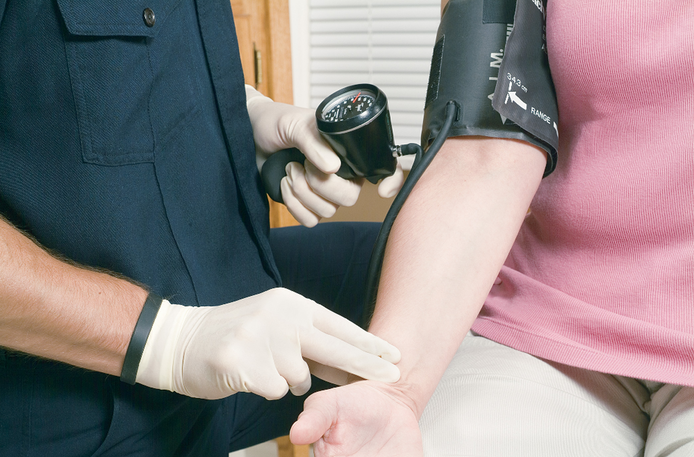
Slowly Deflate the Cuff. Note the Pressure at Which the Radial Pulse Returns (Systolic)
You will not be able to measure the diastolic pressure by palpation.

Slide 55
Vital Signs (24 of 25)
Blood Pressure
  Testing Orthostatic Vital Signs
    Orthostatic vital signs are assessed in patients with suspected volume loss.
    Take the B P and pulse with the patient supine, then two minutes after standing.
    If the heart rate increases by over 10–20 bpm and the systolic pressure decreases by 10–20 m m H g a significant loss of blood or fluid volume is indicated.
Notes:
In a patient with suspected volume loss, you may be asked to obtain a set of orthostatic vital signs. This is done by placing the patient in a supine position and measuring their blood pressure and heart rate, then standing the patient up and, after two minutes, reassessing the blood pressure and heart rate. If, while the patient is standing, the heart rate increases by greater than 10–20 bpm and the systolic blood pressure decreases by 10–20 mmHg as compared to the readings taken while the patient was supine, it is a positive orthostatic test, which typically indicates a significant loss of blood or fluid volume. The orthostatic vital signs test is also commonly known as the tilt test.
Knowledge Application
Give several sets of vital signs and have students determine if they are within expected ranges for the patient's age. For abnormal values, ask students what the findings might indicate.

Slide 56
Vital Signs (25 of 25)
  Blood Pressure
  Vital Sign Reassessment
    If the patient is stable, vital signs should be taken and recorded at least every 15 minutes and as often as necessary to ensure proper care. Take and record vital signs every five minutes if the patient is unstable.
Notes:
If the patient is stable, vital signs should be taken and recorded at least every 15 minutes and as often as necessary to ensure proper care. Take and record vital signs every five minutes if the patient is unstable. Reassess vital signs immediately following every medical intervention, regardless of how soon it follows your previous assessment of vital signs.

Slide 57
E M T Skills 11-3
Taking Orthostatic Vital Signs

Slide 58
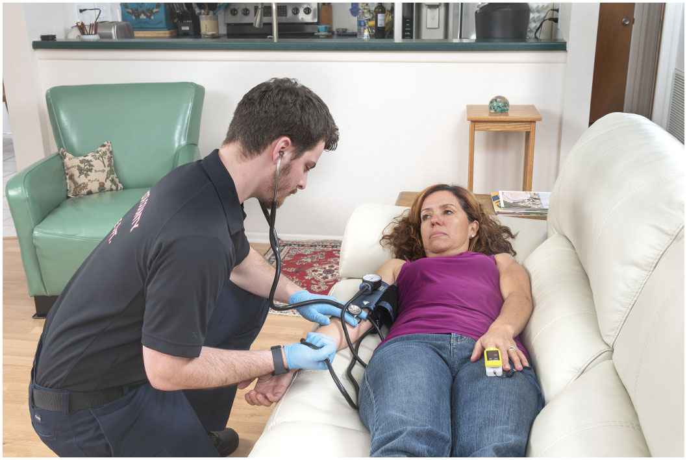
Place the Patient Supine and Measure Heart Rate and Blood Pressure

Slide 59
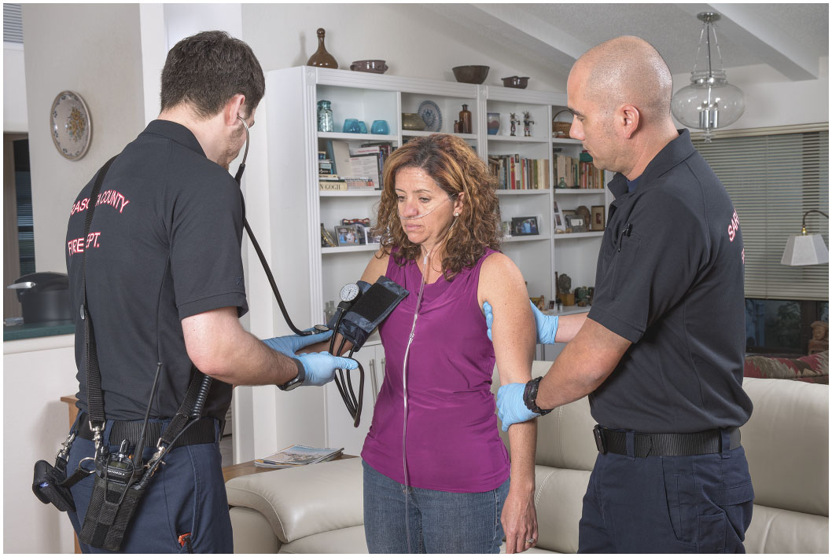
Help the Patient to a Standing Position, Wait Two Minutes, Then Measure Heart Rate and Blood Pressure
Compare the readings to those taken while the patient was supine. An increase in heart rate more than 10–20 beatsperminute and a decrease in blood pressure by 10–20 m m H g is considered a positive orthostatic test, indicating inadequate blood volume.

Slide 60
Monitoring Equipment (1 of 13)
Pulse Oximeter: Oxygen Saturation Assessment
    Pulse oximetry detects hypoxia by measuring oxygen saturation levels in the blood’s hemoglobin.
    Normal S p O₂ is 97 percent to 100 percent
    An S p O₂ <94% indicates hypoxia
    An S p O₂ <90% indicates severe hypoxia
Notes:
Pulse oximetry is a method of measuring oxygen saturation levels in the blood. The device used to measure the level of hemoglobin saturated with oxygen is a pulse oximeter. Because it is used to determine the patient’s oxygenation status, it should be applied early in the assessment—preferably in the primary assessment
Discussion Questions
How does pulse oximetry work?
What are some reasons pulse oximetry readings may be inaccurate?
Points to Emphasize
A pulse oximeter determines the saturation of hemoglobin in a patient's red blood cells by measuring the light absorbed as it passes through the patient's finger or earlobe.
A pulse oximeter reading less than 94 percent must be further investigated.
Pulse oximetry is a good tool for determining the effectiveness of airway management and oxygen therapy.
A number of factors can make pulse oximetry readings inaccurate.

Slide 61
E M T Skills 11-4
Pulse Oximetry

Slide 62
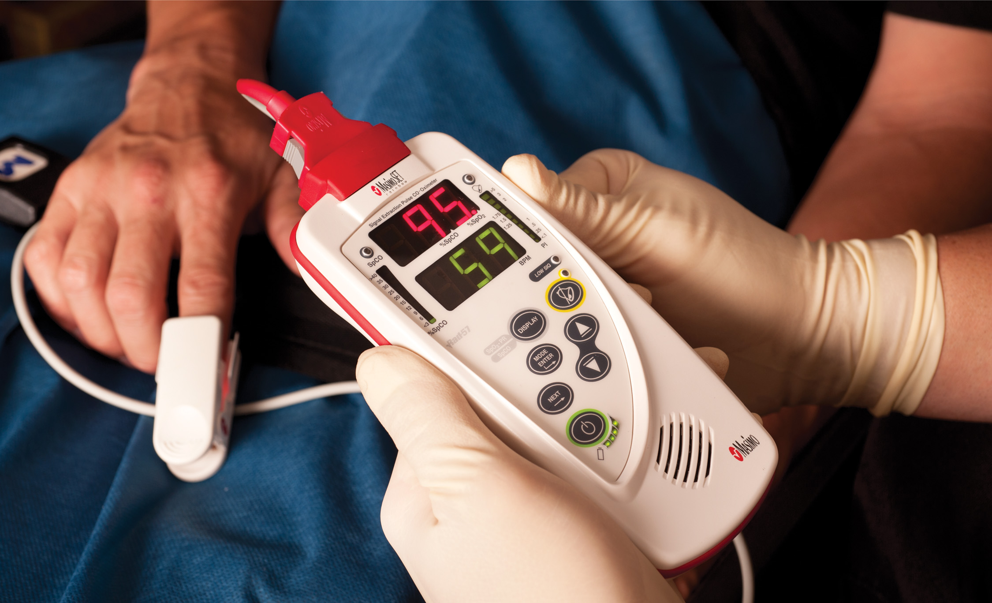
A Pulse Oximeter
Notes:
The pulse oximeter provides a reading as a percent of hemoglobin saturated with oxygen. This is recorded as % SpO₂, which indicates the reading was measured by a pulse oximeter. A normal pulse oximeter reading for a person breathing room air is in the high 90s, typically 97–100% SpO₂.

Slide 63
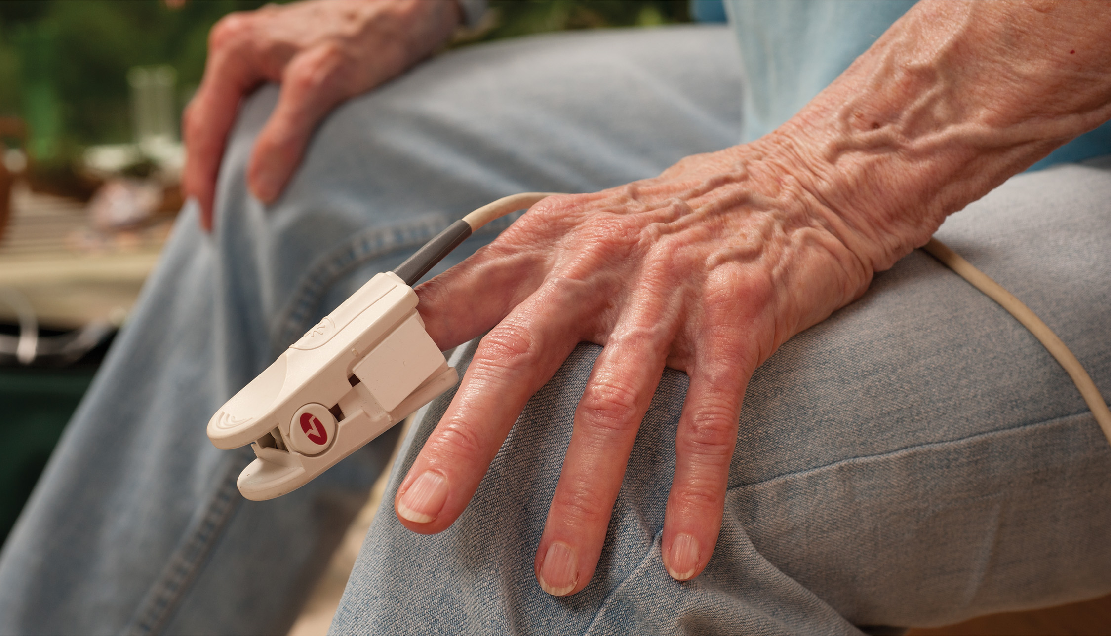
A Pulse Oximeter Placed on the Patient’s Finger
Notes:
The pulse oximeter probe is clipped, somewhat like a clothespin, or attached by adhesive-backed sensors, onto a patient’s finger, toe, earlobe, or across the bridge of the nose. Because the pulse oximeter measures arterial blood oxygen saturation, the probe must be placed in an area where the light from the oximeter shines through arterial blood flow. The most common placement in the adult patient is the finger.

Slide 64
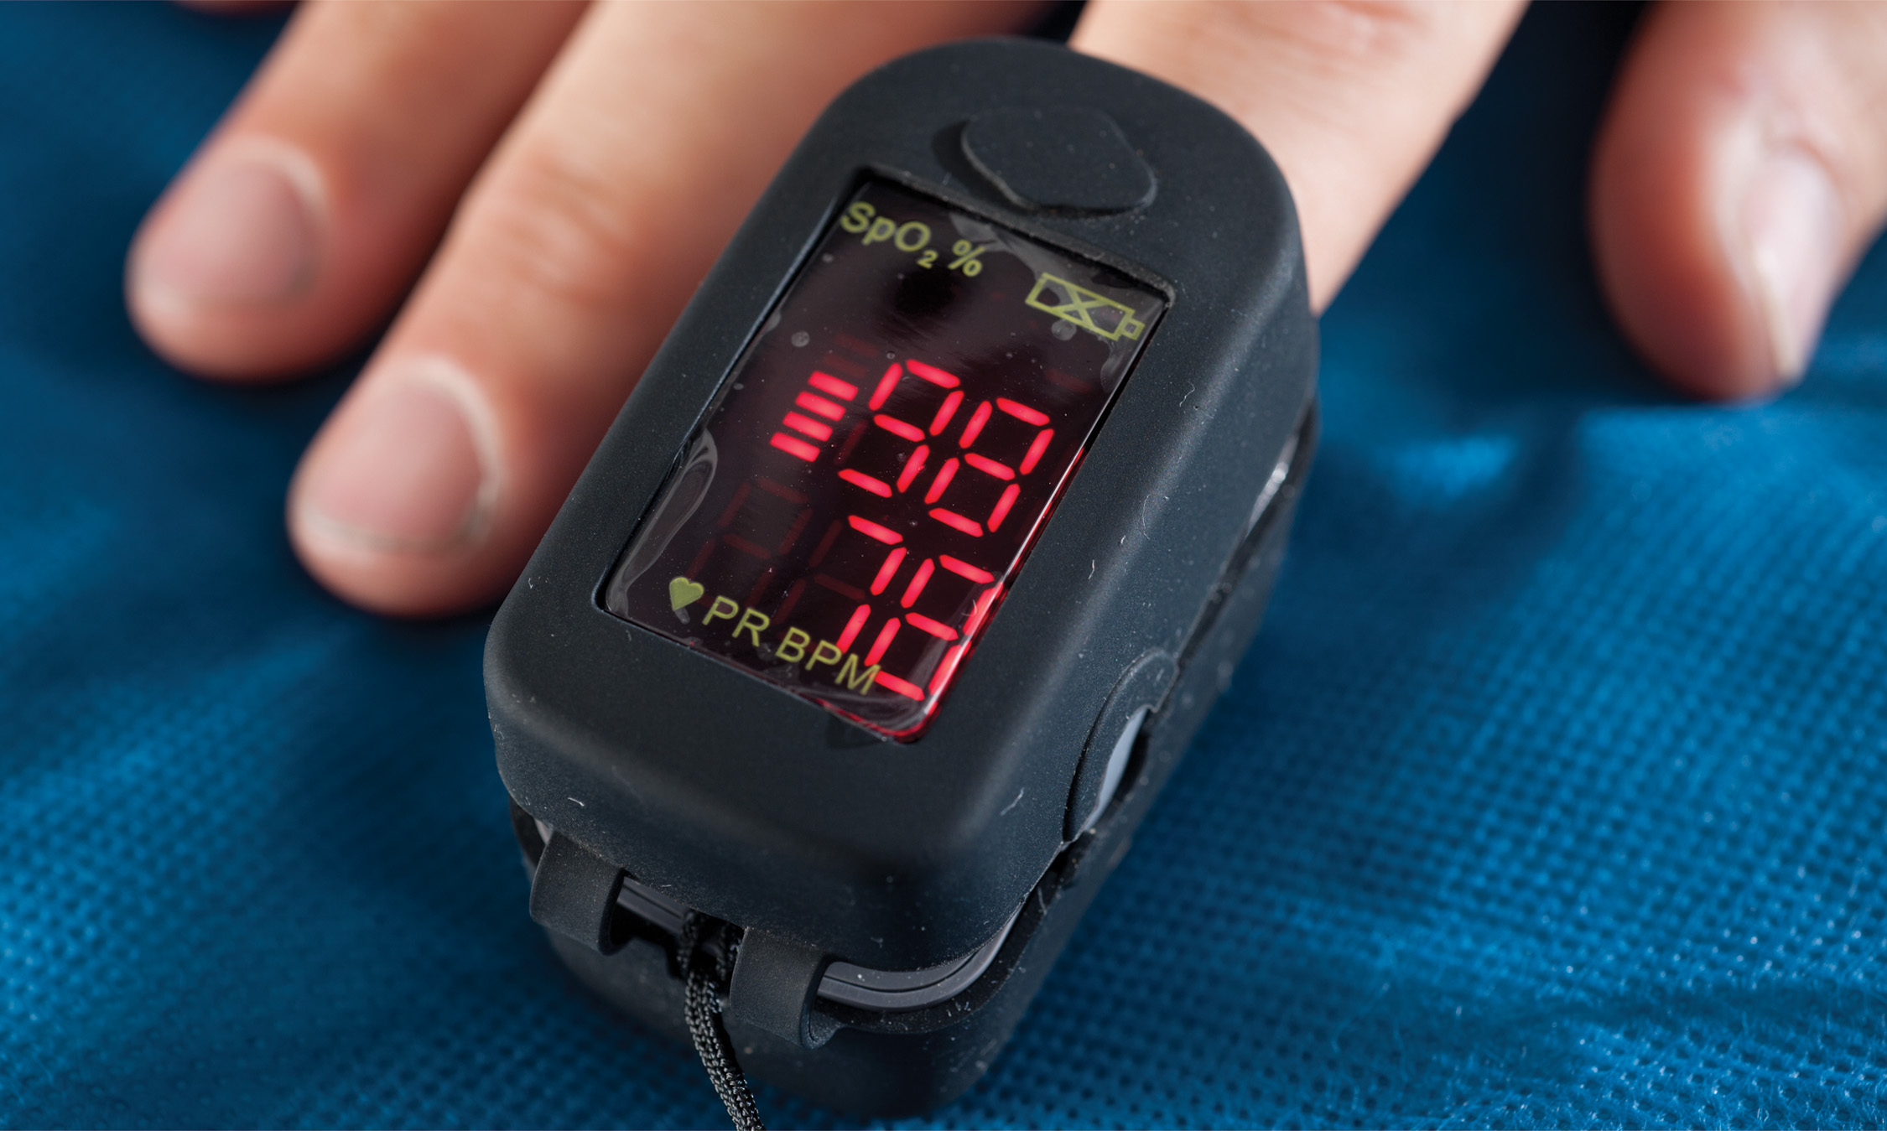
A Mini “Finger-Size” Pulse Oximeter
Notes:
A pulse oximeter reading that is less than 94 percent in a patient may indicate hypoxia. Therefore, any SpO₂ reading of less than 94 percent in a patient must be investigated and oxygen must be applied to the patient.

Slide 65
Monitoring Equipment (2 of 13)
Pulse Oximeter: Oxygen Saturation Assessment
  Indications for Pulse Oximetry
    Apply whenever the patient’s oxygen status is a concern, or when hypoxia is suspected.
    The pulse oximeter reading is a vital sign, it should be a standard measure in patients along with respirations, pulse, skin, pupils, and blood pressure.
Notes:
An SpO₂ reading of 90 percent or less is a definite indication of hypoxia. Assess your patient carefully, paying close attention to their respiratory rate and tidal volume. They may need to be ventilated if either the rate or tidal volume is found to be inadequate. Whether the patient requires assisted ventilation or not, apply oxygen to the patient. Be aggressive in your management of the patient, bearing in mind that the result of severe and prolonged hypoxia is cell death.
If the patient receives supplemental oxygen and the pulse oximeter reading is near or slightly greater than 94 percent, it may still be an indication that the patient is hypoxic. If the supplemental oxygen is removed, the SpO₂ reading may decrease to less than 94 percent again.

Slide 66
Monitoring Equipment (3 of 13)
  Pulse Oximeter: Oxygen Saturation Assessment
  Limitations of the Pulse Oximeter
    Any condition that interferes with the blood flowing to the area where the probe is attached may produce an erroneous reading.
    If the pulse rate shown on the pulse oximeter does not correspond with the patient’s actual pulse rate, the pulse oximeter is also not accurately reading the blood flow and oxygen saturation.
Notes:
The pulse oximeter needs pulsatile arterial blood flow to determine an accurate reading. Any condition that interferes with the blood flowing to the area where the probe is attached may produce an erroneous reading. The pulse oximeter must be used appropriately, because erroneous readings provide false information and may adversely affect your treatment.

Slide 67
Monitoring Equipment (4 of 13)
  Pulse Oximeter: Oxygen Saturation Assessment
  Limitations of the Pulse Oximeter - Readings may be inaccurate in:
    Shock
    Hypothermia
    Excessive patient movement
    Nail polish
    Carbon monoxide exposure
    Anemia
Notes:
Shock or hypoperfusion states associated with blood loss or poor perfusion will lead to inaccurate readings.
Hypothermia or cold injury to the extremities will reduce peripheral perfusion and limit the blood available in the capillaries to be read by the probe.
Excessive movement of the patient will lead to inaccurate readings.
Nail polish on the finger the probe is attached to will produce an inaccurate reading.
Carbon monoxide will give an abnormally high reading although the cells are becoming severely hypoxic. Carbon monoxide binds with the hemoglobin in the blood and absorbs light at the emitted frequencies, creating a red tone. The pulse oximeter erroneously reads the absorbed light of hemoglobin attached to carbon monoxide molecules, providing a false high reading.
Cigarette smokers may have falsely high SpO₂ readings, because carbon monoxide is a by-product of the smoke. Up to 15 percent of the hemoglobin may be bonded with carbon monoxide, not oxygen, giving a false high reading.
Anemia may produce erroneously high readings. The hemoglobin may be saturated with oxygen, but the anemic patient has decreased levels of hemoglobin. The hemoglobin is saturated with oxygen, but the combined hemoglobin-oxygen content of the blood is inadequate.

Slide 68
Monitoring Equipment (5 of 13)
  Pulse Oximeter: Oxygen Saturation Assessment
  Procedure for Determining the S p O₂ Reading
    Connect the sensor to the S p O₂ monitor.
    Attach the probe to the fingertip or the toe or distal foot of an infant.
    Turn on the device and match the pulse reading on the monitor with the patient’s, record S p O₂.
    Reassess every five minutes in the unstable patient, every 15 minutes in the stable patient.
Notes:
To determine the patient’s SpO₂ level:
Connect the sensor to the SpO₂ monitor device.
Attach the probe to the fingertip. In an infant, the toe or distal foot can be used.
Turn on the device and wait for a few seconds for the reading to appear. Match the pulse reading on the SpO₂ monitor with the patient’s. If the heart rate is different, it is likely the SpO₂ reading is inaccurate.
If a poor signal is detected or an “error” reading is indicated, check the probe to be sure it is on properly. Check for nail polish on the fingernails. Remove the nail polish or change the probe to another fingertip. If the ambient temperature is cold, it is useful to wrap the extremity in a warm blanket to provide a better reading.
Once an accurate reading is provided, reassess and document the SpO₂ reading every five minutes in the unstable patient, every 15 minutes in the stable patient.

Slide 69
Monitoring Equipment (6 of 13)
Noninvasive Blood Pressure Monitor
    Can be set to reassess the blood pressure at selected intervals, or can be activated manually.
    Alarms can signal pressures that exceed or fall below set upper and lower limits.
Notes:
Points to Emphasize
Always obtain a blood pressure by auscultation before relying on non-invasive blood pressure monitor readings.
Class Activity
Give students the opportunity for guided practice using pulse oximetry and noninvasive blood pressure monitors.
Critical Thinking Discussion
Why should you first obtain a blood pressure by auscultation before relying on noninvasive blood pressure monitor values?

Slide 70
Monitoring Equipment (7 of 13)
  Noninvasive Blood Pressure Monitor
  Procedure for Noninvasive Blood Pressure Monitoring
    Explain the procedure to the patient.
    Always obtain the first blood pressure reading by the auscultation.
    Apply and position the properly sized cuff.
    Activate the device.
    After the cuff deflates, a systolic and diastolic blood pressure reading will be displayed.
Notes:
The following are the steps of the procedures for noninvasive blood pressure monitoring:
Always obtain the first blood pressure reading by the auscultation method, using a stethoscope and a sphygmomanometer. After this reading has been documented, proceed with applying the noninvasive blood pressure monitor.
Apply and position the cuff. Be sure the cuff is the appropriate size to avoid erroneous readings. The cuff is measured and applied in the same manner as for an auscultated blood pressure.
Activate the device. If in a manual mode, you typically depress a button to begin the measurement process. The cuff inflates. You may need to prepare the patient prior to activating the device by describing what they will feel and instructing the patient not to move the arm during the measurement.
Obtain the reading. After the cuff deflates, a systolic and diastolic blood pressure reading will be displayed on the device. Be sure to record the reading. If the reading is unobtainable, the device will indicate this.

Slide 71
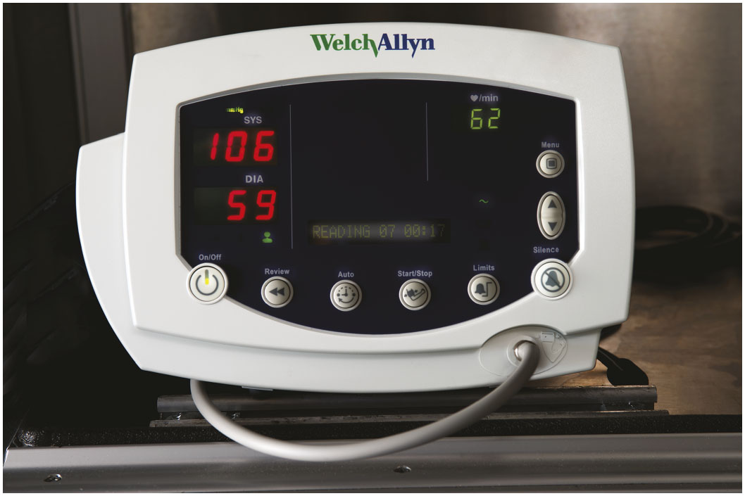
A Noninvasive Blood Pressure Device

Slide 72
Monitoring Equipment (8 of 13)
Capnometry (E t C O₂ Monitor)
    End-tidal carbon dioxide (E t C O₂) monitoring is a noninvasive method of measuring the levels of carbon dioxide (C O₂) at the end of the exhaled breath.
    E t C O₂- The measurement of the C O₂ at the end of expiration.
Notes:
CO₂, a normal by-product of cellular metabolism, is transported by the venous system to the right side of the heart. From there, it is delivered to the capillary beds of the lungs so that the CO₂ can be off-loaded to the alveoli and exhaled. With normal cardiovascular and pulmonary function, there is a relatively reliable correlation between the EtCO₂ and the PaCO₂ (the concentration of CO₂ in the arterial blood). Capnometry is the process of monitoring the carbon dioxide that is exhaled from the body.

Slide 73
Monitoring Equipment (9 of 13)
    Capnometry (E t C O₂ Monitor)
    P a C O₂- The partial pressure of C O₂ in the arterial blood.
    Capnometry- The measurement of expired C O₂.
    Capnogram- The visual recording of the C O₂ waveform throughout the phases of breathing.
Notes:
CO₂, a normal by-product of cellular metabolism, is transported by the venous system to the right side of the heart. From there, it is delivered to the capillary beds of the lungs so that the CO₂ can be off-loaded to the alveoli and exhaled. With normal cardiovascular and pulmonary function, there is a relatively reliable correlation between the EtCO₂ and the PaCO₂ (the concentration of CO₂ in the arterial blood). Capnometry is the process of monitoring the carbon dioxide that is exhaled from the body.

Slide 74
Monitoring Equipment (10 of 13)
Capnometry (E t C O₂ Monitor)
  Reasons for E t C O₂ changes
    The reading will decrease during hyperventilation.
    The reading will increase during hypoventilation.
Notes:
Following are some possible reasons for changes in the EtCO₂ level:
The EtCO₂ level and reading will decrease below normal, indicating there is less carbon dioxide in the exhalation, if there is a rise in alveolar ventilation from hyperventilation.
The EtCO₂ level and reading will increase above normal if there is a reduction in alveolar ventilation due to hypoventilation, indicating that each exhalation contains a greater amount of carbon dioxide.
If there is a decrease in cardiac output, a decrease in blood flow or perfusion of the pulmonary capillaries, or a decline in metabolic activity, the EtCO₂ level and reading will decrease.
The EtCO₂ level and reading will increase if there is an improvement in alveolar ventilation (because each exhaled breath will then contain more carbon dioxide), if metabolic activity suddenly increases (there is a higher production of carbon dioxide in the cells), or if there is an improvement of perfusion of the pulmonary capillaries.

Slide 75
Monitoring Equipment (11 of 13)
Capnometry (E t C O₂ Monitor)
  Reasons for E t C O₂ changes
    The reading will decrease with a decrease in cardiac output, blood flow or pulmonary capillary perfusion or a decline in metabolic activity.
    The reading will increase with an improvement in alveolar ventilation.
Notes:
Following are some possible reasons for changes in the EtCO₂ level:
The EtCO₂ level and reading will decrease below normal, indicating there is less carbon dioxide in the exhalation, if there is a rise in alveolar ventilation from hyperventilation.
The EtCO₂ level and reading will increase above normal if there is a reduction in alveolar ventilation due to hypoventilation, indicating that each exhalation contains a greater amount of carbon dioxide.
If there is a decrease in cardiac output, a decrease in blood flow or perfusion of the pulmonary capillaries, or a decline in metabolic activity, the EtCO₂ level and reading will decrease.
The EtCO₂ level and reading will increase if there is an improvement in alveolar ventilation (because each exhaled breath will then contain more carbon dioxide), if metabolic activity suddenly increases (there is a higher production of carbon dioxide in the cells), or if there is an improvement of perfusion of the pulmonary capillaries.

Slide 76
Monitoring Equipment (12 of 13)
Capnometry (E t C O₂ Monitor)
  Reasons for E t C O₂ changes
    A sudden increase in the E t C O₂ reading in the cardiac arrest patient may indicate the patient has regained a pulse.
    E t C O₂ is used to confirm and monitor correct endotracheal tube placement. A decrease in the level indicates a displaced endotracheal tube.
Notes:
If there is a sudden increase in the EtCO₂ reading in the cardiac arrest patient, it likely indicates the patient has regained a pulse, which is referred to as return of spontaneous circulation (ROSC)—even though, due to arterial vasoconstriction, you might not be able to detect a pulse.
EtCO₂ is used to monitor the effectiveness of chest compressions in cardiac arrest. A decrease in the EtCO₂ level and reading usually indicates compressor fatigue. This produces ineffective chest compressions and poor cerebral and coronary artery perfusion pressures.
EtCO₂ is used to confirm and monitor correct endotracheal tube placement. A sudden decrease in the EtCO₂ level and reading likely indicates a displaced endotracheal tube.

Slide 77
Monitoring Equipment (13 of 13)
Capnometry (E t C O₂ Monitor)
  Reasons for E t C O₂ changes
    E t C O₂ is used to monitor the effectiveness of chest compressions. A decrease in the E t C O₂ level and reading usually indicates compressor fatigue.
Notes:
If there is a sudden increase in the EtCO₂ reading in the cardiac arrest patient, it likely indicates the patient has regained a pulse, which is referred to as return of spontaneous circulation (ROSC)—even though, due to arterial vasoconstriction, you might not be able to detect a pulse.
EtCO₂ is used to monitor the effectiveness of chest compressions in cardiac arrest. A decrease in the EtCO₂ level and reading usually indicates compressor fatigue. This produces ineffective chest compressions and poor cerebral and coronary artery perfusion pressures.
EtCO₂ is used to confirm and monitor correct endotracheal tube placement. A sudden decrease in the EtCO₂ level and reading likely indicates a displaced endotracheal tube.

Slide 78
Case Study (2 of 3)
Mr. Mahon reports that he began feeling some pressure in his chest about 15 minutes ago. Bill organizes several questions in his mind, as Dawn obtains respiratory and pulse rates, a blood pressure, and a pulse oximetry reading. Meanwhile, Bill can see that Mr. Mahon’s skin is slightly pale, and cool and moist to the touch.
Notes:
Case Study Discussion
Review the case study findings presented.

Slide 79
Case Study (3 of 3)
What are the normal ranges of vital signs for this patient?
Given the patient’s complaint, what questions should Bill be prepared to ask?
Notes:
Case Study Discussion
Use the case study content and questions to foreshadow the upcoming lesson content. Gauge the students’ responses as a guide of how well versed they are in this topic.

Slide 80
Preparing to Take the History (1 of 3)
Gain control of the scene
  Display competence, confidence, and compassion.
Achieve a Smooth Transition of Care
  From an Emergency Medical Responder, police officer, or other individual who is providing first aid.
  Quickly gain information from the Emergency Medical Responders before you make actual patient contact.
Notes:
When arriving on the scene, you will frequently encounter patients and family members who are frightened, injured, anxious, or in shock. In addition, you may find an angry or hostile crowd and law enforcement or fire department personnel anxiously awaiting your arrival. You must display competence, confidence, and compassion— through your personal appearance and professional manner—to obtain cooperation not only from the patient but also from others at the scene.
Points to Emphasize
You must control the scene and establish rapport with the patient prior to taking the history.
Being courteous and maintaining control are essential actions.
Teaching Tips
Give examples from your experience of how you have gained control of scenes.

Slide 81
Preparing to Take the History (2 of 3)
Reduce the Patient’s Anxiety
  Bring order to the environment.
  Introduce yourself.
  Gain patient consent.
  Position yourself.
  Use communication skills.
  Be courteous.
  Use touch when appropriate.
Notes:
Once you make contact with the patient, attempt to reduce their anxiety and that of others at the scene. You can do this by employing the following simple techniques:
As quickly as possible, bring order to the environment by asking that televisions or radios be turned down, dogs be removed from the area in which you are working, and children be supervised by a family member, police officer, or Emergency Medical Responder.
Introduce yourself and ask for the patient’s name. Address older individuals formally as “Mr. Jones” or “Mrs. Smith” to avoid any implication of disrespect. If time or the situation permits, you can ask, “What would you like me to call you?”
Your body position and posture are forms of nonverbal communication. Position yourself at a comfortable level in relation to the patient. If the eye levels are equal, so is the authority. If you are standing over the patient, you are in a dominant position of authority and control. This may be uncomfortable for the patient and may set the wrong tone for the scene. (At some scenes, when you need to establish control, this position is warranted.)
As much as possible, maintain eye contact when talking with the patient to help establish rapport and to convey your sincere concern. Speak calmly and deliberately to allow the patient to process the information. Raise your voice only if the patient appears to be hearing-impaired.
The scene of an emergency is stressful. The patient, family members, and bystanders may not be at their best. They may seem quarrelsome, petty, rude, or hostile. As a professional, you must resist yielding to the same stresses.
Touching the patient is a powerful comfort measure when dealing with most people. Use eye contact to avoid the patient’s perception of the touching as encroachment. Hold a hand, pat a shoulder, or lay your hand on a forearm.

Slide 82
Preparing to Take the History (3 of 3)
Maintain Control
  Recognize when a scene cannot be controlled, and do not jeopardize your own safety.
  If necessary, remove yourself and the patient from the scene.
Notes:
It is difficult to conduct an assessment, gather information from the patient, and provide emergency care at a scene that is not controlled. The greater the distractions at the scene, the higher the anxiety level of the patient, family, and bystanders.
It is important to recognize when a scene cannot be adequately controlled. It may be impossible to gain scene control when the crowd is extremely hostile, the family is emotionally charged or upset, threats are being made toward you, or the scene is unstable because of the risk of fire, explosion, or other hazards. You must consider your own safety when working in an uncontrolled environment.

Slide 83
Taking the History (1 of 11)
The history begins with the reason why E M S was called, which is the chief complaint.
The history helps guide the examination.
The process must be dynamic for the situation.
Get history from the patient, if possible.
After the chief complaint, determine the history of the present illness.
Notes:
Information gained in the history is as important in most medical cases as the information determined through the physical examination. The history typically begins with determining the chief complaint. The chief complaint is the reason why the EMS crew was called to the scene. You will continue with obtaining information about the present illness, significant past medical history, and the current health status of the patient. The information gathered may provide direction for the physical examination. Often, the history and physical examination are conducted concurrently depending on the resources at the scene and the condition of the patient.
Once the chief complaint is obtained, you will proceed with a history of the present illness. This is a more detailed evaluation of the chief complaint and associated signs and symptoms. Other components include demographic information, current health status, and past medical history.
Critical Thinking Discussion
What are some things that could alienate a patient during your initial approach to him?

Slide 84
Taking the History (2 of 11)
Statistical and Demographic Information
  Date
  Time
  Patient’s identifying data
Current Health Status
  Current medications
  Allergies to medications or substances
  Tobacco use
Notes:
Certain data is collected for statistical, record keeping, and demographic purposes. This data includes the following:
Date - Be sure to document the correct current date and dates of information provided by the patient regarding complaints, signs, treatments, illnesses, hospitalizations, and any other pertinent information.
Time - Document the time of events accurately.
Identifying data - Record the patient’s age, sex, and race.
Individual health status factors to consider are:
Current medications, including prescription and over-the-counter medications
Allergies to medications or other substances, including specific reactions experienced in the past
Tobacco use, including type of tobacco and how much
Alcohol, drugs, and related substances
Diet, including daily food and drink intake
Screening tests that may have been done recently
Immunization against certain diseases
Environmental hazards the patient is exposed to
Use of safety equipment such as seat belts and bike helmets
Family history, especially for disease with a hereditary link
Teaching Tips
Take the history of a preprogrammed assistant instructor to demonstrate the technique to students.

Slide 85
Taking the History (3 of 11)
Current Health Status
  Alcohol, drugs, and related substances
  Diet
  Recent screening tests
  Immunizations
  Environmental hazards
  Use of safety equipment
  Family history
Notes:
Individual health status factors to consider are:
Current medications, including prescription and over-the-counter medications
Allergies to medications or other substances, including specific reactions experienced in the past
Tobacco use, including type of tobacco and how much
Alcohol, drugs, and related substances
Diet, including daily food and drink intake
Screening tests that may have been done recently
Immunization against certain diseases
Environmental hazards the patient is exposed to
Use of safety equipment such as seat belts and bike helmets
Family history, especially for disease with a hereditary link

Slide 86
Taking the History (4 of 11)
Techniques for Taking a Patient History
  Note-taking
    Document the information the patient provides as accurately as possible.
  Types of questions
    Open-ended questions can yield more information.
    Closed-ended questions are also useful.
Notes:
Document the information the patient provides as accurately as possible. It is typically impossible to remember all the information the patient provides, especially when you are doing multiple calls back-to-back.
There are basically two types of questions used by EMTs to gather a history: open-ended questions and closed-ended questions. An open-ended question requires the patient to respond with a descriptive or more detailed answer. “How are you feeling today?” and “Can you describe the discomfort?” are examples of open-ended questions. The patient is unable to provide a “yes” or “no” answer to open-ended questions. A closed-ended question is often a rapid-fire-type question that requires only a “yes” or “no” answer. “Are you having pain in your chest?” and “Do you feel lightheaded?” are examples of closed-ended questions. Often, both types of questions are used throughout the history. A multiple-choice question that uses a mix of both formats may also be used. “When are you more short of breath: when you lie flat or when you sit up?” is an example of a multiple-choice question.

Slide 87
Taking the History (5 of 11)
  Techniques for Taking a Patient History
  Active Listening Techniques
    Facilitation
    Reflection
    Clarification
    Empathic Response
    Confrontation
    Interpretation
Notes:
The following are active listening techniques:
Facilitation - Maintain eye contact with the patient in a sincere manner. Use posture, actions, words, facial expressions, or cues while listening to help your patient feel comfortable, open up, and provide more information. Phrases such as “I’m listening” or “go on” may be used.
Reflection - Repeating the patient’s words will encourage him to provide additional responses. Avoid interrupting the patient’s train of thought while practicing reflection. This may encourage the patient to reveal information you might not otherwise have discovered. The patient states, “My belly hurts” as a response to your open-ended question to gather the chief complaint. “Your belly hurts?” is your response. The patient then states, “Yes, it has hurt ever since I haven’t had a bowel movement for this past week.” Your response is, “You haven’t had a bowel movement for a week?” The patient then responds with, “No, it has been more than a week and my belly began hurting a few days ago.” As you can see, the chief complaint has changed its focus from abdominal pain to a possible bowel obstruction.
Clarification - Clarification is used to clarify ambiguous statements, responses, symptoms, or words. The patient states, “I feel bad all over.” You then clarify by asking, “Can you describe what the bad feeling feels like?” The patient responds with, “It feels like pins and needles in my arms and legs.” The clarification technique provided a much more descriptive symptom.
Empathetic Response - Show empathy through verbal responses and gestures. “I understand” or “I see how that would be difficult” are some verbal responses that show empathy.
Confrontation. Sometimes patients do not provide the entire truth or try to downplay symptoms. You may need to confront them to determine the accurate information. “You said you have never been to the doctor, but there is a prescription for Glucophage in your name on the table” is an example of confrontation.
Interpretation - Interpretation takes confrontation to the next level. You may need to make an inference based on your observations. As an example, “You say you have never been to the doctor, yet you have a prescription medication in your name. Are you afraid your current medical condition is worsening and you might have to be admitted to the hospital?”

Slide 88
Taking the History (6 of 11)
Standardized Approach to History Taking
  The Sample History
    Signs and Symptoms
    Allergies
    Medications
    Pertinent past history
    Last oral intake
    Events leading up to the illness or injury
Notes:
Signs are observable physical signs of illness or injury.
Symptoms cannot be observed and must be described by the patient.
Signs and symptoms - Signs are any objective physical evidence of medical or trauma conditions that you can see, hear, feel, or smell. For example, you can hear stridor, you can see bleeding, and you can feel skin temperature. Symptoms are conditions that cannot be observed and must be described by the patient, such as pain in the abdomen or numbness in the legs.
Allergies - Determine whether the patient has any allergies to medications, food, or environmental agents such as pollen, grass, ragweed, or molds. Ask about the type of reaction to the allergen, such as a rash or wheezing.
Medications - Has the patient taken any medications recently? Is the patient taking any medications regularly? It is important to determine whether the patient takes (1) prescription medications, (2) nonprescription or over-the-counter medications, (3) birth control pills, (4) illicit drugs, (5) herbal medications, (6) erectile dysfunction drugs, (7) another person’s prescription medication, or (8) vitamins.
Pertinent past history - Find out about underlying medical problems like seizures, heart disease, diabetes, kidney disease, or emphysema. Ask if there have been past surgical procedures or trauma and whether the patient is currently under a doctor’s care.
Last oral intake - Find out when the patient last ingested a solid or liquid. Find out what it was, when it was consumed, and the quantity that was consumed. Ask: “When did you last eat or drink anything?”
Events leading to the injury or illness - What occurred before the patient became ill or had the accident? Were there any unusual circumstances? What was the patient doing? Did the patient have any peculiar feelings or experiences?
Teaching Tips
Remind students that SAMPLE and OPQRST are only memory aids. Have students give you examples of actual questions that would be used to obtain the information represented by the mnemonics.
Hold students to this concept throughout the class. Do not allow students to simply say, "I would get a SAMPLE history," when discussing case studies and scenarios.

Slide 89
Taking the History (7 of 11)
Assessing Patient Complaints: O P Q R S T
  The mnemonic O P Q R S T helps you evaluate the signs and symptoms.
    Onset
    Provocation/Palliation/Position
    Quality
    Radiation
    Severity
    Time
Notes:
OPQRST is a mnemonic for remembering the questions to ask when assessing the patient’s chief complaint or major symptoms, such as pain, that the patient can tell you about.
Onset - When and how did the symptom begin? Ask the patient if the onset was sudden or gradual. Also, determine whether the onset was associated with a particular activity.
Provocation/Palliation/Position - What makes the symptom worse? What makes it better? In what position is the patient found? A patient complaining of chest pain may tell you that walking up the steps made the pain much worse, or a patient complaining of dyspnea states, “When I lie flat in bed, I can’t breathe.” Determine whether the patient has taken any medication to attempt to relieve the symptoms. A patient complaining of abdominal pain may have taken an antacid. If something was taken, determine whether the symptoms were relieved, made worse, or remained the same. Also, pay attention to the position the patient was found in because it can provide clues to the condition.
Quality - How would you describe the pain? Quality is most often associated with a complaint of pain. Ask the patient to describe the pain. Most often, pain is described as crushing, aching, dull, stabbing, knifelike, crampy, gnawing, burning, or tearing. Do not lead the patient.
Radiation - Where do you feel the pain? Where does the pain go? Prior to asking about radiation, it is necessary to determine the exact location of the pain. Ask the patient to point to the pain with one finger. The pain is localized if he can isolate it to one area. Generalized pain cannot be localized and is spread over a general area. From the point of the initial pain, ask if the pain extends, moves, or radiates.
Severity - How bad is the symptom? Ask the patient to rate the pain on a scale of 1 to 10 with 10 being the most severe. Have the patient compare the pain with a previous condition he may have suffered that involved pain. The patient’s appearance should give you some indication as to the severity of the pain.
Time - How long have you had the symptom? Determine whether the symptom has been present for minutes, hours, days, weeks, months, or years. If you get called to the scene and find a patient complaining of a symptom that has been present for more than a day, ask the patient, without appearing to be judgmental, “Why did you call us today?”

Slide 90
Taking the History (8 of 11)
Sensitive Topics or Special Challenges
  Sensitive Topics
    When asking sensitive questions, remain nonjudgmental and ask only questions that pertain directly to the medical history or patient care.
    Respect the patient’s privacy.
    Ask at appropriate time and location.
    Remain within your scope of practice.
Notes:
It may be necessary to ask questions in the history that you might consider to be sensitive in nature, such as alcohol or drug use, physical or sexual abuse, or sexual history. When asking questions that may be sensitive, remain nonjudgmental and ask only questions that pertain directly to the medical history and are necessary to gain answers that are pertinent to your assessment and emergency care. Respect the patient’s privacy and ask questions of a sensitive nature at the appropriate time and in an appropriate location.

Slide 91
Taking the History (9 of 11)
Sensitive Topics or Special Challenges
  Special Challenges
    Silence
    Overly talkative patients
    Patients with multiple symptoms
    Anxious patients
    Angry patients
    Intoxication
    Crying patient
Notes:
Typically, as you become more experienced and build a solid technique for history taking, the challenges become easier to manage. Some of the challenges are:
Silence - Silence can be uncomfortable for both you and the patient. Attempt to determine why the patient has become silent. Watch their body language for nonverbal clues such as crying, facial expressions of anger, confusion, or depression; a closed body posture; and signs of being tense. Try to determine the cause for the silence, rectify it if possible, and proceed with the history.
Overly talkative patient - Some patients continue to talk and do not allow you enough time to ask questions. Give your patient a free rein for a period of time to talk and express themselves.
Patient with multiple symptoms - Some patients present a multitude of complaints. The challenge is attempting to determine the true chief complaint. Asking “But why did you call today?” or “What was the primary reason for calling us today?” may assist you in determining the actual chief complaint.
Anxious patient - Many patients experience anxiety in an acute emergency. The patient may exhibit many nonverbal clues such as sweating, nervousness, trembling, and tachycardia. Encourage the patient to freely express their feelings of anxiousness or anxiety.
Angry and hostile patient - Anger and hostility are a natural part of illness and injury. Because you are likely to be the first medical person to provide care for the patient, it may be that the patient or family directs the anger toward you. They are not angry at you, even though it may appear that way. Remain calm, confident, professional, and competent.
Intoxicated patient - The most significant concern with an intoxicated patient is your own safety. An intoxicated patient may suddenly change their behavior and become violent. Always remain vigilant when dealing with an intoxicated patient. The easiest way to deal with this patient is not to challenge but to accept them.
Crying patient - Crying is a nonverbal clue to the patient’s emotions. Be patient, empathetic, and supportive. It is okay to allow the patient to cry.

Slide 92
Taking the History (10 of 11)
Sensitive Topics or Special Challenges
  Special Challenges
    Depressed patient
    Confusing behavior or history
    Patients with limited intelligence
    Language barrier
    Hearing impairment
    Visual impairment
    Talking with friends or family
Notes:
Depressed patient - Look for signs of depression such as weight loss, flat affect, poor eye contact, insomnia, loss of appetite, fatigue, weight loss, or complaints of aches or pains. Listen carefully to the patient and remain nonjudgmental. If there are signs of serious depression, such as thoughts of suicide, be sure to get the patient the assistance and care that they need.
Confusing behavior or history - A patient who presents with a confusing history or bizarre or unusual behavior may be suffering from a mental illness, dementia, or delirium. Dementia is associated with a gradual decline in the mental status of the patient due to some type of neurological disease. Delirium is an acute alteration in the mental function of the patient that is usually due to a reversible cause.
Patient with limited intelligence - The patient is often able to provide you with adequate history information. Be alert to possible omissions of information. If the patient has a severe cognitive impairment, obtain the history from the family or caregivers.
Language barrier - If the patient speaks a language that you are not fluent in, try to find an interpreter such as a family member. Realize that some history information may be confused or lost in the translation. If a translator is not available, contact a telephone translation service or transport the patient and notify the hospital of the need for a translator.
Hearing impairment - Hearing impairment offers many of the same challenges as a language barrier. The advantage in this situation, however, is that you can revert to writing to ask questions and obtain information. When speaking to a hearing-impaired person, face the patient and look at them when you speak. Such patients often read lips. Use a person who can sign as your translator if available.
Visual impairment - Remember to tell the visually impaired patient everything you are doing. These patients can’t see your movements or hand gestures. You may increase their anxiety significantly if they are not continuously made aware of what is happening at the scene. Constantly communicate with the patient.
Talking with friends and family - Some patients are only able to provide limited information. You may need to rely on family members or friends to fill in the gaps or provide the entire history. Family or friends may be useful in providing information about the events leading up to the emergency.

Slide 93
Taking the History (11 of 11)
Sensitive Topics or Special Challenges
  Special Challenges
    Pediatric patient
    Elderly patient
Notes:
Pediatric patient - The pediatric patient may present with special challenges based on ability to understand the questions you are asking. A child may not have the ability to respond appropriately. Once the child reaches four years of age, they should become the primary source of the history. Use the parent or caregiver to fill in the gaps.
Elderly patient - The elderly patient may have physical limitations such as impaired sight or hearing that make history gathering a challenge; however, it should not be automatically assumed that these exist. Do not assume that an elderly patient suffers from dementia. If mental impairment seems evident, ask family or friends whether this is the patient’s normal presentation or whether it may be a result of the current medical condition or emergency. Normally, the elderly patient should be the primary source for the information.
Discussion Questions
What are some ways to get information from a silent patient?
How should you approach history taking with elderly patients?
Class Activity
Have students divide into groups of three or four. Each student should practice taking the history of another student while the remaining student or students observe the process, then give constructive feedback. Debrief the class at the end of the activity and record important learning points on the white board.

Slide 94
Case Study Wrap-Up (1 of 3)
Bill learns that Mr. Mahon’s chest discomfort started 15 minutes ago while he was working on his computer. Nothing has made the discomfort better or worse. Mr. Mahon describes the sensation as a heavy pressure, and says he can feel the sensation in his left shoulder and arm. When Bill asks, Mr. Mahon says the severity of the discomfort is a 7 on a scale from 1 to 10.
Notes:
Case Study Discussion
Review case conclusion and emphasize the application of knowledge learned from this presentation.

Slide 95
Case Study Wrap-Up (2 of 3)
Mr. Mahon’s vital signs are as follows: respirations 16 per minute, and of normal depth; pulse strong, but occasionally irregular at 84 beats per minute; blood pressure is
and S p O₂ is 99% on room air.
Notes:
Case Study Discussion
Review case conclusion and emphasize the application of knowledge learned from this presentation.

Slide 96
Case Study Wrap-Up (3 of 3)
Based on the history, Bill suspects acute coronary syndrome. He administers aspirin and nitroglycerin to Mr. Mahon, according to protocol, as they prepare to transport him to the hospital.
Notes:
Case Study Discussion
Review case conclusion and emphasize the application of knowledge learned from this presentation.

Slide 97
Summary (1 of 2)
  You will take vital signs on every patient you encounter.
  Baseline vital signs allow comparison with later vital signs to detect trends.
  Vital signs include respirations, pulse, blood pressure, skin, pupils, and pulse oximetry.
Notes:
Follow-Up
Answer student questions.
Follow-Up Assignments
Review Chapter 11 Summary.
Complete Chapter 11 In Review questions.
Complete Chapter 11 Critical Thinking questions.
Assessments
Handouts
Chapter 11 quiz

Slide 98
Summary (2 of 2)
  A medical history is important in determining the patient’s condition and the care needed.
  You must be prepared to overcome many challenges in history-taking.
Notes:
Class Activity
As an alternative to assigning the follow-up exercises in the lesson plan as homework, assign each question to a small group of students for in-class discussion.
Teaching Tips
Answers to In Review questions are in the appendix of the text. Advise students to review the questions again as they study the chapter.

Slide 99
Correct!
This heart rate is outside the expected range for a child who is from 5 to 12 years old.
Click here to return to the quiz.

Slide 100
Incorrect
This number is within the normal, expected range for a child who is from 5 to 12 years old.
Click here to return to the quiz.

Slide 101
Feedback
The expected range for the pulse rate of a child from 5 to 12 years old is from 60 to 120 beats per minute.
Click here to return to the program.

Slide 102

Copyright

