Slide 1
Case Study
USS George Washington (CVN-73)
22 May 2008

Slide 2
Timeline of 22 May 2008
0600 While preparing for UNREP smoke was reported to bridge and thought incinerator was source. Bridge reported incinerator was secured.
0650 Stationed UNREP detail
0729 All stations manned and ready to receive USS CROMMELIN
0745 XO reported to OOD he observed white smoke aft of island
EOOW received report white smoke in Squadron Ready Room #5 03-185-0-L
Heavy Smoke and glow on bulkhead in aft, stbd corner of Dry Provisions Storeroom 5-180-03-A
MM2 noticed a wisp of white smoke coming from access cover to Aux Boiler Exhaust and Supply Space 6-189-1-Q. Tried to call DC Central and said line was busy. Left space to report to At Sea Fire Party.
0747 EOOW called away smoke in 03-185-0-L
0748 Emergency Breakaway

Slide 3
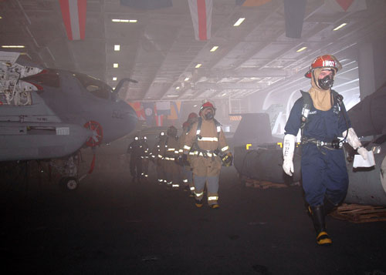
Timeline
0747-0820 DCC received at least 8 reports of smoke from 6th deck to flight deck in vicinity of frame 180.
0810 MM2 reported to ASFP and reported smoke coming out of access cover to 6-189-1-Q to DC1. DC1 does not recall hearing this report.
0816 Repair 7B reported to DCC bubbling paint in passageway 01-185-1-L
0818 4 Sailors on station in Pump Room #3 Control attempted to egress the space with EEBD’s but evacuation unsuccessful due to excessive heat and contacted DCC.
0820 Set GQ

Slide 4
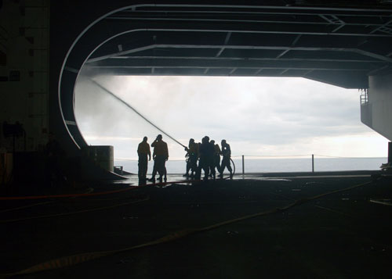
Timeline
0825 DCA and ADCA received report of smoke and fire in 5-180-03-A, 6-185-0-L and possibly 7-190-0-E.
0825 Amperage oscillations on electric plant led to de-energizing and resulted in loss of power aft of frame 180 and the island.
0840 Hosemen entered AC&R Division Office. Heat caused NFTI to white out. No flames noted and led to thinking of possibly steam leak.
0911 Repair 7B reported hot manway access cover 2-188-1 on Auxiliary Boiler Supply and Exhaust. Cover removed and water sprayed for several hours securing at 1400.

Slide 5
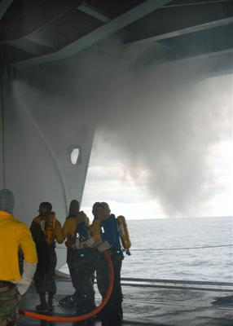
Timeline
0913 Loss of HP air to SCBA recharging station due to only 1 HPAC online. A recharging station of mobile air compressors established in vicinity of frame 120.
0920 Hot spot in ADP 4-180-1-L. Cooled using solid stream and short bursts.
0924-1300 Several attempts to rescue personnel trapped in Pump Room 3.
1000 Repair 3 evacuated due to high carbon monoxide levels.
1002 Repair 5 hose team sent to combat “A” fire in 3-180-3-Q.
1042 HP Air restored
1100 Class “A” fire in 3-180-3-Q out.
1130 Class “A” fire in cable way in Reactor and Engineering Training Office 3-186-1-Q.

Slide 6
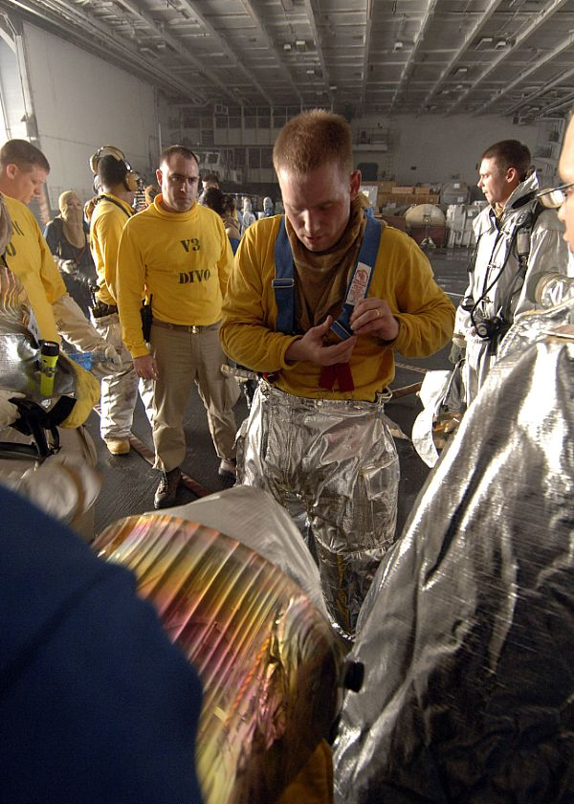
Timeline
1135 ADCA determined possible source of fire was in Auxiliary Boiler Supply and Exhaust 6-189-1-Q.
1140 White smoke in 4-180-1-L and white and black smoke in 6-185-0-E and 7-185-0-E. Hose teams deployed to all three spaces. NIFTI’s proved not effective due to high ambient temperature.
1144 Class “A” fire in cableway in passageway 3-180-1-L out.
1145 ADCA ordered removal of manway access cover to Auxiliary Boiler Supply and Exhaust in 4-180-1-L and spray water into space.
1150 Class “A” fire in 3-180-1-L Reactor and Eng Training Office out.
1200 Class “A” fire in 3-180-3-Q out

Slide 7
Timeline
1215 ADCA ordered the removal the access cover for the Auxiliary Boiler Supply and Exhaust in passageway 1-185-1-L.
1220 CO ordered access cut to allow egress of personnel trapped in Pump Room #3. Efforts delayed due to low charge on oxygen bottle for first PECU and depleted battery on second PECU.
1227 DCA announced source of fires appeared to be 6-189-1-Q on 1MC.
1240 Class “A” fire reported in 6-185-0-E.
1324 Personnel in proximity suits gained access to Pump Room #3, covered 4 personnel in wool blankets soaked in AFFF and evacuated safely
1345 access cover to Auxiliary Boiler Exhaust and Supply in passageway 1-185-1-L was removed and water sprayed into opening.
1400 ADCA expressed frustration and emphasized importance of getting access cover in 4-180-1-L opened.
1545 Access cover in 4-180-1-L was removed and water sprayed into opening.
1602-2016 Fought class “A” fires in 5-180-03-A (reflashed two times) and 6-185-0-E (reflashed once).
2016 Secured from GQ.

Slide 8
Cause of Fire
The fire was in space 6-189-1-Q.
It was being used for unauthorized storage of tech pubs, clothing, lagging, at least 90 gallons of compressor oil and 5 gallons of unknown substance.
Cigarette butts found in plenum of 6-180-0-E AC&R Machinery room which exhausts directly into 6-189-1-Q.
The size of the space led to confusion to as to the actual location of the fire. The space went from 6th deck to 02 Level and about 100 feet wide.
Exact cause of fire is most likely due to unauthorized smoking. Though unlikely, self heating or electrical failure has not been ruled out.
Result: $70 Million worth of damage.

Slide 9
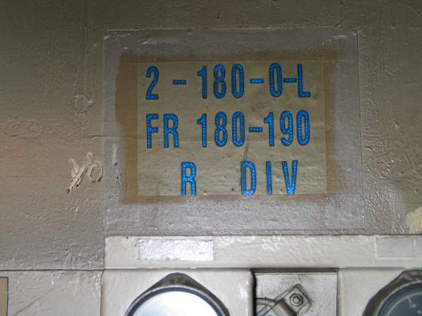
FIRE DAMAGE
Damage frames stbd side above RT classroom

Slide 10
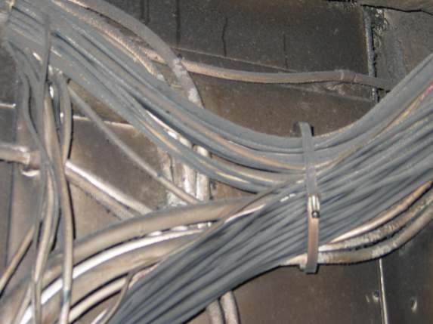
FIRE DAMAGE
Heat/Fire damage to cable ways above RT classroom
(2nd deck) heat damage

Slide 11
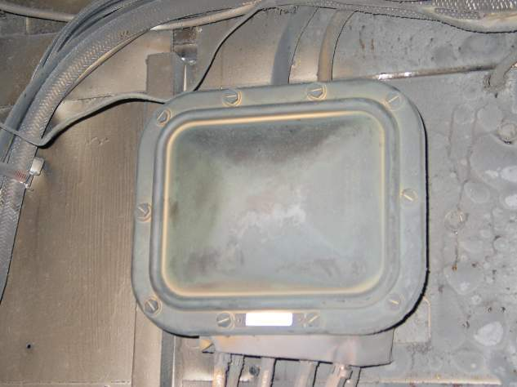
FIRE DAMAGE
Heat/Fire damage to cable ways above RT classroom
(2nd deck) heat damage

Slide 12
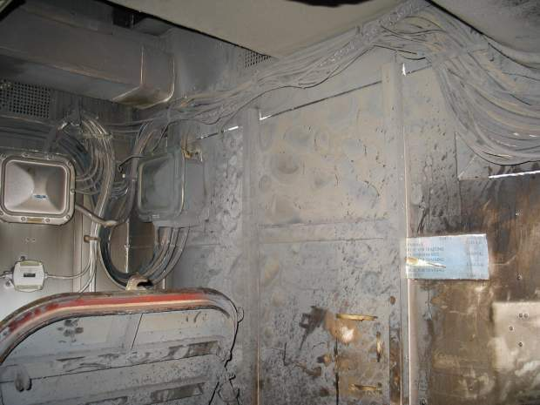
FIRE DAMAGE
Heat/Fire damage to cable ways above RT classroom
(2nd deck) heat damage

Slide 13
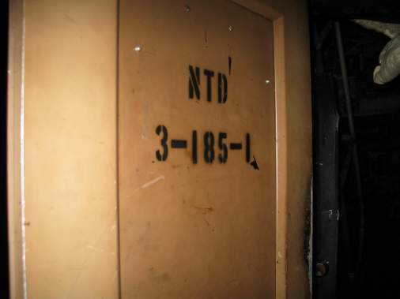
FIRE DAMAGE
Door to Reactor trng classroom

Slide 14
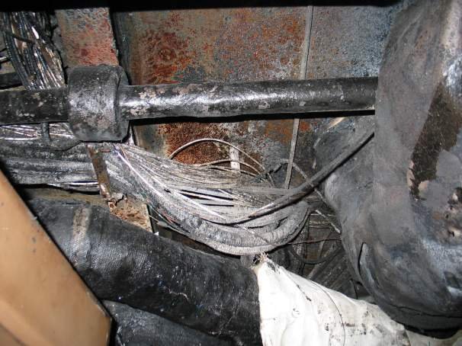
FIRE DAMAGE
Burned cable way in Reactor Classroom

Slide 15
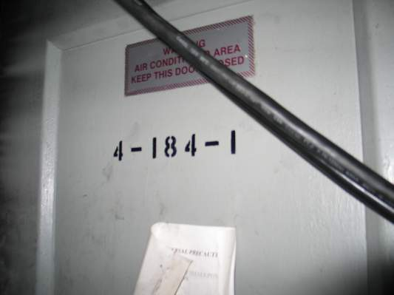
FIRE DAMAGE
Outside space starboard side

Slide 16
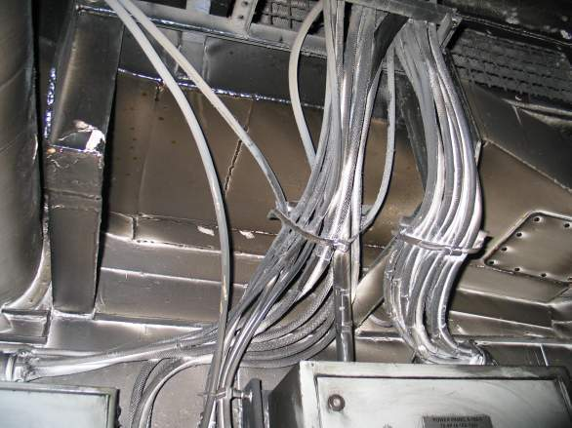
FIRE DAMAGE
Heat damage to cables in back of space

Slide 17
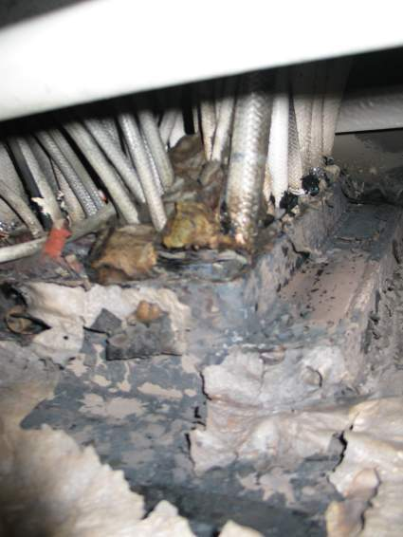
FIRE DAMAGE
Heat damage to major cableway penetration to space

Slide 18
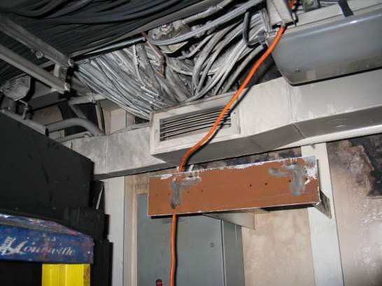
FIRE DAMAGE
Heat damage to major cableway penetration to space (Zoom out from previous slide)

Slide 19
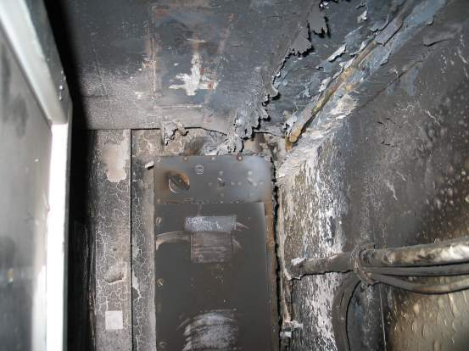
FIRE DAMAGE
Heat/fire damage to ABT in back of ADP
Vent room to the
right, Servers to
the left
Plenum above and behind ABT

Slide 20
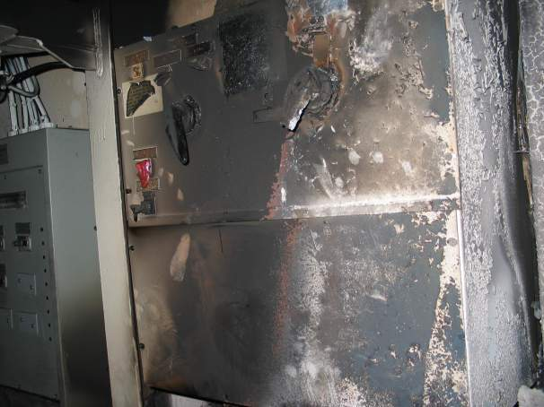
FIRE DAMAGE
Heat/fire damage to ABT in ADP (4th deck)
Zoomed from previous slide

Slide 21
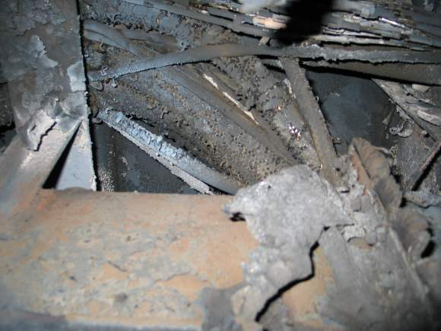
FIRE DAMAGE
Heat/fire damage to overhead cableway

Slide 22
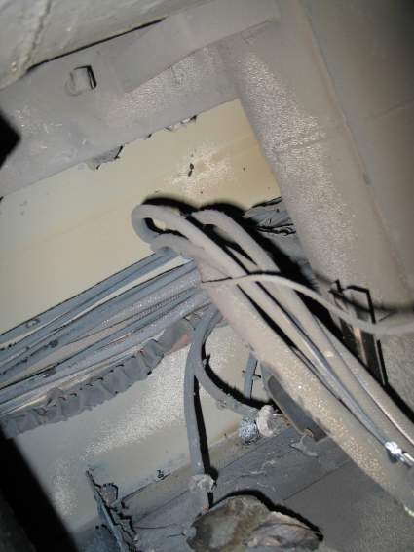
FIRE DAMAGE
Heat/fire damage to overhead in ADP

Slide 23
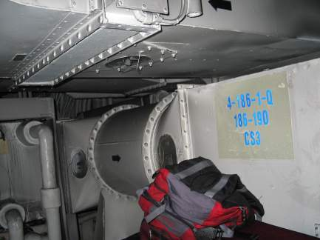
FIRE DAMAGE
Smoke damage to vent room adjacent to ADP
Not pictured, but plastic mop buckets melted in this space

Slide 24
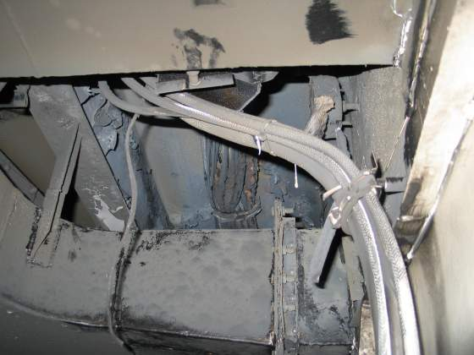
FIRE DAMAGE
Heat/Smoke damage to vent room overhead adjacent to ADP

Slide 25
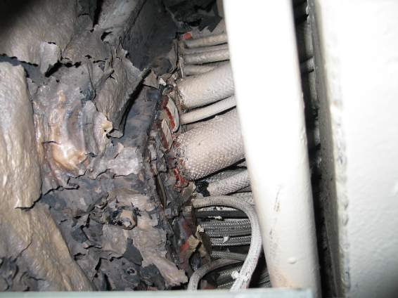
FIRE DAMAGE
Heat/Smoke damage to major cableway into plenum (4th deck)

Slide 26
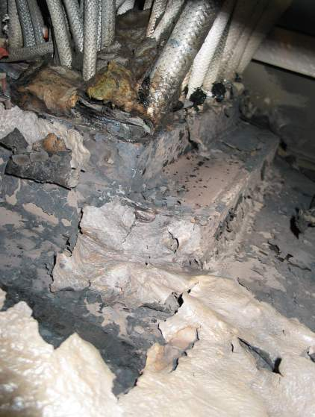
FIRE DAMAGE
Heat/Smoke damage to major cableway into plenum (4th deck)
Same photo from previous slide

Slide 27
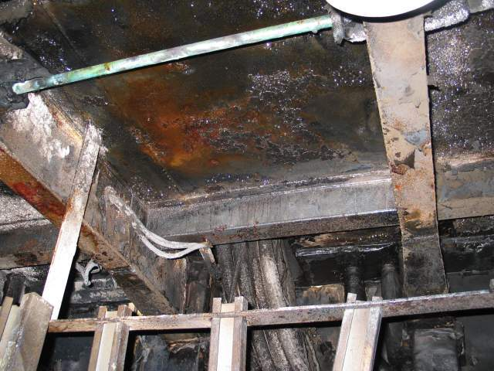
FIRE DAMAGE
Heat/Smoke damage to store room (dry goods)

Slide 28
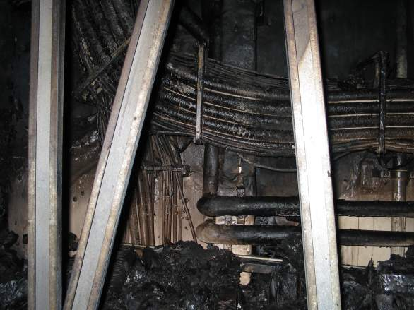
FIRE DAMAGE

Slide 29
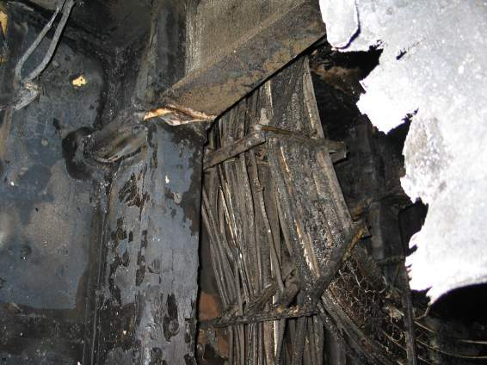
FIRE DAMAGE

Slide 30
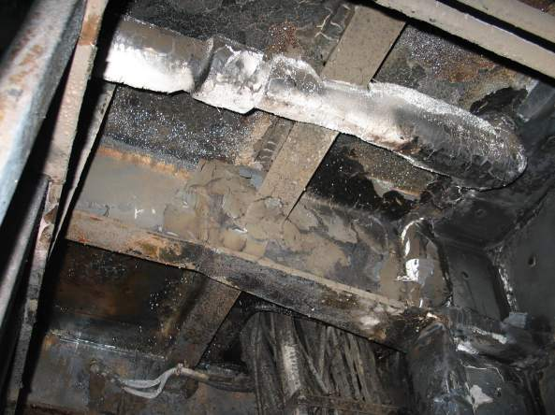
FIRE DAMAGE
Fire damage to overhead of same store room

Slide 31
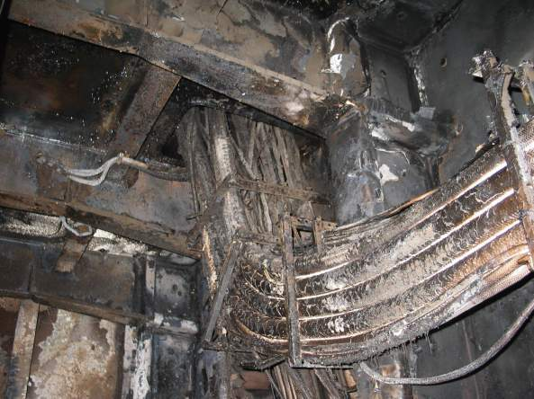
FIRE DAMAGE

Slide 32
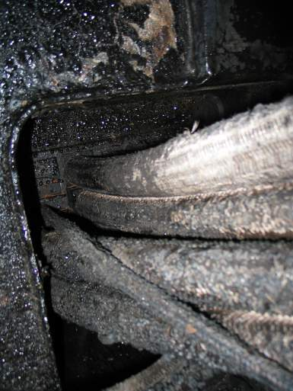
FIRE DAMAGE
Fire damage to overhead/cable way of same store room
Deck penetration of cables
to 4th deck

Slide 33
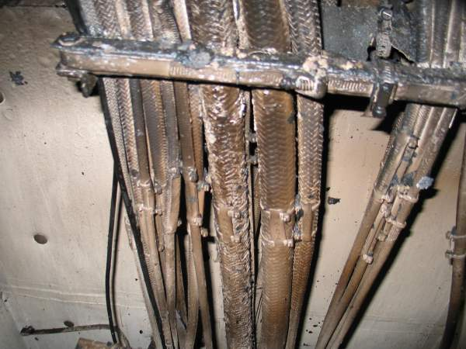
FIRE DAMAGE
Heat damage to bulkhead cables of same store room

Slide 34
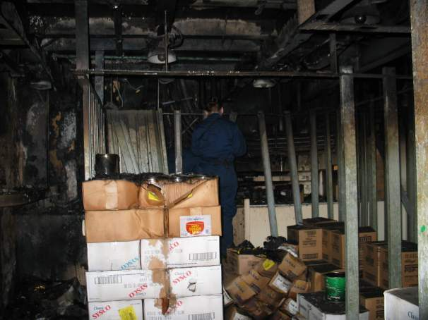
FIRE DAMAGE

Slide 35
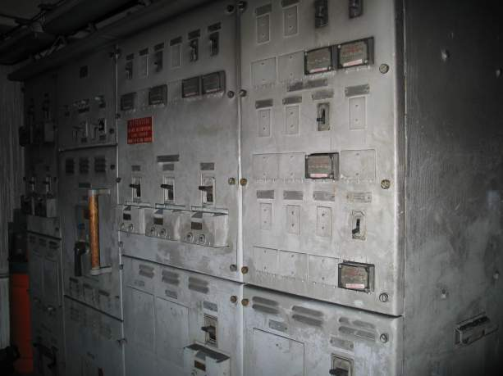
FIRE DAMAGE
Smoke / water damage to load center 71

Slide 36
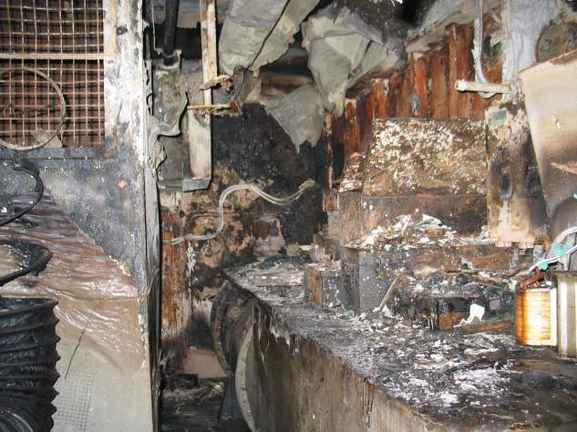
FIRE DAMAGE
Fire/Smoke/water damage to AC&R shop

Slide 37
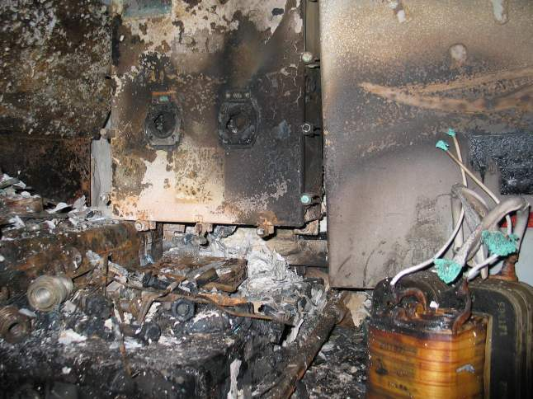
FIRE DAMAGE
Fire/Smoke/water damage to controller/work bench AC&R shop

Slide 38
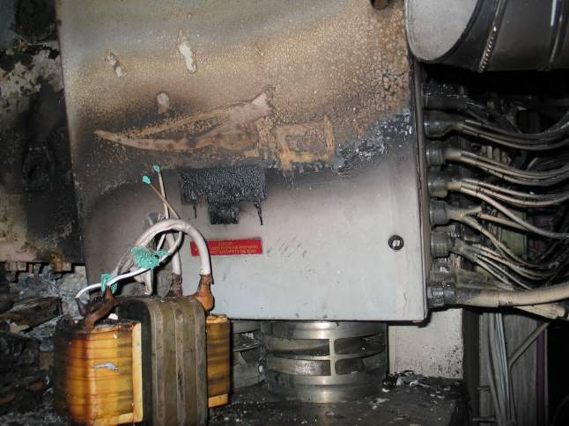
FIRE DAMAGE
Damage to ICAS panel in AC&R shop

Slide 39
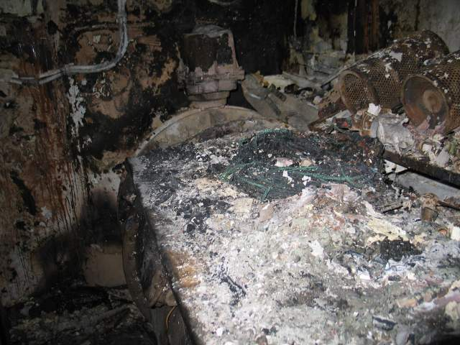
FIRE DAMAGE

Slide 40
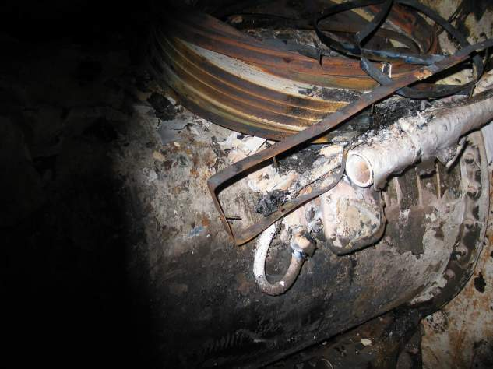
FIRE DAMAGE
Damage to ventilation motor terminal box

Slide 41
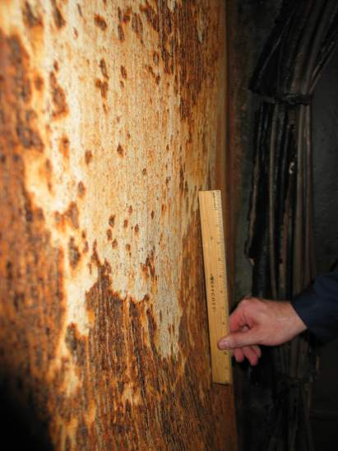
FIRE DAMAGE
6-190-1-T
Access Trunk to
#3 JP5 Pump Room
Common bulkhead
between access trunk
and Aux. Boiler Supply
Exhaust Trunk.
Approx. 3 inches of
warp

Slide 42
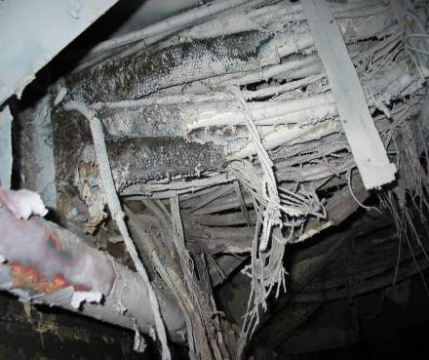
Aux. Boiler Supply Exhaust
Damaged Cable:
2E-4EP(1-246-2)
3E-4OP(2-174-2)
3E-4EP (2-138-2)
3E-4EP-M
3S-4OP 83-LC83
3E-4EP-(4-117-3)(4-117-1)
3E-4EP 4
1E-4EP (2-225-1)
3S-4P 72-LC72
3E-4EP-71-LC71
4E-4EP-S
3E-4OEP A

Slide 43
Events Prior to Fire
In Jun 07 XO raised concerns about the need to improve DCTT. In Jan 08 the XO did not express these concerns to new CHENG when he checked on board. Minimal changes implemented despite his concerns.
12JUN07-18Mar08 DCTT consistently shown as being weak and had trouble training the crew.
14 Aug 07 Completed Crew CERT Phase II. DCTT evaluated as Ineffective and level knowledge was rated as weak.
27 SEP 07 Safety Survey conducted and was rated as average for a CVN.
19 OCT 07 Completed CART II and the reported listed concern of DCTT’s ability to train. Having unqualified members of DCTT was a “major concern for ATG”
OCT07-APR08 Despite multiple hits on DCTT no documented training conducted.

Slide 44
Events Prior to Fire
7 FEB 08 SMI evaluated HAZMAT management as “Excellent”
10 MAR 08 TSTA/FEP the ship was graded as “OUTSTANDING”. Despite this high grade the report stated a major concern of the need to increase DC Training and Knowledge throughout the ship. The DCPO program “requires serious attention” and was evaluated as “unsat”.
12 Mar 08 TRAINO told XO that they wanted to go to GQ once a week. The XO said no to better prepare for COMPTUEX.
24 MAR 08 GW certified by ISIC as ready to proceed to Integrated Training Phase and listed no outstanding training deficiencies that required corrective action despite an UNSAT in damage control area.
7 APR08-22MAY08 GQ only conducted three times.
JAN08-MAY08 conducted 22 DC drills. Last drill before fire was 8 May.

Slide 45
Events Prior to Fire
APR08 CHENG found refrigerant oil stored below deck plates in Aux Boiler Room 7-185-0-E and ordered A-Divo to get rid of it. A-Divo told MMC and MM2 to get rid of it but only 256 of the 346 gallons turned. MM2 stated he stored the oil in 6-189-1-Q in order to have it “on hand” for frequent use. MM2 said this space had been used to store foul weather jackets and tech pubs since 2005
CHENG told XO and other department heads about the HAZMAT and told them to check their spaces.
AUXO and A-DIVO walked their spaces and found no oil. MMC reported to A-Divo that all hazmat had been turned in.
22 May 08 Fire

Slide 46
Findings
The fire could have been completely prevented.
If the ship had been better trained it could have fought the fire more efficiently. This would have prevented millions of dollars of damage and burns to personnel.
The failure of the following contributed to the fire and hampered fire fighting efforts.
Leadership
Lack of Training
Material problems
Sailors not adhering to standards

Slide 47
Training Issues During Fire
During fire, multiple reports of SCBA’s being out of air due to not realizing they needed to open the isolation valve to pressure gage. Sailors had trouble adjusting restraining straps with going from 30 min bottles to 45 min bottles or vice versa.
Throughout GQ, Repair 5 managed hose teams and investigators, not DCC.
DCC was not proficient in sorting through multiple reports throughout the ship.
DCC not proficient in simultaneously coordinating fire fighting efforts and rescue efforts.
No one correlated continuing discharge of smoke from ship after setting zebra as indication of a possible ventilation fire.
Took DCC 50 minutes to announce on 1MC location of fire after determining it.
Did not organize a focused, coordinated effort to access fire once location had been determined.

Slide 48
Training Issues During Fire
Misconceptions about halon hampered efforts to rescue the Sailors trapped. Personnel refrained from entering or leaving Pump Room #3 due to reports of halon being dumped in the space.
12 Jun 08 only 50% of required personnel were qualified for their assigned position within repair locker.
If the ship had been better trained, the confusion would have been minimized and the fire could have been extinguished quicker minimizing damage and repair costs.

Slide 49
Material Problems
First two PECU’s did not work properly delaying rescue efforts.
On 3 April 08, 72 of 186 (39%) of line items required in repair lockers were below required allowance. The ship placed an order for SOME of these missing items on 21 Jun 08. The ship did not have everything they needed to effectively combat the fire.
Majority of FFE’s in repair 1B missing liners due to being laundered. This caused 1st and 2nd degree burns to a Sailor.
Multiple issues with NFTI battery life and long recharge times. Also numerous reports of NFTI whiting out.

Slide 50
Sailors Adhering to Standards and Policy
EA03 knowingly violated the ships HAZMAT policy.
When told to remove unauthorized hazmat Sailors told chain of command it was turned in to hazmat.
When MM2 saw smoke coming from a space he knew hazmat was stored in, he did not make proper efforts to notify chain of command.
Sailors knowingly violating ships smoking policy.

Slide 51
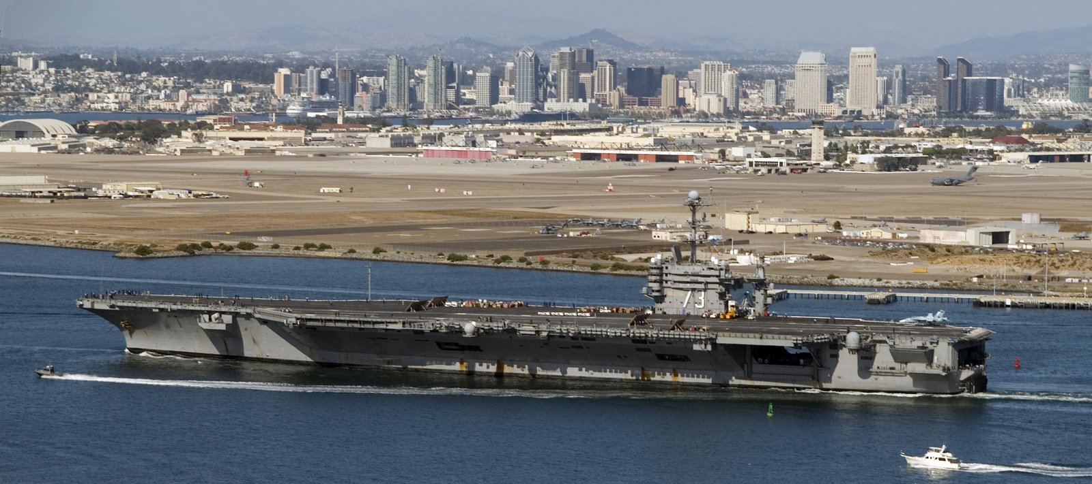
Questions?

