Slide 1
SCOTT X3 SCBA
NFPA 1981 (2013 Edition) COMPLIANT

Slide 2
DISCUSSION
CONSIDER THE SCBA TO BE MOST IMPORTANT PART OF YOUR PPE.
SCBA’S REQUIRE PROPER INSPECTION AND TRAINING BEFORE USE.
USER MAINTENANCE BEFORE AND AFTER USE WILL ENSURE SAFE AND PROPER WORKING OF THE SCBA.
NFPA 1404/1500/ 1852/1981 / 1982
NIOSH CERTIFICATIONS
Notes:
NFPA IS THE INDUSTRY STANDARD FOR USE CARE AND OPERATIONS OF MANY OF OUR JOB REQUIREMENTS AS FIRE FIGHTERS AND SETS TRAINING GUIDELINES TO ENSURE CONSISTANCY AMONGST FIRE AGENCIES.

Slide 3
LEARNING OBJECTIVES
After lecture, discussion, demonstration and practice the student shall identify the components of the Scott AP50 with 100% accuracy.
After lecture, discussion, demonstration and practice, given a specific situation, the student shall demonstrate inspection and operation of the SCBA with 100% accuracy.
Notes:
KNOWING YOUR EQUIPMENT 100% IS VITAL TO ENSURE YOUR SAFETY AND THAT OF THE TEAM YOUR ASSIGNED TO AS WELL AS BUILD CONFIDENCE IN YOUR ABILITY TO PERFORM UNDER EXTREME CONDITIONS WITHOUT SECOND GUESSING YOURSELF.

Slide 4
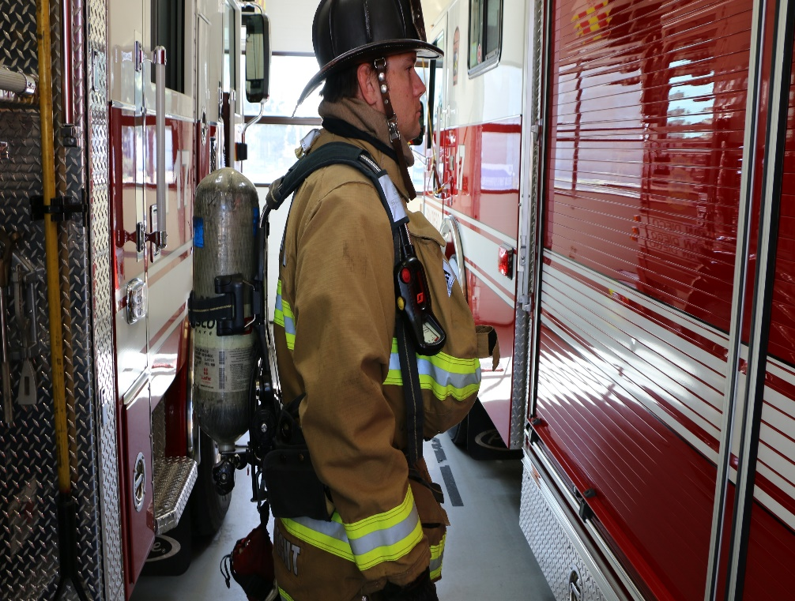
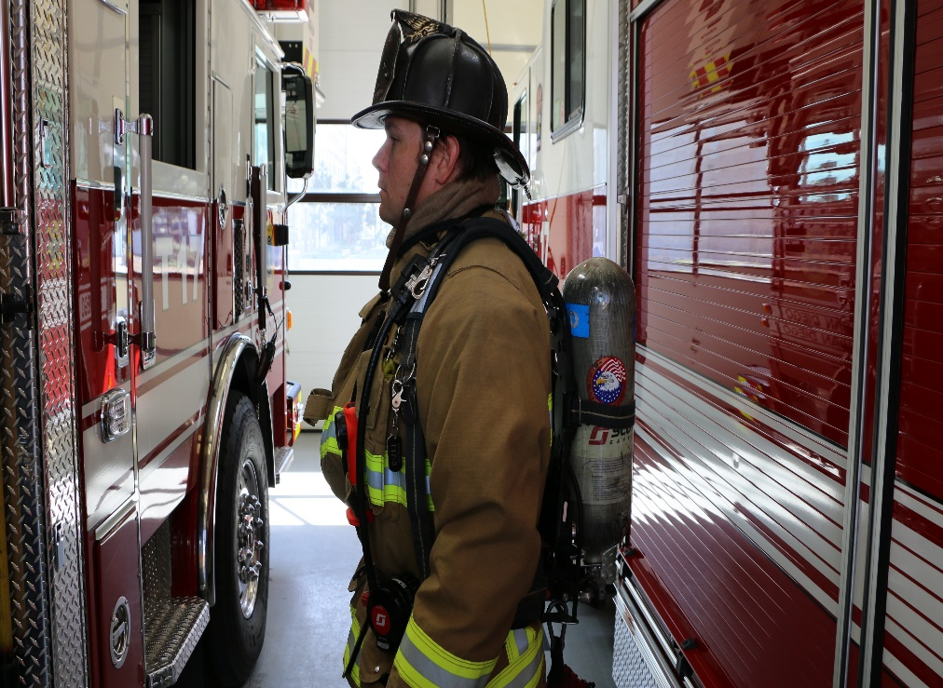
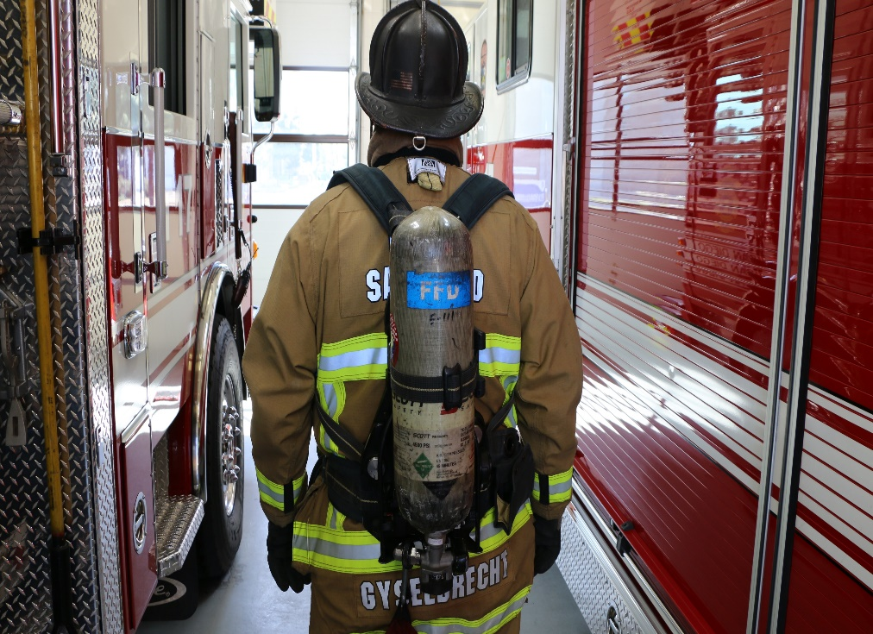
FRONT
RIGHT VIEW
LEFT VIEW
BACK VIEW
Notes:
PROPERLY WORN THE SCBA SHOULD REST ON THE HIPS NOT ON THE SHOULDERS. THIS WILL HELP TO MAINTAIN CENTER OF GRAVITY.

Slide 5
SCBA OVERVIEW

Slide 6
SCBA COMPONENTS
1. FACEPIECE
2. BACKFRAME AND HARNESS ASSEMBLY
3. CYLINDER ASSEMBLY
4. PRESSURE REDUCER AND REGULATOR
5. PASS DEVICE
6. OPTIONAL ACCESSORIES
Notes:
WITHOUT THE FACEPIECE IN WORKING CONDITION THE FOLLOWING STEPS TWO THROUGH SIX ARE NOT OBTAINABLE.

Slide 7
SCOTT AV3000 HT FACEPIECE
Before each use of SCBA, perform the following INSPECTION of the facepiece.
Notes:
MADE FROM POLYCARBONATE AND EPDM SYNTHETIC RUBBER THE MASK PROVIDES A WIDE RANGE OF COMFORT AND CHEMICAL PERMEABILITY FOR THE WEARER.

Slide 8
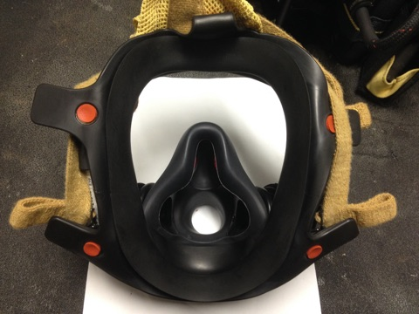
SCOTT AV3000 HT FACEPIECE
1. Inspect the facepiece seal and other rubber components for deformation, wear, damage, or cracks.
Notes:
A DAMAGED FACEPIECE CAN NOT ONLY INJURE YOU BUT THAT OF THE TEAM YOU ARE WORKING WITH. INSPECT THE MASK WITH PURPOSE AND KNOWLEDGE OBTAINED FROM THIS CLASS AND YOUR CONTINUED LEARNING. THE MASK SHALL BE CHECKED AFTER EACH AND EVERY USE AND CLEANED IN ACCODANCE WITH MANUFACTURE’S REQUIREMENTS AND DEPT SOP.

Slide 9
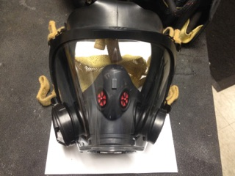
SCOTT AV3000 HT FACEPIECE
2. Inspect the lens & frame assembly for cracks, gouges, scratches, or any condition that could impair the operation of the facepiece or the user’s vision.
LAST NAME
AND INTERNAL SCBA # ON TOP CENTER FRAME
LAST NAME on Rear Center pull strap.
Notes:
MENTION THE MARKING OF THE SCBA MASK.
PROPER INSTALLATION OF NOSE CUP IMPORTANT FOR PROPER AIR FLOW.

Slide 10
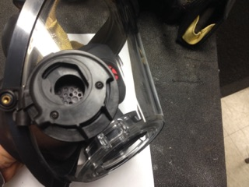
SCOTT AV3000 HT FACEPIECE
Left Side View, & Right Side View with Voice Comm adaptor

Slide 11
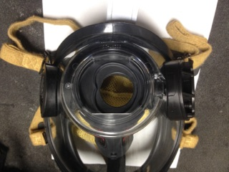
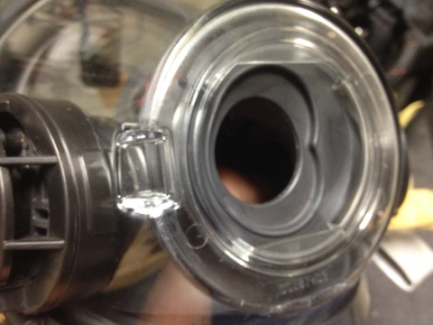
SCOTT AV3000 HT FACEPIECE
3. Inspect the docking port for damage such as cracks or distortion gouges in the sealing ring area. Severe gouging will reduce regulator sealing against the mask and damage the gasket.
Notes:
DAMAGE TO THIS AREA CAN GREATLY EFFECT SEALING AND USE OF THE SCBA AS WELL AS DAMAGE GASKET ON REGULATOR.

Slide 12
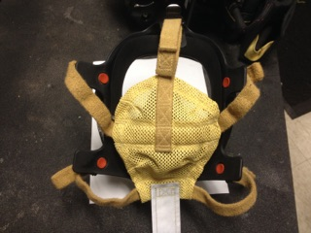
SCOTT AV3000 HT FACEPIECE
4. Check that all lens frame retainers are present and installed correctly.
5. Inspect the head harness for damage or worn components, with all straps oriented correctly.
#3
#2
#1
Notes:
KEVLAR HARNESS Same material as bullet proof vest. Very damaging if pulled over mask and left on lens. SCOTT does not recommend this practice leave in position as depicted in photo. Keep all straps fully extended at all times when not in use.
Tighten BOTTOM MIDDLE TOP IN THIS ORDER.

Slide 13
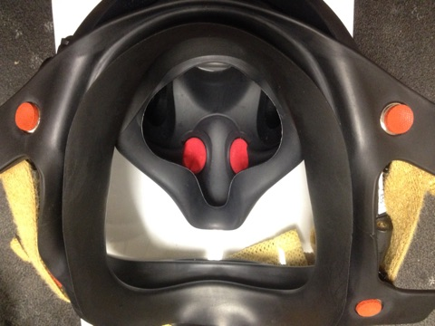
SCOTT AV3000 HT FACEPIECE
6. Inspect that the nose cup is installed correctly and in good repair.
7.The facepiece must be complete and in serviceable condition before using.
Notes:
The nose cup provided is primarily for directing the air the to the users nose and mouth.
Second to reduce co2 dead space.
Third to reduce fogging.
Manufacture recommended anti fogging agent should be used if fogging is an issue.
DO NOT USE toothpaste or shaving cream they can reduce the lens’s safety rating and abilities.

Slide 14
SCOTT AV3000 HT FACEPIECE
If any damage is found, remove the facepiece from service and tag for repair by authorized personnel.
Wash and Clean in warm soapy water not to exceed 110F.
Use mild soap non ultra strength.
Use only a cotton towel to dry.
Paper will damage lens and rubber seal.
Notes:
A DAMAGED FACEPIECE MUST BE TAKEN CARE OF IMMEDIATELY. Ensure your company officer is notified and that you obtain a replacement mask of the same size and style, or a fit test will be required prior to use.

Slide 15
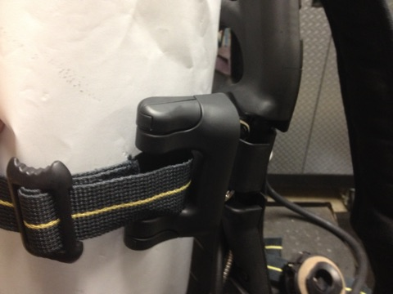
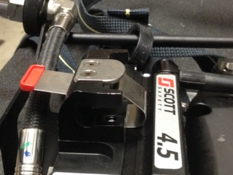
X-3 BACKFRAME AND HARNESS ASSEMBLY
Cylinder Strap & Locking Assembly
Aluminum Frame
Notes:
The harness and frame is vital to the proper and safe operation and damaged component could be disastrous if left to chance. Always inspect and ensure it is in good repair.
The locking cylinder heal plate must securely hold the cylinder.
The strap should positioned to hold the cylinder centered in frame and not be applied to tightly to distort the frame.

Slide 16
X-3 BACKFRAME AND HARNESS ASSEMBLY
Kevlar & NOMEX Shoulder & Waist pad
Quick-release parachute buckles
Regulator holder
Mask Standby Clip
Drag Strap
EBSS Pouch & Hose Assembly.
New Style lighted Chest Gauge.
Notes:
Fading of straps is common and should not be confused with heat, flame or chemical damage.
The straps are naturally yellow and dyed black.
The cylinder strap must be released by the white level.
Regulator is stored in the holder when not in use to keep regulator clean.
Straps on waist are pull forward to tighten.

Slide 17
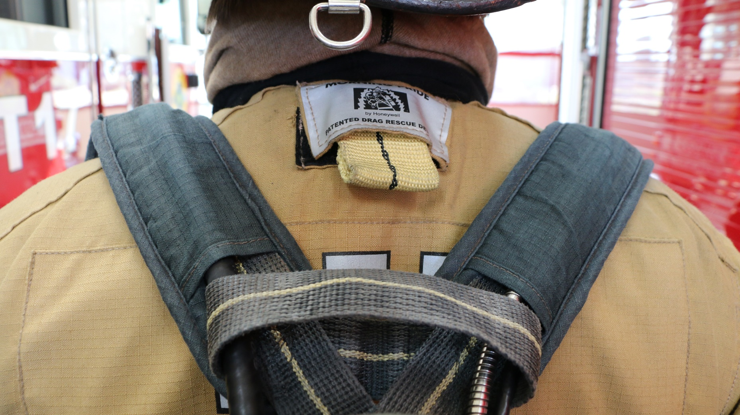
X-3 BACKFRAME AND HARNESS ASSEMBLY
DRAG LOOP ON BACK OF HARNESS ABOVE CYLINDER

Slide 18
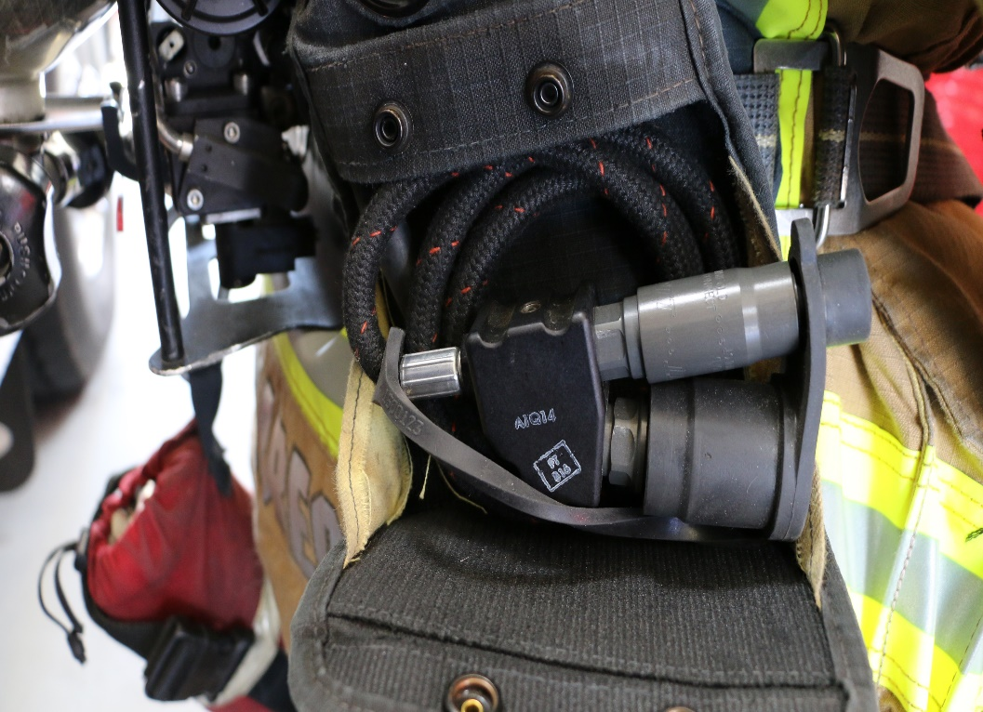
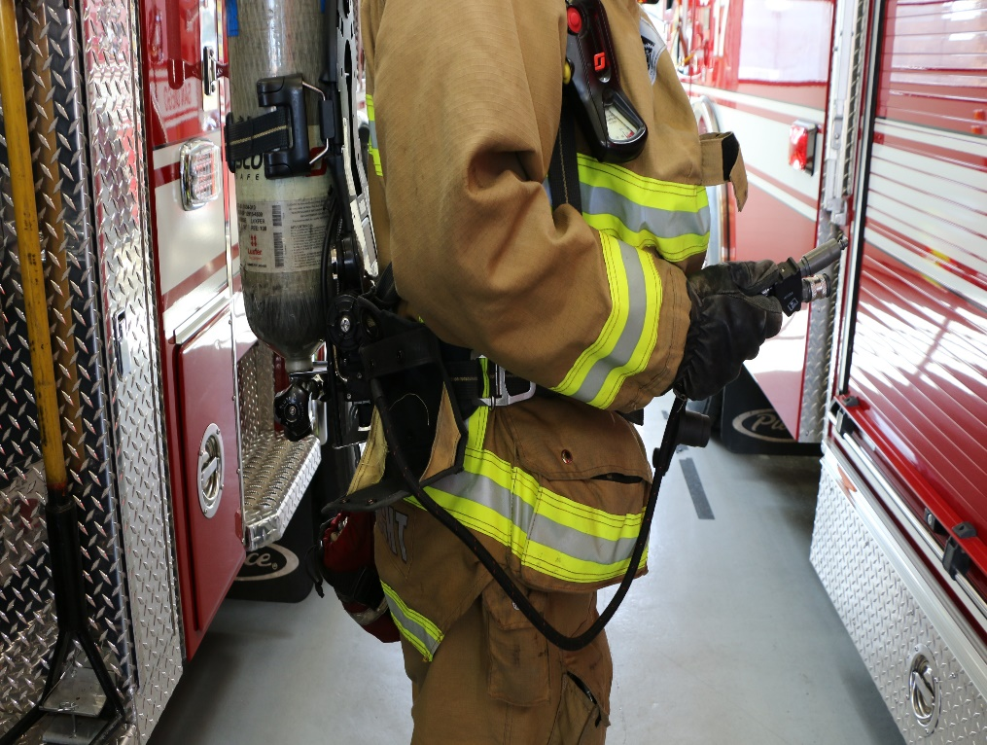
X-3 BACKFRAME AND HARNESS ASSEMBLY
EBSS – Emergency Breathing Support System
Notes:
Male & Female Connections – Stored inside pouch till needed. Hooks up to Regulator hose or Buddy Breather hose on another SCBA.
When used as a Airline connection the cylinder of the SCBA CYL must remain closed and the hose coiled in the pouch. Maintain the airline air pressure at 60 to 115 Psi. DO NOT EXCEED 125Psi on the air line regulator from the supply source. KNOW YOUR ESCAPE ROUTE as being connected will make exiting an area more difficult. Only through proper training and practice will you become familiar with this device, as well as its use and limitations required during a stressful situation.

Slide 19
X-3 BACKFRAME AND HARNESS ASSEMBLY
Clean Shoulder & Waist pad in warm water and mild soap same as mask.
Use soft bristle brush carefully.
Dry in a shaded area out of direct sun.
Dry with a cotton towel.
Refer to Manufacture manual for further details.
Notes:
Mild soaps such as dove ivory dawn or soft soap should be used. Non high strength surfactant's should not be used.
Always refer to manufacture manual if unsure or AHJ policies and procedures.

Slide 20
CARBON FIBER CYLINDER
Carbon fiber / Aluminum
4500 PSI
Refill at 4000 PSI
90 % of working pressure minimum
30 Minute (45 cu ft)
45 Minute (66 cu ft)
60 Minute (88 cu ft)
Notes:
Cylinder is comprised of an aluminum shell with carbon fiber wrap then fiberglass and then a gel coat to provide higher impact and safety to the cylinder.
Out of Hydro means out of service 1st day of the month cylinder was last hydro’d.
Manufacture label should never be covered up or defaced as this will render the cylinder permanently out of service.
DOT governs use and testing of cylinders as well as storage and transportation.
Cylinder valve should not be damage in anyway and the gauge assembly must match the chest gauge within 100psi.

Slide 21
CARBON FIBER CYLINDER
Hydro Date
Gouges / Cuts / Scrapes
Severe discoloration
Labels
Dept. Marking for Inventory
Cylinder Valve Assembly

Slide 22
CARBON FIBER CYLINDER
Use mild Soap only.
Soak cylinder valve in a bucket of clear water to determine if leaking.
Dry with cotton towel.
If damaged is found or is leaking, bleed down slowly till empty and tag out of service.
Notes:
Deep cuts and scratches should be addressed immediately and if found to be unacceptable, bleed remaining air out slowly and tag out of service and obtain a replacement cylinder from scba service center.

Slide 23
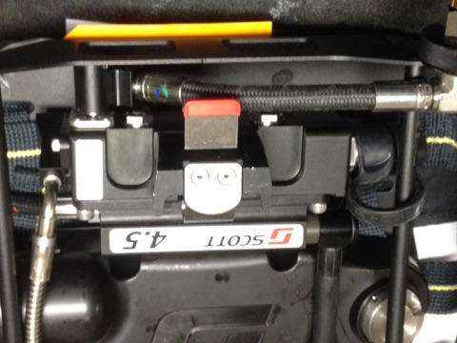
PRESSURE REDUCER & REGULATOR ASSEMBLY
The pressure reducer takes cylinder pressure of 4500psi to 85 to 110psi for use in the regulator.
Pressure reducer & Hose Assemblies
RIC/UAC Fitting
Optional Accessories
Notes:
Damage to pressure reducer can significantly reduce scba performance.
Damaged hoses can cause injury or death if not taken care of properly.
The built in relief valve will vent high pressure high should a malfunction occur and will automatically activated the vibralert in the regulator. Leave the work area immediately.
RIC/UAC fittings are universal to all SCBA’s and RIT PACKS.
Understand how all optional accessories work with your SCBA prior to use.

Slide 24
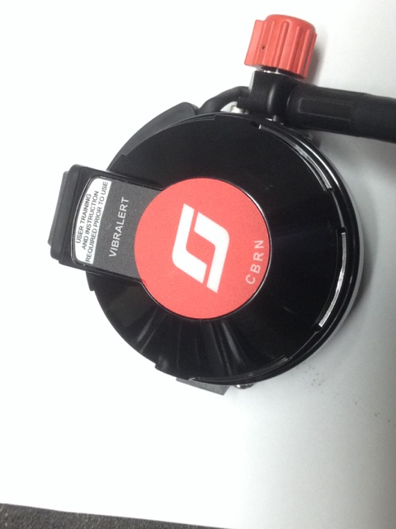
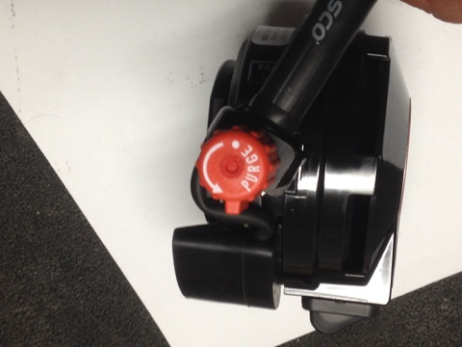
EZ-FLO CBRNE REGULATOR
VIBRALERT alarm
25% of cylinder pressure
Air actuated vibration
Re-circulates into mask
Air saver/Donning switch
Purge Valve
Integrated HUD

Slide 25
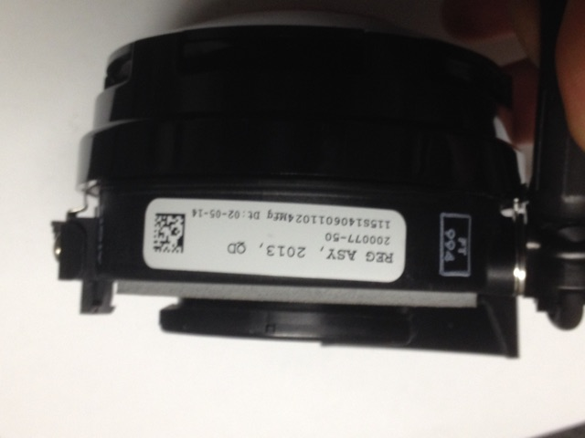
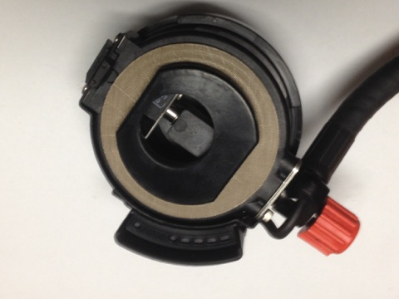
EZ-FLO CBRNE REGULATOR
Inspection
Regulator Serial number. Gasket area and Hud Unit.

Slide 26
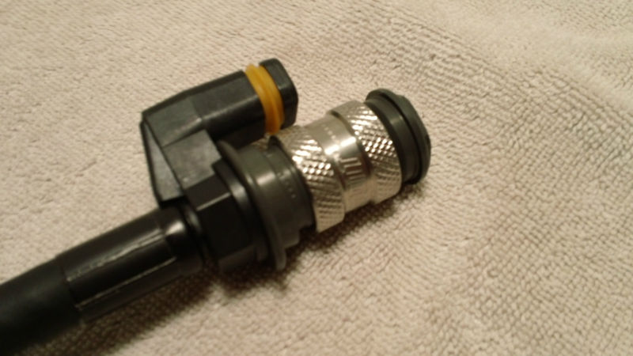
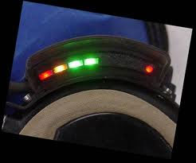
EZ-FLO CBRNE REGULATOR
Quick Disconnect regulator
Regulator with HUD and purge valve
Quick disconnect coupling
Air saver / Donning switch
Hose and rubber
Cuts
Tears
Cracking
Quick connect
Dirt
Debris
Cleanliness
Purge valve
Smooth ½ turn
Notes:
Visually inspect the electrical connector prior to connecting as there could be damage or corrosion.
Ensure HUD unit is in good repair and that all lights function and correspond to the chest gauge.
Steel reinforced front cover. Does not allow for pressing to activate regulator must be first breath on when mounted to mask.

Slide 27
HEADS-UP DISPLAY (HUD)
Visual display of SCBA air status
Series of lights indicate pressure
Full - 2 green solid
3/4 - 1 green solid
1/2 - 1 yellow 1 per sec flash
1/3 - 1 red rapid flashing
LEAVE AREA IMMEDIATELY
Mounted on regulator
Powered by Pakalert unit.
Low battery indicator
Far right red light slow flash
Notes:
Understanding the HUD LIGHTS are extremely important.
They are provided to ensure FF knows is work time and exit time.
If battery light is flashing your SCBA is NOT ready for service.

Slide 28
EZ-FLO CBRNE REGULATOR
6 Even Sprays of SCOTT disinfectant inside of regulator opening.
1 Spray around gasket sealing surface.
10 mins contact time.
Rinse well with cool water.
Notes:
Cleanliness is of the utmost importance and should always be kept in its holder when not in use.
The sealing gasket must not be overly worn or damaged as this will cause a major leak at the mask docking port.
The opening of the regulator should be sat down on a clean work surface not the apparatus and left face down for ten minutes while disinfecting the regulator.
Upon rinsing with cool water, thoroughly shake excess water out then connect to airpak and bleed water out of spray bar with purge knob.
Ensure regulator is dry before use.

Slide 29
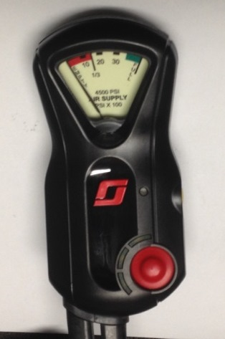
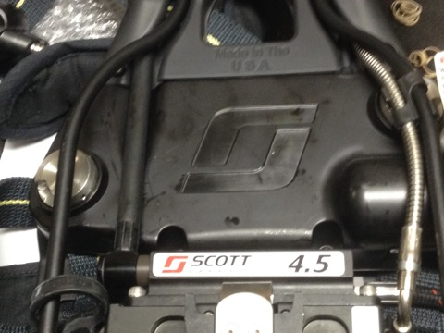
INTEGRATED PASS DEVICE
Console & Gauge
PASS Sensor Module
Notes:
Smoked stained lens can make reading pressure impossible.
Keep clean to ensure safe use. Can be cleaned with warm soapy water.
Check pakalert area after use to ensure the cylinder latch area is clean and remove debris that could ignite if left behind.

Slide 30
INTEGRATED PASS DEVICE
“PAK-ALERT X3”
Air activated
Opening cylinder
3 audible chirps
Green light
Requires 6 AA batteries
Low battery – single audible chirp every 2 seconds / no green light
Notes:
Ensure gauge strap is not broken or melted.
Buttons work properly.
Gauge can be read without error.
Hose assemblies are in good repair and not kinked.
Once Battery cover seals on battery housing, a ¼ turn should be sufficient to secure it properly without overtighten’ it. This will cause batteries to leak and cause damage to battery boards. Also only batteries issued from the SCBA dept shall be used. No mixing of batteries, nor generic batteries shall be used, Energizer industrial or Duracell pro series.

Slide 31
INTEGRATED PASS DEVICE
Manual alarm
Front of PASS
Red button
Full alarm on depression
Auto alarm
Motionless for 32 seconds
Pre-alarm
Ascending / Descending tone
1 Red light flash /second
Full-alarm
12 Seconds after pre-alarm
Continuous tones w/ red lights

Slide 32
INTEGRATED PASS DEVICE
Reset button
Side of PASS
Yellow button – Can be used to check batteries prior to opening air cylinder valve.
De-activation of full-alarm
Press reset button twice slowly
De-activation of PASS
Turn off cylinder
Vent residual pressure from regulator slowly
Press reset button twice slowly
Two tone chirp
Notes:
To perform a battery check prior to opening the cylinder simply press the yellow button for on sec.
1 blue then green flash = ok. 4 red lights or will not reset = bad. TAG O/S !!

Slide 33
INTEGRATED PASS DEVICE
Pre-Alarm
Remain Motionless for Twenty Secs.
Green Light will change to Red
and will flash to cadence of alarm.
De-activation of Pre-alarm
Move hips side to side.
De-activation of Full Alarm 32 seconds total.
Press reset button twice slowly
Two tone chirp
Notes:
To perform a battery check prior to opening the cylinder simply press the yellow button for on sec.
1 green flash = ok.
4 red lights or will not reset = bad. TAG O/S !!

Slide 34
RIC UAC – RAPID INTERVENTION CREW / UNIVERSAL AIR CONNECTION
FOR EMERGENCY USE ONLY!
Permits emergency replenishment of air
Not a quick charge
Within 6” of neck of bottle on all NFPA 1981 (2002) compliant SCBA’s
Notes:
Keep covered until needed, warm soapy wash to clean then dry with clean cotton towel.

Slide 35
RIC UAC – RAPID INTERVENTION CREW / UNIVERSAL AIR CONNECTION
THIS TRAINING WILL BE PROVIDED IN A SEPARATE TRAINING CLASS.
UAC / RIC FITTING
LOW PRESSURE FITTING
BAG EQUIPMENT IDENTIFICATION
USE CARE & OPERATIONS
Notes:
UNIVERSAL TO ALL SCBA’S within 6 inches of valve assembly of cylinder.

Slide 36
RIC UAC – RAPID INTERVENTION UNIVERSAL AIR CONNECTION
Before use ensure
No compromise of cylinder or air system
Dents
Gouges
Other significant damage
Any other air system/UAC damage
Respirator/Regulator compatibility
2216 PSI RIT Pack w/ 2216 PSI SCBA
4500 PSI RIT Pack w/ 4500 PSI SCBA
Receiving cylinder is fully open

Slide 37
WARNING!!!
Utilizing RIC UAC for emergency air replenishment of a structurally compromised cylinder will result in an over pressurization, possible explosion or injury /death.
Notes:
KEEP IT SIMPLE ! When dealing with RIT situations if FF is low on air give air.
If Regulator is faulty change regulator.
If mask is damaged place rit mask on FF along with good regulator from RIT pack.

Slide 38
QUESTIONS ?

