Slide 1
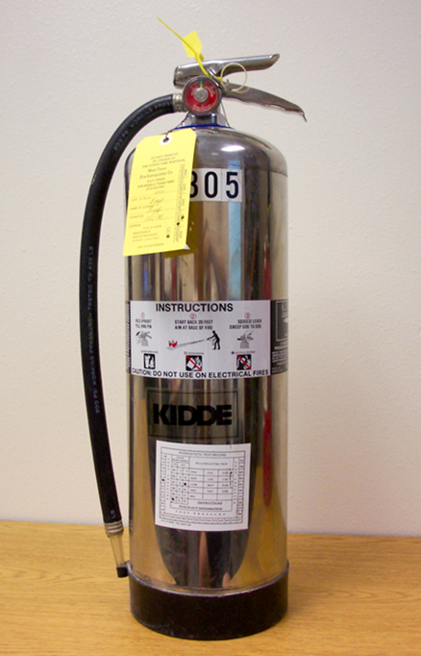
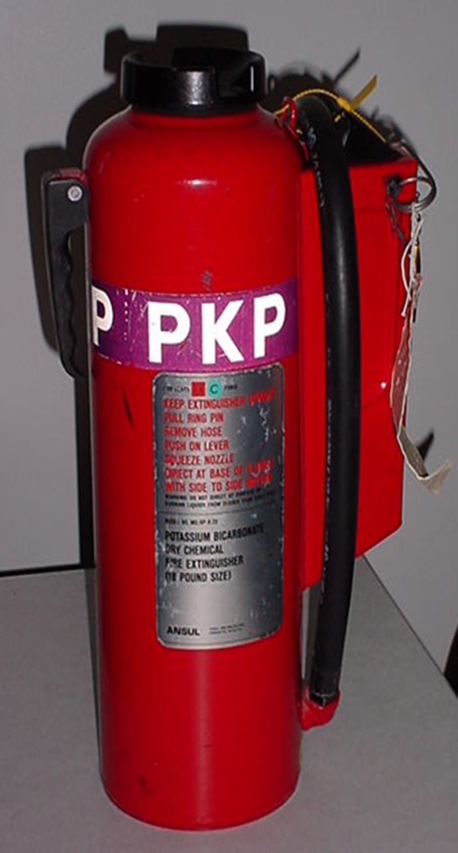
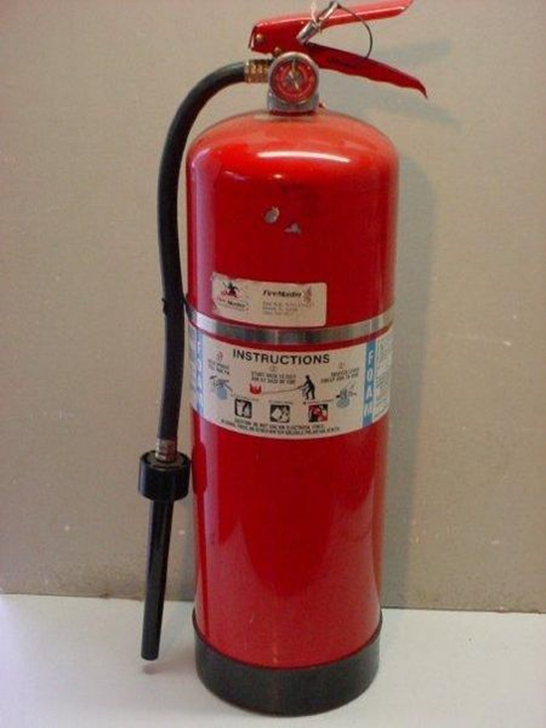
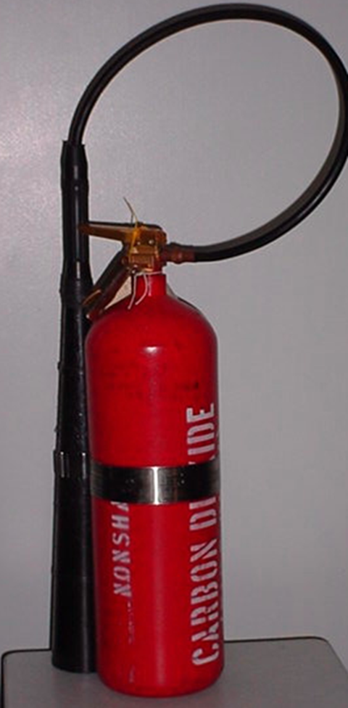
Portable Firefighting Equipment

Slide 2
Enabling Objectives
LIST the five types of portable extinguishers.
LABEL the components of the five types fire extinguishers.
DESCRIBE the capabilities of the AFFF, PKP, ABC, Water, CO2 & K portable fire extinguishers.
SELECT the appropriate portable extinguisher for each classification of fire.
LIST the steps to employ agent on a fire for each portable fire extinguisher.
LIST the safety precautions for portable fire extinguishers.

Slide 3
Types of Portable Extinguishers
Aqueous Film Forming Foam Extinguisher (AFFF)
Purpose: to extinguish a small Class “B” fire (including a deep fat fryer fire), to extinguish a small Class “A” fire and for use in standing fire watch during hot work.
Potassium Bicarbonate Extinguisher (PKP) Dry Chemical
Purpose: use primarily on Class “B” fires (flammable/combustible liquids).
Monoammonium Phosphate (ABC) Dry Chemical
Purpose: used primarily to extinguish class A,B,C fires. It is inappropriate for Metal fires and oxidizers
Stored Pressure Water Extinguishers
All ordinary combustible class A material
Carbon Dioxide Extinguisher (CO2)
Purpose: Used primarily for small electrical fires (Class “C”) and have limited effectiveness on Class “B” fires.
Wet Chemical K Extinguisher
Forms a saponification foam over grease fires

Slide 4
Portable AFFF Components

Slide 5
Portable PKP Components

Slide 6
Portable ABC Components

Slide 7
Stored-pressure water Components

Slide 8
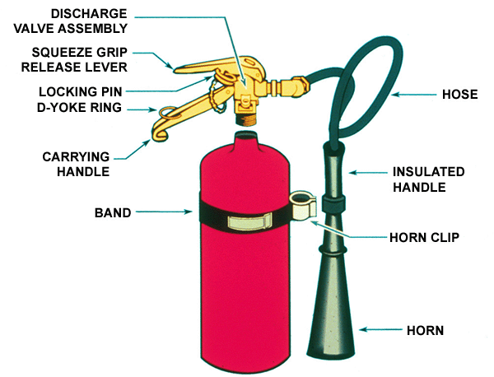
Carbon Dioxide Components

Slide 9
Portable AFFF Extinguisher Capabilities
Weighs 28 lbs when fully charged.
2.5 gallons pre-mixed solution of AFFF concentrate and fresh water.
Effective range: 15 feet and decreases during discharge.
Will last approximately 55 to 65 seconds of continuous use.
Will produce approximately 16 gallons of foam when fully discharged.

Slide 10
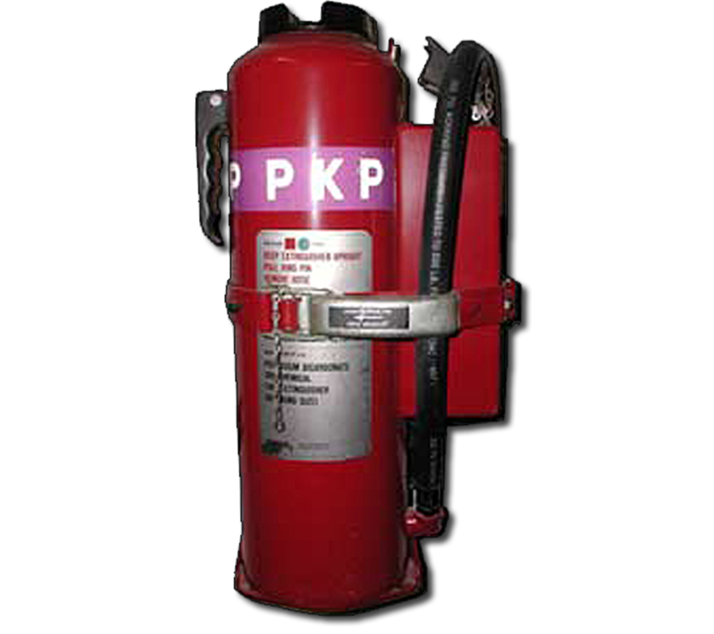
Portable PKP Extinguisher Capabilities
18 and 27 lbs cylinders.
Effective range 18 lb, 19 feet
Discharge time of 10 seconds
Effective range 27 lb, 21 feet
Discharge time of 11 seconds
Ensure tamper seal is in place on pull pin.
Remove discharge hose from holder and pull pin and depress plunger handle.
Conduct agent test prior to fire fighting.
Discharge at the base of fire using a side to side motion

Slide 11
Portable ABC Extinguisher Capabilities
5 lbs
3A:40B:C
Effective range 12’-18”
The ABC Multi-Purpose chemical fire
extinguisher is used to provide protection
against Class A,B,C Fires

Slide 12
Stored pressure water Extinguisher Capabilities
Weighs 17lbs when fully charged
2.5 gallon capacity of pressurized water
Effective range is 15 ft’ and decreases during discharge
Will last approximately 22 seconds of continuous use
Pressurized to 100 PSI

Slide 13
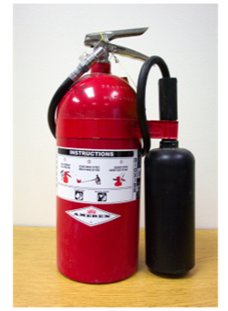
Portable CO2 Extinguisher Capabilities
Discharge range is 4-6 feet from the end of the horn.
Continuous use will expend CO2 in approximately 40 seconds.

Slide 14
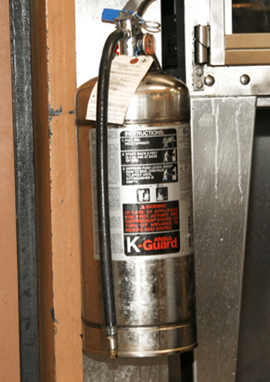
Portable K Extinguisher Capabilities
2.5 gallons
Saponification – Forms oxygen-excluding foam
Potassium based, low pH
Wet chemical that also provides a cooling effect on
animal and vegetable oil fires

Slide 15
Application of extinguishers
Class “A” Fire
CO2, AFFF, Water, ABC
Class “B” Fire
AFFF, PKP, ABC,CO2
Class “C” Fire
CO2, ABC, PKP (last resort)
Class “K” Fire
K Extinguisher

Slide 16
AFFF Operation
Inspect extinguisher
Pressure gauge
Tamper seal
Operation
Ensure tamper seal is in place on pull pin & pull pin.
Gain control of extinguisher & hose assembly. Hold the hose assembly 2” behind the aerator.
Conduct agent test.
Attack fire.

Slide 17
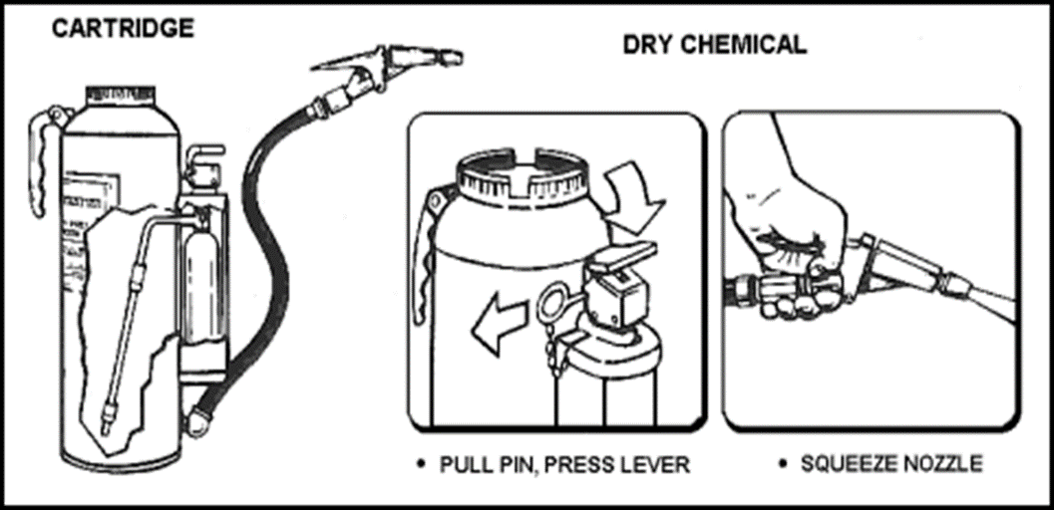
PKP Operation
Inspect extinguisher
Tamper seal
Operation
Remove pin from puncture lever assembly
Gain control of extinguisher and hose assembly
Actuate Extinguisher
Test agent
Attack fire
Back away from the fire eyes forward

Slide 18
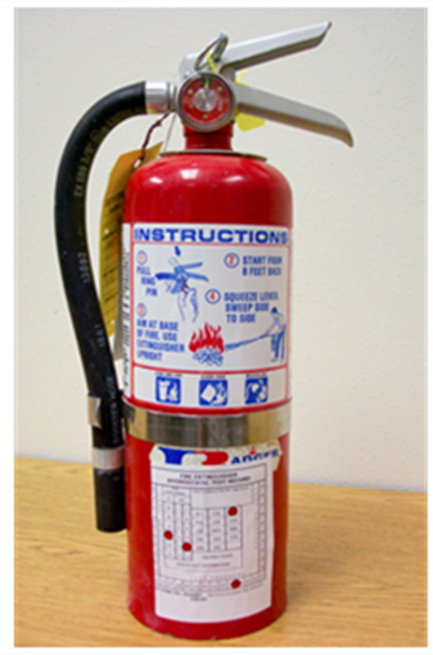
ABC Operation
Inspect extinguisher
Pressure gauge
Tamper seal
Operation
Ensure tamper seal is in place on pull pin & pull pin.
Gain control of extinguisher & hose assembly. Hold the hose assembly Conduct agent test.
Attack fire.

Slide 19
Carbon Dioxide Operation
Inspect
Extinguisher tamper seal
Operation
Remove pin from squeeze grip valve assembly
Gain control of extinguisher and horn assembly
Test agent
Attack Fire
Back away eyes forward

Slide 20
Safety Precautions for Portable Fire Extinguishers
Wet Chemical K & AFFF
Never apply agent directly into the cooking oil. Plunging Agent into the cooking oil can result in immediate boiling of the foam. Violent boiling may result in hot cooking oil being thrown from the fryer.

Slide 21
Safety Precautions for Portable Fire Extinguishers
PKP
Use only short bursts of PKP as necessary in confined spaces.
Unnecessary long discharges will reduce visibility, render breathing difficult and waste the agent.
Direct fill cap in a safe direction when activating.

Slide 22
Safety Precautions for Portable Fire Extinguishers
CO2
Primary hazard to personnel is death by asphyxiation.
Ground the cylinder to the deck prior to and during the discharge of the agent.
Hold only the insulated area of the horn assembly.

Slide 23
Summary & Review
LIST the Six types of portable extinguishers.
LABEL the components of the five types fire extinguishers.
DESCRIBE the capabilities of the AFFF, PKP, ABC, Water, CO2 & K portable fire extinguishers.
SELECT the appropriate portable extinguisher for each classification of fire.
LIST the steps to employ agent on a fire for each portable fire extinguisher.
LIST the safety precautions for portable fire extinguishers.

