Slide 1

Prehospital: Emergency Care
Eleventh Edition
Chapter 7
Anatomy and Physiology
Medical Terminology
Slides in this presentation contain hyperlinks. JAWS users should be able to get a list of links by using INSERT+F7
Copyright © 2018, 2014, 2010 Pearson Education, Inc. All Rights Reserved
Notes:
If this PowerPoint presentation contains mathematical equations, you may need to check that your computer has the following installed:
1) MathType Plugin
2) Math Player (free versions available)
3) NVDA Reader (free versions available)
Advance Preparation
Student Readiness
Assign the associated section of MyBRADYLab and review student scores.
Review the chapter material in the Instructor Resources, which includes Student Handouts, PowerPoint slides, and the MyTest Program.
Prepare
Obtain any needed anatomical models, such as a skeleton, torso with organs, heart, and other structures.
Have a medical dictionary on hand for class.
Bring a roll of masking tape or adhesive tape for an in-class activity (explained later in the lesson plan).
Bring in enough coffee stirrers or drinking straws for each student (activity explained later in the lesson plan).
The total teaching time recommended in the Instructor Review Manual is only a guideline. Take into consideration factors such as the pace at which students learn, the size of the class, breaks, and classroom activities. The actual time devoted to teaching objectives is the responsibility of the instructor.

Slide 2
Learning Readiness
E M S Education Standards, text p. 127.
Chapter Objectives, text p. 127.
Key Terms, text p. 128-129.
Purpose of lecture presentation versus textbook reading assignments.
Notes:
Explain to students what the National EMS Education Standards are. The National EMS Education Standards communicate the expectations of entry-level EMS providers. As EMTs, students will be expected to be competent in these areas. Acknowledge that the standards are broad, general statements. Although this lesson addresses the listed competencies, the competencies are often complex and require completion of more than one lesson to accomplish. The student is also expected to review the chapter objectives to foreshadow what will be in the chapter. By mastering the key terms the EMT student will better understand the learning and be able to communicate more clearly.
Additionally, explain to the students that the purpose of using these slides is to help keep the instructor focused on highlighting important portions of the material, explain interrelationships of topics, and discuss how to apply this information. It’s not the intent of the presentation (or slides alone) to include every component in the chapter. This presentation still requires the student to thoroughly read the chapter.

Slide 3
Setting the Stage
Overview of Lesson Topics
  Anatomical Terms
  Body systems
  Medical terminology

Slide 4
Case Study Introduction (1 of 3)
E M Ts Kevin Henderson and Tom Armstrong have just arrived on the scene of a patient with multiple stab wounds. Law enforcement has secured the scene, allowing Kevin and Tom to approach the patient, a man in his 20s.
Notes:
Case Study
Present the Case Study Introduction provided in the PowerPoint slide set.
Lead a discussion using the case study questions provided on the subsequent slide(s).
The Case Study with discussion questions continues throughout the PowerPoint presentation.
Case Study Discussion
Use the case study content and questions to foreshadow the upcoming lesson content.

Slide 5
Case Study Introduction (2 of 3)
Kevin notices immediately that the patient appears to be unresponsive, with pale skin. His shirt and the upper portion of his pants are saturated with blood, and blood has started to pool on the floor around the patient.
Tom reports that the patient has a weak carotid pulse, and begins managing the patient’s airway and ventilation.
Notes:
Case Study Discussion
Use the case study content and questions to foreshadow the upcoming lesson content. Gauge the student’s responses as a guide of how well versed they are in this topic.

Slide 6
Case Study Introduction (3 of 3)
Cutting away the patient’s clothing to determine where he has been stabbed, Kevin sees two stab wounds to the left side of the chest, a stab wound to the upper right abdomen, a stab wound to the right groin, and several cuts on the forearms and hands.
Notes:
Case Study Discussion
Use the case study content and questions to foreshadow the upcoming lesson content. Gauge the student’s responses as a guide of how well versed they are in this topic.

Slide 7
Case Study (1 of 7)
What organs may have been injured by the stab wounds?
What are the consequences of injury to each of those organs?
What terms will Kevin use to describe the exact location of each wound?
Notes:
Case Study Discussion
Use the case study content and questions to foreshadow the upcoming lesson content. Gauge the student’s responses as a guide of how well versed they are in this topic.

Slide 8
Introduction
Knowledge of the human body is required to assess and care for patients.
  Anatomy refers to how the body is made.
  Physiology refers to how the body works.
  Medical terminology allows for concise communication.
Notes:
Basic knowledge of the human body includes the study of anatomy and physiology. The word anatomy refers to the structure of the body and the relationship of its parts to each other (how the body is made). The word physiology refers to the function of the living body and its parts (how the body works).
Knowledge of the human body and its systems is essential to high-quality patient assessment and emergency care. This knowledge will help you recognize when the body is working as it should and when life-threatening deviations to normal function are present. Using proper terminology to describe the human body will also enable you to concisely and accurately communicate patient information to other health care professionals.

Slide 9
Anatomical Terms (1 of 3)
Anatomical position
  Standing, facing forward
  Arms at sides, palms forward
Notes:
One term that is essential for you to understand and use is the anatomical position. Unless otherwise indicated, all references to the human body assume the anatomical position: The patient is standing erect, facing forward, with arms down at the sides and palms forward. This basic position is used as the point of reference whenever terms of direction and location are used.

Slide 10
Anatomical Terms (2 of 3)
Positions of the body
  Supine
  Prone
  Lateral recumbent
  Fowler’s position
  Semi-Fowler’s position
  Trendelenburg position
  Shock position
Notes:
These are the various positions the patient may be found in, or placed into. Often times ensuring that the patient is in the correct body position is actually part of the treatment for them.

Slide 11
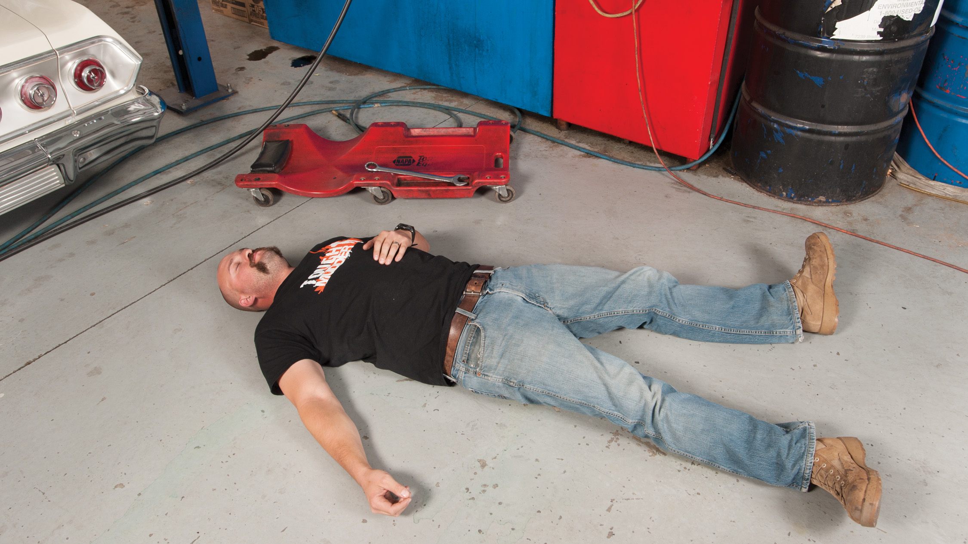
Supine Position
Notes:
Patient lying on their back.

Slide 12
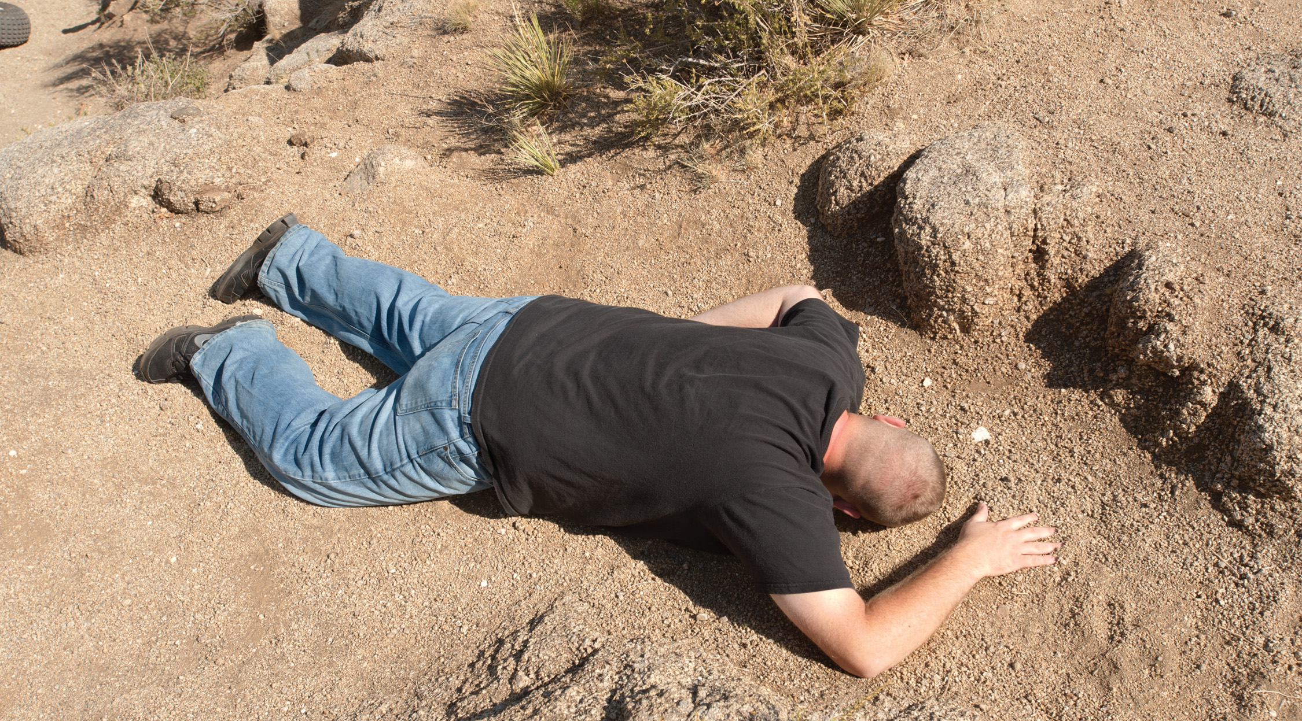
Prone Position
Notes:
Patient lying face down on their stomach.

Slide 13
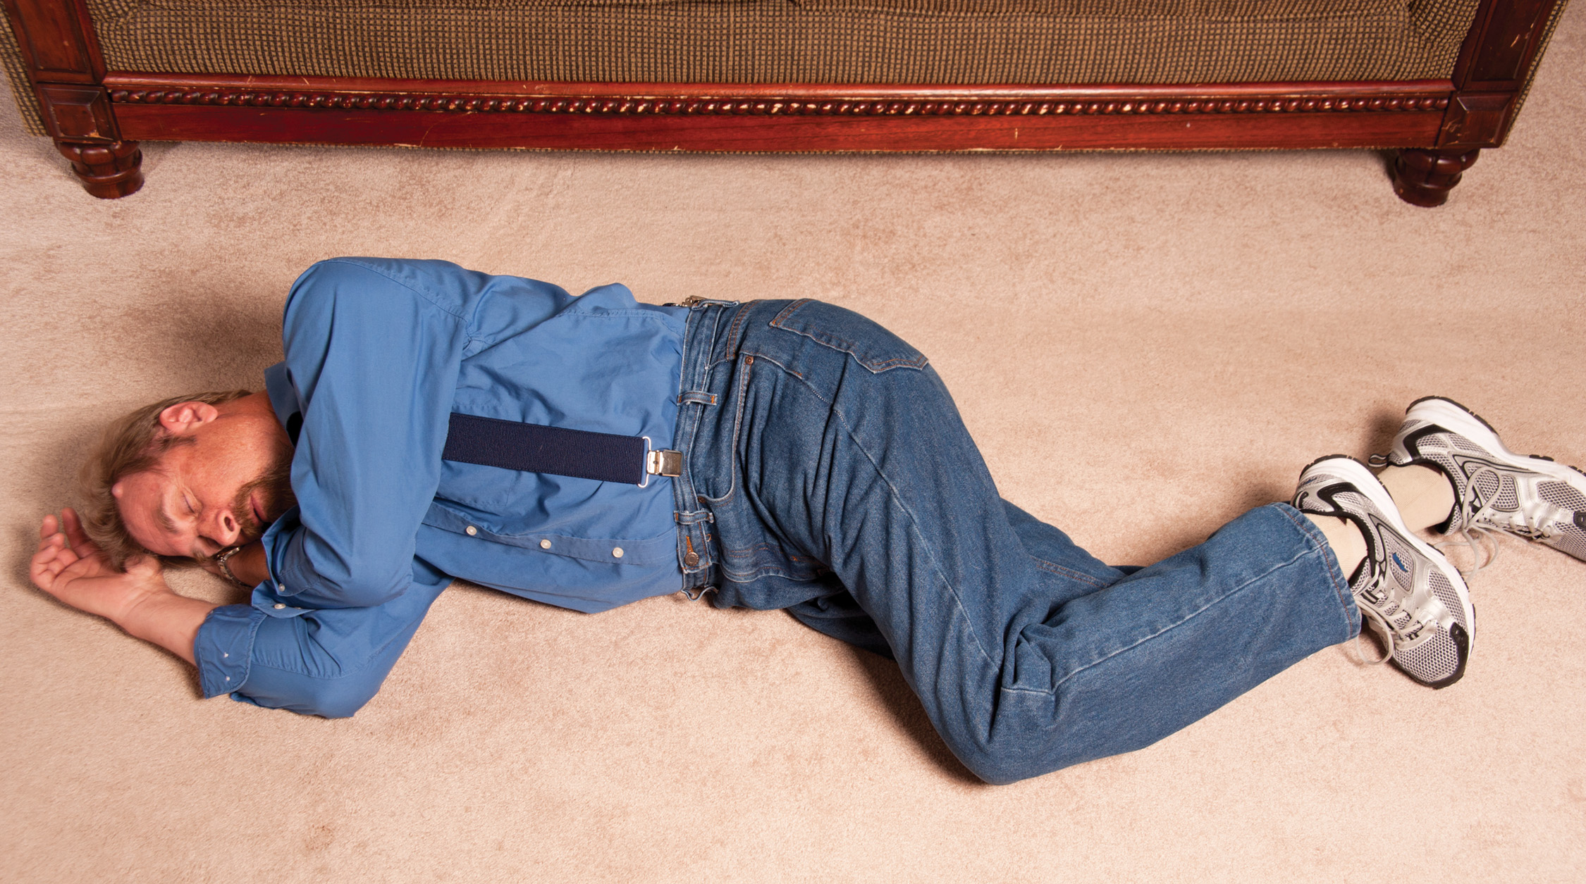
Right Lateral Recumbent Position
Notes:
Patient lying on right side in the right lateral recumbent position.

Slide 14
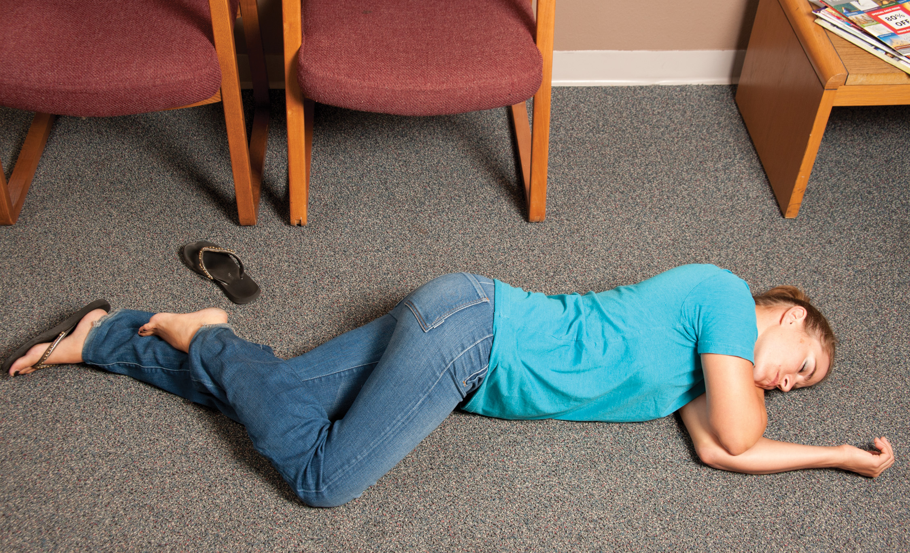
Left Lateral Recumbent Position
Notes:
Patient lying on their left side in the left lateral recumbent position.

Slide 15
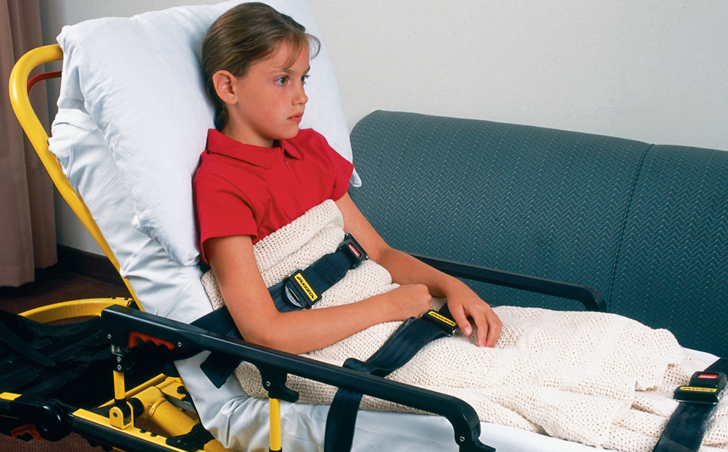
Fowler’s Position
Notes:
Patient lying on their back with the upper body elevated 45 to 60 degrees. Semi-Fowler’s position is when they are elevated at an angle less than 45 degrees.

Slide 16
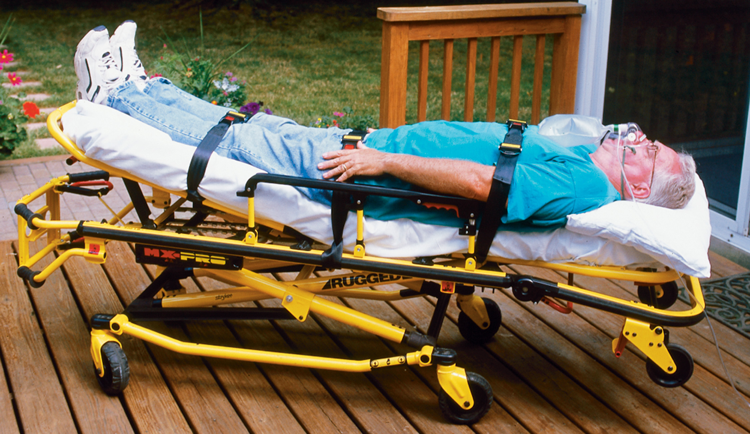
Shock Position
Notes:
Patient lying supine with the feet elevated about 12 inches
Trendelenburg and shock positions are absolutely contraindicated in patients with suspected spinal injury.

Slide 17
Which Statement on the Left Best Describes Each Term on the Right? Click on the Terms to Check Your Answers
Fill in the blank Lying in a face-down position.
Fill in the blank Lifting the arm out to the side, away from the body.
Fill in the blank Lying on the side.
Fill in the blank Bending an extremity toward the body.
Lateral recumbent
Abduction
Prone
Flexion
Click here to return to the program.

Slide 18
Anatomical Terms (3 of 3)
Anatomical Planes
  Imaginary divisions that serve as reference points
    Sagittal and Midsagittal plane
    Frontal and Coronal plane
    Transverse or Horizontal plane
    Midline
    Midaxillary line
    Transverse plane
Notes:
Imaginary divisions of the body are called anatomical planes. Anatomical lines are also used to reference points on the body. These planes and lines indicate the internal body structure and the relationship of different groups of organs to others.

Slide 19
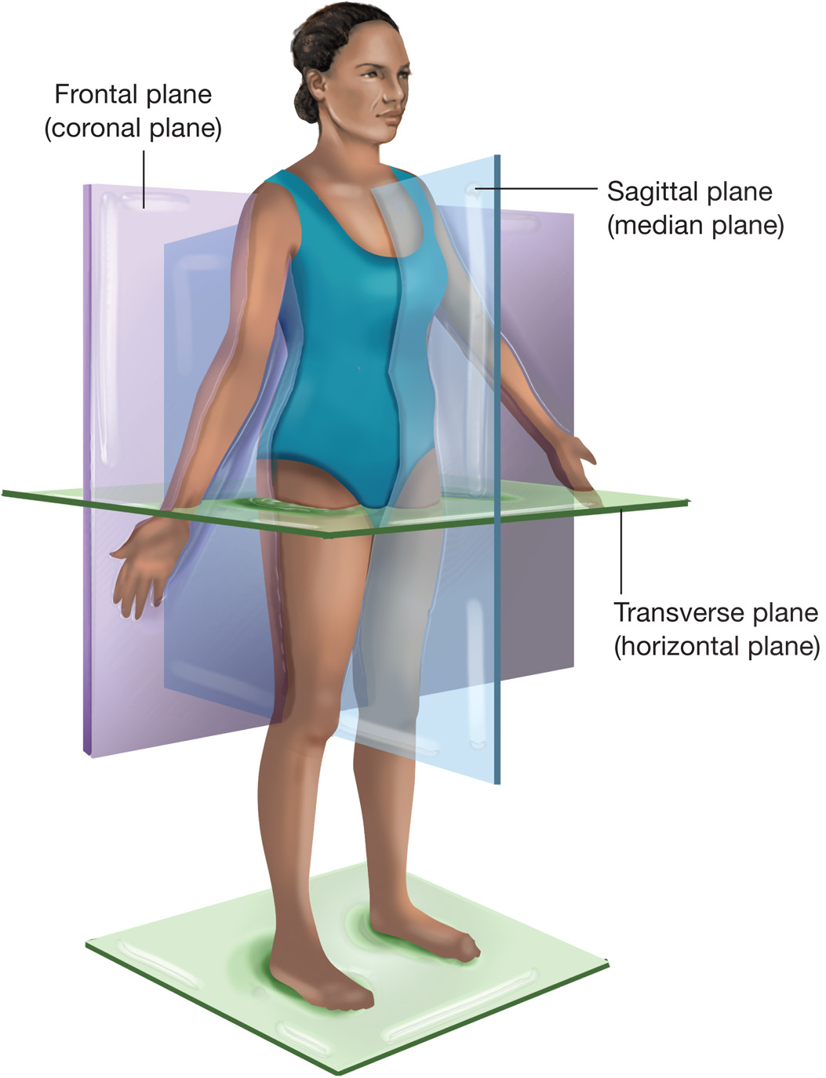
Anatomical Planes
Notes:
The sagittal plane, or median plane, is a vertical plane that runs lengthwise and divides the body into right and left segments. The segments do not have to be equal. If the plane divides the body into two equal halves, it is referred to as the midsagittal plane.
The frontal or coronal plane divides the body into front and back halves.
The transverse or horizontal plane is parallel with the ground and divides the body into upper and lower halves. It may also be referred to as the axial plane.
Midline is an imaginary line drawn vertically through the middle of the patient’s body, beginning at the top of the head and continuing down through the nose and the navel and to the ground between the legs. Midline corresponds with the midsagittal plane because it divides the body into equal halves.
Midaxillary line is an imaginary line drawn vertically from the middle of the patient’s armpit down to the ankle. This line also divides the body into the anterior plane (the patient’s front) and the posterior plane (the patient’s back).
Transverse line is a imaginary line drawn horizontally through the patient’s waist. This divides the body into the superior plane (above the waist) and the inferior plane (below the waist).

Slide 20
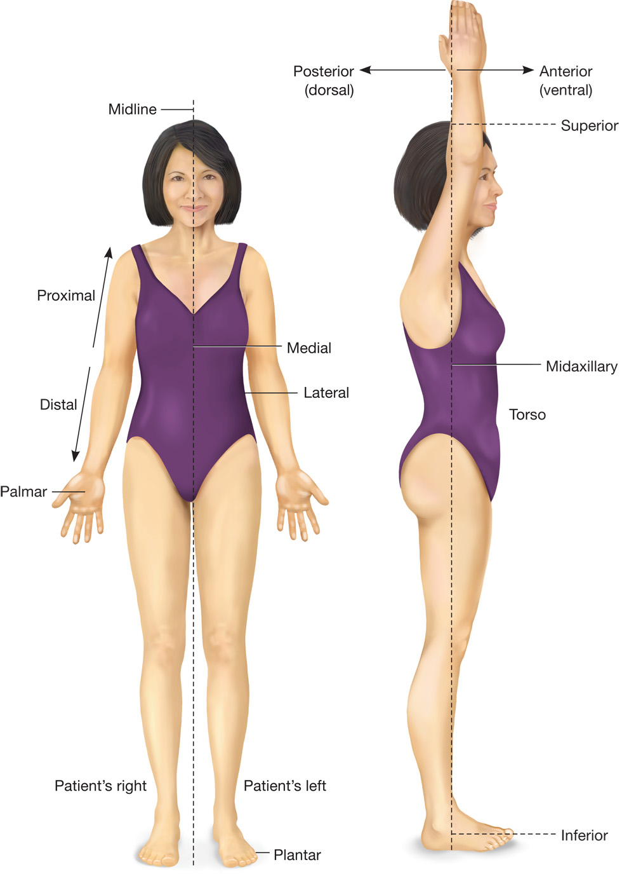
Terms of Direction
Notes:
Anterior is toward the front. Posterior is toward the back.
Superior means toward the head or above the point of reference. Inferior means toward the feet or below the point of reference.
Dorsal means toward the back or backbone (spine). Ventral means toward the front or belly (abdomen).
Medial means toward the midline or center of the body. Lateral refers to the left or right of the midline, or away from the midline of the body. Note that bilateral refers to both left and right, meaning “on both sides.” unilateral refers to one side. Ipsilateral refers to the same side, contralateral to the opposite side.
Proximal means near the point of reference. Distal is distant, or far from the point of reference.
Right and left is always the patient’s right and left.
Midclavicular refers to the center of each of the collarbones (clavicle). The midclavicular line extends from the center of either collarbone down the anterior thorax.
Midaxillary refers to the center of the armpit (axilla). The midaxillary line extends from the middle of the armpit to the ankle.
Plantar and palmar. Plantar refers to the sole of the foot. Palmar refers to the palm of the hand.

Slide 21
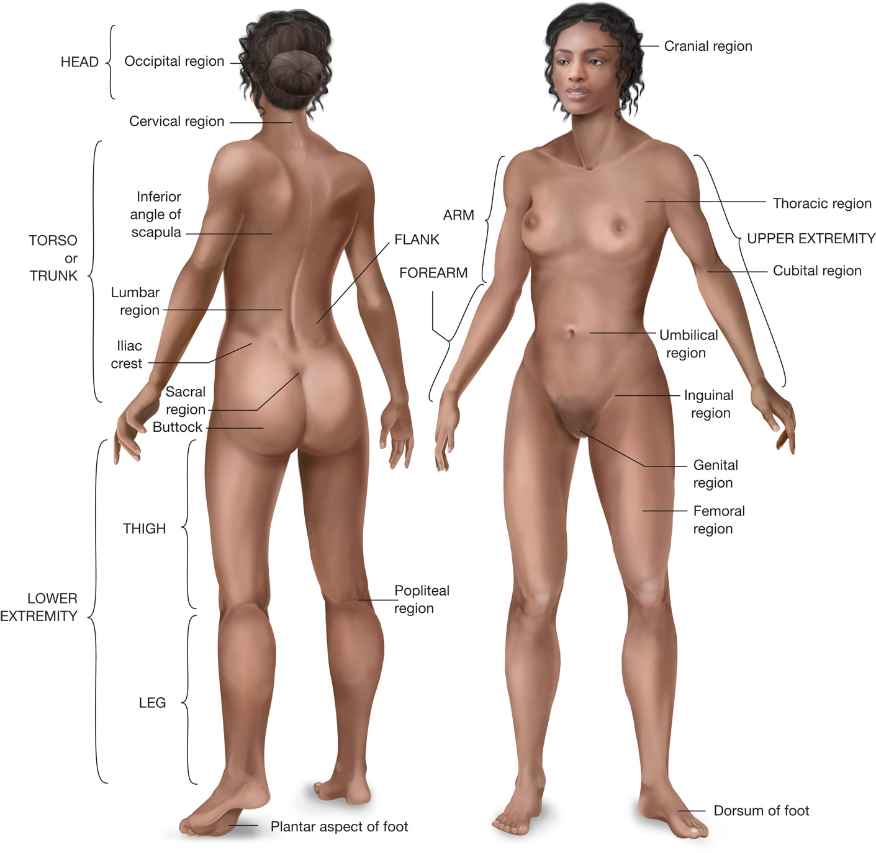
Regions of the Body
Notes:
Review the regions of the body with the students, noting important topical landmarks.

Slide 22
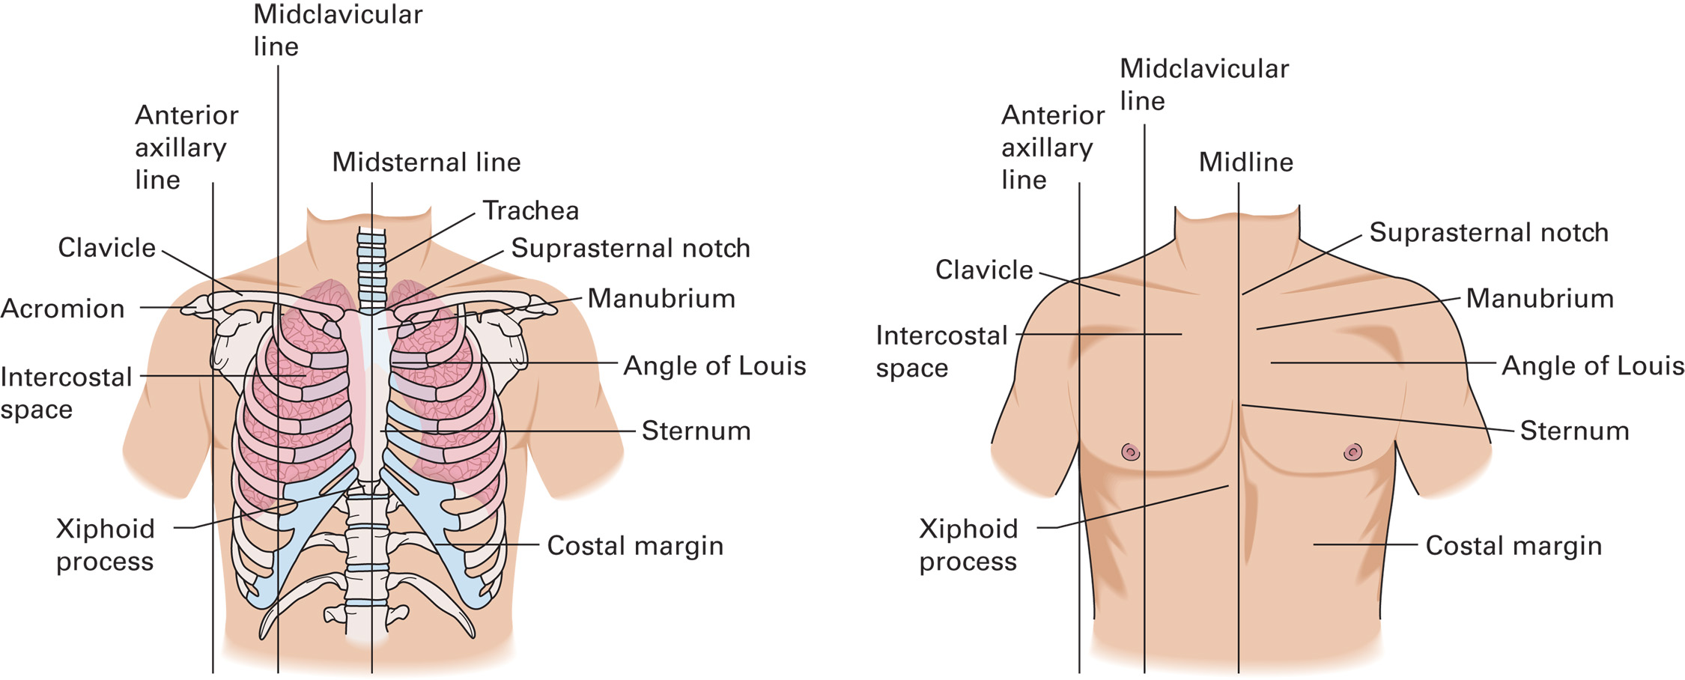
Terms Describing the Anterior Chest
Notes:
Discuss midsternal, midclavicular line, anterior axillary line, intercostal space, and costal margin.

Slide 23
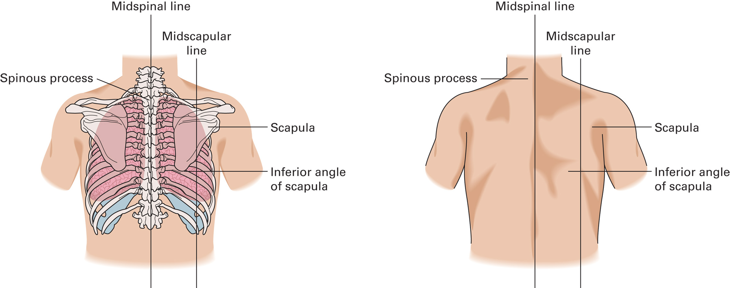
Terms Describing the Posterior Chest
Notes:
Discuss midspinal, midscapular, and the location of the scapula.

Slide 24
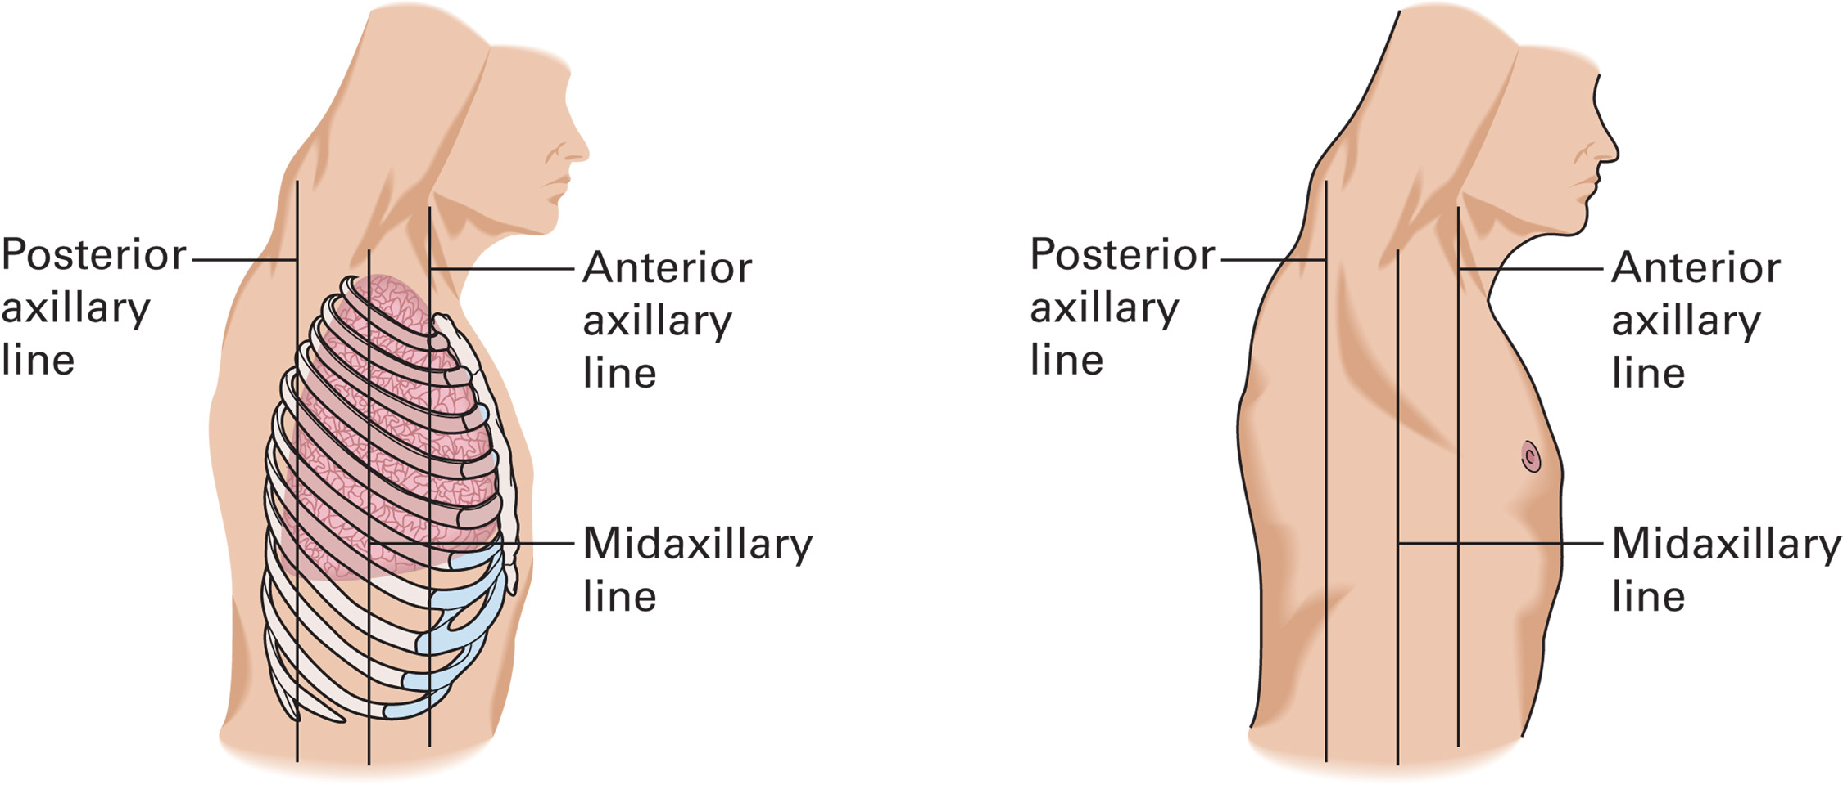
Terms Describing the Lateral Chest
Notes:
Discuss anterior, mid-, and posterior axillary line.

Slide 25
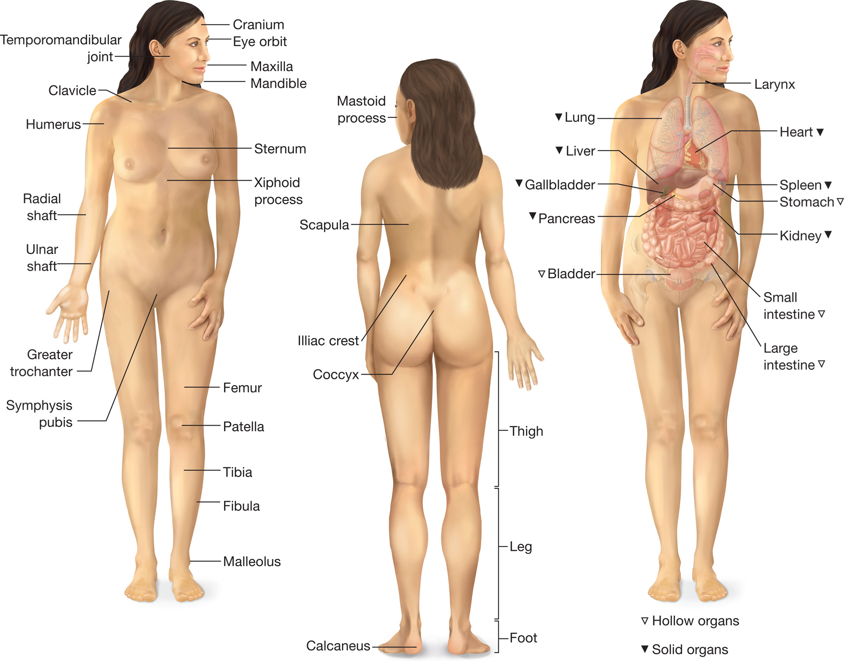
Topographic Anatomy
Notes:
Knowledge Application
Point to several locations on your body. Have students describe the locations using anatomical terms.
Upon hearing "plain English" descriptions of patient positions, students will substitute the anatomically correct term.
Critical Thinking Discussion
What are the pros and cons of using anatomical terms of position and direction?
Why is it important for EMTs to understand this terminology?

Slide 26
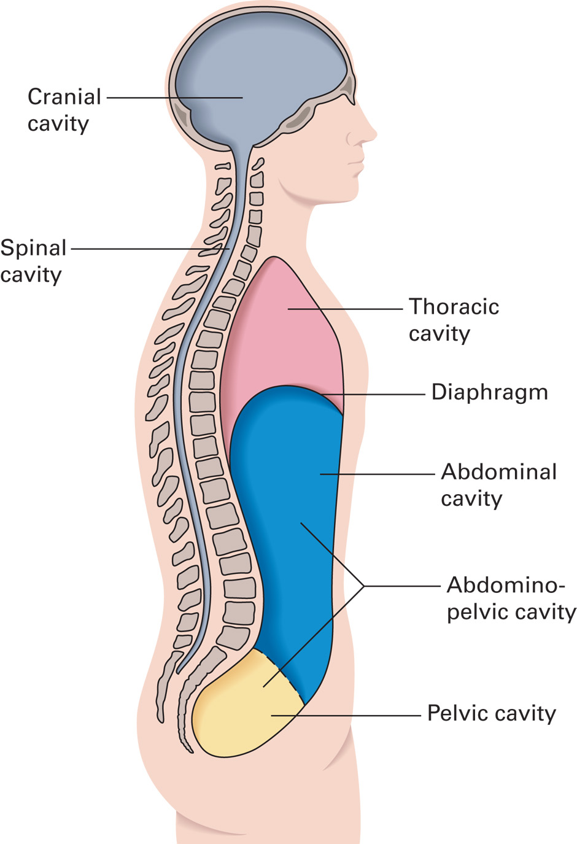
Main Body Cavities
Notes:
Knowledge Application
Given a list of organs provided by the instructor, have the students guess/identify in what cavity these organs are located at.

Slide 27
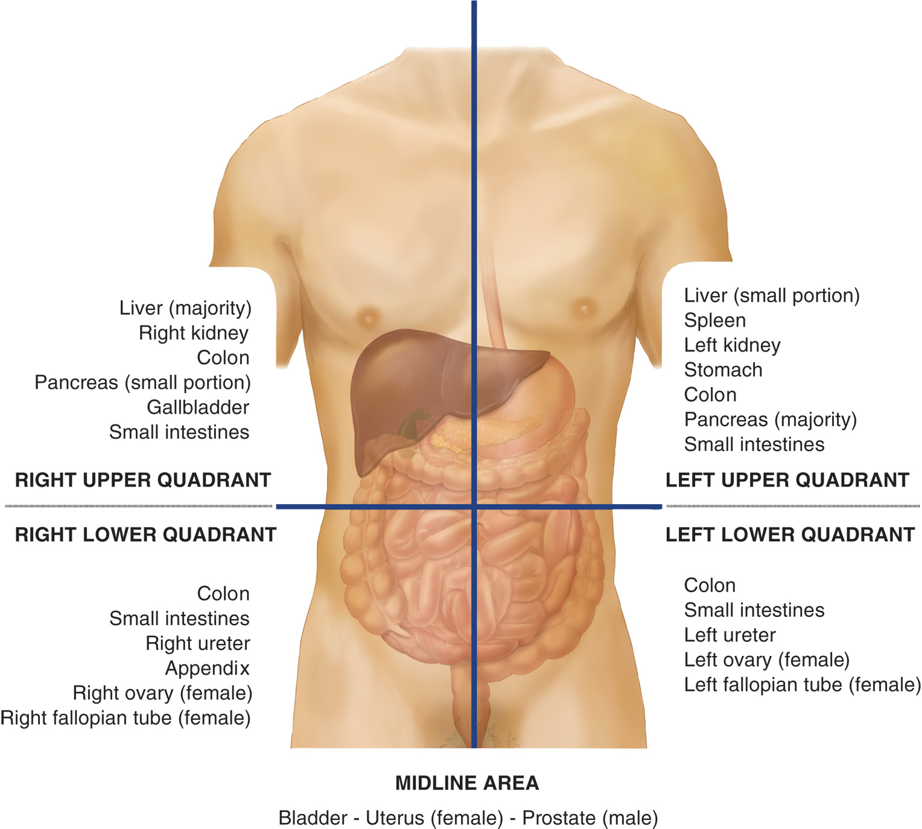
The Abdominal Cavity
Notes:
The abdomen may be referred to as if it were divided by horizontal and vertical lines drawn through the umbilicus (navel). The four parts, or abdominal quadrants, are the right upper quadrant (RUQ), right lower quadrant (RLQ), left upper quadrant (LUQ), and left lower quadrant (LLQ).

Slide 28
Body Systems (1 of 54)
Musculoskeletal System
  The Skeletal System
    A bony framework
      Ligaments and tendons
      Muscles and connective tissues
    Functions
      Provides shape and protects organs
      Allows movement
      Storage purposes
Notes:
The musculoskeletal system of the human body consists of a bony framework, or skeleton, held together by ligaments that connect bone to bone, layers of muscles, tendons that connect muscles to bones, and various other connective tissues. The system must be strong to provide support and protection, jointed to permit motion, and flexible to withstand stress.
The skeletal system serves four functions:
• Giving the body its shape
• Protecting the vital internal organs
• Allowing for movement
• Storing minerals and producing blood cells

Slide 29
Body Systems (2 of 54)
Musculoskeletal System
  The Skeletal System
    Six basic components of the skeleton
      Skull
      Spinal column
      Thorax
      Pelvis
      Upper extremities and lower extremities
Notes:
The skeletal system has six basic components: the skull, spinal column, thorax, pelvis, and the upper and lower extremities. The bones of the adult skeleton are classified by size and shape (long, short, flat, or irregular).

Slide 30
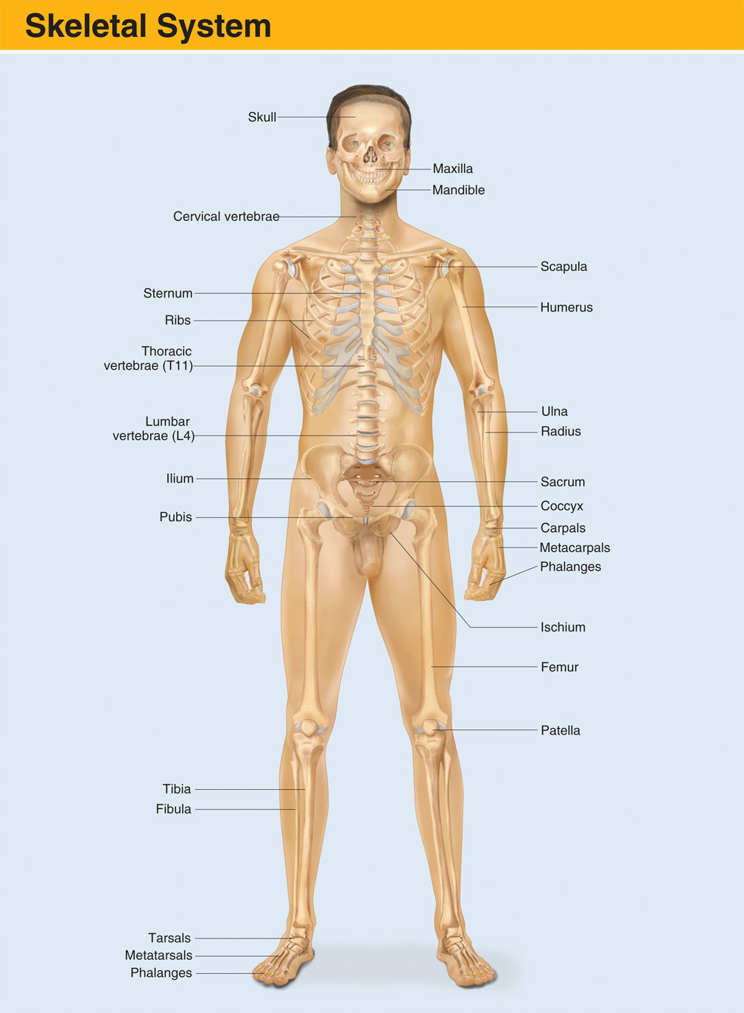
The Skeletal System
Notes:
Discuss common landmarks and locations on the body.

Slide 31
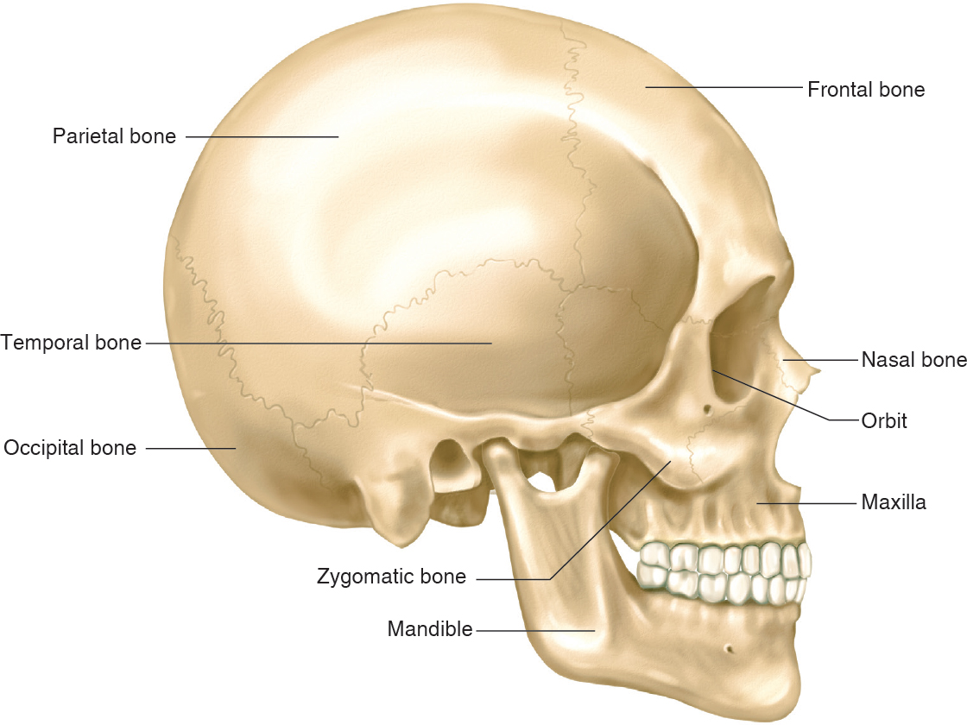
Body Systems (3 of 54)
Musculoskeletal System
  The Skeletal System
    The Skull
Notes:
The skull
Protects the brain
Consists of the cranium and face
Cranial bones
Occipital, parietal, frontal, temporal
14 facial bones
Inflexible cranium cannot accommodate swelling of the brain

Slide 32
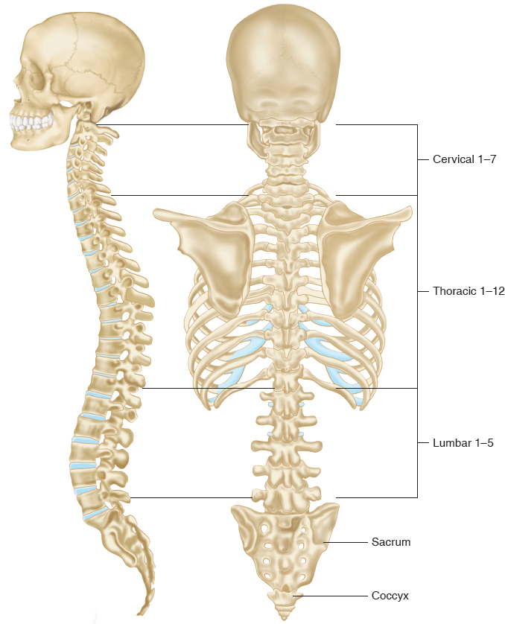
Body Systems (4 of 54)
Musculoskeletal System
  The Skeletal System
    The Spinal Column
Notes:
The spinal column is a column of 33 stacked vertebral bones separated by intervertebral disks
7 cervical
12 thoracic
5 lumbar
5 sacral
4 coccygeal

Slide 33
Body Systems (5 of 54)
Musculoskeletal System
  The Skeletal System
    The Thorax
Notes:
The thorax
12 pairs of ribs attach posteriorly to the thoracic vertebrae
The first seven pairs of ribs attach anteriorly to the sternum
The next three pairs of ribs attach indirectly to the sternum
The last two pairs of ribs are not attached to the sternum

Slide 34
Body Systems (6 of 54)
Musculoskeletal System
  The Skeletal System
    Pelvis
Notes:
The pelvis
Ring-shaped
Consists of sacrum, coccyx, ilium, ischium, pubis
Supports and protects internal organs

Slide 35
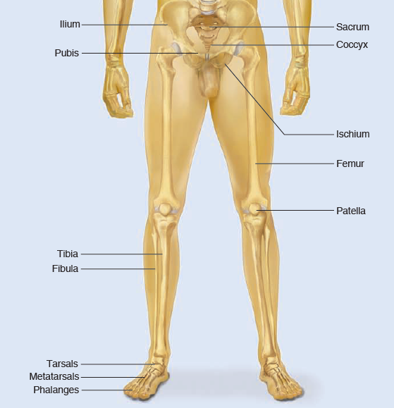
Body Systems (7 of 54)
Musculoskeletal System
  The Skeletal System
    Lower extremities
Notes:
The lower extremities (hips to toes)
Femur forms a joint with the pelvis at the acetabulum
The knee joint is protected by the patella
The lower leg bones are the tibia and fibula
Tarsals and metatarsals make up the foot and toes

Slide 36
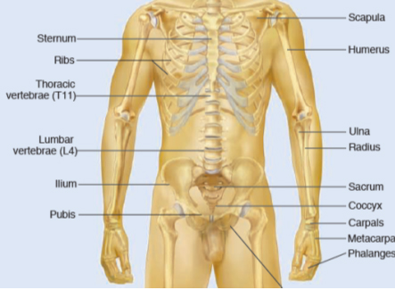
Body Systems (8 of 54)
Musculoskeletal System
  The Skeletal System
    Upper extremities
Notes:
Upper extremities
Shoulder to fingers
Humerus forms a joint with the clavicle and scapula
The bones of the forearm are the radius and ulna
The carpals and metacarpals make up the hand and fingers

Slide 37
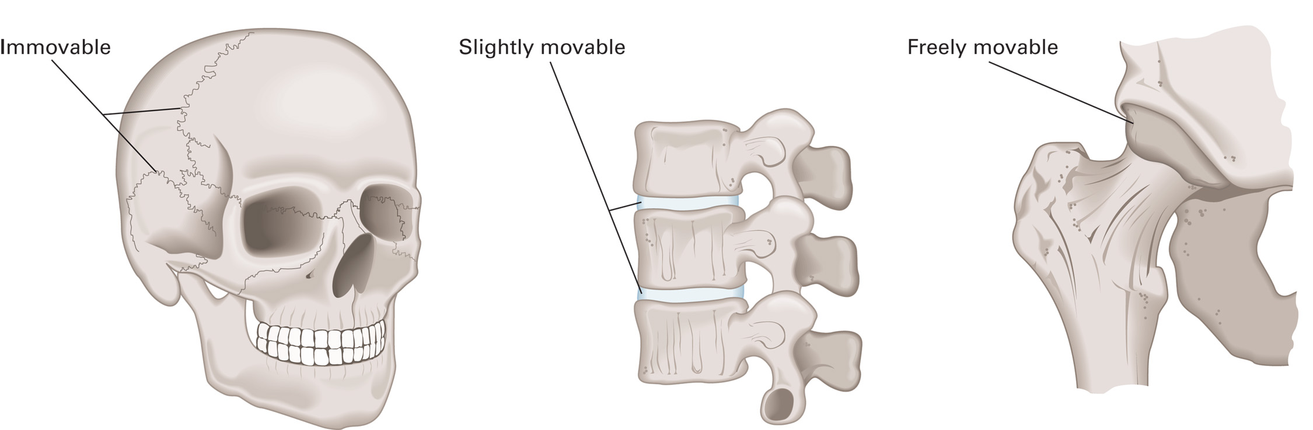
Body Systems (9 of 54)
Musculoskeletal System
  The Skeletal System
    Joints
Notes:
Joints
Points where one bone meets another
May be immovable, slightly movable, or movable

Slide 38
Body Systems (10 of 54)
Musculoskeletal System
  The Skeletal System
    Joint motions
      Flexion and Extension
      Abduction and Adduction
      Circumduction
      Pronation and Supination
Notes:
Flexion: Bending toward the body or decreasing the angle between the bones or parts of the body
Extension: Straightening away from the body or increasing the angle between the bones or parts of the body
Abduction: Movement away from the midline
Adduction: Movement toward the midline
Circumduction: A combination of the preceding motions as is possible with the shoulder joint; conical movement, or movement through 360 degrees
Pronation: Turning the forearm so the palm of the hand is turned toward the back
Supination: Turning the forearm so the palm of the hand is turned toward the front

Slide 39
Body Systems (11 of 54)
Musculoskeletal System
  The Skeletal System
    Types of joints
      Ball and socket
      Hinged
      Pivot
      Gliding
      Saddle
      Condyloid
Notes:
Ball-and-socket joint: This type of joint permits the widest range of motion—flexion, extension, abduction, adduction, and rotation. Examples: joints at the shoulders and hips.
Hinged joint: Hinged joints (such as those in the elbow, knee, and finger) permit flexion and extension. Elbow joints have forward movement (the anterior bone surfaces approach each other), whereas knee joints have backward movement (the posterior bone surfaces approach each other).
Pivot joint: This type of joint allows for a turning motion; it includes the joints between the head and neck at the first and second cervical vertebrae and those in the wrist.
Gliding joint: The simplest movement between bones occurs in a gliding joint, where one bone slides across another to the point where surrounding structures restrict the motion. Gliding joints connect the small bones in the hands and the feet.
Saddle joint: This joint is shaped to permit combinations of limited movements along perpendicular planes. For example, the ankle allows the foot to turn inward slightly as it moves up and down.
Condyloid joint: This is a modified ball-and-socket joint that permits limited motion in two directions. In the wrist, for example, it allows the hand to move up and down and side to side, but not to rotate completely.

Slide 40
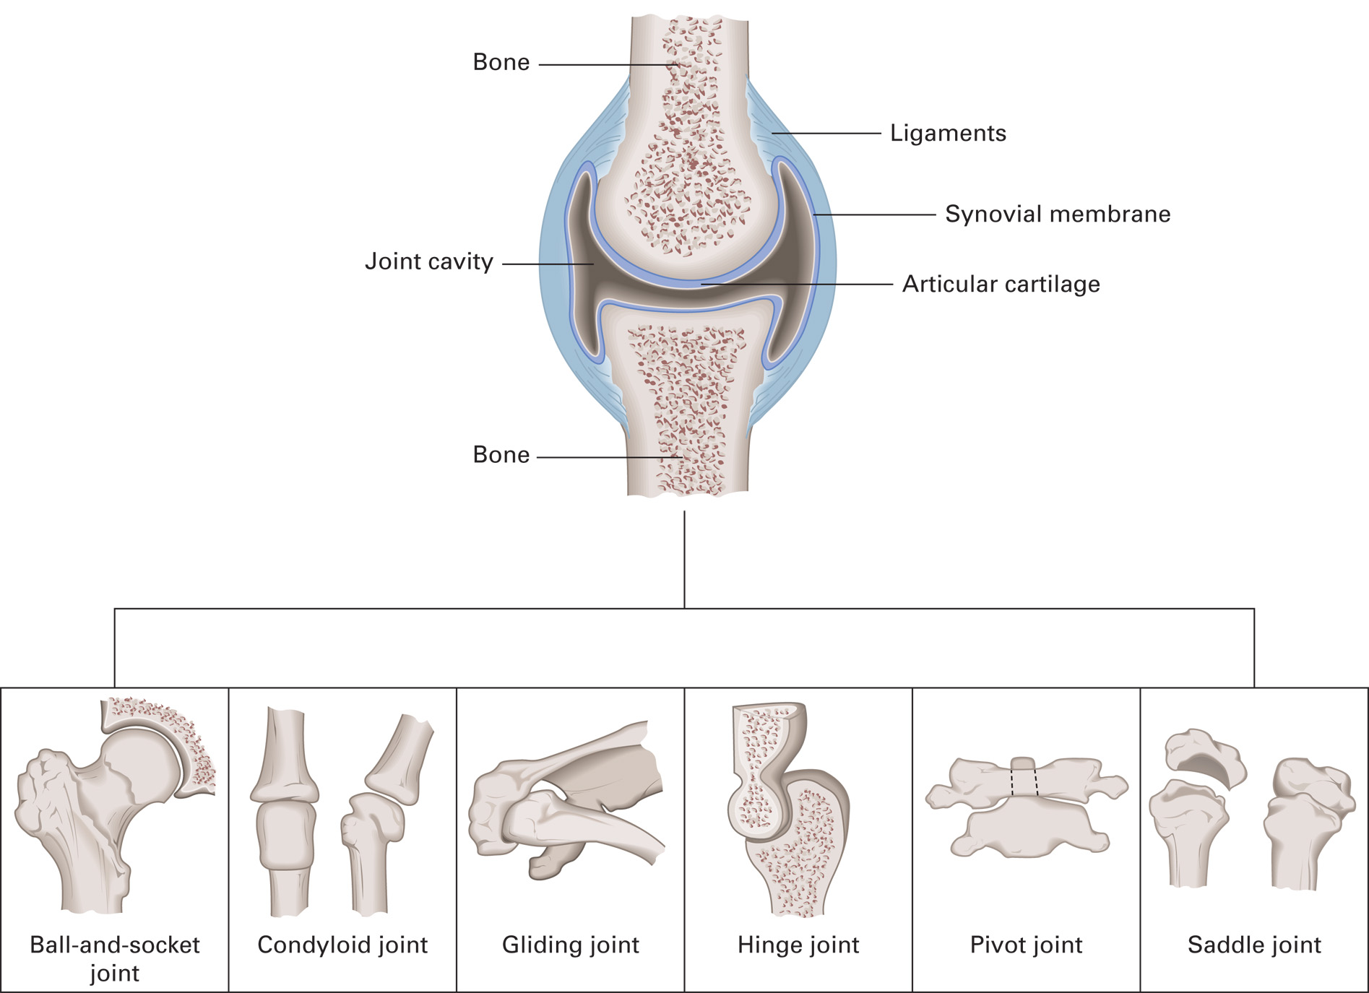
Types of Freely Movable Joints
Notes:
Review the types of joint.

Slide 41
Body Systems (12 of 54)
Musculoskeletal System
  Bone injury
    Bone is living tissue with a rich blood supply.
    Fractures can lead to bleeding from bone or surrounding tissue.
Notes:
A fracture is a loss of continuity in the structure of a bone. When a fracture to a bone occurs, the sharp fragments may injure surrounding tissue, such as nerves, vessels, and connective tissue. However, it is important to note that bones are also living tissue and have a rich blood supply. If a bone is fractured, the vessels within the bone may be torn or ruptured. This sometimes leads to severe bleeding from the bone itself rather than from the surrounding vessels or tissue. A patient can lose from 1,000–2,000 mL of blood from a fractured femur. A bleeding pelvic fracture may cause the patient to lose his entire blood volume of 7 to 8 liters into the pelvic cavity. Thus, when assessing a patient who has suffered a bone fracture, look for signs and symptoms of bleeding at the fracture site. Also, if the bleeding is severe, be aware that it may produce a shock state.

Slide 42
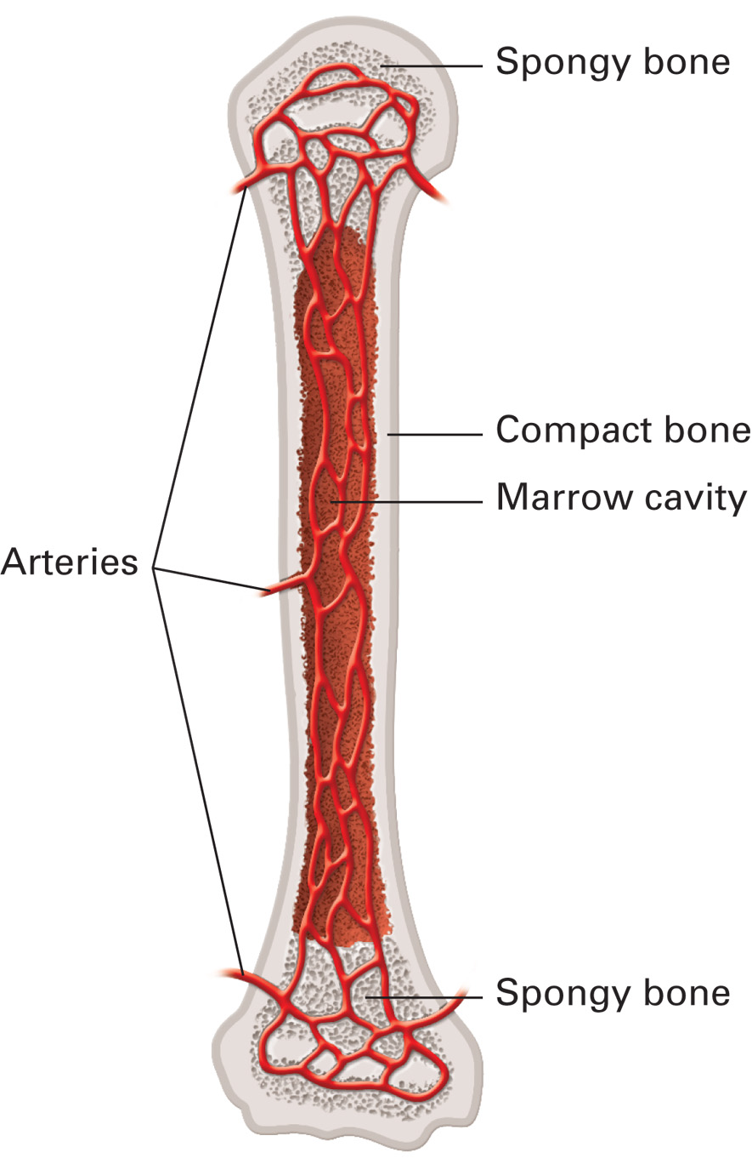
Bones Have Both Arteries and Veins, Though Only Arteries Are Shown Here
The vessels enter and exit through openings in the compact outer bone layers. They branch and extend throughout the marrow cavity and into the spongy bone at the ends. Because they are so richly supplied with blood vessels, bones can bleed profusely when fractured.
Notes:
Discuss that bones receive blood flow and can bleed when fractured. In fact, some of the worst complications of fractured bones in not the actual break, but the resulting hemorrhage that can occur.

Slide 43
Body Systems (13 of 54)
Musculoskeletal System
  Muscular System
    Muscles allow movement by contracting in response to nerve impulses.
    Three types of muscle
      Skeletal
      Smooth
      Cardiac
Notes:
Movement of the body is due to work performed by the muscles. What enables muscle tissue to work is its ability to contract (to become shorter and thicker) when stimulated by a nerve impulse. The cells of a muscle are called fibers, because they are usually long and threadlike. Each muscle has countless bundles of closely packed, overlapping fibers bound together by connective tissue.

Slide 44
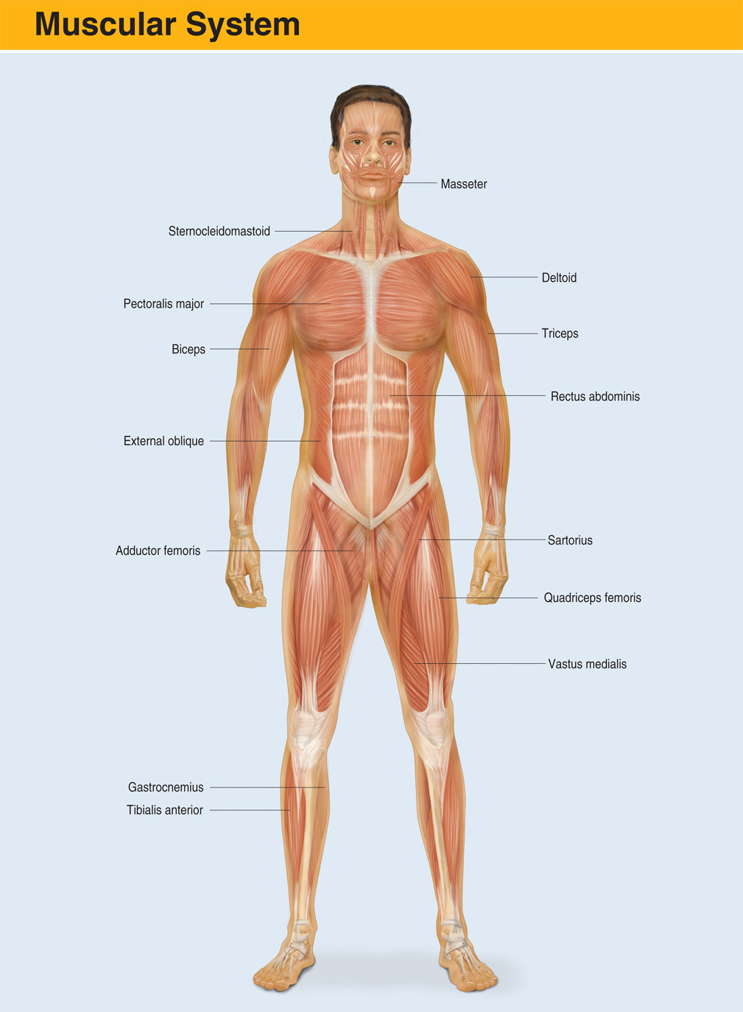
The Muscular System
Notes:
Review major flexors and extensors of the body.

Slide 45
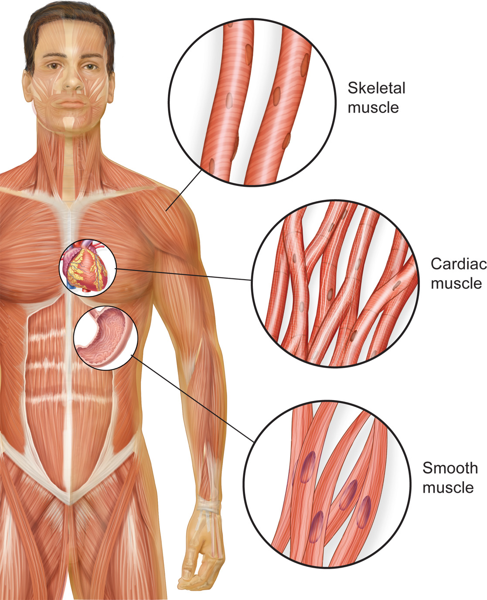
Muscular System and Three Types of Muscle
Notes:
Under the control of the brain and nervous system, skeletal muscle, or voluntary muscle, can be contracted and relaxed by will of the individual. This type of muscle makes possible all deliberate movement, such as walking, chewing, swallowing, smiling, frowning, talking, or moving the eyeballs. It forms the major muscle mass of the body, helps to shape it, and forms its walls.
Smooth muscle, or involuntary muscle, is made up of large fibers that carry out the automatic muscular functions of the body through rhythmic, wavelike movements. For example, smooth muscles move blood through the veins, bile from the gallbladder, and food through the digestive tract. The individual has no direct control over this type of muscle, though it responds to stimuli such as stretching, heat, and cold.
Found only in the walls of the heart, cardiac muscle is a special kind of involuntary muscle particularly suited for the work of the heart. It has the property of automaticity. That is, it can generate an impulse on its own, even when disconnected from the central nervous system.

Slide 46
Case Study (2 of 7)
Tom continues managing the patient’s airway and ventilation. Kevin has directed another E M T to apply direct pressure to the groin wound, as he applies occlusive dressings to the chest wounds. One of the chest wounds is two centimeters inferior to the left clavicle, in the midclavicular line, and the other is four centimeters inferior to the nipple in the midaxillary line.
Notes:
Review the findings in the case study and ask the students to anticipate what organs or structures may be injured.

Slide 47
Case Study (3 of 7)
How can a stab wound to the chest impair ventilation and oxygenation?
How could applying an occlusive dressing over the chest wounds be of benefit to the patient?
Notes:
Allow the students to deliberate of the answers to the questions.

Slide 48
Body Systems (14 of 54)
The Respiratory System
  Respiratory System Functions
    Respiration and ventilation
    Oxygenation of blood and removal of carbon dioxide
    Assists with the buffering of the acid-base balance in the body
Notes:
The body can store food for weeks and water for days, but it can only store enough oxygen to last a few minutes. Simple inhalation normally provides the body with the oxygen it needs. However, if the oxygen supply is cut off, as in a drowning or choking patient, brain cells will ordinarily begin to die in about 5 minutes.
Points to Emphasize
The respiratory system provides a constant supply of the oxygen needed by the body's cells.
The terms respiration, oxygenation, and ventilation are not synonymous.

Slide 49
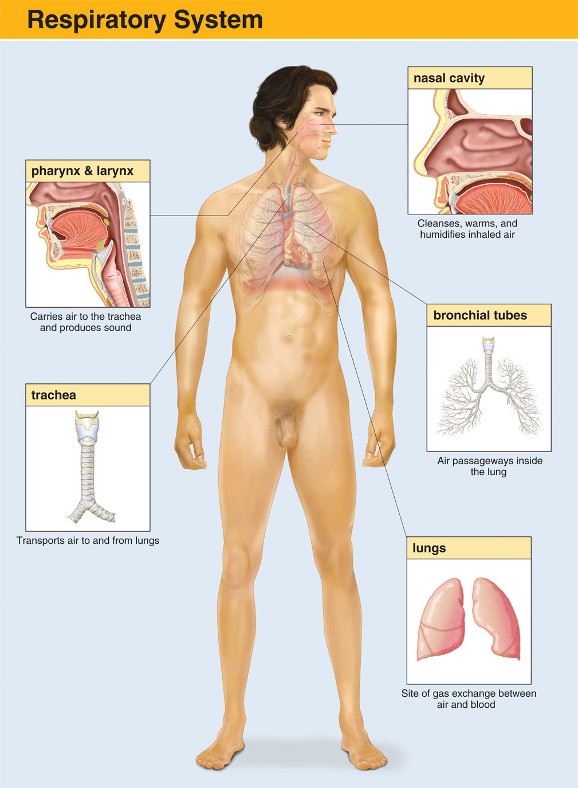
The Respiratory System
Notes:
Discuss the major components of the respiratory system.

Slide 50
Body Systems (15 of 54)
The Respiratory System
  Respiratory System Structures: Airway
    The airway is divided into upper and lower portions, divided by the cricoid ring at the lower portion of the larynx.
Notes:
Points to Emphasize
Anatomically, the airway consists of the upper airway (structures from the larynx upward) and the lower airway (structures below the larynx).
The epiglottis protects the larynx and lower airway from food and liquids.
Discuss the functions of the upper airway and delineate these from the functions of the lower airway.

Slide 51
Body Systems (16 of 54)
The Respiratory System
  Respiratory System Structures: Airway
    Nose and mouth
    Pharynx
    Nasopharynx
    Oropharynx
    Laryngopharynx
Notes:
Points to Emphasize
Explain that these structures represent the major components of the upper airway.
Discussion Questions
How are respiration, ventilation, and oxygenation different from one another?

Slide 52
Body Systems (17 of 54)
The Respiratory System
  Respiratory System Structures: Airway
    Larynx
    Trachea
    Bronchi
    Bronchioles
    Alveoli
Notes:
Points to Emphasize
Respiration is based on the movement of gases from areas of higher concentration to areas of lower concentration.
To be adequate, breathing must be adequate in both rate and the volume of air moved in each breath.
Signs of inadequate breathing include abnormal rate, irregular pattern, decreased or absent breath sounds, unequal or inadequate chest expansion, poor skin color, use of accessory muscles, nasal flaring, agonal respirations, and grunting.
Discussion Questions
What is the path of a molecule of oxygen as it moves from the atmosphere to the level of the cell?

Slide 53
Body Systems (18 of 54)
The Respiratory System
  Respiratory System Structures: Airway
    The lungs and diaphragm
      Organs of respiration
      Contain thousands of microscopic alveoli
      Covered by pleural linings
      Diagrammatic muscle
Notes:
The principle organs of respiration are the lungs, two large, lobed organs that house thousands of tiny alveolar sacs responsible for the exchange of oxygen and carbon dioxide (as explained later). A thin layer of connective tissue called the visceral pleura covers the outer surface of the lungs. A layer of thicker, more elastic tissue called the parietal pleura covers the internal chest wall. Between the two layers is the pleural cavity, a tiny space with negative pressure that allows the lungs to stay inflated with air.
The diaphragm is a dome shaped muscle that provides the majority of action that allows airflow into the lungs. It also separates the thoracic cavity from the abdominal cavity.

Slide 54
The Upper and Lower Airway (1 of 2)
Notes:
Review over the components of the respiratory system.

Slide 55
The Upper and Lower Airway (2 of 2)
Notes:
Discuss the cross section of the bronchioles and illustrate the configuration of smooth muscle to allow for bronchodilation or bronchoconstriction.

Slide 56
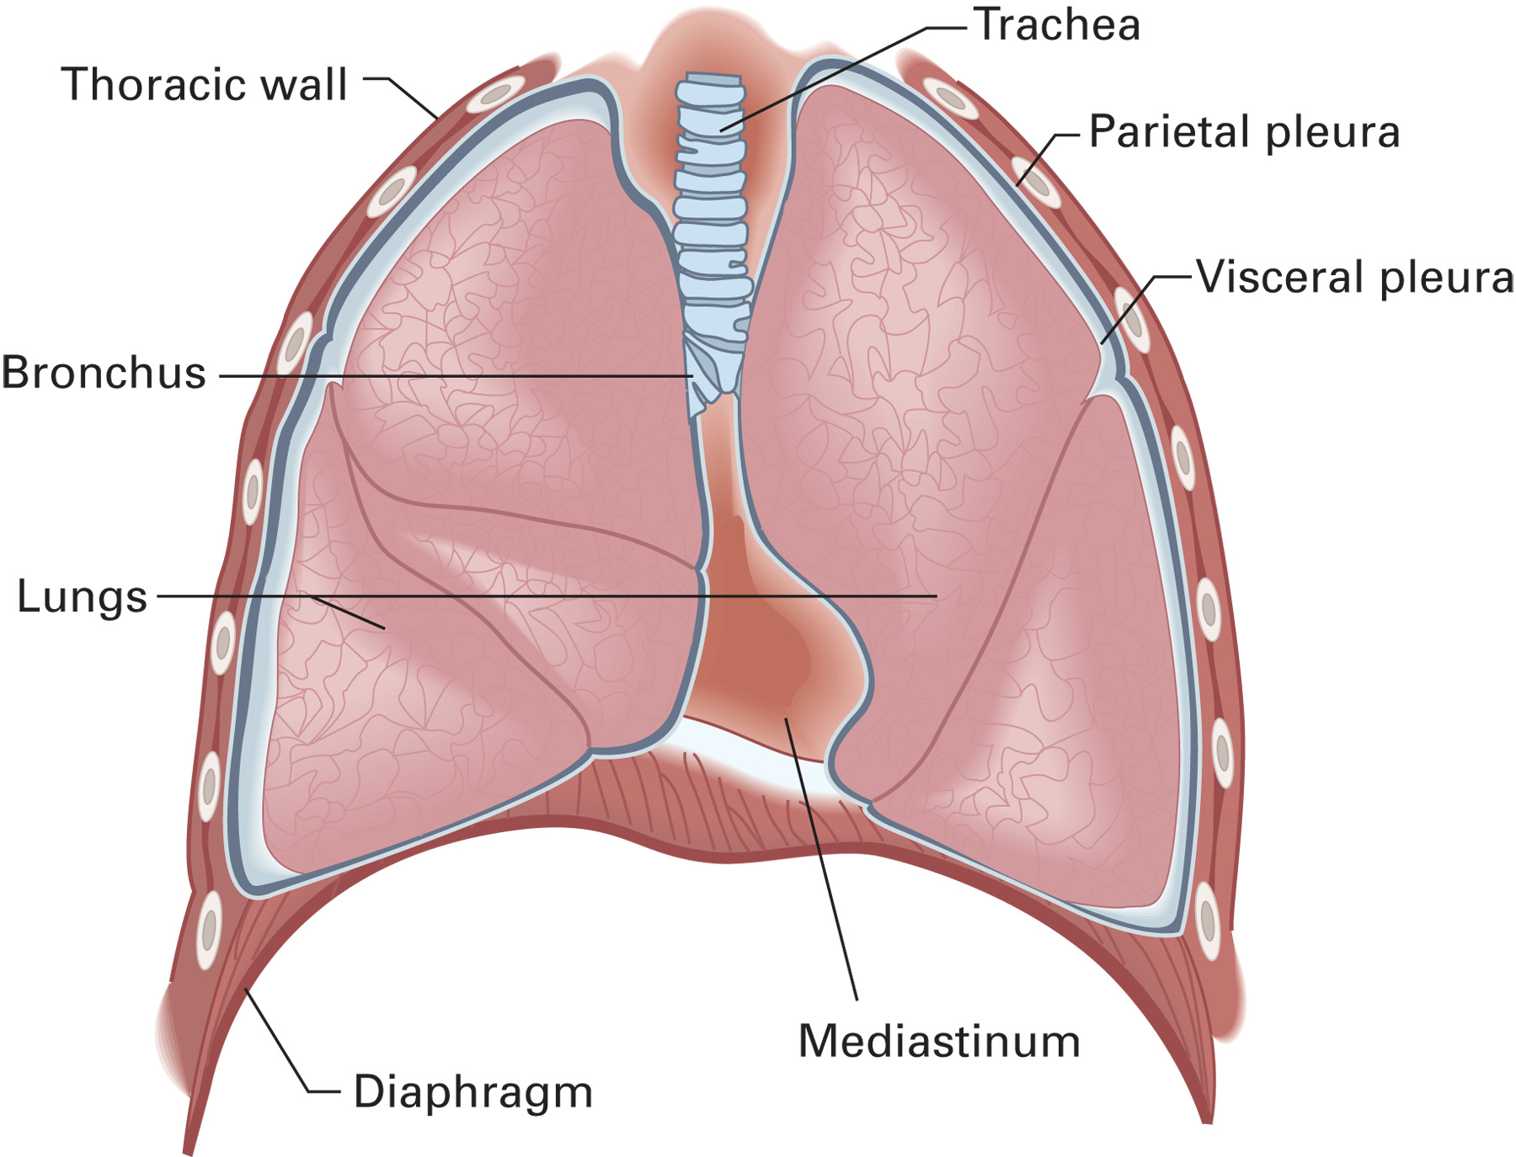
The Pleural Lining of the Lung
Notes:
Critical Thinking Discussion
Why might a patient with a respiratory problem feel weak?
Discussion Question
What are the muscles used in breathing?

Slide 57
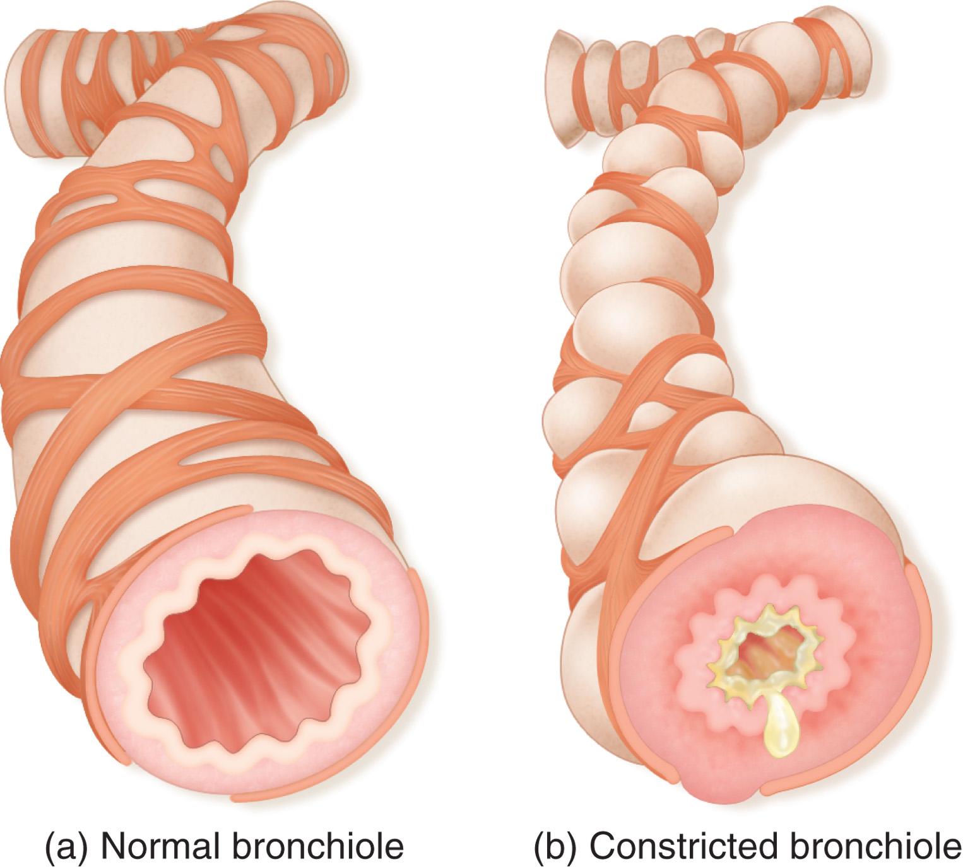
A Normal and a Constricted Bronchiole
Notes:
Teaching Tips
Demonstrate increased resistance to airflow by having students breathe through coffee stirrers or drinking straws to simulate reduced diameter of airways.

Slide 58
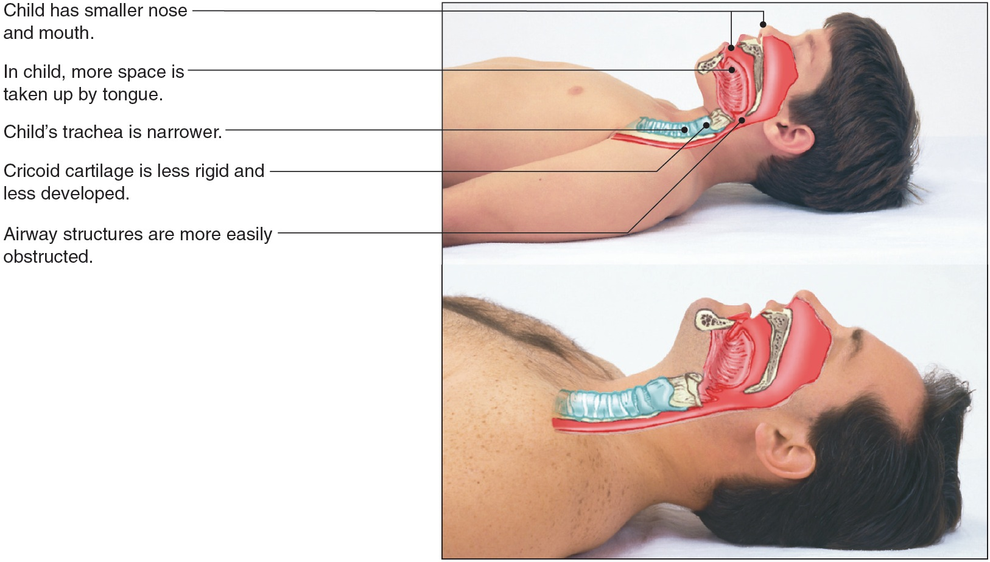
Body Systems (19 of 54)
The Respiratory System
  Anatomy in Infants and Children

Slide 59
Body Systems (20 of 54)
The Respiratory System
  Mechanics of ventilation
      Inhalation
      Exhalation
  Diaphragm and intercostal muscles
Notes:
During inhalation, the diaphragm and the intercostal muscles (the muscles between the ribs) contract, increasing the size of the thoracic cavity. The diaphragm moves slightly downward, flaring the lower portion of the rib cage, which moves upward and outward. This creates a negative pressure in the chest, which causes air to flow into the lungs. During exhalation, the diaphragm and intercostal muscles relax, decreasing the size of the thoracic cavity. The diaphragm moves upward; the ribs move downward and inward, creating a positive pressure in the thorax and causing air to flow out of the lungs.
The diaphragm receives its stimulation to contract from the phrenic nerve that exits the spinal cord at the cervical spine between vertebrae C3 and C5. If a spinal cord injury occurs at C3 to C5, the phrenic nerve may be damaged and the diaphragm will not r receive a nervous impulse to contract, no longer allowing it to contribute to ventilation. The intercostal muscles will also not work properly because the nerves that stimulate these muscles exit from the lower thoracic vertebrae. With an injury to the spinal cord high in the cervical vertebrae, the patient would not be able to breathe spontaneously and would require artificial ventilation.

Slide 60
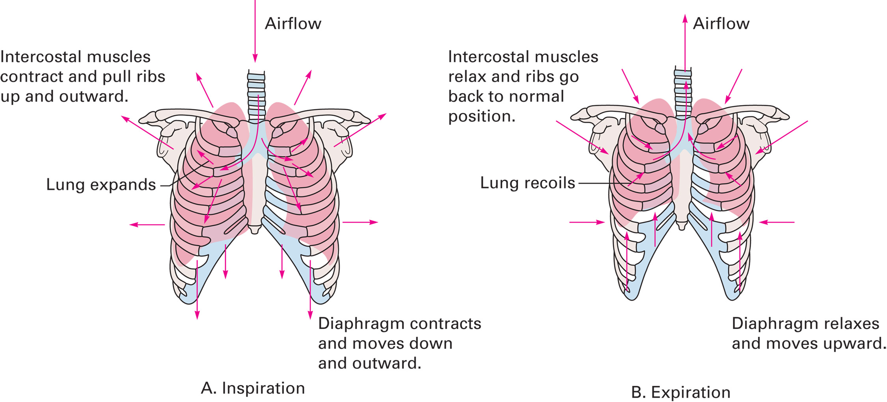
Mechanics of Respiration
Notes:
The diaphragm contributes about 60–70 percent of the effort to breathe, whereas the intercostal muscles contribute the remaining 30–40 percent. Thus, a significant injury that prevents the diaphragm from functioning properly will cause the patient’s breathing to become ineffective.

Slide 61
Body Systems (21 of 54)
The Respiratory System
  Physiology of Respiration
      Oxygen and carbon dioxide exchange in the alveoli
      Carbon dioxide and oxygen exchange in the peripheral capillary beds
Notes:
In the lungs, oxygen and carbon dioxide are exchanged through the thin walls of the alveoli and the capillaries. In alveolar/capillary exchange, oxygen-rich air enters the alveoli during each inspiration and passes through the capillary walls into the bloodstream. Carbon dioxide and other waste gases move from the blood through the capillary walls into the alveoli and are exhaled. In capillary/cellular exchange throughout the body, carbon dioxide moves from the cells to the capillaries, and oxygen moves from the capillaries to the cells.

Slide 62
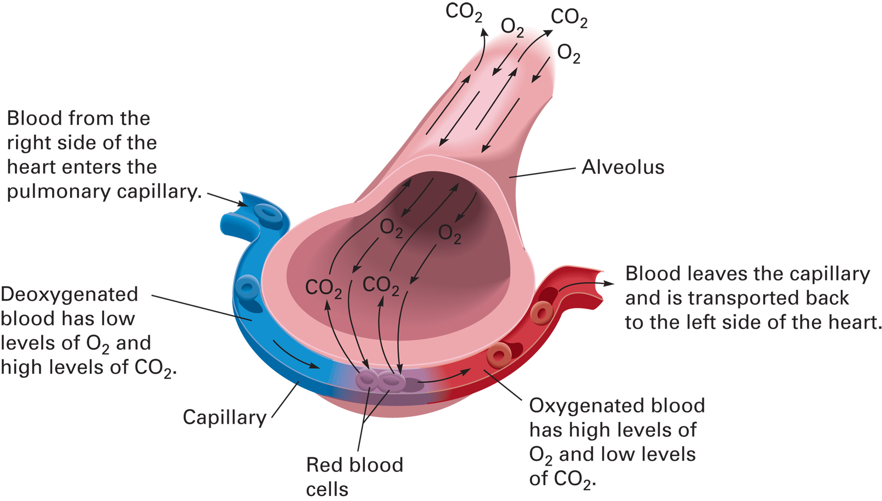
Alveolar/Capillary Gas Exchange

Slide 63
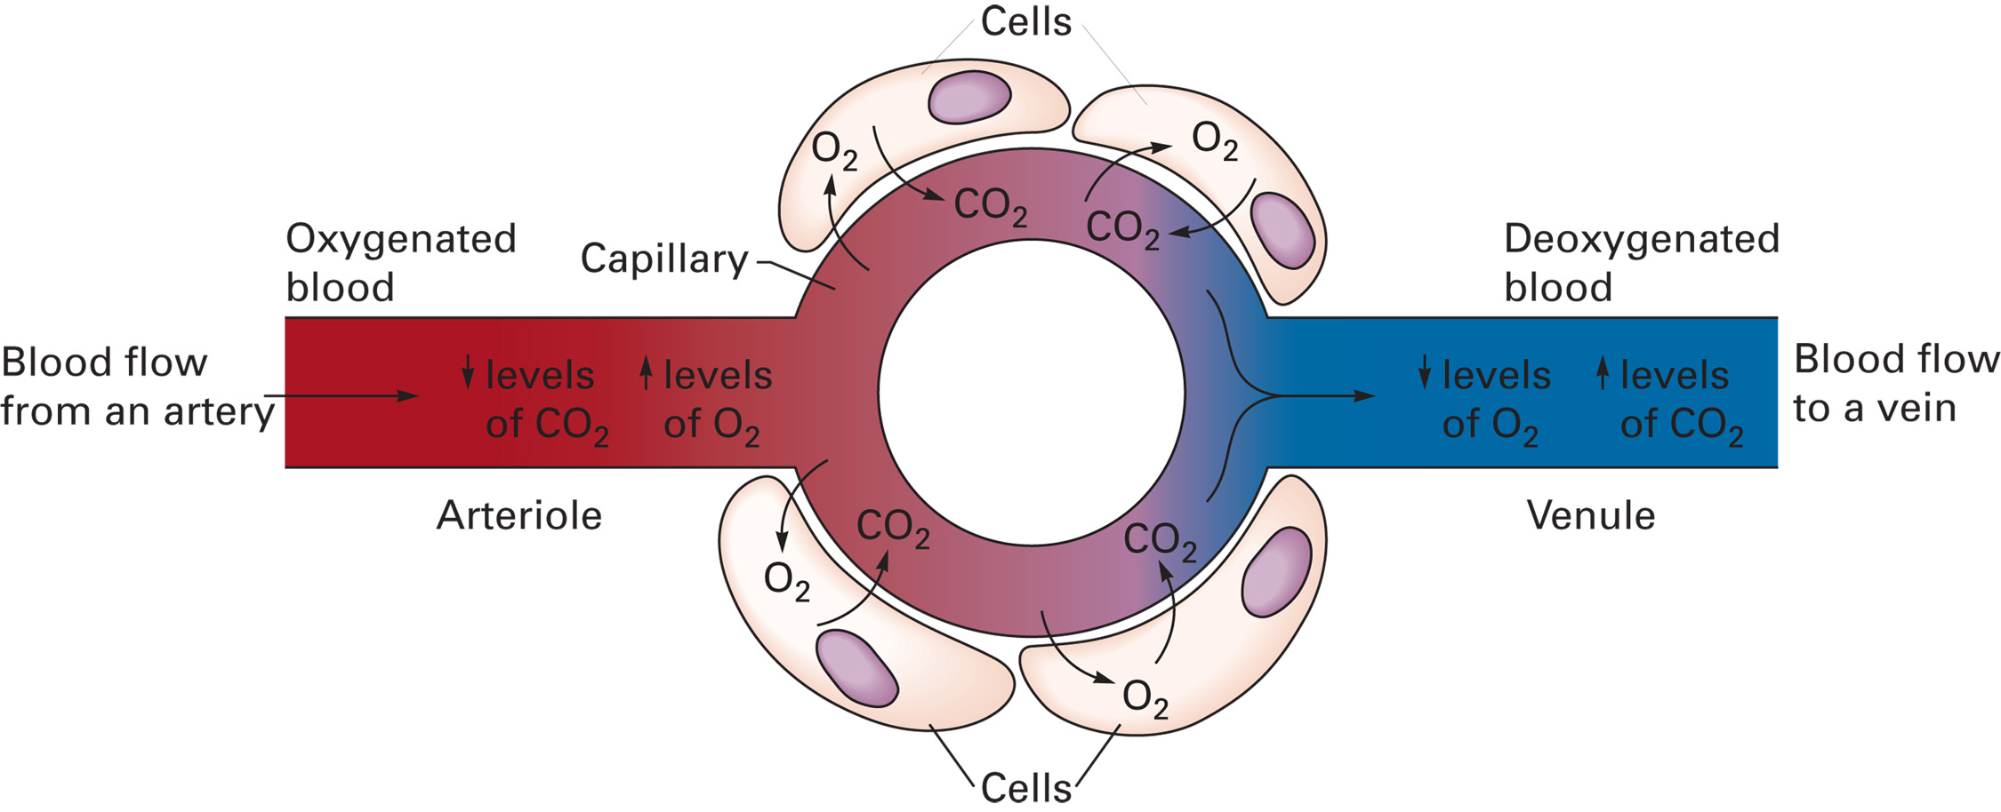
Capillary/Cell Gas Exchange

Slide 64
Body Systems (22 of 54)
The Respiratory System
  Adequate and Inadequate Breathing
    Adequate defined as adequate tidal volume and respiratory rate
    Adequate respiratory rate
      Adults
        Average 12 to 20/minute
      Elderly
        Average 20 to 22/minute
Notes:
Adequate breathing is characterized by an adequate respiratory rate and tidal volume. Respiratory rate is the number of breaths a patient takes in one minute. Tidal volume (VT) is the amount of air the patient breathes in and out with one regular breath. There is a wide variety of normal ranges of respiratory rates.

Slide 65
Body Systems (23 of 54)
The Respiratory System
  Adequate and Inadequate Breathing
    Adequate defined as adequate tidal volume and respiratory rate
    Adequate respiratory rate
      Children
        18 to 37/minute
      Infants
        30 to 60/minute
Notes:
As the infant or child ages, his respiratory rate will decrease. The respirations should be regular in rhythm and free of unusual sounds, such as wheezing. The chest should expand outward and equally with each breath, indicating an adequate depth (tidal volume).

Slide 66
Body Systems (24 of 54)
The Respiratory System
  Adequate and Inadequate Breathing
    Adequate breathing
      Regular rhythm
      Effortless
      Chest expands adequately
      No abnormal sounds
      No use of accessory muscles
Notes:
Review adequate breathing. Stress that just because the patient is breathing spontaneously, that does not mean that he is breathing adequately.

Slide 67
Body Systems (25 of 54)
The Respiratory System
  Adequate and Inadequate Breathing
    Inadequate breathing
      Rate is too fast or too slow
      Irregular rhythm
      Diminished or absent breath sounds
      Unequal or inadequate chest expansion
      Pale or blue skin or mucous membranes
      Agonal breathing
Notes:
For the breathing to be considered adequate, both rate and tidal volume must be adequate. If either rate or tidal volume is inadequate, the breathing is considered inadequate, and immediate ventilation is necessary.

Slide 68
Case Study (4 of 7)
Kevin’s assessment of the patient’s breathing reveals respirations of 30 per minute that are shallow. Breath sounds on the left side of the chest are diminished in comparison to those on the right side.
Notes:
Review the findings presented thus far for the case study.

Slide 69
Case Study (5 of 7)
Are the patient’s ventilations adequate or inadequate? Explain your answer.
How are the patient’s injuries affecting his body at a cellular level?
Notes:
Allow the students to deliberate on the correct answers, and ask what their treatment might be given their decisions.

Slide 70
Body Systems (26 of 54)
The Circulatory System
  Closed system to transport blood, nutrients, oxygen to all tissues of body
  Removes any waste products from tissues
  Comprised of heart, blood vessels, and blood
Notes:
The circulatory system is composed of the heart, blood vessels, and blood. It is a closed system that transports blood to all parts of the body. Blood brings oxygen, nutrients, and other essential chemical elements to tissue cells, and it removes carbon dioxide and other waste products resulting from cell metabolism.
The circulatory system has several functions:
Providing a medium for perfusion of cells with oxygen and other nutrients and removal from the cells of carbon dioxide and other waste products
Transporting blood to cells and the alveoli for gas exchange
Serving as a reservoir to house blood
Serving as a medium for buffering the body’s acid–base balance
Providing a mechanism to deliver immune cells and other substances to fight infection
Containing substances that promote clotting

Slide 71
Circulatory System

Slide 72
Body Systems (27 of 54)
The Circulatory System
  Basic Anatomy
    Heart
      Atria
      Ventricles
    Cardiac valves
      Tricuspid and Bicuspid valve
      Pulmonic and Aortic valve
Notes:
The heart has four chambers. The upper chambers, called the atria, receive blood from the veins. The right atrium receives oxygen-depleted blood from the veins of the body. The left atrium receives oxygen-rich blood from the pulmonary veins from the lungs. The lower chambers are called ventricles. They pump blood out to the arteries. The right ventricle pumps oxygen-depleted blood to the pulmonary arteries, which transport the blood to the lungs where it will be oxygenated. The left ventricle pumps oxygen-rich blood to the major artery from the heart, the aorta from which the blood is gradually delivered to all body cells. A series of valves between the chambers of the heart keep the blood flowing in one direction and prevent the backflow of blood.

Slide 73
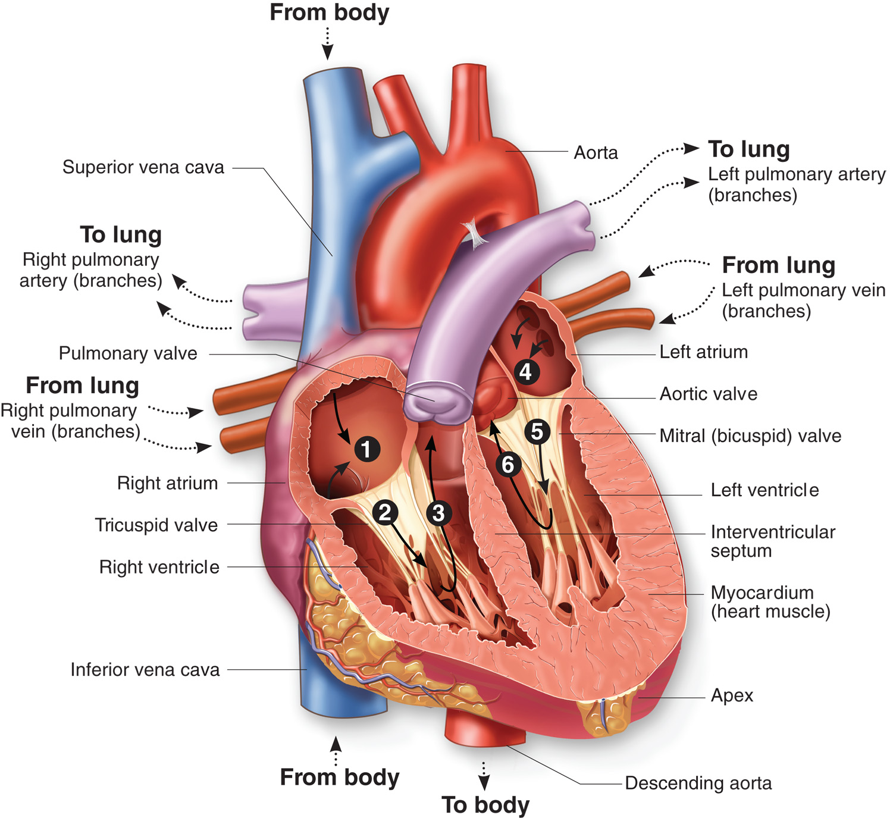
Blood Flow through the Chambers of the Heart
Notes:
Discussion Questions
Where is each of the heart valves located?

Slide 74
Body Systems (28 of 54)
The Circulatory System
  Basic Anatomy
    The arteries
      Aortic artery
      Coronary arteries
      Carotid arteries
      Femoral arteries
      Arteries of arms and legs
Notes:
Discuss the location and the purpose for each of these arterial structures. Also emphasize that arteries carry blood away from the heart.

Slide 75
Cardiovascular System (1 of 2)
Notes:
Identify the locations of the aforementioned arterial locations.

Slide 76
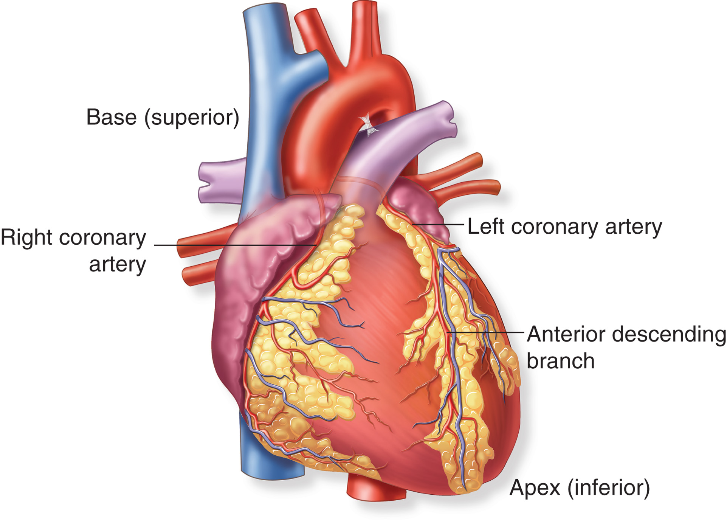
The Coronary Arteries
Notes:
Teaching Tips
Have students locate their carotid, dorsalis pedis, posterior tibial, brachial, and radial pulses.
Discussion Question
What is perfusion?
Critical Thinking Discussion
What are some things that could lead to hypoperfusion?
What would happen in the body if the heart rate became very slow?
What would happen if the smooth muscle in the blood vessels relaxed and the blood vessels throughout the body dilated?

Slide 77
Body Systems (29 of 54)
The Circulatory System
  Basic Anatomy
    Capillary beds
      Capillary beds connect the arteriole to a venule
      Site of gas exchange at the cellular level
Notes:
A tiny blood vessel that connects an arteriole to a venule, a capillary has walls that allow for the exchange of gases, nutrients, and waste at the cellular level. All fluid, oxygen, and carbon dioxide exchange takes place between the blood and tissue cells through the walls of the capillaries in all parts of the body.

Slide 78
Body Systems (30 of 54)
The Circulatory System
  Basic Anatomy
    Venous system
      Venules
      Veins
      Vena Cavae
      Pulmonary veins
Notes:
The smallest branch of the veins, a venule, is connected to the distal ends of capillaries. Blood that has been depleted of oxygen flows from the capillaries into the venules, from which it is transported into larger veins. A vein carries blood back to the heart. All veins except the pulmonary veins carry oxygen-depleted blood. The major veins include the venae cavae and the pulmonary veins. The venae cavae carry oxygen-depleted blood back to the right atrium, where it begins circulation through the heart and lungs. The superior vena cava enters the top of the right atrium, carrying oxygen-depleted blood from the upper body. The inferior vena cava enters the bottom of the right atrium, carrying oxygen-depleted blood from the lower body. The pulmonary veins carry oxygen-rich blood from the lungs to the left atrium. They are the only veins that carry oxygenated blood.

Slide 79
Cardiovascular System (2 of 2)
Notes:
Identify the locations of the aforementioned venous locations.

Slide 80
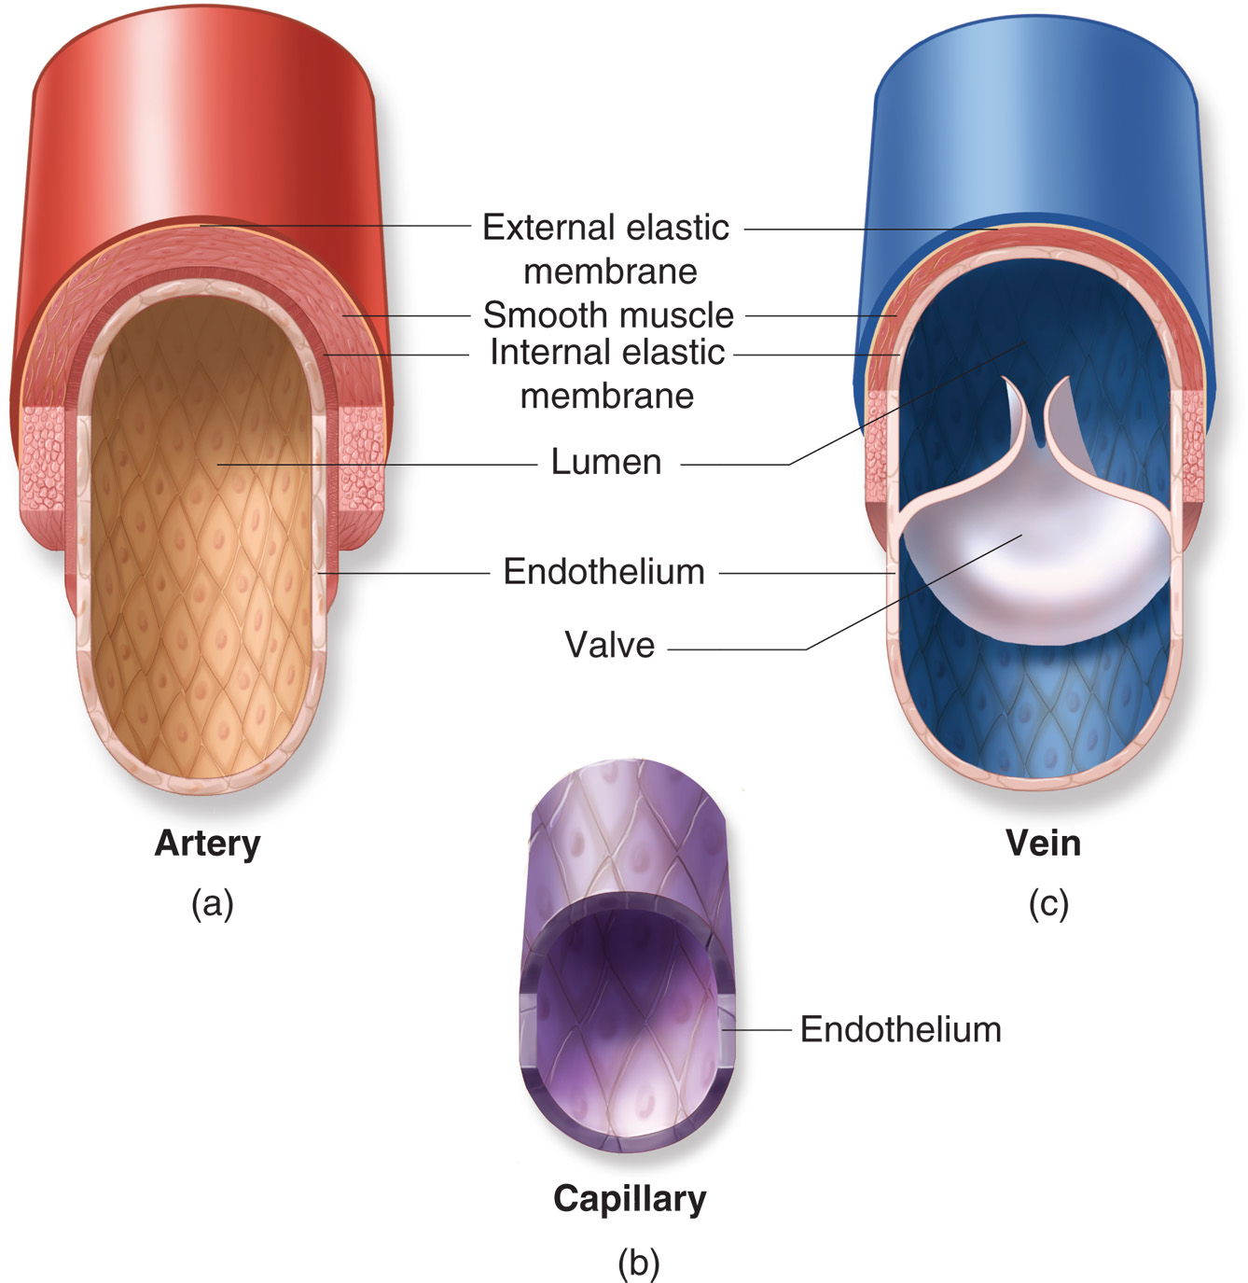
Comparative Structure of Arteries, Capillaries, and Veins
Notes:
Discuss whey the structural changes between arteries, veins, and capillary beds are necessary in order for them to carry out their desired function.

Slide 81
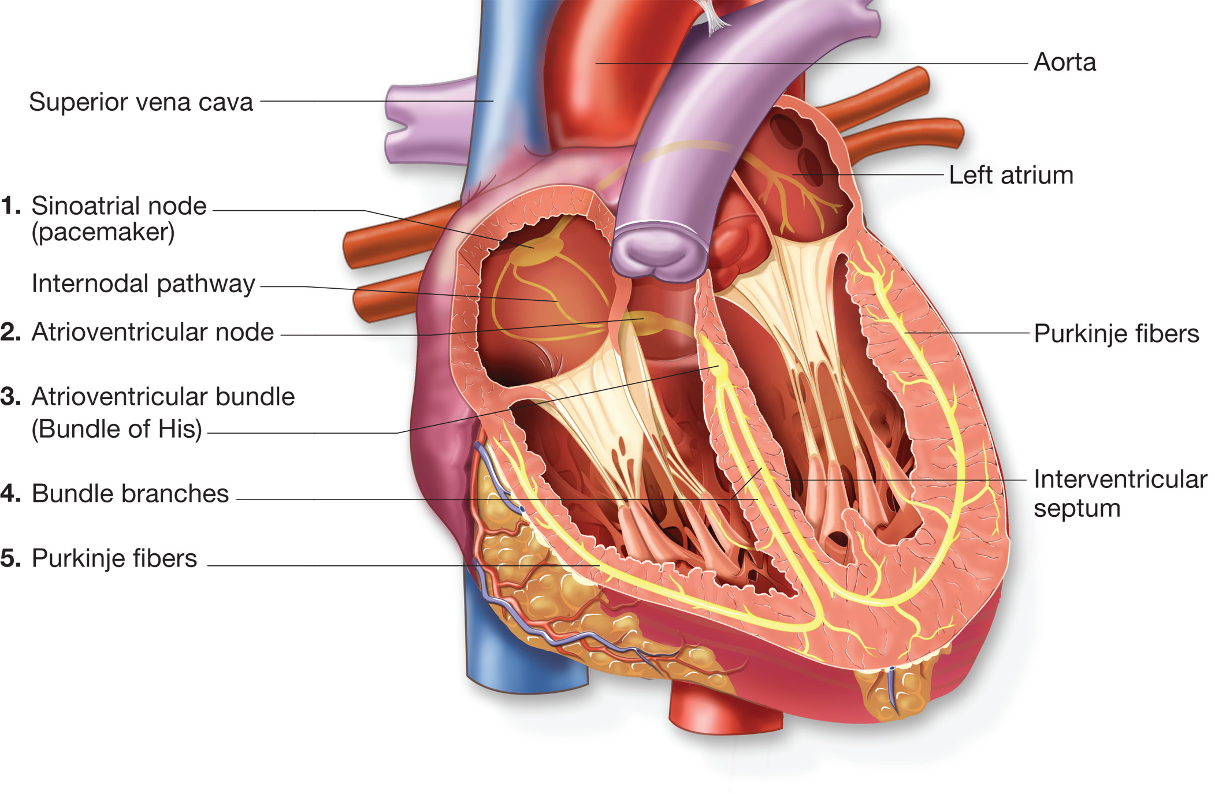
The Cardiac Conduction System
Notes:
Advise students that this slide is a prelude to knowledge that will become necessary when talking about cardiovascular conditions such as cardiac arrest and ventricular fibrillation.

Slide 82
Body Systems (31 of 54)
The Circulatory System
  Composition of the Blood
    Red blood cells
    White blood cells
    Platelets
    Plasma
Notes:
Blood composition:
Red blood cells contain hemoglobin, which allows them to carry oxygen and carbon dioxide.
Hemoglobin gives blood its red color.
White blood cells are part of the immune system and defend against infection.
Platelets help form blood clots.
Plasma is the liquid portion of blood that allows substances to be carried throughout the body.

Slide 83
Body Systems (32 of 54)
  The Circulatory System
  Physiology of Circulation
    Assessing the pulse and blood pressure gives information about the adequacy of circulation.
    The pulse is created by a wave of blood propelled by contraction of the left ventricle.
Notes:
When the left ventricle contracts, sending a wave of blood through the arteries, the pulse, or wave of propelled blood, can be felt at various points called pulse points. Simply, the pulse can be felt at the point where an artery passes over a bone near the skin surface. The pulse is a measure of the effectiveness of the left ventricle as a pump and provides information about the volume of blood being ejected by the left ventricle and being carried in the arteries.

Slide 84
Body Systems (33 of 54)
  The Circulatory System
  Physiology of Circulation
    Central pulses
      Carotid, femoral
    Peripheral pulses
      Radial, brachial, posterior tibial, dorsalis pedis
Notes:
The central pulses are the carotid and femoral, located centrally, closer to the heart. The peripheral pulses are the radial, brachial, posterior tibial, and dorsalis pedis—located on the periphery of the body, farther from the heart.

Slide 85
Body Systems (34 of 54)
  The Circulatory System
  Physiology of Circulation
    Blood pressure is the force exerted on the walls of arteries as blood passes through.
    Systolic blood pressure.
    Diastolic blood pressure.
Notes:
Blood pressure is the force exerted by the blood on the interior walls of the arteries. The systolic blood pressure is exerted against the walls of the arteries when the left ventricle contracts. The diastolic blood pressure is exerted against the walls of the arteries when the left ventricle is at rest, or between contractions. The systolic blood pressure measures the effectiveness of the pumping function of the left ventricle. The diastolic blood pressure measures the resistance in the arteries between contractions.

Slide 86
Body Systems (35 of 54)
  The Circulatory System
  Physiology of Circulation
    Hydrostatic pressure is the force of fluid within the blood vessels, and is determined by the volume of blood.
    Elevated hydrostatic pressure can be detrimental.
Notes:
Another type of pressure found inside the vessel is hydrostatic pressure. Hydrostatic pressure is the force exerted on the inside of the vessel walls because of the blood pressure and volume. A significant increase in hydrostatic pressure may cause the blood in the capillaries to force fluid through the capillary wall. Basically, the capillaries begin to leak fluid, which is typically water and not whole blood. This may produce edema, which is swelling occurring in the tissues. If the capillaries in the lungs are leaking, the fluid will collect between the alveoli and capillary. This will force the alveoli farther away from the capillary, making gas exchange more difficult and less effective.

Slide 87
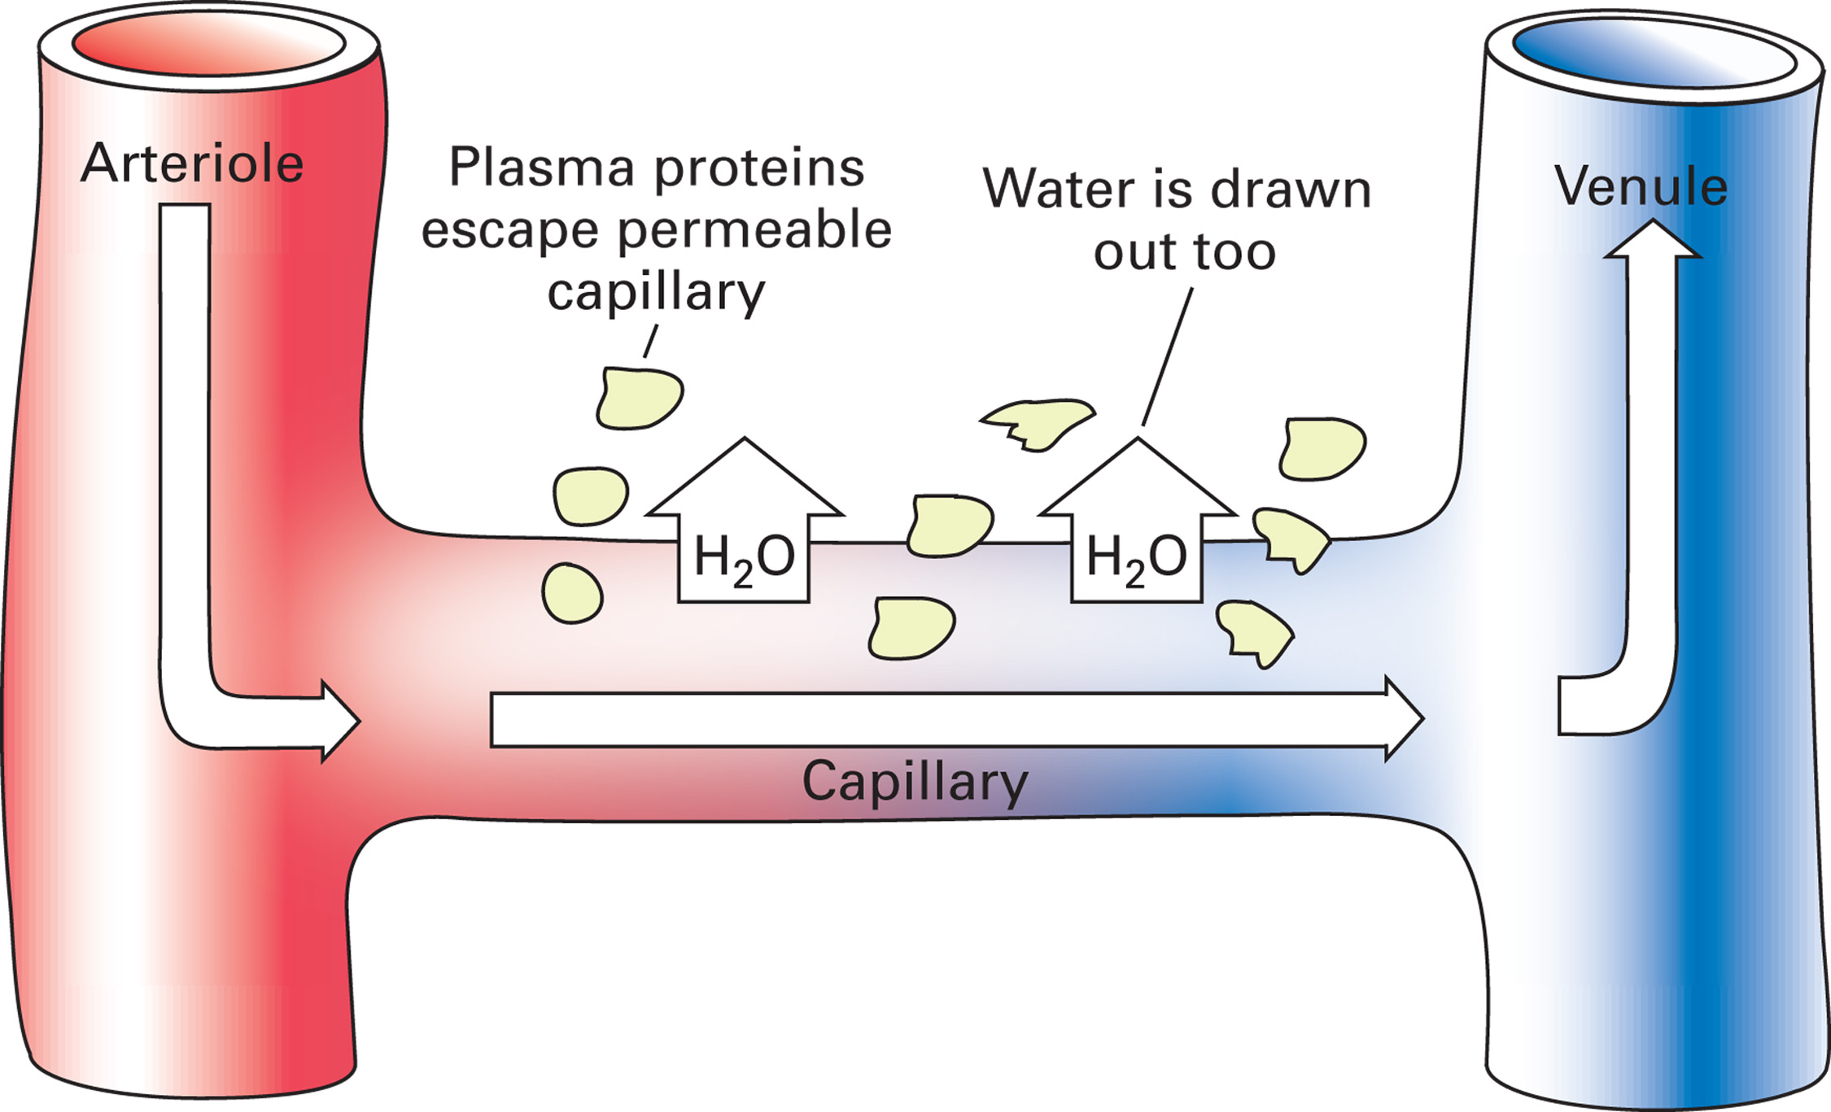
The Effects of Hydrostatic Pressure on a Vessel
Notes:
A significant increase in hydrostatic pressure in the arterioles may cause the blood in the capillaries to force fluid, mainly water, out through the capillary walls. This extra fluid accumulates in the tissues, causing edema (swelling). If this occurs in the lungs, then a condition known as pulmonary edema may develop.

Slide 88
Body Systems (36 of 54)
The Circulatory System
  Physiology of Circulation
    Perfusion
    Hypoperfusion
Notes:
Perfusion is the delivery of oxygen, glucose, and other nutrients to the cells of all organ systems and the elimination of carbon dioxide and other waste products that result from the constant adequate circulation of blood through the capillaries.
Shock, or hypoperfusion, is the insufficient supply of oxygen and other nutrients to some of the body’s cells and the inadequate elimination of carbon dioxide and other wastes that result from inadequate circulation of blood. It is a state of profound depression of the vital processes of the body.

Slide 89
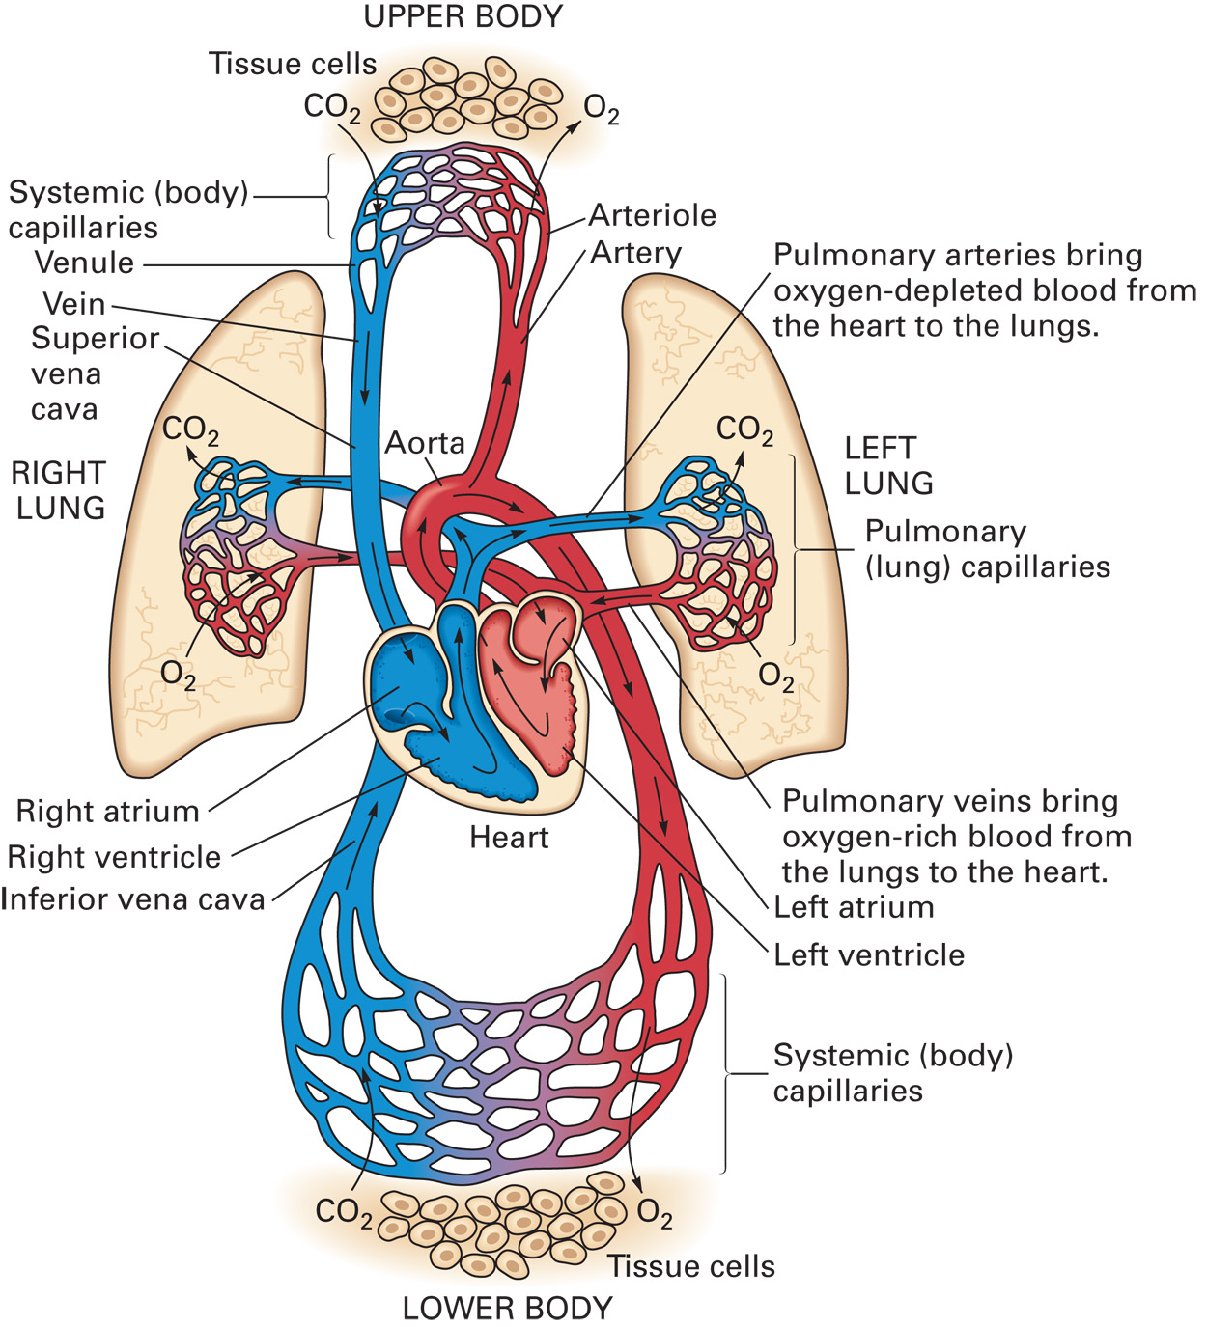
The Circulatory System and Tissue Perfusion

Slide 90
Body Systems (37 of 54)
The Circulatory System
  Transport of Gases in the Blood
    97 percent of oxygen is carried attached to hemoglobin.
    3 percent of oxygen is dissolved in plasma.
Notes:
The two most important gases the EMT is concerned with are oxygen and carbon dioxide. Cells require oxygen to function effectively and survive. Carbon dioxide is a waste product that must be carried away from the cells and eliminated by the lungs. An effective transport system must be in place to continuously deliver oxygen to the cells and eliminate carbon dioxide. Oxygen is carried in the blood in two ways, whereas carbon dioxide is carried in three ways. Oxygen is attached to hemoglobin and dissolved in plasma. About 97 percent of the oxygen carried in the blood is attached to the hemoglobin in the red blood cell. The remaining 3 percent, not enough to survive on alone, is dissolved in the blood plasma.

Slide 91
Body Systems (38 of 54)
The Circulatory System
  Transport of Gases in the Blood
    70 percent of carbon dioxide is carried in plasma in the form of bicarbonate.
    23 percent of carbon dioxide is attached to hemoglobin.
    7 percent of carbon dioxide is dissolved in plasma.
Notes:
Carbon dioxide is transported in the blood as bicarbonate, attached to hemoglobin, and dissolved in plasma. Approximately 70 percent of carbon dioxide is carried in the blood in the form of bicarbonate. The bicarbonate is formed when the carbon dioxide molecule enters the red blood cell and combines with water. The bicarbonate that results leaves the red blood cell and circulates in the blood. When the bicarbonate reaches the lungs, it re- enters the red blood cell, combines with hydrogen, and dissociates into carbon dioxide and water. The carbon dioxide leaves the red blood cell and is blown off by the lungs. Another 23 percent of carbon dioxide attaches to hemoglobin on the surface of the red blood cell. It attaches at a different site than the site where oxygen was attached. Once the blood reaches the lungs, the hemoglobin–carbon dioxide bond is broken and the carbon dioxide enters the alveoli and is exhaled from the lungs. Only 7 percent of carbon dioxide is carried in the blood dissolved in the plasma.

Slide 92
Body Systems (39 of 54)
The Circulatory System
  Transport of Gases in the Blood
    Cell metabolism
      Aerobic metabolism
      Anaerobic metabolism
Notes:
Cells require energy to survive. The main source of energy is glucose (a simple sugar molecule) that is metabolized inside the cell. In the ideal state, glucose metabolism occurs with adequate amounts of oxygen present. The metabolized glucose provides large amounts of energy for the cells to use. The final by-products of glucose metabolism are water, heat, and carbon dioxide. The carbon dioxide is transported away from the cell in one of the methods previously discussed and blown off by the lungs. This kind of metabolism is known as aerobic metabolism. Aerobic means “with oxygen.” Metabolism refers to chemical and physical changes that take place within the cells.
If oxygen is not available when the cell is metabolizing glucose, very little energy is produced for the cell and the end product is acid. Acid is bad for the body if it accumulates. This process of metabolizing glucose without producing much energy is known as anaerobic metabolism; anaerobic means “without oxygen.” If a patient is losing blood and very little oxygen is being delivered to the cells, very little energy is being produced.

Slide 93
Click on the Function That is Most Directly Affected by Systemic Vascular Resistance
A. Systolic blood pressure
B. Diastolic blood pressure
C. Heart rate
D. Heart rhythm

Slide 94
Case Study (6 of 7)
Kevin completes his primary assessment as Tom continues airway management and the assisting E M T continues to control bleeding. They package the patient and load him into the ambulance for transport. During the assessment, Kevin notices again how pale the patient’s skin is, and that it is cool and clammy to the touch.
Notes:
Discuss the findings in the case study with the class. Relate the skin findings to the changes brought about by suspected bleeding.

Slide 95
Case Study (7 of 7)
What about the patient’s situation could explain his decreased level of responsiveness?
What significance should the patient’s skin findings have for the EMTs?
Notes:
Allow the students time to dialogue about the answers.

Slide 96
Body Systems (40 of 54)
The Nervous System
  Functions
    Controls and maintains a state of awareness
    Transmits sensory stimuli to the brain
    Controls voluntary and involuntary motor function
    Controls body functions through the autonomic nervous system
Notes:
The nervous system controls the voluntary and involuntary activity of the human body. It enables the individual to be aware of and react to the environment. It also coordinates the responses of the body to stimuli and keeps body systems working together. Nerves carry impulses from tissues and organs to the nerve centers and from nerve centers to other tissues and organs.

Slide 97
Body Systems (41 of 54)
  The Nervous System
  Structural Divisions of the Nervous System
    Central nervous system
    Peripheral nervous system
Notes:
The nervous system is divided into two main structural divisions: the central nervous system and the peripheral nervous system. The central nervous system consists of the brain, which is located in the cranium, and the spinal cord, which is located in the spinal column The brain, which is the control center of the nervous system, is probably the most highly specialized organ in the body. It weighs about 3 pounds in the average adult, is richly supplied with blood vessels, and requires considerable oxygen to perform effectively. The brain does not store glucose and requires a constant supply. It has three main subdivisions: the cerebrum, the cerebellum, and the brainstem. A smaller subdivision of the brain, the pons, acts as a bridge that connects the three.
The spinal cord is about 18 inches long and is an extension of the brainstem. The major function of the spinal cord is conduction of nerve impulses. Many nerves enter and leave the spinal cord at different levels. These nerves all connect with nerve centers located in the brain or spinal cord.

Slide 98
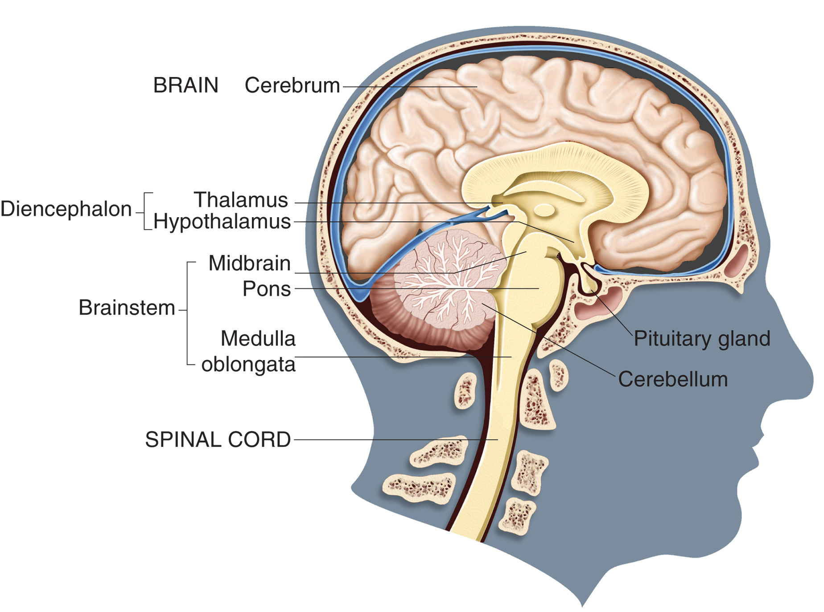
The Central Nervous System
Notes:
The cerebrum
Larger, outermost portion of the brain
Controls sensation, thought, memory
Initiates and manages conscious movements
The brainstem consists of mesencephalon, pons, medulla oblongata. The medulla has three major control centers
Respiratory
Cardiac
Vasomotor
The cerebellum
Located posteriorly and inferiorly
Coordinates muscle activity
Maintains balance with input from eyes and ears
The spinal cord
Extends from the brainstem
Conducts nerve impulses that enter and exit at different levels of the spinal cord

Slide 99
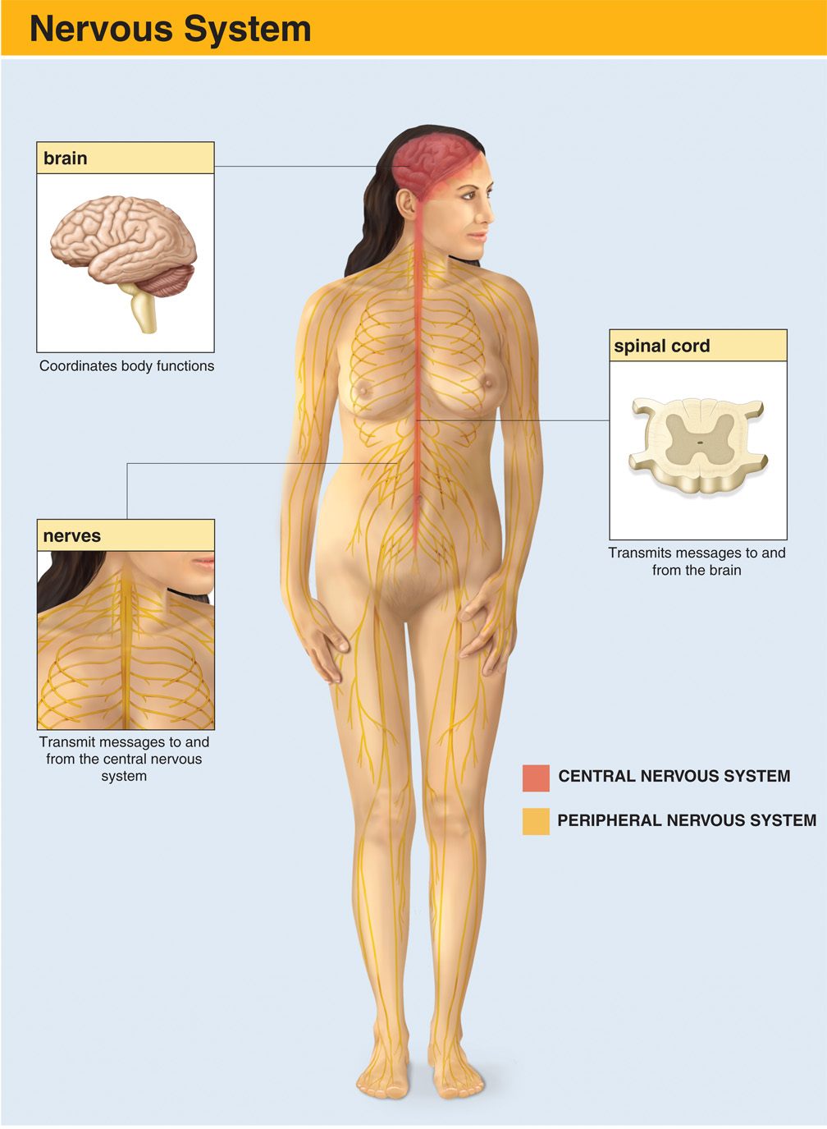
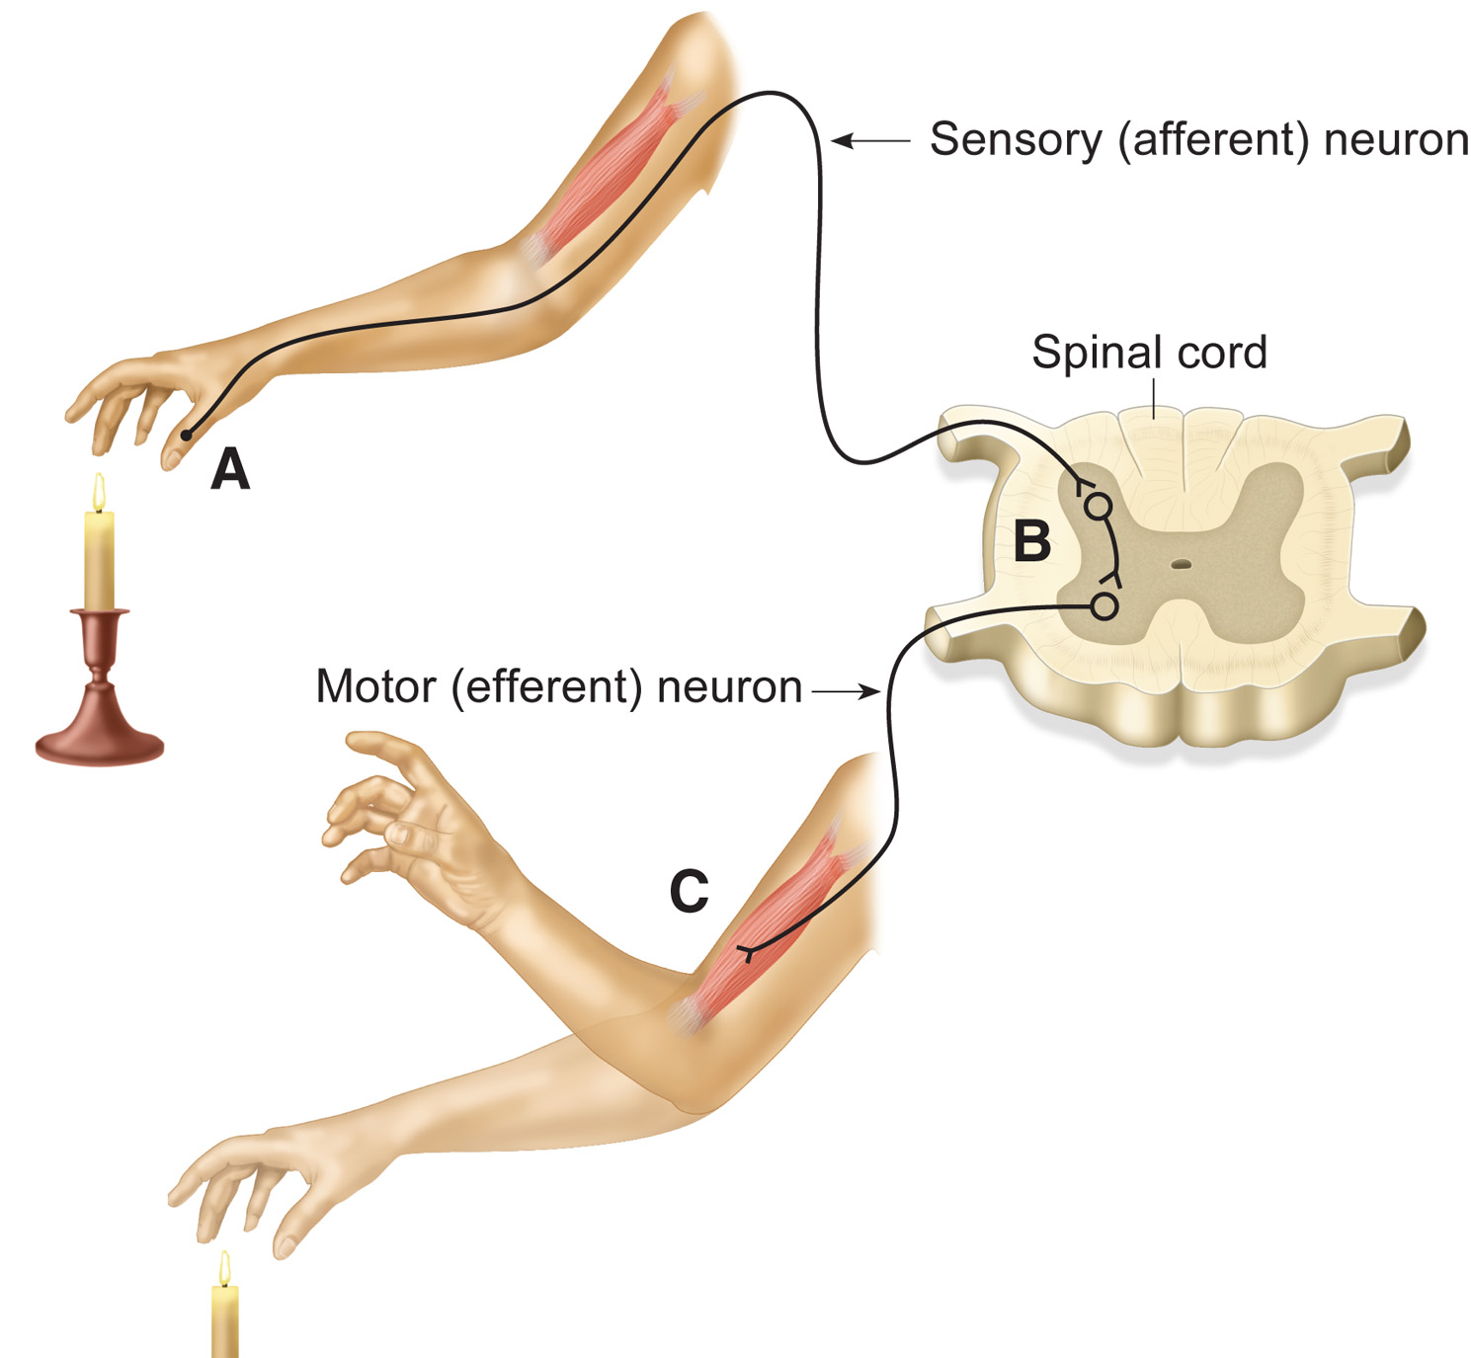
The Nervous System
Notes:
The peripheral nervous system is composed of the nerves located outside the spinal cord and brain. Afferent nerves carry sensory information from the body to the spinal cord and brain. Efferent nerves carry motor information from the brain and spinal cord to the body.
Afferent nerves carry sensory information from the body to the spinal cord and brain. Efferent nerves carry motor information from the brain and spinal cord to the body. The resulting circuit permits, for example, quick reflexive withdrawal from pain.

Slide 100
Body Systems (42 of 54)
The Nervous System
  Functional Divisions of the Nervous System
    The voluntary nervous system
    The autonomic nervous system
      Sympathetic
      Parasympathetic
Notes:
The functional divisions of the nervous system are the voluntary nervous system and the autonomic nervous system. The voluntary nervous system influences the activity of skeletal (voluntary) muscles and movements.
The autonomic nervous system, as its name implies, is automatic. It influences the activities of smooth (involuntary) muscles and glands. It is partly independent of the rest of the nervous system.
The autonomic nervous system is divided into the sympathetic nervous system and the parasympathetic nervous system. The sympathetic nervous system is activated when the body is challenged by stressors: trauma, blood loss, fright, and so on. Its actions are commonly known as the “fight-or-flight” response. The parasympathetic nervous system returns body processes to normal or depresses body function.

Slide 101
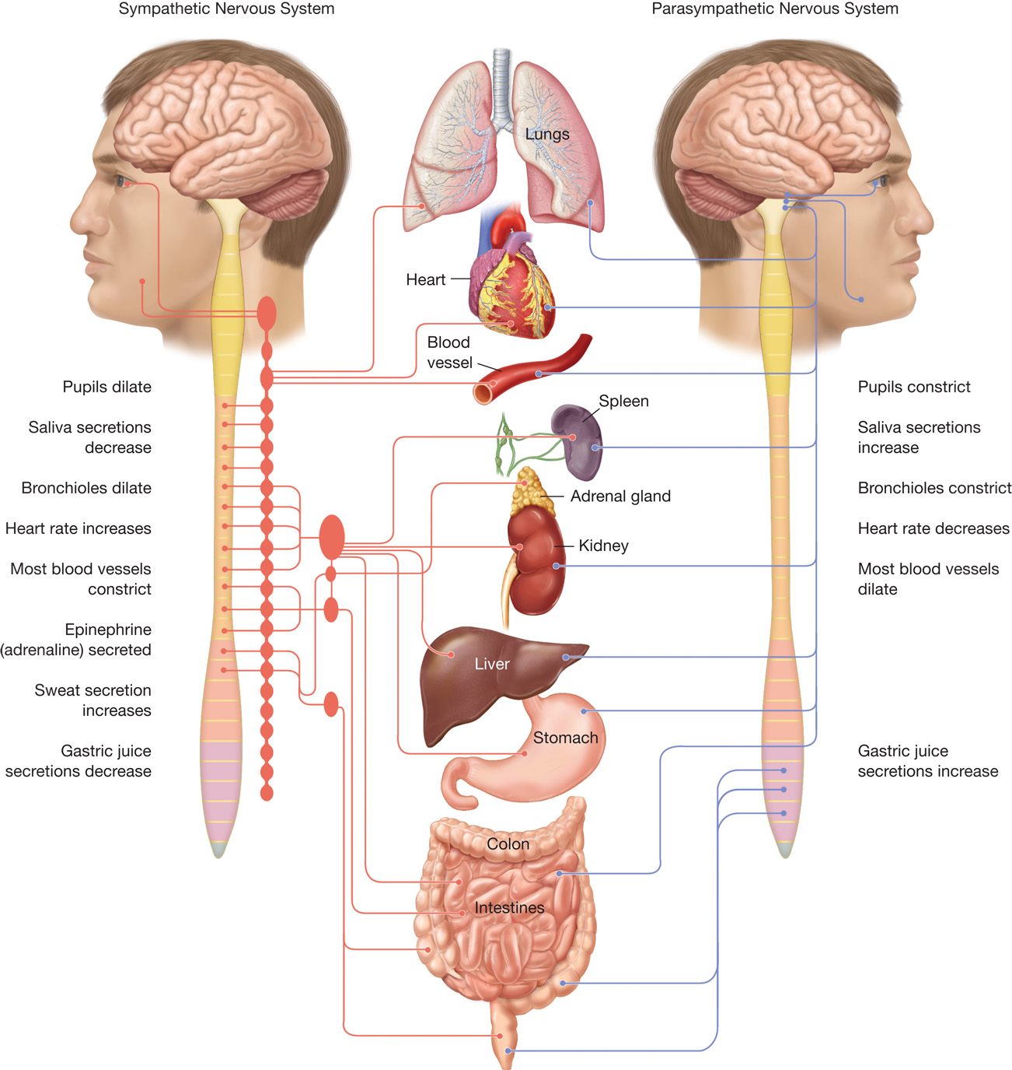
The Effects of the Sympathetic and Parasympathetic Nervous Systems on Organs

Slide 102
Body Systems (43 of 54)
The Nervous System
  Consciousness and Unconsciousness
    Relies on the cerebral hemispheres and Reticular Activating System (R A\S).
    The R A S is a group of nerves in the brainstem.
    Unconsciousness results if the R A S or both cerebral hemispheres are not functioning properly.
Notes:
Consciousness.
For the patient to be in a conscious or awake state, the RAS and at least one
Unconsciousness.
If either the RAS or both cerebral hemispheres are damaged or not functioning properly, the patient will no longer be in an awake state, or conscious
Teaching Point:
Typically, metabolic or perfusion derangements (for example hypoglycemia, hypoxia, hypotension, toxicity, overdose) cause the hemispheres to fail, leading to findings of symmetry. Additionally, when the problem is a space occupying lesion (hematoma, penetration, tumor, stroke), the brainstem starts to fail and it also affects the RAS network, these patients typically have findings of asymmetry.

Slide 103
Body Systems (44 of 54)
The Endocrine System
  Made up of ductless glands that secrete hormones to regulate body functions
    Hormones affect numerous functions.
Notes:
The endocrine system is made up of ductless glands, the body’s regulators. Secretions from these glands are called hormones, chemical substances that have effects on the activity of certain organs. Hormones are carried by the bloodstream to all parts of the body, affecting physical strength, mental ability, build, stature, reproduction, hair growth, voice pitch, and behavior. How people think, act, and feel depends largely on these secretions.
The endocrine glands discharge secretions directly into the bloodstream. Good health depends on a well- balanced output of hormones. Endocrine imbalance yields profound changes in growth and serious changes entail emotional, physical, and sexual behavior.

Slide 104
Body Systems (45 of 54)
  The Endocrine System
  Endocrine Glands
    Pineal
    Thyroid and Parathyroid
    Adrenal
    Gonads (ovaries and testes)
    Islets of Langerhans
    Pituitary gland
    Thymus gland
Notes:
The pineal gland is a small gland located superior and posterior to the thalamus. The pineal gland produces the hormone melatonin, which inhibits the functions of the reproductive system.
The thyroid gland, which is in the anterior neck, regulates metabolism, growth and development, and the activity of the nervous system.
The parathyroid glands, behind the thyroid, produce a hormone necessary for the metabolism of calcium and phosphorus in the bones.
The adrenal glands, which sit atop the kidneys, secrete epinephrine (adrenaline) and norepinephrine, postpone muscle fatigue, increase the storage of sugar, control kidney function, and regulate the metabolism of salt and water.
The gonads (ovaries and testes) produce the hormones that govern reproduction and sex characteristics.
The islets of Langerhans, which are in the pancreas, make insulin, which allows glucose (sugar) to enter cells and produce glucagon, a hormone that raises the glucose level in the blood.
The pituitary gland, which is at the base of the brain, is the “master gland.” It regulates growth, the thyroid, parathyroid glands, the pancreas, the gonads, metabolism of fatty acids, some basic proteins, blood sugar reactions, and urinary excretion.
The thymus gland, which is in the neck superior to the heart, secretes the hormone thymosin. Thymosin influences the development and maturation of the immune system.

Slide 105
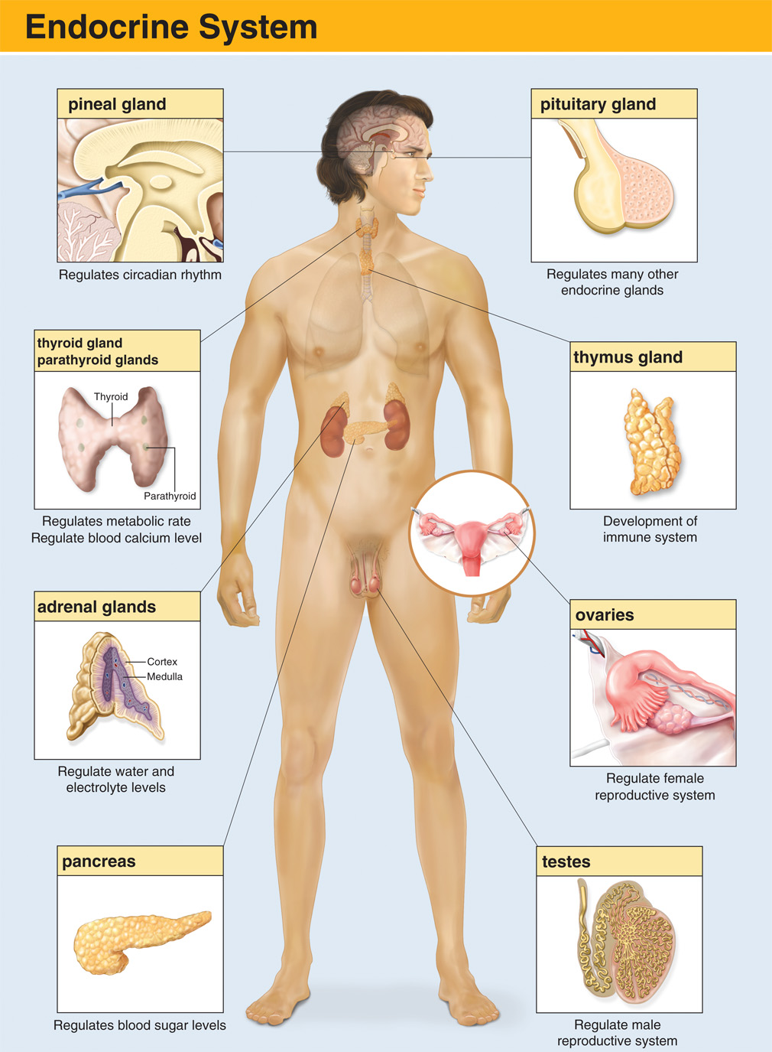
The Endocrine System
Notes:
Discussion Question
What are some examples of endocrine glands?
Points to Emphasize
The endocrine system consists of ductless glands that secrete hormones that travel through the blood to target organs to cause a change in those organs' functions. For example, the pancreas secretes insulin, which regulates blood glucose levels.
Critical Thinking Discussion
What is the relationship among the nervous, circulatory, and respiratory systems? How does the endocrine system interact with these systems?

Slide 106
Body Systems (46 of 54)
The Endocrine System
  Epinephrine and Norepinephrine
    Epinephrine (adrenalin) and norepinephrine are secreted by the adrenal gland.
    They produce many of the signs and symptoms of sympathetic nervous system stimulation.
Notes:
Epinephrine, also known as adrenaline, and norepinephrine are two hormones secreted by the adrenal gland. These hormones produce many of the signs and symptoms seen in patients when the sympathetic nervous system is stimulated. To understand the signs and symptoms that are produced, you must first understand the basics of the four effects - alpha1, alpha2, beta1, and beta2 - activated by these hormones.
Norepinephrine has mostly alpha₁ and alpha₂ properties, with lesser beta₁ and beta₂ properties.
The primary effects of norepinephrine are on the blood vessels.

Slide 107
Body Systems (47 of 54)
Four basic effects
  Alpha₁
  Alpha₂
  Beta₁
  Beta₂
Notes:
The body produces epinephrine and norepinephrine to help compensate for shock. Use the signs and symptoms of their effects to recognize patients with serious conditions. Some drugs administered by EMTs have alpha and beta effects. Here is a description for each receptor site and the corresponding action:
Alpha₁
Vasoconstriction, which makes skin cool and pale
Increased sweat production, which makes skin clammy or moist
Alpha₂
Regulates alpha₁ effects
Beta₁
Increased heart rate, contractility, and speed of cardiac electrical conduction
Beta₂
Smooth muscle relaxation
Dilates bronchioles and blood vessels
Point to Emphasize
An easy way to remember this is that there is “One heart and two lungs”, meaning Beta1 is in the heart, and Beta2 is in the lungs. Epinephrine has alpha₁, alpha₂, beta₁, and beta₂ properties. As such, epinephrine as a drug can be used to treat severe allergic reactions, which cause vasodilation and bronchoconstriction.

Slide 108
Body Systems (48 of 54)
Integumentary System
  The integumentary system separates the body from the outside environment.
  Functions
    Protect the body
    Regulate core temperature
    Serve as a receptor of external stimuli
    Aid in regulation of water and electrolytes
Notes:
All the various tissues, organs, and systems that make up the human body are separated from the outside environment by the skin, which is also known as the integumentary system. The skin has the following functions:
Protecting the body from the environment, bacteria, and other foreign organisms
Regulating the temperature of the body
Serving as a receptor for heat, cold, touch, pain, and pressure
Aiding in the regulation of water and electrolytes (sodium and chloride)

Slide 109
Body Systems (49 of 54)
  Integumentary System
  Layers
    Epidermis
    Dermis
    Subcutaneous
Notes:
The skin has three layers: the epidermis, the dermis, and a subcutaneous layer. The epidermis, or outermost layer of skin, is composed of four layers of cells. The outer two layers are dying and dead cells that are sloughed off as new cells replace them. The skin’s pigmentation—the melanin—is in the deepest layers of the epidermis.
The dermis, or second layer of the skin, is much thicker than the epidermis. It contains the vast network of blood vessels that supply the skin as well as the hair follicles, sweat glands, oil glands, and sensory nerves. Composed of dense connective tissue, the dermis gives the skin its elasticity and strength.
Just below the dermis is a layer of fatty tissue called the subcutaneous layer, or subcutaneous connective tissue. It varies in thickness, depending on what part of the body it covers. Subcutaneous tissue of the eyelids, for example, is thin, but that of the abdomen and buttocks is thick.

Slide 110
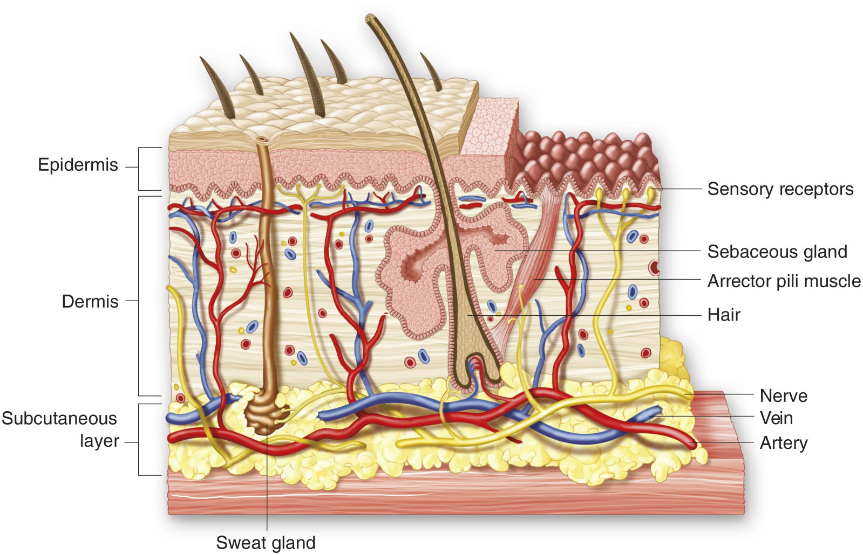
Anatomy of the Skin
Notes:
Identify the layers of the skin and review the main structures and their function that are found in the dermal layer.

Slide 111
Body Systems (50 of 54)
Digestive System
  Consists of the alimentary tract and accessory organs
  Functions to ingest and allow absorption of nutrients and eliminate wastes
Notes:
The digestive system is composed of the alimentary tract (the passage through which food travels) and the accessory organs (organs that help prepare food for absorption and use by tissues of the body). The main functions of the digestive system are to ingest and carry food so that absorption can occur and waste can be eliminated.

Slide 112
Body Systems (51 of 54)
  Digestive System
  Structures
    Stomach
    Pancreas
    Liver and gallbladder
    Spleen
    Small and large intestine
    Rectum and anus
Notes:
Review the location of these in the abdominal cavity and stress that these are hollow organs. The next slide provides definitions and locations for these structures.

Slide 113
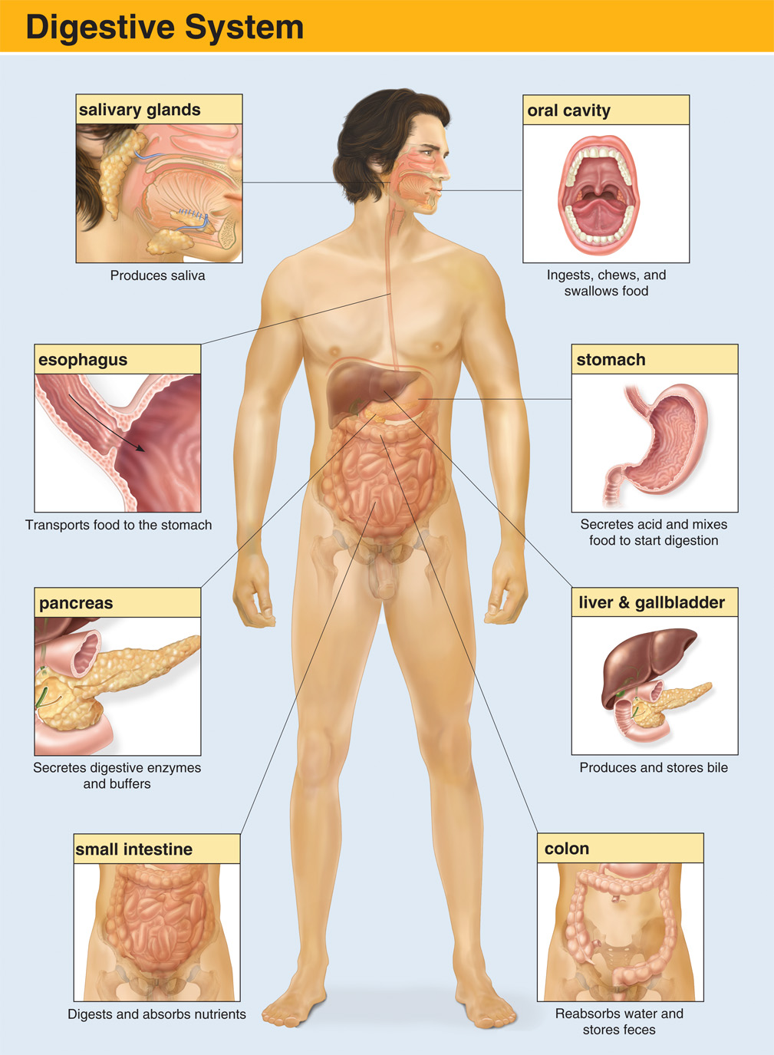
The Digestive System
Notes:
Points to Emphasize
There are many interrelated components for the GI system to work properly. The overall purpose of the GI system is to extract nutrients from diet and eliminate what’s not necessary.
Teaching Tips
Ask students tor repeat the correct pronunciation of anatomical structures.

Slide 114
Body Systems (52 of 54)
Digestive System
  Digestive Process
    Two processes
      Mechanical digestion
      Chemical digestion
Notes:
Digestion consists of two processes—one mechanical and the other chemical. The mechanical process includes chewing, swallowing, peristalsis (the rhythmic movement of matter through the digestive tract), and defecation (the elimination of digestive wastes). The chemical process of digestion occurs when enzymes, or digestive juices, break foods down into simple components that can be absorbed and used by the body. Carbohydrates are converted into glucose (simple sugar), fats are changed into fatty acids, and proteins are converted into amino acids.

Slide 115
Body Systems (53 of 54)
The Urinary or Renal System
  Filters and excretes wastes to maintain balance of water and other substances
  Main structures
    Kidneys
    Ureters
    Urinary bladder
    Urethra
Notes:
The urinary system or renal system filters and excretes wastes from the blood. It consists of two kidneys, which filter waste from the bloodstream and help control fluid balance; two ureters, which carry the wastes from the kidneys to the bladder; one urinary bladder, which stores the urine prior to excretion; and one urethra, which carries the urine from the bladder out of the body. The kidneys also play an important role in blood pressure regulation and red blood cell production.
The urinary system helps the body maintain its delicate balance of water and various chemicals in the proportions needed for health and survival. During the process of urine formation, wastes are removed from the circulating blood for elimination, and useful products are returned to the blood. Kidney function also helps to maintain a normal acid–base balance in the body.

Slide 116
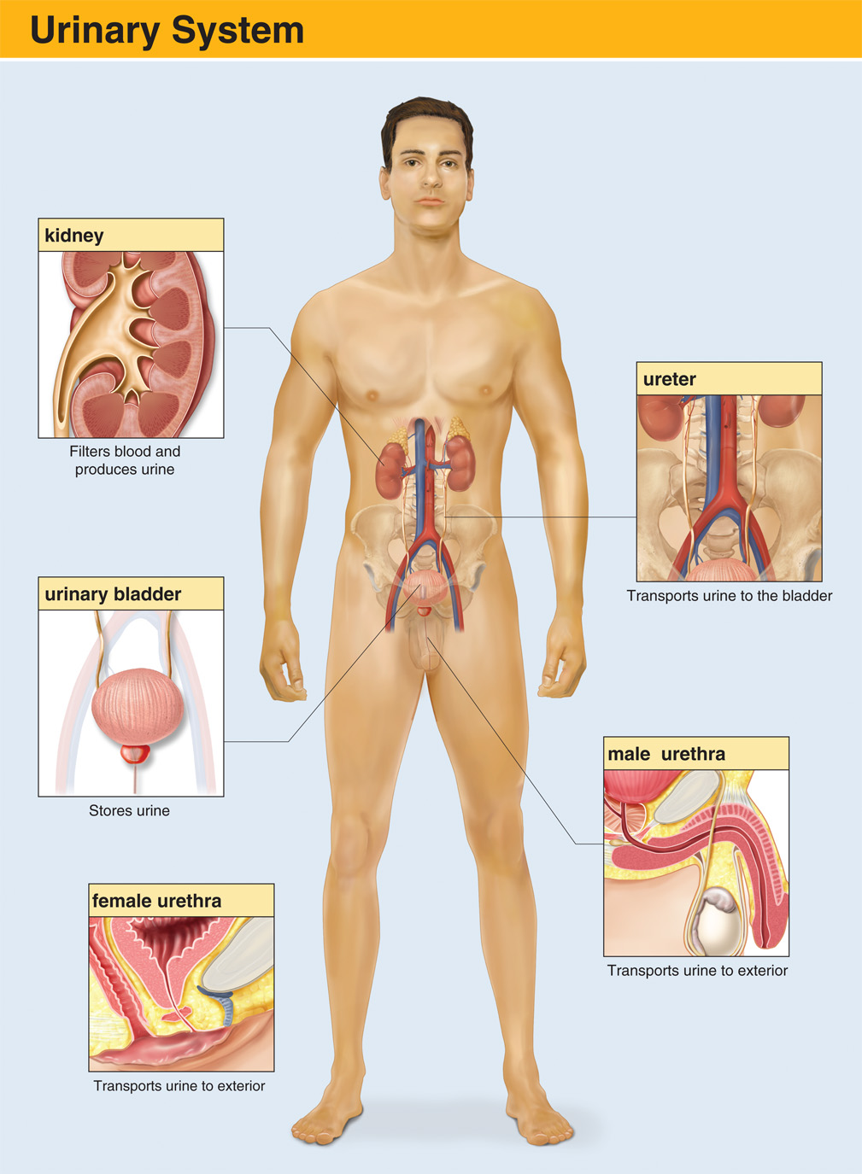
The Urinary System
Notes:
Points to Emphasize
The urinary, or renal, system regulates water and balance of important chemicals in the body, and eliminates wastes filtered from the blood by the kidneys.
Teaching Tips
Ask students tor repeat the correct pronunciation of anatomical structures.

Slide 117
Body Systems (54 of 54)
The Reproductive System
  The male’s sperm and the female’s ovum contribute the genes that determine the hereditary characteristics of an offspring.
  A fertilized ovum grows into an embryo, then into a fetus, and finally into a newborn baby.
Notes:
The reproductive system of women and men consists of complementary organs that can function to accomplish human reproduction. The male’s sperm and the female’s ovum contribute the genes that determine the hereditary characteristics of an offspring. A combination of a single sperm with a single ovum forms a fertilized ovum, which can grow into an embryo, then into a fetus, and finally into a newborn baby.

Slide 118
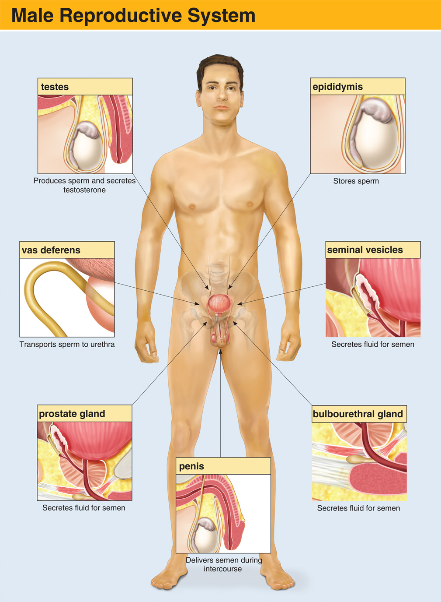
The Male Reproductive System
Notes:
The reproductive system of the male includes two testes, a duct system, accessory glands (including the prostate gland), and the penis. The testes are responsible for the production of testosterone, the primary male hormone.

Slide 119
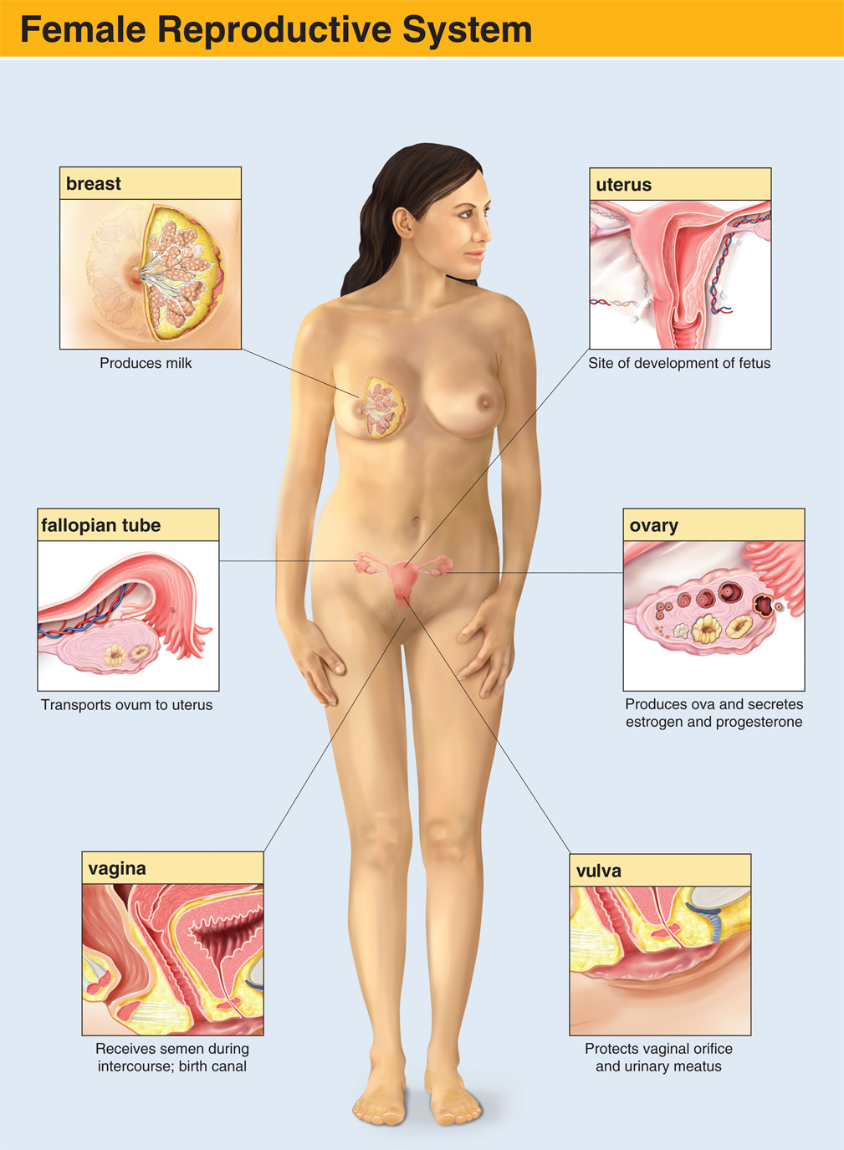
The Female Reproductive System
Notes:
The female reproductive system consists of two ovaries, two fallopian tubes, the uterus, the vagina, and the external genitals. The ovaries produce and secrete estrogen and progesterone, the primary female hormones.

Slide 120
Medical Terminology (1 of 2)
Specialized language, used in all fields of medicine.
Complex words can be simplified with an understanding of combining forms, suffixes, and prefixes.
Notes:
Points to Emphasize
Understanding medical terminology is critical to understanding lectures, reading, and communications with other health care providers.
Using proper medical terminology enhances your professional presentation.
Parts of medical terms include prefixes, suffixes, and combining forms.
The combining form gives the term its basic meaning. Prefixes and suffixes modify the meaning.
Vowels are sometimes added to make terms pronounceable.

Slide 121
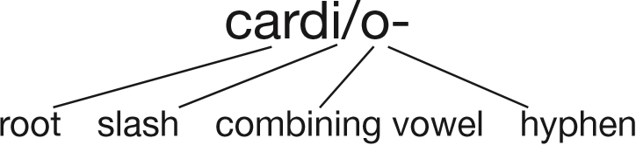
Medical Terminology (2 of 2)
Table 7-1 How to Break Down and Understand Medical Terms: Some Examples
Prefix | Combining Form | Suffix | Medical Word | Meaning
hypo- (below normal) | vol/o- (volume) | -emic (pertaining to the blood) | hypovolemic | Pertaining to a below-normal volume of blood
hyper- (above normal) | glyc/o- (glucose, sugar) | -emia (condition of the blood) | hyperglycemia | Condition of an above-normal blood glucose (sugar) level
a- (without, no) | pne/o- (breathing) | -a (condition) | apnea | Condition of no breathing (absence of breathing)
tachy- (fast) | cardi/o- (heart) | -ia (condition) | tachycardia | Condition of a fast heart rate
brady- (slow) | pne/o- (breathing) | -a (condition) | bradypnea | Condition of a slow breathing rate
Notes:
Class Activities
Have groups of students select medical terms from the glossary in the text or from a medical dictionary and break them down for the class.
Divide into three groups. One group will be assigned the list of prefixes in the text, one will be assigned combining forms, and one will be assigned suffixes. The first group will call out a prefix, the second will add to it by calling out a combining form, and the third group will complete the term by calling out a suffix. Write each term on the board and discuss it. Be sure to indicate if the term is a legitimate medical term or just a fun term created by the exercise.
Teaching Tips
Give examples of medical terms using the lists of prefixes, suffixes, and combining forms in the book.
Discussion Questions
What are the benefits of understanding medical terminology?
What are some medical terms you found interesting in your reading?
Knowledge Application
Given a passage in the text, students should be able to determine the meaning of medical terms.

Slide 122
Case Study Conclusion (1 of 2)
Kevin and Tom began transporting the patient to the closest hospital, 30 minutes away, and requested a paramedic intercept en route, as well as notifying the hospital of the patient’s condition.
Notes:
Follow-Up
Answer student questions.
Follow-Up Assignments
Review Chapter 7 Summary.
Complete Chapter 7 In Review questions.
Complete Chapter 7 Critical Thinking questions.
Assessments
Handouts
Chapter 7 quiz

Slide 123
Case Study Conclusion (2 of 2)
Upon reaching the hospital, surgeons immediately took the patient to the operating room, where they spent several hours repairing damage to the patient’s liver, lung, femoral vein, and several blood vessels in the chest.
Notes:
Follow-Up
Answer student questions.
Follow-Up Assignments
Review Chapter 7 Summary.
Complete Chapter 7 In Review questions.
Complete Chapter 7 Critical Thinking questions.
Assessments
Handouts
Chapter 7 quiz

Slide 124
Lesson Summary
Knowledge of anatomy and physiology helps with understanding patients’ signs and symptoms and the treatments E M Ts provide.
Anatomical terms and planes provide points of reference for describing assessment findings.
Medical terms make up the specialized language shared by health care professionals.
Notes:
Teaching Tips
Answers to In Review questions are in the appendix of the text. Advise students to review the questions again as they study the chapter.

Slide 125
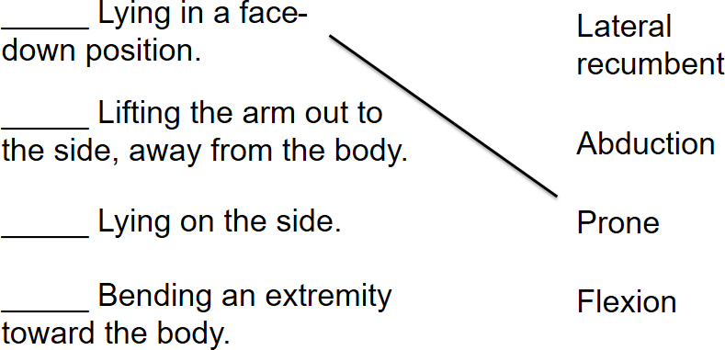
Prone
Click here to return to the quiz.

Slide 126

Abduction
Click here to return to the quiz.

Slide 127

Lateral Recumbent
Click here to return to the quiz.

Slide 128

Flexion
Click here to return to the quiz.

Slide 129
Correct!
Diastolic blood pressure is a function of systemic vascular resistance. Systemic vascular resistance is a function of the degree of constriction of the blood vessels. The greater the degree of constriction, the greater the force of blood within the vascular system between contractions of the left ventricle.
Click here to return to the program.

Slide 130
Incorrect
Click here to return to the quiz.

Slide 131

Copyright

