Slide 1

Prehospital: Emergency Care
Eleventh Edition
Chapter 6
Lifting and Moving Patients
Slides in this presentation contain hyperlinks. JAWS users should be able to get a list of links by using INSERT+F7
Copyright © 2018, 2014, 2010 Pearson Education, Inc. All Rights Reserved
Notes:
If this PowerPoint presentation contains mathematical equations, you may need to check that your computer has the following installed:
1) MathType Plugin
2) Math Player (free versions available)
3) NVDA Reader (free versions available)
Advance Preparation
Student Readiness
Assign the associated section of MyBRADYLab and review student scores. Review the chapter material in the Instructor Resources, which includes Student Handouts, PowerPoint slides, and the MyTest Program.
Prepare
Arrange to have various devices for lifting and moving patients available for demonstration.
Arrange to have an ambulance present at the class location to demonstrate the use of the wheeled stretcher.
Ask a physical therapist from a hospital or private practice to speak on body mechanics.
Obtain one or more assistant instructors to assist you in demonstrating moves and use of equipment.
The total teaching time recommended is only a guideline. Take into consideration factors such as the pace at which students learn, the size of the class, breaks, and classroom activities. The actual time devoted to teaching objectives is the responsibility of the instructor.

Slide 2
Learning Readiness
E M S Education Standards, text p. 101.
Chapter Objectives, text p. 101.
Key Terms, text p. 101.
Purpose of lecture presentation versus textbook reading assignments.
Notes:
Explain to students what the National EMS Education Standards are. The National EMS Education Standards communicate the expectations of entry-level EMS providers. As EMTs, students will be expected to be competent in these areas. Acknowledge that the Standards are broad, general statements. Although this lesson addresses the listed competencies, the competencies are often complex and require completion of more than one lesson to accomplish. The student is also expected to review the chapter objectives to foreshadow what will be in the chapter, and by mastering the key terms the EMT student will better understand the learning and be able to communicate more clearly.
Additionally, explain to the students that the purpose of using these slides is to help keep the instructor focused on highlighting important portions of the material, explain interrelationships of topics, and discuss how to apply this information. It’s not the intent of the presentation (or slides alone) to include every component in the chapter. This presentation still requires the student to thoroughly read the chapter.

Slide 3
Setting the Stage
Overview of Lesson Topics
  Body Mechanics for Safe Lifting
  General Guidelines for Lifting & Moving
  Lifting and Moving Patients
  Packaging for Transportation
  General Guidelines for Carrying a Patient Using a Backboard, Portable Stretcher, or Flexible Stretcher
Notes:
These bulleted points are the major headings from the chapter, in order. The purpose is to provide a basic lecture navigation for the student.

Slide 4
Case Study Introduction
E M T s Brett and Annie have just arrived on the scene of a 60-year-old man who injured his neck and back when he fell down 12 wooden steps, landing on a concrete floor. As they provide spine motion restriction precautions and conduct their assessment, Brett estimates that the patient, who is over six feet tall, weighs about 260 pounds. The patient complains of numbness to his arms and legs, and a sharp neck pain.
Notes:
Case Study
Present the Case Study Introduction provided in the PowerPoint slide set.
Lead a discussion using the case study questions provided on the subsequent slide(s).
The Case Study with discussion questions continues throughout the PowerPoint presentation.
Case Study Discussion
Use the case study content and questions to foreshadow the upcoming lesson content.

Slide 5
Case Study (1 of 3)
What factors should Brett and Annie consider in deciding how to get the patient from the basement into the ambulance?
Notes:
Case Study Discussion
Use the case study content and questions to foreshadow the upcoming lesson content. Gauge the student’s responses as a guide of how well versed they are in this topic.

Slide 6
Introduction
Nearly every E M S call requires lifting and moving patients.
Improper lifting and moving can lead to E M T and patient injuries.
E M T s can take a number of measures to reduce the risk of injury.
Notes:
Introduction
During this lesson, students will learn about the equipment and techniques necessary to provide safe lifting and moving of patients.

Slide 7
Body Mechanics for Safe Lifting (1 of 8)
Four Basic Body Mechanics
  These are efficient methods of using the body to gain a mechanical advantage.
  Using good mechanics will minimize injury.
Notes:
As an EMT, you’re required to lift and carry patients and heavy equipment. If you perform these tasks improperly, bodily injury, strain, and lifelong pain can result. With conscious planning, good health, and skill, you can perform these tasks with minimum risk to yourself. Apply the principles and techniques of proper lifting and moving every day. Practice often enough for them to become automatic. Make them a habit that increases your safety and performance—even in the most stressful emergency situations.

Slide 8
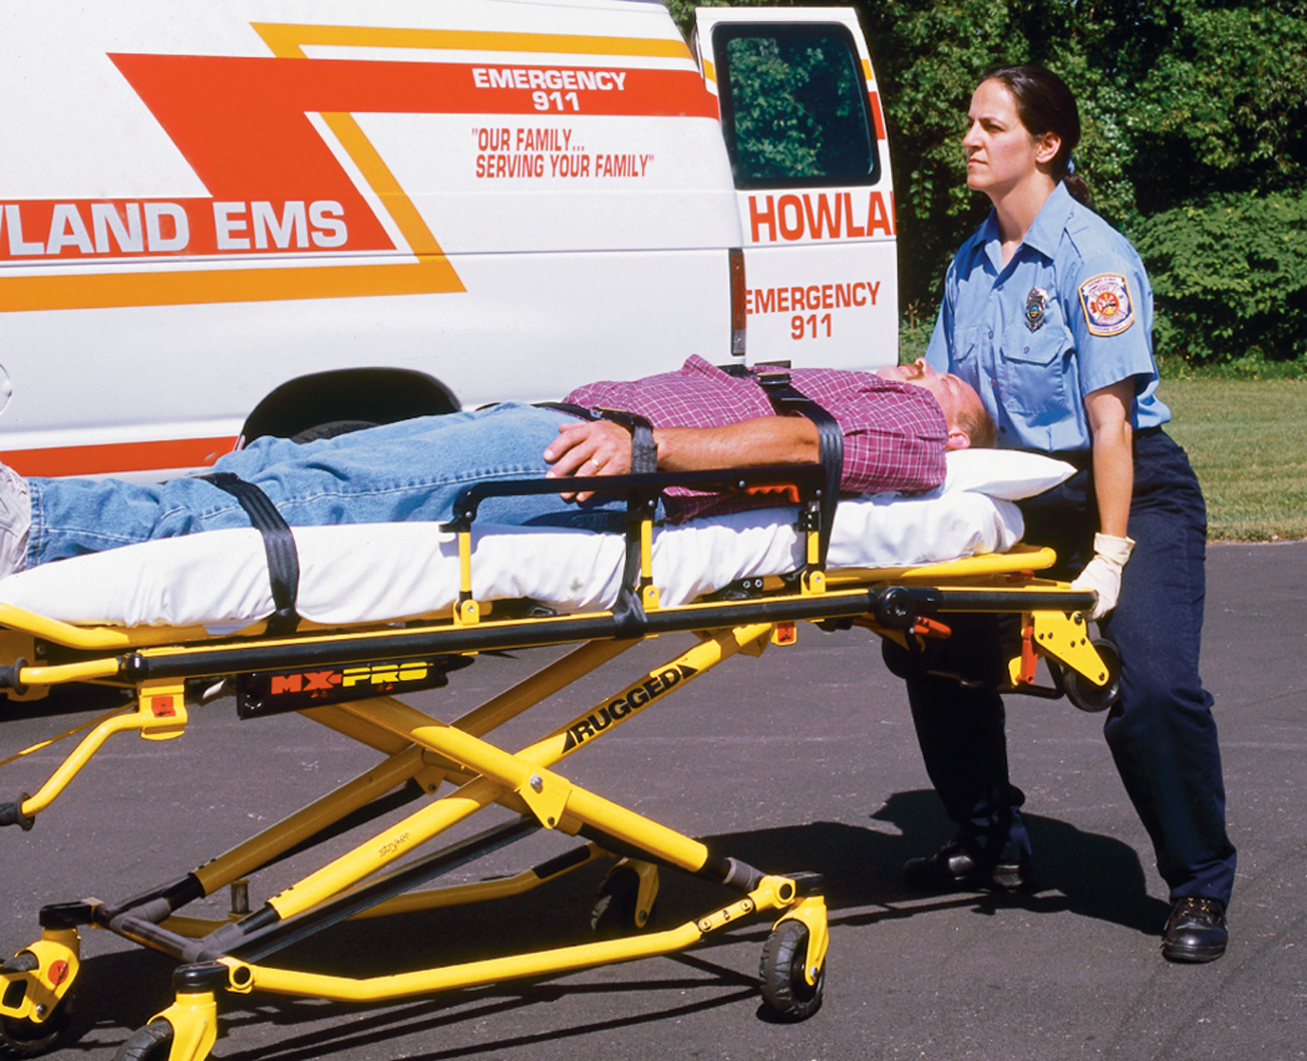
Body Mechanics for Safe Lifting (2 of 8)
  Four Basic Body Mechanics
  Keep the weight of the object as close to the body as possible
  Use the leg, hip, and gluteal muscles when lifting
Notes:
Keep the weight of the object as close to the body as possible. Back injury is much more likely to occur while reaching a great distance to lift a light object than while reaching a short distance to lift a heavy object.
To move a heavy object, use the leg, hip, and gluteal (buttocks) muscles plus contracted abdominal muscles. The use of these muscles will help you generate a huge amount of power safely. Always avoid using back muscles to move a heavy object.
Teaching Tips
Use a ball or book to demonstrate the four principles of good body mechanics.
Discussion Question
What are the four principles of good body mechanics?

Slide 9
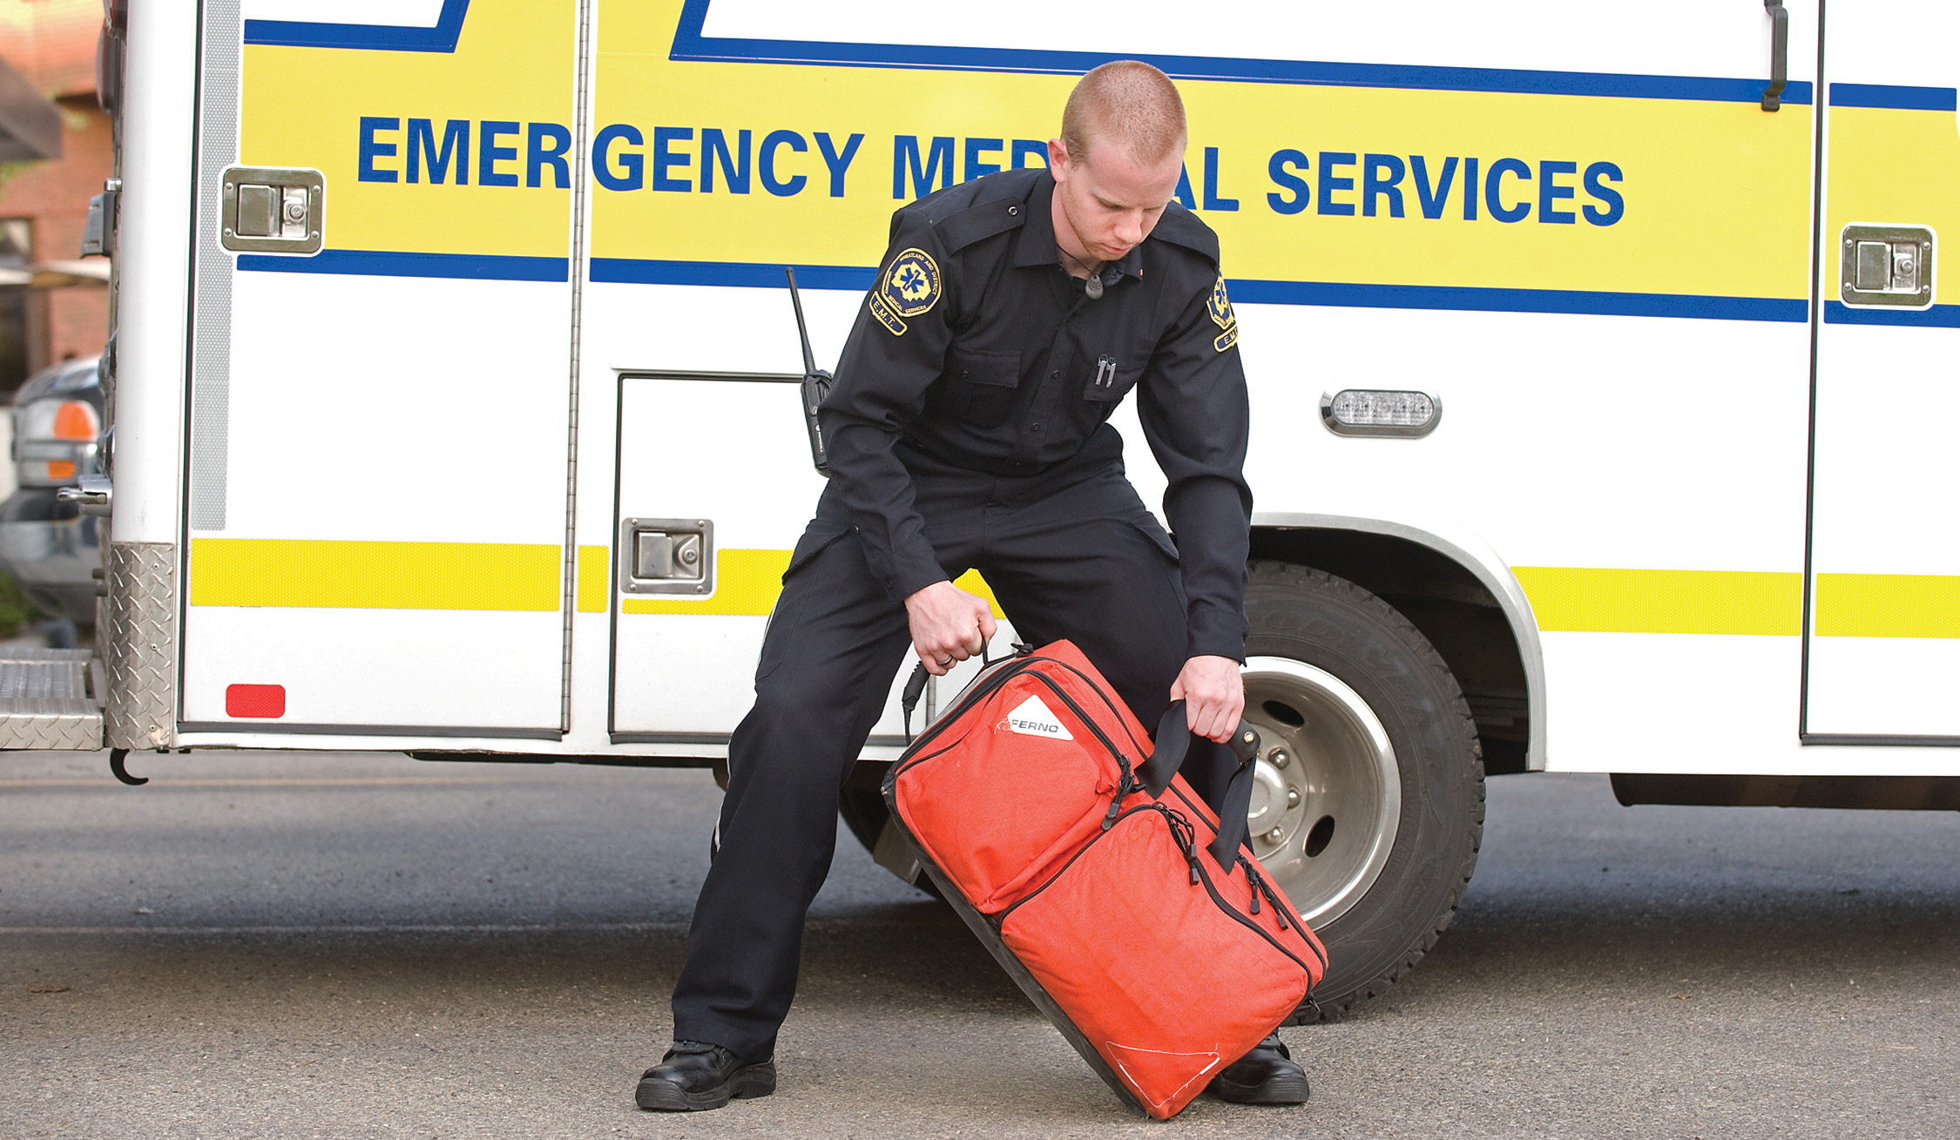
Body Mechanics for Safe Lifting (3 of 8)
  Four Basic Body Mechanics
  “Stack” the shoulders, hips, and feet
  Reduce the height or distance through which the object must be moved
Notes:
3) “Stack.” Visualize the shoulders stacked on top of the hips, and the hips stacked on top of the feet (base). Then move them as a unit. If any of the three are not aligned with the others, you can create twisting forces that are potentially harmful to the lower back.
4) Reduce the height or distance through which the object must be moved. Get closer to the object or reposition it before lifting. Lift in stages if necessary.
Teaching Tips
Use a ball or book to demonstrate the four principles of good body mechanics.
Discussion Question
What are the four principles of good body mechanics?

Slide 10
Body Mechanics for Safe Lifting (4 of 8)
Apply the principles of body mechanics to lifting, carrying, moving, reaching, pushing, and pulling.
  Keep the spine in alignment.
  Whenever possible, substitute equipment for manual force.
Notes:
Lifting, carrying, moving, reaching, pushing, and pulling are all activities to which proper body mechanics should be applied. One important key to preventing injury is correct alignment of the spine. Maintaining a normal inward curve in the lower back significantly reduces the potential for spinal injury. Keeping wrists and knees in normal alignment can also help to prevent injury of the extremities. In addition, whenever possible, substitute equipment for manual force.

Slide 11
Body Mechanics for Safe Lifting (5 of 8)
Posture and Fitness
  Poor posture and fitness can fatigue back and abdominal muscles, increasing the risk of injury.
    Lordosis
    Kyphosis
  Always be aware of your posture.
Notes:
One extreme of poor posture is the swayback, or excessive lordosis. In this posture the stomach is too anterior and the buttocks are too posterior, causing excessive stress on the lumbar region of the back. Another extreme is the slouch, or excessive kyphosis. In this posture, the shoulders are rolled forward, which results in fatigue of the lower back and increases pressure on every region of the spine.
Points to Emphasize
Good posture and physical fitness are keys to good body mechanics and avoiding injury.
Critical Thinking Discussion
How can you apply the principles of good body mechanics in everyday life?
Teaching Tips
Demonstrate proper posture.

Slide 12
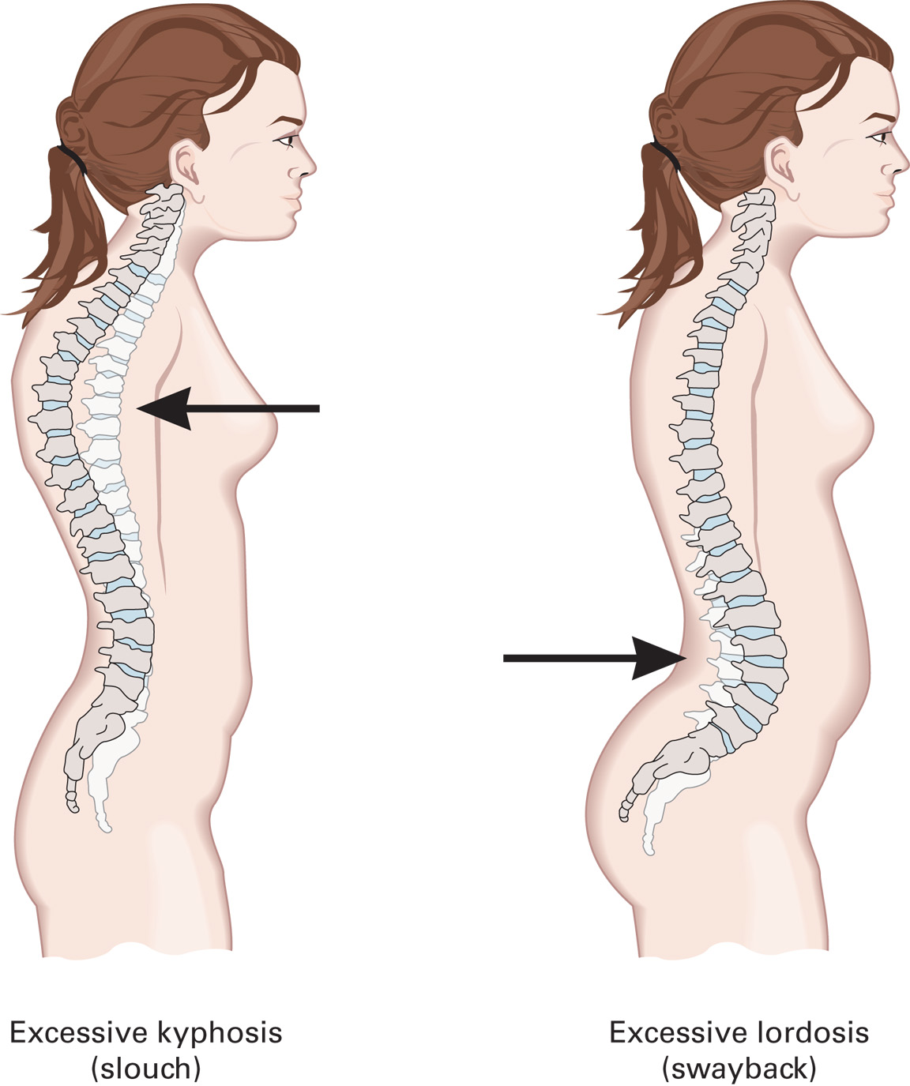
Extremes of Poor Posture are Excessive Lordosis (Swayback) and Excessive Kyphosis (Slouch)

Slide 13
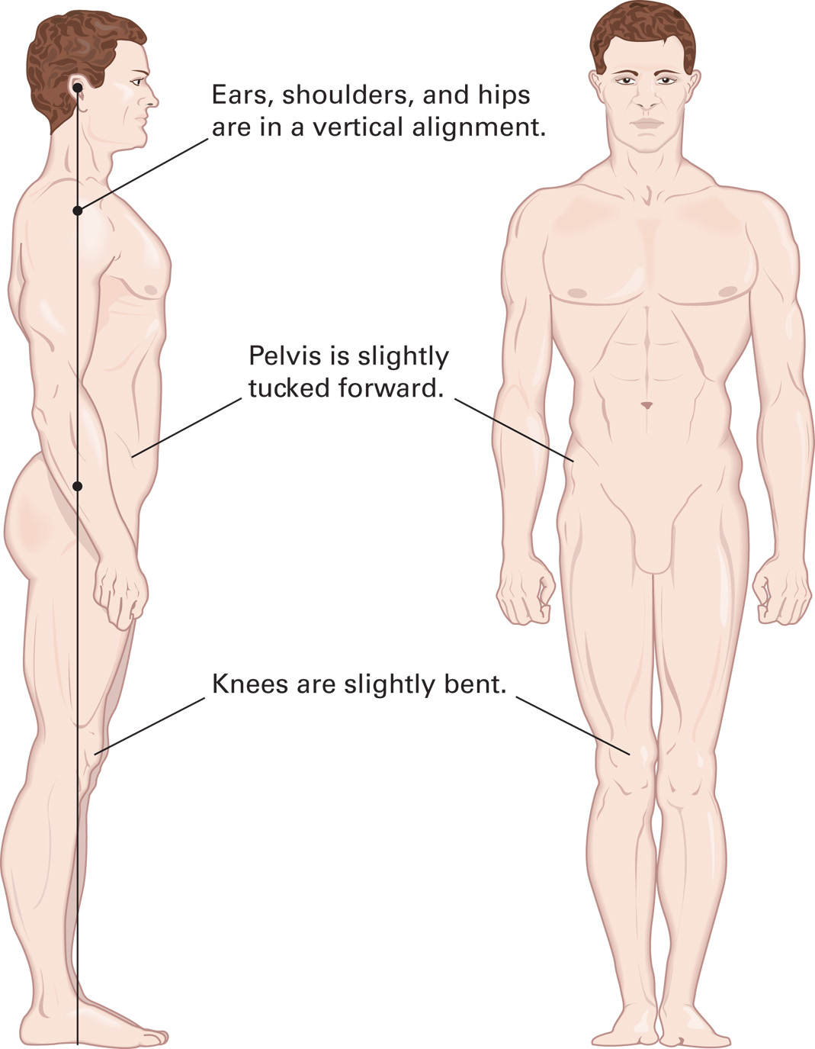
Proper Standing Posture
Notes:
Discuss and demonstrate.

Slide 14
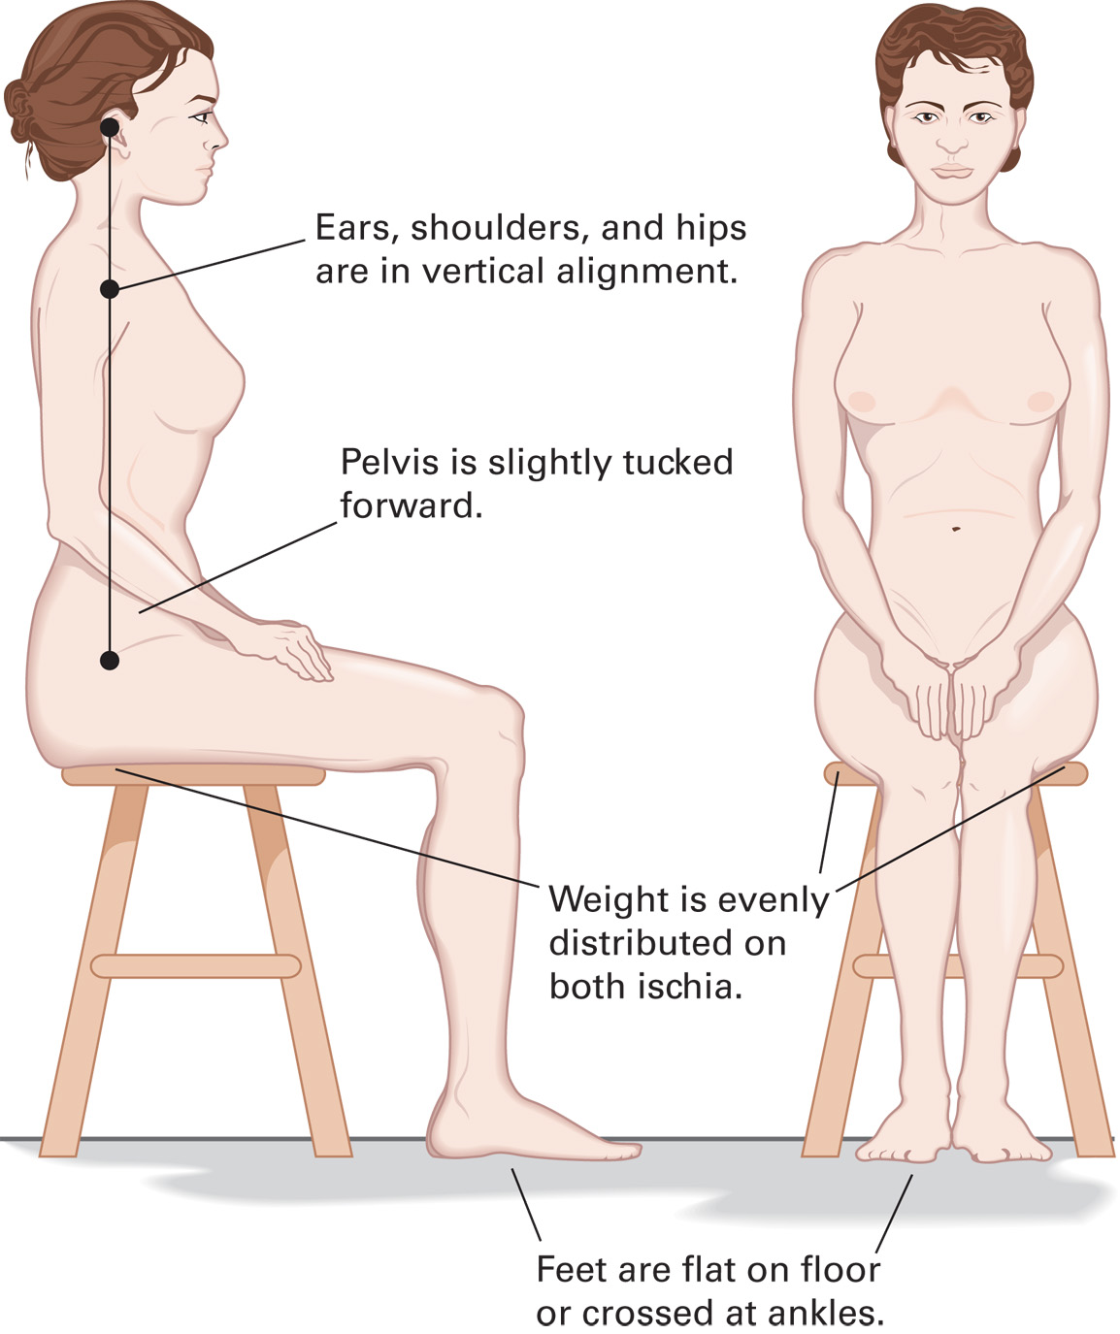
Proper Sitting Posture
Notes:
Discuss and demonstrate.

Slide 15
Body Mechanics for Safe Lifting (6 of 8)
Posture and Fitness
  Good body mechanics cannot fully compensate for poor physical fitness.
  Components of physical fitness:
    Flexibility
    Strength
    Cardiovascular conditioning
    Nutrition
Notes:
Proper body mechanics cannot sufficiently protect you if you are not physically fit. A proactive, well-balanced physical fitness program should include flexibility training, cardiovascular conditioning, strength training, and nutrition. Such a program can help you prevent injury, enhance performance, and manage stress.

Slide 16
Click on the Word from the Highlighted Pair in Each Statement to Complete Each Statement Most Accurately
To lift a heavy object, use the muscles of the:
legs
back
An excessive lumbar curve, resulting in swayback, is called:
kyphosis
lordosis

Slide 17
Body Mechanics for Safe Lifting (7 of 8)
Communication and Teamwork
  All team members must be properly trained.
  Team members should be physically matched when lifting.
  Communicate and coordinate throughout the lift.
  Tell the patient what you are doing.
Notes:
In an emergency, teamwork and effective communication among team members are essential. Patients come in all sizes, shapes, and strengths. Just as a football coach positions players according to their abilities, rescuers should capitalize on their abilities to ensure the best outcome in an emergency.
Points to Emphasize
Communication and teamwork are important aspects of moving and lifting patients.
Discussion Question
What are some of the principles of teamwork and communication in moving and lifting patients?
Class Activity
Have students stand up and use a book to demonstrate proper body mechanics in lifting.
Critical Thinking Discussion
What would you do if you injured your back and were unable to work in EMS or any other occupation that required lifting?

Slide 18
Body Mechanics for Safe Lifting (8 of 8)
  Communication and Teamwork
  Using good teamwork
    Size up scene immediately and accurately
    Consider weight of the patient
    Be aware of abilities and limitations of each team member
    Select most appropriate equipment for the job
Notes:
For team members to work together effectively, they need to communicate throughout all lifting and moving tasks. Use commands that are easy for team members to understand. Verbally coordinate each lift from beginning to end.
Just as important as the communication between team members is the EMT’s communication with the patient. If startled or frightened, the patient might shift body weight while you attempt the lift. Shifts in weight can cause disabling injury to rescuers as well as cause significant additional injury to the patient. Whenever a patient can understand, explain the plan before any action is taken. This can improve patient confidence and engage the patient in assisting in his own rescue.

Slide 19
General Guidelines for Lifting and Moving (1 of 6)
Know your abilities and limitations.
Consider the weight of the patient and of the equipment being used.
Use an even number of rescuers.
Anticipate muscle fatigue.
Notes:
Know your own physical abilities and limitations. Don’t overestimate yourself or other rescuers. Before lifting, know or determine the weight of the patient as well as the weight limitations of the equipment being used. Call for additional help whenever necessary. Even though your first impulse may be to jump in and help the patient, you must not proceed until you know you can do so safely.
Always try to use an even number of rescuers to maintain balance. Two-rescuer teams should carry heavy loads for 1 minute or less. More time can generate a high level of muscle fatigue, which can significantly increase the potential for injury. Whenever possible, transport patients and equipment on wheeled stretchers or other rolling devices.

Slide 20
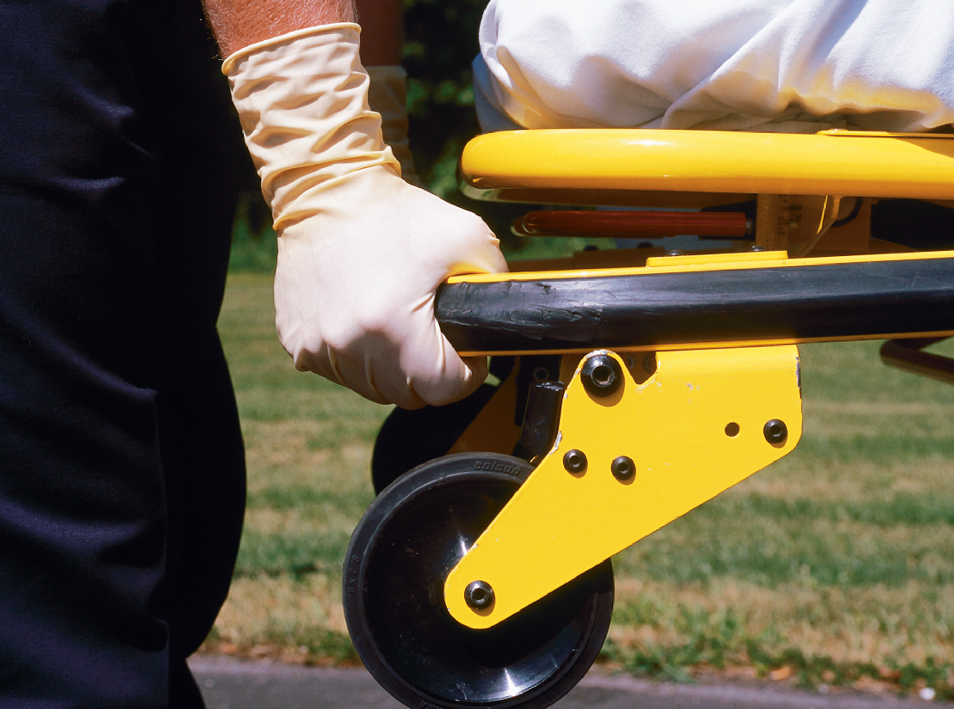
General Guidelines for Lifting and Moving (2 of 6)
The Power Lift
  The power lift offers the best defense against injury and promotes a safe and stable move.
  Use a power grip
Notes:
The power lift is the technique that offers you the best defense against injury and protects the patient with a safe and stable move. It is also a useful technique for rescuers with weak knees or thighs. In performing this technique, keep your back locked and avoid bending at the waist.
Points to Emphasize
Always recognize your limitations and don't try to lift more than is safe for you or your patient. Call for additional resources if needed. The power lift and squat lift are both good ways to lift heavy objects safely.

Slide 21
E M T Skills 6-1
Power Lift

Slide 22
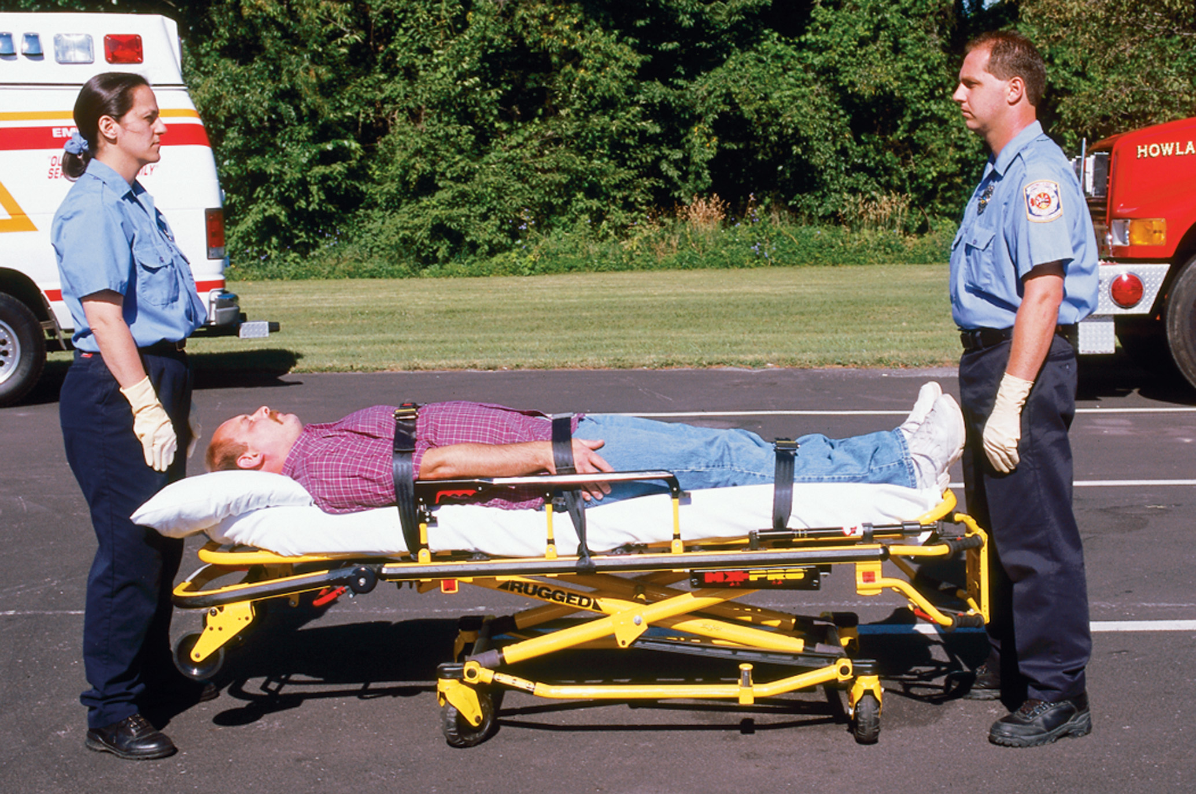
Get in Position. Your Feet Should be about Shoulder Width Apart, Turned Slightly Outward, and Flat on the Ground

Slide 23
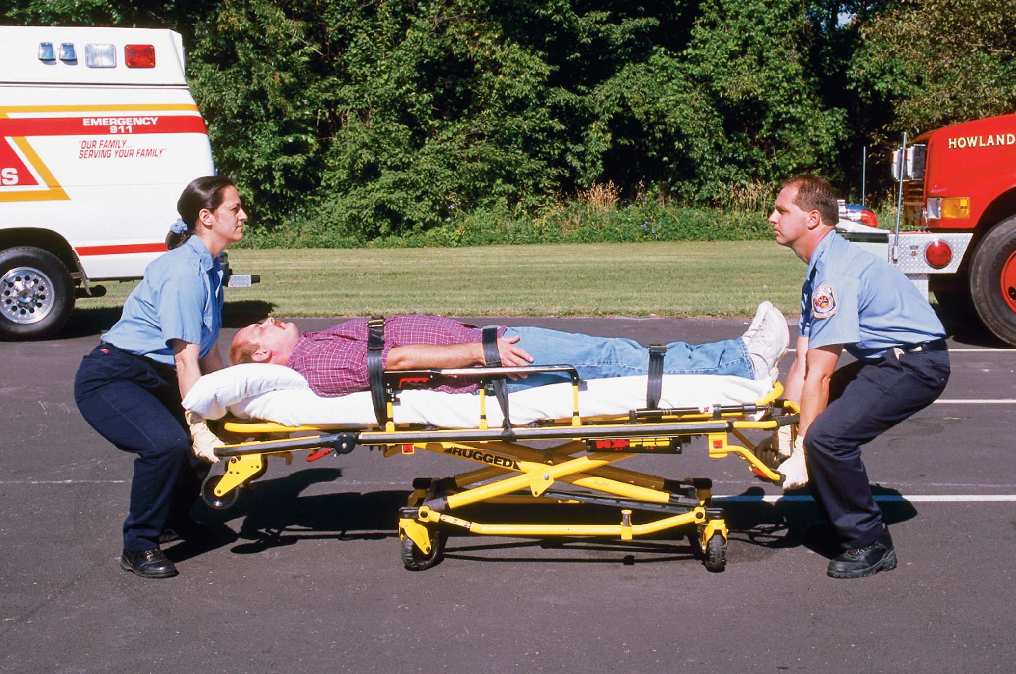
Use a Gloved Finger to Pull a Cuff out and Down on the Other Glove. Do not Touch the Inside of the Glove

Slide 24
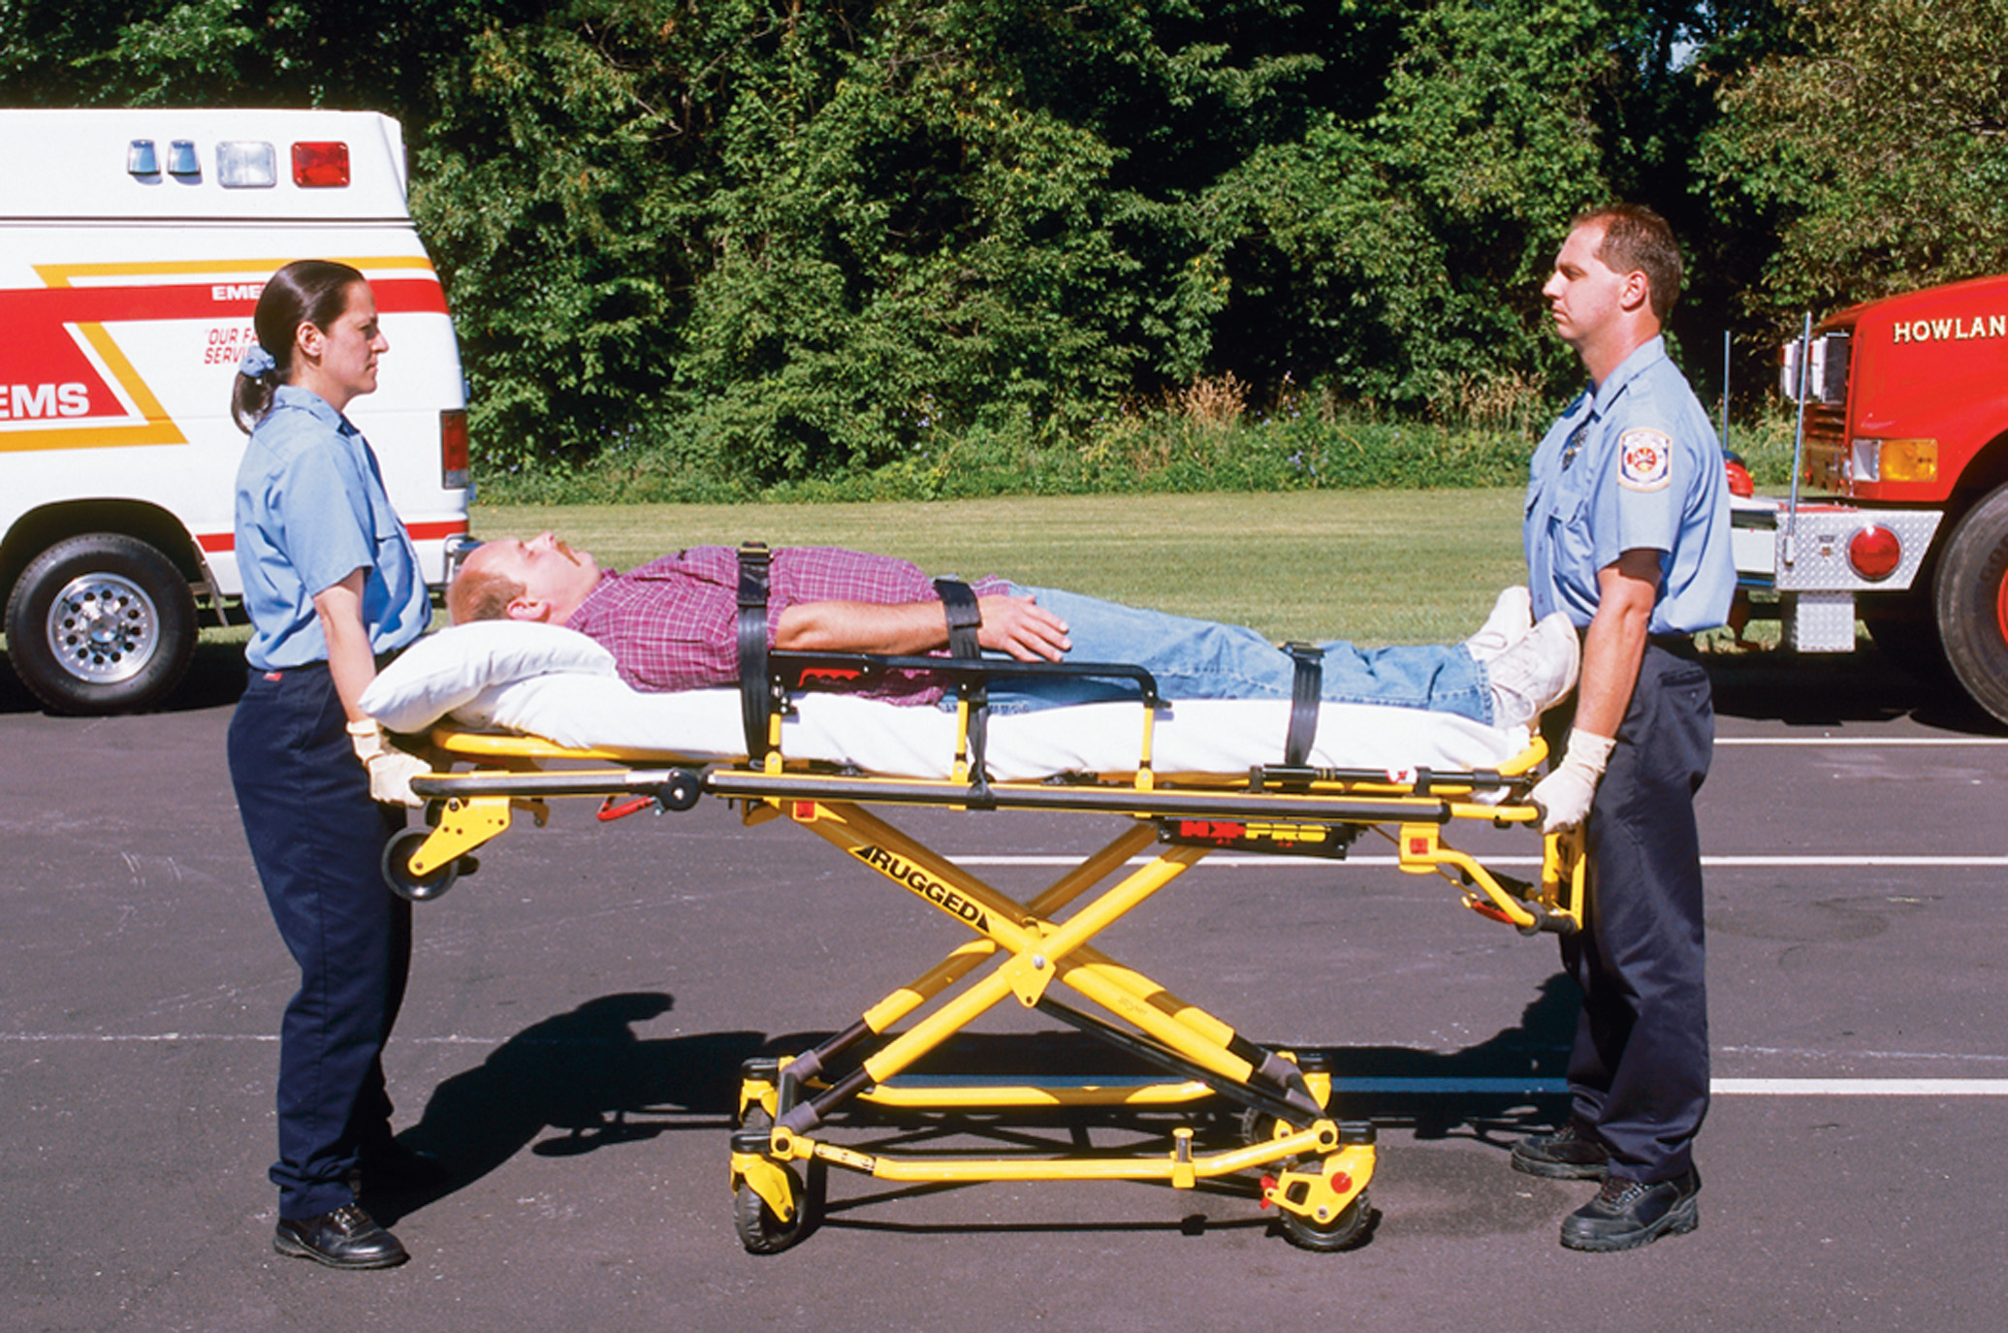
As You Return to a Standing Position, Make Sure Your Back is Locked in and Your Upper Body Comes up before Your Hips

Slide 25
General Guidelines for Lifting and Moving (3 of 6)
The Squat Lift
  The squat lift is an alternative technique if you have a weak leg or ankle.
  In performing this technique, avoid bending at the waist.
Notes:
The squat lift is an alternative technique you can use if you have one weak leg, one weak ankle, or if both your knees and legs are strong and healthy. While performing any lift, always remember to use your leg muscles—not your back—to lift, keep the weight as close to your body as possible, position yourself correctly, and communicate clearly and frequently with your partner.
Teaching Tips
Use one or more assistant instructors to demonstrate the power lift and squat lift.
Discussion Question
How do the power lift and squat lift reduce the possibility of injury?
Knowledge Application
Ask students to give examples of how they can use the power lift or squat lift to replace techniques they use to lift things in everyday life.

Slide 26
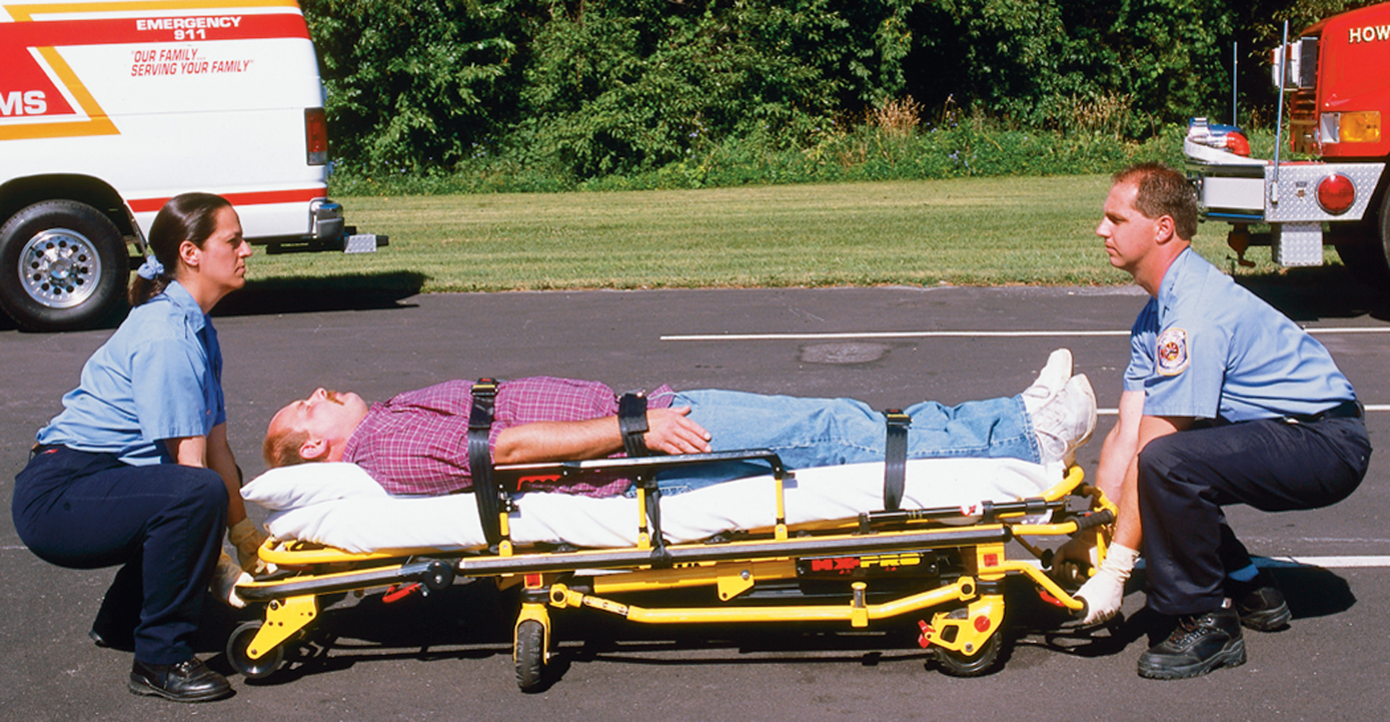
In the Squat Lift, Your Weaker Leg Stays Slightly Forward and You Push up with Your Stronger Leg

Slide 27
General Guidelines for Lifting and Moving (4 of 6)
One Handed Equipment Carrying Technique
  Keep your back in a locked position.
  Maintain proper body mechanics.
  Avoid leaning to the opposite side to compensate for the imbalance.
Notes:
Sometimes, you will need to lift and carry certain equipment with one hand. When you do, be sure to keep your back in a locked position. Maintain proper body mechanics and avoid leaning to the opposite side too much to compensate for the imbalance.
Points to Emphasize
Avoid the tendency to lean in the opposite direction when carrying with one hand.
Teaching Tips
Demonstrate the one-handed equipment carrying technique.

Slide 28
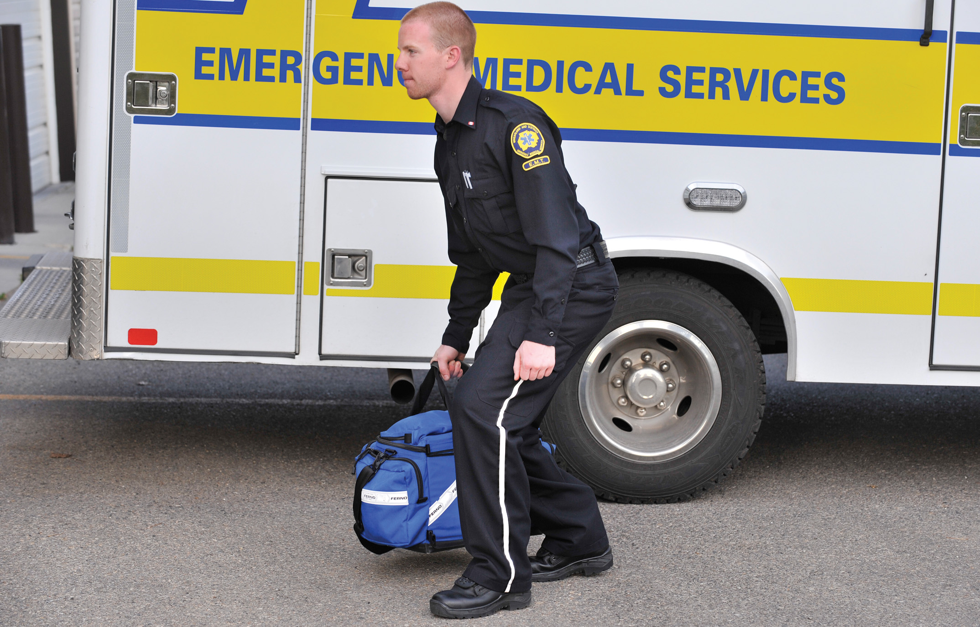
One-Handed Carrying Technique

Slide 29
General Guidelines for Lifting and Moving (5 of 6)
Reaching
  Get as close to the object being lifted as possible to decrease the effort needed.
  Limit reaching to 15 to 20 inches in front of your body.
  Keep the back locked in and do not twist.
Notes:
Generally, a person can sustain a 100 percent effort for 6 seconds and a 50 percent effort for only 1 minute before becoming fatigued. After that minute, the potential for injury greatly increases. So, to minimize effort, whenever possible reposition the object or get closer to the object to avoid or reduce reaching and lifting. Especially avoid situations in which prolonged strenuous effort (more than 1 minute) is required.
Points to Emphasize
Muscle fatigue occurs in only six seconds when maximum effort is used and in a minute when 50 percent effort is used.
Discussion Question
How can you reduce muscle fatigue when lifting and moving patients and equipment?
Class Activity
Divide the class into small groups.
Have each group demonstrate and explain to the rest of the class one of the techniques discussed in this section.
Power lift
Squat lift
One-handed equipment carrying technique
Safe reaching

Slide 30
General Guidelines for Lifting and Moving (6 of 6)
Pushing and Pulling
  When possible, push rather than pull.
  If you must pull
    Keep the load between your shoulders and hips, and close to your body.
    Keep your back straight and slightly bend your knees.
Notes:
Occasionally you might need to decide whether to push or pull an object. Whenever possible, push rather than pull. If an object must be pulled, keep the load between your shoulders and hips. Keep it close to your body. Keep your back straight and slightly bend your knees. This will help to keep the line of pull through the center of your body.

Slide 31
Proper Pulling and Pushing
Notes:
Due to the inherent danger, even likelihood, of injury, avoid pushing or pulling an object that is overhead.

Slide 32
Lifting and Moving Patients (1 of 5)
Emergency Moves
  An emergency move should be performed when there is immediate danger to the patient or to the rescuer.
    The armpit-forearm drag
    The shirt drag
    The blanket drag
Notes:
Points to Emphasize
Use an emergency move when there is immediate danger to the patient or rescuer if the patient is not moved.
Discussion Question
What are examples of situations in which you should use an emergency move?

Slide 33
Lifting and Moving Patients (2 of 5)
Armpit-forearm drag
Shirt drag
Blanket drag

Slide 34
Lifting and Moving Patients (3 of 5)
Urgent Moves
  An urgent move is performed when the patient is suffering an immediate threat to life and must be moved quickly and transported for care.
    Rapid extrication
    Self extrication
Notes:
Points to Emphasize
Use urgent moves when patients have life-threatening conditions and must be transported quickly.
Indications for an urgent move using the rapid extrication technique include but are not limited to the following:
Altered mental status
Inadequate respiratory rate or tidal volume
Indications of shock (altered mental status; pale, cool, clammy skin; tachycardia; increased respiratory rate)
Injuries to the head, neck, chest, abdomen, and pelvis
Fracture of both femurs
Major bleeding
Self-Extrication is another type of urgent move. Sometimes, you must get immediate access to another patient in the vehicle. If the patient blocking access is not critically injured and has no injuries that would keep them from moving themselves out of the vehicle, self-extrication can be used as an urgent move.
Discussion Question
When would you use an urgent move?

Slide 35
Lifting and Moving Patients (4 of 5)
Nonurgent Moves
  A nonurgent move is one in which no immediate threat to life exists and the patient can be moved in a normal manner when ready for transport.
Notes:
Points to Emphasize
Use nonurgent moves in most situations when there’s no immediate danger or threat to the patient's life.
Teaching Tips
Use assistant instructors to demonstrate nonurgent moves (direct ground lift, extremity lift, direct carry method, and draw sheet method).
Discussion Question
When would you use nonurgent moves?
Class Activity
Divide students into small groups and assign each group one of the lifting or moving techniques discussed in this section. Each group will demonstrate and explain the assigned technique to the rest of the class.
Knowledge Application
Describe several EMS scenarios. Have students determine whether the situation requires an emergency, urgent, or nonurgent move.

Slide 36
Lifting and Moving Patients (5 of 5)
  Nonurgent Moves
  Direct ground lift
  Extremity lift
  Direct carry method
  Draw sheet method

Slide 37
E M T Skills 6-2
Direct Ground Lift

Slide 38
Position Your Arms under the Patient. Be Sure to Cradle the Head
If a third rescuer is available, he should slide both arms under the waist while the first two rescuers move their arms up and down as appropriate.
Notes:
Two or three rescuers should line up on the same side of the patient.
Each rescuer should kneel on one knee, preferably the same knee for all rescuers.
The second rescuer should place the patient’s arms on the chest, if possible.
The first rescuer should then cradle the patient’s head by placing one arm under the patient’s neck and shoulder. Then they should place their other arm under the patient’s lower back.
The second rescuer should place one arm under the patient’s knees and one arm above the buttocks.
If a third rescuer is available, they should place both arms under the waist. The other two rescuers then should slide their arms either up to the midback or down to the buttocks as appropriate.
On signal from the first rescuer, they should lift the patient to their knees and roll the patient in toward their chests.
On signal from the first rescuer, they should stand and move the patient to the stretcher or other patient carrying device.
To lower the patient, the steps are reversed.
Remember that you should bend at the hips and not at the waist. Your back should remain straight, and the lifting force should be generated from your legs and buttocks, not the back.

Slide 39
Lift the Patient to Your Knees and Roll Toward Your Chests
Notes:
Two or three rescuers should line up on the same side of the patient.
Each rescuer should kneel on one knee, preferably the same knee for all rescuers.
The second rescuer should place the patient’s arms on the chest, if possible.
The first rescuer should then cradle the patient’s head by placing one arm under the patient’s neck and shoulder. Then they should place their other arm under the patient’s lower back.
The second rescuer should place one arm under the patient’s knees and one arm above the buttocks.
If a third rescuer is available, they should place both arms under the waist. The other two rescuers then should slide their arms either up to the midback or down to the buttocks as appropriate.
On signal from the first rescuer, they should lift the patient to their knees and roll the patient in toward their chests.
On signal from the first rescuer, they should stand and move the patient to the stretcher or other patient carrying device.
To lower the patient, the steps are reversed.
Remember that you should bend at the hips and not at the waist. Your back should remain straight, and the lifting force should be generated from your legs and buttocks, not the back.

Slide 40
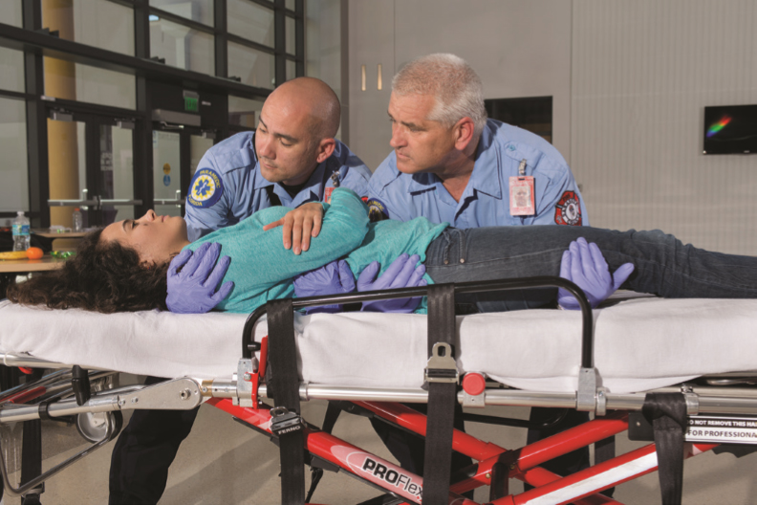
On Signal, Move the Patient to the Carrying Device
Notes:
Two or three rescuers should line up on the same side of the patient.
Each rescuer should kneel on one knee, preferably the same knee for all rescuers.
The second rescuer should place the patient’s arms on the chest, if possible.
The first rescuer should then cradle the patient’s head by placing one arm under the patient’s neck and shoulder. Then they should place their other arm under the patient’s lower back.
The second rescuer should place one arm under the patient’s knees and one arm above the buttocks.
If a third rescuer is available, they should place both arms under the waist. The other two rescuers then should slide their arms either up to the midback or down to the buttocks as appropriate.
On signal from the first rescuer, they should lift the patient to their knees and roll the patient in toward their chests.
On signal from the first rescuer, they should stand and move the patient to the stretcher or other patient carrying device.
To lower the patient, the steps are reversed.
Remember that you should bend at the hips and not at the waist. Your back should remain straight, and the lifting force should be generated from your legs and buttocks, not the back.

Slide 41
E M T Skills 6-3
Extremity Lift

Slide 42
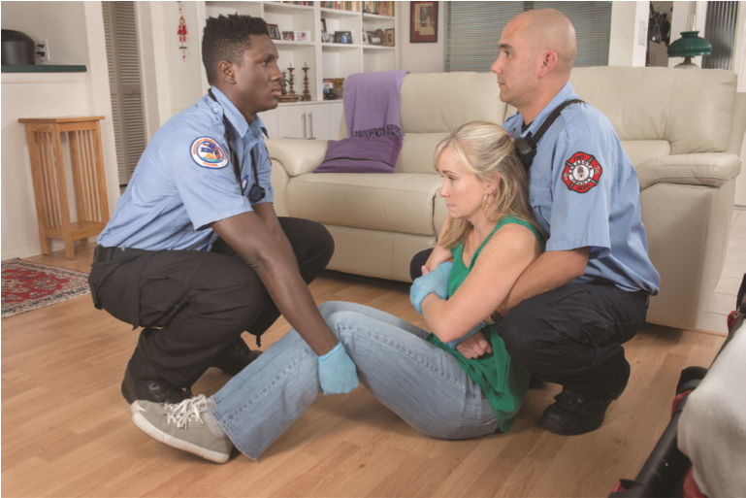
One Rescuer Should Put One Hand under Each Arm and Grasp the Wrists. The Other Should Slip Hands under the Knees
Notes:
The first rescuer should kneel at the patient’s head.
A second rescuer should kneel at the patient’s side by the knees.
The first rescuer should place one hand under each of the patient’s shoulders, while the second rescuer grasps the patient’s wrists.
The first rescuer should slip their hands under the patient’s arms and grasp the patient’s wrists. The second rescuer can then slip their hands under the patient’s knees.
Both rescuers should move up to a crouching position, keeping their backs straight and heads in neutral alignment.
On signal from the first rescuer, the rescuers should stand up simultaneously and move with the patient to a stretcher or other patient-carrying device.

Slide 43
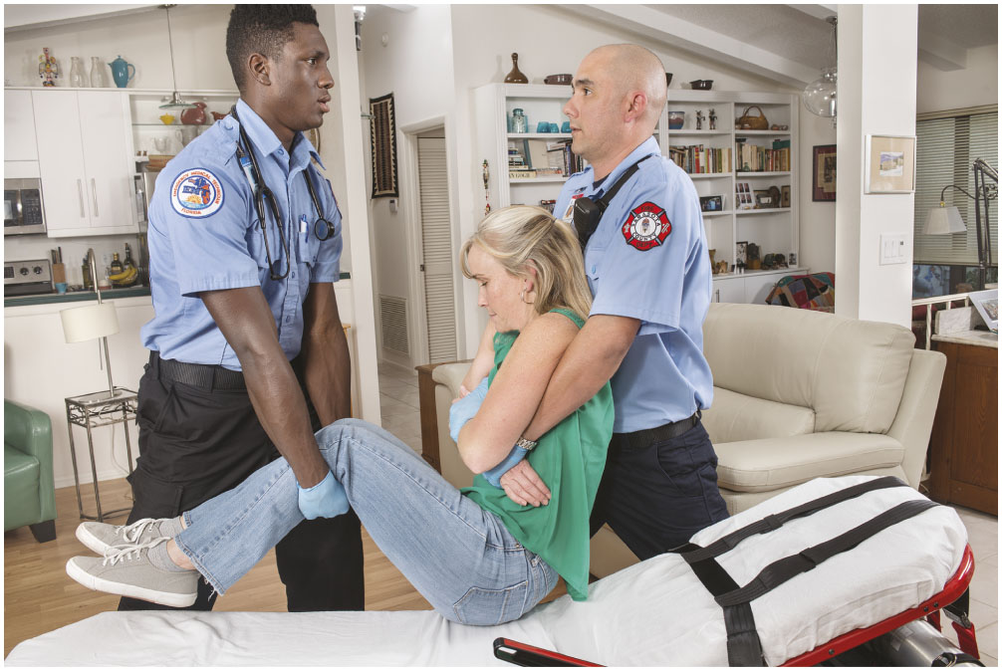
Both Rescuers Should Move up to a Crouching and Then Standing Position
Notes:
The first rescuer should kneel at the patient’s head.
A second rescuer should kneel at the patient’s side by the knees.
The first rescuer should place one hand under each of the patient’s shoulders, while the second rescuer grasps the patient’s wrists.
The first rescuer should slip their hands under the patient’s arms and grasp the patient’s wrists. The second rescuer can then slip their hands under the patient’s knees.
Both rescuers should move up to a crouching position, keeping their backs straight and heads in neutral alignment.
On signal from the first rescuer, the rescuers should stand up simultaneously and move with the patient to a stretcher or other patient-carrying device.

Slide 44
E M T Skills 6-4
Direct Carry

Slide 45
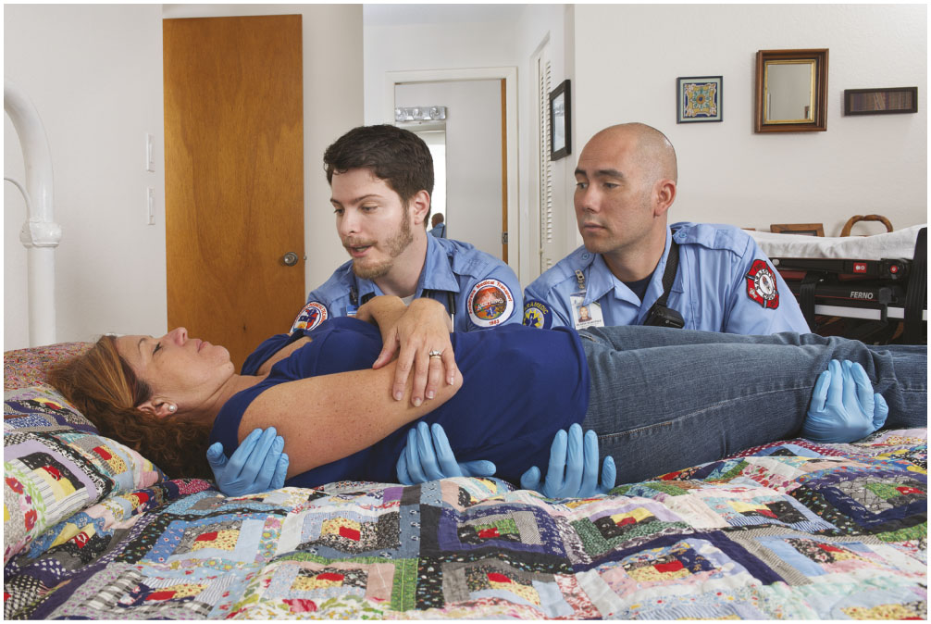
Position Your Arms under the Patient and Slide the Patient to the Edge of the Bed
Notes:
Position the wheeled stretcher perpendicular to the bed, with the head of the device at the foot of the bed.
Prepare the wheeled stretcher by unbuckling straps and removing other items. Both rescuers should stand between the bed and stretcher, facing the patient.
The first rescuer then slides an arm under the patient’s neck and cups the patient’s shoulder.
After the second rescuer slides a hand under the patient’s hip and lifts slightly, the first rescuer should slide an arm under the patient’s back. The second rescuer then places their arms under the patient’s hips and calves.
The rescuers slide the patient to the edge of the bed, lift and curl the patient to their chests. Then rotate and place the patient gently onto the wheeled stretcher.

Slide 46
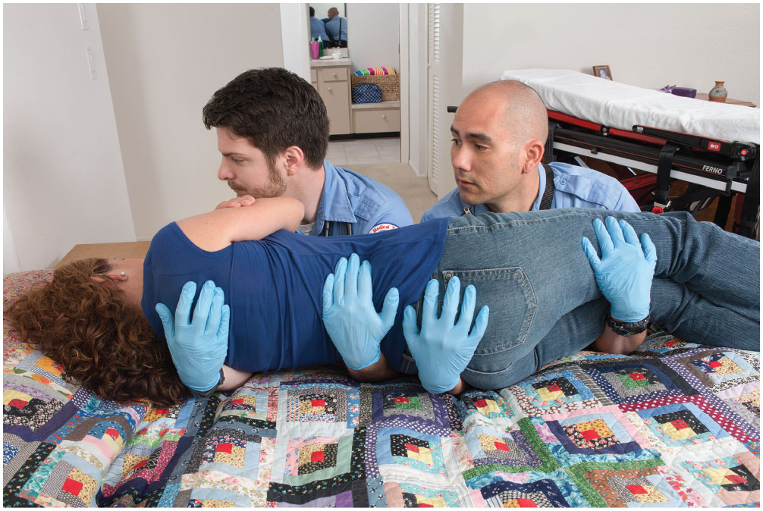
Lift the Patient and Curl Toward Your Chests
Notes:
Position the wheeled stretcher perpendicular to the bed, with the head of the device at the foot of the bed.
Prepare the wheeled stretcher by unbuckling straps and removing other items. Both rescuers should stand between the bed and stretcher, facing the patient.
The first rescuer then slides an arm under the patient’s neck and cups the patient’s shoulder.
After the second rescuer slides a hand under the patient’s hip and lifts slightly, the first rescuer should slide an arm under the patient’s back. The second rescuer then places their arms under the patient’s hips and calves.
The rescuers slide the patient to the edge of the bed, lift and curl the patient to their chests. Then rotate and place the patient gently onto the wheeled stretcher.

Slide 47
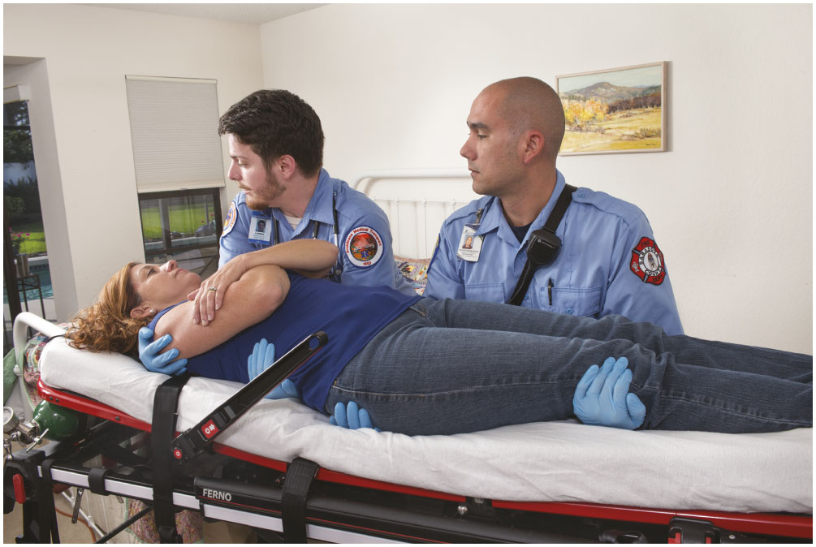
Rotate and Place the Patient Gently on the Carrying Device
Notes:
Position the wheeled stretcher perpendicular to the bed, with the head of the device at the foot of the bed.
Prepare the wheeled stretcher by unbuckling straps and removing other items. Both rescuers should stand between the bed and stretcher, facing the patient.
The first rescuer then slides an arm under the patient’s neck and cups the patient’s shoulder.
After the second rescuer slides a hand under the patient’s hip and lifts slightly, the first rescuer should slide an arm under the patient’s back. The second rescuer then places their arms under the patient’s hips and calves.
The rescuers slide the patient to the edge of the bed, lift and curl the patient to their chests. Then rotate and place the patient gently onto the wheeled stretcher.

Slide 48
E M T Skills 6-5
Draw Sheet Method

Slide 49
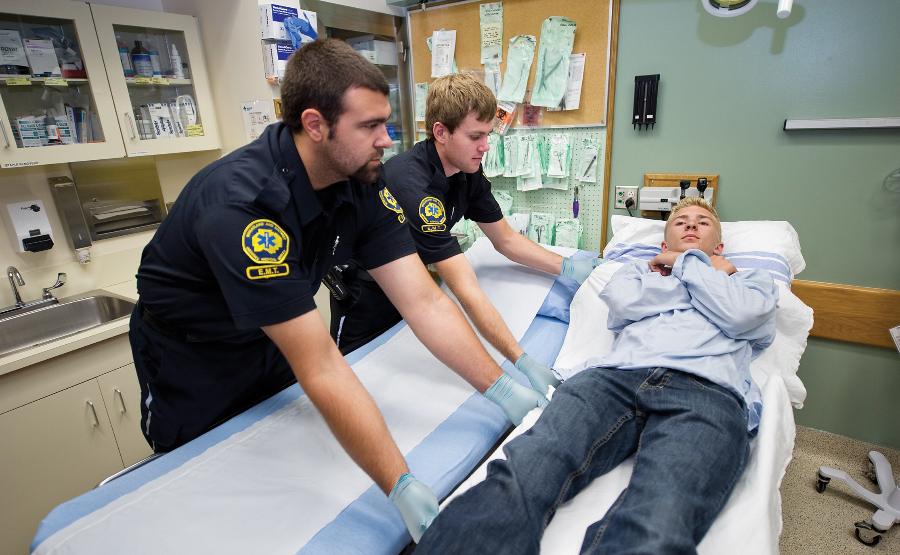
Reach across the Stretcher and Grasp the Sheet Firmly

Slide 50
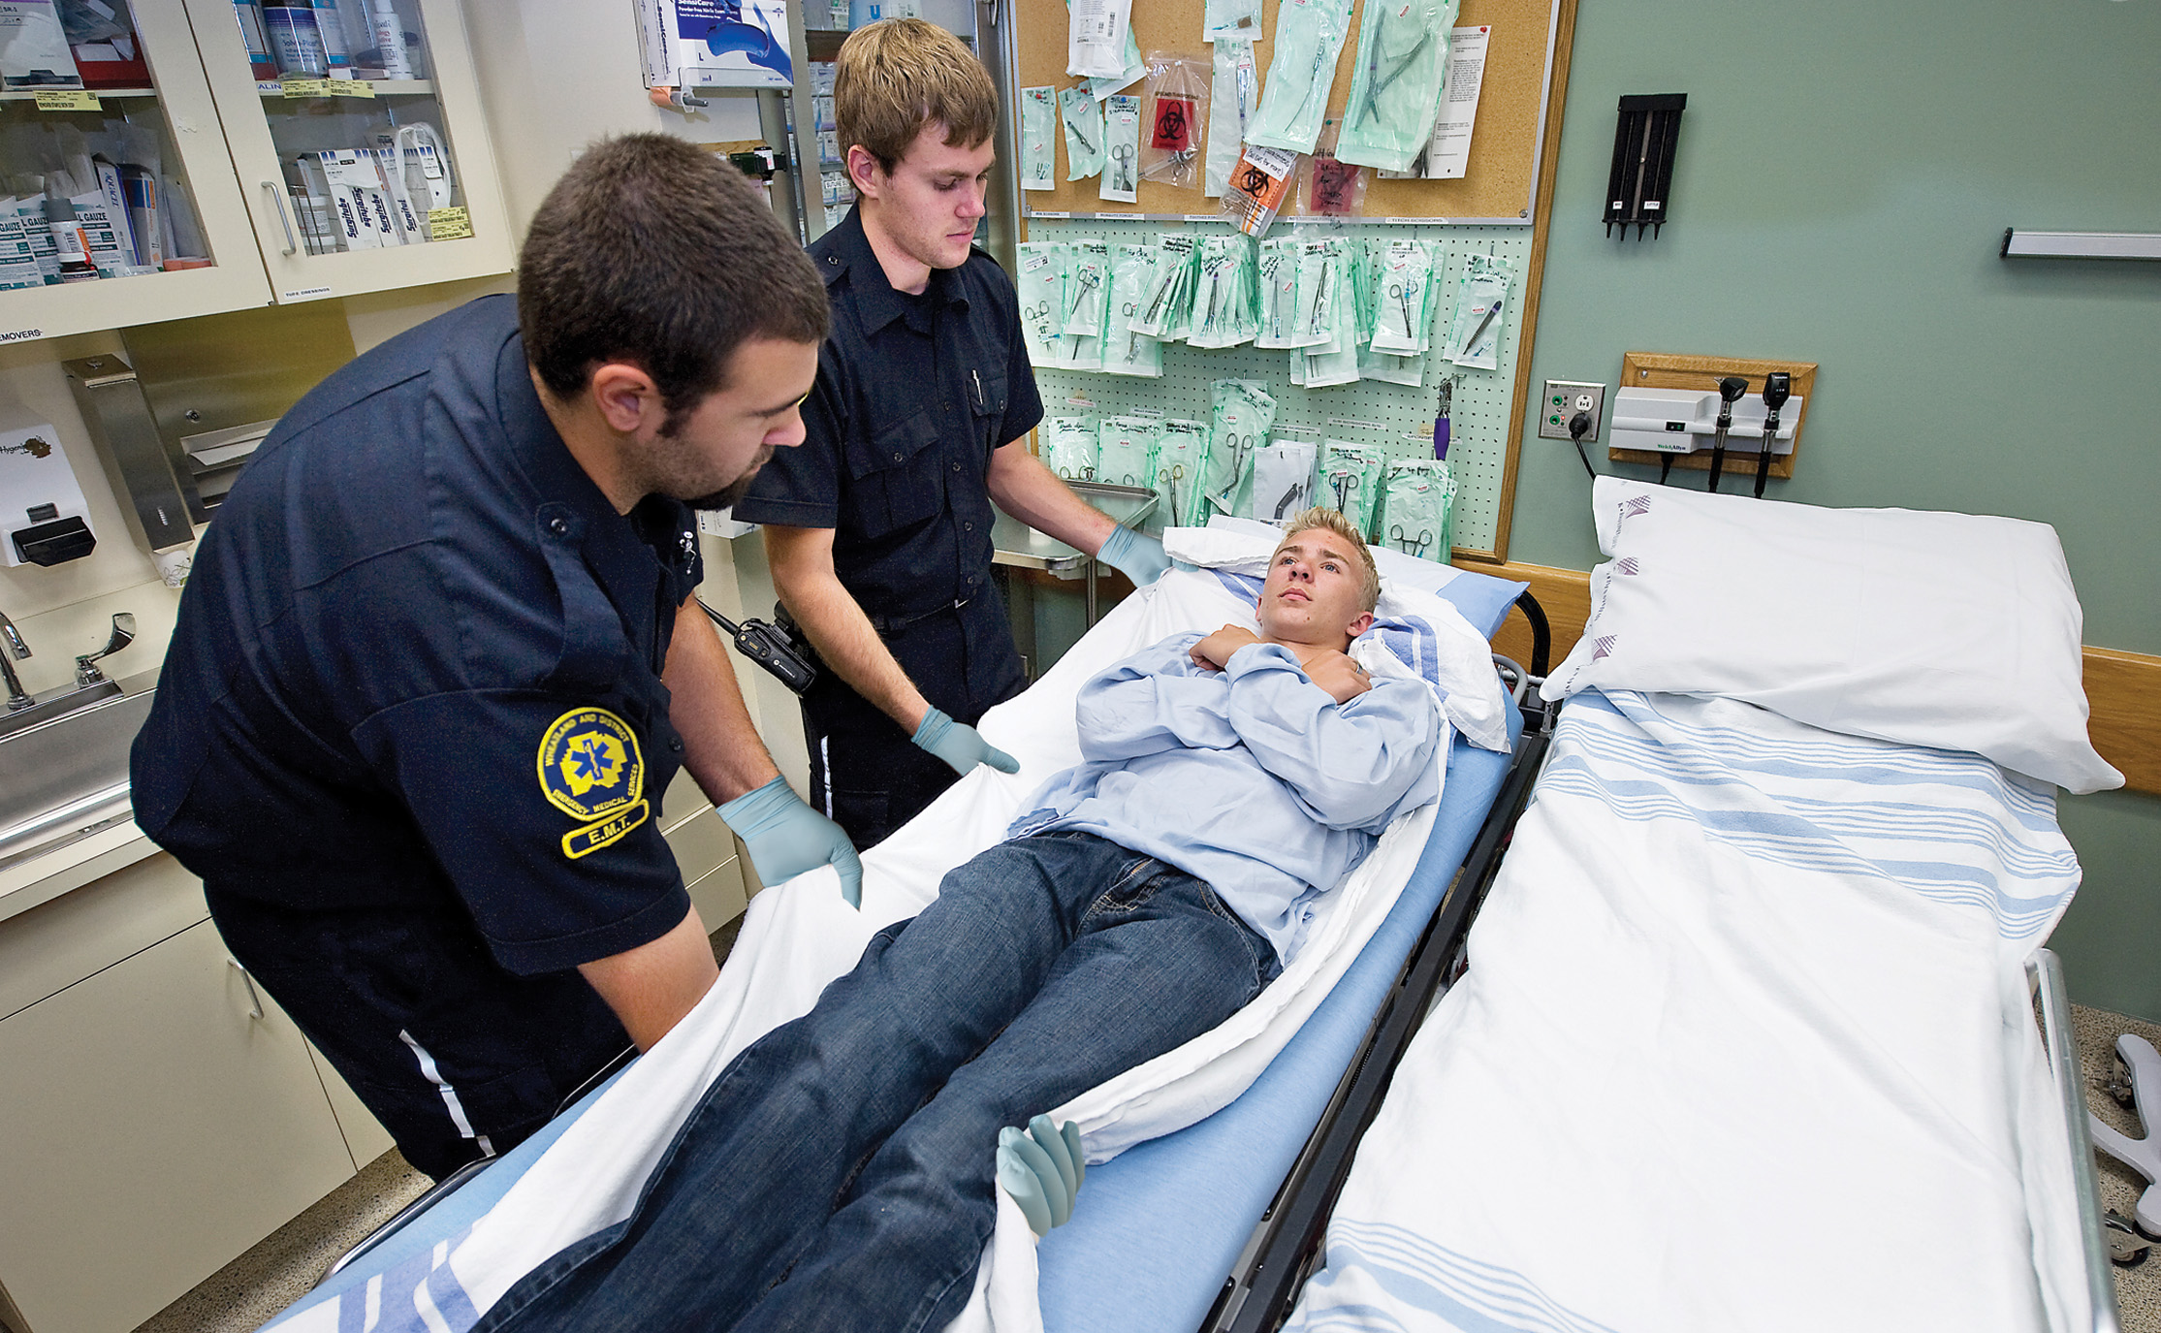
Slide the Patient Gently onto the Carrying Device
Notes:
Loosen the bottom sheet of the bed.
Position the wheeled stretcher next to the bed. Prepare it by adjusting height, lowering rails, unbuckling straps, and so on.
Reach across the stretcher and grasp the sheet firmly at the patient’s head, chest, hips, and knees. As you reach across the stretcher, use your hips to support yourself against the stretcher.
Slide the patient gently onto the wheeled stretcher. Be sure to contract your abdominal and gluteal muscles to splint the lower back.

Slide 51
Case Study (2 of 3)
Brett and Annie determined that the patient's injuries were potentially serious, but that he did not have any immediate problems with his airway, breathing, or circulation. They recognized that the mechanism of injury, pain, and numbness put the patient at risk for spinal injury, and also that they would require assistance because of the patient's size and because it would be necessary to carry him up the stairs.
Notes:
Discuss the continuation of the case study with the class.

Slide 52
Case Study (3 of 3)
As Brett completed the assessment, Annie radioed for additional personnel to assist with lifting.
What equipment should the E M Ts anticipate they will need to lift and move the patient?
Notes:
Teaching Tips
Discuss why it is important to call for assistance as early as possible.

Slide 53
Packaging for Transport (1 of 13)
Packaging means readying the patient for transport.
Once the patient is stabilized, select and prepare a carrying device and move the patient to the ambulance.
Notes:
Points to Emphasize
Always use devices that package patients for transport properly. Secure patients to the device. Use padding on the device as appropriate and needed, and cover the patient with sheets or blankets.
There are limitations to the amount of weight that most devices can support. Special bariatric equipment exists for lifting patients up to 1,600 pounds.
You can use stair chairs to carry patients up or down stairs or in narrow spaces or elevators.
Portable, flexible, or basket stretchers and long backboards are useful in narrow spaces or when you must carry a patient over rough terrain not suited to a wheeled stretcher. Use four rescuers, rather than two, for carrying these devices when possible.
Use a spotter when going up and down stairs.
Carry patients feet first down stairs and head first up stairs.
Communicate with patients during lifting and moving. Tell them what you’re going to do before you do it.

Slide 54
Packaging for Transport (2 of 13)
Equipment
  Wheeled stretcher
    Can accommodate up to 650 pounds
    Limited to use on smooth terrain
    Fasten all straps to secure the patient.
    Never leave a patient unattended.
Notes:
Teaching Tips
Demonstrate loading and unloading a wheeled stretcher into the ambulance.
Demonstrate the use of a stair chair, long backboard, and other devices used in your EMS system.
Knowledge Application
Give several descriptions of patient conditions and locations. Ask students to select the device most suited for packaging the patient.
Critical Thinking Discussion
How would you explain to a patient what you are going to do, and what you would like him to do, when carrying him up or down stairs?

Slide 55
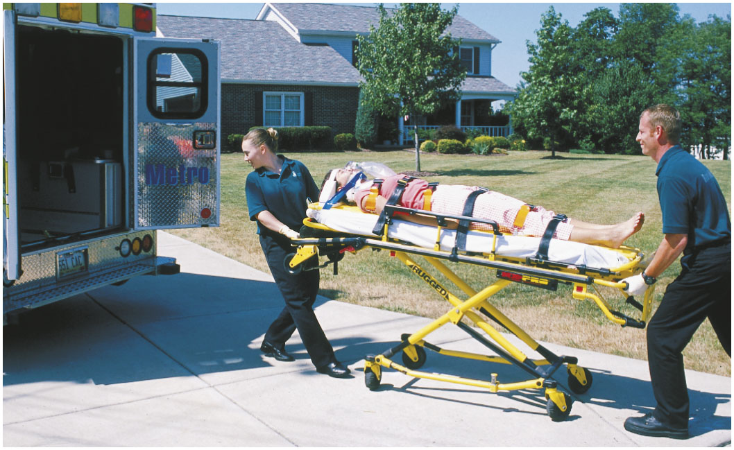
E M T s Move a Wheeled Stretcher into Position to Load into the Ambulance

Slide 56
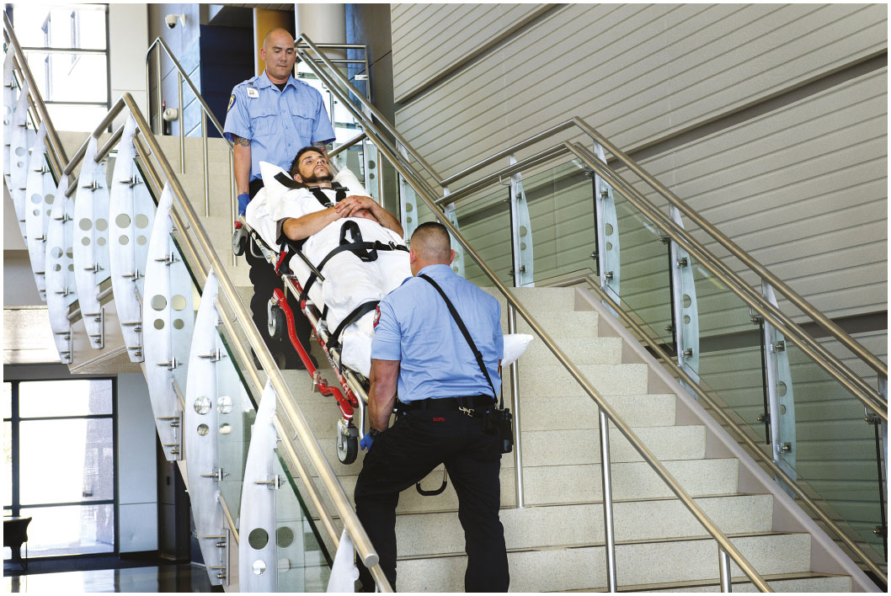
Two-Rescuer Stretcher Carry

Slide 57
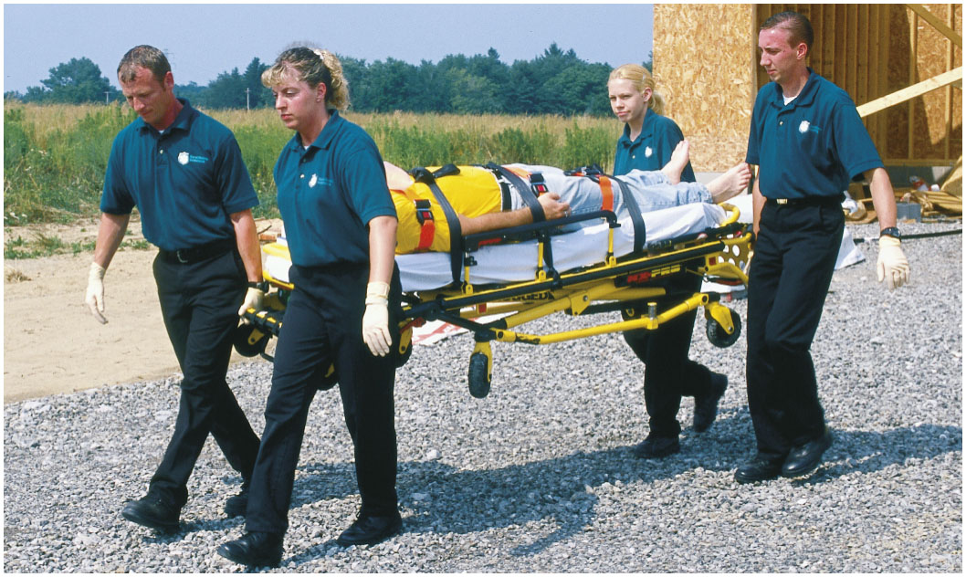
Four-Rescuer Stretcher Carry

Slide 58
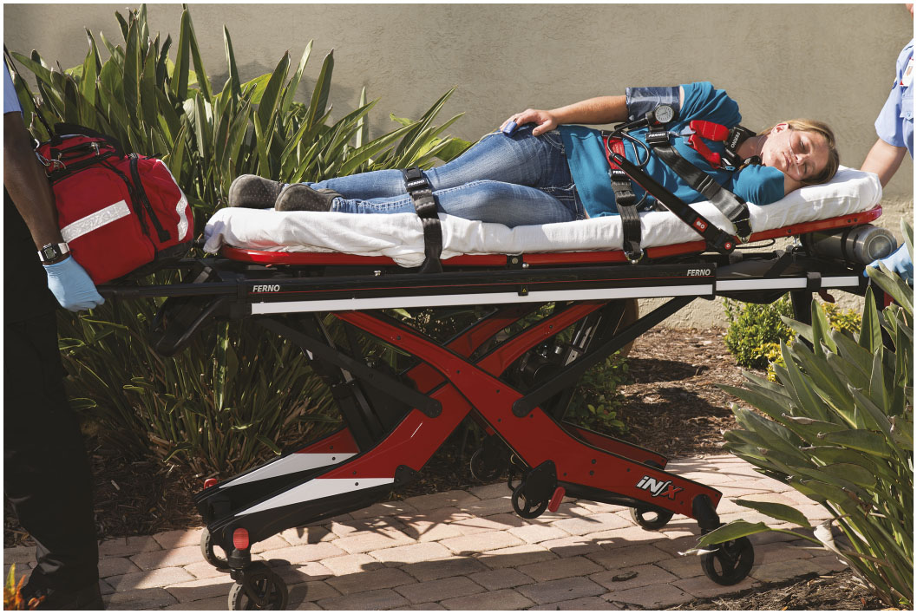
Wheeled Stretcher, Roll-In Type
Notes:
The once-common lift-in type cot has now mostly been replaced by the roll-in cot, which weighs about 70–95 pounds and is constructed of aluminum alloy. The roll-in cot uses special wheels at the head to simplify the loading and unloading procedure. The roll-in type significantly reduces the amount of twisting and lifting that the lift-in type requires of rescuers.

Slide 59
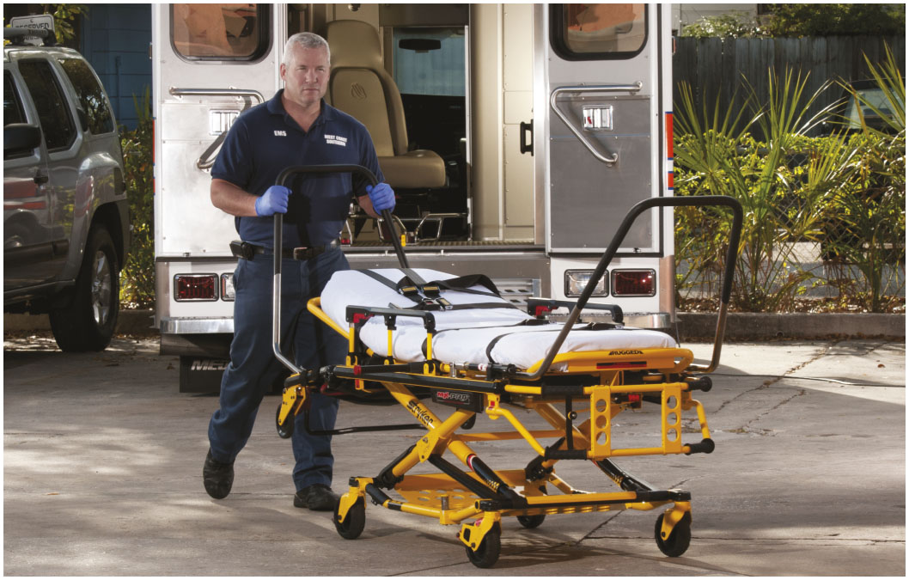
Packaging for Transport (3 of 13)
Equipment
  Bariatric stretchers and devices
    Designed to hold up to 1,600 pounds
Notes:
With an ever-growing overweight population, specialized stretchers and other devices have been designed to transport morbidly obese patients. These stretchers and devices are called bariatric devices. Some bariatric stretchers are designed to hold patients up to 1,600 pounds in a wheels-down position. The stretchers have larger wheels for stability, wider cot dimensions, and more heavily constructed frames. Some stretchers are part of a bariatric transport system that includes an ambulance ramp and winch. There are even specialized bariatric transport ambulances now available.

Slide 60
Packaging for Transport (4 of 13)
  Equipment
  Portable Stretcher
    Useful to carry patients in confined spaces or for calls involving more than one patient
Notes:
The portable ambulance stretcher is usually available in three styles: the basic model, the basic with folding wheels and posts, and the breakaway. The basic model is used as an auxiliary stretcher, which can be placed on the squad bench or suspended from hanging hardware inside the ambulance. It’s light and, though it has a load capacity of up to 350 pounds, it’s not recommended for that much weight. Most models can be folded in half for storage.

Slide 61
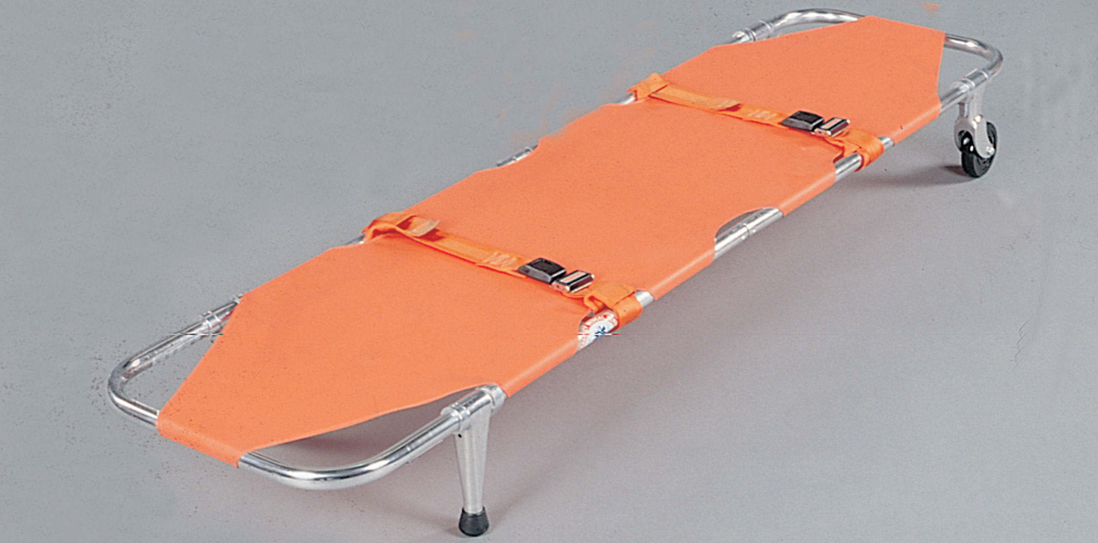
Portable Ambulance Stretcher with Continuous Tubular Metal Frame
Notes:
The portable ambulance stretcher is usually available in three styles: the basic model, the basic with folding wheels and posts, and the breakaway. The basic model is used as an auxiliary stretcher, which can be placed on the squad bench or suspended from hanging hardware inside the ambulance. It’s light and, though it has a load capacity of up to 350 pounds, it’s not recommended for that much weight. Most models can be folded in half for storage.

Slide 62
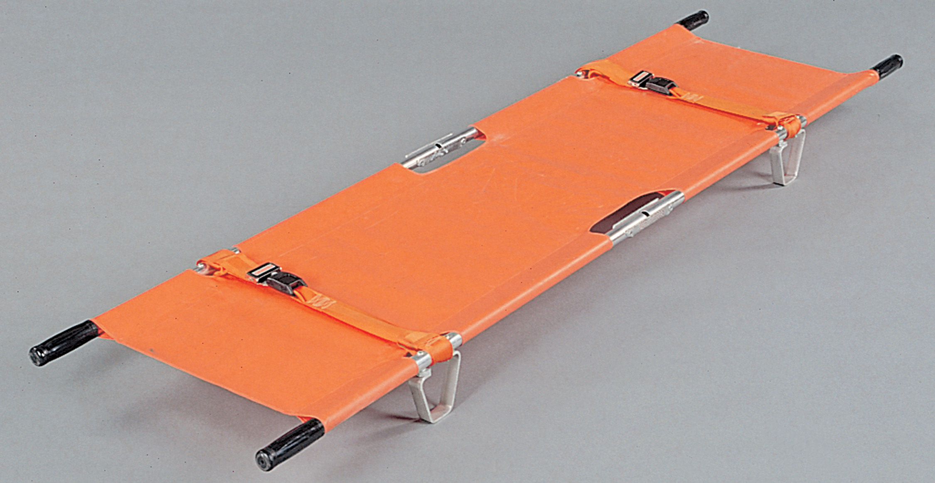
Pole Stretcher, or Canvas Litter
Notes:
One type of portable stretcher is the pole stretcher or canvas litter, which has been used worldwide for centuries. It is lightweight and folds compactly. The vinyl-coated model is easy to clean. It’s comfortable for the patient, especially when the head is padded, though it should not be used when spinal immobilization is necessary unless it’s used with a long backboard.

Slide 63
Packaging for Transport (5 of 13)
Equipment
  Stair Chair
    Useful when a wheeled stretcher cannot traverse narrow walking spaces or stairs.
    Do not use for patients with altered mental status, spinal injury, or lower extremity injury.
Notes:
A stair chair is useful when a wheeled stretcher can’t traverse narrow corridors and doorways, small elevators, and stairways. Some models can be converted into portable stretchers. Don’t use a stair chair when the patient has an altered mental status, suspected spinal injury, or injuries to the lower extremities.

Slide 64
E M T Skills 6-8
Moving a Patient on a Stair Chair
Notes:
To move a patient up or down stairs on a stair chair, explain to the patient everything you plan to do. Check to be sure all straps are secure.

Slide 65
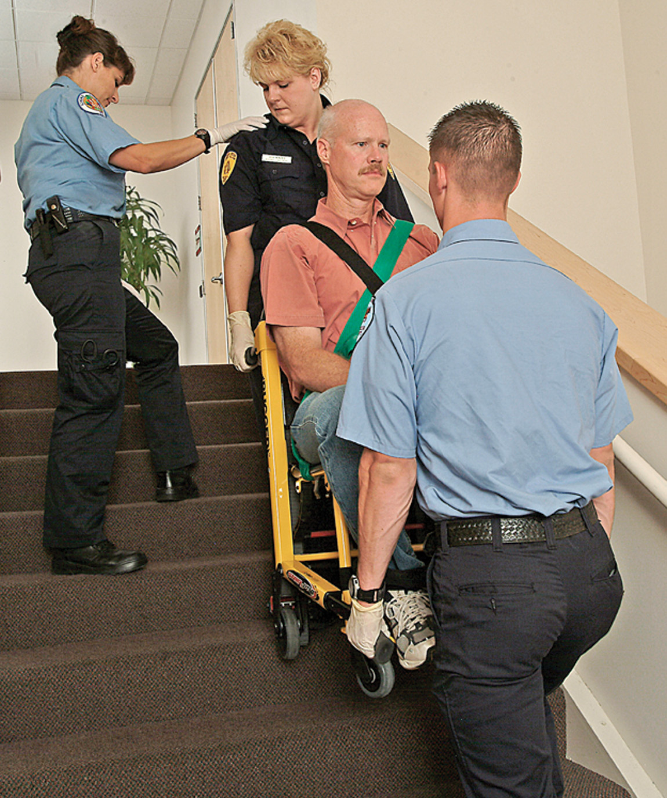
Moving a Patient up Stairs in a Stair Chair—Spotter Above
Notes:
One rescuer should stand behind the chair at the head, and another should stand at the foot facing the patient. A third rescuer, if available, should prepare to “spot” by standing behind the rescuer who will be moving backward (up or down the stairs). Instruct the patient not to reach out.
As the chair is tilted back by the rescuer at the head, the rescuer at the foot should grasp the chair by its legs.
Both rescuers should lift and begin to carry simultaneously. If the chair has wheels, they shouldn’t be allowed to touch the steps.
As the rescuers descend (or ascend) with the patient, the spotter should count out the steps and identify upcoming conditions.

Slide 66
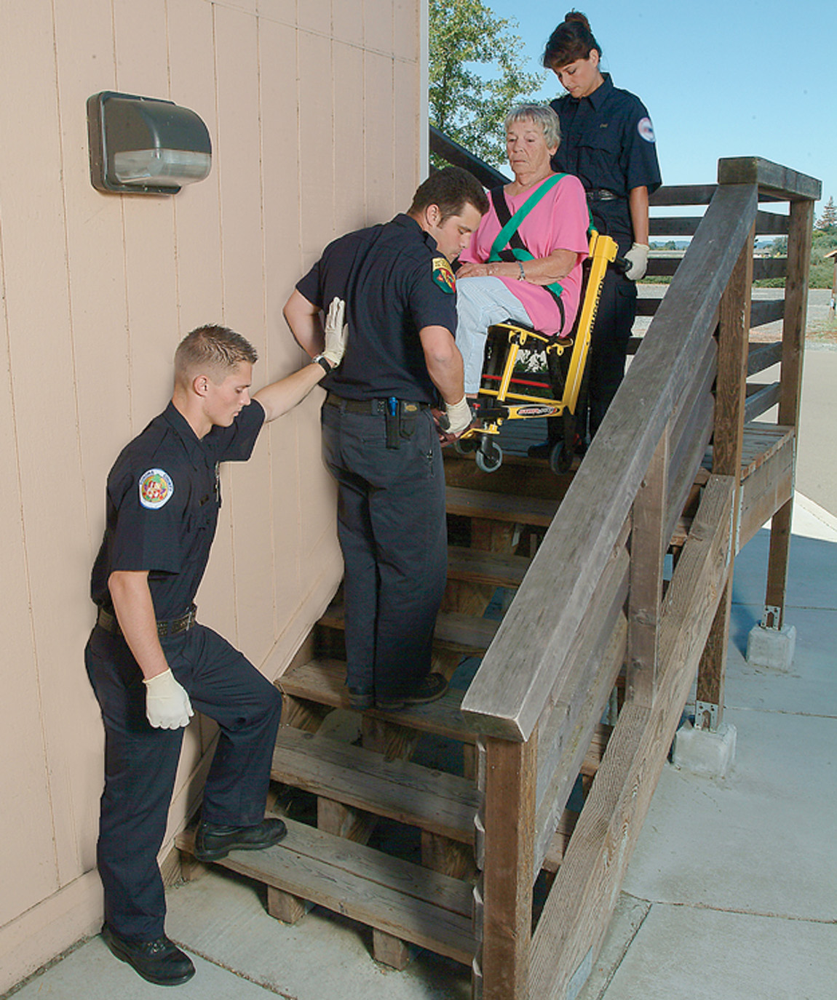
Moving a Patient Down Stairs in a Stair Chair—Spotter Below
Notes:
One rescuer should stand behind the chair at the head, and another should stand at the foot facing the patient. A third rescuer, if available, should prepare to “spot” by standing behind the rescuer who will be moving backward (up or down the stairs). Instruct the patient not to reach out.
As the chair is tilted back by the rescuer at the head, the rescuer at the foot should grasp the chair by its legs.
Both rescuers should lift and begin to carry simultaneously. If the chair has wheels, they shouldn’t be allowed to touch the steps.
As the rescuers descend (or ascend) with the patient, the spotter should count out the steps and identify upcoming conditions.

Slide 67
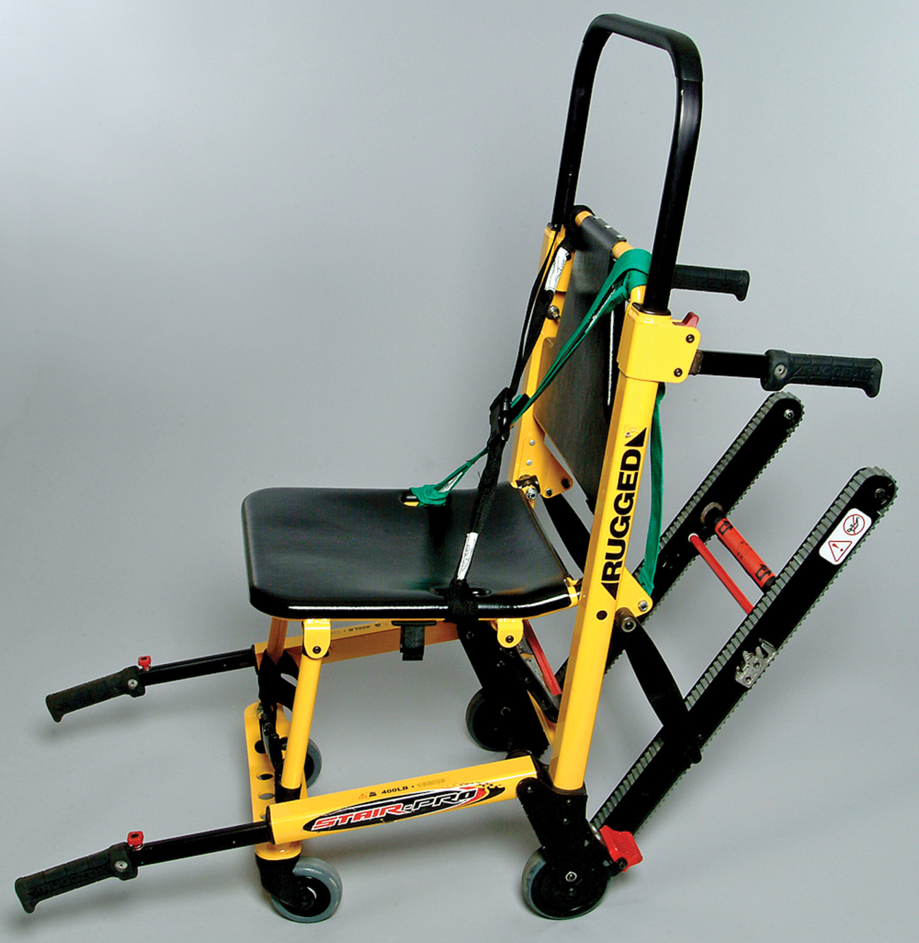
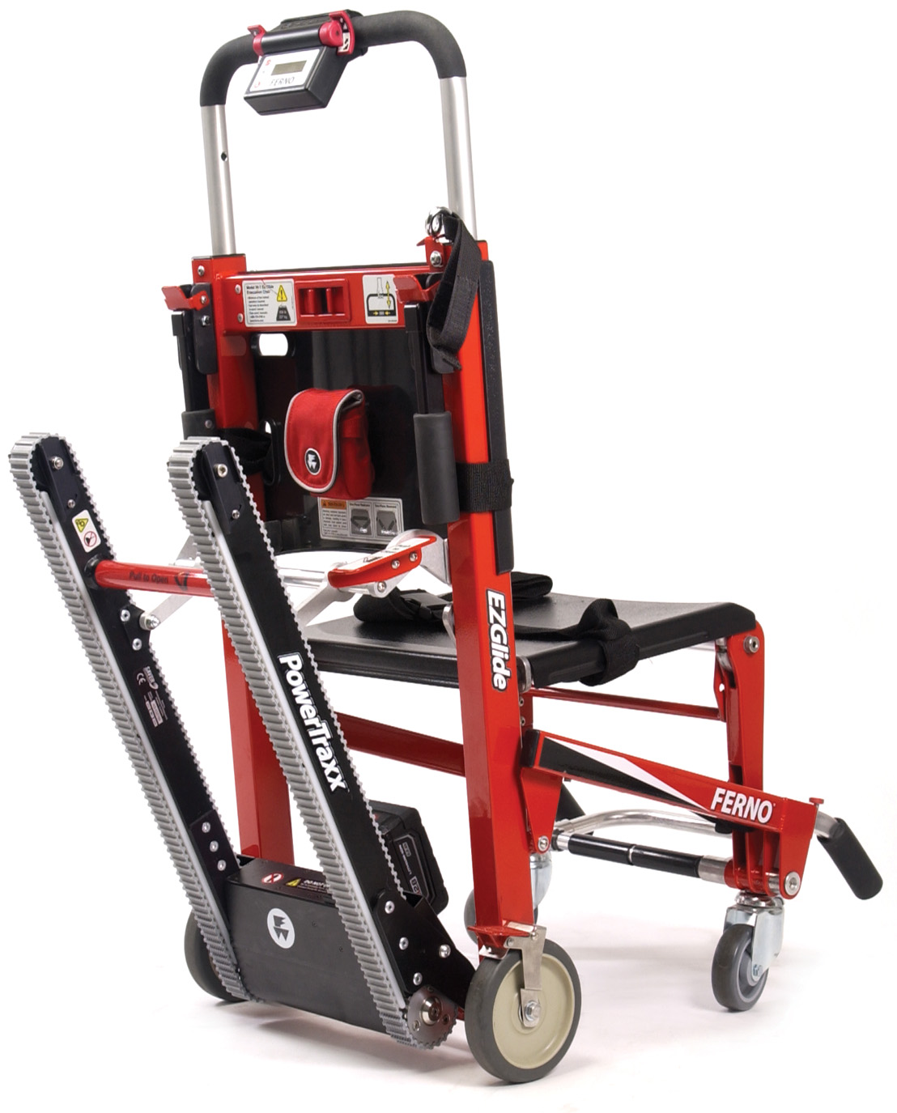
A Stair Chair with a Mechanical Track Allows Easier Patient Movement over Stairs
Notes:
Newer model stair chairs are also available and is designed with a track that can be lowered behind where the patient is sitting. This track comes into contact with the steps as the patient is moved down stairs, and allows the chair to glide down the steps with minimal effort exerted by the EMT. It still requires two rescuers, one at the head and one at the foot of the patient, for stabilization
of the device. Although this style chair still has all the same features as more common models, the new design eliminates the need to lift the chair while moving down the steps.

Slide 68
Packaging for Transport (6 of 13)
Equipment
  Backboards
    Used for spine motion restriction and carrying
      Long spinal board
      Short spinal board
      Vest-type immobilizer
      Full body vacuum mattress
Notes:
Standard operating equipment in any emergency vehicle is the backboard. It can protect the patient from rocky ground surfaces, and it can serve as a spine motion restriction device. Straps and a head immobilizer device can be applied.
Other versions of spine motion restriction and carrying equipment also includes the short spinal board, the vest-type immobilizer, and the full body vacuum mattress.

Slide 69
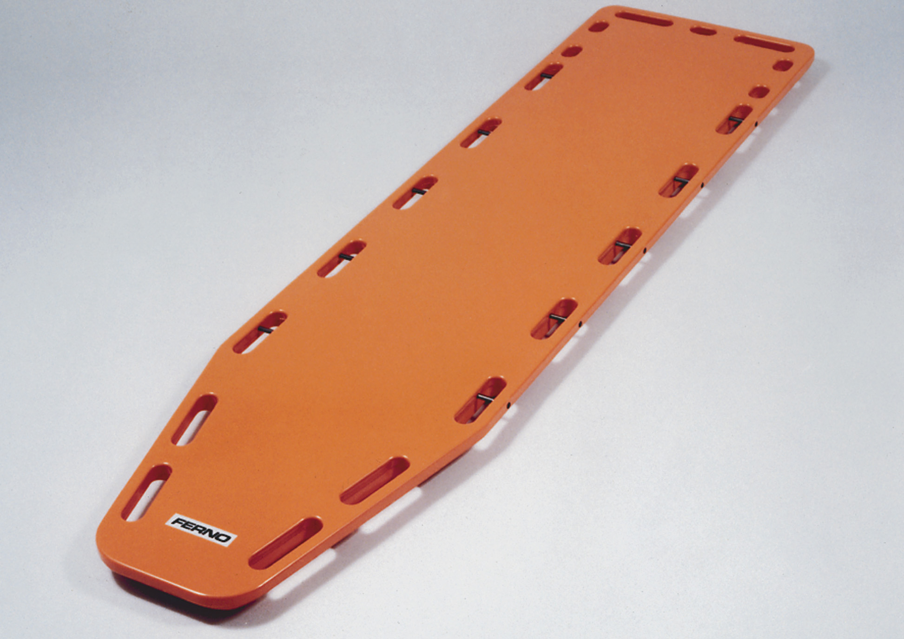
Long Backboard
Notes:
Long and short backboards are made of lightweight plastic or composite materials with molded handholds. Common styles are the Farrington (rectangular with round corners) and the Ohio (with mitered corners and tapering sides). The Ohio fits into most basket stretchers and can be more easily maneuvered in and out of cars. Long backboards may also be referred to as long spine boards.

Slide 70
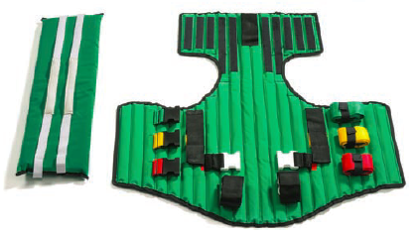
Kendrick Extrication Device (K E D)
(© Ferno Corporation)
Notes:
Short backboards usually are used to immobilize noncritical sitting patients before moving them. One special type of short backboard is the vest-type or corset-type immobilizer such as the Ferno Kendrick Extrication Device (KED). Once a short backboard is applied, the patient should be placed on a long backboard. Refer students to the chapter “Spinal Trauma and Spine Motion Restriction.”

Slide 71
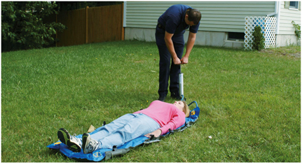
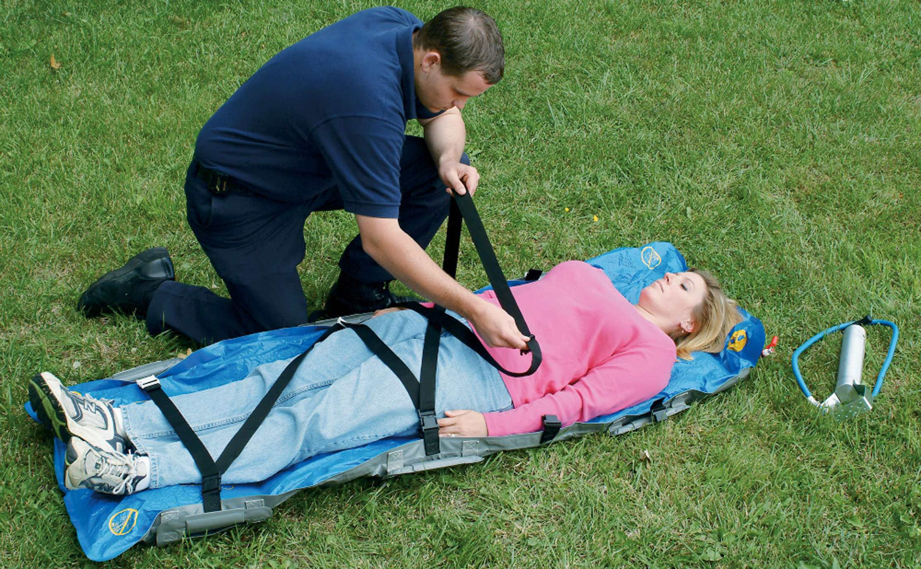
Full Body Vacuum Mattress can be Used for Immobilization or for Moving the Patient
The patient is then secured to the rigid, conforming vacuum mattress.
Notes:
Also available is a full body vacuum mattress that can be used as both a backboard and a moving device once the patient is placed on it. This design uses vacuum technology to conform the mattress into whatever shape is necessary given the patient. It eliminates the need to pad any extra voids between a traditional rigid backboard and the patient’s body. It becomes rigid enough after the vacuum has been applied to allow two or more EMTs to lift and carry the patient. Several benefits of this equipment are that it’s lightweight, it conforms to the patient’s shape, it fits within a basket stretcher, and it’s designed with several hand grips for the care providers to grasp when preparing to lift the patient. The vacuum mattress can be used in spine motion restriction.

Slide 72
Packaging for Transport (7 of 13)
Equipment
  Scoop Stretcher
    Can be assembled and disassembled around the patient
    Not recommended for patients with spinal injury
Notes:
An advantage of the scoop stretcher is that it can be used in confined areas where other conventional stretchers will not fit. It can also be used for pelvic fractures or bilateral femur fractures to prevent further injury. A disadvantage is that some devices are constructed entirely of metal, which picks up the temperature of the environment. Note also that the scoop stretcher is not recommended for patients with suspected spinal injury.

Slide 73
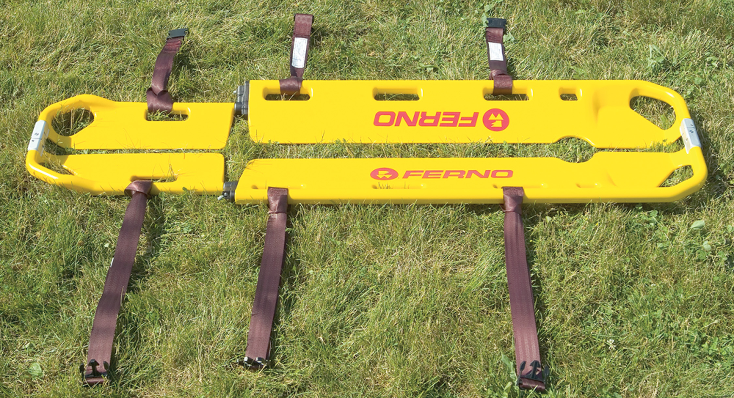
Scoop Stretcher
Notes:
To use a scoop stretcher properly, you must have access to the patient from all sides. At least two rescuers are required: one to prepare and position the stretcher and one to move the patient.

Slide 74
Packaging for Transport (8 of 13)
Equipment
  Basket stretcher
    Also called Stokes basket
    Accommodates scoop stretchers and most backboards
    Can be placed on a wheeled stretcher
Notes:
To use a scoop stretcher properly, you must have access to the patient from all sides. At least two rescuers are required: one to prepare and position the stretcher and one to move the patient.

Slide 75
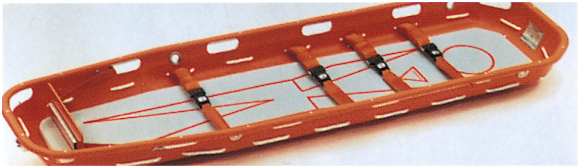
Basket Stretcher
Notes:
Place the mattress from a wheeled stretcher into a basket stretcher to increase patient comfort and insulate them from the cold. If you choose not to use a mattress, be sure to pad the patient’s head. If you anticipate especially rough transport, pad the edges of the patient’s body with rolled blankets and strap them securely into place with nylon webbing.

Slide 76
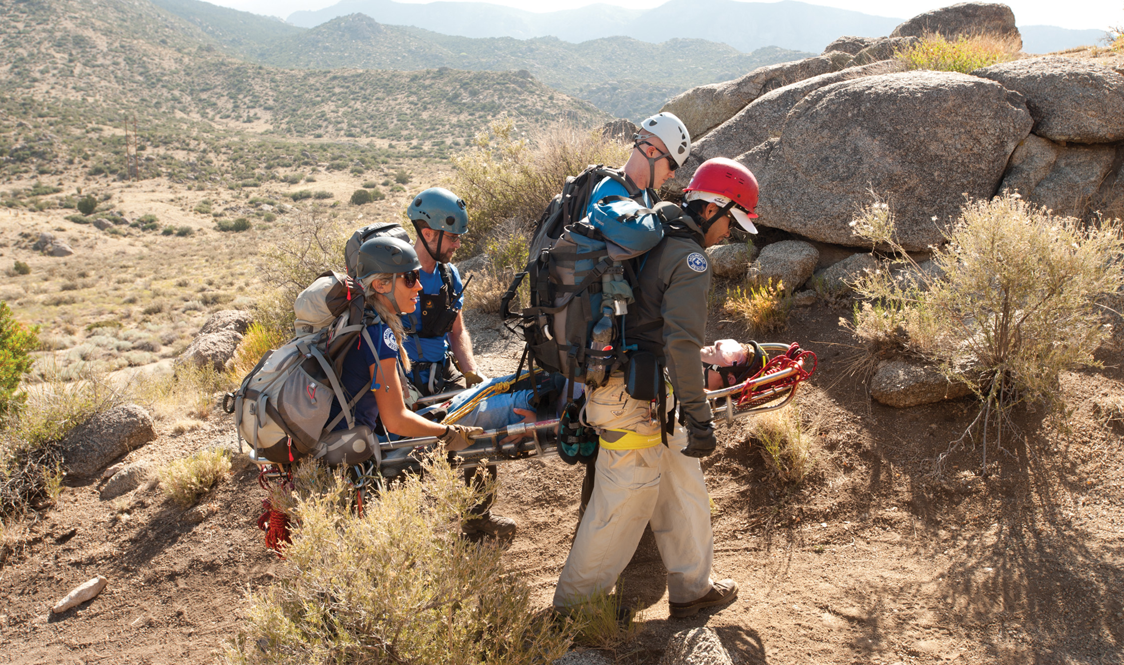
Using a Basket Stretcher to Move a Patient over Rough Terrain
Notes:
A basket stretcher has the advantage of enabling you to completely immobilize a patient who’s already on a backboard and to move him over any kind of terrain. The lightweight polyethylene style slides easily and smoothly over snow and rough terrain while protecting the patient from branches and twigs.

Slide 77
Packaging for Transport (9 of 13)
Equipment
  Flexible stretcher
    Also called a Reeves stretcher
    Useful in restricted spaces
Notes:
A Reeves flexible stretcher is a special transfer device made of canvas or synthetic materials. It has six large lifting and carrying handles, three on each side. It’s especially useful for narrow and restricted hallways such as those found in mobile homes.

Slide 78
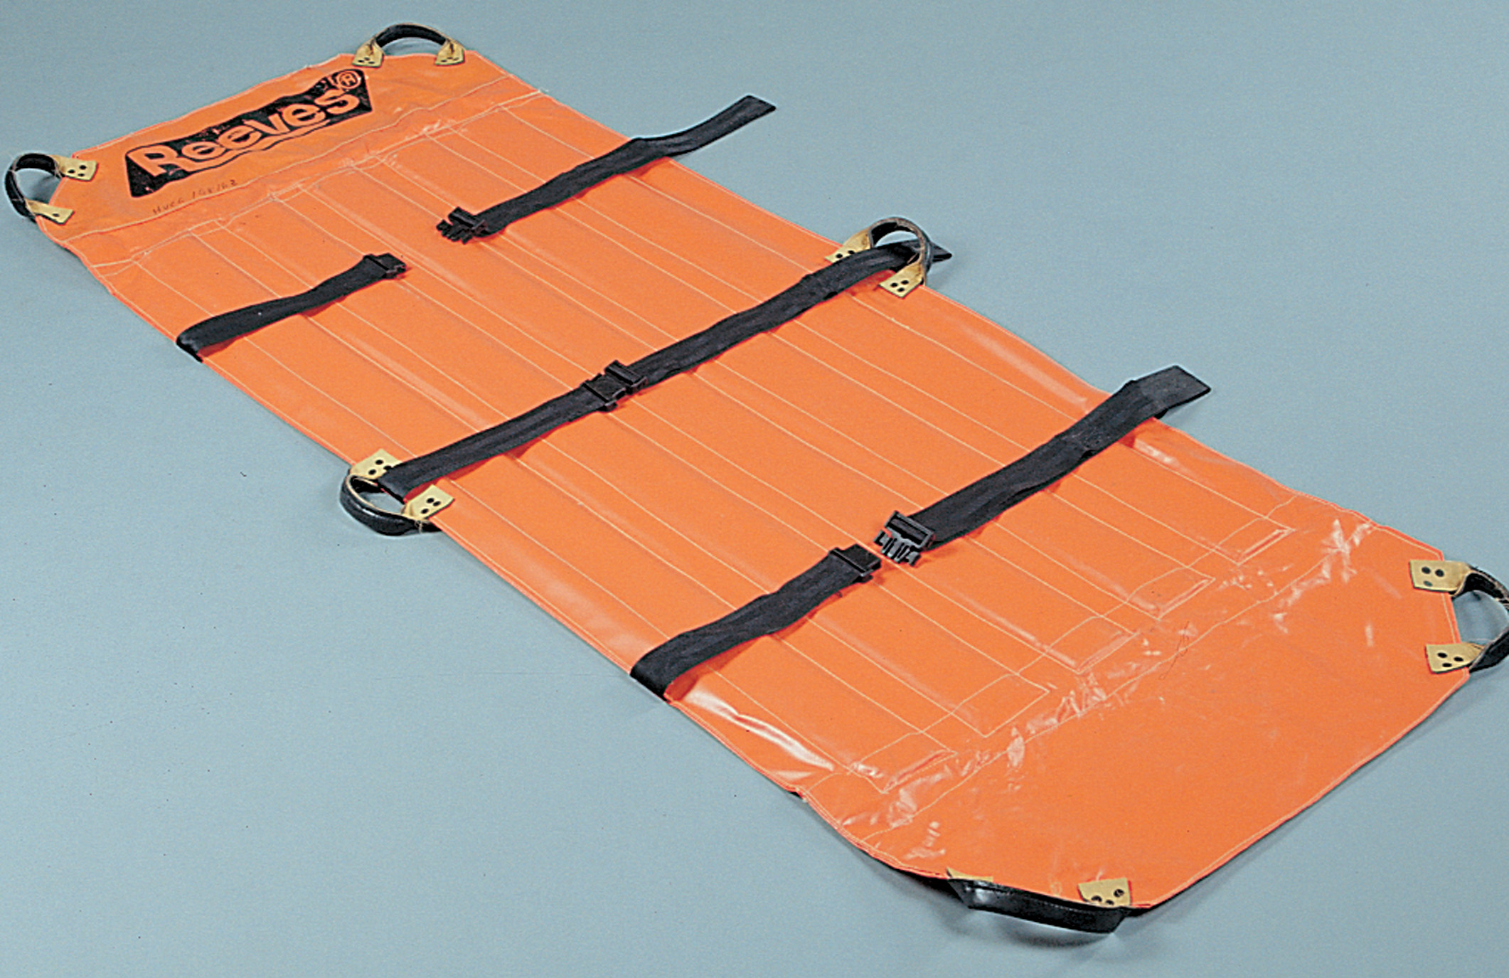
Flexible Stretcher
Notes:
A patient on a backboard can be placed inside the flexible stretcher for moves own stairs or over rough terrain. The Reeves stretcher is designed for rapid spine motion restriction in tight spaces.

Slide 79
Click on the Best Device for Moving an Unresponsive Patient from an Upstairs Bedroom to the Ground Floor
A. A stair chair
B. A wheeled stretcher
C. A scoop stretcher
D. A short backboard

Slide 80
Packaging for Transport (10 of 13)
Patient Positioning
  Patients are most commonly placed in supine or sitting position.
  Special considerations based on the patient's condition include:
Notes:
Points to Emphasize
Some patients, such as those who are in shock, nauseated, or late in pregnancy require special positioning.
Discussion Questions
How would you position a patient who is nauseated?
How would you position a patient in her third trimester of pregnancy?
Teaching Tips
Allowing students to be packaged helps to develop empathy for the patients they will be caring for.
Critical Thinking Discussion
Why is a patient carried head first up stairs and feet first down stairs?

Slide 81
Packaging for Transport (11 of 13)
  Patient Positioning
  Position of comfort
  Supine position
  Sitting position
  Positioned on left side
  Left lateral recumbent position
Notes:
An unresponsive patient with no suspected head, neck, or spinal injury should be placed in a left lateral recumbent position (coma or recovery position) to face the rescuer once in the ambulance. This position aids in draining fluids or vomitus from the mouth and helps prevent aspiration into the lungs.
A patient with chest pain or discomfort or with breathing difficulties should be placed in a position of comfort, usually sitting up, if hypotension is not present.
A patient with suspected spinal injury should be immobilized on a long backboard, vacuum mattress, or secured to the stretcher mattress depending on your local protocol. The backboard may be used only to extricate the patient. Once moved to the cot, the patient may be removed from the backboard.
A patient in shock (hypoperfusion) should be placed in a supine position unless your protocol indicates otherwise.
An alert patient who is nauseated or vomiting should be transported in a sitting or a recovery position. That position should allow you to manage the patient’s airway.
A pregnant patient following her 20th week of gestation (pregnancy) should be positioned on her left side.

Slide 82
Packaging for Transport (12 of 13)
  Patient Positioning
  Other Special Considerations
    Infants and toddlers
    Pregnant females
    Elderly patients
    Patients with physical disabilities
Notes:
Discuss how the patient positioning and packaging may change when transporting a pregnant female following her 20th week of gestation, a noncritically injured infant and toddler who is in a car seat, geriatric patients with debilitating and disfiguring bone diseases, or other types of physical disabilities.

Slide 83
Packaging for Transport (13 of 13)
Packaging Patients for Air Transport
  Tasks to perform
    Decontaminate patient (if needed).
    Manage the airway appropriately.
    Leave the chest accessible.
    Secure all equipment.
    Communicate with the patient.
    Cover eyes, ears, and exposed wounds.
    Listen to the directions of the flight crew.
Notes:
Points to Emphasize
There are special considerations in packaging patients for air medical transport.
Teaching Tips
Hand out copies of any local protocols for packaging patients for air medical transportation.
Discussion Question
What are some special considerations when packaging patients for air medical transportation?

Slide 84
General Guidelines for Carrying Patients (1 of 5)
General Guidelines
  Use a wheeled stretcher (if possible).
  Secure the patient’s hands.
  Consider your lifting limitations.
  Constantly communicate with your partner.
  Keep weight close to body.
Notes:
Teaching Tips
Allow students ample opportunity to practice these skills.
The wheeled device should be the EMT’s preferred to move a patient whenever possible. However, there are many situations in which the wheeled device isn’t feasible, such as moving a patient down or up steps, in a narrow hallway with angles, or over rough terrain. In those cases, the EMT should use a backboard, portable stretcher, or flexible stretcher to move the patient either to the wheeled stretcher or directly to the back of the ambulance, depending on the situation. The method in which you position yourself to carry the patient is dependent on the number of EMTs or other emergency response personnel at the scene to assist with the lift and carry.

Slide 85
General Guidelines for Carrying Patients (2 of 5)
Two-person Carry
  Position one person at the patient’s head and one at the feet, with the stronger person at the head.
  The rescuers must be facing each other, the E M T at the foot must walk backward.
  If there is a third person, use him as a spotter.
Notes:
If only you and your partner are available for a carry, one EMT is positioned at the head of the patient and the other is at the foot. The stronger person should be at the head because most of the weight is at that end. The EMT at the foot end faces the EMT at the head end. This requires the EMT at the foot end to walk backward.

Slide 86
General Guidelines for Carrying Patients (3 of 5)
Four-person carry
  One rescuer at the head
  One rescuer at the foot, facing away from the rescuer at the head
  A rescuer on each side, facing forward
  Alternatively, two rescuers at the head and two at the foot
Notes:
When four emergency personnel are available, a different carrying configuration is often used. One rescuer is placed at the patient’s head. Another is placed at the foot end, facing forward with his hands behind his body to grasp the carrying device. The other two rescuers are placed at each side, facing forward and grasping the carrying device with the hand closest to the patient. This puts all rescuers facing forward, forming a diamond configuration.
An alternative rectangular configuration may be used when four rescuers are present. Two rescuers are placed on opposite sides of the carrying device on the head end and two rescuers on opposite sides at the foot end of the carrying device. All rescuers face forward and grasp the carrying device with the hand that is closest to the patient.

Slide 87
General Guidelines for Carrying Patients (4 of 5)
Carrying a Supine Patient on Stairs
  A stair chair is preferred, but not always feasible.
  Ensure that the patient is secured to the device.
  Secure the patient’s hands.
  Use a spotter.
Notes:
When a supine patient is to be carried down stairs, typically one EMT is placed at the head end of the device facing the patient and the other is placed at the foot end of the device facing the patient with his back to the stairs. If possible, a spotter is placed behind the EMT at the foot end to provide guidance and stabilization and to count off the steps. The EMT at the foot end is first down the steps. This configuration is often used because of the limited width of a stairwell that doesn’t allow EMTs to be on both sides of the patient.
When moving a patient up steps, the same EMT configuration is used. The patient is carried head first; therefore, the EMT at the head end moves backward up the steps. If available, the spotter will be ahead of and guiding the EMT at the head end.

Slide 88
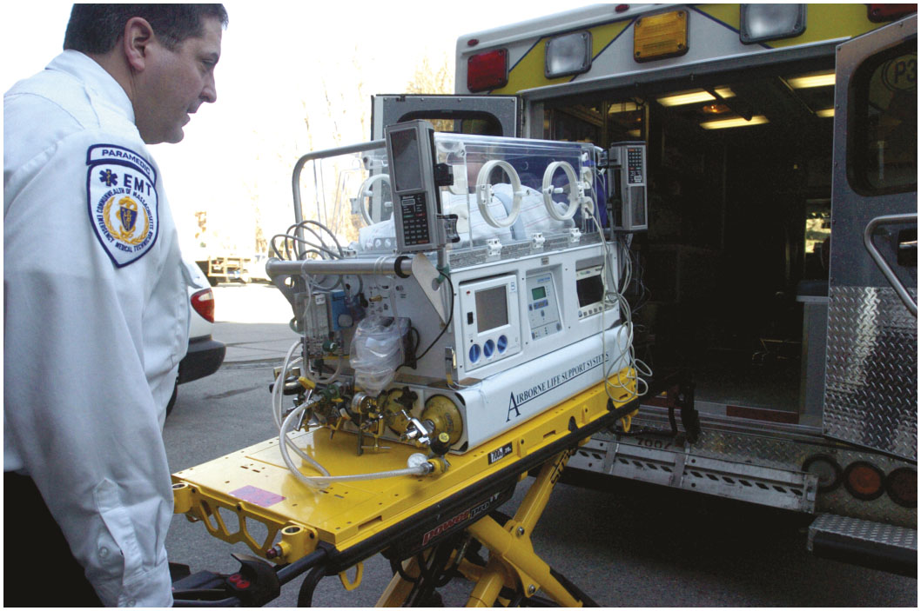
General Guidelines for Carrying Patients (5 of 5)
Neonatal Isolette
  Used for transportation of newborns
  Engages in the stretcher mounts of the ambulance
Notes:
Discussion Question
Why are neonates transported in a neonatal isolette?

Slide 89
Case Study Conclusion (1 of 2)
A rescue engine with a crew of four arrived to assist Brett and Annie. The team log-rolled the patient and then secured him to a long backboard. The stairs were narrow and difficult to navigate, but the four firefighters, two at each end of the backboard, were able to carry the patient up the stairs, with Brett and Annie acting as spotters.

Slide 90
Case Study Conclusion (2 of 2)
Once they were at the top of the stairs, the firefighters placed the patient on a wheeled stretcher and secured him to it for transfer to the ambulance. Brett continued care on the way to the hospital, while Annie notified the receiving facility that they would require lifting assistance on arrival.
Notes:
Follow-Up
Answer student questions.
Follow-Up Assignments
Review Chapter 6 Summary.
Complete Chapter 6 In Review questions.
Complete Chapter 6 Critical Thinking questions.
Assessments
Handouts
Chapter 6 quiz

Slide 91
Lesson Summary
Lifting and moving patients is performed on almost every call.
These are key E M T skills that require special techniques.
Know the capabilities of the crew and equipment when organizing lifts and moves.
Always exercise safety for yourself and your patient.
Notes:
Class Activity
As an alternative to assigning the follow-up exercises in the lesson plan as homework, assign each question to a small group of students for in-class discussion.
Teaching Tips
Answers to In Review questions are in the appendix of the text. Advise students to review the questions again as they study the chapter.

Slide 92
Correct! (1 of 2)
To lift a heavy object, use the muscles of the legs.
Click here to return to the quiz

Slide 93
Incorrect (1 of 2)
To lift a heavy object, use the muscles of the legs.
Click here to return to the quiz

Slide 94
Correct! (2 of 2)
An excessive lumbar curve, resulting in swayback, is called lordosis.
Click here to return to the quiz

Slide 95
Incorrect (2 of 2)
An excessive lumbar curve, resulting in swayback, is called lordosis.
Click here to return to the quiz

Slide 96
Incorrect Answer (1 of 3)
A stair chair is ideal for carrying an alert, responsive patient without spinal or lower extremity injuries up or down stairs. In the case, the patient is unresponsive, so you must seek an alternative.
Click here to return to the quiz

Slide 97
Incorrect Answer (2 of 3)
A wheeled stretcher is too heavy and large to make it a good choice for moving patients up or down stairs or in confined spaces. In such cases, you will choose an alternate device to bring the patient to the wheeled stretcher.
Click here to return to the quiz

Slide 98
Incorrect Answer (3 of 3)
A short backboard is used for non-critical patients with spinal injuries who are found in a seated position. The typical use of such a device is in a motor vehicle collision.
Click here to return to the quiz

Slide 99
Correct Answer!
A scoop stretcher, long backboard, portable stretcher, or flexible stretcher would all be good choices for moving an unresponsive patient up or down stairs to then be placed on a wheeled stretcher.
Click here to return to the program

Slide 100
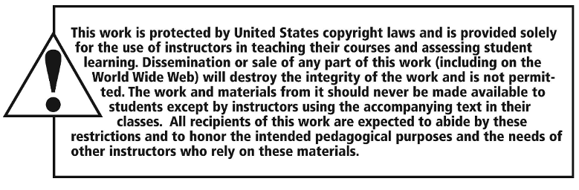
Copyright

