Slide 1

Prehospital: Emergency Care
Eleventh Edition
Chapter 5
Communication
Slides in this presentation contain hyperlinks. JAWS users should be able to get a list of links by using INSERT+F7
Copyright © 2018, 2014, 2010 Pearson Education, Inc. All Rights Reserved
Notes:
If this PowerPoint presentation contains mathematical equations, you may need to check that your computer has the following installed:
1) MathType Plugin
2) Math Player (free versions available)
3) NVDA Reader (free versions available)
Advance Preparation
Student Readiness
Assign the associated section of MyBRADYLab and review student scores.
Review the chapter material in the Instructor Resources, which includes Student Handouts, PowerPoint slides, and the MyTest Program.
Prepare
Arrange for a tour of the dispatch center and emergency department communication center, if not done previously.
Bring two-way radios to class for radio communication practice.
Arrange to have an ambulance present at the class location to demonstrate use of mobile radios.
Ask an emergency department physician to visit the class and talk about the essentials of communicating patient reports.
Make several lists of patient information placed in random order. Students will need to organize the information to provide a radio report.
The total teaching time recommended is only a guideline as described in the IRM lesson plan. Take into consideration factors such as the pace at which students learn, the size of the class, breaks, and classroom activities. The actual time devoted to teaching objectives is the responsibility of the instructor.

Slide 2
Learning Readiness
E M S Education Standards, text p. 81.
Chapter Objectives, text p. 81.
Key Terms, text p. 81.
Purpose of lecture presentation versus textbook reading assignments.
Notes:
Explain to students what the National EMS Education Standards are. The National EMS Education Standards communicate the expectations of entry-level EMS providers. As EMTs, students will be expected to be competent in these areas. Acknowledge that the standards are broad, general statements. Although this lesson addresses the listed competencies, the competencies are often complex and require completion of more than one lesson to accomplish. The student is also expected to review the chapter objectives to foreshadow what will be in the chapter, and by mastering the key terms the EMT student will better understand the learning and be able to communicate more clearly.
Additionally, explain to the students that the purpose of using these slides is to help keep the instructor focused on highlighting important portions of the material, explain interrelationships of topics, and discuss how to apply this information. It’s not the intent of the presentation (or slides alone) to include every component in the chapter. This presentation still requires the student to thoroughly read the chapter.

Slide 3
Setting the Stage
Overview of Lesson Topics
  E M S Communication System
  Communicating Within the System
  Team Communication and Dynamics
  Therapeutic Communication
Notes:
These bulleted points are the major headings from the chapter, in order. The purpose is to provide a basic lecture navigation for the student.

Slide 4
Case Study Introduction
E M T s Krista Martinez and Barb Sanderson are taking a midmorning break when the relative quiet of the crew quarters is broken by the tone that alerts them to an impending dispatch. “Ambulance 12, Engine 14…respond to 2962 Union Street for a report of difficulty breathing.”
Notes:
Case Study
Present the Case Study Introduction provided in the PowerPoint slide set.
Lead a discussion using the case study questions provided on the subsequent slide(s).
The Case Study with discussion questions continues throughout the PowerPoint presentation.
Case Study Discussion
Use the case study content and questions to foreshadow the upcoming lesson content.

Slide 5
Case Study (1 of 5)
What information do the E M T s need to relay back to dispatch?
What types of equipment will the E M T s use to communicate with dispatch and with the hospital?
Notes:
Case Study Discussion
Use the case study content and questions to foreshadow the upcoming lesson content. Gauge the student’s responses as a guide of how well versed they are in this topic.

Slide 6
Introduction
Every E M S call involves communication.
Radio communication involves specialized communications equipment.
E M T s must be able to communicate effectively with patients, family members, bystanders, team members, and other health care providers.
Notes:
Introduction
During this lesson, students will learn about the elements of emergency prehospital care communications and communications systems.
Case Study
Present the Case Study Introduction provided in the PowerPoint slide set.
Lead a discussion using the case study questions provided.
The Case Study with discussion questions continues throughout the PowerPoint presentation.

Slide 7
E M S Communications System (1 of 10)
Components of an Emergency Communication System
  Base station
    Serves as a dispatch and coordination center
    High power output (80-150 watts)
Notes:
Although emergency prehospital care communications systems vary considerably, many of them employ the components discussed over the next several slides.
The base station serves as a dispatch and coordination area and ideally is in contact with all other elements of the system. The base should be located on a suitable terrain, preferably a hill, and be in proximity to the hospital that serves as a medical command center. Base stations generally use relatively high-power output (80 to 150 watts).
Points to Emphasize
Differentiate among base station radios, mobile radios, and portable radios.
Teaching Tips
Show examples of base station, mobile, and portable radios, as well as mobile data terminals or digital pagers used in area EMS systems. Discuss specific communication issues in your area that can interfere with communication, such as mountains, buildings, tunnels, subways, and so on.

Slide 8
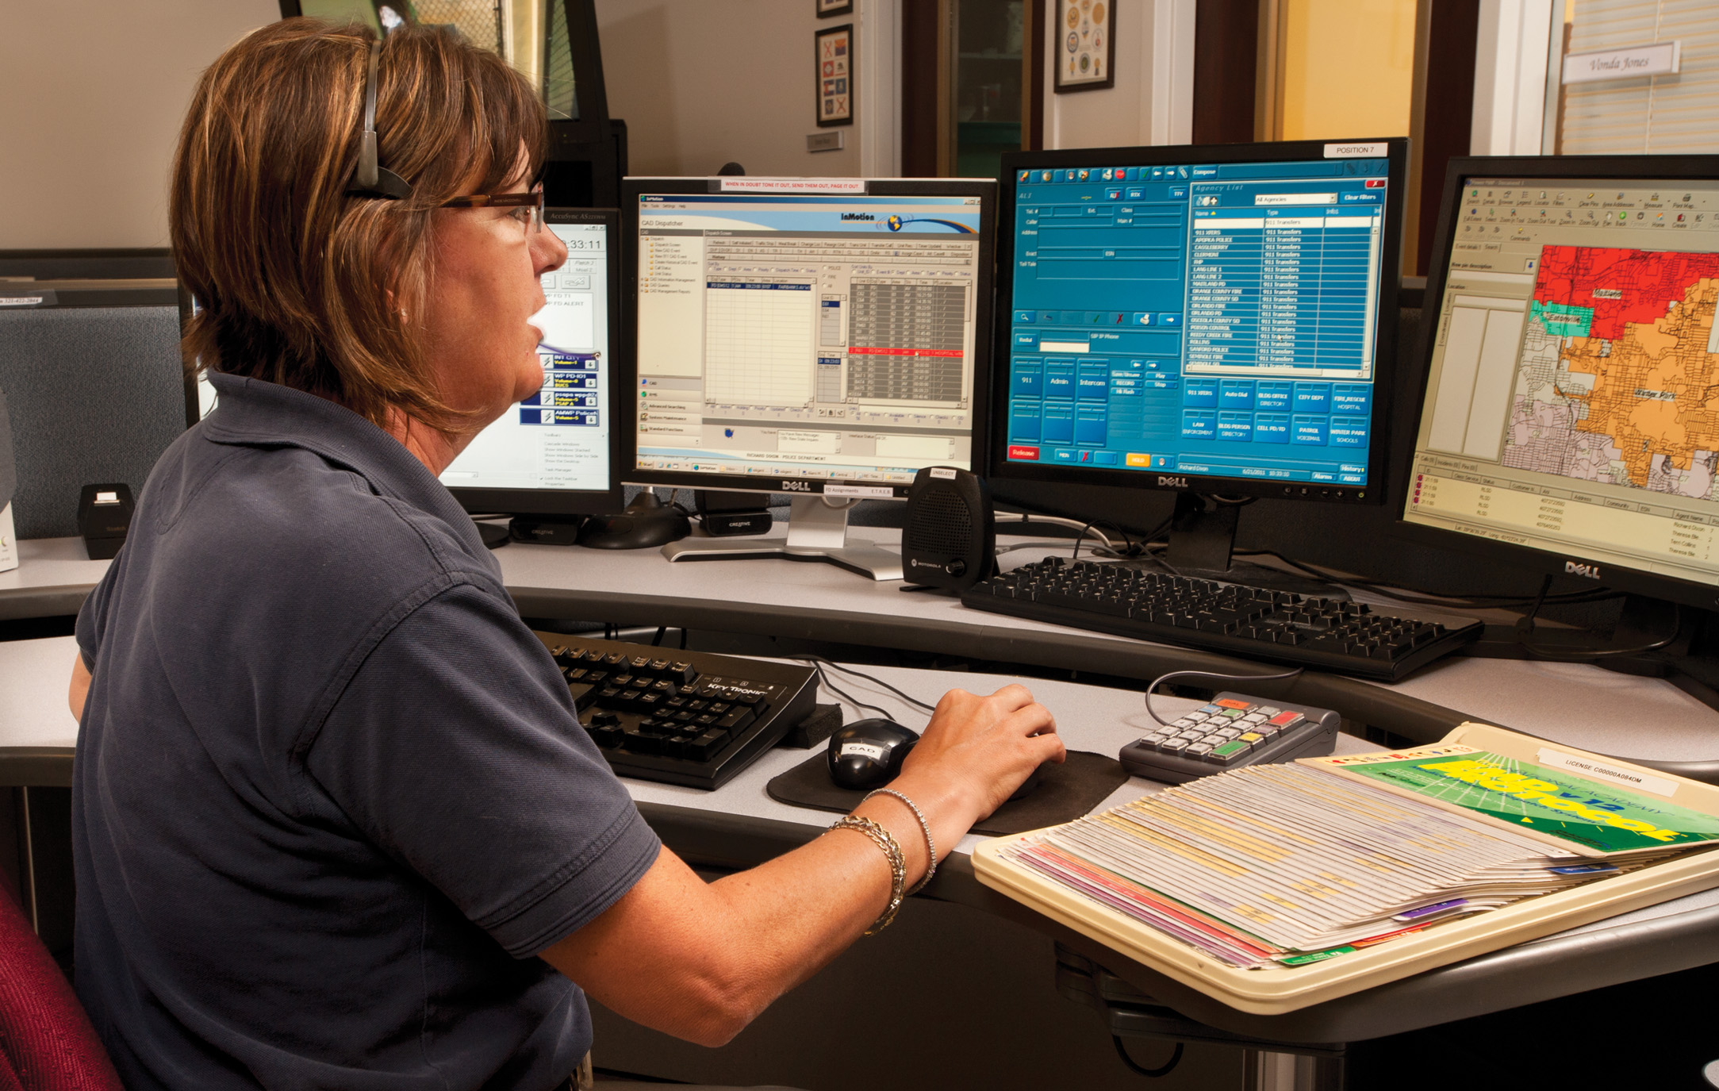
E M S Communications Center
Notes:
The base station serves as a dispatch and coordination area and ideally is in contact with all other elements of the system.

Slide 9
E M S Communications System (2 of 10)
Components of an Emergency Communication System
  Land mobile radio systems
    Vehicle-mounted transmitter/receivers
    Lower power than base stations
    10- to 15-mile range
Notes:
Land mobile radio systems (LMRS) are usually UHF, VHF, or 700- to-800-MHz systems that allow for dispatch base-to-vehicle (mobile and portable radios), vehicle-to-vehicle, vehicle-to-medical facility, and medical facility-to-medical facility communications.

Slide 10
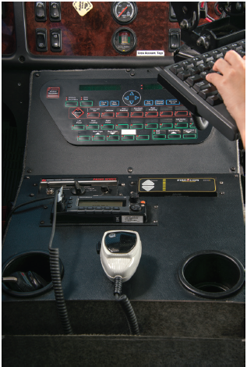
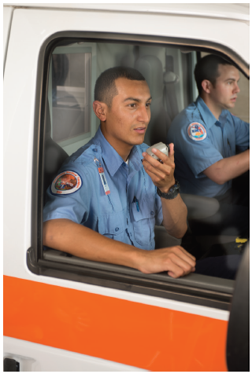
A Small Mobile Two-Way Radio Installed next to the Driver’s Seat in the Ambulance and can be Used to Contact Dispatch

Slide 11
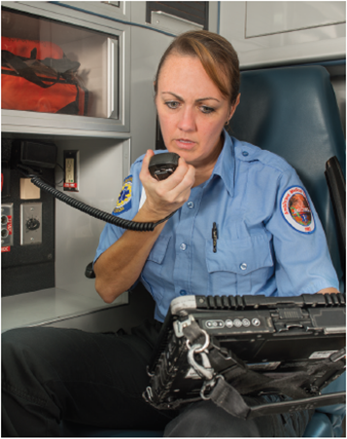
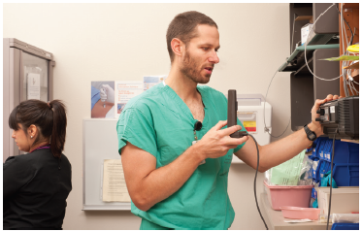
An E M T Using the Two-Way Radio in the Ambulance Patient Compartment to Contact Medical Direction

Slide 12
E M S Communications System (3 of 10)
Components of an Emergency Communication System
  Portable radio
    Handheld transmitter/receiver
    Used when E M T s are out of the vehicle
    Limited transmission range
    Transmission can be boosted by use of a repeater
Notes:
Portable, handheld transmitter/receivers are useful when you’re out of your vehicle or in the patient compartment. You must stay in communication with the base, with one another, and with medical direction. Such portable units may also be used by medical direction when they are stationed at a hospital that has no radio. Portable units usually have power outputs ranging from 1 to 5 watts and thus have limited range, although the signal of a handheld transmitter may be boosted by retransmission through a repeater.

Slide 13
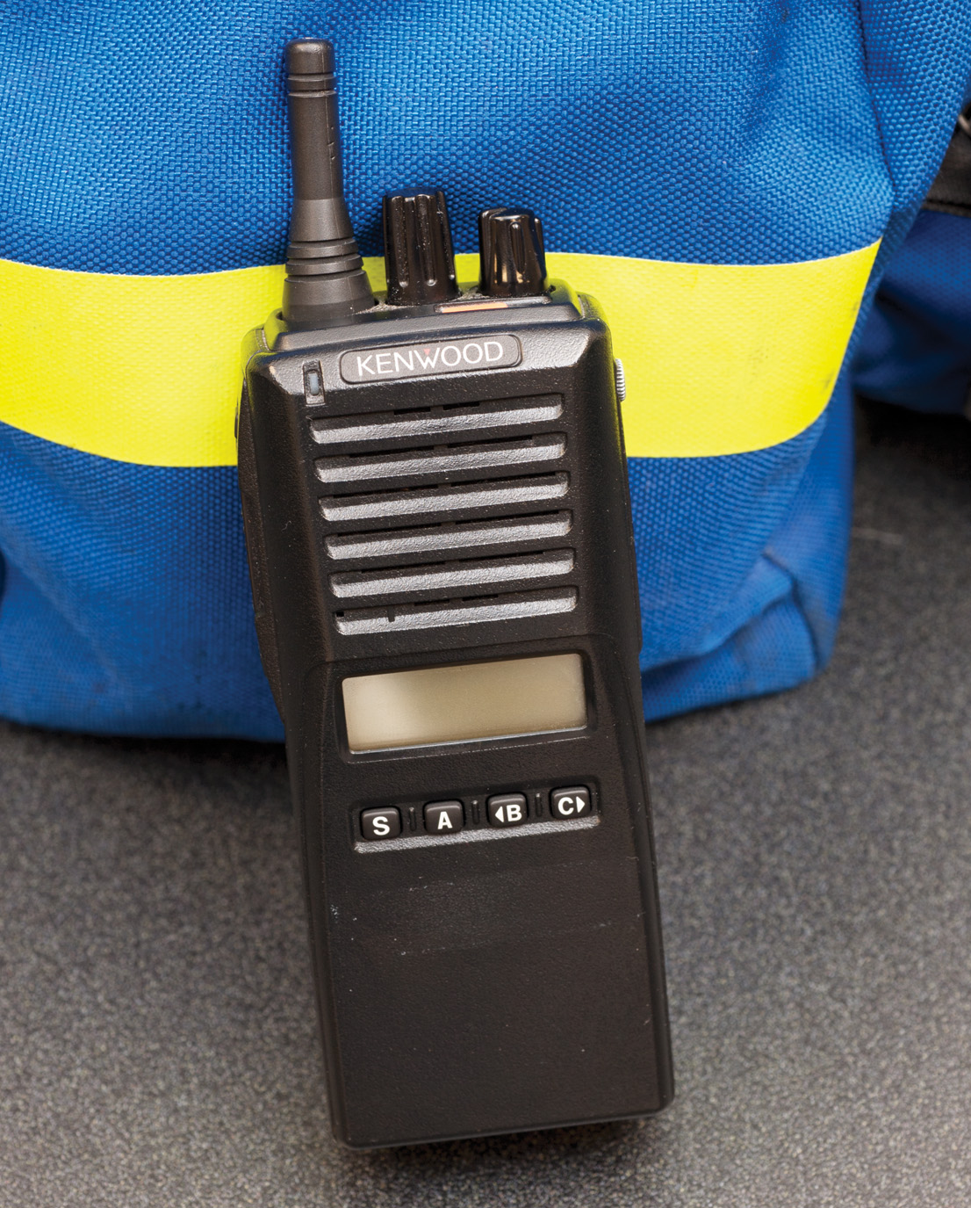
A Portable Hand-Held Radio

Slide 14
E M S Communications System (4 of 10)
Components of an Emergency Communication System
  Repeaters
    Receive lower-power transmissions and amplify them to achieve greater radio range
    Located in vehicles or at fixed sites
Notes:
Repeaters are devices that receive transmissions from a relatively low-powered source such as a mobile or portable radio and then rebroadcast them at another frequency and a higher power. Repeaters make communications possible in EMS systems that cover a wide area or where the terrain makes transmission and reception of signals difficult.

Slide 15
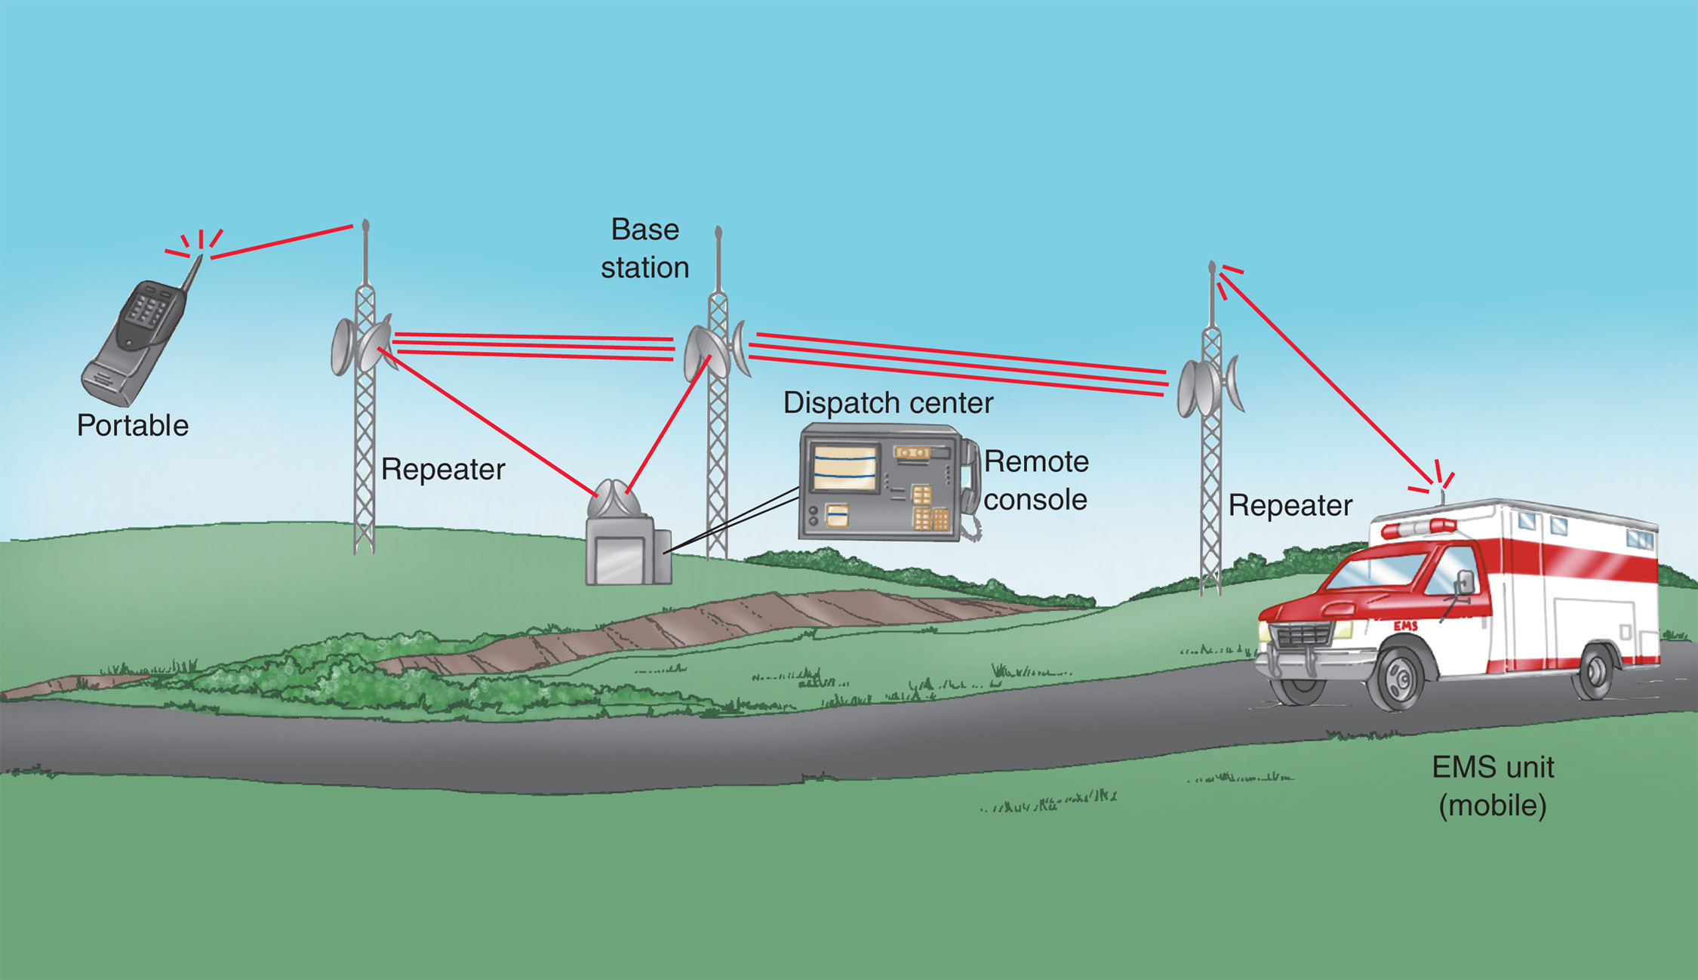
Example of an E M S Communication System Using Repeaters
Notes:
Knowledge Application
Describe a radio communication situation and have students determine whether you’re describing a base station, mobile radio, portable radio, repeater, or mobile data terminal.
Critical Thinking Discussion
What are some ways EMS communication technology may improve in the future?
What would be the consequences of failure of the EMS communication system in your area?
What are some communication problems you could predict if the EMS system continues to grow?

Slide 16
E M S Communications System (5 of 10)
Components of an Emergency Communication System
  Digital equipment
    Allows more radios to operate on crowded frequencies
    Utilizes encoders and decoders
    Includes mobile data terminals that can transmit messages at the push of a button
Notes:
Digital radio equipment allows more radio equipment to operate on crowded radio frequencies. Digital radio equipment also allows transmission of routine information, such as when a unit is en route to a call, with a push of a button, rather than by having to speak over the radio.
Discussion Questions
What are encoders and decoders with respect to radio communications?
What are the advantages and disadvantages to using cell phones for EMS system communication?

Slide 17
Mobile Data Terminals
Notes:
Knowledge Application
Describe a radio communication situation and have students determine whether you’re describing a base station, mobile radio, portable radio, repeater, or mobile data terminal.
Critical Thinking Discussion
What are some ways EMS communication technology may improve in the future?
What would be the consequences of failure of the EMS communication system in your area?
What are some communication problems you could predict if the EMS system continues to grow?

Slide 18
E M S Communications System (6 of 10)
Components of an Emergency Communication System
  Cellular (wireless) phones
    Phones transmit through the air, rather than over wires.
    Networks can become overwhelmed in disaster situations.
    Excellent quality sound.
Notes:
The use of cellular phones as a means of communication in EMS is common today. Cellular phones transmit and receive through the air rather than over wires.
Benefits of cellular phones include excellent sound quality, availability of channels, easy maintenance, and, often, increased privacy of communications. With the prevalence of smartphones, the EMT is able not only to provide voice communication, but also to take and send images from the scene, access or send data files, and call up information on or search the Internet if necessary. The major disadvantage of cellular phone systems for EMS use is that they are part of the public phone system and can easily be overwhelmed during multiple-casualty disasters.

Slide 19
Use of Cellular (Wireless) Phone is Very Common in E M S
Notes:
Cellular phones are often used as backups to an existing radio system or where the expense of establishing a radio system is too great.

Slide 20
E M S Communications System (7 of 10)
Components of an Emergency Communication System
  Telemetry
    Transmission of patient data
    E C G s, vital signs, etc.
Notes:
Telemetry is the process of transmitting data through an automated communications process, most often using wireless data transfer technology. Historically, transmission of an ECG was the most common EMS application of telemetry. Today, however, vital signs and other more advanced patient data are also being transmitted.

Slide 21
E M S Communications System (8 of 10)
  Components of an Emergency Communication System
  Land mobile satellite communications
    Often used in remote areas
    Communication uses satellites to help relay message
Notes:
In remote areas, EMS radio communications are commonly nonexistent or extremely expensive. Land mobile satellite communications systems are an alternative to radio communications for EMS systems in these sparsely populated remote rural areas.

Slide 22
E M S Communications System (9 of 10)
  Components of an Emergency Communication System
  Broadcast regulations
    Radio operations are governed by the Federal Communications Commission (F C C).
Notes:
The Federal Communications Commission (FCC) has jurisdiction over all radio operations in the United States, including those used by EMS systems. The FCC licenses individual base station operations, assigns radio call signs, approves equipment for use, establishes limitations for transmitter power output, assigns radio frequencies, and monitors field operations. The FCC has also set regulations to limit interference with emergency radio broadcasts and to bar the use of obscenity and profanity in broadcasts.

Slide 23
E M S Communications System (10 of 10)
  Components of an Emergency Communication System
  System maintenance
    Routine cleaning
    Regular maintenance schedule
    Changing and charging batteries
    Carry backup batteries
Notes:
The equipment should not be mishandled or unnecessarily exposed to harsh environmental conditions. Regular cleaning with a damp cloth and a mild detergent should be part of the maintenance program.
Points to Emphasize
Check and maintain all communication equipment on a regular basis to ensure that it will operate properly when needed.

Slide 24
What Piece of Radio Communication Equipment Amplifies
A Low-Power Radio Transmission and Rebroadcasts It at Higher Power? Click on Your Answer Below.
Mobile radio
Base station
Portable radio
Repeater

Slide 25
Case Study (2 of 5)
Krista uses the portable radio to acknowledge the dispatch. Once the E M T s are in the vehicle, Barb pushes the status button on the mobile data terminal that indicates they are en route to the scene. At the scene, Barb pushes another button, indicating their arrival. The E M T s check the scene for safety, and proceed to the door of the residence at the dispatched address.
Notes:
Discuss the continuation of the case study with the class.

Slide 26
Case Study (3 of 5)
What further communications will need to take place between the E M T s and dispatch?
What information will the E M T s need to communicate to the receiving facility by radio?
What role does communication play in transferring patient care at the hospital?
Notes:
Use the questions presented here as an opportunity for the students to demonstrate their understanding and application of the information presented thus far to this case study.

Slide 27
Communicating Within the System (1 of 22)
E M T s communicate with:
  Dispatch
  Medical direction
  Receiving facility personnel
Notes:
As an EMT, you will be expected to communicate not just with your partners and patients but also with EMS dispatch, medical direction, and medical personnel at receiving facilities.
Points to Emphasize
It is important to follow the ground rules established for communicating within the EMS system:
Use plain English.
Listen before transmitting, wait one second to speak after depressing the PTT button, and keep transmissions short.
To check for understanding, echo physicians' orders word for word as soon as they are received.
When communicating over the radio or by cell phone, never use information that can identify your patient.
Use "affirmative" and "negative" rather than "yes" and "no" when speaking on the radio.
Use an organized format for communicating patient information, beginning with the patient's age, sex, and chief complaint.

Slide 28
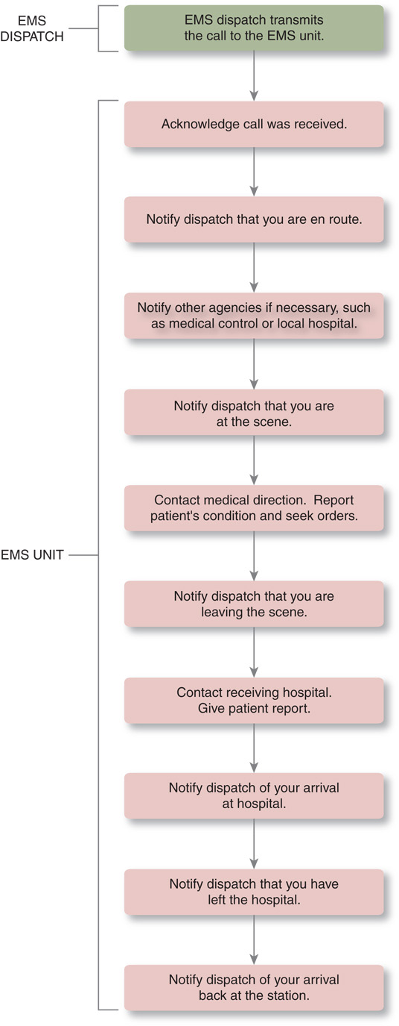
Progression of Radio Transmissions

Slide 29
Communicating Within the System (2 of 22)
Ground Rules for Radio Communication
  Turn on the radio and select the frequency.
  Listen before transmitting and adjust volume.
  Press the “push-to-talk” button and wait one second before speaking.
Notes:
Discussion Questions
What are some of the guidelines used for radio communications?
Why are "please," "thank you," and other courtesy phrases not used in EMS radio communication?
What is the purpose of saying "over" when you have finished speaking on the radio?
Teaching Tips
Explain any unique guidelines or conventions used by your local EMS system.

Slide 30
Communicating Within the System (3 of 22)
  Ground Rules for Radio Communication
  Place the microphone two to three inches from your mouth; speak slowly, clearly, and calmly.
  The unit you’re calling should respond with “go ahead” or “stand by.”
Notes:
Critical Thinking Discussion
Why should radio transmissions be kept to approximately 30 seconds or less?

Slide 31
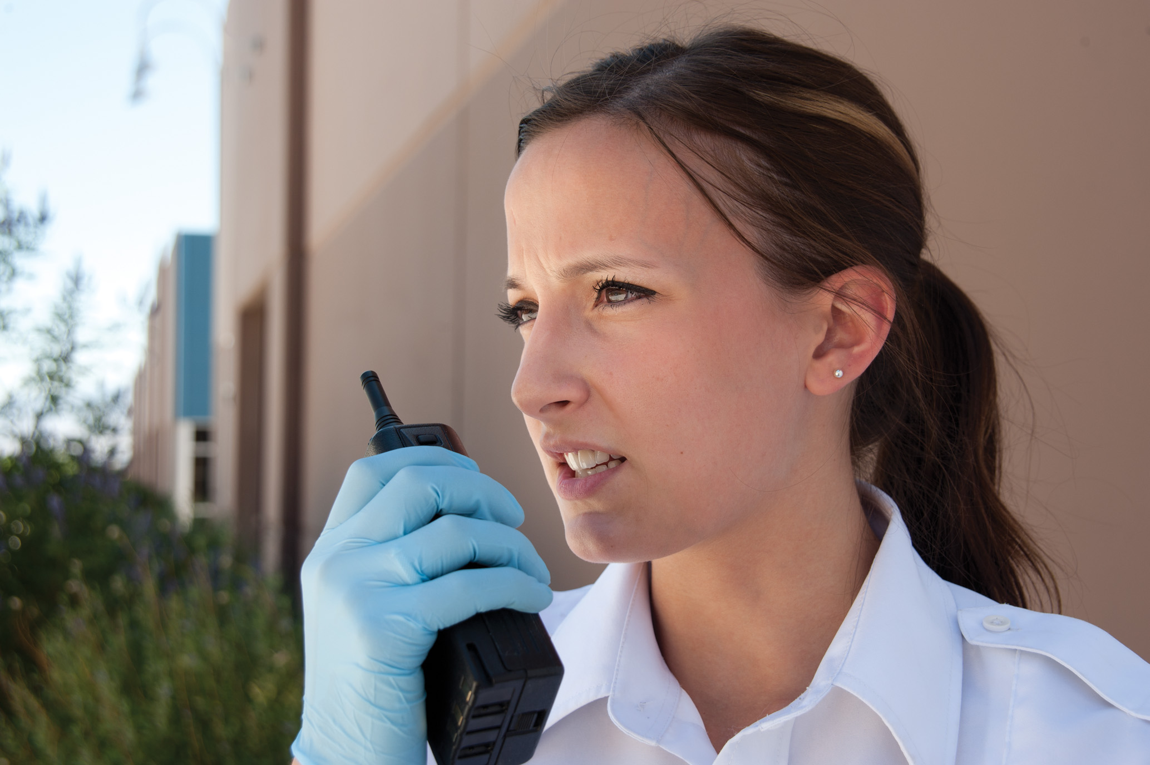
Hold the Microphone About Two Inches from Your Lips as You Speak into It

Slide 32
Communicating Within the System (4 of 22)
Ground Rules for Radio Communication
  Keep transmissions brief.
  Be organized, use plain English; avoid slang and jargon.
  When a number could be confusing over the air, follow it with the digits.
    For example, “Thirteen,” would be stated “One-three.”

Slide 33
Communicating Within the System (5 of 22)
  Ground Rules for Radio Communication
  Give objective information and selected subjective information from the patient assessment.
  Echo medical orders.
  Write down important information, such as addresses and medication orders.

Slide 34
Communicating Within the System (6 of 22)
  Ground Rules for Radio Communication
  Remember that others can hear what you’re saying.
  Use “we,” rather than “I.”
  Use “affirmative” for “yes,” and “negative” for “no.”
  When finished, say “over,” and wait for confirmation from the receiving party.

Slide 35
Communicating Within the System (7 of 22)
Phone/Cellular Phone Communication
  Format of reports is the same.
  Be aware of cellular dead spots.
  Have a backup plan for communication.
  Know important telephone numbers.
Notes:
Some systems use phone or cellular phone communications to deliver pertinent information, the content and format of the information should be treated similarly to that provided during radio communications. The EMT should be familiar with the cellular technology being used and should be aware of the cellular dead spots in the area. There should be another plan in place in case a cellular transmission fails while giving a report or communicating with another agency.

Slide 36
Communicating Within the System (8 of 22)
Communicating with Dispatch
  Dispatch receives information from callers and directs emergency services to the scene.
  Emergency medical dispatchers provide instructions to the caller while awaiting E M S arrival.
Notes:
Your first contact on a run will probably be with your EMS system’s dispatch—perhaps a certified Emergency Medical Dispatcher (EMD). It’s the job of dispatch to obtain as much information as possible about an emergency, to direct the appropriate emergency service(s) to the scene, and to advise the caller on how to manage the situation until help arrives.
Teaching Tips
Give several examples of radio report information to illustrate the information in the text.
Discussion Question
What are the important EMS call times that should be recorded with dispatch?
Knowledge Application
Suggest that students start developing their sense of travel time estimations when traveling by automobile by determining what their ETAs are from one place to another.

Slide 37
Communicating Within the System (9 of 22)
  Communicating with Dispatch
  Dispatchers may receive information from the advanced automatic collision notification (A A C N) systems in some newer vehicle models.
  Information provided can be critical in locating the collision and predicting severity of injury.
Notes:
Teaching Tips
Give several examples of radio report information to illustrate the information in the text.
Discussion Question
What are the important EMS call times that should be recorded with dispatch?
Knowledge Application
Suggest that students start developing their sense of travel time estimations when traveling by automobile by determining what their ETAs are from one place to another.

Slide 38
Communicating Within the System (10 of 22)
  Communicating with Dispatch
  Typical communication points:
    To acknowledge that dispatch information was received
    To advise dispatch when the unit is en route to a call
    To estimate your time of arrival and report any delays
Notes:
The information that dispatch provides to you will assist you in doing your job. But remember that dispatch coordinates the different parts of the EMS system. Dispatch also needs information from you to ensure that all those parts work together efficiently. Discuss with the students these communication points with dispatch.

Slide 39
Communicating Within the System (11 of 22)
  Communicating with Dispatch
  Typical communication points:
    To announce the unit's arrival on scene and, if needed, request additional resources
    To announce the unit's departure from the scene, transport destination, number of patients, and estimated arrival time
Notes:
The information that dispatch provides to you will assist you in doing your job. But remember that dispatch coordinates the different parts of the EMS system. Dispatch also needs information from you to ensure that all those parts work together efficiently. Discuss with the students these communication points with dispatch.

Slide 40
Communicating Within the System (12 of 22)
  Communicating with Dispatch
  Typical communication points:
    To announce arrival at the receiving facility
    To announce when you’re available for another call
    To announce when you’re en route back to the station
    To announce arrival at your station
Notes:
The information that dispatch provides to you will assist you in doing your job. But remember that dispatch coordinates the different parts of the EMS system. Dispatch also needs information from you to ensure that all those parts work together efficiently. Discuss with the students these communication points with dispatch.

Slide 41
Communicating Within the System (13 of 22)
Communicating with Health Care Professionals
  Medical direction
    Medical direction may be located at the receiving facility or elsewhere.
    On many calls you will consult with medical direction.
    Medical direction may give orders and advice.
Notes:
On a run, you may have to communicate with medical personnel at various times via your radio. Most these communications will be with your system’s medical direction and with personnel at the facility to which you’re transporting a patient. In some systems, you may need to communicate with other EMS providers to transfer care of the patient.
Points to Emphasize
EMS is a team effort. EMTs must understand how communication affects teamwork. Ineffective communication with other team members interferes with patient care. Use of radio codes has advantages and disadvantages and may enhance or interfere with clear communication. Common radio terms include clear, copy, ETA, over, stand by, and 10-4.
Teaching Tips
Give students mock medical orders and ask them to repeat the order back to you.

Slide 42
Communicating Within the System (14 of 22)
Communicating with Health Care Professionals
  Medical direction
    Be clear.
    Echo orders.
    Ask for clarification of orders, if needed.
    If the order seems inappropriate, ask questions.

Slide 43
Communicating Within the System (15 of 22)
Communicating with Health Care Professionals
  Communicate this information to medical direction:
    Your unit's identification number and level of care
    The patient's age and sex
    The patient's chief complaint
    History of the present illness

Slide 44
Communicating Within the System (16 of 22)
Communicating with Health Care Professionals
  Communicate this information to medical direction:
    Patient's past medical history
    Patient's mental status
    Patient's baseline vital signs
    Physical exam findings

Slide 45
Communicating Within the System (17 of 22)
Communicating with Health Care Professionals
  Communicate this information to medical direction:
    Emergency care provided
    Patient's response to emergency care
    Patient's current condition
    Request for further interventions
    Estimated time of arrival
Notes:
Class Activity
Divide the class into small groups. Hand out prepared lists of patient information in random order. Each group will take about ten minutes to organize the patient information according the format in the text. Next, have each group take turns using one of the portable radios to go out of the classroom and present their patient information. Ask the class to discuss whether or not they received a clear picture of the patient's presentation.

Slide 46
Communicating Within the System (18 of 22)
Communicating with Health Care Professionals
  Additional guidelines for communicating with medical direction
    Use S B A R to organize information.
      Situation
      Background
      Assessment
      Recommendation
Notes:
SBAR is a method of organizing your communication into a standard format that would be particularly useful when communicating with medical direction, especially if you’re seeking further orders. SBAR is an acronym for situation, background, assessment, and recommendation. Situation refers to the problem or reason why you’re calling and the patient’s chief complaint. Background is a concise description of the past medical history and the patient’s response to treatment to that point. Assessment includes pertinent subjective and objective assessment findings such as mental status, vital signs, neurologic findings, blood glucose level, and Glasgow Coma Score. Recommendation is basically what you’re requesting for the patient, such as an order to administer another nitroglycerin spray.

Slide 47
Communicating Within the System (19 of 22)
Communicating with Health Care Professionals
  Receiving facility
    Pertinent information allows the facility to prepare for the patient.
    The information provided is similar to that provided for medical direction.
    Notify the facility of changes that occur after the report is given.
Notes:
Critical Thinking Discussion
What are some consequences to patient care of giving a disorganized patient report?
Discussion Question
What are important things the receiving facility needs to know about a patient?

Slide 48
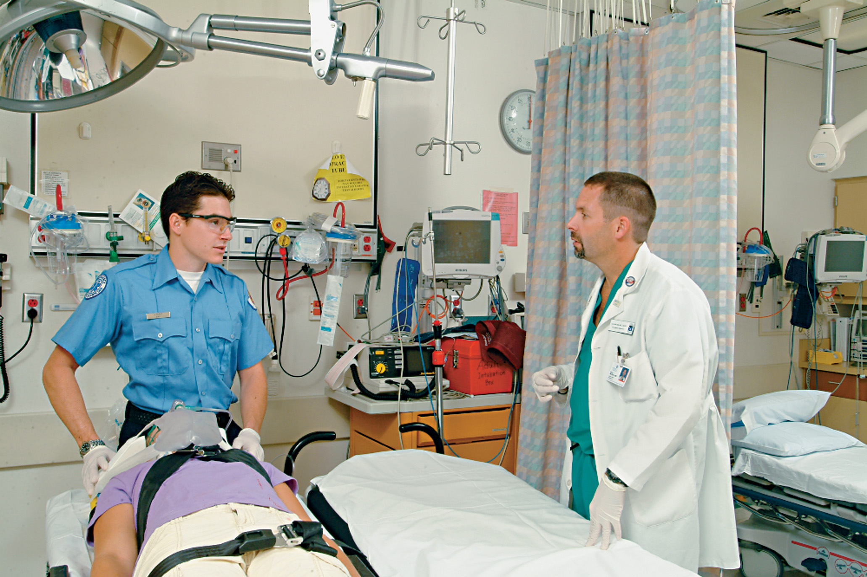
Communicating Within the System (20 of 22)
Communicating with Health Care Professionals
  Provide an oral report on arrival at receiving facility.
Notes:
After you’re at the facility and turning the patient over to staff, you will deliver an oral report that takes into account your reassessment findings. That oral report should summarize the information you already broadcast to the facility, along with updated information from your reassessment.

Slide 49
Communicating Within the System (21 of 22)
Communicating with Health Care Professionals
  When transferring patient care, the report should include:
    The patient's current condition
    The patient's age and gender
    The patient's chief complaint
    A brief, pertinent history
    How you found the patient

Slide 50
Communicating Within the System (22 of 22)
Communicating with Health Care Professionals
  When transferring patient care, the report should include:
    Major past illnesses
    Vital signs
    Pertinent exam findings
    Treatment provided
    Patient's response to treatment
Notes:
Knowledge Application
Describe a scenario in which students will be transferring care of a patient to paramedics on the scene who will then be transporting to the hospital. What are the important facts the paramedics need to know?
Critical Thinking Discussion
What are some ways you can develop your skills in EMS communication?

Slide 51
You’re Transporting a 30-Year-Old Patient Who is Complaining of Left Arm Pain as a Result of a Motor Vehicle Collision
Which piece of information is M O S T relevant during your radio report to the receiving facility? Click on your answer.
A. The name of the patient’s primary care physician
B. All of the medications the patient takes, including vitamins and over-the-counter medications
C. The patient’s age and gender
D. A history of the patient’s childhood illnesses

Slide 52
Case Study (4 of 5)
Krista and Barb arrive at the patient's residence just prior to the engine. Upon entering the residence, Krista approaches the patient, 32-year-old Alyssa Tandy, while Barb takes a moment to speak with Alyssa's husband, David. A few minutes into the assessment, the engine arrives and paramedic Sam Bowles enters the scene.
Notes:
Review case study with students.

Slide 53
Case Study (5 of 5)
What skills are needed to establish rapport with the patient at the scene and obtain the necessary information?
How should the crew interact with each other, and with other responders and medical personnel, to facilitate good patient care?
Notes:
Review questions with the students and allow them time to apply the lessons learned to this case.

Slide 54
Team Communication and Dynamics (1 of 5)
Taking Charge
  E M T s must be able to confidently take charge.
  E M T s interact with fire, rescue, law enforcement, and other health care professionals.
  The E M T must be the advocate for good and proper patient care.
Notes:
The EMT is a team member of health care professionals. At many scenes, the EMT will function as part of a team composed of fire, rescue, law enforcement, and other professionals. In these situations, the EMT is expected to communicate professionally with those working on the team as well as with others. Good team communication not only improves how the team accomplishes its goals, but it also improves the quality of services provided to the patients and the community.
EMTs must take charge confidently at the scene to which they’re called. Your personal appearance and professional manner from the time of your arrival throughout your stay at the scene will help communicate to bystanders, family members, and to the patient that you’re in charge.

Slide 55
Team Communication and Dynamics (2 of 5)
Radio codes
  Advantages
    Can shorten radio air time
    Can provide information clearly and concisely
    Can allow for privacy by transmitting information not easily understood by bystanders
Notes:
Some EMS systems use radio codes, either alone or in combination with messages in plain English. Radio codes can shorten radio air time and provide clear and concise information. They can also allow transmission of information in a format not understood by the patient, family members, or bystanders. There are, however, several disadvantages to the use of codes.
Teaching Tips
If your system uses ten codes or another system of codes, provide a handout for students.

Slide 56
Team Communication and Dynamics (3 of 5)
  Radio codes
  Disadvantages
    Useless unless they are understood by all in the system
    Medical communication may be too complex to be conveyed in codes
    Some codes are used infrequently and must be looked up
Notes:
Some EMS systems use radio codes, either alone or in combination with messages in plain English. Radio codes can shorten radio air time and provide clear and concise information. They can also allow transmission of information in a format not understood by the patient, family members, or bystanders. There are, however, several disadvantages to the use of codes.

Slide 57
Team Communication and Dynamics (4 of 5)
Times
  Clocks must be accurate and synchronous.
  Military time system is generally used.
    1427 hours is 2:27 p.m.
    0030 hours is 30 minutes after midnight
Notes:
Teaching Tips
Give students several 12-hour clock times and have them give the military time equivalents.

Slide 58
Team Communication and Dynamics (5 of 5)
Radio Terms
  Frequently used words or short phrases are used to concisely convey meaning.
  Examples include:
    Break, clear, copy, E T A, and 10-4, landline, stand by, over
Notes:
Teaching Tips
Give examples of the use of radio terms as you explain them.
Discussion Questions
How can radio codes both enhance and interfere with communication?
What does the term copy mean in radio communications?
When would you use the term stand by in radio communications?
Class Activity
Have pairs of students take a portable radio out of the classroom. Contact them by radio and initiate a conversation, giving them an opportunity to both hear and use radio terms. The conversations need not be EMS-related. The point is to use terms that enhance radio communication in general.

Slide 59
Therapeutic Communication (1 of 22)
Principles of Patient Communication
  Therapeutic communication fosters a positive patient relationship.
  Messages composed of thoughts, ideas, information, emotion.
  Many factors can influence how a person interprets these messages.
Notes:
Points to Emphasize
Communication is a critical EMT job skill.
Communication is an essential part of your job as an EMT. You must be able to communicate effectively with all those you meet while you’re on a call. Communication involves more than just what you say. Communication is a dynamic process that incorporates verbal and nonverbal expressions into meaningful messages that are received by others.

Slide 60
Therapeutic Communication (2 of 22)
The Communication Process
  Sender encodes a message.
  Receiver decodes the message.
  Feedback received by sender helps to determine if the message was received as desired.
Notes:
Points to Emphasize
Communication uses verbal and nonverbal messages. The basic communication model involves a sender, who encodes the message and sends it to a receiver, who decodes the message and gives feedback about his understanding.
Teaching Tips
Write the following phrase on the white board: I didn't say he was a terrible EMT. Select eight students to repeat the phrase, each one placing emphasis on a different word in the phrase. Ask students how the meaning of the message changes based on voice inflection.

Slide 61
Therapeutic Communication (3 of 22)
Communication Responses
  Techniques to improve provider and patient communication
    Facilitation
    Clarification
    Summary
    Explanation
Notes:
It’s necessary to develop and establish a good rapport with your patients. Putting the patient and yourself at ease allows for better communication. If you treat your patients with respect, compassion, and empathy, your communication with them will be easier and more accurate.
Points to Emphasize
Techniques to facilitate communication include clarification, summary, explanation, silence, reflection, empathy, and confrontation.
Class Activity
Divide students into seven groups. Assign each group one of the techniques that facilitate communication (clarification, summary, explanation, silence, reflection, empathy, and confrontation). Each group will spend about 15 minutes developing a short (one to two minutes) skit that illustrates their assigned communication technique to the rest of the class.

Slide 62
Therapeutic Communication (4 of 22)
Communication Responses
  Techniques to improve provider and patient communication
    Silence
    Empathy
    Confrontation
    Facilitated communication
Notes:
It’s necessary to develop and establish a good rapport with your patients. Putting the patient and yourself at ease allows for better communication. If you treat your patients with respect, compassion, and empathy, your communication with them will be easier and more accurate.
Points to Emphasize
Techniques to facilitate communication include clarification, summary, explanation, silence, reflection, empathy, and confrontation.
Class Activity
Divide students into seven groups. Assign each group one of the techniques that facilitate communication (clarification, summary, explanation, silence, reflection, empathy, and confrontation). Each group will spend about 15 minutes developing a short (one to two minutes) skit that illustrates their assigned communication technique to the rest of the class.

Slide 63
Therapeutic Communication (5 of 22)
Communicating with the Patient
  People at an emergency scene may be experiencing high-intensity emotions, which can affect communication.
  Use the three C’s:
    Confidence, compassion and cooperation.
Notes:
When the EMT arrives on a call, you may find the people at the scene injured, frightened, anxious, and possibly angry or in shock. These are high-intensity emotions that can make getting information from and delivering information to people difficult. To establish effective face-to-face communications with people in such circumstances, keep in mind the three Cs: competence, confidence, and compassion. If you convey these qualities in what you say and do, you will get better cooperation and deal with fewer hostile or irrational responses.

Slide 64
Therapeutic Communication (6 of 22)
Patient Contact
  First impressions are critical, and include your appearance and professionalism.
  Introduce yourself, your team, and ask the patient's name.
    Determine what he or she wishes to be called.
    Use the patient's name.
Notes:
Developing rapport and communicating with patient begins when the EMT arrives on scene. It includes everything from how you present yourself physically to what you say and do from that first moment on. Discuss
these guidelines when communicating with the patient.

Slide 65
Therapeutic Communication (7 of 22)
  Patient Contact
  Obtain permission to treat.
    If the patient refuses, seek to understand the reason, which may be related to fear or defense mechanisms.
  Be wary of defense mechanisms.
Notes:
Be sure also to say, “I’m going to help you. Is that all right?” This will help in gaining consent for treatment as discussed in the chapters “Medical, Legal, and Ethical Issues” and “Documentation.”
Don’t be surprised if a patient says, “No!” or “I’m okay!” when you ask about providing assistance. Usually the resistance is a form of denial or another defense mechanism because they are simply frightened or confused. Defense mechanisms are psychological coping strategies the person may use to protect himself from unwanted feelings or thoughts.

Slide 66
Therapeutic Communication (8 of 22)
  Patient Contact
  Speak clearly, calmly, slowly; use plain language that avoids jargon.
  Speak professionally and with concern and compassion.
  Respect the patient’s privacy.
Notes:
Speak clearly, calmly, and slowly. People who are under stress or in medical shock process information slowly. Speak distinctly and simply. Try to use language an average person will understand rather than medical terminology, codes, jargon, and abbreviations. Try to speak calmly and give orders quietly. Emotions can escalate quickly in tense situations.

Slide 67
Therapeutic Communication (9 of 22)
  Patient Contact
  Limit interruptions in communication.
  Be aware of your position relative to the patient, body language, and the use of space.
  Control the physical environment, if possible, for the amount of noise and light.
Notes:
Limit interruptions when communicating with your patient. This will give you the chance to actively listen to your patient and help you communicate better with him. Allow interruptions only when necessary for the patient’s care.
Try to control the physical environment. Make sure that the lighting is sufficient for you and the patient to see each other. Limit outside noise and interference so that you may actively listen to what your patient has to say. Turn off distracting equipment if it’s not necessary for patient care.

Slide 68
Therapeutic Communication (10 of 22)
  Patient Contact
  Be courteous, give choices when possible.
  Actively listen to your patient.
  Be honest with your answers and statements made to the patient.
Notes:
Teaching Tips
Ask for a student volunteer so that you can demonstrate to the class how to properly introduce yourself and initiate a patient interview.
Discussion Question
What does "active listening" mean?

Slide 69
Therapeutic Communication (11 of 22)
The Patient Interview
  Conduct interview to gain information.
  Knowing what questions to ask is key.
  Use of interviewing techniques allows you to gather necessary information.
Notes:
It’s important to conduct an interview that will provide you with as much information as possible about your patient and the emergency. To do this, you need to know what types of questions to ask your patients and how to ask them. When you combine effective interviewing techniques with genuine compassion and concern, you will be able to gather the information you need to help your patients.

Slide 70
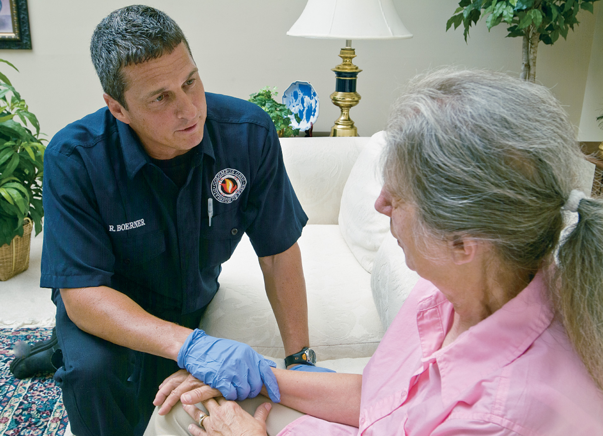
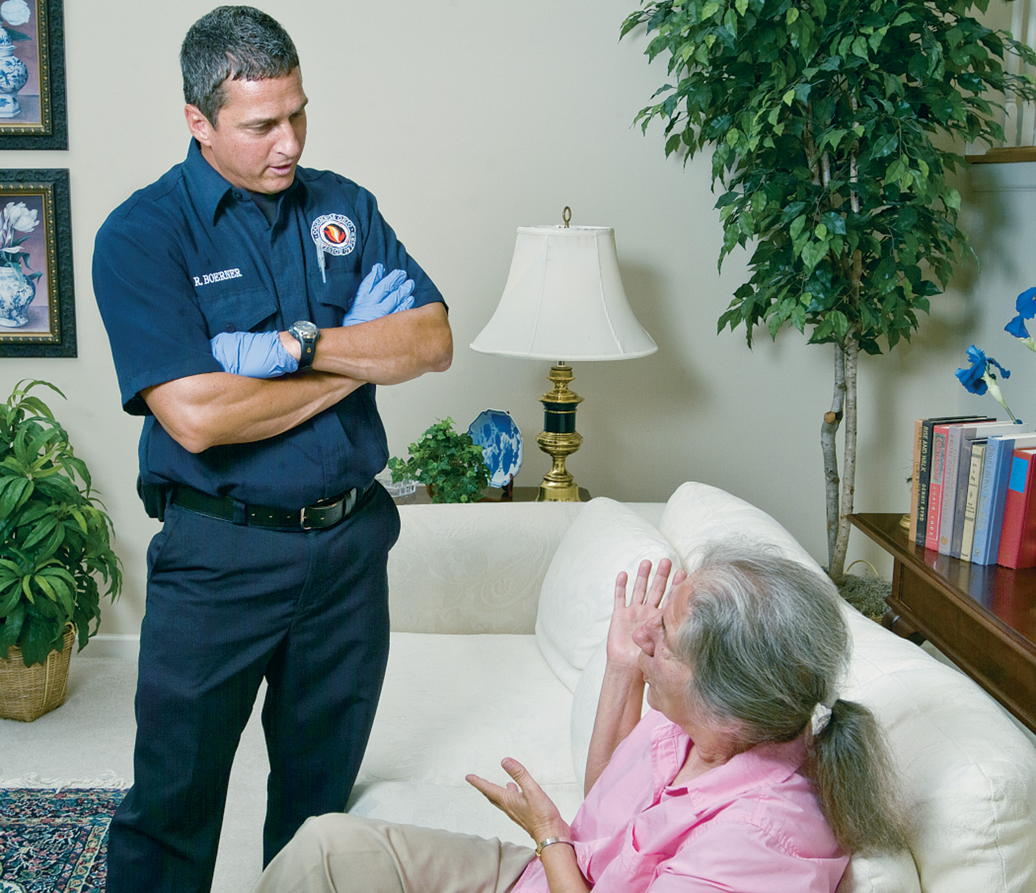
Therapeutic Communication (12 of 22)
  The Patient Interview
  Nonverbal communication
    Posture
      Position of yourself in relative to patient
      Convey a message of concern
Notes:
The way you position yourself in relation to your patient will impact how you’re perceived. Use your arms and body position effectively. Approach the patient with open arms, open hands, and relaxed shoulders. Doing this conveys a message of concern, confidence, safety, and care. If you cross your arms, point your finger, clench your fists, or shake your head negatively, you signal that you’re angry, hostile, disgusted, or uncomfortable around the patient.

Slide 71
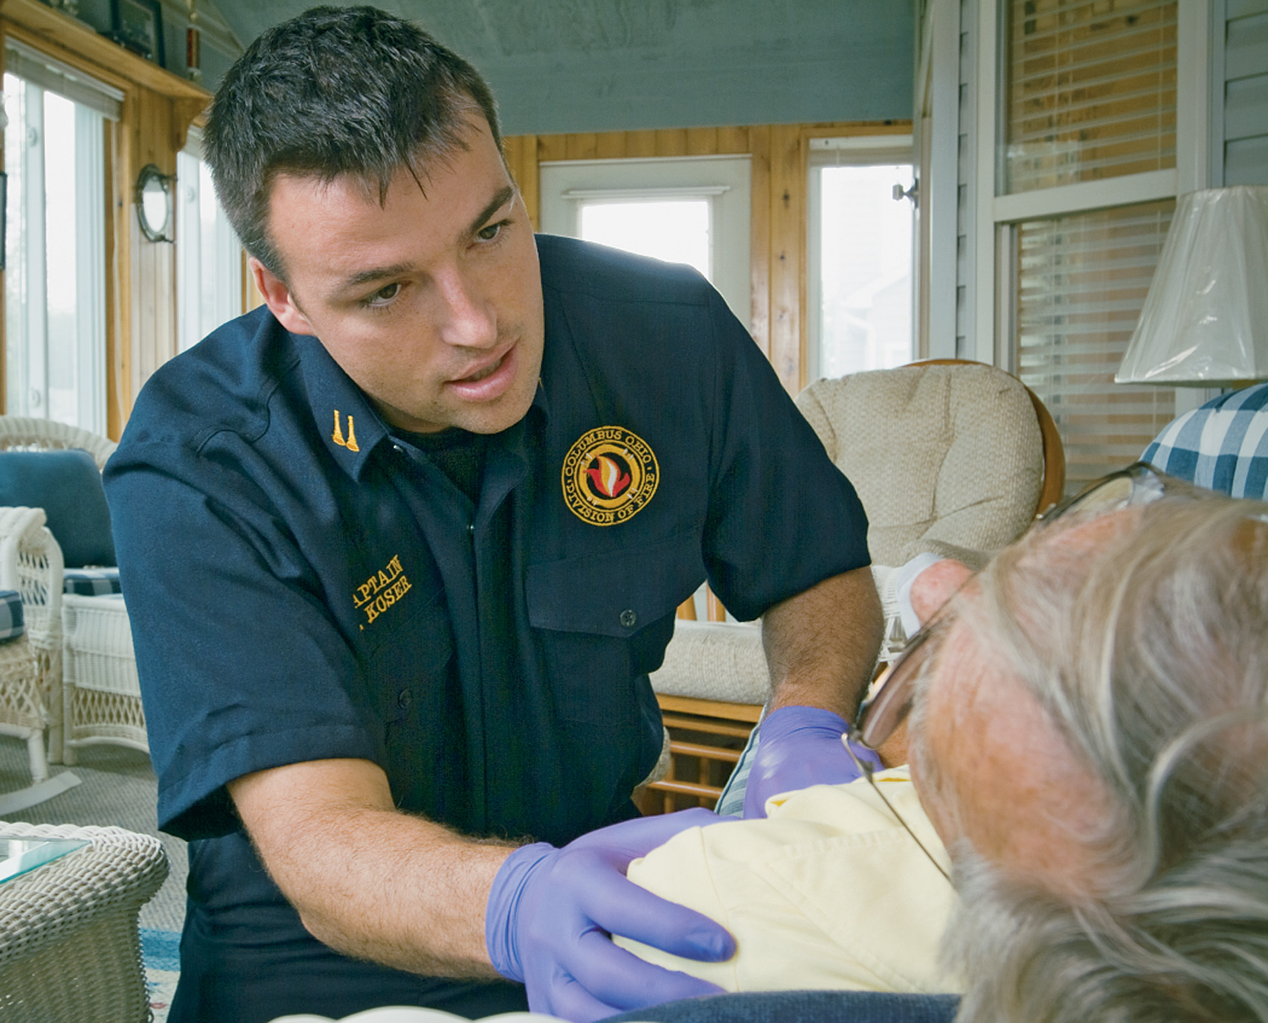
Therapeutic Communication (13 of 22)
  The Patient Interview
  Nonverbal communication
    Distance
      Intimate zone
    Gestures
    Eye contact
    Haptics
Notes:
Points to Emphasize
You convey messages nonverbally through posture, distance (space), gestures, eye contact, and physical contact (haptics).
Discussion Question
What are some nonverbal forms of communication?
Teaching Tips
Ask students what they notice about others' nonverbal communications and what message they get from it.

Slide 72
Therapeutic Communication (14 of 22)
The Patient Interview
  Asking questions
    Ask one question at a time.
    Give the patient time to answer.
    Listen to the response.
    Choose language the patient understands.
Notes:
Points to Emphasize
Open-ended questions and closed questions can both be useful in the patient interview. Pitfalls you must avoid in patient communication include leading questions, interruptions, talking too much, and asking "why" questions.
Knowledge Application
Give several examples of patient interview questions. Have students determine whether each question is open-ended or closed.

Slide 73
Therapeutic Communication (15 of 22)
The Patient Interview
  Asking questions
    Open-ended questions
      Allow the patient to give a detailed response.
      Answers provide detailed information.
      An example is, “How are you feeling?”
Notes:
Open-ended questions. Questions that allow the patient to give a detailed response in his own words are called open-ended questions. This form of questioning will provide you with the most information.

Slide 74
Therapeutic Communication (16 of 22)
The Patient Interview
  Asking questions
    Closed-ended questions
      Also called direct questions.
      Used to get information quickly or to follow up on open-ended questions to get specifics.
      An example is, “What medications do you take?”
Notes:
Closed-ended questions. Questions that call for specific information from the patient are called closed-ended questions, or direct questions. These types of questions are helpful when you need to get information quickly or to obtain additional information that may not have been provided from an open-ended response.

Slide 75
Therapeutic Communication (17 of 22)
The Patient Interview
  Considerations in interviewing
    Do not ask leading or biased questions.
    Do not interrupt the patient.
    Be aware of too much talking by you or the patient.
    Do not provide false reassurance.
    Do not give inappropriate advice.
Notes:
It’s important to keep the patient interview moving in a therapeutic direction. Some considerations to keep in mind when you’re interviewing the patient include these.
Discussion Questions
What is an example of a leading question?
What are some ways to encourage a silent patient to communicate?
Knowledge Application
Ask for a student volunteer and take him or her aside to prepare for a short role-play scenario. You’ll act as the EMT, interviewing the student (patient). Work in various pitfalls (asking why, providing false assurance, and talking too much). Ask the class to critique your interview and see if they recognize your planned pitfalls.
Critical Thinking Discussion
What are some statements you could use to discourage a family member from answering in place of the patient during your interview?
What are some reasons patients might be reluctant to answer an EMT's questions? How could you overcome this reluctance?

Slide 76
Therapeutic Communication (18 of 22)
The Patient Interview
  Considerations in interviewing
    Do not ask “why” questions that imply blame.
    Manage the presence and interactions of family members.
    Motivating the unmotivated patient.
    Interviewing a hostile patient.
Notes:
It’s important to keep the patient interview moving in a therapeutic direction. Some considerations to keep in mind when you’re interviewing the patient include these.
Discussion Questions
What is an example of a leading question?
What are some ways to encourage a silent patient to communicate?
Knowledge Application
Ask for a student volunteer and take him or her aside to prepare for a short role-play scenario. You will act as the EMT, interviewing the student (patient). Work in various pitfalls (asking why, providing false assurance, and talking too much). Ask the class to critique your interview and see if they recognize your planned pitfalls.
Critical Thinking Discussion
What are some statements you could use to discourage a family member from answering in place of the patient during your interview?
What are some reasons patients might be reluctant to answer an EMT's questions? How could you overcome this reluctance?

Slide 77
Therapeutic Communication (19 of 22)
The Patient Interview
  Special circumstances
    Transcultural considerations
    Elderly patients
    Young patients
Notes:
Points to Emphasize
Special considerations in communication include communication with patients from other cultures, elderly patients, hearing-impaired patients, and children.
Teaching Tips
Discuss languages that are common in your community. Ask how many students speak more than one language.
Critical Thinking Discussion
What are possible drawbacks to using a language interpreter when interviewing a patient?

Slide 78
Therapeutic Communication (20 of 22)
The Patient Interview
  Special circumstances - Transcultural
    Cultures view space differently; watch for feedback.
    If there is a language barrier, seek an interpreter.
    Be aware of potential filtering of information by interpreters.
Notes:
When providing care to a patient, you need to consider how the patient’s culture will influence the dynamics of the call. Culture is composed of the thoughts, communications, actions, and values of a racial, ethnic, religious, or social group. It impacts how information is received, how illness is viewed, and what treatments the individual patient prefers.
Ethnocentrism is the view that one culture’s way of doing things is the right way and any other way is inferior. EMTs shouldn’t view any culture as superior to another. It’s important for the EMT to respect the patient’s culture and avoid any cultural imposition. You should never impose your beliefs or values on your patients.

Slide 79
Therapeutic Communication (21 of 22)
The Patient Interview
  Special circumstances - Elderly
    Additional time may be needed when interviewing elderly patients.
    Do not make assumptions about hearing and vision problems, but be alert that they may exist.
    Retrieve hearing aids or write questions on a pad of paper, if needed.
Notes:
Be prepared to take extra time in communicating with elderly people. Aging can bring with it potential problems with hearing and vision. Don’t assume that all elderly patients have such problems, but if you detect signs of them, show understanding. Speak slowly, distinctly, and more loudly to such patients. Obtain their glasses or hearing aids for them. This will help in building a good rapport and communicating more effectively.

Slide 80
Therapeutic Communication (22 of 22)
The Patient Interview
  Special circumstances - Children
    Use extra patience with children.
    Obtain the parents’ assistance in communicating with the child.
    Position yourself at the child's eye level.
    Use simple, direct language.
    Be honest.
Notes:
Working with children requires extra patience and effort. Having a child’s parents present can aid in communicating with the child. Be sure the parents understand that they should remain calm and confident in front of the child. If they seem too frightened or disoriented by the situation, they will communicate those feelings to the child and complicate your ability to assist the child.

Slide 81
Case Study Conclusion (1 of 4)
Krista performs a primary assessment and begins administering oxygen to Alyssa. Barb learns from David that Alyssa seems to have the flu, which triggered an asthma attack. When paramedic Sam Bowles arrives, Krista introduces him to Alyssa. Sam crouches next to the sofa and begins his interview by asking Alyssa how she is feeling.
Notes:
Discuss case study progression.

Slide 82
Case Study Conclusion (2 of 4)
Both Alyssa and David are much calmer now that the providers have shown that they are confident and competent, as well as compassionate and empathetic.
Notes:
Discuss case study progression.

Slide 83
Case Study Conclusion (3 of 4)
After beginning treatment at the scene, the providers place Alyssa in the ambulance, and notify dispatch that they are en route to Brown County Hospital. Sam gives an organized radio report, telling the receiving facility that they have an E T A of 15 minutes.
Notes:
Discuss case study progression.

Slide 84
Case Study Conclusion (4 of 4)
When they arrive at the hospital, Sam gives a transfer of care report, and the crew wishes Alyssa well before notifying dispatch that they are ready for the next call.
Notes:
Discuss case study progression.

Slide 85
Lesson Summary (1 of 2)
E M S system communication and therapeutic communication are key E M T skills.
Radio equipment includes base stations, mobile radios, portable radios, and repeaters.
Follow basic ground rules for radio communication.
Notes:
Follow-Up
Answer student questions.
Follow-Up Assignments
Review Chapter 5 Summary.
Complete Chapter 5 In Review questions.
Complete Chapter 5 Critical Thinking questions.
Assessments
Handouts
Chapter 5 quiz

Slide 86
Lesson Summary (2 of 2)
E M T s communicate with dispatch at key points during calls.
E M T s communicate with medical direction and personnel at the receiving facility.
Therapeutic communication is critical to good patient care.
Notes:
Class Activity
As an alternative to assigning the follow-up exercises in the lesson plan as homework, assign each question to a small group of students for in-class discussion.
Teaching Tips
Answers to In Review questions are in the appendix of the text. Advise students to review the questions again as they study the chapter.

Slide 87
Feedback (1 of 8)
Incorrect answer
  A mobile radio is a radio mounted in a vehicle.
Click here to return to the quiz

Slide 88
Feedback (2 of 8)
Incorrect answer
  A portable radio is a radio an E M T carries with him when he is away from the vehicle.
Click here to return to the quiz

Slide 89
Feedback (3 of 8)
Incorrect answer
  A base station is a high-powered radio, such as those used by dispatch.
Click here to return to the quiz

Slide 90
Feedback (4 of 8)
Correct answer
  A repeater is used to amplify the low-power broadcast of a radio, such as a portable radio, and rebroadcast it at higher power to increase the broadcast distance of the radio.
Click here to return to the program

Slide 91
Feedback (5 of 8)
Incorrect answer
The name of the patient’s physician is not immediately relevant to patient care, and is not usually provided in the radio report.
Click here to return to the quiz

Slide 92
Feedback (6 of 8)
Incorrect answer
It’s rarely necessary to provide a complete list of all the patient's medications during the radio report, although all medications must be documented in your written report.
Click here to return to the quiz

Slide 93
Feedback (7 of 8)
Incorrect answer
The history of an adult patient’s childhood illnesses is not relevant in the radio report.
Click here to return to the quiz

Slide 94
Feedback (8 of 8)
Correct answer!
The patient’s age and gender are always part of a good radio report.
Click here to return to the program

Slide 95
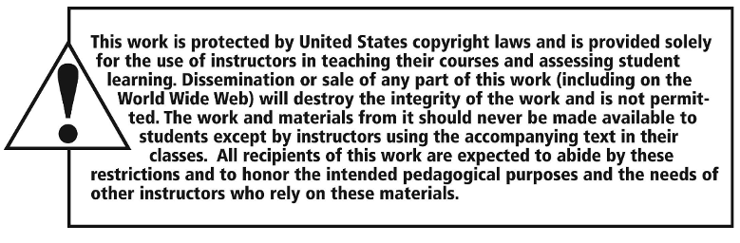
Copyright

