Slide 1

Prehospital: Emergency Care
Eleventh Edition
Chapter 4
Documentation
Slides in this presentation contain hyperlinks. JAWS users should be able to get a list of links by using INSERT+F7
Copyright © 2018, 2014, 2010 Pearson Education, Inc. All Rights Reserved
Notes:
If this PowerPoint presentation contains mathematical equations, you may need to check that your computer has the following installed:
1) MathType Plugin
2) Math Player (free versions available)
3) NVDA Reader (free versions available)
During this lesson, students will learn about the roles and responsibilities of an EMT.
Advance Preparation
Assign the associated section of MyBRADYLab and review student scores.
Review the chapter material in the Instructor Resources, which includes Student Handouts, PowerPoint slides, and the MyTest Program.
Instructor Preparation:
Make copies of course policies and procedures, the syllabus, handouts from the Instructor Resources, and other materials for distribution or post them in your learning management system.
Preview the media resources and Master Teaching Notes in this lesson.
Preview the case study presented in the PowerPoint slides.
Invite the medical director to the first class session.
Make arrangements to tour an emergency department or local PSAP.
Obtain 911 recordings to play for the class.
Arrange to have an ambulance present at the class location.
Bring in a couple of current EMS research articles from a peer-reviewed publication.

Slide 2
Learning Readiness
E M S Education Standards, text p. 64.
Chapter Objectives, text p. 64.
Key Terms, text p. 64.
Purpose of lecture presentation versus textbook reading assignments.
Notes:
Explain to students what the National EMS Education Standards are. The National EMS Education Standards communicate the expectations of entry-level EMS providers. As EMTs, students will be expected to be competent in these areas. Acknowledge that the standards are broad, general statements. Although this lesson addresses the listed competencies, the competencies are often complex and require completion of more than one lesson to accomplish. The student is also expected to review the chapter objectives to foreshadow what will be in the chapter, by mastering the key terms the EMT student will better understand the learning and be able to communicate more clearly.
Additionally, explain to the students that the purpose of using these slides is to help keep the instructor focused on highlighting important portions of the material, explain interrelationships of topics, and discuss how to apply this information. It’s not the intent of the presentation (or slides alone) to include every component in the chapter. This presentation still requires the student to thoroughly read the chapter.

Slide 3
Setting the Stage
Overview of Lesson Topics
  Functions of the prehospital care report
  Collection of data in P C R s
  Medical abbreviations
  Legal concerns
  Alternative documentation methods

Slide 4
Case Study Introduction (1 of 2)
E M T Rory Bruns picked up the phone in the Station 4 crew room on the second ring. “E M T Bruns. How can I help you?”
Notes:
Case Study
Present the Case Study Introduction provided in the PowerPoint slide set.
Lead a discussion using the case study questions provided on the subsequent slide(s).
The Case Study with discussion questions continues throughout the PowerPoint presentation.
Case Study Discussion
Use the case study content and questions to foreshadow the upcoming lesson content.

Slide 5
Case Study Introduction (2 of 2)
“It’s Dana,” replied shift supervisor Dana Hathaway. “I’m afraid I don't have good news. We were served with notice of a subpoena for a patient care report on a call you had last summer. I’ v epulled a copy of the patient care report. I’ll bring it by the station.”
Notes:
Case Study
Present the Case Study Introduction provided in the PowerPoint slide set.
Lead a discussion using the case study questions provided on the subsequent slide(s).
The Case Study with discussion questions continues throughout the PowerPoint presentation.
Case Study Discussion
Use the case study content and questions to foreshadow the upcoming lesson content.

Slide 6
Case Study (1 of 4)
How can the P C R help Rory?
What kind of information will the parties involved in the legal case be looking for in the P C R?
What are some ways to ensure that all important information about each call is documented?

Slide 7
Introduction
Documentation of information about E M S calls serve several purposes.
The record of care provided is called a patient care report (P C R).
Thorough, accurate documentation is a critical E M T skill.
Notes:
Objectives
Chapter 4 objectives can be found in an accompanying folder. These objectives, which form the basis of each chapter, were developed from the National EMS Education Standards
Case Study Discussion
Use the case study content and questions to foreshadow the upcoming lesson content.

Slide 8
Functions of the P C R (1 of 3)
Continuity of medical care
  Emergency department (E D) personnel will reference the P C R.
Administrative uses
  Billing and insurance reimbursement
  Statistical information for future planning
Notes:
Points to Emphasize
Thorough, clear documentation of EMS calls serves several important purposes.
Information recorded about patients allows emergency department and other health care personnel to develop a more complete understanding of the patient's condition.
Administrative uses of the PCR include billing and insurance information to assist with reimbursement for the cost of care and statistics to guide EMS system decision making.
Points to Emphasize
Give examples of calls in which your documentation or that of another EMT has made a difference.
Why is it important that EMS services bill patients and submit insurance claims?

Slide 9
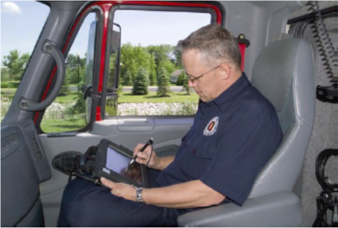
Functions of the P C R (2 of 3)
Legal document
Figure 4-1 Documentation has a variety of important uses.
  The patient may be a crime victim.
  Protection in the event of a civil lawsuit.
Notes:
Points to Emphasize
Legal actions requiring testimony can take place months or years following a call. It will be impossible to recall all the details of a call after so much time. Good documentation will guide your testimony.
Teaching Tips
Ask several students to recall what they ate for breakfast one week ago. Use this to illustrate the difficulty in remembering things that are routine—as EMS calls will one day be for them—even after a short period of time.

Slide 10
Functions of the P C R (3 of 3)
Education and research
  P C R s can be a rich source of data to allow research on many issues.
Continuous Quality Improvement
  C Q I is an essential process in all E M S systems.
Notes:
Points to Emphasize
A PCR can be used for educational purposes, both in the EMS system and during initial education. Additionally, good documentation provides data for research, system evaluation, and continuous quality improvement.
Discussion Question
How can PCR data be useful in research?
Critical Thinking Discussion
What are some reasons EMS documentation may not be as good as it should be?
What are some ideas for improving documentation?

Slide 11
Collection of Data in P C Rs (1 of 13)
All documentation must be careful and thorough.
There are paper and electronic P C R s.
Figure 4-3 (a) Information can be entered on a computerized form from a laptop computer.
Notes:
Points to Emphasize
PCRs can be paper or electronic in format. Electronic formats can be computer, PDA, or electronic pen-based. The use of written formats may allow a more detailed patient care narrative. Electronic formats can link data, spell-check, and alert users to missing information.
Teaching Tips
Provide students with copies of PCRs used locally. If possible, demonstrate an electronic documentation system.

Slide 12
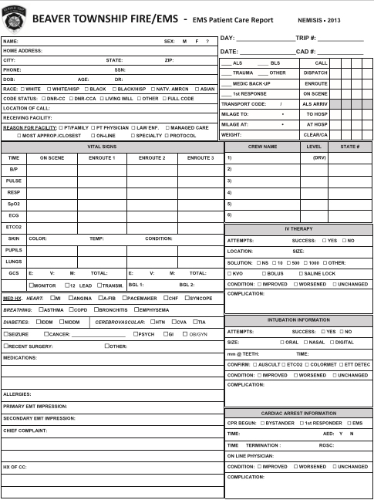
Figure 4-2 Beaver Township Fire/E M S, Beaver Township, Ohio: Prehospital Care Report
Notes:
Points to Emphasize
The U.S. Department of Transportation has established a minimum data set for PCRs in an attempt to improve patient care and allow comparisons among EMS services.
The components of the minimum data set include patient and administrative information.
In general, PCR sections include administrative information, patient demographics, other patient data, vital signs, narrative patient information, and treatment. Use standard abbreviations to avoid miscommunication. Write the narrative in a simple, direct style. Include the patient's chief complaint, medical history, and assessment findings.
Teaching Tips
Since students have not yet covered patient assessment and history taking, explain the meaning of each of the components under the Patient Information heading.
Discussion Questions
What are the purposes of a standard minimum data set?
What are some examples of administrative information in the minimum data set?
Why are synchronous clocks important in EMS systems?

Slide 13
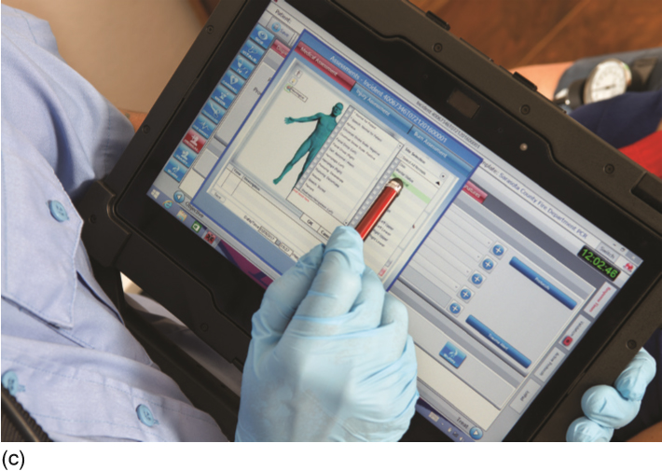
Figure 4-3 (c) A Toughpad with Human Figure and E M S Information on Screen
Notes:
Points to Emphasize
The U.S. Department of Transportation has established a minimum data set for PCRs in an attempt to improve patient care and allow comparisons among EMS services.
The components of the minimum data set include patient and administrative information.
In general, PCR sections include administrative information, patient demographics, other patient data, vital signs, narrative patient information, and treatment. Use standard abbreviations to avoid miscommunication. Write the narrative in a simple, direct style. Include the patient's chief complaint, medical history, and assessment findings.
Teaching Tips
Since students have not yet covered patient assessment and history taking, explain the meaning of each of the components under the Patient Information heading.
Discussion Questions
What are the purposes of a standard minimum data set?
What are some examples of administrative information in the minimum data set?
Why are synchronous clocks important in EMS systems?

Slide 14
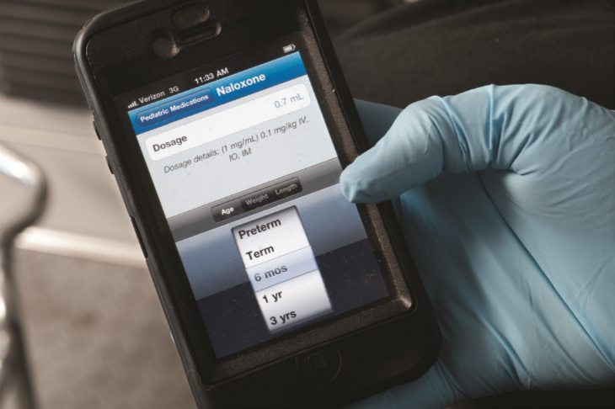
Collection of Data in P C R s (2 of 13)
Two basic rules of P C R s
  If it wasn't written down, it wasn't done.
  If it wasn't done, don't write it down.
Figure 4-4 A smart phone may have an app for direct data entry that is then transferred to a central database.

Slide 15
Collection of Data in P C R s (3 of 13)
U S D O T Minimum data set
  Established by the U.S. Department of Transportation (D O T)
  Collection of standardized information allows meaningful comparison and analysis for the improvement of E M S care, nationally
Notes:
The U.S. Department of Transportation (DOT) has tried to standardize the information collected on PCRs. Such standardization will, it is hoped, lead to a higher general level of patient care across the nation. It will also permit more meaningful comparison and analysis of data from various systems, which may speed the implementation of new and better methods of emergency care.

Slide 16
Collection of Data in P C R s (4 of 13)
Patient Information of Minimum Data Set
  Chief complaint
  Level of responsiveness
  Blood pressure
  Skin perfusion
  Skin color, temperature, condition
  Pulse rate
  Respiratory rate and effort
  Patient demographics

Slide 17
Collection of Data in P C R s (5 of 13)
Administrative Information of Minimum Data Set
  Time incident was reported
  Time E M S unit was notified
  Time of arrival at patient
  Time unit left the scene
  Time unit arrived at destination
  Time care was transferred

Slide 18
Collection of Data in P C R s (6 of 13)
P C R s usually have these sections:
  Administrative information
  Patient demographic and other data
  Vital signs
  Patient narrative
  Treatment

Slide 19
Collection of Data in P C R s (7 of 13)
Other Sections of P C R
  Administrative information (or run data)
    E M S unit number and run or call number
    Names certification levels of crew
    Address of call location
Notes:
The administrative information section of the PCR is sometimes referred to as the run data. It usually includes the administrative information listed in the minimum data set. In addition, it may also include:
• The EMS unit number and the run or call number
• Names of crew members and their levels of certification
• The address to which the unit is dispatched

Slide 20
Collection of Data in P C R s (8 of 13)
  Other Sections of P C R
  Patient demographic and other data
    Patient’s name, age, sex, race, birth date
    Patient’s home address
    Insurance and billing information
    Location patient was found
    Care given before E M T s’ arrival
Notes:
The next major section of the PCR contains primarily demographic patient information and other pertinent data about the patient. Most systems will require the following information:
• The patient’s legal name, age, sex, race, birth date
• The patient’s home address
• The insurance or billing information
• The location where the patient was found
• Any care given before the arrival of the EMTs

Slide 21
Collection of Data in P C R s (9 of 13)
  Other Sections of P C R
  Vital signs
    At least two sets of vital signs are needed.
    Record the patient's position when vitals were obtained.
    Document the time vitals were obtained.
Notes:
A third major division of the PCR documents the patient’s vital signs. On many forms, boxes are provided for checking off or writing in information. Computerized PCRs have drop-down menus that can be selected or data fields where the information can be entered. This section usually includes much of the patient information called for in the minimum data set.
Ideally, at least two complete sets of vital signs should be taken and recorded. It is important to note the patient’s position at the time the vital signs were taken (e.g., supine, standing, sitting). It’s also critical to record the times at which the vital signs were obtained.

Slide 22
Collection of Data in P C R s (10 of 13)
  Other Sections of P C R
  Patient narrative
    Information from the physical exam and pertinent scene information
    Includes the chief complaint, patient’s history, and physical exam findings.
    Select proper medical terms and spell them correctly.
Notes:
In this section of the PCR, you create a brief but thorough picture of the patient and his problem. Remember that you’re recording details for other medical personnel to use, not presenting your own conclusions about an incident. Careful observation of the patient and the scene as well as intelligent questioning of the patient and bystanders are essential. These methods provide objective and pertinent subjective information for the narrative section.
• The patient’s chief complaint. This should be in the patient’s own words or in the words of a bystander, if the patient is unresponsive. Put such statements in quotation marks (“My leg hurts”) on the report.
• The patient’s history or a description of the mechanism of injury. These data will include an account of when the chief complaint began and how it has progressed, along with other details of the patient history.

Slide 23
Collection of Data in P C R s (11 of 13)
  Other Sections of P C R
  Patient narrative
    Objective information is verifiable or measurable.
    Subjective information is based on perceptions or opinions.
    Pertinent negatives are signs and symptoms that might be expected, but which are not found.
Notes:
Objective information is that which the EMT can verify, such as vital signs or pupil assessment. Subjective findings are those that the EMT gathers from the patient, but cannot objectively see, such as headaches, nausea, or dizziness.
When questioning a patient, be alert to pertinent negatives. These are signs or symptoms that might be expected, based on the chief complaint, but that the patient denies having. A pertinent negative might be a patient’s denial of pain after an automobile crash or a
lack of difficulty in breathing in a case of chest pain. By noting the absence of pertinent signs and symptoms, you will provide the medical team that takes over care of the patient a fuller picture of their condition.

Slide 24
Collection of Data in P C R s (12 of 13)
  Other Sections of P C R
  Treatment
    Detail treatment in chronological order.
    Document the time of each treatment.
    Document the patient's response to each treatment.
Notes:
The final information for entry on the PCR involves the treatment provided to the patient. This section should detail in chronological order all treatments you administer to a patient, what time they were administered, and indications of how the patient responded to that treatment. This information should be written in a clear narrative style, following the guidelines cited earlier in “Patient Narrative.” An emergency physician, nurse, paramedic, or fellow EMT should, by reading your report, be able to learn what treatment was provided, and the time it was provided. Whether the patient has improved or deteriorated since then.

Slide 25
Collection of Data in P C R s (13 of 13)
Use of accurate and synchronized clocks
  Dispatch, vehicle, and E M T timekeeping devices must all agree with one another.
  Needed for accurate documentation of medical care.
  Needed for administrative and legal purposes.
Notes:
The use of accurate and synchronous clocks means that all elements of an EMS system should use clocks or timekeeping devices that are accurately set and agree with each other. Dispatch’s clock should not show one time, while the watches of the EMTs show another. Accurate timekeeping helps in the gathering of accurate medical information. for example, synchronous timekeeping by dispatch and the ambulance crew makes it easier to determine how long a patient has been in cardiac arrest before CPR or defibrillation was initiated. Accurate timekeeping can also be critical if administrative issues or legal questions over quality of care arise.

Slide 26
Match the Descriptions on the Left with the Type of P C R Information Listed on the Right. Click in Each Box on the Left to Check Your Answers
Fill in the blank pulse rate
a. Administrative information
b. Patient demographics
c. Vital signs
d. Narrative
e. Treatment
Fill in the blank E M Ts’ names
Fill in the blank “Pt. c/o headache on right side of head for 3 hours.”
Fill in the blank 4 L P M O₂ by N C
Fill in the blank 45 y/o male
Click here to continue the program.

Slide 27
Case Study (2 of 4)
The E M T supervisor, Dana, has just arrived at Station 4 to talk with Rory about the subpoena. As of yet, Rory has not been subpoenaed, but it is possible that he will be. It turns out that it is a criminal case, in which the patient was the victim of domestic violence.

Slide 28
Case Study (3 of 4)
The county attorney is looking for evidence that might support the case. The defense attorney will try to refute any information that could harm his client.

Slide 29
Case Study (4 of 4)
What specific elements of the narrative could be important in the prosecution’s case?
What weaknesses in the documentation will the defense seek to exploit?
If Rory is called to testify, what role will the P C R play?

Slide 30
Medical Abbreviations (1 of 2)
Use only universally accepted abbreviations, or those approved by your E M S system.
You will be mastering medical terminology and abbreviations your entire career.
Refer to Table 4-1 & 4-2.
Notes:
Points to Emphasize
It is critical that EMTs use only standard charting abbreviations.
Teaching Tips
Review Table 4-2 with students. Call out a category or type of patient information and ask students for the abbreviation.
Discussion Question
What are advantages and possible disadvantages of medical abbreviations?
Class Activity
Divide students into teams. Give each team a bell to ring. Write a medical abbreviation on the board. The first team to ring their bell answers. If they answer correctly, the team gets 5 points. If they answer incorrectly, the other team gets an opportunity to answer.
Knowledge Application
As class proceeds, have students write PCRs for their lab scenarios using standard abbreviations.

Slide 31
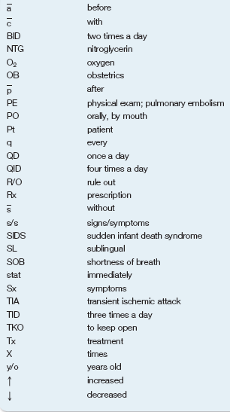
Table 4-1 Commonly Accepted Abbreviations

Slide 32
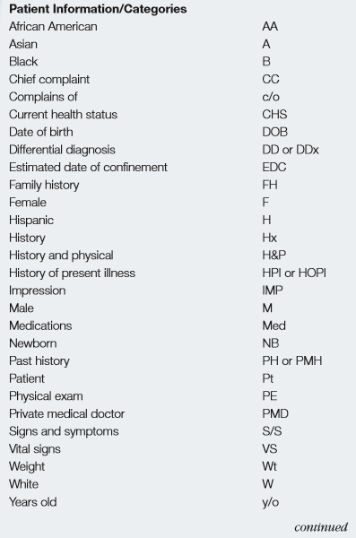
Table 4-2 Standard Charting Abbreviations (1 of 13)

Slide 33
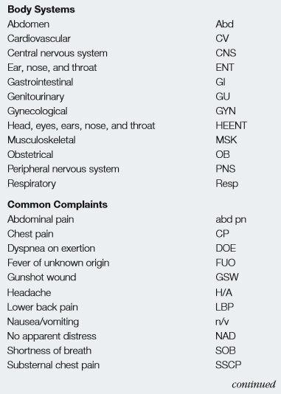
Table 4-2 Standard Charting Abbreviations (2 of 13)

Slide 34
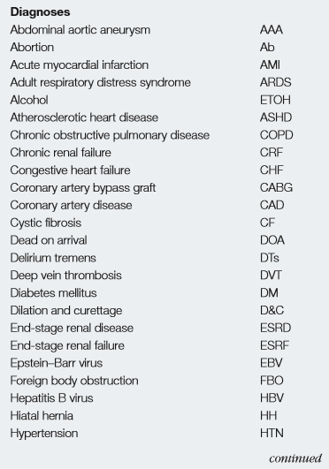
Table 4-2 Standard Charting Abbreviations (3 of 13)

Slide 35
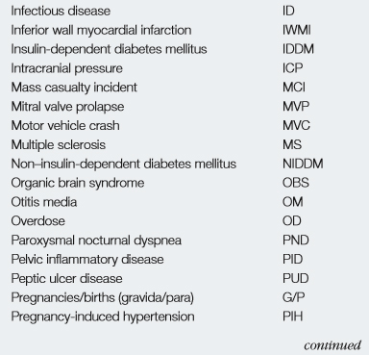
Table 4-2 Standard Charting Abbreviations (4 of 13)

Slide 36
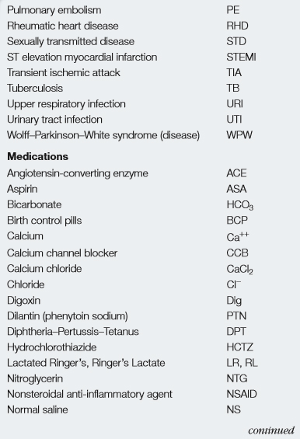
Table 4-2 Standard Charting Abbreviations (5 of 13)

Slide 37
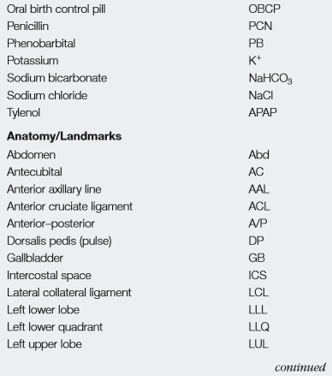
Table 4-2 Standard Charting Abbreviations (6 of 13)

Slide 38
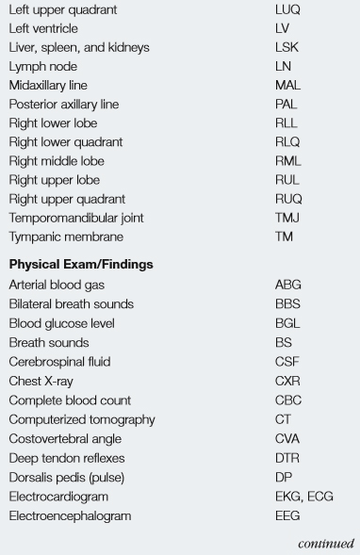
Table 4-2 Standard Charting Abbreviations (7 of 13)

Slide 39
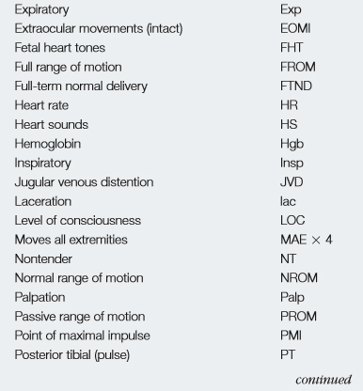
Table 4-2 Standard Charting Abbreviations (8 of 13)

Slide 40
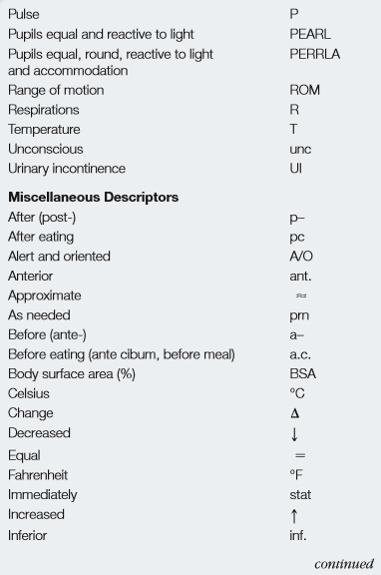
Table 4-2 Standard Charting Abbreviations (9 of 13)

Slide 41
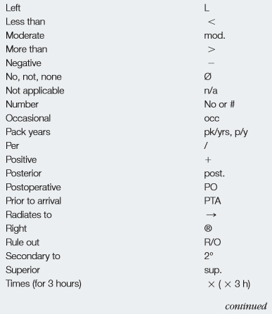
Table 4-2 Standard Charting Abbreviations (10 of 13)

Slide 42
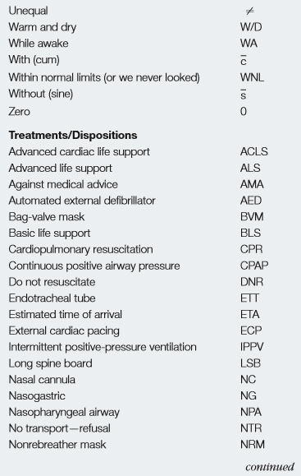
Table 4-2 Standard Charting Abbreviations (11 of 13)

Slide 43
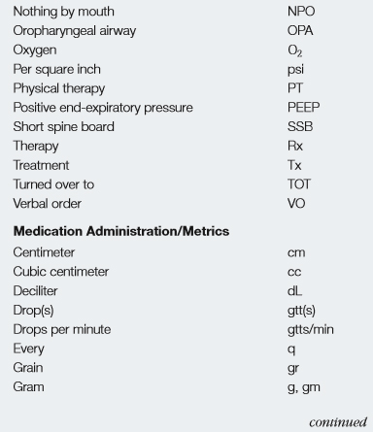
Table 4-2 Standard Charting Abbreviations (12 of 13)

Slide 44
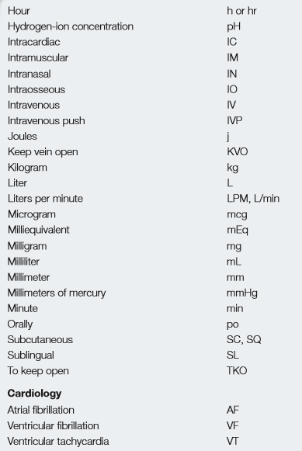
Table 4-2 Standard Charting Abbreviations (13 of 13)

Slide 45
Medical Abbreviations (2 of 2)
  A 48-year-old man is alert and oriented with a chief complaint of severe chest pain and trouble breathing. He took two nitro without relief today, he is prescribed Lasix twice daily. He has no known allergies.
C P and S O B. Took 2
relief and Rx Lasix B I D. N K A.
Notes:
Points to Emphasize
It is critical that EMTs use only standard charting abbreviations. Have them review the first written out description of a chest pain patient. Then have them decipher the abbreviated form to see they contain the same information, but the latter is much shorter and easier to write.
Teaching Tips
Review Table 4-2 with students. Call out a category or type of patient information and ask students for the abbreviation.
Discussion Question
What are advantages and possible disadvantages of medical abbreviations?
Class Activity
Divide students into teams. Give each team a bell to ring. Write a medical abbreviation on the board. The first team to ring their bell answers. If they answer correctly, the team gets 5 points. If they answer incorrectly, the other team gets an opportunity to answer.
Knowledge Application
As class proceeds, have students write PCRs for their lab scenarios using standard abbreviations.

Slide 46
Legal Concerns (1 of 5)
Legal Concerns Include
  Confidentiality
    The P C R contains information that is confidential and which cannot shared with unauthorized individuals.
    Release of information is governed by H I P A A.
Notes:
Points to Emphasize
Legal concerns involving PCR documentation include patient confidentiality, distribution of PCR information, documenting refusals of treatment, avoiding falsification of information, and correcting errors.
Information on PCRs is considered protected health information (PHI) under HIPAA.
Critical Thinking Discussion
How could sharing a patient's protected health information result in harm?

Slide 47
Legal Concerns (2 of 5)
  Legal Concerns Include
  Distribution
    Specific instances in which P C R information can be distributed include:
      To relevant health care providers (E D)
      C Q I, medical oversight, billing
      Police, when needed for a investigation
      Upon subpoena
Notes:
Follow state rules and local protocols when distributing the PCR and any additional information about a patient encounter. By law, you’re generally permitted to provide confidential information about a patient to a health care provider who needs the information to continue care, to the police if they request information as part of a criminal investigation, to a third party if the information is required on a third-party billing form, or in court if required by a legal subpoena.

Slide 48
Legal Concerns (3 of 5)
  Legal Concerns Include
  Refusal of Treatment
    Legal issues arise when a patient refuses care.
    Establish patient mental capacity and contact medical direction.
    Persuade the patient to accept care.
    Inform patient of consequences of refusing care.
Notes:
Points to Emphasize
Situations in which patients refuse treatment require special attention to documenting the fact that the patient understands both the situation and the consequences of refusing care.
Teaching Tips
Prior to class, devise a scenario with an assistant so that you can role play obtaining a refusal of treatment for the class. See below under Class Activity.
Class Activity
Using the role play under Teaching Tips, above, have students document the pertinent information from the refusal. Ask for volunteers to read their documentation aloud.
Knowledge Application
Give several scenarios of patients refusing care. Ask the class for ideas on handling each situation.

Slide 49
Legal Concerns (4 of 5)
  Legal Concerns Include
  Refusal of Treatment
    Document the following information:
      If the patient refused any or all assessment and the treatment offered
      The patient’s mental status in making the decision
      Have patient and witness sign form
Notes:
If the patient still refuses care after you have explained the risks, spoken with medical direction, and have exhausted all ways to get them to agree to be treated and transported – document the refusal form very carefully and have the patient sign and a witness if possible. If the patient refuses to sign, have a police office and/or family member sign the document.
Before leaving scene, offer alternative methods of receiving care such as having a family or friend transport them to the hospital. Finally, advise them not to hesitate calling back EMS if they change their mind.

Slide 50
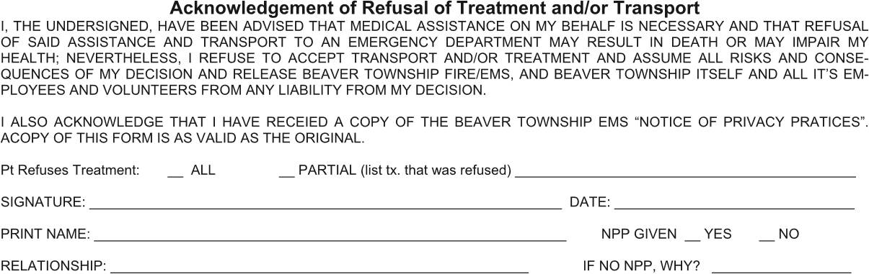
Figure 4-5 Beaver Township Fire/E M S, Beaver Township, Ohio: Patient Refusal Section on Prehospital Report

Slide 51

Legal Concerns (5 of 5)
Legal Concerns Include
  Falsification of P C R information
    Falsification compromises patient care.
    Can lead to loss of licensure and, possibly, criminal charges.
    Mistakes or omissions must be correctly fixed as soon as possible.
Notes:
Points to Emphasize
Regardless of the reason the EMT may be tempted, it’s critical that PCR information never be falsified. Always use acceptable methods of correcting errors on the PCR.
Discussion Questions
What are the consequences to a patient of falsifying documentation?
You have inadvertently written that a patient is 58 years old, instead of 68 years old. What is the acceptable way of correcting this on a written PCR?

Slide 52
Special Situations (1 of 3)
  Legal Concerns Include
  Transfer of care
    Used when it is not possible to complete the full P C R and obtain signatures before leaving the facility.
    A type a special transfer-of-care form may be used.
    A full P C R must still be submitted as soon as possible.
Notes:
Points to Emphasize
If it’s not possible to leave a complete PCR, an abbreviated transfer of care report will help maintain continuity of care. In such cases, an abbreviated transfer-of-care form or “drop report” may be used to provide minimal patient data and collect a transfer-of-care signature. This abbreviated report can be used as a reference later when completing the full PCR. A copy of the transfer report should be submitted with the full PCR.
Teaching Tips
Show students any special reporting forms used locally.

Slide 53
Special Situations (2 of 3)
  Legal Concerns Include
  Multiple-casualty incidents
Triage tags can be used to communicate basic patient information.
Notes:
Points to Emphasize
During multiple-casualty incidents (MCI), such as plane crashes or multiple-vehicle collisions, rescuers are often overwhelmed with the number of patients requiring treatment. The needs of these patients can sometimes conflict with the need for complete documentation. In these cases, there may not be enough time to complete the standard PCR before turning to the next patient.
Each EMS system has its own MCI plan. These plans should have some means of recording important medical information and keeping that information with the patient as he is moved for treatment.
Teaching Tip
As a precursor of discussions yet to come, hold up a typical triage tag (color coded) and see if the students can figure out basically how they work and what type of information is recorded on these during an MCI.

Slide 54
Special Situations (3 of 3)
  Legal Concerns Include
  Special Reports
    Suspected child or elder abuse
    Possible infectious disease exposure
    Injury to the E M S provider
    Situations requiring additional documentation or notification of other agencies
Notes:
Points to Emphasize
In some circumstances, EMTs must fill out special documentation other than the usual PCR. These cases require the notification of agencies and local authorities beyond the usual health care network.
State laws and local protocols usually outline the circumstances in which special reports are required and often provide a form for such reports. These special reports should be accurate, descriptive, and objective; should not lead to any conclusions; should contain the names of all individuals, services, and facilities involved; and should be submitted in a timely manner.
Discussion Question
Why is it important that some events be recorded separately from the PCR?

Slide 55
Alternative Documentation Methods (1 of 5)
Several formats for narrative documentation are represented by mnemonics.
  S O A P
  C H A R T
  C H E A T E D

Slide 56
Alternative Documentation Methods (2 of 5)
S O A P
  Subjective
  Objective
  Assessment
  Plan
Notes:
Points to Emphasize
EMS systems may or may not require a specific format for the PCR narrative.
The SOAP format is often used in nursing and by other health care professionals. The mnemonic SOAP stands for subjective, objective, assessment, and plan. These components can be used to organize the information that needs to be documented on the prehospital care report.
Teaching Tips
If not handed out previously, hand out a photocopied fictitious PCR and explain the method used to format the narrative. Explain that this introduction of documentation is necessary to structure students' thinking about collecting information, but that they will increase their understanding of documentation throughout the course.

Slide 57
Alternative Documentation Methods (3 of 5)
S O A P I E is a variation of S O A P
  Subjective
  Objective
  Assessment
  Plan
  Intervention
  Evaluation
Notes:
EMS systems may use the SOAP method as the basis for standard reporting practices. Some variations of the SOAP method exist and are used to meet the specific needs of an EMS system. For example, the mnemonic SOAPIE may be used. The I refers to intervention and the E refers to evaluation. This allows for a better account of the ongoing assessment that is conducted on the patient.

Slide 58
Alternative Documentation Methods (4 of 5)
C H A R T
  Chief complaint
  History (includes S A M P L E)
  Assessment
  Rx (treatment)
  Transport
Notes:
Points to Emphasize
C—chief complaint. Refers to the main complaint of the patient.
H—history. Refers to the history of the patient (SAMPLE history).
A—assessment. Findings gathered in the primary assessment, secondary assessment, detailed physical exam, and ongoing assessment.
R—Rx. Refers to treatment that was provided to the patient.
T—transport. Any change in the patient’s condition en route and the type of transport (e.g., emergency).
Discussion Questions
What are advantages and possible disadvantages of each of the methods of documentation? How can mnemonics such as these be helpful in documentation?

Slide 59
Alternative Documentation Methods (5 of 5)
C H E A T E D
  Chief complaint
  History
  Exam
  Assessment
  Treatment
  Evaluation
  Disposition
Notes:
Points to Emphasize
C—chief complaint. This is the reason why EMS was called.
H—history. Refers to the history of the patient (SAMPLE history).
E—exam. This is information that is found in the physical examination of the patient.
A—assessment. The field impression you derive by processing the history and physical exam findings and determining a condition the patient may be suffering from.
T—treatment. Describes the treatment that was provided to the patient.
E—evaluation. The information that is found during the ongoing assessment and any identified improvement or deterioration of the patient’s condition.
D—disposition. The transfer of patient care at the medical facility or to another health care provider.
Knowledge Application
Select one of the documentation methods covered. Call out various pieces of information for a PCR narrative in random order. Have students identify where in the narrative each piece of information fits.

Slide 60
Case Study Conclusion (1 of 2)
Rory was eventually called to testify at the trial of the accused perpetrator. Fortunately, because the case occurred a year after the call, Rory was able to rely on his thorough and accurate documentation to answer the attorneys’ questions about his observations of the scene and the patient’s condition.

Slide 61
Case Study Conclusion (2 of 2)
The defense attorney questioned the meaning of several of the abbreviations Rory used in the P C R. Because Rory always uses standard, accepted abbreviations, the defense attorney was unsuccessful in discrediting his documentation. Nonetheless, it is an experience Rory hopes he doesn't have to repeat.

Slide 62
Lesson Summary
P C R s serve several purposes for the E M S system and Emergency Department.
Good documentation should be accurate, concise, complete, and clear.
Exercise cautiously in special reporting situations.
Never falsify a report, and correct mistakes promptly.
Notes:
Class Activity
As an alternative to assigning the follow-up exercises in the lesson plan as homework, assign each question to a small group of students for in-class discussion.
Teaching Tips
Answers to In Review questions are in the appendix of the text. Advise students to review the questions again as they study the chapter.
Follow-Up
Answer student questions.
Follow-Up Assignments
Review Chapter 4 Summary.
Complete Chapter 4 Critical Thinking questions.
Assessments
Handouts
Chapter 4 quiz

Slide 63
Review Answers (1 of 5)
Fill in the blank pulse rate
c. Vital signs
Vital signs include information about the pulse, respirations, blood pressure, body temperature, and oxygen level
Click here to return to the quiz.

Slide 64
Review Answers (2 of 5)
Fill in the Blank E M T s’ names
a. Administrative information
Administrative information includes times of events, E M S unit number, run or call number, crew members’ names and certification levels, and the dispatch address
Click here to return to the quiz.

Slide 65
Review Answers (3 of 5)
Fill in the Blank “Pt. c/o headache on right side of head for 3 hours.”
d. Narrative
Narrative information gives more detailed information about the patient and problem than allowed for in a checklist or data field format and includes the patient's chief complaint, history, and exam findings.
Click here to return to the quiz.

Slide 66
Review Answers (4 of 5)
Fill in the blank 4 L P M O₂ by N C
e. Treatment
The treatment section is a chronological record of all interventions, the time they were given, and the result.
Click here to return to the quiz.

Slide 67
Review Answers (5 of 5)
Fill in the Blank 45 y/o male
b. Patient demographics
Patient demographics include the patient’s name, age, sex, race, date of birth, home address, billing information, where he was found, and care given before E M Ts’ arrival.
Click here to return to the quiz.

Slide 68

Copyright

