Slide 1
Prehospital: Emergency Care
Eleventh Edition
Chapter 44
Hazardous Materials
Slides in this presentation contain hyperlinks. JAWS users should be able to get a list of links by using INSERT+F7
Copyright © 2018, 2014, 2010 Pearson Education, Inc. All Rights Reserved
Notes:
If this PowerPoint presentation contains mathematical equations, you may need to check that your computer has the following installed:
1) MathType Plugin
2) Math Player (free versions available)
3) NVDA Reader (free versions available)
Advance Preparation
Student Readiness
Assign the associated section of MyBRADYLab and review student scores. Review the chapter material in the Instructor Resources, which includes Student Handouts, PowerPoint slides, and the MyTest Program.
Prepare
Preview the case study presented in the PowerPoint slides.
The total teaching time recommended is only a guideline. Take into consideration factors such as the pace at which students learn, the size of the class, breaks, and classroom activities. The actual time devoted to teaching objectives is the responsibility of the instructor.

Slide 2
Learning Readiness
E M S Education Standards, text p. 1300.
Chapter Objectives, text p. 1300.
Key Terms, text p. 1300.
Purpose of lecture presentation versus textbook reading assignments.
Notes:
Explain to students what the National EMS Education Standards are. The National EMS Education Standards communicate the expectations of entry-level EMS providers. As EMTs, students will be expected to be competent in these areas. Acknowledge that the standards are broad, general statements. Although this lesson addresses the listed competencies, the competencies are often complex and require completion of more than one lesson to accomplish. The student is also expected to review the chapter objectives to foreshadow what will be in the chapter. By mastering the key terms the EMT student will better understand the learning and be able to communicate more clearly.
Additionally, explain to the students that the purpose of using these slides is to help keep the instructor focused on highlighting important portions of the material, explain interrelationships of topics, and discuss how to apply this information. It’s not the intent of the presentation (or slides alone) to include every component in the chapter. This presentation still requires the student to thoroughly read the chapter.

Slide 3
Setting the Stage
Overview of Lesson Topics
Identifying Hazardous Materials
Guidelines for Hazardous Materials Rescues
Notes:
These bulleted points are the major headings from the chapter, in order. The purpose is to help the student navigate the lesson.

Slide 4
Case Study Introduction (1 of 2)
E M T s Dawn Dowling and Randy Brenner arrive at the scene of a reported vehicle collision in which a car pulling an enclosed rental trailer overturned. Both the car and the trailer are on their sides.
Notes:
Case Study
Present the Case Study Introduction provided in the PowerPoint slide set.
Lead a discussion using the case study questions provided on the subsequent slide(s).
The Case Study with discussion questions continues throughout the PowerPoint presentation.
Case Study Discussion
Use the case study content and questions to foreshadow the upcoming lesson content.

Slide 5
Case Study Introduction (2 of 2)
A police officer on the scene reports a liquid substance with a strong chemical smell is leaking from the trailer and he believes it may be related to methamphetamine manufacturing. The driver has fled the scene, but an injured passenger remains in the vehicle.
Notes:
Case Study
Present the Case Study Introduction provided in the PowerPoint slide set.
Lead a discussion using the case study questions provided on the subsequent slide(s).
The Case Study with discussion questions continues throughout the PowerPoint presentation.
Case Study Discussion
Use the case study content and questions to foreshadow the upcoming lesson content.

Slide 6
Case Study
What initial actions should Dawn and Randy take?
What information should they report to dispatch regarding the scene?
What additional resources are needed to manage this scene?
Notes:
Case Study Discussion
Use the case study content and questions to foreshadow the upcoming lesson content. Gauge the students' responses as a guide of how well versed they are in this topic.

Slide 7
Introduction
More than 4 billion tons of hazardous materials are shipped through the U . S. every year.
Examples include explosives, gases, flammables, corrosives, and radioactive material.
E M T s must be able to recognize indications of hazardous materials emergencies.
Notes:
During this lesson, students learn about special considerations related to hazardous materials emergencies.

Slide 8
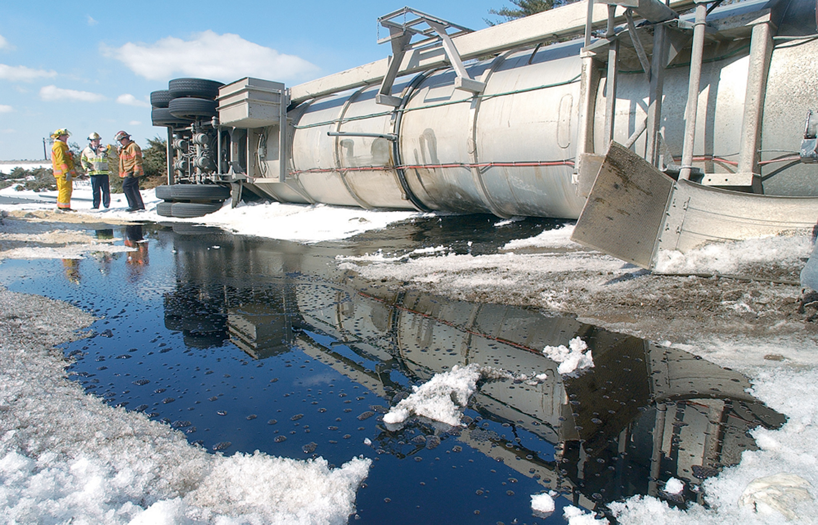
Hazardous Materials Spills and Other Accidents are Common Problems
(© Mark C. Ide/Science Source)
Notes:
Discussion Question
What are some locations in your community that use or store hazardous materials?
Knowledge Application
Students should be able to apply the knowledge in this section to the identification of hazardous materials.

Slide 9
Identifying Hazardous Materials (1 of 11)
What Is a Hazardous Material?
A hazardous material poses a threat or unreasonable risk to life, health, or property if not properly controlled.
The principle dangers are toxicity, flammability, and reactivity.
Notes:
Hazardous materials can asphyxiate, irritate, increase the risk of cancer, act as nerve or liver poisons, or cause loss of coordination, seizures, or altered mental status. They can cause skin irritation, burns, respiratory distress, nausea and vomiting, tingling or numbness of the extremities, and blurred or double vision.

Slide 10
Table 44-2 T R A C E M: Types of Damage from Hazardous Materials
T Thermal: Heat sources, burning, radiant heat
R Radiological: Nuclear fuels and by-products, nuclear bombs
A Asphyxiation: Lack of O₂ due to chemical vapors, heavy gases
C Chemical: Toxic or corrosive chemicals
E Etiological: Biological hazards
M Mechanical: Trauma from bullets, shrapnel, and so on
Notes:
The acronym TRACEM can be used to remember the types of damage that can be caused by hazardous materials: thermal, radiological, asphyxiation, chemical, etiological, and mechanical. The amount of damage depends on the dose, concentration, route of exposure, and amount of time the patient is exposed.

Slide 11
Identifying Hazardous Materials (2 of 11)
Placards and Shipping Papers
The U . S. Department of Transportation (D O T) requires vehicles containing hazardous materials to be marked with labels or placards.
A vehicle driver must have shipping papers, which identify the exact substance, quantity, origin, and destination.
Notes:
A placard is a four-sided, diamond-shaped sign that designates hazardous materials in transit on roadways. The placard contains important information that can aid the EMT in determining the best course of action.
Class Activity
Have students write down the information from three different DOT placards and bring them to the next class for identification.

Slide 12
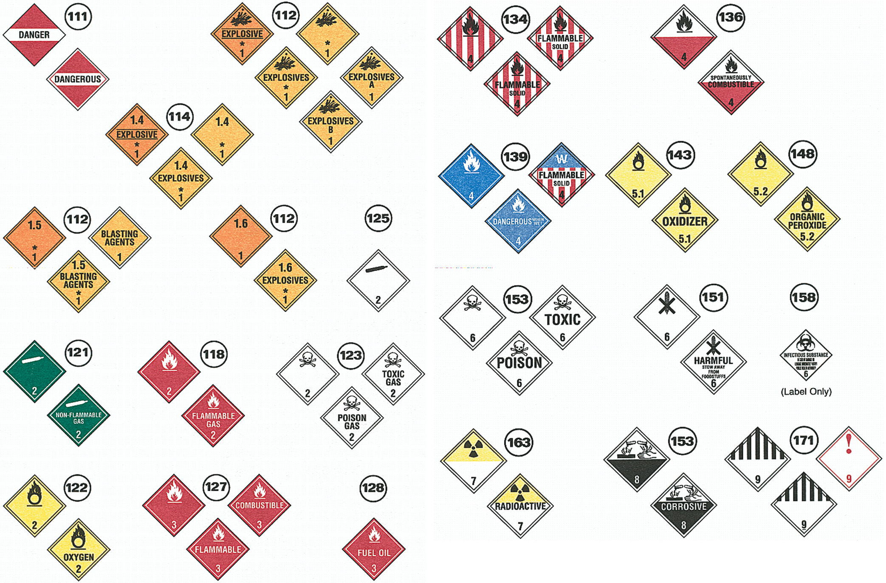
The U.S. Department of Transportation Requires Packages, Storage Containers, and Vehicles Containing Hazardous Materials to be Marked with Specific Hazard Labels
Notes:
The color of a placard also indicates what class of hazard is contained within. A legend that indicates whether the material is flammable, radioactive, explosive, or poisonous is also commonly displayed.

Slide 13
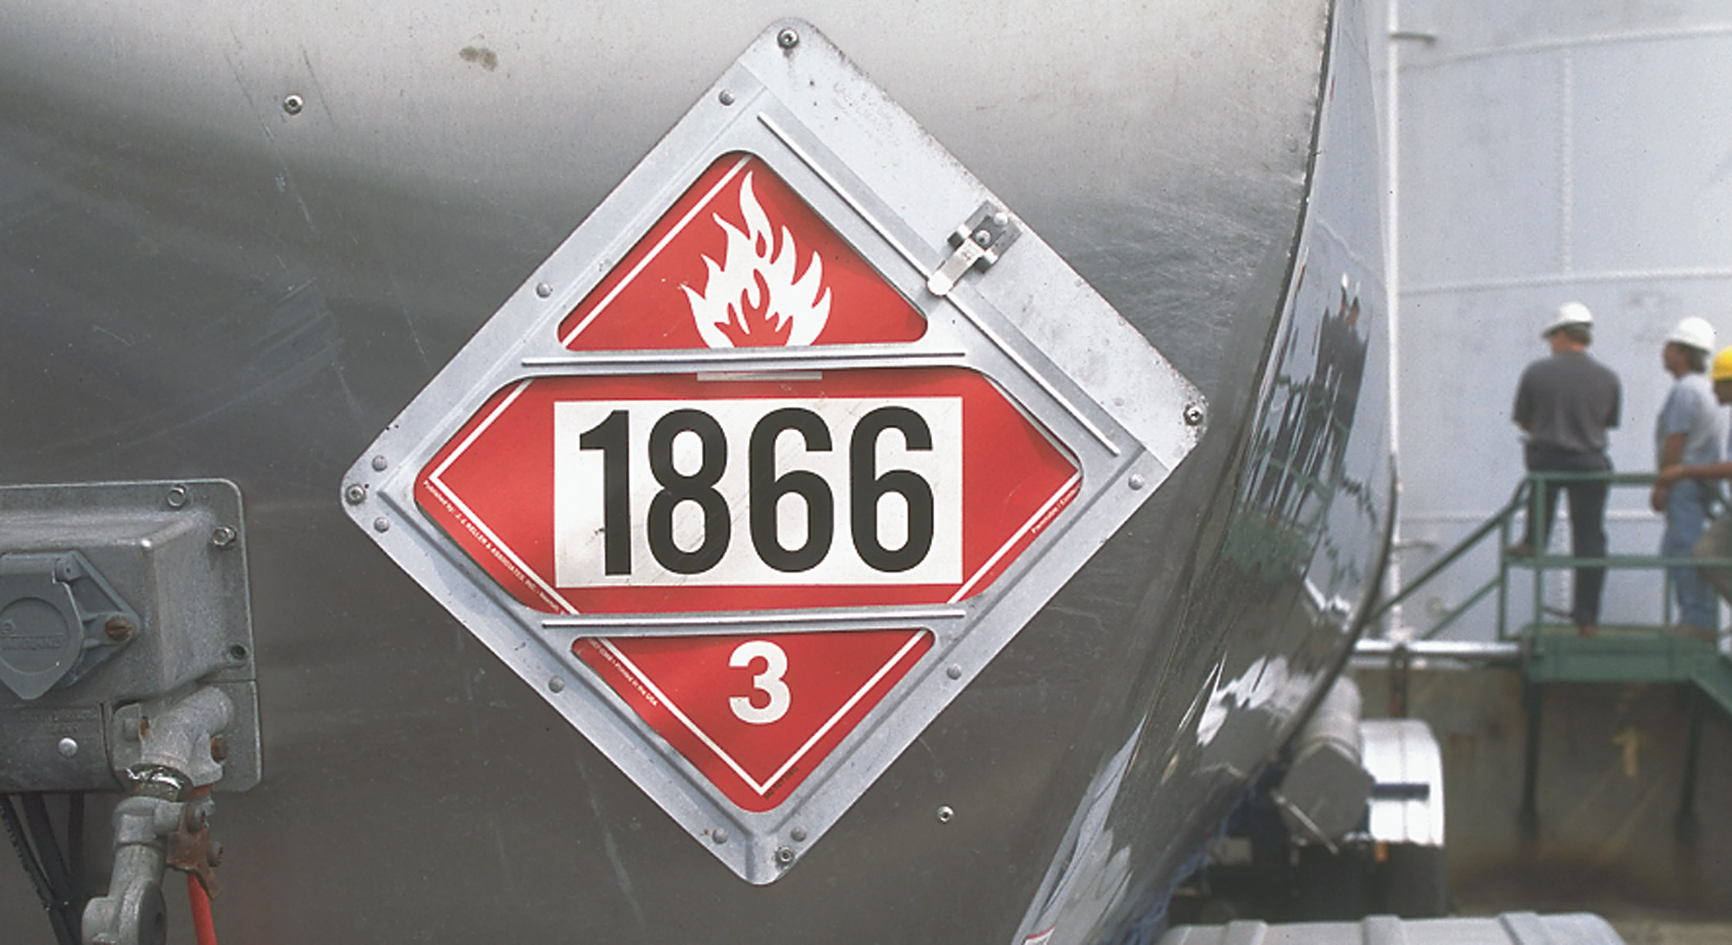
Any Tank, Vehicle, Train, or Ship that Carries Hazardous Materials Must have a Placard That Identifies the Substance
Notes:
Often, a placard displays a four-digit UN number (United Nations identification number) that can identify the hazardous material.

Slide 14
Identifying Hazardous Materials (3 of 11)
Placards and Shipping Papers
N F P A 704 System
The National Fire Protection Association (N F P A) placard system is used to mark fixed storage containers.
Notes:
The NFPA 704 system identifies potential danger with the use of background colors and numbers ranging from 0 to 4. The blue diamond is a gauge of health hazard; the red, fire hazard; and the yellow, reactivity hazard. The white diamond is used for symbols that indicate additional information, such as radioactivity, oxidation, need for protective equipment, and so on.

Slide 15
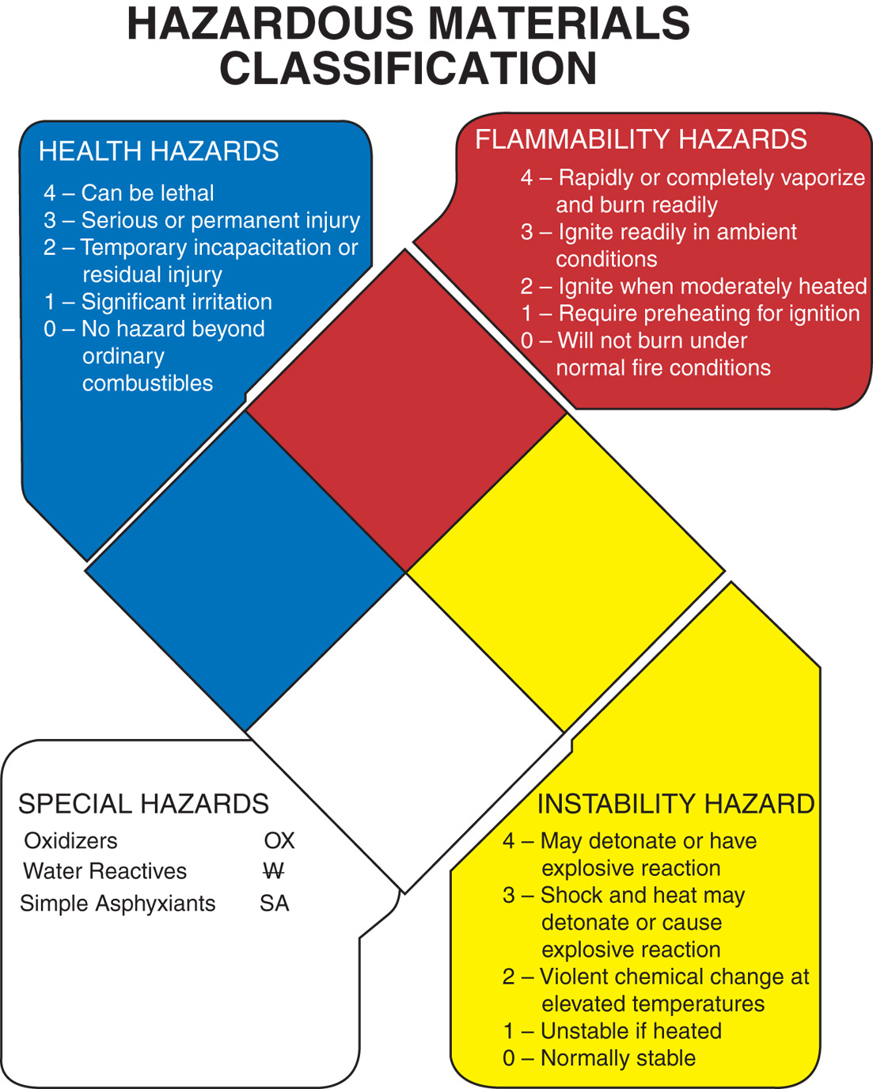
N F P A 704 Hazardous Materials Classification
Reprinted with permission from N F P A 704-2012, System for the Identification of the Hazards of Materials for Emergency Response, Copyright © 2011, National Fire Protection Association. This reprinted material is not the complete and official position of the N F P A on the referenced subject, which is represented solely by the standard in its entirety. The classification of any particular material within this system is the sole responsibility of the user and not the N F P A. The N F P A bears no responsibility for any determinations of any values for any material classified or represented using this system.
Notes:
For example, a symbol that has a 1 in the blue diamond and a 4 in the red diamond would indicate a material that presents a relatively low health hazard but is extremely flammable.

Slide 16
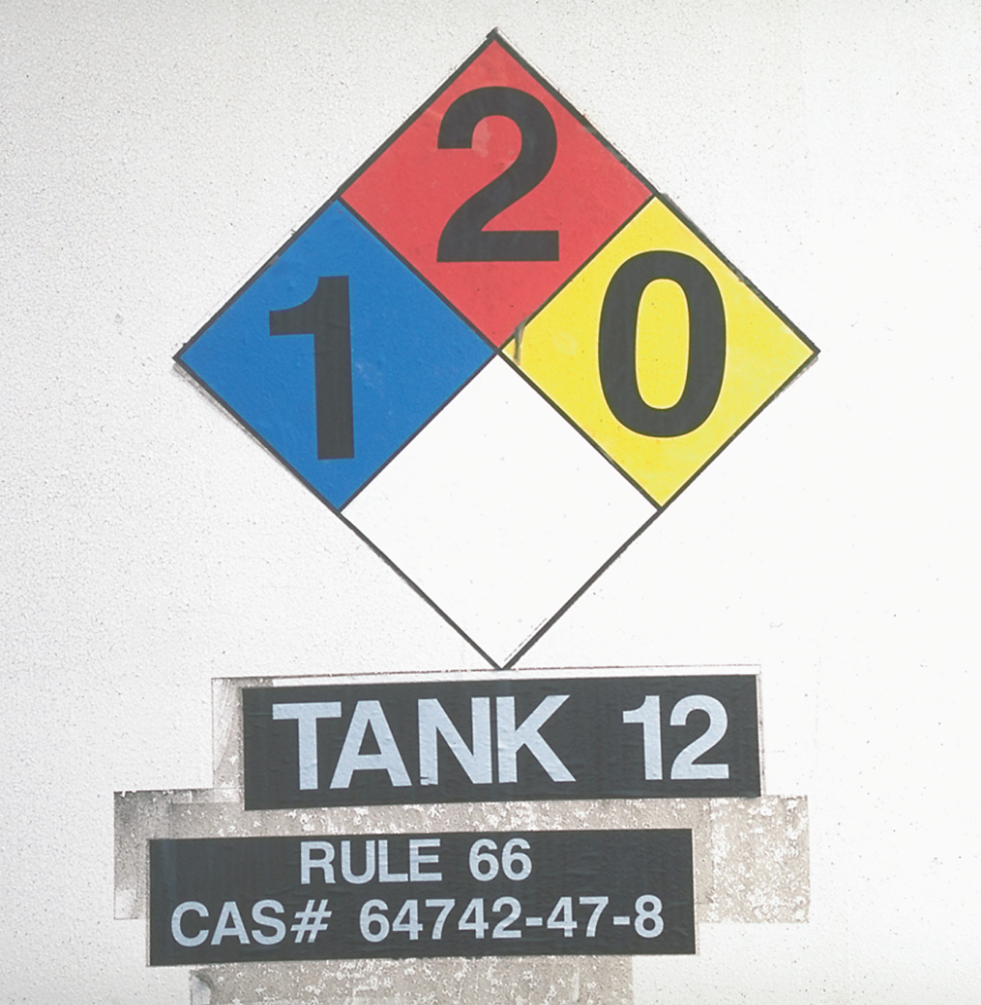
N F P A 704 Labeling on a Tank
Notes:
The white diamond is used for symbols that indicate additional information, such as radioactivity, oxidation, need for protective equipment, and so on.

Slide 17
Identifying Hazardous Materials (4 of 11)
Placards and Shipping Papers
Shipping papers and material safety data sheets (M S D S) also help identify hazardous materials.
Safety Data Sheets
Required to be in a standard format
Sixteen sections are required to be provided.
Notes:
Shipping papers are required to be in the cab of a motor vehicle, in the possession of a train crew member in the engine or caboose, in a holder on the bridge of a water vessel, or in the aircraft pilot’s possession.
As of June 2015, OSHA’s “Hazard Communication Standard” (HCS) requires chemical manufacturers, shippers, or distributors to provide information regarding the hazards of chemicals or chemical compounds. This information is provided in the form of Safety Data Sheets.

Slide 18
Identifying Hazardous Materials (5 of 11)
Using Your Senses
Visual Clues Include:
Smoking or self-igniting materials
Extraordinary fire conditions
Boiling or spattering of materials
Wavy or unusually colored vapors
Characteristically colored vapor clouds
Frost near a container leak
Unusual condition of containers
Notes:
The least reliable way to determine the presence of hazardous materials at the scene of an accident is to use your senses.

Slide 19
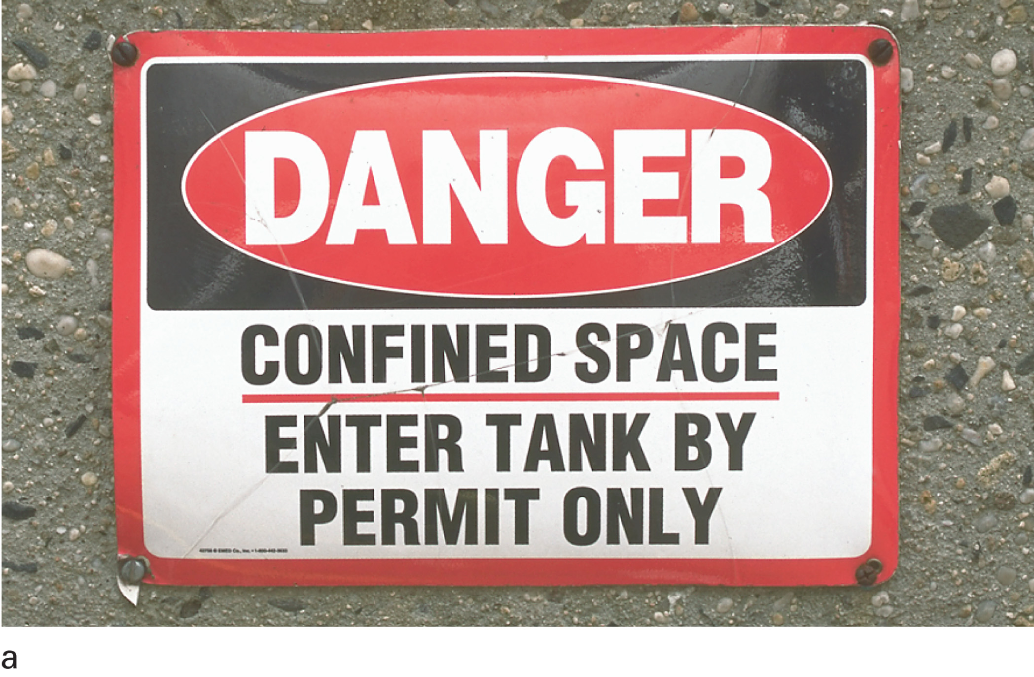
Look for Clues to Potential Hazardous Materials, Such as Signs
Notes:
Quickly scan the scene looking for signs of potential hazardous materials such as signs restricting entry, storage tanks, or containers with placards.

Slide 20
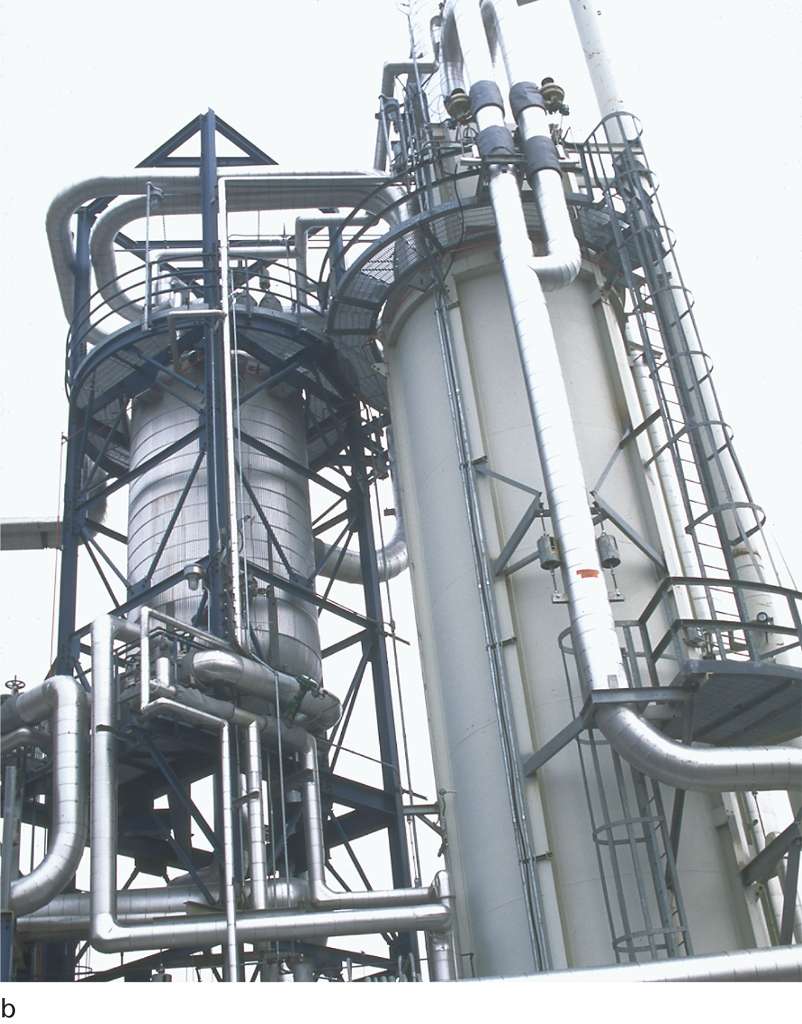
Look for Clues to Potential Hazardous Materials, Such as Storage Tanks
Notes:
Many visual clues can indicate the probable presence of a hazardous material.

Slide 21
Identifying Hazardous Materials (6 of 11)
Resources
American Chemistry Council
Poison Control Centers
U S D O T Emergency Response Guidebook
C H E M T R E C
Chemtel, Inc.
W I S E R — Wireless Information System for Emergency Responders is available as an app or downloadable program.
Notes:
USDOT Emergency Response Guidebook
Yellow section. If only the four-digit UN number for a hazardous material is known, then the name of the chemical can be found here by matching it to the number. This also lists the appropriate guide section for specific actions to take.
Blue section. This section lists hazardous materials by name in alphabetical order cross-referenced by the UN number. It also provides the appropriate guide number for each specific hazardous material.
Orange section. Both the yellow and the blue sections provide information that references the orange section. In the orange section, all hazardous materials listed in the Emergency Response Guidebook are grouped into 1 of 63 guide numbers, which provide information on the primary hazardous and emergency response actions to be taken initially when a hazardous material is contacted. The orange section also provides information regarding personal protective equipment (PPE), evacuation distances, spill control, fire control, and first aid measures.
Green section. Within the blue and yellow sections, certain chemicals are highlighted in green. This denotes that the chemical presents a specific hazard as a toxic industrial hazard (TIH) when spilled. A hazardous material listed in the green section as a toxic industrial hazard has specific initial isolation distances and other information depending on their relative greater toxicity.
Teaching Tips
Provide examples of Emergency Response Guidebooks and material Safety Data Sheets.
Critical Thinking Discussion
If you needed to find a material Safety Data Sheet at your place of employment, where would you look, or whom would you ask?

Slide 22
Identifying Hazardous Materials (7 of 11)
Resources
When contacting a resource, provide the following:
Your name, callback number, and fax number.
Nature and location of product.
U N identification number or name of product(s).
Name of carrier, shipper, manufacturer, consignee, and point of origin.

Slide 23
Identifying Hazardous Materials (8 of 11)
Resources
When contacting a resource, provide the following:
Type of container and size.
Quantity of material.
Local weather conditions.
Number of injuries and/or exposures.
Emergency services that are present or are responding.
Notes:
Accidents involving hazardous materials often occur at inconvenient locations, making communication difficult. It is critical that you make every effort to keep a phone line open.

Slide 24
Identifying Hazardous Materials (9 of 11)
Training Required by Law
The Occupational Safety and Health Administration (O S H A) and the Environmental Protection Agency (E P A) — have developed regulations to enhance the safety of rescuers for a more effective response.
Notes:
Employers are responsible for determining and documenting the appropriate level of training for each employee. Because training addressed by OSHA usually has a fire-service focus, the National Fire Protection Association has published Standard 473, which deals with competencies for EMS personnel at hazardous materials emergencies.
Teaching Tips
Provide details on the level of training required for EMS providers in your state.

Slide 25
Identifying Hazardous Materials (10 of 11)
Training Required by Law
First Responder Awareness
This is the level usually required for E M T s.
First Responder Operations
Help stop the spread of material.
Hazardous Materials Technician
Plug, patch, or stop the release of material.
Hazardous Materials Specialist
Site command and support activities
Notes:
First Responder Awareness:
For those who are likely to witness or discover a hazardous materials emergency
Trained to recognize a problem, call for proper resources, and prevent others from entering the scene
This is the level most often required for EMTs.
First Responder Operations:
This level of training is for those who initially respond to hazardous materials emergencies to protect people, property, and the environment.
They are trained in the use of specialized personal protective equipment and help to stop the emergency from spreading.
Hazardous Materials Technician:
This extensive level of training is for rescuers who actually plug, patch, or stop the release of a hazardous material.
Hazardous Materials Specialist:
Rescuers with this training have advanced knowledge and skills.
They provide command and support activities at the site of a hazardous materials emergency.

Slide 26
Click on the Type of Hazard Represented by the Blue Area of an N F P A 704 Placard
a. A specific hazard, such as radiation or oxidation
b. Fire hazard
c. Health hazard
d. Reactivity hazard

Slide 27
Guidelines for Hazardous Materials Rescues (1 of 19)
Never attempt a hazardous materials rescue unless you have the specialized training and equipment.
Request help.
Locate yourself and bystanders uphill, upwind, upstream, and away from the danger.
Notes:
Teaching Tips
Discuss local policy and procedure for response to hazardous materials incidents.
Discussion Question
What actions should you take to isolate the area of a hazardous materials incident?

Slide 28
Identifying Hazardous Materials (11 of 11)
General Rules:
Protect the safety of all rescuers and patients.
Provide patient care.
Decontaminate clothing, equipment, and the vehicle.
Avoid risking your life or your health if the only threat is to the environment.
Notes:
One rule of a hazardous materials rescue is to avoid contact with any unidentified material, regardless of the level of protection offered by your clothing and equipment.

Slide 29
Table 44-3 Rain: Awareness-Level Responsibilities at a Hazardous Materials Incident
R Recognize that a hazardous materials incident has occurred.
A Avoid contact with the hazardous substance.
I Isolate the area.
N Notify the appropriate authorities or response agencies.
Notes:
At the First Responder Awareness level of training, your actions at a hazardous materials incident should include the ability to recognize that a hazardous materials incident has occurred, avoid contact with the hazardous substance, isolate the area, and notify the appropriate authorities or response agencies. These actions can be easily remembered using the acronym RAIN.

Slide 30
Guidelines for Hazardous Materials Rescues (2 of 19)
Decontamination
Be familiar with the procedures.
Unless specifically trained to Hazardous Materials Operations Level, E M T s are not expected to take part in the decontamination procedures.
60-90 percent of decontaminants are removed with clothing.
Notes:
Decontamination is defined by OSHA as “the removal of hazardous substances from exposed individuals to the extent necessary to prevent the occurrence of foreseeable adverse harm.”

Slide 31
Guidelines for Hazardous Materials Rescues (3 of 19)
Incident Management
Preincident Planning is essential and should include:
One command officer.
Clear chain of command.
Established communication system.
Predesignated receiving facilities
Notes:
One command officer, who is responsible for all rescue decisions, should be appointed. All rescuers should be aware of who the command officer is.
There should be a clear chain of command from each rescuer to the command officer.
There should be an established system of communications used throughout the emergency. The system should be one all rescuers are informed about, know how to use, and have access to.
Receiving facilities should be predesignated. Choose facilities that can handle large numbers of patients, have surgical capacity, and, if possible, have established decontamination procedures. Again, it is essential that any receiving facility be made aware of a patient’s exposure to a hazardous material, even if the patient is appropriately decontaminated before transport. EMTs should let the receiving hospital’s directives guide them for transport procedures.

Slide 32
Guidelines for Hazardous Materials Rescues (4 of 19)
Incident Management
Implementing the Plan
Establish the command system and command post.
Get information as follows:
Nature of the problem.
Identification of the hazardous material.
The type and condition of containers.
Existing weather conditions.
Notes:
Discussion Questions
What information do you need to implement a hazardous materials response plan?
What activities should occur in the hot, warm, and cold zones?

Slide 33
Guidelines for Hazardous Materials Rescues (5 of 19)
Incident Management
Implementing the Plan
Get information as follows:
Whether there is presence of fire.
Amount of time that has elapsed.
Scene work already done.
The number of patients.
The danger of victimizing more people.
Establishing safety zones.
Notes:
Smoke from hazardous materials fires presents an environmental hazard. It carries toxins and particles of hazardous materials through the air, widening the area of contamination.
Unless you are a trained firefighter, do not attempt to extinguish the fire.

Slide 34
Guidelines for Hazardous Materials Rescues (6 of 19)
Incident Management
Establishing Safety Zones
The hot zone is where contamination can be present.
The warm zone still in danger of contamination from the patients and rescue personnel who have exited the hot zone.
The cold zone should not contain any contamination.
Notes:
As an early priority at the scene of any hazardous materials emergency, safety zones are established in which rescue operations and a specific sequence of decontamination procedures take place.
Anyone in the warm and hot zones must have proper protective equipment.
Gross decontamination is performed at the entry to the warm zone.
Primary assessment is performed in the warm zone.
Once life threats are addressed, complete decontamination is performed.
The patient is assessed and major injuries are treated in the warm zone.
All protective equipment is removed before entering the cold zone.

Slide 35
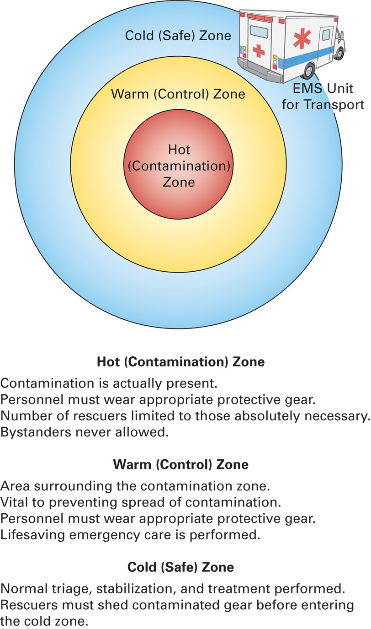
Establishing Safety Control Zones at the Site of a Hazardous Materials Emergency

Slide 36
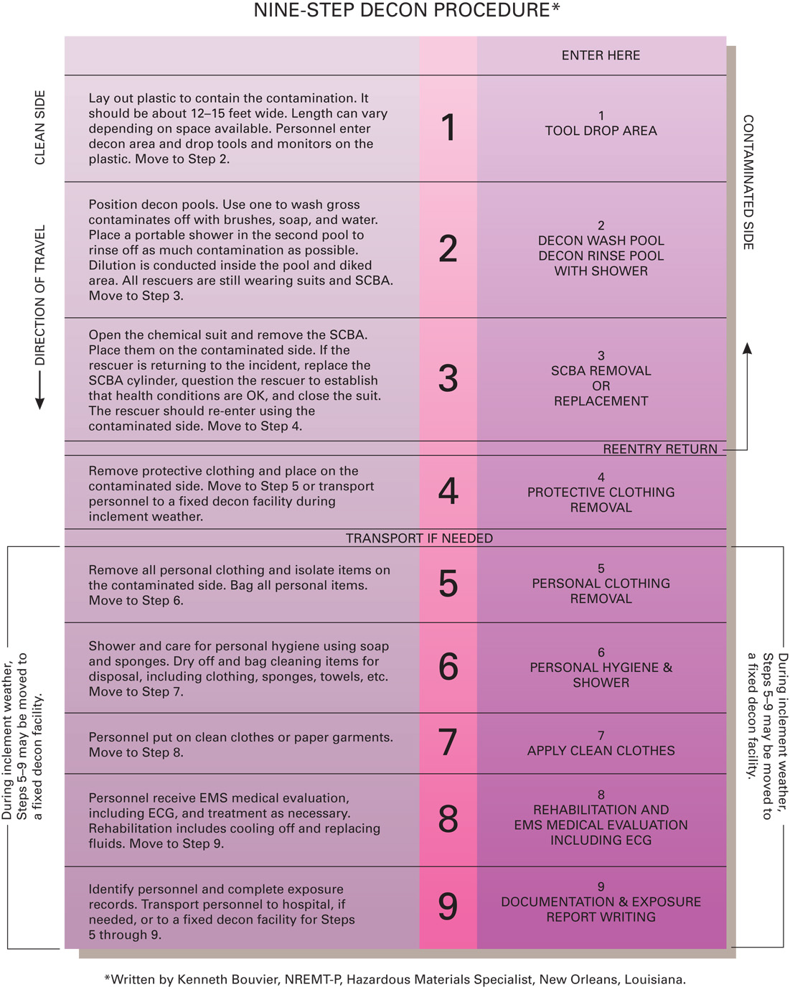
Nine-Step Decontamination Procedure
*written by Kenneth Bouvier, NREMT-P, Materials Specialist, New Orleans, Louisiana.

Slide 37
Guidelines for Hazardous Materials Rescues (7 of 19)
Emergency Procedures
Any rescuers who are exposed must be decontaminated with soap and copious amounts of water.
Report exposures and obtain a medical examination.
Equipment and vehicles also must be decontaminated.
Notes:
In the cold zone, take vital signs and prepare the patient for transport.
Protect the ambulance and equipment from contamination.
Complete decontamination is required prior to air medical transport.

Slide 38
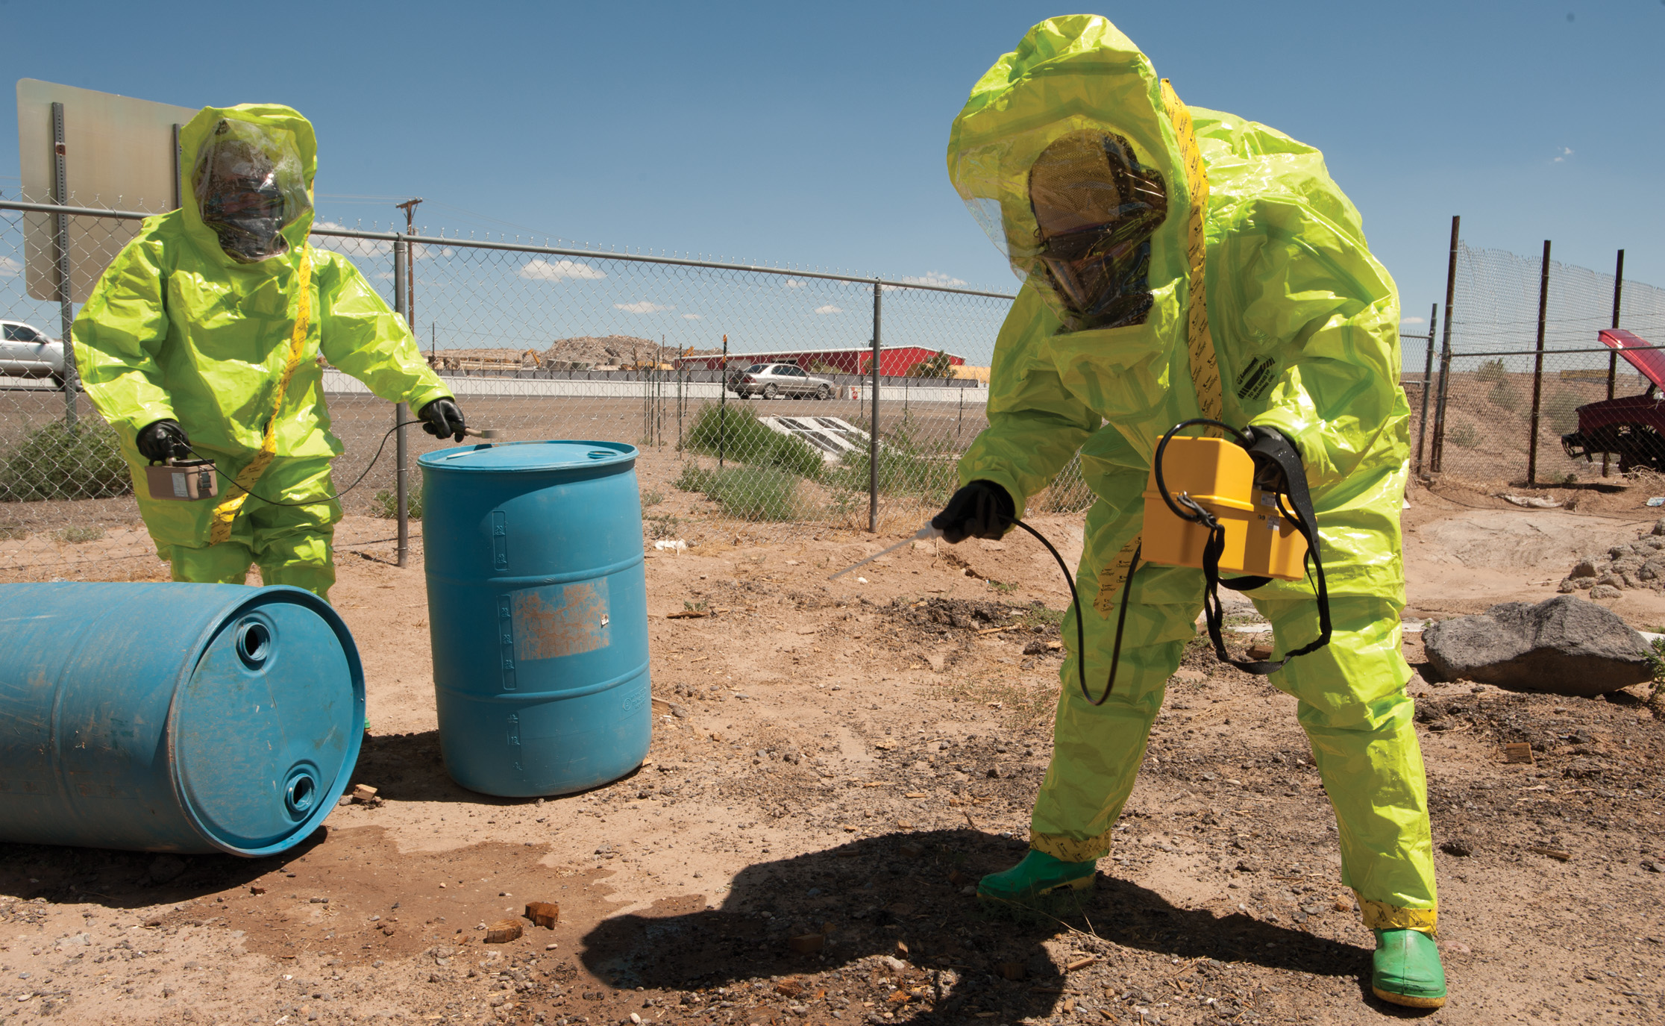
Testing Hazard Levels at a Spill
Notes:
The only work done in the hot zone is hazard assessment, control of the release or hazard, and rescue performed by trained personnel who are wearing appropriate protective equipment.

Slide 39
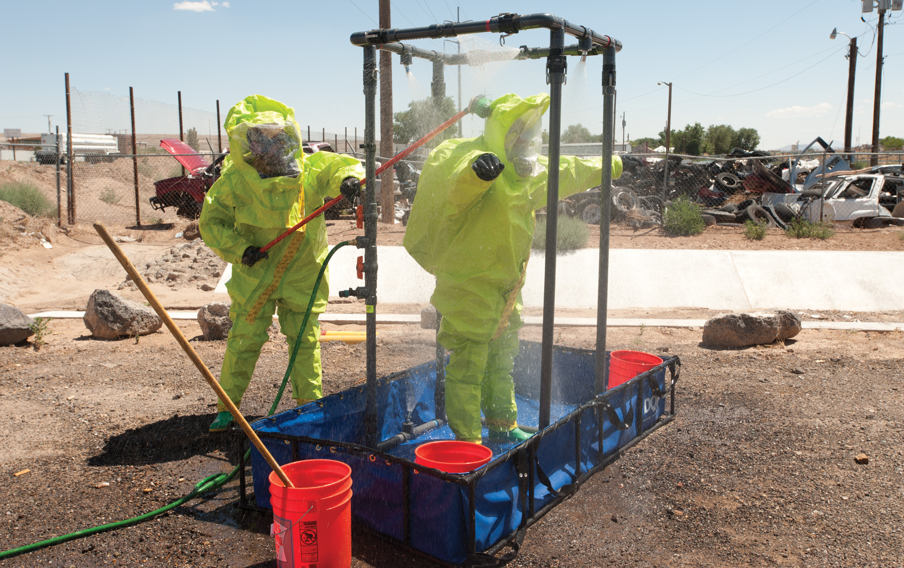
Rescuer in Decontamination Process
Notes:
Initial (gross) decontamination should be performed at the entry to the warm zone.

Slide 40
Guidelines for Hazardous Materials Rescues (8 of 19)
Radiation Emergencies
Exposure and Contamination
Exposure
The patient is in the presence of radioactive material without any of it touching their clothing or body.
The exposure may be harmful to the patient.
The patient does not become radioactive.
Notes:
Discussion Questions
What are exposure and contamination with respect to radiation accidents?
What procedures should you follow when responding to a radiation accident scene?
Critical Thinking Discussion
How can you find out what potential sources of radiation are in your community?

Slide 41
Guidelines for Hazardous Materials Rescues (9 of 19)
Radiation Emergencies
Exposure and Contamination
Contamination
The patient has direct contact with the source of radioactivity.
The radioactive material is present on the patient’s clothes or skin.
The patient is a risk to emergency personnel.
Notes:
Discussion Question
How is radiation decontamination accomplished?

Slide 42
Guidelines for Hazardous Materials Rescues (10 of 19)
Radiation Emergencies
Guidelines for Radiation Emergencies
Protect yourself and others from contamination.
Do not attempt to decontaminate a radiation patient.
If possible, wait for a radiation safety officer (R S O).
Notes:
A Radiation Safety Officer (RSO) an expert specifically trained under federal government provisions to handle such situations.

Slide 43
Guidelines for Hazardous Materials Rescues (11 of 19)
Radiation Emergencies
Guidelines for Radiation Emergencies
If an R S O cannot come to the site:
Place the patient in a body bag up to the neck.
Cover the hair with a cap or towel.
Wipe the face with disposable wipes and place them in a plastic bag for disposal at the hospital.
Notes:
Time is the critical factor in managing radiation emergencies. Trained personnel should remove the patient from the source of radiation as quickly as possible before you begin emergency care. Increase distance between yourself and the source of radiation.

Slide 44
Guidelines for Hazardous Materials Rescues (12 of 19)
Radiation Emergencies
Procedures for Radiation Emergencies
Time, distance, and shielding are critical in reducing exposure in radiation emergencies.
Priorities
Safety of rescuers and patients
Patient care
Decontamination
Notes:
Limit your stay in a contaminated area to as little time as possible. Keep as far away from the source as you can and involve as few rescuers as possible. Exposure to radiation is cumulative and is determined by an inverse square relationship. That is, if you are twice as close, you will receive four times the exposure. If you move twice
as far away, you cut your exposure by four times.

Slide 45
Guidelines for Hazardous Materials Rescues (13 of 19)
Radiation Emergencies
Procedures for Radiation Emergencies
Scene Safety
Survey the area for the radiation symbol.
Be alert for other hazardous materials.
Do not park near a damaged container.
Put on a positive pressure self-contained breathing apparatus.
Decontaminate equipment.
Decontaminate vehicle inside and out.
Notes:
Limit your stay in a contaminated area to as little time as possible. Keep as far away from the source as you can and involve as few rescuers as possible. Exposure to radiation is cumulative and is determined by an inverse square relationship. That is, if you are twice as close, you will receive four times the exposure. If you move twice as far away, you cut your exposure by four times.
If equipment or tools cannot be completely decontaminated, they need to be disposed of. Signs of incomplete decontamination include debris adhering to the equipment, discoloration, corrosion, and stains.

Slide 46
Guidelines for Hazardous Materials Rescues (14 of 19)
Radiation Emergencies
Problems Caused by Radiation
Radiation sickness
Caused by exposure to large amounts of radiation
Onset begins in hours to weeks
Signs and symptoms include nausea, vomiting, hemorrhage, loss of appetite, fever, sores and immune system suppression.
Notes:
Radiation sickness is caused by exposure to large amounts of radiation. Symptoms start from a few hours to days following exposure to the radiation and, depending on the dose, can last from a few days to 7 or 8 weeks. The amount of time between radiation exposure and the onset of symptoms is a relatively reliable indicator of how much radiation a person has absorbed.

Slide 47
Guidelines for Hazardous Materials Rescues (15 of 19)
Radiation Emergencies
Problems Caused by Radiation
Radiation Injury
Local injury caused by exposure to less-penetrating particles
Signs and symptoms include hair loss, burns, and generalized skin lesions.
Notes:
A victim of a radiation accident is not “contagious” or infectious and generally will not endanger a rescuer. You are at risk of becoming contaminated if the patient still has radiation particles on their skin or clothing.

Slide 48
Guidelines for Hazardous Materials Rescues (16 of 19)
Radiation Emergencies
Problems Caused by Radiation
Radiation Poisoning
The patient is exposed to large amounts of radiation internally.
Problems include cancer and amnesia.
Notes:
Radiation poisoning occurs when the patient has been exposed to dangerous amounts of internal radiation. The result is a host of serious diseases, including cancer and anemia.

Slide 49
Guidelines for Hazardous Materials Rescues (17 of 19)
Radiation Emergencies
Protection from Radiation
Factors that determine radiation exposure
Amount and type of shielding used
Strength of radiation source
Distance from radiation source
Type of radiation
Length of exposure
Amount of body exposed
Notes:
You can reduce your risk. The best approach is to divide the rescue work among many rescuers, with teams composed of as few rescuers as possible.
The Federal Nuclear Regulatory Commission recommends that an individual in an emergency, while engaged in activities deemed necessary for the preservation of life, be exposed to no more than a one-time whole-body dose of 25 roentgens.
Another approach to reducing risk is to shield the radiation source (not you or the patient). For example, the best protection against gamma rays (one type of radiation that is extremely dangerous) is lead, preferably 1–2 inches thick. If lead is not available, any material that has thick mass (such as bricks, concrete, or several feet of dirt) will do.

Slide 50
Guidelines for Hazardous Materials Rescues (18 of 19)
Criminal Use of Hazardous Materials
Methamphetamine Clandestine Drug Laboratories
Can result in the production of toxic gases, including phosphine
Marijuana Clandestine Drug Laboratories
Involves cultivation of numerous marijuana plants indoors
Notes:
The production of methamphetamine, a stimulant, requires converting the active ingredient in cold decongestant medicine, pseudoephedrine, into another compound. Doing this requires reacting pseudoephedrine with several hazardous chemicals that may include lithium, phosphorus, sodium hydroxide, anhydrous ammonia, and hydrochloric acid. This can result in the production of toxic gases, including phosphine, an extremely toxic gas that poses an inhalation hazard even in small amounts.

Slide 51
Guidelines for Hazardous Materials Rescues (19 of 19)
Terrorist Attacks
Terrorist attacks involving weapons of mass destruction (W M D)
May use nuclear devices, biological agents, or chemicals
Notes:
The threat of a terrorist attack has heightened the awareness of a need to better prepare EMTs to respond to incidents involving terrorists’ weapons including explosives, nuclear devices, biological agents, and chemicals.

Slide 52
Case Study Conclusion (1 of 2)
Dawn and Randy ensure they are parked uphill, upwind of the trailer as they await the hazardous materials team. Law enforcement closes off all traffic in the area of the collision.
Notes:
Case Study Discussion
Review case conclusion and emphasize the application of knowledge learned from this presentation.

Slide 53
Case Study Conclusion (2 of 2)
Properly outfitted hazardous materials personnel determine that the patient has not had direct contact with the leaking material, but was exposed to fumes. They decontaminate the patient and deliver him to Dawn and Randy, who are waiting in the cold zone.
Hazardous materials personnel contain the leak and prepare to clean up the site.
Notes:
Case Study Discussion
Review case conclusion and emphasize the application of knowledge learned from this presentation.

Slide 54
Lesson Summary (1 of 2)
Emergency care involves medical, legal, and ethical issues.
Scope of practice identifies what care can legally be performed.
Standard of care identifies the accepted level of care.
Notes:
Follow-Up
Answer student questions.
Follow-Up Assignments
Review Chapter 44 Summary.
Complete Chapter 44 In Review questions.
Complete Chapter 44 Critical Thinking questions.
Assessments
Handouts
Chapter 44 quiz

Slide 55
Lesson Summary (2 of 2)
E M T s have a duty to act.
Medical direction is required for medical oversight of an E M S system.
Consent applies in all patient care situations.
A competent adult can refuse care.
Notes:
Class Activity
As an alternative to assigning the follow-up exercises in the lesson plan as homework, assign each question to a small group of students for in-class discussion.
Teaching Tips
Answers to In Review questions are in the appendix of the text. Advise students to review the questions again as they study the chapter.

Slide 56
Correct!
The blue diamond represents health hazards.
Click here to return to the program.

Slide 57
Incorrect (1 of 3)
Specific hazards such as radiation and oxidation are represented by the white diamond.
Click here to return to the quiz.

Slide 58
Incorrect (2 of 3)
Fire hazard is represented by the red diamond.
Click here to return to the quiz.

Slide 59
Incorrect (3 of 3)
Reactivity hazard is represented by the yellow diamond.
Click here to return to the quiz.

Slide 60
Copyright

