Slide 1
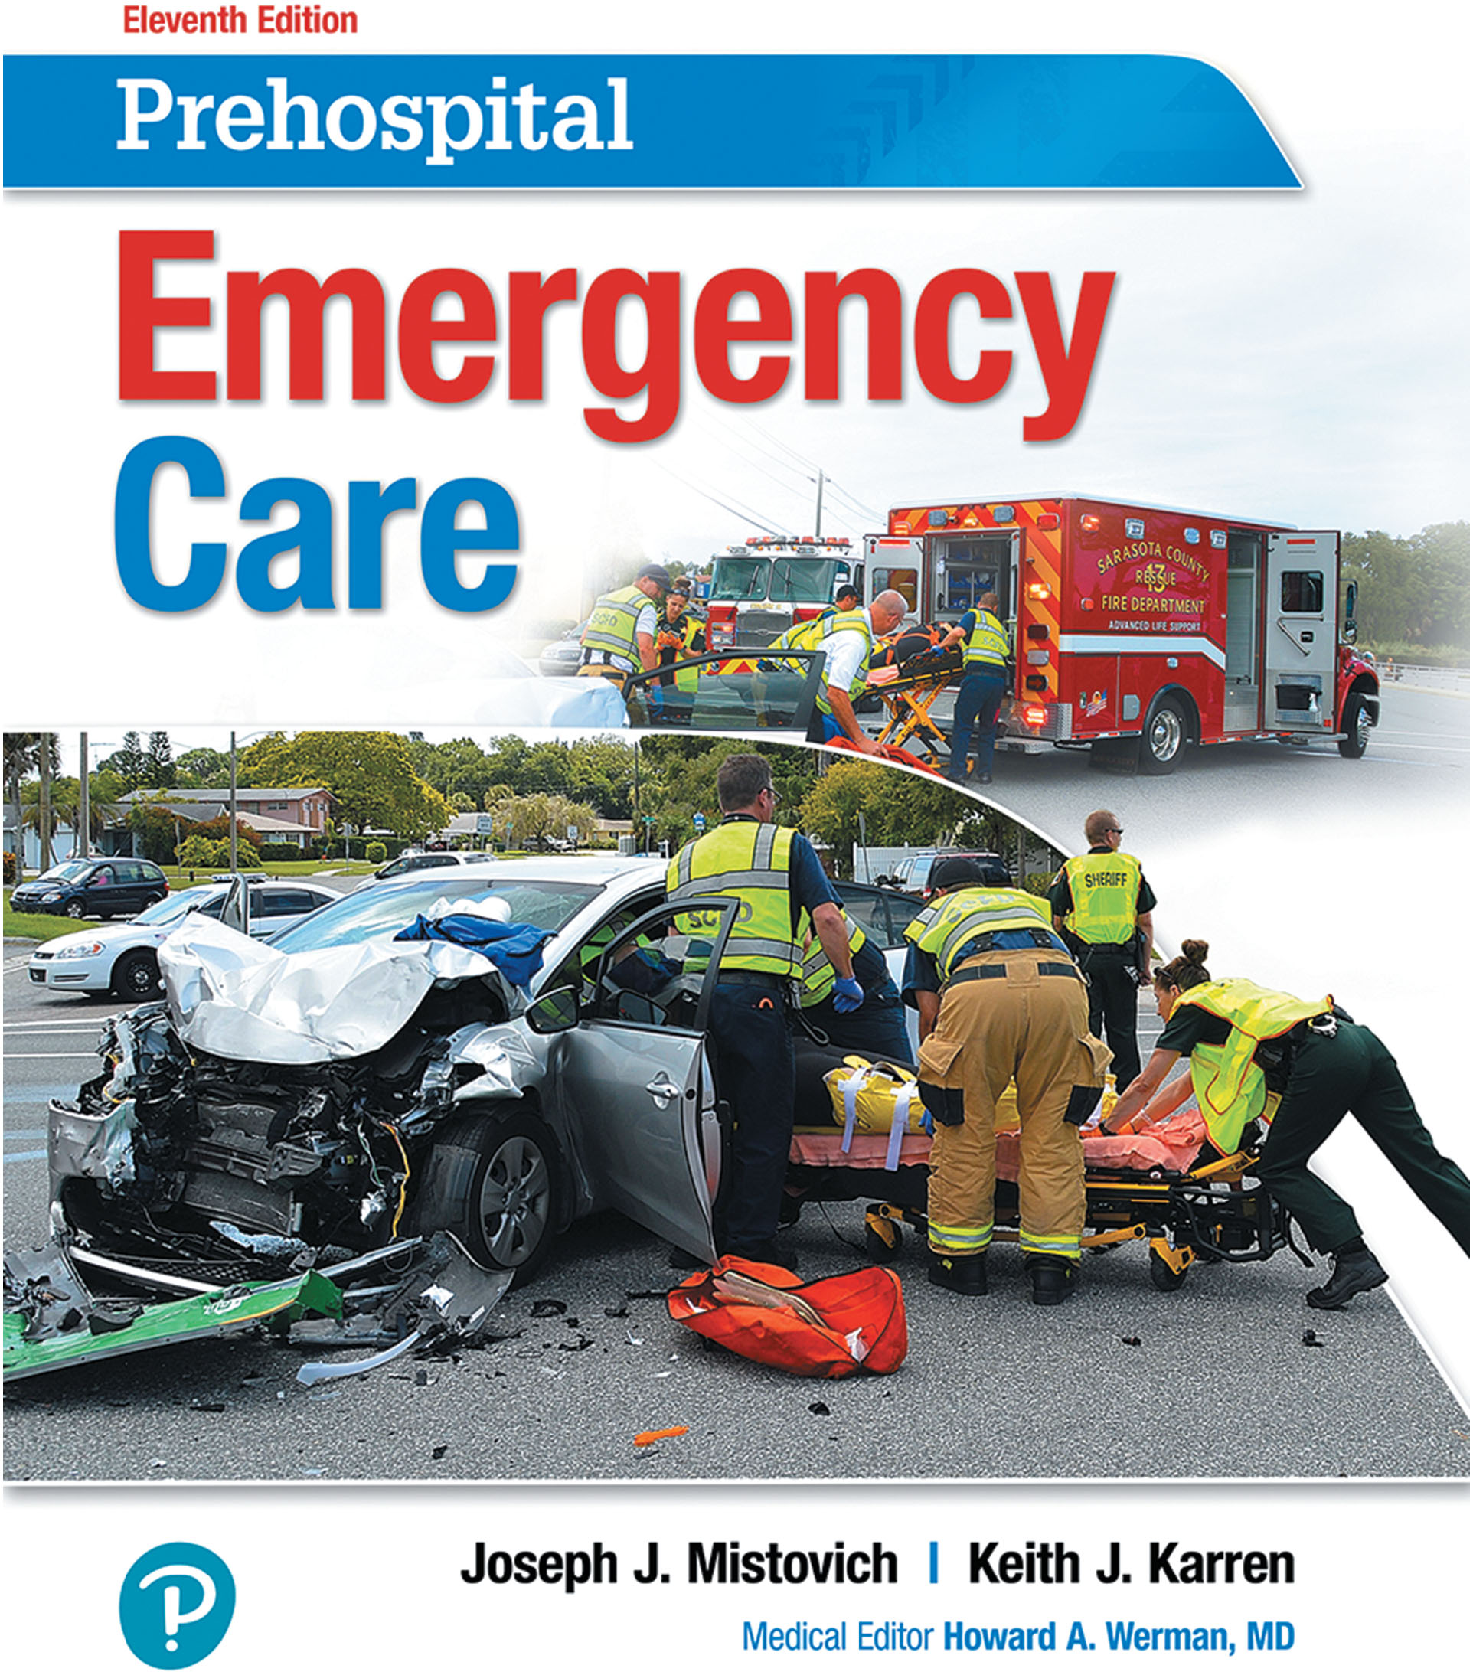
Prehospital: Emergency Care
Eleventh Edition
Chapter 43
Gaining Access and Patient Extrication
Slides in this presentation contain hyperlinks. JAWS users should be able to get a list of links by using INSERT+F7
Copyright © 2018, 2014, 2010 Pearson Education, Inc. All Rights Reserved
Notes:
If this PowerPoint presentation contains mathematical equations, you may need to check that your computer has the following installed:
1) MathType Plugin
2) Math Player (free versions available)
3) NVDA Reader (free versions available)
Advance Preparation
Student Readiness
Assign the associated section of MyBRADYLab and review student scores.
Review the chapter material in the Instructor Resources, which includes Student Handouts, PowerPoint slides, and the MyTest Program.
Prepare
Make copies of course policies and procedures, the syllabus, handouts from the Instructor Resources, and other materials for distribution or post them in your learning management system.
Preview the media resources and Master Teaching Notes in this lesson.
Preview the case study presented in the PowerPoint slides.
The total teaching time recommended is only a guideline. Take into consideration factors such as the pace at which students learn, the size of the class, breaks, and classroom activities. The actual time devoted to teaching objectives is the responsibility of the instructor.

Slide 2
Learning Readiness
E M S Education Standards, text p. 1282.
Chapter Objectives, text p. 1282.
Key Terms, text p. 1282.
Purpose of lecture presentation versus textbook reading assignments.
Notes:
Explain to students what the National EMS Education Standards are. The National EMS Education Standards communicate the expectations of entry-level EMS providers. As EMTs, students will be expected to be competent in these areas. Acknowledge that the standards are broad, general statements. Although this lesson addresses the listed competencies, the competencies are often complex and require completion of more than one lesson to accomplish. The student is also expected to review the chapter objectives to foreshadow what will be in the chapter. By mastering the key terms the EMT student will better understand the learning and be able to communicate more clearly.
Additionally, explain to the students that the purpose of using these slides is to help keep the instructor focused on highlighting important portions of the material, explain interrelationships of topics, and discuss how to apply this information. It’s not the intent of the presentation (or slides alone) to include every component in the chapter. This presentation still requires the student to thoroughly read the chapter.

Slide 3
Setting the Stage
Overview of Lesson Topics
Planning Ahead
Sizing Up the Scene
Gaining Access
Extrication
Specialized Stabilization, Extrication, and Disentanglement Techniques
Notes:
These bulleted points are the major headings from the chapter, in order. The purpose is to provide a basic lecture navigation for the student.

Slide 4
Case Study Introduction
E M T s Jay Gilmore and Lana Ward arrive at the scene of a reported single-vehicle collision to find an S U V resting on the driver’s side, with the windshield against a large tree.
Notes:
Case Study
Present the Case Study Introduction provided in the PowerPoint slide set.
Lead a discussion using the case study questions provided on the subsequent slide(s).
The Case Study with discussion questions continues throughout the PowerPoint presentation.
Case Study Discussion
Use the case study content and questions to foreshadow the upcoming lesson content.

Slide 5
Case Study
What additional resources will Jay and Lana need?
What additional personal protective equipment will the E M T s need in this situation?
What actions must be taken before accessing patients inside the vehicle?
Notes:
Case Study Discussion
Use the case study content and questions to foreshadow the upcoming lesson content. Gauge the student’s responses as a guide of how well-versed they are in this topic.

Slide 6
Introduction
Motor vehicle collisions are a common situation requiring rescue.
The process includes scene size-up, vehicle stabilization, gaining access, extrication, packaging, and moving the patient.
The primary role of E M T s in rescue situations is patient care.
Notes:
During this lesson, students will learn about their roles as EMTs in patient rescue situations.

Slide 7
Planning Ahead
Dispatch
Evaluate information from dispatch to determine if rescue may be required.
Location
Be familiar with locations that can present access difficulties.
Motor Vehicle Collisions
Anticipate situations in which vehicle entrapment is more likely.
Notes:
Points to consider when planning ahead from information provided by dispatch:
Is the patient ill or injured?
What is the mechanism of injury?
What is the location of the incident?
What time of day is it?
What is the weather?
Is there a report of entrapment?
Is there a report of a leak or a spill?
Are there any other hazards or potential hazards (e.g., downed power lines, unrestrained pets)?
Discussion Question
What are some locations in your community that might require special consideration for access?

Slide 8
Sizing up the Scene (1 of 11)
Stay alert as you approach the scene, survey from a safe distance.
Scenes are dynamic; scene size-up is a continual process.
360-Degree Assessment
Assess the scene from all directions.
Look for hazards.
Identify entrapped and ejected patients.
Identify the mechanism of injury.
Notes:
Teaching Tips
Very briefly describe a series of scene situations, such as motor vehicle collisions, specific industrial sites, and so on. Have students list the types of hazards and issues anticipated at the scene.
Discussion Questions
What does 360-degree assessment mean?
What actions should you take as you approach a vehicle involved in a collision?
Knowledge Application
Given several scenarios, students should be able to size up a scene.

Slide 9
Sizing up the Scene (2 of 11)
Evaluate the Need for Additional Resources.
Extrication
Fire Suppression
Law Enforcement
Hazardous Material Team
Utility Company
Air Medical
Water Rescue
Notes:
Based on the initial information provided by the caller, the communications officer might have dispatched additional resources to the scene, such as police for traffic control and crash investigation or the fire department or rescue services for extrication.
Discussion Question
What are some additional resources that you might need at the scene of a motor vehicle collision?

Slide 10
Sizing up the Scene (3 of 11)
Personal Protective Equipment
Consider the presence of glass, sharp metal, flammable liquids, battery acid, and blood.
Wear an A N S I /I S E A 107-2004 Class 2 or Class 3 approved high-visibility vest or 207-2006 public safety vest (P S V).
Turnout gear is required for personnel involved in extrication.
Notes:
Full turnout gear, including a coat, a brightly colored and highly visible vest, bunker pants, and steel-toed boots, is required for personnel involved in the patient extrication process.

Slide 11
Sizing up the Scene (4 of 11)
Scene Safety
Electrical Lines
Always assume downed power lines are electrically alive.
Stay away from vehicles in contact with power lines.
Request assistance from the power company.
Advise patients to remain in the vehicle.
Notes:
Discussion Question
What are the recommended guidelines for dealing with downed utility lines?

Slide 12
Sizing up the Scene (5 of 11)
Scene Safety
Control of Traffic Flow
The safest method is to reroute traffic to different roads.
If traffic must be channeled around the scene, it should be routed at least 50 feet from the wrecked cars.
Notes:
Critical Thinking Discussion
How can you find out more about particular hazards associated with specific types of vehicles?
Discussion Questions
What are some hazards posed by alternative-fueled vehicles?
Why does air bag deployment remain a hazard even after a collision?

Slide 13
Flares are Positioned According to a Formula that Includes the Stopping Distance for the Posted Speed plus a Margin of Safety
Posted speed (milesperhour) | Stopping distance for that speed | + | Posted speed (in feet) | = | Distance of the farthest warning device
20 milesperhour | 50 feet | + | 20 feet | = | 70 feet
30 milesperhour | 75 feet | + | 30 feet | = | 105 feet
40 milesperhour | 125 feet | + | 40 feet | = | 165 feet
50 milesperhour | 175 feet | + | 50 feet | = | 225 feet
60 milesperhour | 275 feet | + | 60 feet | = | 335 feet
70 milesperhour | 375 feet | + | 70 feet | = | 445 feet
Notes:
Flares or cones should begin far enough from the scene so that a car can safely stop before it hits the scene, even if the driver did not notice the flares or cones from a distance.

Slide 14
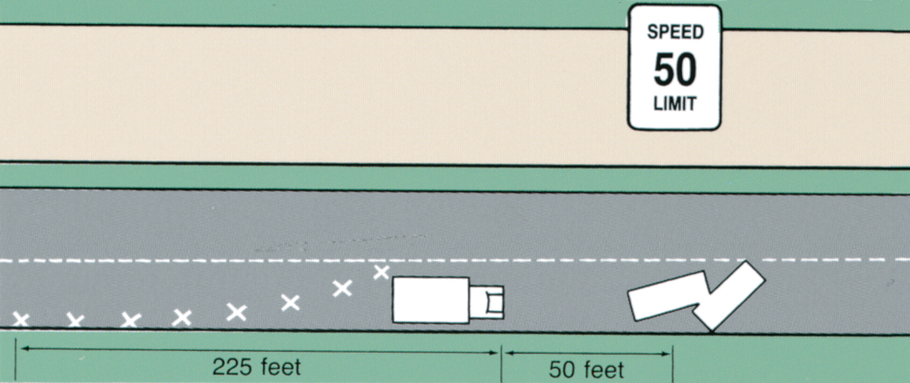
Flares Positioned on a Straight Road. Approaching Vehicles are Moved into the Correct Lane before they Reach the Edge of the Danger Zone
Notes:
Use fire apparatus and other emergency response vehicles as blockers to provide a safety zone.

Slide 15
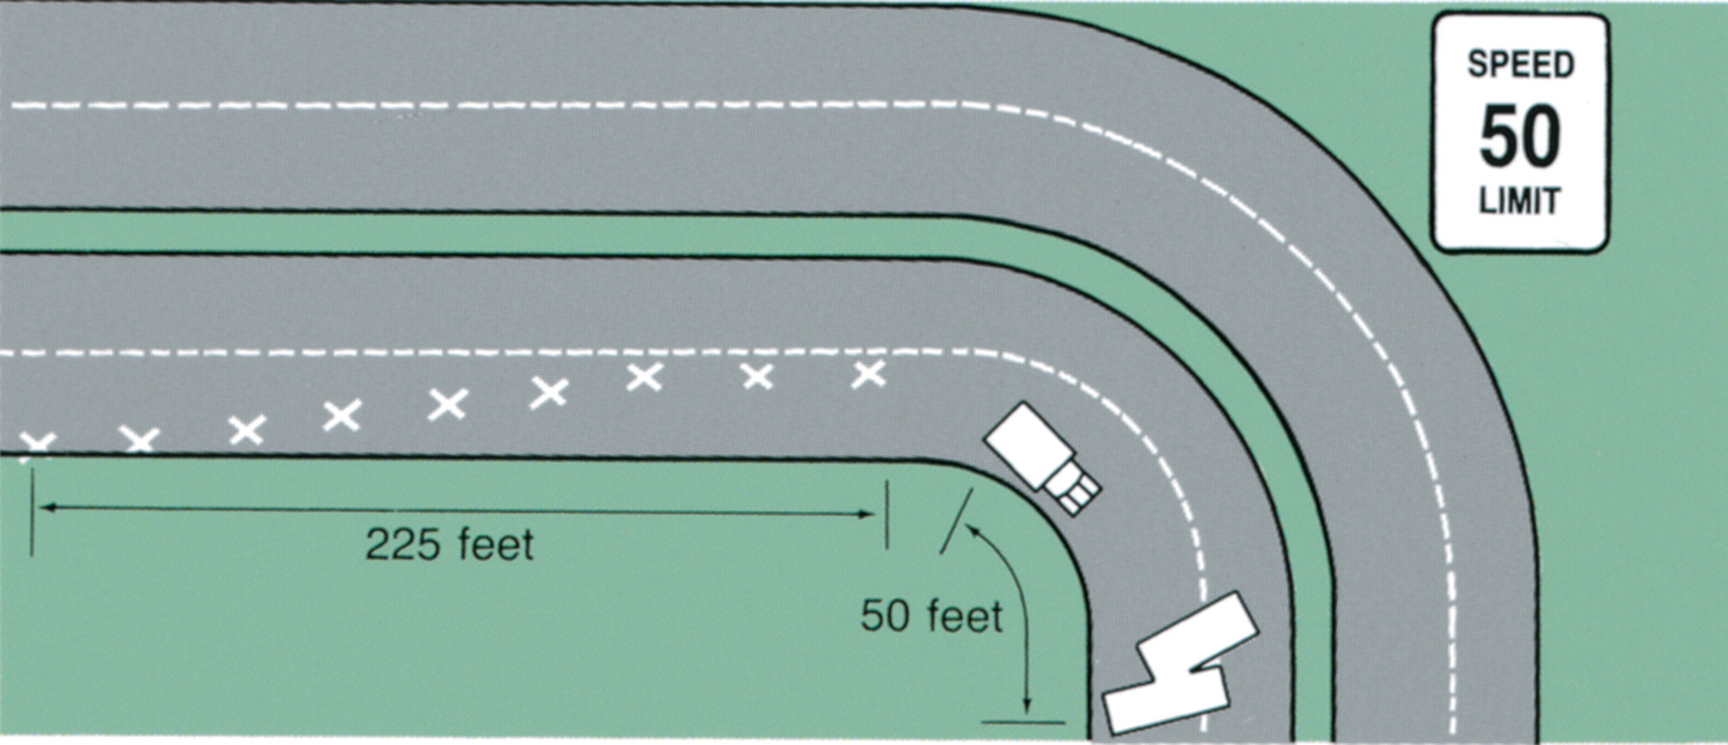
Flares Positioned Ahead of a Curved Section of Road. The Start of the Curve is Considered to be the Edge of the Danger Zone
Notes:
If the regular flow of traffic must be channeled around the scene, it should be routed at least 50 feet from the wrecked cars.

Slide 16
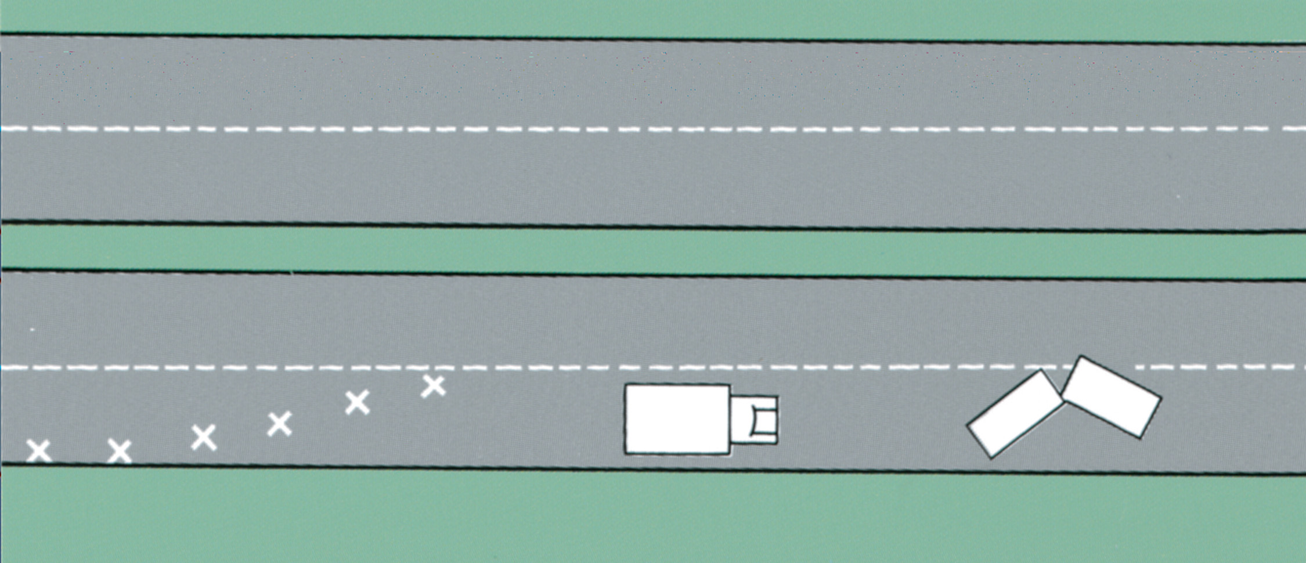
Flares Positioned on a Hill. The Flares Slow Approaching Vehicles and Make Them Turn into the Correct Lane before they Reach the Top of the Hill
Notes:
Use fire apparatus and other emergency response vehicles as blockers to provide a safety zone.

Slide 17
Sizing up the Scene (6 of 11)
Scene Safety
Control of Traffic Flow
Use fire apparatus and other emergency vehicles to block traffic.
Position the ambulance so that the loading doors are angled away from traffic.
Always face the oncoming traffic.
Notes:
Another consideration in vehicle positioning is substances leaking from a vehicle involved in a crash. Park the ambulance upwind to avoid being affected or overcome by potentially hazardous fumes. Also, park the ambulance uphill if a potentially hazardous liquid is leaking from a vehicle so that the liquid will flow away from the ambulance.

Slide 18
Sizing up the Scene (7 of 11)
Scene Safety
Alternative-Fuel Vehicles
Hybrid vehicles use a combination of gasoline and electricity; the high-voltage batteries and cables pose a risk of electric shock.
Natural gas and hydrogen are stored in high-pressure canisters that can pose a fire risk.
Notes:
Many electrical systems in newer model vehicles can retain an electrical charge and remain “active,” even when the battery is disconnected.

Slide 19
Sizing up the Scene (8 of 11)
Scene Safety
Undeployed Air Bags
Air bags are deployed with significant force.
If a rescuer is positioned in front of an air bag that suddenly deploys, the force could cause severe injury.
Air bags must be deactivated before extrication.
Notes:
Deactivation is usually done by simply disconnecting the car’s battery cables.

Slide 20
Sizing up the Scene (9 of 11)
Scene Safety
Energy-Absorbing Bumpers
A piston system can become “loaded” on impact and spring outward after impact, causing injury.
Notes:
In addition, such cylinders, when exposed to the heat created from fire conditions, can burst, becoming projectiles and throwing debris from the involved vehicle. Emergency responders have been injured as these cylinders exploded and struck those around the vehicle.

Slide 21
Sizing up the Scene (10 of 11)
Locate All Patients
Some incidents involve multiple patients, and they may not all be readily identified.
Look for patients at the site and in the immediate vicinity.
Recognize clues that more than one patient may be involved, such as empty child car seats.
Notes:
Ask bystanders if a patient walked away from the scene or if a passerby took a patient away. Before leaving the scene, a thorough search of the area for all victims must be conducted by emergency personnel.
Always look inside all compartments of a vehicle and under all seats. Children have been found thrown under a seat by the force of a crash. Victims of homicide or kidnapping have been found inside the trunks of burned vehicles that were not checked before emergency responders departed the scene after car fires were extinguished.
Discussion Question
What are some clues that you may have more patients than initially accounted for at a scene?

Slide 22
Sizing up the Scene (11 of 11)
Vehicle Safety
Have a fire extinguisher available.
The vehicle must be stabilized before accessing it.
Shut off the engine, set the parking brake, and use cribbing or chocks to help stabilize the vehicle.
Before removing the battery, unlock doors, lower windows, and move seats back.
Notes:
If it is necessary to disconnect the car battery, the engine compartment must be accessed. Cut or use a wrench to remove the negative battery cable first. The negative cable is black in color. If you decide to cut the cable, make two cuts, the first cut approximately 4 inches from the terminal and the second cut approximately 2 inches from the first. This creates a large enough gap in the cable that the cut ends cannot accidently touch and reenergize the electrical system. Remove the positive cable last; if the positive cable is removed first, a spark can occur that could ignite acid fumes from the battery or gasoline spilled from the accident.
Class Activity
In a vacant parking lot, set up mock scenes using vehicles. Allow students to practice sizing up the scene. Be creative in planting clues to additional patients and potential hazards.

Slide 23
Gaining Access (1 of 4)
Simple access requires no special tools.
Complex access requires the use of tools and specialized equipment.
Residential Access
First check all doors and windows.
If you can contact the patient, determine if a neighbor has a key.
If you cannot contact the patient, check with neighbors.
Notes:
Most incidents do not present access problems. If complex access is required, request additional resources.

Slide 24
Gaining Access (2 of 4)
Residential Access
If forced entry is required, request police and fire department.
If possible, wait for police before making forced entry.
Breaking a window is usually easiest and less costly.
Assess for hazards before making entry.
Select an unoccupied room.
Notes:
Inform the patient what you are going to do.
Wear personal protective equipment.
Stand alongside the window and strike the upper corner with a flashlight or similar tool.
Clear the glass before accessing the window.
Discussion Question
What are the preferred ways of accessing a residence?

Slide 25
The Easiest and Least-Costly Method of Gaining Access to a Patient Inside a Locked House Usually is by Breaking a Window
Notes:
If you must break a window, choose a room in which there are no patients and a window through which you can see what is on the other side. Locate the smallest and least expensive window that will still allow you access.

Slide 26
Gaining Access (3 of 4)
Motor Vehicle Access
E M T s’ main function is patient care.
Approach the vehicle from the front.
Advise the patient not to move their head.
Simple Access
Begin by trying the doors and door locks.
If necessary, instruct the patient not to move while attempting to unlock doors or roll down windows.
Notes:
Teaching Tips
Allow students to handle simple tools, such as a spring-loaded punch, under supervision.
Discussion Questions
What is the preferred way of accessing a patient in a vehicle?
When you break a window in a vehicle or residence to gain access, what safety precautions must you observe to protect yourself and your patient?
Knowledge Application
Given several scenarios, students should be able to gain simple access to patients and recognize when complex access is required.

Slide 27
Gaining Access (4 of 4)
Vehicle Access
Complex Access
The quickest means is to break a window.
Wear personal protective equipment.
Tell the patient what you are going to do.
Cover the patient with a blanket/tarp.
Use the window farthest from the patient.
Use a hammer and punch or spring-loaded punch.
Notes:
Carefully remove the broken glass, starting at the top and continuing until all has been removed. Broken correctly, although completely shattered, most tempered safety glass will remain in place even if it was not taped.

Slide 28
Position the Punch in the Corner of the Side Window and Pull Back on the Spring
Notes:
Rescue personnel often carry a spring-loaded punch. Available at most hardware stores, this tool can easily be carried in a pocket or equipment holster.

Slide 29
Keeping the Tip of the Punch in Place, Let Go of the Spring to Shatter the Window
Notes:
Placing the punch against the lower corner of a tempered safety-glass window, you simply push until the spring causes the tip to punch, or you pull back on the spring and suddenly release the spring for the tip to punch and break the glass.

Slide 30
Starting at the Top of the Window, Carefully Push the Broken Glass Away from the Interior of the Vehicle
Notes:
Carefully remove the broken glass, starting at the top and continuing until all has been removed. Broken correctly, although completely shattered, most tempered safety glass will remain in place even if it was not taped.

Slide 31
Click on the First Method that Should be Attempted to Gain Access to a Vehicle Involved in a Collision
A. Try to open the door by the door handle.
B. Use a pry bar to open the driver’s side door.
C. Use a spring-loaded punch to break a window.
D. Ask the patient to open the door.

Slide 32
Extrication (1 of 2)
The Role of the E M T
Components of Extrication
Scene size-up
Stabilization
Gaining access
Disentanglement
Patient removal
Notes:
The role of the EMT in vehicle stabilization and patient extrication is that of patient care provider.
Patient care always precedes removal from the vehicle unless delaying removal would endanger the life of the patient, EMS personnel, or other rescuers.
Cooperate in every way possible with personnel who are working to disentangle the patient.

Slide 33
Extrication (2 of 2)
Caring for the Patient
Maintain spine motion restriction.
Perform a primary assessment and manage any immediate life threats.
Perform a controlled rapid extrication.
Remove the vehicle from around the patient.
Use adequate personnel.
Use the path of least resistance.
Notes:
After gaining safe access to the patient, provide the same care you would provide to any trauma patient. Provide spine motion restriction, including a cervical collar, complete the primary assessment, and provide critical interventions. Be sure you have, or have called for, sufficient personnel to help you provide proper care and to help you protect the patient from hazards.
Communicate with the patient and keep them informed of your actions and the actions of the rescue team. This communication is necessary for the safety of both you and the patient.
Before a forcible rescue is initiated, its effect on the patient must be analyzed. The usual approach to rescue is to remove the vehicle from around the patient. However, when the condition of the patient or the scene dictates speed, the parts of the vehicle that allow for rapid extrication while protecting the patient’s cervical spine should be removed first.
Use heavy blankets, a tarp, or a salvage cover to protect yourself, the patient, and other EMTs from the glass and flying debris that commonly result from disentanglement operations.
Give the patient the opportunity to have some control over the process. For example, when the rescue crew asks you if you are ready for them to do a function, such as remove the door, check with the patient. Asking if they are ready to have the door or dash removed provides them with a feeling of control. If properly prepared, the patient will readily agree with each step of the extrication.

Slide 34
Specialized Stabilization, Extrication, and Disentanglement Techniques (1 of 7)
Stabilizing a vehicle requires specialized equipment and training.
Notes:
Vehicle stabilization is carried out by specialized personnel using equipment such as wood cribbing and wedges,
step chocks, air bags, hydraulic tools and rams, come-alongs, jacks, chains, and winches.

Slide 35
Table 43-1 Common Equipment Used for Vehicle Stabilization
Type | Description and Use
Air bag | A rubber bag, found in various shapes and sizes, that, when inflated with air, has great lifting ability.
Come-along | A ratcheting cable device used to pull in a straight direction.
Cribbing | 4 × 4 or 2 × 4 blocks of hardwood cut to approximately 18-inch-long sections.
Hydraulic cutter | A hydraulic power tool used to cut metal.
Hydraulic ram | A hydraulic power tool used to push or pull in a straight direction.
Hydraulic spreader | A hydraulic power tool used to open, spread, and separate items such as vehicle doors.
Jack | A manual device used much as a ram would be used.
Step chock | A set of several 2 × 6 blocks of hardwood cut to varying lengths and secured together to form “steps.” Plastic step chocks are premanufactured, faster to deploy, lighter than wood, and resistant to most of the fluids spilled at motor vehicle collisions.
Wedge | A 4 × 4 piece of cribbing tapered to an edge at one end.
Winch | A powered cable reel usually electrically or hydraulically driven and mounted to a truck, which is used to pull.

Slide 36
Specialized Stabilization, Extrication, and Disentanglement Techniques (2 of 7)
Upright Vehicle
Use step chocks or cribbing to immobilize the suspension.
The chocks can be pushed in until they touch the undercarriage.
The vehicle should not be lifted to place the chocks.
Remove air from the tires.
Notes:
If step chocks are unavailable, a box crib with wedges can function in much the same manner. Either procedure can prevent the vehicle from rocking.

Slide 37
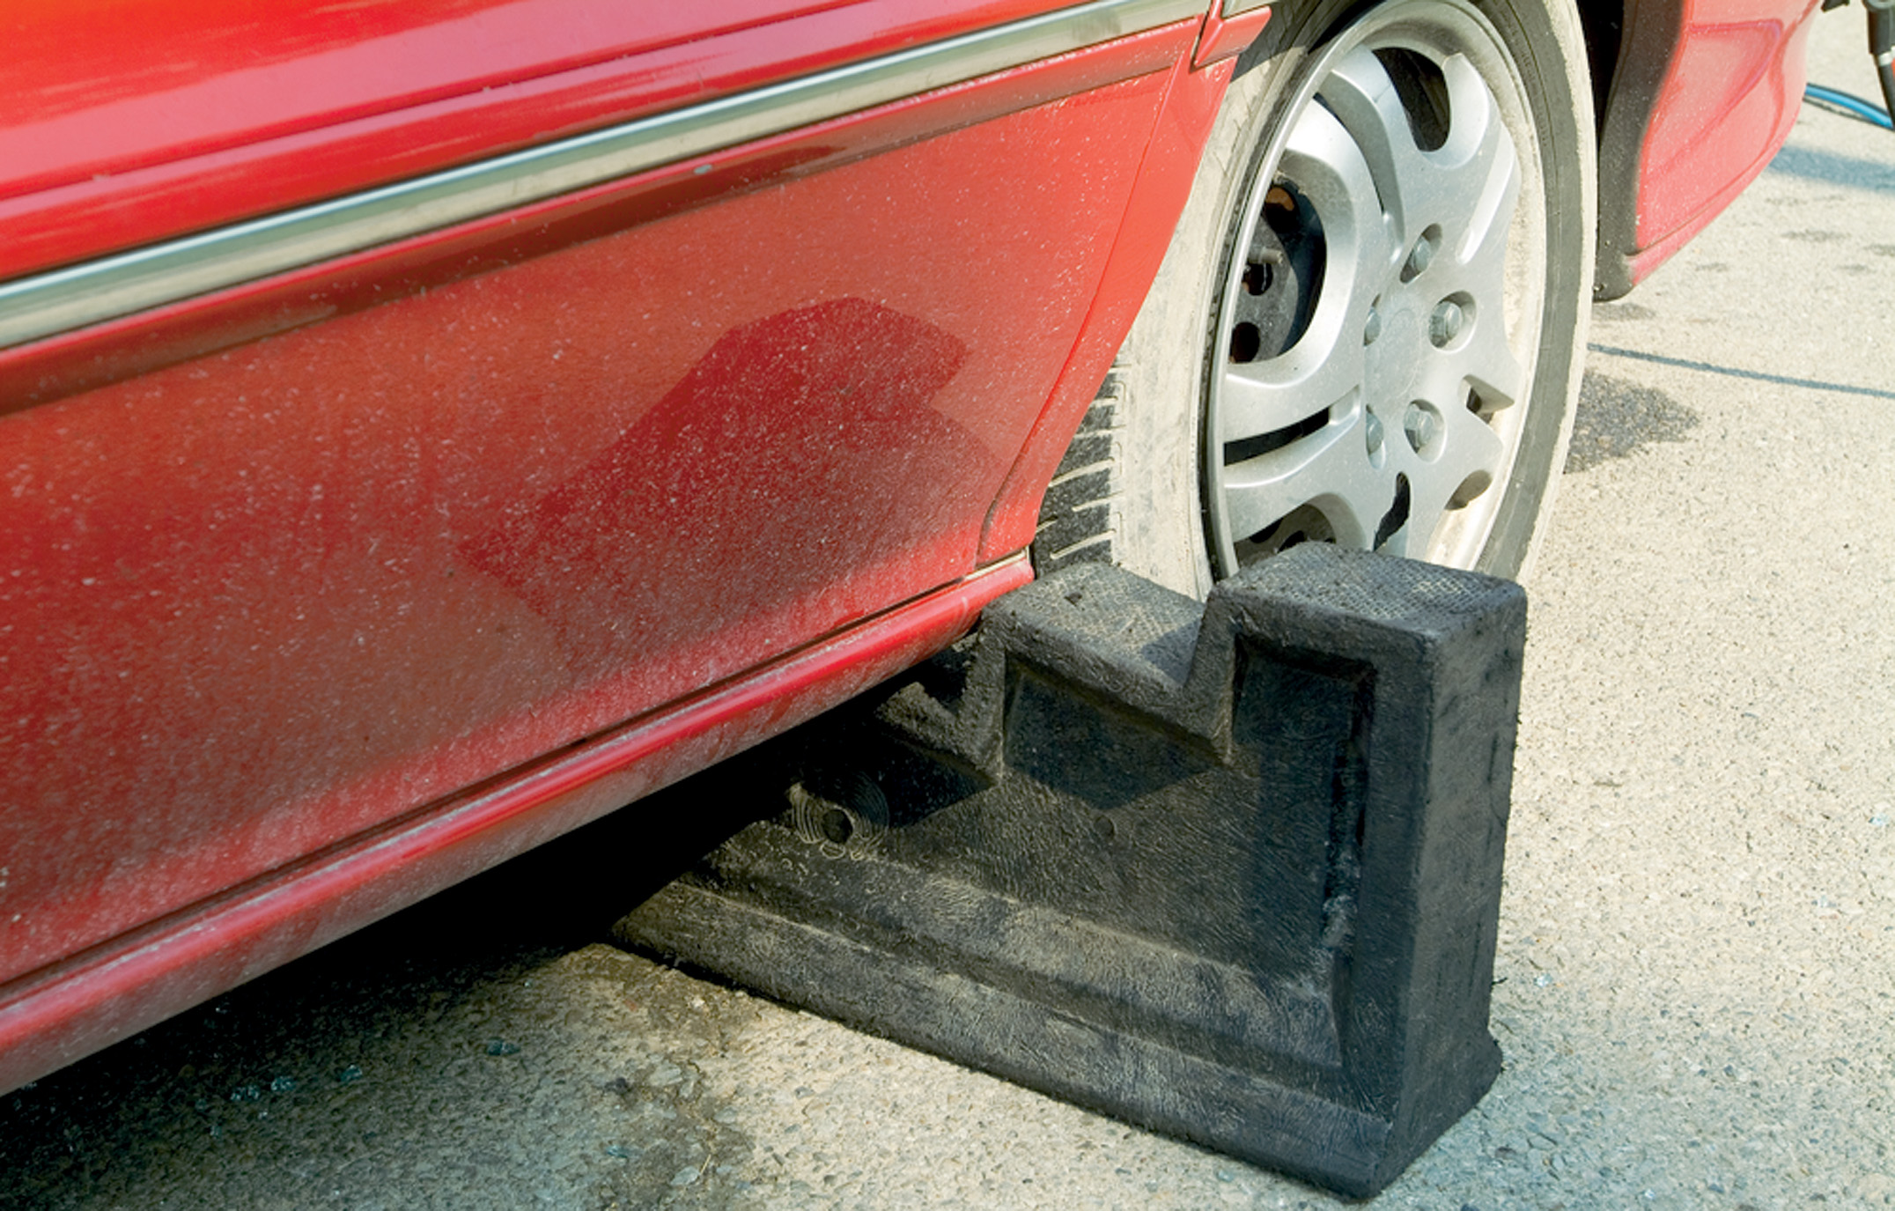
Plastic Step Chocks, as Seen Here, are Strong and Light and Can be Easily Cleaned
Notes:
Upright vehicle
Use step chocks or cribbing to immobilize the suspension.
Remove air from the tires.

Slide 38
Specialized Stabilization, Extrication, and Disentanglement Techniques (3 of 7)
Vehicle on Its Side
Do not enter the vehicle until it is stabilized.
Rescuers use a variety of cables and cribbing to stabilize the vehicle.
Notes:
A vehicle on its side is likely to roll onto its roof, thereby aggravating a patient’s existing injuries and posing a severe risk of injury to rescuers both in and around the vehicle.

Slide 39
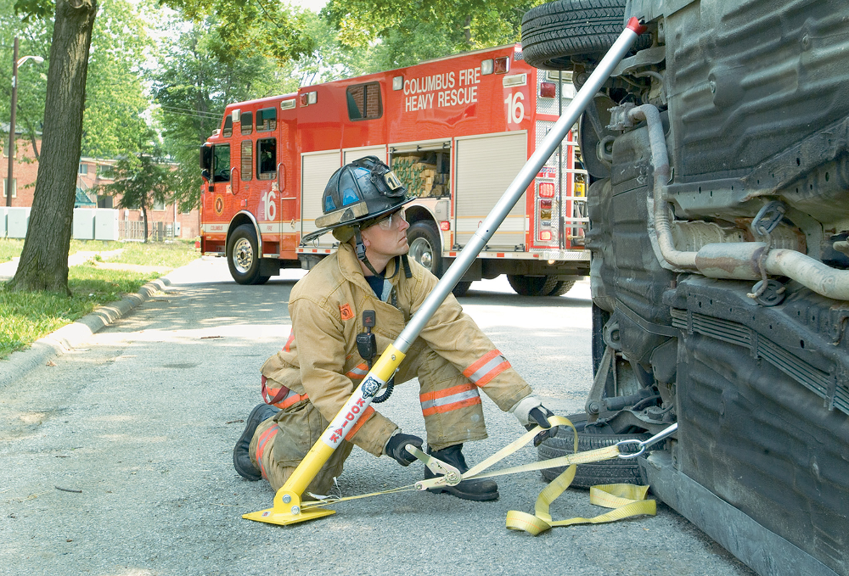
Rescue Struts Can be Used to Prevent a Vehicle on its Side from Rolling Over Onto its Top or Back Onto its Wheels
Notes:
The first step in stabilizing this vehicle, when the equipment is available, is to attach a stabilizing pole, pulling device, cable, or chain from the undercarriage of the car to another vehicle or strong immovable object.

Slide 40
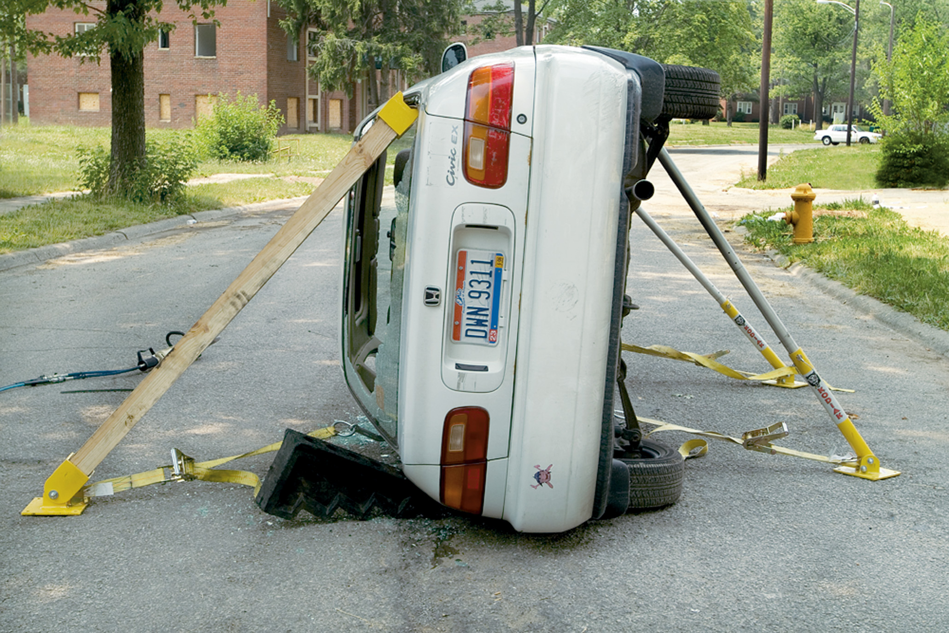
For Extra Safety, Rescue Struts Can be Placed against Both the Underside and the Top of a Vehicle on its Side
Notes:
Rescuers would then crib the length of the vehicle’s side where it has contact with the ground. Every void between the ground and the vehicle should be filled with box cribbing and wedges to minimize movement. The
12- to 18-inch space between the top of the door frame along the roof line and the ground should also be filled.

Slide 41
Specialized Stabilization, Extrication, and Disentanglement Techniques (4 of 7)
Vehicle on Its Roof
The roof posts are not designed to support the vehicle’s weight.
Opening a door decreases the support provided.
Cribbing and airbags can be used to stabilize the vehicle.
Notes:
When the air bag is inflated and one end of the vehicle begins to lift, the other end will settle onto the box crib and the weight of the vehicle will be totally removed from the roof posts.

Slide 42
Specialized Stabilization, Extrication, and Disentanglement Techniques (5 of 7)
Extricating a Patient
The goal of extrication is to remove the car from around the patient.
Patient disentanglement requires specialized equipment, such as hydraulic spreaders, and specially trained personnel.
Notes:
Discussion Question
What is the "rip and blitz" approach to extricating the patient?

Slide 43
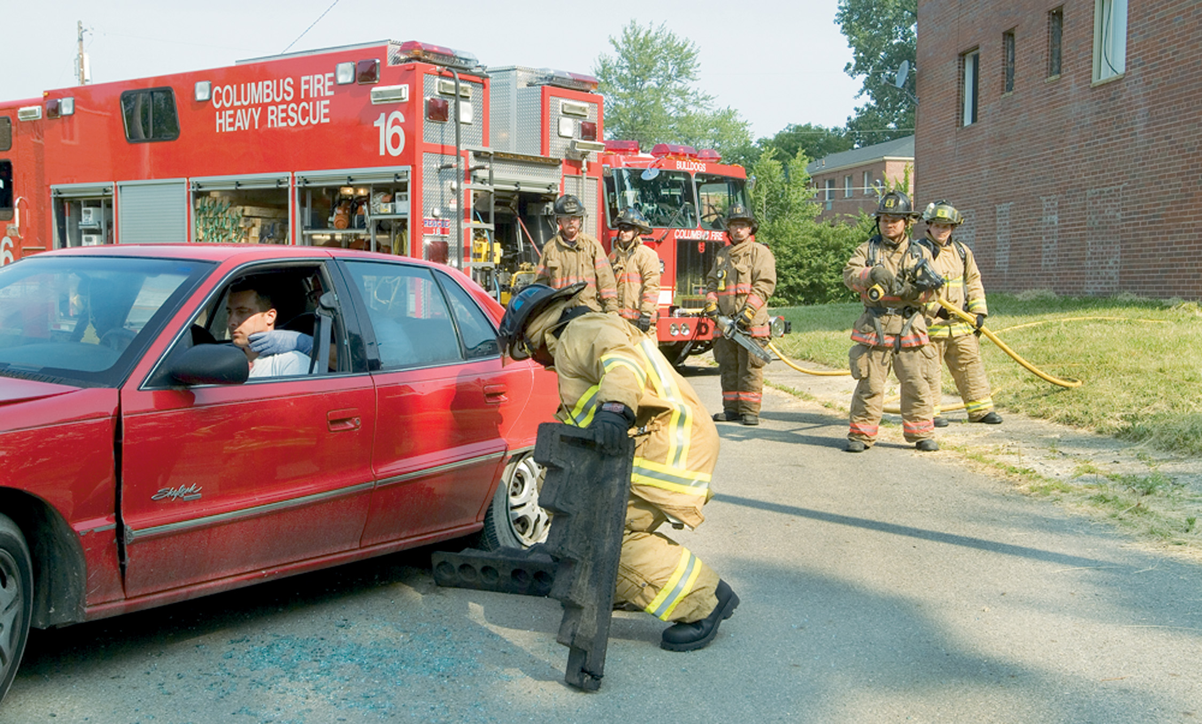
While the E M T Maintains Spine Stabilization from Inside, Rescue Personnel Will Begin to Stabilize the Vehicle
Notes:
An EMT enters the vehicle and establishes and maintains cervical spine motion restriction as rescue personnel begin to stabilize the vehicle by placing chocks under the wheels.

Slide 44
The First Step in Stabilizing the Vehicle is to Place Chocks under the Vehicle
Chocks should be pushed in until they touch the undercarriage; the vehicle should not be lifted up to fit the chocks into place.
Notes:
Rescue personnel begin to stabilize the vehicle by placing chocks under the wheels.

Slide 45
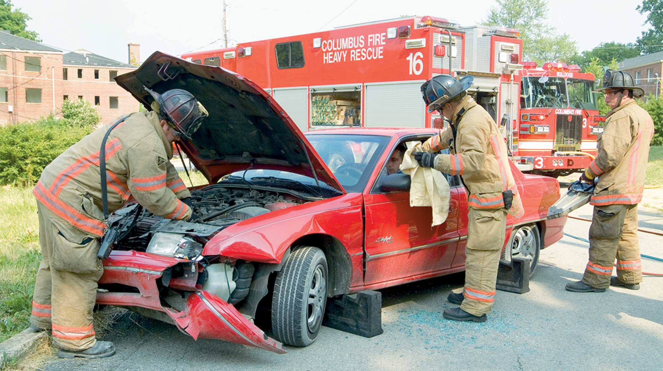
The Patient Should be Covered with a Fire-Retardant Blanket
The air should be released from the tires, and the battery should be disconnected. Always disconnect the negative terminal first.
Notes:
Most electrical hazards can be avoided by simply turning off the ignition. To thoroughly minimize all risks, the battery cables should be disconnected or cut, always the negative terminal first and then the positive. This reduces the risk of post-crash fire or unexpected air bag deployment. As an added precaution, the patient should be covered with a fire-retardant blanket.

Slide 46
Hydraulic Spreaders are Used to “Pop” Open the Rear Door
Notes:
Hydraulic spreaders are used to “pop” the rear door.

Slide 47
Cut the B Post at the Top by the Roof
Notes:
The post between the front and rear sections of the passenger compartment, the B post, should be cut. A strap or rope should be attached to the rear door.

Slide 48
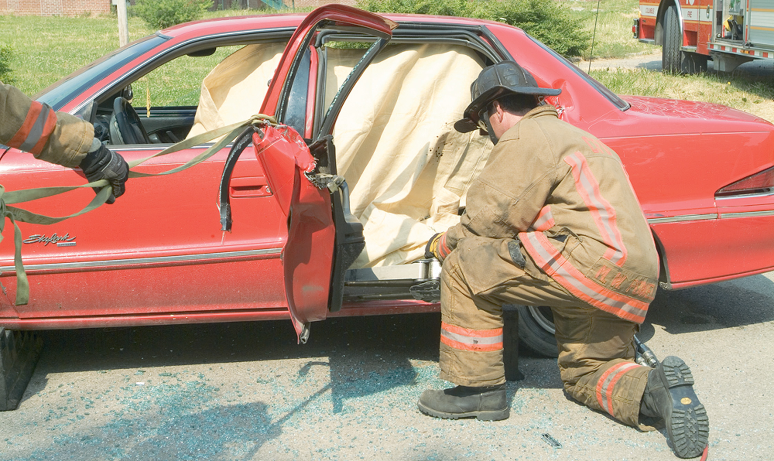
Cut the B Post at the Bottom by the Floor
Notes:
The cutter finishes the cut to the bottom of the B post.

Slide 49
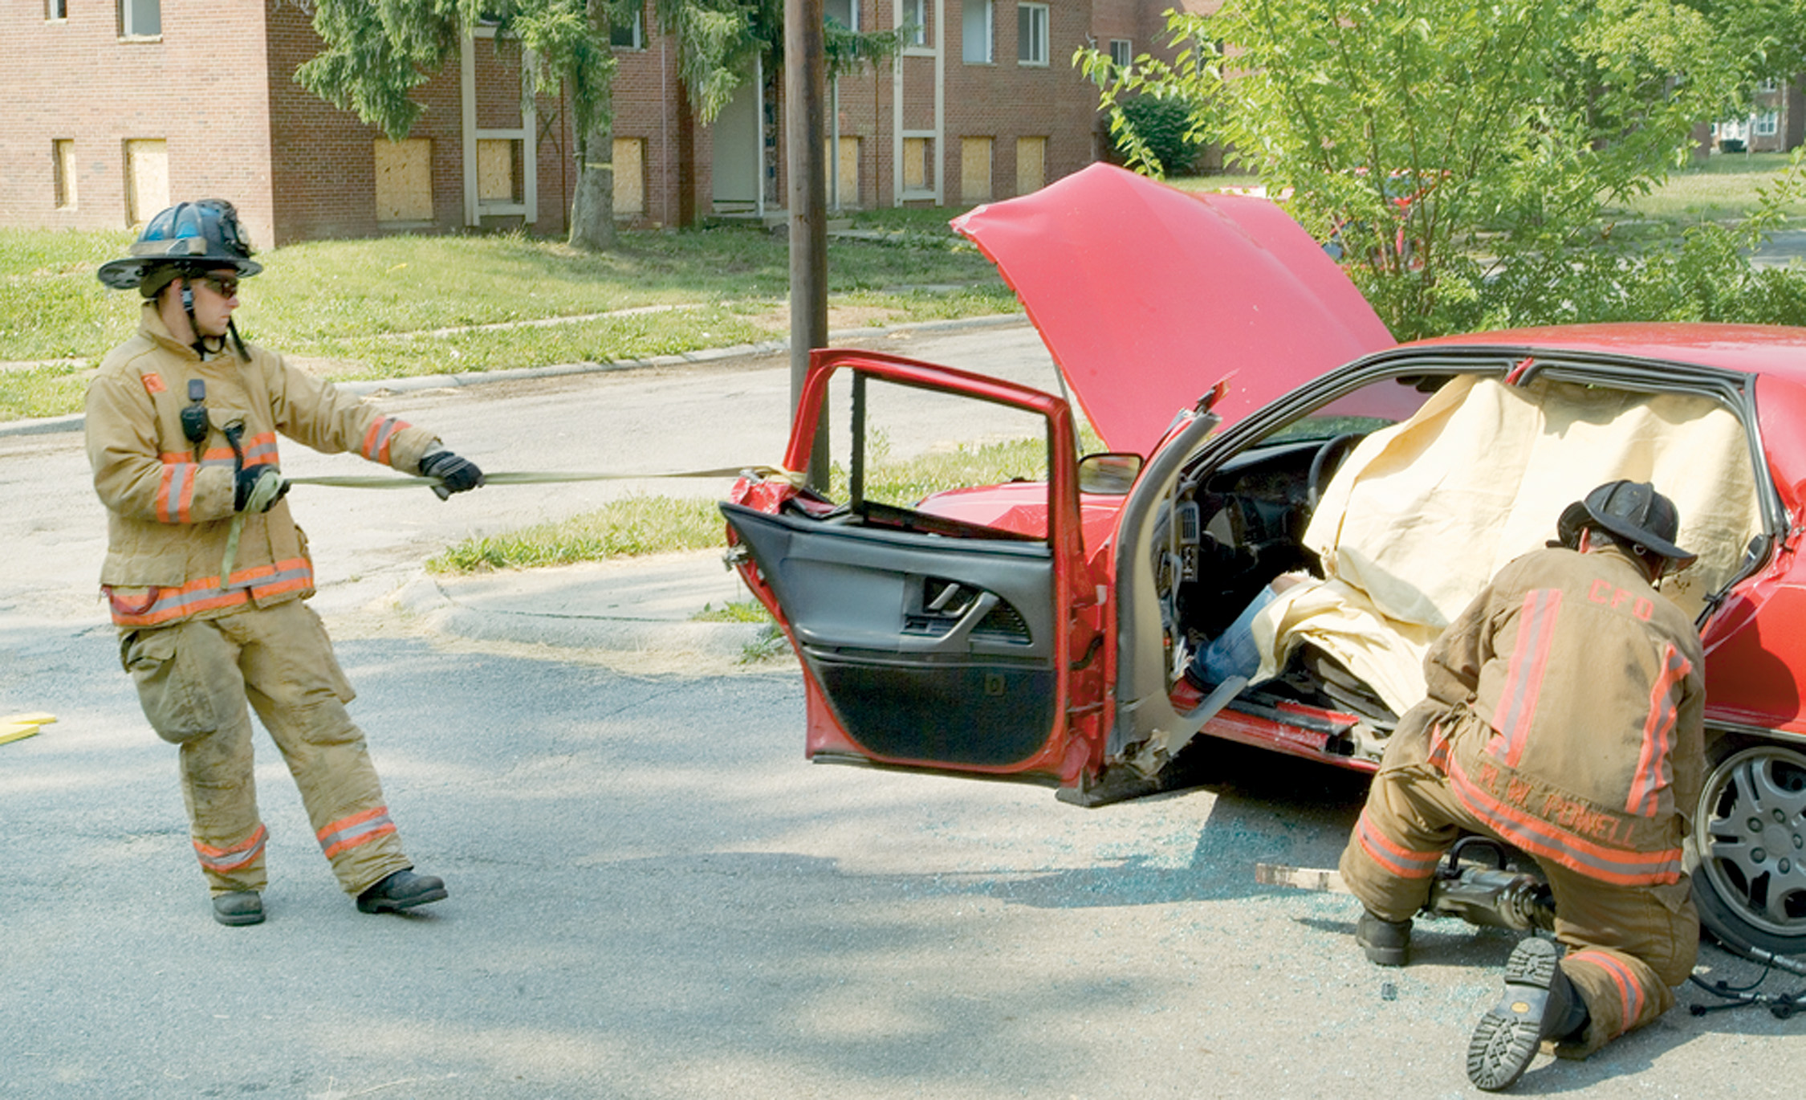
Using a Hydraulic Ram or Spreaders, “Rip” the B Post While Pulling the Doors Open on the Front Hinges
Notes:
Another rescuer uses a hydraulic ram or spreader to “rip” open the doors. Keep in mind that the A posts are the front posts supporting the car roof. The B posts are the middle posts. C posts are at the rear.

Slide 50
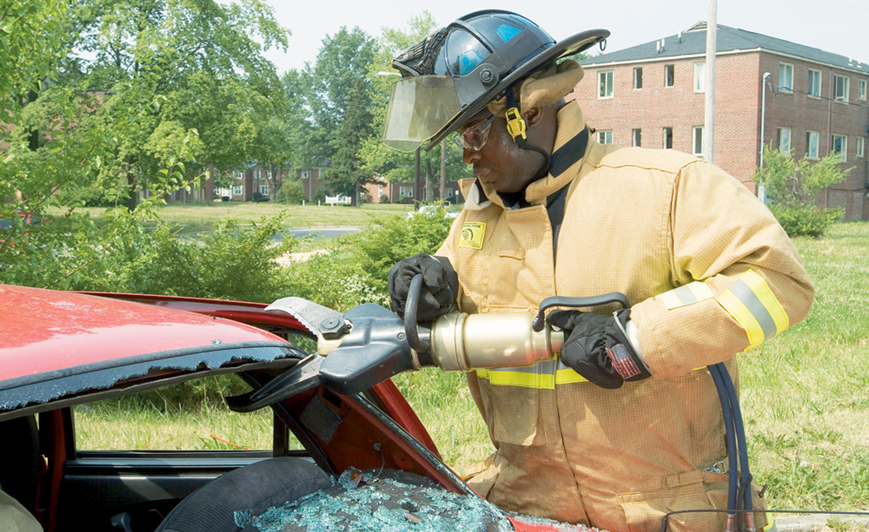
Hydraulic Cutters are Used to Cut the Roof from a Vehicle
Notes:
Next, the roof should be removed. The hydraulic cutters or a Sawzall (reciprocating saw) cut both the A and C posts and the opposite-side B post, and a glass-cutting saw or Sawzall cuts across the bottom of the windshield.

Slide 51
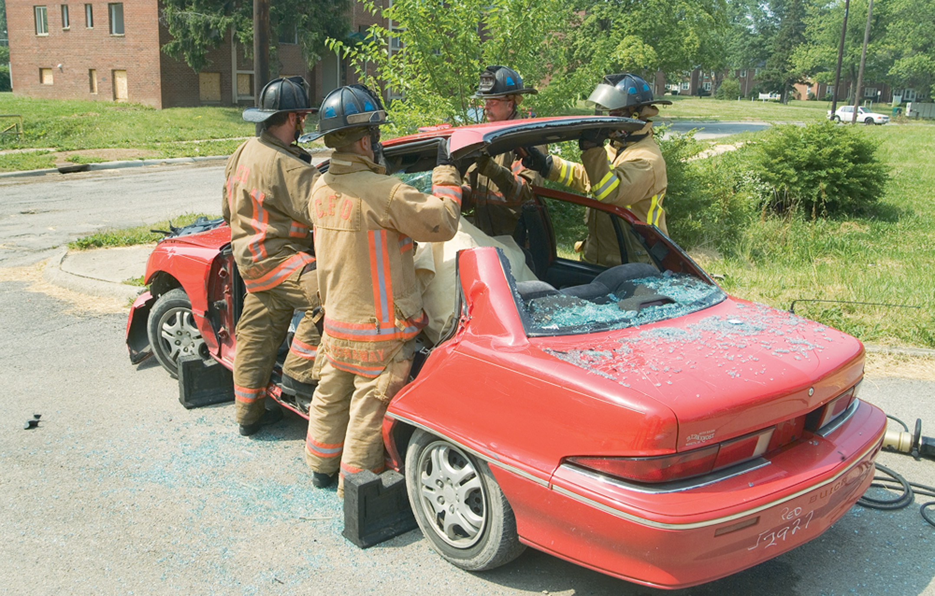
Use as Many People as Necessary to Safely Lift the Roof up and Away from the Vehicle
Notes:
During the cutting process, one of the rescuers must monitor and control the cutting from a vantage point inside the vehicle. Hydraulic cutters then cut the roof from the vehicle.

Slide 52
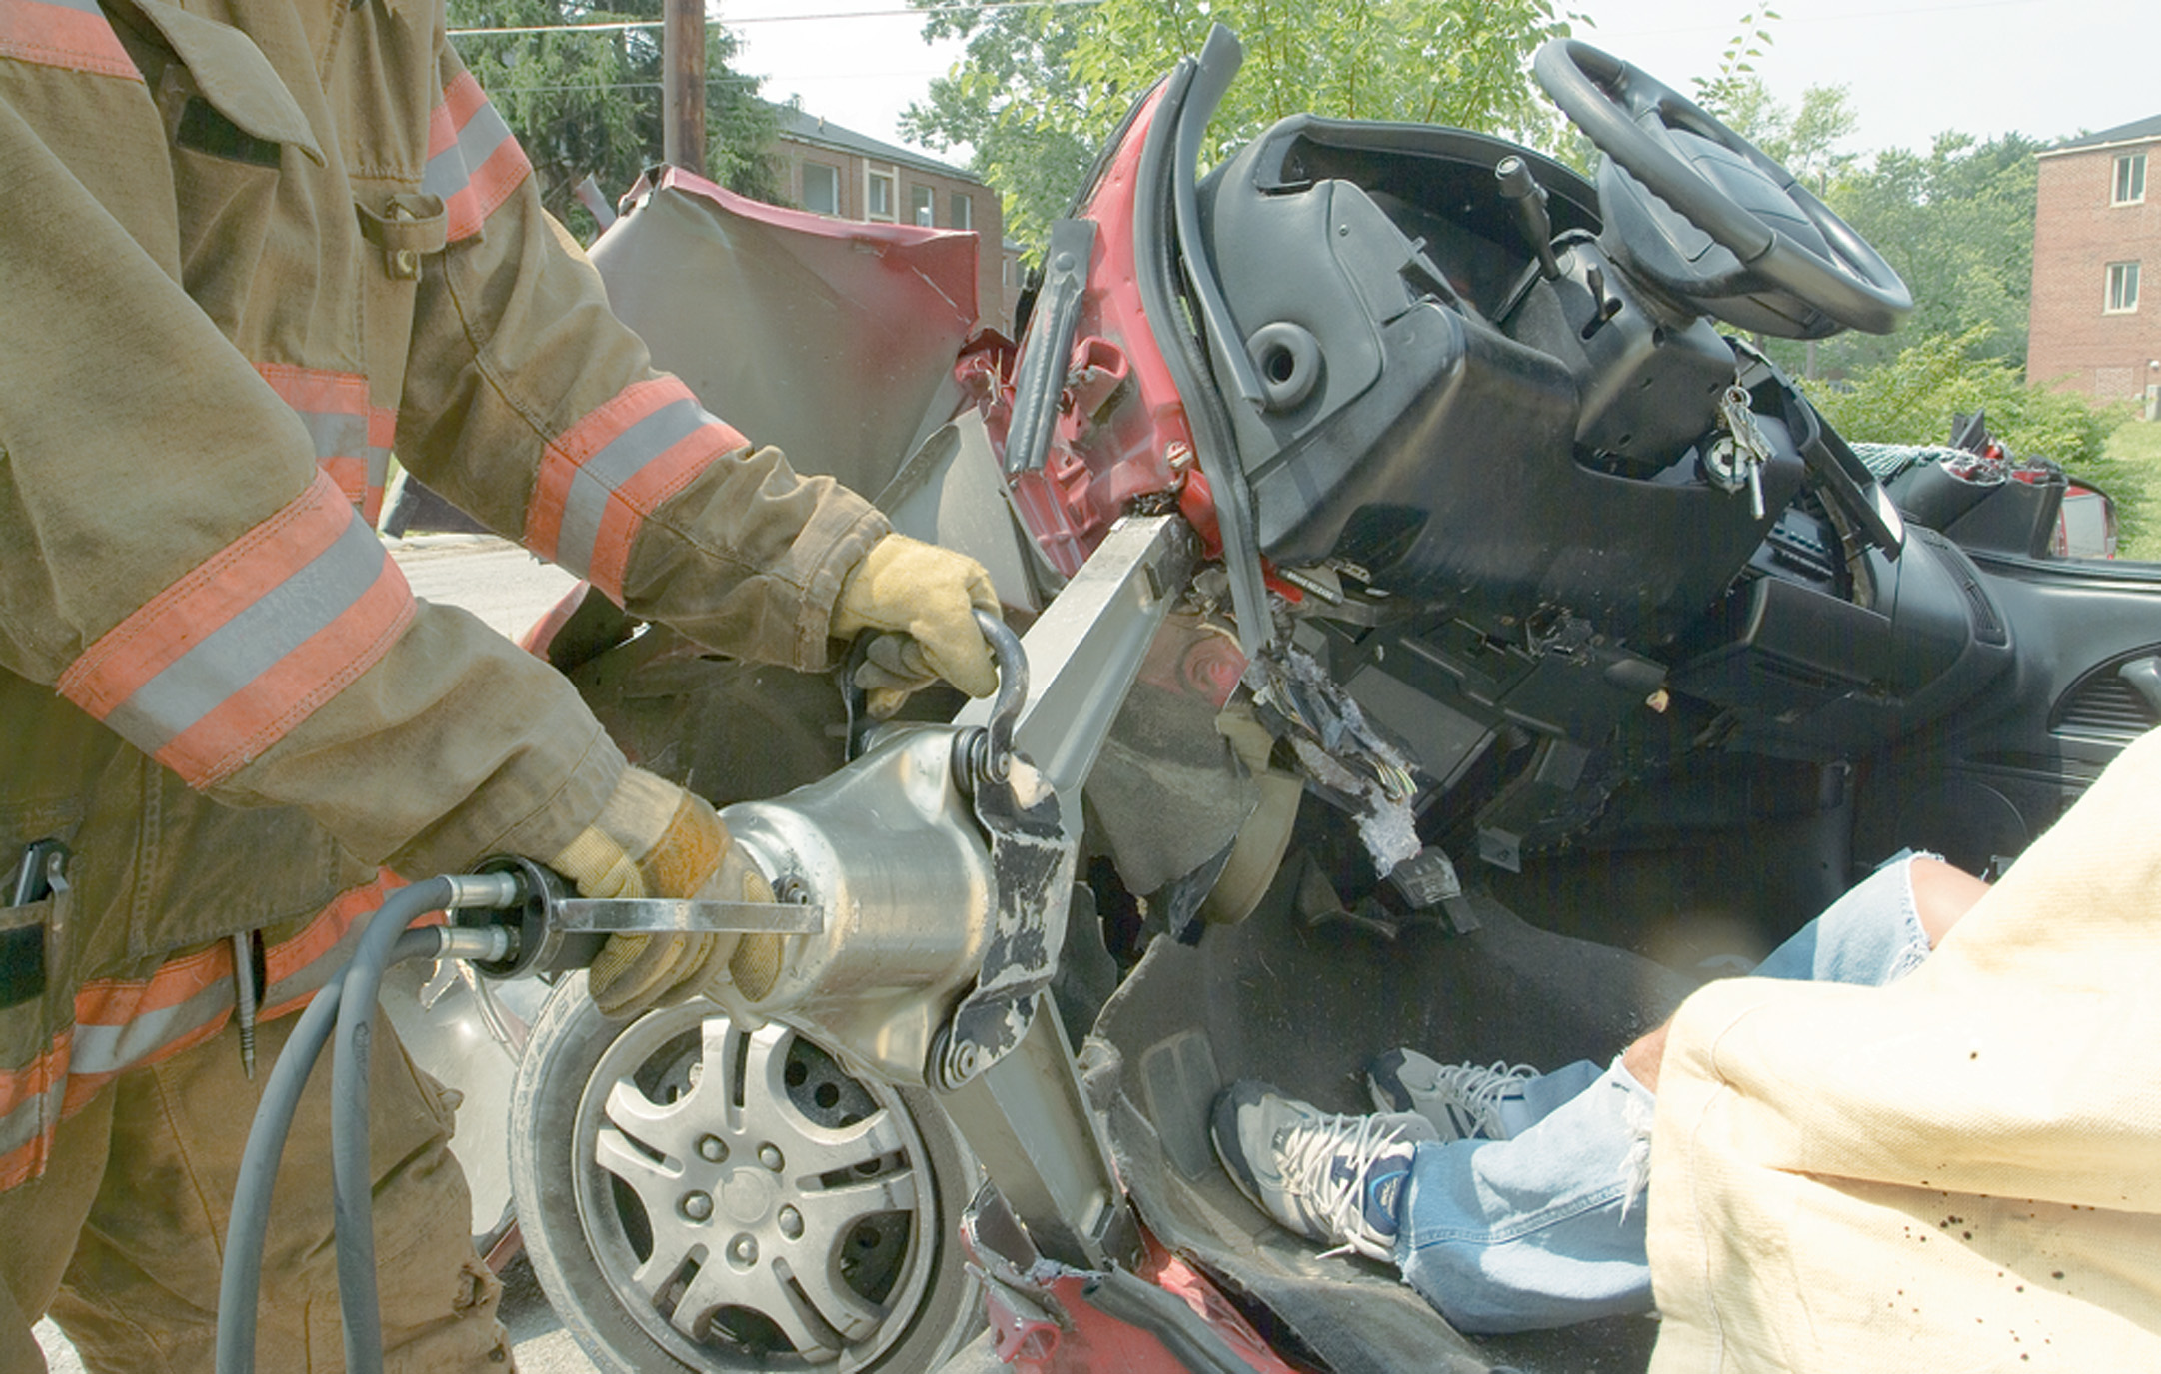
Hydraulic Spreaders are Used to Free the Patient from Entrapment by the Dashboard
Notes:
“Jacking the dash” or performing a “dash roll” is important when a patient is trapped by the dashboard. A relief cut should be made where the rocker panel meets the bottom of the A post. Hydraulic spreaders can then be used to push the dash off the patient. Some hydraulic spreaders have a spreading force of more than 37,000 pounds and can spread up to 40 inches.

Slide 53
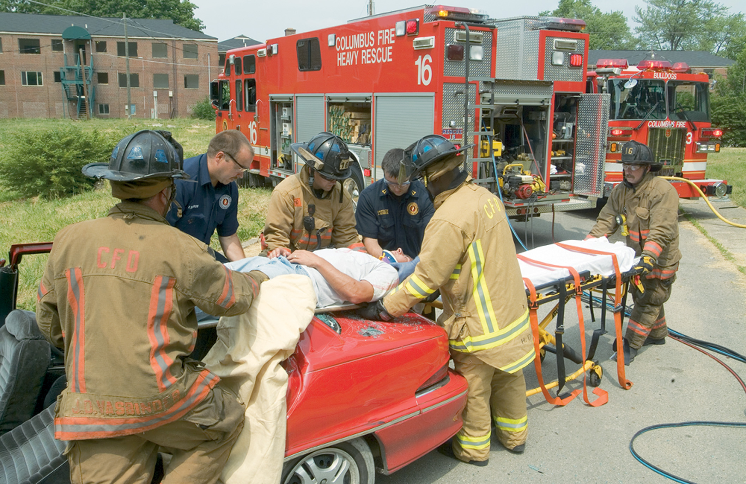
To Prevent Further Injury to the Patient, It is Best to Remove Him Vertically out of the Vehicle
Notes:
The whole purpose of cutting the vehicle from around the patient is to protect the patient from further injury of both the cervical spine and the lower spine. The proper way to remove an injured patient from a damaged vehicle is vertically, or in line with the spine. Having a patient, especially one complaining of pain, “spin” or rotate their body onto a backboard is unacceptable.

Slide 54
Specialized Stabilization, Extrication, and Disentanglement Techniques (6 of 7)
Side-Impact or Head Protection Air Bags
Special consideration must be used in cutting posts.
Air bags can be deployed during extrication, causing serious injury.
Notes:
These deployment systems might utilize high-pressure stored-gas cylinders to deploy the air bags, which can cause serious injuries to rescue personnel or patients if they are punctured by cutting tools.

Slide 55
Specialized Stabilization, Extrication, and Disentanglement Techniques (7 of 7)
Other Methods of Access and Disentanglement
“Popping” or prying a door.
Removing the windshield and rolling the roof.
Patients entrapped in a vehicle on its side must be removed quickly.
Notes:
A rescuer can force or “pop” a door with manual pry tools, hydraulic spreaders, and air chisels. Remember to protect yourself and the patient from flying debris by covering yourselves with a blanket during the procedure. If possible, place a solid object such as a spine board between the tool activity area and the patient.
Although it is usually preferable to totally remove the roof from a damaged vehicle, occasionally it might be decided to just “flap the roof” (displace the roof and windshield of the vehicle) to facilitate patient removal. Because this procedure involves maneuvers close to the patient, you and the patient must be well protected from the tools and flying debris.

Slide 56
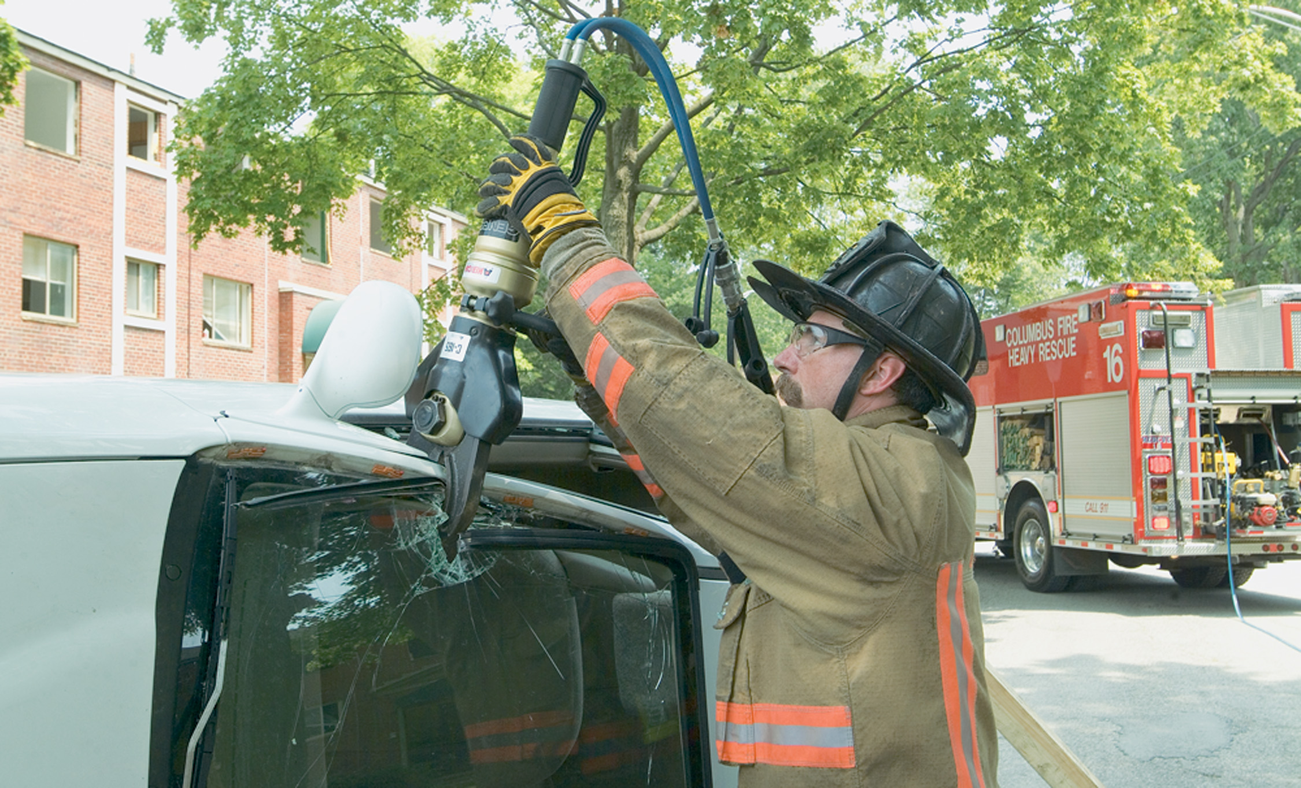
To Extricate a Patient from a Vehicle on its Side, First Cut the Upper Posts Using a Hydraulic Cutter or Other Cutting Tool
The windshield should also be cut.
Notes:
Access to the patient might be gained by removing the rear window.

Slide 57
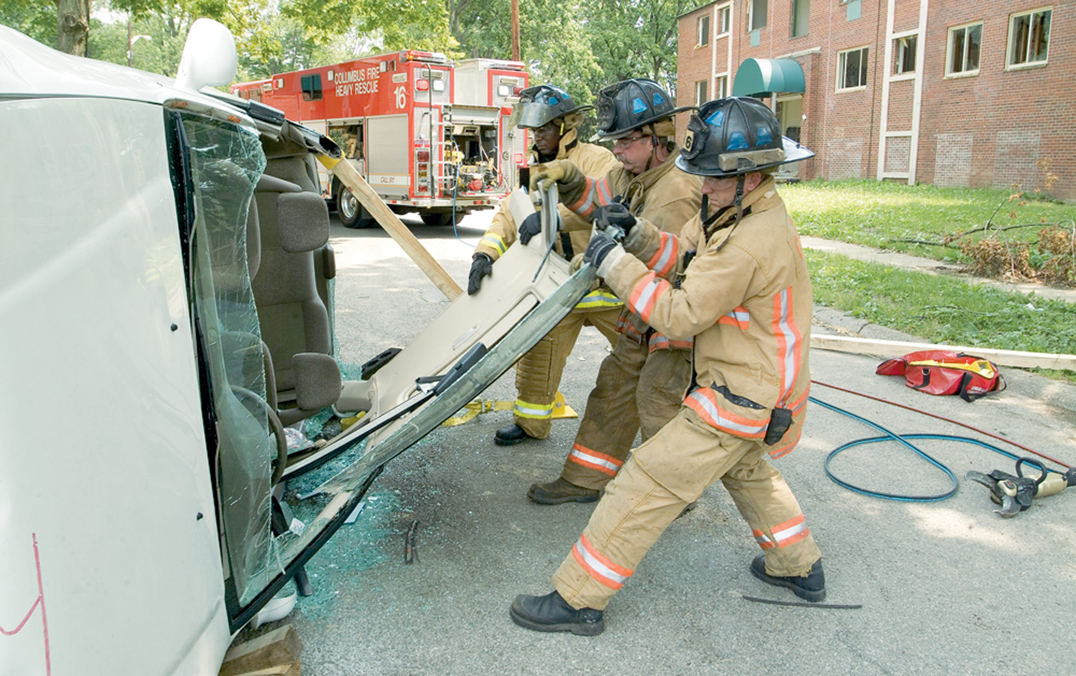
Then Fold the Roof Down to Provide an Adequate Space from Which to Remove the Patient
Notes:
The best way to extricate the patient is to cut the upper posts of the vehicle and fold the roof down.

Slide 58
Case Study Conclusion (1 of 3)
Lana looks for hazards and walks around the vehicle to get a look inside. She determines that they have five patients, two of whom appear to be unresponsive.
Jay advises the incoming fire crew that they have a vehicle on its side with five occupants, and contacts dispatch to request additional ambulances.
Notes:
Case Study Discussion
Review case conclusion and emphasize the application of knowledge learned from this presentation.

Slide 59
Case Study Conclusion (2 of 3)
Jay coordinates with the extrication crew, letting them know which patients are thought to be most critical. Together, they decide on an approach to extrication that begins with stabilizing the vehicle.
Notes:
Case Study Discussion
Review case conclusion and emphasize the application of knowledge learned from this presentation.

Slide 60
Case Study Conclusion (3 of 3)
Once the crew gains access, Jay—wearing full turnout gear—accesses the patients and performs triage. They prioritize removal of the patients, assigning each patient to a waiting ambulance crew.
Notes:
Case Study Discussion
Review case conclusion and emphasize the application of knowledge learned from this presentation.

Slide 61
Lesson Summary (1 of 2)
In most cases, patient access is straightforward, but in some cases, special techniques and equipment are required.
During extrication, E M T s’ primary responsibility is patient care.
Notes:
Follow-Up
Answer student questions.
Follow-Up Assignments
Review Chapter 43 Summary.
Complete Chapter 43 In Review questions.
Complete Chapter 43 Critical Thinking questions.
Assessments
Handouts
Chapter 43 quiz

Slide 62
Lesson Summary (2 of 2)
E M T s must take precautions to protect themselves and their patients during the extrication process.
Notes:
Class Activity
As an alternative to assigning the follow-up exercises in the lesson plan as homework, assign each question to a small group of students for in-class discussion.
Teaching Tips
Answers to In Review questions are in the appendix of the text. Advise students to review the questions again as they study the chapter.

Slide 63
Correct!
Once the vehicle has been stabilized and it is safe to approach it, the first attempt to gain access to the patient is to try to open the doors of the vehicle.
Click here to return to the program.

Slide 64
Incorrect (1 of 3)
A pry bar should not be used until you have not been successful in opening a door or having a patient unlock the doors or put down the windows.
Click here to return to the quiz.

Slide 65
Incorrect (2 of 3)
A spring-loaded punch should not be used until you have not been successful in opening a door or having a patient unlock the doors or put down the windows.
Click here to return to the quiz.

Slide 66
Incorrect (3 of 3)
Try to open the car doors first. If they are locked, instruct the patient, without moving their head, to try to unlock the doors or put down the windows.
Click here to return to the quiz.

Slide 67
Copyright

