Slide 1

Prehospital: Emergency Care
Eleventh Edition
Chapter 42
Ambulance Operations and Air Medical Response
"Slides in this presentation contain hyperlinks. JAWS users should be able to get a list of links by using INSERT+F7"
Copyright © 2018, 2014, 2010 Pearson Education, Inc. All Rights Reserved
Notes:
If this PowerPoint presentation contains mathematical equations, you may need to check that your computer has the following installed:
1) MathType Plugin
2) Math Player (free versions available)
3) NVDA Reader (free versions available)
Advance Preparation
Student Readiness
Assign the associated section of MyBRADYLab and review student scores. Review the chapter material in the Instructor Resources, which includes Student Handouts, PowerPoint slides, and the MyTest Program.
Prepare
Preview the case study presented in the PowerPoint slides.
The total teaching time recommended is only a guideline. Take into consideration factors such as the pace at which students learn, the size of the class, breaks, and classroom activities. The actual time devoted to teaching objectives is the responsibility of the instructor.

Slide 2
Learning Readiness (1 of 2)
E M S Education Standards, text p. 1255
Chapter Objectives, text p. 1255.
Purpose of lecture presentation versus textbook reading assignments.
Notes:
Explain to students what the National EMS Education Standards are. The National EMS Education Standards communicate the expectations of entry-level EMS providers. As EMTs, students will be expected to be competent in these areas. Acknowledge that the standards are broad, general statements. Although this lesson addresses the listed competencies, the competencies are often complex and require completion of more than one lesson to accomplish. The student is also expected to review the chapter objectives to foreshadow what will be in the chapter. By mastering the key terms the EMT student will better understand the learning and be able to communicate more clearly.
Additionally, explain to the students that the purpose of using these slides is to help keep the instructor focused on highlighting important portions of the material, explain interrelationships of topics, and discuss how to apply this information. It’s not the intent of the presentation (or slides alone) to include every component in the chapter. This presentation still requires the student to thoroughly read the chapter.

Slide 3
Setting the Stage (1 of 2)
Overview of Lesson Topics
  Culture of Safety in E M S
  Crew Resource Management (C R M)
  Driving the Ambulance
  Warning Devices
  Roadway Incident Scene Safety
  Phases of an Ambulance Call
  Air Medical Transport
  Security and Safety
Notes:
These bulleted points are the major headings from the chapter, in order. The purpose is to help the student navigate the lesson.

Slide 4
Case Study Introduction (1 of 2)
E M T s Gary Farmer and Harold Begay are completing their pre-shift vehicle inspection when they are dispatched for a report of a vehicle collision.
Notes:
Case Study
Present the Case Study Introduction provided in the PowerPoint slide set.
Lead a discussion using the case study questions provided on the subsequent slide(s).
The Case Study with discussion questions continues throughout the PowerPoint presentation.
Case Study Discussion
Use the case study content and questions to foreshadow the upcoming lesson content.

Slide 5
Case Study (1 of 7)
What steps do Gary and Harold need to take before heading to the scene?
How will Gary and Harold decide the best route to travel to reach their destination?
What actions must they take to minimize their chances of being in a collision during the response?
Notes:
Use the case study content and questions to foreshadow the upcoming lesson content. Gauge the students’ responses as a guide of how well versed they are in this topic.

Slide 6
Introduction (1 of 2)
An ambulance should be a place of comfort and support to patients.
E M T s must be able to skillfully operate an ambulance.
This chapter describes the elements of creating a culture of safety, C R M, and how to operate an ambulance with safety in mind.
Notes:
During this lesson, students learn to prepare themselves, their equipment, their medical supplies, and their vehicle for an ambulance run.

Slide 7
Culture of Safety in E M S
Just Culture
  Based on fairness and accountability
  Focus placed on the assessment of risks
  Coordinated support and resources
  E M S safety data system
  E M S education initiatives
  E M S safety standards
  Requirements for reporting and investigation.
Notes:
Reporting errors must be valued as crucial in improving safety. When risks are identified, the EMS system and personnel must strive to correct the risks to prevent or reduce the chances of the same errors occurring again.

Slide 8
Crew Resource Management (1 of 3)
Five-Step Assertive Statement Process:
  Opening or attention getter.
  State your concern with the situation based on your analysis.
  State the problem.
  State a solution.
  Obtain your partner’s agreement.
Notes:
Benefits of using CRM in EMS include the following:
Minimizing errors.
Improving safety of the EMS crew, patient, and public.
Improving the EMS team’s performance.
Increasing situational awareness.
Allowing all EMS crew members to have equal value and input into a situation.

Slide 9
Crew Resource Management (2 of 3)
Five factors of C R M are essential:
  Communication
  Situational Awareness
  Decision-making
  Teamwork
  Barriers.
Notes:
Characteristics of an effective team leader:
Creates, implements, and revises an action plan.
Communicates accurately and concisely while listening and encouraging feedback.
Receives, processes, verifies, and prioritizes information.
Reconciles incongruent information.
Demonstrates confidence, compassion, maturity, and command presence.
Demonstrates a role or authority for groups and scene.
Maintains accountability for team’s actions and outcomes.
Assesses the situation and resources and modifies them accordingly.
Maintains situational awareness.
Utilizes appreciative inquiry/inquiry/advocacy when miscommunication or potential errors occur.
Uses closed-loop communication.
Reports progress on tasks.
Performs tasks accurately and in a timely manner.
Addresses safety concerns and is always safety consciousness.
Treats all team members as equals and with an equal level of respect, regardless of rank, title, or level of experience.

Slide 10
Crew Resource Management (3 of 3)
Effective use of C R M can reduce errors in patient care and better protect the safety of the E M S personnel, patient, and public.
Notes:
Characteristics of effective team members are:
Communicate accurately and concisely while listening and accepting feedback.
Demonstrate followership but are receptive to leadership.
Demonstrate confidence, compassion, and maturity.
Maintain situational awareness.
Utilize appreciative inquiry, advocacy/inquiry when miscommunications or potential errors occur.
Use closed-loop communications.
Report progress on tasks.
Perform tasks accurately and in a timely manner.
Advocate safety concerns and is always safety conscious.
Treat all team members as equals and with an equal level of respect, regardless of rank, title, or experience.
Immediately suggests corrective action if a harmful intervention is ordered or performed by others.

Slide 11
Driving the Ambulance (1 of 12)
Laws, Regulations, and Ordinances
  Apply to the operation of ambulances.
  Certain privileges are afforded to ambulance operators.
  It is never justified to operate an ambulance unsafely.
Notes:
Most states give you the privilege, with proper precautions, to do the following while driving the ambulance to an emergency:
Exceed the speed limit posted for the area only if you are not endangering lives or property.
Drive the wrong way down a one-way street or drive down the opposite side of the road.
Turn in any direction at any intersection.
Park anywhere as long as you do not endanger lives or property.
Leave the ambulance standing in the middle of a street or intersection.
Cautiously proceed through a red light or red flashing signal.
Pass other vehicles in no-passing zones.
Teaching Tips
Be prepared to discuss local regulations, policies, and practices regarding emergency vehicle operations.
Discussion Question
What are some of the privileges generally granted to emergency drivers?

Slide 12
Driving the Ambulance (2 of 12)
Laws, Regulations, and Ordinances
  You must meet these conditions:
    You must have a valid driver’s license.
    You must be responding to an emergency.
    You must use warning devices, emergency lights, horns, and sirens.
    You must exercise due regard for the safety of others.
    Many E M S systems provide additional guidance.
Notes:
You can cautiously move through a red light, but you must slow down while entering the intersection so that all traffic can stop to allow you to pass. You can park your ambulance anywhere to care for a patient, but you must not park it just over the crest of a hill on a busy highway unless you post flares and get a police officer or a volunteer to divert traffic out of your lane, and you must use good roadway safety practices, which are discussed later in the chapter. The law states that if you do not exercise due regard for the safety of others, you are liable for the consequences.
Many EMS systems provide additional guidance. For instance, some specify that your top speed cannot be more than 10 miles per hour over the speed of traffic, which might not be the posted speed. This allows the emergency vehicle to overtake other moving traffic but promotes safer driving. In some areas, ambulances entering an intersection against the light must come to a complete stop before proceeding.

Slide 13
Driving the Ambulance (3 of 12)
Driving Excellence
  Basics of Good Driving
    Wear seatbelts.
    Hold the steering wheel with both hands.
    Practice with the vehicle you will drive.
    Respond to weather and road conditions.
Notes:
Discussion Questions
What are some considerations in selecting the safest, as opposed to the quickest, route of travel to a destination?
What are some issues that may cause the driver to lose control of a vehicle?
What is the proper way to negotiate curves when driving?
Knowledge Application
Students should be able to apply principles of safe driving, both in personal vehicles and when driving the ambulance.
Critical Thinking Discussion
If you were a policy maker, what would you do to decrease the number of injuries and deaths from ambulance crashes?

Slide 14
Driving the Ambulance (4 of 12)
Driving Excellence
  Basics of Good Driving
    Select the best route for safe travel.
    Maintain a safe following distance.
    Use headlights.
    Exercise caution when using warning devices.
Notes:
Class Activity
If your circumstances (location, liability issues, and so on) allow, let students drive the ambulance in a vacant parking lot under the direction of an experienced emergency vehicle operator to get an idea of how an ambulance handles differently from a personal vehicle.
Discussion Question
What are some special considerations for driving in poor weather and at night?

Slide 15
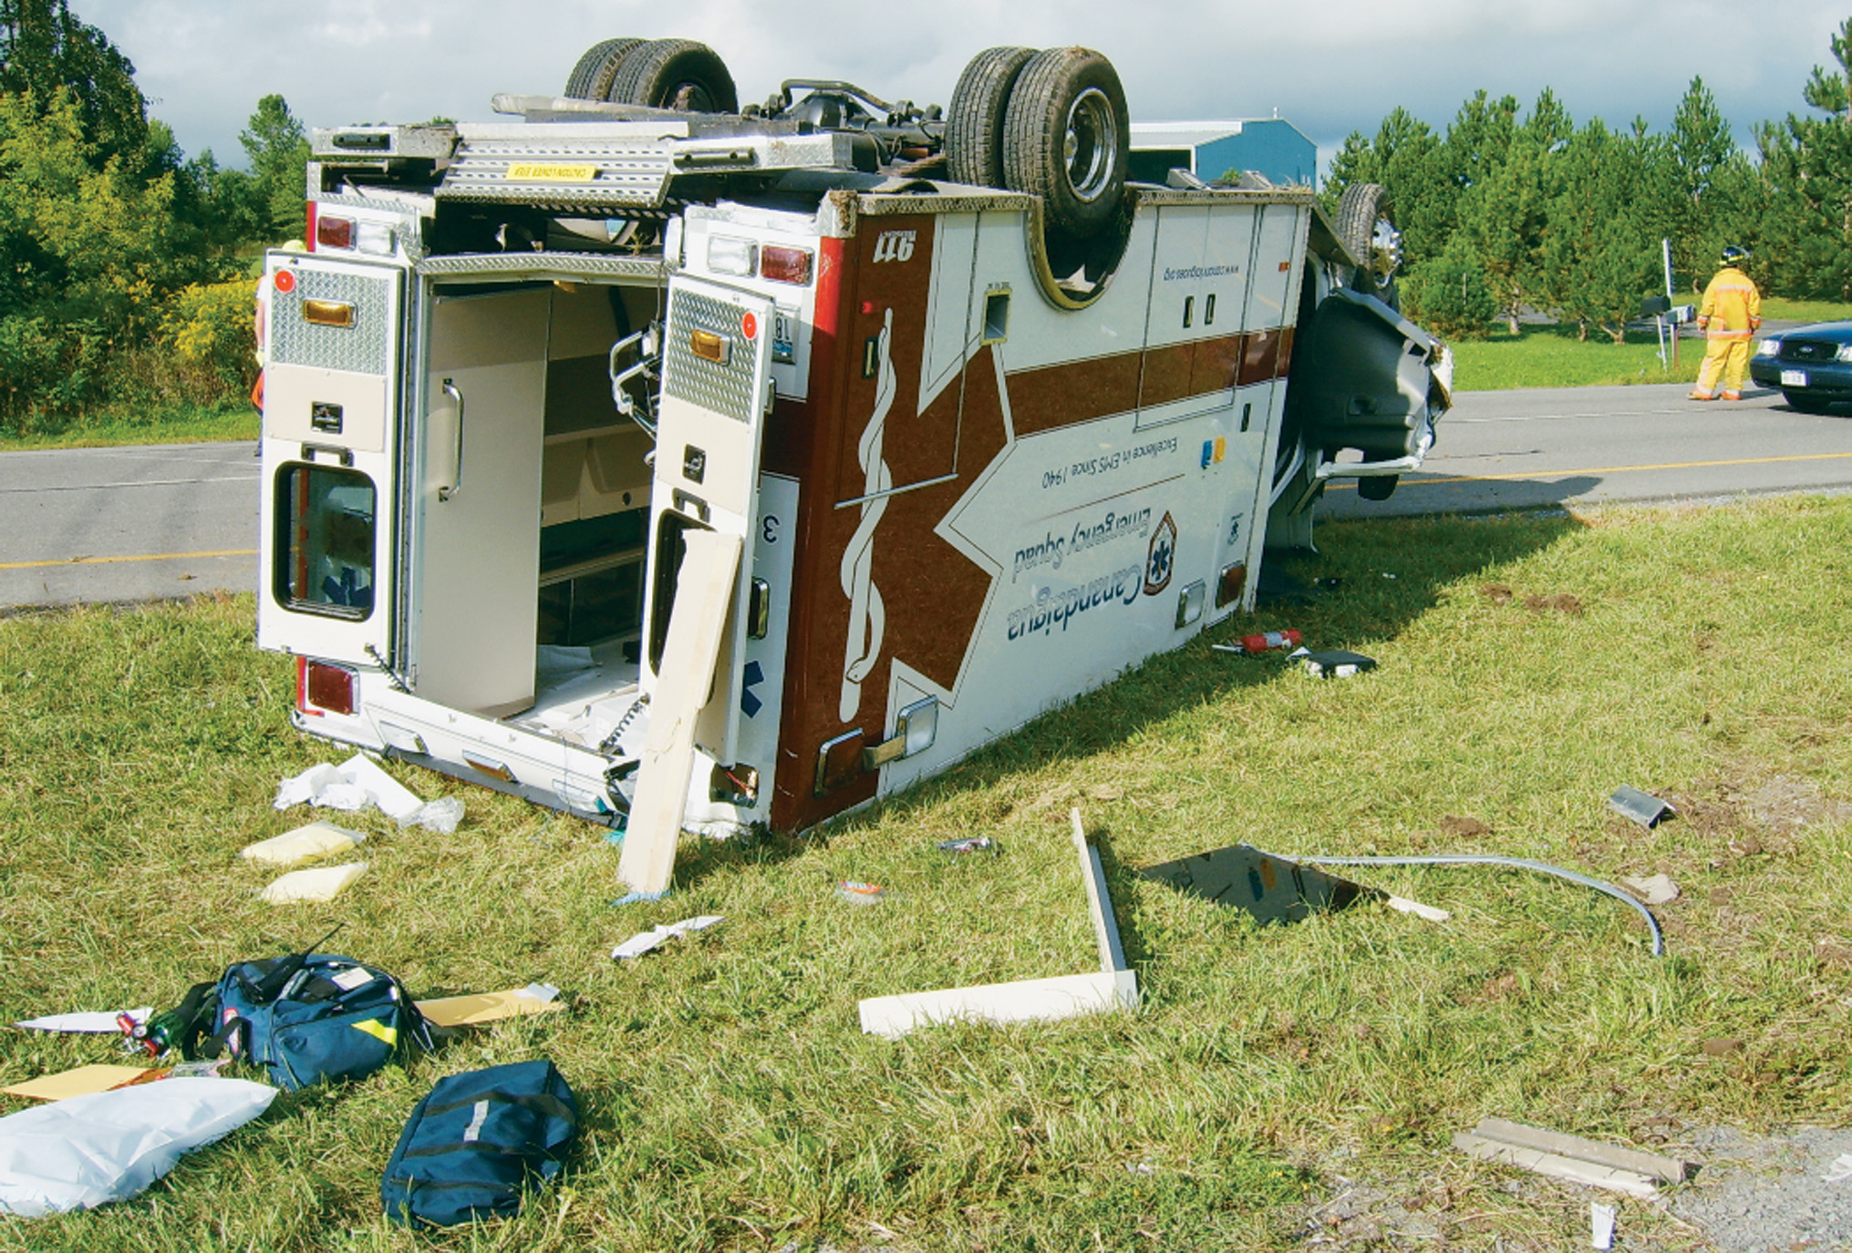
A Number of Factors Can Cause an Operator to Lose Control of the Ambulance
(Courtesy Canandaigua Fire and Rescue)
Notes:
For vehicle control, remember the rule about speed: Go the posted limit unless the situation is critical. Speed can complicate patient care by providing a rougher ride, decrease ambulance stability, and risk the safety of everyone in the ambulance.

Slide 16
Driving the Ambulance (5 of 12)
Driving Excellence
  Maintaining Control
    Go the posted speed limit unless the situation is critical.
    Avoid sudden braking.
    Minimize distractions; realize other drivers may be distracted.
Notes:
Sudden braking can result in loss of control. In older ambulances without antilock braking systems, the brakes cause wheels to lock, and the vehicle may skid dangerously. In these vehicles, pump the brakes slowly and smoothly. Newer ambulances typically have an antilock braking system in which the brakes should be applied firmly and steadily, not pumped. Never brake on a curve.
Remember that those driving the vehicles around the ambulance may be distracted by cell phone use, loud music, conversations, eating and drinking, or other things.
Maintain focus on the safe operation of the ambulance and the safe transportation of the crew and patient.
Driving while fatigued greatly increases the risk of an accident. Proper rest and nutrition can decrease this risk. When on duty, EMTs must be physically prepared for any driving situations that may arise.
If there is simply no way to get around a train, such as an underpass or overpass within a reasonable distance, wait it out instead of trying inappropriate stunts. Plan an alternative route when you can.
Be especially alert when approaching a stopped school bus with its red lights flashing. You must always be prepared for the possibility that a child might dart out across the road heading to or from the bus. Laws regarding ambulances and school buses vary from state to state. In some, an ambulance must come to a full stop and remain stopped until signaled ahead by the bus driver.
There is little room for passing on bridges or in tunnels. If you are in heavily congested traffic near a bridge or tunnel, consider an alternative route. When in a tunnel, go with the flow of traffic at a safe speed until you emerge.
You can expect less traffic on weekends than on workdays in most areas. Rush-hour traffic is more congested in most urban centers than rural areas, so plan accordingly.
Always be on the lookout for potholes and bumps. The goal is to give the patient the smoothest ride possible.

Slide 17
Driving the Ambulance (6 of 12)
Driving Excellence
  Maintaining Control
    Higher speeds
      Be especially careful on curves.
      Brake to the proper speed before you enter a curve.
      Accelerate carefully and gradually.
      Exit from a curve slow and steady. When going down a long hill, use a lower gear.
      Always use a smooth braking motion.
Notes:
Curves can be dangerous in an ambulance because they are generally top-heavy and can roll over easily. Always brake to desired speed before entering a curve and accelerate on the way out of the turn. Always use smooth breaking motion and remember that it will take longer for an ambulance to slow down, especially at a higher speed, than normal vehicles.

Slide 18
Driving the Ambulance (7 of 12)
Driving Excellence
  Maintaining Control
    Aggressive drivers
      Driving an ambulance does not necessarily change the habits of other drivers.
      Aggressive drivers are often distracted.
    Using a police or other emergency vehicle escort en route to a response or the hospital should be a last resort.
Notes:
Aggressive drivers can pose a significant increased risk to you and your vehicle. If you notice another vehicle weaving in and out of traffic, speeding, or otherwise driving in an aggressive or erratic manner, exercise extreme caution when approaching or passing that vehicle. Aggressive drivers are often distracted and may not even notice the presence of the ambulance.
Using a police or other emergency vehicle escort is dangerous, not only to the escort, but also to the EMT driver, to the patient in the ambulance, and to others on the road. All hazards associated with ambulance driving are doubled when an escort is involved because you are the second vehicle through an intersection and motorists might expect only one.

Slide 19
Driving the Ambulance (8 of 12)
Driving Excellence
  Maintaining Control
    Intersection Collisions
      The most common collisions in which ambulances are involved in are those at intersections.
Notes:
A motorist approaches the intersection just as the light changes; they don’t want to sit through the red light, so they sail through the intersection.
There are two emergency vehicles when motorists expect only one. Maintain a safe distance between your vehicle and the emergency vehicle in front of you, but follow closely enough so that the motorist can see both of you in the same glance.
Vehicles waiting at an intersection may block your view of pedestrians in the crosswalk. Again, slow down and anticipate people in the crosswalk.

Slide 20
Driving the Ambulance (9 of 12)
Driving Excellence
  Driving in Inclement Weather
    Rainy or Wet Weather
      An ambulance requires twice the stopping distance on wet pavement, and five times as much on sleet or ice.
      Maintain a safe following distance.
Notes:
Keep your mirrors cleared of water.
Avoid sudden braking and sudden moves of the steering wheel.
If you are about to go through a large standing puddle, slow down and turn on your wipers before you go through the water. As you leave the water, tap the brake lightly a few times to dry it out. If the ambulance pulls to one side, pump the brake slowly and smoothly to dry the brake out.
If you begin to hydroplane, hold the wheel steady, take your foot from the accelerator, and gently pump the brake.

Slide 21
Driving the Ambulance (10 of 12)
Driving Excellence
  Driving in Inclement Weather
    Winter Driving
      Carry emergency weather equipment.
      Use studded snow tires.
      Monitor the temperature. Wet ice and freezing rain occur between 28°Fahrenheit and 40°Fahrenheit.
      Avoid sudden movements of the steering wheel and sudden braking.
Notes:
Make sure that your engine is tuned, your heater and defroster are in good working order, and your battery is charged.
Carry emergency weather equipment, chains, a shovel, sand, booster cables, and a towing device.

Slide 22
Driving the Ambulance (11 of 12)
Driving Excellence
  Driving in Inclement Weather
    Fog, Mist, Dust Storms, and Smog
      Slow down but avoid sudden deceleration.
      Watch for slow traffic ahead and behind.
      Turn on low beams and wipers.
      Use 4-way flashers.
      Use defrosters.
      When braking, pump brakes to flash lights.
Notes:
Turn on your lights, regardless of the time of day, and use your wipers. (Never use the high beams on your headlights. The reflection of the high beams from the fog can reduce your ability to see.) Even if the lights do not improve your ability to see ahead, they can make it possible for other motorists to see you better.
If you are traveling 15 miles per hour or more below the speed limit, use four-way flashers. (These might not be legal in some states.) Use the four-way flashers if you pull off the road and stop.

Slide 23
Driving the Ambulance (12 of 12)
Driving Excellence
  Driving at Night
    The risk of fatal collisions is higher.
    High-beam headlights can cause temporary blindness.
    On high beams, visibility will be 350–400 feet. At 55 miles per hour, it takes 4.5 seconds to cover 350 feet. For night driving, control speed so that the stopping range is within headlight range.
Notes:
To improve your visibility and the ability of others to see you:
Make sure that your ambulance has quartz-halogen headlights, which provide more light on the road.
Have your headlights on whenever you travel in an emergency.
Keep your headlights clean and properly aimed. Check them each day before your shift begins. If the weather is bad, especially if there is sleet or snow, stop as necessary during your shift to clean debris off your headlights.
Replace burned-out bulbs immediately.
Dim your high beams within 500 feet of an approaching vehicle or within 300 feet of a vehicle in front of you.
Never stare into the high beams of another car; guide your ambulance by watching the right edge of the road.
Do not flick your high beams up and down to remind another driver to dim their brights, it can blind them temporarily.
Never use high beams when going into a curve.
Keep your windshield clean, inside and out. Keep a bottle of windshield or glass cleaner in the ambulance for mirrors and interior windshields.
Keep your instrument panels dim.
Keep your eyes moving; avoid focusing on any one object.
If the washing solution under your hood does not leave the glass clean after ten wiper cycles, replace the blades or use a stronger concentration of washing fluid.
Be sure that you are rested before you begin a night driving shift. Between 11:00 P.M., and 3:00 A.M., be particularly alert for intoxicated or drowsy drivers. If you notice erratic speeds, weaving across lines, or delayed starts at intersections, use extreme care in passing.

Slide 24
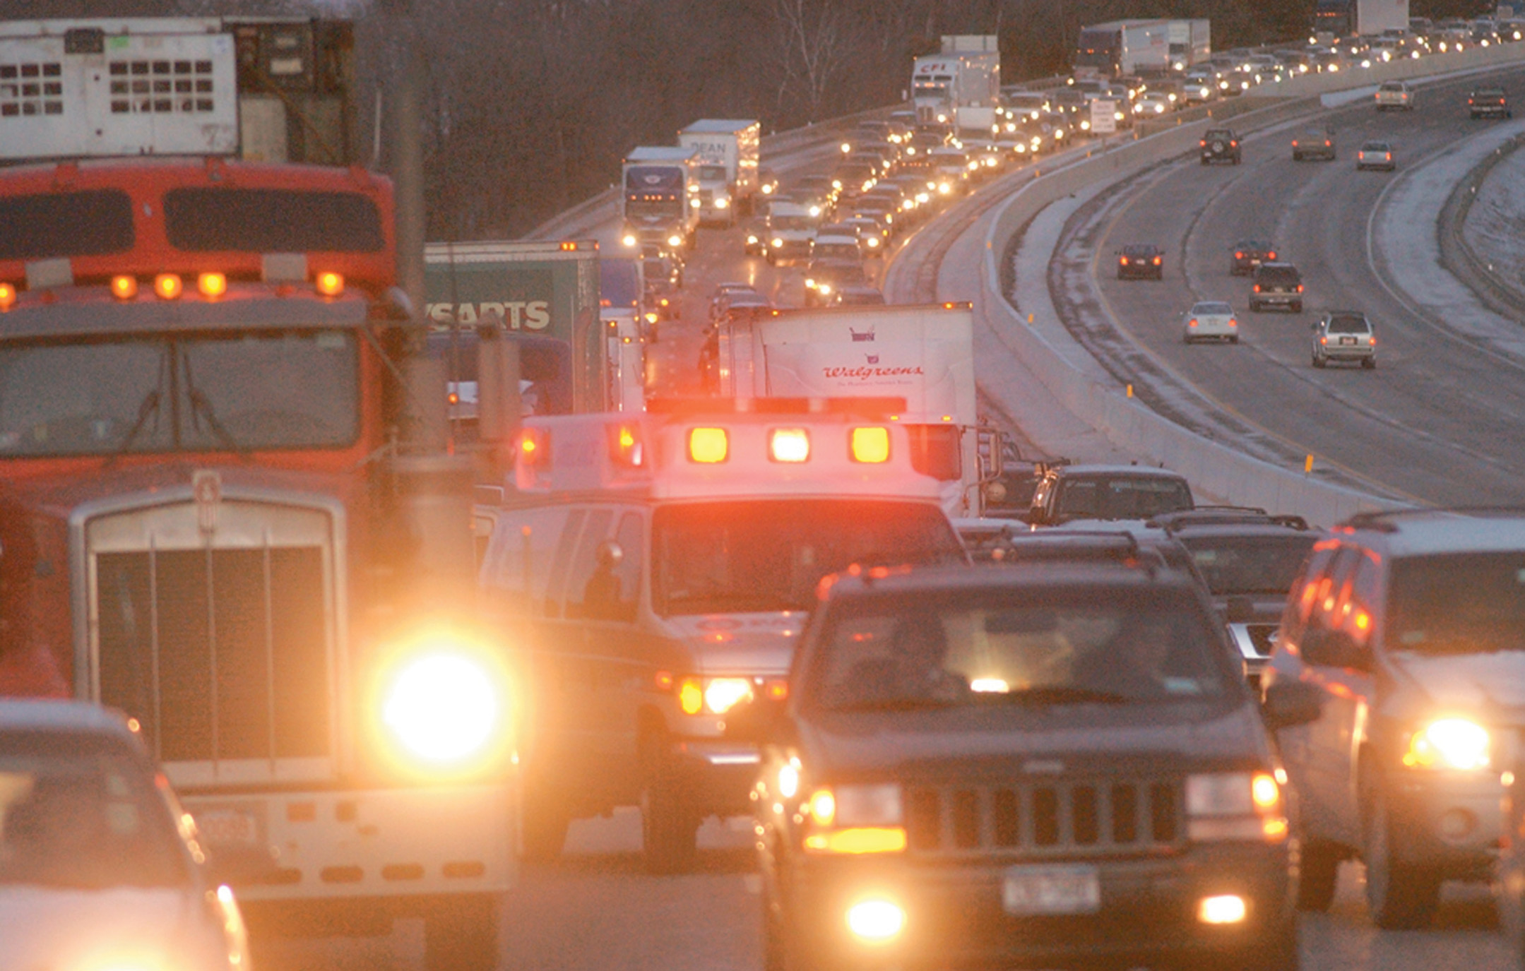
Take Extra Care When Driving at Night
(© Mark C. Ide)
Notes:
Night vision varies considerably among people. Older people generally cannot see well in the dark, and eyestrain can substantially reduce night vision.

Slide 25
Warning Devices (1 of 5)
Warning devices can save time, but have risks.
Follow protocols for use of warning devices.
Warning devices only request the right of way; they do not guarantee it.
Exercise due regard when using warning devices.
Notes:
Always take the increased risk of warning device usage into consideration, and weigh it against the benefit of saving a few minutes in transit time. Most agencies, and many counties and states, have specific protocols for use of these devices. Remember, they are only a means of requesting the right of way from others on the road and do not give the ambulance any special rights or guarantee of clear traffic.

Slide 26
Warning Devices (2 of 5)
Colors and Markings
  Colors and markings provide for quick identification of ambulances and make them visible in traffic.
Notes:
The standard color is white. The markings are an orange stripe running around the body, blue lettering, and the “Star of Life” symbol. It is recommended that any added lettering be kept below the orange stripe so as not to distract from the basic markings. For maximum effectiveness, these standard colors and markings should not be duplicated on vehicles that are not ambulances.

Slide 27
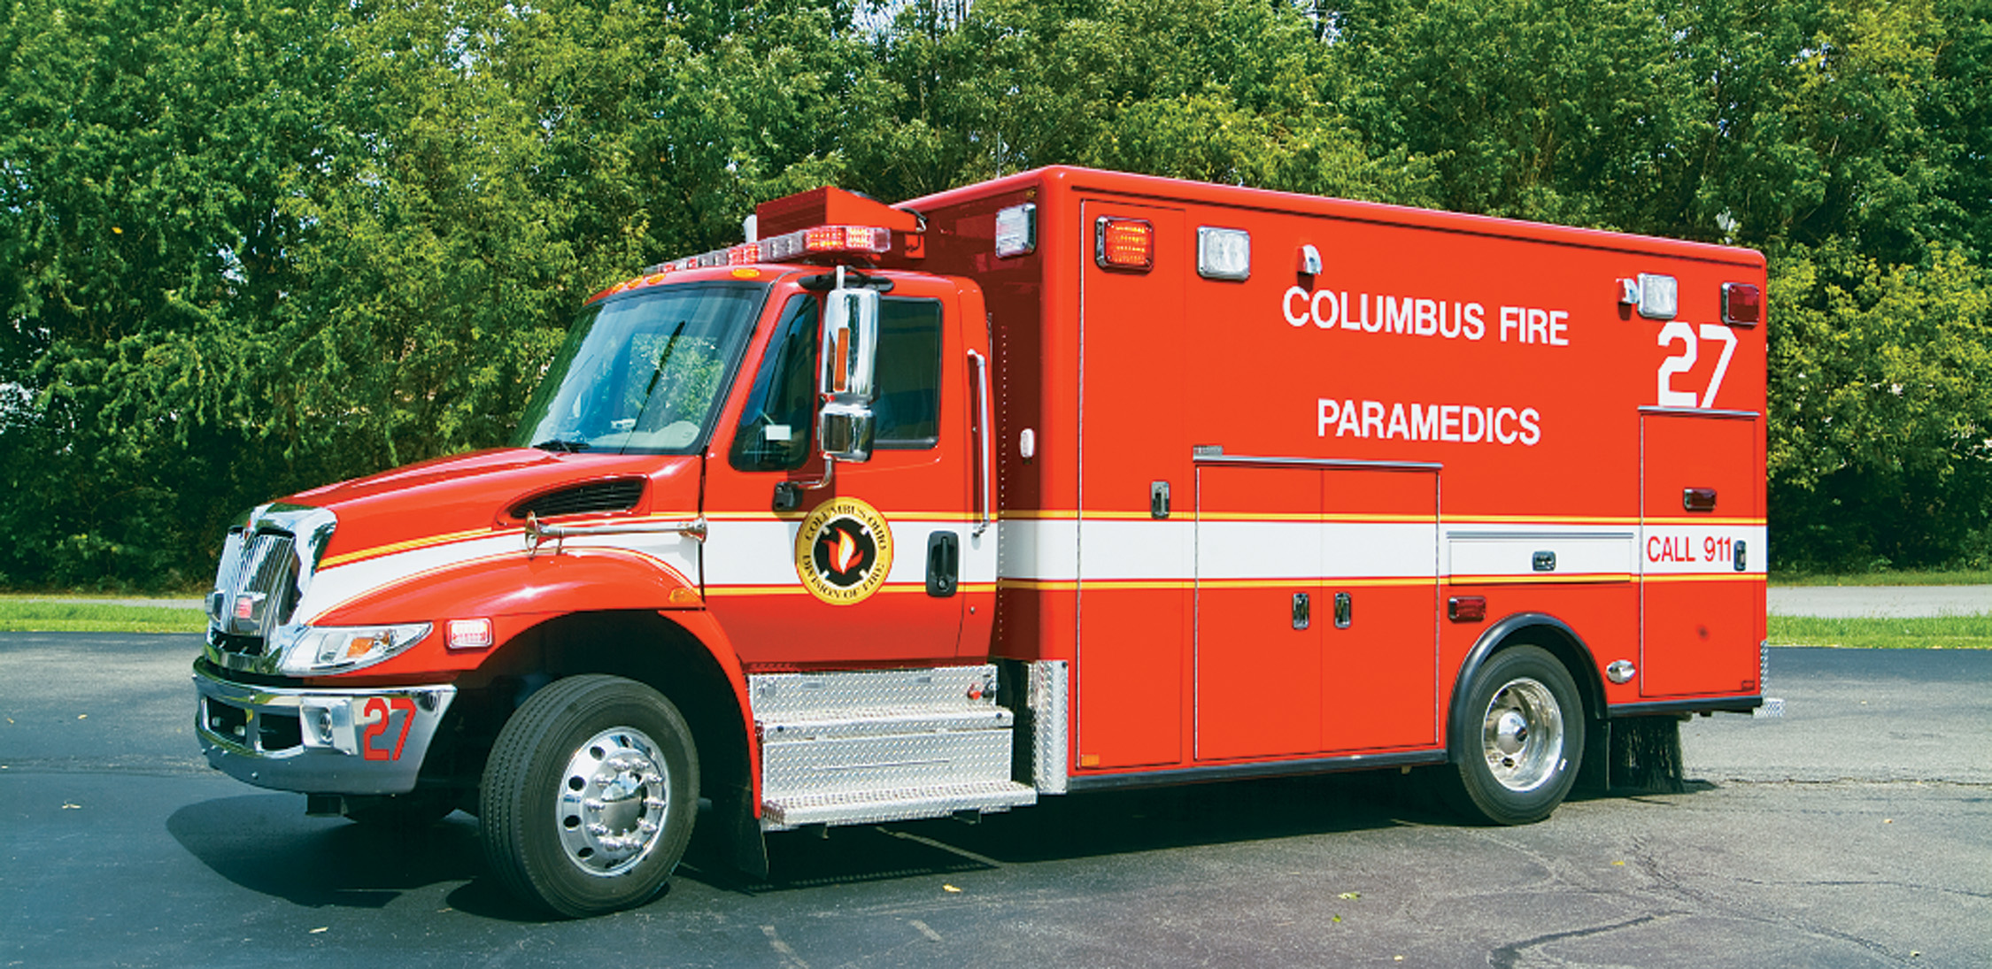
Colors and Markings Are Typically Designed to Provide Quick Identification That the Vehicle Is an Ambulance and to Maximize Visibility in Traffic (1 of 2)
Notes:
Ambulance colors and markings are an aid to traffic safety and reduce the need for excessive dependence on lights and sirens.

Slide 28
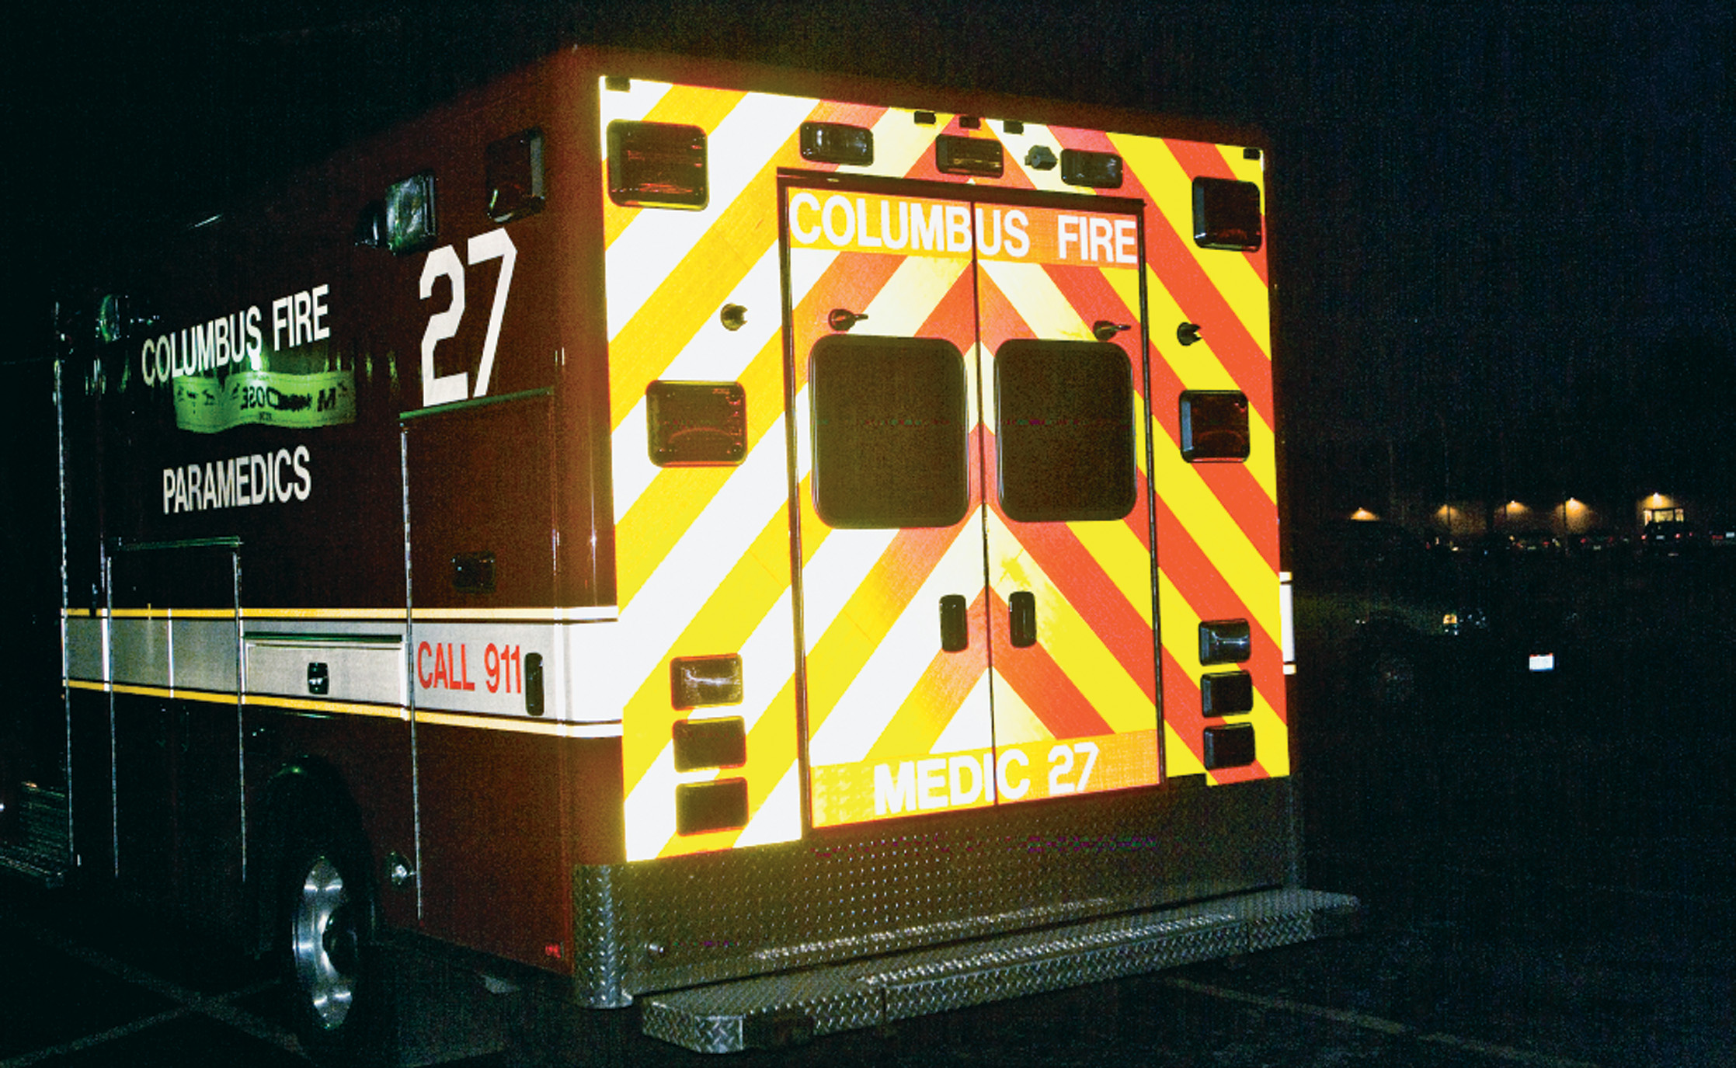
Colors and Markings Are Typically Designed to Provide Quick Identification That the Vehicle Is an Ambulance and to Maximize Visibility in Traffic (2 of 2)
Notes:
An early U.S. Department of Transportation (DOT)/EMS study, “Ambulance Design Criteria”, by the National Academy of Sciences recommended a nationwide system of specific colors and markings.

Slide 29
Warning Devices (3 of 5)
Warning Lights and Emergency Lights
  Activate emergency lights during emergency calls.
    Use headlights, even in daylight.
    Lights are placed at various locations on the ambulance for visibility.
    White lights are more visible than red and blue.
    Minimize lights in fog and when parked.
Notes:
Discussion Question
What are the risks and benefits of using warning devices?
Knowledge Application
Given several scenarios, students should be able to select the appropriate use of warning devices on the ambulance.

Slide 30
Warning Devices (4 of 5)
Using Your Siren
  Siren noise is greatly reduced inside the vehicles.
  Do not startle drivers with sudden siren noise.
  Siren noise is stressful for patients.
  The siren can prevent hearing other emergency vehicles.
Notes:
Critical Thinking Discussion
Does siren noise pose a risk to the hearing of EMS personnel? If so, how can they minimize that risk?

Slide 31
Warning Devices (5 of 5)
Using Your Air Horn
  Consider using the air horn when there’s a need to clear traffic quickly.
  Do not sound the horn when close to other vehicles.
Notes:
Discussion Question
What are some reasons sirens and air horns may not be effective?

Slide 32
Case Study (2 of 7)
Gary and Harold spot the collision just ahead of them, and Gary notifies dispatch that they are on the scene.
Notes:
Case Study Discussion
Review the case study findings presented.

Slide 33
Case Study (3 of 7)
What should Gary and Harold consider in determining how and where to park the ambulance?
What steps should the E M Ts take to make the scene as safe a working environment as possible?
What responsibilities must be completed to carry the ambulance call to completion?
Notes:
Case Study Discussion
Use the case study content and questions to foreshadow the upcoming lesson content. Gauge the students’ responses as a guide of how well versed they are in this topic.

Slide 34
Roadway Incident Scene Safety (1 of 4)
E M S personnel must set up a safe environment when working on or near a roadway.
Poor visibility and impaired, distracted, and/or inexperienced drivers are all factors in roadway incident injuries.
Notes:
Teaching Tips
Demonstrate the use of safety apparel and other items used to increase safety when working at roadway incidents.

Slide 35
Roadway Incident Scene Safety (2 of 4)
High-Visibility Apparel
  E M Ts and other rescue personnel responding to emergencies on or near a roadway must wear approved high-visibility apparel.
  E M Ts must wear apparel that meets the Class 2 or 3 standards of A N S I / I S E A 107-2004 or the Public Safety Vest standard A N S I / I S E A 207-2006.
Notes:
The ANSI/ISEA 207-2006 American National Standard for High-Visibility Public Safety Vests (PSV) was approved to increase the visibility of emergency personnel on the roadway and to reduce the incidence of roadway hazards. The newer standard made significant changes to standard class garments to accommodate the public safety responder. The PSV has the same retroreflective material as the Class 2 vest and nearly the same amount of fluorescent material. The PSV includes breakaway features, specific vest dimensions to allow for fit over firefighting turnout gear, and color-specific markings to allow for differentiation between law enforcement, fire, and EMS personnel.

Slide 36
Roadway Incident Scene Safety (3 of 4)
Safety Benchmarks
  Do not trust approaching traffic.
  Do not turn your back on traffic.
  Use the first-arriving emergency vehicle to create a barrier between traffic and the scene.
  Wear personal protective equipment and A N S I high-visibility vests.
  At night, turn off vision-impairing lights
Notes:
Discussion Questions
What steps can you take to keep yourself safer at roadway incidents?
What can cause driver distraction despite the safety measures you may take at roadway scenes?
Knowledge Application
Given several scenarios, students should be able to identify and manage hazards when responding to roadway incidents.
Critical Thinking Discussion
What can be done to increase EMS provider safety at roadway incidents?

Slide 37
Roadway Incident Scene Safety (4 of 4)
Safety Benchmarks
  Use emergency vehicles to slow and redirect traffic.
  Use warning signs and traffic control measures upstream of the scene.
  Use traffic cones to divert traffic.
  Assign a person to monitor traffic.
  Place vehicles uphill/upwind when hazardous materials may be involved.
Notes:
Class Activity
If your circumstances (location, liability issues, and so on) allow, use a vacant parking lot to provide students with scenarios in which they must set up a safe roadway response scene.

Slide 38
Phases of an Ambulance Call (1 of 12)
The Major Phases Are:
  Daily vehicle and equipment preparation
  Dispatch
  En route to the scene
  At the scene
  En route to the receiving facility
  At the receiving facility
  En route to the station
  Post run.
Notes:
The key to response readiness is a properly maintained and equipped ambulance. Always having a vehicle ready to respond in all conditions and equipped with all necessary supplies can ensure that you can reach, care for, and transport your patients.

Slide 39
Phases of an Ambulance Call (2 of 12)
Daily Prerun Preparation
  Ambulance Maintenance
    Basic ambulance maintenance includes oil and filter changes, transmission and differential checks, wheel bearing check, brake check, and tie-rod end inspection.
    Know your service's policies and procedures for reporting and correcting vehicle problems.
Notes:
Teaching Tips
Have students carry out all phases of an ambulance run on mock calls.
Discussion Question
What are the EMT's responsibilities in the prerun phase?
Knowledge Application
Students should be able to perform their responsibilities in all phases of an EMS call.

Slide 40
Phases of an Ambulance Call (3 of 12)
Daily Prerun Vehicle Preparation
  This includes checking the vehicle and ensuring all supplies and equipment are present and in working order.
Notes:
The key to response readiness is a properly maintained and equipped ambulance. Always having a vehicle ready to respond in all conditions and equipped with all necessary supplies can ensure that you can reach, care for, and transport your patients.

Slide 41
Table 42-1 Daily Ambulance Inspection (1 of 3)
Items Typically Included in a Daily Ambulance Inspection Checklist
Fuel
Oil
Fluid circulation system
Batteries
Brakes
Tires and wheels
Shoreline power connectors
Headlights
Notes:
Inspect the vehicle systems daily. Most ambulance systems have a checklist of the items to be checked. Your service should have a clear protocol for reporting problems with vehicles, taking them out of service if they are deemed unsafe, and performing regular service and maintenance. Legally, you might be within your rights to refuse to use a vehicle that you have reason to believe is unsafe; and incidentally, you might be legally liable for damage caused by a malfunctioning ambulance if you are aware of the problem.

Slide 42
Table 42-1 Daily Ambulance Inspection (2 of 3)
Brake lights
Turn signals
Emergency lights
Wipers
Horn
Siren
Windows
Door closing and latching devices
Power systems

Slide 43
Table 42-1 Daily Ambulance Inspection (3 of 3)
Air-conditioning, heating, and ventilation systems
Radiator hoses and fan belts
Seat belts
Dash lights
Radio
Supplies
Interior and exterior cleanliness

Slide 44
Check Tires for Inflation, Wear, or Danger Spots
Notes:
Most ambulance systems have a checklist of the items to be checked.

Slide 45
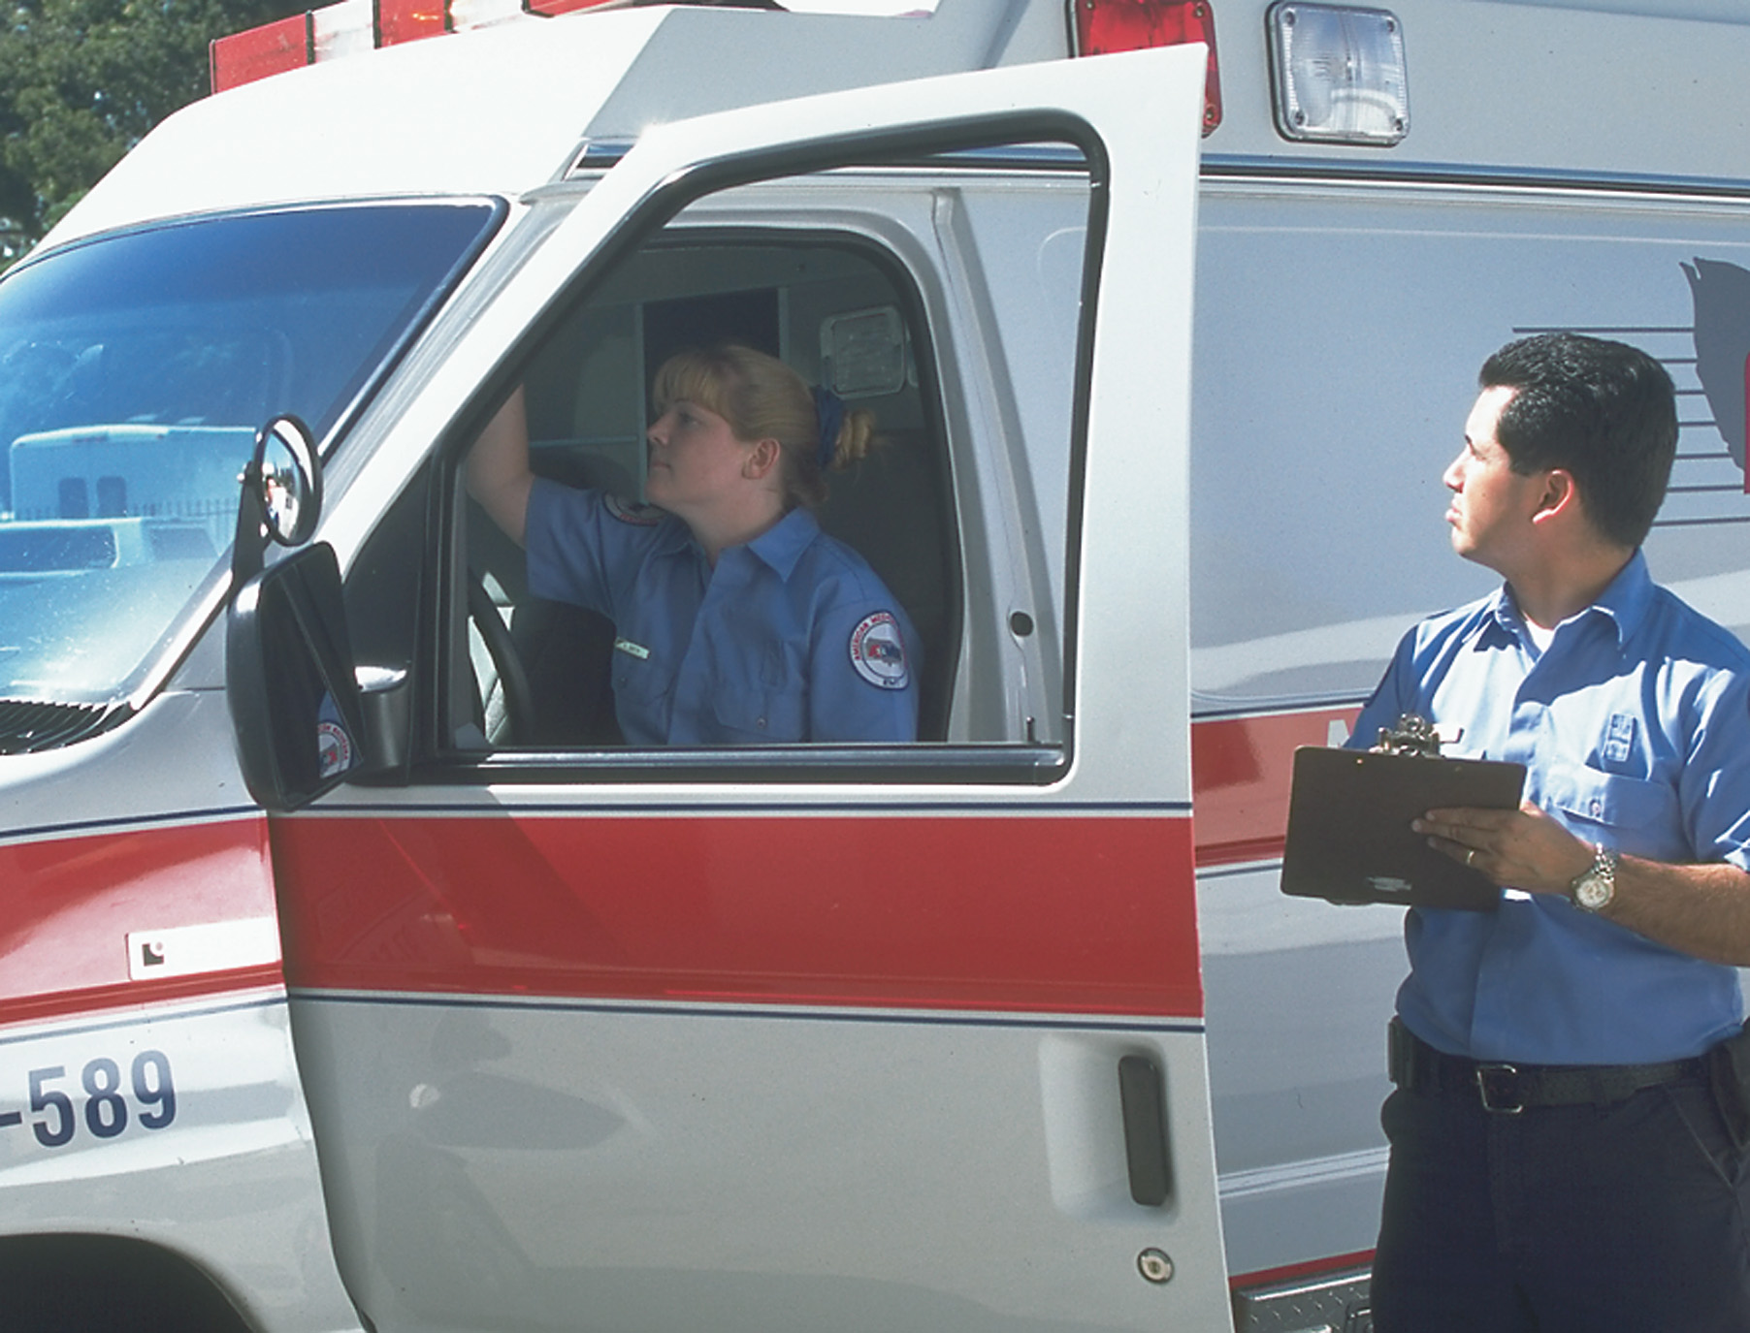
Make Sure All Lights Are Functional
Notes:
Your service should have a clear protocol for reporting problems with vehicles and taking them out of service if they are deemed unsafe.

Slide 46
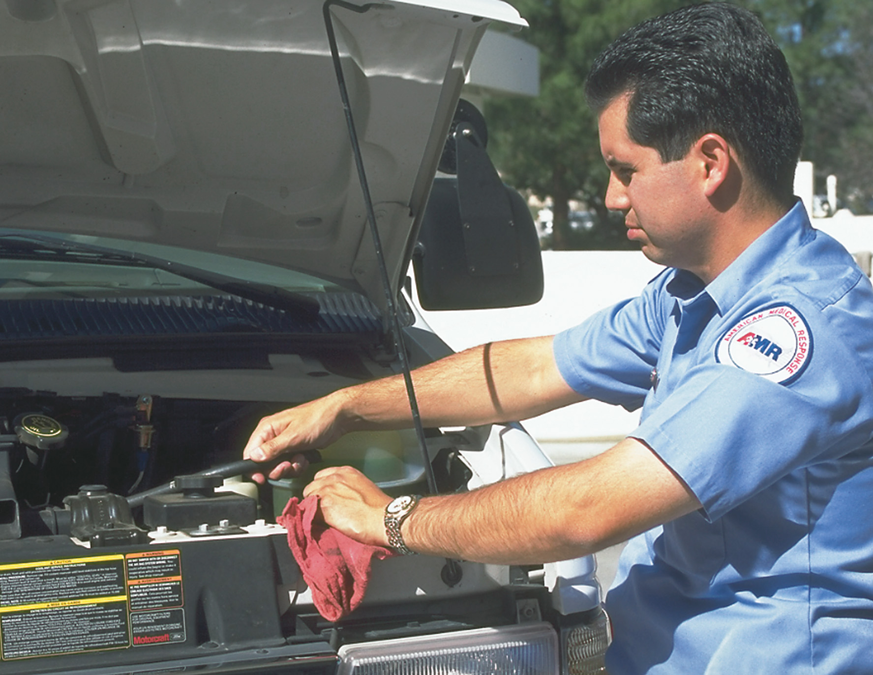
Check All Belts and Hoses
Notes:
Legally, you might be within your rights to refuse to use a vehicle that you have reason to believe is unsafe.

Slide 47
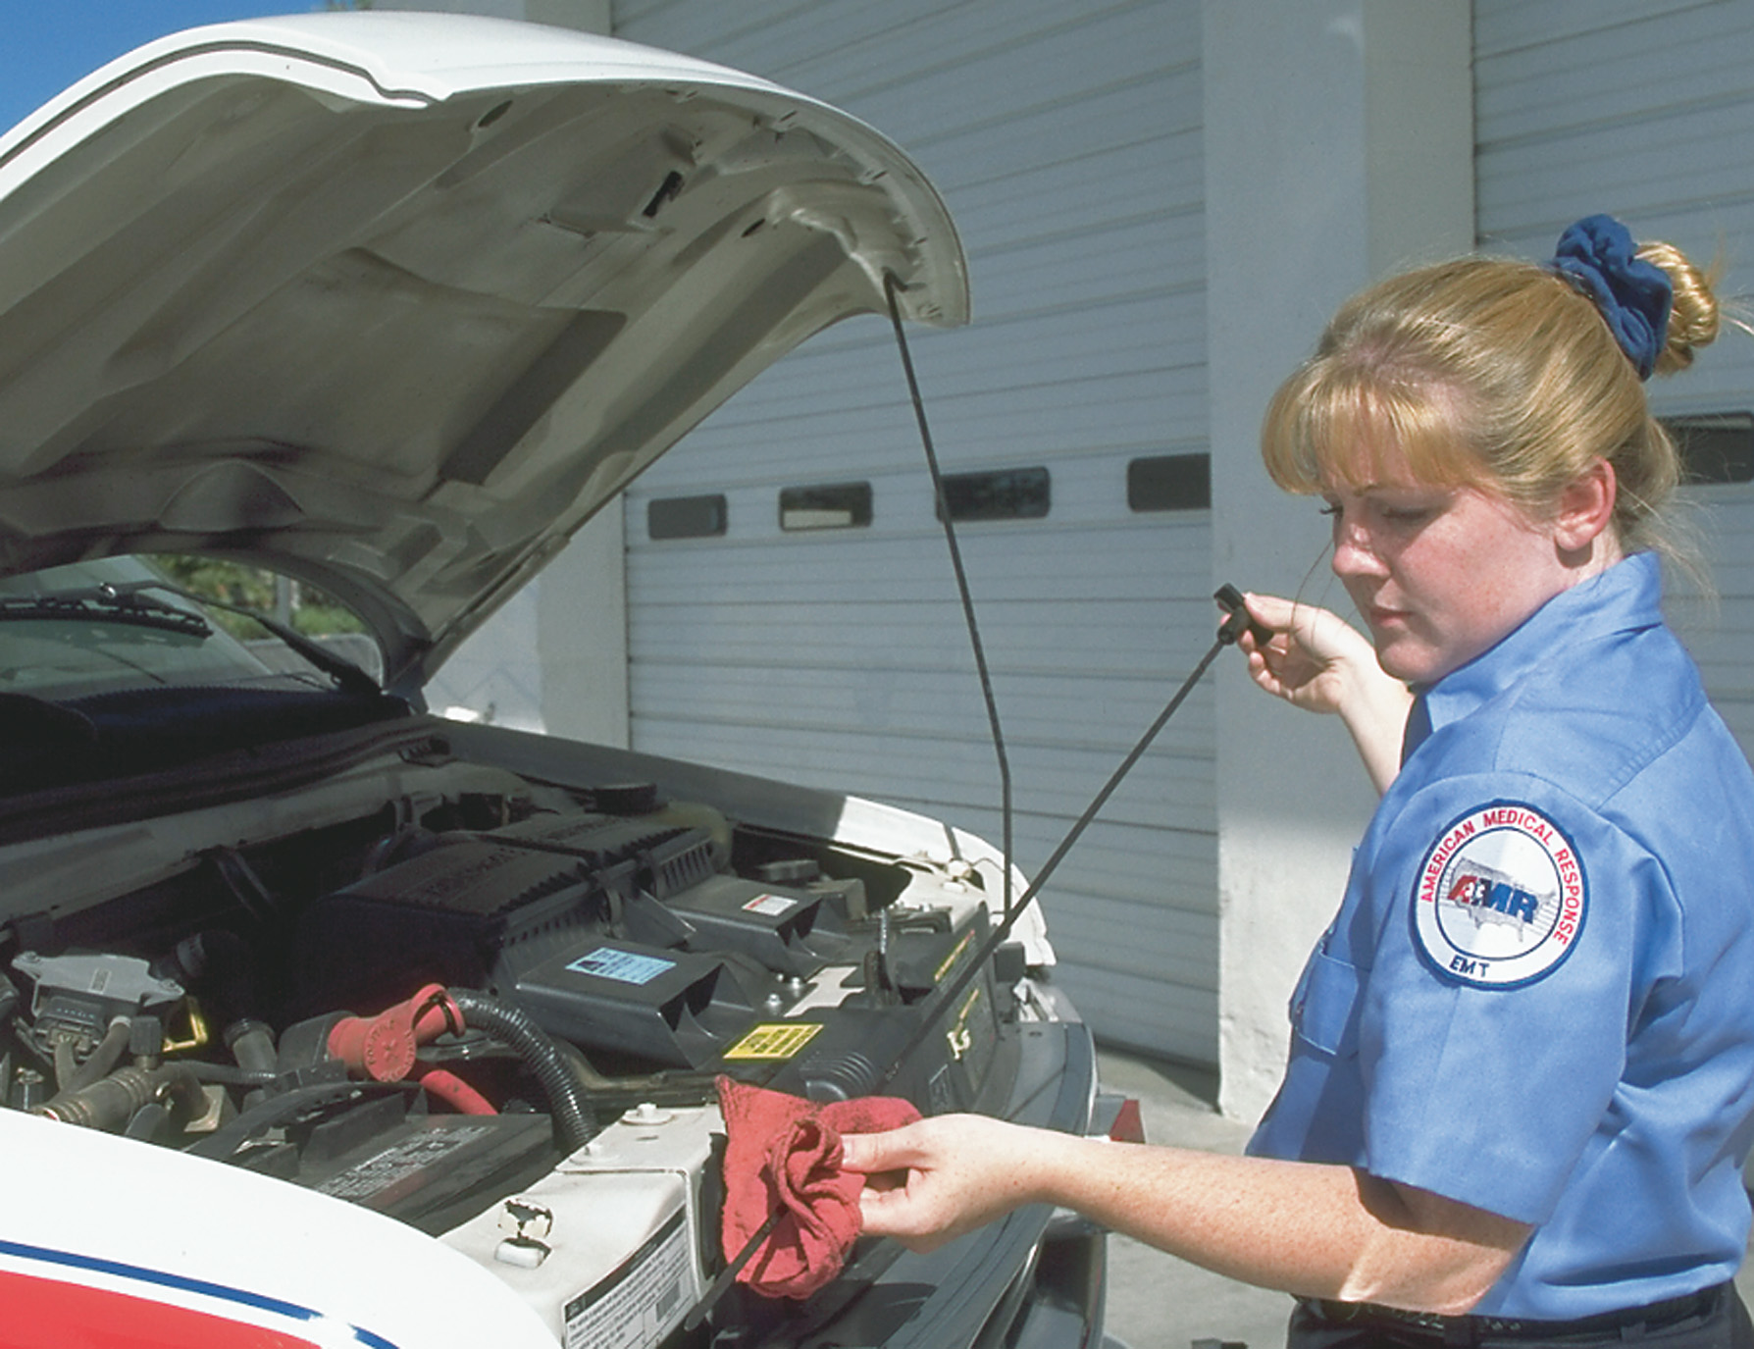
Check All Fluid Levels and Keep Them up
Notes:
You might be legally liable for damage caused by a malfunctioning ambulance if you are aware of the problem.

Slide 48
Table 42-2 Basic Ambulance Supplies (1 of 2)
Medical Supplies
Basic supplies
Patient transfer equipment
Airways
Suction equipment
Artificial (positive pressure) ventilation devices
Oxygen inhalation equipment
Automated external defibrillator (A E D)
Basic wound care supplies
Splinting supplies
Childbirth supplies
Medications
Notes:
Your ambulance must contain supplies and equipment for handling medical emergencies, injuries, extrications, and childbirth. Supplies and equipment should be checked each day and restocked, cleaned, or maintained.
A properly equipped and maintained ambulance is important to emergency prehospital care. Properly trained personnel to operate the ambulance and making optimum use of its equipment are extremely important.

Slide 49
Table 42-2 Basic Ambulance Supplies (2 of 2)
Nonmedical Supplies
Personal protective equipment (Standard Precautions)
High-visibility safety vests
Preplanned routes, comprehensive street maps

Slide 50
Phases of an Ambulance Call (4 of 12)
Dispatch
  A message from the communications center will start the run.
  Ask the dispatcher to repeat any information that seems unclear.
  Write this information down so that you can refer to it.
Notes:
The dispatcher should provide you with the following information:
Location of the call.
Nature of the call.
Name, location, and callback number of the caller.
Location of the patient or patients at the scene.
Number of patients (if more than one) and the severity of the problem.
Any other special problems or circumstances that are pertinent.

Slide 51
Phases of an Ambulance Call (5 of 12)
En Route to the Scene
  Check vehicle’s exterior compartments.
  Fasten your seatbelt.
  Verify dispatch information.
  Listen for status updates.
  Anticipate the equipment needed.
  Drive responsibly.
  Determine crew member scene duties.
  Request A L S, if necessary.
Notes:
Your ambulance is checked and ready to respond. The vehicle’s medical and nonmedical equipment and supplies are clean and operational. Before departure, quickly check the vehicle to make sure outside compartment doors are closed and secure, external shoreline cords are disconnected, and any jump kits are retrieved and properly stowed.

Slide 52
Phases of an Ambulance Call (6 of 12)
At the Scene
  Notify dispatch of arrival.
  Park in the most appropriate location.
  Perform a 360-degree scene survey.
  Put on high-visibility apparel (roadway).
  Take Standard Precautions.
  It is safe to approach the patient?
  Determine the nature of the problem or mechanism of injury.
Notes:
Pay attention to any downed electrical lines, leaking fuels or fluids from accident vehicles, smoke or fire, broken glass, trapped or ejected patients, mechanisms of injury, and other indicators of increased risk to you, your crew, or your patients. Review the procedures discussed in the “Scene Size-Up” chapter.
If other emergency vehicles are on scene and are positioned to block the scene, park in front of or behind a collision, but never alongside it. If no other vehicles are on scene, position the ambulance to provide a safety zone. On a narrow, no-parking road, take up the entire road so that no one will try to squeeze past you. Park in a driveway or on the shoulder of the road whenever possible. Stay a minimum of 100 feet from the wreckage or a burning vehicle and 2,000 feet from a hazardous materials spill, ideally uphill and upwind. Come to a complete stop. Set the parking brake prior to placing the transmission in the “park” position.

Slide 53
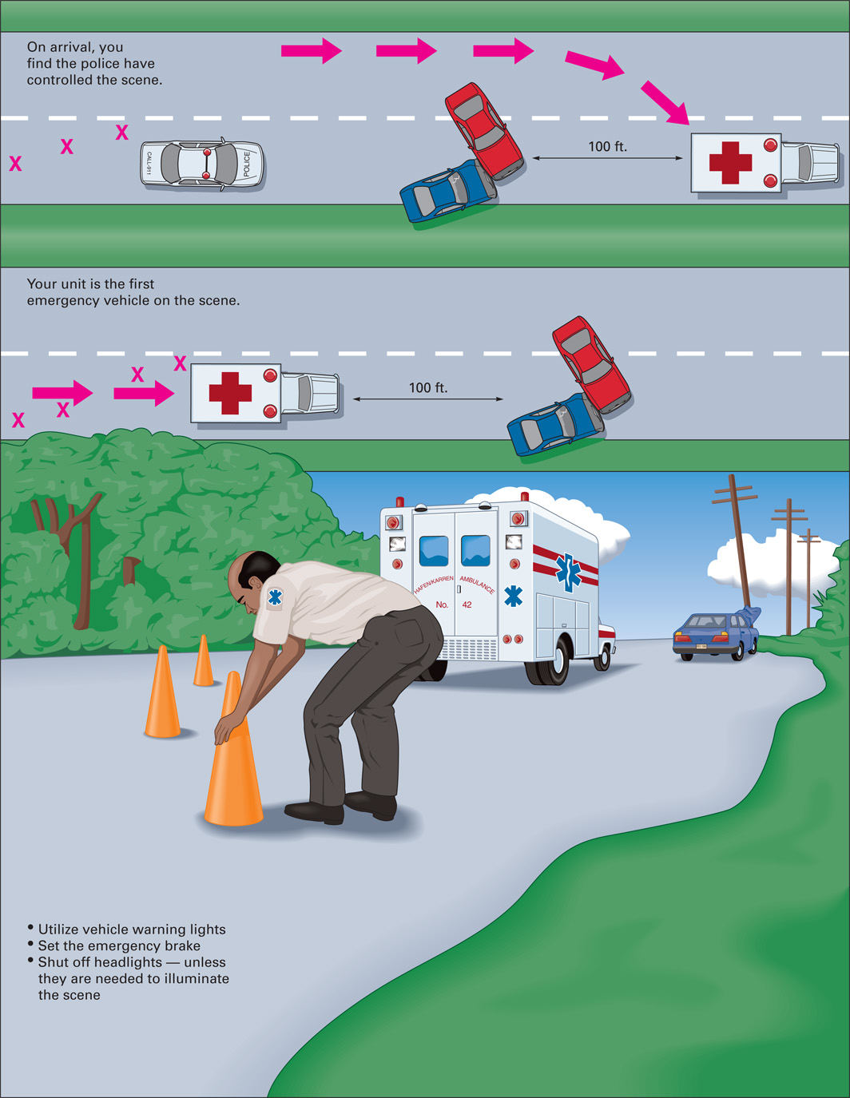
Safety at the Scene
Notes:
If other emergency vehicles are on scene and are positioned to block the scene, park in front of or behind a collision, but never alongside it.

Slide 54
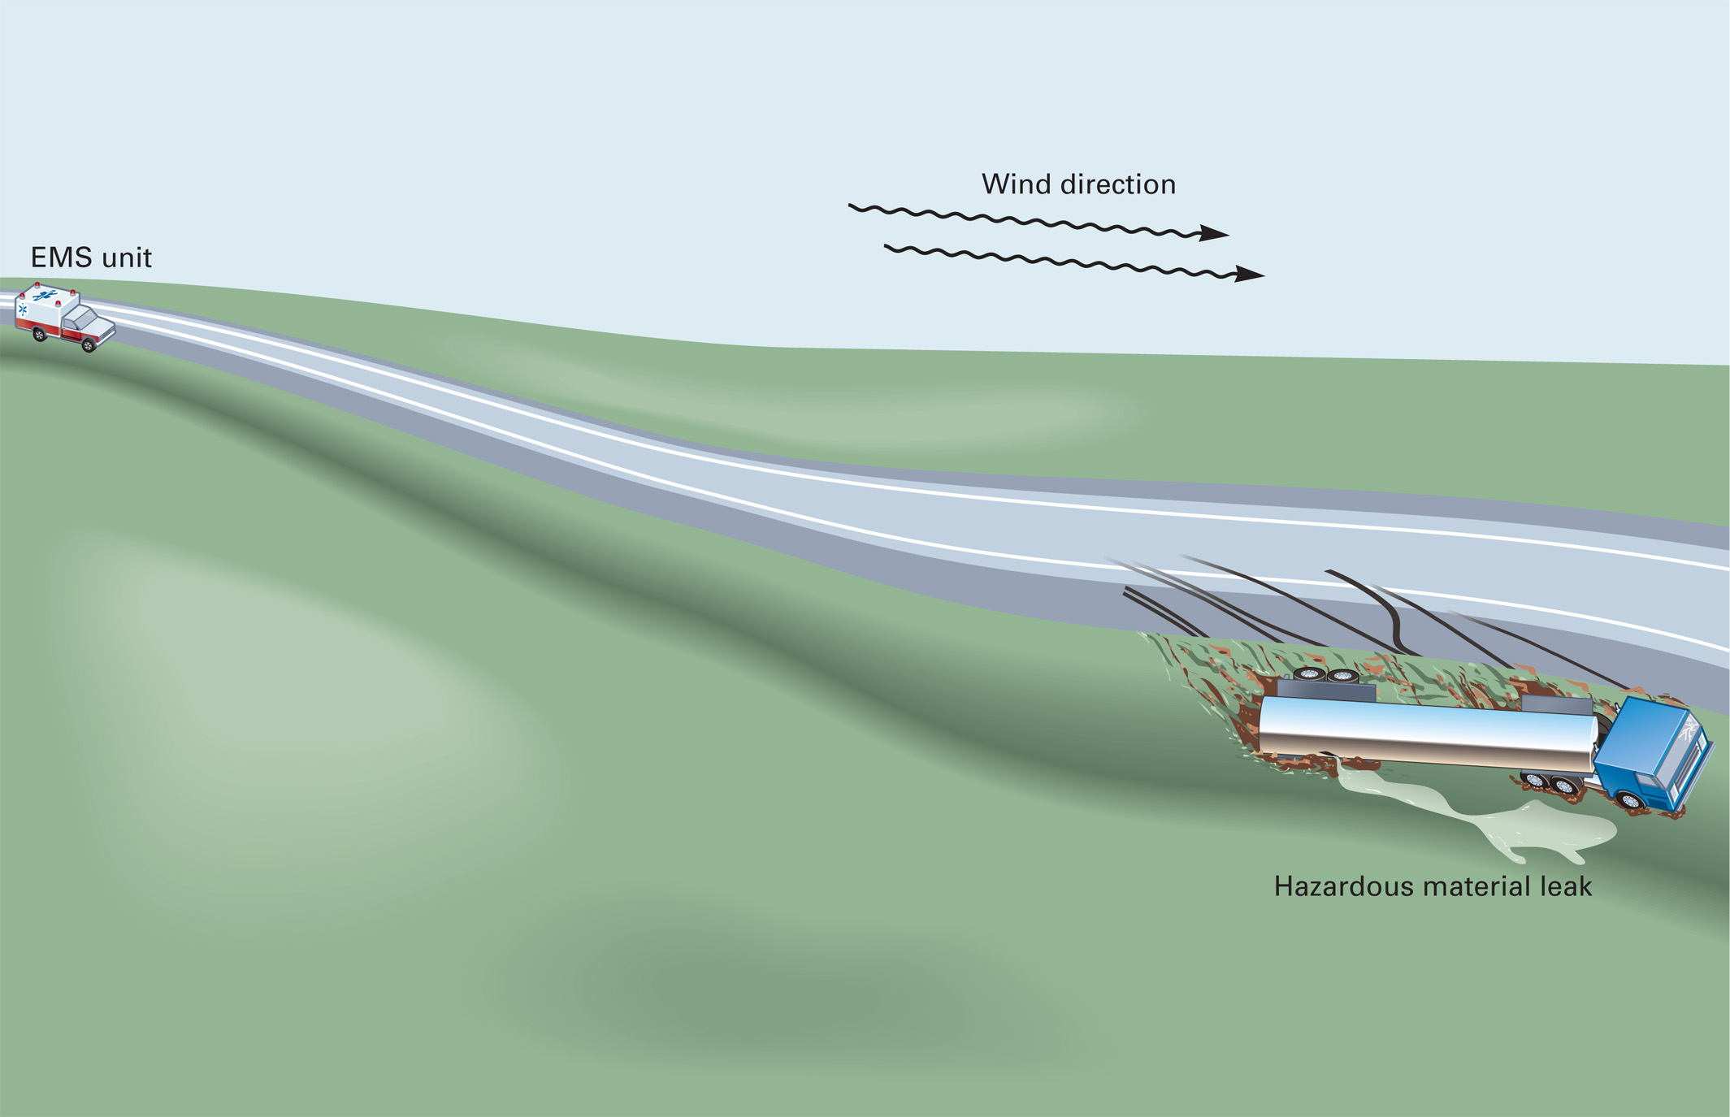
Park the E M S Unit Uphill and Upwind from Any Leaking Hazardous Materials
Notes:
Stay a minimum of 100 feet from the wreckage or a burning vehicle and 2,000 feet from a hazardous materials spill, ideally uphill and upwind.

Slide 55
Phases of an Ambulance Call (7 of 12)
At the scene
  Determine the number of patients.
  Determine priorities of care.
  If needed, gain access to the patient.
  Provide treatment.
  Move the patient to the ambulance, observing safety precautions.
Notes:
For motor vehicle crashes, carefully gain access to the patient or patients and extricate them safely.
Take the time needed to properly splint and immobilize injured extremities before you move the patient, unless they are unstable and determined to be a high priority for immediate transport.
Carefully remove the patient from any wreckage and move them to the ambulance, choosing methods of moving the patient based on their illness or injury.
Transfer the patient to the waiting ambulance. Keep them warm, and watch for any changes in their condition. Make sure the patient is securely strapped on the wheeled stretcher with spine motion restriction performed as necessary.

Slide 56
Phases of an Ambulance Call (8 of 12)
En Route to the Receiving Facility
  Ensure that hazards have been controlled.
  Insure the patient is strapped to the cot.
Notes:
The vehicle driver should quickly check the unit, making sure the outside compartment doors are closed and secure.
All personnel should be properly seated and secured with safety belts.
Determine the necessity of using lights and sirens during the transport.
Begin your reassessment.
Notify dispatch that you are en route to the hospital.
Check any patient interventions.
If a patient’s relative or friend accompanies them, follow local guidelines as to where this person should sit.
Focus on the patient. Reassure them as often as you can.
The driver should drive prudently, use only the necessary speed, and obey all regulations.
If you are the EMT with the patient, you should keep the driver informed of the patient’s condition.
If the patient’s condition worsens and it becomes urgent to reach the hospital immediately, tell your driver so they can proceed as quickly as possible.
Notify the receiving medical facility as soon as your patient’s condition permits you to call in a report.
Continue to reassess your patient’s condition and notify the receiving facility if that condition deteriorates.
Discussion Question
What are the EMT's responsibilities en route to, during, and when transporting patients from calls?

Slide 57
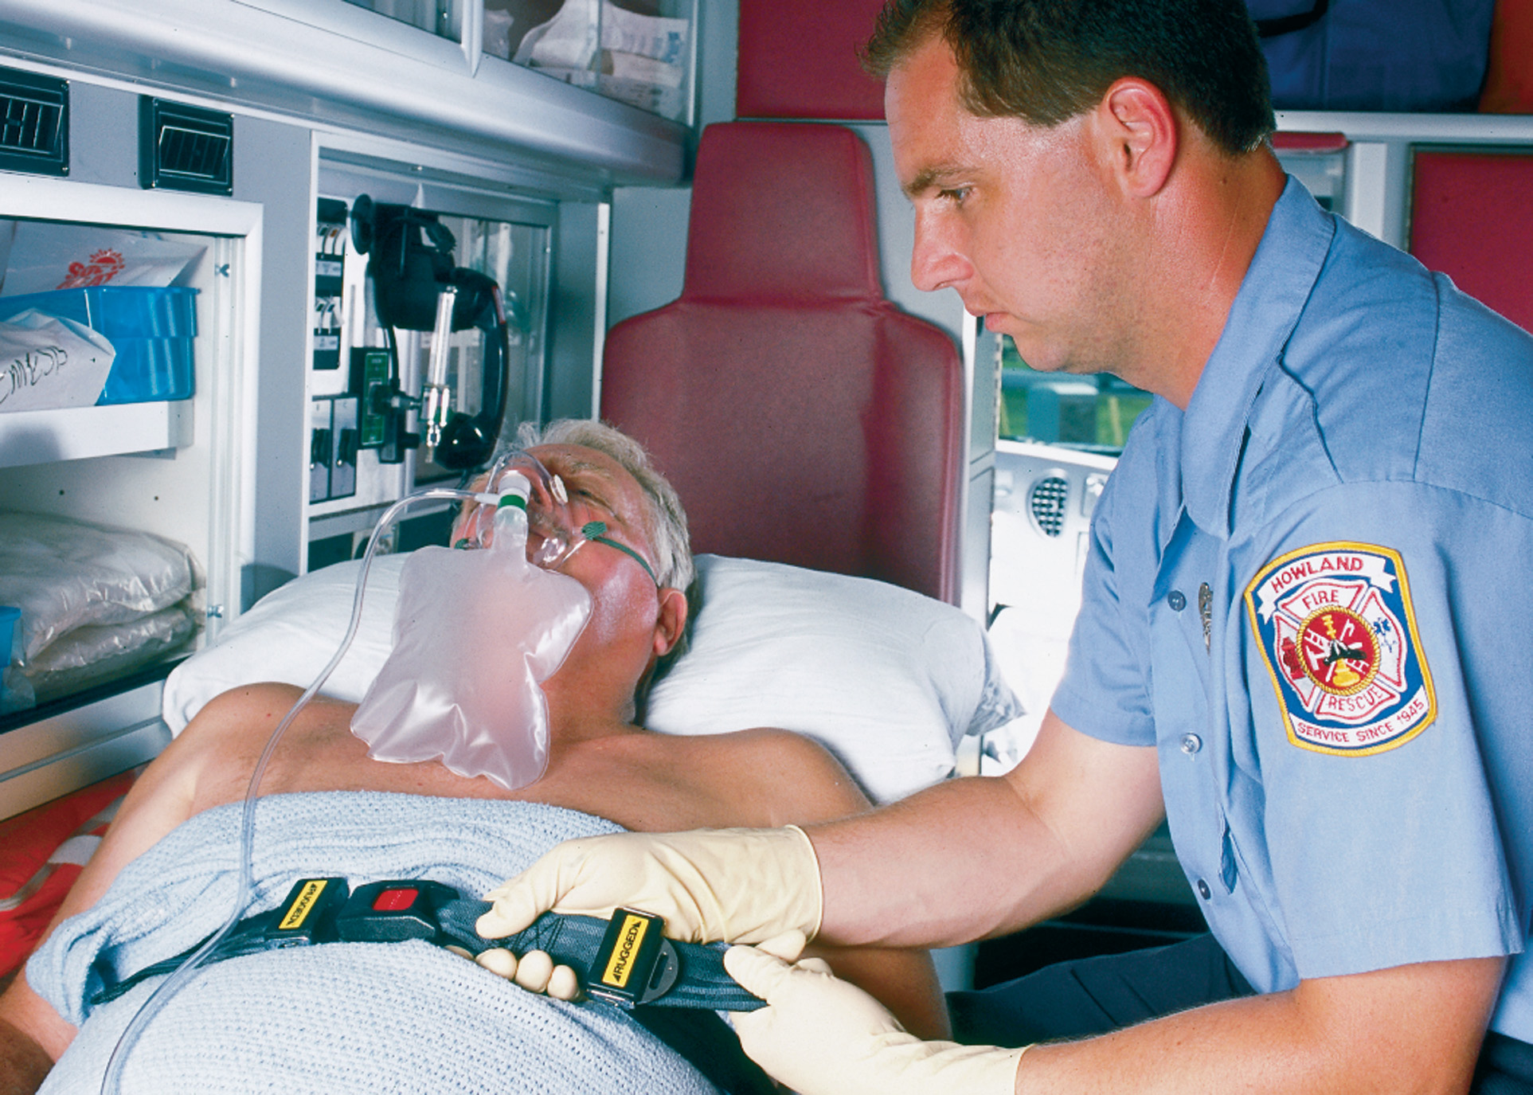
Ensure That the Patient is Secure
Notes:
Make sure your patient is settled and securely strapped to the cot before moving the ambulance.

Slide 58
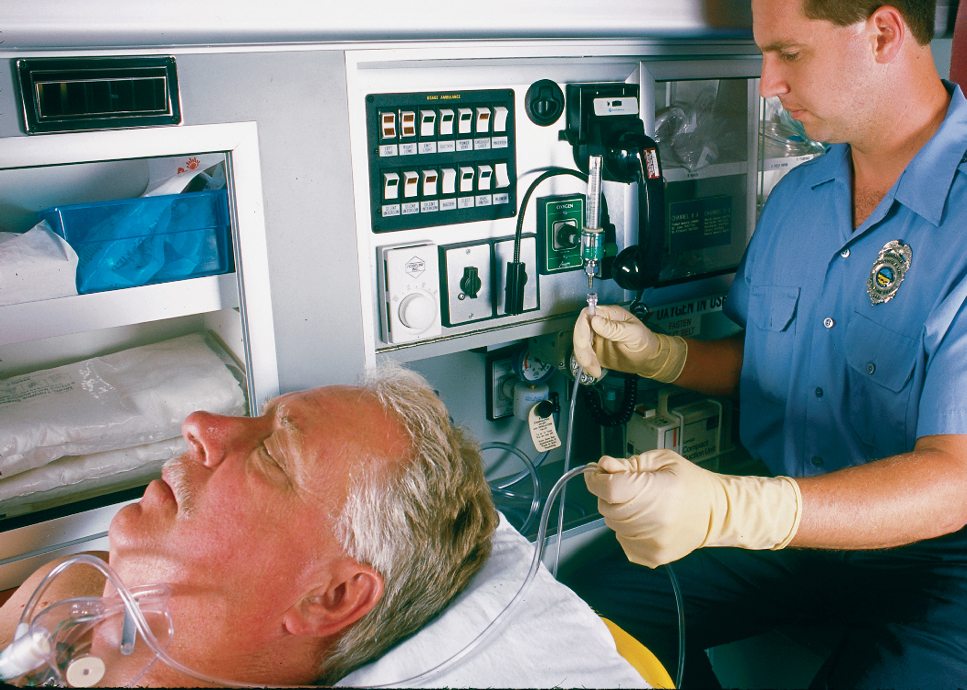
Change to On-Board Oxygen
Notes:
Check any patient interventions. Make sure oxygen is delivered at the correct flow rate. Check dressings and splints. Continue to reassure the patient.

Slide 59
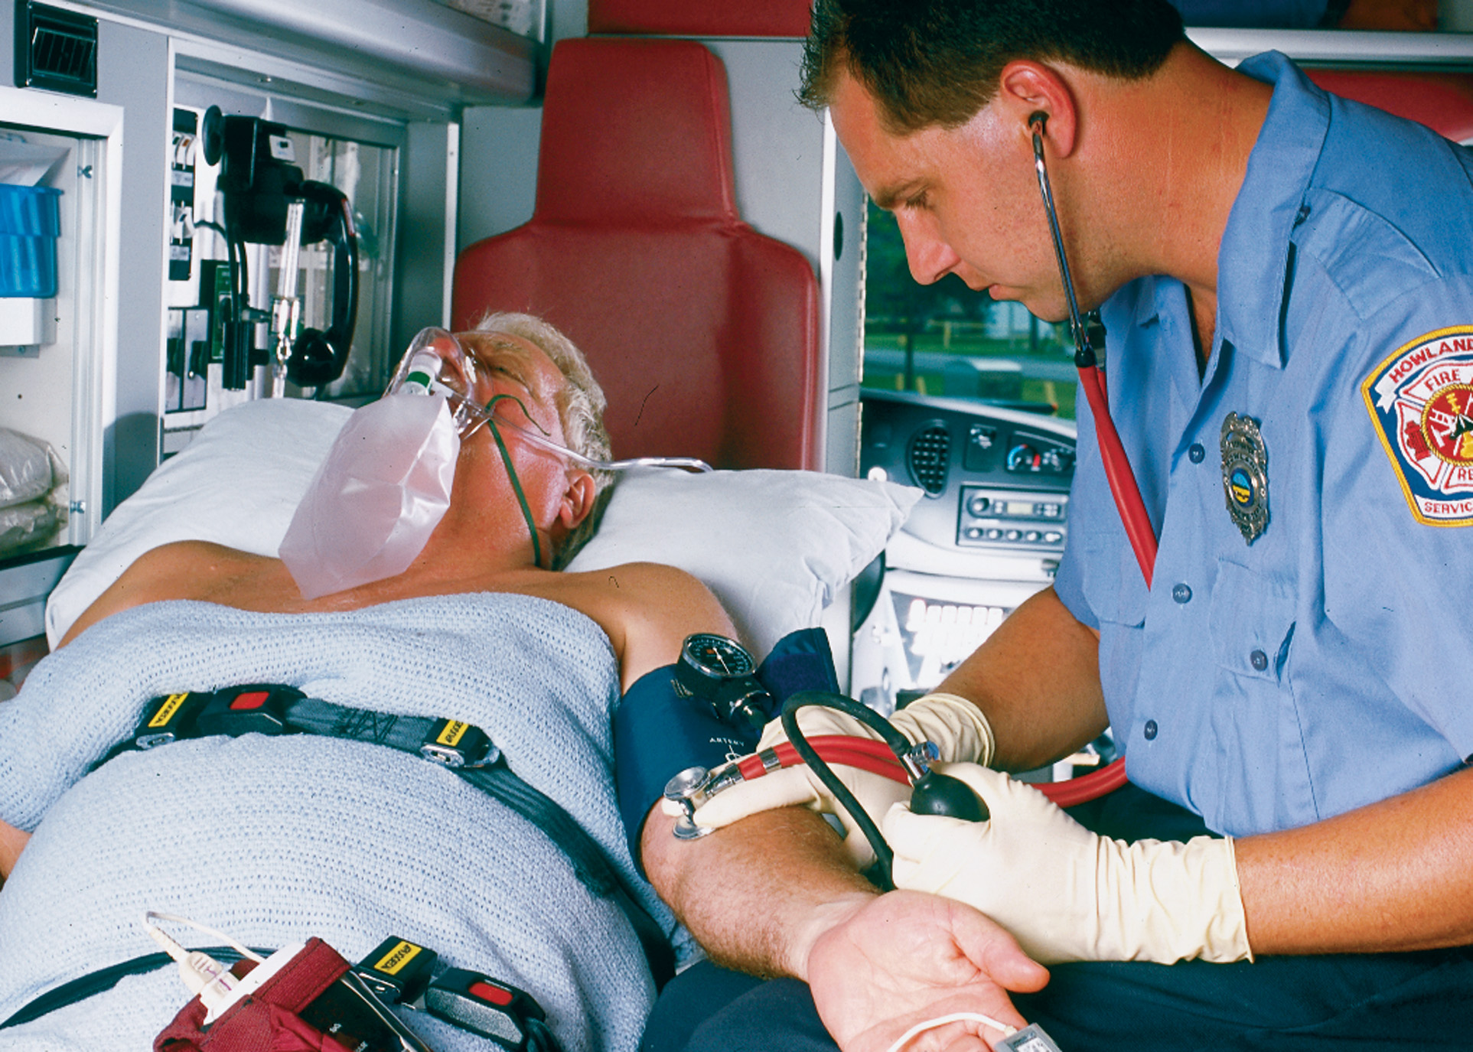
Perform Reassessment
Notes:
Begin your reassessment. This includes a reassessment of the patient’s mental status, airway, and breathing, recording vital signs. Conduct a reassessment at least every 15 minutes for a stable patient and every 5 minutes for an unstable patient.

Slide 60
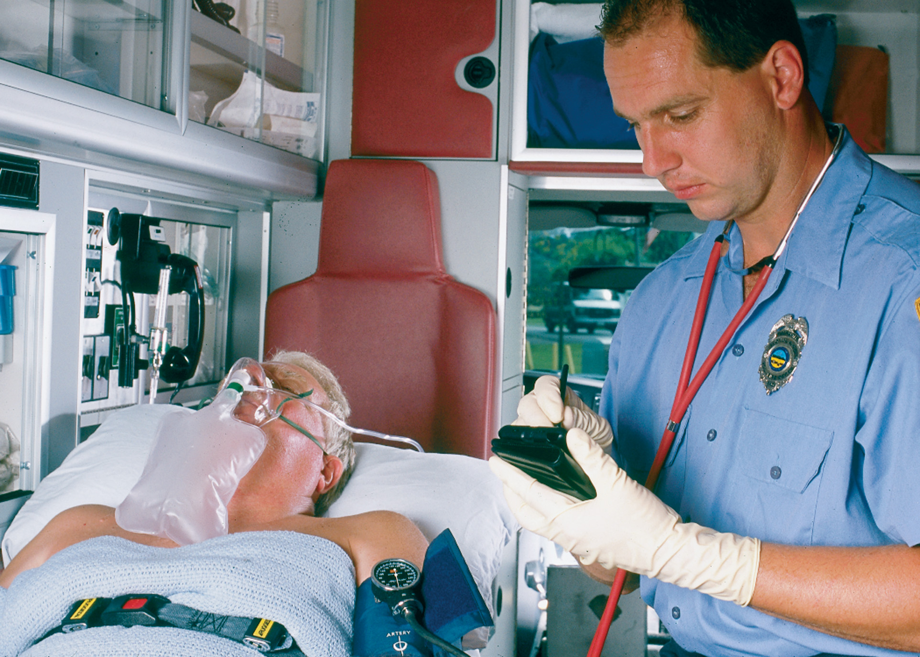
Document Your History and Other Assessment Findings
Notes:
Notify dispatch that you are en route to the hospital. Follow local protocols regarding transmission of additional patient information.

Slide 61
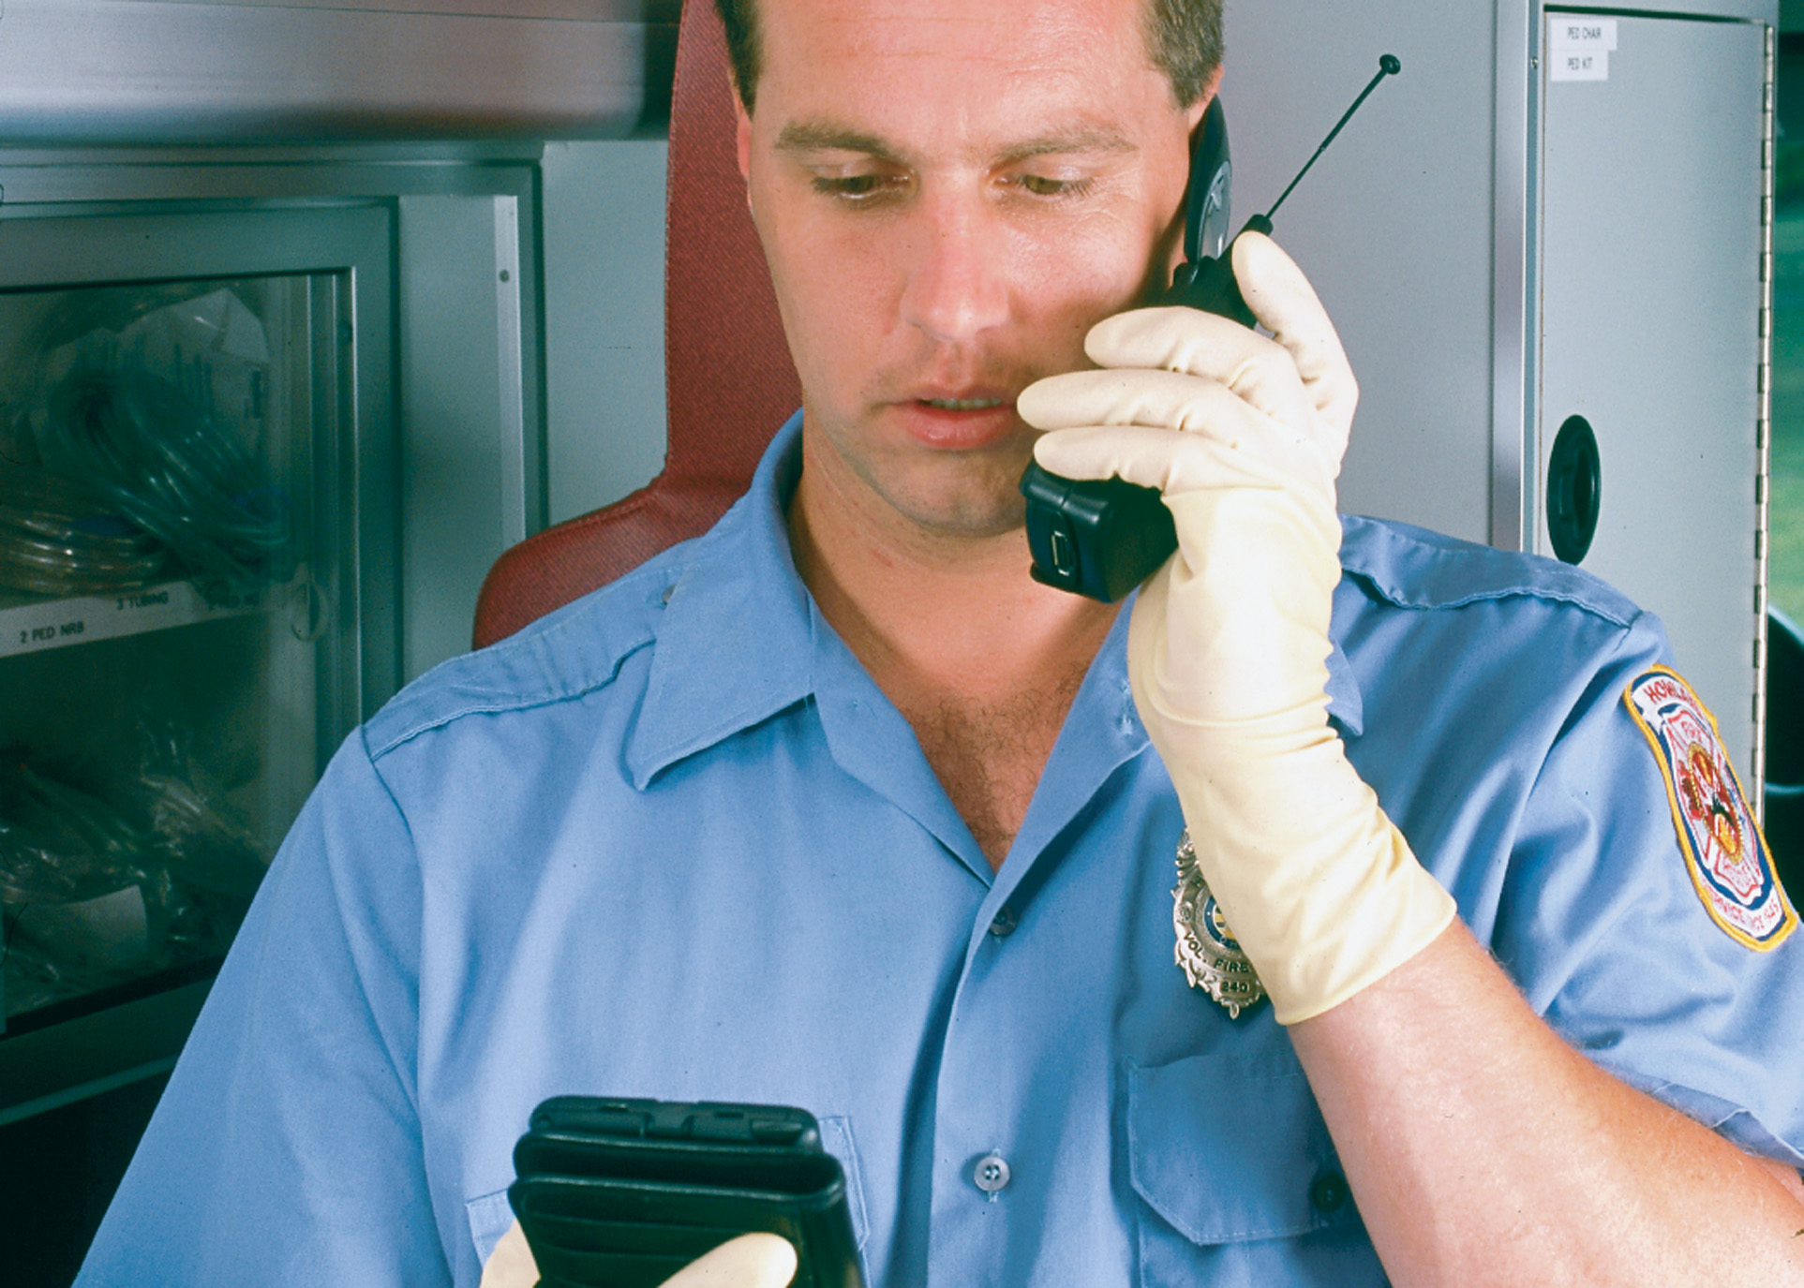
Communicate with Medical Direction and the Receiving Medical Facility
Notes:
Notify the receiving medical facility as soon as your patient’s condition permits you to call in a report. Sometimes, this might not be possible. In those situations in which the patient’s condition demands your full attention, request that your partner notify the hospital.

Slide 62
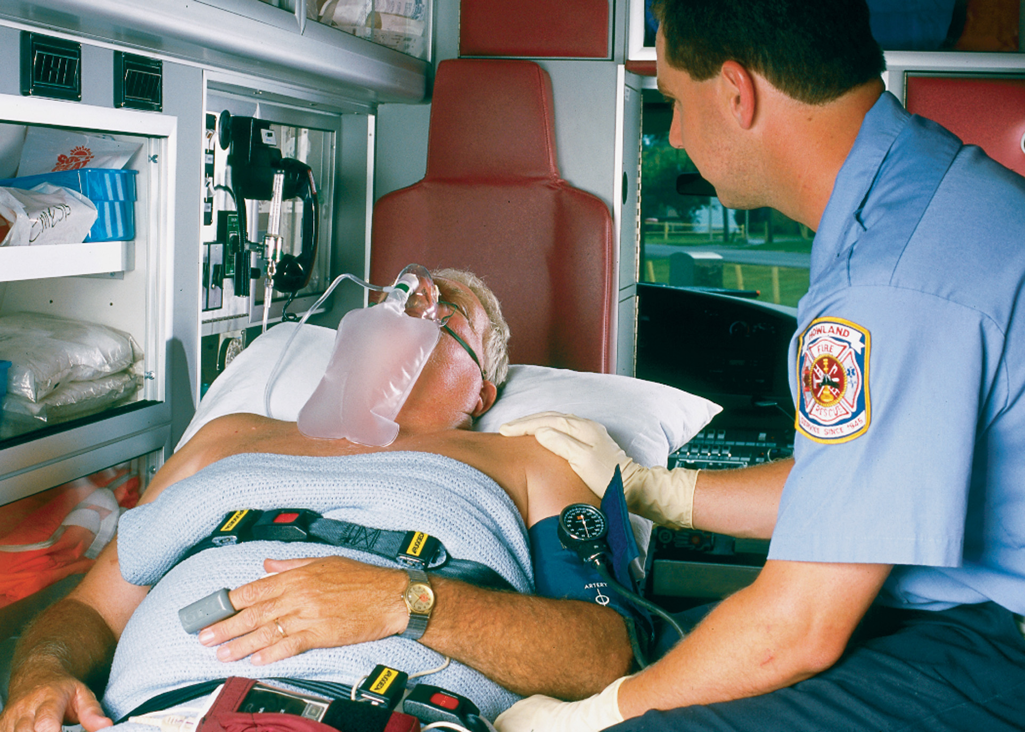
Make the Patient Comfortable and Reassure Him
Notes:
Focus on the patient. Reassure them as often as you can.

Slide 63
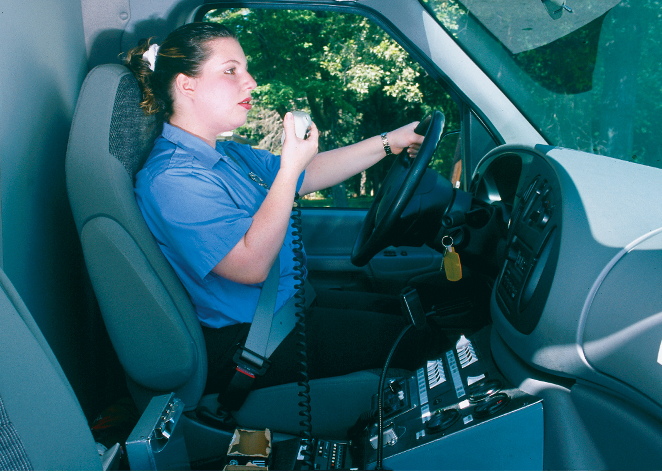
Notify Dispatch When You Are En Route and When You Have Arrived at the Receiving Medical Facility
Notes:
Notify dispatch that you are en route to the hospital. Follow local protocols regarding transmission of additional patient information.
Notify dispatch of your arrival at the medical facility.

Slide 64
Phases of an Ambulance Call (9 of 12)
At the Receiving Facility
  Transfer patient care, with all records, personal belongings and an oral report.
  Assist in moving the patient.
  Exchange linen and equipment that may be left with the patient.
  Complete the patient care report.
Notes:
You must make an official transfer of care to an appropriate health care provider at the receiving facility. As you make the transfer of care, continue to concentrate your care on the patient. Pay particular attention to any equipment that the patient requires in the continuum of care. If the receiving facility is crowded, continue to care for your patient until you can officially transfer your patient care responsibility to qualified personnel.
When you can, transfer all records and information about the patient to appropriate emergency department personnel.
To ensure proper continuity of care, a complete oral report should be given to emergency department personnel at the patient’s bedside. You should summarize the information given over the radio:
Introduce the patient by name (if known).
Repeat the patient’s chief complaint.
Provide additional vital signs taken en route.
Report any history not given previously.
Report any additional treatment you provided.
If requested, assist emergency department personnel in lifting and moving the patient to a hospital gurney or bed.
Make sure that any valuables or personal effects belonging to the patient are also transferred, and indicate this on your report.
After you have released your patient to the care of emergency department personnel, exchange any linens, spine boards, and other equipment you might have to leave at the hospital.
Complete the prehospital care report before you leave the hospital. Leave a copy at the emergency department. Follow local protocol if your system also requires you to leave a copy of your written report with the patient.
Before you leave, ask hospital personnel if you are needed further. You may need to transfer the patient to another medical facility or return the patient home if their condition is not serious enough to warrant hospital admission. Or you may simply provide hospital personnel any additional information regarding the scene or patient assessment findings.

Slide 65
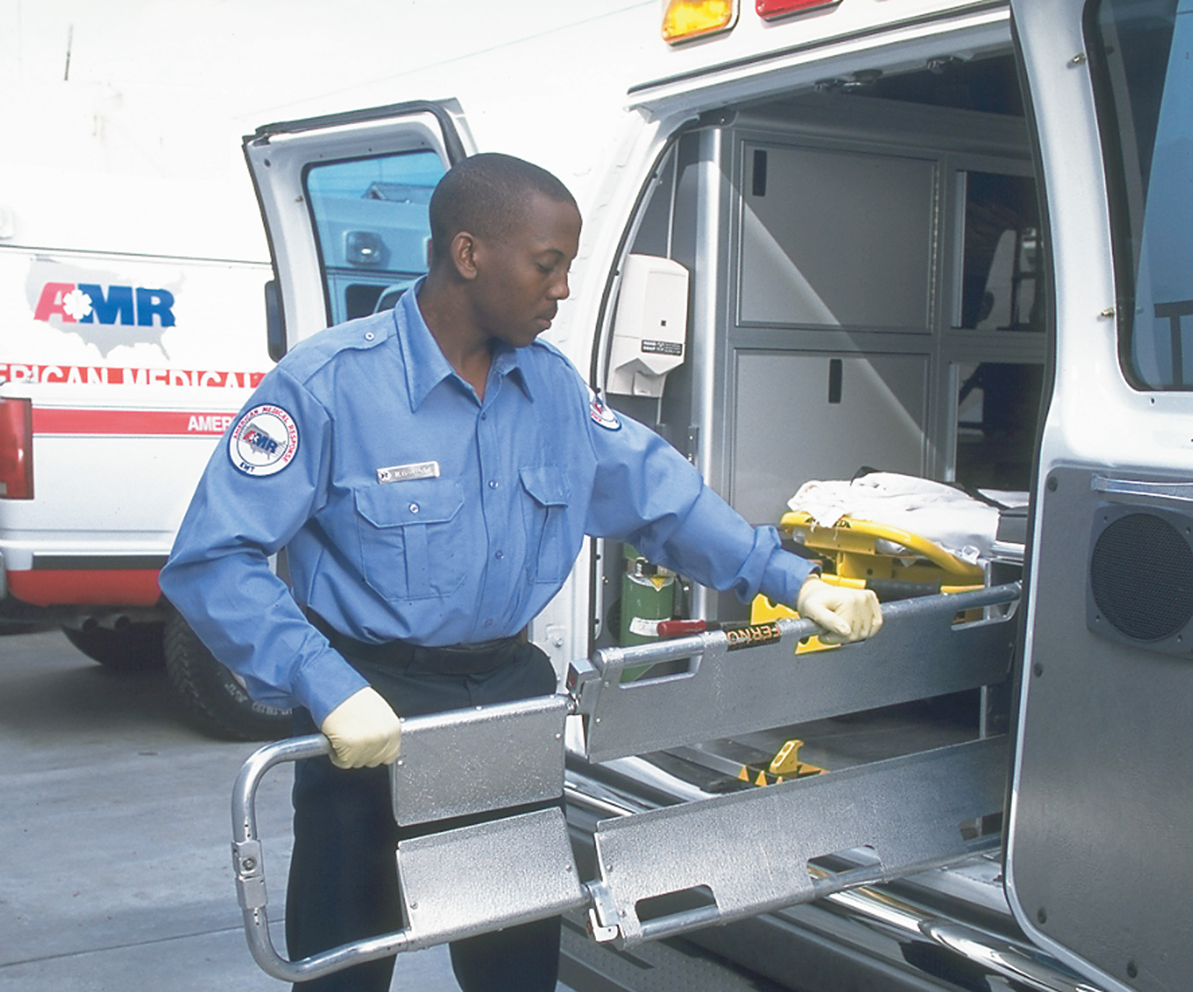
Put All Equipment in Its Proper Place
Notes:
After you have released your patient to the care of emergency department personnel, exchange any linens, spine boards, and other equipment you might have to leave at the hospital.

Slide 66
Phases of an Ambulance Call (10 of 12)
En Route to the Station or Response Area
  Before leaving the hospital, clean, inspect, and restock the ambulance.
  Wash your hands.
  Notify dispatch.
  Refuel if needed.
  Return to station.
Notes:
At the hospital, clean and inspect your ambulance, patient care equipment, reusable supplies, and patient care compartment before notifying dispatch of your availability. During particularly busy shifts, this can be difficult. Always follow your agency’s biohazard disposal procedures. Dispose of any contaminated linen. Disinfect any reusable patient care equipment. These steps are essential for the safety and health of you and your patients. After some calls, the ambulance requires extensive cleaning, disinfecting, and restocking. It might be necessary to go “out of service” and return to the station to clean, disinfect, and restock the ambulance.

Slide 67
Phases of an Ambulance Call (11 of 12)
Post Run
  Fill out and file any reports as required by local protocol.
  After each run, check fuel.
  Replace what you used during the run; clean and disinfect non-disposable equipment used.
  Change soiled uniforms.
Notes:
Discussion Question
What are the EMT's responsibilities in the post-run phase?

Slide 68
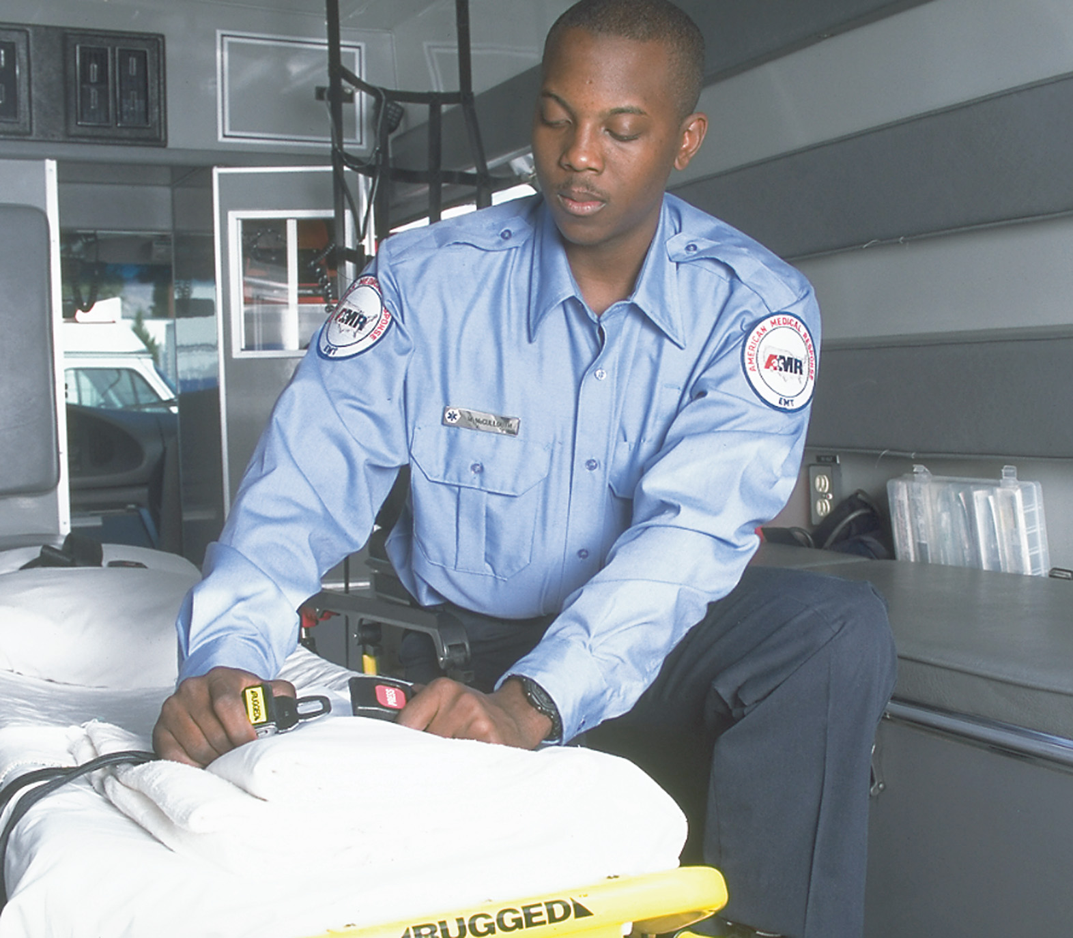
Make up the Wheeled Stretcher and Lock It in Place
Notes:
Complete an inventory of equipment and supplies. Replace what you used during the run and complete the cleaning and disinfection of nondisposable equipment used.

Slide 69
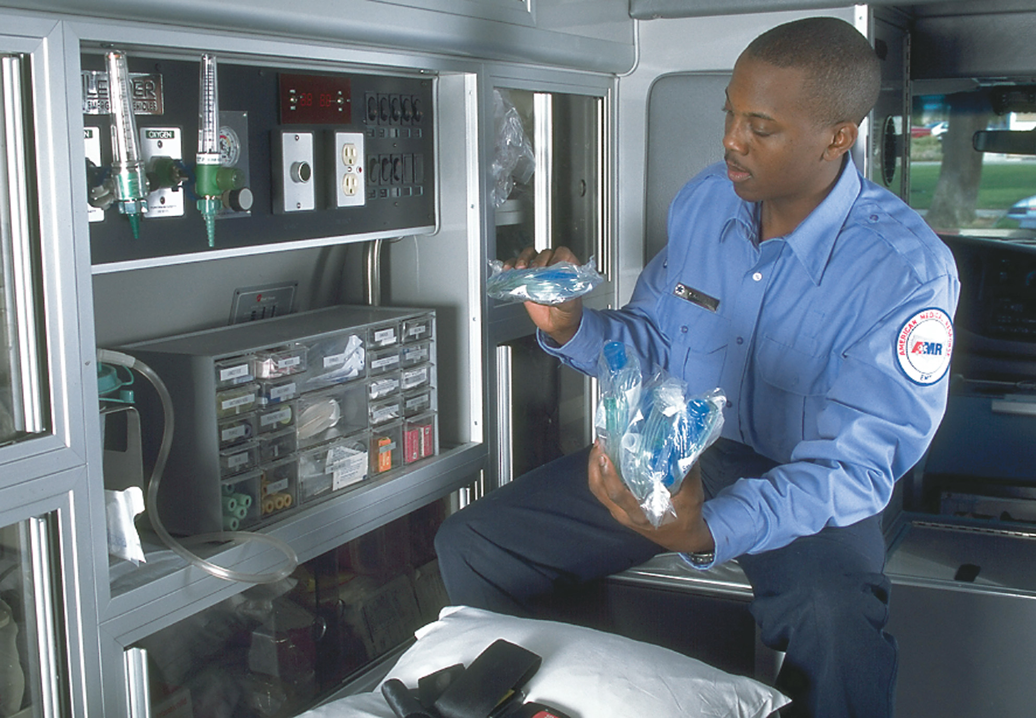
Complete an Inventory of Equipment and Supplies. Replace Necessary Equipment So That the Ambulance Is Fully Stocked
Notes:
Complete an inventory of equipment and supplies. Replace what you used during the run, and complete the cleaning and disinfection of nondisposable equipment used.

Slide 70
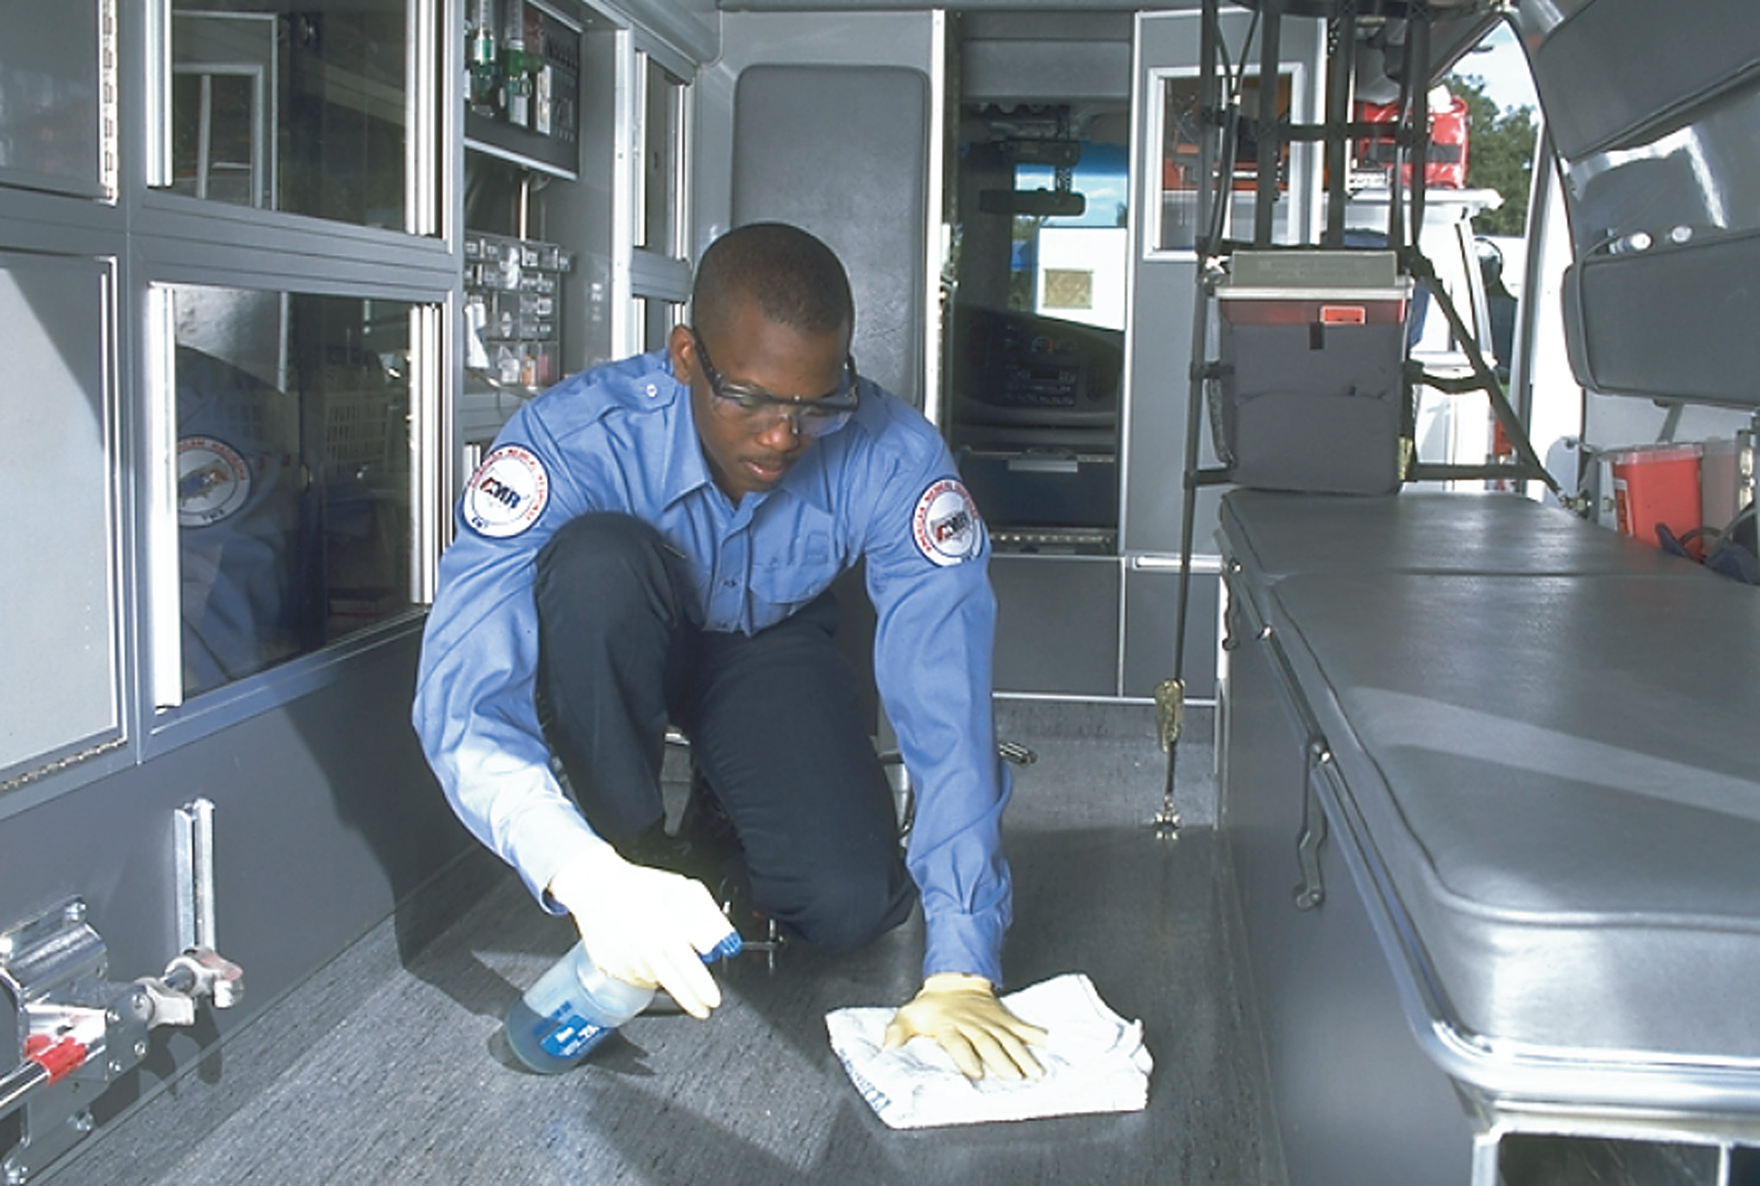
Clean and Disinfect the Patient Compartment
Notes:
Complete an inventory of equipment and supplies. Replace what you used during the run, and complete the cleaning and disinfection of nondisposable equipment used.

Slide 71
Phases of an Ambulance Call (12 of 12)
Post Run
  Infection Control Procedures
    Dispose of sharps
    Wash hands
    Clean, disinfect, or sterilize contaminated equipment.
Notes:
Clean up visible spills of blood, vomitus, or other body fluids.
Disinfect reusable patient care equipment.
Use low-level disinfection for routine housekeeping on environmental surfaces such as floors, ambulance seats, and countertops when there is no visible blood and contamination by body fluids or exposure to tuberculosis is not suspected.
Use intermediate-level disinfection for surfaces that contact intact skin, such as stethoscopes, blood pressure cuffs, or splints.
Use high-level disinfection for reusable instruments that contact mucous membranes, such as laryngoscopes, blades, and handles.
Sterilize equipment that will be used invasively.
Launder soiled clothing and linens.
Dispose of infectious wastes.

Slide 72
Click on the Phase of an Ambulance Call During Which E M T s Complete Checklists to Ensure the Vehicle is in Working Order and All Equipment is available
a. Post run
b. Prerun preparation
c. At the receiving facility
d. Dispatch

Slide 73
Air Medical Transport (1 of 5)
When to Request Air Medical Transport
  Operational Guidelines
    Patient transport to a distant facility
    Prolonged extrication for a high-priority
    Air transport will save time over ground transport in a time-critical patient.
    The patient is in a remote area.
    Ground ambulance transport is blocked.
    Specialty medical skills, supplies, or equipment are available.
Notes:
Teaching Tips
Arrange for a safety demonstration by an air medical transport service.
Discuss local policies and protocols related to air medical transport.
Discussion Question
What are the considerations in determining whether air medical transport is appropriate?
Knowledge Application
Students should be able to evaluate criteria for considering air medical transport.

Slide 74
Air Medical Transport (2 of 5)
When to Request Air Medical Transport
  Medical Guidelines
    Acute stroke
    Head injury with altered mental status and signs of herniation
    Chest or abdominal trauma with signs of respiratory distress or shock
    Serious mechanism of injury with unstable assessment or vital signs
    Unstable patient with a penetrating injury
Notes:
Some air medical services also provide aerial support to search and rescue operations. Consult with your regional air medical services to find out if they provide this service.

Slide 75
Air Medical Transport (3 of 5)
Requesting Air Medical Transport
  Your name
  Department name
  Callback number
  Nature of the incident
  Exact location of the incident
  Your radio frequency
  Exact location of the landing zone and hazards
Notes:
In many cases, local and state guidelines exist regarding the use of air medical transport and even provide specific criteria for when it can be used. Some city, county, or regional ordinances require that the fire department be present when landing a helicopter. Make sure that you are familiar with any guidelines or policies in your area.

Slide 76
Air Medical Transport (4 of 5)
Additional Considerations for Air Medical Transport
  Weather/environmental limitations
  Altitude limitations
  Airspeed limitations
  Aircraft cabin size
  Terrain
  Cost
  Patient preparation
Notes:
Noise within the aircraft will limit your ability to conduct a thorough assessment of the patient, especially when hearing is necessary such as monitoring breath sounds or auscultating blood pressure.
Critical Thinking Discussion
What are some disadvantages in using air medical transport?

Slide 77
Air Medical Transport (5 of 5)
Guidelines for Setting Up a Landing Zone
  Clear of obstructions, flat, free of debris, and 150 feet from collision vehicles
  Minimum 60 feet by 60 feet for day; 100 feet by 100 feet for night
  If highway, stop traffic both ways
  Consider the wind direction.
  Mark each corner of the landing area.
  Fifth warning device on the upwind side
Notes:
If the landing site is a divided highway, stop the traffic going in both directions, even though the aircraft will land on only one side of the highway.
Helicopters take off and land into the wind by preference, rather than making vertical descents and ascents. Establish radio communications with the incoming flight crew and warn them of any power lines, poles, antennas, trees, or other obstructions.
Mark each corner of the landing area with a highly visible device: a flag or surveyor’s tapes by day and a flashing or rotating light at night. Use flares by day or night but only if there is no danger of fire. A beam of light should not be directed upward.
If conditions are dusty or dry enough to create a fire hazard, have the area wet down, if possible.
Keep the patient and crew clear of the air downwash area. Spectators should be at least 200 feet away. EMT personnel should be at least 100 feet away during landing.
Assign one person to guide the pilot in. They should wear eye and ear protection and should stand near the wind direction marker with their back to the wind, facing the touchdown area, arms raised overhead to indicate the landing direction.

Slide 78
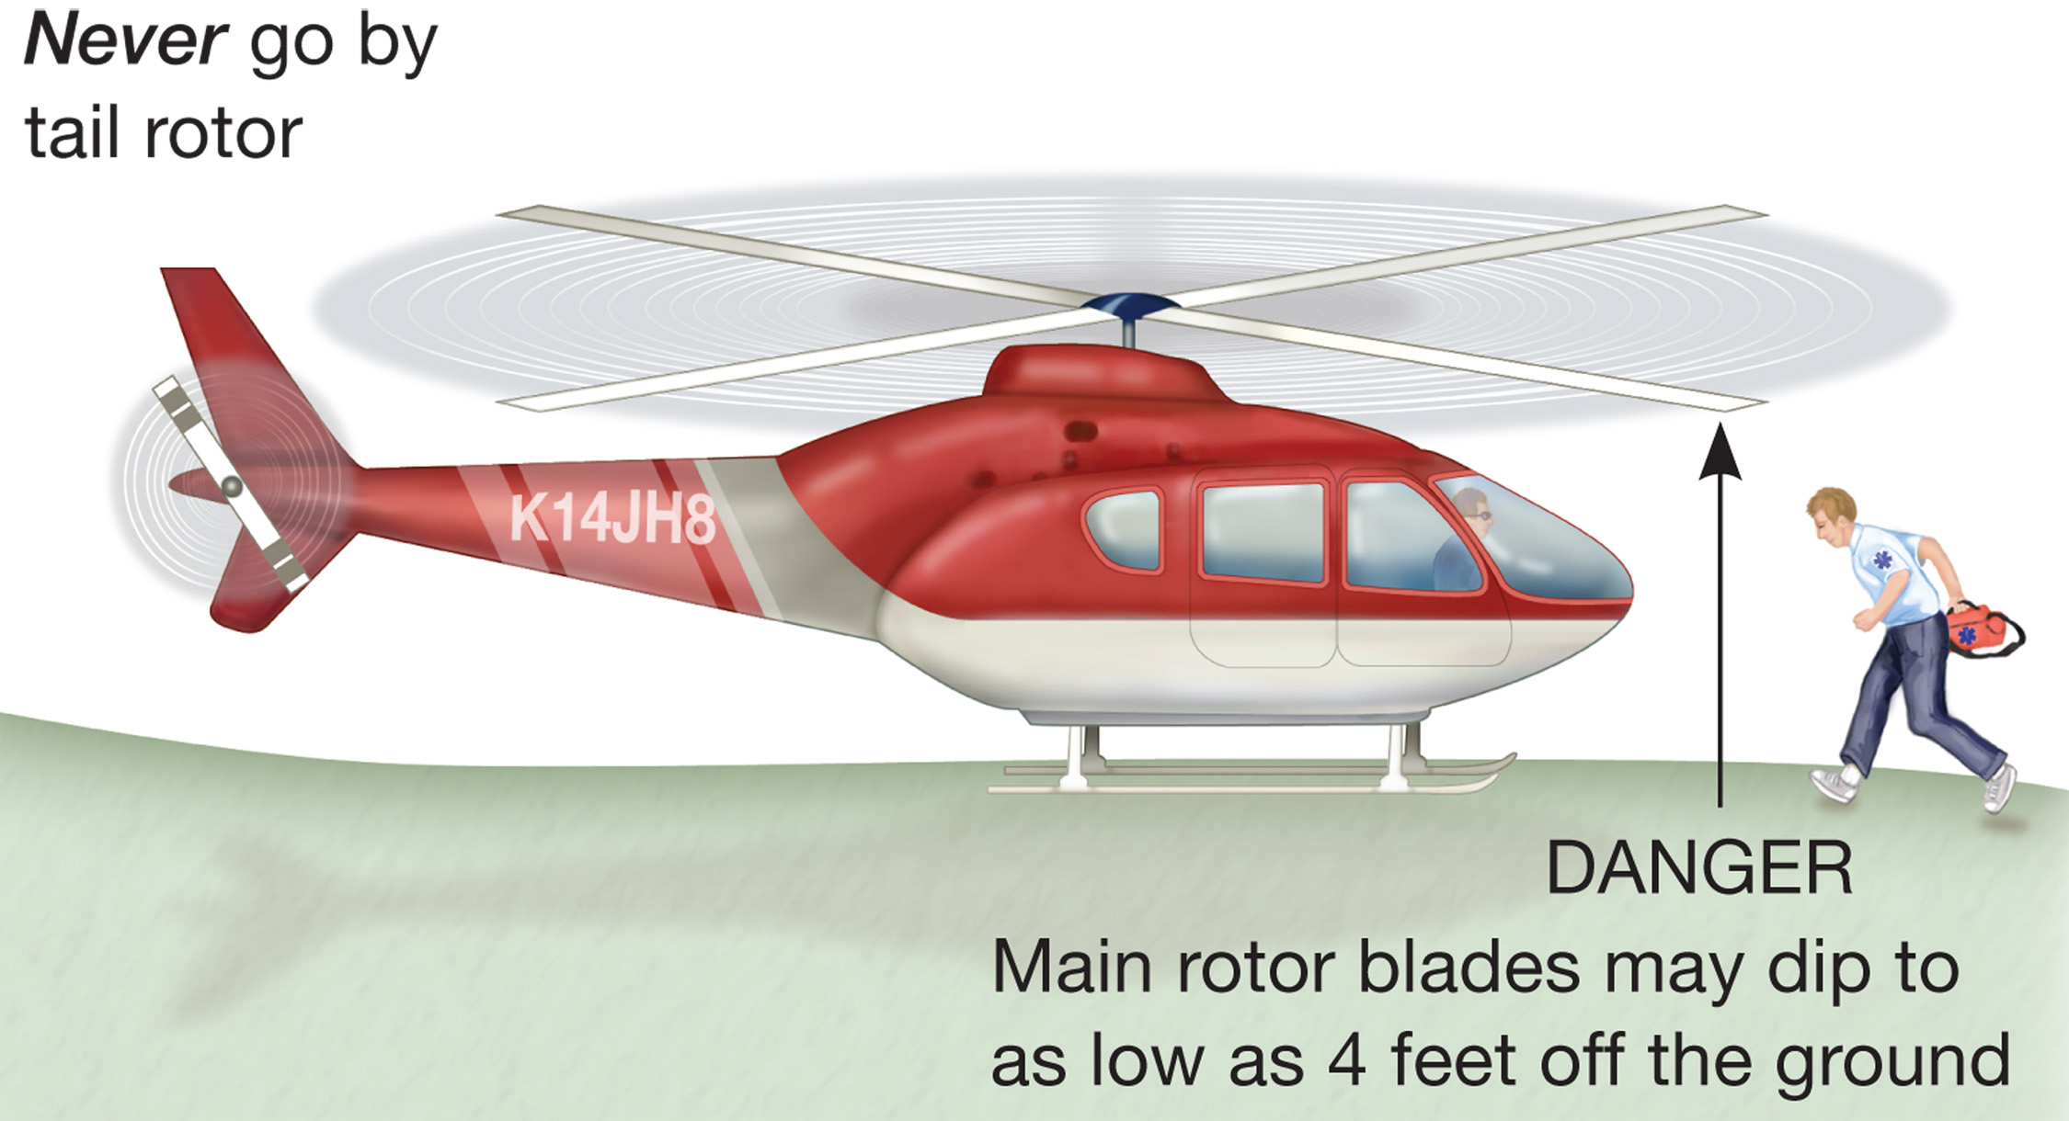
Always Crouch When Approaching or Leaving a Helicopter
Notes:
Be extremely cautious about the rotor blades. Remember that the tips can dip as low as 4 feet above the ground. Always crouch when approaching or leaving the helicopter, and approach or leave only at the pilot’s direction.
Never approach a helicopter until the pilot indicates it is safe. Never approach from behind the pilot. The pilot cannot see behind the craft, the tail rotor is spinning quickly, and the pilot sometimes needs to move the tail boom without warning. If you need to go from one side to another, always cross in front of the craft, never behind it or underneath it.

Slide 79
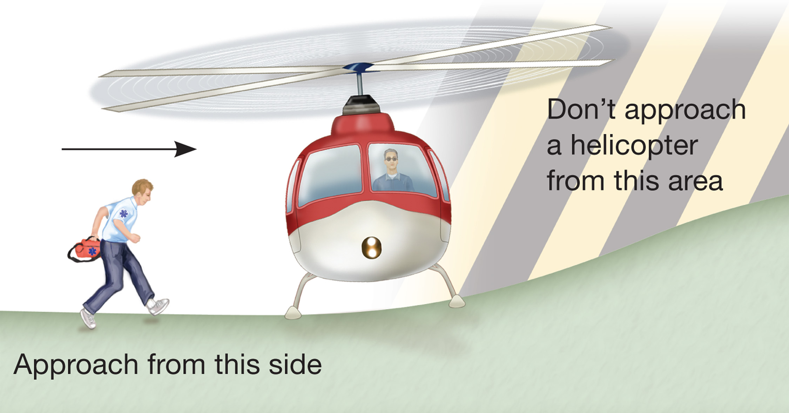
Approach a Helicopter from a Downhill Direction
Notes:
If the helicopter must land on an incline, always approach from the downhill side, never from the uphill side.

Slide 80
Security and Safety (1 of 6)
Operational Security Measures
  There are recommended guidelines to avoid use of emergency vehicles in terrorist attacks and to reduce the risk of theft.
  Personnel
    Conduct security briefings each shift.
    E M S crews should be informed and allowed to participate in development of security measures.
Notes:
Knowledge Application
Students should be able to apply basic safety and security measures to prevent unauthorized use of ambulances and to prevent carbon monoxide poisoning.

Slide 81
Security and Safety (2 of 6)
Operational Security Measures
  Vehicle
    All vehicles must be tracked at all times.
    E M S vehicles should not be left running or unattended with the keys in the vehicle.
Notes:
All EMS vehicles must be tracked. That includes vehicles that are in service, out of service being repaired, and off service. It also includes reserve units and those units that are no longer in service and will be salvaged.

Slide 82
Security and Safety (3 of 6)
Tracking Vehicle Access
  No access by unauthorized persons
  Keeping a key log
  Security measures to be followed during repairs
  All markings must be destroyed when vehicles are sold or salvaged and warning devices must be removed.
Notes:
Ensure that security measures are strongly enforced when the EMS vehicle is off the EMS premises for repairs or other work conducted by repair or installation facilities. These should include securing the vehicle indoors overnight when the facility is not open, not leaving the keys in the vehicle or in a place where there is easy access, not allowing the vehicle to leave the premises for any unauthorized travel when being repaired, and reporting any unusual interest by an individual related to an EMS vehicle.

Slide 83
Security and Safety (4 of 6)
Uniforms and Identification
  Safeguard identification cards and patches from unauthorized persons.
  I D cards and badges should be counterfeit resistant and have a photo of the provider.
  Uniform stores must verify the identification of persons buying uniforms or identification items.
Notes:
The EMS agency should provide identification credentials to anyone who is to purchase EMS uniforms or identification items. A check should be made against a database of authorized purchasers of these types of items.

Slide 84
Security and Safety (5 of 6)
Carbon Monoxide in Ambulances
  May Come From:
    The vehicle's exhaust.
    Equipment powered by gasoline or fuel.
    Exhaust of vehicles parked next to or traveling by the ambulance.
    Greater outside air pressure, which forces the C O into the ambulance.
Notes:
Teaching Tips
Discuss local policies relating to security and prevention of carbon monoxide poisoning.
Discussion Questions
What are the signs and symptoms of carbon monoxide poisoning?
What measures can you take to decrease your risk of carbon monoxide poisoning?

Slide 85
Security and Safety (6 of 6)
To Prevent Carbon Monoxide Poisoning:
  Have frequent engine tune-ups.
  Have an adequate exhaust system.
  Keep rear windows shut.
  Make sure doors shut tightly.
  Covering any opening to the outside.
  Don’t use exhaust fans or static vents.
  Keep the heater or A C on.
Notes:
Don’t use supplemental equipment that is powered by gasoline or liquid petroleum gas inside the ambulance.

Slide 86
Case Study Conclusion (1 of 2)
Gary and Harold park the ambulance and put on their reflective gear. They perform a careful scene size-up and determine that they have a single patient.
After assessing the patient and beginning treatment, they begin transport to the hospital, where they transfer patient care to the emergency department staff.
Notes:
Case Study Discussion
Review case conclusion and emphasize the application of knowledge learned from this presentation.

Slide 87
Case Study Conclusion (2 of 2)
Gary finishes the patient care report, while Harold takes the steps necessary to return the ambulance to service.
Notes:
Case Study Discussion
Review case conclusion and emphasize the application of knowledge learned from this presentation.

Slide 88
Lesson Summary (1 of 3)
Ambulances crashes kill and severely injure many E M Ts, patients, and others.
E M Ts must obey all laws and regulations when operating an ambulance and must exercise due regard.
Notes:
Follow-Up
Answer student questions.
Follow-Up Assignments
Review Chapter 42 Summary.
Complete Chapter 42 In Review questions.
Complete Chapter 42 Critical Thinking questions.
Assessments
Handouts
Chapter 42 quiz

Slide 89
Lesson Summary (2 of 3)
E M Ts have specific responsibilities during each phase of an ambulance call.
E M Ts must take special steps in preparing to interact with an air medical transport crew.
Notes:
Follow-Up
Answer student questions.
Follow-Up Assignments
Review Chapter 42 Summary.
Complete Chapter 42 In Review questions.
Complete Chapter 42 Critical Thinking questions.
Assessments
Handouts
Chapter 42 quiz

Slide 90
Lesson Summary (3 of 3)
Safety and security issues with ambulances include safeguarding against improper use of ambulances and preventing carbon monoxide exposure.
Notes:
Class Activity
As an alternative to assigning the follow-up exercises in the lesson plan as homework, assign each question to a small group of students for in-class discussion.
Teaching Tips
Answers to In Review questions are in the appendix of the text. Advise students to review the questions again as they study the chapter.

Slide 91
Correct!
E M Ts perform a checklist at the beginning of each shift to make sure the vehicle is safe and operational and all needed equipment and supplies are available.
Click here to return to the Program.

Slide 92
Incorrect (1 of 3)
Post run responsibilities include those things that help the crew prepare for the next emergency run. For example, completing the P C R, refueling the ambulance, and restocking the ambulance
Click here to return to the quiz.

Slide 93
Incorrect (2 of 3)
Tasks to complete while at the receiving facility includes notifying dispatch, providing an updated bedside report, and transferring care.
Click here to return to the quiz.

Slide 94
Incorrect (3 of 3)
Dispatch will provide the location, address, and nature of the call. This information is needed to initiate the crew’s response to the emergency.
Click here to return to the quiz.

Slide 95
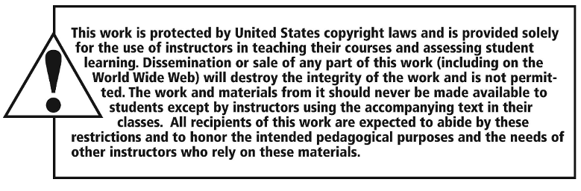
Copyright

