Slide 1

Prehospital: Emergency Care
Eleventh Edition
Chapter 41
The Combat Veteran
Slides in this presentation contain hyperlinks. JAWS users should be able to get a list of links by using INSERT+F7
Copyright © 2018, 2014, 2010 Pearson Education, Inc. All Rights Reserved
Notes:
If this PowerPoint presentation contains mathematical equations, you may need to check that your computer has the following installed:
1) MathType Plugin
2) Math Player (free versions available)
3) NVDA Reader (free versions available)
Advance Preparation
Student Readiness
Assign the associated section of MyBRADYLab and review student scores.
Review the chapter material in the Instructor Resources, which includes Student Handouts, PowerPoint slides, and the MyTest Program.
Prepare
Make copies of course policies and procedures, the syllabus, handouts from the Instructor Resources, and other materials for distribution or post them in your learning management system.
Preview the media resources and Master Teaching Notes in this lesson.
Preview the case study presented in the PowerPoint slides.
The total teaching time recommended is only a guideline. Take into consideration factors such as the pace at which students learn, the size of the class, breaks, and classroom activities. The actual time devoted to teaching objectives is the responsibility of the instructor.

Slide 2
Learning Readiness
E M S Education Standards, text p. 1244.
Chapter Objectives, text p. 1244.
Key Terms, text p. 1244.
Purpose of lecture presentation versus textbook reading assignments.
Notes:
Explain to students what the National EMS Education Standards are. The National EMS Education Standards communicate the expectations of entry-level EMS providers. As EMTs, students will be expected to be competent in these areas. Acknowledge that the standards are broad, general statements. Although this lesson addresses the listed competencies, the competencies are often complex and require completion of more than one lesson to accomplish. The student is also expected to review the chapter objectives to foreshadow what will be in the chapter. By mastering the key terms the EMT student will better understand the learning and be able to communicate more clearly.
Additionally, explain to the students that the purpose of using these slides is to help keep the instructor focused on highlighting important portions of the material, explain interrelationships of topics, and discuss how to apply this information. It’s not the intent of the presentation (or slides alone) to include every component in the chapter. This presentation still requires the student to thoroughly read the chapter.

Slide 3
Setting the Stage (1 of 2)
Overview of Lesson Topics
  The Psychophysiology of Stress Response
  Combat Veterans
  The Nature of P T S D
  Assessing and Providing Emergency Care to Combat Veterans: Recommendations for E M T s
Notes:
These bulleted points are the major headings from the chapter, in order. The purpose is to help the student navigate the lesson.

Slide 4
Case Study Introduction
E M T s Jenny Samuels and Deena Middleman arrive at the scene of a minor, single-vehicle collision. The driver is the only patient, and seems to be inordinately angry about having missed his turn and skidded into a utility pole. A police officer on the scene says, “I’m a vet. Something tells me this guy is, too. There is something more to this than the accident.”
Notes:
Case Study
Present the Case Study Introduction provided in the PowerPoint slide set.
Lead a discussion using the case study questions provided on the subsequent slide(s).
The Case Study with discussion questions continues throughout the PowerPoint presentation.
Case Study Discussion
Use the case study content and questions to foreshadow the upcoming lesson content.

Slide 5
Case Study
What are some clues that Jenny and Deena might look for in helping determine if the patient is a combat veteran?
How can they assess whether the patient is a risk to himself or others?
What special considerations are there in the interaction with this patient?
Notes:
Use the case study content and questions to foreshadow the upcoming lesson content. Gauge the students’ responses as a guide of how well versed they are in this topic.

Slide 6
Introduction
Combat veterans comprise less than 1 percent of the population, but can present unique challenges related to post traumatic stress disorder.
P T S D can affect anyone who has undergone a significant trauma.
Notes:
During this lesson, students learn about special considerations for dealing with combat veterans.

Slide 7
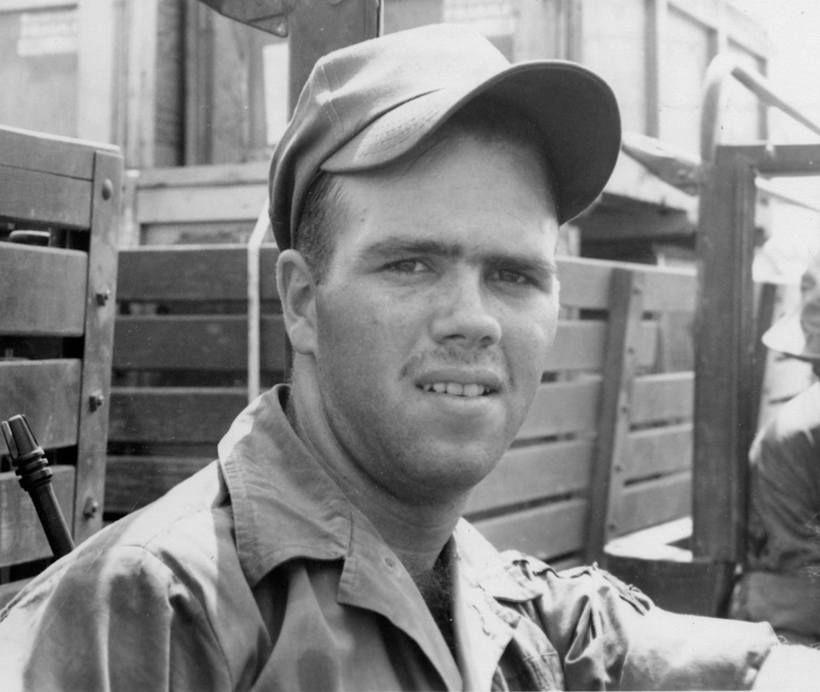
The Facial Expression Often Known as the Thousand Yard Stare May be a Reaction to the Abnormal Stresses of Combat
Notes:
During this lesson, students will learn about special considerations for dealing with combat veterans.

Slide 8
The Psychophysiology of Stress Response
The stress response is a result of sympathetic nervous system (S N S) activity.
  Epinephrine and norepinephrine are released by the adrenal glands.
  The body is prepared for action.
  Normally, the parasympathetic nervous system (P N S) balances the S N S.
  In P T S D, the S N S remains activated.
Notes:
Critical Thinking Discussion
What are some current misunderstandings about PTSD?
Sympathetic nervous system (SNS) effects:
Increased Heart Rate
Blood Channeled to Core
Dilated Pupils
Slowed Food Digestion
Increased Blood Pressure
Sharpened Senses
Release of Clotting Factors
Hyperalert State

Slide 9
Combat Veterans (1 of 3)
P T S D in a combat veteran is different from a war-era veteran.
Each veteran has individual issues.
Notes:
Points to Emphasize
There are about 22 million combat veterans.
Clues to Help Identify a Combat Veteran
Military-style haircut
Military clothing, such as combat boots
War memorabilia, such as photos showing battle gear
Photographs of other soldiers, combat buddies
KIA bracelet (commemorating a person killed in action)
Tattoos
Combat patches
Commendation awards
American flag
Veteran license plate
Military vocabulary/demeanor/bearing
Respect for authority
Reluctance to seek assistance

Slide 10
A History of Combat Service May be Relevant to the Emergency Your Patient is Now Experiencing
A variety of clues can help identify the patient as a combat veteran, such as a “high and tight” military haircut.
(© Alamy )
Notes:
Less than 1 percent of the population, or about 22 million individuals, are combat veterans; 250,000 are women.
Ages range from the 20s into the 80s.

Slide 11
Combat Veterans (2 of 3)
Phrase questions carefully.
  Use, “Where did you see combat?” instead of, “Did you see combat?”
  Do not ask if the veteran has ever killed anyone.
Notes:
98 percent of combat veterans were under fire.
90 percent know someone who was killed.
80 percent saw dead bodies.
40 percent know someone who has committed suicide.

Slide 12
Combat Veterans (3 of 3)
Two-thirds have severe relationship problems since their return.
25 percent of the homeless are veterans.
Two-thirds have P T S D.
Notes:
Discuss statistics about veterans. Ask the class if there is anyone in their immediate family who served in the armed forces.

Slide 13
The Nature of P T S D (1 of 9)
P T S D is a collection of signs and symptoms.
P T S D is a reaction of a normal person to an abnormal situation.
There is sustained S N S activity.
Memories linger and are disruptive to the person.
Notes:
Critical Thinking Discussion
What accounts for the high rate of suicide among combat veterans?
Discussion Question
What accounts for the high level of drug and alcohol abuse among combat veterans?

Slide 14
The Nature of P T S D (2 of 9)
P T S D Four Essential Features:
  Response can involve feelings of anger, fear, horror, and helplessness.
  Reliving events through flashbacks, unwanted thoughts, or nightmares.
  Avoiding anything that reminds him, physically or emotionally of the trauma.
  Anxiety or anger with much time spent in a state of perceived imminent threat.
Notes:
Any event or circumstance related to the original trauma can trigger this re-experience. For example, snow is a reminder of Korea. A palm tree is a reminder of Vietnam. Even the Arizona desert looks like Afghanistan.
The nervous system’s arousal caused by the trauma can result in a “fight or flight” response that is so extreme the veteran simply cannot suppress it. The traumatic event is perceived as immediate, even though it can be months or years later.

Slide 15
The Nature of P T S D (3 of 9)
Signs and Symptoms of P T S D
  Guilt
  Shame
  Avoidance of others
  Depression
  Paranoia
  Hostility
  Feeling they will not live much longer
  Agitation and anger.
Notes:
The level of frustration and anger cannot be overstated; these emotional states can be overwhelming to the veteran as well as to the EMT.

Slide 16
The Nature of P T S D (4 of 9)
Associated Signs and Symptoms of P T S D
  Physical responses include pain, which may be vague or unfocused
  Signs of premature aging.
Notes:
Combat vets can show early signs of aging, such as heart disease, type 2 diabetes, and a loss of brain gray matter. These aging-related physical problems can occur among combat vets at twice the rate as in healthy adults of the same age.

Slide 17
The Nature of P T S D (5 of 9)
Alcohol and Drug Use
  Resulting heightened S N S activity
  40 percent of veterans engage in pathological use of alcohol or drugs.
  Denial is common.
Notes:
When interviewing veterans, a good assessment question is, “What’s the most you can drink (or drug you can use) and still walk and talk?” The answer can lead the EMT to understand the actual level of use because of the structure of the question, as opposed to “How much do you drink?”

Slide 18
The Nature of P T S D (6 of 9)
Danger to Self or Other
  Combat veterans are no more likely to be violent toward others than other veterans are.
  Combat veterans’ suicide rate is 30 percent higher than that of other veterans.
  Prediction of who will be a danger to himself or others is difficult.
Notes:
Factors in assessing danger:
Ensure your own safety first.
Involve others where you can.
A past history of violence is a good predictor of future violence.
Talking about suicide or homicide will not increase its likelihood of happening.
Get rid of any possible weapon.
A tense, agitated, yelling, pacing patient, or one who has not slept or is intoxicated is at risk of becoming violent.
Use physical restraints only as a last resort; they will exacerbate the patient's state.
Trust a "gut feeling" of impending danger.
The suicide formula: pain or turmoil that is believed to be unchangeable, unending and unbearable
Anniversary reactions increase risk for violence.
70 percent of suicide victims have previously told someone of their intent.

Slide 19
The Nature of P T S D (7 of 9)
Signature Wounds of Combat Veterans
  In Iraq and Afghanistan, improvised explosive devices (I E D s) resulted in amputations and traumatic brain injury (T B I).
  T B I is an alteration in brain function as a result of external force.
Notes:
300,000 soldiers have been diagnosed with TBI.
Delayed effects include high cholesterol, hypertension, and diabetes.

Slide 20
The Nature of P T S D (8 of 9)
T B I Versus P T S D: Signs and Symptoms
  There is overlap in the signs and symptoms.
  Loss of consciousness is not necessary for diagnosis of T B I.
  Most T B I s have been diagnosed, but some may have been missed.
  T B I and P T S D can coexist.
Notes:
TBI increases the likelihood of PTSD. This should help the EMT decide what actions to take regarding patient care when there is a suspicion of PTSD, especially if the patient has a history of TBI. PTSD might not require any action on the EMT’s part other than transportation to an emergency department for a referral or consultation with a mental health professional. By contrast, a patient with TBI will likely have been diagnosed and may have been under the care of a physician for the condition.

Slide 21
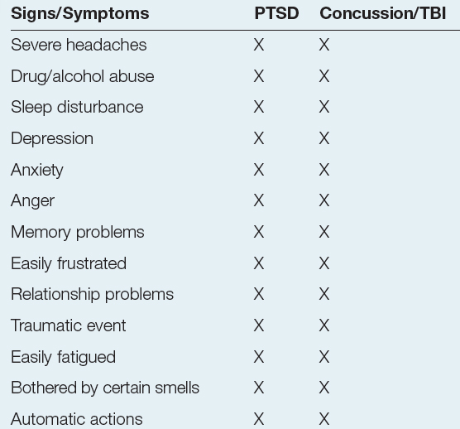
Table 41-1 Signs and Symptoms of P T S D and T B I (1 of 2)
Notes:
Concussion/TBI can be hard to detect. The damage might not always show up on brain imaging studies, which would be considered a false-negative finding.

Slide 22
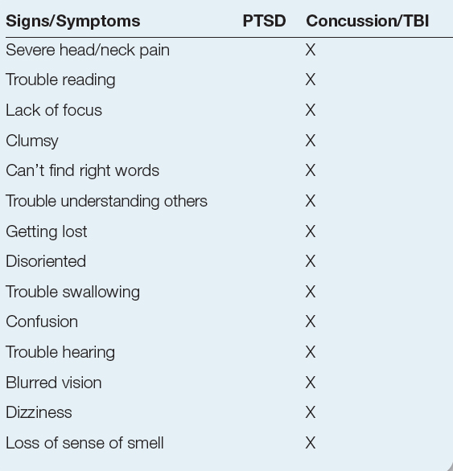
Table 41-1 Signs and Symptoms of P T S D and T B I (2 of 2)
Notes:
The true symptoms of TBI/concussion, dizziness, sensory changes, memory problems, and/or confusion, are often downplayed by the patient.

Slide 23
The Nature of P T S D (9 of 9)
T B I Versus P T S D: Signs and Symptoms
  Repeated concussions can lead to chronic traumatic encephalopathy (C T E).
Notes:
TBI is not a disorder to be “toughed out” or ignored because doing either could make brain damage worse. The military’s dictum that “if you ain’t bleeding, you ain’t hurt” is the poorest possible advice that could be given at this point to a TBI patient.

Slide 24
Click on the Disorder that Seems to Occur at an Unusually High Rate in Returning Combat Veterans
a. Type 2 diabetes
b. Kidney failure
c. Osteoporosis
d. Diverticulosis

Slide 25
Assessing and Providing Care for Combat Veterans (1 of 3)
Do not ask the veteran if they have ever killed anyone. Ever.
Provide structure and limits.
Remind the patient you are there to help.
Use a calm, firm approach.
If you have not been in combat, do not tell the patient that you understand.
Establish rapport.
Notes:
Class Activity
Provide scenarios to allow students to practice interaction with combat veterans.

Slide 26
Assessing and Providing Care for Combat Veterans (2 of 3)
The patient may be reluctant to seek help.
Find out what the person wants from the encounter with E M S.
Do not assume P T S D, but do not rule it out.
Ask about weapons (“How many weapons do you have, and are they secure?”).
Notes:
Class Activity
Provide scenarios to allow students to practice interaction with combat veterans.

Slide 27
Assessing and Providing Care for Combat Veterans (3 of 3)
Keep noise down, do not bang on the door or allow crowds, respect the patient’s space and privacy.
Explain what you are going to do.
Diesel fumes, dust, and helicopters can be triggers.
Combat vets have trouble asking for help.
Take time to listen to the patient.
Notes:
Class Activity
Provide scenarios to allow students to practice interaction with combat veterans.

Slide 28
Case Study Conclusion (1 of 3)
Since the patient is ambulatory, has a minor mechanism of injury and is displaying anger, Jenny and Deena let the police officer make first contact and establish rapport. After establishing rapport, the police officer introduces the E M T s.
“Hi. I’m Jenny. I would like to see if you are hurt and if there is any other way we can help.”
Notes:
Review case conclusion and emphasize the application of knowledge learned from this presentation.

Slide 29
Case Study Conclusion (2 of 3)
During the assessment, Jenny finds that the patient struck his head on the driver’s side window. She asks if he has ever had a concussion or brain injury before. The patient replies that he was injured by an I E D in Iraq, and received shrapnel wounds and a concussion.
Notes:
Review case conclusion and emphasize the application of knowledge learned from this presentation.

Slide 30
Case Study Conclusion (3 of 3)
Although the current impact seems minor, Jenny is concerned about the history of previous T B I. She completes her assessment and gains the patient’s cooperation in consenting to transport. She includes the history of previous combat injury in her written documentation and her verbal handoff report to hospital staff.
Notes:
Review case conclusion and emphasize the application of knowledge learned from this presentation.

Slide 31
Lesson Summary (1 of 2)
P T S D is an intense emotional and physical response to abnormal trauma.
The four essential features are visceral responses to trauma, reliving the trauma, avoiding reminders, and a demeanor of anxiety and anger.
Notes:
Follow-Up
Answer student questions.
Follow-Up Assignments
Review Chapter 41 Summary.
Complete Chapter 41 In Review questions.
Complete Chapter 41 Critical Thinking questions.
Assessments
Handouts
Chapter 41 quiz.

Slide 32
Lesson Summary (2 of 2)
A T B I occurs in combat vets because of I E D s.
There is overlap between signs and symptoms of T B I and P T S D.
Be prepared to take time and listen to the concerns of the vet.
Notes:
Class Activity
As an alternative to assigning the follow-up exercises in the lesson plan as homework, assign each question to a small group of students for in-class discussion.
Teaching Tips
Answers to In Review questions are in the appendix of the text. Advise students to review the questions again as they study the chapter.

Slide 33
Correct!
For some reason, the rate of type 2 diabetes is unusually high in returning combat veterans.
Click here to return to the Program.

Slide 34
Incorrect (1 of 3)
Kidney failure is not currently known to occur at a higher rate in returning combat veterans.
Click here to return to the quiz.

Slide 35
Incorrect (2 of 3)
Osteoporosis is not currently known to occur at a higher rate in returning combat veterans.
Click here to return to the quiz.

Slide 36
Incorrect (3 of 3)
Diverticulosis is not currently known to occur at a higher rate in returning combat veterans.
Click here to return to the quiz.

Slide 37

Copyright

