Slide 1

Prehospital: Emergency Care
Eleventh Edition
Chapter 40
Patients with Special Challenges
Slides in this presentation contain hyperlinks. JAWS users should be able to get a list of links by using INSERT+F7
Copyright © 2018, 2014, 2010 Pearson Education, Inc. All Rights Reserved
Notes:
If this PowerPoint presentation contains mathematical equations, you may need to check that your computer has the following installed:
1) MathType Plugin
2) Math Player (free versions available)
3) NVDA Reader (free versions available)
During this lesson, students will learn about patients with special challenges.
Advance Preparation
Student Readiness
Assign the associated section of MyBRADYLab and review student scores.
Review the chapter material in the Instructor Resources, which includes Student Handouts, PowerPoint slides, and the MyTest Program.
Prepare
Make copies of course policies and procedures, the syllabus, handouts from the Instructor Resources, and other materials for distribution or post them in your learning management system.
Preview the media resources and Master Teaching Notes in this lesson.
Preview the Case Study presented in the PowerPoint slides.
The total teaching time recommended is only a guideline. Take into consideration factors such as the pace at which students learn, the size of the class, breaks, and classroom activities. The actual time devoted to teaching objectives is the instructor’s responsibility.

Slide 2
Learning Readiness
E M S Education Standards, text p. 1209.
Chapter Objectives, text p. 1209.
Key Terms, text p. 1209-1210.
Purpose of lecture presentation versus textbook reading assignments.
Notes:
Explain to students what the National EMS Education Standards are. The National EMS Education Standards communicate the expectations of entry-level EMS providers. As EMTs, students will be expected to be competent in these areas. Acknowledge that the standards are broad, general statements. Although this lesson addresses the listed competencies, the competencies are often complex and require completion of more than one lesson to accomplish. The student is also expected to review the chapter objectives to foreshadow what will be in the chapter. By mastering the key terms the EMT student will better understand the learning and be able to communicate more clearly.
Additionally, explain to the students that the purpose of using these slides is to help keep the instructor focused on highlighting important portions of the material, explain interrelationships of topics, and discuss how to apply this information. It’s not the intent of the presentation (or slides alone) to include every component in the chapter. This presentation still requires the student to thoroughly read the chapter.

Slide 3
Setting the Stage (1 of 4)
Overview of Lesson Topics
  Recognizing the Patient with Special Challenges
  Sensory Impairments
  Cognitive and Emotional Impairments
  Paralysis
  Obesity
  Homelessness and Poverty
Notes:
These bulleted points are the major headings from the chapter, in order. Their purpose is to provide a basic lecture navigation for the student.

Slide 4
Setting the Stage (2 of 4)
Overview of Lesson Topics
  Abuse
  Human Trafficking
  Domestic Violence
  Technology Dependence
  Airway and Respiratory Devices
  Vascular Access Devices
  Ventricular Assist Devices
Notes:
These bulleted points are the major headings from the chapter, in order. Their purpose is to provide a basic lecture navigation for the student.

Slide 5
Setting the Stage (3 of 4)
Overview of Lesson Topics
  Vagus Nerve Stimulator
  Terminally I ll Patients
  Renal Failure and Dialysis
  Gastrointestinal and Genitourinary Devices
  Intraventricular Shunts
  Terminally I ll Patients
Notes:
These bulleted points are the major headings from the chapter, in order. Their purpose is to provide a basic lecture navigation for the student.

Slide 6
Case Study Introduction (1 of 2)
E M T s Alice Combs and Tristan Mullins arrive on a call for a patient whose home ventilator alarm is going off. They are met at the door by the patient’s mother, who says she has tried to determine the problem, but the alarm keeps going off. She tells the E M T s that her 23-year-old son has been ventilator-dependent since becoming a quadriplegic in a car accident 8 years ago.
Notes:
Case Study
Present the Case Study Introduction provided in the PowerPoint slide set.
Lead a discussion using the Case Study questions provided on the subsequent slide(s).
The Case Study with discussion questions continues throughout the PowerPoint presentation.
Case Study Discussion
Use the Case Study content and questions to foreshadow the upcoming lesson content.

Slide 7
Case Study (1 of 7)
What are the first actions the E M T s should take?
What are some special concerns in the assessment of this patient?
What kinds of problems should be anticipated because of the patient’s ventilator and paralysis?
Notes:
Case Study Discussion
Use the Case Study content and questions to foreshadow the upcoming lesson content. Gauge the students’ responses as a guide of how well versed they are on this topic.

Slide 8
Introduction (1 of 2)
Some patients have special health challenges, ranging from obesity to homelessness to dependence on medical technology.
Medical technology ranges from hearing aids to mechanical ventilators.
Advances in medical technology allow people with certain medical problems to live at home.
Notes:
The person’s primary care provider or providers are usually well versed in the equipment or technology used, they might not be as well trained in what to do if that equipment fails or if the patient’s status begins to deteriorate.
It might be necessary to work closely with the specialty hospitals in your area to better understand the constantly emerging technologies.
During this lesson, students will learn about assessment and emergency care for patients with special challenges.

Slide 9
Recognizing the Patient with Special Challenges
Any number of medical or traumatic conditions can cause a loss of function to a body system.
Impairments can result from aging, birth defects, chronic illnesses, traumas, abuse, neglect, and other causes.
Notes:
You must be resourceful when dealing with patients with these disabilities to provide effective emergency care.

Slide 10
Sensory Impairments (1 of 8)
Sensory impairment includes problems with hearing, vision, or speech.
Sensory deficits can lead to difficulty communicating.
There are steps that can improve communication with patients who have sensory deficits.
Notes:
Teaching Tips
Ask students what experiences they have with people who have special challenges.
Critical Thinking Discussion
Why is it important for EMS providers to be knowledgeable about special health care needs?
Are there other populations who may have special challenges in getting the health care they need?

Slide 11
Sensory Impairments (2 of 8)
Hearing Impairment
  Deafness is the inability to hear.
  Deafness may involve one or both ears; a patient may be partially or totally deaf.
Notes:
Discussion Question
What are some ways of improving communication with hearing-impaired patients?

Slide 12
Sensory Impairments (3 of 8)
Vision Impairment
  May be caused by disease, injury, or degenerative disorders.
  Problems include glaucoma, diabetic retinopathy, and cataracts.
  Vision loss can be acute or gradual.
Notes:
Certain diseases such as glaucoma result in an abnormal increase in intraocular pressure that damages the optic nerve, resulting in peripheral vision loss and eventual blindness.
Injury to the eye can be caused by puncture or penetration injuries, blunt trauma to the face, or chemical and thermal burns. This type of vision loss is usually acute but might not be permanent, depending on the degree of trauma endured by the eye and associated structures.
Discussion Question
What are some causes of impaired vision?

Slide 13
Sensory Impairments (4 of 8)
Speech Impairment
  Articulation disorders are caused by impairment of the tongue or other muscles.
  The patient cannot pronounce words correctly.
  Can result from learning words incorrectly or from a hearing impairment.
Notes:
Articulation disorders caused by impairment of the tongue or other muscles needed for speech, called dysarthria, it prevents the patient from pronouncing words correctly.
Teaching Tips
Discuss local protocol regarding the transportation of service animals.
Critical Thinking Discussion
How should you interact with a service animal?
Knowledge Application
Students should be able to integrate information from this section into the assessment and management of patients with sensory impairment.

Slide 14
Sensory Impairments (5 of 8)
Speech Impairment
  Voice production disorders occur from damage to the larynx or vocal cords.
  The sounds produced may be harsh, hoarse, of unusual pitch, or have nasal distortion.
Notes:
Language disorders can occur when the patient displays an impaired or absent ability to understand the spoken word. This can result from congenital problems in children, hearing deficits, or inadequate language stimulation in early life.

Slide 15
Sensory Impairments (6 of 8)
Accommodations for Patients with Sensory Impairments
  Hearing Impairment
      Make sure hearing aids are available and turned on.
      Make sure the patient can see your face.
      Communicate in writing.
      Use a sign language interpreter, if available.
Notes:
Many hearing-impaired patients lip-read, so always try to position yourself so your face is in clear view and the area is adequately lit. You might need to communicate in writing if vital information is unobtainable through oral communication.

Slide 16
Sensory Impairments (7 of 8)
Accommodations for Patients with Sensory Impairments
  Vision Impairment
    Speak clearly.
    Explain what you are going to do before you do it.
    Transport service animals, if possible.
    If necessary, allow the patient to place their hand on your arm or shoulder to guide them.
Notes:
The patient might insist on taking the service dog to the medical facility. Recently, there has been better accommodation of these needs. You must follow your local protocol and service policies and procedures.

Slide 17
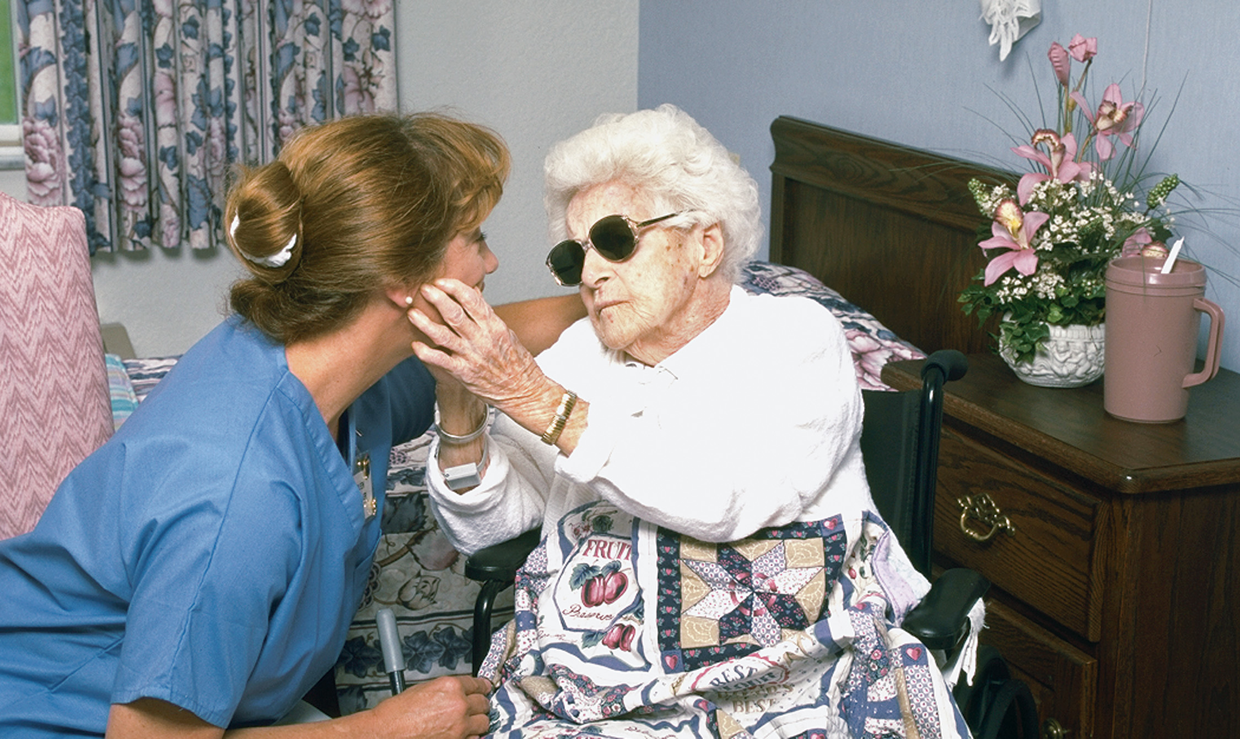
For the Visually Impaired Patient, Speak Clearly and Always Explain What You are Going to Do
Notes:
For the visually impaired patient, be sure to speak clearly because the patient might not see your lips, and always explain what you are going to do before you do it.

Slide 18
Sensory Impairments (8 of 8)
Accommodations for Patients with Sensory Impairments
  Speech Impairment
    Ask questions that allow the patient to answer in as few words as possible.
    Do not finish the patient’s words or statements for him.
    A speech impairment does not reflect cognitive ability.
Notes:
Ask questions in a way that allows the patient to answer in as few words as possible.
Do not attempt to finish the patient’s words or statements for him; this typically frustrates the patient and tends to worsen the speech impairment.
Allow the patient time to respond to your questions and utilize the family or other communication techniques.
Never pretend that you understood something the patient said when you didn’t. You might miss an important piece of information that would have an impact on how you treat the patient.

Slide 19
Cognitive and Emotional Impairment (1 of 11)
Mental or Emotional Impairments
  A patient with a psychosis struggles with interpreting reality and might not communicate effectively with you.
  A patient with an extreme emotional dysfunction, such as depression or anxiety might not be able to focus on your questions or respond appropriately.
Notes:
Critical Thinking Discussion
What are some organizations that help people with developmental disabilities lead more productive lives?
Class Activity
Assign students to research a developmental disability outside of class and make short presentations to the rest of the class at the next class session.

Slide 20
Cognitive and Emotional Impairment (2 of 11)
Developmental Disabilities
  Interfere with how a body part or system operates
  Can involve the brain, spinal cord, nervous system, and endocrine system.
  Can cause speech impediments, behavioral disorders, language difficulties, and movement disorders.
Notes:
Often, the developmental disability involves the brain and causes an inability to learn at a normal rate. The problem might not be noted until the child fails to reach certain developmental milestones.

Slide 21
Persons with Down Syndrome May Have Numerous Disabilities but Can Participate in Normal Activities with Help from Family and Friends
(© Jotl/Science Source)
Notes:
Disabilities that commonly affect the nervous and endocrine systems are Down syndrome, fragile X syndrome, autism, fetal alcohol syndrome, phenylketonuria (PKU), hypothyroidism, and Rett syndrome.

Slide 22
Cognitive and Emotional Impairment (3 of 11)
Autism and E M S
  To better understand the autism patient keep in mind the following:
    Autism is identified by patient behavior.
    Patients might not communicate with you.
    Patients may develop a seizure disorder.
    They may have a difficult time reading facial expressions.
    Patients may have altered sensations.
    They are prone to positional asphyxia.
Notes:
Autism, also known as autism spectrum disorder, is a range of neurodevelopmental conditions that are characterized by impaired social interaction, verbal and nonverbal communication, and restricted and repetitive behavior. It is due to a combination of genetic and environmental factors.
You might find the family or caregiver reporting the patient has autism spectrum disorder (ASD), Asperger’s syndrome, Pervasive Developmental Delay (PDD), or Pervasive Developmental Delay Not Otherwise Specified (PDD NOS).

Slide 23
Cognitive and Emotional Impairment (4 of 11)
Autism and E M S
  Autism Spectrum Disorder Foundation (A S D F) makes recommendations concerning the provision of emergency care.
Notes:
When performing an assessment, providing emergency care or transporting a patient with autism, some Autism Spectrum Disorder Foundation (ASDF) recommendations are:
Move slowly during the physical exam. Begin at the feet and work your way to the head.
Explain what you plan to do in advance of performing the exam. Explain where you are going, who will be with you, and what they will see.
Speak using simple terms and language and a calm voice. Give the patient plenty of time to respond to your questions. It is not uncommon for there to be a 3- to 4-second delay after asking a question.
Expect the unexpected with autistic children. They often ingest unusual things and get into things without the caretaker realizing it.
Ask the caregiver the functional level of the patient. You can then ask appropriate level questions and provide appropriate level explanations. Stuffed animals and other things used for children can also be helpful with older adults with autism.
If the caretaker is present, allow him to ask the questions related to your assessment.
If possible, allow the caretaker to ride with the patient.
Don’t assume a nonverbal patient who seems to not be listening doesn’t understand what you are saying.
A nonverbal patient might be able to write or type a response to your questions.

Slide 24
Cognitive and Emotional Impairment (5 of 11)
Accommodations for patients with mental, emotional, or developmental impairments include:
  Treat the patient with respect.
  Rely on caregivers for information, if needed.
  Compare the patient’s behavior to what is normal for him.
  Provide clear explanations.
Notes:
Discussion Question
What are some guidelines for interacting with patients with developmental disabilities?

Slide 25
Cognitive and Emotional Impairment (6 of 11)
Accommodations for patients with mental, emotional, or developmental impairments include:
  Patients are sensitive to tone of voice and body language.
  Establish trust.
  Avoid loud noises or extreme lighting changes.
Notes:
Although some impairment can be obvious when you first encounter the patient, others, such as hearing and vision impairments, might not be as readily evident. Always approach the patient as if all sensory abilities are intact, but remain alert for evidence that the patient might have some type of deficit. However, don’t assume the patient has a deficit just because of their age.

Slide 26
Cognitive and Emotional Impairment (7 of 11)
Patients with Brain Injuries
  Brain injury can result in permanent damage.
  There may be changes in cognition, learning ability, emotions, and motor function.
  Causes can include infant abuse, meningitis, encephalitis, and traumatic head injury.
Notes:
Discussion Question
What are some additional considerations in managing patients?
Knowledge Application
Students should be able to apply this information to interactions with patients with emotional and cognitive impairments.

Slide 27
Cognitive and Emotional Impairment (8 of 11)
Patients with Brain Injuries
  Cerebral palsy
    Motor impairments arise early in development.
    The degree of impairment varies.
    There is difficulty controlling muscles, and there may be stiffness and contractures.
Notes:
Cerebral palsy is an umbrella term for motor impairments that result from brain abnormalities that arise early in development.

Slide 28
Cognitive and Emotional Impairment (9 of 11)
Patients with Brain Injuries
  Cerebral Palsy
    Facial grimacing may occur.
    In some cases, there is cognitive impairment.
    There may be communication difficulties.
Notes:
Most people with cerebral palsy demonstrate difficulties in controlling muscle function and can demonstrate muscular stiffness and joint contractures.

Slide 29
Cognitive and Emotional Impairment (10 of 11)
Patients with Brain Injuries
  Disability from traumatic brain injury varies.
  Disability ranges from mild speech impairment to being unresponsive and ventilator-dependent.
Notes:
Brain dysfunction from head trauma is a debilitating injury that usually leaves the patient permanently dependent on outsiders for medical care. The dysfunction of the brain from the injury can result in problems in breathing, heart rate, and blood pressure regulation.

Slide 30
Cognitive and Emotional Impairment (11 of 11)
Accommodations for Patients with Brain Injuries
  Distinguish between the baseline condition and acute changes.
  Be aware of and manage any technology (pumps, ventilators, catheters) on which the patient relies.
Notes:
The care you render for this patient depends on the condition(s) for which you were summoned. Above all, remember to maintain a patent airway, ensure adequate breathing and oxygenation, and keep peripheral perfusion intact.
Consider summoning ALS for a patient who is critically unstable or deteriorating, especially if there are equipment needs beyond your scope of practice such as a transport ventilator or intravenous line.
Patients with preexisting brain trauma can range anywhere from being awake and oriented, to confused, to combative, to unresponsive. It is important to accurately determine their baseline mental state and whether their current status is normal for them.

Slide 31
Paralysis (1 of 3)
E M T s may respond to patients who have been paralyzed from past trauma or strokes.
Paralyzed patients are prone to a number of problems related to technology dependence, pressure sores, and infection.
Notes:
Discussion Questions
What are some causes of paralysis?
What are some medical terms associated with paralysis?
What are some considerations in assessment, management, and transport of patients who are paralyzed?
Knowledge Application
Students should be able to apply information from this section to the care of paralyzed patients.

Slide 32
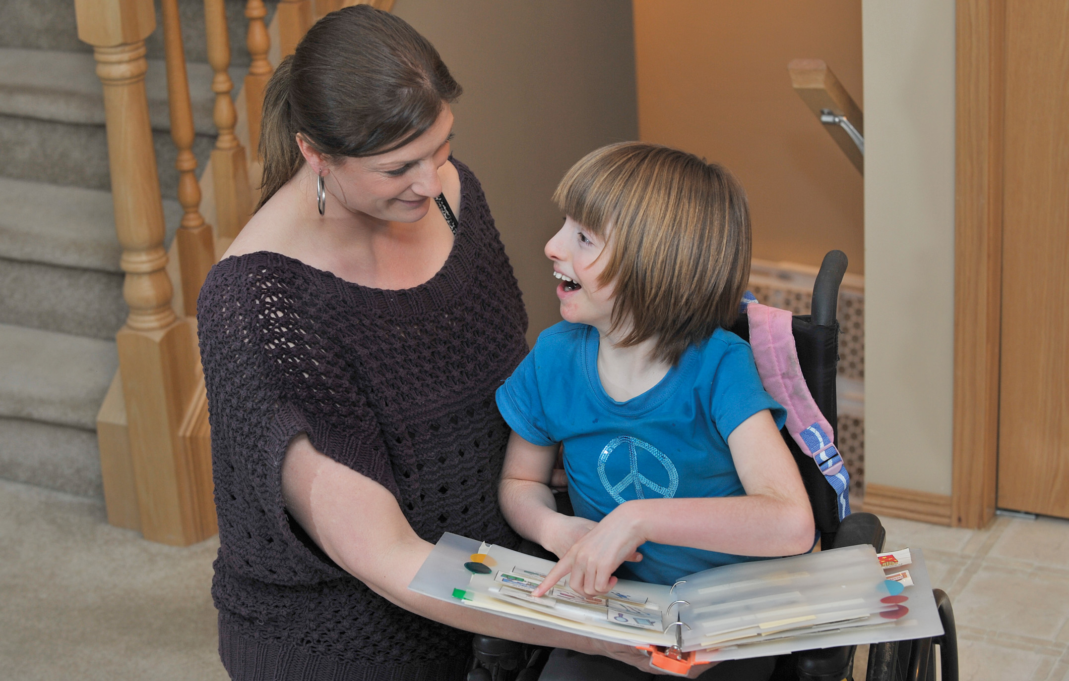
Patients with Paralysis or Muscle Weakness May Want You to Arrange for Transport of their Assisting Devices, Such as Wheelchairs or Canes, to the Hospital
(David M. Grossman/ PhototakeU S A)
Notes:
A patient who is paralyzed or has significant muscular weakness cannot perform many activities of daily living and is dependent on others to provide care. In addition, ongoing muscle weakness and paralysis can lead to breathing inadequacy and reliance on a mechanical ventilator.

Slide 33
Paralysis (2 of 3)
Accommodations for Paralyzed Patients
  A paraplegic displays paralysis from the waist down.
  Follow protocols regarding transportation of wheelchairs.
  For ventilator-dependent patients, keep the ventilator settings as you find them.
  You may need to suction the breathing tube or stoma.
Notes:
If a patient is paralyzed in all four extremities, they are said to be quadriplegic. If the patient with quadriplegia has had a spinal injury in the vicinity of C3–C5, or if they are suffering from a neuromuscular disease, they might not breathe adequately on their own.

Slide 34
Paralysis (3 of 3)
Accommodations for Paralyzed Patients
  Be alert to the possibility of a urinary catheter; keep the catheter bag below the level of insertion.
  Make sure feeding tubes and colostomy bags are secured.
  The family is usually knowledgeable about how to best move the patient.
Notes:
Do not allow necessary tasks and the specialty care distract you from the fact that you were probably called for some other emergency that you must concurrently attend to.

Slide 35
Obesity (1 of 4)
Bariatrics is the branch of medicine that deals with the management of obese patients.
A person who is 20 percent or more over their ideal weight is obese.
A person who is more than 50 percent to 100 percent over their ideal weight, or more than 100 pounds over their ideal weight is morbidly obese.
Notes:
Discussion Questions
What are some causes and risk factors for obesity?
What health risks are associated with obesity?
Critical Thinking Discussion
What do you think accounts for the negative attitudes many people have toward people who are obese?
Teaching Tips
Demonstrate any bariatric equipment available to your EMS system.
Knowledge Application
Students should be able to apply information from this section to the management of obese patients.

Slide 36
Table 40-1 Effects of Excess Weight on Body Systems
System | Disease State
Cardiovascular | Hypertension, coronary artery disease, congestive heart failure, stroke
Respiratory | Obstructive sleep apnea, asthma, chronic obstructive pulmonary disease
Endocrine and reproductive | Diabetes mellitus, infertility, birth defects, menstrual disorders
Gastrointestinal | Esophageal reflux, liver disease
Musculoskeletal | Osteoarthritis, gout, back injuries, immobility
Psychological | Depression, suicide
Notes:
Obesity places great demands on the body’s systems. Over time, this heightened demand can lead to serious medical conditions such as high blood pressure, sleep apnea, diabetes, and cardiovascular disease.

Slide 37
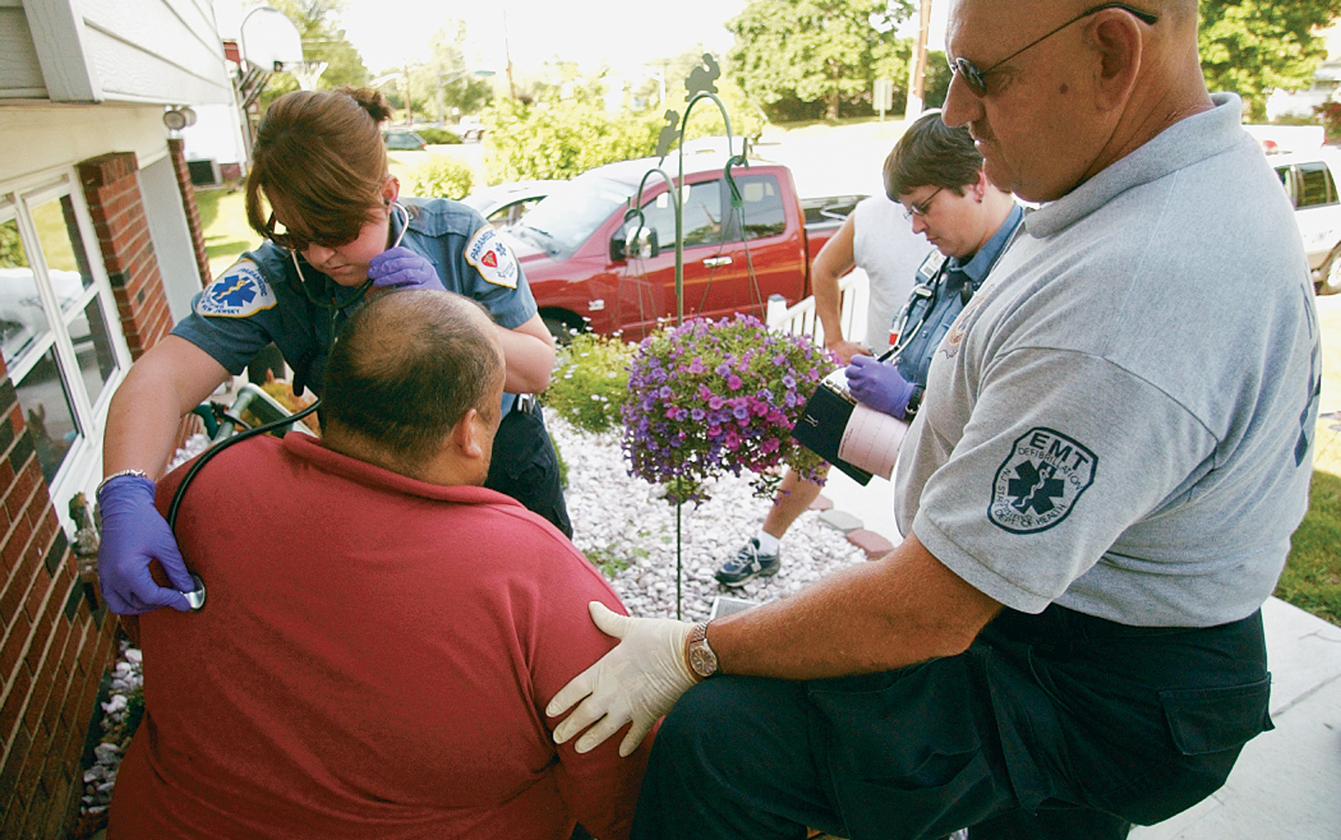
Assessment and Care of the Obese Patient Follows a Normal Format, but Modifications May be Required Because of the Patient‘s Size
(© Mark C. Ide)
Notes:
How the obese patient is positioned on the cot for transport can have a significant impact on how well they can breathe. Try to keep the patient upright or lowered to no more than a semi-Fowler’s position, and diligently monitor the airway and breathing status.

Slide 38
Obesity (2 of 4)
Accommodations for Obese Patients
  Obese patients can have difficulty breathing in a supine position.
  If the patient is unable to protect their own airway, position the head in a neutral position; you may need to place folded towels or bath blankets beneath the shoulders and neck.
Notes:
Airway occlusion can be prevented by proper positioning of the patient. If the patient is conscious, allow him to assume a comfortable position, usually sitting upright or in a slightly reclined position. If the patient cannot protect their own airway, ensure that the airway is maintained in a neutral position to allow airflow.

Slide 39
Obesity (3 of 4)
Accommodations for Obese Patients
  When the airway is ensured, turn your attention to oxygenating and ventilating the patient.
  Pay particular attention to adequacy of respiratory rate and tidal volume.
  Positive-pressure ventilation of obese patients is more difficult.
Notes:
When supine the posterior thoracic wall has limited mobility, and the anterior thoracic wall is weighed down by the patient’s adipose tissue. Rapid fatigue of the respiratory muscles can occur.
It is significantly more difficult to ventilate a patient weighing 380 pounds than a patient weighing 180 pounds.

Slide 40
Obesity (4 of 4)
Accommodations for Obese Patients
  Lifting and moving obese patients requires the assistance of an adequate number of providers.
  Obese patients may exceed the structural limitations of standard ambulance cots, and may require the use of a bariatric device.
Notes:
Cot manufacturers now design “bariatric devices,” which include special cots to hold greater weight and bariatric loading devices such as special ramps and winches that interface with specially designed ambulance cot-locking systems.

Slide 41
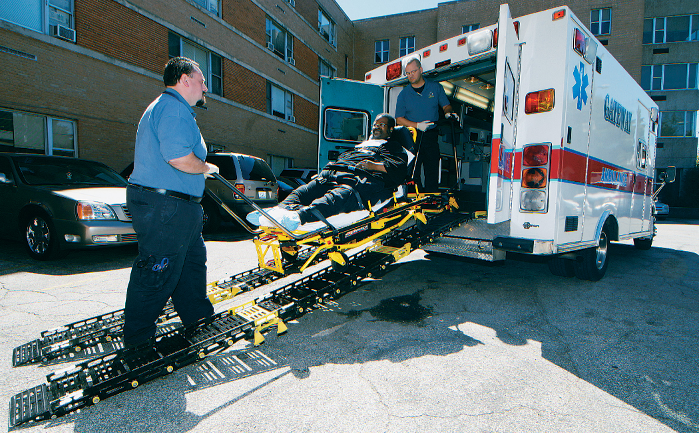
Bariatric Devices Include Special Cots Designed to Support the Greater Weight of an Obese Patient and Loading Devices Such as Ramps and Winches that Interface with Specially Designed Ambulance Cot-Locking Systems
(© Ray Kemp/911 Imaging)

Slide 42
Homelessness and Poverty (1 of 6)
Factors that contribute to homelessness include
  Poverty
  Substance abuse
  Lack of affordable housing
  Mental illness
  Returning to society after being in prison
  Domestic violence
  Mortgage foreclosure/forced eviction
  Natural disasters
Notes:
Teaching Tips
Encourage students to volunteer for an agency that provides services to the homeless.
Class Activity
Have students organize a food or clothing drive, or collect school supplies for the disadvantaged in your community.
Discussion Question
What are the health and health care consequences of poverty and homelessness?

Slide 43
Homelessness and Poverty (2 of 6)
Issues Associated with Homelessness
  Increased risk of violence and abuse
  Increased risk of illness/disease
  Discrimination from others
  Reduced access to health care
Notes:
Critical Thinking Discussion
What are some resources for the homeless and impoverished in your community?
Knowledge Application
Students should be able to apply the information in this section to the care of homeless and impoverished patients.

Slide 44
Homelessness and Poverty (3 of 6)
Issues Associated with Homelessness
  Risk of violence and abuse
  Risk of illness/disease
  Reduced access to health care
  Limited or no access to education
  Limited access to modern communications
  Not seen as suitable for employment
Notes:
Because of the lack of a permanent residence or place for storage of their possessions, the homeless must cart their belongings with them from place to place, for example, in bags or shopping carts.

Slide 45
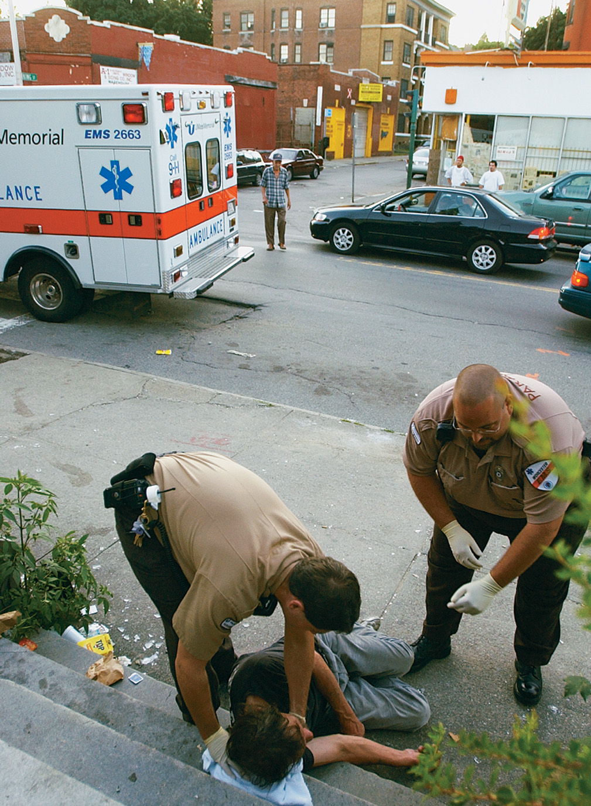
E M S is Often Summoned to Street Corners and Other Public Places to Care for a Homeless Patient
(© Mark C. Ide)
Notes:
When an emergency arises, there is no “address” for you to respond to. Often, you’ll be summoned to street corners, alleys, or phone booths when an emergency involves a homeless person.

Slide 46
Homelessness and Poverty (4 of 6)
Places where the homeless may find refuge include:
  Abandoned buildings
  Public places—parks, train or bus stations, airports, and college campuses
  Vehicles
  Improvised shacks or sleeping bags
  Unoccupied houses
  Homeless shelters.
Notes:
Because of their exposure to the environment and lack of preventive care or any medical care when minor injuries or illnesses arise, the homeless person is at risk for even emergencies.
Ongoing conditions such as poor nutrition, environmental exposure (heat and cold extremes, rain or snow), lack of access to medication, and vulnerability to violent acts leave them at risk for cardiac, pulmonary, vascular, and traumatic emergencies.

Slide 47
Homelessness and Poverty (5 of 6)
Patients in poverty may face many of the same issues as the homeless, including:
  Accidental trauma
  Physical abuse
  Crime
  Chronic medical conditions
  Limited access to health care and medications.
Notes:
Like the homeless, people who fall below the poverty level are at greater risk for illness and injury, partly from their environment and partly from the lack of primary medical care, screening, and treatment needed to prevent the advanced development of disease.

Slide 48
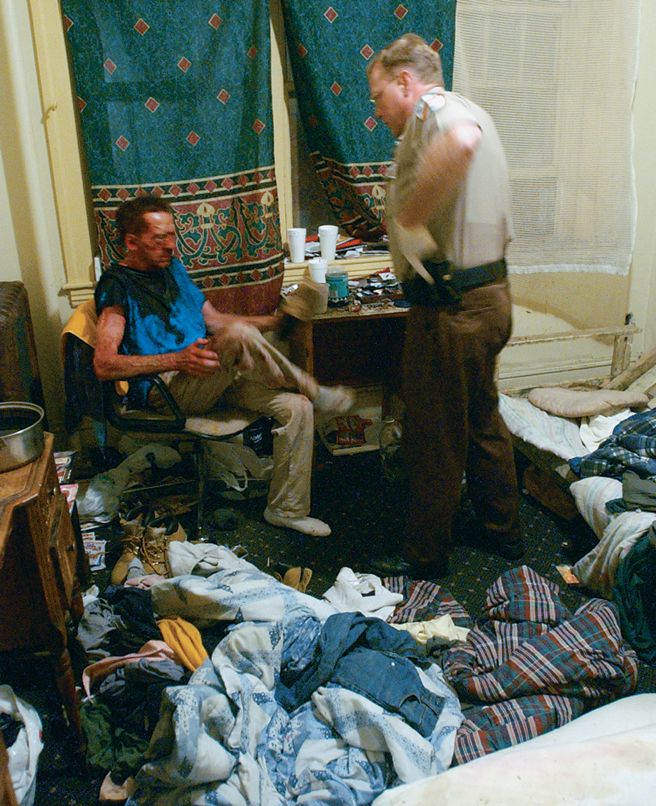
People Who Fall Below the Poverty Level are at Great Risk for Illness and Injury Because of the Environment in Which they Live and a Lack of Resources with Which to Seek Primary Medical Care
(© Mark C. Ide)
Notes:
Often, impoverished people must choose between buying medications for themselves, buying food for the family, or paying the heating bill.

Slide 49
Homelessness and Poverty (6 of 6)
Accommodations for Patients Who Are Homeless or Poor
  Do not be judgmental; display respect.
  Be an advocate; realize the patient may need your help.
  Become familiar with resources in your community.
Notes:
People lower on the economic ladder suffer from higher rates of illness and death.
If you spend any amount of time in EMS, you will undoubtedly encounter homeless people. Your duty to assess and care for these patients is the same as for patients who are not as disadvantaged.
One concern you might hear from the patient is that they don’t have the money to pay for the ambulance or hospital bill. In this situation, explain to the patient that almost all health care providers offer a certain degree of reduced-cost or free medical care.

Slide 50
Abuse
Abuse is any action or failure to act that results in unreasonable suffering, harm, or misery to a person, whether physical or mental.
Abuse transcends all age, gender, race, and socioeconomic groups.
Children, elders, and domestic/intimate partners are some of those who may be abused.
Notes:
Discussion Questions
What are some indications of child abuse?
What are some indications of elder abuse?
Knowledge Application
Students should be able to apply the information in this section to the assessment and management of abused or neglected patients.

Slide 51
Click on the Problem that is Least Likely to be Associated with Homelessness
A. Increased risk of violence
B. Increased risk of environmental emergencies
C. Increased risk of obesity
D. Increased risk of accidental trauma

Slide 52
Human Trafficking (1 of 7)
You might be the only hope for the victim and have only one opportunity to save this individual from human traffickers.
The Victim of Human Trafficking
  Common Characteristics of Victim of Human Trafficking
    Can be men or women, adults or children.
Notes:
According to the National Human Trafficking Resource Center, human trafficking is “a form of modern-day slavery in which traffickers use force, fraud, or coercions to control victims for the purposes of engaging in commercial sex acts or labor services against his/her will.”
“Sex trafficking is the recruitment, harboring, transportation, provision, obtaining, patronizing, or soliciting of a person for the purposes of a commercial sex act, in which the commercial sex act is induced by force, fraud, or coercion, or in which the person induced to perform such an act has not attained 18 years of age.”
“Labor trafficking is the recruitment, harboring, transportation, provision, or obtaining of a person for labor or services, using force, fraud, or coercion for the purposes of subjection to involuntary servitude, peonage, debt bondage, or slavery.”

Slide 53
Human Trafficking (2 of 7)
The Victim of Human Trafficking
  Common Characteristics of Victim of Human Trafficking
    Runaway and homeless youths
    Victims of domestic violence
    Victims of sexual assault
    Victims of social discrimination
    Victims of war or conflict
Notes:
Victims don’t seek help because they might not speak English, have no identification or money, and have no idea where they are, because they are moved frequently.

Slide 54
Human Trafficking (3 of 7)
The Victim of Human Trafficking
  Common Characteristics of Victim of Human Trafficking
    Common Settings
      Prostitution rings and escort services
      Pornography industry, stripping or exotic dancing clubs
      Massage parlors
      Agricultural farms or ranches
      Factories or sweatshops
      Hotels, nail salons, home-cleanings
Notes:
May also be found:
As domestic labor used for cleaning, childcare, eldercare, or other services within a home
In restaurants, bars, or cantinas
Begging or selling items on the street or door to door

Slide 55
Human Trafficking (4 of 7)
The Victim of Human Trafficking
  Common Characteristics of Victims of Human Trafficking
    Victim characteristics
      Controlled physically or psychologically by someone at the scene
      Doesn’t have the ability to leave
      All information is provided by someone else
      No identification
      Few or no personal possessions
Notes:
Additional signs include:
All the information is provided by someone else at the scene who accompanies the victim.
The victim has no sense of the current day or time or the city or state in which they are located.
Many traffickers convince their victims that if they do escape and report them, they will find and harm the victim or their family members or friends.

Slide 56
Human Trafficking (5 of 7)
The Victim of Human Trafficking
  Psychological and behavioral clues to help identify a victim of human trafficking
    Exhibits a feeling of helplessness, shame, guilt, self-blame, or humiliation
    Has an eating or sleep disorders
    Is addicted to drugs or alcohol
    Appears to be emotionally numb
    Shows evidence of “trauma bonding” with the trafficker.
Notes:
The victim may also present with signs and symptoms of denial, post-traumatic stress disorder, phobias, panic attacks, anxiety, or depression.

Slide 57
Human Trafficking (6 of 7)
The Victim of Human Trafficking
  Physical clues to help identify a victim of human trafficking include:
    Signs of physical abuse
    Chronic back, visual, or hearing problems
    Skin or respiratory conditions
    Diseases such as tuberculosis and hepatitis
    Clearly visible tattoos
    Inappropriate clothing for the weather.
Notes:
Trafficking victims may also present with chronic illnesses such as diabetes mellitus and cardiovascular
disease that are untreated; sexually transmitted diseases, urinary tract infections, pelvic inflammatory disease, and genitalia injuries from sexual assault.

Slide 58
Human Trafficking (7 of 7)
E M S Management for a Suspected Victim of Human Trafficking
    Ensure the scene is safe.
    Provide emergency care for any illness or injury, according to your protocol.
    If you cannot transport the victim, contact local law enforcement.
Notes:
You can also call the Human Trafficking Hotline at the Department of Homeland Security at 1-866-347-2423 to report suspected human trafficking. Follow your local protocol. If you transport the victim, notify the emergency department physician or nurse of your suspicion of human trafficking.
Document on a separate special reporting form the objective information found at the scene or divulged by the victim or trafficker and evidence of human trafficking found during your assessment.

Slide 59
Domestic Violence (1 of 7)
The Victim of Domestic Violence
  Women who are at the highest risk of being subjected to domestic violence are:
    Separated or divorced
    Minorities
    Disabled
    Pregnant
    Cohabitating with a same-sex partner
  The abuser typically isolates the victim.
Notes:
Domestic violence is a term for physical violence between two people in an intimate relationship. It is a specific type of domestic abuse. In the United States, domestic violence is a leading cause of injury to women between the ages of 15 and 44 years of age. It is also reported that one in five homicides involve murder of an intimate partner.

Slide 60
Domestic Violence (2 of 7)
The Victim of Domestic Violence
  Types of Domestic Abuse
    The use of physical force
    The use of derogatory terms
    Threat and degrading behavior
    Sexual activity with the victim without consent
    Victim not permitted to practice religion
    Financial or material control
Notes:
The victim is controlled by restricting the person’s financial independence and access to money or the ability to acquire material items such as clothing, medications, and food. The victim might not be allowed to work or might be forced to work and hand over all paychecks.

Slide 61
Domestic Violence (3 of 7)
The Domestic Violence Victim
  Cycle of Violence
    Phase One—The tension between the victim and abuser increases.
    Phase Two—Violence occurs regularly.
      Increases in frequency and severity.
    Phase Three—Referred to as “honeymoon” phase, in which the abuser apologizes, sometimes buying the victim gifts.
Notes:
The tension between the victim and abuser increases. The victim continuously does things to please the abuser to reduce tension and in the hope of avoiding violence. The victim might try to trigger the violence at times to reduce her stress of not knowing when the violence will occur.

Slide 62
Domestic Violence (4 of 7)
E M S Management for a Victim of Domestic Abuse or Violence
  Assessment Findings of Domestic Abuse
    Physical
    Emotional and psychological
    Psychiatric
    Sexual
Notes:
Possible injuries include abrasions, bruises, burns, dislocations, lacerations, bites, fractures, marks on the neck consistent with strangulation, petechial hemorrhage in the eyes, mouth and dental injuries (missing teeth), genitalia and breast injuries, headache, gastrointestinal pain and complaints, and pelvic pain. You will often find multiple bruises and injuries in various stages of healing. You might also find injuries to the hands or ulnar aspects of the arms, indicating defensive posturing.

Slide 63
Domestic Violence (5 of 7)
E M S Management for a Victim of Domestic Abuse or Violence
  Approaching the Scene and Victim of Domestic Violence
    Ensure the scene is safe before entering.
    Do not confront the abuser or the victim.
    Do not get between the abuser and victim.
    Do not allow the abuser or victim to get between you and the door.
Notes:
Many calls and scenes in which EMS personnel are injured involve behaviors that are unpredictable and can quickly change. The domestic violence call is a scene that puts you at extreme risk for becoming a victim of violence yourself.

Slide 64
Domestic Violence (6 of 7)
E M S Management for a Victim of Domestic Abuse or Violence
  Approaching the Scene and Victim of Domestic Violence
    When away from the abuser, ask the victim about the abuse. An example of this kind of question could be, “Violence against women has become a health issue. I ask all my female patients if they have ever experienced any abuse. Have you been abused as a child or adult?”
Notes:
Ask the victim the following questions
“Are you safe now?”
“Would you like to talk about it?”
“Have you discussed this with anyone?”
“What do you need right now?”
Asking these questions will show the victim that you are focused on her well-being and her needs. You can pass this information on to the emergency department staff.

Slide 65
Domestic Violence (7 of 7)
E M S Management for a Victim of Domestic Abuse or Violence
  Preserving Evidence and Documentation
    Do not destroy any possible evidence.
    On your P C R, perform the following:
      Include location and description of injuries.
      Report the mechanism of injury.
      Note any injury patterns.
      Objectively note any comments made by the victim.
Notes:
Additionally, note the following:
Objectively note the abuser and the victim’s behavior at the scene.
Document any other people at the scene such as children, a friend, or a neighbor. Also, note their behavior and any comments.
Document the police officers’ names and badge numbers.
Document any referral information or numbers provided to the victim.
Your primary responsibility at the scene involving domestic violence is to assess and treat the victim for any injuries or illnesses. During your assessment, note any patterns or blunt or penetrating injuries, laceration, burn
marks, ligature marks, or any other injuries that might be consistent with abuse and violence.

Slide 66
Technology Dependence (1 of 5)
Many patients who once required hospital care can now be cared for at home, in part due to medical technology.
Technology may be life-enhancing or life-sustaining.
Notes:
Teaching Tips
Inviting an expert in home health care to speak about this topic and the next several sections will provide students with important information.

Slide 67
Technology Dependence (2 of 5)
Reasons E M S may be summoned include:
  Failed equipment
  A change in the patient’s clinical condition
  Patient experiencing some other emergency.
Notes:
Even though the EMT has most likely not seen the particular type of medical equipment found in a person’s home, they are expected to be able to troubleshoot it and support any lost function of the patient should the medical device fail.

Slide 68
Technology Dependence (3 of 5)
E M T s must have a basic understanding of the technology a patient is using.
You will often have to rely on the patient or their caregivers for specific information about the equipment.
Notes:
Do not discount the family or care provider’s knowledge of the medical devices found at home. They are with that person and that equipment far longer than the EMT’s, thus they will likely have reliable information on how it works and how the patient responds to it.

Slide 69
The Patient’s Primary Health Care Provider Can Usually Provide Information about the Equipment on Which the Patient Relies
Notes:
You must determine what the medical device is supposed to do for the patient, how critical its function is to patient survival, and what type of impact the device has, if any, on other medical or traumatic emergencies the patient might suffer. Often you need to depend on the primary health care providers for information about the equipment on which the patient is reliant prior to initiating any care.

Slide 70
Technology Dependence (4 of 5)
Questions to ask about technology include:
  Where can I get device information?
  What does this device do?
  Can I replicate its function if it fails?
  Will the device have an effect on the assessment or findings?
  Has this problem ever occurred before?
  How was it fixed?
  Has someone tried to remedy the issue?
Notes:
Although much of the equipment you see in patients’ homes is similar to what you would see in a hospital setting, there is usually a difference in the size and the complexity of the device. Often, the tertiary centers that implant these devices have resources available who can be consulted regarding their care.
Are there specific considerations you need to make when deciding how to best prepare the patient for movement
and transport?

Slide 71
Technology Dependence (5 of 5)
Focus on these tasks:
  Keep the airway open.
  Establish and maintain adequate ventilation.
  Maintain adequate oxygenation.
  Support circulation as needed.
Notes:
If, at a minimum, you provide this care, you will ensure the patient the best chance for survival, regardless of the immediate emergency and the patient’s dependence on medical technology.

Slide 72
Case Study (2 of 7)
Alice and Tristan find an alert 23-year-old who is ventilator-dependent, but can speak by plugging their tracheostomy tube. The patient’s skin is hot, and as the E M T s begin their assessment, the high-pressure alarm goes off on the ventilator.
Notes:
Case Study Discussion
Review the Case Study findings presented.

Slide 73
Case Study (3 of 7)
What does the high-pressure alarm signify?
What are possible causes of the high-pressure alarm?
How can the E M T s assess the patient and their device for those causes?
What should the E M T s do with the ventilator as they prepare the patient for transport?
Notes:
Case Study Discussion
Use the Case Study content and questions to foreshadow the upcoming lesson content. Gauge the student’s responses as a guide of how well versed they are on this topic.

Slide 74
Airway and Respiratory Devices (1 of 18)
Medical Oxygen
  Home oxygen equipment is similar to what you are used to.
  Oxygen may be supplied from a cylinder, oxygen concentrator, or liquid oxygen system.
Notes:
Few problems arise from the oxygen systems, and if a problem does arise, it is usually remediated by the patient or primary care providers. Usually the problems that require EMS involve some equipment failure in which the system stops providing oxygen.
Teaching Tips
Demonstrate any available airway and breathing devices to help students learn about their use.

Slide 75
Table 40-2 Common Technical Problems with Oxygen Systems
Problem | Possible Cause | Corrective Action
Oxygen not flowing freely | Faulty tubing | Check for obstruction or replace tubing.
Oxygen not flowing freely | Dirty or plugged humidifier | Remove from oxygen supply, clean, and refill with sterile water or replace with prefilled bottle.
Buzzer goes off on oxygen concentrator | Unit unplugged | Check plug.
Buzzer goes off on oxygen concentrator | Power failure | Check fuses, circuit breaker, or, in cases of power outages, use backup oxygen tank until power is restored. (Or call E M S as necessary to make use of oxygen administration from the ambulance or at the hospital.)
Oxygen tank empties too quickly or hisses | Leak in tank | Open all windows, extinguish all flames, and summon help from the fire department, E M S, and/or supplier.
Notes:
Usually the problems that require EMS involve some equipment failure in which the system stops providing oxygen. The EMT can easily correct this situation. Another situation in which EMS might be summoned is if the patient’s condition changes or worsens, and the amount of oxygen they receive at home for their chronic condition is no longer sufficient.

Slide 76
Airway and Respiratory Devices (2 of 18)
Apnea Monitors
  Designed to constantly monitor the patient’s breathing and emit a warning signal should breathing cease
  May also monitor heart rate
  Used for some babies, especially premature newborns
Notes:
Discussion Question
Outline the assessment of a patient whose apnea monitor's alarm has sounded.

Slide 77
Airway and Respiratory Devices (3 of 18)
Apnea Monitors
  Determine how long the monitor has been emitting an alert.
  Determine whether the caregivers have performed any interventions.
  If the patient is breathing normally, provide oxygen to the infant and transport them to the hospital for evaluation.
Notes:
When you are summoned to the home of a patient with this technology, you should perform your normal scene size-up and primary assessment. Because the apnea monitor is designed to signal a respiratory problem, be especially diligent in your assessment of the patient’s respiratory rate and tidal volume.
If the patient is not breathing adequately, ensure an open airway, provide ventilation, and ensure adequate oxygenation.

Slide 78
Airway and Respiratory Devices (4 of 18)
Pulse Oximetry
  It may be used at home by patients with apnea monitors or respiratory problems
  Treat the patient for the presenting problem.
  Apply the pulse oximeter from the ambulance.
  Ascertain what interventions, if any, were done.
Notes:
Common reasons for pulse oximetry in the home include the following:
A patient with chronic pulmonary disease who needs to adjust oxygen intake to maintain a certain level of blood oxygen saturation
Medical need to keep oxygen saturation within a specific therapeutic range
Need to monitor oxygen needs in a patient who has a fluctuating oxygen demand.

Slide 79
Airway and Respiratory Devices (5 of 18)
Tracheostomy Tubes
  A tracheostomy is a surgical opening into the trachea to provide an alternative route for airflow, bypassing the nose and mouth.
  A tracheostomy may be temporary or permanent.
  A permanent opening is a stoma.
Notes:
A tracheostomy is commonly provided for patients who have either long-term upper airway problems or medical conditions that result in long-term dependence on mechanical ventilation.

Slide 80
Airway and Respiratory Devices (6 of 18)
Tracheostomy Tubes
  A tracheostomy tube is placed into the tracheostomy to keep it patent.
  The tube may be single or double-lumen.
  A patient with a tracheostomy may or may not be able to speak.
  Emergencies include tube obstruction by mucus or a dislodged inner cannula.
Notes:
During your assessment of a patient with an emergency pertaining to a tracheostomy tube, you must rapidly determine whether the problem is that of airway occlusion or (if the patient is also ventilator-dependent) if the ventilator is malfunctioning.
If the tube is partially or totally occluded from bleeding or heavy secretions, use a whistle-tip (soft) suction catheter to clear the airway. Measure the depth of insertion for the suction catheter by comparing it to the tracheostomy tube obturator.

Slide 81
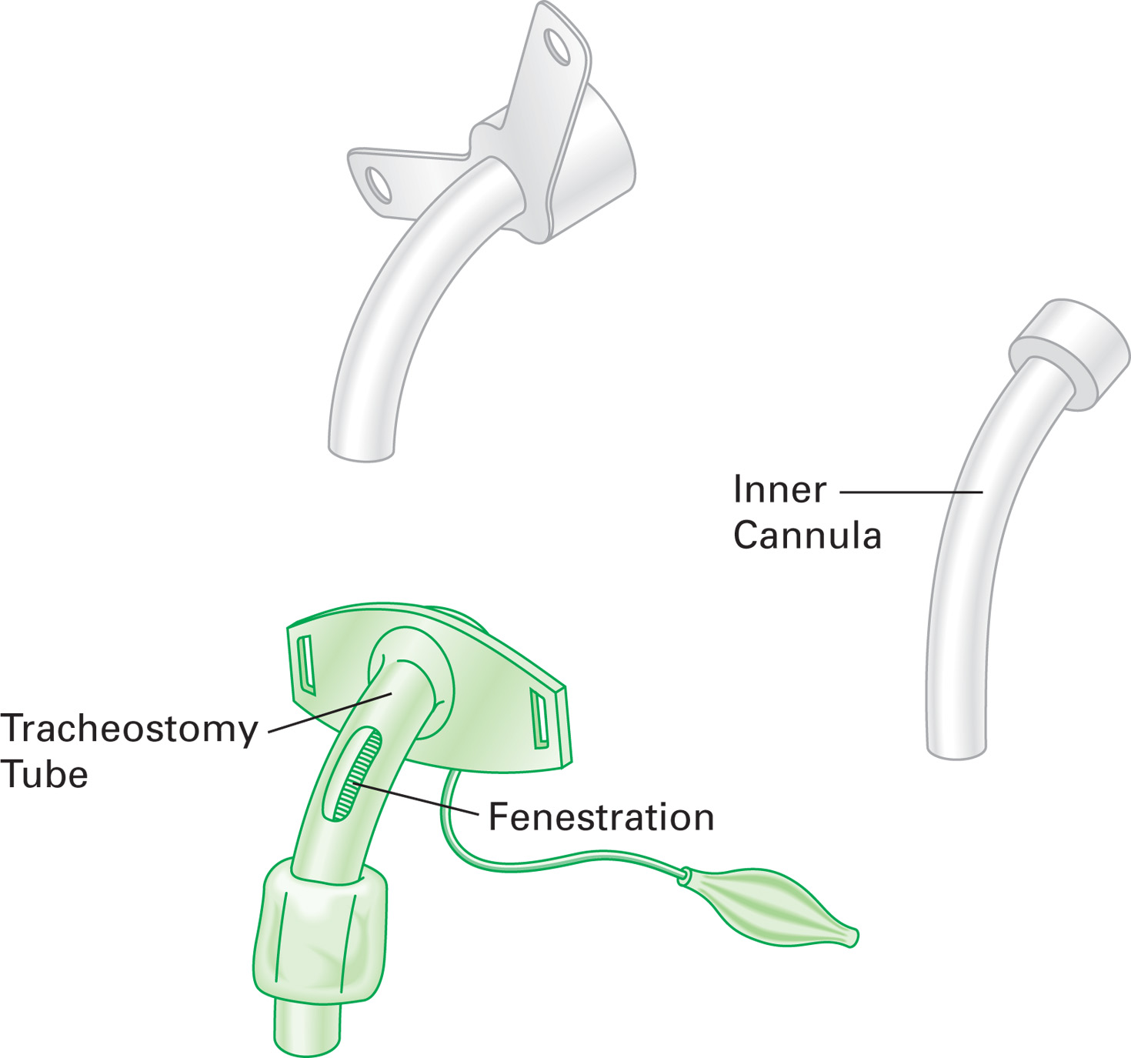
A Tracheostomy Tube for Older Children and Adults Has an Outer Cannula and an Inner Cannula
Notes:
A tracheostomy tube placed in the stoma of an infant commonly has just a single lumen because of the small size of the trachea. For older children and adults, there is an outer cannula and an inner cannula. The outer cannula keeps the stoma open and is held in place by a Velcro strap or twill tape around the neck. The inner cannula is smaller in diameter and slides into the outer cannula.

Slide 82
Airway and Respiratory Devices (7 of 18)
Tracheostomy Tubes
  To suction:
    Measure the depth of insertion for the suction catheter by comparing it to the tracheostomy tube obturator.
    Apply suction; slowly withdraw the catheter while twisting it between your fingers.
    Rinse the suction catheter with sterile water between attempts.
Notes:
Manipulation of a tracheostomy tube might be outside the EMT’s protocol, so make certain that you can perform these interventions before doing so.

Slide 83
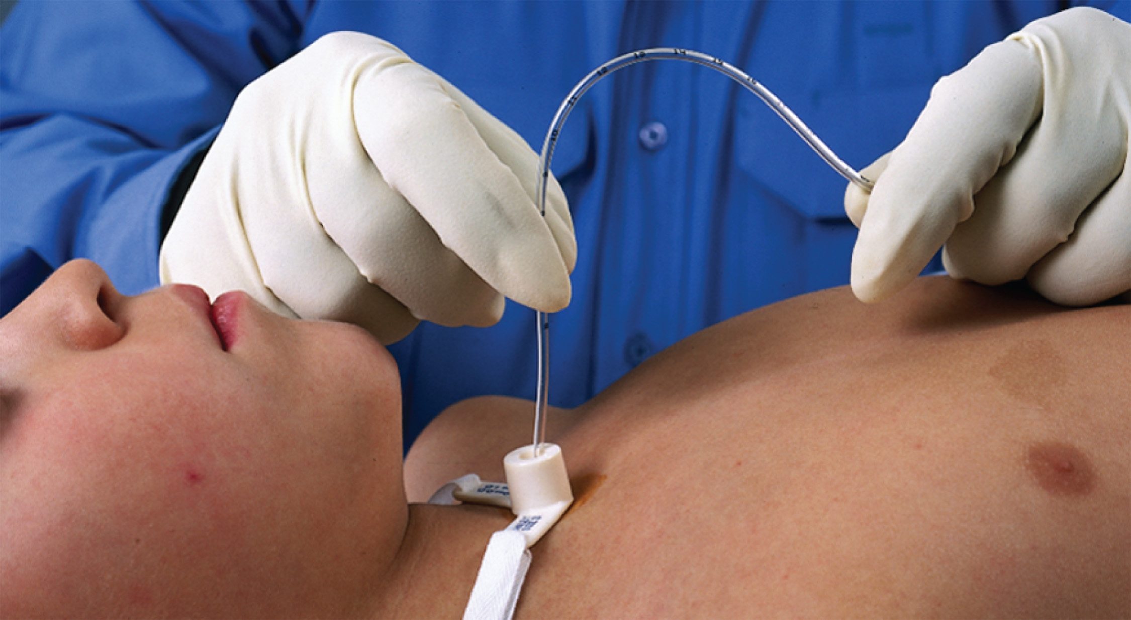
Use a Soft-Suction Catheter to Clear Blood or Secretions from the Tracheostomy Tube
Notes:
Do not suction for longer than 10 to 15 seconds in an adult, and 5 seconds in a pediatric patient.

Slide 84
Airway and Respiratory Devices (8 of 18)
C P A P and B i P A P
  Continuous positive-airway pressure/bilevel positive-airway pressure
  Both provide therapeutic back pressure during respiration.
  Some C P A P and B i P A P machines also allow the administration of oxygen during their use.
Notes:
When there is damage to the lower airway structures from disease, it is difficult for the airways to remain open. The use of CPAP or BiPAP can help keep these smaller airways stented open so that better ventilation can be achieved.

Slide 85
Airway and Respiratory Devices (9 of 18)
C P A P and Bi P A P
  Keep the bronchioles open during exhalation, which improves oxygenation and ventilation and decreases the work of breathing.
  It is commonly used by patients with C O P D or sleep apnea.
Notes:
Emergencies related to a CPAP or BiPAP machine are rare. During your assessment of a patient who uses a CPAP or BiPAP machine for sleep apnea, you will likely learn that EMS was summoned not for an emergency related to the device but rather for a respiratory distress complaint arising from the patient’s chronic pulmonary condition or some other medical emergency.

Slide 86
Airway and Respiratory Devices (10 of 18)
Home Mechanical Ventilators
  Patients may depend on a ventilator because of nervous system disorders, neuromuscular disease, or other problems.
  Home units vary in size.
  They can vary significantly in cost and sophistication.
Notes:
There are two types of mechanical ventilators: negative pressure and positive pressure. Negative pressure ventilators, such as the “iron lung,” encircle the patient’s chest and generate a negative pressure around the thoracic cage. The negative pressure draws the rib cage out, which creates a negative intrathoracic pressure that causes air to be drawn into the lungs. These devices are rarely used in the home setting because newer and better technology is available.

Slide 87
Airway and Respiratory Devices (11 of 18)
Mechanical Ventilators
  Settings include rate, tidal volume, and in some cases, the amount of oxygen provided.
  The tubing, called a ventilator circuit, attaches to the patient’s tracheostomy tube.
Notes:
Tidal volume in most is adjustable, whereas the ventilatory rate and oxygen supply, if provided, might be either fixed or adjustable.

Slide 88
Airway and Respiratory Devices (12 of 18)
Mechanical Ventilators
  A high-pressure alarm is activated when the pressure needed for lung inflation exceeds the present value.
    Causes include:
      Secretions occluding the tracheostomy tube
      Kinked ventilator circuit
      Tracheotomy tube movement.
Notes:
The alarm can also be triggered by decreased lung compliance. Causes for decreased lung compliance include the development of a pneumothorax, progressive pneumonia, development of acute pulmonary edema, or even alveolar collapse (atelectasis).

Slide 89
Airway and Respiratory Devices (13 of 18)
Mechanical Ventilators
  A low-pressure alarm is activated when the tidal volume falls 50—100 milliLiter below the set tidal volume.
    This indicates a problem in the breathing circuit, such as a disconnected segment or a leak in the tracheostomy tube cuff.
Notes:
Whenever a low-pressure alarm goes off, that typically means there is a hole somewhere in the circuit that is allowing the ventilation meant for the patient to be leaked to the atmosphere.

Slide 90
Airway and Respiratory Devices (14 of 18)
Mechanical Ventilators
  Apnea Alarm
    Some patients on a ventilator may have some respiratory effort, and the ventilator is set to trigger when the patient takes a breath.
    The apnea alarm triggers when the patient stops breathing.
  A low F i O₂ alarm occurs when the oxygen is disconnected or depleted.
Notes:
Apnea causes are usually physiological and include decreased mental status, overmedication, and respiratory muscle fatigue.
When approaching the patient with a ventilator emergency, be aware that the alarms going off might have been caused by a change in the patient’s clinical condition, not necessarily by ventilator malfunction.

Slide 91
Airway and Respiratory Devices (15 of 18)
Mechanical Ventilators
  Ventilator alarms can represent a change in the patient’s clinical condition or a problem with the ventilator.
  Troubleshoot the patient and the ventilator.
Notes:
Do not assume that if the ventilator starts to alarm, the remedy is to disconnect it and use a bag-valve mask. Although it might seem logical to simply disconnect the mechanical ventilator and bag the patient manually, if the inadequate breathing is from a change in the patient’s status (e.g., pneumothorax, airway occlusion), ventilating them manually will provide no more help than the mechanical ventilator could supply. Always troubleshoot the ventilator and the patient.

Slide 92
Airway and Respiratory Devices (16 of 18)
Accommodations for Patients with Airway or Respiratory Devices
  Because the device is used to support or replace a lost function, you must assess its adequacy in doing so.
  You also will perform your usual primary assessment, history, and physical exam in the usual order.
Notes:
Discussion Question
What are the special considerations for assessing and managing patients receiving mechanical ventilation at home?
Knowledge Application
Students should be able to apply the information in this section to the assessment and management of patients using home care devices to support their airway and breathing.

Slide 93
Airway and Respiratory Devices (17 of 18)
Accommodations for Patients with Airway or Respiratory Devices
  You may need to suction a tracheostomy tube.
  For patients with ventilators, troubleshoot both the device and the patient.
Notes:
After the suction catheter is placed, apply suction (-80 to -120 cm H₂O) while you withdraw the catheter. Rolling the catheter between your fingers during extraction can provide better clearing of the mucus or fluid. Suction for only 10 to 15 seconds in an adult and only 5 seconds in a child. The tracheal stimulation from your suction catheter will probably cause the patient to cough, sometimes forcefully.

Slide 94
Airway and Respiratory Devices (18 of 18)
Accommodations for Patients with Airway or Respiratory Devices
  If the ventilator provides adequate ventilation, allow it to do its job.
  If the ventilator does not provide adequate ventilations, you will need to use a bag-valve-mask device.
  Ensure you have adequate help to move the patient and the ventilator.
Notes:
If, on arrival, you find the patient breathes inadequately with the device, you must rapidly determine whether the inadequate breathing is secondary to airway occlusion, ventilatory circuit occlusion or kinking, mechanical failure of the ventilator, or a change in the patient’s clinical status that has rendered the ventilator ineffective.

Slide 95
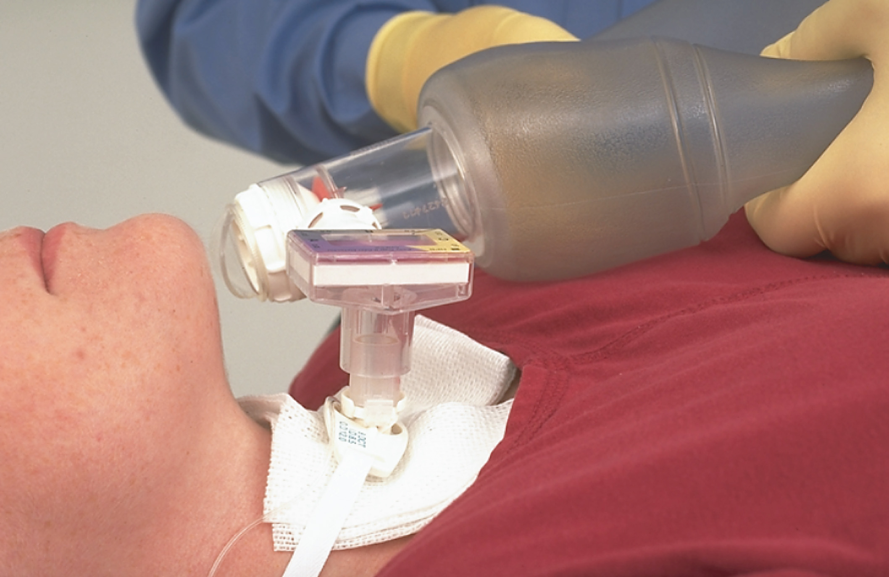
You Can Ventilate a Patient with a Tracheostomy by Attaching the Bag-Valve Device to the Tracheostomy Tube’s 15 over 22 millimeter Adapter
Notes:
Remove the ventilator circuit, place a bag-valve mask on the 15/22 mm adapter of the tracheostomy tube, and attempt one or two ventilations. If the ventilations do go in easily and you see chest wall movement, the problem is likely either ventilator failure or a problem with the ventilation circuit.

Slide 96
Vascular Access Devices (1 of 3)
Patients may have a vascular access device (V A D) for chemotherapy, dialysis, total parenteral nutrition, or antibiotic therapy.
V A D s may be placed in a variety of locations.
The device may have an external catheter portion, or may be a port implanted under the skin.
Notes:
Teaching Tips
If available, have several examples of VADs for students to examine.

Slide 97
Vascular Access Devices (2 of 3)
Central Intravenous Catheters
  Long, thin, hollow catheter inserted into a vein of the arm, neck, or subclavian vein, just below the clavicle
Central Venous Lines
  Port secured to the anterior chest, just below the clavicle.
Implanted Ports
  Surgically placed beneath the skin
Notes:
Teaching Tips
If available, have several examples of VADs for students to examine.
Critical Thinking Discussion
What is total parenteral nutrition (TPN)? Why might it be necessary?

Slide 98
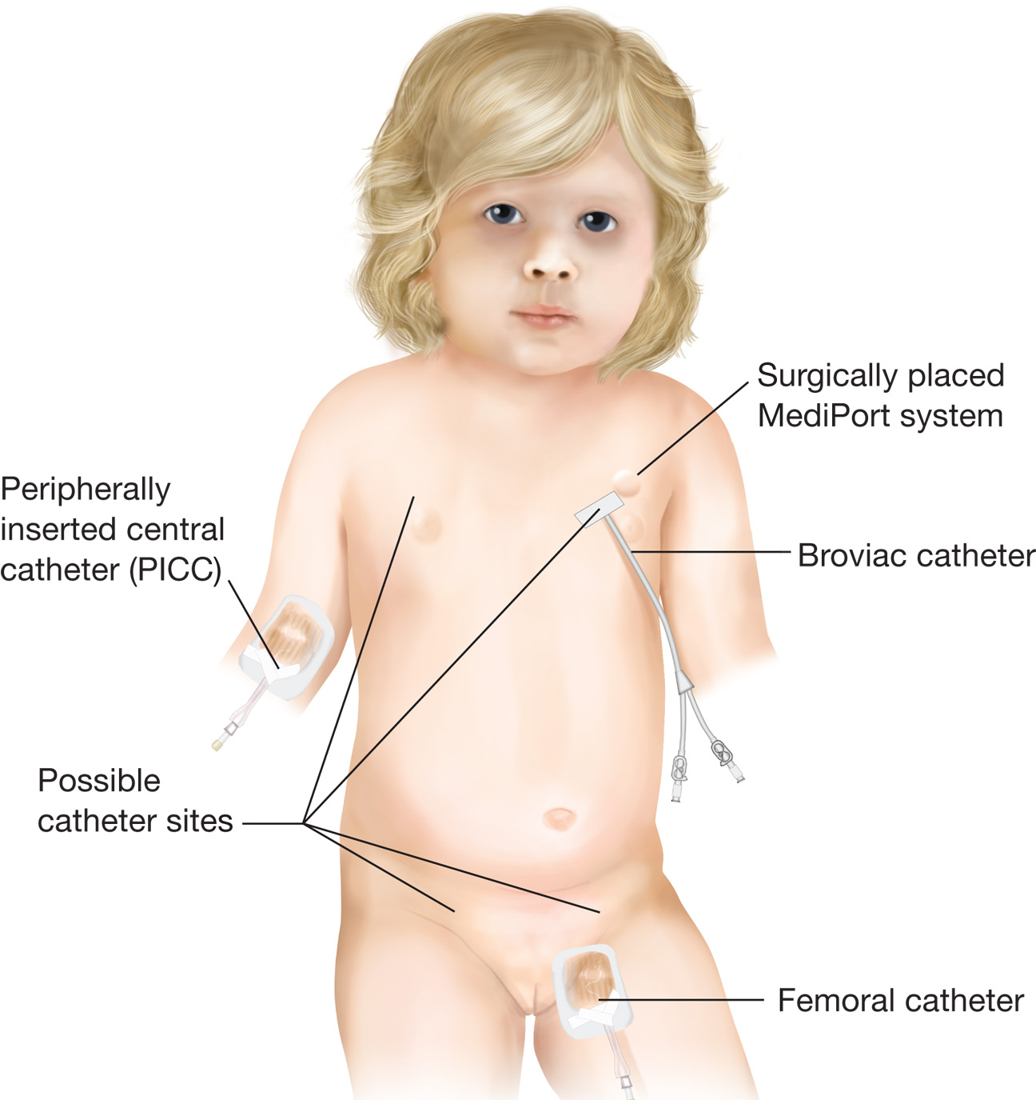
Vascular Access Devices Include Central I V Catheters Such as a P I C C Line, Central Venous Lines Such as the Broviac Catheter, and Implanted Ports Such as the Mediport System
Notes:
Sometimes, a medication that is needed to manage a patient’s condition must be administered often or, because of the drug’s action, must be administered into a large central vein. Placement of a venous access device enables this to be done outside the hospital setting.

Slide 99
Vascular Access Devices (3 of 3)
Accommodations for Patients with Vascular Access Devices
  Obstruction by a blood clot may occur.
  Patients may take anticoagulants.
  Air embolism may occur.
  Note any bleeding or signs of infection.
  The E M T does not access vascular access devices for medication administration.
Notes:
If a patient has a vascular access device that has an external port for medication administration, always inspect the site for bleeding or infection. Also note the depth of insertion and document this on your prehospital care report. If a problem arises with the depth of insertion, it should be made clear that the EMT was not responsible for causing either withdrawal or deeper insertion of the device.
Discussion Questions
What are the complications associated with VADs?
What steps should you take if a VAD becomes dislodged?
Knowledge Application
Students should be able to apply the information in this section to the management of patients with vascular access devices.

Slide 100
Vagus Nerve Stimulator
Implanted device found in patients with a seizure disorder
Accommodations for Patients with a V N S
  If a patient is actively seizing or feels as if they are about to have a seizure because of an aura, a special magnet can be passed over the device to trigger it to deliver a burst of electrical energy.
Notes:
As the EMT on the scene, you might need to pass the specialized magnet over the device to stimulate it.

Slide 101
Renal Failure and Dialysis (1 of 5)
Acute renal failure (A R F) occurs when there is a rapid loss of renal function.
A R F is often reversible.
Chronic renal failure (C R F) occurs when there is a progressive loss of kidney function over a period of months to years.
Dialysis removes the buildup of toxins the kidneys can no longer filter.
Notes:
Critical Thinking Discussion
How do diabetes and hypertension lead to chronic renal failure?
Teaching Tips
A tour of a dialysis center will help students understand the dialysis process.
Discussion Questions
What are the different types of shunts used for hemodialysis?
What is the difference between hemodialysis and peritoneal dialysis?
Knowledge Application
Students should be able to use information from this section to care for patients who receive dialysis.

Slide 102
Renal Failure and Dialysis (2 of 5)
Hemodialysis
  Blood is extracted from the body and sent through a machine called a dialyzer.
  The procedure is performed in a dialysis center.
  It requires a dialysis shunt to remove blood from the body and return it.
Notes:
The process takes anywhere from 2 to 5 hours. Dialysis typically occurs in a dialysis center and must be repeated two to three times per week.

Slide 103
Renal Failure and Dialysis (3 of 5)
Peritoneal Dialysis
  Fluid is placed in the peritoneal cavity through a port, where it acts to remove wastes, and is then emptied from the peritoneal cavity.
  Dialysis can be performed at home, but it is less effective.
Notes:
Because this form of dialysis is not as effective as hemodialysis, it must be repeated several times a day. However, because of current technology, the procedure is relatively easy for the patient to do without assistance and enables the patient greater freedom in daily activities because they are not bound to making several long appointments a week at the dialysis center.

Slide 104
Renal Failure and Dialysis (4 of 5)
Accommodations for Patients on Dialysis
  If a patient is receiving dialysis at a facility and is still attached to the dialysis machine, do not attempt to remove the patient prematurely.
  Only dialysis center staff should remove the patient from the machine.
Notes:
You should never attempt to obtain a blood pressure in any extremity that has an AV shunt, AV fistula, or AV graft. The surgical procedures used to create the shunt can be significantly or irreparably damaged by the application and inflation of a blood pressure cuff. Always use an extremity that does not have an AV shunt.
The AV shunt, if damaged, can bleed excessively. The bleeding could be external, with significant amounts lost rapidly, or internal, with the formation of a large hematoma beneath the surface of the skin. In either instance, you should apply direct pressure to the site.

Slide 105
Renal Failure and Dialysis (5 of 5)
Accommodations for Patients on Dialysis
  Patients with peritoneal dialysis may develop peritonitis or inflammation at the insertion site, or the catheter may be dislodged.
Notes:
Management includes keeping the catheter insertion site clean and dry, supporting any lost function that might be present, and transporting the patient to the hospital for evaluation by the receiving physician.

Slide 106
Gastrointestinal and Genitourinary Devices (1 of 5)
Feeding Tubes
  Feeding tubes are used to provide nutrition to patients who cannot chew or swallow.
  Feeding tubes include nasogastric tubes, orogastric tubes, gastric tubes, and jejunal tubes.
Notes:
Patients who receive their nourishment this way are said to be receiving enteral feeding, or tube feeding. The device is typically a flexible tube that is long and small in diameter. It is named according to the site
of insertion.
Teaching Tips
Show examples of several types of feeding tubes and urinary catheters.

Slide 107
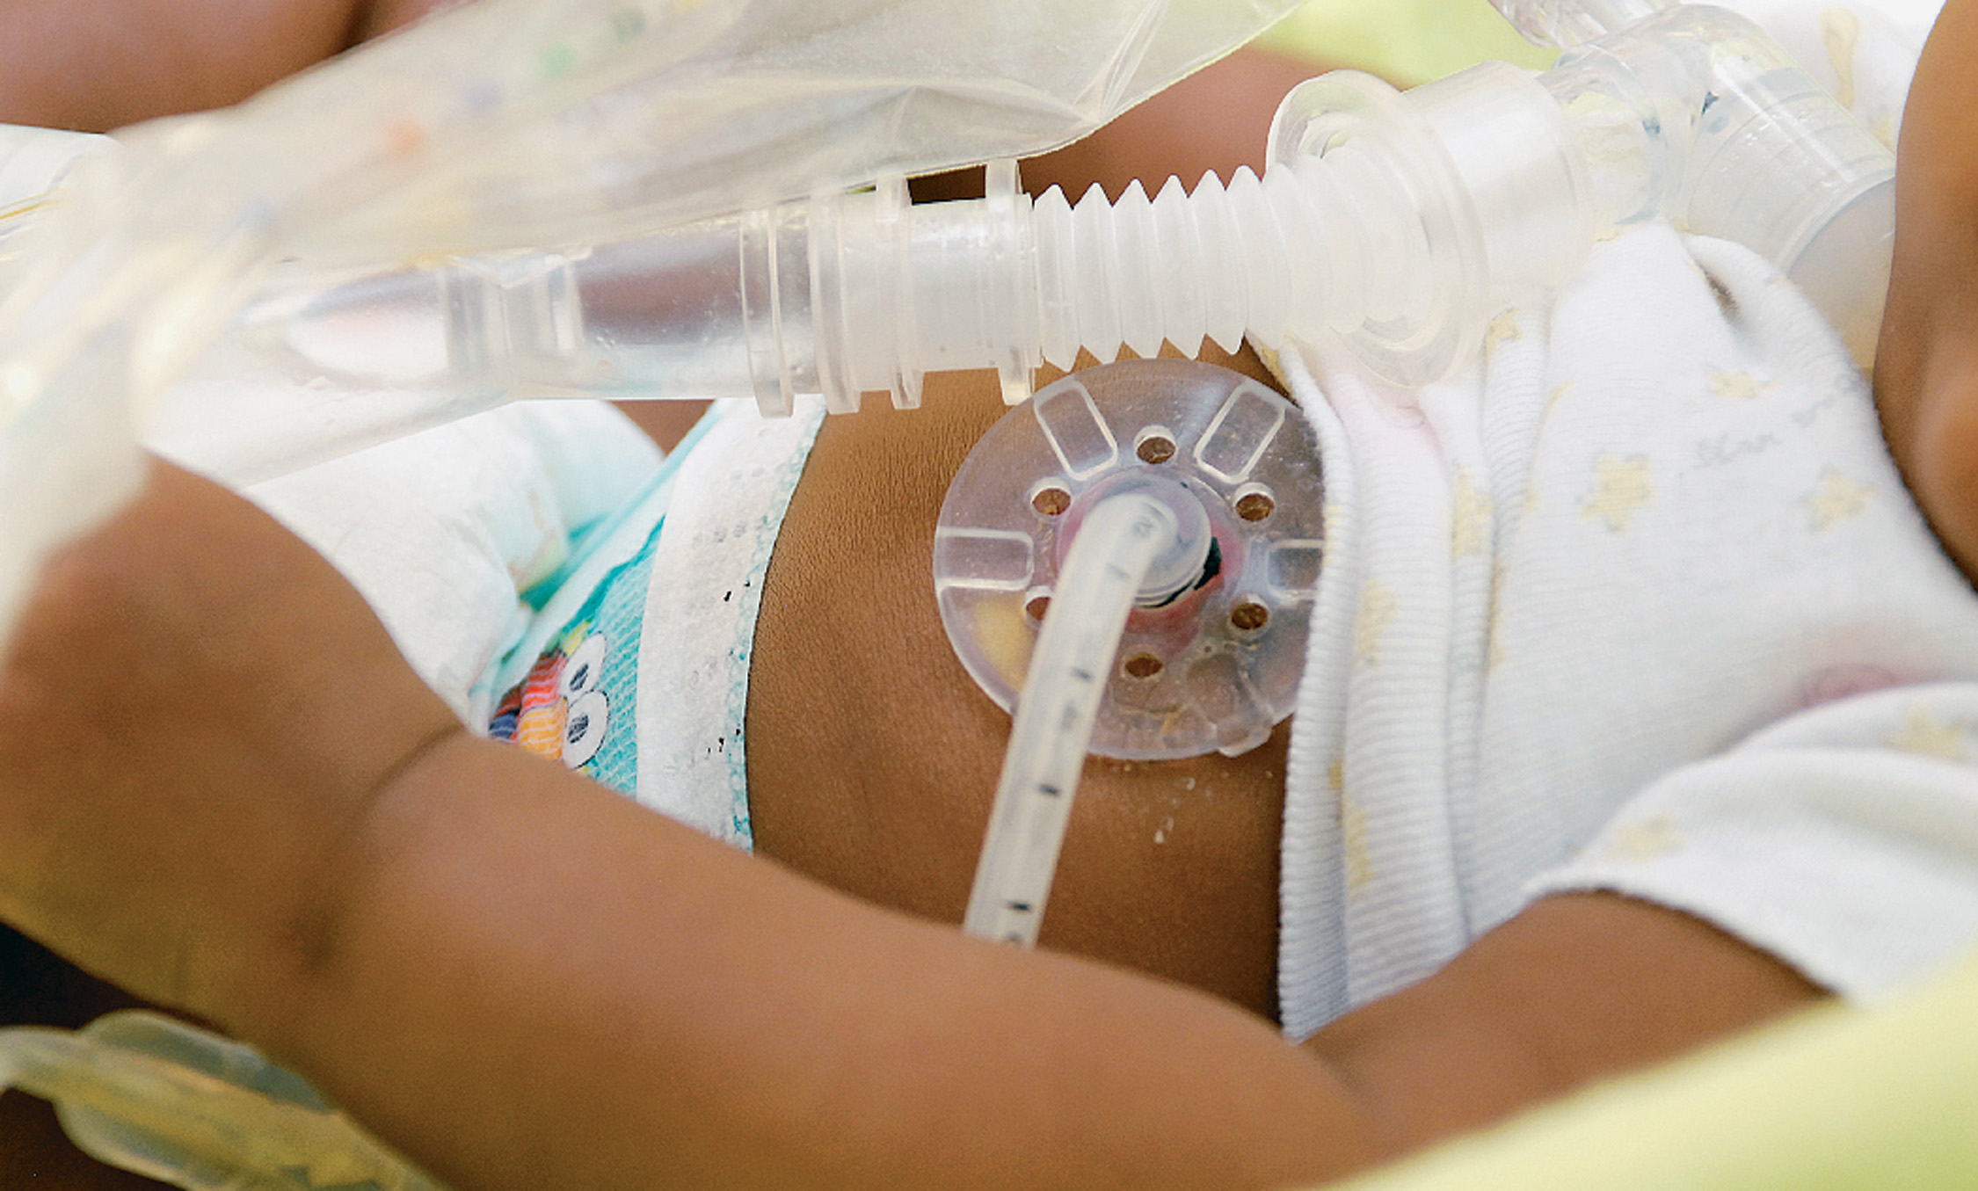
For Long-Term Nutritional Support, a Feeding Tube May be Surgically Inserted through the Abdominal Wall and Directly into the Gastrointestinal System
Notes:
When long-term nutritional support is warranted, a tube might be surgically inserted through the abdominal wall and directly into the GI system. The procedure that places a gastric tube into the abdomen is termed gastrostomy.

Slide 108
Gastrointestinal and Genitourinary Devices (2 of 5)
Ostomy Bags
  A surgical opening through the abdominal wall to which a section of bowel is diverted so that fecal material is directed outside the body into the bag
Notes:
This procedure can be done on a temporary or a long-term basis and is used in patients with Crohn’s disease, ulcerative colitis, colon cancer, or diverticulitis.
Critical Thinking Discussion
Why might a patient with Crohn's disease require an ostomy bag?

Slide 109
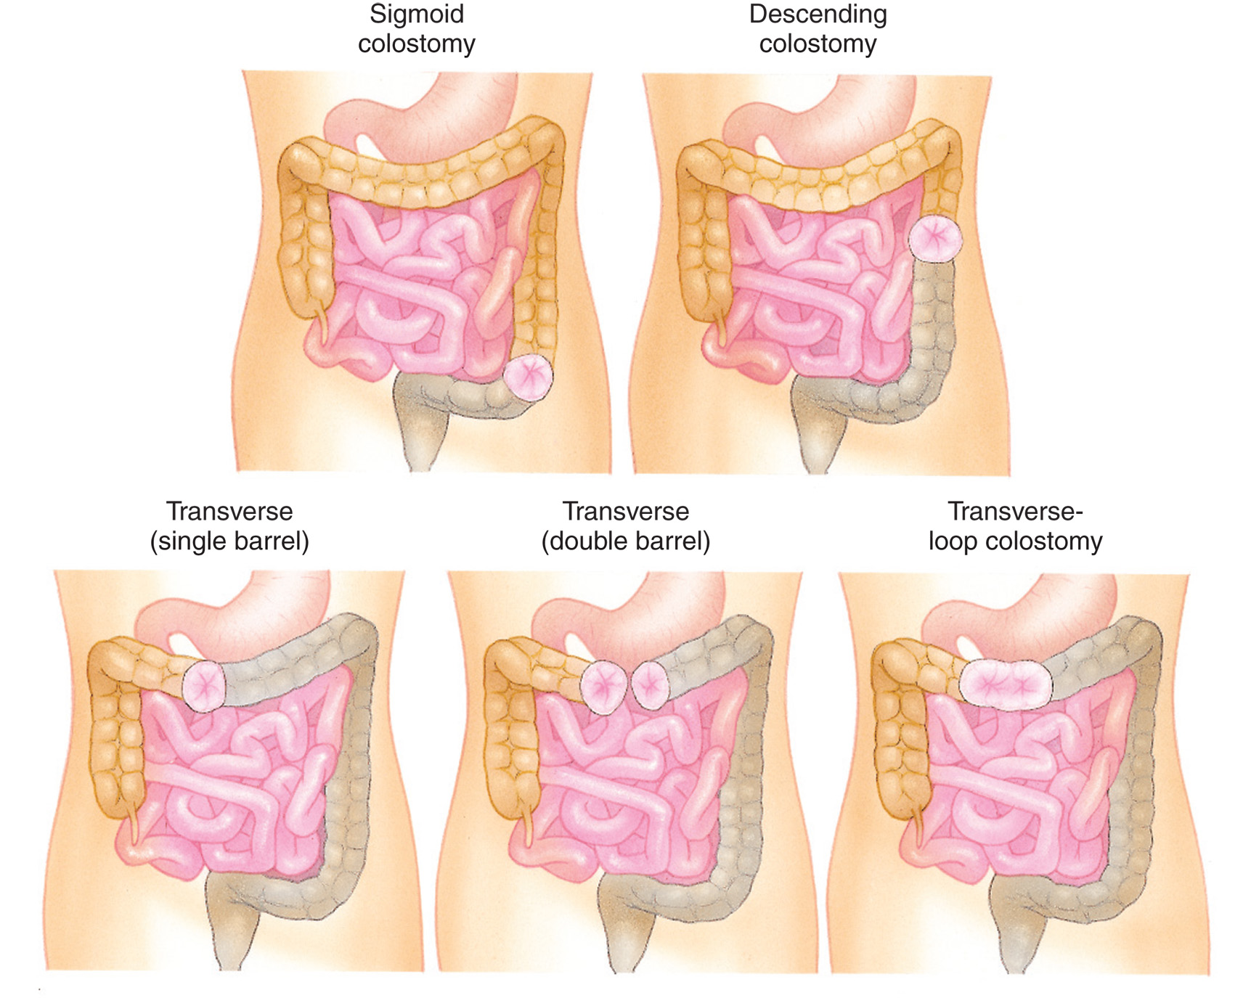
Ostomy Stomas May be Found at Various Abdominal Locations
Notes:
A surgical opening is made through the abdominal wall, and a section of the bowel is diverted through this opening so that the flow of fecal material can be directed outside the body.

Slide 110
Gastrointestinal and Genitourinary Devices (3 of 5)
Urinary Tract Devices
  A urinary catheter is used to empty the bladder when there is a urinary tract dysfunction.
  Urinary Tract Device Types:
    Texas—External catheter
    Foley—Indwelling through the urethra
    Suprapubic—Surgically inserted through the abdominal wall
Notes:
The least invasive of these is called a Texas catheter (or condom catheter) because it attaches to the external male urethra in the same manner as a prophylactic condom would.

Slide 111
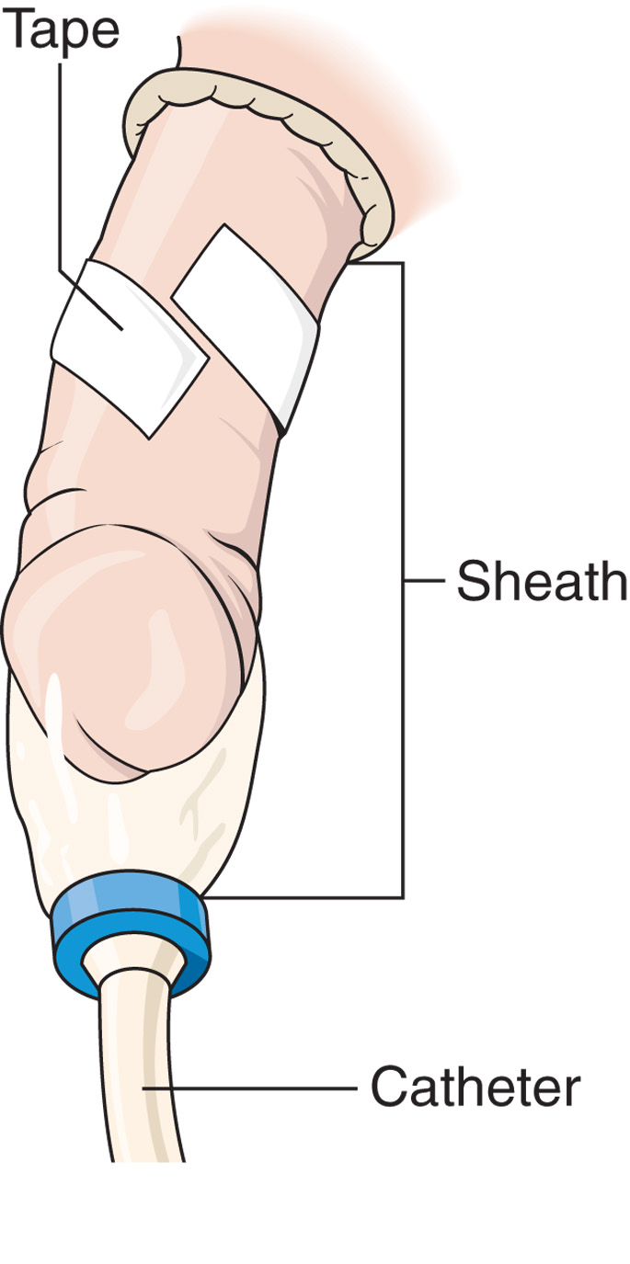
An External Urinary Catheter
Notes:
A Texas catheter (or condom catheter) because it attaches to the external male urethra in the same manner as a prophylactic condom would.

Slide 112
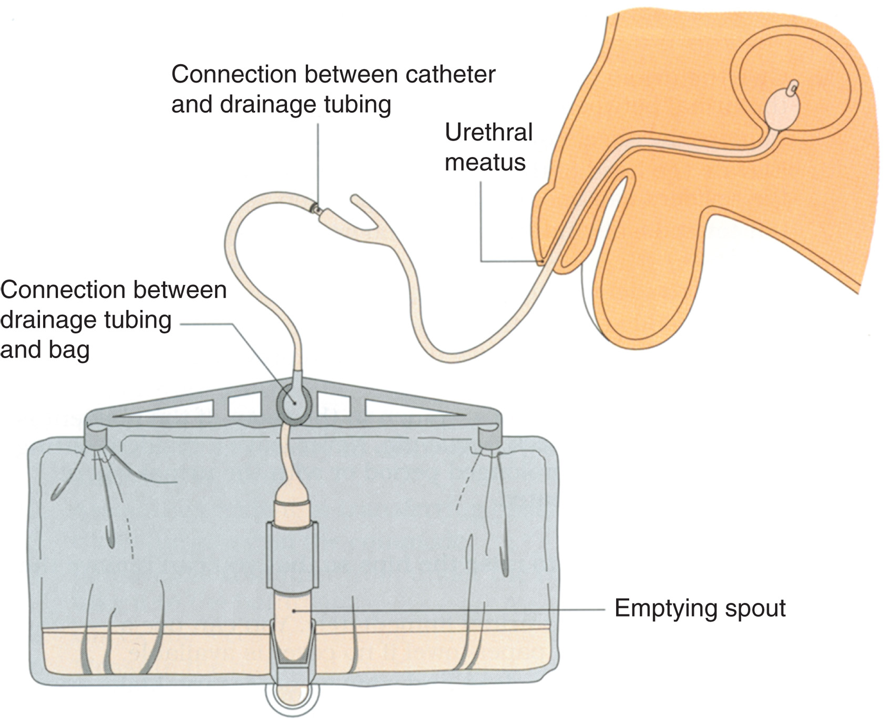
An Internal Urinary Catheter with Balloon
Notes:
If the patient has a urinary catheter, it is a good idea to drain the collection bag prior to transport, taking note of the volume of urine removed and any irregularities in color or odor.

Slide 113
Gastrointestinal and Genitourinary Devices (4 of 5)
Accommodations for Patients with Gastrointestinal and Genitourinary Devices
  Problems include obstruction, infection, and displacement.
    If a device is dislodged, do not attempt to replace it.
Notes:
Discussion Questions
What are some complications associated with feeding tubes?
What are some complications of ostomy bags and ostomy sites?
What precautions should you observe when transporting a patient with a urinary catheter?
Knowledge Application
Students should be able to integrate this information into the assessment and care of patients with GI/GU devices.

Slide 114
Gastrointestinal and Genitourinary Devices (5 of 5)
Accommodations for Patients with Gastrointestinal and Genitourinary Devices
  Drain catheter bags prior to transport and document the appearance and amount of urine.
  Keep the catheter bag lower than the site of insertion.
Notes:
If during inspection of a GI/GU device it appears that the device has shifted or become misplaced, do not attempt to correct the situation. Secure the device in the location in which it was found and transport the patient to the hospital while monitoring the site.

Slide 115
Intraventricular Shunts (1 of 4)
Hydrocephalus occurs when excess cerebrospinal fluid accumulates, which can cause increased intracranial pressure.
An intraventricular shunt allows the excess fluid to drain.
Notes:
Discussion Question
What is hydrocephalus?
Critical Thinking Discussion
What are the indications of increasing intracranial pressure?
Knowledge Application
Students should be able to apply the information from this section to the assessment and management of patients with intraventricular shunts.

Slide 116
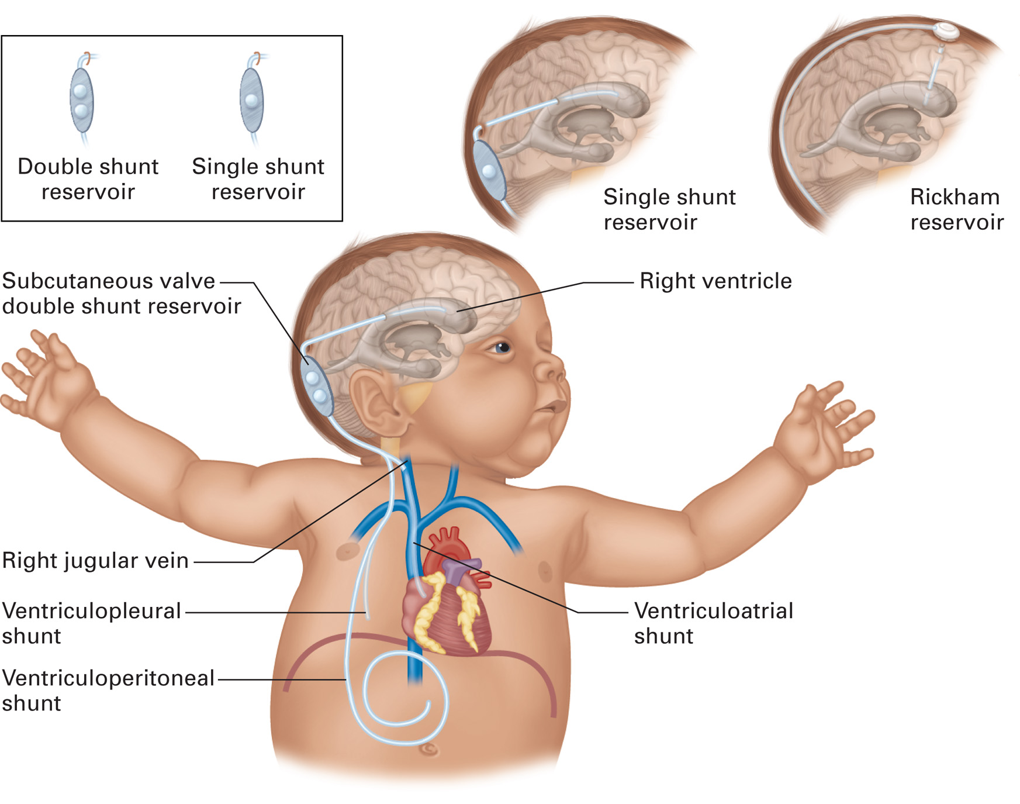
Intraventricular Shunts Allow Excess Cerebrospinal Fluid to Drain from the Brain to a Site in the Neck, Heart, Pleural Space, or Abdomen, or into a Reservoir Beneath the Scalp
Notes:
An intraventricular shunt is surgically placed. It originates within a ventricle of the brain and extends to a blood vessel in the neck, the heart, the pleural space, or the abdomen to drain excess CSF and keep the ICP at an acceptable level. In some patients, you might also find a reservoir on the side of the skull, placed beneath the scalp, that collects the excess CSF for testing purposes.

Slide 117
Intraventricular Shunts (2 of 4)
Complications include infection, shunt occlusion, and subdural bleeding.
Infection may present with malaise, fever, and headache.
Notes:
If the shunt drains into an external reservoir, there can be signs of local skin infection where the tube exits the body. In severe cases, or in situations in which the patient is immunosuppressed, a local infection involving the shunt can result in a systemic blood infection (sepsis).

Slide 118
Intraventricular Shunts (3 of 4)
Shunt obstruction causes the following signs of increased intracranial pressure:
  Headache/Seizures
  Vomiting
  Altered mental status
  Sensory or motor dysfunction
  Respiratory depression
  Pupil changes
  Increased blood pressure.
Notes:
The obstruction can occur because of the body trying to block off the shunt, because one of the two ends has become dislodged and can no longer allow CSF to flow out, or there is a physical obstruction within the shunt. When this occurs, excess CSF accumulates in the brain and starts to raise ICP to potentially dangerous levels.

Slide 119
Intraventricular Shunts (4 of 4)
Accommodations for Patients with Intraventricular Shunts
  Initial complaints include confusion, difficulty with simple tasks, and headaches.
    Manage the airway and if breathing is inadequate, provide positive-pressure ventilation with oxygen.
Notes:
Commonly, the initial complaint seen with intraventricular shunt emergencies is confusion, difficulty with simple tasks, and headaches. As the problem continues, symptoms worsen.

Slide 120
Terminally I ll Patients (1 of 3)
The life expectancy of a terminally ill patient is generally 6 months or less.
Patients may receive palliative care.
Hospice is a philosophy of care aimed at palliation of symptoms for patients and support for their families.
Notes:
The term palliative care is used to describe medical interventions centered on reducing the severity of disease symptoms and providing comfort for the patient.
Discussion Question
What are your obligations in caring for the terminally ill patient?
Knowledge Application
Students should be able to apply this information to the care of terminally ill patients.

Slide 121
Terminally I ll Patients (2 of 3)
Patients receiving hospice care often are ill with the following:
  Cancer
  A I D S
  Alzheimer’s disease
  Cystic fibrosis
  Congestive heart failure
  C O P D.
Notes:
These programs seek to alleviate symptoms, manage pain or discomfort, and provide a certain degree of control to the patients and their families during the final stage of life. Although hospice programs primarily work with the elderly, services are also provided to children with terminal diseases.

Slide 122
Terminally I ll Patients (3 of 3)
Accommodations for Terminally I ll Patients
  Provide emotional support.
    If there is confusion, determine the patient’s and family’s intent.
    A desire to not be resuscitated does not mean the patient does not want comfort care.
Notes:
It is not uncommon to encounter a hospice patient at the end of life who has accepted that death is imminent while the family is more frightened or in denial than the patient. Your emotional support to these families can be just as valuable as the palliative care you provide to the patient.
You need to communicate with the patient, the family, or the primary care provider about any advance directives that might be in place in the absence of a hospice program.

Slide 123
Case Study Conclusion (1 of 3)
The patient has a pulse oximetery reading of 90 percent. Alice checks the ventilator circuit, and finds no obstruction, and the patient’s mother reports that she just suctioned the tracheostomy tube. Alice listens to the patient’s lung sounds, and determines that they are diminished on the right side, with some crackles and wheezes in the right lower lobe.
Notes:
Case Study Discussion
Review Case Conclusion and emphasize the application of knowledge learned from this presentation.

Slide 124
Case Study Conclusion (2 of 3)
The patient’s ventilator does not have an F i O ₂ setting. The E M T s leave the ventilation rate and tidal volume at their current settings.
When the engine crew arrives, the E M T s temporarily disconnect the ventilator and ventilate the patient by bag valve mask as they move him to the ambulance, where they plug in and reconnect the ventilator.
Notes:
Case Study Discussion
Review Case Conclusion and emphasize the application of knowledge learned from this presentation.

Slide 125
Case Study Conclusion (3 of 3)
They transport the patient to the hospital, where he is admitted and treated for pneumonia.
Notes:
Case Study Discussion
Review Case Conclusion and emphasize the application of knowledge learned from this presentation.

Slide 126
Lesson Summary (1 of 2)
Patients can present with a variety of challenges, such as sensory impairment, obesity, poverty, and homelessness.
You must understand the needs of these patients and variations in assessment findings and emergency care.
Notes:
Follow-Up
Answer student questions.
Follow-Up Assignments
Review Chapter 40 Summary.
Complete Chapter 40 In Review questions.
Complete Chapter 40 Critical Thinking questions.
Assessments
Handouts
Chapter 40 quiz

Slide 127
Lesson Summary (2 of 2)
Home medical devices are becoming more commonplace.
Use patients and caregivers as resources for information.
Support the patient’s lost functions and intervene with equipment only if there is a malfunction.
Notes:
Class Activity
As an alternative to assigning the follow-up exercises in the lesson plan as homework, assign each question to a small group of students for in-class discussion.
Teaching Tips
Answers to In Review questions are in the appendix of the text. Advise students to review the questions again as they study the chapter.

Slide 128
Correct!
Homelessness is more likely to be associated with poor nutrition than with obesity.
Click here to return to the program.

Slide 129
Incorrect (1 of 3)
Homelessness is associated with an increased risk of violence and abuse.
Click here to return to the quiz.

Slide 130
Incorrect (2 of 3)
Homelessness is associated with lack of adequate shelter, and therefore increased risk of environmental exposure.
Click here to return to the quiz.

Slide 131
Incorrect (3 of 3)
Homelessness is associated with an increased risk of accidental trauma.
Click here to return to the quiz.

Slide 132
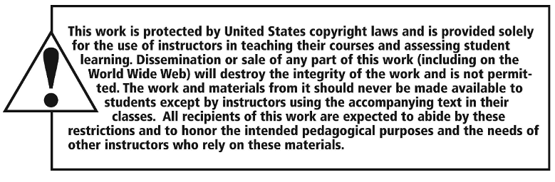
Copyright

