Slide 1

Prehospital: Emergency Care
Eleventh Edition
Chapter 3
Medical, Legal, and Ethical Issues
    Slides in this presentation contain hyperlinks. JAWS users should be able to get a list of links by using INSERT+F7
Copyright © 2018, 2014, 2010 Pearson Education, Inc. All Rights Reserved
Notes:
If this PowerPoint presentation contains mathematical equations, you may need to check that your computer has the following installed:
1) MathType Plugin
2) Math Player (free versions available)
3) NVDA Reader (free versions available)
During this lesson, students will learn about the roles and responsibilities of an EMT. Stress that although this chapter isn’t a “clinical” one that will improve the skills of the EMT, it’s nevertheless an important chapter that is interwoven into all aspects of the EMS profession.
Advance Preparation
Student Readiness
Assign the associated section of MyBRADYLab and review student scores.
Review the chapter material in the Instructor Resources, which includes Student Handouts, PowerPoint slides, and the MyTest Program.
Prepare
Make copies of course policies, procedures, the syllabus, handouts from the Instructor Resources, and other materials for distribution or post them in your learning management system.
Preview the media resources and Master Teaching Notes in this lesson.
Preview the case study presented in the PowerPoint slides.
Invite the medical director to the first class session.
Make arrangements to tour an emergency department or local PSAP.
Obtain 911 recordings to play for the class.
Arrange to have an ambulance present at the class location.
Bring in a couple of current EMS research articles from a peer-reviewed publication.
Ask a health department representative to speak on public health.
The total teaching time recommended is only a guideline as described in the IRM lesson plan. Take into consideration factors such as the pace at which students learn, the size of the class, breaks, and classroom activities. The actual time devoted to teaching objectives is the responsibility of the instructor.

Slide 2
Learning Readiness
E M S Education Standards, text p. 45.
Chapter Objectives, text p. 45.
Key Terms, text p. 45.
Purpose of lecture presentation versus textbook reading assignments.
Notes:
Explain to students what the National EMS Education Standards are. The National EMS Education Standards communicate the expectations of entry-level EMS providers. As EMTs, students will be expected to be competent in these areas. Acknowledge that the standards are broad, general statements. Although this lesson addresses the listed competencies, the competencies are often complex and require completion of more than one lesson to accomplish. The student is also expected to review the chapter objectives to foreshadow what will be in the chapter. By mastering the key terms the EMT student will better understand the learning and be able to communicate more clearly.
Additionally, explain to the students that the purpose of using these slides is to help keep the instructor focused on highlighting important portions of the material, explain interrelationships of topics, and discuss how to apply this information. It’s not the intent of the presentation (or slides alone) to include every component in the chapter. This presentation still requires the student to thoroughly read the chapter.

Slide 3
Setting the Stage
Overview of Lesson Topics
  The scope of practice
  Issues of consent and refusal
  Legal aspects of emergency care
    Negligence
    Intentional tort
    Confidentiality
    H I P A A and E M T A L A
    Protecting yourself
Notes:
These bulleted points are the major headings from the chapter, in order. The purpose is to provide a basic lecture navigation for the student.

Slide 4
Case Study Introduction
E M T s Phil Baker and Caitlyn O‘Shea have responded to an alley behind a strip mall for an unresponsive person. Police are on the scene and are conversing with the patient who is now sitting up. The patient, who is disheveled and smells of alcohol and urine, shouts, “I‘m not going to the hospital. Get out of here!”
Notes:
Case Study
Present the Case Study Introduction provided in the PowerPoint slide set.
Lead a discussion using the case study questions provided on the subsequent slide(s).
The Case Study with discussion questions continues throughout the PowerPoint presentation.
Case Study Discussion
Use the case study content and questions to foreshadow the upcoming lesson content

Slide 5
Case Study (1 of 5)
What are the E M T s’ legal obligations in this situation?
What ethical obligations do the E M T s have?
What information should the E M T s attempt to obtain?
Notes:
Case Study Discussion
Use the case study content and questions to foreshadow the upcoming lesson content. Gauge the student’s responses as a guide of how well versed they are in this topic.

Slide 6
Introduction
Every E M S call involves legal and ethical decision making.
Although most instances are clear, some are not.
In some cases E M T s must weigh complex information to act in the patient's best interests.
Notes:
Critical Thinking Discussion
Why is it important for EMT students to understand the legal and ethical issues of EMS early in the EMT course?
Ask the students these questions to start the dialogue:
Should you stop to treat an accident victim when you are off duty?
May you treat a child when the parents aren’t present to give consent?
Should you withhold cardiopulmonary resuscitation (CPR) if the patient’s family asks you to?
Reinforce that the EMT will often need to act on medical, legal, and ethical issues such as these during your career as an EMT. EMTs are unlikely to be sued successfully if they provide and carefully document emergency care within their scope of practice and local protocols, with knowledge of issues such as patient consent and duty to act.

Slide 7
Scope of Practice (1 of 12)
  Legal Duties
    Scope of practice
    Standard of care
Notes:
Typically, state laws identify the EMT’s scope of practice, or the actions and care that EMTs are legally allowed to perform by the state in which they are providing emergency medical care. The scope of practice asks: Was the EMT allowed by law to do what he did? Scope of practice also identifies which activities would be deemed illegal if performed without licensure or certification and establishes boundaries among professionals.
Teaching Tips
Ask students to give examples of actions that are within the EMT's scope of practice and actions that are not within the EMT's scope of practice.
Points to Emphasize
State laws define the level of care that EMTs can provide. EMTs may not perform care that is outside their scope of practice. There’s a difference between an EMT's scope of knowledge and the scope of practice. EMTs cannot perform skills outside the legal scope of practice, even if they know how to perform the skill. The standard of care defines what is considered competent care by an EMT in a given situation.
The standard of care is defined as the care that is expected to be provided by an EMT with similar training when managing a patient in a similar situation. The concept of “the reasonable person standard” is applied. That is, what would a reasonably prudent EMT with similar training do in the same situation? Also, standard of care asks whether the EMT provided the care properly. Thus, standard of care deals with two principles: (1) Did the EMT provide the right assessment and emergency care for the patient? (2) Did the EMT perform the assessment and emergency care properly?

Slide 8
Scope of Practice (2 of 12)
Legal Duties
  Scope of practice
    The actions and care that E M T s are legally allowed to perform by the state in which they work
    Establishes boundaries among professionals
Notes:
Prehospital emergency care has changed significantly since its early days. One improvement has been in the quality of training that emergency medical personnel receive today. The public and the health care profession have come to expect a competent EMT who understands and accepts the legal and ethical responsibilities to the patient, to the medical director, and to the public.

Slide 9
Scope of Practice (3 of 12)
Legal Duties
  Scope of practice
    Defining scope of practice
      National E M S Scope of Practice Model
      National E M S Education Standards
      State laws, regulations, policies
Notes:
Discussion Questions
How are scope of practice and standard of care different? What is an example that illustrates this difference?
How are scopes of practice and standards of care determined?

Slide 10
Scope of Practice (4 of 12)
Legal Duties
  Standard of care
    Two principles:
      Did the E M T provide the right assessment and care?
      Did the E M T perform the assessment and care properly?
Notes:
Teaching Tips
Ask students to give examples of actions that are within the EMT's scope of practice and actions that aren’t within the EMT's scope of practice.
Points to Emphasize
State laws define the level of care that EMTs can provide. EMTs may not perform care that is outside their scope of practice. There’s a difference between an EMT's scope of knowledge and the scope of practice. EMTs cannot perform skills outside the legal scope of practice, even if they know how to perform the skill. The standard of care defines what is considered competent care by an EMT in a given situation

Slide 11
Scope of Practice (5 of 12)
Legal Duties
  Duty to act
    The legal obligation to provide service.
    Duty to act exists while you are on duty with your service.
    Duty to act does not exist when you are not on duty (in most states).
    Other criteria may apply.
Notes:
The concept known as duty to act refers to your legal obligation to provide service, whether you think the patient needs an ambulance or not. Legally, while you are on duty, you are obligated to care for a patient who requires and consents to it, rendering the necessary emergency care to the best of your ability and training. If off-duty and not functioning in an EMS capacity, however, in most states you have no more legal obligation to act than any other citizen. While off duty in these states, you could legally do any of the following:
• Stop and help the accident victim at the scene.
• Pass the scene and call for help.
• Pass the scene and make no attempt to call for help.
Note, however, that some states do require EMTs to stop and render aid even when off duty.
One of the most important aspects of duty to your patient involves respecting the rights of the patient. Part of that protection includes maintaining the privacy and confidentiality of the patient’s medical status, history, and records. Not only does the EMT provide care for the physical injuries and illness, but also meeting the emotional needs of the patient. You must also don’t further harm. Your duty goes beyond accepting the responsibility to respond and provide emergency care to a patient. You also have a duty to self, a duty to your partner, and a duty to take responsibility for your equipment.
Knowledge Application
Given various scenarios in which an EMT encounters an ill or injured patient, determine whether or not the EMT has a duty to act.

Slide 12
Scope of Practice (6 of 12)
Legal Duties
  Good Samaritan laws
    Protect a person who is not being paid for his services from liability for acts performed in good faith except in cases of gross negligence
Notes:
The first Good Samaritan law was enacted in 1959 in California specifically to protect from liability “persons licensed (such as a physician or surgeon) who in good faith render emergency care at the scene of the emergency. . . for civil damages as a result of any acts or omissions.” Many states have immunity laws of their own, some of which specifically cover prehospital emergency care providers.
Generally, a Good Samaritan law protects a person who isn’t being paid for his services from liability for acts performed in good faith unless those acts constitute gross negligence. Therefore, the person suing must prove that the care provided was markedly below the standard of care and, in some cases, with willful or wanton intent to harm the patient.

Slide 13
Scope of Practice (7 of 12)
Legal Duties
  Good Samaritan laws
    You must:
      Render care to the best of your ability.
      Work within the scope of practice and to the standard of care.
      Act professionally.
Notes:
Critical Thinking Discussion
What are some pros and cons of Good Samaritan laws?

Slide 14
Scope of Practice (8 of 12)
Legal Duties
  Other legal protections
    Sovereign immunity is afforded in some cases to government employees.
    Statutes of limitations restrict the amount of time a person has to file a lawsuit.
    Contributory negligence on the part of the patient.
Notes:
Points to Emphasize
EMTs are provided with certain legal protections, which can vary from state to state.

Slide 15
Scope of Practice (9 of 12)
Legal Duties
  Medical direction
    The legal right to function as an E M T is contingent on approval by medical direction.
Notes:
Points to Emphasize
EMTs may practice only under the direction of a physician medical director according to standing orders, protocols, or direct communication.

Slide 16
Scope of Practice (10 of 12)
Legal Duties
  Medical direction
    With regard to medical direction, you must do the following:
      Follow approved standing orders and protocols
      Communicate with medical direction when needed
Notes:
Your legal right to function as an EMT is contingent on medical direction. When providing emergency care, you should:
• Follow standing orders and protocols, as approved by medical direction.
• Establish cell phone, telephone, and radio communications with medical direction when appropriate.
• Communicate clearly and completely with medical direction, and follow orders medical direction gives in response.
• Any time there is a question about the scope or direction of care, consult medical direction.

Slide 17
Scope of Practice (11 of 12)
  Legal Duties
  Ethical Responsibilities
    Ethics
      Branch of philosophy focused on the study of morality
    Morals
      Concepts of right and wrong
Notes:
Ethics is a branch of philosophy specifically directed toward the study of morality, or morals. Morals are concepts of “right and wrong.” A code of ethics is a list of rules of ideal conduct. A Code of Ethics for EMTs was issued by the National Association of Emergency Medical Technicians in 1978. Basically, if you place the welfare of the patient above all else when providing medical care, you will rarely commit an unethical act.

Slide 18
Scope of Practice (12 of 12)
E M T Code of Ethics
  Places welfare of the patient above all else when providing medical care
    Serve the needs of the patient
    Maintain skill mastery
    Remain abreast of changes in E M S
    Critically review performances
    Report with honesty
    Work harmoniously with health care team
Notes:
Points to Emphasize
The basic principle of ethics in EMS is to place the welfare of the patient above all else.
Teaching Tips
Ask students to give examples to illustrate each of the ethical responsibilities listed in the text on page 48.
Discussion Question
Can you think of an example of something that is legal, but not ethical? What is an example of something that is ethical, but not legal?
Class Activity
Have students divide into small groups and draft a class code of ethics. Allow 10 to 15 minutes for the activity, and then have groups read their codes aloud for class discussion.

Slide 19
Case Study (2 of 5)
The E M T s approach the patient. “Hi,” says Caitlyn. “My name is Caitlyn, and I’m an E M T. We’re here because someone called to say you were unconscious. How are you feeling?”
“Like I‘ve got too many people not minding their business, that’s how I feel!” says the patient. “Why don’t you all just go away and leave me alone?”
Notes:
Review case notes.

Slide 20
Case Study (3 of 5)
Should Caitlyn and Phil do as the patient has requested and leave him alone?
What is the legal basis for your answer?
If you believe Caitlyn and Phil should stay, what do you think they should do next?
Notes:
Allow the students to determine answers to the question. Use silence effectively if their answers are not forthcoming immediately. Don’t lecture, but guide their answers and discussion to reflect their understanding of laws and ethical codes that have been discussed thus far.

Slide 21
Issues of Patient Consent and Refusal (1 of 11)
Competent patients have the right to accept or refuse emergency medical care.
You must obtain consent, or have the legal right to do so, before providing care.
Notes:
Legal issues in EMS include those involving patient consent, advance directives, and refusal of care.

Slide 22
Issues of Patient Consent and Refusal (2 of 11)
Types of Consent
  Informed consent
  Expressed consent
  Implied consent
  Minor consent
  Involuntary consent
Notes:
Under the law, the conscious patient who has the capacity to understand and make an informed and rational decision has the right to accept or refuse emergency medical care. Therefore, it is necessary to obtain consent, or permission, before providing such care.
Points to Emphasize
Patients have the right to decide for themselves whether or not to receive health care, but they must be advised of and be able to understand the proposed treatment, as well as the risks, options, and consequences of not accepting care. Patients who are under legal age or otherwise not competent to decide for themselves what’s best must have someone else consent for them.
For this slide, refer the students to page 48 and 49 of the text, and review each type of consent.
Discussion Question
How is expressed consent different from informed consent?
Teaching Tips
Have students role play both EMTs and patients. Have the EMTs obtain expressed, informed consent and counsel patients who refuse treatment.

Slide 23
Issues of Patient Consent and Refusal (3 of 11)
Advance Directives
  Based on patients’ right to self-determination
  Documents the wish of the chronically or terminally ill patient not to be resuscitated
  Legally allows the health care provider to withhold resuscitation
Notes:
You may sometimes be called to treat terminally ill patients. In some cases, the patient may request—and a physician may order—that no resuscitation measures take place if the heart and lungs stop functioning. Legally, due in part to the federal Patient Self-Determination Act, the patient has a right to refuse resuscitative efforts. An advance directive (instructions written in advance) against resuscitation, signed by the patient, is a legally recognized document.

Slide 24
Issues of Patient Consent and Refusal (4 of 11)
  Advance Directives
  Types
    Do not resuscitate (D N R)
    Living will
    Health care durable power of attorney (health care proxy)
    Physician's orders for life-sustaining treatment (P O L S T)
Notes:
Points to Emphasize
Advance directives include do not resuscitate orders, living wills, and health care proxies.
Discussion Question
How is a DNR different from a living will?
Class Activity
Ask students to draft living wills. Have them document what types of end-of-life care they would consent to and under what conditions. Have several students volunteer to read their document aloud to illustrate that people have different beliefs and wishes about what kind of health care they want and do not want at the end of life.
Knowledge Application
Given a scenario in which a family member states a patient has a DNR, describe what actions EMTs should take.
Given a scenario in which a patient has a DNR, describe what actions EMTs can take in caring for the patient.
Critical Thinking Discussion
What are some reasons patients may refuse medical care, even though they are ill?

Slide 25
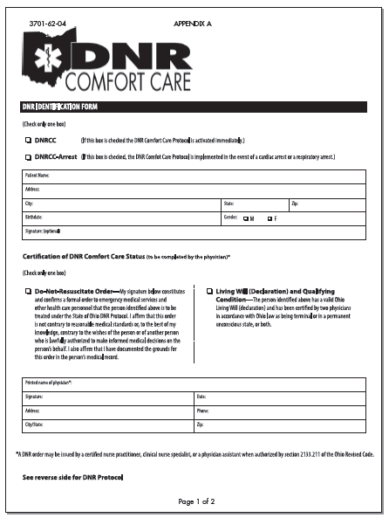
An Ohio E M S D N R Identification Form (1 of 2)

Slide 26
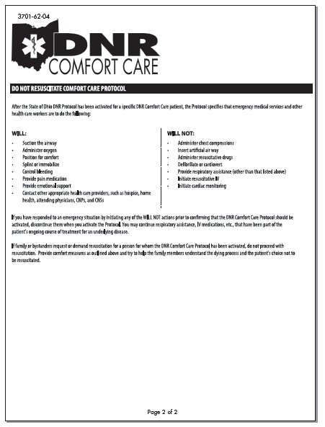
An Ohio E M S D N R Identification Form (2 of 2)

Slide 27
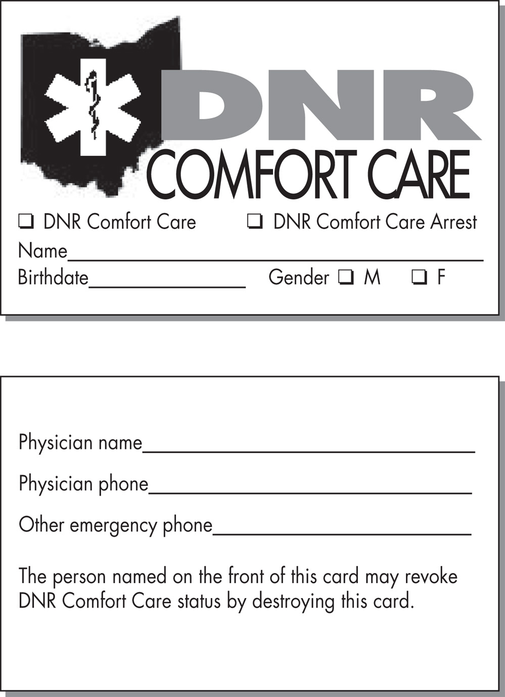
D N R Documents may also take Alternative Forms, as these Examples from Ohio E M S Show (1 of 2)
A D N R wallet card.

Slide 28

D N.R Documents may also take Alternative Forms, as these Examples from Ohio E M S Show (2 of 2)
A D N R hospital bracelet.

Slide 29
Issues of Patient Consent and Refusal (5 of 11)
Advance Directives
  Issues in advanced directives
    Determining validity of the document
    Interpreting the orders
    Conflict between the D N R or P O L S T and wishes of the family
Notes:
Issues you may encounter at the scene regarding the DNR or POLST are questions about the validity of the document, interpretation of what care should or should not be provided, conflict between the DNR or POLST order, and the wishes of a family member. To protect yourself, the best manner to proceed is to
(1) consider initiating treatment immediately so that if the issue cannot be resolved you will not be held negligent for not providing care or delaying treatment, (2) contact medical direction for instructions on how to proceed, (3) continue treatment until the problem has been resolved.

Slide 30
Issues of Patient Consent and Refusal (6 of 11)
  Advance Directives
  Responding to advanced directive issues
    If in doubt, consider initiating immediate treatment.
    Contact medical direction.
    Continue treatment until the issue is resolved.
    Document thoroughly.
Notes:
Points to Emphasize
EMTs must respect the decisions of patients who refuse care but must advise them of the potential risks of their decision and let them know that they can call EMS again, if needed.
You will be in a much better position if you are providing treatment rather than by withholding treatment when faced with questions about whether to provide care. In the absence of a valid DNR or POLST order and
a physician’s written instructions, you are obligated to begin full resuscitation or needed treatment immediately.
Discussion Questions
What are some indications that a patient isn’t competent to consent to or refuse treatment?
What actions can you take to protect yourself in situations in which a patient refuses treatment?
Critical Thinking Discussion
What are some of the difficulties in determining whether or not a patient is competent to consent to or refuse medical care?
Teaching Tips
Pass around copies of refusal-of-treatment forms from local EMS agencies.
Class Activity
Have pairs of students role-play EMTs and patients refusing treatment. Have the EMT document the refusal. Pairs can read their documentation aloud to the class for discussion and feedback.

Slide 31
Issues of Patient Consent and Refusal (7 of 11)
Refusing Treatment
  A patient has the right to refuse care, even if it will result in death.
  For the patient to refuse, he must demonstrate the mental capacity to do so.
Notes:
Patient refusal of treatment involves legal, ethical, and moral decisions. You must assess the patient’s ability to understand treatment options and their ability to respond adequately in making informed decisions regarding consent or refusal of treatment. This is referred to as the patient having the capacity to make a decision. You must make sure you’ve done everything you can to persuade the patient to accept treatment and take steps to protect yourself from liability.

Slide 32
Issues of Patient Consent and Refusal (8 of 11)
  Refusing Treatment
  Capacity
    Patient is lucid and able to make rational and informed decisions
    Patient does not have altered mental status (e.g. is not under the influence of drugs or alcohol)
Notes:
If an adult refuses care, they must have the mental capacity to do so. An adult with the mental capacity to do so is one who is lucid and capable of understanding various treatment options, and are able to make a rational and an informed decision. The term capacity is often used interchangeably with competence. However, capacity is determined by a medical authority, whereas, competence is truly a legal definition and determined by a court. A patient who is determined to lack the capacity to make a rational decision is referred to as de facto incompetent. This means the patient is in fact incompetent but not determined to be so through a legal process.

Slide 33
Issues of Patient Consent and Refusal (9 of 11)
  Refusing Treatment
  Capacity
    The patient must be informed of and fully understand the treatment and the potential risks or consequences of refusing treatment.
    The patient must sign the release form, or if he refuses, attempt to have someone witness the refusal.
Notes:
Under the law, to refuse treatment or transport, a patient must be informed of and fully understand the treatment and all potential risks and consequences of refusal, up to and including the possibility of death if it’s a potential risk. Have the patient explain to you what these potential consequences are if treatment is refused. If the patient does not understand the consequences, they would be deemed to lack the capacity to make a rational decision or simply referred to as incompetent and treated under implied consent. Once this has been accomplished, you must attempt to get the patient to sign an official “release from liability” form.

Slide 34
Issues of Patient Consent and Refusal (10 of 11)
Protecting Yourself in Refusal Situations
  Complete a thorough assessment.
  Make sure the patient is competent.
  Exhaust your attempts to persuade the patient.
  Consult medical direction as needed.
  Clearly document what you told the patient and his response to it.
  Encourage patient to seek help later or through different means.
Notes:
Complete and accurate documentation is a key factor in protecting yourself from liability for malpractice in the form of negligence or abandonment when a patient refuses treatment. Discuss these strategies with the students to ensure what their proper actions should be.

Slide 35
Issues of Patient Consent and Refusal (11 of 11)
  Protecting Yourself in Refusal Situations
  Always keep complete and accurate documentation.
Notes:
Stress importance of accurate documentation with this highly sensitive area of medical liability.

Slide 36
Case Study (4 of 5)
“I can understand how you might feel like people are in your business right now,” says Caitlyn. “We are here to help, but before we can decide what to do, I need to ask you a few questions. First though, what is your name?”
“Mike Blevins.”
“Mr. Blevins, do you know where you are right now?” asks Caitlyn, beginning the process of determining the patient's decision-making ability.

Slide 37
Case Study (5 of 5)
What questions should Caitlyn ask to help her decide whether the patient has the capacity to make an important decision, such as consenting to or refusing medical care?
Notes:
Review the elements of mental capacity with the class as it pertains to this case study.

Slide 38
Other Legal Aspects of Emergency Care (1 of 27)
Negligence
  A breach of legal duty creates a liability.
  Two types of negligence exists
    Criminal negligence
    Civil negligence
Notes:
If you breach your legal duty, you create a liability. Two types of liability are criminal and civil. In a criminal liability case, the government, on behalf of the public, brings legal action against the EMT. This may result in a fine or even incarceration. In a civil action, an individual, known as the plaintiff, files a lawsuit against an individual EMT, the EMS agency or company, or others indirectly involved in the care of the patient, such as the supervisor or medical director. These latter individuals are known as the defendants.
Two types of liability
1) Criminal
The government brings charges against the EMT.
May result in fines or imprisonment
2) Civil
The party who claims injury, the plaintiff, files a lawsuit.
The injury is a result of a wrongdoing, called a tort.
The lawsuit seeks monetary compensation for damages.

Slide 39
Other Legal Aspects of Emergency Care (2 of 27)
  Negligence
  Negligence is a tort in which:
    There was no intent to do harm
    But there was a breach of duty to act
Notes:
Points to Emphasize
Two types of liability in EMS care are criminal liability and civil liability. In criminal cases, a law is broken and the government brings legal action. In civil cases, a person sues for damages. To prove negligence, the plaintiff (complaining party) must prove that the EMT had a duty to act, breached that duty, the patient was injured, and the breach of duty caused the injuries.
Knowledge Application
Give several scenarios of EMTs' actions. Ask students to determine whether or not a claim of negligence could be supported.
Critical Thinking Discussion
A patient in a motor vehicle collision refuses to allow EMTs to immobilize his spine. The patient's X-ray shows a fracture of his spine. The patient receives surgery and recovers. Are the EMTs negligent? Why or why not?

Slide 40
Other Legal Aspects of Emergency Care (3 of 27)
  Negligence
  Elements to prove negligence:
    The E M T had a duty to act.
    The E M T breached the duty to act.
    The patient suffered harm or injury.
    The injury was a result of the breach of duty (proximate cause).
Notes:
The plaintiff (person who files the lawsuit) has to prove the following four elements:
• The EMT had a duty to act.
• The EMT breached that duty to act.
• The patient suffered an injury or harm that is recognized by the law as a compensable injury.
• The injuries were the result of the breach of the duty (proximate cause).
If the plaintiff cannot prove all four of the elements, the suit will fail and no damages will be awarded.

Slide 41
Other Legal Aspects of Emergency Care (4 of 27)
  Negligence
  Associated legal principles
    Res ipsa loquitur
      “The thing speaks for itself.”
      The inappropriate actions are obvious.
    Negligence per se
      The act is negligent simply because it violates a statute or regulation.
Notes:
Two common legal principles are often associated with negligence claims against EMS. The first is res ipsa loquitur, meaning “the thing speaks for itself.” This concept is used in cases where a caregiver’s inappropriate actions are obviously the cause of patient harm. The concept of negligence per se means that an act is considered to be negligent simply because it is in violation of a statute or regulation such as written EMS protocols or approved scope of practice.

Slide 42
Other Legal Aspects of Emergency Care (5 of 27)
Intentional Torts
  Various types of intentional torts
    Abandonment
    Assault
    Battery
    False imprisonment
    Defamation (slander and libel)
Notes:
Discuss each type of intentional tort and how they relate to the EMT. The corresponding page numbers of the textbook are 55 and 56.

Slide 43
Other Legal Aspects of Emergency Care (6 of 27)
  Intentional Torts
  The difference between intentional tort and negligence is that negligence is a failure to meet the standard of care whereas intentional tort is knowingly committed.
Notes:
An intentional tort is an action knowingly committed by an individual that is considered civilly wrong according to the law. Common intentional torts in EMS are abandonment, assault, battery, false imprisonment, and defamation. The primary difference between an intentional tort and negligence is that negligence is a failure to meet the standard of care that is typically permissible, whereas an intentional tort is knowingly committed.

Slide 44
E M T s Transferring Care to a Flight Crew for Transport to a Trauma Center
You must always transfer care of the patient to a professional of equal or better training to avoid charges of abandonment.

Slide 45
Medical-Legal Terminology Check (1 of 5)
Match the term below to the statement that best describes it by clicking on the text box of your selected response.
A tort in which there was no intent to cause harm.
Unlawfully touching a patient.
Transporting a competent patient against his will.
Terminating patient care without the patient's agreement and without transferring care to another provider.
A legal responsibility to do something.
Abandonment

Slide 46
Medical-Legal Terminology Check (2 of 5)
Match the term below to the statement that best describes it by clicking on the text box of your selected response.
A legal responsibility to do something.
Transporting a competent patient against his will.
Unlawfully touching a patient.
Threatening a patient, verbally or nonverbally, with harm.
A tort in which there was no intent to cause harm.
Battery

Slide 47
Medical-Legal Terminology Check (3 of 5)
Match the term below to the statement that best describes it by clicking on the text box of your selected response.
A tort in which there was no intent to cause harm.
Releasing confidential patient information without his consent.
Transporting a competent patient against his will.
Deliberately performing or omitting an act that results in harm to a patient.
A legal responsibility to do something.
Negligence

Slide 48
Medical-Legal Terminology Check (4 of 5)
Match the term below to the statement that best describes it by clicking on the text box of your selected response.
A tort in which there was no intent to cause harm.
A written authorization to perform certain care for patients who present with specific complaints.
Transporting a competent patient against his will.
The skills and actions that an E M T is legally allowed to and expected to perform.
A legal responsibility to do something.
Duty to act

Slide 49
Medical-Legal Terminology Check (5 of 5)
Match the term below to the statement that best describes it by clicking on the text box of your selected response.
Making statements about a person, orally or in writing, that harm his reputation.
Releasing confidential information about a patient without his consent.
Transporting a competent patient against his will.
Treating a patient who is not competent to give consent on the assumption that he would agree to treatment if he was able.
Refusing to transport a patient who requests it.
Defamation

Slide 50
Other Legal Aspects of Emergency Care (7 of 27)
Confidentiality
  Do not speak to the press, your family, friends, or the public about details of the emergency care you provided to a patient.
  Releasing confidential information requires a written release form signed by the patient or a legal guardian.
Notes:
Information obtained while getting a patient history, performing a physical assessment, and treating the patient must be kept strictly confidential. The deliberate invasion of a patient’s privacy by an EMT may lead to loss of certification or licensure and other legal actions.

Slide 51
Other Legal Aspects of Emergency Care (8 of 27)
  Confidentiality
  By law, you can release information if:
    Needed in order to continue medical care.
    Mandatory reporting laws apply.
    Required by police as part of a potential criminal investigation.
    A third-party billing form requires the information.
    You are subpoenaed.
Notes:
Discussion Question
Under what conditions are you allowed to share a patient's protected (confidential) health information?

Slide 52
Other Legal Aspects of Emergency Care (9 of 27)
Health Insurance Portability and Accountability Act (H I P A A)
  Federal law protects the privacy of patient health care information.
Notes:
The Health Insurance Portability and Accountability Act (HIPAA) of 1996 is a federal law that protects the privacy of patient health care information and gives the patient control over how the information is distributed and used. HIPAA requires strict adherence to policies and procedures regarding record keeping, storage, access, release, and discussion of patient medical records. EMS systems are required by federal law to have specific policies and procedures in place regarding confidentiality and privacy issues related to patient care records and information.

Slide 53
Other Legal Aspects of Emergency Care (10 of 27)
  Health Insurance Portability and Accountability Act
  H I P A A and E M S
    You may discuss patient-specific information only when there is a medical necessity.
    You must receive training in your agency’s policies.
    Patients must be provided with privacy policies.
Notes:
Points to Emphasize
HIPAA is a federal law that protects the privacy of patients' health care information.

Slide 54
Other Legal Aspects of Emergency Care (11 of 27)
Consolidated Omnibus Budget Reconciliation Act (C O B R A)
Emergency Medical Treatment and Active Labor Act (E M T A L A)
  Federal regulations that ensure access to emergency health care regardless of ability to pay
Notes:
The Consolidated Omnibus Budget Reconciliation Act (COBRA) and the Emergency Medical Treatment and Active Labor Act (EMTALA) are federal regulations that ensure the public’s access to emergency health care regardless of ability to pay.

Slide 55
Other Legal Aspects of Emergency Care (12 of 27)
C O B R A and E M T A L A
  E M S involvement
    E M S becomes involved when patients are being transferred from a hospital to another medical facility.
    The patient must first be stabilized to the best of the medical facility’s ability.
    The ambulance crew performing the transfer must be qualified and capable of managing the patient and his condition.
Notes:
Points to Emphasize
COBRA and EMTALA are federal laws that prohibit refusal of emergency health care to patients who cannot pay for it. In an emergency transport do not make a decision to transport to a specific facility based on the patient's ability to pay. Also, don’t bypass a facility that is able to treat the patient, unless directed to do so by medical direction or protocol. If a bypass occurs, thoroughly document the reason for bypassing the closer facility.
Discussion Question
To what types of situations does EMTALA apply?

Slide 56
Other Legal Aspects of Emergency Care (13 of 27)
  C O B R A and E M T A L A
  Protecting yourself in transport and transfer situations
    Obtain written certification for the transfer from the transferring physician.
    Ensure you can provide the level of care needed during transport.
    Know where you are going and take the quickest possible route.

Slide 57
Other Legal Aspects of Emergency Care (14 of 27)
Special Situations
  Organ donation
    Organs can be donated only if there is a legal signed document giving permission.
    A signed donor card is a legal document; driver's license organ donor status provides an intent to donate organs.
Notes:
A potential organ donor should be treated no differently than any other patient requiring emergency care. The individual is a patient first, an organ donor last.
Teaching Tips
Have someone from the local organ procurement services talk to students about organ donation.
Class Activity
Have students research the tissues and organs that can be donated and write a one-page report on tissue and organ donation.
Knowledge Application
Give a scenario in which EMTs are called to transfer a patient from one hospital to another. Have students discuss considerations in determining whether the EMT should perform the transfer.

Slide 58
Other Legal Aspects of Emergency Care (15 of 27)
  Special Situations
  Medical identification insignia
    Bracelets, necklaces, or cards

Slide 59
Other Legal Aspects of Emergency Care (16 of 27)
  Special Situations
  Medical alert tattoo
    Not universally accepted yet
    May be overlooked as body art

Slide 60
Other Legal Aspects of Emergency Care (17 of 27)
  Special Situations
  Recognizing death in the field
    Generally, if the patient is still warm and does not exhibit any obvious signs of death, begin resuscitation.
    There is an exception for patients with hypothermia.
Notes:
Points to Emphasize
Obvious signs of death that preclude resuscitation attempts include decapitation, decomposition, rigor mortis, and dependent lividity.
EMTs must recognize causes that require contacting legal authorities, including the medical examiner or coroner, police, and authorities who investigate abuse.

Slide 61
Other Legal Aspects of Emergency Care (18 of 27)
  Special Situations
  Recognizing death in the field
    For patients with an advanced directive
      Absence of a pulse and breathing
      Completely unresponsiveness to any stimuli
      No eye movement or pupil response
      Absence of a blood pressure
      No reflexes
Notes:
Points to Emphasize
Obvious signs of death that preclude resuscitation attempts include decapitation, decomposition, rigor mortis, and dependent lividity. EMTs must recognize causes that require contacting legal authorities, including the medical examiner or coroner, police, and authorities who investigate abuse.

Slide 62
Other Legal Aspects of Emergency Care (19 of 27)
Special Situations
  Recognizing death in the field
    For patients with no advanced directive
      Decapitation
      Rigor mortis
      Decomposition
      Dependent lividity
Notes:
Points to Emphasize
Obvious signs of death that preclude resuscitation attempts include decapitation, decomposition, rigor mortis, and dependent lividity. EMTs must recognize causes that require contacting legal authorities, including the medical examiner or coroner, police, and authorities who investigate abuse.

Slide 63
Other Legal Aspects of Emergency Care (20 of 27)
  Special Situations
  Cases requiring investigation by the coroner or medical examiner
    Homicide or suicide
    Violent death
    Crash-related death
    Unusual scene characteristics
    Sudden infant death syndrome (S I D S)
    Dead on arrival (in some locations)
Notes:
Cases involving violent, unusual, or suspicious causes of death usually require investigation by the medical examiner or coroner.
It’s important to understand your local protocol related to death-in-the-field situations. It is better to err to benefit the patient and begin resuscitation, if you have any doubt. Also, be sure you understand the situations in which the medical examiner or coroner must be called to investigate a field death.

Slide 64
Other Legal Aspects of Emergency Care (21 of 27)
  Special Situations
  Crime Scenes
    Your first concern upon approaching a crime scene should be for your own safety.
    Recognizing a possible crime scene requires a high index of suspicion.
    Potential crime scenes require police support.
Notes:
Whenever an EMS is called to a potential crime scene, dispatch should also notify the police. Recognizing a possible crime scene requires a high index of suspicion. As a general guideline, a potential crime scene is any scene that may require police support, including a potential or actual suicide, homicide, drug overdose, domestic dispute, rape, abuse, hit-and-run accident, riot, robbery, gunfire, or potentially dangerous weapons.

Slide 65
Other Legal Aspects of Emergency Care (22 of 27)
  Special Situations
  Crime Scenes
    Wait until the police declare that the scene is safe.
    Even when the police declare the scene safe, it can still be potentially dangerous.
    Once the scene is secure, your priority is emergency care of the patient.
Notes:
Points to Emphasize
Patient care takes priority, but EMS should disturb crime scenes and potential evidence as little as possible.
Discussion Question
What are some considerations for preserving evidence at a crime scene while caring for a patient?

Slide 66
Other Legal Aspects of Emergency Care (23 of 27)
  Special Situations
  Crime Scenes
    Avoid disturbing potential evidence.
      Take one way in and out.
      Touch only what you must; tell a police officer if you move or touch anything.
      Do not use a crime scene telephone.

Slide 67
Other Legal Aspects of Emergency Care (24 of 27)
  Special Situations
  Crime Scenes
    Avoid disturbing potential evidence.
      In the absence of police permission, move the patient only if he is in danger or must be moved for you to provide care.
      Observe and document carefully.
      Do not cut through holes in clothing.

Slide 68
Other Legal Aspects of Emergency Care (25 of 27)
  Special Situations
  Crime Scenes
    Avoid disturbing potential evidence.
      Do not cut through any rope knot or tie.
      Do not cover the patient with a sheet.
      If the crime is rape:
        Do not wash the patient or allow the patient to wash.
        Ask the patient not to change clothing, use the bathroom, or take anything by mouth.

Slide 69
Other Legal Aspects of Emergency Care (26 of 27)
  Special Situations
  Special reporting situations
    Abuse
    Crime
    Drug-related injuries
Notes:
The EMT may be required to report certain conditions to law enforcement, social work at the hospital, or both. Other situations than those listed that the EMT may be required to report include suspected infectious disease exposure, use of patient restraints to treat or transport patients against their will, cases in which a patient appears to lack mental capacity to make decisions, intoxication, attempted suicides, and dog bites.
Familiarize the students with the requirements in your state.

Slide 70
Other Legal Aspects of Emergency Care (27 of 27)
Baby Safe-Haven Laws
  Designed to prevent child abandonment.
  Allow a parent to relinquish custody of an unharmed infant to a proper authority.
  An E M S station may be a designated safe haven.
Notes:
In the 1990s, an alarming number of infant abandonments occurred, resulting in many infant deaths. At that time, a parent was criminally prosecuted for neglect or abandonment if an infant was left unattended with the intent of relinquishing custody. As a result of the surge in abandonments many states now have a safe-haven law designed to allow a parent to relinquish custody of an unharmed infant to a proper authority.

Slide 71
Lesson Summary (1 of 3)
Emergency care involves medical, legal, and ethical issues.
Scope of practice identifies what care can legally be performed.
Standard of care identifies the accepted level of care.
Medical direction is required for medical oversight of an E M S system.
Notes:
Follow-Up
Answer student questions.
Follow-Up Assignments
Review Chapter 3 Summary.
Complete Chapter 3 In Review questions.
Complete Chapter 3 Critical Thinking questions.
Assessments
Handouts
Chapter 3 quiz

Slide 72
Lesson Summary (2 of 3)
A competent adult can refuse care.
Notes:
Class Activity
As an alternative to assigning the follow-up exercises in the lesson plan as homework, assign each question to a small group of students for in-class discussion.
Teaching Tips
Answers to In Review questions are in the appendix of the text. Advise students to review the questions again as they study the chapter.

Slide 73
Lesson Summary (3 of 3)
Consent applies in all patient care situations.
Four elements must be proven to establish negligence.
H I P A A, C O B R A, and E M T A L A apply to E M S.
There are special considerations in responding to crime scenes.

Slide 74
Feedback (1 of 6)
Correct answer!
Abandonment
Terminating patient care without the patient's agreement and without transferring care to another provider.
Click here to return to quiz.

Slide 75
Feedback (2 of 6)
Correct answer!
Battery
Unlawfully touching a patient.
Click here to return to quiz.

Slide 76
Feedback (3 of 6)
Correct answer!
Negligence
A tort in which there was no intent to cause harm.
Click here to return to quiz.

Slide 77
Feedback (4 of 6)
Correct response!
Duty to act
A legal responsibility to do something.
Click here to return to the quiz.

Slide 78
Feedback (5 of 6)
Correct answer!
Defamation
Making statements about a person, orally or in writing, that harm his reputation.
Click here to return to the program.

Slide 79
Feedback (6 of 6)
Incorrect answer
Your answer is not correct.
Click here to try again.

Slide 80
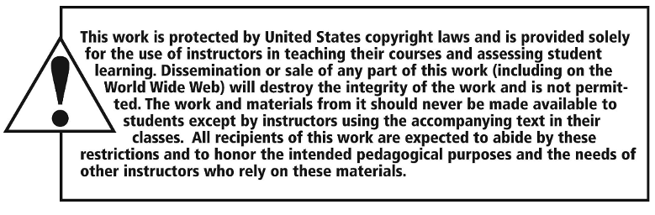
Copyright

