Slide 1
Prehospital: Emergency Care
Eleventh Edition
Chapter 39
Geriatrics
Slides in this presentation contain hyperlinks. JAWS users should be able to get a list of links by using INSERT+F7
Copyright © 2018, 2014, 2010 Pearson Education, Inc. All Rights Reserved
Notes:
If this PowerPoint presentation contains mathematical equations, you may need to check that your computer has the following installed:
MathType Plugin
Advance Preparation
Student Readiness
Assign the associated section of MyBRADYLab and review student scores.
Review the chapter material in the Instructor Resources, which includes Student Handouts, PowerPoint slides, and the MyTest Program.
Prepare
Preview the media resources and Master Teaching Notes in this lesson.
Preview the case study presented in the PowerPoint slides.
The total teaching time recommended is only a guideline. Take into consideration factors such as the pace at which students learn, the size of the class, breaks, and classroom activities. The actual time devoted to teaching objectives is the responsibility of the instructor.
2) Math Player (free versions available)
3) NVDA Reader (free versions available)

Slide 2
Learning Readiness
E M S Education Standards, text p. 1181.
Chapter Objectives, text p. 1181.
Key Terms, text p. 1181.
Purpose of lecture presentation versus textbook reading assignments.
Notes:
Explain to students what the National EMS Education Standards are. The National EMS Education Standards communicate the expectations of entry-level EMS providers. As EMTs, students will be expected to be competent in these areas. Acknowledge that the Standards are broad, general statements. Although this lesson addresses the listed competencies, the competencies are often complex and require completion of more than one lesson to accomplish. The student is also expected to review the chapter objectives to foreshadow what will be in the chapter, and by mastering the key terms the EMT student will better understand the learning and be able to communicate it more clearly.
Additionally, explain to the students that the purpose of using these slides is to highlight important portions of the material, explain interrelationships of topics, and discuss how to apply this information. It is not the intent of the presentation (or slides alone) to include every component in the chapter. This presentation still requires the student to thoroughly read the chapter.

Slide 3
Setting the Stage
Overview of Lesson Topics
Effects of Aging on Body Systems
Special Geriatric Assessment Findings
Assessment-Based Approach—Geriatric Patients
Notes:
These bulleted points are the major headings from the chapter, in order. The purpose is to provide a basic lecture navigation for the student.

Slide 4
Case Study Introduction
E M T s, Vic Bowman and Tina Stambaugh, arrive at the scene of a motor vehicle collision to find a single patient, a woman in her 80s, still sitting in the driver's seat. The car struck a utility pole and has moderate damage to the front end, and the airbags have deployed. Upon making contact with the patient, Vic finds that she is confused and unable to answer questions appropriately. With the exception of a few abrasions on her face, there are no immediately obvious signs of injury.
Notes:
Case Study
Present the Case Study Introduction provided in the PowerPoint slide set.
Lead a discussion using the case study questions provided on the subsequent slide(s).
The Case Study with discussion questions continues throughout the PowerPoint presentation.
Case Study Discussion
Use the case study content and questions to foreshadow the upcoming lesson content.

Slide 5
Case Study (1 of 3)
What are the first actions the E M T s should take?
How could the injuries received be affected by the patient’s age?
How are the body’s responses to the injuries affected by the patient’s age?
Notes:
Case Study Discussion
Use the case study content and questions to foreshadow the upcoming lesson content. Gauge the students’ responses as a guide of how well-versed they are in this topic.

Slide 6
Introduction
The geriatric are at greater risk for injuries and illnesses.
The changing physiology of the geriatric body system results in a different presentation of signs and symptoms.
The geriatric patient often has one or more long-term condition that might require multiple medications.
Notes:
During this lesson, students will learn about physiological changes, special assessment concerns, and emergency care considerations for geriatric patients.

Slide 7
Effects of Aging on Body Systems (1 of 15)
Age-related physiological changes begin around age 30.
People are living longer with chronic illnesses.
Illness is common among the geriatric, but not inevitable.
The aging body has fewer reserves for acute (severe, with rapid onset) medical and traumatic emergencies.
Notes:
Teaching Tips
Generate discussion by asking students what they think of when they think of the geriatric patients.
Class Activity
Have students write a paragraph describing how they envision themselves and their lives when they are 70 years old. Students can read the thoughts aloud to the class to generate discussion.
Discussion Questions
What are the effects of aging on the heart valves? How do these changes affect cardiac output?
What are the effects of arteriosclerosis?

Slide 8
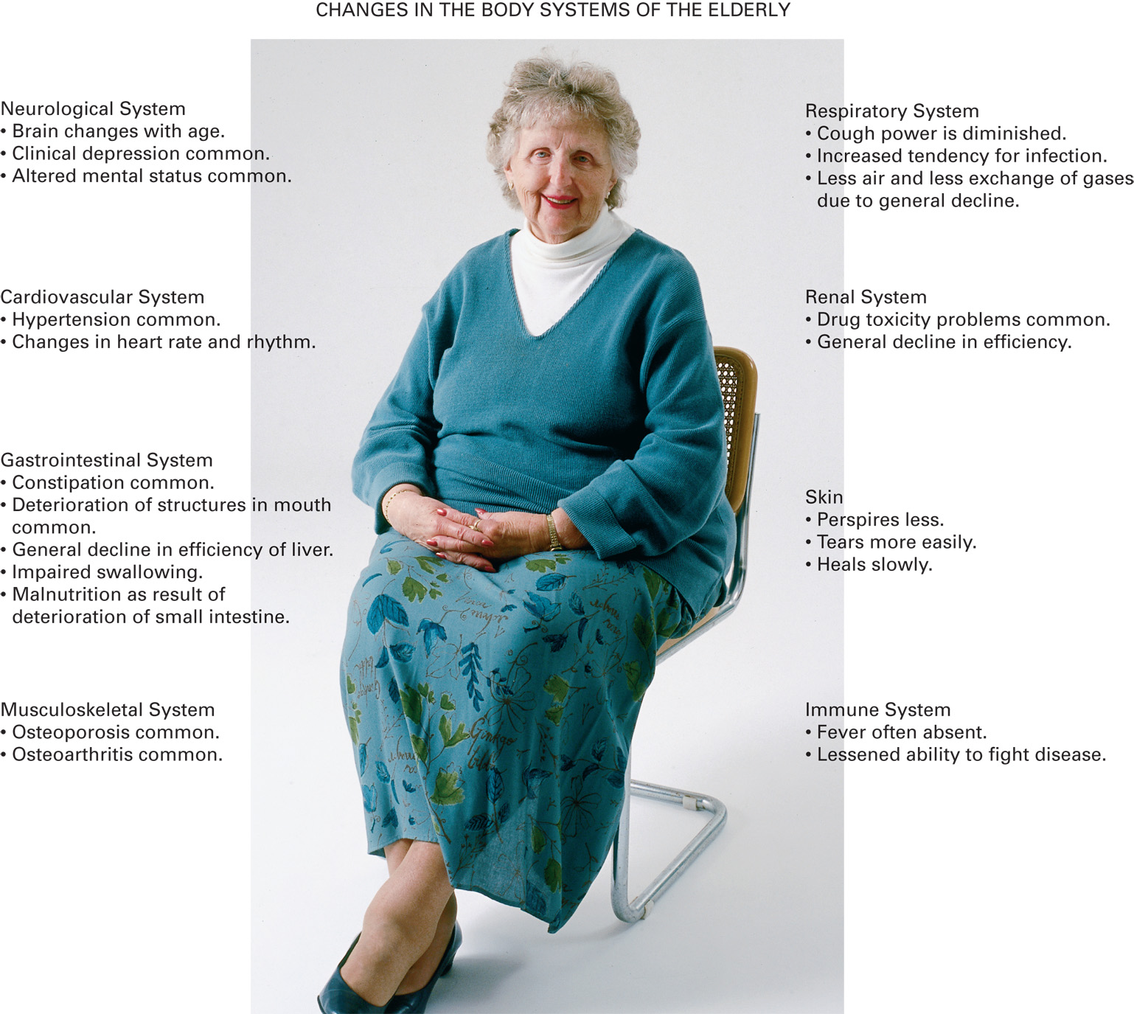
Changes in the Body Systems of the Geriatric
Notes:
Critical Thinking Discussion
How would you expect the aging process to affect a geriatric patient's response to blood loss?
How might it change the signs and symptoms associated with shock?

Slide 9
Effects of Aging on Body Systems (2 of 15)
The Cardiovascular System
Stenosis of heart valves can reduce blood flow and cause pulmonary edema.
Cardiac hypertrophy can reduce cardiac output, and affects the ability to compensate for illness and injury.
There is a decreased ability to increase heart rate to meet demand.
Notes:
As the heart grows older, there are fewer electrical conducting cells (“pacemaker cells”) and the heart is less responsive to catecholamines in the body. This prevents the heart from increasing its rate when a greater cardiac output is required.

Slide 10
Effects of Aging on Body Systems (3 of 15)
The Cardiovascular System
Dysrhythmias may occur, and electrical conduction is impaired.
Arteriosclerosis increases workload of the heart.
Baroreceptors are less sensitive; orthostatic hypotension may occur.
Notes:
Just as all other muscles in the body contract in response to an electrical impulse, the heart muscle contracts in response to electrical impulses created by the conduction system of the heart. With aging, there can be a general deterioration in the heart’s conduction system, resulting in the inability of the heart to initiate and propagate a normal impulse.

Slide 11
Effects of Aging on Body Systems (4 of 15)
The Respiratory System
Decreased strength of respiratory muscles
Decreased pliability of the rib cage
Decreased alveolar surface area
Chemoreceptors become less sensitive
Notes:
In the geriatric, there is a decline in diffusion of oxygen and carbon dioxide across the alveolar membrane as alveolar surfaces progressively decrease. Chemoreceptors located in the aortic arch, in the carotid bodies, and on the surface of the brainstem that monitor the levels of carbon dioxide and oxygen in the blood become less sensitive over time. This
Discussion Question
How does aging affect the respiratory system?

Slide 12
Effects of Aging on Body Systems (5 of 15)
The Respiratory System
Decreased smooth muscle decreases airflow to the alveoli.
Weakening of cough reflex and decreased function of cilia increase the risk of infection.
Notes:
Another change is in the airflow in and out of the lungs. In a younger person, the smaller airways (bronchioles) are supported by smooth muscle, which enables them to keep their open shape so that oxygen is easily inhaled with each incoming breath, and carbon dioxide is easily exhaled with each exiting breath. With aging, there is a decrease in both the number and strength of these smooth muscle fibers that support the smaller airways. The result is turbulent airflow, which diminishes airflow to the terminal alveoli during inspiration and can also result in air trapping during exhalation.

Slide 13
Effects of Aging on Body Systems (6 of 15)
The Neurologic System
Decrease in brain mass, with an increase in C S F volume.
Degeneration of neurons leads to accumulation of plaques and tangles, which decrease nervous function.
Notes:
The capability of the brain to monitor and regulate vital functions such as the rate and depth of breathing, heart rate, blood pressure, and core body temperature can become deranged and not operate with the same efficiency during stressful times as in the younger patient.
Discussion Question
How does aging affect the nervous system? What are the consequences of these changes?
Teaching Tips
Alter several pairs of cheap glasses to mimic age-related vision changes. Assign students to perform various tasks, such as reading aloud from the textbook.

Slide 14
Effects of Aging on Body Systems (7 of 15)
The Neurologic System
Reflexes slow
Decreased ability to sense body position
Diminished vision and hearing
Decreased efficiency of autonomic functions
Notes:
Sensory perception tends to diminish over time, including everyday senses such as auditory, visual, olfactory (smell), touch, pain, hot and cold sensations, and body position.

Slide 15
Effects of Aging on Body Systems (8 of 15)
The Neurologic System
Sight Changes
Cataracts
Glaucoma
Macular degeneration
Retinal detachment
Notes:
Neurologic changes, especially diminished vision and hearing, separately or in combination, can easily result in falls, automobile crashes, and other causes of injury.

Slide 16
Effects of Aging on Body Systems (9 of 15)
The Neurologic System
Neuropathy affects motor, sensory, and autonomic nerve tracts; numbness, tingling, pain, swelling, weakness, and decreased pain perception may occur.
Diabetes increases the risk of neuropathy.
Notes:
Neuropathy is any derangement or abnormal function of the motor, sensory, and autonomic nerve tracts. It could be diffuse, involving multiple neurons and nerve tracts that affect many parts of the body, or focal neurons that affect a single, specific nerve and part of the body.
Findings include pain, numbness, tingling, swelling, muscle weakness, or even absent pain perception. This can further complicate the presentation of findings characteristic to a specific problem.

Slide 17
Effects of Aging on Body Systems (10 of 15)
The Gastrointestinal System
Deterioration in smell and taste, loss of teeth, decreased salivation, and changes in the stomach and esophagus can lead to malnutrition.
The liver decreases in size, weight, and function.
Peristalsis throughout the G I tract is slowed.
Notes:
Because of degeneration of the lining of the small intestine, nutrients are not as readily absorbed, further contributing to malnutrition. Fecal impaction and constipation are common because smooth muscle contractions of the large intestine diminish. In some, degeneration of the rectal sphincter muscle can cause loss of bowel control.

Slide 18
Effects of Aging on Body Systems (11 of 15)
The Endocrine System
There is an increased risk of type 2 diabetes.
There is less efficient regulation of blood pressure, fluid balance, electrolyte balance, and beta sympathetic response.
Decreased thyroid hormone decreases metabolic rate.
Notes:
An increase in the levels of hormones can increase blood pressure (vasopressor hormones such as norepinephrine and vasopressin), which contributes to development of hypertension (high blood pressure). The levels of certain hormones that help regulate the body’s fluid balance (such as renin and aldosterone) become deranged and contribute to fluid imbalance, which has further effects on blood pressure.
Collectively, changes to the endocrine system can cause elevation of blood sugar levels, alteration of the blood pressure, and fluid imbalance.

Slide 19
Effects of Aging on Body Systems (12 of 15)
The Musculoskeletal System
Osteoporosis weakens bones.
Loss of vertebral disk space with kyphosis; modifications to spine motion restriction may be required.
Notes:
The disks located between the vertebrae of the spine start to narrow, which causes the characteristic curvature of the spine, seen in two out of every three geriatric patients, known as kyphosis. This curvature is seen along the entire spine but is usually most pronounced in the thoracic vertebrae and can complicate spine motion restriction, especially if the patient is being secured to a backboard.

Slide 20
E M T s Apply Padding to Make the Patient Comfortable on the Backboard
Notes:
It might be necessary to place additional padding under the patient to fill voids and create effective spine motion restriction.

Slide 21
Effects of Aging on Body Systems (13 of 15)
The Musculoskeletal System
Degeneration of joints, decreased range of motion
Decreased skeletal muscle mass
Notes:
The ligaments that provide joints with stability start to weaken as well. The effects are diminished range of joint motion, possible pain with movement, and increased risk of joint injury.

Slide 22
Effects of Aging on Body Systems (14 of 15)
The Renal System
Nephron loss with decrease in kidney mass
Decreased renal blood flow and filtration rate
Disturbances in fluid and electrolyte balance
Decreased clearance of drugs may result in toxicity
Notes:
Because of diminished kidney function, altered GI absorption, and altered liver function, geriatric patients are more susceptible to toxicologic emergencies. Other factors that can place the geriatric patient at an even greater risk of a toxicologic emergency include poor eyesight, medication noncompliance, polypharmacy, loss of the integrity of the blood brain barrier, and poor motor skills.

Slide 23
Effects of Aging on Body Systems (15 of 15)
The Integumentary System
The skin is thinner, looser, and more prone to injury.
Wounds heal slowly.
Notes:
As the skin breaks down, there is a tendency for sores and tearing injuries to occur. This diminishes the effectiveness of the skin as a protective barrier in keeping microorganisms out of the body. Also, skin is the major organ of thermoregulation; therefore, hypothermia and hyperthermia are more likely in the geriatric patient.
Knowledge Application
Students should be able to integrate knowledge of age-related physiological changes into the assessment and management of geriatric patients.

Slide 24
Special Geriatric Assessment Findings (1 of 42)
Physiological changes make certain injuries and illnesses more likely.
Pain may be diminished or absent.
Physiological changes impair the ability to compensate for illness and injury.
Notes:
The patient or EMT might underestimate the severity of the patient’s condition. The EMT must recognize these emergencies and provide appropriate emergency care.

Slide 25
Special Geriatric Assessment Findings (2 of 42)
Assessment Finding: Chest Pain or Absence of Chest Pain
Heart Attack (Myocardial Infarction)
Instead of presenting with chest pain, myocardial infarction in the geriatric may present as a "silent heart attack.“
Patients may present with weakness, fatigue, confusion, dizziness, nausea/vomiting, abdominal pain, syncope, or trouble breathing.
Notes:
Teaching Tips
Assign small groups of students to each of the topics in the section. Give students 20 to 30 minutes to research their topic before presenting it to the class. Be prepared to correct misconceptions and fill in gaps.
Discussion Questions
How is the presentation of the geriatric patient with a heart attack often different from that of younger patients?
What is the relationship between aging and congestive heart failure?

Slide 26
Special Geriatric Assessment Findings (3 of 42)
Assessment Finding: Chest Pain or Absence of Chest Pain
Heart Attack (Myocardial Infarction)
Patients may complain of aching shoulders or indigestion.
Patients with chronic chest pain may be prescribed nitroglycerin.
Follow protocols for assisting with nitroglycerin administration.
Notes:
Trouble breathing is also a common initial complaint. Although one-third of geriatric heart attack patients never experience pain, aching shoulders and indigestion are common.

Slide 27
Special Geriatric Assessment Findings (4 of 42)
Assessment Finding: Chest Pain or Absence of Chest Pain
Heart Attack (Myocardial Infarction)
If heart attack is suspected, with or without chest pain, follow protocols, consult with medical direction as needed, and transport.
Notes:
Emergency care steps for a suspected heart attack are to administer oxygen via a nasal cannula at 2 lpm if the SpO₂ is less than 94%. If there are signs of hypoxia, poor perfusion, heart failure or if the patient complains of dyspnea, administer aspirin and nitroglycerin as appropriate in consultation with medical direction, and transport the patient expeditiously (but cautiously) to the hospital.

Slide 28
Special Geriatric Assessment Findings (5 of 42)
Assessment Finding: Chest Pain or Absence of Chest Pain
Congestive Heart Failure
May be chronic or new-onset
Backup of blood behind a weakened heart results in characteristic signs and symptoms.

Slide 29
Special Geriatric Assessment Findings (6 of 42)
Assessment Finding: Chest Pain or Absence of Chest Pain
Congestive Heart Failure
Signs and symptoms:
Jugular vein distention, peripheral edema.
Altered mental status.
Fatigue or anxiety.
Wheezing, dyspnea, orthopnea and tachypnea.
Crackling on auscultation.
Chest pain.
Notes:
Congestive heart failure (CHF) can be a chronic condition that the patient might tell you about during your history taking, or it can have an acute onset and be the cause for the geriatric person summoning EMS.
CHF is primarily caused by a cardiac disease, it can present differently than a heart attack. It is caused by a heart that becomes weakened over time because of the changes in aging, as well as hypertension, arteriosclerotic disease, dysrhythmias (abnormal heart rhythms), and heart valve damage.

Slide 30
Special Geriatric Assessment Findings (7 of 42)
Assessment Finding: Chest Pain or Absence of Chest Pain
Congestive Heart Failure
Management:
Oxygen,
Fowler's position,
Transport,
Assist ventilations.
Notes:
Emergency care steps for CHF include administering oxygen, placing the patient in a Fowler’s position, and expediting transport. Be sure to watch for inadequate breathing, and be prepared to ventilate.

Slide 31
Special Geriatric Assessment Findings (8 of 42)
Assessment Finding: Shortness of Breath (Dyspnea)
Common causes are pulmonary edema, pulmonary embolism, pneumonia, and C O P D.
Breathing can easily become inadequate.
Notes:
Discussion Question
What are some causes of shortness of breath in geriatric patients?

Slide 32
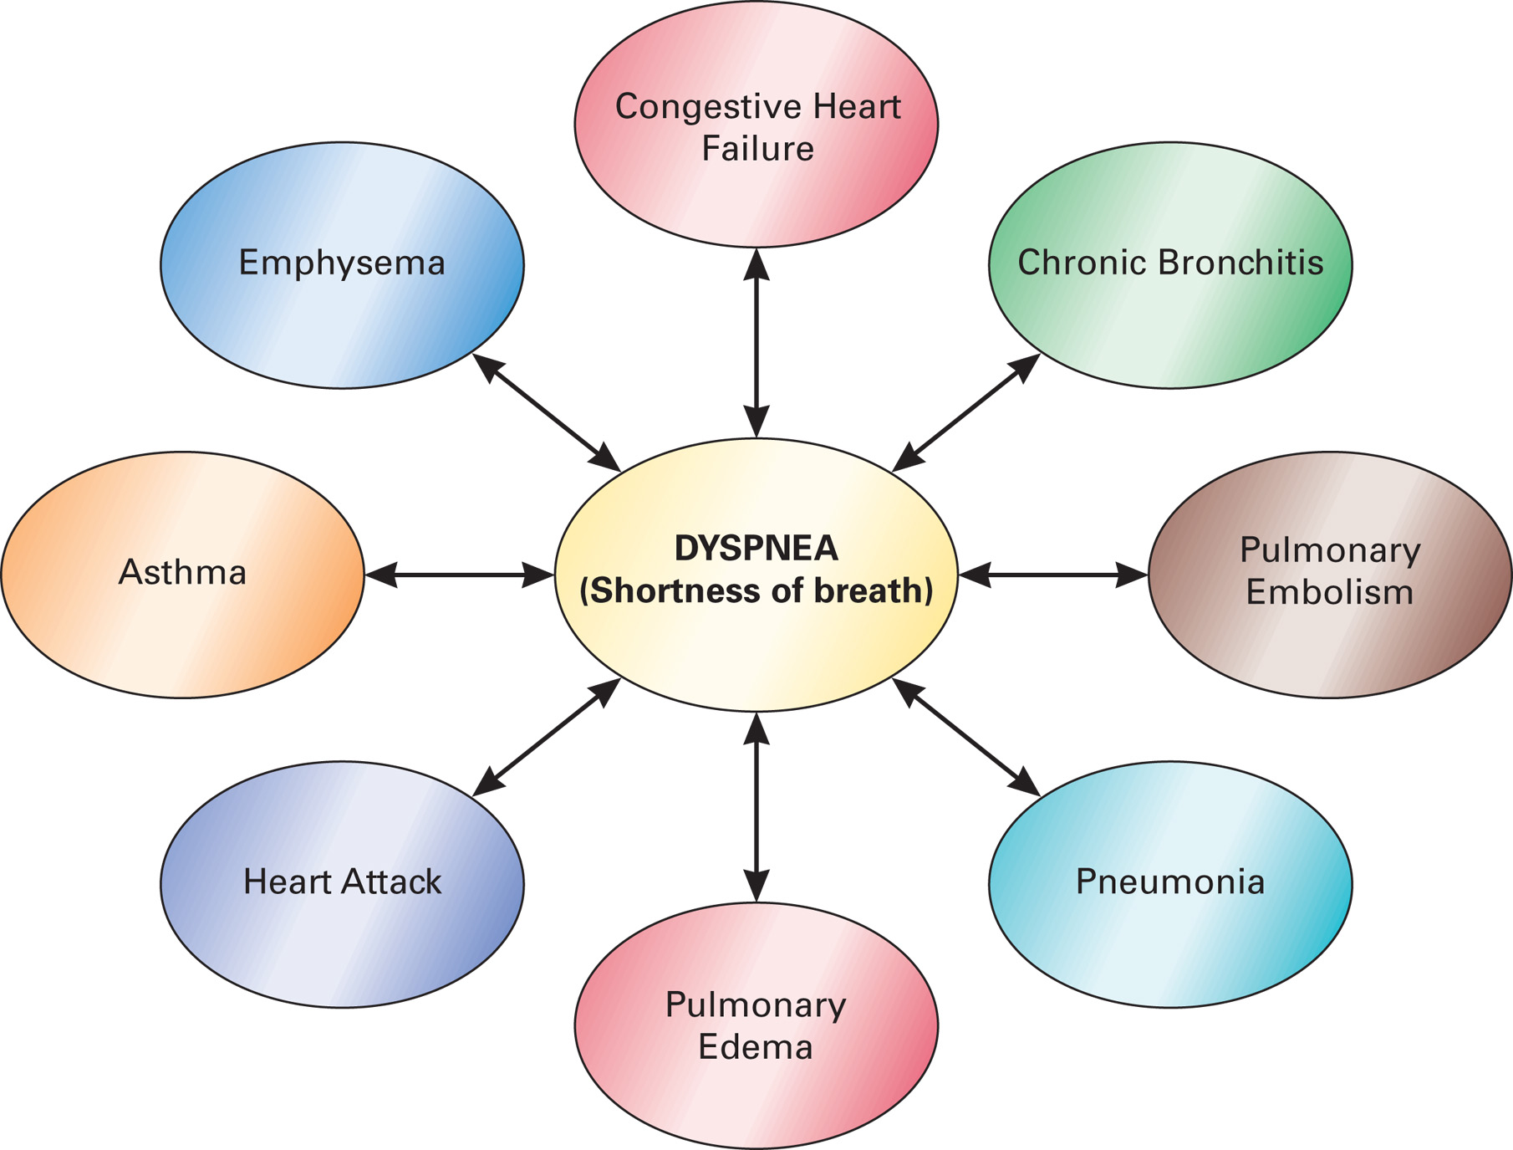
Common Causes of Dyspnea (Shortness of Breath) in the Geriatric Patient

Slide 33
Special Geriatric Assessment Findings (9 of 42)
Assessment Finding: Shortness of Breath (Dyspnea)
Pulmonary Edema
The left ventricle starts to eject less blood than the right.
Excessive pressure in the vessels in the lungs results.
Fluid leaks into the space between the alveoli and the capillaries.
Gas exchange becomes inadequate
Notes:
Pulmonary edema, or fluid in the lungs, can have a gradual or sudden onset and can result in death if proper emergency care is not provided.

Slide 34
Special Geriatric Assessment Findings (10 of 42)
Assessment Finding: Shortness of Breath (Dyspnea)
Pulmonary Edema
Signs and symptoms include severe respiratory distress, orthopnea, altered mental status, coughing, blood-tinged sputum.
Emergency care centers around respiratory support.
Notes:
Emergency care includes administering oxygen to maintain an SpO₂ of 94% or greater, placing the patient in a Fowler’s position, monitoring for inadequate breathing, and transporting expeditiously. Continuous positive airway pressure (CPAP) can be administered if the patient is in significant respiratory distress or if the SpO₂ cannot be maintained at 94%.

Slide 35
Special Geriatric Assessment Findings (11 of 42)
Assessment Finding: Shortness of Breath (Dyspnea)
Pulmonary Embolism
Usually occurs when a blood clot breaks free from veins of the lower extremities or pelvis and is transported back through the right side of the heart, eventually reaching the pulmonary arteries
Notes:
Poor gas exchange and respiratory distress result.
A large clot may prevent blood return to the left heart, resulting in hypotension.

Slide 36
Special Geriatric Assessment Findings (12 of 42)
Assessment Finding: Shortness of Breath (Dyspnea)
Pulmonary Embolism
Signs and symptoms include:
Sudden onset of dyspnea.
Localized, nonradiating chest pain.
Possible back or shoulder pain.
Weakness or syncope.
Anxiety.
Notes:
With large clots the blood cannot make it from the right side of the heart to the left, and hypotension ensues. The EMT might also notice localized wheezing to one of the lungs, and, with blockage, the pulse oximeter might drop dangerously low.
If a large embolism occludes more than half of the pulmonary circulation, it can cause a rapid death.

Slide 37
Special Geriatric Assessment Findings (13 of 42)
Assessment Finding: Shortness of Breath (Dyspnea)
Pulmonary Embolism
Treatment
Maintain an S p O₂ greater than or equal to 94%.
Monitor for inadequate breathing.
Provide positive pressure ventilation if breathing is inadequate.
Transport the patient; request A L S, if possible.
Notes:
Predisposing factors include:
Aging.
Smoking.
Cancer.
Fractures.
Surgery.
Cardiovascular disease.
Prolonged bedrest.
Trauma.

Slide 38
Special Geriatric Assessment Findings (14 of 42)
Assessment Finding: Shortness of Breath (Dyspnea)
Pneumonia
It can be bacterial, viral, or fungal infection of lungs
The geriatric are at an increased risk.
The geriatric may not exhibit classic pneumonia signs, such as pain, high fever, and chills.
Watch for severe respiratory distress and malaise.
Notes:
Aspiration pneumonia often results from accidental aspiration of food or vomitus into the lungs. This is why preventing aspiration of foreign material is so important in the maintenance of the geriatric airway.
Pneumonia tends to strike when multiple risk factors are present. Some of these include advancing age, being bedridden at home or institutionalized, immune system compromise, a history of other pulmonary diseases, cancer, prior stroke, or a history of inhaled toxins.

Slide 39
Special Geriatric Assessment Findings (15 of 42)
Assessment Finding: Shortness of Breath (Dyspnea)
Pneumonia
Altered mental status and inadequate breathing may occur.
Ensure adequate oxygenation; consider C P A P if the patient cannot maintain an S p O₂ greater than or equal to 94%.
Provide positive pressure ventilation if breathing is inadequate.
Notes:
Emergency care is primarily supportive and includes maintaining the patient’s airway, administering oxygen to maintain an SpO₂ of 94% or greater, and transporting the patient in a Fowler’s position or a position of comfort.

Slide 40
Special Geriatric Assessment Findings (16 of 42)
Assessment Finding: Shortness of Breath (Dyspnea)
Chronic Obstructive Pulmonary Disease
It includes emphysema and chronic bronchitis.
Patients may be on oxygen at home.
The patient usually presents with respiratory distress and use of accessory muscles.
Notes:
COPD is a disease complex that includes many individual pulmonary disease processes (principally chronic bronchitis and emphysema) that result from the gradual deterioration of the pulmonary structures.

Slide 41
Special Geriatric Assessment Findings (17 of 42)
Assessment Finding: Shortness of Breath (Dyspnea)
Chronic Obstructive Pulmonary Disease
Maintain an S p O₂ at or over 94%.
If the patient has an inhaler, follow your protocols for assisting the patient with its use.
If the patient cannot maintain an S p O₂ at or over 94%, consider C P A P, according to protocol.
Notes:
Transport the patient in a position of comfort, which will usually be a Fowler’s (sitting) position. Because the COPD patient can become easily fatigued from the effort of breathing, monitor the patient closely for signs of inadequate breathing. If breathing becomes inadequate, provide positive pressure ventilation with supplemental oxygen.

Slide 42
Special Geriatric Assessment Findings (18 of 42)
Assessment Finding: Altered Mental Status
May be chronic or new-onset
Can range from confusion to unresponsiveness
Do not assume altered mental status is "normal" for a patient.
Notes:
The patient can have an altered mental status from some chronic condition such as Alzheimer’s disease, or from an acute onset of the primary emergency such as stroke.
Discussion Questions
What are some causes of altered mental status in geriatric patients?
Why are geriatric patients more prone to drug toxicity?
What are some characteristics of Alzheimer's disease?

Slide 43
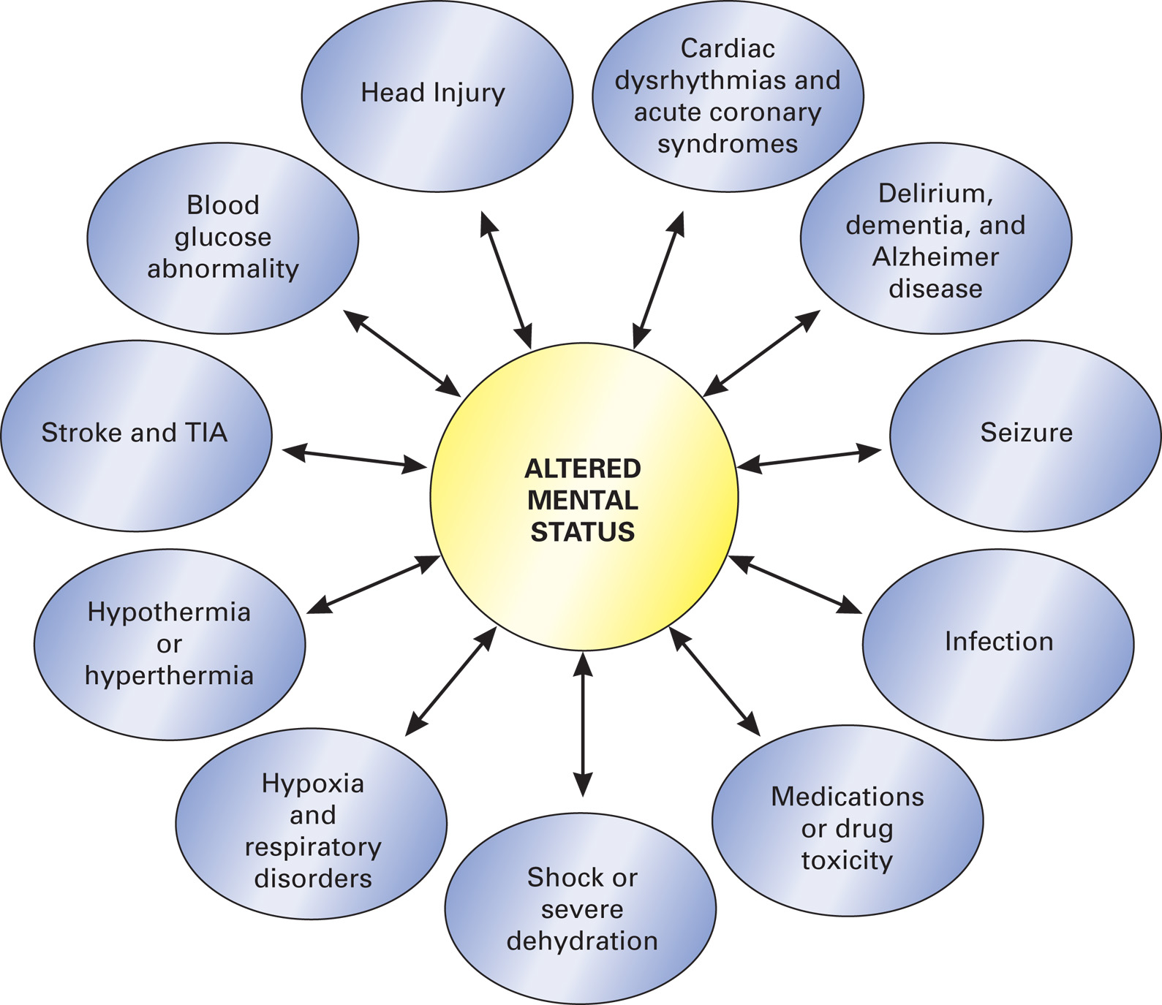
Common Causes of Altered Mental Status in the Geriatric Patient
Notes:
Never assume that a patient’s altered mental status is normal for them or that it is “what happens when you get old” and risk missing an important sign of injury or illness.

Slide 44
Special Geriatric Assessment Findings (19 of 42)
Assessment Finding: Altered Mental Status
Cognitive Impairment
There is a deterioration of the geriatric person’s thinking, memory, language, and judgment skills.
Recognize the patient who doesn’t have the ability to take care of himself.
Notes:
Severe cognitive impairment can cause the patient to lose the ability to understand the importance of something and the ability to talk or write.
There is a higher morbidity and mortality associated with an impaired cognitive state; therefore, it is important for EMS to identify the condition.
The key in emergency care of the patient with an identified cognitive impairment is to ensure that they can take care of themselves or are in an environment in which adequate resources are available to take care of them.
Discussion Questions
What are some causes of altered mental status in geriatric patients?
Why are geriatric patients more prone to drug toxicity?
What are some characteristics of Alzheimer's disease?

Slide 45
Special Geriatric Assessment Findings (20 of 42)
Assessment Finding: Altered Mental Status
Stroke
It may be ischemic or hemorrhagic
Intracranial pressure may be increased.
It may result in an altered mental status, ranging from disorientation to unresponsiveness.
Notes:
A stroke occurs when there is an interruption in blood supply to an area of the brain when a blood vessel in the brain becomes blocked by a clot, obstructing blood flow, or ruptures and enables blood to accumulate in the brain tissue.

Slide 46
Special Geriatric Assessment Findings (21 of 42)
Assessment Finding: Altered Mental Status
Stroke
The extent and location of the stroke affects the severity of the altered mental status from lightly disoriented to totally unresponsive.
A massive stroke can lead to death within minutes.
Notes:
Other signs and symptoms:
Unequal pupils.
Slurred or abnormal speech.
Headache.
Memory problems.
Altered respirations.
Increased or decreased heart rate.
Hypertension.
Seizures.
Nausea, vomiting.
Muscle weakness or paralysis.
Sensory loss.

Slide 47
Special Geriatric Assessment Findings (22 of 42)
Assessment Finding: Altered Mental Status
Stroke
Treatment:
Recognition is key.
Protect the airway.
Maintain an S p O₂ greater than or equal to 94%.
Transport in Fowler's (conscious) or lateral recumbent (unconscious) position.
Notes:
Emergency care steps for stroke should include protecting the airway, administering oxygen if the SpO₂ reading is less than 94%, and suctioning as necessary to prevent aspiration.

Slide 48
Special Geriatric Assessment Findings (23 of 42)
Assessment Finding: Altered Mental Status
Transient Ischemic Attack
It has the same presentation as stroke, but signs and symptoms resolve within 24 hours
Treat similarly as for a stroke.
A T I A is often the precursor of a stroke.
Notes:
No permanent neurologic dysfunction occurs with a TIA. A TIA is caused when blood supply to an area of the brain is temporarily occluded, causing a malfunction of brain tissue that is not being perfused.

Slide 49
Special Geriatric Assessment Findings (24 of 42)
Assessment Finding: Altered Mental Status
Seizure
Common causes include:
Cardiac arrest.
Low blood sugar.
Tumors.
Head trauma/stroke/T I A.
Infection.
Electrolyte imbalance.
Notes:
A sudden and temporary alteration in mental status is caused by massive electrical discharge in a group of nerve cells in the brain.

Slide 50
Special Geriatric Assessment Findings (25 of 42)
Assessment Finding: Altered Mental Status
Seizure
Treatment is the same as for younger patients.
Monitor the airway, suction as needed.
Maintain an S p O₂ greater than or equal to 94%.
Provide positive pressure ventilation if breathing is inadequate.
Notes:
Place the patient in a recovery position to help prevent aspiration if they are unresponsive and if trauma is not suspected.

Slide 51
Special Geriatric Assessment Findings (26 of 42)
Assessment Finding: Altered Mental Status
Syncope
It is common in the geriatric.
There is a temporary loss of consciousness from an interruption of blood flow to the brain.
Consider spine motion restriction if the patient fell.
Notes:
Syncope is a temporary loss of responsiveness that usually reverses when the patient is lying down.

Slide 52
Special Geriatric Assessment Findings (27 of 42)
Assessment Finding: Altered Mental Status
Syncope
Ensure an adequate airway.
Maintain an S p O₂ greater than or equal to 94%.
Apply positive pressure ventilation if breathing is inadequate.
Place an unresponsive patient in the recovery position.
Notes:
If the patient suffered a fall with the syncopal episode, they should be assessed for a possible spine or spinal cord injury.

Slide 53
Special Geriatric Assessment Findings (28 of 42)
Assessment Finding: Altered Mental Status
Hyperosmolar hyperglycemic Syndrome (H H S)
It is a complication of diabetes.
Blood glucose rises, but enough insulin is present to allow glucose to be used for energy so that ketones are not produced.
Dehydration occurs from excessive urination.
Notes:
Hyperosmolar hyperglycemic syndrome (HHS) is a diabetic complication that is more common to the geriatric patient with diabetes mellitus.

Slide 54
Special Geriatric Assessment Findings (29 of 42)
Assessment Finding: Altered Mental Status
Hyperosmolar hyperglycemic Syndrome
Signs and symptoms have a gradual onset.
The blood glucose level is elevated.
Other findings include polydipsia, polyuria, dry mucous membranes, dizziness, confusion, and seizures.
Notes:
The geriatric patient with HHS most likely presents with an altered mental status, typically with a gradual onset (possibly progressing over a day or two), a possible history of diabetes, and an elevated blood glucose level.

Slide 55
Special Geriatric Assessment Findings (30 of 42)
Assessment Finding: Altered Mental Status
Hyperosmolar hyperglycemic Syndrome
Treatment:
Manage the airway.
Maintain an S p O₂ greater than or equal to 94%.
Consider an A L S intercept.
Notes:
Management includes positioning to protect the airway, supplemental oxygen to maintain an SpO₂ reading of 94% or greater, positive pressure ventilation if the patient breathes inadequately, and circulatory support.

Slide 56
Special Geriatric Assessment Findings (31 of 42)
Assessment Finding: Altered Mental Status
Drug Toxicity
Drug interactions, adverse effects, and toxicity are more common in the geriatric.
Treatment includes maintaining an airway and ensuring adequate ventilation and oxygenation.
Transport all medications with the patient.
Notes:
The geriatric population takes approximately one-third of all prescription medications. They also buy the greatest number of over-the-counter medications. Because they tend to have many coexisting diseases, they are at greater risk for drug interaction from prescription medications.

Slide 57
Special Geriatric Assessment Findings (32 of 42)
Assessment Finding: Altered Mental Status
Delirium and Dementia
Dementia is a chronic, irreversible deterioration in mental function that occurs in about 15 percent of the geriatric.
Management is supportive.
Notes:
It is chronic and irreversible and can be severely worsened by infection, medication change, trauma, or another acute condition. Changes in mental function are normal with aging, but approximately 15 percent of those over age 65 develop severe dementia with profound disturbances in cognition, including loss of short-term memory and decline in judgment, intellectual ability, and abstract thought.

Slide 58
Special Geriatric Assessment Findings (33 of 42)
Assessment Finding: Altered Mental Status
Delirium and Dementia
Delirium is an alteration in mental function with a recent and sudden onset.
It indicates an underlying disturbance of a body system.
Consider causes such as low blood glucose levels.
Management is supportive.
Notes:
Delirium can also result in an alteration in mental status, but unlike dementia, which is a chronic condition, delirium presents with a more recent and sudden onset. Delirium is often described by family members as starting abruptly and can present with delusions. The patient might have a history consistent with a delirium episode, which can include intoxication or withdrawal from alcohol, sedative use, infectious medical conditions, dehydration, fever, stroke, blood sugar level abnormality, a psychiatric disorder, malnutrition, hypoxia, endocrine disorders, or even environmental emergencies.

Slide 59
Special Geriatric Assessment Findings (34 of 42)
Assessment Finding: Altered Mental Status
Alzheimer’s Disease
It is the most common cause of dementia in the geriatric.
Patients may be uncooperative; this is an indication of the disease, not a personal attack.
You may need to repeat information.
Notes:
The treatment of patients suffering from Alzheimer’s disease or any other form of dementia requires special compassion from the EMT. Naturally, you must take necessary actions to establish and maintain the airway, breathing, oxygenation, and circulatory systems. But often you will transport these patients in a nonemergency setting. At times, you might find the patient uncooperative, even combative, with biting, spitting, and punching. It may help to enlist the assistance of a caregiver the person trusts. Remember that the uncooperativeness and aggression are symptoms of the disease, not conscious acts of aggression against you personally.

Slide 60
Special Geriatric Assessment Findings (35 of 42)
Assessment Finding: Signs of Trauma or Shock
Trauma is a leading cause of death in the geriatric.
Several physiological changes increase the risk of trauma.
Falls are a common cause of trauma deaths in the geriatric.
Notes:
Many geriatric people who fall do not develop life-threatening injuries and do not die from the fall. But certain injuries are common among those who fall. Make sure you assess for a hip fracture, head injuries, chest and abdominal injuries, spinal fractures, and fractures of the hand, wrist, forearm, or shoulder.

Slide 61
Special Geriatric Assessment Findings (36 of 42)
Assessment Finding: Signs of Trauma or Shock
Consider the events that may have resulted in trauma, such as dizziness, faintness, or palpitations.
The geriatric are much less able to compensate for the effects of trauma and can deteriorate rapidly.
Notes:
Head injuries are harder to detect in the geriatric patient. As mentioned previously, the brain shrinks in size during the aging process. Even though there is additional CSF surrounding the smaller brain, there is still more space in which the brain can swell or blood can accumulate in response to an injury.

Slide 62
Special Geriatric Assessment Findings (37 of 42)
Assessment Finding: Signs of Trauma or Shock
Treatment
Provide spine motion restriction, if indicated.
Ensure an adequate airway, oxygenation, and ventilation.
Treat and transport the patient expeditiously.
Notes:
Treatment of geriatric trauma must be executed expeditiously. Provide spine motion restriction precautions during the primary assessment if necessary, administer high-concentration oxygen if poor perfusion is evident, and provide positive-pressure ventilation if the patient breathes inadequately.

Slide 63
Special Geriatric Assessment Findings (38 of 42)
Assessment Finding: Gastrointestinal Bleeding
Common and potentially life threatening
Indicates an underlying disease process
May be from the upper or lower G I tract
May be obvious or occult
May be associated with abdominal pain
Notes:
Findings that support the field impression of GI bleeding in an geriatric patient include:
• Hematemesis (vomiting blood).
• Hematochezia (red undigested blood in bowel movement).
• Melena (dark tarry bowel movement, indicative of digested blood).
• Dyspepsia (indigestion).
• Hepatomegaly (enlarged liver).
• Jaundice (yellowing of sclera and skin, indicative of liver problems).
• Constipation or diarrhea.
• Agitation.
• Dizziness.
• Inability to find a comfortable position.

Slide 64
Special Geriatric Assessment Findings (39 of 42)
Assessment Finding: Gastrointestinal Bleeding
Treatment
Be alert to signs of shock.
Maintain the airway and ensure adequate breathing and oxygenation.
Position the patient in recovery position.
A B P that is 10 m m H g lower when the patient is standing than when they are supine indicates volume depletion.
Notes:
Your approach and assessment should be similar to any assessment format for the geriatric patient. Focus on ensuring a patent airway, and provide manual or mechanical airway assistance if the patient cannot protect the airway himself, possibly because of a depressed mental status. If breathing is adequate, provide supplemental oxygen to maintain an SpO₂ reading of 94% or greater; if breathing is inadequate, the oxygen should be provided via positive pressure ventilation.

Slide 65
Special Geriatric Assessment Findings (40 of 42)
Assessment Finding: Environmental Temperature Extremes
The ability of the geriatric to create heat when cold, or to dissipate heat when hot can be impaired from the aging process, diseases, and medications.
Hypothermia or hyperthermia may result.
Notes:
Treatment of the geriatric patient prone to hypothermia includes protecting the airway and maintaining normal breathing and circulatory status. Not only should you remove the patient from the cold environment, but you should also remove any wet clothes and insulate the patient in a dry blanket. Use caution when handling a severely hypothermic patient as excessive handling or moving can put the patient into a lethal heart rhythm.
Discussion Question
What are some factors that make a geriatric patient more prone to environmental emergencies?

Slide 66
Special Geriatric Assessment Findings (41 of 42)
Elder/Geriatric Abuse
It includes neglect, physical abuse, sexual abuse, financial abuse, and emotional abuse
Elderly who are bedridden, demented, incontinent, frail, or have disturbed sleep patterns are at higher risk.
Notes:
Geriatric neglect is the withholding by a care provider of attention or medical care that the victim is entitled to. This type of neglect can occur passively or actively, the difference being the intent of the care provider.
With passive neglect, the failure is said to occur unintentionally and is often the result of the care provider feeling overwhelmed by the needed tasks or that the care provider simply does not know or understand the care or interventions that the patient needs.
Discussion Question
What are some indications of abuse of the geriatric patient?
Knowledge Application
Given several scenarios, students should be able to identify and manage common complaints in geriatric patients.

Slide 67
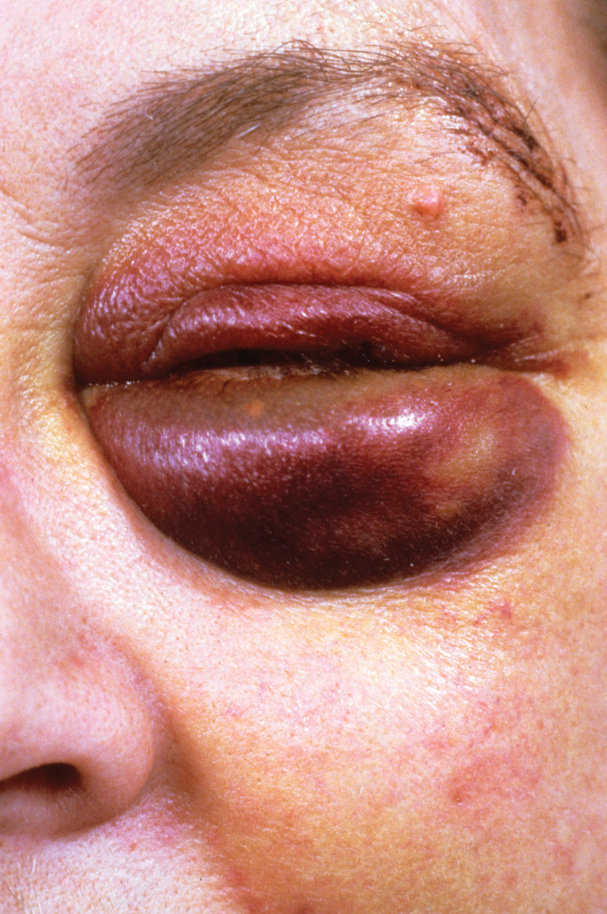
Physical Abuse of an Geriatric Person Can Have Dire Consequences Because of the Patient’s Frailty
(© Wellcome Image Library/Custom Medical Stock Photo)

Slide 68
Special Geriatric Assessment Findings (42 of 42)
Elder/Geriatric Abuse
Your priority is to provide emergency care for the injuries.
Do not confront the family or care provider with your suspicion of abuse.
Make your suspicion known to the receiving hospital; follow protocols regarding reporting suspected abuse.
Notes:
Many indications that the EMT encounter, both physical and emotional, can point to abuse. Your primary role is to provide assessment and care for the patient. Do not try to investigate the suspicion of abuse or attempt to confront the alleged abuser. However, do report your findings or suspicions to the medical staff and provide thorough and objective documentation in your prehospital care report.

Slide 69
Click on the Underlying Cause of Hyperglycemic Hyperosmolar Nonketotic Syndrome
A. Gastrointestinal bleeding
B. Stroke
C. Dementia
D. Type 2 diabetes

Slide 70
Case Study (2 of 3)
Vic immediately stabilizes the cervical spine and performs a primary assessment. He notes that the patient's respiratory rate is about 24 per minute, and shallow. She has a radial pulse of 88, and it is irregular. The patient is agitated and cannot remember that Vic has explained what happened and what he is doing.
Meanwhile, Tina has placed an oxygen mask on the patient. An engine crew has arrived and has prepared a long backboard.
Notes:
Case Study Discussion
Review the case study findings presented.

Slide 71
Case Study (3 of 3)
What are some potential causes of altered mental status in this patient?
What special considerations are there in spine motion restriction?
What additional assessment information do the E M T s need?
Notes:
Case Study Discussion
Use the case study content and questions to foreshadow the upcoming lesson content. Gauge the student’s responses as a guide of how well-versed they are in this topic.

Slide 72
Assessment-Based Approach: Geriatric Patients (1 of 22)
The population over age 65 is increasing.
The geriatric deserve respect; E M T s must avoid ageism.
The geriatric have a number of social issues, including isolation, loss of loved ones, and financial difficulty.
Notes:
Always consider approaching the geriatric patient with the same degree of concern and consideration that you would show a pediatric patient. In addition, avoid any of the purposeful or accidental stereotyping of ageism. Ageism occurs when a person either knowingly or unknowingly discriminates against people who are old.
Probably the two greatest social issues are isolation and marital status. With advancing age comes the loss of many friends and family near their own age. This isolates the geriatric patient from the rest of society as their social network decreases.

Slide 73
Assessment-Based Approach: Geriatric Patients (2 of 22)
The geriatric can be found in a variety of living situations.
Advance directives should be considered when caring for the geriatric.
Notes:
One consistent feature of almost all living arrangements is that the EMT might be delayed in getting to the patient’s side due to locked doors of care facilities, privacy gates in adult communities, or simply waiting for the patient’s primary care provider to arrive and give the patient’s medical and physical history. Attempt to obtain as much information as possible from the patient.
Advance directives are designed to express the patient’s wishes as to the care they want to receive should they experience a significant change in their health. For example, a geriatric person with incurable cancer might have had advance directives prepared on their behalf should they later experience another significant health crisis. Because the depth and breadth of advance directives vary from state to state, the EMT must become familiar with how they are handled in their state and EMS system.

Slide 74
Assessment-Based Approach: Geriatric Patients (3 of 22)
Elderly who are at particular risk are those who:
Live alone.
Are incontinent.
Are immobile.
Have been recently hospitalized.
Have been recently bereaved.
Have an altered mental status.
Notes:
Because of the normal aging process, the response to illness is altered. Many medical problems present with different signs and symptoms in the geriatric patient than in the general population. For example, as already noted, a lack of chest pain in a geriatric patient who experiences a heart attack is common. In general, the geriatric patient needs to be assessed and treated carefully. Any delay in recognizing health care needs and providing care can have devastating, irreversible consequences.

Slide 75
Assessment-Based Approach: Geriatric Patients (4 of 22)
Scene Size-Up
Assess for hazards, including the possibility of infectious disease.
Assess the environment, including the temperature.
Determine if the problem is medical, traumatic, or combined.
Look for clues to the problem.
Notes:
When the geriatric patient shares living quarters, or lives in an extended-care facility, numerous patients can be victim to an environmental emergency (e.g., temperature extremes, toxic fumes). Determine whether any additional patients are present and call for additional resources, if necessary.
Teaching Tips
Ensure that students have ample opportunities to practice assessment and management of geriatric patients.
Discussion Question
Why is it especially important to assess the environment of the geriatric patient?

Slide 76
Table 39-3 Clues to Illness Found in the Scene Size-Up (1 of 2)
Clues | May Indicate
Bucket next to bed | The patient suffers from nausea and vomiting.
Hospital bed | The patient has no or limited mobility and a preexisting chronic illness.
Nebulizer setup | Patient has a chronic respiratory disease process.
Oxygen tank setup or oxygen concentrator | Patient has a chronic respiratory or cardiac disease.
Medications found at the scene | A clue about the patient’s preexisting condition(s).
Washcloth on the patient’s forehead or near the patient | Patient has a severe headache or fever.
Patient in nightclothes in the middle of the afternoon | The patient has been sick all day.
Notes:
Although you might make a preliminary determination of the nature of the problem during the scene size-up, maintain a high index of suspicion. Look for clues to chronic or acute conditions.

Slide 77
Table 39-3 Clues to Illness Found in the Scene Size-Up (2 of 2)
Clues | May Indicate
Tripod position | The patient has significant respiratory distress.
Patient propped up on pillows | The patient has difficulty breathing when lying flat, commonly because of C H F.
A hot room temperature in the summer months | A possible heat emergency caused by dehydration or hyperthermia (elevated core body temperature).
A cold room temperature in the winter months | A possible cold emergency, hypothermia (decreased core body temperature).
Notes:
Although you might make a preliminary determination of the nature of the problem during the scene size-up, maintain a high index of suspicion. Look for clues to chronic or acute conditions.

Slide 78
Assessment-Based Approach: Geriatric Patients (5 of 22)
Primary Assessment
Mental Status
Establish a baseline mental status.
Ask caregivers to describe the patient's usual status.
The geriatric may process information more slowly.
The stress of an emergency or change in environment can cause confusion.
Notes:
The geriatric patient’s mental status can be influenced by a chronic illness, the present illness or injury, prescription drugs they take, or relative familiarity with their surroundings. The purpose of assessing the mental status is to determine a baseline level of consciousness and the possible need for airway protection and ventilatory assistance. It is important to ask family or caregivers to describe the patient’s normal mental status
Discussion Question
What unique considerations should you keep in mind when assessing the breathing of an geriatric patient?

Slide 79
Assessment-Based Approach: Geriatric Patients (6 of 22)
Primary Assessment
Mental Status
A sudden altered mental status is not normal.
Hypoxia is a cause of agitation.
High levels of carbon dioxide can cause confusion.
Notes:
Geriatric patients normally process information more slowly than their younger counterparts, the stress and confusion of an emergency can slow them even more.

Slide 80
Assessment-Based Approach: Geriatric Patients (7 of 22)
Primary Assessment
Causes of an altered mental status include:
Poor brain perfusion.
Dehydration.
Infection.
Altered blood glucose levels.
Hypothermia.
Stroke/Head trauma.
Drugs or alcohol.
Notes:
Give the geriatric patient time to formulate a response to your questioning, rather than simply dismissing the failure to answer immediately as a form of altered mental status.

Slide 81
Assessment-Based Approach: Geriatric Patients (8 of 22)
Primary Assessment
Airway
There is an increased risk of choking and aspiration.
Arthritis and dentures can complicate airway management.
Notes:
Geriatric patient’s diminished gag reflex makes them vulnerable to aspiration of fluids and food or other solids, which can be fatal.

Slide 82
Assessment-Based Approach: Geriatric Patients (9 of 22)
Primary Assessment
Breathing and Oxygenation
Elderly patients have higher resting respiratory rates and lower tidal volumes.
Retractions are less likely in respiratory distress.
Fatigue can occur easily in respiratory distress.
Notes:
Don’t get a false sense of security if the geriatric patient’s rate starts to slow. This can indicate respiratory failure rather than improved oxygenation.

Slide 83
Assessment-Based Approach: Geriatric Patients (10 of 22)
Primary Assessment
Breathing and Oxygenation
Maintain an S p O₂ greater than or equal to 94%.
Use positive pressure ventilation if breathing is inadequate.
Notes:
If a geriatric patient suffers acute respiratory distress, the muscles of respiration can fatigue and fail more rapidly than in a younger person.

Slide 84
Assessment-Based Approach: Geriatric Patients (11 of 22)
Primary Assessment
Circulation
Assess central and peripheral pulses, noting the rate, strength, and rhythm.
Resting heart rates are higher unless the patient is on beta blockers.
An irregularly irregular pulse is common in the geriatric.
Notes:
Note any irregularity to the rhythm of the heart. This could be from the degenerative processes that affect the conduction system of the heart or from a drug (or drugs) that the patient takes.

Slide 85
Assessment-Based Approach: Geriatric Patients (12 of 22)
Primary Assessment
Skin
The skin is normally drier and less elastic.
Check the mucous membranes for signs of dehydration.
Notes:
The geriatric body does not display the same signs and symptoms of dehydration as in the younger patient. Because the geriatric patient has, overall, a lower amount of body water, and because of the changes in the skin from aging, dry-looking skin can be normal.

Slide 86
Assessment-Based Approach: Geriatric Patients (13 of 22)
Primary Assessment
Determine transport priority:
Is the patient stable or unstable?
Any patient with abnormality of the airway, breathing, circulation, or mental status is unstable.
Notes:
A geriatric patient who is alert and has an open airway, adequate breathing, signs of good peripheral perfusion, and a strong peripheral pulse is categorized as stable.
A geriatric patient with an acute change in mental status, an obstructed airway, inadequate breathing, or signs of poor perfusion is categorized as unstable and needs immediate emergency care during the primary assessment. Any one of these conditions is enough to place the patient in the unstable category.

Slide 87
Assessment-Based Approach: Geriatric Patients (14 of 22)
Secondary Assessment
Sensory changes may affect history-taking.
Position yourself so that the patient can see you.
Explain what you are doing.
Notes:
When interviewing a geriatric patient, you might encounter characteristic challenges resulting from the general depression of the sensory organs.

Slide 88
Assessment-Based Approach: Geriatric Patients (15 of 22)
Secondary Assessment
If the patient has eyeglasses, make sure they have them.
Cataracts and glaucoma decrease tolerance for bright lights and glare.
Notes:
You can expect increased patient anxiety because of an inability to see surroundings, coupled with an inability to exert control over the situation. You must talk calmly and be positioned so that the patient can best see you if they have any sight.
Discussion Question
What guidelines should you follow when interacting with patients with diminished sight or hearing?
Class Activity
Give pairs of students items to simulate age-related changes. Students should take turns playing the role of both the EMT and the patient. Have students wear the items described for additional activities to demonstrate some of the challenges faced by the geriatric patient.
Attempting to purchase something from a vending machine
Trying to determine the color of "pills" (pastel candies)
Trying to grasp small "pills" or buttons
Trying to read medication and household product labels

Slide 89
Assessment-Based Approach: Geriatric Patients (16 of 22)
Secondary Assessment
Do not assume that the patient is deaf.
If the patient has a hearing aid, make sure that it is turned on.
Do not shout.
Note-writing may help if the patient is hearing-impaired.
Notes:
Many geriatric people cannot hear high-frequency (or pitch) speech, especially consonants. Obtaining a history can be difficult if the patient cannot understand questions. Do not assume that the patient is deaf without first inquiring with the family or bystanders.

Slide 90
Assessment-Based Approach: Geriatric Patients (17 of 22)
Secondary Assessment
For the geriatric trauma patient.
The geriatric are at greater risk for injury.
Decreased pain sensation can make absence of pain an unreliable finding.
Maintain a high index of suspicion for injury.
Notes:
Examine the head, neck, chest, abdomen, pelvis, extremities, and posterior body. Inspect and palpate for any evidence of trauma.

Slide 91
Assessment-Based Approach: Geriatric Patients (18 of 22)
Secondary Assessment
For the geriatric medical patient.
Chronic diseases or medications can mask or alter the presentation of signs and symptoms.
The patient's memory and orientation can affect history-taking.
There may be multiple complaints.
Notes:
The geriatric patient might not report everything that is wrong. If you have some doubts about whether the patient can grasp what you are saying, you might want to make sure, subtly of course, that a family member or bystander is also hearing and noting the information.

Slide 92
Table 39-5 Special Considerations in Vital Signs of the Elderly (1 of 2)
The resting respiratory rate is normally higher in the elderly.
The resting heart rate is normally greater than 90 beatsperminute, unless influenced by medications.
The skin is normally dry and less elastic.
Fever is less common in the elderly, even when a serious infectious disease is present.
Notes:
While completing the secondary assessment, also assess and record vital signs and obtain a history from the patient if they are responsive, or from family and bystanders.

Slide 93
Table 39-5 Special Considerations in Vital Signs of the Elderly (2 of 2)
The systolic blood pressure increases in the elderly patient, making systolic hypertension more common. The hypertension might give a false reading in the patient who has lost blood or who is dehydrated; however, the blood pressure will fall quickly because the patient cannot compensate well.
The pupils are more sluggish to respond to light because of the normal aging process. The pupils might be distorted (not round) because of cataract surgery or other conditions. Eye drops that the patient may be taking for conditions such as glaucoma can cause the pupils to dilate and not react normally to light.
Notes:
While completing the secondary assessment, also assess and record vital signs and obtain a history from the patient if they are responsive, or from family and bystanders.

Slide 94
If Possible, Talk to the Geriatric Patient Rather than Talking about the Patient to Others
Notes:
Approach the geriatric patient with concern and compassion and talk to the patient about the emergency rather than talking about the patient to others, unless unavoidable. If you have some doubts about whether the patient can grasp what you are saying, you might want to make sure, subtly of course, that a family member or bystander is also hearing and noting the information .

Slide 95
Assessment-Based Approach: Geriatric Patients (19 of 22)
Secondary Assessment
For the geriatric medical patient
In the history and exam, remember:
The patient may become fatigued easily.
To explain what you are going to do before you do it.
The patient may minimize or deny symptoms.
Peripheral pulses may be difficult to evaluate.
Notes:
You must distinguish signs and symptoms of chronic problems or natural aging processes, which can be very difficult to do without help from a family member or caregiver, from the signs and symptoms of acute problems:
• Loss of skin elasticity and mouth breathing can give the false appearance of dehydration.
• Edema (swelling) can be caused by varicose veins, inactivity, and position rather than heart failure.

Slide 96
Assessment-Based Approach: Geriatric Patients (20 of 22)
Secondary Assessment
For the geriatric medical patient
You should anticipate that the geriatric patient might not report or fully report all complaints, you should elicit as much information as you can.
Notes:
Questions should include the following:
Have you had any trouble breathing?
Have you had a cough lately?
Have you had any chest pain?
Did you get dizzy?
Have you fainted?
Have you had any headaches lately?
Have you been eating and drinking normally?
Have there been any changes in your bowel or bladder habits?
Have you fallen lately?

Slide 97
Assessment-Based Approach: Geriatric Patients (21 of 22)
Secondary Assessment
For the geriatric medical patient
In the examination:
Address the patient as Mr., Mrs., Ms., or Miss.
Remove layers of clothing as necessary.
Perform a complete secondary assessment on patients who have an altered mental status.
Perform a complete secondary exam on trauma patients.
Notes:
The geriatric patient is not “set at ease” when an unknown EMT arrives on the scene and talks to them as if they have been friends for years. It is inappropriate to address the geriatric patient by their first name or a nickname and contributes to ageism stereotyping. The only exception is if the geriatric patient voluntarily tells you otherwise.

Slide 98
Assessment-Based Approach: Geriatric Patients (22 of 22)
Emergency Medical Care and Reassessment
Anticipate problems and reassess continually.
Maintain patient airway.
Be prepared to assist ventilations.
Maintain adequate oxygenation.
Determine the best position for transport.
Notes:
To ensure appropriate care, reevaluate the geriatric patient frequently. The length of time spent with the patient or the condition of the patient can assist in establishing how often to repeat the reassessment phase. Repeat and record the assessment at least every 15 minutes for a stable patient. If the patient is unstable, repeat and record at a minimum of every 5 minutes.

Slide 99
Case Study Conclusion (1 of 2)
Tina performs a rapid secondary assessment, and is concerned to find crepitus to palpation over the patient's anterior chest wall. En route, the patient's vital signs are H R 96, irregular; R R 28, shallow; B P 128/88; S p O₂ 88% with a nonrebreather mask at 15 litersperminute.
Notes:
Case Study Discussion
Review case conclusion and emphasize the application of knowledge learned from this presentation.

Slide 100
Case Study Conclusion (2 of 2)
The patient's mental status worsens, and she is more agitated and confused. Vic prepares to assist her ventilations with a bag-valve-mask, as Tina notifies the receiving hospital.
The patient is found to have multiple rib fractures and a pulmonary contusion. She is placed on a ventilator and admitted to critical care.
Notes:
Case Study Discussion
Review case conclusion and emphasize the application of knowledge learned from this presentation.

Slide 101
Lesson Summary (1 of 2)
All body systems are affected by aging.
Aging of body systems affects the ability to compensate for illness and injury.
Signs and symptoms of illness and injury may be diminished in the geriatric.
Notes:
Follow-Up
Answer student questions.
Follow-Up Assignments
Review Chapter 39 Summary.
Complete Chapter 39 In Review questions.
Complete Chapter 39 Critical Thinking questions.
Assessments
Handouts
Chapter 39 quiz

Slide 102
Lesson Summary (2 of 2)
Medical problems, trauma, exposure to environmental extremes, and abuse are common geriatric problems.
Social and financial considerations complicate the health of the geriatric.
Always treat the geriatric with respect.
Notes:
Class Activity
As an alternative to assigning the follow-up exercises in the lesson plan as homework, assign each question to a small group of students for in-class discussion.
Teaching Tips
Answers to In Review questions are in the appendix of the text. Advise students to review the questions again as they study the chapter.

Slide 103
Correct!
Hyperglycemic hyperosmolar nonketotic syndrome is a complication of type 2 diabetes.
Click here to return to the program.

Slide 104
Incorrect (1 of 3)
Gastrointestinal bleeding is not the underlying cause of hyperglycemic hyperosmolar nonketotic syndrome.
Click here to return to the quiz.

Slide 105
Incorrect (2 of 3)
Stroke is not the underlying cause of hyperglycemic hyperosmolar nonketotic syndrome.
Click here to return to the quiz.

Slide 106
Incorrect (3 of 3)
Dementia is not the underlying cause of hyperglycemic hyperosmolar nonketotic syndrome.
Click here to return to the quiz.

Slide 107
Copyright

