Slide 1

Prehospital: Emergency Care
Eleventh Edition
Chapter 38
Pediatrics
Slides in this presentation contain hyperlinks. JAWS users should be able to get a list of links by using INSERT+F7
Copyright © 2018, 2014, 2010 Pearson Education, Inc. All Rights Reserved
Notes:
If this PowerPoint presentation contains mathematical equations, you may need to check that your computer has the following installed:
1) MathType Plugin
2) Math Player (free versions available)
3) NVDA Reader (free versions available)
Advance Preparation
Student Readiness
Assign the associated section of MyBRADYLab and review student scores. Review the chapter material in the Instructor Resources, which includes Student Handouts, PowerPoint slides, and the MyTest Program.
Prepare
Make copies of course policies and procedures, the syllabus, handouts from the Instructor Resources, and other materials for distribution or post them in your learning management system.
Preview the media resources and Master Teaching Notes in this lesson.
Preview the case study presented in the PowerPoint slides.
The total teaching time recommended is only a guideline. Take into consideration factors such as the pace at which students learn, the size of the class, breaks, and classroom activities. The actual time devoted to teaching objectives is the responsibility of the instructor.

Slide 2
Learning Readiness
E M S Education Standards, text p. 1116.
Chapter Objectives, text p. 1116.
Key Terms, text p. 1116.
Purpose of lecture presentation versus textbook reading assignments.
Notes:
Explain to students what the National EMS Education Standards are. The National EMS Education Standards communicate the expectations of entry-level EMS providers. As EMTs, students will be expected to be competent in these areas. Acknowledge that the standards are broad, general statements. Although this lesson addresses the listed competencies, the competencies are often complex and require completion of more than one lesson to accomplish. The student is also expected to review the chapter objectives to foreshadow what will be in the chapter. By mastering the key terms the EMT student will better understand the learning and be able to communicate more clearly.
Additionally, explain to the students that the purpose of using these slides is to help keep the instructor focused on highlighting important portions of the material, explain interrelationships of topics, and discuss how to apply this information. It’s not the intent of the presentation (or slides alone) to include every component in the chapter. This presentation still requires the student to thoroughly read the chapter.

Slide 3
Setting the Stage (1 of 2)
Overview of Lesson Topics
  Dealing with Caregivers
  Dealing with the Child
  Assessment-Based Approach to Pediatric Emergencies
  Airway and Respiratory Problems
  Airway and Respiratory Problems in Pediatric Patients
Notes:
These bulleted points are the major headings from the chapter, in order. The purpose is to help the student navigate the lesson.

Slide 4
Setting the Stage (2 of 2)
  Overview of Lesson Topics
  Specific Pediatric Respiratory and Cardiopulmonary Conditions
  Other Pediatric Medical Conditions and Emergencies
  Pediatric Trauma
  Child Abuse and Neglect
  Special Care Considerations
Notes:
These bulleted points are the major headings from the chapter, in order. The purpose is to help the student navigate the lesson.

Slide 5
Case Study Introduction
E M T s Julian Ballard and Tammy Pell are responding to a call for a 2-year-old with difficulty breathing. En route, the E M T s talk about their approach to the patient and possible causes to look for.
Notes:
Case Study
Present the Case Study Introduction provided in the PowerPoint slide set. Lead a discussion using the case study questions provided on the subsequent slide(s).
The Case Study with discussion questions continues throughout the PowerPoint presentation.
Case Study Discussion
Use the Case Study content and questions to foreshadow the upcoming lesson content.

Slide 6
Case Study (1 of 4)
What criteria should Julian and Tammy use to develop a general impression of the patient's condition?
What questions should they ask the parents?
What are some special considerations in the assessment of a 2-year-old child?
Notes:
Case Study Discussion
Use the case study content and questions to foreshadow the upcoming lesson content. Gauge the students’ responses as a guide of how well versed they are in this topic.

Slide 7
Introduction
Many E M S providers agree with the stressful nature of pediatric emergencies.
Trauma is the leading cause of fatal injuries in children under the age of 14.
Of medical problems, respiratory problems are the most serious.
Assessment of the pediatric patient varies somewhat different than that of the adult.
Notes:
During this lesson, students learn about special assessment and emergency care considerations when dealing with pediatric patients.

Slide 8
Dealing with Caregivers
Caregivers may be upset, cry, blame themselves, or be angry.
Listen carefully and remain nonjudgmental.
Let caregivers verbalize their emotions.
Be supportive and display competence and confidence.
Notes:
Emotionally distressed caregivers need to see that you are competent, calm, and confident. Do not allow yourself to display doubt or indecision, which would certainly reduce their confidence in you. Take advantage of many resources such as pediatric hospitals and poison control centers that can be very useful when dealing with pediatric patients.
Teaching Tips
Solicit student volunteers, if they are willing, to discuss feelings they have had when their child was sick or injured. If appropriate, share your own experiences.
Discussion Questions
How are caregivers of sick or injured children likely to react?
What do caregivers of sick or injured children need from the EMTs caring for their children?
Knowledge Application
Students should be able to apply the principles of interacting with caregivers to their care of sick and injured pediatric patients.
Critical Thinking Discussion
Why might caregivers feel guilty when a child is sick or injured?

Slide 9
Dealing with the Child (1 of 6)
Developmental Characteristics
  Each age group has specific emotional and physical characteristics that affect assessment and treatment.
  Pain is difficult to assess in most age groups.
  Ask caregivers what typical reactions are for the pediatric patient.
Notes:
What you can expect from a pediatric patient depends to some degree on age. Many growth and development considerations come into play.
Discussion Questions
What is the best way to approach assessment in a preschool-age child?
What are the concerns of adolescents regarding illness and injury?
Critical Thinking Discussion
How is the concrete thinking of children different from the more abstract thinking of adults? What are the implications for communicating with children?

Slide 10
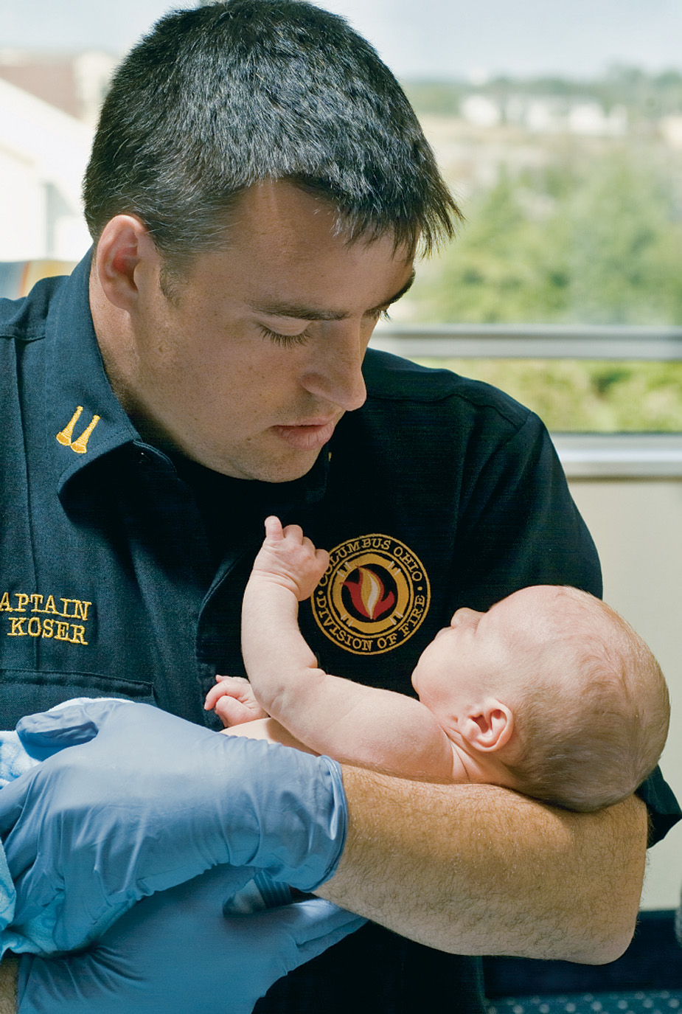
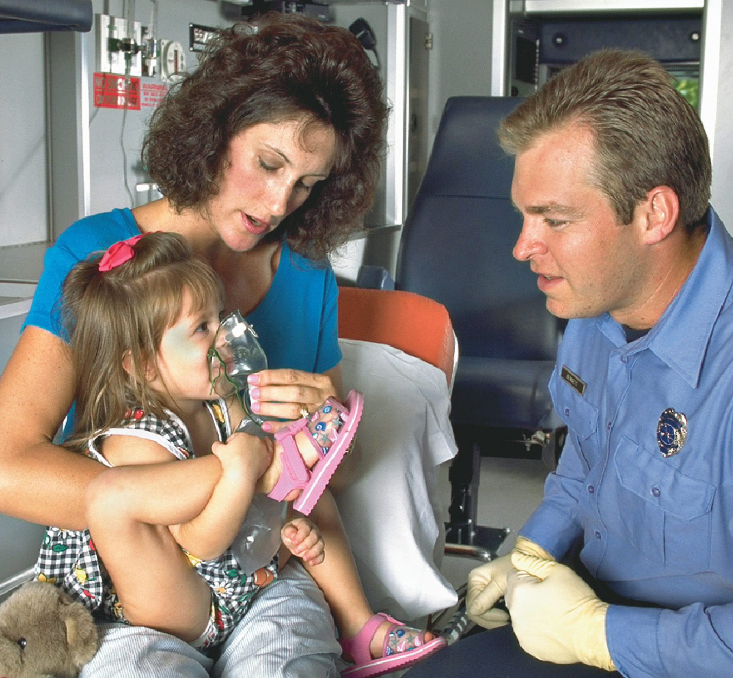
Dealing with the Child (2 of 6)
Developmental Characteristics
  Neonates (birth to one month)
  Infants (one month to one year)
  Toddlers (1 to 2 years of age)
  Preschoolers (3 to 5 years of age)
Notes:
Neonates (birth to one month)
Infants older than 6 months often cry if separated from their caregiver.
Assess from toe to head.
Toddlers
1 to 3 years
Do not like to be touched
Do not like to be separated from caregivers
Do not like having clothing removed
Do not like an oxygen mask on the face
Do not like needles
Think of your exam as an intrusion; respect the child's space.
Preschoolers
3 to 6 years of age
Use concrete thinking and literal interpretation.
Vivid imagination.
May believe illness or injury is a punishment.
Fear loss of bodily integrity
Aware of death; fear pain, blood, and permanent injury
Explain what you are doing in terms the child understands.

Slide 11
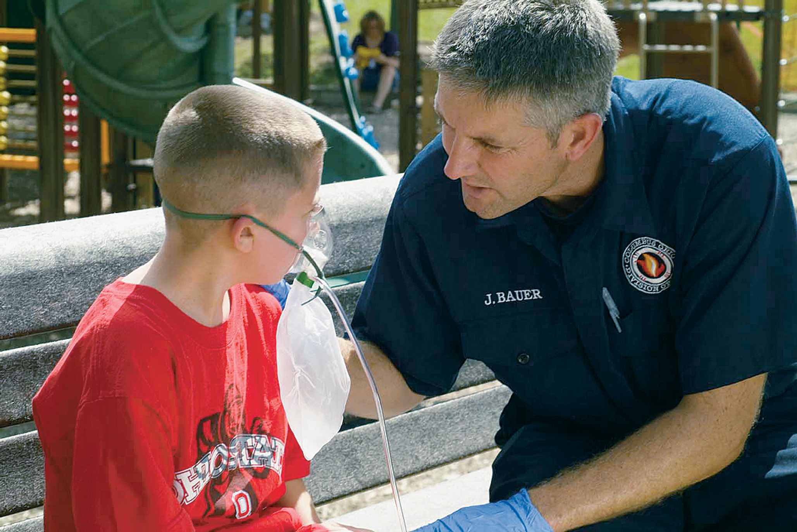
Dealing with the Child (3 of 6)
Developmental Characteristics
  School-Age and Preadolescent Children (6 to 12 years of age)
  Adolescents (12 to 18 years of age)
Notes:
School-age
6 to 12 years
More cooperative, better understanding of the body
Honesty is key
Explain what you are doing.
Adolescents
Abstract thinking is developing
Feelings of invincibility
Establish trust
Respect privacy
Anticipate fears and provide reassurance.

Slide 12
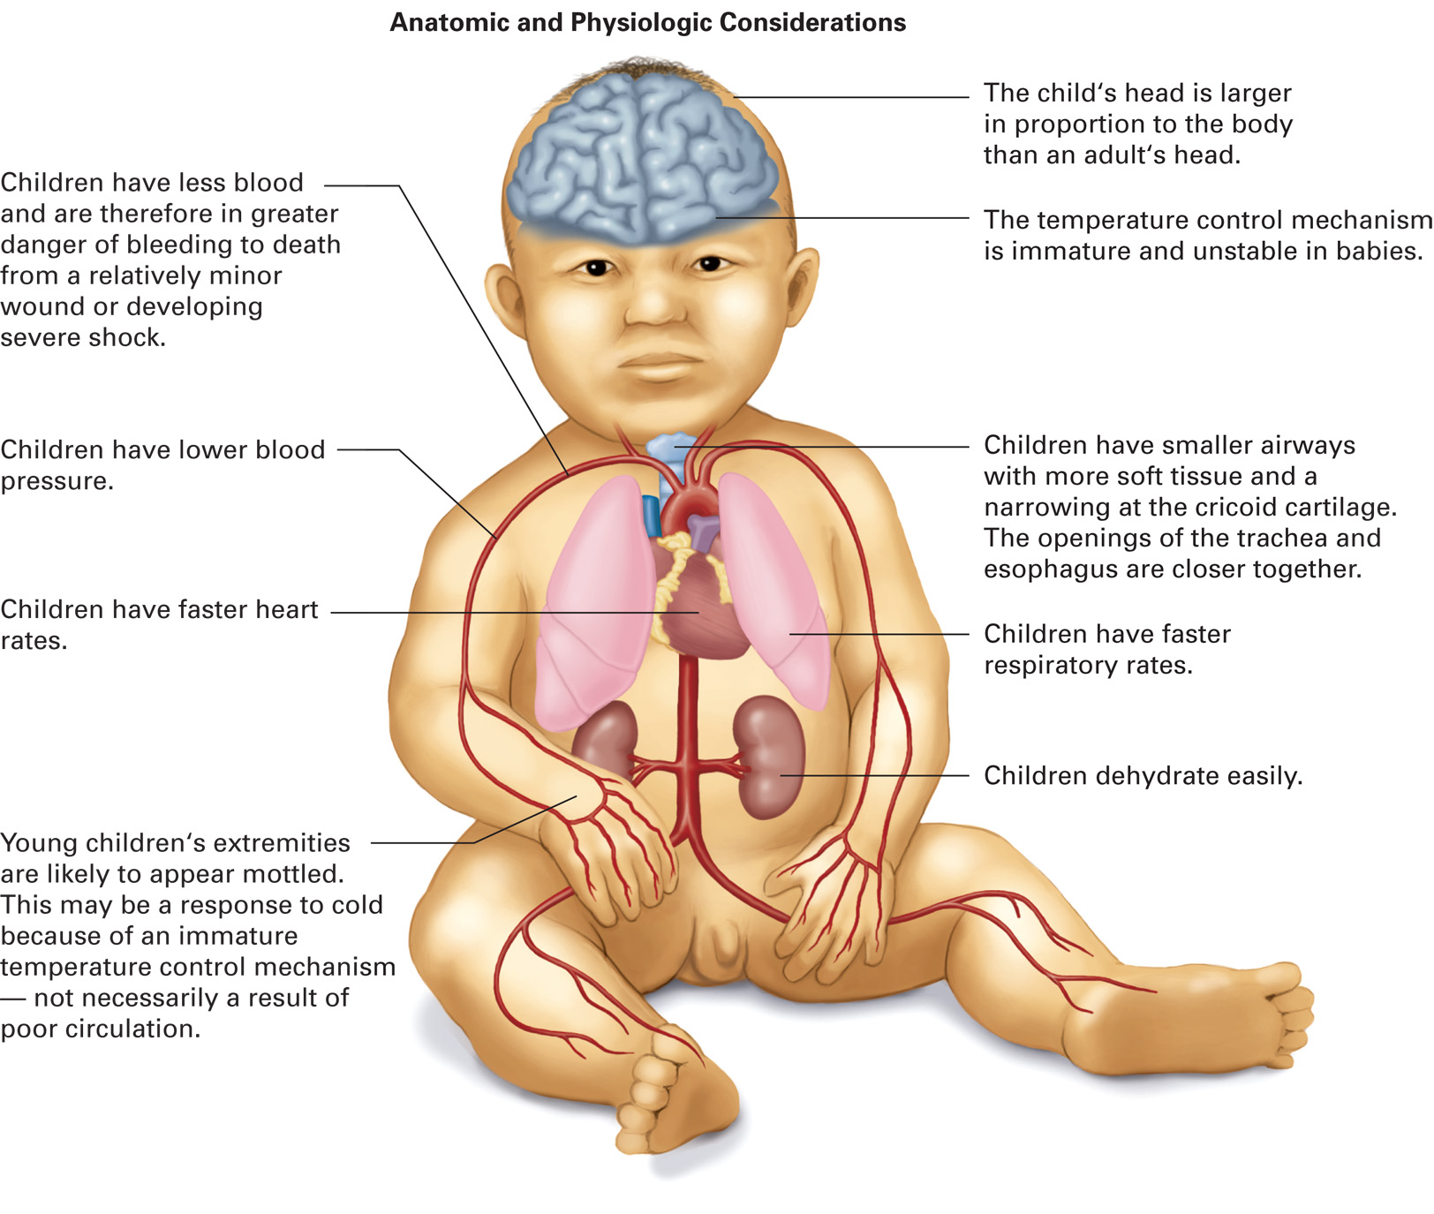
Dealing with the Child (4 of 6)
Anatomical and Physiologic Differences
Notes:
Most emergencies involving children are managed similarly to those involving adults experiencing the same emergency. However, there are certain modifications EMTs may need to make based on the anatomic and physiologic development of children. For the average, normally developing child, the following considerations are appropriate. For an infant or child with special health care needs, the anatomic and physiologic differences can be quite different from the norm and using the caretaker to help with the assessment is critical. When treating a child, be aware of some of the following special conditions and situations. Also, be aware the most significant of these differences typically concern the airway.
Teaching Tips
Draw a grid on the white board to compare and contrast the characteristics of adults and children.
Discussion Questions
What are some characteristics of the pediatric head that must be considered in assessment and management?
What are some consequences of the undeveloped pediatric skeleton?
Summarize the differences between adult and pediatric respiratory systems.
Why do infants and children tire so easily when they are in respiratory distress?
Knowledge Application
Students should be able to apply the knowledge in this section to scenarios involving assessment and management of pediatric patients.

Slide 13
Table 38-1 Estimated Pediatric Heart Rate, Respiratory Rate, Systolic Blood Pressure, and Diastolic Blood Pressure Based on Age
Age | Heart Rate (beats/minute) | Respiratory Rate (breaths/minute) | Systolic Blood Pressure (mmHg) | Diastolic Blood Pressure (mmHg) | Systolic Hypotension (mmHg)
Neonate | 100–205 | 40–60 | 67–84 | 35–53 | <60
Infant | 100–180 | 30–53 | 72–104 | 37–56 | <70
Toddler | 98–140 | 22–37 | 86–106 | 42–63
Preschool | 80–120 | 20–28 | 89–112 | 46–72
School-age | 75–118 | 18–25 | 97–120 | 57–80
Adolescent | 60–100 | 12–20 | 110–131 | 64–83 | <90

Slide 14
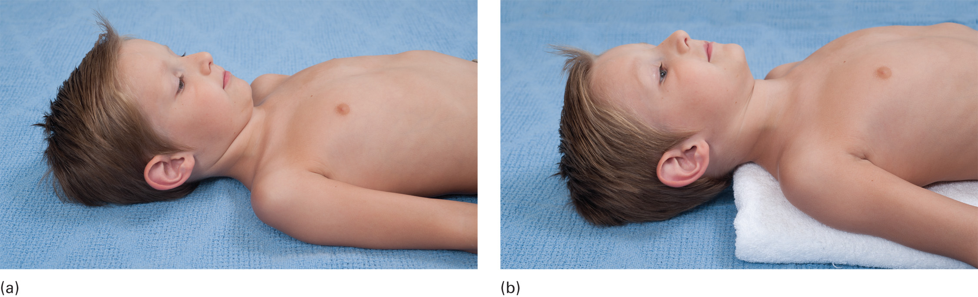
Dealing with the Child (5 of 6)
Anatomic and Physiologic Differences
  Airway
  Head
  Chest and Lungs
  Respiratory System
Notes:
Airway
Infants have a proportionally larger tongue.
A newborn's trachea is 4 to 5 mm in diameter.
The trachea is more pliable.
Pressure on the soft tissue under the chin can obstruct the airway.
Newborns are obligate nasal breathers.
The smallest part of the airway is at the level of the cricoid cartilage.
The epiglottis is positioned higher in the airway
Head
The head is proportionally larger.
The head and neck are more prone to injury.
Place padding beneath the shoulders during spine motion restriction procedures for the spine.
Infants less than 6 to 7 months old cannot support their heads.
Avoid handling the fontanelles.
The fontanelles may be sunken (dehydration) or bulging (increased intracranial pressure).
Chest and lungs
Ribs are more pliable
Ribs are more horizontal
Lung tissue is more fragile
Minimal chest rise with normal breathing
Chest muscles are underdeveloped
Respiratory system
Breathing is inadequate at rates ≥60.
Children younger than 5 years old have a breathing rate two to three times faster than that of adults.

Slide 15
Dealing with the Child (6 of 6)
Anatomic and Physiologic Differences
  Cardiovascular System
  Abdomen
  Extremities
  Metabolic Rate
  Skin and Body Surface Area
Notes:
Cardiovascular system
The heart rate increases from fear, fever, anxiety, hypoxia, activity, and hypovolemia.
Bradycardia is a late response to hypoxia in infants and children, but an early response in newborns.
The circulating blood volume is smaller.
Hypotension does not develop until more than 30percent of the blood volume is lost.
Limited ability to increase the strength of cardiac contraction.
Extremities
Bones can fracture by bending and splintering (greenstick fractures).
Motor development occurs from head to toe.
Metabolic rate
The metabolic rate is faster, requiring rapid consumption of oxygen and glucose.
Risk of developing hypoglycemia.
Skin and body surface area
The large skin surface increases the risk of hypothermia.
The skin is thinner and more delicate.

Slide 16
Assessment-Based Approach to Pediatric Emergencies (1 of 25)
Scene Size-up
  Look for clues to the nature of the problem.
  Assess the need for additional resources.
  Determine scene safety.
Notes:
The first component of the assessment process is the scene size-up. As with the adult patient, take the necessary Standard Precautions prior to assessment. The scene size-up can provide many clues to the nature of the emergency, the initial status of the infant or child, and obstacles that might hamper extrication to the ambulance. Determine whether the pediatric patient is a medical or trauma patient, if there is only one patient, and if any additional resources are needed at the scene. Finally, determine whether the scene is safe for you to enter.
Teaching Tips
Allow ample opportunity for students to practice pediatric assessment scenarios under supervision.
Arrange a tour of a pediatric emergency department or, if this is not possible, consider a tour of the area of the ED in which pediatric patients are treated.
Discussion Questions
Describe the Pediatric Assessment Triangle.
What are indications of respiratory distress in children?
Critical Thinking Discussion
Why do pediatric patients tend to compensate well and then deteriorate suddenly?

Slide 17
Assessment-Based Approach to Pediatric Emergencies (2 of 25)
Primary Assessment
  Form a general impression using the Pediatric Assessment Triangle (P A T).
    Assess the level of consciousness.
    Assess the airway.
    Assess breathing.
    Assess circulation.
    Determine priority.
Notes:
Discussion Question
How is the assessment of circulation different in pediatric patients than in adults?

Slide 18
Table 38-2 Primary Assessment “From the Doorway”
P A T (Pediatric Assessment Triangle: American Academy of Pediatrics) | P A L S (Pediatric Advanced Life Support, American Heart Association)
Appearance | Consciousness
Work of Breathing | Breathing
Circulation to Skin | Color

Slide 19
Assessment-Based Approach to Pediatric Emergencies (3 of 25)
Primary Assessment
  Form a general impression using the Pediatric Assessment Triangle (P A T)
    Appearance
      Tone
      Interactivity and irritability
      Consolability
      Look or gaze
      Speech or cry.
Notes:
These characteristics to assess for on the appearance side of the triangle can be remembered by using the TICLS (pronounced “tickles”). If the child has good muscle tone, is interacting appropriately with the environment, is not irritable, can be consoled, responds to stimuli and people, and has a normal cry, they can be assumed to have a “normal” appearance. This typically indicates an adequate airway, ventilation, oxygenation, and brain perfusion.

Slide 20
Assessment-Based Approach to Pediatric Emergencies (4 of 25)
Primary Assessment
  Form a general impression using the Pediatric Assessment Triangle (P A T)
    Work of Breathing
      Abnormal sounds
      Abnormal posture or position
      Retractions
      Nasal flaring
      Head bobbing.
Notes:
When the child transitions from respiratory distress to respiratory failure, you may find that the work of breathing and the respiratory rate both decrease. If the decrease in the work of breathing and respiratory rate is due to effective emergency care, expect to see an improvement in the appearance side of the triangle. However, if the decrease in the work of breathing and respiratory rate is due to exhaustion and respiratory failure, expect to see a deterioration in the appearance side of the triangle.

Slide 21
Assessment-Based Approach to Pediatric Emergencies (5 of 25)
Primary Assessment
  Form a general impression using the Pediatric Assessment Triangle (P A T)
    Circulation to Skin
      Pallor — skin and mucous membranes
      Mottling
      Cyanosis
      Petechiae.
Notes:
Visually assess the skin. Pale skin with tachycardia indicates compensated shock. As the perfusion further deteriorates (shock develops), the skin becomes mottled, which is an ominous sign. Cyanosis usually indicates respiratory failure or decompensated shock. Cyanosis can be seen at baseline in children with congenital heart defects and chronic cardiac or pulmonary disease.

Slide 22
Assessment-Based Approach to Pediatric Emergencies (6 of 25)
Primary Assessment
  Form a general impression using the Pediatric Assessment Triangle (P A T)
    A well versus sick child.
Notes:
Does the Patient:
Display normal behavior for their age?
Move about spontaneously, or do they seem lethargic?
Appear attentive and recognize the parents or caregivers?
Additionally, Does the Patient:
Maintain any eye contact?
Seem easily consoled by the parents?
Respond to the parent or caregivers calling to him?

Slide 23
Assessment-Based Approach to Pediatric Emergencies (7 of 25)
Primary Assessment
  Form a general impression using the Pediatric Assessment Triangle (P A T)
    Conditions presenting with an abnormal P A T finding.
Notes:
Does the Patient:
Display normal behavior for their age?
Move about spontaneously, or do they seem lethargic?
Appear attentive and recognize the parents or caregivers?
Additionally, Does the Patient:
Maintain any eye contact?
Seem easily consoled by the parents?
Respond to the parent or caregivers calling to him?

Slide 24
Assessment-Based Approach to Pediatric Emergencies (8 of 25)
  Primary Assessment
  Form a general impression using the Pediatric Advanced Life Support (P A L S) initial impression
    Consciousness
    Breathing
    Color.
Notes:
The PALS initial impression is an alternative to the PAT for forming a general impression. As with PAT, PALS can be used to establish the general impression “at the doorway” as you approach the pediatric patient. The PALS assessment criteria are similar to the PAT criteria and collect similar information. To perform an initial impression using the PALS criteria, assess the following:
Consciousness
What is the level of consciousness?
Unresponsive? Irritable? Alert?
Breathing.
What is the work of breathing? Absent? Decreased? Abnormal sounds? Use of accessory muscles? Abnormal breathing pattern?
Color
What is the skin color? Cyanotic? Pale? Flushed? Mottled?

Slide 25
Assessment-Based Approach to Pediatric Emergencies (9 of 25)
Primary Assessment
  Acting on Life Threats Identified During the General Impression
    If breathing is adequate, proceed to the primary assessment.
    If the patient is unresponsive and breathing is absent or gasping, begin positive pressure ventilation at 12 to 20/minute, and assess the pulse.
Notes:
After forming the general impression and addressing any immediate life threats as just discussed, proceed with the remainder of the primary assessment by assessing the level of consciousness, airway, breathing, and circulation.

Slide 26
Assessment-Based Approach to Pediatric Emergencies (10 of 25)
Primary Assessment
  Acting on Life Threats Identified During the General Impression
    If there is no pulse, begin chest compressions.
    If there is a pulse but signs of poor perfusion are present and the heart rate is less than 60, begin chest compressions
    If the pulse is greater than 60/minute, proceed to the primary assessment
Notes:
After forming the general impression and addressing any immediate life threats as just discussed, proceed with the remainder of the primary assessment by assessing the level of consciousness, airway, breathing, and circulation.

Slide 27
Click on the Item that is NOT a Component that is Assessed Using the Pediatric Assessment Triangle (P A T)
a. Muscle tone
b. Blood pressure
c. Breathing
d. Skin color

Slide 28
Assessment-Based Approach to Pediatric Emergencies (11 of 25)
Primary Assessment
  Assessing the Level of Consciousness
    Use the A V P U approach.
Table 38-3 A V P U Scale in the Pediatric Patient
A (Alert) | Infant or child is curious, alert, and awake.
V (Verbal response) | Infant or child turns head to sounds.
P (Painful response) | Infant or child moans or cries to pain.
U (Unresponsive) | Infant or child does not respond or displays no activity.
Notes:
The simplest method for determining the level of consciousness in a pediatric patient is the AVPU scale. It is a variation of the adult AVPU scale.

Slide 29
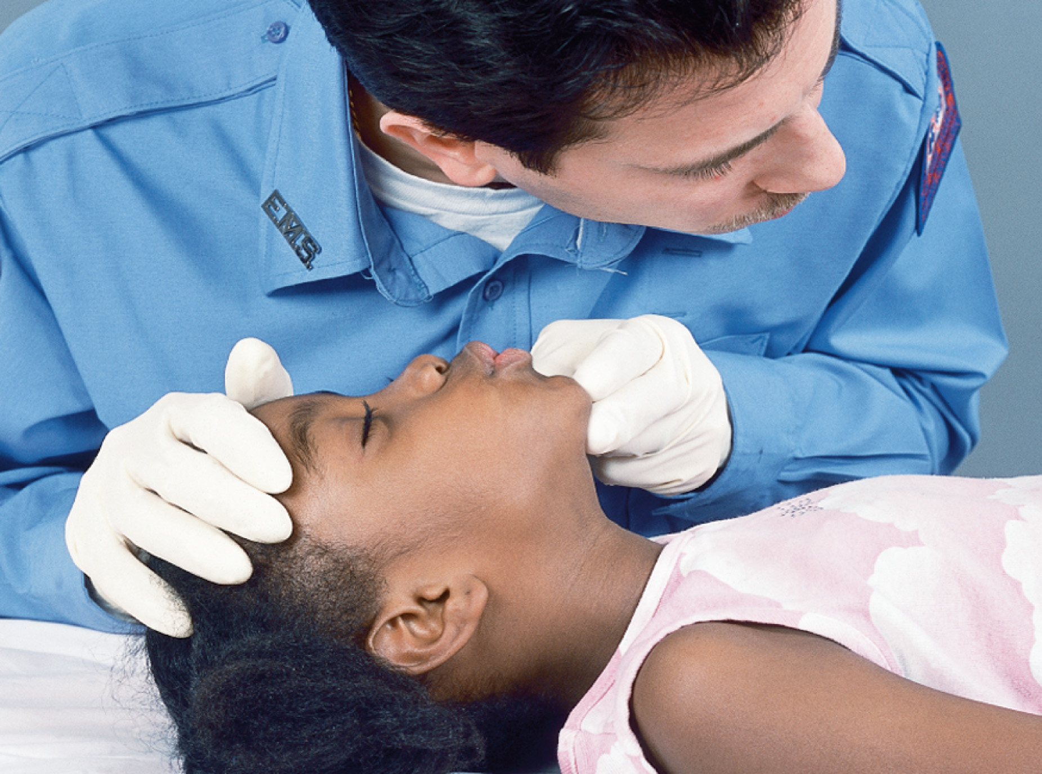
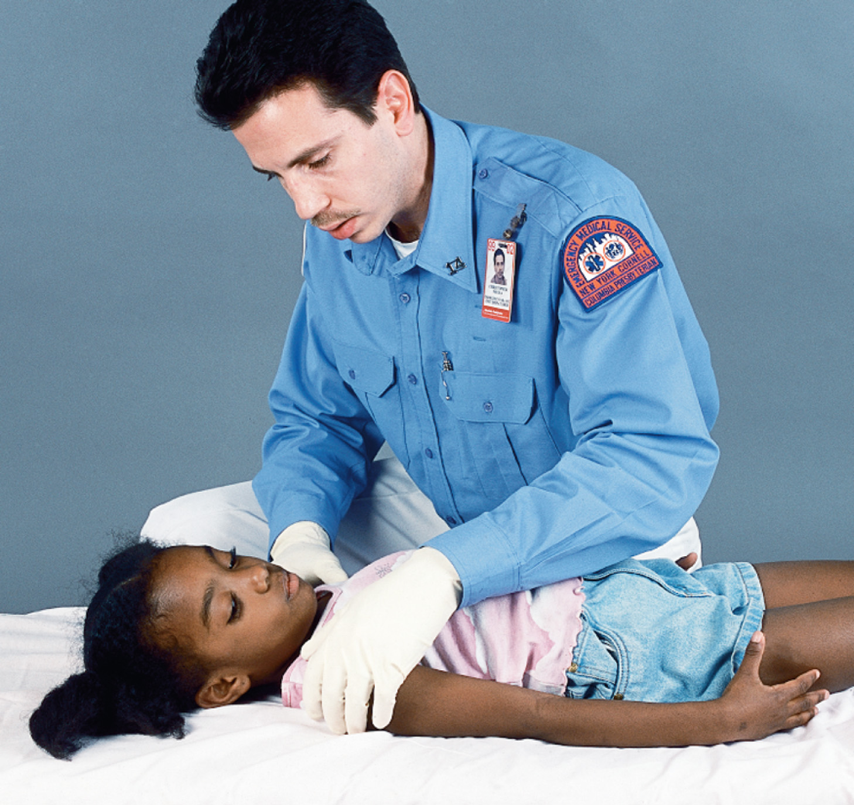
Assessment-Based Approach to Pediatric Emergencies (12 of 25)
Primary Assessment
  Airway Assessment
  Breathing Assessment.
Notes:
Airway Assessment
Hypoxia and death may occur from an obstructed airway.
Keep in mind pediatric anatomical and physiological differences.
Breathing Assessment
Count respirations for 30 to 60 seconds.
Assess tidal volume.
If the rate or tidal volume are inadequate, begin positive pressure ventilation with supplemental oxygen.

Slide 30
Assessment-Based Approach to Pediatric Emergencies (13 of 25)
Primary Assessment
  Breathing Assessment
    Rapid breathing
      Normal breathing rates are 25–30/minute in an infant and 15–30/minute in a child.
      Check for signs of hypoxia and respiratory distress.
      Causes of rapid breathing.
Notes:
Generally, children breathe faster than adults. The key to recognizing rapid breathing is to be familiar with normal ranges of respirations (25–30 per minute in an infant; 15–30 per minute in a child) and to repeat assessment of respiratory rate frequently, each time counting the rate over a complete minute. In cases of rapid breathing (tachypnea) look for breathing through the mouth, flaring of the nostrils, retractions, and/or the use of accessory muscles. Also check for cyanosis around the mouth and changes in mental status. Possible causes of rapid
breathing follow:
• Oxygen deficiency (hypoxia)
• Head injury
• Lung infection
• Fever, which raises the metabolic rate, increasing the need for oxygen
• Diabetes, when glucose levels get high
• Aspirin overdoses and other forms of poisoning
• Stress, pain, or fear
• Shock.

Slide 31
Assessment-Based Approach to Pediatric Emergencies (14 of 25)
Primary Assessment
  Breathing Assessment
    Noisy breathing
    Coughing, gagging, gasping
    Crackles, wheezing, stridor
    Diminished breathing.
Notes:
When assessing breath sounds with a stethoscope, listen along both midaxillary lines (below the armpits). This is necessary because breath sounds typically transmit easily from one side of the child’s small chest to the other. Listening midaxillary or down the back can reduce the amount of sound you hear that is transmitted from the
opposite side.
Coughing, gagging, gasping
Aspiration of a foreign body or body secretions, creating a partial blockage of the airway
Sounds that characterize certain problems:
Crackles
Fluid in the alveoli
Wheezing
Narrowed bronchioles
Stridor
Severe upper airway obstruction
Diminished breathing
Part of the lung is not inflating

Slide 32
Assessment-Based Approach to Pediatric Emergencies (15 of 25)
Primary Assessment
  Circulatory assessment
    Assess the pulse.
    Capillary refill is reliable in children.
    Also assess blood pressure, urine output, and mental status to check for hypoperfusion.
Notes:
Like pediatric respiratory rates, pediatric heart rates are variable. Pulse points are the same in children as they are in adults, but there are some differences in the way these pulses are evaluated. In small children, it is recommended that peripheral pulses be obtained at the brachial artery (inside of the bicep). Central pulses can be obtained at either the carotid or the femoral artery. In the older child, check the radial pulse. Compare the strength of the central (carotid or femoral) pulse to the strength of the peripheral pulse. If no pulses can be palpated, the EMS provider should consider auscultating the heart with a stethoscope. If a heartbeat can be heard, the child likely has a pulse, but the presence of a pulse does not mean that there is adequate perfusion.

Slide 33
Assessment-Based Approach to Pediatric Emergencies (16 of 25)
Primary Assessment
  Circulatory Assessment
    Pulse rate and strength
    Strength of peripheral versus central
    Warmth and color of hands and feet
    Urinary output
    Mental status.
Notes:
Discuss the clinical and physiological indications of changes in these pulse characteristics.

Slide 34
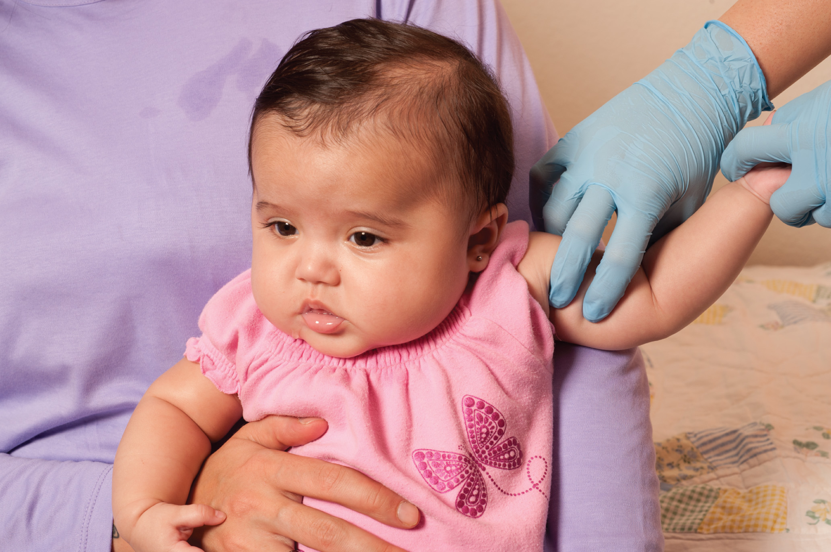
Assess the Strength of the Peripheral Pulse. in an Infant, Check the Brachial Pulse
Notes:
Assessment of brachial pulse in an infant.

Slide 35
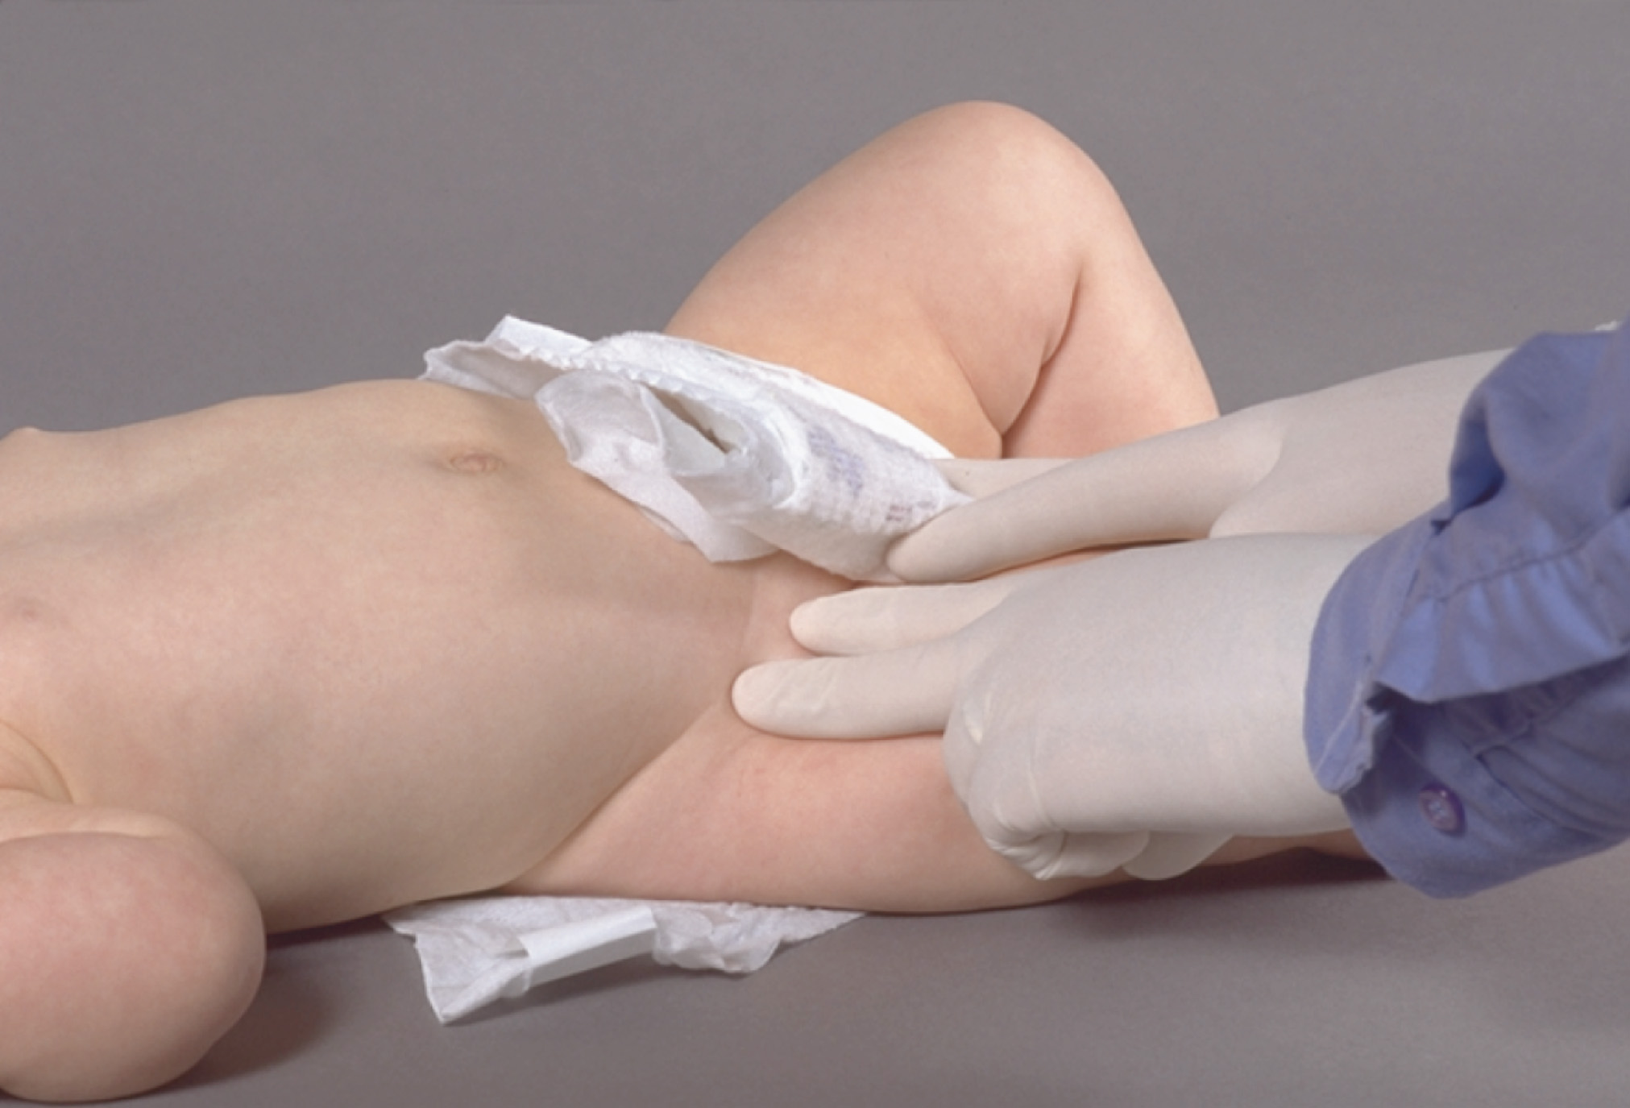
Assess the Strength of the Central Pulse. In an Infant, Check the Femoral Pulse
Locate this pulse by identifying the midpoint of an imaginary line extending from the anterior superior iliac spine to the symphysis pubis, then moving your fingertip about one to two finger breadths inferior.
Notes:
Assessment of femoral pulse in an infant.

Slide 36
In a Child, Check the Radial Pulse
Notes:
Assessment of a radial pulse in a child.

Slide 37
To Assess the Strength of the Central Pulse in an Older Child, Check the Carotid Pulse
Compare the strength of the central pulse to the previously determined strength of the peripheral pulse.
Notes:
Assessment of a carotid pulse in an older child.

Slide 38
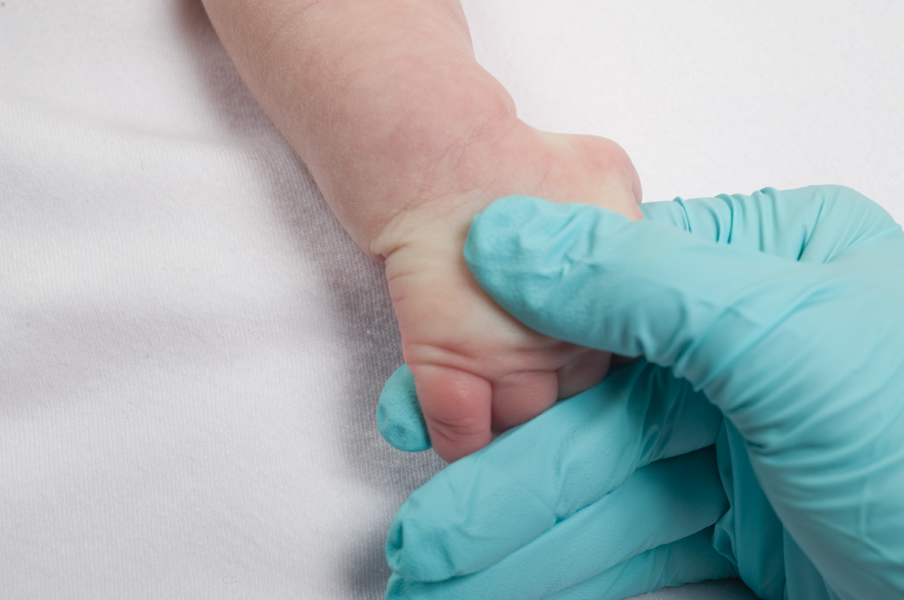
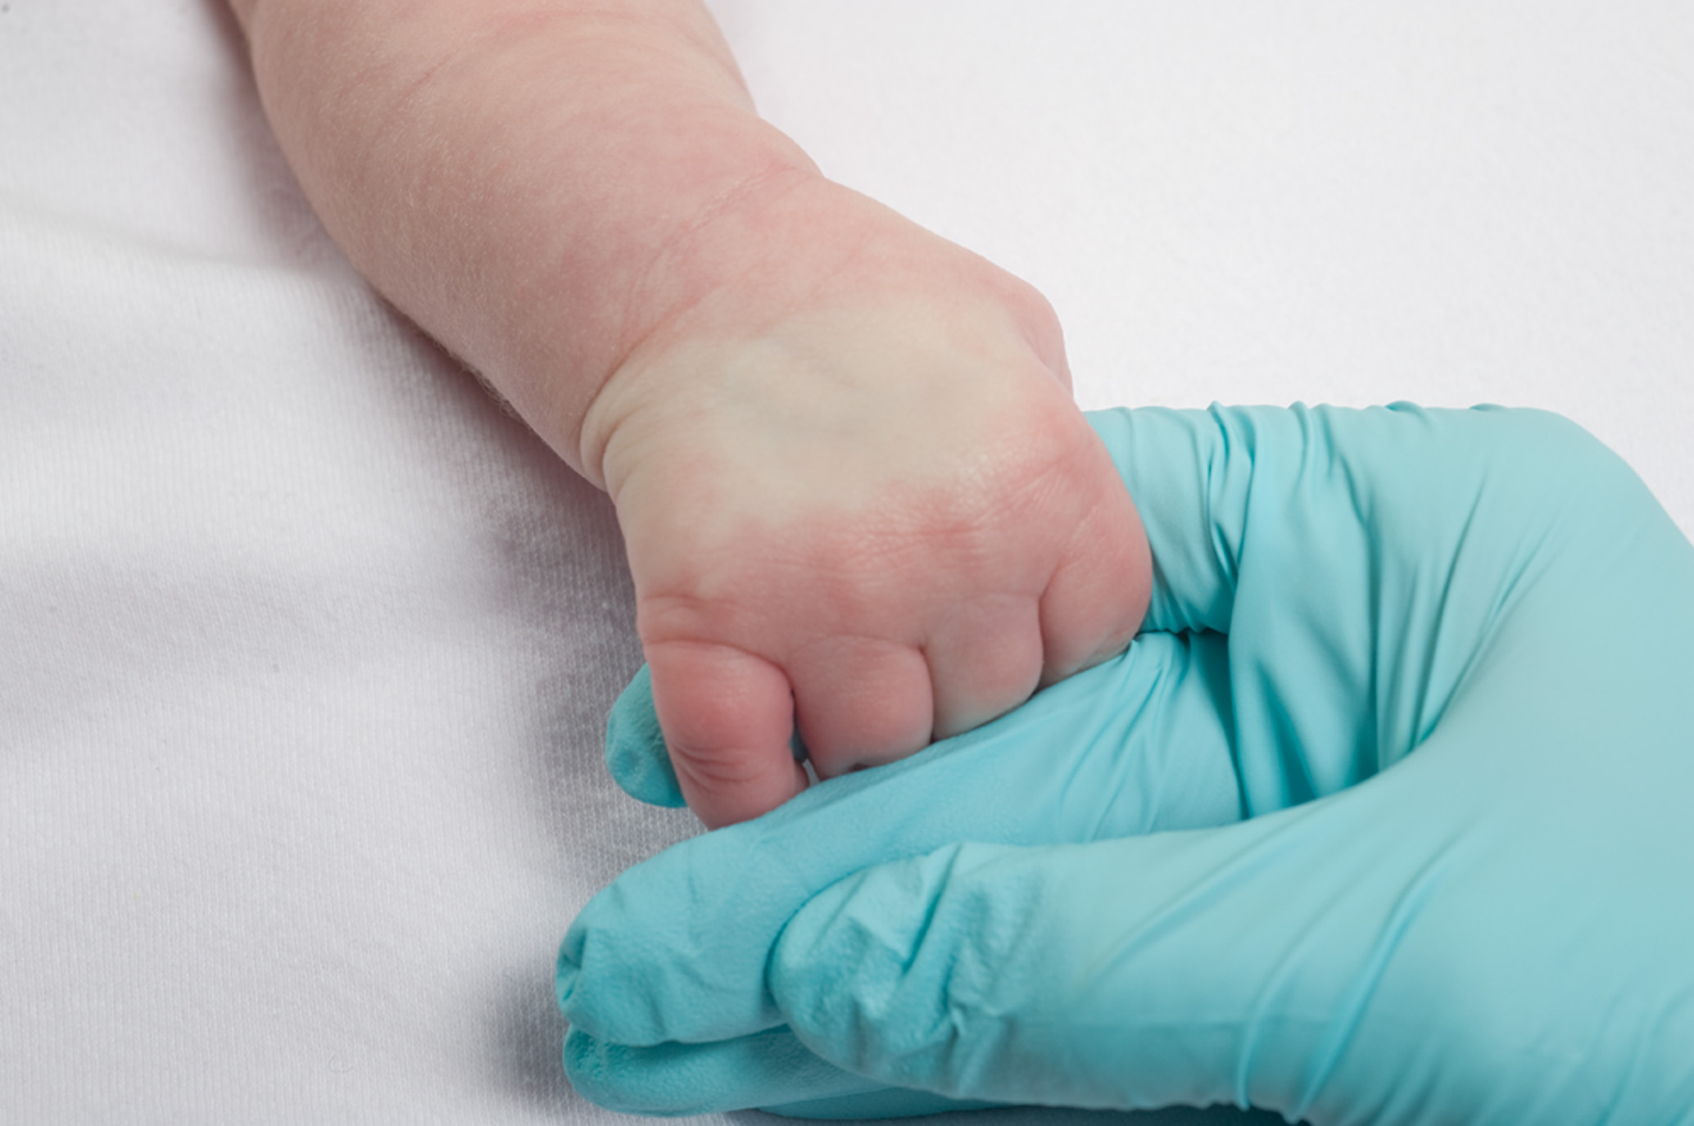
Press the Top of the Patient’s Hand or Foot
Release and note how long before normal color returns.
Notes:
Assessment of capillary refill.

Slide 39
Assessment-Based Approach to Pediatric Emergencies (17 of 25)
Primary Assessment
  Priority Determination
    Consider scene size-up, P A T/P A L S, and primary assessment information.
    Priority patients
      Respiratory distress
      Respiratory failure
      Respiratory arrest
      Poor perfusion.
Notes:
From the information you have gathered, you need to decide based on your scene size-up and primary assessment, including your general impression using the PAT or PALS, whether the patient should be a priority for immediate transport. Any patient with signs and symptoms of early respiratory distress, decompensated respiratory failure, respiratory arrest, or poor perfusion should be considered a priority patient.

Slide 40
Assessment-Based Approach to Pediatric Emergencies (18 of 25)
Secondary assessment
  For trauma, perform the assessment first, then the history and baseline vital signs.
  For a responsive patient with a medical problem, a focused assessment may be performed.
  For younger patients, use a toe-to-head approach.
Notes:
Complete the history, using the OPQRST mnemonic if pain is identified during your assessment. If the developmental age of the patient allows, the EMT should gather this history from the patient and confirm it with the bystanders or caretaker; if not, question the family or bystanders. While gathering the history, find out if any care or treatment has already been rendered and if so, whether it was effective. Remember to ask if all shots and immunizations are up to date.
Knowledge Application
Given a series of scenarios, students should be able to assess pediatric patients.

Slide 41
Table 38-4 Ten Tips for Examining Infants and Children (1 of 3)
When examining an infant or child:
If possible, have only one E M T deal with the infant or child. This reduces the fear the patient may experience by being assessed by two unknown individuals.
Get down to the child’s eye level. Towering above an infant or child will only increase his fear and anxiety. Sit down next to the child whenever possible.
With children under school age, start the assessment with your hands and save stethoscopes, blood pressure cuffs, and scissors until you have developed some trust with the child. Keep the most painful parts of the examination for the end.
Speak in a calm, quiet voice and maintain eye contact as much as possible. Even infants will respond to a calm voice, and an apparently unresponsive child may actually hear much of what you say.

Slide 42
Table 38-4 Ten Tips for Examining Infants and Children (2 of 3)
Never become impatient or lose your temper. This will just ignite the patient’s temper. Switch off with a partner or take a brief time-out for yourself, if you need to.
Avoid questions that require “yes” or “no” answers. Given the choice, a child will almost always say “no” when asked if you can do something to him. Instead, ask questions in this format: “Would you like your mother to take off your shirt, or may I do it?” Giving the child a choice also empowers him in what may be a very scary situation.
Involve the caregivers (or a familiar person) as much as possible during care and transport. If the child sees his caretaker respecting and trusting you, he is much more likely to do the same.

Slide 43
Table 38-4 Ten Tips for Examining Infants and Children (3 of 3)
Be honest. For instance, you might say, “It will hurt when I touch you here, but it will only last a moment. If you feel like crying, it’s okay.” Children can tolerate some pain if they are prepared for it and are given adequate support.
Ask children for their help and assure them that they are doing a good job. Have toys, stickers, or other “rewards” to console and encourage a child.
Be gentle. Use all appropriate measures to reduce the amount of pain that a child must endure. If you must restrain a child, be sure that it is necessary. Use only the minimum degree of restraint to be safe and allow you to provide good care. As a rule, “humane” (soft) restraints are much better than “mechanical” ones.

Slide 44
Assessment-Based Approach to Pediatric Emergencies (19 of 25)
Secondary Assessment
  Special Considerations for the Physical Exam
    Pediatric Glasgow coma scale
    Assessing lung sounds
    Pulse oximetry
Notes:
Discussion Question
What is the role of pulse oximetry in assessing pediatric patients?
When using pulse oximetry, also consider the patient's overall presentation.
Administer supplemental oxygen to maintain an SpO₂ greater than or equal to 94%.
Recognize limitations of pulse oximetry in shock and hypothermia, and with movement.
Discussion Question
Why are vital signs not as useful in the assessment of pediatric patients as they are in adults?
How can you estimate a child's normal blood pressure?
To estimate the normal systolic blood pressure in a child who is 1 to 10 years of age, take 80 + (2 * age in years) for the median average systolic blood pressure limit. The diastolic pressure should be approximately two thirds of the systolic pressure.

Slide 45
Assessment-Based Approach to Pediatric Emergencies (20 of 25)
Table 38-6 Evaluating Blood Pressure in the Pediatric Patient
Neonate | Systolic BloodPressure less than 60 mmHg is considered hypotensive
Infant | Systolic BloodPressure less than 70 mmHg is considered hypotensive
Child 1 to 10 years of age | Upper limit of normal for systolic BloodPressure = 90 + (2 × age in years)
Child 1 to 10 years of age | Median systolic BloodPressure = 80 + (2 × age in years)
Child 1 to 10 years of age | Lower limit of normal systolic BloodPressure = 70 + (2 × years in age)
Child 1 to 10 years of age | Diastolic BloodPressure is the systolic BloodPressure
Child older than 10 years | Systolic BloodPressure less than 90 mmHg is considered hypotensive
Notes:
Discussion Question

Slide 46
Assessment-Based Approach to Pediatric Emergencies (21 of 25)
Secondary Assessment
  Special Considerations for Assessing the Vital Signs
    Respirations
    Pulse
    Skin
    Pupils
    Blood pressure.
Notes:
When assessing the vital signs in infants and children, be aware that outside of heart and respiratory rates, vital signs play only a limited role in the determination of the patient’s overall status. Instead, pay more attention to the general impression you developed of the child’s appearance of “sickness” or “wellness.” Infants and children have excellent compensatory mechanisms that delay deterioration. It is only after the exhaustion of these mechanisms that you might see indicative changes in the vital signs.

Slide 47
Assessment-Based Approach to Pediatric Emergencies (22 of 25)
Secondary Assessment
  Special Considerations for Taking a History
    Watch the child’s interaction with the caregiver.
    If there are no life threats, take time to establish trust.
    Use a calm voice and include the child in the conversation.
Notes:
Discussion Question
What are some considerations in successfully obtaining a history from a pediatric patient?

Slide 48
Assessment-Based Approach to Pediatric Emergencies (23 of 25)
Secondary Assessment
  Special Considerations for Taking a History
    Avoid rapid-fire “yes” and “no” questions.
    Avoid words that increase anxiety.
    Keep the child with the parent.
    Examine small children toe to head.
    Place yourself at the child's eye level.
Notes:
Discussion Question
What are some considerations in successfully obtaining a history from a pediatric patient?

Slide 49
Assessment-Based Approach to Pediatric Emergencies (24 of 25)
Secondary Assessment
  Special Considerations for Taking a History
    Do not explain things too far in advance.
    Let the child handle equipment.
Notes:
Discussion Question
What pieces or types of equipment would be most scary for a pediatric patient? How do you deal with this apprehension?

Slide 50
Assessment-Based Approach to Pediatric Emergencies (25 of 25)
Reassessment
  Monitor the mental status, airway, breathing, and circulation.
  Remember that compensatory mechanisms fail rapidly and without warning.
  Assess and record the vital signs and check interventions.
Notes:
The reassessment must be performed on all patients to continuously monitor for changes in mental status, airway, breathing, and circulation status. Also assess and record the vital signs and check interventions. Repeat the reassessment at least every 3–5 minutes or as frequently as possible for the pediatric patient with any airway or cardiopulmonary compromise. Communicate your findings and treatment to the receiving medical facility.

Slide 51
Case Study (2 of 4)
Julian and Tammy arrive to find a 2-year-old boy held by their father. The child seems listless and tired. He is slightly pale, and his respirations are rapid with nasal flaring and retractions.
The child has been sick with a cough, runny nose, and fever for about 12 hours, and his breathing has worsened substantially over the past hour.
Notes:
Case Study Discussion
Gauge the students’ responses as a guide of how well versed they are in this topic.

Slide 52
Case Study (3 of 4)
The child’s skin is warm and dry. Julian auscultates the breath sounds and hears crackles in the right lung. Tammy reports an S p O ₂ of 92%.
Notes:
Case Study Discussion
Gauge the students’ responses as a guide of how well versed they are in this topic.

Slide 53
Case Study (4 of 4)
What additional assessment information do the E M T s need?
What interventions are needed, and how should they be carried out in this patient?
Notes:
Case Study Discussion
Gauge the students’ responses as a guide of how well versed they are in this topic.

Slide 54
Airway and Respiratory Problems in Pediatric Patients (1 of 22)
The leading cause of cardiac arrest in pediatric patients is respiratory failure.
Failure to establish and maintain the airway and ventilations will defeat any other treatment and lead to failure.
Compensatory mechanisms function until total exhaustion occurs, causing respiratory and cardiac arrest.
Notes:
Teaching Tips
Create three columns on the white board: Respiratory Distress, Respiratory Failure, and Respiratory Arrest. List and discuss the features of each.

Slide 55
Airway and Respiratory Problems in Pediatric Patients (2 of 22)
Early Respiratory Distress
  Adequate depth and rate of respiration
  Work of breathing is increased.
  The patient can progress to respiratory failure and respiratory arrest.
  Provide oxygen and transport.
Notes:
The patient in early respiratory distress is still in serious trouble. The patient can progress from early (compensated) respiratory distress to decompensated respiratory failure and respiratory arrest in minutes.

Slide 56
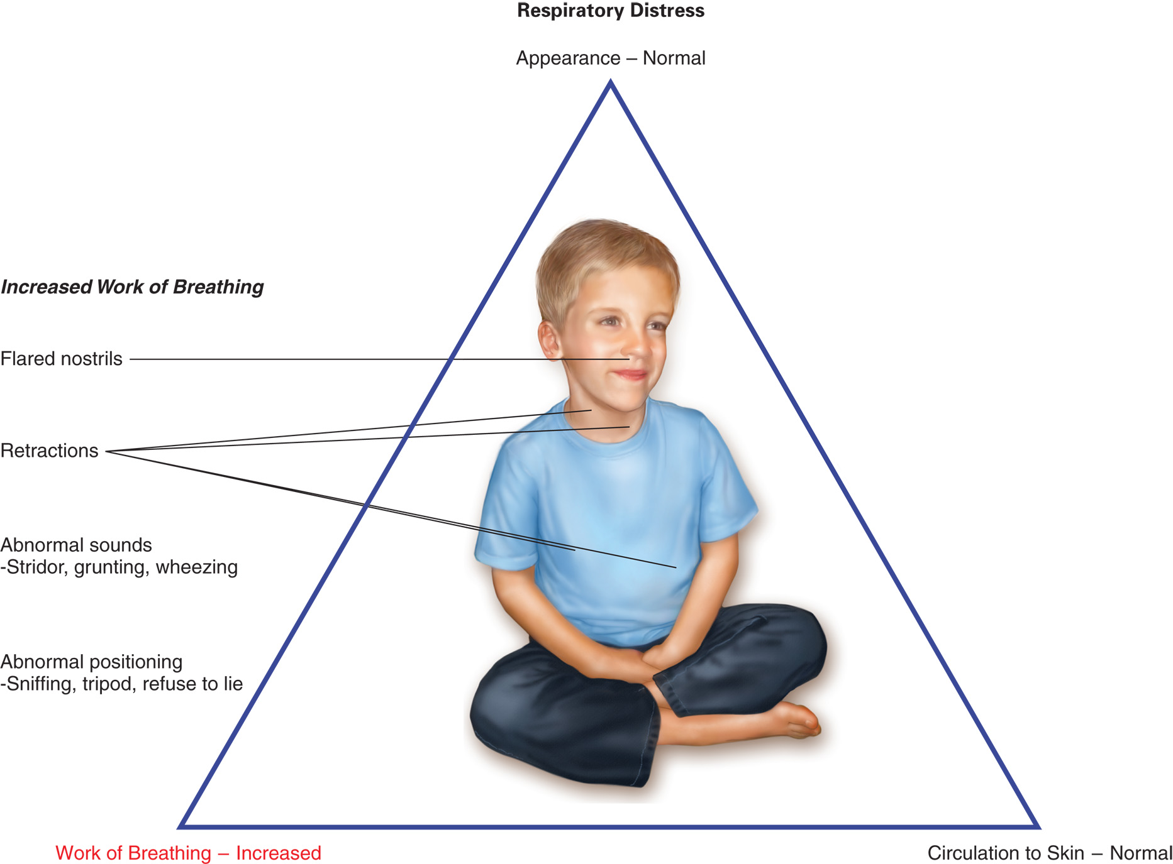
Findings for a Child in Respiratory Distress
Notes:
Review the PAT assessment for a child in respiratory distress.

Slide 57
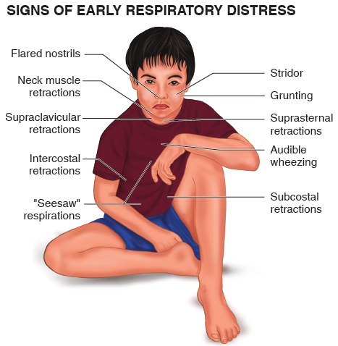
Signs of early respiratory distress
Notes:
Review the assessment findings for a child in early respiratory distress.

Slide 58
If Signs of Early Respiratory Distress are Present, Provide Oxygen and Prompt Transport to the Hospital

Slide 59
Airway and Respiratory Problems in Pediatric Patients (3 of 22)
Decompensated Respiratory Failure
  Patient cannot compensate and is unable to maintain adequate breathing.
  Either the respiratory rate or the tidal volume is inadequate.
  The patient requires immediate intervention.
Notes:
The EMT may also encounter an infant or child in decompensated respiratory failure. As the name implies, the infant or child is failing to compensate for the impaired respiratory condition and cannot maintain adequate breathing. Either the respiratory rate or the tidal volume is inadequate and the infant or child requires immediate intervention.

Slide 60
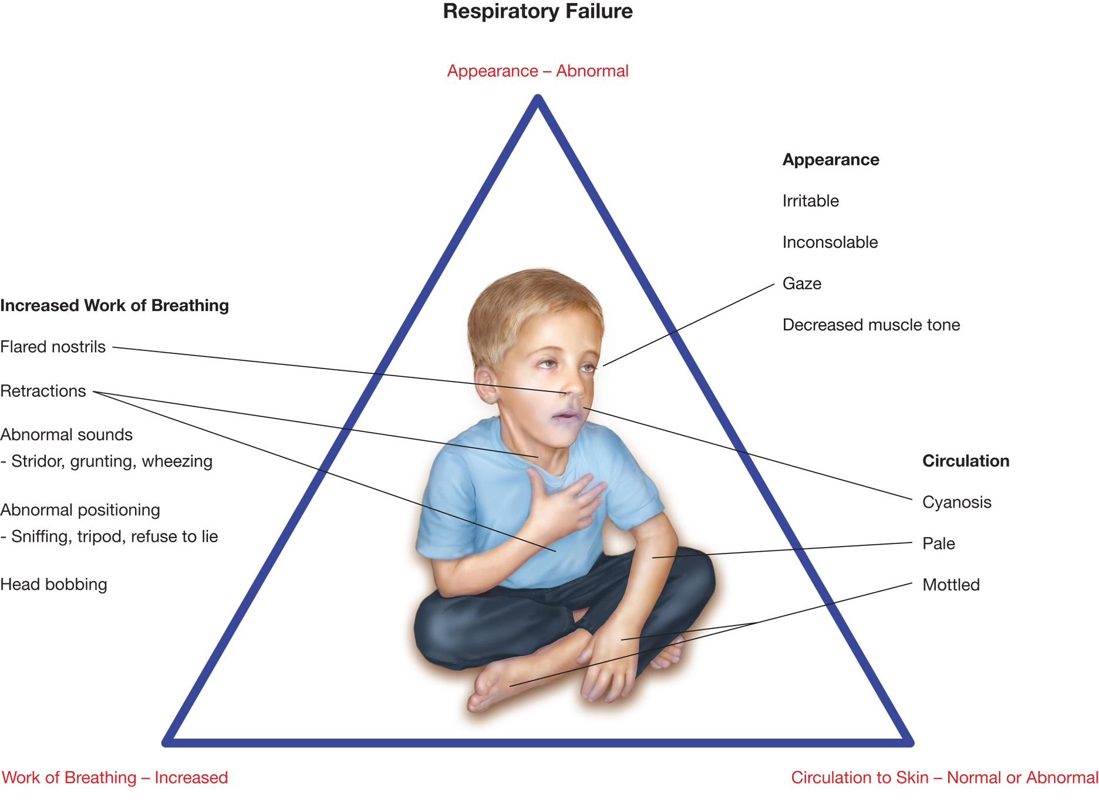
Findings for a Child in Decompensated Respiratory Failure
Notes:
Review the PAT assessment for a child in decompensated respiratory failure.

Slide 61
Airway and Respiratory Problems in Pediatric Patients (4 of 22)
In addition to signs of respiratory distress, patients in respiratory failure may have:
  Respiratory rate greater than 60
  Cyanosis
  Decreased muscle tone
  Severe use of accessory muscles.

Slide 62
Airway and Respiratory Problems in Pediatric Patients (5 of 22)
Decompensated Respiratory Failure
  In addition to signs of respiratory distress, patients in respiratory failure may have:
    Respirations greater than 60/min, cyanosis
    Poor peripheral perfusion
    Altered mental status
    Grunting
    Head bobbing.
Notes:
If these signs are present, provide positive pressure ventilation with a bag-valve-mask device or other acceptable ventilation device and supplemental oxygen and immediately transport to the hospital.

Slide 63
Airway and Respiratory Problems in Pediatric Patients (6 of 22)
Respiratory Arrest
  Respiratory rate less than10
  Irregular or gasping respirations
  Limp muscle tone
  Unresponsiveness
  Slower than normal or absent heart rate
  Weak or absent peripheral pulses
  Hypotension.
Notes:
Discussion Question
What are indications of respiratory arrest in children?
Knowledge Application
Given a series of scenarios, students should be able to assess and manage respiratory distress, respiratory failure, and respiratory arrest in pediatric patients.

Slide 64
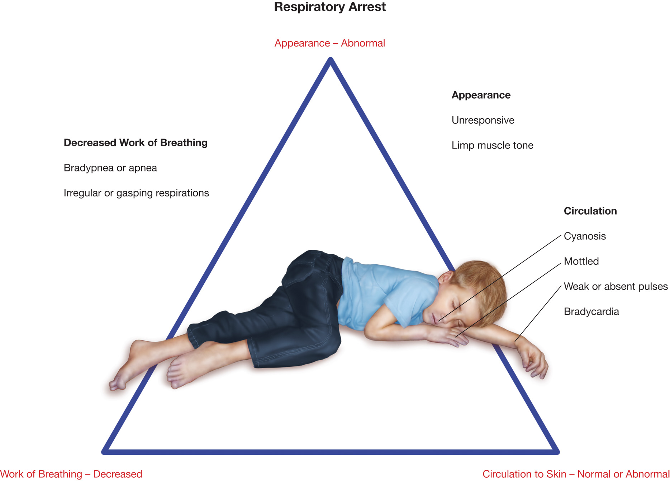
Findings for a Child in Imminent Respiratory Arrest
Notes:
Remember, cardiopulmonary arrest in children is usually preceded by the progressive failure of the respiratory system. If any of the conditions listed here are present, the patient should be treated aggressively with oxygenation and positive pressure ventilation and transported immediately to the hospital.

Slide 65
Airway and Respiratory Problems in Pediatric Patients (7 of 22)
Airway Obstruction
  Partial Airway Obstruction
    If the airflow is adequate, allow the patient to assume a comfortable upright position.
    Administer oxygen.
    Encourage the patient to cough.
    Do not agitate the patient.
    Transport immediately.
Notes:
Partial Airway Obstruction Signs and Symptoms
May be alert with good peripheral perfusion.
Skin may be normal or slightly pale.
Stridor.
If the patient displays the signs just listed and still maintains an adequate respiratory volume, general treatment principles include allowing the patient to assume a position of comfort (except do not lay the patient down). Enlist the help of the parents or caregivers while you administer oxygen. Encourage the patient to cough if a tangible obstruction is present. Limit your exam so as not to further agitate the patient, and transport immediately.

Slide 66
Airway and Respiratory Problems in Pediatric Patients (8 of 22)
Airway Obstruction
  Complete Airway Obstruction
    No crying or talking
    Ineffective or absent cough
    Altered mental status
    Cyanosis probable
    Requires use of procedures for relieving airway obstruction.
Notes:
Discussion Question
Why are pediatric patients prone to airway obstruction?

Slide 67
Airway and Respiratory Problems in Pediatric Patients (9 of 22)
Emergency Medical Care — Respiratory Emergencies
  Establish and maintain a patent airway.
    If no cervical spine injury is suspected, use a head-tilt, chin-lift maneuver.
    If a spine injury is suspected, use a jaw-thrust maneuver.
Notes:
Teaching Tips
Ensure adequate opportunity for students to practice pediatric airway management with feedback from instructor.
Discussion Question
Why should you avoid manual maneuvers in pediatric patients with partial foreign body airway obstruction?

Slide 68
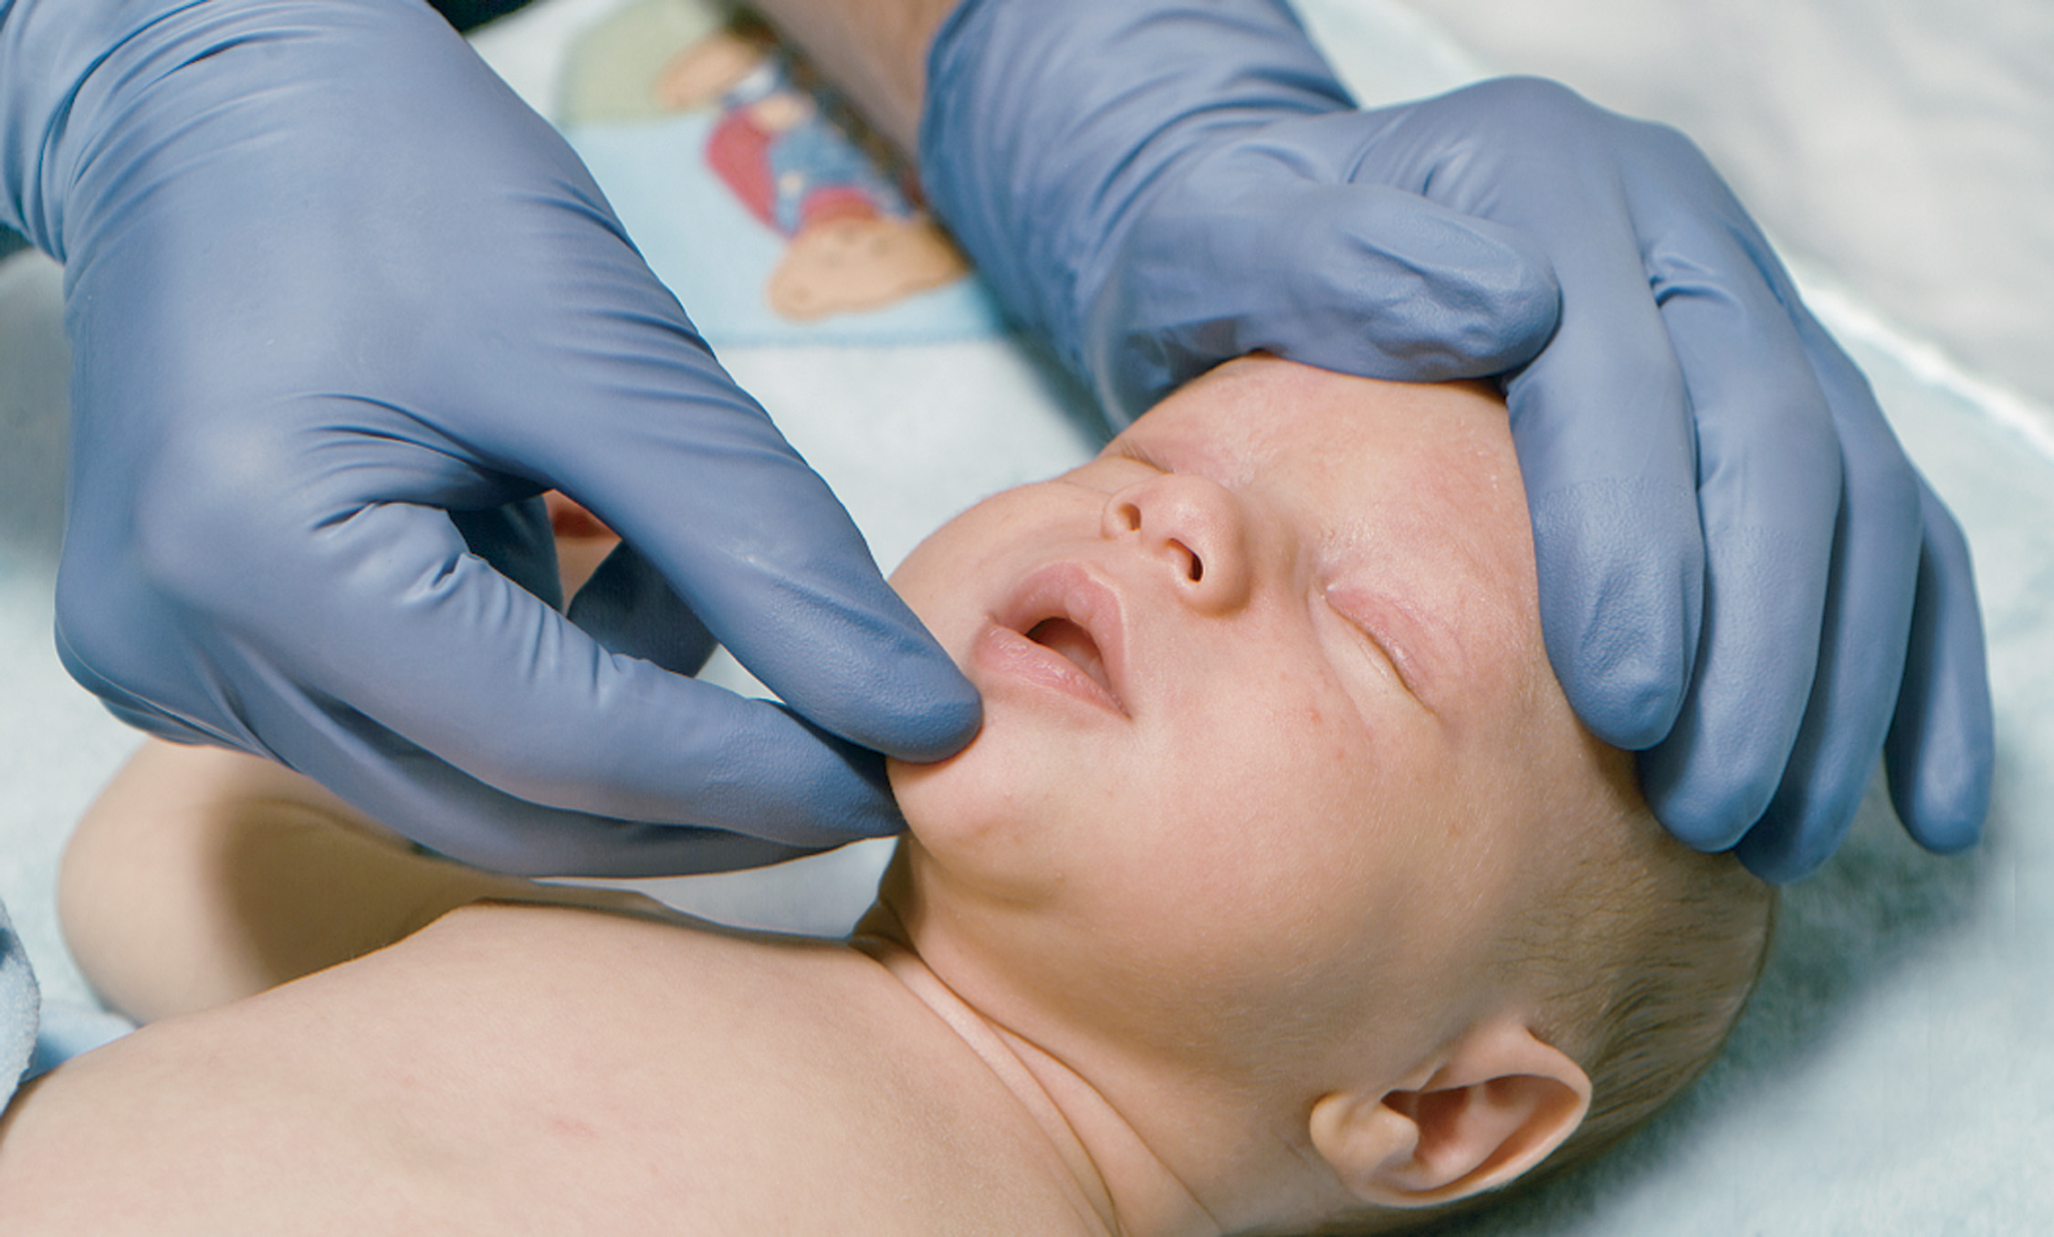
Head-Tilt, Chin-Lift Maneuver in an Infant. Avoid Overextension

Slide 69
Head-Tilt, Chin-Lift Maneuver in a Child

Slide 70
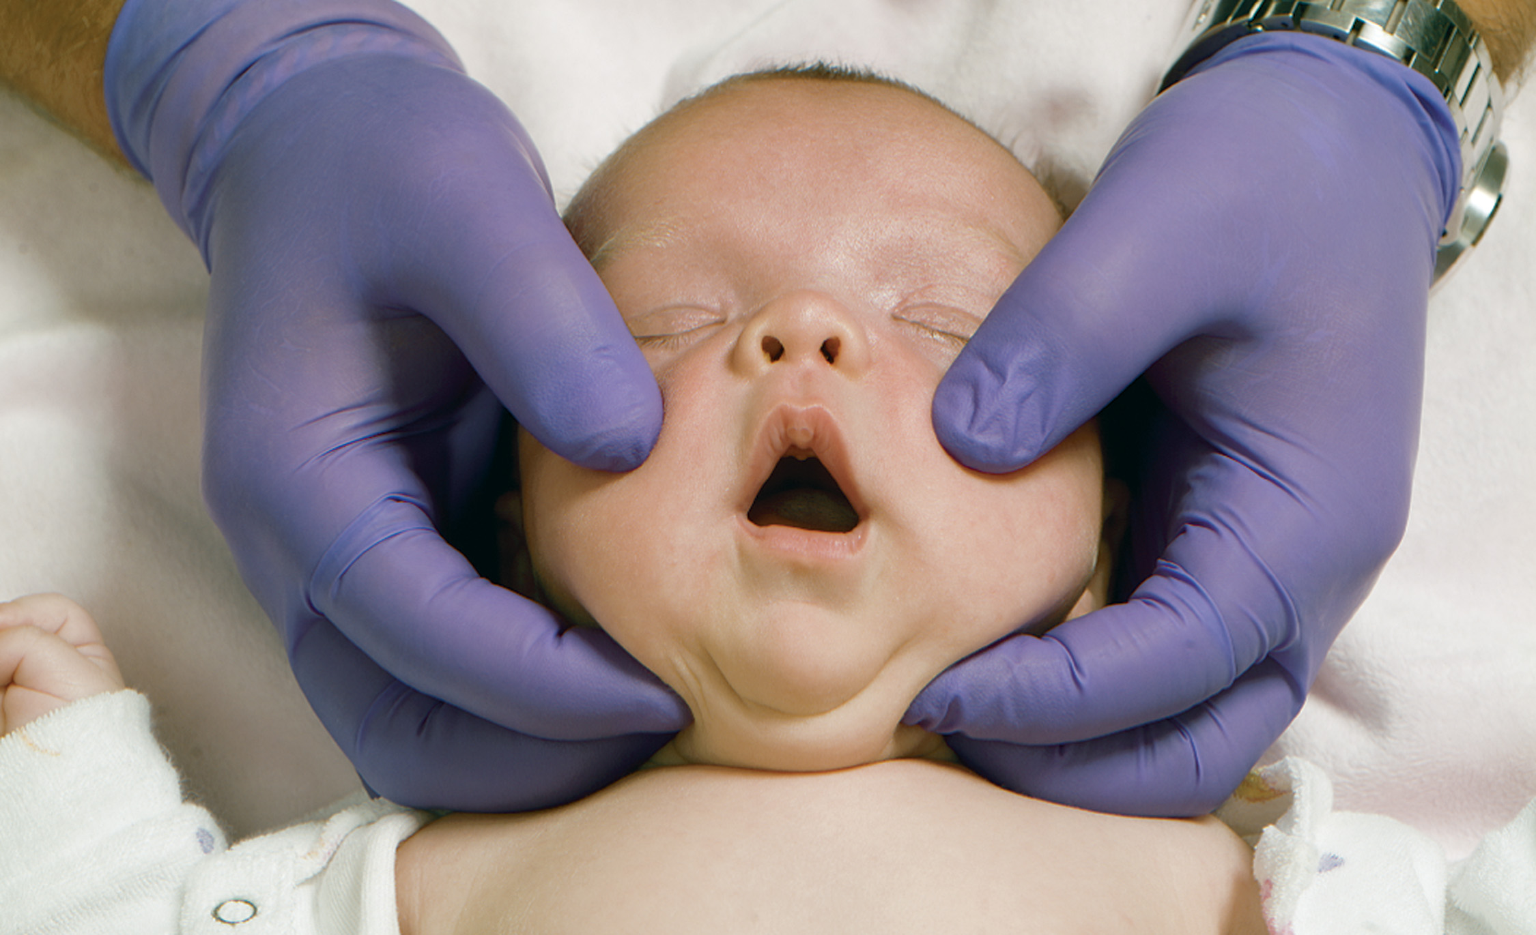
Jaw-Thrust Maneuver in an Infant

Slide 71
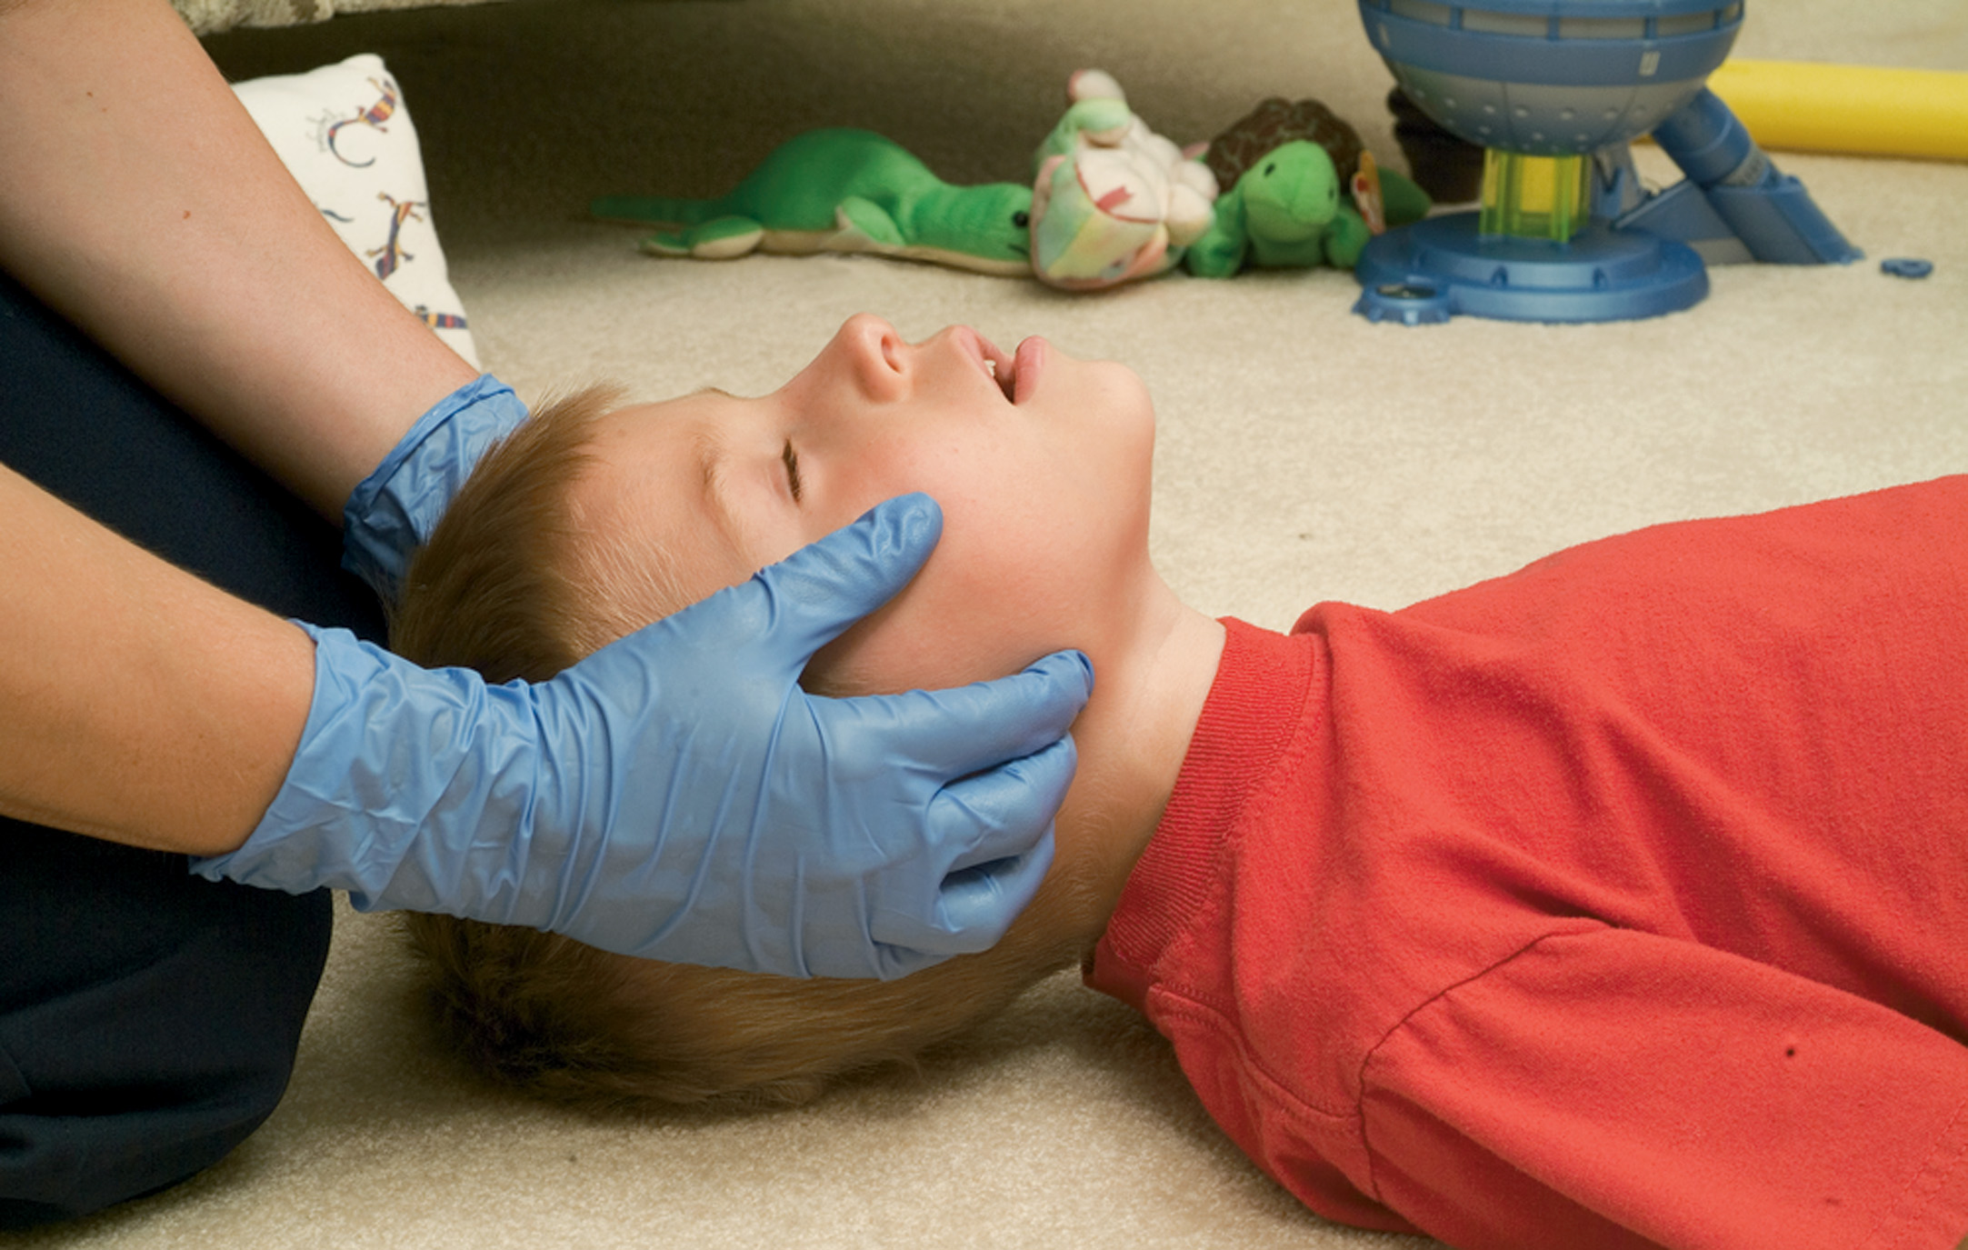
Jaw-Thrust Maneuver in a Child

Slide 72
Airway and Respiratory Problems in Pediatric Patients (10 of 22)
Emergency Medical Care — Respiratory Emergencies
  Emergency care for obstructed airway
    Suction secretions, vomitus, or blood.
    Limit suctioning to 3 to 5 seconds.
    Use appropriately sized equipment.
Notes:
The suctioning process temporarily prevents air from being breathed into the lungs. When suctioning an infant or child, do not suction any longer than 3 to 5 seconds at a time, so as not to promote hypoxia or cause a profound bradycardia from vagal stimulation. Use appropriately sized equipment.

Slide 73
Airway and Respiratory Problems in Pediatric Patients (11 of 22)
Emergency Medical Care — Respiratory Emergencies
  Assist ventilations as needed
    If positive pressure ventilation is needed, insert an oropharyngeal airway if the patient does not have a gag reflex.
    In general, avoid the use of nasopharyngeal airways in pediatric patients.
Notes:
Use an oropharyngeal airway if the child is unresponsive and there is no gag reflex. Use a nasopharyngeal airway if the patient cannot tolerate an oral airway. However, nasopharyngeal airways should be avoided in patients with possible head trauma. Because children are prone to having adenoidal hypertrophy, nasopharyngeal airways can “core out” adenoidal tissue resulting in significant upper airway bleeding that is difficult to control. In general, nasopharyngeal airways should be avoided in children and especially in infants whose nares are so small in diameter that the airway resistance created by the small diameter of the nasopharyngeal airway is too great to make breathing through it effective.

Slide 74
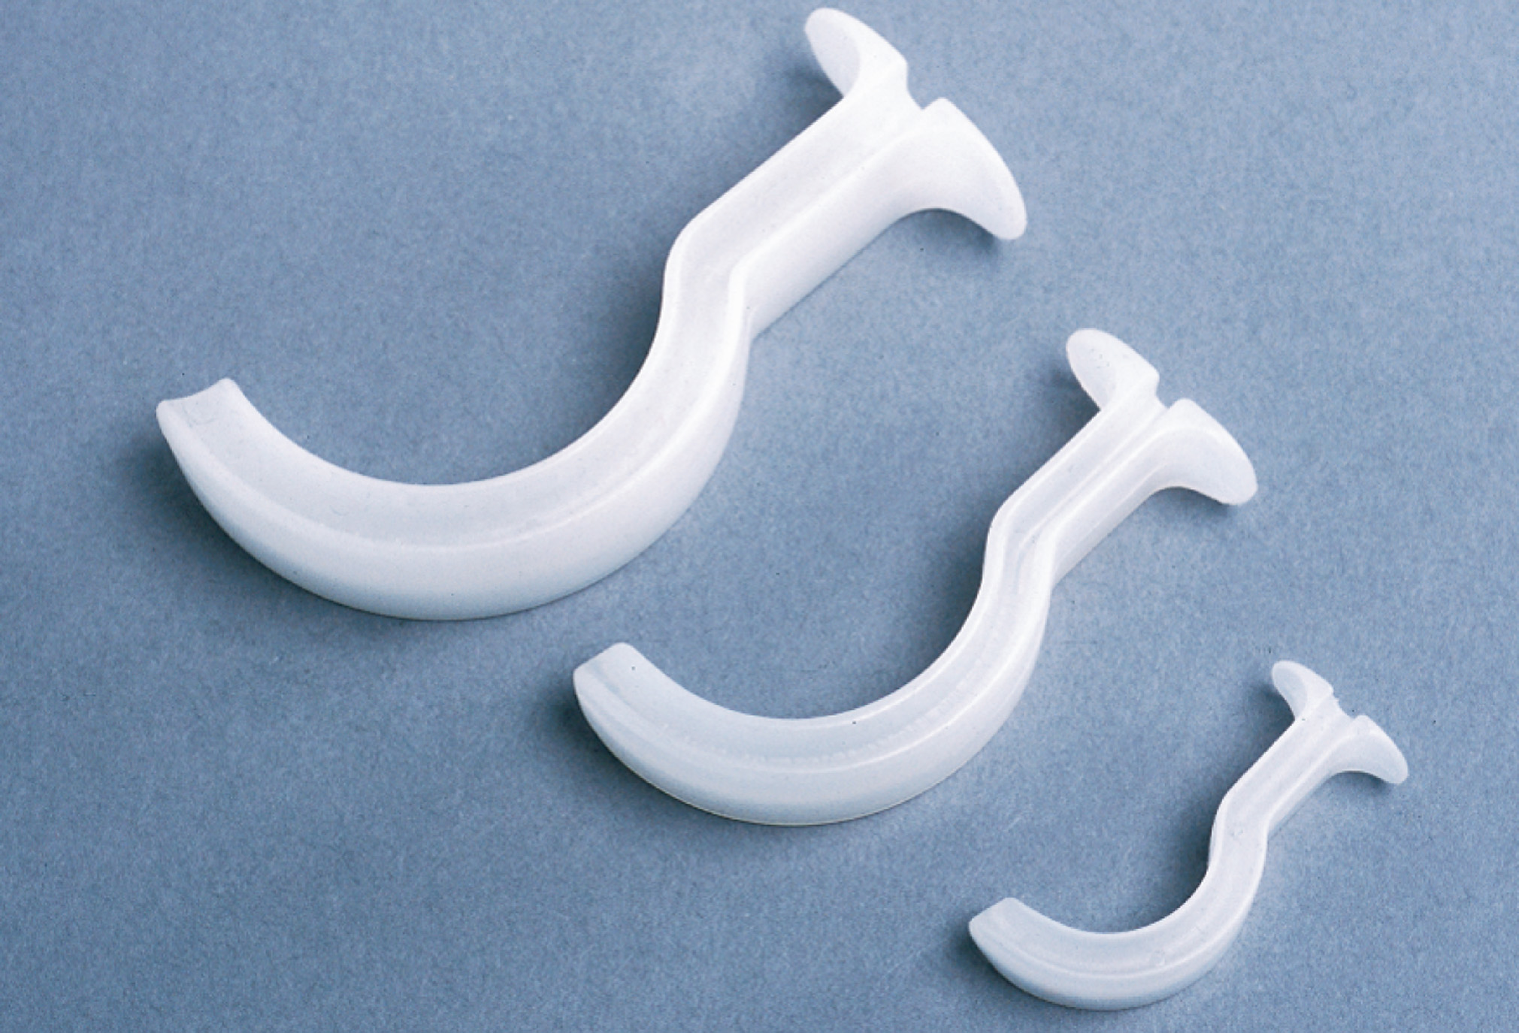
A Variety of Oropharyngeal Airways
Notes:
Oropharyngeal airways help keep the tongue off the back of the throat in the patient with no gag reflex.

Slide 75
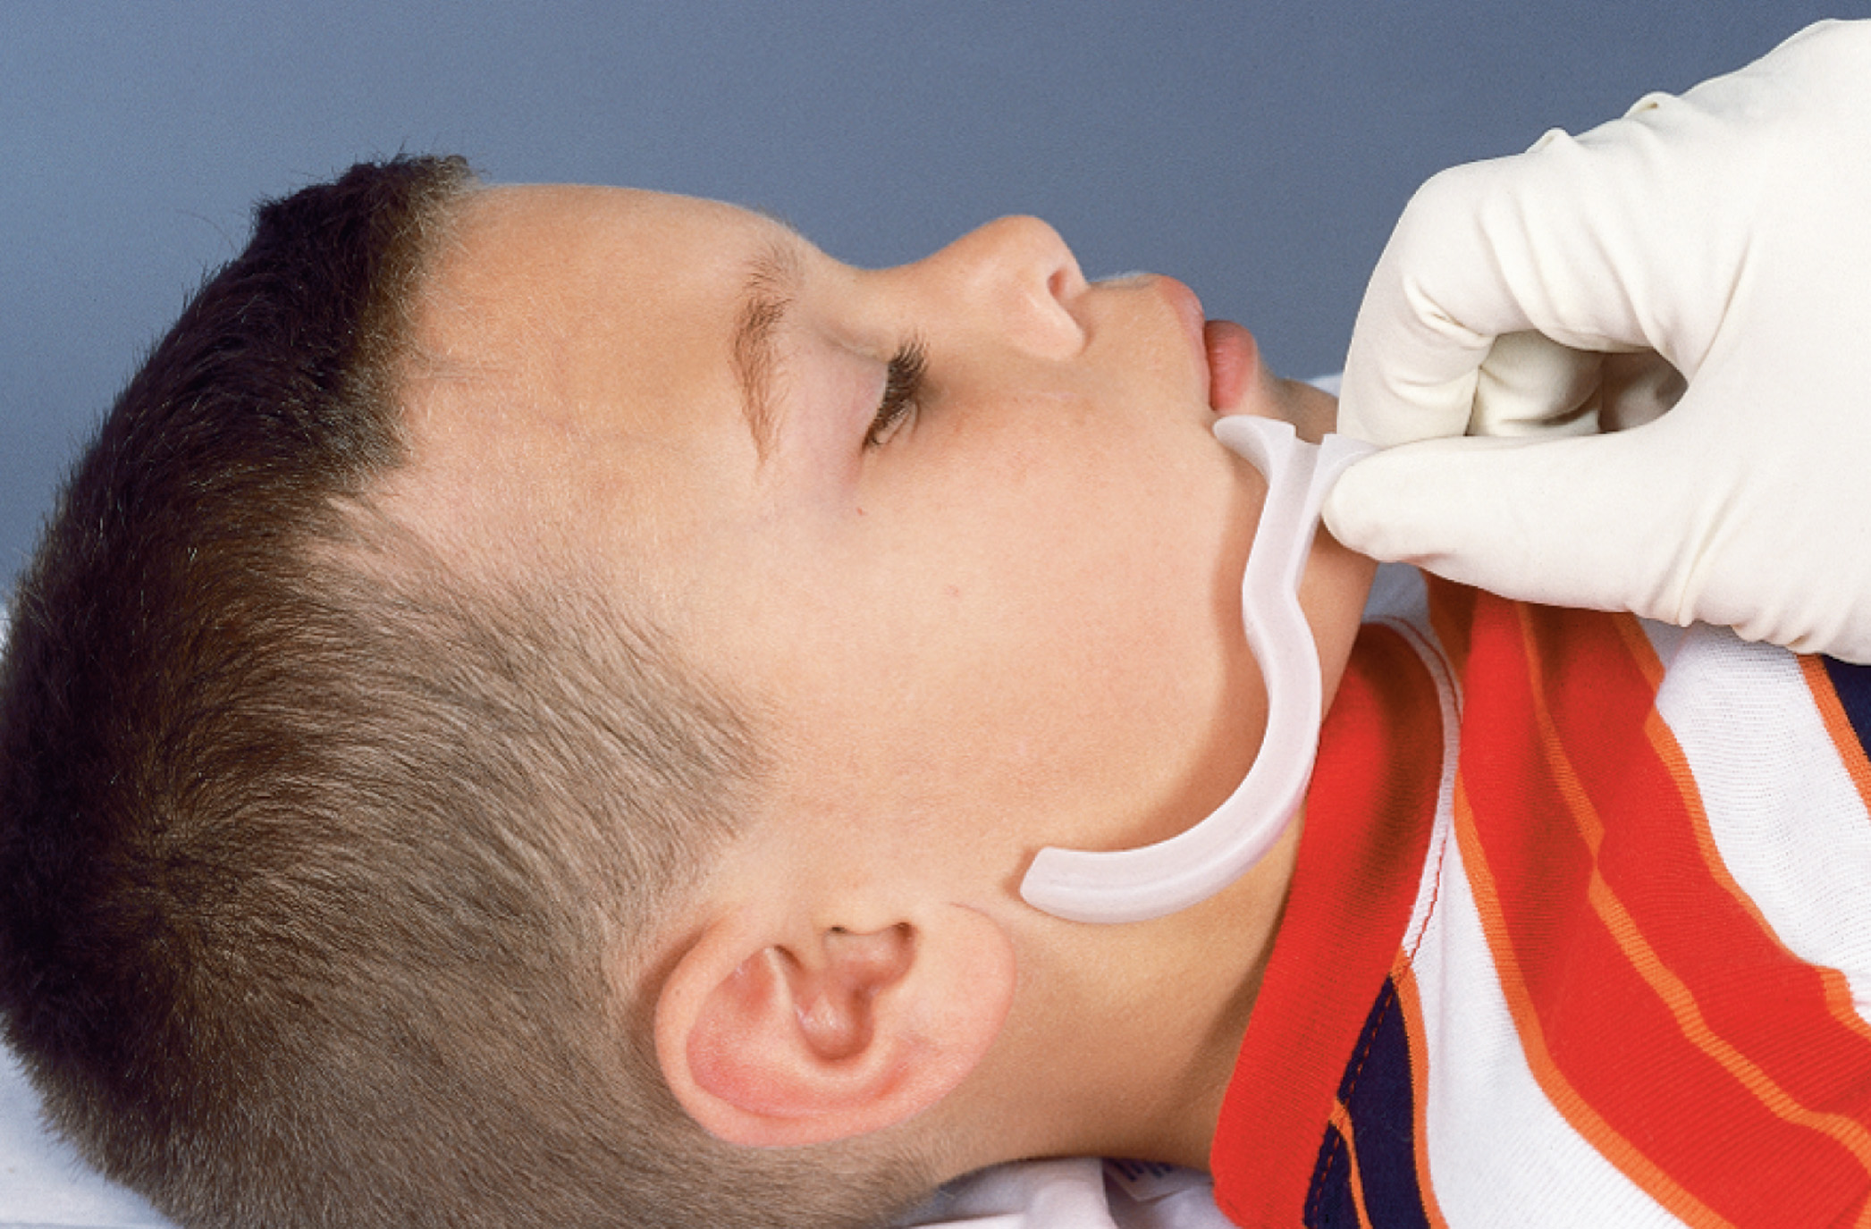
Sizing an Oropharyngeal Airway
Notes:
Discuss sizing of the oropharyngeal airway.

Slide 76
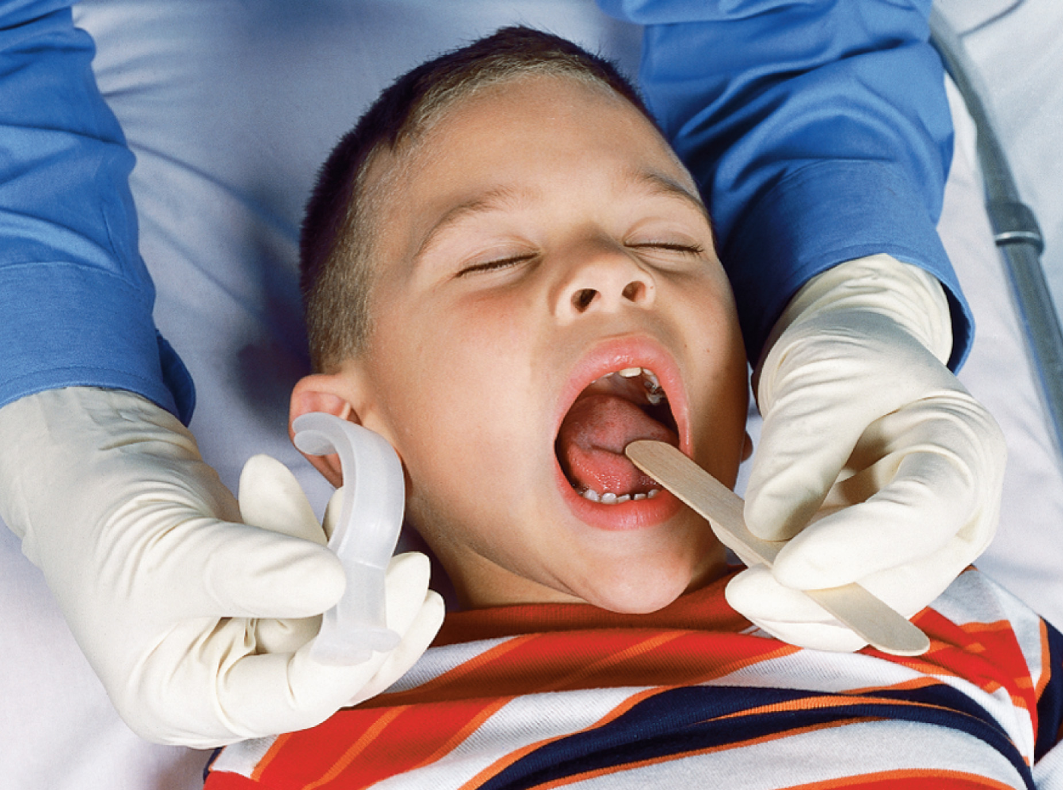
Inserting an Oropharyngeal Airway, Using a Tongue Depressor for Insertion in a Pediatric Patient
Notes:
Insert the oropharyngeal airway in a straight fashion after displacing the tongue with a tongue depressor.

Slide 77
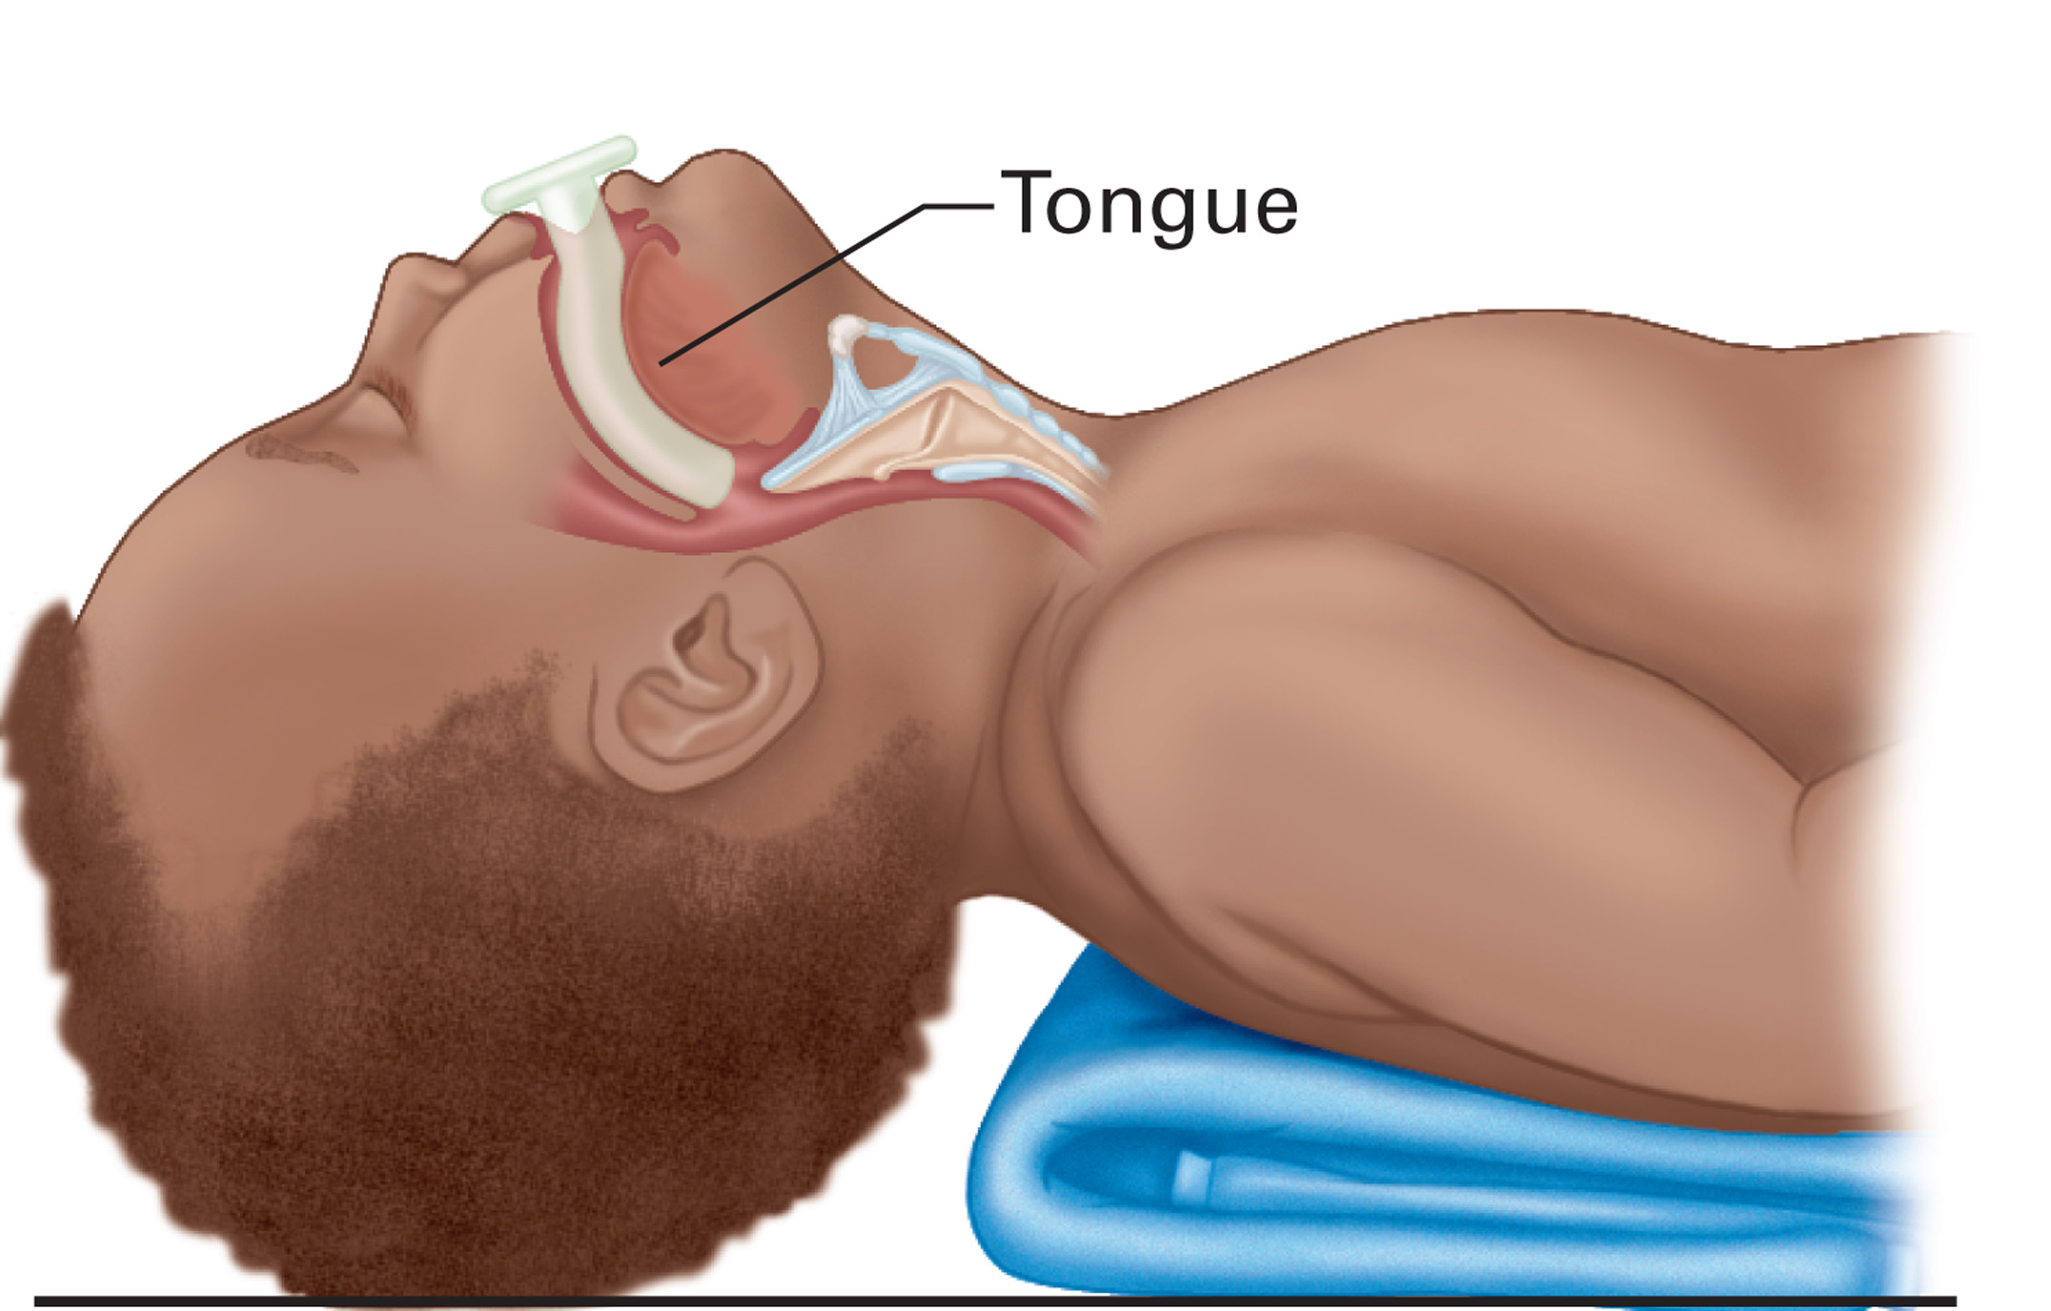
An Oropharyngeal Airway in Place
Notes:
When properly placed, the oropharyngeal airway will help to assure an open airway. A manual airway technique should also be used with this airway adjunct.

Slide 78
Airway and Respiratory Problems in Pediatric Patients (12 of 22)
Emergency Medical Care — Respiratory Emergencies
  Assist ventilations as needed
    Initiate positive pressure ventilation for respiratory failure or respiratory arrest.
      Ventilate 20 to 25 times per minute.
    Attach supplemental oxygen.
    Use an appropriately sized bag-valve-mask.
Notes:
If the infant or child is in decompensated respiratory failure or respiratory arrest — that is, with inadequate breathing or not breathing — you should start positive pressure ventilation using a bag-valve-mask device or a pocket mask. Supplemental oxygen must be attached to the ventilation device as soon as possible.
The infant or child patient should be ventilated at a rate of 20–25 per minute. Breathe into the pocket mask or squeeze the bag-valve-mask device slowly and evenly to ensure adequate chest rise. If regurgitation is a problem, applying cricoid pressure might help prevent it.

Slide 79
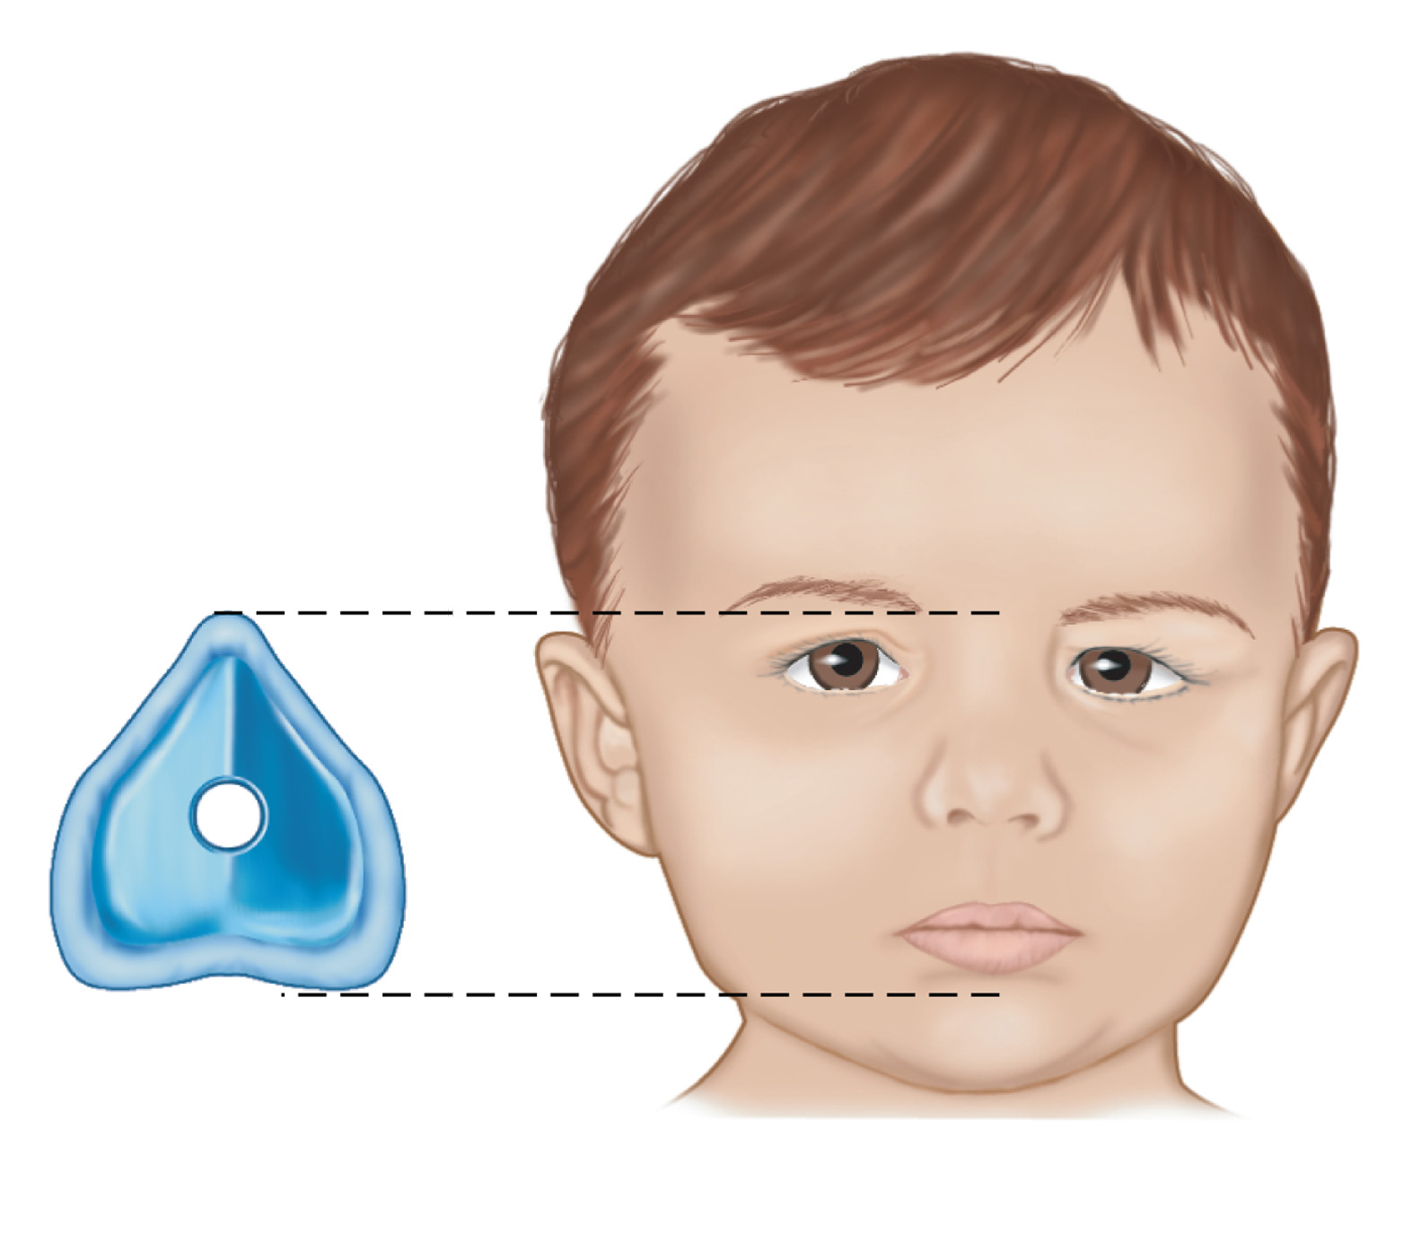
Correct Placement of a Properly Sized Mask is Necessary to Ensure a Good Mask Seal. Correct Placement of the Mask
Notes:
Sizing of a mask for positive pressure ventilation.

Slide 80
Correct Placement of a Properly Sized Mask is Necessary to Ensure a Good Mask Seal. the Mask Placed on a Child
Notes:
Discuss techniques to detect when the face mask is too large, too small, or is still allowing leaks to occur.

Slide 81
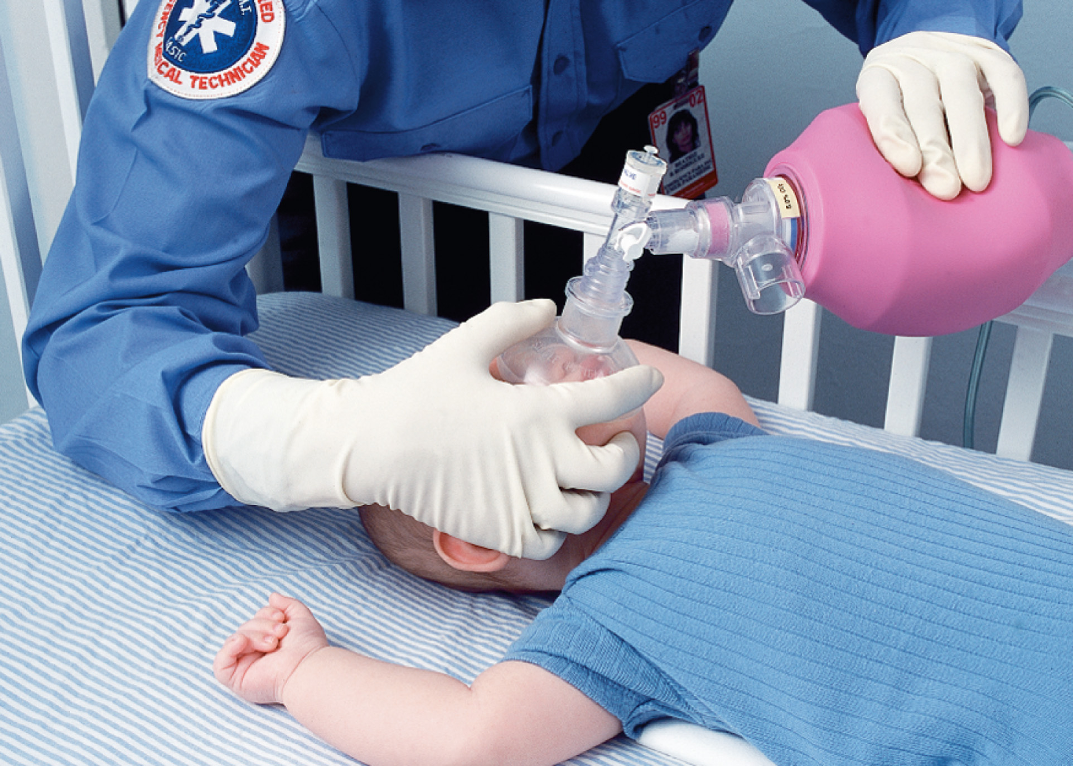
Ensure a Good Mask Seal by Using Proper Hand Placement (1 of 2)
For a one-handed technique, place the middle, ring, and little finger of your non-dominant hand along the jaw in an “E” or “3” shape. Place the thumb and index finger on the mask in a “C” shape, thumb over the bridge of the nose and index finger over the anterior jaw.
Notes:
If using a bag-valve-mask device, be sure to use an appropriate sized bag. Infants and children need a respiratory tidal volume of approximately 6–8 mL/kg. Therefore, bag-valve-mask devices for a full-term newborn, infant, or child should have a minimum volume of 450–500 mL. The bag-valve-mask should be no larger than 250 mL for a neonate. Ensure a good mask seal by using one or two hands to hold the mask to the face.

Slide 82
Ensure a Good Mask Seal by Using Proper Hand Placement (2 of 2)
For a two-handed technique, position yourself behind the patient’s head and apply the same “E-C ” or “3-C” position as described for the one-handed technique, but with the two hands on opposite sides of the mask.
Notes:
The two-handed seal is preferred to ensure delivery of an adequate tidal volume. Although this might require a second rescuer, it is truly a lifesaving skill that depends on a good seal and just enough manual compression of the bag to make the chest rise.

Slide 83
Airway and Respiratory Problems in Pediatric Patients (13 of 22)
Emergency Medical Care — Respiratory Emergencies
  Oxygen Therapy
    If the patient is breathing adequately, administer oxygen to maintain an S p O ₂ greater than or equal to 94%.
    If the patient cannot tolerate a cannula or mask, try the blow-by method.
Notes:
If the patient breathes adequately but has other signs of early respiratory distress, administer oxygen to maintain an SpO₂ of 94% or greater. If the patient cannot tolerate the nasal cannula or mask, try a blow-by method.
Provide bag-valve-mask ventilation with supplemental oxygen attached to the device for all infants and children who have:
• Respiratory distress and altered mental status
• Cyanosis present despite oxygen via a nonrebreather mask
• Display respiratory distress with poor muscle tone
• Are in respiratory failure or in respiratory arrest.

Slide 84
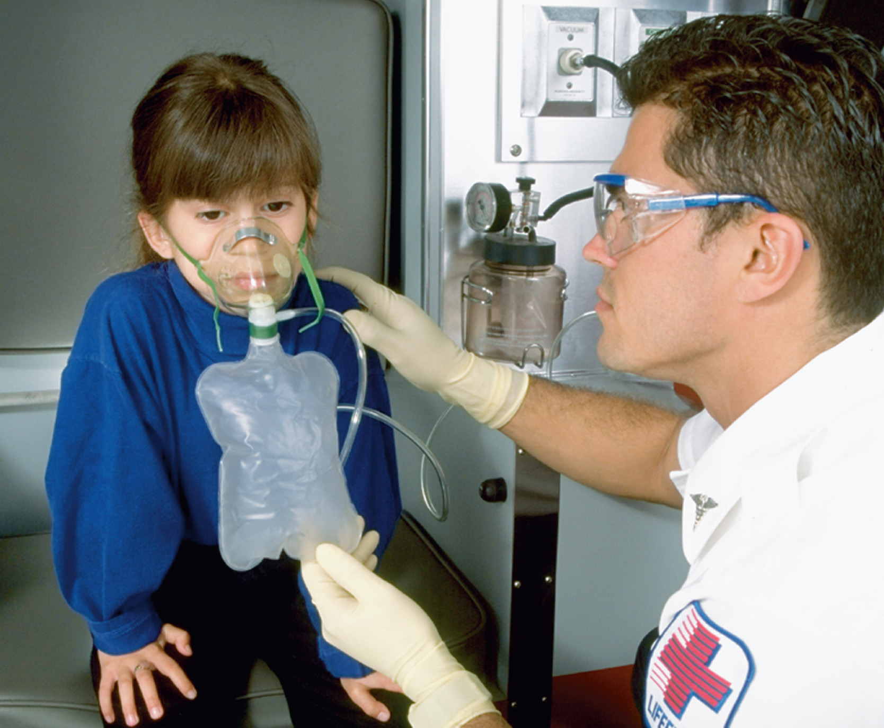
To Administer Oxygen, a Nonrebreather Mask is Appropriate for a Child
Notes:
Discuss techniques for keeping the child compliant with oxygen therapy.

Slide 85
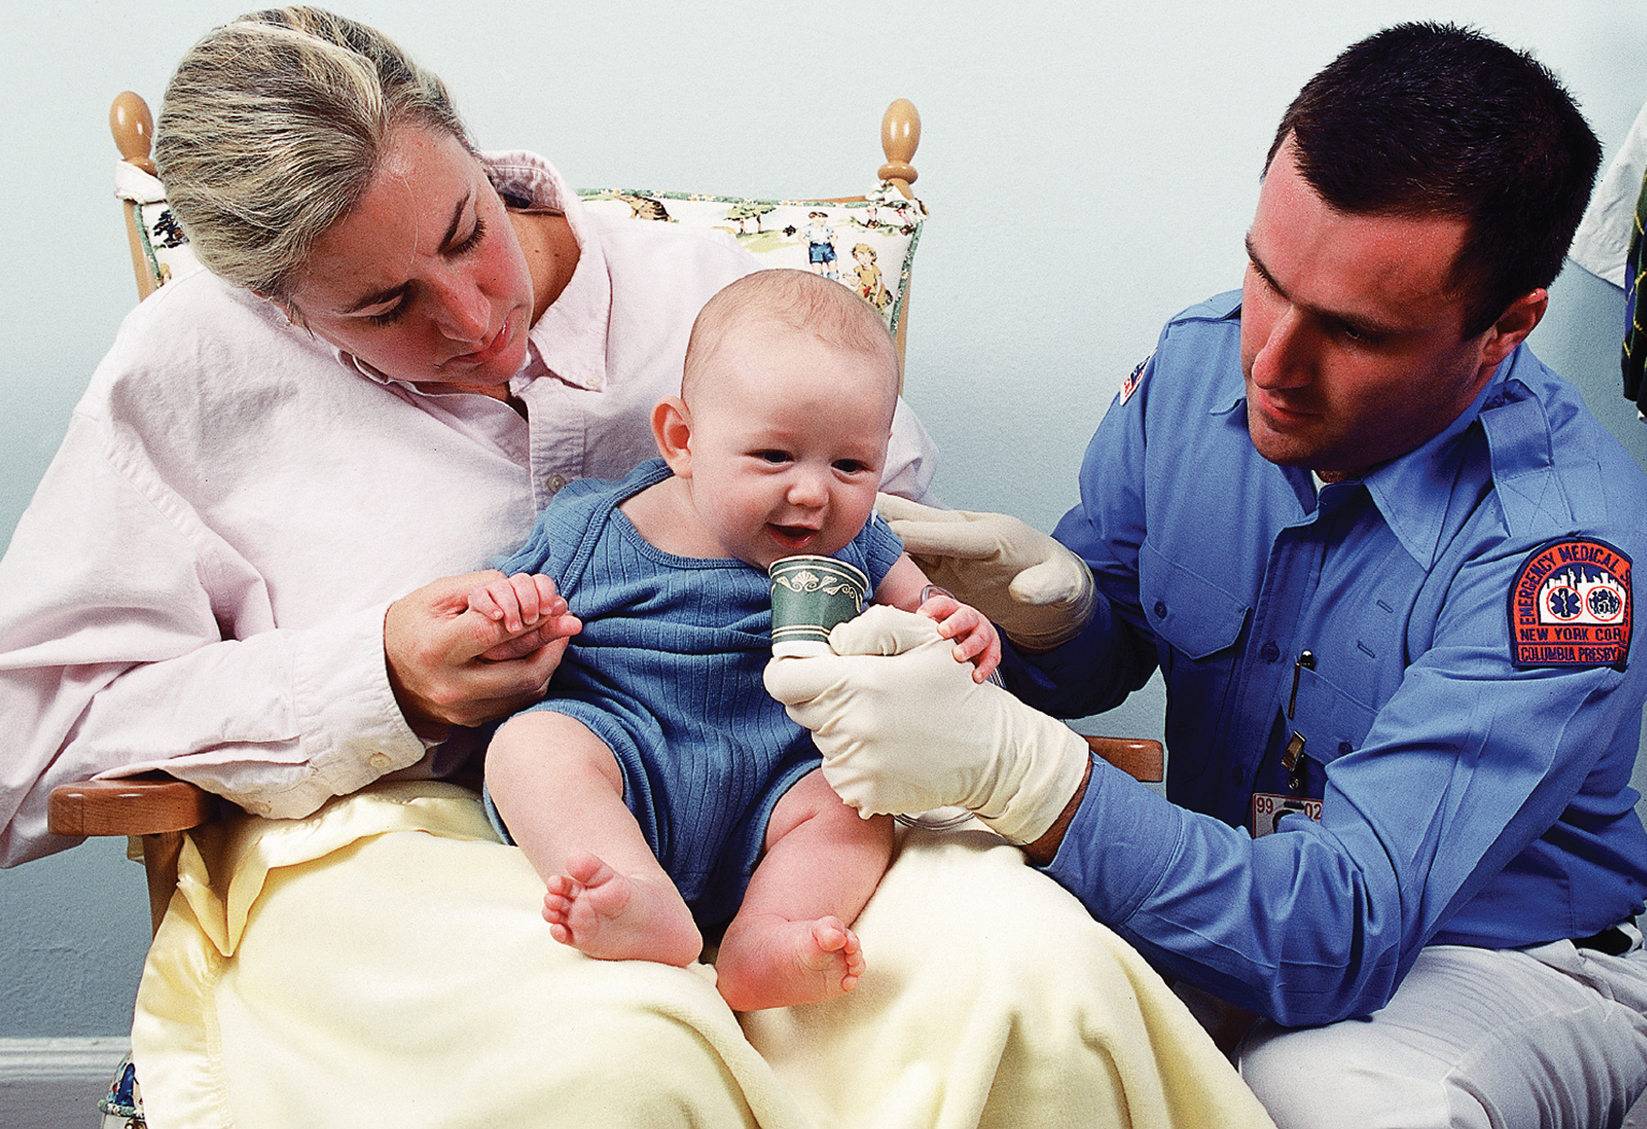
To Administer Oxygen, the Blow-By Method, Using Oxygen Tubing and a Paper Cup, is Appropriate for an Infant or for a Child Who Will Not Tolerate a Mask
Notes:
Discuss alternative ways of administering oxygen to an infant.

Slide 86
Airway and Respiratory Problems in Pediatric Patients (14 of 22)
Emergency Medical Care — Respiratory Emergencies
  Position the patient
    Respiratory distress
    Unresponsive patients
    Patients in need of ventilation
    Patients requiring spine motion restriction.
Notes:
Patients who are in mild respiratory distress probably prefer to sit in the lap of the caregiver. If the patient is unresponsive, place them in a lateral recumbent position to help prevent aspiration, and have suction available. If the patient requires ventilation, they must be kept in a supine position.
It may be necessary to provide spine motion restriction for the infant or child to prevent possible aggravation of an existing spine injury. The key in providing spine motion restriction for the infant or child patient is to place a folded towel (or similar item) beneath the shoulder blades to keep the head from flexing forward.

Slide 87
Airway and Respiratory Problems in Pediatric Patients (15 of 22)
Emergency Medical Care – Respiratory Emergencies
  Transport the patient
    If they have respiratory distress complaints
    If they have respiratory distress findings
    Transport to children’s hospital if possible.
Notes:
Any pediatric patient with a respiratory complaint, or with evidence of respiratory distress, needs to be transported to an appropriate medical facility for further evaluation, preferably a children’s hospital or a hospital with specialized pediatric practitioners.

Slide 88
Airway and Respiratory Problems in Pediatric Patients (16 of 22)
Emergency Medical Care — Foreign Body Airway Obstruction
  Suspect foreign body airway obstruction if there is high resistance to airflow with positive pressure ventilation.
  Attempt to reposition the airway, first.
  If no success, assume the airway is obstructed.
Notes:
If you notice a high resistance to airflow after initiating positive pressure ventilation on a patient with respiratory failure or respiratory arrest, attempt to reposition the airway and reventilate. If, after repositioning, the airway is still not patent, and there are no indications that the child is suffering from an illness, assume the infant or child has an airway obstructed by a foreign body.

Slide 89
Airway and Respiratory Problems in Pediatric Patients (17 of 22)
Emergency Medical Care — Foreign Body Airway Obstruction
  Infant or child with a mild foreign body airway obstruction
    If a foreign body, and not airway infection, is suspected, take actions to clear the airway.
Notes:
The following pertains to the infant (less than 1 year of age) or child (over 1 year of age).

Slide 90
Airway and Respiratory Problems in Pediatric Patients (18 of 22)
Emergency Medical Care – Foreign Body Airway Obstruction
  Infant or child with a mild foreign body airway obstruction
  Do not intervene.
    Allow the patient to continue to cough.
    Provide supplemental oxygen.
    Monitor for worsening obstruction.
Notes:
Do not perform any intervention in mild foreign body airway obstruction. However, if the infant or child can no longer make any sounds or cough, indicating a severe obstruction, you must react quickly to remove the obstruction. You must constantly and closely assess the infant or child with a mild obstruction for signs of a developing severe obstruction. You can provide blow-by oxygen to the infant or supplemental oxygen to the child with a mild obstruction to maintain an SpO₂ of 94% or greater.

Slide 91
Airway and Respiratory Problems in Pediatric Patients (19 of 22)
Emergency Medical Care — Foreign Body Airway Obstruction
  Infant with a severe foreign body airway obstruction
    If the patient is still responsive, initiate steps to remove the obstruction.
Notes:
If the infant (less than 1 year of age) cannot cough or make any sounds, a severe foreign body airway obstruction is suspected. You must intervene immediately to remove the obstruction.
Severe foreign body airway obstruction - Infant
Place the infant prone on your forearm.
Deliver 5 back blows.
Transfer the patient to a supine position on your other forearm; deliver 5 chest thrusts.
Repeat until the obstruction is relieved, the patient is unresponsive, or you arrive at the medical facility.

Slide 92
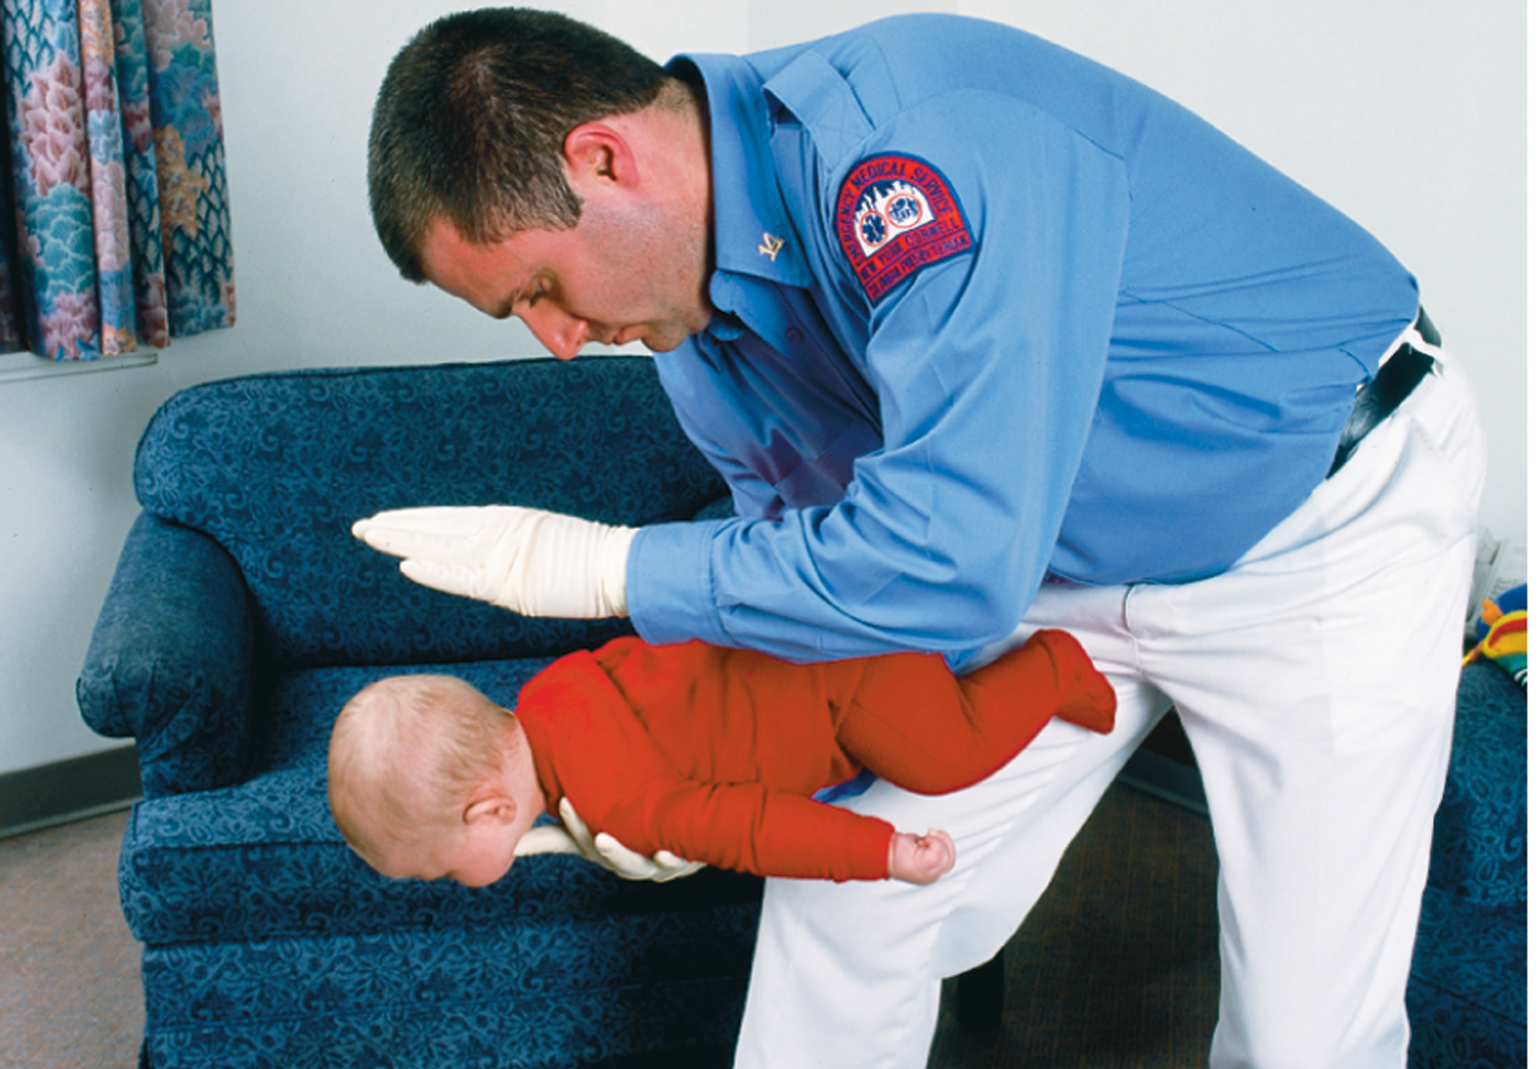
Position the Infant to Deliver Back Slaps
Notes:
Position the patient prone (belly down, back up) on your forearm in a head-down position, supporting the infant’s head with your hand and supporting your arm on your thigh.
Deliver five sharp back slaps (blows) between the shoulder blades.
Transfer the patient to a supine, head-down position on your other forearm, and deliver five chest thrusts using two fingertips positioned one finger width beneath the nipple line.

Slide 93
Use the Finger Sweep Only When the Foreign Body is Visible
Notes:
Continue to repeat the steps en route until the obstruction is dislodged, the infant becomes unresponsive, or you arrive at the medical facility. Consider ALS backup.
If the infant becomes unresponsive, go to the steps on relieving an airway obstruction in an unresponsive infant.

Slide 94
Airway and Respiratory Problems in Pediatric Patients (20 of 22)
Emergency Medical Care — Foreign Body Airway Obstruction
  Unresponsive infant with a foreign body airway obstruction
  If the patient is unresponsive, initiate steps to remove the obstruction.
Notes:
If the infant (less than 1 year of age) is unresponsive and a foreign body airway obstruction is suspected, or if the infant with a mild or severe foreign body airway obstruction becomes unresponsive during your treatment, immediately perform the following steps:
Foreign Body Airway Obstruction on Unresponsive Infant
Provide two ventilations over a 1-second period.
Perform 30 chest compressions
After the chest compressions, look in the mouth for the obstruction. If it can be seen in the oropharynx, attempt to remove it.
Provide two ventilations followed by another set of 30 compressions.
Continue this sequence until the foreign body is removed.
If the foreign body cannot be visualized and/or removed, continue chest compressions and attempted ventilations.

Slide 95
Airway and Respiratory Problems in Pediatric Patients (21 of 22)
Emergency Medical Care – Foreign Body Airway Obstruction
  Child with severe foreign body airway obstruction
  If the patient is responsive, initiate steps to remove the obstruction.
Notes:
If the patient is older than 1 year of age, has a severe foreign body airway obstruction, and cannot cough or make sounds, perform subdiaphragmatic abdominal thrusts as follows:
Severe Foreign Body Airway Obstruction in Responsive Child
Place the thumb side of one clenched fist midway between the navel and the xiphoid process.
Wrap the other hand over the clenched hand.
Deliver five abdominal thrusts inward and upward.
Repeat until the object is dislodged, you arrive at the medical facility, or the patient becomes unresponsive.

Slide 96
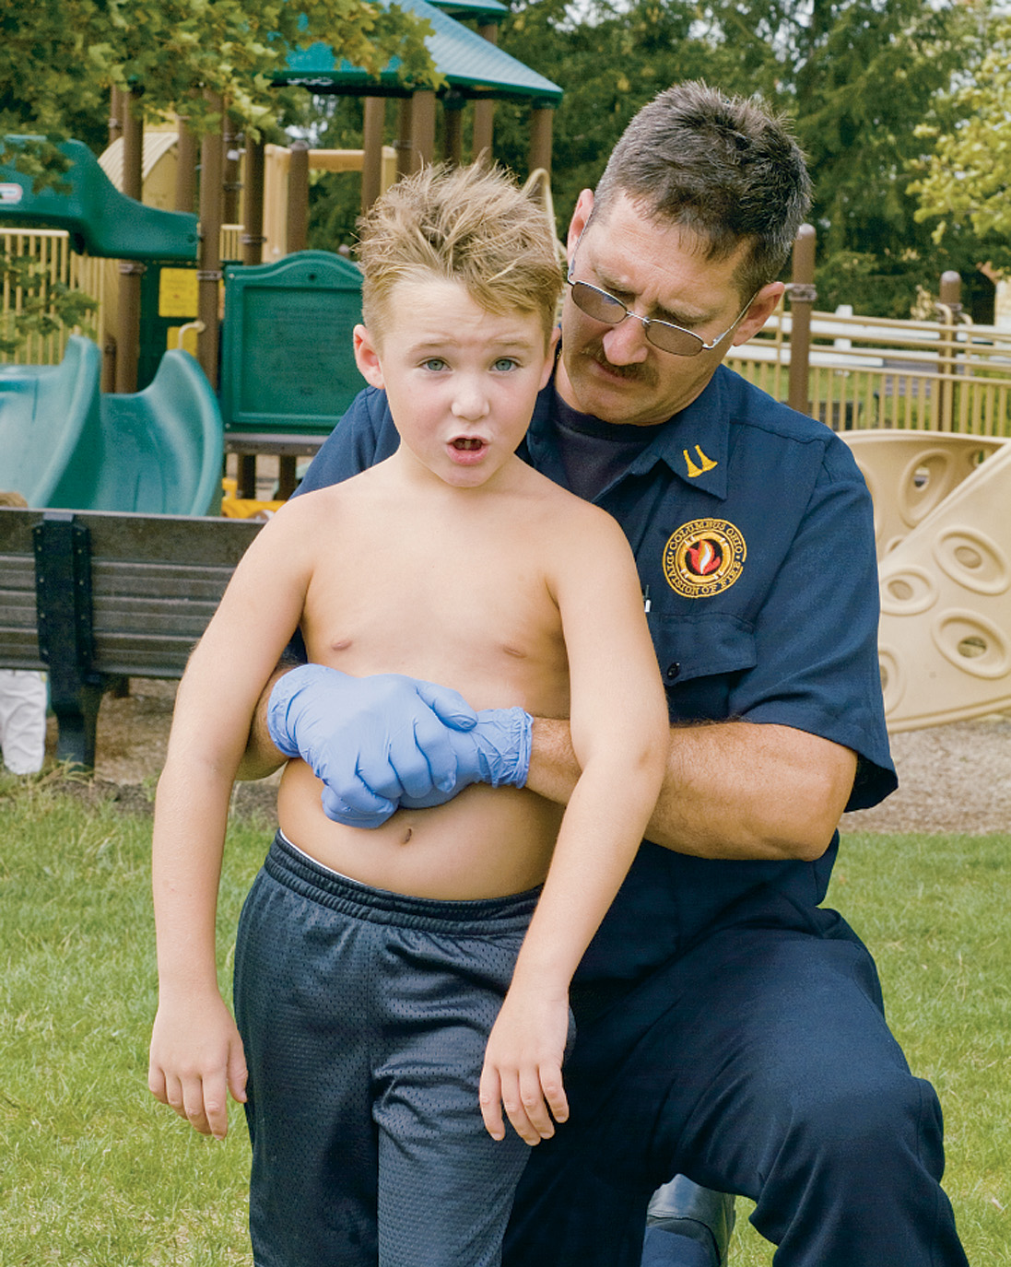
Abdominal Thrusts on a Choking but Responsive Child
Notes:
Placement of hands for performing subdiaphragmatic thrusts on a responsive child with an airway obstruction.

Slide 97
Airway and Respiratory Problems in Pediatric Patients (22 of 22)
Emergency Medical Care — Foreign Body Airway Obstruction
  Unresponsive child with foreign body airway obstruction
    If the patient is unresponsive, initiate steps to remove the obstruction.
Notes:
If the child (over 1 year of age) is unresponsive and a foreign body airway obstruction is suspected, or if the child with a mild or severe foreign body airway obstruction becomes unresponsive during your treatment, immediately perform the following steps:
Open the airway, using a head-tilt, chin-lift maneuver.
Open the mouth and look for the foreign body. If the foreign body is seen in the oropharynx, attempt to remove it.
Provide two ventilations over a 1-second period.
Provide 30 chest compressions.

Slide 98
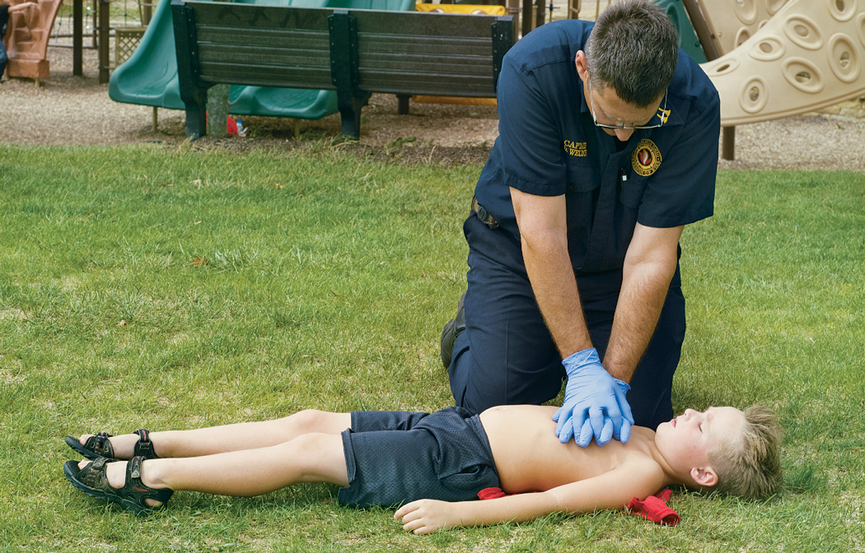
Chest Compressions on a Child Who is Unresponsive. for an Older Child, Place One Hand on Top of the Other
Notes:
Discuss hand placement for both younger and older child. Also, discuss the EMT may not actually see the foreign body should it become dislodged (for example, it could slip into the esophagus). Point is, repeat this sequence of steps until the ventilations are successful.

Slide 99
Case Study Conclusion (1 of 4)
Tammy hands the patient’s father the oxygen tubing, with oxygen flowing, and instructs him to hold it near the patient’s face. Julian allows the father to continue to hold the patient as they complete vital signs.
The patient’s respirations are 40 per minute, and he has a heart rate of 120 per minute.
Notes:
Review case conclusion and emphasize the application of knowledge learned from this presentation thus far.

Slide 100
Case Study Conclusion (2 of 4)
The E M T s place the child in his car seat and secure the car seat in the ambulance, so they can transport the patient and his father to the emergency department.
En route, Julian constantly monitors the patient's mental status and respirations.
Notes:
Review case conclusion and emphasize the application of knowledge learned from this presentation thus far.

Slide 101
Case Study #2 Introduction
E M T s Deb Maestes and Ben Allen arrive on the scene of an 8-year-old who was struck by a car while riding her bicycle. The patient is lying in the street, shivering and crying. Deb can see immediately that her skin is pale and mottled, and there is swelling and deformity of her left thigh.
Notes:
Case Study
Present the Case Study Introduction provided in the PowerPoint slide set.
Lead a discussion using the case study questions provided on the subsequent slide(s).
The Case Study with discussion questions continues throughout the PowerPoint presentation.
Case Study Discussion
Use the case study content and questions to foreshadow the upcoming lesson content.

Slide 102
Case Study #2
What is your general impression of this patient?
What injuries should be suspected with this mechanism of injury?
How should treatment of this patient be prioritized?
Notes:
Use the students responses to foreshadow the upcoming lecture material and to assess their current knowledge base.

Slide 103
Specific Pediatric Respiratory and Cardiopulmonary Conditions (1 of 23)
Croup
  Infection of the upper airway
  Common between 6 months to 4 years
  Causes swelling beneath the glottis
  Presents with a “seal bark” cough
  Severe attacks can lead to respiratory distress.
Notes:
Croup is a common infection of the upper airway, usually caused by a virus but sometimes by bacteria. It has a slow onset of symptoms, is accompanied by a low-grade fever, and is most common in children between 6 months and 4 years of age.
Discussion Question
How does it cause airway obstruction?

Slide 104
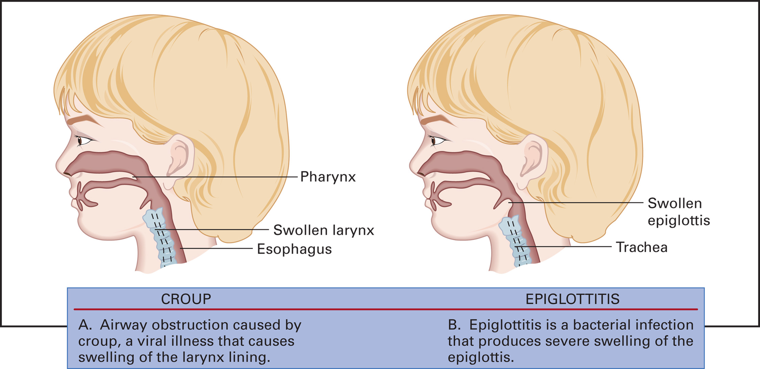
Pathophysiology of Pediatric Croup and Epiglottitis
Notes:
Identify for the students the anatomical site of airway involvement.

Slide 105
Specific Pediatric Respiratory and Cardiopulmonary Conditions (2 of 23)
Croup
  Emergency Medical Care
    Administer oxygen, humidified if possible, to maintain an S p O ₂ greater than or equal to 94%.
    Keep the patient in a comfortable position.
    Transport without agitating the patient.
Notes:
Also discuss cool night air can reduce swelling in the airway.

Slide 106
Specific Pediatric Respiratory and Cardiopulmonary Conditions (3 of 23)
Epiglottitis
  Bacterial infection that causes swelling of the epiglottis
  Usually between ages of 2 to 7 years
  Untreated, it has a 50percent mortality rate.
  Rapid onset with a high temperature.
Notes:
A condition that resembles croup, epiglottitis is caused by a bacterial infection that inflames and causes swelling of the epiglottis. Epiglottitis is life threatening; if left untreated it has a 50 percent mortality rate. The onset is usually rapid and is accompanied by a high temperature.
Discussion Questions
What vaccination was introduced that greatly reduced the incidence of epiglottitis?
How should you manage the patient with epiglottis?
Critical Thinking Discussion
What is the role of childhood immunizations in preventing respiratory illnesses?

Slide 107
Specific Pediatric Respiratory and Cardiopulmonary Conditions (4 of 23)
Epiglottitis
  Specific Signs and Symptoms
    Pain on swallowing
    High fever; “toxic” ill-appearance
    Drooling and mouth breathing
    Changes in voice quality, pain with speaking
    Chin and neck thrust outward
    Inspiratory stridor.
Notes:
Discuss that these are not the only findings with epiglottitis, rather, just more specific ones. The patient may also display general signs and symptoms of dyspnea.

Slide 108
Specific Pediatric Respiratory and Cardiopulmonary Conditions (5 of 23)
Epiglottitis
  Emergency Medical Care
    Do not place anything in the child’s mouth.
    Place patient in comfortable position
    Oxygen by nonrebreather mask or blow-by method
    Consider A L S backup
    Rapidly transport.
Notes:
Discuss treatment by the EMT, and the need for ALS intercept if available.
Discuss what the EMT should do if the airway becomes occluded from swelling.

Slide 109
Specific Pediatric Respiratory and Cardiopulmonary Conditions (6 of 23)
Asthma
  Inflammatory process characterized by
    Increased mucous production
    Swelling of airway walls
    Smooth muscle contraction.
Notes:
Asthma is a long-term inflammatory process that targets the lower airways. This inflammation is characterized by increased production of mucus and an acute narrowing of the airways through inflammation of airway tissue, leading to edema (swelling) within the airways.
Discussion Question
What is the significance of asthma in the pediatric population?

Slide 110
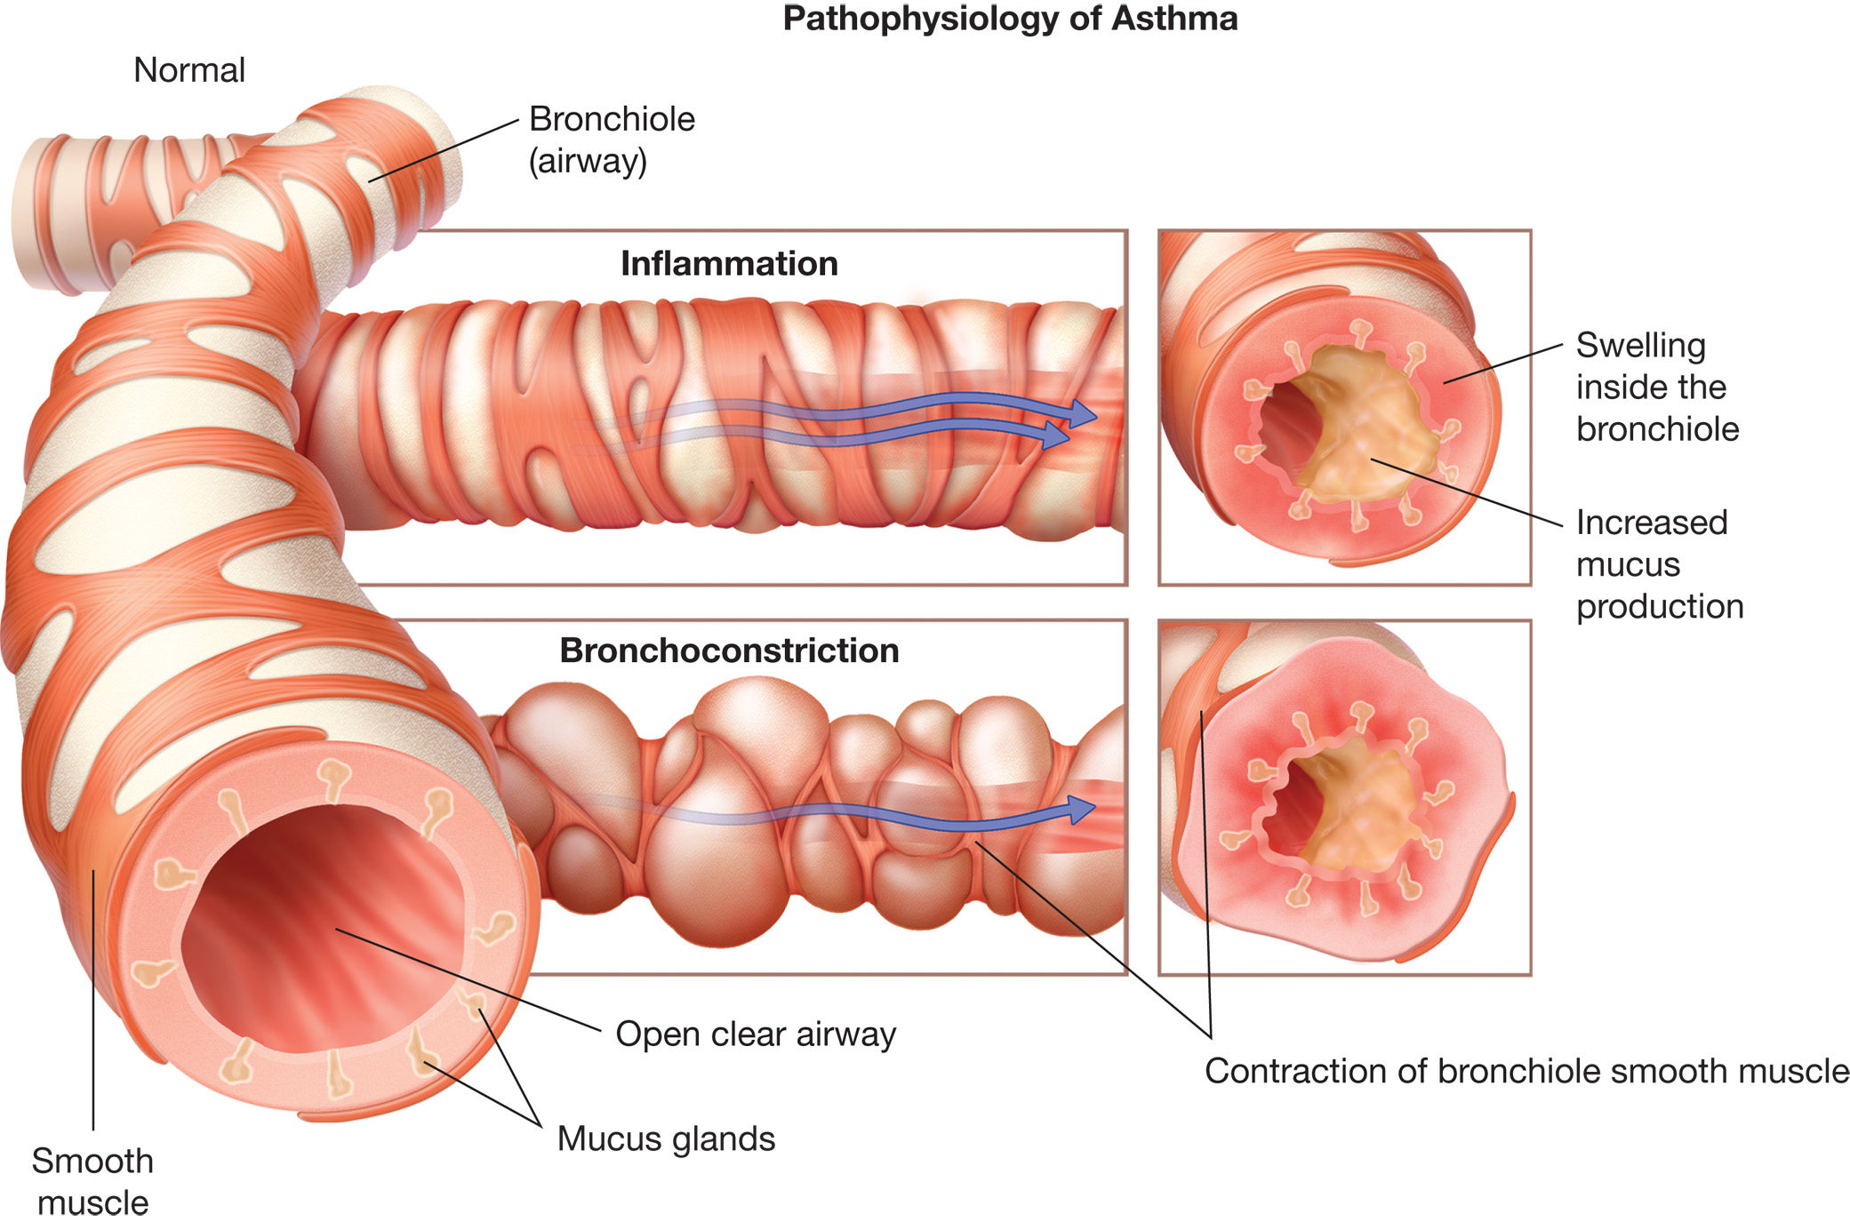
Pathophysiology of Asthma
Inflammation inside the bronchiole, an increase in the production of thick, sticky mucus, and bronchiole smooth muscle contraction (bronchoconstriction) lead to a reduced bronchiole internal diameter and a higher airway resistance.
Notes:
Relate the three major pathophysiological changes in asthma to what is occurring in with the images.
Discuss how these changes can lead to hypoxemia in the patient.

Slide 111
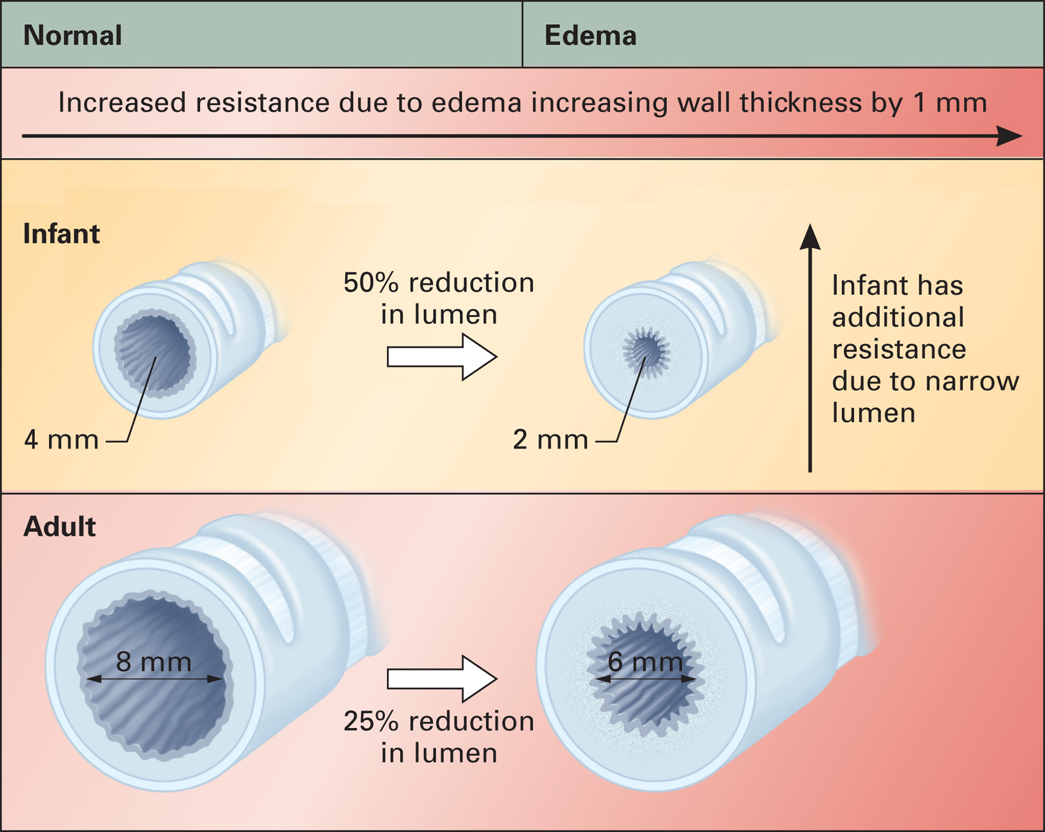
Effects of Edema on Airway Resistance in the Infant Compared to the Adult
Notes:
Discuss how the same amount of airway closure in the adult and pediatric patient has such a greater negative effect in the pediatric.

Slide 112
Specific Pediatric Respiratory and Cardiopulmonary Conditions (7 of 23)
Asthma
  Signs and Symptoms
    Shortness of breath
    Chest tightness
    Wheezing
    Nonproductive, “tight” cough.
Notes:
Common symptoms of asthma include shortness of breath, chest tightness, wheezing, and nonproductive, “tight” coughing. For a more detailed discussion of asthma signs, symptoms, and emergency medical care, see the chapter “Respiratory Emergencies.”

Slide 113
Specific Pediatric Respiratory and Cardiopulmonary Conditions (8 of 23)
Asthma
  Questions to ask regarding medical history
    How long has the child been wheezing?
    Have they had a recent cold or other infection?
    Have they had any medication for this attack? What is it? When? How much?
    Do they have any known allergies to drugs, foods, pollens, or other inhalants?
Notes:
Although not an exhaustive list of necessary questions, these are examples of questions that can help gauge the severity of the attack.

Slide 114
Specific Pediatric Respiratory and Cardiopulmonary Conditions (9 of 23)
Asthma
  In the assessment, pay attention to:
    Position
    Mental status
    Vital signs
    Skin color and condition
    Respirations.
Notes:
Relate each of these back to the effects of an asthma attack on the body. Also identify those that indicate a more severe attack.

Slide 115
Specific Pediatric Respiratory and Cardiopulmonary Conditions (10 of 23)
Asthma
  Emergency Medical Care
    Maintain oxygen to keep pulse ox greater than or equal to 94%.
      Initiate PPV if patient’s condition deteriorates.
    Assist with prescribed inhaler if present.
    Consider ALS backup or intercept
    Transport to emergency department.
Notes:
A severe attack that cannot be managed with medication is called status asthmaticus and is extremely serious. Consider ALS backup, if available.

Slide 116
Specific Pediatric Respiratory and Cardiopulmonary Conditions (11 of 23)
Bronchiolitis
  The mucosal layer of the bronchioles is inflamed by a viral infection, often R S V.
  This produces wheezing and other signs and symptoms of asthma.
  There usually is a low-grade fever.
  Often more predominant in patients less than 2 years of age.
Notes:
Discussion Question
How would you recognize a child with bronchiolitis versus asthma?

Slide 117
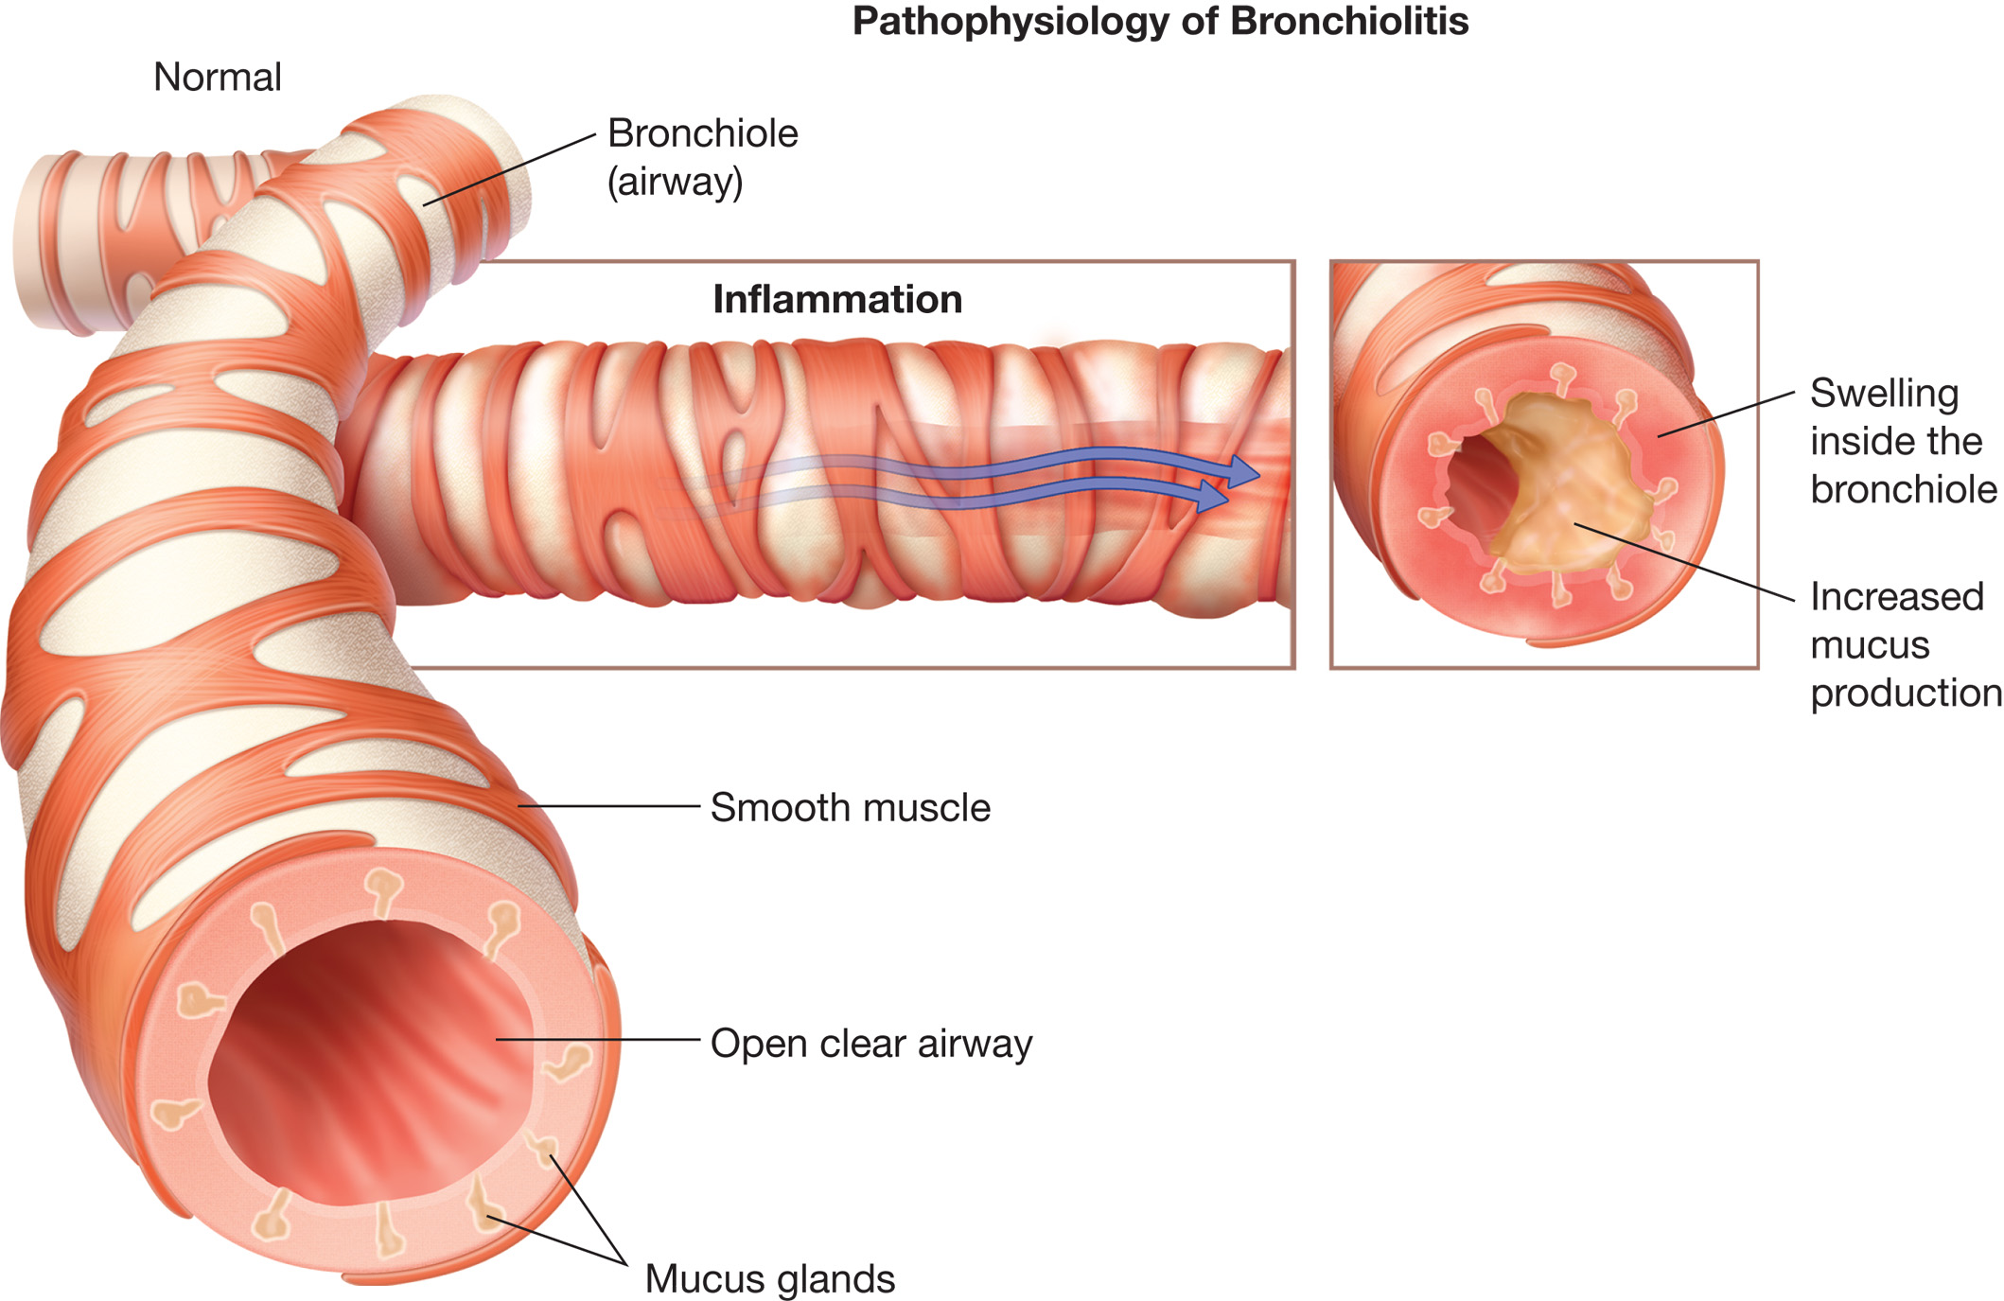
Pathophysiology of Bronchiolitis
Inflammation inside the bronchiole and an increase in the production of thick, sticky mucus from an infection lead to a reduced bronchiole internal diameter and a higher airway resistance.
Notes:
Relate the major pathophysiological changes in bronchiolitis to what is occurring in with the images.
Discuss how these changes can lead to hypoxemia in the patient.

Slide 118
Specific Pediatric Respiratory and Cardiopulmonary Conditions (12 of 23)
Bronchiolitis
  Emergency Medical Care
    Maintain oxygen to keep pulse ox greater than or equal to 94%.
      Initiate P P V if patient’s condition deteriorates.
    Place patient in position of comfort
    Monitor vitals and mental status en route.
    Consider A L S intercept.
Notes:
Generally, management of bronchiolitis is almost identical to that of other types of respiratory distress.

Slide 119
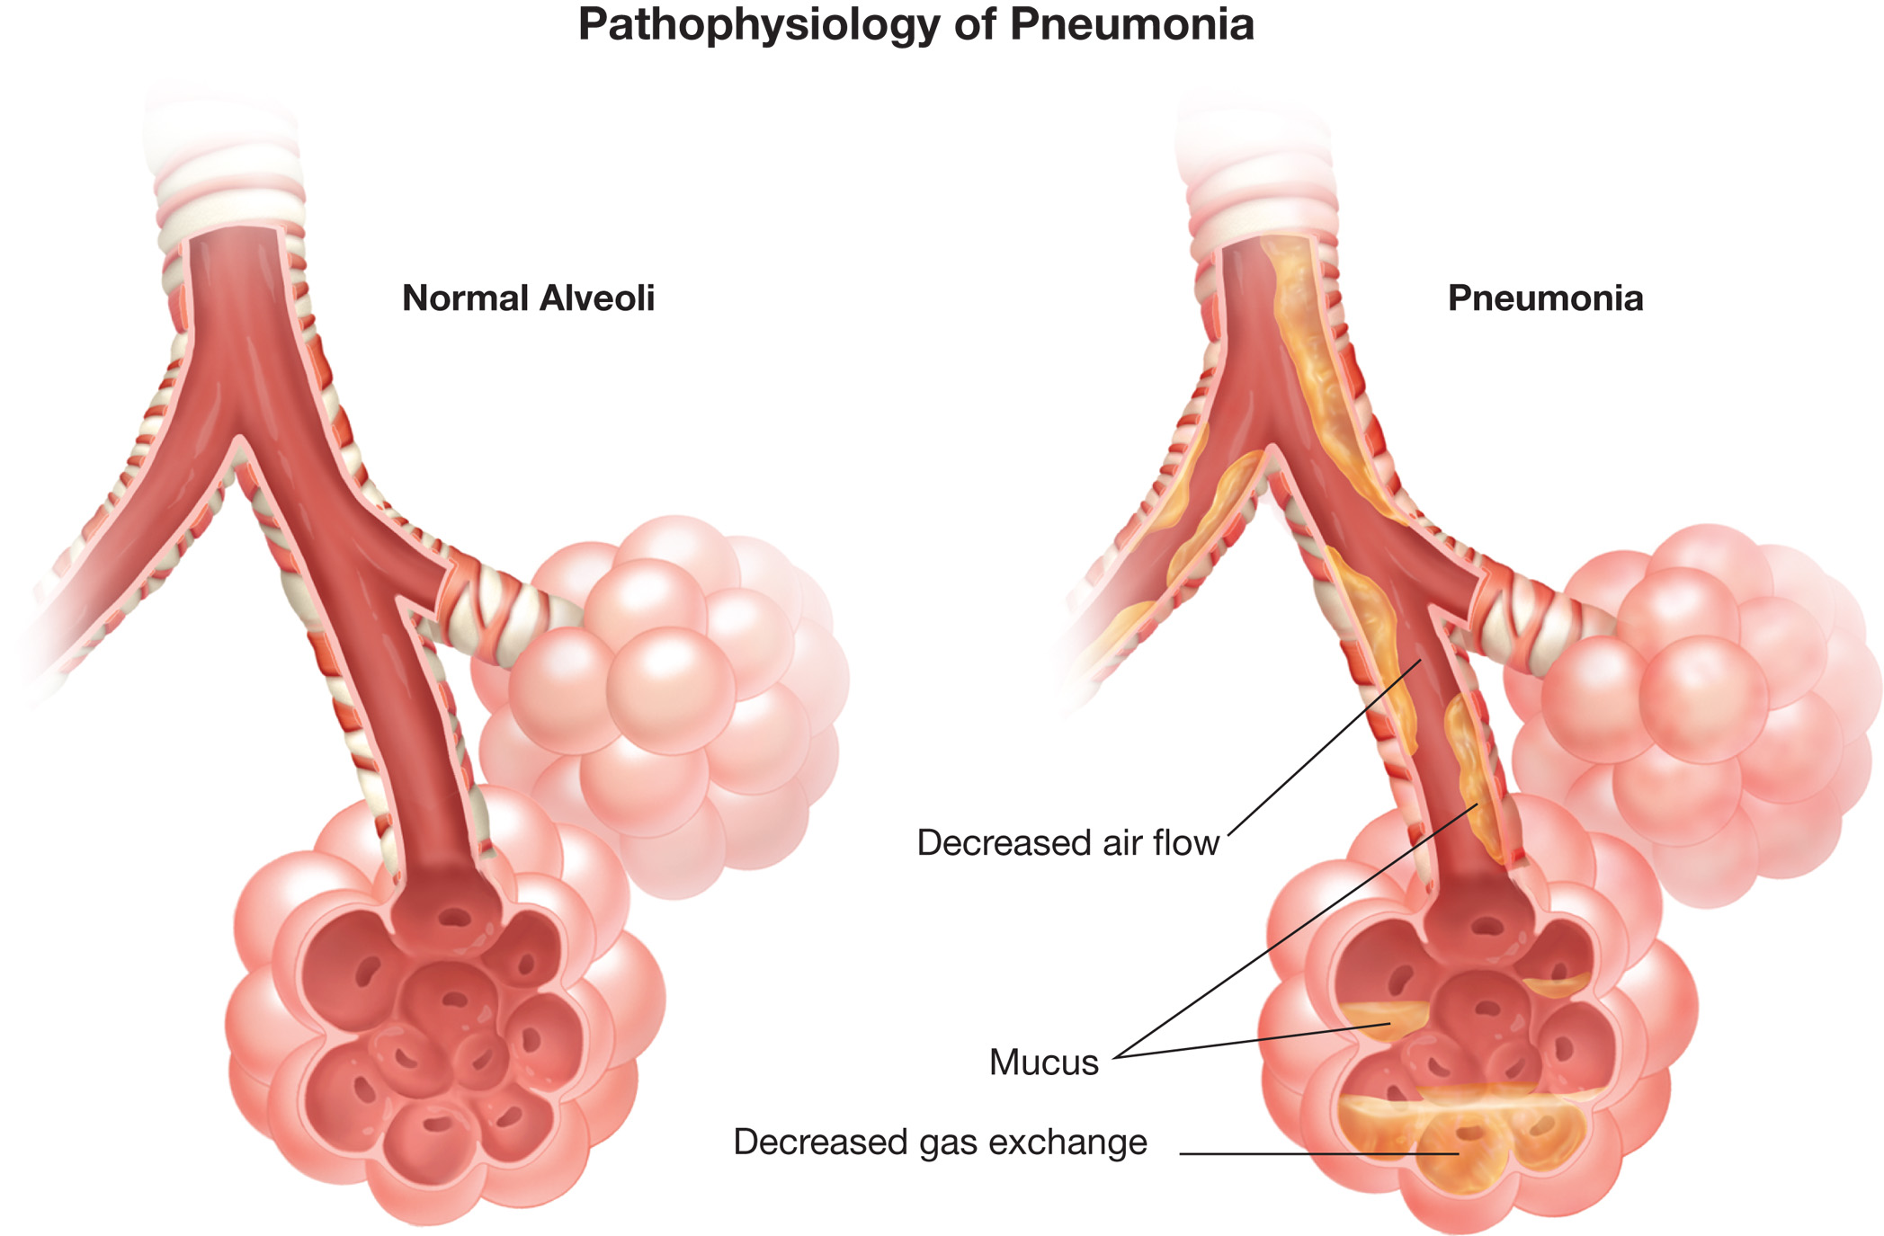
Pathophysiology of Pneumonia. Mucus Inside the Bronchioles Leads to a Reduced Airflow, and Mucus in the Alveoli Causes Poor Gas Exchange

Slide 120
Specific Pediatric Respiratory and Cardiopulmonary Conditions (13 of 23)
Pneumonia
  Infection in the lungs can obstruct the airways and lead to respiratory compromise.
  Signs include shortness of breath, chest tightness, diminished breath sounds, and cough.
Notes:
Pneumonia is estimated to cause approximately 4 million deaths among children worldwide. In the United States from 1939–1996, mortality caused by pneumonia in children declined by 97 percent. This decline is most likely attributable to the introduction of antibiotics, vaccines, improvements in medical care, and the expansion of medical insurance coverage for children. Pneumonia can involve a bacterial, viral, mycoplasmal, and fungal infection of the lung.

Slide 121
Specific Pediatric Respiratory and Cardiopulmonary Conditions (14 of 23)
Pneumonia
  Assessment
    Position
    Mental status
    Vital signs
    Skin Color and Condition
    Respirations.
Notes:
Position
The child may lie on their side with their knees drawn up or assume a tripod position.
With severe respiratory distress, the child will be exhausted.
Children under 2 years of age may lie on the back and may not show agitation.
Mental status
Drowsiness with intermittent periods of restlessness.
Skin
Look for evidence of dehydration.
Look for cyanosis.
Vital signs
Pulse rate may increase, but bradycardia is a sign of respiratory failure and potential for cardiac arrest.
Blood pressure may fall due to sepsis and shock.
Monitor the SpO_{2.}
Respirations
Diminished breath sounds
Possible wheezes or crackles

Slide 122
Specific Pediatric Respiratory and Cardiopulmonary Conditions (15 of 23)
Pneumonia
  Emergency Medical Care
    Maintain oxygen to keep pulse ox greater than or equal to 94%.
      Initiate P P V if patient’s condition deteriorates
    Place patient in comfortable position.
    Transport the patient.
    Consider A L S intercept.

Slide 123
Specific Pediatric Respiratory and Cardiopulmonary Conditions (16 of 23)
Congenital Heart Disease (C H D)
  Can be due to abnormal valves, vessels, or chambers
  Results in more deaths during first year of life than any other birth defect
  Key is to recognize an abnormality may exist and rapidly transport the patient.
Notes:
Congenital heart defects are responsible for more deaths in the first year of life than any other birth defects, according to the National Institutes of Health. The initial presentation of the infant with CHD can be inconsistent, looking like respiratory distress, infection, failure to thrive, and shock.

Slide 124
Specific Pediatric Respiratory and Cardiopulmonary Conditions (17 of 23)
Congenital Heart Disease
  May present with:
    Inadequate pulmonary blood flow with cyanosis and hypoxia
    Excessive pulmonary blood with congestive heart failure, hypoperfusion, and shock
    Respiratory distress with or without cyanosis or shock.
Notes:
Because the defect can be due to abnormal valves, vessels, or chambers, diagnosing the defect is less important than recognizing the abnormality on assessment, initiating emergency care, and transporting rapidly to an appropriate medical facility.

Slide 125
Specific Pediatric Respiratory and Cardiopulmonary Conditions (18 of 23)
Congenital Heart Disease
  Emergency Medical Care
    Maintain oxygen to keep pulse ox greater than or equal to 94%.
      Initiate P P V if patient’s condition deteriorates.
    Support the cardiovascular system as necessary.
    Transport immediately and consider A L S backup or intercept.
Notes:
There is little that the EMT can do with congenital heart defects other than support lost function during transport.

Slide 126
Specific Pediatric Respiratory and Cardiopulmonary Conditions (19 of 23)
Shock
  Causes include hypovolemic, obstructive, distributive, and cardiogenic.
    Less common causes of shock are allergic reactions, poisoning, or cardiac events.
  Common findings include diarrhea, dehydration, trauma, vomiting, blood loss, infection, and abdominal injuries.

Slide 127
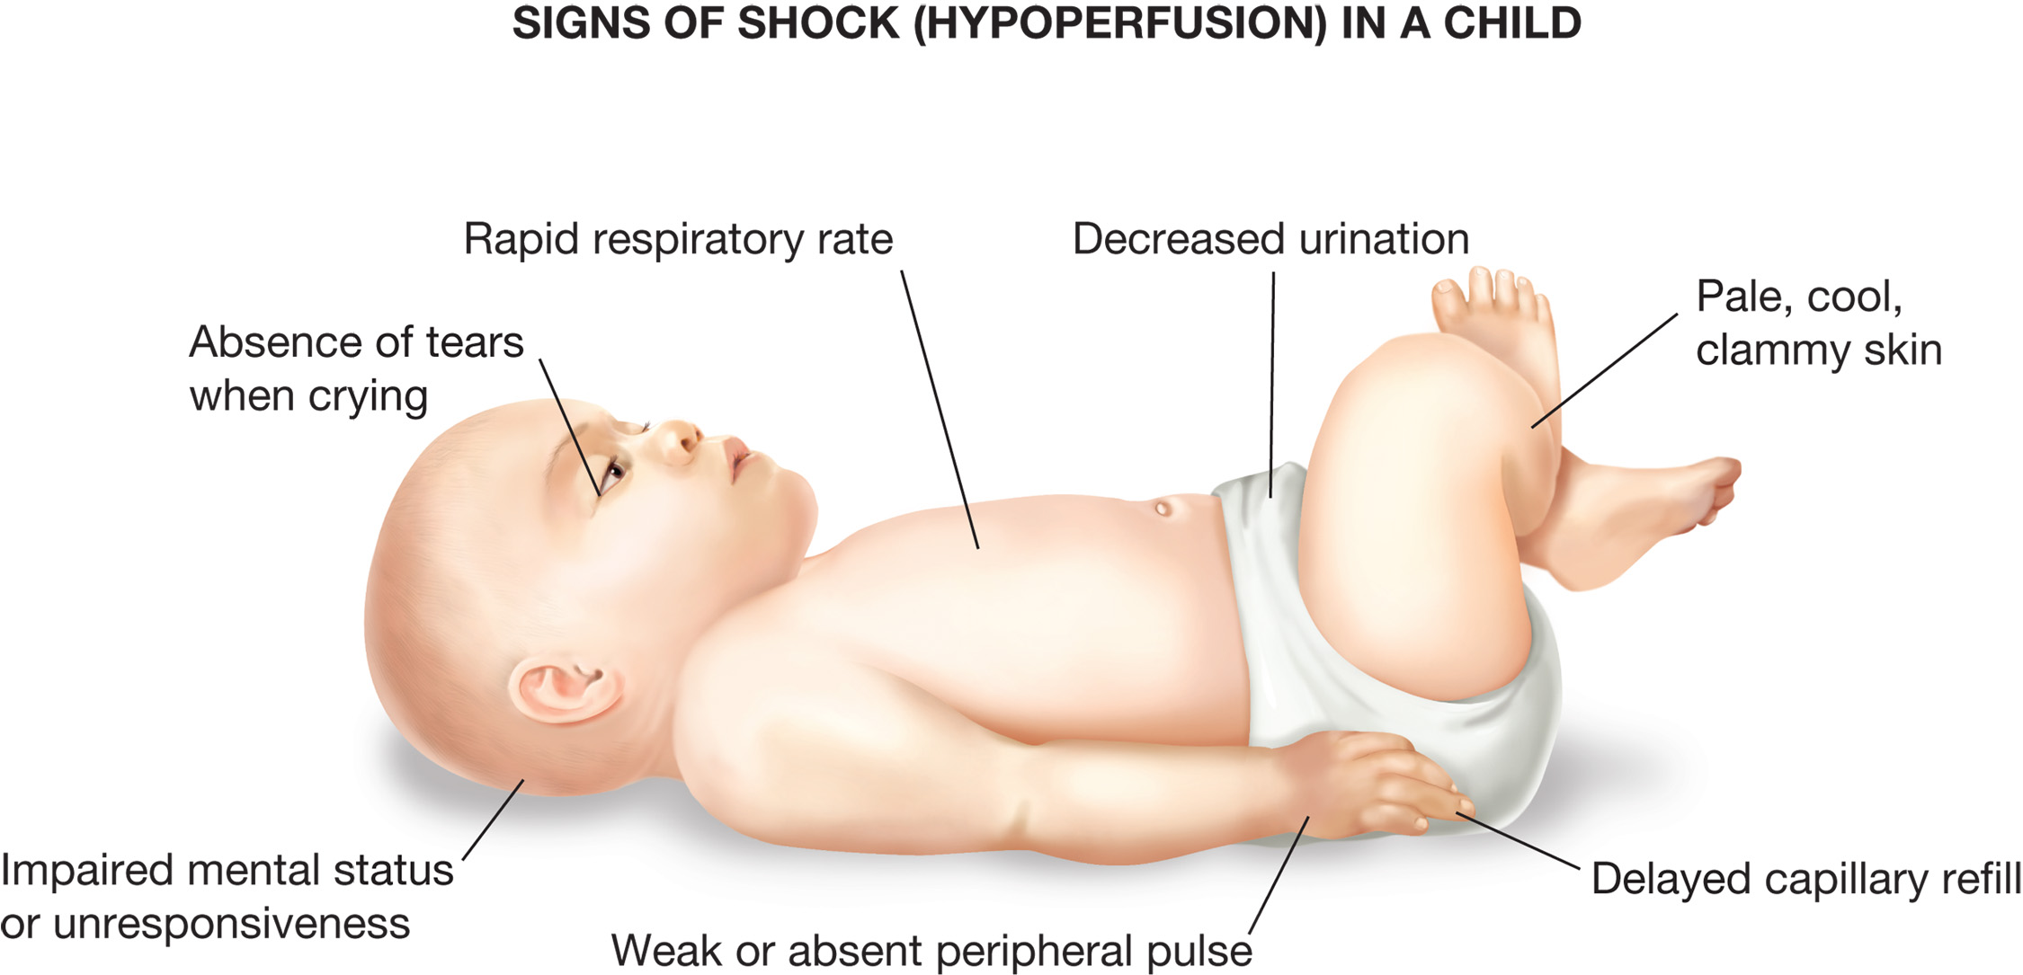
Signs of Shock (Hypoperfusion) in a Child
Notes:
List and delineate the findings of shock with the different etiologies of shock. The student needs to be able to appreciate the difference between the various types of shock so the treatment is more specific and appropriate.

Slide 128
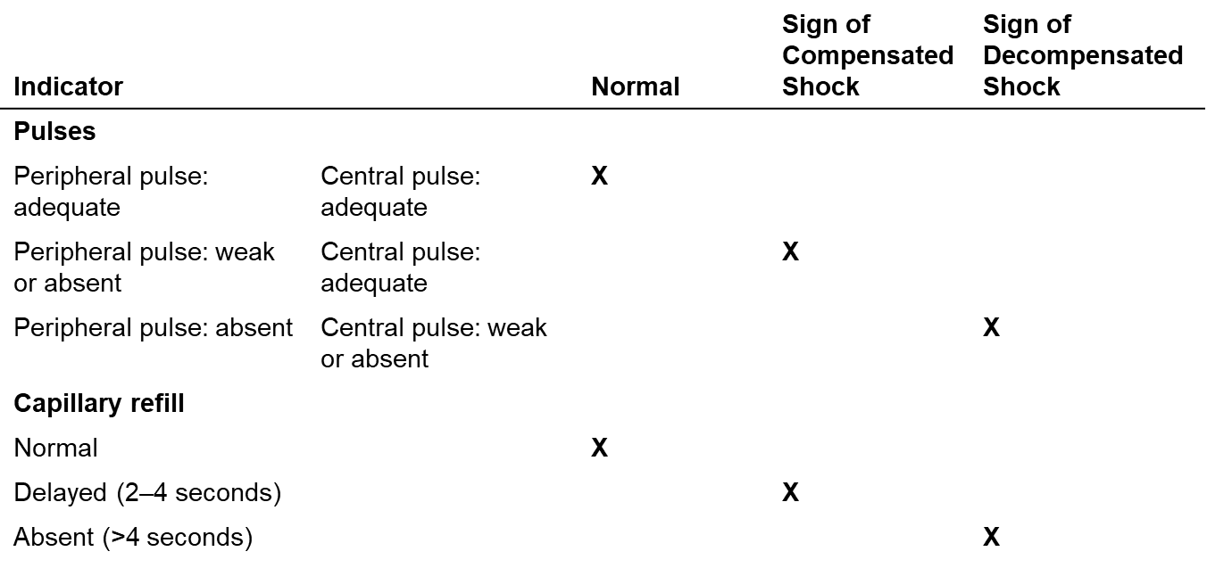
Compensated and Decompensated Shock
Table 38-7 Pulses and Capillary Refill as Indicators of Compensated and Decompensated Shock

Slide 129
Specific Pediatric Respiratory and Cardiopulmonary Conditions (20 of 23)
Shock
  Emergency Medical Care
    Maintain an open airway and use oxygen to maintain an S p O ₂ greater than or equal to 94%.
      Positive pressure ventilation, if breathing is inadequate
    Control bleeding if present.
    Keep the patient supine and warm.
    Transport rapidly, consider A L S intercept.
Notes:
Discuss care steps for the pediatric patient in shock. Emphasize when to alert ALS and what the best destination hospitals are.

Slide 130
Emergency Care Protocol: Pediatric Shock (1 of 2)
Establish and maintain an open airway, extending the head only enough to allow an open airway and avoid hyperextension.
Suction secretions.
Provide positive pressure ventilation with supplemental oxygen connected to the ventilation device at a rate of 12–20 ventilations/minute if breathing is inadequate.
If breathing is adequate, administer oxygen via nonrebreather mask at 15 lpm; consider blow-by oxygen in infants and very young children.
If shock is due to blood loss, control any external bleeding with direct pressure. If internal bleeding is suspected, transport immediately and expeditiously.
Notes:
Review protocol with students. Find out if local EMS protocol varies from this, and if so, discuss changes.

Slide 131
Emergency Care Protocol: Pediatric Shock (2 of 2)
Keep the patient warm. If hypothermia is suspected, wrap the patient in warm blankets and place the ambulance heater on high. Cover the infant or child’s head. (Note: All patients in shock should be kept warm.)
Consider calling advanced life support.
Expedite transport.
Perform a reassessment every 5 minutes.

Slide 132
Specific Pediatric Respiratory and Cardiopulmonary Conditions (21 of 23)
Cardiac arrest
  Almost all cardiac arrests in children result from airway obstruction or respiratory distress leading to respiratory arrest.
  Shock is also a cause of cardiac arrest.
  Aggressively manage both respiratory problems and shock before they progress to cardiac arrest.
Notes:
Discussion Point
Preventing arrest is of utmost importance in the deteriorating pediatric patient. The airway should be aggressively managed and chest compressions should be started if the heart rate drops below 60 beats per minute and signs of poor perfusion are evident.
Class Activity
Randomly hand out index cards prepared ahead of time (see the description in the Advance Preparation chart) to students. Students will explain the signs, symptoms, and management of the condition listed.
Knowledge Application
Given a series of scenarios, students should be able to assess pediatric patients with respiratory and cardiopulmonary problems.

Slide 133
Specific Pediatric Respiratory and Cardiopulmonary Conditions (22 of 23)
Cardiac arrest
  Signs of cardiac arrest include:
    Unresponsiveness
    Gasping or no respiratory sounds
    No audible heart sounds
    Chest is not moving
    Pallor or cyanosis
    Absent pulse.
Notes:
The EMT’s goal is to keep the brain viable. Standing orders that provide for orderly direction of treatment, easy access to paramedic backup, and continuous assessment are important. Unless too much time has elapsed between the arrest and initiation of artificial ventilation, the child may recover with minimal or no neurological deficit even following comparatively long periods of arrest.

Slide 134
Specific Pediatric Respiratory and Cardiopulmonary Conditions (23 of 23)
Cardiac Arrest
  Emergency Medical Care
    P P V with supplemental oxygen
    C P R and A E D application
    Early A L S backup or intercept
    Rapid transport

Slide 135
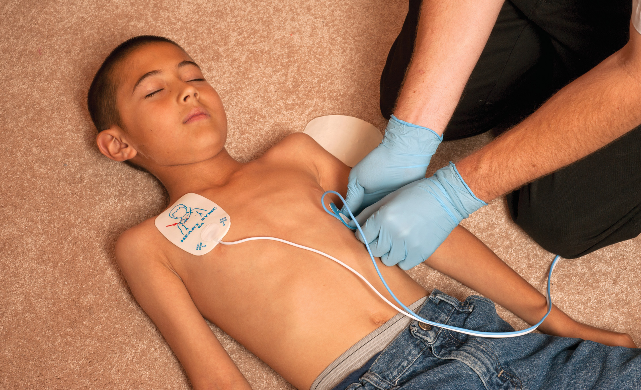
A E D Applied to a Child and Infant

Slide 136
Click on the Condition that is Most Consistent with a Child Who is Found Sitting up, Remaining Very Still, with a High Fever, Drooling, and Inspiratory Stridor
a. Epiglottitis
b. Croup
c. Pneumonia
d. Bronchiolitis

Slide 137
Other Pediatric Medical Conditions and Emergencies (1 of 27)
Seizures
  Abnormal electrical discharge that occurs in the brain
  Seizures are a brain dysfunction with muscular manifestations (seizures).
Notes:
Discussion Question
What are some causes of seizures in children?
Class Activity
Assign students a topic from this section for further research. Have students bring their research findings to the next class for discussion.

Slide 138
Other Pediatric Medical Conditions and Emergencies (2 of 27)
Seizures
  Causes include:
    Fever, epilepsy, drug overdose
    Brain tumors or brain injury
    Electrolyte abnormalities
    Hypoglycemia
    Meningitis
    Hypoxia.
Notes:
The risk of seizures is high among children up to age 2, and approximately 3 to 5 percent of all children in the United States will experience a febrile seizure by the time they reach their 5th birthday. Although these childhood seizures can be frightening, they generally have no permanent adverse effects and usually do not predict the development of epilepsy in the child unless there is a family history of epilepsy and the seizure is particularly prolonged or difficult to control.

Slide 139
Other Pediatric Medical Conditions and Emergencies (3 of 27)
Seizures
  Assessment
    Muscular rigidity or twitching
    Dilated pupils
    Irregular breathing
    Incontinence
    Cyanosis
    Excessive salivation.
Notes:
During the “generalized, tonic-clonic” seizure, the child’s arms and legs may become rigid, the back arches, the muscles twitch or jerk in spasm, the eyes roll up and become fixed, the pupils dilate, and the breathing is often irregular or ineffective. The patient may lose bladder and bowel control and be completely unresponsive. If the seizure lasts long enough, the skin can turn cyanotic from ineffective respirations. The muscle spasms might prevent the child from swallowing effectively. Hence, excessive saliva coming from the mouth is a common finding. (Saliva production is also more copious during the seizure.) If saliva is trapped in the throat, the child may make a gurgling sound with respirations.

Slide 140
Other Pediatric Medical Conditions and Emergencies (4 of 27)
Seizures
  History Findings
    History of prior seizures?
    If so, is this the normal pattern?
    Has the child taken any prescribed medications?
    Duration of unconsciousness?
    Description of seizure activity?
Notes:
While obtaining the history, ascertain whether the child has had prior seizures and, if so, find out whether this is the child’s normal seizure pattern. Determine whether the child has taken their anti-seizure medications, if any have been prescribed.

Slide 141
Other Pediatric Medical Conditions and Emergencies (5 of 27)
Seizures
  Emergency Medical Care
    Maintain an open airway and use oxygen to maintain an S p O₂ greater than or equal to 94%.
      Provide PPV if breathing is inadequate.
    Position the patient on their side.
    Be prepared to suction.
    Transport.
Notes:
Seizures lasting longer than 5 minutes or recurring with no recovery between are considered prolonged seizures and are a true medical emergency. (Seizures lasting 30 minutes or more are called status epilepticus.) Provide positive pressure ventilation with supplemental oxygen during a prolonged seizure, if possible, and even after the seizure has ended if necessary. Provide rapid transport to the hospital, paying attention to maintaining the airway and protecting the patient from injury.

Slide 142
Emergency Care Protocol: Pediatric Seizures (1 of 2)
Establish and maintain an open airway, extending the head only enough to allow an open airway and avoid hyperextension.
Protect the infant or child from injuring himself; place him on his left side.
Suction secretions.
Provide positive pressure ventilation with supplemental oxygen via reservoir at a rate of 12–20 ventilations/minute if breathing is inadequate.
If breathing is adequate, administer oxygen to maintain an S p O ₂ of 94% or greater; consider blow-by oxygen in infants and very young children.
Notes:
Review pediatric seizure protocol. Discuss any local protocol differences that may exist.

Slide 143
Emergency Care Protocol: Pediatric Seizures (2 of 2)
Check the blood glucose level, if your protocol permits.
Expedite transport in any of the following situations:
a. Epileptic seizures lasting >5 minutes
b. Two or more epileptic seizures without a period of consciousness between them
c. Febrile seizures lasting >15 minutes
d. Seizure from any other cause (e.g., hypoxia, head injury)
Consider calling advanced life support.
Expedite transport.
Perform a reassessment every 5 minutes.

Slide 144
Other Pediatric Medical Conditions and Emergencies (6 of 27)
Altered Mental Status
  The change to mental status could be mild to significant.
  There are many underlying causes of altered mental status in a pediatric patient.
  The goals are to manage threats to the airway, breathing, oxygenation, and circulation.
Notes:
Your pediatric patient could have an altered mental status for the same reason an adult patient would, such as hypoglycemia, poisoning, post seizure, or severe blood infection. If your protocol permits, assess the blood glucose in any patient presenting with an altered mental status. However, this is especially important in the pediatric patient. Note that if the altered mental status is associated with poor brain perfusion or brain injury, all three PAT findings — appearance, work of breathing, and circulation to skin — might be abnormal.

Slide 145
Other Pediatric Medical Conditions and Emergencies (7 of 27)
Altered Mental Status
  Assessment Considerations
    Use modified A V P U or G C S scale.
Notes:
The child’s level of maturity can greatly influence the format of the EMT’s assessment of the mental status. If using AVPU or the Glasgow Coma Scale, modify them for a child. Ask the child simple questions. If the child appears to be lethargic, inconsolable, or agitated, ask the caregivers if this is a typical or an unusual response. To assess the unresponsive infant or child, shout to elicit a response to verbal stimulus. Inflict a pinch to see if the child responds to pain. Never shake an infant or child for any reason.

Slide 146
Other Pediatric Medical Conditions and Emergencies (8 of 27)
Altered Mental Status
  Emergency Medical Care
    Maintain an open airway, use oxygen to keep S p O₂ greater than or equal to 94%
      Apply positive pressure ventilation if breathing is inadequate.
    Position the patient on their side.
    Be prepared to suction.
    Transport and consider A L S intercept.
Notes:
Treatment of a pediatric patient with an altered mental status is aimed at managing life threats such as airway compromise.

Slide 147
Emergency Care Protocol: Pediatric Drowning (1 of 4)
Pediatric Altered Mental Status
Establish and maintain an open airway, extending the head only enough to allow an open airway and avoid hyperextension.
Suction secretions.
Provide positive pressure ventilation with supplemental oxygen at a rate of 12–20 ventilations/minute if breathing is inadequate.
If breathing is adequate, administer oxygen to maintain an S p O ₂ of 94% or greater; consider blow-by oxygen in infants and very young children.
Check the blood glucose level, if your protocol permits.
Notes:
Review protocol for pediatric AMS and draw distinctions from any local protocol differences.

Slide 148
Emergency Care Protocol: Pediatric Drowning (2 of 4)
If signs and symptoms of hypoglycemia are present and the child is a known diabetic on medication for the condition, consider oral glucose if the child is able to swallow and medical direction approves.
Consider calling advanced life support.
Expedite transport.
Perform a reassessment every 5 minutes.

Slide 149
Other Pediatric Medical Conditions and Emergencies (9 of 27)
Drowning
  Can occur in any amount of water
  Most drownings are “dry” drownings.
Notes:
Drowning can occur in any amount of water — from the ocean to the bathtub to a bucket. The main cause of death in infants or children who are submerged is not the aspiration of fluid; although, it can occur in some patients. Rather, it is the hypoxia that occurs secondary to glottic closure reflex, which occurs when the water contacts the glottic opening. After an initial period of glottis closure, the victim becomes hypoxic and ultimately gasps, leading to aspiration of water into the lungs.

Slide 150
Other Pediatric Medical Conditions and Emergencies (10 of 27)
Drowning
  Assessment Considerations
    Be aware of associated trauma and hypothermia.
    Possibility of secondary drowning syndrome.
Notes:
When confronted with a drowning emergency, be aware of the possibility of trauma and/or hypothermia. Infants and children are especially prone to hypothermia. In any drowning emergency, be alert for a secondary drowning syndrome, a deterioration that takes place after normal breathing is restored — from minutes to hours after the event.

Slide 151
Other Pediatric Medical Conditions and Emergencies (11 of 27)
Drowning
  Emergency medical care
    Consider spinal injury.
    Maintain an open airway and use oxygen to keep S p O₂ greater than or equal to 94%.
      P P V if breathing is inadequate.
    Place the patient on their side, if possible.
    Provide C P R and use the A E D, if needed.
    Transport with A L S backup or intercept.
Notes:
In a cold-water drowning, be particularly aggressive and persistent about resuscitating a pediatric patient. In response to the cold water, the mammalian dive reflex, which is pronounced in children, might slow blood perfusion and metabolism. This means that the residual oxygen in the blood lasts longer for the brain to consume. Numerous cases of “saves” have been reported even after prolonged submersion in cold water (30 minutes or more). It is controversial whether these saves are made possible by the mammalian dive reflex or the cold water. If unclear about the length of time under water, always give the patient the benefit of the doubt and initiate resuscitation.

Slide 152
Emergency Care Protocol: Pediatric Drowning (3 of 4)
Remove the infant or child from the water. If diving was involved in children or adolescents, consider spine motion restriction.
Establish and maintain an open airway, extending the head only enough to allow an open airway and avoid hyperextension.
Suction secretions.
Provide positive pressure ventilation with supplemental oxygen connected to the ventilation device at a rate of 12–20 ventilations/minute if breathing is inadequate.
Perform chest compressions if no pulse is present. Apply the A E D. Contact medical direction otherwise for orders. If hypothermia is suspected, deliver only one defibrillation.
Notes:
Review protocol for pediatric drowning and draw distinctions from any local protocol differences.

Slide 153
Emergency Care Protocol: Pediatric Drowning (4 of 4)
If breathing is adequate, administer oxygen to maintain an S p O ₂ of 94% or greater; consider blow-by oxygen in infants and very young children.
If hypothermia is suspected, remove wet clothing, wrap the patient in warm blankets, and place the ambulance heater on high. Cover the infant or child’s head.
Consider calling advanced life support.
Expedite transport.
Perform a reassessment every 5 minutes.

Slide 154
Other Pediatric Medical Conditions and Emergencies (12 of 27)
Fever
  Fevers of 104° to Fahrenheit–105° Fahrenheit are concerning.
    Causes include infection and heat exposure.
  Seizures and dehydration may occur.
Notes:
Discussion Question
What should the EMT do for the child with a fever?

Slide 155
Other Pediatric Medical Conditions and Emergencies (13 of 27)
Fever
  Assessment Considerations
    Rise of temperature more important than actual temperature
    Changes may occur to pulse amplitude
    Fontanelle may be sunken in the infant.
    Urinary frequency may be diminished.
Notes:
The degree of temperature is not always of the greatest concern, but how quickly the temperature “spikes.” If the temperature rises rapidly, a febrile seizure (a seizure caused by a high body temperature) might result. Not all high temperatures produce seizures. In addition to seizures, another common result of a fever is dehydration caused by the increased insensible (evaporative) loss of fluids and electrolytes, especially if the fever has been present for some time.

Slide 156
Other Pediatric Medical Conditions and Emergencies (14 of 27)
Fever
  Emergency Medical Care
    Maintain an S p O₂ greater than or equal to 94%.
    Remove excess layers of clothing.
    Cool patient as needed in a controlled fashion.
    Be alert for seizures.
Notes:
If the elevated core body temperature is a result of exposure to a hot environment, conduct cooling if the core temperature is excessive (104 or greater). Remove the child from the hot environment and avoid extreme cooling and shivering while cooling. Sponge the child’s skin with tepid water. Transport the patient and remain alert for seizures. If cooling is done, it should be performed in a slow, controlled manner unless the child has a temperature over 106.9°F. If a child with an elevated core body temperature is cooled too quickly, the brain will be overstimulated and the child might seize.

Slide 157
Emergency Care Protocol: Pediatric Fever (1 of 2)
Establish and maintain an open airway, extending the head only enough to allow an open airway and avoid hyperextension.
Suction secretions.
Provide positive pressure ventilation with supplemental oxygen via reservoir at 12–20 ventilations/minute if breathing is inadequate.
If breathing is adequate, administer oxygen to maintain an S p O 2 of 94% or greater; consider blow-by oxygen in infants and very young children.
Notes:
Review protocol for pediatric fever and draw distinctions from any local protocol differences.

Slide 158
Emergency Care Protocol: Pediatric Fever (2 of 2)
Febrile seizures >15 minutes are a dire emergency and require expeditious transport and consideration for advanced life support.
Consider calling advanced life support.
Transport.
Perform a reassessment every 5 minutes.

Slide 159
Other Pediatric Medical Conditions and Emergencies (15 of 27)
Meningitis
  Infection of the lining of the brain and spinal cord
  Fever in infants younger than 3 months is suspected as meningitis.
  May be rapidly fatal.
Notes:
Discussion Question
What are signs and symptoms of meningitis?
Critical Thinking Discussion
Why are pediatric patients susceptible to a variety of infectious illnesses?

Slide 160
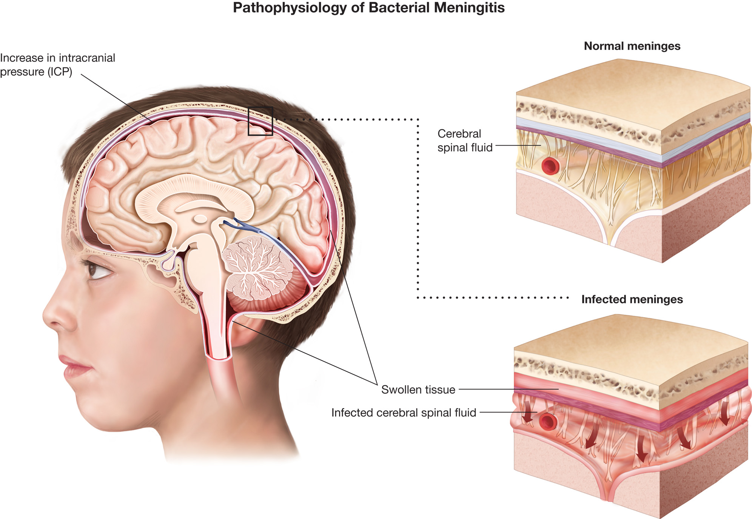
Pathophysiology of Bacterial Meningitis
Meningitis causes the meningeal tissue to swell inside the skull and around the spinal cord, causing an increase in pressure inside the skull and compression of the brain.
Notes:
Discuss the pathological changes in meningitis as they relate to changes in ICP and findings presentation.

Slide 161
Other Pediatric Medical Conditions and Emergencies (16 of 27)
Meningitis
  Assessment Considerations
    Recent ear or U R I
    High fever, lethargy
    Nausea and vomiting
    Fontanelle may bulge in infant
    Pain with movement
    Possible skin rash.
Notes:
Signs and symptoms of meningitis in children include recent ear or respiratory tract infection, high fever, lethargy, irritability, or vomiting. They generally do not have headaches or stiff necks but are lethargic and will not eat. The fontanelle may be bulging unless the child is dehydrated. Movement is painful so the caretakers might report that “they cry every time we pick them up.” A rash might be present.

Slide 162
Other Pediatric Medical Conditions and Emergencies (17 of 27)
Meningitis
  Emergency Medical Care
    Wear a mask, gloves, and possibly a gown.
    Keep pulse ox at greater than or equal to 94%
    Ventilate the patient if needed
    Transport to hospital.
Notes:
If you suspect meningitis, you should wear a mask, gloves, and possibly a gown as the infection is spread by respiratory droplets. Complete the assessment rapidly and transport to the hospital. If the child is in shock (hypoperfusion), establish and maintain an open airway. Administer oxygen to maintain an SpO₂ of 94% or greater. If the breathing is or becomes inadequate, begin positive pressure ventilation with supplemental oxygen delivered through the ventilation device.

Slide 163
Other Pediatric Medical Conditions and Emergencies (18 of 27)
Gastrointestinal Disorders
  Assessment Considerations
    Conditions include gastroenteritis, which can lead to dehydration, and appendicitis.
  Emergency Medical Care
    Maintain an S p O ₂ greater than or equal to 94%, place the patient in a position of comfort, anticipate vomiting, and transport.
Notes:
Discussion Question
What are the concerns for a child with a gastrointestinal disorder?

Slide 164
Other Pediatric Medical Conditions and Emergencies (19 of 27)
Poisoning
  Assessment Considerations
    Most common to children younger than 4 years old.
    A thorough secondary assessment is critically important to find the cause.
    Gather as much information as possible about the type of overdose prior to transport.
Notes:
For these patients, a thorough secondary assessment is critically important. Because poisons can enter the body through numerous routes (ingestion, inhalation, absorption, injection), gather as much information as possible about the type of overdose prior to transporting the patient to the hospital.

Slide 165
Other Pediatric Medical Conditions and Emergencies (20 of 27)
Poisoning
  Emergency Medical Care
    Contact medical direction or P C C.
    If activated charcoal is ordered, the dose is 1 gram/kg.
    Maintain an open airway and adequate ventilation and oxygenation.
    Transport with frequent reassessment of mental status, airway, and breathing.
Notes:
Emergency treatment of poisoned patients focuses on the effects of the poisoning on the patient, rather than treating the specific type of poisoning.
If the Patient Is Initially Unresponsive or Becomes Unresponsive en Route
Establish and maintain an open airway and adequate ventilation and oxygenation. Administer oxygen to maintain an SpO₂ of 94% or greater.
If the breathing is or becomes inadequate, begin positive pressure ventilation with supplemental oxygen delivered through the ventilation device.
Expedite transport.
Perform a rapid secondary assessment to identify or rule out trauma as a cause of the altered mental status.
Check blood glucose level, if your protocol permits.

Slide 166
Protocol for Pediatric Poisoning (1 of 3)
Extend the head only enough to allow an open airway; avoid hyperextension.
Suction secretions.
Provide positive pressure ventilation with supplemental oxygen at a rate of 12–20 ventilations/minute if breathing is inadequate.
If breathing is adequate, administer oxygen to maintain an S p O2 of 94% or greater; consider blow-by oxygen in infants and very young children.
Treat the specific poisoning:
Ingestion
If you are instructed to administer activated charcoal and the patient is alert and able to swallow, give at 1. gram/kilogram (12.5–25 grams). Activated charcoal is contraindicated in the following:
Notes:
Review the protocol for pediatric poisoning and discuss any differences to management with local protocol.

Slide 167
Protocol for Pediatric Poisoning (2 of 3)
Altered mental status
Ingestion of acids or alkalis
Patient who is unable to swallow
Inhalation
Remove from toxic environment. Maximize oxygenation by nonrebreather mask at 15 litreperminute if breathing adequately or by positive pressure ventilation if breathing inadequately.
Absorption
Flush with water for 20 minutes at the scene. If eyes are involved, continue to flush en route.

Slide 168
Protocol for Pediatric Poisoning (3 of 3)
Injection
Carefully monitor airway and breathing. If allergic reaction, and with order from medical direction, consider administration of epinephrine at 0.15 mg if the child weighs less than 66 lb. If the child’s weight is greater than 66 l b, an adult (0.3 milligram) dose should be used. Apply a constricting band proximal to site of bite or injection.
Consider calling advanced life support.
Expedite transport.
Perform a reassessment every 5 minutes.

Slide 169
Other Pediatric Medical Conditions and Emergencies (21 of 27)
Brief Resolved Unexplained Events (B R U E)
  Assessment Considerations
    An episode that is frightening to the observer in infants younger than 1 year of age
    Characterized by some combination of apnea, color change, marked change in muscle tone, choking, or gagging.
  Event is usually transient.
Notes:
Discussion Question
What are the characteristics of BRUE?
Knowledge Application
Given a series of scenarios, students should be able to assess and manage pediatric medical emergencies.

Slide 170
Other Pediatric Medical Conditions and Emergencies (22 of 27)
Brief Resolved Unexplained Events (B R U E)
  Emergency Medical Care
    Maintain an open airway and adequate breathing and oxygenation.
    Apply positive pressure ventilation for inadequate breathing.
    Transport with A L S intercept.
Notes:
If called for, for an infant exhibiting any of these transient signs, establish and maintain an open airway and adequate ventilation and oxygenation. Administer oxygen to maintain an SpO₂ of 94% or greater. If the breathing is or becomes inadequate, begin positive pressure ventilation with supplemental oxygen delivered through the ventilation device and immediately transport to a medical facility for further evaluation.

Slide 171
Other Pediatric Medical Conditions and Emergencies (23 of 27)
Sudden Infant Death Syndrome (S I D S)
  Sudden and unexpected death of an infant in which an autopsy fails to identify the cause of death
  Peak incidence at 2 to 4 months
  Exact cause is unknown.
  Cannot be diagnosed in the field.
Notes:
Teaching Tips
Consider a guest speaker on SIDS.
Discussion Questions
How should the EMT interact with the parents of an apparent SIDS infant?
What observations of the scene should you document in an infant death?

Slide 172
Other Pediatric Medical Conditions and Emergencies (24 of 27)
Sudden Infant Death Syndrome (S I D S)
  Assessment Considerations
    Physical appearance of the infant
    Position of the infant in the crib
    Physical appearance of the crib
    Presence of objects in the crib
    Unusual or dangerous items in the room.
Notes:
Because this might be a potential crime scene rather than a medical case of SIDS, be careful not to convey by the wording of your questions or your manner any suspicion that the parents or caretakers might be responsible for the child’s condition.

Slide 173
Other Pediatric Medical Conditions and Emergencies (25 of 27)
Sudden Infant Death Syndrome (S I D S)
  Emergency Medical Care
    Attempt resuscitation unless rigor mortis or dependent lividity is present.
    Encourage caregivers to talk.
    Do not provide false reassurances.
    Transport with A L S backup or intercept.
    Use caution in communications.
Notes:
Advise students that all elements of arrest management need to be at their best for a successful outcome, if one is possible.

Slide 174
Other Pediatric Medical Conditions and Emergencies (26 of 27)
Sudden Infant Death Syndrome (S I D S)
  Aiding Family Members in S I D S Emergencies
    Reactions vary, but shock and disbelief are common.
    Making decisions may be difficult for the parents.
    Be supportive and aware of your own emotions.
Notes:
The reactions of family members to the SIDS incident will be varied. One of the most common immediate reactions of caregivers to SIDS is shock and disbelief. This can cause family members to become immobilized or incapable of making decisions. Or it can cause them to act as if they are cold and unfeeling. It is not that they do not care, just that they are having a hard time facing reality.
Don’t neglect your own emotional turmoil. After a SIDS call, it is common for rescuers to experience anxiety, guilt, or anger. Ignoring your emotions will not cause them to go away. You should talk out your feelings with colleagues, friends, or your partner or spouse.

Slide 175
Other Pediatric Medical Conditions and Emergencies (27 of 27)
Sudden Infant Death Syndrome (S I D S)
  Presence of Parents During Pediatric Resuscitation
    Allow parents to be present during resuscitation attempts.
    Infants who survived also more accepting of procedures when parents present.
Notes:
Several scientific studies conducted within the recent past suggest the presence of parents during resuscitation is beneficial to children and the parents. When a child died during resuscitation, parents in one study stated that they felt more accepting of the death if they were with the child at the time of death. Children who survived appeared to be more cooperative and accepting of procedures when their parents were present. The studies also found that there were minimal negative effects on the success rates of clinicians who performed the interventions.

Slide 176
Pediatric Trauma (1 of 14)
Thousands of children die from unintentional injury and more are permanently disabled.
Leading cause of death from ages 1-14 years of age
50percent of deaths from trauma occur within the first hour after an injury.
Many of the deaths and injuries are preventable.
Notes:
Discussion Questions
What are the most common causes of injury in children?
What anatomical differences affect injury patterns in children?
What are the priorities of assessment and management of the pediatric trauma patient?
Critical Thinking Discussion
Why, despite the programs that have been implemented, does pediatric trauma continue at such an alarming rate?
Knowledge Application
Given a series of scenarios, students should be able to assess and manage pediatric trauma patients.

Slide 177
Pediatric Trauma (2 of 14)
Mechanisms of Injury
  Common Modes of Injury
    Unrestrained M V C
    Pedestrian versus vehicle
    Cyclist versus vehicle
    Water accident
    Burn trauma
    Sport injuries
    Child abuse
Notes:
When assessing the mechanism of injury during the scene size up, look at not only the vehicle (or other object) that caused the trauma, but also the size of the patient in relation to what they came into contact with.
Blunt trauma is the most common injury in children.

Slide 178
Pediatric Trauma (3 of 14)
Trauma and Pediatric Anatomy
  Assessment Considerations
    Head
    Chest
    Abdomen
    Extremities
    Burns.
Notes:
Because of differences in infant and child anatomy, as compared to adult anatomy, there are some special considerations for the assessment of the infant or child trauma patient.
Head injuries are common in children because of the relatively larger size of the child’s head compared to the body.
Infants and children have ribs that are more pliable than adult ribs. This means that the young patient is less likely to suffer rib fractures but is more likely to sustain internal damage (lung injury, heart wall injury) because the ribs do not protect these structures very well from forces applied to the chest.
The abdominal muscles are not as developed in the child as in the adult, so they cannot offer as much protection from blunt trauma.
The presentation of injuries to the extremities is the same for infants, children, and adults, and assessment and treatment of them is essentially the same. However, you should be sure to use the appropriately sized spine motion restriction equipment rather than trying to “makeshift” an adult device to fit an infant or child.
Infants and children under the age of
5 years suffer more severe consequences from burns
than do older children and adults. They are more at
risk for hypothermia, fluid loss, and other effects,
partly because of their greater skin surface in relation
to body mass.

Slide 179
Head Injuries are Common in Children Because of the Relatively Large Size of the Child’s Head
Notes:
Review type of soft tissue injury and common mechanisms of injury for it.

Slide 180
Be Aware That Children with Facial Injuries are Especially Vulnerable to Airway Compromise
Notes:
Review type of soft tissue injury and common mechanisms of injury for it.

Slide 181
Pediatric Trauma (4 of 14)
Emergency Medical Care—Pediatric Trauma
  Maintain an airway and provide a high concentration of oxygen.
    Provide P P V if breathing is inadequate.
  Provide spine motion restriction as needed.
  Transport rapidly to a trauma center.
Notes:
As with an adult, the priorities in treating an infant or child trauma patient center around airway management, breathing, oxygenation, and circulatory support.

Slide 182
Pediatric Trauma (5 of 14)
Infant and Child Car Seats in Trauma
  Can protect a properly secured child from injury, particularly with frontal and rear-end collisions
  More than half of children are improperly secured or not secured at all.
Notes:
Because of child-restraint laws, EMTs will encounter most children involved in motor vehicle crashes who are in child safety seats. These seats, if properly installed, are designed to hold a child in place during impact, particularly from head-on or rear-end collisions. Their effectiveness in broadside or rotating crashes is not yet clear. A survey of caretakers by the National SAFE KIDS Campaign found that more than one-half of all children are either buckled incorrectly into child safety seats or don’t use restraints at all. The most common mistakes caregivers make include choosing an inappropriate seat size for the child, improperly threading the safety belt through the seat, and failing to make the safety strap fit snugly enough.

Slide 183
Pediatric Trauma (6 of 14)
Infant and Child Car Seats in Trauma
  Removing the Infant or Child from a Car Seat
    If the seat was involved in a moderate-to-severe crash, do not use it to transport the patient.
    If the crash was minor, the seat may be used if certain criteria are met.
Notes:
Teaching Tips
Consider a demonstration by a certified child car seat technician.

Slide 184
Pediatric Trauma (7 of 14)
Infant and Child Car Seats in Trauma
  Removing the Infant/Child from a Car Seat
    The vehicle was able to be driven away from the crash site.
    The vehicle door nearest the safety seat was undamaged.
    There were no injuries to the occupants.
    No air bag deployment or damage to seat.
Notes:
Review criteria for using a car seat as a transport device.

Slide 185
Pediatric Trauma (8 of 14)
Infant and Child Car Seats in Trauma
  Removing the Infant/Child from a Car Seat
    If a child must be removed from a car seat, it must be done in a coordinated manner, maintaining in-line stabilization of the spine.
Notes:
Review procedure for removal of a pediatric patient from a car seat as discussed in text.

Slide 186
Pediatric Trauma (9 of 14)
Infant and Child Car Seats in Trauma
  Safe Transport of Children in Ground Ambulances
    Guidelines established by the National Highway Traffic Safety Administration.
Notes:
The Dos and Don’ts of Transporting Children in an Ambulance, which included the following recommendations that are still applicable to transportation of children:
Do tightly secure all monitoring devices and equipment.
Do ensure that available restraint systems are used by EMTs and other occupants, including the patient.
Do transport children who are not patients properly restrained in an alternate passenger vehicle whenever possible.
Do not leave monitoring devices and other equipment unsecured in moving EMS vehicles.
Do not allow parents, caregivers, EMTs, or other passengers to be unrestrained during transport.
Do not have the child/infant held in the parent, caregiver, or EMT’s arms or lap during transport.
Do not allow emergency vehicles to be operated by persons who have not completed the DOT NHTSA Emergency Vehicle Operating Course (EVOC), national Standard Curriculum, or its equivalent.

Slide 187
Pediatric Trauma (10 of 14)
Infant and Child Car Seats in Trauma
  Safe Transport of Children in Ground Ambulances
    The National Highway traffic Safety Administration’s 2012 recommendations for safe transport are divided into five different situations.
    Ideal recommendations are provided. If they are not achievable, other practical recommendations are provided.
Notes:
It is necessary that EMS services are planned for situations that may involve the transport of children. One such situation may involve an infant or child at the scene of an injured or ill adult who must be transported with the patient because no other caregiver is at the scene who can care for the child. Another situation may involve multiple patients who might require transport, such as a mother and one or more newborns.

Slide 188
Pediatric Trauma (11 of 14)
Infant and Child Car Seats in Trauma
  Safe Transport of Children in Ground Ambulances
    Uninjured or not ill child at the scene of an injured or ill patient
    Injured or ill child who does not require intensive monitoring
    Child who requires continuous or intensive medical monitoring or interventions.
Notes:
Ask the students what they would do for each of these situations, then provide the guidelines set forth by the NHTSA guidelines.

Slide 189
Pediatric Trauma (12 of 14)
Infant and Child Car Seats in Trauma
  Safe Transport of Children in Ground Ambulances
    Child who’s condition requires spinal immobilization or lying flat.
    Child requiring transport and is part of a multiple patient transport.
Notes:
Ask the students what they would do for each of these situations, then provide the guidelines set forth by the NHTSA guidelines.

Slide 190
Pediatric Trauma (13 of 14)
Infant and Child Car Seats in Trauma
  Four-Point Spine Motion Restriction of an Infant or Child
    At times, the E M T may have to improvise the restraint of a child with equipment intended for an adult.
Notes:
If an appropriate child restraint is not available and the child must be transported, adult equipment (such as a KED — Kendrick Extrication Device — or like product) can be modified to provide spine motion restriction. When you must secure an infant or child to a stretcher, be aware that most straps attached to stretchers are designed to accommodate an adult. One way to accommodate children and infants is to use a four-point safety harness.

Slide 191
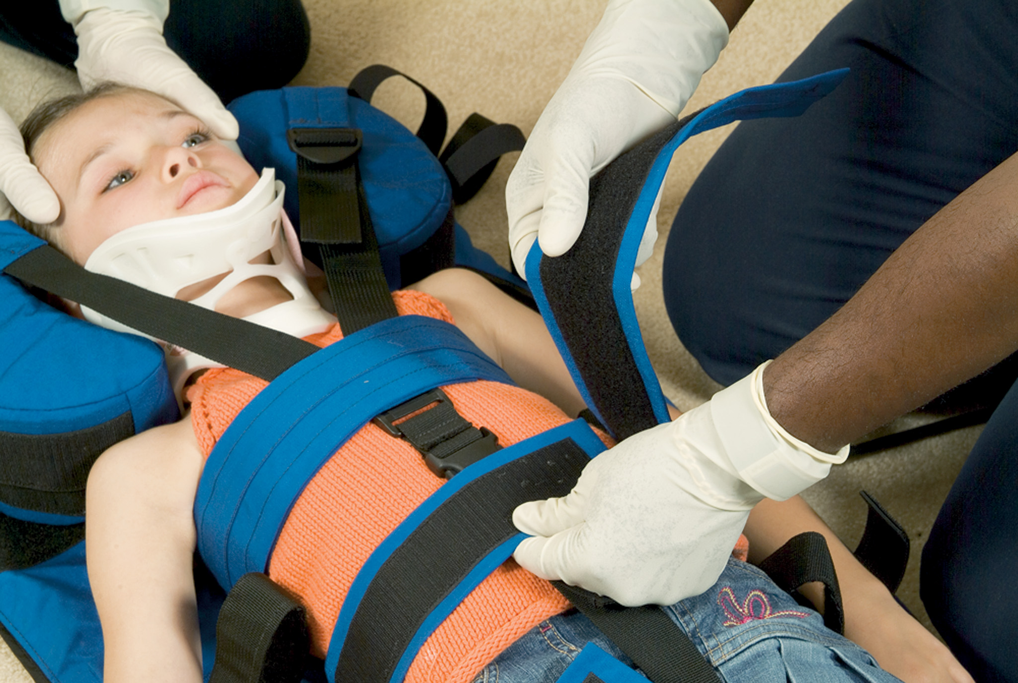
Secure the Three Body Straps across the Patient at the Chest, Waist, and above the Knees

Slide 192
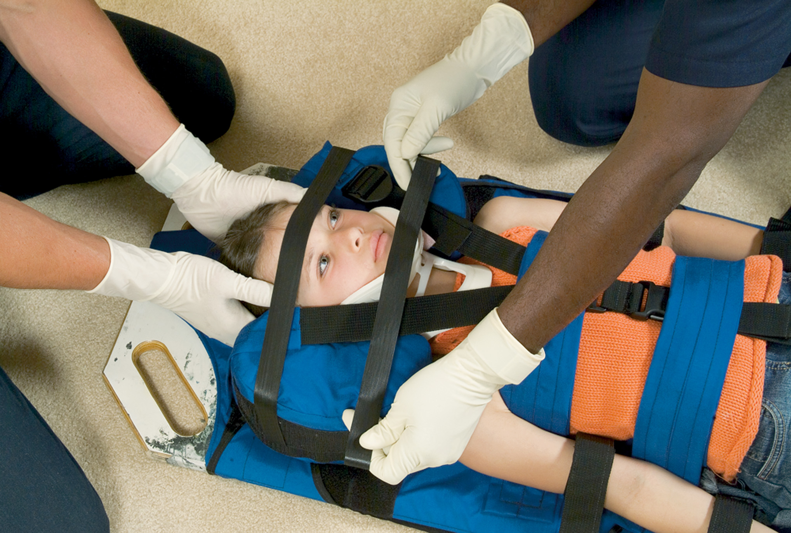
Secure the Arms and Legs Using the Extremity Straps
Place straps across the forehead and chin to securely affix the patient's head to the pediatric sleeve.

Slide 193
Child Fully Secured to a Backboard Device

Slide 194
Pediatric Trauma (14 of 14)
Injury Prevention
  Preventable childhood injuries account for 44percent of deaths between the ages of 1 and 19 years.
  Injury prevention must be of paramount concern to E M S providers.
Notes:
Discussion Question
What is the role of EMS in pediatric trauma prevention?
Class Activity
Have students use the website below and others to develop a child injury prevention program plan.
www.nhtsa.dot.gov/

Slide 195
Child Abuse and Neglect (1 of 10)
Physical abuse takes place when improper or excessive action is taken to injure or cause harm.
Sexual abuse indicates the involvement of a child in sexual activities for the gratification of an older or more powerful person.
Notes:
Critical Thinking Discussion
Why do you think the incidence of child abuse and child abuse deaths is increasing?
Discussion Question
What are some indications of abuse or neglect?

Slide 196
Child Abuse and Neglect (2 of 10)
Neglect is the provision of inadequate attention or respect to someone who has a claim to that attention.
Emotional abuse takes place when one person shames, ridicules, embarrasses, or insults another to damage the child victim's self-esteem.
Notes:
Discussion Questions
How should you interact with a child you believe has been abused or neglected?
What is the EMT's role in situations of suspected abuse or neglect?
Teaching Tips
Bring examples of any forms EMTs must fill out if they suspect abuse or neglect.
Knowledge Application
Students should be able to apply the information in this section to scenarios of suspected abuse or neglect.

Slide 197
Child Abuse and Neglect (3 of 10)
The adult who abuses a child often behaves in an evasive manner and may show outright hostility toward the child.
An abused child usually shows fear and reluctance when asked to describe how the injury occurred.
Notes:
The adult (often a caregiver) who abuses a child often behaves in an evasive manner, volunteering limited, inconsistent, and contradictory information in describing what happened to the child. The caregiver may show outright hostility toward the child or another caregiver and rarely shows any guilt. An abused child often shows fear and reluctance when asked to describe how the injury occurred.

Slide 198
Child Abuse and Neglect (4 of 10)
General Indications of Abuse and Neglect
  Multiple abrasions, lacerations, incisions, bruises, or broken bones
  Multiple injuries or bruises in various stages of healing
  Injuries on multiple planes of the body
  Unusual wounds and pattern injuries
  A fearful child.
Notes:
Review findings of child abuse and neglect. Integrate how to delineate between abuse and accidental injury.

Slide 199
Child Abuse and Neglect (5 of 10)
General Indications of Abuse and Neglect
  Injuries to non bumper areas such as the genitals, abdomen, back, buttocks, ears, and neck
  Injuries to the brain or spinal cord that occur when the infant or child is violently shaken.
Notes:
Review findings of child abuse and neglect. Integrate how to delineate between abuse and accidental injury.

Slide 200
Child Abuse and Neglect (6 of 10)
General Indications of Abuse and Neglect
  Injuries that do not match the mechanism of injury described
  Lack of adult supervision
  Untreated chronic illnesses.
Notes:
Review findings of child abuse and neglect. Integrate how to delineate between abuse and accidental injury.

Slide 201
Child Abuse and Neglect (7 of 10)
General Indications of Abuse and Neglect
  Malnourishment and unsafe living environment
  Delay in reporting injuries
  Implausible explanations based on the child’s developmental level.
Notes:
Review findings of child abuse and neglect. Integrate how to delineate between abuse and accidental injury.

Slide 202
Heater Radiator Burns on a Child’s Buttocks
Notes:
Discuss how the EMT should both manage this injury and interact with the family or care provider without raising suspicions of abuse.

Slide 203
Injuries from a Switch on the Thigh of a School-Age Child
Notes:
Discuss how the EMT should both manage this injury and interact with the family or care provider without raising suspicions of abuse.

Slide 204
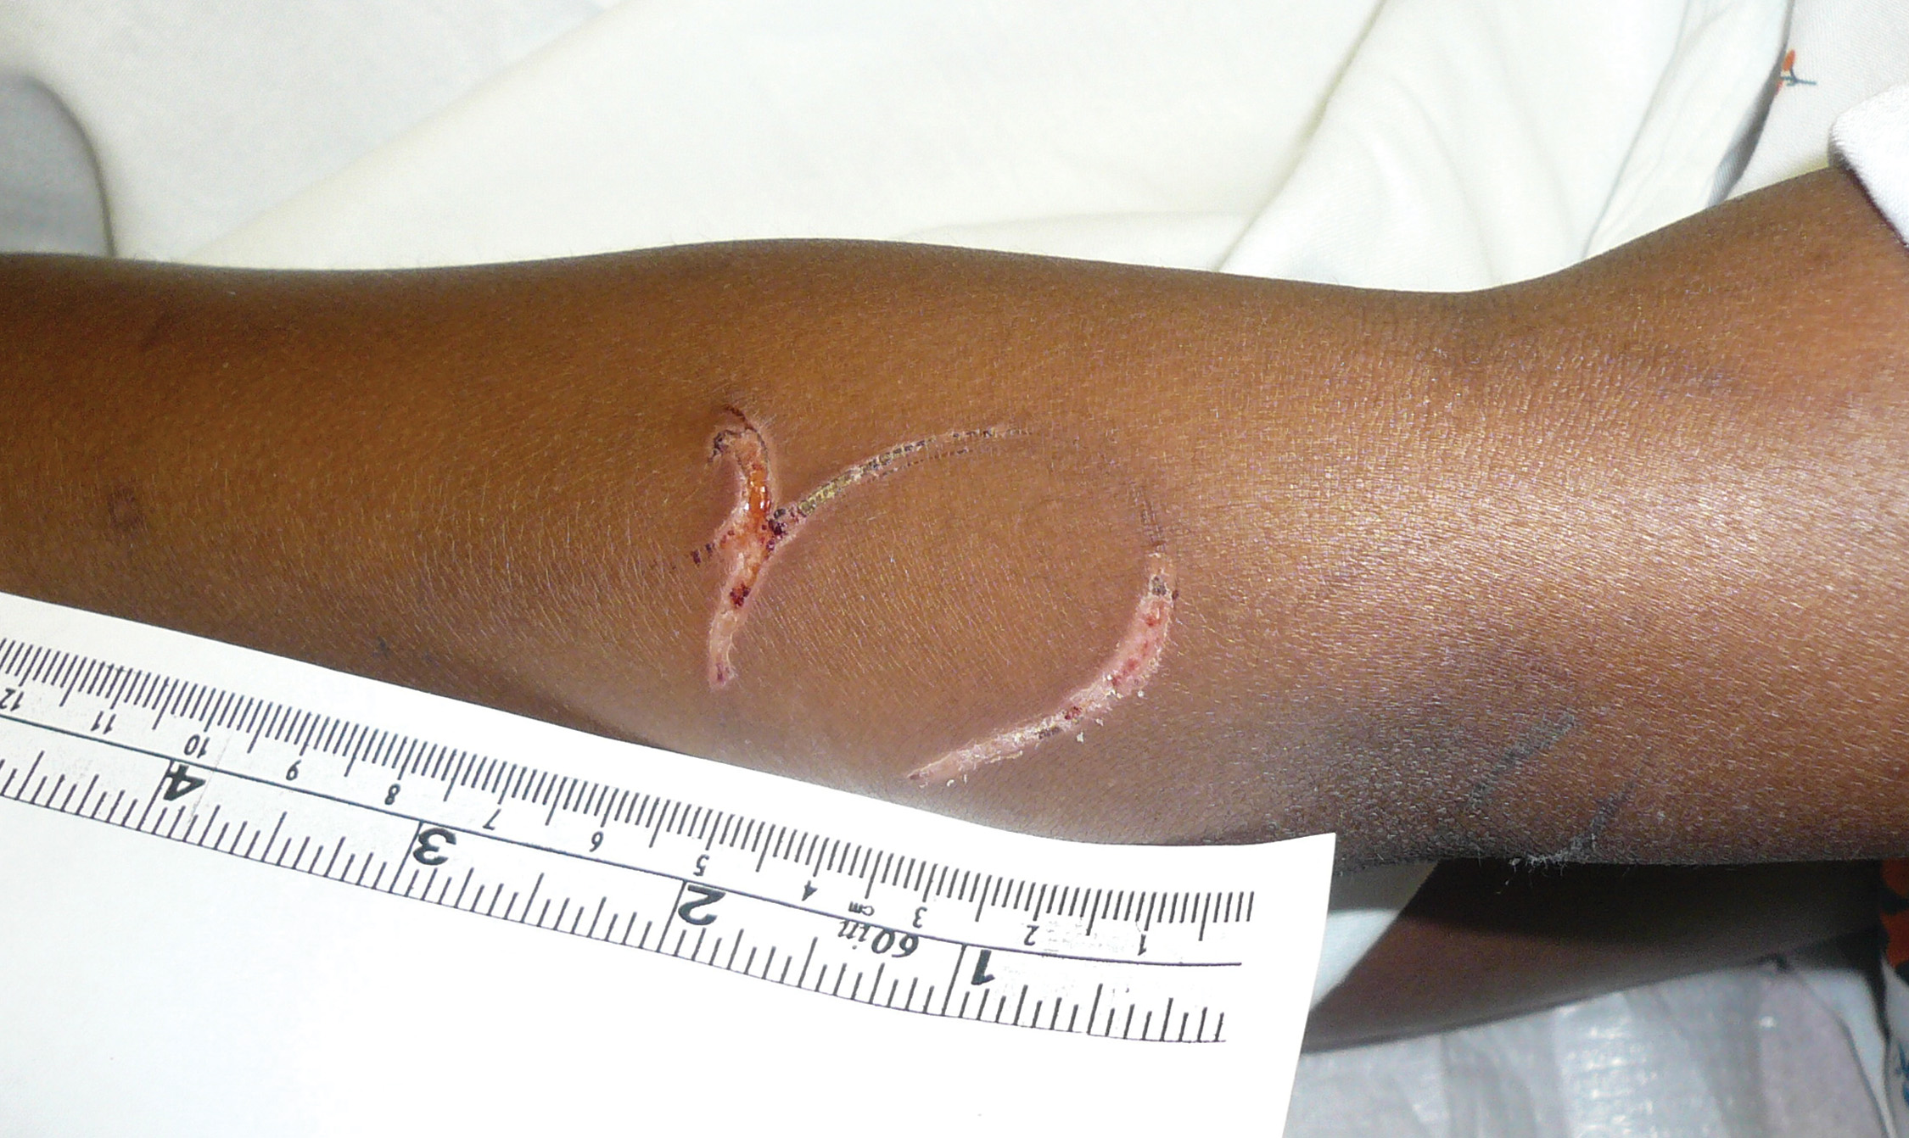
A Loop Mark on a School-Age Child from Being Whipped with an Electric Cord
Notes:
Discuss how the EMT should both manage this injury and interact with the family or care provider without raising suspicions of abuse.

Slide 205
Child Abuse and Neglect (8 of 10)
Emergency Medical Care Guidelines for Child Abuse
  Involve law enforcement if the scene is dangerous or you cannot gain access.
  Do not ask the child what happened while they are in the crisis environment.
  Perform a head-to-toe exam.
  Make observations as if the scene is a crime scene.
Notes:
All aspects of patient care should occur without confronting or alerting the possible perpetrator that these injuries are suspected to be that of child abuse or neglect.

Slide 206
Child Abuse and Neglect (9 of 10)
Emergency Medical Care Guidelines for Child Abuse
  Take the child to the hospital.
  Do not question the caregivers about abuse or make accusations.
  Do not allow the child to be alone with the suspected abuser.
  E M Ts are mandatory reporters of abuse.
Notes:
All aspects of patient care should occur without confronting or alerting the possible perpetrator that these injuries are suspected to be that of child abuse or neglect.

Slide 207
Child Abuse and Neglect (10 of 10)
Emergency Medical Care Guidelines for Child Abuse
  Document objectively.
  Record details.
  Keep information confidential.
Notes:
All aspects of patient care should occur without confronting or alerting the possible perpetrator that these injuries are suspected to be that of child abuse or neglect.

Slide 208
Special Care Considerations (1 of 4)
Emergency Medical Services for Children (E M S C) is designed to ensure that all children have access to appropriate emergency care.
Established in 1984, it has provided grant funding to all states.
Notes:
Discussion Question
What is the purpose of EMS for Children?
Teaching Tips
Discuss any local or state EMS for Children–funded projects.

Slide 209
Special Care Considerations (2 of 4)
Family Centered Care
  Advocates open communication with family members throughout the assessment and management of the child.
  E M S providers must be able to anticipate the physiological and emotional needs of the child.
Notes:
Discussion Question
What is the idea behind family-centered care?
Critical Thinking Discussion
What can you do to ensure that sick and injured children receive the best care possible?

Slide 210
Special Care Considerations (3 of 4)
Taking Care of Yourself
  Caring for infants and children can be stressful because of lack of experience in treating them, fear of failure, or identifying patients with your own children.
Notes:
Discussion Question
What are some common reactions to caring for ill and injured children?
Knowledge Application
Students should be able to apply the information in this section to the care of ill and injured children.

Slide 211
Special Care Considerations (4 of 4)
Taking Care of Yourself
  To Reduce Stress:
    Realize that much of what you know about adults applies to children, with variations in techniques.
    Practice skills.
    Focus on the task at hand.
Notes:
As a professional EMT, you need to control your emotions so that you can render the best possible assistance to your patient and be supportive of other victims. But after the incident is over, you still need to deal with those feelings. Most EMS systems have ready access to mental health services that can help defuse the stress that certain events can create. Use them. If not, find a trusted friend to listen to you and allow you to talk about the EMS field.

Slide 212
Case Study Conclusion (3 of 4)
Ben applies immediate in-line spine motion restriction of the patient’s head, reassuring them as he does so. Deb checks a radial pulse, noting that the patient’s skin is cool, the radial pulse is rapid, weak, and at a rate of 116. Deb places an oxygen mask on the patient, then completes a rapid secondary assessment. In addition to the suspected fractured femur, she also suspects an abdominal injury.
Notes:
Use the case study findings and discussion to highlight the presentation and help ensure the students are applying the information correctly.

Slide 213
Case Study Conclusion (4 of 4)
The E M T s provide spine motion restriction precautions and secure the patient on a long backboard, and begin transport to the emergency department.
Deb takes special care to keep the patient warm and reassesses vital signs every 5 minutes.
Notes:
Use the case study findings and discussion to highlight the presentation and help ensure the students are applying the information correctly.

Slide 214
Lesson Summary (1 of 3)
Each age group has specific emotional and physical characteristics that affect assessment and care.
Use the Pediatric Assessment Triangle or P A L S initial impression to form a general impression of whether the child is sick or well.
Notes:
Follow-Up
Answer student questions.
Follow-Up Assignments
Review Chapter 38 Summary.
Complete Chapter 38 In Review questions.
Complete Chapter 38 Critical Thinking questions.
Assessments
Handouts
Chapter 38 quiz.

Slide 215
Lesson Summary (2 of 3)
Respiratory problems are a common cause of medical emergencies in pediatric patients.
It is critical to recognize signs of respiratory distress and respiratory failure and to intervene immediately.
S I D S is the sudden, unexpected death of an infant in which an autopsy fails to identify the cause of death.
Notes:
Follow-Up
Answer student questions.
Follow-Up Assignments
Review Chapter 38 Summary.
Complete Chapter 38 In Review questions.
Complete Chapter 38 Critical Thinking questions.
Assessments
Handouts
Chapter 38 quiz.

Slide 216
Lesson Summary (3 of 3)
Pediatric anatomy causes some differences in patterns of traumatic injury.
Certain injury patterns and behaviors by a child and/or caregiver should alert you to the possibility of abuse or neglect.
Notes:
Class Activity
As an alternative to assigning the follow-up exercises in the lesson plan as homework, assign each question to a small group of students for in-class discussion.
Teaching Tips
Answers to In Review questions are in the appendix of the text. Advise students to review the questions again as they study the chapter.

Slide 217
Correct! (1 of 2)
Epiglottitis is a bacterial infection of the epiglottitis that leads to upper airway obstruction, which presents with respiratory distress and stridor. It is painful to swallow, leading to drooling. Although it is not common, epiglottitis is potentially life-threatening. Do not place anything in the mouth of a patient with suspected epiglottitis.
Click here to return to the Program.

Slide 218
Incorrect (1 of 4)
Croup is a respiratory infection that leads to swelling beneath the glottis, and can present with a classic “seal bark” cough. Fever, if present, is low grade. In severe cases, patients can present with stridor, but drooling would not be present.
Click here to return to the quiz.

Slide 219
Incorrect (2 of 4)
Pneumonia is an infection of the lungs that can make the patient quite ill with fever and respiratory distress. However, as an infection of the lower airway, it does not cause drooling or stridor.
Click here to return to the quiz.

Slide 220
Incorrect (3 of 4)
Bronchiolitis is an infection of lower airways that can make the patient quite ill with fever and respiratory distress. However, as an infection of the lower airway, it does not cause drooling or stridor.
Click here to return to the quiz.

Slide 221
Correct! (2 of 2)
The Pediatric Assessment Triangle uses appearance (skin color, muscle tone, etc.), work of breathing, and circulation to the skin to form a general impression of the patient “from the doorway.” Blood pressure is not part of this assessment.
Click here to return to the Program.

Slide 222
Incorrect (4 of 4)
The Pediatric Assessment Triangle uses appearance (skin color, muscle tone, etc.), work of breathing, and circulation to the skin to form a general impression of the patient “from the doorway.”
Click here to return to the quiz.

Slide 223
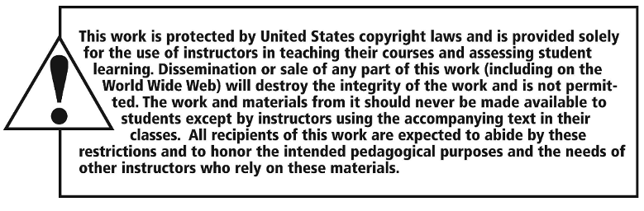
Copyright

