Slide 1
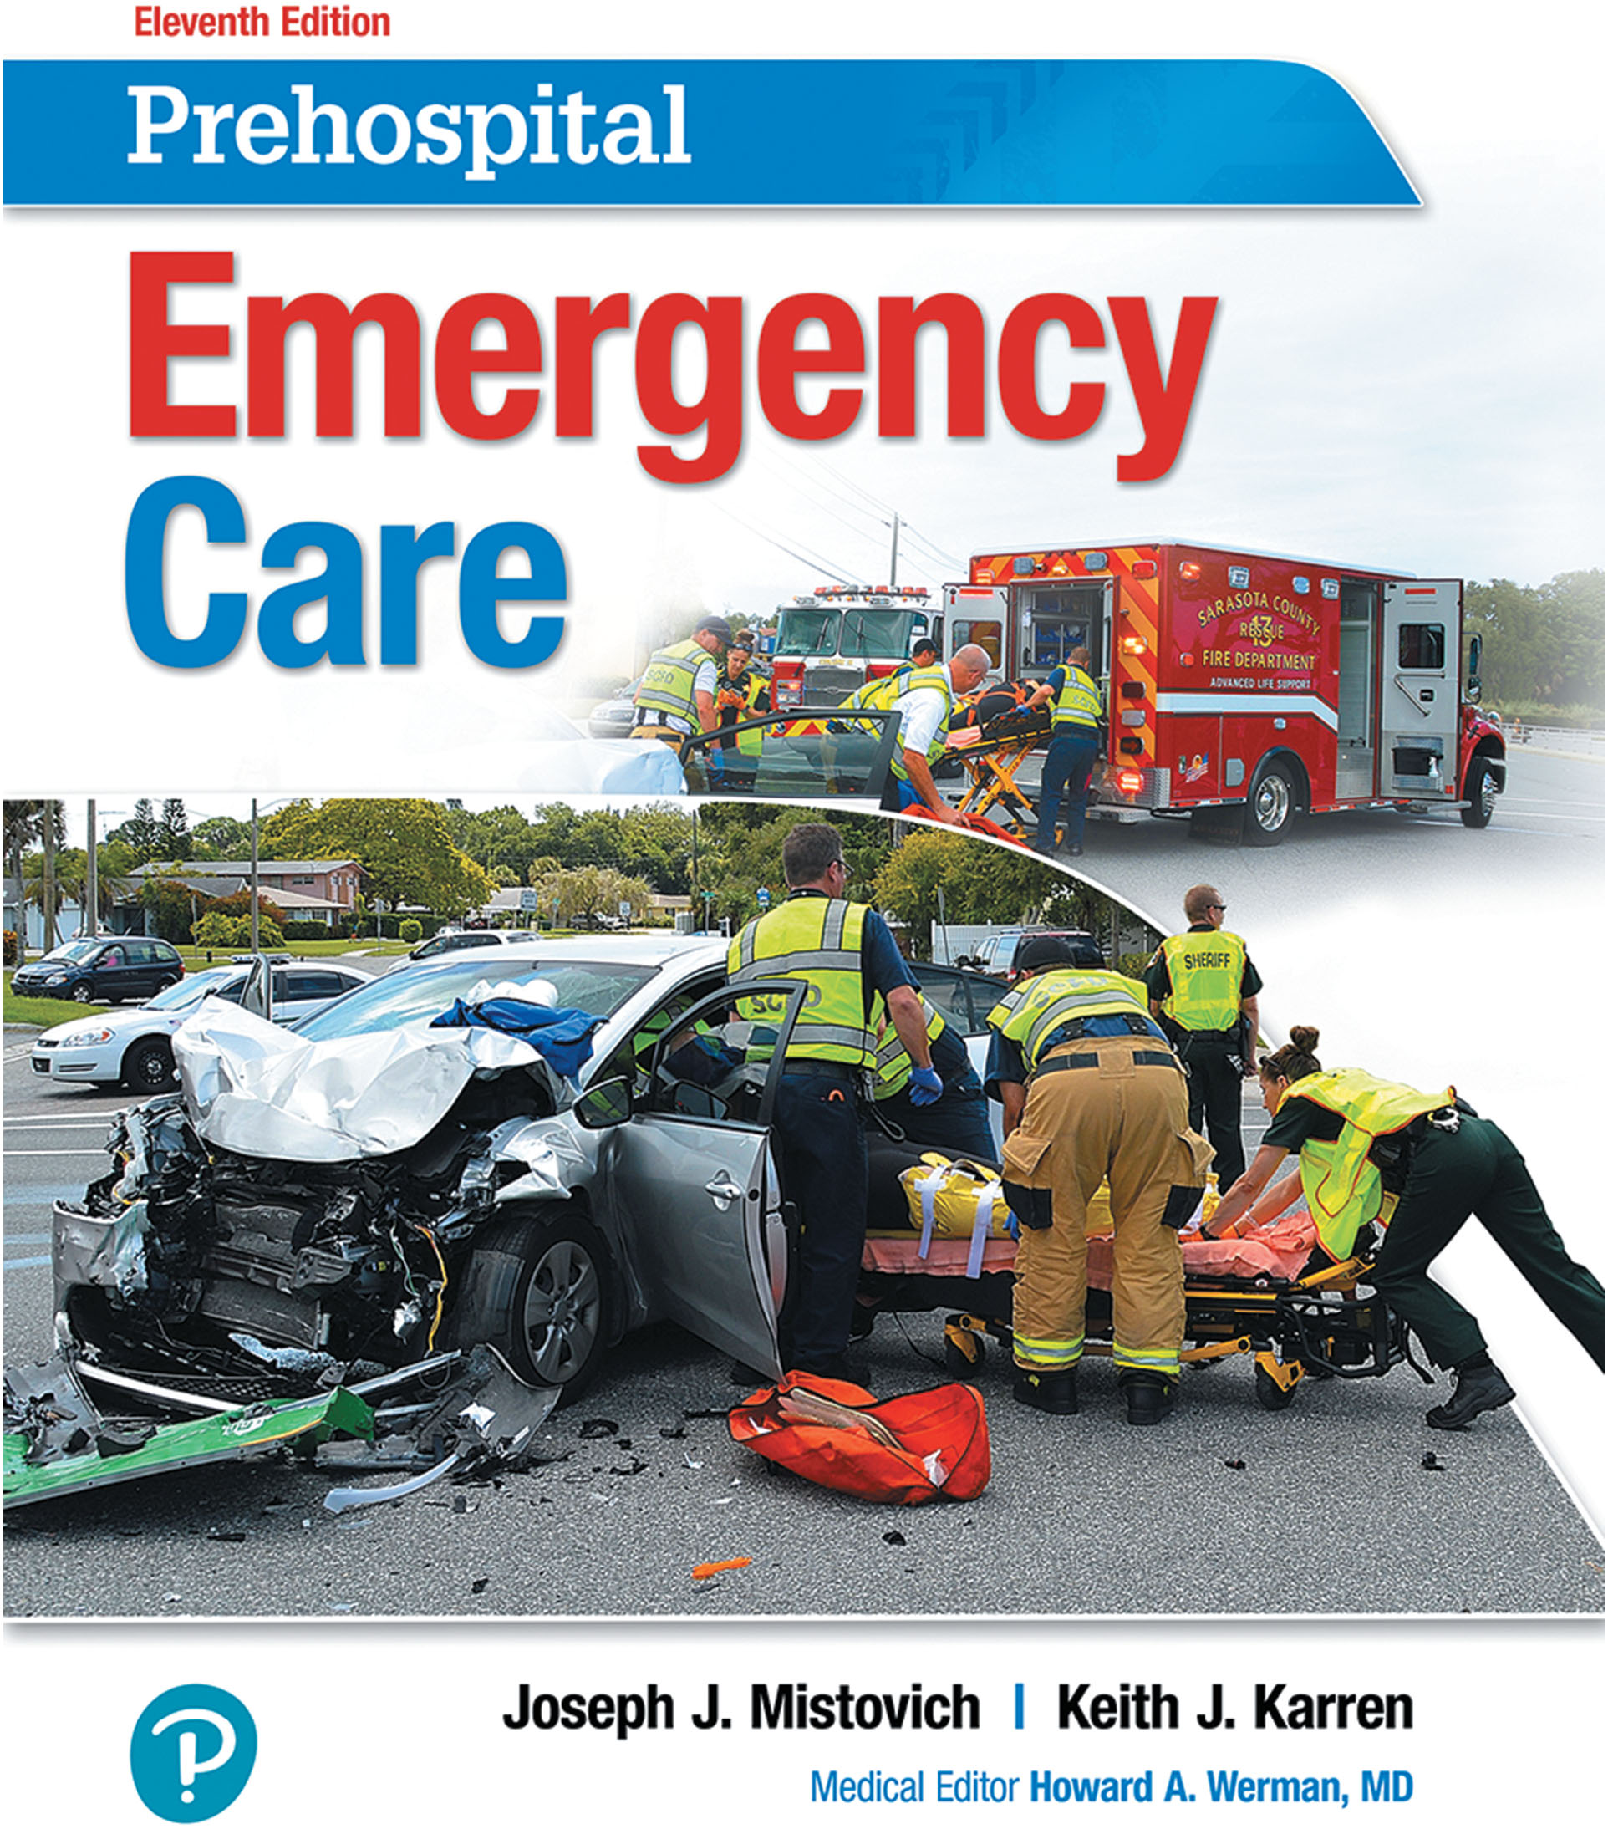
Prehospital: Emergency Care
Eleventh Edition
Chapter 37
Obstetrics and Care of the Newborn
Slides in this presentation contain hyperlinks. JAWS users should be able to get a list of links by using INSERT+F7
Copyright © 2018, 2014, 2010 Pearson Education, Inc. All Rights Reserved
Notes:
If this PowerPoint presentation contains mathematical equations, you may need to check that your computer has the following installed:
1) MathType Plugin
2) Math Player (free versions available)
3) NVDA Reader (free versions available)
Advance Preparation
Student Readiness
Assign the associated section of MyBRADYLab and review student scores.
Review the chapter material in the Instructor Resources, which includes Student Handouts, PowerPoint slides, and the MyTest Program.
Prepare
Make copies of course policies and procedures, the syllabus, handouts from the Instructor Resources, and other materials for distribution or post them in your learning management system.
Preview the media resources and Master Teaching Notes in this lesson.
Preview the Case Study presented in the PowerPoint slides.
The total teaching time recommended is only a guideline. Take into consideration factors such as the pace at which students learn, the size of the class, breaks, and classroom activities. The actual time devoted to teaching objectives is the instructor’s responsibility.

Slide 2
Learning Objectives
E M S Education Standards, text p. 1066.
Chapter Objectives, text p. 1066.
Key Terms, text p. 1067.
Purpose of lecture presentation versus textbook reading assignments.
Notes:
Explain to students what the National EMS Education Standards are. The National EMS Education Standards communicate the expectations of entry-level EMS providers. As EMTs, students will be expected to be competent in these areas. Acknowledge that the standards are broad, general statements. Although this lesson addresses the listed competencies, the competencies are often complex and require completion of more than one lesson to accomplish. The student is also expected to review the chapter objectives to foreshadow what will be in the chapter. By mastering the key terms the EMT student will better understand the learning and be able to communicate more clearly.
Additionally, explain to the students that the purpose of using these slides is to help keep the instructor focused on highlighting important portions of the material, explain interrelationships of topics, and discuss how to apply this information. It’s not the intent of the presentation (or slides alone) to include every component in the chapter. This presentation still requires the student to thoroughly read the chapter.

Slide 3
Setting the Stage
Overview of Lesson Topics
Anatomy and Physiology of the Obstetric Patient
Antepartum (Predelivery) Emergencies
Labor and Normal Delivery
Abnormal Delivery
Care of the Newborn
Notes:
These bulleted points are the major headings from the chapter, in order. Their purpose is to provide a basic lecture navigation for the student.

Slide 4
Case Study Introduction
E M T s Lacy Schroeder and Alan Phillips arrive on the scene of a dispatch for an O B call to find an obviously pregnant woman in her 30s who appears to be uncomfortable and anxious. “I’m only 35 weeks,” she says. “The baby shouldn’t be here for another month, but I think they’re coming now!”
Notes:
Case Study
Present the Case Study Introduction provided in the PowerPoint slide set.
Lead a discussion using the Case Study questions provided on the subsequent slide(s).
The Case Study with discussion questions continues throughout the PowerPoint presentation.
Case Study Discussion
Use the Case Study content and questions to foreshadow the upcoming lesson content.

Slide 5
Case Study (1 of 3)
At 35 weeks of gestation, what is the risk of distress if the baby is born now?
How should the E M T s prioritize the order of the information they need?
What factors will determine whether there is time to transport the patient to the hospital?
Notes:
Case Study Discussion
Use the Case Study content and questions to foreshadow the upcoming lesson content. Gauge the student’s responses as a guide of how well versed they are on this topic.

Slide 6
Introduction
Childbirth is a natural process.
On occasion, E M T s assist with out-of-hospital delivery.
Complications of pregnancy, labor, and delivery are not common, but E M T s must be prepared to manage them when they occur.
Notes:
During this lesson, students will learn how to recognize and provide emergency medical care for obstetric and gynecological emergencies.

Slide 7
Anatomy and Physiology of the Obstetric Patient (1 of 15)
Anatomy of Pregnancy
Ovaries
Produce hormones.
Release eggs (ova).
Fallopian Tubes
Fertilization of the ovum may occur.
Transport ovum to the uterus.
Notes:
Discussion Question
What are the layers of the uterus, from outermost to innermost?

Slide 8
Anatomy and Physiology of the Obstetric Patient (2 of 15)
Anatomy of Pregnancy
Uterus
Three sections: fundus, body, cervix
The cervix dilates to allow delivery.
Three layers: endometrium, myometrium, perimetrium
The smooth muscle layer contracts during labor.
Allows development of fetus
Notes:
The uterus is the pear-shaped organ that contains the developing fetus, the unborn baby.
The cervix contains a plug of mucus that seals the uterine opening during pregnancy, preventing contamination from entering the uterus. The plug is discharged when the cervix starts to dilate, and appears as pink-tinged mucus in the vaginal discharge. The expulsion of the plug signals the first stage of labor and is known as bloody show.

Slide 9
Anatomy and Physiology of the Obstetric Patient (3 of 15)
Anatomy of Pregnancy
Placenta
Temporary organ of pregnancy, attached to inner uterine wall
Highly vascular
Provides for fetal nourishment and waste removal
Separates from the uterus after delivery and is expelled
Notes:
The blood of the fetus and the blood of the mother do not mix, except during birth or miscarriage.
After the baby is born, the placenta separates from the uterine wall and is delivered as the afterbirth.

Slide 10
Anatomy and Physiology of the Obstetric Patient (4 of 15)
Anatomy of Pregnancy
Umbilical cord
The umbilical cord attaches the fetus to the placenta
The umbilical vein carries oxygen and nutrients to the fetus; umbilical arteries carry deoxygenated blood from the fetus to the placenta.
Notes:
The placenta contains one vein and two arteries in a spiral arrangement that is covered by a protective substance called Wharton jelly. The vessels in the umbilical cord are unique: The vein carries oxygenated blood and nutrients to the fetus, and the arteries carry deoxygenated blood and waste products back to the placenta. The structure of the cord and the blood traveling through it keep it from kinking.

Slide 11
Anatomy and Physiology of the Obstetric Patient (5 of 15)
Anatomy of Pregnancy
Amniotic Sac
Encloses the fetus
Contains 500 to 1,000 milliLitre of amniotic fluid
May rupture at the beginning of labor
Notes:
The amniotic sac is filled with the amniotic fluid in which the baby floats, insulating and protecting it throughout the pregnancy.

Slide 12
Anatomy and Physiology of the Obstetric Patient (6 of 15)
Anatomy of Pregnancy
Vagina
Lower portion of the birth canal
Extends from the cervix to an external opening of the body
Notes:
When the fetus moves down into the vagina, the head causes the vaginal walls to bulge, especially during a contraction, and the top of the head appears at the vaginal opening. This is known as crowning and is a sign of imminent delivery.

Slide 13
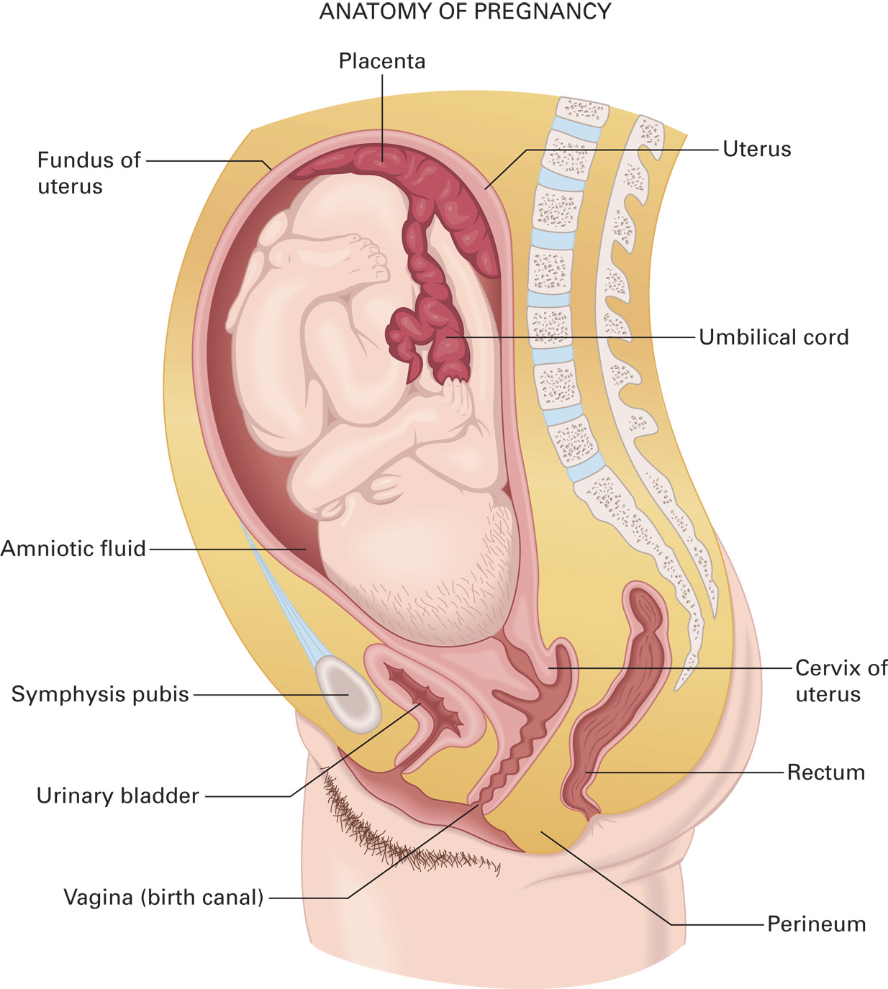
Anatomy of Pregnancy
Notes:
Review the relative anatomic structures to obstetrics.

Slide 14
Anatomy and Physiology of the Obstetric Patient (7 of 15)
Menstrual Cycle
The cycle averages 28 days and is controlled by estrogen and progesterone.
The first day of the cycle begins with menstruation.
During menstruation, the endometrium is shed.
After menstruation, the endometrium is rebuilt.
Notes:
On day 14 of the cycle, ovulation occurs.
The ovum travels through the fallopian tube, where it may be fertilized.
If fertilization occurs, the ovum is implanted into the endometrium.
Teaching Tips
Ask students to take turns, each listing one of the sequential events or benchmarks from ovulation to delivery.
Discussion Question
At what point in the menstrual cycle does ovulation occur?
Critical Thinking Discussion
How do multiple-gestation pregnancies occur?
How might hormonal contraceptives affect the reproductive tract to prevent pregnancy?

Slide 15
Anatomy and Physiology of the Obstetric Patient (8 of 15)
Prenatal Period
For the first 14 days, the fertilized ovum is in the pre-embryonic phase.
The period from Day 15 to 8 weeks is the embryonic stage.
The period from 8 weeks to birth is the fetal stage.
At birth, the baby is called a neonate.
Pregnancy lasts 280 days, or nine calendar months.
Notes:
Pregnancy is also referred to as gestation. Gestational age refers to the age of the fetus in weeks, from the time of fertilization of the ovum through delivery.
Each 3-month period of the approximately 9-month pregnancy is referred to as a trimester.
Discussion Questions
At what point does the placenta develop? In which portion of the uterus is it normally located?
How is gestational age measured?

Slide 16
Anatomy and Physiology of the Obstetric Patient (9 of 15)
Physiologic Changes in Pregnancy
Caused by hormones, growing fetus, and increased metabolic rate
Many body systems affected
Notes:
Discussion Question
What are some of the physiological changes of pregnancy?
Knowledge Application
Students should be able to apply knowledge of the anatomy and physiology of the female reproductive system to the assessment and management of obstetric patients.

Slide 17
Anatomy and Physiology of the Obstetric Patient (10 of 15)
Physiologic Changes in Pregnancy
Reproductive System
Uterus substantially increases in size.
The uterus is extremely vascular and contains about one-sixth of the mother’s blood volume.
A mucus plug forms in the opening to the cervix.
The breasts enlarge in preparation for lactation.
Notes:
The prepregnant uterus weighs about 2 ounces and holds approximately 10 mL. At the end of pregnancy, the uterus weighs more than 2 pounds and holds 5,000 mL.
The pregnant uterus is extremely vascular and contains approximately one sixth of the total blood volume of the mother.
A mucous plug forms in the opening to the cervix (os) to protect the fetus from infection.
The breasts enlarge and become more nodular in preparation for lactation (milk production).

Slide 18
Anatomy and Physiology of the Obstetric Patient (11 of 15)
Physiologic Changes in Pregnancy
Respiratory System
The mother’s oxygen demand increases.
Respiratory tract resistance decreases.
Tidal volume increases by 40%.
Respiratory rate increases slightly.
Oxygen consumption increases by 20%.
Notes:
The respiratory tract resistance decreases as a result of hormones causing smooth muscle dilation.
The tidal volume increases by 40 percent; however, the functional reserve volume decreases, meaning the pregnant patient has respiratory reserve.
There is an increase in oxygen consumption of approximately 20 percent.

Slide 19
Anatomy and Physiology of the Obstetric Patient (12 of 15)
Physiologic Changes in Pregnancy
Cardiovascular System
Cardiac output increases.
Maternal blood volume increases.
Maternal heart rate increases by 10-15 beatsperminute.
B P decreases slightly in the first and second trimesters and returns to normal in the third trimester.
Notes:
Maternal blood volume increases by 45 percent. There is also an increase in red blood cell (RBC) content and plasma; however, the plasma volume increase is greater than the RBCs, causing a relative anemia. The pregnant patient is given iron supplements to increase oxygen binding on the RBC. This blood volume increase delays the signs and symptoms of shock in the pregnant patient.

Slide 20
Anatomy and Physiology of the Obstetric Patient (13 of 15)
Physiologic Changes in Pregnancy
Gastrointestinal System
Nausea and vomiting commonly occur during the first trimester.
Bloating and constipation may occur from a decrease in peristalsis.
Notes:
Nausea and vomiting commonly occur during the first trimester as a result of hormone changes and the change in the need for carbohydrates.

Slide 21
Anatomy and Physiology of the Obstetric Patient (14 of 15)
Physiologic Changes in Pregnancy
Urinary System
Renal blood flow increases.
Glomerular filtration increases.
Urinary bladder is displaced superiorly and anteriorly, increasing the risk of injury.
Urinary frequency increases in the first and third trimesters.
Notes:
Glomerular filtration increases by approximately 50 percent during the second trimester and remains elevated.
An increase in urinary frequency is common in the first and third trimester because of the uterus compressing the bladder.

Slide 22
Anatomy and Physiology of the Obstetric Patient (15 of 15)
Physiologic Changes in Pregnancy
Musculoskeletal System
Pelvic joints loosen as a result of hormone changes.
The center of gravity changes caused by the heavy uterus; accompanied by lower back pain.
Notes:
The mother’s center of gravity changes because of the heavy uterus. The patient compensates for this and therefore often experiences lower back pain.

Slide 23
Antepartum (Predelivery) Emergencies (1 of 31)
Antepartum Condition—Hyperemesis Gravidarum
Extreme morning sickness is accompanied by severe nausea and vomiting.
Increased hormone levels may cause the severe nausea and vomiting.
Notes:
The symptoms of hyperemesis gravidarum usually occur between 4 and 6 weeks of pregnancy and can peak between weeks 9 and 13.
Teaching Tip
Invite an OB nurse to speak on these emergencies.
Discussion Question
How are placenta previa and abruptio placentae different?
Critical Thinking Discussion
Why is maternal cocaine use a risk factor for abruptio placentae?
What are some other potential risks of maternal substance abuse?

Slide 24
Antepartum (Predelivery) Emergencies (2 of 31)
Antepartum Condition—Hyperemesis Gravidarum
Assessment
Severe nausea
Severe vomiting
Excessive salivation
Headaches
Syncope
Jaundice
Notes:
Additional signs and symptoms include:
Weight loss of 5 percent or more of prepregnancy weight
Confusion, decreased ability to concentrate
Extreme fatigue
Hypotension
Tachycardia
Poor skin turgor
Dry mucous membranes
Anxiety, depression
Irritability.

Slide 25
Antepartum (Predelivery) Emergencies (3 of 31)
Antepartum Condition—Hyperemesis Gravidarum
Emergency Medical Care
Care is primarily supportive.
Ensure an adequate airway, ventilation, and oxygenation.
Notes:
If the SpO₂ is <94% or if poor perfusion and hypovolemia from severe dehydration are suspected, administer oxygen. It is important to distinguish this condition from typical nausea and vomiting associated with pregnancy.

Slide 26
Antepartum (Predelivery) Emergencies (4 of 31)
Antepartum Conditions Causing Hemorrhaging
Uterine bleeding may or may not be associated with vaginal bleeding.
Hemorrhage may be life-threatening.
Causes include spontaneous abortion, placenta previa, abruptio placentae, ruptured uterus, and ectopic pregnancy.
Notes:
If bleeding occurs behind the placenta where the margins of the placenta are intact, there will be no vaginal bleeding, even though the patient can lose a significant amount of blood and present in hypovolemic shock.

Slide 27
Antepartum (Predelivery) Emergencies (5 of 31)
Antepartum Conditions Causing Hemorrhaging
Spontaneous Abortion (Miscarriage)
Delivery of the fetus and placenta before the fetus is viable (before 20 weeks of gestation)
Most often occurs before 12 weeks of gestation
Notes:
The cause is usually genetic (50 percent of cases), or it can be caused by a uterine abnormality, infection, drugs, or maternal disease. Cramping and vaginal bleeding are usually present at 8 to 12 weeks of gestation.
Discussion Question
What are some risk factors for uterine rupture?
Discussion Question
What is an ectopic pregnancy?

Slide 28
Antepartum (Predelivery) Emergencies (6 of 31)
Antepartum Conditions Causing Hemorrhaging
Spontaneous Abortion (Miscarriage)
Assessment
Cramplike lower abdominal pain, similar to labor
Moderate to severe vaginal bleeding, which may be bright or dark red
Passage of tissue or blood clots
Notes:
The spontaneous abortion is a naturally occurring expulsion of the fetus that is generally related to a genetic abnormality. An elective abortion is the termination of the pregnancy in a medical setting upon the mother’s request.
Any tissue that is retained within the uterus following a spontaneous abortion can lead to severe bleeding and infection. Transport any patient with a suspected spontaneous abortion.
Emergency Medical Care—Provide emergency care for shock if the signs and symptoms are present.
Provide emotional support to the mother and the members of their family throughout treatment and transport. Intense grief over loss of the pregnancy is normal and expected in both parents. The most significant danger to the patient is severe bleeding from the point where the fetal tissue separated from the uterus.

Slide 29
Antepartum (Predelivery) Emergencies (7 of 31)
Antepartum Conditions Causing Hemorrhaging
Ectopic Pregnancy
A fertilized ovum is implanted outside the uterus, usually in a fallopian tube.
The tissue which surrounds the developing embryo ruptures.
Notes:
The predisposing factors for an ectopic pregnancy are:
Previous ectopic pregnancies
Pelvic inflammatory disease (PID)
Adhesions from surgery
Tubal surgery, including elective tubal ligation
Intrauterine device.

Slide 30
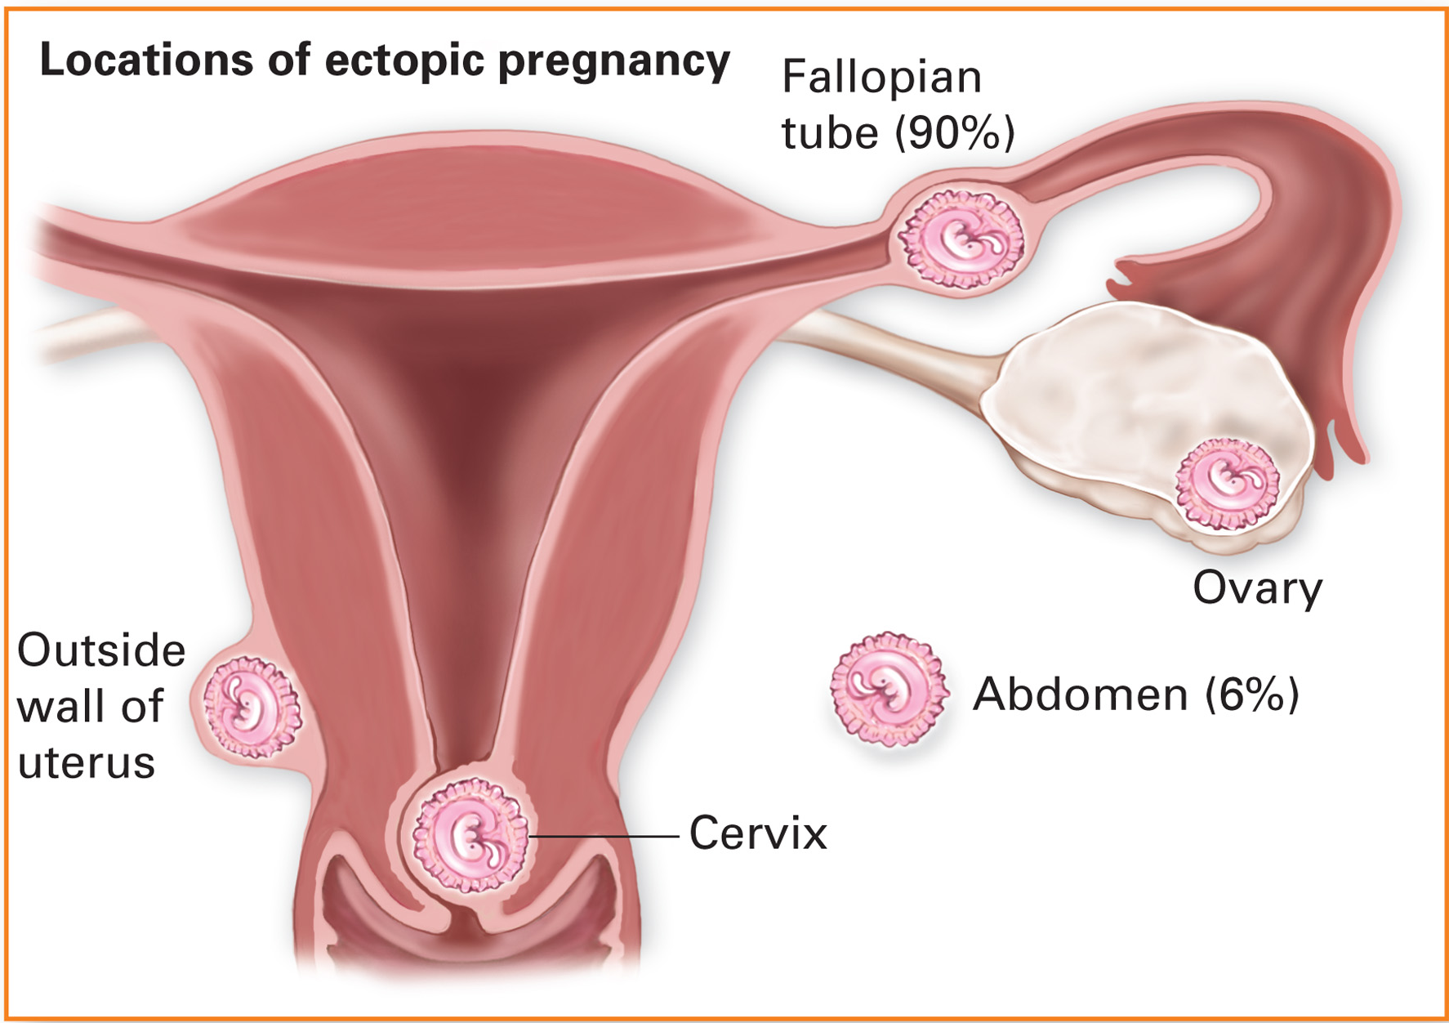
Ectopic Pregnancy
Notes:
The placenta eventually invades surrounding tissue and, unable to accommodate the growing embryo, the tissue ultimately ruptures.

Slide 31
Antepartum (Predelivery) Emergencies (8 of 31)
Antepartum Conditions Causing Hemorrhaging
Ectopic Pregnancy
Assessment
Dull, aching pain
Shoulder pain
Vaginal bleeding
Tender, bloated abdomen
Palpable mass in the abdomen
Decreased blood pressure
Notes:
Additional signs and symptoms include:
Increased pulse rate
Dull, aching pain that is poorly localized and becomes sharp, and localized to one lower quadrant
Weakness or dizziness when sitting or standing
Signs of shock
Discoloration around the umbilicus
Urge to defecate.

Slide 32
Antepartum (Predelivery) Emergencies (9 of 31)
Antepartum Conditions Causing Hemorrhaging
Ectopic Pregnancy
Emergency Medical Care
Follow the general guidelines for emergency medical care of a predelivery emergency.
Notes:
The primary treatment is to administer a high concentration of oxygen, regardless of the SpO₂ reading and oxygenation status of the pregnant patient, via a nonrebreather mask at 15 lpm to maximize oxygenation of the fetus. Transport the patient to a facility that can manage a surgical emergency.

Slide 33
Antepartum (Predelivery) Emergencies (10 of 31)
Placenta Previa
Antepartum Conditions Causing Hemorrhaging
Pathophysiology
Condition is caused by an abnormal implantation of the placenta near or over the cervix.
Excessive bleeding can occur as the cervix begins to dilate; the bleeding is painless.
Hemorrhage may be total, partial, or marginal.
Notes:
Predisposing factors for placenta previa are:
Multiparity (more than two deliveries)
Rapid succession of pregnancies
Greater than 35 years of age
Previous placenta previa
History of early vaginal bleeding
Bleeding immediately after intercourse during pregnancy.

Slide 34
Antepartum (Predelivery) Emergencies (11 of 31)
Placenta Previa
Antepartum Conditions Causing Hemorrhaging
Pathophysiology
Anticipate and treat the patient for shock.
Notes:
Predisposing factors for placenta previa:
Multiparity (more than two deliveries)
Rapid succession of pregnancies
Greater than 35 years of age
Previous placenta previa
History of early vaginal bleeding
Bleeding immediately after intercourse during pregnancy

Slide 35
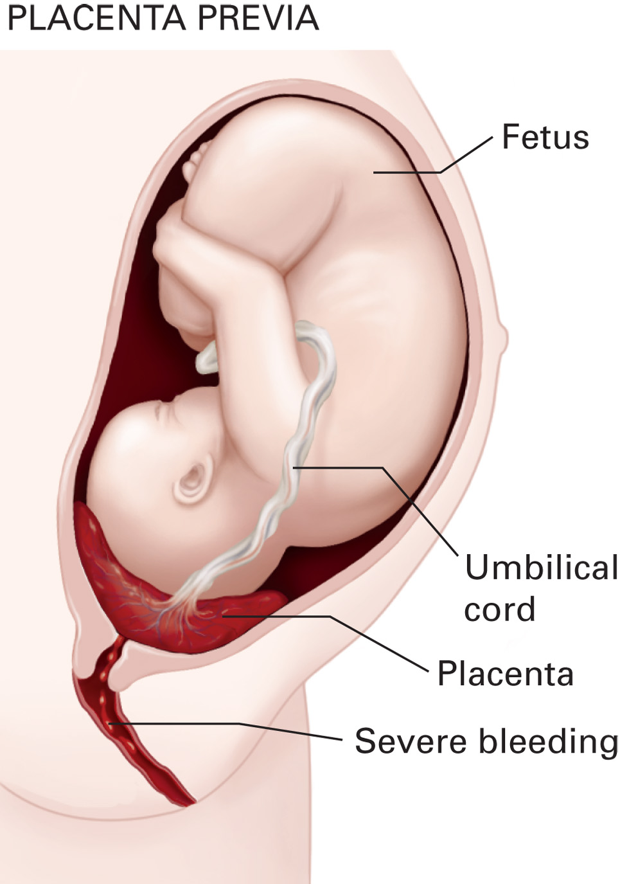
Placenta Previa
Notes:
Major concerns are blood loss for the mother and hypoxia and distress for the fetus. This is a situation in which, regardless of the SpO₂ reading and oxygenation status of the pregnant patient, a high concentration of oxygen is administered via a nonrebreather mask at 15 lpm to maximize oxygenation of the fetus.

Slide 36
Antepartum (Predelivery) Emergencies (12 of 31)
Antepartum Conditions Causing Hemorrhaging
Abruptio Placentae
Abnormal separation of the placenta from the uterine wall prior to delivery
Fetal — A reduction in fetal blood flow causes fetal hypoxia, inadequate nutrient delivery, and poor elimination of carbon dioxide and other waste products.
Maternal — Severe hemorrhage and hypovolemic shock.
Notes:
Bleeding occurs from the arteries between the uterine wall and placenta, and the bleeding separates the placenta from the uterine wall.
In a complete abruption, the placenta completely separates from the uterine wall. A complete abruptio placentae carries a 100 percent fetal mortality rate.
In a partial abruptio placentae, the placenta is partially torn from the uterine wall. Because it remains partially attached, it is associated with a 30 to 60 percent, rather than a total, fetal mortality rate. The type of abruption cannot be distinguished; therefore, it is important to transport any patient with a suspected placental abruption.
Predisposing factors for an abruptio placentae are:
Hypertension
Use of cocaine or other vasoactive drugs
Preeclampsia
Multiparity (several births)
Previous abruption
Smoking
Short umbilical cord
Premature rupture of the amniotic sac
Diabetes mellitus
Trauma involving the abdomen during pregnancy.

Slide 37
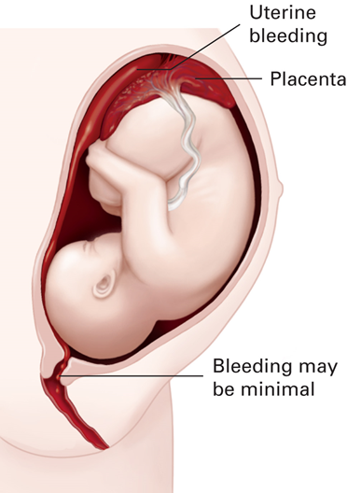
Abruptio Placentae
Notes:
Because the head of the fetus might block a large amount of blood flow from the vaginal opening, use the clinical signs and symptoms of shock to gauge the severity of blood loss.

Slide 38
Antepartum (Predelivery) Emergencies (13 of 31)
Antepartum Conditions Causing Hemorrhaging
Abruptio Placentae
Assessment
Vaginal bleeding
Abdominal pain
Lower back
Uterine contractions
Symptoms of hypovolemic shock
Notes:
Vaginal bleeding, which can be severe, minimal, or absent, depending on the location of the head of the fetus.
Abdominal tenderness upon palpation.
Constant abdominal pain from uterine muscle spasms that can be mild or acute. If the patient is in labor and having contractions, the pain will not subside and will be constant, even between contractions.
Pain in the lower back.
Uterine contractions.
Signs and symptoms of hypovolemic shock if bleeding is severe or occurs over a longer period of time.

Slide 39
Antepartum (Predelivery) Emergencies (14 of 31)
Antepartum Conditions Causing Hemorrhaging
Abruptio Placentae
Emergency Medical Care
Administer the same care as for the placenta previa.
Administer concentration oxygen.
Treat for hypovolemic shock.
Notes:
The primary treatment is to administer a high concentration of oxygen, regardless of the SpO₂ reading and oxygenation status of the pregnant patient, via a nonrebreather mask at 15 lpm to maximize oxygenation of the fetus. Treat the patient for shock and provide immediate transport, preferably to a medical facility than can manage surgical obstetric emergencies.

Slide 40
Antepartum (Predelivery) Emergencies (15 of 31)
Antepartum Conditions Causing Hemorrhaging
Ruptured Uterus
Pathophysiology
Possibility of the uterine wall rupturing, releasing the fetus into the abdominal cavity
High mortality rate
Severe maternal hemorrhaging and severe fetal distress
Requires immediate surgery
Notes:
A ruptured uterus results in severe maternal hemorrhaging and fetal distress and requires immediate surgery.

Slide 41
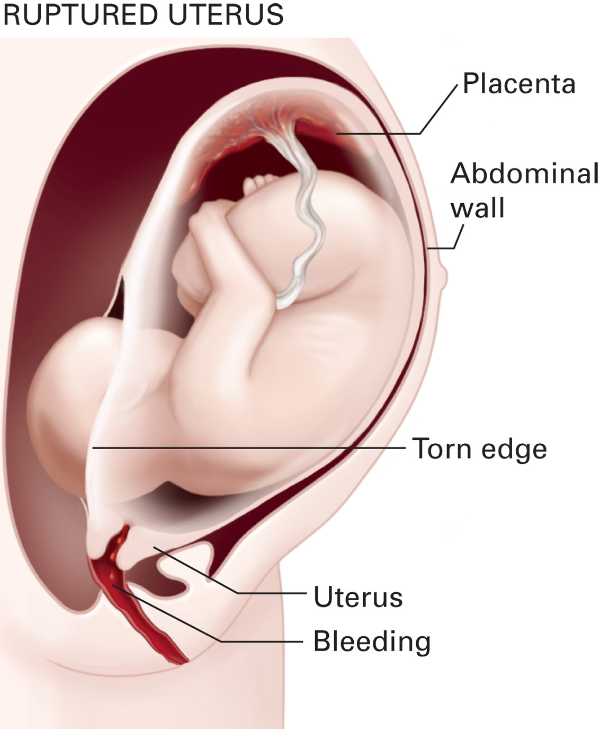
Ruptured Uterus
Notes:
As the uterus enlarges during pregnancy, the uterine wall becomes extremely thin, especially around the cervix.

Slide 42
Antepartum (Predelivery) Emergencies (16 of 31)
Antepartum Conditions Causing Hemorrhaging
Ruptured Uterus
Assessment
History of previous uterine rupture
History of abdominal trauma
More than two previous births
Prolonged, difficult labor
Constant, severe abdominal pain
Signs and symptoms of shock
Notes:
Additional assessment findings include:
Large fetus
Nausea
Prior cesarean birth or uterine surgery
Tearing or shearing sensation in the abdomen
Vaginal bleeding
Cessation of uterine contractions
Palpation of the fetus through the abdominal wall.

Slide 43
Antepartum (Predelivery) Emergencies (17 of 31)
Antepartum Conditions Causing Hemorrhaging
Ruptured Uterus
Emergency Medical Care
Follow the general guidelines for emergency medical care of a predelivery emergency.
Notes:
The primary treatment is to administer a high concentration of oxygen, regardless of the SpO₂ reading and oxygenation status of the pregnant patient, via a nonrebreather mask at 15 lpm to maximize oxygenation of the fetus. Transport the patient to a facility that can manage a surgical obstetric emergency.

Slide 44
Antepartum (Predelivery) Emergencies (18 of 31)
Antepartum Seizures and Hypertensive Emergencies
Seizures During Pregnancy
Status epilepticus is especially dangerous.
Provide the same care as for any seizure patient.
Transport the patient on their left side or with their right hip elevated at least 15 degrees to the left if they are at greater than 20 weeks of gestation.
Notes:
Seizures can result in maternal injury, hypoxia, hypercarbia, increased intracranial pressure, acidosis, hyperthermia, and possible abruptio placenta. Death of the mother can also result from cerebral hemorrhaging, respiratory arrest, kidney failure, or circulatory collapse. The fetus will most likely experience hypoxia during the seizure.
Seizures can be associated with hypertensive emergency eclampsia.

Slide 45
Antepartum (Predelivery) Emergencies (19 of 31)
Antepartum Seizures and Hypertensive Emergencies
Pregnancy-Induced Hypertension
Maternal blood pressure greater than
mmHg on two or more occasions at 6 hours apart
Resolves upon delivery of the baby
Notes:
If the patient has a lower blood pressure prior to the pregnancy, an increase in the systolic blood pressure of greater than 30 mmHg, and a diastolic blood pressure greater than 15 mmHg above the baseline blood pressure is used to define the condition.

Slide 46
Antepartum (Predelivery) Emergencies (20 of 31)
Antepartum Seizures and Hypertensive Emergencies
Preeclampsia/Eclampsia
Preeclampsia occurs most frequently in the last trimester and is most likely to affect women in their 20s who are pregnant for the first time.
Eclampsia is a more severe form of preeclampsia and includes coma or seizures.
Notes:
Discussion Question
What are preeclampsia and eclampsia?

Slide 47
Antepartum (Predelivery) Emergencies (21 of 31)
Antepartum Seizures and Hypertensive Emergencies
Preeclampsia/Eclampsia
Pathophysiology
History of hypertension, diabetes, kidney (renal) disease, liver (hepatic) disease, or heart disease
No previous pregnancies
History of poor nutrition
Sudden weight gain
Notes:
The cause of preeclampsia is unknown; it is thought to be a result of a vasospasm, increasing the mother’s blood pressure and decreasing blood flow to the fetus. Preeclampsia typically occurs in the last 10 weeks of pregnancy, during labor, or within the first 48 hours after delivery. In fact, preeclampsia can occur up to 2 weeks after delivery.
Risk factors in pregnant patients for developing preeclampsia include:
Pregnancy for the first time (primaparity)
Pregnancy with multiple gestations (twins, triplets, or more)
Known history of previous preeclampsia
Obesity
Diabetes mellitus
Connective tissue disorders
Preexisting hypertension (prior to the pregnancy).

Slide 48
Antepartum (Predelivery) Emergencies (22 of 31)
Antepartum Seizures and Hypertensive Emergencies
Preeclampsia/Eclampsia
Assessment
Altered mental status
Abdominal pain
Blurred vision or spots before the eyes
Excessive swelling of the face, fingers, legs, or feet
Notes:
Assessment findings include:
Elevated blood pressure usually greater than 140/90 mmHg or a systolic increase of over 30 mmHg and/or a diastolic increase of more than 15 mmHg of prepregnancy pressure
Severe preeclampsia, associated with a blood pressure of 160/110 mmHg or higher
Visual disturbances, including blurred vision, light sensitivity, spots before the eyes, or loss of vision
Signs of pulmonary edema such as crackles upon auscultation, respiratory distress and an SpO₂ reading of 694%
Sudden weight gain
Altered mental status
Epigastric abdominal pain or right upper quadrant pain
Nausea and vomiting
Excessive swelling of the face, fingers, legs, or feet
Decreased urine output
Severe, persistent headache.

Slide 49
Antepartum (Predelivery) Emergencies (23 of 31)
Antepartum Seizures and Hypertensive Emergencies
Supine Hypotensive Syndrome
Complication occurs in the third-trimester.
The weight of the fetus compresses the inferior vena cava when the patient is in a supine position.
Notes:
Compression of the inferior vena cava when the patient is in a supine position reduces the blood flow to the right atrium, which decreases the preload. The decrease in the preload reduces the stroke volume and in turn reduces the cardiac output. The decrease in cardiac output reduces the systolic blood pressure and perfusion.

Slide 50
Antepartum (Predelivery) Emergencies (24 of 31)
Antepartum Seizures and Hypertensive Emergencies
Supine Hypotensive Syndrome
Assessment
Dizziness or light-headedness when in a supine position
Tachycardia
Cool, clammy skin
Decrease in blood pressure
Notes:
Because the signs and symptoms of supine hypotensive syndrome mimic those of hypovolemia, it is
extremely important to assess for any possible blood loss as the cause of this condition.

Slide 51
Antepartum (Predelivery) Emergencies (25 of 31)
Antepartum Seizures and Hypertensive Emergencies
Supine Hypotensive Syndrome
Emergency Medical Treatment
Place patient on either side or elevate their right hip 15 degrees.
Notes:
To avoid supine hypotensive syndrome, any patient who is in their 20th week of gestation or later or in whom the height of the fundus of the uterus is at the umbilicus or above should be placed in a sitting position, if appropriate, or lying on their side (supine), preferably with the right hip elevated at least 15 degrees to shift their weight to the left, which moves the uterus away from the vena cava.

Slide 52
Antepartum (Predelivery) Emergencies (26 of 31)
Assessment-Based Approach
Scene Size-Up
Consider the dispatch information.
Any female between 12 and 50 could potentially be experiencing an obstetric emergency.
Notes:
Discussion Question
What specific questions should you ask when obtaining the history of a patient with an antepartum emergency?
Class Activity
Hand out index cards to pairs or small groups of students. One student in the group will play the role of patient (or family member of a patient) with the disorder listed on the card. Another student will play the role of the EMT who is obtaining a history. Each student will have to know enough about the disorder to play their role. Additional students in the group can observe and give feedback while waiting their turn to role-play. Provide several cards to each group.

Slide 53
Antepartum (Predelivery) Emergencies (27 of 31)
Assessment-Based Approach
Primary Assessment
Take Standard Precautions.
Assess the mental status, airway, breathing, and circulation.
Secondary Assessment
Gather a history.
Examine the abdominal region.
Obtain a set of baseline vital signs.
Notes:
The term gravida refers to pregnancy. When a Roman numeral is added after gravida, it indicates the number of pregnancies. For example, a gravida I is a patient who is pregnant for the first time. This is also referred to as a primigravida. Para refers to a woman who has given birth to a fetus of 20 weeks of gestation or greater regardless of whether it was a live birth or stillborn. Para I would indicate a mother who gave birth for the first time or once to one or more children. If the first-time mother delivers twins, they would be gravida I, para I, because para refers to the number of delivery events and not to the number of children. A primipara is a mother who gave birth for the first time.
Discussion Question
What are signs and symptoms associated with antepartum emergencies?
Discussion Questions
What are the priorities of management for patients with antepartum emergencies?
What steps should you take to reduce the risk of seizures in patients with preeclampsia/eclampsia?
Knowledge Application
Students should be able to apply the knowledge in this section to scenarios involving assessment and management of patients with antepartum emergencies.

Slide 54
Antepartum (Predelivery) Emergencies (28 of 31)
Assessment-Based Approach
Secondary Assessment
Include appropriate questions such as:
Have you ever been pregnant before?
If so, how many pregnancies? (gravida)
How many pregnancies resulted in live births? (para)
Have there been any previous complications?
When was your last normal menstrual period?
Notes:
Are you experiencing any pain or discomfort?
What is the quality of the pain (e.g., dull, cramping, sharp)?
How intense is the pain?
Did the pain have a sudden or a gradual onset?
Does the pain radiate?
Can you point to the pain with one finger?
Is the pain constant? Does it come in regular or irregular intervals?
What is the duration of the pain or cramps?
How often do the cramps occur?
Are you nauseated? Have you thrown up?
Is the pain related to a menstrual cycle or sexual intercourse?
When was your last normal menstrual period?
Do you remember the date?
Was the volume and color of blood normal?
Have there been any episodes of bleeding between menstrual periods?
Have your periods been regular?
Have you missed a menstrual period?
Is there any chance of pregnancy? Have you had any unprotected intercourse? What form of contraception do you use?
Is there any breast tenderness, or an increase in urination, fatigue, nausea, or vomiting?
Have you had an unusual period?
Have you had any unusual vaginal discharge?
What color was it?
Did it have an abnormal or foul odor?
How much was discharged?
When (if patient knows they are pregnant) is your due date?
Have you had any prenatal care?
How many pregnancies have you had?
How many children do you have?
Did you have any complications with previous pregnancies?

Slide 55
Antepartum (Predelivery) Emergencies (29 of 31)
Assessment-Based Approach
Secondary Assessment
Signs and Symptoms
Abdominal pain, nausea, vomiting
Vaginal bleeding, passage of tissue
Weakness, dizziness
Altered mental status
Seizures
Excessive swelling of face or extremities
Hypertension
Notes:
Pregnancy might mask early signs and symptoms of hypovolemic shock. The initial indications can be subtle or even absent. This is because a woman’s blood volume is normally increased during pregnancy, which can mask a fall in blood pressure associated with shock. Also, the mother’s body will shunt blood away from the fetus and redirect it back to the vital organs of the mother. So even though the mother seems well, the fetus could be in extreme distress.

Slide 56
Antepartum (Predelivery) Emergencies (30 of 31)
Assessment-Based Approach
Emergency Medical Care
Provide the pregnant patient with the same emergency medical care you would provide to any patient with the same signs and symptoms.
If patient is at 20 weeks of gestation or more, position them to avoid supine hypotensive syndrome.
Notes:
Ensure adequate airway, breathing, oxygenation, and circulation. Administer a high concentration of oxygen at 15 lpm by nonrebreather mask if any state of poor perfusion or hypoxia is suspected, regardless of the SpO₂ reading, complaints of the patient, and signs exhibited.
Care for bleeding from the vagina. If there is vaginal bleeding, place a sanitary pad over the vaginal opening.
Treat for shock, if indicated.
Provide emergency medical care as you would for the nonpregnant patient, based on any other signs and symptoms.
Transport the patient on their side. If the pregnant patient is in their 20th week of gestation or later, transport them on their side or elevate their hip, preferably the right hip.

Slide 57
Antepartum (Predelivery) Emergencies (31 of 31)
Assessment-Based Approach
Reassessment
If the patient is stable, repeat every 15 minutes; if unstable, every 5 minutes.
Maintaining the mother’s circulation and oxygenation is critical to saving the fetus.
Performing C P R on the mother may save the fetus.
Notes:
Repeat the primary assessment and vital signs. Check any interventions, being especially careful about delivering a high concentration of oxygen. Be attentive for any signs of developing shock and treat the patient immediately.

Slide 58
Labor and Normal Delivery (1 of 16)
Labor
This process consists of contractions of the uterus, which expels the fetus and the placenta out of the uterus and vagina.
Normal labor is divided into three stages:
Dilation
Expulsion
Placental delivery
Notes:
Toward the end of a full-term pregnancy, the third trimester, the fetus normally moves into a head-down position. When the head descends through the broad upper inlet of the mother’s pelvis, the uterus moves downward and forward.

Slide 59
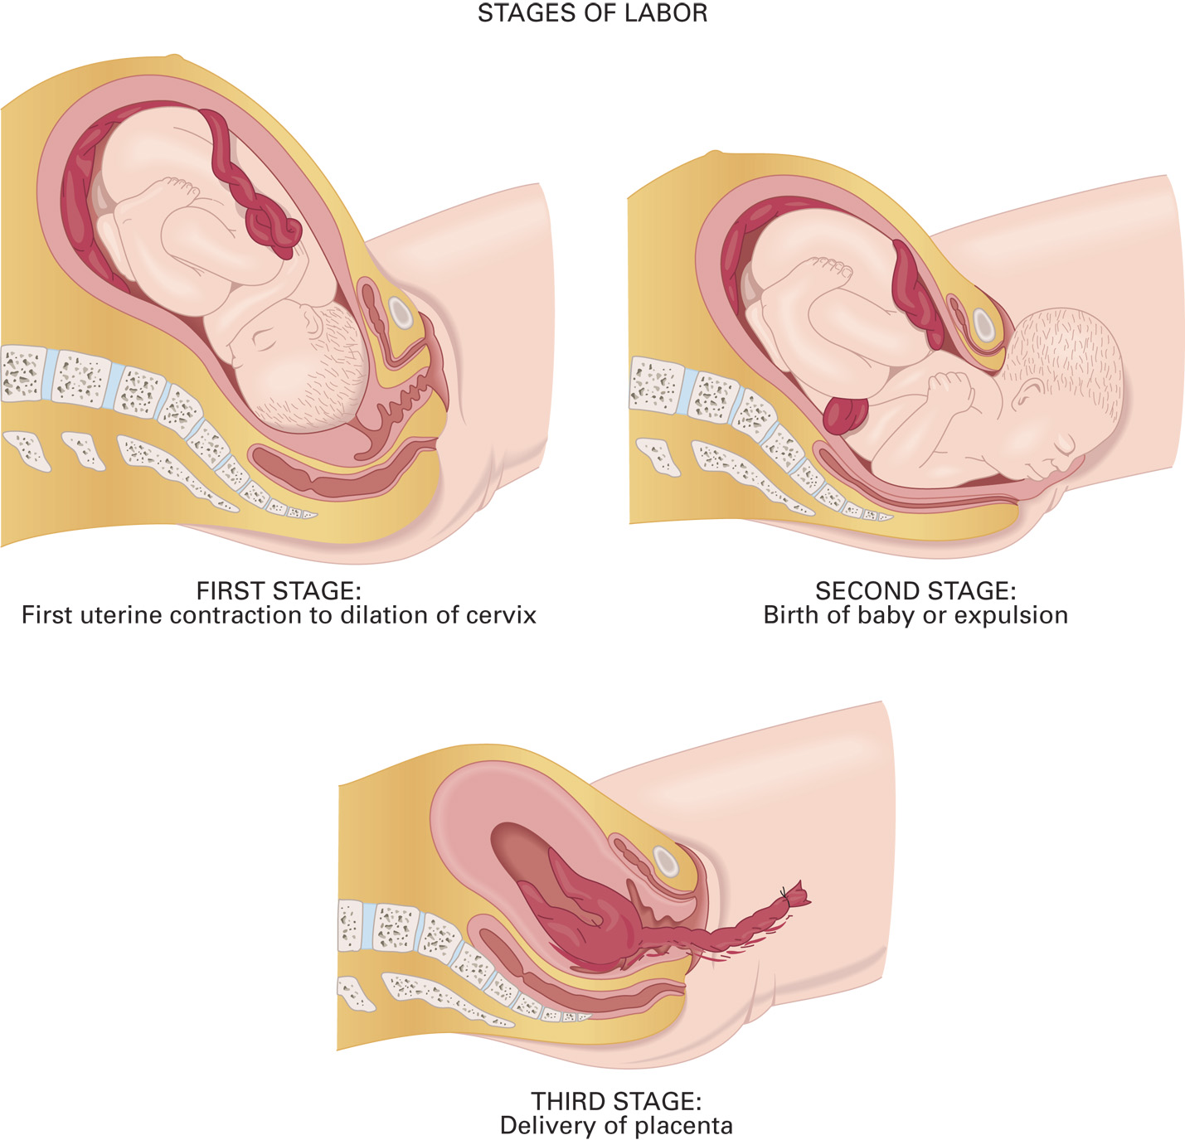
Stages of Labor
Notes:
The length of each stage varies in different women and under different circumstances.

Slide 60
Labor and Normal Delivery (2 of 16)
Labor
First Stage—Dilation
Stage one, for a first-time mother, lasts 8–10 hours, and 5–7 hours in a woman who has had a child before.
At the end of stage one, contractions are at regular 3- to 4-minute intervals, last at least 60 seconds each, and feel very intense.
Braxton-Hicks contractions are not labor.
Notes:
The first stage of labor is from the beginning of true labor (contractions) to complete cervical dilation and 100 percent effacement. During this first and longest stage, the cervix becomes fully dilated at 10 cm.
Braxton-Hicks contractions become more frequent throughout pregnancy but are not true labor.
It is not possible to differentiate between Braxton-Hicks contractions and true labor in the prehospital setting.
Transport any patient who is having contractions.

Slide 61
Labor and Normal Delivery (3 of 16)
Labor
First Stage—Dilation
The frequency or interval is the time between the start of contractions.
The duration describes how long the contraction lasted.
The intensity or strength of the contraction describes the amount of pain associated with the contractile force.
Notes:
With the onset of true labor, the contractions become more frequent, last longer, and become more intense. This pattern continues until the contractions occur less than 2 minutes apart, last longer than 60 seconds, and are a +10 on the pain scale.

Slide 62
Labor and Normal Delivery (4 of 16)
Labor
Second Stage—Expulsion
During the second stage, the infant moves through the vagina and is born.
Contractions are less than 2 minutes apart and last 60 to 90 seconds each.
As the infant moves downward, the mother experiences considerable pressure in their rectum.
Notes:
The tightening and bearing-down sensations become stronger and more frequent. The mother has an uncontrollable urge to push down, which they might do.

Slide 63
Labor and Normal Delivery (5 of 16)
Labor
Second Stage—Expulsion
The perineum bulges, indicating impending birth.
The infant crowns.
After the head delivers, the body follows.
Notes:
When the head is the presenting part in the vaginal opening, it is referred to as a vertex presentation. At this point, the mother should be coached to push with each contraction. The shoulders and the rest of the baby’s body follow. For the patient for whom this is the first delivery, the second stage typically lasts 50 to 60 minutes.

Slide 64
Labor and Normal Delivery (6 of 16)
Labor
Third Stage—Placental Delivery
In the third stage, the placenta is delivered, usually within 5 to 20 minutes.
Do not pull on the umbilical cord to facilitate delivery of the placenta.
Notes:
The signs that the delivery of the placenta is imminent are:
There is a sudden increase in bleeding from the vagina.
The uterus becomes smaller in size.
The umbilical cord begins to lengthen.
The mother has an urge to push.
Pulling or tugging on the umbilical cord to deliver the placenta can cause the uterus to invert. If inverted, the uterus cannot contract and tone up effectively. The exposed uterine vessels continue to bleed and lead to serious hemorrhaging and hypovolemia.

Slide 65
Labor and Normal Delivery (7 of 16)
Assessment-Based Approach
Scene Size-Up, Primary Assessment, and Secondary Assessment
Determine if delivery is imminent.
It is best to transport a mother in labor so that the delivery can occur at a hospital.
Notes:
To determine whether you should transport or commit to a delivery on scene, answer the following questions:
What is the age of the pregnant patient?
How many times has the patient been pregnant?
Is this the patient’s first delivery? If not, how many deliveries have they experienced?
How long has the patient been pregnant? What is the estimated due date?
Has there been any bleeding or discharge (bloody show)?
Has the amniotic sac ruptured? If so, when and what color is the fluid?
Has fetal movement been present or absent?
Are there any contractions or pain present?
What is the frequency and duration of contractions?
Is crowning occurring with contractions?
Does the patient feel the need to push?
Does the patient feel as if they are having a bowel movement with increasing pressure in the vaginal area?
Is the abdomen (uterus) hard upon palpation?
Did the pregnant patient take any medication? If so, what was taken and when was it taken?

Slide 66
Labor and Normal Delivery (8 of 16)
Assessment-Based Approach
Estimating Gestational Age Based on Fundal Height
The closer the top of the fundus is to the xiphoid process, the higher the number of weeks of gestation.
Gestational age by landmark:
Fundus at the umbilicus – 20 weeks
Fundus at the xiphoid – 38 weeks
Notes:
At 40 weeks, the fundus drops to below the xiphoid as the fetus moves into position for delivery.

Slide 67
Labor and Normal Delivery (9 of 16)
Assessment-Based Approach
Prehospital Delivery
There is no suitable transportation.
The hospital or physician cannot be reached due to bad weather, a natural disaster, or catastrophe.
Delivery is imminent.
Notes:
In these three situations, you must assist in the delivery of the baby.

Slide 68
Labor and Normal Delivery (10 of 16)
Assessment-Based Approach
Imminent Delivery
Determine if delivery is imminent.
Has crowning occurred?
Are contractions less than 2 minutes apart?
Do they last 60-90 seconds?
Does the patient have the urge to defecate?
Does the patient has a strong urge to push?
Notes:
If birth is imminent with crowning, the top of the head is the presenting part, and the patient is pushing with contractions, commit to delivery at the scene.

Slide 69
Labor and Normal Delivery (11 of 16)
Assessment-Based Approach
Imminent Delivery
Determine if delivery is imminent.
Is the patient’s abdomen is extremely hard?
Notes:
If birth is imminent with crowning, the top of the head is the presenting part, and the patient is pushing with contractions, commit to delivery at the scene.

Slide 70
Labor and Normal Delivery (12 of 16)
Assessment-Based Approach
Imminent Delivery
Take Standard Precautions.
Do not touch the vaginal area except during delivery.
Do not allow the patient to use the toilet.
Do not hold the mother’s legs together.
Use a sterile O B kit.
Notes:
If you are to assist the mother in delivery, stay calm and explain to them that you are trained to help. Ensure the mother’s comfort, modesty, and peace of mind as much as possible and try to limit distractions and onlookers.

Slide 71
Click on the Finding that Should Prompt You to Anticipate the Need for Immediate, On-The-Scene Delivery
A. Contractions are five minutes apart.
B. Contractions started five hours ago.
C. The mother has not had regular prenatal care.
D. The mother states she feels like she needs to have a bowel movement.

Slide 72
Labor and Normal Delivery (13 of 16)
Assessment-Based Approach
Delivery at the Scene
Take all appropriate Standard Precautions.
Position the patient.
Apply oxygen by nasal cannula at 2-4 litersperminute.
Create a sterile field.
Anticipate vomiting.
Assess for crowning.
Notes:
Have the patient lie supine on a firm surface with their knees drawn up to their chest as far as possible and legs spread apart. This is referred to as the McRoberts position. By placing the patient in this position, the distance between the symphysis pubis and sacrum increase slightly, which might make it easier for the fetus to pass through the opening of the pelvis during delivery.
Even if the SpO₂ is 94% or greater, apply a nasal cannula to the pregnant patient at 2 lpm to provide additional oxygenation.
Use sheets from the OB kit, sterile towels, or paper barriers. Remove the patient’s clothing or push it up above their waist. Place one sheet under the woman’s hips, unfolding it toward their feet, and another sheet over their abdomen and legs.
Have your partner or a close family member stay at the patient’s head, in case they vomit.
When the head appears (crowning), have the patient push hard with each contraction. The normal head presentation is occiput anterior, where the back of the head is facing upward and the face of the baby is downward.

Slide 73
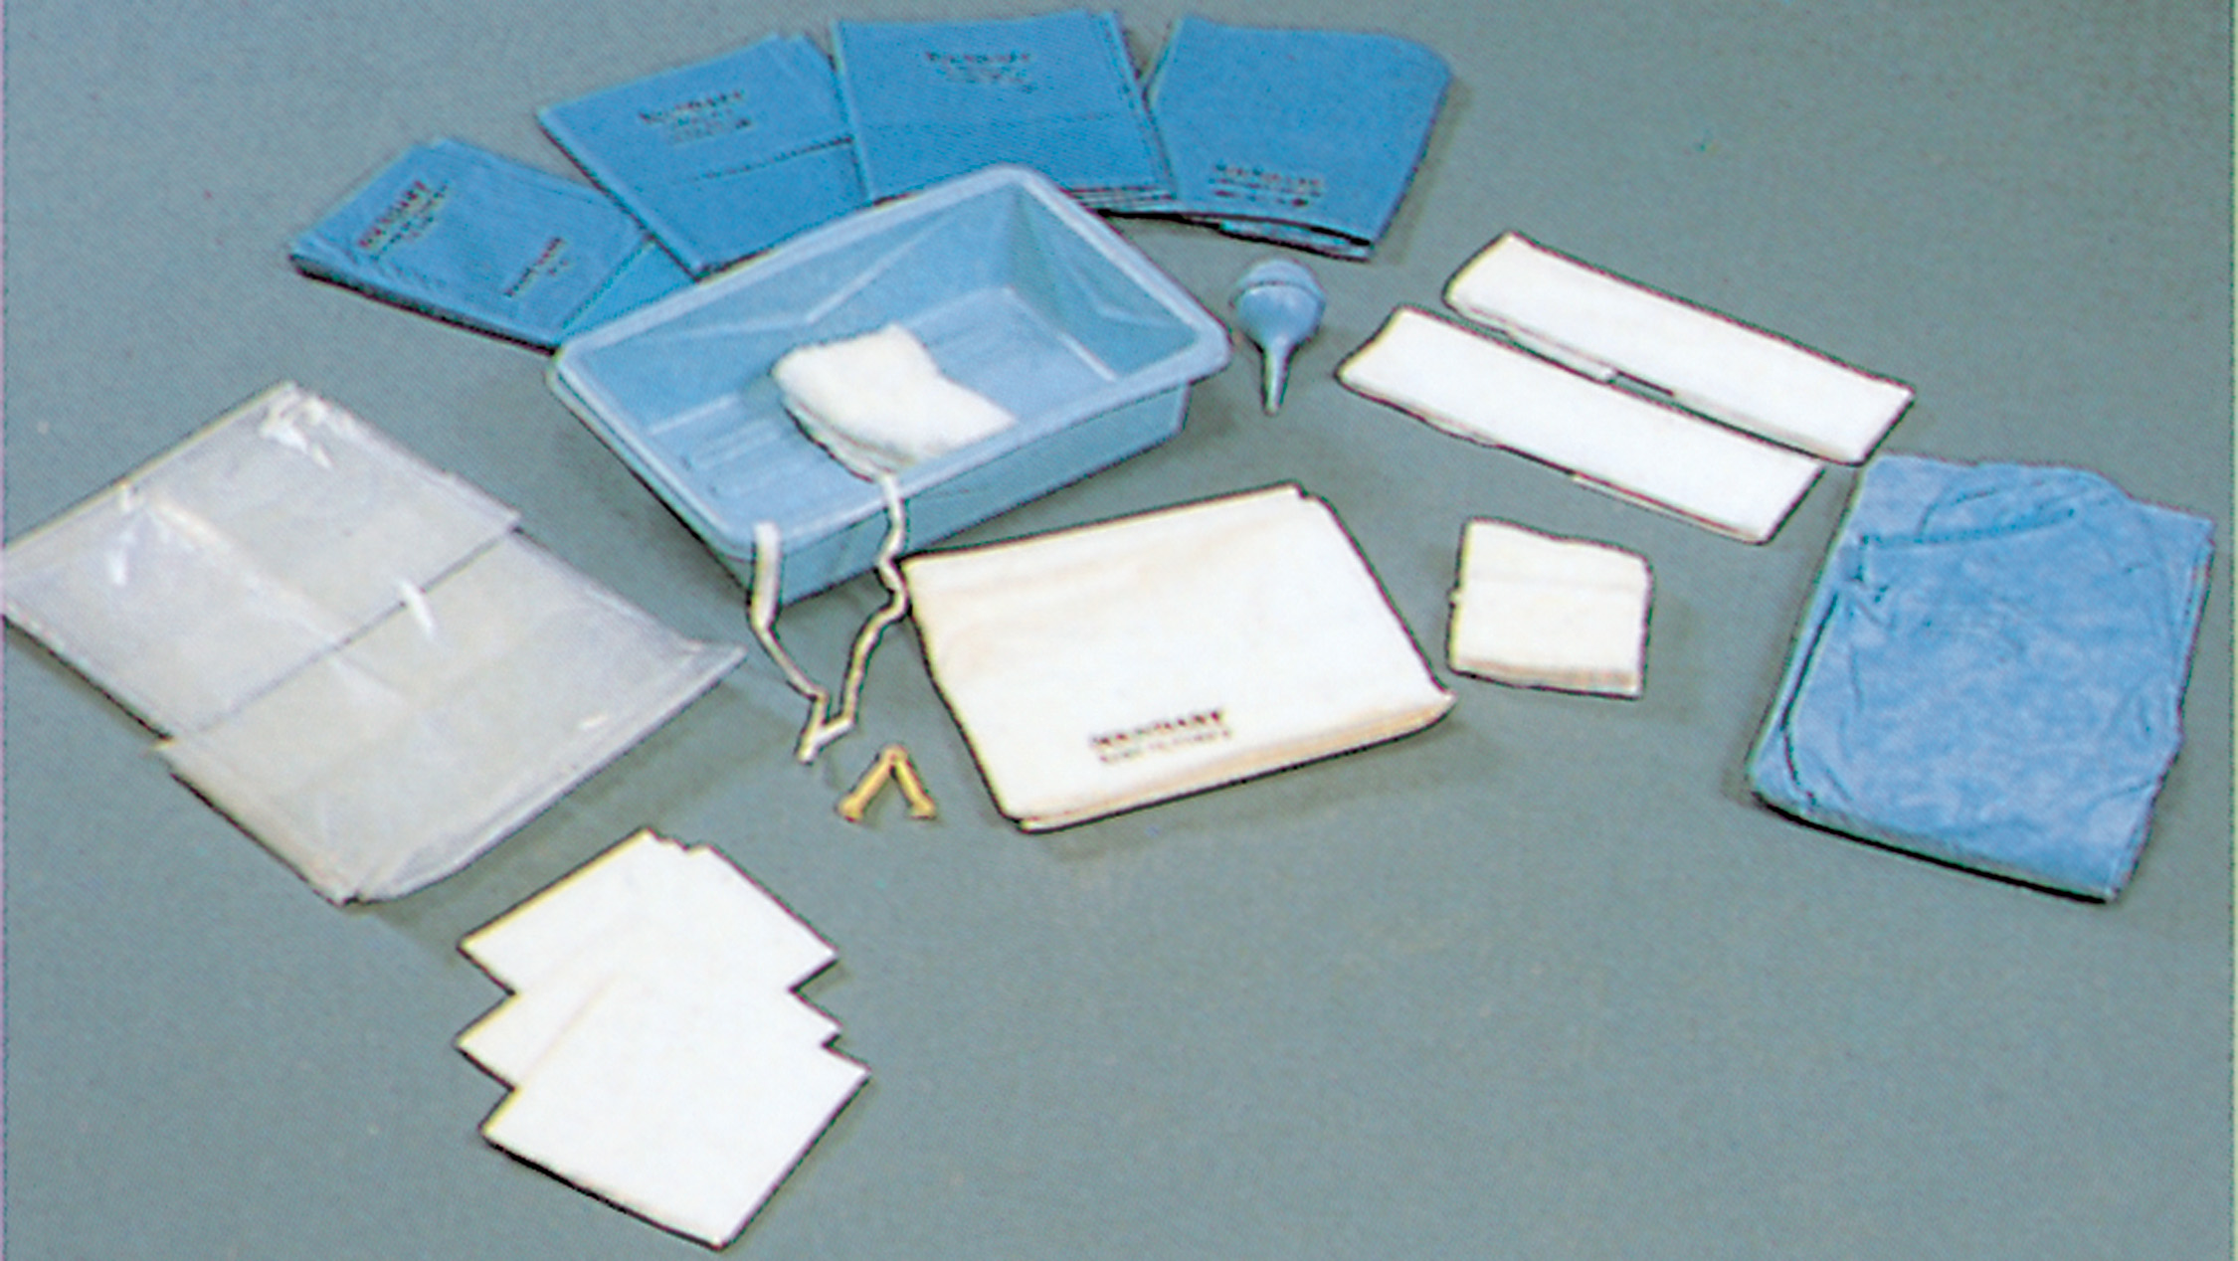
Disposable Obstetrics (O B) Kit
Notes:
Place one sheet under the woman’s hips, unfolding it toward their feet, and another sheet over their abdomen and legs. Place your OB kit or equipment within reach, but away from the birth canal so it will not be contaminated by vaginal discharge, blood, and amniotic fluid.

Slide 74
Labor and Normal Delivery (14 of 16)
Assessment-Based Approach
Delivery at the Scene
Apply gentle pressure to the head to prevent an explosive delivery.
Tear the amniotic sac, if not ruptured.
Assess for the possibility of nuchal cord.
Suction the airway only if needed.
Deliver anterior, then posterior shoulder.
Support the baby’s body with both hands as it is delivered.
Notes:
Exert very gentle pressure to prevent an explosive delivery. Avoid touching and exerting pressure on the baby’s face and on any soft spot (fontanelle) on the head.
The amniotic sac appears as a membrane with fluid between it and the baby’s head. Use your fingers to rupture the sac, and then tear it away from the baby’s head and face as they appear.
Determine whether the umbilical cord is around the baby’s neck. If so, this is referred to as a nuchal cord. A nuchal cord must be managed immediately when it is found. Use two fingers to slip the cord over the baby’s shoulders or head. If you cannot move the cord, place two clamps 2 to 3 inches apart and cut between the clamps using scissors.
Suction the nose and mouth of the newborn immediately following birth, only when secretions or other substances are present that obstruct spontaneous breathing. A bulb syringe may be used.
With both hands supporting the head of the baby, apply a slight downward movement that enables the upper shoulder to deliver. With both hands continuing to support the baby’s head, apply a slight upward movement that enables the upper shoulder to deliver. Typically, after the shoulders are delivered, the remainder of body follows rapidly.
Never pull the baby from the vagina or apply traction. Do not put your fingers in the baby’s armpit; pressure there can damage nerve centers (brachial plexus) resulting in permanent damage. Receive the newborn in a clean or sterile towel to help you hold it securely. Be sure to support the head and neck, as the baby does not have the ability to hold them up.

Slide 75
Labor and Normal Delivery (15 of 16)
Assessment-Based Approach
Delivery at the Scene
Secure the baby’s head, neck, and body and grasp the feet to complete the delivery.
Dry the newborn with towels.
Clamp the cord and use sterile surgical scissors or a scalpel to cut it.
An Apgar score should be done 1 minute and 5 minutes after birth.
Notes:
Do not pull on the umbilical cord as you lift or receive the newborn. Keep the baby at the level of the uterus. Don’t lift the baby high above or low below the mother’s uterus.
Immediately dry the baby with towels. Remove the wet towels well away from the infant’s body to avoid inadvertent cooling. Place the newborn in a warm, dry blanket, wrap with plastic wrap, or place in a food-grade zip lock storage bag with the head exposed and on its back with the head in a sniffing position to maintain an open airway.
It is recommended that a delay of at least 30 seconds should occur before cutting the cord. It has been found that delayed cord clamping results in the following for the newborn:
Less cerebral hemorrhaging
Higher blood pressure
Increased blood volume
Less need for transfusion after birth
Less necrotizing enterocolitis
An Apgar score should be done 1 minute and 5 minutes after birth. The Apgar score provides a numerical means to determine the need and/or effectiveness of newborn care and the need for further resuscitation.

Slide 76
Labor and Normal Delivery (16 of 16)
Assessment-Based Approach
Delivery at the Scene
Keep the newborn dry and warm.
Deliver the placenta.
Place a sanitary pad or sterile dressings over the vaginal opening and perineum.
Control postpartum hemorrhaging.
Record the time of delivery; transport the mother, newborn, and placenta to the hospital.
Notes:
Do everything possible to prevent newborn hypothermia. Be sure to turn on the heat in the back of the ambulance to create as warm an environment as possible for the newborn. Do not turn on the air conditioner; this is not about your comfort in the patient compartment. Apply a neonatal pulse oximeter probe. Continuously assess respirations, heart rate, and SpO₂.
Assess for delivery of the placenta. It usually is delivered within 10 minutes of the baby’s delivery and almost always within 20 minutes. When the placenta has completely delivered, place it in the plastic bag contained within the OB kit and transport it to the hospital with the mother.
After the placenta has been delivered, place a sanitary pad or sterile dressings over the vaginal opening and perineum. There will be vaginal bleeding after delivery. Up to 500 mL of blood loss is normal and well tolerated by the mother.
If the mother’s blood loss appears to be excessive, provide care for postpartum hemorrhaging.
Immediately begin uterine massage. Massaging the uterus after delivery helps to stimulate smooth muscle contractions, which decrease the uterine size and tone the smooth muscle of the uterus, causing it to contract around the exposed bleeding vessels where the placenta sheared off and tamponade the bleeding.
Allow the newborn to suckle on the mother’s breast. This releases oxytocin, a naturally occurring hormone that causes the uterus to contract.
Record the time of delivery, transport the mother, newborn, and placenta to the hospital. During transport, continuously reassess the mother for any signs of postpartum hemorrhage or hypovolemia. Keep the newborn warm to prevent hypothermia. Continuously reassess the newborn’s airway, respirations, heart rate, and SpO₂. Notify the receiving medical facility that you are en route with a mother and her newborn.

Slide 77
Crowning. the Vertex of the Head is Showing in the Vaginal Opening
Notes:
Exert very gentle pressure to prevent an explosive delivery. Avoid touching and exerting pressure on the baby’s face or any soft spot (fontanelle) on the head.

Slide 78
Once the Head is Delivered, Check if the Umbilical Cord is around the Neck (Nuchal Cord). Deliver the Shoulders with the Next Contraction
Notes:
As the baby’s head is delivered, determine whether the umbilical cord is around the neck. This is referred to as a nuchal cord, must be managed immediately.

Slide 79
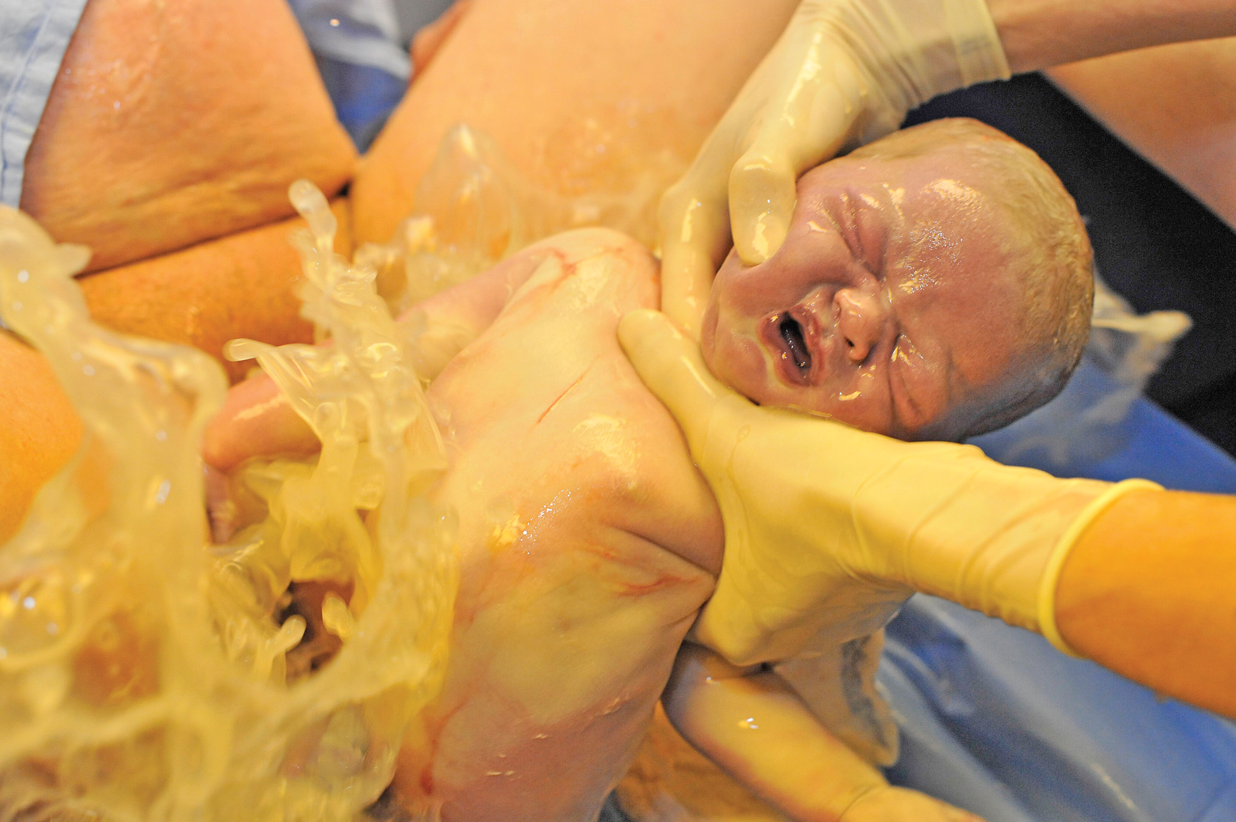
Once the Shoulders are Delivered, the Entire Torso is Likely to be Delivered Quickly
Notes:
As the torso and full body are expelled, support the newborn with both hands. Never pull the baby from the vagina or apply traction.

Slide 80
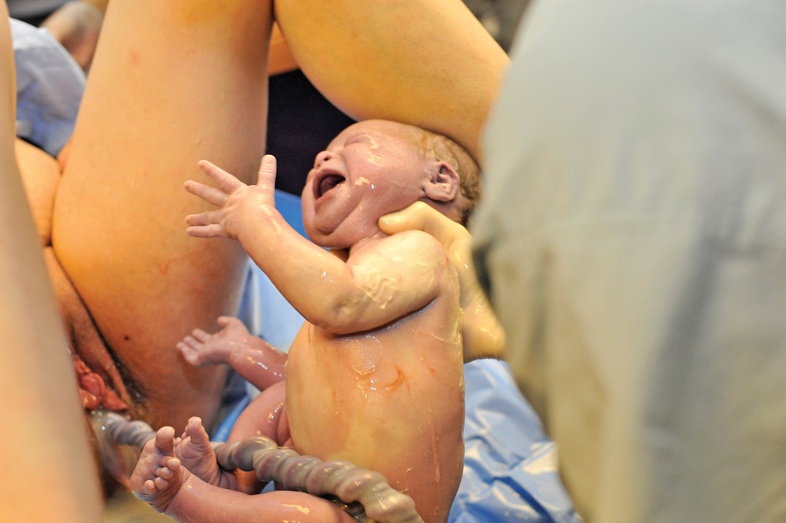
Maintain a Good Grasp of the Newborn and Keep the Baby Level with the Mother’s Body
Notes:
Do not pull on the umbilical cord as you lift or receive the newborn. Keep the baby at the level of the uterus. Don’t lift the baby high above or low below the mother’s uterus.

Slide 81
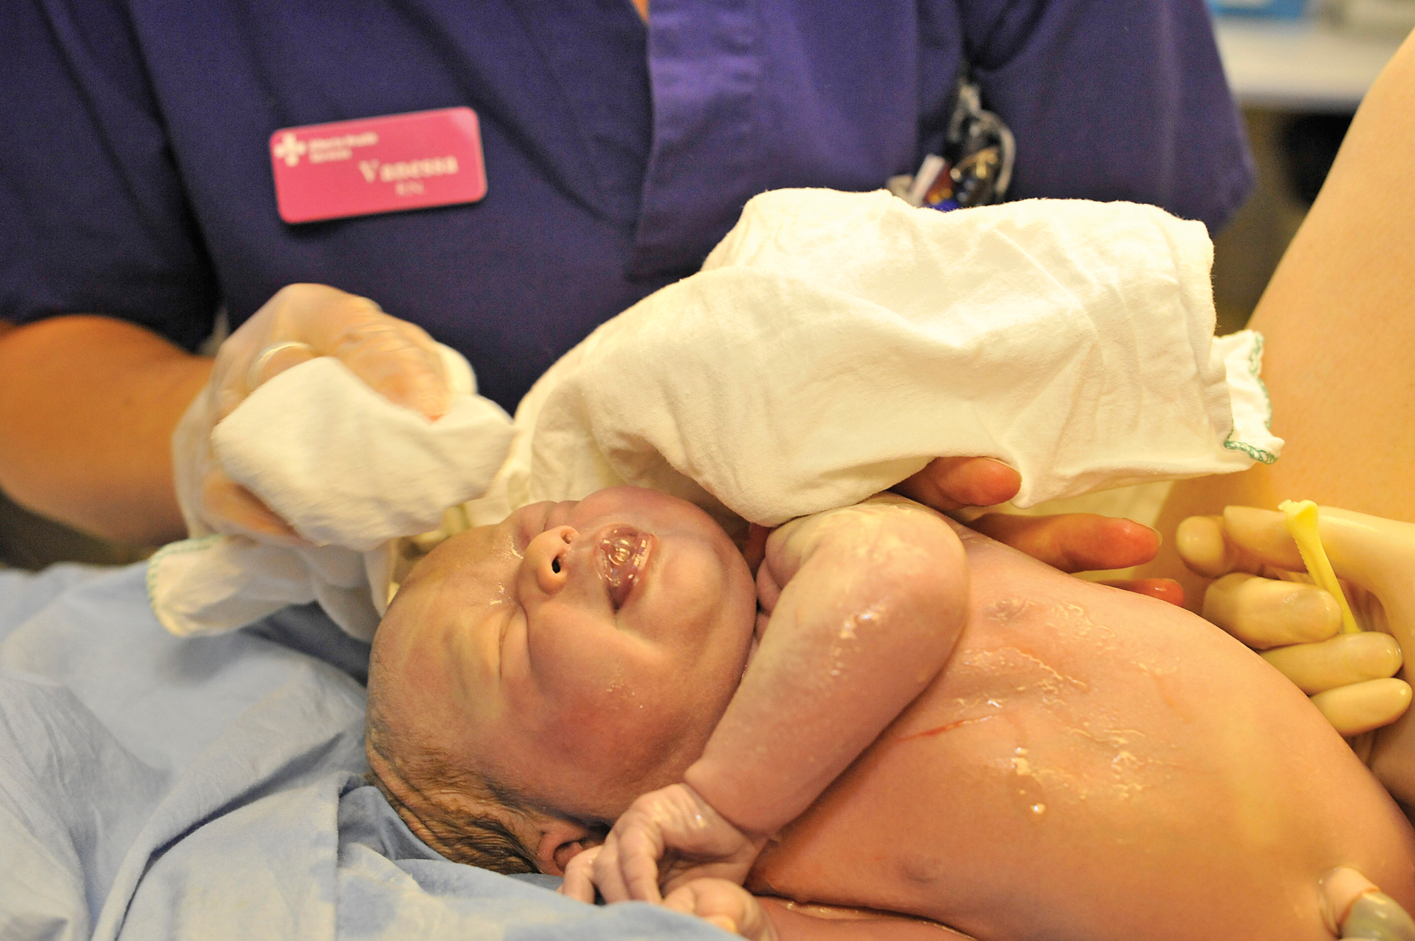
Provide Newborn Care, Keeping the Baby Dry and Warm
Notes:
Immediately dry the newborn with towels. Remove the wet towels well away from the baby’s body to avoid inadvertent cooling. Place the newborn in a warm, dry blanket, wrap with plastic wrap, or place in a food-grade zip lock storage bag with the head exposed.

Slide 82
Clamp and Cut the Umbilical Cord
Notes:
It is recommended that a delay of at least 30 seconds should occur before cutting the cord.

Slide 83
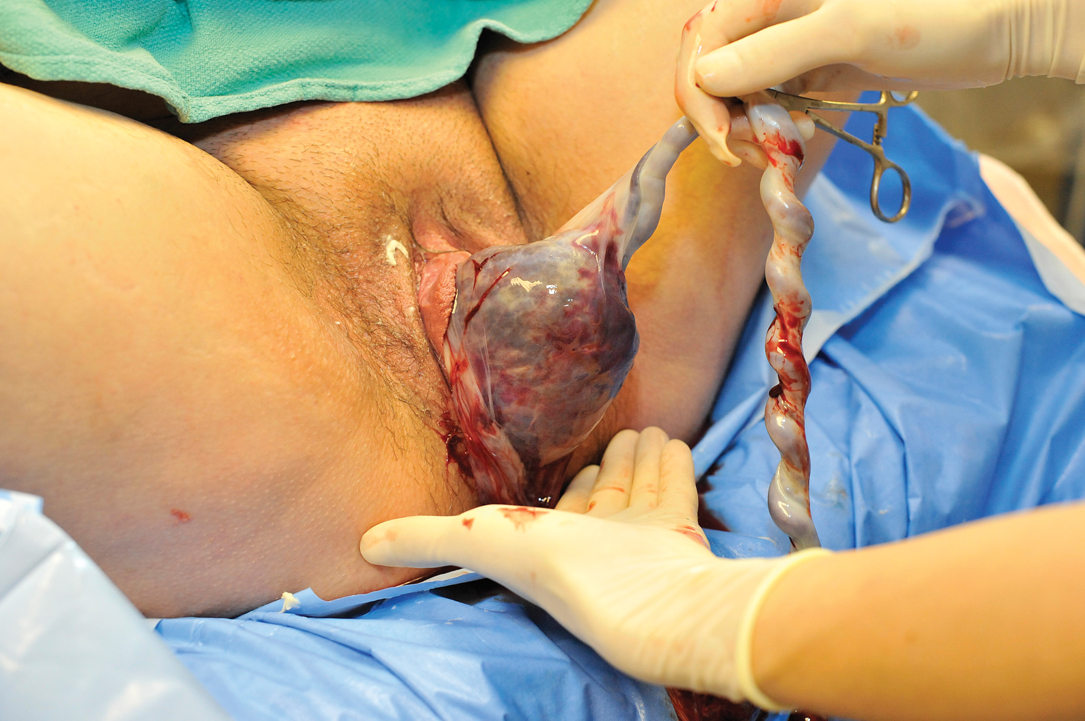
Deliver the Placenta
Notes:
When the placenta appears at the vagina, grasp it gently. Never pull or tug on the umbilical cord. Instead, slowly and gently guide the placenta and the attached membranes from the vagina.

Slide 84
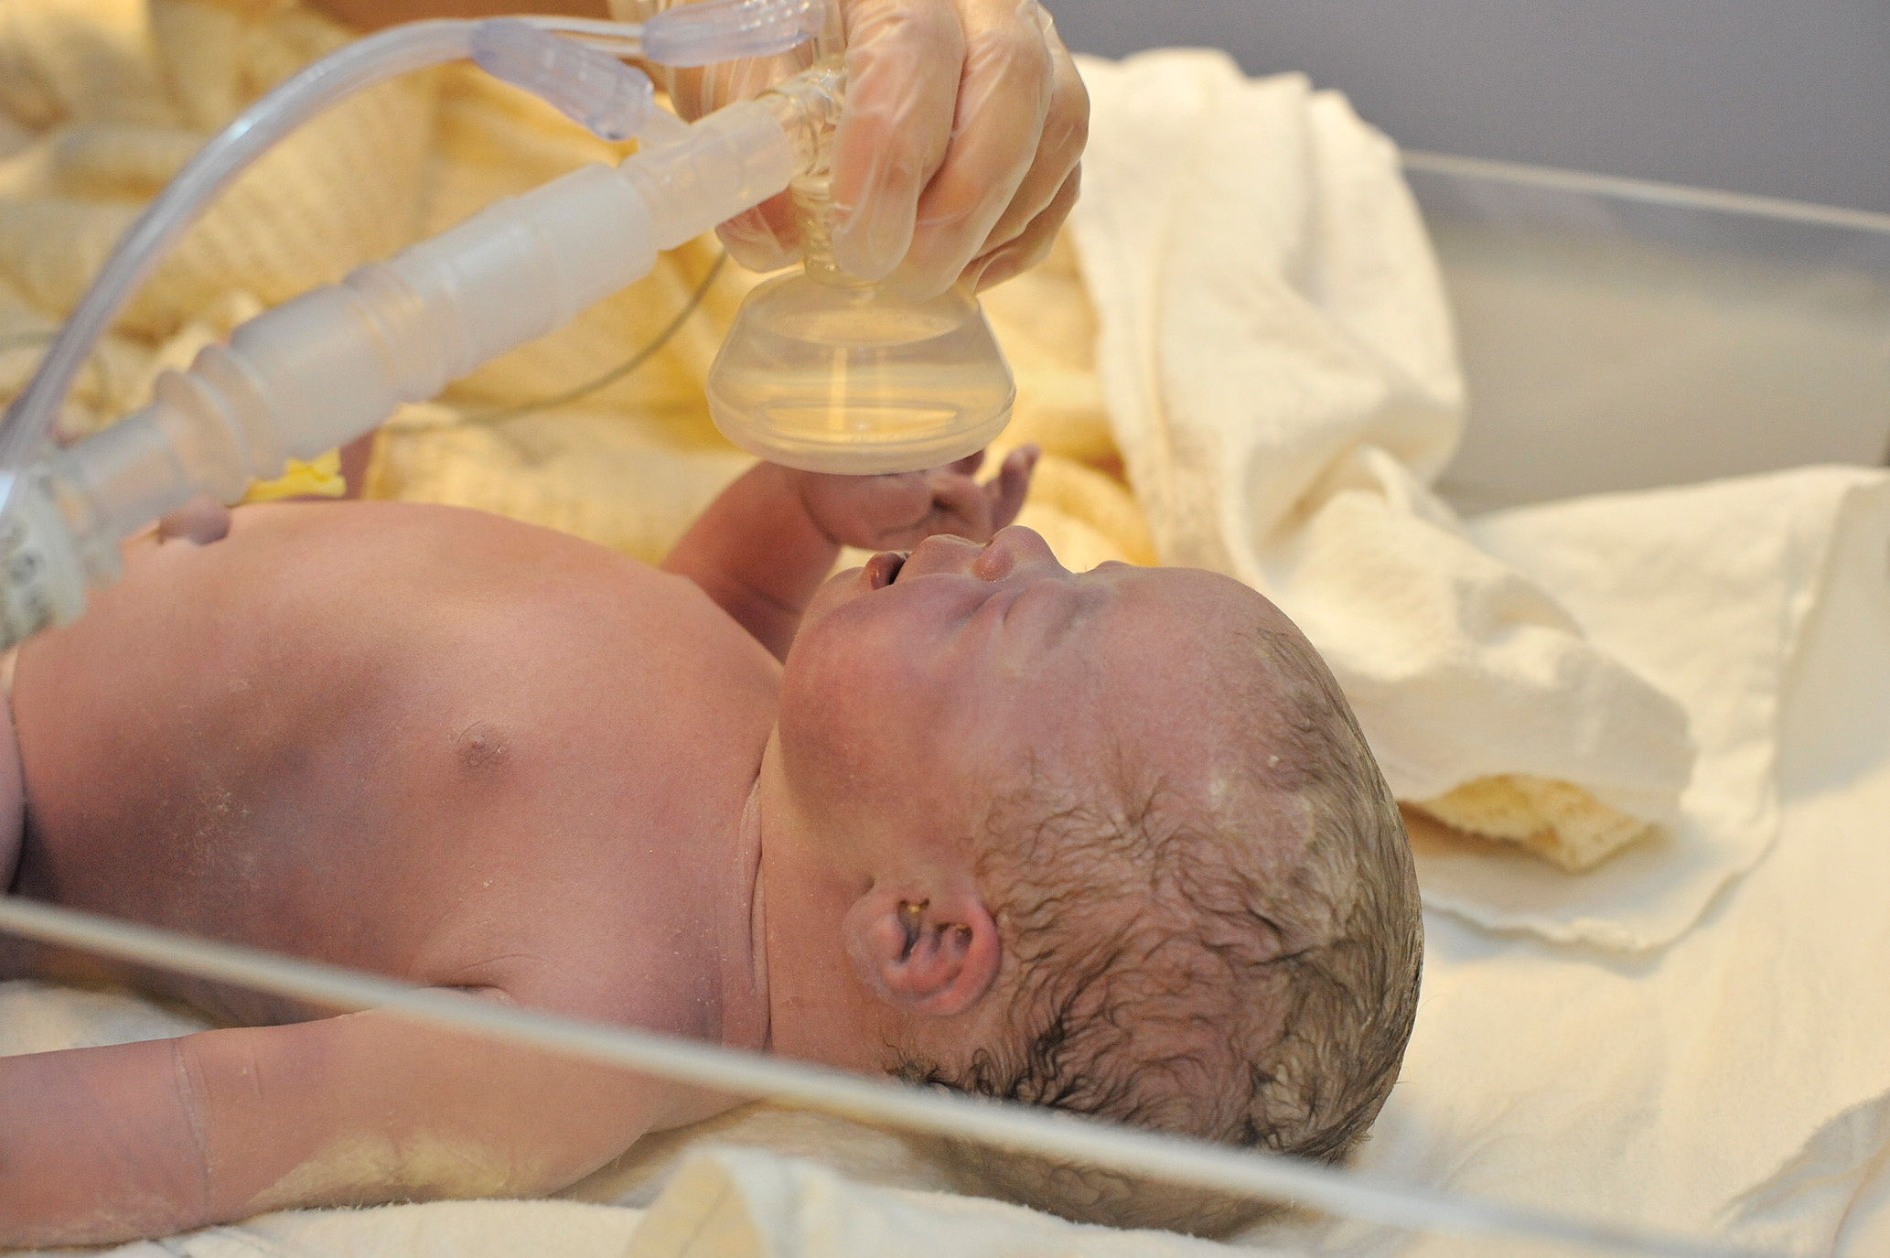
Provide Blow-By Oxygen, Based on the Spo2 Reading
Notes:
Apply a neonatal pulse oximeter probe. Continuously assess respirations, heart rate, and SpO₂.

Slide 85
Case Study (2 of 3)
Lacy reassures the patient and explains that she needs to check and see if the baby is about to be born. Lacy confirms that the delivery is imminent. Lacy pulls on a gown and eye protection as Alan prepares the O B kit.
Within 10 minutes, Lacy has assisted with the delivery of a baby girl.
Notes:
Case Study Discussion
Review the Case Study findings presented.

Slide 86
Case Study (3 of 3)
What steps are required in the immediate care and assessment of the newborn?
What special considerations should be taken if a newborn is premature?
Notes:
Case Study Discussion
Use the Case Study content and questions to foreshadow the upcoming lesson content. Gauge the student’s responses as a guide of how well versed they are on this topic.

Slide 87
Abnormal Delivery (1 of 21)
Signs and Symptoms of Abnormal Delivery
Assessment-Based Approach—Active Labor with Abnormal Delivery
Scene Size-Up, Primary Assessment, and Secondary Assessment—Abnormal
Any presentation besides normal crowning
Umbilical cord protruding from the vagina
Amniotic fluid with an abnormal color or smell
Notes:
Labor and delivery at less than 37 weeks of gestation and recurrence of contractions after the first baby is born are also signs of an abnormal delivery.
Discussion Questions
What signs should alert you to an abnormal delivery?
How should you manage a prolapsed umbilical cord?
What should you do if there is a limb presentation?
Teaching Tips
Use an OB mannequin to allow students ample practice assisting with abnormal delivery situations. Simulate meconium with a small amount of pureed spinach baby food placed in water.

Slide 88
Abnormal Delivery (2 of 21)
Signs and Symptoms of Abnormal Delivery
Assessment-Based Approach—Active Labor with Abnormal Delivery
Emergency Medical Care and Reassessment
Emphasis is on:
Immediate transport
Administering oxygen
Continuously monitoring vital signs.
Notes:
For most intrapartum emergencies, delivery in the prehospital setting is not possible. Contact medical
direction for further orders. In some emergencies, medical direction might recommend that you perform certain maneuvers to facilitate the baby’s delivery.
Discussion Question
What is preterm labor?
Knowledge Application
Students should be able to demonstrate management of a variety of abnormal delivery situations.

Slide 89
Abnormal Delivery (3 of 21)
Intrapartum Emergencies
Prolapsed Cord
The umbilical cord is the presenting part.
The cord may be compressed, cutting off oxygen to the infant.
Instruct the mother not to push.
Administer high-concentration oxygen.
Put patient in a knee-chest position.
Notes:
Insert a gloved hand into the vagina and gently push or lift the presenting part of the fetus, head or buttocks, up, back, or away from the pulsating cord. Do not try to push the cord back into the vagina.
An intrapartum emergency is one that occurs during the period from the onset of labor to the actual delivery of the newborn. Several conditions can lead to an abnormal delivery. In almost all of these conditions, delivery at the scene or en route is not possible and immediate expeditious emergency transport to a medical facility that can manage obstetric emergencies is necessary.

Slide 90
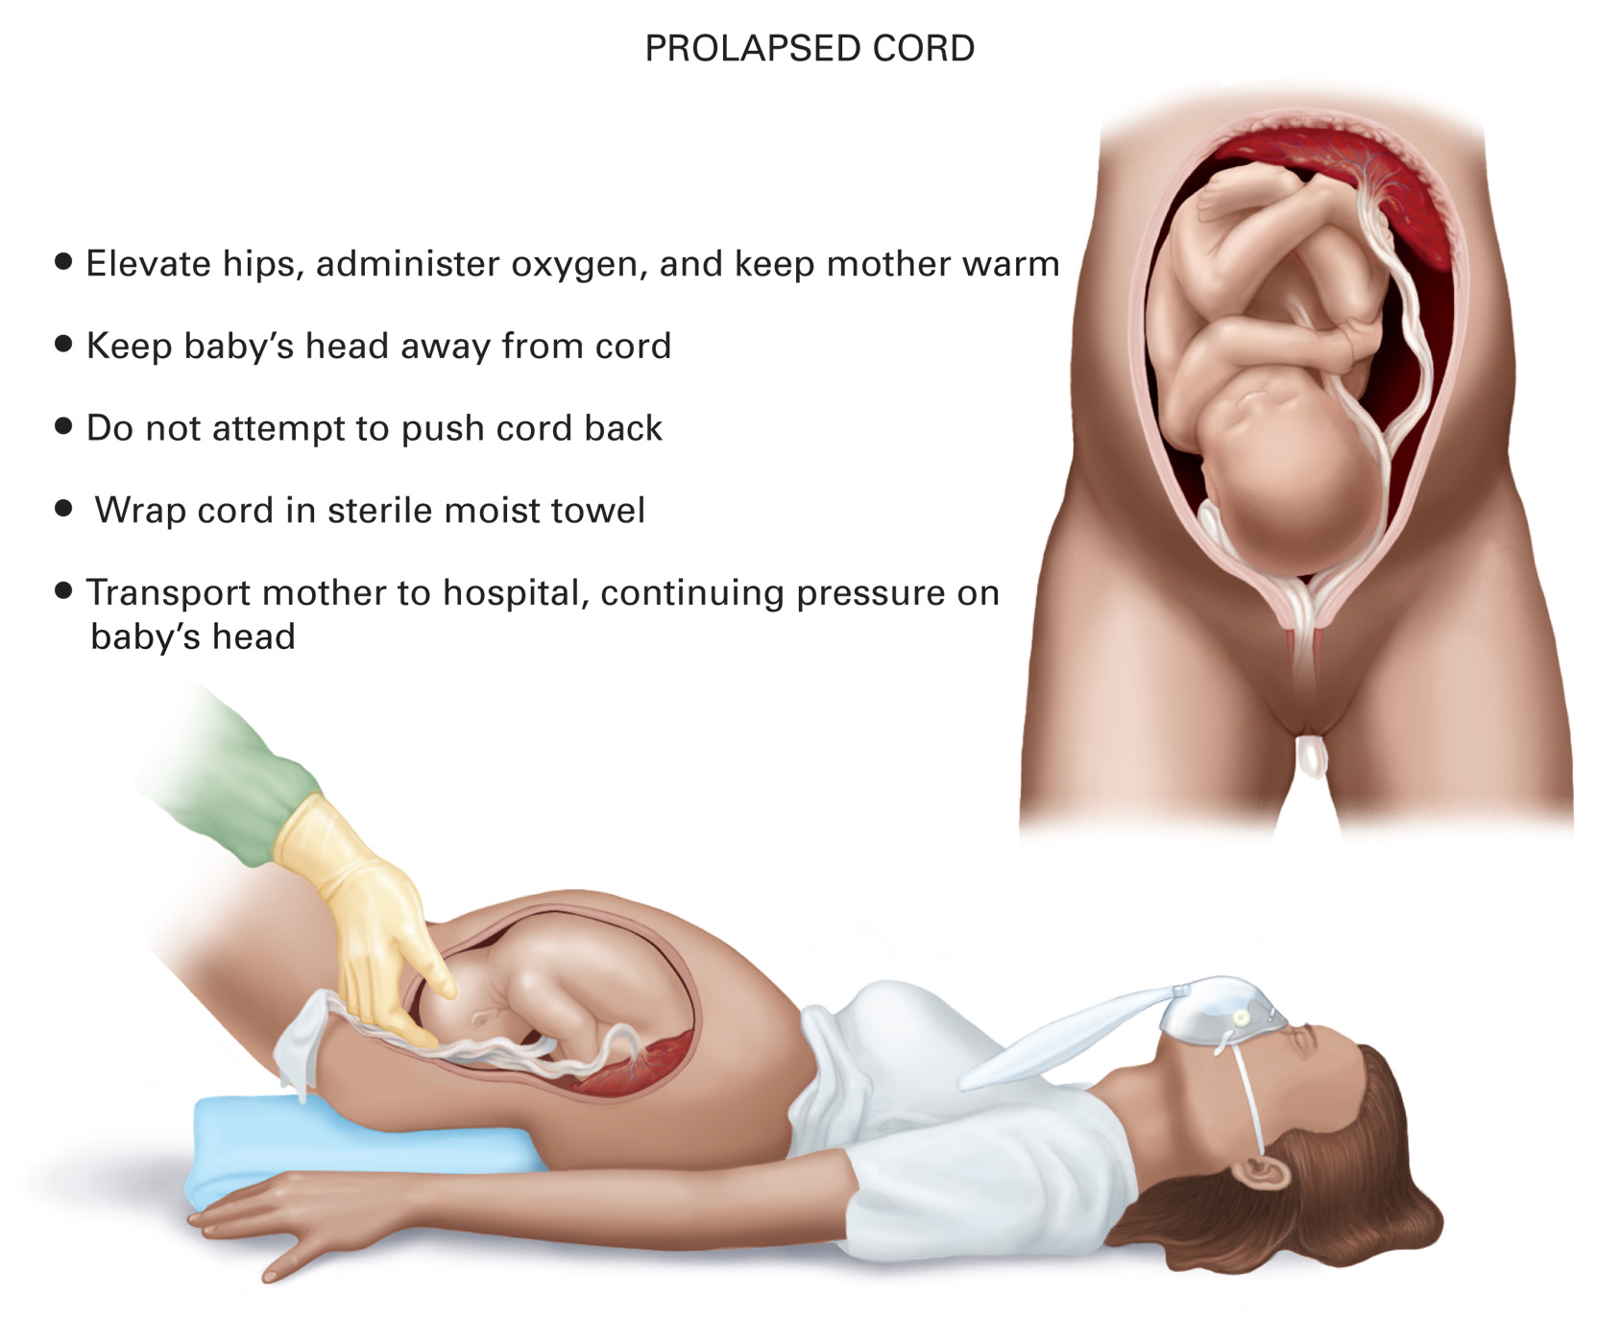
Prolapsed Cord
Notes:
Review the anatomical structures relative to a prolapsed cord delivery and how to manage them.

Slide 91
Abnormal Delivery (4 of 21)
Intrapartum Emergencies
Breech Birth
Buttocks/lower extremities are presenting.
This condition presents a high risk of fetal complications.
Transport in a supine, head-down position.
You should not attempt to deliver a breech presentation in the field.
Notes:
In the event of a breech delivery with only legs and buttocks visible in the vaginal opening during crowning:
Instruct the patient not to push. Have them pant during contractions.
Administer a high concentration of oxygen at 15 lpm via a nonrebreather mask regardless of the patient’s SpO₂ reading.
Place a hand in the vagina on the presenting part to keep the fetus from being delivered.
Transport the patient immediately to the nearest hospital with obstetric services. This is an extreme emergency.
Contact medical direction for further orders. If transport will not be delayed, consider ALS backup to deliver medications to stop uterine contraction and delivery.

Slide 92
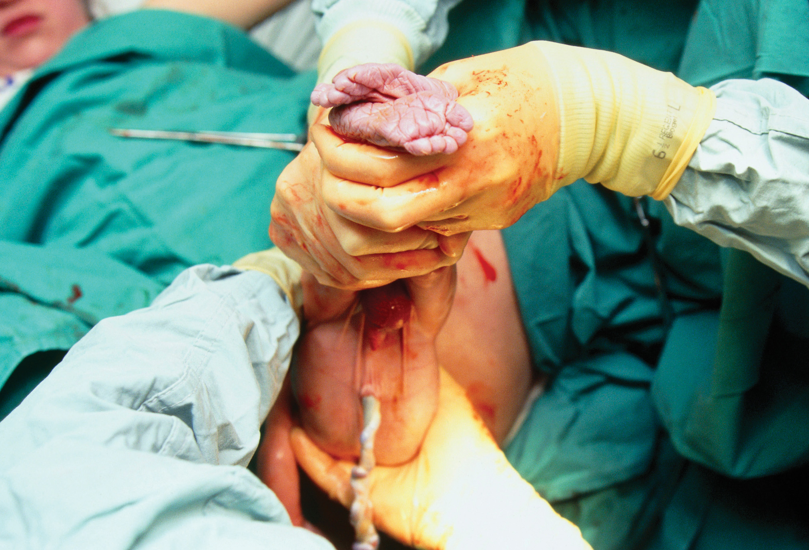
Breech Delivery
(© Science Photo Library/Custom medical Stock Photo)
Notes:
A Frank breech is where the hips are flexed and the knees are extended. It makes up 60 to 65 percent of all breech presentations. Because of the position of the buttocks and legs, it creates a fairly good dilating wedge; therefore, umbilical cord prolapse is less likely to occur.
A complete breech is where the hips and knees are flexed. It is less common and occurs in approximately 5 percent of all breech presentations.
In an incomplete breech, the hips are flexed and either one or both feet are the presenting part. Incomplete breech occurs in 25 to 35 percent of all breech presentations. This position provides the poorest dilating wedge and provides the least filling of the pelvic and cervical opening.

Slide 93
Abnormal Delivery (5 of 21)
Intrapartum Emergencies
Breech Birth
If a prehospital breech delivery is unavoidable:
Contact medical direction for assistance.
Have the mother push hard during contractions.
As the infant delivers, support the legs.
Allow the legs and buttocks to deliver until the umbilicus is seen.
Notes:
Medical direction might instruct you on how to perform various maneuvers based on the presentation.

Slide 94
Abnormal Delivery (6 of 21)
Intrapartum Emergencies
Breech Birth
Breech Delivery with Entrapped Head
Immediately begin emergency transport.
Administer high-flow oxygen.
Insert a gloved hand in to the vagina and attempt to manually push the cervix over the head of the entrapped fetus.
Notes:
If the head can still not be delivered, contact medical control for further orders. Medical direction might instruct you to perform the Zavanelli maneuver. This maneuver would require you to attempt to replace the born fetal parts into the uterus. The patient would then be transported to a medical facility capable of performing obstetric care so that an emergency cesarean birth could be performed. Follow your medical direction and local protocol.
If the buttocks are delivering first (Frank breech), medical direction might instruct you to perform the Mariceau maneuver.

Slide 95
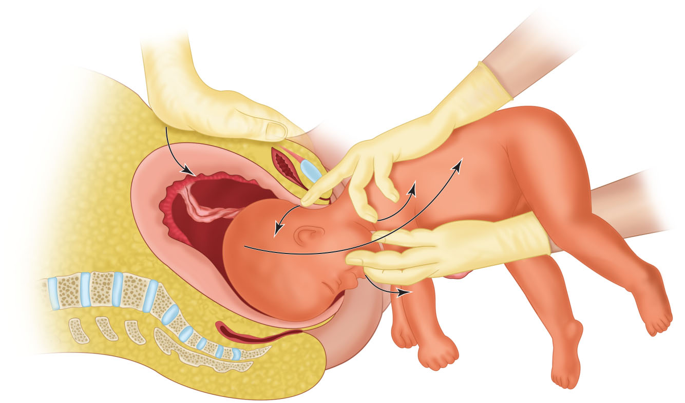
The Mariceau Maneuver
Notes:
One EMT would apply suprapubic pressure (suprapubic pressure is described in the section on shoulder dystocia) as the other EMT places their nondominant hand on the fetal shoulders. The second EMT places their dominant hand inside the vagina and places two fingers on the maxilla (the bony part of the face just below the nose) and applies downward pressure on the maxilla, causing the fetal head to flex forward. The forearm supports the weight of the baby’s body that has already been delivered. The baby’s body is elevated gently toward the mother’s abdomen while keeping the head flexed. Suprapubic pressure is maintained during the entire procedure.

Slide 96
Abnormal Delivery (7 of 21)
Intrapartum Emergencies
Face, Chin, Brow, Limb, and Compound Presentations
An arm or leg is the presenting part.
Vaginal delivery is impossible.
Administer oxygen and transport the patient in knee-chest position.
Notes:
A face, chin, or brow presentation is literally what the names imply. When crowning, a face presentation is when the face is the presenting part in the vaginal opening. A chin presentation is when the chin is the presenting part and a brow presentation is when the eyebrows (or an eyebrow) are the presenting part in the vaginal opening.

Slide 97
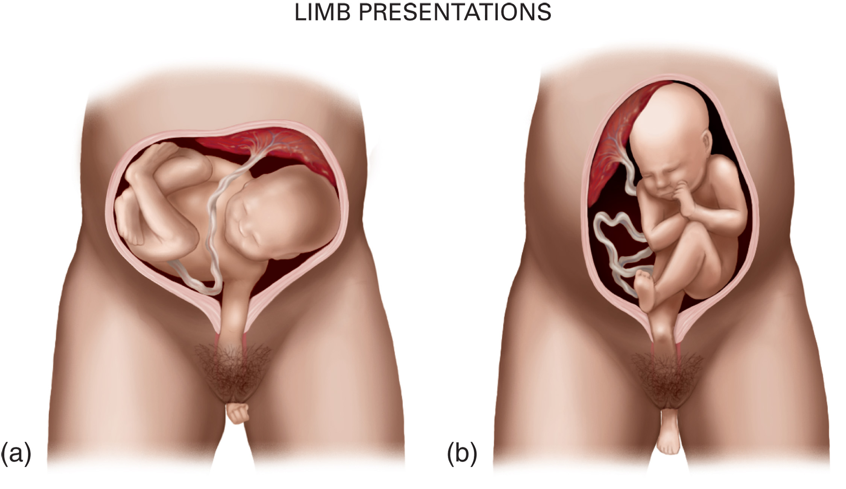
Limb Presentations: (a) Arm, (b) Leg
Notes:
When one arm or one leg is the first to protrude from the birth canal, it is considered a limb presentation. When an arm or leg enters the birth canal and presents with the head or buttocks, it is termed a compound presentation.

Slide 98
Abnormal Delivery (8 of 21)
Intrapartum Emergencies
Shoulder Dystocia
The fetal shoulders are larger than the fetal head.
The head delivers, but then retracts back into the vagina.
Notes:
Complications associated with dystocia:
Fetal. Asphyxia, injury to the brachial plexus (group of nerves in the axillary region) and humerus and clavicle fractures.
Maternal. Trauma to the uterus, vagina, and perineum.

Slide 99
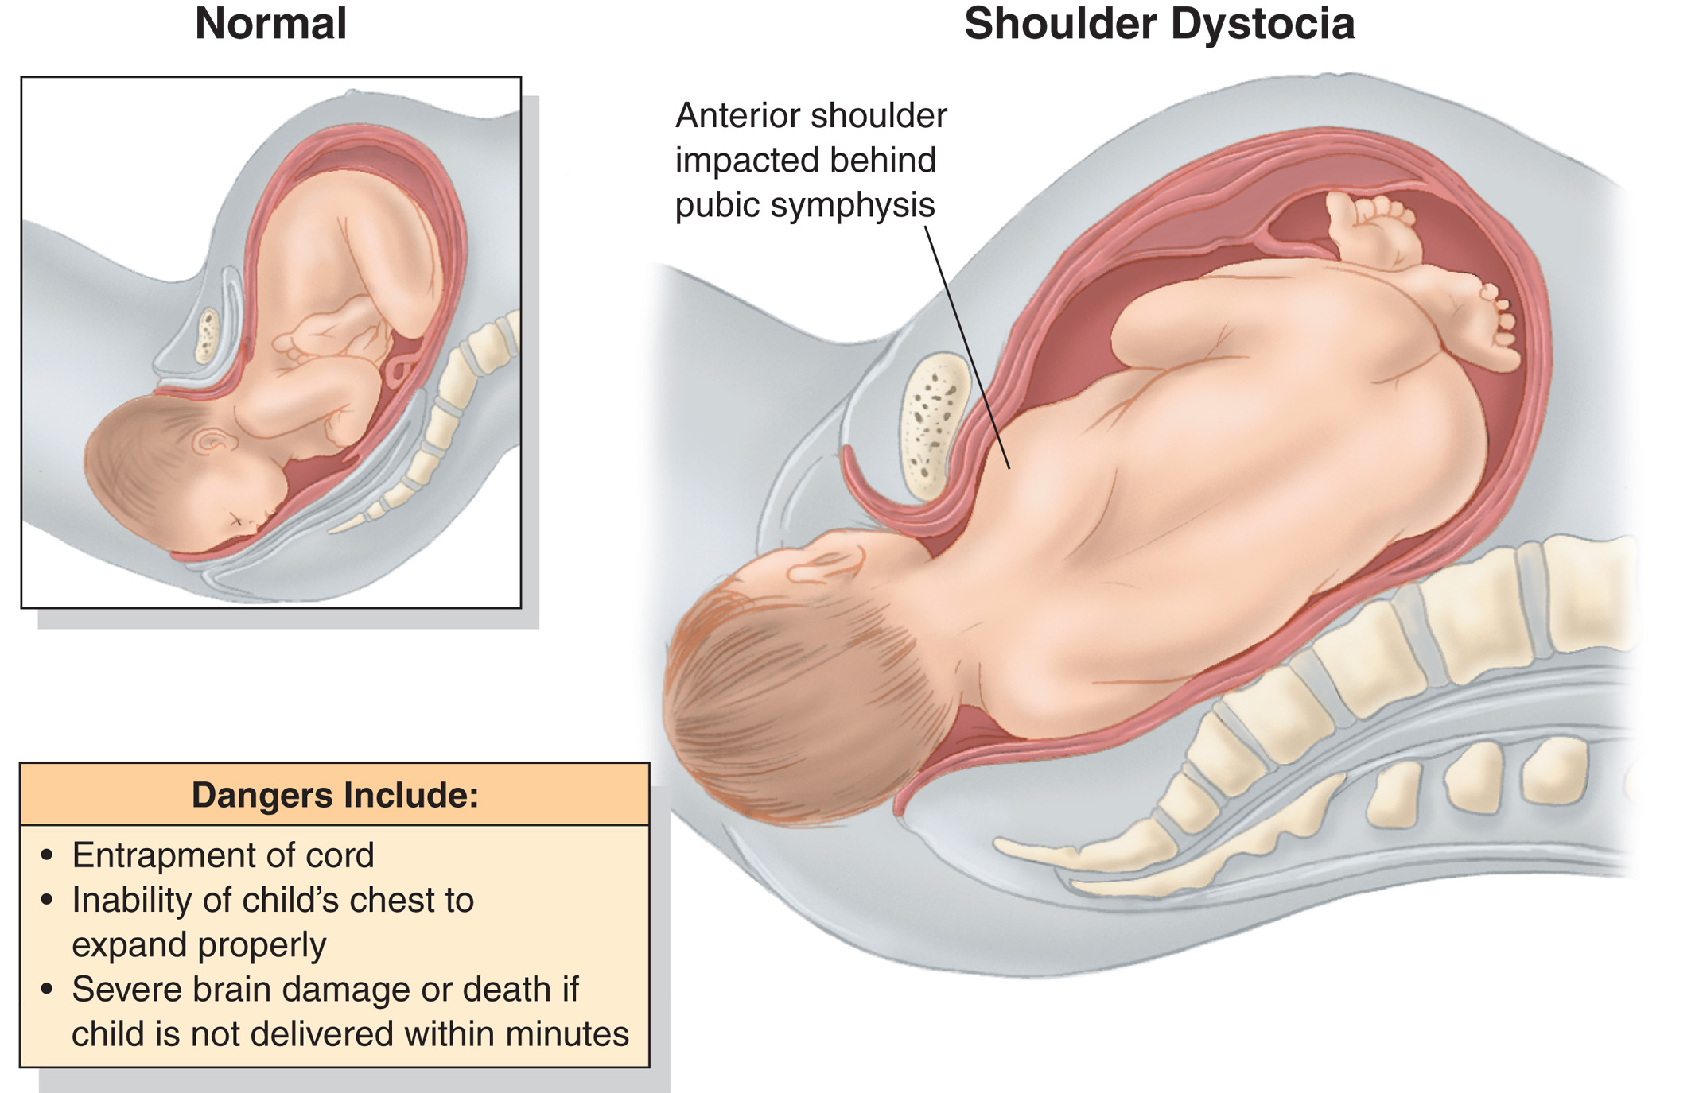
Shoulder Dystocia
Notes:
The retraction into the vagina is referred to as a “turtle sign.” This continues to occur with each contraction following the delivery of the head when the shoulders can’t be delivered.

Slide 100
Abnormal Delivery (9 of 21)
Intrapartum Emergencies
Shoulder Dystocia
Emergency Care
Place the patient in the McRoberts position.
If the McRoberts position alone does not work, apply suprapubic pressure.
If the McRoberts position and suprapubic pressure do not allow the delivery of the shoulders, you might be instructed by medical direction to attempt the Gaskin maneuver.
Notes:
If none of the emergency care procedures work in converting the shoulder dystocia, you must begin emergency transport immediately. The mother must now be instructed not to push with each contraction. Contact medical direction for further orders while en route.

Slide 101
Abnormal Delivery (10 of 21)
Intrapartum Emergencies
Precipitous Delivery
Baby delivered within three hours of the onset of labor
Most common in multiparas
Increased risk of trauma to the baby and mother
Notes:
The delivery would be conducted in the same manner as any other delivery; however, it might occur rapidly and without much warning. The care for the neonate is the same as in a normal delivery.

Slide 102
Abnormal Delivery (11 of 21)
Intrapartum Emergencies
Multiple Births
Be prepared for multiple births if:
The abdomen is still very large after one infant is delivered.
Uterine contractions continue to be strong after delivering the first infant.
Uterine contractions resume about 10 minutes after one infant has delivered.
The infant is small compared to the abdomen.
Notes:
Follow the general guidelines for emergency medical care in a normal delivery, with the following exceptions:
Be prepared to care for more than one baby. Call for assistance.
Approximately one third of the deliveries of the second baby will be breech, so assess carefully and take immediate action. If the second baby is not breech, handle the delivery as you would for a single baby.

Slide 103
Abnormal Delivery (12 of 21)
Intrapartum Emergencies
Meconium
Fetal distress can lead to the fetus passing a bowel movement into the amniotic fluid.
If the meconium-stained fluid is aspirated, pneumonia can result.
Notes:
Meconium staining is most often seen in breech births.
Typically, the thicker and darker the color of the meconium, the higher the risk for fetal problems.

Slide 104
Abnormal Delivery (13 of 21)
Intrapartum Emergencies
Meconium
Medical Care
If meconium is present but the newborn has a good cry or vigorous activity, do not suction.
If the baby is depressed or nonvigorous and the H R is less than 100 bpm or has inadequate respirations, quickly suction the nose and mouth with a bulb syringe and immediately begin P P V.
Notes:
When the fetus becomes hypoxic, the digestive tract increases movement (peristalsis) and the anal sphincter relaxes, causing the meconium to be released into the amniotic fluid. In a breech delivery, the uterus contracts against the fetus’s head and stimulates the parasympathetic nervous system, which increases the peristalsis in the intestines, making meconium staining more likely to occur.

Slide 105
Abnormal Delivery (14 of 21)
Intrapartum Emergencies
Preterm Labor
Occurs between the 20th and 37th week of gestation.
Cocaine and other drugs are known to induce labor.
Emergency Care
Do not allow the mother to push.
Place the mother on oxygen.
Notes:
A mother with a history of preterm labor is usually placed on bed rest during the pregnancy. Preterm labor carries a higher incidence of abnormal presentations of the fetus during delivery.

Slide 106
Abnormal Delivery (15 of 21)
Intrapartum Emergencies
Preterm Birth
Infant weighing less than 5 lb. or born before the 37th week of gestation
Prone to hypothermia and respiratory problems
Notes:
A premature baby is thinner and smaller, and its skin has a reddened and wrinkled appearance. There will be a single crease across the sole of the foot and there will be fine, fuzzy scalp hair. The external ear cartilage will not be fully developed.

Slide 107
Abnormal Delivery (16 of 21)
Intrapartum Emergencies
Preterm Birth
Care for Premature Baby
Dry the newborn thoroughly; use warmed blankets or a plastic bubble-bag swaddle.
Use gentle suction if it is necessary to clear the airway.
Prevent bleeding from the umbilical cord.
Administer supplemental oxygen, if needed
Prevent contamination.
Notes:
Administer oxygen by blowing oxygen across the baby’s face, with the end of the oxygen tube approximately 1 inch above the newborn’s mouth and nose. Never blow the oxygen directly into the face. Support ventilation if breathing is inadequate. Administer only 21 to 30 percent oxygen via the BVM when providing PPV in the preterm newborn.
Prevent contamination and do not let anyone breathe into the newborn’s face. Premature babies are highly susceptible to infection.
Wrap the newborn securely to keep it warm, and heat the vehicle during transport.

Slide 108
Abnormal Delivery (17 of 21)
Intrapartum Emergencies
Post term Pregnancy
Delivery beyond 42 weeks of gestation
Causes postmaturity syndrome, a deterioration of conditions necessary to support the well-being of the baby
Increased risk of complications
Increased risk of intrapartum hypoxia
Notes:
The postmature baby is more prone to insufficient oxygen and nutrient delivery, hypoxia, a hardened skull that causes a more difficult delivery, and the presence of meconium from increased bowel maturity.
The postmature fetus is at greater risk for intrapartum hypoxia because of the inability of the placenta to meet the demands of the fetus during labor.

Slide 109
Abnormal Delivery (18 of 21)
Intrapartum Emergencies
Premature Rupture of Membranes (P R O M)
Spontaneous rupture of the amniotic sac prior to the onset of true labor and before the end of the 37th week of gestation
Increased risk of infection
Prevents adequate lubrication of the vaginal canal at the time of birth
Notes:
Infection of the amniotic fluid or a dry delivery places stress on the fetus during labor and delivery. These babies often need additional resuscitation beyond normal newborn care after being delivered.

Slide 110
Abnormal Delivery (19 of 21)
Postpartum Complications
Postpartum refers to the period following delivery and involves the mother.
Postpartum hemorrhage
A loss of >500 milliLitre blood occurs after delivery.
The uterus fails to regain tone after delivery.
Manage this condition with fundal massage; administer oxygen, and transport the patient.
Notes:
Postpartum hemorrhaging is most common in multigravida patients following multiple births or delivery of a large baby. Prolonged labor and precipitous delivery can lead to failure of the uterus to tone.

Slide 111
Abnormal Delivery (20 of 21)
Postpartum Complications
Embolism
Pregnant and postpartum patients are at increased risk of forming blood clots, which can lead to pulmonary embolism.
Amniotic fluid embolism may occur.
Patients can present with shortness of breath, syncope, tachycardia, sharp chest pain, hypotension, cyanosis, and pale, cool, clammy skin.
Notes:
Clot formation in the venous system can lead to a pulmonary embolism. The patient with a pulmonary embolism can present with shortness of breath, syncope, tachycardia, sharp chest pain, hypotension, cyanosis, and pale, cool, clammy skin.

Slide 112
Abnormal Delivery (21 of 21)
Embolism
Ensure adequate ventilation and maximize oxygenation.
Transport the patient.
Notes:
Provide oxygen via a nonrebreather mask at 15 lpm. If the patient’s breathing becomes inadequate, begin positive-pressure ventilation with supplemental oxygen connected to the ventilation device.

Slide 113
Care of the Newborn (1 of 12)
General Considerations
Neonates lose body heat quickly.
Immediately dry the newborn.
Wrap the baby in a blanket or a plastic bubble-bag swaddle.
Suction to clear the airway only if obstruction to breathing is present.
Place the newborn on their back with neck slightly extended in a sniffing position.
Notes:
Teaching Tips
Allow students ample opportunity to practice neonatal care and resuscitation.
Discussion Questions
How can you use the APGAR score to assess newborns?
What are indications that a newborn requires resuscitation?

Slide 114
Care of the Newborn (2 of 12)
Assessment-Based Approach—Care of the Newborn
Assessment
Score A P G A R at 1 and 5 minutes after birth.
Score each category with a 0, 1, or 2:
Appearance
Pulse
Grimace
Activity
Respirations.
Notes:
Appearance
0 points if the entire body is blue or pale
1 point if the body is pink but the extremities are blue
2 points if the body and extremities are pink
Pulse
0 points for no pulse
1 point for heart rate <100
2 points for heart rate >100
Grimace (reflex irritability)
0 points for no activity
1 point for some facial grimace
2 points for grimace with cough, sneeze, or cry
Activity
0 points for limp, or no movement
1 point for some flexion
2 points for active movement
Respiration
0 points for no respiratory effort
1 point for slow or irregular breathing effort or weak cry
2 points for good respiration and strong cry

Slide 115
Care of the Newborn (3 of 12)
Assessment-Based Approach—Care of the Newborn
Assessment
Use the A P G A R to determine the need for resuscitation.
7 to 10 points—Provide routine care.
4 to 6 points—Stimulate and provide oxygen.
0 to 3 points—Provide care, including oxygen, positive pressure ventilation, and C P R.
Notes:
Critical Thinking Discussion
Why are airway management, oxygenation, and ventilation the most commonly needed interventions in neonatal resuscitation?
Discussion Question
What are the steps of neonatal resuscitation?
Knowledge Application
Students should be able to demonstrate assessment and care of normal newborns and those who need resuscitation.

Slide 116
Care of the Newborn (4 of 12)
Assessment-Based Approach—Care of the Newborn
Assessment
If the newborn is not breathing adequately, stimulate by rubbing the back or flicking the soles of the feet.
Continually assess the newborn during transport.
Notes:
En route to the hospital, provide continual assessment for the newborn. Pay particular attention to body temperature; airway, breathing, and oxygenation status; heart rate; color; and activity level. Contact medical direction to update them on conditions of the mother and newborn.

Slide 117
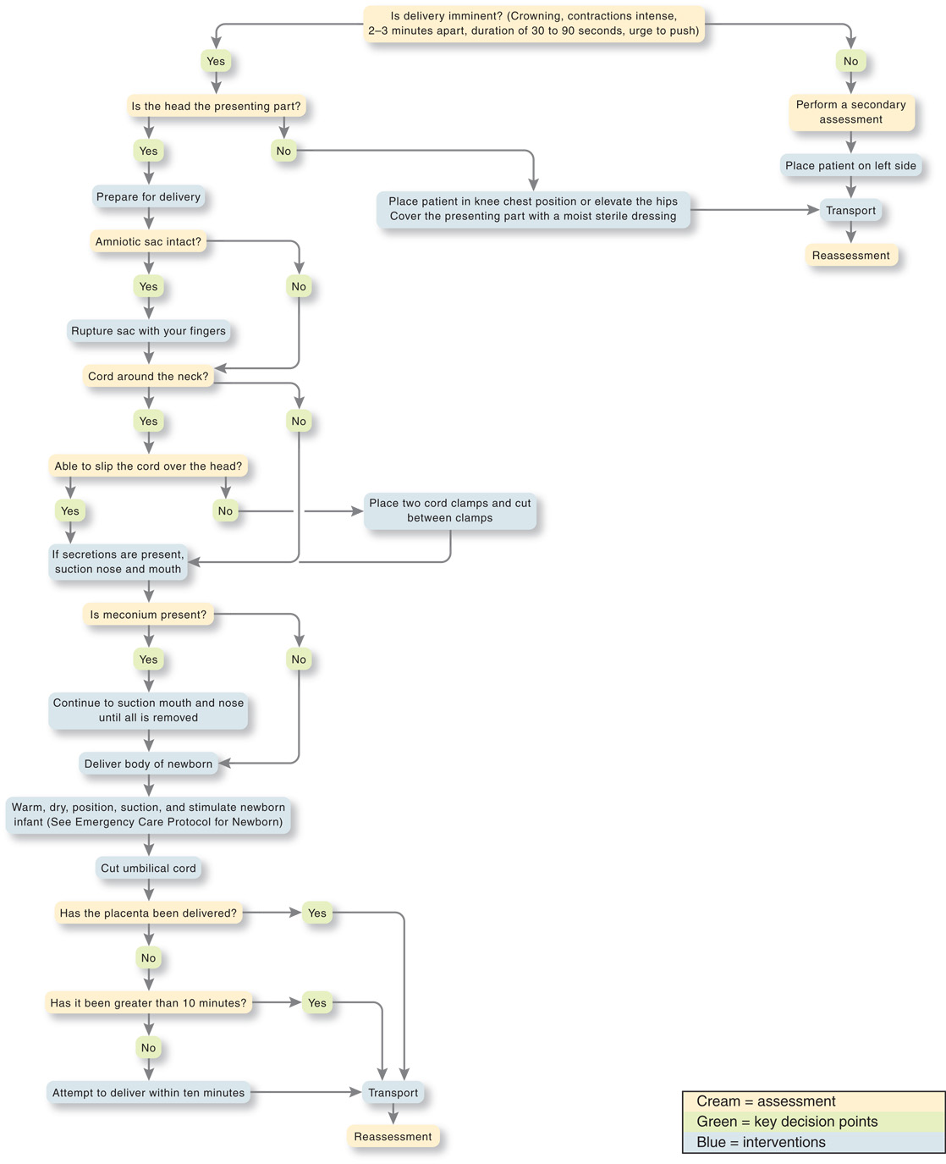
Emergency Care Algorithm: Obstetric Emergency—Active Labor and Delivery
Notes:
Most newborns require no resuscitation beyond temperature maintenance, mild stimulation, and suctioning.

Slide 118
Care of the Newborn (5 of 12)
Assessment-Based Approach—Care of the Newborn
Assessment
Most newborns require only routine care.
Of those who require more care, most need only oxygen and bag-valve mask ventilations.
A few newborns require chest compressions and advanced care.
Notes:
Signs of a severely depressed newborn include:
Respiratory rate over 60 per minute
Diminished breath sounds
Heart rate over 180 per minute or under 100 per minute
Obvious signs of trauma from the delivery process
Poor or absent skeletal muscle tone
Respiratory arrest, or severe distress
Heavy meconium staining of amniotic fluid and a nonvigorous newborn
Weak pulses
Cyanotic body (core and extremities)
Poor peripheral perfusion
Lack of or poor response to stimulation
Apgar score under 4.

Slide 119
Care of the Newborn (6 of 12)
Assessment-Based Approach—Care of the Newborn
Emergency Medical Care
Expected S p O₂ readings in the newborn are based on preductal readings, obtained from the right upper extremity.
The expected S p O₂ takes several minutes to reach normal levels.
Notes:
The establishment and maintenance of an adequate airway, ventilation, and oxygenation is the “cornerstone” treatment for any newborn who does not exhibit vigorous activity following birth.

Slide 120
Table 37-1 Targeted Preductal S p O₂ after Birth
Preductal oxygen saturation is measured by placing the S p O₂ probe on the right hand or extremity to measure blood oxygen saturation before it reaches the ductus Arteriosus in the aorta.
Minutes After Birth | Expected Preductal S p O₂ Reading
1 minute | 60% to 65%
2 minute | 65% to 70%
3 minute | 70% to 75%
4 minute | 75% to 80%
5 minute | 80% to 85%
10 minute | 85% to 90%
Notes:
The preductal (measured in the right hand or extremity) SpO₂ reading and blood oxygenation will be much lower immediately after birth (SpO₂ of 60–65%) and will steadily improve within the first 10 minutes.

Slide 121
Care of the Newborn (7 of 12)
Assessment-Based Approach—Care of the Newborn
Emergency Medical Care
The majority of newborns who require intervention require only simple measures.
Newborn bradycardia (H R <100 beatsperminute), labored breathing, apnea, or persistent cyanosis typically respond to blow-by oxygen or to bag-valve mask ventilations.
Notes:
Approximately 80 percent of newborns require no resuscitation beyond keeping them warm and keeping the airway clear of secretions, if necessary.
To provide blow-by oxygen, hold the tube 1 inch from the baby’s nose and mouth and direct the oxygen flow, at 5 lpm or greater, across the mouth and nose. Make sure the baby is kept warm and the airway remains clear.

Slide 122
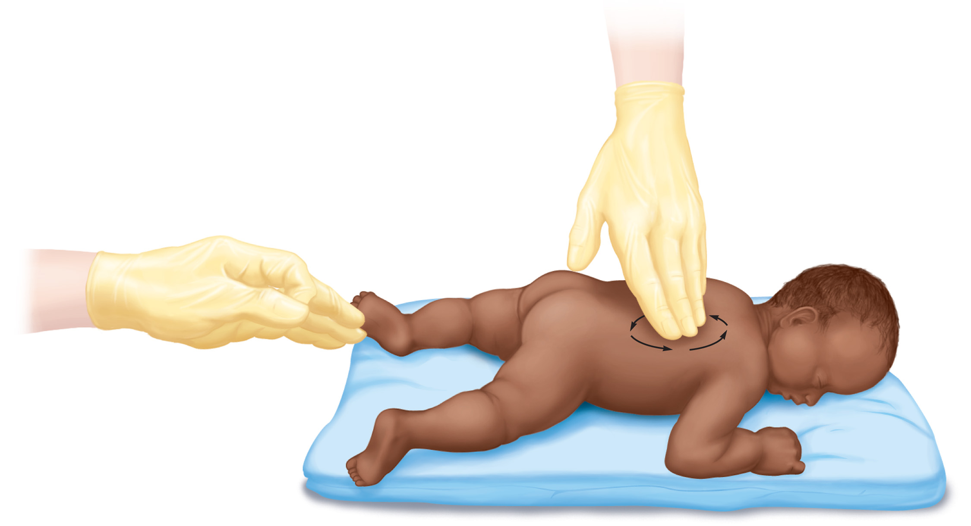
Stimulate the Infant Who is not Breathing by Flicking the Soles of their Feet or by Rubbing their Back
Notes:
A small number of newborns might require chest compressions, and an even smaller number might require the medications or an advanced airway that an advanced life support team can provide.

Slide 123
Care of the Newborn (8 of 12)
Assessment-Based Approach—Care of the Newborn
Emergency Medical Care
These three questions guide the need for resuscitation:
Is this a term gestation?
Does the newborn have a good cry or are they breathing adequately?
Does the newborn have good muscle tone?
Notes:
If the answer to all the three questions is “yes,” the newborn should not require resuscitation beyond normal newborn care and can be kept with the mother for transportation, provided the mother is not experiencing any life-threatening complications.
If you have answered “no” to any of the three questions, the newborn will require one or more additional interventions. The newborn resuscitation steps follow. In many of these interventions, after 60 seconds, reassess to determine the need for continued intervention.

Slide 124
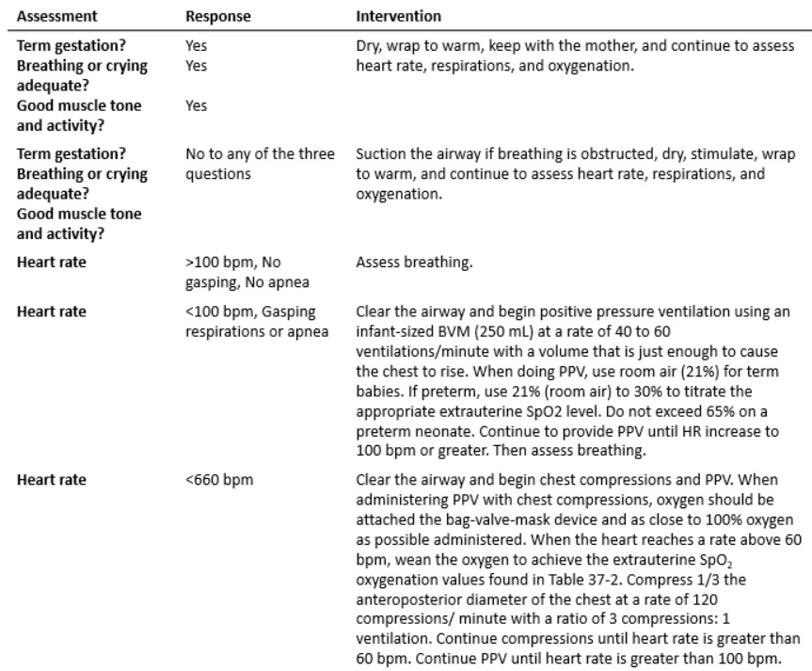
Table 37-2 Assessment and Initial Management of the Newborn (1 of 2)
Notes:
The entire time the newborn is in your care, you must continuously reevaluate:
Heart rate
Respirations
Oxygenation (determined by SpO₂ monitoring).

Slide 125
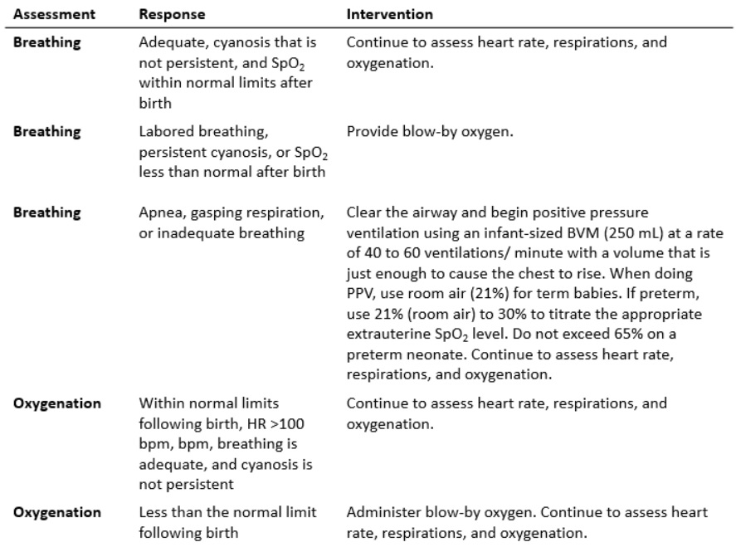
Table 37-2 Assessment and Initial Management of the Newborn (2 of 2)
Source: 2015 American Heart Association Guidelines for Cardiopulmonary Resuscitation and Emergency Cardiovascular Care.
Notes:
Assessment and initial management of the newborn should be conducted as outlined in Table 37-3.

Slide 126
Care of the Newborn (9 of 12)
Assessment-Based Approach—Care of the Newborn
Emergency Medical Care
Interventions within 30 seconds of delivery:
Dry and warm the newborn.
Position the airway.
Suction if there is obstruction to breathing.
Stimulate by flicking the soles of the baby’s feet or rubbing their back.
Notes:
The following interventions must be conducted within the 30 seconds after delivery:
If the heart rate is <100 bpm or there are gasping respirations or apnea, immediately suction and begin PPV. Use room air (21 percent) for term babies. If preterm, use 21 percent (room air). Add and titrate oxygen using the least amount possible to reach the appropriate extrauterine SpO₂ level. Do not exceed 65 percent on a preterm neonate.
If the breathing is labored or cyanosis is persistent, assess, position, and clear the airway, apply the pulse oximeter, and administer blow-by oxygen if the extrauterine SpO₂ value is less than what it should be at that point in time post-delivery.

Slide 127
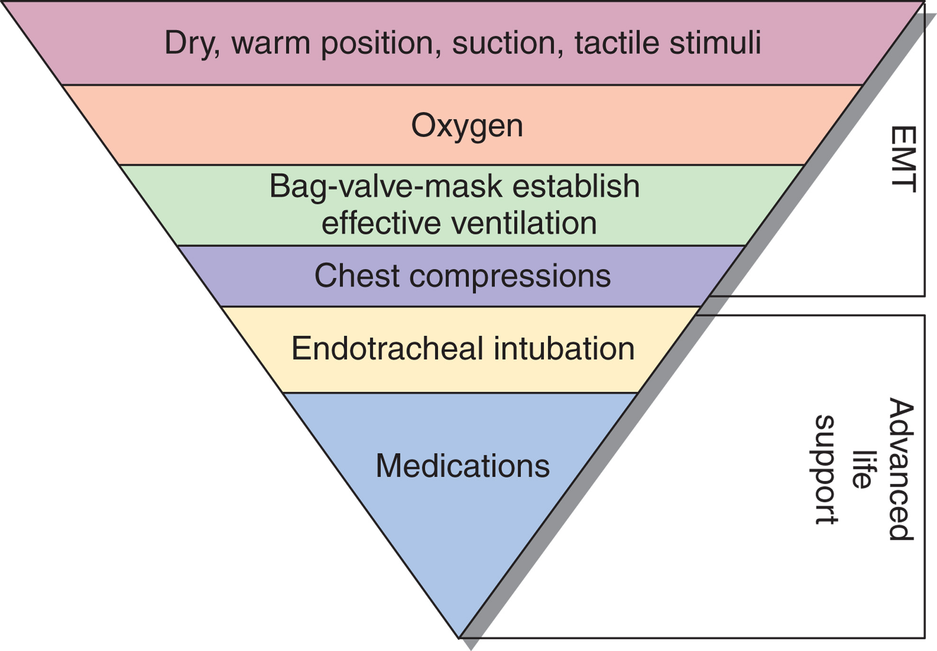
The Inverted Pyramid for Neonatal Resuscitation Shows that the Majority of Newborns Will Respond to Simple Routines of Care
only a few will require aggressive resuscitation.
Notes:
The relative frequency of need for resuscitative measures is often shown as an inverted pyramid with the simple care most newborns require at the top.

Slide 128
Care of the Newborn (10 of 12)
Assessment-Based Approach—Care of the Newborn
Emergency Medical Care
Positive Pressure Ventilation
Clear the airway by suction.
Provide ventilations by bag-valve mask at the rate of 40–60 per minute.
Reassess every 30 seconds.
If breathing has not improved, continue ventilations.
Notes:
To provide blow-by oxygen, hold the tube 1 inch from the nose and mouth and direct the oxygen flow, at 5 lpm or greater, across the mouth and nose.

Slide 129
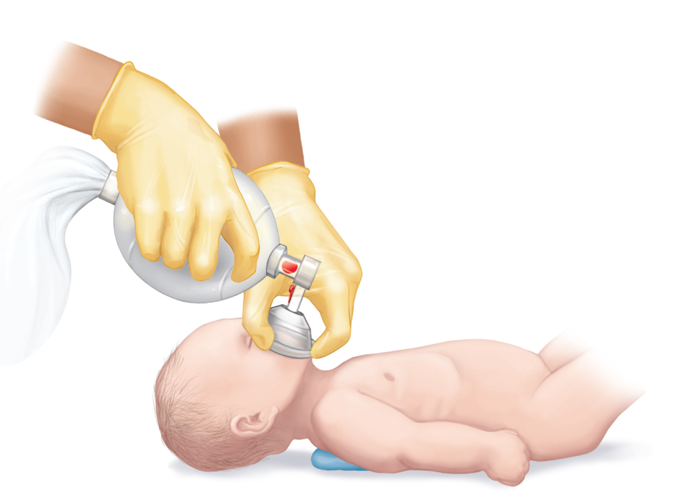
To Provide Positive Pressure Ventilation, Use a Bag-Valve Mask. Maintain a Good Mask Seal
Ventilate with just enough force to raise the infant's chest. Ventilate at a rate of 40–60 per minute for 30 seconds, then reassess.
Notes:
Clear the airway by suction. Provide ventilations by bag-valve mask at the rate of 40 to 60 per minute with 100 percent oxygen if the baby is a term newborn and only 21 percent to 30 percent if they are a preterm newborn. You should maintain a tight face mask seal and provide ventilations with just enough force to raise the infant’s chest. Reassess after 30 seconds of ventilation. If the baby’s breathing has not improved and the heart rate is less than 100/minute, continue ventilations and reassess every 30 seconds.

Slide 130
Care of the Newborn (11 of 12)
Assessment-Based Approach—Care of the Newborn
Emergency Medical Care
If the infant’s heart rate drops to <60, continue ventilations and begin chest compressions.
Notes:
If, despite adequate ventilations, the baby’s heart rate drops to less than 60 beats per minute, continue ventilations and begin chest compressions. Circle the torso with your fingers and place both thumbs on the lower third of the newborn’s sternum. If the baby is small, you might need to overlap your thumbs. Compress the chest approximately one third the depth of the chest at 120 compressions per minute.

Slide 131
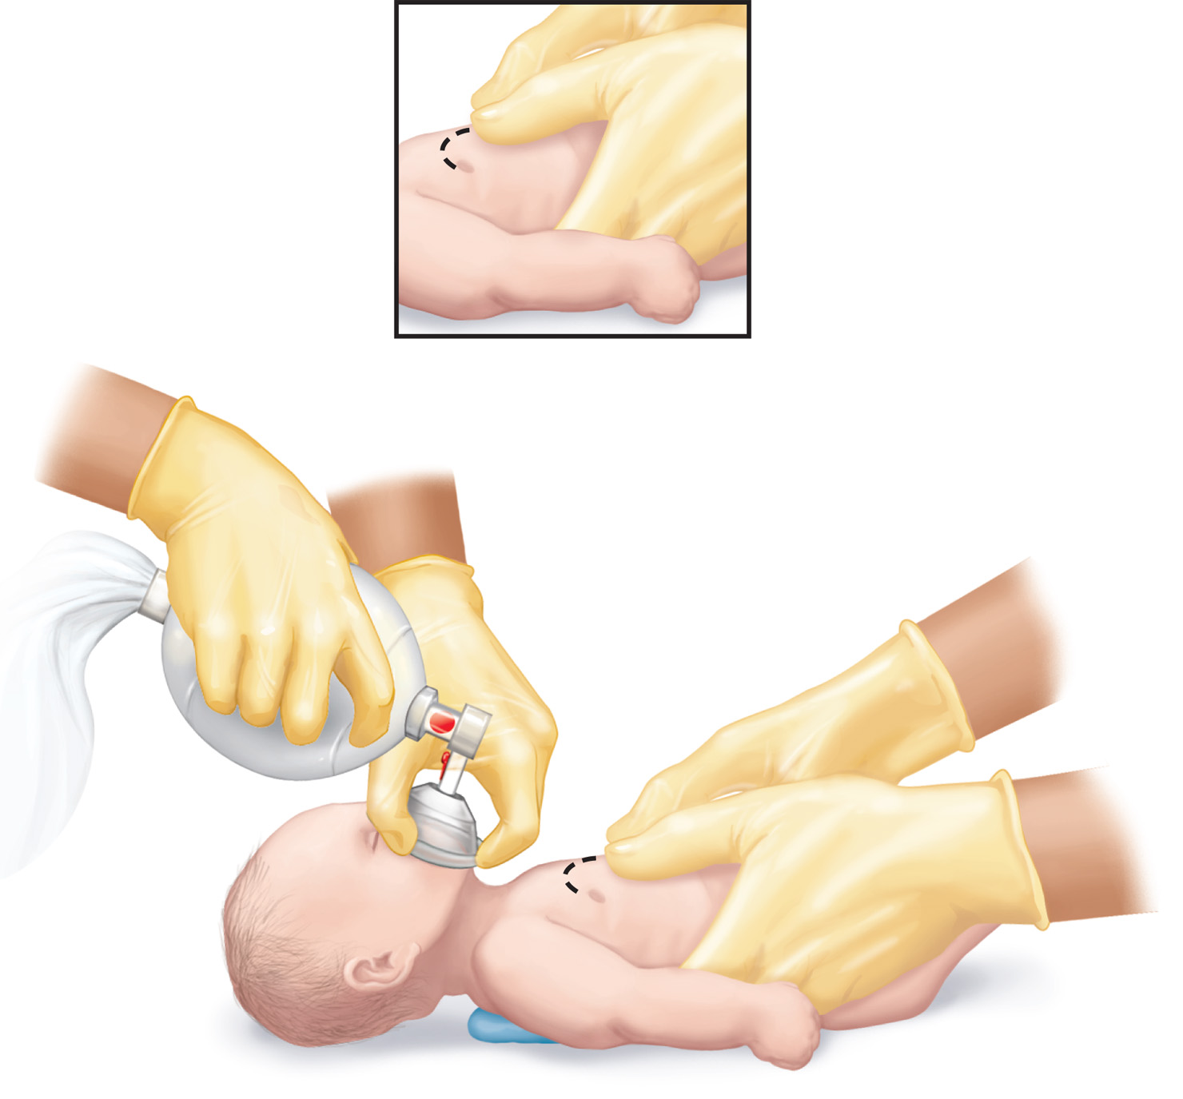
To Provide Chest Compressions, Circle the Torso with the Fingers and Place Both Thumbs on the Lower Third of the Infant’s Sternum
If the infant is very small, you may need to overlap the thumbs. If the infant is very large, compress the sternum with the ring and middle fingers placed one finger's depth below the nipple line. Compress the chest one-third the depth of the chest at the rate of 120 per minute and a ratio of 3:1 compressions to ventilations.

Slide 132
Care of the Newborn (12 of 12)
Assessment-Based Approach—Care of the Newborn
Emergency Medical Care
Meconium Present at Birth
Newborn is crying vigorously with good respiratory effort and good muscle tone,
Newborn has absent or depressed respirations, poor muscle tone, or H R <100 beatsperminute.
Notes:
If the newborn is crying vigorously with good respiratory effort and good muscle tone:
Do not suction unless meconium is visible in the airway. If visible in nose or mouth, suction with a bulb syringe until clear.
Keep the baby with the mother and perform normal newborn care (dry, warm, position)
If the newborn has absent or depressed respirations, poor muscle tone, or HR *100 bpm:
Suction the nose and mouth, even if meconium is not visible.
Immediately begin PPV. When providing PPV, use room air (21 percent) for term babies. If the baby is preterm, use 21 percent (room air) to 30 percent to titrate the appropriate extrauterine SpO₂ level. Do not exceed 65 percent on a preterm neonate. If, at any time, the heart rate decreases to 660 bpm, immediately begin chest compressions and increase oxygen delivery to 100 percent via the BVM.

Slide 133
Case Study Conclusion
As Lacy assists with delivery of the placenta and monitors the mother, Alan determines that the newborn has a one-minute A P G A R score of 7, and a five-minute A P G A R score of 8.
Alan ensures that the baby is dry and warm, and hands them to their mother.
En route, the E M T s continue to monitor both patients, who are stable on arrival at the hospital.
Notes:
Case Study Discussion
Review Case Study Conclusion and emphasize the application of knowledge learned from this presentation.

Slide 134
Lesson Summary (1 of 2)
Pregnancy results in physiological changes to several body systems.
Antepartum emergencies include hemorrhagic emergencies and hypertensive emergencies.
There are three stages of normal labor.
Notes:
Follow-Up
Answer student questions.
Follow-Up Assignments
Review Chapter 37 Summary.
Complete Chapter 37 In Review questions.
Complete Chapter 37 Critical Thinking questions.
Assessments
Handouts
Chapter 37 quiz

Slide 135
Lesson Summary (2 of 2)
Most abnormal deliveries cannot take place in the prehospital setting.
Newborn resuscitation begins with simple measures such as drying, warming, and stimulation.
Notes:
Class Activity
As an alternative to assigning the follow-up exercises in the lesson plan as homework, assign each question to a small group of students for in-class discussion.
Teaching Tips
Answers to In Review questions are in the appendix of the text. Advise students to review the questions again as they study the chapter.

Slide 136
Correct!
As the baby descends into the birth canal, the mother will have a feeling of pressure in the rectum, such as that caused by the need to have a bowel movement.
Click here to return to the program.

Slide 137
Incorrect (1 of 3)
As delivery becomes imminent, contractions will be 2 to 3 minutes, lasting 60 to 90 seconds.
Click here to return to quiz.

Slide 138
Incorrect (2 of 3)
The first stage of labor can last several hours, on the average 8 to 10 hours for a first birth. The length of labor, on its own, is not an indicator of imminent birth.
Click here to return to quiz.

Slide 139
Incorrect (3 of 3)
Lack of prenatal care puts the mother and infant at higher risk of complications, but does not predict whether delivery is imminent.
Click here to return to quiz.

Slide 140
Copyright

