Slide 1
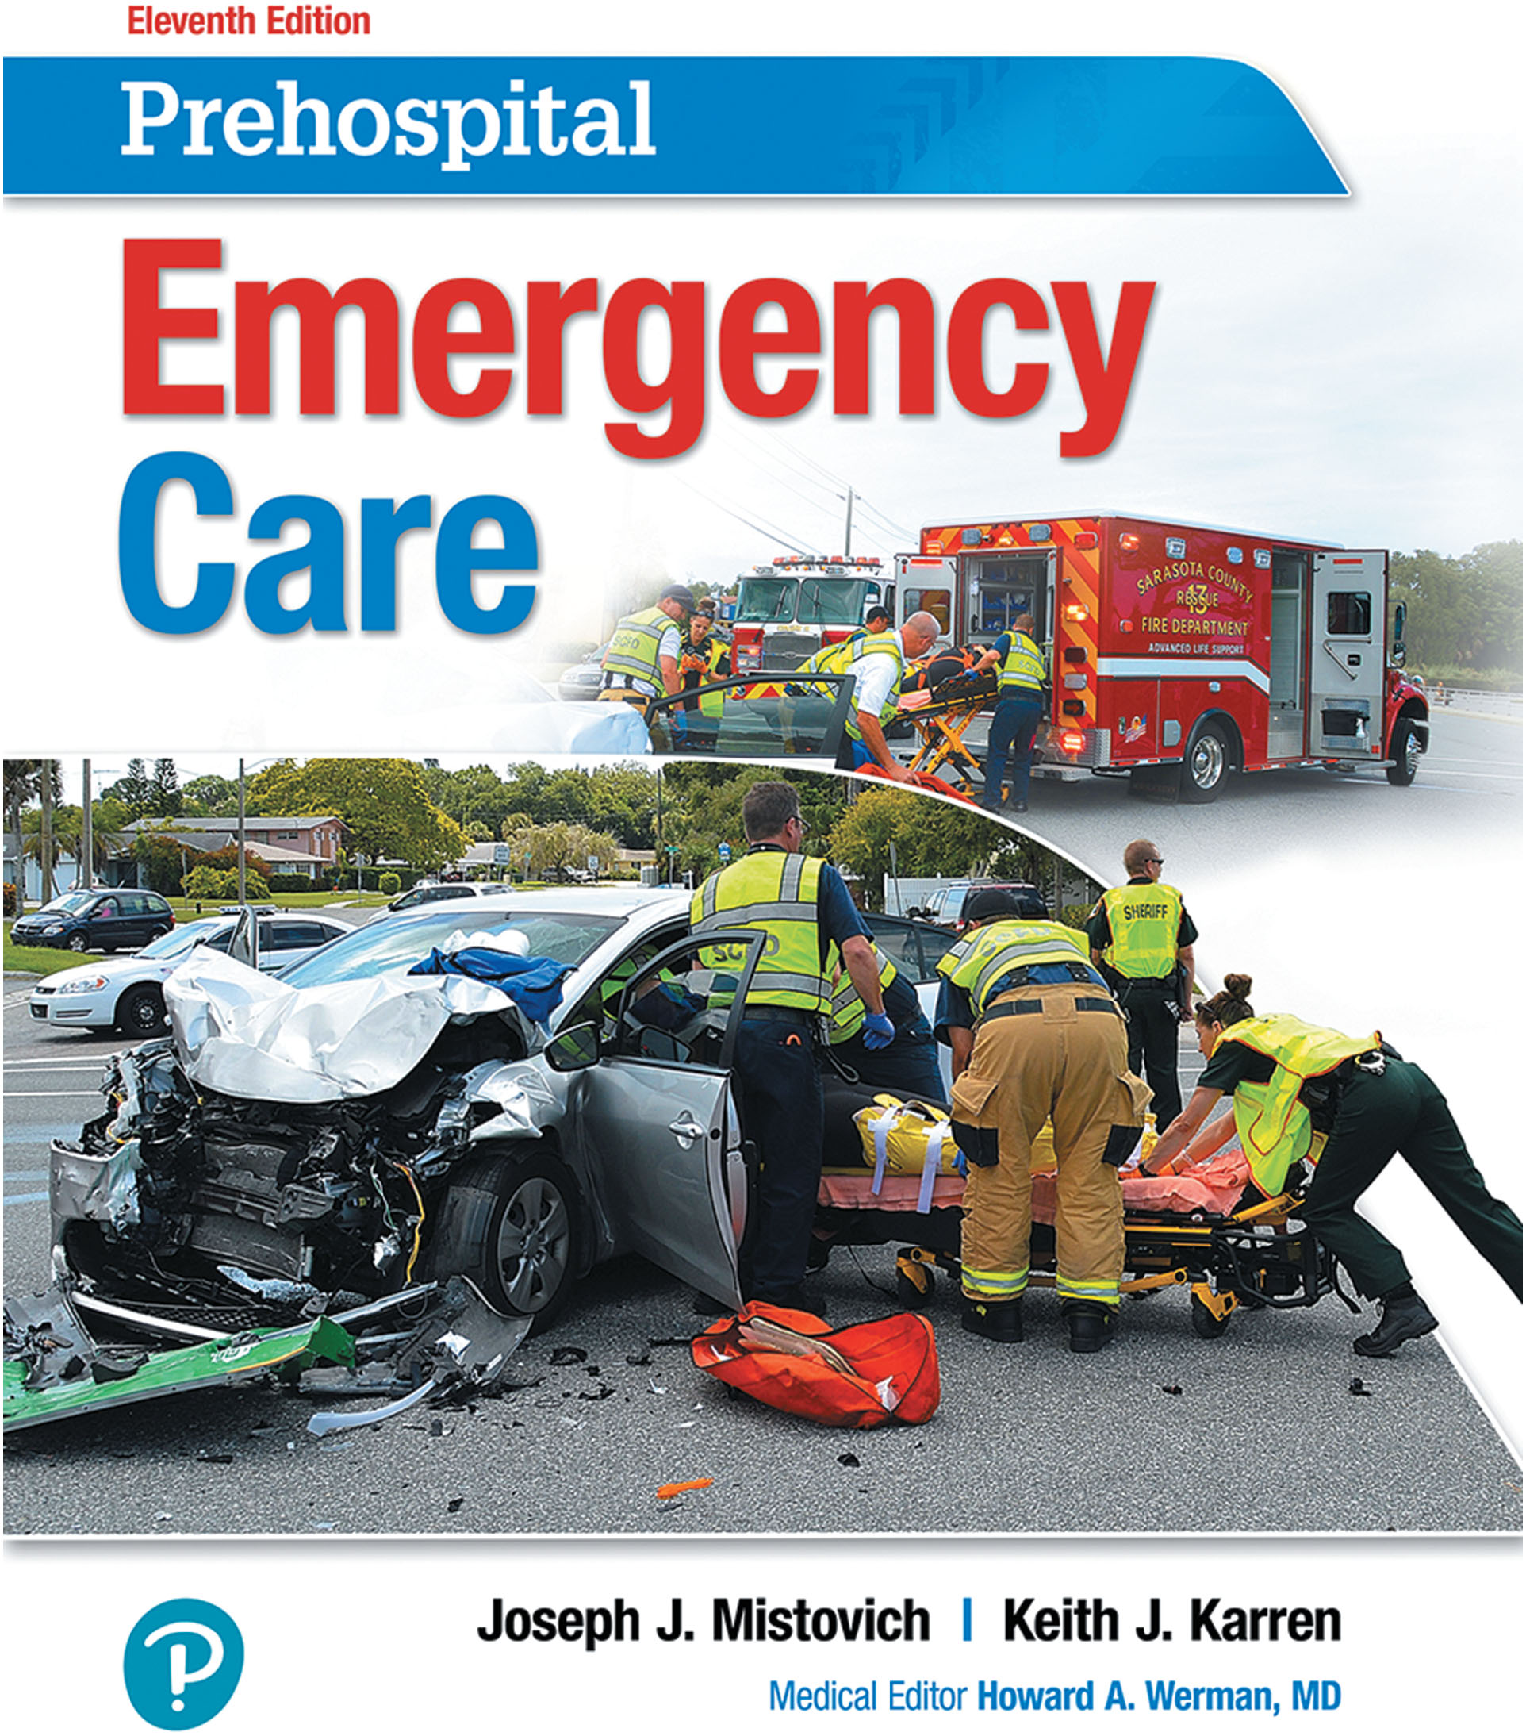
Prehospital: Emergency Care
Eleventh Edition
Chapter 36
Multisystem Trauma and Trauma in Special Patient Populations
Slides in this presentation contain hyperlinks. JAWS users should be able to get a list of links by using INSERT+F7
Copyright © 2018, 2014, 2010 Pearson Education, Inc. All Rights Reserved
Notes:
If this PowerPoint presentation contains mathematical equations, you may need to check that your computer has the following installed:
1) MathType Plugin
2) Math Player (free versions available)
3) NVDA Reader (free versions available)
Advance Preparation
Student Readiness
Assign the associated section of MyBRADYLab and review student scores. Review the chapter material in the Instructor Resources, which includes Student Handouts, PowerPoint slides, and the MyTest Program.
Prepare
Make copies of course policies and procedures, the syllabus, handouts from the Instructor Resources, and other materials for distribution or post them in your learning management system.
Preview the media resources and Master Teaching Notes in this lesson.
Preview the case study presented in the PowerPoint slides.
The total teaching time recommended is only a guideline. Take into consideration factors such as the pace at which students learn, the size of the class, breaks, and classroom activities. The actual time devoted to teaching objectives is the responsibility of the instructor.

Slide 2
Learning Readiness
E M S Education Standards, text p. 1053.
Chapter Objectives, text p. 1053.
Key Terms, text p. 1053.
Purpose of lecture presentation versus textbook reading assignments.
Notes:
Explain to students what the National EMS Education Standards are. The National EMS Education Standards communicate the expectations of entry-level EMS providers. As EMTs, students will be expected to be competent in these areas. Acknowledge that the standards are broad, general statements. Although this lesson addresses the listed competencies, the competencies are often complex and require completion of more than one lesson to accomplish. The student is also expected to review the chapter objectives to foreshadow what will be in the chapter. By mastering the key terms the EMT student will better understand the learning and be able to communicate more clearly.
Additionally, explain to the students that the purpose of using these slides is to help keep the instructor focused on highlighting important portions of the material, explain interrelationships of topics, and discuss how to apply this information. It’s not the intent of the presentation (or slides alone) to include every component in the chapter. This presentation still requires the student to thoroughly read the chapter.

Slide 3
Setting the Stage
Overview of Lesson Topics
Multisystem Trauma
Trauma in Special Patient Populations
Assessment-Based Approach: Multisystem Trauma and Trauma in Special Patient Populations
Notes:
These bulleted points are the major headings from the chapter, in order. The purpose is to help the student navigate the lesson.

Slide 4
Case Study Introduction
Excited to hear the approach of the ice cream truck in his neighborhood, 7-year-old Russ Moffat runs into the street to look for it. He fails to see the car approaching from the opposite direction until it is too late, turning toward it at the last second. The bumper strikes Russ in the torso, causing his head to impact the hood, before throwing him down to the ground as the driver screeches the car to a halt.
Notes:
Case Study
Present the Case Study Introduction provided in the PowerPoint slide set.
Lead a discussion using the case study questions provided on the subsequent slide(s).
The Case Study with discussion questions continues throughout the PowerPoint presentation.
Case Study Discussion
Use the case study content and questions to foreshadow the upcoming lesson content.

Slide 5
Case Study
How will Russ’s age affect the type and distribution of his injuries?
How might Russ’s injuries present differently from the same injuries in an adult patient?
What differences are required in the assessment and management of this patient, as compared to an adult?
Notes:
Case Study Discussion
Use the case study content and questions to foreshadow the upcoming lesson content. Gauge the students’ responses as a guide of how well versed they are in this topic.

Slide 6
Introduction
The involvement of multiple body systems in trauma makes management of the trauma patient more challenging.
There are special considerations in assessment and management of pediatric, geriatric, pregnant, and cognitively impaired trauma patients.
Notes:
During this lesson, students learn about special considerations an EMT should have when caring for specific trauma populations.

Slide 7
Multisystem Trauma (1 of 4)
A patient is considered to have multisystem trauma when more than one major system is involved.
Significant forces increase the risk for injuries to multiple systems.
Morbidity and mortality are higher in patients with multisystem trauma.
The risk of developing shock is higher with multisystem trauma.
Notes:
Discussion Questions
What is the relationship between multisystem trauma and shock?
Under what circumstances should the EMT request ALS or air medical support when caring for a multisystem trauma patient?
What are the priorities when managing a multisystem trauma patient?
Why is it important to perform a secondary assessment and obtain a medical history from a multisystem trauma patient?

Slide 8
Multisystem Trauma (2 of 4)
The care for multisystem trauma patients depends on the systems involved.
The definitive care is often surgery.
Notes:
Knowledge Application
Students should be able to apply the principles of managing multisystem trauma patients to a variety of lab scenarios.
Class Activity
Have groups of students prepare multisystem trauma scenarios to demonstrate their understanding of the effects of multisystem trauma. Review the scenarios for accuracy during a break and use the scenarios for lab practice.
Teaching Tips
Allow ample opportunity for students to apply the principles in lab scenarios.
If weather and resources allow, have students practice outdoors.
Critical Thinking Discussion
How can you develop the level of skill and efficiency needed to care for critically injured multisystem trauma patients?

Slide 9
Multisystem Trauma (3 of 4)
Golden Principles of Prehospital Multisystem Trauma Care
Ensure safety of personnel and patient.
Determine additional resources needed.
Understand kinematics.
Identify and manage life threats.
Manage the airway while maintaining cervical spine stabilization.
Support ventilation and oxygenation.
Notes:
Your personal safety is most important and should be maintained when you arrive on the scene and throughout your patient’s care.
After arriving on the scene, determine whether you need additional resources. Because multisystem trauma can result from various causes, the additional resources required may vary.
Knowing the mechanism of injury (MOI) can help the EMT anticipate what injuries the patient may have. Multisystem trauma can result from blunt trauma, penetrating trauma, motor vehicle collisions, blast injuries, deceleration injuries, or any other type or combination of mechanisms.
Airway, ventilation, and oxygenation are key to the successful management of a multisystem trauma patient. Each multisystem trauma patient should be assessed and that patient’s specific emergency care needs identified.
Because multisystem trauma patients may have suffered a spinal injury, always consider spine motion restriction. Inspect for possible airway obstructions and apply suction if necessary. Open the airway using the jaw-thrust method.
Determine whether your patient is breathing adequately based on the rate and tidal volume. If the ventilation is inadequate, provide positive pressure ventilation. Administering high-concentration oxygen is necessary in the multisystem trauma patient to saturate the hemoglobin with as much oxygen as possible and to attempt to maintain delivery of oxygen to the cells.

Slide 10
Multisystem Trauma (4 of 4)
Golden Principles of Prehospital Multisystem Trauma Care
Control external hemorrhage and treat for shock.
Perform a secondary assessment and obtain a medical history.
Splint skeletal injuries and maintain spine motion restriction if needed.
Make transport decisions.
Notes:
Cellular oxygenation is impaired when a patient is bleeding profusely. The loss of hemoglobin reduces the capability of the blood to carry and deliver oxygen to the cells. This leads to cellular hypoxia and anaerobic metabolism.
After treating immediate life threats, perform a rapid secondary assessment to identify any additional injures that could potentially be life-threatening.
Multisystem trauma patients may be found standing, sitting, prone, or supine when you arrive on the scene. These patients may require spine motion restriction. Any musculoskeletal injuries should be splinted en route if the patient is unstable.
Rapid extrication and rapid transport of the critically injured multisystem trauma patients are essential. The on-scene time is critical and should not be prolonged. The on-scene time is considered part of the platinum 10 minutes and the golden period between injury and definitive care at the hospital, a time span that should not be exceeded and should be minimized if possible.

Slide 11
Trauma in Special Patient Populations (1 of 25)
Trauma in Pregnant Patients
Anatomic and Physiologic Considerations in the Pregnant Trauma Patient
It is difficult to assess the fetus, so manage the mother aggressively.
The blood volume is increased by 50percent in late pregnancy.
The heart rate increases by 10 to 15 beatsperminute by the third trimester.
The uterus becomes highly vascular.
Notes:
Injury to a pregnant uterus can result in severe bleeding. These changes can make the injured pregnant patient more susceptible to shock. However, because of the increased plasma volume in pregnancy, the signs of shock may be masked and delayed.
Discussion Questions
What are common causes of injury in pregnant patients?
How do the anatomy and physiology of pregnancy affect the response to injuries?

Slide 12
Trauma in Special Patient Populations (2 of 25)
Trauma in Pregnant Patients
Anatomic and Physiologic Considerations in the Pregnant Trauma Patient
The diaphragm is elevated.
Pain perception in the abdomen is altered.
Decreased gastric motility and increased risk of vomiting.
The uterus and bladder are at greater risk of injury.
Notes:
The pregnant woman’s renal blood flow is also increased. Their pelvic joints are loosened and their center of gravity changes, both of which can make them prone to accidents and falls. Pregnancy has also been shown to be a time when domestic abuse is more likely to occur.

Slide 13
Trauma in Special Patient Populations (3 of 25)
Trauma in Pregnant Patients
Assessment Considerations in the Pregnant Trauma Patient
The more severe the injury to the mother, the greater the chances of fetal injury.
Fetal death rates are nine times higher than maternal death rates following trauma.
Notes:
Trauma to a pregnant woman, whether severe or minor, can have significant effects on the health of the fetus.

Slide 14
Trauma in Special Patient Populations (4 of 25)
Trauma in Pregnant Patients
Assessment Considerations in the Pregnant Trauma Patient
The most common problem caused by maternal trauma is uterine contractions that may progress into labor.
Abruptio placentae is premature separation of the placenta from the uterine wall.
Notes:
If there is any complaint of abdominal pain or contractions, you must assess for crowning and vaginal bleeding.
Abruptio placentae most commonly occurs with blunt trauma. There may be abdominal pain and vaginal bleeding. There is a high risk of fetal and maternal death.

Slide 15
Trauma in Special Patient Populations (5 of 25)
Trauma in Pregnant Patients
Assessment Considerations in the Pregnant Trauma Patient
Fetal and maternal outcomes from motor vehicle collisions are more favorable when the mother wears a seatbelt.
Uterine rupture may occur as a result of motor vehicle trauma.
It can result in maternal and fetal death.
Notes:
The unbelted pregnant crash victim is twice as likely to have vaginal bleeding or to give birth, and fetal death is three to four times more likely.

Slide 16
Trauma in Special Patient Populations (6 of 25)
Trauma in Pregnant Patients
Assessment Considerations in the Pregnant Trauma Patient
Fetal distress can be caused by hypoxia or hypovolemia, but signs of shock can be delayed or masked in pregnant patients.
Attempt resuscitation of the pulseless pregnant trauma patient according to your protocol.
Notes:
Shock is a frequent cause of death to both the fetus and the mother. It is estimated that 41 percent of fetuses die when the mother suffers a life-threatening injury. A traumatic maternal cardiac arrest poses a significant risk to the fetus. Although the chance of the fetus surviving maternal cardiac arrest is poor, it is still possible, especially with high-quality CPR.

Slide 17
Trauma in Special Patient Populations (7 of 25)
Trauma in Pregnant Patients
Management Considerations for the Pregnant Trauma Patient
When spine motion restriction is required, tilt the spine board to the left to prevent supine hypotensive syndrome.
Airway, ventilation, and oxygenation are critical to the pregnant trauma patient. E M T s should anticipate vomiting and have suction readily available.
Notes:
You should anticipate vomiting and have suction readily available, especially in the supine patient. Assess if the patient is breathing adequately and if bilateral breath sounds are present. Assist the patient’s ventilations if the tidal volume or respiratory rate is inadequate. Administer a high concentration of oxygen by nonrebreather mask if the breathing is adequate or via the bag-valve mask in the patient with inadequate breathing.

Slide 18
Trauma in Special Patient Populations (8 of 25)
Trauma in Pregnant Patients
Management Considerations for the Pregnant Trauma Patient
Airway and ventilation
Assist inadequate ventilations.
Administer oxygen and maintain as high an S p O₂ as possible.
The fetus can be severely hypoxic before the mother shows signs of hypoxia.
Notes:
The vasoconstriction response in hypovolemia or shock will reduce the blood flow to the uterus. The fetus is vulnerable to any reduction in oxygen and can become severely hypoxic before the pregnant patient shows signs of hypoxia.

Slide 19
Trauma in Special Patient Populations (9 of 25)
Trauma in Pregnant Patients
Management Considerations for the Pregnant Trauma Patient
Circulation
Check for major bleeding.
Absorb vaginal bleeding with a pad; do not pack the vagina.
Anticipate and treat for shock.
Notes:
Perform a visual exam at the vaginal opening to assess for crowning and/or bleeding. Remember that you have two patients. If labor occurs because of the trauma, you may need additional resources to help you manage both the mother and the newborn.

Slide 20
Trauma in Special Patient Populations (10 of 25)
Trauma in Pregnant Patients
Management Considerations for the Pregnant Trauma Patient
Consider A L S intercept or air medical transport for major traumas involving pregnant patients.
Anticipate the need for additional resources if delivery is imminent.
Notes:
The best method to care for the fetus is by anticipating injuries and shock and aggressively managing the mother.

Slide 21
Click on the Intervention That is Required to Prevent Supine Hypotensive Syndrome When Managing a Pregnant Trauma Patient
a. Fill all voids beneath the patient’s back with padding when applying a long backboard.
b. Administer oxygen at 15 l p m by nonrebreather mask to all pregnant trauma patients.
c. Tilt the long backboard to the patient’s left once straps are applied.
d. Transport the patient in semi-Fowler’s position with the knees and hips flexed.

Slide 22
Trauma in Special Patient Populations (11 of 25)
Trauma in Pediatric Patients
Mechanisms include drowning, burns, falls, penetrating trauma, motor vehicle collisions, and pedestrian-vehicle collisions.
Children are at risk of being abused by adults.
Shaken baby syndrome is one of many causes of brain injury.
Notes:
Some findings that may prompt you to suspect abuse include:
Bruises or burns in unusual shapes and locations.
An injury that doesn’t seem to correlate with the cause provided or the developmental stage of the patient.
More injuries than usual for a child that same age
Multiple injuries in various healing stages.
Delay in seeking emergency care.

Slide 23
Trauma in Special Patient Populations (12 of 25)
Trauma in Pediatric Patients
Anatomic and Physiologic Considerations in the Pediatric Trauma Patient
Traumatic forces are more widely distributed in pediatric patients.
Pediatric patients have heavy heads and weak neck muscles.
Infants and children have greater chest wall flexibility than adults.
Notes:
An improperly placed lap belt across the abdomen can lead to a compression fracture of the thoracolumbar vertebrae in a rapid deceleration motor vehicle crash in pediatric patients. The high displacement of the ribcage and internal organ placement makes them more susceptible to injuries to the spleen and liver.
Greater chest wall flexibility can allow for internal chest injuries with few external signs of trauma. Children also have higher metabolic rates, which require a greater amount of oxygen and glucose to be constantly delivered to their cells.
Discussion Question
What are the differences in pediatric patients that account for their greater severity of injuries as compared with adults exposed to similar forces?
Teaching Tips
Arrange a tour of a pediatric emergency department or, if this is not possible, consider a tour of the area of the ED in which pediatric patients are treated.

Slide 24
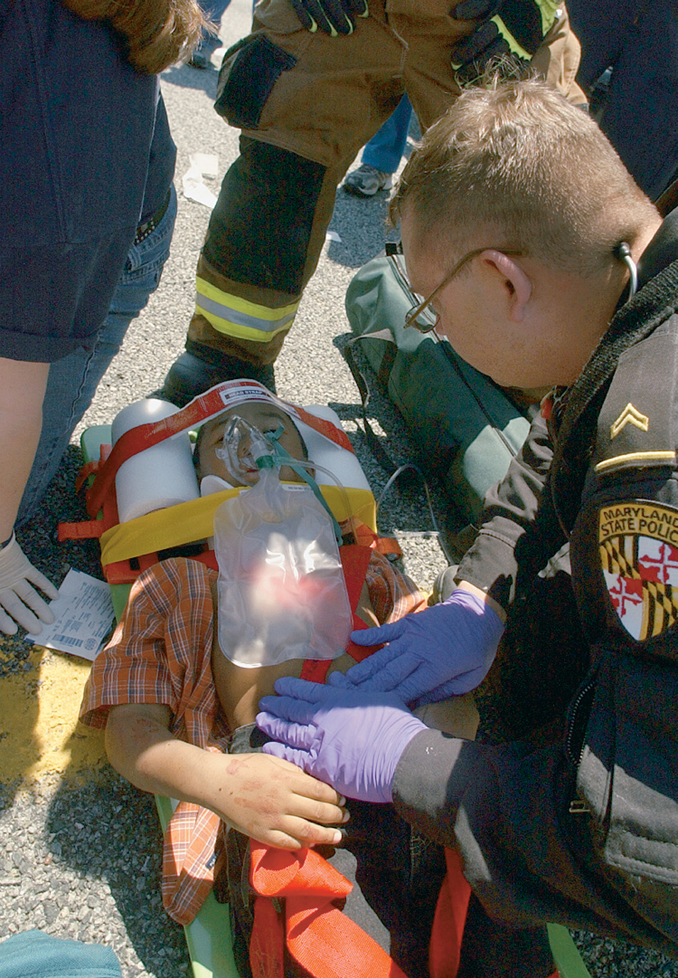
Children are Frequently Victims of Major and Minor Trauma
(© Mark C. Ide)
Notes:
Traumatic forces are more widely distributed in pediatric patients than in adults and this makes them more prone to suffering multisystem trauma.

Slide 25
Trauma in Special Patient Populations (13 of 25)
Trauma in Pediatric Patients
Assessment Considerations in the Pediatric Trauma Patient
The Pediatric Assessment Triangle (P A T) helps with formation of a general impression.
P A T assesses appearance, work of breathing, and circulation to the skin.
P A L S assesses consciousness, breathing, and color.
Notes:
Both the PAT and the PALS assessments collect the same information in the general impression of the pediatric patient:
The appearance or consciousness component refers to assessing the child’s overall mental status (unresponsive, irritable, alert), body position, and muscle tone.
The breathing component relates to the work of breathing as determined by a visual assessment of the effort of breathing, absence of breathing, or decreased respiratory effort, plus any audible sounds associated with the patient’s respiration.
The circulation or color component is assessed by observing the patient’s skin color (cyanosis, pallor, mottling).

Slide 26
Trauma in Special Patient Populations (14 of 25)
Trauma in Pediatric Patients
Assessment Considerations in the Pediatric Trauma Patient
Subtle changes in heart rate, blood pressure, and skin perfusion may indicate cardiorespiratory failure.
A slow heart rate may indicate hypoxia.
Assess the brachial pulse.
Blood pressure readings are difficult to obtain in children 3 years of age or younger.
Notes:
The brachial pulse should be assessed in an infant less than 1 year of age. Because the myocardium is immature, the pediatric patient’s ability to increase cardiac output depends primarily on raising the heart rate. Therefore, tachycardia is the earliest and most sensitive sign of hemorrhagic shock in the pediatric patient.

Slide 27
Trauma in Special Patient Populations (15 of 25)
Trauma in Pediatric Patients
Management Considerations for the Pediatric Trauma Patient
In spine motion restriction, pad beneath the child who is younger than 8 years of age from the shoulders to the hips to prevent neck flexion.
Open the airway and assess for any possible obstructions; gurgling or stridor indicate upper airway obstruction.
Notes:
Assess the breathing rate and tidal volume. Keep in mind that what is considered a normal respiratory rate and tidal volume are age and weight dependent. Look at both the chest and the abdomen when doing so. Carefully provide ventilations if either the rate or the tidal volume is inadequate or if bradycardia is present. Pediatric trauma patients can fatigue quickly. Administer supplemental oxygen to maintain an SpO₂ of 95% or greater.

Slide 28
Trauma in Special Patient Populations (16 of 25)
Trauma in Pediatric Patients
Management Considerations for the Pediatric Trauma Patient
Assess circulation and control direct bleeding.
Manage hypovolemia and shock.
Prevent hypothermia.
Transport to an appropriate facility.
Continually reassess.
Notes:
Most of the management for a pediatric trauma patient is the same as for adults.

Slide 29
Trauma in Special Patient Populations (17 of 25)
Trauma in Geriatric Patients
The risk of death and significant injury is greater than for younger patients.
A number of physiological changes predispose the elderly to injuries.
Falls are the most common cause of injury.
Many falls are the result of medical conditions.
Notes:
The most common injury associated with falls is fractures.
Motor vehicle collisions are the second most common cause of trauma in the elderly. Older drivers are more likely to be killed or injured in these accidents than younger drivers
Discussion Question
What are some things that affect the elderly patient’s ability to compensate for hemorrhage?
Teaching Tips
Arrange with an extended care facility to have students assess elderly patients under nursing supervision.

Slide 30
Trauma in Special Patient Populations (18 of 25)
Trauma in Geriatric Patients
Anatomic and Physiologic Considerations in the Geriatric Trauma Patient
Changes in the pulmonary, cardiovascular, neurological, and musculoskeletal systems occur with aging.
These changes make injury more likely and make it harder for the elderly patient to compensate when injury occurs.
Notes:
Geriatric patients are more susceptible to injury than other adults, even in cases of minor trauma. Minor chest
trauma can cause lung injury. Decreased muscle size in the abdomen can mask abdominal trauma in the elderly. Thinner skin in the elderly results in more easily inflicted soft tissue injuries.

Slide 31
Trauma in Special Patient Populations (19 of 25)
Trauma in Geriatric Patients
Assessment Considerations in the Geriatric Trauma Patient
Preexisting medical conditions and medications affect the patient’s outcome.
Altered mental status is a significant sign.
Be alert to airway obstruction from dentures and impaired cough reflex.
Notes:
Chest wall injuries can quickly lead to respiratory failure in this population. You should monitor the elderly trauma patient’s oxygenation, using pulse oximetry. Elderly patients who are hypertensive prior to an injury may have normal blood pressure readings when they are in shock.

Slide 32
Trauma in Special Patient Populations (20 of 25)
Trauma in Geriatric Patients
Management Considerations for the Geriatric Trauma Patient
Use padding when spine motion restriction is necessary.
Maintain a clear airway and be prepared to suction.
Support ventilation as needed to maintain an S p O ₂
greater than or equal to 95%.
Notes:
Prevent hypothermia and splint factures. Remember that traction splints are not used to treat hip fractures.
Provide rapid transport to the closest appropriate facility.

Slide 33
Trauma in Special Patient Populations (21 of 25)
Trauma in Cognitively Impaired Patients
Cognitively impaired patients are more prone to trauma.
Conditions include dementia, autism, brain injuries, stroke, Alzheimer’s disease, and Down syndrome.
Cognitive impairments can affect assessment and management.
Notes:
Discussion Question
What are some guidelines to follow when dealing with the cognitively impaired trauma patient?
Knowledge Application
Students should be able to apply the information in this section to scenarios involving assessment and management of pregnant, pediatric, geriatric, and cognitively impaired patients.

Slide 34
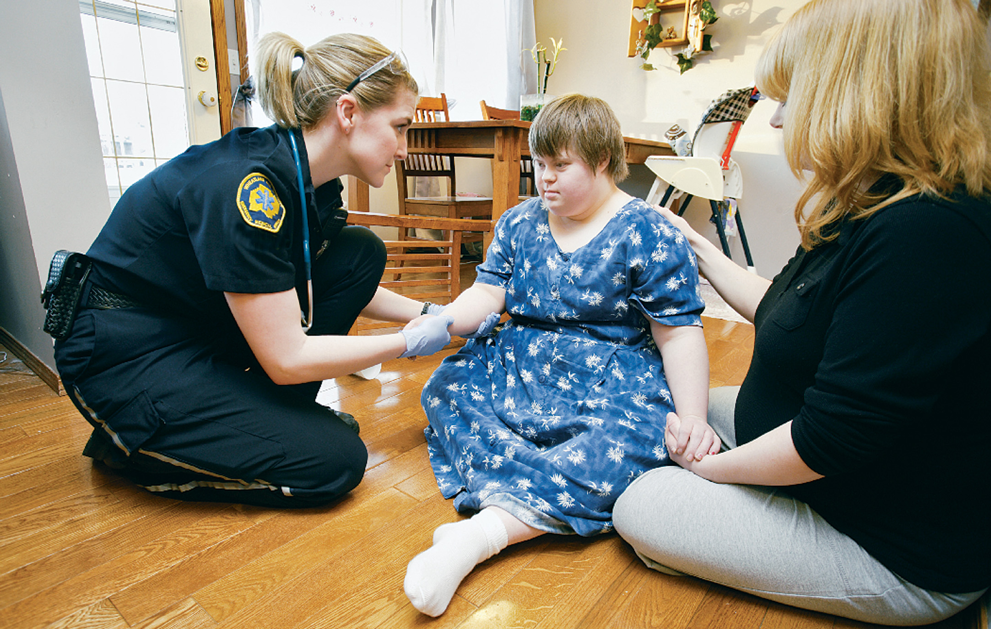
A Down Syndrome Patient May Have a Mild-To-Moderate Developmental Impairment
You may have to rely on a parent or other caregiver to help reassure the patient and to provide information about the patient’s history.
Notes:
It can be difficult to recognize patients with cognitive impairment when you begin your assessment. Some patients have no physical signs of their mental condition.

Slide 35
Trauma in Special Patient Populations (22 of 25)
Trauma in Cognitively Impaired Patients
Anatomic and Physiologic Considerations in the Cognitively Impaired Trauma Patient
Physiological changes can accompany some forms of cognitive impairment, depending on the underlying cause.
Many patients have sensory loss related to aging and disease.
Notes:
Some patients with dementia experience cardiovascular changes that make them prone to injury. Other patients have a loss in musculoskeletal strength due to aging or impairment that can lead to falls and other injuries. Memory loss from Alzheimer’s disease or other cognitive impairments can alter the patient assessment.

Slide 36
Trauma in Special Patient Populations (23 of 25)
Trauma in Cognitively Impaired Patients
Assessment Considerations in the Cognitively Impaired Trauma Patient
History and consent may be difficult to obtain.
First attempt to get information from the patient.
Rely on others for information, if needed.
Patients may be confused, upset, and uncooperative.
Notes:
The psychological implications of trauma can be different in this population. Many of these patients do not know what is happening even before the trauma. They may be confused or upset. The traumatic event can make it more difficult for them to communicate and cooperate with you.

Slide 37
Trauma in Special Patient Populations (24 of 25)
Trauma in Cognitively Impaired Patients
Assessment Considerations in the Cognitively Impaired Trauma Patient
Pain perception may be altered.
Gain information through the trauma assessment; reassess frequently.
Maintain a high index of suspicion that impairment results from injury, rather than the preexisting condition.
Notes:
The trauma assessment provides the most pertinent information about your patient. Because many of these patients are not able to tell you what is wrong, it is important that you constantly reevaluate them.

Slide 38
Trauma in Special Patient Populations (25 of 25)
Trauma in Cognitively Impaired Patients
Management Considerations for the Cognitively Impaired Trauma Patient
Involve the caregivers to increase cooperation.
Err on the side of caution and treat as if the patient has a head injury.
Notes:
Cognitively impaired trauma patients need special care.

Slide 39
Assessment-Based Approach: Multisystem Trauma and Trauma in Special Patient Populations (1 of 9)
Scene Size-Up
Assess the mechanism of injury; suspect injury of more than one body system.
Identify whether the patient belongs to any special patient populations.
Do not assume altered mental status is due to a preexisting condition.
Notes:
Unresponsiveness or altered mental status, especially in trauma patients, should always suggest the possibility of head injury. Never assume that mental status changes in a trauma patient are due to drug or alcohol intoxication or previous medical conditions. However, caregivers can give insight into the patient’s baseline mental state.

Slide 40
Assessment-Based Approach: Multisystem Trauma and Trauma in Special Patient Populations (2 of 9)
Primary Assessment
Suspect spinal injury, provide in-line stabilization.
Assess the mental status.
Establish an airway using a jaw-thrust maneuver.
Anticipate vomiting, be prepared to suction.
Notes:
Assess your patient’s mental status, using the AVPU mnemonic. Utilize tools such as the Glasgow Coma Scale and the pediatric assessment triangle to provide additional information about the patient’s mental status. This will provide a baseline when you reassess your patient.

Slide 41
Assessment-Based Approach: Multisystem Trauma and Trauma in Special Patient Populations (3 of 9)
Primary Assessment
Provide oxygen for adequately breathing patients.
Provide positive pressure ventilation if breathing is inadequate.
For bradycardic pediatric patients, assist ventilations.
Notes:
Any pregnant patient in their twentieth week of gestation or greater who has any trauma, even minor, should receive a high concentration of oxygen regardless of the SpO₂ reading. Although the pregnant patient may not have any signs or symptoms of hypoxia, the reduction in blood flow to the uterus during compensated shock can cause the fetus to become severely hypoxic.

Slide 42
Assessment-Based Approach: Multisystem Trauma and Trauma in Special Patient Populations (4 of 9)
Secondary Assessment
Physical exam — Perform a rapid secondary assessment.
Anticipate altered reactions to pain among special patient populations.
Vital Signs — Obtain vital signs.
Normal vital signs are based on the patient’s age.
Notes:
Critical Thinking Discussion
How do the psychosocial developmental stages of children of various ages affect their responses to trauma and treatment by health care providers?

Slide 43
Assessment-Based Approach: Multisystem Trauma and Trauma in Special Patient Populations (5 of 9)
Secondary Assessment
History
When and how did the incident occur?
What is the chief complaint?
Are there any signs or symptoms associated with the trauma?
Is the patient pregnant? If so, how far along is she? Is there any vaginal bleeding or crowning?
Notes:
The history can provide vital information about the MOI.

Slide 44
Assessment-Based Approach: Multisystem Trauma and Trauma in Special Patient Populations (6 of 9)
Secondary Assessment
History
How old is the patient?
Does the patient take any medications?
Is the patient allergic to anything?
What is the patient’s medical history? Is there a history of previous trauma or a cognitive impairment?
Notes:
Patients, especially children, those with cognitive impairments, or those with an altered mental status, may not be able to provide you with the information you need.
Special trauma patients may not respond to injury the same way that another trauma patient would. Document signs and symptoms accurately.

Slide 45
Assessment-Based Approach: Multisystem Trauma and Trauma in Special Patient Populations (7 of 9)
Emergency Medical Care
Use Standard Precautions.
Establish and maintain in-line spinal stabilization.
For third-trimester pregnancy, tilt the backboard to the left.
For children younger than 8 years old, pad from the shoulders to the hips.
For the elderly, pad voids beneath the back.
Notes:
Discussion Questions
What are the priorities of care for multisystem trauma patients?
How is the management of pediatric trauma patients different from that of adults?
What are some special considerations in management of geriatric trauma patients?
Knowledge Application
Given a series of scenarios, students should be able to assess and manage a variety of patients from special populations.

Slide 46
Assessment-Based Approach: Multisystem Trauma and Trauma in Special Patient Populations (8 of 9)
Emergency Medical Care
Maintain a patient airway and adequate breathing and oxygenation.
Use a jaw-thrust maneuver.
Be prepared to suction.
Administer oxygen.
Monitor the airway, breathing, pulse, and mental status for deterioration.
Notes:
Any patient who deteriorates must be transported immediately.
Remember, bradycardia in the pediatric patient requires ventilation.

Slide 47
Assessment-Based Approach: Multisystem Trauma and Trauma in Special Patient Populations (9 of 9)
Emergency Medical Care
Control bleeding.
Treat for shock.
Identify and treat other injuries.
Transport immediately.
Notify the receiving facility.
Consider requesting A L S.
Reassess vital signs every 5 minutes.
Notes:
If major bleeding to an extremity is not stopped with direct pressure, apply a tourniquet.
Notify the receiving facility specifically what type of trauma patient you are bringing to their facility.
Consider the use of ALS intercept or air medical transport for these patients. Follow your local protocol.

Slide 48
Case Study Conclusion (1 of 4)
E M T s arrive and, as they approach to apply in-line stabilization to the spine and open the airway, they note a pale patient who appears unresponsive and who has labored breathing.
Notes:
Review case conclusion and emphasize the application of knowledge learned from this presentation.

Slide 49
Case Study Conclusion (2 of 4)
One E M T uses a jaw-thrust maneuver to open the airway, as another completes the primary assessment. The E M T s insert an oropharyngeal airway and begin assisting ventilations and administering supplemental oxygen.
Russ has several superficial abrasions and minor lacerations, but no major external bleeding.
Notes:
Review case conclusion and emphasize the application of knowledge learned from this presentation.

Slide 50
Case Study Conclusion (3 of 4)
The E M T s perform a rapid secondary assessment, and provide spine motion restriction, padding from the shoulders to the hips to maintain the neck in neutral alignment.
The E M T s are transporting within 6 minutes of arriving, and immediately notify the receiving facility.
Notes:
Review case conclusion and emphasize the application of knowledge learned from this presentation.

Slide 51
Case Study Conclusion (4 of 4)
En route, they continue management of the airway and breathing, and keep Russ warm, as well as obtaining baseline vital signs.
Russ is stabilized at a Level III trauma center and then flown to a children’s hospital for further management. Although he faces months of rehabilitation, the quick action of the E M T s provided him with the best opportunity for a full recovery.
Notes:
Review case conclusion and emphasize the application of knowledge learned from this presentation.

Slide 52
Lesson Summary (1 of 2)
Suspect multisystem trauma in any patient who has been subjected to a significant external force.
Use the golden principles of trauma care to manage patients with multisystem trauma.
Notes:
Follow-Up
Answer student questions.
Follow-Up Assignments
Review Chapter 36 Summary.
Complete Chapter 36 In Review questions.
Complete Chapter 36 Critical Thinking questions.
Assessments
Handouts
Chapter 36 quiz

Slide 53
Lesson Summary (2 of 2)
Special populations of patients require additional assessment and management considerations.
The E M T must incorporate knowledge of the special needs of these patients into the care provided.
Notes:
Class Activity
As an alternative to assigning the follow-up exercises in the lesson plan as homework, assign each question to a small group of students for in-class discussion.
Teaching Tips
Answers to In Review questions are in the appendix of the text. Advise students to review the questions again as they study the chapter.

Slide 54
Correct!
Supine hypotensive syndrome occurs when the pregnant uterus compresses the vena cava, reducing blood return to the heart. Tilting the long backboard to the left takes the weight of the uterus off the vena cava.
Click here to return to the Program.

Slide 55
Incorrect (1 of 3)
Filling the voids on a backboard is important for motion restriction and patient comfort, but does not prevent supine hypotensive syndrome, which is caused by the weight of the uterus on the vena cava.
Click here to return to quiz.

Slide 56
Incorrect (2 of 3)
Administering oxygen to a pregnant trauma patient to maintain an S p O₂ as close to 100% as possible is an important part of management, but does not prevent supine hypotensive syndrome, which is caused by the weight of the uterus on the vena cava.
Click here to return to quiz.

Slide 57
Incorrect (3 of 3)
While semi-Fowler’s position can be helpful in a pregnant medical patient in preventing supine hypotensive syndrome, it is contraindicated in a trauma patient.
Click here to return to quiz.

Slide 58
Copyright

