Slide 1
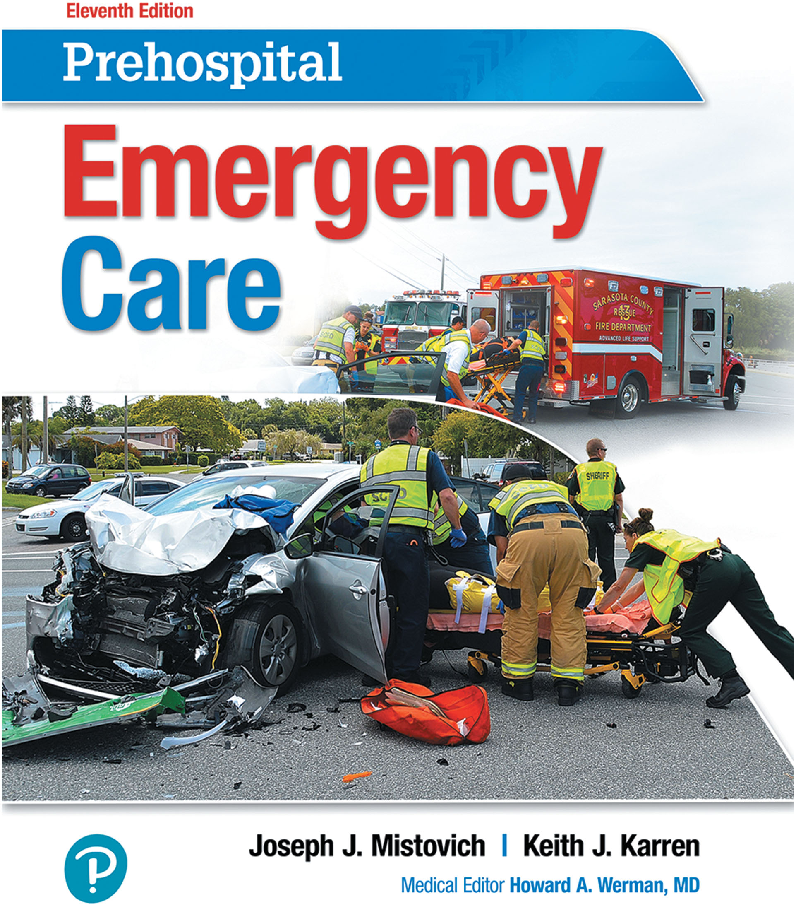
Prehospital: Emergency Care
Eleventh Edition
Chapter 34
Chest Trauma
Slides in this presentation contain hyperlinks. JAWS users should be able to get a list of links by using INSERT+F7
Copyright © 2018, 2014, 2010 Pearson Education, Inc. All Rights Reserved
Notes:
If this PowerPoint presentation contains mathematical equations, you may need to check that your computer has the following installed:
1) MathType Plugin
2) Math Player (free versions available)
3) NVDA Reader (free versions available)
Advance Preparation
Student Readiness
Assign the associated section of MyBRADYLab and review student scores. Review the chapter material in the Instructor Resources, which includes Student Handouts, PowerPoint slides, and the MyTest Program.
Prepare
Make copies of course policies and procedures, the syllabus, handouts from the Instructor Resources, and other materials for distribution or post them in your learning management system.
Preview the media resources and Master Teaching Notes in this lesson.
Preview the case study presented in the PowerPoint slides.
The total teaching time recommended is only a guideline. Take into consideration factors such as the pace at which students learn, the size of the class, breaks, and classroom activities. The actual time devoted to teaching objectives is the responsibility of the instructor.

Slide 2
Learning Readlines
E M S Education Standards, text p. 1020.
Chapter Objectives, text p. 1020.
Key Terms, text p. 1020.
Purpose of lecture presentation versus textbook reading assignments.
Notes:
Explain to students what the National EMS Education Standards are. The National EMS Education Standards communicate the expectations of entry-level EMS providers. As EMTs, students will be expected to be competent in these areas. Acknowledge that the standards are broad, general statements. Although this lesson addresses the listed competencies, the competencies are often complex and require completion of more than one lesson to accomplish. The student is also expected to review the chapter objectives to foreshadow what will be in the chapter. By mastering the key terms the EMT student will better understand the learning and be able to communicate more clearly.
Additionally, explain to the students that the purpose of using these slides is to help keep the instructor focused on highlighting important portions of the material, explain interrelationships of topics, and discuss how to apply this information. It’s not the intent of the presentation (or slides alone) to include every component in the chapter. This presentation still requires the student to thoroughly read the chapter.

Slide 3
Setting the Stage
Overview of Lesson Topics
The Chest
Anatomy of the Chest
General Categories of Chest Injuries
Specific Chest Injuries
Assessment–Based Approach: Chest Trauma
Summary: Assessment and Care — Chest Trauma
Notes:
These bulleted points are major headings from the chapter, in order. The purpose is to help the student navigate the lesson.

Slide 4
Case Study Introduction
E M T s Roxanne Freidman and Laura Cahill are on the scene of a patient who was ejected from the driver’s seat of a vehicle that rolled multiple times after leaving the roadway at a high speed. As Roxanne maintains in-line stabilization of the spine while opening the airway with a jaw-thrust maneuver, Laura quickly exposes the chest and listens for breath sounds.
“No breath sounds on the right. There is jugular vein distention,” says Laura.
Notes:
Case Study
Present the Case Study Introduction provided in the PowerPoint slide set.
Lead a discussion using the case study questions provided on the subsequent slide(s).
The Case Study with discussion questions continues throughout the PowerPoint presentation.
Case Study Discussion
Use the case study content and questions to foreshadow the upcoming lesson content.

Slide 5
Case Study
What injuries are suggested by the mechanism of injury and the E M T s’ findings so far?
What immediate interventions are required?
Notes:
Use the Case Study content and questions to foreshadow the upcoming lesson content. Gauge the students’ responses as a guide of how well versed they are in this topic.

Slide 6
Introduction
Chest injuries may not have a dramatic appearance and can be overlooked.
Chest injuries can be lethal.
Maintain a high index of suspicion based on mechanism of injury.
Notes:
During this lesson, students learn about assessment and emergency medical care for a patient with chest trauma.

Slide 7
The Chest (1 of 35)
Anatomy of the Chest
Is also known as the thoracic cavity.
Is bordered inferiorly by the diaphragm
Contains vital organs.
Vital organs in the chest are protected by the ribs.
The thoracic cavity is lined by two layers of pleura.
Notes:
A hollow area, the mediastinum, is in the middle of the thoracic cavity between the right and left lungs. The mediastinum houses the trachea, the venae cavae, the aorta, the esophagus, and the heart.
The visceral pleura is the innermost layer and is in contact with the lung. The parietal pleura is the outermost layer and is in contact with the thoracic wall. The two pleural layers are separated by serous fluid that provides lubrication to reduce friction between them.
Teaching Tips
Use the anatomical models to review the structures of the chest.
Discussion Questions
What structures are in the mediastinum?
How is the contact between the pleural layers important to lung expansion and inhalation?

Slide 8
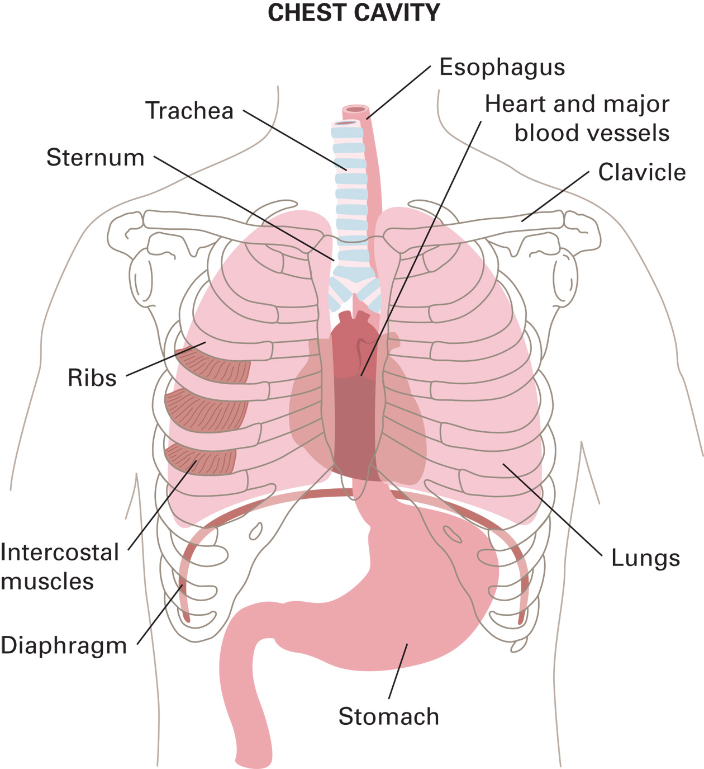
The Chest Cavity
Notes:
The rectangular portion of the anterior chest framed by the clavicles superiorly, midclavicular lines laterally, and costal margin inferiorly is referred to as the “cardiac box.” Any penetrating or blunt injury to this area dramatically increases the likelihood of a cardiac or great vessel injury.

Slide 9
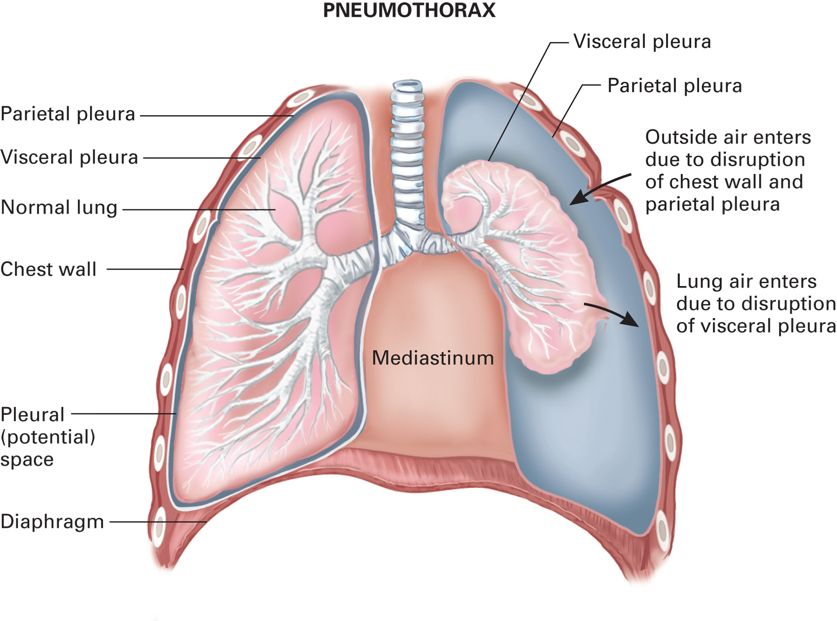
Normally, Negative Pressure Acts Like a Vacuum, Holding the Visceral Pleura that Covers the Lung to the Parietal Pleura that Lines the Chest Wall and Keeping the Lung Expanded
When either the lung and its visceral pleura are punctured or the chest wall and its parietal pleura are punctured, air enters the space between the pleura, creating positive pressure on the lung and causing it to collapse.
Notes:
If a puncture to the visceral pleura, the parietal pleura, or both pleurae occurs, the seal is broken and air is sucked into the pleural space each time the chest wall expands. As the pleural space expands, it creates pressure on the lung, and the lung collapses, leading to a pneumothorax.

Slide 10
The Chest (2 of 35)
General Categories of Chest Injuries
Open Chest Injury
Is caused by a penetration injury.
Cavitation occurs with gunshot wounds.
If one of the great vessels in the chest is injured, it can result in immediate death.
Notes:
An open chest injury is the result of a penetrating chest wound caused by a knife, gunshot, or a wide variety of other objects such as ice picks, screwdrivers, letter openers, broken glass, nails, and car keys.
An open chest wound can pull air into the thoracic cavity, sometimes with a noticeable sucking sound. This is referred to as a sucking chest wound. There are two problems in managing an open or sucking chest wound. One is preventing additional air from sucking into the chest cavity, and the other is avoiding trapping the air already in the chest cavity.
Cover a sucking chest wound with your gloved hand on first identifying it, then apply a nonporous dressing and tape it on three sides.
Teaching Tips
Draw a grid on the white board with types of chest injuries at the top and rows for signs, symptoms, pathophysiology, and treatment at the left. Give students time to review the chapter material and notes. Then, have students come to the board and fill in the grid. When the grid is complete, review it with the class by comparing and contrasting the various injuries.

Slide 11
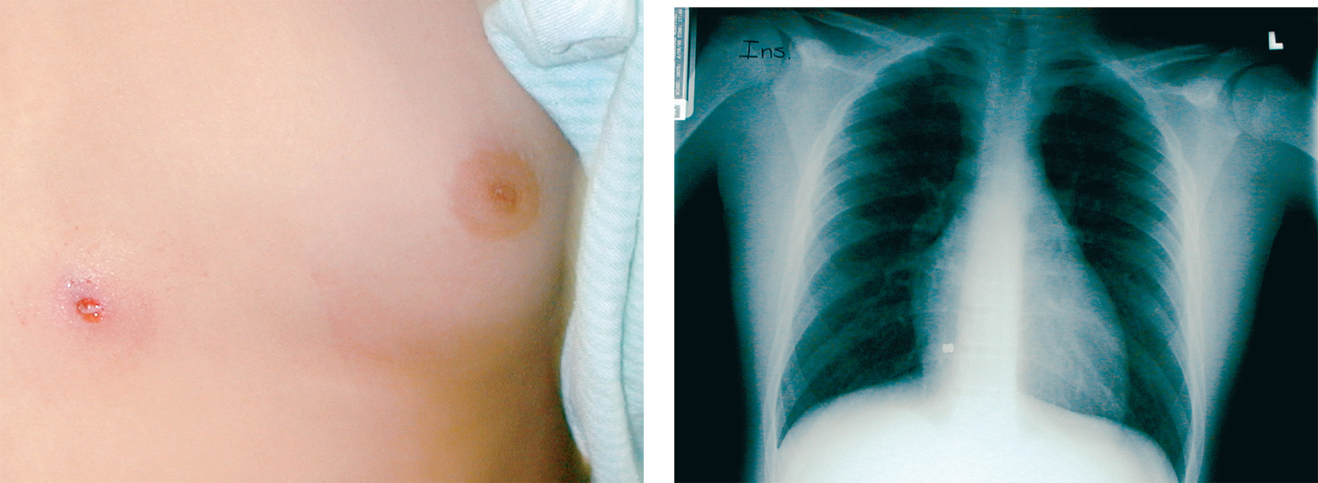
A Pellet Fired from an Air Gun Creates an Extremely Small Entrance Wound
Although a pellet wound may be very small, a pellet can penetrate the thoracic cavity, ricochet around, and potentially cause lethal injuries. When you suspect trauma, you must expose and closely inspect the chest to avoid missing potentially lethal injuries.
(© Charles Stewart, M D, F A C E P)
Notes:
Cover a sucking chest wound with your gloved hand on first identifying it, then apply a nonporous dressing and tape it on three sides. This prevents both pulling in additional air and trapping air that is already in the cavity.

Slide 12
The Chest (3 of 35)
General Categories of Chest Injuries
Open Chest Injury
May involve injury of the heart, major blood vessels.
May include Pneumothorax.
Penetrating trauma can interfere with the negative pressure needed for inhalation by allowing air to enter through the wound.

Slide 13
The Chest (4 of 35)
General Categories of Chest Injuries
Closed Chest Injury
Results from blunt trauma.
Can injure the heart, lung, great vessels, and other structures.
Flail chest results when two or more adjacent ribs are each fractured in two or more places.
Notes:
A large, unstable flail segment is life threatening because it interferes with proper expansion of the chest cavity, limiting intrathoracic pressure changes, and leading to severe respiratory distress or inadequate respiration and rapid patient deterioration.

Slide 14
The Chest (5 of 35)
Specific Chest Injuries
Flail Segment
Flail chest results when two or more adjacent ribs are each fractured in two or more places, creating a segment of the rib cage that is not attached to the rest of the rib cage.
The flail segment interferes with chest expansion and changes in intrathoracic pressure.
Notes:
During inhalation and exhalation, the flail segment may display paradoxical movement; that is, the flail segment moves in a direction opposite to the movement of the rest of the chest wall.

Slide 15
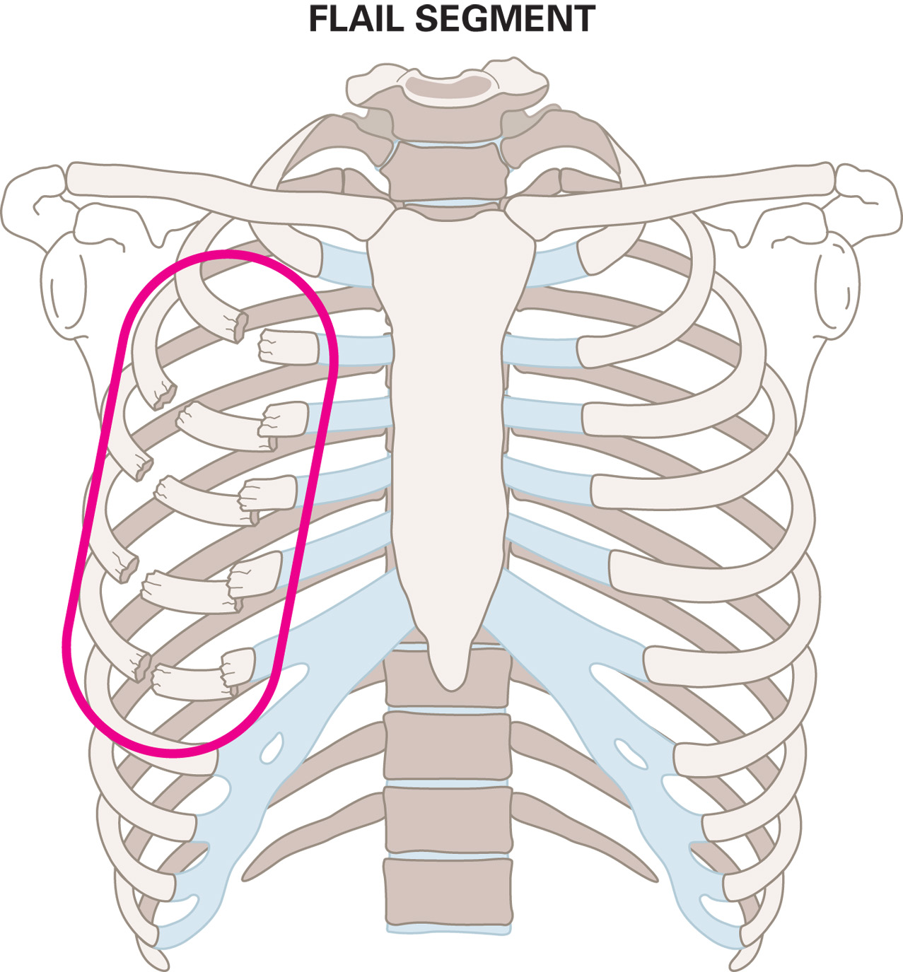
Flail Segment Occurs When Blunt Trauma Causes Fracture of Two or More Ribs, Each in Two or More Places
Notes:
If there is splinting, the flail segment may not exhibit paradoxical chest wall movement.

Slide 16
The Chest (6 of 35)
Specific Chest Injuries
Flail Segment
The effects of pressure during inhalation and exhalation explain why paradoxical movement happens.
Notes:
Inhalation takes place when the chest expands, making pressure inside the chest less than the pressure outside the chest, which causes air to draw in from outside the lungs. The pressure that draws air into the expanded chest also moves the flail segment inward. Exhalation takes place when the pressure inside the chest becomes greater than the pressure outside the chest, pushing air out of the lungs, and decreasing the size of the chest.
Discussion Questions
How does a flail segment interfere with ventilation?
How does pulmonary contusion interfere with gas exchange?
What are the signs and symptoms of a pneumothorax?
Critical Thinking Discussion
What could the sudden compression of the chest do to the heart valves? What signs and symptoms might you find in association with these consequences?

Slide 17
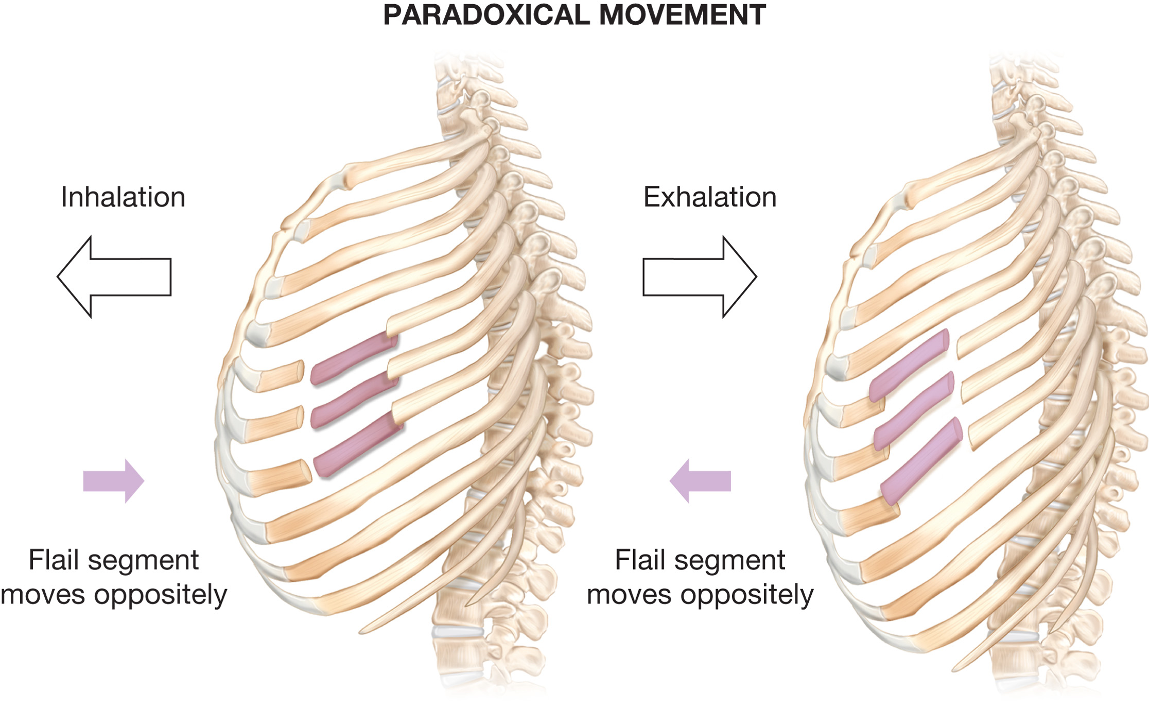
Paradoxical Movement
Notes:
The pressure that drives air out of the contracting chest also pushes the flail segment outward.

Slide 18
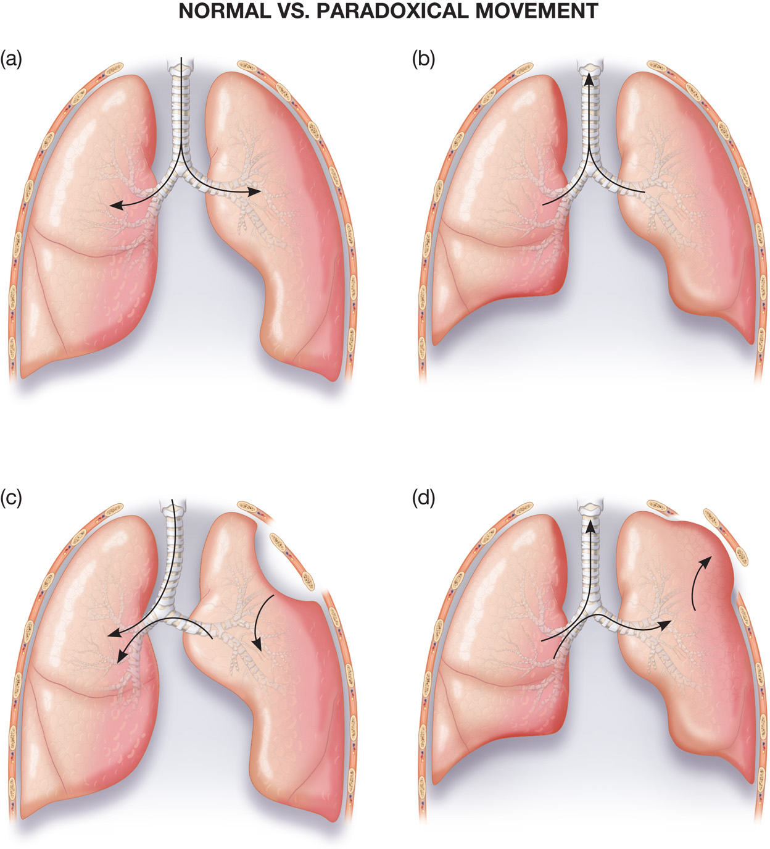
Normal Versus Paradoxical Movement Caused by Flail Segment
(a) Normal inhalation. (b) Normal exhalation. (c) Flail segment drawn inward as the rest of the lung expands with inhalation. (d) Flail segment pushed outward as the rest of the lung contracts with exhalation.
Notes:
The flail segment requires immediate recognition and management, but the underlying contusion to the lung is a more serious injury, resulting from the blunt force applied to the chest. The flail segment prevents the chest from generating the normal negative pressure necessary for inhalation.
Stabilization of the segment can reduce the paradoxical movement; however, it can also compromise other chest wall motion and lead to the collapse of more lung tissue and alveoli.

Slide 19
The Chest (7 of 35)
Specific Chest Injuries
Flail Segment
To avoid further compromise of chest movement:
Do not place the patient on the injured side.
Do not stabilize the chest wall with objects that restrict chest wall motion.
Consider C P A P if patient demonstrates signs of respiratory distress.
Notes:
Because lung contusion and lung collapse are associated with a flail segment, continuous positive airway pressure (CPAP) or positive pressure ventilation using a bag-valve-mask device with supplemental oxygen is the ideal treatment.

Slide 20
The Chest (8 of 35)
Specific Chest Injuries
Pulmonary Contusion
Bleeding occurs in the lung tissue in and around the alveoli and in the interstitial space.
Gas exchange is severely impaired leading to severe hypoxia.
A patient who has suffered a direct blow or any other blunt trauma to the chest may have a pulmonary contusion.
Notes:
The amount of respiratory distress depends on the amount of damaged lung tissue. Other signs and symptoms include dyspnea, cyanosis, and signs of blunt trauma to the chest.

Slide 21
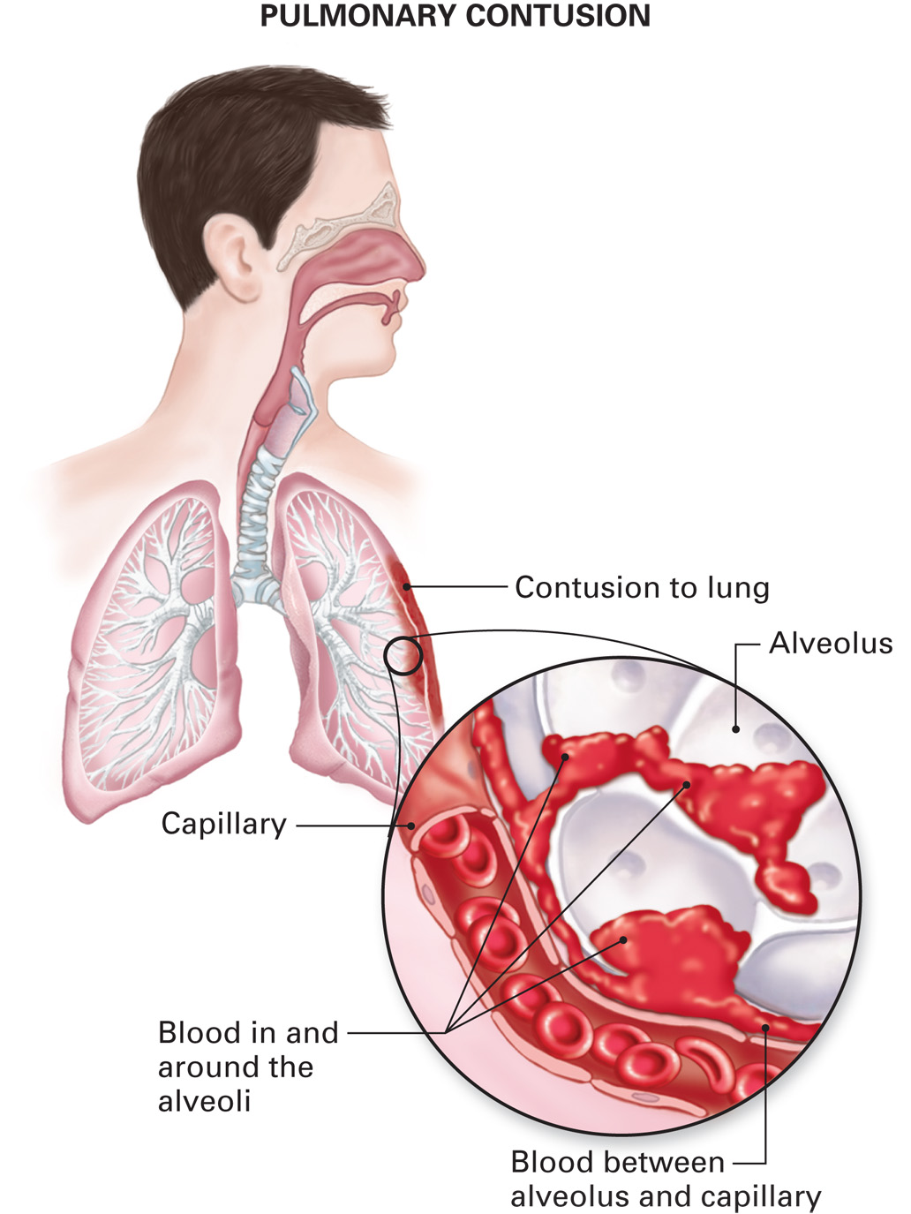
When the Lung is Bruised (Pulmonary Contusion)
There is bleeding into and around the alveoli and the space between the alveoli and the capillaries, greatly reducing the exchange of oxygen and carbon dioxide in the affected area.
Notes:
Emergency care is directed toward support of ventilation and maximizing oxygenation by delivery of a high concentration of oxygen by a nonrebreather mask. If supplemental oxygen alone cannot improve or maintain adequate oxygenation in the alert and spontaneously breathing patient who is in respiratory distress, using continuous positive airway pressure (CPAP) may improve oxygenation.

Slide 22
The Chest (9 of 35)
Specific Chest Injuries
Pneumothorax
Is an accumulation of air in the pleural space resulting in collapse of a portion of the lung.
Causes
A “paper bag” effect may occur upon sudden compression of the chest.
Penetrating trauma.
Spontaneous pneumothorax.
Notes:
Signs and symptoms of a pneumothorax include chest pain that worsens with deep inspiration, dyspnea (shortness of breath), tachypnea (faster than normal rate of breathing), and decreased or absent breath sounds on the affected side.
A pneumothorax is primarily identified by decreased or absent breath sounds from the side of the chest where the lung is partially or totally collapsed. If the patient with a pneumothorax is in a seated position, gravity can cause the air in the pleural space to move upward and decreased breath sounds are heard in the apex (top) of the lung first.

Slide 23
The Chest (10 of 35)
Specific Chest Injuries
Open Pneumothorax
Is caused by an open chest wound that allows air to enter the pleural space with inspiration.
The open wound must immediately be occluded, first by your gloved hand, and then by an occlusive dressing.
Notes:
Symptoms of an open pneumothorax are the same as for a closed pneumothorax, except for an open wound to the chest.

Slide 24
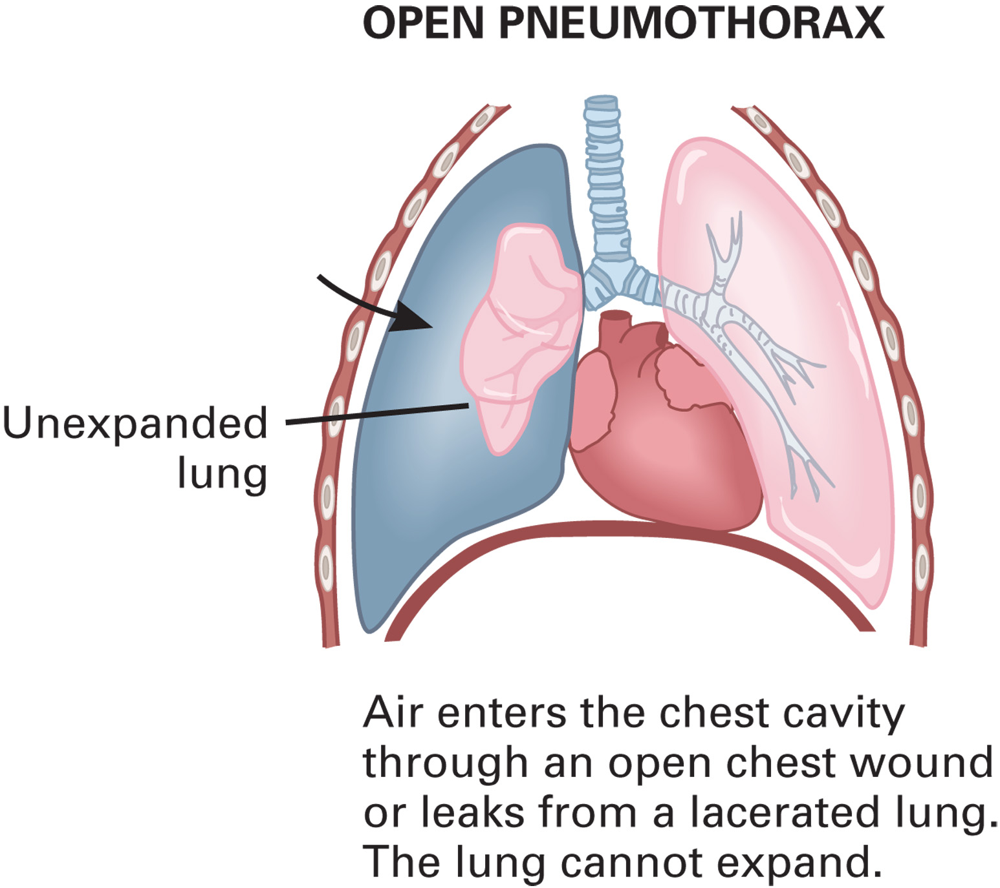
Open Pneumothorax is a Possible Complication of Chest Injury
Notes:
An open pneumothorax is referred to as a “sucking chest wound.”

Slide 25
The Chest (11 of 35)
Specific Chest Injuries
Tension Pneumothorax
Is immediately life-threatening.
Air accumulates in the pleural space with no route of escape, increasing pressure in the thoracic cavity.
The lungs, heart, and large veins are compressed, leading to poor cardiac output and hypotension, poor ventilation and oxygenation, and severe hypoxia.
Notes:
Rapid deterioration, severe respiratory distress, signs of shock, and absent breath sounds on one side of the chest should alert the EMT to a possible tension pneumothorax. Other signs and symptoms include cyanosis, unequal movement of the chest, distended neck veins, diminished breath sounds on the side opposite to the injury, and deviation of the trachea on the uninjured side.

Slide 26
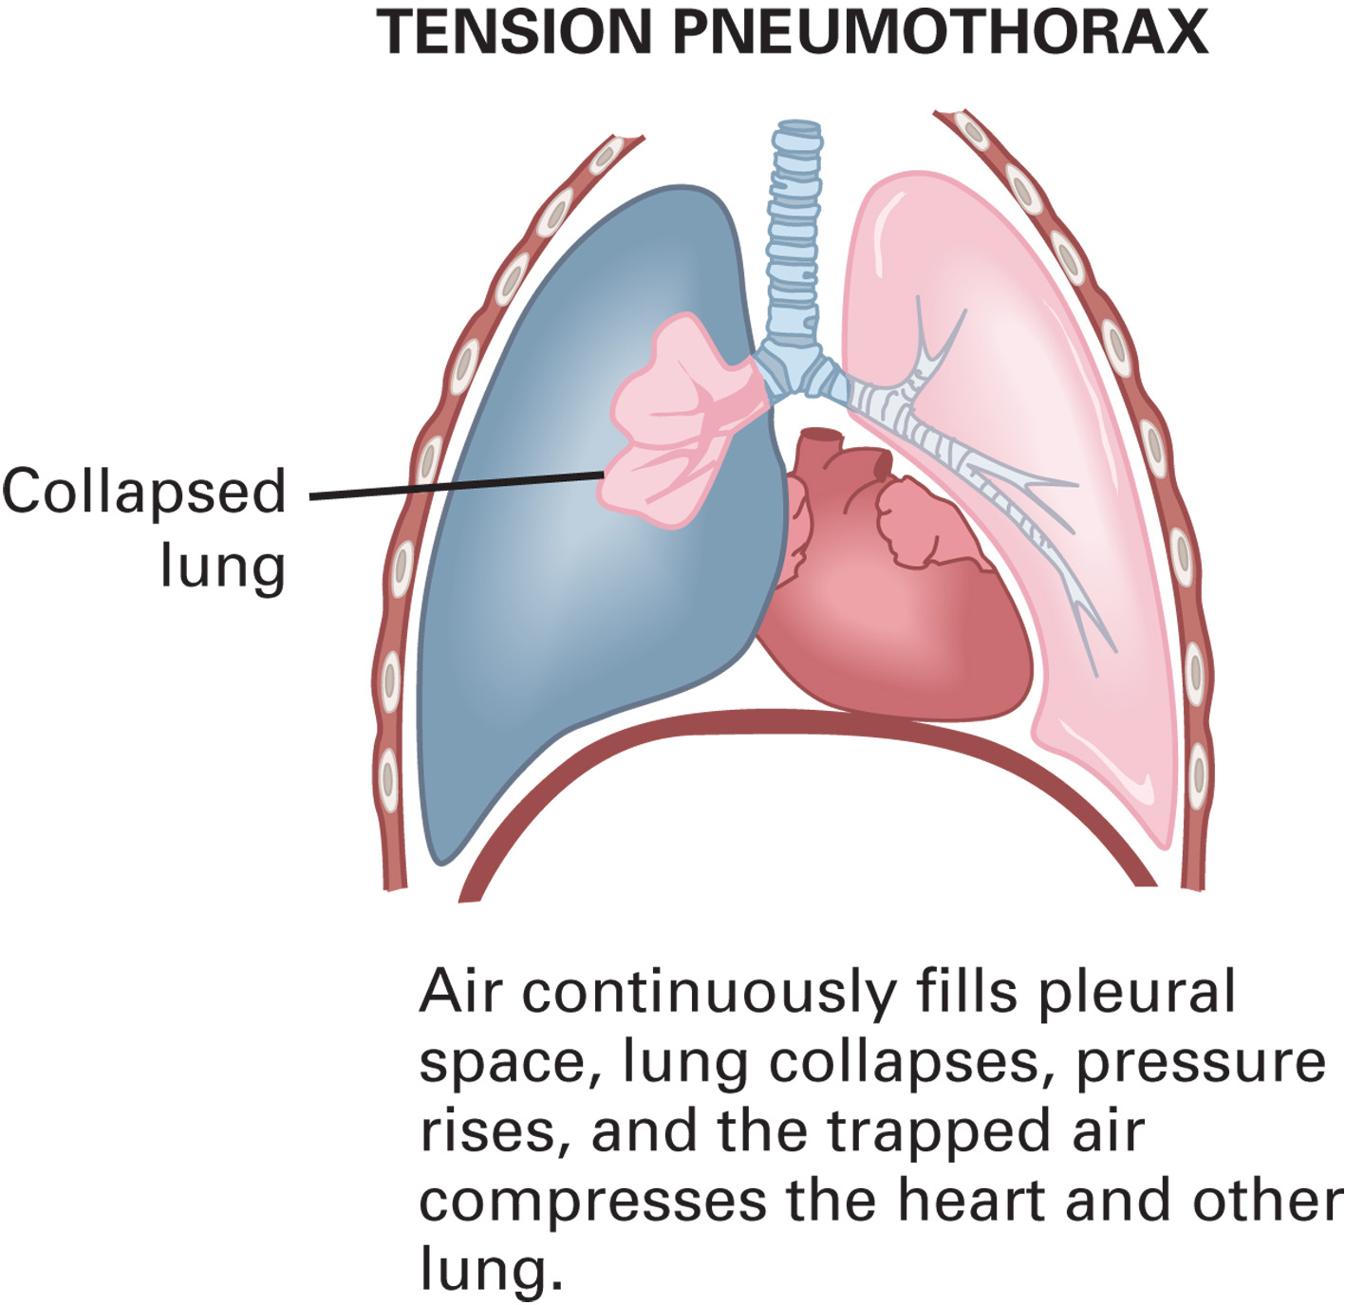
Tension Pneumothorax is a Possible Complication of Chest Injury
Notes:
This condition might develop following the application of an occlusive dressing to an open chest wound. Alleviate the pressure by lifting the dressing and allowing air to escape during expiration, even if it is taped on only three sides.

Slide 27
The Chest (12 of 35)
Specific Chest Injuries
Hemothorax
Blood in the pleural space compresses the lung.
May occur in open and closed injuries.
The blood loss can result in shock.
Signs and symptoms
Severe respiratory distress
Signs of shock
Absent breath sounds on one side
Notes:
Bleeding in and around the lung commonly produces a pink or red frothy sputum when the patient coughs. Care is the same as for pneumothorax and shock.

Slide 28
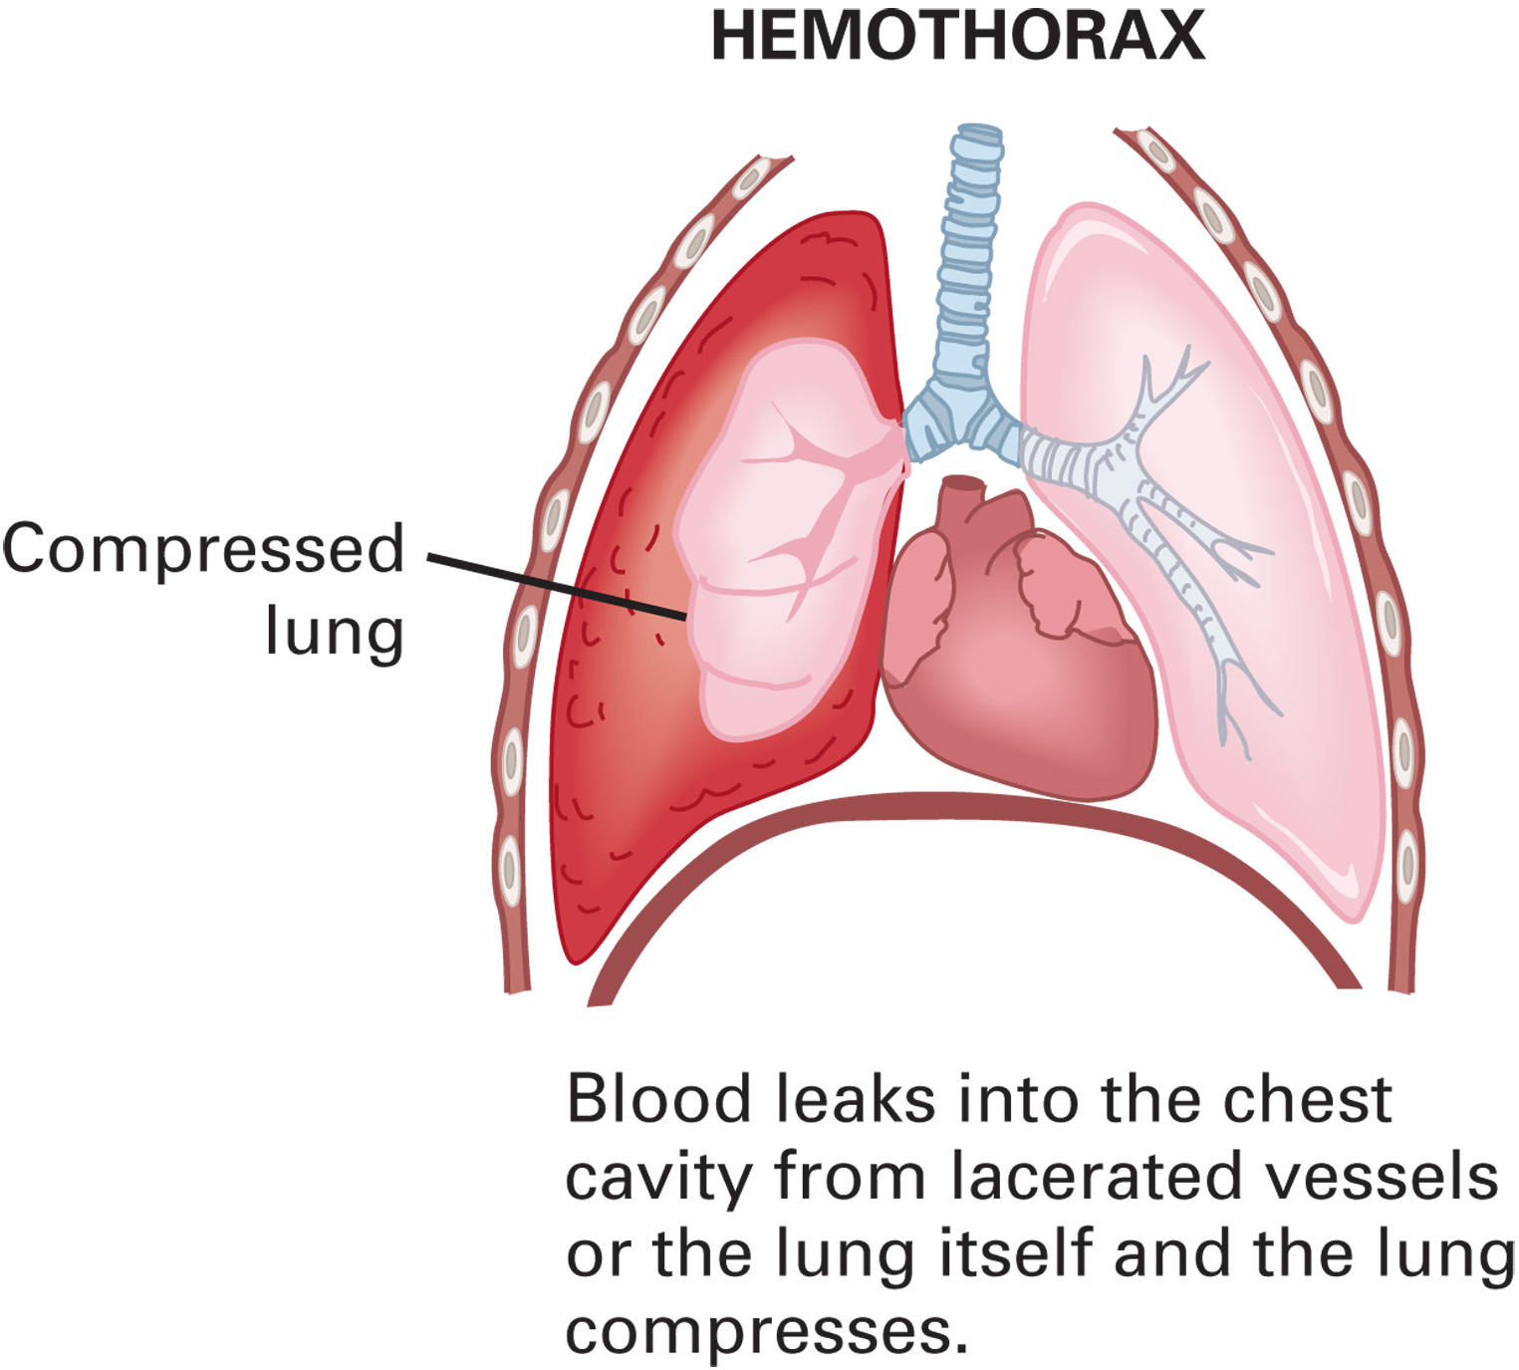
Hemothorax is a Possible Complication of Chest Injury
Notes:
The bleeding usually originates from lacerated blood vessels in the chest wall or chest cavity caused by penetrating objects or fractured ribs.

Slide 29
The Chest (13 of 35)
Specific Chest Injuries
Traumatic Asphyxia
Sudden, severe compression of the thorax causes a rapid increase in intrathoracic pressure.
There is a backflow of blood out of the right ventricle into the upper body.
Notes:
Signs and symptoms
Bluish or purple discoloration of the face, head, neck, and shoulders
Jugular vein distention
Bloodshot eyes that protrude from the socket
Cyanotic and swollen tongue and lips
Bleeding of the conjunctiva

Slide 30
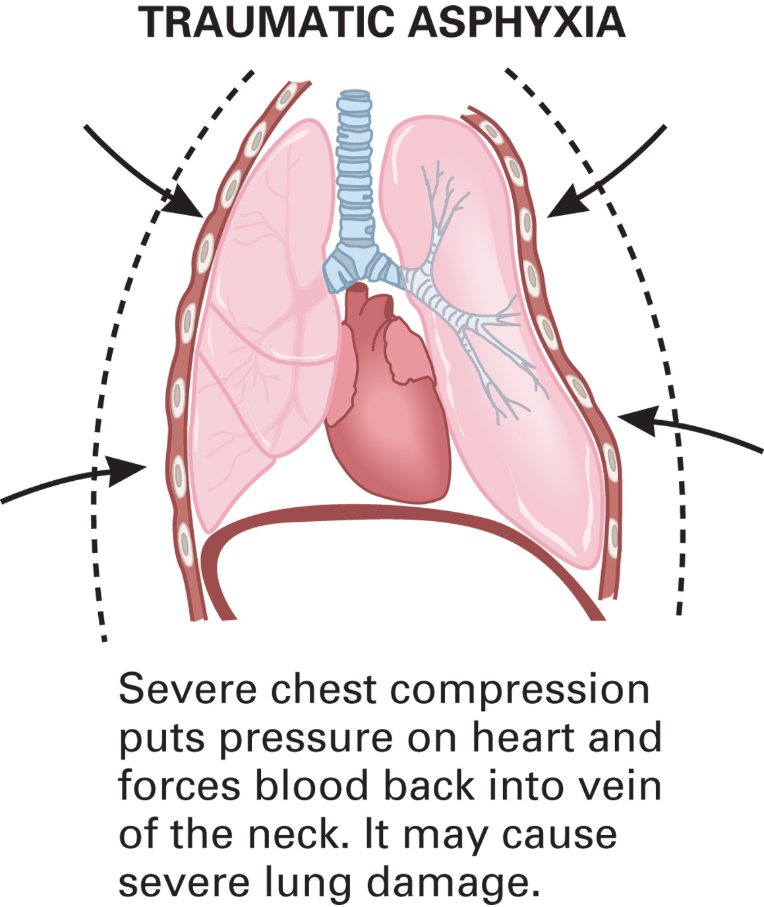
Traumatic Asphyxia is a Possible Complication of Chest Injury
Notes:
Provide emergency care for any wounds to the chest and for shock.

Slide 31
The Chest (14 of 35)
Specific Chest Injuries
Cardiac Contusion
Is associated with blunt trauma from violent compression of the chest.
A bruise to the heart wall may form, or the heart may ruptured; disruption in electrical conduction may occur.
Notes:
Signs and symptoms of cardiac contusion can include chest pain or chest discomfort; signs of blunt trauma to the chest, including bruises, swelling, crepitation (grating sensation), and deformity; tachycardia (faster than normal heart rate); and an irregular pulse.

Slide 32
The Chest (15 of 35)
Specific Chest Injuries
Commotio Cordis
Is sudden cardiac arrest from blunt force to the precordial area.
A blow to the chest during a vulnerable period of the cardiac cycle can lead to a lethal dysrhythmia.
Start C P R and apply the A E D.
Notes:
The patient can present sudden cardiac arrest. The most common presenting rhythm is ventricular fibrillation; therefore, the applied AED will likely recommend defibrillation. A bruise may be noted to the center of the anterior chest wall.

Slide 33
The Chest (16 of 35)
Specific Chest Injuries
Pericardial Tamponade
It’s bleeding into the fibrous sac around the heart from blunt or penetrating trauma.
Compression of the ventricles results in inadequate ventricular filling and reduced cardiac output.
Notes:
Pericardial tamponade develops in 60 to 80 percent of stab wounds to the heart.

Slide 34
The Chest (17 of 35)
Specific Chest Injuries
Pericardial Tamponade
Signs and Symptoms
Jugular vein distention
Signs of shock
Tachycardia and decreased blood pressure
Narrow pulse pressure and weak pulses
Radial pulse diminishes on inhalation
Notes:
Emergency care focuses on early recognition and rapid transport while maintaining an adequate airway and ventilation and maximizing oxygenation by delivering a high concentration of oxygen via a nonrebreather mask.

Slide 35
The Chest (18 of 35)
Specific Chest Injuries
Rib Injury
The fractured rib may cause damage to the lung or intercostal vessels.
Rib fracture is less common in children.
S&S of rib injury include pain with movement and breathing, crepitation, tenderness upon palpation chest wall deformity, inability to breathe deeply, coughing, and tachypnea.
Notes:
The intercostal artery or vein can be lacerated because of the fracture and cause bleeding into the chest cavity.
If a simple rib fracture is suspected, the patient usually presents in the guarded position, holding their arm over the injured site. The EMT can use the arm to splint the injury by placing it over the injury site and applying a sling and swathe to hold it in place.

Slide 36
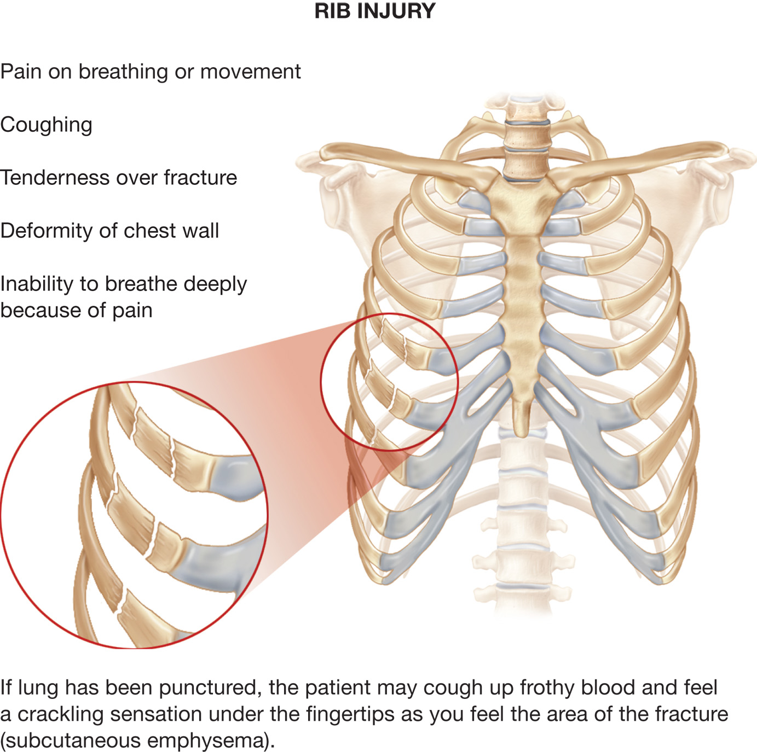
Rib Injury
Notes:
A patient who has a chest injury may appear relatively well at first but can deteriorate suddenly and rapidly. The patient may not complain about a chest injury. In fact, in this scenario the patient’s chief complaint related to the chest is only shortness of breath. It is your responsibility to suspect a potential chest injury based on the MOI and a high index of suspicion, to adequately assess the patient and provide necessary emergency medical care.

Slide 37
Click on the Injury that is Characterized by Air Trapped in the Pleural Space under Pressure, Resulting in Compression of the Structures of the Affected Side, Mediastinum, and Opposite Side of the Chest
a. Hemothorax
b. Tension pneumothorax
c. Pericardial tamponade
d. Sucking chest wound

Slide 38
The Chest (19 of 35)
Assessment-Based Approach: Chest Trauma
Scene Size-Up
If violence was involved, be especially careful with the scene size-up.
Do not enter a scene that is not safe to enter.
Use Standard Precautions.
Notes:
Do not enter the scene of a shooting or stabbing until the police secure it and tell you it is safe to enter.
Knowledge Application
Given a variety of chest injury scenarios, students should be able to identify patients’ injuries and provide both general supportive and injury-specific management.

Slide 39
The Chest (20 of 35)
Assessment-Based Approach: Chest Trauma
Scene Size-Up
Mechanisms of Injury
Sports accidents
Falls, fights
Gunshot
Vehicle collision
Crushing injury
Explosion
Notes:
While the scene is cleared of safety hazards, concentrate on the MOI. Ask bystanders to tell you what happened.
Scan the scene.

Slide 40
The Chest (21 of 35)
Assessment-Based Approach: Chest Trauma
Primary Assessment
Use spinal stabilization, if indicated.
Form a general impression.
Expose and examine the chest.
Assess the mental status.
Assess the airway.
Look for signs of respiratory distress.
Notes:
As soon as you determine that the scene is safe, proceed with the primary assessment. If a spine injury is suspected, take the necessary spine-motion restriction precautions. Form a general impression of the patient:
Is the patient severely cyanotic?
Do they appear to be in extreme respiratory distress?
Are they breathing shallowly and rapidly?
Are they holding their arms tightly against their chest to splint the movement?
Do they appear to be in extreme pain?
Are there any open wounds to the chest?
Is the chest moving unevenly when they breathe?

Slide 41
The Chest (22 of 35)
Assessment-Based Approach: Chest Trauma
Primary Assessment
If breathing is adequate, apply oxygen as needed, to maintain an S p O ₂ greater than or equal to 94%.
Consider C P A P for flail segment or pulmonary contusion.
Do not use C P A P if pneumothorax is suspected.
Notes:
Do they appear to be in extreme respiratory distress?
Are they breathing shallowly and rapidly?
Are they holding their arms tightly against their chest to splint the movement?
Do they appear to be in extreme pain?
Are there any open wounds to the chest?
Is the chest moving unevenly when they breathe?

Slide 42
The Chest (23 of 35)
Assessment-Based Approach: Chest Trauma
Primary Assessment
If breathing is inadequate, provide positive-pressure ventilation.
Tension pneumothorax results in increasing difficulty in ventilating the patient.
Cyanosis is an indicator of poor oxygenation and ventilation.
Notes:
Clothing can disguise a life-threatening sucking wound or flail segment. If the MOI indicates possible chest injury or the patient shows any signs of respiratory distress, quickly expose the chest and examine it.

Slide 43
The Chest (24 of 35)
Assessment-Based Approach: Chest Trauma
Primary Assessment
Pallor can indicate early hypoxia, poor pumping function of the heart, or blood loss.
A weak, rapid pulse can indicate bleeding or compression of the heart.
Chest injury patients are a high priority for transport.
Notes:
Continue with the primary assessment and determine the patient’s mental status. An altered mental status or unresponsiveness might be an indication of severe hypoxia (oxygen deficiency) resulting from a significant chest injury. Visually inspect the airway in the patient with an altered mental status.

Slide 44
The Chest (25 of 35)
Assessment-Based Approach: Chest Trauma
Secondary Assessment
Perform a rapid secondary assessment.
Assess the neck for subcutaneous emphysema, jugular vein distention, and tracheal deviation.
If indicated, apply a cervical collar after examination of the neck.
Notes:
When assessing for tracheal deviation, palpate the trachea immediately above the suprasternal notch (indentation immediately above the sternum). Inspection of the trachea rarely reveals the deviation; however, palpation might allow you to feel the abnormal shift prior to seeing it.

Slide 45
The Chest (26 of 35)
Assessment-Based Approach: Chest Trauma
Secondary Assessment
Expose the chest, if not already done.
Examine the lateral and posterior chest.
Immediately seal open chest wounds.
For signs of flail segment with inadequate breathing, use positive-pressure ventilation.
Notes:
The buildup of pressure in a tension pneumothorax can also cause the heart and large vessels to compress, causing decreased blood flow to the heart and ineffective pumping, which produce signs and symptoms of shock (hypoperfusion). Jugular vein distention and tracheal deviation are late signs of a tension pneumothorax.

Slide 46
The Chest (27 of 35)
Assessment-Based Approach: Chest Trauma
Secondary Assessment
Look for chest symmetry, paradoxical movement, swelling, deformities, crepitation, and guarding of injured ribs.
Auscultate the lung sounds.
Assess baseline vital signs.
Obtain a history.
Notes:
Paradoxical movement of the chest indicates a flail segment. One of the major complications associated with a flail segment is the inability of the patient to generate pressure changes in the chest necessary to adequately move air into the chest cavity. If the patient exhibits signs and symptoms of a flail segment with evidence of inadequate breathing, the ideal treatment is to provide positive pressure ventilation.

Slide 47
The Chest (28 of 35)
Assessment-Based Approach: Chest Trauma
Secondary Assessment: Signs/Symptoms
Cyanosis
Dyspnea, tachypnea, or bradypnea
Obvious signs of injury
Hemoptysis
Signs of shock
Tracheal deviation
Notes:
Certain signs and symptoms may occur in major open or closed chest trauma, many simultaneously.

Slide 48
The Chest (29 of 35)
Assessment-Based Approach: Chest Trauma
Secondary Assessment: Signs/Symptoms
Paradoxical movement
Open wounds
Subcutaneous emphysema
Jugular vein distention
Absent or decreased breath sounds
Notes:
Not all these signs need to be present to suspect serious chest injury. Sometimes, only subtle signs of pain or symptoms of slight breathing difficulty are present.

Slide 49
The Chest (30 of 35)
Assessment-Based Approach: Chest Trauma
Secondary Assessment: Signs/Symptoms
Pain at the site of injury, especially with inhalation
Failure of the chest to expand normally
Weak or absent peripheral pulses
Drop in systolic B P of
mmHg on inhalation
Notes:
A sudden drop in the systolic blood pressure by greater than 10 mmHg during inhalation can be another sign of a tension pneumothorax or pericardial tamponade. The drop in systolic blood pressure during inhalation is referred to as pulsus paradoxus.

Slide 50
The Chest (31 of 35)
Assessment-Based Approach: Chest Trauma
General Emergency Medical Care —Chest Trauma
Maintain an open airway, use in-line spinal stabilization if indicated.
Maintain adequate oxygenation.
Re-evaluate breathing status, avoid forceful ventilation.
Notes:
If at any time signs of inadequate breathing appears, immediately begin positive pressure ventilation with supplemental oxygen. Ventilation should be administered at a maximum of 10 to 12 ventilations per minute in an adult and 12 to 20 ventilations per minute in an infant and child.

Slide 51
Provide Positive-Pressure Ventilation with Supplemental Oxygen if Breathing is Inadequate
Notes:
Keep in mind that providing positive pressure ventilation can worsen a pneumothorax by forcing air out of the lung through the visceral pleura and into the pleural space. This increases the air in the pleural space and causes the lung to collapse further.

Slide 52
The Chest (32 of 35)
Assessment-Based Approach: Chest Trauma
General Emergency Medical Care —Chest Trauma
Stabilize an impaled object in place.
Provide spine-motion restriction if spinal injury is suspected.
Treat for shock.
Notes:
If an impaled object is found, do not remove it. Stabilize the object with bulky gauze and bandages to prevent excessive movement. The exceptions in which removal is necessary are:
If the impaled object impedes your ability to perform chest compressions in a pulseless patient and
The impaled object impedes your ability to establish or maintain an open airway.

Slide 53
The Chest (33 of 35)
Assessment-Based Approach: Chest Trauma
Emergency Medical Care — Open Chest Wound
Immediately seal the wound with a gloved hand.
Apply an occlusive dressing.
Continuously assess the respiratory status; be alert to signs of developing tension pneumothorax.
Notes:
Increased respiratory distress, tachypnea, and severely decreased or absent breath sounds on the injured side are indicators of a tension pneumothorax.
If an occlusive dressing has been applied and there are signs of developing tension pneumothorax, lift the dressing on exhalation.

Slide 54
The Chest (34 of 35)
Assessment-Based Approach: Chest Trauma
Emergency Medical Care — Flail Segment
Do not splint the chest wall in any way that interferes with chest movement.
Maintain oxygenation.
Consider C P A P.
Positive-pressure ventilation if breathing is inadequate.
Notes:
If respiratory distress and adequate oxygenation can’t be maintained with supplemental oxygen, apply CPAP to improve oxygenation if the patient meets the application criteria and no contraindications exist.

Slide 55
Apply a Sling and Swathe to Stabilize the Area of Rib Injury
Notes:
It was previously recommended patients be placed on the injured side or the chest wall be splinted to prevent outward movement. These emergency care procedures are no longer recommended because they can potentially impede chest wall movement and increase the amount of alveolar collapse, worsening hypoxia.

Slide 56
The Chest (35 of 35)
Assessment-Based Approach: Chest Trauma
Reassessment
Be alert for signs of deterioration such as increased difficulty breathing, decreasing mental status, decreased breath sounds, worsening cyanosis, and shock.
Reassess for missed injuries, interventions, and vital signs
Notes:
A decreasing blood pressure, increasing heart rate, increasing respiratory rate, and cyanotic, cool, moist skin may indicate a worsening chest injury or shock from blood loss.

Slide 57
Case Study Conclusion (1 of 3)
In the primary assessment, the E M T s find the patient responsive to pain, with rapid, shallow respirations, and a weak, rapid pulse that disappears on inspiration.
Roxanne begins positive-pressure ventilation as Laura requests A L S backup. With the assistance of other responders on the scene, the E M T s perform a rapid secondary assessment and package the patient for transport.
Notes:
Review case conclusion and emphasize the application of knowledge learned from this presentation.

Slide 58
Case Study Conclusion (2 of 3)
The E M T s meet the A L S unit at the agreed-upon point. Roxanne reports that ventilations are very difficult. After a quick assessment, the paramedic performs a needle-chest decompression, which immediately improves the patient's ventilatory status and circulation.
Notes:
Review case conclusion and emphasize the application of knowledge learned from this presentation.

Slide 59
Case Study Conclusion (3 of 3)
The crew transports the patient to a trauma center, where she undergoes surgery for chest and abdominal injuries, as well as for multiple fractures.
Notes:
Review case conclusion and emphasize the application of knowledge learned from this presentation.

Slide 60
Lesson Summary (1 of 2)
Chest injuries can lead to respiratory compromise, poor ventilation, and poor oxygenation.
An open wound to the chest can allow air into the pleural space.
A flail chest interferes with ventilation and oxygenation.
Notes:
Follow-Up
Answer student questions.
Follow-Up Assignments
Review Chapter 34 Summary.
Complete Chapter 34 In Review questions.
Complete Chapter 34 Critical Thinking questions.
Assessments
Handouts.
Chapter 34 quiz.

Slide 61
Lesson Summary (2 of 2)
Immediately cover an open chest wound with a gloved hand, followed by an occlusive dressing.
Patients with flail chest or pulmonary contusion may require C P A P or positive-pressure ventilation.
Do not use C P A P for patients with pneumothorax.
Notes:
Class Activity
As an alternative to assigning the follow-up exercises in the lesson plan as homework, assign each question to a small group of students for in-class discussion.
Teaching Tips
Answers to In Review questions are in the appendix of the text. Advise students to review the questions again as they study the chapter.

Slide 62
Correct!
A tension pneumothorax occurs with either an open or closed chest injury in which air accumulates in the pleural space, and cannot escape. Pressure in the chest increases, compressing the structures within the chest.
Click here to return to the Program.

Slide 63
Incorrect (1 of 3)
A hemothorax occurs when an injury within the chest results in bleeding into the pleural space, which compresses the lung on the affected side.
Click here to return to the quiz.

Slide 64
Incorrect (2 of 3)
A pericardial tamponade is a collection of blood in the fibrous sac around the heart, which compresses the ventricles, preventing them from filling adequately with blood.
Click here to return to the quiz.

Slide 65
Incorrect (3 of 3)
A sucking chest wound is an open wound in the chest wall that allows air to be sucked into the pleural space on inhalation.
Click here to return to the quiz.

Slide 66
Copyright

