Slide 1

Prehospital: Emergency Care
Eleventh Edition
Chapter 32
Spinal Injury and Spine Motion Restriction
Slides in this presentation contain hyperlinks. JAWS users should be able to get a list of links by using INSERT+F7
Copyright © 2018, 2014, 2010 Pearson Education, Inc. All Rights Reserved
Notes:
If this PowerPoint presentation contains mathematical equations, you may need to check that your computer has the following installed:
1) MathType Plugin
2) Math Player (free versions available)
3) NVDA Reader (free versions available)
Advance Preparation
Student Readiness
Assign the associated section of MyBRADYLab and review student scores. Review the chapter material in the Instructor Resources, which includes Student Handouts, PowerPoint slides, and the MyTest Program.
Prepare
Make copies of course policies and procedures, the syllabus, handouts from the Instructor Resources, and other materials for distribution or post them in your learning management system.
Preview the media resources and Master Teaching Notes in this lesson.
Preview the Case Study presented in the PowerPoint slides.
The total teaching time recommended is only a guideline. Take into consideration factors such as the pace at which students learn, the size of the class, breaks, and classroom activities. The actual time devoted to teaching objectives is the instructor’s responsibility.

Slide 2
Learning Readiness
E M S Education Standards, text p. 947.
Chapter Objectives, text p. 947.
Key Terms, text p. 947.
Purpose of lecture presentation versus textbook reading assignments.
Notes:
Explain to students what the National EMS Education Standards are. The National EMS Education Standards communicate the expectations of entry-level EMS providers. As EMTs, students will be expected to be competent in these areas. Acknowledge that the standards are broad, general statements. Although this lesson addresses the listed competencies, the competencies are often complex and require completion of more than one lesson to accomplish. The student is also expected to review the chapter objectives to foreshadow what will be in the chapter. By mastering the key terms the EMT student will better understand the learning and be able to communicate more clearly.
Additionally, explain to the students that the purpose of using these slides is to help keep the instructor focused on highlighting important portions of the material, explain interrelationships of topics, and discuss how to apply this information. It’s not the intent of the presentation (or slides alone) to include every component in the chapter. This presentation still requires the student to thoroughly read the chapter.

Slide 3
Setting the Stage
Overview of Lesson Topics
  Anatomy and Physiology of Spinal Injury
  Emergency Care for Suspected Spinal Injury
  Guidelines for Spine Motion Restriction
  Spine Motion Restriction Techniques
  Special Considerations
Notes:
These bulleted points are the major headings from the chapter, in order. Their purpose is to provide a basic lecture navigation for the student.

Slide 4
Case Study Introduction
E M T s Sarah Smithson and Angela Ruiz arrive on the scene of a person who made a hard landing while skydiving. Sarah approaches the patient, instructing her not to move, and immediately provides in-line stabilization of the head and neck.
The patient, a 25-year-old female, landed on both feet and is complaining in pain in both ankles and her lower back.
Notes:
Case Study
Present the Case Study Introduction provided in the PowerPoint slide set.
Lead a discussion using the Case Study questions provided on the subsequent slide(s).
The Case Study with discussion questions continues throughout the PowerPoint presentation.
Case Study Discussion
Use the Case Study content and questions to foreshadow the upcoming lesson content.

Slide 5
Case Study (1 of 3)
How could this mechanism of injury lead to injury of the spine?
What signs and symptoms of spinal injury should the E M T s assess for?
Notes:
Use the Case Study content and questions to foreshadow the upcoming lesson content. Gauge the students’ responses as a guide of how well versed they are on this topic.

Slide 6
Introduction
Vehicle collisions, falls, and recreational activities pose a risk of spine injury.
Spine include injuries to the spinal column and to the nervous system.
Patients with spinal injury must be handled in such a way as to avoid movement of the spine.
Notes:
During this lesson, students will learn special considerations of assessment and emergency care for a patient suffering from a possible spinal injury.

Slide 7
Anatomy and Physiology of Spinal Injury (1 of 12)
The Nervous System
  Parts of the Nervous System
    Two major functions:
      Communication
      Control
    Enables awareness of and reaction to the environment
    Coordinates body responses to changes in the environment
Notes:
Discussion Question
What are the functions of the autonomic nervous system?

Slide 8
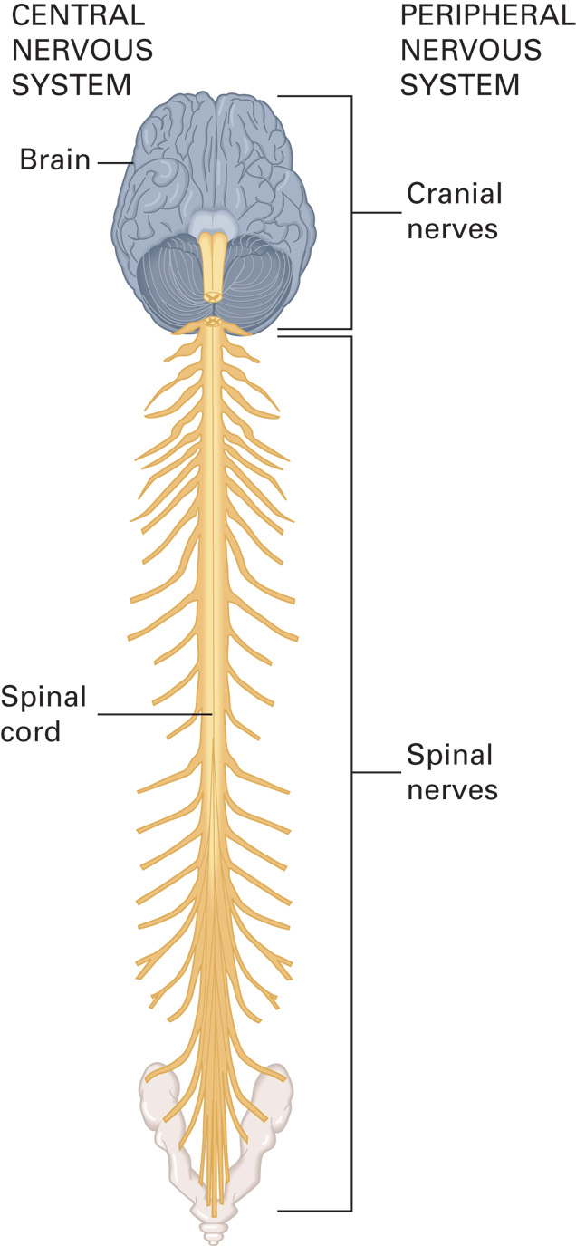
Components of the Central and Peripheral Nervous Systems
Notes:
The structural divisions of the nervous system are the central nervous system (CNS), which consists of the brain and the spinal cord, and the peripheral nervous system, which consists of nerves located outside of the brain and spinal cord.

Slide 9
Anatomy and Physiology of Spinal Injury (2 of 12)
Functional divisions of the nervous system
  Voluntary
    Influences the activity of skeletal muscles
  Autonomic
    Influences the activities of involuntary muscles and glands
      Sympathetic
      Parasympathetic
Notes:
The autonomic system is partly independent of the rest of the nervous system. The sympathetic nervous system and parasympathetic nervous system are included in the autonomic nervous system.

Slide 10
Anatomy and Physiology of Spinal Injury (3 of 12)
The Skeletal System
  Skull
    Cranium
    Face
  Spinal Column
    33 vertebrae in five divisions.
    Vertebrae bound together by ligaments.
    Vertebrae are separated by disks.
Notes:
The spinal column is divided into five parts:
Cervical spine. The first seven vertebrae that form the neck. The cervical vertebrae are the most mobile and delicate; injury to the cervical spine is the most common cause of spinal cord injury.
Thoracic spine. The 12 vertebrae directly below the cervical vertebrae that compose the upper back.
Lumbar spine. The next five vertebrae that form the lower back.
Sacral spine (sacrum). The next five vertebrae that are fused together and form the rigid posterior portion of the pelvis.
Coccyx (tailbone). The four fused vertebrae that form the lower end of the spine.
Discussion Question
Describe the structure of the spinal column.
Teaching Tips
The use of graphics will enhance students' understanding of the anatomy and physiology of the spinal tracts.

Slide 11
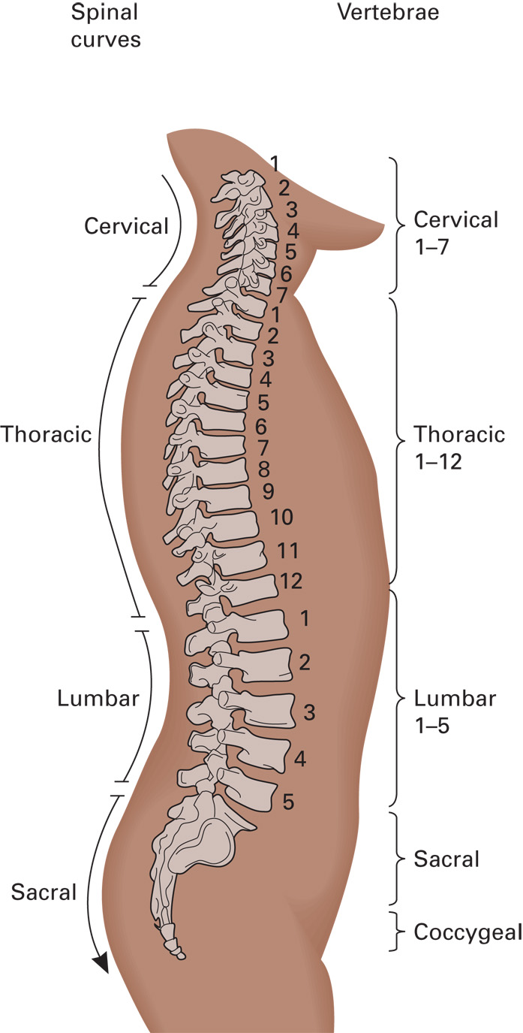
The Spinal (Vertebral) Column
Notes:
The spinal column, or vertebral column, is the principal support system of the body. Ribs originate from it to form the thoracic cavity, and the rest of the skeleton is directly or indirectly attached to the spine.

Slide 12
Anatomy and Physiology of Spinal Injury (4 of 12)
The Skeletal System
  Spinal column
    The spinal cord consists of nerve tissue
    Spinal cord tracts
      Motor tracts carry impulses to the same side of the body.
      Pain tracts carry impulses from the opposite side of the body.
      Light touch tracts carry impulses from the same side of the body.
Notes:
Because light touch and pain are carried by different tracts, the patient might not feel light touch but can feel the pain of a pinch. This finding can be present if the spinal cord is partially injured.

Slide 13
Anatomy and Physiology of Spinal Injury (5 of 12)
Common Mechanisms of Spinal Injury
  Vehicle collisions most common cause.
  85percent of patients with a spinal fracture or dislocation do not present a neurologic deficit.
  Improper handling of a spinal column injury may result in neurological injury.
  The spine is susceptible to injury from several mechanisms.
Notes:
A patient may have spinal cord injury without spinal column injury.
The spine is particularly susceptible to injury from:
Compression. The weight of the body is driven against the head. This is common in falls, diving accidents, motor vehicle crashes, or other accidents in which a person impacts an object headfirst.
Flexion. There is severe forward movement of the head in which the chin meets the chest, or the torso is excessively curled forward.
Extension. There is severe backward movement of the head in which the neck is stretched, or the torso is severely arched backward.
Rotation. There is lateral movement of the head or spine beyond its normal rotation.
Lateral bending. When the body or neck is bent severely from the side.
Distraction. The vertebrae and spinal cord are stretched and pulled apart. This is common in hangings.
Penetration. There is injury from gunshots, stabbings, or other types of penetrating trauma that involve the cranium or spinal column.

Slide 14
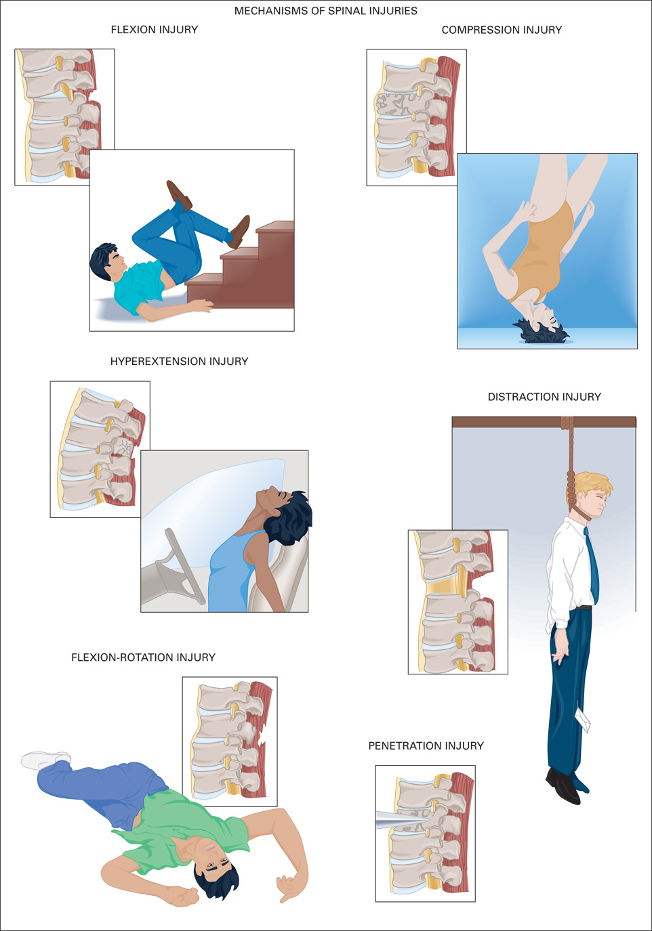
Mechanisms of Spine Injury
Notes:
You must suspect spinal injury in any case that might involve one or more of these mechanisms, even if the patient appears to move normally. Injured vertebrae that are still aligned but unstable can become unstable at any moment and damage or sever the spinal cord.

Slide 15
Anatomy and Physiology of Spinal Injury (6 of 12)
Spinal Column Injury Versus Spinal Cord Injury
  Spinal column injury: injury to the vertebrae
    Fractures and dislocations
    Results in pain or tenderness
  Spinal cord injury
    Damage to the nervous tissue
    Disruption in movement or sensation
Notes:
Although a patient complaining of pain to the spinal column likely has a vertebral (spinal column) fracture or injury, they could have a vertebral injury without a spinal cord injury. Conversely, a loss of motor or sensory function indicates a spinal cord injury; however, it does not imply a vertebral fracture or injury.
Knowledge Application
Students should be able to apply knowledge of spinal column and cord anatomy and physiology to the assessment of patients with suspected spinal injury.

Slide 16
Anatomy and Physiology of Spinal Injury (7 of 12)
Spinal Column Injury Versus Spinal Cord Injury
  Complete spinal cord injury
    Transection of the cord; loss of motor, sensory, and autonomic function below the site of injury.
  Spinal Shock
    Spinal shock also can result in initial presentation with complete loss of function.
Notes:
A patient in spinal shock can present with complete paralysis that might resolve within 24 hours to several days after the injury.

Slide 17
Anatomy and Physiology of Spinal Injury (8 of 12)
  Spinal Column Injury Versus Spinal Cord Injury
  Spinal Shock, loss of sympathetic control
    Neurogenic hypotension
      Vasodilation of arterioles.
      Diminished release of epinephrine and norepinephrine.
      The skin is warm and dry, and the pulse rate is normal.
Notes:
A male patient might have an involuntary erection of the penis called priapism.
Treatment for spinal shock is much the same as for any other shock. Spinal motion restriction must be applied, and the patient must be kept warm because of the increased heat loss from the peripheral vasodilation.
Discussion Question
What is spinal shock? How is it related to neurogenic hypotension?
Critical Thinking Discussion
Explain how and why the patient with spinal neurologic hypotension presents differently from the patient with hemorrhagic shock.

Slide 18
Anatomy and Physiology of Spinal Injury (9 of 12)
  Spinal Column Injury Versus Spinal Cord Injury
  Incomplete spinal cord injury
    Injury does not involve all three tracts.
    Some, but not all, signs of spinal injury are present.
    The pattern of lost functions is reflected in different syndromes.

Slide 19
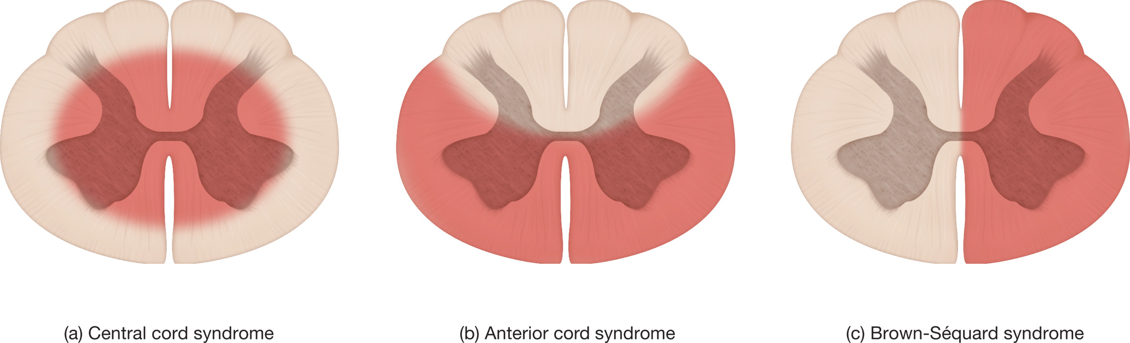
Cross Sections of the Spinal Cord Showing the H-Shaped Gray Matter Surrounded by White Matter
Illustrated here are the three most common types of incomplete spinal cord injury. (The areas of injury are highlighted in red.) Each results in a distinctive syndrome, or pattern of sensory and motor deficits. (a) Central cord syndrome results from injury to the central cord. (b) Anterior cord syndrome results from injury to the anterior cord. (c) Brown-Séquard syndrome results from injury to the right or left half of the cord.

Slide 20
Anatomy and Physiology of Spinal Injury (10 of 12)
Spinal Column Injury Versus Spinal Cord Injury
  Incomplete spinal cord injury
    Central cord syndrome
      The medial portion of the motor and pain tracts control the upper extremities.
      The lateral portions of the tracts control the lower extremities.
      In central cord syndrome, the medial portion of the spinal cord is injured.
Notes:
In central cord syndrome, the patient presents with a loss of motor function or weakness and loss of pain sensation to the upper extremities while motor and sensory functions remain normal in the lower extremities.

Slide 21
Anatomy and Physiology of Spinal Injury (11 of 12)
Spinal Column Injury Versus Spinal Cord Injury
  Incomplete spinal cord injury
    Anterior cord syndrome
      Loss of function in motor and pain tracts, but not in light touch tracts.
      The patient experiences paralysis and inability to feel pain below the level of injury, but can detect light touch.
Notes:
In anterior cord syndrome, the patient loses the ability to feel pain and crude touch below the site of injury and likely experiences the loss of motor function below the injury site. However, the patient retains the ability to feel light touch above and below the site of injury.

Slide 22
Anatomy and Physiology of Spinal Injury (12 of 12)
Spinal Column Injury Versus Spinal Cord Injury
  Incomplete spinal cord injury
    Brown-Séquard syndrome
      The injury affects only one side of the cord.
      Loss of motor and light touch sensation on the affected side.
      Loss of pain sensation on the side opposite the injury.
Notes:
In Brown-Séquard syndrome, the patient loses motor function and light touch sensation on one side of the body while retaining pain sensation on that same side. On the opposite side of the body, the patient retains motor function and light touch sensation while losing pain sensation.

Slide 23
Click on the Findings that Would te Most Consistent with Central Cord Syndrome
A. Loss of movement and light touch sensation below the site of injury on one side, and loss of pain sensation on the opposite side
B. Loss of all motor and sensory function on both sides below the site of injury
C. Weakness and loss of pain sensation of the upper extremities, with no weakness of the lower extremities
D. Loss of motor function and sensation of pain on both sides below the site of injury, but retention of light touch sensation

Slide 24
Emergency Care for Suspected Spinal Injury (1 of 22)
Assessment-Based Approach: Spinal Injury
  Scene Size Up: Mechanisms of Injury
    Crashes
    Falls
    Blunt or penetrating trauma
    Sporting or recreation injuries
    Gunshot injuries
    Electrical
Notes:
Mechanisms that can result in spinal injury:
Motorcycle crashes
Motor vehicle crashes
Pedestrian–vehicle collisions
Falls
Blunt trauma
Penetrating trauma to the head, neck, or torso
Sporting injuries
Hangings
Diving or other water-related accidents
Gunshot wounds to the head, neck, chest, abdomen, back, or pelvis
Unresponsive trauma
Electrical injuries
Discussion Questions
On what type of calls should you suspect spinal injury?
At what point in your approach to a patient with a potential spinal injury do you apply manual in-line stabilization of the cervical spine?
What patient factors may interfere with satisfactory assessment for indications of spinal injury?
Explain the steps in the assessment of the upper and lower extremities for pulse and motor and sensory functions.
Teaching Tips
Discuss applicable local protocols related to spinal motion restriction.
Critical Thinking Discussion
If you must rely on bystanders to help you move a patient with a spinal injury, which tasks should you delegate and which should you perform yourself?

Slide 25
Emergency Care for Suspected Spinal Injury (2 of 22)
Assessment-Based Approach: Spinal Injury
  Scene Size Up: Mechanisms of Injury
    An M O I heightens your suspicion that a potential injury might have occurred; it does not provide any evidence that an injury did occur.
    Deduce the M O I from evidence at the scene; determine if such a mechanism could have injured the spine.
Notes:
You might arrive at a collision scene and find the patient walking around or sitting in the back of a police car. This does not rule out the possibility of spinal injury, especially an incomplete spinal cord injury or a vertebral injury. Often, a patient with a stable spinal injury does not exhibit signs and symptoms consistent with injury to the spine. However, improper movement by either the patient or the EMT can potentially cause the stable injury to become unstable, resulting in permanent neurologic damage or even death.
Knowledge Application
Given several scenarios, students should be able to identify and manage patients with possible spinal injuries.
Class Activity
Have pairs of students practice neurological examination on patients with suspected spinal injury.
Discussion Question
What are the priorities of care in managing a patient with a suspected spinal injury?

Slide 26
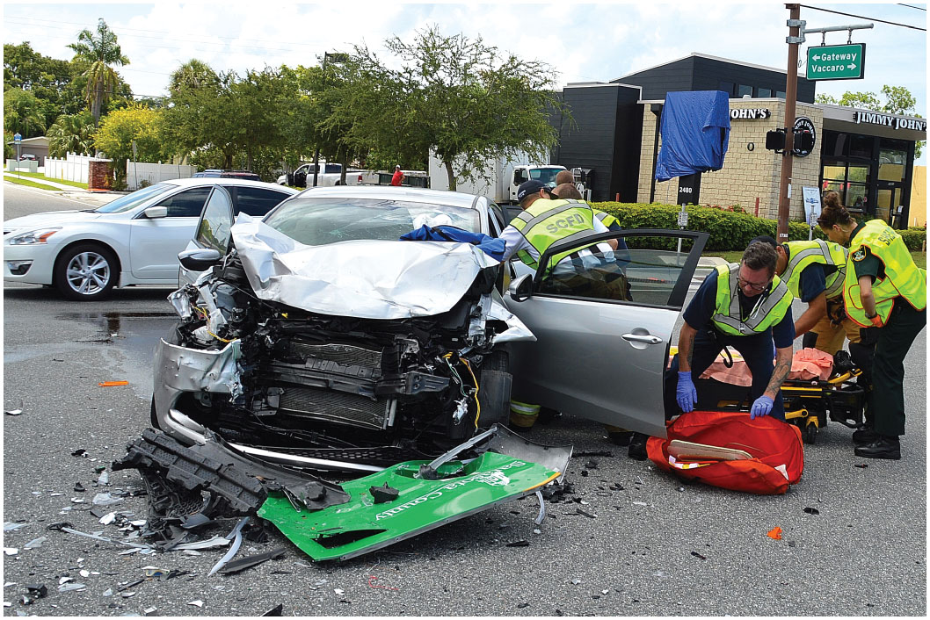
Front-End Damage and a Driver’s Side Windshield Fracture Indicate that the Driver was Probably Thrown Head First into the Windshield
Notes:
This evidence should create a high index of suspicion that the patient was propelled forward in the crash and struck his head on the windshield. This would likely have caused the head and neck to bend (flex) forward during the forward movement and bend backward (hyperextend) during the rearward movement. Both motions are significant mechanisms of injury that might not be suspected if the damage to the vehicle were not observed.

Slide 27
Emergency Care for Suspected Spinal Injury (3 of 22)
Assessment-Based Approach: Spinal Injury
  Primary Assessment
    With mechanism of injury consistent with potential for spine injury:
      Immediately provide in-line manual stabilization of the spine.
      Use jaw-thrust maneuver to open airway.
      Follow local protocols for spine motion restriction.
Notes:
An injury to the cervical spine in the third (C3) to fifth (C5) cervical vertebrae might injure the phrenic nerve that controls the function of the diaphragm. Because the diaphragm provides more than 60 percent of the effort to breathe, the patient can develop respiratory failure and require ventilation.

Slide 28
Emergency Care for Suspected Spinal Injury (4 of 22)
Assessment-Based Approach: Spinal Injury
  Primary Assessment
    Perform manual stabilization of the spine based on mechanism of injury.
    Maintain manual stabilization until a thorough assessment does not reveal indications for motion restriction, OR spine motion restriction has been accomplished.
Notes:
Spinal cord damage from a cervical spinal injury can block nerve impulses traveling from the brain to the diaphragm and intercostal muscles, which are necessary for adequate respiration.

Slide 29
Emergency Care for Suspected Spinal Injury (5 of 22)
Assessment-Based Approach: Spinal Injury
  Primary Assessment
    Provide spine motion restriction on patients with positive mechanism of injury who:
      Have an altered mental status
      Have painful distracting injuries
      Cannot effectively communicate with you
Notes:
The mental status of a patient with a spinal injury can range from completely alert and oriented to unresponsive.

Slide 30
Emergency Care for Suspected Spinal Injury (6 of 22)
Assessment-Based Approach: Spinal Injury
  Primary Assessment
    High-priority patients
      Unresponsive
      Responsive but unable to obey commands
      Abnormal respiratory pattern
      Obvious signs of spine injury
Notes:
Based on the assessment findings, categorize the patient as either high or low priority for emergency care or transport. If the patient is unresponsive, responsive but cannot obey your commands, or displays an abnormal respiratory pattern or obvious signs of spinal injury such as numbness or paralysis, you must consider the patient a high priority for emergency care and prompt transportation to the highest-level trauma center, based on your destination proposals.

Slide 31
Emergency Care for Suspected Spinal Injury (7 of 22)
  Assessment-Based Approach: Spinal Injury
  Secondary Assessment
    Maintain in-line spinal stabilization.
    Conduct a physical exam.
    After assessing the neck, apply a cervical collar.
    Assess pulses and motor and sensory function.
Notes:
Some protocols allow you to instruct the patient to perform self-restriction, which is to ask the patient to restrict or prevent his movements to keep his head, neck, and spine in proper alignment.

Slide 32
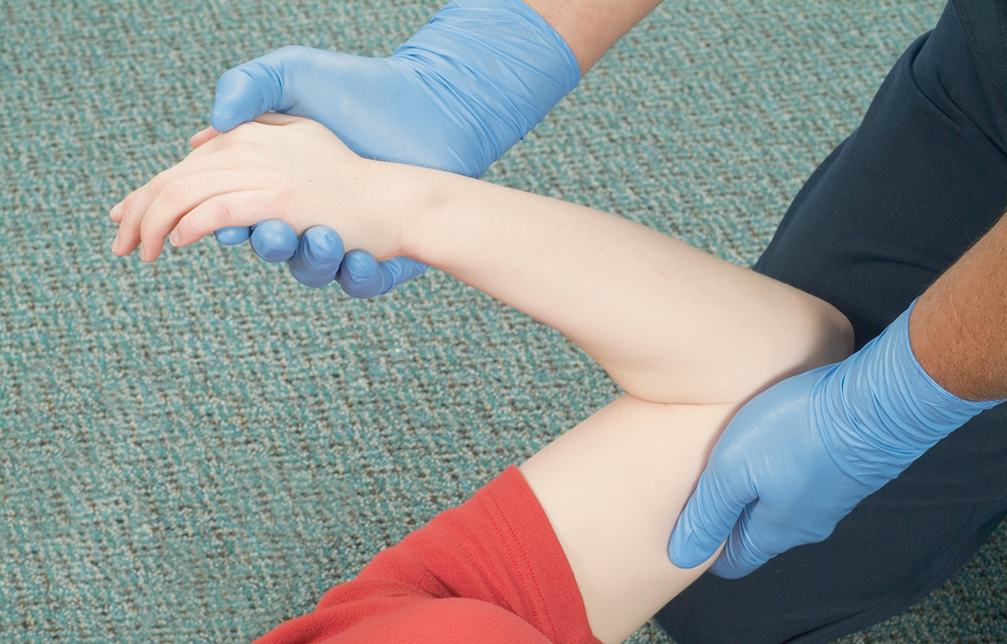
Assess Flexion
Notes:
Say to the patient, “bend your arms at the elbows and place them across your chest.” This flexion tests motor function at C6.

Slide 33
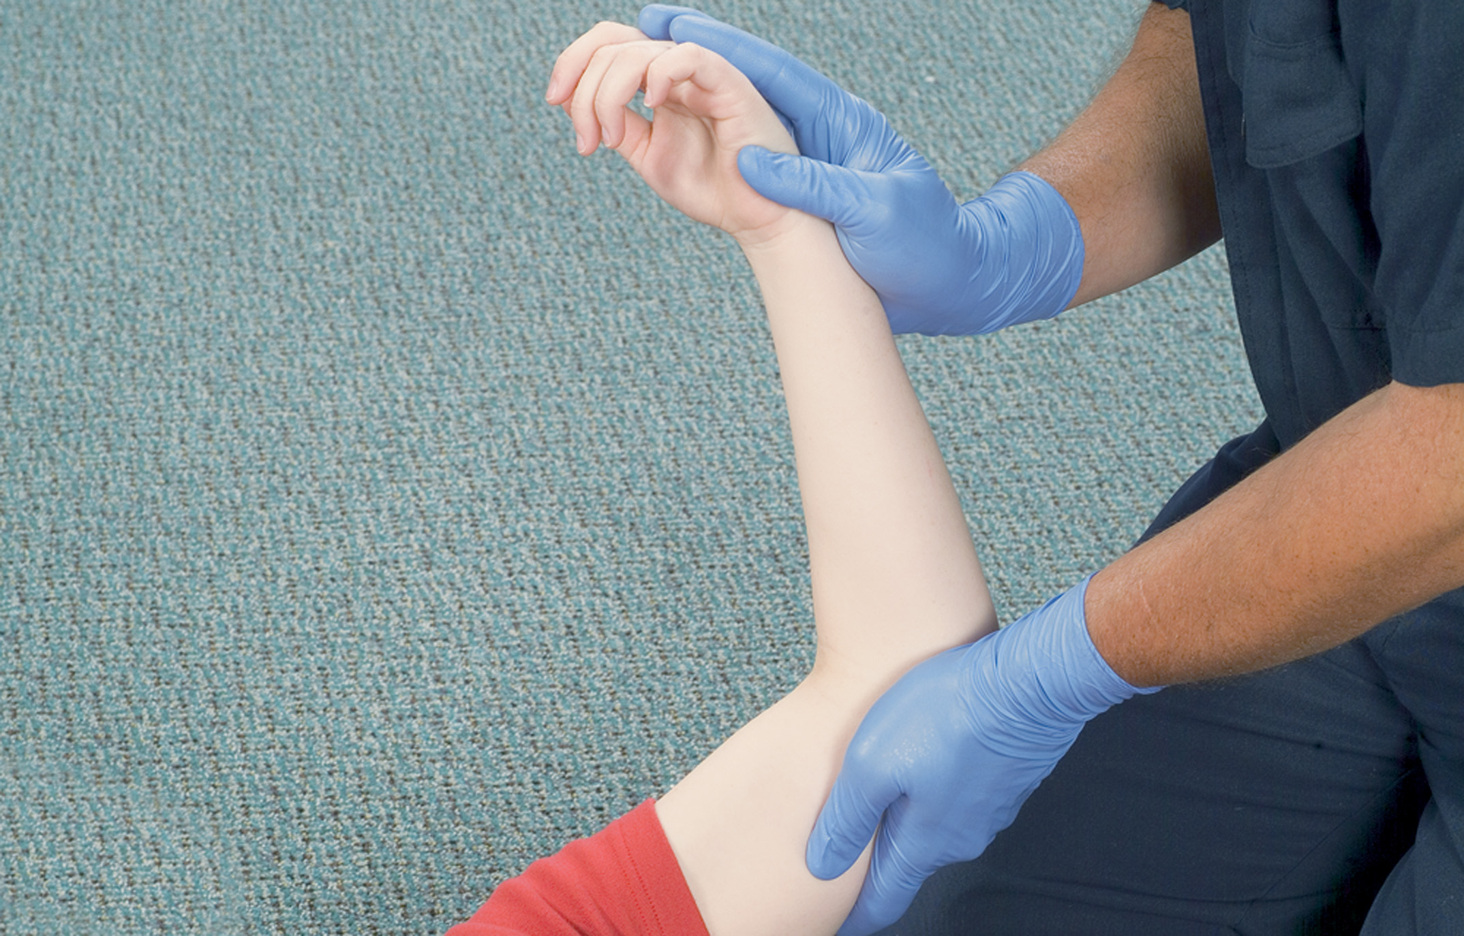
Assess Extension
Notes:
Say to the patient, “Straighten your arms, then bring them to either side of your body”. This extension tests motor function at C7.

Slide 34
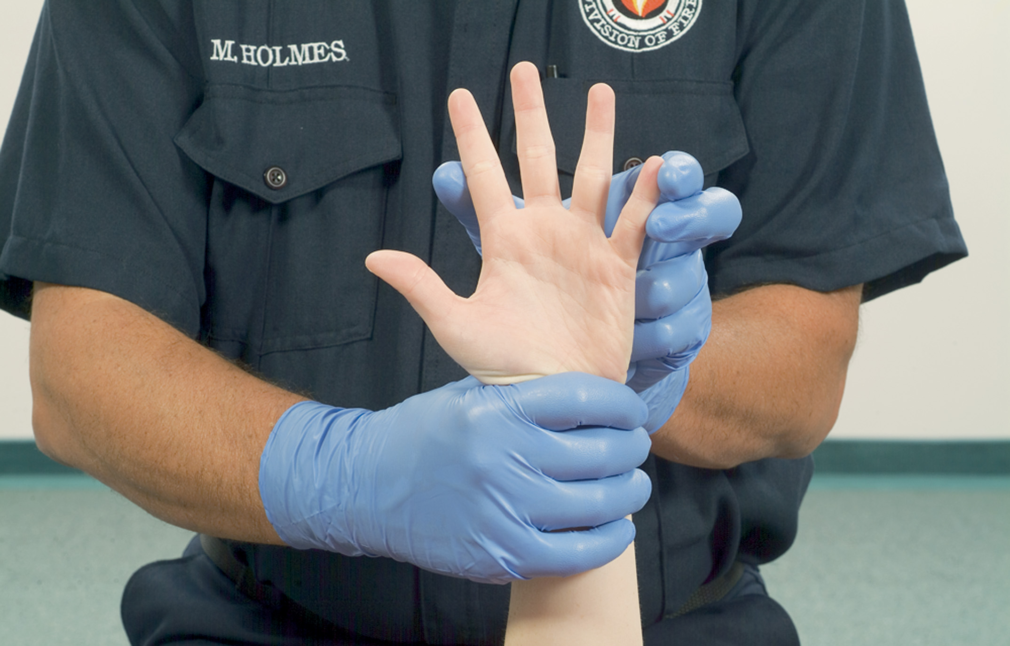
Assess Finger Abduction
Notes:
Say to the patient, “Spread your fingers out on both hands and don’t let me squeeze them together.” This abduction tests motor function at T1.

Slide 35
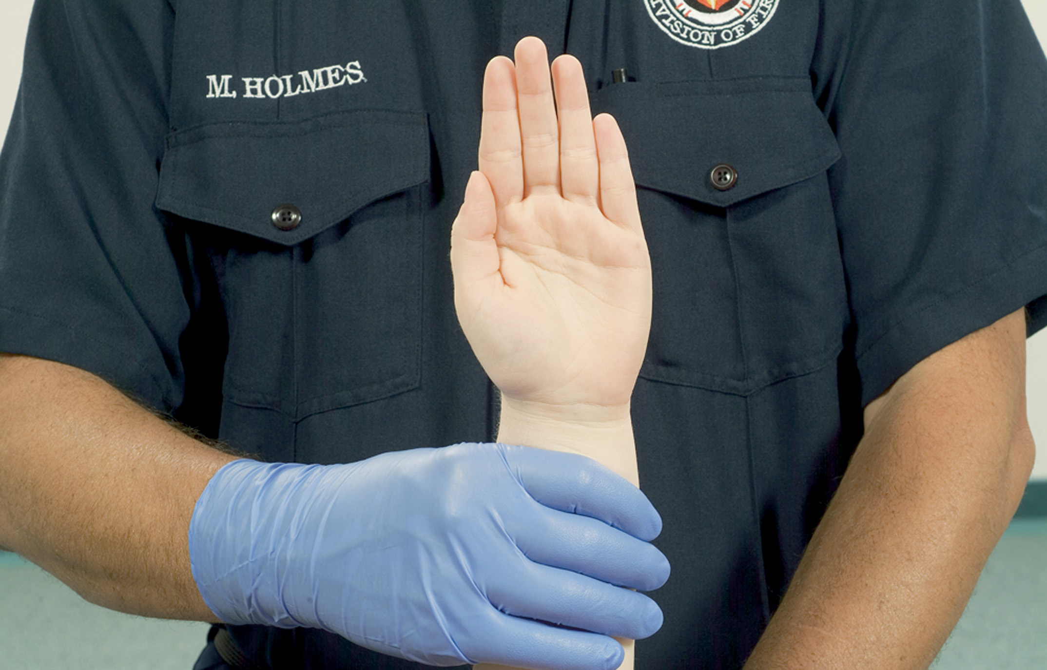
Assess Finger Adduction

Slide 36
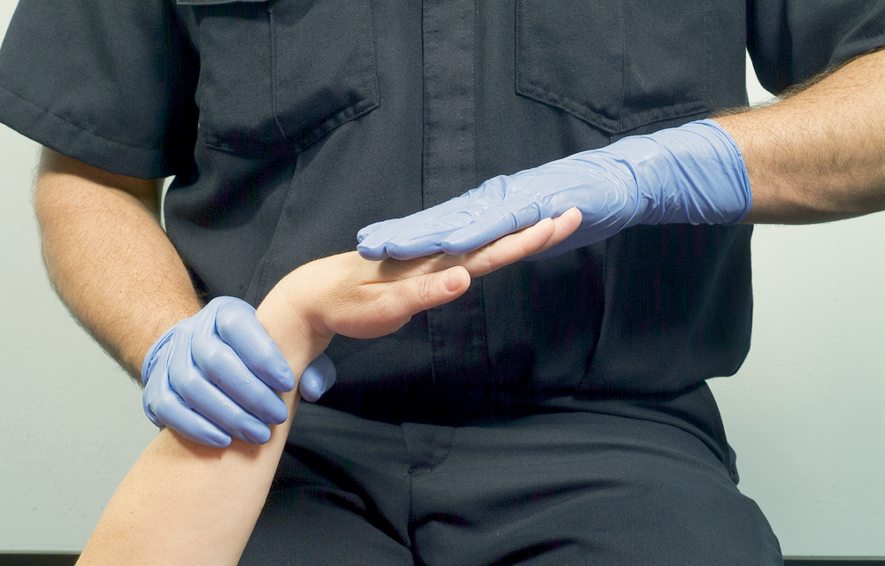
Assess the Wrist and Hand
Notes:
Support the patient’s hand under the wrist and say to the patient, “Hold out both arms and don’t let me push your hand down.” This test assesses motor function at C7.

Slide 37
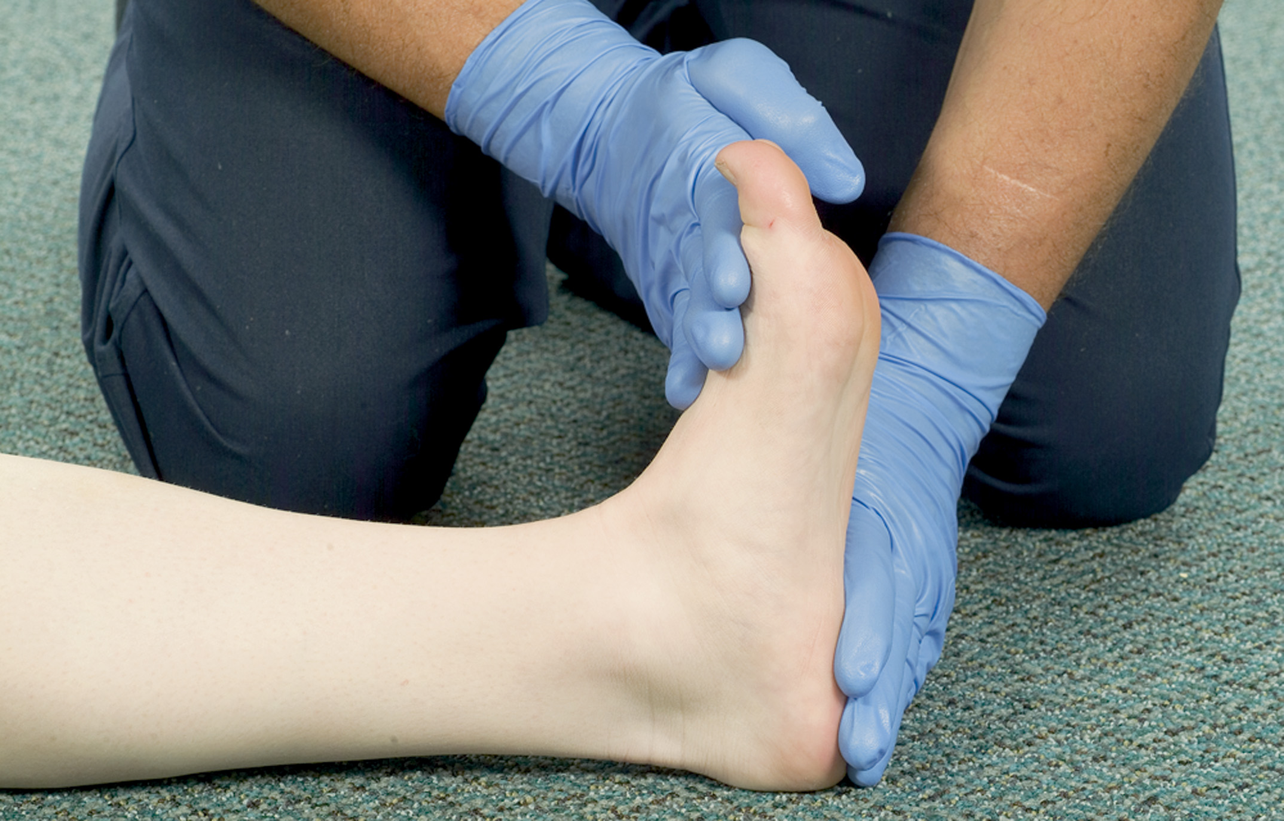
Assess Plantar Flexion
Notes:
Place your hands on the top of the patient's feet and say to the patient, “Pull up against my hands with your feet.” This plantar flexion tests motor function at the level of L5.

Slide 38
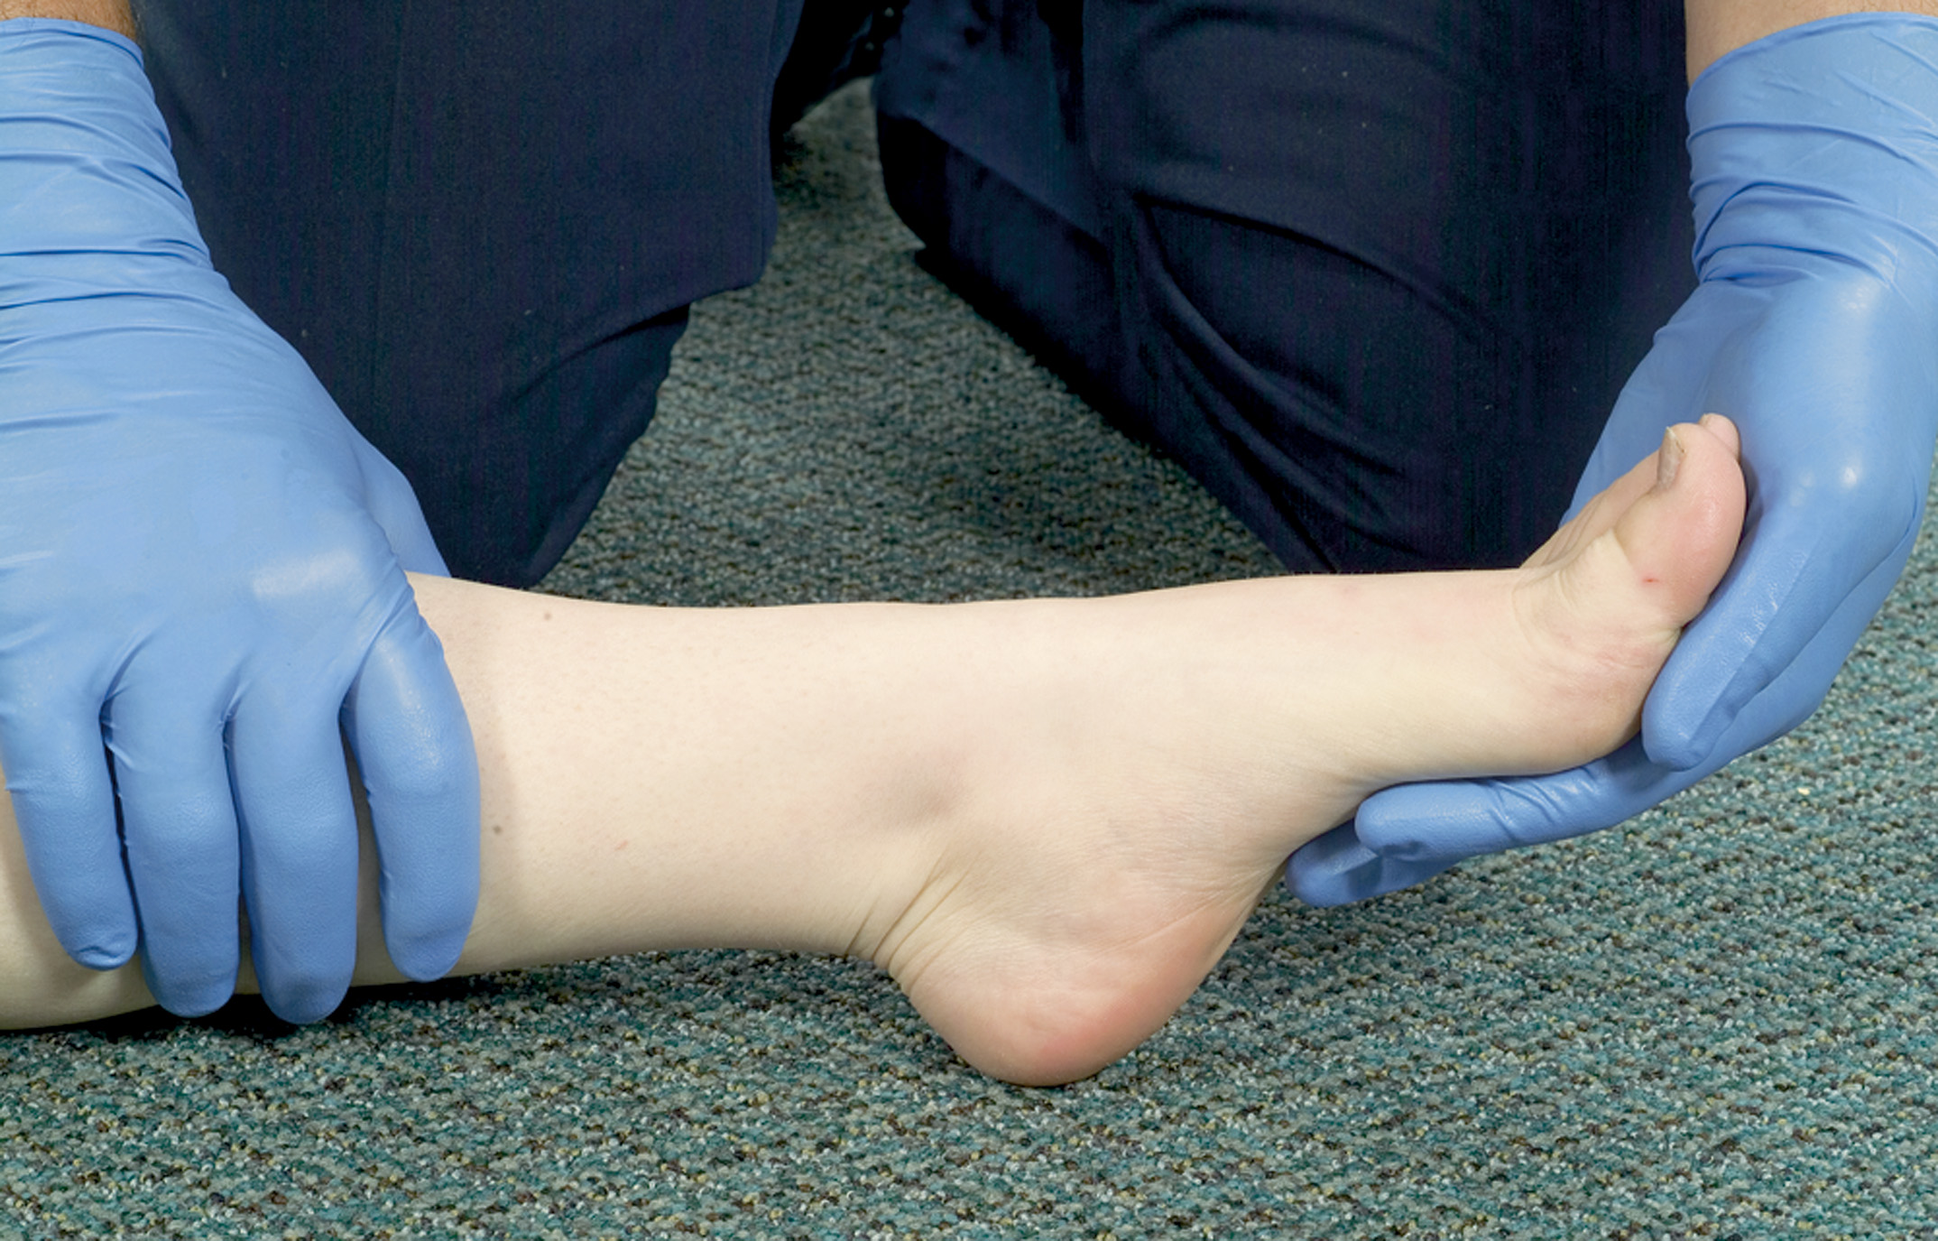
Assess Dorsiflexion
Notes:
Place your hands under the patient's feet and say to the patient, “Push down against my hands with your feet.” This dorsiflexion tests motor function at S1 and S2.

Slide 39
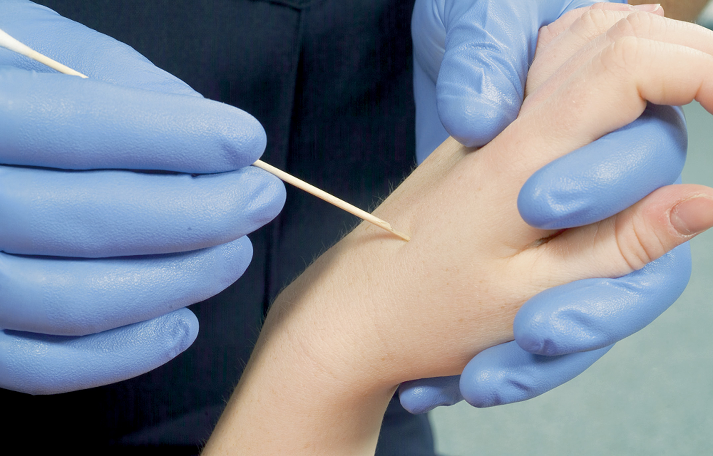
Assess Pain Response in the Hand
Notes:
A cotton swab with a wooden stick can be used for checking both pain and light touch. Break the stick in half and use the jagged broken end to test for pain. Have the patient close his eyes. With the sharp end of the swab’s wooden stick, poke one of his hands. When the patient grimaces, moans, or responds in some other way, ask, “Where does it hurt?” Repeat the test on the other hand and on each foot.

Slide 40
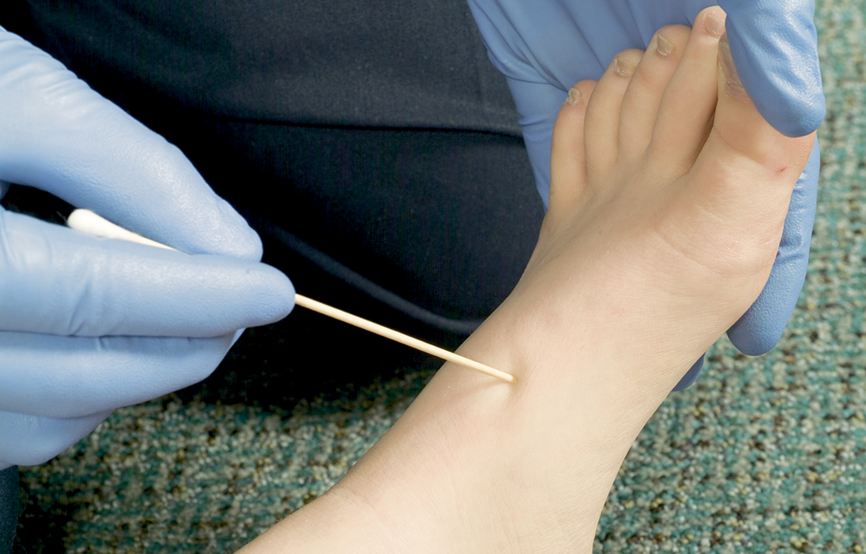
Assess Pain Response in the Foot
Notes:
Have the patient close his eyes. With the sharp end of the swab’s wooden stick, poke one of his feet.
When the patient grimaces, moans, or responds in some other way, ask, “Where does it hurt?” Repeat the
test on the other foot.

Slide 41
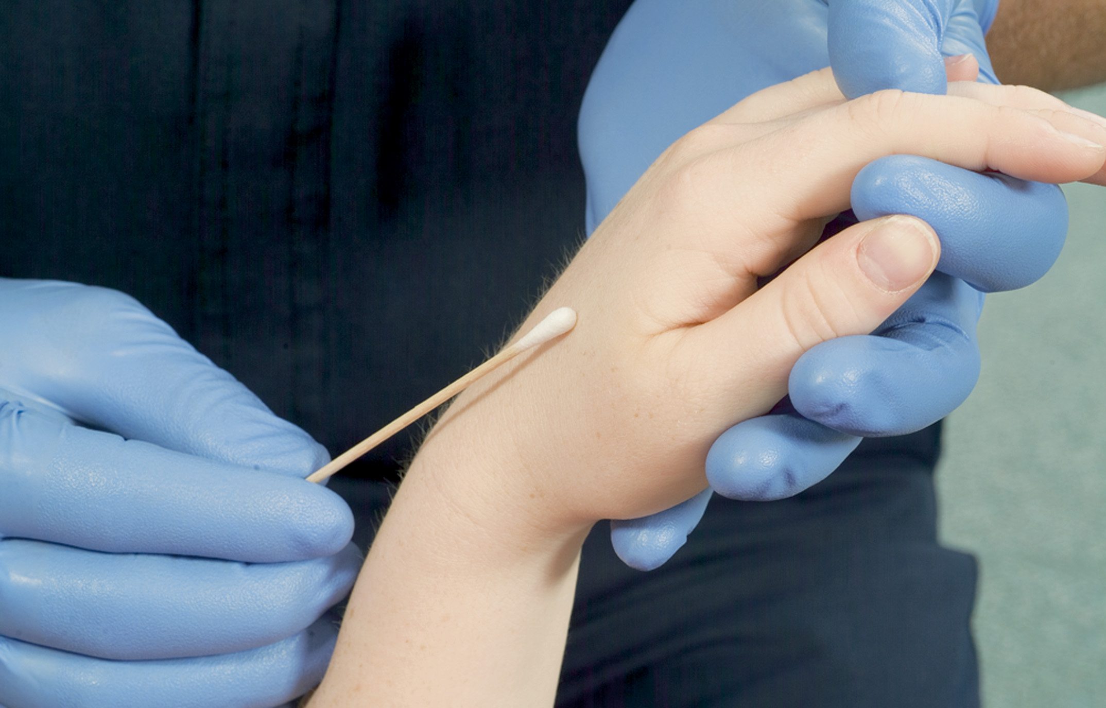
Assess Light Touch Response in the Hand
Notes:
Have the patient again close his eyes. Lightly touch the patient’s fingers on one hand, then the other. As you perform this test for light touch to the fingers, ask:
“Can you feel me touching your finger?”
“Can you tell me which hand and which finger I’m touching?”

Slide 42
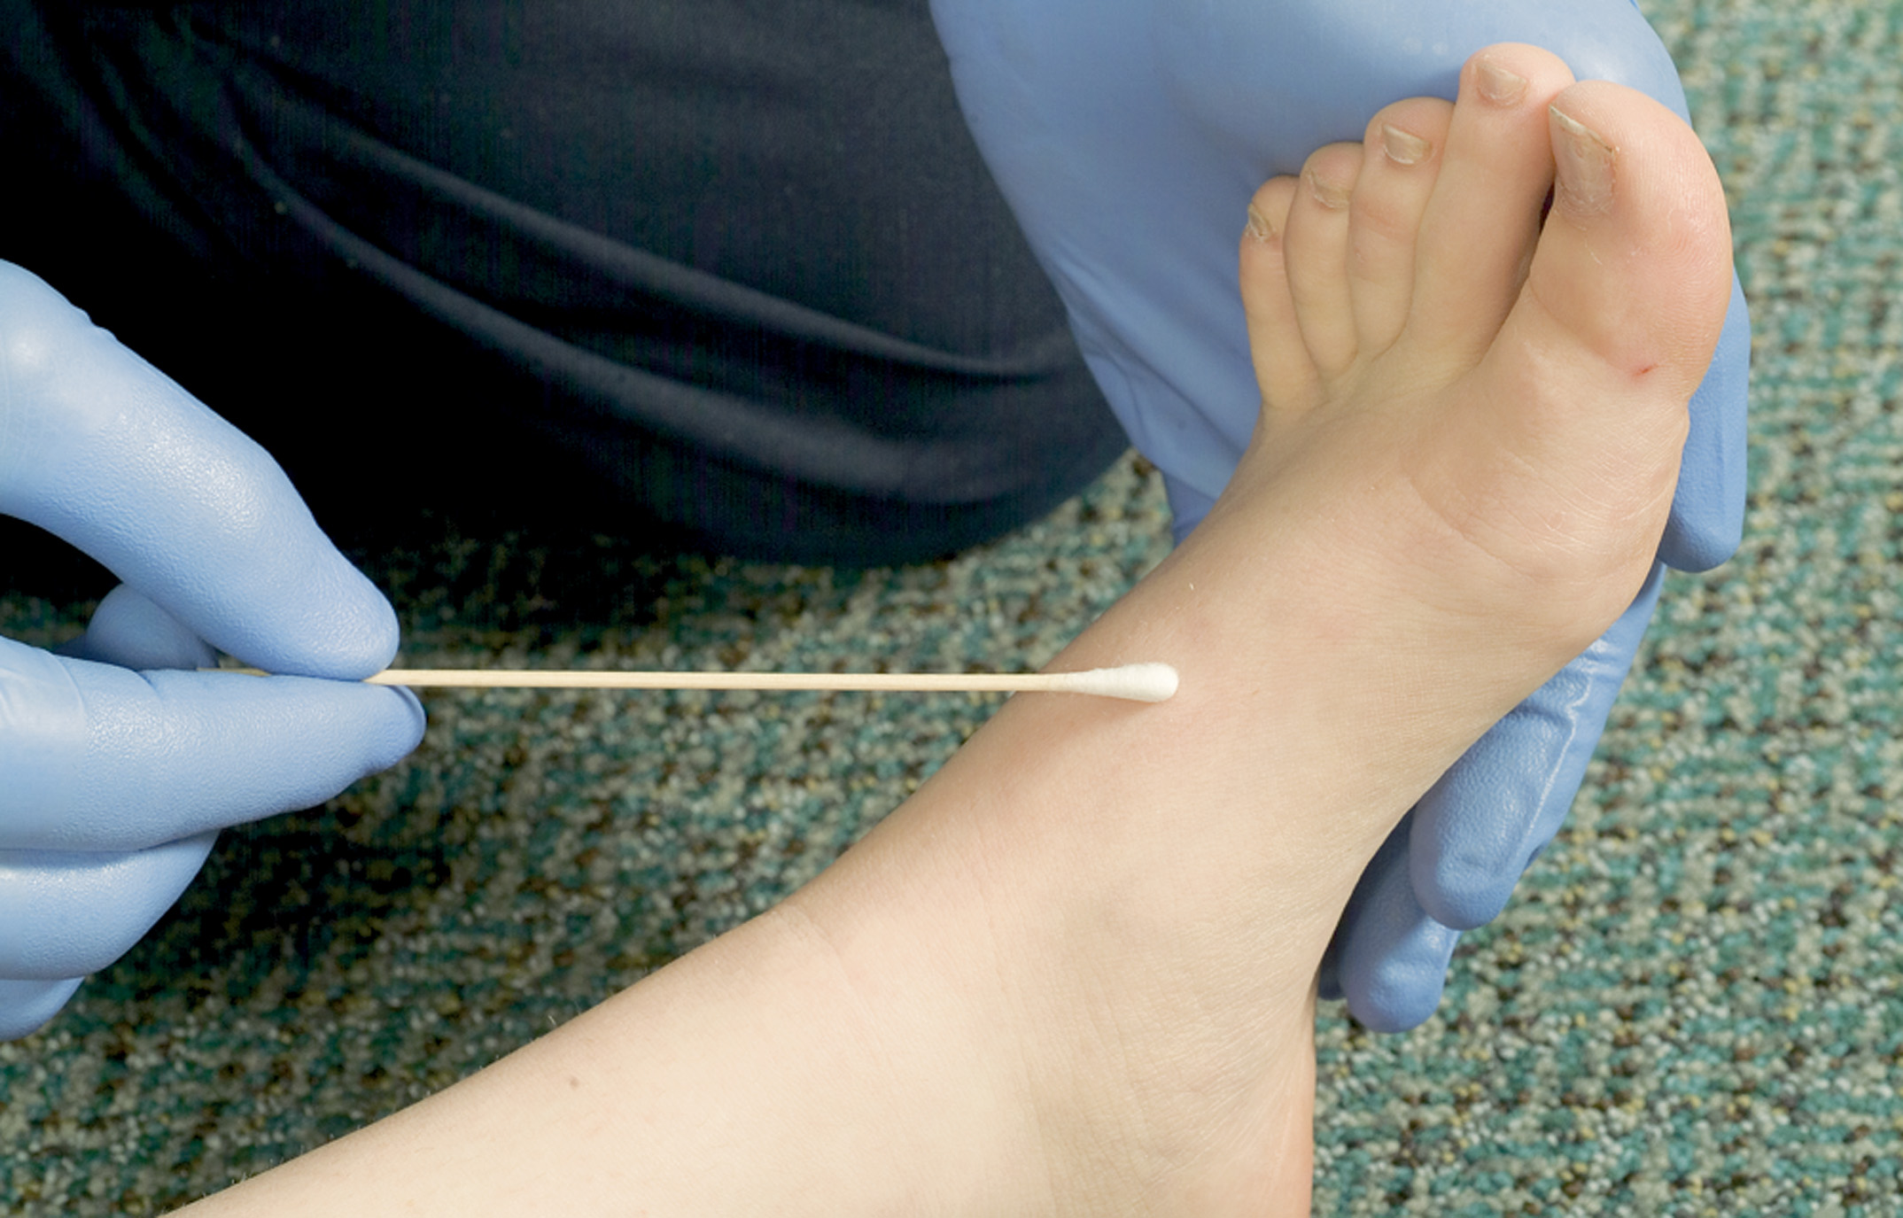
Assess Light Touch Response in the Foot
Notes:
Repeat the test on one of the toes on each foot. As you test for light touch on the toes, ask:
“Can you feel me touching your toe?”
“Can you tell me which foot and what toe I’m touching?”

Slide 43
Emergency Care for Suspected Spinal Injury (8 of 22)
Assessment-Based Approach: Spinal Injury
  Secondary Assessment
    Posterior exam - Log roll the patient with spine motion restriction maintained to assess the posterior body. Palpate the area of the spine gently.
Notes:
Evidence of deformity, tenderness, contusions, lacerations, punctures, or swelling to the spine or around the spine should heighten your suspicion that a spinal column injury exists.

Slide 44
Emergency Care for Suspected Spinal Injury (9 of 22)
Assessment-Based Approach: Spinal Injury
  Secondary Assessment
    Baseline Vital Signs
      If the brain or spinal cord is damaged, vital signs might reflect neurogenic hypotension.
      If the hypotension is severe and the patient has tachycardia, suspect bleeding as the cause of shock.
Notes:
Hypovolemia and spinal cord injury can both be present in the same patient; therefore, be cautious in your assessment because a spinal cord injury might prevent the typical signs of hypovolemic shock from occurring.

Slide 45
Emergency Care for Suspected Spinal Injury (10 of 22)
Assessment-Based Approach: Spinal Injury
  Secondary Assessment: History
    Obtain a history from the responsive patient.
    Assess for allergies, medications, past medical history, and last food or drink.
    Events prior to the onset of signs or symptoms.
Notes:
Questions that might be asked in cases of suspected spinal injury include the following:
Does your neck or back hurt?
Where does it hurt?
Can you move your hands and feet?
Do you have any pain or muscle spasms along your back or on the back of your neck?
Do you have any numbness or tingling sensations in either of your arms or legs?
Was the onset of pain associated with a fall or other injury?
Did you move or did someone move you before our arrival?
Were you up walking around before our arrival?

Slide 46
Emergency Care for Suspected Spinal Injury (11 of 22)
Assessment-Based Approach: Spinal Injury
  Secondary Assessment: History
    Signs and Symptoms:
      Tenderness along the spine
      Pain associated with movement
      Pain independent of palpation or movement
      Deformity of the spine on palpation
      Soft tissue injuries
Notes:
Spinal motion restriction should be based on physical assessment findings and not solely on MOI.

Slide 47
Emergency Care for Suspected Spinal Injury (12 of 22)
Assessment-Based Approach: Spinal Injury
  Secondary Assessment: History
    Signs and Symptoms:
      Numbness, tingling, weakness; loss of sensation or motor function
      Loss of bladder or bowel control
      Priapism
      Impaired breathing
Notes:
It is imperative to recognize that a patient’s lack of pain in the spinal column or his ability to walk, move his extremities, and sensations does not rule out the possibility of spinal column (vertebral) or incomplete spinal cord injury.

Slide 48
Emergency Care for Suspected Spinal Injury (13 of 22)
Assessment-Based Approach: Spinal Injury
  Secondary Assessment: History
    Assessment findings that are indications for spine motion restriction
      G C S <15
      Suspected traumatic brain injury
      Altered mental status
      Pain or tenderness of spinal column
      Paralysis, weakness, numbness, tingling
Notes:
After a thorough assessment of a patient with blunt and penetrating trauma, these indicators show that the patient should be transported using with spinal motion.

Slide 49
Emergency Care for Suspected Spinal Injury (14 of 22)
Assessment-Based Approach: Spinal Injury
  Secondary Assessment: History
    Assessment findings that are indications for spine motion restriction
      Deformity of the vertebral column
      Under the influence of drugs or alcohol
      Cannot communicate effectively
      Has a painful, distracting injury
Notes:
If any of these indications are found during the assessment, you must provide spinal motion restriction throughout the remainder of the assessment, treatment, and transport of the patient.

Slide 50
Emergency Care for Suspected Spinal Injury (15 of 22)
Assessment-Based Approach: Spinal Injury
  Secondary Assessment: History
    Complications of spine injury
      Inadequate breathing effort.
      Paralysis of the respiratory muscles can lead to respiratory failure.
      Respirations may be shallow with little movement or the chest or abdomen.
      Provide positive pressure ventilation.

Slide 51
Emergency Care for Suspected Spinal Injury (16 of 22)
Assessment-Based Approach: Spinal Injury
  Secondary Assessment: History
    Complications of spine injury
      Paralysis
      Paraplegia
      Quadriplegia (tetraplegia)
      Hemiplegia- more common in head injuries and stroke
Notes:
Incomplete spinal cord injury can cause loss of motor and sensory functions in different areas of the body.

Slide 52
Emergency Care for Suspected Spinal Injury (17 of 22)
Assessment-Based Approach: Spinal Injury
  Secondary Assessment: History
    Complications of spine injury
      Inadequate circulation.
      Vasodilation leads to hypotension and poor tissue perfusion.
      The skin may be warm and dry, and the heart rate is normal to slightly decreased.
Notes:
Always look for other reasons for hypotension.

Slide 53
Emergency Care for Suspected Spinal Injury (18 of 22)
  Assessment-Based Approach: Spinal Injury
  Emergency Medical Care
    Use Standard Precautions.
    Establish in-line spinal stabilization.
Notes:
If the patient complains of severe pain to the neck or cervical spine, or the head does not easily move, maintain the head in the position found.

Slide 54
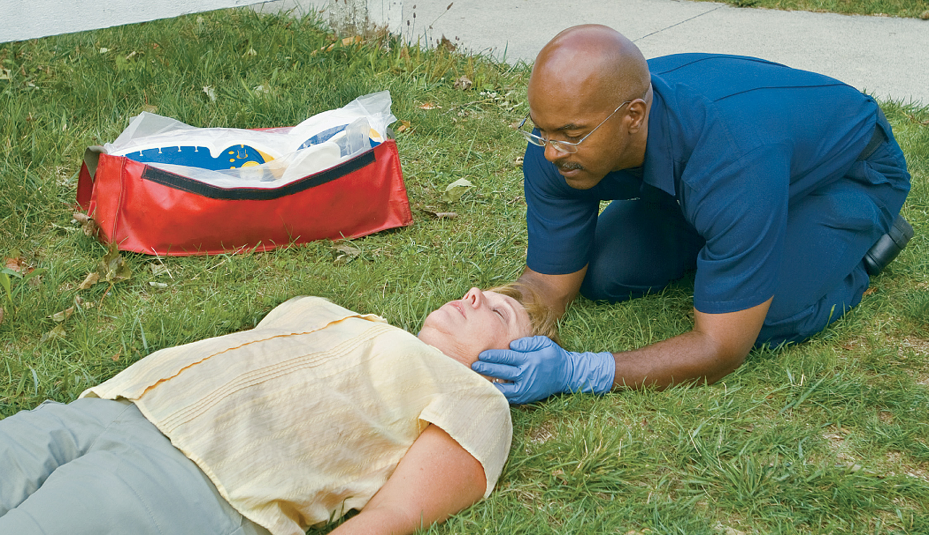
Keep the Head in a Neutral Position and the Nose in Line with the Patient’s Navel
Notes:
Ensure that the head is in a neutral, in-line position.

Slide 55
Emergency Care for Suspected Spinal Injury (19 of 22)
Assessment-Based Approach: Spinal Injury
  Emergency Medical Care
    Airway and breathing
      Use a jaw-thrust maneuver, if necessary.
      Provide positive pressure ventilation for inadequate breathing; maintain an S p O ₂ greater than or equal to 94%.
      Suction secretions without turning the patient’s head.
Notes:
Insert an oropharyngeal or nasopharyngeal airway, if necessary.

Slide 56
Emergency Care for Suspected Spinal Injury (20 of 22)
Assessment-Based Approach: Spinal Injury
  Emergency Medical Care
    Assess the pulse, motor function, and sensation in all extremities.
    Assess the neck before applying a cervical collar.
    Apply a cervical collar.
Notes:
An improperly sized collar can cause more harm to the patient, compromise the airway, and further aggravate a potential spinal injury. Information about sizing and applying the cervical collar.

Slide 57
Emergency Care for Suspected Spinal Injury (21 of 22)
Assessment-Based Approach: Spinal Injury
  Emergency Medical Care
    Provide spine motion restriction of the patient on a long backboard.
    After placement on the backboard, reassess pulse, motor, and sensory function.
    Transport.
Notes:
It is safer to err on the side of caution and provide spinal motion restriction if spinal injury is suspected. Spinal motion restriction devices can always be removed at the emergency department after the physician or radiographic studies determine that no spinal injury exists.

Slide 58
Emergency Care for Suspected Spinal Injury (22 of 22)
Assessment-Based Approach: Spinal Injury
  Reassessment
    Airway and breathing
    Vital signs
    Complaints
    Interventions
Notes:
Because a spinal injury is rarely an isolated injury, look for signs of hypovolemic shock: The skin becomes pale, cool, and moist; the blood pressure falls; the heart rate increases; and the patient’s mental status decreases. Remember that a decreasing level of responsiveness is an early sign of head injury.

Slide 59
Case Study (2 of 3)
The patient is alert and oriented, with a patent airway and adequate breathing. She has a strong radial pulse of 88 per minute.
She has movement and sensation to pain and light touch in her upper extremities. She has sensation to pain and light touch in her lower extremities, but bilateral ankle injuries make assessment of motor function difficult.
Notes:
Review the Case Study findings presented.

Slide 60
Case Study (3 of 3)
What equipment will Sarah and Angela need to provide spine motion restriction for the patient?
Describe the procedures Sarah and Angela should use to provide spine motion restriction for the patient.
Notes:
Use the Case Study content and questions to foreshadow the upcoming lesson content. Gauge the student’s responses as a guide of how well versed they are on this topic.

Slide 61
Guidelines for Spine Motion Restriction (1 of 12)
Historical Perspective: Spinal Immobilization Versus Spine Motion Restriction
  Spinal Immobilization
    Until 2013, immobilization was the standard of care for any patient found to have an M O I which may result in spinal injury.
Notes:
It is estimated that up to 5 million patients a year with no evidence of spinal injury received spinal immobilization. The backboard also became a popular and convenient device to move patient’s regardless of suspected spinal injury.

Slide 62
Guidelines for Spine Motion Restriction (2 of 12)
Historical Perspective: Spinal Immobilization Versus Spine Motion Restriction
  Spine Motion Restriction
    A C E P stated its belief that efficacy of current practices in out-of-hospital care of patients who may have spinal injuries are not supported by evidence.
    A C E P recommends spine motion restriction over immobilization attempts.
Notes:
It is impossible to achieve complete spinal immobilization. ACEP recommends spinal motion restriction over immobilization attempts. Spinal motion restriction aims to maintain anatomic alignment of the spine and to keep gross movement to a minimum. Specific adjuncts are not mandated for spinal motion restriction.
The following spinal motion restriction teaching points summarize the new approach to emergency care of patients with suspected spinal injury in the prehospital setting:
Do not use mechanism of injury as the sole criteria for spinal motion restriction. Assessment findings should guide SMR.
Differentiate between stable and unstable cervical column injuries.
Differentiate the multisystem, multitrauma victim from the patient with moderate, low kinetic energy trauma, who likely does not require SMR.
Emphasize the complete assessment of the patient before deciding on SMR.
Omit SMR altogether for those patients who meet the “clearance” criteria.
Victims of penetrating trauma should not be provided spinal motion restriction unless neurologic deficits are present.
There is a lack of evidence and potential harm in using an unpadded backboard; therefore, avoid its use.
Stable spinal injuries need little in terms of field stabilization;
application of a cervical collar and securing the patient to the stretcher mattress is usually all that is necessary.
The use of a vacuum mattress alternative method of SMR.
The SMR method should conform to the patient. You should not make the patient conform to the SMR device.
When performing SMR, allow patients to be comfortably secured in a variety of positions such as sitting, reclining, or on their sides.

Slide 63
Guidelines for Spine Motion Restriction (3 of 12)
  Historical Perspective: Spinal Immobilization Versus Spine Motion Restriction
  Indications for Spine Motion Restriction
    Follow local protocol.
    Use criteria to “clear the spine”.
    Must be a reliable patient.
    Unreliable patients with a qualifying M O I must be provided with spine motion restriction.
Notes:
The indications for which patients should receive spinal motion restriction are based on a variety of sources. It is important to follow your local protocol, which might include many of those described in this section.
A reliable patient is one who:
Has a Glasgow Coma Scale score of 15 (the maximum score)
Does not have a head injury
Is not intoxicated or under the influence of drugs
Does not have a distracting injury (long bone fracture, large laceration, or other injury that causes more pain than the vertebral column, if injured)
Can communicate effectively to understand your questions and provide appropriate responses (does not have communication barriers such as hearing loss, deafness, or a language barrier).

Slide 64
Guidelines for Spine Motion Restriction (4 of 12)
  Historical Perspective: Spinal Immobilization Versus Spine Motion Restriction
  Indications for Spine Motion Restriction
    S M R is necessary for:
      An unreliable patient
      Patient with a neurologic deficit
      Pain or tenderness near vertebral column
      Distracting injury
Notes:
Other SMR criteria might be required by your local protocol. Some protocols can include motor vehicle crashes with high-energy collision, rollovers, ejection, and pedestrian-vehicle collision.

Slide 65
Guidelines for Spine Motion Restriction (5 of 12)
  Historical Perspective: Spinal Immobilization Versus Spine Motion Restriction
  Indications for Spine Motion Restriction
    S M R not necessary for:
      Reliable patient who communicates
      No spinal pain or tenderness
      No abnormal neurologic findings
      No distracting injury or intoxication
Notes:
Patients with penetrating injuries to the head, neck, or torso who do not have any neurologic deficits or indication of spinal injury should not receive spinal motion restriction utilizing a backboard.

Slide 66
Guidelines for Spine Motion Restriction (6 of 12)
  Historical Perspective: Spinal Immobilization Versus Spine Motion Restriction
  Spine Motion Restriction Protocols
    Protocols vary widely.
    Old S M R protocols have fallen out of favor due to poor outcomes.
Notes:
SMR techniques vary widely; they might include any of the following:
Application of a soft cervical collar and the patient secured to the ambulance mattress.
Application of a rigid cervical collar and the patient secured to the ambulance stretcher.
Application of a cervical collar and the patient secured in a vacuum mattress and then placed on the stretcher.
Application of a cervical collar and the patient lifted and moved to the stretcher using a scoop stretcher. After the patient is moved to the stretcher, the scoop stretcher is removed.
Application of a cervical collar and the patient lifted and moved to the stretcher using a backboard. After the patient is moved to the stretcher, they are removed from the backboard and placed directly on the stretcher mattress.
Application of a cervical collar and vest-type device applied to the patient for extrication. The patient is secured to the backboard with the vest-type device in place. The backboard, holding the patient, is placed on the stretcher.
Application of a cervical collar and the patient placed on and strapped to a long backboard, the head secured by a head-stabilization device. The backboard, holding the patient, is placed on the stretcher.

Slide 67
Guidelines for Spine Motion Restriction (7 of 12)
Tools for S M R
  Cervical Collars
    Cervical collar can increase intracranial pressure.
    Cervical collar can cause pressure sores.
    Increase in difficulty in managing the airway with a cervical collar.
Notes:
Teaching Tips
Demonstrate a variety of devices and techniques so that students will be able to adapt their approach to the situation.
Knowledge Application
Given a series of scenarios, students should be able to choose the best method of spinal motion restriction and perform it efficiently.
Discussion Questions
What is the purpose of a cervical collar?
What are the considerations in determining placement of backboard straps?

Slide 68
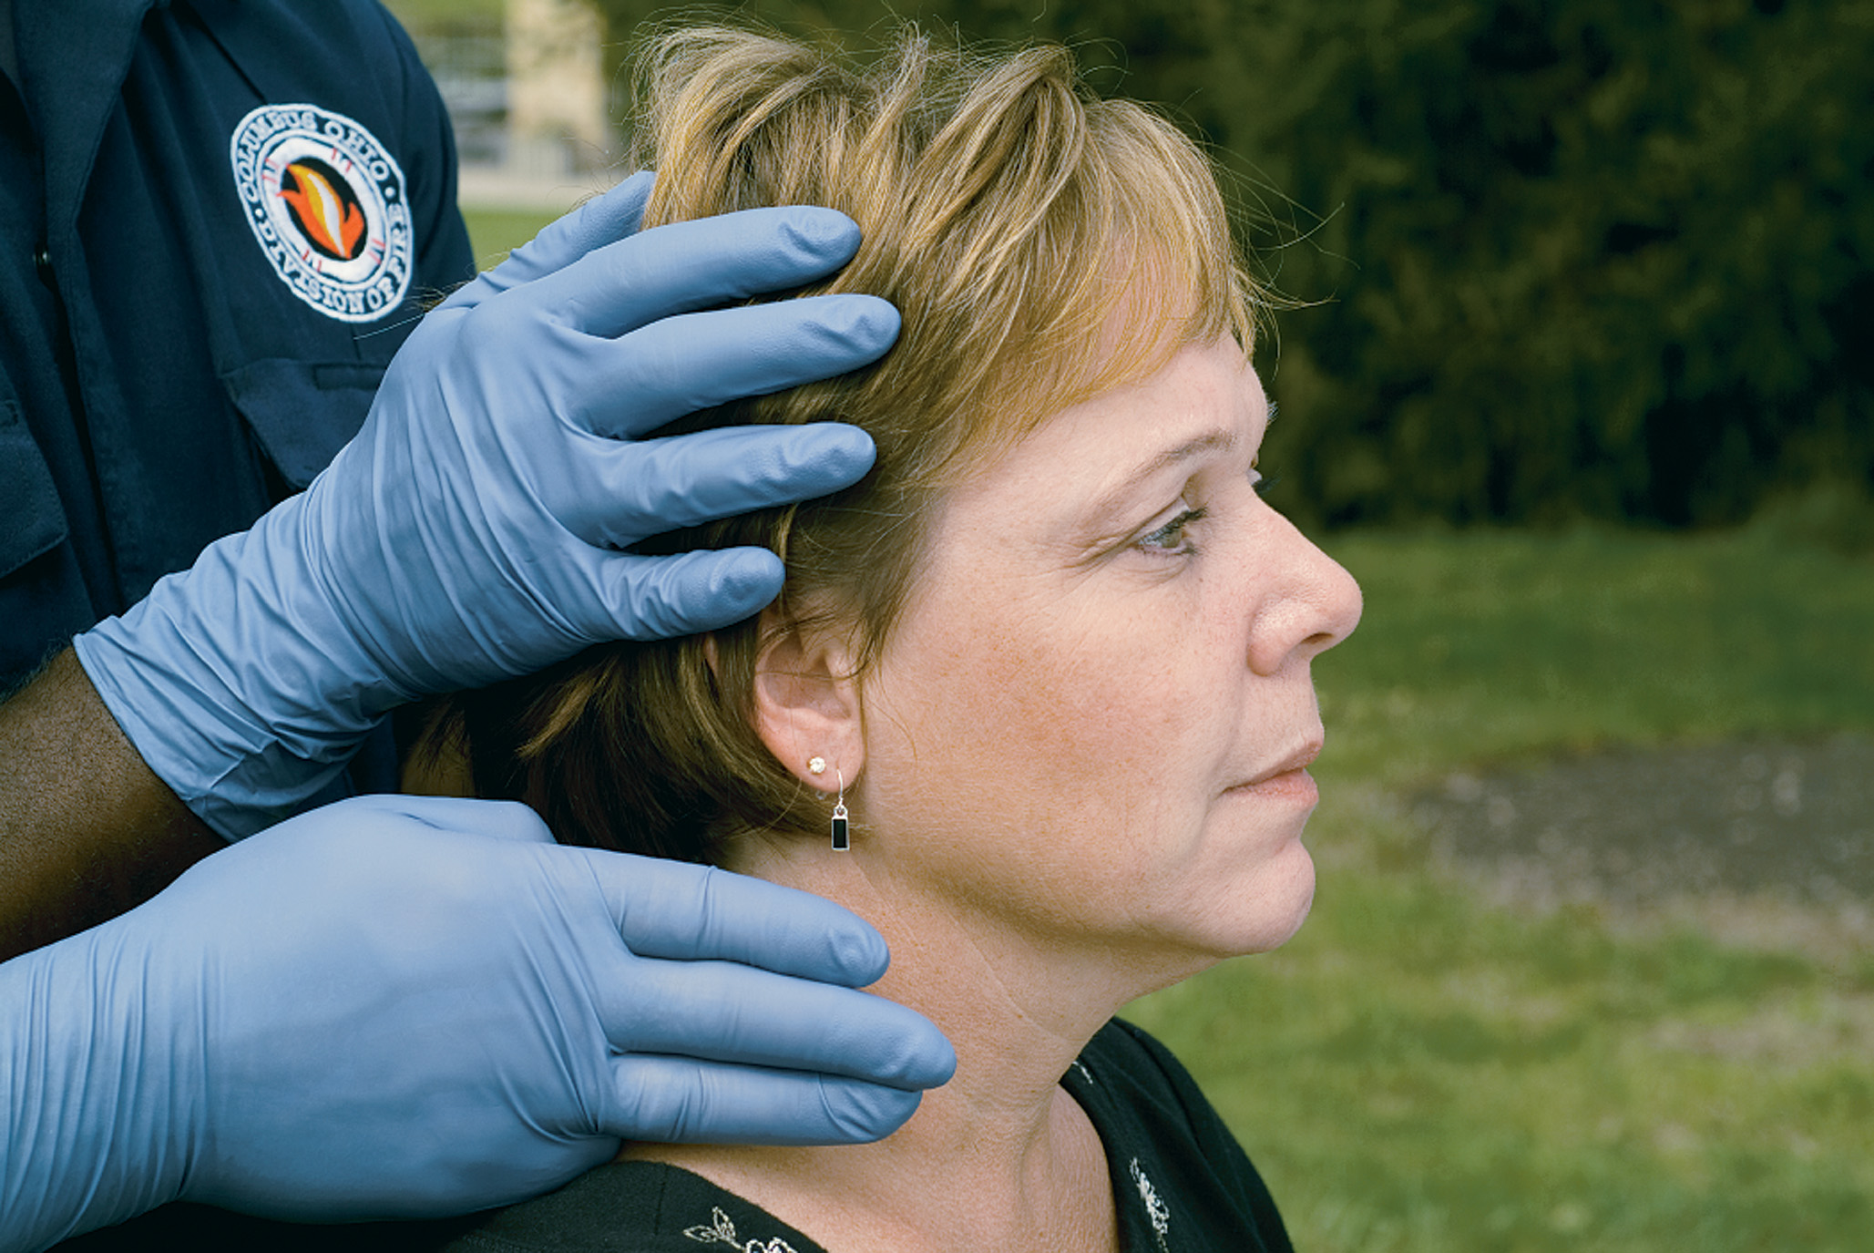
To Size a Cervical Collar, First Draw an Imaginary Line across the Top of the Shoulders and the Bottom of the Chin
Use your fingers to measure the distance from the shoulder to the chin.
Notes:
If not fitted properly, the placement of a cervical collar might lead to greater movement of the head and neck.

Slide 69
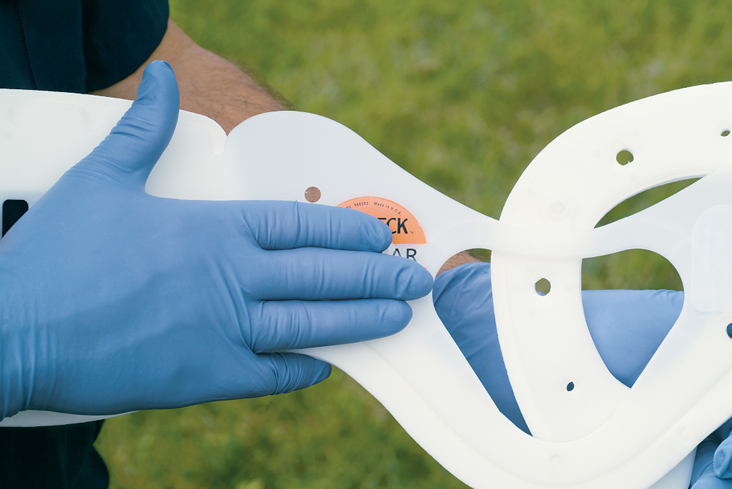
Check the Collar You Select
The distance between the sizing post (black fastener) and lower edge of the rigid plastic should match that of the number of stacked fingers previously measured against the patient’s neck.
Notes:
Sizing the rigid collar for the patient is based on the design of the device. Be sure to use a collar of the proper size for the patient.

Slide 70
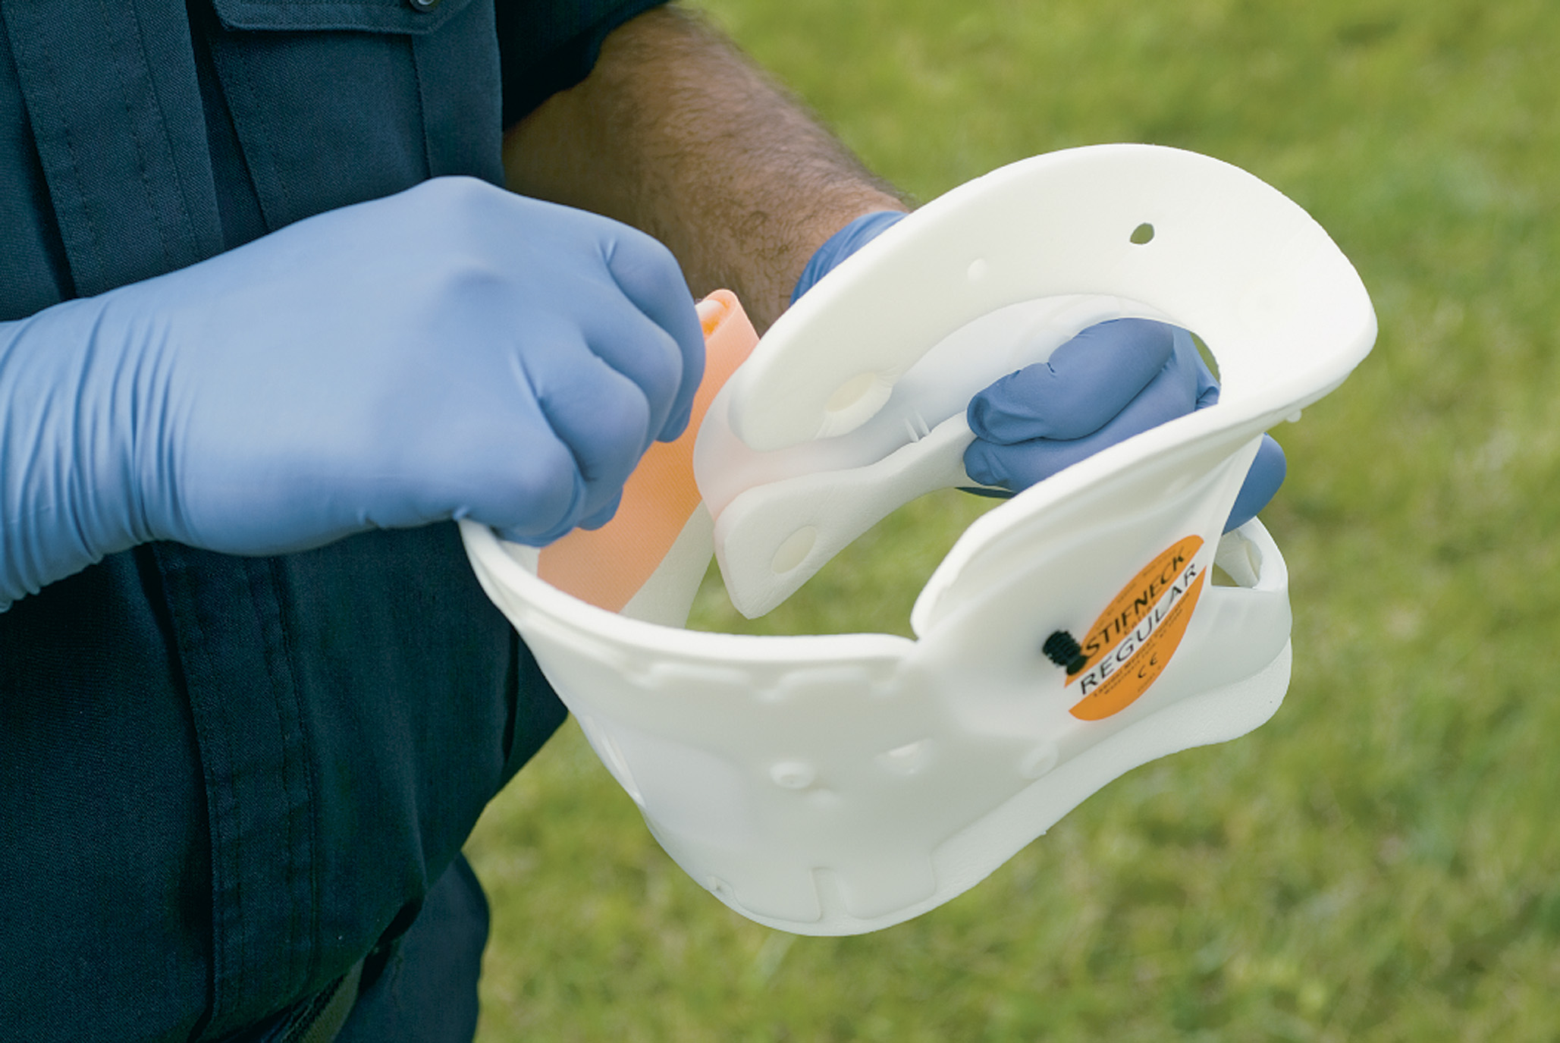
Assemble and Preform the Collar
Notes:
Keep in mind that in the current SMR protocols, the real purpose of the cervical collar is simply to remind the patient not to move his head and neck.

Slide 71
Guidelines for Spine Motion Restriction (8 of 12)
Applying a cervical collar to a seated patient

Slide 72
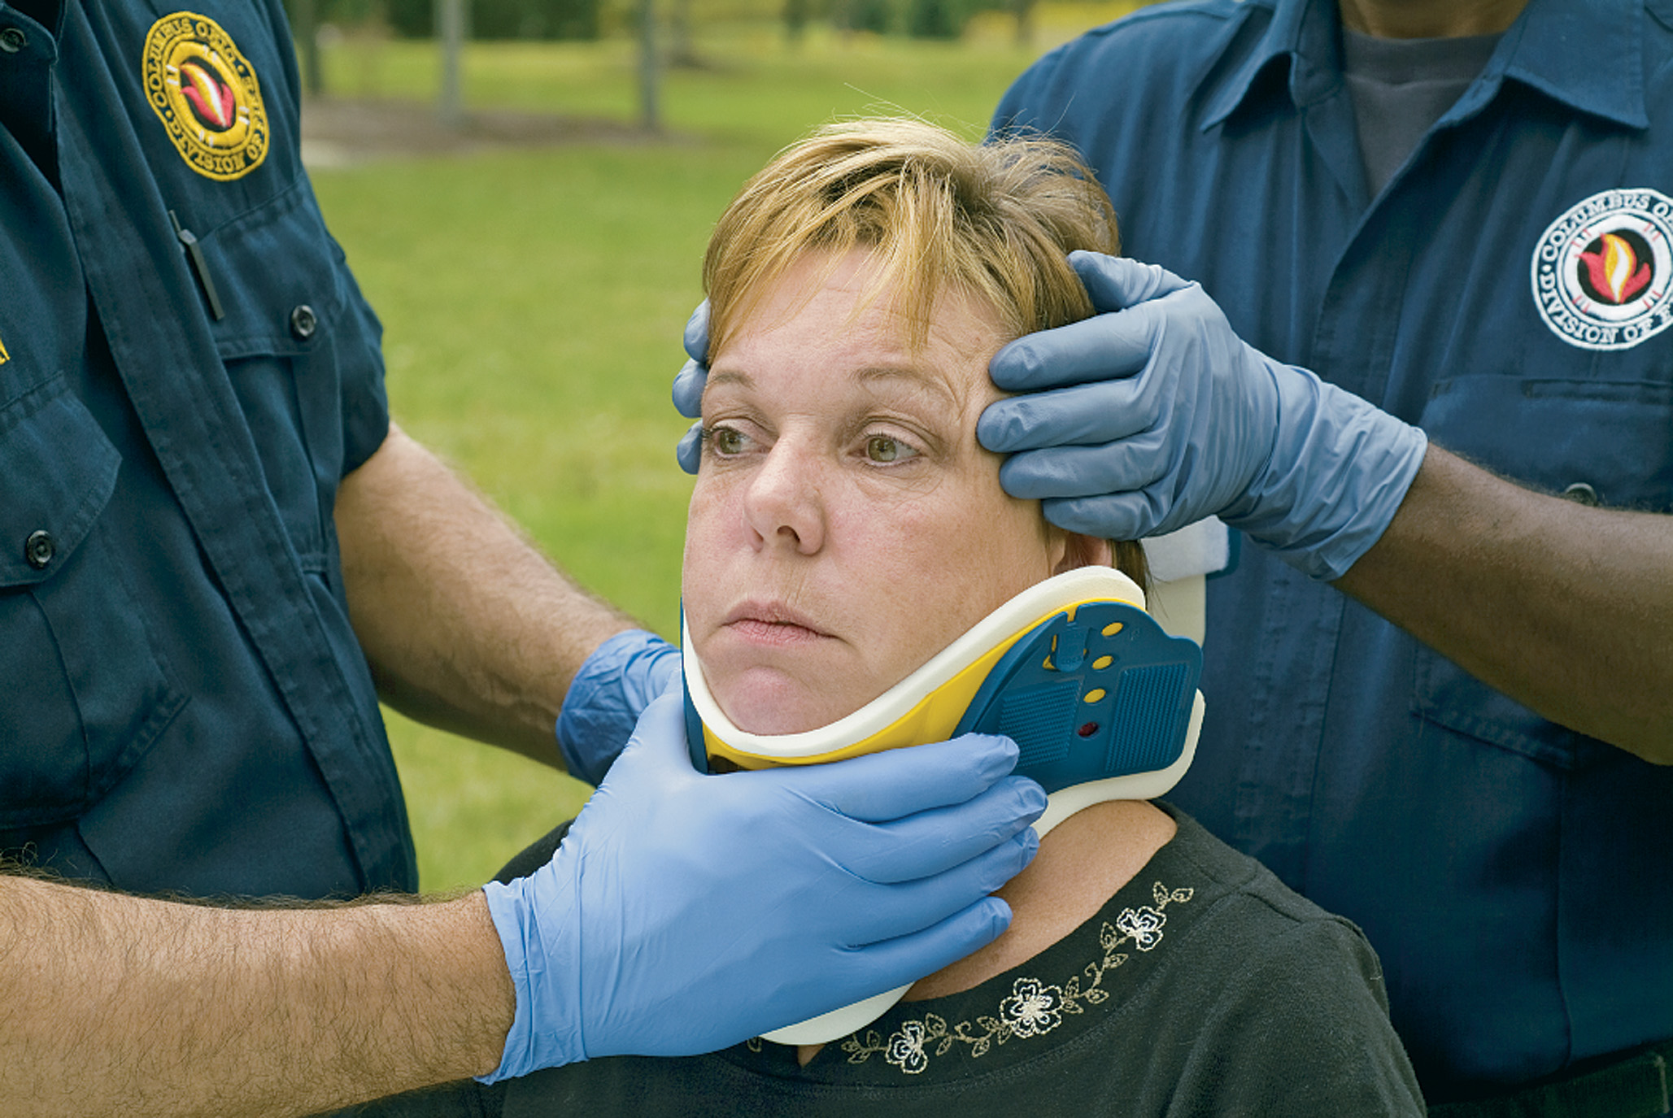
After Selecting the Proper Size, Slide the Cervical Collar up the Chest Wall. the Chin Must Cover the Central Fastener in the Chin Piece
Notes:
Because of the many hazards listed for rigid cervical collars, the soft cervical collar is a viable alternative.

Slide 73
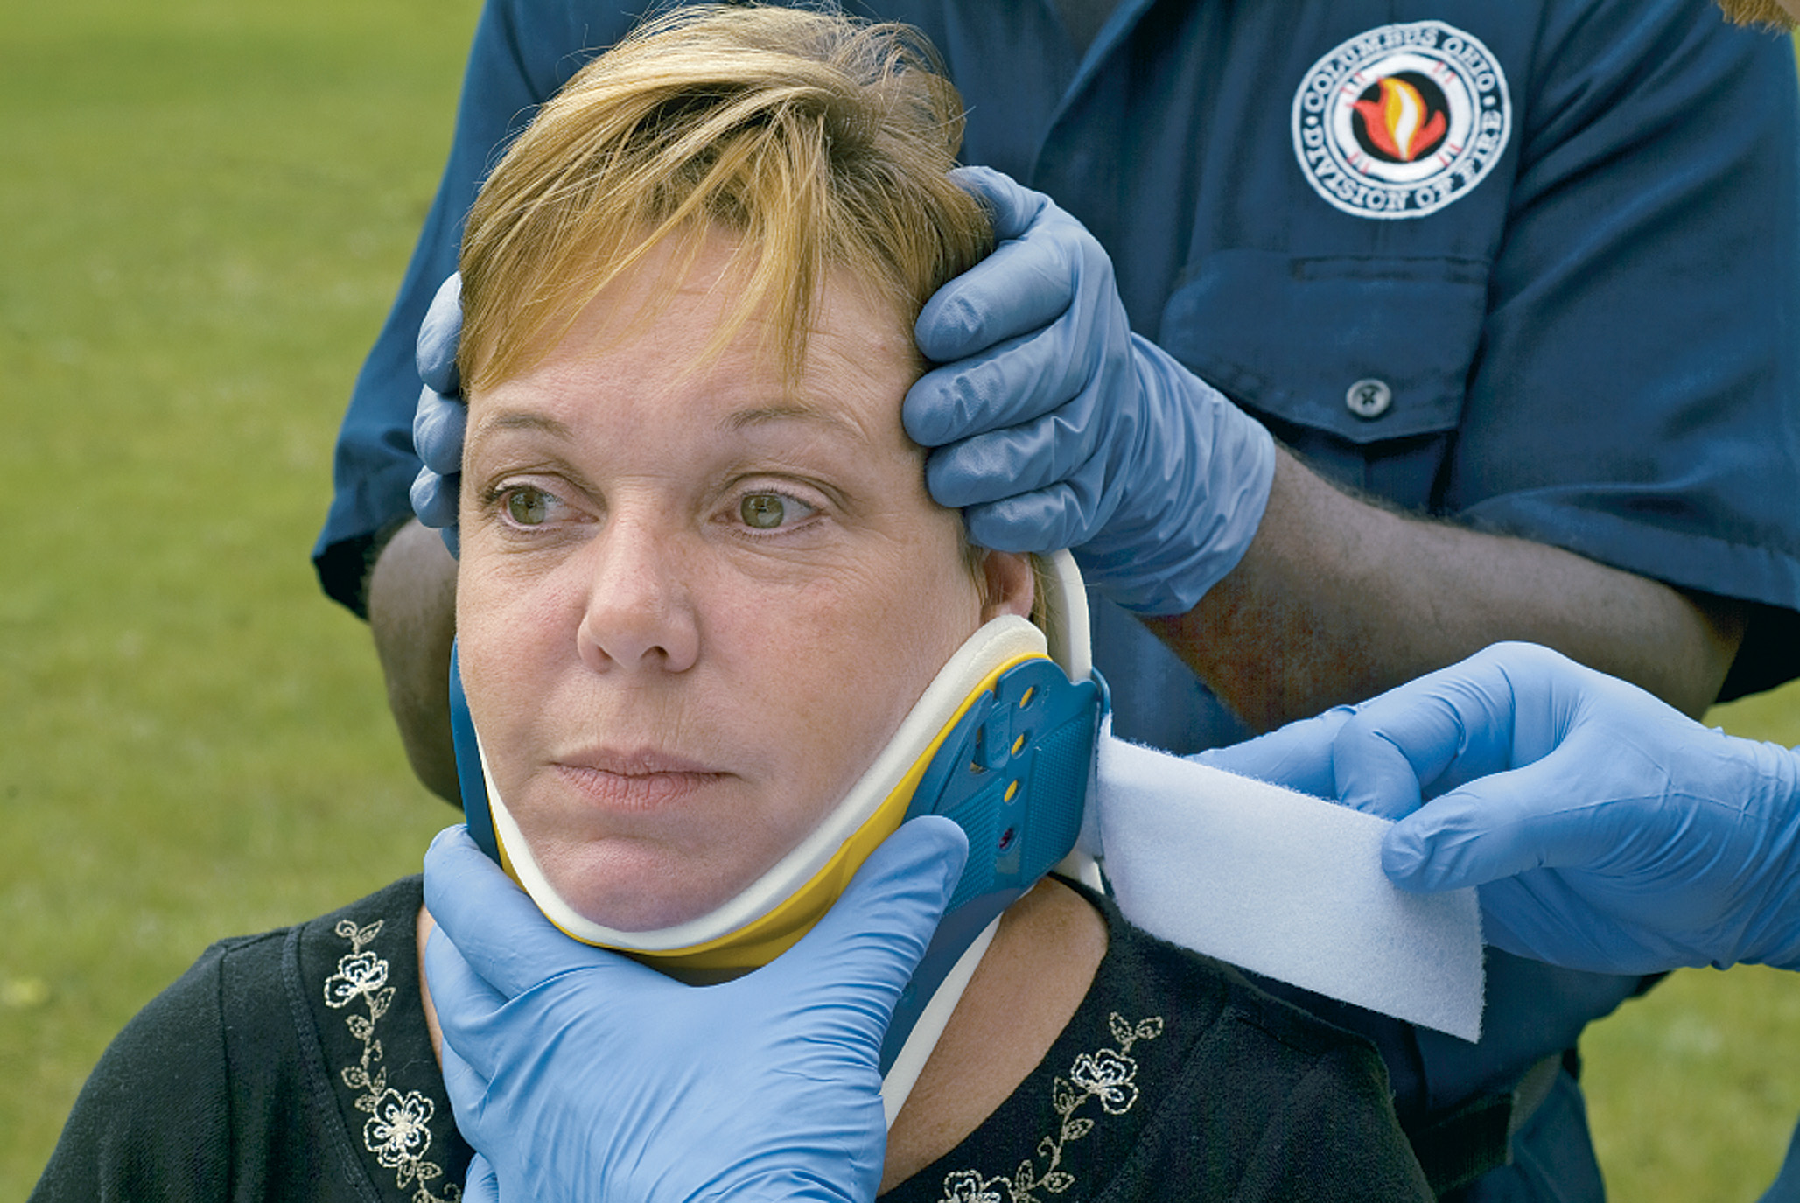
Bring the Collar around the Neck and Secure the Velcro
Recheck the position of the patient’s head and collar for proper alignment. Make sure the patient’s chin covers the central fastener of the chin piece.
Notes:
The correct application of a cervical collar can create an unnatural separation of the spine by as much as 11.3 mm. This is enough to cause a secondary spinal injury.

Slide 74
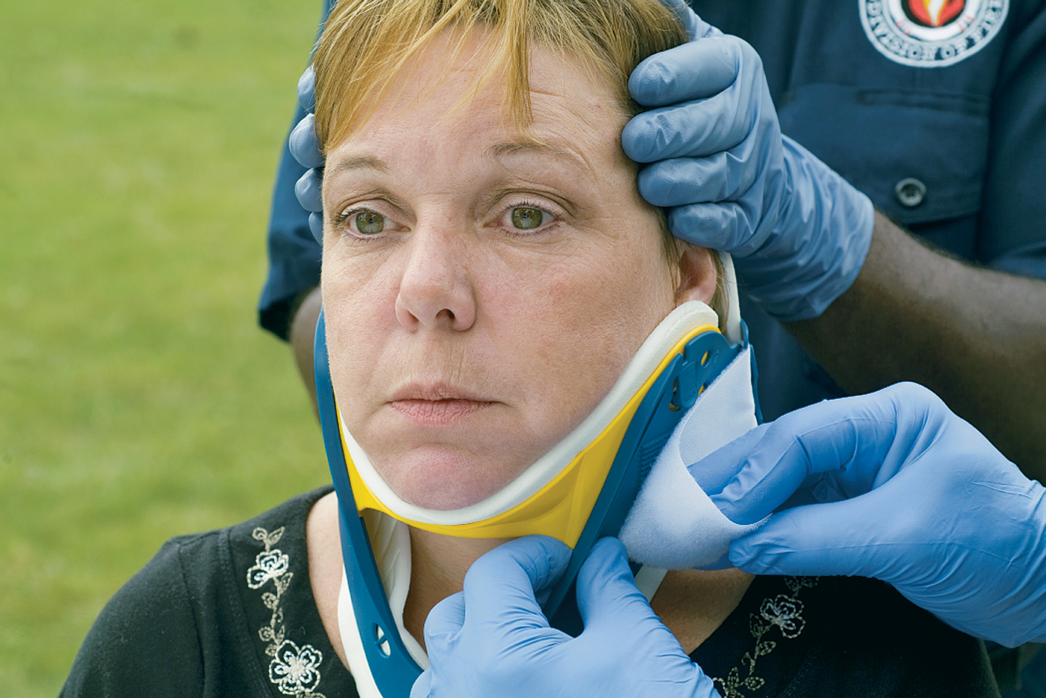
If the Chin is not Covering the Fastener of the Chin Piece, Readjust the Collar by Tightening the Velcro until a Proper Sizing is Obtained
If further tightening will cause hyperextension of the patient’s head, select the next smaller size.
Notes:
If not fitted properly, placement of a cervical collar might lead to greater movement of the head and neck.

Slide 75
Guidelines for Spine Motion Restriction (9 of 12)
Applying a cervical collar to a supine patient

Slide 76
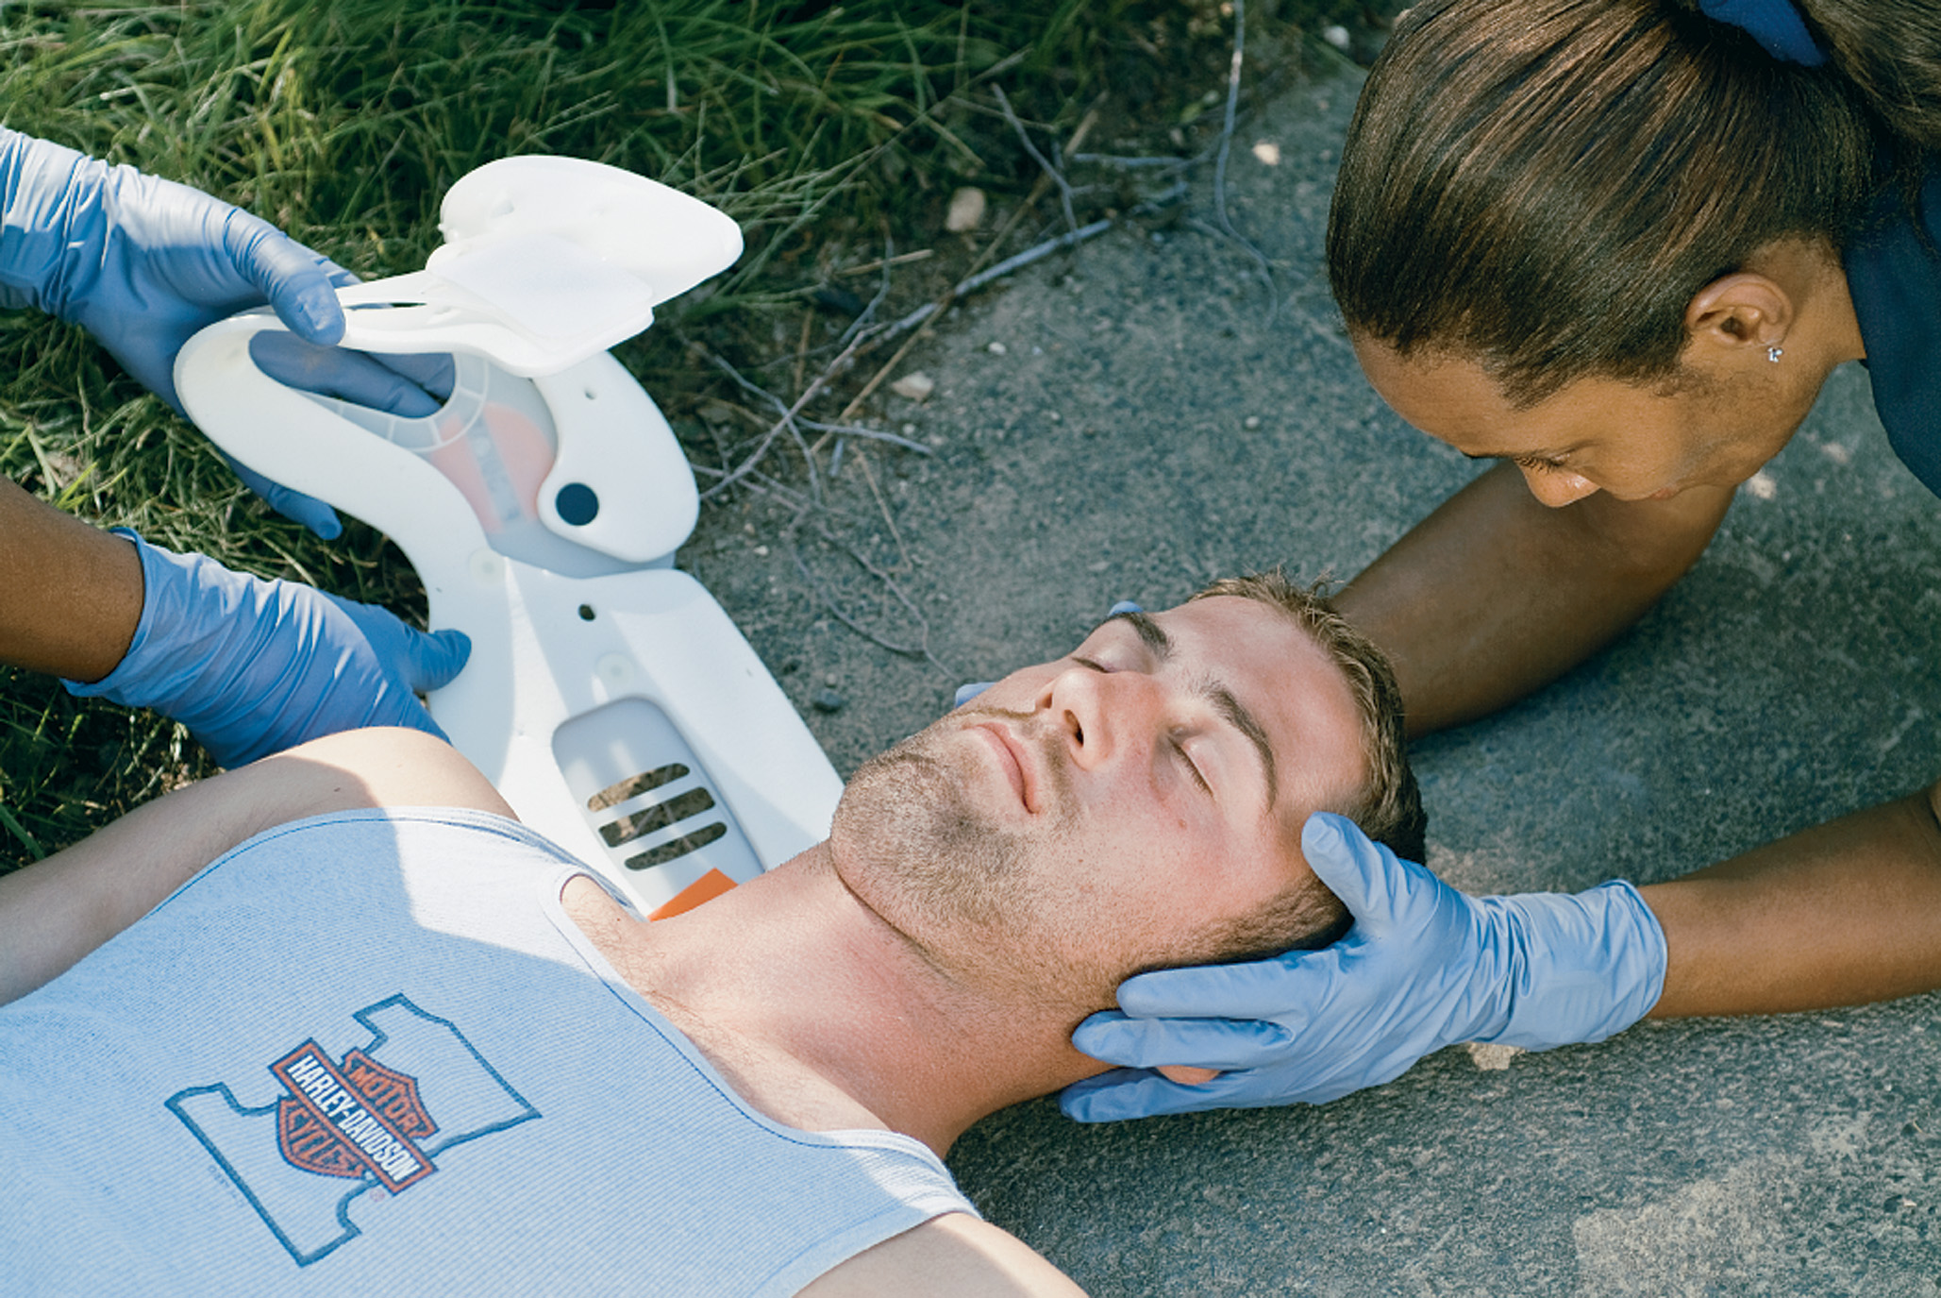
Slide the Back Portion of the Cervical Collar behind the Patient’s Neck. Fold the Loop Velcro Inward on the Foam Padding
Notes:
The cervical collar can cause separation of C1 and C2 while stretching the spinal cord.

Slide 77
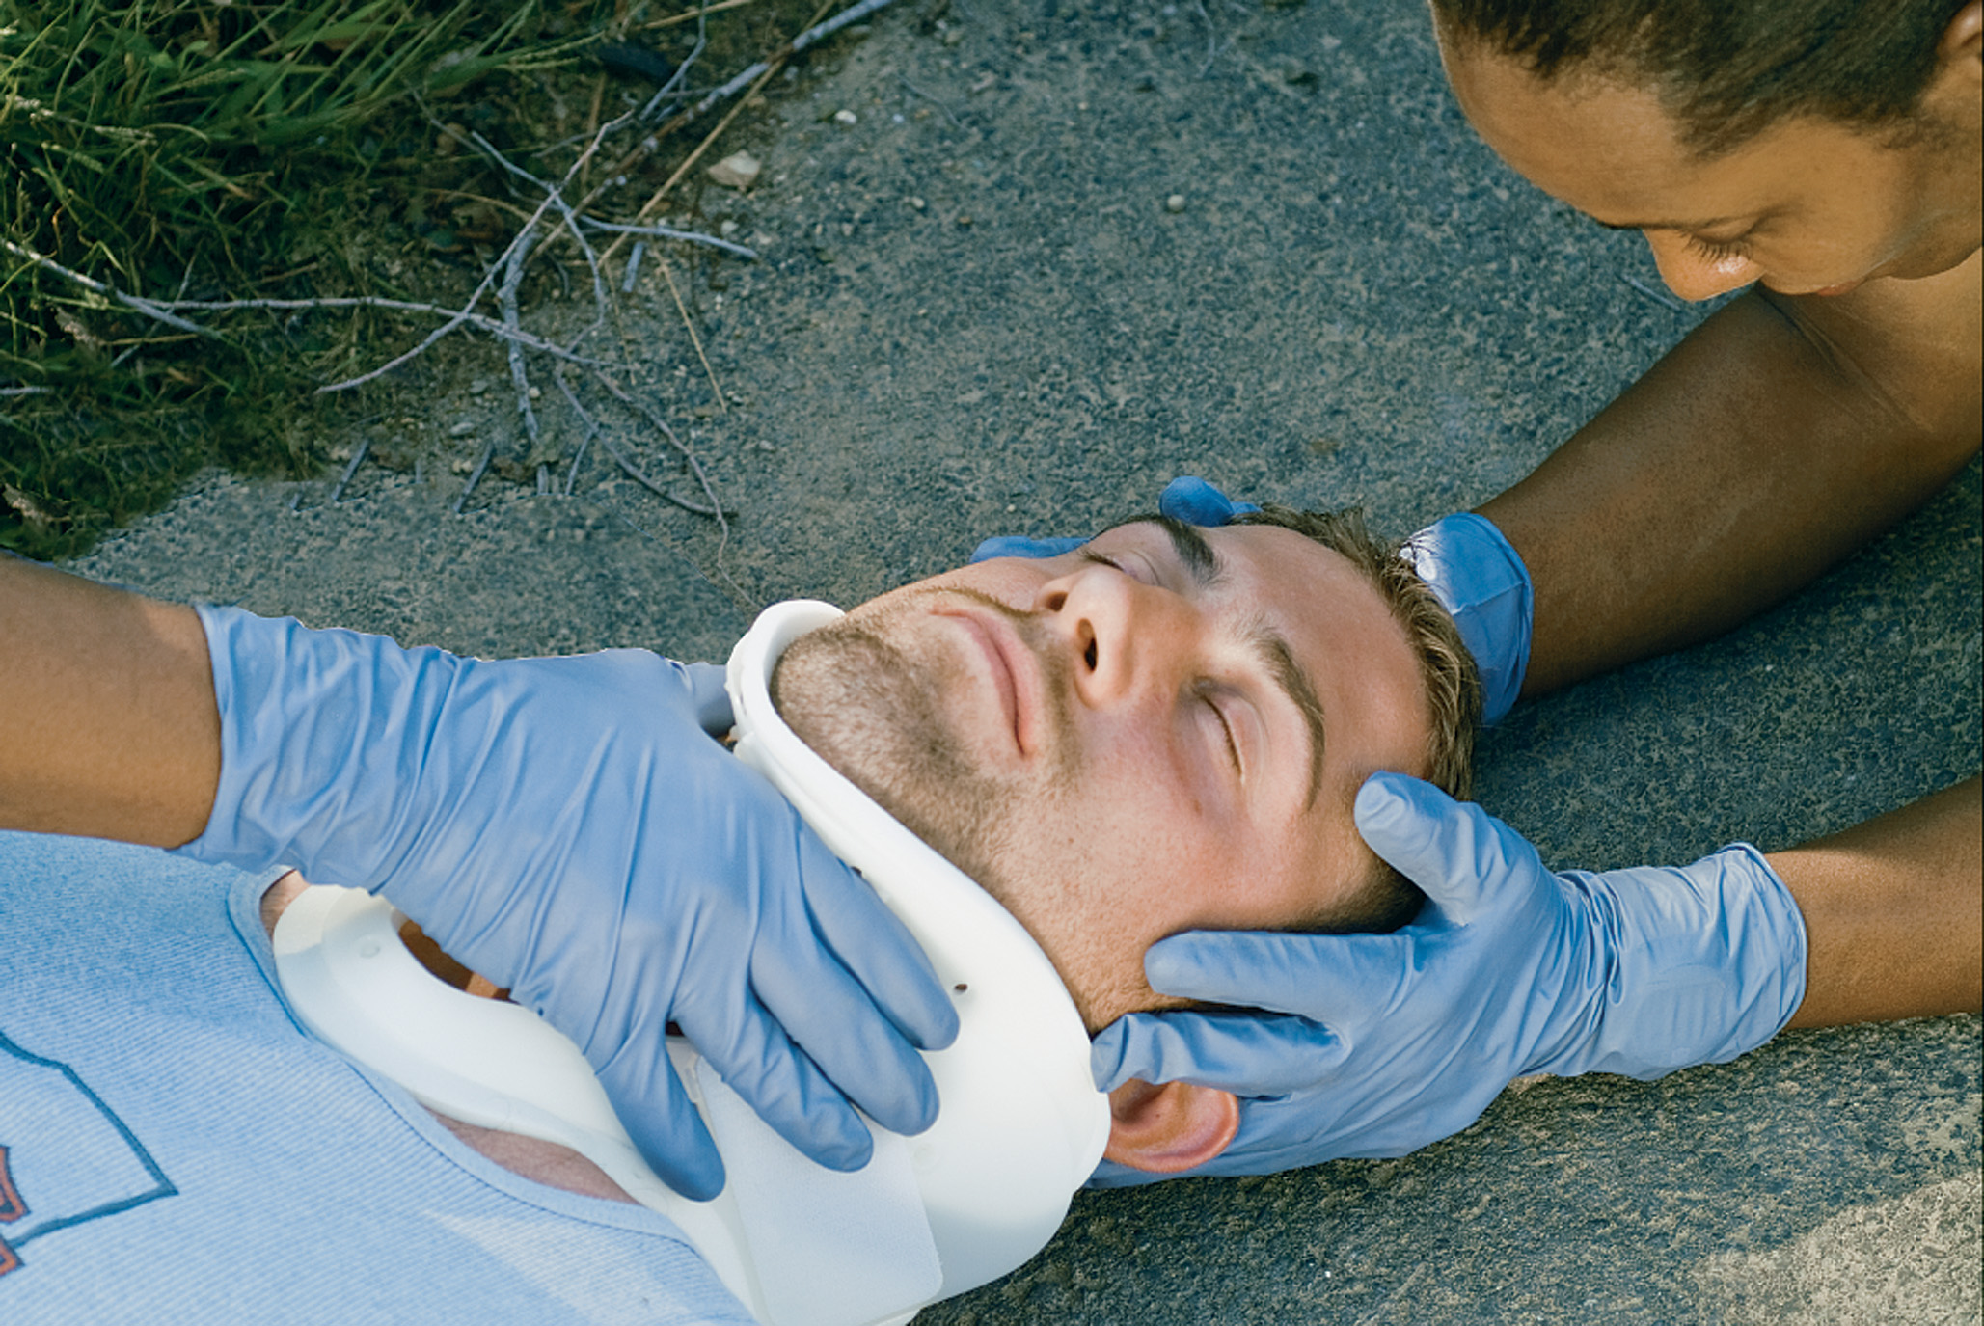
Position the Collar So That the Chin Fits Properly. Secure the Collar by Attaching the Velcro
Notes:
The cervical collar itself can produce pain and discomfort.

Slide 78
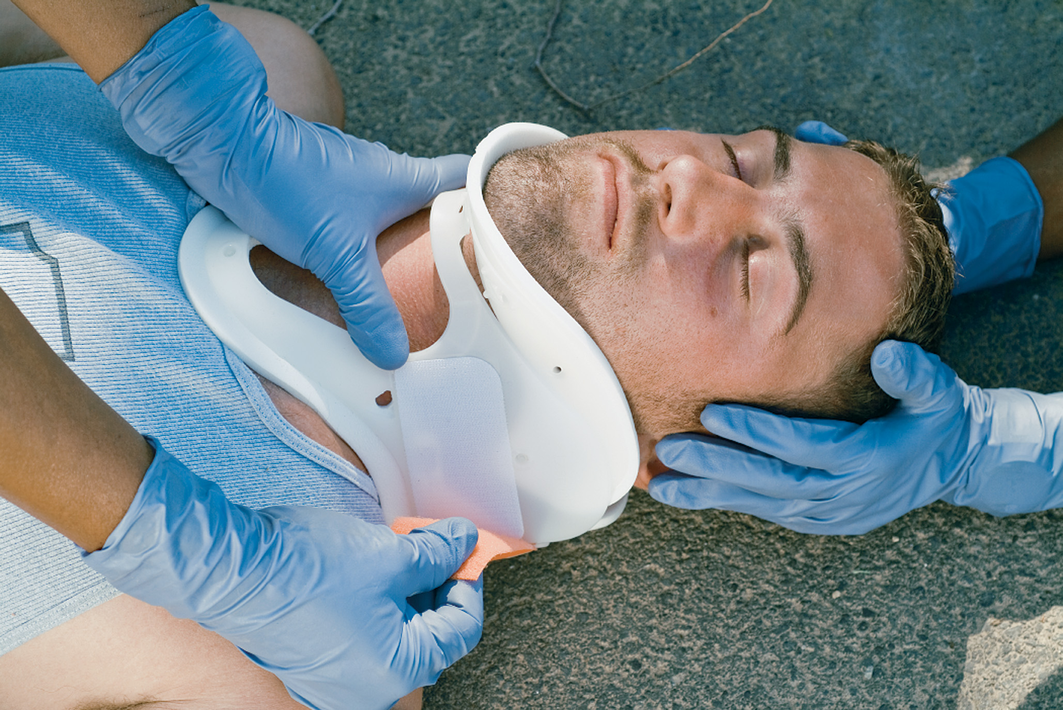
Hold the Collar in Place by Grasping the Trachea Hole. Attach the Loop Velcro So it Mates with (and is Parallel to) the Hook Velcro
Notes:
The cervical collar can increase intracranial pressure. Intracranial pressure is increased even more when the patient is placed supine and backboard is applied. This could be detrimental for a patient with a head injury.

Slide 79
Guidelines for Spine Motion Restriction (10 of 12)
Placing a supine patient on a long backboard

Slide 80
Guidelines for Spine Motion Restriction (11 of 12)
Tools for S M R
  Full Body Spinal Restriction Devices
  Long Rigid Backboards
    There are many hazards and harmful effects associated with placing a patient on a long rigid backboard.
  Alternative Long Devices for Spine Motion Restriction
    Vacuum mattress & scoop stretcher.
Notes:
Historically, the standard device used to restrict movement of the entire spinal column was the long, rigid backboard. Although backboards can have many harmful effects, some EMS systems continue to allow their use as part of the SMR protocol.
Hazards and harmful effects of securing and transporting a patient on a rigid long backboard:
Patients in a supine position who receive spine motion restriction on a backboard, cannot control their own airway and are prone to aspiration of gastric contents if they vomit.
The straps that are tightened across the patient’s chest have a restrictive effect on breathing by interfering with its mechanics.
The rigid board can cause pain in patients who had no pain before being secured to the backboard.
Existing pain can be worsened when the patient is placed on a rigid backboard.
Backboards are commonly stored in outside ambulance compartments. For EMS systems that operate in cold or cool environments, the backboard is often the same temperature as the ambient air outside or in the station bay. Even if it is the temperature of the station bay, it is commonly only 68 to 70 degrees. Placing an exposed trauma patient on a 68- or 70- degree or colder backboard can allow the patient’s body to lose heat through the board. This can cause a reduction in the patient’s body core temperature. In the trauma patient who is bleeding.
Pressure sores (decubitus ulcers) can occur from being secured to the rigid backboard. One study found pressure sore development begins soon after the patient is placed on the board and before their arrival at the hospital.
Patients who are placed supine in the back of the ambulance are more likely to experience motion sickness in a moving ambulance, which increases their risk of aspiration if secured to a backboard.

Slide 81
Guidelines for Spine Motion Restriction (12 of 12)
Tools for SMR
  Short Spine Motion Restriction Devices
    K.E.D. is most common.
    These devices are rarely used.
    Some E M S systems might make it part of their S M R protocol, so you need to be familiar with the proper use of this device
  Other S M R Equipment
    Head stabilization device and straps.
Notes:
Current research has shown that more manipulation can occur when applying and using these devices as compared to having patients simply extricate themselves from the vehicle while maintaining their own self-restriction of their head and neck. The EMS crew can instead remove the patient using a rapid extrication (rollout) technique.
Straps or cravats are placed to keep the patient from sliding up and down or laterally on the board. Deceleration straps are another important adjunct to securing the patient. These straps are fastened across the patient’s shoulders.

Slide 82
Spine Motion Restriction Techniques (1 of 8)
  Tools for SMR
  The Ambulatory Patient
    Self-Restriction and Assessing an Ambulatory Patient
      A reliable patient with no indications of spinal injury or reason for S M R does not require it.
      Instruct the patient to hold his head and neck in a neutral, in-line position during your evaluation.
Notes:
Instruct the patient to hold his head and neck in a neutral in-line position and not to move it. When approaching the patient, do so from directly in front of them so that they remain focused forward and don’t move their head and neck to the side to look at you. Immediately instruct the patient as you approach them to bring their head and neck in an in-line position by lining up their nose with their umbilicus and not to bend, rotate, extend, or flex their head or neck; they should bring their feet and toes together and in line with their umbilicus and nose.
Assess the patient for pain or tenderness. Ask them if they have any pain anywhere, especially in their neck or along their vertebral column. Palpate the posterior vertebral column gently. Determine if the patient has any tenderness or if you feel any abnormality to the bony structure.
Assess motor and sensory function in the upper extremities. Have the patient maintain self-restriction, and continue to look forward with their arms at their sides. Test motor and sensory function in both upper extremities following the neurologic assessment steps previously covered in the Physical Exam section. Ask the patient if they have any abnormal sensations such as tingling or numbness in the extremities or upper body.
Assess motor and sensory function in the lower extremities. Test motor and sensory function in both lower extremities, following the neurologic assessment steps. Ask the patient if they have any abnormal sensations such as tingling or numbness in the lower extremities or lower body.
The patient should be instructed to relax and allowed to freely move if they meet the following criteria; patient is reliable (GCS 15, no distracting injury, can communicate, not intoxicated or under influence of drugs); the patient has no pain, tenderness, or abnormality in the vertebral column; and the patient has no motor or sensory deficits or abnormal sensations; the spine has been “cleared”; and there is no need for any further spine motion restriction procedures. If the patient is to be transported, they could be placed directly on the stretcher mattress in a comfortable position.

Slide 83
Spine Motion Restriction Techniques (2 of 8)
  Tools for SMR
  The Ambulatory Patient
    Performing S M R for an Ambulatory Patient
      Apply cervical collar
      Sit back on stretcher
      Have patient lift their legs onto the stretcher
      Have patient lie back on stretcher
      Secure the patient to the stretcher
Notes:
Instruct the patient to remain in a supine position and to constantly maintain self-restriction until instructed otherwise at the medical facility.

Slide 84
Spine Motion Restriction Techniques (3 of 8)
The Patient Found Supine or Prone
  S M R for a Supine or Prone Patient to Be Secured to a Long Backboard
    Apply cervical collar
    Log roll patient
    Position board
    Position patient on board
    Secure the torso
    Secure the head and legs
Notes:
When you encounter a supine or prone patient with a suspected spinal injury, first ensure that all life-threatening situations have been managed.

Slide 85
Maintain In-Line Spinal Stabilization While Preparing for the Log Roll
Notes:
This move is ideally performed by at least four rescuers. One rescuer at the patient’s head directs the movement and maintains in-line stabilization of the patient.

Slide 86
Roll the Patient Onto the Side at Command of the E M T Maintaining Stabilization. Inspect the Back
Notes:
One to three other rescuers move the patient onto the backboard.

Slide 87
Move the Spine Board into Place
Notes:
Position the long backboard under the patient by sliding the board under the patient during the logroll. Then place the patient on the board at the command of the rescuer maintaining in-line stabilization.

Slide 88
Lower the Patient Onto the Spine Board at Command of the E M T Maintaining In-Line Stabilization. Center the Patient on the Board
Notes:
Use a slide, proper lift, logroll, or scoop stretcher to position the patient on the backboard so that movement is as limited as possible.

Slide 89
Apply Straps to Secure the Patient to the Backboard
Place one strap at the level of the chest, one at the hip, one above the knee, and another below the knee. Pad between the legs.
Notes:
Place padding in the spaces between the patient and the board. In an adult, pad under the head and torso, taking care to avoid extra movement. In an infant or child up to approximately 8 years of age, pad under the shoulders.

Slide 90
A “Spider” Strap Method with Velcro Straps
Notes:
Secure the patient’s torso and head to the board with straps. The strap across the chest should be tight enough to prevent shifting of the torso but not so tight that it inhibits movement of the chest muscles and impairs breathing.

Slide 91
Spine Motion Restriction Techniques (4 of 8)
The Patient Found Supine or Prone
  S M R for a Supine or Prone Patient with the Backboard as a Movement Device Only
    Logroll the patient onto the backboard.
    Secure the patient to the backboard.
    Move the patient to the stretcher.
    Place the backboard onto the stretcher.
    Instruct the patient to keep his toes, nose and umbilicus lined up.
Notes:
The patient might be able to self-restrict if they are alert and can obey commands.
Secure the patient to the stretcher mattress.

Slide 92
Spine Motion Restriction Techniques (5 of 8)
The Patient Seated in a Vehicle
  S M R and Self-Extrication from a Vehicle
    Instruct patient to hold his head and neck in a neutral in-line position
    Assess for pain or tenderness
    Assess motor and sensory function
    Apply cervical collar
    Instruct patient to pivot his legs and body
    Instruct the patient to stand straight up
Notes:
Instruct the patient to maintain constant self-restriction and rotate 180 degrees until his back faces the stretcher. Have the second EMT, who should now be positioned on the opposite side of the stretcher as the patient, prevent the stretcher from moving and guide the patient back onto the stretcher mattress.

Slide 93
Spine Motion Restriction Techniques (6 of 8)
The Patient Seated in a Vehicle
  S M R and Self-Extrication from a Vehicle
    Have the patient rotate 180 degrees and then sit directly back onto the stretcher.
    Have the patient lift his legs onto the stretcher and then lie back into a supine position.
    Secure the patient to the stretcher.
Notes:
Instruct the patient to maintain self-restriction and rotate 180 degrees until his back faces the stretcher. Have the second EMT, who should now be positioned on the opposite side of the stretcher as the patient, prevent the stretcher from moving and guide the patient back onto the stretcher mattress.

Slide 94
Spine Motion Restriction Techniques (7 of 8)
The Patient Seated in a Vehicle
  S M R for Seated Patient Using a Vest-Type
    Assess the back, scapula, arms, or clavicles before you apply the board
    Never use a chin cup or strap
    Always tighten the torso and leg straps before securing the patient’s head
    Never pad between the cervical collar and the board
Notes:
Assess pulses and motor and sensory functions before and after applying the device.

Slide 95
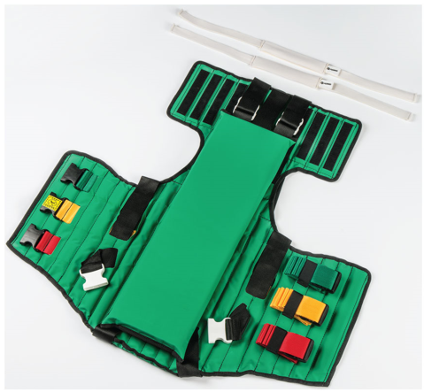
The Ferno Kendrick Extrication Device (K.E.D.)
Notes:
Use manual in-line spinal stabilization and apply a cervical collar. Assess pulses and motor and sensory functions in all four extremities.

Slide 96
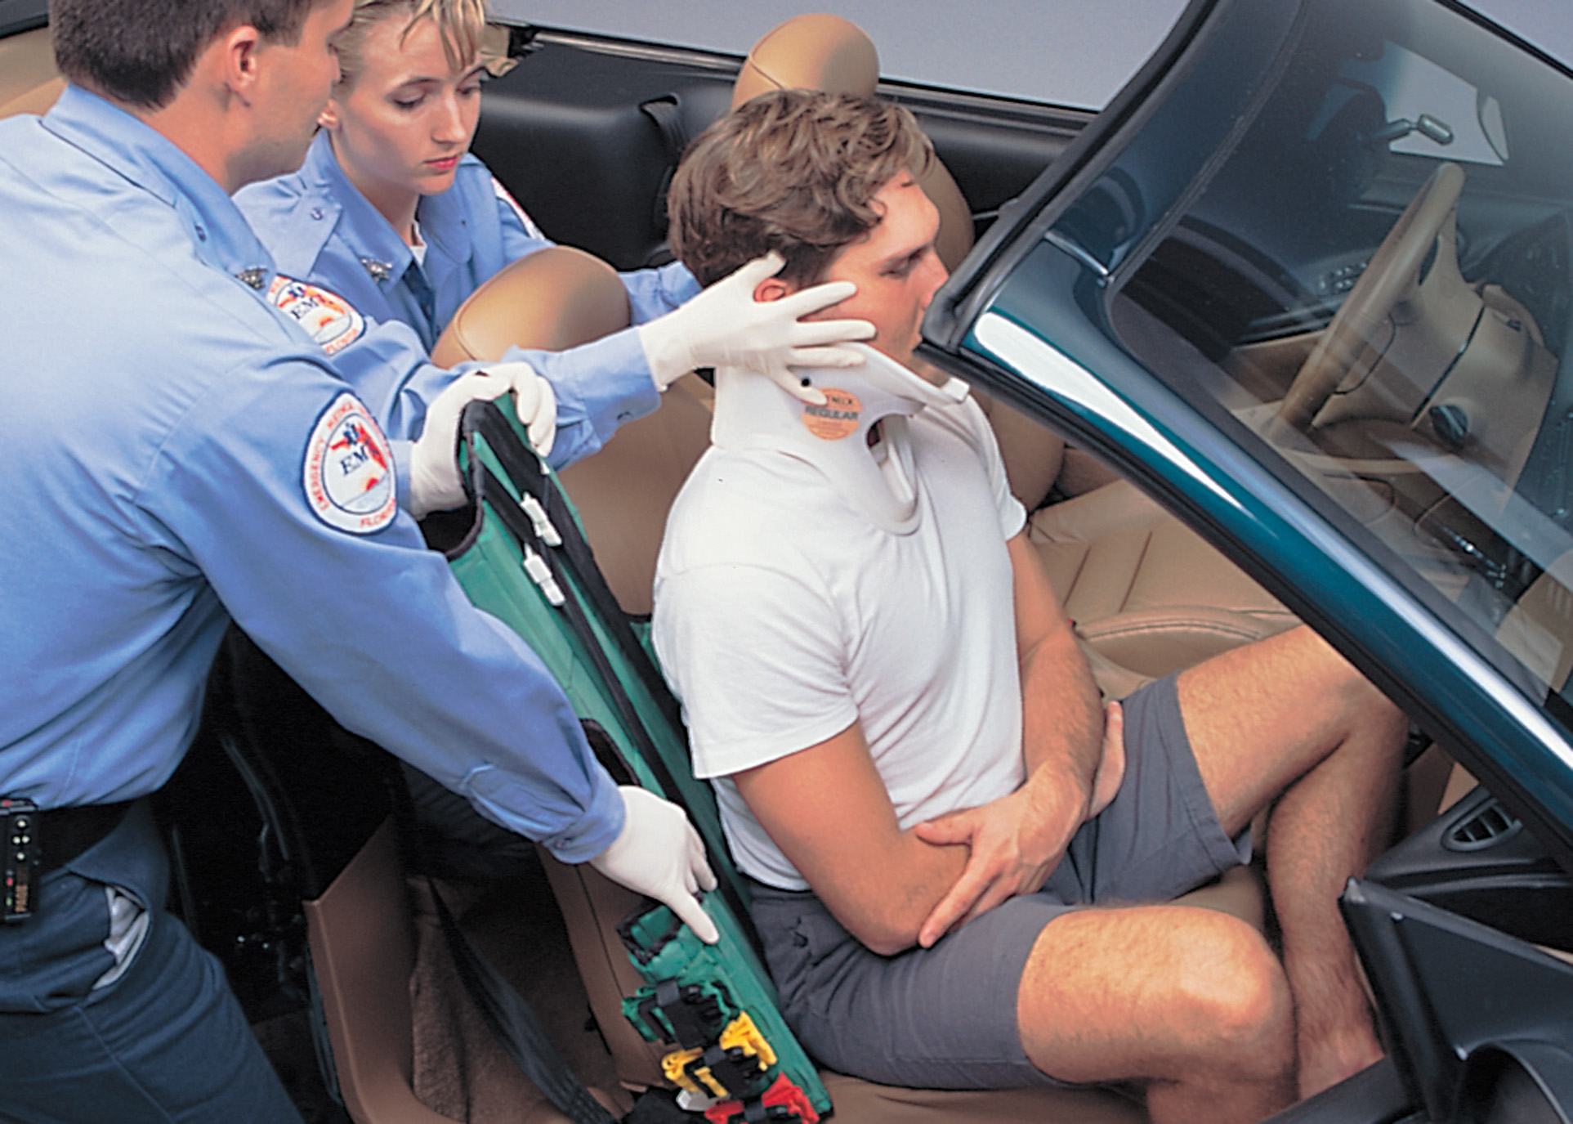
After a Cervical Collar has been Applied, Slip the K.E.D. behind the Patient and Center it
Notes:
Position the short spinal device behind the patient. Examine the back carefully. Be careful that the EMT who is holding in-line spinal stabilization does not move excessively or move the patient as the device is positioned.

Slide 97
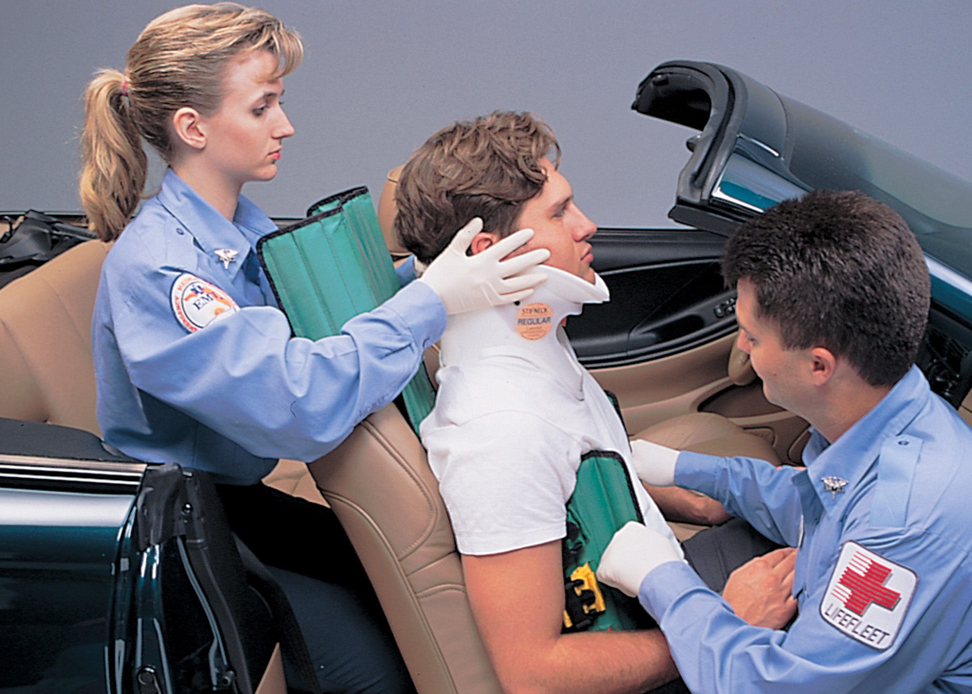
Properly Align the Device. Then Wrap the Vest around the Patient’s Torso
Notes:
You should slide the board behind the patient and as far into the seat as you can. The top of the board should be level with the top of the patient’s head, and the bottom of the board should not extend past the coccyx. The body flaps should fit snugly under the patient’s armpits.

Slide 98
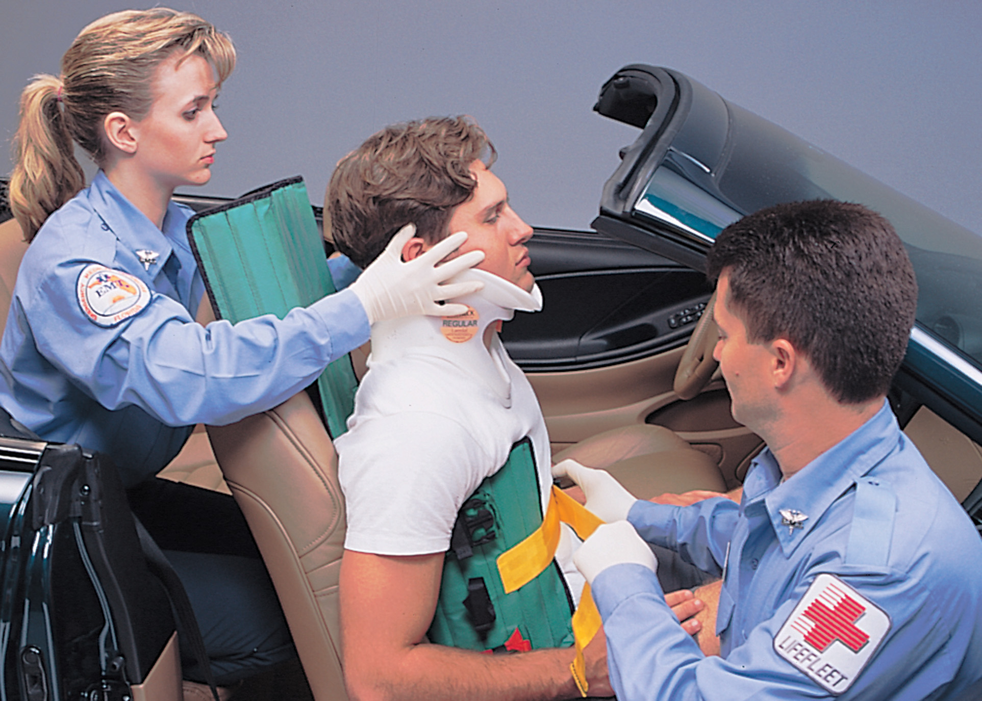
When the Device is Tucked Well up into the Armpits, Secure the Chest Straps
Notes:
Secure the device to the patient’s torso. Make sure the straps are tight enough to prevent movement of the device, laterally and vertically.

Slide 99
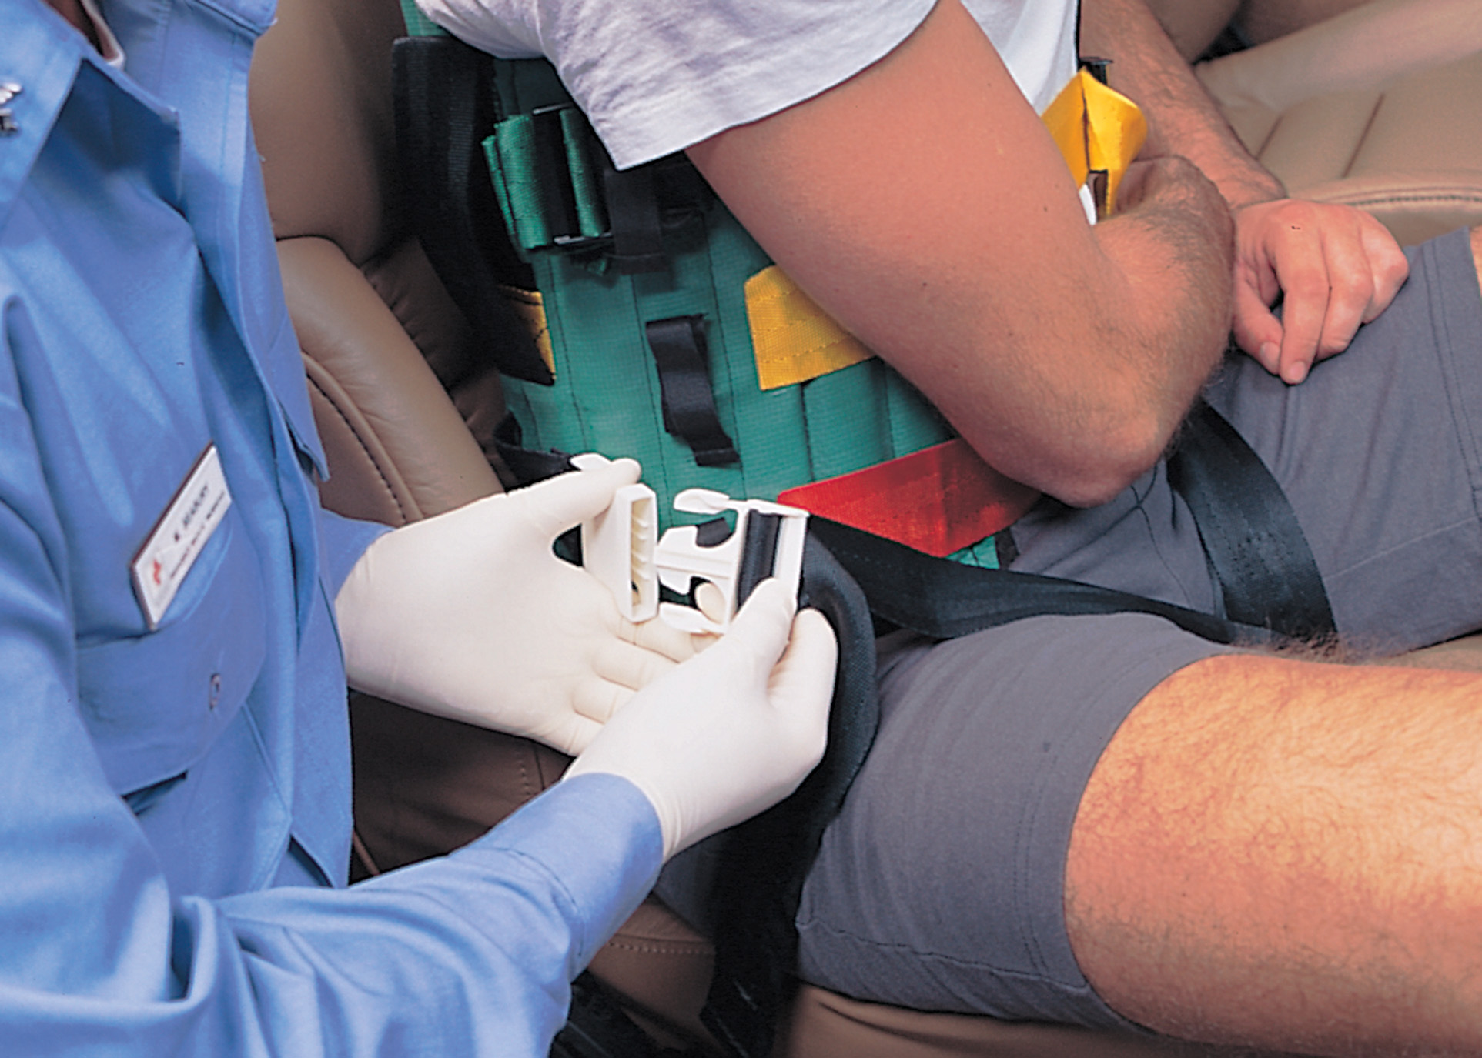
Secure the Leg Straps
Notes:
If the device has straps that circle the legs, apply and tighten these after the chest straps are applied.

Slide 100
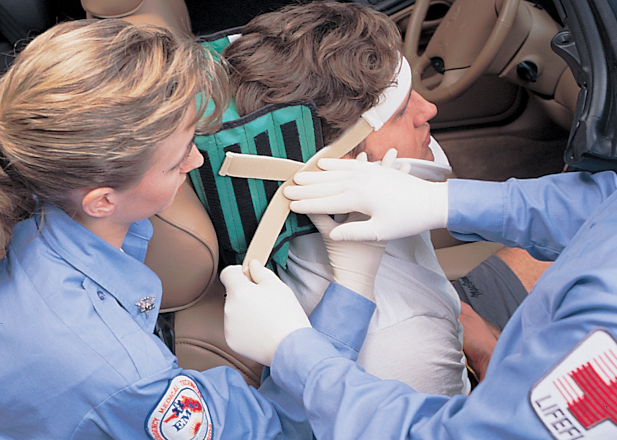
Secure the Patient’s Head with the Velcro Head Straps
Notes:
Pad behind the patient’s head to ensure neutral alignment of the head and neck with the rest of the spine.
Secure the patient’s head to the device. Maintain manual in-line spinal stabilization, even though the head is secured to the device. Securing the head is the last step in the application of the device.

Slide 101
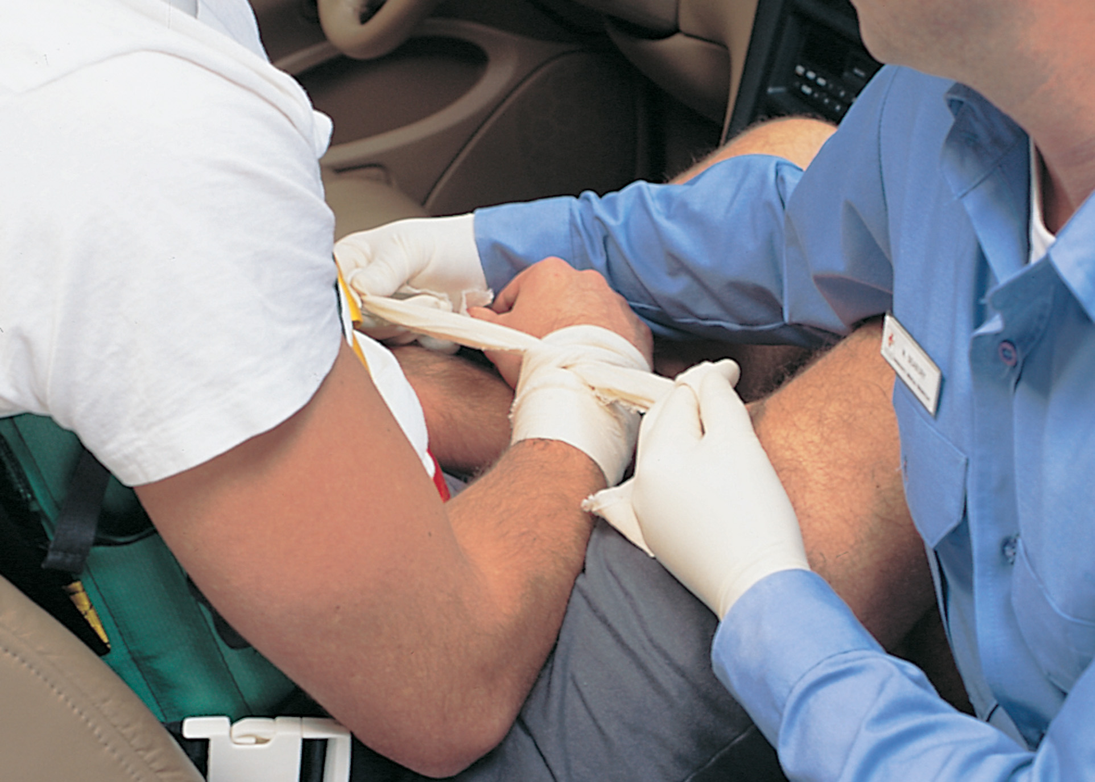
Tie the Hands Together
Notes:
Tie the hands together and pivot the patient onto the backboard while maintaining manual in-line spinal stabilization.

Slide 102
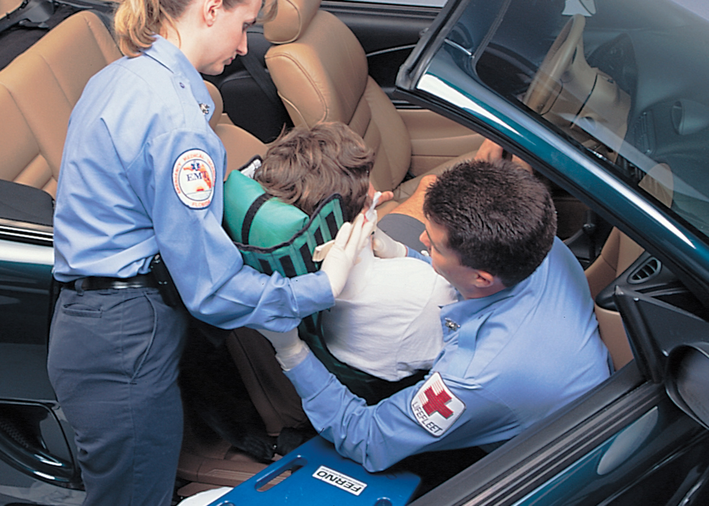
Pivot the Patient Onto the Backboard While Maintaining In-Line Stabilization
Notes:
Position a long backboard under or next to the patient’s buttocks and rotate them until their back is in line with the backboard. If it is not possible to get a long backboard next to the patient, lift the patient under their arms and legs and lower them onto the long board.
Release manual in-line spinal stabilization only when the patient is completely secured to the backboard. Assess pulses and motor and sensory function and record your findings on the prehospital care report.

Slide 103
Spine Motion Restriction Techniques (8 of 8)
The Patient Seated in a Vehicle
  Rapid Extrication (Rapid Rollout)
    Three situations in which such movement is permissible:
      The scene is not safe.
      The patient’s condition is so unstable that you need to move and transport them immediately.
      The patient blocks your access to a second, more seriously injured patient.

Slide 104
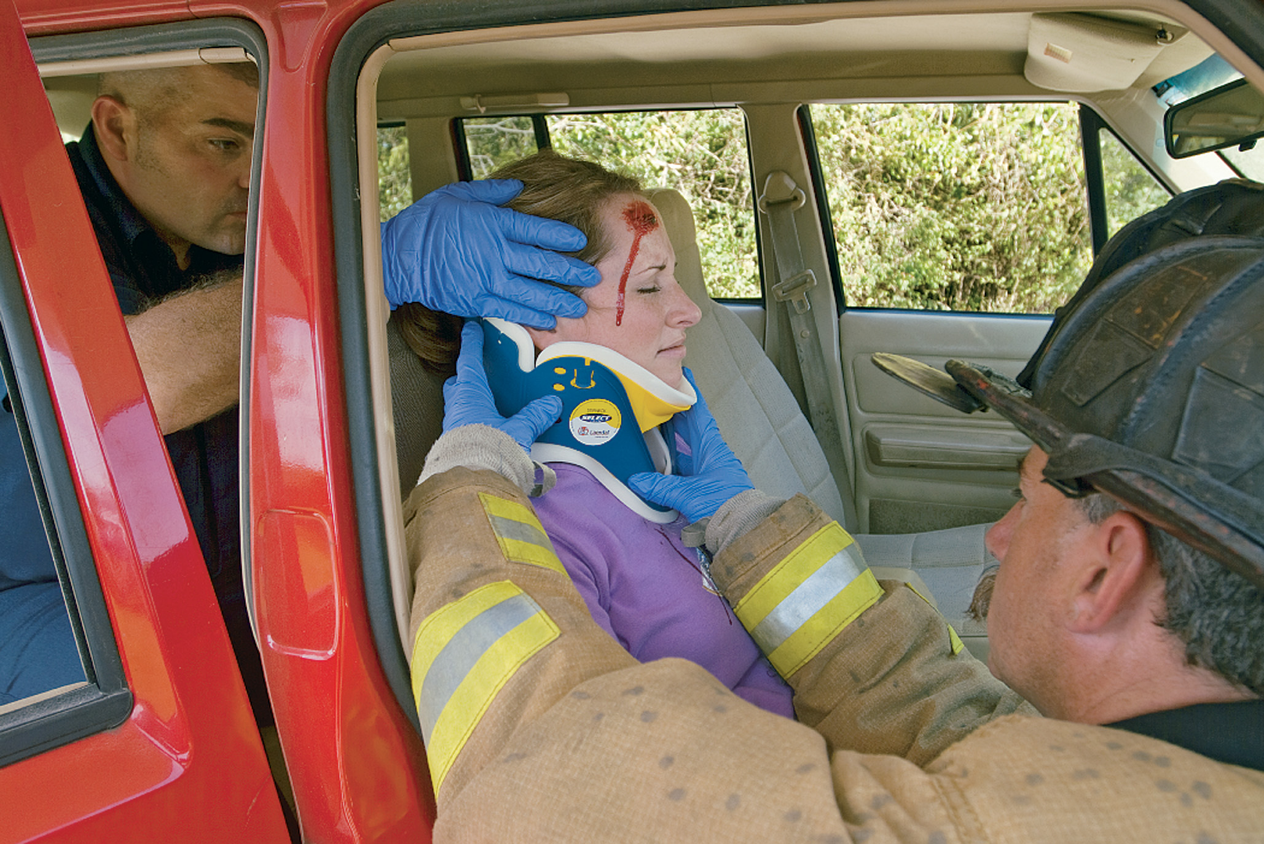
Bring the Patient’s Head into a Neutral In-Line Position
This is best achieved from behind or to the side of the patient. Perform a primary assessment and a rapid physical exam. Then, apply a cervical collar.
Notes:
In rapid extrication, the patient is brought into alignment with manual in-line spinal stabilization and a cervical collar is applied.

Slide 105
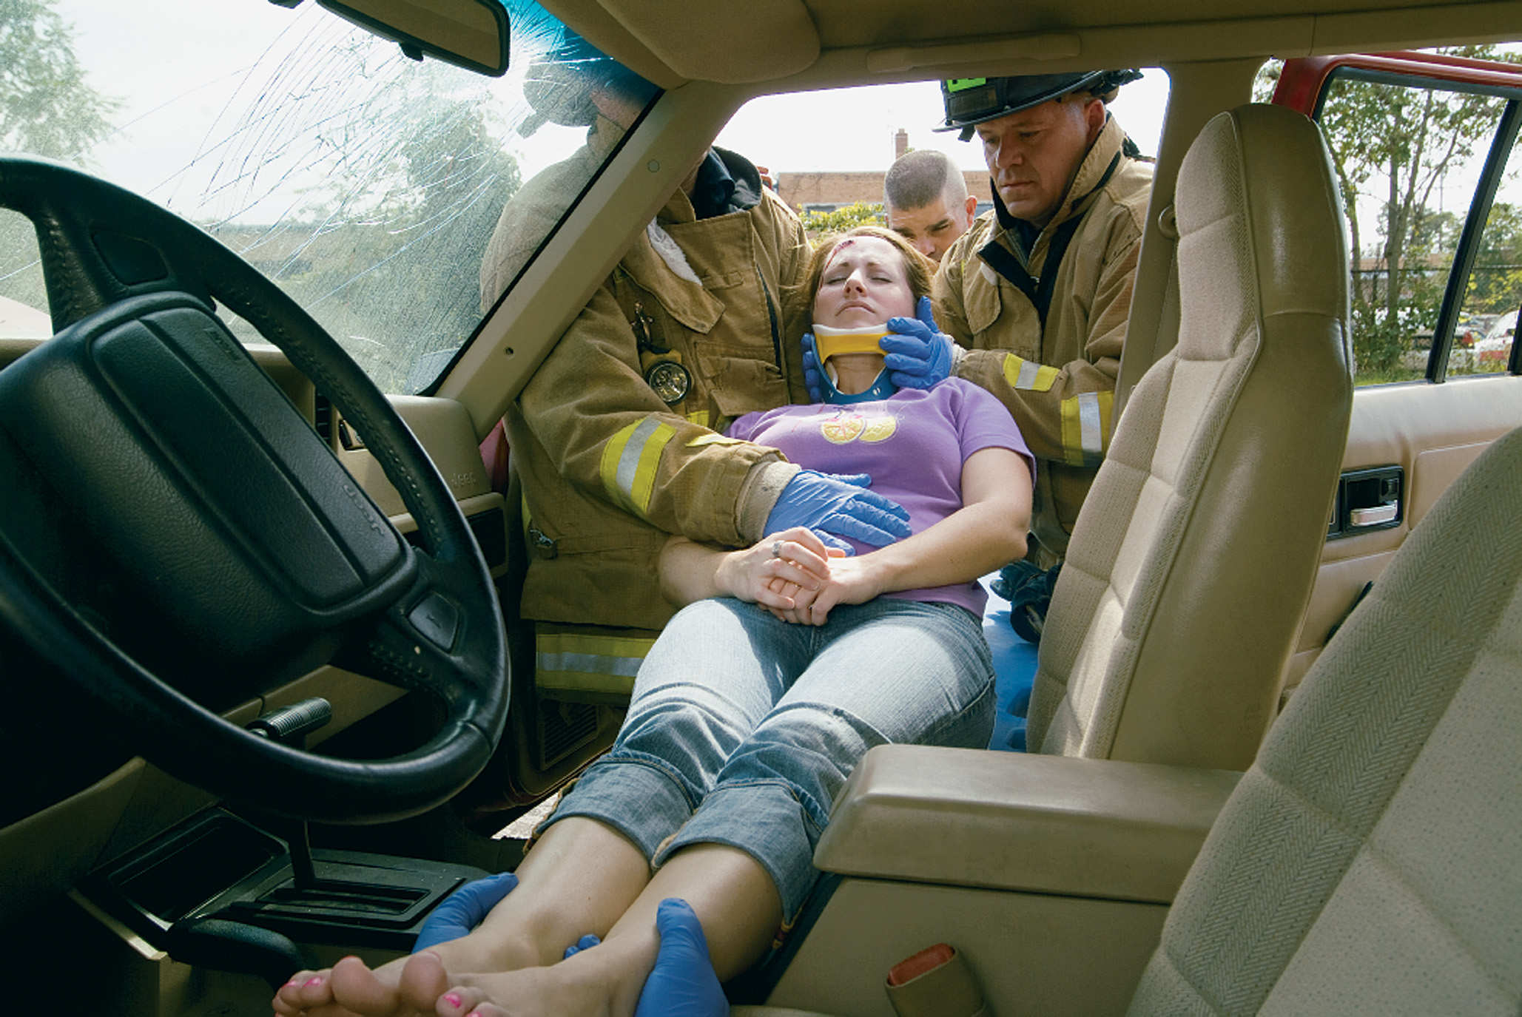
Support the Patient’s Thorax. Rotate the Patient until Her Back is Facing the Open Car Door. Bring the Patient’s Legs and Feet up Onto the Car Seat
Notes:
A long backboard is positioned next to the patient.

Slide 106
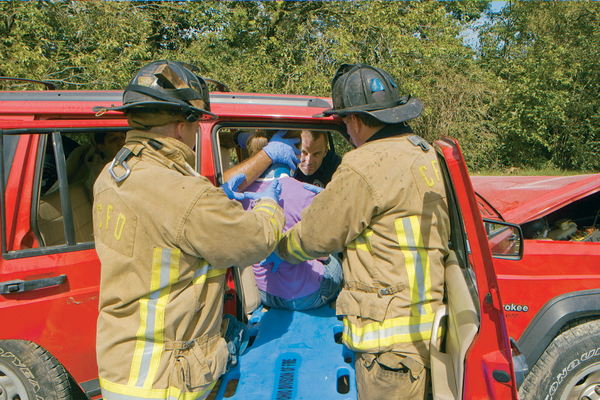
Bring the Board in Line with the Patient and against the Buttocks. Stabilize the Cot under the Board. Begin to Lower the Patient Onto the Board
Notes:
The rapid extrication technique requires EMTs to improvise at the scene.

Slide 107
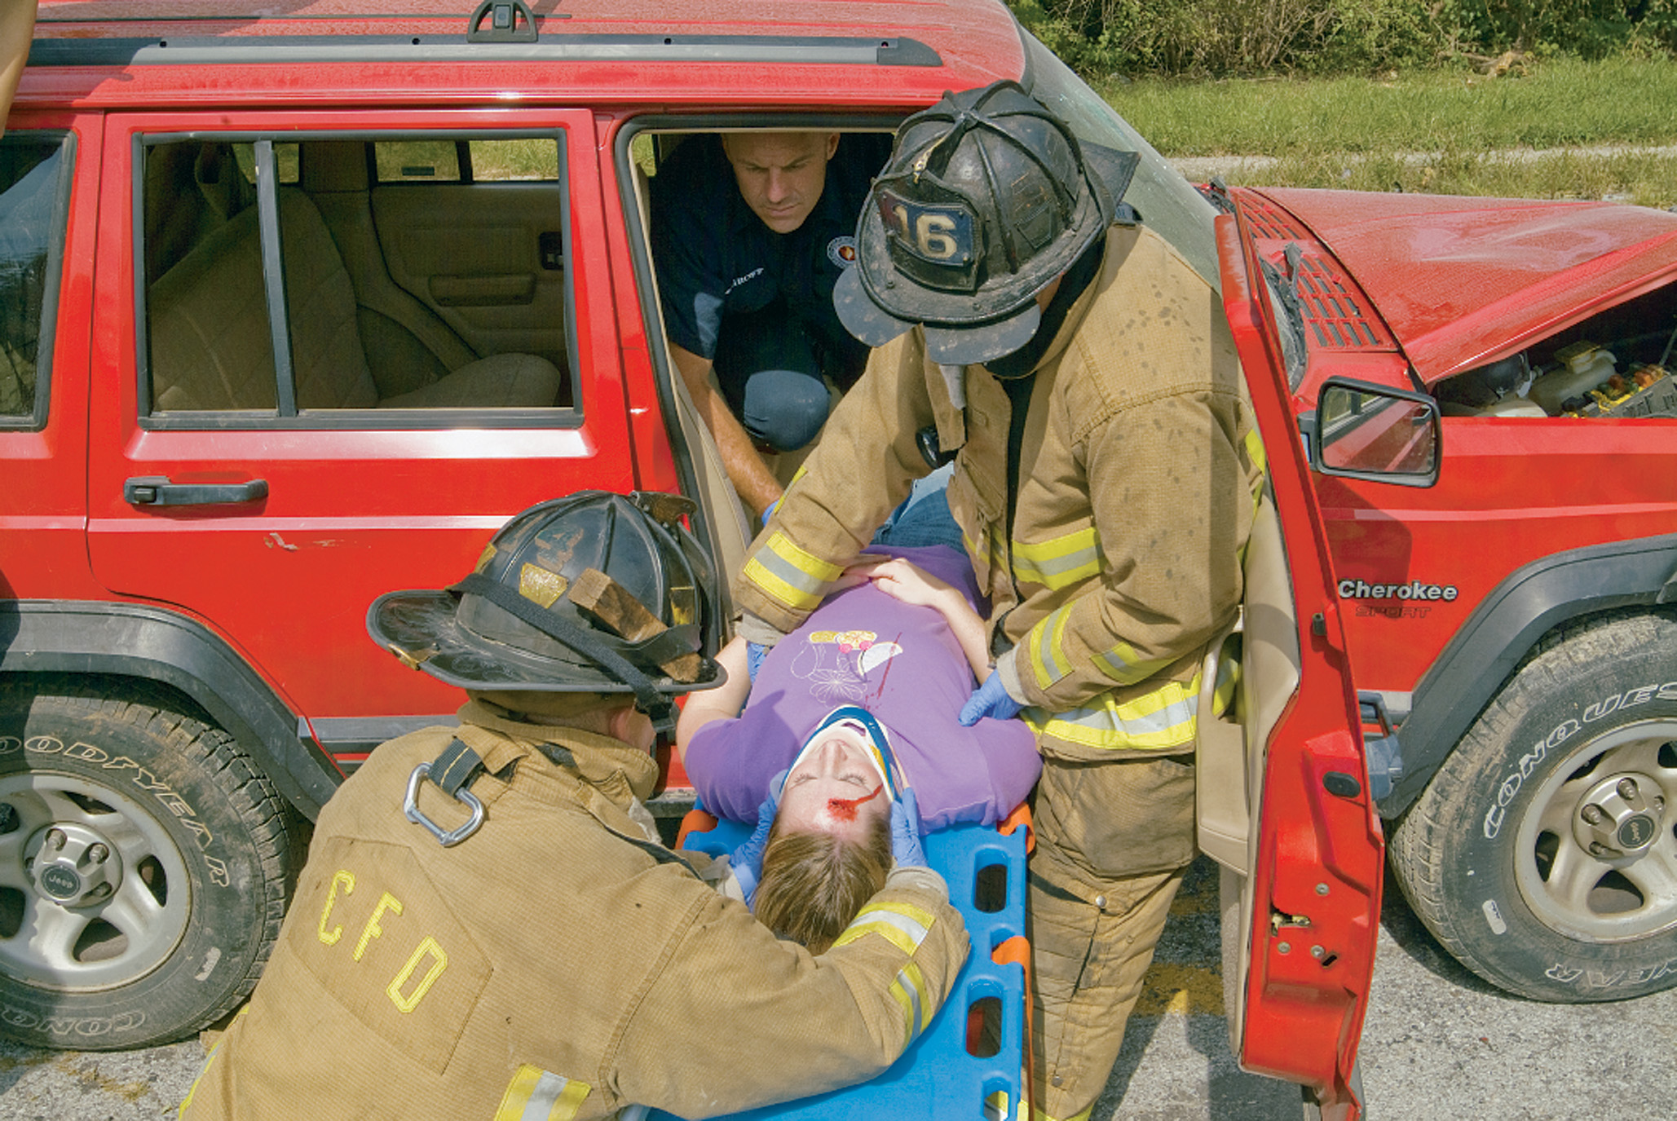
Lower the Patient Onto the Board
Depending on the structure of the car, It may be necessary to change positions to maintain in-line stabilization while lowering the patient onto the board.
Notes:
The patient is quickly transferred to a long backboard while manual in-line spinal stabilization is maintained.

Slide 108
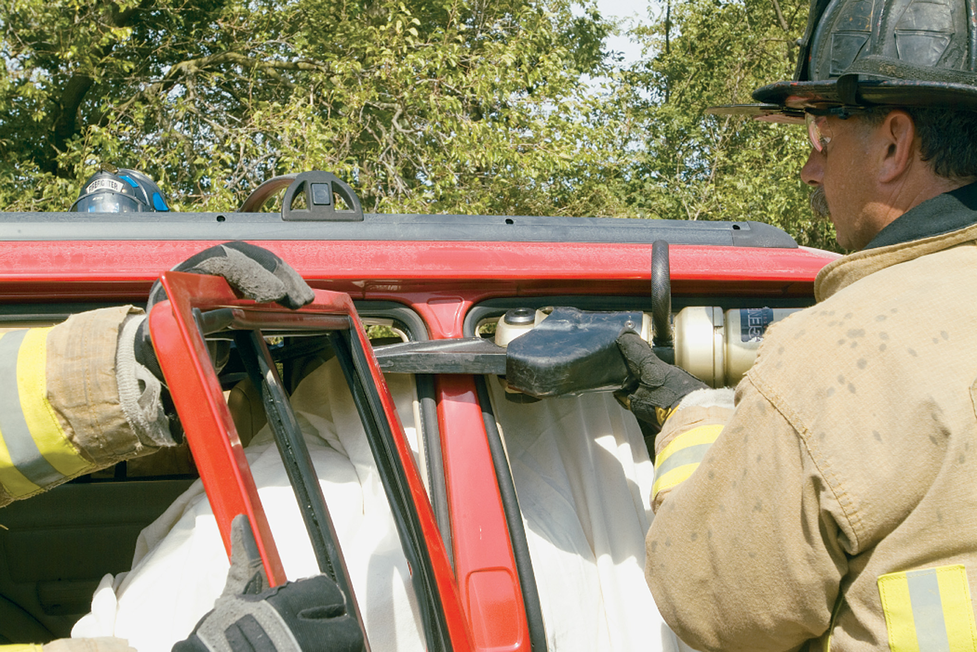
If the Structural Features of the Vehicle, Time, Resources, and the Patient’s Condition Permit, It May be Worthwhile to Remove the Roof Before Performing a Rapid Extrication
Notes:
The rapid extrication technique requires EMTs to improvise at the scene based on the type of car and location
of the roof support posts.

Slide 109
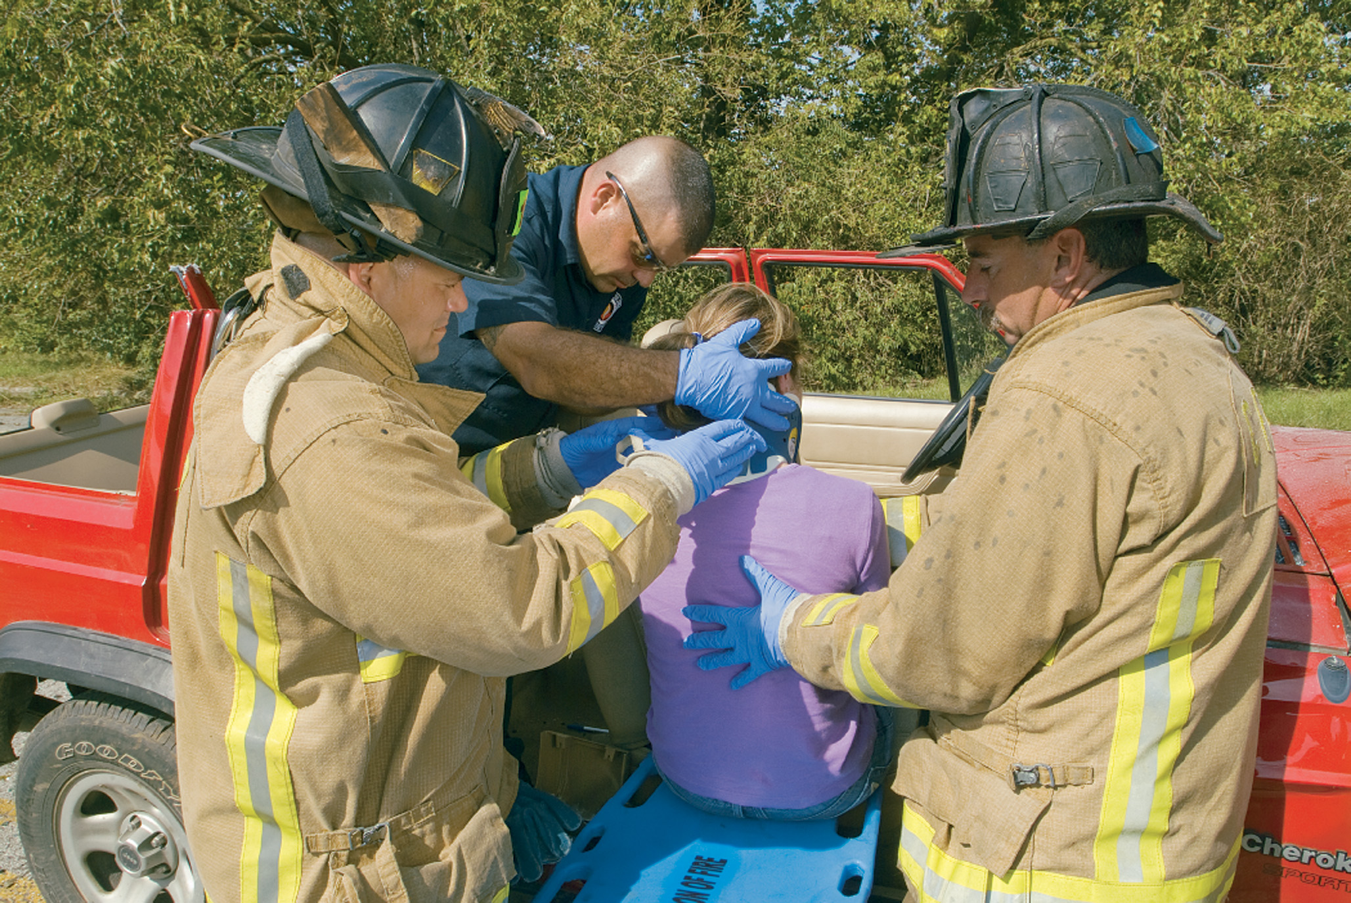
Depending on Variables Such as the Vehicle’s Structure and the Patient’s Condition, a Rapid Extrication May be Performed More Easily and Safely If the Roof Has Been Removed
Notes:
If time, resources, and patient condition permit, removing the roof can enable better access to the patient and easier removal using the rapid extrication technique.

Slide 110
Special Considerations (1 of 7)
Helmets
  First, assess the patient wearing the helmet.
    Assess the patient’s mental status.
    Assess the patient’s airway and breathing.
    Assess the fit of the helmet and the likelihood of movement.
    Determine your ability to gain access to the patient’s airway.
Notes:
Thorough assessment of a patient is difficult under any circumstances, and the presence of a helmet makes the task even more difficult. But the removal of a helmet should not be an automatic step because such removal could risk aggravating a spinal injury, if one exists.

Slide 111
Special Considerations (2 of 7)
Helmets
  Leave the helmet in place if:
    The helmet fits well, and there is little or no movement.
    No impending airway problems.
    Helmet removal would cause further injury.
    You can provide S M R with the helmet on.
    It doesn’t interfere with your ability to reassess airway and breathing.
Notes:
Thorough assessment of a patient is difficult under any circumstances, and the presence of a helmet makes the task even more difficult. But the removal of a helmet should not be an automatic step because such removal could risk aggravating a spinal injury, if one exists.

Slide 112
Special Considerations (3 of 7)
  Helmets
  Remove the helmet if it:
    Interferes with your ability to assess or reassess airway and breathing.
    Interferes with your ability to adequately manage the airway.
    Does not fit well.
    Interferes with spine motion restriction.
    Patient is in cardiac arrest.
Notes:
The removal of a helmet should not be an automatic step because such removal could risk aggravating a spinal injury, if one exists.

Slide 113
Special Considerations (4 of 7)
  Helmets
  Helmet Removal
    Two basic types of helmets:
      Sports helmets
      Motorcycle helmets
    Face masks on football helmets can be removed by cutting the plastic clips.
    Motorcycle helmets generally cover the full face and prevent access to the airway.
Notes:
Techniques for the removal of motorcycle and sports helmets follow this slide.

Slide 114
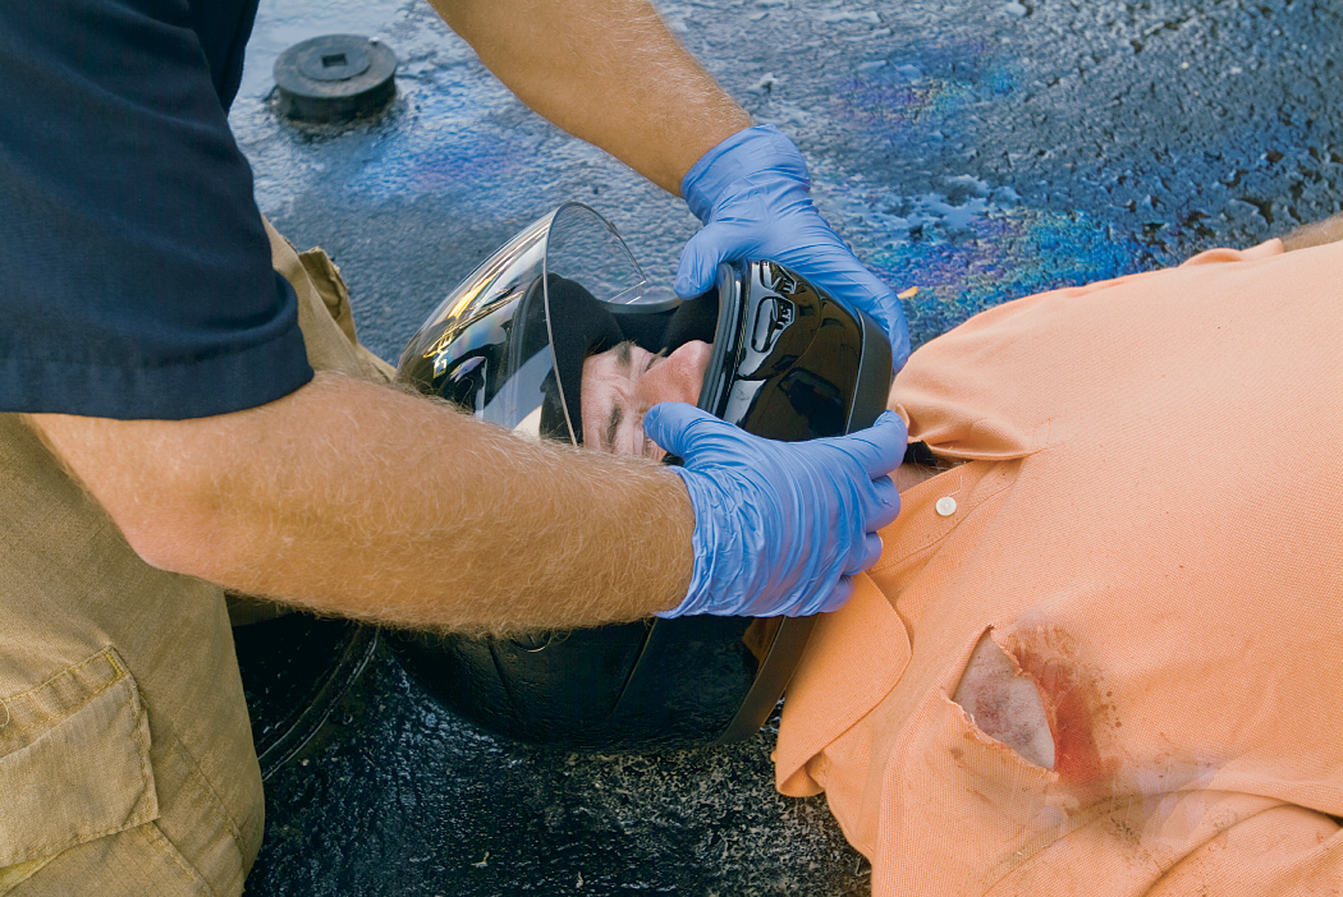
One Rescuer Applies Stabilization by Placing Hands on Each Side of the Helmet with Fingers on the Patient’s Mandible to Prevent Movement
Notes:
Take the patient’s eyeglasses off before you attempt to remove the helmet. One rescuer should stabilize the helmet by placing hands on each side of the helmet with fingers on the mandible (lower jaw) to prevent movement.

Slide 115
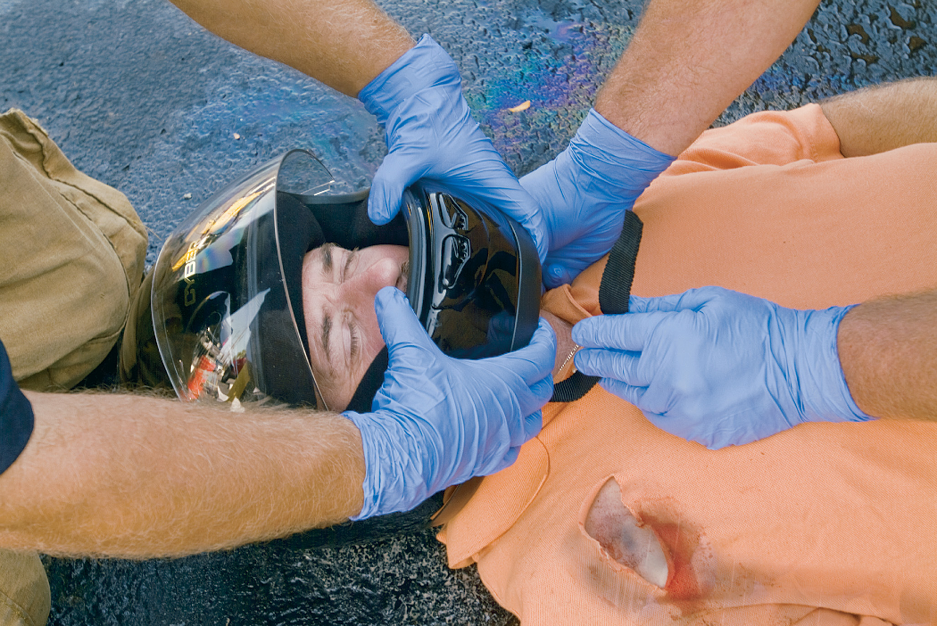
A Second Rescuer Places One Hand on the Mandible at the Angle of the Jaw
Notes:
A second rescuer should loosen the chin strap and place one hand anteriorly on the mandible at the angle of the jaw and the other hand at the back of the head.

Slide 116
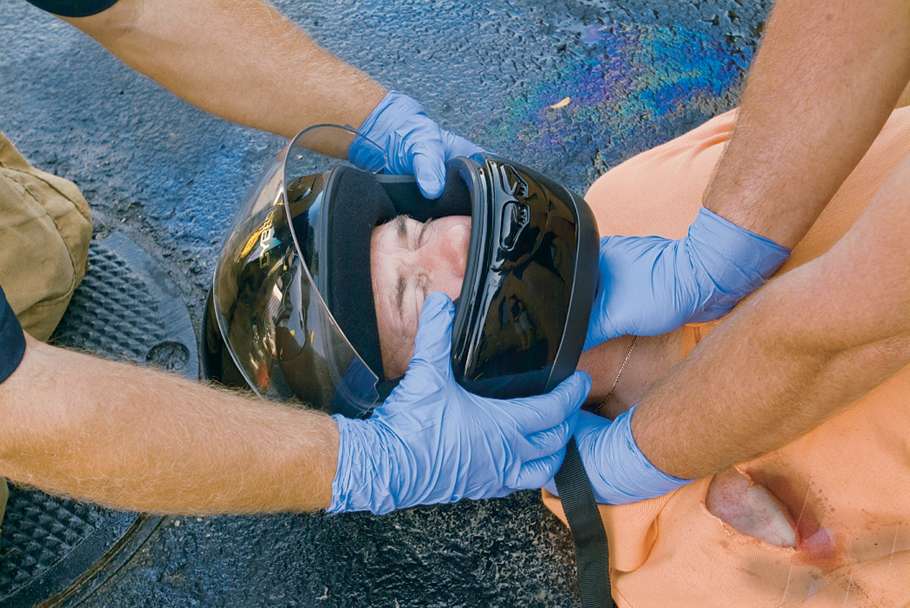
With the Other Hand, the Second Rescuer Holds the Occipital Region. This Maneuver Transfers the Stabilization Responsibility to the Second Rescuer
Notes:
The rescuer holding the helmet should pull the sides of the helmet apart, gently slip the helmet halfway off the patient’s head, and then stop.

Slide 117
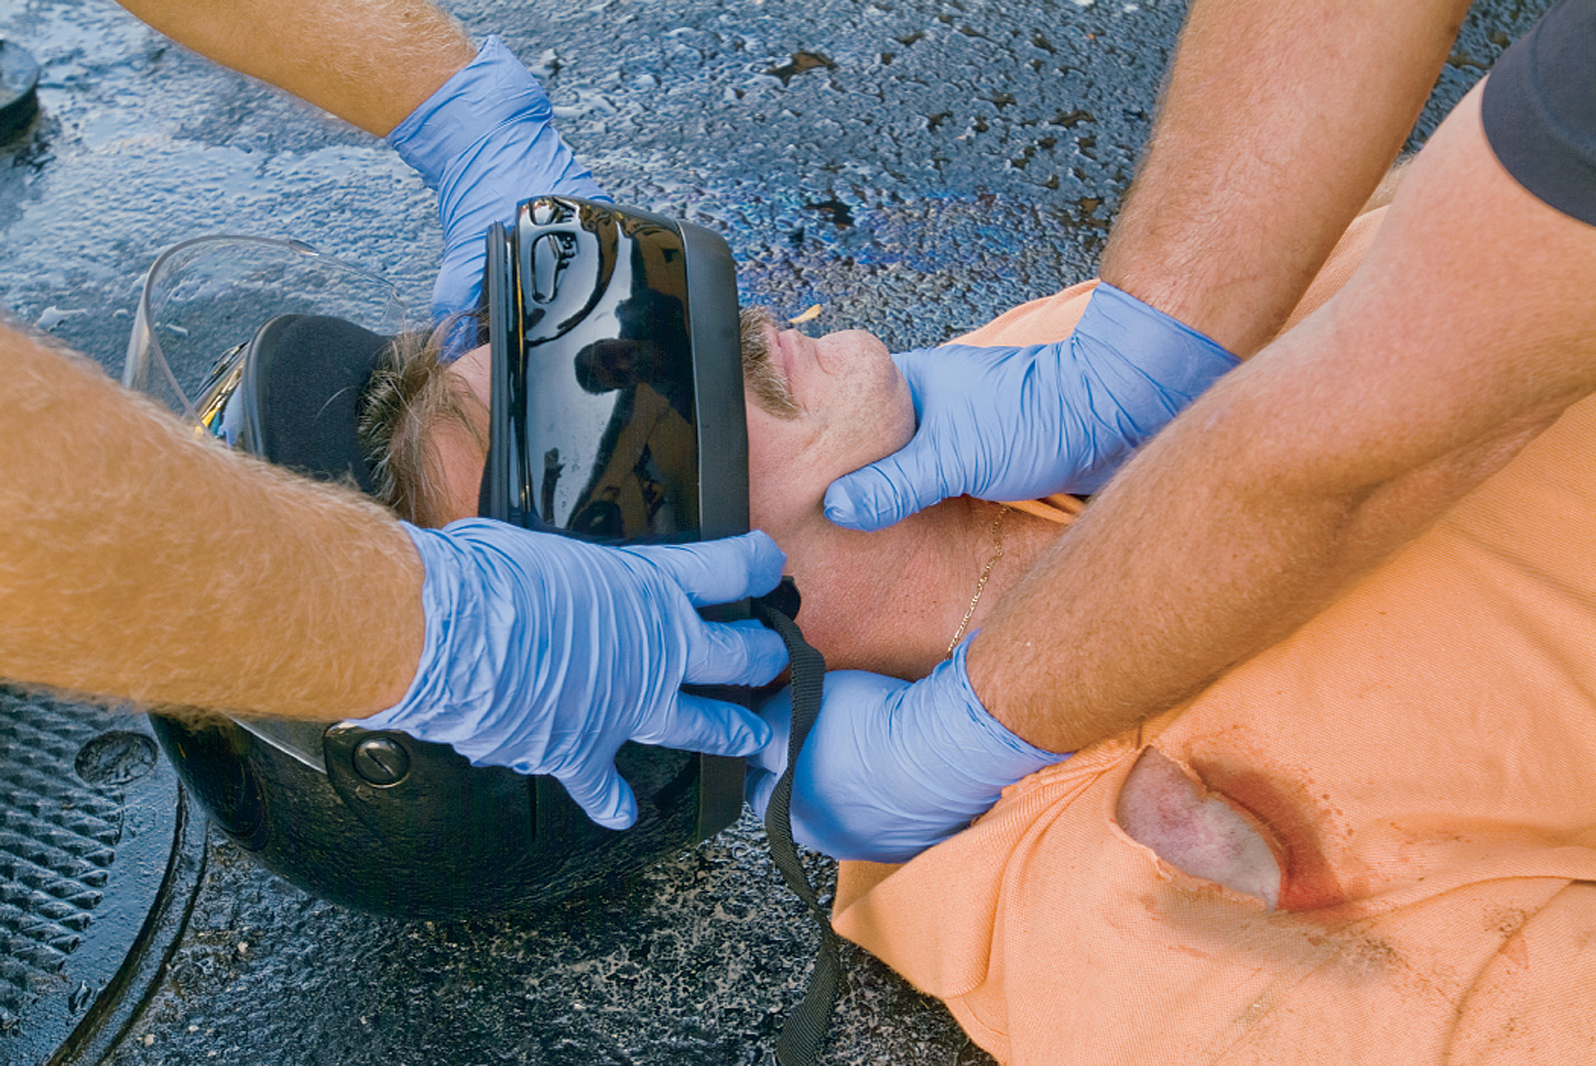
The Rescuer at the Top Begins to Remove the Helmet
Pulling the sides apart to clear the ears and allowing the second rescuer to readjust his hand position around the mandible and under the occipital region.
Notes:
The rescuer who maintains stabilization of the neck should reposition, sliding their hand under the patient’s head to keep the head from falling back after the helmet is completely removed.

Slide 118
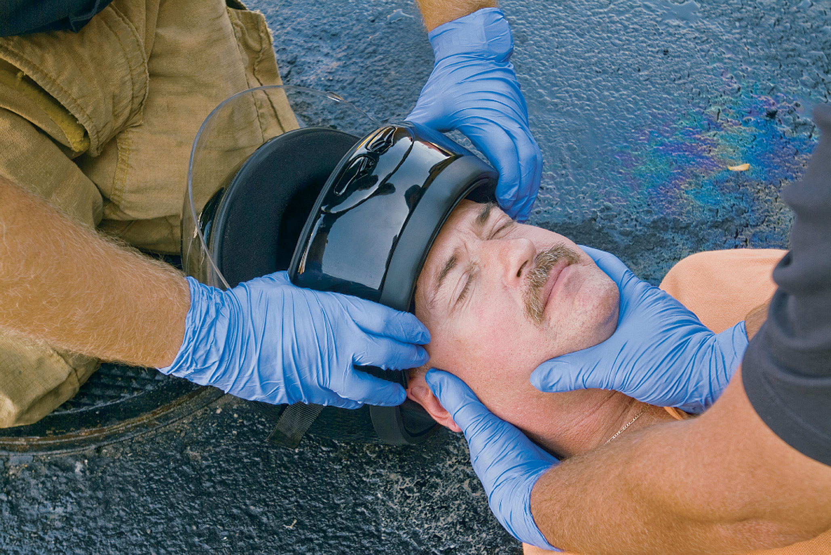
Throughout the Removal Process, the Second Rescuer Maintains In-Line Stabilization from Below to Prevent Head Tilt
Notes:
The first rescuer should remove the helmet completely.

Slide 119
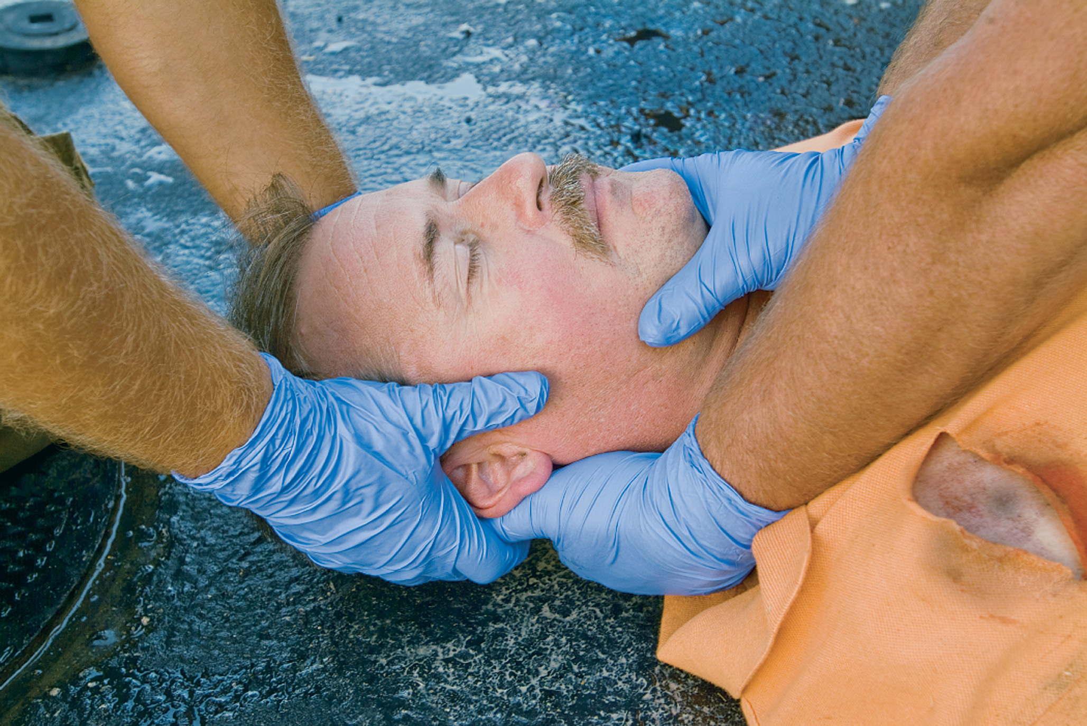
After the Helmet Has Been Removed, the Rescuer at the Top Replaces His Hands on Either Side of the Patient’s Head with Palms over the Ears, Taking over Stabilization
Notes:
The patient should then receive spinal motion restriction.

Slide 120
Special Considerations (5 of 7)
Helmets
  Equipment-Intensive Sports (Football, Hockey, and Lacrosse) Injuries
    It is important that the A T and E M T are prepared to work together.
    When appropriate, helmets and shoulder pads should be removed before transport.
    Removal should be performed by a minimum of three trained rescuers.
Notes:
Recommendations now state that, when appropriate, helmets and shoulder pads should be removed before transport of an athlete with a suspected cervical spinal injury. This rationale for equipment removal is due to advances in sporting equipment technology, and removing this equipment expedites the athlete’s care. Another reason why this equipment should be removed before transport is that the AT and EMT often have more experience with equipment removal than other medical team members or hospital and emergency department staff.

Slide 121
Special Considerations (6 of 7)
Helmets
  Equipment-Intensive Sports (Football, Hockey, and Lacrosse) Injuries
    Several tools can be used to remove the face mask.
    S M R for the Player
      Remove face mask and helmet
      Pad beneath head
      Remove shoulder pads and pad
      Apply cervical collar
Notes:
When all equipment has been removed, a cervical collar should be applied. Following the application of the cervical collar, the athlete should be lifted onto a long backboard.

Slide 122
Special Considerations (7 of 7)
S M R in Infants and Children
  Pad from the shoulders to the heels of an infant or child, if necessary, to maintain neutral in-line stabilization.
  Make sure the cervical collar fits before applying it to an infant or child.
  Extrication from a Car Seat
    Car seats involved in crashes may have lost integrity.
Notes:
Car seats involved in crashes might have lost the integrity of the structure and might not provide protection for the child if another crash were to occur. Transfer the child to a backboard.

Slide 123
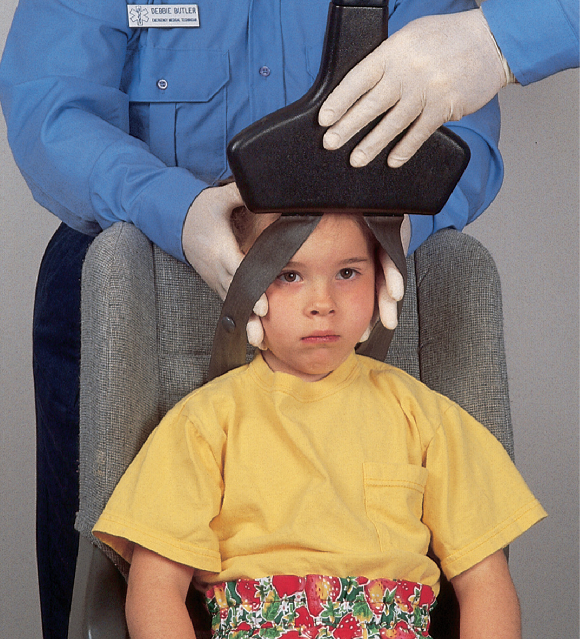
E M T #1 Stabilizes the Car Seat in an Upright Position and Applies Manual Stabilization to the Child’s Head and Neck
E M T #2 prepares equipment, then loosens or cuts the seat straps and raises the front guard.
Notes:
In children less than 8 years of age, if any MOI suggests possible spinal injury, it is prudent to provide spinal motion restriction appropriate for the young child.

Slide 124
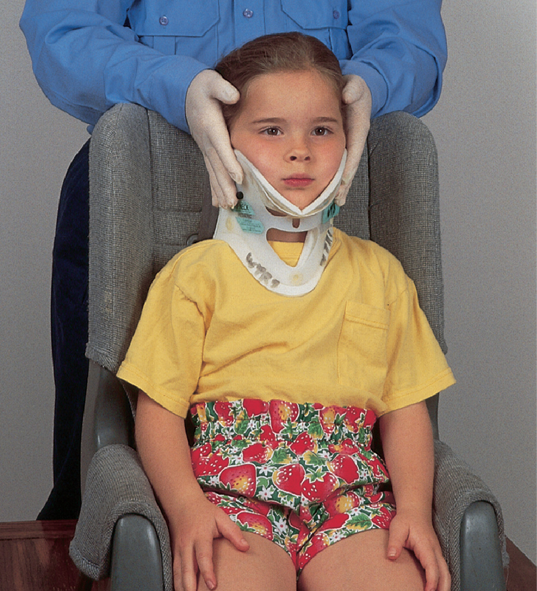
A Cervical Collar is Applied to the Child as E M T #1 Maintains Manual Stabilization of the Head and Neck
Notes:
Make sure the cervical collar fits properly before applying it to an infant or child.

Slide 125
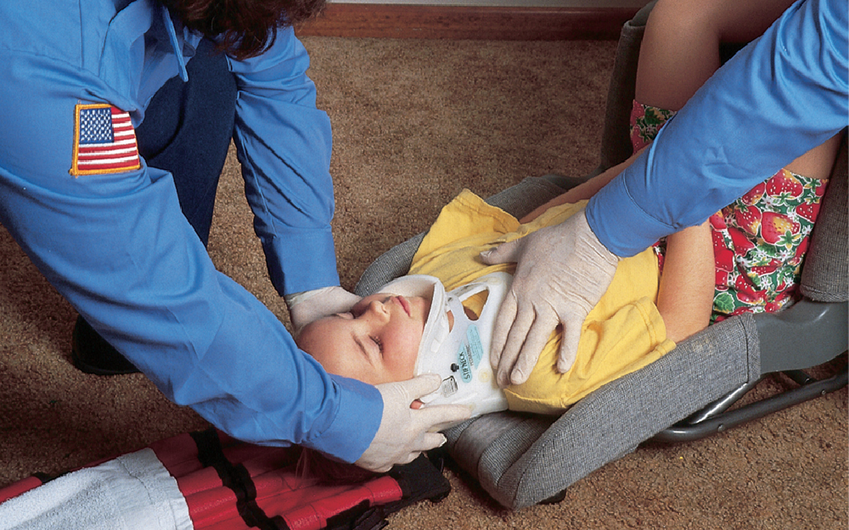
As E M T #1 Maintains Manual Stabilization, EMT #2 Places the Child Safety Seat on the Center of a Backboard and Slowly Tilts it into Supine Position
The E M T s are careful not to let the child slide out of the safety seat. For a child with a large head, place a towel under the area where the shoulders will eventually be placed on the board to prevent the child’s head from tilting forward.
Notes:
If you don’t have a collar that fits, stabilize the neck with a rolled towel. Tape the towel to the backboard, and manually support the patient’s head in a neutral in-line position.

Slide 126
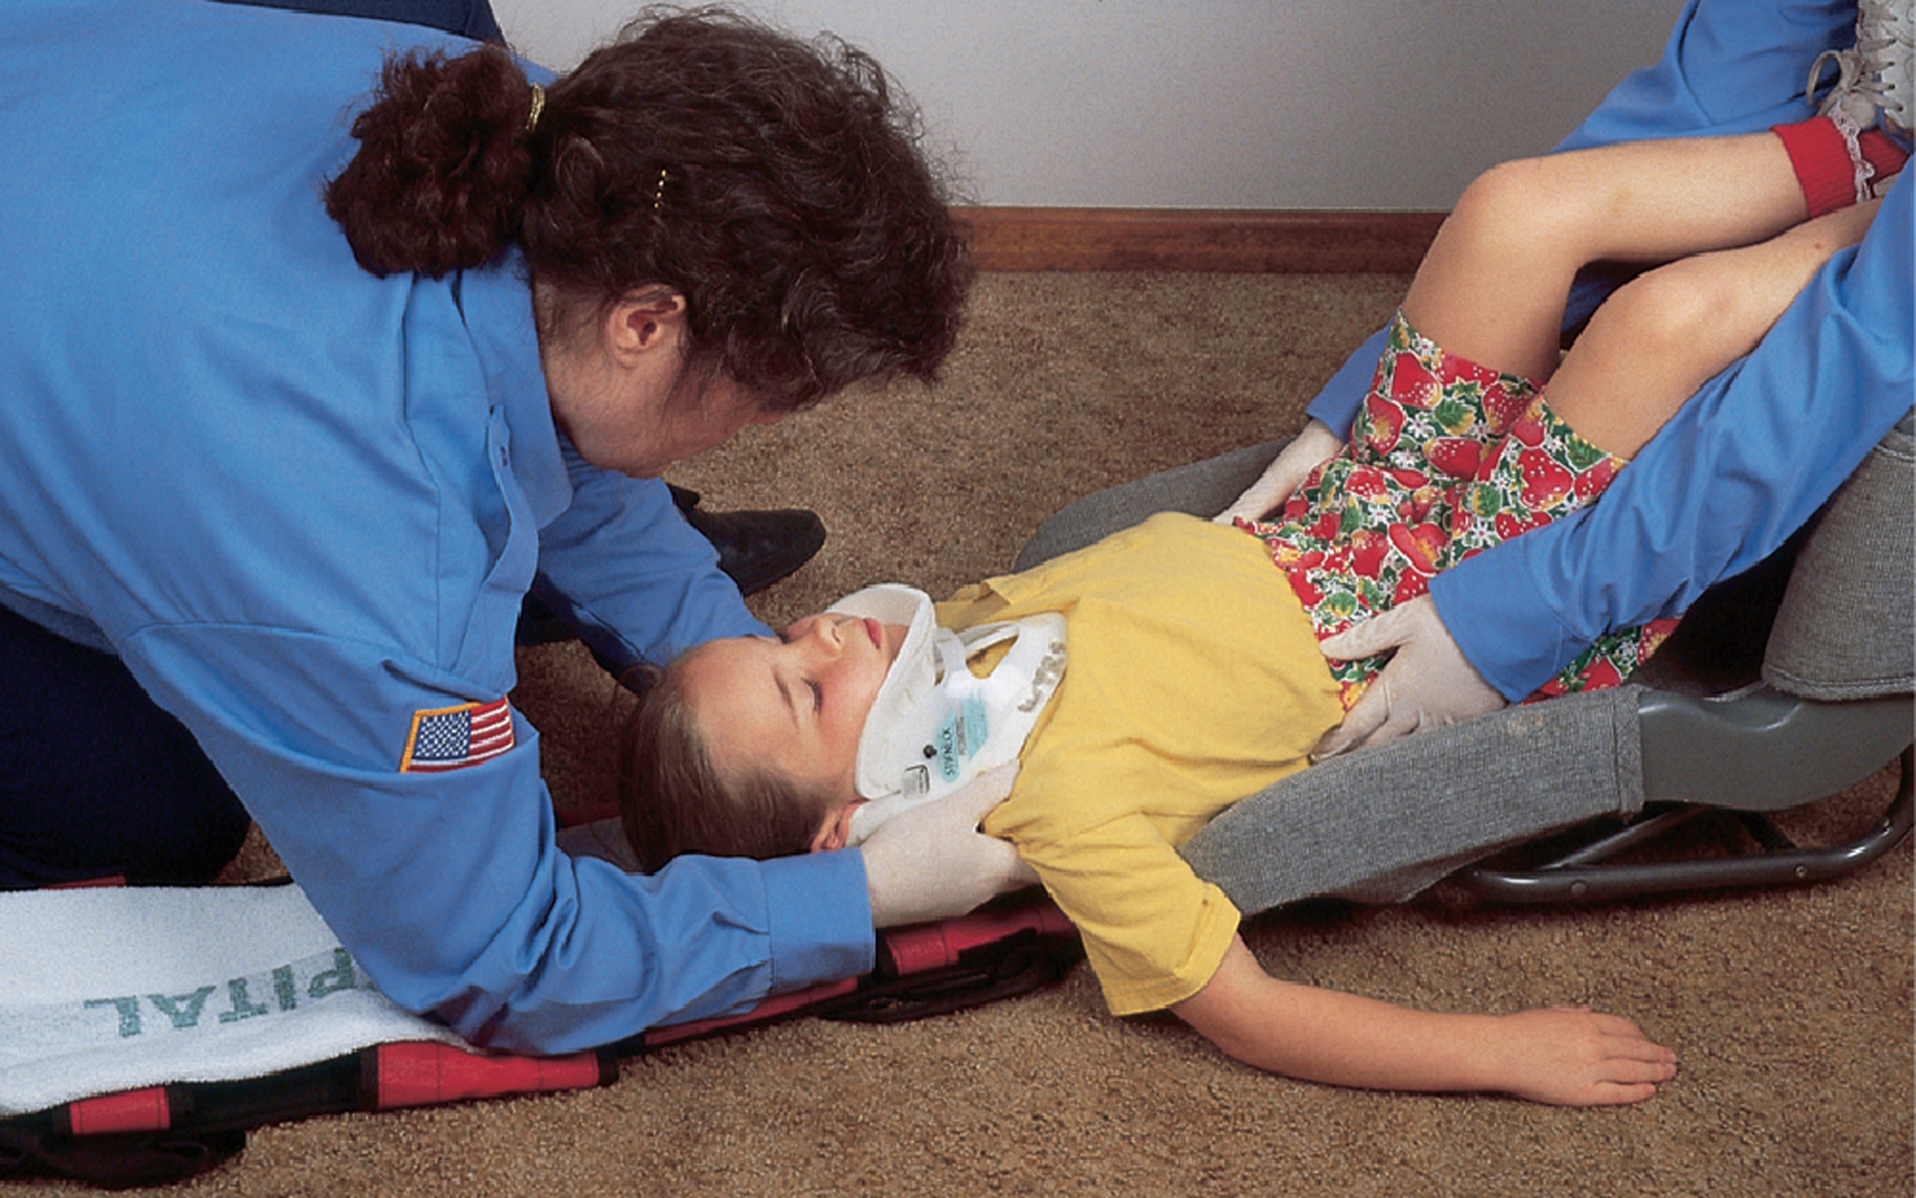
E M T #1 Maintains Manual Stabilization and Calls for a Coordinated Long Axis Move Onto the Backboard
Notes:
Transfer the child to a backboard or other spinal motion restriction device.

Slide 127

E M T #1 Maintains Manual Stabilization as the Move Onto the Board is Completed with the Child’s Shoulders over the Folded Towel
Notes:
When treating infants or children, use a rigid board or device appropriate for the child’s size.

Slide 128

E M T #1 Maintains Manual Stabilization as E M T #2 Places Rolled Towels or Blankets on Both Sides of the Child
Notes:
Use padding behind the shoulders and upper back to eliminate flexion and maintain neutral alignment of the head, neck, and spine.

Slide 129

E M T #1 Maintains Manual Stabilization as E M T #2 Straps or Tapes the Child to the Board at the Level of the Upper Chest, Pelvis, and Lower Legs
Do Not Strap Across The Abdomen.
Notes:
The pediatric patient’s torso and lower extremities need to be padded adequately to elevate them to the level of the head to achieve a neutral in-line position of the neck.

Slide 130

E M T #1 Maintains Manual Stabilization as E M T #2 Places Rolled Towels on Both Sides of the Head
Then tapes the head securely in place across the forehead and cervical collar. Do not tape across the chin to avoid pressure on the neck.
Notes:
Stabilize the neck with a rolled towel, tape the towel to the backboard, or hold it in place with the head stabilization device.

Slide 131
Case Study Conclusion (1 of 2)
Angela applies a cervical collar after assessing the neck, as Sarah continues manual stabilization of the spine.
Since the patient is stable, the E M T s quickly splint both ankles to prevent further pain and damage upon moving her.
Sarah and Angela apply a long backboard for spine motion restriction and begin transport.
Notes:
Review the Case Study Conclusion and emphasize the application of knowledge learned from this presentation.

Slide 132
Case Study Conclusion (2 of 2)
At the hospital, the patient is found to have compression fractures of L3 and L4. She requires surgery for both the ankle fractures and spinal injury.
Notes:
Review Case Study Conclusion and emphasize the application of knowledge learned from this presentation.

Slide 133
Lesson Summary (1 of 2)
Spine injuries can lead to permanent disability.
Proper management to avoid movement of the spine is imperative.
Spinal cord injuries can be partial or complete.
Notes:
Follow-Up
Answer student questions.
Follow-Up Assignments
Review Chapter 32 Summary.
Complete Chapter 32 In Review questions.
Complete Chapter 32 Critical Thinking questions.
Assessments
Handouts
Chapter 32 quiz

Slide 134
Lesson Summary (2 of 2)
Spinal cord injuries can cause loss of motor and sensory function.
Complications of spinal cord injury include respiratory failure and neurogenic shock.
Notes:
Class Activity
As an alternative to assigning the follow-up exercises in the lesson plan as homework, assign each question to a small group of students for in-class discussion.
Teaching Tips
Answers to In Review questions are in the appendix of the text. Advise students to review the questions again as they study the chapter.

Slide 135
Correct!
If the central portion of the spinal cord is injured, the patient may present with weakness or paralysis and loss of pain sensation in the upper extremities while the lower extremities have good function.
Click here to return to the program.

Slide 136
Incorrect (1 of 3)
Loss of movement and light touch sensation below the site of injury on one side, and loss of pain sensation on the opposite side is characteristic of Brown-Séquard syndrome.
Click here to return to the quiz.

Slide 137
Incorrect (2 of 3)
Loss of all motor and sensory function on both sides below the site of injury is characteristic of complete cord injury.
Click here to return to the quiz.

Slide 138
Incorrect (3 of 3)
Loss of motor function and sensation of pain on both sides below the site of injury, but retention of light touch sensation is characteristic of anterior cord syndrome.
Click here to return to the quiz.

Slide 139

Copyright

