Slide 1

Prehospital: Emergency Care
Eleventh Edition
Chapter 31
Head Trauma
Slides in this presentation contain hyperlinks. JAWS users should be able to get a list of links by using INSERT+F7
Copyright © 2018, 2014, 2010 Pearson Education, Inc. All Rights Reserved
Notes:
If this PowerPoint presentation contains mathematical equations, you may need to check that your computer has the following installed:
1) MathType Plugin
2) Math Player (free versions available)
3) NVDA Reader (free versions available)
Advance Preparation
Student Readiness
Assign the associated section of MyBRADYLab and review student scores. Review the chapter material in the Instructor Resources, which includes Student Handouts, PowerPoint slides, and the MyTest Program.
Prepare
Make copies of course policies and procedures, the syllabus, handouts from the Instructor Resources, and other materials for distribution or post them in your learning management system.
Preview the media resources and Master Teaching Notes in this lesson.
Preview the Case Study presented in the PowerPoint slides.
The total teaching time recommended is only a guideline. Take into consideration factors such as the pace at which students learn, the size of the class, breaks, and classroom activities. The actual time devoted to teaching objectives is the instructor’s responsibility.

Slide 2
Learning Readiness
E M S Education Standards, text p. 927.
Chapter Objectives, text p. 927.
Key Terms, text p. 927.
Purpose of lecture presentation versus textbook reading assignments.
Notes:
Explain to students what the National EMS Education Standards are. The National EMS Education Standards communicate the expectations of entry-level EMS providers. As EMTs, students will be expected to be competent in these areas. Acknowledge that the standards are broad, general statements. Although this lesson addresses the listed competencies, the competencies are often complex and require completion of more than one lesson to accomplish. The student is also expected to review the chapter objectives to foreshadow what will be in the chapter. By mastering the key terms the EMT student will better understand the learning and be able to communicate more clearly.
Additionally, explain to the students that the purpose of using these slides is to help keep the instructor focused on highlighting important portions of the material, explain interrelationships of topics, and discuss how to apply this information. It’s not the intent of the presentation (or slides alone) to include every component in the chapter. This presentation still requires the student to thoroughly read the chapter.

Slide 3
Setting the Stage
Overview of Lesson Topics
  Anatomy of the Skull and Brain
  Head Injury
Notes:
These bulleted points are the major headings from the chapter, in order. Their purpose is to provide a basic lecture navigation for the student.

Slide 4
Case Study Introduction
E M T s Matt Brooks and Luis Garcia have arrived on the scene of a motorcycle collision, involving a single patient who was ejected from his bike when he struck the side of a car. The patient, a male in his 30s, was not wearing a helmet. Matt and Luis’s initial impression is that of a patient who is not responsive and whose airway is compromised by facial bleeding.
Notes:
Case Study
Present the Case Study Introduction provided in the PowerPoint slide set.
Lead a discussion using the Case Study questions provided on the subsequent slide(s).
The Case Study with discussion questions continues throughout the PowerPoint presentation.
Case Study Discussion
Use the Case Study content and questions to foreshadow the upcoming lesson content.

Slide 5
Case Study (1 of 3)
What are the first steps the E M T s must take?
What findings would lead the E M T s to suspect traumatic brain injury?
What types of head injuries may have occurred from this mechanism of injury?
Notes:
Use the Case Study content and questions to foreshadow the upcoming lesson content. Gauge the student’s responses as a guide of how well versed they are on this topic.

Slide 6
Introduction
Head injuries can be life threatening, and can lead to permanent disability.
The patient’s mental status can make assessment difficult.
Prompt recognition and proper treatment are critical to patient outcomes.
Notes:
During this lesson, students will learn about assessment and care for a patient suffering from a head injury.

Slide 7
Anatomy of the Skull and Brain (1 of 5)
The Skull
  The cranial skull surrounds the brain.
  The face is made up of 14 bones.
  The basilar skull is the weakest portion.
  Some of the basilar skull bones are thin and perforated extensively by the spinal cord, nerves, and blood vessels.
Notes:
Teaching Tips
Pass around an anatomical model of the skull to illustrate the basilar skull—a set of structures that is often difficult for students to visualize.

Slide 8
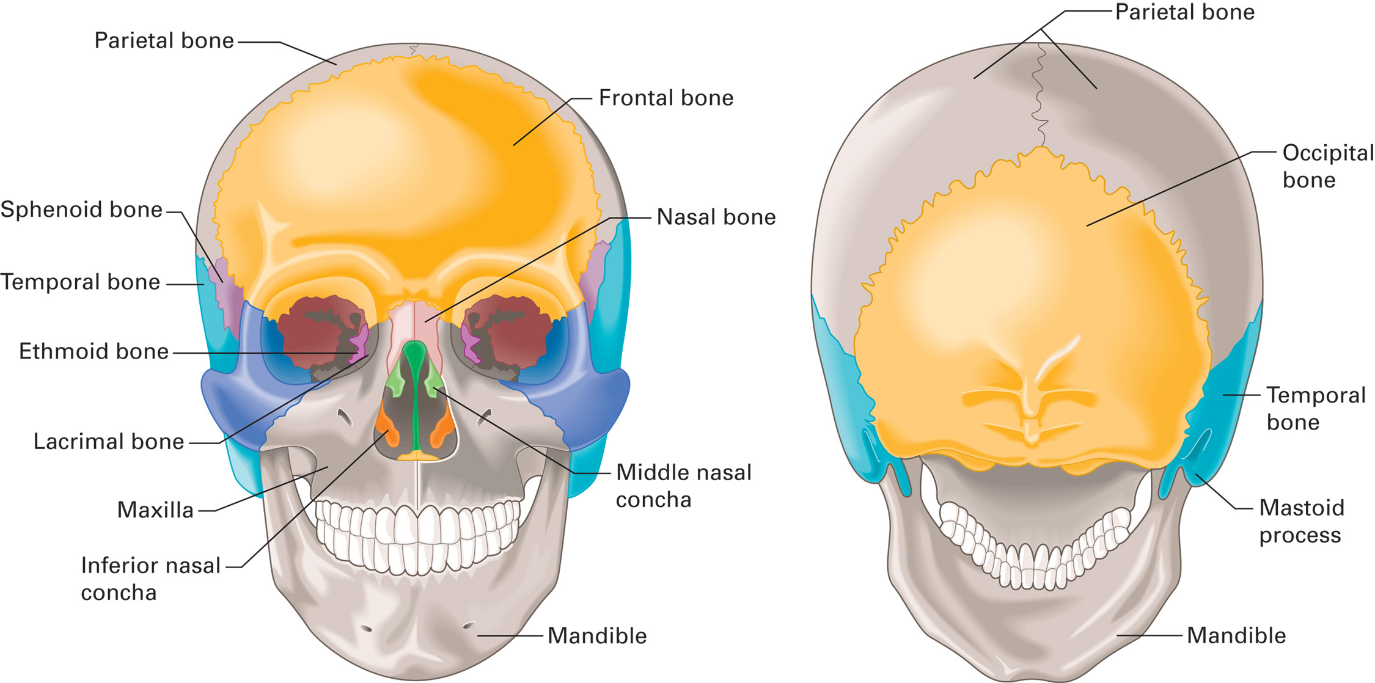
The Skull
Notes:
The brain occupies 80 to 90 percent of the space inside the skull.

Slide 9
Anatomy of the Skull and Brain (2 of 5)
The Brain
  Cushioned by cerebrospinal fluid (C S F)
    C S F leaking from the nose or ears is an indication of basilar skull fracture.
  The Meninges
    Three layers surround the brain.
      Outermost is the dura mater
      The next layer is the arachnoid
      Beneath that, in contact with the brain, is the pia mater
Notes:
All three layers enclose not only the brain, but also the brainstem and the spinal cord.
Discussion Questions
How can you describe the location of intracranial bleeding with respect to the meninges?
Why is swelling or bleeding within the brain quickly life-threatening?
What are the functions of the brainstem?
Knowledge Application
Given a description of the location of bleeding within the cranium, students should be able to describe it using the correct terminology.
Given a description of a region of the brain, students should be able to describe the major functions of that area.
Class Activity
Assign groups of students to research and present the anatomy and physiology of different parts of the brain.

Slide 10
Anatomy of the Skull and Brain (3 of 5)
  The Brain
  The Meninges
    Bleeding that occurs between the dura mater and the skull is called epidural.
    Subdural bleeding occurs beneath the dura and is usually venous.
    Bleeding that occurs between the arachnoid membrane and the surface of the brain is called subarachnoid hemorrhage.
Notes:
Any bleeding within the meningeal layers can be fatal within minutes, especially epidural bleeding, which is commonly from a lacerated or ruptured artery.

Slide 11
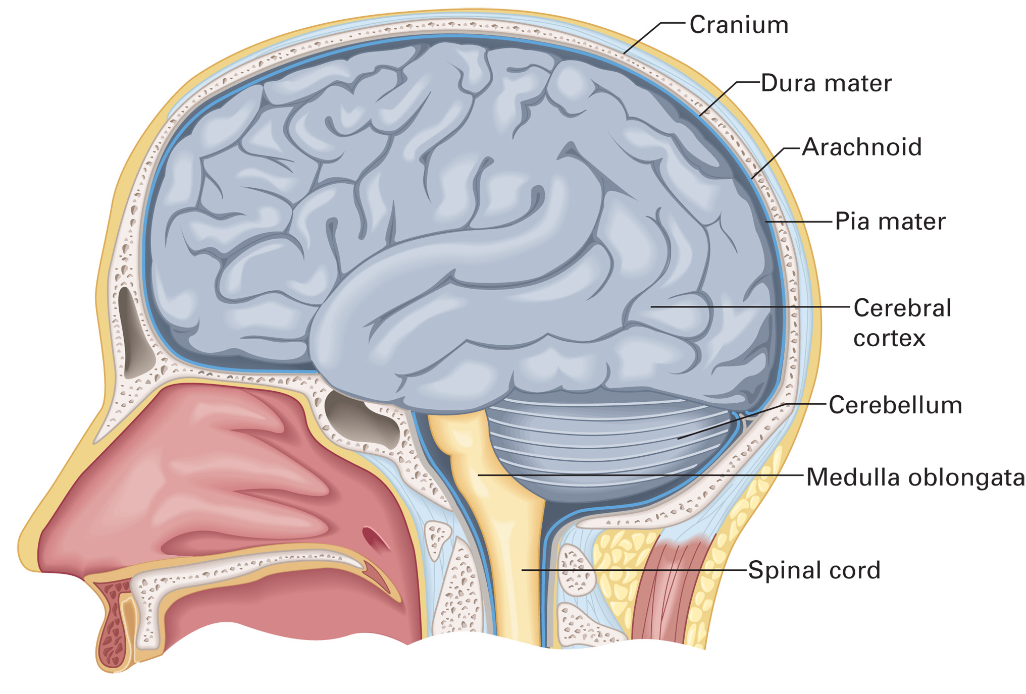
The Meninges and Brain
Notes:
The arachnoid membrane and the pia mater are separated by the subarachnoid space, a lattice of fibrous, spongy tissue filled with cerebrospinal fluid.

Slide 12
Anatomy of the Skull and Brain (4 of 5)
The Brain
  Parts of the Brain
    Cerebrum
      Two hemispheres.
      Each hemisphere has four lobes.
      Responsible for conscious and sensory functions, emotion, personality.
    Cerebellum
      Coordinates movements and reflexes that maintain posture and equilibrium.
Notes:
The cerebrum is not attached to the inside of the skull.
Sometimes called the “little brain,” the cerebellum controls equilibrium and coordinates muscle activity.

Slide 13
Anatomy of the Skull and Brain (5 of 5)
The Brain
  Parts of the Brain
    Brainstem
      Made up of the pons, midbrain, and medulla oblongata.
      Controls automatic functions, including cardiac, respiratory, and vasomotor function.
      The medulla connects the brain the to the spinal cord.
Notes:
The brainstem is the most primitive and best-protected part of the brain. It is tethered to the skull by numerous nerves and vessels and controls most automatic functions of the body, including cardiac, respiratory, vasomotor (blood pressure), and other functions vital to life.

Slide 14
Head Injury (1 of 33)
Scalp Injuries
  Soft tissue injuries.
  Blood vessels do not constrict well; bleeding can be profuse.
  Bleeding beneath the scalp can make assessment of the skull difficult.
Notes:
The vessels in the scalp are not able to constrict as effectively as other blood vessels in the body; thus, they bleed more heavily when injured, which can lead to shock, if uncontrolled.
The reason for this is that the fascia, which lies under the scalp but above the skull, can rupture and become depressed and feel, on palpation, like a depressed skull fracture. Conversely, blood can fill the area between a depressed skull fracture and the scalp, making the skull feel normal and not depressed during palpation.

Slide 15
Head Injury (2 of 33)
Skull Injuries
  Deformity requires extreme trauma.
  Most skull fractures are linear.
  Depressed skull fracture occurs when the bone ends are pushed in toward the brain.
  Skull fractures can be open or closed.
  A basilar skull fracture involves the floor of the cranium.
  Underlying brain damage may occur.
Notes:
A skull deformity itself does not cause disability or death; rather, it is any underlying damage to the brain that leads to serious consequences. In short, the skull deformity presents no danger if it is not accompanied by brain injury, hematoma, cerebrospinal fluid leakage, or subsequent infection.
Discussion Questions
What is a basilar skull fracture?
What are the signs and symptoms of a basilar skull fracture?

Slide 16
Head Injury (3 of 33)
Brain Injuries
  Swelling and bleeding within the skull can increase the pressure within the skull, which decreases brain tissue perfusion.
  Brain injury caused by trauma is often referred to as a traumatic brain injury (T B I).
Notes:
Both conditions can cause increased pressure inside the skull and decreased perfusion of the brain, resulting in an inadequate delivery of oxygen and glucose to and removal of carbon dioxide and other waste products from the brain tissues.
Teaching Tips
Take time to explain how increased intracranial pressure affects cerebral blood flow.
Critical Thinking Discussion
What happens to perfusion of the brain when brain tissue swells?

Slide 17
Head Injury (4 of 33)
Pathophysiology of Traumatic Brain Injury
  Traumatic brain injuries can occur from penetrating trauma, blunt trauma, or secondary injury.
  Brain injuries can be open or closed.
Notes:
Discussion Questions
How do intracranial hematomas develop?
What conditions can lead to secondary brain injury?
What are the similarities and differences between subdural and epidural hematomas?
What are indications of herniation?
Critical Thinking Discussion
What is the explanation for Cushing's reflex?

Slide 18
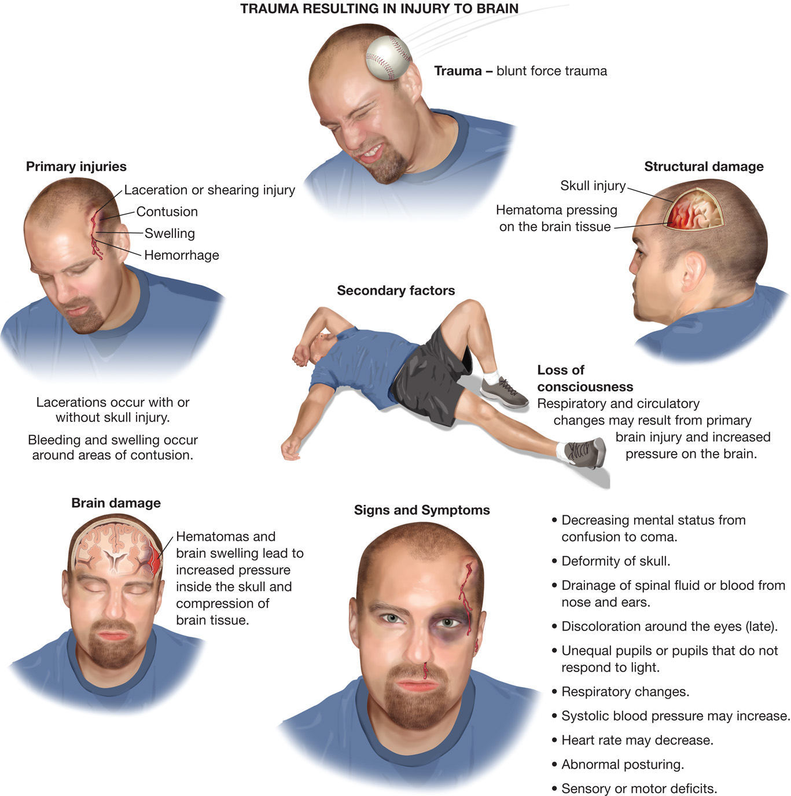
Trauma to the Head and Resulting Injury to the Brain
Notes:
Continued brain damage resulting after the initial injury is called secondary brain injury.

Slide 19
Head Injury (5 of 33)
Pathophysiology of Traumatic Brain Injury
  Primary Brain Injury
    The primary brain injury is the result of trauma to the brain that occurs at the time of insult from direct impact, acceleration/deceleration, or a penetrating wound.
Notes:
There is nothing that an EMT can do to reverse the effects of damage done by primary brain injury.

Slide 20
Head Injury (6 of 33)
  Pathophysiology of Traumatic Brain Injury
  Secondary Brain Injury
    Traumatic brain injury will be worsened by:
      Hypoxemia
      Hypercarbia
      Hypoglycemia
      Hyperglycemia
      Hyperthermia
      Hypotension (systolic B P <90 m m H g)
Notes:
Hypotension and hypoxemia are the two conditions most critical to prevent. It has been reported that when hypotension and hypoxemia occur together as secondary injuries in the brain-injured patient, a 75 percent mortality rate occurs, which is a significant increase from the overall mortality rate from brain injuries. In fact, just a single episode of hypoxemia has been associated with a 150 percent increase in overall mortality.

Slide 21
Head Injury (7 of 33)
  Pathophysiology of Traumatic Brain Injury
  Secondary Brain Injury
    To minimize secondary injury maintain:
      A patient airway
      Adequate ventilation
      S p O₂
      Systolic B P > 90 mmHg
      Normal body temperature
      Normal blood glucose level
Notes:
Emergency care of a traumatic brain injury patient, regardless of the cause or type, should focus on preventing or limiting secondary injury by establishing and maintaining these six items.

Slide 22
Head Injury (8 of 33)
  Pathophysiology of Traumatic Brain Injury
  Secondary Brain Injury
    Stop seizures as quickly as possible.
    Consider contacting an A L S unit.
Notes:
Seizure activity in the traumatic brain injury patient can lead to worsening of the injury, increased hypoxia and hypercarbia levels, increased hypoglycemia, and higher increased core body temperature.

Slide 23
Head Injury (9 of 33)
  Pathophysiology of Traumatic Brain Injury
  Brain Herniation
    Increased intracranial pressure from bleeding or swelling forces the brain out of its normal position.
    Compression of the brain causes dysfunction.
    Herniation obliterates vital brainstem functions.
Notes:
Compression of the brain causes it to dysfunction. Pushing the brain downward and out of the foramen magnum or through the tentorium compresses the brainstem, destroying vital functions, including the heartbeat, respirations, and blood pressure.

Slide 24
Head Injury (10 of 33)
  Pathophysiology of Traumatic Brain Injury
  Brain Herniation
    Brain herniation signs and symptoms:
      Dilated or sluggish pupil on one side
      Weakness or paralysis
      Severe alteration in consciousness
      Abnormal posturing
      Abnormal breathing pattern
      Cushing reflex
Notes:
Posturing, decorticate, also called flexion; decerebrate, also called extension, is also known as nonpurposeful movement.
Cushing reflex is increased systolic blood pressure and decreased heart rate.
Herniation is an extremely serious and potentially deadly condition.

Slide 25
Head Injury (11 of 33)
Types of Head and Brain Injuries
  Closed and Open Head Injuries
    An open wound to the head does not signify a more severe brain injury.
    The lack of a wound to the head does not indicate a lesser brain injury.
    Closed head injury- The scalp can be lacerated but the skull remains intact.
    Open head injury- A break in the skull and a break in the scalp.
Notes:
Severe brain injury can occur with or without wounds to the head.

Slide 26
Head Injury (12 of 33)
  Types of Head and Brain Injuries
  Brain injury from shearing, tearing, and stretching nerve fibers is known as a diffuse axonal injury (D A I).
  D A I interferes with transmission of nerve impulses.
  D A I is related to severe acceleration and deceleration forces.
  May be mild (concussion), moderate, or severe.
Notes:
DAI is most common in car crashes and pedestrians who have been struck by a vehicle.
Specific types of brain injuries include concussion, a temporary loss of the brain’s ability to function; contusion, bruising or swelling of the brain; hematoma, pooling of blood within the brain; and laceration, or tearing of the brain tissue.

Slide 27
Closed Head Injury
(© David Effron, M D)
Notes:
In a closed head injury, the scalp may be lacerated but the skull remains intact.

Slide 28
Open Head Injury
(© Edward T. Dickinson, M D)
Notes:
An open head injury involves a break in the skull as well as a break in the scalp.

Slide 29
Head Injury (13 of 33)
Types of Head and Brain Injuries
  Concussion
    Mild D A I.
    Presentation ranges from momentary confusion to brief complete loss of responsiveness.
    Usually results in headache.
    Effects occur immediately and gradually improve.
Notes:
Signs of simple concussion might include:
Momentary confusion
Confusion that lasts several minutes
Inability to recall the incident and, sometimes, the period just before it (retrograde amnesia) and after it (anterograde amnesia)
Repeated questioning about what happened
Mild to moderate irritability or resistance to treatment
Combativeness
Inability to answer questions or obey commands appropriately
Nausea and vomiting
Restlessness.

Slide 30
Head Injury (14 of 33)
  Types of Head and Brain Injuries
  Contusion
    Bruising and swelling of the brain
    Can accompany concussion
    May or may not cause increased intracranial pressure
    Caused by coup/contrecoup or acceleration/deceleration mechanism
Notes:
Signs and symptoms of contusion include the initial signs and symptoms of concussion and can include one
or more of the following:
Decreasing mental status or unresponsiveness
Paralysis
Unequal pupils
Vomiting
Alteration of vital signs
Profound personality changes.

Slide 31
Head Injury (15 of 33)
  Types of Head and Brain Injuries
  Subdural Hematoma
    Collection of blood between dura mater and arachnoid.
    Results from damage to bridging veins in skull.
    The hematoma can lead to increased intracranial pressure.
Notes:
Two types of subdural hematoma are:
Acute. Signs and symptoms begin almost immediately after the injury.
Occult or chronic. Bleeding continues over time and the signs and symptoms don’t become apparent for days to weeks after the injury.

Slide 32
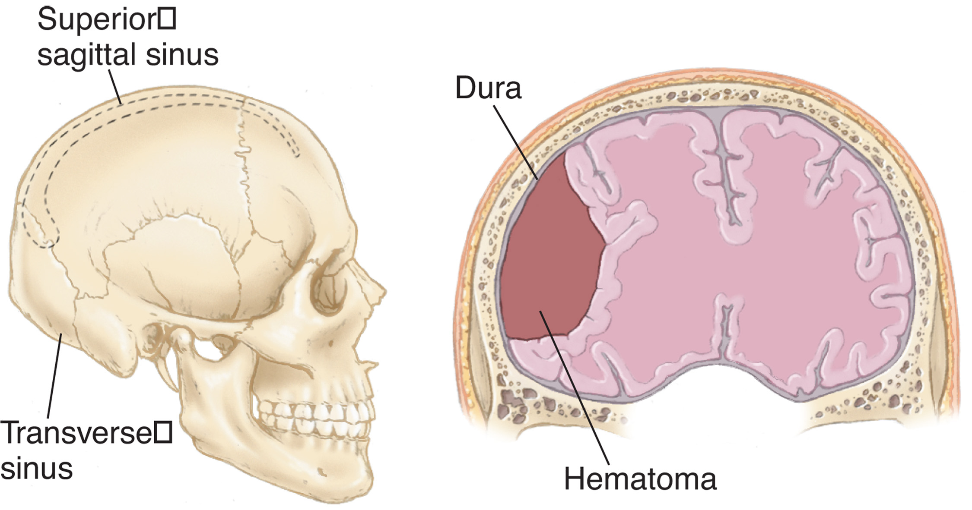
Subdural Hematoma
Notes:
Any patient with an abnormally long blood-clotting time, which prolongs the period of bleeding, is particularly susceptible to subdural hematoma.

Slide 33
Head Injury (16 of 33)
Types of Head and Brain Injuries
  Subdural Hematoma
    Acute: signs and symptoms begin immediately.
    Occult: signs and symptoms are delayed for days to weeks.
    The elderly, those with delayed blood clotting, and alcoholics are at increased risk.
Notes:
Signs and symptoms of subdural hematoma include:
Weakness or paralysis to one side of the body
Deterioration in level of responsiveness
Vomiting
Dilation of one pupil
Abnormal respirations or apnea
Possible increasing systolic blood pressure
Decreasing pulse rate
Headache
Seizures
Confusion
Personality change (chronic subdural hematoma).

Slide 34
Head Injury (17 of 33)
  Types of Head and Brain Injuries
  Epidural Hematoma
    More rare, but extremely emergent.
    Often associated with fracture of the temporal skull.
    Bleeding is rapid and severe, causing a rapid increase in intracranial pressure.
    Late signs can include fixed and dilated pupils, absent reflexes, and decreasing vital signs.
Notes:
Signs and symptoms of epidural hematoma include:
Decreasing mental status (the common presentation)
Loss of responsiveness followed by return of responsiveness (lucid interval) and then rapidly deteriorating responsiveness (a presentation that occurs in only 20 percent of cases)
Severe headache
Fixed and dilated pupil
Seizures
Vomiting
Apnea or abnormal breathing pattern
Systolic hypertension and bradycardia (Cushing reflex)
Posturing (withdrawal or flexion).
Immediate surgical repair is needed in cases of epidural hematoma. Treated early, the prognosis is generally good, because underlying brain damage is usually minimal.

Slide 35
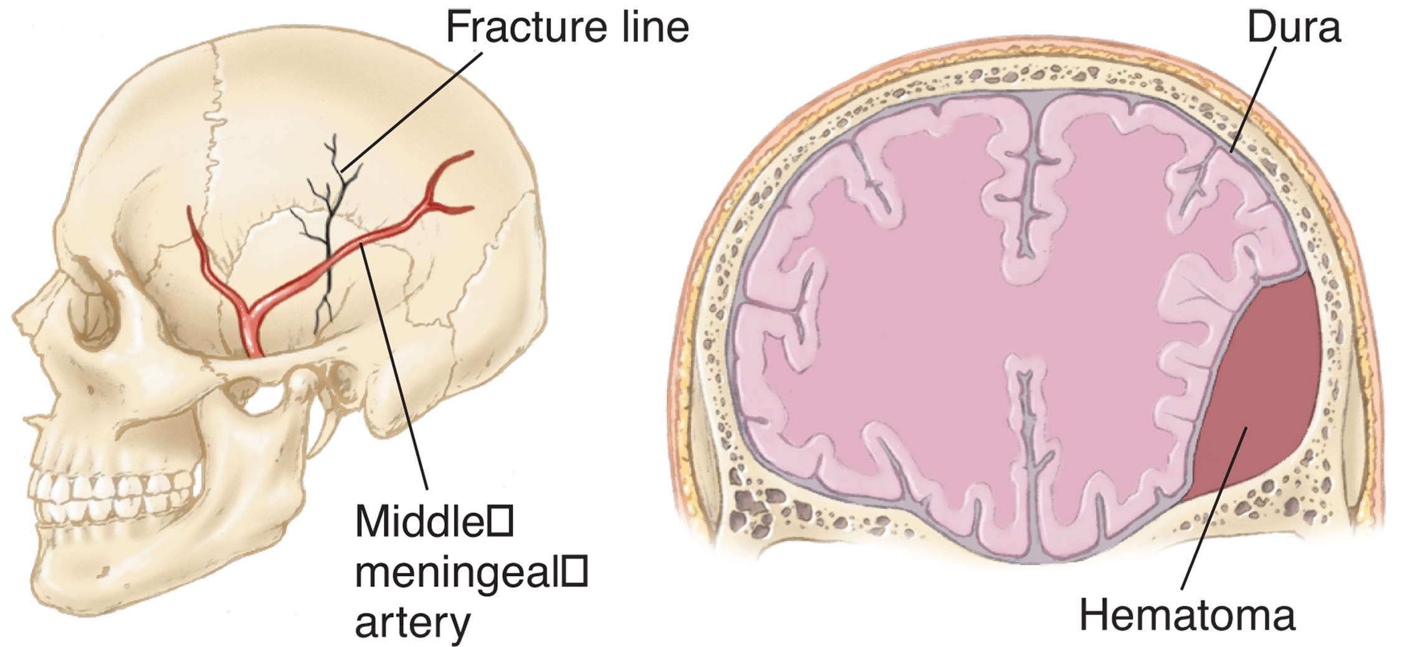
Epidural Hematoma
Notes:
The bleeding expands rapidly in a small space, causing a dramatic rise in intracranial pressure.

Slide 36
Head Injury (18 of 33)
Types of Head and Brain Injuries
  Laceration
    May occur with closed or open injury.
    Results in bleeding and nervous system disruption.
    With isolated head trauma, Cushing reflex can cause the patient’s systolic blood pressure to increase and the heart rate to decrease.
Notes:
If your patient has a subdural or epidural hematoma or brain laceration, but his blood pressure is dropping, the pulse pressure is narrowing, and his heart rate is increasing, you must consider that they could be bleeding somewhere else in the body.

Slide 37
Case Study (2 of 3)
Matt immediately performs in-line spinal stabilization and uses a jaw-thrust maneuver to open the airway, as Luis prepares to suction the airway.
  The patient has bleeding from his nose, a hematoma over the frontal area of his head, and many abrasions to his face.
  His breathing is deep and rapid; his radial pulse is strong at about 60 per minute.
  The patient responds to pain with nonpurposeful movement.
Notes:
Review the Case Study findings presented.

Slide 38
Case Study (3 of 3)
What immediate indications are there of a traumatic brain injury?
What additional information do the E M T s need to obtain through their assessment?
What are the treatment goals for this patient?
Notes:
Use the Case Study content and questions to foreshadow the upcoming lesson content. Gauge the student’s responses as a guide of how well versed they are on this topic.

Slide 39
Click on the Sign That Is Most Consistent with a Concussion
A. Unequal pupils
B. Paralysis on one side of the body
C. Nonpurposeful response to pain
D. A period of unresponsiveness followed by gradually improving mental status

Slide 40
Head Injury (19 of 33)
Assessment-Based Approach: Head Injury
  Scene size-up
    Unresponsiveness or altered mental status suggest head injury.
    Signs of head injury may be apparent.
    Never assume that mental status changes in a trauma patient are due to drug or alcohol intoxication.
Notes:
Knowledge Application
Given a variety of scenarios, students should be able to identify and properly manage patients with head injuries.
Critical Thinking Discussion
How can EMTs' actions help minimize secondary brain injury?
Discussion Questions
What are some general signs and symptoms of brain injury?
What are flexion and extension posturing?

Slide 41
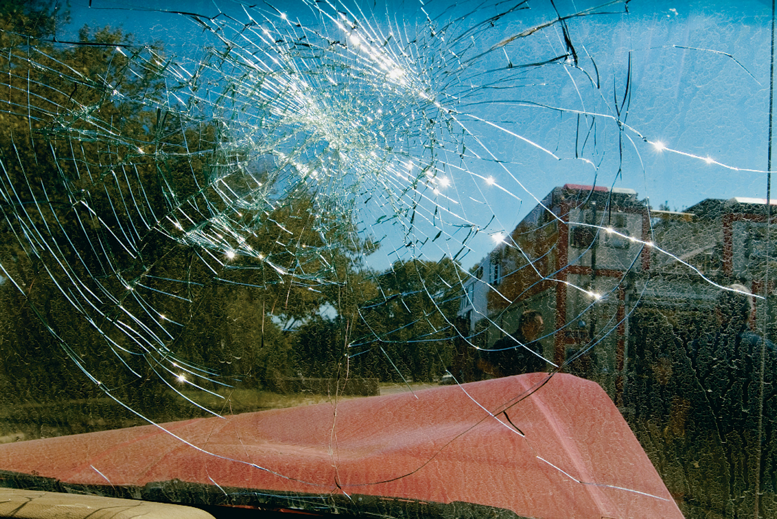
A Fractured Windshield Indicates a Probable Head Injury
Notes:
Signs of head injury can be obvious.

Slide 42
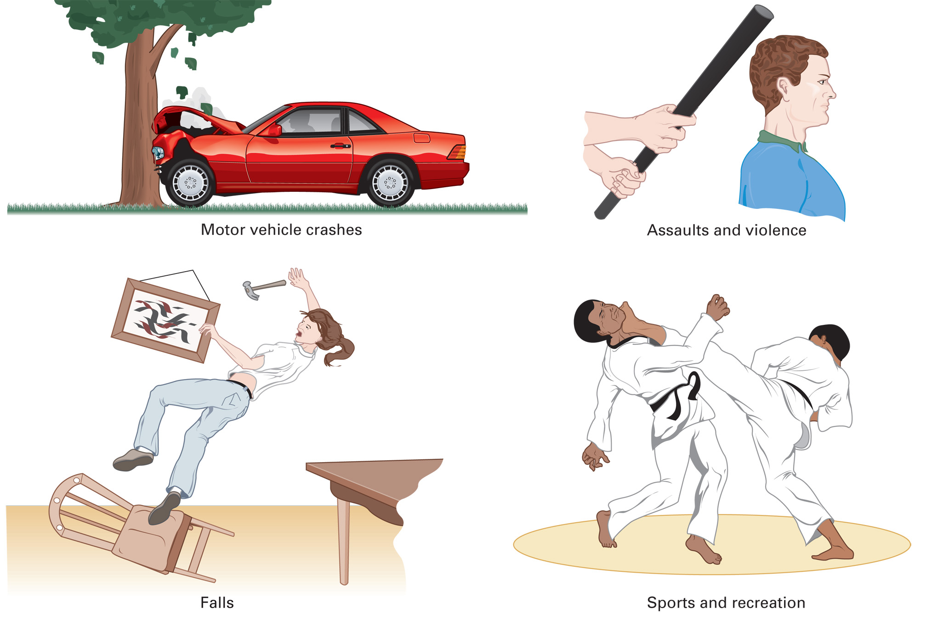
Mechanisms of Head Injury
Notes:
Signs of head injury might include bleeding from the scalp or face or an apparent MOI, such as a fractured windshield at the scene of an automobile crash, a deformed helmet at a crash involving a bicycle or motorcycle, or evidence of a fall.

Slide 43
Head Injury (20 of 33)
Assessment-Based Approach: Head Injury
  Primary assessment
    Manual in-line stabilization of the spine.
    If needed, establish an airway with a jaw-thrust maneuver.
    Maintain an S p O ₂ of 94% or above.
    Use positive pressure ventilation for inadequate breathing.
Notes:
Maintain an adequate airway and oxygenation.

Slide 44
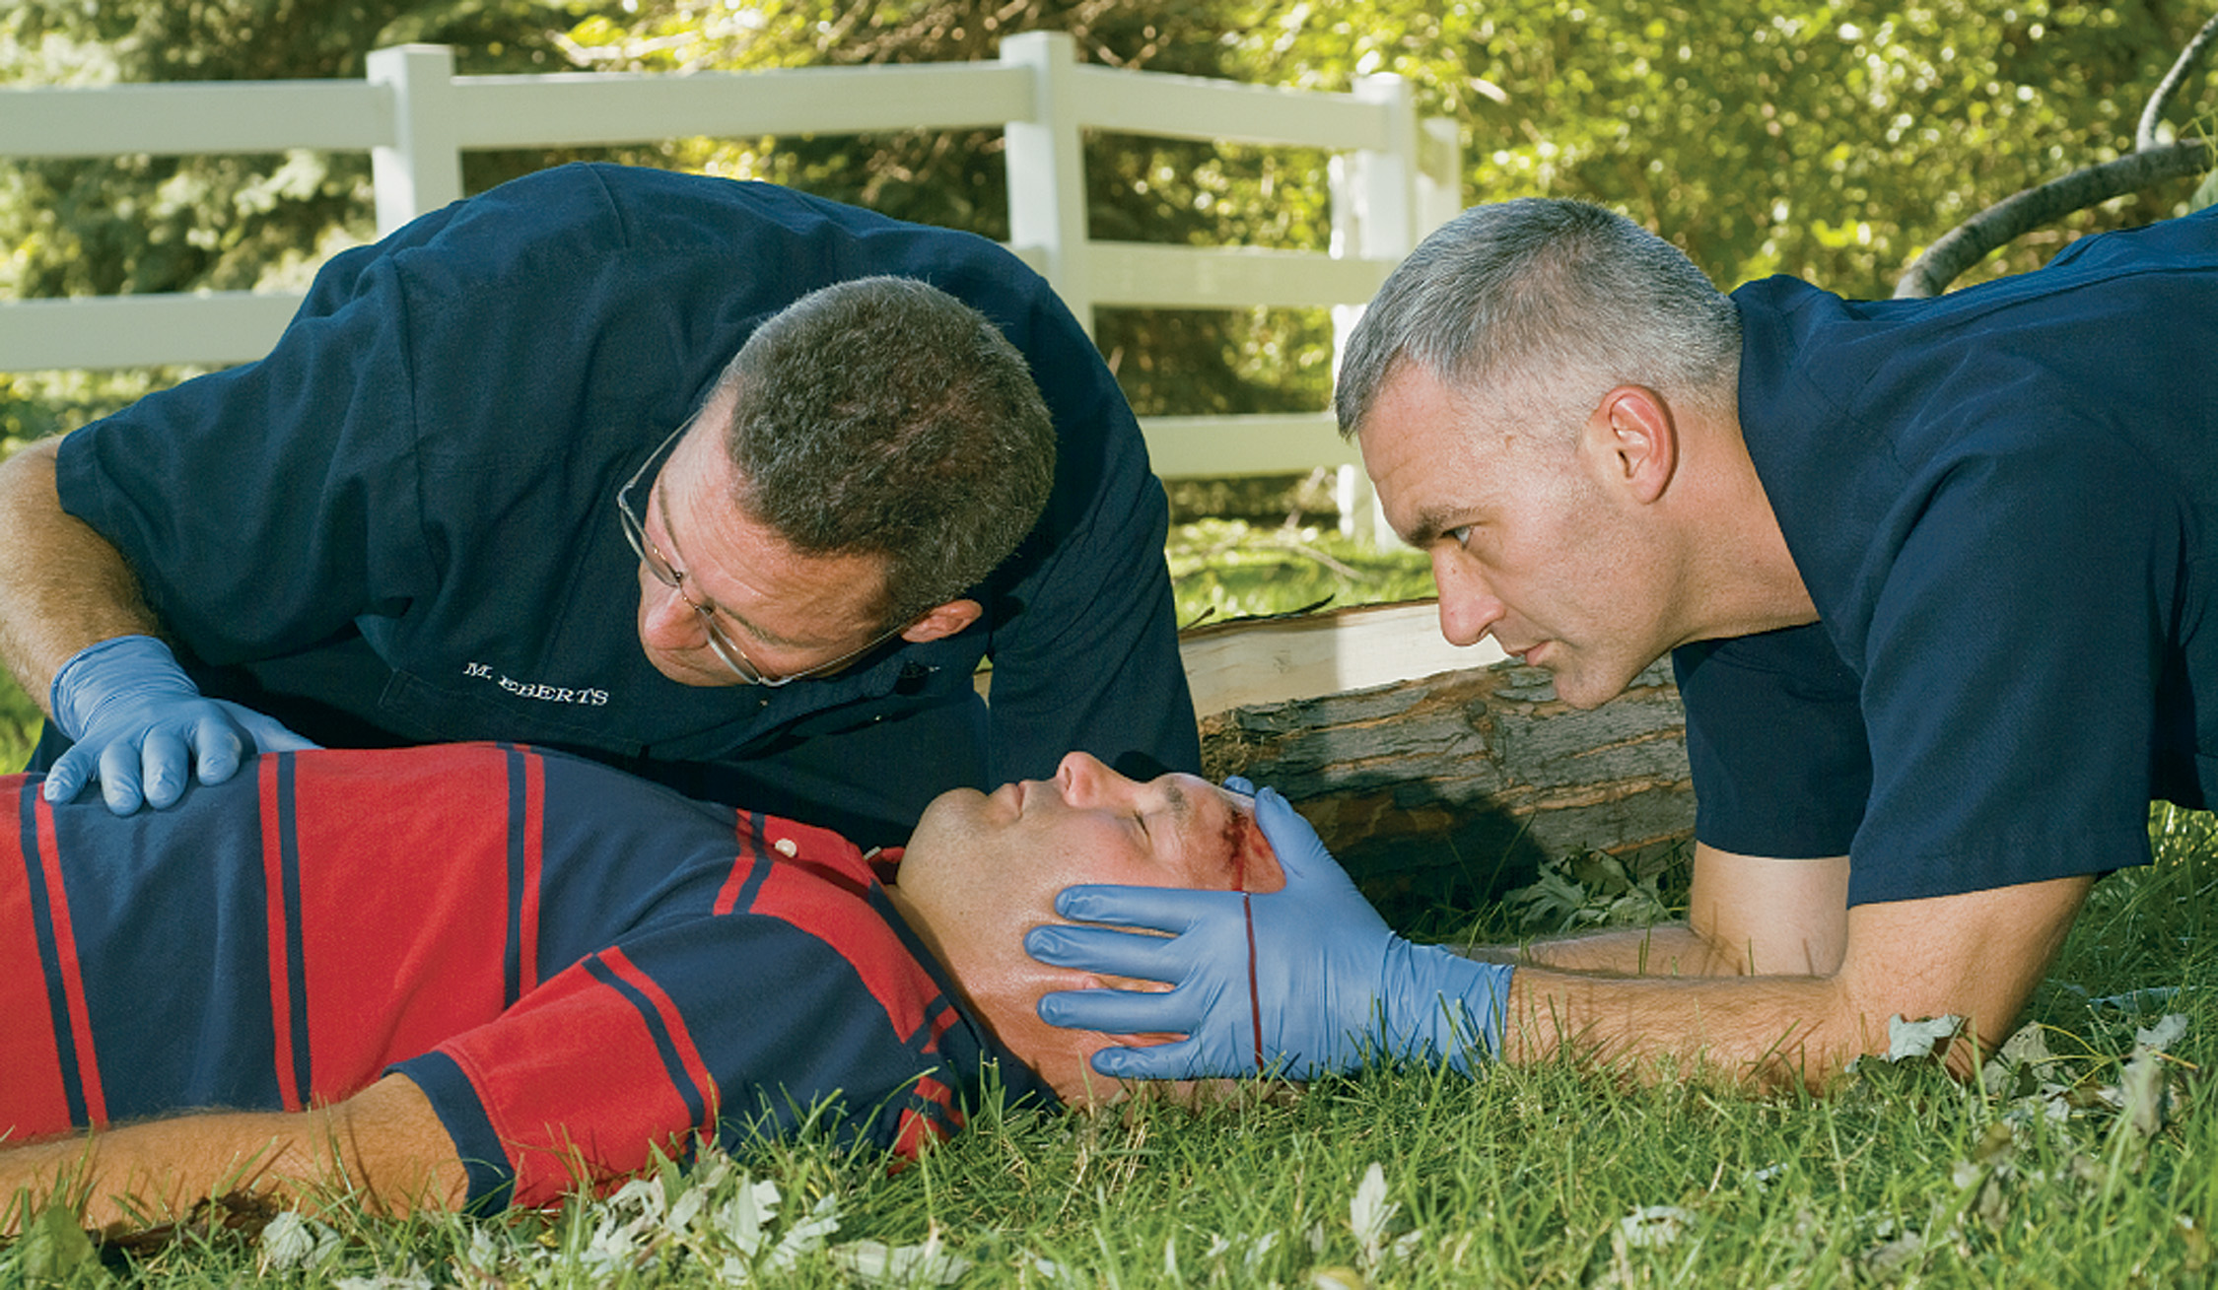
Establish and Maintain Spinal Stabilization. Then Open the Airway and Assess Breathing
Notes:
Maintaining an adequate airway and oxygenation are vital, because head injuries can become worse if there is an inadequate supply of oxygen to the brain.

Slide 45
Head Injuries, Especially Injuries to the Face Such as the Mandible Injury Shown Here, Often Cause Airway Blockage
(© David Effron, M D)
Notes:
Keep in mind that head injuries often involve injury to or blockage of the airway.

Slide 46
Head Injury (21 of 33)
Assessment-Based Approach: Head Injury
  Primary assessment
    Determine the mental status with A V P U.
      Alert
      Verbal
      Painful
      Unresponsive
Notes:
The lowest level on the AVPU scale is “unresponsive.” A patient at this level exhibits no response at all to verbal or painful stimuli. This is an ominous sign in head injury.

Slide 47
Head Injury (22 of 33)
Assessment-Based Approach: Head Injury
  Primary assessment
    The Glasgow Coma Scale is a more precise way to determine the mental status.
    The G C S is a measure of the patient’s eye opening, verbal response, and motor response to different stimuli, generally reproducible by other health care providers.
Notes:
In a prehospital setting, the numerical values on the scale are not as important as the types of responses to specific stimuli.

Slide 48
Table 31-1 Glasgow Coma Scale (1 of 2)
Eye Opening
Spontaneous | 4
To verbal command | 3
To pain | 2
No response | 1
Verbal Response
Oriented and converses | 5
Disoriented and converses | 4
Inappropriate words | 3
Incomprehensible sounds | 2
No response | 1
Notes:
The scale is a measure of the patient’s ability to open his eyes, verbal response, and motor response to different stimuli and is generally reproducible by other health care providers at various levels to monitor trends in the level of the patient’s responsiveness.

Slide 49
Table 31-1 Glasgow Coma Scale (2 of 2)
Motor Response
Obeys verbal commands | 6
Localizes pain | 5
Withdraws from pain (flexion) | 4
Abnormal flexion in response to pain (decorticate rigidity) | 3
Extension in response to pain (decerebrate rigidity) | 2
No response | 1

Slide 50
Head Injury (23 of 33)
Assessment-Based Approach: Head Injury
  Secondary assessment
    Perform a physical exam.
    Anticipate altered pain response.
    Check vital signs.
    Obtain a history, if possible.
Notes:
A patient with a head injury might not complain of pain or other symptoms of trauma. Therefore, it is extremely important to perform a complete physical exam of the patient with a head injury to identify signs of trauma and injury to other areas of the body.

Slide 51
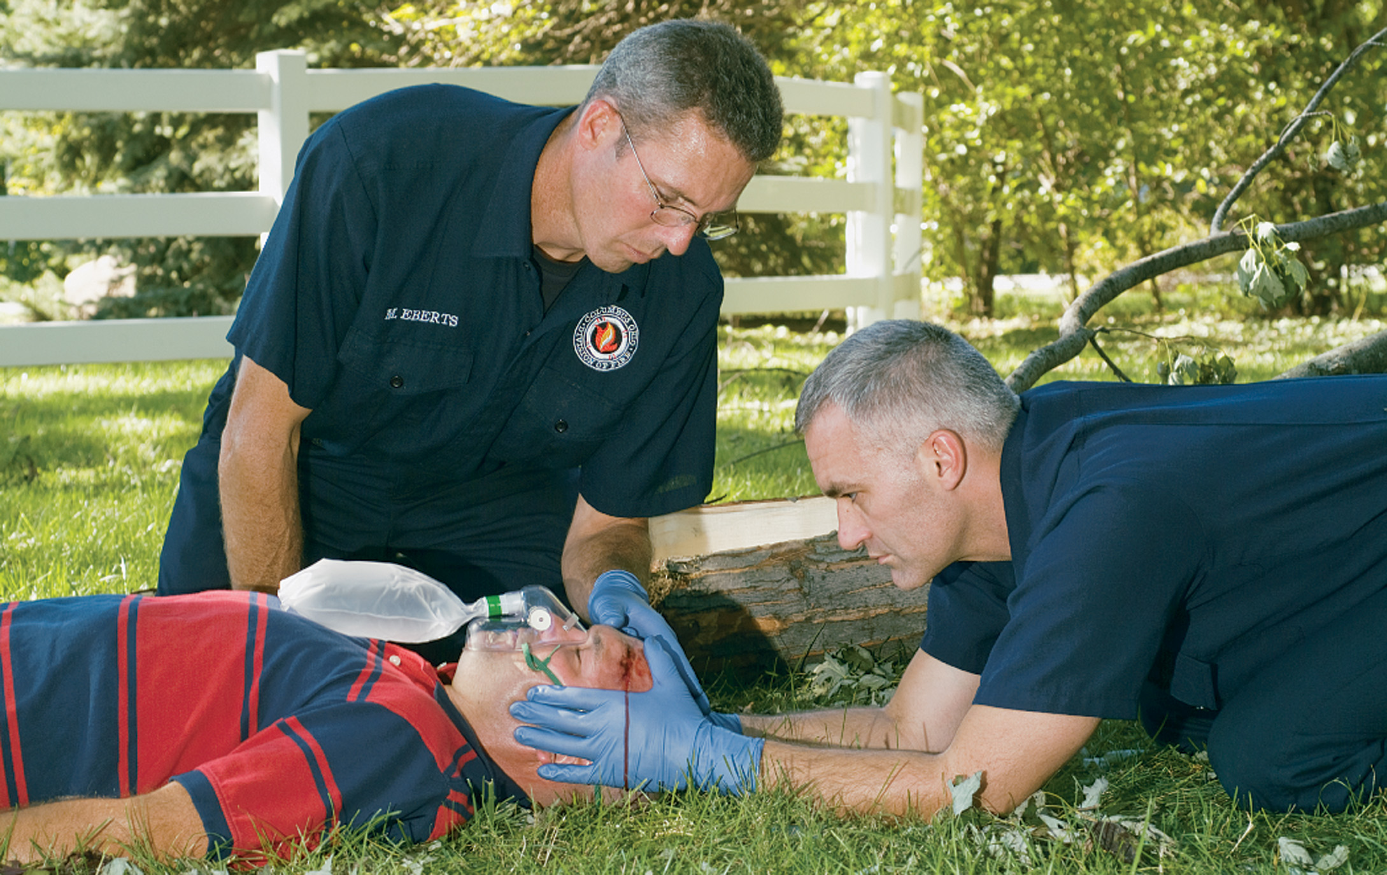
Inspect and Carefully Palpate the Patient’s Head
Notes:
Use extreme care in checking the patient’s head. Be careful not to jab or apply pressure to skull depressions or deformities.

Slide 52
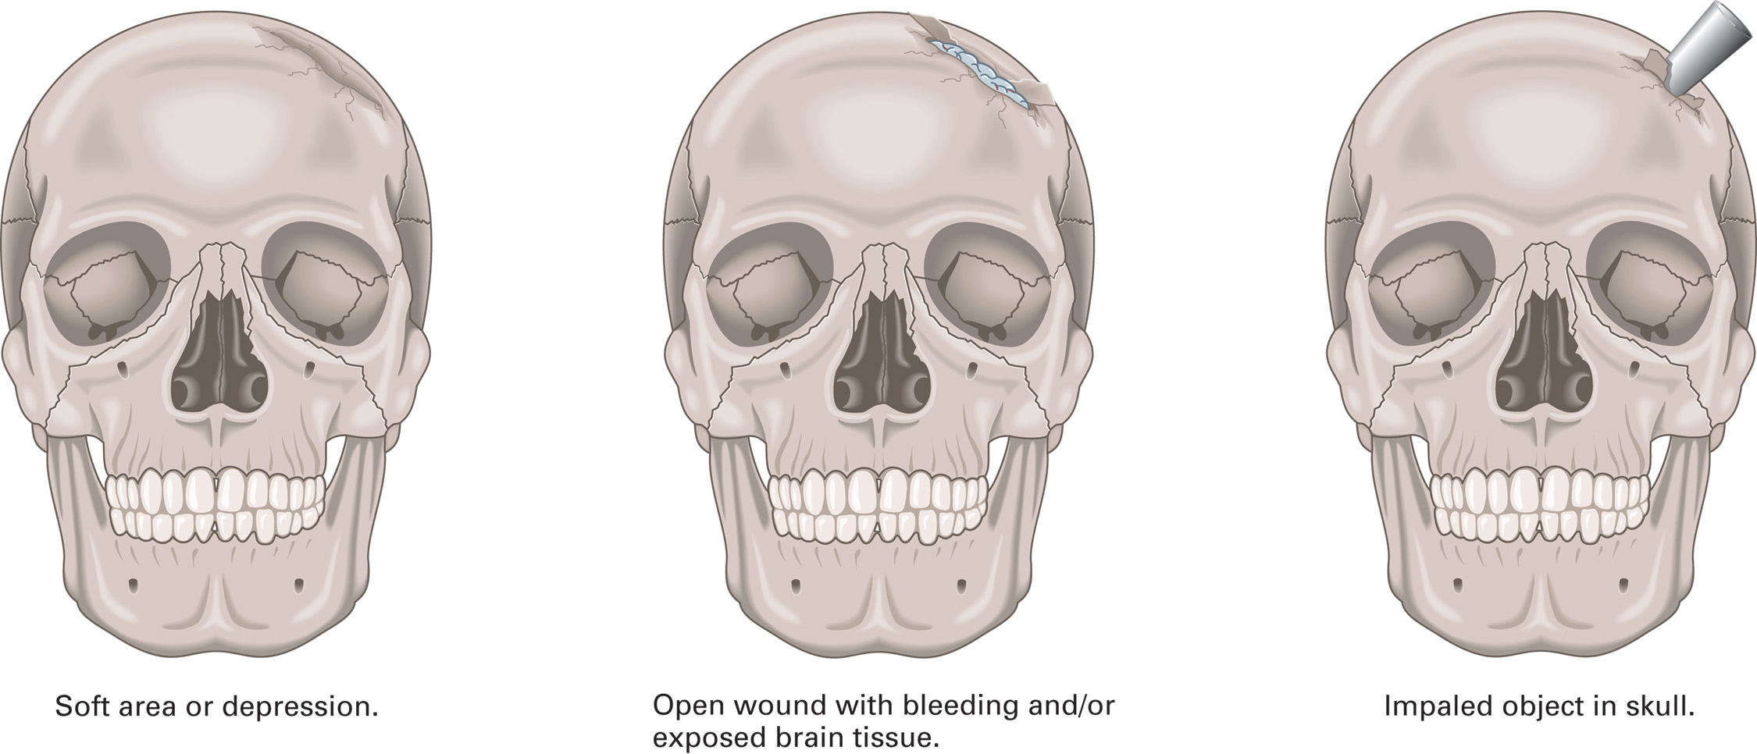
Examine the Head for Deformities, Depressions, Lacerations, or Impaled Objects
Notes:
Palpate for deformities, depressions, lacerations, or impaled objects around the head and face.

Slide 53
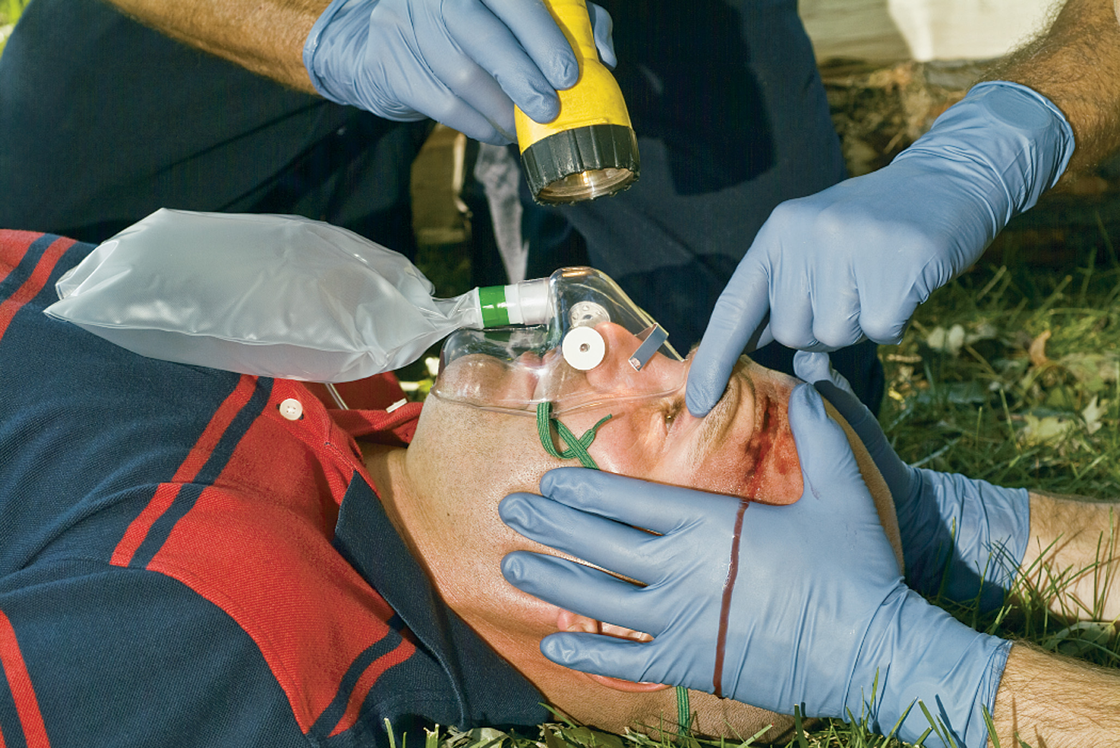
Assess Pupils for Size, Equality, and Reactivity
Notes:
Check the patient’s pupils with a bright light. Are they equal in size? Do they react equally? Both pupils should constrict the same when a light is shined in only one of the pupils. This reflex in the unstimulated eye is known as a consensual reflex. If one or both pupils are fixed and dilated, this can signal an increase in pressure in the brain.
Check eye movements. Do the eyes track (follow movement normally)? Is one eye positioned downward and outward?

Slide 54
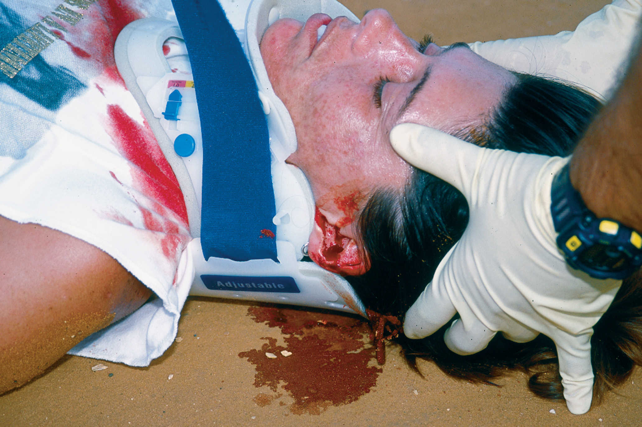
This Patient was Riding on a B M X Track, Doing Flips on a Bicycle without a Helmet or Other Protective Gear
She fell backward and hit her head, causing a cranial injury. Note the blood leaking from her ear.
(© Maria A. H. Lyle)
Notes:
The ears and nose
Check both ears for leakage of blood or clear fluid; a fracture of the base of the skull can cause both.
Battle sign, a purplish discoloration (bruising) of the mastoid area behind the ear, is another delayed and late sign of a basilar skull fracture.
Check the nose for leakage of blood or clear fluid, which can indicate skull fracture or intracranial injury.

Slide 55
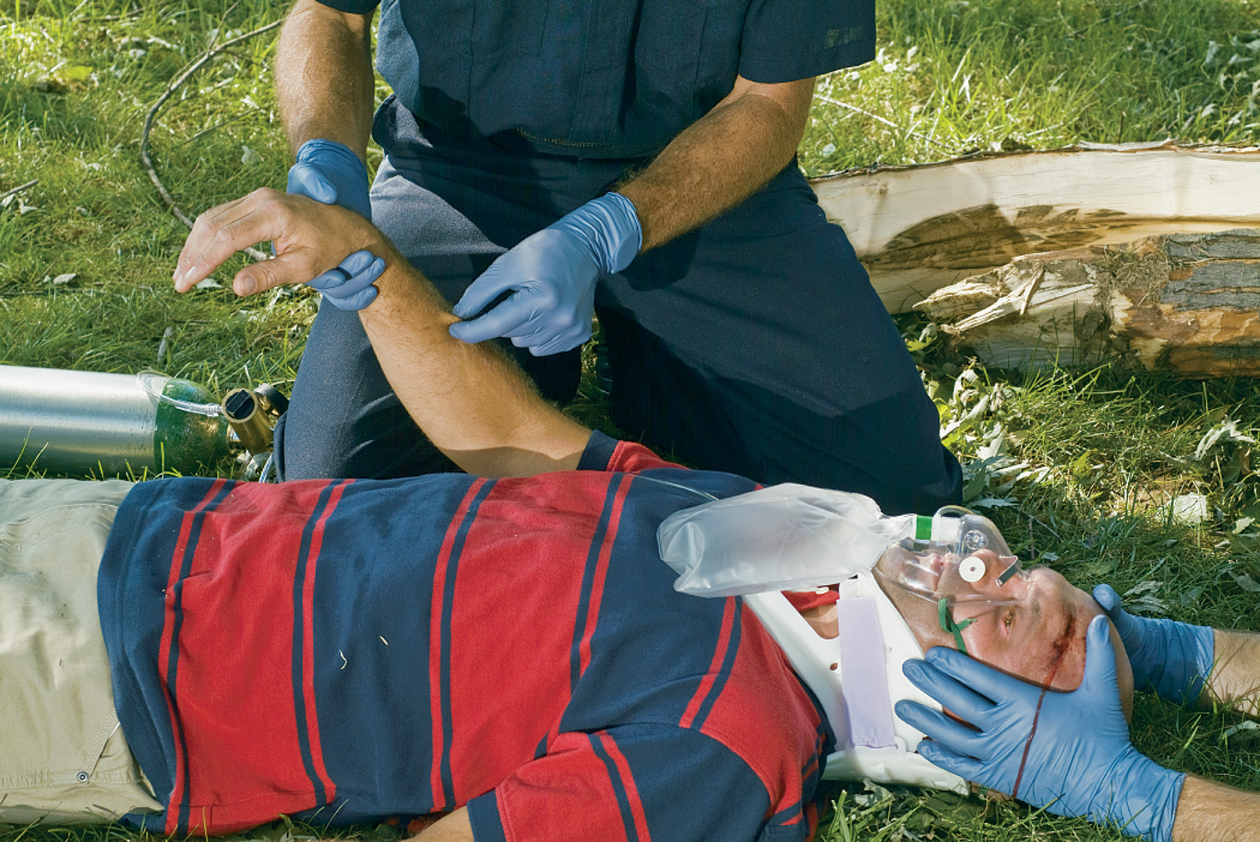
Assess Motor and Sensory Function
Notes:
Motor/sensory assessment. To examine motor and sensory function of an alert patient, check his ability to move his fingers and toes. Have them squeeze your fingers with both hands simultaneously to test for equal grip strength. Ask the patient to tell which finger or toe you are touching without watching what you are doing. Pinch each extremity and ask if they can identify the pain. Ask if the patient feels any weakness on one side of the body compared to the other.

Slide 56
Head Injury (24 of 33)
Assessment-Based Approach: Head Injury
  Secondary assessment
    Vital signs
      Record every five minutes.
      Blood pressure
        High systolic B P indicates increasing intracranial pressure.
        Low B P indicates another source of bleeding.
Notes:
Low blood pressure very early in a patient with a head injury is almost always due to bleeding elsewhere in the body because there is not enough space in the brain to permit enough bleeding to reduce blood pressure.

Slide 57
Head Injury (25 of 33)
Assessment-Based Approach: Head Injury
  Secondary assessment
    Vital signs
      Pulse
        Increased rate indicates another source of bleeding.
        Decreased rate indicates increasing intracranial pressure or severe hypoxia.
Notes:
If the heart rate is fast or increasing, suspect hemorrhaging elsewhere in the body or the early onset of hypoxia.

Slide 58
Head Injury (26 of 33)
Assessment-Based Approach: Head Injury
  Secondary assessment
    Vital signs
      Respirations
        Assess the rate, depth, and pattern.
        Head injury can alter the rate, depth, and pattern.
Notes:
The patient might display several different respiratory patterns if the brain is compressed from increased intracranial pressure resulting from swelling and/or bleeding inside the skull. The respirations might be extremely fast and shallow, completely irregular, or absent (apnea). A sign of severe head injury, increasing intracranial pressure, and possible herniation is the Cushing reflex, in which the systolic blood pressure increases and the heart rate decreases. The respiratory pattern might also change and become irregular.

Slide 59
Head Injury (27 of 33)
Assessment-Based Approach: Head Injury
  Secondary assessment
    If the following signs are present, consider hyperventilation at rate of 20/minute.
      Unequal pupils
      Fixed pupil
      Cushing reflex
      Hemiplegia or hemiparesis
      Decrease of two or more points in the G C S

Slide 60
Head Injury (28 of 33)
Assessment-Based Approach: Head Injury
  Secondary assessment
    History
      Ask questions relevant to head injury.
      Sometimes an injury to the head, days or weeks after an incident in which a patient was knocked unconscious, can reinjure the brain.
Notes:
The following questions are particularly relevant in cases of head injury:
When did the incident occur?
What is the patient’s chief complaint? Did they feel pain, tingling, numbness, or paralysis? Where? How have symptoms changed since the accident?
How did the accident occur? Do they remember the accident?
Did they lose consciousness at any time? This information is critically important in assessing a brain injury. How long was the period of unresponsiveness? When did it occur in relation to the injury? Did the patient suddenly lose consciousness and then gradually reawaken, or did they pass out immediately, suddenly wake up, and then gradually lose consciousness again?
Was the patient moved after the incident?
Has there been a previous injury to the head? If so, when did it occur? Was the patient knocked unconscious? Sometimes an injury to the head in which the patient was knocked unconscious can reinjure the brain, days or weeks after the incident occurred.

Slide 61
Head Injury (29 of 33)
Assessment-Based Approach: Head Injury
  Secondary assessment
    Look for pertinent signs and symptoms
    Retrograde amnesia—the patient is unable to remember circumstances leading up to the incident
    Anterograde amnesia—the patient is unable to remember circumstances after the incident
Notes:
Signs and symptoms of head injury include:
Altered mental status—disorientation to unresponsiveness that doesn’t improve or that continues to deteriorate
Decreasing mental status
Irregular breathing pattern (severe)
Increasing blood pressure and decreasing pulse (Cushing reflex, a late finding) (severe)
Obvious signs of injury—contusions, lacerations, or hematomas to the scalp or deformity to the skull
Visible damage to the skull (visible through laceration in the scalp)
Pain, tenderness, or swelling at the site of injury
Blood or cerebrospinal fluid from the ears or nose
Discoloration (bruising) around the eyes in the absence of trauma to the eyes (raccoon sign—very late)
Discoloration (bruising) behind the ears, the mastoid process (Battle sign—very late)
Absent motor or sensory function (severe or poor response)
Nausea and/or vomiting; vomiting can be forceful or repeated
Unequal pupil size with altered mental status (severe)
Diplopia—double vision
Possible seizures
Nonpurposeful response to painful stimuli (severe).

Slide 62
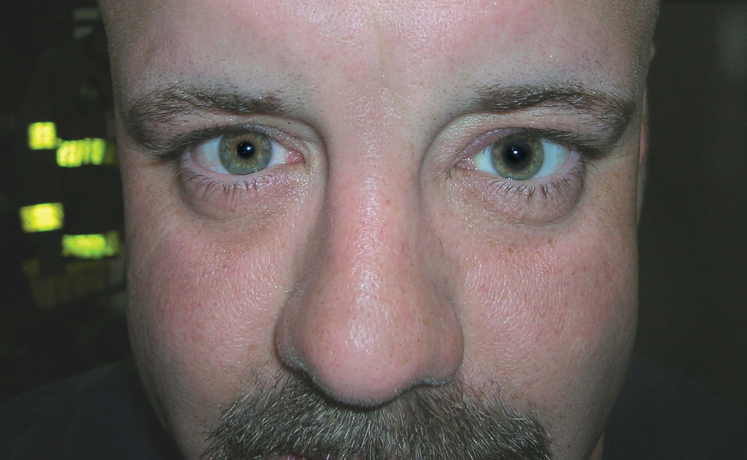
Unequal Pupils
(© Edward T. Dickinson, M D)
Notes:
Both pupils should constrict the same when a light is shined in only one of the pupils. This reflex in the unstimulated eye is known as a consensual reflex.

Slide 63

Nonpurposeful Responses to Painful Stimuli Include Flexion (Decorticate) Posturing
Notes:
Flexion posturing, or decorticate posturing, is a posture in which a patient flexes their arms across their chest and extends their legs. This posture could indicate an upper-level brainstem injury.

Slide 64
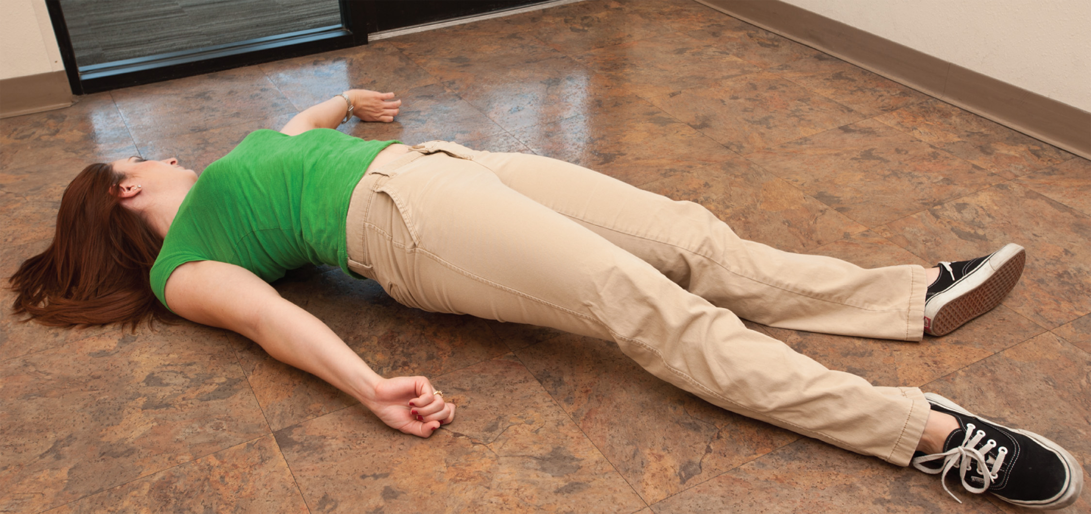
Nonpurposeful Responses to Painful Stimuli Include Extension (Decerebrate) Posturing
Notes:
Extension posturing, or decerebrate posturing, is a posture in which a patient extending both arms at their sides, extends their legs, and sometimes arches their backs. Decerebrate posturing represents the lowest level of nonpurposeful pain response, indicating a lower-level brainstem injury.

Slide 65
Head Injury (30 of 33)
Assessment-Based Approach: Head Injury
  Emergency Medical Care
    Standard Precautions.
    Manual in-line spinal stabilization.
    Maintain the airway, breathing, and oxygenation.
    Consider controlled hyperventilation (20 breaths per minute) if signs of herniation are present.
Notes:
Signs of brain herniation include:
Unequal pupils
Dilated and nonreactive pupils
Decerebrate posturing
No response on motor examination
Continued neurologic deterioration identified as a decrease of 2 or more points in a patient with an initial GCS of 8 or less.

Slide 66
Head Injury (31 of 33)
Assessment-Based Approach: Head Injury
  Emergency Medical Care
    Monitor the airway, breathing, pulse, and mental status for deterioration.
    Control bleeding.
      Do not apply pressure to an open or depressed skull injury.
      Do not stop the flow of blood or fluid from the ears or nose.
Notes:
Do not apply pressure to an open or depressed skull injury; doing so can drive pieces of fragmented bone into the brain tissue.

Slide 67
Head Injury (32 of 33)
Assessment-Based Approach: Head Injury
  Emergency Medical Care
    Be prepared for seizures.
    Continuously monitor mental status.
    Transport immediately.
Notes:
For other wounds, use gentle, continuous direct pressure with sterile gauze only as needed to control bleeding.

Slide 68
Head Injury (33 of 33)
  Assessment-Based Approach: Head Injury
  Reassessment
    Every five minutes.
    Pay close attention to the airway and mental status.
Notes:
Class Activity
Give students 20 to 30 minutes to review the lecture and their textbooks. Divide the class into two teams. Read aloud the In Review questions from the text. The team to ring its bell first gets an opportunity to answer. If the students on the team are correct, they get a point. If they are incorrect, the other team gets an opportunity to answer.

Slide 69
Case Study Conclusion (1 of 3)
Matt and Luis recognize the indications of severe traumatic brain injury. Their priorities are continuing to manage the airway, breathing, and oxygenation while immobilizing the spine in preparation for transport.
En route, they obtain a complete set of baseline vital signs and perform a complete secondary assessment.
Notes:
Review Case Conclusion and emphasize the application of knowledge learned from this presentation.

Slide 70
Case Study Conclusion (2 of 3)
At the hospital, the patient is found to have a severe traumatic brain injury with a subdural hematoma and increased intracranial pressure. He is intubated and there is immediate intervention to relieve the intracranial pressure.
Notes:
Review Case Conclusion and emphasize the application of knowledge learned from this presentation.

Slide 71
Case Study Conclusion (3 of 3)
The patient is admitted to critical care. Despite rapid and appropriate care by all involved, his prognosis for recovery is poor, as it is for many patients with devastating head injuries.
Notes:
Review Case Conclusion and emphasize the application of knowledge learned from this presentation.

Slide 72
Lesson Summary
Brain injuries can be devastating, leading to death or disability.
Increasing I C P worsens damage to the brain and can lead to herniation.
Treatment is aimed at protecting the spine and managing airway, breathing, oxygenation and circulation.
Consider controlled hyperventilation if signs of herniation are present.
Notes:
Follow-Up
Answer student questions.
Follow-Up Assignments
Review Chapter 31 Summary.
Complete Chapter 31 In Review questions.
Complete Chapter 31 Critical Thinking questions.
Assessments
Handouts
Chapter 31 quiz

Slide 73
Correct!
A concussion is characterized by an initial period of unresponsiveness or confusion followed by improving mental status.
Click here to return to the program.

Slide 74
Incorrect (1 of 3)
Unequal pupils are an indication of severe brain injury with increasing intracranial pressure.
Click here to return to the quiz.

Slide 75
Incorrect (2 of 3)
Paralysis on one side of the body is an indication of severe brain injury with increasing intracranial pressure.
Click here to return to the quiz.

Slide 76
Incorrect (3 of 3)
Nonpurposeful response to pain is an indication of severe brain injury with increasing intracranial pressure.
Click here to return to the quiz.

Slide 77

Copyright

