Slide 1

Prehospital: Emergency Care
Eleventh Edition
Chapter 2
Workforce Safety and Wellness of the E M T
    Slides in this presentation contain hyperlinks. JAWS users should be able to get a list of links by using INSERT+F7
Copyright © 2018, 2014, 2010 Pearson Education, Inc. All Rights Reserved
Notes:
If this PowerPoint presentation contains mathematical equations, you may need to check that your computer has the following installed:
1) MathType Plugin
2) Math Player (free versions available)
3) NVDA Reader (free versions available)
During this presentation the student will learn about elements of workforce safety and wellness of the EMT.
Advance Preparation
Assign the associated section of MyBRADYLab and review student scores. Review the chapter material in the Instructor Resources, which includes Student Handouts, PowerPoint slides, and the MyTest Program.
Prepare copies of handouts from the Instructor Resources and other materials for distribution, or post them in your learning management system. Preview the media resources and Master Teaching Notes in this lesson. Preview the case study presented in the PowerPoint slides. Contact a funeral home for a guest speaker on dealing with grieving families. Bring examples of different types of personal protective equipment to show to students. Contact your employer's employee health department, the exercise science department of a local university, or a gym to find a guest speaker on physical fitness.
Describes measures EMTs can take to improve and maintain physical, intellectual, emotional, social, environmental, and spiritual health. The total teaching time recommended is only a guideline as described in the IRM lesson plan. Take into consideration factors such as the pace at which students learn, the size of the class, breaks, and classroom activities. The actual time devoted to teaching objectives is the responsibility of the instructor.

Slide 2
Learning Readiness
E M S Education Standards, text page 19.
Chapter Objectives, text page 19.
Key Terms, text page 19.
Purpose of lecture presentation versus textbook reading assignments.
Notes:
Explain to students what the National EMS Education Standards are. The National EMS Education Standards communicate the expectations of entry-level EMS providers. As EMTs, students will be expected to be competent in these areas. Acknowledge that the standards are broad, general statements. Although this lesson addresses the listed competencies, the competencies are often complex and require completion of more than one lesson to accomplish. The student is also expected to review the chapter objectives to foreshadow what will be in the chapter, and by mastering the key terms the EMT student will better understand the learning and be able to communicate more clearly.
Additionally, explain to the students that the purpose of using these slides is to help keep the instructor focused on highlighting important portions of the material, explain interrelationships of topics, and discuss how to apply this information. It is not the intent of the presentation (or slides alone) to include every component in the chapter. This presentation still requires the student to thoroughly read the chapter.

Slide 3
Setting the Stage
Overview of Lesson Topics
  Emotional aspects of emergency care
  Scene safety
  Wellness principles
Notes:
Introduction
During this lesson, students will learn about methods of safeguarding themselves from stress, body substances, and other hazards.

Slide 4
Case Study Introduction
E M Ts Connor Fleisher and Melinda Jurgens are approaching unit 121 at Ashford Springs, an assisted living facility, where they were dispatched for a report of a sick person.
Notes:
Case Study Discussion
Use the case study content and questions to foreshadow the upcoming lesson content.
Case Study
Present the Case Study Introduction provided in the PowerPoint slide set. Lead a discussion using the case study questions provided on the subsequent slide(s).
The Case Study with discussion questions continues throughout the PowerPoint presentation.

Slide 5
Case Study (1 of 11)
Are there particular issues that should be anticipated when responding to an assisted living facility?
What hazards should the E M Ts be looking for in this situation?
What actions should they consider in anticipation of potential hazards?

Slide 6
Introduction
E M S providers’ safety is the first priority on every call.
E M Ts must be prepared to deal with emotions of patients and their family members.
E M Ts must be concerned with their own physical and emotional wellness.

Slide 7
Emotional Aspects of Emergency Care (1 of 12)
Death and dying
  Inherent parts of emergency medicine
Five emotional stages:
  Denial
  Anger
  Bargaining
  Depression
  Acceptance
Notes:
Points to Emphasize
Death and dying are inherent parts of emergency medical care. You must care for the dying patient’s emotional needs and his injuries or illnesses. If the patient has suffered a sudden death, you may also need to help the family or bystanders deal with the situation.
Teaching Tips
To help students relate to the five emotional stages of loss, ask them to think of examples of each of the emotional reactions in response to a loss or disappointment in their own lives, such as loss of a job or important relationship. Even the impending loss of an important basketball or football game can bring about these feelings, although not as intensely.

Slide 8
Review Questions (1 of 5)
Click the statement on the right that represents the thought process of a person in the stage of grief below:
“Oh please, if you just let my husband be ok, I’ll be a better person.”
“No! I can’t believe this. This can’t be happening!”
“This is the doctor’s fault. He should have tested me sooner. I am going to sue him!”
“I can’t go through this. I can’t get up every day knowing I only have a few months to live.”
“I know my wife is gone, but life goes on, and I will honor her memory in my actions.”
Denial

Slide 9
Review Questions (2 of 5)
Click the statement on the right that represents the thought process of a person in the stage of grief below:
“Oh please, if you just let my husband be ok, I’ll be a better person.”
“This is the doctor’s fault. He should have tested me sooner. I am going to sue him!”
“No! I can’t believe this. This can’t be happening!”
“I can’t go through this. I can’t get up every day knowing I only have a few months to live.”
“I know my wife is gone, but life goes on, and I will honor her memory in my actions.”
Anger

Slide 10
Review Questions (3 of 5)
Click the statement on the right that represents the thought process of a person in the stage of grief below:
“I know my wife is gone, but life goes on, and I will honor her memory in my actions.”
“No! I can’t believe this. This can’t be happening!”
“This is the doctor’s fault. He should have tested me sooner. I am going to sue him!”
“I can’t go through this. I can’t get up every day knowing I only have a few months to live.”
“Oh please, if you just let my husband be ok, I’ll be a better person.”
Bargaining

Slide 11
Review Questions (4 of 5)
Click the statement on the right that represents the thought process of a person in the stage of grief below:
“Oh please, if you just let my husband be ok, I’ll be a better person.”
“No! I can’t believe this. This can’t be happening!”
“This is the doctor’s fault. He should have tested me sooner. I am going to sue him!”
“I can’t go through this. I can’t get up every day knowing I only have a few months to live.”
“I know my wife is gone, but life goes on, and I will honor her memory in my actions.”
Depression

Slide 12
Review Questions (5 of 5)
Click the statement on the right that represents the thought process of a person in the stage of grief below:
“Oh please, if you just let my husband be ok, I’ll be a better person.”
“No! I can’t believe this. This can’t be happening!”
“This is the doctor’s fault. He should have tested me sooner. I am going to sue him!”
“I know my wife is gone, but life goes on, and I will honor her memory in my actions.”
“I can’t go through this. I can’t get up every day knowing I only have a few months to live.”
Acceptance

Slide 13
Emotional Aspects of Emergency Care (2 of 12)
Dealing with the dying patient, their family members, and bystanders
  E M T has obligation to help the patients and others.
  Each individual may be in their own respective stage.
  Textbook lists several ways to reduce their emotional burden (page 21).
Notes:
Class Activity
Have students divide into small groups and role play communicating with a dying patient or family members of a patient who has died, using the guidelines under Dealing with the Dying Patient, Family, and Bystanders. After 10 to 15 minutes, ask each group to share examples of things that demonstrated each of the guidelines listed.

Slide 14
Case Study (2 of 11)
Connor and Melinda are met at the door by a young woman who has been crying. The woman says, “It’s my grandfather. His name is James Bennett. He has heart failure and kidney failure, but he is a lot worse today. My mom called and said he has a high fever and is disoriented.”
Notes:
Review case with students.

Slide 15
Case Study (3 of 11)
How should Connor and Melinda interact with Mr. Bennett?
What can they say or do to help comfort his family?
What is the significance of knowing the patient has a fever?
Notes:
Invite students to respond, or selectively choose students that may not participate as much to offer suggestions on how to interact with Mr. Bennet. Use this case study to further apply and integrate the aforementioned strategies for reducing their emotional burden.
A fever indicates the patient may have an infection, which would be more of an acute change in the patient’s status, possibly heralding sudden deterioration of the patient. The goal here is to identify there is a change in the patient’s status, not get lost in a pathophysiological discussion pyrexia and metabolic causes of altered mental status.

Slide 16
Emotional Aspects of Emergency Care (3 of 12)
High stress situations and stressors related to the profession
  Long hours
  Boredom between calls
  Working too much, too hard
  Getting little recognition
  Having to respond instantly
Notes:
Points to Emphasize
EMS is a rewarding career, but it can be emotionally demanding.
Discussion Question
What are some examples of high-stress situations in EMS?
Critical Thinking Discussion
Why is it important for EMT students to understand the emotional aspects of EMS early in the EMT course?

Slide 17
Emotional Aspects of Emergency Care (4 of 12)
  High stress situations and stressors related to patient care
  Making life-and-death decisions, fearing serious errors
  Being responsible for someone’s life
  Abuse and neglect of pediatrics and geriatrics
  Caring for infants and children
  Mass casualty incidents
  Injury or death of a coworker
Notes:
Patients, families, and bystanders are not the only ones who experience extreme stress in an emergency situation. The EMT does, too. Accepting and understanding that fact is the first step in learning how to handle it in healthy ways.
Points to Emphasize
EMS is a rewarding career, but it can be emotionally demanding
Discussion Question
What are some examples of high-stress situations in EMS?
Critical Thinking Discussion
Why is it important for EMT students to understand the emotional aspects of EMS early in the EMT course?

Slide 18
Emotional Aspects of Emergency Care (5 of 12)
Stress Reactions
  E M Ts may suffer three types of stress reactions:
    Acute stress reaction
    Delayed stress reaction
    Cumulative stress reaction (i.e. burnout)
Notes:
Teaching Tips
Ask students to recall some of the emotions and physical feelings they have felt when they have experienced a stressful situation.
Points to emphasize
An EMT may experience three basic types of stress reactions as a result of a high-stress incident or from constant exposure to stressful situations. Discuss and delineate the three types of stress reactions, and as possible, give real-life situations where this has happened in your own career.

Slide 19
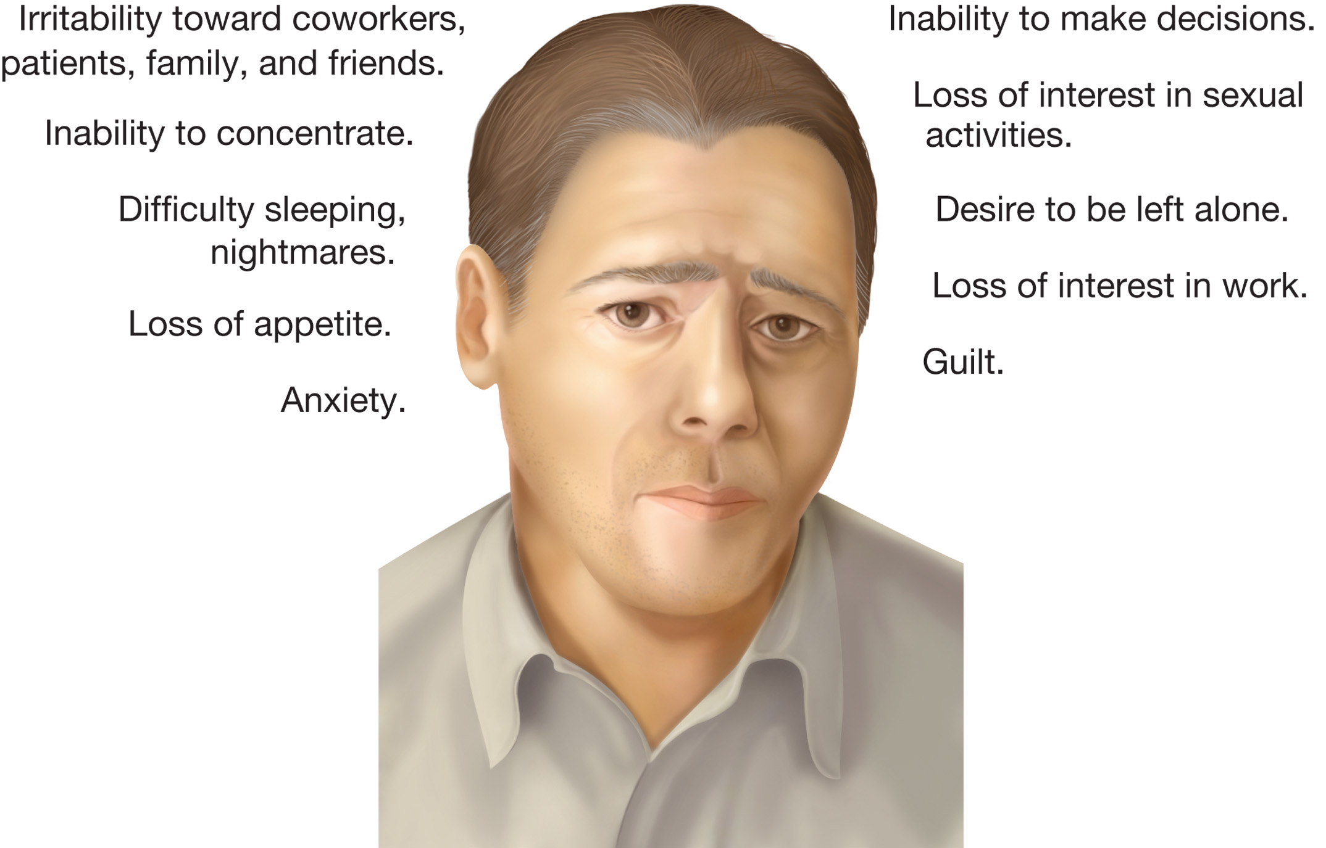
Emotional Aspects of Emergency Care (6 of 12)
Stress Reactions
  General categories of stress findings
    Thinking
    Psychological
    Physical
    Behavioral
    Social
Notes:
General categories of signs and symptoms also have been identified with stress. In addition to the warning signs discussed, review these categories.

Slide 20
Emotional Aspects of Emergency Care (7 of 12)
Stress Management
  Making lifestyle changes by the E M T
    Avoid self medication
    Exercise often
Notes:
Knowledge Application
Give a scenario in which a friend or family member is experiencing stress due to the EMT’s job. Ask students for responses to help the friend or family member understand and cope.
Describe various EMS work situations to the class. Ask what changes can be made to manage job-related stress.

Slide 21
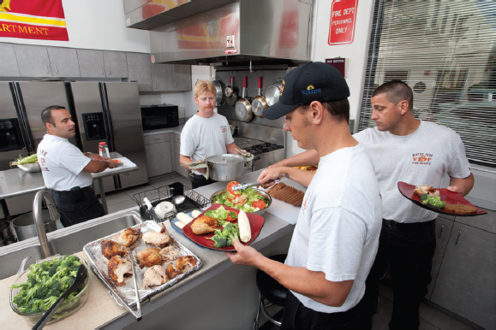
Emotional Aspects of Emergency Care (8 of 12)
Stress Management
  Making lifestyle changes by the E M T
    Diet considerations
    Learn to relax
  Take measures to maintain balance in your life
Notes:
Discussion Question
How can you "eat on the run" as EMS providers sometimes do, and still make healthy choices about food and drink?
Class Activity
Divide students into small groups. Have each group plan a healthy menu for breakfast, lunch, and dinner for a day at work. Have groups share their ideas with the rest of the class.
One way to keep a balance of work, recreation, family, health, and other interests is to assess your priorities. You can also share your worries with someone else. Talking to someone you trust and respect can help relieve stress. Still another way to help keep balance in your life is to accept the fact that you will occasionally make mistakes. Honestly admit to yourself that no person is right all of the time, and understand that a mistake does not reduce your value. You do not have to be perfect to do a good job.

Slide 22
Emotional Aspects of Emergency Care (9 of 12)
Stress Management
  Recognize the responses of family and friends:
    Lack of understanding
    Fear of separation
    Inability to plan
    Frustrated desire to share
Notes:
Help family and friends understand the nature of your work and what you do for patients. Talk to them. Describe how you feel about what you do. Answer their questions. Explaining the safety precautions you and coworkers take every day can ease their anxieties. Always include time with them on your list of priorities.

Slide 23
Emotional Aspects of Emergency Care (10 of 12)
Stress Management
  Make changes in your work environment.
    Develop a buddy system with a coworker.
    Encourage and support coworkers, resist the temptation to dwell on the negative.
    Take a break to exercise.
    Request shifts that allow more relaxation.
    Seek professional help if necessary.
Notes:
Discuss these changes in the work environment to better help one manage stress both inside and outside of work. Reinforce that seeking professional help is not a sign of weakness, rather one of strength as this represents the willingness of a person to remain mentally healthy in all aspects of one’s life.

Slide 24
Emotional Aspects of Emergency Care (11 of 12)
Critical Incident Stress Management
  Symptoms of burnout may occur after exposure to a critical incident.
  Sufferers of critical incident stress also may have repeated mental images of the situation, inability to function on subsequent calls, and fear of continuing work in E M S.
Notes:
Emergency service personnel who suffer critical incident stress develop many of the signs and symptoms of burnout. They also may suffer from repeated mental images of the incident, fear of continuing in EMS work, and an inability to function at the scene of subsequent emergencies. Critical incident stress management (CISM) is a process to deal with stress encountered by the EMT. It consists of two different approaches to stress management: critical incident stress debriefing and critical incident defusing.

Slide 25
Emotional Aspects of Emergency Care (12 of 12)
The critical incident stress management (C I S M) process consists of two approaches:
  Critical incident stress debriefing (C I S D)
  Critical incident stress defusing
Notes:
A critical incident stress debriefing (CISD) is ideally held within 24 to 72 hours of a critical incident. During CISD, a team of peer counselors and mental health professionals help emergency service personnel work through seven phases.
Defusing is a version of CISD held up to 8 hours following a critical incident. It is attended only by those most directly involved in the critical incident and lasts only 30 to 45 minutes. Less structured than a CISD meeting, defusing gives the smaller group of emergency service personnel an opportunity to vent their emotions and get information they may need before the larger group meets for CISD.
Comprehensive CISM should include:
• Preincident stress education
• On-scene peer support
• One-on-one support
• Disaster support services
• Defusing
• CISD
• Follow-up services
• Spouse and family support
• Community outreach programs
• Other health and welfare programs

Slide 26
Case Study (4 of 11)
Connor assures the family that he and Melinda are there to help and that they will let the family know what their findings are. The E M Ts pull on disposable exam gloves as they ask about symptoms that may be related to infectious diseases against which they should take additional precautions.

Slide 27
Case Study (5 of 11)
What signs and symptoms may indicate that the patient has a communicable illness?
What factors should the E M Ts take into considerations in deciding whether it is necessary to use Standard Precautions other than gloves?
As they approach the patient, are there other safety considerations?
Notes:
Discuss the case study questions with the students. Allow proper use of “silence” should no one initially venture an answer. Eventually, students will start talking. The educator’s role in this is to guide the conversation to ensure that proper concepts and techniques are being reinforced by the students, not simple what the student have seen others do.

Slide 28
Scene Safety (1 of 35)
What is scene safety?
  Taking appropriate measures to protect yourself from infectious diseases
  Following proper rescue procedures
  Handling violence properly
  Being an advocate for safety
Notes:
Keeping yourself safe at the scene of an illness or injury involves taking appropriate measures to protect yourself from infectious disease, following proper rescue procedures, and knowing how to handle violence, especially at a crime scene. It is also important to be an advocate for these protective measures—to help keep fellow emergency service personnel, as well as yourself, safe and well. Unless specifically trained and given the authority to do so, the EMT is never expected to act in any other capacity than that of a medical responder.

Slide 29
Scene Safety (2 of 35)
Protecting Yourself from Disease
  Infectious diseases are caused by pathogens, which include:
    Bacteria
    Viruses
    Fungi
    Protozoa
    Helminths
Notes:
As an EMT, you will often come into close contact with patients who are suffering from various diseases and you will often work in contaminated environments. It is important to know how diseases spread and how to protect yourself from them. Pathogens spread in a number of ways, including by blood and other body fluids or through the air. Infectious diseases are contracted from a pathogen transmission, but are not necessarily communicable.
Discussion Question
What are simple ways you can protect yourself from on-the-job illness and injury every day?
Teaching Tips
Have examples of gloves, eye and face protection, gowns, and other personal protective equipment available for students to see and try out.
Knowledge Application
Give several descriptions of patients. Ask what types of PPE should be used.

Slide 30
Scene Safety (3 of 35)
Types of Pathogens
  Bacteria
    Single-celled organisms that can reproduce
    Usually respond to antibiotic therapy (when needed)
Notes:
Discuss different types of bacteria and the common conditions they cause.

Slide 31
Scene Safety (4 of 35)
  Types of Pathogens
  Viruses
    Require a host to reproduce
    Invade cells in order to reproduce new viral particles
    Not responsive to antibiotics; there are few medications to treat viral infections
    Most cause mild, self-limiting illnesses
Notes:
Discuss different types of viruses and the common conditions they cause. Include a discussion regarding AIDS, HIV, hepatitis, SARS, RSV, chicken pox, EID, Ebola and Zika virus.

Slide 32
Scene Safety (5 of 35)
  Types of Pathogens
  Fungi
    Plant-like microorganisms
    Usually do not cause illness when the immune system is functioning normally
    Can be a problem in patients with immune deficiency
Notes:
Discuss different types of fungi and the common conditions they can cause such as pneumonia in the HIV infected patient.

Slide 33
Scene Safety (6 of 35)
  Types of Pathogens
  Protozoa
    Single-celled organisms capable of movement
    Often found in the soil
    Illnesses include:
      Some forms of gastroenteritis
      Some vaginal infections
      Malaria
Notes:
Discuss different types of protozoa and the common conditions they cause. Discuss the fecal-oral route, and that malaria is from a protozoa that is carried by mosquitoes.

Slide 34
Scene Safety (7 of 35)
  Types of Pathogens
  Helminths (parasitic worms)
    Examples include:
      Roundworms
      Flukes
      Tapeworms
      Hookworms
Notes:
Discuss different types of helminths and the common conditions they cause such as a hookworm infection of the GI that leads to blood loss and anemia.
Class Activity
Have students research information from the newspaper (or other news media) or EMS websites for articles that involved an EMS response. Have students bring in their articles and discuss what actions EMS personnel might have taken to protect their health and safety.

Slide 35
Scene Safety (8 of 35)
Protecting Yourself from Disease
  Infectious disease are contracted from pathogens.
  Some infectious diseases can be passed from person to person, and are called communicable diseases.
  Diseases can be spread directly or indirectly.

Slide 36
An Open Sore on the Arm of an Apparent Drug User is an Example of an Open Wound that has the Potential to Spread Infection

Slide 37
Scene Safety (9 of 35)
Protecting Yourself from Disease
  Standard Precautions
    Guidelines developed by O S H A to protect health care workers from communicable disease.
    Employers must ensure that the Standard Precautions are available, and must have a written exposure control plan.

Slide 38
Scene Safety (10 of 35)
Protecting Yourself from Disease
  Standard Precautions
    Hand washing
      Wet
      Lather
      Scrub
      Rinse
      Dry
Notes:
Hand washing reduces the spread of infection to you as the provider and from you who could pass it from patient-to-patient. Hand washing is the single most important way you can prevent the spread of infection. You should wash your hands even if you wear gloves.

Slide 39
Scene Safety (11 of 35)
  Protecting Yourself from Disease
  Alcohol-based hand sanitizer can be used when you do not have access to soap and water.
    Use a product with at least 60 percent alcohol.
    As soon as possible, wash with soap and water.
Notes:
Alcohol-based hand sanitizer can be used if you do not have access to soap and running water in the field. According to the CDC, you should use an alcohol-based hand sanitizer that contains at least 60 percent alcohol. Sanitizers don’t eliminate all of the germs; therefore, be sure to wash your hands thoroughly as soon as possible.

Slide 40
Scene Safety (12 of 35)
  Protecting Yourself from Disease
  Personal protective equipment (P P E)
    Eye protection

Slide 41
Scene Safety (13 of 35)
  Protecting Yourself from Disease
  Personal protective equipment (P P E)
    Protective gloves

Slide 42
Scene Safety (14 of 35)
  Protecting Yourself from Disease
  Personal protective equipment (P P E)
    Gowns
    Masks

Slide 43
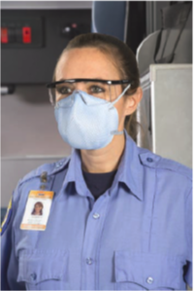
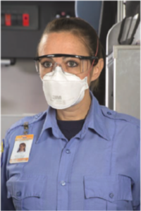
Scene Safety (15 of 35)
  Protecting Yourself from Disease
  Personal protective equipment (P P E)
    H E P A respirator
    N - 9 5 respirator
Notes:
Discuss the use of high efficiency particulate air respirators or an N-95 respirator when the EMT suspects the patient may have tuberculosis.

Slide 44
E M T Skills 2-1
Safe Glove Removal

Slide 45
Follow a Safe Technique for Removal of Gloves
Use only contaminated glove surfaces to touch other contaminated glove surfaces, and use clean inside glove surfaces to touch other clean inside glove surfaces. Do not touch a contaminated surface with your bare hand or fingers.

Slide 46
Use a Gloved Finger to Pull a Cuff out and Down on the Other Glove
Do not touch the inside of the glove.

Slide 47
Without Touching the Inside of the Glove, Continue Pulling it Downward

Slide 48
Crumple the Contaminated Glove in the Hand Still Wearing a Contaminated Glove and Discard it in a Biohazard Receptacle
Ensuring that it does not touch any clean surfaces.

Slide 49
Begin to Remove the Other Glove by Inserting Clean, Uncontaminated Fingers into the Uncontaminated Inside of the Remaining Glove Cuff

Slide 50
Continue to Roll the Glove off Your Hand, Being Sure Your Clean Hand Touches Only the Clean Inside Surfaces of the Second Glove

Slide 51
Drop the Glove into the Biohazard Receptacle
Being careful that the contaminated glove does not touch your clean hands nor any other clean surface

Slide 52
Scene Safety (16 of 35)
Protecting Yourself from Disease
  Additional guidelines
    Use disposable equipment.
    Wash soiled clothing/uniforms.
    Document any exposures.
    Bag infectious items.
Notes:
Discuss the above guidelines as part of routine patient care and preparation for the next call or shift.

Slide 53
Scene Safety (17 of 35)
Protecting Yourself from Disease
  Additional guidelines
    Use sharps containers.
    Clean up blood/body fluids.
    Clean visible soil from nonhorizontal walls.
    Always wash hands thoroughly.
Notes:
Discuss the above guidelines as part of routine patient care and preparation for the next call or shift.

Slide 54
Scene Safety (18 of 35)
Protecting Yourself from Disease
  Additional guidelines
    Cleaning
    Disinfecting
    Sterilization
Notes:
Cleaning, disinfecting, and sterilizing are all related terms. Cleaning is simply the process of washing a soiled object with soap and water. It is a mechanical process that uses only friction. Disinfecting includes cleaning, it also involves using a hospital-grade disinfectant or germicide to kill many of the microorganisms that may be present on the surface of the object. It is a chemical process. Sterilization is the process by which an object is subject to a chemical or physical substance (such as superheated steam in an autoclave) that kills all microorganisms on the surface of an object.

Slide 55
Scene Safety (19 of 35)
  Protecting Yourself from Disease
  Immunizations
  Influenza (annually)
  Tetanus (every 10 years)
  Hepatitis B
  Polio
  Rubella
  Measles
  Mumps
  Varicella (chickenpox)
Notes:
Before the EMT begins active duty, a physician should ensure you are adequately protected against common diseases. Every year, have a purified protein derivative (PPD) tuberculin test to detect tuberculosis. This and the other immunizations listed here are recommended for active-duty EMTs.

Slide 56
Scene Safety (20 of 35)
  Protecting Yourself from Disease
  Reporting exposures
    Report exposures following state and local laws and your employer’s policies.
    Report the exposure as soon as possible to your supervisor, including the date, time, and details of the exposure.
Notes:
State and local laws vary regarding the reporting of exposure to blood and other body fluids, especially if a patient is known to be HIV positive, known to have hepatitis B, or known to be in a high-risk category for infection. In general, promptly report any suspected exposure to your supervisor, including date and time of the exposure, type of body fluid involved, the amount of fluid, and details of the exposure. Follow local protocol and your service’s exposure policies.

Slide 57
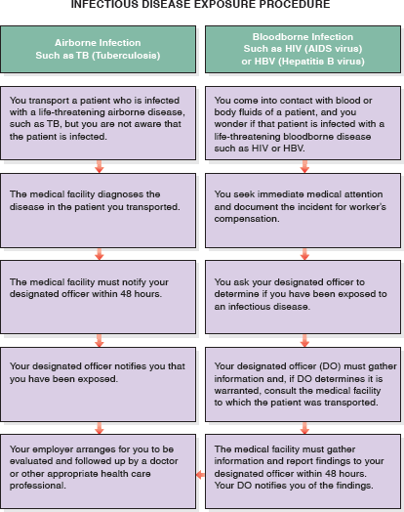
Scene Safety (21 of 35)

Slide 58
Scene Safety (22 of 35)
Infectious Diseases of Concern
  Hepatitis
    Hepatitis B and hepatitis C are viral infections of the liver.
    Contracted through contact with blood and body fluids.
    Infected persons can be asymptomatic, but still transmit the disease.
Notes:
Discussion Question
What are some examples of airborne and bloodborne communicable diseases?
Critical Thinking Discussion
What are some communicable diseases that have received attention in the media recently?
What are the implications for EMS providers?

Slide 59
Scene Safety (23 of 35)
  Infectious Diseases of Concern
  Tuberculosis
    Most often tuberculosis affects the lungs, but it can affect other tissues.
    Spreads by breathing in the infected droplets of sputum of a the patient with a cough.
    There are antibiotic-resistant forms.
Notes:
Tuberculosis signs and symptoms include:
Fever
Cough; patient may cough up blood
Night sweats
Weight loss
For known or suspected active TB
Wear gloves.
Wear a HEPA mask or N-95 respirator.
Wash your hands.
Disinfect equipment.

Slide 60
Scene Safety (24 of 35)
  Infectious Diseases of Concern
  Acquired immune deficiency syndrome (A I D S)
    Results from infection with the human immunodeficiency virus (H I V)
    More difficult than hepatitis B to transmit through occupational exposure
    Impairs the body’s ability to fight infections
Notes:
Acquired immune deficiency syndrome (AIDS)
Transmitted by:
Sexual contact involving exchange of semen, blood, cervical, or vaginal secretions
Infected needles
Infected blood or blood products
Mother-child transmission
Contact between mucous membranes or open skin with infected body fluids
The most common signs and symptoms of HIV/AIDS include:
Persistent, low-grade fever
Night sweats
Swollen lymph glands
Loss of appetite
Nausea
Persistent diarrhea
Headache
Sore throat
Fatigue
Weight loss
Shortness of breath
Mental status changes
Muscle and joint aches
Rash
Various opportunistic infections

Slide 61
Scene Safety (25 of 35)
  Infectious Diseases of Concern
  Severe acute respiratory syndrome (S A R S)
    Spread by person-to-person respiratory contact
    Accompanied by high fever, headache, body aches
Notes:
Severe acute respiratory syndrome (SARS)
Causes pneumonia and severe respiratory distress
PPE includes surgical mask and eye protection; place a mask on the patient.

Slide 62
Scene Safety (26 of 35)
  Infectious Diseases of Concern
  West Nile virus
    Mosquito-borne
    Most infected patients have no symptoms or mild symptoms
    A few patients develop severe symptoms that can last for weeks
Notes:
Mild symptoms of West Nile virus include:
Fever
Headache, body ache
Nausea, vomiting
Rash on the chest, stomach, back
Swollen lymph nodes in the neck
Severe symptoms of West Nile virus include:
High fever
Headache and stiff neck
Confusion, disorientation, coma
Seizures
Muscle weakness
Numbness, paralysis
Vision loss

Slide 63
Scene Safety (27 of 35)
  Infectious Diseases of Concern
  Ebola
    Viral hemorrhagic fever
    Normally found on African continent
    Marburg, Lassa, Yellow fever, and Ebola
Notes:
Signs and Symptoms
• High fever
• Severe headache
• Muscle pain and weakness
• Severe vomiting and diarrhea
• Unexplained severe hemorrhage
The signs and symptoms of Ebola virus disease typically appear 2–21 days after exposure with an average onset of eight to ten days. It is transmitted by exposure to the blood and body fluids of the infected. Key to this transmission is contact with an exposed person or travel to the African continent where exposure may occur. As with all bloodborne pathogens, the use of Standard Precautions is essential. In many cases, specialized personal protective equipment requiring advanced training is also used.

Slide 64
Scene Safety (28 of 35)
  Infectious Diseases of Concern
  Zika virus disease
    Spread by mosquitos
    Rarely fatal, but can cause birth defects to unborn child of infected mother
    No vaccination exists
    Avoidance and prevention are key to limiting infection
Notes:
Zika is a virus spread through the bite of an infected mosquito, much like WNV. In fact, the two viruses belong to the same family of viruses. Prior to 2015, the virus was found generally in Africa and Asia. For reasons not quite understood, the virus has begun spreading to previously uninfected regions, including Latin America and Caribbean countries. Recently, the virus has been detected on the North American continent.
Signs and Symptoms
• Fever
• Rash
• Joint and muscle pain
• Headache
• Conjunctivitis
Protection from Zika consists of avoiding mosquito bites where Zika has been found, avoiding sex with an infected or potentially infected partner (using condoms throughout sex will reduce but not eliminate risk), and preventing pregnancy or avoiding mosquito bites if already pregnant in areas where Zika has been found. A vaccination for Zika doesn’t exist; however, most signs and symptoms can be successfully treated with the administration of acetaminophen.

Slide 65
Scene Safety (29 of 35)
  Infectious Diseases of Concern
  Multidrug-resistant organisms
    Common to patients who frequent the health care system.
    May cause pneumonia; infections of the blood, ear, sinuses, and skin; peritonitis.
    Follow Standard Precautions, and any additional instructions provided by the medical facility.
Notes:
Multidrug-resistant organisms
Methicillin/oxacillin-resistant Staphylococcus aureus (MRSA)
Vancomycin-resistant enterococci (VRE)
Penicillin-resistant Streptococcus pneumoniae (PRSP)
Drug-resistant Streptococcus pneumoniae (DRSP)

Slide 66
Table 2-1 Infectious Diseases, Transmission, and Personal Protective Measures (1 of 3)
Disease | Transmission Mode | Incubation Period | Protective Measures
HIV/AIDS | Blood, semen, vaginal fluid, blood transfusion, needlestick, transplacental | Months | Gloves, eyewear, hand washing
Hepatitis B and C | Blood, semen, vaginal fluid, needlestick, transplacental, human bite, sexual contact (H B V) | Weeks or months | Gloves, eyewear, hand washing
Tuberculosis | Respiratory secretions, airborne or direct contact | 2–6 weeks | Gloves, eyewear, H E P A or N-95 respirator, hand washing
Influenza | Airborne droplets, direct contact with body fluids | 1–3 days | Gloves, surgical mask, hand washing
Chicken pox (varicella) | Airborne droplets, direct contact with open sores | 11–21 days | Gloves, surgical mask, hand washing

Slide 67
Table 2-1 Infectious Diseases, Transmission, and Personal Protective Measures (2 of 3)
Disease | Transmission Mode | Incubation Period | Protective Measures
Bacterial meningitis | Oral and nasal secretions | 2–10 days | Gloves, surgical mask, hand washing
Pneumonia | Respiratory secretions and droplets | 1–3 days | Gloves, surgical mask, hand washing
German measles (rubella) | Airborne droplets, transplacental | 10–12 days | Gloves, surgical mask, hand washing
Whooping cough (pertussis) | Respiratory secretions, airborne droplets | 6–20 days | Gloves, surgical mask, hand washing
Staphylococcal skin infection | Direct contact with infected lesion or contaminated object | 1–3 days | Gloves, hand washing

Slide 68
Table 2-1 Infectious Diseases, Transmission, and Personal Protective Measures (3 of 3)
Disease | Transmission Mode | Incubation Period | Protective Measures
Severe acute respiratory syndrome (S A R S) coronavirus | Respiratory airborne, direct contact | 10 days | Gloves, surgical mask, hand washing, eye protection
Ebola virus disease (E V D) | Direct contact with blood or contact with body fluids | 2–21 days (average onset of 8–10 days) | Gloves, hand washing, N-95 respirator, surgical/isolation gown, boot covers, specialized training in donning/doffing P P E
Zika virus disease (Z V D) | Bite of an infected Aedes mosquito, from pregnant woman to fetus, sexual contact with an infected person | 3–12 days | Avoiding mosquito bites, abstaining from sex with an infected or potentially infected partner (using condoms during sexual intercourse reduces the risk), preventing pregnancy. avoiding mosquito exposure in areas where Z V D is known to occur

Slide 69
Case Study (6 of 11)
Mr. Bennett has not had a cough, but has a history of urinary tract infections that have led to similar signs and symptoms. Mr. Bennett’s confusion is accompanied by some agitation, so Connor and Melinda speak calmly to him, but maintain alertness to the possibility that the agitation could lead to physical combativeness.

Slide 70
Case Study (7 of 11)
In addition to gloves, what P P E, if any, is needed?
Notes:
Discuss potential answers with the students as well as potential conditions the patient may be suffering from.

Slide 71
Scene Safety (30 of 35)
Protecting Yourself from Injury
  Prevention strategies include:
    Use of vehicle restraint systems
    Safe lifting and moving techniques
    Getting adequate sleep
    Physical fitness and proper nutrition
    Using Standard Precautions
Notes:
Points to Emphasize
Motor vehicle-related incidents are the most common cause of EMS provider death, making safe driving and the use of caution when working motor vehicle collisions some of the most important skills an EMT can develop.
Discussion Question
What kinds of calls may put you at risk for exposure to hazardous materials?
Teaching Tips
Pass around a copy of the DOT Emergency Response Guidebook for students to review.

Slide 72
Scene Safety (31 of 35)
  Protecting Yourself from Injury
  Other actions to protect yourself must be taken in the following situations:
    Rescue operations
    Hazardous materials incidents
    Violence/crime scenes
    Biological and chemical weapons of mass destruction
Notes:
Class Activity
Give small groups of students five to ten minutes to think of potential response-related hazards in addition to those listed in the text. Have each group share their ideas with the rest of the class.
Knowledge Application
Give several descriptions of scene situations. Ask what actions and additional resources are necessary to ensure EMT and patient safety.

Slide 73
Scene Safety (32 of 35)
  Protecting Yourself from Injury
  Other actions to protect yourself must be taken in the following situations:
    Hazardous materials
      Use binoculars and the U.S. DOT Emergency Response Guidebook.
      Request a hazardous materials team.
      Allow hazardous materials personnel to decontaminate patients and bring them to you.

Slide 74
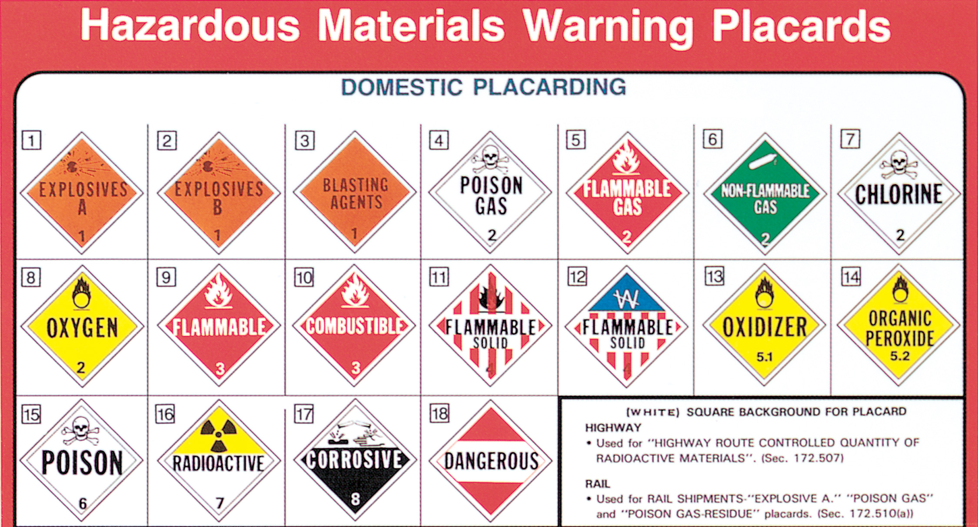
Examples of Hazardous Materials Warning Placards

Slide 75
The Emergency Response Guidebook Should be Carried on all E M S Vehicles

Slide 76
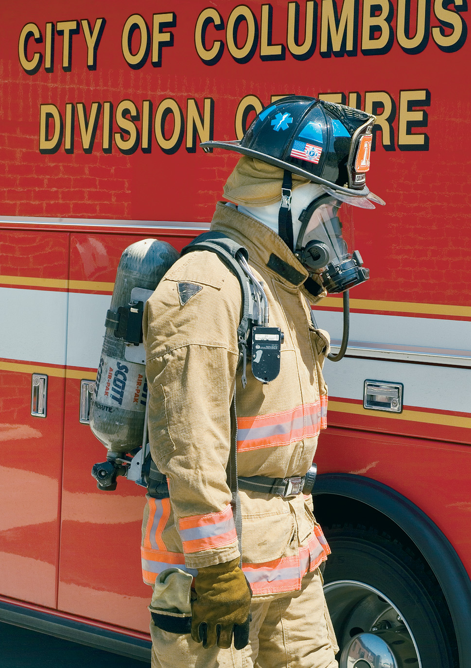
Self-Contained Breathing Apparatus (S C B A)

Slide 77
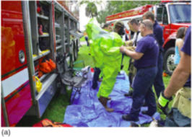
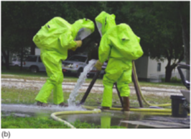
Typical Hazardous Materials Protective Suits (a) Being Donned (b) In Use

Slide 78
Scene Safety (33 of 35)
Protecting Yourself from Injury
  Rescue situations
    Hazards may include, but are not limited to:
      Downed power lines
      Fire or threat of fire
      Explosion or threat of explosion
      Hazardous materials
      Low oxygen environments
Notes:
Rescue situations involve potential threat to the life of both patients and emergency service personnel:
• Downed power lines or other potential for electrocution
• Fire or threat of fire (including gasoline or chemical spills)
• Explosion or threat of explosion
• Hazardous materials
• Possible structural collapse
• Low oxygen levels in confined spaces
• Trenches that are not properly secured
• Biological, nuclear, and chemical weapons
• Motor-vehicle accidents (MVA) that occur on highways or busy roadways

Slide 79
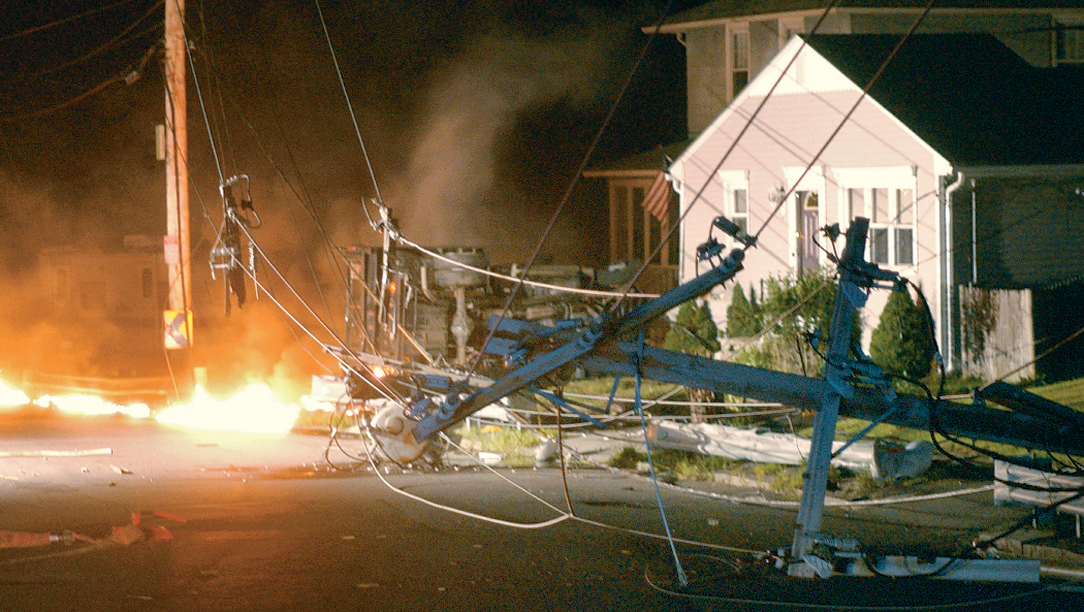
Downed Power Lines Pose a Potential Life Threat for Patients and Rescuers

Slide 80
Downed Wires are Dangerous Even if no Fire or Sparks are Evident

Slide 81
Scene Safety (34 of 35)
Protecting Yourself from Injury
  Federal law requires use of high visibility apparel at/near roadways
  High visibility vest/garments
    Class 1
    Class 2
    Class 3
Notes:
The ANSI/ISEA 207-2006 American National Standard for High-Visibility Public Safety vests (PSV) was approved to increase the visibility of emergency personnel on the roadway and to reduce the incidence of roadway hazards. The newer standard made significant changes to standard class garments to accommodate the public safety responder. The PSV has the same retro-reflective material as the Class 2 vest and nearly the same amount of fluorescent material. The PSV has breakaway features, specific vest dimensions to allow for fit over turnout gear, and color-specific markings to allow for differentiation between law enforcement, fire, and EMS personnel.
Class 1—Designed for workers in parking lots and other areas with traffic flow moving at less than 25 mph
Class 2—Designed for personnel whose attention is diverted from traffic or where the traffic flow is moving at 25 mph or greater
Class 3—Designed for personnel whose work greatly diverts their attention away from the roadway and where they are at serious risk from hazards created by moving vehicles

Slide 82
Use of A N S I / I S E A 107-2004 High Visibility Apparel Worn over Other Protective Gear

Slide 83
Scene Safety (35 of 35)
Protecting Yourself from Injury
  Violence and crime
    Violence can arise from patients, bystanders, family members, or perpetrators of a crime.
    If you suspect the potential for violence, request law enforcement.
    Do not enter an unsafe scene.
Notes:
Scenes with high risk for violence include:
Domestic disputes
Patients (or bystanders) under the influence of drugs or alcohol
Agitated, hostile patients, family, bystanders
Street or gang fights; bar fights
Potential suicide
Behavioral emergencies
Crime scenes

Slide 84
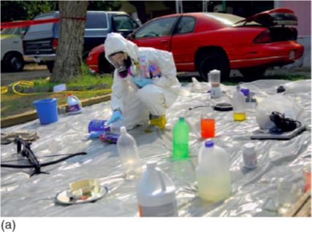
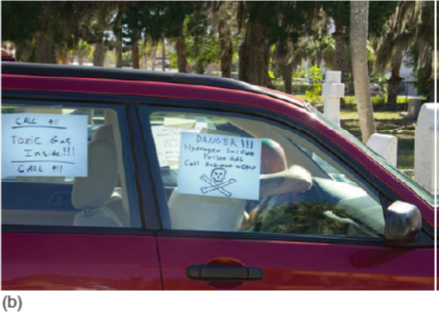
E M T s are Often Endangered at Scenes of Crime and Violence
(a) A raid at a clandestine methane lab
(b) A warning note left by the victim of a chemical suicide.

Slide 85
Case Study (8 of 11)
Conner and Melinda complete their assessment and initial treatment of Mr. Bennett, and prepare to place him on the stretcher for transport.

Slide 86
Case Study (9 of 11)
What are the potential risks to Connor and Melinda at this phase of the call?
How can E M T s be proactive about minimizing these risks?
Notes:
Given the discussion so far regarding safety principles, have the students answer these questions and devise ways to minimize any risks to themselves or their partner.

Slide 87
Wellness Principles (1 of 7)
Physical Well-Being
  Physical well-being is necessary to performing the job of an E M T.
  Physical well-being includes:
    Physical fitness
    Adequate sleep
    Injury prevention
Notes:
Points to Emphasize
Wellness is more than just the absence of illness. It includes well-being in all aspects of living. The core components of physical fitness are cardiovascular endurance, muscular strength, endurance, flexibility, and body composition.
Teaching Tips
Plan a stretching or relaxation exercise for the class. Have a personal trainer or exercise physiologist present a lecture on physical fitness.

Slide 88
Wellness Principles (2 of 7)
  Physical Well-Being
  Core components of physical fitness are:
    Cardiovascular endurance
    Muscle strength
    Muscle endurance
    Muscle flexibility
    Body composition
Notes:
Cardiovascular endurance improves the ability of the heart, lungs, and blood vessels to supply the body with oxygen and nutrients. Activities include walking, jogging, swimming, and elliptical or step machines. Reach and maintain your target heart rate for 30 to 40 minutes, at least three times per week.
Class Activity
Ask each student to calculate his target heart rate for aerobic exercise.
Discussion Questions
Besides jogging or running, what are some examples of aerobic exercise?
What are some ways to improve sleep habits?
What are some of the health risks associated with tobacco use?

Slide 89
Wellness Principles (3 of 7)
  Physical Well-Being
  Muscle strength
    Required for the frequent, heavy lifting E M T s do
  Muscle endurance
    Ability of muscle to function over time without fatigue
Notes:
The core components to remaining physically fit and able to perform your job as an EMT are cardiovascular endurance, muscle strength, muscle endurance, muscle flexibility, and body composition.

Slide 90
Wellness Principles (4 of 7)
  Physical Well-Being
  Muscle flexibility
    Allows movement through the full range of motion without injury
  Body composition
    Ratio of body fat to total weight
    Lower ratio of body fat decreases risk of chronic illnesses
Notes:
The core components to remaining physically fit and able to perform your job as an EMT are cardiovascular endurance, muscle strength, muscle endurance, muscle flexibility, and body composition.

Slide 91
Wellness Principles (5 of 7)
  Physical Well-Being
  Adequate sleep
    Obtain eight to ten hours of sleep each day.
    Working shifts that conflict with the body’s natural rhythms can create physical, mental, and social difficulties.
    Techniques exist for improving the quality of sleep.
Notes:
One of the keys to maintaining as near normal function as possible is getting an adequate amount of sleep. Lack of sleep (sleep deprivation) puts you at risk for accidents and injury. It also puts your patients at risk of improper care, resulting from your inability to function at the necessary mental and physical level. Individuals require a minimum of eight to ten hours of sleep each day. Studies have shown that a lack of regular sleep contributes to chronic diseases, such as heart disease, weight gain, and poor mental function.
Discuss methods identified in the text for improving the quality of sleep.
Create an environment that mimics nighttime.
Create a block of time for uninterrupted sleep.
Avoid heavy meals, caffeine, and exercise before sleep time.
Reduce interruptions by turning off pagers and phones, if possible.

Slide 92
Wellness Principles (6 of 7)
  Physical Well-Being
  Smoking cessation
  Alcohol and drug-related issues
Notes:
Physical well-being includes smoking cessation. Smoking is a risk to your personal health and a violation of your responsibility to promote public health. Also, alcohol and drug-related issues should be avoided.
Self-medication or abuse of alcohol or medications to cope with stress is not a good strategy. Seek professional assistance for alcohol and drug issues.

Slide 93
Wellness Principles (7 of 7)
Mental Well-Being
  Stress associated with E M S can affect your mental well-being.
  Over time, stress can lead to chronic physical illness and emotional issues.
Notes:
Knowledge Application
Ask each student to write down three goals for improving or maintaining well-being.
Critical Thinking Discussion
What are some ways EMTs can incorporate wellness principles into a sometimes hectic workday?

Slide 94
Case Study (10 of 11)
Connor and Melinda transport Mr. Bennett to the emergency department, where they turn his care over to the nursing staff with verbal and written reports. The E M Ts dispose of their gloves and wash their hands. Connor puts on a fresh pair of gloves and performs routine cleaning and disinfection of the ambulance and equipment.
Notes:
Review case study. Identify techniques used to reduce the likelihood of illness or injury that the EMTs demonstrated.

Slide 95
Case Study (11 of 11)
After their shift, Connor heads to the gym, while Melinda plans to read a book after talking a walk with her dog. After a good night’s sleep, both E M Ts return to work the next day, ready to meet any challenges that await them.
Notes:
Review the case study conclusion and ask the students to identify strategies used to help maintain the EMTs well being.

Slide 96
Lesson Summary (1 of 2)
Dealing with death and dying is a regular part of E M Ts’ jobs.
Five stages of grief exist, and the patient may be in any one of them.
Take measures to manage job stress.
Recognize signs and symptoms of stress reactions.
Notes:
Follow-Up
Answer student questions.
Follow-Up Assignments
Review Chapter 2 Summary.
Complete Chapter 2 In Review questions.
Complete Chapter 2 Critical Thinking questions.
Assessments
Handouts
Chapter 2 quiz

Slide 97
Lesson Summary (2 of 2)
Be aware of the risks associated with emergency response.
Use Standard Precautions for protection from communicable disease.
Assess all scenes for potential hazards and make sure they have been addressed before entering the scene.
Notes:
Class Activity
As an alternative to assigning the follow-up exercises in the lesson plan as homework, assign each question to a small group of students for in-class discussion.
Teaching Tips
Answers to In Review questions are in the appendix of the text. Advise students to review the questions again as they study the chapter.

Slide 98
Death and Dying
That is not the correct response. Click here to try again.
Notes:
Teaching Tip
To help students relate to the five emotional stages of loss, ask them to think of examples of each of the emotional reactions in response to a loss or disappointment in their own lives, such as loss of a job or important relationship. Even the impending loss of an important basketball or football game can bring about these feelings, although not as intensely.

Slide 99
Feedback (1 of 5)
Correct, it is denial
  A person in this stage cannot believe what is happening or what has happened. A statement that might represent this thought process is:
    “No! I can’t believe this. This can’t be happening!”
Click to return to the quiz.
Notes:
Teaching Tip
To help students relate to the five emotional stages of loss, ask them to think of examples of each of the emotional reactions in response to a loss or disappointment in their own lives, such as loss of a job or important relationship. Even the impending loss of an important basketball or football game can bring about these feelings, although not as intensely.

Slide 100
Feedback (2 of 5)
Correct, it is anger
  A person in this stage of grief is mad at what is happening or what has happened, and may blame himself or others. A statement that might represent this thought process is:
    “This is the doctor’s fault. He should have tested me sooner. I am going to sue him!”
Click to return to the quiz.
Notes:
Teaching Tip
To help students relate to the five emotional stages of loss, ask them to think of examples of each of the emotional reactions in response to a loss or disappointment in their own lives, such as loss of a job or important relationship. Even the impending loss of an important basketball or football game can bring about these feelings, although not as intensely.

Slide 101
Feedback (3 of 5)
Correct, it is bargaining
  The person in this stage of grief tries to strike a deal in an attempt to stop or reverse the event that has happened. A statement that might represent this thought process is:
    “Oh please, if you just let my husband be ok I ’ l lbe a better person.”
Click to return to the quiz.
Notes:
Teaching Tip
To help students relate to the five emotional stages of loss, ask them to think of examples of each of the emotional reactions in response to a loss or disappointment in their own lives, such as loss of a job or important relationship. Even the impending loss of an important basketball or football game can bring about these feelings, although not as intensely.

Slide 102
Feedback (4 of 5)
Correct, it is depression
  The person is gripped by a sense of deep sadness and may suffer signs and symptoms associated with depression. A statement that might represent the thought process is:
    “I can’t go through this. I can’t get up every day knowing I only have a few months to live.”
Click to return to the quiz.
Notes:
Teaching Tip
To help students relate to the five emotional stages of loss, ask them to think of examples of each of the emotional reactions in response to a loss or disappointment in their own lives, such as loss of a job or important relationship. Even the impending loss of an important basketball or football game can bring about these feelings, although not as intensely.

Slide 103
Feedback (5 of 5)
Correct, it is acceptance
  Although there still may be sadness about the situation, the person has come to terms with it and is able to cope with it. A statement that might represent the thought process is:
    “I know my wife is gone, but life goes on, and I will honor her memory in my actions.”
Click to return to the program.
Notes:
Teaching Tip
To help students relate to the five emotional stages of loss, ask them to think of examples of each of the emotional reactions in response to a loss or disappointment in their own lives, such as loss of a job or important relationship. Even the impending loss of an important basketball or football game can bring about these feelings, although not as intensely.

Slide 104
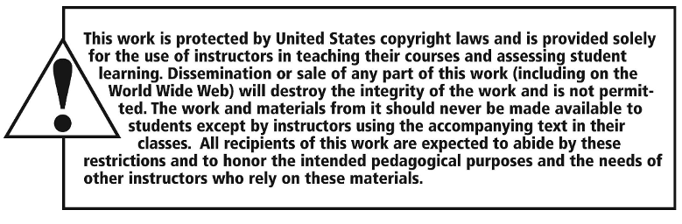
Copyright

