Slide 1

Prehospital: Emergency Care
Eleventh Edition
Chapter 28
Bleeding and Soft Tissue Trauma
Slides in this presentation contain hyperlinks. JAWS users should be able to get a list of links by using INSERT+F7
Copyright © 2018, 2014, 2010 Pearson Education, Inc. All Rights Reserved
Notes:
If this PowerPoint presentation contains mathematical equations, you may need to check that your computer has the following installed:
1) MathType Plugin
2) Math Player (free versions available)
3) NVDA Reader (free versions available)
Advance Preparation
Student Readiness
Assign the associated section of MyBRADYLab and review student scores.
Review the chapter material in the Instructor Resources, which includes Student Handouts, PowerPoint slides, and the MyTest Program.
Prepare
Make copies of course policies and procedures, the syllabus, handouts from the Instructor Resources, and other materials for distribution or post them in your learning management system.
Preview the media resources and Master Teaching Notes in this lesson.
Preview the Case Study presented in the PowerPoint slides.
The total teaching time recommended is only a guideline. Take into consideration factors such as the pace at which students learn, the size of the class, breaks, and classroom activities. The actual time devoted to teaching objectives is the instructor’s responsibility.

Slide 2
Learning Readiness
E M S Education Standards, text p. 833.
Chapter Objectives, text p. 833.
Key Terms, text p. 833.
Purpose of lecture presentation versus textbook reading assignments.
Notes:
Explain to students what the National EMS Education Standards are. The National EMS Education Standards communicate the expectations of entry-level EMS providers. As EMTs, students will be expected to be competent in these areas. Acknowledge that the standards are broad, general statements. Although this lesson addresses the listed competencies, the competencies are often complex and require completion of more than one lesson to accomplish. The student is also expected to review the chapter objectives to foreshadow what will be in the chapter. By mastering the key terms the EMT student will better understand the learning and be able to communicate more clearly.
Additionally, explain to the students that the purpose of using these slides is to help keep the instructor focused on highlighting important portions of the material, explain interrelationships of topics, and discuss how to apply this information. It’s not the intent of the presentation (or slides alone) to include every component in the chapter. This presentation still requires the student to thoroughly read the chapter.

Slide 3
Setting the Stage
Overview of Lesson Topics
  External and Internal Bleeding
  Factors that Increase Bleeding
  Hemorrhagic Shock
  Soft Tissue Trauma
  Closed Soft Tissue Injuries
  Open Soft Tissue Injuries
  Dressings and Bandages
Notes:
These are the major headings for the chapter. The intent is to show the student how the information will be presented.

Slide 4
Case Study #1 Introduction (1 of 2)
E M Ts Mick Horton and Dave Bowling arrive at the scene of a M V C on South Avenue Extension and quickly perform a scene size-up. They have one patient, a male in his 30s, who was the unrestrained driver of a an older model truck that struck a tree along the roadway. There is an E M R maintaining manual spine motion restriction and another preparing a long backboard and stretcher.
Notes:
Case Study
Present the Case Study Introduction provided in the PowerPoint slide set. Lead a discussion using the Case Study questions provided on the subsequent slide(s). The Case Study with discussion questions continues throughout the PowerPoint presentation.
Case Study Discussion
Use the Case Study content and questions to foreshadow the upcoming lesson content.

Slide 5
Case Study #1 Introduction (2 of 2)
Mick’s general impression is that the patient is awake but confused and is pale and sweating, with blood running from his scalp down onto his neck and clothing.
Notes:
Case Study
Present the Case Study Introduction provided in the PowerPoint slide set. Lead a discussion using the Case Study questions provided on the subsequent slide(s). The Case Study with discussion questions continues throughout the PowerPoint presentation.
Case Study Discussion
Use the Case Study content and questions to foreshadow the upcoming lesson content.

Slide 6
Case Study #1
From the mechanism of injury and general impression, what conditions should the E M Ts be suspecting?
What are the priorities in assessing and managing this patient?
What are the consequences of failing to recognize and manage this patient’s problems?
Notes:
Case Study Discussion
Use the Case Study content and questions to foreshadow the upcoming lesson content. Gauge the student’s responses as a guide of how well versed they are on this topic.

Slide 7
Introduction
Bleeding can be a life-threatening emergency.
  Severe bleeding is controlled in the primary assessment.
Most soft tissue injuries are cared for after the primary assessment.
Recognizing shock is an important element of emergency care.
Notes:
During this lesson, students will learn about bleeding and shock.

Slide 8
External Bleeding (1 of 18)
Always use Standard Precautions for patients with external bleeding.
Standard Precautions are the best defense against the transmission of disease.
Notes:
Teaching Tips
Use a red soft drink, red food coloring, some old clothing, a large, clear container of water, and a syringe to demonstrate the difficulty in quantifying blood loss.
Without showing students how much liquid you have in the syringe, place some on an old T-shirt and have students try to estimate the amount of liquid involved. (In this case, a little can look like a lot.)
Discussion Questions
What are some factors that can affect the severity of blood loss?
How much blood loss typically results in signs and symptoms of shock?
How can you estimate how much blood loss has occurred?
Critical Thinking Discussion
How is a 200-mL blood loss different in an average 8-year-old child than in a 20-year-old adult?

Slide 9
External Bleeding from a Soft Tissue Injury to the Head
Notes:
Bleeding from soft tissue injuries may look disproportionate from the extent of the injury. For example, relatively superficial injuries to the scalp can bleed a considerable amount.

Slide 10
External Bleeding (2 of 18)
The severity of blood loss depends upon the following:
  Amount of blood loss
  Rate of blood loss
  Other injuries or existing conditions
  Patient’s existing medical problems
  Patient’s age.
Notes:
The severity of bleeding relative to the amount of blood loss depends on the patient. A 500-mL blood loss might not be as severe in a large patient as it would be in a child or smaller adult. An adult patient has 70 mL/kg of blood volume. An average-sized adult weighs 154 lb., which is 70 kg. Thus, an average-sized adult has 4,900 mL or 4.9 liters of blood volume (70 mL * 70 kg = 4,900 mL). A loss of 15 percent of blood volume or more is considered significant and can lead to shock. In the 154-lb patient, a loss of 735 mL of blood can lead to shock. Infants and young children typically have 80 mL/kg of blood volume. A 22-lb infant (10 kg) would have a total blood volume of 800 mL (10 kg * 80 mL = 800 mL). A 15 percent blood loss would be 120 mL (800 mL * 15% = 120 mL). A 200-mL blood loss in an average-sized adult would represent only a 4 percent blood loss, whereas a 200-mL blood loss in a 10-kg infant would represent a 25 percent blood loss.

Slide 11
External Bleeding (3 of 18)
The best way to estimate blood loss is by assessing the patient’s signs and symptoms.
Notes:
Since judging the amount of blood loss on appearance alone is unreliable, it is better to assess the amount of blood loss based upon the presenting signs and symptoms. Additionally, internal bleeding does not show any external blood loss and therefore is not “seen.”

Slide 12
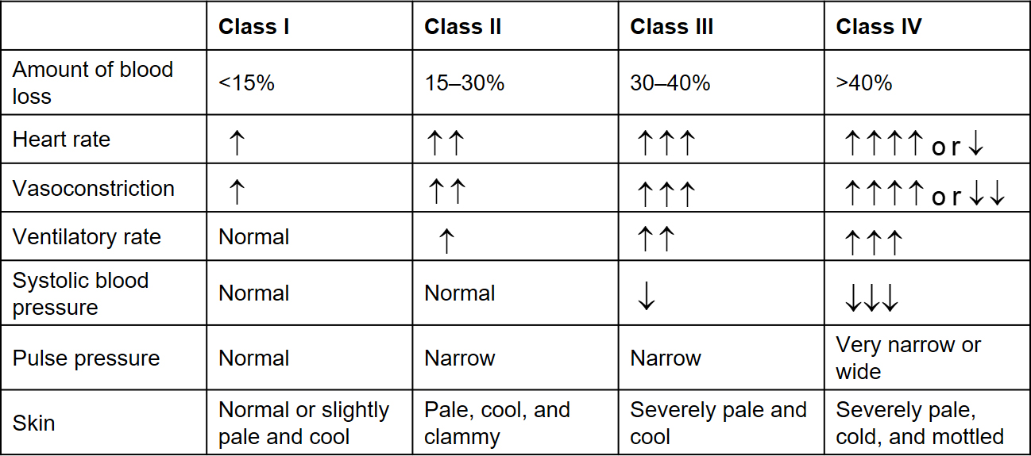
Table 28-1 Classes of Hemorrhage
Note: In this table, up arrows indicate an increase, down arrows indicate a decrease, and multiple arrows indicate a greater degree of increase or decrease.
For example, two arrows indicate a greater change than one arrow, and so on.
Notes:
Review the hemorrhage classes as compared to the patient’s symptoms. This is the best way to determine the amount of blood lost. and help shape the treatment the patient will receive.

Slide 13
External Bleeding (4 of 18)
Types of Bleeding
  Arterial
  Venous
  Capillary
Notes:
Arterial bleeding. Bright red, spurting blood from a wound usually indicates a severed or damaged artery. The blood is bright red because it is rich in oxygen.
Venous bleeding. Dark red blood that flows steadily and briskly from a wound usually indicates a severed or damaged vein. When blood is dark red, it is depleted of oxygen. A steady flow usually indicates venous bleeding because veins are under less pressure than arteries.
Capillary bleeding. Slowly oozing blood that is a dark or medium red usually indicates damaged capillaries. In most cases, capillary bleeding is easily controlled.

Slide 14
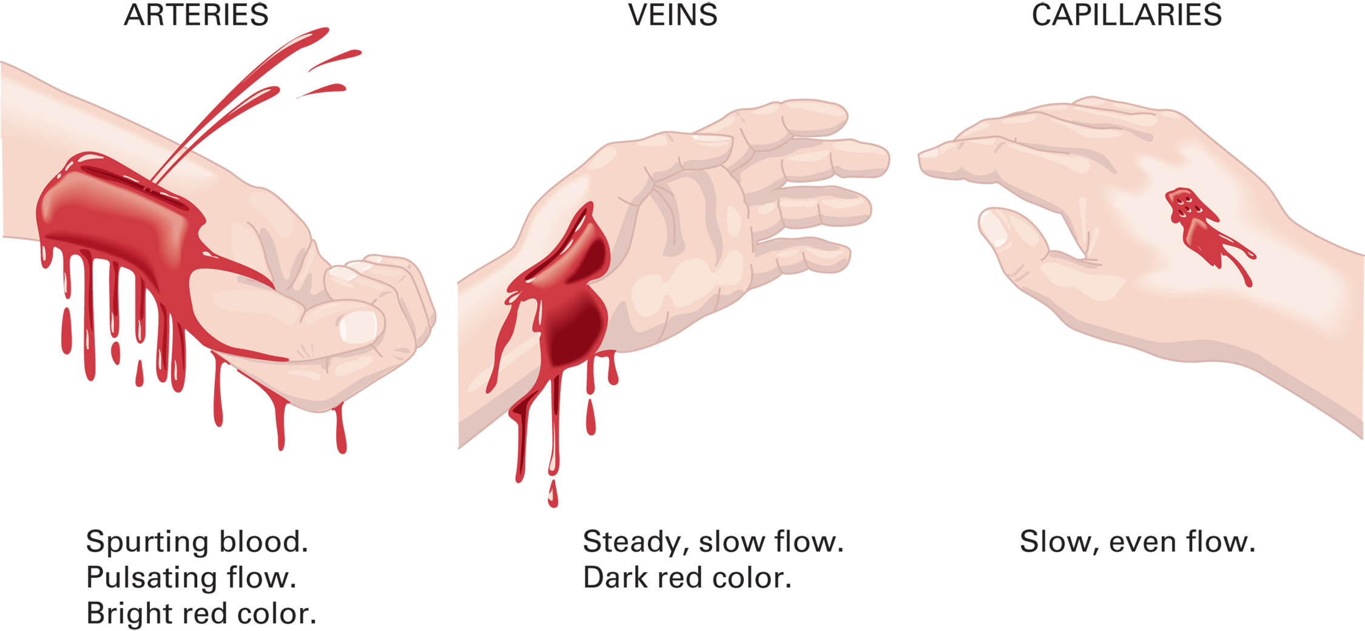
Types of Bleeding
Notes:
Review the types of bleeding and remind students that in most instances, there is “mixed” bleeding as soft tissue trauma can easily result in simultaneous bleeding of arteries, veins, and capillary beds.

Slide 15
External Bleeding (5 of 18)
Methods of Controlling External Bleeding
  Direct pressure
  Tourniquets
  Splints
  Topical hemostatic agents
Notes:
Discussion Questions
What is the approach to controlling external bleeding?
What principles must you follow when using a tourniquet to control bleeding?
What are the roles of elevation, splinting, and topical hemostatic agents in controlling external bleeding?

Slide 16
External Bleeding (6 of 18)
Methods of Controlling External Bleeding
Steps to Control Bleeding
    Apply direct pressure.
    Apply a pressure dressing.
    Apply a tourniquet.
If a tourniquet can’t be used, consider using a hemostatic agent.
If multiple patients are hemorrhaging (i.e. M C I), proceed immediately to Step 3.

Slide 17
External Bleeding (7 of 18)
Methods of Controlling External Bleeding
  Direct Pressure
    This is the first method to use to control bleeding.
    A pressure dressing can be used.
    Do not apply pressure to or remove impaled objects.
Notes:
The first method for controlling bleeding is direct pressure. This is usually accomplished by placing a sterile gauze pad or dressing over the injury site and applying fingertip pressure directly to the point of bleeding. If severe bleeding persists while direct pressure is applied over dressings, remove the dressings and apply direct pressure to the point of bleeding, typically directly to a blood vessel.

Slide 18
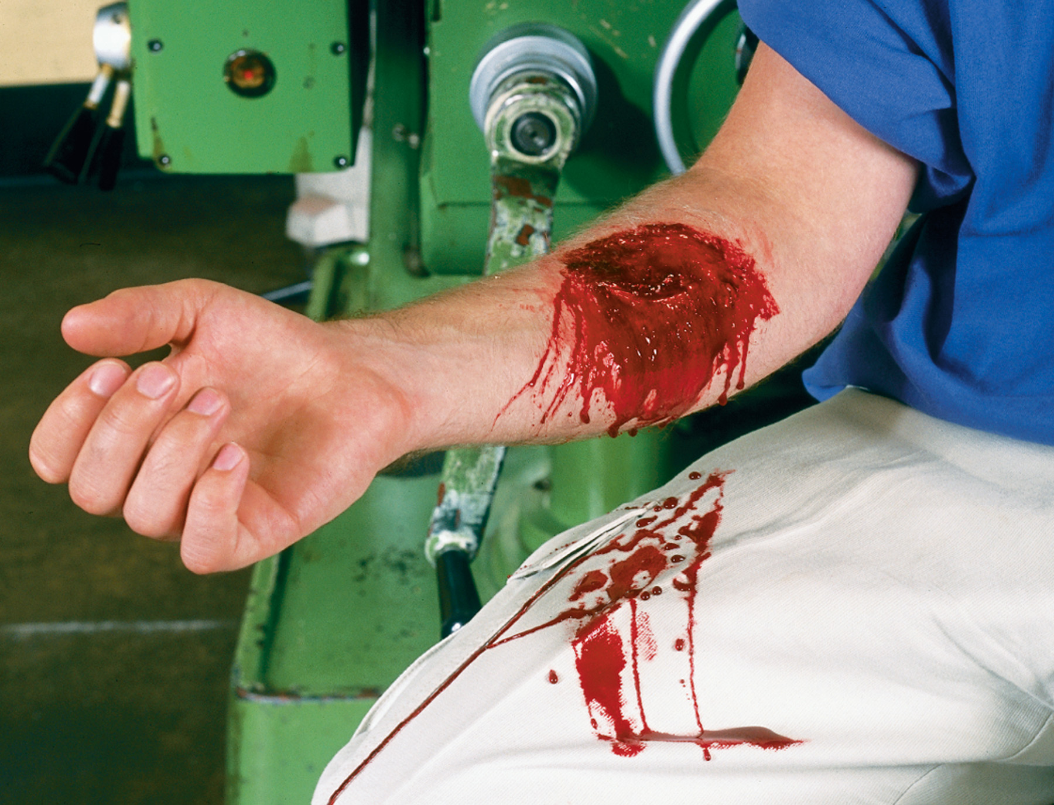
Bleeding from a Wound to the Forearm
Notes:
Discuss the steps for controlling external bleeding with direct pressure.

Slide 19
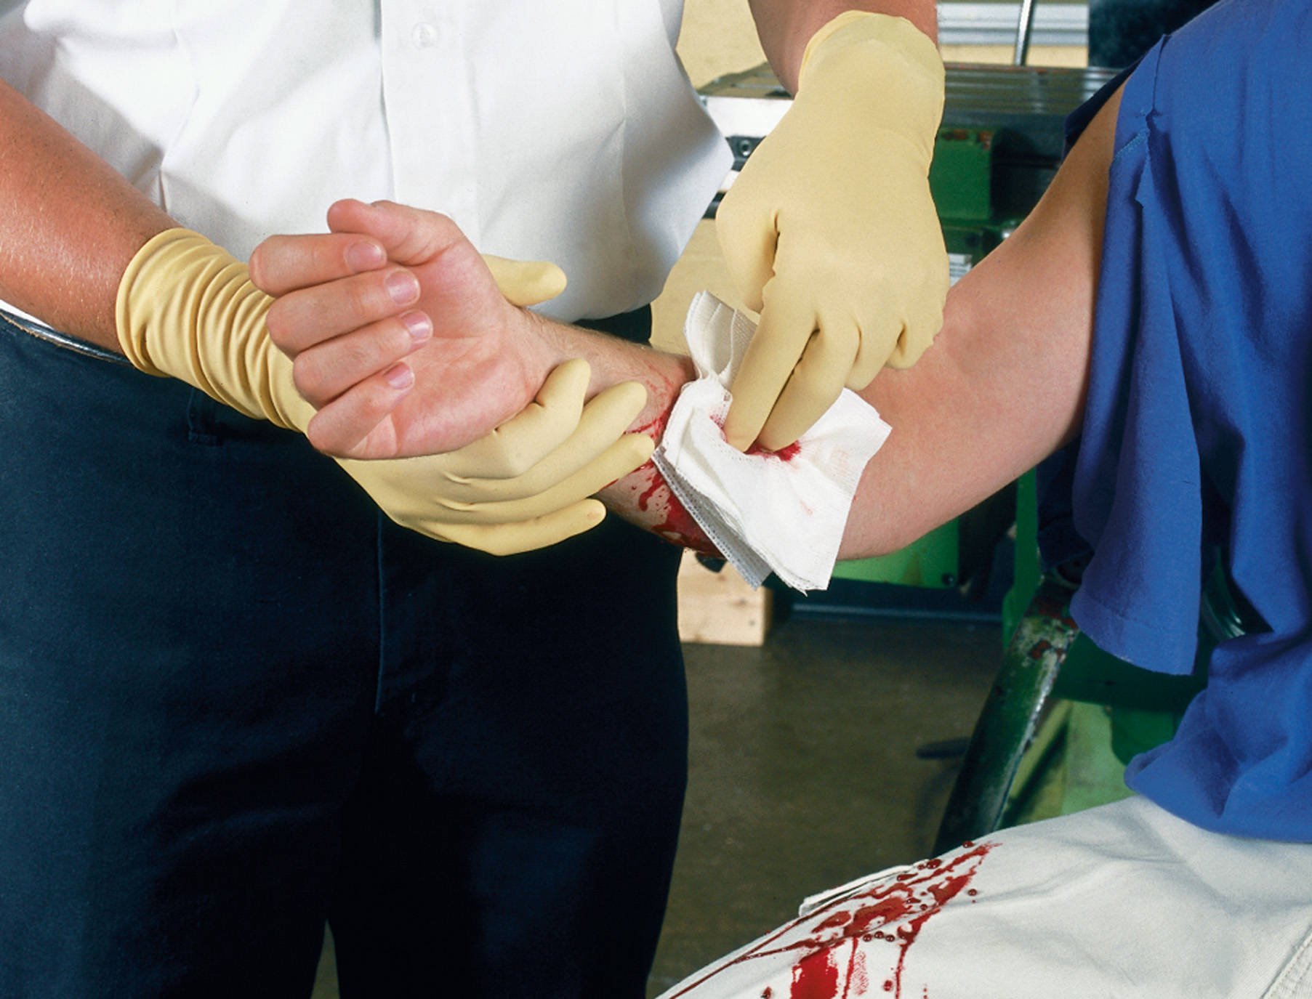
Apply Gloved Fingertip Pressure over a Dressing Directly on the Point of Bleeding
Notes:
Discuss the steps for controlling external bleeding with direct pressure.

Slide 20
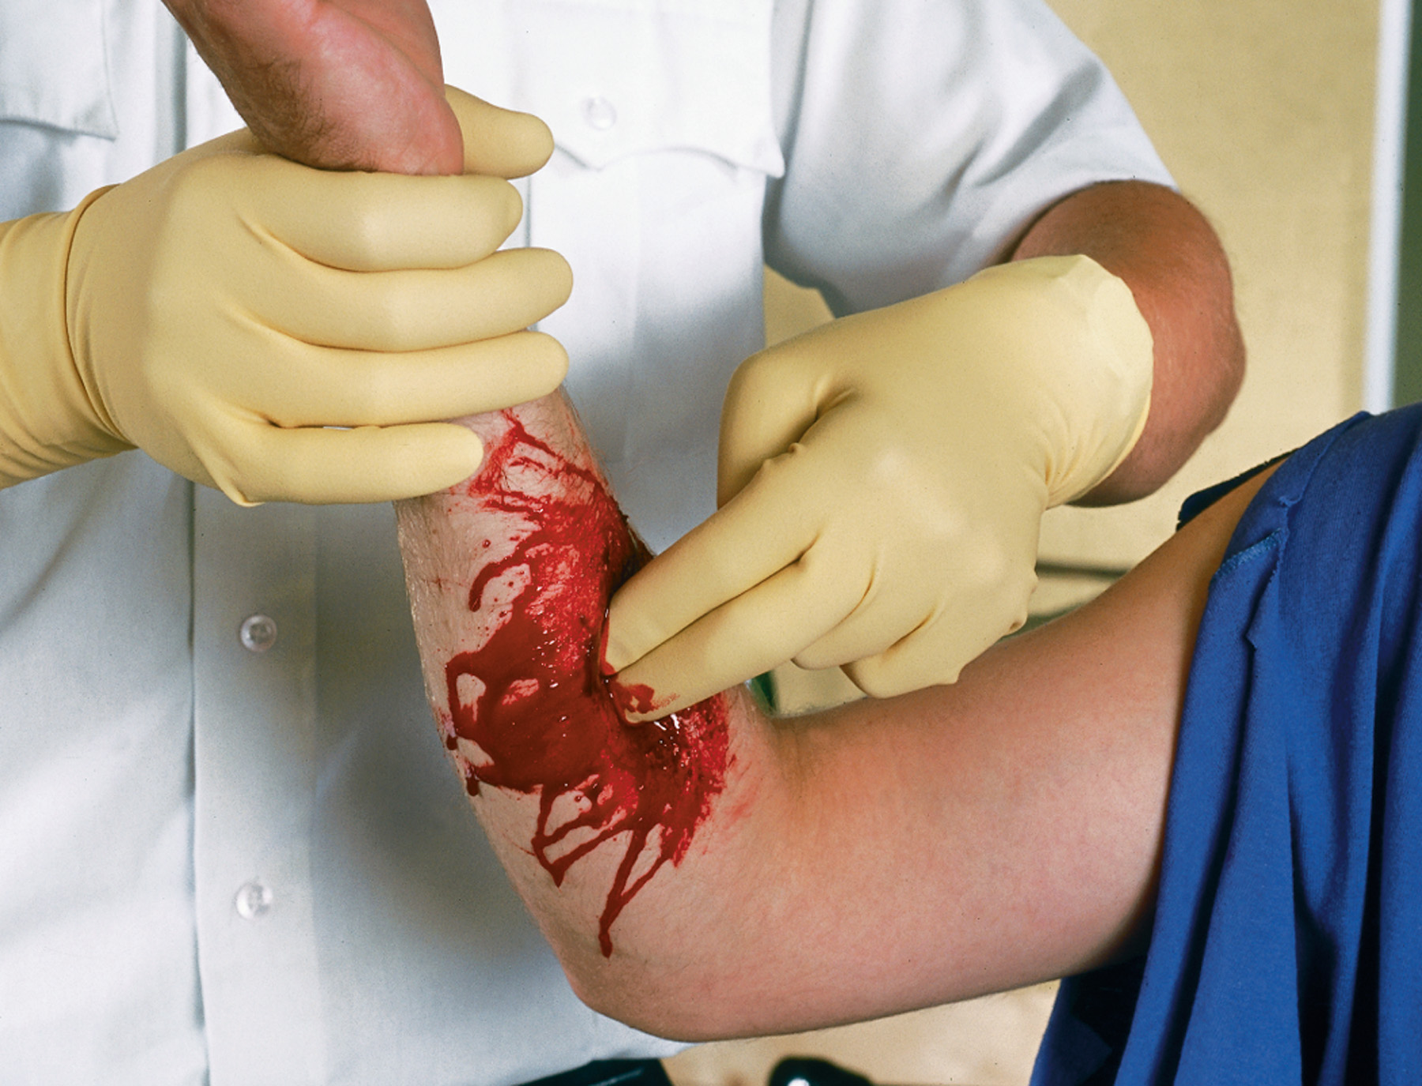
If the Bleeding Does not Stop, Remove the Dressing and Apply Direct Pressure with Gloved Fingertips to the Point of Bleeding
Notes:
This particular step is performed if the bleeding is severe and persists despite initial application of direct pressure.

Slide 21
Pack Large, Gaping Wounds with Sterile Gauze and Apply Direct Pressure
Notes:
Discuss the steps for controlling external bleeding with direct pressure.

Slide 22
External Bleeding (8 of 18)
Methods of Controlling External Bleeding
  Tourniquets
    Tourniquets are used when direct pressure does not control bleeding.
    There are several types of commercial tourniquets.
    Tourniquets can be improvised if a commercial tourniquet is not available.
Notes:
If bleeding to an extremity is not controlled with direct pressure, the next step is to apply a tourniquet. A commercial tourniquet is recommended. There are no contraindications to the application of a tourniquet. Multiple tourniquets can be applied to multiple extremities.

Slide 23
Different Types of Tourniquets are Available
Notes:
Different types of tourniquets are available. Bring various models to class for students to examine. Find out which model is generally used in the local EMS community.

Slide 24
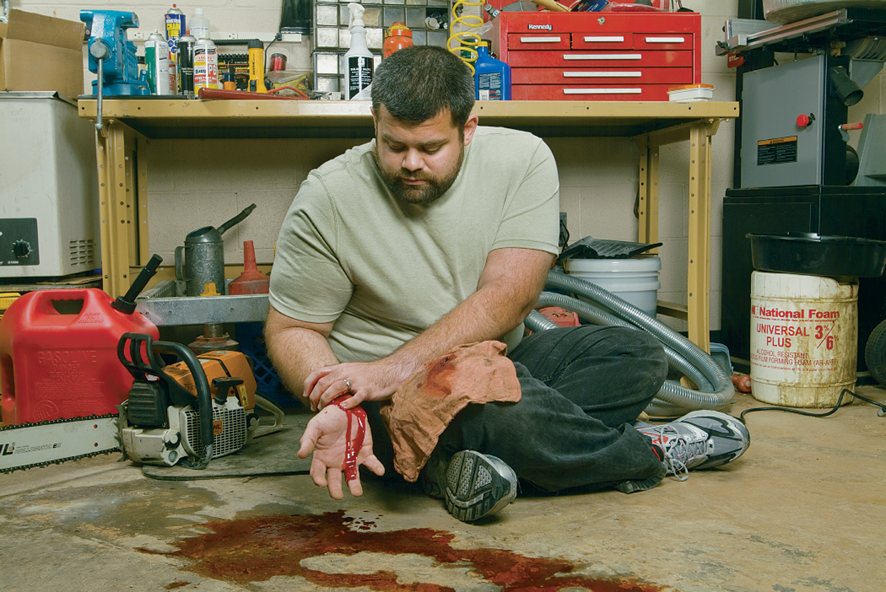
First Attempt to Control Bleeding by Direct Pressure
Notes:
Discuss indications and the procedure for applying a tourniquet.

Slide 25
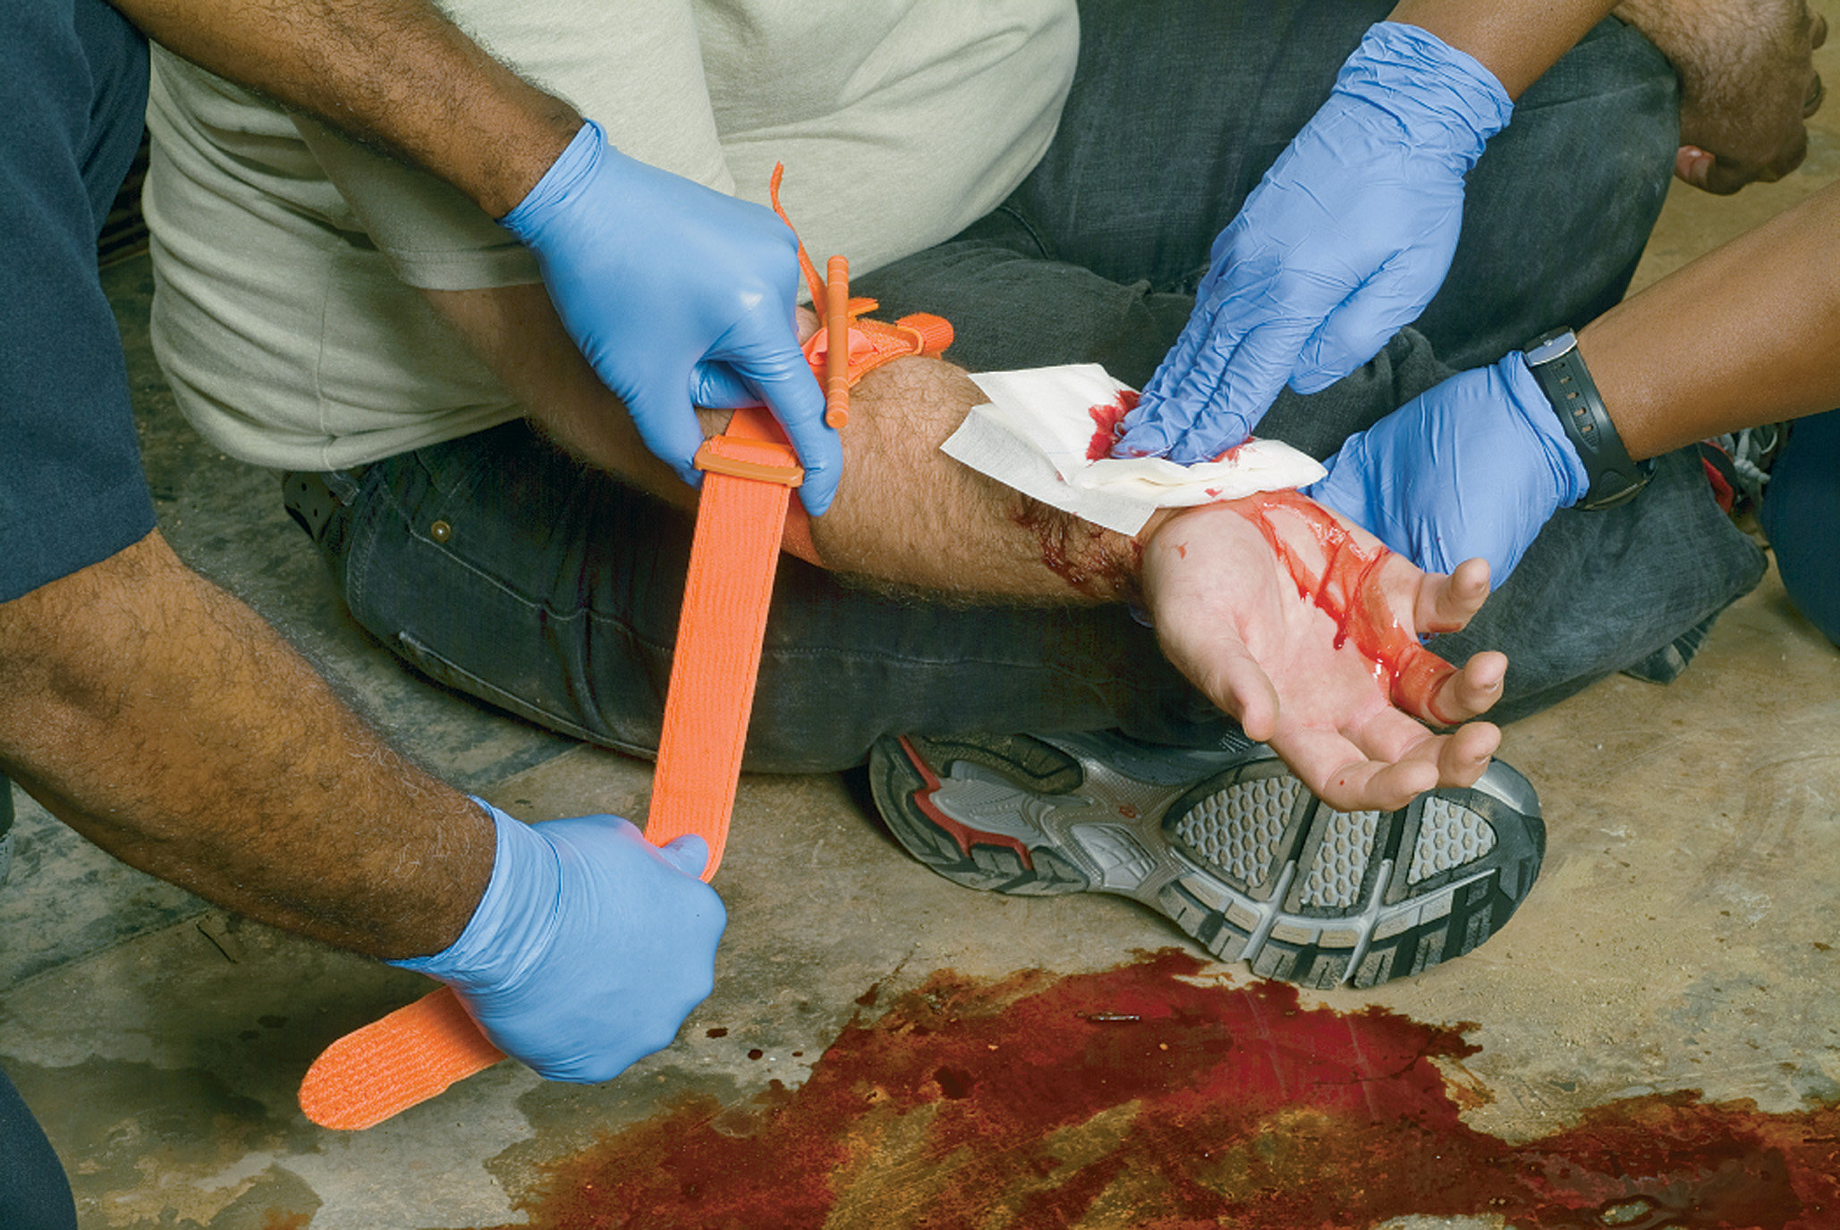
If Direct Pressure is Ineffective, Apply Direct Pressure over a Thick Dressing While Preparing the Tourniquet
Notes:
Discuss indications and the procedure for applying a tourniquet.

Slide 26
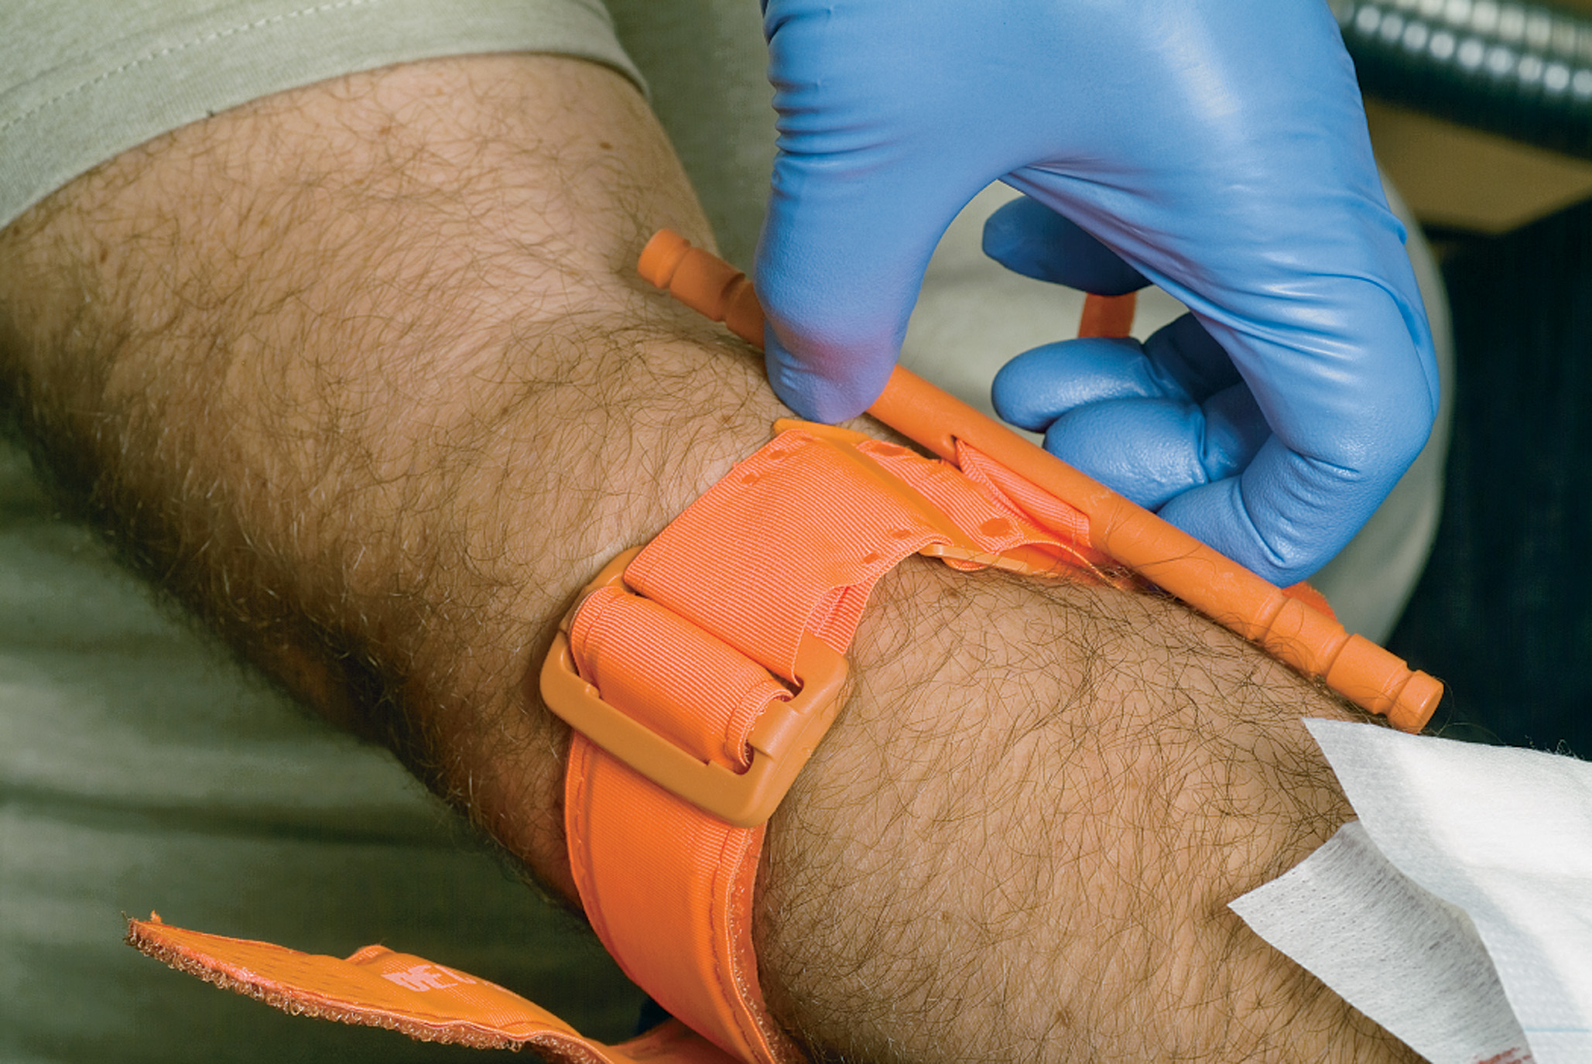
Apply the Tourniquet Proximal to the Wound but not over a Joint
Notes:
Discuss indications and the procedure for applying a tourniquet.

Slide 27
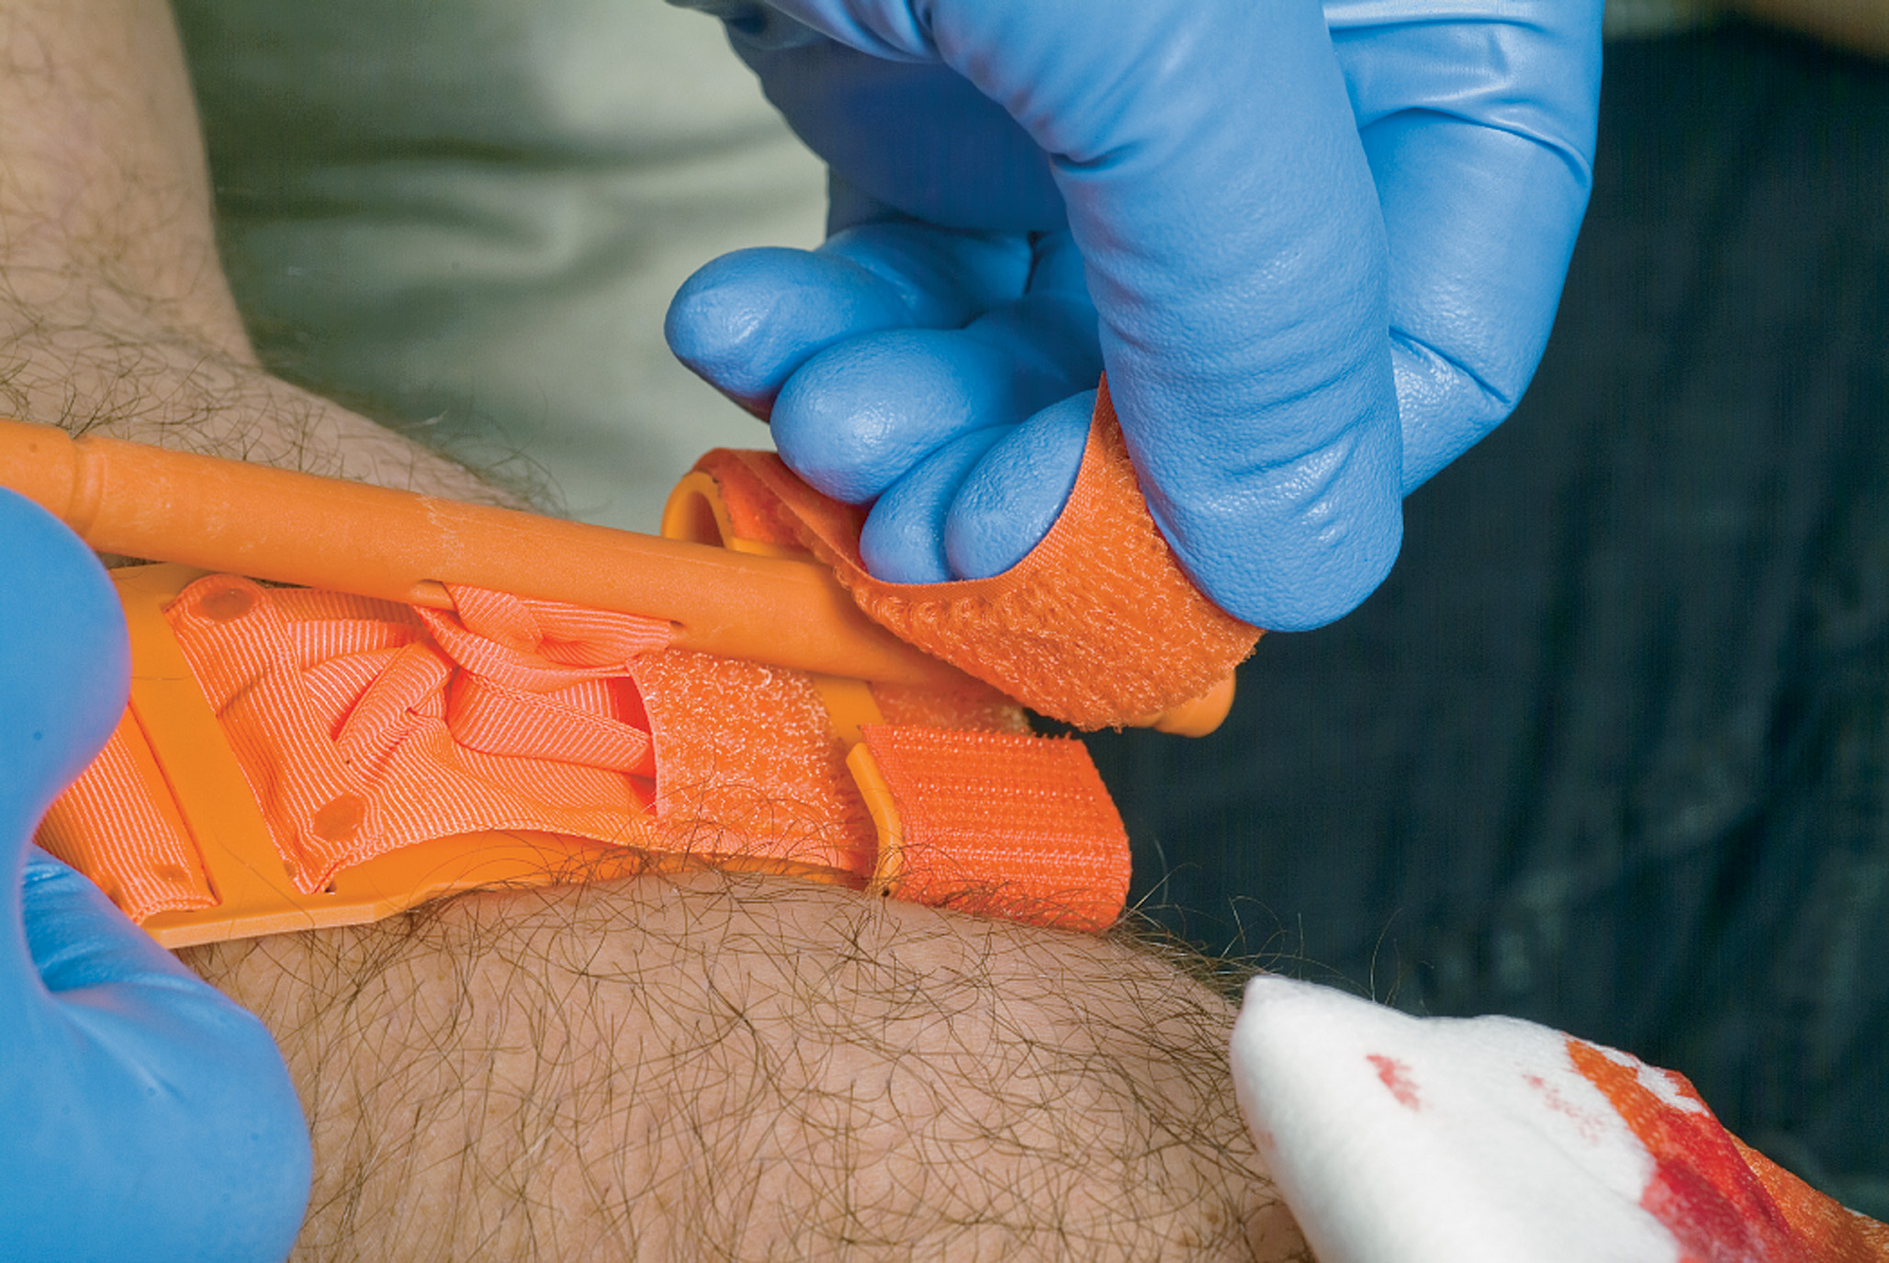
Twist the Rod to Tighten the Tourniquet to the Extent Necessary to Control Bleeding and Secure the Tightening Rod
Write the time of tourniquet application on tape and apply it to the tourniquet, leaving the tourniquet exposed to view, then notify the receiving facility that a tourniquet has been applied.
Notes:
Discuss indications and the procedure for applying a tourniquet.

Slide 28
This Junctional Injury, Where a Regular Tourniquet Would not Work, Would Call for the use of a Special Junctional Tourniquet
Notes:
Briefly discuss the junctional tourniquet.

Slide 29
External Bleeding (9 of 18)
Methods of Controlling External Bleeding
  Splints
    Splinting is an important way to reduce bleeding from an injured extremity.
    A traction splint can be helpful for a fractured femur.
    Do not delay splinting at the scene with an unstable patient.
Notes:
Bleeding can be life-threatening in an extremity with a suspected fracture. If left unsplinted, movement of broken bone ends or bone fragments can continue to damage surrounding tissues and blood vessels. Also, movement of the extremity can cause any clots that have formed to be broken, which enables the vessels to continue bleeding.
Apply splints on scene to extremity fractures only if the patient is stable and there are no other life-threatening conditions. If the patient is unstable, has any other life-threatening conditions, or exhibits signs of hemorrhagic shock, place the patient on a backboard or vacuum mattress and align the extremity fractures. Begin rapid transport.

Slide 30
External Bleeding (10 of 18)
Methods of Controlling External Bleeding
  Hemostatic Agents
    These agents can be used when direct pressure is ineffective.
    Hemostatic agents promote blood clotting.
    Their use is generally reserved for long transport times.
    There are some associated complications.
Notes:
Hemostatic agents are designed to improve clotting and control life-threatening hemorrhages that can’t be controlled with direct pressure.
The hemostatic-impregnated gauze, dressing, or sponge is recommended because it can be packed into the wound. These hemostatic agents are used for bleeding that can’t be controlled with direct pressure in wounds to areas of the body where a tourniquet can’t be applied.

Slide 31
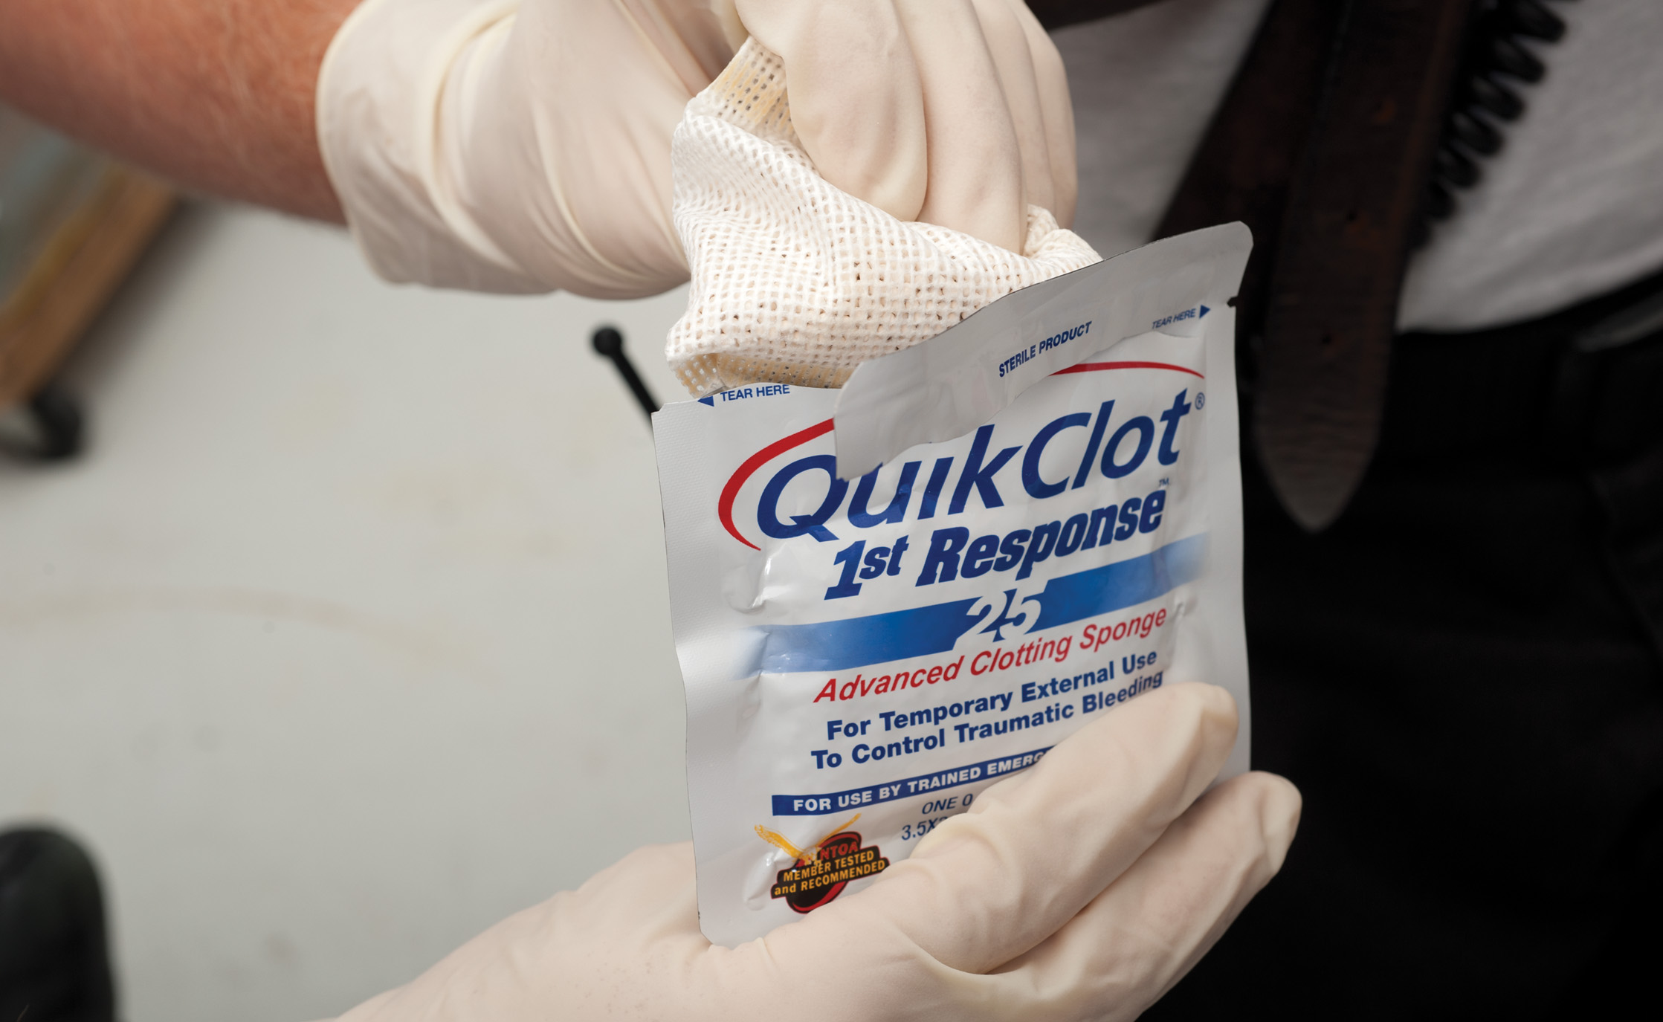
Topical Hemostatic Agents Such as Quikclot Can be Used with Pressure Dressings to Control Bleeding
Notes:
Discuss the different types of hemostatic agents.
Dressing, gauze, or sponge
Powder type (not recommended)
Hold direct pressure for 3 minutes after using hemostatic agent to help assure bleeding stoppage.

Slide 32
External Bleeding (11 of 18)
Methods of Controlling External Bleeding
  Junctional Bleeding Control
    Junctional areas are where the extremities (and head) meet the torso.
    Traditional tourniquets cannot be used.
    There are devices used by military for these types of injures, but they are not yet approved for civilian use in E M S.
Notes:
The Committee on Tactical Combat Casualty Care (CoTCCC) has approved many devices (SAM junctional tourniquet, Combat Ready Clamp, and Junctional Emergency Treatment Tool) that have been used in the military setting for junctional bleeding control. However, these devices have not yet been approved for civilian use. Direct pressure and hemostatic dressings are currently the only approved methods to control bleeding to the junctional areas.

Slide 33
Click on the Method That is Always Used First to Control External Hemorrhaging
A. Pressure dressing
B. Tourniquet
C. Direct pressure
D. Topical hemostatic agents

Slide 34
External Bleeding (12 of 18)
Assessment-Based Approach-External Bleeding
  Scene Size-Up
    Scene safety
    Standard precautions
    M O I /N O I
    Number of patients
    Additional resources
Notes:
Scene Size-Up, Primary Assessment, and Rapid Secondary Assessment
Ensure that the scene is safe.
Form a general impression, noting any signs of shock or the presence of significant bleeding.
Control significant bleeding immediately.
Continue with the primary assessment.

Slide 35
External Bleeding (13 of 18)
Assessment-Based Approach-External Bleeding
  Primary Assessment
    Assess the airway and breathing.
    Maintain S p O₂ of 94% or above.
    Assess the pulses and skin.
    Control bleeding, but do not let dramatic injuries distract you from the primary assessment.
Notes:
Ensure that the patient has a patent airway. Assess the breathing rate and tidal volume to determine whether breathing is adequate. Assess for adequate oxygenation. If the breathing is adequate and the patient exhibits signs and symptoms of poor perfusion, administer a high concentration of oxygen. This is an early and necessary emergency care procedure for shock and for blood loss. If the breathing is inadequate, begin positive pressure ventilation with supplemental oxygen attached to the ventilation device. Assess the central and peripheral pulses, skin, and capillary refill.

Slide 36
External Bleeding (14 of 18)
Assessment-Based Approach-External Bleeding
  Perform a rapid secondary assessment if:
    There is significant bleeding.
    The patient has an altered mental status.
    There are multiple injuries.
    There is a significant mechanism of injury.
Notes:
After the primary assessment, perform a rapid secondary assessment in any patient who has undergone significant bleeding, has an altered mental status, presents with multiple injuries, or has suffered a significant MOI. The rapid secondary assessment can reveal any other potential life threats and provide further information about the stages of shock. Because bleeding is a serious condition, the rapid secondary assessment should not, if possible, take more than 90 seconds to perform.

Slide 37
External Bleeding (15 of 18)
Assessment-Based Approach-External Bleeding
  Obtain baseline vital signs.
  Assess for signs of hypoperfusion.
Notes:
Be sure to obtain a set of vital signs for two reasons: 1. The vital signs indicate the seriousness of the blood
loss. 2. The baseline vital signs can be compared to a series of later vital sign measurements to determine whether the patient’s condition is deteriorating, remaining the same, or improving. Keep in mind that vital signs can be deceiving and might not indicate the seriousness of the condition, especially in pediatrics. Also assess signs of perfusion or hypoperfusion.

Slide 38
External Bleeding (16 of 18)
  Assessment-Based Approach-External Bleeding
  Emergency Medical Care
    Maintain airway and ventilations.
      Keep pulse oximeter
    Control bleeding with direct pressure.
      If direct pressure is ineffective, apply a tourniquet.
    Provide care for shock.
    Immobilize injured extremities.
    Reassess.
Notes:
If a traumatized patient is unstable, research has shown that oxygen should be provided to keep the pulse oximeter reading at 95% and above (as compared to most medical conditions that require a minimum pulse oximeter of 94%).

Slide 39
External Bleeding (17 of 18)
Bleeding from the Nose, Ears, or Mouth
  This may indicate the following:
    Skull injury or facial trauma
    Digital trauma to the nose
    Sinusitis
    Hypertension
    Clotting disorders
    Esophageal disease.
Notes:
These special areas can be cause for concern because they can indicate a serious condition.

Slide 40
External Bleeding (18 of 18)
Bleeding from the Nose, Ears, or Mouth
  Do not attempt to control bleeding from the ears or nose if the patient has experienced a head injury.
  Epistaxis is controlled by direct pressure.
Notes:
Epistaxis, or a nosebleed, can result from injury, disease, or the environment. Usually this type of bleeding is more of an annoyance than a threat to life. However, in cases of extreme blood loss, hemorrhagic shock can develop.

Slide 41
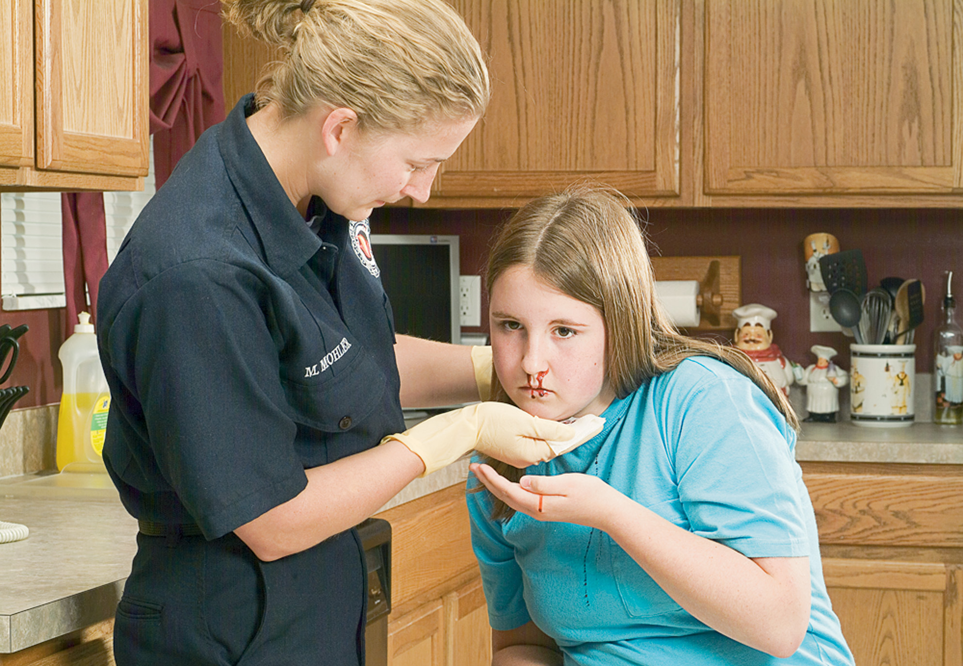
Have the Patient Sit and Lean Forward
Notes:
Discuss the steps for controlling a nosebleed.
Have the patient sit up straight and tip her head forward.

Slide 42
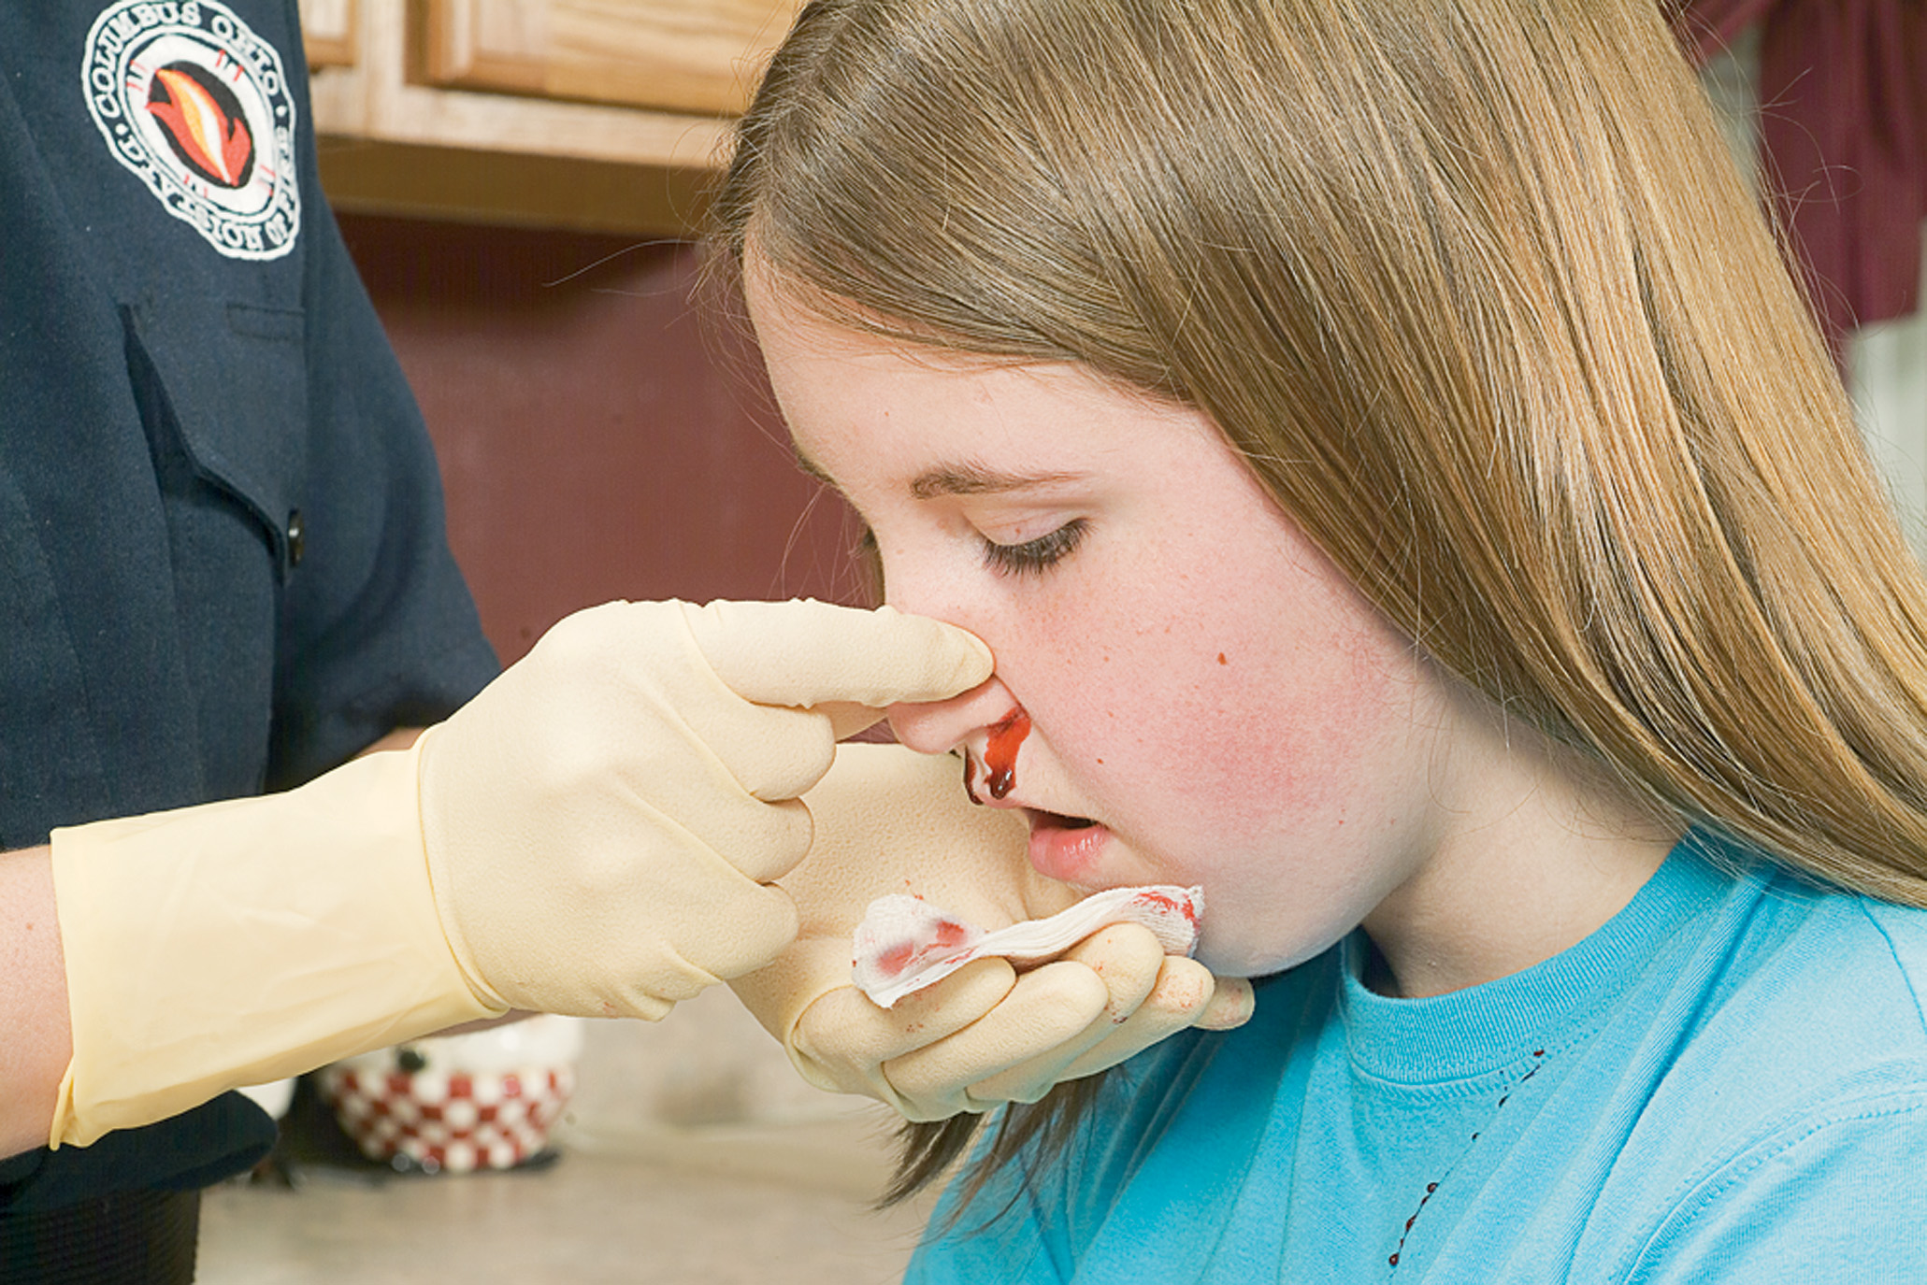
Pinch the Fleshy Part of the Nostrils Together
Notes:
Discuss the steps for controlling a nosebleed.
1. Use your thumb and forefinger to pinch soft part of the nose shut.
Apply an ice pack to the nose and cheek.
Continue to pinch the nose shut for 10 minutes.
Tell the patient not to blow her nose for 12 hours after the bleeding has stopped.

Slide 43
Internal Bleeding (1 of 9)
Internal bleeding may result from trauma or medical problems.
Internal bleeding may not be obvious and can rapidly result in death.
Notes:
Discussion Question
What are some causes of internal bleeding?
Critical Thinking Discussion
How can fractures of the femur or pelvis result in extreme blood loss?

Slide 44
Internal Bleeding (2 of 9)
Severity
  Common sources of internal bleeding are injured organs and fractured extremities.
  A hematoma is a contained collection of blood that can contain a significant amount of blood.
  Use signs and symptoms to estimate the severity of blood loss.
Notes:
Discussion Questions
What are some signs and symptoms of internal bleeding?
What are the treatment priorities for patients with internal bleeding?
Knowledge Application
Given several patient descriptions, students should be able to identify indications of internal bleeding and hemorrhagic shock.

Slide 45
Internal Bleeding (3 of 9)
Assessment-Based Approach-Internal Bleeding
  Scene Size-Up and Primary Assessment
    Perform a scene size-up; look for a mechanism of injury.
    Form a general impression.
    Immediately control major external bleeding.
    Pay close attention to the patient’s mental status.
Notes:
After ensuring that the scene is safe, approach the patient. During your general impression, look for any obvious major external bleeding. If you find a major bleed, immediately control it with direct pressure. As you continue with the primary assessment, assess the patient’s mental status. A decreasing mental status is a sign of both hypoxia and shock. As the patient loses blood, the mental status will continue to deteriorate.

Slide 46
Internal Bleeding (4 of 9)
Assessment-Based Approach-Internal Bleeding
  Scene Size-Up and Primary Assessment
    Assess airway, breathing, and oxygenation.
    Assess the pulses, skin, and capillary refill.
    Pay attention to changes in the respirations, pulse, and skin that can indicate blood loss.
Notes:
Support lost functions of the airway, breathing, or ventilations.

Slide 47
Internal Bleeding (5 of 9)
Assessment-Based Approach-Internal Bleeding
  Secondary Assessment
    Perform a rapid secondary assessment if the mechanism of injury and assessment suggest internal bleeding.
Notes:
If the potential MOI and your general impression of the patient suggest internal bleeding, proceed to a rapid secondary assessment following the primary assessment. If there is evidence of contusions, abrasions, deformity, impact marks, swelling, or other trauma, treat the patient for internal bleeding. This is a priority patient; prepare for immediate transport after rapid secondary assessment and initial emergency care.

Slide 48
Internal Bleeding (6 of 9)
Assessment-Based Approach-Internal Bleeding
  Secondary Assessment
    Signs and Symptoms
      Contusions
      Abrasions
      Deformity
      Impact marks
      Swelling
Notes:
Internal bleeding is not visible and might not be easily detectable. In some patients, by the time obvious signs and symptoms are present, the patient may have lost a significant amount of blood. Watch for subtle signs and symptoms and changes in the patient’s condition.

Slide 49
Internal Bleeding (7 of 9)
Assessment-Based Approach-Internal Bleeding
  Secondary Assessment
    Signs and symptoms of internal bleeding include:
      Pain, tenderness, swelling, discoloration
      Bleeding from a bodily orifice
      Vomiting, bright red or coffee-ground material
      Hypotension or a narrowing pulse pressure
      Nausea, vomiting.
Notes:
Internal bleeding may be more subtle, Encourage students to vigilantly assess and reassess the patient for findings that suggest internal bleeding.

Slide 50
Internal Bleeding (8 of 9)
Assessment-Based Approach-Internal Bleeding
  Secondary Assessment
    Additional signs and symptoms of internal bleeding or hemorrhagic shock include:
      Anxiety, restlessness, combativeness, altered mental status
      Weakness, faintness, dizziness
      Tachycardia, tachypnea.
Notes:
Explain to students that general indications of hemorrhagic shock are the same for external or internal bleeding, arising mainly from the body’s attempt to maintain perfusion with compensatory mechanisms until they fail.

Slide 51
Internal Bleeding (9 of 9)
  Assessment-Based Approach-Internal Bleeding
  Emergency Medical Care
    Maintain an open airway and adequate breathing. Keep S p O₂ at
    Control any external bleeding as needed.
    Initiate immediate transport; consider A L S.
    Provide ongoing care for shock.
Notes:
Remind students of the benefits of ALS backup or intercept, as well as choosing the appropriate destination hospital.

Slide 52
Factors That May Increase Bleeding
Movement
Low body temperature
Medications
Intravenous fluids
Removal of dressings and bandages
Notes:
Discussion Questions
What are some ways to reduce movement of an injured area?
What are some medications that can interfere with blood clotting?
Critical Thinking Discussion
For what types of medical problems would a patient take Coumadin (warfarin)?

Slide 53
Hemorrhagic Shock (1 of 7)
Shock results from inadequate tissue perfusion.
Significant hemorrhaging leads to inadequate perfusion.
Cells are deprived of oxygen and nutrients and begin to fail and die.
Immediate recognition and treatment are critical.
Notes:
Critical Thinking Discussion
Why is thirst a sign of hemorrhagic shock?
What causes a narrow pulse pressure in hemorrhagic shock?
Discussion Question
Why are restlessness, anxiety, and altered mental status indications of shock?
Class Activity
In a supervised lab setting, provide students with ample opportunity to practice assessing and managing patients in shock.

Slide 54
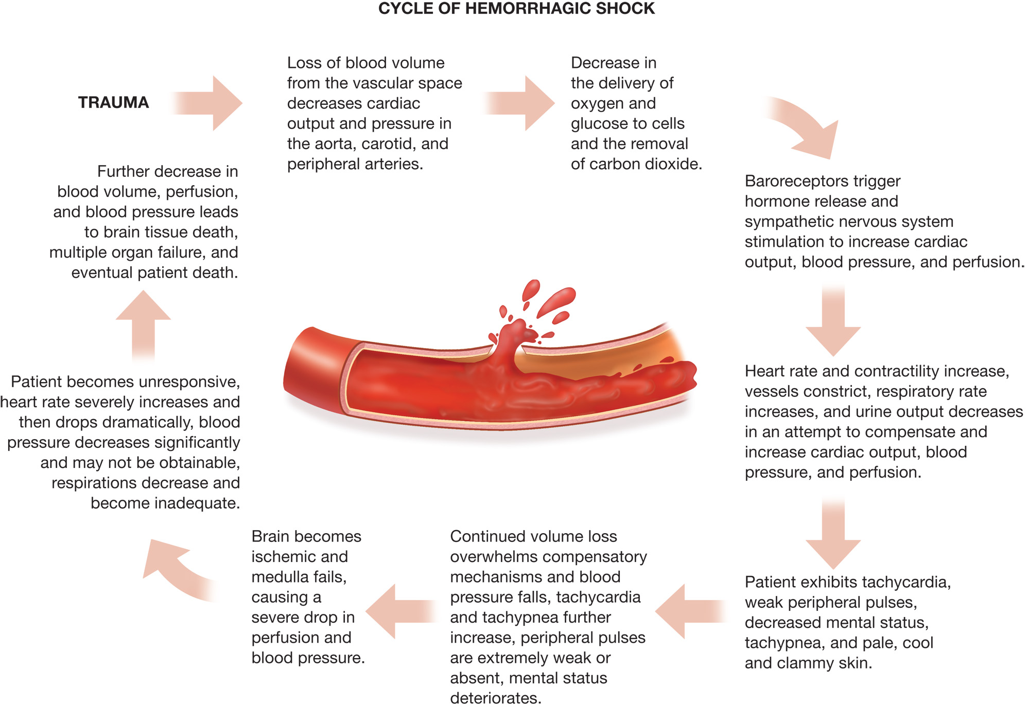
Continuous Cycle of Shock

Slide 55
Hemorrhagic Shock (2 of 7)
Assessment-Based Approach- Hemorrhagic Shock
    Scene Size-Up
    Primary Assessment
    Secondary Assessment
      Physical Exam
      Vital Signs
    Reassessment
Notes:
Scene Size-Up
Protect yourself.
MOI may give clues to injuries.
Summon law enforcement, if needed.
Primary Assessment
Check Airway, Breathing, and Circulation.
Support lost function.
Make patient-priority determination.
Secondary Assessment
Perform rapid trauma assessment if patient is critical.
A loss of >15% of blood volume will cause changes in vital signs.
Relate signs and symptoms to their corresponding stage of shock.

Slide 56
Hemorrhagic Shock (3 of 7)
Assessment-Based Approach- Hemorrhagic Shock
  Secondary Assessment
    Signs and Symptoms
      Mental status changes
      Decreased peripheral perfusion
      Vital sign changes and narrowed pulse pressure
      Dilated pupils, nausea/vomiting, thirst
Notes:
Discuss findings consistent with hemorrhagic shock. Given scenarios of findings, have the students predict the patient’s stage of shock, as well as what the treatment will be.

Slide 57
Hemorrhagic Shock (4 of 7)
Assessment-Based Approach- Hemorrhagic Shock
  Emergency Medical Care
    Maintain an open airway, administer oxygen, and assist ventilations as needed.
    Control external bleeding.
    Splint injuries as appropriate.
    Place patient supine and treat for shock.
    Transport the patient rapidly to an appropriate facility.
Notes:
Maintain Standard Precautions by wearing the appropriate personal protective equipment, including gloves and eye protection.
Maintain an open airway. If breathing is adequate, administer a high concentration of oxygen via a nonrebreather mask at 15 lpm. If breathing is inadequate, begin positive pressure ventilation with supplemental oxygen connected to the ventilation device.
Control any external bleeding, using the techniques described earlier in this chapter.
Place the patient in a supine position.
Splint suspected bone or joint injuries. In the hemorrhagic shock patient, transport is critical. Thus, the fractures will be initially stabilized by the long backboard or vacuum mattress. If there is time and the patient’s condition permits, the fractures can be individually splinted while en route.
Use a blanket to cover patient who may be in hemorrhagic shock to prevent loss of body heat. Warm the patient compartment to 85 degrees during transport to prevent loss of body heat. Remove any wet or blood-soaked cloth.
Transport the patient immediately.

Slide 58

Take all Necessary Standard Precautions
Notes:
Discuss the management of a patient in hemorrhagic shock.

Slide 59
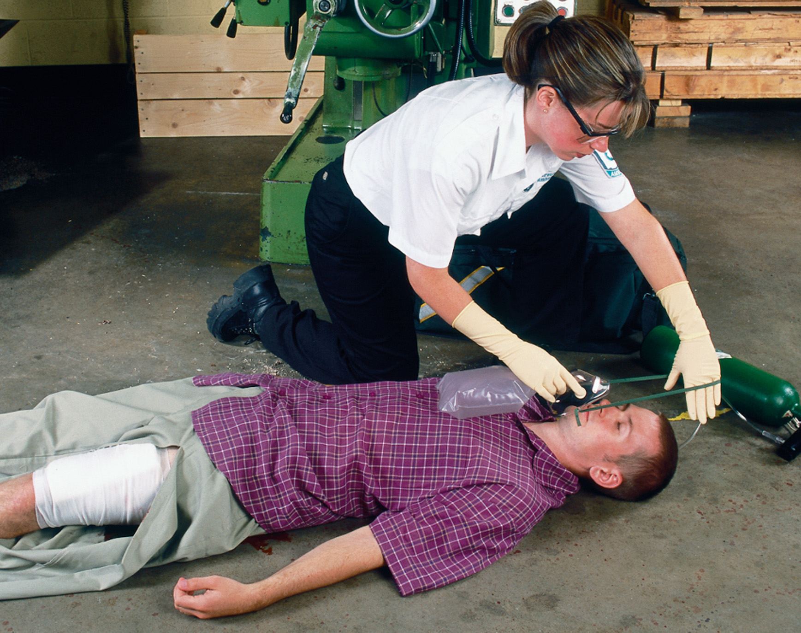
Administer Supplemental Oxygen or Positive Pressure Ventilation as Indicated
Notes:
Discuss the management of a patient in hemorrhagic shock.

Slide 60
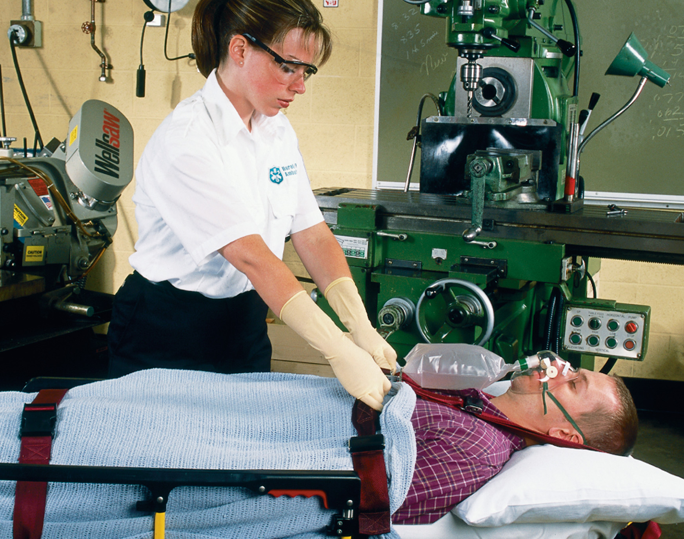
Cover the Patient to Prevent Loss of Body Heat
Notes:
Discuss the management of a patient in hemorrhagic shock.

Slide 61
Hemorrhagic Shock (5 of 7)
Summary: Assessment and Care
Emergency Care Protocol
Bleeding and Hemorrhagic Shock
Control any major life-threatening bleeding.
Establish spine motion restriction if spinal injury is suspected.
Establish and maintain an open airway; insert a nasopharyngeal or oropharyngeal airway if the patient is unresponsive and has no gag or cough reflex.
Notes:
Discussion Question
What are the indications and contraindications for the application of a PASG?

Slide 62
Hemorrhagic Shock (6 of 7)
Suction secretions as necessary.
I f breathing is inadequate, provide positive pressure ventilation with supplemental oxygen at a minimum rate of 10–12 ventilations/minute for an adult and 12–20 ventilations/minute for an infant or child.
If breathing is adequate, administer a high concentration of oxygen by nonrebreather mask at 15 literperminute if signs or symptoms of poor perfusion are present to maintain t h e S p O₂ greater than 95%.
Control bleeding with direct pressure (use fingertip pressure).
Apply a tourniquet if bleeding is not controlled with direct pressure. Note the time the tourniquet was applied and document the time. If it is not possible to apply a tourniquet to the body, apply a hemostatic agent with a dressing and continue to apply direct pressure.

Slide 63
Hemorrhagic Shock (7 of 7)
Apply sterile dressings and bandages.
Maintain body temperature.
Consider application of the P A S G.
Place the patient supine.
If spinal injury is suspected, provide spine motion restriction.
Transport.
Perform reassessment every 5 minutes.

Slide 64
Case Study #1 Conclusion (1 of 3)
Mick ensures that the patient has an open airway and adequate breathing as Dave applies direct pressure to the scalp wound. Mick detects a weak, thready, rapid radial pulse. He performs a rapid secondary assessment, noting tenderness to the chest and abdomen.
Breath sounds are present on both sides but seem to be deceased on the right side. There are swelling, deformity, and tenderness of the right femur and right lower leg exhibit swelling, deformity, and tenderness.
Notes:
Review the Case Study Conclusion and emphasize the application of knowledge learned from this presentation up to this point.

Slide 65
Case Study #1 Conclusion (2 of 3)
The E M Ts recognize indications of significant internal bleeding and rapidly extricate the patient, securing him to a long backboard. They begin transport immediately, applying oxygen by nonrebreather mask, assessing baseline vital signs, and performing a head-to-toe secondary assessment.
Notes:
Review the Case Study Conclusion and emphasize the application of knowledge learned from this presentation up to this point.

Slide 66
Case Study #1 Conclusion (3 of 3)
At the emergency department, the patient receives a chest tube for a right pneumothorax, then is quickly prepared for surgery to repair damage to his liver and right leg.
Notes:
Review case conclusion and emphasize the application of knowledge learned from this presentation thus far.

Slide 67
Case Study #2 Introduction
Seven-year-old Tara Lambert shrieks as her older brother, Denny, chases her through the living room. She is taken by surprise as she slips on a rug in the entryway. She loses her balance and falls hands-first into the panes of glass in the door. The glass shatters as Tara’s left hand and forearm break through it. She sits down, stunned, as blood begins pouring out from a long laceration below the crease of her elbow.
“Mom!” Denny screams. “Come quick!”
Notes:
Case Study
Present the Case Study Introduction provided in the PowerPoint slide set.
Lead a discussion using the Case Study questions provided on the subsequent slide(s).
The Case Study with discussion questions continues throughout the PowerPoint presentation.
Case Study Discussion
Use the Case Study content and questions to foreshadow the upcoming lesson content.

Slide 68
Case Study #2 (1 of 3)
What will be the E M Ts’ first steps as they arrive at the scene?
What methods will the E M Ts use to control bleeding?
Once bleeding is controlled, what other treatment should the E M Ts perform?
Notes:
Use the student’s responses to foreshadow the upcoming lecture material and to assess their current knowledge base.

Slide 69
Soft Tissue Trauma (1 of 3)
Soft tissue injuries may be closed or open.
The appearance of soft tissue injuries can be dramatic, but don’t be distracted from the priorities of care.
Dressings and bandages are used to help control bleeding and prevent further wound contamination.
Notes:
Soft tissue trauma, also referred to as a wound or wounds, involves injuries to the skin and underlying
tissues.

Slide 70
Soft Tissue Trauma (2 of 3)
The Skin
  Protects the body from the environment and organisms
  Helps regulate body temperature
  Senses heat, cold, touch, pressure, pain
  Assists in elimination of water, salts
Notes:
Discussion Question
What are the roles of the skin?
Critical Thinking Discussion
What would be the bodily consequences if large areas of skin were damaged?

Slide 71
Soft Tissue Trauma (3 of 3)
The Skin
  Skin Layers
    Epidermis
    Dermis
    Subcutaneous layer
Notes:
Discuss the main features and structures contained within each skin layer and how these contribute to the presentation of soft tissue trauma.

Slide 72
Closed Soft Tissue Injury (1 of 6)
In closed injuries, there is no break in the skin.
Three types of closed injury are:
  Contusions
  Hematomas
  Crush injuries.
Notes:
Critical Thinking Discussion
Why does the discoloration associated with a contusion change from red to blue/black to green to brown/yellow?

Slide 73
Closed Soft Tissue Injury (2 of 6)
Contusions
  A bruise
  Injury to blood vessels in the dermis
  Swelling, discoloration (ecchymosis)
Notes:
A contusion, or bruise, is an injury to the tissue and blood vessels contained within the dermis. This type of injury causes localized swelling and pain at the injury site. The patient can also have some discoloration at the injury site, caused by blood leaking from damaged vessels and accumulating in the surrounding tissues. The black and blue discoloration is called ecchymosis.

Slide 74
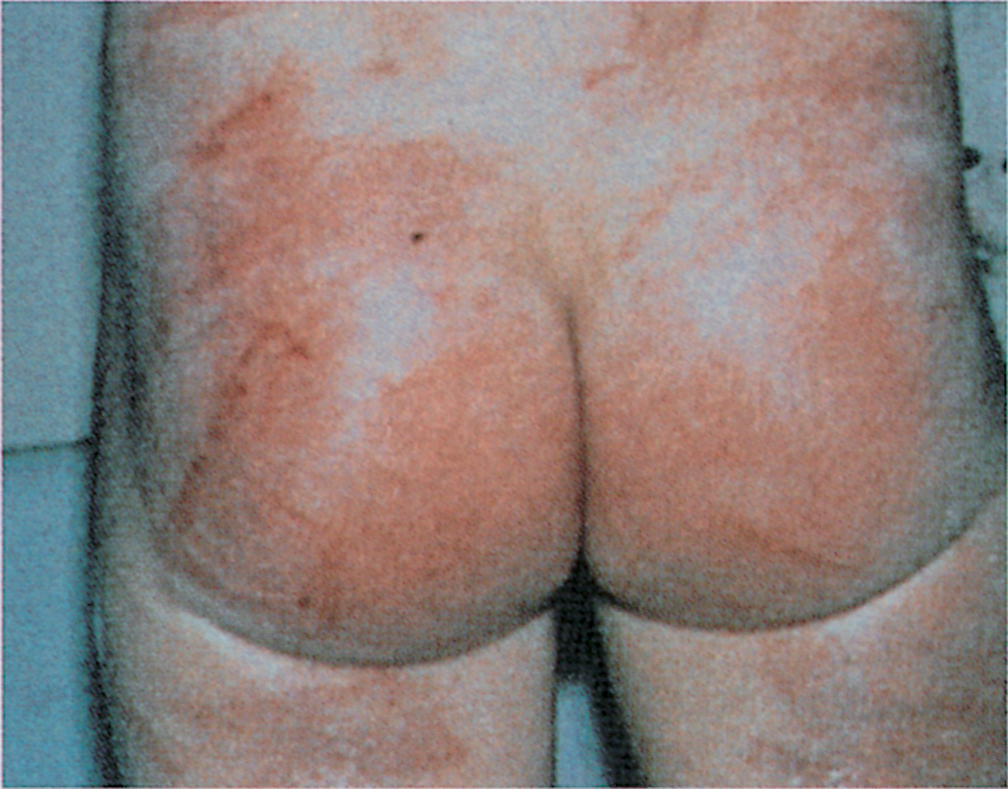
Contusion

Slide 75
Closed Soft Tissue Injury (3 of 6)
Hematoma
  Involves larger blood vessels and tissue areas than a contusion
  Forms as a pocket of blood beneath the skin and can separate tissues
  Presents as a lump with discoloration
Notes:
A hematoma is similar to a contusion, except it usually involves damage to a larger blood vessel and a wider tissue area. It is characterized by a large lump with bluish discoloration, caused by blood collecting beneath the skin.

Slide 76
Hematoma

Slide 77
Closed Soft Tissue Injury (4 of 6)
Crush Injury
  Results from significant blunt trauma or crushing force
  May be open or closed
  Serious damage to underlying tissues
  Internal bleeding
Notes:
A crush injury is one in which force great enough to cause injury has been applied to the body. Severe blunt trauma or crushing force can cause serious damage to the underlying soft tissues, with associated internal bleeding that results in hemorrhagic shock. Internal organs can rupture if a severe crush injury is sustained.

Slide 78
Closed Soft Tissue Injury (5 of 6)
Assessment-Based Approach-Closed Soft Tissue Injuries
  Scene Size-Up and Primary Assessment
    Perform a scene size-up; look for mechanism of injury.
    Provide spine motion restriction precautions, if indicated.
  Primary Assessment
  Secondary Assessment
Notes:
Knowledge Application
Students should be able to apply the information in this section to assess and manage patients with soft tissue injuries.

Slide 79
Closed Soft Tissue Injury (6 of 6)
Assessment-Based Approach-Closed Soft Tissue Injuries
  Emergency Medical Care
    Ensure an open airway, adequate breathing, and maintain oxygenation.
    Treat for shock, if indicated.
    Splint suspected fractures.
    Reassess and transport the patient.

Slide 80
Open Soft Tissue Injury (1 of 20)
In open injuries, the continuity of the skin is broken.
Open injuries are at risk for external bleeding and contamination.
An open injury may be a sign of a deeper underlying injury.
Notes:
When the continuity of the skin is broken, the wound is called an open injury. In open injuries, the patient is at risk for external bleeding and contamination with dirt and bacteria, which can lead to infection. The open injury can be the first indicator of a deeper, more serious injury, such as a fracture or ruptured or lacerated organ.

Slide 81
Open Soft Tissue Injury (2 of 20)
Six types of open injuries are:
  Abrasions
  Lacerations
  Avulsions
  Amputations
  Penetrations/punctures
  Crush injuries.
Notes:
Each of these will be discussed over the next several slides.

Slide 82
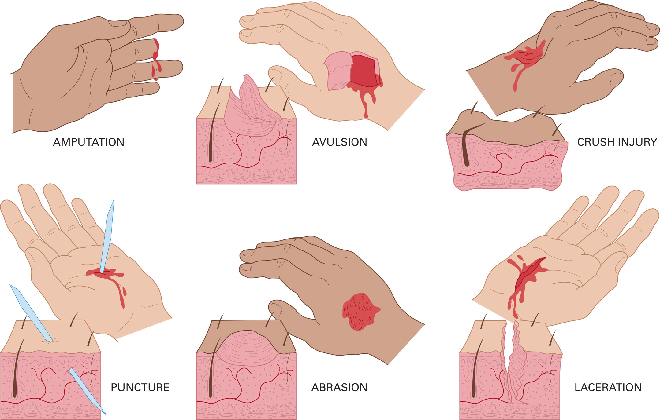
The Six Types of Open Injuries
Notes:
Review these briefly as each will be discussed in more detail in the upcoming slides.

Slide 83
Open Soft Tissue Injury (3 of 20)
Abrasion
  Abrasion injuries are caused by scraping or rubbing away the epidermis.
  The injuries are superficial, but painful.
  Bleeding is easily controlled.
  If large areas of the body are involved, infection is a concern.
Notes:
An abrasion is generally caused by scraping, rubbing, or shearing away the epidermis, the outermost layer of the skin. Even though an abrasion is considered a superficial injury, it can be extremely painful because of the presence of exposed nerve endings. In most cases, blood oozes from the wound (capillary bleeding), which can easily be controlled with direct pressure.

Slide 84
Light and Deep Abrasions

Slide 85
Open Soft Tissue Injury (4 of 20)
Laceration
  A break in the skin
  Depth may vary
  May be linear or stellate
  Possibility of significant bleeding
Notes:
A laceration, which is a break in the skin of varying depth, can be linear (regular) or stellate (irregular). Lacerations can bleed more than other types of open soft tissue injuries, especially when an artery is involved.

Slide 86
Lacerations to the Face and Legs

Slide 87
Open Soft Tissue Injury (5 of 20)
Avulsion
  A flap of skin is torn loose or pulled off completely.
  Bleeding can be severe.
  Healing can be prolonged and scarring may be extensive.
Notes:
An avulsion is a loose flap of skin and underlying soft tissue that has been torn loose (partial avulsion) or pulled completely off (total or complete avulsion). Bleeding can be severe because of blood vessel injury, although some blood vessels can tamponade (compress) by retracting into the soft tissue.

Slide 88
Avulsion

Slide 89
Open Soft Tissue Injury (6 of 20)
Amputations
  Disruptions in the continuity of an extremity or other body part
  Result from ripping or tearing forces
  Minimal or massive bleeding.
  May be partial or complete
Notes:
An amputation involves a disruption in the continuity of an extremity or other body part. Amputations are the result of ripping or tearing forces often associated with accidents involving industrial or agricultural equipment, power tools, or motor vehicles. Bleeding from amputations can be extreme.
Discussion Question
Explain the management of partial and complete amputations and amputated parts.

Slide 90
Finger Amputation
Notes:
In the image on the right, the amputated fingertips are very pale compared to the rest of the hand after being cut off from the blood supply.

Slide 91
Open Soft Tissue Injury (7 of 20)
Penetrations/Punctures
  The injuries result from sharp, pointed objects being pushed or driven into soft tissues
  The entry wound may be small, but the underlying damage can be severe.
  A gunshot is a type of penetration injury.
  A knife injury is also a penetration injury, and may be hidden.
Notes:
A penetration/puncture injury is generally the result of a sharp, pointed object being pushed or driven into soft tissues. The entry wound can appear small with little visible bleeding. However, such injuries can be deep and damaging, causing severe internal bleeding. The overall severity of the injury depends on the location, the size of the penetrating object, depth of penetration, forces involved, and structures in the path of the injury.
Discussion Question
Why are impaled objects stabilized in place?

Slide 92
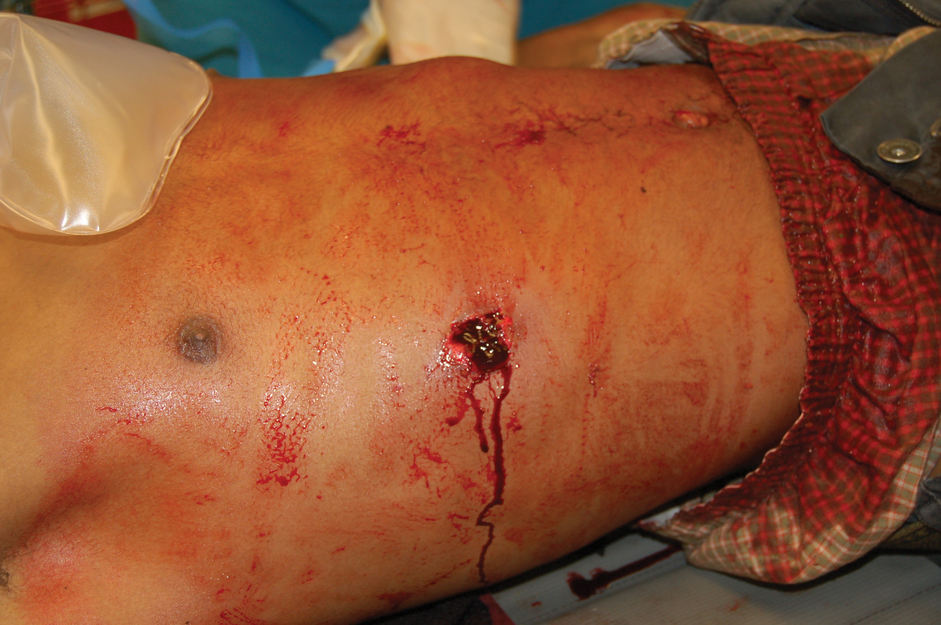
Penetration/Puncture Wound to the Chest
(© Edward T. Dickinson, M D)

Slide 93
Open Soft Tissue Injury (8 of 20)
Crush Injuries
  The affected part may be painful, swollen, and deformed; bleeding can be minimal or absent.
  There may be internal injuries and bleeding.
  Shock can develop rapidly when the crushing object is lifted from the patient.
Notes:
Crushing forces, crush injuries, usually the result of blunt trauma or crushing forces, might not appear to be serious. The only external sign can be an injury site that is painful, swollen, and deformed. External bleeding can be minimal or absent. In cases of crush injury, always suspect that there might be hidden injuries and severe internal bleeding.

Slide 94
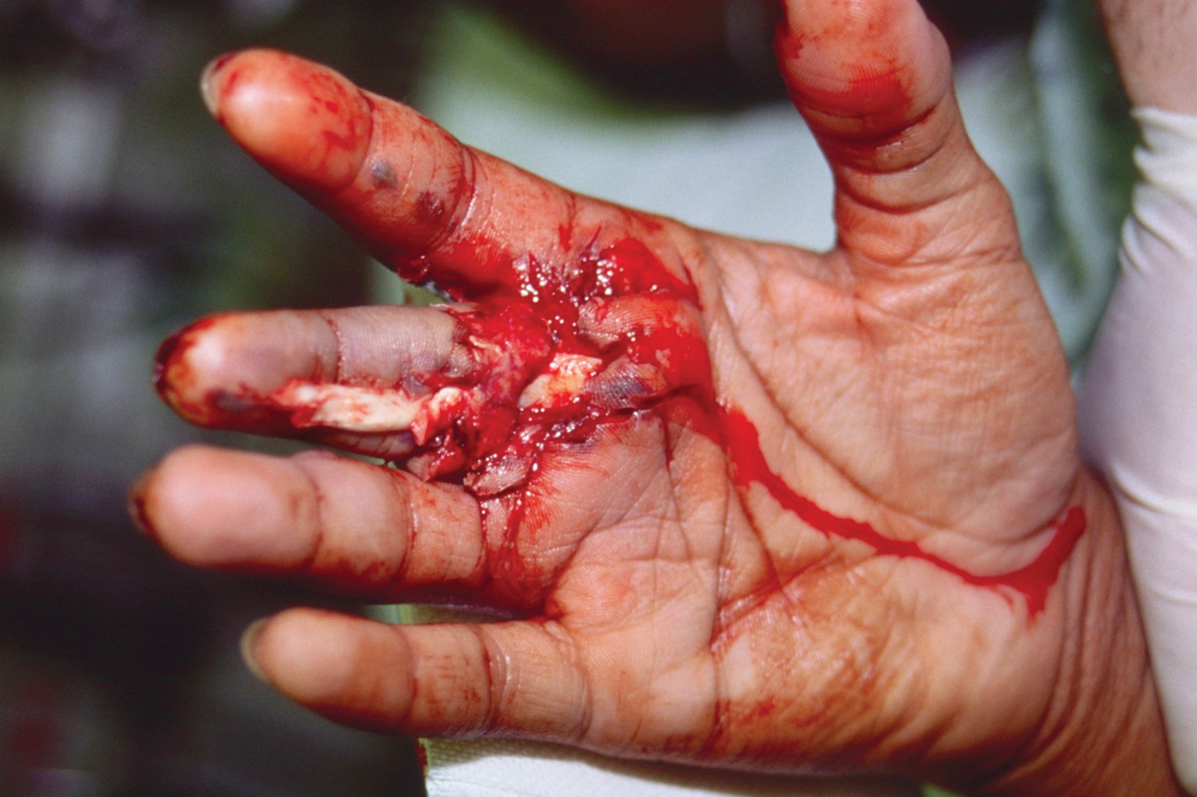
Crush Injury, Open Wound

Slide 95
Open Soft Tissue Injury (9 of 20)
Other Soft Tissue Injuries
  Bites
    Dog bites can be complicated by infection, cellulitis, septicemia, and concerns of rabies and tetanus.
    Human bites can result in infection and hepatitis.
Notes:
Discuss human and animal bites.

Slide 96
Dog Bite to a Woman’s Face

Slide 97
Open Soft Tissue Injury (10 of 20)
Other Soft Tissue Injuries
  Clamping Injuries
    A body part is caught or strangled in machinery.
    These injuries often include a finger or hand.
    It becomes more difficult with time to extricate the body part(s) from machinery because of swelling.
Notes:
A clamping injury occurs when a body part is caught or strangled by machinery, a tool, or another object or piece of equipment. Most clamping injuries involve a finger or hand caught in an opening (the mouth of a bottle, for example). Time is of the essence factor because the longer a part remains clamped, the more damage can occur. Edema also makes removal more difficult over time.

Slide 98
Clamping Injury

Slide 99
Click on the Type of Injury That Occurs When a Flap of Skin is Partially or Completely Torn Away from the Body
A. Laceration
B. Avulsion
C. Abrasion
D. Amputation

Slide 100
Open Soft Tissue Injury (11 of 20)
Assessment-Based Approach-Open Soft Tissue Injuries
  Scene Size-Up and Primary Assessment
  Secondary Assessment
    Signs and Symptoms
Notes:
Before you enter a scene, make sure it is safe to do so, and notice any potential mechanisms of injury. Provide spine motion restriction precautions if spinal injury. Get a general impression of the patient and his mental status as you approach. When you reach the patient, ensure an open airway. If the patient’s breathing is inadequate, initiate positive pressure ventilation with supplemental oxygen connected to the ventilation device. Bring any severe bleeding under control with direct pressure.

Slide 101
Open Soft Tissue Injury (12 of 20)
  Assessment-Based Approach-Open Soft Tissue Injuries
  Secondary Assessment Signs and Symptoms
    For an unstable patient or significant mechanism of injury, perform a rapid secondary assessment.
    For a stable patient without significant mechanism of injury, perform a modified secondary assessment.
Notes:
Conduct a secondary assessment. Assess baseline vital signs and obtain a history. For patients without a significant MOI, altered mental status, and multiple injuries, perform a modified secondary assessment, using components of the complete secondary assessment for the specific injury site.
Discussion Questions
Why are open chest wounds managed with an occlusive dressing that is sealed on three sides?
Why is an open neck wound managed with an occlusive dressing?

Slide 102
Open Soft Tissue Injury (13 of 20)
  Assessment-Based Approach-Open Soft Tissue Injuries
  Emergency Medical Care
    Ensure an open airway and adequate breathing and oxygenation.
    Expose the wound and control bleeding.
    Prevent further contamination.
    Dress the wound; keep patient calm.
    Treat the patient for shock and transport.
Notes:
Unless bleeding is severe, emergency care for open soft tissue injuries is performed after the primary assessment.

Slide 103
Open Soft Tissue Injury (14 of 20)
  Assessment-Based Approach-Open Soft Tissue Injuries
  Emergency Medical Care
    Special Considerations
      Penetrating chest wounds
      Penetrating or open abdominal injuries
      Impaled objects
      Amputations
      Large neck injuries
Notes:
Identify the need for occlusive dressings in certain types of injuries, and explain how this specific treatment works.

Slide 104
Open Soft Tissue Injury (15 of 20)
  Assessment-Based Approach-Open Soft Tissue Injuries
  Emergency Medical Care
    Special Considerations
      Penetrating chest wounds
        Requires an occlusive dressing
Notes:
A chest injury can prevent adequate respiration by causing the lung to collapse.

Slide 105
Open Chest Injury with Occlusive Dressing Taped on Three Sides

Slide 106
Open Soft Tissue Injury (16 of 20)
Assessment-Based Approach-Open Soft Tissue Injuries
  Emergency Medical Care
    Special Considerations
      Abdominal injuries
        Do not repack protruding organs.
        These injuries require moist and sterile dressings and occlusive dressings.
Notes:
Discussion Question
What are the preferred materials for managing an evisceration?
Abdominal wounds sometimes result in an evisceration, meaning that abdominal organs protrude through the wound.

Slide 107
Abdominal Injury with Moist and Sterile Dressing and Occlusive Dressing

Slide 108
Open Soft Tissue Injury (17 of 20)
Assessment-Based Approach-Open Soft Tissue Injuries
  Emergency Medical Care
    Special Considerations
      Impaled object
        Do not remove the object unless it is in the cheek or neck and obstructing airflow through the airway.
        Stabilize the object in place.
Notes:
An impaled object, an object that is still embedded in a wound, should never be removed in the field, unless it is through the cheek or the neck, where it is obstructing airflow through the trachea.

Slide 109
An Impaled Object in the Cheek May Be Removed. Dress the Outside of the Wound and Inside the Mouth, between the Cheek and Teeth

Slide 110
An Impaled Knife
Notes:
Discuss the process for managing an impaled object.

Slide 111
Stabilize the Knife
Notes:
Discuss the process for managing an impaled object.

Slide 112
Cut Away Clothing
Notes:
Discuss the process for managing an impaled object.

Slide 113
Stabilize and Bandage the Object in Place
Notes:
Discuss the process for managing an impaled object.

Slide 114
Open Soft Tissue Injury (18 of 20)
Assessment-Based Approach-Open Soft Tissue Injuries
  Emergency Medical Care
    Special Considerations
      Amputations
        Some amputated parts can be reattached, if cared for properly.
        Transport the amputated part(s) and patient together, if possible.
Notes:
In amputation injuries, you must care for the amputated part as well as for the patient and the injury. Your handling of the amputated part can have significant impact on the success of surgical reattachment.

Slide 115
Open Soft Tissue Injury (19 of 20)
  Assessment-Based Approach-Open Soft Tissue Injuries
  Caring for Amputated Parts
    Remove gross contamination.
    Wrap the part in dry, sterile gauze.
    Wrap or bag the part in plastic.
    Keep the amputated part cool.
    Never complete a partial amputation.
Notes:
Provide emergency medical care for the patient. Enlist others to look for any missing body parts or retrieve them if they are embedded in machinery or other equipment. When an amputated body part is located, follow the guidelines on the following site.

Slide 116
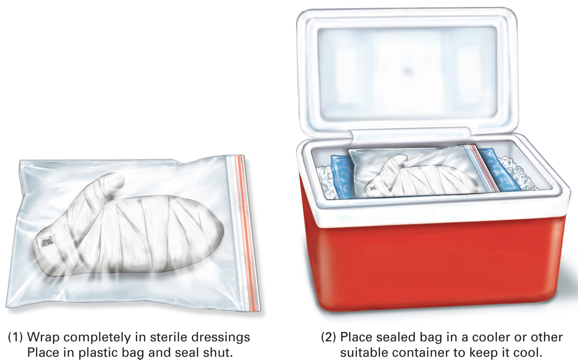
Emergency Care for Amputated Part. Follow Local Protocol

Slide 117
Open Soft Tissue Injury (20 of 20)
Assessment-Based Approach-Open Soft Tissue Injuries
  Emergency Medical Care
    Special Considerations
      Open neck wounds
        Bleeding may be severe.
        Air can be sucked into damaged veins, causing an air embolism.
Notes:
In addition to severe bleeding from a wound involving the major blood vessels of the neck, there is a danger of air being sucked into a neck vein and carried to the heart, which can be lethal.

Slide 118
Open Wound to the Neck
Notes:
Discuss care for open neck wounds.
Use a gloved hand to control bleeding.
Apply an occlusive dressing, taped on four sides.
Cover the occlusive dressing with a regular dressing.
Apply only enough pressure to control bleeding.
Once bleeding is controlled, apply a pressure dressing; do not use a circumferential dressing.
Provide spinal immobilization, if appropriate.

Slide 119
Case Study #2 (2 of 3)
E M Ts arrive to find a pale and sobbing Tara, sitting on the floor. Her mother is kneeling next to her, holding a blood-soaked hand towel around her arm.
“Please help,” her mother says. “I can’t seem to get the bleeding to stop.”
“Okay. We’re here to help,” says one of the E M Ts as he removes the towel and uses his gloved fingertips to firmly apply pressure to the laceration. His partner pulls out packages of sterile gauze to help with bleeding control.
Notes:
Review the information presented in the case and relate it to the lessons taught so far. What can be learned from this additional information?

Slide 120
Case Study #2 (3 of 3)
Once bleeding is under control, what guidelines should the E M Ts follow in applying dressings and bandages?
Notes:
Use the student’s responses to foreshadow the upcoming lecture material and assess their current knowledge base.

Slide 121
Dressings and Bandages
Dressings
  Cover the wound to help control bleeding and prevent further contamination.
  Dressings should be sterile.
  Various types of dressings are available.
Notes:
A dressing covers an open wound to aid in the control of bleeding and to prevent further damage or contamination. The dressing should be sterile, free of any organisms (bacteria, viruses, or spores) that can cause infection. Commercially wrapped and packaged dressings are available in various types and sizes.
Teaching Tips
Use a simple moulage to simulate soft tissue injuries for student lab practice in dressing and bandaging wounds.

Slide 122
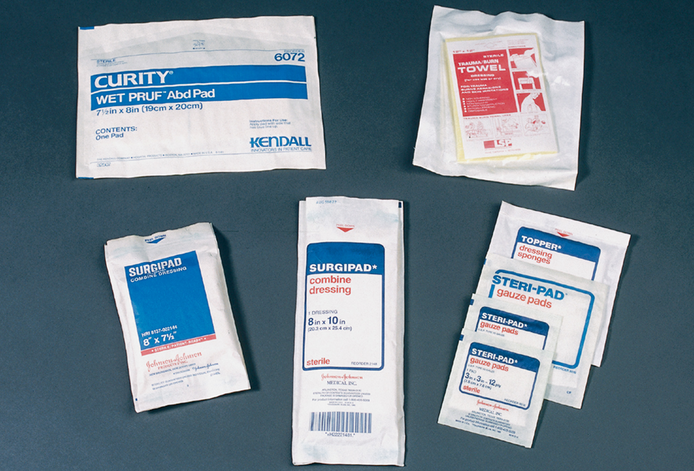
Sterile Gauze Pads
Notes:
Discuss the various sizes and purposes of dressing material.
Gauze pad
Self-adhering dressing
Multitrauma dressing
Occlusive dressing (aluminum vs. plastic occlusive dressings)

Slide 123
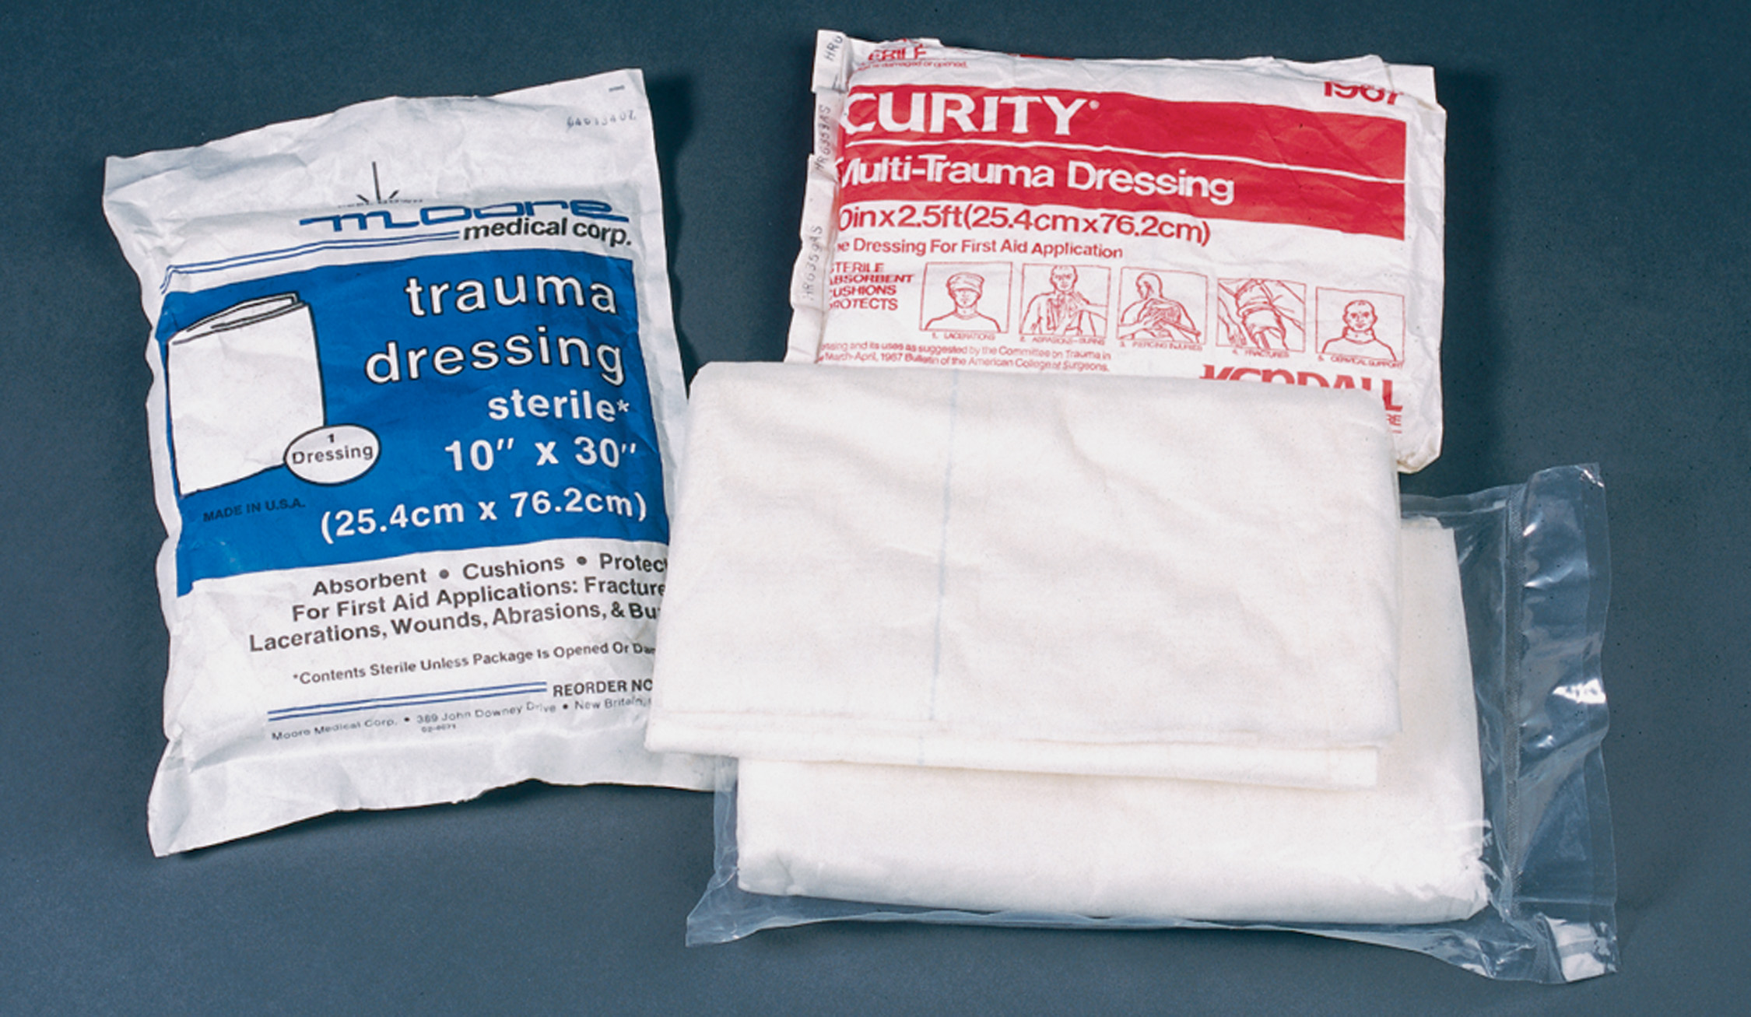
Multitrauma Dressings
Notes:
Discuss the various sizes and purposes of dressing material.
Gauze pad
Self-adhering dressing
Multitrauma dressing
Occlusive dressing (aluminum vs. plastic occlusive dressings)

Slide 124
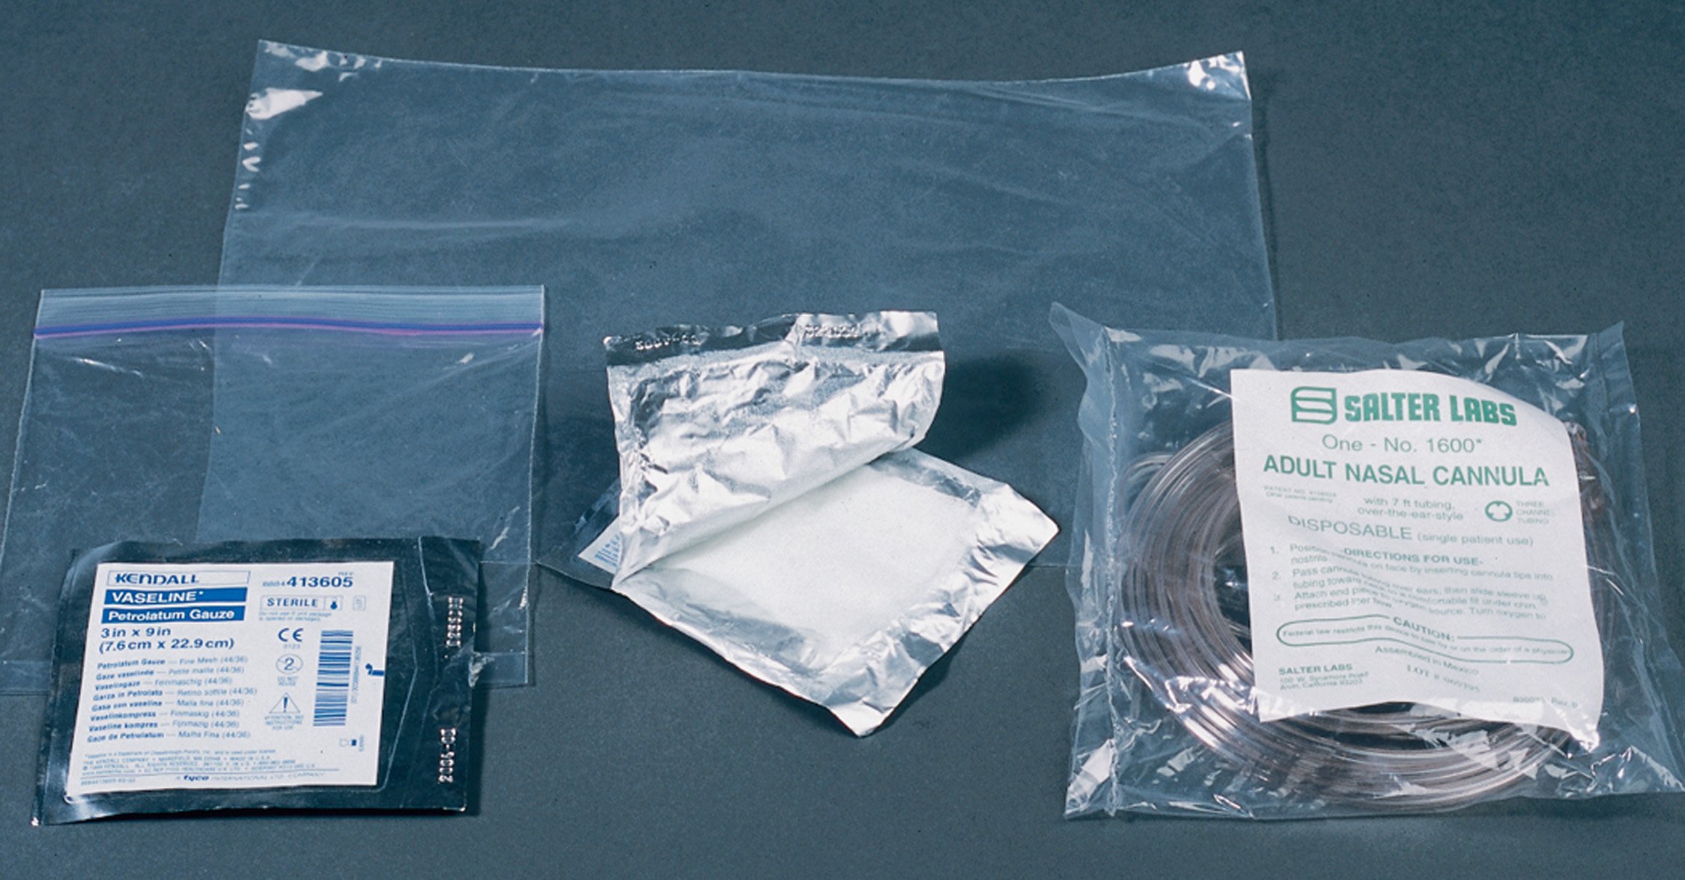
Materials That Can be Used as Occlusive Dressings
Notes:
Discuss the various sizes and purposes of dressing material.
Gauze pad
Self-adhering dressing
Multitrauma dressing
Occlusive dressing (aluminum vs. plastic occlusive dressings)

Slide 125
Dressing and Bandages (1 of 4)
Bandages
  Used to secure dressings
  Should be clean and free of debris
  Various types available
Notes:
After a dressing is applied, a bandage is used to secure it in place. In most cases, it is not necessary for a bandage to be sterile, but it should be clean and free of debris. Bandages that can be used as dressings are also available in various types and sizes.

Slide 126
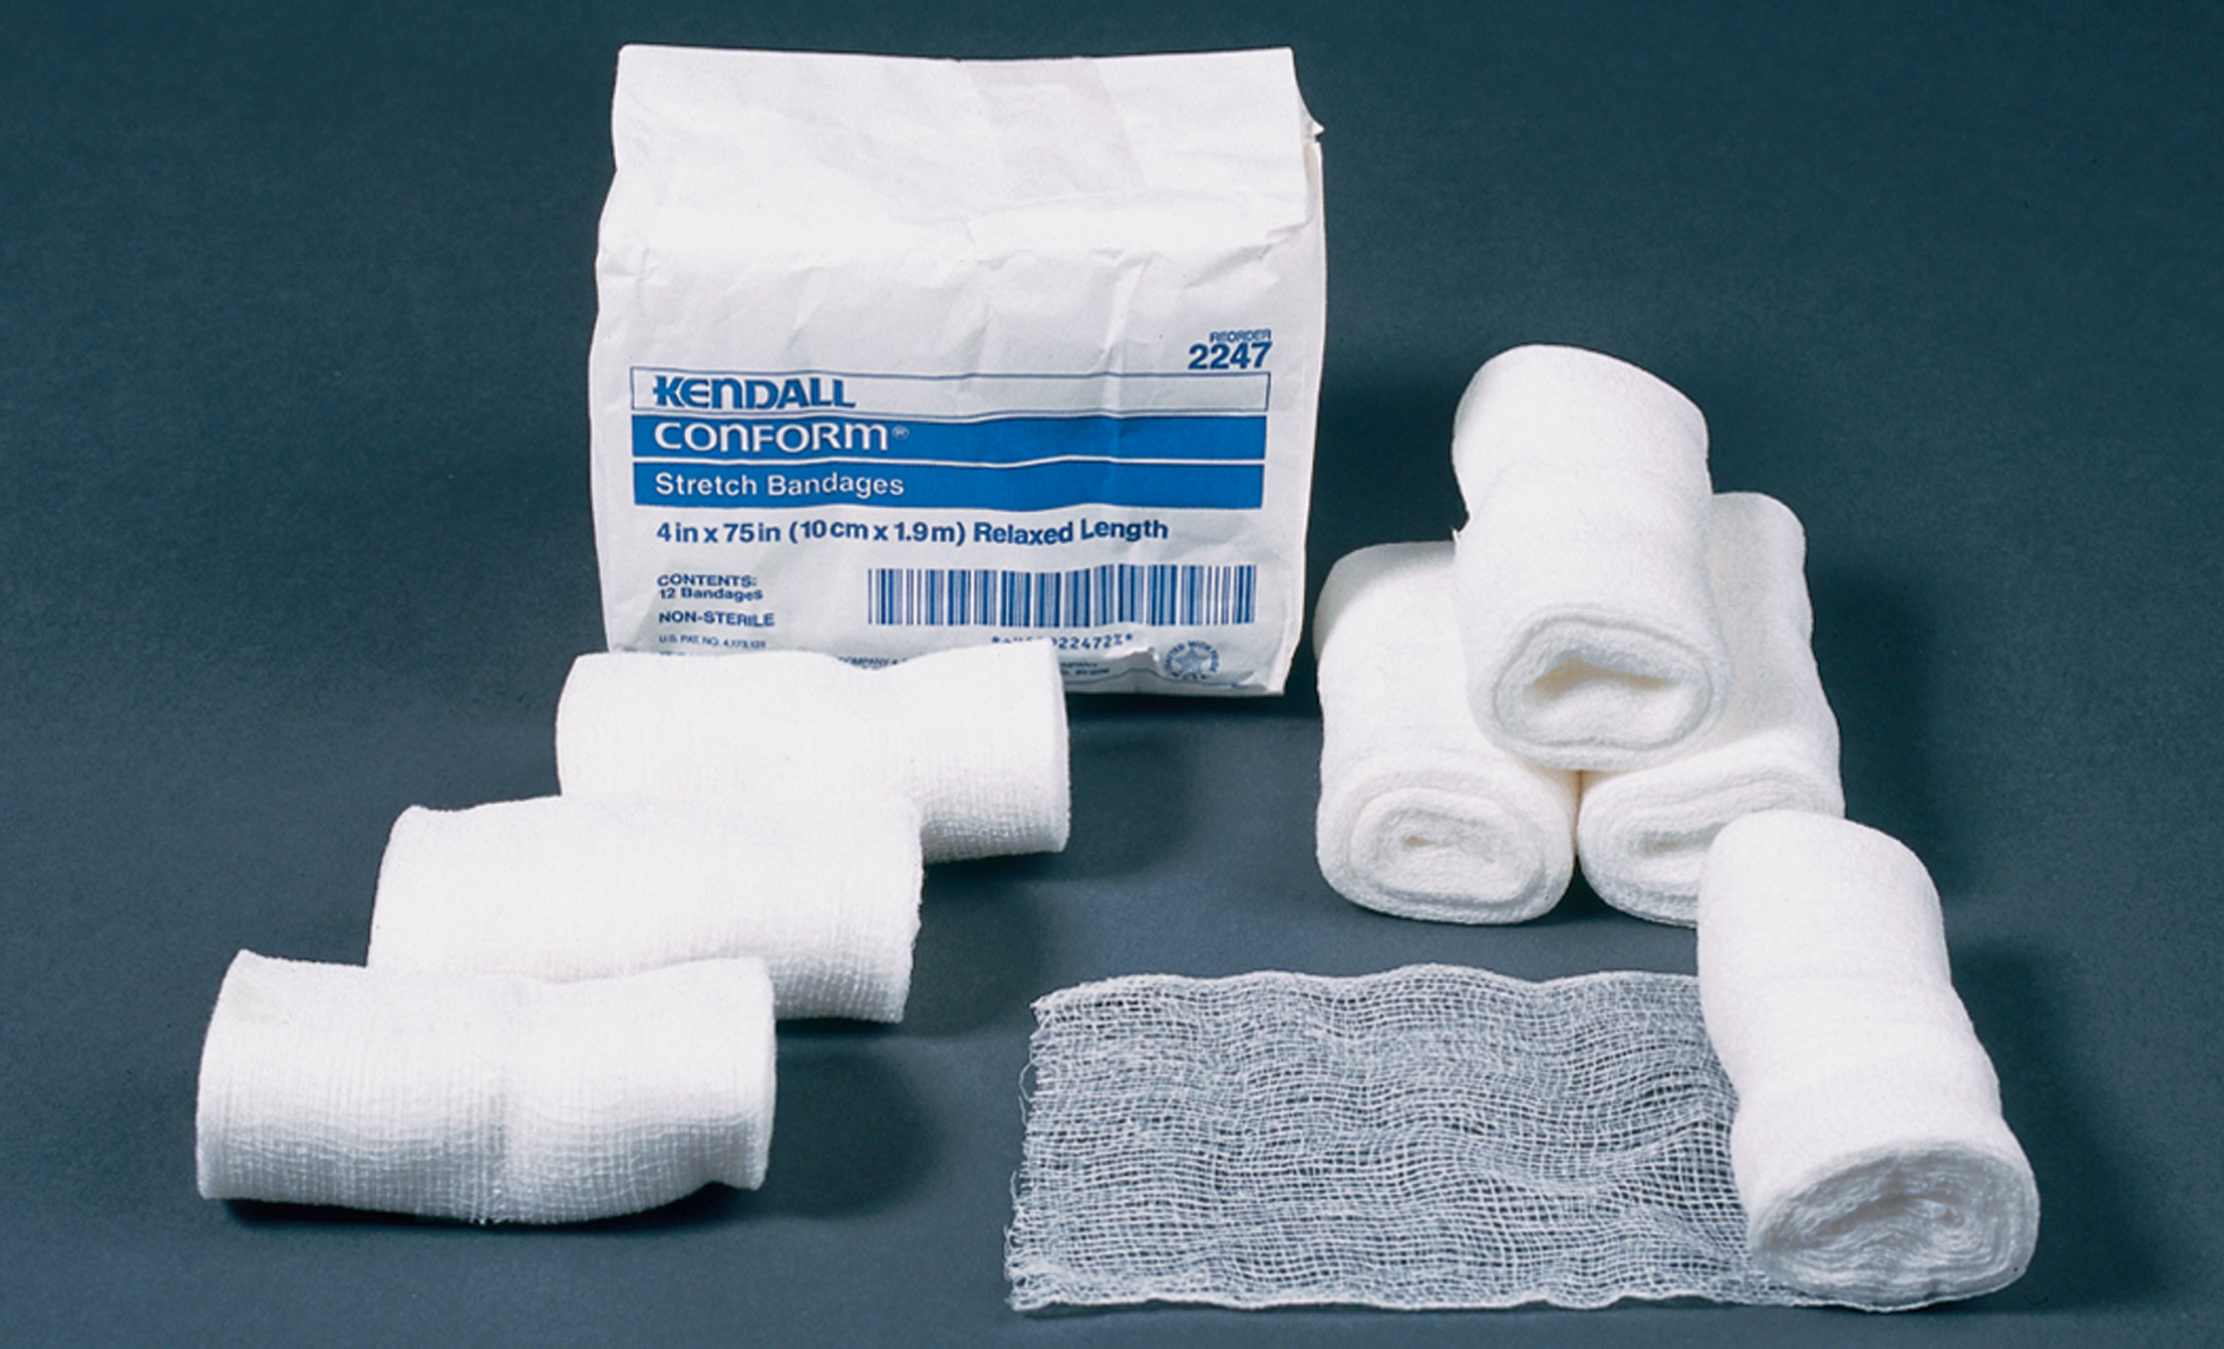
Nonelastic, Self-Adhering Dressing and Roller Bandages
Notes:
Discuss the types of bandages.
Self-adhering bandage
Gauze rolls
Triangular bandage
Air splint

Slide 127
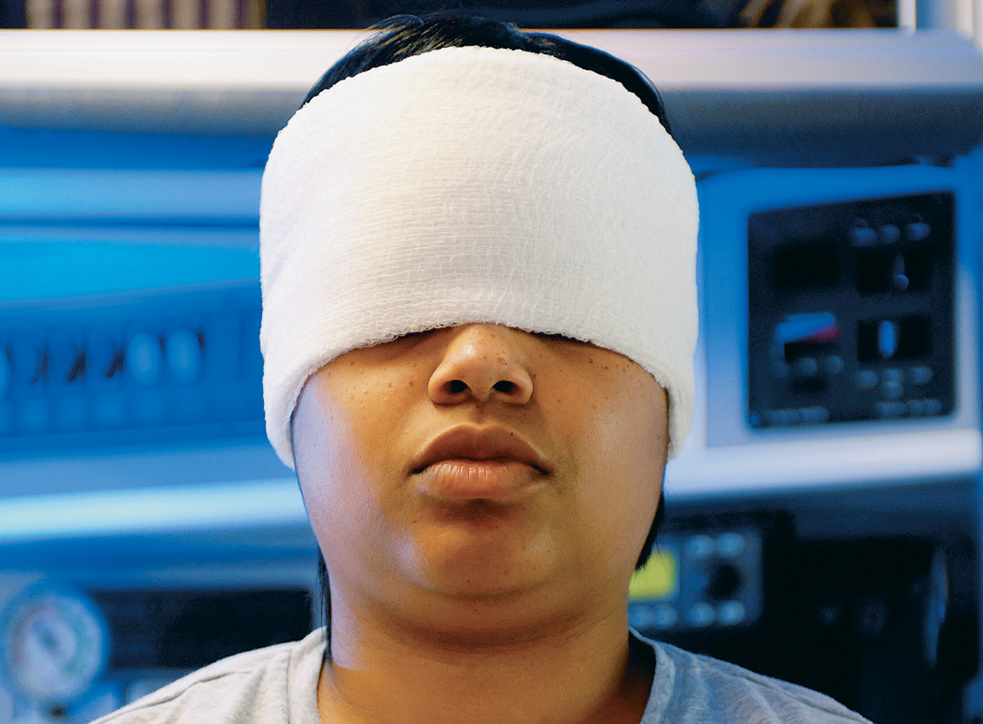
Head and/or Eye Bandage
Notes:
Discuss the basic procedure for applying this type of bandage.

Slide 128
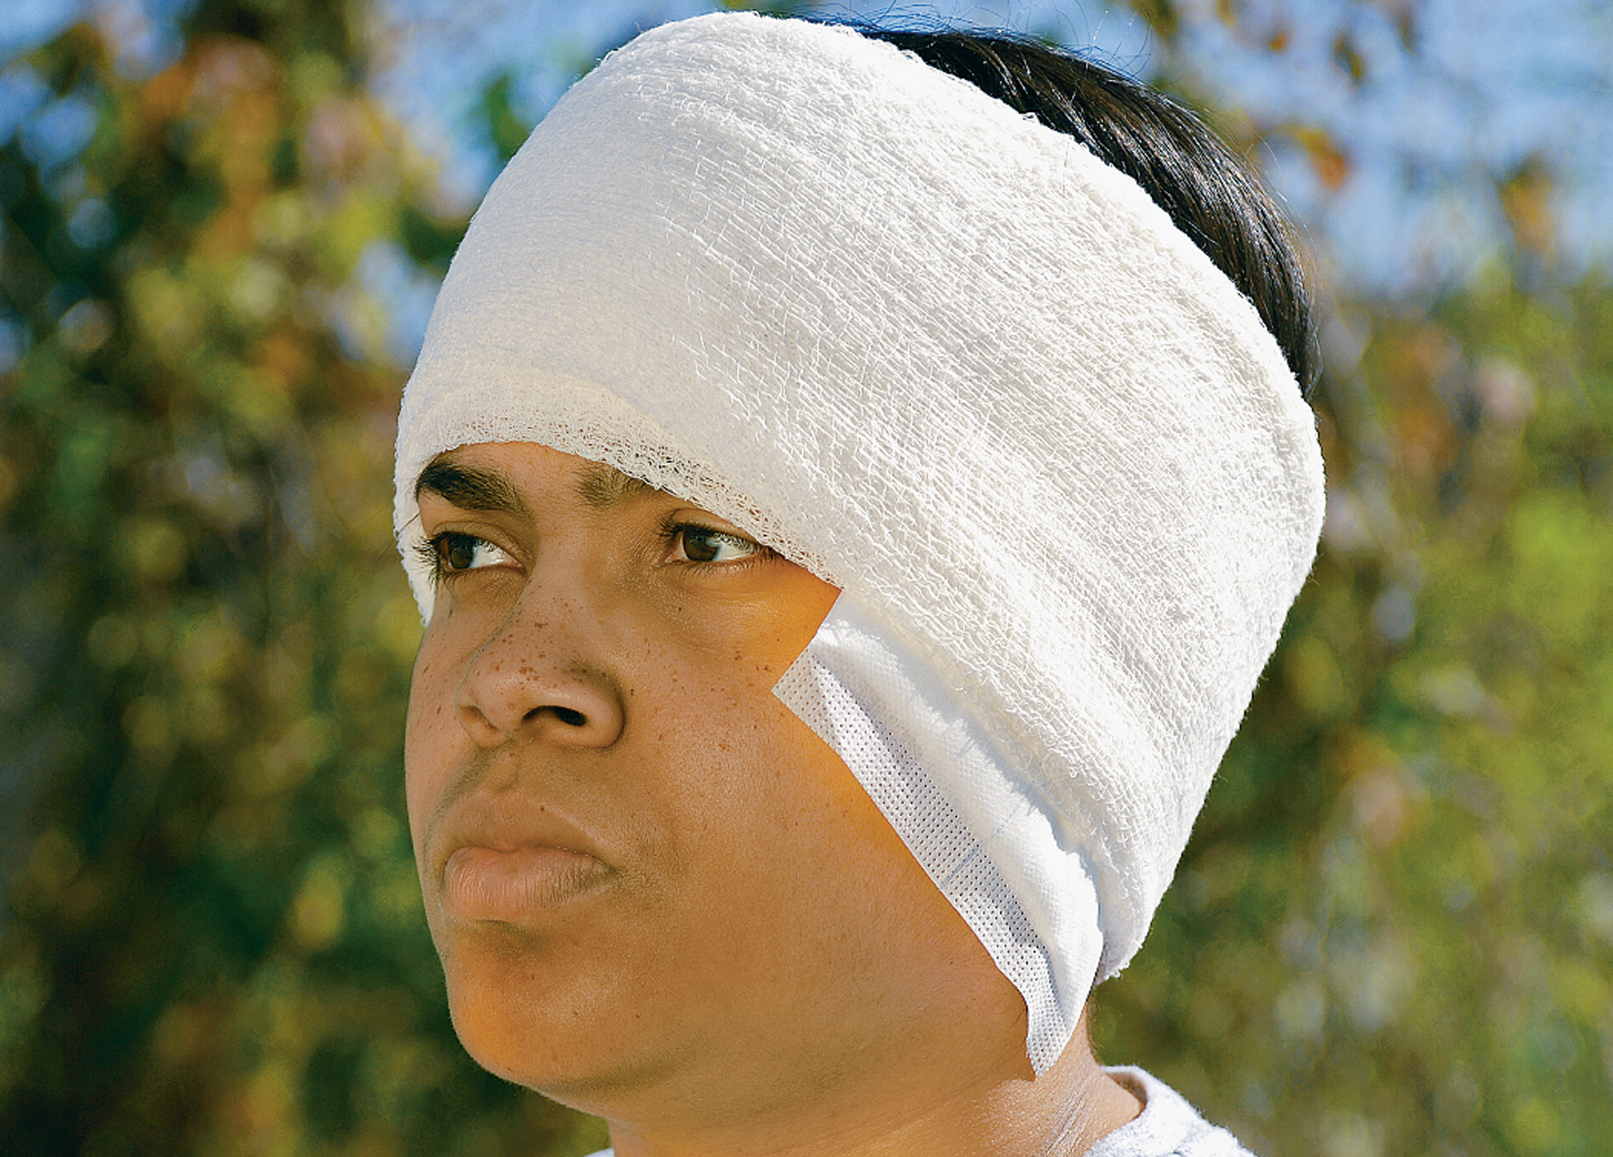
Head and/or Ear Bandage
Notes:
Discuss the basic procedure for applying this type of bandage.

Slide 129
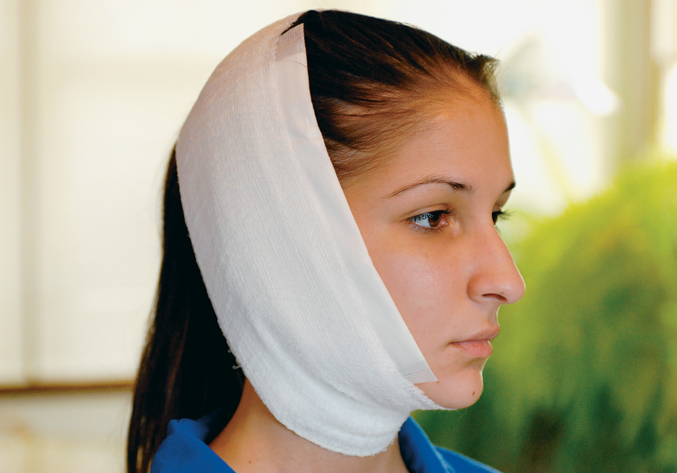
Cheek Bandage (Be Sure the Mouth Will Open)
Notes:
Discuss the basic procedure for applying this type of bandage.

Slide 130
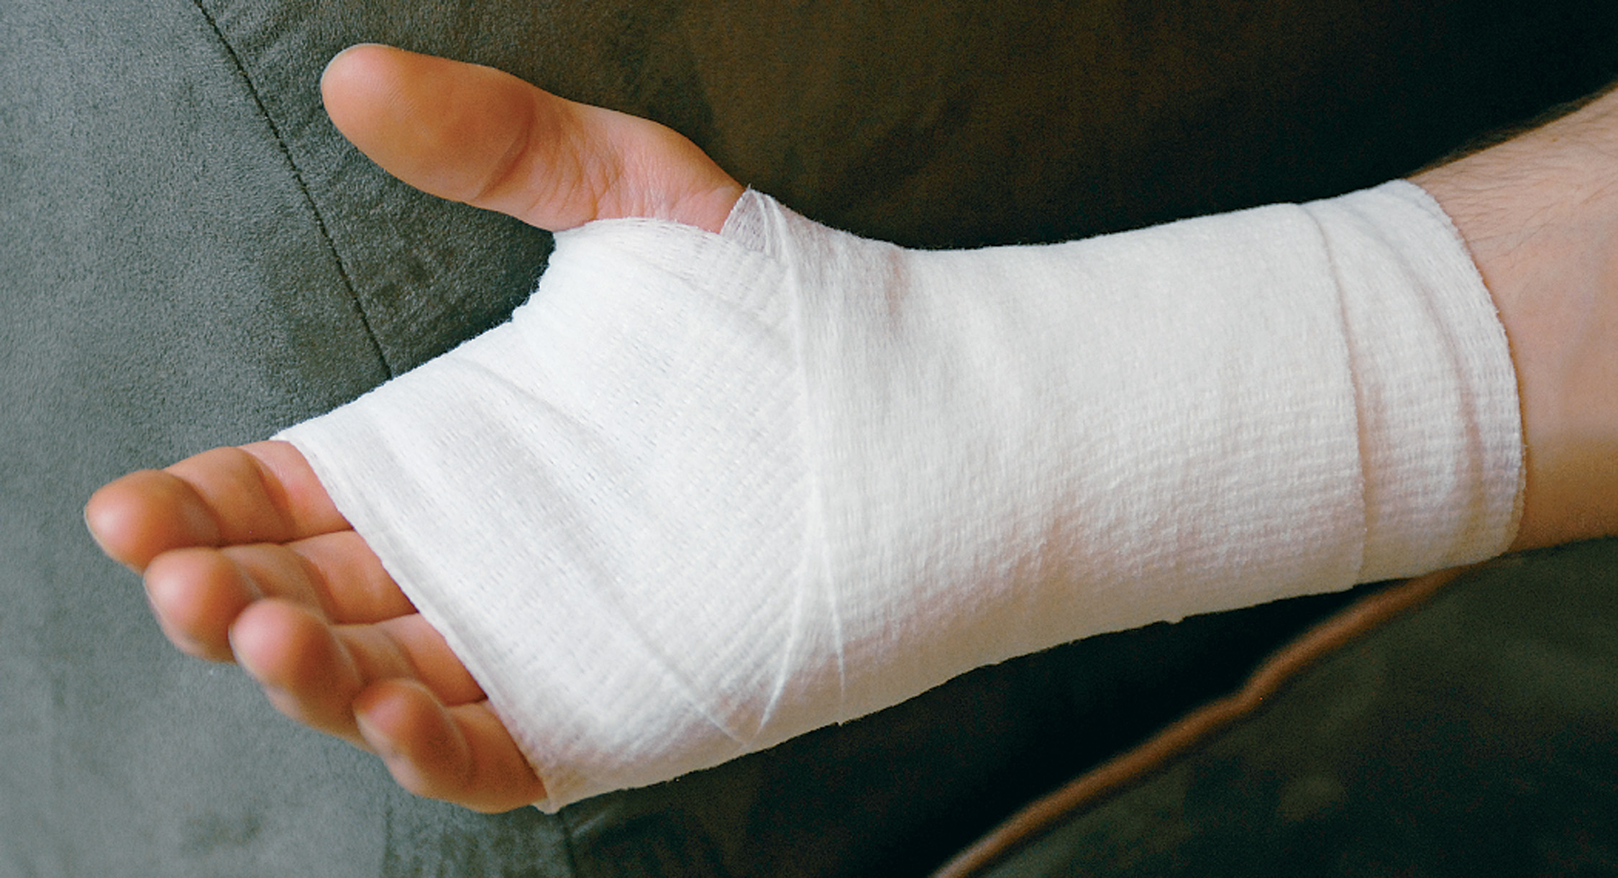
Hand Bandage
Notes:
Discuss the basic procedure for applying this type of bandage.

Slide 131
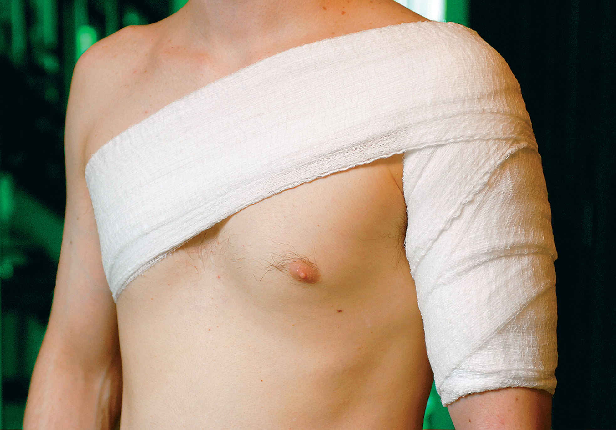
Shoulder Bandage
Notes:
Discuss the basic procedure for applying this type of bandage.

Slide 132
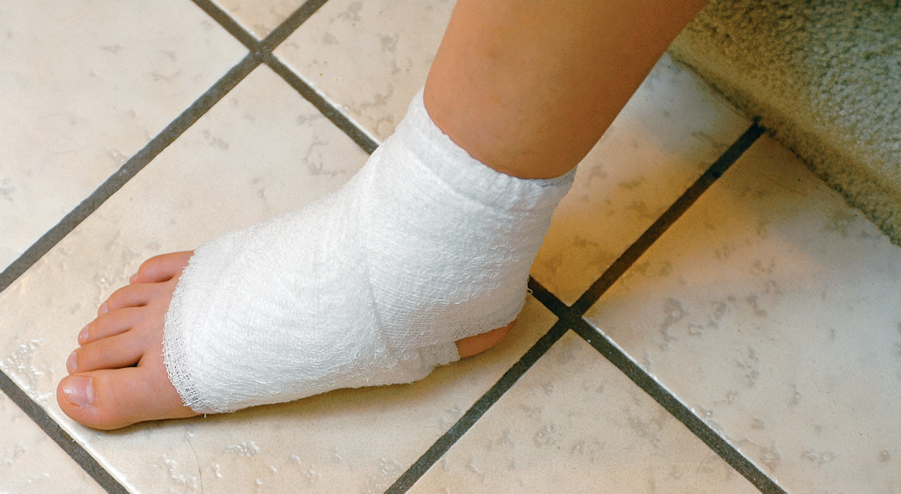
Foot and/or Ankle Bandage
Notes:
Discuss the basic procedure for applying this type of bandage.

Slide 133
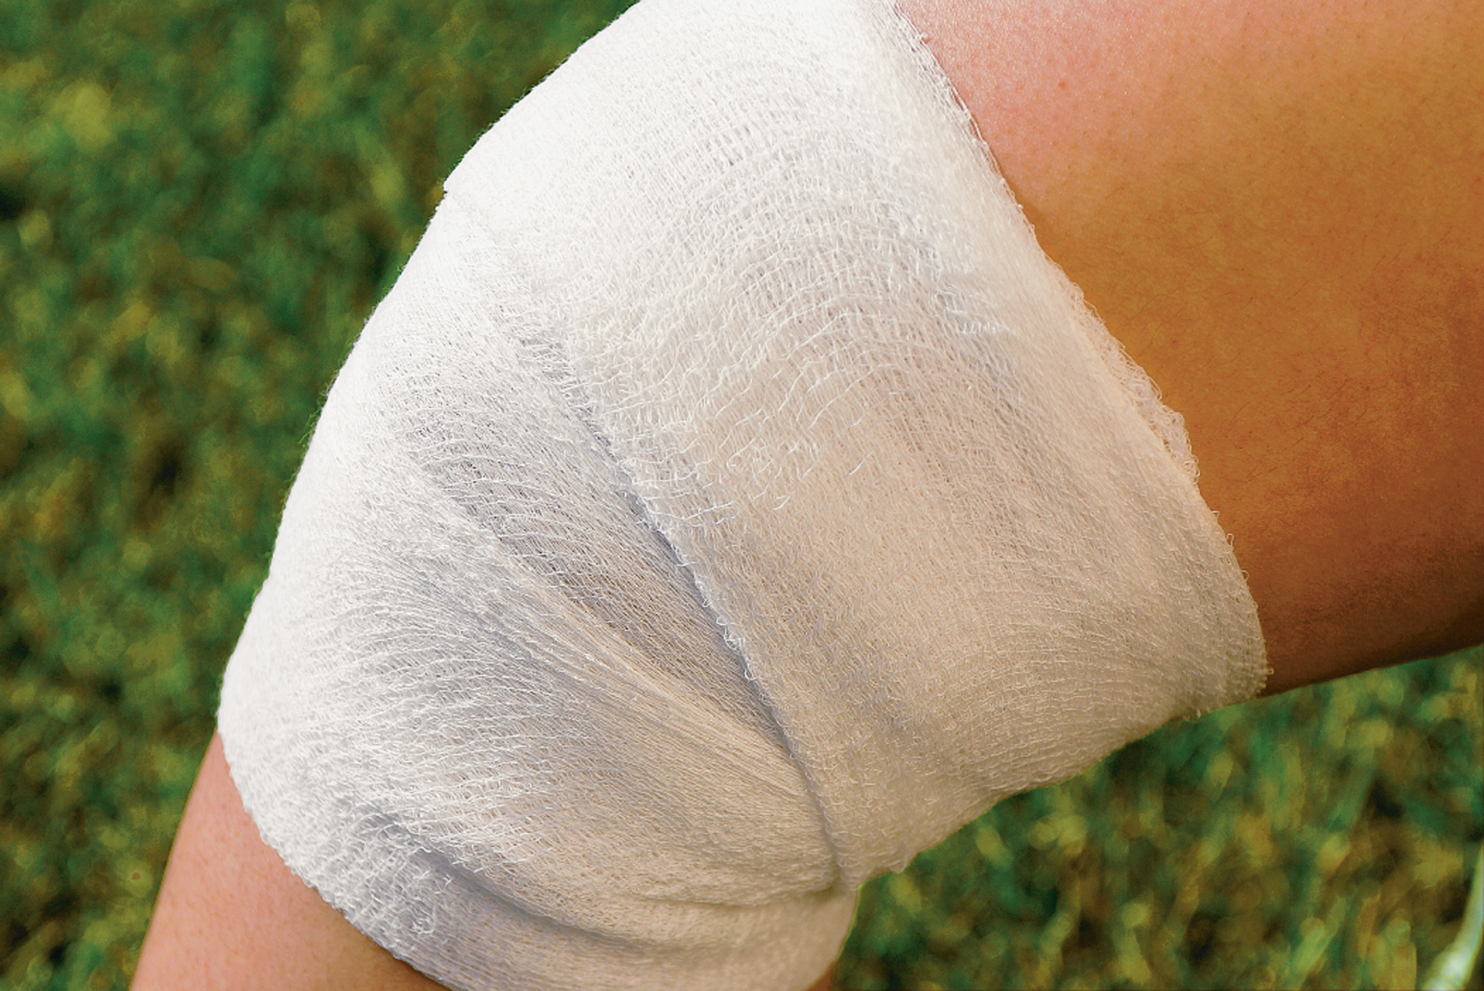
Knee Bandage
Notes:
Discuss the basic procedure for applying this type of bandage.

Slide 134
Dressing and Bandages (2 of 4)
Pressure Dressing
  Applying a Pressure Dressing
    Cover the wound with sterile dressings.
    Apply direct pressure over the wound to control bleeding.
    Bandage firmly to maintain bleeding control; reassess pulses.
    If blood soaks through, remove the dressings and apply fingertip pressure.
Notes:
A pressure dressing can be used to maintain control of bleeding.

Slide 135
Dressing and Bandages (3 of 4)
General Principles of Dressing and Bandaging
  Sterile materials are preferred.
  Do not apply a bandage until bleeding is controlled.
  Dressings should cover the entire wound.
  Remove all jewelry from the injured part.
  Do not bandage too loosely.
Notes:
There are no hard-and-fast rules for dressing and bandaging wounds. Often, adaptability and creativity are far more important ingredients. In dressing and bandaging, use the materials you have on hand and the methods you can best adapt.

Slide 136
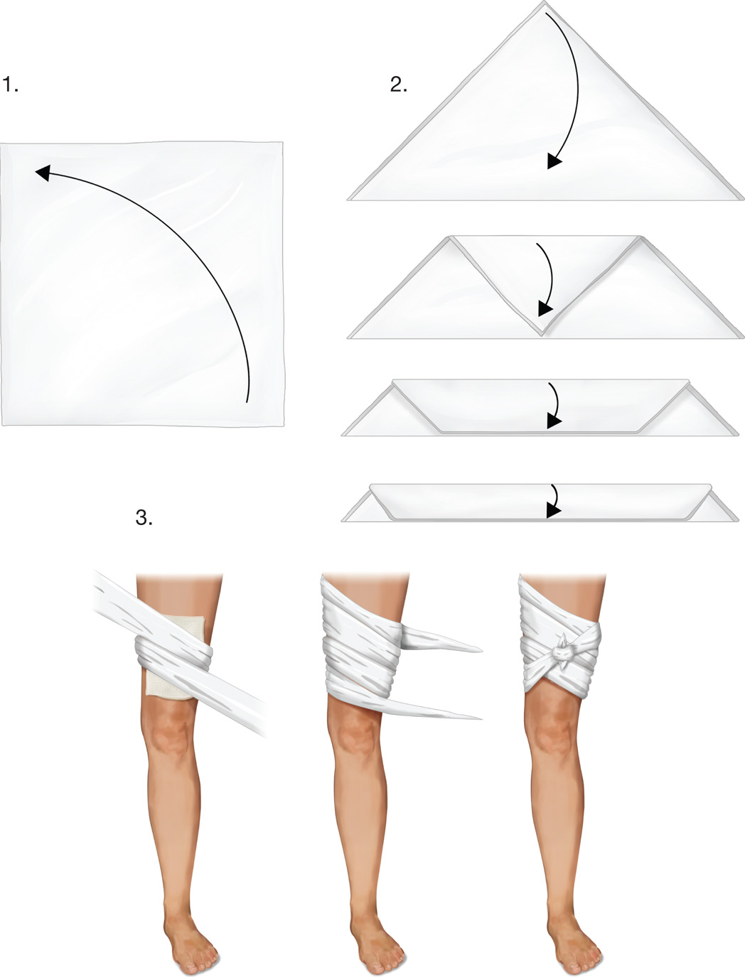
Triangular Bandage as Cravat
Notes:
A cravat can be used as a triangular bandage.

Slide 137
Dressing and Bandages (4 of 4)
General Principles of Dressing and Bandaging
  Bandage snugly but not too tightly.
  If the wound is small, use a wider bandage to avoid creating a pressure point.
  Position the part before bandaging.
  If bleeding is not controlled with direct pressure, apply a tourniquet.
Notes:
Review the general principles of dressing use with students. Provide ample time in simulated laboratory sessions to work on these techniques.

Slide 138
Case Study #2 Conclusion (1 of 2)
After several minutes of direct pressure, the bleeding from the laceration is under control. Meanwhile, the E M Ts have assessed Tara for other injuries and obtained a baseline set of vital signs.
Tara’s color has improved, and her sobs have diminished to occasional sniffles. Her heart rate is 96, respirations are
20, and her BloodPressure is
Her skin is warm and moist, and
her S p O₂ is 100%.
Notes:
Review the Case study Conclusion and emphasize the application of knowledge learned from this presentation.

Slide 139
Case Study #2 Conclusion (2 of 2)
The E M Ts apply a snug pressure dressing and splint the arm, then recheck Tara’s pulse, motor, and sensory function below the injury.
The E M Ts transport Tara to the emergency department, where she receives 22 stitches to close the wound in her arm. Fortunately, there was no damage to the arteries, nerves, or tendons, and the wound is expected to heal without complications.
Notes:
Review Case Conclusion and emphasize the application of knowledge learned from this presentation.

Slide 140
Lesson Summary (1 of 3)
Hypoperfusion and shock can result from blood loss.
Bleeding can be arterial, venous, or capillary.
Bleeding can be external or internal.
The first method of controlling external bleeding is direct pressure.
Notes:
Follow-Up
Answer student questions.
Follow-Up Assignments
Review Chapter 28 Summary.
Complete Chapter 28 In Review questions.
Complete Chapter 28 Critical Thinking questions.
Assessments
Handouts
Chapter 28 quiz

Slide 141
Lesson Summary (2 of 3)
Do not let the appearance of soft tissue injuries distract you from the priorities of patient care.
Dressings and bandages are used to help control bleeding and prevent further contamination of wounds.
Notes:
Class Activity
As an alternative to assigning the follow-up exercises in the lesson plan as homework, assign each question to a small group of students for in-class discussion.
Teaching Tips
Answers to In Review questions are in the appendix of the text. Advise students to review the questions again as they study the chapter.

Slide 142
Lesson Summary (3 of 3)
Tourniquets and hemostatic agents are only used if direct pressure is not effective for ongoing significant bleeding.
Notes:
Class Activity
As an alternative to assigning the follow-up exercises in the lesson plan as homework, assign each question to a small group of students for in-class discussion.
Teaching Tips
Answers to In Review questions are in the appendix of the text. Advise students to review the questions again as they study the chapter.

Slide 143
Correct! (1 of 2)
When a flap of skin is partially or completely torn away from the body, it is called an avulsion.
Click here to return to the program.

Slide 144
Incorrect (1 of 6)
A laceration is a smooth or jagged cut in the skin, which may be caused by a sharp object, such as a knife, or by blunt force.
Click here to return to the quiz.

Slide 145
Incorrect (2 of 6)
An abrasion occurs when the epidermis is scraped or rubbed away.
Click here to return to the quiz.

Slide 146
Incorrect (3 of 6)
An amputation is a disruption in the continuity of an extremity or other body part. The part may be partially or completely torn away from the body.
Click here to return to the quiz.

Slide 147
Correct! (2 of 2)
Direct pressure is effective in most cases of external bleeding, and is always the first method used in an attempt to control external bleeding.
Click here to return to the program.

Slide 148
Incorrect (4 of 6)
A pressure dressing is used to maintain control of bleeding, after bleeding control is achieved through direct pressure.
Click here to return to the quiz.

Slide 149
Incorrect (5 of 6)
A tourniquet is used to control severe, ongoing bleeding from an extremity if direct pressure has not been effective.
Click here to return to the quiz.

Slide 150
Incorrect (6 of 6)
Topical hemostatic agents may be used to control significant, ongoing bleeding if direct pressure has not been effective.
Click here to return to the quiz.

Slide 151
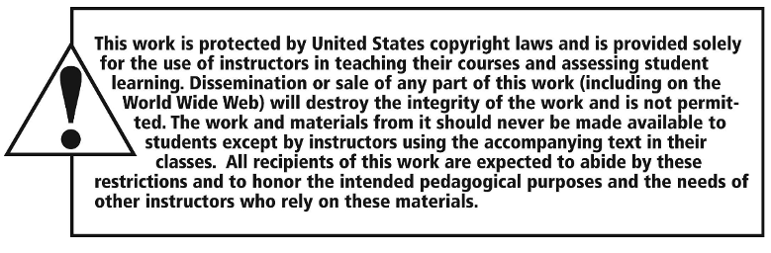
Copyright

