Slide 1

Prehospital: Emergency Care
Eleventh Edition
Chapter 27
Trauma Overview: The Trauma Patient and the Trauma System
"Slides in this presentation contain hyperlinks. JAWS users should be able to get a list of links by using INSERT+F7"
Copyright © 2018, 2014, 2010 Pearson Education, Inc. All Rights Reserved
Notes:
If this PowerPoint presentation contains mathematical equations, you may need to check that your computer has the following installed:
1) MathType Plugin
2) Math Player (free versions available)
3) NVDA Reader (free versions available)
Advance Preparation
Student Readiness
Assign the associated section of MyBRADYLab and review student scores.
Review the chapter material in the Instructor Resources, which includes Student Handouts, PowerPoint slides, and the MyTest Program.
Prepare
The total teaching time recommended is only a guideline. Take into consideration factors such as the pace at which students learn, the size of the class, breaks, and classroom activities. The actual time devoted to teaching objectives is the responsibility of the instructor.

Slide 2
Learning Readiness
E M S Education Standards, text p. 810.
Chapter Objectives, text p. 810.
Key Terms, text p. 810.
Purpose of lecture presentation versus textbook reading assignments.
Notes:
Explain to students what the National EMS Education Standards are. The National EMS Education Standards communicate the expectations of entry-level EMS providers. As EMTs, students will be expected to be competent in these areas. Acknowledge that the standards are broad, general statements. Although this lesson addresses the listed competencies, the competencies are often complex and require completion of more than one lesson to accomplish. The student is also expected to review the chapter objectives to foreshadow what will be in the chapter. By mastering the key terms the EMT student will better understand the learning and be able to communicate more clearly.
Additionally, explain to the students that the purpose of using these slides is to help keep the instructor focused on highlighting important portions of the material, explain interrelationships of topics, and discuss how to apply this information. It’s not the intent of the presentation (or slides alone) to include every component in the chapter. This presentation still requires the student to thoroughly read the chapter.

Slide 3
Setting the Stage
Overview of Lesson Topics
  The Kinetics of Trauma
  Mechanisms of Injury
  The Multisystem Trauma Patient
  The Golden Period and Platinum 10 Minutes
  The Trauma System
  Golden Principles of Prehospital Trauma Care
Notes:
These bulleted points are the major headings from the chapter, in order. The purpose is to provide a basic lecture navigation for the student.

Slide 4
Case Study Introduction (1 of 2)
E M T s Nina Segall and Scotty Lindquist respond to a report of a person shot in a hunting accident. After a 15-minute response to the remote area, they meet state police on the scene. Police confirm that it was a hunting accident and all weapons have been secured. The patient, a 27-year-old man, was accidentally shot by another hunter with a high-velocity rifle.
Notes:
Case Study
Present the Case Study Introduction provided in the PowerPoint slide set.
Lead a discussion using the case study questions provided on the subsequent slide(s).
The Case Study with discussion questions continues throughout the PowerPoint presentation.
Case Study Discussion
Use the case study content and questions to foreshadow the upcoming lesson content.

Slide 5
Case Study Introduction (2 of 2)
As the E M T s size up the scene, they see a police officer holding direct pressure on the patient's thigh. The patient is lying supine on the ground, and seems combative and confused. He is pale and sweating, despite the cool temperatures.
Notes:
Case Study
Present the Case Study Introduction provided in the PowerPoint slide set.
Lead a discussion using the case study questions provided on the subsequent slide(s).
The Case Study with discussion questions continues throughout the PowerPoint presentation.
Case Study Discussion
Use the case study content and questions to foreshadow the upcoming lesson content.

Slide 6
Case Study (1 of 4)
What are the priorities in managing this patient?
What information will help the E M T s determine the extent of the patient's injuries?
Notes:
Use the case study content and questions to foreshadow the upcoming lesson content. Gauge the student’s responses as a guide of how well versed they are in this topic.

Slide 7
Introduction
Trauma makes up a significant percentage of the calls to which prehospital personnel respond.
Recognizing the extent of injury is critical to making decisions to giving trauma patients the best chances of survival.
Notes:
During this lesson, students will learn special considerations in sizing up the mechanism of injury.
To make these judgments, the EMT must not only recognize obvious injuries but also maintain a high index of suspicion for hidden injuries. An understanding of mechanisms of injury is the chief component of this crucial assessment skill.

Slide 8
The Kinetics of Trauma (1 of 6)
The mechanism of injury (M O I) is how a person is injured.
The science of analyzing mechanisms of injury is the kinetics of trauma.
Kinetics is the branch of mechanics dealing with the movements of bodies, understanding kinetics is helpful in understanding M O I and trauma.
Notes:
How severely a person is injured depends on the force with which he collides with something, or something collides with him. This force depends partly on the energy contained in the moving body or bodies. The energy contained in a moving body is called kinetic energy.
Teaching Tips
Use simple demonstrations with toy vehicles to explain the laws of motion.
Give several examples of changes of velocity and mass in the kinetic energy equation to demonstrate the effects of each.
Knowledge Application
Given several descriptions of mass and velocity, students should be able to calculate the kinetic energy exchanged in an impact.
Discussion Question
What are the effects of rates of acceleration or deceleration on force?

Slide 9
The Kinetics of Trauma (2 of 6)
Mass and Velocity
Kinetic Energy =
Notes:
Kinetic energy in a moving body is calculated this way: the mass (weight in pounds) times the velocity (speed in feet per second) squared divided by two.

Slide 10
The Kinetics of Trauma (3 of 6)
Kinetic energy
  Velocity is the more significant factory in determining the amount of kinetic energy.
  Estimate the speed of the objects involved.
    Motor vehicle collisions
    Penetrating trauma
Notes:
The formula illustrates that as the mass of a moving object is doubled, its kinetic energy is also doubled. You would be injured twice as badly if you were hit by a 2-pound rock as if you were hit by a 1-pound rock thrown at the same speed.
Velocity is a much more significant factor than mass. Suppose you are hit by a rock thrown at a velocity of 1 foot per second, and then hit by the same rock thrown again at 2 feet per second. The rock thrown at 2 feet per second would not be twice as harmful as at 1 foot per second, but would be four times as harmful, because the factor of velocity is squared.
Understanding the factor of velocity is important in evaluating MOI in vehicle collisions. During your scene size-up, as you try to get an idea of how seriously vehicle passengers may have been injured, it is important to estimate the speed of the vehicle (or vehicles) at the time of collision, knowing that a high-velocity collision will almost certainly have caused greater injury.

Slide 11
The Kinetics of Trauma (4 of 6)
Acceleration and deceleration
  The law of inertia
    A body at rest will remain at rest, and a body in motion will remain in motion, unless acted upon by an outside force.
  A faster change of speed (acceleration or deceleration) results in more force exerted.
Notes:
The rate at which a body in motion increases its speed is known as acceleration. The rate at which a body in motion decreases its speed is known as deceleration.
If one car is braked to a gradual stop and the other is stopped suddenly by striking a telephone pole, the one with the faster rate of deceleration, the one that struck the pole, exerts more force.

Slide 12
The Kinetics of Trauma (5 of 6)
Energy Changes Form and Direction
  Energy travels in a straight line unless it meets interference.
  Interference with the travel of kinetic energy can cause it to change direction and form.
Notes:
If kinetic energy, transmitted to a human body, continues to travel in a straight line without interruption, injury may not occur. However, energy traveling through the human body is frequently interrupted by the body itself or deflected.

Slide 13
The Kinetics of Trauma (6 of 6)
Impacts
  Three types of impacts in a vehicle collision
    Energy is absorbed in each impact.
    There can be multiple impacts of each type.
      Vehicle collision
      Body collision
      Organ collision
Notes:
By comparing the number of impacts, it is easy to understand why a person in or on a moving vehicle who gets thrown has a much greater chance for injury than one who is restrained or remains in the vehicle.
Critical Thinking Discussion
How do laws of physics explain why you might break a bone if you punched a brick wall with your fist, but why you would not be likely to break a bone if you struck a pillow with the same velocity?
Discussion Questions
What injuries are predicted in frontal motor vehicle collisions?
What are the variables that affect severity and patterns of injury in vehicle-pedestrian collisions?

Slide 14
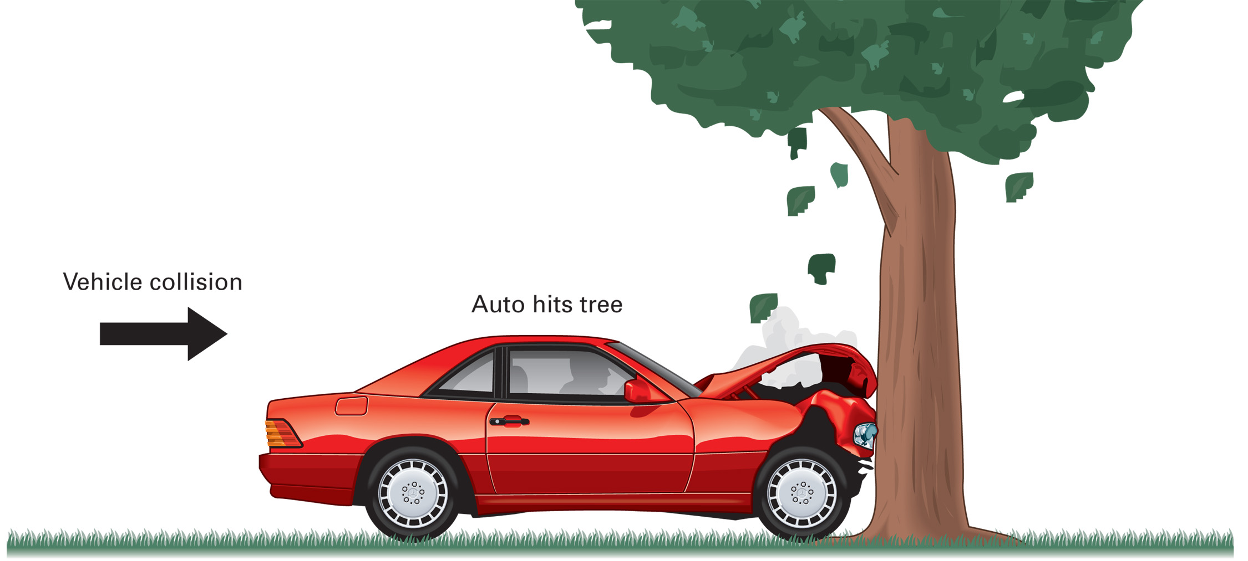
Vehicle Collision
The Vehicle Strikes an Object
Notes:
Class Activity
Break the class into small groups. Give each group a photograph of a motor vehicle collision. Have the group analyze the photo and make a list of predicted injuries from the collision. Have each group present any findings to the class for further discussion and analysis.
Critical Thinking Discussion
You have a family member who refuses to wear a seatbelt because he states he is afraid that if he crashed into a body of water, he might not be able to get his seatbelt off and would drown. How can you convince your relative that it would be better to wear a seatbelt?

Slide 15
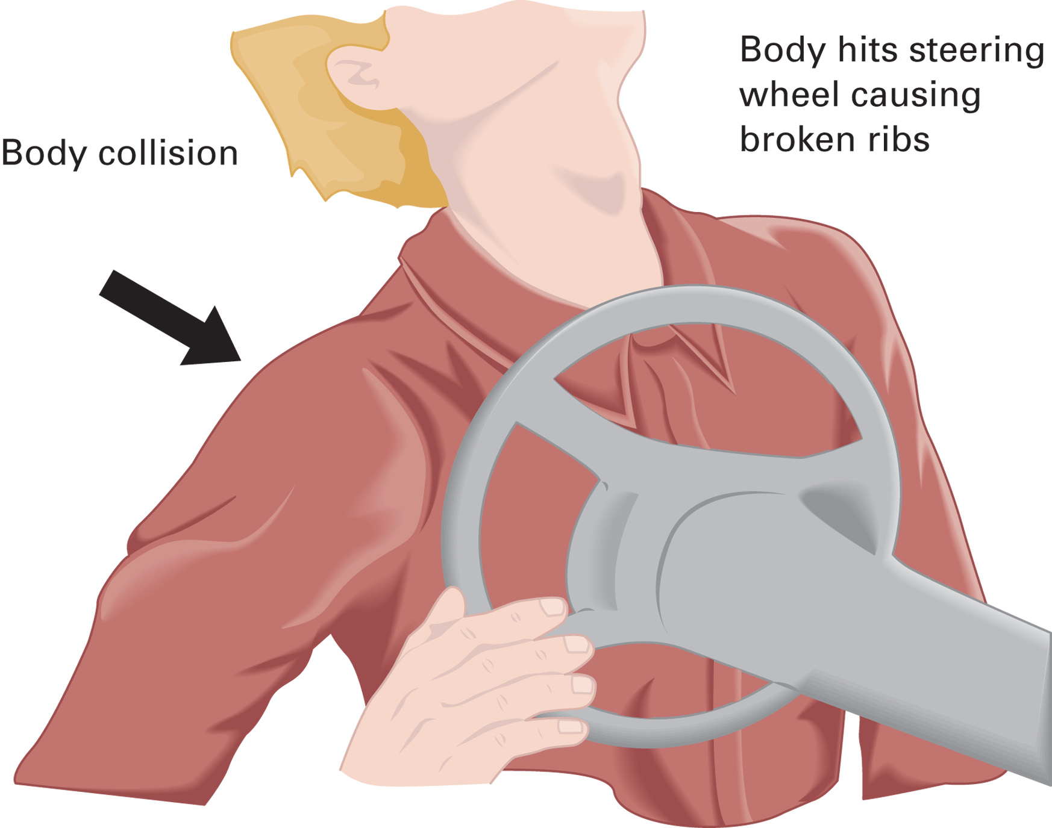
Body Collision
The Occupant Continues Forward and Strikes the Inside of the Automobile
Notes:
The patient comes to a quick stop on some part or parts of the inside of the vehicle, such as the steering wheel, causing injury to the chest. This is called the body collision.

Slide 16
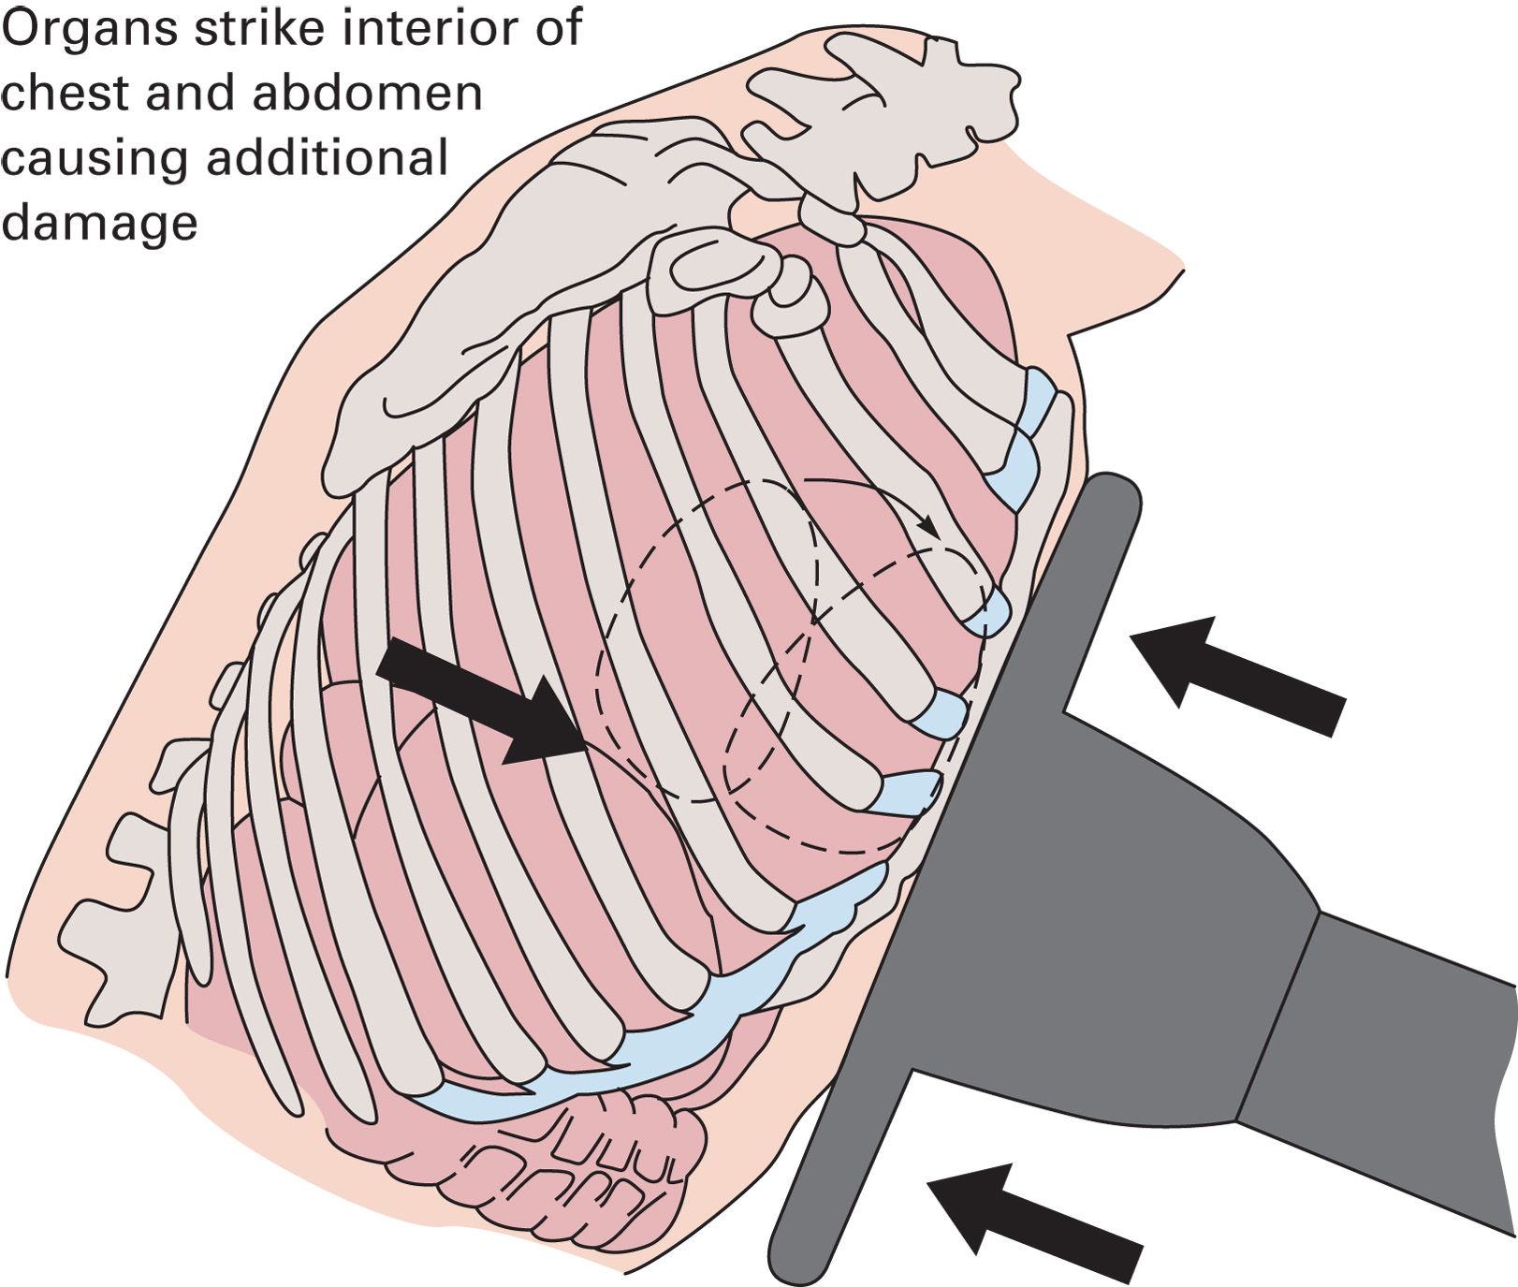
Organ Collision
The Organs Continue to Move Forward and Strike the Inside of the Skull, Chest, or Abdomen
Notes:
In the organ collision the patient’s internal organs, which are all suspended in their places by tissue, come to a quick stop, sometimes striking an inside surface of the body, the inner chest wall or the inner skull for example.

Slide 17
Click on the Factor That Most Significantly Determines the Amount of Kinetic Energy Involved in a Vehicle Collision
A. The center of gravity of the vehicle
B. The mass of the vehicle the patient is in
C. The mass of the vehicle that strikes the patient's vehicle
D. The combined speed of the two vehicles

Slide 18
Mechanisms of Injury (1 of 22)
M O I provides a suspicion of injury; not an accurate indicator of injury.
You must assess the patient for indictors of injury.
Notes:
With an understanding of mechanisms of injury (MOI), you will be able to arrive on the scene of a vehicle collision and suspect, simply from looking at the damaged vehicle, which types of traumatic injuries the patient may have experienced.

Slide 19
Mechanisms of Injury (2 of 22)
Vehicle Collisions
  Have a high suspicion of injury when there is:
    Death of another vehicle occupant.
    Altered mental status.
    Intrusion over 12” for the occupant site.
    Ejection from the motor vehicle.
    Vehicle telemetry data consistent with a high risk of injury.
Notes:
A force severe enough to kill one passenger will almost certainly cause severe injuries, if not death, to all other passengers in the same compartment.
One of the earliest signs of brain injury is altered mental status or unresponsiveness. Consider the patient’s mental status prior to your arrival when determining a baseline mental status, especially in the patient with a suspected head injury.
Intrusion of the vehicle is a deformity occurring to the interior compartment. The occupant site is anywhere in the vehicle where the patient was riding.
A patient who has been partially or completely ejected from a motor vehicle is at a much greater risk of injury than one who has remained inside the vehicle.
Studies have shown that mechanical aspects of vehicle collisions can predict injury in motor vehicles crashes. Data from telemetry systems such as seat belt use, direction of impact, and change in velocity provide the most important predictors of severity of injury.

Slide 20
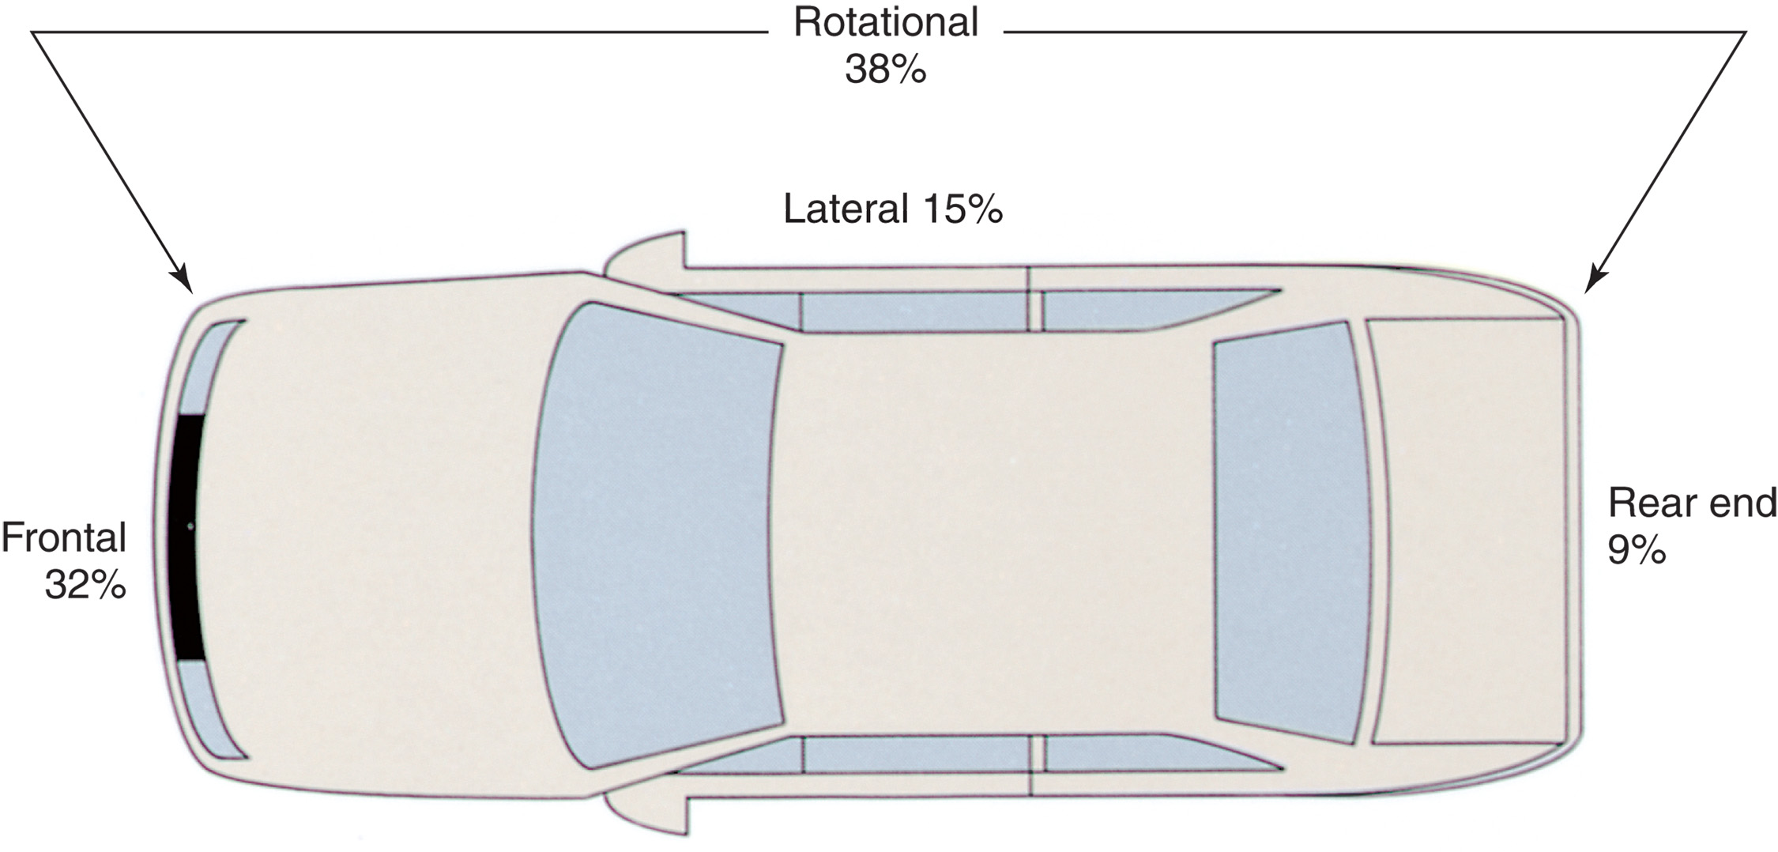
Types of Impacts in Motor Vehicle Trauma and their Incidence of Frequency in Urban Areas (By Percentage)
Notes:
Discuss the types of impacts and their percentages. Ask students to rationalize what type of injuries may be present for each impact location.

Slide 21
Mechanisms of Injury (3 of 22)
Vehicle Collisions
  Frontal Impact
    The occupant is traveling at the same speed as the vehicle.
Notes:
In the frontal impact, the driver continues to move forward at the same speed the vehicle is traveling. He proceeds to go either up and over the steering wheel, causing injuries to the head, neck, chest, and abdomen and possible ejection through the windshield, or he goes down and under the steering wheel, causing injuries to the knees, femurs, hips, pelvis, and spine.

Slide 22
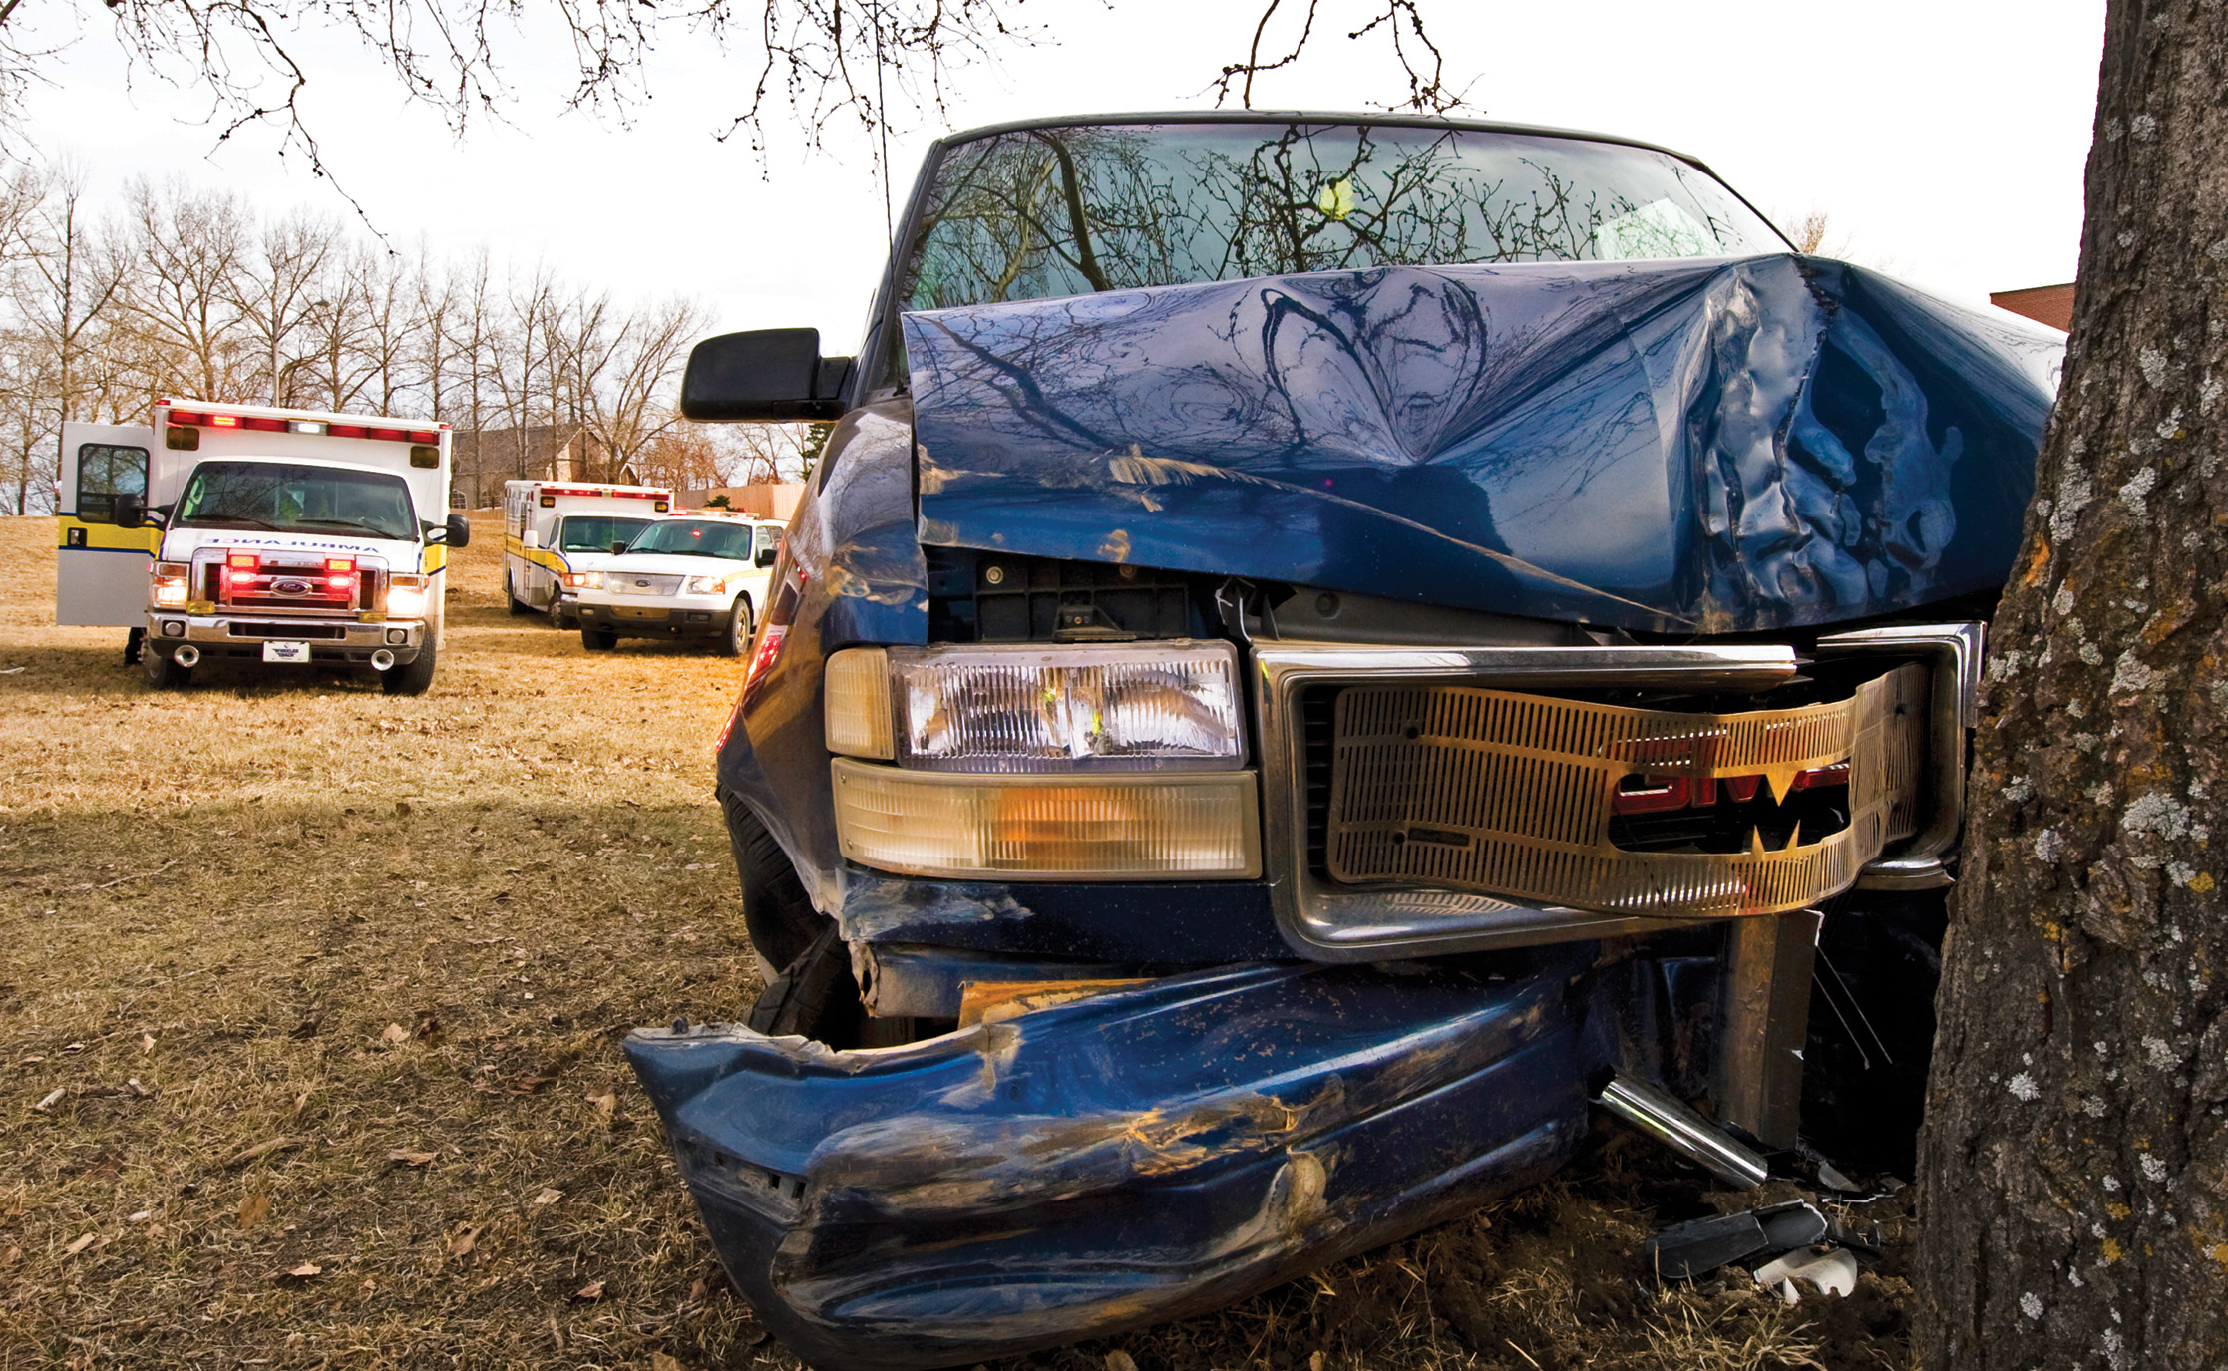
Frontal Impact
(© Kevin Link)
Notes:
In the frontal impact, the driver continues to move forward at the same speed the vehicle is traveling.

Slide 23
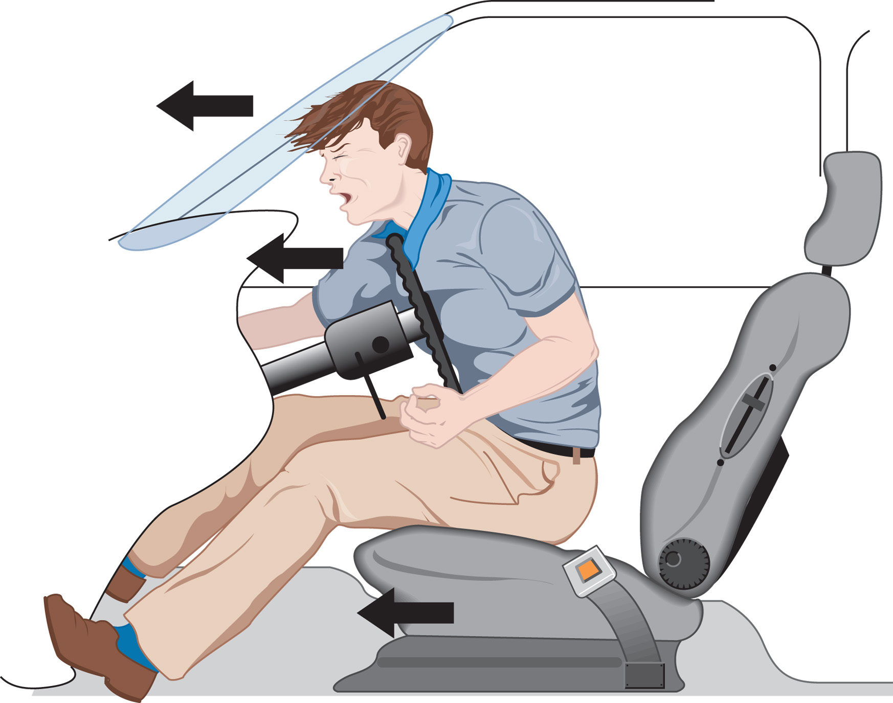
In a Frontal Collision, the Occupant Continues to Move Forward at the Same Speed the Vehicle was Moving
Notes:
If the unrestrained occupants of a vehicle involved in a collision travel in an up-and-over direction, they may be ejected from the vehicle.

Slide 24
Mechanisms of Injury (4 of 22)
Vehicle Collisions
  Frontal Impact
    With an up-and-over pathway look for injuries to the abdomen, chest, face, head, and neck.
Notes:
Abdomen - A damaged dashboard or steering wheel should cause you to suspect abdominal injury. As the abdomen strikes the dashboard or steering wheel, the liver, spleen, and hollow organs of the abdomen are compressed between the front and back abdominal walls and spine. The hollow organs are more easily displaced, leaving the solid liver and spleen to bear the brunt of the compression.
Chest - As the chest hits the dashboard or steering wheel, bones and soft tissues are both affected. The ribs and sternum can break, and the cartilage connecting the ribs to the sternum can separate. A torn intercostal artery can bleed 50 mL per minute into the chest cavity with no blood seen externally. The heart and lungs are the major organs affected. The heart suffers the effect of two forces: compression and shear. Compression force occurs when the heart is caught between the sternum and the spine, which can bruise the heart muscle. The heart is suspended by the aorta, which is attached posteriorly at the arch by a ligament. Shear force tends to pull the aorta at the ligament, which can tear or transect the aorta. The lungs can also be affected. Air trapped in the lungs by sudden closure of the epiglottis is compressed between the ribs and spine. This kind of compression injury is called a “paper bag injury” because it is like blowing up a paper bag, then popping it between your hands.
Face, Head, and Neck - The face, head, and neck are next to impact the deployed airbag, dashboard, windshield, or window, depending on whether there is more than one impact. As you approach the vehicle, check for the typical “starburst” windshield cracking. Depending on the impact point, the face may have extensive soft tissue damage. Head injuries usually result when an occupant is ejected from the vehicle, and skull fracture can occur. Depending on the force involved, penetrating bone shards or a depressed skull fracture can result, lacerating the brain tissue.

Slide 25
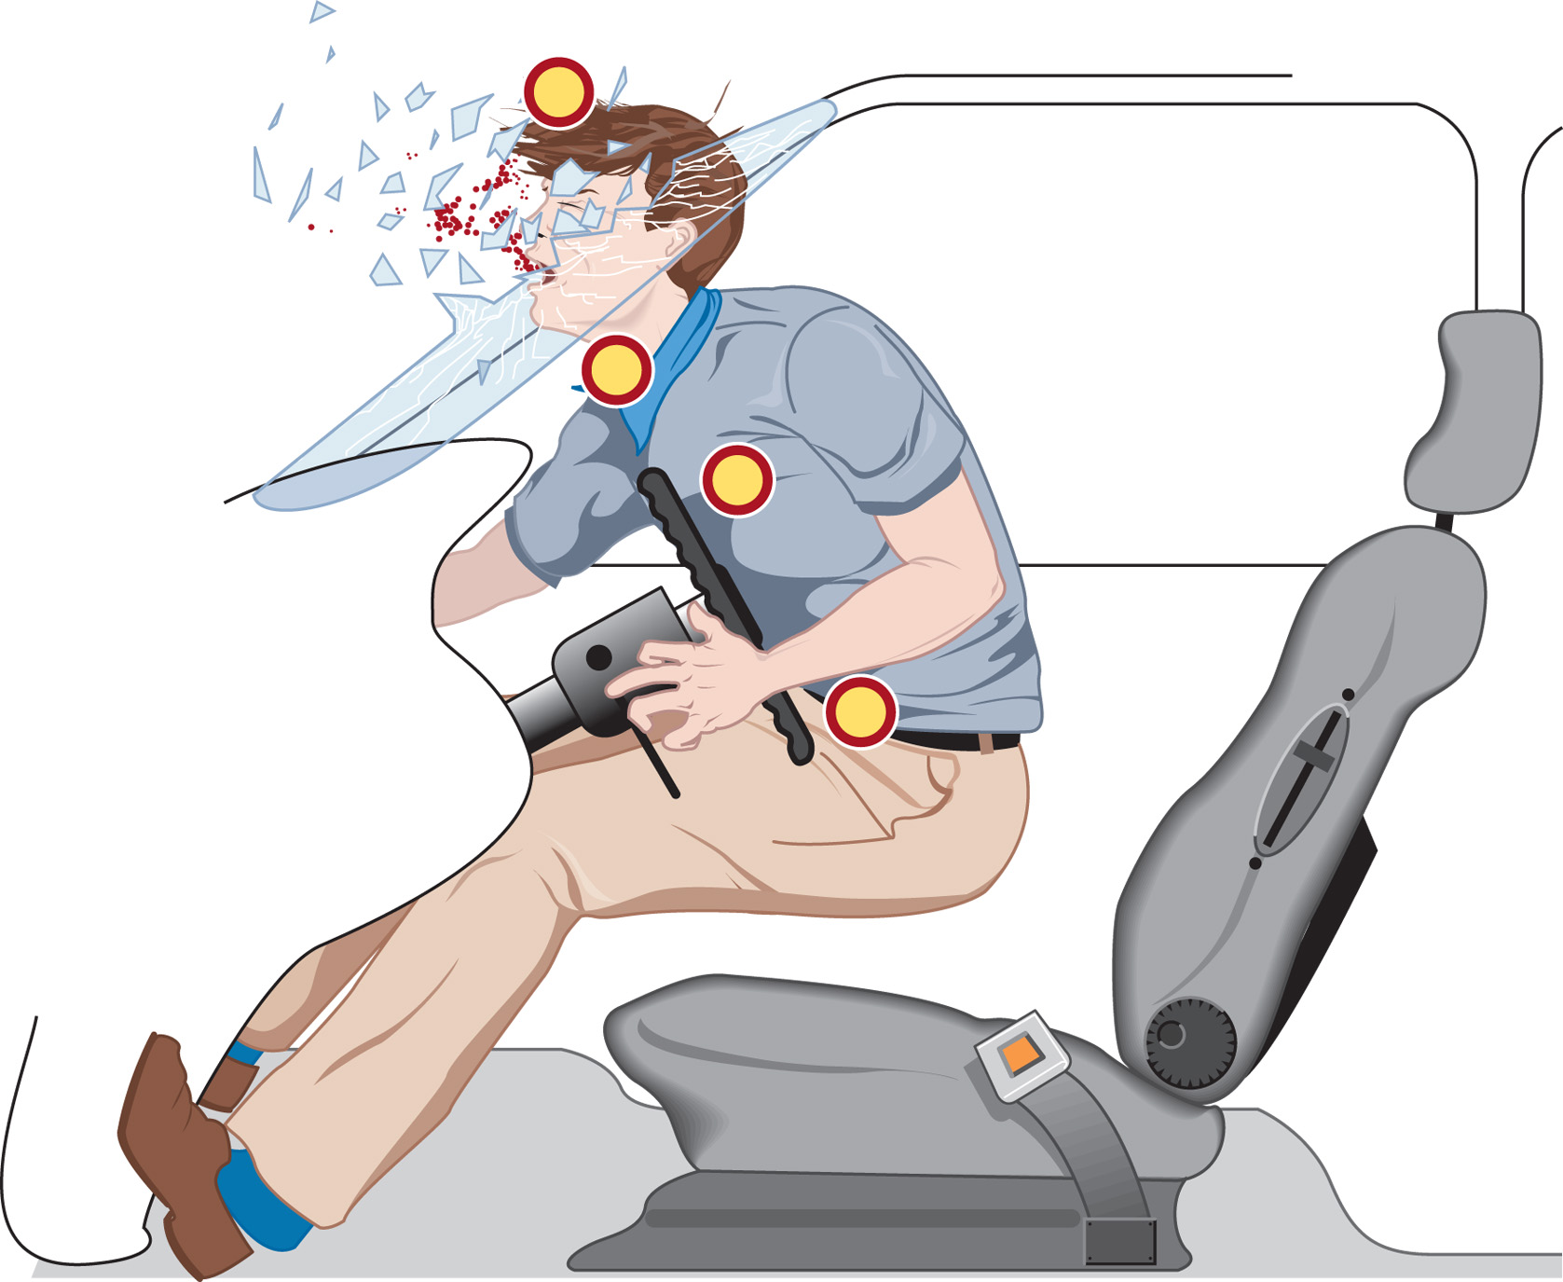
The Up-And-Over Pathway Causes Impact to the Head, Neck, Chest, and Abdomen

Slide 26
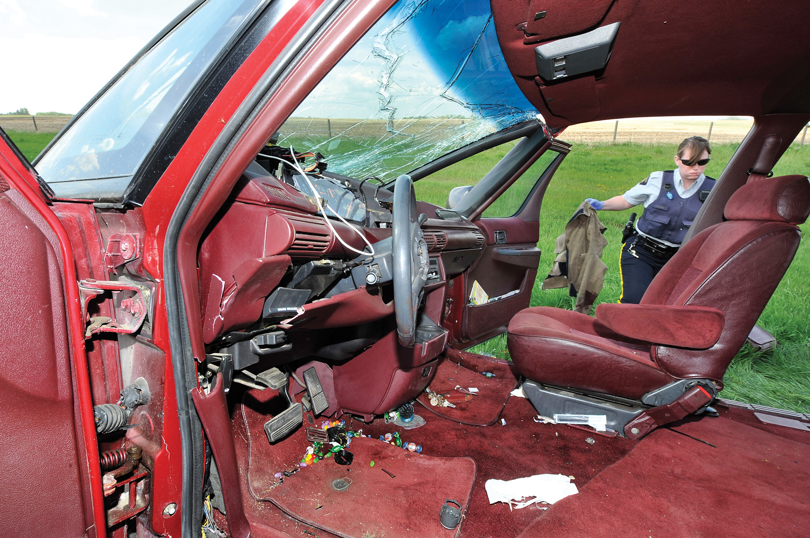
A Deformed Steering Wheel Indicates Possible Chest or Abdominal Injury
(© Kevin Link)
Notes:
Patients in a frontal collision who are unrestrained can come into contact with the steering wheel or dashboard as the air bag deploys. The explosive force of the air bag can produce chest injury.

Slide 27
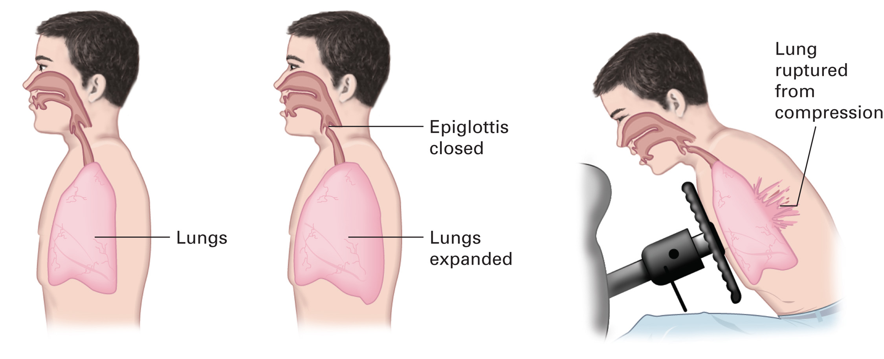
The “Paper Bag” Syndrome Results from Compression of the Chest against the Steering Column
Notes:
Air trapped in the lungs by sudden closure of the epiglottis is compressed between the ribs and spine. This kind of compression injury is called a “paper bag injury” because it is like blowing up a paper bag, then popping it between your hands.

Slide 28
Mechanisms of Injury (5 of 22)
Vehicle Collisions
  Frontal Impact
    With a down-and-under pathway look for injuries to the knees, femurs, hips, acetabulum, and spine.
Notes:
The driver that goes down and under the steering wheel is subject to injuries to the knees, femurs, hips, pelvis, and spine.

Slide 29
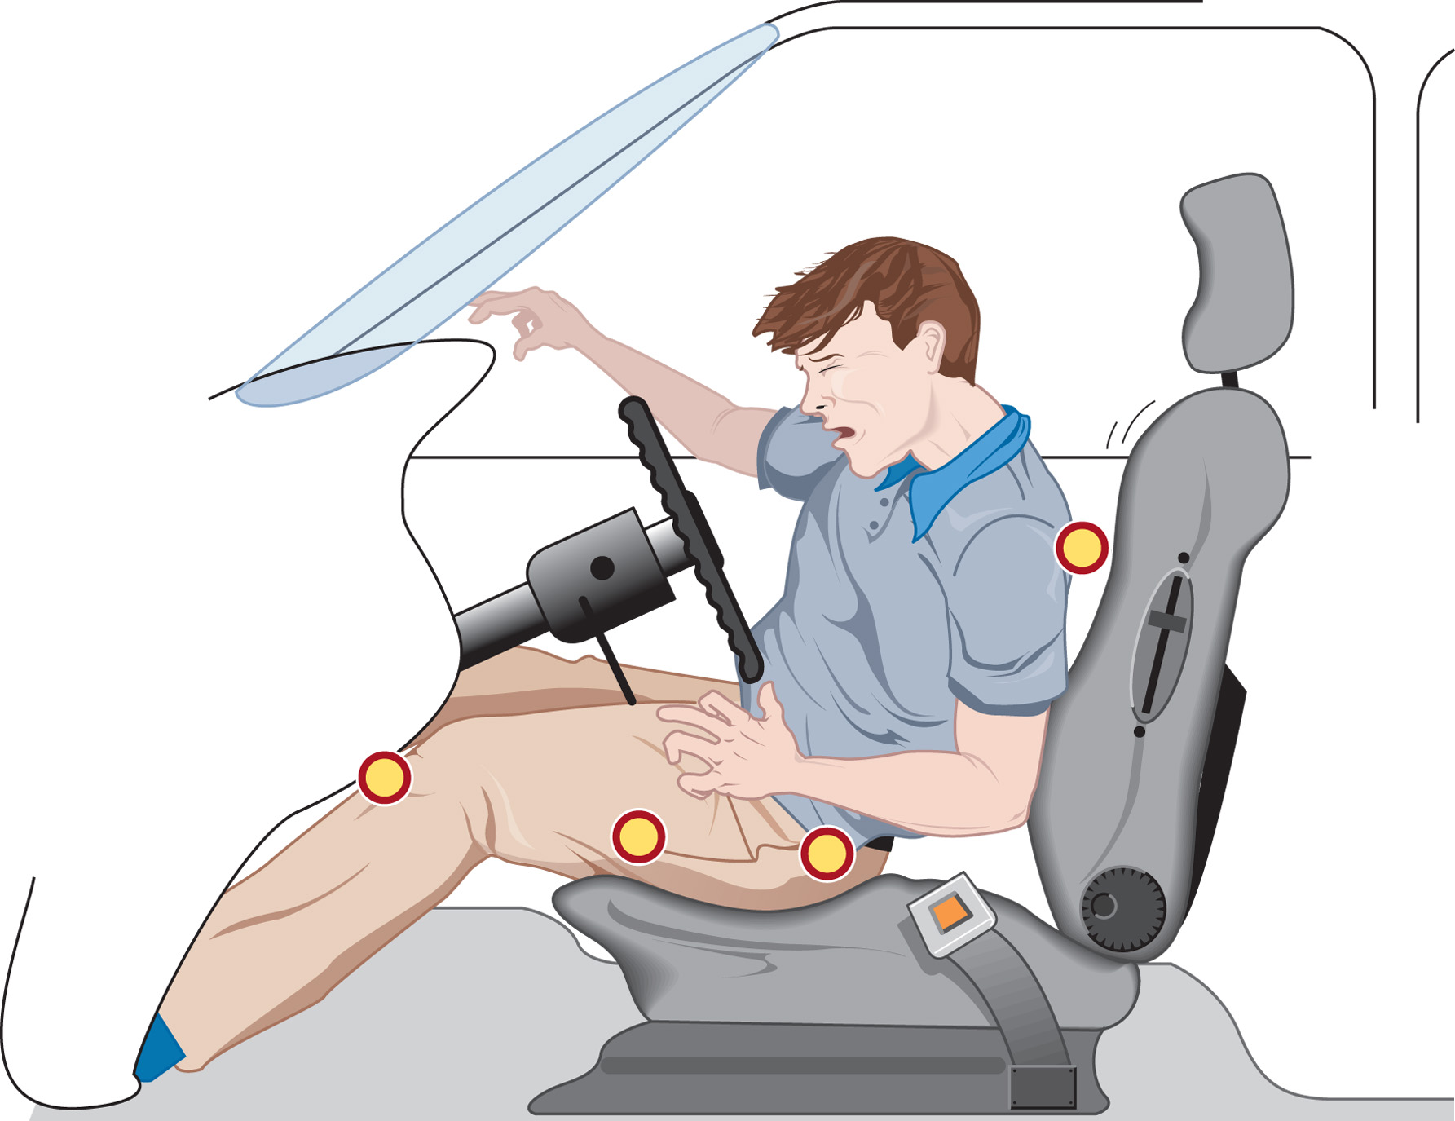
The Down-And-Under Pathway Causes Impact to the Knees, Femurs, Hips, Acetabulum, and Spine

Slide 30
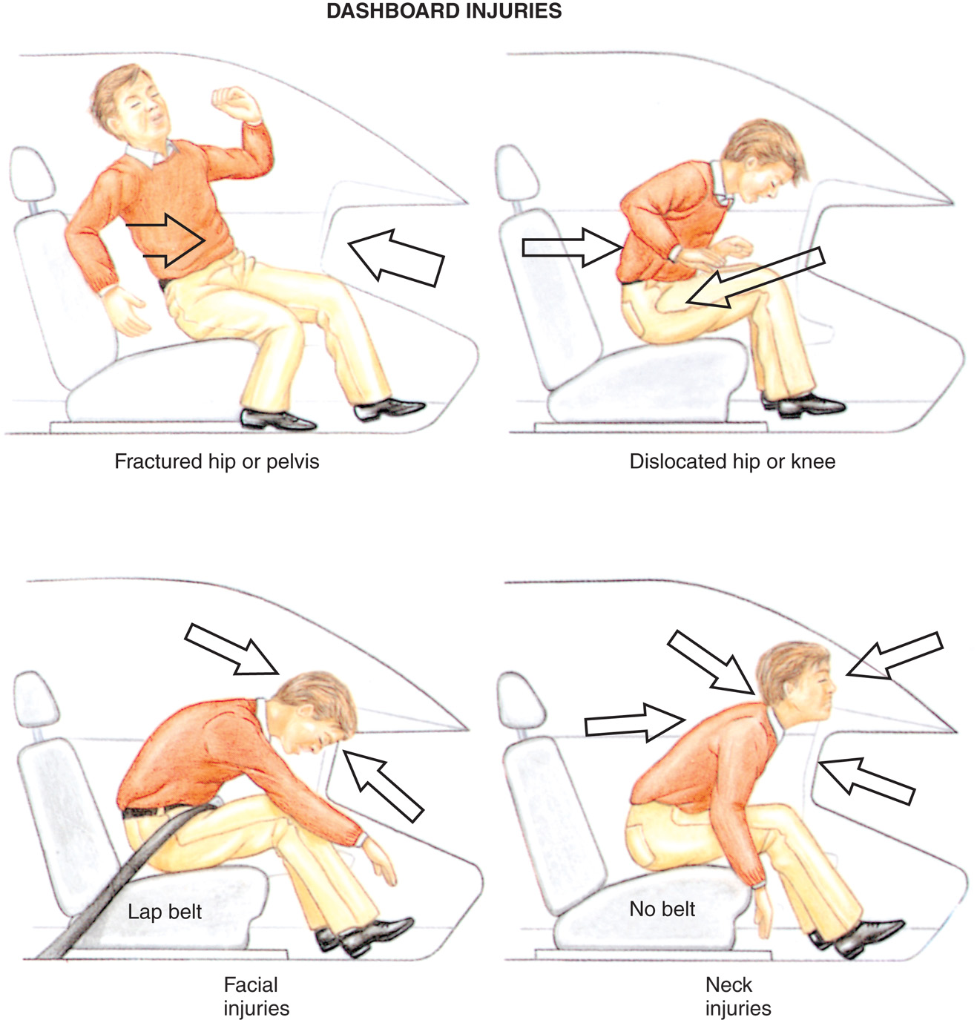
Examples of Mechanisms of Injury Associated with Frontal Impact
Notes:
Even in the absence of bone injury, the force of the impact can damage the brain. First, the floor of the skull is rough, with many sharp projections. When the brain moves across these projections, it can become lacerated or bruised. Second, the brain can rebound against the opposite side of the skull from the original point of impact.

Slide 31
Mechanisms of Injury (6 of 22)
Vehicle Collisions
  Rear-End Impact
    Initially, the head and neck are whipped back.
    A properly adjusted headrest and seat belt reduce injury.
    Subsequent injury can follow an up-and-over or down-and-under pathway.
Notes:
The body is propelled forward by the seat, while the head and neck, tend to remain at rest, following the law of inertia. Because the weight of the body exceeds that of the head, the body keeps moving while the head slows.

Slide 32
Rear Impact
(© Ed Effron)
Notes:
An improperly positioned headrest that is pushed all the way down to restrain just the neck and not the head can contribute to the severity of the injury by creating a fulcrum against which to bend the neck backward.

Slide 33
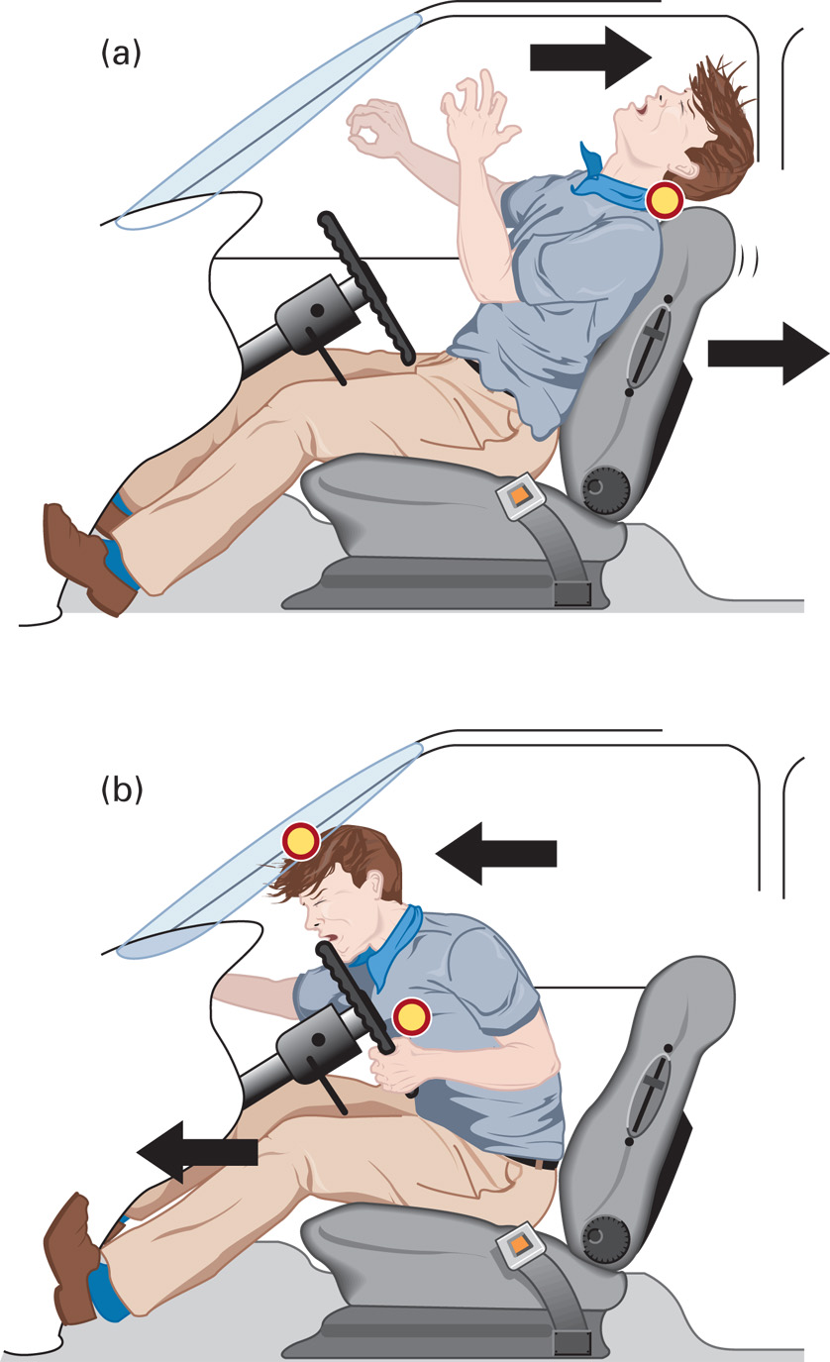
The Effects of Driver Not Wearing a Seat Belt
(a) In a Rear Impact with an Unrestrained Occupant Initial movement is backward, causing potential neck injury.
(b) The occupant then moves forward, causing impact to the head and chest.
Notes:
If there is a headrest that has been properly positioned and seat belts are worn, injury is minimized. However, if the vehicle does not have headrests or they are improperly positioned, the neck is hyperextended and the anterior spinal ligaments are often stretched or torn. This is often referred to as a “whiplash” injury.

Slide 34
Mechanisms of Injury (7 of 22)
Vehicle Collisions
  Lateral Impact
    There may be injuries of the head, neck, chest, abdomen, pelvis, and extremities.
    Assess whether the patient bore the brunt of the impact.
Notes:
Head and Neck - As the energy of the impact is absorbed, the body is pushed laterally, out from under the head. This causes the head to move in the opposite direction.
Chest and Abdomen - Injuries occur when the door strikes the side of the chest and abdomen. If the impact is on the shoulder, the energy traveling in a straight line may dissipate at the curve in the clavicle, resulting in a fracture. If the arm is caught between the door and chest, or if the door hits the chest, fractured ribs and flail segments are possible.
Pelvis - The impact of the vehicle door to the chest wall also causes a lateral impact to the pelvis. Fractures of the pelvis and upper femur usually complete this pattern.

Slide 35
Lateral Impact
(© Ed Effron)
Notes:
When a vehicle is struck laterally, or directly on the side, it can be crushed inward, impinging on the occupants.

Slide 36
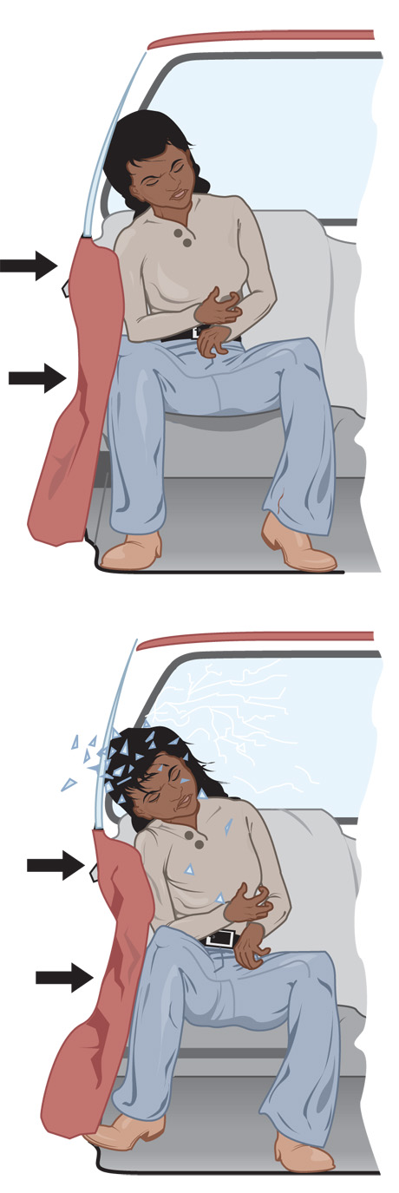
Lateral Impact Causes Impact to the Head, Shoulder, Lateral Chest, Lateral Abdomen, Lateral Pelvis, and Femur
Notes:
Injuries can occur to the head, neck, chest, abdomen, pelvis, and extremities. You need to ask yourself who took the brunt of that collision and carefully examine the side of the patient’s body that bore the brunt of the lateral impact.

Slide 37
Mechanisms of Injury (8 of 22)
Vehicle Collisions
  Rotational or Rollover Crash
    Injury patterns are less predictable.
    In rollovers, there are multiple impacts and changes in direction.
    Multisystem trauma is common.
    Ejection is common with rollover; crushing injuries to ejected occupants are common.
Notes:
The vehicle spins around the point of impact, causing the occupants who are not restrained to strike the mirror, posts, and doors, resulting in many injuries. Both head-on and lateral injury patterns occur. The vehicle hits the ground multiple times and in various places. The occupant changes direction every time the vehicle does.
Although a specific pattern of injury is impossible to predict in a rollover, there are a few common characteristics. First, multiple systems injury is common. Second, ejection is common if the occupant was not restrained. Finally, crushing injuries to ejected occupants are common.

Slide 38
Rotational Impact
(© Ed Effron)
Notes:
During a rollover, the vehicle hits the ground multiple times and in various places.

Slide 39
Rollover Impacts
(© Ed Effron)
Notes:
Vehicles with a high center of gravity, such as sports utility vehicles and vans, are more prone to rollovers.

Slide 40
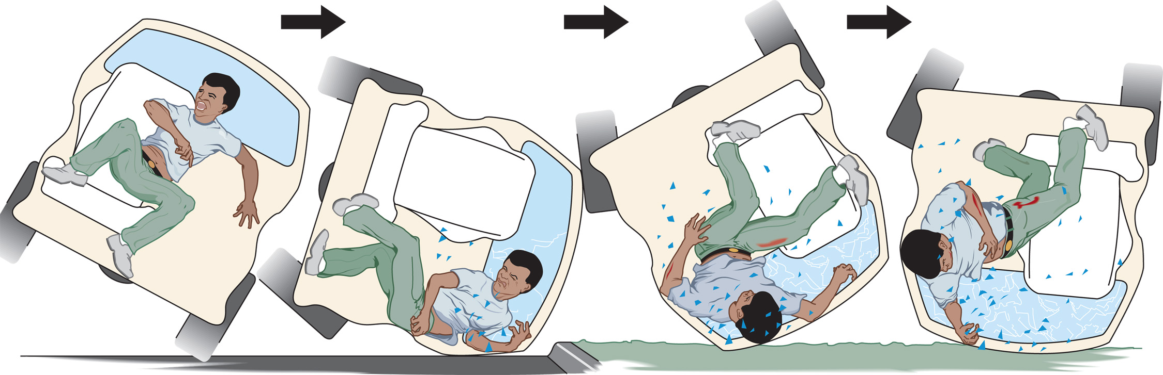
In a Rollover of an Unrestrained Occupant, Impact to the Body is Difficult to Predict and Commonly Results in Multiple System Injury
Notes:
Following the laws of motion, if you go straight through the windshield into the ditch, so does your vehicle, right into the ditch on top of you. Sometimes patients are thrown into other lanes of traffic too fast for oncoming vehicles to avoid.

Slide 41
Mechanisms of Injury (9 of 22)
Vehicle Collisions
  Vehicle-Pedestrian Collision
    Extent of injury depends on:
      Vehicle speed.
      What part of the body is hit.
      How far the pedestrian was thrown.
      The surface the pedestrian landed on.
      The body part that first struck the ground.
      Injury patterns are different in children and adults.
Notes:
The patterns of injury are likely to be different in children than in adults. This is because adults are larger and have a different weight distribution. Also, children and adults react to an impending collision differently. A child who is about to be hit by a vehicle, whether the child is walking or riding a bicycle, generally turns toward the oncoming vehicle, so injuries from the impact are generally to the front of the body. An adult, on the other hand, usually turns away from an oncoming vehicle, so the most common impact is to the side of the body.

Slide 42
Mechanisms of Injury (10 of 22)
  Vehicle Collisions
  Restraints: A Cause of Hidden Injuries
    The benefits of restraints outweigh the risks, but they are associated with certain injuries that must be suspected.
    Injury is more likely if lap belts and shoulder straps are not positioned properly.
    Air bags are not designed for multiple collisions.
Notes:
Hidden injuries can occur from the use of restraints in motor vehicles, including air bags and seat belts. Lap belts, when worn properly, distribute force across the iliac crests of the pelvis. The lap belt prevents the occupant from being ejected, but without a shoulder strap, it does not prevent the chest from striking the steering wheel or the head and neck from striking the dashboard or steering wheel. Compression fractures of the lumbar spine occur as the torso is forcibly flexed forward. If the seat belt is worn too low, it can dislocate the hips.

Slide 43
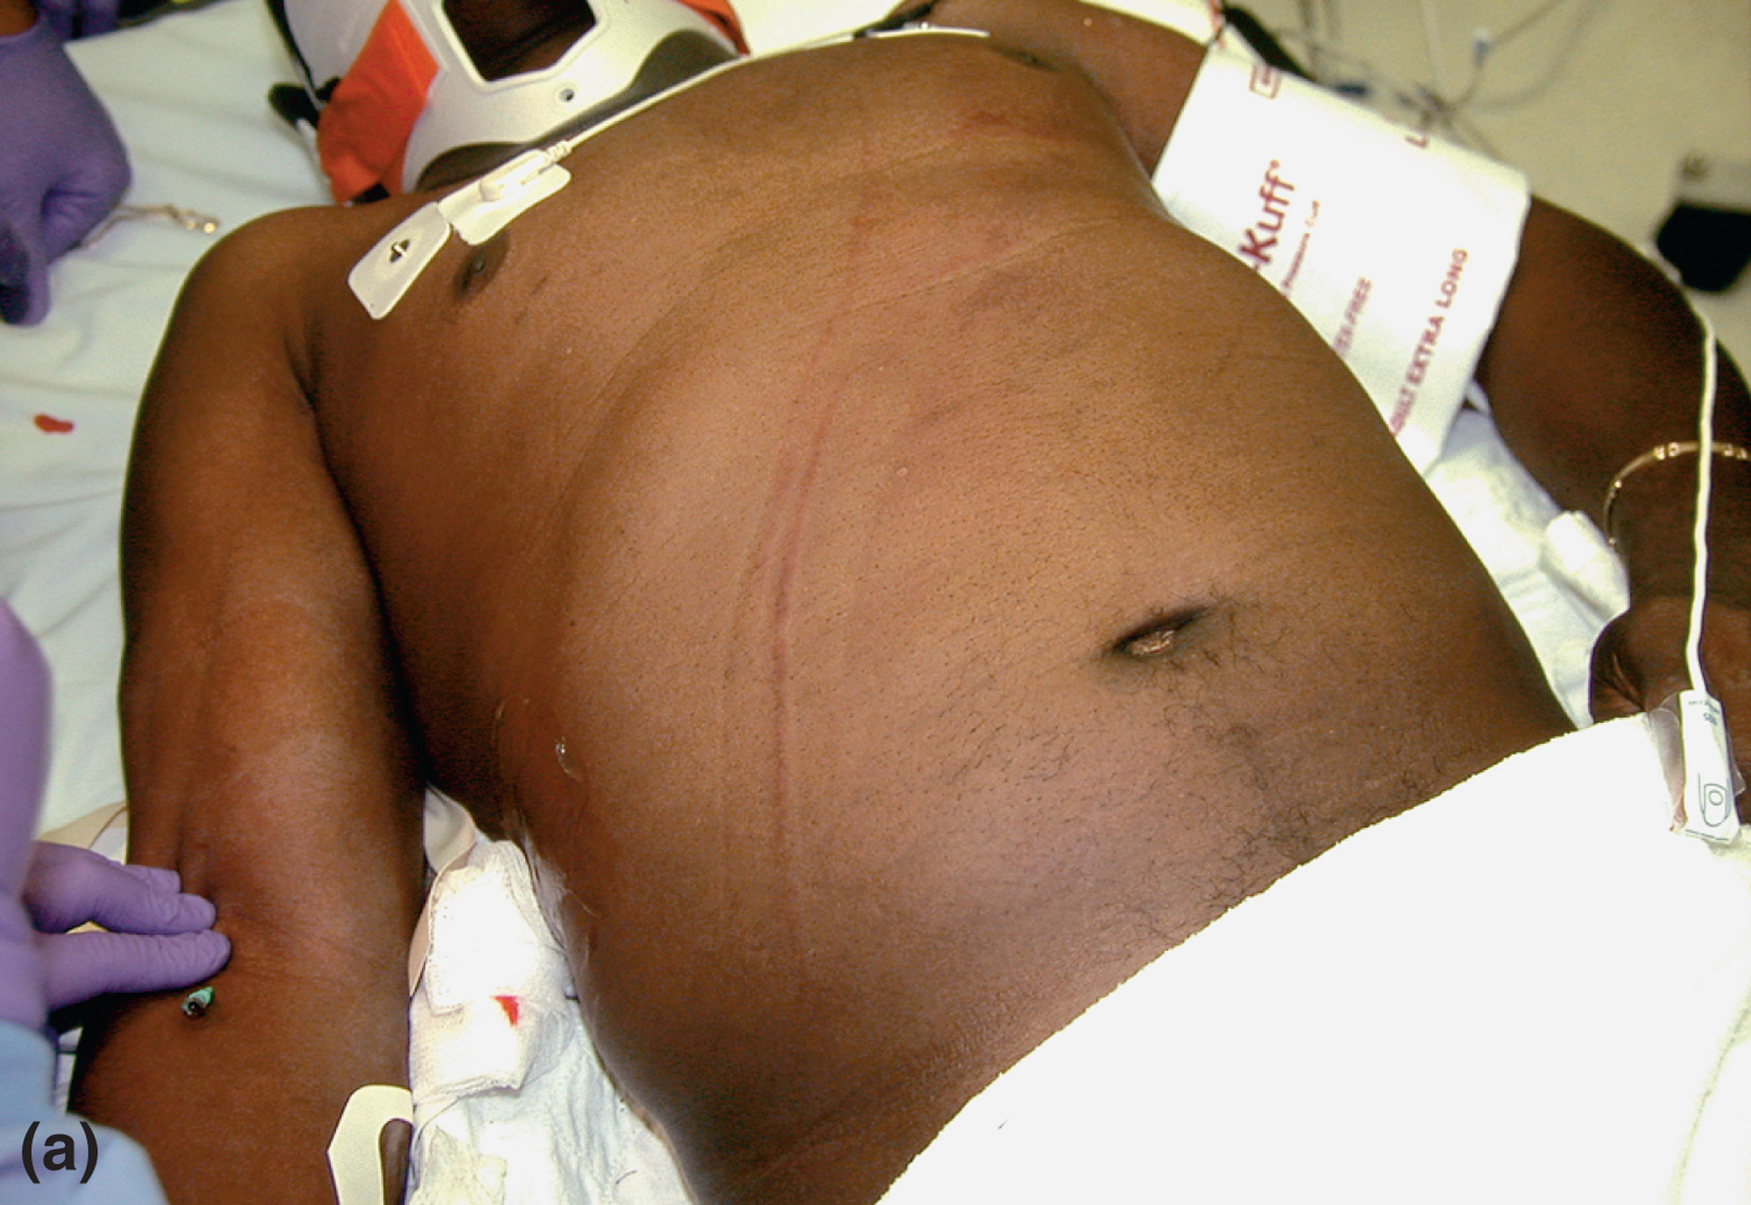
Seat Belt Injuries to the Upper Chest
( © Edward T. Dickinson, M D)
Notes:
A shoulder strap worn without a lap belt can result in severe neck injury.

Slide 44
Seat Belt Injuries to the Abdomen
(© David Effron, M D)
Notes:
Lap belts, when worn properly, distribute force across the iliac crests of the pelvis. The lap belt prevents the occupant from being ejected, but without a shoulder strap, it does not prevent the chest from striking the steering wheel or the head and neck from striking the dashboard or steering wheel.

Slide 45
Mechanisms of Injury (11 of 22)
Vehicle Collisions
  Restraints: A Cause of Hidden Injuries
    Considerations for infants and children
      The head and neck are not secured.
      The head snaps forward, straining the neck.
      Spinal cord injury can occur, even without injury to the vertebrae.
      Car seats should be placed in the backseat of the vehicle only.
Notes:
To prevent head snapping, the proper position for the car seat is to face backward and reclined to a 45-degree angle. To completely avoid injury from air bag deployment, children should always be restrained in the back seat of the vehicle and not in the front passenger seat.

Slide 46
Mechanisms of Injury (12 of 22)
  Vehicle Collisions
  Motorcycle Collisions
    Helmet use is a significant factor in reducing morbidity and mortality.
    Impacts may be head-on or angular, and may involve ejection.
    Laying the bike down can result in severe abrasions and burns.
Notes:
“Laying the Bike Down” is an evasive action on the part of the rider, designed to prevent ejection and separation of the driver from the bike in an impending collision. The bike is turned sideways and “laid down” with the driver’s inside leg dragging on the pavement or ground. The driver tends to lose speed faster than the bike, thus moving the bike out from under the driver. Abrasions can range from superficial abrasions, involving only the epidermis, to full-thickness abrasions, which extend through the subcutaneous tissue and, in severe cases, to the covering over the bone. Abrasions can be complicated by particles embedded in the tissue such as dirt, grass, or asphalt.

Slide 47
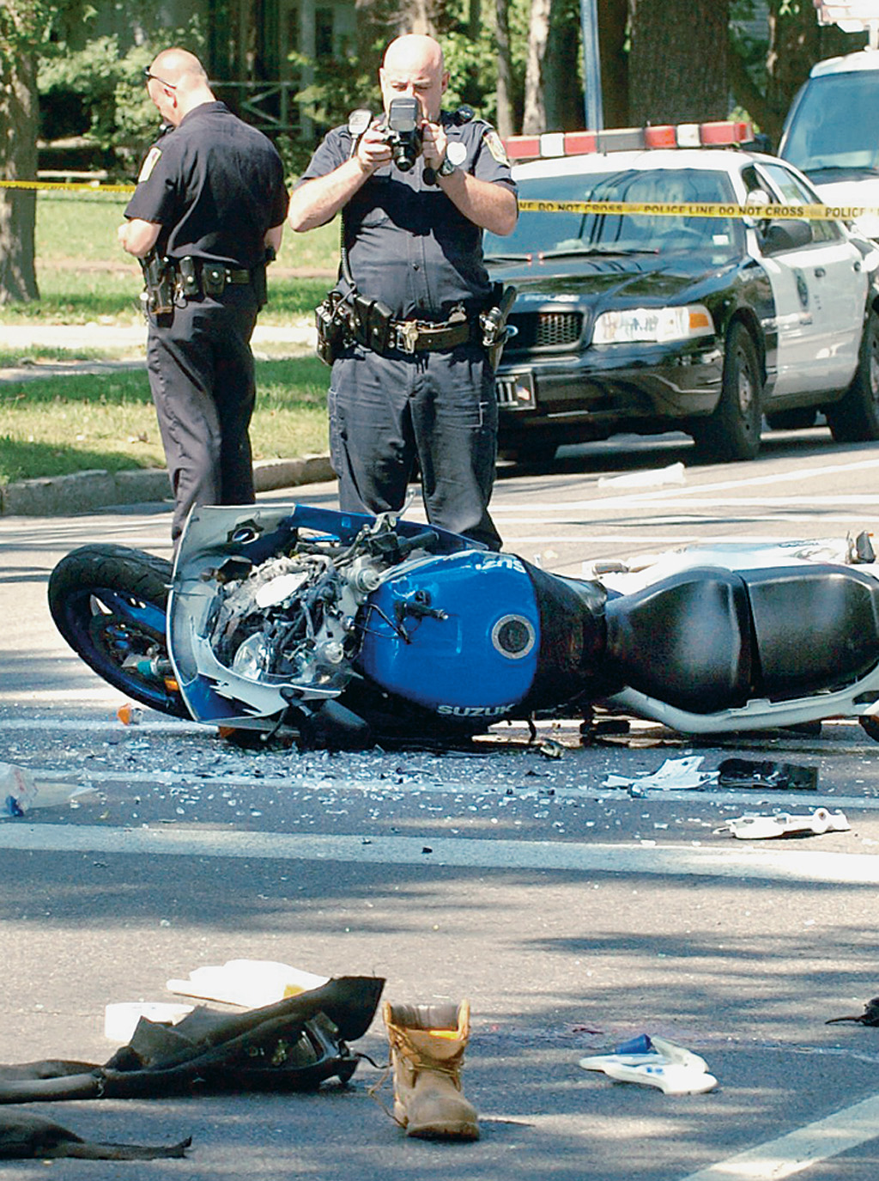
Motorcycle Collisions Can Result in Multisystem Trauma from Multiple Impacts to the Rider
(© C W Mckean/Syracuse Newspapers/The Image Works)
Notes:
The incidence of morbidity and incidence of mortality are greatly affected by whether the rider is wearing a helmet.

Slide 48
Soft Tissue Injury to the Face
(© David Effron, M D)
Notes:
Boots, leather clothing, and a helmet help to protect against soft tissue damage, commonly called “road rash,” and against head and facial injuries

Slide 49
Mechanisms of Injury (13 of 22)
Vehicle Collisions
  All-terrain vehicles
    Vehicles are unstable and easily tipped.
    Vehicle Collisions are similar to motorcycle collisions.

Slide 50

All-Terrain Vehicles (A T V s) Can Cause Multiple Injuries from the Combination of Speed and Instability
Notes:
ATVs are problematic because they are easily tipped over.

Slide 51
Mechanisms of Injury (14 of 22)
Falls
  Severity of trauma depends on:
    Distance
    Surface
    Body part impacted first
  A severe fall is:
    >20 feet in an adult
    >10 feet or two to three times the height in a child
Notes:
Internal organ damage is frequent, and you should have a high index of suspicion regardless of how the patient looks initially.
The pattern of trauma injuries also depends on the body part that impacts first.
Discussion Question
What factors affect the severity and pattern of injury produced in falls?
Knowledge Application
Given several descriptions of mechanism of injury, students should be able to develop an index of suspicion for patterns and severity of injuries.

Slide 52
Mechanisms of Injury (15 of 22)
  Falls
  Feet-First Falls
    Injuries to lower extremities.
    Injuries to spine.
    Injury to internal organs.
    Wrist and elbow injuries may occur.
Notes:
A feet-first landing causes energy to travel up the skeletal system. Fractures of the heels and fractures or dislocations of the ankles are common. If the knees are flexed at the time of impact, most energy is dissipated at the knees and preserves the rest of the skeletal system. However, If the person lands flat-footed with knees locked, energy is transmitted up through the femurs to the hips and pelvis, possibly causing fractures.
In falls of more than 20 feet, the internal organs are likely to be injured from deceleration forces. The liver, spleen, kidney, aorta, and heart can be affected.

Slide 53
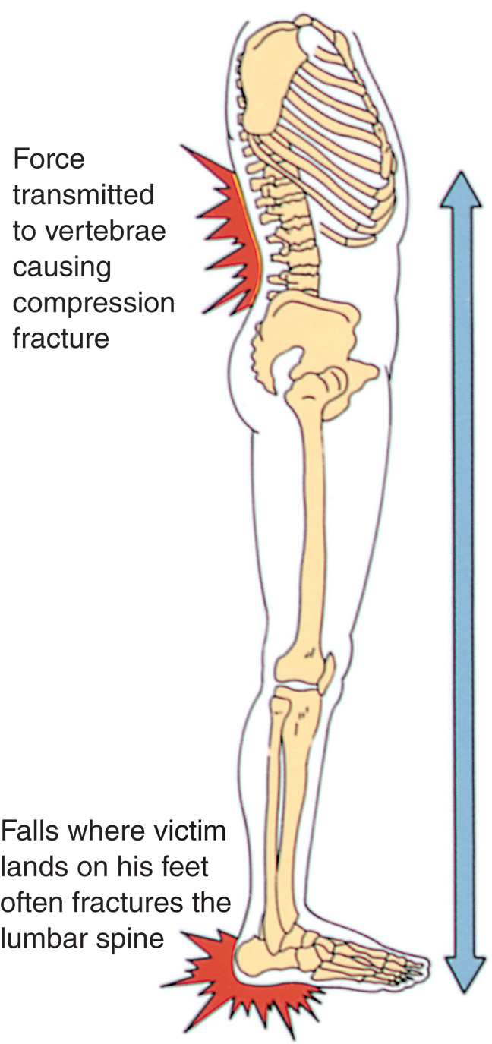
In Falls, the Energy of Impact is Transmitted up the Skeletal System
Notes:
A feet-first landing causes energy to travel up the skeletal system. Fractures of the heels and fractures or dislocations of the ankles are common.

Slide 54
Mechanisms of Injury (16 of 22)
Falls
  Head-first falls
    Upper extremity injuries.
    Head and neck injuries.
    Chest, spine, and pelvis injuries may occur.
Notes:
In head-first falls, the pattern of injury begins with the arms and extends up to the shoulders. The head can be forcibly hyperextended, hyperflexed, or compressed, all of which can cause extensive damage to the cervical spine.

Slide 55
Mechanisms of Injury (17 of 22)
Penetrating Injuries
  Kinetic energy predicts the amount of damage.
  Low, medium, or high velocity.
Notes:
Penetrating injuries are caused by any object that can penetrate the surface of the body, such as bullets, darts, nails, and knives. The amount of damage that results depends on the amount of kinetic energy transferred to the tissue and the area of the body it penetrates.

Slide 56
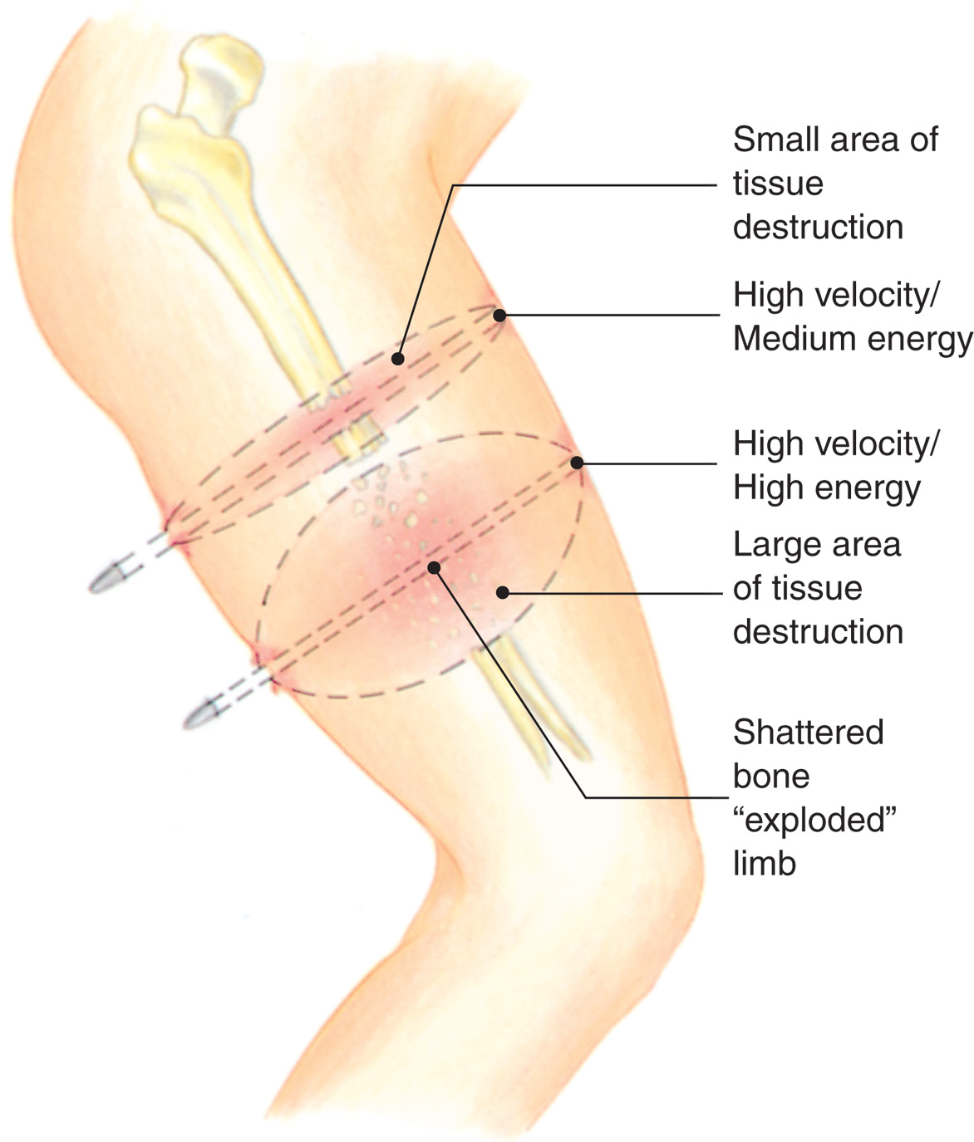
The Severity of Injury Caused by Penetrating Trauma is Related to the Velocity of the Penetrating Object
Notes:
The amount of kinetic energy transferred to the tissue is the greatest indicator of potential damage. For example, if the object is a knife, the low kinetic energy limits the damage to just the immediate site of impact and the underlying structures. The higher kinetic energy of a bullet results in tissue damage extending relatively far from the site of impact. If the kinetic energy produced by the bullet is totally absorbed by the body tissues, the bullet will not exit. If kinetic energy remains with the bullet, however, an exit wound will occur.

Slide 57
Mechanisms of Injury (18 of 22)
Penetrating Injuries
  Low velocity
    Knife or similar object.
    Can include defensive slash wounds.
    The length of the object provides clues to injury.
Notes:
A person stabbed from behind in the left upper chest with a short (3-inch) paring knife may suffer a pneumothorax (air in the chest cavity). If stabbed with an 8-inch knife, the injuries can include lacerated pulmonary veins, lacerated aorta, and even laceration to the heart itself.

Slide 58
Mechanisms of Injury (19 of 22)
  Penetrating Injuries
  Medium- and high-velocity injuries
    Includes pellets and bullets.
    Shotguns and handguns are generally medium-velocity.
    High velocity weapons include rifles.
Notes:
Shotgun wounds differ significantly from rifle or handgun wounds, because shotguns have multiple pellets that spray in a pattern. The multiple pellets increase the impact surface area, thus increasing the amount of energy transferred to the tissues. Close-range shotgun wounds can cause devastating tissue damage.

Slide 59
Mechanisms of Injury (20 of 22)
Penetrating Injuries
  Medium- and high-velocity injuries
    Damage is determined by the trajectory and the dissipation of energy.
    Dissipation of energy is affected by:
      Drag
      Profile
      Cavitation
      Fragmentation
Notes:
Trajectory - The path or motion of a projectile during its travel.
Dissipation of Energy - The way energy is transferred to the human body from the force acting on it.
Drag - The factors that slow a bullet down, such as wind resistance, constitute drag.
Profile - The impact point of the bullet is its profile. The greater the size of the impact point, the more energy is transferred.
Cavitation - Sometimes called pathway expansion, cavitation is the cavity in the body tissues formed by a pressure wave resulting from the kinetic energy of the bullet. Cavitation greatly extends the tissue damage beyond the initial bullet pathway. That is, the hole created in the tissues is larger than the diameter of the bullet. Blown-out tissue caused by cavitation and carried along with the bullet explains why the exit wound is always larger than the entry wound.
Fragmentation - A bullet that breaks up into small pieces or releases small pieces upon impact increases the body damage. The fragments increase the frontal impact area and create greater tissue damage with injuries spread over a larger area of the body.

Slide 60
Mechanisms of Injury (21 of 22)
  Penetrating Injuries
  Gunshot wounds
    90 percent of fatal wounds involve the head, thorax, and abdomen.
    Wounds also occur to the neck and extremities.
Notes:
The interior of the skull is a fixed space with little-to-no room for expansion. When the energy from a projectile enters the skull and starts to dissipate, brain tissue is severely compressed. Gunshot wounds to the face generally result in major soft tissue injuries that immediately threaten the airway.
Lung tissue is relatively tolerant of the cavitation caused by projectiles. The numerous air-filled alveoli form a spongy mass that is easily movable. Pneumothorax is a common result of injury to the chest and/or lung, with air or a combination of air and blood escaping into the pleural cavity. Associated rib fractures can also occur.
The abdomen is often secondarily injured when the chest is injured. The abdominal cavity is large and contains structures that are fluid-filled, air-filled, solid, and bony. The air-filled and fluid-filled structures are more tolerant of cavitation than are the solid organs.
The extremities contain bone, muscle, blood vessels, and nerves. Bone injury from a projectile results in bony fragments becoming secondary missiles, lacerating surrounding vessels, muscles, and nerves. Muscle expands, resulting in capillary tears and swelling.

Slide 61
Mechanisms of Injury (22 of 22)
Blast injuries
  Occurs from explosions.
  Each of the phases of an explosion causes specific types of injury.
Notes:
Blast injuries can occur because of explosions from different situations, such as those including natural gas, gasoline, fireworks, improvised explosive devices, and grain elevators. Regardless of the cause, every explosion has primary, secondary, tertiary, quaternary, and quinary phases.
Discussion Question
What types of injuries are produced in each of the three phases of a blast?
Teaching Tips
Inform students of local trauma triage criteria based on mechanism of injury.

Slide 62
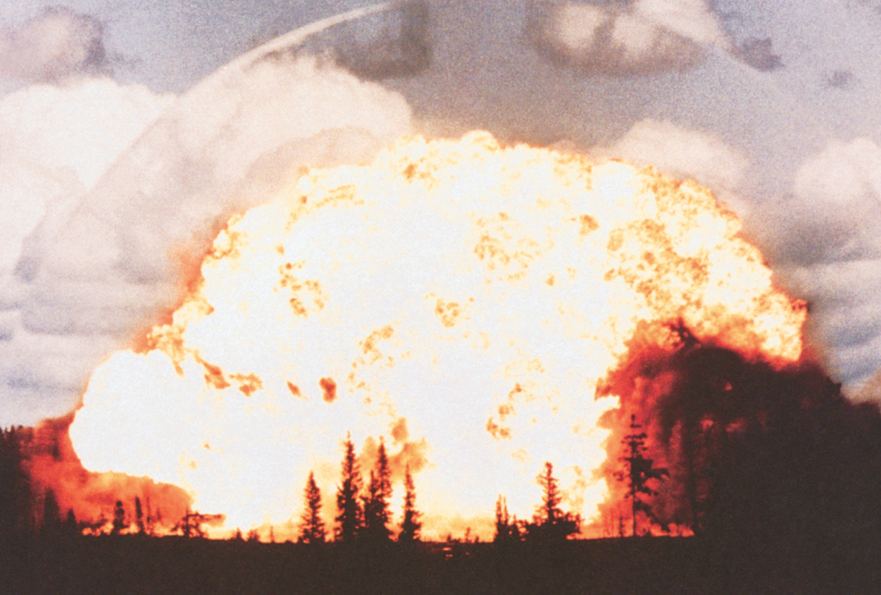
An Explosion Releases Tremendous Amounts of Heat Energy, Generating a Pressure Wave, Blast Wind, and Projection of Debris
(Reproduced from Bombing Injury Patterns and Care, Office of Public Health Preparedness and Response. www.CDC.gov)
Notes:
Primary phase injuries are due to the pressure wave of the blast. These injuries primarily affect the gas-containing organs, such as the lungs, stomach, intestines, middle and inner ears, and sinuses. Severe damage and death can occur from this phase without any external sign of injury.

Slide 63
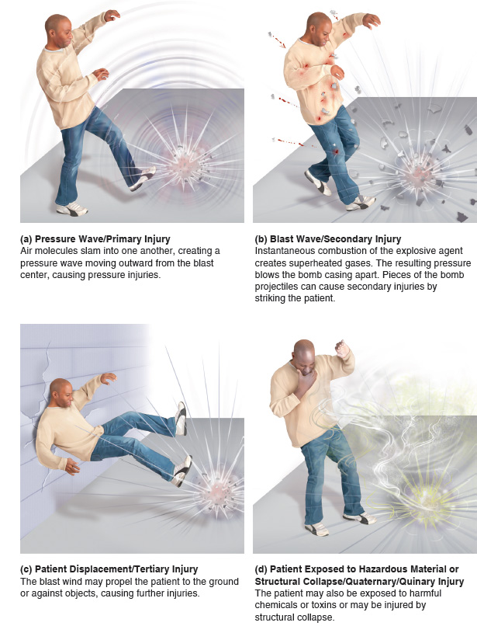
Types of Blast Injuries
Notes:
Secondary phase injuries are due to flying debris propelled by the force of the blast, or blast wind. In contrast to the injuries in the primary phase, the injuries of this phase are obvious. Most common are lacerations, impaled objects, fractures, and burns.
Tertiary phase injuries occur when the patient is thrown away from the source of the blast. Injuries are much the same as would be expected from ejection from a vehicle. The pattern depends on the distance thrown and the point of impact.
Quaternary and quinary phase injuries result from structural collapse and exposure to chemicals, toxins, bacteria, metals, and radiation.

Slide 64
Case Study (2 of 4)
Nina and Scotty ensure that the patient has an open airway and is breathing adequately, and apply oxygen by nonrebreather mask as the police officer continues to apply direct pressure. Nina detects a weak, thready radial pulse that she estimates to be greater than 100 per minute.
Notes:
Review the case study findings presented.

Slide 65
Case Study (3 of 4)
She performs a rapid secondary assessment, during which she finds an entry wound to the front of the thigh, and an exit wound posteriorly.
Meanwhile, Scotty is preparing a long backboard so they can prepare the patient for transport.
Notes:
Review the case study findings presented.

Slide 66
Case Study (4 of 4)
What factors should the E M T s consider in determining where the patient should be transported?
Notes:
Use the case study content and questions to foreshadow the upcoming lesson content. Gauge the student’s responses as a guide of how well versed they are in this topic.

Slide 67
The Multisystem Trauma Patient
Most trauma patients have a simple or single injury.
Multisystem trauma has a high incidence of morbidity and mortality.
Managing immediate life threats and expeditious transport are the appropriate care.
Notes:
Approximately 90 percent of trauma patients have a simple or single injury that involves only one body system, such as a fractured tibia or a soft tissue laceration with no major bleeding. A multisystem trauma patient has multiple injuries or involvement of more than one body system. The body systems can include the central nervous, pulmonary, cardiovascular, gastrointestinal, urinary, reproductive, musculoskeletal, and integumentary systems. Multiple organ injuries are multisystem trauma, even though they may be part of the same body system, such as the small intestine or the liver.
Discussion Question
What is meant by multisystem trauma?

Slide 68
Loading a Multisystem Trauma Patient at the Rear of the Helicopter for Rapid Transport to an Appropriate Facility
(© Mark Foster)
Notes:
Multisystem trauma carries a high incidence of morbidity and mortality. It requires the EMT to respond quickly, provide a rapid assessment to identify immediately life-threatening injuries, manage any life threats, rapidly prepare the patient for transport, and expeditiously transport the patient to an appropriate facility.

Slide 69
The Golden Period and Platinum 10 Minutes (1 of 2)
The best chances of survival from trauma occurs when intervention takes place as quickly as possible.
The goal is for E M S providers to limit scene time to ten minutes with severely injured patients.
Notes:
The Golden Period was once referred to as the “golden hour.” However, some injured patients require definitive care in less than an hour to survive, whereas some patients can survive if care is provided beyond one hour.
Some EMS systems refer to the “platinum 10 minutes.” This means that in cases of severe trauma, 10 minutes is the maximum time the EMS team should devote to on-scene activities, with patient assessment, emergency care for life threats, and preparation for transport all being accomplished within 10 minutes of arriving on the scene.
Discussion Question
Why is it difficult to assign an exact time to the golden period?

Slide 70
The Golden Period and Platinum 10 Minutes (2 of 2)
Within the 10-minute scene time, you must assess the patient, manage immediate life threats, and prepare the patient for transport.
Notes:
If a patient is not severely injured (or is without any life-threatening medical problems), more time can and should be devoted to completing normal on-scene assessment and emergency care before transport is undertaken.

Slide 71
Table 27-1 Indications for On-Scene Time of 10 Minutes or Less and Rapid Transport (1 of 3)
Airway occlusion or difficulty in maintaining a patent airway
Respiratory rate <10 or >29/minute
Inadequate tidal volume
Hypoxia
Respiratory distress, failure, or arrest
Suspected skull fracture
Flail chest
Suspected pneumothorax, hemothorax, or tension pneumothorax
Pelvic fracture
Notes:
The key is determining whether the patient is or is not severely injured. It is to the patient’s potential benefit to err on the side of overestimating, rather than underestimating, the extent or severity of injuries. The harm that can be done by delaying transport when it is needed outweighs the good that can be done by completing on-scene assessment and care at a more deliberate pace.

Slide 72
Table 27-1 Indications for On-Scene Time of 10 Minutes or Less and Rapid Transport (2 of 3)
Two or more proximal long-bone fractures
Crushed or mangled extremity
Uncontrolled external hemorrhage
Suspected internal hemorrhage
Signs and symptoms of shock
Significant external blood loss with controlled hemorrhage
Glasgow Coma Scale score 13 or less
Altered mental status
Seizure activity
Sensory or motor deficit
Notes:
The key is determining whether the patient is or is not severely injured. It is to the patient’s potential benefit to err on the side of overestimating, rather than underestimating, the extent or severity of injuries. The harm that can be done by delaying transport when it is needed outweighs the good that can be done by completing on-scene assessment and care at a more deliberate pace.

Slide 73
Table 27-1 Indications for On-Scene Time of 10 Minutes or Less and Rapid Transport (3 of 3)
Any penetrating trauma to the head, neck, anterior or posterior chest, abdomen, and above the elbow or knee
Amputation of an extremity proximal to the finger
Trauma in a patient with significant medical history (for example, myocardial infarction, chronic obstructive pulmonary disease, and congestive heart failure), >55 years of age, hypothermia, burns, or pregnancy
Multisystem trauma
Open or depressed skull fracture
Suspected brain injury
Paralysis
Notes:
The key is determining whether the patient is or is not severely injured. It is to the patient’s potential benefit to err on the side of overestimating, rather than underestimating, the extent or severity of injuries. The harm that can be done by delaying transport when it is needed outweighs the good that can be done by completing on-scene assessment and care at a more deliberate pace.

Slide 74
The Trauma System (1 of 2)
The trauma system exists to provide immediate surgical intervention for critically injured trauma patients.
Different levels of trauma centers have different levels of capability.
This care dramatically reduces the morbidity and mortality of patients requiring immediate surgical intervention.
Notes:
The trauma system is designed to provide immediate surgical intervention for patients with internal trauma if necessary, extensive intensive care services specific to trauma, and rehabilitation services.
Teaching Tips
Discuss trauma centers available in your community.
Discussion Question
What are the capabilities of a Level I trauma center?
Critical Thinking Discussion
Why is a Level I trauma center not feasible for all communities?

Slide 75
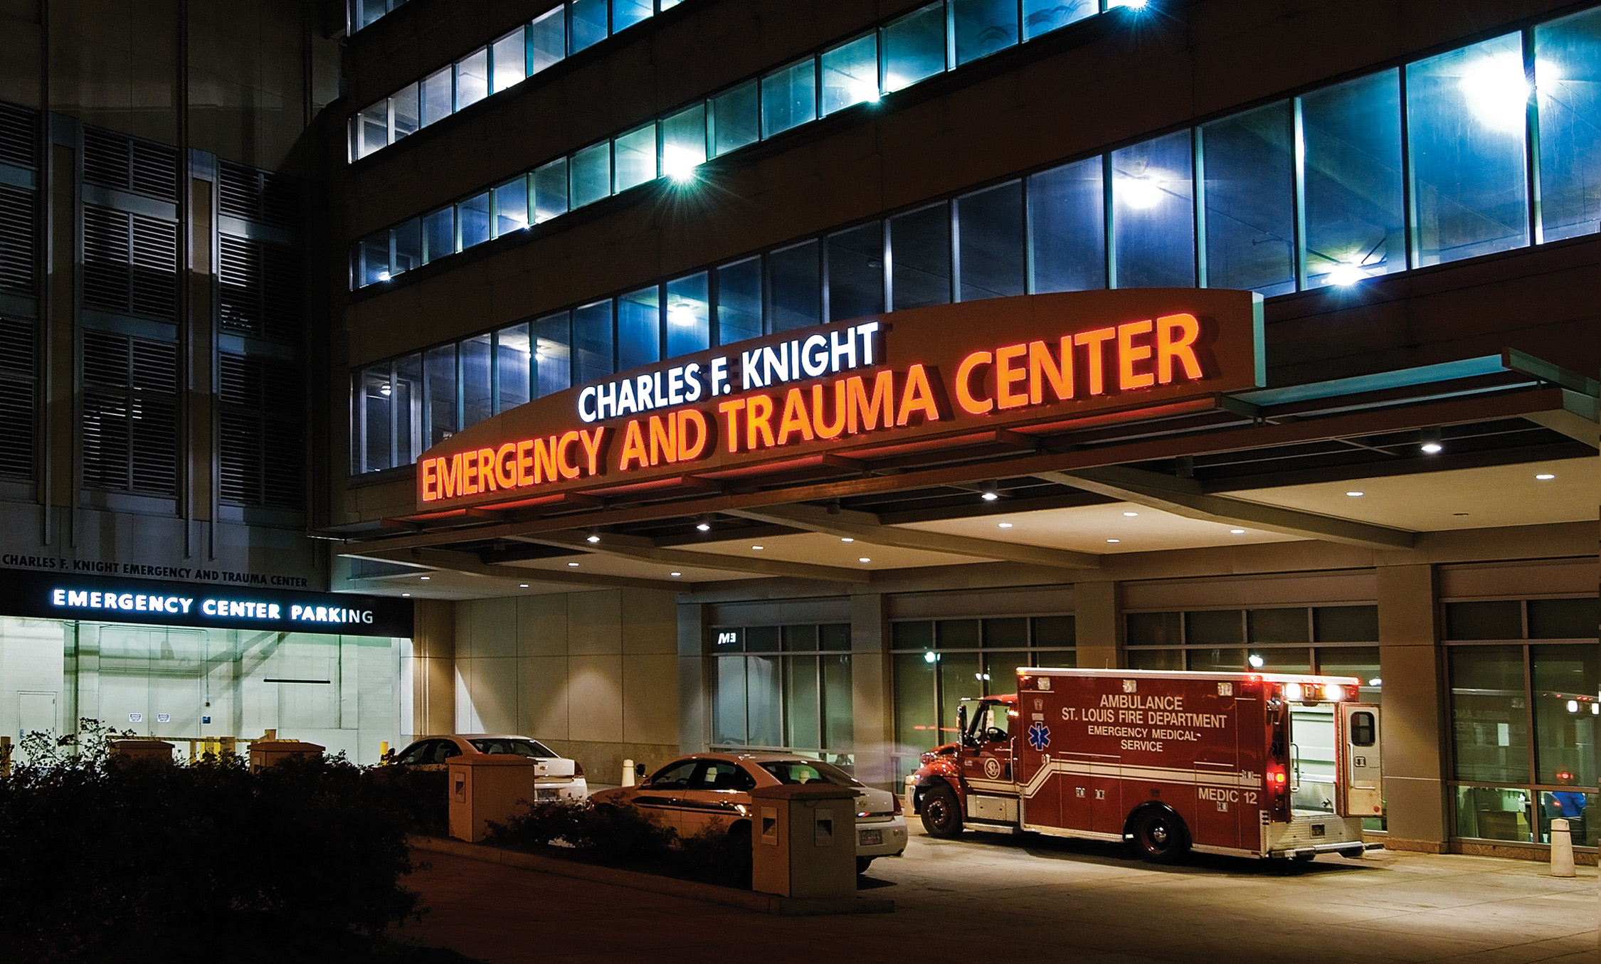
A St. Louis Fire Department Ambulance Pulls up at the Charles F. Knight Emergency and Trauma Center
Notes:
The trauma system requires significant resources and is expensive to maintain and operate. Hospitals with certain recognized capabilities are part of the trauma system and are recognized as trauma centers.

Slide 76
The Trauma System (2 of 2)
Level I – Regional Trauma Center
Level II – Area Trauma Center
Level III – Community Trauma Center
Level IV – Trauma Facility
Notes:
Level I—Regional Trauma Center. Can manage all types of trauma 24 hours a day, 7 days a week.
Level II—Area Trauma Center. Can manage the vast majority of trauma with surgical capabilities 24 hours a day, 7 days a week. They are capable of stabilizing more specialized trauma patients and then transferring them to a level I center.
Level III—Community Trauma Center. Has some surgical capability and specially trained emergency department personnel to manage trauma. This type of center focuses on stabilizing the seriously injured trauma patient and then transferring to a higher-level center.
Level IV—Trauma Facility. Is typically a small community hospital in a remote area capable of stabilizing seriously injured trauma patients and then transferring them to a higher-level trauma center.

Slide 77
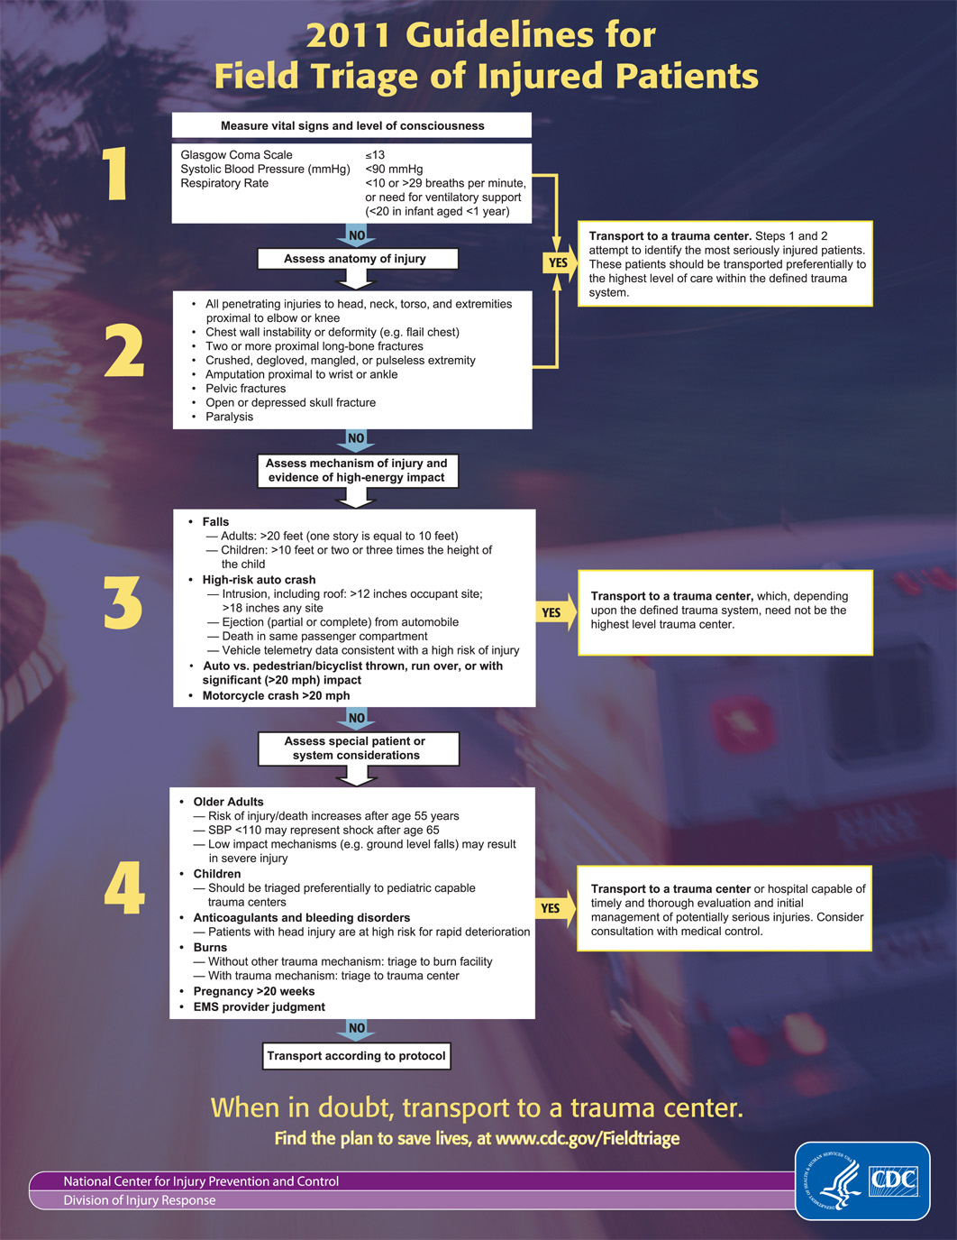
Guidelines for Field Triage of Injured Patients
Notes:
It is crucial that EMS personnel triage patients accurately for transport to an appropriate trauma center. This is the field triage criteria regarding transport of trauma patients to an appropriate trauma facility, as developed by the Centers for Disease Control (CDC).

Slide 78
Golden Principles of Prehospital Trauma Care (1 of 3)
The golden principles of prehospital trauma care apply to all patients who have experienced some type of injury but especially those with multisystem trauma or critical injuries.
Notes:
The principles are:
Ensure at all times the safety of EMS personnel, patients, and bystanders.
Quickly determine the need for additional resources at the scene.
Determine the MOI and kinematics involved in producing real or potential injuries.
Provide a primary assessment to identify and manage immediate life threats.
Establish and maintain spine motion restriction for patients suspected of having a vertebral or spinal cord injury.
Establish and maintain a patent airway.
Establish and maintain adequate oxygenation in the patient with an adequate rate and adequate tidal volume by keeping the SpO₂ reading greater than 95%.
Provide positive pressure ventilation with a high concentration of oxygen connected to the ventilation device in the patient with an inadequate respiratory rate or inadequate tidal volume.
Control external hemorrhage with direct pressure followed by a tourniquet if direct pressure is ineffective.
Maintain a normal body temperature.
Splint fractures when appropriate.
Ensure spine motion restriction precautions are taken.
Transport critically injured or multisystem trauma patients within 10 minutes to the appropriate trauma facility according to the trauma triage criteria. Always follow your local, regional, or state destination protocols.
Obtain a history from the patient, relatives, or bystanders.
Perform a secondary assessment to identify all other life-threatening and non-life-threatening injuries and manage each according to priority.
Critical Thinking Discussion
What is the relationship between each of the golden principles and increased chances of survival for trauma patients?

Slide 79
Golden Principles of Prehospital Trauma Care (2 of 3)
Special Considerations in Trauma Care
  Your personal safety is the highest priority.
  Airway management and adequate ventilation and oxygenation are key elements of trauma management.
  Stop significant bleeding.
  Assessment of the trauma patient is conducted in a systematic sequence.
Notes:
You must always remain alert for potential scene hazards. These might involve traffic on the roadway, hazardous materials, hostile environment, an unsecured crime scene, and sudden changes of patient behavior.
Shock from blood loss results in an inadequate delivery of oxygen to the cells. This causes the cells to convert from aerobic to anaerobic metabolism, resulting in little energy production, acid accumulation, and eventual cellular dysfunction and death.
If a patient is losing a significant amount of blood, the delivery of oxygen and glucose to the cells is impaired. Hemoglobin in the red blood cell is the primary mechanism for oxygen transport. With any type of bleeding, red blood cells and hemoglobin are removed from the vessels, decreasing the oxygen-carrying capability of the blood. The result is shock.
There are times when you must deviate from the sequence to provide emergency care for a life threat. As an example, airway always is assessed before circulation in the sequence. However, if you identify a major bleed (arterial or venous) during the general impression, you must first control the bleeding prior to moving on in the assessment.

Slide 80
Golden Principles of Prehospital Trauma Care (3 of 3)
Special considerations
  Rapid transport is essential to survival of severely injured patients.
  A backboard serves to splint fractures in unstable trauma patients.
  Do not develop tunnel vision and become focused on dramatic injuries or patients.
Notes:
The definitive care for many seriously injured trauma patients is surgery. On-scene time should be limited to 10 minutes if possible. Rapid extrication should be used to remove the patient from a vehicle.
En route, if time or the patient’s condition permits, further stabilization of fractures can be accomplished through splinting. Taking the time at the scene to splint suspected fractures can delay transport and may contribute to the deterioration of the patient.
An open humerus fracture with a bone protruding from the skin at a 90-degree angle will attract your attention. However, if the patient is alert and screaming in pain, you must assume that he has an adequate amount of energy, good perfusion, and an adequate amount of oxygen and glucose delivered to the cells. On the other hand, the patient sitting next to him who barely nods his head in response to your question of “Are you okay?” likely is lacking energy from inadequate perfusion.

Slide 81
Case Study Conclusion
Nina consults with medical direction concerning their destination for the patient. There is a community trauma center 20 minutes away, and a regional trauma center 70 minutes away.
Medical direction advises transport to the community trauma center, where the patient will receive initial stabilization. It is likely that the patient will be transferred to the regional trauma center for definitive treatment.
Notes:
Review case conclusion and emphasize the application of knowledge learned from this presentation.

Slide 82
Lesson Summary (1 of 2)
Assessing the M O I helps predict potential injuries.
Mass and velocity are the determinants of kinetic energy.
Trauma may be blunt or penetrating.
High-velocity weapons are particularly prone to producing massive bodily injury.
Notes:
Follow-Up
Answer student questions.
Follow-Up Assignments
Review Chapter 27 Summary.
Complete Chapter 27 In Review questions.
Complete Chapter 27 Critical Thinking questions.
Assessments
Handouts
Chapter 27 quiz

Slide 83
Lesson Summary (2 of 2)
Trauma systems exist to allow rapid surgical intervention for severely injured patients.
Trauma triage criteria help determine which patients should be transported to a trauma center.
Notes:
Class Activity
As an alternative to assigning the follow-up exercises in the lesson plan as homework, assign each question to a small group of students for in-class discussion.
Teaching Tips
Answers to In Review questions are in the appendix of the text. Advise students to review the questions again as they study the chapter.

Slide 84
Correct!
The velocity, or speed, involved in the collision of two objects is the greatest determinant of kinetic energy.
Click here to return to the program.

Slide 85
Incorrect (1 of 3)
Although a vehicle's center of gravity can affect whether it rolls over, it does not affect the kinetic energy of the collision.
Click here to return to the quiz.

Slide 86
Incorrect (2 of 3)
Mass is one determinant of kinetic energy, but it plays a less significant role than velocity, or speed.
Click here to return to the quiz.

Slide 87
Incorrect (3 of 3)
Mass is one determinant of kinetic energy, but it plays a less significant role than velocity, or speed.
Click here to return to the quiz.

Slide 88

Copyright

