Slide 1
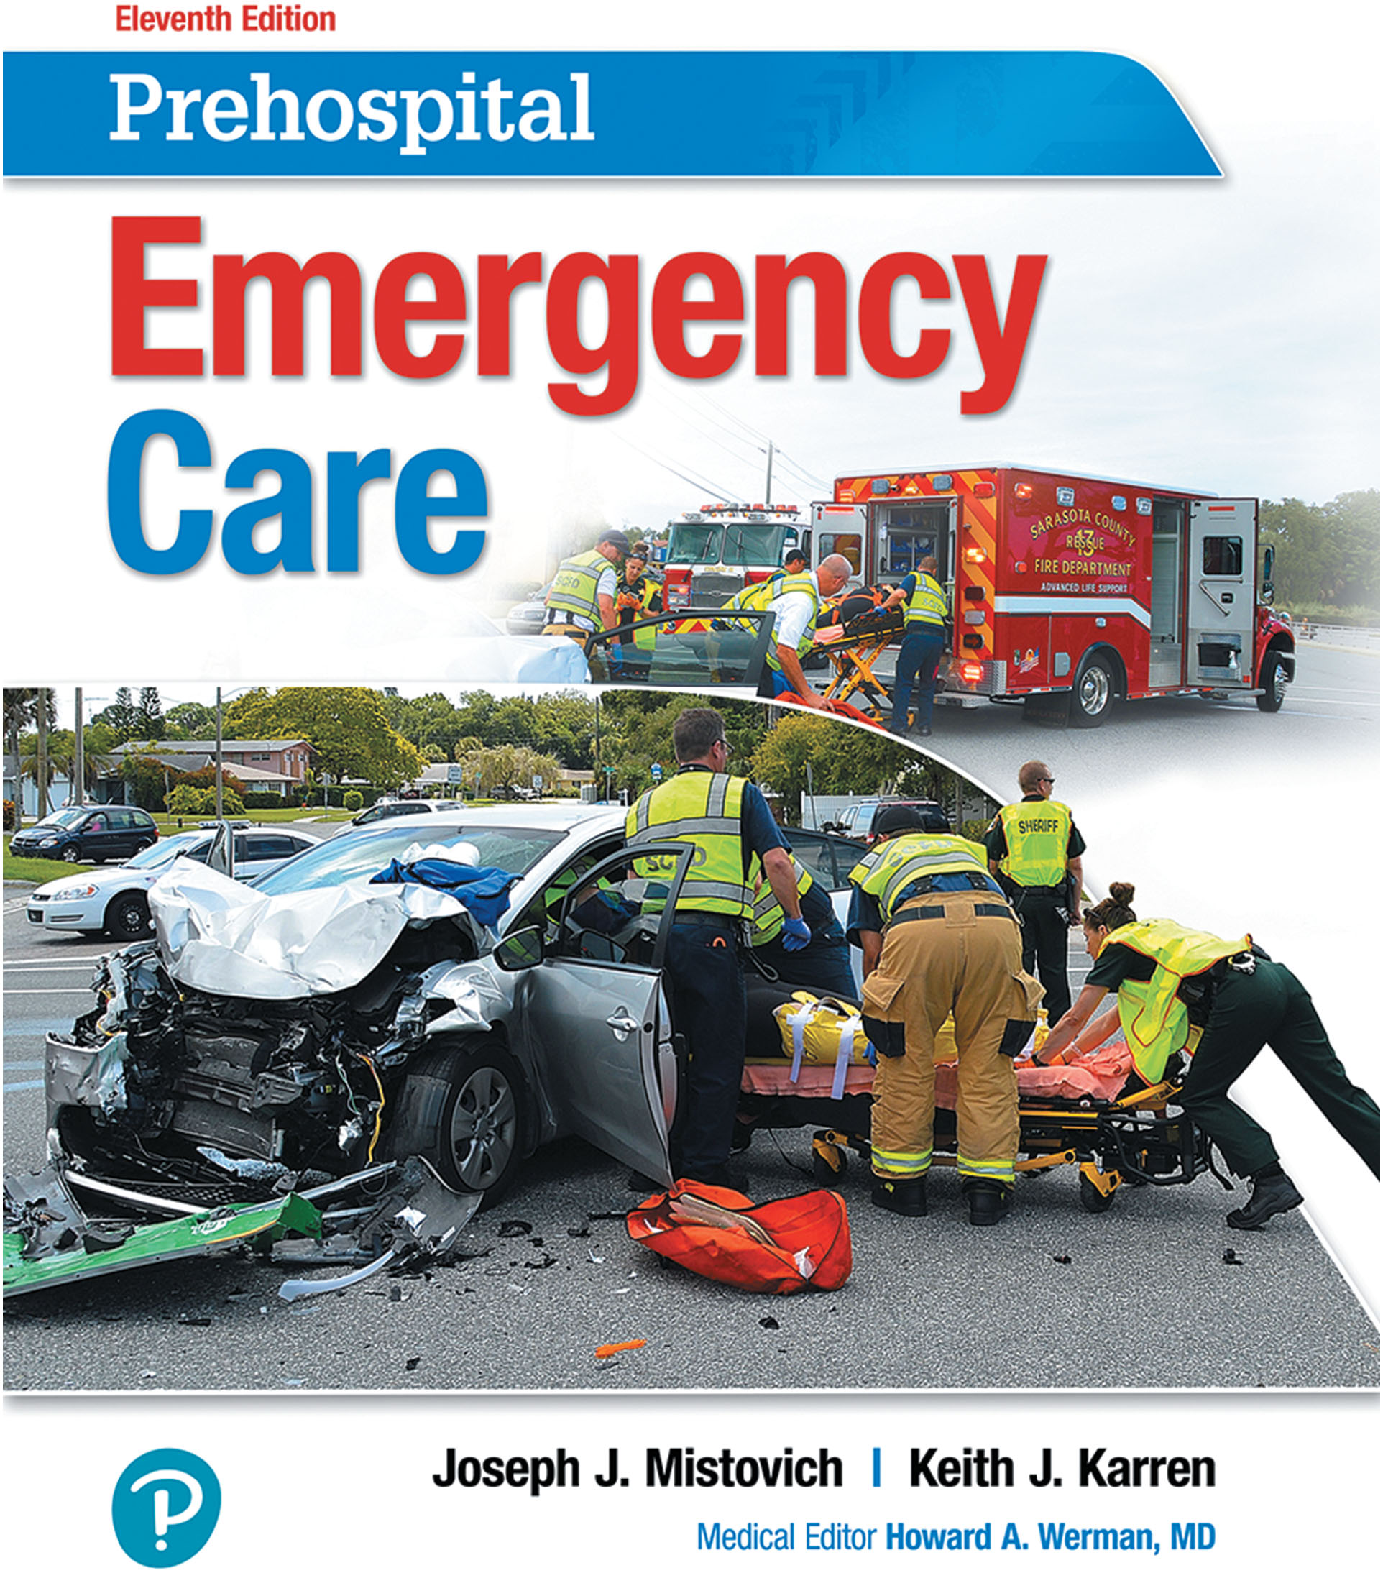
Prehospital: Emergency Care
Eleventh Edition
Chapter 26
Psychiatric Emergencies
Slides in this presentation contain hyperlinks. JAWS users should be able to get a list of links by using INSERT+F7
Copyright © 2018, 2014, 2010 Pearson Education, Inc. All Rights Reserved
Notes:
If this PowerPoint presentation contains mathematical equations, you may need to check that your computer has the following installed:
1) MathType Plugin
2) Math Player (free versions available)
3) NVDA Reader (free versions available)
Advance Preparation
Student Readiness
Assign the associated section of MyBRADYLab and review student scores. Review the chapter material in the Instructor Resources, which includes Student Handouts, PowerPoint slides, and the MyTest Program.
Prepare
Bring recent articles regarding behavioral emergencies from EMS or law enforcement to class for discussion.
Ask a physician from an ED to speak on patient care during a behavioral emergency.
Ask a member of law enforcement to speak on patient restraint and when to call for their assistance.
The total teaching time recommended is only a guideline. Take into consideration factors such as the pace at which students learn, the size of the class, breaks, and classroom activities. The actual time devoted to teaching objectives is the responsibility of the instructor.

Slide 2
Learning Readiness
E M S Education Standards, text p. 730.
Chapter Objectives, text p. 730.
Key Terms, text p. 730.
Purpose of lecture presentation versus textbook reading assignments.
Notes:
Explain to students what the National EMS Education Standards are. The National EMS Education Standards communicate the expectations of entry-level EMS providers. As EMTs, students will be expected to be competent in these areas. Acknowledge that the standards are broad, general statements. Although this lesson addresses the listed competencies, the competencies are often complex and require completion of more than one lesson to accomplish. The student is also expected to review the chapter objectives to foreshadow what will be in the chapter. By mastering the key terms the EMT student will better understand the learning and be able to communicate more clearly.
Additionally, explain to the students that the purpose of using these slides is to help keep the instructor focused on highlighting important portions of the material, explain interrelationships of topics, and discuss how to apply this information. It’s not the intent of the presentation (or slides alone) to include every component in the chapter. This presentation still requires the student to thoroughly read the chapter.

Slide 3
Setting the Stage
Overview of Lesson Topics
Psychiatric Problems and Emergencies
Dealing with Psychiatric Emergencies
Legal Considerations
Notes:
These bulleted points are the major headings from the chapter, in order. The purpose is to provide a basic lecture navigation for the student.

Slide 4
Case Study Introduction
E M T s Nancy Snyder and Colby Nixon respond to assist law enforcement with a person hallucinating. When they arrive, they find a 26-year-old man who is terrified, agitated, and screaming, “Help me! Get them off! Get these spiders off me!”
Notes:
Case Study
Present the Case Study Introduction provided in the PowerPoint slide set.
Lead a discussion using the case study questions provided on the subsequent slide(s).
The Case Study with discussion questions continues throughout the PowerPoint presentation.
Case Study Discussion
Use the case study content and questions to foreshadow the upcoming lesson content.

Slide 5
Case Study (1 of 3)
How should the E M T s approach this patient? What should they say?
What are some potential causes of the patient’s behavior?
Notes:
Use the case study content and questions to foreshadow the upcoming lesson content. Gauge the student’s responses as a guide of how well versed they are in this topic.

Slide 6
Introduction
You cannot always see a psychiatric issue.
The care you give patients with behavioral emergencies can save lives, just as the care you provide for physical problems does.
Your assessment is important for the continuing care of the patient.
Notes:
During this lesson, students will learn special considerations of assessment and emergency care for a patient who has attempted or is threatening suicide as well as for patients suffering other behavioral emergencies.

Slide 7
Psychiatric Problems and Emergencies (1 of 31)
A psychiatric disorder is an abnormal mental condition.
A psychiatric emergency is behavior that is unacceptable or intolerable to the patient or someone else.
Abnormal behavior.
Is a threat to themselves or others.
Shows a rapid change in cognition.
Notes:
A psychiatric disorder is defined as an abnormal mental condition that significantly impacts one’s thoughts, moods, perceptions, orientation, or memory and that impairs judgment, behavior, recognition of reality, or the ability to perform activities of daily living to care for oneself.
A psychiatric emergency is a situation in which patients present with behaviors that are abnormal, a threat to themselves or others, are incongruent with their baseline, or have shown a rapid change in cognition.
Discussion Questions
What are some causes of behavioral emergencies?
What are some particular things to pay attention to during your assessment of a patient with a behavioral emergency?

Slide 8
Psychiatric Problems and Emergencies (2 of 31)
Behavioral Changes: Psychiatric or Physical?
Behavioral change has many causes.
Always consider that an apparent behavioral problem may have a physical cause.
Notes:
Common specific reasons why behavior can change:
Low blood sugar in a diabetic, which can cause delirium, confusion, and even hallucinations
Hypoxia (lack of oxygen)
Inadequate blood flow to the brain
Head trauma
Mind-altering substances, such as alcohol, depressants, stimulants, psychedelics, and narcotics
Psychogenic substances, which can cause psychotic thinking, depression, or panic
Excessive cold or heat
Infections of the brain or its coverings
Seizure disorder
Toxic ingestion or overdose
Drug or alcohol withdrawal

Slide 9
Psychiatric Problems and Emergencies (3 of 31)
Table 26-1 Medical Conditions That Commonly Produce Psychiatric Symptoms
Mend a Mind
Metabolic: Electrolytes, Cushing’s disease . . .
Electrical: Epilepsy, temporal lobe seizures . . .
Nutritional: Thiamine/folate deficiency, anemia . . .
Drugs/toxins: Street and/or medical drugs, lead . . .
Arterial: Stroke, T I A
Notes:
A mnemonic that can be used to remember medical conditions that commonly produce psychiatric symptoms is MEND A MIND.

Slide 10
Psychiatric Problems and Emergencies (4 of 31)
Mechanical: Brain injury, subdural/epidural hematoma
Infection: H I V, syphilis, meningitis, hepatitis C
Neoplastic: Primary or metastatic tumor
Degenerative: Alzheimer’s disease, Parkinson’s disease, Creutzfeldt-Jakob disease, multiple sclerosis . . .
Source: The Psychiatric E R Survival Guide; James L. Knoll, IV, M.D.
Notes:
A mnemonic that can be used to remember medical conditions that commonly produce psychiatric symptoms is MEND A MIND.

Slide 11
Psychiatric Problems and Emergencies (5 of 31)
Behavioral Changes: Psychiatric or Physical?
Mental Status Exam
General appearance and demeanor
Grooming
Build
Behavior
Notes:
This is a version of a mental status exam, which will be useful during patient assessment to obtain specific information to help determine the type and severity of a potential psychiatric emergency.

Slide 12
Psychiatric Problems and Emergencies (6 of 31)
Behavioral Changes: Psychiatric or Physical?
Mental Status Exam
During the assessment, pay attention to the following speech issues:
Pattern
Slurring
Appropriateness of responses
Pressured speech
Notes:
Determine whether the responses are appropriate, inappropriate, or incomprehensible. An abnormality commonly observed in psychiatric emergencies is pressured speech, which is an increase in rapid, loud, and accelerated spontaneous speech. Pressured speech is most often observed in patients who are in an active phase of mania, schizophrenia, or an organic brain disorder.

Slide 13
Psychiatric Problems and Emergencies (7 of 31)
Behavioral Changes: Psychiatric or Physical?
Mental Status Exam
Skin
Color, temperature, condition
Posture or gait
Look for unusual movements
Orientation
Person, place, and time
Notes:
Condition of the skin can provide some indication of the patient’s condition.

Slide 14
Psychiatric Problems and Emergencies (8 of 31)
Behavioral Changes: Psychiatric or Physical?
Mental Status Exam
Memory
Can the patient recall events?
Ability to think abstractly?
Awareness
Awareness of surroundings
Notes:
Does he show the ability to think abstractly or is his thinking more concrete? Concrete thinkers take things at face value, literally, and can’t conceive of alternative interpretations. Abstract thinkers, by contrast, can see more in depth and come up with meanings other than just a literal interpretation.

Slide 15
Psychiatric Problems and Emergencies (9 of 31)
Behavioral Changes: Psychiatric or Physical?
Mental Status Exam
Body language
Threatening gestures or expression?
Dystonia
Tardive dyskinesia
Notes:
Dystonia is a movement disorder that causes involuntary contractions of muscles resulting in twisting and repetitive movements that are sometimes painful. Tardive dyskinesia (TD) is another movement disorder that causes involuntary movements of the tongue, lips, face, trunk, and extremities. Patients who have been treated long term with dopaminergic antagonist medications such as Thorazine or Prolixin are prone to tardive dyskinesia.

Slide 16
Psychiatric Problems and Emergencies (10 of 31)
Behavioral Changes: Psychiatric or Physical?
Mental Status Exam
Perception and thought content
Organization of thoughts
Indications of hallucinations, delusions, phobias
Rapid shifts in topic
Repeated words
Notes:
Does he rapidly shift from one topic to the next or repeat words despite apparent efforts to make new responses?
Does the patient pause for a period before responding to a question?

Slide 17
Psychiatric Problems and Emergencies (11 of 31)
Behavioral Changes: Psychiatric or Physical?
Mental Status Exam
Mood and affect
Normal mood, anger, euphoria, or irritability
Restricted or flat affect
Rapid shifts in emotion
Notes:
Mood can be identified by paying attention to the patient’s affect. With a constricted affect, the patient shows a reduction in intensity of feeling tone. Flat affect, which is the absence in the amount of emotional tone or outward emotional reaction, is common in individuals who are depressed. Labile affect shows as rapid shifts in emotional expression and is most common in organic brain syndromes or intoxication.

Slide 18
Psychiatric Problems and Emergencies (12 of 31)
Behavioral Changes: Psychiatric or Physical?
Mental Status Exam
Judgment
Rational decision-making
Insight
Notes:
Is the patient making rational decisions?
Does he appear to lack insight into his behavior or current situation?

Slide 19
Psychiatric Problems and Emergencies (13 of 31)
Behavioral Changes: Psychiatric or Physical?
Clues to a Physical Cause
Indications that the cause is physical:
Sudden onset of symptoms
Memory loss or impairment
Pupillary changes
Excessive salivation
Incontinence
Unusual odors on the breath
Notes:
Most psychiatric problems develop gradually. You need to obtain the timeline and frequency of the symptoms. Age is also a factor. Individuals in their late 50s, for example, are less likely to present with a new developing psychiatric emergency, although, it can happen.
The patient has memory loss or impairment. In most psychiatric problems, the memory remains intact, and the patient is usually alert, being oriented to person, place, and time.
Hallucinations would indicate that the cause is mental rather than physical. Note if the hallucinations are visual or auditory. Visual hallucinations are defined as the perception of an object or event with the absence of a stimulus. Auditory hallucinations are defined as the perception of received sounds without auditory stimulus. In addition to auditory and visual hallucinations, there are also olfactory (smell) and gustatory (taste) hallucinations.

Slide 20
Psychiatric Problems and Emergencies (14 of 31)
Behavioral Changes: Psychiatric or Physical?
History and Physical Exam:
Can help determine whether the patient’s condition is psychiatric in nature.
A patient who experiences his first.
psychotic break might begin hallucinating or having delusions resulting from decompensation.
Notes:
A patient who experiences his first psychotic break might begin hallucinating or having delusions that were not provoked by any outside stimulus but rather are a result of mental decompensation. Also, if a patient has stopped taking his medications, he can experience a return of psychiatric symptoms from the medication discontinuation that are not necessarily related to any triggering event, medical illness, or trauma. This is also true for the patient that just began taking a new medication.

Slide 21
Psychiatric Problems and Emergencies (15 of 31)
Psychiatric Problems
Anxiety Disorders
Anxiety is a state of uneasiness about impending problems.
Characterized by agitation and restlessness.
A panic attack is a discrete period of intense fear or discomfort.
A phobia is an irrational fear triggered by a specific object or event.
Notes:
Anxiety is a state of painful uneasiness about impending problems and, most often, things that are out of one’s control. It is characterized by agitation and restlessness and is one of the most common emotions.
Panic attacks often have a sudden onset that rapidly builds to a peak usually lasting 10 minutes or less. The body becomes flooded with epinephrine (adrenaline) in the same way as the common “fight or flight” response.
Agoraphobia is anxiety about being in places or situations from which escape would be difficult or help might not be available. Just the thought of leaving the home can cause impending fear and often causes individuals to avoid specific social situations.
Knowledge Application
Given several descriptions of characteristics of common psychiatric disorders, students should be able to categorize the disorders.
Discussion Questions
What are the most common types of psychiatric disorders?
What is schizophrenia?

Slide 22
Psychiatric Problems and Emergencies (16 of 31)
Psychiatric Problems
Bipolar disorder
Changes in mood from very high to very low
Manic phase involves abnormally elevated, expansive, or irritable mood.
Elevated mood alternates with periods of normal or depressed mood.
Notes:
To meet criteria for a bipolar disorder, an individual must have experienced both a manic or hypomanic episode and a major depressive episode. Mania, also referred to as a manic state, is a period of abnormally elevated, expansive, or irritable mood that lasts for at least 1 week. When mania occurs, a patient is at increased peril of engaging in dangerous or risk-taking behavior.
In either the manic or the depressive stage, the patient with bipolar disorder can suffer delusions or hallucinations. Sometimes, one phase can last for months; at other times, the patient can swing from one mood to another quickly.

Slide 23
Psychiatric Problems and Emergencies (17 of 31)
Psychiatric Problems
Depression
Feelings of sadness, worthlessness, discouragement
A factor in suicides
Flat affect, withdrawal, crying
Changes in appetite or sleeping
Feelings of guilt and indecision
Notes:
Depression is one of the most common psychiatric conditions. Depression is the leading cause of disability in the United States for ages 15 to 44. It is estimated that 16 million adults had at least one major depressive episode in the year 2012 alone.
Do not just assume an individual is good to go because he has no predetermined risk factors or obvious triggers for a depressive
Depression in an elderly patient is a serious condition which may lead to suicide and in which the patient must receive medical attention.

Slide 24
Psychiatric Problems and Emergencies (18 of 31)
Psychiatric Problems
Neurocognitive Disorders
Replaces the term dementia.
Agitated delirium is a neurocognitive disorder and physiological response.
Can be associated with drug use.
The patient can suffer a sudden cardiac arrest.
The patient is typically violent and a potential danger to you and others.
Notes:
Agitated delirium is characterized by:
Unusual strength and endurance
Tolerance of pain
Agitation
Hostility
Frenzied and bizarre behavior
Hot and diaphoretic skin
Unusual speech

Slide 25
Psychiatric Problems and Emergencies (19 of 31)
Psychiatric Problems
Schizophrenia Spectrum and Other Psychotic Disorders
Schizophrenia
Chronic mental illness
Distortions of speech and thought
Delusions, hallucinations, social withdrawal, catatonic behavior, lack of emotional expressiveness
Notes:
Schizophrenia spectrum and other psychotic disorders are those in which mental function is so impaired that contact with reality is lost. Patients with this illness suffer debilitating distortions of speech and thought, bizarre delusions, hallucinations, social withdrawal, catatonic behavior, and lack of emotional expressiveness.

Slide 26
Psychiatric Problems and Emergencies (20 of 31)
Psychiatric Problems
Schizophrenia Spectrum and Other Psychotic Disorders
Paranoia
Exaggerated or unwarranted mistrust and suspicion.
Delusions of persecution.
May be aloof, hypersensitive, argumentative.
Behavior can be unpredictable and aggressive.
Notes:
Persons with persecutory delusions tend to brood over real or imagined injustices, carry grudges, and recall wrongs done to them years earlier. Because of their mistrust and suspiciousness of others, they often present as detached, aloof, antagonistic, hypersensitive, defensive, and argumentative.

Slide 27
Psychiatric Problems and Emergencies (21 of 31)
Psychiatric Problems
Schizophrenia Spectrum and Other Psychotic Disorders
Psychosis
The patient is out of touch with reality.
The patient lives within his own reality.
Can manifest through delusions, hallucinations, disorganized speech or behaviors, and loose associations
Notes:
Acute psychosis can result from mind-altering drugs, which is the most common cause, or from intense stress, delusional disorders, or schizophrenia, which is another common cause. The psychosis can last for only a short period of time or occur as a chronic condition. If a patient presents in a psychotic state, do not discount what he tells you but rather question it as if you are interested.
There is no easy way to differentiate primary from secondary psychosis, specifically for EMS. Primary psychosis is a true mental disorder; secondary psychosis is a temporary condition resulting from another traumatic or medical cause.

Slide 28
Psychiatric Problems and Emergencies (22 of 31)
Psychiatric Problems
Substance Use and Addictive Disorders
An individual’s use of drugs and alcohol results in clinically significant impairment and distress.
Common substances of abuse include alcohol, caffeine, cannabis, hallucinogens, inhalants, opioids, sedatives, hypnotics, anxiolytics, stimulants, and tobacco.
Notes:
Individuals with mental health issues often use drugs and alcohol as a means of coping with their symptoms. Therefore, each patient who presents exhibiting psychiatric symptoms should also be screened for drugs and alcohol, as psychiatric symptoms and symptoms of substance use or abuse can closely mimic each other.
When individuals are under the influence of drugs or alcohol, they have an altered mental status making them incompetent to make sound decisions regarding their treatment and care.

Slide 29
Psychiatric Problems and Emergencies (23 of 31)
Psychiatric Problems
Trauma- and Stressor-Related Disorders
A trauma is defined as a deeply distressing or disturbing experience.
Anyone has the potential to experience trauma, including E M T s.
Trauma that is not dealt with appropriately has the potential to develop to P T S D.
Notes:
Trauma- and stressor-related disorders is a category that encompasses a wide range of diagnoses you might encounter. One to specifically focus on is posttraumatic stress disorder (PTSD).
The concept of PTSD is often associated with combat veterans. Combat veterans are susceptible to developing PTSD from their exposure and experiences in combat or even in noncombat service.
If you are on scene following a reported rape or even with a patient who was sexually abused as a child, a contraindication would be touch. In these circumstances, when needing to provide hands-on care, extensive verbal explanations and asking of permission are necessary to prevent the retriggering of traumatic experiences.

Slide 30
Psychiatric Problems and Emergencies (24 of 31)
Psychiatric Problems
Extrapyramidal Symptoms
Caused by dopamine blockade or depletion in the brain.
The motor system causes involuntary muscle movement.
Symptoms often develop as the result of taking certain psychiatric medications.
There are several medication induced movement disorders.
Notes:
Medication induced movement disorders:
Neuroleptic malignant syndrome - A severe, potentially life-threatening reaction as associated with antipsychotics or other dopamine antagonist use. Neuroleptic malignant syndrome typically presents within 72 hours of exposure to a dopamine antagonist but can also be up to 1 week. Symptoms include extreme elevation in temperature, diaphoresis, muscle rigidity, altered mental status, blood pressure elevation or fluctuation, urinary incontinence, and tachypnea. A few differential diagnoses for neuroleptic malignant syndrome include certain inflammatory or autoimmune disorders, status epilepticus, subcortical structural lesions, and central nervous system infections (American Psychiatric Association, 2013).
Medication-induced acute dystonia – Typically develops within a few days of raising the dosage of or starting a medication used to treat extrapyramidal symptoms, such as a neuroleptic medication. Symptoms include abnormal and prolonged contraction of the eyes, head, neck, limbs, or trunk.
Medication-induced acute akathisia – Subjective complaints of restlessness, fidgety movements, rocking, pacing, or inability to sit or stand still. Symptoms typically occur within a few weeks of initiating, increasing, or decreasing the dose of an extrapyramidal targeting medication.
Tardive dyskinesia - Involuntary movements of the tongue, jaw, trunk, or extremities. Symptoms include choreiform movements (rapid, jerky, nonrepetitive), athetoid movements (slow, sinuous, continual), and rhythmic movements (stereotypes). Symptoms typically last a few weeks in relation to a neuroleptic medication that had been used for at least a few months; although, symptoms can develop more quickly in the elderly population.
Neuroleptic withdrawal-emergent dyskinesia - Mimics tardive dyskinesia but results from discontinuation or reduction in dosage of a neuroleptic medication.
Medication-induced postural tremor - Fine postural tremor associated with use of a medication such as lithium, antidepressant, or valproic acid with a presentation similar to a tremor from anxiety and stimulants. The tremor presents with regular, rhythmic movements of the mouth, tongue, head, and limbs with a frequency between 8 to 12 cycles per second.
Antidepressant discontinuation syndrome – Can develop after abrupt cessation or reduction of an antidepressant taken for at least 1 month and often begins within 2–4 days. Symptoms include flashes of light, electric shock sensations, nausea, hypersensitivity to noise/lights, anxiety, and feelings of dread. The symptoms could not have been present prior to discontinuation or reduction of antidepressant dose to meet criteria for antidepressant discontinuation syndrome.
Serotonin syndrome - Serotonin syndrome develops as the result of high levels of serotonin in the body often from starting new SSRI medication or increasing the dosage. Serotonin syndrome can be caused by illicit drug use. Serotonin syndrome can occur from just an SSRI/SNRIs medication or when combining these with a migraine medication, and it can be fatal if not treated. Symptoms: agitation or restlessness, confusion, rapid heart rate and high blood pressure, dilated pupils, loss of muscle coordination or twitching muscles, muscle rigidity, heavy sweating, diarrhea, headache, shivering, and goose bumps. Serious side effects: high fever, seizures, irregular heartbeat, and unconsciousness.

Slide 31
Psychiatric Problems and Emergencies (25 of 31)
Violence
Suicide- any willful act designed to end one’s own life.
At least half of all people who commit suicide attempted it previously.
There are risk factors and potential signs of impending suicide.
Document statements by suicide-attempt patients, suicide notes, and any other evidence of suicide attempts at the scene.
Notes:
Patients sometimes express their inability to handle the pressures they feel through violent acts.
Risk factors and potential signs of impending suicide:
History of a mental illness such as depression, bipolar disorder, or schizophrenia
Previous suicidal gestures or attempts (eighty percent who are successful have made previous attempts)
Family history of successful suicide
History of physical, emotional, or sexual abuse
Feelings of hopelessness and “like there is no way out”
Unwillingness to seek mental health care because of the stigma attached to suicidal thoughts
Feeling of being isolated from others
Local epidemic of suicide
A history of impulsive or aggressive behavior
Inability to access mental health care
A recent diagnosis of serious illness, especially an illness that signals a loss of independence
The recent loss of a loved one, the loss of a job or money, or a social loss
Recent change in psychiatric medication
Living in a chaotic environment
Alcohol or drug abuse
Divorced or widowed (five times more likely to commit suicide)
Person who gives away personal belongings and cherished possessions
Homosexuality (higher incidence of depression, HIV infection, alcoholism)
Major physical stress such as surgery and long periods of sleep deprivation
Chronic pain
Suicide of same-sex partner
Expression of a clear plan for committing suicide
Availability of the mechanism to carry out the suicide, especially access to firearms
Discussion Question
What are some risk factors for suicide?

Slide 32
Psychiatric Problems and Emergencies (26 of 31)
Violence
Violence to Others
Early signs that a person has lost control and may become violent:
Nervous pacing
Shouting
Threatening
Cursing
Throwing objects
Clenched teeth and/or fists
Notes:
The angry, violent patient might be ready to fight with anyone who approaches and will probably be difficult to control.
Discussion Question
What are indications that a patient may become violent?
Critical Thinking Discussion
What do you think the experience of a patient with a mental illness is like?

Slide 33
Psychiatric Problems and Emergencies (27 of 31)
Mini Assessment for Common Psychiatric Emergencies
The mental status exam can provide you with an indication that you may be dealing with a psychiatric emergency.
Your role is not to diagnose.
Look for imminent risk.
Assess first for anything that could be life-threatening.
Notes:
If you can identify through your assessment what you believe to be a specific condition, you are more apt to provide the appropriate care for the patient. The mental status exam provides indicators that something might not be right with the patient.

Slide 34
Psychiatric Problems and Emergencies (28 of 31)
Mini Assessment for Common Psychiatric Emergencies
Suicidal Ideation
Be straightforward and direct.
Identify if there is a plan, a means to the plan, and/or intent.
Question the patient.
Notes:
Ask the following questions:
Are you having thoughts about killing yourself? (ideation)
Do you have a plan or have you been planning to end your life? If so, how would you do it? (plan)
Do you have the (drugs, gun, rope) that you would use? Where is it right now? (means)
How likely do you think you are to carry out your plan? What stops you from killing yourself? (intent)

Slide 35
Psychiatric Problems and Emergencies (29 of 31)
Mini Assessment for Common Psychiatric Emergencies
Homicidal Ideation
Assessing for homicidal ideation follows the same formula as for suicide ideation.
Be alert for early signs of potential violence to others while assessing.
Ask questions.
Notes:
Questions to ask:
Are you having thoughts to kill that person? (ideation)
Have you thought about how you plan to kill him? (plan)
Do you have access to (gun, knife) the weapon you want to use? (means)
How likely do you think you are to kill him? What stops you from acting on your thoughts to kill? (intent)

Slide 36
Psychiatric Problems and Emergencies (30 of 31)
Mini Assessment for Common Psychiatric Emergencies
The Need for Law Enforcement Involvement
Contact law enforcement in situations of suicide or homicide ideation.
Law enforcement can force a patient to be transported when necessary.
Application for Emergency Admission (Pink Slip).
Notes:
The pink slip usually can be signed only by specific medical or law enforcement professionals, such as medical doctors, psychologists, deputy sheriffs, police, and health officers. In general, this serves as a legal document under which a patient’s rights are taken away for 72 hours for him to be appropriately assessed until cleared by a medical doctor or transported to a psychiatric unit.
Being pink-slipped does not necessarily mean that the patient will be hospitalized for psychiatric care, but neither EMS personnel nor the police can complete a full psychiatric assessment, which is what is often done in the emergency department, to determine their future needs.

Slide 37
Psychiatric Problems and Emergencies (31 of 31)
Mini Assessment for Common Psychiatric Emergencies
The Need for Law Enforcement Involvement
There are some questions to ask to in situations such as these to help determine whether the patient might be a danger to himself or others and whether law enforcement should be called to the scene.
Notes:
Questions to ask to help determine whether the patient might be a danger to himself or others:
Psychosis
Are you hearing voices? Are the voices coming from inside your head or outside your head? Is it a male or female voice? Do the voices tell you to do things?
Can you see things that other people can’t see? Can you describe them to me?
Mania
Do you feel like your mind is racing and your body cannot keep up? Have you felt this way before? How long did it last?
When was the last time you slept?
Have you been doing impulsive things that you normally wouldn’t do?
Activities of Daily Living
When was the last time you slept? What is the longest you have gone without sleeping?
How have your appetite and eating been?
Have you been taking care of yourself? (showering/changing your clothes?)
Outpatient/Inpatient mental health treatment
Are you active with a counselor or psychiatrist? Have you ever seen one in the past?
Have you ever been hospitalized psychiatrically?
Do you take any psychiatric medications or have you taken any in the past?

Slide 38
Click on the Disorder that is Characterized by Sadness Feelings of Guilt and Worthlessness and Loss of Interest in Pleasurable Activities
A. Anxiety
B. Depression
C. Psychosis
D. Bipolar disorder

Slide 39
Dealing with Psychiatric Emergencies (1 of 20)
Basic Principles
Every person has limitations.
Each person has a right to their feelings.
Each person has more ability to cope than they might think.
Everyone feels some emotional disturbance when involved in a disaster or when injured.
Notes:
Every person at a psychiatric emergency, including you, is susceptible to emotional injury. Every person has a threshold, and some can cope more than others.
Persons who are experiencing an emotional or mental breakdown are often embarrassed about it, but at that time, those feelings are valid and real.
How individuals handle a crisis depends on their previous problem-solving experience, the way they view the problem, and the amount and kind of support or resources available to them. An individual who has experienced repetitive and prolonged trauma can have a decreased ability to handle crises as compared with someone who experiences a single incident trauma.
You do not know what a specific physical injury might mean to a given individual. A relatively minor hand injury might seem of little consequence, but it could ruin the career or the personal fulfillment of a person who works with his hands as a profession or a hobby.
Discussion Question
What are some useful techniques for communicating with the patient who has a behavioral emergency?
Teaching Tips
Use a mental health professional as a guest speaker for this content.

Slide 40
Dealing with Psychiatric Emergencies (2 of 20)
Basic Principles
Emotional injury is as real as physical injury.
People who have been through a crisis do not “just get better.”
Cultural differences have special meaning in behavioral emergencies.
Notes:
Because emotional injury is less visible, it is often treated as being less “real.” Mental health stigmas continue to keep patients from seeking the help that they need from fear of being regarded as different or inferior.
Do not expect instantaneous or automatic results; the patient probably will not realize the extent of the event until long after you leave. You are likely to be first on the scene, and your role is to provide a positive beginning to a long, difficult healing process. The goal is not to provide a solution but rather to focus on providing comfort and support to help the patient achieve a degree of emotional stabilization.
Come to terms with your own feelings as you approach a situation, and take the time to understand your patient.

Slide 41
Dealing with Psychiatric Emergencies (3 of 20)
Techniques for Treating Psychiatric Emergency Patients
Approach the patient slowly.
Engage in active listening.
Be supportive and empathetic.
Limit the interruptions in the interview.
Notes:
Use the following therapeutic interviewing techniques to establish a rapport:
Approach the patient slowly and with a purpose.
Engage in active listening.
Be supportive and empathetic.
Limit the interruptions in the interview and allow the patient to fully express himself.
Respect the patient’s space. (You never know what his triggers are.)
Limit physical touch until a rapport is established.
Avoid any action the patient might interpret as threatening.
Avoid any questions or statements the patient might construe as threatening.

Slide 42
Dealing with Psychiatric Emergencies (4 of 20)
Techniques for Treating Psychiatric Emergency Patients
Other techniques include:
Speak in a calm, reassuring voice
Maintain a comfortable distance
Seek the patient’s cooperation
Maintain good eye contact
Do not make any quick movements
Respond honestly to patient questions
Notes:
Speak in a calm, reassuring voice directly to the patient. Explain who you are and why you are there.
Maintain a comfortable distance between yourself and the patient. Many patients are threatened by physical contact. Unwanted touching could set off a violent response.
Encourage the patient to explain the problem. Never assume that you can’t communicate with a patient until you have tried, even if friends or family members insist it cannot be done. Typically, a patient in crisis is willing to return to his state before the crisis. When you give him the opportunity to tell his story in detail, you provide him a sense of control over his care.
The patient’s eyes can reveal emotions, telling you whether he is terrified, confused, struggling, or in pain. Furthermore, the eyes can telegraph intentions. If a patient is about to reach for a weapon or make a leap or a dash, his eyes can alert you. Eye contact also conveys your engagement with the patient.
Act quietly and slowly; let the patient see that you’re not going to make any sudden moves.
Make sure that statements are true, based on encouraging factors you actually observe. By approaching the patient through the perspective of his strengths, you can help guide him into identifying strengths within himself that he might have been unable to see, which can be helpful in guiding him to begin overcoming his issue.

Slide 43
Dealing with Psychiatric Emergencies (5 of 20)
Techniques for Treating Psychiatric Emergency Patients
Other techniques include:
Never threaten, or argue with the patient.
Never lie to the patient.
Do not “play along” with visual or auditory disturbances.
If possible involve trusted family members.
Be prepared to spend time at the scene.
Notes:
Behaviorally disturbed patients are adept at picking out your weaknesses; they can feel threatened themselves and might try to improve their situation by belittling you. Remain kind and calm and treat the patient with respect. Remember that the patient is ill, and comments are not directed at you personally.
Always tell the patient the truth.
Do not “play along” with visual or auditory disturbances. If the patient seems frightened by these disturbances, reassure him that these are temporary and that, with a combination of medication and other therapies, these symptoms can be stabilized or even completely removed. However, the patient in an active state of psychosis might not find his hallucinations and delusions frightening; rather they might be his reality. Some patients find comfort in their psychoses and fear a life without the familiar hallucinations or delusions.
When you can, involve trusted family members or friends. Some patients are calmed and reassured by the presence of these people, but others can be upset or embarrassed. Let the patient decide.
Be prepared to spend time at the scene. Don’t rush to the hospital unless a medical emergency dictates the need for life-saving care. Avoid panicking the patient.

Slide 44
Dealing with Psychiatric Emergencies (6 of 20)
Techniques for Treating Psychiatric Emergency Patients
Other techniques include:
Never leave the patient alone
Avoid the use of restraints
Don’t force the patient to make decisions
Get the patient to engage in motor activity
Disperse any crowd which gathered
Have a preplanned & clear route to an exit
Notes:
Remain kind and calm and treat the patient with respect. Remember that the patient is ill, and comments are not directed at you.
Never leave the patient alone. All psychiatric emergency patients are escape risks, and violence to self or others is a distinct possibility. After you respond to the emergency, the patient’s safety is one of your primary concerns. Even if the patient pleads to be left alone for just a few minutes, firmly explain that you realize he can handle things, but that you could get into trouble for leaving a patient alone. If the patient needs to go to the bathroom, first check the bathroom for potential weapons (e.g., razors, scissors). Leave the door ajar, but be discreet as you watch. Follow local protocol.
Avoid the use of restraint. Enlist the support of law enforcement or those trained in the use of restraint if you decide restraint is necessary.
Do not force the patient to make decisions. The patient has probably lost the ability to cope and make rational decisions. If necessary, “suggest” things that need to be done or even ask them what they believe they need to feel better.
Encourage the patient to participate in a motor activity, which helps reduce anxiety. For example, have the patient gather an extra set of clothing or his medication to take with him. Deep breathing exercises are also helpful in briefly managing anxiety.
If the patient has attracted a crowd, do what you can to disperse it. You need to deal with the patient on a one-to-one basis. If the scene is especially hectic, remove the patient from it or remove distressing stimuli from the scene before trying to calm the patient.
When entering the scene, determine the fastest and safest route of egress from the scene. If there is a family member or bystander blocking that route, politely ask that he move to another location in the room without identifying exactly why you want him to move.

Slide 45
Case Study (2 of 3)
Colby kneels down near the patient, who is sitting on the ground. “I’m Colby. I want to help you. Tell me what is going on.”
Meanwhile, Nancy learns from the patient’s friend that “he has a drinking problem,” but he has not been able to get alcohol for two to three days. “I think it’s the D T s,” the friend says. “I’ve seen it before. It looks like the D T s.”
Notes:
Review the case study findings presented.

Slide 46
Case Study (3 of 3)
What consideration should Colby and Nancy give to the information received from the patient’s friend?
What steps should the E M T s take in the assessment and management of this patient?
Notes:
Use the case study content and questions to foreshadow the upcoming lesson content. Gauge the student’s responses as a guide of how well versed they are in this topic.

Slide 47
Dealing with Psychiatric Emergencies (7 of 20)
Assessment-based approach
Scene size-up
Behavioral emergencies can be unpredictable and volatile.
Do not enter a dangerous situation without law enforcement support.
Be aware of dangers associated with a patient’s choice of mechanism for suicide.
Notes:
If you cannot guarantee your own safety, call the police and wait for them to arrive before you leave your vehicle.
Be alert if you are dispatched to the scene of a suicide or potential suicide that you do not fall victim to a mechanism that the patient planned to use to end his own life. Running an automobile in a closed garage, blowing out a pilot light and turning on all the burners on a gas stove, and using electrical devices in water are common suicide methods that can pose risks for EMTs. Another newer method of suicide that poses an extreme risk to the EMT is the use of a chemical suicide bag.
Discussion Question
What are some specific scene safety considerations on a behavioral emergency call?
What are the priorities of care in the management of patients with behavioral emergencies?
Critical Thinking Discussion
Why do so many people have trouble displaying empathy and respect toward patients with psychiatric illnesses?

Slide 48
Dealing with Psychiatric Emergencies (8 of 20)
Assessment-based approach
Scene size-up
Locate the patient before entering the scene.
Scan for objects that could be used as weapons.
Scan for items that could have been used in a suicide attempt.
Do not assume there is only one patient.
Notes:
If you can’t visually locate the patient, wait for police to enter and secure the scene. Always stay between the patient and an open door so that you can exit quickly should the scene deteriorate.
If the patient displays a weapon, never ignore or disregard it. Instead, in a calm and nonconfrontational way, tell the patient that you want to help but cannot do so until the weapon is released. Ask the patient to give you the weapon. If he does not, back out of the scene and call or wait for police response. Remember that any weapon can be used against the EMT. Stay outside the danger zone, for a knife, 22 feet; for a gun, much farther.
Do not automatically assume that there is just one patient. Sometimes, two or more persons make a suicide pact. Occasionally, a person tries a murder-suicide.

Slide 49
Visually Locate the Patient Before Approaching. Look for any Weapons
Notes:
If you can’t visually locate the patient, wait for police to enter and secure the scene. Always stay between the patient and an open door so that you can exit quickly should the scene deteriorate.

Slide 50
Dealing with Psychiatric Emergencies (9 of 20)
Assessment-based approach
Primary assessment
Formulate a general impression.
Assess the mental status.
Assess airway and breathing.
Control bleeding; assess for shock.
Notes:
If a patient has attempted suicide, caring for his trauma or medical problem rather than his behavioral problem is your priority. For a hanging attempt, for example, establish manual inline stabilization during the primary assessment, followed by complete immobilization. Proceed with assessment and care based on the mechanism of the suicide attempt.

Slide 51
Dealing with Psychiatric Emergencies (10 of 20)
Assessment-based approach
Secondary assessment
Obtain a history.
Be polite and respectful.
Respect the patient’s privacy.
Use active listening.
Use open-ended questions.
Notes:
In the patient who is alert and has no significant mechanism of injury, try to obtain a history first. Pay attention to medications the patient has taken; they can help you clarify if the situation is a psychiatric or medical emergency. Note carefully the events leading to the emergency to help clarify if a suicide attempt is involved.
Allow the patient to tell you what happened. If you can, interview the patient in a quiet room where he has privacy. A patient might be ashamed and hesitant to talk in front of family or friend.
Throughout the assessment attempt to evaluate:
Intellectual function
Orientation
Memory
Concentration
Judgment
Thought content (disordered, delusions, hallucinations, worries, fears)
Language (speech pattern, appropriate words, inappropriate words, incomprehensible)
Mood (anxiety, depression, elation, agitation, alertness, distractibility)

Slide 52
Dealing with Psychiatric Emergencies (11 of 20)
Assessment-based approach
Secondary assessment
Suicidal Patients:
When performing an assessment on a patient who has attempted or threatened suicide, keep additional guidelines in mind.
Notes:
Injuries or medical conditions related to the suicide attempt are your primary concern.
Listen carefully.
Accept all the patient’s complaints and feelings. Do not underestimate what the patient might be feeling and do not dismiss what you consider to be minor.
Do not trust “rapid recoveries.” Transport the patient even if he seems to be “better.”
Be specific in your actions. Do something tangible for the patient such as arranging for a member of the clergy to meet the patient at the hospital.
Never show disgust or horror when you care for the patient. Watch your body language; the patient is analyzing you, too…
Do not try to deny that the suicide attempt occurred. Your denial can be perceived as condemnation of the patient’s feelings.
Never try to shock a patient out of a suicidal act. Never try to argue the person out of it, and never challenge the patient to go ahead.

Slide 53
Dealing with Psychiatric Emergencies (12 of 20)
Assessment-based approach
Secondary assessment
For violent patients:
Take a history.
Look at the patient’s posture.
Listen to the patient.
Monitor the patient’s physical activity.
Be firm and clear.
Be prepared to use restraints, but only if necessary.
Notes:
Anticipate violence if the patient is standing or sitting in a way that threatens anyone (including himself), if the patient’s fists are clenched, or if the patient is holding anything that could be used as a weapon.
Anticipate violence if the patient is yelling, cursing, arguing, or verbally threatening to hurt himself or others.
Signs of potential violence include moving toward the caregiver, carrying a heavy or threatening object, using quick or irregular movements, and having muscle tension.
Give the patient instructions regarding his behavior. Clearly state the consequences of an aggressive behavior before such behavior occurs.

Slide 54
Dealing with Psychiatric Emergencies (13 of 20)
Assessment-based approach
Secondary assessment
Signs and Symptoms
Fear
Anxiety
Confusion
Behavioral changes
Anger
Mania
Depression
Notes:
Behavioral changes, such as radical alterations in lifestyle, values, or relationships
Anger that is inappropriate and directed at an inappropriate source; usually brief but intense and, often, destructive
Mania that is unrealistically optimistic and grandiose; pressured speech; prone to take unwarranted risks and display poor judgment
Depression that might involve crying, the inability to function, or feelings of worthlessness or hopelessness, and threats of suicide

Slide 55
Dealing with Psychiatric Emergencies (14 of 20)
Assessment-based approach
Secondary assessment
Signs and Symptoms
Withdrawal
Loss of contact with reality
Sleeplessness
Change in appetite
Loss of sex drive
Constipation
Crying
Notes:
Withdrawal or the loss of interest in people or things previously considered important
Loss of contact with reality, such as hallucinations and delusions that are auditory or visual
Tension and irritability

Slide 56
Dealing with Psychiatric Emergencies (15 of 20)
Assessment-based approach
Emergency Medical Care
Maintain your own safety.
Assess for trauma and medical conditions.
Calm the patient and stay with him
If needed to protect yourself, others, or the patient from harm, use restraints.
Transport to a facility where he can get needed care.
Notes:
Be alert to the possibility that the patient can become violent and do harm to you, others at the scene, or himself. Do not let yourself fall victim to the same mechanism of injury as the patient. Never allow a patient to come between you and an exit.
Assess the patient for trauma or a medical condition. Remember that what seems to be a psychiatric emergency can arise from trauma or a medical condition. When patients have attempted suicide, their medical treatment has priority.
Calm the patient, and stay with the patient. Follow the guidelines discussed earlier for communicating with a patient in a psychiatric emergency. Never leave a suicidal patient alone. Never turn your back or drop your guard with a violent or potentially violent patient.
If it’s necessary to protect yourself or others, or the patient from harming himself, use restraints. Never use restraints as a substitute for observation, and never use metal handcuffs if your local protocol does not authorize them and if you are not properly trained in their use. Use restraints only if emergency care would be dangerous or impossible without them. Enlist the aid of trained public safety personnel.
Transport the patient to a facility where he can get the physical and psychological treatment that is needed. If a patient attempted to commit suicide by drug or medication overdose, be sure to monitor airway, breathing, and circulation carefully and be prepared to assist ventilation. Bring any drugs or medications you find at the scene to the receiving facility with the patient.

Slide 57
Dealing with Psychiatric Emergencies (16 of 20)
Assessment-based approach
Emergency Medical Care
Reassessment
Reassess as warranted by the patient’s condition.
Continue to calm and reassure the patient.
Notes:
Monitor the patient’s airway, breathing, oxygenation, circulation, and mental status. Repeat vital signs assessment and check any interventions, such as the security of restraints.

Slide 58
Dealing with Psychiatric Emergencies (17 of 20)
Restraining a Patient
If you believe the patient is a danger to himself/others, contact law enforcement.
Use restraints only for a patient who is a danger to himself or others.
Seek medical direction and follow protocols.
Do not restrain a patient in a prone position.
Notes:
When a patient is placed in a prone position, the weight of the body places upward pressure on the abdomen and forces the abdominal organs to be displaced toward the diaphragm. The added compression prevents a normal downward movement of the diaphragm, leading to the inability of the patient to take in adequate breaths. This results in a decreased tidal volume and inadequate breathing. The inadequate breathing results in hypoxia and acidosis, which can cause further agitation and cardiac arrest.
With a patient in a prone position, it is impossible to adequately assess the airway and the ventilatory status. You cannot assess for chest rise and adequate tidal volume with the patient in a prone position.
For these reasons, it is necessary to restrain patients in a supine position. If increased upper extremity movement in supine restraint is a problem, take the supine patient’s arms over his head and restrain each wrist to the head of the stretcher. This will limit his ability to move. If vomiting or secretions are a concern, restrain the patient in a lateral position.
Restraints used with a patient should be humane restraints. This means that they are padded so that they will not injure a patient who struggles against them.

Slide 59
Dealing with Psychiatric Emergencies (18 of 20)
Restraining a Patient
Gather enough people to overpower the patient before you attempt restraint.
Plan your activities before you attempt restraint.
Use only as much force as needed for restraint.
Estimate the range of motion of the patient’s arms and legs.
Notes:
A patient who begins to “calm down” might be hypoxic from the efforts to fight against the restraints. Carefully and thoroughly assess the patient’s airway, ventilation, oxygenation, and circulation.

Slide 60
Dealing with Psychiatric Emergencies (19 of 20)
Restraining a Patient
After you have made the decision to restrain, act quickly.
One rescuer should talk to the patient throughout the restraining process.
Approach the patient with at least four rescuers at the same time.
Secure the patient with equipment approved by medical direction.
Notes:
One person should be assigned to each of the patient’s limbs. If the patient is taken down in a prone position to gain control, immediately get the patient into a supine position to allow for adequate ventilation and assessment.

Slide 61
Dealing with Psychiatric Emergencies (20 of 20)
Restraining a Patient
Secure the patient to the stretcher in a supine position with multiple straps.
If the patient is spitting on rescuers, cover his face with a disposable surgical mask. Reassess airway and breathing frequently.
After you have applied restraints, do not remove them.
Notes:
After you have applied restraints, do not remove them, not even during transport. It might be necessary to remove restraints to reposition the patient. This can be done by removing one restraint at a time and controlling the extremity until it is re-restrained to the stretcher. Reassess the patient’s circulation frequently to make sure the restraints are not binding.
Make sure you document on the prehospital care report why you felt it necessary to restrain the patient, and thoroughly document the technique you used for the restraint.

Slide 62
E M T Skills 26-1
Restraining the Combative Patient

Slide 63
If a Possibility of Danger Exists, the Patient should be Interviewed with another E M T Present
Identify yourselves and let the patient know what you expect.

Slide 64
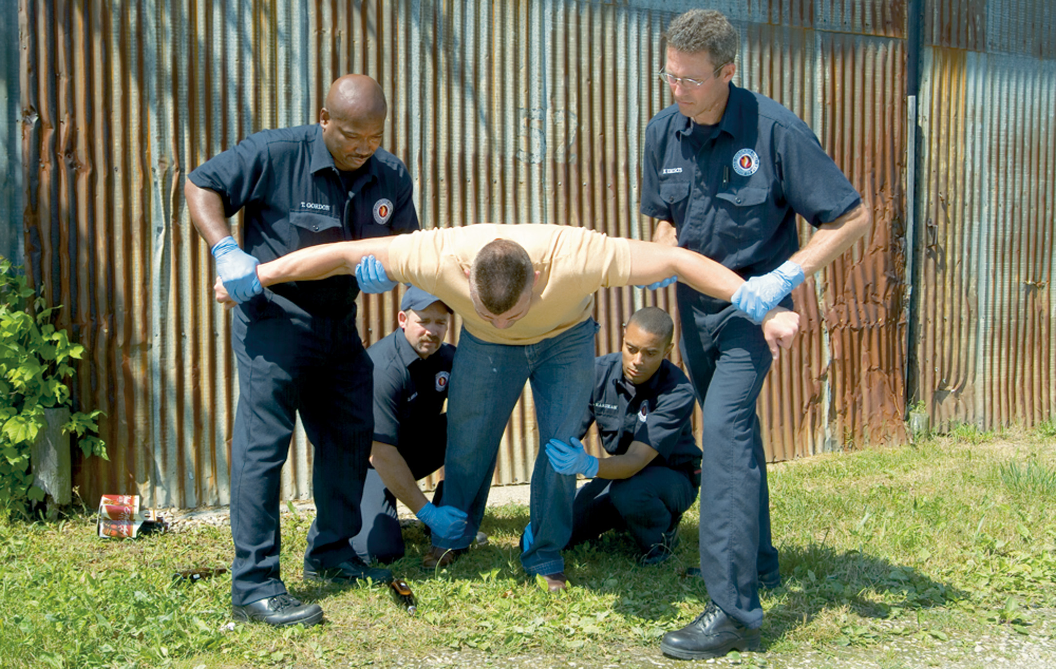
Never Try to Restrain a Patient Until You have Sufficient Help and an Appropriate Plan
If necessary, create a safe zone and wait for police. Follow local protocol.

Slide 65
Place the Patient Supine on the Ambulance Stretcher and Apply Ankle and Wrist Restraints
Never restrain the patient in a prone position.

Slide 66
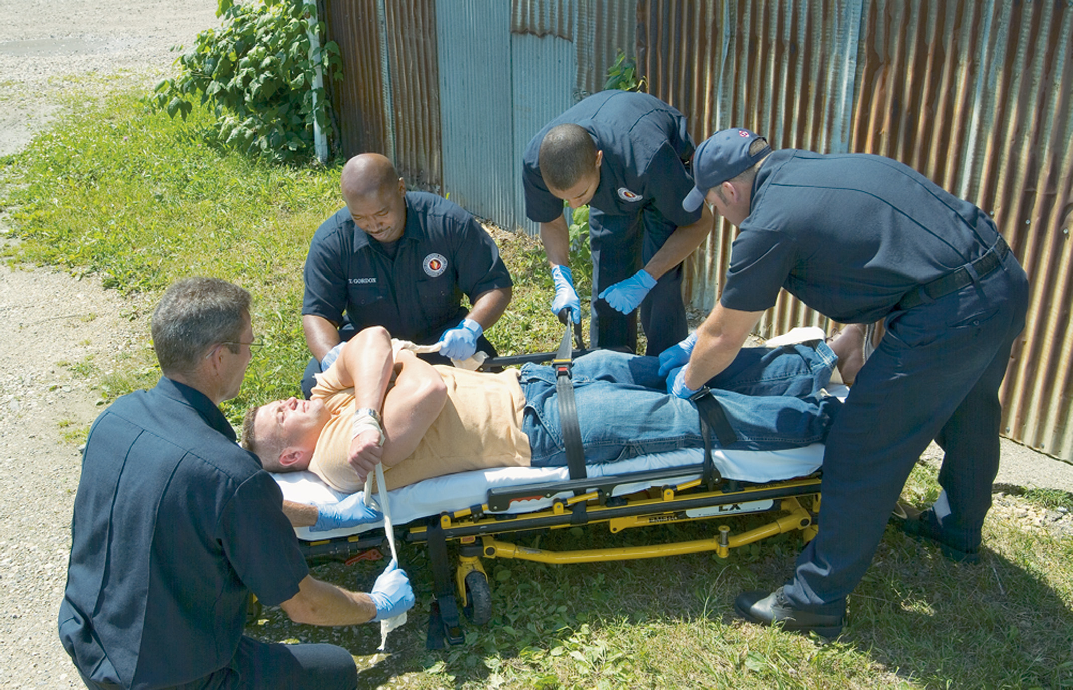
One Method is to Pull Arms across the Patient’s Chest and Tie on Opposite Sides of the Stretcher Frame

Slide 67
Legal Considerations (1 of 5)
Consent
Patients who are unresponsive or not competent to consent may be treated under implied consent.
Consent principles can be difficult to apply in the case of a patient suffering a psychiatric emergency.
Consult medical direction and carefully follow local protocols.
Notes:
Under most state laws, any adult of sound mind has the right to determine whether he will be treated or, more specifically, touched by another person during treatment.
In most states, anyone age 18 or over is considered an adult, and anyone under the age of 18 who is in the armed services or is married, pregnant, or a parent is also considered an adult (emancipated minor).
If you cannot find a responsible adult to consent to the treatment of a minor or of a patient without mental competence, or if an adult patient is unresponsive, you can still go ahead and treat. You will act in such cases on the principle of implied consent. This is the belief that the person who could grant consent would if he were present or able to do so.

Slide 68
Legal Considerations (2 of 5)
Refusal of Care
Competent patients can refuse care.
If a patient threatens to harm himself or others, you may be able to transport without consent.
Document the situation; use direct quotes.
Involve law enforcement.
Follow protocol.
Notes:
Your best protection against legal problems when dealing with emotionally disturbed patients is to document carefully and thoroughly all aspects of the encounter. If a patient refuses care who has the capacity to understand and make a reasoned decision, complete a refusal-of-care form (or a similar form used in your jurisdiction), and then have it signed and witnessed by a police officer.
If a patient threatens to hurt himself or others and you can demonstrate reason to believe that the patient’s threats are real, you can transport that patient without his consent. However, you must be able to show that your belief that the patient poses a threat is reasonable.

Slide 69
Legal Considerations (3 of 5)
Using Reasonable Force
The minimum amount of force required to keep the patient from injuring himself or others.
The amount of force depends on the situation.
Involve law enforcement and follow protocol.
Notes:
The amount of force deemed reasonable depends on the situation:
The size and strength of the patient.
The type of behavior exhibited by the patient.
The mental state of the patient.
The method of restraint. Soft restraints, commonly called humane restraints, and straps are generally considered reasonable; metal handcuffs are not. Do not use metal handcuffs unless you are specifically trained in their use. If the police apply handcuffs to the patient, ensure that a police officer accompanies the patient in the ambulance or drives directly behind the ambulance in case the handcuffs would need to be removed quickly.
Always be aware that a patient who has become calm following a period of combativeness and aggression can suddenly revert to the earlier behavior.

Slide 70
Legal Considerations (4 of 5)
Police and Medical Direction
Before you restrain any patient for any reason, seek medical direction.
Law enforcement personnel should be involved when you need to restrain a patient or transport without consent or if there is any threat of violence.
Law enforcement can help protect you from injury, and they can serve as credible witnesses if needed.
Notes:
In any case where you might need to use reasonable force or transport without consent, the best way to protect yourself legally is to involve your chain of command.

Slide 71
Legal Considerations (5 of 5)
False accusations
Document carefully and completely.
Document the patient’s behavior and statements.
Have witnesses, if possible.
Use providers that are the same gender as the patient.
Notes:
The best way to protect yourself against false accusations by a patient is to carefully and completely document everything that happens during the encounter, including detailed aspects of the patient’s abnormal behavior.
To protect against these kinds of charges, consider employing these measures:
Involve other medical responders who can testify that there was no misconduct.
Use medical responders that are the same gender as the patient.
Involve third-party witnesses.
Carefully document your physical assessment.

Slide 72
Case Study Conclusion (1 of 4)
Colby questions the patient about his perception that spiders are crawling on him. “I know you may see and feel spiders, but there aren’t any spiders on you,” she says. “What you are seeing is because of a medical problem.”
Notes:
Review case conclusion and emphasize the application of knowledge learned from this presentation.

Slide 73
Case Study Conclusion (2 of 4)
The patient is calmed a little by Colby’s reassurances, but still is agitated and disoriented. Colby performs a physical exam and obtains baseline vital signs and a blood glucose level before transport to the hospital. In the history, she is able to confirm that the patient is usually a heavy drinker, but that he has not had a drink for two days.
Notes:
Review case conclusion and emphasize the application of knowledge learned from this presentation.

Slide 74
Case Study Conclusion (3 of 4)
The patient denies a history of other medical problems, as well as taking any medications or other drugs. En route, he occasionally experiences hallucinations that he is covered in spiders.
Well aware of the potential for serious side effects from alcohol withdrawal, Colby reassesses the patient’s mental status and vital signs every 15 minutes.
Notes:
Review case conclusion and emphasize the application of knowledge learned from this presentation.

Slide 75
Case Study Conclusion (4 of 4)
At the hospital, the patient is diagnosed and treated for alcohol withdrawal. He is then admitted to an in-patient psychiatric facility for completion of an alcohol treatment program.
Notes:
Review case conclusion and emphasize the application of knowledge learned from this presentation.

Slide 76
Lesson Summary (1 of 2)
Psychiatric emergencies may result from a psychiatric disorder or from a medical or traumatic condition.
A psychiatric emergency can place E M T s at risk.
Notes:
A psychiatric emergency occurs when a person exhibits behavior that is a threat to himself/others, incongruent with his baseline, or shows a rapid change in cognition.
Your primary responsibility in managing a psychiatric emergency patient is to provide emergency care for any underlying medical conditions or injuries that might cause the disorder or that the patient might have inflicted on himself. Know and understand both the patient’s limitations and your own limitations.
Follow-Up
Answer student questions.
Follow-Up Assignments
Review Chapter 26 Summary.
Complete Chapter 26 In Review questions.
Complete Chapter 26 Critical Thinking questions.
Assessments
Handouts
Chapter 26 quiz

Slide 77
Lesson Summary (2 of 2)
Physical restrain is only used when the patient is a threat to himself or others.
Behavioral emergencies can involve legal issues of consent and refusal of consent.
Notes:
Class Activity
As an alternative to assigning the follow-up exercises in the lesson plan as homework, assign each question to a small group of students for in-class discussion.
Teaching Tips
Answers to In Review questions are in the appendix of the text. Advise students to review the questions again as they study the chapter.

Slide 78
Correct!
Depression is characterized by feelings of sadness, hopelessness, guilt, and worthlessness, as well as loss of interest in pleasurable activities. Patients also may have changes in appetite and sleep habits.
Click here to return to the program.

Slide 79
Incorrect (1 of 3)
Anxiety is a feeling of unease characterized by agitation and restlessness. Panic attacks are a type of anxiety disorder.
Click here to return to the quiz.

Slide 80
Incorrect (2 of 3)
Psychosis is a loss of contact with reality that can manifest through hallucinations, delusions, disorganized thoughts, and bizarre behavior.
Click here to return to the quiz.

Slide 81
Incorrect (3 of 3)
Patients with bipolar disorder experience alternating periods of mania, in which the mood is excessively elevated, and depression.
Click here to return to the quiz.

Slide 82
Copyright

