Slide 1
Prehospital: Emergency Care
Eleventh Edition
Chapter 25
Submersion Incidents: Drowning and Diving Emergencies
Slides in this presentation contain hyperlinks. JAWS users should be able to get a list of links by using INSERT+F7
Copyright © 2018, 2014, 2010 Pearson Education, Inc. All Rights Reserved
Notes:
If this PowerPoint presentation contains mathematical equations, you may need to check that your computer has the following installed:
1) MathType Plugin
2) Math Player (free versions available)
3) NVDA Reader (free versions available)
Advance Preparation
Student Readiness
Assign the associated section of MyBRADYLab and review student scores. Review the chapter material in the Instructor Resources, which includes Student Handouts, PowerPoint slides, and the MyTest Program.
Prepare
The total teaching time recommended is only a guideline. Take into consideration factors such as the pace at which students learn, the size of the class, breaks, and classroom activities. The actual time devoted to teaching objectives is the responsibility of the instructor.

Slide 2
Learning Readiness
E M S Education Standards, text p. 768
Chapter Objectives, text p. 768
Key Terms, text p. 768
Purpose of lecture presentation versus textbook reading assignments.
Notes:
Explain to students what the National EMS Education Standards are. The National EMS Education Standards communicate the expectations of entry-level EMS providers. As EMTs, students will be expected to be competent in these areas. Acknowledge that the standards are broad, general statements. Although this lesson addresses the listed competencies, the competencies are often complex and require completion of more than one lesson to accomplish. The student is also expected to review the chapter objectives to foreshadow what will be in the chapter. By mastering the key terms the EMT student will better understand the learning and be able to communicate more clearly.
Additionally, explain to the students that the purpose of using these slides is to help keep the instructor focused on highlighting important portions of the material, explain interrelationships of topics, and discuss how to apply this information. It’s not the intent of the presentation (or slides alone) to include every component in the chapter. This presentation still requires the student to thoroughly read the chapter.

Slide 3
Setting the Stage
Overview of Lesson Topics
Water-Related Emergencies
Scuba or Deep-Water Diving Emergencies
Notes:
These bulleted points are the major headings from the chapter, in order. The purpose is to provide a basic lecture navigation for the student.

Slide 4
Case Study Introduction
E M T s Jacob Stilts and Lydia Huse are responding to a report of a child drown in a backyard pool. When they arrive, they see a woman performing C P R on a toddler. The initial report from family members is that the child was not seen for five to ten minutes before being discovered on the bottom of the pool. The patient was pulled from the pool by a family member, who immediately began C P R.
Notes:
Case Study
Present the Case Study Introduction provided in the PowerPoint slide set.
Lead a discussion using the case study questions provided on the subsequent slide(s).
The Case Study with discussion questions continues throughout the PowerPoint presentation.
Case Study Discussion
Use the case study content and questions to foreshadow the upcoming lesson content.

Slide 5
Case Study (1 of 3)
What are some ways in which this incident could have been prevented?
What factors will influence the patient's chances of survival?
Notes:
Use the case study content and questions to foreshadow the upcoming lesson content. Gauge the student’s responses as a guide of how well versed they are in this topic.

Slide 6
Introduction
Patients in such incidents need emergency medical care as rapidly as possible. However, the circumstances in which they received the injuries can expose medical personnel to the risk of injury.
Caring for these patients require not only emergency medical skills but also the ability to recognize and avoid or reduce potential hazards at the scene.
Notes:
During this lesson, students will learn special considerations of assessment and care for patient in water-related emergencies.

Slide 7
Water-Related Emergencies (1 of 28)
Prevention measures
P F D s could prevent many drowning deaths.
All pools should be fenced.
Constantly supervise children who are in the area of any body of water or large container of water.
Do not use alcohol when engaged in water activities.
Notes:
An adult can drown in just a few inches of water, and infants often drown in five-gallon buckets; others drown in bathtubs and toilets.
Commonsense precautions include the following:
All pools should be fenced.
Children should be under constant supervision if they are near a lake, pool, pond, or container of water of any significant size.
Water activities and alcohol do not mix.
Life preservers or PEDs (life jackets) must always be worn when boating.
Avoid diving into shallow or unexplored bodies of water.
Those with seizure disorders must be especially careful when in or around bodies of water.
Teaching Tips
Describe local bodies of water where drowning is a public health concern.
Discussion Question
Why are adolescent males more prone to water-related emergencies?
Class Activity
Assign a type of body of water (river, home swimming pool, public swimming pool, and so on) to each of several groups of students. Ask each group to come up with a drowning prevention plan.

Slide 8
Water-Related Emergencies (2 of 28)
Definitions
Drowning is an incident in which someone is submerged or immersed in a liquid that results in a primary respiratory impairment.
The liquid prevents the patient from breathing air.
The patient may live or may die from the event.
Notes:
Regardless of the outcome, it is termed a drowning. Many sources, however, continue to refer to the patient who survives the submersion event as a near-drowning.

Slide 9
Water-Related Emergencies (3 of 28)
Incidence of Drowning
In children <1 year of age, the bathtub is the most common drowning location.
40percent of deaths are of children younger than 5 years old.
The second-highest incidence is among teenagers.
85percent of drownings are in males.
Alcohol is frequently involved.
Notes:
In the adult patient, consider the following conditions that may have led to the submersion:
Hypoglycemia
Myocardial infarction (heart attack) from exertion
Cardiac dysrhythmia
Syncope
Seizure
Depression or a suicide attempt
Anxiety or a panic disorder
Arthritis, Parkinson’s disease, or another neuromuscular disorder that leads to poor body control
Exhaustion
Hypothermia
Alcohol or drug use
Trauma (especially head or spinal)

Slide 10
Water-Related Emergencies (4 of 28)
Water sports pose a risk of drowning and of head and spinal trauma.
Scuba accidents may involve exertion, inexperience panic, and poor judgment.
Notes:
Water sports also pose a hazard of submersion and drowning.
The use of alcohol and drugs can impair judgment and lead to boating and other water-related accidents.
Water skiing, jet skiing, and surfing can cause head or spinal trauma leading to submersion and drowning.
Scuba diving accidents from exertion, inexperience, panic, and poor judgment can also cause a drowning.

Slide 11
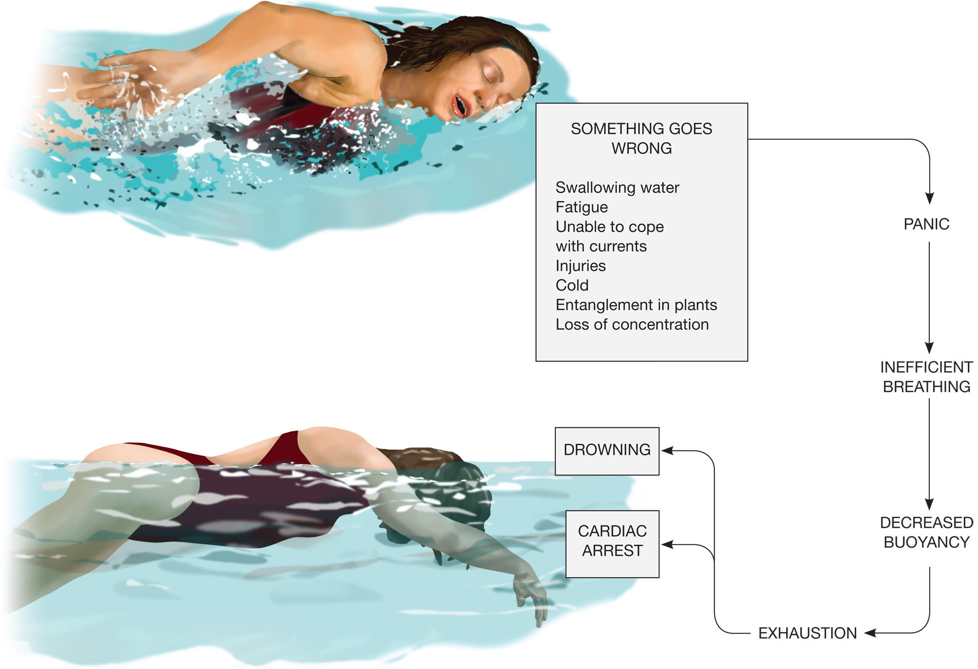
Panic can Often Contribute to the Death of the Person Who Loses Self-Control

Slide 12
Water-Related Emergencies (5 of 28)
Prognostic Predictors
Chances of survival are greatest in patients with two or fewer of these characteristics:
Age 3 years or older
Submerged >5 minutes
Resuscitation delayed >10 minutes after rescue
Comatose on arrival at the E D
Arterial blood p H <7.10
Notes:
Quick rescue of the submerged patient from the water and early resuscitation are the most critical factors associated with better outcomes. No single individual characteristic has been found to predict survivability.
Moderate body core hypothermia associated with submersion can provide a protective mechanism that reduces brain and other organ damage in children. However, most people do not become hypothermic quickly enough.
Critical Thinking Discussion
If you were to design a research project on improving survival from drowning, how would you go about it?

Slide 13
Water-Related Emergencies (6 of 28)
Pathophysiology of Drowning
Submersion results in aspiration of water or laryngeal spasms, leading to suffocation.
Hypoxia and acidosis lead to brain damage and death.
Notes:
As the person is submerged in water, he attempts to breathe, and either he aspirates water or his larynx spasms and causes him to suffocate. The most significant consequence of a drowning is the lack of ventilation while submerged, which leads to severe and prolonged hypoxia and the accumulation of carbon dioxide in the blood, which can lead to severe acid buildup within the body.
In dry drowning, laryngeal spasm prevents water from entering the lungs. When water does enter the lungs, the amount is small, and it is usually absorbed into the bloodstream.
The factor that has the greatest impact on the patient’s prognosis is the duration of the submersion and the consequent severity of the hypoxia.
Discussion Question
Is a patient's outcome affected by whether it is a dry or wet drowning?
Critical Thinking Discussion
How does surfactant work to keep the lungs open?

Slide 14
Water-Related Emergencies (7 of 28)
Pathophysiology of Drowning
Surfactant maintains surface tension in the alveoli to keep them from collapsing.
Water in the lungs washes out the surfactant.
When surfactant is washed out, the alveoli collapse.
Acute respiratory distress syndrome (A R D S) results.
Notes:
If surfactant is washed out, the alveoli tend to collapse (a condition called atelectasis). The damage to alveolar-capillary structures creates ventilation problems by decreasing functional lung volume and allowing fluid to leak around and into the alveoli, which creates pulmonary edema. The alveolar-capillary damage also interferes with gas exchange, impairing oxygenation of the blood and off-loading of carbon dioxide from the blood.
The patient who is breathing spontaneously but has signs or symptoms of respiratory distress or hypoxia can benefit dramatically from continuous positive airway pressure (CPAP) application. If CPAP is not available, consider early positive pressure ventilation with a bag-valve-mask device.

Slide 15
Water-Related Emergencies (8 of 28)
Pathophysiology of Drowning
Maximize oxygen delivery.
Hypothermia results from submersion in cold water, and may play a protective role.
Complications of hypothermia include hypovolemia from increased capillary permeability, and cardiac dysrhythmias.
Notes:
Maximize the oxygen delivered to the patient by applying a nonrebreather mask at 15 lpm in the patient who has an adequate respiratory rate and tidal volume. If positive pressure ventilation is performed, be sure to connect oxygen to the ventilation device and deliver the highest possible concentration.
Primary hypothermia can provide a role in protecting tissues against hypoxia. In other submersion patients, a secondary hypothermia can occur from heat loss through evaporation after the patient is removed from the water and resuscitation is attempted. Secondary hypothermia plays no role in protecting the patient against hypoxia and can cause further detrimental effects on patient outcome.
Hypovolemia can occur during and after the initial resuscitation period from an increase in capillary permeability (capillaries becoming leaky), producing hypotension (low blood pressure). This can become especially evident when the patient’s body begins to rewarm, causing the vessels to dilate.
Dysrhythmias result from hypothermia and cardiac hypoxia as well as from an increased amount of acid or a disturbance in the balance of electrolytes in the blood.

Slide 16
Water-Related Emergencies (9 of 28)
Pathophysiology of Drowning
Factors that influence the seriousness of drowning:
Persistent cough
Dyspnea or apnea
Altered mental status during submersion
Vomiting
Drug or alcohol use
Notes:
Important signs, symptoms, or factors to consider can determine the seriousness of a drowning event.

Slide 17
Water-Related Emergencies (10 of 28)
Pathophysiology of Drowning
Factors that influence the seriousness of drowning:
History of seizures, diabetes, or neuromuscular disorder
Hypothermia
Duration of cardiac or respiratory arrest
Age of the patient
Pre-existing diseases or conditions
Notes:
Pertinent past medical history includes seizures, diabetes mellitus, and neuromuscular disorders.

Slide 18
Water-Related Emergencies (11 of 28)
Diving emergencies
Usually occur in pools or other shallow water.
Head and spine injuries may occurs, as well as fractures of the extremities or ribs.
Assume neck and spine injuries in diving emergencies.
Notes:
Patients who dive into water from a diving board, shore, poolside, boat, or dock often sustain injuries to the head and spine and fractures of the arms, legs, and ribs. You should always assume that a diver has sustained neck and spine injuries, even if the diver is still responsive.

Slide 19
Water-Related Emergencies (12 of 28)
Safety measures in Water-Related Emergencies
Do not attempt rescue unless you meet all of these criteria:
You are a good swimmer
You are trained in water rescue techniques
You are wearing a P F D
You are accompanied by other rescuers
Notes:
Do not let your desire to provide these simple lifesaving measures overwhelm your judgment. You can easily fall victim to the same hazard as the patient. Remember that water can conceal many hazards. Holes, sharp drop-offs, and underwater entanglements such as fallen trees or wire fences might not be visible from shore. In addition, currents in streams, rivers, or storm drains can easily overpower the best swimmer.
Discussion Question
Under what conditions should you attempt to rescue a patient still in the water?

Slide 20
Water-Related Emergencies (13 of 28)
Safety measures in Water-Related Emergencies
If the patient is close to shore, use the reach, throw, row, go strategy
Notes:
Make sure you have firm, solid footing and can’t slip into the water. Try to reach to the patient by holding out an object for him to grab. You can use an oar, branch, fishing pole, towel, shirt, or other strong object that won’t break. When the patient has grabbed the object, pull him to shore.
If the patient is responsive but too far away to grasp an object you are holding, another way of reaching him is to throw something. The best thing to throw is a rope. Any EMS unit whose territory includes bodies of water should carry 100 feet of polypropylene rope in a throw bag that can be quickly deployed. Make sure you have firm, solid footing and can’t slip into the water. Tie a long rope or line to an object that floats and is heavy enough to throw (an inflatable ball, a rescue ring, a thermos jug, a picnic cooler, a capped empty plastic milk jug, or the like). Throw the object underhand to the patient. When he has grabbed the floating object, pull him to shore.
If the patient is unresponsive or out of reach with a line, you need to either row to him in a boat if one is immediately accessible or go to him by wading out, swimming, or using a float board.

Slide 21
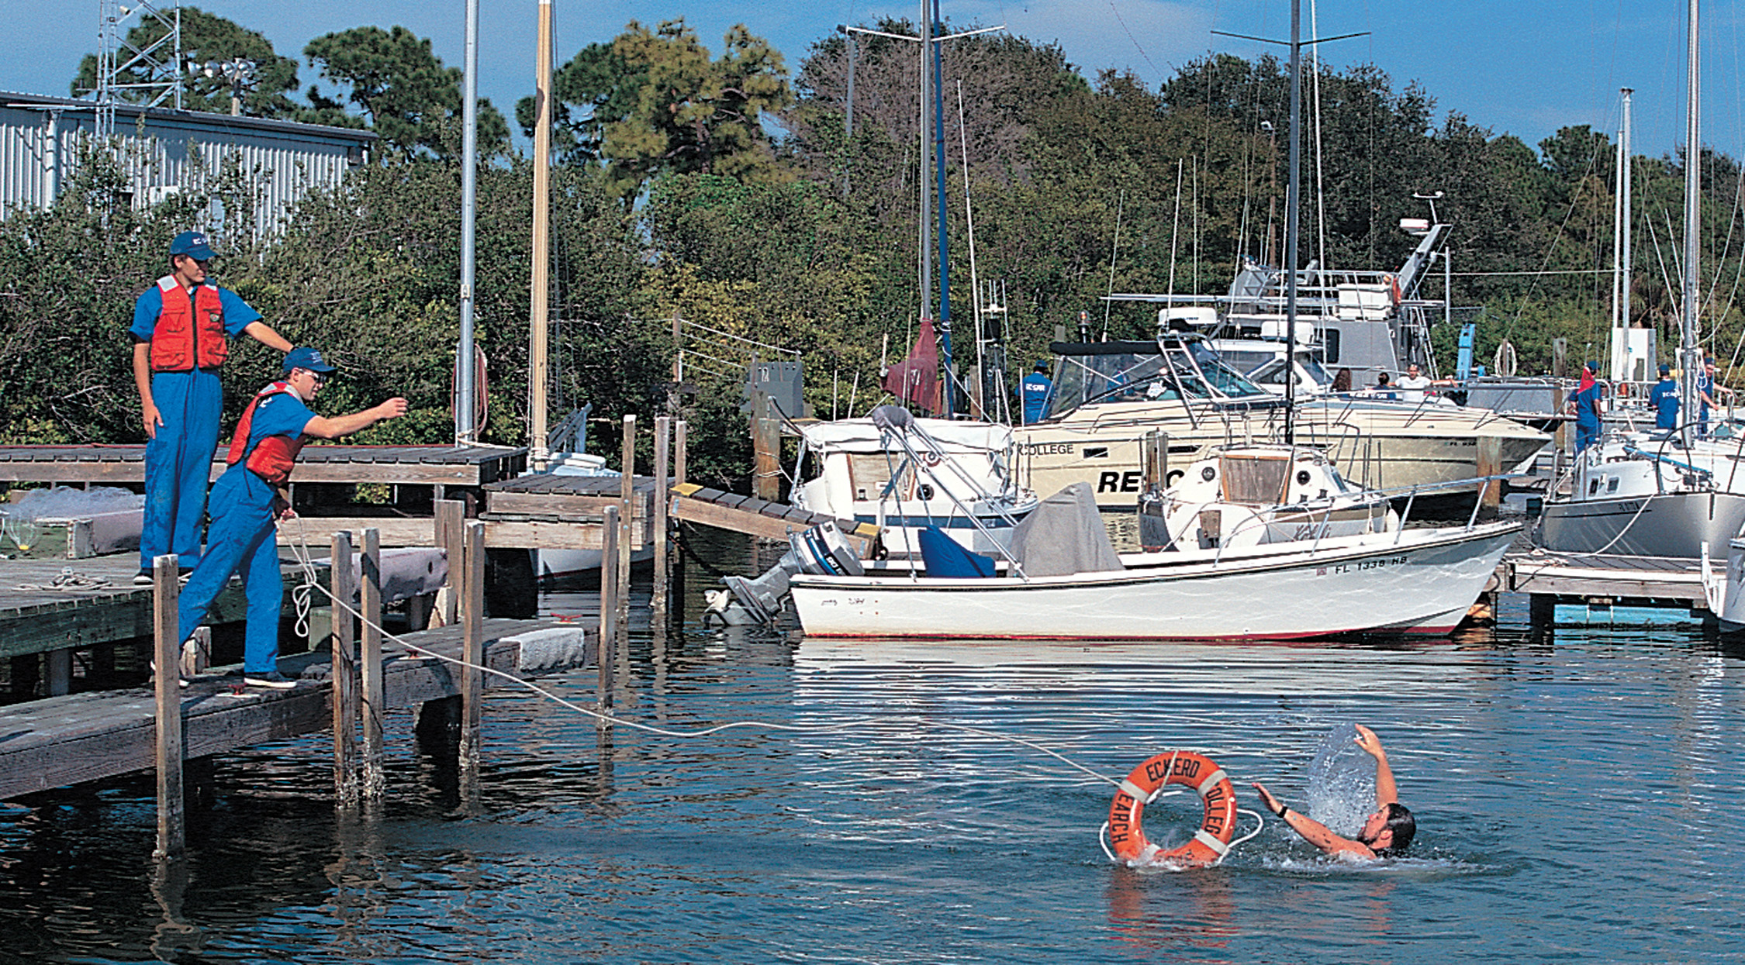
Use an Object that Floats and is Unlikely to Break Tied to the End of a Rope to Pull the Patient to Shore
Notes:
Any EMS unit whose territory includes bodies of water should carry 100 feet of polypropylene rope in a throw bag that can be quickly deployed.

Slide 22
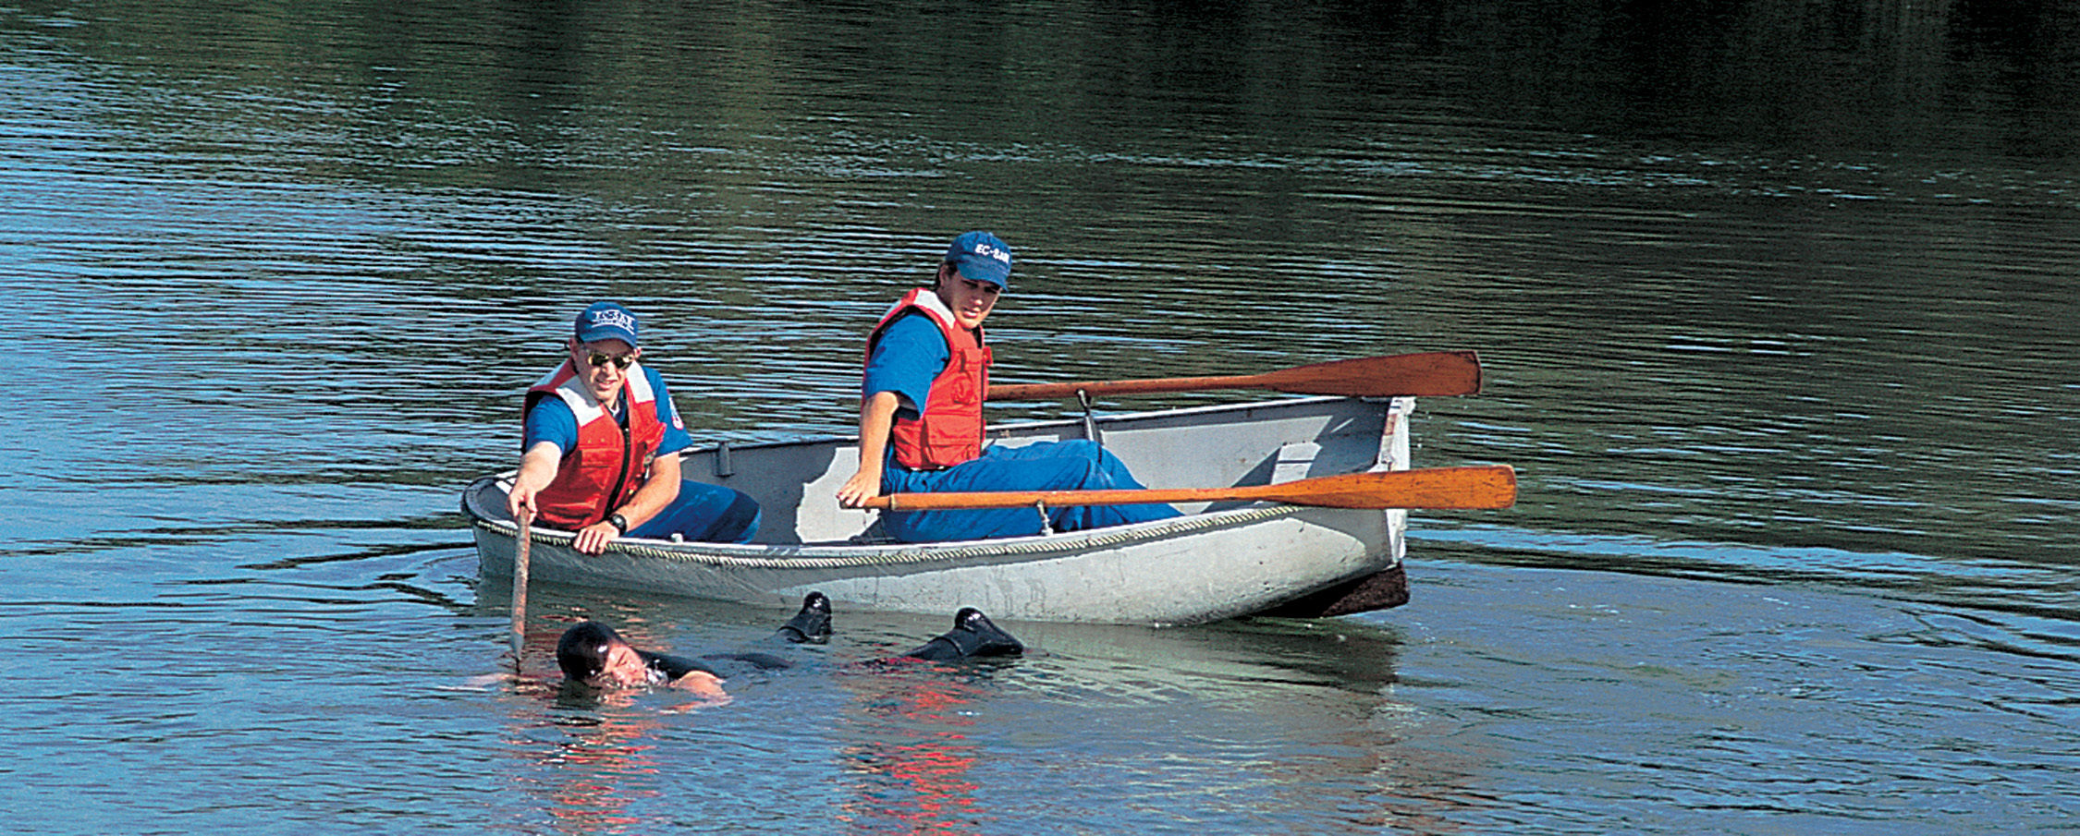
Don’t Become a Patient Yourself. Use a Boat to Reach an Unresponsive Patient
Notes:
If the patient is unresponsive or out of reach with a line, you need to either row to him in a boat if one is immediately accessible or go to him by wading out, swimming, or using a float board. Never try to go to the swimmer unless you meet the safety criteria listed earlier.

Slide 23
Water-Related Emergencies (14 of 28)
Possible Spine Injury
Suspect spinal injury if:
There was a diving accident
The patient may have been struck by a skier, surfboard, or other object
The swimmer was using a water slide
There is suspicion of intoxication
There is evidence of traumatic injury
Notes:
If the swimmer might have been involved in a diving accident or have been struck by a boat, water skier, surfboard, or other object, you should suspect possible spine injury. You should also suspect a spine injury in any swimmer or diver who has been diving or using a water slide, is suspected of being intoxicated, or has evidence of traumatic injury.
The goal is to support the back and stabilize the head and neck as other care is given. It is important to stabilize the patient properly in the water and then to remove him carefully from the water if possible and if it does not pose a hazard for the rescuers.
If the patient is in swift moving water or a body of water with waves, attempting to secure the patient to a backboard is not feasible and can likely put the rescuers in jeopardy. In this case, remove the patient from the water and apply spine motion restriction after he is removed.
Discussion Question
What is the relationship between drowning and spinal injury?

Slide 24
Water-Related Emergencies (15 of 28)
Resuscitation
The mammalian diving reflex may be activated in cold water drowning.
The mammalian diving reflex results in a drastic decrease in the metabolic rate.
The patient may be able to be resuscitated even after prolonged submersion.
Notes:
When the face of a human, or any mammal, is submerged in cold water, the larynx spasms, breathing is inhibited, the heart rate slows, and the blood vessels throughout most of the body constrict. Blood flow to the heart and brain, however, is maintained. In this way, oxygen is sent and used only where it is needed to immediately sustain life. The colder the water, the more oxygen is diverted to the heart and brain.
Patients who have been submerged in cold water, even after 30 minutes or longer in cardiac arrest, can be resuscitated. As a guideline, you should attempt resuscitation on any pulseless, nonbreathing patient who has been submerged in cold water.
Discussion Question
What is the relationship between hypothermia and survival from drowning?
Class Activity
Have students research and report on the most recent evidence regarding the mammalian diving reflex.

Slide 25
Water-Related Emergencies (16 of 28)
Assessment-Based Approach: Drowning and Water-Related Emergencies
Scene Size-Up
Ensure your own safety.
If you are within 10 feet of the edge of the water, wear a P F D.
Take Standard Precautions.
Request additional resources, as needed.
Notes:
If you choose to go into the water to rescue a patient, be sure you can swim and do not put yourself in danger. Make sure to take appropriate Standard Precautions because drowning patients often vomit.
Decide if you need any additional assistance, such as a dry team to work on shore and a wet team to secure the patient in the water. Be aware that rescues in white water or swift water require specialized techniques and training.

Slide 26
Water-Related Emergencies (17 of 28)
Assessment-Based Approach: Drowning and Water-Related Emergencies
Primary Assessment
Form a general impression.
Assess the mental status.
Consider the possibility of spinal injury.
Establish a patent airway.
Notes:
If the patient is found face down, and a spine injury is suspected, work with a partner or partners, if possible, to carefully turn the patient over while maintaining manual in-line stabilization. Suction water, vomitus, and secretions from the airway. Insert an oral or nasal airway if the airway cannot be managed with manual maneuvers.

Slide 27
Water-Related Emergencies (18 of 28)
Assessment-Based Approach: Drowning and Water-Related Emergencies
Primary Assessment
Positive pressure ventilation for inadequate breathing.
Maintain oxygenation.
Assess for bleeding and hypoperfusion.
Determine priority for transport.
Notes:
Patients with spinal injury often do not breathe if they have a high cervical injury. Assess for any open wounds to the chest that would seriously impede breathing. Any patient who has been submerged should receive a high concentration of oxygen because of the potential for pulmonary complications. If signs of severe hypoxia are present, consider placing the patient on CPAP. If breathing is inadequate, provide positive pressure ventilation with supplemental oxygen.
Check the circulation to make sure the patient has a pulse and no life-threatening external bleeding that needs to be controlled.
Patients with high spinal injuries affecting respirations, who are found in respiratory distress, or who are unresponsive are a high transport priority.

Slide 28
Water-Related Emergencies (19 of 28)
Assessment-Based Approach: Drowning and Water-Related Emergencies
Secondary Assessment
Perform a physical exam.
Obtain a history.
Notes:
Perform a rapid secondary assessment if the patient has an altered mental status or is unresponsive. Also, look for evidence of possible injury. If the patient is alert, obtain a history from the patient. If the patient has an altered mental status, attempt to collect a history from relatives, friends, or bystanders at the scene.

Slide 29
Water-Related Emergencies (20 of 28)
Assessment-Based Approach: Drowning and Water-Related Emergencies
Secondary Assessment
Signs and symptoms
Airway obstruction.
Absent or inadequate breathing.
Pulseless.
Spinal or head injury.
Soft tissue injuries.
Musculoskeletal injuries.
Notes:
For the water-related emergency patient, look for signs and symptoms of any of the listed injuries or medical problems.

Slide 30
Water-Related Emergencies (21 of 28)
Assessment-Based Approach: Drowning and Water-Related Emergencies
Secondary Assessment
Signs and symptoms
External or internal bleeding.
Shock.
Hypothermia.
Alcohol or drug abuse.
Drowning or submersion.
Notes:
Drowning patients can be unresponsive, not breathing, or pulseless, or they can be responsive and possibly gasping or coughing up water.

Slide 31
Water-Related Emergencies (22 of 28)
Assessment-Based Approach: Drowning and Water-Related Emergencies
Secondary Assessment
Categorize drowning patients as one of these four categories:
Asymptomatic
Symptomatic
Cardiac arrest
Dead
Notes:
Asymptomatic
Patient displays no signs or symptoms of the drowning event
Symptomatic
Altered mental status (can be as slight as confusion)
Altered vital signs (e.g., tachycardia, bradycardia, tachypnea, bradypnea, hypothermia)
Respiratory distress or respiratory arrest (Respirations can be agonal.)
Dyspnea (No matter how slight, patient is considered symptomatic.)
SpO₂ is 694% with or without oxygen support (An SpO₂ reading can be difficult to obtain or be low if the patient is hypothermic.)
Persistent cough
Wheezing or crackles (rales) upon auscultation of breath sounds
Decreased body core temperature (hypothermia)
Cool skin or cyanosis
Vomiting, diarrhea, or both
Anxiety
Cardiac Arrest
No pulses
Apnea
Obviously Dead
Rigor mortis
Dependent lividity (purplish color caused by blood pooling in the lowest areas of the body)

Slide 32
Case Study (2 of 3)
Jacob directs another rescuer to take over C P R from the family member, and quickly verifies the absence of a pulse as the switch is made.
Lydia makes observations of the scene to determine if there are any other mechanisms of injury or important factors to consider. She questions family members to try to determine exactly how long the child was submerged, and to find out about the child's medical history.
Notes:
Review the case study findings presented.

Slide 33
Case Study (3 of 3)
What are the steps in managing this patient?
Notes:
Use the case study content and questions to foreshadow the upcoming lesson content. Gauge the student’s responses as a guide of how well versed they are in this topic.

Slide 34
Water-Related Emergencies (23 of 28)
Assessment-Based Approach: Drowning and Water-Related Emergencies
Emergency Medical Care
Remove the patient from the water as quickly and safely as possible.
If spinal injury is suspected, protect the spine.
Notes:
If you suspect that the patient has a spine injury, maintain in-line stabilization and then secure the patient to a backboard before removing him from the water if possible and if it doesn’t jeopardize the rescuers.

Slide 35
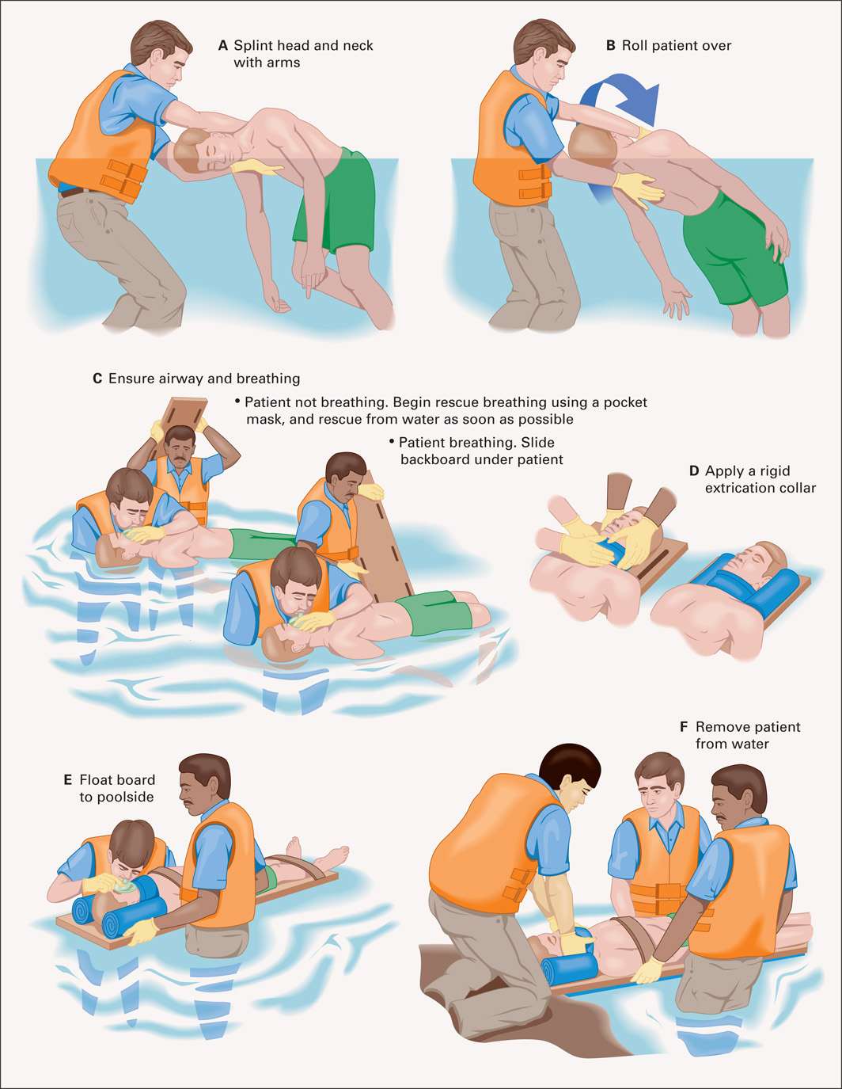
Water Rescue, Possible Spinal Injury
Notes:
Follow these steps to remove a patient with a suspected spinal injury from the water:
If you find the patient face down, stabilize the patient’s head and neck with your arms, and then roll the patient over, supporting the back and stabilizing the head and neck.
If the patient is not breathing, begin positive pressure ventilation if possible.
Keeping the head and neck in line with the spinal column, slide a long backboard under the patient; secure the torso and legs to the backboard with straps.
Apply a cervical collar.
Float the board to shore or poolside and lift the patient from the water. The chest and head are heavier than the lower extremities, and this results in a tendency for the head of the backboard, and the patient secured to it, to slip underwater. Make sure that sufficient support is given to the head end of the backboard. The patient can be removed from the backboard when placed on the stretcher, depending on your spine motion restriction protocols.

Slide 36
Water-Related Emergencies (24 of 28)
Assessment-Based Approach: Drowning and Water-Related Emergencies
Emergency Medical Care
If there is no spinal injury, place the patient on his left side (if the patient is breathing and has a pulse).
Be prepared to suction.
For absent or inadequate breathing, establish an airway and begin ventilations with supplemental oxygen.
Notes:
If you do not suspect spine injury, place the patient on his left side so that water, vomitus, and secretions can drain from the upper airway.
Be prepared to suction, as these patients often have water in the airways and tend to vomit because of the water that has been swallowed.
If the patient is in respiratory arrest or is not breathing adequately, establish an airway and begin positive pressure ventilations with supplemental oxygen as rapidly as you can. After you have determined that there are no foreign objects in the airway, provide ventilations with increasing force until you see the patient’s chest rise with compression of the bag-valve device.

Slide 37
Water-Related Emergencies (25 of 28)
Assessment-Based Approach: Drowning and Water-Related Emergencies
Emergency Medical Care
Maintain an S p O ₂ of 94% or greater.
If the patient is pulseless and apneic, begin C P R and apply the A E D.
If gastric distention interferes with ventilation, decompress the stomach.
Notes:
If the patient breathes spontaneously and adequately, administer a high concentration of oxygen to any submersion patient because of the potential for pulmonary complications from aspiration of water. Apply a nonrebreather mask and set the oxygen at 15 lpm. Consider CPAP for a patient who is spontaneously breathing and exhibits respiratory distress and an SpO₂ <94%.
If the patient is pulseless and apneic, begin CPR and apply the AED and proceed with the AED protocol.
When gastric distention reaches the point at which it interferes with the capability to ventilate the patient, place the patient on his side. With suction immediately available, place your hand over the epigastric area of the abdomen and apply firm pressure to relieve the distention.
Do not apply the Heimlich as a routine maneuver in the submersion or drowning patient. It can lead to vomiting and aspiration.

Slide 38
Water-Related Emergencies (26 of 28)
Assessment-Based Approach: Drowning and Water-Related Emergencies
Emergency Medical Care
Manage any other medical or traumatic conditions present.
Transport with resuscitation continuing.
Notes:
Manage any other medical or trauma conditions associated with the drowning event, such as soft tissue injuries, seizure, or diabetic emergencies.
Transport the patient as quickly as possible, continuing resuscitative measures during transport.

Slide 39
Water-Related Emergencies (27 of 28)
Assessment-Based Approach: Drowning and Water-Related Emergencies
Emergency Medical Care
Always transport a drowning patient, even if he is not experiencing symptoms. Complications can arise up to 72 hours after the incident.
Notes:
Approximately 15 percent of all drowning-related deaths result from secondary complications. During transport, you should keep the patient warm and continue to provide high-concentration oxygen.

Slide 40
Water-Related Emergencies (28 of 28)
Assessment-Based Approach: Drowning and Water-Related Emergencies
Reassessment
Repeat the primary and secondary assessments and vital signs
Every 5 minutes for unstable patients.
Every 15 minutes for stable patients.
Notes:
Be alert for signs the patient is deteriorating into respiratory or cardiac arrest, especially if you previously resuscitated this patient.

Slide 41
Scuba or Deepwater Diving Emergencies (1 of 28)
Basic Laws of Physics Related to Scuba or Deepwater Diving Emergencies
Dysbarism results from the effects of changes in pressure on gases within the the body.
Basic laws of physics explain the changes.
Notes:
You may not practice as an EMT in or around oceans, but accidents involving diving can occur anywhere. Many people dive in quarries, lakes, rivers, and caves.
Dysbarism is a medical condition that results from the effects on the body of changes in ambient pressure. The pressure changes occur when a person descends in water or ascends in altitude. Recreational and commercial divers, when descending into depths of water, experience a drastic increase of pressure on the body. The pressure affects only the compressible structures and substances within the body. The gas contained within the organs, dissolved in the blood, and found in hollow spaces is compressible and is affected by changes in pressure.
Discussion Questions
What is meant by the partial pressure of a gas?
Use Boyle's law to explain what happens when a diver holds his breath on ascent.
Teaching Tips
If teaching in cold weather, blow up a balloon at the beginning of class and place it outside. (If the weather is warm, put the balloon in a refrigerator.) Have the class go outside on breaks and after class to observe what happens to the balloon to demonstrate Charles's law.
Class Activity
Have students search the Internet to get ideas for quick science fair-type experiments to demonstrate relevant gas laws.

Slide 42
Scuba or Deepwater Diving Emergencies (2 of 28)
Basic Laws of Physics Related to Scuba or Deepwater Diving Emergencies
Boyle’s law
At a constant temperature, the volume of a gas is inversely related to the pressure.
As the pressure increases, the volume of the gas decreases.
As the pressure decreases, the volume of the gas increases.
Notes:
If the diver breathes in compressed air at a depth where there is a higher pressure on the body and then suddenly ascends, the volume of air in the lungs rapidly expands because of the decrease in pressure as the diver ascends. This can lead to barotrauma, or rupture of the alveoli and other lung structures.

Slide 43
Scuba or Deepwater Diving Emergencies (3 of 28)
Basic Laws of Physics Related to Scuba or Deepwater Diving Emergencies
Dalton’s law
The total pressure of a mixture of gases equals the sum of the partial pressures of the individual gases.
As a diver descends, the pressure of each gas in the air increases proportionately.
As the pressure of nitrogen increases, it begins to dissolve into the blood.
Notes:
As the diver goes deeper underwater and the pressure of the inhaled nitrogen increases, the nitrogen begins to dissolve into the blood. (Other gases in the mixture of inhaled air do not have this action.) Nitrogen in the blood affects the electrical properties of the brain and produce a “nitrogen narcosis” with effects similar to an anesthetic.

Slide 44
Scuba or Deepwater Diving Emergencies (4 of 28)
Basic Laws of Physics Related to Scuba or Deepwater Diving Emergencies
Henry’s law
At a constant temperature, the amount of gas that dissolves in a liquid is proportionate to the pressure of the gas around it.
With increasing depth, gases that have dissolved into the blood will dissolve into and accumulate in the fat and tissues.
Notes:
As noted, when a diver descends and pressure increases, the nitrogen inhaled tends to dissolve into the body’s liquids, mainly the blood plasma. It then also begins to dissolve into and accumulate in the body fat and tissues. If the diver then ascends too quickly, the dissolved nitrogen returns to a gaseous state while it is still dissolved, causing bubbles to form in the blood and tissues.

Slide 45
Scuba or Deepwater Diving Emergencies (5 of 28)
Basic Laws of Physics Related to Scuba or Deepwater Diving Emergencies
Charles’ law
All gases expand equally upon being heated.
As a diver descends into colder water temperatures, the inhaled and dissolved gases contract.
As the diver ascends, the temperature increases and the gases expand.
Notes:
These laws all contribute to the conditions the diver can experience while descending into or ascending from deep water.

Slide 46
Scuba or Deepwater Diving Emergencies (6 of 28)
Decompression Sickness
Pathophysiology
Occurs as the result of the bubbles formed by the expansion of nitrogen in the blood and tissues.
Notes:
Decompression sickness (DCS) also known as divers’ disease, the bends, or caisson disease, is a condition caused by dissolved gases coming out of solution to form bubbles inside the body on depressurization.
Discussion Question
How does decompression sickness occur?
Critical Thinking Discussion
How does flying immediately after deep water diving increase the risk for dysbarism?

Slide 47
Scuba or Deepwater Diving Emergencies (7 of 28)
Decompression Sickness
Pathophysiology
The bubbles have two primary effects on the body:
They act as emboli and cause obstruction in the circulation.
They compress or stretch the blood vessels and nerves.
Notes:
The bubbles can cause coagulation of blood to occur. In response, the vessels and surrounding tissues release substances as they would in an allergic reaction. These substances produce signs and symptoms similar to those of an allergic reaction.

Slide 48
Scuba or Deepwater Diving Emergencies (8 of 28)
Decompression Sickness
Pathophysiology
Factors that predispose to decompression sickness:
Flying too soon after a dive.
Failure to take safety stops while ascending.
Inadequate surface intervals.
Inadequate decompression
Diving at depths for too long a period
Repeated dives at depth on the same day.
Notes:
Factors that increase the risk of a patient developing decompression sickness:
Flying or going to a high altitude too soon after a dive (12–24 hours)
Failure to take the necessary safety stops while ascending from a dive
Inadequate surface intervals (allows nitrogen to accumulate during a sequence of dives)
Inadequate decompression or passing the no-decompression limit
Diving at depths for too long a period
Repeated dives at depth on the same day

Slide 49
Scuba or Deepwater Diving Emergencies (9 of 28)
Decompression Sickness
Pathophysiology
Physical characteristics that predispose to decompression sickness
Poor physical condition/Obesity
Age
Dehydration
Heart or lung diseases or conditions
Pre-existing musculoskeletal injury
Fatigue
Notes:
Physical characteristics or conditions that predispose an individual to decompression sickness:
Poor physical condition
Obesity (nitrogen dissolves easily in fat)
Age
Dehydration
Heart or lung diseases or conditions
Preexisting musculoskeletal injury
Fatigue

Slide 50
Scuba or Deepwater Diving Emergencies (10 of 28)
Decompression Sickness
Pathophysiology
Environmental factors that predispose to decompression sickness
Cold water
Rough seas
Heated diving suits
Heavy work
Notes:
Environmental factors can also put the diver at risk for DCS.

Slide 51
Scuba or Deepwater Diving Emergencies (11 of 28)
Decompression Sickness
Categories of Decompression Sickness:
Type I D C S
Type II D C S
Arterial gas embolism (A G E)
Notes:
The pain characteristically associated with decompression sickness has given this disorder its nickname, “the bends.” It usually results from a diver ascending too rapidly from a deep, prolonged dive. As noted earlier, gases, typically nitrogen, form bubbles within the blood and tissues, causing obstruction of vessels and compression and stretching of tissue. The onset of DCS can occur up to 72 hours following the dive.

Slide 52
Scuba or Deepwater Diving Emergencies (12 of 28)
Decompression Sickness
Categories of Decompression Sickness
Type I D C S signs and symptoms
Pain
Pruritus and burning of the skin
Skin rash
Orange peel appearance of skin
Painless pitting edema
Notes:
Pain is the hallmark symptom of DCS. It is seen in approximately 70–85 percent of patients with type I DCS. It is typically a dull, aching, throbbing pain usually in the joints or tendons. It can also be in other tissue. The shoulder is the joint in which the pain is most commonly experienced. The pain typically begins as mild, or not severe, and then gradually intensifies. Many divers initially think that the pain they experience early on from DCS is due to a pulled muscle or muscle overexertion.

Slide 53
Scuba or Deepwater Diving Emergencies (13 of 28)
Decompression Sickness
Categories of Decompression Sickness
Type II D C S signs and symptoms:
Nervous system
Low back pain progressing to weakness, paralysis, numbness, tingling, etc.
Headache, visual disturbances, dizziness
Altered mental status
Nausea, vomiting, vertigo, tinnitus
Notes:
Type II DCS is more serious than type I DCS. The patient experiences more significant signs and symptoms; however, they can be diverse. The onset of the signs and symptoms is usually immediate, but it could be delayed for up to 36 hours after the incident.
Nervous System
Low back pain that progresses to paresis (weakness), paralysis, numbness or tingling, loss of sphincter control, and girdle pain from spinal cord effects, the most common site for type II DCS
Headache, visual disturbances, dizziness, tunnel vision
Altered mental status
Nausea, vomiting, vertigo, tinnitus, partial deafness

Slide 54
Scuba or Deepwater Diving Emergencies (14 of 28)
Decompression Sickness
Categories of Decompression Sickness
Type II D C S signs and symptoms:
Circulatory system symptoms
Respiratory system symptoms
Notes:
Respiratory System
Substernal burning sensation on inhalation
Nonproductive cough
Respiratory distress
The respiratory signs and symptoms are known as the “chokes.” The symptoms can begin up to 12 hours following the dive and last for 12–48 hours.
Circulatory System
Signs of hypovolemic shock, primarily tachycardia and hypotension, resulting from fluid shifting from intravascular to extravascular
Formation of a thrombus from activation of the blood coagulation system

Slide 55
Scuba or Deepwater Diving Emergencies (15 of 28)
Decompression Sickness
Categories of Decompression Sickness
In assessment for D C S, look for:
Fatigue
Signs and symptoms of shock
Pupillary changes
Pallor of the tongue
Bloody sputum
Nasal flaring, retractions, accessory muscle use
Notes:
When performing an assessment on the patient, the above can be seen in DCS.

Slide 56
Scuba or Deepwater Diving Emergencies (16 of 28)
Decompression Sickness
Categories of Decompression Sickness
In assessment for D C S, look for:
Tachypnea
Crackles in the lungs
S p O ₂ <94%
Vomiting
Urinary bladder distention
Notes:
When performing an assessment on the patient, the above can be seen in DCS.

Slide 57
Scuba or Deepwater Diving Emergencies (17 of 28)
Decompression Sickness
Categories of Decompression Sickness
In assessment for D C S, look for:
Seizure
Uncoordinated movements, weakness, motor and sensory deficits
Joint pain, decreased range of motion
Edema
Cyanosis, pallor, itching, mottling, marbling
Notes:
When performing an assessment on the patient, the above can be seen in DCS.

Slide 58
Scuba or Deepwater Diving Emergencies (18 of 28)
Decompression Sickness
Categories of Decompression Sickness
In assessment for D C S, ask the following:
Where did the patient dive?
What was the deepest depth, and for how long?
What were the other depths and times?
What was the rate of ascent?
What has the patient done since the dive?
Notes:
Where did the patient dive (river, lake, ocean, cave)?
What was the lowest depth and for what period of time?
What were the other depths and for what periods of time?
What was the rate of ascent from the various depths?
What has the patient done since the dive? Did the patient fly on an airplane?

Slide 59
Scuba or Deepwater Diving Emergencies (19 of 28)
Decompression Sickness
Categories of Decompression Sickness
In assessment for D C S, ask the following:
What did the patient do in the 72 hours before the dive?
Did the patient do work during the dive?
What gases were used during the dive?
Did the patient have any problems during the dive?
Notes:
What did the patient do the 72 hours prior to the dive? Number of dives? Length of dives? Time off between dives? Surface intervals? Water temperature?
Did the patient do any type of work during the dive?
What gases did the patient use during the dive?
Were there any problems experienced by the diver like entanglement, marine animal bites or stings, equipment problems, etc.?

Slide 60
Scuba or Deepwater Diving Emergencies (20 of 28)
Decompression Sickness
Categories of Decompression Sickness
In assessment for D C S, ask the following:
What was the patient’s physical condition before, during, and after the dive?
Was any first aid provided?
Notes:
What physical condition was the patient in before, during, and after the dive? Was there fatigue, drug or alcohol use, fever, dizziness, or nausea?
• Was any first aid provided for the patient? Oxygen, position, medications?

Slide 61
Scuba or Deepwater Diving Emergencies (21 of 28)
Decompression Sickness
Arterial Gas Embolism
An artery is obstructed by a bubble or cluster of bubbles.
Rapid ascent with breath-holding can cause alveolar rupture, allowing air to enter the bloodstream.
Signs and symptoms have a rapid onset.
Notes:
AGE is blocking of blood vessels by an air bubble or clusters of air bubbles. The blockage interferes with perfusion of body tissues with oxygen and nutrients normally supplied by the blood.
If the diver ascends rapidly while holding his breath, the air in the lungs expands rapidly, rupturing the alveoli and damaging adjacent blood vessels. As a result, air bubbles enter the bloodstream.
The signs and symptoms of air embolism have a rapid onset, often appearing within 15 minutes of a diver’s surfacing.

Slide 62
Scuba or Deepwater Diving Emergencies (22 of 28)
Decompression Sickness
Arterial Gas Embolism
A G E signs and symptoms:
Itchy, blotchy, mottled skin
Difficulty breathing
Dizziness
Chest pain
Severe, deep aching pain in muscles, joints, tendons
Notes:
The signs and symptoms of air embolism include the listed.

Slide 63
Scuba or Deepwater Diving Emergencies (23 of 28)
Decompression Sickness
Arterial Gas Embolism
A G E signs and symptoms:
Blurred or distorted vision
Partial deafness
Nausea, vomiting
Numbness, paralysis
Weakness or numbness on one side of the body
Staggering gait or lack of coordination
Notes:
The signs and symptoms of air embolism include the listed.

Slide 64
Scuba or Deepwater Diving Emergencies (24 of 28)
Decompression Sickness
Arterial Gas Embolism
A G E signs and symptoms:
Frothy blood in the nose or mouth
Swelling and crepitus in the neck
Loss or distortion of memory
Coma
Cardiac or respiratory arrest
Behavioral changes
Notes:
The signs and symptoms of air embolism include the listed.
Behavioral changes are sometimes the only sign.

Slide 65
Scuba or Deepwater Diving Emergencies (25 of 28)
Decompression Sickness
Barotrauma
During ascent or descent, pressure becomes too great within the body's air-filled cavities, such as the sinuses or middle ear.
Notes:
Divers with upper respiratory infection or allergy are at increased risk of barotrauma. Signs and symptoms of the condition include:
Mild to severe pain in the affected area
Clear or bloody discharge from the nose or ears
Extreme dizziness
Nausea
Disorientation
Patients suffering from barotrauma must be cared for at a medical facility immediately to prevent permanent deafness, residual dizziness, or the inability to dive in the future.

Slide 66
Scuba or Deepwater Diving Emergencies (26 of 28)
Decompression Sickness
Emergency Medical Care for Decompression Sickness, Air Embolism, or Barotrauma
Consider the need for spinal stabilization.
Keep the patient supine or in lateral recumbent position.
Establish an airway and assess breathing.
Notes:
If any suspected spinal injury exists, take the necessary spine motion restriction precautions. Keep the patient in a supine position if spinal injury is suspected or if the patient is alert. If the patient does not have a suspected spinal injury and has an altered mental status, place the patient in a lateral recumbent position.
Open the airway and assess for adequate breathing.

Slide 67
Scuba or Deepwater Diving Emergencies (27 of 28)
Decompression Sickness
Emergency Medical Care for Decompression Sickness, Air Embolism, or Barotrauma
Administer oxygen 15 litersperminute by nonrebreather mask if breathing is adequate.
Assist ventilations with supplemental oxygen for inadequate breathing.
Notes:
If the breathing is adequate, administer oxygen via nonrebreather mask at 15 lpm, even if the SpO₂ reading is greater than 94%. Oxygen is critical in diving emergencies because it reduces the size of the nitrogen bubbles and improves circulation. Be sure to document the exact time of oxygen delivery. If the tidal volume or respiratory rate is inadequate, begin positive pressure ventilation.

Slide 68
Scuba or Deepwater Diving Emergencies (28 of 28)
Decompression Sickness
Emergency Medical Care for Decompression Sickness, Air Embolism, or Barotrauma
Initiate C P R and apply the A E D, if indicated.
Transport immediately.
Notes:
Initiate CPR and apply the AED if indicated.
Transport the patient immediately. If it is a diving emergency, try to obtain the patient’s diving log and transport it with him to the hospital. Contact medical direction to consider transport to a facility with a hyperbaric oxygen chamber.

Slide 69
Click on the Mechanism That Explains the Reduction in Metabolic Rate Associated with Cold Water Drowning
The mammalian diving reflex
The Boyle law
Dissolved nitrogen in the bloodstream
Laryngospasm

Slide 70
Case Study Conclusion (1 of 3)
The patient, a two-year old girl, was most likely submerged between five and seven minutes. There does not appear to be a reason to suspect spinal injury.
Jacob is particularly concerned with providing a patent airway and adequate ventilation and oxygenation. He opens the airway with a head-tilt, chin-lift, and places a folded towel beneath the patient's shoulders. He suctions the airway, and inserts an oropharyngeal airway as another E M T continues chest compressions.
Notes:
Review case conclusion and emphasize the application of knowledge learned from this presentation.

Slide 71
Case Study Conclusion (2 of 3)
Meanwhile, Lydia dries the patient and applies the A E D. However, no shock is indicated. Jacob performs positive pressure ventilation with supplemental oxygen, but he finds that there is increasing resistance to ventilation. The patient’s stomach appears very distended, so the E M T s position her on her side and decompress the stomach, suctioning away the stomach contents to prevent aspiration.
Notes:
Review case conclusion and emphasize the application of knowledge learned from this presentation.

Slide 72
Case Study Conclusion (3 of 3)
The E M T s begin immediate transport, and request intercept with an A L S unit because of their 20-minute transport time.
The patient regains a pulse prior to arriving at the emergency department, but remains unresponsive. She is admitted to pediatric critical care, where she is carefully monitored for neurological damage and respiratory complications. Currently, her prognosis for recovery is uncertain.
Notes:
Review case conclusion and emphasize the application of knowledge learned from this presentation.

Slide 73
Lesson Summary (1 of 2)
Drowning is immersion in a liquid that impairs the ability to breathe.
Drowning causes a significant number of deaths, but is preventable.
In some cases, drowning is associated with the possibility of spinal injury.
If no pulse is present, begin C P R and apply the A E D.
Notes:
Follow-Up
Answer student questions.
Follow-Up Assignments
Review Chapter 25 Summary.
Complete Chapter 25 In Review questions.
Complete Chapter 25 Critical Thinking questions.
Assessments
Handouts
Chapter 25 quiz

Slide 74
Lesson Summary (2 of 2)
Scuba diving emergencies can be explained by basic gas laws.
Treatment of drowning and diving emergencies focuses on airway, ventilation, oxygenation, and, if the pulse is absent, C P R and A E D.
Notes:
Be prepared to provide emergency care for the scuba diving patient even though you might not have diving locations in your response area.
Class Activity
As an alternative to assigning the follow-up exercises in the lesson plan as homework, assign each question to a small group of students for in-class discussion.
Teaching Tips
Answers to In Review questions are in the appendix of the text. Advise students to review the questions again as they study the chapter.

Slide 75
Correct!
The mammalian diving reflex is a response to immersion of the face in cold water. Breathing is inhibited, the heart rate decreases, and blood vessels constrict to maintain cerebral and cardiac blood flow. The metabolic rate decreases.
Click here to return to the program.

Slide 76
Incorrect (1 of 3)
The Boyle law states that the volume of a gas varies inversely with its pressure. This phenomenon does not affect the metabolic rate, but explains a mechanism of decompression sickness.
Click here to return to the quiz.

Slide 77
Incorrect (2 of 3)
Nitrogen is dissolved in the bloodstream as pressure on the body and the gases within it increase during deep water diving, and is not involved in the body's response to cold-water drowning.
Click here to return to the quiz.

Slide 78
Incorrect (3 of 3)
Laryngospasm may occur in response to water in the airway, or in response to the mammalian diving reflex, but is in itself not a mechanism that reduces the metabolic rate.
Click here to return to the quiz.

Slide 79
Copyright

