Slide 1

Prehospital: Emergency Care
Eleventh Edition
Chapter 24
Environmental Emergencies
"Slides in this presentation contain hyperlinks. JAWS users should be able to get a list of links by using INSERT+F7"
Copyright © 2018, 2014, 2010 Pearson Education, Inc. All Rights Reserved
Notes:
If this PowerPoint presentation contains mathematical equations, you may need to check that your computer has the following installed:
1) MathType Plugin
2) Math Player (free versions available)
3) NVDA Reader (free versions available)
Advance Preparation
Student Readiness
Assign the associated section of MyBRADYLab and review student scores.
Review the chapter material in the Instructor Resources, which includes Student Handouts, PowerPoint slides, and the MyTest Program.
Prepare
Make copies of course policies and procedures, the syllabus, handouts from the Instructor Resources, and other materials for distribution or post them in your learning management system.
Preview the media resources and Master Teaching Notes in this lesson.
Preview the case study presented in the PowerPoint slides.
The total teaching time recommended is only a guideline. Take into consideration factors such as the pace at which students learn, the size of the class, breaks, and classroom activities. The actual time devoted to teaching objectives is the responsibility of the instructor.

Slide 2
Learning Readiness
E M S Education Standards, text p. 728.
Chapter Objectives, text p. 728.
Key Terms, text p. 728.
Purpose of lecture presentation versus textbook reading assignments.
Notes:
Explain to students what the National EMS Education Standards are. The National EMS Education Standards communicate the expectations of entry-level EMS providers. As EMTs, students will be expected to be competent in these areas. Acknowledge that the standards are broad, general statements. Although this lesson addresses the listed competencies, the competencies are often complex and require completion of more than one lesson to accomplish. The student is also expected to review the chapter objectives to foreshadow what will be in the chapter. By mastering the key terms the EMT student will better understand the learning and be able to communicate more clearly.
Additionally, explain to the students that the purpose of using these slides is to help keep the instructor focused on highlighting important portions of the material, explain interrelationships of topics, and discuss how to apply this information. It’s not the intent of the presentation (or slides alone) to include every component in the chapter. This presentation still requires the student to thoroughly read the chapter.

Slide 3
Setting the Stage
Overview of Lesson Topics
  Heat and Cold Emergencies
  Exposure to Cold
  Exposure to Heat
  Exercise-Associated Hyponatremia
  Bites and Stings
  Lightning Strike Injuries
  High Altitude Sickness
Notes:
These bulleted points are the major headings from the chapter, presented in order. The purpose is to provide a basic lecture navigation for the student.

Slide 4
Case Study Introduction (1 of 2)
E M T s, Seth Ebers and Steve Holly, can feel the cold and wind, despite their heavy winter gear, as they head toward the center of an empty field, where a police officer and bystanders are surrounding someone on the ground.
Notes:
Case Study
Present the Case Study Introduction provided in the PowerPoint slide set.
Lead a discussion using the case study questions provided on the subsequent slide(s).
The Case Study with discussion questions continues throughout the PowerPoint presentation.
Case Study Discussion
Use the case study content and questions to foreshadow the upcoming lesson content.

Slide 5
Case Study Introduction (2 of 2)
“I’m glad you’re here,” says one of the bystanders. “This is Stan. We hadn’t seen him since last night and we found him here this morning on our way to get breakfast. He’s freezing cold!”
Notes:
Case Study
Present the Case Study Introduction provided in the PowerPoint slide set.
Lead a discussion using the case study questions provided on the subsequent slide(s).
The Case Study with discussion questions continues throughout the PowerPoint presentation.
Case Study Discussion
Use the case study content and questions to foreshadow the upcoming lesson content.

Slide 6
Case Study
How should the E M T s organize their priorities in managing this patient?
What findings should they anticipate in this patient?
What is the emergency care of this patient?
Notes:
Case Study Discussion
Use the case study content and questions to foreshadow the upcoming lesson content. Gauge the students’ responses as a guide of how well-versed they are in this topic.

Slide 7
Introduction
Environmental emergencies:
  Disruptions in the body’s physiology in response to elements in the patient’s natural surroundings.
  Elements include the climate, altitude, lightning, and contact with insects or animals.
Notes:
During this lesson, students will learn considerations for assessing and managing patients who have suffered from environmental emergencies including exposure to heat and cold as well as bites, stings, and altitude sickness.

Slide 8
Heat and Cold Emergencies (1 of 8)
Regulation of Temperature
  Body mechanisms normally keep the temperature at 98.6°Fahrenheit(37°Celsius).
  Thermoreceptors send information to the hypothalamus.
  The hypothalamus sends signals for adjustments to maintain body temperature.
Notes:
Discussion Questions
How does the basic process of thermoregulation work?
What are examples of heat loss through radiation, convection, conduction, and evaporation?
Critical Thinking Discussion
What medications or illnesses could interfere with heat loss or heat production?
Knowledge Application
Given a series of scenarios, students should be able to identify whether patients are gaining or losing heat and by what mechanism(s).

Slide 9
Heat and Cold Emergencies (2 of 8)
Regulation of Temperature
  Heat is exchanged with the environment via a thermal gradient in which warmer temperatures move toward cooler temperatures.
  The body responds by increasing or decreasing the amount of heat produced or lost from the body.
Notes:
Critical Thinking Discussion
Why is hyperthermia more common when high humidity and low air movement accompany high ambient temperatures?
Discussion Question
What changes in the appearance of a patient's skin would tell you the patient's body is trying to cool itself?

Slide 10
Heat and Cold Emergencies (3 of 8)
Regulation of Temperature
  The body has two primary systems to regulate body temperature:
    Behavioral regulation.
      The patient makes a conscious effort to change the comfort level by taking some action.
    Physiologic regulation.
      The body responds to thermoreceptors with a physiologic action to change the temperature.
Notes:
Behavioral regulation – Input from the thermoreceptors provides information to the brain regarding the patient’s comfort level. The patient makes a conscious effort to change the sensation and comfort level by taking some action. If too hot, the person might take off clothing, spray cool water onto himself, fan himself, or perform some other behavior to attempt to cool himself. However, if the patient is too cold, he might add clothing, stand next to a heat source, get out of the cold or wind, or move about to increase their muscular activity to produce more heat.
Physiologic regulation – Input from thermoreceptors provides information to the brain, and the body responds with a physiologic action to change the temperature disturbance without any conscious control by the patient. In a cold environment, the body constricts the peripheral vessels to preserve body heat and initiates shivering to involuntarily produce heat. In a hot environment, the body dilates the peripheral vessels to facilitate heat loss and initiates sweating to increase heat loss through evaporation.

Slide 11
Heat and Cold Emergencies (4 of 8)
Regulation of Temperature
  Cellular damage occurs when there are significant changes in body temperature.
  Heat is produced by metabolism; the body increases the metabolic rate when too much heat is lost from the body.
  Heat is conserved through vasoconstriction.
Notes:
The body must maintain an optimum body temperature so that cellular function can continue normally. If at any time the body cannot compensate for the heat that is either gained or lost, the resulting cellular and organ damage can lead to an environmental emergency.

Slide 12
Heat and Cold Emergencies (5 of 8)
Regulation of Temperature
  Heat is lost through vasodilation, increased blood flow to the skin, increased sweating, and increased respiration.
  When heat loss exceeds heat gain, hypothermia results.
  When heat gained exceeds heat lost, hyperthermia results.
Notes:
The body relies on three body systems – skin, cardiovascular, and respiratory – to help maintain a normal temperature when the body becomes too warm.

Slide 13
Heat and Cold Emergencies (6 of 8)
Regulation of Temperature
  When Heat Lost Exceeds Heat Gained
    Take actions to reduce patients' heat loss.
    Wind increases heat loss by convection; wind chill increases the risk of hypothermia.
Notes:
When the body loses more heat than it gains or produces, the result is hypothermia, or low body temperature.

Slide 14
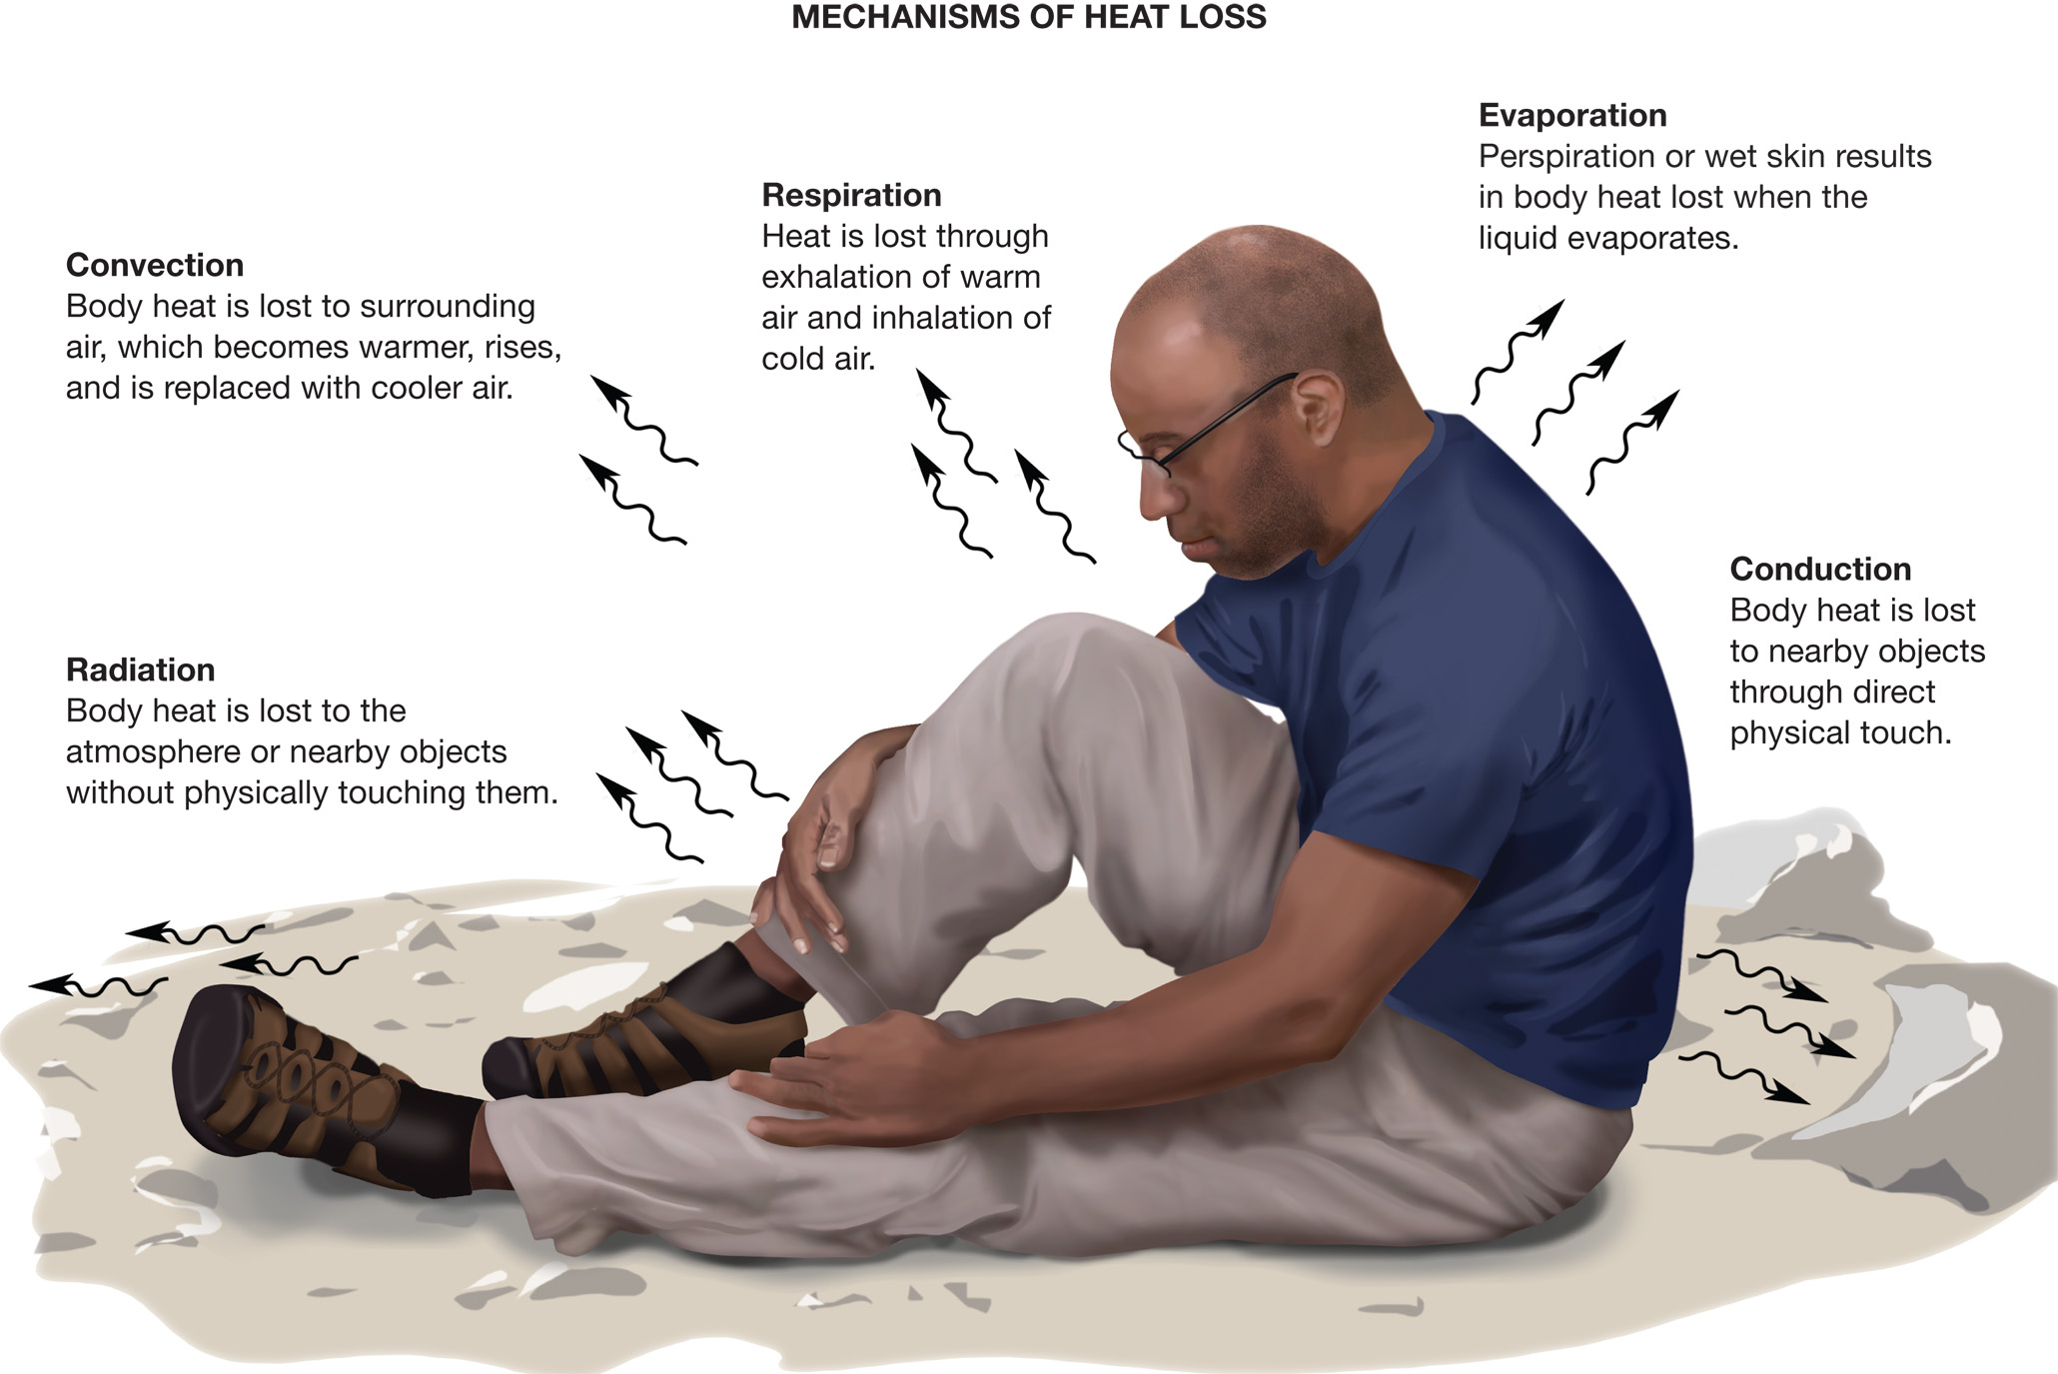
The Illustration Shows a Situation in Which a Wet, Poorly Dressed Climber Has Taken Shelter in a Crevasse or Among Cold, Wet Rocks
Notes:
Heat loss occurs through five mechanisms: radiation, convection, conduction, evaporation, and respiration.

Slide 15
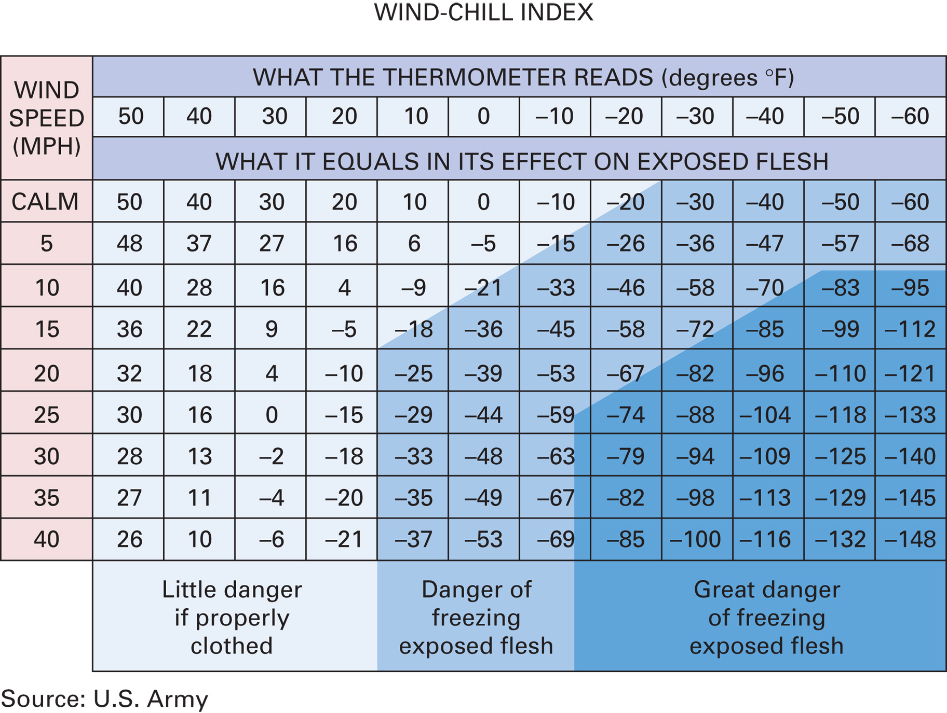
Wind-Chill Index
Source: U.S. Army
Notes:
Anything that speeds movement of the air, such as the wind, also speeds the cooling process. That is where the concept of wind chill comes into understanding and predicting hypothermia.

Slide 16
Heat and Cold Emergencies (7 of 8)
Regulation of Temperature
  When Heat Lost Exceeds Heat Gained
    Exposure to water increases heat loss by conduction and evaporation.
    High relative humidity reduces heat loss by evaporation.
      A relative humidity of 90 percent causes evaporation to become essentially ineffective.
Notes:
The process in which a liquid changes to a vapor is called evaporation. Evaporation has a cooling effect. When body heat causes the body to perspire and the perspiration evaporates, the heat that has been absorbed by the sweat is dissipated into the air, and the body surface is cooled.

Slide 17
Heat and Cold Emergencies (8 of 8)
  Regulation of Temperature
  When Heat Gained Exceeds Heat Lost
    Hyperthermia, or a high body temperature, occurs when the body cannot cool itself effectively.
    It is most common in situations in which the air temperature is high, the humidity is high, and there is little or no breeze.
Notes:
When the amount of heat the body produces or gains exceeds the amount the body loses, the result is hyperthermia, or high body temperature.

Slide 18
Exposure to Cold (1 of 29)
Generalized Hypothermia
  Thermoregulation ability is lost when the body temperature reaches 95°Fahrenheit.
  Coma occurs at 79°Fahrenheit.
  Mortality is as high as 87 percent.
  It can have a sudden onset, as when someone falls through ice, or a gradual onset, as from prolonged exposure to wind, cold air, or cool water.
Notes:
Teaching Tips
Consider having a wilderness medicine expert lecture on hypothermia and local cold injuries.
Discussion Question
What are some risk factors for generalized hypothermia?
Teaching Tips
Have students consider the difference in comfort level between being exposed to 70°F air and 70°F water to illustrate the increased rate of heat loss in water.

Slide 19
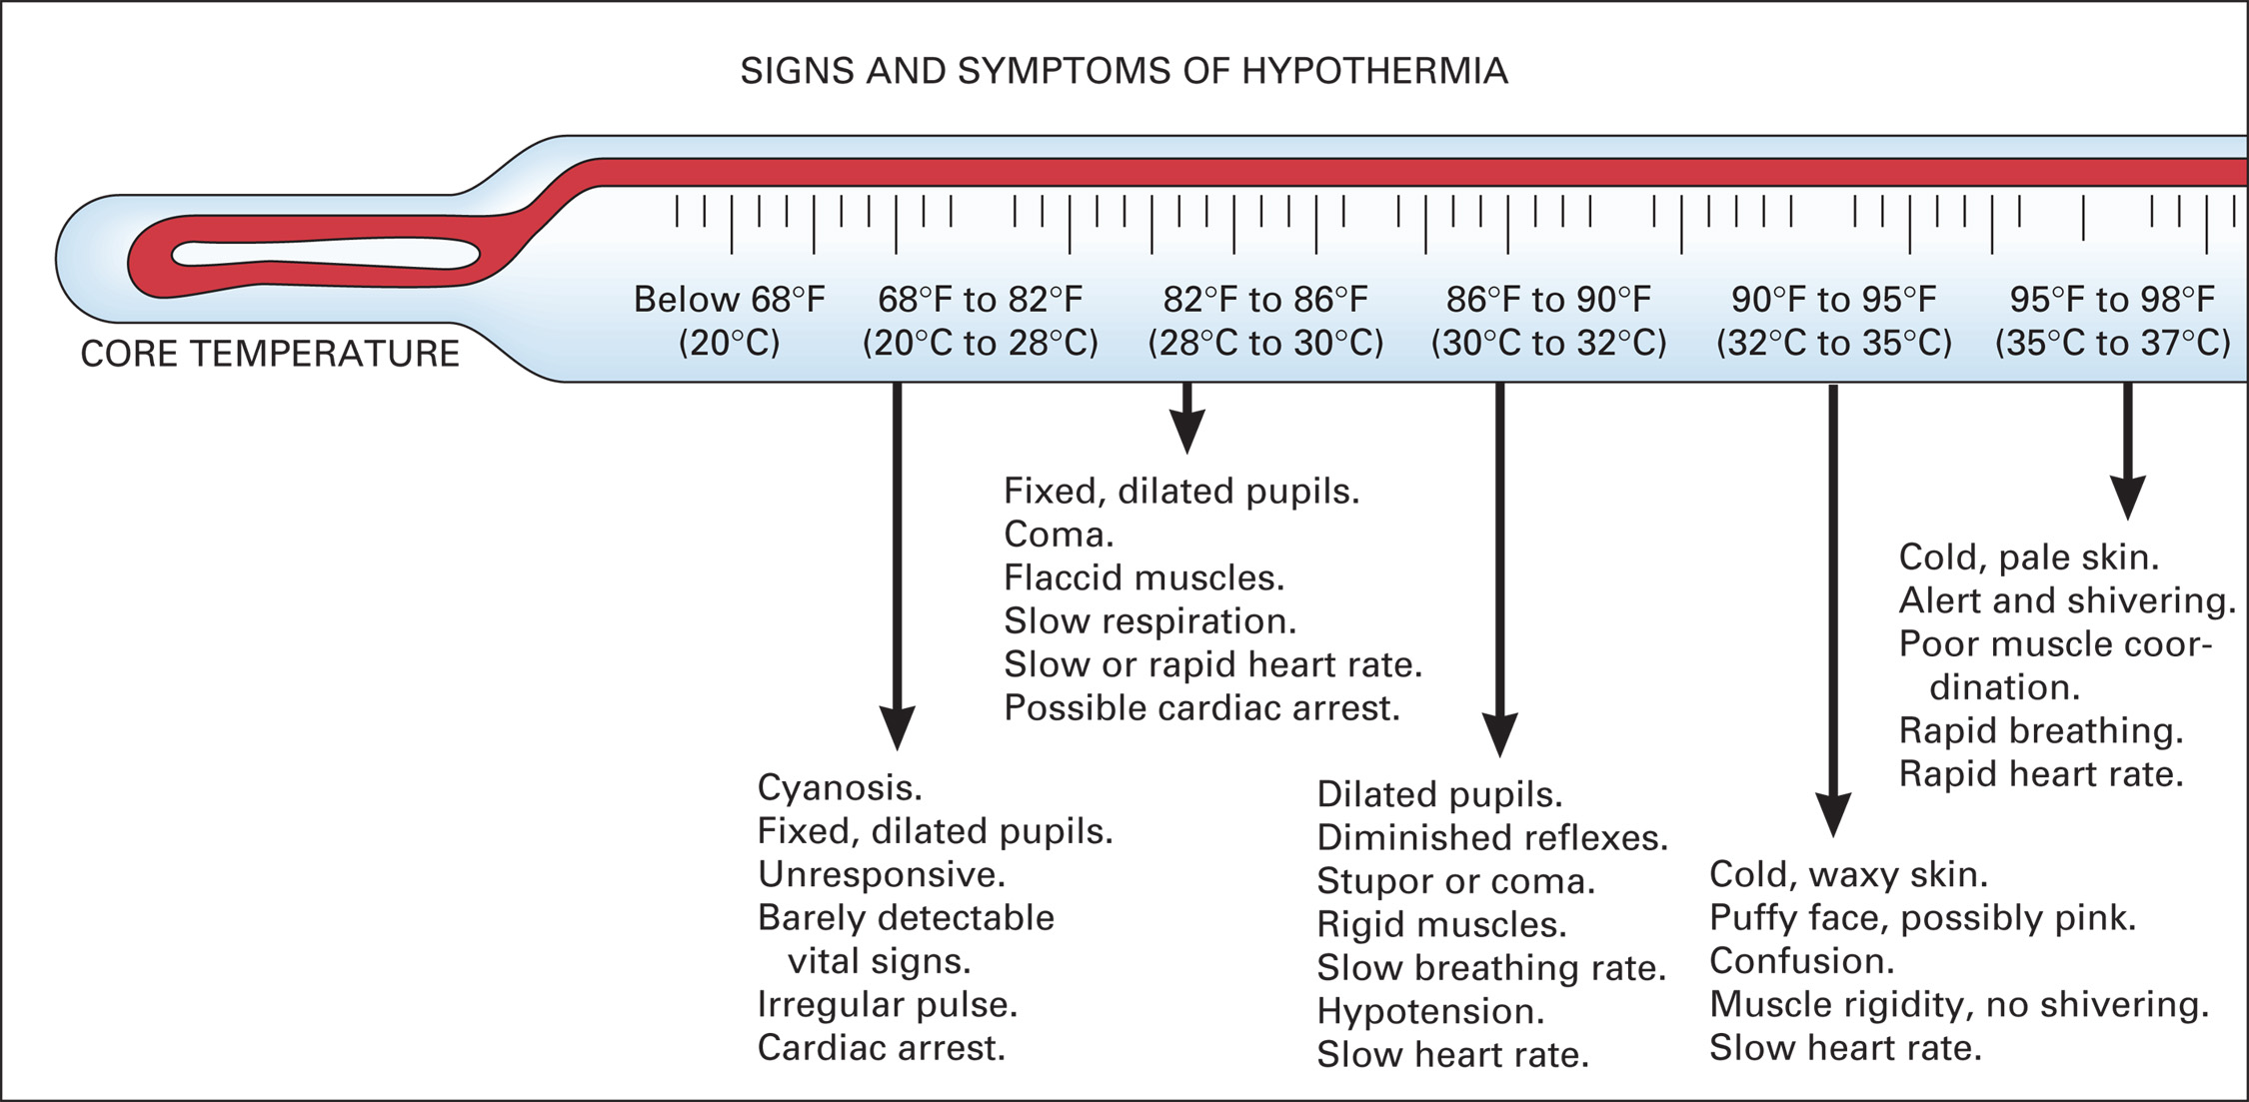
Signs and Symptoms of a Sinking Core Temperature
Notes:
Thermal control (the capability of the body to regulate its temperature) is lost when the body temperature is lowered to 95°F (35°C). Coma occurs when the body’s core temperature reaches approximately 79°F (26°C). Cases have been documented in which patients have survived after reaching a core temperature as low as 64.4°F (17.7°C). Death can occur within 2 hours of the first signs and symptoms of generalized hypothermia.

Slide 20
Exposure to Cold (2 of 29)
Pathophysiology of Generalized Hypothermia
  Predisposing Factors
    Ambient temperature, wind chill, and moisture
    Extremes of age
    Medical conditions
    Alcohol, drugs, and poisons
    Clothing and duration of exposure
    Activity level
Notes:
Extremely low temperatures are not necessary for hypothermia to occur. It can occur in temperatures as high as 65°F, depending on the wind-chill factor.
People who are at the extremes of age, such as infants (especially newborns) and toddlers and the elderly, are at an increased risk of hypothermia.
People who have had recent surgery or who have shock, head injury, burns, generalized infection, spinal cord injuries, thyroid gland disorders, and diabetic <emergencies such as hypoglycemia, are at increased risk for hypothermia.
Some drugs, alcohol, and poisons can increase the risk of hypothermia.
The longer the time a person
spends unprotected in a cold environment, the greater the chance that he will become hypothermic.
Clothing that is inappropriate for the temperature enables a person to lose heat at a greater rate than if he had layers of clothing for cold environments.
Physical activity requires muscular movement that produces heat as a by-product (thermogenic). Thus, a person who continues to move can generate internal heat that maintains the body’s core temperature at a higher level than if he were not moving.

Slide 21
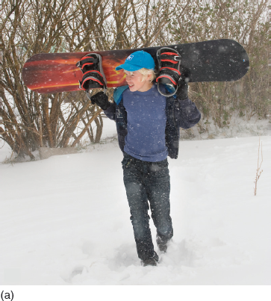
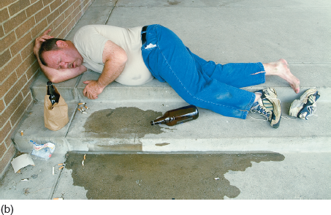
Hypothermia Can Occur in Cold or Merely Cool Environments
All of the persons in these photographs are subject to possible hypothermia: (a) a person dressed too lightly for outdoor activity on a very cold day (b) a person sleeping outdoors on a cool surface in cool weather.
(Photo a: © Corbis)
Notes:
The elderly have an impaired recognition of cold, a diminished basal metabolism, and poor constriction of blood vessels in the extremities (a heat-conserving mechanism). This can lead to a condition known as urban hypothermia, in which an elderly person becomes hypothermic in their own home.

Slide 22
Table 24-1 Stages of Hypothermia
Stage | Core Temperature Range
Mild | 35°Celsius to 33°Celsius 95°Fahrenheit to 91.4°Fahrenheit
Moderate | 32°Celsius to 29°Celsius 89.6°Fahrenheit to 85.2°Fahrenheit
Severe | 28°Celsius to 22°Celsius 82.4°Fahrenheit to 71.6°Fahrenheit
Profound | 20°Celsius to 9°Celsius 68°Fahrenheit to 48.2°Fahrenheit
Notes:
Hypothermia can occur with little warning and can progress rapidly from mild to moderate to severe to profound.

Slide 23
Exposure to Cold (3 of 29)
Pathophysiology of Generalized Hypothermia
  Stages of Hypothermia
    Initial reactions to cold exposure are increases in the basal metabolic rate, muscular shivering, and “piloerection” (goosebumps).
    In hypothermia, these mechanisms are not enough to maintain body temperature.
Notes:
As core body temperature drops, the body’s thermal-regulating mechanism and perception become confused. A person, even though dangerously cold, might undress, thinking he is too warm.

Slide 24
Exposure to Cold (4 of 29)
  Pathophysiology of Generalized Hypothermia
  Immersion Hypothermia
    Heat loss occurs 25 to 30 times faster in water than in air.
    Death can occur in minutes in water temperatures as high as 50°Fahrenheit.
Notes:
In water temperature less than 77°F, an immersed person who is not wearing protective gear can’t generate enough heat from movement to maintain a normal body core temperature. In water temperatures that are below 68°F, the person is at increased risk of dying from either drowning or severe hypothermia.

Slide 25
Exposure to Cold (5 of 29)
  Pathophysiology of Generalized Hypothermia
  Immersion Hypothermia
    There are two phases to cold water immersion response:
      Cold shock response.
      Cold incapacitation.
    Sudden death within 24 hours following rescue has been reported in approximately 20 percent of immersion patients.
Notes:
Cold Shock Response – Cold shock response is the first phase of response to cold water immersion. The immersed person exhibits:
Respiratory pattern change with hyperventilation and a gasp response.
Loss of breath-holding ability if not acclimatized.
Breathing becomes erratic.
Cold Incapacitation – If the immersed person survives the initial cold shock response, he has approximately 10 minutes before he becomes unable to perform any useful activity. He loses fine motor function first, followed by a loss of gross motor function, followed by the inability to perform any useful or meaningful activity.

Slide 26
Exposure to Cold (6 of 29)
  Pathophysiology of Generalized Hypothermia
  Immersion Hypothermia
    Cold water immersion patients should be kept in a supine position and should not be asked to do any physical activity that is not necessary.
Notes:
The reason for sudden death within 24 hours following rescue is related to:
Upon rewarming, the circulation of cold, acidotic, or alkalotic blood back into the core circulation.
Catecholamine (epinephrine, norepinephrine) release.
Decreased hydrostatic pressure upon removal from the water.
Cold baroreceptors that have a decreased sensitivity to blood pressure changes.
Increased blood viscosity.
Decrease in intravascular blood volume.
Decreased pump function of the heart.

Slide 27
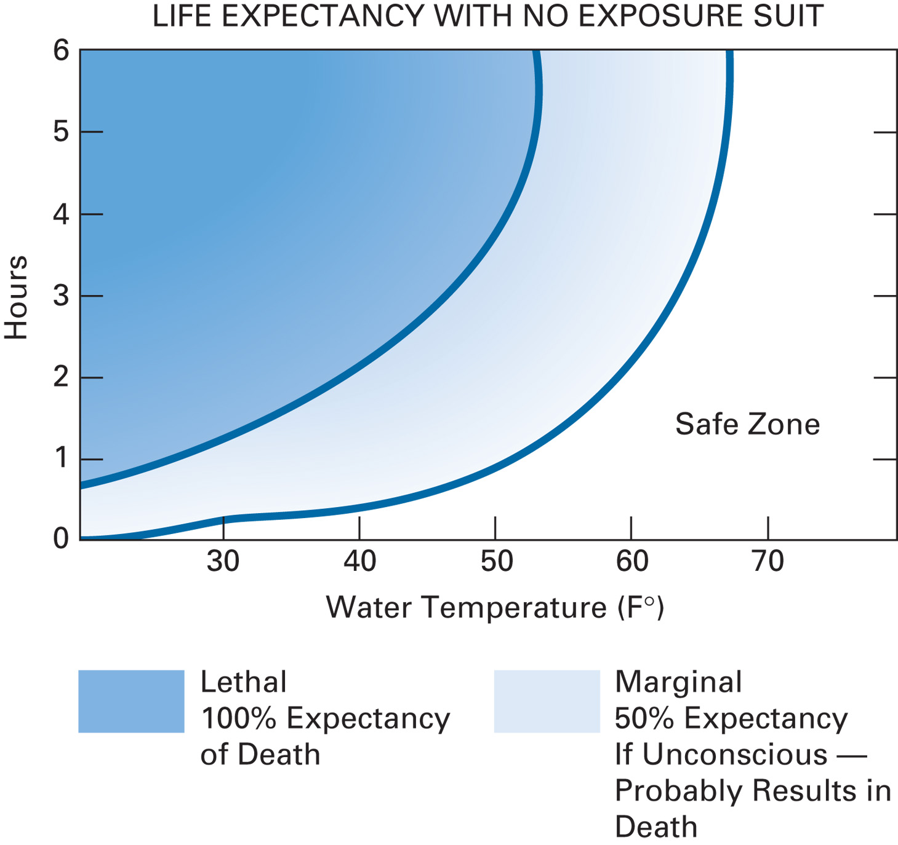
Effects of Water Temperature on Survival in Cold Water Immersion
Notes:
Body temperature can drop to the water temperature in as little as 10 minutes in some circumstances. In fact, body temperature drops 25 to 30 times faster in water than in air of the same temperature.

Slide 28
Exposure to Cold (7 of 29)
Pathophysiology of Generalized Hypothermia
  Urban Hypothermia
    Illness, medication, and age predispose patients to hypothermia.
    External hypothermia occurs because of inadequate access to shelter.
    Internal hypothermia occurs because of inadequate heating of the home.
Notes:
Do not overlook the possibility of hypothermia in an elderly (or pediatric) patient who has been subject to the cool ambient temperatures of air-conditioned buildings.
A patient in an air-conditioned environment who has decreased tissue insulation and inability to move from a cold surface is a prime candidate for urban hypothermia, even on a warm day.

Slide 29
Exposure to Cold (8 of 29)
  Pathophysiology of Generalized Hypothermia
  Myxedema Coma
    The thyroid hormone maintains a normal metabolic rate.
    Myxedema coma is a complication of chronic hypothyroidism.
    Core temperature may be as low as 75°Fahrenheit.
Notes:
Myxedema coma is a complication that occurs late in the progression of hypothyroidism and can be fatal. It occurs most commonly in elderly women who present with extreme hypothermia (core temperatures often 75°F to 90°F or 24°C to 32.2°C), seizures, slow reflexes, and respiratory depression. Although myxedema coma occurs rarely (in only 0.1 percent of hypothyroidism patients), it is a true emergency, as death from this complication is likely.

Slide 30
Exposure to Cold (9 of 29)
Nonfreezing Cold Injury
  Immersion Foot and Trench Foot
    Erythema, white, mottled, or cyanotic
    Maceration
    Blisters and open sores
    Edema/Pulseless
    Numbness or no feeling (anesthesia)
    Clumsiness
    Cool or cold, but not frozen
Notes:
Trench foot – Common in military personnel, trench foot results from exposure of the feet to a constant cold, but not freezing temperature.
Immersion foot – Immersion foot results from prolonged immersion of the feet in cool or cold water or moisture. This can occur if the foot is kept in cool or cold wet socks for a long period of time.
The key in your emergency management of nonfreezing cold injury is to recognize the condition and to prevent any further cooling or trauma to the extremity. Don’t allow the patient to walk or stand on the affected foot or feet. Remove the footwear and socks carefully. Loosely cover the area with a dry, sterile dressing.

Slide 31
Exposure to Cold (10 of 29)
Freezing Cold Injury
  Local cold injury occurs when ice crystals form between the cells of the skin.
  It tends to occur on the hands, feet, ears, nose, and cheeks.
  Cold injury requires much colder temperatures than are needed to produce generalized hypothermia.
Notes:
Discussion Question
How is early (superficial) local cold injury differentiated from late (deep) local cold injury?

Slide 32
Exposure to Cold (11 of 29)
Pathophysiology of Freezing Cold Injury
  Predisposing Factors
    Any kind of trauma
    Extremes of age
    Wet clothing/tight footwear
    Use of alcohol
    High altitudes
    Loss of blood
    Arteriosclerosis
Notes:
Predisposing factors can increase the likelihood of a person suffering a freezing cold injury.

Slide 33
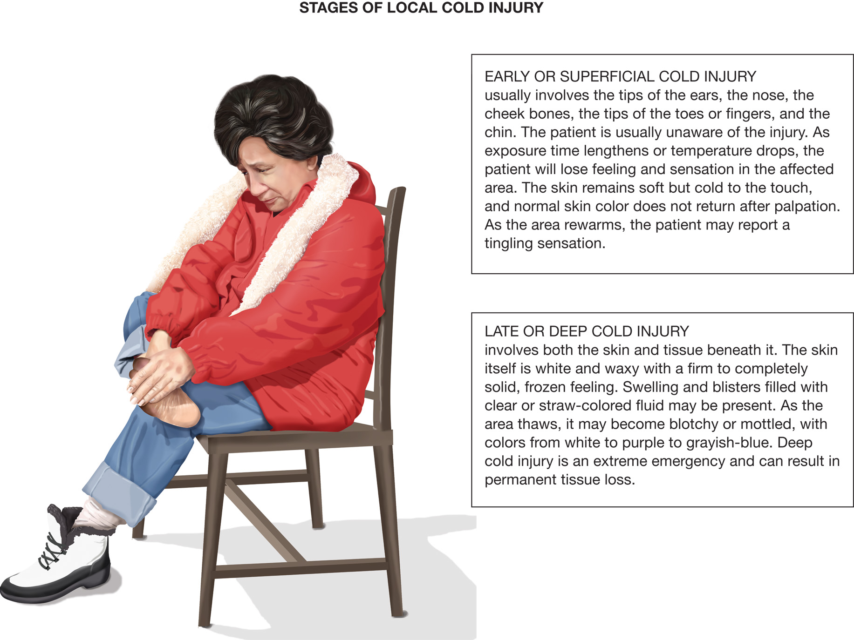
Local Cold Injuries May Progress from Early or Superficial to Late or Deep
Notes:
Freezing cold injuries that are localized fall into two basic categories: early or superficial injury and late or deep injury.

Slide 34
In a Late or Deep Freezing Cold Injury, the Skin Can Appear White and Waxy and Feel Firm to Solidly Frozen. Swelling and Blisters Can Be Present
(© Edward T. Dickinson, M D)
Notes:
The injury can involve the whole hand or foot. Swelling and blisters filled with clear or straw-colored fluid can be present.

Slide 35
As a Late or Deep Freezing Cold Injury Thaws, It Can Become Blotchy or Mottled and Colored from White to Purple to Grayish-Blue
(© David Effron, M D)
Notes:
Deep freezing cold injury is an extreme emergency and can result in permanent tissue loss.

Slide 36
Exposure to Cold (12 of 29)
Pathophysiology of Freezing Cold Injury
  Stages of Freezing Cold Injury
    Early or superficial freezing cold injury:
      Usually involves the tips of the ears, the nose, the cheekbones, the tips of the toes or fingers, and the chin.
    Late or deep freezing cold injury:
      Involves both the skin and tissue beneath it.
Notes:
Early or superficial freezing cold injury (frostbite) – The patient is usually unaware of the injury, which commonly develops after direct contact with a cold object, cold air, or cold water.
Late or deep freezing cold injury (frostbite) – The skin is white and waxy in appearance. Palpation of the affected area reveals a firm-to-completely solid, frozen feeling. The injury can involve the whole hand or foot. Swelling and blisters filled with clear or straw-colored fluid can be present.

Slide 37
Exposure to Cold (13 of 29)
Assessment-Based Approach – Cold-Related Emergency
  Scene Size-Up
    Ensure your own safety.
    Look for clues to how the environment has affected the patient.
      Mechanisms of heat loss.
      Predisposing factors.
Notes:
Discussion Question
What are some special considerations in scene safety in conditions that could lead to hypothermia?
Critical Thinking Discussion
How can you protect yourself from local cold injury?
Discussion Question
What are the assessment findings that would lead you to suspect a patient is hypothermic?

Slide 38
Exposure to Cold (14 of 29)
Assessment-Based Approach – Cold-Related Emergency
  Scene Size-Up
    Is the patient’s clothing wet?
    Are they dressed for the environment?
    What’s the temp inside the residence?
    Has the patient ingested alcohol or been using drugs?
    Any injury that can interfere with normal thermoregulation?

Slide 39
Exposure to Cold (15 of 29)
Assessment-Based Approach – Cold-Related Emergency
  Primary Assessment
    General impression—Are there risk factors for or indications of hypothermia?
    Assess mental status.
    Assess and maintain the airway.
      Respirations slow, and eventually stop in hypothermia.
    Maintain oxygenation.
Notes:
Carbon dioxide is the major stimulus to breathe in the normal patient. Thus, a decrease in carbon dioxide production decreases the drive to breathe, causing the respiratory rate and tidal volume to decrease and eventually become ineffective.
Class Activity
Divide the class into groups of four to six students. Assign each group a hypothermia scenario with different circumstances (stage of hypothermia, type of hypothermia, distance from the hospital, and so on). Have each group work through their scenario on their own first, and then have them explain their decision-making process to the rest of the class.
Discussion Questions
How are passive warming techniques different from active warming techniques?
How do you determine whether a patient should be passively or actively rewarmed?
Knowledge Application
Given several different scenarios, students should be able to assess and manage patients with generalized hypothermia and local cold injuries.

Slide 40
Exposure to Cold (16 of 29)
Assessment-Based Approach – Cold-Related Emergency
  Primary Assessment
    Check the pulse carefully; if it is completely absent, begin chest compressions, followed by ventilation.
    A hypothermic patient is a high priority for transport.
Notes:
The pulse, breathing, and blood pressure are difficult to assess in a hypothermic patient. The EMT should exercise due diligence in confirming the presence or absence of vital signs prior to the application of cardiopulmonary resuscitation.

Slide 41
Exposure to Cold (17 of 29)
Assessment-Based Approach – Cold-Related Emergency
  Secondary Assessment
    Place the patient in a warm environment.
    Obtain a medical history.
      Current and past history.
      Predisposing factors for hypothermia.
Notes:
The secondary assessment should be conducted in the back of the warmed ambulance. Do not delay moving the patient out of the cold environment to conduct the exam. If the patient is responsive, gather a history.

Slide 42
Exposure to Cold (18 of 29)
Assessment-Based Approach – Cold-Related Emergency
  Secondary Assessment
    Perform a physical exam.
      Signs of trauma.
      Signs of hypothermia.
    Obtain baseline vital signs.
    Obtain a temperature, if possible.
Notes:
Factors predisposing people to hypothermia:
Exposure to a cold environment.
Age (either young or elderly).
Preexisting medical conditions.
Use of drugs (including medications such as beta blockers or antipsychotics), alcohol, or poisons.
Be especially cautious for hypothermia when treating a patient who was resuscitated outside. Sometimes rescuers lose track of the time as they work on a patient in a snowbank or on an icy road.

Slide 43
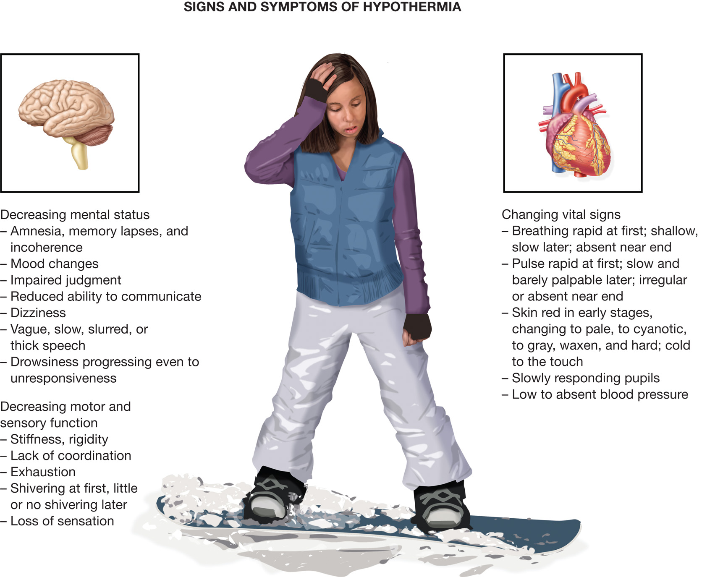
Signs and Symptoms of Hypothermia
Notes:
Signs and symptoms of generalized hypothermia include:
Decreasing mental status correlating with the degree of hypothermia.
Amnesia, memory lapses, and incoherence.
Mood changes.
Impaired judgment.
Reduced ability to communicate.
Dizziness.
Vague, slow, slurred, or thick speech.
Drowsiness progressing even to unresponsiveness to verbal or painful stimuli.
Decreasing motor and sensory function correlating with the degree of hypothermia:
Joint and/or muscle stiffness; muscle rigidity as hypothermia progresses; stiff or rigid posture.
Lack of coordination
Apparent exhaustion or inability to get up after rest.
Uncontrollable fits of shivering at first, with little or no shivering as hypothermia progresses.
Reduced sensation or loss of sensation.
Changing vital signs:
Respiratory changes: rapid breathing at first; shallow and slow later; absent near the end.
Changes in pulse: rapid pulse at first; slow and barely palpable pulse later; irregular or absent pulse near the end.
Changes in skin color, from red in early stages, changing to pale, then cyanotic, and finally to gray, waxen, and hard; skin that is cold to the touch.
Slowly responding pupils, typically dilated.
Low to absent blood pressure.

Slide 44
Table 24-2 Stages of Hypothermia and Associated Physiologic Changes (1 of 2)
Stage | Core Temperature Range | Physiological Changes
Mild | 35°Celsius to 33°Celsius 95°Fahrenheit to 91.4°Fahrenheit | Maximum shivering (early) Metabolic rate increases Amnesia and difficulty in speaking develop Blood pressure remains normal Ataxia and apathy develop
Moderate | 32°Celsius to 29°Celsius 89.6°Fahrenheit to 85.2°Fahrenheit | Stupor develops Oxygen consumption decreases by 25% Shivering ceases Cardiac dysrhythmias develop Inability to maintain a body core temperature independent of the ambient temperature (poikilothermia) Heart rate and cardiac output reduced by one third and progressively decrease as body core temperature declines Insulin becomes ineffective Progressive decrease in consciousness Pupils dilate
Notes:
Signs and symptoms of generalized hypothermia typically occur in stages as the body core temperature falls.

Slide 45
Table 24-2 Stages of Hypothermia and Associated Physiologic Changes (2 of 2)
Stage | Core Temperature Range | Physiological Changes
Severe | 28°Celsius to 22°Celsius 82.4°Fahrenheit to 71.6°Fahrenheit | Susceptible to ventricular fibrillation Oxygen consumption decreases by 50% (early) to 75% (late) Heart rate decreases by 50% Reflexes and voluntary motion are lost Cerebral blood flow decreases by ⅔ Cardiac output declines by 55% Pulmonary edema may develop Significant hypotension No corneal reflexes
Profound | 20°Celsius to 9°Celsius 68°Fahrenheit to 48.2°Fahrenheit | Heart rate declines by 80% (early) and deteriorates to pulselessness

Slide 46
Exposure to Cold (19 of 29)
Assessment-Based Approach – Cold-Related Emergency
  Emergency Medical Care for Generalized Hypothermia
    Basic principles
    Prevent further heat loss.
    Rewarm the patient as quickly and safely as possible.
    Be alert for complications.
Notes:
Remove any wet clothing, dry the patient, and use blankets to insulate the patient from the cold.

Slide 47
Exposure to Cold (20 of 29)
Assessment-Based Approach – Cold-Related Emergency
  Emergency Medical Care for Generalized Hypothermia
    Remove the patient from the environment and prevent further heat loss.
    Handle the patient gently.
    Maintain adequate oxygenation.
Notes:
Insulate the patient from the ground up; get something underneath the patient as quickly as possible. Remember to insulate the head. Protect the patient from exposure to the wind.
Rough handling can cause a cardiac dysrhythmia, especially ventricular fibrillation. Never allow the patient to walk or exert himself in any way. Even minor physical activity can disrupt the rhythm of the heart.
Administer supplemental oxygen to maintain an SPO₂ >94%. If possible, use warm, humidified oxygen. There is increasing evidence that the application of warm humidified oxygen can be extremely beneficial to the hypothermic patient during resuscitation.

Slide 48
Exposure to Cold (21 of 29)
Assessment-Based Approach – Cold-Related Emergency
  Emergency Medical Care for Generalized Hypothermia
    If the patient goes into cardiac arrest, immediately initiate C P R beginning with chest compressions and apply the A E D.
    Actively rewarm patients with moderate and severe hypothermia.
Notes:
If ventricular fibrillation or ventricular tachycardia persists after the initial defibrillation, it might be reasonable to continue to defibrillate as the patient is rewarmed. Follow your local protocol. Continue CPR aggressively because prolonged survival in cases of hypothermia has been reported.
Some experts advise active rewarming only if you are more than 15 minutes from the receiving facility. According to the AHA 2015 guidelines, active rewarming should be applied to patients with a body core temperature less than 34°C or 93.2°F or those in moderate or severe hypothermia. Follow medical direction and your local protocol for hypothermia treatment.

Slide 49
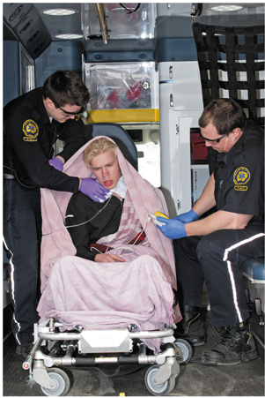
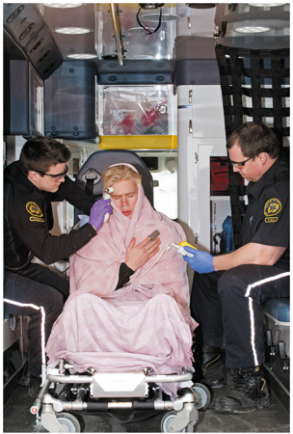
One Way to Actively Warm the Patient is To
(a) Place heat packs in the groin, and the armpits, and on the chest, insulating the packs to prevent burns, and then (b) cover with blankets to maximize the effect of the heat packs.
Notes:
Active rewarming is a technique of aggressively applying heat to warm the patient’s body and includes these measures: wrapping the patient in warm blankets; placing heat packs or hot water bottles in the groin, in the armpits, and on the chest; and turning up the heat in the patient compartment of the ambulance.

Slide 50
Exposure to Cold (22 of 29)
Assessment-Based Approach – Cold-Related Emergency
  Emergency Medical Care for Generalized Hypothermia
    Passive rewarming should be applied to all hypothermic patients.
    Do not allow the patient to take stimulants.
    Never rub or massage the patient’s arms or legs.
    Transport as quickly as possible.
Notes:
Passive rewarming is taking measures to prevent further heat loss and giving the patient’s body the optimum chance to rewarm itself. Passive rewarming includes inhibiting further heat loss by wrapping the patient in blankets and then increasing the heat in the patient compartment of the ambulance.
Do not allow the patient to consume stimulants, including tobacco, coffee, or alcohol.
Never rub or massage the patient’s arms or legs. You could force cold venous blood into the heart, resulting in cardiac irritability or cardiac arrest.
The safest rewarming takes place at a medical facility, so transport is the most important factor.

Slide 51
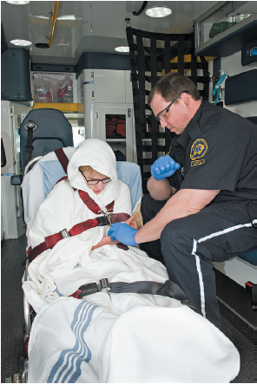
Passive Rewarming Includes Wrapping the Patient in Blankets and Turning up the Heat in the Patient Compartment
Notes:
Passive rewarming is taking measures to prevent further heat loss and giving the patient’s body the optimum chance to rewarm itself. Passive rewarming includes inhibiting further heat loss by wrapping the patient in blankets and then increasing the heat in the patient compartment of the ambulance.

Slide 52
Exposure to Cold (23 of 29)
Assessment-Based Approach – Cold-Related Emergency
  Emergency Medical Care for Immersion Hypothermia
    Instruct a patient in the water to make the least effort needed to stay afloat.
    Remove the patient from the water in horizontal position.
    Remove wet clothing.
Notes:
Turbulence and activity in the water decrease survival time by approximately 75 percent. If the patient continues to move or struggle, they can cool more quickly because of the increase in the movement of cold water molecules next to the skin and around the body.
Lift the patient from the water in a horizontal or supine position to prevent vascular collapse and provide spine motion restriction if spinal injury is suspected.
Remove the patient’s wet clothing carefully and gently. Excessive activity can cause the heart to go into ventricular fibrillation. If it is too difficult to remove the clothing, cut it off and layer dry, warm materials around the patient.

Slide 53
Exposure to Cold (24 of 29)
Assessment-Based Approach – Cold-Related Emergency
  Signs and Symptoms of Freezing Cold Injury – Early or Superficial
    Blanching of the skin
    Loss of sensation
    Tissue soft to palpation
    Tingling during rewarming
Notes:
Freezing cold injury that is localized can be difficult to assess. While still frozen, even severely affected tissue can appear almost normal with purplish or other abnormal colors appearing only with thawing.

Slide 54
Exposure to Cold (25 of 29)
Assessment-Based Approach – Cold-Related Emergency
  Signs and Symptoms of Freezing Cold Injury – Late or Deep
    White, waxy skin
    Firm to frozen feeling on palpation
    Swelling and blisters
    If thawing has occurred, skin is mottled or cyanotic.
Notes:
The tissue can be completely numb when frozen but will be painful—burning, stinging, and throbbing – before it freezes and as it thaws. Although you might be unable to assess its severity accurately, you can almost always see a clear demarcation at the site of a local freezing cold injury.

Slide 55
Exposure to Cold (26 of 29)
Assessment-Based Approach – Cold-Related Emergency
  Emergency Medical Care for Freezing Cold Injury
    Never allow the tissue to thaw if there is any possibility of refreezing.
    Follow medical direction and local protocol.
    Remove the patient immediately from the cold environment, if possible.
Notes:
Never initiate thawing procedures if there is any danger of refreezing. Keeping the tissue frozen is less dangerous than submitting it to refreezing.

Slide 56
Exposure to Cold (27 of 29)
Assessment-Based Approach – Cold-Related Emergency
  Emergency Medical Care for Freezing Cold Injury
    Maintain oxygenation (S P O₂ 94% or higher).
    Prevent further injury to the affected part.
Notes:
If the SPO₂ is >94% and no signs or symptoms of hypoxia or respiratory distress are present, oxygen might not be necessary.
Prevent further injury to the injured part.
Carefully remove any jewelry or wet or restrictive clothing to prevent causing further injury. If clothing is frozen to the skin, leave it in place.
Secure the affected extremity to a board splint to minimize movement and elevate. No part of the injured extremity should be in direct contact with a hard surface.
Cover the affected skin with dressings or dry clothing to prevent friction or pressure.
Never rub or massage the affected skin.
Never reexpose the injured skin to the cold.
If the patient has a late or deep injury:
Carefully remove any jewelry or wet or restrictive clothing to prevent causing further injury. If clothing is frozen to the skin, leave it in place.
Cover the affected skin with dressings or dry clothing to prevent friction. Avoid pressure.
Do not break any blisters or treat them with salve or ointment.
Do not rub or massage the affected skin.
Never apply direct heat to rewarm the affected part.
Do not allow the patient to walk on an injured extremity.

Slide 57
Exposure to Cold (28 of 29)
Assessment-Based Approach – Cold-Related Emergency
  Emergency Medical Care for Freezing Cold Injury – Late or Deep
    Rewarming may be necessary for long or delayed transport.
      Follow protocol; contact medical direction.
      Rapid rewarming is preferred.
      Rewarming is painful.
Notes:
Rapid rewarming steps:
Immerse the affected part in a warm water bath just above body temperature (104°F).
Keep the water temperature constant.
Stir the water to keep heat evenly distributed.
Keep the tissue in the water until it is soft, and color and sensation return.
After thawing, dress with dry, sterile dressings; place dressings between the fingers and toes.
Elevate the extremity.
Protect against refreezing.
Transport as soon as possible.

Slide 58
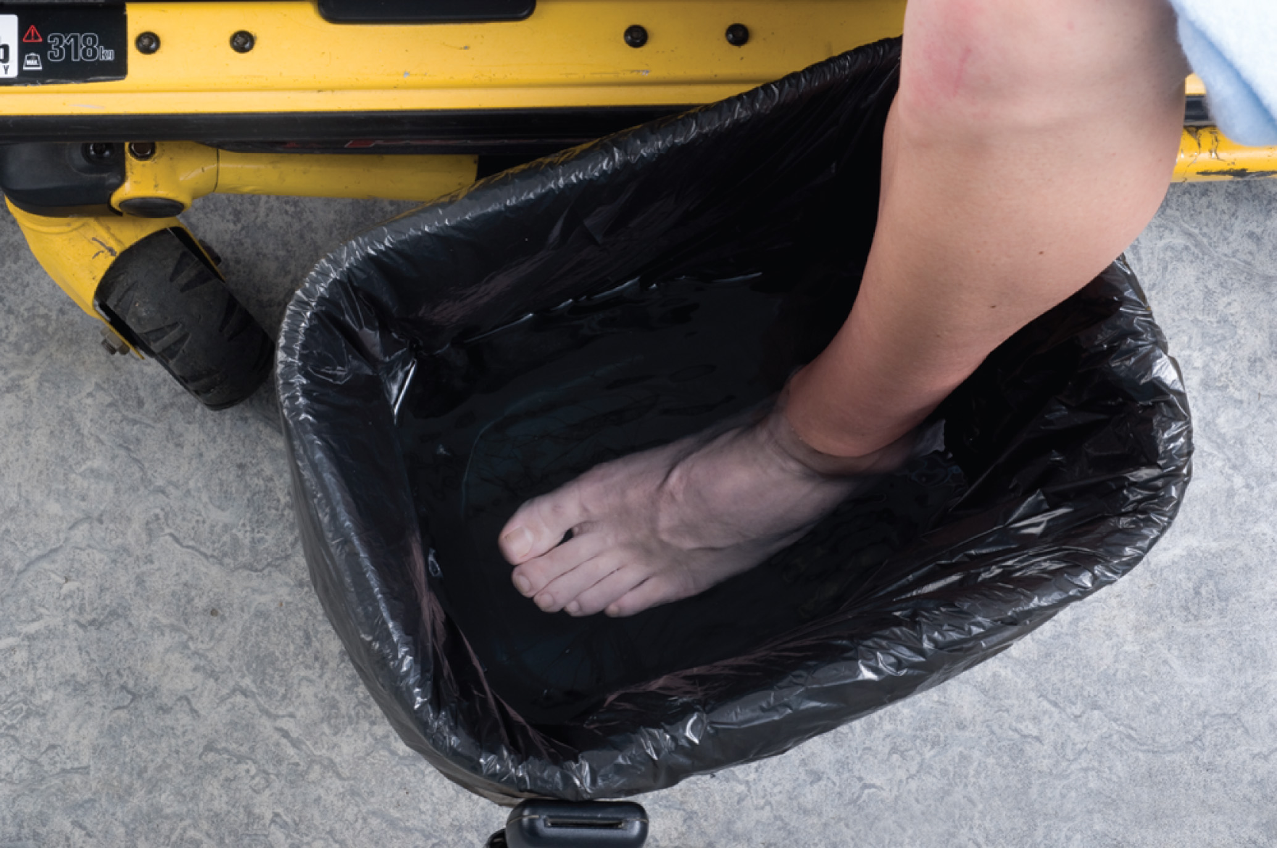
Thaw the Affected Area Rapidly in Water Just above Body Temperature (100°Fahrenheit to 110°Fahrenheit)

Slide 59
Exposure to Cold (29 of 29)
Assessment-Based Approach – Cold-Related Emergency
  Reassessment
    Reassess all cold emergency patients.
    Monitor mental status, airway, and breathing.
    Begin C P R if pulseless; apply the A E D.
    Assess affected areas.
    Check vital signs every 5 minutes.
Notes:
Keep the patient warm and try not to reexpose them to the cold.

Slide 60
Click on the Mechanism of Heat Loss That is Increased with Increased Wind Speeds
A. Evaporation
B. Conduction
C. Radiation
D. Convection

Slide 61
Exposure to Heat (1 of 19)
Hyperthermia
  Hyperthermia is caused by an increase in the body’s heat production or inability to eliminate the heat produced.
  Various stages of hyperthermia are heat cramps, heat exhaustion, and heat stroke.
Notes:
Class Activity
Before lecturing on this topic, assign different groups of students each of the heat-related emergencies. Give the groups 20 minutes to research their topic and prepare to report back to the class. Be prepared to correct misconceptions and fill in any gaps in information.
Discussion Questions
What physical findings are associated with heat cramps?
What are some factors that predispose someone to heat-related emergencies?
Critical Thinking Discussion
What is the mechanism (or mechanisms) by which cardiovascular disease predisposes a patient to heat-related emergencies?

Slide 62
Exposure to Heat (2 of 19)
Pathophysiology of Heat-Related Emergencies
  Heat Cramps
    Muscle spasms are related to an electrolyte imbalance in the body.
    The large flexor groups are usually affected first.
Notes:
Heat cramps are caused by electrolyte imbalance to the muscles, most commonly from overexertion in hot temperatures with excessive diaphoresis.
Knowledge Application
Given several descriptions of patients with heat-related emergencies, students should be able to collect a relevant history and perform a physical examination.
Discussion Questions
Under what circumstances could you consider giving oral fluids to a patient with a heat-related emergency?
What are the management priorities for a patient with heatstroke?

Slide 63
Exposure to Heat (3 of 19)
Pathophysiology of Heat-Related Emergencies
  Heat Exhaustion
    A mild state of shock:
      Vasodilation leads to blood pooling beneath the skin.
      In extreme cases, organs are not well perfused.
      Prolonged and profuse results in salt and water loss.
Notes:
Heat exhaustion occurs when the body’s cooling mechanisms have been expended, and the central nervous system and other systems start to show the consequences of this depletion.
Patients present with dizziness or fatigue, normal body temperature, and diaphoresis.
A patient with heat exhaustion commonly has slight alterations in mental status, such as dizziness or fatigue, and presents with a normal body temperature and diaphoretic skin.

Slide 64
Exposure to Heat (4 of 19)
Pathophysiology of Heat-Related Emergencies
  Heat Stroke
    Thermoregulation fails; the body is unable to cool itself.
    High body temperature damages brain cells.
    Mortality ranges from 20 percent to 80 percent.
    It may be classic (nonexertional) or exertional.
Notes:
Heat stroke occurs when the body’s heat-regulating mechanisms break down and become unable to cool the body sufficiently. The body becomes overheated, body temperature rises, and sweating ceases in approximately one-half of the patients.
Patients have altered mental status.

Slide 65
Exposure to Heat (5 of 19)
Pathophysiology of Heat-Related Emergencies
  Predisposing Factors
    Climate
    Exercise and strenuous activity
    Extremes of age
    Pre existing illnesses
    Drugs and medications
    Lack of acclimation
Notes:
Preexisting illnesses include:
Heart disease.
Kidney disease.
Cerebrovascular disease.
Parkinson’s disease.
Thyroid gland disorders.
Skin diseases, including eczema, scleroderma, and healed burns.
Dehydration.
Obesity.
Infections or other conditions that cause fever.
Fatigue.
Diabetes.
Malnutrition.
Alcoholism.
Mental retardation.
Peripheral vascular disease.

Slide 66

Exercise and Strenuous Activity Can Cause the Loss of More Than One Liter of Sweat Per Hour
(© Michal Heron)
Notes:
Exercise and strenuous activity can cause the loss of more than one liter of sweat per hour and increase heat production. Exertional heat stroke is the second leading cause of death in high school students.

Slide 67
Exposure to Heat (6 of 19)
Assessment-Based Approach – Heat-Related Emergency
  Scene Size-Up
      Protect yourself from overexposure to heat.
      Check surroundings for clues to heat exposure or exertion.
      Look for medications and drugs.
Notes:
Scan the scene for evidence that the patient is suffering from a heat-related emergency. Probably the most important factors to consider are the ambient temperature and humidity.
Infants and children left in closed vehicles or in structures that are hot and poorly ventilated are prone to heat emergencies, especially if the infant or child is overdressed and too young to remove their own clothing. Elderly patients, especially those who are not mobile enough to escape their hot environments, are also likely to become victims of a heat emergency.

Slide 68
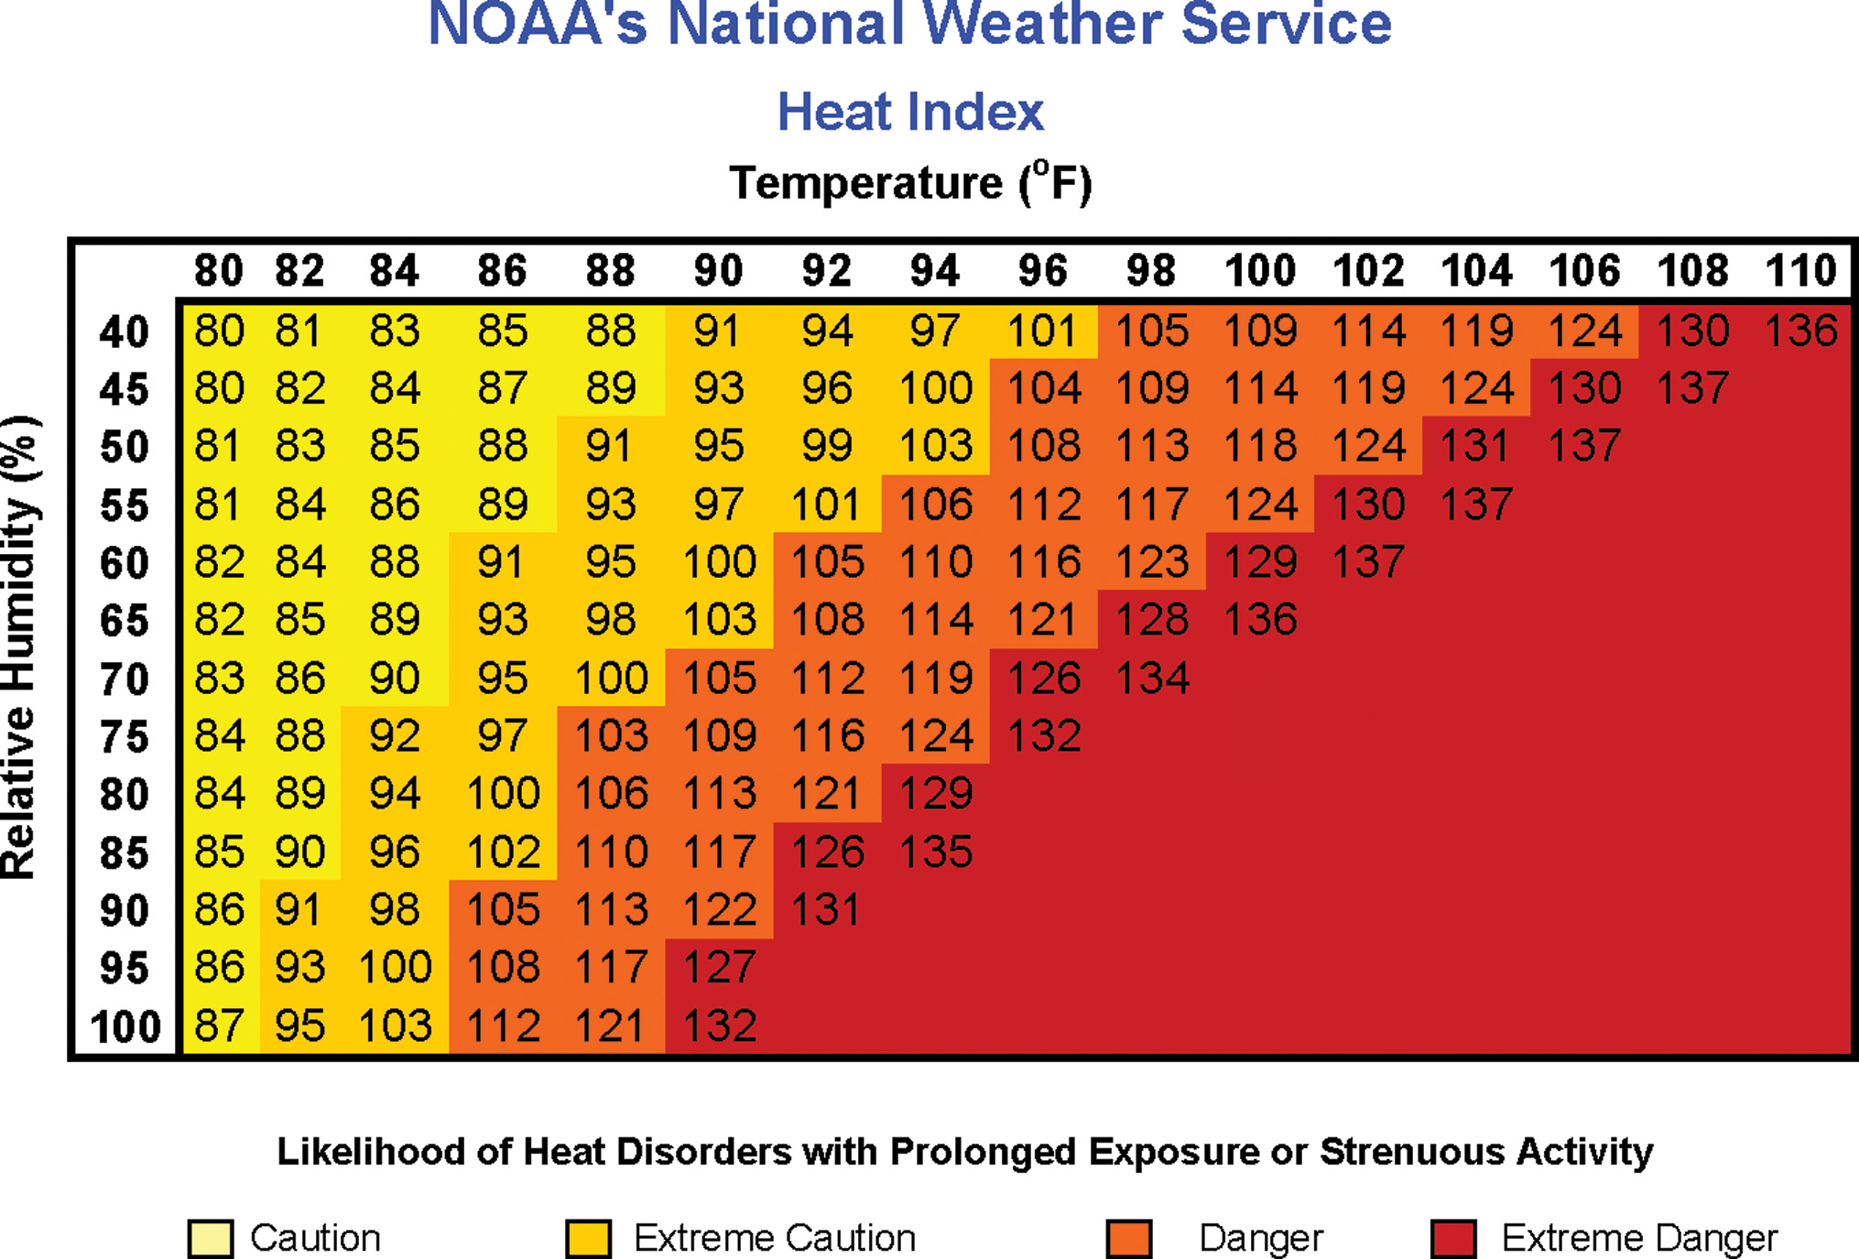
The Risk of Illness is Increased When Heat and Humidity Produce Dangerous Conditions
Lower temperatures with high humidity can also cause the body’s temperature to rise.
Notes:
High temperatures, especially if greater than 90°F, and relative humidity greater than 75 percent combine to create an environment that renders the body’s cooling mechanisms less effective

Slide 69
Exposure to Heat (7 of 19)
Assessment-Based Approach – Heat-Related Emergency
  Primary Assessment
    Form a general impression.
    Assess mental status.
    Assess the airway and breathing.
    Maintain oxygenation.
    Check the pulse and skin.
Notes:
A patient with altered mental status and hot skin is a high-priority patient.

Slide 70
Exposure to Heat (8 of 19)
Assessment-Based Approach – Heat-Related Emergency
  Secondary Assessment
    Move the patient to a cool environment.
    Obtain a history.
      Medications.
      Oral intake.
      Events leading up to the situation.
    Physical exam.
      Vital signs.
Notes:
If the patient is in a hot environment, move them to a cool environment as quickly as possible. If the patient is responsive, gather a history, paying attention to the symptoms of which the patient complains. The OPQRST can be modified to gather further information about some of the symptoms.
The baseline vital signs can reveal a blood pressure that is normal or low. The heart rate and respirations are typically elevated in heat emergencies.

Slide 71
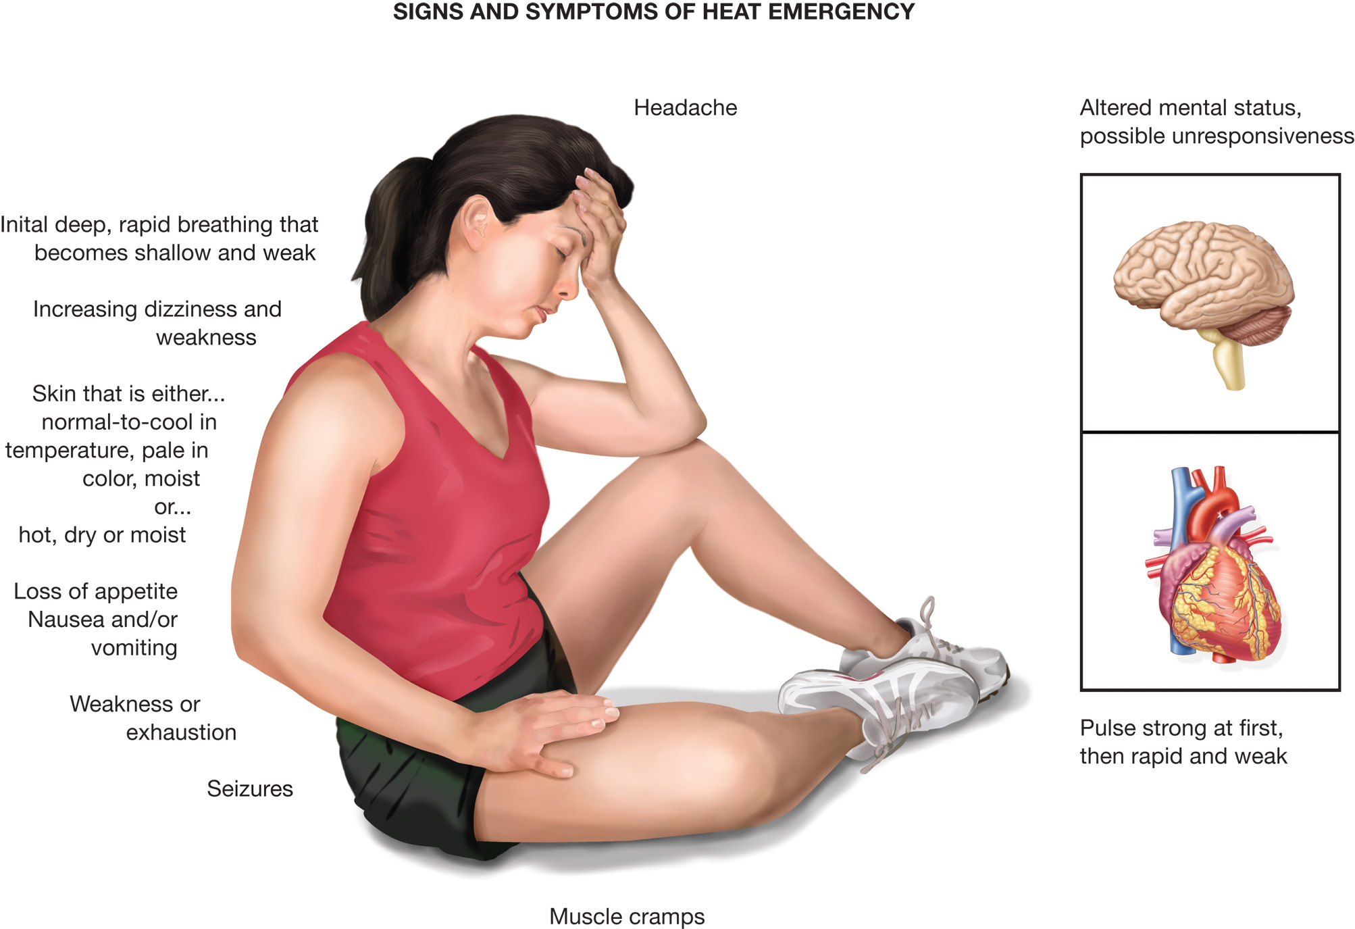
Signs and Symptoms of a Serious Heat Emergency
Notes:
The general signs and symptoms of heat-related injuries:
Elevated core temperature.
Muscle cramps.
Weakness or exhaustion.
Dizziness or faintness.
A rapid pulse that is usually strong at first but becomes weak.
Initial deep, rapid breathing that becomes shallow and weak as damage progresses.
Headache.
Seizures.
Loss of appetite, nausea, or vomiting.
Altered mental status, possibly unresponsiveness.
Skin that is either moist and pale with a normal-to-cool temperature, or hot and either dry or moist.

Slide 72
Exposure to Heat (9 of 19)
Assessment-Based Approach – Heat-Related Emergency
  Emergency Medical Care for a Heat Emergency Patient with Moist, Pale, Normal-to-Cool Skin
    Move the patient to a cool place.
    Maintain adequate oxygenation.
    Remove heavy clothing.
    Cool the patient.
Notes:
Move the patient to a cool place, such as the back of an air-conditioned ambulance, away from the source of heat. If no cooler location is immediately available, at least move the patient into the shade.
If breathing is adequate, administer oxygen based on the SPO₂ reading, and patient signs and symptoms. If the SPO₂ is 794% and no signs or symptoms of hypoxia, hypoxemia, poor perfusion, respiratory distress, or heart failure are present, oxygen might not be necessary.
Remove as much of the patient’s clothing as you can; loosen what you cannot remove. The patient should be kept as comfortable as possible.
You want to help cool the patient, but make sure they don’t get chilled to prevent shivering, which increases heat production.

Slide 73
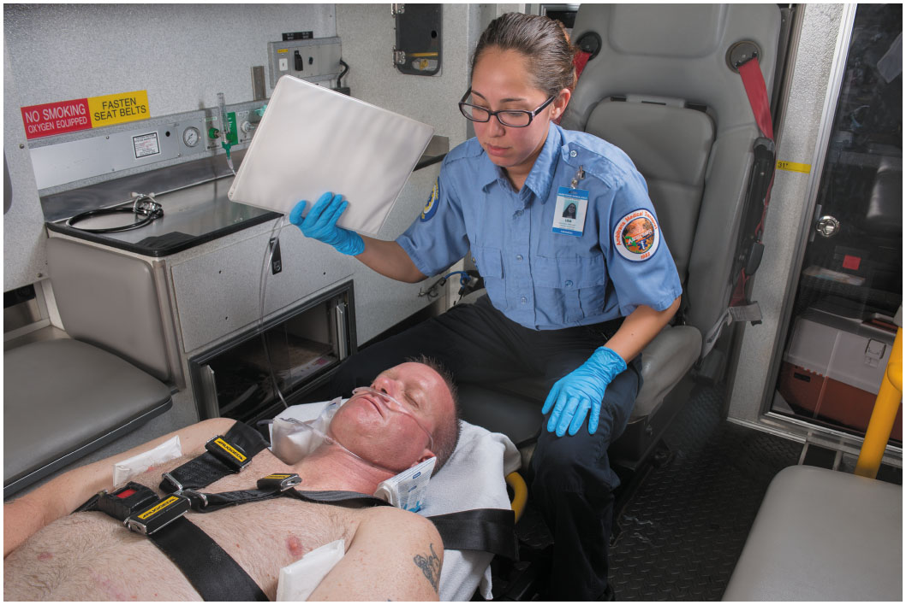
If the Skin Is Moist, Pale, and Normal to Cool, Place the Patient in a Cool Environment, Mist with Water or Apply Cold, Wet Compresses, and Fan to Promote Cooling
Notes:
Make sure they don’t get chilled to prevent shivering, which increases heat production.

Slide 74
Exposure to Heat (10 of 19)
Assessment-Based Approach – Heat-Related Emergency
  Emergency Medical Care for a Heat Emergency Patient with Moist, Pale, Normal-to-Cool Skin
    Place the patient supine; consider elevating the feet. Use lateral recumbent position if nauseated or vomiting.
    If the patient is alert and not nauseated, give cool water to drink.
Notes:
Consider raising the feet and legs 8 to 12 inches to improve blood circulation to the brain and other core organs by reducing pooling in the lower extremities. If the patient is nauseated or vomiting, place the patient in a lateral recumbent position.

Slide 75
Exposure to Heat (11 of 19)
Assessment-Based Approach – Heat-Related Emergency
  Emergency Medical Care for a Heat Emergency Patient with Moist, Pale, Normal-to-Cool Skin
    Give nothing by mouth if the patient has altered mental status or is vomiting.
    Make a transport decision.
Notes:
If the patient is fully responsive and is not nauseated, have them drink cool water. Consult with medical direction and follow local protocol. If the patient is unresponsive, has an altered mental status, or is vomiting, do NOT give fluids.

Slide 76
Exposure to Heat (12 of 19)
Assessment-Based Approach – Heat-Related Emergency
  Emergency Medical Care for a Heat Emergency Patient with Moist, Pale, Normal-to-Cool Skin
    Has A M S or known medical problems
    Is vomiting, nauseated, or refuses fluids
    Has a core temperature >100°Fahrenheit
    Does not respond to treatment
Notes:
Generally, a hyperthermic patient with moist, pale skin that is normal to cool in temperature needs transport when the patient displays any of the listed criteria.

Slide 77
Exposure to Heat (13 of 19)
Assessment-Based Approach – Heat-Related Emergency
  Emergency Medical Care for a Heat Emergency Patient with Hot Skin That Is Moist or Dry
    This is a dire emergency; cooling is the highest priority except airway, breathing, and circulation.
Notes:
Remove the patient from the source of heat and place them in a cool environment, such as an air conditioned room or ambulance. If nothing else, move the patient out of the sun and into the shade.

Slide 78
Exposure to Heat (14 of 19)
Assessment-Based Approach – Heat-Related Emergency
  Emergency Medical Care for a Heat Emergency Patient with Hot Skin That Is Moist or Dry
    Remove the patient from the hot environment.
    Remove as much of the patient’s clothing as possible.
    Maintain adequate oxygenation.
Notes:
If breathing is adequate, administer oxygen based on the SPO₂ reading and patient signs and symptoms. If the SPO₂ is 794 percent and no signs or symptoms of hypoxia, hypoxemia, poor perfusion, respiratory distress, or heart failure are present, oxygen might not be necessary. If signs of hypoxia, hypoxemia, respiratory distress, poor perfusion or heart failure are present or the SPO₂ is 694%, apply a nasal cannula at 2 lpm to achieve and maintain the SPO₂ at or above 94%. Provide positive pressure ventilation if needed.

Slide 79
Exposure to Heat (15 of 19)
Assessment-Based Approach: Heat-Related Emergency
  Emergency Medical Care for a Heat Emergency Patient with Hot Skin That Is Moist or Dry
    Begin immediate cooling.
      Pour tepid water over the patient.
      Cold packs in the groin, armpits, at each side of the neck, and behind the knees.
      Fan aggressively and keep the skin wet.
Notes:
Immediately begin to cool the patient. Generally, one method will not effectively cool the patient, so
use a combination of the listed techniques.

Slide 80
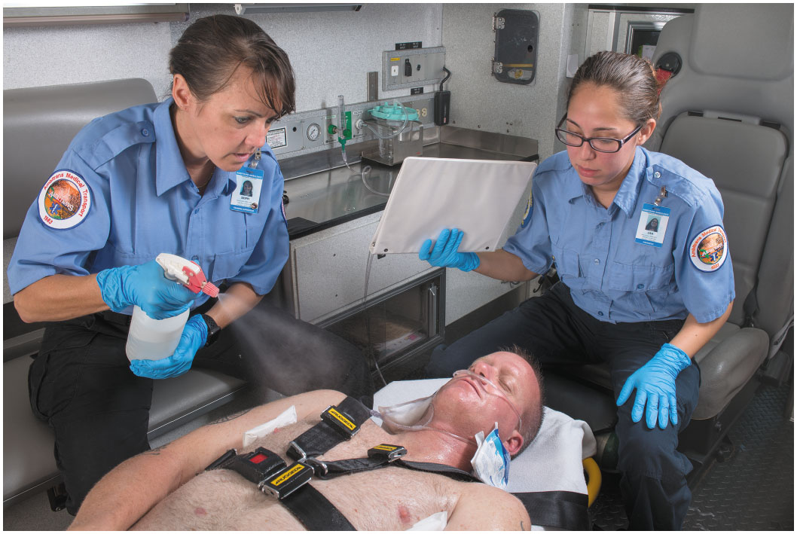
If the Skin Is Hot and Dry or Moist, Promote Cooling by Applying Cold Packs to the Groin, Neck, Armpits, and Backs of Knees; Fanning the Patient; and Spraying or Pouring Tepid Water over the Patient’s Body
Then wrap in a wet sheet and continue fanning.
Notes:
Generally, one method will not effectively cool the patient, so use a combination of the listed techniques.

Slide 81
Exposure to Heat (16 of 19)
Assessment-Based Approach – Heat-Related Emergency
  Emergency Medical Care for a Heat Emergency Patient with Hot Skin That Is Moist or Dry
    Be prepared for complications, such as seizures and aspiration.
    Transport immediately, continuing cooling methods.
Notes:
Transport immediately, continuing to administer oxygen and cooling methods during transport. Always transport a hyperthermic patient with hot skin that is moist or dry. Such a patient always needs further emergency care. Consider early ALS intercept.

Slide 82
Exposure to Heat (17 of 19)
Assessment-Based Approach – Heat-Related Emergency
    Emergency Medical Care for Heat Cramps
    Remove the patient from the hot environment.
    Consult medical direction about giving sips of low-concentration salt water or a commercial product.
Notes:
Consult medical direction before giving the patient sips of low-concentration salt water at the rate of one-half a glassful every 15 minutes. If possible, use a commercial product, such as Gatorade, with a low glucose content. Salt water is made by diluting one teaspoon of salt in one quart of water. Do not give the patient salt tablets.

Slide 83
Exposure to Heat (18 of 19)
Assessment-Based Approach – Heat-Related Emergency
    Emergency Medical Care for Heat Cramps
    Apply moist towels to the forehead and cramped muscles; try to stretch the muscles involved.
    Educate the patient about the event and advise avoiding exertion for 12 hours.
Notes:
Try to gently stretch the involved muscle groups. Some experts advise massaging the involved muscles if it does not cause additional pain. Consult with medical direction and follow local protocol.

Slide 84
Exposure to Heat (19 of 19)
Assessment-Based Approach – Heat-Related Emergency
  Reassessment
    Mental status
    Airway
    Breathing
    Circulation
    Vital signs (every 5 minutes)
    Treatment
Notes:
Closely reassess the airway and breathing. Be prepared to establish an airway and to provide positive pressure ventilation if breathing becomes inadequate, especially in patients with hot skin. Also, be prepared to manage seizures with such patients. The pulse can continue to weaken, or the rate can increase further. Correlate changes in the pulse rate with the patient’s mental status.

Slide 85
Exercise-Associated Hyponatremia (1 of 2)
Severe Electrolyte Imbalance
  Not a core temperature disorder
  Results from consuming large amounts of water during prolonged physical activity
  Results in cerebral edema or pulmonary edema
Notes:
Exercise-associated hyponatremia (EAH), also known as exertional hyponatremia and water intoxication, is associated with prolonged exercise or exertion; however, the pathophysiology of the condition is not from an increased body core temperature but from a depletion of sodium relative to water content and a severe electrolyte imbalance.

Slide 86
Exercise-Associated Hyponatremia (2 of 2)
Emergency Care
  Place patient in Fowler’s position.
  Place in left lateral recumbent position if unconscious.
  Prepare for projectile vomiting.
  Give no fluids.
  Be prepared for seizures.
Notes:
Mild EAH is associated with nausea, vomiting, headache, bloating, and edema to the hands, legs, and feet. The hallmark findings to assess for in EAH are a decrease in mental status, fatigue, headache, ill feeling, and nausea.

Slide 87
Case Study Conclusion (1 of 3)
The E M T s quickly determine that Stan is unresponsive, but that respirations and pulse are present. They immobilize Stan on a long backboard, with cervical collar in place, and move him into the ambulance before further assessment or treatment.
Once in the ambulance, Steve reassesses the airway and breathing, and decides to insert a nasopharyngeal airway and assist ventilations. At the same time, Seth removes Stan’s wet clothing and covers him with blankets.
Notes:
Case Study Discussion
Review case conclusion and emphasize the application of knowledge learned from this presentation.

Slide 88
Case Study Conclusion (2 of 3)
Seth puts the heat in the ambulance on high and continues a physical exam. He finds a hematoma on Stan's head, as well as abrasions on his hands, suggesting there may be injury in addition to cold exposure.
Without further delay, the E M T s begin transport, with Steve managing the airway and ventilations, and monitoring the patient’s pulse.
Notes:
Case Study Discussion
Review case conclusion and emphasize the application of knowledge learned from this presentation.

Slide 89
Case Study Conclusion (3 of 3)
At the hospital, it is determined that Stan’s core temperature is 89° Fahrenheit. Rewarming measures are implemented, as a thorough examination is performed. Although Stan’s blood alcohol level is elevated, his injuries appear to be minor. The nursing staff continues to monitor Stan carefully for complications of hypothermia and rewarming.
Notes:
Case Study Discussion
Review case conclusion and emphasize the application of knowledge learned from this presentation.

Slide 90
Bites and Stings (1 of 26)
Poisonous snakes include pit vipers and coral snakes.
Symptoms usually begin immediately if the bite is envenomated.
Pit viper bites are characterized by one or two puncture marks.
Notes:
Class Activity
Assign students to research the specific effects of a poisonous snake, insect, or marine animal indigenous to your area and write a brief report on it as homework.
Discussion Question
How are pit vipers distinguished from other snakes?
What are the general guidelines for treating snakebites?
Teaching Tip
If available, show preserved specimens of snakes, insects, or marine animals indigenous to your area.

Slide 91
Case Study 2 Introduction
Randy Wrask is on foot, cutting through an open space on the edge of the city, hoping to reach the bus stop in time so he can get out of the desert heat. As he walks by some sagebrush, he feels a sharp stinging at the same time he hears the rattler’s warning. Looking down, he sees two small puncture wounds just above his left ankle. “Oh, no!” he thinks, and pulls out his cell phone to call 911.
Notes:
Case Study
Present the Case Study Introduction provided in the PowerPoint slide set.
Lead a discussion using the case study questions provided on the subsequent slide(s).
The Case Study with discussion questions continues throughout the PowerPoint presentation.
Case Study Discussion
Use the case study content and questions to foreshadow the upcoming lesson content

Slide 92
Case Study 2
When E M T s arrive, what should their initial actions be?
What is the prehospital treatment for a snake bite?
Notes:
Case Study Discussion
Use the case study content and questions to foreshadow the upcoming lesson content. Gauge the students’ responses as a guide of how well-versed they are in this topic.

Slide 93
Bites and Stings (2 of 26)
Snakebite
  Poisonous snake characteristics:
    Large fangs (except the coral snake).
    Elliptical pupils.
    A pit between the eye and mouth.
    Blotches on the skin (coral snake is ringed).
    Large, triangular head.
Notes:
A poisonous snakebite is characterized by one or two distinct puncture wounds. The exception is the coral snake, which leaves a semicircular pattern with its teeth as it “chews” the skin.

Slide 94
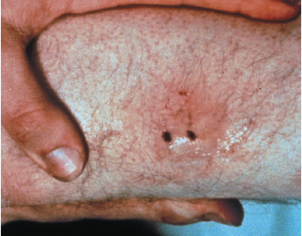
Typical Rattlesnake Bite
Notes:
Many people who venture into the outdoors fear the possibility of a snakebite. But, in fact, such bites are relatively uncommon, and the number of people who die from a snakebite each year is extremely small.

Slide 95
Bites and Stings (3 of 26)
Snakebite
  Envenomated pit viper bites cause signs and symptoms immediately.
  Coral snake bite effects can be delayed 1 to 8 hours
  Several factors affect the severity of the bite.
Notes:
The severity of a pit viper bite, depending on how much poison was injected, is gauged by how rapidly symptoms develop.

Slide 96
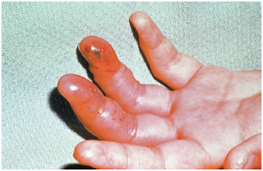
Snakebite to the Hand
Notes:
The severity of a pit viper bite, depending on how much poison was injected, is gauged by how rapidly symptoms develop.

Slide 97
Bites and Stings (4 of 26)
Snakebite
  Factors affecting snake bite severity.
    Amount of venom injected.
    Location of the bite.
    Presence of pathogens.
    Patient’s weight and size.
    Patient’s health.
    Amount of physical activity following the bite.
Notes:
The emergency medical care for snakebite is the same as general emergency medical care for other bites and stings.

Slide 98
Bites and Stings (5 of 26)
Insect Bites and Stings
  Most bites and stings are not serious, but severe allergic reactions can occur.
    Many people are allergic to the stings of bees, wasps, hornets, and yellow jackets.
  Localized signs and symptoms include sharp, stinging pain, itching, redness, tenderness, and swelling.
Notes:
Discussion Question
How are the effects of a black widow spider bite different from those of the brown recluse spider bite?

Slide 99
Bites and Stings (6 of 26)
Insect Bites and Stings
  Black Widow Spider
    I has a characteristic black body with red hourglass marking on the abdomen.
    Bite can be fatal.
    Extremes of age, chronic illnesses, and hypertension increase the risk of severe reaction.
Notes:
Black widow spider bites are the leading cause of death from spider bites in the United States.

Slide 100
Bites and Stings (7 of 26)
Insect Bites and Stings
  Black Widow Spider
    Black widow spider bites can cause:
      Initial pinprick sensation that becomes a dull ache.
      Severe muscle spasms.
      Rigid, board-like abdomen.
      Dizziness, nausea, and vomiting.
      Respiratory distress in severe cases.
Notes:
When treating patients with a black widow spider bite, you should usually provide general wound care and transport.

Slide 101
Bites and Stings (8 of 26)
Insect Bites and Stings
    Brown Recluse Spider
    It is characteristically brown with a darker violin-shaped mark on the back.
    The bite usually does not heal and may require surgical repair.
Notes:
Most brown recluse spider bite victims are unaware that they have been bitten because the bite is often painless at first. Several hours after the bite, it becomes bluish surrounded by a white periphery, and then a red halo or “bull’s-eye” pattern appears. Within 7 to 10 days, the bite becomes a large ulcer.

Slide 102
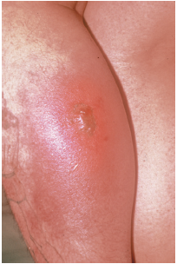
Wound from a Brown Recluse Spider Bite
Notes:
Within 7 to 10 days, the bite becomes a large ulcer.

Slide 103
Bites and Stings (9 of 26)
Insect Bites and Stings
  Scorpion
    Only one species in the U.S. produces bites that can be fatal.
    The severity depends on the amount of venom injected.
    Signs and symptoms can include sharp pain, drooling, poor coordination, incontinence, and seizures.
Notes:
Ninety percent of all scorpion stings occur on the hands.

Slide 104
Bites and Stings (10 of 26)
Insect Bites and Stings
  Fire Ant
    It has painful bite that produces fluid-filled vesicles.
    localized reaction can affect the entire extremity.
Notes:
Fire ant bites can also cause a large local reaction, characterized by swelling, pain, and redness that affect the entire extremity.

Slide 105
Bites and Stings (11 of 26)
Insect Bites and Stings
  Tick
    Ticks can carry tick fever, Rocky Mountain spotted fever, Lyme disease, and other diseases.
    Remove ticks promptly by pulling them out of the skin with tweezers
    Wash the wound with soap and water, and apply an antiseptic.
Notes:
Lyme disease, usually transmitted by the tiny deer tick but now thought sometimes to be

Slide 106
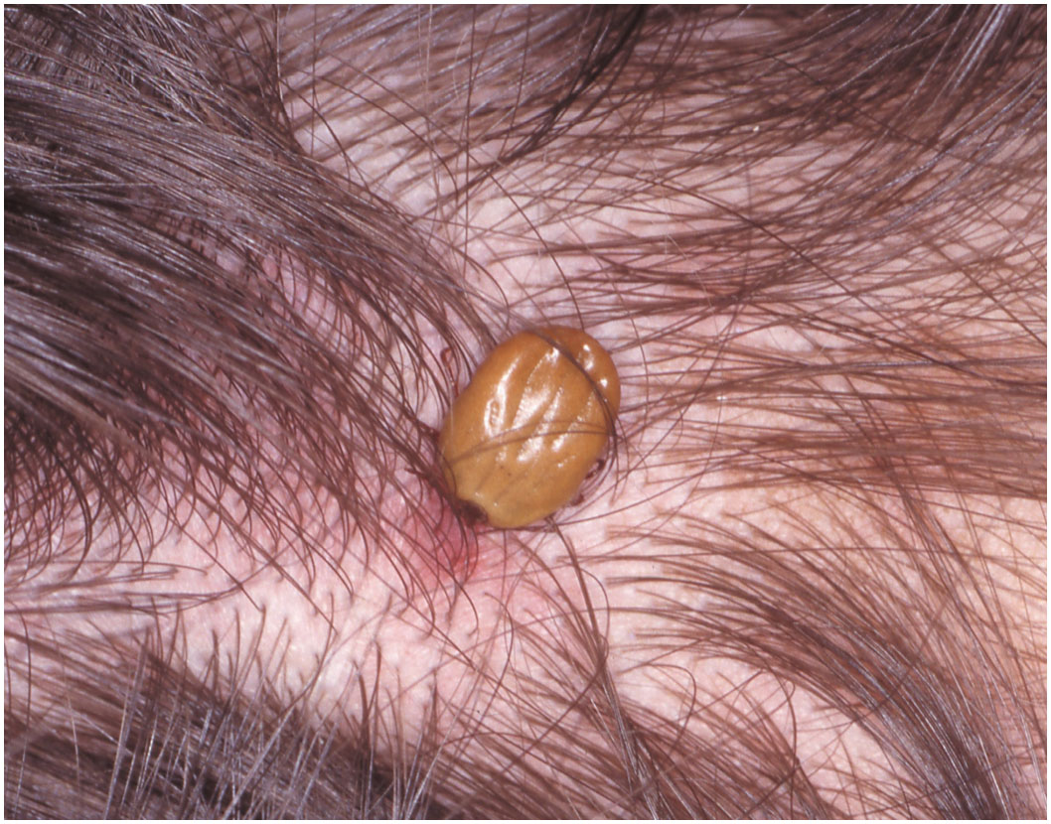
A Tick Embedded in the Scalp
(© Charles Stewart, M D, & Associates)
Notes:
The only appropriate prehospital treatment for a tick bite is prompt removal of the tick, which can help prevent infection. To remove a tick, use tweezers and grasp the tick as close as possible to the point where it is attached to the skin. Pull firmly and steadily until the tick is dislodged. Do not twist or jerk the tick because that can result in incomplete removal.

Slide 107
Bites and Stings (12 of 26)
Assessment-Based Approach – Bites and Stings
  Scene Size-Up
    Exercise caution to avoid the snake or insects.
    Look for clues to what may have caused the bite.
    Look and listen for swarming bees or hornets.
Notes:
Your priority during scene size-up should be to protect yourself and your partner. If your patient has been bitten or stung, you too might fall victim to bites and stings unless you exercise caution.
Knowledge Application
Given several descriptions of patients with bites or stings, students should be able to collect a relevant history and perform a physical examination.
Critical Thinking Discussion
Why is ice to be avoided in the treatment of a patient with a snakebite?

Slide 108
Bites and Stings (13 of 26)
Assessment-Based Approach – Bites and Stings
  Primary Assessment
    Form a general impression.
    Assess mental status.
    Be alert to signs of anaphylaxis when assessing the airway and breathing.
Notes:
Anaphylactic shock generally has a rapid and life-threatening effect on the airway and breathing.

Slide 109
Bites and Stings (14 of 26)
Assessment-Based Approach – Bites and Stings
  Secondary Assessment
    Look for signs and symptoms of anaphylactic shock and intervene immediately, as needed.
    Look for signs and symptoms of localized reactions, and treat similarly as injected poisons.

Slide 110
Bites and Stings (15 of 26)
Assessment-Based Approach – Bites and Stings
  Secondary Assessment
    Signs and symptoms of anaphylaxis.
      Hives and flushing.
      Upper airway obstruction.
      Faintness or dizziness.
      Generalized itching.
Notes:
Anaphylactic shock, a life-threatening medical emergency, can develop following bites or stings. If a patient develops signs and symptoms of this condition, perform the necessary emergency care and transport immediately.

Slide 111
Bites and Stings (16 of 26)
Assessment-Based Approach – Bites and Stings
  Secondary Assessment
    Signs and symptoms of anaphylaxis.
      Generalized swelling.
      Difficulty swallowing.
      Shortness of breath, wheezing, and stridor.
      Labored breathing.
      Abdominal cramps.
Notes:
Additional signs and symptoms of anaphylaxis:
Confusion.
Loss of responsiveness.
Convulsions.
Hypotension.

Slide 112
Bites and Stings (17 of 26)
Assessment-Based Approach – Bites and Stings
  Emergency Medical Care for Anaphylactic Shock
    Maintain a patient airway.
    Maintain adequate oxygenation.
    Assist ventilations if breathing is inadequate.
Notes:
If signs of hypoxia, hypoxemia, respiratory distress, poor perfusion, or heart failure are present or the SPO₂ is <94%, administer oxygen to achieve and maintain the SPO₂ at or above 94%. Provide positive pressure ventilation with supplemental oxygen at 10 to 12 per minute if breathing is (or becomes) inadequate.

Slide 113
Bites and Stings (18 of 26)
Assessment-Based Approach – Bites and Stings
  Emergency Medical Care for Anaphylactic Shock
    Administer epinephrine by auto-injector, if prescribed to the patient and approved by medical direction.
    Request A L S.
    Initiate early transport.
Notes:
Administer epinephrine with a prescribed auto-injector with permission from medical direction for patients with airway obstruction, wheezing, hypotension, or prior anaphylaxis.

Slide 114
Bites and Stings (19 of 26)
Assessment-Based Approach – Bites and Stings
  Signs and Symptoms of a Bite or Sting
    History of bite or sting
    Immediate, severe pain or burning; area may become numb
    Redness or discoloration
    Swelling
    Weakness or faintness
Notes:
History of a bite from a spider or snake, or a sting from an insect, scorpion, or marine animal.
Pain that is often immediate and severe or burning; within several hours the area can become numb.

Slide 115
Bites and Stings (20 of 26)
Assessment-Based Approach – Bites and Stings
  Signs and Symptoms of a Bite or Sting
    Dizziness
    Chills
    Fever
    Nausea, and vomiting
    Bite marks
    Stinger

Slide 116
Bites and Stings (21 of 26)
Assessment-Based Approach – Bites and Stings
  Emergency Medical Care for a Bite or Sting
    Remove the stinger by scraping.
    Wash the area.
    Remove jewelry or constricting objects.
    Lower the affected area below the heart.
    Apply a cold pack to insect bites (not snake or marine animal bites).
Notes:
Scrape in the direction of the base of the stinger to avoid breaking it off below the skin. Be careful not to squeeze the stinger with tweezers, forceps, or your fingers as doing so can force additional venom from the venom sac into the wound. Make sure you remove the venom sac because it can continue to secrete venom even though the stinger is detached from the insect.

Slide 117
Bites and Stings (22 of 26)
Assessment-Based Approach – Bites and Stings
  Emergency Medical Care for a Bite or Sting
    Follow medical direction concerning use of a constricting band for snake bites.
    Observe carefully for anaphylaxis.
    Keep patient calm and limit activity.
    Reassess.
Notes:
Some experts advise the use of a constricting band in the treatment of a snakebite, proximal to the bite. Consult medical direction and follow local protocols.

Slide 118
Bites and Stings (23 of 26)
Assessment-Based Approach – Bites and Stings
  Reassessment
    Monitor the patient’s airway, breathing, and circulation.
    Signs and symptoms of anaphylactic shock can take minutes to several hours to develop.
Notes:
Anaphylactic shock can take minutes to several hours to develop. You should be alert to its appearance and be prepared to provide the emergency medical care for this life-threatening condition.

Slide 119
Bites and Stings (24 of 26)
Marine Life Bites and Stings
  Most cases of marine poisoning occur when a person swims into or steps on an animal.
    Venom may cause extensive damage.
    Venom is destroyed by heat.
    Some effective antivenins are available.
      Try to identify the marine animal.
Notes:
The venom of marine life can cause more extensive tissue damage than that of land animals. Venoms of aquatic organisms are destroyed by heat; so heat should be applied to marine bites and stings.
Discussion Question
Why is the application of heat used in the management of marine animal bites and stings?

Slide 120
Bites and Stings (25 of 26)
Marine Life Bites and Stings
  Emergency Medical Care for Marine Life Poisoning
    Treat similarly as soft tissue injuries.
    Use forceps to remove material that stuck to the sting site, then irrigate with water.
    Do not attempt to remove embedded spines.
Notes:
In general, bites and stings inflicted by marine life should be treated the same as soft tissue injuries.

Slide 121
Bites and Stings (26 of 26)
Marine Life Bites and Stings
  Emergency Medical Care for Marine Life Poisoning
    For jellyfish, coral, hydra, or anemone, remove dried tentacles and pour vinegar over the area.
    Apply heat for 30 minutes or throughout transport.
Notes:
If the patient were stung by a jellyfish, coral, hydra, or anemone, carefully remove dried tentacles and pour vinegar on the affected area to denature the toxin. If meat tenderizer is available, sprinkle the area with it; doing so helps stop the stinging.

Slide 122
Click on the Item Below That Is Characteristic of Pit Vipers
A. Alternating bands of red, yellow, and black
B. Small, rounded head
C. Elliptical pupils
D. Small, rounded teeth instead of fangs

Slide 123
Lightning Strike Injuries (1 of 11)
Pathophysiology of a Lightning Strike Injury
  100 million to 2 billion volts per bolt
  Amperage as high as 200,000
  Duration of
  of a second
  Travels 1 to 2 million meters per second
  Contact temp is 15,000°Fahrenheit to 60,000°Fahrenheit.

Slide 124
Lightning Strike Injuries (2 of 11)
Pathophysiology of a Lightning Strike Injury
  Rapid expansion of air around the lightning bolt propels the person, causing blunt trauma.
  Changes in air pressure can damage the body’s air-containing cavities.

Slide 125
Lightning Strike Injuries (3 of 11)
Pathophysiology of a Lightning Strike Injury
  Four mechanisms of lightning strike injury:
    Direct strike.
    Contact strike.
    Splash or side flash strike.
    Ground current or step voltage strike.
Notes:
A direct strike carries the highest rate of injury and death. In a ground current, the farther the patient is from the strike, the less the injury and other effects suffered by the patient.

Slide 126
Lightning Strike Injuries (4 of 11)
Pathophysiology of a Lightning Strike Injury
  The heart and nervous tissue are sensitive to the electrical energy of lightning.
    Lightning can overwhelm and short circuit the body’s electrical system.
    Cardiac or respiratory arrest may occur.
Notes:
The heart muscle has properties of automaticity, which means that it can stimulate its own impulse without the help of the brain. What commonly happens in a lightning strike patient is that the heart begins to beat spontaneously on its own without any intervention; however, the inspiratory centers in the medulla of the brain remain dormant for a much longer time. Despite the patient’s heart resuming its beat and regaining a spontaneous pulse, the patient cannot yet begin to breathe on their own.

Slide 127
Lightning Strike Injuries (5 of 11)
Assessment of the Lightning Strike Patient
  Signs and Symptoms
    Nervous system:
      Altered mental status.
      Retrograde or anterograde amnesia.
      Weakness.
      Pain, tingling, and numbness.
      Pale, cool, clammy skin; possible mottling or cyanosis.

Slide 128
Lightning Strike Injuries (6 of 11)
Assessment of the Lightning Strike Patient
  Signs and Symptoms
    Nervous system:
      Temporary paralysis.
      Dizziness, and vertigo.
      Loss of pupillary function.
      Seizures.
Notes:
Abnormal nervous system findings can be due to head injury from blunt trauma and not the lightning strike.

Slide 129
Lightning Strike Injuries (7 of 11)
Assessment of the Lightning Strike Patient
  Signs and Symptoms
    Cardiac:
      Asystole, ventricular fibrillation.
      Irregular pulse.
    Respiratory:
      Respiratory distress.
      Apnea.

Slide 130
Lightning Strike Injuries (8 of 11)
Assessment of the Lightning Strike Patient
  Signs and Symptoms
    Skin.
      Burns.
      Feathering.
    Musculoskeletal.
      Dislocations.
      Fractures.
Notes:
Burns, most often superficial, partial-thickness and full-thickness burns are typically caused by metal heating up on the patient.
Linear burns appear as streaks down the body caused by sweat heating up on the skin.
Feathering is not a true burn; it appears as a nonblanching, reddish brown fern pattern (Lichtenberg lines).
Punctuate burns appear similar to cigarette burns.
Thermal burns can occur if the clothing catches fire
Various unusual patterns.

Slide 131
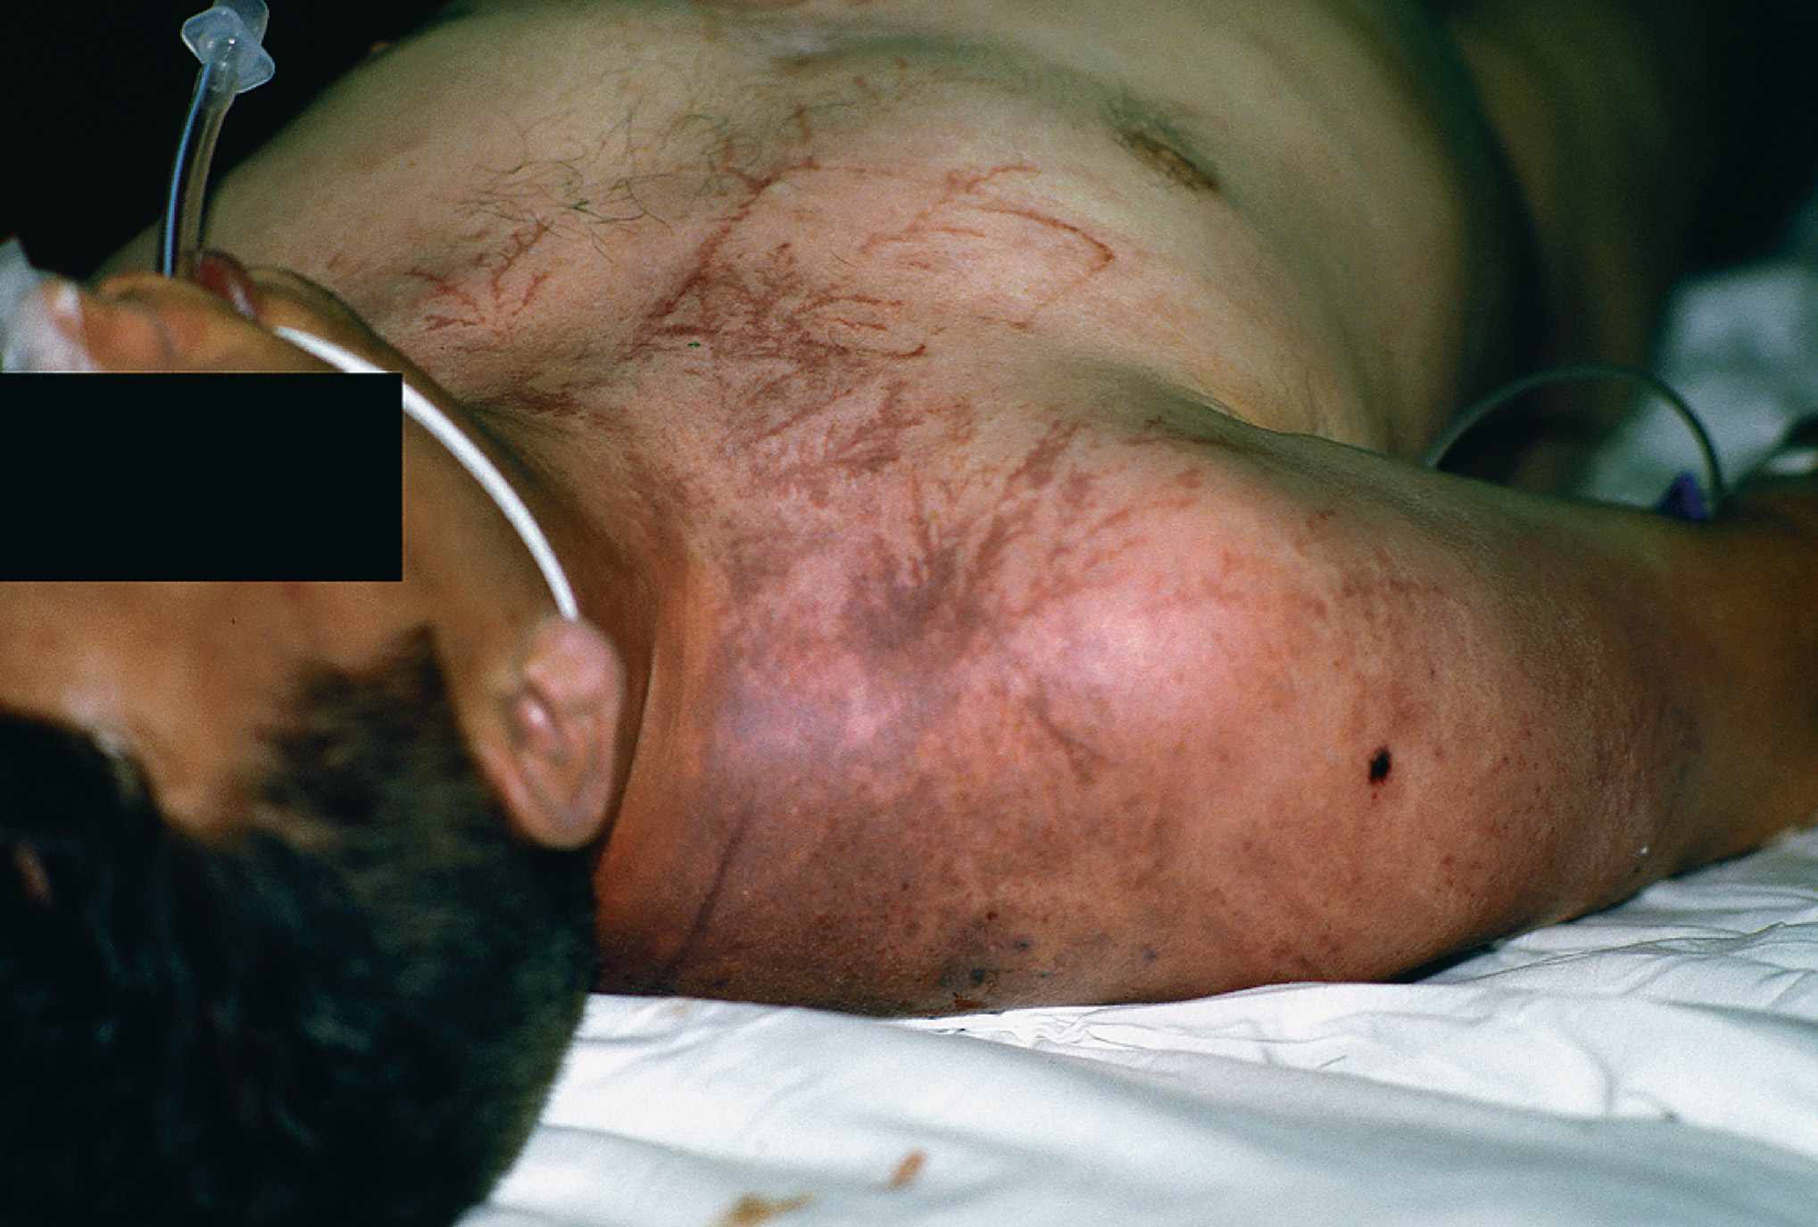
A Feathering Pattern on the Skin Resulting from a Lightning Strike
(© David Effron, M D)
Notes:
Contrary to a common misconception, lightning injuries are not typically major burn injuries; however, superficial linear patterns (called Lichtenberg lines) are common.

Slide 132
Lightning Strike Injuries (9 of 11)
Assessment of the Lightning Strike Patient
  Signs and Symptoms
    Eye.
      Unequal pupils.
      Drooping eyelids.
    Ear.
      Ruptured eardrum.
      Tinnitus.
      Deafness.

Slide 133
Lightning Strike Injuries (10 of 11)
Emergency Care for the Lightning Strike Patient
  Focus on nervous system damage and possible cardiac dysrhythmias.
    Ensure the scene is safe.
    If the clothing is on fire, put it out.
    Establish in-line manual stabilization.
    If mental status is altered, open the airway.
Notes:
Discussion Question
What are the management priorities for a patient with a lightning strike?
Knowledge Application
Given a scenario of a lightning strike, students should be able to perform a scene survey, assess, and manage the patient.

Slide 134
Lightning Strike Injuries (11 of 11)
Emergency Care for the Lightning Strike Patient
  Begin C P R and apply the A E D for cardiac arrest.
    Apply positive pressure ventilation for inadequate breathing.
    Maintain oxygenation.
    Maintain complete spine motion restriction.
    Transport while continuously monitoring the patient’s condition.
Notes:
If the patient is in cardiac arrest, immediately begin CPR and attach the AED. Deliver defibrillation based on the analysis and prompts of the AED. Provide aggressive ventilation with a high concentration of oxygen.

Slide 135
High Altitude Sickness (1 of 13)
At high altitude, atmospheric pressure is decreased, which makes less oxygen available.
Decreased oxygen can aggravate pre-existing medical conditions.
Illness may occur even in healthy individuals at high altitude.
Notes:
Symptoms of altitude illness:
General ill feeling.
Loss of appetite.
Headache.
Disturbance in sleep.
Respiratory distress upon exertion.

Slide 136
High Altitude Sickness (2 of 13)
High altitude is >5,000 feet, but serious illness usually occurs at altitudes >8,000 feet, especially with rapid ascent.
Notes:
Discussion Questions
How can high altitude sickness be prevented?
What are the signs and symptoms of AMS?
What are the management priorities for a patient with high altitude sickness?

Slide 137
High Altitude Sickness (3 of 13)
Signs and symptoms include:
  General ill feeling.
  Loss of appetite.
  Headache.
  Sleep disturbance.
  Respiratory distress on exertion.
Notes:
High Altitude sickness can be prevented by ascending gradually, allowing the body time to acclimate, limiting exertion at high altitude, descending to a lower altitude to sleep, and eating a high-carbohydrate diet.

Slide 138
High Altitude Sickness (4 of 13)
Acute Mountain Sickness
  Acute mountain sickness occurs when there is rapid ascent to 6,600 feet or higher.
  Symptoms develop 6 to 24 hours after ascent.
  Symptoms can worsen if the person ascends higher.

Slide 139
High Altitude Sickness (5 of 13)
Acute Mountain Sickness
  Signs and Symptoms of A M S
    Weakness/Headache
    Nausea
    Shortness of breath
    Lightheadedness
    Loss of appetite
    Fatigue
    Difficulty sleeping

Slide 140
High Altitude Sickness (6 of 13)
Acute Mountain Sickness
  Signs and Symptoms of A M S
    Severe weakness
    Decreased urine output
    Vomiting
    Increased shortness of breath
    Altered mental status
Notes:
Acute mountain illness often resolves itself within 1 to 2 days if the patient does not ascend any higher.

Slide 141
High Altitude Sickness (7 of 13)
Acute Mountain Sickness
  Emergency Medical Care for A M S
    Primary care is descent to a lower altitude
    Oxygen may relieve signs and symptoms; S P O₂ of 90% is normal at high altitudes.
Notes:
An SPO₂ of 90% is often considered a normal SPO₂ reading, or the number to achieve during oxygenation to relieve hypoxia. Follow your local protocol.

Slide 142
High Altitude Sickness (8 of 13)
  High Altitude Pulmonary Edema (H A P E)
  Affects the lungs and gas exchange
  Can occur at >8,000 feet, but usually occurs at >14,500 feet
Notes:
Changes in the pressure of the pulmonary vessels cause fluid to be forced out of the capillaries and to collect in and around the alveoli. Children and men are more prone to HAPE.
Discussion Question
How does HAPE and HACE occur?

Slide 143
High Altitude Sickness (9 of 13)
  High Altitude Pulmonary Edema (H A P E)
  Signs and Symptoms of H A P E
    Shortness of breath at rest/cyanosis
    Cough
    Fatigue/Weakness
    Loss of appetite
    Tachypnea/Tachycardia
    Crackles or wheezing
    Headache
Notes:
Crackles or wheezing occurs in at least one lobe of the lung.

Slide 144
High Altitude Sickness (10 of 13)
  High Altitude Pulmonary Edema (H A P E)
  Emergency Medical Care for H A P E
    The best treatment is descent.
    Oxygen administration may relieve signs and symptoms.
Notes:
HAPE can take 36 to 72 hours to resolve with oxygen therapy alone.

Slide 145
High Altitude Sickness (11 of 13)
High Altitude Cerebral Edema (H A C E)
  Most cases occur at >12,000 feet.
  Collection of fluid within the brain tissue results in increased pressure within the skull.
Notes:
Knowledge Application
Given several descriptions of patients with high altitude disorders, students should be able to identify the problem and develop a treatment plan.
Critical Thinking Discussion
How do people who live at higher altitudes adjust physiologically to living with lower atmospheric pressure environments?

Slide 146
High Altitude Sickness (12 of 13)
High Altitude Cerebral Edema (H A C E)
  Signs and Symptoms of H A C E
    Severe headache
    Incoordination
    Nausea, and vomiting
    Altered mental status
    Seizures
    Coma
Notes:
Fluid in brain tissue increases the pressure within the skull and puts pressure on the brain.

Slide 147
High Altitude Sickness (13 of 13)
High Altitude Cerebral Edema (H A C E)
Emergency Medical Care for H A C E
  Descent to a lower altitude
  Supplemental oxygen, in some cases with positive pressure ventilation
Notes:
In severe cases, it can be necessary to provide positive pressure ventilation with oxygen connected to the ventilation device.

Slide 148
Case Study 2 Conclusion (1 of 3)
When the E M T s arrive, thankful for boots that reach above the ankle, they look and listen carefully as they approach Randy, and ask him if he saw where the snake went. Rather than begin secondary assessment and treatment in the open space, the E M T s feel it is safer to place Randy in the ambulance first.
Randy is positioned with his legs flat on the stretcher for the ride to the hospital.
Notes:
Case Study Discussion
Review case conclusion and emphasize the application of knowledge learned from this presentation.

Slide 149
Case Study 2 Conclusion (2 of 3)
The E M T caring for Randy obtains a history and complete set of vital signs, and places a dressing over the puncture wounds, which continue to ooze blood. He then notifies the receiving hospital, giving a description of the snake as Randy had described it to him.
Notes:
Case Study Discussion
Review case conclusion and emphasize the application of knowledge learned from this presentation.

Slide 150
Case Study 2 Conclusion (3 of 3)
Medical direction advises against a constricting band. By the time they reach the hospital, Randy’s left foot and ankle have begun to discolor, and are swollen. Fortunately, antivenin is immediately available.
Notes:
Case Study Discussion
Review case conclusion and emphasize the application of knowledge learned from this presentation.

Slide 151
Lesson Summary (1 of 3)
The body’s thermoregulation mechanisms normally keep the body temperature at 98.6°Fahrenheit.
When heat loss exceeds heat production, hypothermia results.
When heat gain exceeds heat loss, hyperthermia results.
Notes:
Follow-Up
Answer student questions.
Follow-Up Assignments
Review Chapter 24 Summary.
Complete Chapter 24 In Review questions.
Complete Chapter 24 Critical Thinking questions.
Assessments
Handouts.
Chapter 24 quiz.

Slide 152
Lesson Summary (2 of 3)
Cold-related emergencies include generalized hypothermia and local cold injuries.
Heat-related emergencies include heat cramps, heat exhaustion, and heat stroke.
Notes:
Class Activity
As an alternative to assigning the follow-up exercises in the lesson plan as homework, assign each question to a small group of students for in-class discussion.

Slide 153
Lesson Summary (3 of 3)
Lightning strikes may cause serious injury to the nervous and cardiovascular systems, as well as causing burns and blunt trauma.
Altitude sickness generally occurs at levels >8,000 feet.
An important part of treating altitude illness is to get the patient to a lower altitude.
Notes:
Teaching Tips
Answers to In Review questions are in the appendix of the text. Advise students to review the questions again as they study the chapter.

Slide 154
Correct! (1 of 2)
Convection warms air molecules in immediate contact with the skin. As wind speed increases, removing the warmed air and replacing it with cold air, heat loss increases as heat is lost to the colder air.
Click here to return to the program.

Slide 155
Incorrect (1 of 6)
Evaporation is the loss of heat associated with water on the skin’s surface. As the water evaporates, heat is dissipated into the air.
Click here to return to the quiz.

Slide 156
Incorrect (2 of 6)
Conduction is the transfer of heat from the body to surfaces it is in contact with.
Click here to return to the quiz.

Slide 157
Incorrect (3 of 6)
Radiation is the loss of heat to still air.
Click here to return to the quiz.

Slide 158
Correct! (2 of 2)
Pit vipers have large fangs, a large, triangular head, elliptical pupils, and a pit between the eye and mouth.
Click here to return to the program.

Slide 159
Incorrect (4 of 6)
Pit vipers have a blotchy pattern of markings on a solid background. Coral snakes have alternating bands of red, yellow, and black.
Click here to return to the quiz.

Slide 160
Incorrect (5 of 6)
Pit vipers have a large, triangular head.
Click here to return to the quiz.

Slide 161
Incorrect (6 of 6)
Pit vipers have fangs, although coral snakes have smaller teeth and do not have fangs.
Click here to return to the quiz.

Slide 162

Copyright

