Slide 1
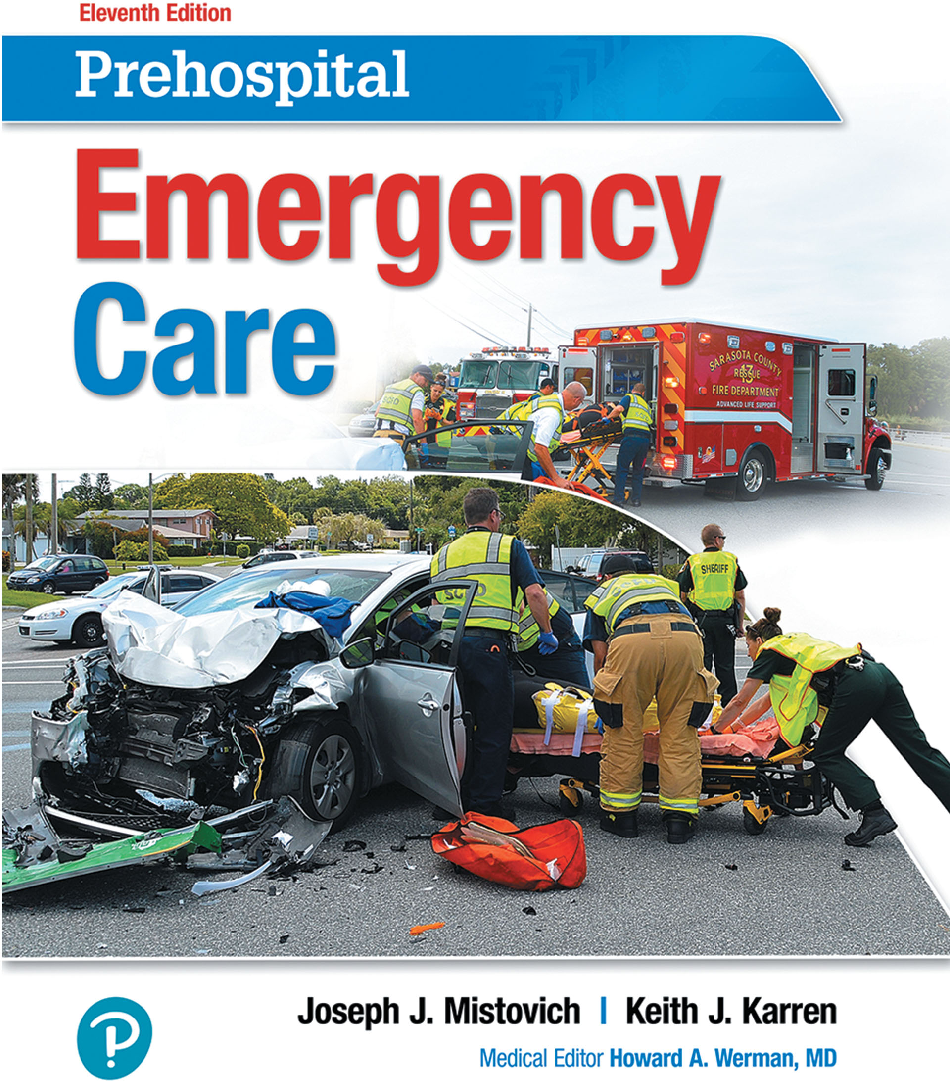
Prehospital: Emergency Care
Eleventh Edition
Chapter 23
Abdominal, Hematologic, Gynecologic, Genitourinary, and Renal Emergencies
Slides in this presentation contain hyperlinks. JAWS users should be able to get a list of links by using INSERT+F7
Copyright © 2018, 2014, 2010 Pearson Education, Inc. All Rights Reserved
Notes:
If this PowerPoint presentation contains mathematical equations, you may need to check that your computer has the following installed:
1) MathType Plugin
2) Math Player (free versions available)
3) NVDA Reader (free versions available)
Advance Preparation
Student Readiness
Assign the associated section of MyBRADYLab and review student scores.
Review the chapter material in the Instructor Resources, which includes Student Handouts, PowerPoint slides, and the MyTest Program.
Prepare
Make copies of course policies and procedures, the syllabus, handouts from the Instructor Resources, and other materials for distribution, or post them in your learning management system.
Preview the media resources and Master Teaching Notes in this lesson.
Preview the Case Study presented in the PowerPoint slides.
The total teaching time recommended is only a guideline. Take into consideration factors such as the pace at which students learn, the size of the class, breaks, and classroom activities. The actual time devoted to teaching objectives is the responsibility of the instructor.

Slide 2
Learning Readiness
E M S Education Standards, text p. 696.
Chapter Objectives, text p. 696.
Key Terms, text p. 696-697.
Purpose of lecture presentation versus textbook reading assignments.
Notes:
Explain to students what the National EMS Education Standards are. The National EMS Education Standards communicate the expectations of entry-level EMS providers. As EMTs, students will be expected to be competent in these areas. Acknowledge that the standards are broad, general statements. Although this lesson addresses the listed competencies, the competencies are often complex and require completion of more than one lesson to accomplish. The student is also expected to review the chapter objectives to foreshadow what will be in the chapter. By mastering the key terms the EMT student will better understand the learning and be able to communicate more clearly.
Additionally, explain to the students that the purpose of using these slides is to help keep the instructor focused on highlighting important portions of the material, explain interrelationships of topics, and discuss how to apply this information. It’s not the intent of the presentation (or slides alone) to include every component in the chapter. This presentation still requires the student to thoroughly read the chapter.

Slide 3
Setting the Stage
Overview of Lesson Topics
Acute Abdomen
Hematologic Emergencies
Gynecologic Emergencies
Genitourinary/Renal Emergencies
Notes:
These bulleted points are the major headings from the chapter, in order. The purpose is to provide a basic lecture navigation for the student.

Slide 4
Case Study Introduction
67-year-old Mary Hill began experiencing intermittent, abdominal pain and cramping around her umbilical area several hours ago, but the pain has since become more intense and steady, and more localized toward the right lower quadrant. She feels nauseated, and as if she might be developing a fever.
Notes:
Case Study
Present the Case Study Introduction provided in the PowerPoint slide set.
Lead a discussion using the case study questions provided on the subsequent slide(s).
The Case Study with discussion questions continues throughout the PowerPoint presentation.
Case Study Discussion
Use the Case Study content and questions to foreshadow the upcoming lesson content.

Slide 5
Case Study (1 of 4)
How concerning is the patient's chief complaint? Explain your answer.
What questions should you ask this patient?
What are the steps of physical examination for this patient?
Notes:
Case Study Discussion
Use the Case Study content and questions to foreshadow the upcoming lesson content. Gauge the student’s responses as a guide of how well versed they are in this topic.

Slide 6
Introduction (1 of 2)
Abdominopelvic pain has many causes, and can be caused by serious underlying conditions.
Care includes managing life threats, making the patient comfortable, and transport.
Hematologic disorders are disorders of the blood and its components.
Notes:
During this lesson, students will learn about assessment and emergency medical care for abdominal, hematologic, gynecologic, genitourinary, and renal emergencies.

Slide 7
Introduction (2 of 2)
Gynecologic emergencies can present with abdominopelvic pain and vaginal bleeding.
Some gynecologic emergencies can be life-threatening.
Renal disease is common, and E M T s commonly encounter patients undergoing dialysis.
Notes:
Regardless of the cause, in all cases of abdominopelvic pain, you must assess for and treat life-threatening conditions, make the patient as comfortable as possible, and get the patient to the hospital quickly.

Slide 8
Acute Abdomen (1 of 48)
Abdominal Structures and Functions
The abdominal cavity extends from the diaphragm to the pelvis.
The parietal peritoneum lines the abdominal cavity, and the visceral peritoneum is in contact with the organs.
Notes:
Points to Emphasize
The kidneys, ureters, pancreas, and abdominal aorta are retroperitoneal.
The abdomen can be divided into four quadrants or nine regions as reference points for assessment.
The abdomen contains hollow organs, solid organs, and vascular structures.
Teaching Tips
Draw the nine abdominal regions on the white board. Have students come up and write the names of the organs in their respective regions.
Discussion Questions
In what quadrant or region of the abdomen is the appendix located?
What is the location of the kidneys?
What are examples of solid organs in the abdominal cavity?

Slide 9
Acute Abdomen (2 of 48)
Abdominal Structures and Functions
Abdominal Quadrants and Regions
Organs can be located the intraperitoneal or retroperitoneal space.
The abdomen is divided into four quadrants for reference.
Notes:
The kidneys, ureters, pancreas, and abdominal aorta are in the retroperitoneal space.

Slide 10
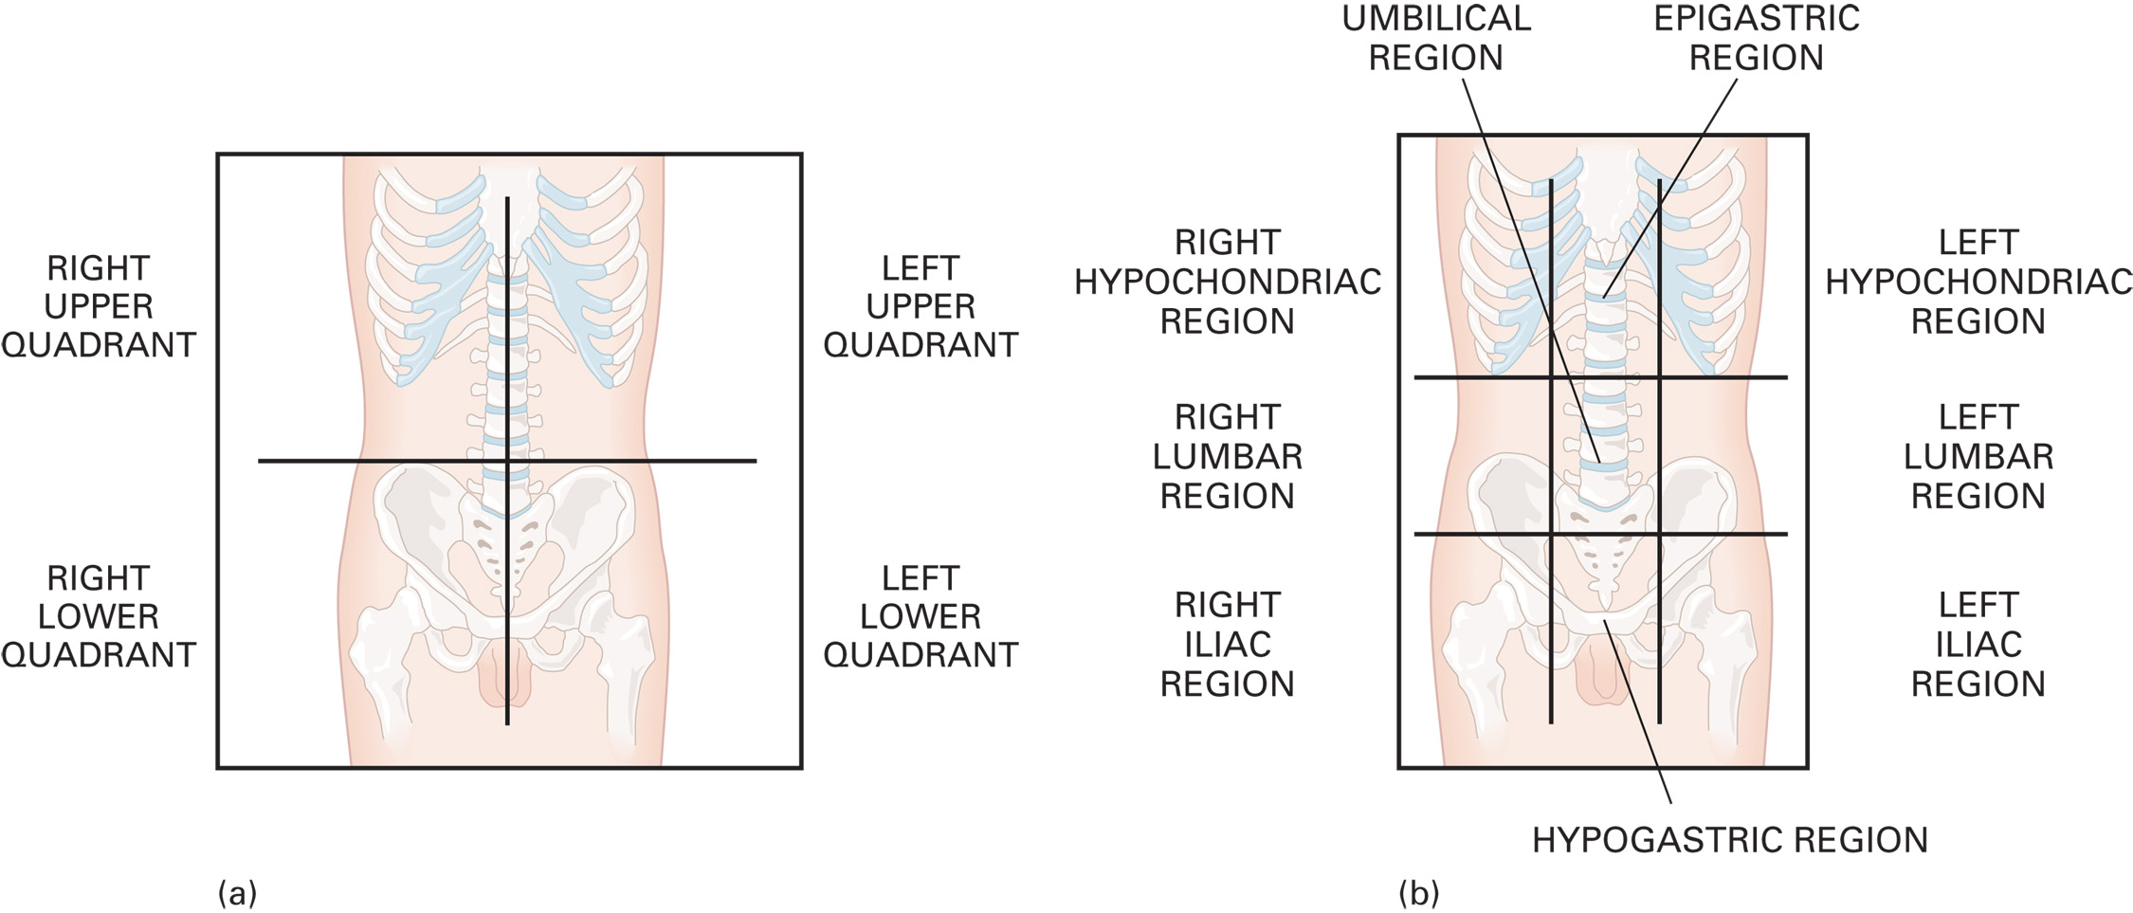
(a) Abdominal Quadrants and (b) Abdominal Regions
Notes:
Left upper quadrant (LUQ). Contains most of the stomach, the spleen, the pancreas, and part of the large intestine. The left kidney is behind the abdominal lining.
Right upper quadrant (RUQ). Contains most of the liver, the gallbladder, and part of the large intestine. The right kidney is behind the abdominal lining.
Right lower quadrant (RLQ). Contains the appendix (a worm-shaped structure extending from the beginning of the large intestine), part of the large intestine, and the female reproductive organs.
Left lower quadrant (LLQ). Contains part of the large intestine and the female reproductive organs.

Slide 11
Acute Abdomen (3 of 48)
Abdominal Structures and Functions
Types of Abdominal Structures
The abdominal cavity contains three types of structures:
Hollow organs
Solid organs
Vascular structures.
Notes:
Hollow organs contain some type of substance that might leak into the abdominal cavity if the organ is perforated or injured.
Solid organs are vascular; they contain many vessels and a large amount of blood. Some are covered by a thick fibrous capsule. When a solid organ is ruptured or injured, it tends to bleed, potentially leading to severe shock.
Vascular structures are the large blood vessels found in the abdominal cavity. Portions of the descending aorta and the inferior vena cava are in the abdominal cavity. Rupture or injury to either vessel can result in major bleeding, rapid blood loss, and a probable quick death.

Slide 12
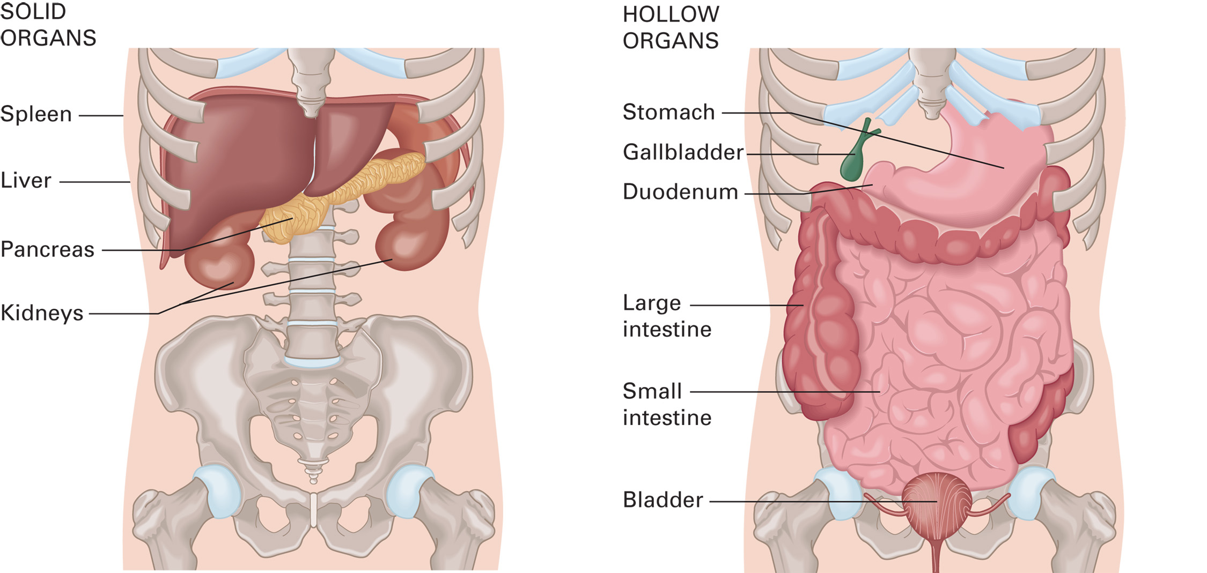
Organs in the Abdominal Cavity
Notes:
The functions of most of the organs contained in the abdomen involve the digestion of food, absorption of nutrients into the body, and excretion of wastes.

Slide 13
Table 23-1 Abdominal Structures
Hollow Organs | Solid Organs | Major Vascular Structures
Appendix | Kidneys | Abdominal aorta
Bladder | Liver | Inferior vena cava
Common bile duct | Ovaries | Blank
Fallopian tubes | Pancreas | Blank
Gallbladder | Spleen | Blank
Intestines | Blank | Blank
Stomach | Blank | Blank
Uterus | Blank | Blank
Ureters | Blank | Blank
Notes:
The abdominal cavity contains three types of structures: hollow organs, solid organs, and vascular structures.

Slide 14
Table 23-2 Organs of the Abdomen and Their Functions (1 of 2)
Stomach | A saclike, stretchable pouch located below the diaphragm that receives food from the esophagus (tubelike structure from the throat). The stomach enables digestion by secreting a specialized fluid to aid in the breakdown and absorption of food.
Duodenum | The first part of the small intestine that connects to the stomach.
Small intestine | A tubelike structure beginning at the distal end of the stomach and ending at the beginning of the large intestine. Its digestive function is to absorb nutrients from intestinal contents.
Large intestine | A tubelike structure beginning at the distal end of the small intestine and ending at the anus. It reabsorbs fluid from intestinal contents, enabling the excretion of solid waste from the body.
Liver | A large, solid organ located in the R U Q just beneath the diaphragm with a slight portion extending to the L U Q. It filters the nutrients from blood as it returns from the intestines, stores glucose (sugar) and certain vitamins, plays a part in blood clotting, filters dead red blood cells, metabolizes medications and toxins, and aids in the production of bile. The liver is proportionally larger in the pediatric patient.
Notes:
The functions of most of the organs contained in the abdomen involve the digestion of food, absorption of nutrients into the body, and excretion of wastes.

Slide 15
Table 23-2 Organs of the Abdomen and Their Functions (2 of 2)
Gallbladder | A pear-shaped sac that lies on the underneath right side of the liver. The gallbladder holds bile, which aids in the digestion of fats.
Spleen | An elongated, oval, solid organ located in the L U Q behind and to the side of the stomach. It aids in the production of blood cells as well as the filtering and storage of blood. The spleen is proportionally larger in the pediatric patient.
Pancreas | A gland composed of many lobes and ducts located in both the R U Q and L U Q, just behind the stomach. It aids in digestion and regulates carbohydrate metabolism.
Kidneys | Paired organs located behind the abdominal wall lining (retroperitoneal), one on each side of the spine. The kidneys excrete urine and regulate water, electrolytes, and acid–base balance.
Urinary bladder | A saclike structure that acts as a reservoir for the urine received from the kidneys.

Slide 16
Acute Abdomen (4 of 48)
Abdominal Pain
Pathophysiology of Abdominal Pain
Abdominal pain results from these mechanisms:
Stretching
Inflammation
Ischemia.
Notes:
Abdominal organ emergencies do not typically create a perception of “cutting” or “tearing.” The exception is the aorta, in which certain complications can cause a tearing sensation. However, it has been reported that a “tearing” complaint occurs in only a small number of patients experiencing a ruptured or dissected aorta. For the other abdominal viscera, if an organ is torn, the pain does not result from the tearing of the organ but from blood irritating the peritoneum.
Discussion Question
How is visceral abdominal pain different from somatic pain?
Critical Thinking Discussion
How could a problem elsewhere in the body, such as pneumonia, cause abdominal pain?

Slide 17
Acute Abdomen (5 of 48)
Abdominal Pain
Types of Abdominal Pain
Visceral pain arises from organ and can be:
Less severe
More generalized
Dull or aching
Constant or intermittent.
Notes:
Although the pain might not be severe, a serious condition can still exist. This is one of the most important lessons to learn from the differences in the types of pain. Mild and intermittent pain does not mean a mild or insignificant condition.

Slide 18
Acute Abdomen (6 of 48)
Abdominal Pain
Types of Abdominal Pain
Parietal Pain
Arises from the peritoneum
More severe
More localized
Sharp
Constant
Notes:
Parietal pain, also called somatic pain, is associated with the irritation of the peritoneal lining. Remember, the peritoneum has a larger number of highly sensitized nerve endings. Thus, you would expect the pain to be more severe and more localized (easier to point to with one finger). Parietal pain is more localized, intense, usually found on one side or the other, sharp, and typically constant.

Slide 19
Acute Abdomen (7 of 48)
Abdominal Pain
Types of Abdominal Pain
Referred Pain
Visceral pain that is felt somewhere other than the organ affected
Notes:
Referred pain is visceral pain (pain from an organ) that is not felt in the organ itself but instead is felt elsewhere in the body. The pain is usually poorly localized but is felt consistently in the part of the body to which it refers. Referred pain occurs when organs share a nerve pathway with a skin sensory nerve.

Slide 20
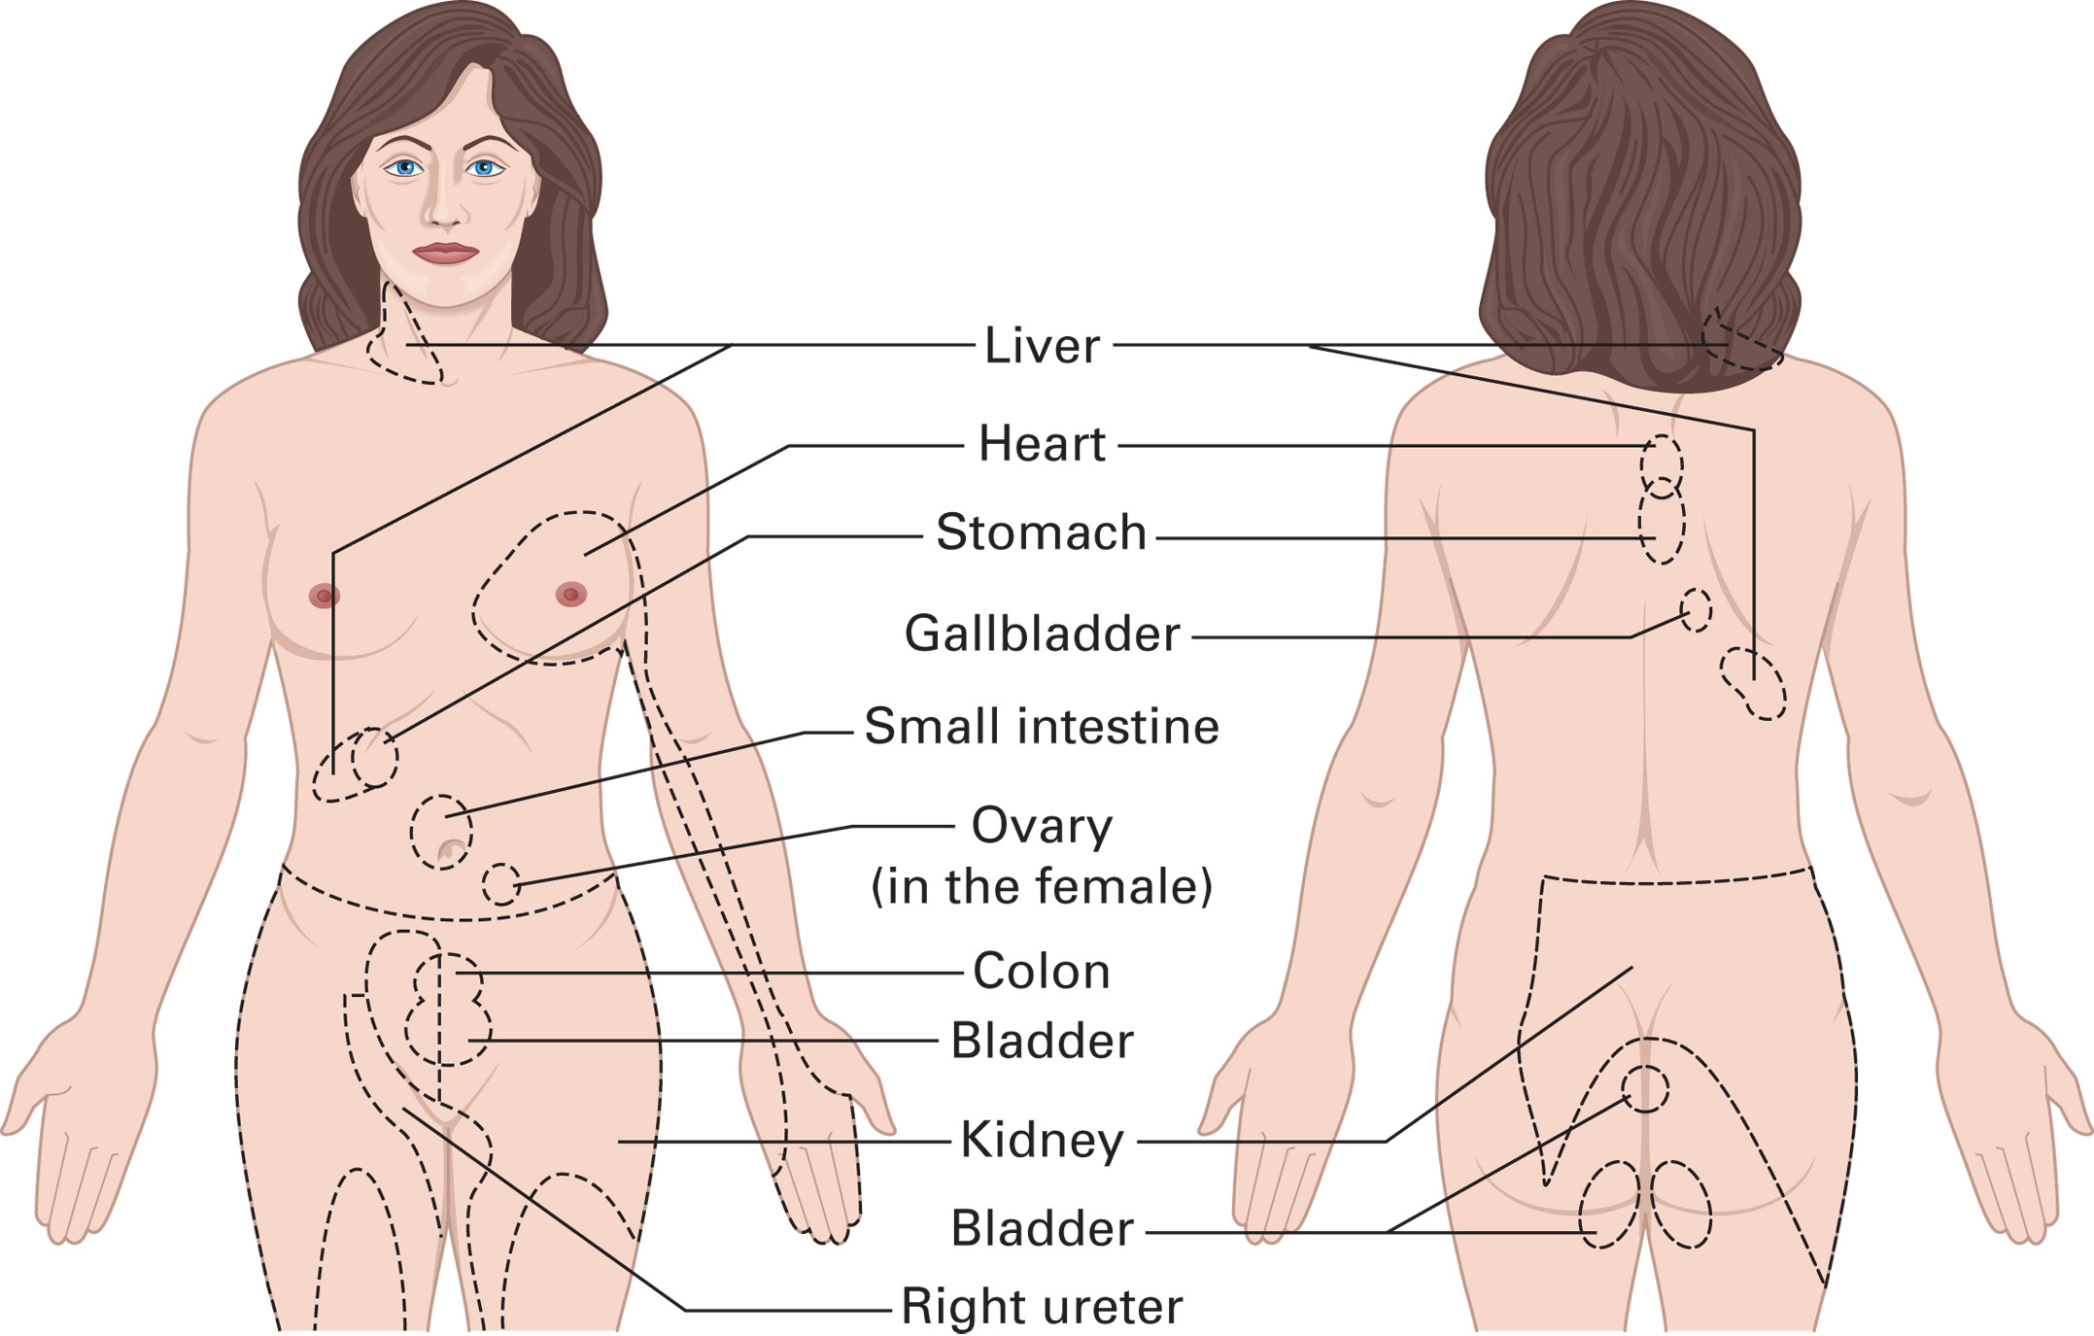
Sites of Referred Pain. The Lines Point to Locations Where Pain May be Felt When There is Disease of or Injury to the Named Organ
Notes:
The brain becomes confused in the interpretation of the impulse and causes the patient to feel pain at a location that can be totally unrelated to the organ involved.

Slide 21
Acute Abdomen (8 of 48)
Conditions That Can Cause Acute Abdominal Pain
There are several causes.
Hospital care is usually required.
Do not spend time at the scene trying to determine the exact cause.
Notes:
Discussion Questions
What is a positive Markle sign?
What are some typical complaints associated with pancreatitis?
What are causes of gastrointestinal bleeding?
Critical Thinking Discussion
What are some reasons gastrointestinal bleeding may not be diagnosed and treated promptly?

Slide 22
Table 23-3 Some Conditions That May Cause an Acute Abdomen
Peritonitis
Appendicitis
Pancreatitis
Cholecystitis
Gastrointestinal bleeding
Gastroenteritis
Peptic ulcer disease
Intestinal obstruction
Hernia
Abdominal aortic aneurysm
Notes:
Abdominal contents that are acidic or alkaline, that leak into the abdominal cavity, and irritate the peritoneum can produce a sudden onset of severe, sharp, and constant abdominal pain.

Slide 23
Acute Abdomen (9 of 48)
Conditions That Can Cause Acute Abdominal Pain
Peritonitis
Caused by peritoneal inflammation
Signs and symptoms include:
Abdominal pain or tenderness
Nausea, vomiting, diarrhea
Fever, chills
Lack of appetite
Positive Markle test.
Notes:
Peritonitis occurs when blood, pus, bacteria, or chemical substances leak into the peritoneal cavity. The onset and type of the abdominal pain that a patient experiences are somewhat dependent on the type of substance leaking into the peritoneum.
As an alternative to the rebound tenderness test, the Markle test has been shown to be just as reliable but without the number of false positives or negatives seen with the rebound tenderness test. For the Markle technique, instruct the patient to stand on their feet with their knees straight. Then ask them to raise themselves onto their toes and drop suddenly down on their heels, flat-footed, with enough force to produce an audible thump.

Slide 24
Acute Abdomen (10 of 48)
Conditions That Can Cause Acute Abdominal Pain
Appendicitis
Untreated, the tissue can die and rupture.
It is more common in children.
Definitive care is surgical.
Notes:
Appendicitis is an inflammation of the appendix that commonly causes an acute abdomen. Appendicitis is usually caused by a blockage in the intestines, and results in inflammation and irritation. If left untreated, the inflammation eventually causes the tissue to die and rupture.

Slide 25
Acute Abdomen (11 of 48)
Conditions That Can Cause Acute Abdominal Pain
Appendicitis
Signs and Symptoms
Periumbilical abdominal pain, localizing to the right lower quadrant
Nausea, vomiting
Low-grade fever, chills
Lack of appetite
Abdominal guarding/positive Markle sign

Slide 26
Acute Abdomen (12 of 48)
Conditions That Can Cause Acute Abdominal Pain
Pancreatitis
Signs and Symptoms
Pain, tenderness, distention; pain may radiate from the umbilicus to the back
Jaundice
Fever
Signs of shock
Notes:
Pancreatitis or (inflammation of the pancreas) can cause severe pain in the middle of the upper quadrants (epigastric area) of the abdomen. This abdominal pain sometimes radiates to the mid to lower back.

Slide 27
Acute Abdomen (13 of 48)
Conditions That Can Cause Acute Abdominal Pain
Cholecystitis
Associated with gallstones
Often occurs to patients between the ages of 30 and 50
More common in women
Without treatment, complications could occur.
Notes:
Inflammation of the gallbladder is commonly associated with the presence of gallstones. This condition rarely
occurs in children. In some cases of cholecystitis, the gallstones actually block the opening of the gallbladder to the small intestine. This blockage causes an increase in pressure inside the gallbladder, which can cause severe pain.

Slide 28
Acute Abdomen (14 of 48)
Conditions That Can Cause Acute Abdominal Pain
Cholecystitis
Signs and Symptoms
Upper middle to upper right quadrant abdominal pain
Tenderness of the right upper quadrant
Belching or heartburn
Nausea, vomiting
Notes:
Definitive care for this condition is hospitalization and sometimes surgical intervention to remove the gallbladder, stones, or blockage. If left untreated, tissue death, perforation, or pancreatitis can occur.

Slide 29
Acute Abdomen (15 of 48)
Conditions That Can Cause Acute Abdominal Pain
Gastrointestinal Bleeding
Can occur at any point in the gastrointestinal tract
Classified as upper or lower
Many causes, including ulcers, esophageal varices, diverticulosis
Notes:
Gastrointestinal bleeding most commonly affects people in their 40s to 70s, but children and younger adults can experience it, too.

Slide 30
Acute Abdomen (16 of 48)
Conditions That Can Cause Acute Abdominal Pain
Gastrointestinal Bleeding
Signs and Symptoms
Abdominal pain or tenderness
Hematemesis, Hematochezia, Melena
Altered mental status, weakness, syncope
Tachycardia
Shock
Notes:
Hematemesis - Vomiting blood, which can be bright red or look like coffee grounds
Hematochezia - Bright red blood in the stool, normally signifying a rapid onset
Melena -Dark tarry stools containing decomposing blood, normally from the upper gastrointestinal system

Slide 31
Acute Abdomen (17 of 48)
Conditions That Can Cause Acute Abdominal Pain
Esophageal Varices
Engorged, weakened veins in the esophagus
Commonly caused by heavy alcohol use or liver disease
Usually painless, but bleeding can be profuse
Airway management can be challenging.
Notes:
Caused by increased pressure in the venous blood supply system of the liver, stomach, and esophagus, known as portal hypertension.

Slide 32
Acute Abdomen (18 of 48)
Conditions That Can Cause Acute Abdominal Pain
Esophageal Varices
Signs and Symptoms
Large amounts of bright red hematemesis
No pain or tenderness in the abdomen
Rapid pulse
Difficulty breathing
Pale, cool, clammy skin; signs of shock
Jaundice
Notes:
Jaundice is yellowing of the skin or sclerae of the eyes from liver disease.

Slide 33
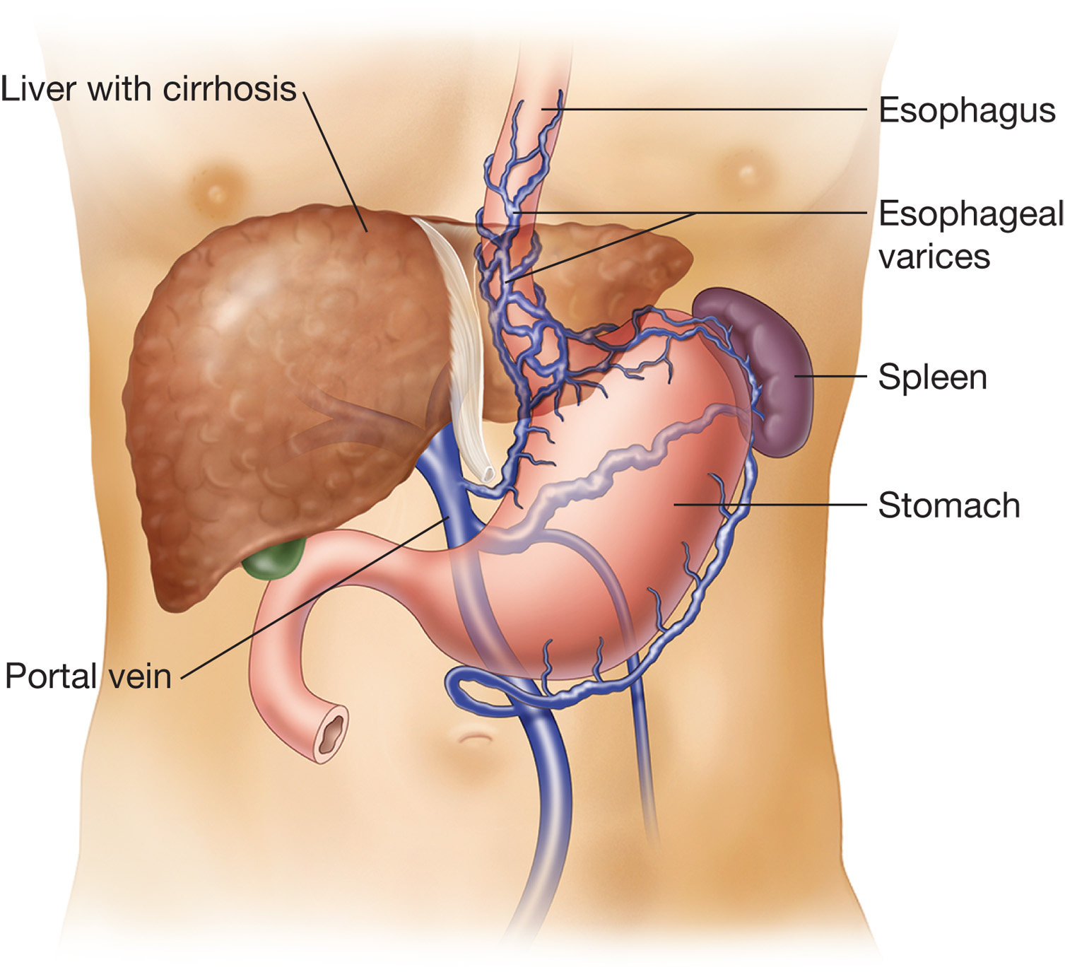
Esophageal Varices are Common to Heavy Alcohol Drinkers or Patients with Liver Disease
Notes:
Esophageal varices are usually identified with painless bleeding in the digestive tract. Bleeding can be profuse, leading to shock.

Slide 34
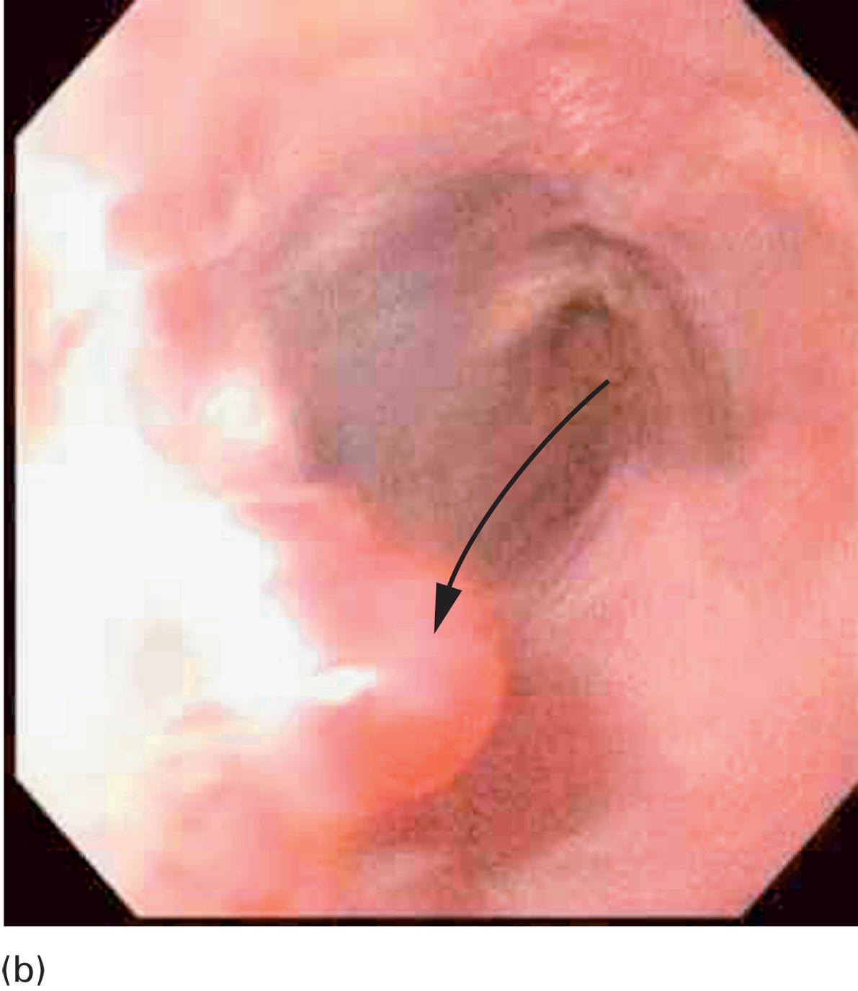
Endoscopic View of an Esophageal Varix
Notes:
Esophageal varices are caused by increased pressure in the venous blood supply system of the liver.

Slide 35
Acute Abdomen (19 of 48)
Conditions That Can Cause Acute Abdominal Pain
Gastroenteritis
May be chronic or acute
Often caused by infection
Notes:
Gastroenteritis is inflammation of the stomach and small intestines; it is commonly associated with the presence of abdominopelvic pain. This condition can be chronic or acute.

Slide 36
Acute Abdomen (20 of 48)
Conditions That Can Cause Acute Abdominal Pain
Gastroenteritis
Signs and Symptoms
Abdominal pain, cramping
Nausea, vomiting, diarrhea
Abdominal tenderness
Fever, dehydration
Signs of shock in severe cases
Notes:
If left untreated, it can result in the breakdown of the mucosal layers in the gastrointestinal tract. This breakdown can lead to dehydration, hemorrhage, ulceration, and perforation.

Slide 37
Acute Abdomen (21 of 48)
Conditions That Can Cause Acute Abdominal Pain
Ulcers
Open sores in the stomach or beginning of the small intestine
May result in bleeding or perforation
Notes:
Ulcers are associated with a breakdown of \the lining that normally protects the intestine from the digestive fluids contained inside the digestive tract. This breakdown can cause damage to the stomach or intestine and, in some instances, massive bleeding or perforation.

Slide 38
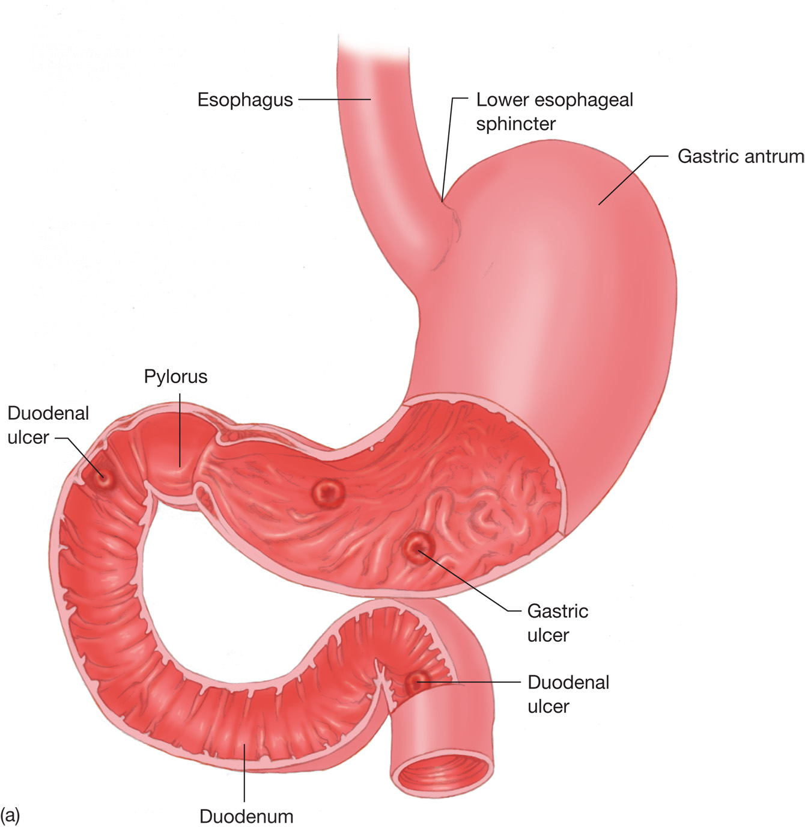
Ulcers Often Form in the Stomach or the Beginning of the Small Intestine
Notes:
This can result in hematemesis, hematochezia, or melena, depending on the location and severity of the bleed.

Slide 39
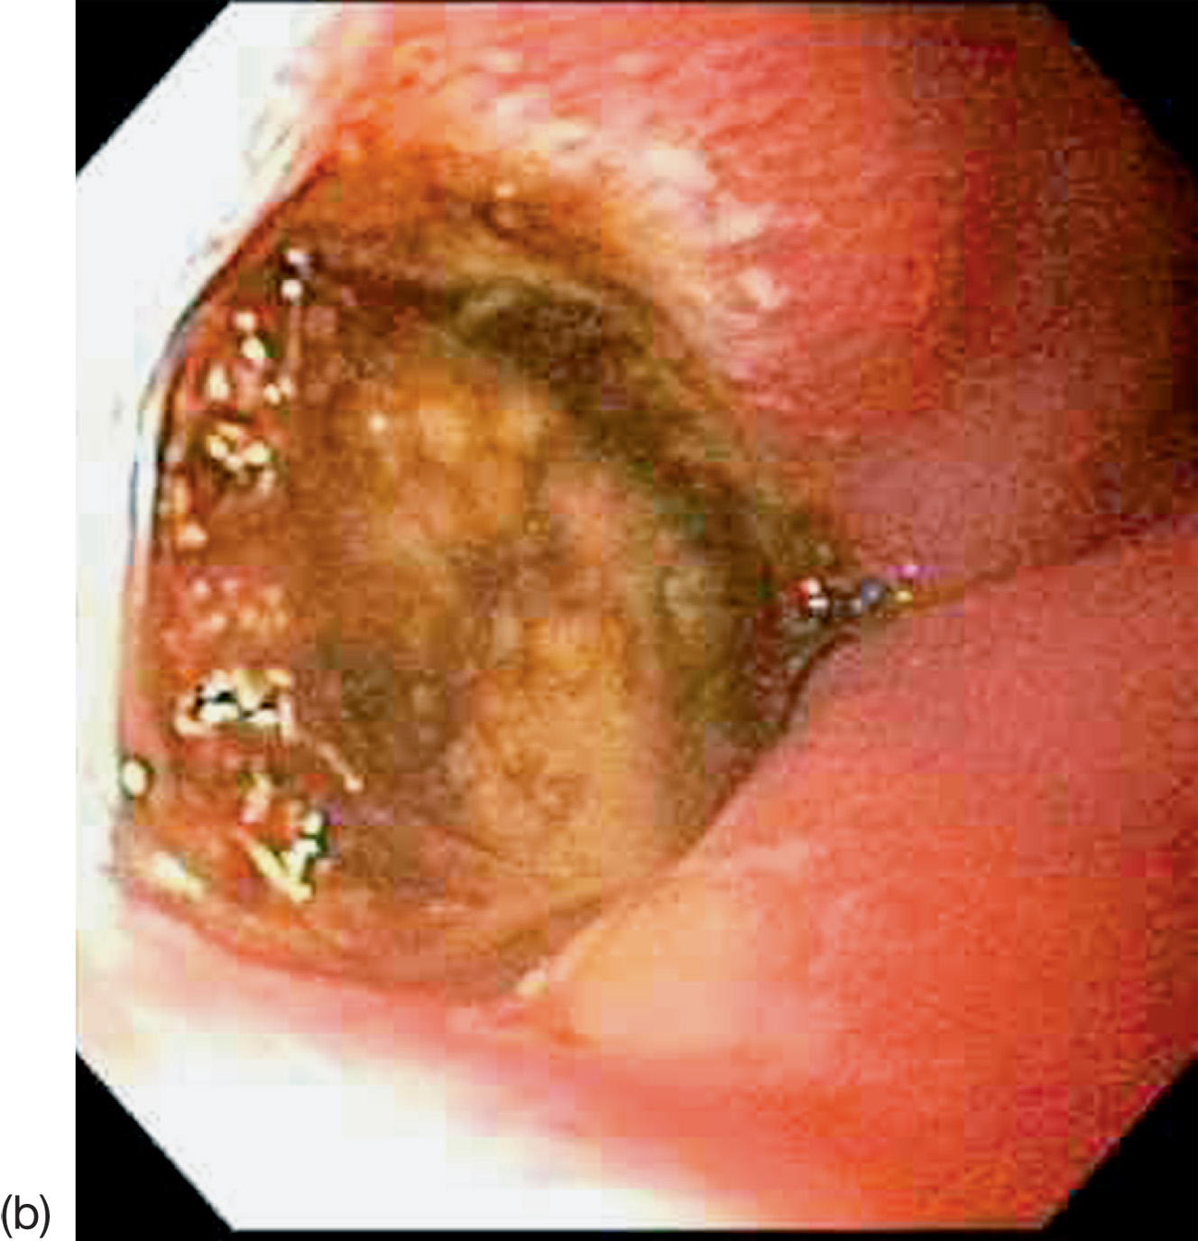
Endoscopic View of an Ulcer in the Small Intestine
Notes:
The type of abdominal pain is also affected by the location and severity of the ulcer.

Slide 40
Acute Abdomen (22 of 48)
Conditions That Can Cause Acute Abdominal Pain
Ulcers
Signs and Symptoms
Sudden onset of left upper quadrant or epigastric pain
Nausea, vomiting
Hematemesis, hematochezia, melena
Signs of shock in cases of severe bleeding
Peritonitis in cases of perforation
Notes:
Most patients are usually aware of their ulcers and provide you with this information during the history obtainment process. In some cases, the patient takes over-the-counter antacids or prescribed medications for this condition.

Slide 41
Acute Abdomen (23 of 48)
Conditions That Can Cause Acute Abdominal Pain
Intestinal Obstruction
May include small or large intestine
May result from tumors, fecal impaction, or adhesions
Untreated, may lead to sepsis, perforation, intestinal infarction, peritonitis
Notes:
An intestinal obstruction is a blockage that interrupts the normal flow of the intestinal contents within the intestines. This condition can occur in both the small and the large intestines, and can be either partial or complete.

Slide 42
Acute Abdomen (24 of 48)
Conditions That Can Cause Acute Abdominal Pain
Intestinal Obstruction
Signs and Symptoms
Abdominal pain
Nausea, vomiting
Constipation
Abdominal distention, tenderness
Prominent, high-pitched bowel sounds; diminished or absent bowel sounds
Notes:
The patient with an intestinal obstruction might want to continue to walk and move, whereas the patient with peritonitis might want to lie still and not be moved or touched.

Slide 43
Acute Abdomen (25 of 48)
Conditions That Can Cause Acute Abdominal Pain
Hernia
Protrusion of the intestine through an opening or weakness in the abdominal wall
Associated with increased pressure in the abdominal cavity
May become incarcerated
Notes:
Most hernias are not life threatening, and can be easily treated.

Slide 44
Acute Abdomen (26 of 48)
Conditions That Can Cause Acute Abdominal Pain
Hernia
Signs and Symptoms
Abdominal pain with lifting or straining
Fever
Rapid pulse
Tender mass at site of hernia
Signs and symptoms of intestinal obstruction
Notes:
In some cases, hernias can become incarcerated or strangulated, causing the portion of the intestine to be pinched or cut off, producing obstruction.

Slide 45
Acute Abdomen (27 of 48)
Conditions That Can Cause Acute Abdominal Pain
Abdominal Aortic Aneurysm (A A A)
Weakened, ballooned area of aorta
May rupture
Most common in men over 60
Notes:
Aneurysm can eventually rupture, and is one of the most lethal causes of abdominal pain.

Slide 46
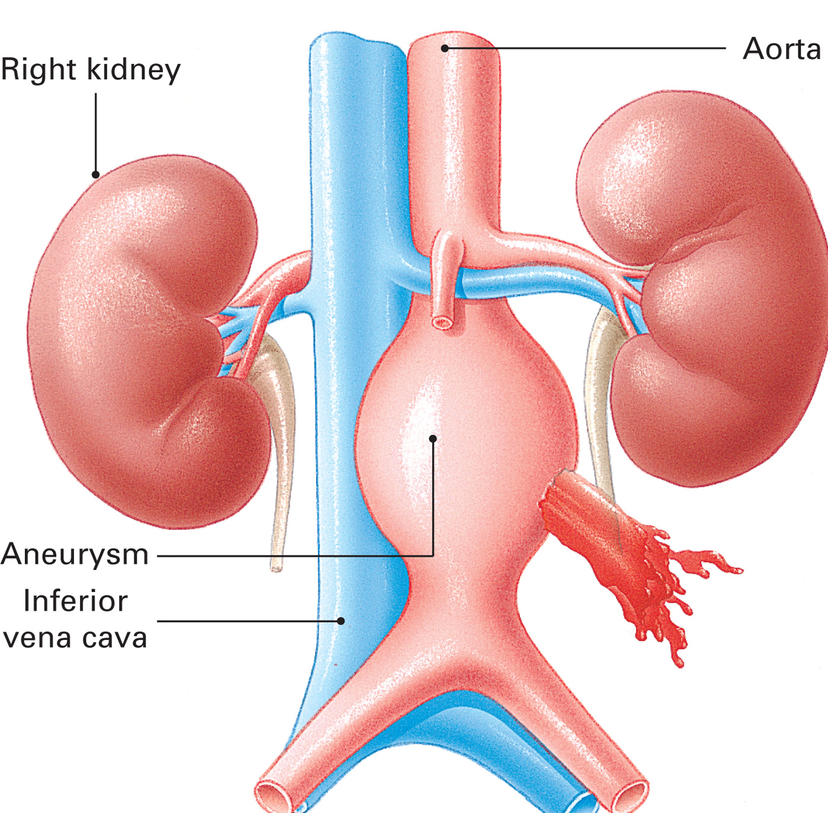
Abdominal Aortic Aneurysm
Notes:
An abdominal aortic aneurysm (AAA) is a weakened, ballooned, and enlarged area of the wall of the abdominal aorta.

Slide 47
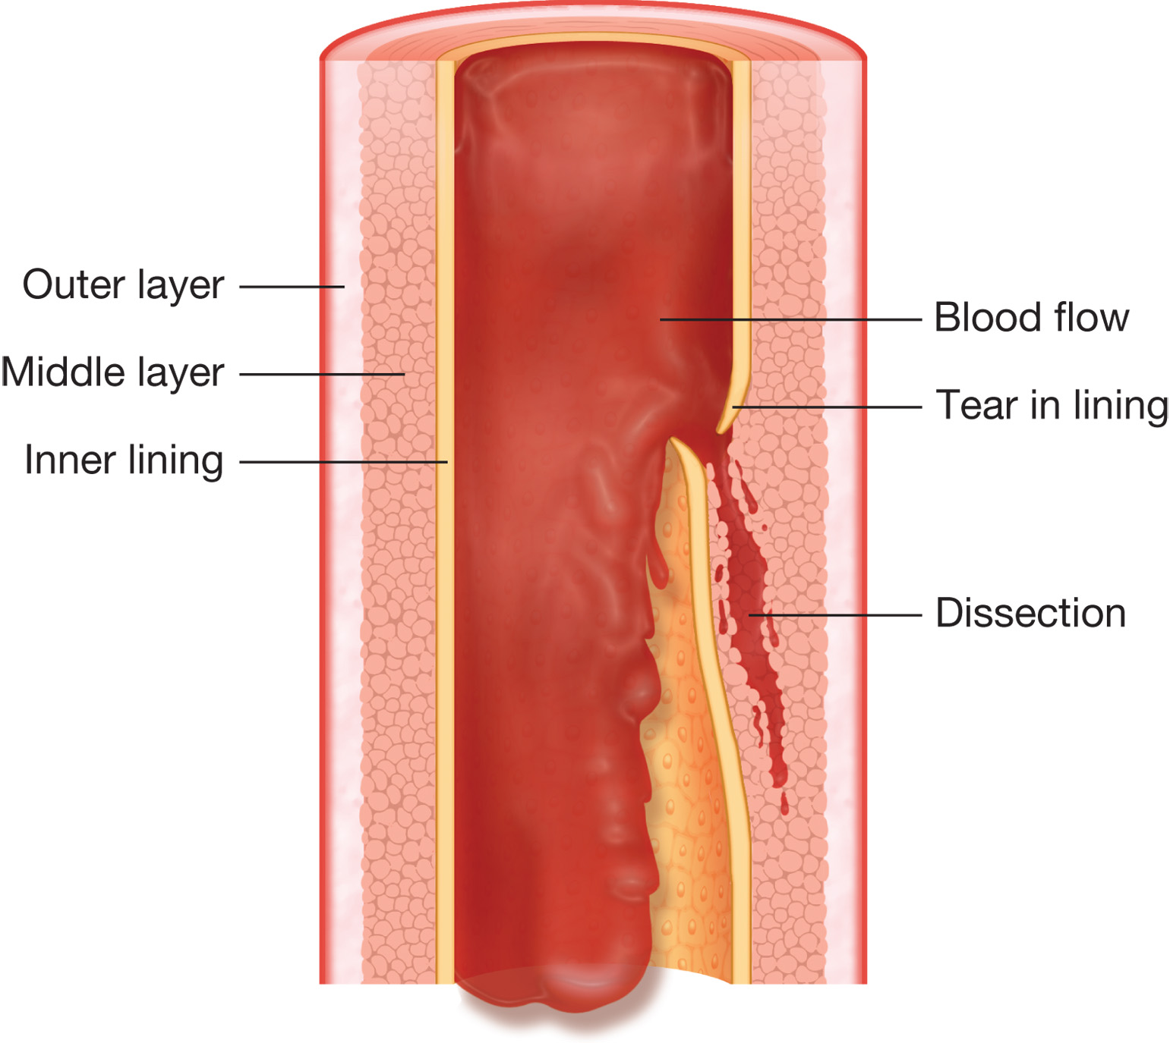
Aortic Dissection
Notes:
Another condition involving the aorta is an aortic dissection or a dissecting aorta, which begins with a small tear of the inner vessel structure, which enabling blood to leak between the walls of the aorta.

Slide 48
Acute Abdomen (28 of 48)
Conditions That Can Cause Acute Abdominal Pain
Abdominal Aortic Aneurysm (A A A)
Signs and Symptoms
Gradual onset of lumbar, groin, and abdominal pain
With rupture, sudden onset of severe, constant pain of the lower back, flank, or pelvis; described as “tearing”
Testicular pain
Notes:
The process of dissection continues with increasing pressure until, the outer wall is damaged and blood leaks out behind the peritoneum or into the abdominal cavity.

Slide 49
Acute Abdomen (29 of 48)
Conditions That Can Cause Acute Abdominal Pain
Abdominal Aortic Aneurysm (A A A)
Signs and Symptoms
Nausea, vomiting
Mottled or spotty abdominal skin
Pale, cool, clammy, cyanotic skin in legs
Absent/decreased femoral or pedal pulses
Skin below the waist may be cyanotic, cold, mottled.
Notes:
If you suspect a patient has an abdominal aortic aneurysm, do not palpate the abdomen. Pressure or excessive movement can aggravate the aneurysm, causing it to leak or rupture.

Slide 50
Acute Abdomen (30 of 48)
Conditions That Can Cause Acute Abdominal Pain
Abdominal Aortic Aneurysm (A A A)
Do not palpate the abdomen.
Do not continue to palpate a pulsating mass.
Assess for shock.
Transport the patient without delay.
Notes:
A pulsating mass may be felt; abdomen may be rigid and tender if rupture has occurred. Assessment for shock is crucial. Transport without delay. If the rupture is in the process of occurring, this is a true emergency.

Slide 51
Acute Abdomen (31 of 48)
Conditions That Can Cause Acute Abdominal Pain
Vomiting/Diarrhea/Constipation
Associated with many acute abdominal disorders
Can cause abdominal pain
May lead to dehydration serious enough to cause shock.
Notes:
The EMT should be concerned when diarrhea has persisted for days, (hours in the case of vomiting), and the patient has become dehydrated.

Slide 52
Acute Abdomen (32 of 48)
Considerations in Special Populations with Abdominal Pain
Pediatrics
Questions – Infants or Small Children
Has the child been more irritable than normal recently?
Can you console the child when they are crying or upset?
Has the child had poor feeding habits recently?
Notes:
Young pediatric patients, especially infants, cannot effectively describe their specific symptoms. Therefore, you need to collect as much of the history as you can from the parent or primary caregiver.
It is important for EMS to transport any child suspected of having abdominal pain, even if the vital signs appear to be within normal limits for that child’s age.

Slide 53
Acute Abdomen (33 of 48)
Considerations in Special Populations with Abdominal Pain
Elderly (Geriatric)
Have decreased perception of abdominal pain
May wait longer to seek medical care
Immunocompromised Patients
Have a poor inflammatory response to abdominal conditions
Notes:
When conducting a history on immunocompromised patients, it is important to ask about fever, vomiting, diarrhea, similar episodes in the past, and any recent changes in medications or treatment. Be sure to ask any transplant patient about the date and location of the surgery.

Slide 54
Acute Abdomen (34 of 48)
Considerations in Special Populations with Abdominal Pain
Bariatric Surgery Patients
Are at risk for ulcers, perforations, and obstruction of the bowel
Notes:
Within one year of surgery, 20 percent of post-bariatric-surgery patients are admitted to the hospital; within three years, 40 percent are hospitalized. Abdominal complaints in post-bariatric-surgery patients could be an indication of a serious condition.

Slide 55
Click on the Term that is Used to Describe an Inflammation of the Gallbladder
A. Cholecystitis
B. Peritonitis
C. Gastroenteritis
D. Varices

Slide 56
Acute Abdomen (35 of 48)
Assessment-Based Approach – Acute Abdomen
Assume the problem is potentially life-threatening.
Low blood pressure, syncope, and pale, cool clammy skin associated with abdominal pain indicates a serious condition.
Abdominal pain lasting more than 6 hours is an emergency.
Notes:
Points to Emphasize
Abdominal pain lasting longer than 6 hours, regardless of intensity, is considered a medical emergency.
Assess the patient with an abdominal emergency for signs of shock.
Palpate the least painful area of the abdomen first.
Movement of the diaphragm may increase abdominal pain, causing shallow breathing.
Allow the patient to assume a position of comfort for transport.
Discussion Question
What are the management priorities for patients with acute abdominal pain?

Slide 57
Acute Abdomen (36 of 48)
Assessment-Based Approach – Acute Abdomen
Scene Size-up
Take Standard Precautions.
Look for a mechanism of injury.
Look for indications of bleeding, vomiting, or medications used to relieve abdominal pain.
Notes:
Class Activities
Divide students into small groups. Provide individual students in each group with an index card listing a cause of abdominopelvic pain. Instruct students not to share the information on the cards with their classmates. Ideally, each student will have a card, but at least one student in each group must have a card. Students will spend time researching the presentation of their condition, and will develop a complaint and a history to be elicited by the other students in their group. The other students must obtain a history to determine their classmate's condition. Students will then discuss how well the complaints and history matched the condition.
Provide ample opportunity for students to practice skills.
Knowledge Application
Given a series of scenarios of patients complaining of abdominal pain, students should be able to develop an index of suspicion for the cause and provide appropriate management for the patient.

Slide 58
Acute Abdomen (37 of 48)
Assessment-Based Approach – Acute Abdomen
Primary Assessment
Form a general impression.
Patients with abdominal pain may assume a guarded position.
Ensure an open airway.
Be alert for vomiting.
Assist ventilations if they are inadequate.
Notes:
A person with an acute abdomen generally appears ill and assumes a guarded position with his knees drawn up and his hands clenched over his abdomen.

Slide 59
Acute Abdomen (38 of 48)
Assessment-Based Approach – Acute Abdomen
Primary Assessment
Check the circulation.
Pulse
Skin color, temperature, condition
Notes:
Shock is only one indicator that this is a serious medical emergency. The patient with an acute abdomen should be categorized as a priority for transport if they meet any of the following criteria:
Poor general appearance
Unresponsive
Responsive but not following commands
Signs of shock (hypotension, narrow pulse pressure, tachycardia, pale cool skin)
Severe pain

Slide 60
Acute Abdomen (39 of 48)
Assessment-Based Approach – Acute Abdomen
Primary Assessment
Categorize the patient as high priority if they exhibit any of the following:
Poor general appearance
Unresponsive
Responsive, not following commands
Shock
Severe pain
Notes:
Look for signs of shock (hypoperfusion): a rapid, thready pulse; restlessness; cool, clammy skin; and as a late sign, falling blood pressure.

Slide 61
Acute Abdomen (40 of 48)
Assessment-Based Approach – Acute Abdomen
Secondary Assessment
Ask the following:
O P Q R S T questions
If the patient has any allergies
If there is a past history of abdominal problems
When the patient last ate or drank
Notes:
If the patient is responsive, first conduct the history. If the patient is unresponsive or has an altered mental status and cannot respond appropriately, conduct the history after the physical exam and vitals, gathering information from family or bystanders.

Slide 62
Acute Abdomen (41 of 48)
Assessment-Based Approach – Acute Abdomen
Secondary Assessment
Ask the following:
Has the patient’s appetite changed?
What was the color of the patient’s last stools?
Has the patient had difficulty urinating?
What was the patient doing when the distress started?
Notes:
If more than one EMT is on the scene, the physical exam can be conducted, and baseline vital signs can be obtained by one EMT while the other EMT collects the history.

Slide 63
Acute Abdomen (42 of 48)
Assessment-Based Approach – Acute Abdomen
Secondary Assessment
Inspect the abdomen.
Palpate the abdomen in all four quadrants.
Begin palpating with the least painful area.
Notes:
Note any involuntary guarding: an abdominal wall muscle contraction that the patient cannot control, resulting from inflammation of the peritoneum.

Slide 64
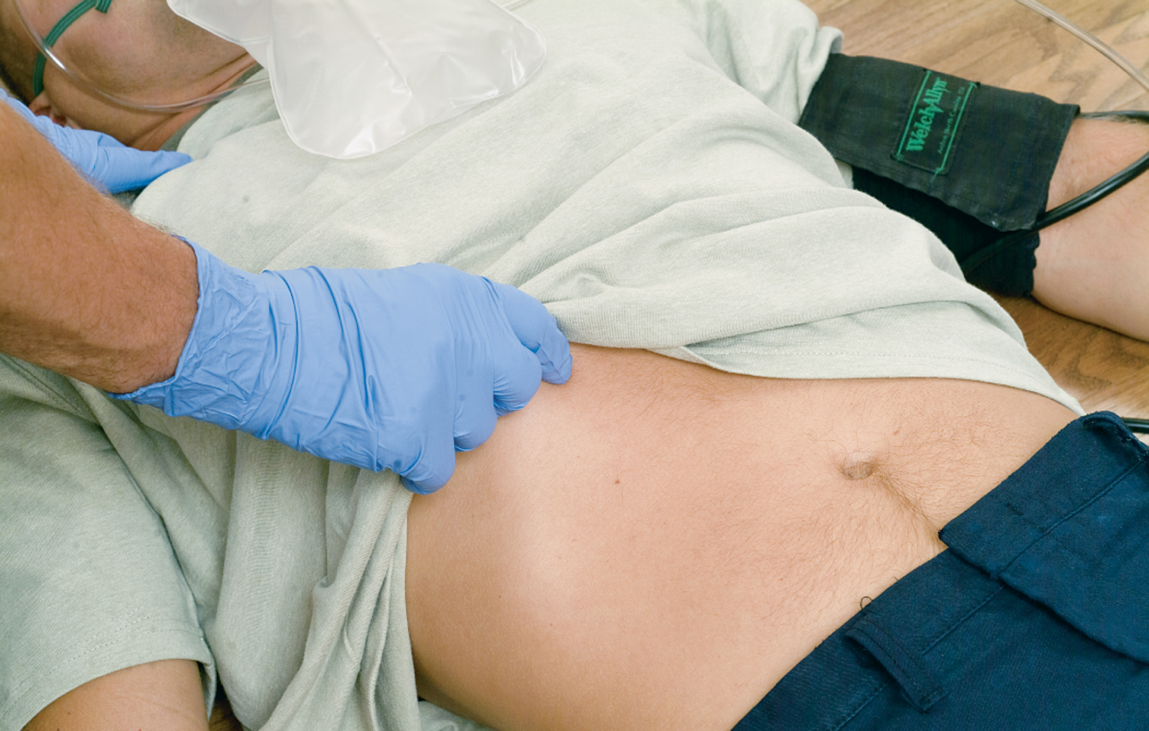
Inspect the Abdomen, Then Palpate Each Quadrant. Note Any Tenderness, Rigidity, or Masses (1 of 2)
Notes:
Involuntary guarding is also referred to as rigidity.

Slide 65
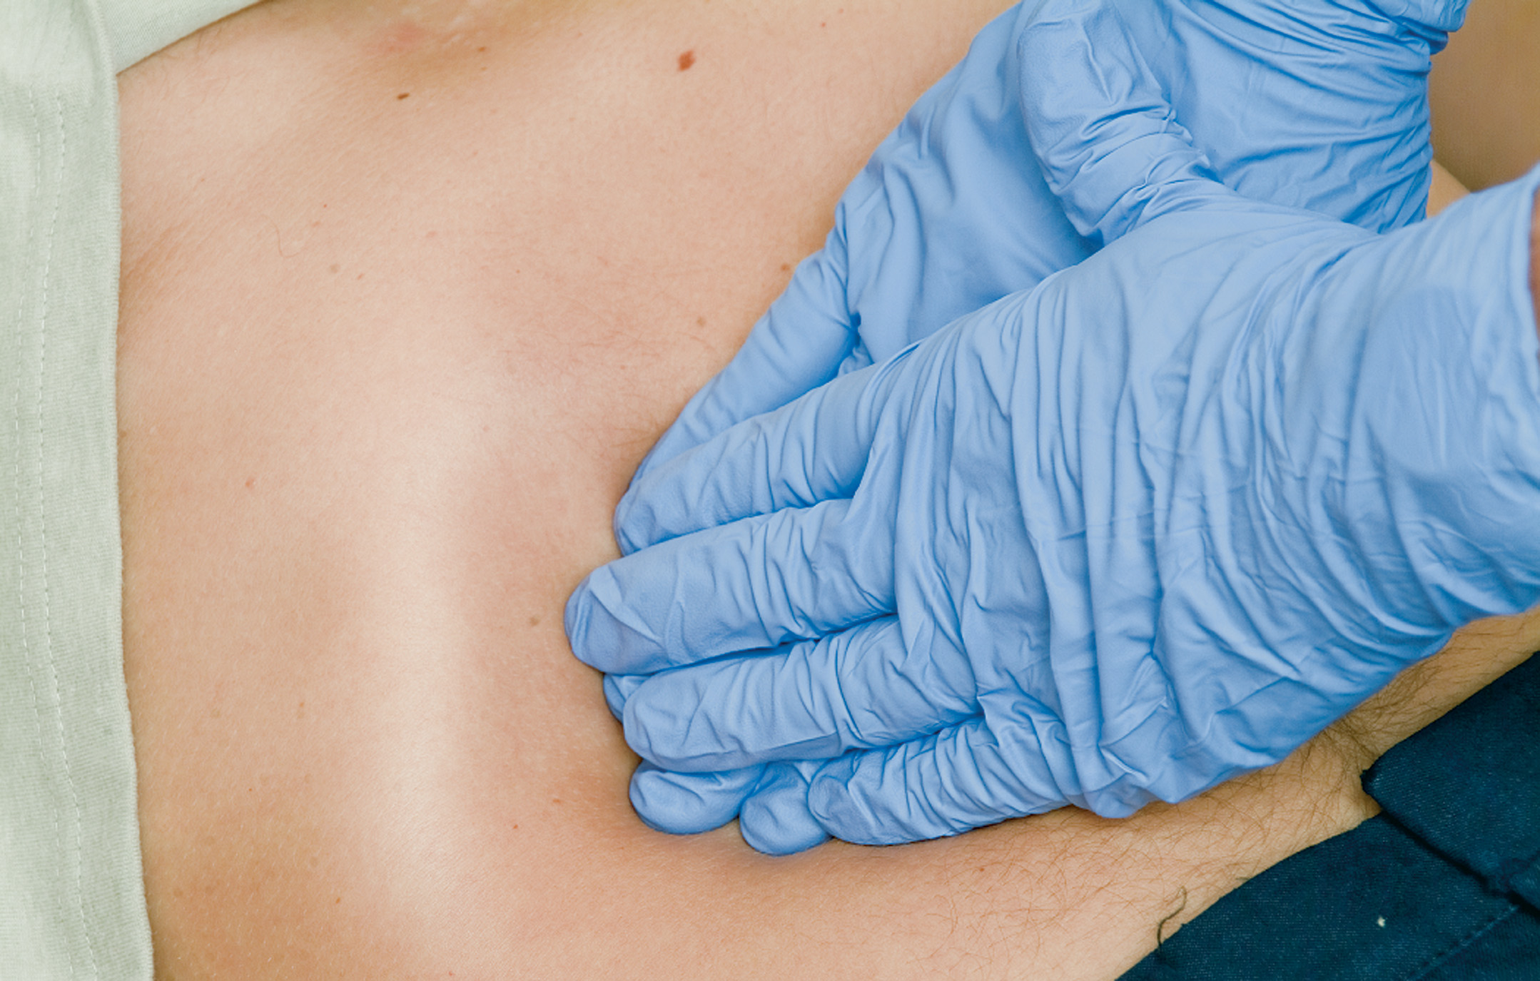
Inspect the Abdomen, Then Palpate Each Quadrant. Note Any Tenderness, Rigidity, or Masses (2 of 2)
Notes:
Voluntary guarding is when the patient contracts the abdominal muscles, usually in anticipation of pain or an unpleasant sensation.
Assess if the abdomen is tender or nontender when touched.
When palpating the abdomen, note any masses that are present. Are they pulsating?
Ask the patient if they have pain in other areas.
Document the quadrant in which pain is located.

Slide 66
Acute Abdomen (43 of 48)
Assessment-Based Approach – Acute Abdomen
Secondary Assessment
The abdomen normally should be soft and nontender.
Assess for voluntary guarding, involuntary guarding, and rigidity.
Palpate for masses.
Assess vital signs; be alert to signs of shock.
Notes:
Clinically, it is important to recognize the contracted abdominal muscles (guarding or rigidity) and proceed as if an acute abdomen is suspected.
Respiratory rate may be increased and breathing may be shallow.

Slide 67
Acute Abdomen (44 of 48)
Assessment-Based Approach – Acute Abdomen
Secondary Assessment
Associated Signs and Symptoms
Tenderness
Anxiety, fear
Guarded position
Rapid, shallow breathing
Rapid pulse
Notes:
Pay attention to blood pressure and heart rate. Decreased blood pressure, increased heart rate, and pale, cool, moist skin are indicators of shock.

Slide 68
Acute Abdomen (45 of 48)
Assessment-Based Approach – Acute Abdomen
Secondary Assessment
Associated Signs and Symptoms
Blood pressure changes from pain or shock
Nausea, vomiting, diarrhea
Abdominal rigidity or guarding
Distended abdomen
Fever or chills
Notes:
Severe abdominal pain activates the sympathetic nervous system. This causes an increase in heart rate, respiratory rate, and blood pressure, and can cause the skin to become pale, cool, and clammy. These responses can be mistakenly interpreted as indications of hypovolemia.

Slide 69
Acute Abdomen (46 of 48)
Assessment-Based Approach – Acute Abdomen
Secondary Assessment
Associated Signs and Symptoms
Belching or flatulence
Changes in bowel habits or urination
Signs and symptoms of shock
Signs of internal bleeding
Notes:
In infants and children, suspect an acute abdominal emergency if tenderness or guarding upon palpation is present. Do not waste time with extensive exams or palpation prior to initiating transport.

Slide 70
Acute Abdomen (47 of 48)
Assessment-Based Approach – Acute Abdomen
Emergency Medical Care
Keep the airway patent; be alert to vomiting.
Place the patient in a comfortable position.
Maintain an S p O₂ of 94% or greater.
Administer nothing by mouth.
Notes:
If the SpO2 is 94% or greater and no other signs of respiratory distress, hypoxia, hypoxemia, or poor perfusion are present, there is no need to administer supplemental oxygen. If the SpO₂ is 694% or signs of respiratory distress, hypoxia, hypoxemia, or poor perfusion are present, administer oxygen via a nasal cannula to achieve and maintain an SpO₂ of 94% or greater.

Slide 71
Emergency Care Protocol: Acute Abdominal Pain
Establish and maintain an open airway. Insert a nasopharyngeal or oropharyngeal airway if the patient is unresponsive and has no gag or cough reflex.
Suction secretions as necessary.
If breathing is inadequate, provide positive pressure ventilation with supplemental oxygen at a minimum rate of 10–12 ventilations/minute for an adult and 12–20 ventilations/minute for an infant or child.
If breathing is adequate, administer oxygen to maintain an
Place the patient in a position of comfort, usually with knees flexed. If the patient is vomiting, place in a left lateral recumbent position only if no spinal injury is suspected.
Transport according to the patient’s condition.
Perform a reassessment every 5 minutes.

Slide 72
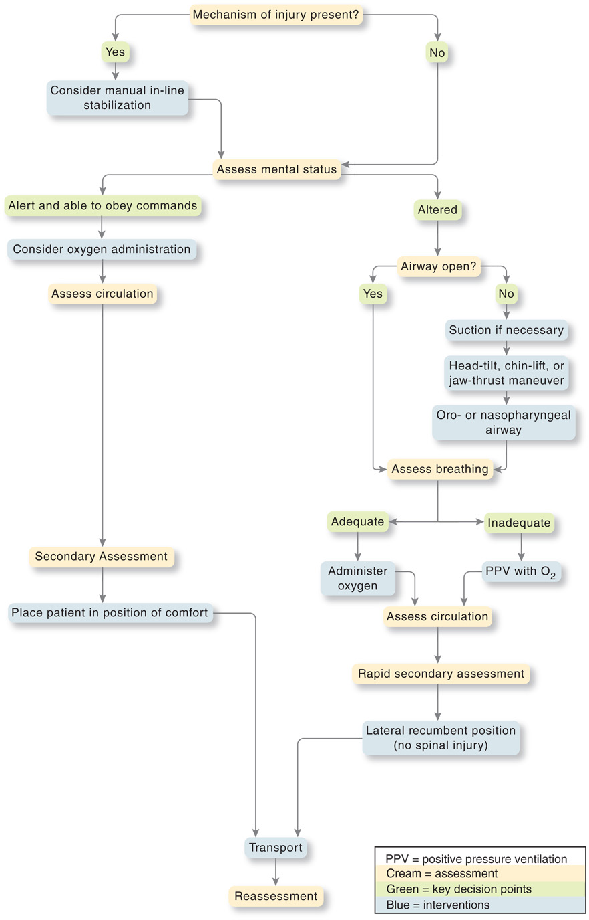
Emergency Care Algorithm: Acute Abdominal Pain
Notes:
Review assessment findings that can be associated with acute abdominal pain and emergency care for acute abdominal pain.

Slide 73
Acute Abdomen (48 of 48)
Assessment-Based Approach – Acute Abdomen
Emergency Medical Care
Calm and reassure the patient.
Treat for shock, if present.
Initiate transport.
Notes:
If signs of severe hypoxia are present, a nonrebreather mask at 15 lpm could be used to quickly achieve a SpO₂ of 94% and then changed to a nasal cannula to maintain a SpO₂ of 94%, especially if the patient can’t tolerate the NRB mask.

Slide 74
Case Study (2 of 4)
Mrs. Hill’s history reveals that she has been constipated for one to two days, and that she feels bloated. She has had previous abdominal surgeries for a hysterectomy, appendectomy, and cholecystectomy. She takes medications for atrial fibrillation, and has no allergies. She has not had an appetite for two days, and was not doing anything in particular when the discomfort began.
Notes:
Case Study Discussion
Review the Case Study findings presented.

Slide 75
Case Study (3 of 4)
The physical exam reveals a facial expression consistent with experiencing pain; the a patient, who is lying on her right side with her hips flexed, has very warm, dry skin, and a distended abdomen that is tender to palpation, particularly in the lower right quadrant.
Vital signs are: pulse 92, irregular; B P 132/84; respirations 20 and slightly shallow; S p O₂ 96% on room air.
Notes:
Case Study Discussion
Review the Case Study findings presented.

Slide 76
Case Study (4 of 4)
What are some disorders that would explain Mrs. Hill's signs and symptoms?
What emergency care is required for Mrs. Hill?
Notes:
Case Study Discussion
Use the Case Study content and questions to foreshadow the upcoming lesson content. Gauge the student’s responses as a guide of how well versed they are in this topic.

Slide 77
Hematologic Emergencies (1 of 8)
Common Hematologic Conditions
Hematologic problems that may be encountered in prehospital care include:
Anemia
Sickle cell disease
Hemophilia.

Slide 78
Hematologic Emergencies (2 of 8)
Common Hematologic Conditions
Anemia
Decrease in red blood cell volume
May be chronic or acute
Decrease in oxygen-carrying capability
May cause patient to be pale and easily fatigued with shortness of breath on exertion.
Notes:
Acute anemia can result from a sudden decrease in red blood cells resulting from a source of bleeding. Chronic anemia results from a slow source of blood loss, such as a gastrointestinal bleed, lack of production or maturity of red blood cells, increased destruction of red blood cells, or issues with the structure of the hemoglobin on the surface of the red blood cell.
Because hemoglobin is not available to change the color of the skin, cyanosis is often a late sign of hypoxia associated with anemia.

Slide 79
Hematologic Emergencies (3 of 8)
Common Hematologic Conditions
Sickle Cell Anemia
Hereditary disorder
More common in African Americans, Africans, and those of Mediterranean, South and Central American, and Middle Eastern origin
Notes:
In sickle cell anemia, some red blood cells have abnormal hemoglobin that does not carry adequate oxygen. As a result, the cells take on a crescent (sickle) shape and become fragile, stiff, and rigid. The sickled cells begin to stack up, blocking capillary blood flow. Cells and tissues become ischemic and can die.

Slide 80
Hematologic Emergencies (4 of 8)
Common Hematologic Conditions
Sickle Cell Disease
The four common patterns of sickle cell crisis, all of which are painful, are the following:
Bone crisis
Acute chest syndrome
Abdominal crisis
Joint crisis.
Notes:
There are many consequences of sickle cell anemia, including damage to organs, stroke, and infections. Almost all sickle cell patients develop kidney damage.

Slide 81
Hematologic Emergencies (5 of 8)
Common Hematologic Conditions
Sickle Cell Disease
Signs and Symptoms of Sickle Cell Crisis
Bone and joint pain
Fever
Chest pain
Shortness of breath
Fatigue
Pale skin
Notes:
Severe abdominal pain is a frequent complaint leading to EMS response.

Slide 82
Hematologic Emergencies (6 of 8)
Common Hematologic Conditions
Sickle Cell Disease
Signs and Symptoms of Sickle Cell Crisis
Priapism
Jaundice
Tachycardia
Ulcers on lower legs
Sudden blindness in one eye
Excessive thirst and frequent urination
Notes:
Anemia can cause shortness of breath, lightheadedness, and fatigue.

Slide 83
Hematologic Emergencies (7 of 8)
Common Hematologic Conditions
Sickle Cell Disease
Emergency Care
Ensure an adequate airway, breathing, and circulation.
Maintain adequate oxygenation.
Notes:
The emergency care is supportive.

Slide 84
Hematologic Emergencies (8 of 8)
Common Hematologic Conditions
Hemophilia
Blood clotting is impaired.
What normally is considered minor bleeding can be an emergency in hemophiliacs.
Use normal methods to control bleeding, but be aware that bleeding control is more difficult.
Notes:
The missing clotting factor must be restored by infusion.

Slide 85
Case Study Conclusion
Prehospital care for Mrs. Hill consists of placing her on her right side on the stretcher, with her knees drawn up, which is the position in which she is the most comfortable. It also allows for less risk to the airway if she vomits. Transport is expeditious, but with care to provide as smooth a ride as possible.
At the hospital, Mrs. Hill is diagnosed with a bowel obstruction, and taken to surgery, where a portion of her bowel is removed and a colostomy is created.
Notes:
Case Study Discussion
Review the case conclusion and emphasize the application of knowledge learned from this presentation.

Slide 86
Gynecologic Emergencies (1 of 27)
Gynecology deals with the female reproductive system.
Signs and symptoms include abdominal pain, vaginal bleeding, or abnormal discharge.
Some gynecologic problems are life threatening.
Notes:
Gynecology is the branch of medicine concerned with the health of the female patient and their reproductive system.
Gynecologic emergencies often present with abdominal pain, vaginal bleeding, or vaginal discharge.
Discussion Question
What are some gynecological conditions that can lead to life-threatening emergencies?

Slide 87
Case Study 2 Introduction
E M T s Donna Smith and Jade Gladstone have arrived at an assisted-living facility for a report of a sick person. Their patient, Hugh Carpenter, is a 78-year-old man who has a history of urinary incontinence following surgery and radiation for prostate cancer. He has a Foley catheter in place for that problem. His home health aide called today because Mr. Carpenter is confused, and he has a temperature of 100.4°Fahrenheit.
Notes:
Case Study
Present the Case Study Introduction provided in the PowerPoint slide set.
Lead a discussion using the case study questions provided on the subsequent slide(s).
The Case Study with discussion questions continues throughout the PowerPoint presentation.
Case Study Discussion
Use the Case Study content and questions to foreshadow the upcoming lesson content

Slide 88
Case Study 2
Explain how there could there be a relationship between Mr. Carpenter’s medical history and his current problem.
What questions should E M T s ask in obtaining Mr. Carpenter’s history?
What aspects of the physical exam are particularly important in this patient?
Notes:
Case Study Discussion
Use the Case Study content and questions to foreshadow the upcoming lesson content. Gauge the student’s responses as a guide of how well versed they are in this topic.

Slide 89
Gynecologic Emergencies (2 of 27)
Female Reproductive Structures and Functions
The vagina functions as the birth canal during childbirth.
The ovaries are the primary sex glands.
The fallopian tubes extend from near each of the ovaries to the uterus.
the endometrium is sloughed off during menses, or the menstrual period.
Notes:
The fallopian tubes extend from near each of the ovaries to the uterus. Fertilization of the egg normally occurs here. The uterus is the pear-shaped muscular organ that provides an appropriate site for egg implantation and fetal development during pregnancy.

Slide 90
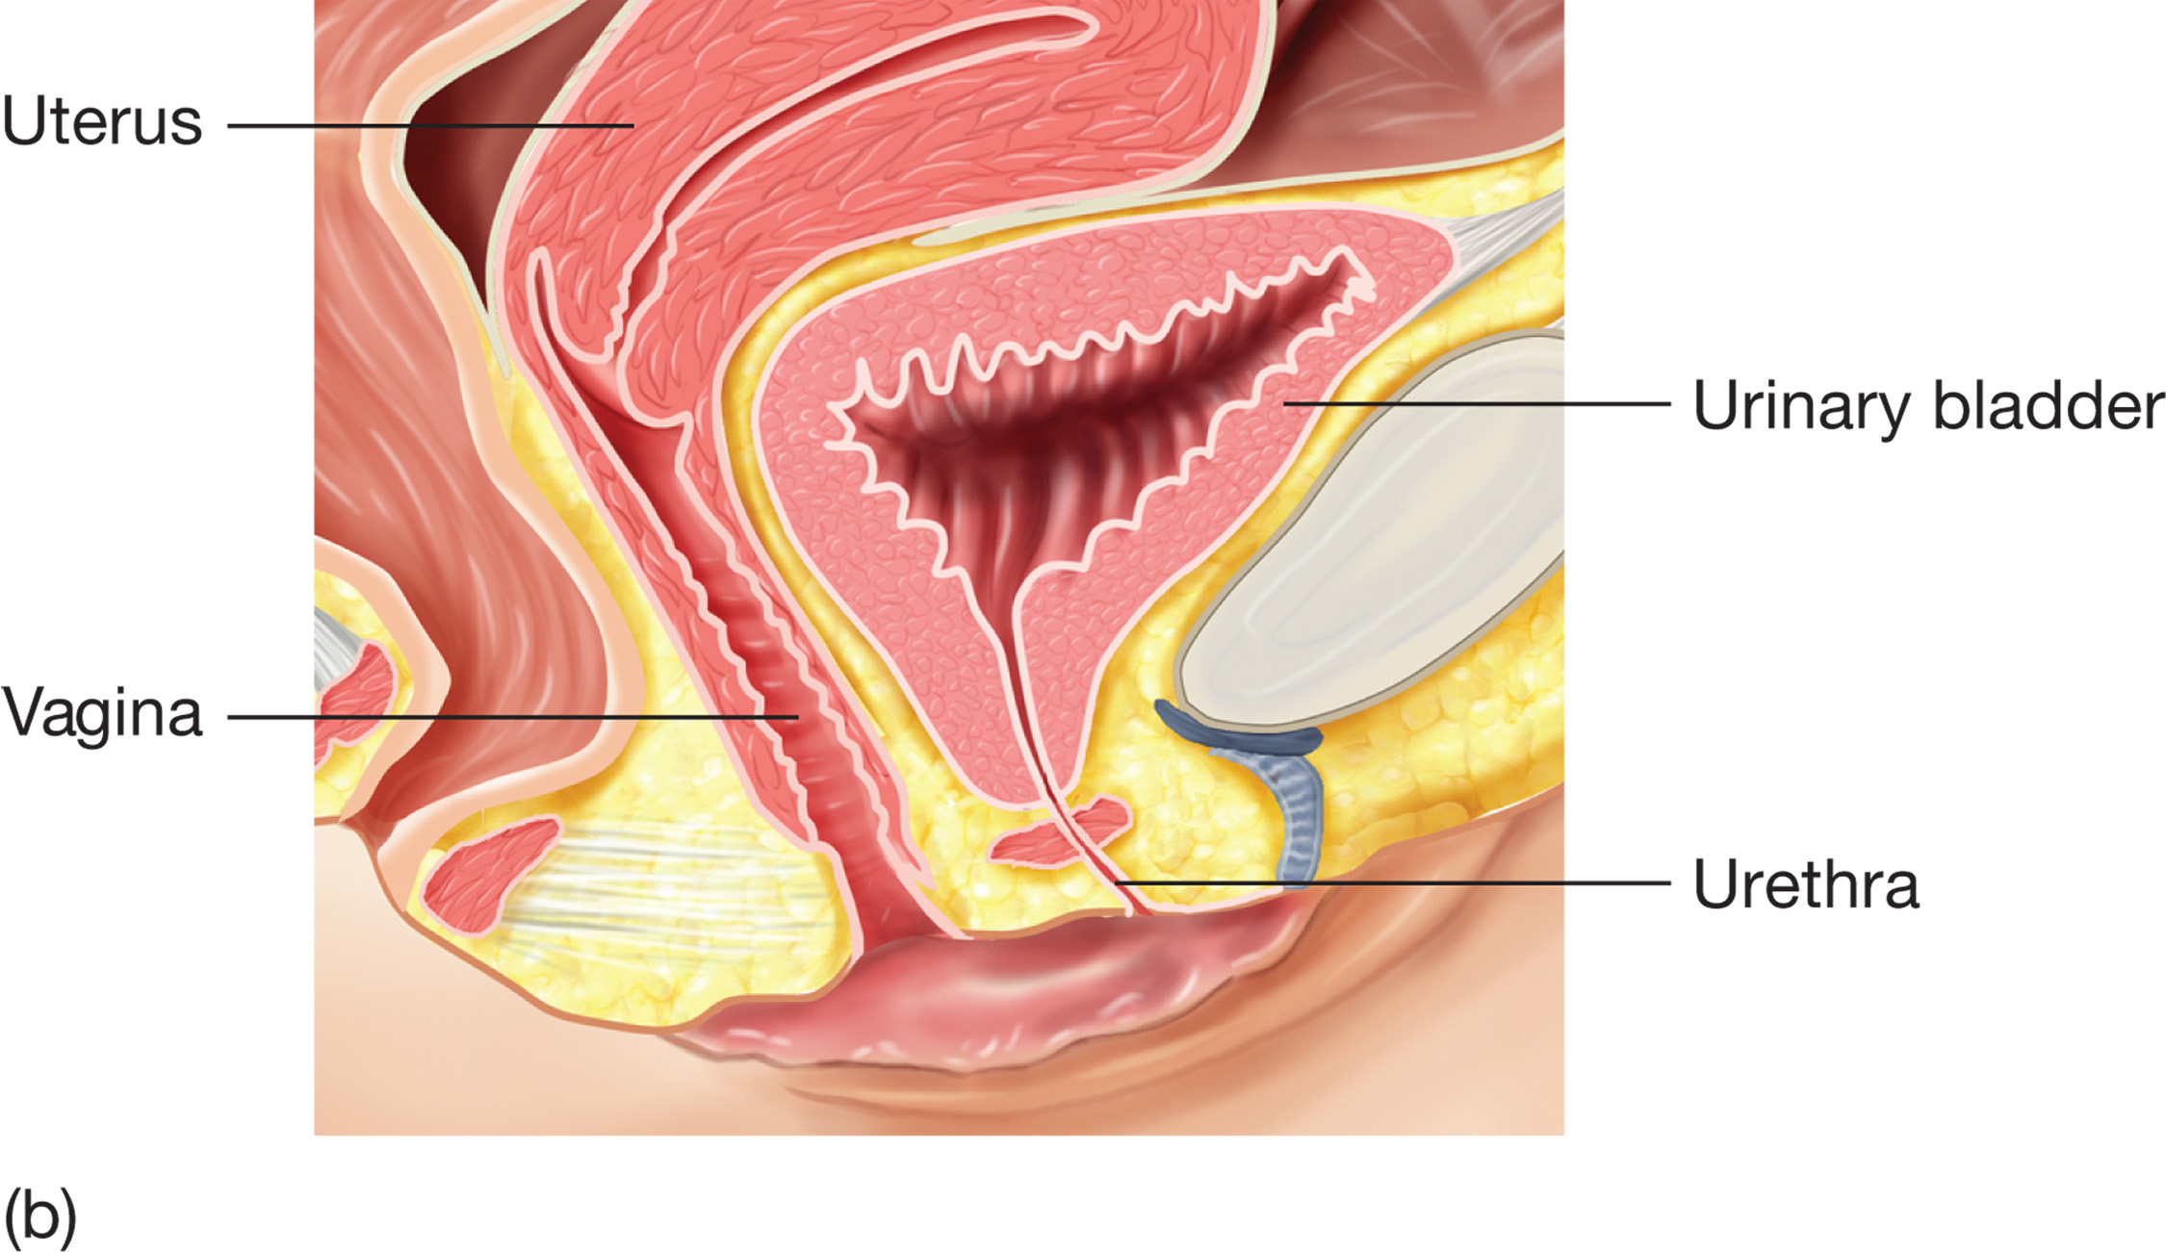
The Much Shorter Female Urethra Extends from the Urinary Bladder, Exiting Just in Front of the Vaginal Opening
Notes:
The female reproductive system is composed of the external genitalia and internal organs and structures. The female external genitalia, also called the vulva, consist of vascular tissues called the perineum, mons pubis, labia, and clitoris. The internal organs of the female reproductive system are the vagina, uterus, ovaries, and fallopian tubes.

Slide 91
Table 23-4 Gynecologic Conditions That May Cause Abdominal Pain or Bleeding
Sexual assault
Vaginal bleeding
Dysmenorrhea (primarily from menstruation)
Ovarian cyst
Endometritis
Endometriosis
Pelvic inflammatory disease
Sexually transmitted diseases
Notes:
These conditions can have either medical or traumatic causes. Gynecologic conditions can result in life-threatening complications if left untreated.

Slide 92
Gynecologic Emergencies (3 of 27)
Gynecologic Conditions
Sexual Assault
Follow protocols for reporting sexual assault.
Sexual assault has physical and psychological effects that may include:
Notes:
Caring for the patient who was sexually assaulted involves attention to the patient's physical and emotional needs, as well as legal concerns.
Teaching Tips
Consider having a sexual assault nurse examiner lecture on management of patients who have been sexually assaulted.
Discussion Question
What are some special considerations in management of the patient who has been sexually assaulted?

Slide 93
Gynecologic Emergencies (4 of 27)
Gynecologic Conditions
Sexual Assault
Physical effects of sexual assault include:
Traumatic injuries
Genital/rectal swelling, bleeding, pain
Sexually transmitted diseases
Pregnancy.
Notes:
It is important to provide emergency care that addresses both the physical and the emotional needs of the patient.

Slide 94
Gynecologic Emergencies (5 of 27)
Gynecologic Conditions
Sexual Assault
Psychological effects of sexual assault include:
Anxiety, depression, fear
Inappropriate feelings of guilt
Flashbacks, nightmares
Emotional withdrawal, numbness, irritability.
Notes:
It is important that the victims of sexual assaults are evaluated at the hospital and that any evidence related to the crime is preserved to the extent possible.

Slide 95
Gynecologic Emergencies (6 of 27)
Gynecologic Conditions
Sexual Assault
Follow these sexual assault guidelines:
Don’t allow the patient to change, bathe, comb, or clean any part of the body.
Don’t cut holes or tears in the clothing.
Don’t touch or change the crime scene.
Don’t clean wounds.
Transport clothing along with the patient.
Notes:
Do not examine the genital area unless there is a life-threatening hemorrhage. Minor bleeding can be absorbed by a pad. Make sure all bloody articles are collected and transported with the patient.

Slide 96
Gynecologic Emergencies (7 of 27)
Gynecologic Conditions
Sexual Assault
Be nonjudgmental.
Provide a safe environment.
Respect confidentiality and privacy.
Ask only questions that are pertinent to patient care.
Notes:
Do not touch the patient without their consent or unnecessarily. Respect your patient’s wishes and privacy. Obtain vitals and evaluate any other associated injuries that can have occurred.

Slide 97
Gynecologic Emergencies (8 of 27)
Gynecologic Conditions
Vaginal Bleeding (Nontraumatic)
Bleeding may be related to menses or to medical problems.
The most common cause is spontaneous abortion.
Notes:
Women of childbearing age, of course, are most at risk for a spontaneous abortion. However, menopausal women can also become pregnant and experience spontaneous abortions.

Slide 98
Gynecologic Emergencies (9 of 27)
Gynecologic Conditions
Vaginal Bleeding (Nontraumatic)
Signs and symptoms of spontaneous abortion include:
Lower abdominal or pelvic pain
Abdominal tenderness
Vaginal bleeding
Rapid pulse
Signs and symptoms of shock.
Notes:
Regardless of the cause, vaginal hemorrhage can be life-threatening, and should be treated as such.

Slide 99
Gynecologic Emergencies (10 of 27)
Gynecologic Conditions
Menstrual Pain
Strong uterine cramping that causes severe pain during menstruation is called dysmenorrhea.
Dysmenorrhea is normally caused by hormonal imbalances.
Notes:
Occasionally, a patient experiences abdominopelvic pain in the middle of their menstrual cycle. This pain is called mittelschmerz (German for “middle pain”). It is caused by irritation of the peritoneum by the small amount of bleeding associated with the rupture of ovarian tissue that occurs with release of the mature ovum.

Slide 100
Gynecologic Emergencies (11 of 27)
Gynecologic Conditions
Ovarian Cysts
Fluid-filled sacs that form on the ovary.
Signs and symptoms include:
Unilateral abdominopelvic pain
Abdominal tenderness
Vaginal bleeding
Pain during sexual intercourse or bowel movements.
Notes:
Most cysts are asymptomatic, but they may rupture, twist, or break open causing pain.

Slide 101
Gynecologic Emergencies (12 of 27)
Gynecologic Conditions
Endometritis
Inflammation of the endometrium, commonly caused by infection.
Signs and symptoms include:
Abdominopelvic pain or tenderness
Fever
Abdominal distention
Vaginal bleeding or discharge
Discomfort during bowel movements.
Notes:
If left untreated, endometritis can lead to peritonitis, abscess formation, septicemia, shock, and infertility.

Slide 102
Gynecologic Emergencies (13 of 27)
Gynecologic Conditions
Endometriosis
Signs and symptoms include:
Abdominopelvic pain or tenderness
Dysmenorrhea
Vaginal bleeding
Pain during sexual intercourse or bowel movement.
Notes:
Endometrial tissue grows outside the uterus and implants on tissues within the abdominal cavity, pelvis, or elsewhere. Endometrial tissue can bleed into the surrounding area and result in inflammation, scarring, pain, and adhesions.

Slide 103
Gynecologic Emergencies (14 of 27)
Gynecologic Conditions
Pelvic Inflammatory Disease (P I D)
Infection of the female reproductive tract
Signs and symptoms include:
Abdominopelvic pain or tenderness
Abnormal vaginal discharge
Fever and chills/nausea or vomiting
Anorexia
Irregular vaginal bleeding or cramping
Pain during sexual intercourse.
Notes:
Pelvic infections are caused by bacteria, fungi, or viruses. Most of these infections are caused by the same bacteria that lead to sexually transmitted diseases. Approximately 1 million women develop PID each year. Untreated, it can lead to scarring, infertility, or sepsis.

Slide 104
Gynecologic Emergencies (15 of 27)
Gynecologic Conditions
Sexually Transmitted Diseases
Infections contracted through sexual contact
Most sexually transmitted diseases are caused by bacteria, viruses, parasites, or fungi.
The most common are chlamydia and gonorrhea.
Notes:
Patients most at risk for developing STDs are those who have multiple sexual partners, do not use condoms, or have had a history of previous STDs or PID.

Slide 105
Table 23-5 Common Sexually Transmitted Diseases and Their Causes
Sexually Transmitted Disease | Type of Microorganism
Gonorrhea | Bacteria
Syphilis | Bacteria
Chancroid | Bacteria
Chlamydia | Bacteria
H I V | Viral
Herpes | Viral
Genital warts | Viral
Pediculosis | Parasitic
Trichomoniasis | Parasitic

Slide 106
Gynecologic Emergencies (16 of 27)
Gynecologic Conditions
Sexually Transmitted Diseases
Signs and symptoms include:
Abdominopelvic pain or tenderness
Abnormal vaginal discharge
Nausea, vomiting, fever, chills
Irregular vaginal bleeding or cramping
Pain during sexual intercourse or urination
Genital itching, redness, or swelling
Lesions or ulcers
Notes:
If left untreated, some STDs can lead to sepsis, infertility, abscesses, peritonitis, or other systemic illnesses. It is important to note that the patient and the patient’s sexual partners should receive treatment for these conditions.

Slide 107
Gynecologic Emergencies (17 of 27)
Assessment-Based Approach – Gynecologic Emergencies
Scene Size-Up
Take Standard Precautions.
Determine the nature of the illness or mechanism of injury.
If it appears to be a crime scene, contact law enforcement.
Notes:
Discussion Question
What are key questions to ask when obtaining the history of a patient with a gynecological complaint?
Critical Thinking Discussion
How can you lessen the embarrassment or self-consciousness of a patient with a gynecological complaint?
How can you increase your own comfort level in dealing with patients with gynecological complaints?
Knowledge Application
Given several different scenarios, students should be able to obtain a relevant history from the patient with a gynecological complaint.

Slide 108
Gynecologic Emergencies (18 of 27)
Assessment-Based Approach –Gynecologic Emergencies
Primary Assessment
Determine the patient’s mental status.
Ensure an open airway and adequate breathing.
Administer oxygen to maintain an S p O₂ of 94% or greater.
Pay attention to perfusion status.
Control external bleeding.
Notes:
Form a general impression of your patient. If a spinal injury is possible, take the necessary spine motion restriction precautions. Determine whether the patient is alert and oriented or if they have an alteration in their mental status.
If the patient has vaginal bleeding, absorb the blood flow with pads. Never pack the patient’s vagina.

Slide 109
Gynecologic Emergencies (19 of 27)
Assessment-Based Approach – Gynecologic Emergencies
Primary Assessment
Categorize as high priority for transport if the patient exhibits any of these symptoms:
Poor general appearance
Unresponsive
Responsive, not following commands
Severe pain
Shock
Notes:
Shock is only one indicator that this is a serious medical emergency. The patient with acute abdominal pain or vaginal bleeding because of a possible gynecologic emergency should be categorized as a priority for transport if they meet any of these criteria.

Slide 110
Gynecologic Emergencies (20 of 27)
Assessment-Based Approach –Gynecologic Emergencies
Secondary Assessment
Protect privacy and modesty.
Be compassionate and professional.
Obtain a history and vital signs.
Perform a physical exam.

Slide 111
Gynecologic Emergencies (21 of 27)
Assessment-Based Approach –Gynecologic Emergencies
Secondary Assessment
Ask the following:
What are the signs and symptoms?
Have the signs and symptoms gotten better or worse?
How long have the signs and symptoms been present?
Was the onset sudden or gradual?
Notes:
Review the questions with the students and ask them why each one is important.

Slide 112
Gynecologic Emergencies (22 of 27)
Assessment-Based Approach – Gynecologic Emergencies
Secondary Assessment
Ask the following:
What was the patient doing at the onset?
Does the patient have allergies?
When did the patient last eat or drink?
What are the patient’s medications?
Are they using contraceptives?
Notes:
Be patient, compassionate, and professional when communicating with the patient. If the patient is responsive, your partner can take baseline vital signs as you begin gathering information and a history from her.

Slide 113
Gynecologic Emergencies (23 of 27)
Assessment-Based Approach – Gynecologic Emergencies
Secondary Assessment
Ask the following:
What is the patient’s past medical history?
When was the patient’s last menstrual period?
Is there any vaginal bleeding? If so, how many menstrual pads have been saturated?
Is there a possibility of pregnancy? How many pregnancies has she had?
Notes:
Review the questions with the students and ask them why each one is important.

Slide 114
Gynecologic Emergencies (24 of 27)
Assessment-Based Approach – Gynecologic Emergencies
Secondary Assessment
Ask the following:
Is there any vaginal discharge?
Has there been nausea or vomiting?
Is there pain with urination?
Notes:
Review the questions with the students and ask them why each one is important.

Slide 115
Gynecologic Emergencies (25 of 27)
Assessment-Based Approach – Gynecologic Emergencies
Secondary Assessment
Signs and symptoms include:
Vaginal discharge and/or pain
Abdominopelvic pain or tenderness
Nausea, vomiting
Fever, chills
Genital itching, redness, swelling
Signs of shock.
Notes:
S&S also include:
Syncope
Irregular vaginal bleeding or cramping
Pain during sexual intercourse, urination, or bowel movement
The signs and symptoms associated with a gynecologic emergency vary depending on the cause. Abdominopelvic pain and vaginal bleeding are two of the most common signs and symptoms associated with a gynecologic emergency.

Slide 116
Gynecologic Emergencies (26 of 27)
Assessment-Based Approach – Gynecologic Emergencies
Secondary Assessment
Physical Exam
Examine the abdomen.
Ask if there is vaginal bleeding, clots, or tissue.
Obtain baseline vital signs.
Notes:
If there is vaginal bleeding, use a pad to absorb the blood and take any tissues with you to the hospital. Document the number of pads that the patient saturates.

Slide 117
Gynecologic Emergencies (27 of 27)
Assessment-Based Approach – Gynecologic Emergencies
Emergency Medical Care
If trauma is involved, consider spine motion restriction.
Maintain a patent airway.
Maintain adequate oxygenation.
Control external bleeding.
Place the patient in a comfortable position.
Notes:
Calm and reassure the patient. Be supportive and nonjudgmental. Initiate a quick and efficient transport; consider ALS intercept based on your protocols.

Slide 118
Click on the Term That is Used to Describe the Condition in Which Tissue from the Lining of the Uterus is Implanted Outside of the Uterus, Where It May Cause Inflammation, Scarring, Bleeding, and Adhesions
A. Pelvic inflammatory disease
B. Endometriosis
C. Endometritis
D. Mittelschmerz

Slide 119
Genitourinary/Renal Emergencies (1 of 29)
Organs of the female reproductive system are separate from those in the female urinary system.
In males, some of the structures are shared.
Patients with genitourinary or renal conditions may experience abdominopelvic pain.
Notes:
Discussion Questions
What are the functions of the kidneys?
What are the signs and symptoms of a urinary tract infection?
What are some risk factors for kidney stones?

Slide 120
Genitourinary/Renal Emergencies (2 of 29)
Genitourinary/Renal Structures and Functions
The urinary system produces, stores, and eliminates urine.
The kidneys filter the blood to excrete waste products into the urine.
The kidneys also play roles in pH regulation and regulating blood volume and pressure.
Notes:
Knowledge Application
Given several descriptions of patients with genitourinary/renal complaints, students should be able to collect a relevant history and perform a physical examination.

Slide 121
Genitourinary/Renal Emergencies (3 of 29)
Genitourinary/Renal Structures and Functions
The ureters carry urine from the kidneys to the urinary bladder.
The urinary bladder stores urine until it is eliminated through the urethra.
In men, the urethra serves both urinary and reproductive functions.
Notes:
The urinary system produces, stores, and eliminates urine from the body. In women, the urethral opening is anterior to the vagina and excretes urine; however, in men the urethra is located at the tip of the penis and eliminates both urine and male reproductive fluid.

Slide 122
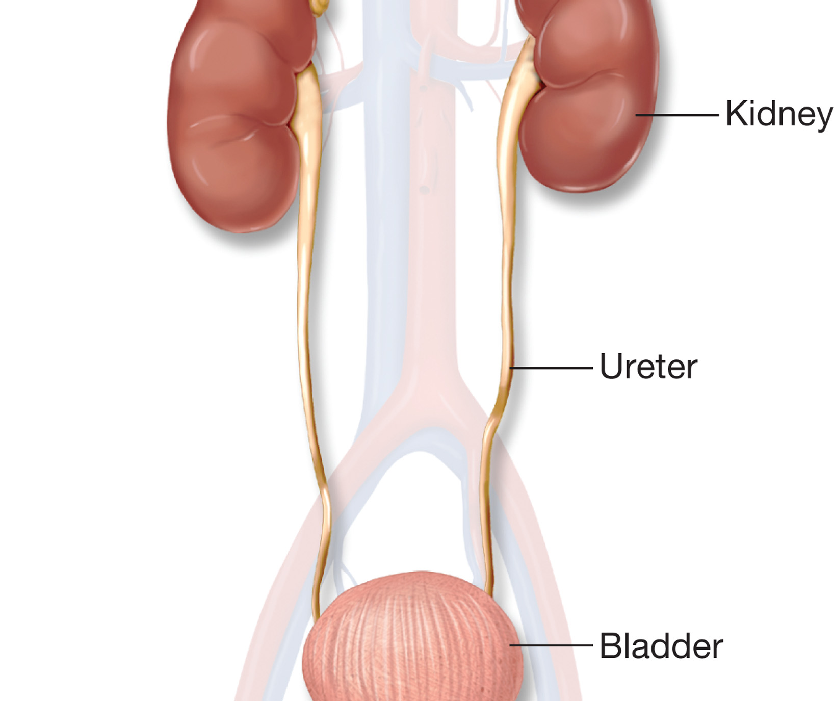
The Ureters Extend from the Kidneys to the Urinary Bladder
Notes:
The urinary system is composed of the kidneys, ureters, urinary bladder, and urethra. The urinary system produces, stores, and eliminates urine from the body.

Slide 123
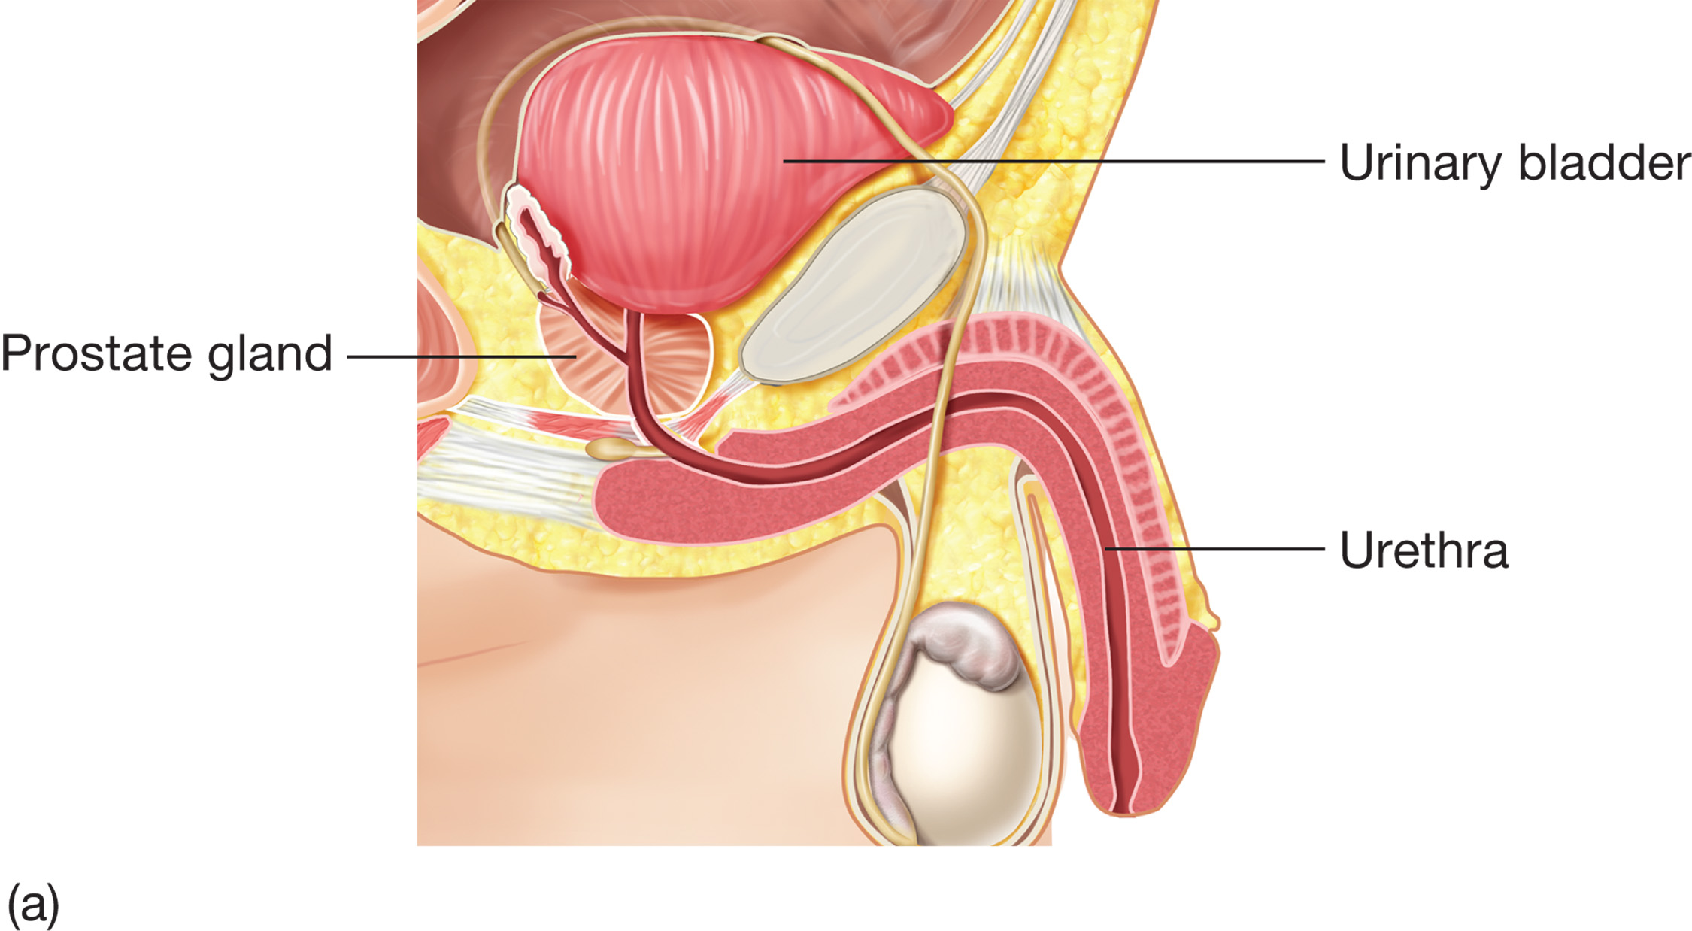
The Male Urethra Extends from the Urinary Bladder through the Prostate Gland and Penis
Notes:
For the sperm to leave the body, it passes through the two ducts called the vas deferens. The sperm then mixes with fluid from the prostate gland before it can be ejaculated from the body. The prostate gland surrounds the male urinary bladder and houses the first part of the male’s urethra.

Slide 124
Table 23-6 Common Genitourinary/Renal Conditions
Urinary tract infections
Kidney stones
Kidney failure
Notes:
This section presents an overview of some of the most common genitourinary/renal conditions.

Slide 125
Genitourinary/Renal Emergencies (4 of 29)
Genitourinary/Renal Conditions
Urinary Tract Infection
Most frequently caused by bacteria that enter through the urethra
More common in women, the elderly, diabetics, and patients who are immobile or catheterized
May affect the urethra, bladder, ureters, kidneys, and in men, the prostate
Notes:
Women – especially those who are pregnant – elderly patients, immobile patients, catheterized patients, and diabetics are prone to urinary tract infections; however, anyone can contract a UTI.

Slide 126
Genitourinary/Renal Emergencies (5 of 29)
Genitourinary/Renal Conditions
Urinary Tract Infection
Signs and symptoms include:
Abdominopelvic pain or tenderness
Blood in the urine
Cloudy urine, strong odor to the urine
Pain/burning with urination or intercourse
Frequent or urgent need to urinate
Genital or flank pain
Fever or chills.
Notes:
Additional signs can include nausea or vomiting, and altered mental status.

Slide 127
Genitourinary/Renal Emergencies (6 of 29)
Genitourinary/Renal Conditions
Kidney Stones
Crystals form in the kidneys and must travel through the urinary system.
Family history and dehydration are risk factors.
Stones can cause severe pain.
Untreated, stones can lead to obstruction and kidney damage.
Notes:
Kidney stones, or renal calculi, are crystals of substances such as calcium, uric acid, struvite, and crystine that are formed from metabolic abnormalities. They most frequently occur in men between the ages of 20 and 50.

Slide 128
Genitourinary/Renal Emergencies (7 of 29)
Genitourinary/Renal Conditions
Kidney Stones
Signs and symptoms include:
Abdominopelvic pain or tenderness
Colicky, severe back, or flank pain
Groin pain, fever, chills
Abnormal urine color
Pain with urination
Frequent or urgent need to urinate
Nausea, vomiting.
Notes:
Older patients with kidney stones present similarly to an acute abdominal aortic aneurysm, and the latter should always be suspected.

Slide 129
Genitourinary/Renal Emergencies (8 of 29)
Genitourinary/Renal Conditions
Kidney Failure
The kidneys do not adequately filter wastes and maintain homeostasis.
Kidney failure may be acute or chronic.
Acute kidney injury occurs over a period of days.
Kidney failure may be reversible.
Notes:
Acute kidney injury may result from decreased blood flow to the kidneys, trauma, shock, or urinary obstruction. This condition is sometimes reversible, but many patients require dialysis.

Slide 130
Genitourinary/Renal Emergencies (9 of 29)
Genitourinary/Renal Conditions
Kidney Failure
Chronic renal failure occurs over years.
Symptoms progress from mild to severe.
Diabetes and hypertension are leading causes.
Condition is not reversible.
Patient requires dialysis or a kidney transplant for survival.
Notes:
Chronic renal failure results in an accumulation of waste products and fluids that can affect almost every organ system in the body. This condition is permanent and life threatening.

Slide 131
Genitourinary/Renal Emergencies (10 of 29)
Genitourinary/Renal Conditions
Kidney Failure
Complications of kidney failure include:
Pulmonary edema
Cardiac tamponade or pericarditis
Electrolyte and other metabolic problems
Cardiac dysrhythmias
Congestive heart failure
Hypertension
Infections.
Notes:
Other complications of kidney failure include:
Hemorrhage
Liver failure
Altered mental status
Seizures
Uremia

Slide 132
Genitourinary/Renal Emergencies (11 of 29)
Genitourinary/Renal Conditions
Kidney Failure
Signs and symptoms include:
Blood in urine or stools
Altered mental status
Edema of feet, ankles, legs
Decreased or no urine output
Hypertension
Anorexia
Tachycardia.
Notes:
Patients with this type of kidney failure ultimately require dialysis or a kidney transplant for survival.

Slide 133
Genitourinary/Renal Emergencies (12 of 29)
Genitourinary/Renal Conditions
Dialysis
In hemodialysis, blood is removed from the body and circulated through a machine that filters it before returning it to the body.
Access is through a shunt, fistula, port, or graft.
Notes:
In hemodialysis, a dialysis machine containing the dialysate is connected to an access site on the patient. The access site can be a shunt, fistula, port, or graft. The patient’s blood, which is heparinized, is pumped through the access site and into the machine to have the waste removed.

Slide 134
Genitourinary/Renal Emergencies (13 of 29)
Genitourinary/Renal Conditions
Dialysis
In peritoneal dialysis, fluid is placed in the abdomen by a tube and the peritoneum functions as a dialysis membrane.
The fluid is then drained from the abdomen.
The process can be performed at home.
Notes:
In peritoneal dialysis, the dialysate is run through a tube into the patient’s abdomen. The peritoneal membrane functions as the semipermeable membrane during peritoneal dialysis. The fluid remains in the abdomen for several hours so that it can absorb the wastes, then is drained out of the body through a different tube. Peritoneal dialysis is commonly performed at home, and often while the patient is sleeping at night.

Slide 135
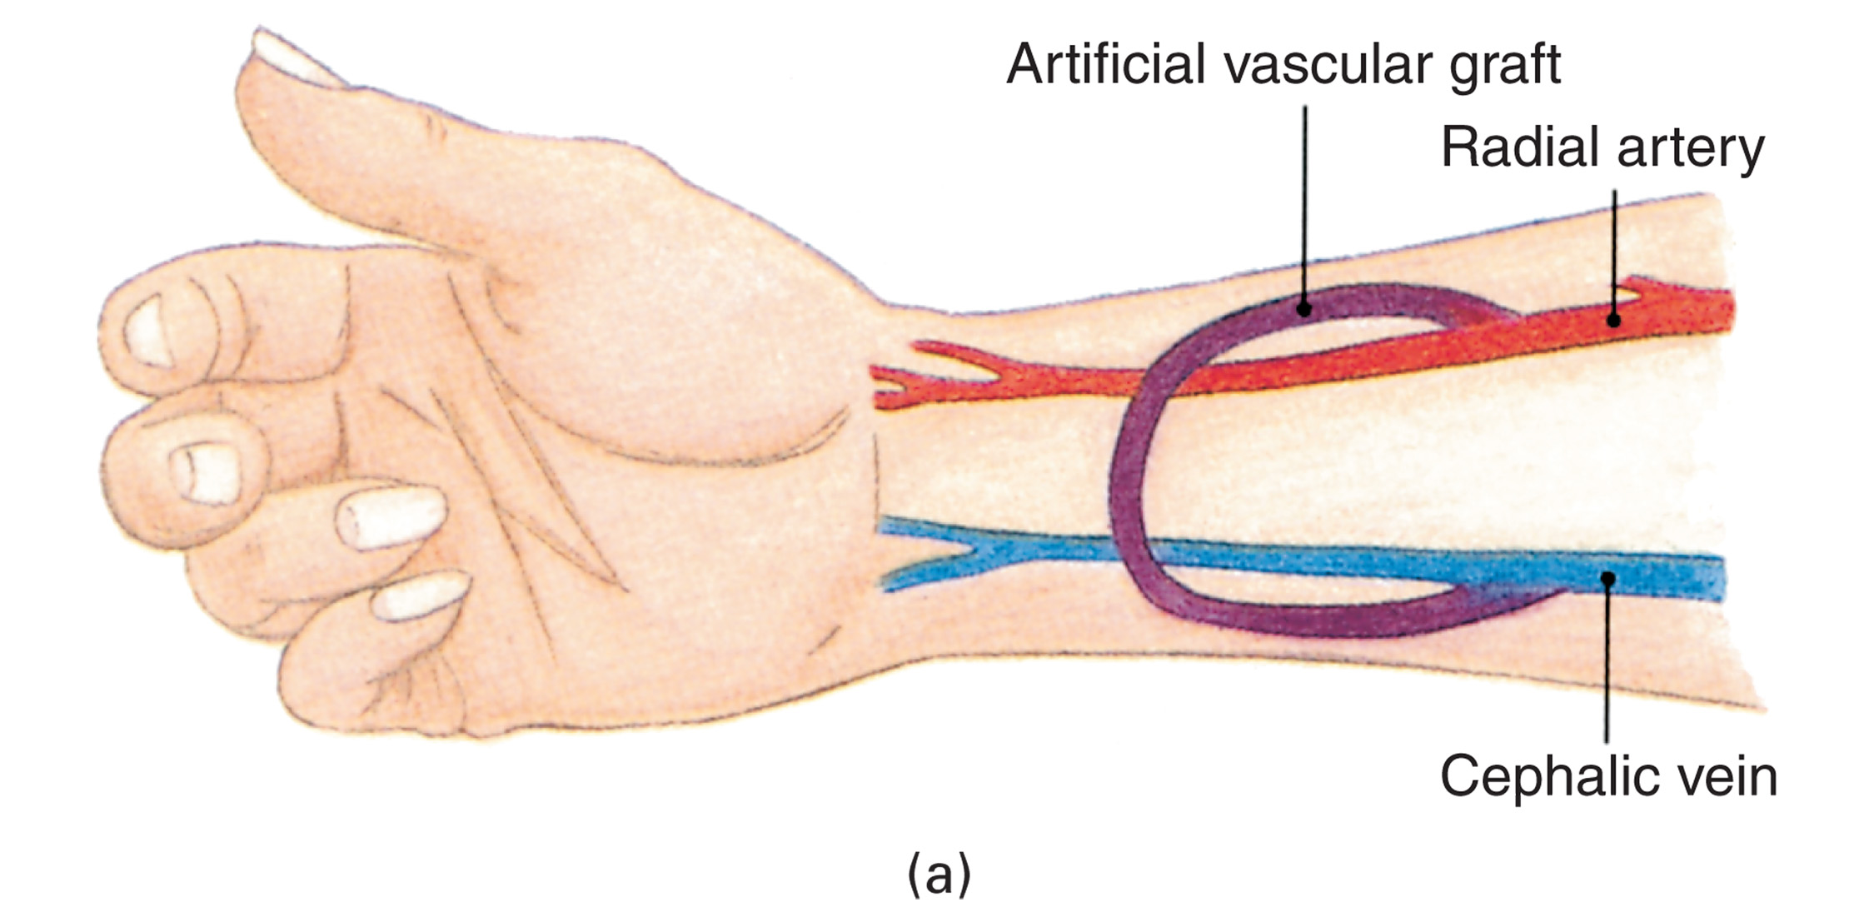
In Hemodialysis, a Dialysis Machine is Connected to an Access Site Such as a Shunt Formed by an Artificial Graft between an Artery and a Vein (1 of 2)
(Photo: © Edward T. Dickinson, M D)
Notes:
Remember to take the blood pressure of a dialysis patient on the arm without the shunt or access site.

Slide 136
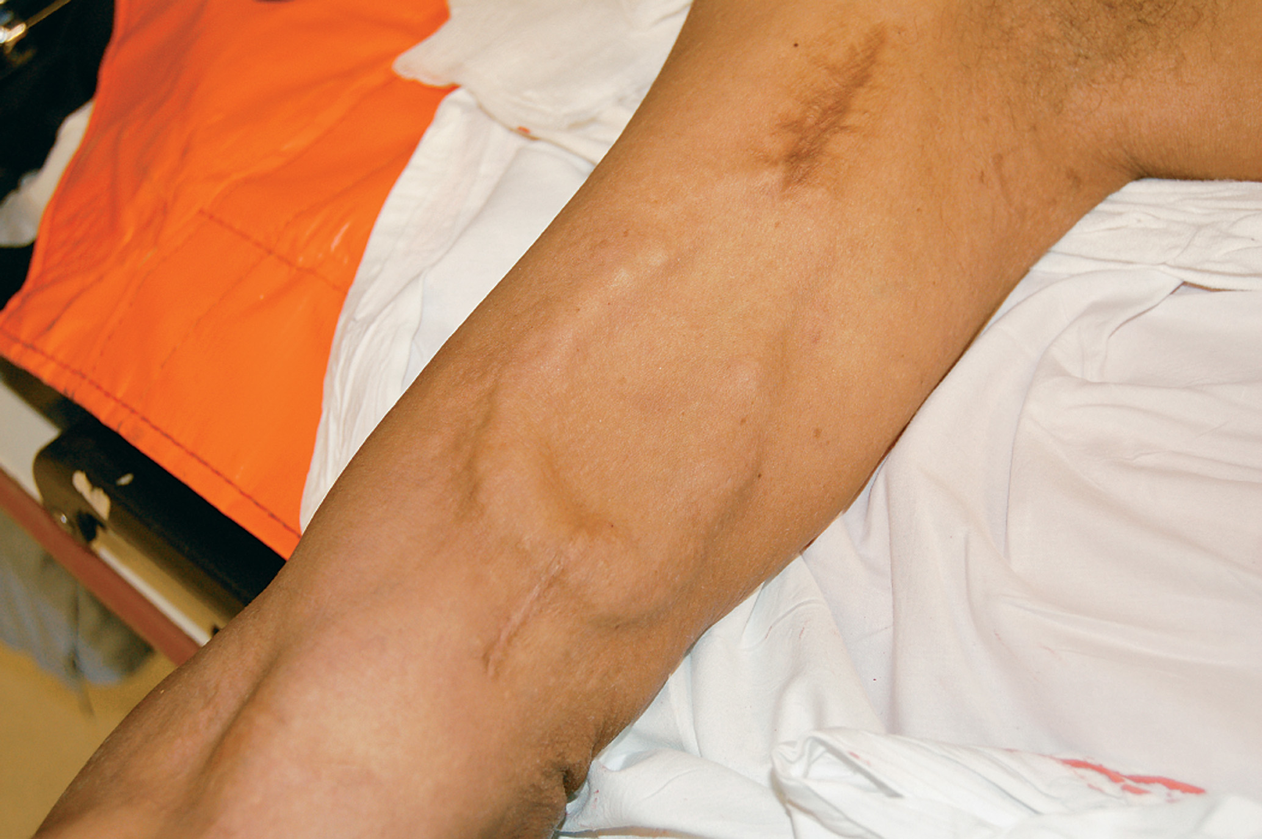
In Hemodialysis, a Dialysis Machine is Connected to an Access Site Such as a Shunt Formed by an Artificial Graft between an Artery and a Vein (2 of 2)
(Photo: © Edward T. Dickinson, M D)
Notes:
Discussion Question
How are acute and chronic renal failure different?

Slide 137
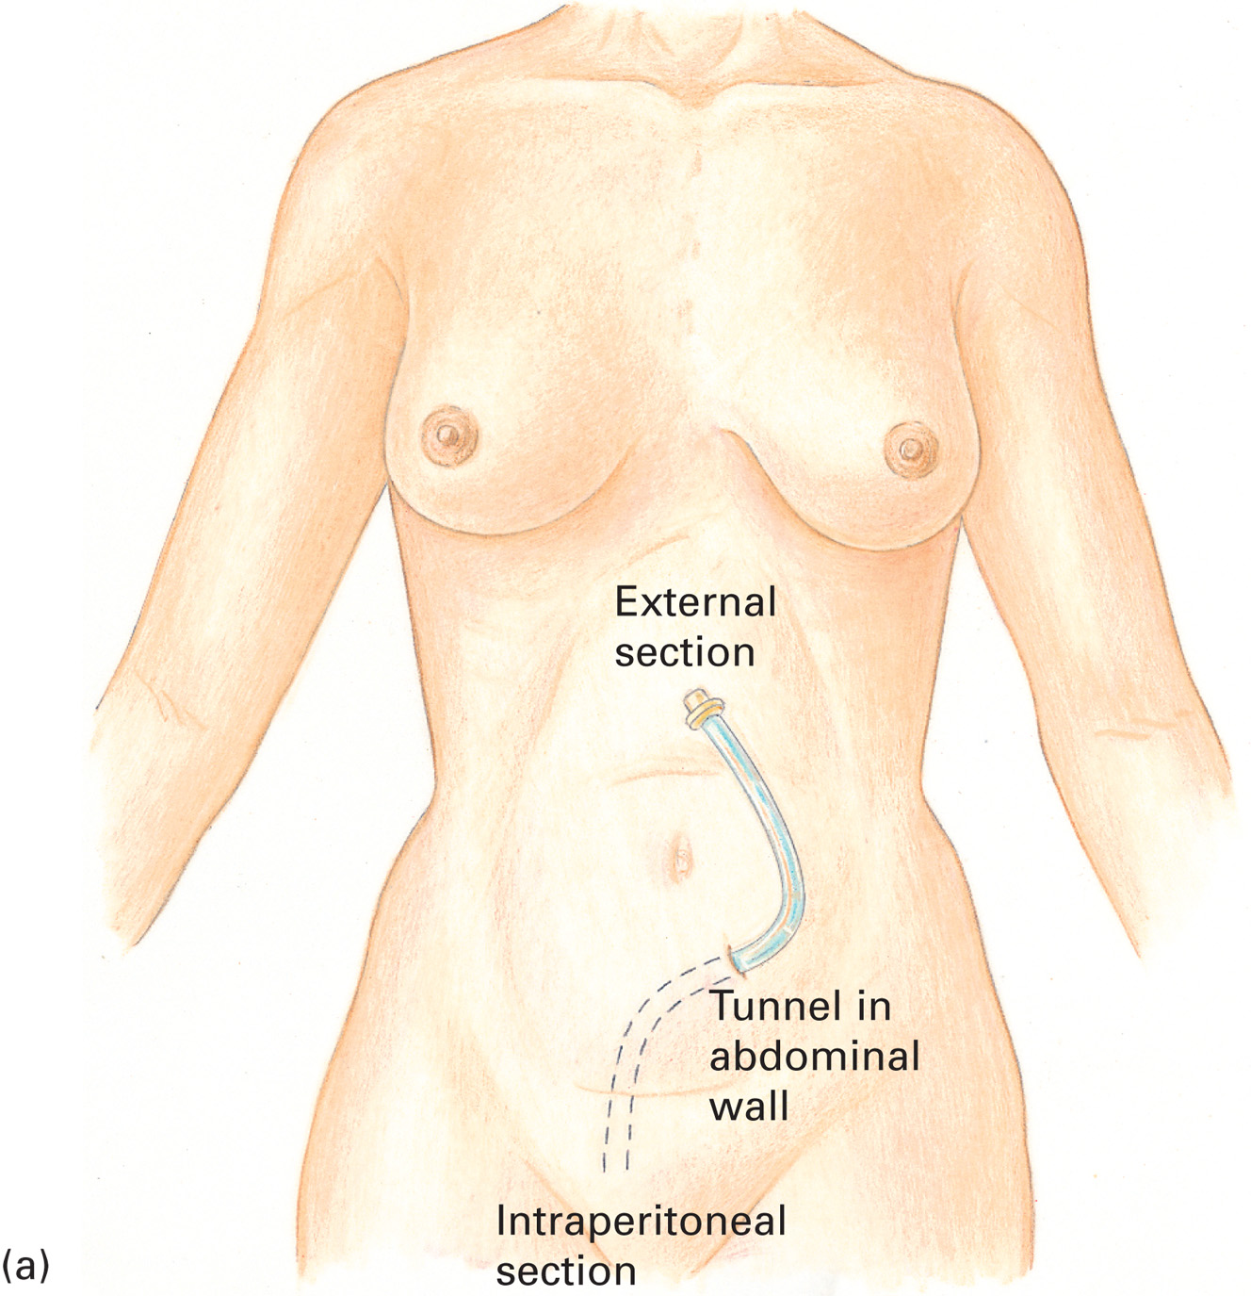
In Peritoneal Dialysis, Dialysate is Run Through a Tube into the Patient’s Abdomen
Notes:
Discussion Question
What are some complications of dialysis?
Critical Thinking Discussion
How would a dialysis patient be affected by missing dialysis appointments?
Teaching Tips
Pass around an example of a urinary catheter kit to allow students to examine it.
Critical Thinking Discussion
Why are women and patients with a urinary catheter at increased risk of UTIs?

Slide 138
Genitourinary/Renal Emergencies (14 of 29)
Genitourinary/Renal Conditions
Dialysis
Complication include:
Hemorrhage, hypotension
Muscle cramps
Peritonitis
Nausea, vomiting
Infection at the access site
Irregular pulse, cardiac arrest
Difficulty breathing.
Notes:
Although dialysis provides a necessary treatment for patients with kidney failure, it has risks that can result in adverse effects and life-threatening complications.

Slide 139
Genitourinary/Renal Emergencies (15 of 29)
Genitourinary/Renal Conditions
Dialysis
Complications of Missed Dialysis
Weakness
Pulmonary edema
Dialysis Emergency Management
Support airway, breathing, circulation.
Provide oxygen, as needed.
Stop bleeding from the access site.
Position the patient and transport.
Notes:
If the patient has signs of shock, place them in a supine position. If the patient has pulmonary edema, place them upright.

Slide 140
Genitourinary/Renal Emergencies (16 of 29)
Genitourinary/Renal Conditions
Urinary Catheters
Urinary catheters drain urine from the bladder.
An indwelling (Foley) catheter is the most common type.
Patients are prone to urinary tract infection and device malfunction.
Notes:
Foley or indwelling catheters are the most common. These catheters have a balloon that is inserted into the urinary bladder via the urethra. The urine drains from the bladder into the catheter and is deposited into a bag. Suprapubic catheters work in a similar way, but instead of being inserted through the urethra, they are placed into the urinary bladder directly through the patient’s abdominal wall.

Slide 141
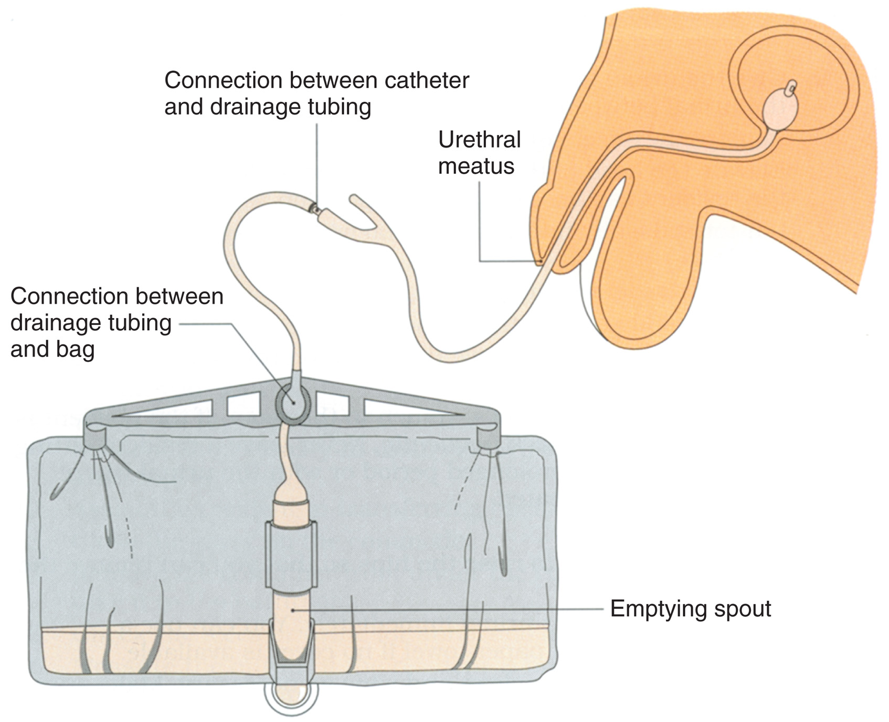
Indwelling Catheters Have a Balloon That is Inserted into the Urinary Bladder Via the Urethra. The Urine That Drains from the Bladder is Deposited into an External Bag (1 of 2)
Notes:
The urine drains from the bladder into the catheter and is deposited into a bag.

Slide 142
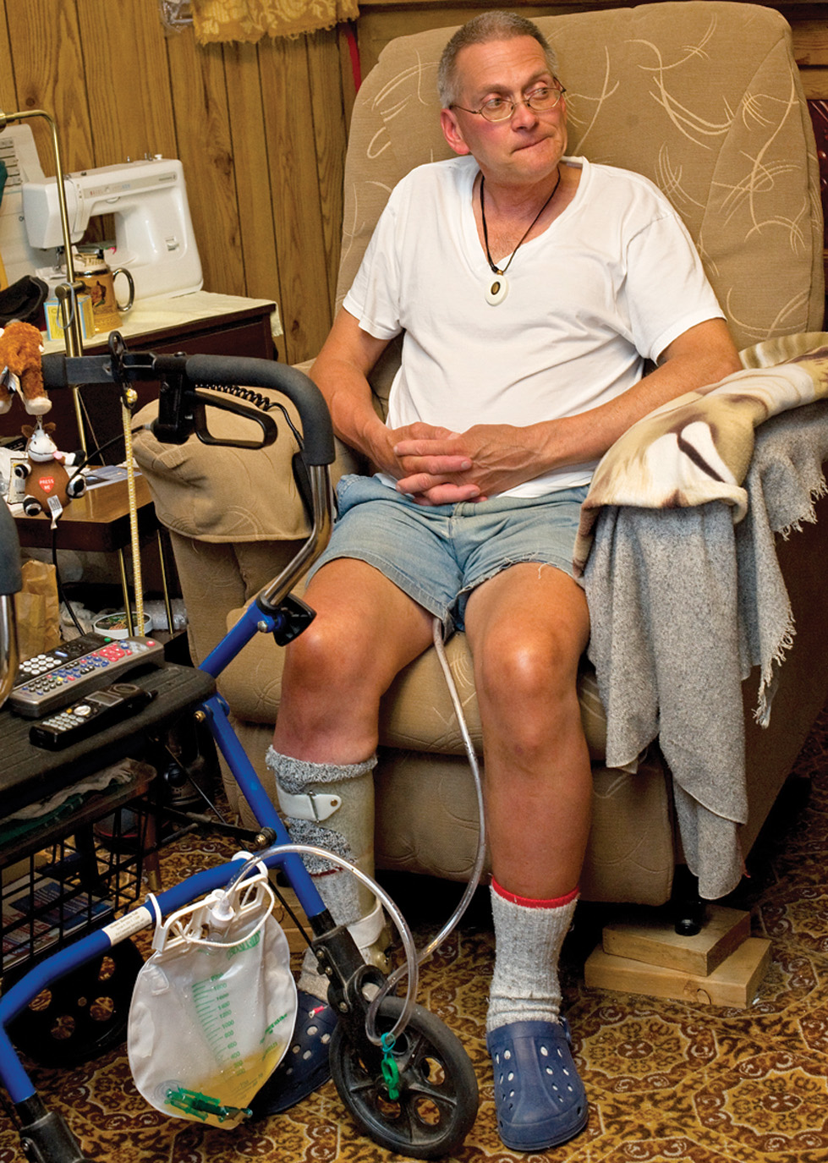
Indwelling Catheters Have a Balloon That is Inserted into the Urinary Bladder Via the Urethra. The Urine That Drains from the Bladder is Deposited into an External Bag (2 of 2)
Notes:
Before you move and transport the patient, you should drain the bag. Record how much urine was in the bag and the time that you emptied it.

Slide 143
Genitourinary/Renal Emergencies (17 of 29)
Genitourinary/Renal Conditions
Urinary Catheters
Catheter Management
Note any unusual color, bleeding, swelling, or odor.
If possible, drain the bag before transport and record the amount drained and the time.
Notes:
Make sure there are no kinks in the device and that it is free from anything it could get caught on before you move the patient. After transferring the patient to either the cot or the bed, ensure that you lower the bag so the urine can freely flow into it.

Slide 144
Genitourinary/Renal Emergencies (18 of 29)
Assessment-Based Approach – Genitourinary/Renal Emergencies
Scene Size-Up
Ensure that the scene is safe.
Take all Standard Precautions.
Determine whether the patient has been injured or is suffering from a medical illness.
Notes:
If a mechanism of injury is not apparent, you would then suspect that the complaint is a result of a medical illness. Remember that patients experiencing genitourinary or renal emergencies can fall or suffer other trauma because of their condition.

Slide 145
Genitourinary/Renal Emergencies (19 of 29)
Assessment-Based Approach – Genitourinary/Renal Emergencies
Primary Assessment
Form a general impression from the following:
Mental status
Airway
Breathing
Oxygenation
Circulation/perfusion.
Notes:
Because a genitourinary or renal emergency can have many complications, the patient might be disoriented or unresponsive. Ensure that your patient has an open and clear airway, and use a mechanical airway device if necessary.

Slide 146
Genitourinary/Renal Emergencies (20 of 29)
Assessment-Based Approach – Genitourinary/Renal Emergencies
Primary Assessment
The patient is a high priority for transport if they exhibit any of the following symptoms:
Poor general appearance
Unresponsive
Responsive, not following commands
Severe pain
Shock.
Notes:
Shock is only one indicator of a serious medical emergency. The patient having a genitourinary or renal emergency should be categorized as a priority for transport if they meet any of the criteria.

Slide 147
Genitourinary/Renal Emergencies (21 of 29)
Assessment-Based Approach – Genitourinary/Renal Emergencies
Secondary Assessment
Protect privacy and modesty.
Be compassionate and professional.
Obtain a history and perform a physical exam.
Obtain vital signs.
Notes:
Ask questions involving personal issues that some patients can be hesitant or embarrassed to answer. Be patient, compassionate, and professional when communicating with them.

Slide 148
Genitourinary/Renal Emergencies (22 of 29)
Assessment-Based Approach – Genitourinary/Renal Emergencies
Secondary Assessment
History
Signs and symptoms-what, when, how fast
What was the patient doing at the time?
Does the patient have any known allergies?
When was the patient’s last oral intake?
What medications are they on?
What is their past medical history?
Notes:
Ask questions involving personal issues that some patients can be hesitant or embarrassed to answer. Be patient, compassionate, and professional when communicating with them.

Slide 149
Genitourinary/Renal Emergencies (23 of 29)
Assessment-Based Approach – Genitourinary/Renal Emergencies
Secondary Assessment
History
When was the patient’s last menstrual period?
Is there any genital pain or discharge?
Is there a change in urine?
Does the patient receive dialysis?
Do they have any abdominopelvic or flank pain?
Notes:
Also ask if the patient has any pain associated with urination, defecation, or sexual intercourse.
If the patient receives dialysis, when was the last treatment received? Was there any complication during the dialysis? When is the next treatment due?

Slide 150
Genitourinary/Renal Emergencies (24 of 29)
Assessment-Based Approach – Genitourinary/Renal Emergencies
Secondary Assessment
History
Has there been any nausea or vomiting?
Signs and Symptoms
Abnormal color, consistency, or odor of urine
Abdominopelvic pain or tenderness
Nausea, vomiting
Notes:
The signs and symptoms associated with a genitourinary or renal emergency vary depending on the cause.

Slide 151
Genitourinary/Renal Emergencies (25 of 29)
Assessment-Based Approach – Genitourinary/Renal Emergencies
Secondary Assessment
Signs and Symptoms
Fever or chills
Syncope or altered mental status
Pain or burning during sexual intercourse
Flank, groin, or back pain
Frequent or urgent need to urinate
Blood in the urine
Notes:
Discussion Question
How would the various signs and symptoms assist the EMT in differentiating the involved body systems?

Slide 152
Genitourinary/Renal Emergencies (26 of 29)
Assessment-Based Approach – Genitourinary/Renal Emergencies
Secondary Assessment
Signs and Symptoms
Edema of feet, ankles, legs
Hypertension
Anorexia
Tachycardia
Signs of shock

Slide 153
Genitourinary/Renal Emergencies (27 of 29)
Assessment-Based Approach – Genitourinary/Renal Emergencies
Secondary Assessment
Physical exam
Assess the abdomen.
Assess other systems such as the lungs and cardiovascular system.
If there is a catheter, observe the amount and appearance of the urine.
Take and record the vital signs.
Notes:
The physical exam will primarily focus on the genitourinary or renal complaint, and will normally involve the abdominopelvic area. Genitourinary and renal conditions can affect other body systems; therefore, you must assess related body systems, such as the cardiovascular and respiratory systems, for associated signs and symptoms.

Slide 154
Genitourinary/Renal Emergencies (28 of 29)
Assessment-Based Approach – Genitourinary/Renal Emergencies
Emergency Medical Care
Establish spine motion restriction, if needed.
Maintain the airway and ventilation.
Maintain oxygenation.
Control major bleeding.
Position the patient according to condition.
Notes:
If trauma to the spine or spinal cord is suspected, maintain the necessary spine motion restriction precautions. If signs or symptoms of shock are present, place in a supine position. If pulmonary edema is suspected, place the patient in an upright position.

Slide 155
Genitourinary/Renal Emergencies (29 of 29)
Assessment-Based Approach – Genitourinary/Renal Emergencies
Emergency Medical Care
Calm and reassure the patient.
Transport.
Reassessment
Continuously monitor the patient for changes in mental status, airway, breathing, and circulation.
Notes:
For a patient with an altered mental status or signs of shock, repeat the reassessment every 5 minutes. Record the vital signs and communicate your findings to the receiving medical facility.

Slide 156
Lesson Summary (1 of 4)
Gynecologic conditions can present with abdominopelvic pain and vaginal discharge or bleeding.
Be aware of special considerations in managing sexual assault patients.
Protect the patient's privacy and modesty.
Notes:
Follow-Up
Answer student questions.
Follow-Up Assignments
Review Chapter 23 Summary.
Complete Chapter 23 In Review questions.
Complete Chapter 23 Critical Thinking questions.
Assessments
Handouts
Chapter 23 quiz

Slide 157
Case Study 2 Conclusion (1 of 4)
During the assessment, Donna and Jade learn that Mr. Carpenter seemed fine 24 hours ago, but today when the aide arrived, he was disoriented in person, place, and time. Jade notices that the collection bag for the catheter has about 350 milliLiter of dark, cloudy urine.
Notes:
Case Study Discussion
Review the case conclusion and emphasize the application of knowledge learned from this presentation.

Slide 158
Case Study 2 Conclusion (2 of 4)
Mr. Carpenter’s skin is hot and moist. His lungs sound are clear and equal, and he complains of tenderness to his lower abdomen and right flank area. His vital signs are: pulse 96 and regular, respirations 20 with good tidal volume, B P 126/78, and S p O₂ 96%.
Notes:
Case Study Discussion
Review the case conclusion and emphasize the application of knowledge learned from this presentation.

Slide 159
Case Study 2 Conclusion (3 of 4)
The E M T s recognize the altered mental status as a condition that makes the patient a high priority for transport.
Using care, Donna empties the urine collection bag, noting the time, amount, and appearance of the urine. The E M T s use care to avoid pulling on the catheter tubing. Once in the ambulance, they place the collection bag lower than Mr. Carpenter's body.
Notes:
Case Study Discussion
Review the case conclusion and emphasize the application of knowledge learned from this presentation.

Slide 160
Case Study 2 Conclusion (4 of 4)
Donna and Jade reassess the patient en route, and they transfer his care to staff at the hospital, where he is diagnosed with a urinary tract infection.
Notes:
Case Study Discussion
Review the case conclusion and emphasize the application of knowledge learned from this presentation.

Slide 161
Lesson Summary (2 of 4)
There are many potential causes of abdominopelvic pain, many of which can be serious.
In emergency care, anticipate vomiting and be prepared to manage the airway; make the patient as comfortable as possible.
Be alert to the possibility of shock.
Notes:
Follow-Up
Answer student questions.
Follow-Up Assignments
Review Chapter 23 Summary.
Complete Chapter 23 In Review questions.
Complete Chapter 23 Critical Thinking questions.
Assessments
Handouts
Chapter 23 quiz

Slide 162
Lesson Summary (3 of 4)
Hematologic conditions are problems with the blood and blood components.
Problems E M T s may encounter include anemia, sickle cell disease, and hemophilia.
Notes:
Class Activity
As an alternative to assigning the follow-up exercises in the lesson plan as homework, assign each question to a small group of students for in-class discussion.

Slide 163
Lesson Summary (4 of 4)
Genitourinary disorders can present with abdominopelvic pain.
Urinary tract infections and kidney stones are common problems.
Patients with chronic renal failure require dialysis, which can have serious complications.
Notes:
Teaching Tips
Answers to In Review questions are in the appendix of the text. Advise students to review the questions again as they study the chapter.

Slide 164
Correct! (1 of 2)
The term that is used to describe inflammation of the gallbladder is cholecystitis.
Click here to return to the program.

Slide 165
Incorrect (1 of 6)
Peritonitis is a term used to describe inflammation of the lining of the abdominal cavity, which is known as the peritoneum.
Click here to return to the quiz.

Slide 166
Incorrect (2 of 6)
Gastroenteritis is a term used to described irritation and inflammation of the stomach and intestines.
Click here to return to the quiz.

Slide 167
Incorrect (3 of 6)
Varices are distended veins. One area in which varices may occur is the lower end of the esophagus, in which case they are known as esophageal varices.
Click here to return to the quiz.

Slide 168
Correct! (2 of 2)
The condition in which tissue from the lining of the uterus, the endometrium, is implanted outside the uterine cavity, is called endometriosis. This condition can result in inflammation, scarring, and adhesions.
Click here to return to the program.

Slide 169
Incorrect (4 of 6)
Pelvic inflammatory disease is an infection of the female reproductive tract, often due to a sexually transmitted infection, which can lead to scarring, sepsis, and infertility.
Click here to return to the quiz.

Slide 170
Incorrect (5 of 6)
Endometritis is an inflammation or infection of the lining of the uterus, the endometrium.
Click here to return to the quiz.

Slide 171
Incorrect (6 of 6)
Mittelschmerz is pain experienced by some women when ovulation, the release of an egg from the ovary, occurs.
Click here to return to the quiz.

Slide 172
Copyright

