Slide 1

Prehospital: Emergency Care
Eleventh Edition
Chapter 22
Toxicologic Emergencies
Slides in this presentation contain hyperlinks. JAWS users should be able to get a list of links by using INSERT+F7
Copyright © 2018, 2014, 2010 Pearson Education, Inc. All Rights Reserved
Notes:
If this PowerPoint presentation contains mathematical equations, you may need to check that your computer has the following installed:
1) MathType Plugin
2) Math Player (free versions available)
3) NVDA Reader (free versions available)
Advance Preparation
Student Readiness
Assign the associated section of MyBRADYLab and review student scores.
Review the chapter material in the Instructor Resources, which includes Student Handouts, PowerPoint slides, and the MyTest Program.
Prepare
Make copies of course policies and procedures, the syllabus, handouts from the Instructor Resources, and other materials for distribution or post them in your learning management system.
Preview the media resources and Master Teaching Notes in this lesson.
Preview the case study presented in the PowerPoint slides.
The total teaching time recommended is only a guideline. Take into consideration factors such as the pace at which students learn, the size of the class, breaks, and classroom activities. The actual time devoted to teaching objectives is the instructor’s responsibility.

Slide 2
Learning Readiness
E M S Education Standards, text p. 650.
Chapter Objectives, text p. 650.
Key Terms, text p. 650.
Purpose of lecture presentation versus textbook reading assignments.
Notes:
Explain to students what the National EMS Education Standards are. The National EMS Education Standards communicate the expectations of entry-level EMS providers. As EMTs, students will be expected to be competent in these areas. Acknowledge that the standards are broad, general statements. Although this lesson addresses the listed competencies, the competencies are often complex and require completion of more than one lesson to accomplish. The student is also expected to review the chapter objectives to foreshadow what will be in the chapter. By mastering the key terms the EMT student will better understand the learning and be able to communicate more clearly.
Additionally, explain to the students that the purpose of using these slides is to help keep the instructor focused on highlighting important portions of the material, explain interrelationships of topics, and discuss how to apply this information. It’s not the intent of the presentation (or slides alone) to include every component in the chapter. This presentation still requires the student to thoroughly read the chapter.

Slide 3
Setting the Stage
Overview of Lesson Topics
  Poisons and Poisoning
  Ingested, Inhaled, Injected, and Absorbed Poisons
  Specific Types of Poisoning
  Poison Control Centers
  Drug and Alcohol Emergencies
  Specific Substance Abuse Considerations

Slide 4
Case Study #1 Introduction
E M T s Trisha Trujillo and Brian Long have just obtained the chief complaint and some preliminary information from the mother of a two-year-old boy named John. John was found with an open container of lamp oil, and because he had the substance around his mouth, his mother believes he may have drunk some of it.
John is awake and alert, and he seems a little scared at the commotion now going on in his home.
Notes:
Case Study
Present the Case Study Introduction provided in the PowerPoint slide set. Lead a discussion using the case study questions provided on the subsequent slide(s). The Case Study with discussion questions continues throughout the PowerPoint presentation.
Case Study Discussion
Use the case study content and questions to foreshadow the upcoming lesson content.

Slide 5
Case Study #1
What additional questions should the E M T s ask John and his mother?
What information do they need about the product that may be involved?
What resource will be helpful in assisting the E M T s with treatment and transport decisions?
Notes:
Case Study Discussion
Use the Case Study content and questions to foreshadow the upcoming lesson content. Gauge the student’s responses as a guide to how well versed they are on this topic.

Slide 6
Introduction
Poisoning may be accidental or intentional.
Many calls to poison control centers involve children.
There are special problems associated with drug and alcohol emergencies.
Notes:
During this lesson, students will learn about assessment and emergency care for patients who have been exposed to various types of poisons.

Slide 7
Poisons and Poisoning (1 of 6)
Poisons and Routes of Exposure
  A poison is any substance that impairs health or causes death by its chemicals.
  Most poisonings are accidental and involve young children.
  Other causes of poisoning include suicide and homicide.
Notes:
Discussion Questions
What is a poison?
What are the four routes by which poisons can enter the body?
How does the route of exposure to a poison affect the onset of its effects in the body?
Class Activity
Bring in common household toxins and split your class into groups, assigning each to a different toxin. Have each group research the ingredients of the substance and prepare a short presentation on the toxic effects of the substance and/or its component ingredients.

Slide 8
Poisons and Poisoning (2 of 6)
Poisons and Routes of Exposure
  Toxicology is the study of toxins and antidotes.
  Overdose of drugs or medications is a type of poisoning.
Notes:
Teaching Tips
Have students list examples of toxic substances that they might find in their homes.
Ask students to give examples of poisons that can enter the body by each of the four routes of exposure.
Pass around common toxic household items you have collected for this purpose to illustrate the range of toxic substances around us in our everyday environment.
Knowledge Application
Given a scenario involving exposure to a poison, students should be able to determine the route of exposure.

Slide 9
Poisons and Poisoning (3 of 6)
  Poisons and Routes of Exposure
  Poisons can enter the body by four routes:
    Ingestion
    Inhalation
    Injection
    Absorption
Notes:
Discuss the fundamental meanings of each:
Ingestion – the poison is swallowed.
Inhalation – the poison is inhaled.
Injection – the poison is injected into the skin.
Absorption – the poison is absorbed through the skin.
Remind students this is also the same for routes that may cause an allergic reaction.

Slide 10
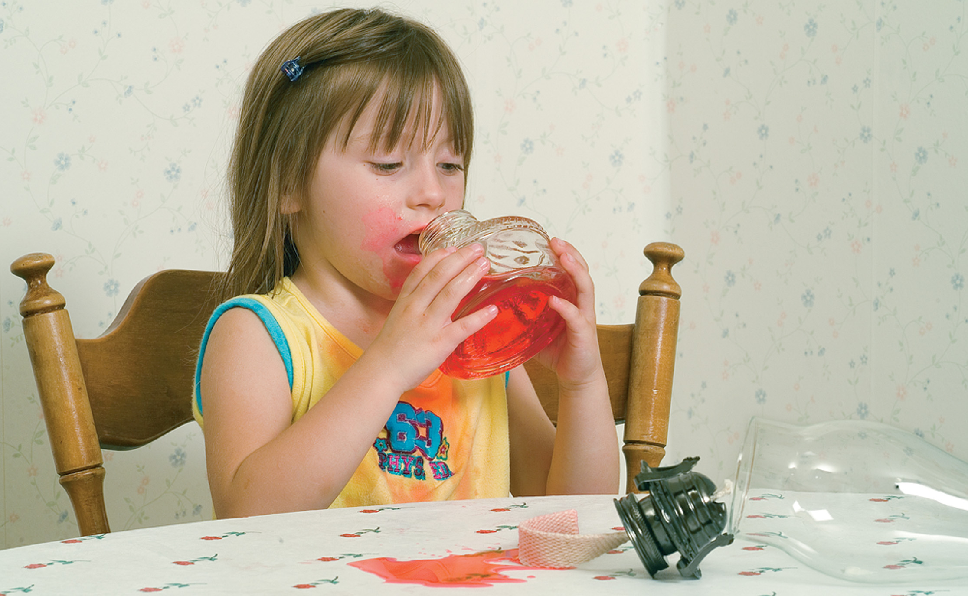
Ingestion
Notes:
Ingestion. A drug or substance can be swallowed, with absorption occurring through the gastrointestinal tract (stomach and intestines). This is the most common route of poisoning.

Slide 11
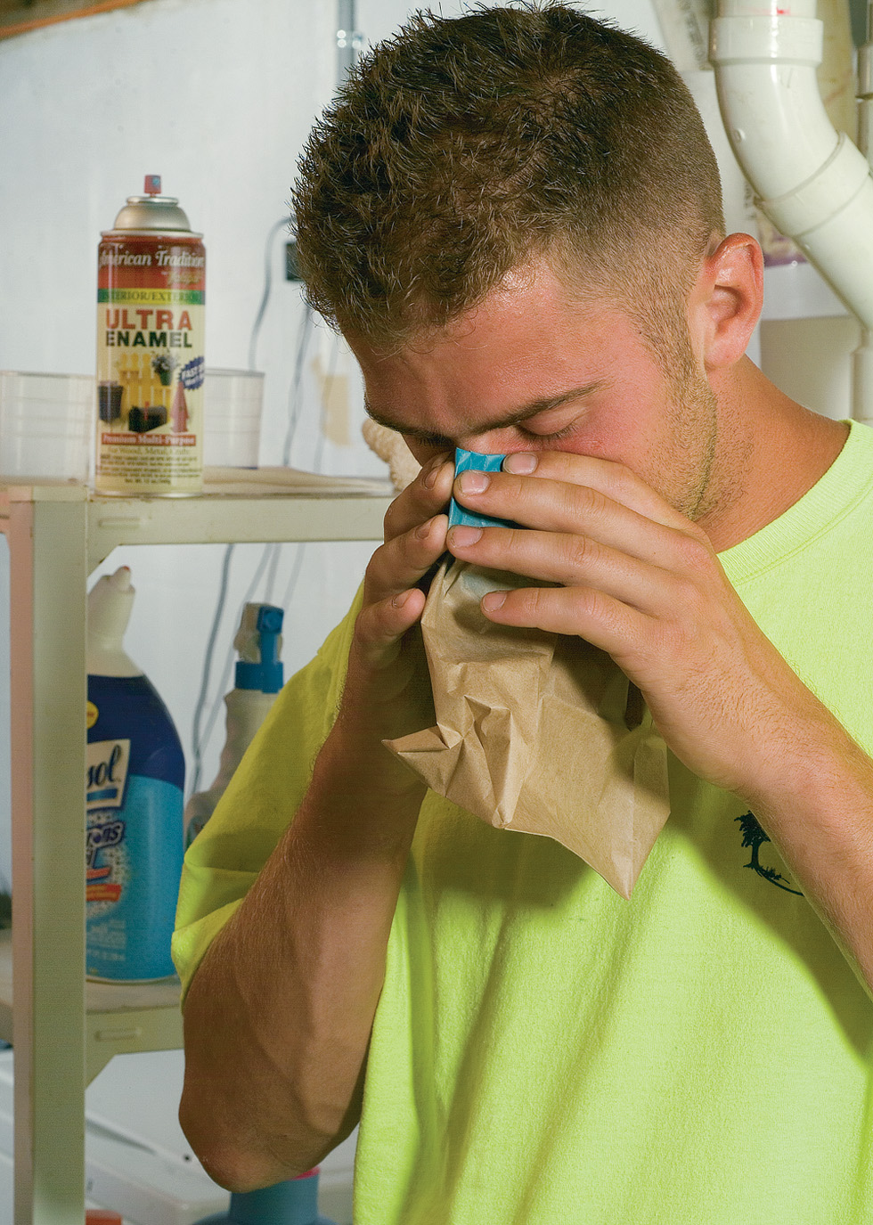
Inhalation
Notes:
Inhalation. Breathing a poison—typically a gas, vapor, fume, or aerosol—into the lungs enables rapid absorption into the body. The poison is transported down the respiratory tract with each inhalation until it reaches the alveoli. When in the alveoli, the poison can cross the alveolar-capillary membrane and enter the bloodstream, where it is then transported throughout the entire body.

Slide 12
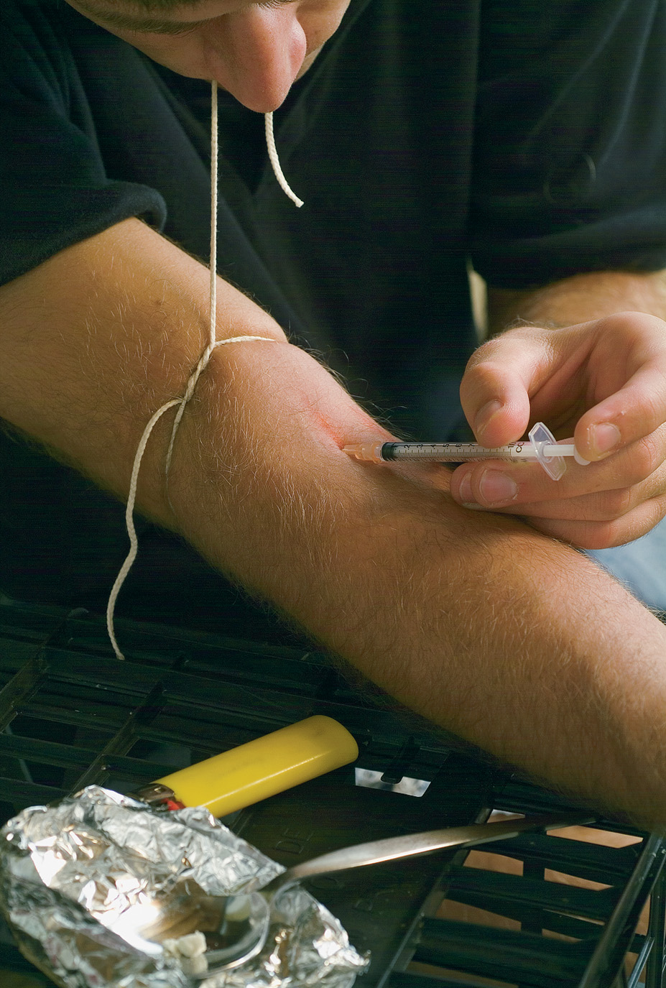
Injection
Notes:
Injection. A poison can be injected under the skin, into the muscle, or directly into a blood vessel. This can result in a local reaction to the poison, which is usually immediate. A local reaction typically causes edema (swelling) at the site of injection, redness, irritation, and sometimes pain. A systemic reaction can occur from injection of a poison, where it gets distributed throughout the body.

Slide 13

Absorption
Notes:
Absorption. A poisonous substance can enter the body when it contacts the skin or mucous membranes.

Slide 14
Poisons and Poisoning (4 of 6)
  Poisons and Routes of Exposure
  Signs and symptoms depend on the specific poison and the route of entry into the body.
  Always be prepared for patient deterioration in a suspected poisoning.
  Monitor the patient’s mental status, airway, and breathing.
Notes:
The signs and symptoms of poisoning in patients depend on the specific poison and the route of entry into the body. One poison might depress the central nervous system, leading to bradycardia, slow, shallow respirations, and hypotension, whereas another poison might stimulate the central nervous system and cause tachycardia, tachypnea, and hypertension. The route of entry can determine how quickly the patient presents with the expected signs and symptoms.

Slide 15
Poisons and Poisoning (5 of 6)
Managing the Poisoning Patient
  Most care for poisoning patients is supportive.
    Intervene in airway, breathing, oxygenation, and circulation as needed.
    Monitor mental status.
    Be prepared for vomiting.
    Make frequent reassessments.
Notes:
Discussion Question
What are the treatment priorities for patients with poisoning?
Critical Thinking Discussion
What are some ways that unintentional poisonings can be prevented?
What is the EMT's role in providing education to prevent poisoning?

Slide 16
Poisons and Poisoning (6 of 6)
Antidotes
  Few antidotes are available.
  Treatment is geared toward limiting or preventing absorption of the poison, and treating signs and symptoms.
Notes:
An antidote is a substance that neutralizes the effects of the poison or toxic substance. Many people think that antidotes are available for most poisons; however, true antidotes are available for only a small number of poisons. The treatment of poisons is generally limits or prevents the absorption of the poison, and then manages any other signs and symptoms that can occur.
Discussion Question
What role do specific antidotes play in the management of poisoned patients?

Slide 17
Ingested Poisons (1 of 10)
Emptying of the stomach and absorption from the small intestine varies.
Always determine when the substance was ingested.
Notes:
Discussion Question
What are some commonly ingested poisons?
Critical Thinking Discussion
What are the critical facts to determine when collecting the history of a patient who has ingested a poison?
How are all of these things important in the patient's treatment?

Slide 18
Ingested Poisons (2 of 10)
Commonly Ingested Substances
  Poisonous Substances
    Over-the-counter medications
    Illegal drugs
    Household products and cleaning agents
Notes:
Discussion Questions
What are some indications that a patient may have ingested a poison?
What are the key management priorities in patients who have ingested poisons?
Knowledge Application
Given several different scenarios, students should be able to assess and manage patients with poisoning by ingestion.

Slide 19
Ingested Poisons (3 of 10)
Commonly Ingested Substances
  Foods (spoiled or underprepared)
  Insecticides
  Petroleum products
  Plants
Common Accidental Ingestions
  Medication misuse
  Medications taken with alcohol
Notes:
The ingestion of poisonous plants is a common poisoning emergency, especially in children under the age of 5. Poisonous plants are not necessarily exotic—they include common household and backyard plants, such as morning glory, rhubarb leaves, buttercup, daisy, daffodil, lily of the valley, narcissus, tulip, azalea, English ivy, mistletoe berries, iris, hyacinth, laurel, philodendron, rhododendron, wisteria, and certain parts of the tomato, potato, and petunia plants. A high number of poisonings result from eating wild mushrooms.

Slide 20
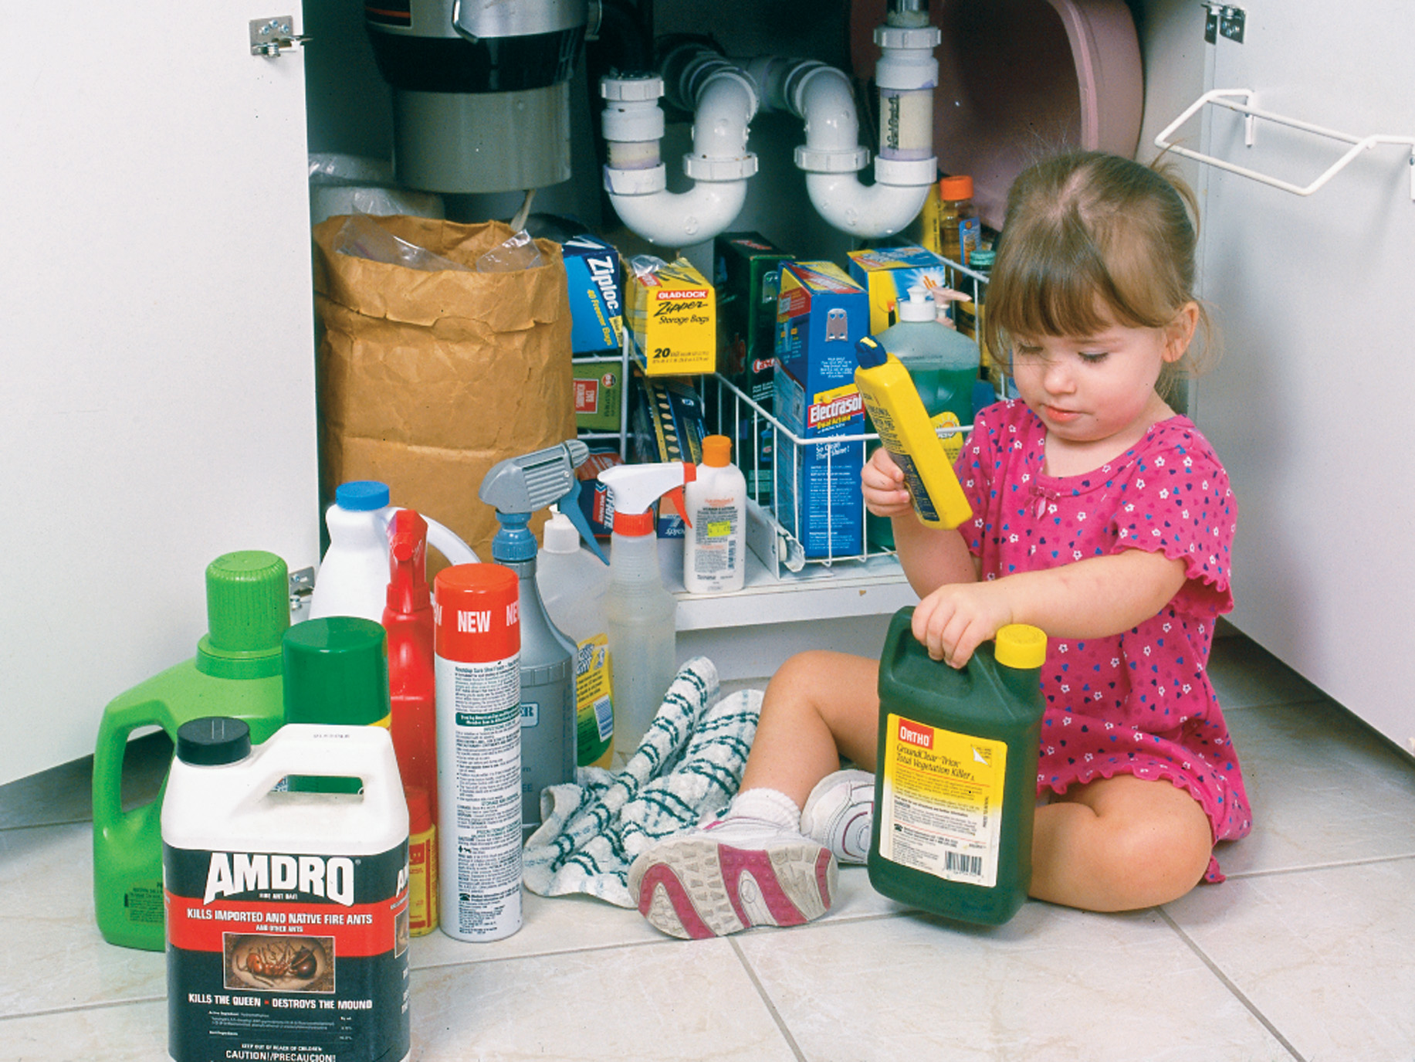
Poisoning is the Number One Cause of Accidental Death Among Children
Notes:
Critical Thinking Discussion
How could EMS providers help reduce the number of accidental poison by children?

Slide 21
Ingested Poisons (4 of 10)
Assessment-Based Approach – Ingested Poisons
  Size-Up
  Primary Assessment
  Secondary Assessment
    History
    Physical Exam
    Signs and Symptoms
  Reassessment
Notes:
Primary Assessment
Assess mental status.
Assess the airway, anticipate vomiting; intervene as needed.
Provide positive pressure ventilation as needed.
Maintain oxygenation (SpO₂ 94% or higher).
Assess circulation.
Secondary Assessment
History
Consider that multiple substances may be involved.
Consider the trustworthiness of the history from a patient who has overdosed.
Ask the following:
What substance was ingested?
Was alcohol also ingested?
When was the substance ingested?
Over what time period did the ingestion occur?
How much of the substance was taken?
Has anyone attempted treatment?
Does the patient have a psychiatric history?
Are there any underlying illnesses?
How much does the patient weigh?
What medications are available at the scene?
Physical Exam
Focus on the patient’s complaints; if the mental status is altered, perform a complete secondary assessment.
Take the patient’s vital signs.

Slide 22
Ingested Poisons (5 of 10)
Assessment-Based Approach – Ingested Poisons
  Signs and Symptoms
    History of ingestion
    Swelling of mucous membranes of the mouth
    Nausea, vomiting
    Diarrhea
    Altered mental status
Notes:
Review findings.
Ask students to try to identify poisons that could result in these findings.

Slide 23
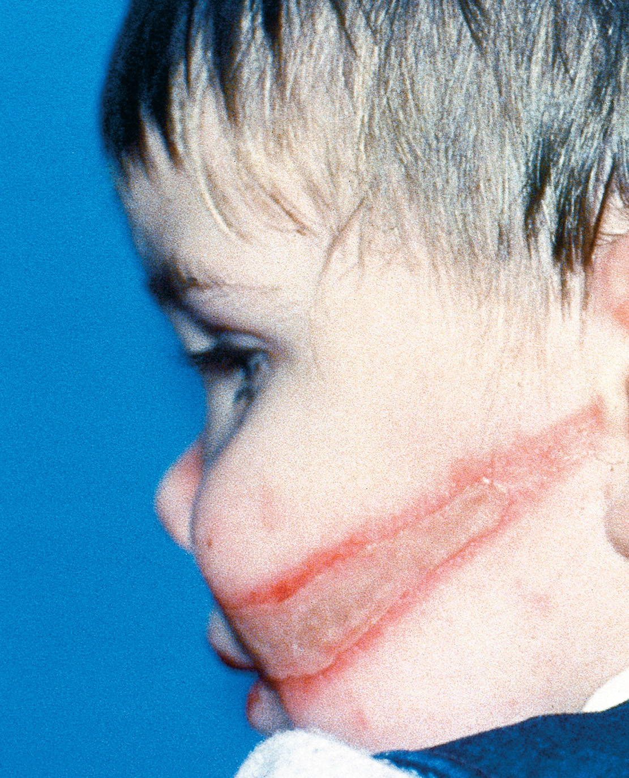
Discoloration or Burns around the Mouth Are Signs of Possible Poisoning
Notes:
What would be the immediate concerns for this patient?

Slide 24
Ingested Poisons (6 of 10)
Assessment-Based Approach – Ingested Poisons
  Signs and Symptom
    Abdominal pain, tenderness
    Burns or stains around the mouth, pain in the mouth or throat
    Unusual breath or body odors
    Respiratory distress
    Altered heart rate
Notes:
Review findings.
Ask students to try to identify poisons that could result in these findings.

Slide 25
Ingested Poisons (7 of 10)
Assessment-Based Approach – Ingested Poisons
  Signs and Symptom
    Altered blood pressure
    Dilated or constricted pupils
    Warm and dry or cool and moist skin
    Altered mental status
    Coma
    Seizures
Notes:
Review findings.
Ask students to try to identify poisons that could result in these findings.

Slide 26
Ingested Poisons (8 of 10)
  Assessment-Based Approach – Ingested Poisons
  Activated Charcoal
    May occasionally be used ingestion of certain substances
    Absorbs certain toxins, preventing them from being absorbed into the body
    No evidence that it improves outcome
Notes:
Activated charcoal is medication that is occasionally used in the emergency medical care of ingested poisonings. The prehospital use of activated charcoal is currently controversial. It should be administered only if directed to do so by medical professionals or a poison control center.

Slide 27
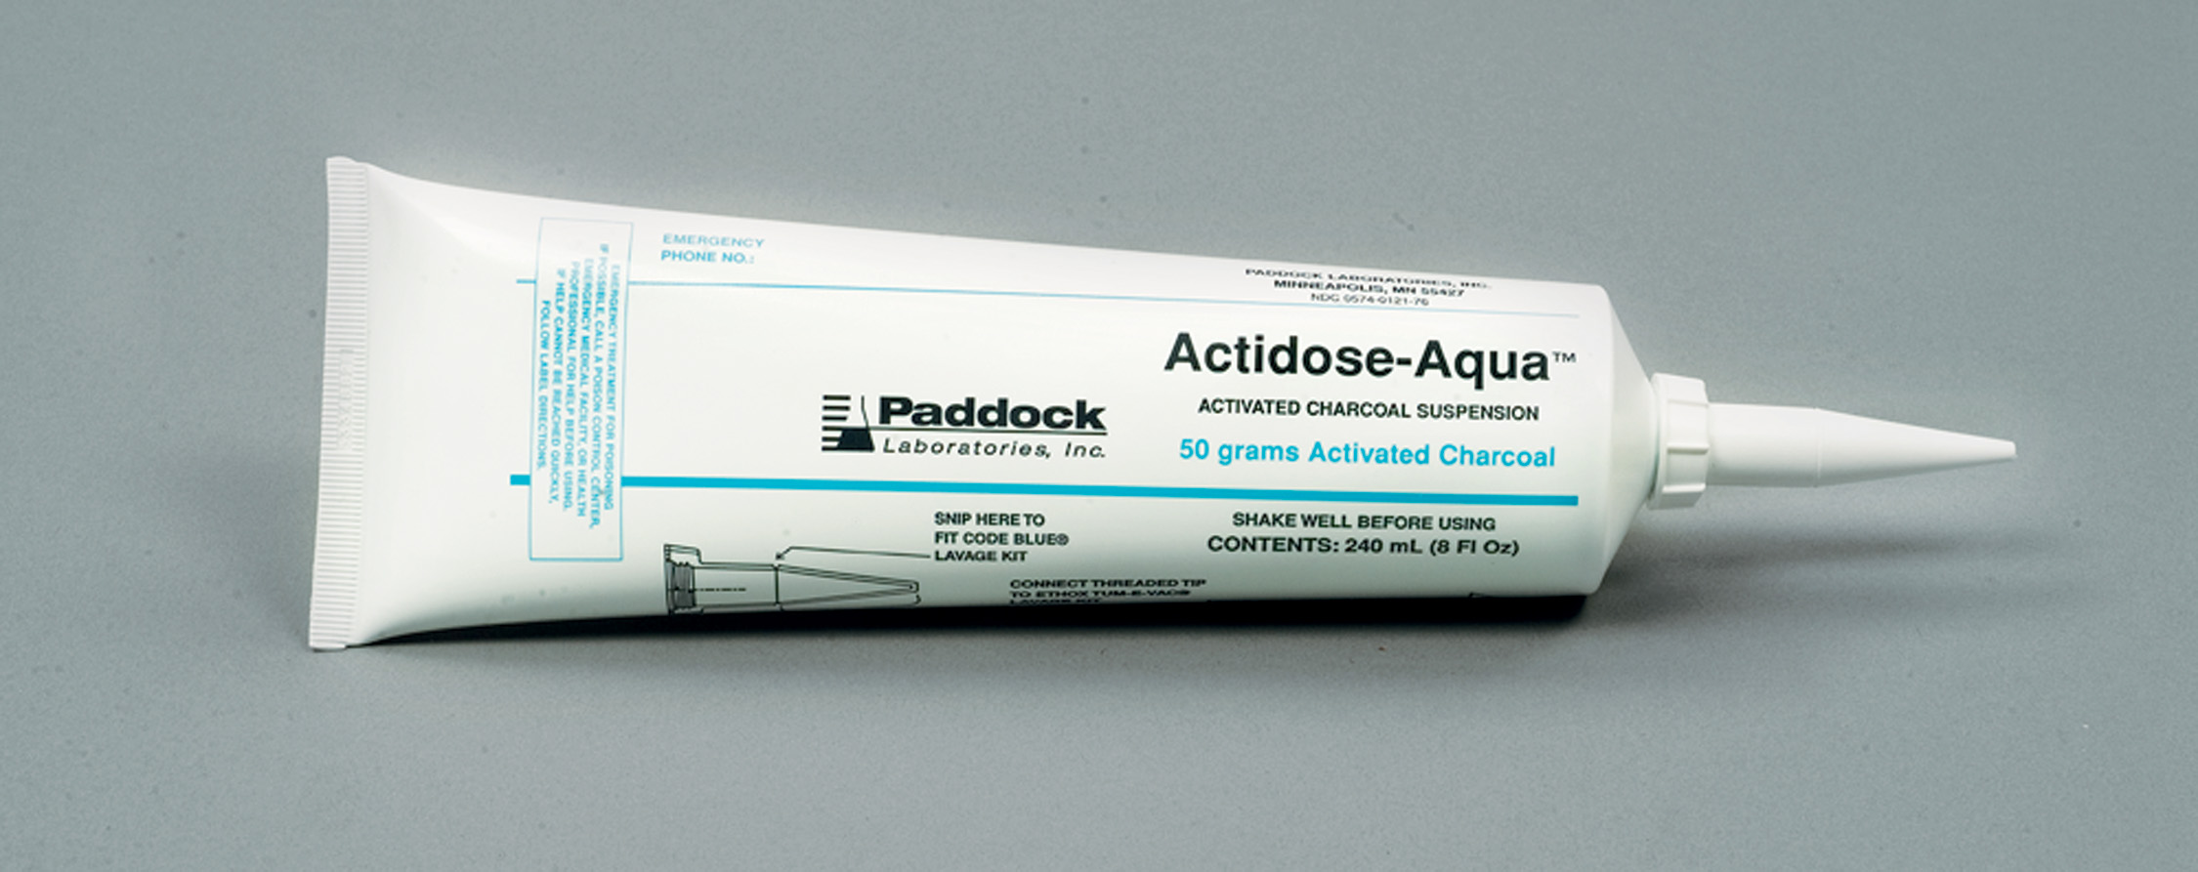
Several Brands and Forms of Activated Charcoal Are Available
Notes:
Discussion Question
What is the role of activated charcoal in treating patients with poisoning by ingestion?
Teaching Tips
Pass around bottles of activated charcoal for students to examine.
Emphasize the ability of activated charcoal to absorb substances by describing its use in water filters and shoe insoles (Odor Eaters®).
Usual dosage is 1g/kg

Slide 28
Ingested Poisons (9 of 10)
  Assessment-Based Approach – Ingested Poisons
  Emergency Medical Care
    Maintain the airway, protect from aspiration.
    Assist inadequate ventilation.
    Maintain oxygenation.
    Prevent further injury.
    Transport the patient immediately.
Notes:
Remind the students that the key to any toxicological emergency is not to determine definitively what the poison was, but rather to support lost function of the airway, breathing, and circulation, then rapidly transport them.

Slide 29
Ingested Poisons (10 of 10)
  Emergency Medical Care
  Consult medical direction or poison control center; activated charcoal may be ordered.
  Bring the substance to the hospital.
  Reassess frequently.

Slide 30
Inhaled Poisons (1 of 9)
Thousands of people die yearly from inhaling a poisonous vapor or fume.
  Many poisonings from inhalation occur as a result of fire.
  These poisons are rapidly absorbed into the body.
  The longer the patient is exposed to the substance, the worse his prognosis.
Notes:
Discussion Question
What are some common inhaled poisons?
Teaching Tips
Ask students to name some sources of inhaled poisons in the community.
Critical Thinking Discussion
Why is the Scene Size Up especially critical when dealing with inhaled toxins?

Slide 31
Inhaled Poisons (2 of 9)
Common Inhaled Poisons
  Ammonia and chlorine gas
  Sulfur dioxide
  Industrial gases
  Carbon monoxide and carbon dioxide
  Fumes from liquid chemicals and sprays
  Solvents used in dry cleaning, degreasing agents, fire extinguishers
Notes:
Knowledge Application
Given several patient descriptions, students should be able to assess and manage patients with inhaled poisonings, with special emphasis on scene safety.
Discussion Question
What are some indications that a patient may have inhaled a poison?

Slide 32
Inhaled Poisons (3 of 9)
Intentional inhalation of certain substances, such as propellants, is called huffing.
Huffing can result in displacement of oxygen from the lungs, and can have toxic effects and cause damage to the alveoli.
Notes:
Some poisons are inhaled intentionally to “get high.” Patients who inhale paints and propellants are commonly referred to as huffers. (Huffers are discussed later in the chapter.) The toxins are inhaled in a variety of ways to produce certain expected effects. These substances can have many effects as they displace the oxygen content in the alveoli, leading to hypoxia.
Commonly abused inhalants
Paints
Freon
Gas propellants
Glue
Nitrous oxide
Amyl nitrate
Butyl nitrate

Slide 33
Inhaled Poisons (4 of 9)
Assessment-Based Approach – Inhaled Poisons
  Scene Size-Up
  Primary Assessment
  Secondary Assessment
    History
    Physical Exam
    Signs and Symptoms
  Reassessment
Notes:
Scene Size Up
Be aware of your own safety; note odors or fumes.
Some inhaled poisons are colorless and odorless.
Placards
If hazardous materials are involved, request resources.
Do not enter the scene unless it is safe.
Determine the number of patients.
Primary Assessment
Assess and closely monitor the airway.
Assess and closely monitor breathing.
Assist inadequate breathing.
For adequate breathing, apply oxygen by nonrebreather mask.
Assess circulation.
Secondary Assessment
Consider trauma
History
Physical exam
Ask the following:
Does the history suggest a suicide attempt?
Did the exposure occur in an open or a confined space?
How long was the exposure?

Slide 34
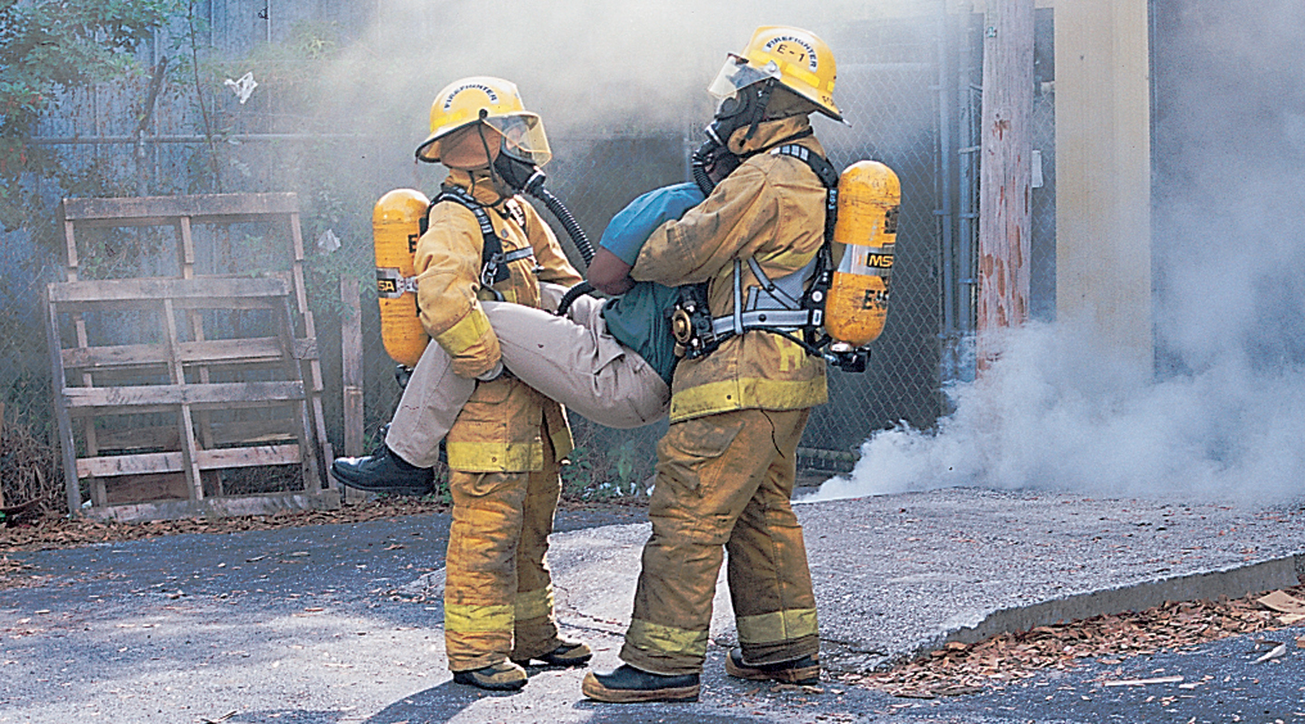
Protect Yourself. Have Trained Rescuers Remove the Patient from a Toxic Environment
Notes:
Discuss the various hazards seen in this situation.

Slide 35
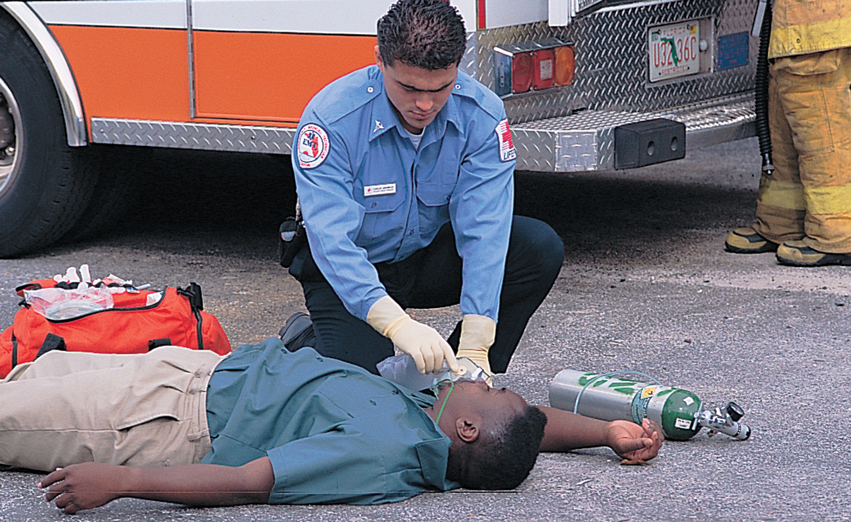
Administer Oxygen to the Inhaled Poisoning Patient
Notes:
Support any lost function during the primary assessment.

Slide 36
Inhaled Poisons (5 of 9)
  Assessment-Based Approach – Inhaled Poisons
  Signs and Symptoms
    History of toxic inhalation
    Difficulty breathing
    Chest pain, tightness, burning in chest or throat
    Cough, stridor, wheezing, crackles
    Hoarseness
Notes:
Discuss various findings and allow the students to state what kind of poisons would create these findings.

Slide 37
Inhaled Poisons (6 of 9)
  Assessment-Based Approach – Inhaled Poisons
  Signs and Symptoms
    Confusion or altered mental status
    Oral or pharyngeal burns
    Copious secretions
    Headache
    Dizziness
    Seizures
Notes:
Discuss various findings and allow the students to state what kind of poisons would create these findings.

Slide 38
Inhaled Poisons (7 of 9)
  Assessment-Based Approach – Inhaled Poisons
  Signs and Symptoms
    Nausea, vomiting
    Paint, glue, chemicals on face or lips
    Signs of respiratory tract burns (singed nasal hairs, soot in sputum or throat)
Notes:
Discuss various findings and allow the students to state what kind of poisons would create these findings.

Slide 39
Inhaled Poisons (8 of 9)
  Assessment-Based Approach – Inhaled Poisons
  Emergency Medical Care
    Protect yourself; use S C B A or await specialized rescue team.
    Get the patient out of the environment.
    Place the patient in a position of comfort.
    Ensure an open airway, maintain as needed.
Notes:
Respiratory symptoms are typically the first to appear in cases of inhalation injury.

Slide 40
Inhaled Poisons (9 of 9)
  Assessment-Based Approach – Inhaled Poisons
  Emergency Medical Care
    Administer oxygen by nonrebreather mask for adequate breathing, regardless of S p O₂
      Use P P V for inadequate breathing.
    Bring all information available about the substance to the receiving facility.
    Reassess the patient frequently.
Notes:
Respiratory symptoms are typically the first to appear in case of inhalation injury.

Slide 41
You Have Arrived at a Greenhouse Where There is a Report of a Worker Inhaling a Sprayed Pesticide
The person who meets the ambulance urges you to hurry, stating that the patient is not responsive and seems to be having difficulty breathing. Click on the first action you should take.
A. Open the airway.
B. Obtain information about the nature of the exposure.
C. Begin positive pressure ventilation.
D. Remove the patient’s clothing and decontaminate him.

Slide 42
Injected Poisons (1 of 6)
These poisons enter the body through a break in the skin.
  These include intentional injection of drugs and animal or insect bites or stings.
  The effects can be local and systemic.
  Anaphylaxis may occur in response to insect stings.
Notes:
Teaching Tips
Discuss any particular injected poisons of concern in your area, such as marine animals, insects, or areas in which intravenous drug abuse is common.
Discussion Question
What are some common injected poisons?
Knowledge Application
Given several patient descriptions, students should be able to assess and manage patients with injected poisonings, with special emphasis on scene safety.

Slide 43
Injected Poisons (2 of 6)
Assessment-Based Approach – Injected Poisons
  Scene Size-Up
  Primary Assessment
  Secondary Assessment
    History
    Physical Exam
    Signs and Symptoms
  Reassessment
Notes:
Scene Size Up
Drug paraphernalia
Indications of bites or stings
Primary Assessment
Mental status
Airway
Breathing
Oxygenation
Circulation
Secondary Assessment
History
Physical exam
Ask the following:
Is there a history of drug use?
Is there a time lapse between exposure and the onset of signs and symptoms?
What type of animal or insect bit or stung the patient?

Slide 44
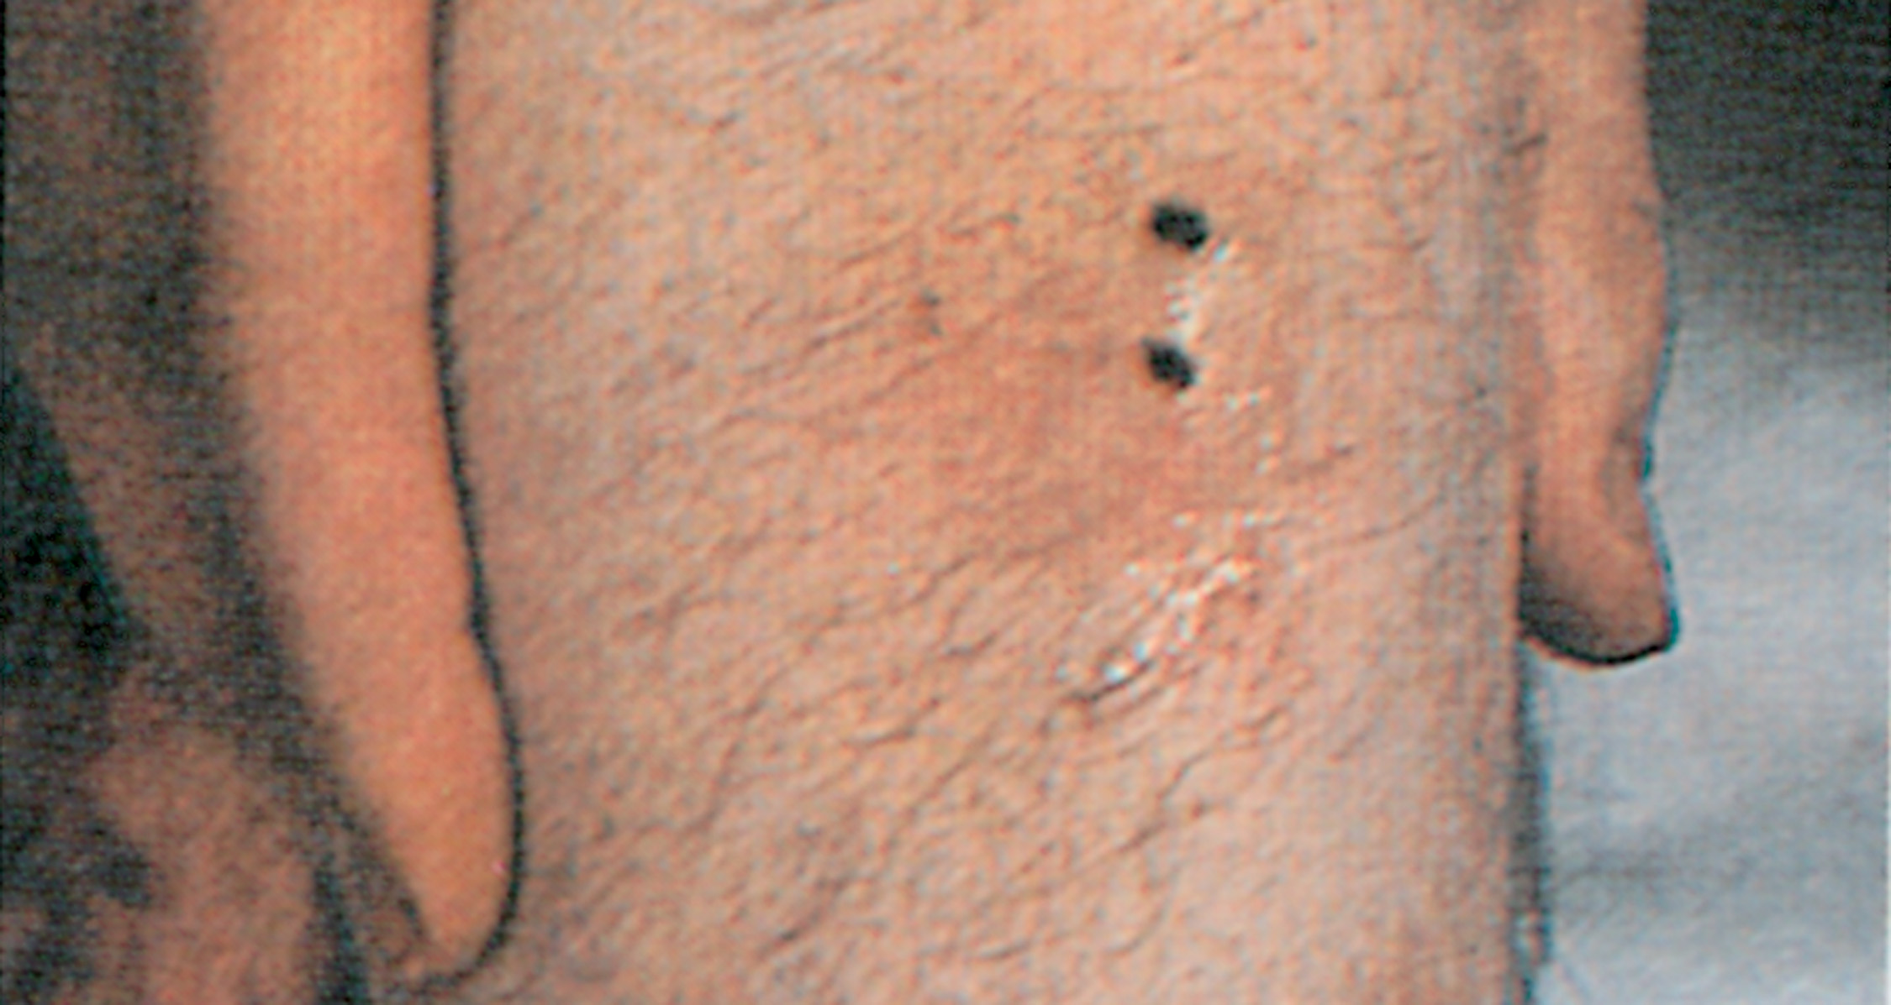
Rattlesnake Bite
Notes:
Remind the EMT that they need to be sure the scene is safe, even if it is a snake bite.

Slide 45
Injected Poisons (3 of 6)
  Assessment-Based Approach – Injected Poisons
  Secondary Assessment
    Signs and Symptoms
      Dizziness
      Chills
      Fever
      Nausea/vomiting
      Euphoria
Notes:
During the secondary assessment, get a history from the patient or bystanders and as much information as you can about any substance that might have been injected or about the kind of insect or animal that might have inflicted a bite or sting.

Slide 46
Injected Poisons (4 of 6)
  Assessment-Based Approach – Injected Poisons
  Secondary Assessment
    Signs and Symptoms
      Sedation
      High or low blood pressure
      Pupillary changes
      Needle tracks
      Pain at injection site
Notes:
Review the common signs and symptoms of an injected poison and allow the EMT student the chance to identify different poisons that could cause some of these findings.

Slide 47
Injected Poisons (5 of 6)
  Assessment-Based Approach – Injected Poisons
  Secondary Assessment
    Signs and Symptoms
      Trouble breathing
      Abnormal skin findings
      Possible paralysis
      Swelling and redness at injection site
Notes:
Review the common signs and symptoms of an injected poison and allow the EMT student a chance to identify different poisons that could cause some of these findings.

Slide 48
Injected Poisons (6 of 6)
  Assessment-Based Approach – Injected Poisons
  Emergency Care
    Protect yourself.
    Maintain the airway and be alert for vomiting.
      Use P P V for inadequate breathing.
      Maintain pulse oximeter >94%.
    Bring all available information about the substance to the hospital.
    Transport rapidly and reassess.
Notes:
Stress to EMT students that care should center first around keeping themselves safe, and followed by supporting lost function.

Slide 49
Absorbed Poisons (1 of 6)
Absorbed poisons enter through the skin or mucous membranes.
  Can cause skin and mucous membrane irritation or burns
Risk of exposure increases daily.
These poisons can cause both local (skin) reactions and systemic reactions.
Notes:
Discussion Questions
What are some common sources of absorbed poisons?
What are some indications that a patient may have been exposed to an absorbed poison?
Critical Thinking Discussion
What are some conditions that might make it easier for poisons to be absorbed through the skin?
Why is it important to brush away solid or dry chemicals before irrigating the area with water?

Slide 50
Absorbed Poisons (2 of 6)
Assessment-Based Approach – Absorbed Poisons
  Scene Size-Up
  Primary Assessment
  Secondary Assessment
    History
    Physical Exam
    Signs and Symptoms
  Reassessment
Notes:
Scene Size Up
Note containers or plants in the environment.
Wear gloves and other protective gear as needed.
Call for additional resources, as needed.
Remove the patient from the area.
Note containers or plants in the environment.
Wear gloves and other protective gear as needed.
Call for additional resources, as needed.
Remove the patient from the area.
Primary Assessment
Assess the mental status.
Assess the airway and breathing.
Inspect for any poison remaining on the patient or his clothing.
Secondary Assessment
History
Physical exam

Slide 51
Absorbed Poisons (3 of 6)
Assessment-Based Approach – Absorbed Poisons
  Secondary Assessment
    Signs and Symptoms
      History of exposure
      Traces of liquid or powder on the skin
      Skin, burns, itching, irritation
      Redness or swelling
Notes:
Have the students relate the clinical findings of absorbed poisoning with possible causes.

Slide 52
Absorbed Poisons (4 of 6)
Assessment-Based Approach – Absorbed Poisons
  Secondary Assessment
    Signs and symptoms of contact with a poisonous plant
    Fluid-filled, oozing blisters
    Swelling, pain, rash
    Itching, burning
Notes:
Have the students relate the clinical findings of absorbed poisoning with possible causes.

Slide 53
Absorbed Poisons (5 of 6)
Assessment-Based Approach – Absorbed Poisons
  Emergency Medical Care
    While wearing gloves, remove the source of poison and the patient’s contaminated clothing.
Notes:
Reinforce scene safety.

Slide 54
Absorbed Poisons (6 of 6)
Assessment-Based Approach – Absorbed Poisons
  Emergency Medical Care
    Establish and maintain an open airway.
    Use oxygen to keep S p O₂
      Use P P V for inadequate breathing.
    Remove any residual poison from skin as appropriate. Rinse eyes, if needed.
    Constantly reassess and rapidly transport the patient.
Notes:
Review the care steps for a patient who has absorbed poison. Reinforce the need to decontaminate the patient, if possible, before transporting them in the ambulance.

Slide 55
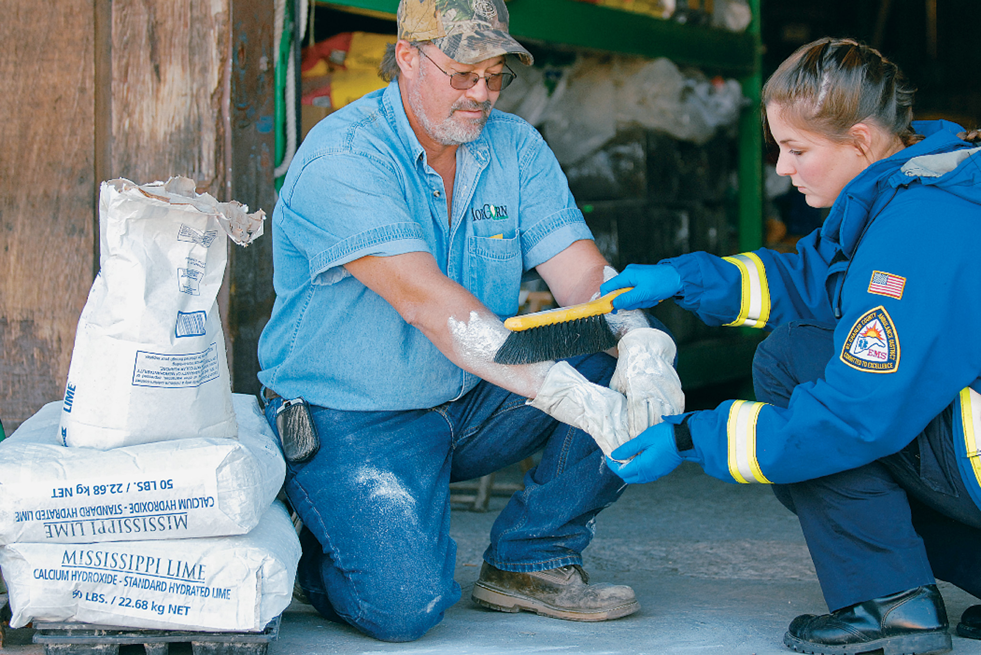
Brush Dry Powder off the Patient. Then Flush with Clean Water to Remove Poison on the Surface of the Skin
Notes:
Knowledge Application
Given several patient descriptions, students should be able to assess and manage patients who have absorbed poisons.
Teaching Tips
Explain local procedures and equipment for irrigating the eyes.

Slide 56
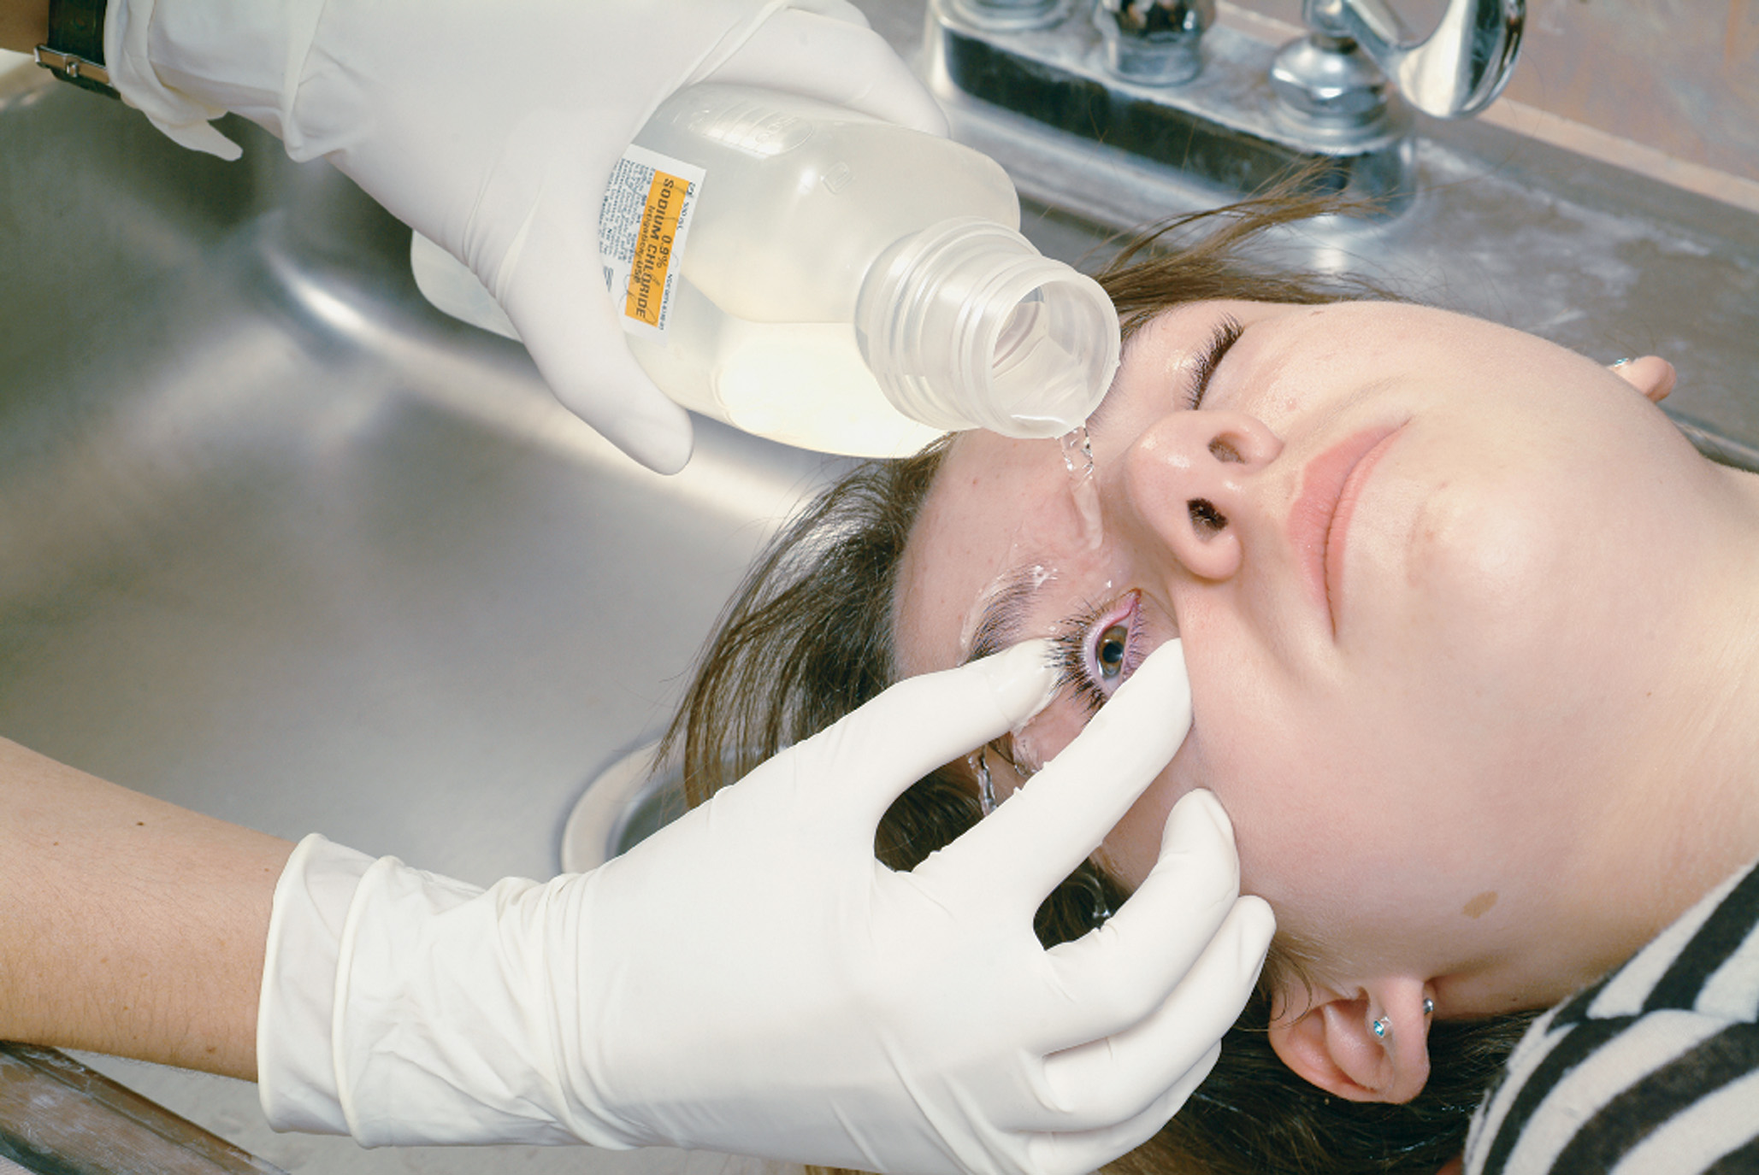
Irrigate Chemical Burns of the Eye with Clean Water for at Least 20 Minutes
Notes:
If the poison entered the eye, irrigate the affected eye with clean water for at least 20 minutes; continue irrigation while en route to the receiving facility, if possible. Position the patient so water runs away from the unaffected eye, taking care not to spread the contamination.

Slide 57
Case Study Conclusion (1 of 4)
Trisha and Brian begin by removing John’s clothes and having his mother help with rinsing him in the bathtub to remove any residue.
As they do so, they examine him and monitor him for problems with his airway and breathing.
The E M T s have decided to contact the Poison Control Center, as soon as they have collected additional information. They will include the guidance from Poison Control in their radio report to medical direction.
Notes:
Review the Case Study Conclusion and emphasize the application of knowledge learned from this presentation thus far.

Slide 58
Case Study Conclusion (2 of 4)
John’s mother had left him alone just long enough to put a load of clothes from the washing machine into the dryer. When she returned, she found John with the open bottle of lamp oil. She estimates that the event occurred about 15 minutes ago.
The 16 oz. bottle was full, and now appears to have about an ounce gone. It appears that most of the oil is on John’s clothing, but she is uncertain whether he ingested any of it.
Notes:
Review Case Study Conclusion and emphasize the application of knowledge learned from this presentation thus far.

Slide 59
Case Study Conclusion (3 of 4)
John’s mother confirms that John has not vomited, but he did have a period of coughing before the ambulance arrived.
John’s airway is open, and his breathing is normal, with clear and equal breath sounds. He is active and denies pain in his mouth, throat, and abdomen.
Because of the uncertainty of ingestion, the history of coughing, and the potential seriousness of hydrocarbon exposure, Poison Control recommends transport.
Notes:
Review Case Study Conclusion and emphasize the application of knowledge learned from this presentation thus far.

Slide 60
Case Study Conclusion (4 of 4)
The E M T s make sure John is warm, and they use his safety seat for transport. The E R physician thanks the E M T s, telling them that John will be observed for several hours for indications of aspiration or ingestion of hydrocarbons.
Notes:
Review Case Study Conclusion and emphasize the application of knowledge learned from this presentation thus far.

Slide 61
Case Study #2 Introduction
Warren Meade is traveling on business and staying in a hotel, when he starts feeling ill. He becomes nauseated, followed shortly by the onset of vomiting and diarrhea. He has severe abdominal cramping, and is beginning to feel as if he has a fever.
“Oh, no,” he thinks. “Maybe eating at that buffet last night wasn’t such a great idea.”
Notes:
Case Study
Present the Case Study Introduction provided in the PowerPoint slide set.
Lead a discussion using the Case Study questions provided on the subsequent slide(s).
The Case Study with discussion questions continues throughout the PowerPoint presentation.
Case Study Discussion
Use the Case Study content and questions to foreshadow the upcoming lesson content.

Slide 62
Case Study #2
How is food poisoning similar to other types of poisoning?
What are the particular concerns with this type of poisoning?
What other signs and symptoms might you expect to see?
Notes:
Use the students’ responses to foreshadow the upcoming lecture material and to assess their current knowledge base.

Slide 63
Specific Types of Poisoning (1 of 31)
Food Poisoning
  Illness can result from bacteria in food, or from the toxins released by the bacteria.
  Food poisoning is increasing in incidence.
  A common source of food poisoning is seafood.
Notes:
Discussion Question
What are some common types of food poisoning?
Critical Thinking Discussion
What can you do to make foods safer to ingest?

Slide 64
Specific Types of Poisoning (2 of 31)
Food Poisoning
  Common sources of food poisoning include:
    Eggs
    Chicken
    Ready-to-eat foods
    Untreated water, unpasteurized milk
    Fish.
Notes:
The food products most commonly associated with poisoning emergencies (which are most prevalent in the summer months) are:
• Eggs
• Chicken
• Ready-to-eat foods (cheese, processed meat)
• Untreated water or unpasteurized milk
• Fish.

Slide 65
Specific Types of Poisoning (3 of 31)
  Food Poisoning
  Common types of food poisoning include:
    Salmonella
    Campylobacter
    Escherichia coli (E. coli)
    Staphylococcus aureus.
Notes:
Salmonella. From contaminated food and water, or from undercooked food
Campylobacter. Common poisoning from contaminated poultry, milk, and water
Escherichia coli (E. coli). Severe gastrointestinal poisoning from numerous contaminated foods, undercooked foods, and untreated (contaminated) water
Staphylococcus aureus. Food poisoning from unhygienic food preparation, associated with foods served cold (such as desserts, custards, and salads)

Slide 66
Specific Types of Poisoning (4 of 31)
  Food Poisoning
  Signs and Symptoms
    Fever
    Blood disorders
    Blood in the stool
    Abdominal cramping
    Muscle cramps or paralysis
    Nausea, vomiting, diarrhea
    Loud or frequent bowel sounds

Slide 67
Specific Types of Poisoning (5 of 31)
  Food Poisoning
  Emergency Medical Care
    Follow general guidelines for ingested poisons.
    Establish and maintain an open airway.
    Use oxygen to keep S p O₂
      P P V for inadequate breathing.
    Constantly reassess and rapidly transport.

Slide 68
Specific Types of Poisoning (6 of 31)
Carbon Monoxide Poisoning
  Carbon monoxide (C O) is formed by incomplete combustion of certain fuels.
    C O poisoning is the leading cause of death from fires.
    Sources include furnaces, wood-burning fireplaces, heaters, automobile exhaust, barbeque grills.
    Gas is odorless, tasteless, colorless, and nonirritating.
Notes:
CO reduces the amount of oxygen in the bloodstream.
Displaces oxygen in the atmosphere
Inhibits body's ability to use oxygen
Critical Thinking Discussion
What are some settings in which carbon monoxide poisoning could occur?
Discussion Question
What are some clues to carbon monoxide exposure?

Slide 69
Specific Types of Poisoning (7 of 31)
Carbon Monoxide Poisoning
  Signs and Symptoms
    Headache
    Tachypnea
    Nausea, vomiting
    Altered mental status
    High (but inaccurate) pulse oximeter reading
Notes:
The initial symptoms of carbon monoxide poisoning are similar to those of the flu, but there is no accompanying fever, general body aches, or swollen and tender lymph nodes. You should consider carbon monoxide poisoning whenever you encounter unexplained flu symptoms (such as headache, nausea, vomiting, and confusion)—especially if the symptoms are shared by other people in the same environment.

Slide 70
Specific Types of Poisoning (8 of 31)
Carbon Monoxide Poisoning
  Emergency Medical Care
    Evacuate patients from the area of the source.
    Provide high-flow oxygen; do not rely on pulse oximetery.
      Provide PPV as needed.
    Transport the patient immediately.
Notes:
If you suspect that someone has carbon monoxide poisoning, evacuate everyone in the enclosed space—even people who apparently have no symptoms. Ideally, patients should be moved at least 150 feet from the suspected sources of the carbon monoxide into open air. All patients with carbon monoxide poisoning must receive medical care; many develop delayed neurological complications after initial recovery. Transport a carbon monoxide patient immediately, even if they appear to be recovering.

Slide 71
Specific Types of Poisoning (9 of 31)
Cyanide
  Found in many forms and can enter the body in a variety of ways
  Found in items such as rodent poisons, silver polish, and fruit pits
  Is a byproduct of burning plastics, silks, and synthetic materials
  Interferes with use of oxygen at the cellular level
Notes:
Class Activity
Have students look through their homes for poisons and make a list of them to bring to the next class. Ask students if they feel these poisons were stored safely or if they will take measures to improve safety in their homes.

Slide 72
Specific Types of Poisoning (10 of 31)
Cyanide Poisoning
  Signs and Symptoms
    Early signs and symptoms
    Late signs and symptoms or those seen in large-dose cyanide poisoning
Notes:
Cyanide poisoning in large doses can cause death within a few minutes. The patient may progress quickly from early signs and symptoms to more severe effects. The signs and symptoms of cyanide poisoning are:
Early Signs and Symptoms
• Headache
• Confusion
• Agitation or combative behavior
• Burning sensation in the mouth or throat
• Dyspnea
• Hypertension
• Bradycardia or tachycardia
• Smell of bitter almonds.
Late Signs and Symptoms or Those Seen in Large-Dose Cyanide Poisoning
• Seizures
• Coma
• Hypotension
• Pulmonary edema
• Cardiac dysrhythmias
• Cardiac arrest
• Acidosis.

Slide 73
Specific Types of Poisoning (11 of 31)
Cyanide Poisoning
  Emergency Medical Care
    Scene safety
      Remove the patient from the source, and the source from the patient.
    Open and maintain an airway.
    Administer high-flow oxygen via N R B or P P V.
    Provide rapid transport with A L S backup or intercept.
Notes:
Review the care steps for a cyanide poisoning. Discuss the cyanide antidote kit with the students.

Slide 74
Click on the Statement about Carbon Monoxide Poisoning That is True
A. Carbon monoxide is found in many household products as well as fruit pits.
B. Carbon monoxide poisoning is asymptomatic.
C. Pulse oximetery is unreliable in carbon monoxide poisoning.
D. Carbon monoxide has an odor like bitter almonds.

Slide 75
Specific Types of Poisoning (12 of 31)
Acids and Alkalis
  Caustics are found in many household products.
  Acids (low p H) burn on contact for 1 to 2 minutes.
  Alkalis (high p H) burn on contact but sensation may be delayed and can last for hours.
Notes:
Strong acids have an extremely low pH. They are commonly found in liquid plumbing drain openers and other bathroom cleaners. Alkalis have an extremely high pH. They are in the form of either a liquid or a solid and are also commonly found around the house in plumbing drain openers. Acids burn on contact, causing immediate and severe pain. At the burn site, the tissue often dies immediately, producing a protective layer to lessen further burning.
Alkalis also burn on contact; however, it takes longer to recognize the burning sensation. Alkalis tend to burn deeper by continuing to burn through tissue for longer contact times because the burn goes unrecognized for
longer periods.
Discussion Question
What are the effects of exposure to acids and alkalis?

Slide 76
Specific Types of Poisoning (13 of 31)
Acids and Alkalis
  Signs and symptoms
    Burns of the mouth, lips, face
    Dysphagia, hoarseness, stridor
    Dyspnea
    Abdominal pain
    Signs of shock
Notes:
Review general findings about acid and alkali burns.

Slide 77
Specific Types of Poisoning (14 of 31)
Acids and Alkalis
  Emergency Medical Care
    Ensure the safety of self and others.
    Remove contaminated clothing and decontaminate the patient.
    Maintain the airway, keep pulse oximeter
    with N R B or P P B.
    Consider A L S and rapid transport.

Slide 78
Specific Types of Poisoning (15 of 31)
Hydrocarbons
  Substances are found in kerosene, lighter fluid, glue, cleaning agents, propellants, and other products.
  The toxicity varies and there is a risk of aspiration.
  Poisoning may occur by ingestion, inhalation, or absorption.
Notes:
Discussion Question
What are some examples of hydrocarbons?

Slide 79
Specific Types of Poisoning (16 of 31)
Hydrocarbons
  Signs and Symptoms
    Coughing, choking, crying
    Burns to mouth or contact area
    Dyspnea, wheezing, stridor
    Tachypnea, cyanosis
    Abdominal pain, nausea, vomiting
    Seizures
Notes:
The patients who are most commonly poisoned with hydrocarbons are children under 5 years of age. The toxicity of the hydrocarbon varies widely and is somewhat dependent on the viscosity of the substance. The lower the viscosity, the greater the risk of aspiration and the greater the potential side effects. Hydrocarbon poisoning can occur by ingestion, inhalation, or absorption.

Slide 80
Specific Types of Poisoning (17 of 31)
Hydrocarbons
  Signs and Symptoms
    Coma
    Altered mental status
    Headache, dizziness, dulled reflexes
    Slurred speech
    Cardiac dysrhythmia
Notes:
The signs and symptoms of hydrocarbon poisoning vary, depending on the type of hydrocarbon and the route of poisoning. If the patient does not exhibit any signs or symptoms upon your arrival, it is likely the patient will not suffer a serious consequence of exposure to the hydrocarbon.

Slide 81
Specific Types of Poisoning (18 of 31)
Hydrocarbons
  Emergency Medical Care
    Remove the patient from the environment.
    Decontaminate the patient.
    Open and maintain the airway.
    Maintain pulse ox at
      Use P P V, if necessary.
    Rapidly transport the patient.

Slide 82
Specific Types of Poisoning (19 of 31)
Methanol
  This substance is found in gasoline, antifreeze, canned fuels, and other sources.
  It differs from ethanol; but may be drunk deliberately by alcoholics.
  Ingestion results in acidosis.
Notes:
Methanol, or wood alcohol, is a poisonous form of alcohol in a variety of common products such as gasoline, antifreeze, windshield washer fluid, paints, paint removers, Sterno and other canned fuels, and shellac. Methanol is a colorless liquid. It is different from ethyl alcohol (also called ethanol or drinking alcohol), which is the form of alcohol that is designed for consumption. Methanol poisoning can occur from ingestion, inhalation, or absorption.
Children might ingest substances containing methanol alcohol accidentally. Methanol, when ingested, causes the liver to produce massive amounts of acid in the body. The onset of signs and symptoms following ingestion usually occur 40 minutes to 72 hours after ingestion.

Slide 83
Specific Types of Poisoning (20 of 31)
Methanol
  Signs and Symptoms
    Altered mental status
    Seizures
    Nausea, vomiting, abdominal pain
    Blurred vision, dilated or sluggish pupils
    Changes in vision, blindness
    Dyspnea, tachypnea
Notes:
The signs and symptoms are typically related to the central nervous system, gastrointestinal system, and overwhelming acid in the body. Blindness can occur from the ingestion of as little as 4 mL of methanol.

Slide 84
Specific Types of Poisoning (21 of 31)
Methanol
  Emergency Medical Care
    Open and maintain the airway.
    Maintain pulse ox at
      Use P P V, if necessary.
    Rapidly transport the patient.
Notes:
Emergency medical care for methanol poisoning is primarily supportive. Administration of ethyl alcohol (drinking alcohol) can prevent the methanol from being converted to an acid. An antidote, fomepizole, is now available.

Slide 85
Specific Types of Poisoning (22 of 31)
Isopropanol (Isopropyl Alcohol)
  Found in rubbing alcohol and household products
  May intentionally be ingested by alcoholics
  More toxic than ethanol
Notes:
Rubbing alcohol, the most common form of isopropyl alcohol, is in many households. Isopropyl alcohol is also in many household products such as cosmetics, degreasers, disinfectants, solvents, and other cleaning agents. Poisoning most frequently occurs by ingestion, both accidental and intentional. Alcoholics might ingest isopropyl alcohol as a substitute for ethyl (drinking) alcohol.
Isopropyl alcohol is more toxic than ethyl
alcohol
but less toxic than methanol (wood) alcohol.
Following
ingestion of isopropyl alcohol, the liver creates
acetone. This has a major effect on the central nervous
system, gastrointestinal system, and kidneys.

Slide 86
Specific Types of Poisoning (23 of 31)
Isopropanol (Isopropyl Alcohol)
  Signs and Symptoms
    Respiratory depression
    Altered mental status
    Abdominal pain
    Bloody vomitus
    Signs of shock
Notes:
The signs and symptoms of isopropanol poisoning occur rapidly, usually within 30 minutes following ingestion. Isopropanol acts as a central nervous system depressant, causing respiratory depression.

Slide 87
Specific Types of Poisoning (24 of 31)
  Isopropanol (Isopropyl Alcohol)
  Emergency Medical Care
    Open and maintain the airway.
    Maintain pulse ox at
      Use P P V, if necessary.
    Rapidly transport the patient.

Slide 88
Specific Types of Poisoning (25 of 31)
Ethylene Glycol
  Found in deicers and detergents; has a sweet taste
  May be ingested accidentally or intentionally
  Has harmful metabolites that affect the C N S, lungs, heart, blood vessels, and kidneys
Notes:
Ethylene glycol is commonly found in detergents, radiator antifreeze, windshield deicers, and coolants. Children are commonly susceptible to accidental ingestion of ethylene glycol. The products usually are colorful and have a sweet taste. Therefore, children ingest the substance containing ethylene glycol with no reason to believe it is harmful.
Discussion Question
What signs and symptoms would you look for in ethylene glycol ingestion?
Knowledge Application
Given several scenarios, students will recognize the problems associated with exposure to specific poisons.

Slide 89
Specific Types of Poisoning (26 of 31)
Ethylene Glycol
  Signs and Symptoms
    First stage – neurological
    Second stage – cardiopulmonary
    Third stage – renal
Notes:
The signs and symptoms of ethylene glycol poisoning commonly occur in three stages. The stages are typically associated with the time from ingestion and affect various body systems.
First stage – neurological
Uncoordinated movements
Slurred speech
Altered mental status
Nausea, vomiting
Seizures
Hallucinations
Second stage – cardiopulmonary
Tachypnea
Pulmonary edema, crackles
Cyanosis
Dyspnea, respiratory distress
Heart failure
Third stage – renal
Little to no urine production
Bloody urine
Pain in the flanks

Slide 90
Specific Types of Poisoning (27 of 31)
  Ethylene Glycol
  Emergency Medical Care
    Open and maintain the airway.
    Maintain pulse ox at
      Use P P V, if necessary.
    Rapidly transport the patient.
Notes:
The emergency medical care for ethylene glycol poisoning is primarily supportive. However, administration of ethyl (drinking) alcohol should be considered. Be prepared to manage seizures and respiratory arrest.

Slide 91
Specific Types of Poisoning (28 of 31)
Poisonous Plants
  These plants include poison ivy, poison sumac, poison oak as well as other plants that can cause contact dermatitis.
  Decontaminate the patient.
  Deter the patient from scratching.
Notes:
Teaching Tips
Show pictures of poisonous plants common to the local area to help students learn to identify them.
Emergency treatment includes scene safety, personal protection measures, and decontamination if any plant substance is still on the person’s body. You should first ensure the airway, breathing, and circulatory status. Routine treatment for this type of absorbed poisoning is mainly supportive until arrival at the hospital. You should keep the patient from scratching the site as this can cause a break in the skin, which can enable an infection to set in.

Slide 92
Specific Types of Poisoning (29 of 31)
Suicide Bags and Chemical Suicide by Toxic Gas Inhalation
  Inhalation of helium or nitrogen concentrated in a bag over the head causes suffocation.
  Scene safety is critical; evacuate the room and contact the fire department.
  Treat the patient for toxic inhalation.
Notes:
Suicide bags, also known as “exit bags” are a common form of euthanasia worldwide. EMS crews in the United States are encountering patients using the suicide bag as a less violent method to commit suicide. The suicide bag method is simple, inexpensive, and made from materials and ingredients that are accessible to the general population.

Slide 93
Poison Control Centers
These centers are staffed by experts and is available 24 hours a day by a toll-free call.
  Staff can help advise on a treatment plan.
Provide the patient’s age, weight, condition, and the specifics of the poisoning.
Verify advice with medical direction.
Notes:
Discussion Question
What is the role of poison control centers?
Teaching Tips
Provide students with the local poison control center telephone number.
Have a guest speaker from the poison control center speak to the class.

Slide 94
Case Study #2 Conclusion
After several hours of vomiting and diarrhea, Warren feels weak and lightheaded. Being from out of town, and having no one to drive him, he calls an ambulance.
Although Warren’s vital signs appear to be within normal limits, an orthostatic tilt test is positive, indicating that he is dehydrated and has lost vascular volume.
The E M T s transport Warren to the emergency department, where he receives medication for his nausea and vomiting, along with IV fluids.
Notes:
Review Case Study Conclusion and emphasize the application of knowledge learned from this presentation thus far.

Slide 95
Case Study #3 Introduction
E M T s Tomas Armenta and Bob Palick respond to a convenience store, where a disoriented person was found sitting on the sidewalk. There is a paper bag with gold spray paint on it next to the patient, and the patient has gold spray paint around his mouth and nose. The patient seems confused as Tomas and Bob approach.
Notes:
Case Study
Present the Case Study Introduction provided in the PowerPoint slide set.
Lead a discussion using the Case Study questions provided on the subsequent slide(s).
The Case Study with discussion questions continues throughout the PowerPoint presentation.
Case Study Discussion
Use the Case Study content and questions to foreshadow the upcoming lesson content.

Slide 96
Case Study #3
What do the clues at the scene tell you about the problems you should anticipate as you assess this patient?
What treatment should you anticipate this patient may need?
Notes:
Use the students’ responses to foreshadow the upcoming lecture material and to assess their current knowledge base.

Slide 97
Drug and Alcohol Emergencies (1 of 20)
Significant medical problems are associated with drug overdose and withdrawal.
Problems include altered mental status and respiratory depression.
Patients abusing drugs or alcohol can be unpredictable and violent.
Notes:
During the next part of this lesson, students will learn about assessment and emergency care for patients who have been exposed to various types of poisons.

Slide 98
Drug and Alcohol Emergencies (2 of 20)
Drug Abuse
  Self-administration of a drug in a manner that is not in accord with approved medical or social patterns
Overdose
  Emergency that involves poisoning by drugs or alcohol
Notes:
Drug abuse is defined as the self-administration of drugs (or of a single drug) in a manner that is not in accord with approved medical or social patterns. A drug or alcohol overdose is an emergency that involves poisoning by drugs or alcohol. A patient’s withdrawal from alcohol or drugs—a period of abstinence from the drug or alcohol to which the body has become accustomed—can be as serious an emergency as an overdose.

Slide 99
Drug and Alcohol Emergencies (3 of 20)
Withdrawal
  Period of abstinence from the drug or alcohol to which the body has become accustomed
Notes:
Several medical problems can result from any drug overdose or from sudden withdrawal from a drug. Among the most common findings are altered mental status, respiratory depression, damage to organs such as the kidneys or liver, seizures, cardiac arrest, and hyperthermia or hypothermia. The range of medical problems you can confront in a drug abuse patient is extremely wide and depends on the type of drug taken. For example, stimulants such as cocaine increase heart rate and blood pressure, whereas depressants such as barbiturates lower them.

Slide 100
Drug and Alcohol Emergencies (4 of 20)
Stimulants
  Amphetamines, cocaine, ephedrine, methamphetamine
  Increased alertness, elevated mood, loss of appetite, insomnia, increased blood pressure and heart rate
  Cardiac dysrhythmias, paranoia, hallucinations, agitation, violence, seizures
Notes:
Amphetamines
Caffeine
Cocaine
Ephedrine
Methylphenidate
Nicotine
Over-the-counter and prescription drugs
Methamphetamine

Slide 101
Drug and Alcohol Emergencies (5 of 20)
Cannabis
  Hashish, marijuana, T H C
  Euphoria, decreased inhibitions, dry mouth, disorientation
Notes:
Hashish
Marijuana
THC (tetrahydrocannabinol)

Slide 102
Drug and Alcohol Emergencies (6 of 20)
Depressants
  Narcotics and Opiates/Opioids
    Codeine, heroin, morphine, oxycodone, opium, methadone
    Drowsiness, lethargy, respiratory depression, constricted pupils, nausea, constipation
Notes:
Codeine
Heroin
Methadone
Morphine
Fentanyl
Oxycodone
Hydrocodone
Hydromorphone
Buprenorphine
Opium (90 percent of opiate/opioid-dependent abusers will have a mixed overdose.)

Slide 103
Drug and Alcohol Emergencies (7 of 20)
Depressants
  Sedatives and Tranquilizers
    Alcohol, antihistamines, barbiturates, benzodiazepines
    Slurred speech, drowsiness, incoordination, impaired thinking, respiratory depression, respiratory/circulatory failure
Notes:
Alcohol
Antihistamines
Barbiturates
Chloral hydrate
Other nonbarbiturate and nonbenzodiazepine sedatives
Over-the-counter preparations
Diazepam and other benzodiazepines
Other major or minor tranquilizers

Slide 104
Drug and Alcohol Emergencies (8 of 20)
Hallucinogens
  D E T, D M T, L S D, mescaline, M D A, P C P, S T P
  Motor disturbances, anxiety, paranoia, delusions, illusions, hallucinations, poor perception of time and distance, psychosis, flashbacks, rage, violence
Notes:
DET (N, N-Diethyltryptamine)
DMT (N, N-Dimethyltryptamine)
LSD (Lysergic acid diethylamide)
Mescaline MDA (3, 4)
Methylenedioxyamphetamine)
PCP (Phencyclidine)
STP (DOM-2, 5-Dimethoxy)
4-Methylamphetamine

Slide 105
Drug and Alcohol Emergencies (9 of 20)
Inhalants
  Aerosol propellants, gasoline/kerosene, glues, lighter fluid, correction fluid, anesthetics, propane, toluene
  Excitement, euphoria, giddiness, loss of inhibitions, aggressiveness, delusions, drowsiness, hallucinations, erratic
Notes:
Aerosol propellants
Gasoline, kerosene
Glues, organic cements
Lacquer, varnish thinners
Lighter fluid
Typing correction fluid
Medical anesthetics
Propane
Toluene

Slide 106
Drug and Alcohol Emergencies (10 of 20)
Habitual Alcohol Abusers
  Alcohol is a central nervous system depressant which, in large doses, can cause unresponsiveness or death.
  Alcohol intoxication plays a role in M V C s, drug overdoses, homicides, drowning, and trauma.
Notes:
Habitual alcohol abusers, or alcoholics, are prone to a wide variety of illnesses ranging from cirrhosis of the liver to peritonitis. In addition to causing medical problems, alcohol intoxication is a major cause of automobile crashes. Alcohol ingestion, even in smaller doses, is also a major factor in drug overdoses, homicides, burns, drowning, nonaccidental trauma, and general trauma.

Slide 107
Drug and Alcohol Emergencies (11 of 20)
Assessment-Based Approach — Drug and Alcohol Emergencies
  Scene Size-Up
  Primary Assessment
  Secondary Assessment
    Physical Exam
    History
    Signs and Symptoms
  Secondary Assessment
Notes:
Scene Size Up
Scenes involving drugs or alcohol can involve violence and unpredictable behavior.
Consider contacting law enforcement.
Note anything that could be used as a weapon.
Use Standard Precautions.
Look for evidence of drug/alcohol use, as well as of other medical conditions.
Primary Assessment
Form a general impression.
Consider the need for spinal stabilization.
Assess for immediate threats to life.
With altered mental status, pay particular attention to the airway.
CNS depressants can cause inadequate breathing.
The heart rate and blood pressure can be affected, which may decrease perfusion.
Always consider the possibility of underlying trauma and medical conditions.
Secondary Assessment
Rapid secondary assessment for patients with altered mental status
Physical exam
History
Vital signs

Slide 108
Drug and Alcohol Emergencies (12 of 20)
Assessment-Based Approach — Drug and Alcohol Emergencies
  These signs and symptoms make the patient a high priority:
    Unresponsiveness or seizures
    Inadequate breathing
    Abnormal heart rate
    Vomiting with an altered mental status.

Slide 109
Drug and Alcohol Emergencies (13 of 20)
  Assessment-Based Approach — Drug and Alcohol Emergencies
  Signs and Symptoms
    C N S stimulants
      Dilated pupils
      Dry mouth and seating
      Loss of appetite and sleep
      Tachycardia, tachypnea, hypertension
      Excitability, agitation, being uncooperative.
Notes:
The signs and symptoms can vary widely, depending on the substance or drug that was abused. Often, the patient abuses more than one substance or drug. For example, a patient can take a CNS stimulant, drink large amounts of alcohol, and then take a CNS depressant. This would produce a variety of conflicting signs and symptoms.

Slide 110
Drug and Alcohol Emergencies (14 of 20)
  Assessment-Based Approach — Drug and Alcohol Emergencies
  Signs and Symptoms
    C N S Depressants
      Euphoria, drowsiness, sleepiness
      Bradycardia, hypotension
      Decreased breathing rates and volumes
      Dilated pupils that are sluggish to respond to light
Notes:
The signs and symptoms can vary widely, depending on the substance or drug that was abused. Often, the patient abuses more than one substance or drug. For example, a patient can take a CNS stimulant, drink large amounts of alcohol, and then take a CNS depressant. This would produce a variety of conflicting signs and symptoms.

Slide 111
Drug and Alcohol Emergencies (15 of 20)
  Assessment-Based Approach — Drug and Alcohol Emergencies
  Signs and Symptoms
    Narcotics
      Bradycardia, hypotension, bradypnea
      Cool, clammy skin
      Constricted pupils
      Lethargy
      Nausea
Notes:
The signs and symptoms can vary widely, depending on the substance or drug that was abused. Often, the patient abuses more than one substance or drug. For example, a patient can take a CNS stimulant, drink large amounts of alcohol, and then take a CNS depressant. This would produce a variety of conflicting signs and symptoms.

Slide 112
Needle Track Marks on the Extremities—A Sign of Injected Drug Use
Notes:
Discuss drug abuse rates in your community with the students.

Slide 113
Drug and Alcohol Emergencies (16 of 20)
    Assessment-Based Approach — Drug and Alcohol Emergencies
      Signs and Symptoms
    Hallucinogens
      Dilated pupils
      Paranoia, anxiety
      Motor disturbances
      Tachycardia, flushed face
      Visual or auditory hallucinations
      Poor perception of time and distance
Notes:
The signs and symptoms can vary widely, depending on the substance or drug that was abused. Often, the patient abuses more than one substance or drug. For example, a patient can take a CNS stimulant, drink large amounts of alcohol, and then take a CNS depressant. This would produce a variety of conflicting signs and symptoms.

Slide 114
Drug and Alcohol Emergencies (17 of 20)
  Assessment-Based Approach — Drug and Alcohol Emergencies
  Signs and Symptoms
    Volatile Inhalants
      Headache, nausea, vomiting
      Aggressiveness or depression
      Excitement, euphoria, drunkenness
      Erratic blood pressure and pulse rate
      Swollen membranes of the nose and mouth
Notes:
The signs and symptoms can vary widely, depending on the substance or drug that was abused. Often, the patient abuses more than one substance or drug. For example, a patient can take a CNS stimulant, drink large amounts of alcohol, and then take a CNS depressant. This would produce a variety of conflicting signs and symptoms.

Slide 115
Drug and Alcohol Emergencies (18 of 20)
  Assessment-Based Approach — Drug and Alcohol Emergencies
  Emergency Medical Care
    Scene safety is a priority.
    Closely monitor the patient; changes can occur rapidly.
    Calm the patient; protect him from injuring himself.

Slide 116
Drug and Alcohol Emergencies (19 of 20)
  Assessment-Based Approach — Drug and Alcohol Emergencies
  Emergency Medical Care
    Establish and maintain an airway and adequate ventilation.
    Maintain oxygenation.
    Position the patient.
Notes:
The emergency care provided to the drug, substance, or alcohol abuse patient is mostly supportive. Scene safety is a priority at many of these scenes. Close monitoring of the patient is necessary because a rapid change in his condition can occur because of alcohol, drug, or other substances in the patient’s system.

Slide 117
Drug and Alcohol Emergencies (20 of 20)
  Assessment-Based Approach — Drug and Alcohol Emergencies
  Emergency Medical Care
    Maintain the body temperature.
    Assess the blood glucose level.
    Restrain the patient only if necessary.
    Reassess frequently.
Notes:
The emergency care provided to the drug, substance, or alcohol abuse patient is mostly supportive. Scene safety is a priority at many of these scenes. Close monitoring of the patient is necessary because a rapid change in his condition can occur because of the alcohol, drug, or other substances in the patient's system.

Slide 118
Specific Types of Poisoning (30 of 31)
Managing a Violent Drug or Alcohol Abuse Patient
  Drug and alcohol abuse can lead to unpredictable and violent behavior.
  There are special considerations for the safety of the crew, patient, and bystanders.
Notes:
Class Activity
Have students role-play the talk-down technique.
Knowledge Application
Given several scenarios, students should be able to manage a patient who has a drug or alcohol emergency.
Critical Thinking Discussion
How can the talk-down technique be helpful for patients experiencing a "bad trip" after using marijuana or a hallucinogen?

Slide 119
Specific Types of Poisoning (31 of 31)
Managing a Violent Drug or Alcohol Abuse Patient
  Talk-down Technique
    This technique is used to help decompress a potentially hostile situation.
    Focus on the patient
    Use a calm and reassuring voice.
Notes:
Talk-Down Technique
Make the patient feel welcome.
Identify yourself.
Do not invade the patient's personal space.
Reassure the patient that the condition is caused by the drug and is temporary.
Help the patient verbalize what is happening to him.
Reiterate simple, concrete statements.
Forewarn the patient what will happen as the drug begins to wear off.
Once the patient is calm, transport them.

Slide 120

Explain Who You Are and Maintain a Nonjudgmental Attitude
Notes:
Role-play a talk-down exercise in class.

Slide 121
Click on the Substance with Which Constricted Pupils Are Most Associated
A. Volatile inhalants, such as toluene
B. Methamphetamine and cocaine
C. Sedative/hypnotics, such as barbiturates and benzodiazepines
D. Narcotics, such as heroin and oxycodone

Slide 122
Specific Substance Abuse Considerations (1 of 35)
Drug Withdrawal
  Tolerance
    Larger doses are required to produce the same effects.
  Dependence
    Patient exhibits a strong need for repeated use of the drug.
Notes:
Discussion Questions
What are the stages of alcohol withdrawal?
What are some of the names by which PCP can be recognized?
What are some of the signs and symptoms of PCP, cocaine, amphetamine, and methamphetamine use?

Slide 123
Specific Substance Abuse Considerations (2 of 35)
Drug Withdrawal
  Psychological Dependence
    The person is preoccupied with procuring the drug.
  Physical Dependence
    Absence of the drug results in physical withdrawal effects.
Notes:
Critical Thinking Discussion
How should you respond to a patient who is experiencing hallucinations?
Discussion Question
What types of cardiac medications are commonly implicated in overdoses?
Discussion Question
What is huffing?

Slide 124
Specific Substance Abuse Considerations (3 of 35)
Drug Withdrawal
  Drugs that produce physical dependence include:
    Narcotics
    Sedatives
    Hypnotics
    Barbiturates
    Cocaine
    Marijuana.
Notes:
Discuss the drugs that are most often abused in your EMS community.

Slide 125
Specific Substance Abuse Considerations (4 of 35)
  Drug Withdrawal
  Withdrawal signs and symptoms begin when the next dose is missed and peak 48 to 72 hours later.
  The E M T should be aware of common signs and symptoms of withdrawal.
Notes:
It is important to recognize drug withdrawal as a condition that can cause seizures or a deterioration in the patient’s mental status that can result in a blocked airway, inadequate breathing, or poor circulation.
Common findings of withdrawal:
Anxiety, agitation
Confusion
Tremors
Profuse sweating
Elevated heart rate, blood pressure
Hallucinations (visual and auditory)
Tactile hallucinations
Nausea
Abdominal cramping
Seizures

Slide 126
Specific Substance Abuse Considerations (5 of 35)
The Alcoholic Syndrome
  This syndrome consists of problem drinking and addiction.
  Many forms of alcohol can be abused.
  There also may be dependence on other drugs.
  Alcoholics may begin drinking early in the day, drink secretly, or go on binges.
Notes:
The alcoholic syndrome usually consists of problem drinking (during which alcohol is used frequently to relieve tensions or other emotional difficulties) and true addiction (in which abstinence from drinking causes physical withdrawal symptoms).

Slide 127
Specific Substance Abuse Considerations (6 of 35)
The Alcoholic Syndrome
  Abstinence can result in withdrawal symptoms.
  Work and relationships may deteriorate.
  Alcoholics are prone to injuries and medical conditions related to alcoholism.
Notes:
The alcoholic usually begins drinking early in the day, is more prone to drink alone or secretly, and can periodically go on prolonged binges characterized by loss of memory (“blackout periods”). Abstinence from alcohol is likely to produce withdrawal symptoms, such as tremulousness, anxiety, seizures, or delirium tremens (DTs).

Slide 128
Specific Substance Abuse Considerations (7 of 35)
The Alcoholic Syndrome
  Alcoholics are prone to:
    Hypertension
    Altered mental status (due to liver malfunction)
    Cirrhosis of the liver
    Liver failure
    Pancreatitis.

Slide 129
Specific Substance Abuse Considerations (8 of 35)
The Alcoholic Syndrome
  Alcoholics are prone to:
    Cardiomyopathy, hypoglycemia
    Upper gastrointestinal bleeding
    Bone marrow suppression
    Subdural hematoma
    Peritonitis
    Seizures
    Fractures.
Notes:
One of the most serious disorders associated with
alcoholism is Wernicke-Korsakoff syndrome, a chronic brain syndrome resulting from the toxic effect of alcohol on the central nervous system combined with malnutrition, which is common among alcoholics. Common signs and symptoms of the syndrome include paralysis of the eyes, dementia, hypothermia, the inability to sort fiction from reality, and eventual coma.

Slide 130
Specific Substance Abuse Considerations (9 of 35)
The Withdrawal Syndrome
  Withdrawal symptoms dose dependent
    Insomnia
    Seizures or tremors
    Disorientation, confusion
    Anorexia, nausea, vomiting
    Hyperthermia, sweating
    Tachycardia, hypertension
    Hallucinations (visual, tactile, auditory)
Notes:
Withdrawal syndrome occurs after a period of abstinence from the drug or alcohol to which a person’s body has become accustomed. However, it does not require that the alcoholic or drug abuser stop drinking or taking the drug completely. The withdrawal syndrome can also occur when an alcoholic’s alcohol intake falls below the amount usually ingested. Alcohol withdrawal is dose-dependent: The more the alcoholic was drinking, the more severe the syndrome will be.

Slide 131
Specific Substance Abuse Considerations (10 of 35)
The Withdrawal Syndrome
  Stages of the Withdrawal Syndrome
    Stage 1 occurs within 8 hours.
    Stage 2 occurs within 8 to 72 hours.
    Stage 3 can occur as early as 48 hours.
    Stage 4 can occur 1-14 days after the patient’s last drink.
Notes:
Stage 1 - occurs within 8 hours after the patient's last drink.
Nausea, insomnia, sweating, tremors
Stage 2 - occurs within 8 to 72 hours.
Worsening of stage 1, hallucinations
Stage 3 - can occur as early as 48 hours.
Seizures
Stage 4 - can occur within 1-14 days.
Delirium tremens

Slide 132
Specific Substance Abuse Considerations (11 of 35)
The Withdrawal Syndrome
  Delirium Tremens
    Severe, life-threatening complication
    Occurs most commonly 2 to 5 days after the last drink
    Mortality rate of 5% to 15%
    Lasts 1 to 3 days
Notes:
The last stage of alcohol withdrawal, delirium tremens (DTs), is a severe, life-threatening condition with a mortality rate of approximately 5 to 15 percent. DTs can occur between 1 and 14 days after the patient’s last drink, most commonly within 2 to 5 days. A single episode of DTs lasts between 1 and 3 days. Multiple episodes can last as long as a month. DTs should be suspected in any patient with delirium (mental confusion) of unknown cause.

Slide 133
Specific Substance Abuse Considerations (12 of 35)
  The Withdrawal Syndrome
  Delirium Tremens Signs and Symptoms
    Tremors, restlessness, irritability
    Severe confusion, loss of memory
    Terrifying hallucinations
    Extremely high fever
    Profuse sweating
    Dilated pupils
    Elevated vitals
Notes:
Seizures are common in alcoholic withdrawal, but not in DTs. However, approximately a third of those who have seizures in early withdrawal progress to DTs if left untreated or if treated inadequately. The treatment goals for a patient who experiences DTs include psychological as well as physical support. (DTs can be a frightening experience.)

Slide 134
Specific Substance Abuse Considerations (13 of 35)
Opioids
  Opioids are natural, synthetic, semisynthetic agents that mimic morphine.
  Opioids are derived from opium and act on opiate receptors in the body.
  Heroin, a type of opioid, is increasing in abuse rates in the U.S.
Notes:
An opioid is any natural, synthetic, or semisynthetic agent that mimics the effects of morphine. Opiate is a term specific to natural agents derived from opium. Narcotic is a much broader term that specifically refers to agents that induce sleep; therefore, it does not truly describe an opioid. Although these terms are commonly used interchangeably, they do have different meanings. An opioid specifically refers to agents that act on opiate receptors in the body such as heroin, a naturally occurring agent.

Slide 135
Specific Substance Abuse Considerations (14 of 35)
Opioids
  Types of Opioids
    Morphine
    Heroine
    Fentanyl
    Carfentanil (used in veterinary medicine)
Notes:
Delineate between narcotics and opioids

Slide 136
Specific Substance Abuse Considerations (15 of 35)
  Opioids
  Signs and Symptoms
    C N S and respiratory depression
    Miosis (constricted pupils)
    Seizures or incoordination
    Hypotension, bradycardia, bradypnea
    Crackles in the lungs
    Pruritus, hypoglycemia, hypothermia
Notes:
Stress the most common physical findings of an opioid overdose.

Slide 137
Specific Substance Abuse Considerations (16 of 35)
  Opioids
  Emergency Medical Care
    Establish and maintain an airway
    Maintain S p O₂
      Use P P V as necessary.
    Administer naloxone, if protocol permits.
      2 milligram intranasal (1 milligram in each nostril)
    Transport the patient with A L S intercept.
    Reassess the patient for deterioration.
Notes:
Patients who abuse and overdose on opioid drugs and narcotics such as heroin have a depressed central nervous system. They often present with respiratory depression, hypotension, and bradycardia. Focus your emergency care on reversing these effects, not to completely reverse the altered mental status. Many EMS systems allow EMTs to carry and administer naloxone to reverse these effects.

Slide 138
Draw up Naloxone
Notes:
Medication Name
Naloxone is the generic name. The trade name is Narcan.
Indications
Naloxone is indicated for patients with suspected or known opioid intoxication who have CNS depression with
respiratory depression, hypotension or bradycardia.
Contraindication
The drug naloxone itself has not real effect on the body unless an opioid substance is present. Therefore, the only contraindication is a known hypersensitivity to naloxone.
Medication Form
The medication is a liquid form that can be administered by an intravenous, subcutaneous, intramuscular, intranasal, or endotracheal route. EMTs typically only administer naloxone by an intranasal route; however, some may also use an intramuscular route. A naloxone auto-injector is available. Follow your local protocol.
Dosage
The typical dose is 0.4 mg to 2 mg when given by various routes. When administered by an intranasal route, the typical dose is 2 mg–1 mg is administered via a mucosal atomization device (MAD) in each nostril.

Slide 139
Attach the Mucosal Atomizer Device
Notes:
Intranasal naloxone administration.

Slide 140
Administer Naloxone in the Nostril
Notes:
Actions
Naloxone is a pure opioid antagonist with a rapid onset of action. It competitively binds opioid receptors and can reverse all of the receptor actions of the opioid by effectively blocking the ability of the drug to bind with the receptor site.
Side Effects
Side effects may include:
• Acute opioid withdrawal
• Increased blood pressure
• Headache
• Musculoskeletal pain
• Nasal dryness, edema, congestion, or inflammation.

Slide 141
Specific Substance Abuse Considerations (17 of 35)
P C P, Cocaine, Amphetamines, Methamphetamines, P A B S, and M D M A
  Each of these abused drugs have unique effects.
  Be familiar with each drug and know what is most common in your E M S area.
Notes:
The emergency consequences of commonly abused drugs have unique effects. Others that are often abused include PCP, cocaine, amphetamines and methamphetamines, and the drugs known as bath salts and ecstasy; their use requires special considerations in emergency care.

Slide 142
Specific Substance Abuse Considerations (18 of 35)
P C P, Cocaine, Amphetamines, Methamphetamines, P A B S, and M D M A
  P C P
    Dangerous hallucinogen
    Significant psychological effects, which may last for years
    Stored in body fat and can be released over time
Notes:
One of the most dangerous hallucinogens is phencyclidine (PCP). Known by at least 46 names, it is also called angel dust, killer weed, supergrass, crystal cyclone, hog, elephant tranquilizer, PeaCe Pill, embalming fluid, horse tranquilizer, mintweed, mist, monkey dust, rocket fuel, goon, surfer, KW, or scuffle.

Slide 143
Specific Substance Abuse Considerations (19 of 35)
  P C P, Cocaine, Amphetamines, Methamphetamines, P A B S, and M D M A
  Cocaine
    May be inhaled, injected, or smoked
    Highly addictive
    Overdose can be fatal
Notes:
Cocaine is inhaled through the nose, injected into the veins, and injected into the muscles. An almost - pure form of cocaine known as “crack” is smoked. Another special form of cocaine is heated and inhaled (“free-based”). Cocaine is highly addictive, and an overdose can be fatal.

Slide 144
Specific Substance Abuse Considerations (20 of 35)
  P C P, Cocaine, Amphetamines, Methamphetamines, P A B S, and M D M A
  Amphetamines and methamphetamines
    Pill form, smoked, injected, or snorted
    C N S stimulants
    Can cause cardiovascular excitation, hallucinations, hyperthermia, muscle rigidity
Notes:
Amphetamines and methamphetamines stimulate the central nervous system, excite the cardiovascular system, and can produce hallucinations. Hyperthermia, muscle
rigidity, or severe excitation can occur, leading to long periods of an awake, excited state. The resulting hypertension, hyperthermia, and increased muscle tone can be life-threatening. Methamphetamine use is associated with the sensation of ants or bugs crawling under the skin. The patient often picks at his skin or mutilates himself. Panic attacks and visual and auditory hallucinations can also occur.

Slide 145
Specific Substance Abuse Considerations (21 of 35)
  P C P, Cocaine, Amphetamines, Methamphetamines, P A B S, and M D M A
  P A B S (bath salts)
    Synthetic designer drugs, C N S stimulants
    Similar to effects of cocaine and methamphetamine
Notes:
EMS is seeing an increase in the frequency of use of the illegal drug psychoactive “bath salts” (PABS). These “bath salts” have no ingredients related to hygiene, however; they are a synthetic designer drug with properties that inhibit the reuptake of norepinephrine and dopamine in the body. As a result, the drug acts as a central nervous system stimulant. The effect of the drug is similar to methamphetamine and cocaine and produces similar signs and symptoms. A long-term user can build up a tolerance and the cessation of use can trigger withdrawal and intense cravings.

Slide 146
Specific Substance Abuse Considerations (22 of 35)
  P C P, Cocaine, Amphetamines, Methamphetamines, P A B S, and M D M A
  P A B S (bath salts)
    Sympathetic Effects
      Tachycardia, hypertension, hyperthermia
      Seizures
    Altered Mental Status
      Paranoia, panic attacks, agitation
      Hallucinations or violent behavior
Notes:
patient who has taken a PABS can experience extreme sympathetic stimulation and altered mental status.

Slide 147
Specific Substance Abuse Considerations (23 of 35)
  P C P, Cocaine, Amphetamines, Methamphetamines, P A B S, and M D M A
  Methylenedioxymethamphetamine (M D M A or Ecstasy)
    Psychoactive stimulant causing empathy, euphoria, and heightened sensation
    Common to the rave culture
    Overdose can cause death
Notes:
Methylenedioxymethamphetamine (MDMA), most commonly known as ecstasy, is a recreationally used psychoactive stimulant drug that produces a feeling of empathy, euphoria, and heightened sensations. It is also known by the street names of E, X, XTC, Smarties, Scooby-Snacks, and Skittles. The drug has no medical purpose. MDMA is usually taken by mouth; however, it can also be snorted and smoked. When ingested, its actions begin after approximately 30 to 45 minutes and can last 3 to 6 hours. MDMA is a drug commonly used by the rave culture.

Slide 148
Specific Substance Abuse Considerations (24 of 35)
  P C P, Cocaine, Amphetamines, Methamphetamines, P A B S, and M D M A
  Methylenedioxymethamphetamine (M D M A or Ecstasy)
    Stimulatory effects on C N S
    Memory impairment
    Overdose can cause intracranial hemorrhage and death
Notes:
Overdose of MDMA can cause intracranial hemorrhage, severe hypertension or hypotension, seizures, hallucinations, acute respiratory distress syndrome, cerebral edema, and hyperpyrexia (life-threatening elevation of the body core temperature).

Slide 149
Specific Substance Abuse Considerations (25 of 35)
  P C P, Cocaine, Amphetamines, Methamphetamines, P A B S, and M D M A
  General Signs and Symptoms
    Profound C N S stimulatory findings
    Involuntary eye movements
    Seizures
    Cardiovascular and respiratory emergencies
    Intracranial hemorrhage
Notes:
Physical signs and symptoms of PCP, cocaine, amphetamines, methamphetamines, or PABS are somewhat similar. However, the EMT should remember that emergency management is supportive and not geared toward figuring out exactly what drug was used, if the history is unclear.

Slide 150
Specific Substance Abuse Considerations (26 of 35)
  P C P, Cocaine, Amphetamines, Methamphetamines, P A B S, and M D M A
  Emergency Medical Care
    Protect yourself and your crew.
    Keep the patient in a quiet, non-stimulating environment.
    Check for injuries.
    Manage as for other overdoses.
Notes:
Treat an amphetamine, methamphetamine, cocaine, PCP, PABS, or MDMA overdose as you would any other drug emergency.
Check quickly to determine whether there are any injuries that need attention. If there are such injuries, administer emergency medical care as you would for any trauma patient (ensuring the airway, providing oxygen and ventilations if required, and supporting the circulatory system) before continuing with psychological care. Monitor vital signs regularly and transport the patient as quickly as possible.

Slide 151
Specific Substance Abuse Considerations (27 of 35)
Tetrahydrocannabinol
  Principal psychoactive substance in cannabis
  Causes feelings of euphoria
  Can be smoked, vaporized, eaten, used as extract
  Has limited medical applications
  Legalized in eight U.S. states
Notes:
Tetrahydrocannabinol (THC), in its natural form, is the principal psychoactive substance found in cannabis. Cannabis, also known as marijuana, is a plant that is used for its psychoactive properties as a recreational drug or a medication. Common slang terms for marijuana are weed, bud, doobie, Mary Jane, pot, blunt, herb, hemp, and grass. Cannabis can be smoked, vaporized, eaten in a food, or used as an extract. It is used as a recreational drug for the mental and physical effects to get “high” or “stoned.”

Slide 152
Specific Substance Abuse Considerations (28 of 35)
Tetrahydrocannabinol
  Common findings include:
    Decrease in short-term memory
    Dry mouth
    Tachycardia
    Decrease in blood pressure
    Reddening of the eyes.
Notes:
The user feels a general change in conscious perception, euphoria, an increase in the awareness of sensation, distortion in perception of time or place, and an increase in appetite.

Slide 153
Specific Substance Abuse Considerations (29 of 35)
  Tetrahydrocannabinol
  Synthetic Cannabinoids
    Chemically similar to T H C of cannabis
    Affect the brain more powerfully than marijuana
Notes:
A synthetic cannabinoid, often categorized as a new psychoactive substance (NPS), is a manufactured chemical that has similar effects as THC found in cannabis. It is an unregulated substance that is sold as a mind-altering chemical.
Common brand names are K2, Spice, Joker, Black, Mamba, Kush, Bombay, Blue, Genie, Zohai, and Kronic. Synthetic cannabinoids can affect the brain more powerfully than marijuana and can produce unpredictable and life-threatening effects. This occurs because synthetic cannabinoids bind more strongly to the cell receptors affected by THC.

Slide 154
Specific Substance Abuse Considerations (30 of 35)
Tetrahydrocannabinol
  Cannabinoid Hyperemesis Syndrome
    Recurrent nausea, vomiting, and abdominal pain and cramping
    Acute episodes last 24-48 hours
    Thought to be result of a buildup of cannabinoids in the body
Notes:
Cannabinoid hyperemesis syndrome is experienced by chronic cannabis users who report recurrent nausea, vomiting, and abdominal pain and cramping. A hot shower or bath can reduce the symptoms temporarily. Cessation of the use of cannabis will likely fully eliminate the symptoms. Acute episodes of the syndrome typically last for 24 to 48 hours; however, it can take months to resolve completely after stopping cannabis use. Theories on the cause of cannabinoid hyperemesis syndrome include a dose-dependent buildup of cannabinoids and related toxicity and the effect of the cannabinoid on the receptors in the brain, primarily the hypothalamus, which regulates body core temperature and the digestive system.

Slide 155
Specific Substance Abuse Considerations (31 of 35)
Tetrahydrocannabinol
  Cannabinoid Hyperemesis Syndrome
    Recurrent nausea, vomiting, and crampy abdominal pain
    Acute episodes last 24-48 hours
    Thought to be result of a buildup of cannabinoids in the body
Notes:
Cannabinoid hyperemesis syndrome is experienced by chronic cannabis users who report recurrent nausea, vomiting, and abdominal pain and cramping. A hot shower or bath can reduce the symptoms temporarily. Cessation of the use of cannabis will likely fully eliminate the symptoms. Acute episodes of the syndrome typically last for 24 to 48 hours; however, it can take months to resolve completely after stopping cannabis use. Theories on the cause of cannabinoid hyperemesis syndrome include a dose-dependent buildup of cannabinoids and related toxicity and the effect of the cannabinoid on the receptors in the brain, primarily the hypothalamus, which regulates body core temperature and the digestive system.

Slide 156
Specific Substance Abuse Considerations (32 of 35)
Tetrahydrocannabinol
  Cannabinoid Hyperemesis Syndrome
    Syndrome Criteria
      Long-term cannabis use
      Severe nausea, vomiting
      Abdominal pain, cyclic vomiting
      Relief of symptoms with hot bath/shower
      Subsiding of symptoms with cannabis stoppage
Notes:
Emergency care for the patient focuses on ensuring an adequate airway, ventilation, oxygenation, and circulation. The patient can present with signs of dehydration from the vomiting and frequent hot baths and showers. If not treated, cannabinoid hyperemesis syndrome can lead to acute renal failure.

Slide 157
Specific Substance Abuse Considerations (33 of 35)
Medication Overdose
  An overdose may be intentional or accidental.
  Synergistic reactions can occur from the interaction of medications.
Notes:
Other common sources of drug overdoses are prescription and over-the-counter medications.

Slide 158
Specific Substance Abuse Considerations (34 of 35)
Medication Overdose
  Medications commonly involved in overdose include:
    Cardiac medications
    Psychiatric medications
    Over-the-counter pain relievers
    Antihistamines
    Herbal remedies
    Dietary supplements.
Notes:
Accidental overdose typically occurs when the patient does not understand the prescription instructions and takes too much of the drug or the patient is forgetful and mistakenly takes the drug more often than it is needed. Patients who are on many different medications might have synergistic drug interactions when adding a new
or an over-the-counter medication.

Slide 159
Specific Substance Abuse Considerations (35 of 35)
Huffing
  Inhaled poisons with intention of “getting high”
  Commonly involves the following substances:
    Products that contain toluene
    Paints, glue
    Gas propellants
    Freon.
Notes:
Many chemicals used for huffing accumulate in the regions of the brain responsible for feelings of pleasure and reward. After time, they migrate to other regions, where they can cause abnormal muscle coordination and alterations in mental status.

Slide 160
A “Huffer” Inhales Poisons Deliberately to “Get High”
Notes:
Keep in mind that inhaled poisons typically have a more immediate onset of effects than injected poisons and can produce more systemic effects. Remember also that inhaled poisons can destroy lung tissue, leading to severe respiratory compromise and significant respiratory distress or failure. Treatment is geared toward removing the patient from the exposure, assessing and treating any loss of vital function caused by the drug (such as airway, breathing, oxygenation, or circulatory deficits), and providing rapid transport to the emergency department.

Slide 161
Case Study #3 Conclusion (1 of 2)
The patient, Vince Ett, is 37 years old, and known to law enforcement as being homeless and having a history of schizophrenia. Vince is disoriented in person, place, and time.
Tomas takes a set of vital signs while Bob listens to Vince’s breath sounds. Bob hears scattered wheezing throughout both lungs. The heart rate is 92, with an occasional irregular beat. The blood pressure is
respirations are 24, and the S p O₂ is 95%.
Notes:
Review Case Study Conclusion and emphasize the application of knowledge learned from this presentation thus far.

Slide 162
Case Study #3 Conclusion (2 of 2)
Despite the S p O₂, the history of inhalation and the wheezing make Tomas and Bob concerned about oxygenation, so they administer 4 literperminute of oxygen by nasal cannula, and frequently reassess the lung sounds and S p O₂.
After evaluation and treatment in the emergency department, Vince is admitted to the psychiatric unit for treatment of his schizophrenia and drug abuse.
Notes:
Review Case Study Conclusion and emphasize the application of knowledge learned from this presentation thus far.

Slide 163
Lesson Summary (1 of 2)
Poisons can enter the body through ingestion, inhalation, injection, or absorption.
Ingestion is the most common route of poisoning.
There are few antidotes for specific poisons.
Notes:
Follow-Up
Answer student questions.
Follow-Up Assignments
Review Chapter 22 Summary.
Complete Chapter 22 In Review questions.
Complete Chapter 22 Critical Thinking questions.
Assessments
Handouts
Chapter 22 quiz

Slide 164
Lesson Summary (2 of 2)
Care of the poisoned patient is largely supportive.
Be aware of scene safety.
Identify the substance and, if possible, transport it with the patient.
Notes:
Class Activity
As an alternative to assigning the follow-up exercises in the lesson plan as homework, assign each question to a small group of students for in-class discussion.
Teaching Tips
Answers to In Review questions are in the appendix of the text. Advise students to review the questions again as they study the chapter.

Slide 165
Correct! (1 of 3)
Constricted pupils are an effect of many, but not all, narcotic drugs, Narcotics include heroin, opium, morphine, fentanyl, hydrocodone, and oxycodone.
Click here to return to the quiz.

Slide 166
Incorrect (1 of 9)
Volatile inhalants are not associated with constricted pupils.
Click here to return to the quiz.

Slide 167
Incorrect (2 of 9)
Stimulant drugs, such as cocaine and methamphetamines can result in dilated pupils.
Click here to return to the quiz.

Slide 168
Incorrect (3 of 9)
Non-narcotic sedatives, such as barbiturates and benzodiazepines, are not associated with constricted pupils.
Click here to return to the quiz.

Slide 169
Correct! (2 of 3)
Carbon monoxide binds to hemoglobin, saturating the hemoglobin molecule. Since pulse oximetery tests for hemoglobin saturation, it cannot detect the difference between saturation with oxygen and saturation with carbon monoxide. Therefore, the pulse oximetery reading will be high, despite the fact that the amount of oxygen bound to hemoglobin is low.
Click here to return to the program.

Slide 170
Incorrect (4 of 9)
Carbon monoxide is a product of incomplete combustion of carbon-containing fuels, such as wood, charcoal, natural gas, gasoline, and kerosene.
Click here to return to the quiz.

Slide 171
Incorrect (5 of 9)
Carbon monoxide poisoning produces symptoms, although these symptoms may be confused with those of other illnesses. Headache, dizziness, confusion, nausea, and vomiting, as well as other signs and symptoms, may occur.
Click here to return to the quiz.

Slide 172
Incorrect (6 of 9)
Carbon monoxide is colorless, tasteless, and odorless. An odor of bitter almonds is sometimes detected in cyanide poisoning.
Click here to return to the quiz.

Slide 173
Correct! (3 of 3)
You do not yet have enough information to know if it is safe to enter the scene. You will need to know more about how the exposure occurred, what the substance is, and how much is involved. You should consider requesting additional resources, if needed, to remove the patient from the area.
Click here to return to the program.

Slide 174
Incorrect (7 of 9)
Although opening the airway is a critical step, you do not yet know if it is safe to approach the patient. Before undertaking any patient care steps, you must carefully evaluate scene safety by finding out more about the nature of the exposure.
Click here to return to the quiz.

Slide 175
Incorrect (8 of 9)
Although positive pressure ventilation is a critical step if the patient’s breathing is inadequate, you do not yet know if it is safe to approach the patient. Before undertaking any patient care steps, you must carefully evaluate scene safety.
Click here to return to the quiz.

Slide 176
Incorrect (9 of 9)
If the patient has the substance on his skin or clothing, he will need to be decontaminated, both to protect you from exposure, and to prevent absorption of the substance through the patient’s skin. However, you do not yet know if the scene is safe enough for you to approach the patient, so this is not the first step you would take.
Click here to return to the quiz.

Slide 177

Copyright

