Slide 1

Prehospital: Emergency Care
Eleventh Edition
Chapter 21
Anaphylactic Reactions
Slides in this presentation contain hyperlinks. JAWS users should be able to get a list of links by using INSERT+F7
Copyright © 2018, 2014, 2010 Pearson Education, Inc. All Rights Reserved
Notes:
If this PowerPoint presentation contains mathematical equations, you may need to check that your computer has the following installed:
1) MathType Plugin
2) Math Player (free versions available)
3) NVDA Reader (free versions available)
Advance Preparation
Student Readiness
Assign the associated section of MyBRADYLab and review student scores. Review the chapter material in the Instructor Resources, which includes Student Handouts, PowerPoint slides, and the MyTest Program.
Prepare
Consider asking an allergist to be a guest speaker on immune response, antibodies, and sensitization.
Have epinephrine auto-injector examples available to pass around in class.
The total teaching time recommended is only a guideline. Take into consideration factors such as the pace at which students learn, the size of the class, breaks, and classroom activities. The actual time devoted to teaching objectives is the responsibility of the instructor.

Slide 2
Learning Readiness
E M S Education Standards, text p. 629
Chapter Objectives, text p. 629
Key Terms, text p. 629
Purpose of lecture presentation versus textbook reading assignments.
Notes:
Explain to students what the National EMS Education Standards are. The National EMS Education Standards communicate the expectations of entry-level EMS providers. As EMTs, students will be expected to be competent in these areas. Acknowledge that the standards are broad, general statements. Although this lesson addresses the listed competencies, the competencies are often complex and require completion of more than one lesson to accomplish. The student is also expected to review the chapter objectives to foreshadow what will be in the chapter. By mastering the key terms the EMT student will better understand the learning and be able to communicate more clearly.
Additionally, explain to the students that the purpose of using these slides is to help keep the instructor focused on highlighting important portions of the material, explain interrelationships of topics, and discuss how to apply this information. It’s not the intent of the presentation (or slides alone) to include every component in the chapter. This presentation still requires the student to thoroughly read the chapter.

Slide 3
Setting the Stage
Overview of Lesson Topics
  Allergic and Anaphylactic Reactions
    Pathophysiology of Allergic Reaction
    Pathophysiology of Anaphylactic Reaction
    Assessment-Based Approach to Anaphylactic Reaction
    Summary: Assessment and Care
    Epinephrine
  Summary
Notes:
These bulleted points are the major headings from the chapter, in order. The purpose is to provide a basic lecture navigation for the student.

Slide 4
Case Study Introduction
E M T s Luke Boyce and Joy Dunn arrive at Armstrong Elementary School for a report of an allergic reaction. Six-year-old Jesse Mendoza began having difficulty breathing, with weakness and a rash, within a few minutes of accidentally being exposed to peanuts, to which he has a known allergy.
The E M T s see a young boy sitting in the nurse’s office with swelling of his lips, and they can hear wheezing without a stethoscope.
Notes:
Case Study
Present the Case Study Introduction provided in the PowerPoint slide set.
Lead a discussion using the case study questions provided on the subsequent slide(s).
The Case Study with discussion questions continues throughout the PowerPoint presentation.
Case Study Discussion
Use the case study content and questions to foreshadow the upcoming lesson content.

Slide 5
Case Study
What level of concern should the E M T s have, based on their general impression?
What is going on in the patient’s body to cause his signs and symptoms?
What steps should be considered in formulating a treatment plan for this patient?
Notes:
Case Study Discussion
Use the case study content and questions to foreshadow the upcoming lesson content. Gauge the student’s responses as a guide of how well versed they are in this topic.

Slide 6
Introduction
An allergic reaction is a hypersensitivity reaction.
An anaphylactic reaction (anaphylaxis) is a severe, life-threatening allergic reaction.
A delay in treatment can result in death.
Notes:
An allergic reaction is a hypersensitivity reaction resulting from exposure to an allergen, which can occur at any time and to anyone. A wide variety of substances can produce such reactions. Foods, medications, insect stings, and even exercise are common causes. An allergic reaction can be a mild, localized reaction presenting as redness, itching skin (pruritus), and edema or a mild systemic reaction resulting in widespread hives (urticaria) and pruritus.
In its most severe form, an allergic reaction can cause a systemic, multisystem, life-threatening condition with respiratory failure, circulatory collapse, and shock. This severe reaction is known as an anaphylactic reaction and also known as anaphylaxis.
An anaphylactic reaction is a severe, exaggerated, systemic, allergic reaction that is associated with severe swelling of the upper and lower airways, constriction of the bronchioles, leakage of fluid from the capillaries, systemic vessel dilation, and an increased production of mucus.
An anaphylactic reaction can be so severe that the upper airway closes, the respirations become labored because of high airway resistance from swollen and constricted bronchioles, and the blood pressure becomes dangerously low because of the dilation of the vessels and leakage of fluid from the capillaries.
Delay in emergency care can easily and rapidly lead to deterioration in the patient’s condition and even to death.
During this lesson, students will learn about assessment and emergency care for patients suffering from allergic reaction.

Slide 7
Allergic and Anaphylactic Reactions (1 of 33)
The immune system responds to foreign substances called antigens.
Allergens are a type of antigen that can provoke a reaction in some people.
The response of the immune system upon exposure to an antigen is to produce antibodies.
This immune response typically occurs with little or no allergic reaction.
Notes:
Discussion Question
What is the relationship between an allergic reaction and anaphylaxis?
Critical Thinking Discussion
How does the body's response to an allergen result in signs and symptoms of anaphylaxis?

Slide 8
Allergic and Anaphylactic Reactions (2 of 33)
The body can produce immunoglobulin E (I g E) in response to allergens.
When I g E encounters an allergen, it triggers an immune system response.
An excessive immune system response to an allergen is called an allergic reaction.
Occasionally there is a severe, life-threatening anaphylactic reaction.
Notes:
An allergic reaction is an abnormal reaction of the immune system to a foreign substance. The reaction can range from mild to life-threatening.
The chemicals released in anaphylaxis result in swelling of the airway, bronchoconstriction, and poor perfusion.
Anaphylaxis requires a prior exposure to the antigen. An anaphylactoid reaction is similar, but does not require prior sensitization to the substance.
Penicillin, bee venom, nuts, and berries are common causes of anaphylaxis.

Slide 9
Allergic and Anaphylactic Reactions (3 of 33)
Pathophysiology of Allergic Reaction
  An excessive response to an allergen is an allergic reaction.
  A severe, systemic immune response to an allergen is called an anaphylactic reaction.
  Chemicals released by the body in anaphylaxis cause airway swelling, bronchoconstriction, and vasodilation.
Notes:
An antigen can enter the body through the skin, the gastrointestinal tract, or the respiratory tract. When one does, it sets off an immune response in which the immune system detects the antigen and produces antibodies.
Antibodies are proteins that search for the antigen, combine with it, and help to destroy it.
An allergic reaction is a misdirected and excessive response by the immune system to an allergen.
The allergen is usually harmless to the patient, and most allergic reactions are mild, producing nothing more than discomfort, such as itching, a runny nose, and watery eyes—results of the body’s attempts to eliminate the allergen or antigen.
Discussion Question
What are some common causes of anaphylaxis?

Slide 10
Allergic and Anaphylactic Reactions (4 of 33)
  Pathophysiology of Anaphylactic Reaction
  Sensitization
    On first exposure to an allergen, sensitization occurs, and I g E is produced.
    After sensitization, I g E antibodies attach to two types of immune cells.
      Mast cells (in the tissues)
      Basophils (in the blood)
Notes:
Once sensitization occurs, the patient is primed for a possible anaphylactic reaction. It can take several exposures to a foreign substance over a long period to become sensitized.

Slide 11
Allergic and Anaphylactic Reactions (5 of 33)
  Pathophysiology of Anaphylactic Reaction
  Sensitization
    On subsequent exposure to an allergen, the allergen attaches to I g E.
    Mast cells and basophils release chemicals that mediate the events of anaphylaxis.
    The primary chemical mediator is histamine.
Notes:
When the antigen is reintroduced into the body, it attaches to the IgE antibodies that are now located on the mast cells and basophils. Granules located inside the mast cells and basophils attach to the cell membrane allowing them to release their contents, which are chemical substances known as chemical mediators, into the interstitial fluid. Once they are outside of the cell membrane and in the interstitial fluid, these chemical mediators can be picked up by the capillaries and transported by the blood throughout the body.
The primary chemical mediator released from mast cells and basophils is histamine. Histamine causes bronchoconstriction, vasodilation, and an increase in capillary permeability (leakage). After the chemical mediators are released, the mast cells and basophils regenerate the granules inside the cell membrane, priming them for another allergic or anaphylactic reaction.

Slide 12
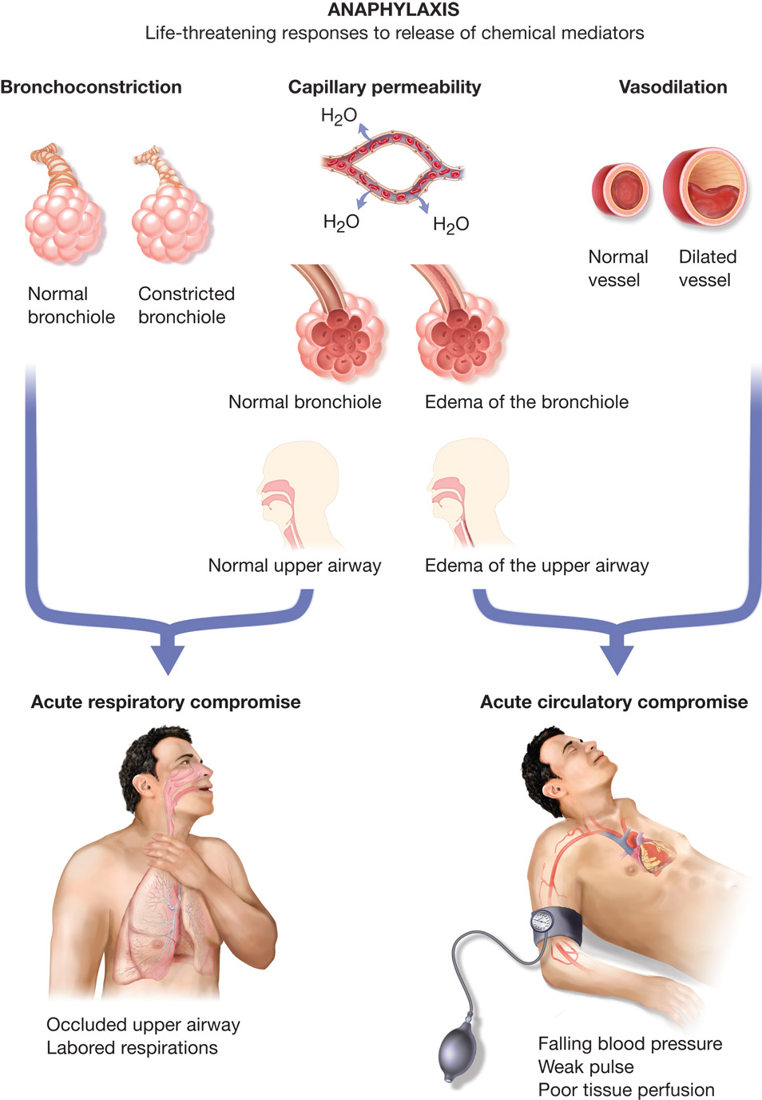
Figure 21-1 Life-Threatening Responses in Anaphylactic Reaction
Bronchoconstriction, capillary permeability, vasodilation, and an increase in mucus production.
Notes:
The life-threatening responses that are directly produced from the release of the chemical mediators are bronchoconstriction, increase in capillary permeability, and vasodilation. These produce most of the signs and symptoms seen in anaphylaxis.

Slide 13
Allergic and Anaphylactic Reactions (6 of 33)
Pathophysiology of Anaphylactic Reaction
  Anaphylactoid (Non-I g E-Mediated) Reaction
    An anaphylactoid reaction does not involve I g E, but the signs, symptoms, and treatment are the same as for anaphylaxis.
Notes:
In some reactions, the chemical mediators can be released from the mast cells and basophils the first time the antigen is introduced into the body without the patient ever being sensitized. The antigen causes the release of the chemical mediators. This reaction, in which no sensitization is required, is referred to as an anaphylactoid reaction or a non-IgE-mediated reaction. The body’s responses (bronchoconstriction, increased capillary permeability, and vasodilation) and the signs and symptoms are the same as for an IgE-mediated anaphylactic reaction. Thus, the treatment is the same.

Slide 14
Allergic and Anaphylactic Reactions (7 of 33)
  Pathophysiology of Anaphylactic Reaction
  Causes of Anaphylactic and Anaphylactoid Reaction
    Allergens may enter the body through:
      Injection
      Ingestion
      Inhalation
      Contact
Notes:
Injection - The substance is introduced directly into the body by bites, stings, needles, or infusions.
Ingestion - The patient swallows the substance.
Inhalation - The patient breathes the substance into his lungs.
Contact (absorption) - The antigen is absorbed through the skin.
Injection, especially intramuscular or intravenous injection, is the route most often associated with anaphylactic reactions. Penicillin is the most common medication that causes of anaphylactic reactions.

Slide 15
Allergic and Anaphylactic Reactions (8 of 33)
  Pathophysiology of Anaphylactic Reaction
  Causes of Anaphylactic and Anaphylactoid Reaction
    Common types of allergens include:
Notes:
Hymenoptera account for the majority of severe allergic reactions and anaphylaxis related to insect bites.
Venom from insect bites or stings, especially from millipedes, caterpillars, and centipedes, most often cause only a localized reaction.
Foods, including peanuts, other nuts, milk, eggs, shellfish, whitefish, food additives, chocolate, cottonseed oil, and berries cause anaphylactic reactions in some people.
Pollen from plants, especially ragweed and grasses, can cause anaphylactic reactions.
Mediations including antibiotics, local anesthetics, aspirin, seizure medications, muscle relaxants, nonsteroidal anti-inflammatory agents, and vitamins are known to cause anaphylactic reactions in some patients. Insulin and tetanus and diphtheria toxoids can also produce anaphylactic reactions.
Many other substances (for example, glue, hair dye, nickel, henna tattoos, and transfused blood) can produce rare anaphylactic reactions in some people.
Exercise can accentuate the anaphylactic response when certain foods have been ingested close to the time of exercise. This condition is most common in dedicated athletes, such as joggers, but rarely also occurs from physical activities, such as raking leaves or dancing.
Weather conditions, including heat, cold, and humidity, can trigger an anaphylactic reaction.
Latex is most often found in examination gloves and other medical devices.

Slide 16
Table 21-1 Common Causes of an Anaphylactic or Antaphylactoid Reaction (1 of 3)
Antibiotics (Penicillin, Vancomycin, Bactrim, Sulfatrim, Cephalosporins, Tetracycline, Aminoglycosides, Sulfonamides, Amphotericin B, Nitrofurantoin)
Local anesthetics (Procaine, Lidocaine, Tetracaine, Benzocaine, Novocaine)
Opiates
Hormones (Insulin, Progesterone)
Steroids (Methyprednisilone)
Vitamins (Thiamine*, Folic acid)
Angiotensin-converting enzyme inhibitors (A C E Inhibitors)*
Notes:
An anaphylactic or anaphylactoid reaction can be triggered by many substances. The most common cause is medications that are either taken orally or injected.

Slide 17
Table 21-1 Common Causes of an Anaphylactic or Antaphylactoid Reaction (2 of 3)
Aspirin*
Non-steroidal inflammatory drugs (N S A I D S)*
Radiographic iodine-based dyes
Protamine (heparine antagonist)*
Polysaccharides*
Skin creams and cosmetics
Vaccines
Blood transfusions
Food (peanuts, nuts, eggs, shellfish, whitefish, wheat, soybeans)

Slide 18
Table 21-1 Common Causes of an Anaphylactic or Antaphylactoid Reaction (3 of 3)
Red dye sulfite additives
Insects (hornets, wasps, fire ants, scorpion, catepillars, kissing bugs, centipededs, millipedes, arachnids, ticks)
Marine life stings (sea nettle, man-o-war, jellyfish)
Mammal bites (rats, mice, gerbils, hamsters)
Environmental (mold, pollen, cold)
Latex
Perfumes
Exercise
Idiopathic (unknown)

Slide 19
Click on the Problem Below That Is Responsible for Decreased Perfusion Related to the Effects of Histamine in Anaphylactic Reactions
A. Weakening and failure of the left ventricle of the heart
B. Obstruction of blood flow through the pulmonary arterial system
C. Vasodilation and loss of fluid from the vascular space
D. Inability of cells to use the oxygen that is delivered to them

Slide 20
Allergic and Anaphylactic Reactions (9 of 33)
Assessment-Based Approach to Anaphylactic Reaction
  Scene Size-Up
    Anaphylactic reaction is often apparent because of the characteristic signs and symptoms.
      In the scene size-up, be aware of dangers, such as wasps and bees.
      The type of setting and medications at the scene can provide clues.
Notes:
During the scene size-up, you must be certain that your own safety is not in jeopardy, especially if the anaphylactic reaction is the result of a bite or sting. You might encounter a patient who disrupted a yellow jacket or wasp nest and was stung several times. The yellow jackets or wasps can still be at the scene and will attack when you exit the ambulance, exposing you to the risk of an anaphylactic reaction from the stings. If you detect the presence of many wasps or yellow jackets, you might have to wait until they settle or disperse before approaching the patient.
Because so many different substances can cause an anaphylactic reaction, the scene size-up might not provide any obvious clues as to the nature of the illness.
Points to Emphasize
Assess the patient for signs of airway obstruction, impaired ventilation, and poor perfusion.
Patients with a history of anaphylaxis may have a prescribed epinephrine auto-injector with them.
Epinephrine helps the patient with anaphylaxis by causing vasoconstriction, bronchodilation, and improving cardiac output.
Class Activity
Provide ample opportunity for students to practice skills.

Slide 21
Allergic and Anaphylactic Reactions (10 of 33)
  Assessment-Based Approach to Anaphylactic Reaction
  Primary Assessment
    General impression may be malaise, general discomfort, or sense of impending doom.
    Mental status may be alert to unresponsive.
    High risk of airway obstruction.
    Stridor/crowing indicate upper airway swelling.
Notes:
In gathering your general impression of a patient with an anaphylactic reaction, you might note that he complains of “not feeling well” or of a malaise, a generalized feeling of weakness or discomfort. Such a patient can display a sense of “impending doom.” He may also complain of difficulty swallowing or itching or tightness in his throat. The patient’s mental status can be anywhere on the continuum from responsive and alert, to responsive but disoriented, to unresponsive.
Closely assess the airway for signs of obstruction. Stridor, hoarseness, or crowing sounds indicate significant swelling to the upper airway. Inserting an airway adjunct might not help relieve the obstruction if the swelling is at the level of the larynx. You might also find a swollen tongue that interferes with the airway.
Discussion Question
What are signs and symptoms of anaphylaxis?
Discussion Question
What are the treatment priorities for patients with anaphylaxis?

Slide 22
Allergic and Anaphylactic Reactions (11 of 33)
  Assessment-Based Approach to Anaphylactic Reaction
  Primary Assessment
    Airway adjuncts will not help laryngeal edema.
    Wheezing may be prominent.
    Positive pressure ventilation may needed.
    Maintain S p O₂ at 94% or greater.
    Ventilations may be difficult from increased airway resistance.
Notes:
It might be necessary to provide positive pressure ventilation to force the air past the swollen upper airway. You might also find a swollen tongue that interferes with the airway. Wheezing can be prominent upon assessment of breathing. If a patient is severely disoriented, unresponsive, or breathing inadequately, immediately begin positive pressure ventilation with supplemental oxygen. If the breathing is adequate, provide supplemental oxygen if any signs of respiratory distress, poor perfusion, hypoxemia, or hypoxia are present. Maintain an SpO2 reading at or above 94%.

Slide 23
Allergic and Anaphylactic Reactions (12 of 33)
  Assessment-Based Approach to Anaphylactic Reaction
  Primary Assessment
    Consider A L S for airway management.
    The pulse may be weak and rapid.
    There may be edema, and the skin may be red and warm or cyanotic.
    Hives and itching are characteristic.
Notes:
The pulse in a patient suffering from an anaphylactic reaction can be weak and rapid. The radial pulse might not be present because of the low blood pressure. Edema, or swelling, may can obvious in the face, neck, lips, tongue, hands, and feet. The skin can be red and warm, or the patient’s skin can be cyanotic from inadequate breathing. You might notice hives, raised red blotches, all over the skin.

Slide 24
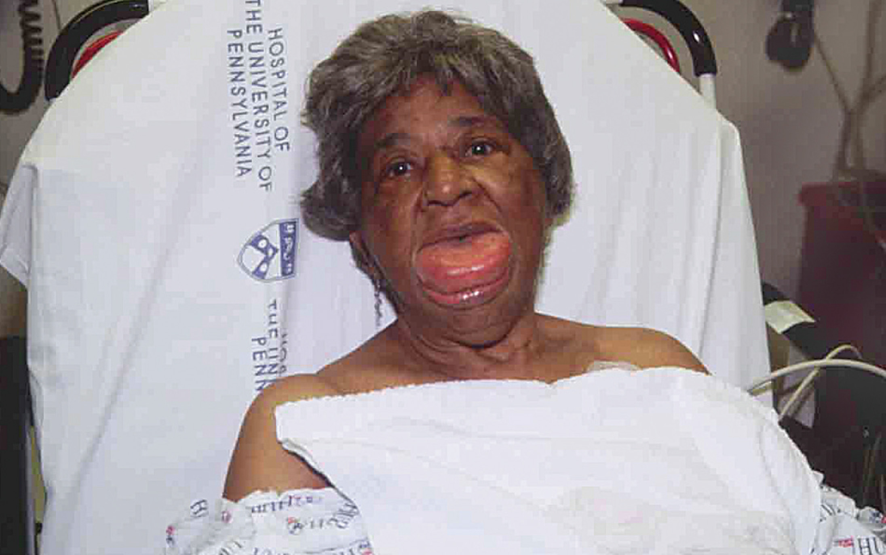
Localized Angioedema to the Tongue from an Anaphylactic Reaction
(© Edward T. Dickinson, M D

Slide 25
Hives (Urticaria) from an Allergic Reaction to a Penicillin-Derivative Drug
(© David Effron, M D)
Notes:
Hives are usually accompanied by severe itching.

Slide 26
Hives from a Food Allergy
(© Edward T. Dickinson, M D)
Notes:
Hives (urticaria) and itching (pruritus) are the hallmark signs and symptoms of an allergic reaction.

Slide 27
Allergic and Anaphylactic Reactions (13 of 33)
Assessment-Based Approach to Anaphylactic Reaction
  Primary Assessment
    Signs and symptoms include:
      Rhinitis
      Tachycardia
      Pruritus
      Faintness
Notes:
Some of the early noticeable signs of anaphylaxis, which are nonspecific:
Rhinitis - stuffy, runny, itchy nose
Tachycardia
Pruritus - itching that is localized or diffuse
Faintness or light -headedness

Slide 28
Allergic and Anaphylactic Reactions (14 of 33)
Assessment-Based Approach to Anaphylactic Reaction
  Primary Assessment
    Signs and symptoms include:
      Warm, flushed skin (may be pale)
      Agitation, anxiety
      Urticaria
      Edema
Notes:
Additional early noticeable signs of anaphylaxis, which are nonspecific:
Warm, flushed skin (skin can appear pale)
Agitation or anxiousness
Urticaria (hives)
Edema (swelling) of the skin and other tissues such as the lips and tongue (angioedema or angioneurotic edema)

Slide 29
Allergic and Anaphylactic Reactions (15 of 33)
Assessment-Based Approach to Anaphylactic Reaction
  Primary Assessment
    Be prepared for immediate intervention and transport.
    Determine whether the patient has an epinephrine auto-injector.
Notes:
Because of the potential seriousness of an anaphylactic reaction and its effects on the airway, lungs, blood vessels, and heart, the patient is considered a priority and should be prepared for immediate transport.
Before leaving the scene, determine whether the patient has a prescribed epinephrine auto-injector. Inquire of relatives or any bystanders if the patient is unresponsive.

Slide 30
Table 21-3 Signs and Symptoms of Anaphylaxis and Related Pathophysiology (1 of 2)
Organ System Reaction | Signs and Symptoms | Pathophysiology Causing the Signs and Symptoms
Rhinitis | Nasal congestion, itchy nose, sneezing, swollen nasal mucosa, and runny nose | Increased capillary permeability, vasodilation, and stimulation of nerve endings
Laryngeal edema | Stridor, dyspnea, hoarseness, tightness in the throat, and excessive salivation | Increased capillary permeability, vasodilation, and stimulation of nerve endings
Increased bronchiole airway resistance | Wheezing, rhonchi, cough, dyspnea, tightness in the center of the chest, tachypnea, respiratory distress, and cyanosis | Increased capillary permeability, vasodilation, stimulation of nerve endings, and bronchiole smooth muscle contraction
Cardiovascular collapse and poor perfusion | Tachycardia, hypotension, syncope, lightheadedness, general weakness, syncope, and chest pain | Increased capillary permeability, vasodilation, stimulation of nerve endings, and bronchiole smooth muscle contraction, and increased venous capacitance

Slide 31
Table 21-3 Signs and Symptoms of Anaphylaxis and Related Pathophysiology (2 of 2)
Skin: Urticaria (Hives) | Pruritus (itching), tingling and warmth sensation, flushing, and redness | Increased capillary permeability and vasodilation
Skin: Edema | Swelling especially around eyes, mouth, and extremities | Increased capillary permeability
Eye: Conjunctivitis | Red and itchy eyes, increased tears, swelling to eyes | Stimulation of nerve endings
Gastrointestinal | Cramping, abdominal pain, nausea, vomiting, diarrhea, difficulty swallowing (dysphagia), feeling of constantly having to move bowels (tenesmus) | Increased mucous secretion and gastrointestinal smooth muscle contraction
Central nervous system | Anxiety, apprehension, headache, sense of impending doom, confusion | Cerebral hypoperfusion and hypoxia secondary to vasodilation, increased capillary permeability and bronchiole constriction
Genitourinary | Urinary incontinence, vaginal bleeding, and pelvic pain | Uterine smooth muscle contraction and bladder smooth muscle contraction

Slide 32
Allergic and Anaphylactic Reactions (16 of 33)
Assessment-Based Approach to Anaphylactic Reaction
  Secondary Assessment
    For the history of the present illness, use O P Q R S T.
    Time is critical—generally, the more quickly the reaction develops, the more severe it will be.
Notes:
The secondary assessment should be conducted whether the patient’s signs and symptoms indicate a mild, moderate, or severe allergic reaction; however, if the patient exhibits signs of severe reaction, do not delay transport of the patient to complete the secondary assessment.

Slide 33
Allergic and Anaphylactic Reactions (17 of 33)
Assessment-Based Approach to Anaphylactic Reaction
  Secondary Assessment
    Determine the following:
      Are signs and symptoms consistent with anaphylaxis?
      Are signs and symptoms mild, moderate, or severe?
      Are signs and symptoms getting worse or better?
Notes:
Signs and Symptoms:
Are the signs and symptoms consistent with an anaphylactic reaction?
Do the signs and symptoms indicate a mild, moderate, or severe reaction?
Are the signs and symptoms getting progressively worse or better?
Is the patient experiencing dyspnea or chest pain? Patients sometimes complain of shortness of breath and chest pain before any of the other signs and symptoms occur in anaphylaxis.

Slide 34
Allergic and Anaphylactic Reactions (18 of 33)
Assessment-Based Approach to Anaphylactic Reaction
  Secondary Assessment
    Determine the following:
      Does the patient have a history of allergies or anaphylactic reaction?
      Is an epinephrine auto-injector prescribed?
      Any other medications taken?
      What medications is the patient taking? Any new medications?
Notes:
Allergies:
Does the patient have a history of allergies to food, medications, plants, insect stings or bites, or other things? Prior anaphylactic reaction? To what?
Medications:
Does the patient have a prescribed epinephrine auto-injector?
Has the patient taken any medications to relieve the current signs or symptoms, including over-the-counter medications such as diphenhydramine (Benadryl)?
What other medication is the patient taking? Any new medications prescribed?
Does the patient take a beta-blocker? If the patient is taking a beta-blocker, his response to epinephrine might be limited.

Slide 35
Allergic and Anaphylactic Reactions (19 of 33)
Assessment-Based Approach to Anaphylactic Reaction
  Secondary Assessment
    Determine the following:
      Has the patient had an anaphylactic reaction in the past?
      How severe was the last reaction?
      Does the patient have other illnesses?
Notes:
Pertinent Past History:
• Has the patient suffered an anaphylactic reaction in the past?
• How severe was the last reaction?
• Does the patient have any other significant illnesses?

Slide 36
Allergic and Anaphylactic Reactions (20 of 33)
Assessment-Based Approach to Anaphylactic Reaction
  Secondary Assessment
    Determine the following:
      When did the patient last eat or drink? What did he recently eat or drink?
      Activities prior to onset of the reaction?
      Was the patient exposed to anything that could have caused the reaction?
Notes:
Last Oral Intake:
• When was the last time the patient had anything to eat or drink? What did he recently eat or drink?
• How much food or drink did the patient consume?
Events Prior to Illness:
• What was the patient doing prior to onset of the anaphylactic reaction?
• What was the patient exposed to that might have caused the anaphylactic reaction?
• What was the route of exposure; injection, ingestion, inhalation, or contact?

Slide 37
Allergic and Anaphylactic Reactions (21 of 33)
Assessment-Based Approach to Anaphylactic Reaction
  Secondary Assessment – S&S
    Skin
    Respiratory System
    Cardiovascular System
    Central Nervous System
    Gastrointestinal & Genitourinary Systems
    Generalized Signs and Symptoms
Notes:
Skin:
Warm, tingling feeling in the face, mouth, chest, feet, and hands (early symptom)
Intense itching (pruritus), especially of hands and feet (hallmark symptom)
Hives (urticaria) (hallmark sign)
Flushed or red skin
Swelling to the face, lips, neck, hands, feet, and tongue
Cyanosis (severe cases)
Respiratory System:
Patient complaints of a “lump in the throat”
Tightness in the chest
High-pitched cough
Tachypnea (increased breathing rate)
Labored breathing
Noisy breathing (wheezing, stridor, or crowing)
Impaired ability to talk or hoarseness
Excessive amounts of coughed-up mucus
Partially or completely occluded airway
Difficulty in breathing
Cardiovascular System:
Tachycardia (increased heart rate)
Hypotension (decreased blood pressure)
Irregular pulse
Absent radial pulse (severe shock)
Central Nervous System:
Increased anxiety
Light-headedness
Unresponsiveness
Disorientation
Restlessness
Seizures
Headache
Gastrointestinal System:
Nausea/vomiting
Abdominal cramping
Diarrhea
Difficulty in swallowing
Loss of bowel control
Genitourinary System:
Urgent need to urinate
Cramping of the uterus
Generalized Signs and Symptoms:
Itchy, watery eyes
Runny or stuffy nose
Sense of impending doom
Complaints of “not feeling well”
General weakness or discomfort

Slide 38
Allergic and Anaphylactic Reactions (22 of 33)
Assessment-Based Approach to Anaphylactic Reaction
  Secondary Assessment
    Obtain baseline vital signs.
      Hypotension may be present.
      Respirations may be fast and labored.
      Wheezing may be heard without a stethoscope.
      The pulse may be rapid and weak.
Notes:
Assess the vital signs, paying attention to the breathing, pulse, and blood pressure. The respiratory rate can be beyond the normal limits. Early in an anaphylactic reaction, you might find that the respiratory rate is fast and labored. As the condition progresses and the patient begins to tire, the breathing can become slower than normal and shallow. Wheezes can be heard without a stethoscope. The breathing can also sound noisy, with a rattling sound on inspiration and exhalation, from the excessive mucus in the larger lower airways. The pulse is rapid and can be weak. In severe cases of anaphylaxis, the radial pulse can be absent or extremely weak. Unlike other types of shock, the skin is usually red, dry, and warm to the touch. Hives and itching are the most common complaints in all types of allergic reaction: mild, moderate, and severe. Hypotension is common in a severe reaction.

Slide 39
Allergic and Anaphylactic Reactions (23 of 33)
Assessment-Based Approach to Anaphylactic Reaction
  Emergency Medical Care
    Distinguish between a systemic and a local reaction.
    Treatment depends on this distinction.

Slide 40
Allergic and Anaphylactic Reactions (24 of 33)
Assessment-Based Approach to Anaphylactic Reaction
  Emergency Medical Care
    Two key categories of signs and symptoms:
      Airway and respiratory compromise
      Shock
Notes:
The local reaction typically does not require aggressive intervention or administration of medication by the EMT. In a patient with a local reaction, you can maintain adequate oxygenation and transport the patient while constantly assessing for signs and symptoms of a systemic reaction. Epinephrine should be administered to patients with signs and symptoms of systemic reaction, especially if they present with hypotension, respiratory distress, or upper airway edema. Your major concern is that the mild local reaction can rapidly progress to a moderate-to-severe, or anaphylactic, reaction. Be prepared to manage the worst case scenario and continuously reassess the patient’s condition.

Slide 41
Table 21-3 Indicators of a Severe Systemic Anaphylactic Reaction
Acute onset (minutes to several hours) with involvement of skin, mucosal tissue, or both (hives, itching, flushing, redness, edema to face, lips, and tongue)
AND
Signs or symptoms of respiratory distress (e.g., dyspnea, wheezing, stridor, and S p O₂ <94%)
AND/OR
Signs or symptoms of poor perfusion or hypotension

Slide 42
Allergic and Anaphylactic Reactions (25 of 33)
Assessment-Based Approach to Anaphylactic Reaction
  Emergency Medical Care
    Maintain a patent airway; airway adjuncts may not be effective.
    Suction secretions.
    Maintain an S p O₂ of 94% or greater.
Notes:
Maintain a patent airway. The patient might initially present with airway compromise associated with swelling of the tissues lining the larynx. Because airway adjuncts are not effective in managing the obstruction, you might need to force air past the swollen tissues by positive pressure ventilation. If using a bag-valve-mask device, you might find it much harder to compress the bag to deliver the contents.
Suction any secretions. In the severe anaphylactic reaction, heavy secretions can be present. Clear the mouth of secretions by suction when necessary.
Maintain adequate oxygenation. It is vital that hypoxia and hypoxemia are reversed and adequate oxygenation maintained. If the breathing is adequate, a high concentration of oxygen should be administered by a nonrebreather mask to maintain an SpO₂ of 94% or greater and signs of hypoxia are eliminated.

Slide 43
Allergic and Anaphylactic Reactions (26 of 33)
Assessment-Based Approach to Anaphylactic Reaction
  Emergency Medical Care
    Be prepared to provide positive pressure ventilation.
    Administer epinephrine by prescribed auto-injector, according to protocol.
    Consider requesting A L S.
    Initiate transport early.
Notes:
Be prepared to assist ventilation. Patients with a mild allergic reaction might not exhibit any respiratory distress during the length of your contact. However, a patient’s condition can progress rapidly over minutes, or more slowly over hours, and eventually produce severe respiratory distress. Have your ventilation equipment ready and prepared to begin positive pressure ventilation, if necessary.
Administer epinephrine. In any patient with signs and symptoms of a severe systemic anaphylactic reaction, especially when the patient presents with hypotension, respiratory distress, or upper airway edema, obtain an order from medical direction to administer epinephrine. This is typically done by an epinephrine auto-injector.
Consider calling for advanced life support. Because of the potential for severe compromise to the airway, breathing, and circulation, you might need to request ALS for advanced airway control and further administration of medication.
Initiate early transport. Do not unnecessarily delay transport of the patient. Continued assessment and emergency care can be done en route to the hospital.

Slide 44
Allergic and Anaphylactic Reactions (27 of 33)
Assessment-Based Approach to Anaphylactic Reaction
  Reassessment
    Look for indications a mild or moderate reaction is progressing.
    Monitor the effects of treatment.
    Closely monitor airway, breathing, oxygenation, and circulation.
    Reassess vital signs.
Notes:
Reassessment is critical in the management of mild, moderate, and severe allergic reactions. The patient with a local reaction should be constantly monitored for indications that the reaction is worsening and that further intervention, such as epinephrine injection or airway control, might be needed. The patient who has received an epinephrine injection should be reassessed to determine whether the injection has been effective in reversing the life-threatening condition.
Reassess the patient 2 minutes after the injection of epinephrine. Look for improvement in the patient’s ability to breathe, improvement in his mental status, increasing SpO₂ reading, and an increase in the blood pressure.

Slide 45
Allergic and Anaphylactic Reactions (28 of 33)
Assessment-Based Approach to Anaphylactic Reaction
  Biphasic Anaphylactic Reaction
    20 percent of patients experiencing an anaphylactic reaction have a biphasic (or late stage) reaction.
Notes:
A biphasic reaction that occurs when initial signs and symptoms resolve, sometimes without treatment if not severe and then, approximately 4 to 6 hours afterward, a second reaction occurs. The signs and symptoms of the second reaction could be “life threatening” even if the first reaction was not.
A severe biphasic anaphylactic reaction should be treated the same as an initial severe anaphylactic reaction. Readministration of epinephrine is common and necessary if the second reaction is severe.

Slide 46
Allergic and Anaphylactic Reactions (29 of 33)
Summary: Assessment and Care
  Recognition and prompt treatment of allergic reactions are critical to positive outcomes.
Notes:
Review and memorize assessment findings that can be associated with allergic reaction and emergency care for allergic reaction.

Slide 47
Allergic and Anaphylactic Reactions (30 of 33)
Epinephrine
  Epinephrine auto-injector
    Epinephrine mimics the effects of the sympathetic nervous system to treat the signs and symptoms of anaphylaxis.
    Alpha₁ effects cause vasoconstriction.
    Beta₂ effects cause bronchodilation.
    Beta₁ effects result in side effects.
Notes:
Epinephrine is the drug of choice for the emergency treatment of a systemic allergic reaction to insect stings or bites, foods, drugs, and other antigens. The drug mimics the responses of the sympathetic nervous system.
Epinephrine has four properties: alpha 1, alpha 2, beta 1, and beta 2. Alpha 1 causes the vessels to constrict. Alpha 2 regulates the amount of vasoconstriction. Beta 1 increases the heart rate, force of contraction of the heart, and the speed at which the electrical impulses are carried through the heart. Beta 2 causes the bronchiole smooth muscle to dilate.
Three of the major responses to the chemical mediators by the body causing the life-threatening anaphylactic condition are an increase in capillary permeability, vasodilation, and bronchoconstriction and inflammation. Epinephrine’s alpha properties cause vasoconstriction and tighten the capillaries, reversing the vasodilation and increased capillary permeability experienced by the anaphylactic patient. The beta 2 properties cause bronchodilation, reversing the bronchoconstriction. The beta 1 properties are responsible for side effects from administration. Also, epinephrine has a direct antihistamine effect, reducing the effects of histamine.
Teaching Tips
Pass around examples of epinephrine auto-injectors for students to see and handle.
Critical Thinking Discussion
What are the actions of epinephrine that are beneficial to the patient with anaphylaxis?

Slide 48
Allergic and Anaphylactic Reactions (31 of 33)
Epinephrine
  Epinephrine auto-injector
    The effects of epinephrine are rapid, but short-lived.
    Auto-injectors may be packed singly or in pairs.
    There are two dosages.
      0.3 milligram for patients 66 l b. or greater
      0.15 milligram for patients less than 66 l b.
Notes:
The body’s response to epinephrine is rapid; within seconds, the patient will begin to feel relief. However, the duration of the drug’s effectiveness is short, only approximately 10–20 minutes.
Both epinephrine auto-injectors, the EpiPen and the Auvi-Q, come in different doses. The 0.3 mg dose of epinephrine is for patients weighing 66 pounds or greater. The injector for infants and children weighing 33 to 66 pounds delivers 0.15 mg of epinephrine. A child who weighs more than 66 pounds requires an adult epinephrine auto-injector or epinephrine dose.

Slide 49
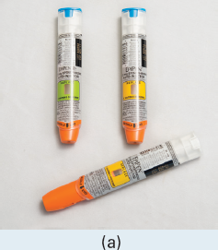
Figure 21-6 Epinephrine Auto-Injectors: Epipen Auto-Injectors for Infant/Child and Adult
Notes:
Epinephrine comes packaged in a disposable delivery system for self-administration. Common systems prescribed to patients are the EpiPen and the Auvi-Q auto-injector.

Slide 50
Allergic and Anaphylactic Reactions (32 of 33)
Epinephrine
  Epinephrine auto-injector
    If the patient has more than one injector, transport the second device.
    The dose can be repeated in 5 to 15 minutes, if needed.
Notes:
If epinephrine is not carried on the EMS unit, it is important to determine whether the patient has more than one injector so that you can take it along and be prepared to deliver a second injection. The dose can be repeated in 5 to 15 minutes if the condition does not improve.

Slide 51
Allergic and Anaphylactic Reactions (33 of 33)
Epinephrine
  Epinephrine auto-injector side effects
    Increased heart rate
    Pale skin
    Dizziness
    Chest pain
    Headache
    Nausea and vomiting
    Excitability and anxiousness
Notes:
The patient may complain of side effects following the administration of epinephrine.

Slide 52
E M T Skills 21-1
Administering an EpiPen Epinephrine Auto-Injector

Slide 53

Administer Oxygen by Nonrebreather Mask
Notes:
Establish and maintain an open airway. If breathing is adequate, administer oxygen via nonrebreather mask at 15 lpm if severe respiratory distress or poor perfusion is present to achieve and maintain an SpO₂ of 94% or greater. In a mild reaction with mild respiratory distress and good perfusion, administer oxygen via a nasal cannula to achieve and maintain the SpO₂ at >94%.

Slide 54

Check the Epipen Epinephrine Auto-Injector to Ensure It is Prescribed for the Patient. Check the Expiration Date and Clarity of the Drug
Notes:
If skin or mucosal signs are present (hives, itching, redness, or swelling of lips or tongue) and respiratory distress and/or hypotension are present, administer epinephrine by intramuscular injection. Epinephrine is an alpha and beta drug that mimics the sympathetic nervous system and constricts blood vessels, tightens the capillaries, dilates bronchioles, and increases heart rate and contractility.
Epinephrine adult dose: 0.3 mg (over 66 lb)
Epinephrine pediatric dose: 0.15 mg (up to 66 lb)
Obtain order from medical direction.
Check medication.

Slide 55
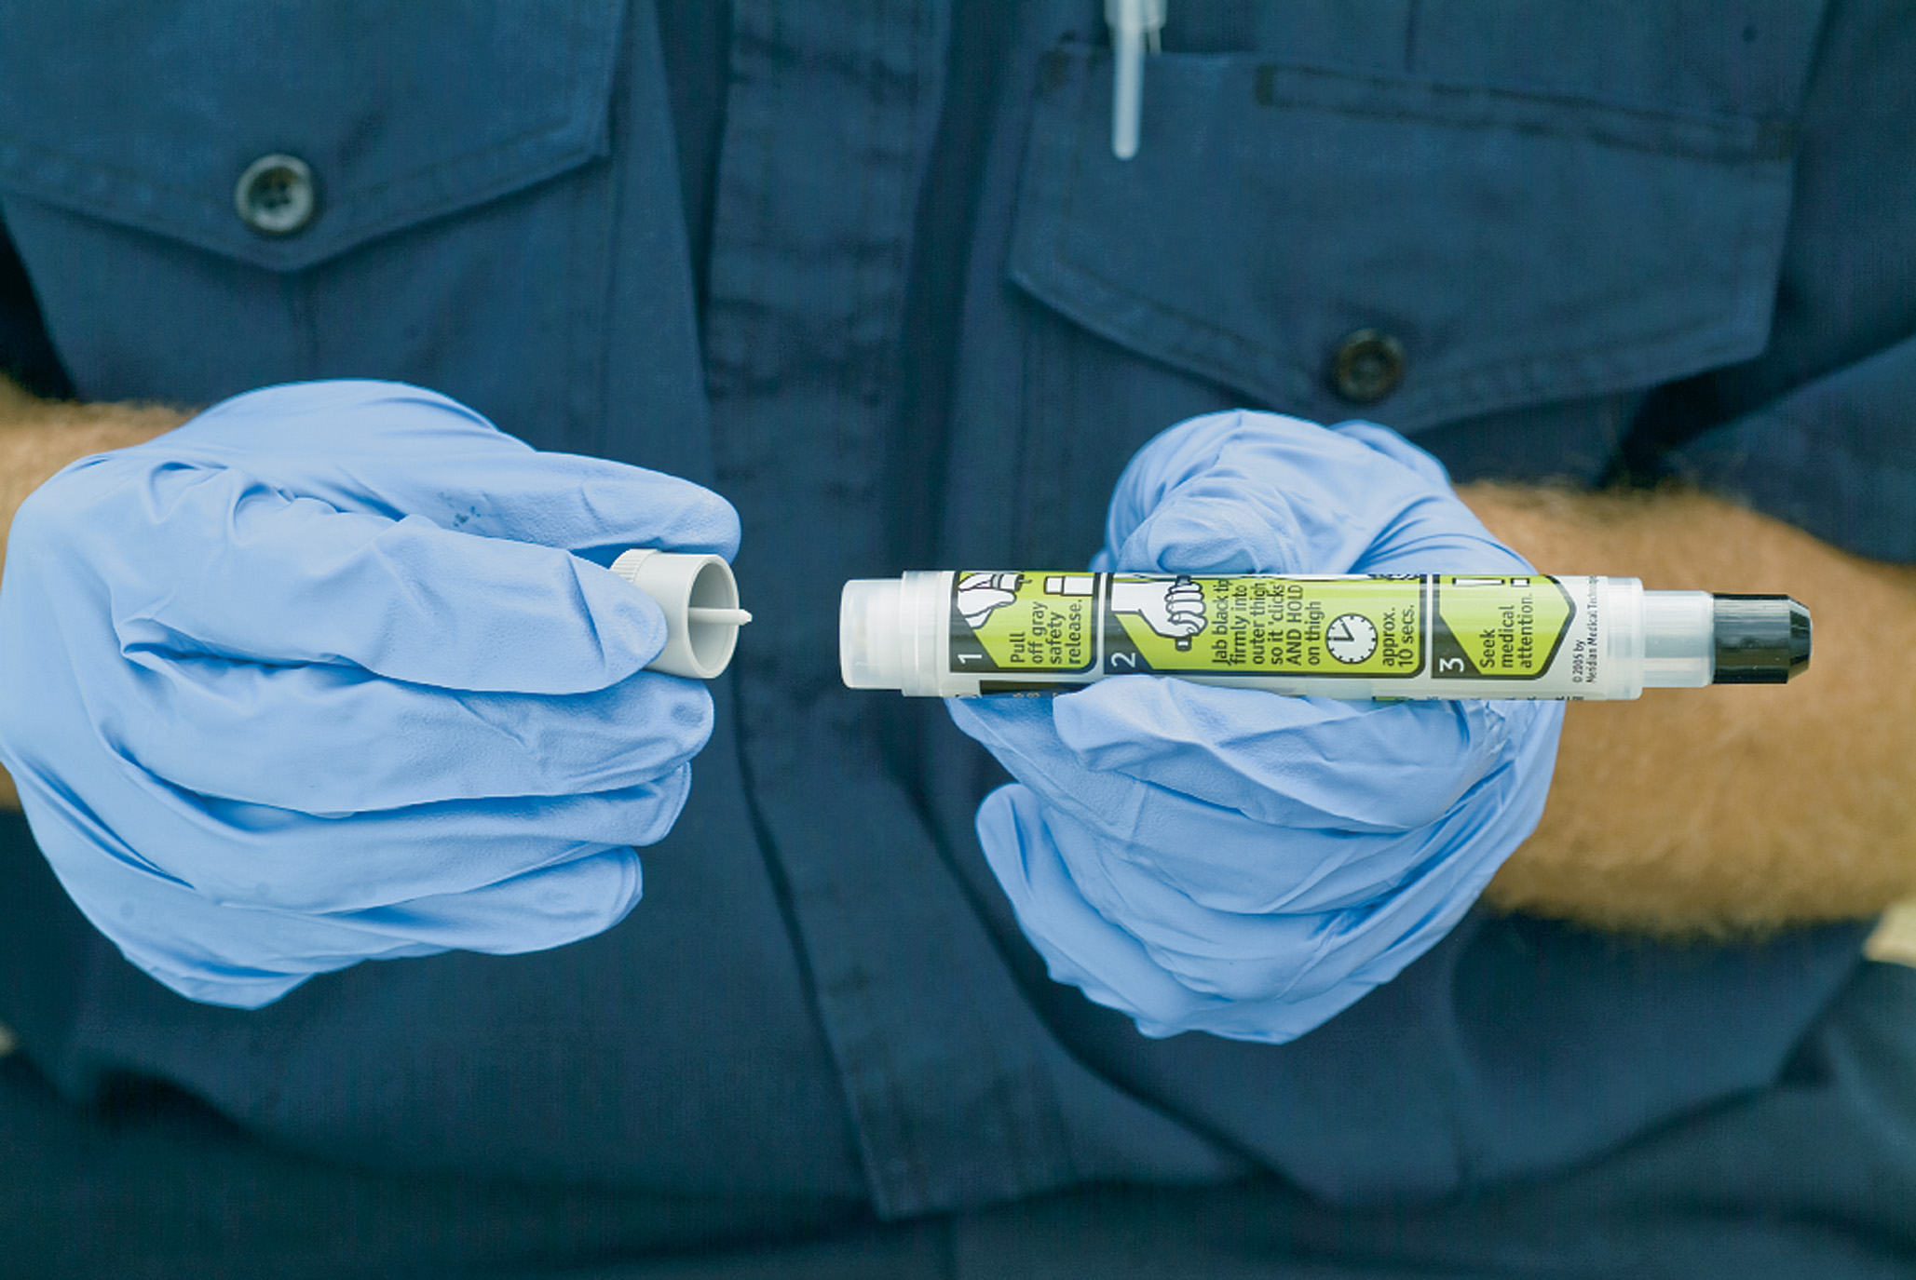
Remove the Safety Cap from the Epipen Auto-Injector

Slide 56
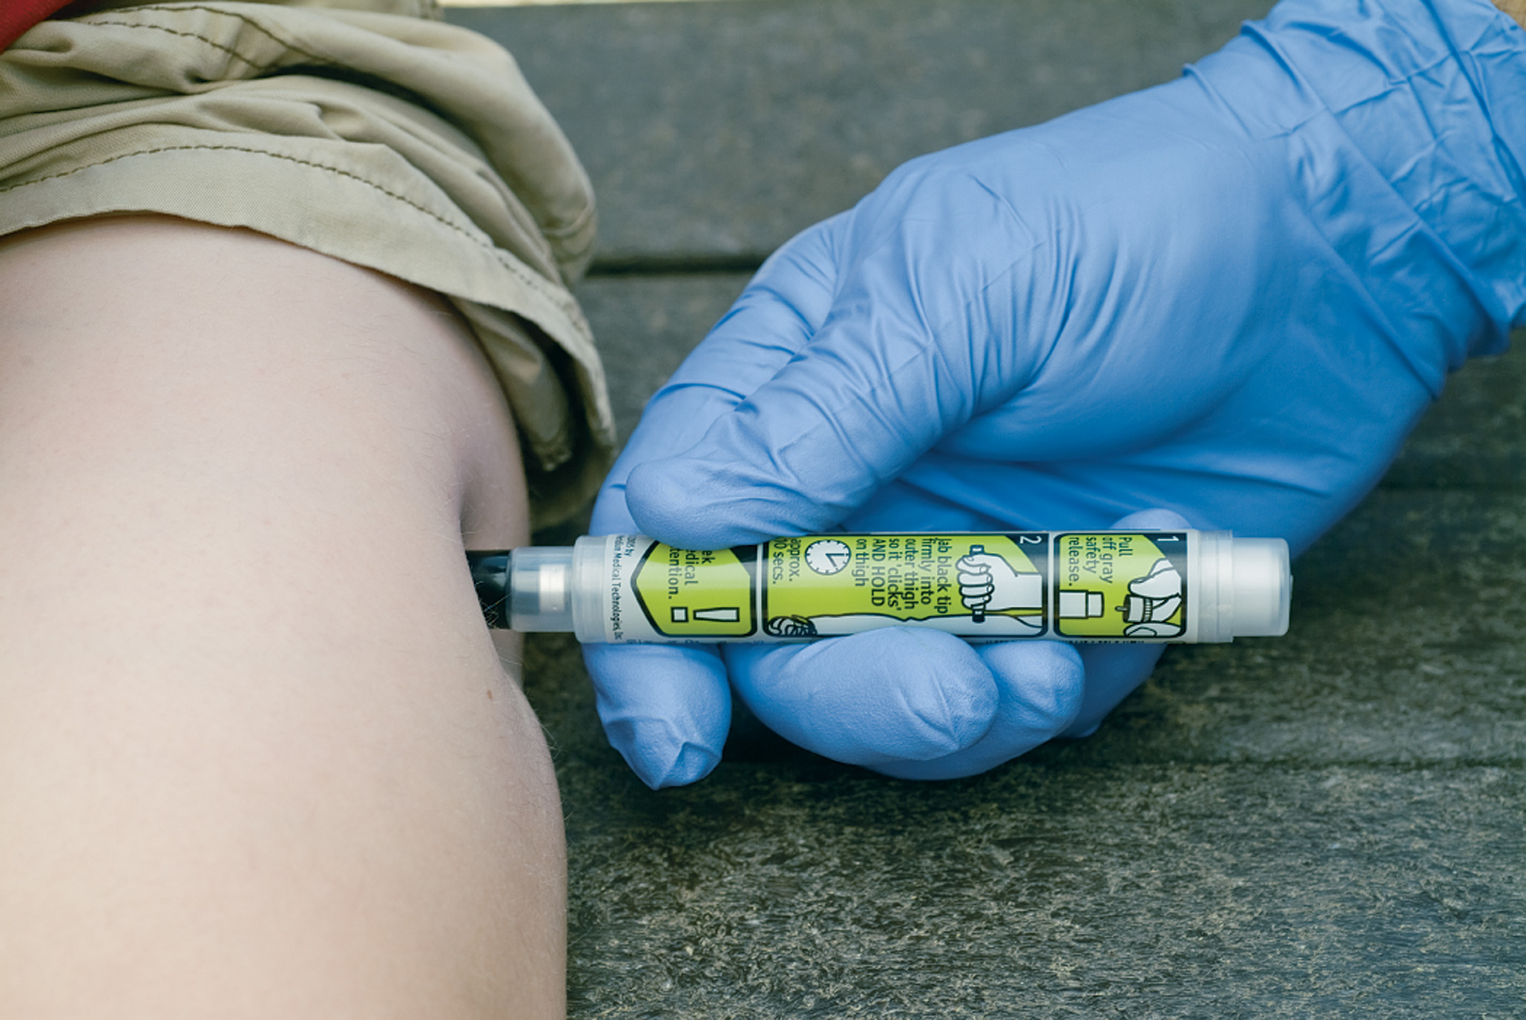
Place the Tip of the Auto-Injector on the Anterolateral Aspect of the Thigh, Midway Between the Hip and Knee
Push the injector firmly against the thigh until it activates. Hold it in place until the medication is injected.
Notes:
Administer the deep intramuscular injection in the lateral thigh midway between knee and hip.
Hold for 10 seconds if using an auto-injector.

Slide 57

Properly Dispose of the Auto-Injector. Then Record the Time of the Epinephrine Injection
Notes:
Dispose of injector or syringe in biohazard sharps container.
Record time and reassess patient.

Slide 58
Case Study Conclusion (1 of 3)
Luke and Joy quickly gather information to confirm their initial impression of anaphylaxis. Jesse has an epinephrine auto-injector in the nurse’s office, but the nurse is not currently at the school.
As Joy reassures Jesse and completes a rapid secondary assessment, including vital signs, Luke confirms that the auto-injector is prescribed to Jesse and administers it.
Notes:
Review case conclusion and emphasize the application of knowledge learned from this presentation.

Slide 59
Case Study Conclusion (2 of 3)
Recognizing the short duration of action of epinephrine, the E M T s do not spend further time at the scene, but transport immediately.
Jesse’s wheezing decreases en route, and there is no worsening of his swelling or rash. His blood pressure remains normal, as well as his S p O₂, although is heart rate has increased from an initial 104 to 116.
Notes:
Review case conclusion and emphasize the application of knowledge learned from this presentation.

Slide 60
Case Study Conclusion (3 of 3)
At the emergency department, Jesse receives additional epinephrine, as well as an antihistamine. After being observed and monitored for several hours, Jesse’s parents are grateful to be able to take him home.
Notes:
Review case conclusion and emphasize the application of knowledge learned from this presentation.

Slide 61
Lesson Summary (1 of 2)
An anaphylactic reaction is a severe allergic reaction.
The pathophysiology includes airway edema, bronchoconstriction, and vasodilation.
Care includes airway management, ventilation and oxygenation, and administration of epinephrine.
Notes:
Establishing and maintaining an airway, ventilation, oxygenation, and circulation are the key components of emergency care for an anaphylactic reaction. The drug treatment of choice is epinephrine. Epinephrine’s alpha properties cause the vessels to constrict and the capillaries to tighten, reversing the vasodilation and increased capillary permeability caused by the chemical mediators. The beta 2 properties cause the bronchioles to dilate, reversing the bronchoconstriction.
Follow-Up
Answer student questions.
Follow-Up Assignments
Review Chapter 21 Summary.
Complete Chapter 21 In Review questions.
Complete Chapter 21 Critical Thinking questions.
Assessments
Handouts
Chapter 21 quiz

Slide 62
Lesson Summary (2 of 2)
Anaphylaxis can progress rapidly; reassess the patient frequently.
Notes:
Class Activity
As an alternative to assigning the follow-up exercises in the lesson plan as homework, assign each question to a small group of students for in-class discussion.
Teaching Tips
Answers to In Review questions are in the appendix of the text. Advise students to review the questions again as they study the chapter.

Slide 63
Correct!
Several factors lead to decreased delivery of oxygen to the tissues in anaphylaxis. Among these are hypotension from vasodilation and loss of fluids from the vascular space, and decreased ventilation from airway swelling and bronchoconstriction.
Click here to return to the program.

Slide 64
Incorrect (1 of 3)
Weakening of the left ventricle of the heart is not a factor in decreased perfusion in anaphylaxis.
Click here to return to the quiz.

Slide 65
Incorrect (2 of 3)
Obstruction of blood flow through the pulmonary arterial system is not a cause of hypoperfusion in anaphylaxis.
Click here to return to the quiz.

Slide 66
Incorrect (3 of 3)
Although the delivery of oxygen to cells may be impaired in anaphylaxis because of hypotension and problems with ventilation, the ability of the cells to use oxygen that is delivered to them is not affected.
Click here to return to the quiz.

Slide 67

Copyright

