Slide 1
Prehospital: Emergency Care
Eleventh Edition
Chapter 20
Acute Diabetic Emergencies
Slides in this presentation contain hyperlinks. JAWS users should be able to get a list of links by using INSERT+F7
Copyright © 2018, 2014, 2010 Pearson Education, Inc. All Rights Reserved
Notes:
If this PowerPoint presentation contains mathematical equations, you may need to check that your computer has the following installed:
1) MathType Plugin
2) Math Player (free versions available)
3) NVDA Reader (free versions available)
Advance Preparation
Student Readiness
Assign the associated section of MyBRADYLab and review student scores.
Review the chapter material in the Instructor Resources, which includes Student Handouts, PowerPoint slides, and the MyTest Program.
Prepare
Make copies of course policies and procedures, the syllabus, handouts from the Instructor Resources, and other materials for distribution or post them in your learning management system.
Preview the media resources and Master Teaching Notes in this lesson.
Preview the case study presented in the PowerPoint slides.
The total teaching time recommended is only a guideline. Take into consideration factors such as the pace at which students learn, the size of the class, breaks, and classroom activities. The actual time devoted to teaching objectives is the responsibility of the instructor.

Slide 2
Learning Readiness
E M S Education Standards, text p. 603.
Chapter Objectives, text p. 603.
Key Terms, text p. 603.
Purpose of lecture presentation versus textbook reading assignments.
Notes:
Explain to students what the National EMS Education Standards are. The National EMS Education Standards communicate the expectations of entry-level EMS providers. As EMTs, students will be expected to be competent in these areas. Acknowledge that the standards are broad, general statements. Although this lesson addresses the listed competencies, the competencies are often complex and require completion of more than one lesson to accomplish. The student is also expected to review the chapter objectives to foreshadow what will be in the chapter. By mastering the key terms the EMT student will better understand the learning and be able to communicate it more clearly.
Additionally, explain to the students that the purpose of using these slides is to highlight important portions of the material, explain interrelationships of topics, and discuss how to apply this information. It’s not the intent of the presentation (or slides alone) to include every component in the chapter. This presentation still requires the student to thoroughly read the chapter.

Slide 3
Setting the Stage
Overview of Lesson Topics
Understanding Diabetes Mellitus
Acute Diabetic Emergencies
Assessment-Based Approach: Altered Mental Status in a Diabetic Emergency
Notes:
These bulleted points are the major headings from the chapter, in order. The purpose is to provide a basic lecture navigation for the student.

Slide 4
Case Study Introduction
E M Ts Heidi Burr and J D Hudson arrive at the scene of a reported diabetic emergency to find a man in his 20s sitting in the reception area of an office building, with two coworkers tending to him. The patient seems confused, and appears pale and sweaty. One of the coworkers says, “He was fine this morning, but he started acting strangely about ten minutes ago.”
Notes:
Case Study
Present the Case Study Introduction provided in the PowerPoint slide set.
Lead a discussion using the case study questions provided on the subsequent slide(s).
The Case Study with discussion questions continues throughout the PowerPoint presentation.
Case Study Discussion
Use the case study content and questions to foreshadow the upcoming lesson content.

Slide 5
Case Study (1 of 3)
What diabetic emergency seems likely, based on the information so far?
What information would you need to confirm your hypothesis?
Notes:
Use the case study content and questions to foreshadow the upcoming lesson content. Gauge the students’ responses as a guide of how well-versed they are in this topic.

Slide 6
Introduction
Diabetes can cause changes in mental status related to alterations in blood glucose level.
Acute diabetic emergencies are life threatening.
Prompt recognition and care are critical.
Diabetes has serious long-term complications.
Notes:
During this lesson, students will learn about assessment and emergency care for a patient suffering from an acute diabetic emergency.
The mental state can range from disorientation to complete unresponsiveness. Significant deterioration of the mental status from acute diabetic emergencies can lead to serious airway and breathing compromise.
Brain cell damage and death can occur if the blood glucose reaches a low level.
Acute diabetic emergencies can include hypoglycemia, in which the blood glucose level is too low, or diabetic ketoacidosis or hyperglycemic hyperosmolar syndrome, in which the blood glucose level is excessively high.
Long-term complications of diabetes mellitus can include vascular disease leading to stroke, heart attack, and peripheral vascular disease; kidney disease; nerve dysfunction; and retinal nerve disease leading to blindness.

Slide 7
Understanding Diabetes Mellitus (1 of 16)
Under normal circumstances, hormones control the blood glucose level.
Diabetic emergencies result from abnormalities in blood glucose control.
Notes:
Knowledge Application
Ask students to explain what happens to glucose and hormone levels in response to eating and fasting.

Slide 8
Understanding Diabetes Mellitus (2 of 16)
Glucose (Sugar)
Carbohydrates are the primary energy source for cells.
Complex carbohydrates are broken down into simple sugars, primarily glucose, for use by the cells.
Notes:
Glucose is a major source of fuel for the cells. Maintenance of the glucose level in the blood is crucial for the normal function of cells. Some cells can use fats and proteins as energy sources if little or no glucose is available in the blood; however, brain cells cannot use anything but glucose.
Teaching Tips
Use the analogy of a thermostat's role in regulating heat to explain the pancreas' role in regulating blood glucose levels.
Discussion Question
How is the blood glucose level normally regulated?

Slide 9
Understanding Diabetes Mellitus (3 of 16)
Glucose (Sugar)
Regulation of blood glucose level is critical to normal cell function.
Brain cells can only use glucose for energy, and cannot function when glucose is inadequate.
Low blood glucose results in A M S.
Prolonged low blood glucose leads to brain cell death.
Notes:
The brain cells cannot make glucose, they cannot store glucose for more than a few minutes, nor can they collect glucose in a concentration from the blood. As already noted, the consequence of a lack of glucose to brain cells for a short period of time is brain cell dysfunction.

Slide 10
Understanding Diabetes Mellitus (4 of 16)
Glucose (Sugar)
Excess glucose in cells causes water to enter the cell, which worsens head injury or stroke.
With high blood glucose, glucose is excreted in urine, bringing water along with it, leading to dehydration.
Notes:
If a large amount of glucose moves across a membrane, a large amount of water follows it. This is one reason why a high blood glucose level is dangerous and proven to be detrimental in patients with a head injury or stroke. By giving glucose, the brain allows more glucose to cross into the cells and the glucose brings water with it. This causes brain cells to swell, leading to more edema (swelling) within the skull, which worsens the head injury or stroke.

Slide 11
Understanding Diabetes Mellitus (5 of 16)
Hormones That Control Blood Glucose Levels
Insulin
Insulin is secreted when blood glucose levels are high.
Without insulin, little glucose can enter the cells.
Glucose remains in the bloodstream, resulting in elevated blood glucose levels.
Notes:
Insulin has three main functions:
It increases the movement of glucose out of the blood and into the cells.
It causes the liver to take glucose out of the blood and convert it into glycogen, the stored form of glucose.
It decreases the blood glucose level by the actions just listed: facilitating the movement of the glucose out of the blood and into the cells and the liver.
Insulin attaches to the cell at a specific (receptor) site and causes another channel on the cell membrane to open. A protein then carries the glucose into the cell through this channel.
Glucose crosses the blood-brain barrier readily, whether insulin is present or not.

Slide 12
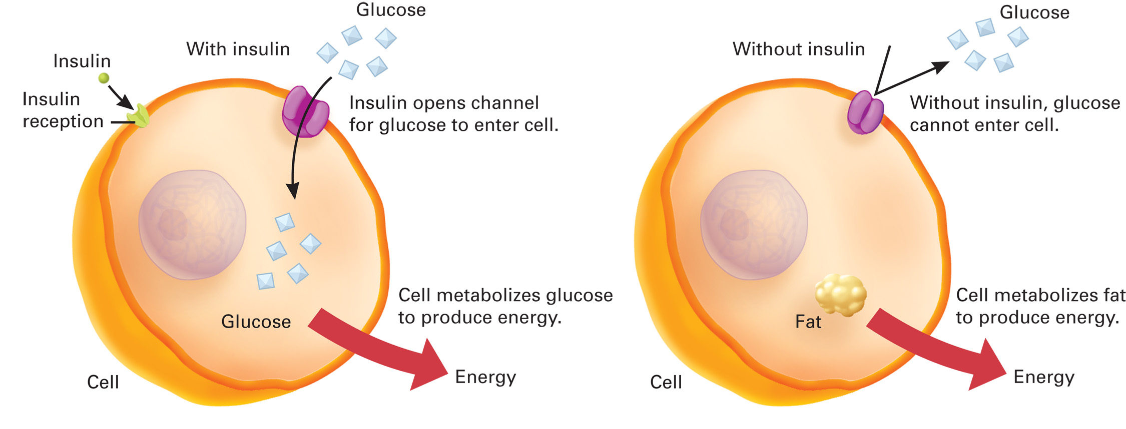
Glucose Movement into the Cell with Insulin and the Inability of Glucose to Get into the Cell without Insulin
Notes:
Insulin attaches to the cell at a specific (receptor) site and causes another channel on the cell membrane to open. A protein then carries the glucose into the cell through this channel. Thus, insulin facilitates the movement of glucose into the cell. If insulin is not available, glucose moves into the cell at a rate approximately 10 times slower, causing glucose to build up in the bloodstream.

Slide 13
Understanding Diabetes Mellitus (6 of 16)
Hormones That Control Blood Glucose Levels
Glucagon
Secreted when blood glucose level is low
Functions to increase and maintain the blood glucose level
Notes:
When the blood glucose level decreases to approximately 70 mg/dL, glucagon is secreted.
The major functions of glucagon follow:
It converts glycogen stored in the liver back into glucose and releases it into the blood.
It converts other, noncarbohydrate substances into glucose in the liver.
It increases and maintains the blood glucose level by converting glycogen and other substances into glucose.

Slide 14
Understanding Diabetes Mellitus (7 of 16)
Hormones That Control Blood Glucose Levels
Other Hormones: Epinephrine
Released when blood glucose levels are very low.
Inhibits insulin secretion and promotes release of stored glucose from the liver.
Some signs and symptoms of hypoglycemia are related to the release of epinephrine.
Notes:
Epinephrine stops the secretion of insulin and promotes the release of stored glucose from the liver, as well as the conversion of other substances into glucose. Many of the signs you see in a patient with a low blood glucose level are caused by epinephrine.

Slide 15
Understanding Diabetes Mellitus (8 of 16)
Normal Metabolism and Glucose Regulation
The normal range of blood glucose levels is 70 to 120 milligram/deciLitre.
Insulin is secreted in response to increased blood glucose levels.
Between meals, blood glucose levels drop, glucagon is secreted to increase and maintain the blood glucose level.
Notes:
Within 1 hour after a meal, a person’s blood glucose level increases 120 and 140 mg/dL. When the blood glucose rises, it triggers the pancreas to secrete insulin, which is released from the pancreas and immediately begins to increase the movement of the glucose into the cells. About two-thirds of the glucose is taken up by the liver, which converts it to glycogen to be stored by the liver and muscles for later use. The brain takes up as much glucose as it needs without the aid of insulin.
As the cells continue to require and use insulin in the hours after a meal, the blood glucose level drops near the lower end of the normal range. The pancreas recognizes the decreased blood glucose level and secretes glucagon. The glucagon causes the liver to begin converting the glycogen (stored glucose) back into glucose, and releasing it into the bloodstream. Other, noncarbohydrate substances are also converted into glucose. This raises the blood glucose level and maintains it in that normal range until the next meal.

Slide 16
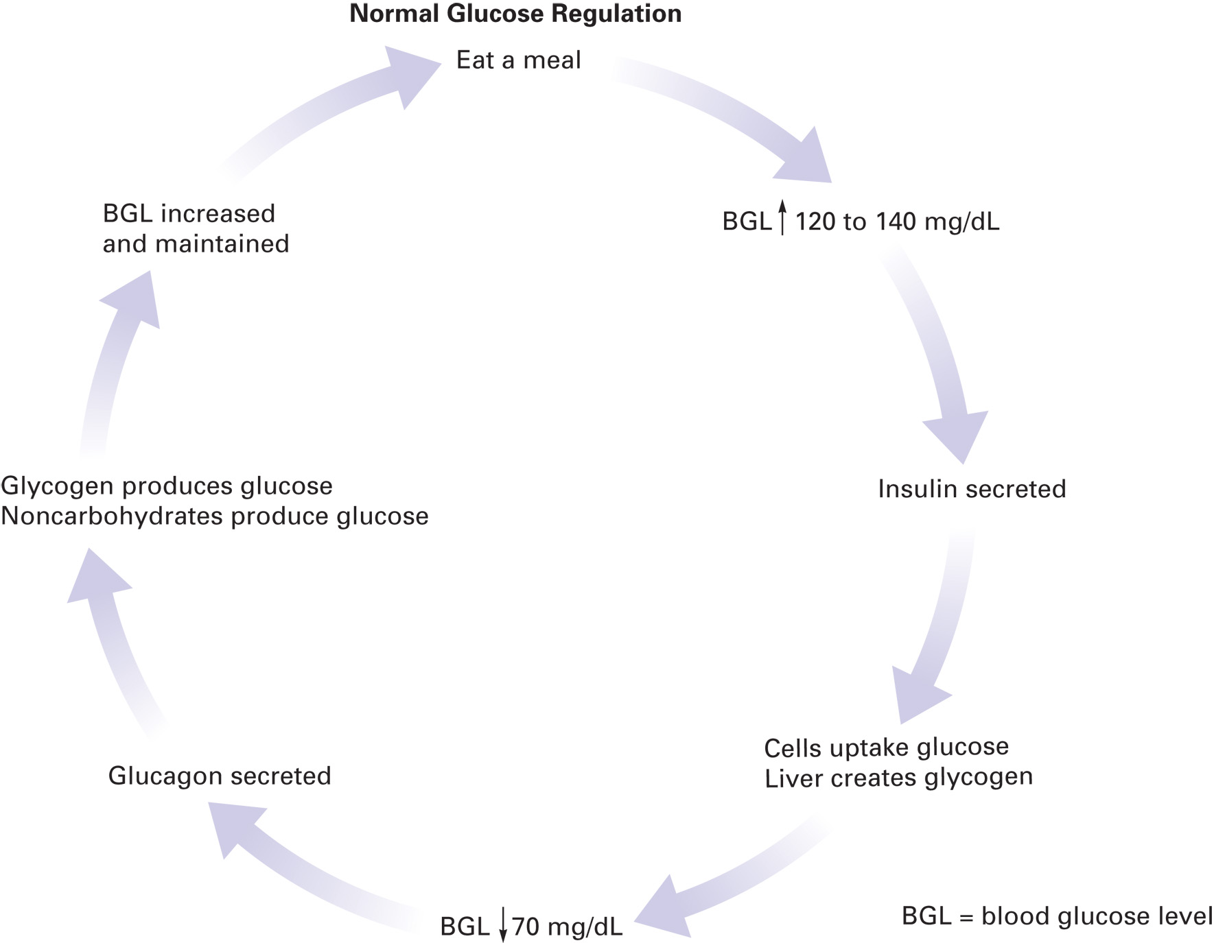
Normal Glucose Regulation
Notes:
Glycogen stores in the liver can last up to 24 to 48 hours. After that, there is typically no more glycogen left in the liver to be converted into glucose and the blood glucose may drop drastically, whereas fats and proteins begin to be used by the body cells at a high rate for energy.

Slide 17
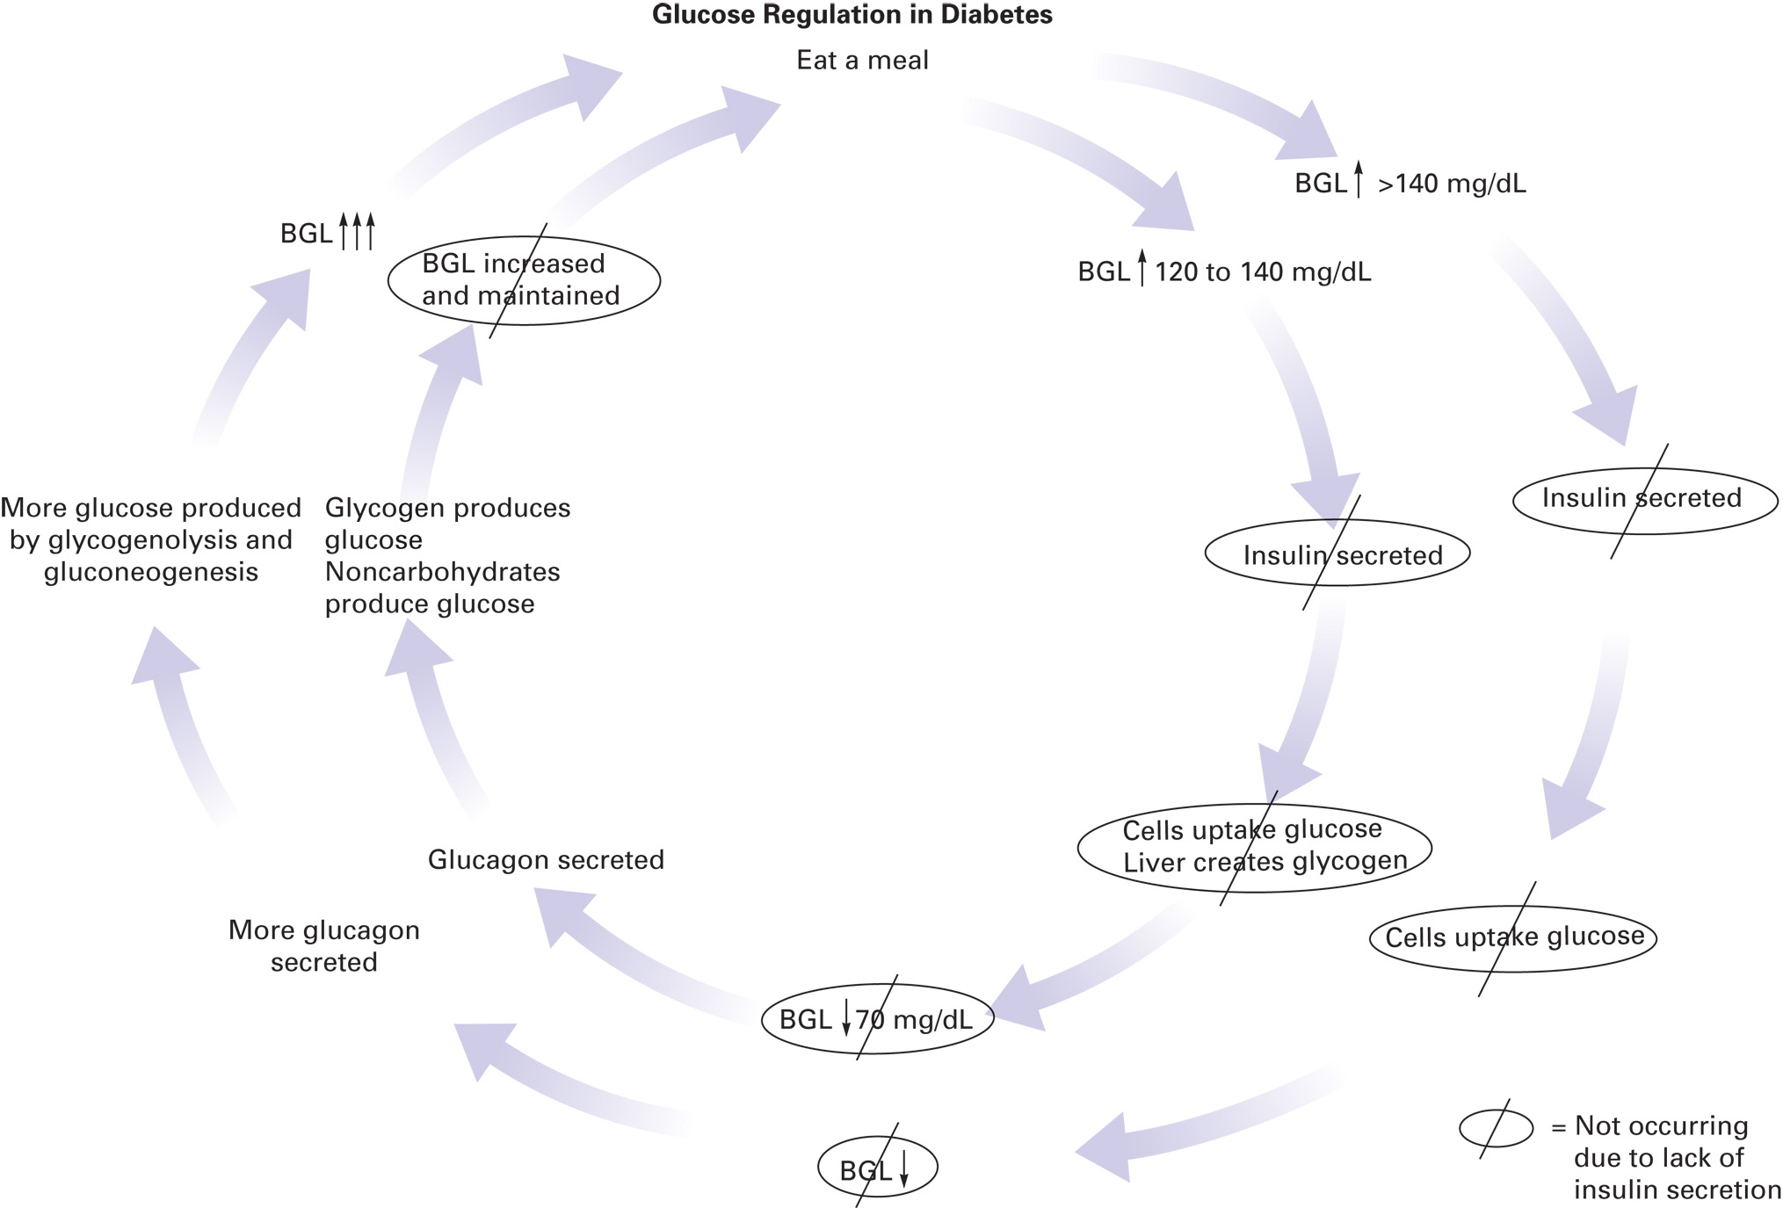
Glucose Regulation in Diabetes Mellitus
Notes:
Diabetes mellitus (DM) is a condition in which there is a disturbance in the metabolism of carbohydrates, fats, and proteins. The primary problem in this condition is either (1) a lack of insulin secreted by the pancreas or (2) the inability of the cell receptors to recognize the insulin and allow the glucose to enter at a normal rate.

Slide 18
Understanding Diabetes Mellitus (9 of 16)
Checking the Blood Glucose Level
Testing the Blood Glucose Level with a Glucose Meter.
Normal readings range from 80 to 120 milligram/deciLitre.
When interpreting the reading, determine the last time the patient ate or drank anything.
Notes:
Blood glucose is measured in milligrams per deciliter (mg/dL). The body normally maintains blood glucose levels within a wide range—from 70 to 140 mg/dL.
The specific level within this range depends on the last time the patient ate or drank, especially carbohydrate containing foods and drinks, and other factors such as exercise and activity.
Discussion Questions
At what point is a patient considered hypoglycemic?
At what point is a patient considered hyperglycemic?

Slide 19
Understanding Diabetes Mellitus (10 of 16)
Checking the Blood Glucose Level
Testing the Blood Glucose Level with a Glucose Meter.
Hypoglycemia is a B G L of 70 milligram/deciLitre or less with signs and symptoms.
Hyperglycemia is a B G L of 200 milligram/deciLitre or higher.
Notes:
Fluctuations within the normal BGL range are generally considered normal and not unexpected, a reading less than 70 mg/dL can indicate a lower-than-normal level of glucose (sugar) in the blood, whereas a reading greater than 140 mg/dL may indicate a higher-than-normal amount of glucose in the blood.

Slide 20
E M T Skills 20-1
Testing the Blood Glucose Level with a Glucose Meter
Notes:
The blood glucose level should be tested prior to the administration of any oral glucose or sugar-containing solution.

Slide 21
Prepare the Glucose Meter
Notes:
To test the blood glucose level with a glucose meter, you need the following supplies and equipment:
Glucose meter.
Glucose meter test strips.
Lancet.
Lancet device (optional).
Alcohol swabs.

Slide 22
Clean the Site

Slide 23
Perform the Finger Stick
Notes:
This device will make a small penetration into the skin to allow a drop of capillary blood to form.

Slide 24
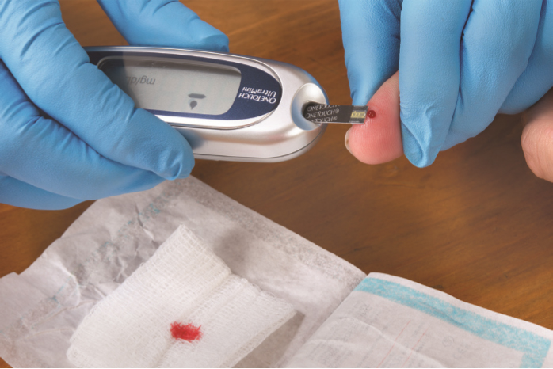
Waste the First Drop of Blood onto a Dressing. Drop the Second Blood Drop onto the Test Strip
Notes:
To get an accurate glucose reading, you need to get a good blood sample.

Slide 25
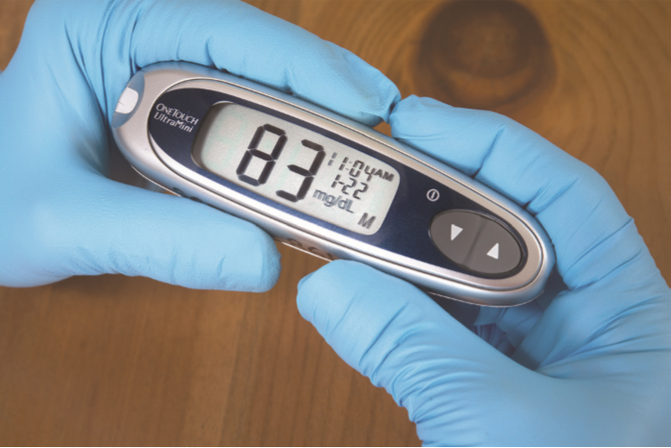
Read the Blood Glucose Value Displayed on the Glucose Meter
Notes:
The reading is typically displayed shortly after obtaining the sample.

Slide 26
Understanding Diabetes Mellitus (11 of 16)
Diabetes Mellitus
A disturbance in the metabolism of carbohydrates, fats, and proteins
Results from:
Lack of insulin secreted from pancreas
(OR)
Inability of cell receptors to respond to insulin to allow glucose into the cells
Notes:
If there is no insulin or a minimal amount of insulin in the blood, the cells take up glucose at a much slower rate. Or if there is enough insulin but there is a deficit in the cell receptor sites that prevents them from recognizing and attaching insulin, this can also cause a drastic reduction in the amount of glucose that is allowed to enter the cell.
Critical Thinking Discussion
What causes the three "Ps" of untreated diabetes mellitus?
Discussion Question
What are the similarities and differences between Type 1 and Type 2 diabetes?

Slide 27
Understanding Diabetes Mellitus (12 of 16)
Diabetes Mellitus
The patient has a high blood glucose level, but the cells are deprived of glucose.
The brain cells do not require insulin to use glucose.
Excess glucose is excreted by the kidneys, causing excess water loss.
Notes:
An excessive amount of glucose collects in the blood and raises the blood glucose level. Because the glucose cannot enter the cells at a normal rate, the cells begin to starve for energy and must use other sources, such as fat. Even though the blood is filled with glucose molecules, they are not available to the cells for energy production.

Slide 28
Understanding Diabetes Mellitus (13 of 16)
Diabetes Mellitus
The three P s of diabetes are:
Polydipsia
Polyuria
Polyphagia
Notes:
The peak ages for onset of type 1 diabetes mellitus are 4 to 6 years and again at 10 to 14 years. The patients are typically lean from weight loss. Their blood glucose levels are extremely high if untreated. These patients suffer from the three Ps

Slide 29
Understanding Diabetes Mellitus (14 of 16)
Diabetes Mellitus
Type 1 diabetes
Pancreas does not secrete insulin.
Patients must take insulin to regulate blood glucose.
Peak onset is between 10-14 years of age.
Patients often have a lean build.
Patients are prone to diabetic ketoacidosis (D K A).
Notes:
Type 1 diabetics often have difficulty keeping their blood glucose level within the normal range, with the possibility of having too high or too low a blood glucose level.
Type 1 diabetes is much less common than type 2 diabetes.

Slide 30
Understanding Diabetes Mellitus (15 of 16)
Diabetes Mellitus
Type 2 diabetes
Patients use oral medication, diet, and exercise, rather than insulin, to manage blood glucose levels.
Patients are usually middle-aged or older, and overweight.
Patients are prone to hyperglycemic hyperosmolar nonketotic syndrome (H H N S).
Notes:
Type 2 patients usually do not need to take insulin. However, they do have to regulate their diet and exercise and take oral drugs to help the pancreas secrete more insulin or to make the insulin that is secreted more effective in facilitating movement of glucose into the cells.

Slide 31
Understanding Diabetes Mellitus (16 of 16)
Diabetes Mellitus
Diabetics are prone to diseases and disorders of the blood vessels
Heart attack
Stroke
Kidney failure
Notes:
The patient with diabetes mellitus typically has a high blood glucose level. A blood glucose reading that is randomly taken can be greater than 200 mg/dL, compared to 70 to140 mg/dL in a patient without diabetes mellitus.

Slide 32
Click on the Action Below That Results from Release of Insulin
A. Glucose enters brain cells in larger quantities than required for cell metabolism.
B. Glycogen in the liver is broken down into glucose, increasing the blood glucose level.
C. The rate at which glucose is taken up by body cells increases.
D. Epinephrine levels are increased, leading to tachycardia, pale skin, and sweating.

Slide 33
Case Study (2 of 3)
The patient, whose name is Trent, is confused as to the day of the week, and has difficulty answering other questions, but can follow commands. He is able to confirm a history of diabetes, but it is unclear when he last took insulin or ate.
J D obtains a blood glucose reading of 48 milligram/deciLitre.
Notes:
Review the case study findings presented.

Slide 34
Case Study (3 of 3)
Is the patient’s blood glucose level high, low, or normal?
Explain the findings of confusion and pale, diaphoretic skin.
What treatment does this patient require?
Notes:
Use the case study content and questions to foreshadow the upcoming lesson content. Gauge students’ responses as a guide of how well-versed they are in this topic.

Slide 35
Acute Diabetic Emergencies (1 of 21)
Hypoglycemia
Usually occurs in type 1 diabetes
Results from excess insulin that the patient takes to manage their diabetes
Notes:
Hypoglycemia is the term for a low blood glucose level. It is usually defined as a blood glucose concentration less than 70 mg/dL and is the most common type of endocrine emergency. It is more common in type 1 patients than in type 2 patients. Hypoglycemia is the most dangerous acute complication of diabetes mellitus. It is estimated that most diabetics experience mild episodes of hypoglycemia one to two times per week that are self-treated, and 30 percent experience a severe hypoglycemic episode annually.
Discussion Question
What are the likely events leading to an episode of hypoglycemia?
Class Activity
Draw a grid on the white board with Hypoglycemia and Hyperglycemia as column headings. Label rows Signs, Symptoms, History, and Management. Have students fill in the grid. Review the grid, emphasizing key points and filling in any gaps.
Critical Thinking Discussion
Why do patients with hypoglycemia often present with bizarre or aggressive behavior?
Discussion Question
What are the management priorities for patients with hypoglycemia?

Slide 36
Acute Diabetic Emergencies (2 of 21)
Hypoglycemia
Pathophysiology of Hypoglycemia
The patient takes insulin, but does not eat a meal.
The patient takes insulin, eats a meal, and drastically increases their activity.
The patient takes too much insulin.
Can also occur in type 2 diabetics from the effects of oral mediations.
Notes:
Hypoglycemia usually occurs in type 1 diabetes mellitus in which the patient must take insulin to regulate their blood glucose levels. This patient takes their insulin, but with excessive results.
Type 2 diabetes mellitus patients can also suffer from hypoglycemia. The oral medications that they take can cause the blood glucose level to drop too far, resulting in hypoglycemia. Because these oral medications have long-lasting effects, hypoglycemia can be prolonged or can recur if these patients are not monitored.

Slide 37
Acute Diabetic Emergencies (3 of 21)
Hypoglycemia
Assessment Findings in Hypoglycemia
Altered mental status occurs from low blood glucose.
Other signs and symptoms occur from epinephrine release.
Notes:
As the blood glucose level drops, epinephrine is secreted at higher levels. The effect of the epinephrine is to shut down secretion of insulin and to stimulate secretion of glucagon, which, in turn, converts stored glycogen and other noncarbohydrate substances into glucose. As a result, many of the signs and symptoms seen in hypoglycemia are associated with the epinephrine circulating in the body.
Signs and symptoms caused by epinephrine release:
Diaphoresis (sweating).
Tremors.
Weakness.
Hunger.
Tachycardia (increased heart rate).
Dizziness.
Pale, cool, clammy skin.
Warm sensation.

Slide 38
Acute Diabetic Emergencies (4 of 21)
Hypoglycemia
Assessment Findings in Hypoglycemia
Symptoms related to brain cell dysfunction (low blood glucose)
Confusion, disorientation, or drowsiness
Unresponsiveness
Seizures
Stroke-like symptoms
Notes:
Signs and symptoms caused by brain cell dysfunction:
Confusion.
Drowsiness.
Disorientation.
Unresponsiveness.
Seizures (can occur in severe cases).
Stroke-like symptoms including hemiparesis (especially in the elderly).
The hypoglycemic patient can present with bizarre or even violent behavior and, for this reason, the patient’s condition can be mistaken for a behavioral or psychiatric disorder, head injury, drug use, or alcohol intoxication. This is potentially a tragic mistake because hypoglycemia can be fatal if not recognized and treated quickly.
Any patient who presents with an altered mental status, bizarre behavior, violence, or an intoxicated appearance, even if alcohol is smelled on the breath, must be assessed for possible hypoglycemia.

Slide 39
Acute Diabetic Emergencies (5 of 21)
Hypoglycemia
Hypoglycemia Unawareness
Over time the signs and symptoms of hypoglycemia can change.
This can allow blood glucose levels to drop significantly without intervention.
Notes:
Patients with long-term diabetes mellitus usually recognize their own signs and symptoms that occur when their blood glucose levels are decreasing and they are becoming hypoglycemic. Over time the signs and symptoms of hypoglycemia might begin to change and they may not recognize the change; this can cause them to allow their blood glucose levels to drop significantly without any intervention until they suddenly experience hypoglycemia.

Slide 40
Acute Diabetic Emergencies (6 of 21)
Hypoglycemia
Emergency care for hypoglycemia
Categorize the patient as:
Unresponsive, unable to swallow, or unable to follow commands; Or
Altered mental status but responsive, able to swallow, and able to follow commands
Notes:
Your management is based on the patient’s mental status.

Slide 41
Acute Diabetic Emergencies (7 of 21)
Emergency care for hypoglycemia
For patients who are unresponsive, unable to swallow, or unable to follow commands
Establish an open airway.
Apply oxygen if the S p O₂ is <94%.
Provide positive pressure ventilation if breathing is inadequate.
Assess the blood glucose level.
Request A L S.
Notes:
Administer oxygen via a nasal cannula if the SPO₂ is <94 percent or signs of respiratory distress, hypoxia, hypoxemia, or poor perfusion are present, to achieve and maintain an SPO₂ of 94 % or greater. Provide positive pressure ventilation if the breathing is inadequate (either an inadequate rate or an inadequate tidal volume).
Contact advanced life support in accordance with your protocols. Severe hypoglycemia can result in brain cell death; therefore, it is critical to quickly get glucose to the patient's brain cells.
Be sure to continuously reassess the patient’s condition for improvement or deterioration. Pay attention to the airway and breathing status.

Slide 42
Acute Diabetic Emergencies (8 of 21)
Emergency care for hypoglycemia
For patients with altered mental status but responsive, able to swallow, and able to follow commands
Ensure a patent airway.
Assess the blood glucose level.
Administer one tube of oral glucose.
Notes:
Oral glucose is the medication of choice for the EMT in the emergency medical care of the diabetic patient with an altered mental status.
Be sure to continuously reassess the patient’s condition for improvement or deterioration. Pay attention to the airway and breathing status.

Slide 43
Acute Diabetic Emergencies (9 of 21)
Emergency care for hypoglycemia
Oral glucose
Gel is absorbed quickly, increasing the blood glucose level.
Oral glucose may be administered only if all these patient conditions are met:
Altered mental status
History of diabetes controlled by medication or a B G L <70 m m H g
Has the ability to swallow
Notes:
In cases in which all three criteria are not met, do not administer oral glucose. Instead, provide emergency medical care for a patient with altered mental status and an unknown history.
Teaching Tips
Pass around tubes of oral glucose for students to see and handle.

Slide 44
One Method of Administering Oral Glucose is to Squeeze the Tube of Oral Glucose Between the Patient’s Cheek and Gum
Notes:
Oral glucose is the medication of choice for the EMT in the emergency medical care of the diabetic patient with an altered mental status. After it is administered, this heavy sugar gel raises the amount of glucose circulating in the blood, which increases the amount of glucose available to the brain.

Slide 45
Acute Diabetic Emergencies (10 of 21)
Emergency care for hypoglycemia
Intranasal Glucagon
Glucagon does not contain glucose
Converts glycogen in the liver to glucose
Administer via M A D and syringe
May take 13 to 16 minutes to work
Notes:
Administering glucagon can raise the BGL; however, its effectiveness depends on the amount of glycogen that remains in the liver for the glucagon to work on.
Administer the glucagon solution intranasally (IN) using a mucosal atomizer device (MAD) and syringe. Intranasal administration of glucagon has been shown to have effectiveness comparable to that of IM and SQ glucagon administration.
Teaching Tips
Pass around tubes of oral glucose for students to see and handle.

Slide 46
Acute Diabetic Emergencies (11 of 21)
Hyperglycemia
High blood glucose levels caused by a relative lack of insulin
Extreme hyperglycemia may result in:
Diabetic ketoacidosis (D K A)
Hyperglycemic Hyperosmolar Nonketotic Syndrome (H H N S)
Notes:
Hyperglycemia is the term for a high blood glucose level and is defined as a blood glucose level greater than 200 mg/dL. Any hyperglycemic episode in a diabetic patient should prompt the EMT to assess for an infection, acute medical illness, recent cocaine use, or medication noncompliance.
Discussion Question
What are the management priorities for patients with hyperglycemia?

Slide 47
Acute Diabetic Emergencies (12 of 21)
Hyperglycemic Condition: Diabetic Ketoacidosis
Pathophysiology of D K A
Blood glucose typically >350 milligrams/deciLitre.
Without insulin to help move glucose into cells, cells are starved.
Cells begin to burn fat.
Notes:
The cells begin to burn fat for energy as the glucose collects in the blood. This causes two problems within the body: dehydration and acidosis.
The excess glucose from the blood begins to spill into the urine, drawing large amounts of water with it. The patient begins to urinate frequently because of the excessive glucose, simultaneously eliminating large amounts of water attracted to the glucose. This leads to dehydration in the patient.
Because the liver cells are not taking in glucose, the liver begins to metabolize fats for energy, which produces a byproduct called ketones. The ketones produce a form of strong acid. As the liver metabolizes more fat, acid levels in the body begin to increase to dangerous levels (acidosis).

Slide 48
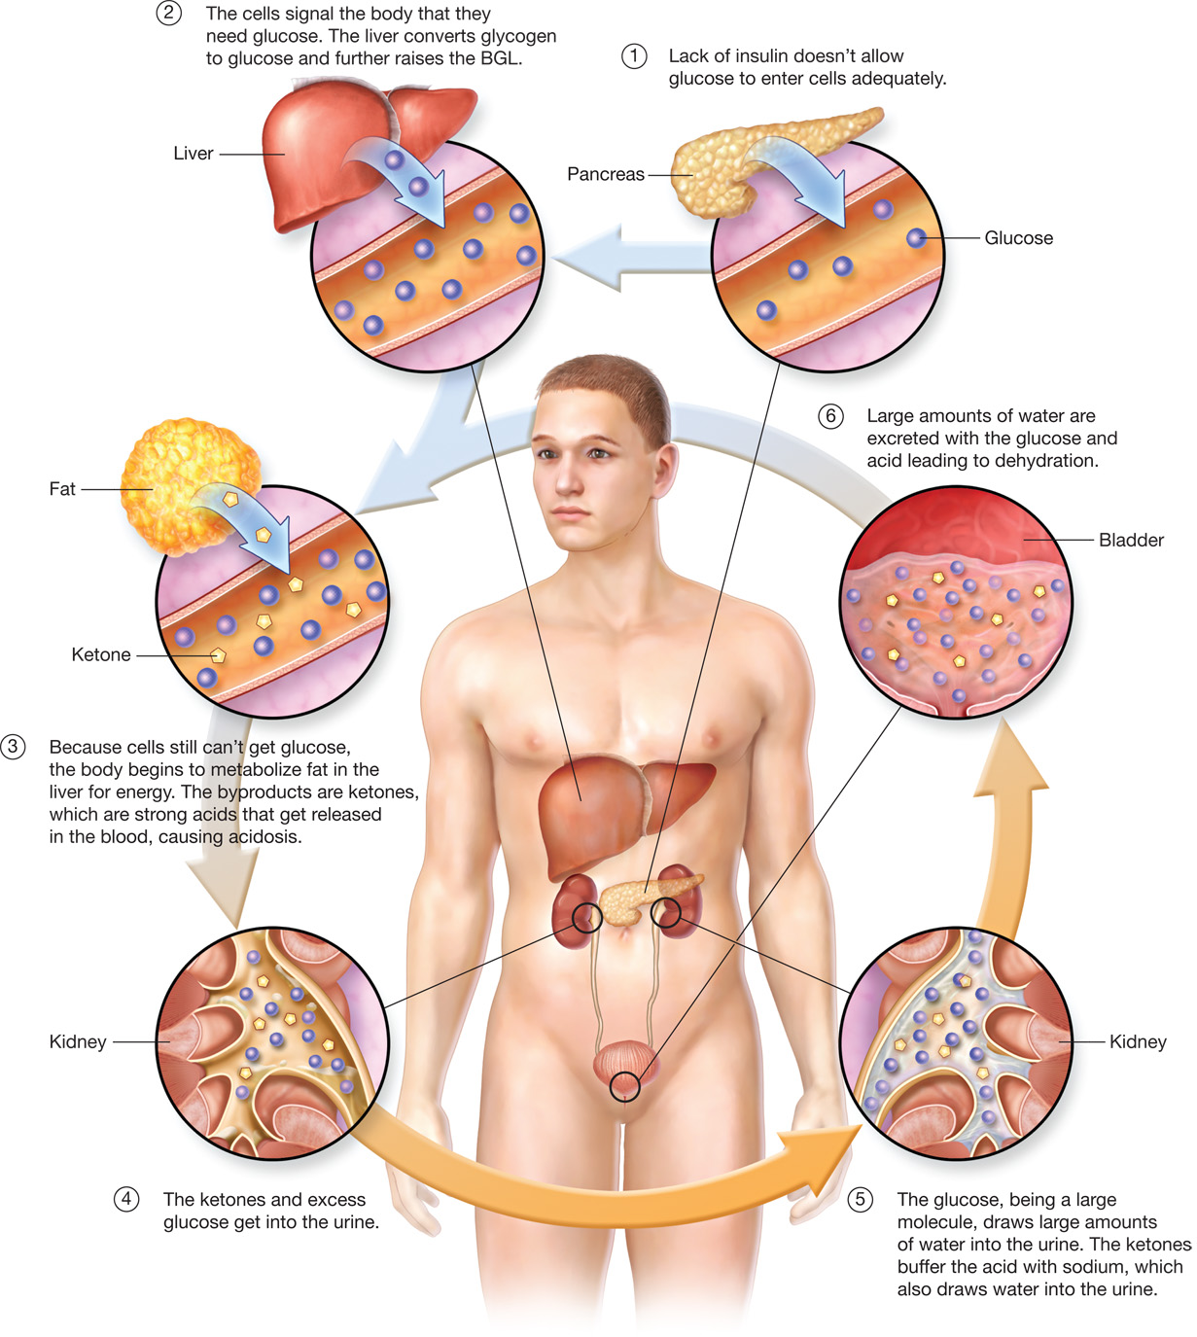
Pathophysiology of Diabetic Ketoacidosis (D K A)
Notes:
An altered mental status in the DKA patient is not from a lack of glucose to the brain, but rather, an altered mental status results from dehydration, fluid shift, and acidosis affecting the brain cells.

Slide 49
Acute Diabetic Emergencies (13 of 21)
Hyperglycemic Condition: Diabetic Ketoacidosis
Pathophysiology of D K A
Factors that can lead to D K A
Infection
Inadequate insulin dose
Certain medications
Physical stress (surgery, trauma)
Increase in carbohydrate intake
Notes:
The patient suffers from an infection such as a urinary tract infection or pneumonia that has upset the insulin and glucose balance, especially in the elderly or debilitated patient.
The patient takes an inadequate dose of insulin or is not compliant with their medications used to treat the diabetic condition.
The patient takes medications such as thiazide, Dilantin, or steroids.
The patient has suffered some type of stress such as surgery, trauma, pregnancy, or acute medical illness such as heart attack or stroke.
The patient had a change in diet in which they have overeaten or increased their carbohydrate or sugar intake.
Recent cocaine use in a diabetic patient can also precipitate DKA.

Slide 50
Acute Diabetic Emergencies (14 of 21)
Hyperglycemic Condition: Diabetic Ketoacidosis
Assessment Findings in D K A
D K A signs and symptoms are produced primarily by the dehydration and acid buildup.
D K A progresses slowly over a few days.
Notes:
Many children will be in DKA the first time they present with diabetes mellitus. They will have no history of having diabetes mellitus; however, they will be exhibiting the signs and symptoms of DKA.
Signs and symptoms of DKA:
Polyuria (excessive urination).
Polyphagia (excessive hunger).
Polydipsia (excessive thirst).
Nausea and vomiting.
Poor skin turgor.
Tachycardia.
Rapid deep respirations (called Kussmaul respirations).
Fruity or acetone odor on the breath.
Positive orthostatic tilt test.
Blood glucose level (BGL) 7350 mg/dL.
Muscle cramps.
Abdominal pain (in 50 percent of patients; more common in children with DKA).
Warm, dry, flushed skin.
Altered mental status.
Coma (very late).

Slide 51
Acute Diabetic Emergencies (15 of 21)
Hyperglycemic Condition: Diabetic Ketoacidosis
Assessment Findings in D K A
S&S related to dehydration are polyuria, polydipsia, poor skin turgor, tachycardia, and positive tilt test.
Nausea, vomiting, and muscle cramps are typically due to electrolyte disturbances from the loss of sodium, potassium, and magnesium.
Notes:
Kussmaul respirations are a pattern of deep and rapid breathing that is commonly seen in the patient with DKA. It is an attempt by the body to blow off carbon dioxide to reduce the acid load in the body. Carbon dioxide produces another form of acid called carbonic acid. If the patient can blow off large amounts of carbon dioxide by hyperventilating (deep and rapid breathing), they can then reduce the amount of carbonic acid and, thus, reduce the total amount of acid in the body.

Slide 52
Acute Diabetic Emergencies (16 of 21)
Hyperglycemic Condition: Diabetic Ketoacidosis
Emergency Care for D K A
Establish and maintain a patent airway.
Administer oxygen if S p O₂ <94%.
Positive pressure ventilation, if needed
Determine the blood glucose level.
If you are not sure of the condition, administer oral glucose if the patient can swallow.
Contact medical direction.
Notes:
The patient with DKA is typically dehydrated and acidotic. Thus, the treatment is aimed at reducing the blood glucose level and rehydrating the patient. It may be prudent to contact an advanced life support unit to begin rehydration in the field.
Prehospital emergency medical care includes the following:
Establish and maintain a patent airway.
Maintain adequate oxygenation. Administer oxygen if the SPO₂ is <94% or signs of respiratory distress, hypoxia, hypoxemia, or poor perfusion are present via a nasal.
If breathing is inadequate (either an inadequate rate or an inadequate tidal volume), provide positive pressure ventilation with oxygen connected to the ventilation device.
Determine the blood glucose level.
If the BGL is less than 70 mg/dL, administer oral glucose if the patient can swallow.
Contact medical direction for further orders.

Slide 53
Acute Diabetic Emergencies (17 of 21)
Hyperglycemic Condition: Hyperglycemic Hyperosmolar Syndrome
Pathophysiology of H H S
The blood glucose is very high; 600 to 1,200 milligrams/deciLitre (hyperglycemic).
Glucose is excreted in urine, with large amounts of water (hyperosmolar effect).
Notes:
The pathophysiology of HHS is similar to DKA. HHS is also sometimes referred to as hyperglycemic hyperosmolar nonketotic syndrome (HHNS) and nonketotic hyperosmolar state (NKHS).
HHS is more common in the patient with type 2 diabetes. This is because the type 2 patient’s pancreas can continue to produce and secrete some insulin, so some glucose is still getting into the cells. The glucose entering the cells keeps the amount of fat being metabolized by the liver to a lesser amount than is seen in DKA.
The patient presents with the signs of significant dehydration but with no signs of acidosis. The patient’s mental status is altered because of dehydration of the brain tissue and not because of acidosis or a lack of glucose.
Discussion Question
How are DKA and HHNS distinguished from one another?
Critical Thinking Discussion
Why is the blood glucose level typically higher in HHNS than in DKA?
Knowledge Application
Given several different scenarios, students should be able to identify patients with hypoglycemia and hyperglycemia.

Slide 54
Acute Diabetic Emergencies (18 of 21)
Hyperglycemic Condition: Hyperglycemic Hyperosmolar Syndrome
Pathophysiology of H H S
There is enough insulin present to allow use of glucose and prevent ketone production from use of fats for energy (nonketotic).
Carries a high mortality rate.
Notes:
HHS patients are more likely to have seizures than hypoglycemic patients. HHS carries a high mortality rate because of the preexisting comorbid factors (conditions that already existed before the hyperglycemic episode) and a severe state of dehydration.

Slide 55
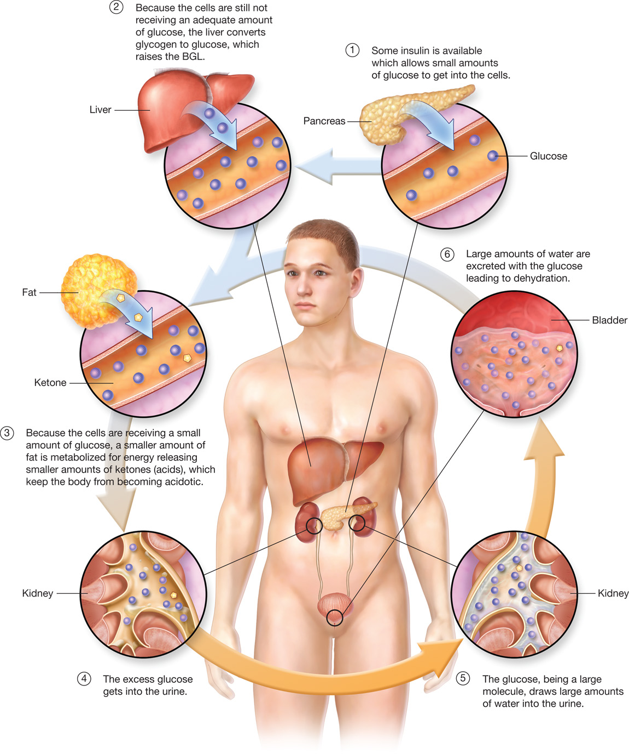
Pathophysiology of Hyperglycemic Hyperosmolar Nonketotic Syndrome (H H N S)
Notes:
Like the DKA patient, the HHS patient needs to be rehydrated with fluids. It might be necessary to call for advanced life support for this purpose. Follow your local protocols.

Slide 56
Acute Diabetic Emergencies (19 of 21)
Hyperglycemic Condition: Hyperglycemic Hyperosmolar Syndrome
Assessment Findings in H H S
H H N S signs and symptoms
Similar to those of D K A.
No significant buildup of ketones in the body and therefore no significant acid load.
No Kussmaul respirations or fruity odor on the breath with H H S.
Notes:
Signs and symptoms of HHS:
Tachycardia.
Fever.
Positive orthostatic tilt test.
Dehydration.
Thirst (polydipsia).
Dizziness.
Poor skin turgor.
Altered mental status.
Confusion.
Weakness.
Dry oral mucosa.
Dry, warm skin
Polyuria (if dehydrated, the urine output will be scanty [oliguria]).
Nausea and vomiting.

Slide 57
Acute Diabetic Emergencies (20 of 21)
Hyperglycemic Condition: Hyperglycemic Hyperosmolar Syndrome
Emergency Medical Care for H H S
Establish and maintain a patent airway.
Administer oxygen if the S p O₂ is <94%.
Provide positive pressure ventilation if breathing is inadequate.
Notes:
The emergency medical care for HHS is basically the same as for DKA. If you are unsure or if your protocol does not permit you to attempt to distinguish between hypoglycemia, DKA, and HHS, treat the patient as if they are hypoglycemic.

Slide 58
Acute Diabetic Emergencies (21 of 21)
Hyperglycemic Condition: Hyperglycemic Hyperosmolar Syndrome
Emergency Medical Care for H H S
Check the B G L.
If you are unsure of the condition, administer glucose, if the patient can swallow.
Contact medical direction.
Notes:
Like the DKA patient, the HHS patient needs to be rehydrated with fluids. It might be necessary to call for advanced life support for this purpose. Follow your local protocols.

Slide 59
Table 20-2 Signs and Symptoms of Diabetic Emergency Conditions (1 of 2)
Sign or Symptom | D K A | H H S | Hypoglycemia
Onset | Slow, over days | Slow, over days | Sudden, over minutes
Heart rate | Tachycardia | Tachycardia | Tachycardia
Blood pressure | Low | Low | Normal
Respirations | Kussmaul | Normal | Normal or shallow
Breath odor | Sweet and fruity | None | None
Mental status | Coma (very late) | Confusion | Bizarre behavior, agitated, aggressive, altered, unresponsive
Oral mucosa | Dry | Dry | Salivation
Thirst | Intense | Intense | Absent
Vomiting | Common | Common | Uncommon
Abdominal pain | Common | Uncommon | Absent
Insulin level | Low | Low | High
Blood glucose level | High greaterthan 350 miligram per deciliter | Very high greaterthan 700 miligram per deciliter | Very low less than 70 miligram per deciliter

Slide 60
Table 20-2 Signs and Symptoms of Diabetic Emergency Conditions (2 of 2)
Emergency Care and Patient Needs | D K A | H H S | Hypoglycemia
Basic care | Supportive | Supportive | Supportive and glucose
A L S care | Fluids | Fluids | I V glucose, I M glucagon
Patient needs | Insulin | Insulin | Glucose

Slide 61
Assessment-Based Approach: A M S in A Diabetic Emergency (1 of 6)
Scene Size-Up and Primary Assessment
Look for medical alert tags, tattoos, or other medical identification.
An insulin pump is a clue to diabetes.
Notes:
If clues gathered during the scene size-up and primary assessment lead you to suspect that the patient can be diabetic, look for medical alert tags, tattoos, or other medical identification that confirms a diabetic history.
Discussion Questions
What are some medications that would indicate to you that your patient is a diabetic?
What are some key characteristics to help differentiate between hypoglycemia and hyperglycemia?
Knowledge Application
Given several descriptions of patients with altered mental status, students should be able to obtain a relevant history to determine if the patient is more likely suffering from hypoglycemia or hyperglycemia.
Class Activity
Have pairs of students role play assessing and instructing each other as if they were assessing a patient to see if they can follow commands and swallow in order to receive oral glucose.

Slide 62
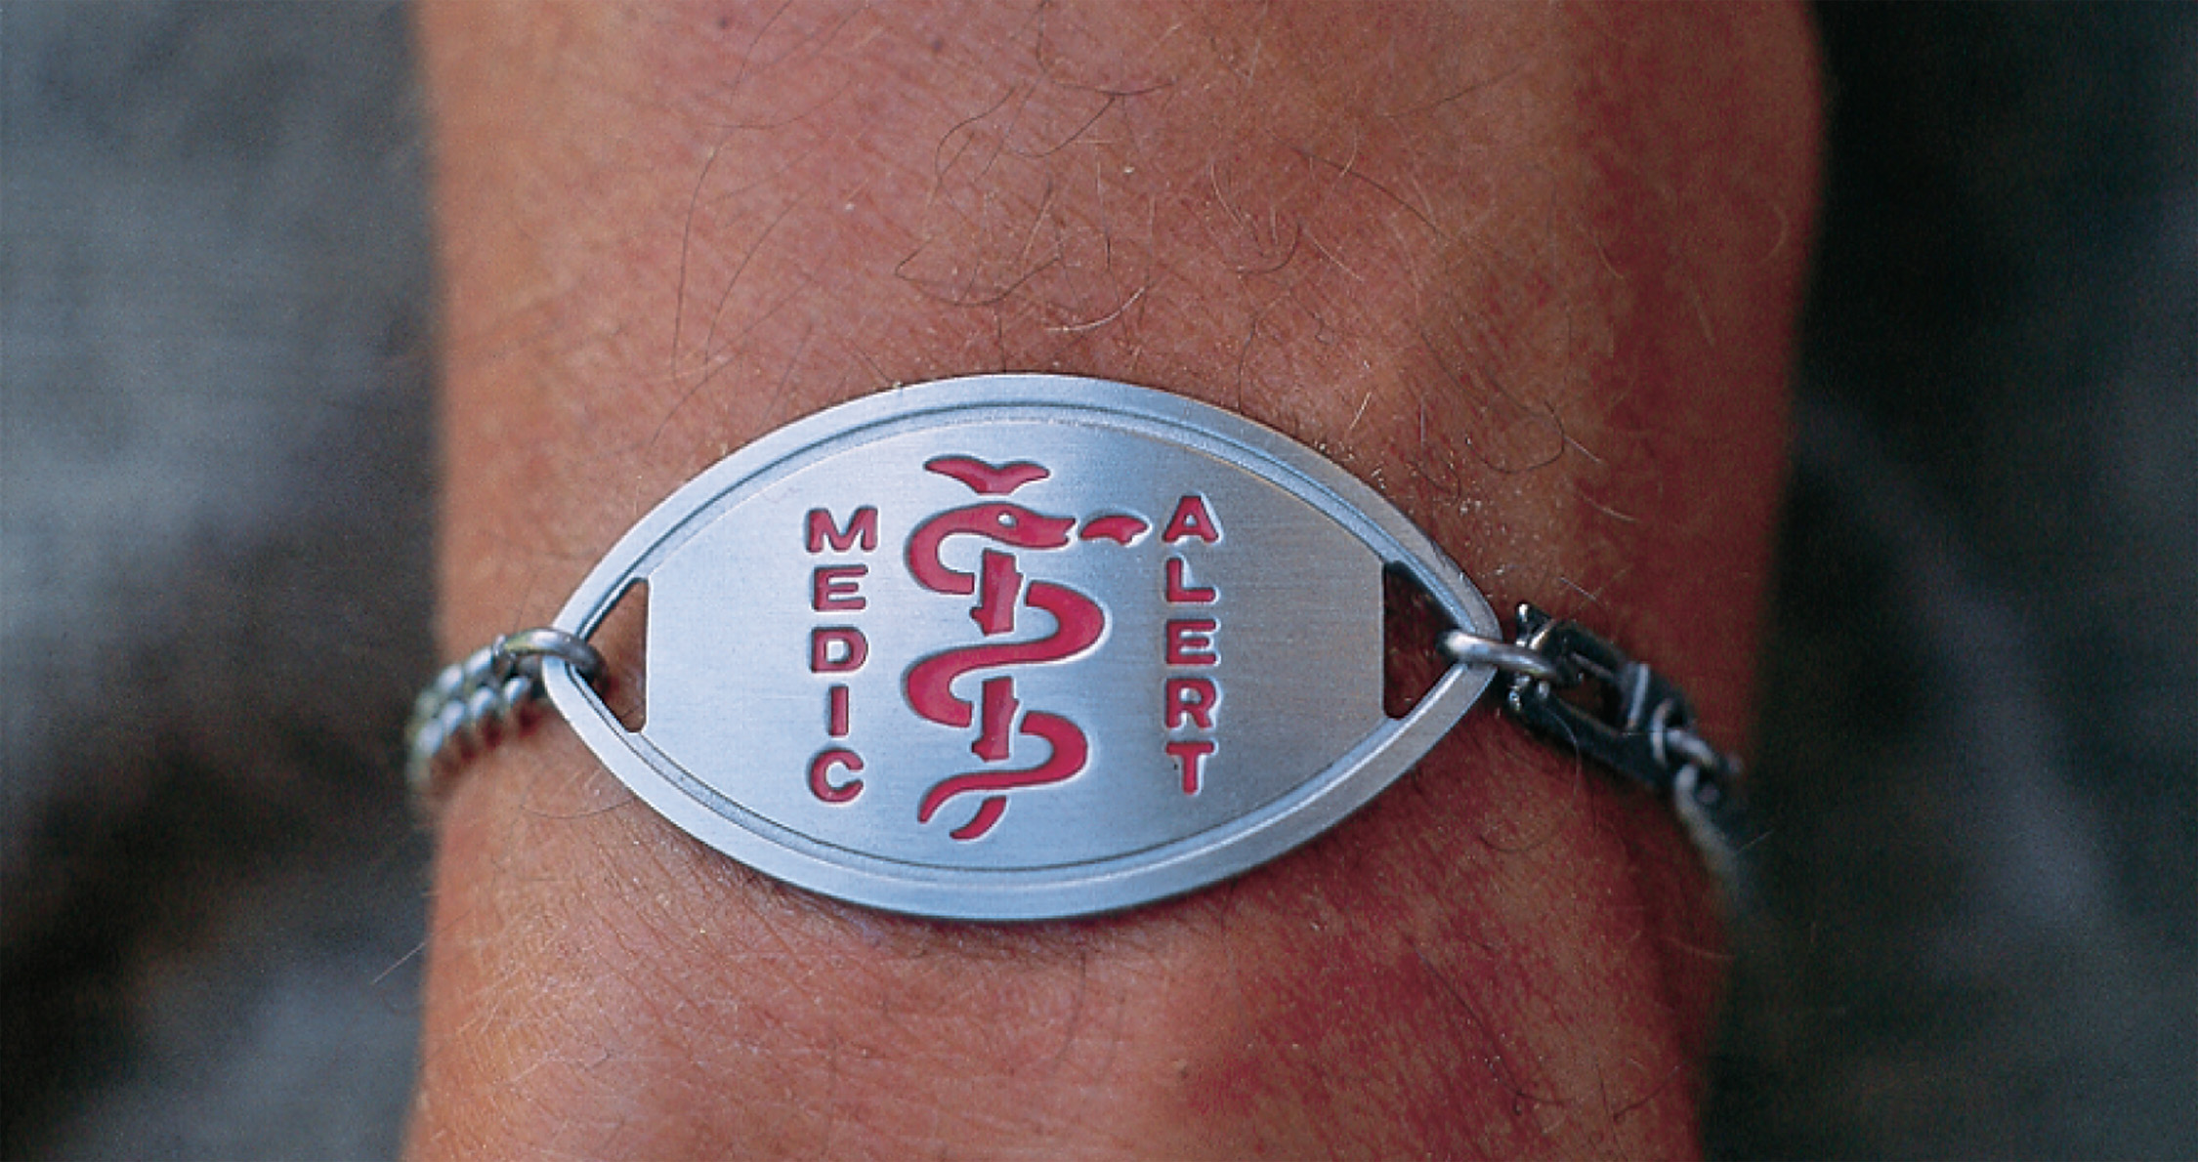
A Medical Identification Tag May Indicate That the Patient is a Diabetic
Notes:
Look for medical alert tags, tattoos, or other medical identification that confirms a diabetic history.

Slide 63
Assessment-Based Approach: A M S in A Diabetic Emergency (2 of 6)
History and Secondary Assessment
Sample
Especially ask about medications taken for diabetes.
Notes:
It is important that the EMT recognize the prescribed medications that a diabetic patient might be taking. Presence of such a medication can help to establish the history of diabetes.
An altered mental status from hypoglycemia can typically have a sudden onset. The signs and symptoms may progress rapidly over 5 to 30 minutes.

Slide 64
Assessment-Based Approach: A M S in A Diabetic Emergency (3 of 6)
History and Secondary Assessment
Ask the following:
Has the patient taken their medication?
Has the patient eaten their regular meals?
Has the patient vomited?
Has the patient had any unusual physical activity?
Notes:
Did the patient take their medication the day of the episode?
Did the patient eat (or skip any) regular meals on that day?
Did the patient vomit after eating a meal on that day?
Did the patient do any unusual exercise or physical activity on that day?
Was the onset of altered mental status gradual or fast?
How long has the patient had the signs and symptoms?
Are there any other signs or symptoms associated with the altered mental status?
Is there any evidence of injury that might be the cause of the altered mental status?
Was there any period in which the patient regained a normal mental status and then deteriorated again?
Did the patient suffer a seizure?
Does the patient appear to have a fever or other signs of infection?

Slide 65
Assessment-Based Approach: A M S in A Diabetic Emergency (4 of 6)
History and Secondary Assessment
Signs and Symptoms:
Elderly patients frequently suffer signs and symptoms that mimic a stroke, such as weakness or paralysis on one side of the body. Keep in mind that some medications (beta blockers) can hide the signs of hypoglycemia.
Notes:
Signs and symptoms commonly associated with a patient who has an altered mental status and has a history of diabetes:
Rapid onset of an altered mental status after missing or vomiting a meal, unusual exercise, or physical work.
Intoxicated appearance—from staggering or slurred speech to complete unresponsiveness.
Tachycardia (elevated heart rate).
Cool, moist skin.
Hunger.
Seizure activity.
Uncharacteristic or bizarre behavior, combativeness.
Anxiousness or restlessness.
Bruising at insulin injection sites on the abdomen.
Blood glucose reading of 670 mg/dL.

Slide 66
Assessment-Based Approach: A M S in A Diabetic Emergency (5 of 6)
Emergency Medical Care
Establish and maintain an open airway.
Administer oxygen if the S p O₂ is <94%.
Provide positive pressure ventilation if breathing is inadequate.
If the patient is able to swallow and has a low blood glucose level, administer oral glucose.
Transport.
Notes:
Establish and maintain an open airway. If the patient’s mental status is severely altered, it might be necessary to suction the airway to clear secretions or vomitus, and to insert an oropharyngeal or nasopharyngeal airway.
Maintain adequate oxygenation. If the SPO₂ is <94% or signs of respiratory distress, hypoxia, hypoxemia, or poor perfusion are present, administer oxygen via a nasal cannula to achieve and maintain an SPO₂ of 94% or greater.
Provide positive pressure ventilation if the breathing is inadequate. If the breathing rate or depth is inadequate, assist breathing by positive pressure ventilation with supplemental oxygen.
Determine the blood glucose level using a glucose meter. If the BGL is <70 mg/dL, consider administration of oral glucose.
Administer oral glucose. If the patient cannot swallow, you risk the chance that the patient will aspirate the medication or that the thick, sticky glucose will block the airway. One method to ensure that the patient is alert enough to swallow is to hand them the tube of glucose and instruct them to squeeze the contents into their mouth and swallow. Because the patient might be disoriented, it might take some coaching on your part to get the patient to comply with your command. If they are not alert enough to hold onto the tube or squeeze it in their mouth, you might want to reconsider the administration of glucose. Some protocols allow the EMT to rub the glucose on the patient’s gum between the cheek and gum.
Position the patient. Place the patient in a lateral recumbent position to reduce the risk of aspiration.
Reassess the patient. Reassess the patient’s airway, breathing, and circulation. Prepare to suction if secretions are present or if the patient vomits.
Transport.
Critical Thinking Discussion
Why is it important to err on the side of giving glucose if in doubt about a patient's blood glucose level?

Slide 67
Assessment-Based Approach: A M S in A Diabetic Emergency (6 of 6)
Reassessment
Determine if the administration of glucose has improved the mental status.
This may take as long as 20 minutes.
If the mental status does not improve:
Consult medical direction about administering more glucose.
Consider other causes of altered mental status.
Notes:
If the patient’s mental status continues to deteriorate or does not improve, maintain a patent airway and adequate breathing and oxygenation. Communicate and record any changes in the patient’s condition.

Slide 68
Case Study Conclusion
The patient meets criteria in the E M Ts’ protocol for administering oral glucose. J D administers the oral glucose, and they prepare Trent for transport to the hospital.
En route, J D continues to monitor Trent’s airway and mental status, and he begins to see some improvement in Trent’s mental status as they arrive at the hospital.
Notes:
Review the case conclusion and emphasize the application of knowledge learned from this presentation.

Slide 69
Lesson Summary (1 of 2)
Diabetes is a problem related to regulation of blood glucose level.
Hypoglycemia is a state of low blood glucose levels.
Oral glucose may be indicated in hypoglycemic patients.
Notes:
An altered mental status resulting from an acute diabetic emergency, especially hypoglycemia, is a significant medical condition that requires prompt assessment and emergency care.
Follow-Up
Answer student questions.
Follow-Up Assignments
Review Chapter 20 Summary.
Complete Chapter 20 In Review questions.
Complete Chapter 20 Critical Thinking questions.
Assessments
Handouts
Chapter 20 quiz

Slide 70
Lesson Summary (2 of 2)
Hyperglycemic problems result from a relative lack of insulin.
Type 1 diabetics are prone to D K A.
Type 2 diabetics are prone to H H N S.
Notes:
Your local protocol might not allow you to distinguish between the diabetic emergency conditions hypoglycemia, DKA, and HHS; although, there are significant differences between them. Primarily, hypoglycemia patients experience a rapid onset of an altered mental status (minutes), whereas the DKA or HHS patient suffers an altered mental status only after being ill for one to two days or more.
Class Activity
As an alternative to assigning the follow-up exercises in the lesson plan as homework, assign each question to a small group of students for in-class discussion.
Teaching Tips
Answers to In Review and Critical Thinking questions are in the appendix of the text. Advise students to review the questions again as they study the chapter.

Slide 71
Correct!
Two functions of insulin are to increase the rate at which glucose enters cells in the body and to allow the liver to store excess glucose in the form of glycogen. In doing so, the effect of insulin is to lower the blood glucose level.
Click here to return to the program

Slide 72
Incorrect (1 of 3)
Glucose readily enters brain cells without insulin, although other cells in the body require insulin for sufficient amounts of glucose to enter.
Click here to return to the quiz

Slide 73
Incorrect (2 of 3)
One of the functions of insulin is to promote the storage of excess glucose in the liver as glycogen.
Click here to return to the quiz

Slide 74
Incorrect (3 of 3)
Epinephrine is released when blood glucose levels are very low. Its release promotes the release of glucose from the liver, as well as the release of insulin.
Click here to return to the quiz

Slide 75
Copyright

