Slide 1

Prehospital: Emergency Care
Eleventh Edition
Chapter 1
Emergency Medical Care Systems, Research, and Public Health
    Slides in this presentation contain hyperlinks. JAWS users should be able to get a list of links by using INSERT+F7
Copyright © 2018, 2014, 2010 Pearson Education, Inc. All Rights Reserved
Notes:
If this PowerPoint presentation contains mathematical equations, you may need to check that your computer has the following installed:
1) MathType Plugin
2) Math Player (free versions available)
3) NVDA Reader (free versions available)
During this lesson, students will learn about the roles and responsibilities of an EMT.
Advance Preparation
Student Readiness
Assign the associated section of MyBRADYLab and review student scores.
Review the chapter material in the Instructor Resources, which includes Student Handouts, PowerPoint slides, and the MyTest Program.
Prepare
Make copies of course policies and procedures, the syllabus, handouts from the Instructor Resources, and other materials for distribution or post them in your learning management system.
Preview the media resources and Master Teaching Notes in this lesson.
Preview the case study presented in the PowerPoint slides.
Invite the medical director to the first class session.
Make arrangements to tour an emergency department or local PSAP.
Obtain 911 recordings to play for the class.
Arrange to have an ambulance present at the class location.
Bring in a couple of current EMS research articles from a peer-reviewed publication.
Ask a health department representative to speak on public health.
Plan 100 to 120 minutes for this class as follows:
The Emergency Medical Services System: 30 minutes
Provides a brief history of EMS system development
Describes the current state of EMS and where EMS should be in the future
The EMT: 30 minutes
Students learn about the characteristics of EMTs, the roles they will play, and the responsibilities of being a health care provider.
Research and EMS Care: 20 minutes
Describes the concept of evidence-based medicine and the use of research data to improve patient outcomes
Public health: 20 minutes
Public health is a recent focus for EMS.
EMTs can make a difference in public health by participating in health education and illness and injury prevention activities in their communities.
The total teaching time recommended is only a guideline. Take into consideration factors such as the pace at which students learn, the size of the class, breaks, and classroom activities. The actual time devoted to teaching objectives is the responsibility of the instructor.

Slide 2
Learning Readiness
E M S Education Standards, text p. 1.
Chapter Objectives, text p. 1.
Key Terms, text p. 1.
Purpose of lecture presentation versus textbook reading assignments.

Slide 3
Setting the Stage (1 of 2)
Overview of Lesson Topics
  The emergency medical services (E M S) system
  The Emergency Medical Technician
  E M S system organization and standards
  E M S research
Notes:
These bulleted points are the major headings from the chapter, in order. The purpose is to provide a basic lecture navigation for the student.

Slide 4
Setting the Stage (2 of 2)
  Overview of Lesson Topics
  Evidenced-based guidelines
  Public Health
  Mobile integrated healthcare and community paramedicine
Notes:
These bulleted points are the major headings from the chapter, in order. The purpose is to provide a basic lecture navigation for the student.

Slide 5
Case Study Introduction (1 of 2)
Every Saturday Ben Melton has breakfast at Dave’s Diner, a favorite with locals in the small tourist town. Despite having diabetes and carrying an extra 40 pounds around his waist, 51-year-old Ben finds it hard to pass on Dave’s breakfast platter of eggs, steak, and fried potatoes.
Notes:
Case Study
Present the Case Study Introduction provided in the PowerPoint slide set.
Lead a discussion using the case study questions provided on the subsequent slide(s). The Case Study with discussion questions continues throughout the PowerPoint presentation.
Case Study Discussion
Use the case study content and questions to foreshadow the upcoming lesson content.

Slide 6
Case Study Introduction (2 of 2)
This morning, by the time his coffee arrives, Ben isn’t feeling so well. Just as his friend, Arnie, notices that Ben has turned pale and broken into a sweat, Ben collapses, pulling the tablecloth with him to the floor.
Notes:
Case Study
Present the Case Study Introduction provided in the PowerPoint slide set.
Lead a discussion using the case study questions provided on the subsequent slide(s). The Case Study with discussion questions continues throughout the PowerPoint presentation.
Case Study Discussion
Use the case study content and questions to foreshadow the upcoming lesson content.

Slide 7
Case Study (1 of 15)
What components of a health care system must be in place for Ben to receive immediate help?
What weaknesses in a system could decrease Ben’s chances of getting help?
Notes:
Case Study Discussion
Use the case study content and questions to foreshadow the upcoming lesson content.

Slide 8
Introduction
Sudden loss of life and disability from catastrophic accidents and illnesses is a major public health problem.
Thousands of people die or suffer permanent harm yearly because of a lack in access to adequate to E M S.
E M T s can make a positive difference.

Slide 9
The E M S System: History (1 of 6)
What happens to an injured or ill patient before he reaches the hospital can make a critical difference.
Lessons learned from observations in the Korean and Vietnam wars have impacted the development of modern E M S systems.
Notes:
Emergency medical care has developed from the days when the local funeral home was the ambulance provider and patient care did not begin until arrival at the hospital. Lessons learned through military conflicts taught lessons that have contributed to modern day EMS.

Slide 10
The E M S System: History (2 of 6)
In the past, care did not begin until the patient reached the hospital.
In 1966, the E M S “white paper” identified deficiencies in prehospital medical care, including lack of E M T training and lack of organized systems.
Notes:
Points to Emphasize
Caring for the ill and injured outside the hospital setting dates back hundreds of years, but the EMS system as we know it began in the 1960s.
NHTSA provides guidance for EMS systems and EMS education at the federal level.
EMS Agenda for the Future lays out the roadmap for enhancement of EMS education and practice.
Media Resources
Go to www.bradybooks.com and click on the mykit link for Prehospital Emergency Care, 11th edition to access web resources on the National Registry of EMTs, National EMS Scope of Practice Model, the CDC Weekly Morbidity and Mortality Report, and the EMS Agenda for the Future.

Slide 11
The E M S System: History (3 of 6)
Modern E M S is part of a continuum of care that begins at the scene of the emergency and continues through hospital discharge and rehabilitation.
Several significant developments helped lead to this E M S system.
Notes:
Use the concepts on this slide to segway into the most important developments and publications that have impacted current day EMS systems.

Slide 12
The E M S System: History (4 of 6)
Introduction of cardiopulmonary resuscitation (C P R) in the 1960s
The Highway Safety Act of 1966
The E M S System Act of 1973
National Emergency Medical Services Education and Practice Blueprint in 1993 by the National Registry of E M T s
Notes:
Review these significant developments that have had a profound effect on EMS systems. The intent is not to make the student intimately familiar with all elements of each document or breakthrough, rather, to give the student an idea of the seminal events that have shaped modern day EMS and how we have arrived to where we are today as a profession.

Slide 13
The E M S System: History (5 of 6)
N H T S A documents
  1996 E M S Agenda for the Future
  2000 E M S Education Agenda for the Future: A Systems Approach
  2005 National E M S Core Content
  2006 National E M S Scope of Practice Model
    National E M S Education Standards
Notes:
Review these significant developments that have had a profound effect on EMS systems. The intent is not to make the student intimately familiar with all elements of each document or breakthrough, rather, to give the student an idea of the seminal events that have shaped modern day EMS and how we have arrived to where we are today as a profession.

Slide 14
The E M S System: History (6 of 6)
The 2006 Institute of Medicine (I O M) report The Future of E M S Care: E M S at the Crossroads recommends:
  Common scopes of practice to allow reciprocity between states
  National accreditation for all paramedic educational programs
  National certification as a prerequisite for state licensure and local credentialing

Slide 15
The E M S System: Standards (1 of 3)
N H T S A provides a set of recommended state standards, the Technical Assistance Program Assessment Standards.
There are ten components:
Notes:
Each state has control of its own EMS system design and regulations, independent of the federal government. However, the NHTSA provides a set of recommended standards called the “Technical Assistance Program Assessment Standards.” Advise the student to read about these in their textbook (pages 3 and 4).

Slide 16
The E M S System: Standards (2 of 3)
Regulation and policy
Resource management
Human resources and training
Transportation
Facilities
Notes:
Provide a brief outline to each of the “Technical Assistance Program Assessment Standards”. Refer the students to the textbook (p. 3 for a more thorough discussion).
Critical Thinking Discussion
What would happen without regulation and policy as part of an EMS system?
Discussion Question
How do people in your community access EMS?
Teaching Tips
Play 911 recordings from your local agency and discuss them with students. Be careful to ensure that the recordings contain no confidential information.
Class Activity
Arrange a tour of a PSAP to see how calls are received and dispatched.
Knowledge Application
Describe a vehicle collision scenario. Ask students how they would access EMS and describe the location and situation.

Slide 17
The E M S System: Standards (3 of 3)
Communications
Public information and education
Medical direction
Trauma systems
Evaluation
Notes:
Provide a brief outline to each of the “Technical Assistance Program Assessment Standards”. Refer the students to the textbook (p. 3 for a more thorough discussion).
Critical Thinking Discussion
What would happen without regulation and policy as part of an EMS system?
Discussion Question
How do people in your community access EMS?
Teaching Tips
Play 911 recordings from your local agency and discuss them with students. Be careful to ensure that the recordings contain no confidential information.
Class Activity
Arrange a tour of a PSAP to see how calls are received and dispatched.
Knowledge Application
Describe a vehicle collision scenario. Ask students how they would access EMS and describe the location and situation.

Slide 18
The E M S System: System Goals
Emergency Medical Services: Clinical Practice and Systems Oversight, 2015
  Clinical quality
  Service quality
  Economic efficiency
  Accountability
  Improvement
  Resilience
Notes:
Although not a federal standard or document, this text has been identified as one that discusses elements of EMS system design that should be included in an EMS system’s goals (Gunderson, M. Principles of EMS System Design, Emergency Medical Services: Clinical Practice and Systems Oversight, Wiley, 2015):

Slide 19
E M S System Access (1 of 4)
The most common way for the public to access E M S is by dialing 911.
Enhanced 911 (E-911) allows:
  Automatic number identification
  Automatic location information
Notes:
Often referred to as the universal number, 911 is the phone number used nationwide to access emergency services, including police, fire, and EMS. The most common 911 system is enhanced. An enhanced 911 system, called E-911, provides automatic number identification (ANI) and automatic location identification (ALI), which indicate the exact address and phone number from which the call is made. This information is automatically displayed on the computer screen of the call taker, even if the individual making the call hangs up.

Slide 20
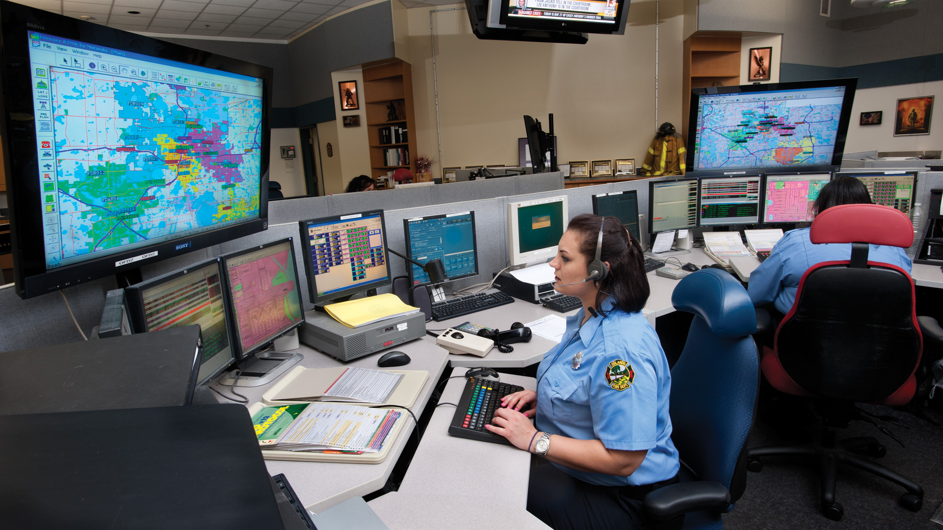
Communications Play a Vital Role in the Emergency Medical Services (E M S) System

Slide 21
E M S System Access (2 of 4)
Benefits of 911
  The number is easy to remember and use.
  Public safety answering point (P S A P) is staffed by specially trained dispatchers.
  All emergency services—police, fire, and E M S—are accessible by dialing one number.

Slide 22
E M S System Access (3 of 4)
Cell phones pose some challenges to 911 systems:
  They are not identified with a fixed site, so the location is identified as the closest cell tower.
  Calls near geographic boundaries can go to a different P S A P.
  F C C rules are being implemented to improve cellular access to 911.
Notes:
The FCC has adopted rules to improve the accuracy of location information provided to PSAPs by wireless technology companies.

Slide 23
E M S System Access (4 of 4)
Voice over Internet Protocol (V o I P) also poses challenges addressed by F C C rules.
  911 service must be a standard feature.
  Must give the physical location of where the service will be used.
  The provider must transmit all 911 calls to the appropriate P S A P.
Notes:
Voice over Internet Protocol (VoIP) services also present challenges to accessing 911 in an emergency. The FCC imposed requirements that VoIP providers must provide 911 service to all customers as a standard feature, obtain a physical location from the subscriber of where the service will be used, and transmit all 911 calls, including callback number and registered location, to the appropriate public service answering point.

Slide 24
Case Study (2 of 15)
Charlene, one of the waitresses in the restaurant, pulls a cell phone from her pocket and dials 911. The dispatcher immediately transfers the call to a specially trained emergency medical dispatcher. The E M D asks Charlene a series of questions to get help on the way, and gives her instructions for checking and monitoring Ben’s condition until help arrives.

Slide 25
Case Study (3 of 15)
What components of the E M S system have been used in this case so far?
Regulations & Policy
Resource Management
Human Resources & Training
Transportation
Facilities
Communication
Public Information & Education
Medical Direction
Trauma Systems
Evaluation
Notes:
While in “slide-show” view, each blue box is hyperlinked to its answer on a different slide. After reading the answer, click on the blue box of the answer slide and it will hyperlink you back to this slide to continue.

Slide 26
Case Study (4 of 15)
E M T s Juliana Smock and Peter Saylor respond to the dispatch, heading down Highway 129 toward Dave’s restaurant. An anxious customer holds open the front door as Juliana and Peter pull to a stop in front of the restaurant. Taking a look around at the scene, the E M T s grab their equipment and head for the door.

Slide 27
Case Study (5 of 15)
What E M T responsibilities have Juliana and Peter demonstrated so far?
What E M T responsibilities do you predict they will perform next?
How will the E M T s’ appearance and actions determine how they are perceived by others?
Notes:
The following are only guides for the discussion:
They have utilized proper communications in order to reach the appropriate address. They have also exercised a knowledge of the area in taking the best route to the location and they have overviewed the scene to help decide what equipment to bring.
Next the EMTs will start the assessment process of the patient to determine what care to render and what destination facility to transport the patient to.
Finally, if the EMTs demonstrate confidence and empathy as well as looking and acting professional, the public will tend to recognize that they are knowledgeable, caring, and experienced.

Slide 28
Types of E M S Systems
A variety of E M S system types exist in the United States:
  Fire Department E M S
  Municipal E M S
  Private E M S
  Hospital based E M S
  Law enforcement E M S
Notes:
A variety of types of EMS providers exist across the United States in urban, suburban, and rural areas and in industrial settings. They can be quite different in their organization and each has its own set of advantages and disadvantages. Briefly describe each type to the students.

Slide 29
Levels of Providers
The National E M S Scope of Practice Model identifies four levels of E M S practitioners:
  Emergency Medical Responder (E M R)
  Emergency Medical Technician (E M T)
  Advanced Emergency Medical Technician (A E M T)
  Paramedic
Notes:
As defined by the National EMS Scope of Practice Model, there are four levels of recognized EMS certifications. Identify for the students the basic roles and education pertinent to the EMT within relation to the other certification levels. Instruct the students to review pages 5 and 6 of the text for a full explanation of the certification levels.

Slide 30
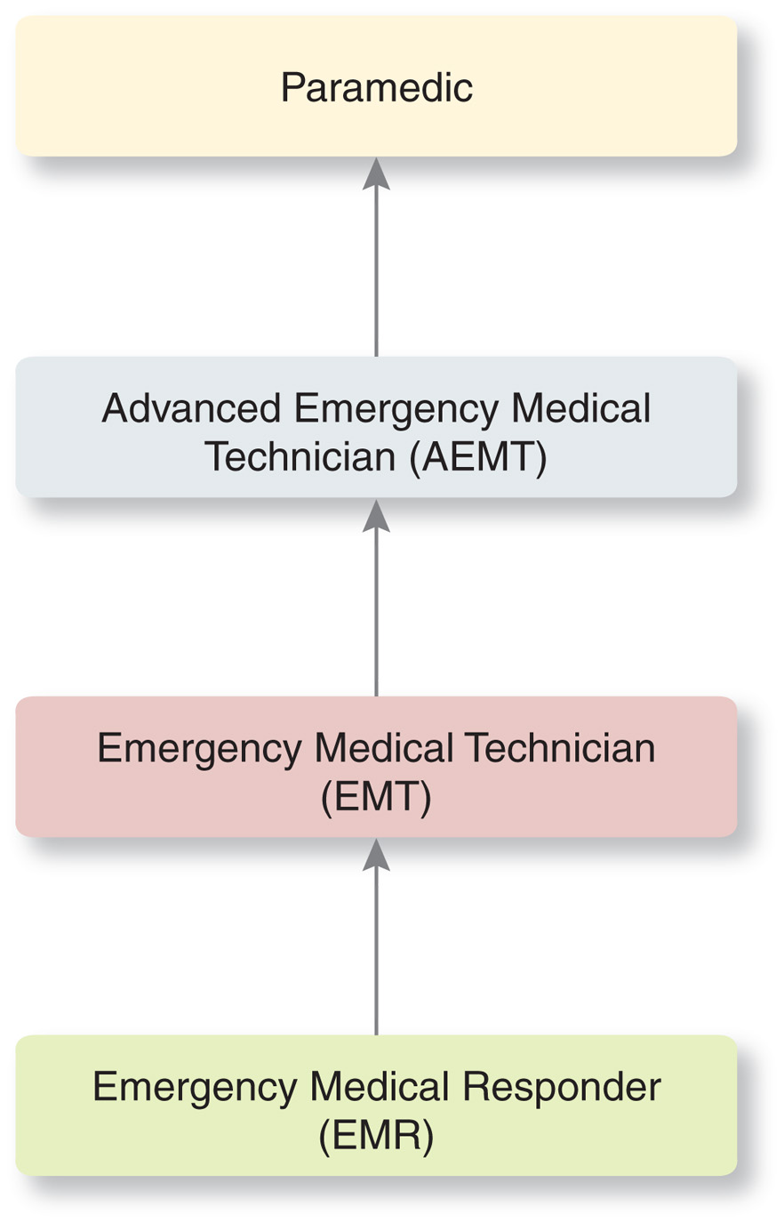
The Four Levels of E M S Practitioners
Notes:
Discussion Question
What are the differences in the scopes of practice of EMRs, EMTs, AEMTs, and paramedics?
Knowledge Application
Describe a scenario where EMRs are on the scene first. Ask students to describe (1) what care they should expect the EMRs to provide; (2) how they will interact with EMRs on the scene.

Slide 31
The Health Care System (1 of 5)
A health care system is a network of medical care that begins in the field and extends to hospitals and other treatment centers, including:
  “Prehospital” care
  “Out-of-hospital” care
Notes:
EMS is an integral part of a community’s health care system. A network of medical care that begins in the field and extends to hospitals and other treatment centers. In essence, EMTs provide prehospital care, emergency medical treatment given to, patients before they are transported to a hospital or other facilities.
In some areas, the term out-of-hospital care is preferred, reflecting a trend toward providing care on the scene with or without subsequent transport to a hospital. Out-of-hospital care also includes care provided during interfacility transport.

Slide 32
The Health Care System (2 of 5)
The different health care facilities to which E M T s may transport patients have different capabilities.
Trauma center
Burn center
Obstetrical center
Pediatric center
Poison center
Stroke center
Cardiac center
Hyperbaric center
Spine injury center
Psychiatric center
Notes:
The EMT may be required to decide on the facility to which the patient must be transported. The most familiar destination is the hospital emergency department, which is staffed by physicians, nurses, and others trained in emergency medical treatment. Here patients are stabilized and prepared for further care. Some patients may need to be transported to special facilities.

Slide 33
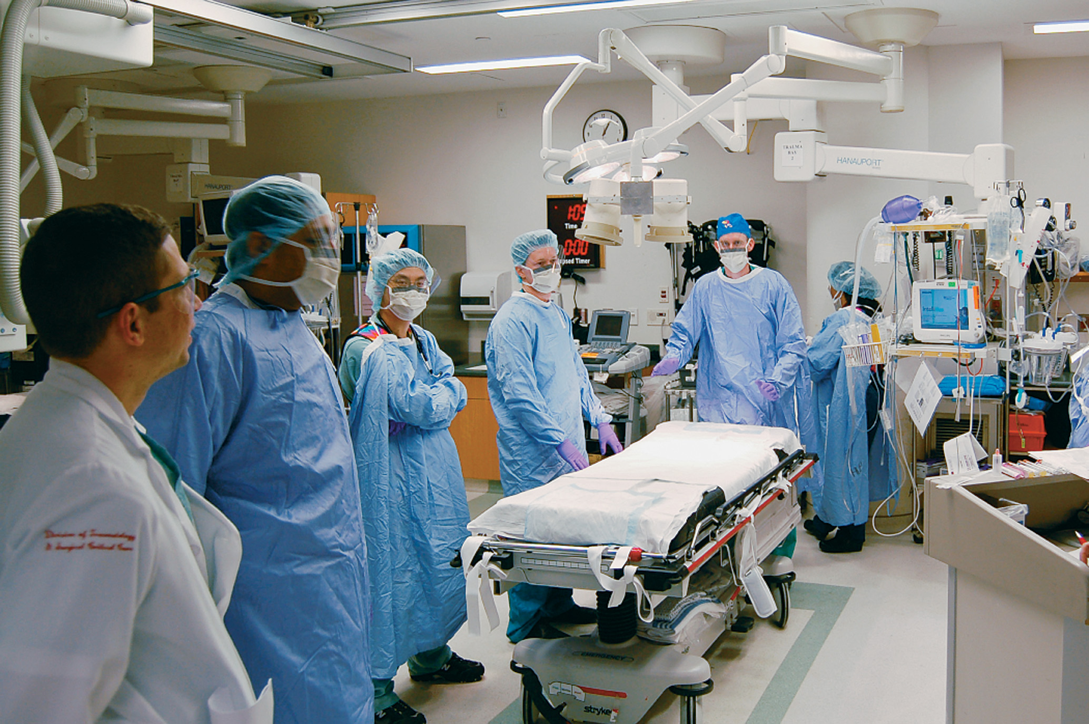
The Health Care System (3 of 5)
Inside the “trauma bay” of a designated trauma center
Notes:
Discussion Question
What are the specialty medical care facilities in your area?
Class Activity
Tour an emergency department to familiarize students with the facility.

Slide 34
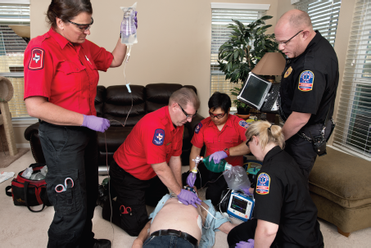
The Health Care System (4 of 5)
E M T s often work along side of paramedics and others.

Slide 35
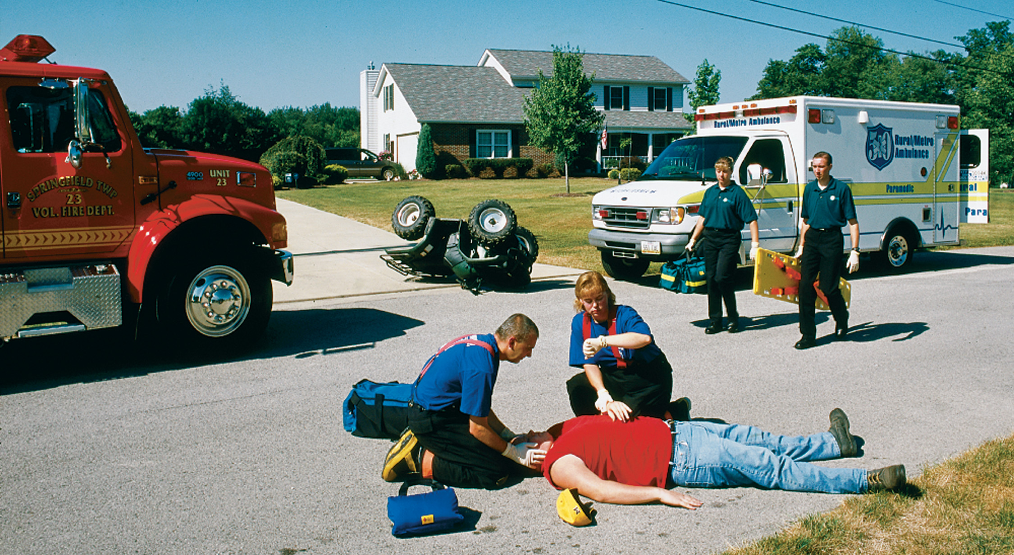
The Health Care System (5 of 5)
E M T s interface with team members from other public safety organizations.

Slide 36
Case Study (6 of 15)
After quickly determining the nature of Ben’s problem, the E M T s head toward the closest hospital, a 35-minute trip, with Juliana behind the wheel and Peter in the back of the ambulance, caring for Ben. Having arranged for a paramedic unit to meet them en route, Peter gives the paramedics a quick radio report.

Slide 37
Case Study (7 of 15)
How can requesting a paramedic intercept benefit the patient?
What are some of the potential pitfalls in patient safety at this phase of the call?
Notes:
The following are only suggested answers, more possibilities exist. Allow students time to dwell and delve into the questions.
The intercept with EMS providers with the highest level of certification, paramedics, will allow additional knowledge, skills, medications, and equipment to be available and used on the patient’s behalf.
Pitfalls however with paramedic intercept may include time delays if the rendezvous location is missed or one ambulance misjudges the time to intercept. Additionally, stopping of two ambulances and the exchange of personnel may be a safety hazard should the intercept occur on a busy stretch of road or intersection.

Slide 38
E M T Responsibilities (1 of 10)
All E M T s share a common set of roles and responsibilities.
Table 1-1 Roles and Responsibilities of the Emergency Medical Technician
Maintain vehicle and equipment readiness.
Ensure safety of the E M S crew, the patient, and bystanders at the scene.
Operate the emergency vehicle.
Assess the patient.
Notes:
Points to Emphasize
Roles and responsibilities of EMTs extend beyond patient care. Safety of EMS providers comes before patient care. Maintaining one’s certification and licensure through continuing education and meeting other criteria are personal responsibilities of the EMT, not the responsibility of the employer or educational institution.
Critical Thinking Discussion
What factors should you consider when deciding which hospital to transport a patient to?
Discussion Question
What are some examples of patient advocacy?

Slide 39
E M T Responsibilities (2 of 10)
Provide emergency care.
Safely lift and move the patient.
Prepare oral and written reports.
Safely transport the patient.
Transfer patient care.
Perform record keeping and data collection.
Serve as the patient’s advocate.

Slide 40
E M T Responsibilities (3 of 10)
Provide emotional support to the patient, relatives, and others at the scene.
Integrate the E M S service with other emergency and nonemergency services.
Resolve the emergency incident.
Maintain medical and legal standards.
Provide administrative support.
Enhance professional development.
Develop and maintain community relations.

Slide 41
E M T Responsibilities (4 of 10)
You cannot help the patient, other rescuers, or yourself if you are injured.
  Use safe driving habits.
  Do not enter or stay on an unsafe scene.
  Be alert to situations with a risk for violence.
  Wear reflective clothing and protective clothing as indicated.

Slide 42
E M T Responsibilities (5 of 10)
Personal safety and the safety of others

Slide 43
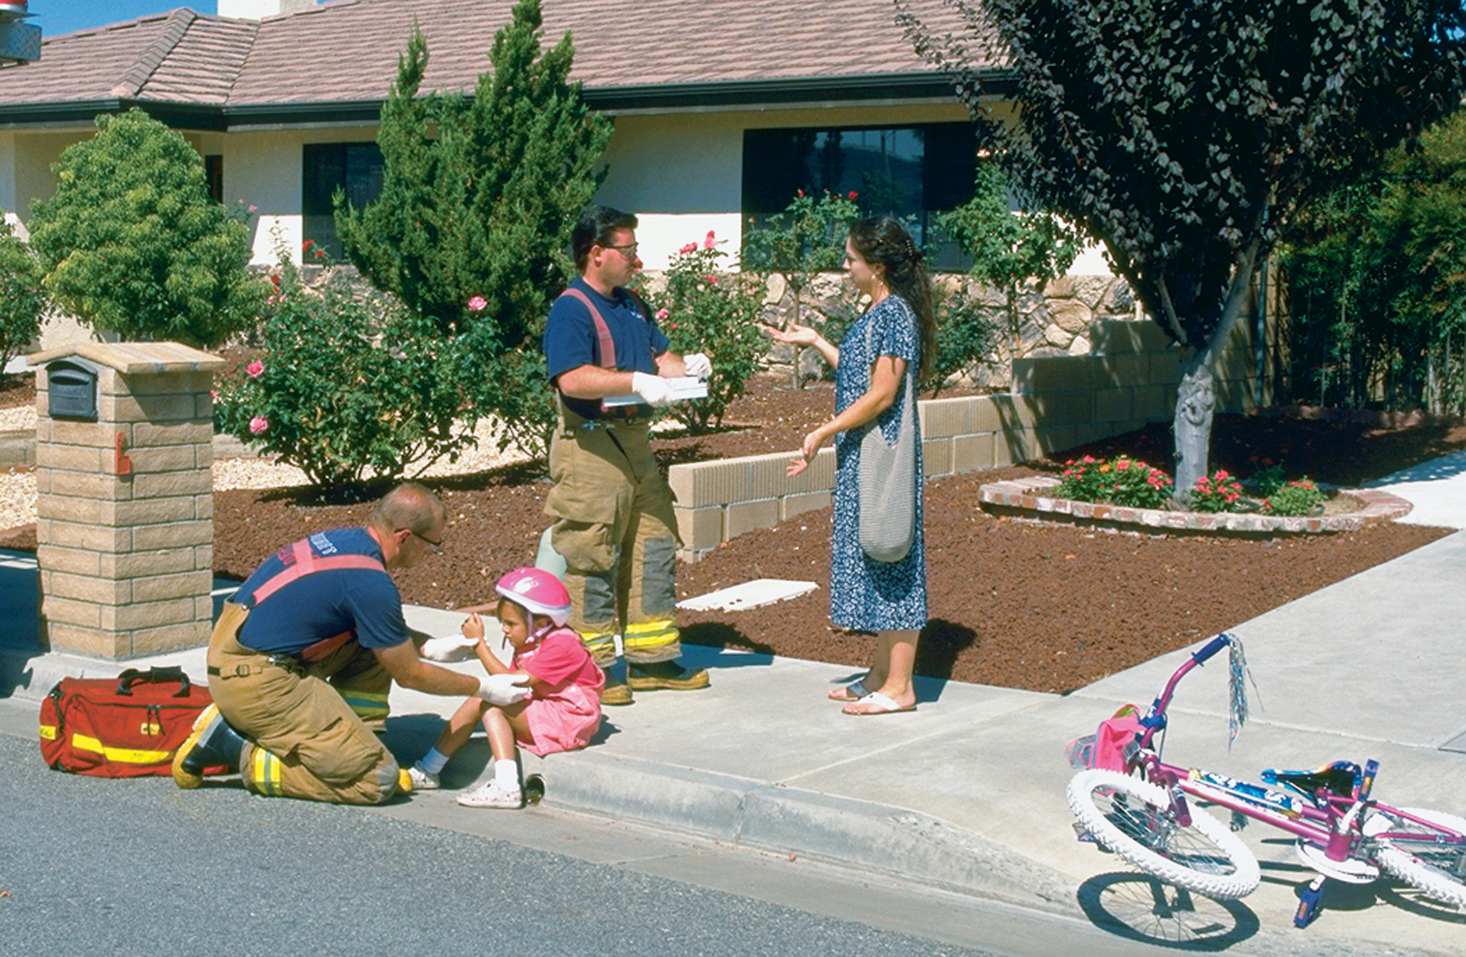
E M T Responsibilities (6 of 10)
Patient assessment and emergency care
Notes:
Gain access to patients, recognize and evaluate problems, and provide emergency care.
Primary assessment
Identify and manage immediate threats to life.
Secondary assessment
Identify other problems.
Treat the conditions you find.

Slide 44
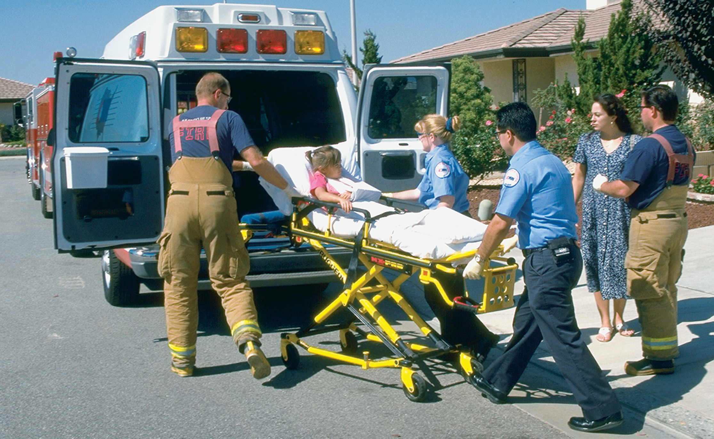
E M T Responsibilities (7 of 10)
Patient transport and care en route
Notes:
Safe lifting and moving
Prevent further harm to the patient. Prevent yourself from being injured through good body mechanics and having an adequate amount of help.
Transport and care en route
Continue care en route and always drive safely.

Slide 45
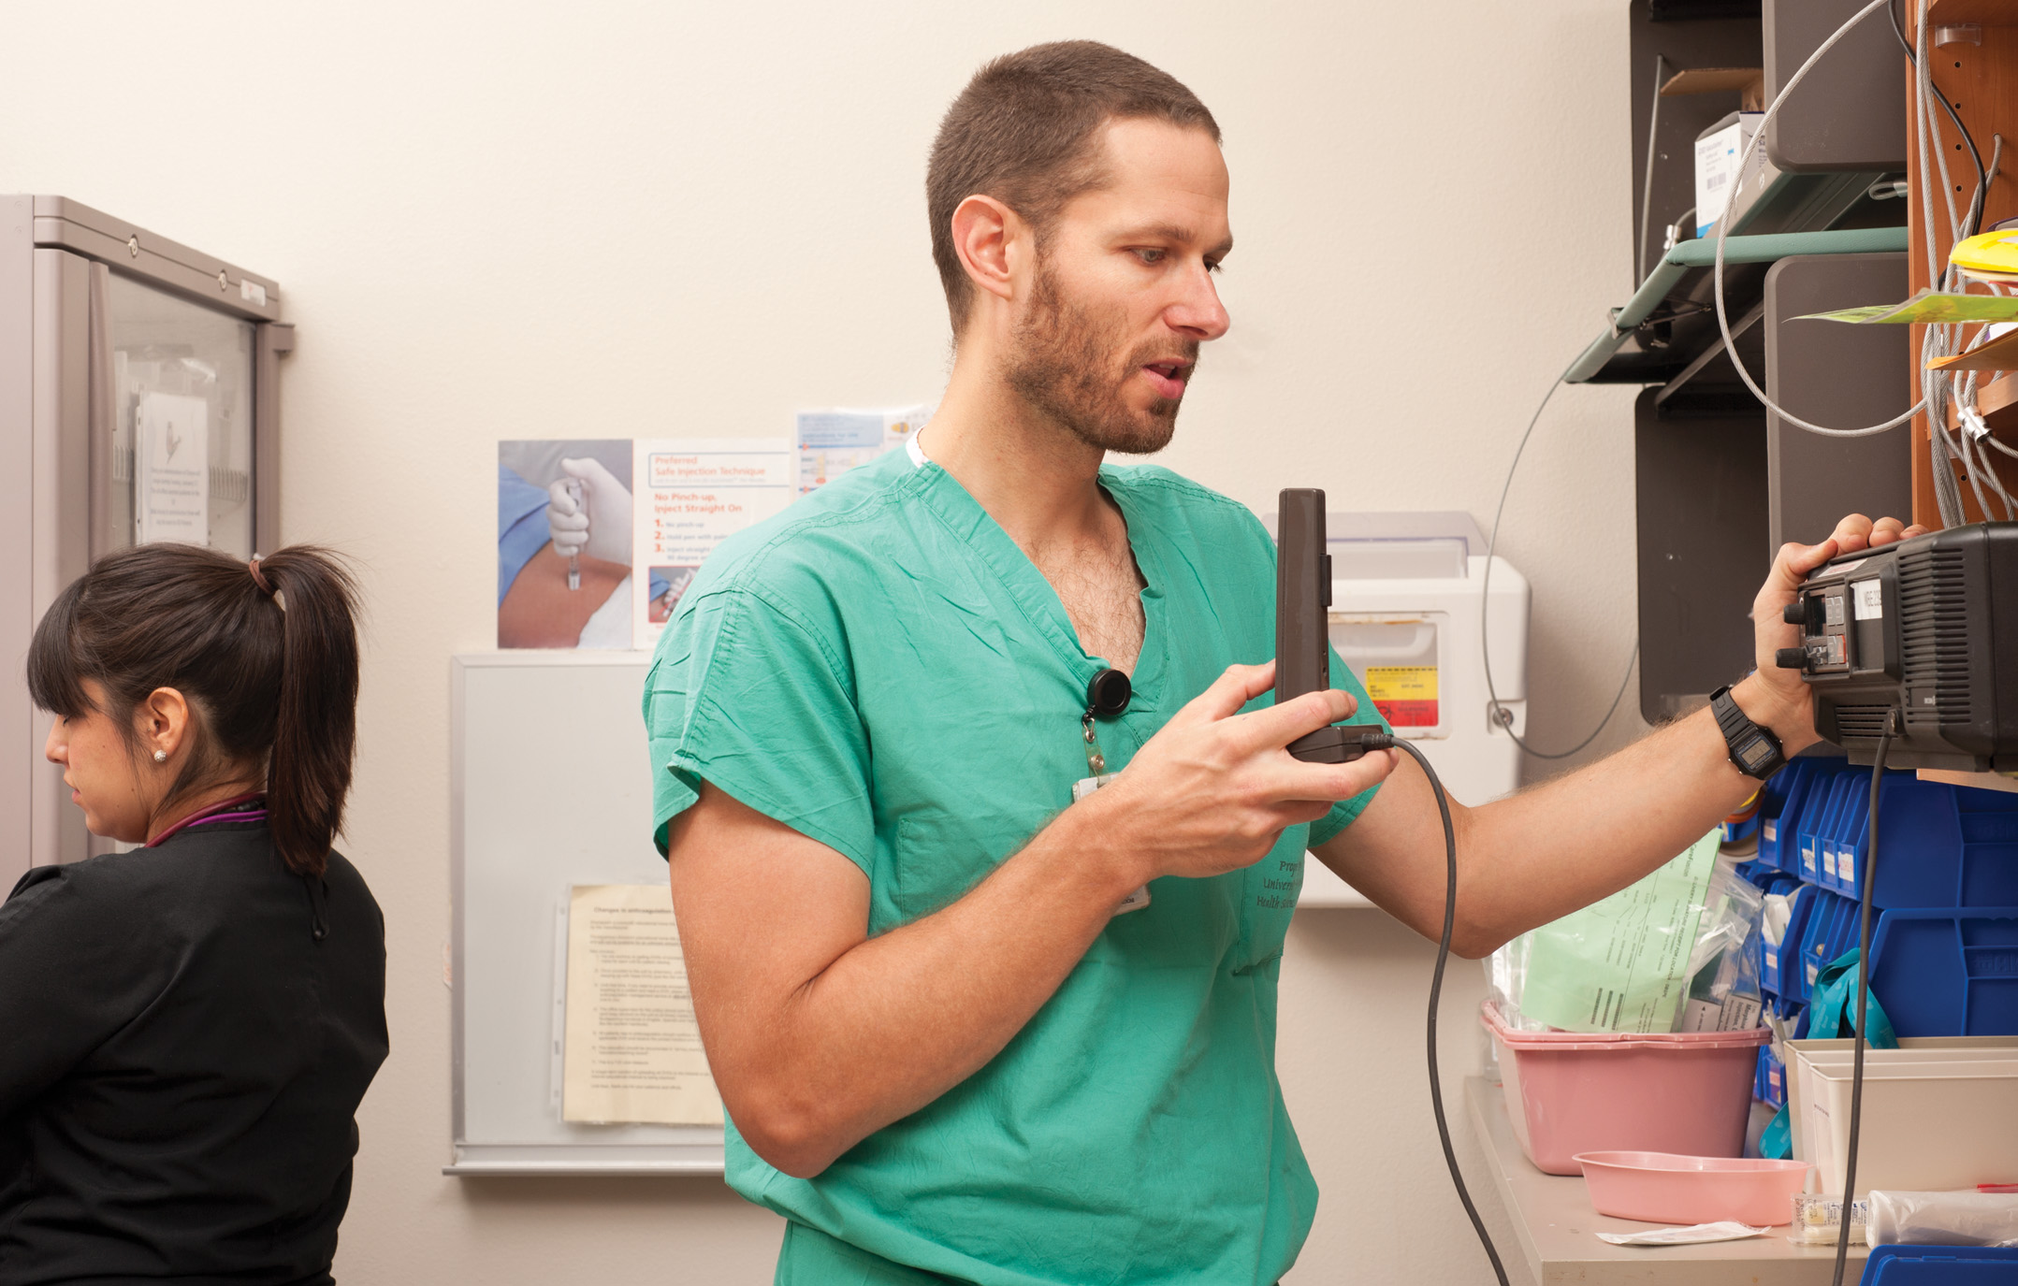
E M T Responsibilities (8 of 10)
Contacting medical direction
Notes:
Use the communications equipment available to you to notify the receiving facility of the number of patients, the destination(s), and the nature and extent of injuries. Alert the emergency department or receiving facility about high-priority patients and what will be needed immediately upon arrival, such as a trauma team or a stroke team. Report changes in the patient’s condition, and consult medical direction during transport as appropriate (and as required.)

Slide 46
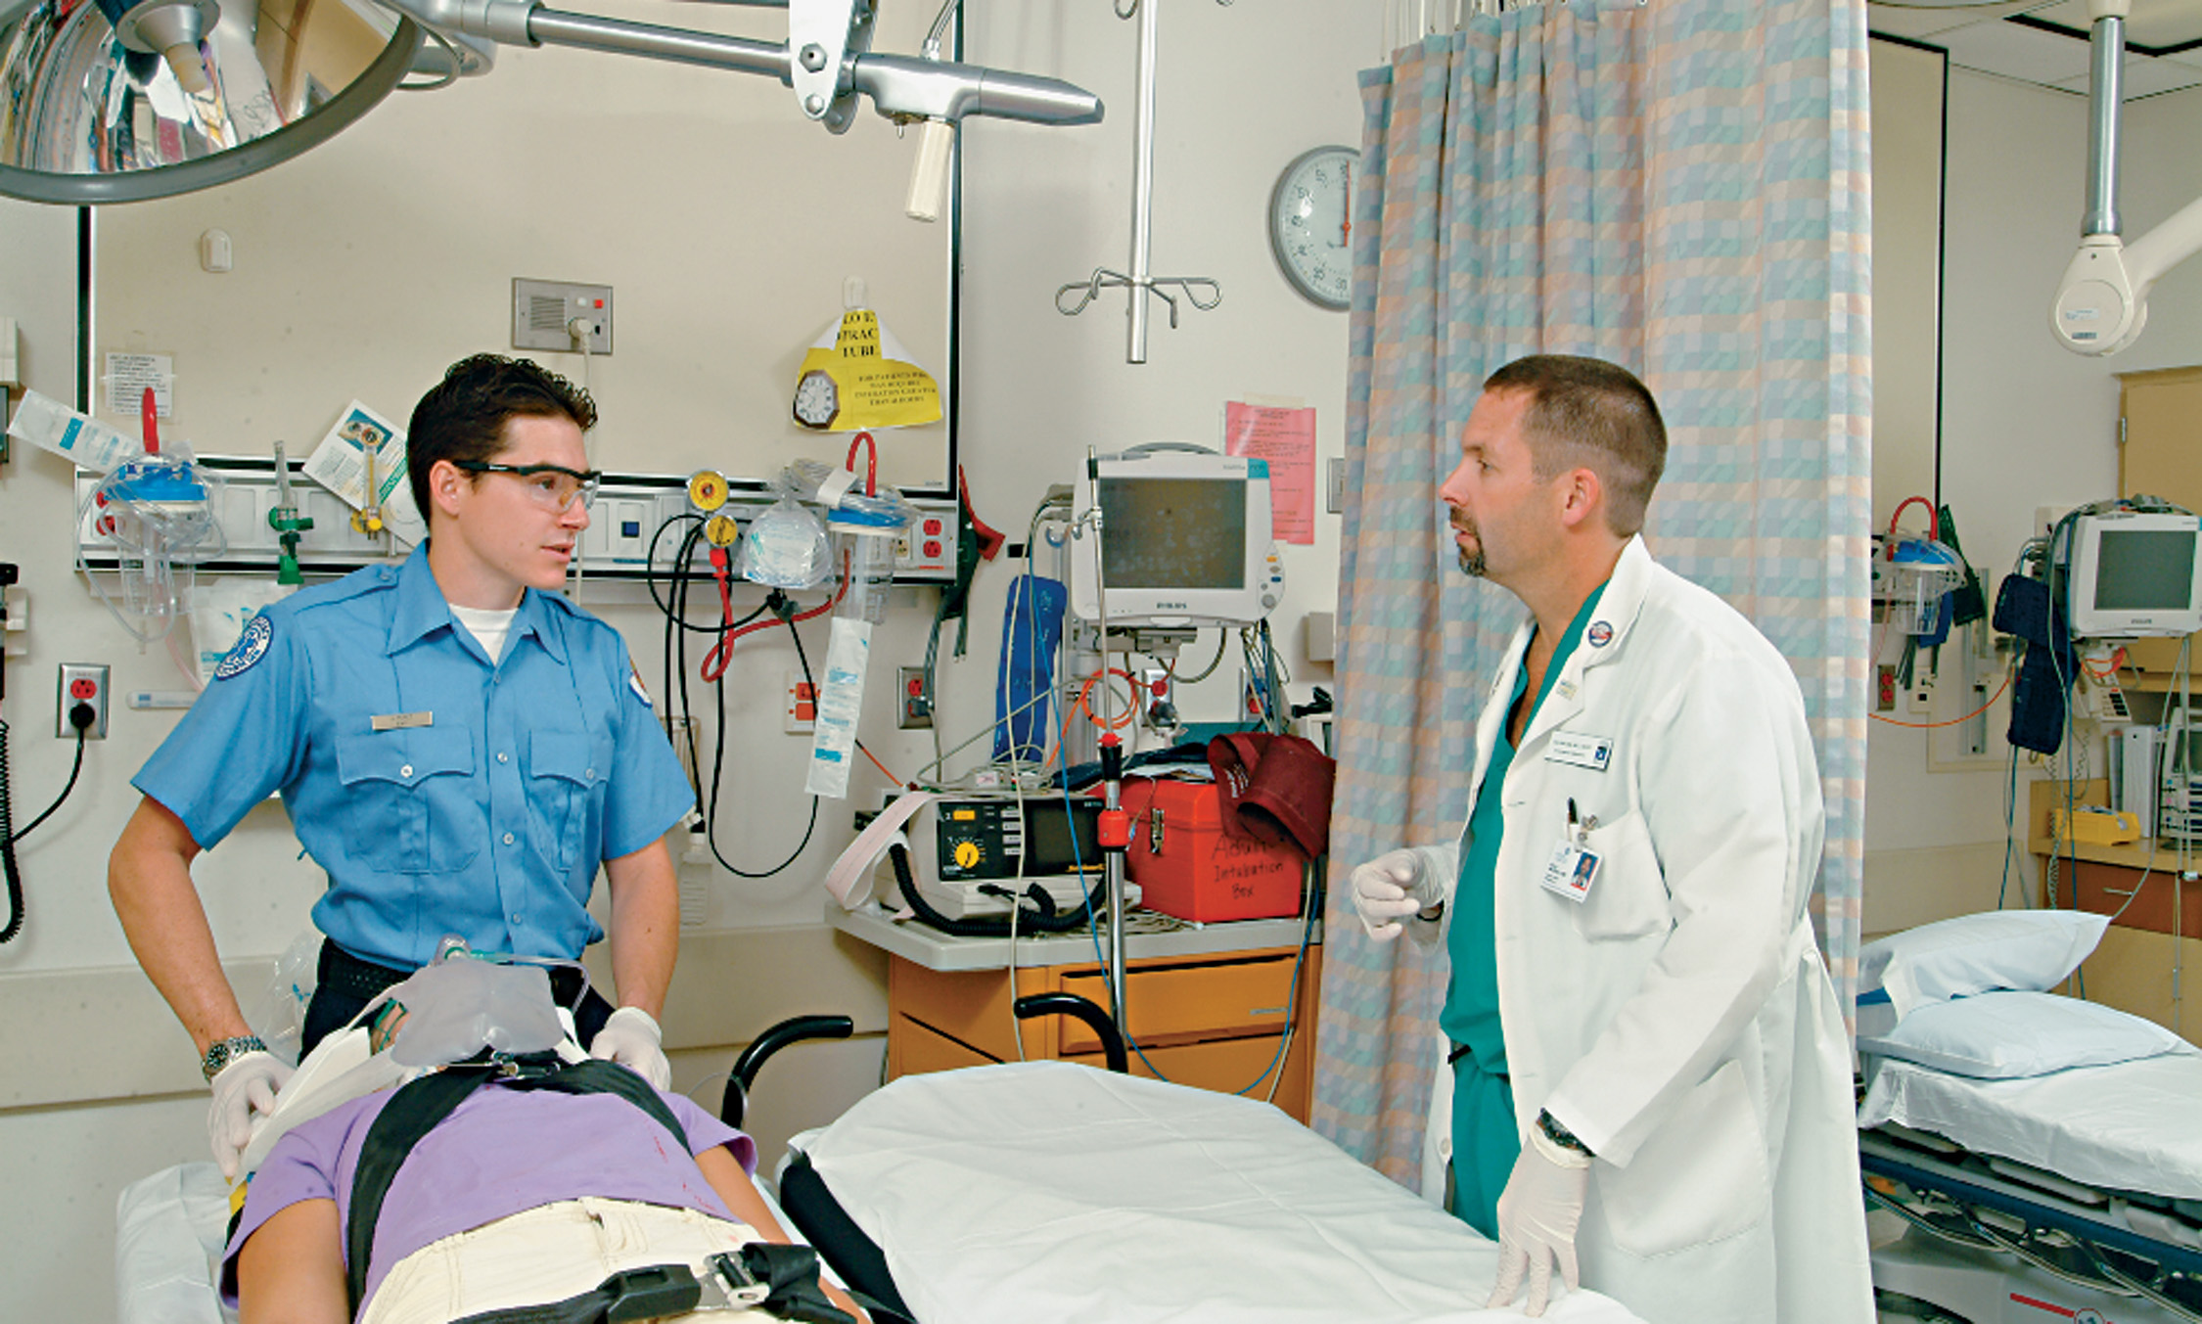
E M T Responsibilities (9 of 10)
Transferring care at receiving facility
Notes:
Report both verbally and in writing to the appropriate receiving facility personnel what injuries or conditions were identified, what care has been given to the patient, and the patient’s response to treatment. Provide other assistance as needed and do not leave before the patient has been properly transferred to the care of the receiving facility personnel.

Slide 47
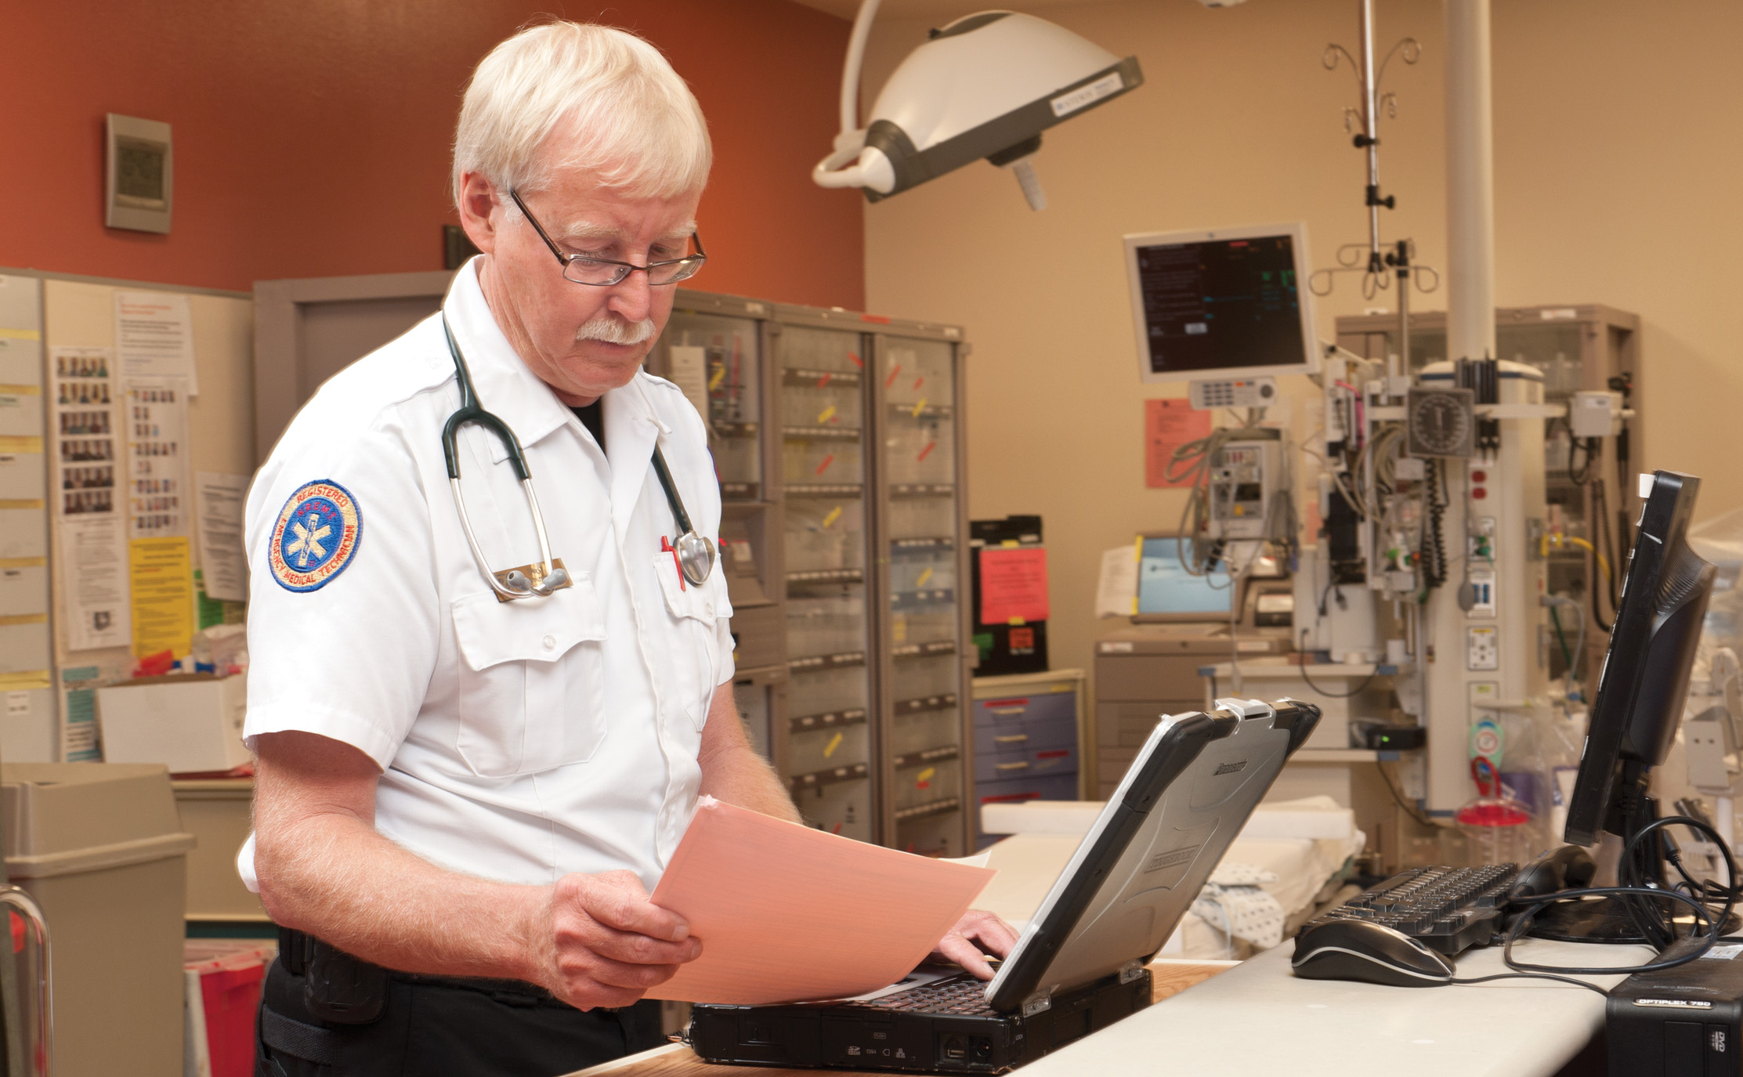
E M T Responsibilities (10 of 10)
Record-keeping, data collection and patient advocacy
Notes:
Throughout your shift, maintain an up-to-date log of calls, if required. Before leaving the hospital, or as soon as possible, complete the written or electronic prehospital care report.
As an emergency care provider, you are also responsible for protecting the patient’s rights. At the scene, collect and safeguard a patient’s valuables on his person, transport them with the patient, and document what was given to the emergency department personnel. In the field, protect the patient’s privacy, shield the patient as much as possible from curious bystanders, and answer questions truthfully. Conceal the body of a patient who has died from curious onlookers.

Slide 48
Case Study (8 of 15)
At the designated point, the E M T s meet the paramedic unit and give an update on Ben’s status. The paramedic, Alexis Brady, further assesses Ben and implements advanced life support (A L S) treatment. Following the treatment, which was administered to increase Ben’s abnormally slow heart rate, Ben regains consciousness and is confused about what is happening.

Slide 49
Case Study (9 of 15)
Now that Ben is conscious, what do you think are his expectations for how Peter and Alexis interact with him?
How could the nature of those interactions affect the quality of patient care?

Slide 50
E M T Professional Attributes (1 of 4)
E M S has professional attributes that are important to maximize effectiveness of the E M T.
Table 1-2 Characteristics of Professional Behavior for E M T s
Integrity
Empathy
Self-motivation
Professional appearance and hygiene
Self-confidence
Notes:
A number of professional attributes are important to maximize your effectiveness as an EMT. They include appearance, knowledge, skills, the ability to meet physical demands, general interests and temperament, and maintenance of certification and licensure.
The EMT—Professional Attributes
Appearance
Neat, clean appearance
Complete uniform or other appropriate dress
Knowledge and Skills
Completion of basic training program for EMT
Use and maintenance of common emergency equipment
Assistance with the administration of medications
Cleaning, disinfection, and sterilization of nondisposable equipment
Safety and security measures
Territory and terrain
State and local traffic laws and ordinances
Physical Demands
Lift and carry up to 125 pounds
Good eyesight and color vision
Communicate effectively both orally and in writing
Good hearing
Personal Traits
Calm and reassuring personality
Leadership ability
Good judgment
Good moral character
Stability and adaptability
Ability to listen
Resourcefulness and ability to improvise
Cooperativeness
Maintenance of Certification and Licensure
Meet necessary continuing education requirements
Verify skill competency
Avoid criminal or unethical behavior
Submit all fees to maintain current certification and licensure

Slide 51
E M T Professional Attributes (2 of 4)
Effective time management
Good verbal and written communication skills
Teamwork and diplomacy
Respect for patients, coworkers, and other health care professionals
Patient advocate
Careful delivery of service
Notes:
A number of professional attributes are important to maximize your effectiveness as an EMT. They include appearance, knowledge, skills, the ability to meet physical demands, general interests and temperament, and maintenance of certification and licensure.
The EMT—Professional Attributes
Appearance
Neat, clean appearance
Complete uniform or other appropriate dress
Knowledge and Skills
Completion of basic training program for EMT
Use and maintenance of common emergency equipment
Assistance with the administration of medications
Cleaning, disinfection, and sterilization of nondisposable equipment
Safety and security measures
Territory and terrain
State and local traffic laws and ordinances
Physical Demands
Lift and carry up to 125 pounds
Good eyesight and color vision
Communicate effectively both orally and in writing
Good hearing
Personal Traits
Calm and reassuring personality
Leadership ability
Good judgment
Good moral character
Stability and adaptability
Ability to listen
Resourcefulness and ability to improvise
Cooperativeness
Maintenance of Certification and Licensure
Meet necessary continuing education requirements
Verify skill competency
Avoid criminal or unethical behavior
Submit all fees to maintain current certification and licensure

Slide 52
E M T Professional Attributes (3 of 4)
Appearance
Knowledge and skills
Physical demands
Personal traits
Leadership ability
Good judgement
Notes:
Teaching Tips
Have students close their books and describe the traits and attributes they feel are important to being excellent EMTs. Explain the importance of getting to know classmates. Learning in the course depends on teamwork, and teamwork is an important EMS competency.
Class Activity
Have pairs of students interview each other for ten minutes, and then have them introduce each other to the class.
Teaching Tips
Assign groups of students to each of the characteristics listed under Personal Traits. Give each group ten minutes to come up with examples of their characteristic and explain the consequences of having EMS providers without these traits. Explain your state’s requirements for maintaining certification and licensure.
Critical Thinking Discussion
What are some ways you can ensure that your knowledge and skills are up to date?

Slide 53
E M T Professional Attributes (4 of 4)
Good moral character
Stability and adaptability
Ability to listen
Resourcefulness
Cooperative
Maintenance of certification/licensure
Notes:
Continue discussion from previous page and outline any other attributes not mentioned by the students. Also emphasize the importance (both legally and professionally) to maintain all licensures and certifications. Often times, if one expires, it makes the other certifications less valid. For example, if an EMT allows their CPR credentials to expire, then often they cannot work as an EMT even though their EMT card is still active.

Slide 54
E M S System Organization and Standards (1 of 4)
State E M S agency role:
  State E M S agencies are responsible for planning and coordinating E M S.
  Every state and territory in the U S has a lead E M S agency.
Notes:
According to the National Association of State EMS Officials (NASEMSO), every state and territory in the United States has a lead EMS agency. The primary responsibilities of the state EMS agency are:
Overall planning of the statewide EMS system
Coordination of the statewide EMS system
Regulation of the statewide EMS system
Licensing local EMS agencies and personnel

Slide 55
Case Study (10 of 15)
En route to the hospital, Alexis and Peter continue their treatment and Alexis calls in a report to the receiving hospital. As Peter continues to reassure Ben and monitor his condition, Alexis begins some preliminary paperwork.

Slide 56
Case Study (11 of 15)
What is the legal basis for E M T s providing medical treatment to patients?
What mechanisms must be in place to ensure that the care provided is of the highest quality and conforms to the standards of the medical community?
Notes:
Review case study questions and introduce the concept of medical direction (next topic).

Slide 57
E M S System Organization and Standards (2 of 4)
Medical Oversight of E M S
  Every E M S system must have a physician medical director.
    Direct medical oversight
    Indirect medical oversight
    On and off-line medical direction
    Standing orders
Notes:
As described under “Medical Oversight of EMS,” of the text (page 11-2) the medical director is a physician who is legally responsible for the clinical and patient care aspects of the EMS system. An EMS medical director is responsible for providing medical direction and is also involved in overseeing and providing EMS education programs, refresher courses, and continuing education; credentialing providers for the system; and facilitating the quality improvement system. Every EMS must have a medical director to provide any level of prehospital care.

Slide 58
Medical Direction
Medical directors participate in E M S provider education and E M S system quality assurance.
A primary charge of medical direction is developing and establishing the guidelines under which the emergency medical service personnel function.
Notes:
Points to Emphasize
Medical direction can be on-line or off-line.
Teaching Tips
Have the course medical director speak about his or her roles and responsibilities in the EMS system.
Discussion Question
What are the differences between on-line and off-line medical direction?
Critical Thinking Discussion
Why is medical direction a critical component of EMS?

Slide 59
E M S System Organization and Standards (3 of 4)
Quality improvement (Q I)
  Is a system of internal and external reviews and audits of all aspects of an emergency medical system.
  May also be known as continuous quality improvement (C Q I).
Notes:
Quality improvement (QI), also known as continuous quality improvement (CQI), is a system of internal and external reviews and audits of all aspects of an emergency medical system. To ensure the public receives the highest quality of prehospital care, the goals of QI are to identify those aspects of the system that can be improved and to implement plans and programs that will remedy any shortcomings. It is important to recognize that QI is not designed to evaluate individual performance, but rather is intended to determine how effective the system is and to identify what improvements can be made to deliver a better service.

Slide 60
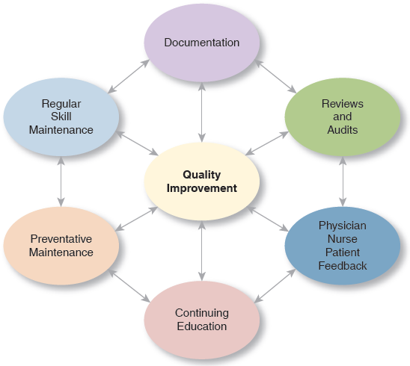
Quality Improvement
The E M T also has roles in Q I
Notes:
Points to Emphasize
The purpose of quality improvement programs is not to penalize EMTs, but to improve the EMS system overall.
Teaching Tips
Describe the quality improvement process in your EMS system.
Discussion Question
What are ways in which EMTs can participate in EMS quality improvement programs?
Class Activity
Have groups of students develop a list of five to ten benchmarks for EMS system quality improvement. Have students determine how the benchmarks could be measured and present their ideas to the class.
Knowledge Application
List several areas of focus from your local quality improvement program. Ask students to discuss how improvements could be made in each area.

Slide 61
E M S System Organization and Standards (4 of 4)
Issues in Patient Safety
  Certain aspects of prehospital care are high-risk in terms of patient safety.
    Transfer of care from one provider to another
    Communications with other providers
    Carrying and moving patients
    Ambulance transport destinations
    Spine motion restriction decisions
Notes:
Points to Emphasize
EMTs can take steps to minimize issues in patient safety and medical mistakes.
Discussion Question
How can EMTs reduce risk of patient injury during high-risk EMS activities?

Slide 62
Issues in Patient Safety
Errors during patient care can cause harm, and usually result from:
  Improper skill performance
  Not following the rules
  Lack of knowledge
Notes:
Errors during patient care also put patients at risk. These errors usually result from failure of the EMT to
properly perform a skill, failure of the EMT to follow the rules, or failure of the EMT to obtain or retain the appropriate knowledge to perform patient care effectively.
Discuss the guidelines used to help EMS providers prevent errors that may jeopardize the patient’s safety:
• Develop clear protocols.
• Light the scene effectively.
• Minimize interruptions during assessment and emergency care.
• Clearly mark all drugs and packages so each is distinct.
• Reflect on all actions.
• Question all assumptions.
• Use decision aids if necessary.
• Ask for assistance if you need it.

Slide 63
E M S Research
Research in E M S
  Evidence-based medicine (E B M) uses research to provide evidence that certain procedures, medications, and equipment improve the patient’s outcome.
Notes:
The traditional approach to the practice of medicine involved a combination of a strong foundation of scientific knowledge, intuition, and good judgment. As the medical practice has evolved, the science component has become more emphasized through the concept of evidence-based medicine. Evidence-based medicine focuses on research to provide clear evidence that certain procedures, medications, and equipment improve the patient’s outcome.

Slide 64
Research in E M S (1 of 3)
There are four steps in evidence-based decision-making:
  Formulate a question that needs to be answered.
  Search medical literature for applicable data.
Notes:
Points to Emphasize
Evidence-based medicine focuses on the results of research to support the use procedures, equipment, and medications in medicine, including EMS care. Research investigations differ from the observations we make in everyday life. The use of researched-based evidence is ideal, but many traditional approaches in EMS have not yet been studied through research.
Teaching Tips
Provide examples of peer-reviewed research articles. Students can look at them during class breaks.
Discussion Questions
Why is it not always possible to apply emergency medicine research to prehospital care?
What are reliability and validity in research?

Slide 65
Research in E M S (2 of 3)
  There are four steps in evidence-based decision-making:
  Appraise the data for validity and reliability.
  If the evidence supports a change in practice, change protocols and implement the change in prehospital emergency care.
Notes:
Class Activity
Have students read a short research article. Discuss the applicability and limitations of the article.
Critical Thinking Discussion
What are some reasons that research in EMS may be difficult?
What is the benefit of a peer-review process for research articles?

Slide 66
Research in E M S (3 of 3)
Research does not exist to support many practices in E M S.
Research in hospital settings does not always transfer well to E M S settings.
If the opportunity arises, every E M T has an obligation to participate in research that contributes to the profession.
Notes:
Class Activity
Have students read a short research article. Discuss the applicability and limitations of the article.
Critical Thinking Discussion
What are some reasons that research in EMS may be difficult?
What is the benefit of a peer-review process for research articles?

Slide 67
Evidence-Based Guidelines (1 of 2)
Evidence Based Guidelines:
  Uses the same approach as evidence based medicine to develop guidelines for medical practice.
  F I C E M S and N E M S A C facilitated the development of the “National Prehospital Evidence-Based Guideline Model Process.”
Notes:
Evidence-based guidelines (EBG) take the same approach as EBM, using strong, valid research studies to develop guidelines for the medical practice. In EMS, the research is used to develop guidelines (which are best practices) to establish standards of care that impact the delivery of EMS. Changes to the guidelines are based on current research findings that support or reject current practice.
The FICEMS and the National EMS Advisory Council (NEMSAC) facilitated the development and approved the National Prehospital Evidence-Based Guideline Model Process.

Slide 68
Evidence-Based Guidelines (2 of 2)
National Prehospital Evidence-Based Guideline Model Process
  Process starts with input from national guidelines
  Evidence is collected and evaluated
  Protocols are developed and disseminated
  Following implementation, the process is reviewed for effectiveness
Notes:
National Prehospital Evidence-Based Guideline Model Process
• System inputs (protocols and AHA guidelines)
• Guideline initiation: EMS evidence accumulation and evaluation
• Establish priorities for guideline development
• Guideline development
• EMS protocol development
• Dissemination of guidelines and protocols
• Implementation
• Evaluation of effectiveness, outcomes, clinical research, and QI evaluation
The last step in the process returns to the second step in the process, “Guideline initiation: EMS evidence
accumulation and evaluation.”

Slide 69
Case Study (12 of 15)
Ben was seen in the emergency department, and then admitted to the cardiac care unit of the hospital. Ben’s cardiologist told Ben that he has several risk factors for heart problems, but that some of the risk factors can be changed.

Slide 70
Case Study (13 of 15)
What are some public health efforts that can help decrease the rate of illnesses like Ben’s?
What role could E M S providers take in such public health efforts?
Notes:
Use this slide to further integrate the student’s understanding of the combined roles of Public Health and EMS. Discuss cardiovascular disease risk factors and how EMS is uniquely positioned to help educate the public about this disease and how to limit or reduce risk factors.

Slide 71
Public Health (1 of 6)
E M T s are part of the public health team.
Public health deals with protecting the health of an entire population.
E M T s can play a role in identifying public health problems and in attempts to reduce injury and illness and promote health.
Notes:
The majority of the EMT’s responsibilities are concerned with treating patients who have an acute medical illness or traumatic injury. However, as an EMT, you are also part of the public health team. Public health deals with protecting the health of an entire population. Specific populations are defined differently depending on the issue at hand. The population under consideration may be a select group, such as children, elderly adults, individuals with mental or physical disabilities, a neighborhood, a city, a state, or an entire nation.

Slide 72
Public Health (2 of 6)
The 10 greatest public health achievements in the United States in the 20th century were:
    Vaccinations
    Motor vehicle safety
    Workplace safety
    Control of infectious diseases
    Reduction in deaths from coronary heart disease and stroke
Notes:
Points to Emphasize
Public health focuses on the health of communities, rather than that of individual patients. Public health activities include collecting data on illnesses and injuries and developing education and prevention strategies. EMTs can play important roles in collecting data, educating the public, and participating in prevention activities.
Teaching Tips
Invite a guest speaker from the health department.
Arrange for students to assist at a health fair sometime during the course.
Discussion Question
What are some examples of prevention programs?

Slide 73
Public Health (3 of 6)
    The 10 greatest public health achievements in the United States in the 20th century were:
    Safer and more healthful foods
    Decline in maternal and infant mortality
    Use of barrier devices during sex
    Fluoridation of drinking water
    Reduction in the use of tobacco products
Notes:
Public health professionals may be involved in enforcing laws and regulations that protect the health and ensure the safety of the public. This may be achieved through legislation such as seat belt and helmet laws.

Slide 74
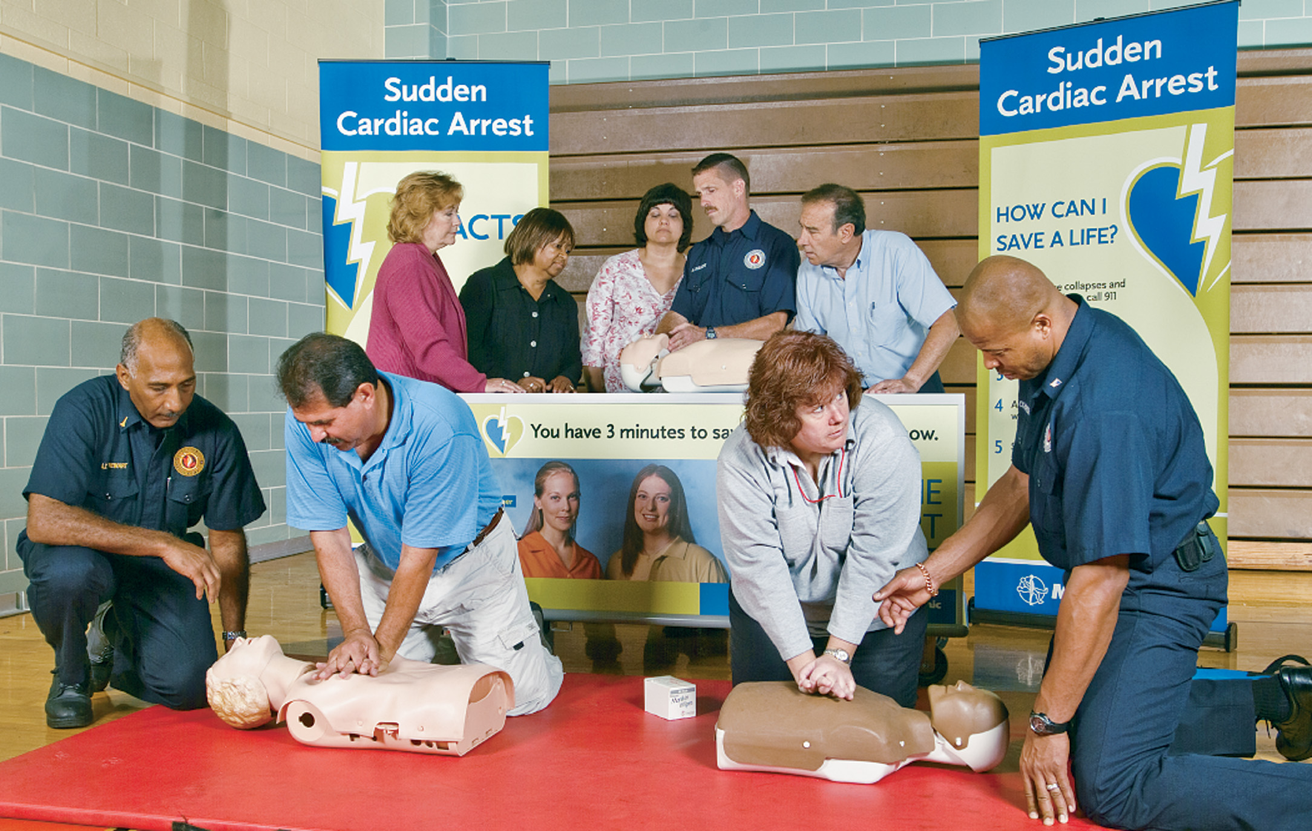
Public Health (4 of 6)
Roles of E M S in public health include health prevention and promotion
Notes:
Health prevention and promotion through primary prevention (vaccinations and education), secondary prevention of complications of disease, and health screenings.

Slide 75
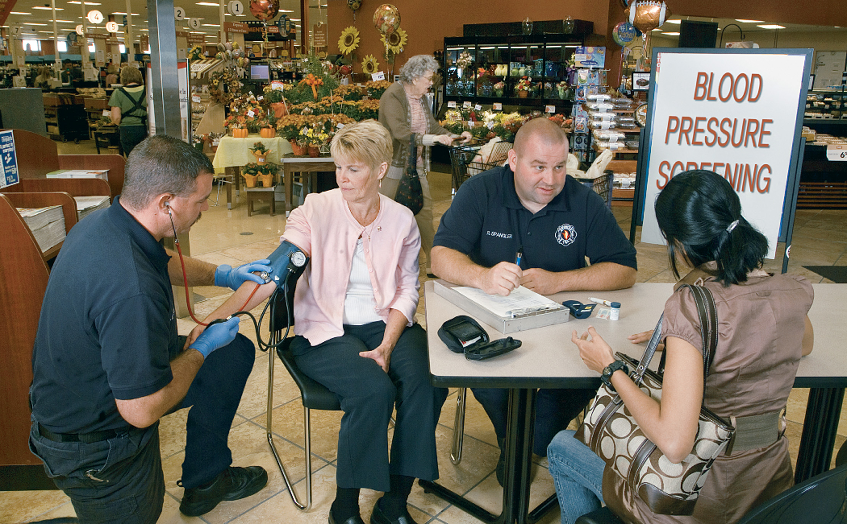
Public Health (5 of 6)
Roles of E M S in public health include disease surveillance
Notes:
Disease surveillance through identifying and reporting certain diseases or conditions that are identified as public health issues.

Slide 76
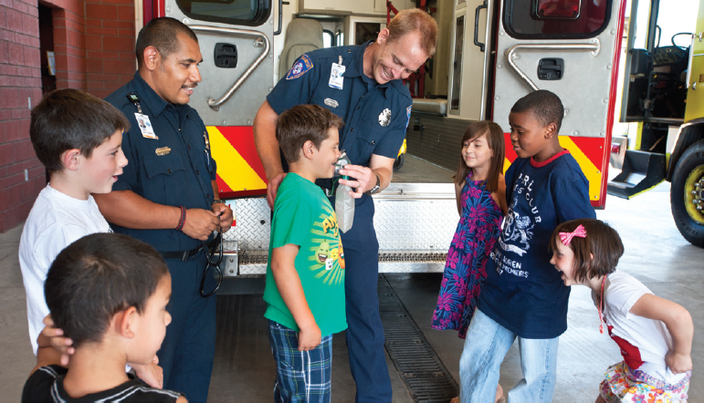
Public Health (6 of 6)
Roles of E M S in public health include education and injury prevention
Notes:
Injury prevention through education, promotion of the use of safety equipment (seat belt use, helmet use, fall prevention, fire prevention), and injury surveillance.

Slide 77
Mobile Integrated Healthcare and Community Paramedicine (1 of 2)
Mobile Integrated Healthcare
  Integrates services provided by a variety of health care entities and practitioners into E M S
Community Paramedicine
  Services provided by the E M S agency and its E M S personnel
Notes:
Mobile Integrated Healthcare (MIH) and Community Paramedicine (CP) are the provision of patient centered health care in the out-of-hospital environment using mobile technology and resources. MIH consists of services provided by a variety of health care entities and health care practitioners that are administratively or clinically integrated with the EMS agency or system. By contrast, CP consists of services provided by the EMS agency and its EMS personnel that are administratively and clinically integrated with other health care entities.

Slide 78
Mobile Integrated Healthcare and Community Paramedicine (2 of 2)
M I H-C P may include services such as:
  Increasing access to underserved areas
  Providing advice to 911 callers via phone rather than dispatching resources
  Use of specially trained E M S providers to help individuals manage chronic diseases and follow up care
Notes:
According to the National Association of EMTs (NAEMT) 2016 Vision Statement on Mobile Integrated Healthcare and Community Paramedicine, MIH-CP may include services such as:
• Increasing access to care in underserved areas
• Providing advice to 911 callers via telephone instead of dispatch of resources
• Using specially trained EMS personnel to manage patients who are high-volume users of health care or at high risk for admission or readmission to a medical facility; to manage chronic disease conditions; and to provide preventative care or post-discharge follow-up visits.
EMS is in a unique position to contribute significantly to the mission of MIH because of its familiarity with and capability to function in the out-of-hospital environment in service of the entire community. EMS can become a significant resource for MIH by transitioning from a focus exclusively on emergency response, emergency care, and transportation to a focus that includes providing patient education, preventative care, chronic disease management, post-discharge follow-up, and alternative health care for patients. By doing so, EMS will significantly increase its value in the health care system.

Slide 79
Case Study (14 of 15)
After giving a report to the emergency department (E D) about Ben’s condition and prehospital treatment, Alexis compliments Peter and Juliana on their assessment and care. Peter takes the opportunity to ask Alexis a few questions about patients who present as Ben did.

Slide 80
Case Study (15 of 15)
Ben was discharged from the hospital with a cardiac pacemaker to keep his heart beating at the right rate. He participates in a cardiac rehabilitation program and is working with a nutritionist on his diet. He still frequents Dave’s, but more often than not, opts for a bowl of oatmeal with fruit.

Slide 81
Lesson Summary (1 of 3)
The shape of the modern E M S system has been influenced by many events throughout history.
E M S systems must address 10 specific areas as defined by N H T S A.
911 is the access number for E M S in the United States.
Notes:
Follow-Up
Answer student questions.
Follow-Up Assignments
Review Chapter 1 Summary.
Complete Chapter 1 In Review questions.
Complete Chapter 1 Critical Thinking questions.
Assessments
Handouts
Chapter 1 quiz

Slide 82
Lesson Summary (2 of 3)
There are four nationally recognized levels of E M S providers in the United States.
E M T s have several specific responsibilities.
Medical direction and Q I are essential components of all E M S systems.
Notes:
Class Activity
As an alternative to assigning the follow-up exercises in the lesson plan as homework, assign each question to a small group of students for in-class discussion.
Teaching Tips
Answers to In Review questions are in the appendix of the text. Advise students to review the questions again as they study the chapter.

Slide 83
Lesson Summary (3 of 3)
E M S practices change over time, based on research findings.
E M S is part of the public health system and can make an impact on the health of the community.
Mobile Integrated Healthcare and Community Paramedicine will continue to evolve and shape E M S.

Slide 84
Feedback Regulation & Policy
We have not yet seen influences of specific legislation and policy, but there are certain to be legislation and policy underlying the structure of the E M S system

Slide 85
Feedback Resource Management
Although there is likely resource management at play, we have not yet seen direct evidence of resource management in this case study.

Slide 86
Feedback Human Resource & Training
The E M D has special training in order to ask the right questions of the caller and start the appropriate emergency response based on the answers to the caller's questions.

Slide 87
Feedback Transportation
Although the dispatcher will soon be requesting the response of one or more vehicles, we have not yet seen evidence of the transportation component of this E M S system.

Slide 88
Feedback Facilities
Facilities play a vital role in the patient's survival, but we have not yet seen evidence of the system's facilities in the case study.

Slide 89
Feedback Communications
Communications systems have been demonstrated by the caller's contact with the dispatch center, and the information exchanged between the caller and dispatcher. Additional communications will still be necessary to complete the call.

Slide 90
Feedback Public Information & Education
We have not seen direct evidence of public information and education, but it is likely that there has been at least some P I & E activity to allow the caller to recognize the emergency and dial the correct number for help.

Slide 91
Feedback Medical Direction
We have not yet directly seen the medical direction component of the system in this case study, but it is likely that medical direction plays a role in assigning dispatch priorities based on information collected by the E M D s.

Slide 92
Feedback Trauma Systems
We do not yet have any information to allow us to recognize the trauma system component of the E M S system in this case study.

Slide 93
Feedback Evaluation
We do not yet have any information to allow us to recognize the evaluation component of the E M S system in this case study.

Slide 94
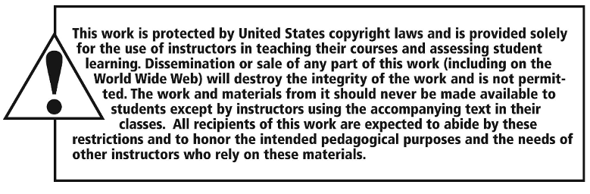
Copyright

