Slide 1
Prehospital: Emergency Care
Eleventh Edition
Chapter 19
Seizures and Syncope
Slides in this presentation contain hyperlinks. JAWS users should be able to get a list of links by using INSERT+F7
Copyright © 2018, 2014, 2010 Pearson Education, Inc. All Rights Reserved
Notes:
If this PowerPoint presentation contains mathematical equations, you may need to check that your computer has the following installed:
1) MathType Plugin
2) Math Player (free versions available)
3) NVDA Reader (free versions available)
Advance Preparation
Student Readiness
Assign the associated section of MyBRADYLab and review student scores. Review the chapter material in the Instructor Resources, which includes Student Handouts, PowerPoint slides, and the MyTest Program.
Prepare
Preview the case study presented in the PowerPoint slides.
Invite a guest speaker to discuss living with seizures.
The total teaching time recommended is only a guideline. Take into consideration factors such as the pace at which students learn, the size of the class, breaks, and classroom activities. The actual time devoted to teaching objectives is the responsibility of the instructor.

Slide 2
Learning Readiness
E M S Education Standards, text p. 584.
Chapter Objectives, text p. 584.
Key Terms, text p. 584.
Purpose of lecture presentation versus textbook reading assignments.
Notes:
Explain to students what the National EMS Education Standards are. The National EMS Education Standards communicate the expectations of entry-level EMS providers. As EMTs, students will be expected to be competent in these areas. Acknowledge that the standards are broad, general statements. Although this lesson addresses the listed competencies, the competencies are often complex and require completion of more than one lesson to accomplish. The student is also expected to review the chapter objectives to foreshadow what will be in the chapter. By mastering the key terms the EMT student will better understand the learning and be able to communicate more clearly.
Additionally, explain to the students that the purpose of using these slides is to help keep the instructor focused on highlighting important portions of the material, explain interrelationships of topics, and discuss how to apply this information. It’s not the intent of the presentation (or slides alone) to include every component in the chapter. This presentation still requires the student to thoroughly read the chapter.

Slide 3
Setting the Stage
Overview of Lesson Topics
Seizures
Syncope
Notes:
These bulleted points are the major headings from the chapter, in order. The purpose is to help the student navigate the lesson.

Slide 4
Case Study Introduction
E M T s Ana Salinas and Loren Dyer enter a residence for a report of a seizure to find a man in his early 30s who appears unresponsive, and who has increased respirations with copious oral secretions. They can see that the patient was incontinent of urine. The patient’s brother reports that the patient was playing a game of cards when he experienced a seizure, falling out of his chair.
Notes:
Case Study
Present the Case Study Introduction provided in the PowerPoint slide set.
Lead a discussion using the case study questions provided on the subsequent slide(s).
The Case Study with discussion questions continues throughout the PowerPoint presentation.
Case Study Discussion
Use the case study content and questions to foreshadow the upcoming lesson content.

Slide 5
Case Study
What are the first priorities in the assessment and care of this patient?
What additional information do the E M T s need about the seizure and the patient’s history?
Does this patient require transport to the hospital?
Notes:
Use the case study content and questions to foreshadow the upcoming lesson content. Gauge the students’ responses as a guide of how well versed they are in this topic.

Slide 6
Introduction
A seizure is a sudden onset of random continuing electrical impulses in the brain.
Notes:
During this lesson, students will learn special considerations of assessment and emergency care for a patient experiencing a seizure or syncope.
It is important for the EMT to recognize that seizures that are prolonged or are associated with life-threatening conditions or injuries, such as head injury or stroke, are abnormal and dangerous. Your prompt intervention in the prolonged or abnormal seizure might save a life.

Slide 7
Seizures (1 of 26)
A seizure is a sudden and temporary alteration in brain function caused by electrical discharges in in the brain.
There are typically changes in mental activity and behavior.
Epilepsy is a common cause of seizures.
Seizures also result from injuries or medical conditions.
Notes:
Many people think that a seizure is a convulsion and a convulsion is a seizure. However, a convulsion occurs in only one type of seizure and is a sign of the abnormal electrical activity occurring in that seizure. In many types of seizures, a convulsion does not occur.
Seizures also result from injuries or medical conditions other than epilepsy and can last much longer than the typical epileptic seizure.
Points to Emphasize
A seizure is an alteration in brain function. A convulsion is the jerky muscle contractions that accompany some kinds of seizures.
Discussion Question
Besides epilepsy, what are some causes of seizures?
Critical Thinking Discussion
What are the consequences of prolonged seizure activity?

Slide 8
Seizures (2 of 26)
Pathophysiology of Seizures
Primary (Unprovoked) Seizures
Occur from a genetic or unknown cause.
Generalized seizures involve both hemispheres of the brain.
Partial seizures involve one hemisphere.
Simple partial seizures
Complex partial seizures
Notes:
Seizures are thought to begin through excitation of a group of susceptible neurons in the cerebral cortex or thalamus of the brain. These neurons begin to discharge electrical impulses, which then recruit other surrounding large groups of neurons.
Brain cell damage associated with seizures was thought to occur from episodes of hypoxia, acidosis, hyperthermia, hypotension, and reduced blood flow to the brain. However, the most current research shows brain cell injury is associated with prolonged, excessive neuron electrical discharge.
Seizures are categorized as either primary or unprovoked seizures or secondary or provoked seizures.
Primary seizures are categorized as generalized or partial seizures.
Generalized seizures involve both hemispheres of the brain and the reticular activating system, which typically results in a loss of consciousness. Generalized seizure activity is usually characterized by a jerking muscle activity known as convulsions.
Partial seizures are typically related to abnormal activity in just one cerebral hemisphere. Partial seizures are either simple or complex. A patient who has a simple partial seizure remains awake and aware, whereas a patient who has a complex partial seizure normally remains awake but not aware.

Slide 9
Seizures (3 of 26)
Pathophysiology of Seizures
Secondary (Provoked) Seizures
Occur from an underlying cause.
There are several causes, and the seizures are usually generalized.
Notes:
Secondary or provoked seizures, also known as reactive or symptomatic seizures, do not result from a genetic cause but occur as the result of an insult to the body, such as fever, infection, hypoxia, hypoglycemia, hyperglycemia, drug intoxication, drug withdrawal, eclampsia in pregnancy, degenerative brain diseases, toxins, or imbalances of electrolytes in the body.

Slide 10
Table 19-1 Common Causes of Secondary Seizures (1 of 2)
High fever
Noncompliance with seizure control medication
Seizure disorder (epilepsy)
Infection
Poisoning
Hypoglycemia (low blood sugar)
Hyperglycemia (high blood sugar)
Traumatic brain injury
Shock
Notes:
Secondary or provoked generalized seizures that are due to an insult to the body are dangerous and can result in death if not treated promptly.

Slide 11
Table 19-1 Common Causes of Secondary Seizures (2 of 2)
Hypoxia
Stroke
Drug or alcohol withdrawal
Dysrhythmias
Hypertension (high blood pressure)
Pregnancy complications (eclampsia)
Blood electrolyte imbalance (sodium, calcium)
Hyperthermia
Idiopathic (unknown cause)

Slide 12
Seizures (4 of 26)
Pathophysiology of Seizures
Status epilepticus
Generalized motor seizures that last more than 30 minutes or seizures that occur consecutively without a period of responsiveness between them
Life-threatening emergency
Notes:
Status epilepticus is defined as:
A continuous seizure activity lasting longer than 30 minutes
Two or more sequential seizures without a full recovery of consciousness between seizures
Once a seizure exceeds five minutes, it is likely to be prolonged. The 30 minutes of continuous seizure activity in the definition of status epilepticus is the duration of convulsive seizure activity that leads to permanent brain cell injury. Therefore, status epilepticus protocols require aggressive treatment after only five minutes of seizure activity to avoid the potential for adverse outcomes for the patient if the seizure is allowed to continue for 30 minutes before intervening.
Status epilepticus may lead to the following complications:
Aspiration
Brain cell damage from hypoxia and lack of glucose
Dehydration
Fractures or dislocations
The longer the delay in treatment, the greater the chance of the patient suffering permanent brain damage, especially after 30 minutes of convulsive seizure activity.

Slide 13
Seizures (5 of 26)
Types of Seizures
Generalized Seizures
Tonic-clonic seizure.
Involves the cerebral hemispheres and reticular activating system.
Patient is not awake or aware.
Notes:
Generalized Convulsive Seizures
Tonic-Clonic - A generalized tonic-clonic seizure usually begins with abnormal electrical activity low in the cerebral cortex that spreads upward, affecting both cerebral hemispheres, and downward, affecting the reticular activating system (RAS). Because of the involvement of both cerebral hemispheres and the RAS, the patient does not remain awake or aware.
Generalized Nonconvulsive Seizures
Absence
Myoclonic
Tonic
Atonic
The type of seizure the patient experiences depends on:
Where in the brain the abnormal electrical activity begins;
The level of awake and awareness that is determined by the cerebral hemispheres and RAS involvement and,
Other features of the seizure.

Slide 14
Seizures (6 of 26)
Types of Seizures
Generalized Seizures
Generalized tonic-clonic seizure stages
Aura
Loss of consciousness
Tonic phase (muscle rigidity)
Hypertonic phase
Clonic phase (convulsion)
Postictal state
Notes:
The aura serves as a warning that a seizure is going to begin and involves some type of sensory perception by the patient. The aura may be a sound, an abnormal twitch, anxiety, dizziness, a smell or odor, an unpleasant feeling in the stomach, visual disturbance, or odd taste.
The patient loses consciousness soon after the aura.
The patient’s muscles become contracted and tense, and the patient exhibits muscular rigidity. The patient may then exhibit extreme muscular rigidity with hyperextension of the back, which is referred to as the hypertonic phase. Both phases usually last for a total of 30 to 60 seconds.
Muscle spasms then alternate with relaxation, producing the typical violent and jerky seizure activity of the clonic phase. This is known as the convulsion or convulsive activity.
The postictal state is the recovery phase. The patient’s mental status is altered and may range from complete unresponsiveness to confusion and disorientation. The mental status progressively improves over time.

Slide 15
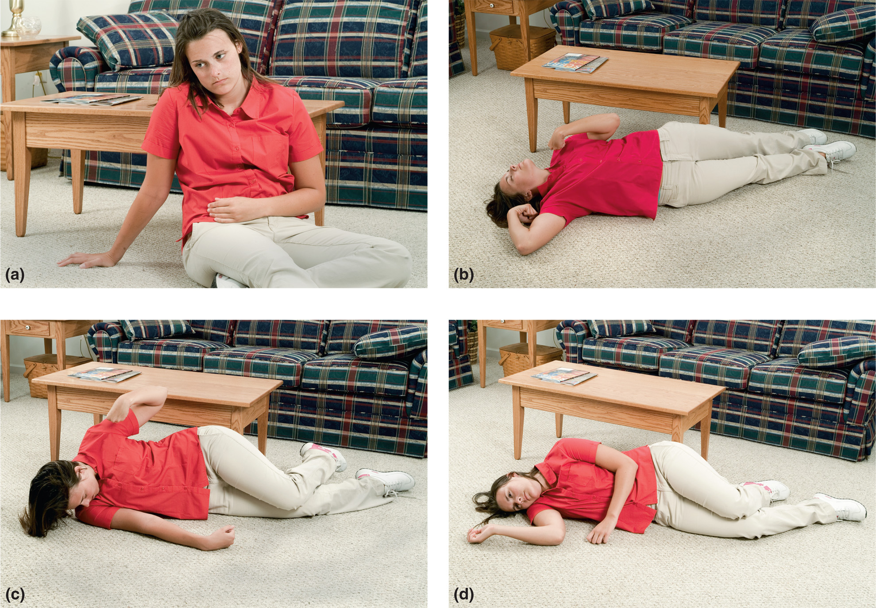
A Generalized Tonic-Clonic, or Grand Mal, Seizure
Notes:
A generalized tonic-clonic, or grand mal, seizure is a sign of abnormal release of electrical impulses in the brain: (a) aura, (b) loss of consciousness followed by tonic phase, (c) clonic phase, (d) postictal phase.

Slide 16
Seizures (7 of 26)
Types of Seizures
Generalized Seizures
Generalized tonic-clonic seizure emergency medical care
If the seizure has stopped, provide reassurance and conduct an assessment.
Follow protocol if the patient refuses treatment.
Status epilepticus is a life-threatening emergency.
Notes:
If the seizure presents as status epilepticus, provide the emergency medical care outlined in the “Assessment- Based Approach to Seizure Activity” section later in the chapter. Focus on protecting the patient from injury and establishing and maintaining an adequate airway, ventilation, oxygenation, and circulation. Remember that status epilepticus is a dire emergency that can result in damage to or death of brain cells, other tissue damage, and organ failure.
Teaching Tips
Emphasize the need to balance a patient's rights and autonomy with concern for their medical condition. Try to gain the cooperation of the patient who does not wish to be transported.
Class Activity
Provide students with ample opportunity to practice assessment and management of patients with seizures.
Discussion Question
What causes hypoxia in the patient having a tonic-clonic seizure?

Slide 17
Seizures (8 of 26)
Types of Seizures
Generalized Seizures
Absence Seizure
Myoclonic Seizure
Tonic Seizure
Atonic Seizure
Febrile Seizure
Notes:
Absence seizure, which was once known as a petit mal seizure, is most common in children; however, an adult onset can occur. These seizures do not involve convulsive activity, but instead, they are characterized by a sudden cessation of conscious activity that involves a lack of vocalization and a blank stare, beginning and ending abruptly, and lasting only five to 15 seconds.
A myoclonic seizure involves sporadic brief jerks of muscle groups on both sides of the body. Some patients describe it as electrical shocks. If severe enough, the muscle jerk may cause the patient to drop an object or throw it. These seizures often occur during sleep or when the patient is just falling asleep.
A tonic seizure is characterized by a sudden onset of greatly increased muscle tone in the body, arms, or legs, causing sudden muscular rigidity. The “tonic” in the name refers to muscle tone. Tonic seizures most often occur during sleep and usually involve most of or the entire brain; thus, the categorization as a generalized seizure and the involvement of muscles on both sides of the body.
An atonic seizure results in the total loss of muscle tone, resulting in loss of muscle strength. The eyelids may droop, the head nods forward, and the loss of muscle strength causes the person to suddenly drop to the ground. Because of this presentation, atonic seizures are frequently referred to as “drop attacks” or “drop seizures.” The person remains conscious and recovers almost immediately.
A febrile seizure is defined as a seizure associated with a high fever without any evidence of intracranial infection or other definite cause of seizure. It was once thought that the sudden spike in temperature provoked the seizure; however, current research suggests that the magnitude and peak of the fever is more likely the cause and not the rate at which the fever develops. Febrile seizures are most common in children as young as three to six months and as old as five to six years of age.

Slide 18
Seizures (9 of 26)
Types of Seizures
Partial Seizures
Simple partial seizure
Involves abnormal movements of one area of the body.
The patient is awake and aware.
The seizure may spread and generalize.
Notes:
A simple partial seizure was once known as a focal motor seizure or Jacksonian motor seizure. The patient is awake and aware that the seizure activity is occurring because the reticular activating system is not involved and only one cerebral hemisphere is involved.

Slide 19
Seizures (10 of 26)
Types of Seizures
Partial Seizures
Simple partial seizure presentations
Motor Seizures
Sensory Seizures
Autonomic Seizures
Psychic Seizures
Emergency Medical Care
If reoccurring and less than five minutes, no treatment may be needed.
Notes:
A simple partial seizure was once known as a focal motor seizure or Jacksonian motor seizure. The patient is awake and aware that the seizure activity is occurring because the reticular activating system is not involved and only one cerebral hemisphere is involved.
Motor seizures. The patient has jerking or stiffening of only one part of the body and on only one side of the body. The abnormal motor activity may spread to other areas of the body on the same side.
Sensory seizure. The patient’s senses may be affected by the simple partial seizure. The patient may smell or taste something; hear abnormal sounds such as ringing, clicking, or someone’s voice; feel pain, tingling, or numbness; feel as if they are floating in space or spinning; have visual hallucinations; or have illusions.
Autonomic seizure. There will be a change in the autonomic function of the patient’s body. These signs or symptoms commonly include strange or unpleasant sensations in the stomach, head, or chest; changes in the heart rate; changes in the respiratory rate; or goose bumps.
Psychic seizure. The psychic signs and symptoms are changes in how the patient thinks, feels, or experiences things. The patient may present with memory disturbances, garbled speech, trouble understanding, difficulty speaking, fear, depression, happiness for no reason, déjà vu (they feel as if they have been through this before), or jamais vu (they think they have never had this experience before even though it is a very familiar setting the patient has often experienced).

Slide 20
Seizures (11 of 26)
Types of Seizures
Partial Seizures
Complex partial seizure
The patient remains awake, but is not aware.
Starts with a blank stare followed by random movements.
May repeat words or phrases.
Does not respond to commands.
Emergency medical care.
Notes:
Once known as a psychomotor seizure or temporal lobe seizure, the complex partial seizure usually lasts 30 seconds to two minutes. It is termed “partial” because it involves only one cerebral hemisphere. The seizure usually starts in one small area in the temporal lobe or frontal lobe.
Complex partial seizures may present as a patient with a behavioral emergency or intoxication when, in fact, they are having a seizure.
Speak calmly and reassuringly. Guide the patient gently away from objects that may be hazardous to themselves or others. Stay with the patient until they are completely aware of their surroundings. Because these seizures are recurring in nature, they will most likely refuse transport.

Slide 21
Seizures (12 of 26)
Types of Seizures
Partial Seizures
Secondarily Generalized Seizure
Involves the entire body
Typical phases of a generalized tonic-clonic seizure
Notes:
Secondarily generalized seizures occur when simple partial or complex partial seizure activity spreads to both sides of the brain and involves the entire body.
The seizure activity may spread from one area of the body to another and sometimes progresses to a generalized tonic-clonic seizure, which usually begins with stiffening of the muscles.
The patient then goes through the typical phases of a generalized tonic-clonic seizure.
If it lasts longer than five minutes, it must be treated as status epilepticus.

Slide 22
Click on the Description That Best Characterizes a Simple Partial Seizure
A. Jerky muscle movements localized to one extremity
B. Full-body rhythmic muscle contraction and relaxation
C. Staring into space with brief loss of awareness, accompanied by rapid eye-blinking
D. Awake, with loss of awareness and bizarre behavior, such as repetitive movements

Slide 23
Seizures (13 of 26)
Assessment-Based Approach to Seizure Activity
Scene size-up
Look for evidence of trauma, poisoning, or medical conditions.
The patient may be postictal.
If the patient is actively seizing, move objects away from him.
Seizure activity may precede a cardiac arrest.
Notes:
The convulsive phase of a seizure causes the muscles in the body to contract and relax abnormally. Because the diaphragm is a large muscle, it also contracts and relaxes abnormally. This causes a temporary interruption in the patient’s normal ventilatory status. After a convulsive state ceases, the sympathetic nervous system is activated and causes tachycardia, tachypnea, and possibly hypertension. The hyperventilation might help restore the oxygen depletion that occurred during the convulsive phase.
Once responsive, the patient might refuse emergency care and transportation. This frequently occurs in public places where bystanders call EMS. The epileptic patient, however, may be accustomed to the seizure activity and does not necessarily want or need emergency care.
Some cardiac arrests are preceded by seizure activity because of a lack of oxygen and blood to the brain. You should proceed with CPR, application of the automated external defibrillator (AED), and emergency care for cardiac arrest if no pulse is found.

Slide 24
Protect the Seizing Patient from Injury by Moving Furniture and Objects Away
Notes:
The patient’s movements should always be guided, rather than restrained, to prevent further injury. It may also be necessary to move objects away from the patient. Some people place spoons or other hard objects in the patient’s mouth to prevent them from “swallowing their tongue,” which is anatomically impossible. Remove these objects immediately because they can easily cause injury to the mouth, tongue, teeth, and jaw, or they can break and cause an airway obstruction.

Slide 25
Seizures (14 of 26)
Assessment-Based Approach to Seizure Activity
Primary assessment
Assess the airway.
Assess breathing and oxygenation.
Assess circulation.
Assess transport priority.
Notes:
Open the airway with a jaw-thrust or head-tilt, chin-lift maneuver. It may be necessary to insert a nasopharyngeal airway to resolve the persistent snoring (sonorous) sounds created by the partially occluded airway. Keep in mind that the patient’s mental status is expected to improve.
During a seizure, the chest wall muscles contract and restrict effective breathing. The patient may appear to have an airway obstruction and may be. As long as the patient is not in status epilepticus, this should not pose a major problem because respiration quickly returns to normal following the abnormal muscle activity. The EMT should begin positive pressure ventilation with supplemental oxygen if the patient is severely cyanotic, the seizure has lasted for longer than five minutes from the time of onset (not from your arrival), or the breathing does not immediately become adequate following the episode.
High body temperatures are a common cause of seizures in infants and young children. Hot skin can also indicate a high body temperature resulting from the excessive uncontrolled muscle movement in an adult. Administer supplemental oxygen to maintain an SpO₂ of <94% if breathing is adequate.
Ensure the presence of a pulse if the patient is unresponsive. Initiate CPR and apply the AED if the patient is pulseless. Check for and manage any serious bleeding that might have resulted from trauma.

Slide 26
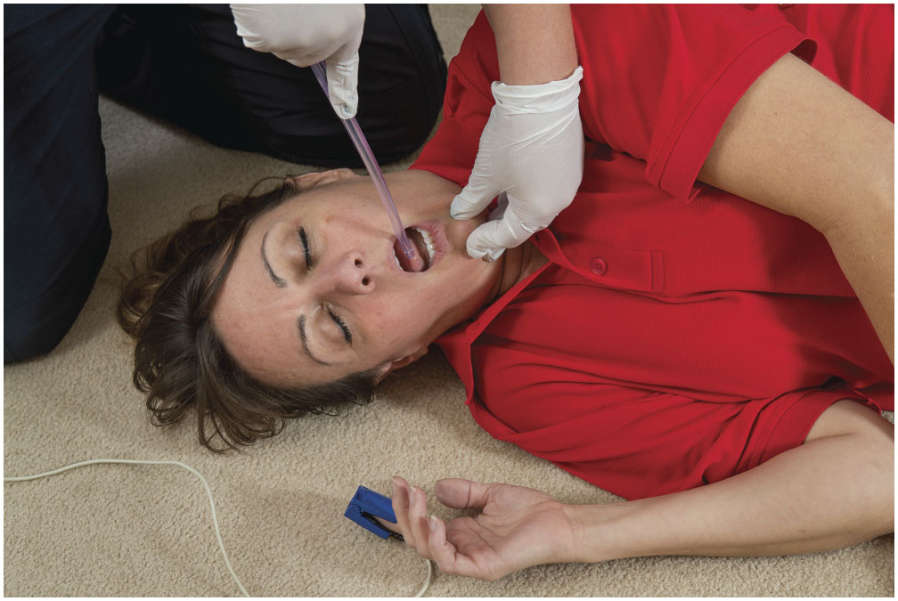
Clear the Airway of Secretions, Blood, and Vomitus
Notes:
Large amounts of saliva are produced during the seizure and the tongue is commonly bitten and bleeding; suction any secretions, vomitus, or blood from the airway.

Slide 27
Seizures (15 of 26)
Assessment-Based Approach to Seizure Activity
Primary assessment
Transport priority circumstances
The patient remains unresponsive.
Airway, breathing, or circulation is poor.
Status epilepticus.
History of pregnancy, diabetes, or injury.
Seizure occurred in water, such as a swimming pool or lake.
Notes:
Transport Priority Circumstances:
The patient remains unresponsive following the seizure.
The airway, breathing, or circulation is inadequate following the seizure activity.
A second generalized tonic-clonic seizure occurs without a period of responsiveness between the seizure episodes (status epilepticus).
A generalized tonic-clonic seizure lasts longer than five minutes (status epilepticus).
The patient is pregnant, has a history of diabetes, or is injured.
The seizure has occurred in water, such as a swimming pool or lake.
There is evidence of head trauma leading to the seizure.
There is no history of epilepsy or other seizure disorders.
The seizure is the result of drug or alcohol withdrawal or exposure to toxins.

Slide 28
Seizures (16 of 26)
Assessment-Based Approach to Seizure Activity
Primary assessment
Transport priority circumstances
There is evidence of head trauma leading to the seizure.
There is no history of epilepsy or other seizure disorder.
The seizure is the result of drug or alcohol withdrawal.
Notes:
Discussion Questions
What are some indications that a patient having, or who has had, a seizure, is a high priority for transport?
What should we look for in the secondary assessment of a patient who has had a seizure?
Knowledge Application
Given several scenarios of patients who have had, or who are having, a seizure, students should be able to identify the appropriate priority for transport.

Slide 29
Seizures (17 of 26)
Assessment-Based Approach to Seizure Activity
Secondary assessment
Assess the head for signs of trauma.
There may be weakness or paralysis on one side.
Assess the extremities for signs of trauma.
Notes:
Perform a rapid assessment if the patient is postictal and still has an altered mental status, or if they don’t have a past medical history of epilepsy or seizures. The head must be assessed for possible signs of injury. The pupils may be unequal if the brain is injured. Look for medical alert tags that might provide information about the patient.
You may find weakness or paralysis on one side of the body or to one area of the body (hand, arm, or leg) following a seizure. This should disappear as the patient slowly becomes more responsive. However, it can last up to 24 hours.
Assess the head and extremities for injury that may have occurred as a result of the muscular activity or the fall to the ground.

Slide 30
Seizures (18 of 26)
Assessment-Based Approach to Seizure Activity
Secondary assessment
Assess vital signs.
Apply oxygen if the S p O₂ is <94%.
Assess the blood glucose level.
Consider the need for A L S.
Obtain a history, including medications.
Notes:
Assess and record vital signs. The respirations and heart rate can be elevated. The skin is often warm and moist.
Apply a pulse oximeter and determine the SpO₂ reading. If the SpO₂ reading is <94%, it may be a result of the inadequate breathing the patient had during the active seizure period or, alternatively, it might be an indication of hypoxia that possibly caused the seizure.
Because hypoglycemia can trigger a seizure, if protocol permits, assess the blood glucose level by using a glucose meter. If the blood glucose is less than 70 mg/dL, you might suspect the seizure is due to a low blood glucose level.
Gather a history from the responsive patient, relatives, and bystanders.

Slide 31
Seizures (19 of 26)
Assessment-Based Approach to Seizure Activity
Secondary assessment
Obtain a thorough history for the hospital staff.
Notes:
Was the patient awake during the seizure?
Was the muscle activity a twitching or jerking motion?
Was the muscle activity isolated to one part of the body or generalized at the time the seizure started?
Did the seizure activity begin as generalized (both sides of the body) or did it start focally (one part of the body) and then generalize? If so, determine and note where the seizure activity started and how it progressed to other parts of the body.
When did the seizure start?
How long did the seizure last? (Remember, however, that bystanders tend to overestimate seizure duration.)
Did the patient experience an aura before the seizure (an unusual sensation that might precede a seizure episode by hours or only a few seconds)?
Did the patient hit their head or fall?
Did the patient bite their tongue or mouth?
Was there a loss of bowel or bladder control?
Is there any recent history of fever, headache, or stiff neck?
Is the patient allergic to any medications?
What medications does the patient take? Are any to control seizures?
Did the patient take their seizure medication as prescribed?
Does the patient have a history of epilepsy, previous seizures, diabetes, stroke, or heart disease?
When was the last time the patient had a seizure?
Was this a typical type of seizure for them to have?
When did the patient last have something to eat or drink?
What was the patient doing immediately prior to the seizure activity? (Could there have been a fall or injury that caused the seizure, rather than the seizure causing the fall or injury?)

Slide 32
Table 19-3 Medications Commonly Used in the Treatment of Epilepsy (1 of 3)
Bivaracetam (Briviact)
Carbamazepine (Atretol, Carbagen S R, Epitol, Mazepine, Tegretol, Tegrital, Teril, Timonil)
Carbamazepine X R (Carbatrol, Tegretol X R)
Clobazam (Frisium, Onfil)
Clonazepam (Epitril, Klonopin, Rivotril)
Diazepam (Diastat, Diazepam, Valium)
Divalproex Sodium (Depacon, Depakote, Epival)
Elicarbazepine Acetate (Aptiom)
Ethosuximide (Zarontin)
Notes:
What medications does the patient take? Are any to control seizures?

Slide 33
Table 19-3 Medications Commonly Used in the Treatment of Epilepsy (2 of 3)
Ezogabine (Potiga)
Felbamate (Felbatol)
Gabapentin (Neurotin)
Lacosamide (Vimpat)
Lamotrigine (Lamictal)
Levetiracetam (Keppra)
Lorazepam (Ativan)
Oxcarbaqzepine (Oxtellar, Tripetal)
Perampanel (Fycompa)
Phenobarbital

Slide 34
Table 19-3 Medications Commonly Used in the Treatment of Epilepsy (3 of 3)
Phenytoin (Dilantin, Epanutin, Phenytek)
Pregabalin (Lyrica)
Primidone (Mysoline)
Rufinamide (Benzel, Inovelon)
Tiagabine Hydrochloride (Gabitril)
Topiramate (Topamax)
Valporic Acid (Convulex, Depakene, Depakine, Orfiril, Valporal, Valporal, Valprosid)
Vigabatrin (Sabril)
Zonisamide (Zonegran)

Slide 35
Seizures (20 of 26)
Assessment-Based Approach to Seizure Activity
Secondary assessment
Signs and symptoms may include:
Aura
Loss of consciousness
Convulsions
Biting the tongue
Excessive saliva
Notes:
The most commonly recognized type of seizure activity is the generalized tonic-clonic seizure.

Slide 36
Seizures (21 of 26)
Assessment-Based Approach to Seizure Activity
Secondary assessment
Signs and symptoms may include:
Urinary or bowel incontinence
Hyperventilation and tachycardia
Postictal confusion
Notes:
Signs and symptoms of a generalized tonic-clonic seizures are::
Aura
Loss of consciousness
Rigid muscular contraction throughout the entire body
Convulsive activity (jerky muscular movement throughout the entire body)
Bitten tongue
Excessive saliva
Urinary or bowel incontinence
Hyperventilation and tachycardia following the convulsion
Postictal state of confusion and physical exhaustion

Slide 37
Seizures (22 of 26)
Assessment-Based Approach to Seizure Activity
Emergency Medical Care
Protect the patient from injury.
Position the patient.
lateral recumbent for postictal patients.
Consider need for spine motion restriction.
Maintain the patient’s airway.
Insert a nasopharyngeal airway, if needed.
Notes:
Prevent injury to the patient. Move objects away from the seizing patient so they do not injure themselves. Protect the head, arms, and legs. Do not restrain the patient or try to control the movements. Loosen ties, shirt collars, or other tight clothing.
Position the patient. The postictal patient should be placed in a lateral recumbent (recovery) position to protect the airway and facilitate drainage of secretions. If a spinal injury is suspected, take the necessary spine-motion restriction precautions. If the patient requires ventilation, position them in a supine position.
Maintain a patent airway. If the patient is actively seizing for more than 5 minutes or is unresponsive with sonorous airway sounds in the postictal phase, it may be necessary to insert a nasopharyngeal airway. Because the nasopharyngeal airway is flexible, in contrast to the rigid oropharyngeal airway, it is the airway of choice.

Slide 38
Seizures (23 of 26)
Assessment-Based Approach to Seizure Activity
Emergency Medical Care
Use suction as needed.
Begin positive pressure ventilation, if needed.
Maintain adequate oxygenation.
Transport.
Notes:
Suction. Suction any secretions, blood, or vomitus.
Assist ventilation if necessary. If the seizures last longer than 5 minutes or the breathing status is inadequate during the postictal phase, begin positive pressure ventilation with supplemental oxygen.
Maintain adequate oxygenation. Immediately following the convulsive activity, it is recommended the patient is provided a high concentration of oxygen by a nonrebreather mask to manage the hypoxia that likely occurred during the convulsion. After the patient has regained consciousness, if the breathing is adequate in the postictal phase, the SpO₂ is 94% or greater, and no other signs of respiratory distress, hypoxia, hypoxemia, or poor perfusion are present, there is no need to administer supplemental oxygen. If the SpO₂ remains less than 94% or signs of respiratory distress, hypoxia, hypoxemia, or poor perfusion are present, continue with oxygen therapy by a nonrebreather mask or via a nasal cannula at 2 lpm and titrate to maintain an SpO₂ reading of 94% or greater. Oxygen administration can shorten the postictal period.
Transport. You must obtain medical direction or follow local protocol if confronted with a patient who refuses emergency care or transportation. Basically, if this is a normal seizure for the patient, it may not be necessary to seek additional medical treatment, if the patient is awake and competent to refuse. However, if anything is abnormal about the seizure, more than one seizure occurred, or the seizure has lasted longer than 5 minutes, the patient must be transported for further evaluation. Follow your local protocol.

Slide 39
Seizures (24 of 26)
Assessment-Based Approach to Seizure Activity
Reassessment
Be prepared to manage additional seizures.
Prehospital Medications Used to Stop Seizures
Notes:
Reassessment. Be prepared to manage additional seizures. Monitor the airway, breathing, and circulation. Repeat and record vital signs. Document and communicate any changes to the receiving medical facility.
The medication most commonly used to stop generalized tonic-clonic seizures in the prehospital setting is a benzodiazepine.
The medication most commonly used by personnel to stop seizure activity is also a benzodiazepine. The most common benzodiazepines are midazolam (Versed), lorazepam (Ativan), and diazepam (Valium). Although intravenous administration has been the most common route historically because of its rapid action onset, recent research has found other routes, including intramuscular (IM), intranasal (IN), buccal, and rectal, to be effective in stopping seizures.
The most recent research has identified the intramuscular (IM) administration of midazolam (Versed) as one of the preferred medications and routes for an actively seizing patient in addition to intravenous administration of lorazepam or diazepam.
Benzodiazepines are well-tolerated medications and can be administered safely in the prehospital environment. Major side effects are sedation and respiratory depression. Thus, if administered, you must closely assess and monitor the airway and respiratory status of the patient.

Slide 40
Seizures (25 of 26)
Summary: Assessment and Care for Seizures
Emergency Care Protocol
Seizures
Establish and maintain an open airway. Insert a nasopharyngeal airway if the seizing patient is unresponsive or has been actively seizing for greater than 5 minutes (prolonged seizure). Insert a nasopharyngeal airway immediately if the patient is seizing from an etiology other than epilepsy or other known seizure disorder.
Suction secretions as necessar.
If the patient is actively seizing, or if breathing is inadequate in the postictal phase, provide positive pressure ventilation with supplemental oxygen at a rate of 10–12 ventilations/minute for an adult and 12–20 ventilations/minute for an infant or child. Ventilations may be difﬁcult to deliver because of resistance related to convulsions.
Notes:
Review assessment findings and emergency care for seizures.

Slide 41
Seizures (26 of 26)
If breathing is adequate, administer oxygen to maintain an S p O₂ of 94% or greater.
Place the patient in a lateral recumbent position.
Consider advanced life support backup if the patient continues to actively seize, especially beyond 5 minutes or has two or more seizures without a period of consciousnes between seizures.
Transport.
Perform a reassessment every 5 minutes.

Slide 42
Syncope (1 of 2)
Sudden, temporary loss of consciousness.
Occurs from interruption of cerebral perfusion.
A common cause is increased parasympathetic influence.
Bystanders may mistake syncope for a seizure.
Notes:
Syncope, or fainting, is a sudden and temporary loss of consciousness. It occurs when, for some reason, there is a temporary lack of blood flow to the brain and the brain is deprived of oxygen for a brief period. A common cause of syncope is an overwhelming influence of the parasympathetic nervous system that causes blood vessels to dilate throughout the body. With a patient in a standing or seated position, gravity causes the blood to pool in the lower extremities, decreasing blood flow, and perfusion to the brain. The hypoperfused brain no longer functions adequately and the patient has a syncopal episode.
Bystanders might confuse a syncopal episode with a seizure because the patient might experience a short period of jerky muscle movement during the episode.
The difference is that with syncope:
The episode usually begins in a standing position.
The patient remembers feeling faint or light-headed.
The patient becomes responsive almost immediately after becoming supine.
The skin is usually pale and moist.
Discussion Questions
What are some causes of syncope?
What signs and symptoms may be reported just prior to a syncopal episode?
Critical Thinking Discussion
What kinds of medications might make a patient prone to syncope?
Class Activity
Provide students with opportunities to practice assessment and management of patients with a complaint of syncope.

Slide 43
Table 19-4 Differentiation between Seizures and Syncope
Syncope | Seizure
Usually begins in standing or upright position | Might begin in any position
Might complain of being light-headed, dizzy, or weak prior to the episode | Might have an aura or begin without warning
Sudden loss of consciousness that immediately returns when supine or prone | Sudden loss of consciousness that persists, and then has a gradual return to consciousness
May have some muscle twitching | Convulsive muscle activity or repetitive movements during unconsciousness
Skin is usually cool, moist, and pale | Skin can be warm and sweaty
Notes:
Bystanders might confuse a syncopal episode with a seizure.

Slide 44
Syncope (2 of 2)
Conduct primary and secondary assessments.
Keep the patient supine.
Consider serious underlying causes and encourage transport.
Notes:
Syncope can be a sign of a serious illness or injury. This is particularly true in older patients in whom cardiac and neurological causes are common. If the patient faints, or has an episode of syncope, and is not responding appropriately upon your arrival, consider the condition an altered mental status. Perform primary and secondary assessments and manage the patient’s airway, breathing, oxygenation, and circulation as in any altered mental status patient.

Slide 45
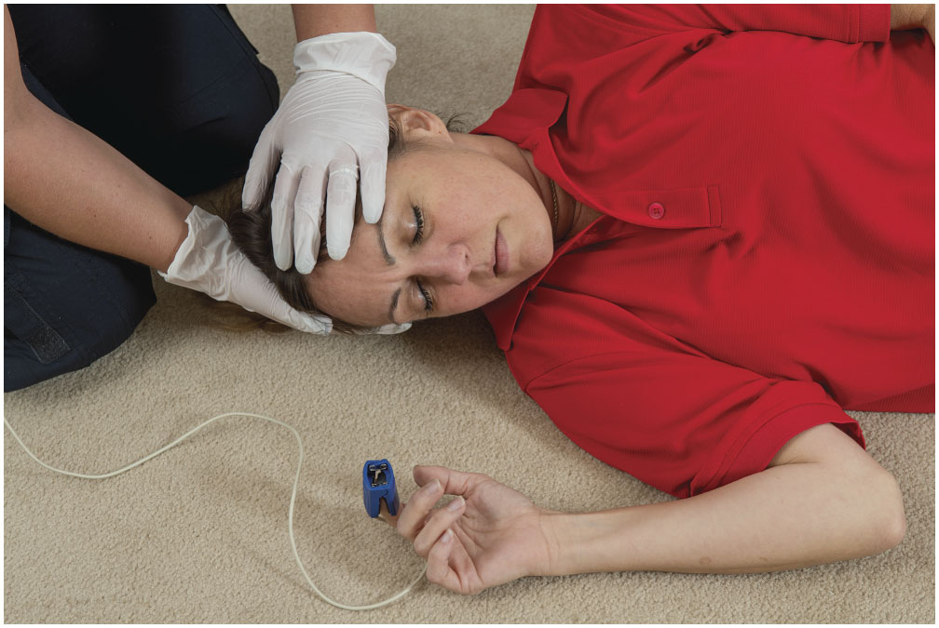
Assess the Head for Any Sign of Trauma
Notes:
Assess the head and extremities for injury that may have occurred as a result of the muscular activity or the fall to the ground.

Slide 46
Case Study Conclusion (1 of 3)
Ana and Loren turn the patient, Dan, onto his left side and Ana suctions his airway. Dan is responsive to painful stimuli, and has adequate breathing. His skin is warm and moist, and there is no cyanosis. His S p O₂ is 99 percent.
The seizure lasted about two minutes. Its description is consistent with a tonic-clonic seizure, and looked like other seizures Dan has had.
Notes:
Review case conclusion and emphasize the application of knowledge learned from this presentation.

Slide 47
Case Study Conclusion (2 of 3)
There is no evidence of injury to the head, trunk, or extremities, though it does appear that Dan may have bitten his tongue.
Dan has a history of seizures, for which he takes the medication carbamazepine.
A quick check of the prescription bottle shows that Dan may have missed several doses since the prescription was filled two weeks ago.
Notes:
Review case conclusion and emphasize the application of knowledge learned from this presentation.

Slide 48
Case Study Conclusion (3 of 3)
Dan has become responsive to verbal stimuli, but because his mental status remains altered and he has not been compliant with his medications, Ana and Loren recognize that he should be transported.
En route to the hospital, Dan becomes more responsive, but remains sleepy. The E M T s turn his care over to the E D staff with a complete report.
Notes:
Review case conclusion and emphasize the application of knowledge learned from this presentation.

Slide 49
Summary (1 of 2)
Seizures result from abnormal electrical impulses in the brain, which can manifest in a variety of ways.
Seizures may be generalized or partial.
Status epilepticus is a life-threatening emergency.
Notes:
Follow-Up
Answer student questions.
Follow-Up Assignments
Review Chapter 19 Summary.
Complete Chapter 19 In Review questions.
Complete Chapter 19 Critical Thinking questions.
Assessments
Handouts
Chapter 19 quiz

Slide 50
Summary (2 of 2)
Syncope results from a temporary interruption in brain perfusion.
Syncope may be benign, but can have serious underlying causes.
Notes:
Class Activity
As an alternative to assigning the follow-up exercises in the lesson plan as homework, assign each question to a small group of students for in-class discussion.
Teaching Tips
Answers to In Review and Critical Thinking questions are in the appendix of the text. Advise students to review the questions again as they study the chapter.

Slide 51
Correct!
A simple partial seizure is localized to one area of the body, usually presenting as jerky muscle movements in an extremity, although simple partial seizures can spread and become generalized.
Click here to return to the program.

Slide 52
Incorrect (1 of 3)
When there is full-body involvement in rhythmic muscle contraction and relaxation, it is a tonic-clonic seizure. The rhythmic contraction and relaxation is preceded by a phase of rigid muscle contraction known as the hypertonic phase.
Click here to return to the quiz.

Slide 53
Incorrect (2 of 3)
A brief loss of awareness with staring into space, sometimes accompanied by chewing or lip-smacking motions, is an absence seizure, which occurs in children.
Click here to return to the quiz.

Slide 54
Incorrect (3 of 3)
A seizure in which the patient remains awake, but unaware of their surroundings, and engages in bizarre, repetitive behavior is a complex partial seizure.
Click here to return to the quiz.

Slide 55
Copyright

