Slide 1

Prehospital: Emergency Care
Eleventh Edition
Chapter 18
Altered Mental Status, Stroke, and Headache
"Slides in this presentation contain hyperlinks. JAWS users should be able to get a list of links by using INSERT+F7"
Copyright © 2018, 2014, 2010 Pearson Education, Inc. All Rights Reserved
Notes:
If this PowerPoint presentation contains mathematical equations, you may need to check that your computer has the following installed:
1) MathType Plugin
2) Math Player (free versions available)
3) NVDA Reader (free versions available)
Advance Preparation
Student Readiness
Assign the associated section of MyBRADYLab and review student scores.
Review the chapter material in the Instructor Resources, which includes Student Handouts, PowerPoint slides, and the MyTest Program.
Prepare
The total teaching time recommended is only a guideline. Take into consideration factors such as the pace at which students learn, the size of the class, breaks, and classroom activities. The actual time devoted to teaching objectives is the responsibility of the instructor.

Slide 2
Learning Readiness
E M S Education Standards, text p. 555.
Chapter Objectives, text p. 555.
Key Terms, text p. 555.
Purpose of lecture presentation versus textbook reading assignments.
Notes:
Explain to students what the National EMS Education Standards are. The National EMS Education Standards communicate the expectations of entry-level EMS providers. As EMTs, students will be expected to be competent in these areas. Acknowledge that the standards are broad, general statements. Although this lesson addresses the listed competencies, the competencies are often complex and require completion of more than one lesson to accomplish. The student is also expected to review the chapter objectives to foreshadow what will be in the chapter. By mastering the key terms the EMT student will better understand the learning and be able to communicate more clearly.
Additionally, explain to the students that the purpose of using these slides is to help keep the instructor focused on highlighting important portions of the material, explain interrelationships of topics, and discuss how to apply this information. It’s not the intent of the presentation (or slides alone) to include every component in the chapter. This presentation still requires the student to thoroughly read the chapter.

Slide 3
Setting the Stage
Overview of Lesson Topics
  Altered mental status
  Stroke
  Headache
Notes:
These bulleted points are the major headings from the chapter, in order. The purpose is to provide a basic lecture navigation for the student.

Slide 4
Case Study Introduction
“Hurry, he’s back here,” Mrs. Hewlett calls to E M T s Fred Archuleta and Reese Kemp. “I think he’s having a stroke!”
The E M T s find John Hewlett, a 69-year-old male, sitting in a chair, looking anxious. Mr. Hewlett begins to speak, but his speech is slurred, and there is a noticeable droop on the right side of his face.
Notes:
Case Study
Present the Case Study Introduction provided in the PowerPoint slide set.
Lead a discussion using the case study questions provided on the subsequent slide(s).
The Case Study with discussion questions continues throughout the PowerPoint presentation.
Case Study Discussion
Use the case study content and questions to foreshadow the upcoming lesson content.

Slide 5
Case Study
What would make the E M T s suspect the patient might be having a stroke?
What other conditions could explain the patient’s presentation?
How should the E M T s go about determining what the problem is?
Notes:
Use the case study content and questions to foreshadow the upcoming lesson content. Gauge the student’s responses as a guide of how well versed they are in this topic.

Slide 6
Introduction
Altered mental status has many causes, and can place the patient’s airway at risk.
Early recognition of stroke is critical for proper care.
Headache should be considered a serious symptom that could be caused by an underlying condition.
Notes:
During this lesson, students will learn about assessment and emergency care for a patient suffering from an altered mental status, stroke, or headache.

Slide 7
Altered Mental Status (1 of 9)
Dysfunction of the reticular activating system or cerebral hemispheres interferes with consciousness.
Altered mental status (A M S) is an indication of significant illness or injury.
Causes of A M S may be structural or toxic-metabolic.
Notes:
For a patient to remain in an awake or conscious state, two functioning components are necessary: an intact reticular activating system and at least one cerebral hemisphere. The reticular activating system (RAS) isn't a structure but a network of nerve cells in the brainstem that constantly transmit environmental and sensory stimuli to and from the cerebrum. If this network is damaged or becomes dysfunctional, the patient loses consciousness. Similarly, if both cerebral hemispheres are damaged or become dysfunctional, the patient can no longer remain conscious. Thus, for the patient to remain in an awake and alert state, the reticular activating system and at least one cerebral hemisphere must be intact.
An altered mental status is a significant indication of injury or illness in a patient. The alteration can range from simple disorientation to complete unconsciousness in which the patient isn't responsive.
Structural causes of an altered mental status:
Brain tumor.
Hemorrhage in the cranium but outside of the brain.
Hemorrhage in the brain tissue.
Direct brain tissue damage from trauma to the brain.
Degenerative disease of the brain.
Brain abscess or infection.
Toxic-metabolic causes of an altered mental status:
Severe hypoxia or anoxia (reduced oxygen or no oxygen).
Abnormal blood glucose conditions (high blood glucose or low blood glucose).
Liver failure.
Kidney failure.
Poisoning (e.g., carbon monoxide, cyanide).
Discussion Questions
What is an altered mental status (AMS)?
What are some causes of AMS?
What are some causes of AMS that EMTs can treat?
Teaching Tips
Emphasize detecting and correcting causes of AMS, such as hypoxia and hypoglycemia.

Slide 8
Altered Mental Status (2 of 9)
Other causes of A M S
  Shock
  Drugs that depress the C N S
  Post-seizure state
  Infection
  Cardiac rhythm disturbance
  Stroke
Notes:
In any patient with an altered mental status, it is vital that you manage any life-threatening injuries or conditions, recognize the mental status change, document it, and continue to monitor the patient for further deterioration.

Slide 9
Altered Mental Status (3 of 9)
Assessment-Based Approach: A M S
  Scene size-up
    Causes of A M S can be medical or traumatic.
    Look for the mechanism of injury or clues to the nature of the illness.
    Collect the patient’s medications.
    Remove the patient from a hazardous environment.
Notes:
Do a scene size-up to begin establishing why the patient has an altered mental status.
Determine if the patient has been injured or is suffering from a medical illness.
If no mechanism of injury is apparent, you would then suspect that the altered mental status is the result of a medical illness. As you are approaching the patient, look for clues that can indicate the nature of the illness. Alcohol bottles, drug paraphernalia, home oxygen tanks, or chemicals might help explain the cause.
The patient’s medications may provide the most valuable information.
If no family members are present, ask an Emergency Medical Responder or police officer at the scene to look near the kitchen and bathroom sink, kitchen table, and nightstand for both prescription and nonprescription medications.
If more than one patient at the scene presents with an altered mental status, suspect that some type of hazardous gas or poison can be causing the illness. Note any unusual odors. The priority is to protect yourself so that you don’t also become a patient. The second priority is to move the patient out of the hazardous environment.
Discussion Question
Why is the scene size-up especially useful in assessing the patient with AMS?
Critical Thinking Discussion
What are some clues at the scene of a patient with AMS that you would specifically search for?
Knowledge Application
Given a scenario involving a patient with AMS, students should be able to develop a relevant line of questioning about the problem.

Slide 10
Altered Mental Status (4 of 9)
Assessment-Based Approach: A M S
  Primary assessment
    Stabilize the spine, if indicated.
    Assess for airway patency.
    Assess for breathing adequacy.
    Assess the need for supplemental oxygen.
Notes:
Recognize that inadequate breathing from an inadequate tidal volume, or an inadequate respiratory rate or an occluded airway can be the cause of the altered mental status, as well as a result.

Slide 11
Altered Mental Status (5 of 9)
  Assessment-Based Approach: A M S
  Secondary assessment
    Baseline vital signs
    History
    Physical exam
    What were the signs and symptoms prior to the altered mental status
Notes:
Your partner can take vital signs as you begin gathering information from the patient, relatives, or bystanders regarding the patient’s history.
During your history, ask the following questions:
What were the signs and symptoms the patient was complaining of prior to the alteration in the mental status?
Did the signs and symptoms seem to get progressively worse or better?
Does the patient have any known allergies?
What medications, prescription and nonprescription, is the patient taking?
What is the patient’s past medical history? When was the last time they saw a doctor for their medical condition?
When did the patient last have something to eat or drink? What did they eat or drink? Did they take any drugs or ingest any alcohol?
What was the patient doing prior to the onset of the altered mental status?
Was the onset of signs and symptoms gradual or sudden?
Did the patient suffer from a seizure, severe headache, or confusion prior to the alteration in the mental status?
How long has the patient been sick or suffering from these signs and symptoms? When was the patient last well?
The physical exam conducted on a patient with an altered mental status must include an examination of the following:
Head for any evidence of possible trauma.
Pupils for indications of a head injury (unequal or fixed), drugs (narcotics usually cause pinpoint pupils), hypoxia (sluggish to respond to light).
Mouth and oral mucosa for cyanosis and pallor indicating hypoxia and poor perfusion.
Chest for indication of any trauma leading to hypoxia from lung dysfunction.
Breath sounds indicating poor gas exchange from injury (pneumothorax) or abnormal breath sounds indicating a possible pulmonary or cardiac condition, for example, crackles (pulmonary edema) or wheezing (asthma attack).
Abdomen for any evidence of intraabdominal bleeding such as a rigid and tender abdomen (look at the patient’s face when palpating the abdomen for grimacing from pain).
Lower and upper extremities for motor and sensory function and pulses.
Lower extremities for peripheral edema (can indicate congestive heart failure).
Posterior body for sacral edema (can indicate congestive heart failure).

Slide 12
Altered Mental Status (6 of 9)
  Assessment-Based Approach: A M S
  Secondary assessment
    Possible findings in trauma
      Obvious signs of trauma
      Abnormal respiratory pattern or heart rate
      Unequal pupils
      High or low blood pressure
      Discoloration around the eyes/behind ears
      Pale, cool, moist skin
      Abnormal flexion or extension
Notes:
Signs and Symptoms of an altered mental status commonly associated with trauma:
Obvious signs of trauma: deformity, contusions, abrasions, punctures or penetrations, burns, tenderness, lacerations, or swelling.
Abnormal respiratory pattern.
Increased or decreased heart rate.
Unequal pupils.
High or low blood pressure.
Battle’s Sign (discoloration around the eyes—late sign).
Raccoon eyes (discoloration behind the ears—late sign).
Pale, cool, moist skin.
Flexion (decorticate posturing—arms flexed, legs extended) or extension (decerebrate posturing—arms and legs extended).
A common mnemonic used to easily recall possible causes of altered mental status is AEIOU-TIPPSS.

Slide 13
Altered Mental Status (7 of 9)
  Assessment-Based Approach: A M S
  Secondary assessment
    Possible findings in medical emergencies
      Abnormal vitals
      Cool, hot, dry or moist skin
      Pinpoint, midsize, or unequal pupils
      Stiff neck
      Lacerations to the tongue (seizure)
      Loss of bladder or bowel control
      High or low blood glucose reading
Notes:
Signs and Symptoms of an altered mental status commonly associated with a nontraumatic or medical condition:
Abnormal respiratory pattern.
Dry or moist skin.
Cool or hot skin.
Pinpoint, midsize, dilated, or unequal pupils.
Stiff neck.
Lacerations to the tongue indicating seizure activity.
High systolic blood pressure and low heart rate.
Loss of bowel or bladder control.
Abnormally high or abnormally low blood glucose reading.
A common mnemonic used to easily recall possible causes of altered mental status is AEIOU-TIPPSS.

Slide 14
Altered Mental Status (8 of 9)
  Assessment-Based Approach: A M S
  Emergency Medical Care
    Spinal motion restriction, if indicated.
    Maintain the airway.
    Suction, as needed.
    Maintain S p O₂ at or above 94%.
    Ventilate, if needed.
    Position the patient.
    Transport.
Notes:
Consider spine motion restriction precautions if trauma is suspected or the cause can't be immediately determined.
Maintain a patent airway. A patient with an altered mental status might be unable to maintain their airway. If this is the case, perform a manual maneuver and insert a nasopharyngeal or oropharyngeal airway adjunct to help keep the patient’s airway open.
Suction any secretions, vomitus, or blood. Closely monitor the airway by frequently inspecting inside the mouth and suctioning any secretions, blood, or vomitus.
Maintain adequate oxygenation. It is extremely important to achieve and maintain oxygenation at an SPO₂ of 94% or greater and to eliminate any signs of hypoxia. If the SPO₂ is <94% or if signs of respiratory distress, hypoxia, hypoxemia, or poor perfusion are present, administer oxygen via a nasal cannula to maintain an SPO₂ of 94% or greater.
Be prepared to assist ventilation. Continuously assess the breathing status. If the breathing rate or depth becomes inadequate, immediately begin positive pressure ventilation. If positive pressure ventilation is delivered, ensure the device used to ventilate the patient is connected to a supplemental oxygen source and the highest concentration is delivered.
Position the patient. Patients with an altered mental status should be placed in a lateral recumbent (recovery) position to avoid possible aspiration. If the altered mental status patient requires ventilation, do not place them in a lateral recumbent position. It isn't be possible to effectively establish and maintain an adequate mask seal and perform bag-valve-mask ventilation with the patient in a lateral position. Place the patient needing ventilation in a supine position and be sure to have suction readily available.
Transport. Any patient with an altered mental status must be transported to a medical facility for further evaluation. Consider ALS intercept according to local protocols.

Slide 15
Altered Mental Status (9 of 9)
  Assessment-Based Approach: A M S
  Reassessment
    Reassess every five minutes.
    Look for changes in mental status, airway, breathing, and circulation.
    Record vital signs.
Notes:
Continuously monitor for changes in the patient’s mental status, airway, breathing, oxygenation, and circulation. Record vital signs and communicate your findings to the receiving medical facility.

Slide 16
Stroke (1 of 20)
Neurologic Deficit Resulting from Stroke
  A deficiency in nervous system function is called a neurological deficit.
  A neurological deficit is an indication of a problem affecting the central nervous system.
Notes:
When the patient loses some or all of these abilities, they experience a neurologic deficit. A neurologic deficit is defined as any deficiency in the functioning of the brain or nervous system. A neurologic deficit alerts you to the possibility of a condition that is affecting the patient’s central nervous system, which is composed of the brain and spinal cord. Thus, you must look for signs and symptoms of both traumatic and medical conditions that affect the brain or the spinal cord.

Slide 17
Stroke (2 of 20)
Acute Stroke
  Time is a critical factor in stroke management.
  E M T s can make a significant difference through early recognition and transport.
  The American Heart Association/ American Stroke Association developed the mnemonic F.A.S.T. to quickly recognize possible stroke.
Notes:
The American Heart Association (AHA)/American Stroke Association (ASA) has developed a “Stroke Chain of Survival” that includes the following foundational goals:
Rapid recognition of stroke signs and symptoms by the public and immediate access to EMS through 911.
911 call taker recognition of the signs and symptoms of stroke resulting in rapid EMS dispatch.
Rapid EMS response, assessment, recognition of stroke, and transport while providing prearrival notification of a stroke patient to include the results of a verified stroke scale to the receiving medical facility.
Rapid diagnosis and treatment by the medical facility.

Slide 18
Stroke (3 of 20)
Acute Stroke
  Time is a critical factor in stroke management.
  E M T s can make a significant difference through early recognition and transport of stroke patients.
Notes:
The American Heart Association (AHA)/American Stroke Association (ASA) has developed a “Stroke Chain of Survival” that includes the following foundational goals:
Rapid recognition of stroke signs and symptoms by the public and immediate access to EMS through 911.
911 call taker recognition of the signs and symptoms of stroke resulting in rapid EMS dispatch.
Rapid EMS response, assessment, recognition of stroke, and transport while providing prearrival notification of a stroke patient to include the results of a verified stroke scale to the receiving medical facility.
Rapid diagnosis and treatment by the medical facility.
The American Heart Association/American Stroke Association developed the mnemonic F.A.S.T. to quickly recognize possible stroke. F.A.S.T. stands for the following:
F–Facial Droop. Is one side of the face drooping or is the patient experiencing numbness to one side of the face? Have the person make an exaggerated smile to determine if there is a facial droop.
A–Arm Weakness. Is the hand or arm paralyzed, weak, or numb on one side of the body? Ask the patient to raise both arms to check if one arm can’t be raised or if one arm drifts downward after it is raised.
S–Speech Difficulty. Does the person have slurred speech, can't speak, or are they not making any sense when speaking? Have the person repeat a simple sentence such as “The sky is blue” to determine if the speech is slurred, if they can obey the command to do so, and if the words are repeated back correctly.
T–Time to Call 911. If there is any sign or symptom found with F, A, or S in the brief F.A.S.T. assessment, even if the signs or symptoms quickly resolve, 911 must be called to get the person to the hospital as fast as possible. Be sure to note the time when the first sign or symptom appeared. The answer to “When was the patient last known to be well?” is a more complex finding, which is very important to the medical team providing stroke care.

Slide 19
Stroke (4 of 20)
Pathophysiology of a Stroke
  Cerebral Circulation and the Ischemic Penumbra
    Cerebral arteries can develop collateral circulation.
    Collateral circulation is often inadequate.
    Ischemic cells can become electrically silent until circulation is restored.
    The area of silent cells is called the ischemic penumbra.
Notes:
When, over time, a clot forms inside a large cerebral artery, increasingly blocking blood flow through that artery, the smaller surrounding arteries begin to dilate and supply more blood than normal to the affected area of the brain. The blood supply from the smaller arteries is referred to as collateral circulation.
Although collateral circulation can “step in” to supply blood to brain tissue that is affected by a large artery blockage, it is unlikely to provide enough perfusion to keep the cells from becoming ischemic.
In your assessment, you see the result of the electrically silent cells as a neurologic deficit, which can be cognitive, sensory, or motor, depending on the area of brain that has shut down its function. It is important to recognize this deficit because, if the brain cell membranes are still intact and the brain cells are still alive and you act quickly to restore perfusion of an adequate supply of oxygen and glucose, the cells will reverse their “electrically silent” status, turn back on, and begin to function normally again.
The area of ischemia during the stroke, where the brain cells are electrically silent from a lack of ATP but are still alive, is referred to as the ischemic penumbra or the ischemic shadow.
There is no treatment that reverses or restores an area of dead tissue. However, when you first note a neurologic deficit in your assessment, you can't know if it is or isn't reversible; therefore, you must immediately try to restore an adequate supply of oxygen and glucose to give the patient every chance of recovery. If these efforts aren't made and made quickly, then brain cells die that might have been saved.

Slide 20
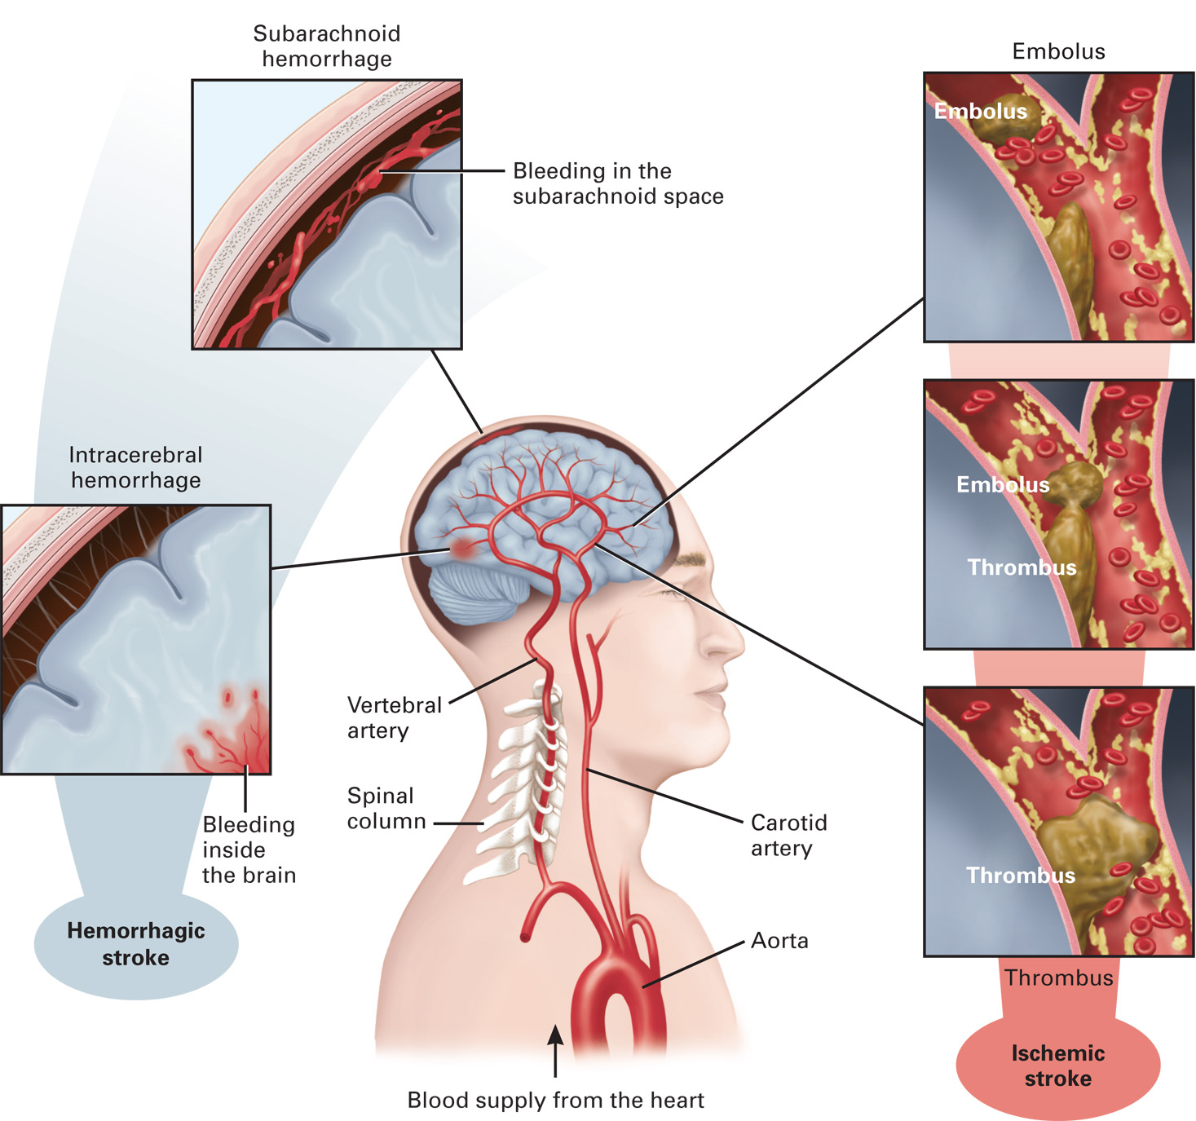
Causes of Stroke
Notes:
Blood is carried from the heart to the brain via the carotid and vertebral arteries, which form a ring and branches within the brain. A hemorrhagic stroke occurs when a cerebral artery ruptures and bleeds into the brain (examples shown: subarachnoid bleeding on the surface of the brain; intracerebral bleeding within the brain). An ischemic stroke occurs when a thrombus is formed on the wall of an artery or when an embolus travels from another area until it lodges in and blocks an arterial branch.

Slide 21
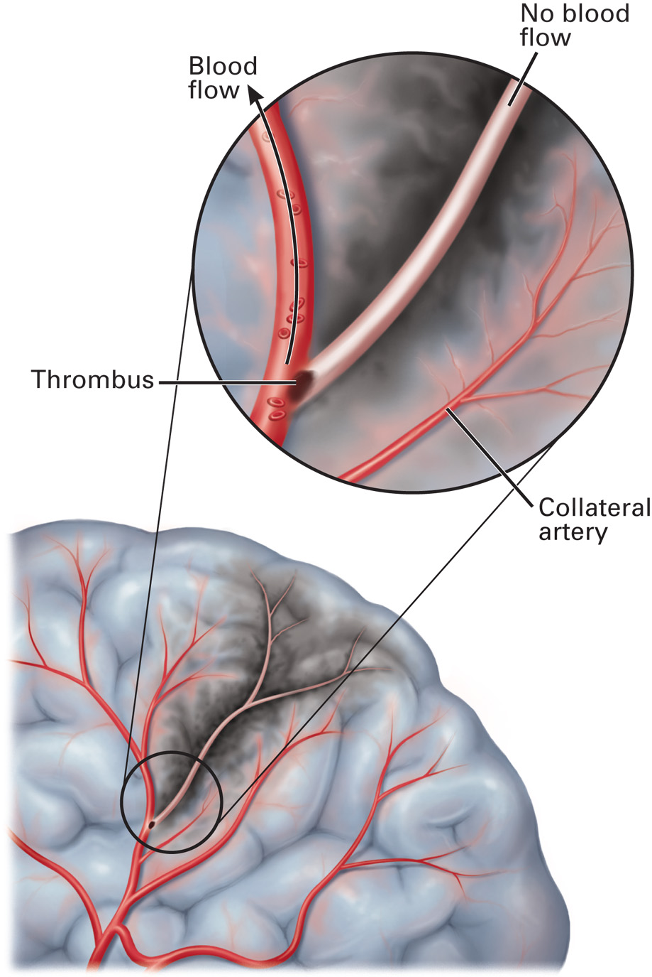
Ischemia, Infarction, and Collateral Flow
Notes:
Brain tissues distal to a rupture, thrombus, or embolus receive little or no perfusion and become ischemic (starved of oxygen) and eventually infarcted (dead). When a thrombus grows slowly enough, collateral arteries may form parallel to the blocked artery to perfuse or partially perfuse the oxygen-starved area of the brain.

Slide 22
Click on the Statement That Best Describes a Thrombotic Stroke
A. An artery in the brain ruptures, causing bleeding within the brain tissue.
B. A blood clot forms in the left side of the heart and travels through the arterial system into the brain, causing an obstruction to blood flow.
C. An artery on the surface of the brain ruptures, causing bleeding between the brain and the skull.
D. A blood clot forms at the site of a damaged artery within the brain, causing an obstruction to blood flow.

Slide 23
Stroke (5 of 20)
Types of Stroke
  Stroke caused by a blockage is referred to as an ischemic stroke and stroke caused by rupture and bleeding is referred to as a hemorrhagic stroke.
  It is difficult to distinguish between types of stroke in the prehospital setting.
Notes:
Stroke is caused by an interruption of blood flow to the brain. This occurs either by the blockage of an artery that is carrying blood to a specific area within the brain or from bleeding within the brain resulting from a ruptured cerebral artery. Stroke caused by a blockage is referred to as an ischemic stroke, and stroke caused by rupture and bleeding is referred to as a hemorrhagic stroke.

Slide 24
Stroke (6 of 20)
Types of Stroke
  Ischemic Strokes
    Occur when the cerebral artery is blocked by a clot or other foreign matter.
    A clot that develops at the site of occlusion is called a thrombus.
    Patients with an ischemic stroke may be eligible to receive fibrinolytic drugs.
    Atrial Fibrillation can precipitate an ischemic stroke.
Notes:
A clot that develops at the site of an occlusion is called a thrombus, and the process of clot formation is referred to as thrombosis. A stroke resulting from thrombus formation is called a thrombotic stroke. A clot or other matter that has traveled from another area of the body is called an embolus. When the embolus lodges in a cerebral artery and occludes it, it is known as a cerebral embolism and results in an embolic stroke.
As the body ages, it is common for fatty deposits (plaque) to form on the inner wall of arteries and cause them to narrow, reducing the amount of blood they can carry. This process is called atherosclerosis, and the narrowed portions of the arteries are common sites for blood clot formation. When a thrombus forms inside an artery, it can completely block the flow of blood through that artery to the brain. This results in the death of brain tissue, which is a stroke.
Atrial fibrillation is an irregular heart rhythm that is highly associated with cerebral embolism. In atrial fibrillation, the atria of the heart fibrillate, which means they make a quivering movement from a lack of a synchronized contraction of the atria heart muscle. Blood tends to stagnate in the quivering atria, which causes it to begin to clump together, forming clots. One of these clots can easily be transported from the left atrium to the left ventricle, then through the aorta, and up the carotid arteries to the brain.

Slide 25
Stroke (7 of 20)
  Types of Stroke
  Hemorrhagic Strokes
    Results from the rupture of a weakened cerebral artery.
    High blood pressure can precipitate a hemorrhagic stroke.
    Hemorrhagic strokes are usually caused by an aneurism or an Arteriovenous Malformation (A V M).
Notes:
People with hypertension (high blood pressure) are likely candidates for a hemorrhagic stroke because ruptures are most likely to occur in arteries that have been damaged by hypertension.
Hemorrhagic strokes are usually caused by either of two types of weakened blood vessels: an aneurysm or an arteriovenous malformation (AVM). An aneurysm is a ballooning of a weakened area within an artery wall. If left untreated, the area continues to weaken and balloon until it ruptures. An Arteriovenous Malformation (AVM) is a tangle of abnormally formed blood vessels in the brain or on its surface that divert blood directly from the artery to the vein, bypassing the capillaries. The AVM is a congenital anomaly that occurs in approximately one percent of the population. This abnormal vessel structure can weaken and rupture, leading to bleeding within or around the brain, causing a hemorrhagic stroke.

Slide 26
Stroke (8 of 20)
  Types of Stroke
  Hemorrhagic Strokes
    Signs and symptoms of a hemorrhagic stroke depend on the area of the brain where the hemorrhage occurs.
    Common signs include nausea & vomiting, headache and decreased level of consciousness.
    It is difficult to distinguish between the two types of stroke in the field.
Notes:
Common signs and symptoms of hemorrhagic stroke:
Hemorrhagic stroke with bleeding in brain tissue (Intracerebral).
Headache.
Nausea and vomiting.
Weakness to one side of the body.
Decreased level of consciousness.
Hemorrhagic stroke with bleeding in the subarachnoid space (Subarachnoid).
Worst headache.
Intolerance to light.
Vomiting.
Decreased level of consciousness.
Your role as an EMT is to provide supportive care to the patient by managing any immediate life threats and by collecting the most accurate information possible to report to the emergency department. Your purpose in collecting the information isn't to distinguish between the types of stroke, but to report it accurately to the emergency department staff.

Slide 27
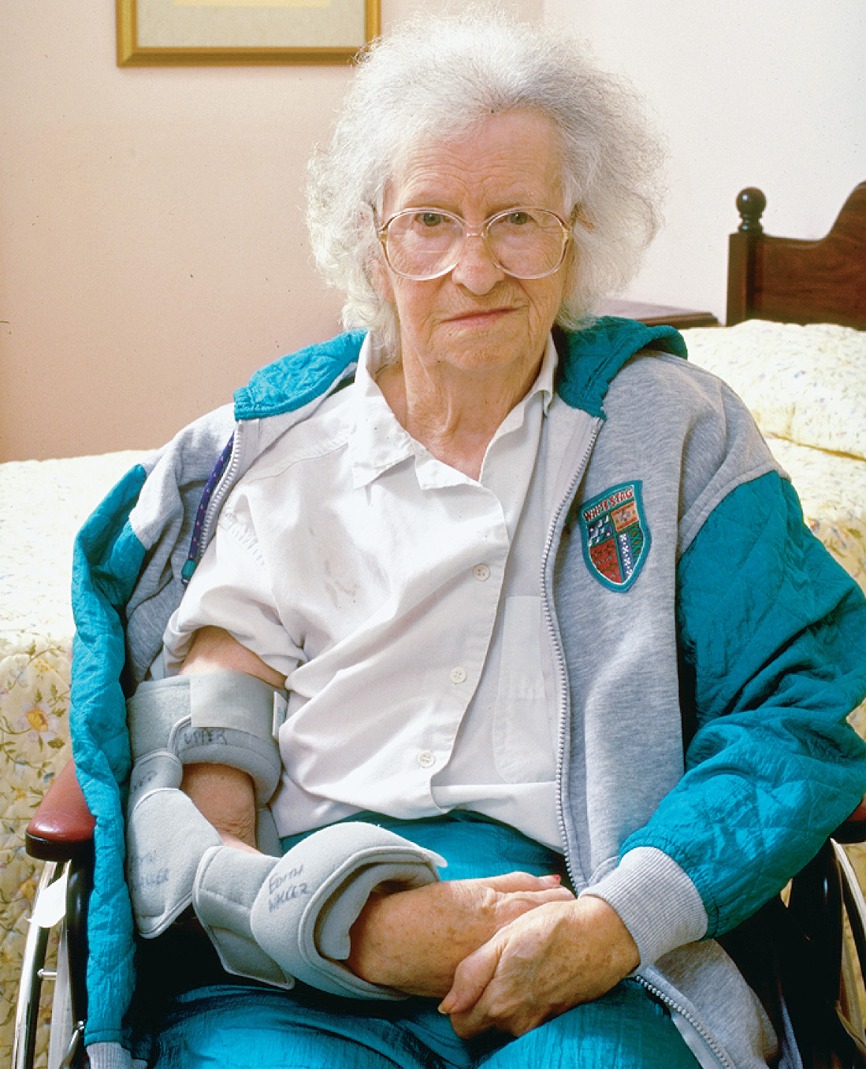
The Stroke Patient Will Often Suffer Paralysis Affecting the Face and Extremities on One Side of the Body
Notes:
The signs and symptoms of a stroke are associated with the specific area of the brain that has been affected by a disruption in the blood flow. Most commonly, it involves the areas that control speech, sensation, and muscle function.

Slide 28
Stroke (9 of 20)
Stroke or Transient Ischemic Attack
  Same signs and symptoms as stroke
    Symptoms disappear, usually within one hour.
    The emergency care for T I A is the same as for stroke.
Notes:
Discussion Question
What are common signs and symptoms of a stroke? A TIA?

Slide 29
Stroke (10 of 20)
Stroke or Transient Ischemic Attack
  Stroke
    Signs and Symptoms
      Sudden onset weakness or paralysis
      Facial droop
    Anterior and Posterior Circulation Strokes.
      It is rare that paralysis from a stroke affects both extremities on both sides of the body
Notes:
The signs and symptoms of a stroke are associated with the specific area of the brain that has been affected by a disruption in the blood flow. Most commonly, it involves the areas that control speech, sensation, and muscle function. The onset of the signs and symptoms is usually sudden; however, some signs or symptoms might continue to progress as the cells become more ischemic or infarcted.
Strokes are also categorized as anterior or posterior circulation strokes. This only describes the area of the brain affected, but also the typical signs and symptoms expected.
Common signs and symptoms of an anterior circulation stroke:
Paralysis and motor deficits - Weakness, clumsiness, heaviness, or complete paralysis of the hand, arm, leg, or face on one side of the body (unilateral).
Numbness, tingling, and loss of sensation – Numbness, tingling, or loss of sensation can occur to the hand, arm, leg, or face and all on the same side of the body.
Language disturbance – In expressive aphasia (nonfluent), the patient knows exactly what they want to say; however, they have trouble saying it because they can’t form the right response in their brain or pick the correct words. In receptive aphasia (fluent), the person has difficulty understanding what you are asking or telling him. They might respond fluently with words that don’t match what was asked or told. In global aphasia, which is the most severe, but most common after a stroke, the patient can't understand or speak.
Vision disturbance – Total or partial loss of vision in one eye (monocular blindness) might occur. The patient might also describe their vision disturbance as a dropped curtain, fog, or a grayout or blackout.
Eye gaze – The eyes can have a conjugate (both eyes together) gaze toward the side of the brain the clot is on.
Common signs and symptoms of a posterior circulation stroke:
Paralysis and motor deficits – Weakness, clumsiness, heaviness, or complete paralysis of the hand, arm, leg, or face on one (unilateral) or both (bilateral) sides of the body, alone or in combination.
Numbness, tingling, and loss of sensation – Numbness, tingling, or loss of sensation can occur to the hand, arm, leg, or face on the right, left, or both sides of the body.
Language disturbance – Aphasia usually doesn’t occur; however, the patient can have dysarthria. Dysarthria is slurred or difficult-to-understand speech caused by weakness or paralysis of the muscles used to form words.
Vision disturbance – The patient might complain of double vision (diplopia) or bouncing or moving visual objects. You might note the eyes aren't looking in the same direction (dysconjugate gaze).
Ataxia and vertigo – The patient may also complain of a spinning sensation (vertigo) or you may note a loss of coordination (ataxia).
Discussion Question
What are common signs and symptoms of a stroke? A TIA?

Slide 30
Stroke (11 of 20)
  Stroke or Transient Ischemic Attack
  Transient Ischemic Attack
    Many of the same signs and symptoms as a stroke.
    Most T I A s resolve in less than five minutes with the average being one minute.
    10–20 percent risk of a stroke in the subsequent 90 days, half of these within 24-48 hours.
Notes:
According to the AHA/ASA, most TIAs last less than five minutes with the average being one minute. According to the National Institute of Neurologic Disorders and Stroke (NINDS), the signs and symptoms of the TIA typically last only a few minutes and most resolve within 60 minutes; however, many do so before 30 minutes. When the temporary blockage of the cerebral artery occurs, the brain cells distal to that vessel receive a significantly reduced amount of blood or no perfusion. This creates cellular ischemia and the brain cells become electrically silent, producing the typical signs and symptoms of a stroke.
Discussion Question
What are common signs and symptoms of a stroke? A TIA?

Slide 31
Stroke (12 of 20)
  Stroke or Transient Ischemic Attack
  Cryptogenic Stroke
    can’t be attributed to a specific cause.
    Thought to be secondary to atrial fibrillation.
Notes:
A cryptogenic stroke is defined as one that can't be conclusively attributed to an embolism originating from the heart, thrombosis in an artery, or small artery disease despite extensive medical diagnostic testing. Cardiac embolism secondary to atrial fibrillation is thought to be a common cause. Other possible causes include a defect between the walls of the atria, thrombophilia (an abnormal tendency to form clots), a nonbacterial infection to the inner lining of the heart (endocarditis), and cerebrovascular disease that is subclinical (not yet producing any signs or symptoms).
Discussion Question
What are common signs and symptoms of a stroke? A TIA?

Slide 32
Stroke (13 of 20)
Assessment-Based Approach: Stroke and Transient Ischemic Attack
  Scene size-up
    Determine the nature of the problem.
    Note where the patient is found.
Notes:
As you arrive, scan the scene to try to determine whether the neurologic deficit is due to trauma or to a medical condition. Look for any signs that would make you suspect that the patient’s head or spine has been injured. Scan the scene for alcohol, drugs or drug paraphernalia, and prescription or illegal drugs, which are other possible causes of an altered function. Specifically, look for evidence of amphetamines, cocaine, and other stimulants because they are related to nontraumatic brain injury in young adults.
Note where the patient is found and how they are dressed. Many strokes occur at night and the patient awakens with the neurologic deficit.
Teaching Tips
Role play the assessment of a patient complaining of stroke symptoms.
Knowledge Application
Given several different scenarios, students should be able to use either the Cincinnati Prehospital Stroke Scale or the Los Angeles Prehospital Stroke Screen.
Discussion Question
What are key components of the history in a patient who may be having a stroke?
Class Activity
Have pairs of students assist each other in immobilizing their dominant arm, and have them try to take notes in class and go on break with their upper extremity immobilized to help students appreciate the frustration of a stroke patient with impaired motor function.
Critical Thinking Discussion
What do you think is the experience of a stroke patient, both immediately and over time?
Discussion Question
What are important considerations in the management of a patient who may be having a stroke?

Slide 33
Stroke (14 of 20)
Assessment-Based Approach: Stroke and Transient Ischemic Attack
  Primary assessment
    Assess the airway and suction as needed.
    Position the patient.
    Use an airway adjunct, as needed.
    Assess for inadequate breathing and abnormal breathing patterns.
    Apply oxygen if the S p O₂ is <94%.
Notes:
Any patient presenting with a sudden weakness of the face, hand, arm, or leg; trouble speaking or stuttering; difficulty seeing in one or both eyes; problem walking or a loss of balance or coordination; confusion; dizziness; or a sudden onset of a severe headache should be suspected of having suffered a stroke.
If the patient is unresponsive, perform a physical exam and obtain vital signs before obtaining the history. If the patient is responsive, take the history before performing the physical exam and obtaining vitals.
The physical exam is a rapid head-to-toe assessment. Any patient with a loss of motor or sensory function, speech difficulties, or an altered mental status may be suffering from a head injury. Carefully inspect and palpate the head to determine if there is any evidence of trauma.

Slide 34
Stroke (15 of 20)
  Assessment-Based Approach: Stroke and Transient Ischemic Attack
  Secondary assessment
    Findings suspicious for stroke include:
      Sudden weakness of face or extremities
      Trouble speaking and/or difficulty seeing
      Problems walking or loss of balance or coordination
      Sudden, severe headache
Notes:
Inspect the face for a drooped appearance on one side by instructing the patient to look up and smile or show their teeth.
Listen for garbled sounds or slurring when the patient speaks. Have the patient say the following phrase to assess their speech capability: “You can’t teach an old dog new tricks.” An abnormal finding would be if the patient said the wrong words, slurred words, could not say the phrase at all, uttered a completely unrelated phrase, or didn’t understand your directions.
If you find the patient walking, note their movement and the manner they are walking. An abnormality such as unsteadiness can indicate a neurologic deficit.
When assessing the extremities, you may find a reduction in sensory and motor function on one side of the body. The patient may lack the ability to feel your touch or to feel pain and may display weakness or paralysis.

Slide 35
Stroke (16 of 20)
  Assessment-Based Approach: Stroke and Transient Ischemic Attack
  Secondary assessment
    Prehospital Stroke Screening Tools
      Cincinnati Prehospital Stroke Scale (C P S S)
      Los Angeles Prehospital Stroke Screen (L A P S S)
      Miami Emergency Neurologic Deficit (M E N D)
      Rapid Arterial Occlusion Evaluation (R A C E)
      Scale and Large Vessel Occlusion (L V O)
    Two types of stroke centers
Notes:
When performing a neurologic examination on a responsive patient who presents with any suspected signs or symptoms of a stroke, you should use one of the following validated stroke screening evaluation tools:
Cincinnati Prehospital Stroke Scale (CPSS) tests for facial droop by having the patient show their teeth or make a smile; arm drift by having the patient close their eyes and hold both arms straight out in front of them for ten seconds; and abnormal speech pattern and muscle paralysis by having the patient say, “You can’t teach an old dog new tricks.”
Los Angeles Prehospital Stroke Screen (LAPSS) takes into consideration other possible causes of altered mental status, such as hypoglycemia, hyperglycemia, or seizures, and requires a physical test of asymmetry (unequal amount) of strength. The information gathered in the LAPSS is age greater than 45 years, history of seizures or epilepsy, duration of symptoms, wheelchair or bedridden status of patient, and blood glucose level. Asymmetry of strength is assessed by testing the facial smile or grimace, grip, and arm strength.
Miami Emergency Neurologic Deficit (MEND) Scale is more comprehensive than CPSS and takes approximately three minutes to complete. The MEND exam is based on CPSS and adds elements of the National Institutes of Health Stroke Scale (NIHSS) that also evaluate posterior circulation. This should enable EMS providers to better assess for stroke and ensure transport to a primary stroke center or a medical facility that provides stroke care. The MEND exam assesses mental status, cranial nerves, and limbs.) Under the mental status check, AVPU, speech, and the ability to answer questions and obey commands are assessed. The cranial nerves are assessed for facial droop, visual fields, and horizontal gaze. The limbs section tests motor and sensory function by assessing for arm drift, leg drift, ability to feel touch and pain in the arms and legs, and coordination in the arms and legs.
Rapid Arterial Occlusion Evaluation (RACE) Scale and Large Vessel Occlusion (LVO) Stroke. A large vessel occlusion (LVO), also known as an emergent large vessel occlusion (ELVO), is a stroke caused by blockage of a large cerebral artery. LVO has the highest mortality rate and worst patient outcomes among all strokes because the blockage of a large artery cuts off blood flow to a large area of the brain. The two primary treatment options for strokes are thrombolytic drugs and interventional endovascular procedures, which are similar to cardiac catheterization, but involve the cerebral arteries instead, to remove the clot. Thrombolytic drugs alone typically aren't enough to remove the clot in an LVO. The most effective treatment is a combination of a thrombolytic drug and an endovascular procedure.
The RACE scale is a five- or six-item scale. The last items of the scale depend on the side of the body where the patient is exhibiting any of the deficits listed in the previous items. The assessment items follow:
Facial palsy - Ask the patient to show their teeth or make an exaggerated smile. Assess for facial droop on one side.
Arm Motor Function - Have the patent extend their arms 90 degrees if sitting or 45 degrees if supine. Assess if the patient can lift their arms and hold them up for ten seconds without drifting downward.
Leg motor function - Have the patient lift each leg (one at a time) to 30 degrees in a supine patient. Assess if the patient can lift their legs and hold each up one at a time for five seconds without drifting downward.
Head and gaze deviation - Observe the eyes and head for deviation to one side. If the head or eyes are deviated to one side, ask the patient to look toward the opposite side of the gaze.
Aphasia (right side deficit) - If the patient has right-sided weakness or paralysis on the previous motor function assessments, perform the aphasia assessment. Aphasia is assessing for difficulty in or an inability in understanding spoken or written words. Ask the patient to (1) close their eyes and (2) make a fist.
Agnosia (left side deficit) - If the patient has left-sided weakness or paralysis on the previous motor function assessments, perform the agnosia assessment. Agnosia is the inability to recognize familiar objects. Have the patient lift the affected (weak or paralyzed) extremity and ask the patient (1) “Whose arm is this?” and (2) “Can you move your arm?”
Each item is scored from 0 (indicating no deficit or normal) to 2 (having the most severe deficit).
There are two types of stroke centers:
Primary stroke centers that administer thrombolytic drugs.
Comprehensive stroke centers that perform endovascular procedures in addition to administering thrombolytic drugs.

Slide 36
Stroke (17 of 20)
  Assessment-Based Approach: Stroke and Transient Ischemic Attack
  Secondary assessment
    Obtain a history
    Perform a physical exam
    Obtain baseline vital signs
Notes:
During your history, look for medical alert tags, collect the patient’s prescription and nonprescription medications, and don’t forget to look in the refrigerator for a vial of insulin, used to treat diabetes. Remember that diabetics may be hypoglycemic, and patients who are hypoglycemic may show signs and symptoms similar to those of a stroke patient, especially if the patient is elderly.
Answers to the following questions can guide you in your emergency care of the patient:
When did the symptoms begin?
Is there any recent history of trauma to the head?
Does the patient have a history of a previous stroke?
Was there any seizure activity noted prior to your arrival?
What was the patient doing at the time of onset of the signs and symptoms?
Does the patient have a history of diabetes?
Has the patient complained of a headache? A stiff neck?
Has the patient complained of dizziness, nausea, vomiting, or weakness?
Has the patient experienced any slurred speech?
If the patient’s mental status is deteriorating, the hospital staff might not get this information later and need to rely on the information you obtain:
Does the patient take any oral anticoagulant drugs?
Does the patient have a history of hypertension (high blood pressure)?
Has the patient taken amphetamines, cocaine, or some other stimulant drug?
Was the onset of signs and symptoms gradual or sudden?
Did the signs and symptoms get progressively worse or better?
Did the paralysis or weakness affect one part of the body first and then progress to other areas?
Does the patient have a history of atrial fibrillation or irregular heartbeat?

Slide 37
Stroke (18 of 20)
  Assessment-Based Approach: Stroke and Transient Ischemic Attack
  Secondary assessment
    Dangers of administering too much oxygen in a stroke
      Free radicals cause tissue damage
      Provide oxygen titrated to 94 percent
Notes:
Blood restored to an area of brain tissue that was previously ischemic from low blood flow or occlusion of a vessel is called reperfusion. The oxygen in the blood flowing to the reperfused brain tissue increases the production of free radicals, which directly damage brain cell membranes and other cellular components and result in brain cell death. A higher oxygen level in the blood results in a greater production of damaging free radicals and greater brain cell and tissue death. It is extremely important to limit oxygen therapy in the stroke patient. It is recommended that oxygen be provided only to stroke patients with an SPO₂ <94% or if an SPO₂ is unknown.

Slide 38
(a) The Face of a Nonstroke Patient Has Normal Symmetry
(b) The face of a stroke patient often has an abnormal, drooped appearance on one side.
(© Edward T. Dickinson, M D)
Notes:
Inspect the face for a drooped appearance on one side by instructing the patient to look up and smile or show their teeth.

Slide 39
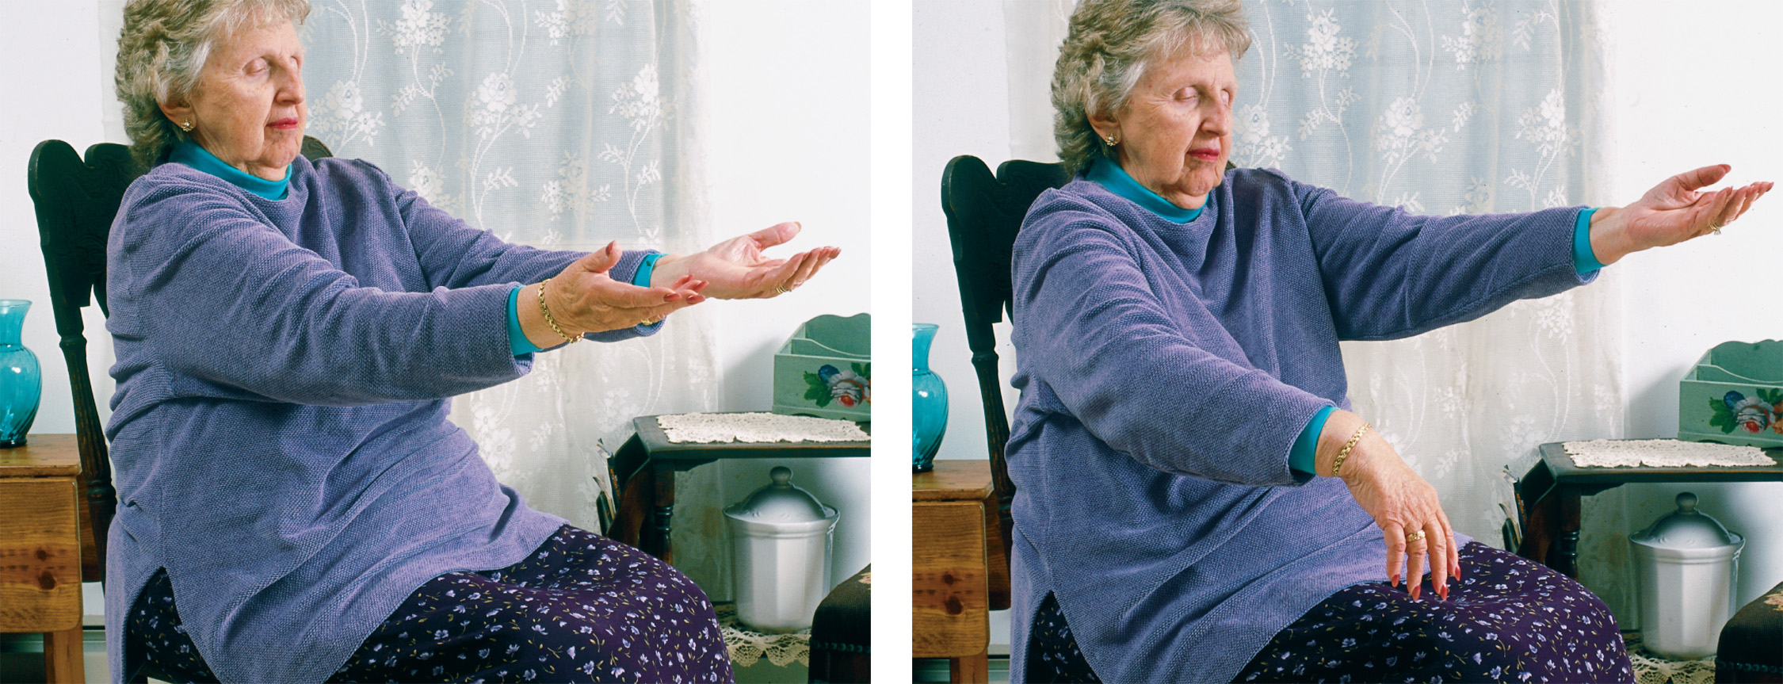
(a) A Patient Who Has Not Suffered a Stroke Can Generally Hold Arms in an Extended Position with Eyes Closed
(b) A stroke patient will often display “arm drift” or “pronator drift”; that is, one arm will remain extended, when held outward with eyes closed, but the other arm will drift or drop downward and pronate (turn palm downward).
Notes:
One arm does not move or one arm drifts downward when the patient’s arms are extended outward for ten seconds with their eyes closed.

Slide 40
The Cincinnati Prehospital Stroke Scale
Sign of Stroke | Paient Activity | Interpretation
Facial droop | Have patient look up at you, smile, and show his teeth. | Normal: Symmetry to both sides. Abnormal: One side of the face droops or does not move symmetrically.
Arm drift | Have patient lift arms up and hold them out with eyes closed for 10 seconds. | Normal: Symmetrical movement in both arms. Abnormal: One arm drifts down or asymmetrical movement of the arms.
Abnormal speech | Have the patient say, “You can’t teach an old dog new tricks.” | Normal: The correct words are used and no slurring of words is noted. Abnormal: The words are slurred, the wrong words are used, or the patient is aphasic.
Kothari R. U., Pancioli A., Liu T., Broderick J. Cincinnati Prehospital Stroke Scale: Reproducibility and validity. Annals of Emergency Medicine. 1999; 33:373–378.
Notes:
CPSS tests for:
Facial droop by having the patient show their teeth or make a smile.
Arm drift by having the patient close their eyes and hold both arms straight out in front of them for ten seconds.
Abnormal speech pattern and muscle paralysis by having the patient say, “You can’t teach an old dog new tricks.”

Slide 41
The Los Angeles Prehospital Stroke Screen (L A P S S)
Considerations | Yes | Unknown | No
Age greater than 45 years | Blank | Blank | Blank
No history of seizures or epilepsy | Blank | Blank | Blank
Duration of symptoms is less than 24 hours | Blank | Blank | Blank
Patient is not wheelchair bound or bedridden | Blank | Blank | Blank
Blood glucose level between 60 and 400 milligram/d eciL itre | Blank | Blank | Blank
Physical exam to determine unilateral asymmetry | Equal | R Weakness | L Weakness
A. Have patient look up, smile, and show teeth | Blank | Droop | Droop
B. Compare grip strength of upper extremities | Blank | Weak grip | Weak grip
Blank | Blank | No grip | No grip
C. Assess arm strength for drift weakness | Blank | Drifts down | Drifts down
Blank | Blank | Falls rapidly | Falls rapidly
Kidwell C.S., Saver J.L., Schubert G.B., Eckstein M., Starkman S. Design and retrospective analysis of the Los Angeles Prehospital Stroke Screen (L A P S S). Prehospital Emergency Care. 1998; 2:267–273.
Kidwell C.S., Starkman S., Eckstein M., Weems K., Saver J.L., Identifying stroke in the ﬁeld: Prospective validation of the Los Angeles Prehospital Stroke Screen (L A P S S). Stroke. 2000; 31:71–76.
Notes:
The information gathered in the LAPSS is:
Age greater than 45 years.
History of seizures or epilepsy.
Duration of symptoms.
Wheelchair or bedridden status of patient.
Blood glucose level.
Asymmetry of strength is assessed by testing the facial smile or grimace, grip, and arm strength.

Slide 42
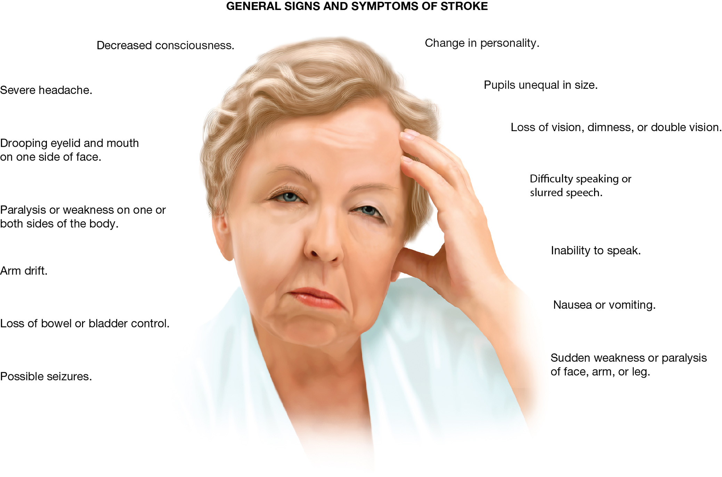
Stroke and Transient Ischemic Attack (T I A) Are Conditions That May Result from Nontraumatic Brain Injury
Loss of speech, sensory, or motor function and altered mental status are among the possible signs and symptoms. facial asymmetry is a common sign.
(© Pressmaster/Shutterstock)
Notes:
Stroke and transient ischemic attack (TIA) are conditions that may result from nontraumatic brain injury. Loss of speech, sensory, or motor function and altered mental status are among the possible signs and symptoms. Facial asymmetry is a common sign.

Slide 43
Stroke (19 of 20)
  Assessment-Based Approach: Stroke and Transient Ischemic Attack
  Emergency medical care
    Maintain the patient’s airway.
    Suction as needed.
    Assist ventilation as needed.
    Maintain adequate oxygenation.
    Position the patient.
Notes:
Airway compromise in the stroke patient is common. It may be necessary to insert an oropharyngeal or nasopharyngeal airway. Typically, the nasopharyngeal airway is preferred because it is better tolerated by the patient.
Because vomiting is associated with a brain injury or stroke, be prepared to remove vomitus by suctioning.
As the patient deteriorates, breathing may become inadequate. If the rate or quality of breathing is inadequate, begin positive pressure ventilation with supplemental oxygen. It is important to recognize early signs of respiratory failure. Inadequate breathing could drastically increase injury to the brain because of decreased oxygen flow to the brain and a buildup of carbon dioxide. If the patient is unresponsive and has unequal pupils or posturing and is breathing inadequately, hyperventilation at a rate of 20 ventilations per minute with supplemental oxygen might be considered. Follow your local protocol or contact medical direction because hyperventilation of patients with increased pressure inside the skull is considered controversial and may worsen the blood flow to the brain.
According to the AHA 2015 guidelines, if the SPO₂ reading is less than 94 percent, the patient complains of dyspnea, or signs and symptoms of hypoxia, heart failure, or shock are present, administer oxygen by nasal cannula at two lpm. If necessary, titrate the liter flow upward to establish and maintain a SPO₂ of 94 percent or greater. Follow your local protocol.
If the patient can't protect their own airway because of a reduction in their mental status, place them in a left lateral recumbent position. Place the responsive patient in a supine position. If the patient wants to be placed in a semi-Fowler’s position, do not elevate the head and chest more than 30 degrees. If a spinal injury is suspected, perform a jaw-thrust maneuver to open the airway and provide manual spine motion restriction with the patient supine. If the patient requires ventilation, place them in a supine position.

Slide 44
Place the Unresponsive Patient in a Left Lateral Recumbent Position If Spinal Injury isn’t Suspected
Notes:
If the patient can't protect their own airway because of a reduction in their mental status, place them in a left lateral recumbent position.

Slide 45
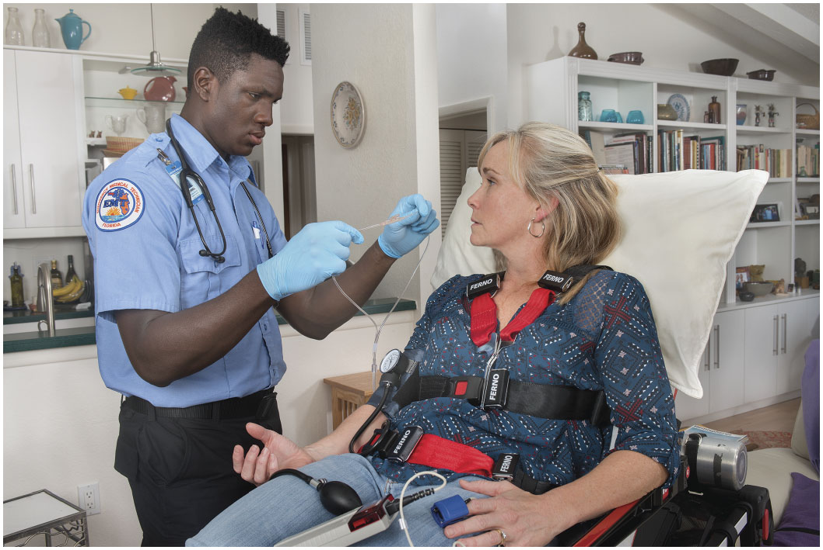
Place the Responsive Patient in a Supine Position with the Head and Chest Elevated If Spinal Injury isn’t Suspected
Notes:
If the patient wants to be placed in a semi-Fowler’s position, don’t elevate the head and chest more than 30 degrees.

Slide 46
Stroke (20 of 20)
    Assessment-Based Approach: Stroke and Transient Ischemic Attack
    Emergency medical care
    Check the blood glucose level.
    Protect paralyzed extremities.
    Rapid transport.
  Reassessment
    Reassess every five minutes.
Notes:
Check the blood glucose level if your protocol permits. If the blood glucose reading is less than 70 mg/dL, suspect a low blood glucose (hypoglycemia) as the possible cause of the signs and symptoms, especially in an elderly patient.
Because the patient can't move the paralyzed extremity, it is vital to protect the paralyzed extremities from any injury.
Transport any patient with suspected stroke to a medical facility capable of immediate imaging and intervention, preferably a stroke center.

Slide 47
Headache (1 of 5)
Headache may be a condition in itself, or can be a symptom of another condition.
Notes:
Teaching Tips
Ask students who are willing to share their experience of headaches, particularly if a student in class has a history of migraine headaches. It is difficult for a person who has not experienced a migraine to appreciate the discomfort associated with the condition.
Discussion Question
What are some of the causes of headaches?

Slide 48
Headache (2 of 5)
Types of Headache
  Vascular headaches
    Migraine
    Hypertension
  Cluster headaches
  Tension headache
  Organic, traction, or inflammatory headaches
Notes:
Vascular headaches occur because of dilation or distention of vessels, or inflammation within the cranium. Migraine headaches are thought to be caused by spasm of vessels followed by vasodilation and a change in the chemicals that transmit nervous impulses in the brain. Migraines are often described as throbbing and can be generalized or localized to one side of the head. The patient also commonly experiences sensitivity to light (photosensitivity), nausea, vomiting, and sweating. A vascular headache can also be caused by hypertension (high blood pressure), typically reaching a diastolic pressure of 120 mmHg for a headache to occur.
Cluster headaches are headaches that occur repetitively, in clusters. They are similar to migraines because they are believed to have a vascular origin.
Tension headaches are thought to be caused by contraction of the muscles of the neck and scalp. The pain is usually described as “tight” or “viselike.” This is the most common type of recurring headache found in children, adolescents, and adults.
Organic headaches are also called traction or inflammatory headaches, these aren't simply headache conditions, but rather are symptoms of another condition. They may be a result of tumors, infection, stroke, or inflammatory disorders within the cranium such as a hemorrhage or meningitis.

Slide 49
Headache (3 of 5)
Assessment
  Suspect a serious underlying condition with any of the following findings:
    Altered mental status
    Motor or sensory deficit
    Behavior change
    Seizure
Notes:
During scene size-up, look for clues that a headache might be associated with a toxic exposure. Assess the airway, ventilation, and oxygenation status. Apply oxygen based on the SPO₂ and patient presentation. Oxygen can relieve a cluster headache. Assess pulse and perfusion. Pain often triggers the sympathetic nervous system and causes tachycardia and pale, cool, clammy skin. Perform a history and secondary assessment looking for any underlying cause of the headache. Assess the blood glucose level if permitted.

Slide 50
Headache (4 of 5)
Assessment
  Suspect a serious underlying condition with any of the following findings:
    First experience of this type of headache with abrupt onset
    Worsening of pain with coughing, sneezing, or bending over
    Fever or stiff neck
    Change in the quality of a chronic headache
Notes:
Discussion Question
What are some important questions to ask of the patient experiencing a headache?
Class Activity
Have pairs of students role play obtaining the history from a patient with a complaint of headache.
Knowledge Application
Given several descriptions of patients with a complaint of headache, students should be able to develop a relevant line of questioning.

Slide 51
Headache (5 of 5)
Emergency Medical Care
  Establish and maintain an airway.
  Be prepared to suction.
  Assess and maintain adequate ventilation.
  Administer oxygen for an S p O₂ >94%.
  Position for comfort.
  Be prepared for seizures.
  Transport.
Notes:
Critical Thinking Discussion
Why is it important to reassess the patient complaining of a headache?

Slide 52
Case Study Conclusion (1 of 3)
Because of Mr. Hewlett’s slurred speech, both E M T s are immediately aware of the potential for airway compromise. Fred carefully assesses the airway and breathing as Reese asks Mrs. Hewlett what happened.
Mr. Hewlett is alert, and appears frustrated at his difficulty in making himself understood. Fred assures him that they will quickly do what they need to do and then will get him to the hospital for further assessment and care.
Notes:
Review case conclusion and emphasize the application of knowledge learned from this presentation.

Slide 53
Case Study Conclusion (2 of 3)
Fred’s stroke scale assessment confirms the facial droop and difficulty speaking, and reveals a slight weakness of Mr. Hewlett’s left hand. Mr. Hewlett is able to maintain a sitting position, so the E M T s position him in semi-Fowler’s position on the stretcher.
Notes:
Review case conclusion and emphasize the application of knowledge learned from this presentation.

Slide 54
Case Study Conclusion (3 of 3)
Meanwhile, Reese was able to obtain information from Mrs. Hewlett, including the time of onset of signs and symptoms, which the E M T s know will be important in determining Mr. Hewlett's ongoing treatment in the hospital.
Notes:
Review case conclusion and emphasize the application of knowledge learned from this presentation.

Slide 55
Summary
Causes of altered mental status include structural and metabolic-toxic causes.
Strokes may be ischemic or hemorrhagic.
Time is of the essence in the management of stroke.
Notes:
The most common signs and symptoms seen in a stroke are sudden onset of weakness, paralysis, or numbness to the arm, hand, leg, or face on one side of the body; confusion or inability of the patient to respond to your questions or commands; trouble speaking; difficulty in vision in one or both eyes; difficulty walking or loss of coordination or balance; or a sudden onset of a severe headache.
Follow-Up
Answer student questions.
Follow-Up Assignments
Review Chapter 18 Summary.
Complete Chapter 18 In Review questions.
Complete Chapter 18 Critical Thinking questions.
Assessments
Handouts
Chapter 18 quiz

Slide 56
Lesson Summary
Use a validated stroke scale to assess patients with suspected stroke.
Headache may be a condition itself, or a symptom of an underlying condition.
Notes:
A headache can be a condition itself or an indication of a serious underlying condition such as stroke, meningitis, hypertension, poisoning, toxic inhalation, or many other conditions.
Carefully assess the patient and pay attention to any evidence of deterioration in mental status or vital signs.
Class Activity
As an alternative to assigning the follow-up exercises in the lesson plan as homework, assign each question to a small group of students for an in-class discussion.
Teaching Tips
Answers to In Review questions are in the appendix of the text. Advise students to review the questions again as they study the chapter.

Slide 57
Correct!
A thrombotic stroke is a type of ischemic stroke in which a blood clot forms at a site of atherosclerosis within an artery in the brain, obstructing the flow of blood.
Click here to return to the program.

Slide 58
Incorrect (1 of 3)
When a blood vessel within the brain ruptures, thereby interrupting blood supply beyond that point and causing bleeding within the brain, it is an intracerebral hemorrhage, a type of hemorrhagic stroke.
Click here to return to the quiz.

Slide 59
Incorrect (2 of 3)
When a blood vessel between the brain and the skull ruptures, causing bleeding between the brain and skull, within the subarachnoid space, it is a type of hemorrhagic stroke.
Click here to return to the quiz.

Slide 60
Incorrect (3 of 3)
When a blood clot forms elsewhere and travels to the brain, interrupting the flow of blood, it is a type of ischemic stroke called an embolic stroke.
Click here to return to the quiz.

Slide 61

Copyright

