Slide 1

Prehospital: Emergency Care
Eleventh Edition
Chapter 17
Cardiovascular Emergencies
Slides in this presentation contain hyperlinks. JAWS users should be able to get a list of links by using INSERT+F7
Copyright © 2018, 2014, 2010 Pearson Education, Inc. All Rights Reserved
Notes:
If this PowerPoint presentation contains mathematical equations, you may need to check that your computer has the following installed:
1) MathType Plugin
2) Math Player (free versions available)
3) NVDA Reader (free versions available)
Advance Preparation
Student Readiness
Assign the associated section of MyBRADYLab and review student scores.
Review the chapter material in the Instructor Resources, which includes Student Handouts, PowerPoint slides, and the MyTest Program.
Prepare
Make copies of course policies and procedures, the syllabus, handouts from the Instructor Resources, and other materials for distribution or post them in your learning management system.
Preview the media resources and Master Teaching Notes in this lesson.
Preview the case study presented in the PowerPoint slides.
Invite the medical director to the first class session.
Make arrangements to tour an emergency department or local PSAP.
Obtain 911 recordings to play for the class.
Arrange to have an ambulance present at the class location.
Bring in a couple of current EMS research articles, pertaining to the topic, from a peer-reviewed publication.
Ask a health department representative to speak on public health and its relationship with prevention.
The total teaching time recommended is only a guideline. Take into consideration factors such as the pace at which students learn, the size of the class, breaks, and classroom activities. The actual time devoted to teaching objectives is the responsibility of the instructor.

Slide 2
Learning Readiness
E M S Education Standards, text p. 520.
Chapter Objectives, text p. 520.
Key Terms, text p. 520-521.
Purpose of lecture presentation versus textbook reading assignments.
Notes:
Explain to students what the National EMS Education Standards are. The National EMS Education Standards communicate the expectations of entry-level EMS providers. As EMTs, students will be expected to be competent in these areas. Acknowledge that the standards are broad, general statements. Although this lesson addresses the listed competencies, the competencies are often complex and require completion of more than one lesson to accomplish. The student is also expected to review the chapter objectives to foreshadow what will be in the chapter. By mastering the key terms the EMT student will better understand the learning and be able to communicate more clearly.
Additionally, explain to the students that the purpose of using these slides is to help keep the instructor focused on highlighting important portions of the material, explain interrelationships of topics, and discuss how to apply this information. It’s not the intent of the presentation (or slides alone) to include every component in the chapter. This presentation still requires the student to thoroughly read the chapter.

Slide 3
Setting the Stage (1 of 2)
Overview of Lesson Topics
  Review of the Circulatory System Anatomy, Physiology and Pathophysiology
  Cardiac Compromise and Acute Coronary Syndrome
  Nitroglycerin
  Age-Related Variations: Pediatrics and Geriatrics
  Assessment and Care
Notes:
These bulleted points are the major headings from the chapter, in order. The purpose is to provide a basic lecture navigation for the student.

Slide 4
Setting the Stage (2 of 2)
  Overview of Lesson Topics
  Assessment and Care: General Guidelines
  Summary
Notes:
These bulleted points are the major headings from the chapter, in order. The purpose is to provide a basic lecture navigation for the student.

Slide 5
Case Study Introduction
E M T s Ella Bray and Lisa Mullins are caring for Bart Frey, a 62-year-old man with a history of angina. Mr. Frey experienced an onset of a “heavy pressure” in the center of his chest, radiating to his left shoulder, and accompanied by profuse sweating. Ella’s general impression is of an alert, but anxious, patient who appears pale and diaphoretic and whose facial expression indicates distress.
Notes:
Case Study
Present the Case Study Introduction provided in the PowerPoint slide set.
Lead a discussion using the case study questions provided on the subsequent slide(s).
The Case Study with discussion questions continues throughout the PowerPoint presentation.
Case Study Discussion
Use the case study content and questions to foreshadow the upcoming lesson content.

Slide 6
Case Study (1 of 4)
What is the underlying process that leads to angina?
Is the patient’s presentation consistent with angina, or do you suspect something else?
What additional information do Ella and Lisa need as they begin patient care?
Notes:
Case Study Discussion
Use the case study content and questions to foreshadow the upcoming lesson content. Gauge the students’ responses as a guide of how well versed they are in this topic.

Slide 7
Introduction
Heart disease is America’s number one killer.
Heart disease can lead to chest discomfort or cardiac arrest.
Because of the potential consequences, E M T s treat all patients with signs and symptoms of cardiac compromise as a cardiac emergency.
Notes:
During this lesson, students will learn about assessment and emergency care for a patient suffering from cardiovascular emergencies such as chest discomfort or pain and cardiac arrest.

Slide 8
Circulatory System Anatomy, Physiology and Pathophysiology (1 of 13)
The Circulatory System
  Has three major components:
    Heart
    Blood vessels
    Blood
Notes:
Each of these components can play a significant role in patients experiencing a cardiac-related emergency.

Slide 9
Circulatory System Anatomy, Physiology and Pathophysiology (2 of 13)
  The Circulatory System
  The Conduction System
    Generates electrical impulses that stimulate contraction of muscle cells
    Pacemaker sites
      Sinoatrial node
      Atrioventricular node
      Purkinje fibers
Notes:
Properties of cardiac muscle include automaticity, conductivity, and contractility.
The primary pacemaker of the heart is the SA node. The AV node and fibers in the ventricles can both also generate impulses automatically if the SA node fails.
Impulses generated by the pacemaker travel along a conduction pathway so that the impulse reaches the individual muscle cells of the heart.
Discussion Question
Describe the conduction of an impulse from the SA node through the heart.

Slide 10
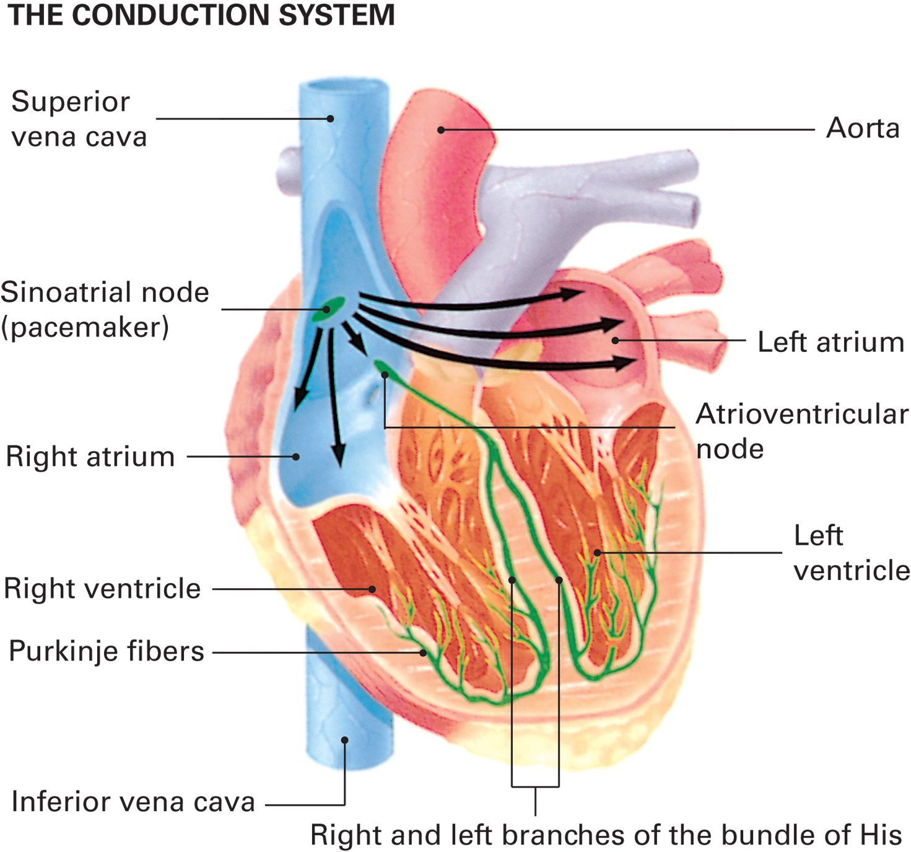
The Cardiac Conduction System
Notes:
The heart’s electrical impulses travel through the heart from the pacemaker sites via a conduction pathway that is composed of cells that neither initiate an impulse nor contract. Instead, the cells of the conduction pathway rapidly conduct each impulse to the rest of the heart muscle. They do this in a unified fashion so that, rather than the whole heart contracting at once, there is a sequential contraction of the chambers.

Slide 11
Circulatory System Anatomy, Physiology and Pathophysiology (3 of 13)
The Circulatory System
  The Conduction System
    The heart has the property of automaticity, but heart rate can be influenced by the sympathetic and parasympathetic nervous systems.
Notes:
The heart’s activity is monitored by the body to ensure that it is meeting the body’s blood flow requirements. If the heart’s activity needs to be modified, assistance is provided by the autonomic nervous system.
Discussion Question
How do the sympathetic and parasympathetic nervous systems influence the heart?
The sympathetic branch of the autonomic nervous system innervates all three pacemaker sites and the working cells of the heart. When the body needs increased blood flow, the sympathetic nervous system is stimulated and causes the heart to beat faster and with greater contractile force, which increases the ejection of blood. The parasympathetic branch of the autonomic nervous system innervates the sinoatrial and atrioventricular nodes. When the parasympathetic nervous system is stimulated, it slows the heart rate and eases the force of contraction.

Slide 12
Circulatory System Anatomy, Physiology and Pathophysiology (4 of 13)
  The Circulatory System
  The Heart
    Pumps blood throughout the body.
    The left ventricle must overcome the pressure in the aorta to eject blood.
    Excessive pressure in the aorta over time can lead to heart failure with pulmonary edema.
Notes:
The right side of the heart receives deoxygenated blood from the venous system and pumps it to the lungs for oxygenation. The left side of the heart receives oxygenated blood from the lungs and pumps it to the body.
The pressure in the pulmonary vessels is low; thus, the right ventricle does not need to generate a great deal of force to eject the blood. In some pulmonary (lung) diseases, such as emphysema, however, the pulmonary vessels are compressed or narrowed. This increases the pressure in the pulmonary vessels and makes it much more difficult for the right ventricle to pump the blood out. If this high pressure is sustained over time, the right ventricle begins to weaken and eventually can fail. This is referred to as right-sided or right ventricular heart failure, also known as cor pulmonale.
The pressure in the aorta is high; therefore, the left ventricle must generate a significant amount of force to eject the blood against this pressure. If the pressure in the aorta is excessively high, as seen in severe hypertensive patients (those with high blood pressure), or if the blood pressure is simply higher than normal over a long period of time, the left ventricle will begin to weaken and fail. Also, if the left ventricle muscle is damaged due to a blockage of a coronary artery, the ventricle weakens and can't pump an adequate amount of blood out of the left ventricle. This can lead to heart failure.
Teaching Tips
An anatomical model of the heart will be helpful in explaining the concepts of this section.
Critical Thinking Discussion
What are the consequences of the heart working against chronically increased resistance?

Slide 13
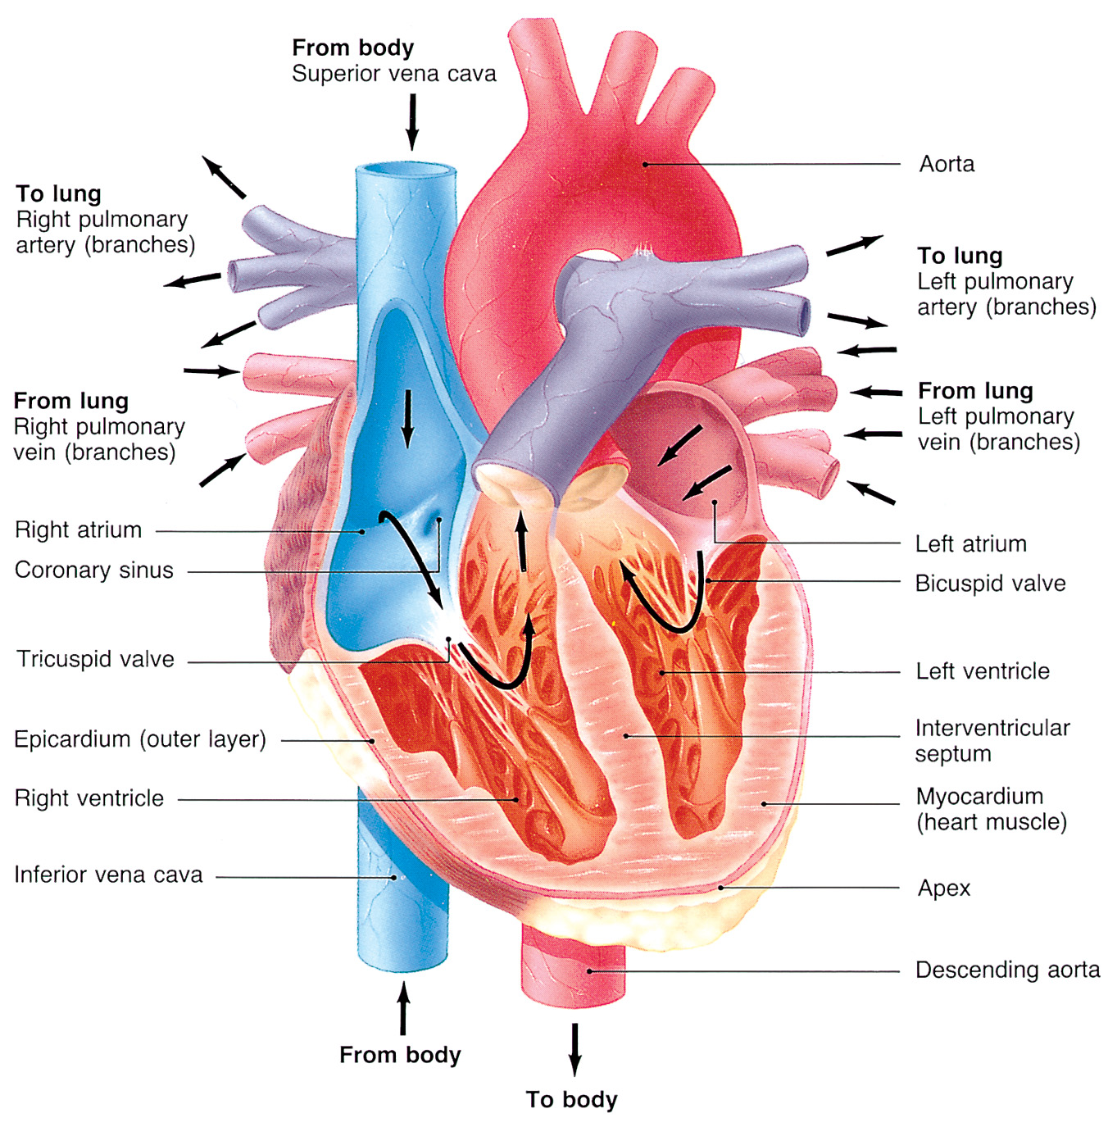
The Heart
Notes:
The heart consists of four chambers: the atria and the ventricles. The heart has only one purpose: pumping blood within the body. If that single purpose is interrupted, even momentarily, cardiac arrest ensues and the chance of survival is slim.

Slide 14
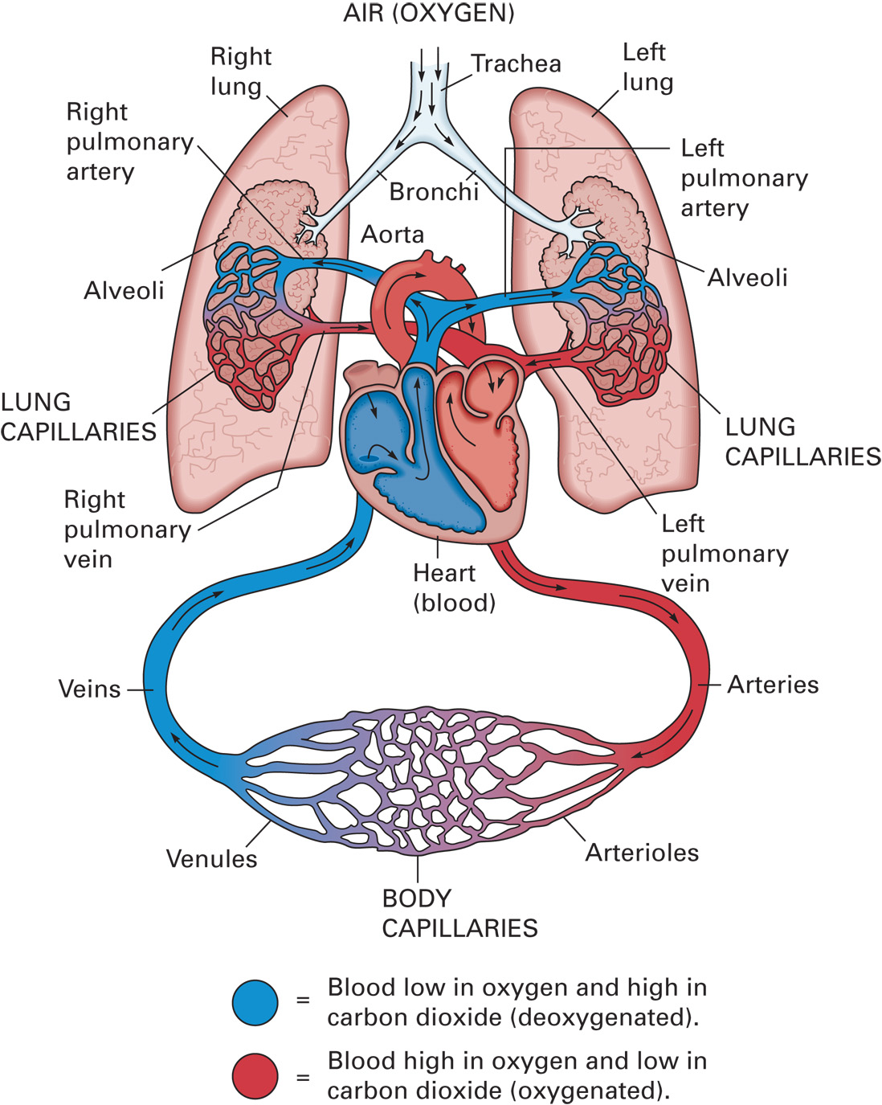
Circulation of Blood through the Cardiovascular System
Notes:
The arteries carry oxygenated blood to the arterioles and then to the capillaries, which interface with cells throughout the body. The exception to the rule that arteries carry oxygenated blood is the pulmonary arteries, which carry deoxygenated blood from the right ventricle to the lungs to be oxygenated.
The veins carry deoxygenated blood from the capillaries, where the blood has picked up carbon dioxide and other waste products given off by the cells, through the w, to the veins and back to the right ventricle. Again, the exception to the rule that veins carry deoxygenated blood is the pulmonary veins, which carry oxygenated blood from the lungs back to the left atrium.

Slide 15
Circulatory System Anatomy, Physiology and Pathophysiology (5 of 13)
  The Circulatory System
  The Vessels
    Arteries
    Arterioles
    Capillaries
    Venules
    Veins
Notes:
Capillary walls are thin enough to allow the movement of gases, nutrients and waste products between the blood and the tissues.
The heart receives the constant supply of oxygenated blood it needs through the coronary arteries.

Slide 16
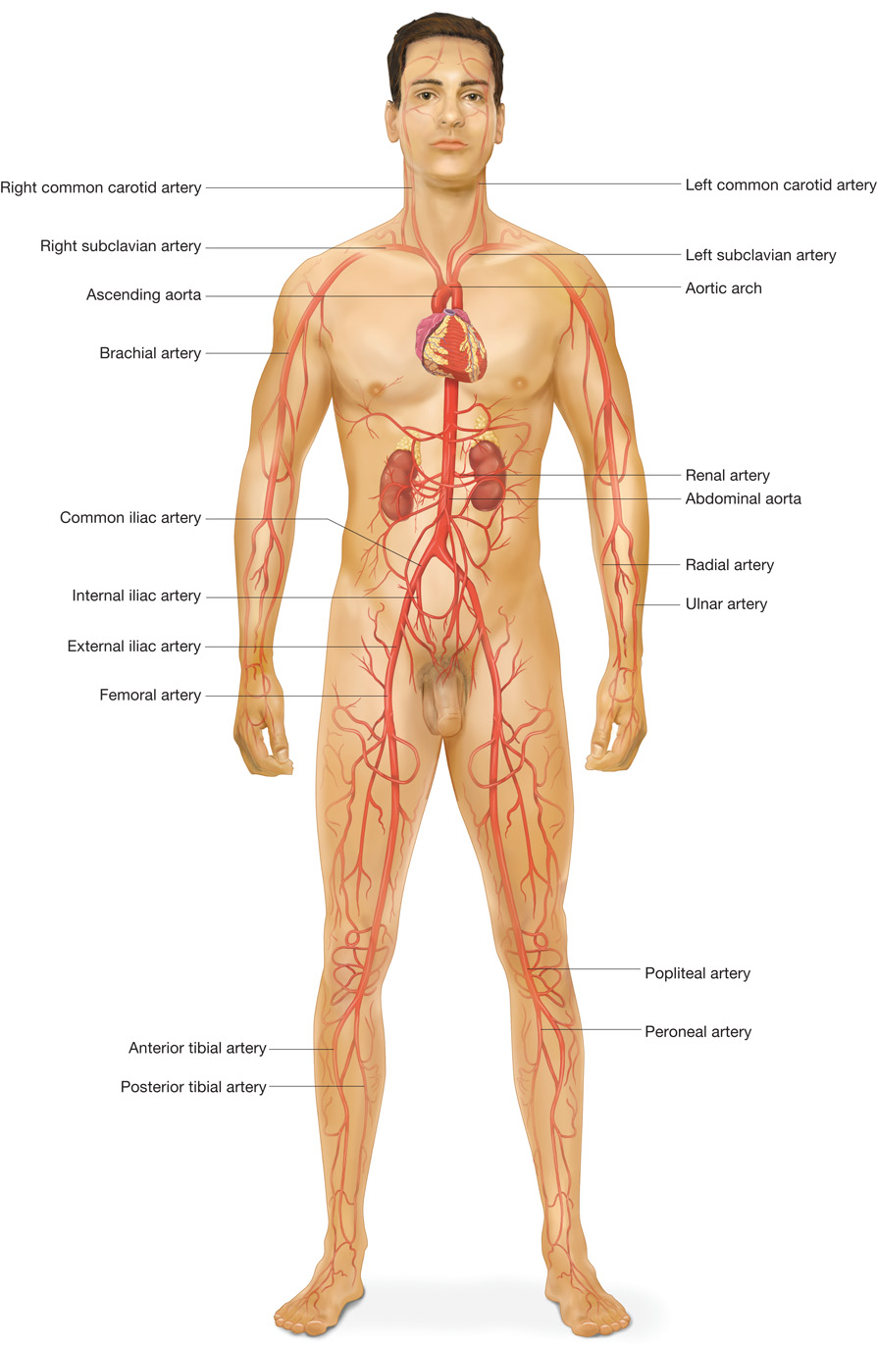
Major Arteries
Notes:
The arterial system carries blood away from the heart.

Slide 17
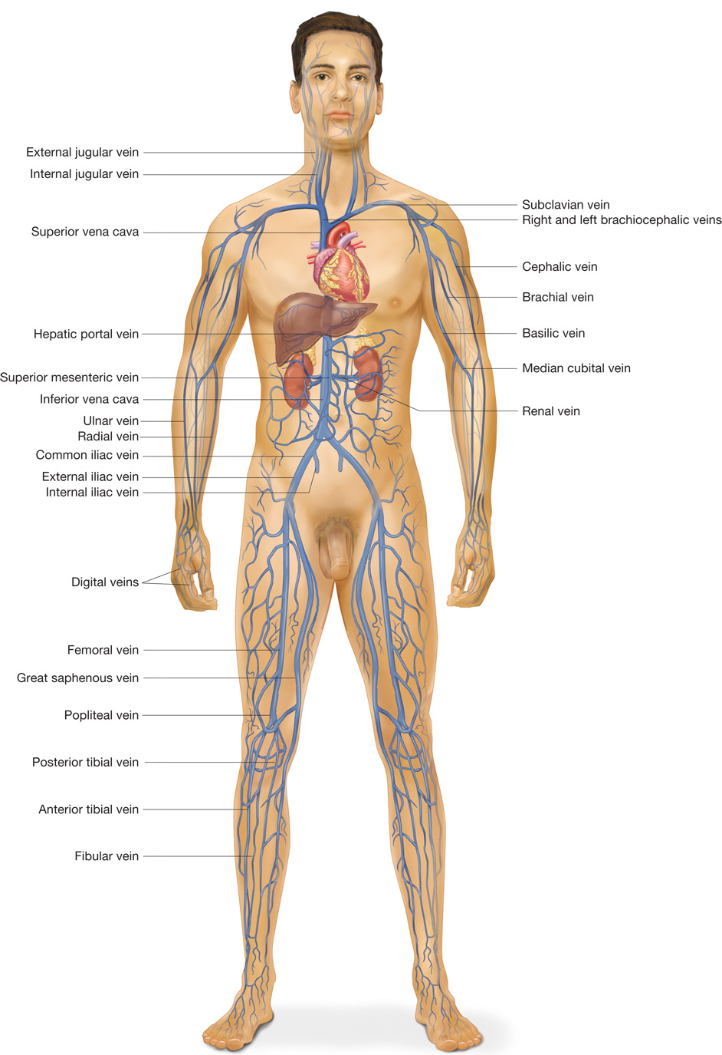
Major Veins
Notes:
The arterial system carries blood away from the heart.

Slide 18
Circulatory System Anatomy, Physiology and Pathophysiology (6 of 13)
The Circulatory System
  The Vessels
    The heart muscle is perfused by the coronary arteries.
    Occlusion of the coronary arteries deprives the muscle of oxygen.
    Heart attack, heart failure, and abnormal cardiac rhythms may occur.
Notes:
If a large coronary artery is blocked, it can’t supply an adequate amount of blood to the heart muscle. Eventually, if the occluded coronary artery isn't opened or unblocked, the heart muscle becomes hypoxic and begins to die.
Discussion Question
How can a coronary artery become blocked?

Slide 19
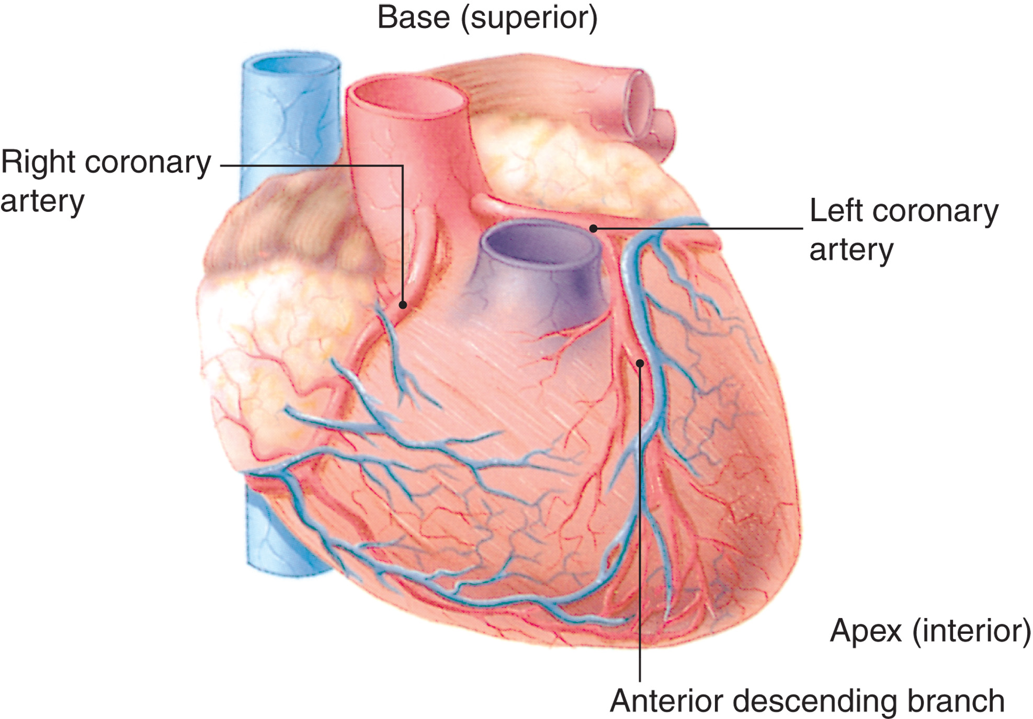
The Coronary Arteries
Notes:
The heart perfuses itself, first, with oxygenated blood before sending the oxygenated blood to the arteries throughout the body. The coronary arteries are the first two arteries to originate off the aorta and are the same arteries that are associated with many cardiac emergencies.

Slide 20
Circulatory System Anatomy, Physiology and Pathophysiology (7 of 13)
  The Circulatory System
  The Blood
    Red blood cells
    White blood cells
    Platelets
    Serum
Notes:
The blood is composed of several components that serve multiple functions for the body. The liquid portion of the blood, the serum, serves as the transport medium for the formed elements. The formed elements include the red blood cells which, among other functions, carry oxygen to the tissues of the body. Also, white blood cells serve to protect the body and eliminate infections from viruses or bacteria. Platelets are cellular elements whose job is to help in the clotting process to stop bleeding.

Slide 21
Circulatory System Anatomy, Physiology and Pathophysiology (8 of 13)
The Circulatory System
  The Blood
    Platelets play a role in cardiac emergencies through their role in blood clotting.
    Platelets, thrombin, and fibrin are components of clots.
    A thrombus may form at the site of a plaque in a coronary artery.
Notes:
The normal clotting mechanisms of the blood can form a clot in a coronary artery that is damaged by plaque. The clot may partially or completely occlude the coronary artery, cutting off or reducing the supply of oxygenated blood to the heart muscle. The heart muscle becomes deprived of oxygen and may eventually begin to die.

Slide 22
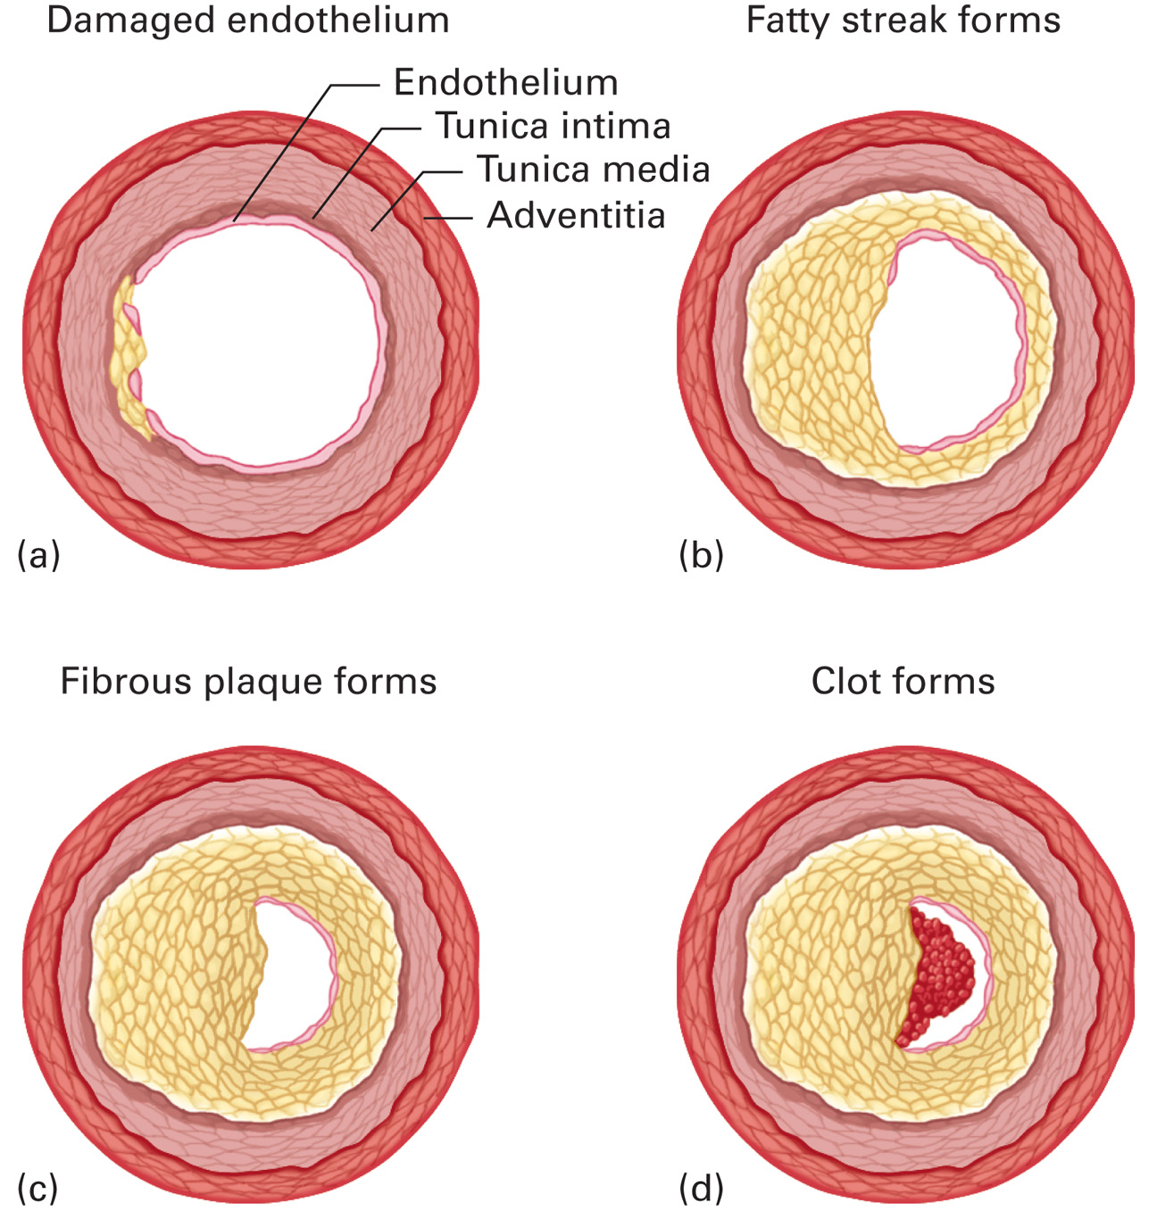
The Process of Artery Occlusion (Atherosclerosis)
(a) The Endothelium (Inner Wall) of the Artery Is Damaged as a Result of Smoking, Diabetes, High Blood Pressure, High Blood Cholesterol, or Other Causes.(b) Fatty Streaks Begin to Form in the Damaged Vessel Walls. (c) Fibrous Plaque Forms, Causing Further Vessel Damage and Progressive Resistance to Blood Flow. (d) the Plaque Deposits Begin to Ulcerate or Rupture, and Platelets Aggregate and Adhere to the Surface of the Ruptured Plaque, Forming Clots That May Nearly or Totally Block the Artery
Notes:
The heart muscle becomes deprived of oxygen and may eventually begin to die. This can lead to a heart attack and subsequent heart failure or serious cardiac rhythm disturbances.

Slide 23
Circulatory System Anatomy, Physiology and Pathophysiology (9 of 13)
  The Circulatory System
  Cardiac contraction
    Electrical impulse is generated in the S A node and travels first to the atria, causing atrial contraction, then to the ventricles, causing ventricular contraction, or systole.
Notes:
right atrium at the SA node. It travels through both the right and left atria by way of the Bachmann bundle. Both atria contract simultaneously because of the electrical impulse.
The impulse then travels to the AV node by way of an internodal tract located in the area between the atria and the ventricles. There the impulse is inhibited briefly to allow the blood from the contracted atria to fill the ventricles, and then the impulse travels down the bundle to the left and right ventricles via the left and right bundle branches.
From the bundle and the left and right bundle branches, the electrical impulse travels to the Purkinje fibers, which are embedded in the ventricular muscle, causing the ventricles to contract simultaneously.

Slide 24
Circulatory System Anatomy, Physiology and Pathophysiology (10 of 13)
The Electrocardiogram (E C G)
  Graphic representation of the heart’s electrical activity.
  Electrical activity includes depolarization and repolarization.
  The electrical activity is detected on the skin’s surface by electrodes.
Notes:
The electrical activity of the heart is represented on an ECG as a series of waves that correspond to electrical events in the heart. The waves, or deflections, of a normal ECG have three portions; the P wave, the QRS wave and the T wave.
Discussion Question
What do the P, QRS, and T waves represent on the ECG?

Slide 25
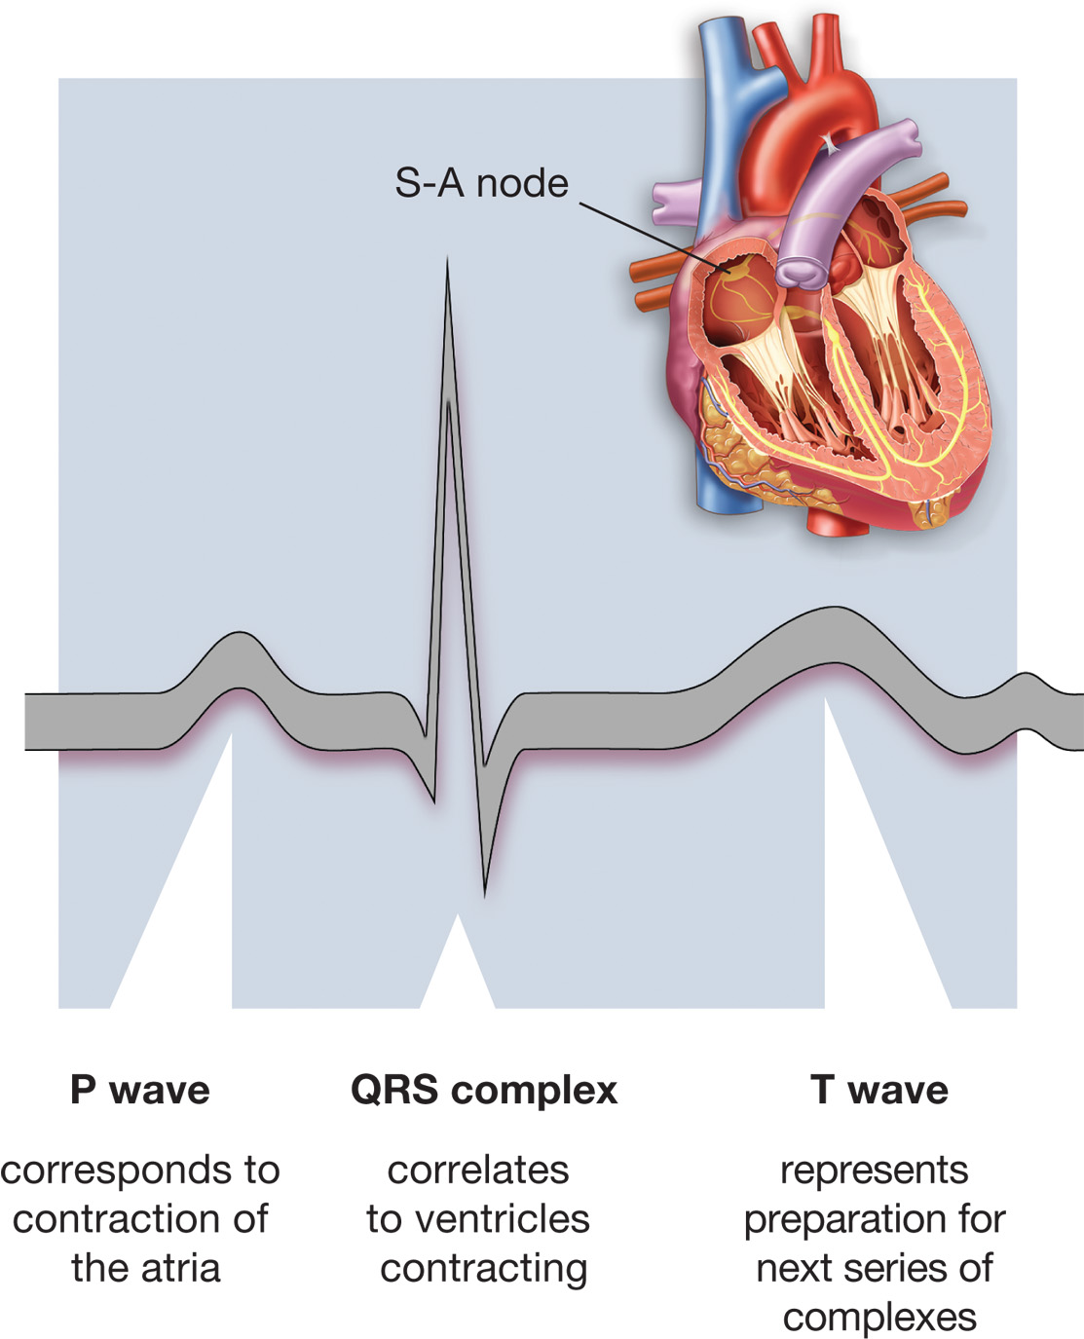
An E C G Tracing of Normal Sinus Rhythm
Notes:
The P wave is the first waveform of the ECG and represents the depolarization (contraction) of the atria.
The QRS complex is the second waveform and represents the depolarization (contraction) of the ventricles and the main contraction of the heart.
The T wave is the third waveform and represents the repolarization (relaxation) of the ventricles.
The atria also has a repolarization wave, but it is usually hidden within the QRS complex.
Another portion of the ECG, the PR interval (also referred to as the PRI), is measured in terms of time and used for analysis of the ECG. The PRI is calculated from the beginning of the P wave to the beginning of the QRS complex. It represents the time it takes the heart’s electrical impulse to travel from the atria to the ventricles.

Slide 26
Circulatory System Anatomy, Physiology and Pathophysiology (11 of 13)
The Electrocardiogram (E C G)
  Hypoxia or damage to the electrical conduction system can cause improper functioning of the heart.
  Uncoordinated firing of ventricular impulses can lead to P V C s, ventricular tachycardia, or ventricular fibrillation.
Notes:
The heart muscle can become hypoxic, be injured, or die. The electrical conduction system can also be damaged or disturbed and cause the improper functioning of the heart. Sometimes, these conditions produce an irritability of the heart that causes the uncoordinated firing of electrical ventricular impulses called premature ventricular complexes (PVC). When PVCs occur in succession, they can produce ventricular tachycardia (V-Tach), which displays on an ECG as steep peaks and valleys that are close together. If left untreated, ventricular tachycardia can degenerate into ventricular fibrillation (VF or V-Fib), which shows up as smaller, uneven, disorganized peaks and valleys.

Slide 27
Circulatory System Anatomy, Physiology and Pathophysiology (12 of 13)
Blood Pressure
  Systolic blood pressure is measured during contraction of the heart.
  Diastolic blood pressure is measured during relaxation of the heart.
  The degree of resistance of blood vessels affects blood pressure.
Notes:
The blood pressure is the amount of pressure exerted against the arterial wall during circulation. A smaller-sized vessel offers greater resistance, resulting in a higher pressure. Thus, vasoconstriction (constriction of the vessels) increases vessel resistance and blood pressure.

Slide 28
Circulatory System Anatomy, Physiology and Pathophysiology (13 of 13)
Inadequate Circulation
  Results in hypoperfusion, or shock
  Deprives cells of oxygen, nutrients, and waste removal
  May result from hypovolemia, heart failure, or vasodilation
Notes:
The delivery of oxygen and nutrients from the blood through the thin capillary walls into the cells, and the removal of carbon dioxide and other wastes, is known as perfusion.
The chief result of inadequate circulation is a state of profound depression of cell perfusion, called shock (or hypoperfusion).

Slide 29
Cardiac Compromise and Acute Coronary Syndrome (1 of 23)
Cardiac-related emergencies are a significant problem.
E M S plays a role in reducing the death rate associated with heart attacks.
Time is critical; early recognition is key to effective treatment.
Notes:
Time is a critical element in the survival and improved outcome of many of these patients. Death of a portion of the heart muscle is permanent and irreversible. Thus, it is important for you as an EMT to recognize the signs and symptoms of the many possible cardiac conditions, referred to collectively as cardiac compromise, and to provide emergency care and expeditious transport to a medical facility that is prepared to manage a patient with such a condition.
Class Activity
To reinforce important concepts, ask students to write down questions they predict will be on their next examination or quiz. Also have them write their answer to the questions. You can use these questions to assess whether or not students are focusing on important concepts, and you may get some ideas for quiz questions.

Slide 30
Cardiac Compromise and Acute Coronary Syndrome (2 of 23)
Collectively, cardiac conditions are referred to as cardiac compromise.
The sooner the patient receives treatment, the better the prognosis.
Notes:
Some of these patients might be eligible for drugs (fibrinolytics and antiplatelet agents) or mechanical therapy (angioplasty) that can destroy the clot and restore the blood flow to the heart. The sooner these therapies are delivered, the less the damage that can occur to the heart, and the better the prognosis of the patient’s outcome.

Slide 31
Cardiac Compromise and Acute Coronary Syndrome (3 of 23)
Arteriosclerosis and Atherosclerosis
  Atherosclerosis is an inflammatory disease that affects the arteries.
  The inflammatory process may eventually lead to the development of a thrombus and occlusion of the vessel.
  Atherosclerosis of the coronary vessels is called Coronary Artery Disease (C A D).
Notes:
Arteriosclerosis is a condition that causes the smallest of arterial structures to become stiff and less elastic. This is often referred to as “hardening of the arteries.”
Atherosclerosis is a form of arteriosclerosis, the development of plaque within arteries, which can lead to narrowing of the arteries and reduction in blood flow to the heart.
The inability to deliver increased blood flow to the myocardium when it is needed causes ischemia of the heart cells, which may result in chest pain or discomfort called angina pectoris.

Slide 32
Cardiac Compromise and Acute Coronary Syndrome (4 of 23)
Acute Coronary Syndrome
  Acute coronary syndrome includes unstable angina and myocardial infarction.
  Narrowed arteries lead to myocardial ischemia.
  The typical response to myocardial ischemia is chest discomfort.
Notes:
Acute coronary syndrome is a significant disease and significant cause of death in the United States. Early recognition of signs and symptoms and early intervention are keys to reducing death from ACS. Acute coronary syndrome results from a variety of conditions that can affect the heart in which the coronary arteries are narrowed or occluded by fat deposits (plaque), clots, or spasm. The words acute and syndrome refer to the sudden onset of symptoms from coronary artery narrowing or occlusion.
Chest discomfort or pain that is a result of heart muscle ischemia is referred to as ischemic-type chest pain. If you ask the patient if they have “chest pain”, they might answer “no” More often, the patient feels a crushing chest pressure that is described as “dull and aching” and not as “pain.” The pain or discomfort can be localized to the area of the sternum and radiate to the jaw, arms, shoulders, or back.

Slide 33
Cardiac Compromise and Acute Coronary Syndrome (5 of 23)
  Acute Coronary Syndrome
  Angina pectoris
    Results from reduced oxygen delivered to the myocardium.
    Results in chest discomfort.
    Usually occurs during physical or emotional stress.
    Generally relieved with rest and nitroglycerin.
Notes:
A complete blockage of blood flow through a coronary artery results in ischemia and death of myocardial cells. Myocardial ischemia can result in chest discomfort or pain.
Rest to reduce the heart's oxygen needs and nitroglycerin to relax the smooth muscle in the coronary arteries to dilate them usually relieve classic angina.

Slide 34
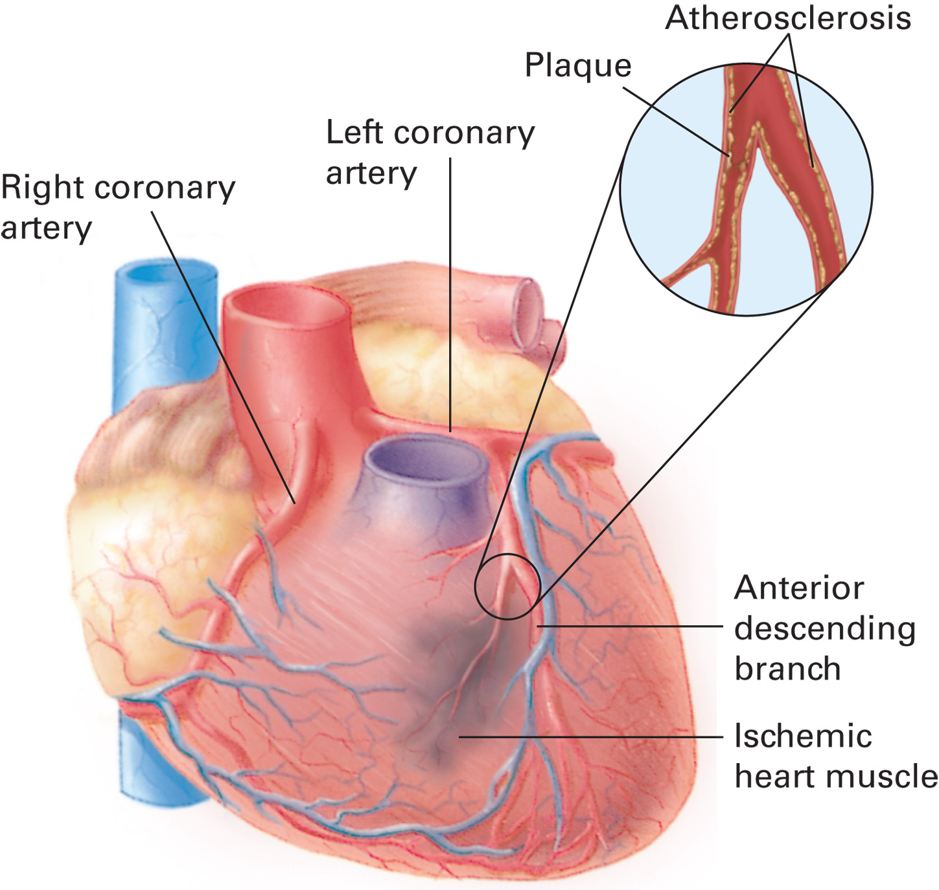
Atherosclerotic Plaque Formation in the Coronary Arteries Results in Ischemia Distal to the Blockage, Which Causes Angina (Chest Pain)
Notes:
A decrease in oxygen delivered to the myocardium, which is often caused by partial blockage of the coronary arteries, which causes ischemia (reduced delivery of oxygenated blood) that results in tissue hypoxia.

Slide 35
Cardiac Compromise and Acute Coronary Syndrome (6 of 23)
Acute Coronary Syndrome
  Angina pectoris
    When angina discomfort is prolonged and worsening, or occurs without exertion, it is called unstable angina.
Notes:
Unstable angina has a variety of definitions but usually indicates angina discomfort that is prolonged and worsening or that occurs without exertion and when the patient is at rest.
Characteristics of unstable angina can include pain or discomfort that occurs at rest, continues without relief, or is prolonged. If the patient experiences angina that occurs at rest and lasts for more than 20 minutes, angina with a recent onset that progressively worsens, or angina that wakes the patient at night (nocturnal angina), you should view it as an acute coronary syndrome emergency and provide prompt treatment and transport.
Discussion Question
What is the pathophysiology of angina pectoris?

Slide 36
Cardiac Compromise and Acute Coronary Syndrome (7 of 23)
Acute Coronary Syndrome
  Angina pectoris
    Women, diabetics, and the elderly may not have a typical presentation of angina.
    Discomfort is more diffuse, or does not occur.
    Patient may complain of shortness of breath, fainting, weakness, or light-headedness.
Notes:
Classic angina is typically relieved with rest and nitroglycerin. If the classic angina following exertion isn't relieved after rest or after three nitroglycerin tablets or sprays over a ten minute period, you should recognize this as an acute coronary syndrome emergency and provide prompt treatment and transport.

Slide 37
Cardiac Compromise and Acute Coronary Syndrome (8 of 23)
Acute Coronary Syndrome
  Angina pectoris
    Emergency medical care for angina
      Manage airway and breathing.
      Supplemental oxygen at two to four literperminute if the S p O₂ is <94%.
      Assist the patient with nitroglycerin if their systolic B P is >90 m m H g.
      If protocols allow, administer 160 to 325 milligram aspirin.
Notes:
Administer supplemental oxygen if the patient is dyspneic, hypoxemic, has obvious signs of heart failure, has an SpO₂ of 694%, or the SpO₂ is unknown. Initiate oxygen therapy via a nasal cannula at two lpm and titrate the concentration and liter flow to achieve and maintain an SpO₂ of 94% or greater.
If the patient has prescribed nitroglycerin and their systolic blood pressure is greater than 90 mmHg, place them in a sitting or lying position and administer the nitroglycerin tablets or spray.
If the patient is suspected of suffering from a coronary artery occlusion, administer 160–325 mg of aspirin if your local protocol allows it.
Consider contacting advanced life support and be prepared to manage a cardiac arrest patient.

Slide 38
Cardiac Compromise and Acute Coronary Syndrome (9 of 23)
  Acute Coronary Syndrome
  Acute myocardial infarction
    Typically occurs when a plaque ruptures and a thrombus forms.
    Within 20 to 30 minutes of inadequate perfusion, heart muscle begins to die.
    Ischemia may lead to dysrhythmias and sudden cardiac death.
Notes:
A myocardial infarction, the severe narrowing or complete obstruction of the coronary arteries, will result in death of myocardial cells if the blockage isn't quickly reversed. Ischemia of myocardial cells can result in potentially lethal dysrhythmias.
Rarely, a heart attack can also result from a spasm of the coronary artery. This can be caused by use of a sympathetic stimulating drug such as cocaine.
If the blood flow isn't restored to that portion of heart muscle, the cells begin to die. Ischemic heart tissue can become irritable. It can produce abnormal beats in the conduction system that could lead to dysrhythmias. Some dysrhythmias, such as ventricular fibrillation and ventricular tachycardia, can be fatal.

Slide 39
Cardiac Compromise and Acute Coronary Syndrome (10 of 23)
Acute Coronary Syndrome
  Acute myocardial infarction
    Treatments are available to restore myocardial perfusion.
    Success of treatments is time-dependent.
    Diabetics, the elderly, and women may complain only of shortness of breath, nausea, light-headedness, or weakness.
Notes:
Signs and symptoms of AMI include:
Chest discomfort radiating to jaw, arms, shoulders, or back
Anxiety
Dyspnea
Sense of impending doom
Diaphoresis
Nausea and vomiting
Light-headedness or dizziness
Weakness
The classic signs and symptoms of myocardial infarction aren't present in all patients. Diabetics, the elderly, and women are more prone to an atypical presentation of symptoms when suffering a heart attack. Many might suffer a “silent MI” in which no chest discomfort is experienced. They might complain only of shortness of breath, nausea, light-headedness, or weakness.
Teaching Tips
Provide examples from your experience to illustrate atypical presentations of ACS.
Critical Thinking Discussion
Is it necessary to differentiate between angina pectoris and myocardial infarction in the prehospital setting?

Slide 40
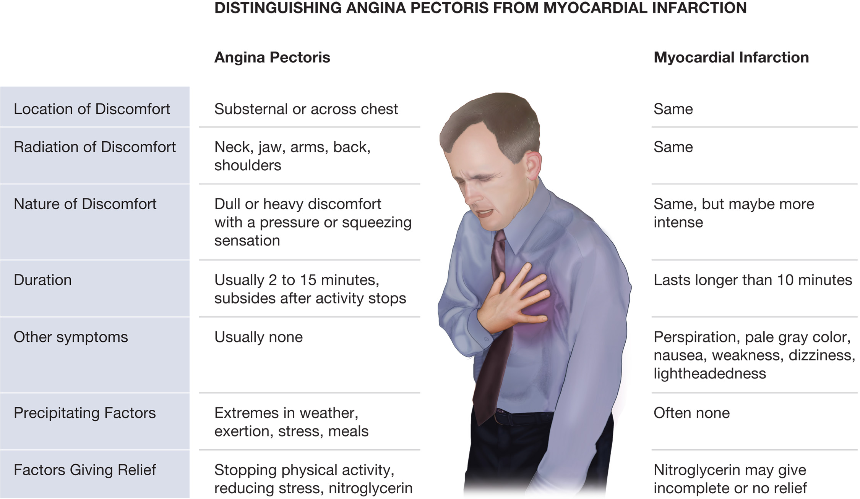
Both Myocardial Infarction and Less Serious Angina Can Present Symptoms of Severe Chest Pain
Treat all cases of chest pain as cardiac emergencies.
Notes:
Chest discomfort is the most significant symptom of a heart attack. The discomfort the patient experiences is similar to that of angina; however, the symptoms last longer. Also, chest discomfort from an acute myocardial infarction will usually be only partially relieved with nitroglycerin or not relieved at all. The boundaries between unstable angina and AMI aren't so distinct, and it can be difficult to distinguish between the two conditions.

Slide 41
Cardiac Compromise and Acute Coronary Syndrome (11 of 23)
Acute Coronary Syndrome
  Acute myocardial infarction
    Emergency medical care
      Have the A E D available.
      Manage the airway and breathing.
      Administer O₂.
      Administer nitroglycerin.
      Administer 160 to 325 milligram aspirin.
      Notify the receiving facility early.
      Request A L S, if available.
Notes:
This patient has the potential to go into cardiac arrest; therefore, you should frequently assess the patient and maintain a vigilant watch over the patient’s condition. The automated external defibrillator must always be available and close to the patient.
Ensure a patent airway and provide positive pressure ventilation with oxygen connected to the device if the breathing is inadequate.
If breathing is adequate, administer supplemental oxygen if the patient is dyspneic, is hypoxemic, has obvious signs of heart failure, has an SpO₂ of 694%, or the SpO₂ is unknown. Initiate oxygen therapy via nasal cannula and titrate the concentration and liter flow to achieve and maintain an SpO₂ of 94% or greater.
Place the patient in a position of comfort. If the patient has a prescription for nitroglycerin, administer one tablet every three to five minutes up to a total of three tablets. Be sure the systolic blood pressure is above 90 mmHg and remains above 90 mmHg following each nitroglycerin administration.
If local protocol allows, administer 160–325 mg of aspirin.
Notify the receiving hospital early of suspected MIs. Continue to assess the patient en route to the medical facility.
Contact ALS for further assistance if available.

Slide 42
Case Study (2 of 4)
Ella obtains a history from Mr. Frey as Lisa conducts a focused physical exam and takes baseline vital signs. Mr. Frey’s discomfort came on 20 minutes ago while he was riding a stationary bike, but it was not relieved with rest or after taking a nitroglycerin tablet. He rates the discomfort a seven on a scale from one to ten, and says the sensation is worse than he normally has with angina.
Notes:
Review the case study findings presented.

Slide 43
Case Study (3 of 4)
His vital signs are: pulse 80, strong, and regular; B P
respirations 16; S p O₂ 99%.
Notes:
Review the case study findings presented.

Slide 44
Case Study (4 of 4)
What treatment should be implemented for this patient?
What additional information will be helpful for the receiving hospital to know?
Notes:
Use the case study content and questions to foreshadow the upcoming lesson content. Gauge the student’s responses as a guide of how well versed they are in this topic.

Slide 45
Cardiac Compromise and Acute Coronary Syndrome (12 of 23)
  Acute Coronary Syndrome
  Aortic Aneurysm or Dissection
    Aortic aneurysm
      A weakened area of the aortic wall dilates.
      Rupture may occur with rapid, fatal internal bleeding.
      Often occurs in the abdominal region.
Notes:
Aortic aneurysm occurs when a weakened section of the aortic wall, usually resulting from atherosclerosis, begins to dilate or balloon outward from the pressure exerted by the blood flowing through the vessel. An aneurysm can exist for a long time with no symptoms or signs that the patient is aware of and then suddenly rupture, causing rapid and fatal internal bleeding.
Discussion Question
What is the difference between an aortic aneurysm and aortic dissection?

Slide 46
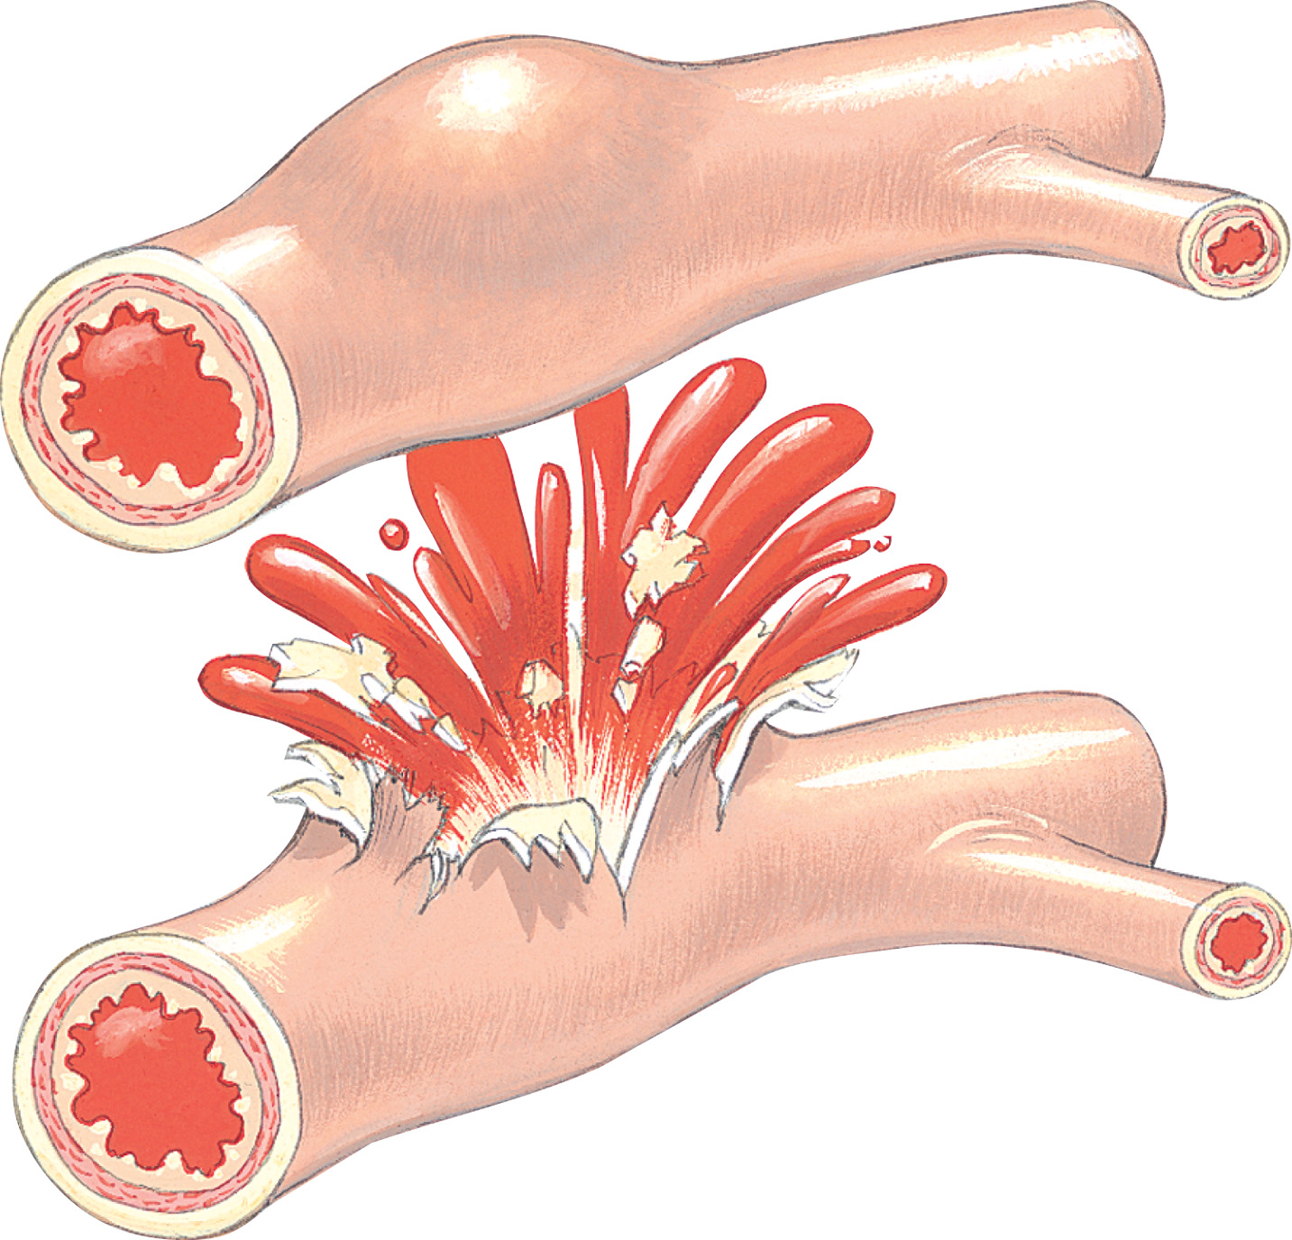
Aortic Aneurysm Leading to Aortic Rupture
Notes:
Aortic aneurysms occur most often in the abdominal region. Pain can be felt, especially in the back, when the aneurysm gets large enough, perhaps shortly before rupture occurs. Usually, the aorta can't be felt with a physical examination, but at this final stage it can be felt as a pulsating mass in the abdomen.

Slide 47
Cardiac Compromise and Acute Coronary Syndrome (13 of 23)
Acute Coronary Syndrome
  Aortic Aneurysm or Dissection
    Aortic dissection
      Blood enters a tear in the inner lining of the aorta and separates the layers of the aortic wall.
      Often occurs in the thoracic region.
      Pain is severe, sharp, tearing in nature; often experienced in back, flank, or arm.
Notes:
Aortic dissection occurs when there is a tear in the inner lining of the aorta and blood enters the opening and causes separation of the layers of the aortic wall. Aortic dissections occur most often in the thorax. The pain is classically most severe when the dissection first occurs and is most often described as a “sharp” pain, or sometimes as a “tearing” or “ripping” pain.

Slide 48
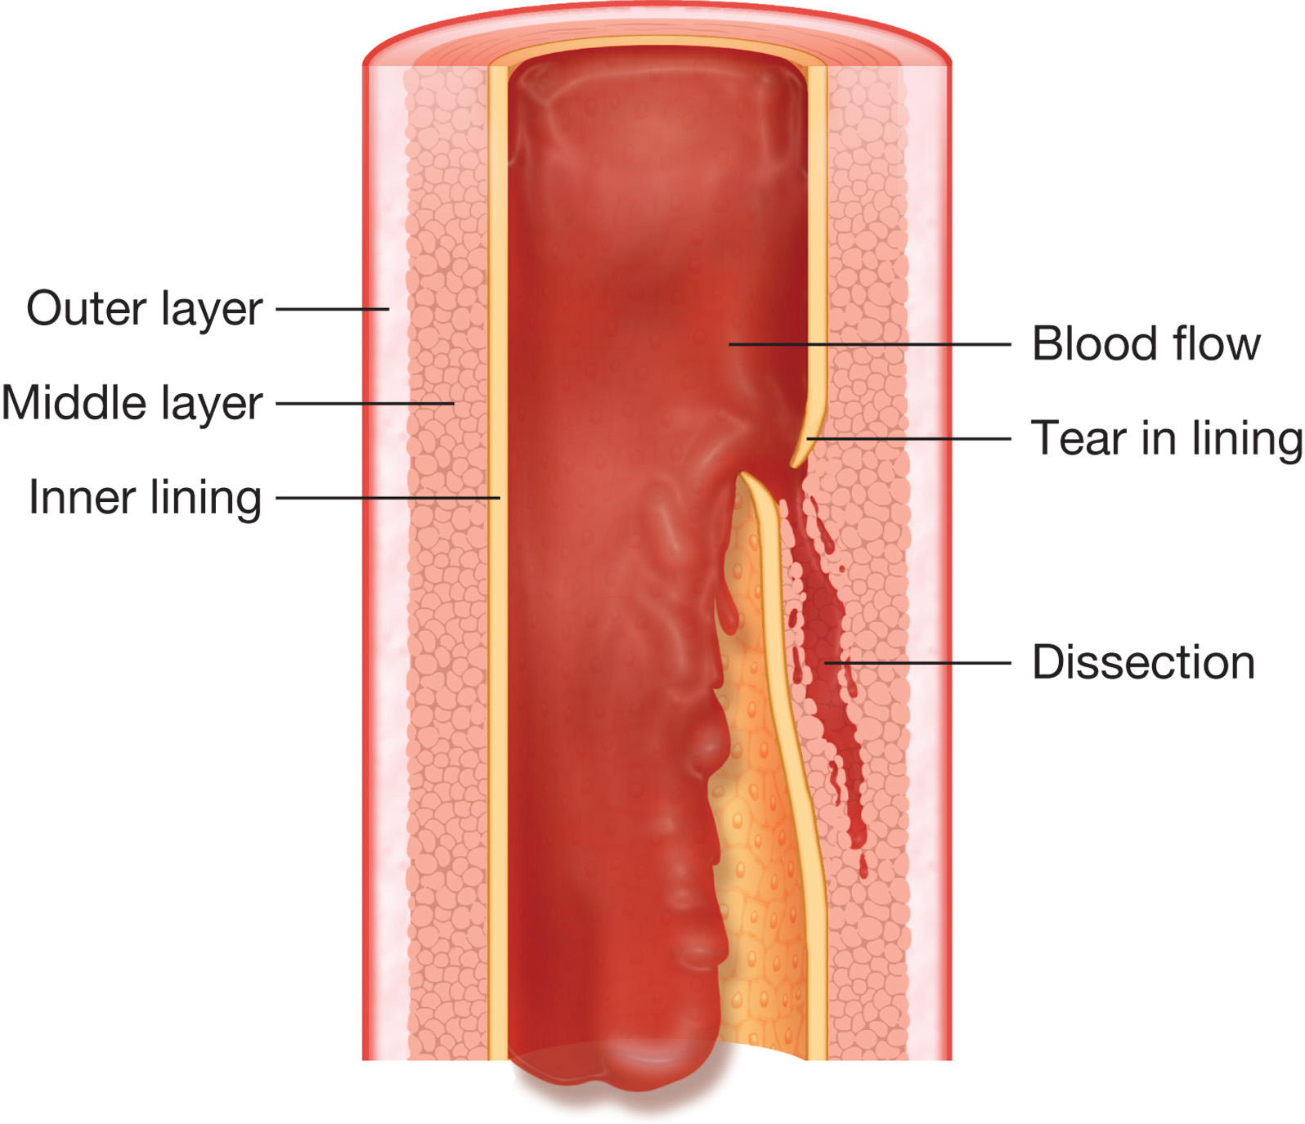
Aortic Dissection
Notes:
Depending on the location of the dissection along the aorta, it can cause symptoms similar to a stroke or to a myocardial infarction and can lead to a myocardial infarction or other damage to the heart.

Slide 49
Cardiac Compromise and Acute Coronary Syndrome (14 of 23)
Acute Coronary Syndrome
  Aortic Aneurysm or Dissection
    Emergency medical care
      Conditions require immediate surgery.
      Do not administer aspirin.
Notes:
If a pulsating mass is felt and aortic aneurysm is suspected, administer oxygen and transport the patient immediately because only surgery can prevent or repair a rupture of the aneurysm. For chest or back pain that can result from an aortic dissection or that can be a symptom of myocardial infarction, administer oxygen and assist the patient with prescribed nitroglycerin if the blood pressure is more than 90 mmHg and no signs of hypovolemia are present. If aortic dissection is suspected, do not administer aspirin.

Slide 50
Cardiac Compromise and Acute Coronary Syndrome (15 of 23)
Acute Coronary Syndrome: In Females
  Often occurs at older age than in males, with twice the likelihood of death.
  “Classical” findings
    Dull substernal chest pain or discomfort
    Respiratory distress
    Nausea, vomiting and diaphoresis
Notes:
Because the death rate for females who suffer heart attacks is higher than males when the event occurs, the EMT should have a high index of suspicion of ACS when gathering a history from the female patient.

Slide 51
Cardiac Compromise and Acute Coronary Syndrome (16 of 23)
  Acute Coronary Syndrome: In Females
  “Nonclassical” findings
    Neck ache
    Pressure in chest
    Pains in back, breast, upper abdomen
    Tingling in fingers
    Unexplained fatigue or weight gain
    Insomnia
Notes:
Err on the side of the patient and provide emergency care for a potential myocardial infarction or ACS, despite a presentation of “atypical” signs of ischemia or infarction. Note that diabetics and the elderly are also high-risk groups that can present with atypical findings.

Slide 52
Cardiac Compromise and Acute Coronary Syndrome (17 of 23)
Dangers of administering too much oxygen in Acute Coronary Syndrome
  Too much oxygen can increase cell damage in certain situations.
  The return of oxygen to ischemic tissues increases free radical production.
  Give oxygen only when the S p O₂ is <94 percent.
Notes:
Oxygen was previously thought to be helpful to all patients in all situations. Based on the most current research, oxygen still has tremendous benefits; however, it is also clear that oxygen can be harmful and increase the amount of cell damage and death in certain situations.
One such condition is acute coronary syndrome in which a coronary artery is occluded and cuts off blood supply to a distal area of heart tissue. This area of tissue becomes ischemic from the lack of oxygenated blood. During this period, there is an inflammatory response and the release of damaging molecules made from oxygen, which are referred to as free radicals.
The restoration of blood to an area of tissue that was ischemic from low blood flow or occlusion of a vessel is called reperfusion. The oxygen in the blood flowing to the reperfused tissue increases the production of oxygen free radicals. The free radicals directly damage cell membranes and other cellular components and result in cell death. This is called reperfusion injury.
In managing the acute coronary syndrome patient, it is necessary to reverse any hypoxia. However, it is also extremely important while reversing the hypoxia not to deliver more oxygen than is needed to avoid creating unnecessary cell damage. Therefore, it is recommended that oxygen be provided only to acute coronary syndrome patients with an SpO₂ 694%, or if an SpO₂ is unknown, or if the patient is dyspneic, hypoxemic, or has obvious signs of heart failure.

Slide 53
Cardiac Compromise and Acute Coronary Syndrome (18 of 23)
Other Causes of Cardiac Compromise
  Heart Failure
    Occurs when the ventricle can’t adequately eject blood.
    May be caused by heart attack, heart valve problems, hypertension, pulmonary embolism, cardiac rhythm disturbances, and some drugs.
Notes:
Heart failure can be categorized as left ventricular failure or right ventricular failure. The consequences of left or right ventricular failure can be understood by recalling the functions of the two sides of the heart. Cardiogenic shock can result from the combined pumping inadequacy of both ventricles or from either the left or right ventricle.

Slide 54
Cardiac Compromise and Acute Coronary Syndrome (19 of 23)
Other Causes of Cardiac Compromise
  Heart failure
    Left ventricular failure reduces blood flow and perfusion throughout the body.
    Blood backs up behind the left atrium, increasing pressure in the pulmonary veins.
    Pulmonary capillaries leak fluid, resulting in pulmonary edema and impaired gas exchange.
Notes:
Left ventricular failure can lead to pulmonary edema. When the left ventricle fails, the cardiac output drops and there is a diminishment in the perfusion pressure to the rest of the body’s organs. Common findings include a drop in systolic blood pressure (to include frank hypotension), diminished or absent peripheral pulse amplitude, altered mental status, changes in the heart rate, poor urinary output, respiratory distress, inspiratory rales, and possible pulmonary edema.

Slide 55
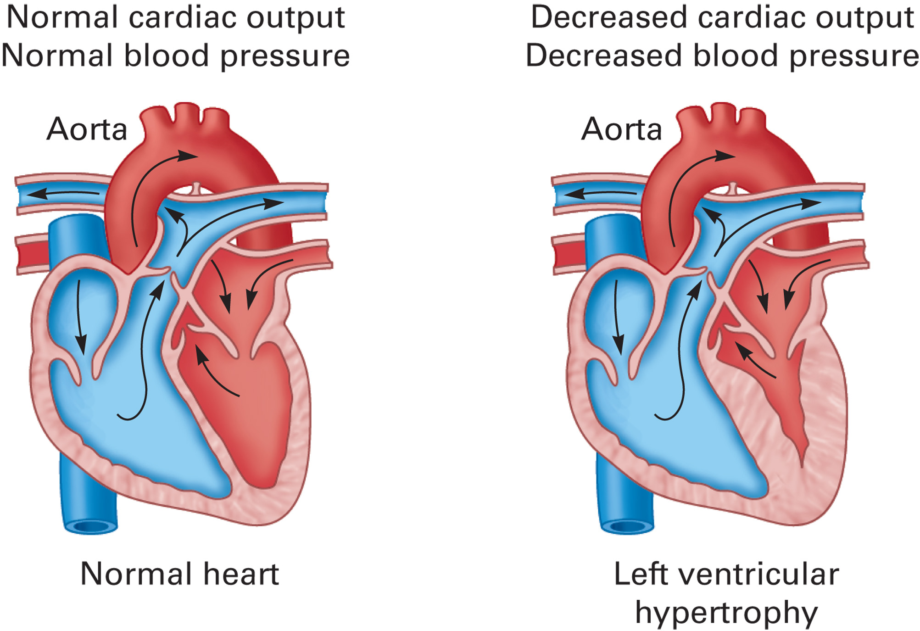
Left Ventricular Hypertrophy
Notes:
Left ventricular hypertrophy (enlargement of the heart muscle) compromises the ability of the left ventricle to pump adequately, causing a decrease in cardiac output and a decrease in blood pressure.

Slide 56
Cardiac Compromise and Acute Coronary Syndrome (20 of 23)
Other Causes of Cardiac Compromise
  Heart Failure
    Right ventricular failure
      May be caused by failure of left ventricle or C O P D.
      Signs include peripheral edema, J V D, enlarged liver.
    Cardiogenic shock can occur with left or right ventricular failure.
Notes:
Right ventricular failure can cause peripheral edema. When the right side of the heart fails, the blood backs up into the venous system. The right side of the heart can fail due to failure of the left ventricle. It can also fail because of cardiac valve disease or an increase in pulmonary vessel pressure (pulmonary hypertension). Chronic obstructive pulmonary disease (COPD) can increase the pressure in the pulmonary vessels in the lungs and cause the right ventricle to work much harder. Over time, this can cause the right ventricle to fail. Signs include peripheral edema, jugular vein distention, and liver enlargement.
Cardiogenic shock occurs when the heart can't pump effectively and cardiac output isn't maintained. This occurs when the left or right ventricle fails to pump out enough blood to meet the demands of the body. The most common cause for this is myocardial damage that occurs secondary to a heart attack less common reasons include sustained hypertension, valve damage, extremes in heart rate, and other cardiac muscle diseases.
The patient with congestive heart failure with pulmonary edema can benefit from positive pressure ventilation.

Slide 57
Table 17-1 Findings in Right and Left Heart Failure
Blank | Pure Right Heart Failure | Pure Left Heart Failure
Systolic blood pressure | Low to normal | Normal to high
Breath sounds | Clear sounds | Inspiratory rales
Peripheral edema | J V D and peripheral edema | No J V D or peripheral edema
Notes:
Congestive heart failure (CHF) is a medical diagnosis that refers to the condition in which there is a buildup of fluid (congestion) in the body resulting from the pump failure of the heart. It represents the condition in which the left, the right, or both ventricles are failing to meet the body’s needs.

Slide 58
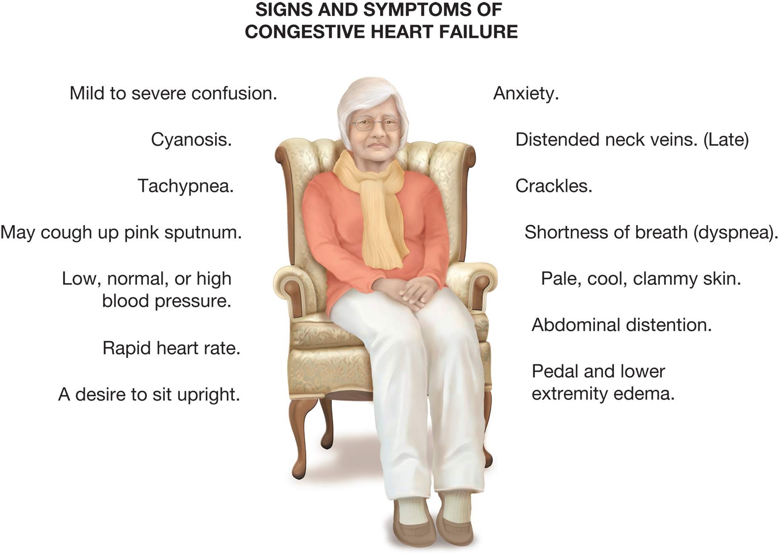
Signs and Symptoms of Congestive Heart Failure
Notes:
The signs and symptoms of heart failure depend on the severity of the condition and whether it is an acute-onset or a long-term problem.
The signs and symptoms of heart failure include the following:
Marked or severe dyspnea (shortness of breath)
Tachycardia (rapid heart rate greater than 100 bpm)
Difficulty breathing when supine (orthopnea)
Suddenly waking at night with dyspnea (paroxysmal nocturnal dyspnea)
Fatigue on any type of exertion
Anxiety
Tachypnea (rapid respiratory rate)
Diaphoresis (sweating)
Upright position with legs, feet, arms, and hands dangling
Cool, clammy, pale skin
Chest discomfort
Cyanosis
Agitation and restlessness due to hypoxia
Edema (swelling) to the hands, ankles, and feet
Crackles and possibly wheezes on auscultation
Decreased SpO₂ reading
Signs and symptoms of pulmonary edema
Blood pressure may be normal, elevated, or low
Distended neck veins—jugular venous distention
Distended and soft spongy abdomen

Slide 59

Edema to the Lower Extremities is a Classic Sign of Congestive Heart Failure
Notes:
Commonly, these patients will tell you that they are taking a “water pill.” This is a diuretic that is used to reduce the amount of fluid in the body.

Slide 60
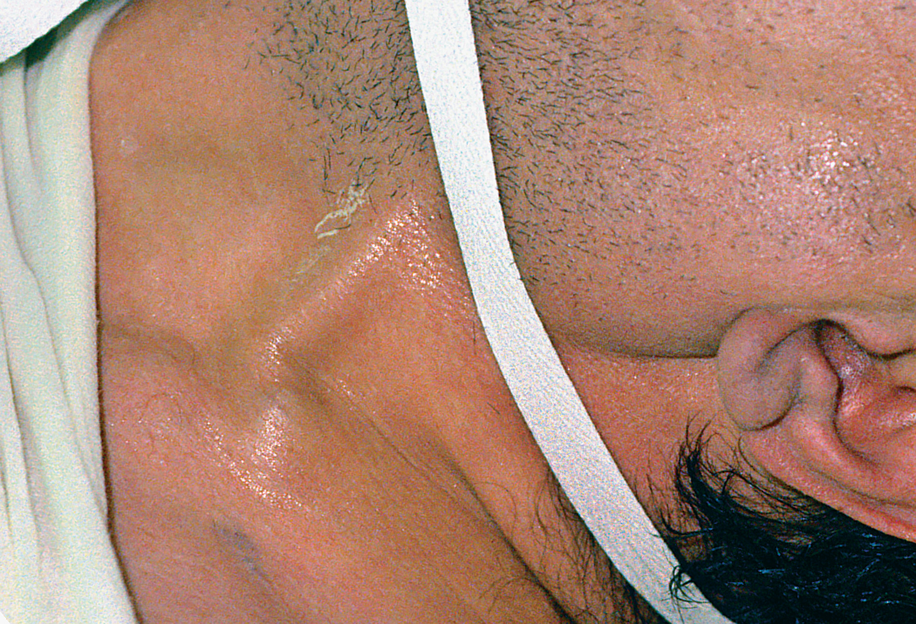
Figure 17-15 Jugular Vein Distention is a Late Sign of Congestive Heart Failure
(© David Effron, M D)
Notes:
Findings of right ventricular failure can include jugular venous distension and peripheral edema.

Slide 61
Cardiac Compromise and Acute Coronary Syndrome (21 of 23)
Other Causes of Cardiac Compromise
  Heart Failure
    Emergency medical care for heart failure
      Treat as for A M I.
      Positive pressure ventilation may be required.
      Supplemental oxygen according to 2010 A H A Guidelines.
      Consider the need for C P A P.
Notes:
The heart failure patient with pulmonary edema will benefit significantly from positive pressure ventilation. It will increase the effectiveness of gas exchange by forcing the oxygen to cross over the alveoli and the space between the alveoli and the capillary. You may see drastic improvement in the patient’s condition following positive pressure ventilation.
If the patient has an adequate respiratory rate and tidal volume, administer supplemental oxygen if the patient is dyspneic, hypoxemic, has obvious signs of heart failure, has an SpO₂ of 694%, or the SpO₂ is unknown.
If the patient experiences chest discomfort and has a prescription for nitroglycerin, administer one tablet every three to five minutes to a total of three tablets. Nitroglycerin can be beneficial to the patient by reducing the pressure in the arteries of the body, making it easier for the left ventricle to pump the blood out.
If pulmonary edema is present or the patient is in moderate to severe respiratory distress, consider the use of continuous positive pressure ventilation (CPAP) if they meet the indications and criteria for its use.
Continuously assess the patient and be prepared for respiratory failure and cardiac arrest.

Slide 62
Cardiac Compromise and Acute Coronary Syndrome (22 of 23)
  Other Causes of Cardiac Compromise
  Hypertension Associated with Emergency Conditions
    Systolic B P >160 m m H g and/or diastolic B P >94 m m H g.
    In assessment, consider the patient’s usual blood pressure.
Notes:
Chronic hypertension is different from episodes of hypertension that frequently occur during acute emergencies, often because of anxiety and pain. This type of hypertension typically results from sympathetic nervous system discharge and the release of epinephrine and norepinephrine. Treating the hypertension in this situation is meaningless. The EMT must ascertain from the patient if they have chronic elevations in their blood pressure. The EMT should evaluate the current blood pressure and compare it to a “normal” blood pressure for the patient. An elevated blood pressure is often a sign of a condition and not a condition. Identify and treat the underlying cause.
Discussion Question
What are indications of a hypertensive emergency?

Slide 63
Cardiac Compromise and Acute Coronary Syndrome (23 of 23)
  Other Causes of Cardiac Compromise
  Cardiac arrest
    The heart is pumping inadequately or not at all and no pulses can be felt.
    May be caused by acute coronary syndrome or other causes.
Notes:
Cardiac arrest is the worst manifestation of cardiac compromise from an acute coronary event. It occurs when the heart, for any of a variety of reasons, isn't pumping effectively or at all, and no pulses can be felt. Although cardiac arrest is commonly caused by an acute coronary syndrome, it can also be caused by a myriad of other conditions. For example, a traumatized patient may be in arrest following severe multisystem trauma, isolated head injury, or significant blood loss. A person who accidentally or purposely overdoses on their medication may be in arrest because of the effects of the medication. Even a stroke or seizure patient may go into cardiac arrest secondary to the initial emergency.

Slide 64
Nitroglycerin (1 of 3)
Potent vasodilator that increases coronary blood flow and reduces the workload of the heart.
E M T s may assist a patient with nitroglycerin tablets or spray.
Notes:
Nitroglycerin is a potent vasodilator that works quickly to improve coronary blood flow.
Nitroglycerin isn't a selective vasodilator. It will dilate peripheral arteries and veins, lowering the blood pressure.
Nitroglycerin must not be given to patients with a systolic blood pressure less than 90 mmHg or 30 mmHg less than their baseline systolic pressure.

Slide 65
Nitroglycerin (2 of 3)
Systolic B P must remain >90 m m H g or no more than 30 m m H g less than the baseline to administer nitroglycerin.
Nitroglycerin must not be given to patients who have taken a drug for erectile dysfunction within 24 hours (longer for some drugs).
Notes:
Do not administer nitroglycerin to a patient who has recently taken a drug for erectile dysfunction.
Patients may complain of a headache after taking nitroglycerin.
Teaching Tips
Cover your specific protocols for administering nitroglycerin.
Discussion Questions
How does nitroglycerin benefit the patient with ACS?
What are contraindications for administering nitroglycerin?

Slide 66
Nitroglycerin (3 of 3)
Do not administer if the heart rate is <50 or >100.
Up to three doses, total, may be administered in three to five minute intervals if pain isn’t relieved.
Notes:
Do not administer the nitroglycerin to a patient with extreme bradycardia (<50 bpm) or tachycardia (>100 bpm).
Class Activity
Have pairs of students role play instructing patients to take nitroglycerin, including an explanation of its actions and side effects.
Knowledge Application
Give several patient descriptions and have students determine whether or not it would be appropriate to assist the patient in taking nitroglycerin.
Critical Thinking Discussion
Why can nitroglycerin cause a headache?
How is lowering the blood pressure too much detrimental to the patient?

Slide 67
Click on the Condition That Would Make a Patient with Chest Discomfort Ineligible to Receive Nitroglycerin
A. Age over 65 years
B. Heart rate of 60
C. Viagra taken one week ago
D. Systolic B P of 88 m m H g

Slide 68
E M T Skills 17-1
Assisting a Patient with Prescribed Nitroglycerin

Slide 69
Have the Patient Sit or Lie Down. Assess Blood Pressure. Systolic Pressure Must Be Greater Than 90 m m H g
Notes:
Nitroglycerin lowers blood pressure, it must not be given to a patient whose systolic blood pressure is less than 90 mmHg or no more than 30 mmHg lower than their baseline systolic blood pressure.

Slide 70
Obtain an Order from Medical Direction to Administer the Nitroglycerin
Notes:
If the patient suffers from cardiac-related chest pain and has nitroglycerin that has been prescribed for them by a medical provider, or if you carry nitroglycerin on your EMS unit and the patient meets requirements for administration, you can assist the patient in taking their medication or you can administer the medication, depending on your local protocol.

Slide 71
Check the Medication to Ensure That It is Prescribed to the Patient, It is the Proper Medication, and It has Not Expired
Notes:
Patients are commonly instructed to keep a fresh supply in a sealed bottle in a dark area. If the patient has a prescription for nitroglycerin, ask for the “fresh” supply and assist with the administration of the fresh nitroglycerin.

Slide 72
Place the Nitroglycerin Tablet under the Patient’s Tongue
Notes:
Nitroglycerin is available as either a sublingual (under-the-tongue) tablet or a sublingual spray.

Slide 73
To Administer Nitroglycerin Spray, Depress the Container and Deliver One Spray under the Tongue
Notes:
Nitroglycerin is available as either a sublingual (under-the-tongue) tablet or a sublingual spray.

Slide 74
Reassess Blood Pressure within Two Minutes of Administering the Nitroglycerin
Notes:
Be sure to find out if the patient has already taken one or more doses prior to your arrival. Assess the blood pressure and follow your local protocol on administration of additional doses.

Slide 75
Age-Related Variations: Pediatrics and Geriatrics (1 of 2)
Pediatric Considerations
  Problems are usually due to congenital heart conditions, not acute coronary syndrome.
  Cardiac arrest is usually due to airway compromise or respiratory failure.
Notes:
Typically, when a pediatric patient experiences a cardiac disturbance, it is from some congenital heart condition that the family usually knows about.
Pediatric patients may also experience cardiac arrest, but its frequency is much lower than in adults, and the underlying cause is typically respiratory in nature, rather than cardiovascular as with the adult patient.
Discussion Question
What are the most common causes of cardiac problems in children?
Knowledge Application
Given several scenarios involving atypical ACS presentations, students should recognize the potential for ACS.

Slide 76
Age-Related Variations: Pediatrics and Geriatrics (2 of 2)
Geriatric Considerations
  Geriatric patients represent the highest number of patients you treat who experience some form of acute coronary syndrome.
Notes:
There may be some differences in presentation or management of these patients if an acute coronary event occurs, or if they go into cardiac arrest, based on the patient’s medical history and current medical conditions.
Discussion Question
What are the most common causes of cardiac problems in the elderly?
Knowledge Application
Given several scenarios involving atypical ACS presentations, students should recognize the potential for ACS.

Slide 77
Table 17-2 Special Considerations in Geriatric Cardiac Events (1 of 2)
History of diabetes mellitus | A geriatric patient with diabetes has long-term damage to the nerve endings in the body. This causes the typical pain from an M I to be perceived poorly, if at all, by the diabetic patient. Therefore, the diabetic patient experiencing an M I may complain only of respiratory distress, nausea, or dizziness when standing or even excessive weakness and dyspnea on exertion. It is important for the E M T to identify the patient with diabetes as potentially having an acute coronary event and to treat him appropriately. Contact A L S early, follow your local protocol, and ascertain if additional or alternative therapies are desired by medical direction.
History of trauma | If the geriatric patient is a trauma patient, there must be a high index of suspicion for cardiac involvement as well. Geriatric patients who are traumatized can progress quickly into cardiac arrest and do not respond well to typical interventions. Geriatric patients with head trauma, chest trauma, abdominal trauma, or extremity trauma with severe bleeding are especially susceptible to cardiac arrest.
Notes:
Discussion Question
How can an elderly patient's medications or medical history affect the presentation and management of ACS?

Slide 78
Table 17-2 Special Considerations in Geriatric Cardiac Events (2 of 2)
History of asthma | If a patient with a history of asthma goes into cardiac arrest, the cause may be acute bronchoconstriction that led to hypoxemia, acidosis, and cardiac arrest. Until the bronchoconstriction is reversed, the patient will not regain a pulse or breathing. Early intercept or backup by an A L S unit will allow the administration of medications that may help reverse this condition.
History of C O P D | Elderly patients commonly have some form of C O P D (emphysema or chronic bronchitis). The arrest may have been caused by an exacerbation of the C O P D, which led to hypoxemia, acidosis, and then arrest. ALS backup is needed during the resuscitation of this patient. Remember also that C O P D disorders can weaken the lung tissue and cause the development of a pneumothorax and collapse of the lung. (This too may precipitate a cardiac arrest.) Be alert for the presence or the development of a pneumothorax during positive pressure ventilation, which may cause a bleb on the lung tissue to rupture.
Notes:
Discussion Question
How can an elderly patient's medications or medical history affect the presentation and management of ACS?

Slide 79
Assessment and Care: General Guidelines (1 of 13)
Assessment-Based Approach: Cardiac Compromise and Acute Coronary Syndrome
  Consider dispatch information.
  Size-up the scene.
Notes:
Dispatch information can provide you with the first indications that a patient may be suffering from cardiac compromise. When you are directed to patients complaining of chest pain or chest discomfort and/or difficulty in breathing, suspect the possibility of cardiac problems.
On arrival, perform the scene size-up to ensure that the scene is secure, and then proceed rapidly with the primary assessment.

Slide 80
Assessment and Care: General Guidelines (2 of 13)
Assessment-Based Approach: Cardiac Compromise and A C S
  Primary assessment
    Categorize as unresponsive/cardiac arrest or responsive in minor, moderate, or severe distress.
    Begin C P R for cardiac arrest and apply the A E D.
    For responsive patients, assess airway, breathing, circulation, and oxygenation.
Notes:
Form a general impression of the patient. Act immediately for unresponsive patients without pulse and breathing.
For responsive patients, determine the status of the airway, ventilation, and circulation. Provide oxygen as needed.
Discussion Question
What should you look for in the primary assessment?
Teaching Tips
Role play the assessment and management of a patient with ACS or cardiac compromise.
Knowledge Application
Give students ample opportunity to practice assessment and management of patients with ACS and cardiac compromise.

Slide 81
Assessment and Care: General Guidelines (3 of 13)
  Assessment-Based Approach: Cardiac Compromise and A C S
  Secondary assessment
    Obtain the history, use O P Q R S T.
    Ask about contraindications to fibrinolytic therapy.
    Anticipate that patients may downplay their symptoms.
Notes:
Obtain a history of the event and explore the chief complaint using the OPQRST mnemonic.
Determining the duration of symptoms is critical in determining if the patient is a potential candidate for fibrinolytic therapy.
Fibrinolytic drugs carry many risks and are given only when the potential benefits outweigh the risks. Use a fibrinolytic checklist to help determine the patient's eligibility for treatment.
Recent head or facial trauma.
Recent stroke or any history of bleeding within the cranium.
Pregnant patient.
Any recent trauma or surgery.
Recent history of gastrointestinal or genitourinary bleeding.
Patient taking blood thinners or one who has a clotting disorder.
History of cancer, kidney disease, liver disease or any other disease involving the central nervous system.
Suspected aortic aneurysm.
Realize that many patients will have delayed seeking help.
Keep in mind both typical and atypical presentations.

Slide 82
Assessment and Care: General Guidelines (4 of 13)
  Assessment-Based Approach: Cardiac Compromise and A C S
  Treat the following as cardiac compromise:
    Patient with angina lasting >20 minutes
    Recent onset of progressively worsening angina
    Nocturnal angina
Notes:
Discussion Question
What are key questions in the history of a patient with possible ACS or cardiac compromise?
Teaching Tips
Emphasize that patients do not need to have all signs and symptoms of ACS to be experiencing ACS.

Slide 83
Assessment and Care: General Guidelines (5 of 13)
Assessment-Based Approach: Cardiac Compromise and A C S
  Treat the following as cardiac compromise:
    Angina unrelieved by rest or three nitroglycerin tablets over ten minutes
    Chest discomfort lasting longer than five to ten minutes after rest
Notes:
Discussion Question
What are key questions in the history of a patient with possible ACS or cardiac compromise?
Teaching Tips
Emphasize that patients do not need to have all signs and symptoms of ACS to be experiencing ACS.

Slide 84
Assessment and Care: General Guidelines (6 of 13)
  Assessment-Based Approach: Cardiac Compromise and A C S
  Consider atypical presentations.
  Not all symptoms have to be present for A C S to be present.
  Physical exam and baseline vital signs
    Pupils
    Oral cavity
    Neck
Notes:
During the exam, assess the following:
Pupils- Sluggish or dilated pupils may suggest hypoxia and poor perfusion.
Oral cavity- Cyanotic mucous membranes indicate hypoxia.
Neck- Congestive heart failure or cardiac tamponade (fluid in the sac surrounding the heart) may produce jugular venous distention.
Chest- Auscultate for abnormal breath sounds, especially crackles, which might indicate fluid in the alveoli from left ventricular heart failure.
Lower and upper extremities- Assess for peripheral edema, suggesting heart failure, and peripheral cyanosis, usually indicating vessel disease.
Posterior body- Presacral edema to the lower back is another indicator of heart failure that may be more prominent in the patient who is sedentary and commonly in a supine or lying position.

Slide 85
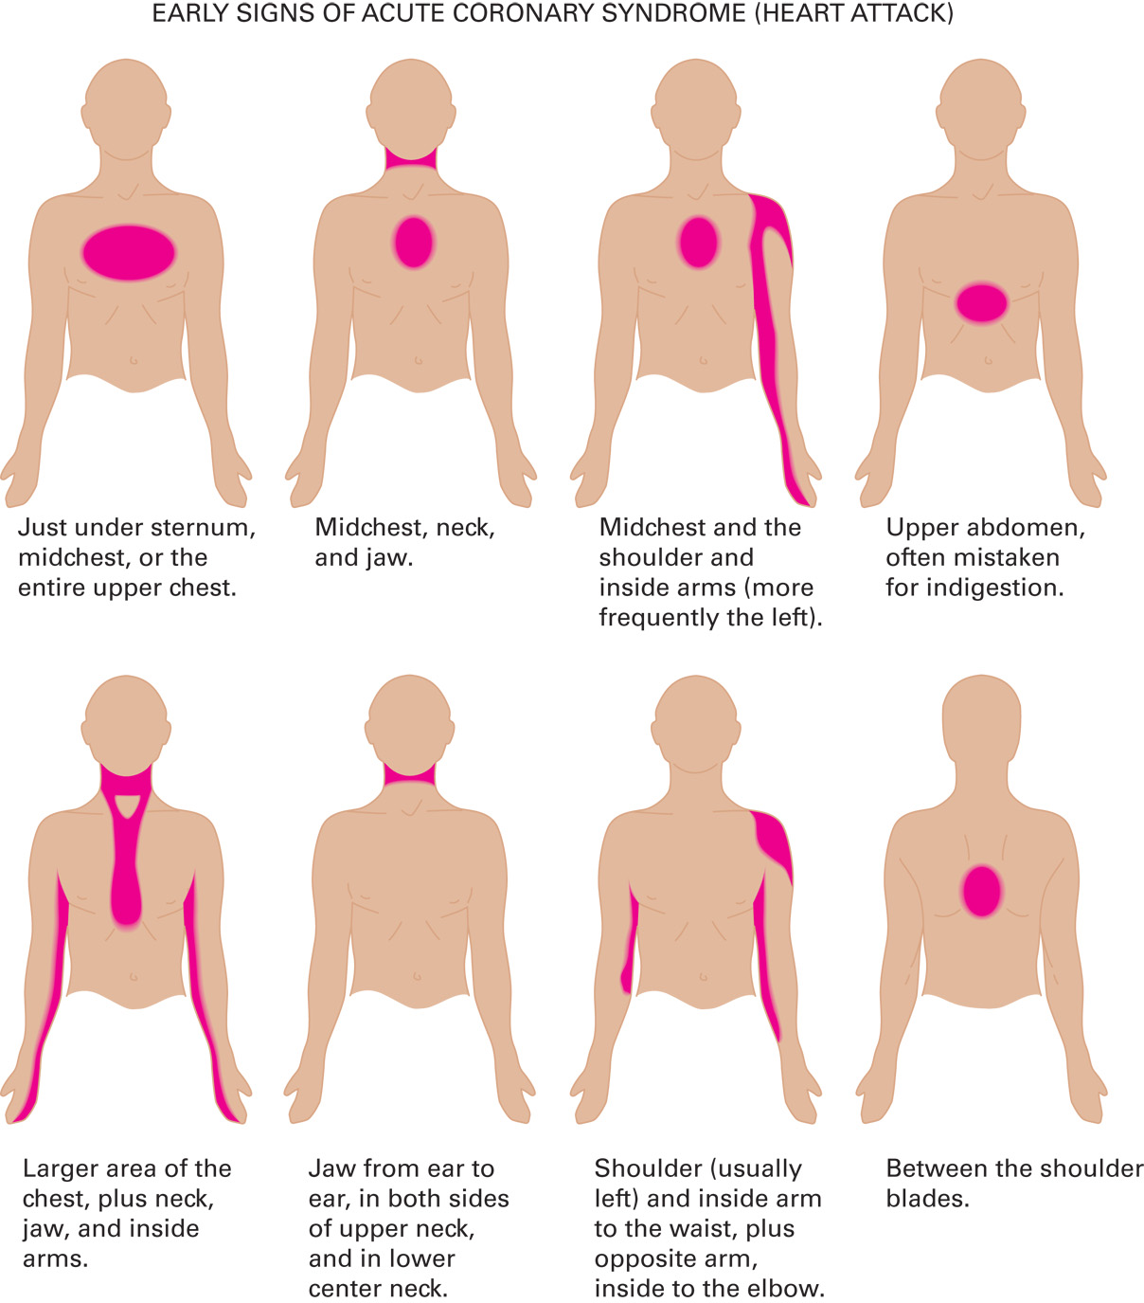
Typical Locations and Radiation of Chest Discomfort Associated with Cardiac Emergencies
Notes:
Chest discomfort or pain that radiates to any of the following areas: chest, neck, jaw, arm, or back; also, epigastric (upper abdomen) pain that may be described as indigestion.

Slide 86
Assessment and Care: General Guidelines (7 of 13)
  Assessment-Based Approach: Cardiac Compromise and A C S
  Physical exam and baseline vital signs
    Chest
    Lower and Upper extremities
    Posterior body
    Vital signs
Notes:
During the exam, assess the following:
Pupils- Sluggish or dilated pupils may suggest hypoxia and poor perfusion.
Oral cavity- Cyanotic mucous membranes indicate hypoxia.
Neck- Congestive heart failure or cardiac tamponade (fluid in the sac surrounding the heart) may produce jugular venous distention.
Chest- Auscultate for abnormal breath sounds, especially crackles, which might indicate fluid in the alveoli from left ventricular heart failure.
Lower and upper extremities- Assess for peripheral edema, suggesting heart failure, and peripheral cyanosis, usually indicating vessel disease.
Posterior body- Presacral edema to the lower back is another indicator of heart failure that may be more prominent in the patient who is sedentary and commonly in a supine or lying position.
In addition to performing the focused physical exam, obtain and record the patient’s vital signs.

Slide 87
Assessment and Care: General Guidelines (8 of 13)
  Assessment-Based Approach: Cardiac Compromise and A C S
  Signs and symptoms
    Chest discomfort or pain, which may radiate; epigastric pain
    Sudden onset of sweating
    Cool, pale, skin
    Difficulty breathing
    Light-headedness or dizziness
Notes:
Signs and symptoms associated with cardiac compromise or acute coronary syndrome may vary widely.

Slide 88
Assessment and Care: General Guidelines (9 of 13)
Assessment-Based Approach: Cardiac Compromise and A C S
  Signs and symptoms
    Anxiety or irritability
    Feeling of impending doom
    Abnormal pulse
    Nausea or vomiting
Notes:
Increased respiratory rate and heart rates in the acute coronary syndrome patient may indicate hypoxia or may be only a response to the chest pain or discomfort.

Slide 89
Assessment and Care: General Guidelines (10 of 13)
  Assessment-Based Approach: Cardiac Compromise and A C S
  Emergency medical care
    Provide reassurance and place patient in a position of comfort.
    Apply oxygen according to 2010 A H A Guidelines.
Notes:
Decrease the patient’s anxiety by providing calm reassurance and placing them in a position of comfort.
Administer supplemental oxygen. If the patient is dyspneic, hypoxemic, has obvious signs of heart failure, has an SpO₂ of 694%, or the SpO₂ is unknown, administer oxygen via a nasal cannula at two lpm and titrate the concentration and liter flow to achieve and maintain an SpO₂ of 94% or greater. If the SpO₂ is 94% or greater, the patient has no complaint of dyspnea, and has no signs of poor perfusion or heart failure, oxygen isn't administered in the acute coronary syndrome patient.

Slide 90
Assessment and Care: General Guidelines (11 of 13)
Assessment-Based Approach: Cardiac Compromise and A C S
  Emergency medical care
    Assist a patient who has prescribed nitroglycerin.
    Administer aspirin according to protocol.
    Call for A L S backup; initiate early transport.
Notes:
Assist the patient who has prescribed nitroglycerin.
If local protocol permits and the patient does not have a known aspirin allergy, administer 160–325 mg of uncoated aspirin. Have the patient chew the aspirin. Aspirin reduces the incidence of coronary arteries reoccluding and has antiplatelet effects.
Call for ALS backup; initiate early transport.

Slide 91
Assessment and Care: General Guidelines (12 of 13)
  Assessment-Based Approach: Cardiac Compromise and A C S
  Reassessment
    Patients with A C S can deteriorate to cardiac arrest.
    Closely reassess breathing and pulse.
Notes:
Closely assess and reassess the patient’s breathing and pulse at the scene and during transport. If the patient becomes unresponsive with no breathing or no normal breathing quickly assess the carotid pulse in the adult or child or the brachial pulse in the infant. If there is no normal breathing and no pulse, immediately perform CPR and, as appropriate, use automated external defibrillation.

Slide 92
Assessment and Care: General Guidelines (13 of 13)
  Assessment-Based Approach: Cardiac Compromise and A C S
  Summary: Assessment and Care
Notes:
Review assessment findings that may be associated with cardiac compromise and emergency care for cardiac compromise.

Slide 93
Case Study Conclusion (1 of 2)
As Lisa prepares the stretcher so that they can begin transport without delay, Ella assists Mr. Frey in taking an additional nitroglycerin tablet and, according to protocol, administers 325 milligram aspirin. En route, Ella reassess Mr. Frey’s pain level and vital signs. With a B P of
and discomfort rated a 4 out of 10, Mr. Frey is a candidate for another dose of nitroglycerin. Ella advises the receiving hospital of Mr. Frey’s condition.
Notes:
Review case conclusion and emphasize the application of knowledge learned from this presentation.

Slide 94
Case Study Conclusion (2 of 2)
Upon arrival, a nurse performs a 12-lead E C G, and the physician begins his assessment and history. It is determined that Mr. Frey is having an A M I, and he is immediately prepared to receive fibrinolytic medications.
Notes:
Review case conclusion and emphasize the application of knowledge learned from this presentation.

Slide 95
Summary (1 of 2)
Cardiovascular disease is a significant problem.
Presentations can range from atypical symptoms to cardiac arrest.
Time is of the utmost essence in treating A C S.
Notes:
Treatment for cardiac-related chest pain and other coronary emergencies must be delivered in a timely manner, without error. Patient outcomes are always better if they do not degrade into cardiac arrest. If they should arrest, outcomes are generally poor, carrying with them a low rate of successful resuscitation.
Follow-Up
Answer student questions.
Follow-Up Assignments
Review Chapter 17 Summary.
Complete Chapter 17 In Review questions.
Complete Chapter 17 Critical Thinking questions.
Assessments
Handouts
Chapter 17 quiz

Slide 96
Summary (2 of 2)
For cardiac arrest, remember the Chain of Survival.
Oxygen, nitroglycerin, and aspirin are drugs the E M T may use in the treatment of A C S.
Notes:
Class Activity
As an alternative to assigning the follow-up exercises in the lesson plan as homework, assign each question to a small group of students for in-class discussion.
Teaching Tips
Answers to In Review questions are in the appendix of the text. Advise students to review the questions again as they study the chapter.

Slide 97
Correct!
A systolic blood pressure of less than 90 m m H g is a contraindication to receiving nitroglycerin.
Click here to return to the program.

Slide 98
Incorrect (1 of 3)
An E M T may assist an adult patient of any age with nitroglycerin, as long as the patient has signs and symptoms of A C S, there is medical direction approval, and the patient does not have any contraindications, such as having taken the maximum dose or having a systolic B P less than 90 m m H g.
Click here to return to the quiz.

Slide 99
Incorrect (2 of 3)
A heart rate of 60 is within the acceptable range for assisting a patient with nitroglycerin. Do not give nitroglycerin if the heart rate is less than 50 or greater than 100 per minute.
Click here to return to the quiz.

Slide 100
Incorrect (3 of 3)
Nitroglycerin is contraindicated in patients who have taken Viagra within 24 hours. For some erectile dysfunction drugs, the patient must not have taken a dose within 48 hours.
Click here to return to the quiz.

Slide 101

Copyright

