Slide 1

Prehospital: Emergency Care
Eleventh Edition
Chapter 16
Respiratory Emergencies
"Slides in this presentation contain hyperlinks. JAWS users should be able to get a list of links by using INSERT+F7"
Copyright © 2018, 2014, 2010 Pearson Education, Inc. All Rights Reserved
Notes:
If this PowerPoint presentation contains mathematical equations, you may need to check that your computer has the following installed:
1) MathType Plugin
2) Math Player (free versions available)
3) NVDA Reader (free versions available)
Advance Preparation
Student Readiness
Assign the associated section of MyBRADYLab and review student scores. Review the chapter material in the Instructor Resources, which includes Student Handouts, PowerPoint slides, and the MyTest Program.
Prepare
Review local protocols for administration of respiratory drugs and treatment of respiratory emergencies.
Bring MDI samples or demonstration units and small-volume nebulizers for demonstration and student practice.
Bring enough stethoscopes to class for pairs of students to practice auscultation of breath sounds.
Bring enough small drinking straws of coffee stirrers to class for each student.
Arrange for lab instructors and equipment for skills practice. A ratio of one instructor for every four students is recommended.
The total teaching time recommended is only a guideline. Take into consideration factors such as the pace at which students learn, the size of the class, breaks, and classroom activities. The actual time devoted to teaching objectives is the responsibility of the instructor.

Slide 2
Learning Readiness
E M S Education Standards, text p. 472
Chapter Objectives, text p. 472.
Key Terms, text p. 473.
Purpose of lecture presentation versus textbook reading assignments.
Notes:
Explain to students what the National EMS Education Standards are. The National EMS Education Standards communicate the expectations of entry-level EMS providers. As EMTs, students will be expected to be competent in these areas. Acknowledge that the standards are broad, general statements. Although this lesson addresses the listed competencies, the competencies are often complex and require completion of more than one lesson to accomplish. The student is also expected to review the chapter objectives to foreshadow what will be in the chapter. By mastering the key terms the EMT student will better understand the learning and be able to communicate more clearly.
Additionally, explain to the students that the purpose of using these slides is to help keep the instructor focused on highlighting important portions of the material, explain interrelationships of topics, and discuss how to apply this information. It’s not the intent of the presentation (or slides alone) to include every component in the chapter. This presentation still requires the student to thoroughly read the chapter.

Slide 3
Setting the Stage (1 of 2)
Overview of Lesson Topics
  Respiratory Anatomy, Physiology, and Pathophysiology
  Respiratory Distress
  Pathophysiology of Conditions that Cause Respiratory Distress
  Metered-Dose Inhalers and Small-Volume Nebulizers
Notes:
These bulleted points are the major headings from the chapter, in order. The purpose is to provide a basic lecture navigation for the student.

Slide 4
Setting the Stage (2 of 2)
  Overview of Lesson Topics
  Age Related Variations: Pediatrics and Geriatrics
  Assessment and Care: General Guidelines.
Notes:
These bulleted points are the major headings from the chapter, in order. The purpose is to provide a basic lecture navigation for the student.

Slide 5
Case Study Introduction (1 of 3)
E M T s Jake Pratt and and Paul Berg arrive at a residence to find 62-year-old Margaret Brown sitting at the kitchen table, leaning forward on her hands to breathe. They immediately note that she is a thin woman with a barrel-shaped chest who is using accessory muscles to breathe.
Notes:
Case Study
Present the Case Study Introduction provided in the PowerPoint slide set. Lead a discussion using the case study questions provided on the subsequent slide(s). The Case Study with discussion questions continues throughout the PowerPoint presentation.
Case Study Discussion
Use the case study content and questions to foreshadow the upcoming lesson content.

Slide 6
Case Study Introduction (2 of 3)
Despite an increased respiratory rate and increased work of breathing, Mrs. Brown's skin color is pink. Jake notices a portable oxygen concentrator, as well as a nebulizer, nearby.
Notes:
Case Study
Present the Case Study Introduction provided in the PowerPoint slide set. Lead a discussion using the case study questions provided on the subsequent slide(s). The Case Study with discussion questions continues throughout the PowerPoint presentation.
Case Study Discussion
Use the case study content and questions to foreshadow the upcoming lesson content.

Slide 7
Case Study (1 of 7)
What is your general impression of this patient so far?
What additional information will help you complete your general impression?
What immediate actions should the E M T s take while completing the primary assessment?
Notes:
Use the case study content and questions to foreshadow the upcoming lesson content. Gauge the student’ responses as a guide of how well-versed they are in this topic.

Slide 8
Introduction
Respiratory distress is frightening, and potentially life threatening.
You must be able to recognize signs and symptoms of respiratory distress and provide immediate intervention.
Notes:
During this lesson, students will learn about assessment and emergency care for a patient suffering from respiratory distress.

Slide 9
Respiratory Anatomy, Physiology, and Pathophysiology (1 of 4)
The respiratory system consists of:
  Upper airway
  Lower airway
  Lungs
Normal Breathing
  Normal respiratory rates are based on patient age and medical history.
  Certain findings are consistent with a person who is breathing adequately.
Notes:
Findings consistent with a patient who is breathing adequately:
An intact (open) airway.
Normal respiratory rate.
Good rise and fall of the chest.
Normal respiratory rhythm.
Breath sounds that are present bilaterally.
Chest expansion and relaxation that occurs normally.
Minimal-to-absent use of accessory muscles to aid in breathing.
Normal mental status.
Normal muscle tone.
Normal pulse oximeter reading (>94 percent).
Normal skin condition findings.
Discussion Questions
What are the characteristics of normal breathing?
How does the body respond to decreases in oxygen and increases in carbon dioxide levels?

Slide 10
Respiratory Anatomy, Physiology, and Pathophysiology (2 of 4)
Abnormal Breathing
  Conditions that impair gas exchange
    Increased space between alveoli and pulmonary capillaries
    Lack of perfusion of the pulmonary system from the right heart
    Fluid, blood, or pus in the alveoli
Notes:
During periods of heightened respiratory effort, the body can employ accessory muscles to help change the size of the thorax (chest cavity) more aggressively to move air better.
Other accessory structures that are part of the respiratory system include the inspiratory and expiratory centers in the medulla and pons, located in the brainstem, which exert nervous control of breathing.
Respiratory centers receive information about the oxygen and carbon dioxide content of the bloodstream from special sensors in the vascular system.
Points to Emphasize
Inadequate breathing can be caused by problems with the upper or lower airways, or the lungs and accessory structures that allow oxygenation of the cells and elimination of carbon dioxide.
Lung conditions can lead to decreased efficiency of gas exchange across the alveolar-capillary membrane.

Slide 11
Respiratory Anatomy, Physiology, and Pathophysiology (3 of 4)
  Abnormal Breathing
  Assessing Breath sounds
    Auscultation of breath sounds provide additional evidence of breathing difficulty.
    To achieve the most accurate breath sounds, it is important to auscultate in the appropriate fashion.
    Have the patient sit upright and use the diaphragm end of your stethoscope over bare skin.
Notes:
Auscultation
Place your stethoscope on the patient's skin with the patient in a sitting position.
Listen in each place for an inhalation and exhalation.
Compare each location to its mirror location on the other side.

Slide 12
E M T Skills 16-1
Auscultating the Chest

Slide 13
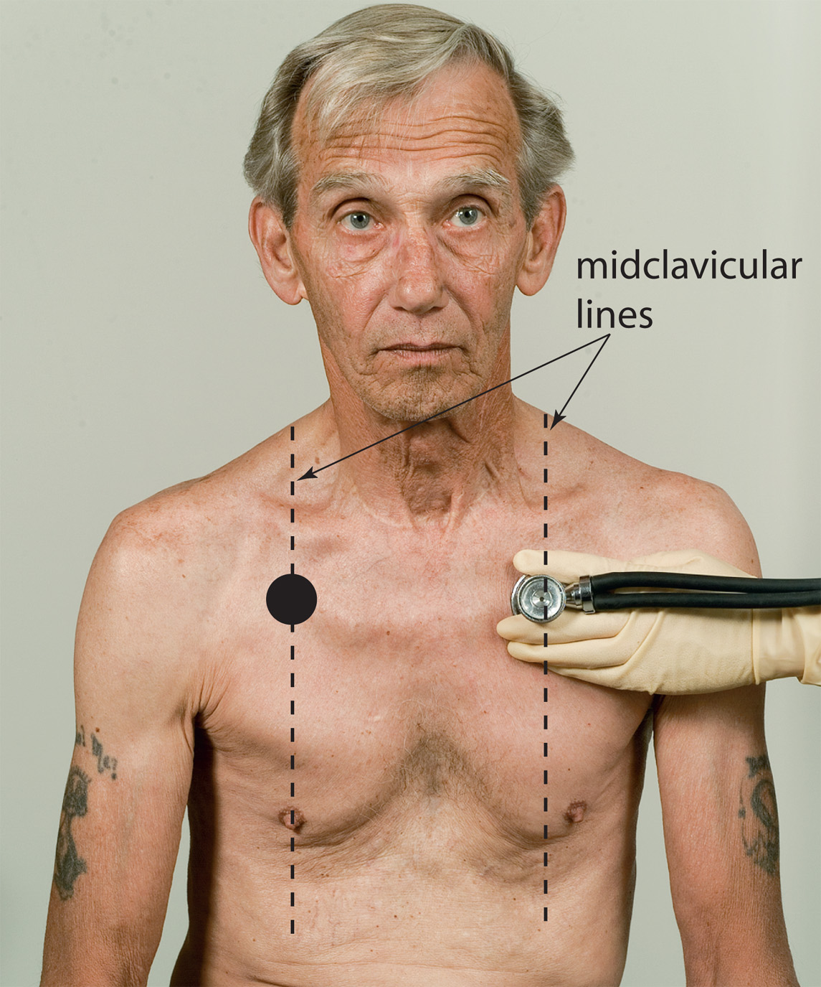
Auscultate the Anterior Chest at the Second Intercostal Space at Each Midclavicular Line

Slide 14
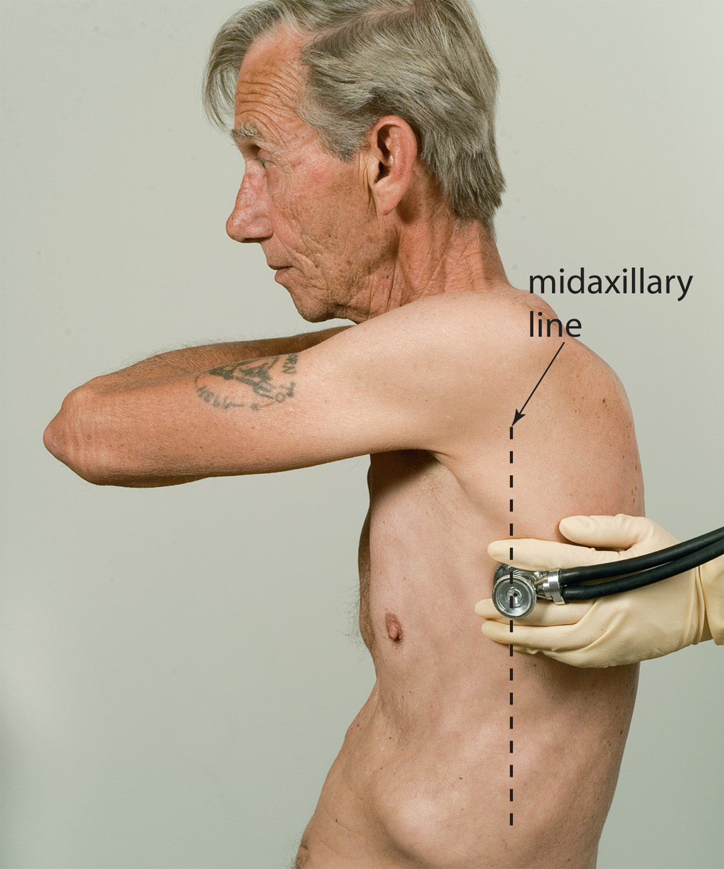
Auscultate the Lateral Chest at the Fourth to Fifth Intercostal Space at Each Midaxillary Line

Slide 15
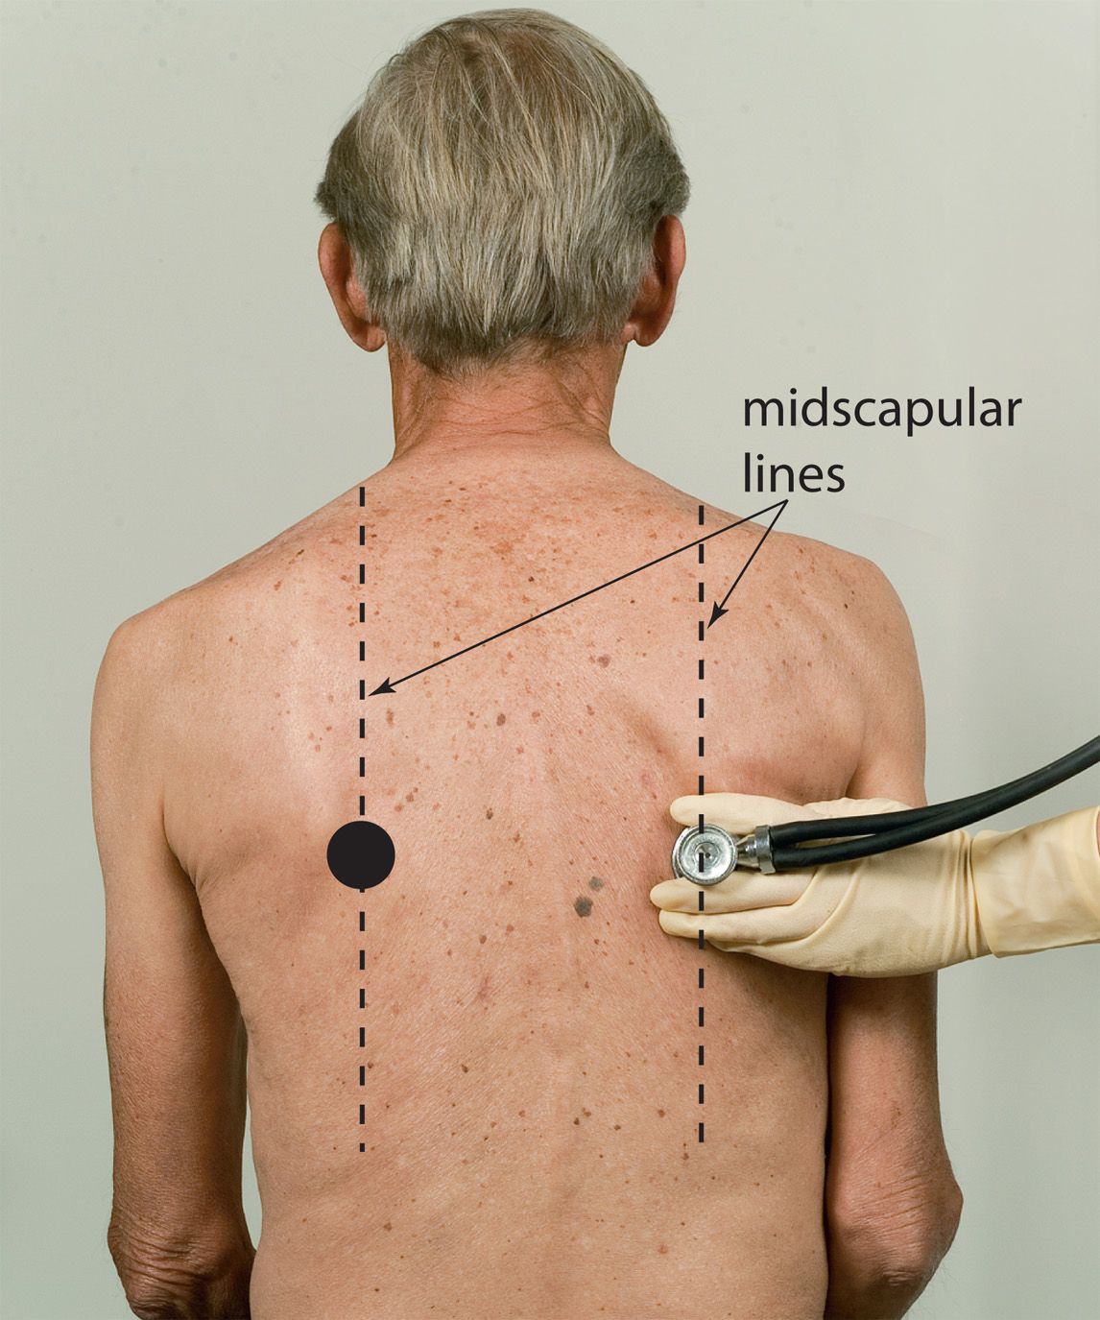
Auscultate the Posterior Chest Below the Tip of the Scapula on Each Midscapular Line

Slide 16
Respiratory Anatomy, Physiology, and Pathophysiology (4 of 4)
Abnormal Breathing
  Assessing Breath Sounds
    Abnormal breath sounds
      Wheezing
      Rhonchi
      Crackles
Notes:
Wheezing is a high-pitched, musical, whistling sound that is best heard initially on exhalation, but can also be heard during inhalation in more severe cases. It is an indication of swelling and constriction of the inner lining of the lower airways, primarily the bronchioles. Wheezing that is diffuse (heard over all the lung fields) is a primary indication for the administration of a beta₂ agonist medication. Wheezing is usually heard in asthma, emphysema, chronic bronchitis, and other breathing disorders.
Rhonchi, which can also be referred to as coarse crackles, are snoring or rattling noises heard on auscultation. They indicate obstruction of the larger conducting airways of the respiratory tract by thick secretions of mucus. Rhonchi are often heard in chronic bronchitis, emphysema, aspiration, and pneumonia. Rhonchi may change the quality of sound if the person coughs or even when the person changes position.
Crackles, also known as rales, are bubbly or crackling sounds heard during inhalation. These sounds are associated with fluid that has surrounded or filled the alveoli or small bronchioles. The crackling sound is commonly associated with the alveoli and terminal bronchioles “popping” open with each inhalation. The bases of the lungs posteriorly reveal crackles first because of the natural tendency of fluid to be pulled downward by gravity. Crackles can indicate pulmonary edema or pneumonia. This type of breath sound typically does not change with coughing or movement.
Teaching Tips
Demonstrate the correct locations for assessing breath sounds.
Discussion Questions
What conditions are associated with wheezing?
What conditions are associated with rhonchi?
What conditions are associated with crackles in the lungs?
Class Activity
Have pairs of students practice listening to each other's breath sounds in the proper locations.
Knowledge Application
Given several descriptions of breath sounds, students should be able to suggest general causes of abnormal sounds.

Slide 17
Respiratory Distress (1 of 7)
Inadequate breathing leads to hypoxemia (S p O₂ <94%) and hypercarbia.
Hypoxemia leads to cardiovascular failure and hypoperfusion.
Untreated, inadequate breathing leads to death.
Notes:
Respiratory emergencies can range from “shortness of breath,” or dyspnea, to complete respiratory arrest, or apnea, in which the patient is no longer breathing. These conditions can result from many causes, but most typically involve the respiratory tract or the lungs.
Points to Emphasize
Inadequate breathing, even for brief periods, leads to hypoxemia. Hypoxemia leads to the failure of other body systems and, if untreated, the patient will die.
EMTs must immediately recognize indications of respiratory distress.
The sensation of shortness of breath is usually related to mechanical disruption of the airway, lungs or chest wall; stimulation of receptors in the lungs; or inadequate gas exchange.
Respiratory distress occurs when breathing is difficult, but adequate. Respiratory failure occurs when either the tidal volume or rate are no longer adequate. Respiratory arrest is the cessation of breathing effort.
Class Activity
Have students attempt to breathe normally through drinking straws or coffee stirrers to demonstrate the increased respiratory effort and decreased airflow associated with severe bronchoconstriction.
Discussion Question
What are indications of respiratory distress?

Slide 18
Respiratory Distress (2 of 7)
Common findings in respiratory distress
  Complaint of shortness of breath
  Restlessness
  Increased or decreased pulse rate
  Changes in breathing rate or depth
  Skin color changes
Notes:
The following findings also commonly occur in patients with respiratory distress:
Pale, cool, clammy skin (early finding, or cyanosis later finding).
Abnormal respiratory pattern.
Wheezing, rhonchi, or crackles.
Difficulty or inability to speak.
Muscle retractions. (Suprasternal, supraclavicular, subclavicular, and intercostal retractions indicate difficulty in inhaling through constricted airways or difficulty in expanding lungs against poor compliance.)
Altered mental status. (Anxiety and confusion is an early finding; aggressive or complacent behavior and sleepiness is a later finding.)
Abdominal breathing. (Excessive use of abdominal muscles indicates difficulty in exhaling through constricted airways.)
Excessive coughing (with or without expectorating material).
Tripod position (leaning forward, braced with arms and elbows locked and hands on a hard surface).
Pulse oximeter reading <94 percent.
Critical Thinking Discussion
Why is increased respiratory rate an indication of respiratory distress?

Slide 19
Respiratory Distress (3 of 7)
Causes
  Narrowing of the bronchioles from inflammation, swelling, or bronchoconstriction.
  Bronchodilators can provide relief
  Injuries to the head, neck, face, spine, chest, or abdomen.
  Cardiac compromise.
  Hyperventilation.
Notes:
A beta₂ agonist bronchodilator is designed to relax the bronchi and bronchiole smooth muscle, causing dilation, which results in a decrease in airway resistance and an increase in the effectiveness of moving air in and out of the alveoli, better gas exchange, and a relief from the signs and symptoms of respiratory distress.
The sensation of shortness of breath occurs when the metabolic demands of the body are not met. This typically results from an inadequate amount of oxygen delivered to the cells to allow for normal aerobic metabolism to continue.
Teaching Tips
Emphasize that all respiratory problems discussed in the upcoming section will have at least one of these underlying causes.
Critical Thinking Discussion
What is the significance of the patient's experience of anxiety in respiratory distress?

Slide 20
Respiratory Distress (4 of 7)
  Causes
  Abdominal conditions
  Dysfunction of the respiratory system by:
    Mechanical disruption to the airway, lung, or chest wall
    Stimulation of receptors in the lungs
    Inadequate gas exchange related to a ventilation or perfusion disturbance
Notes:
Symptoms of dyspnea are usually caused by one of the following:
Mechanical disruption to the airway, lung, or chest wall that prevents effective mechanical ventilation. Conditions that can cause a disruption in mechanical ventilation include airway obstruction, flail chest, chest muscle weakness, neuromuscular diseases, and lung collapse.
Stimulation of the receptors in the lungs produce a sensation of shortness of breath. Conditions that stimulate the receptors include asthma, pneumonia, and congestive heart failure.
Inadequate gas exchange at the level of the alveoli and capillaries causing a decrease in the oxygen content in the blood (hypoxemia) or a rise in the level of carbon dioxide (hypercarbia). This can occur because of any of the following:
A ventilation disturbance — An inadequate amount of oxygen-rich air entering the alveoli and passing across the alveolar membrane to the capillary.
A perfusion disturbance — An inadequate amount of blood traveling through the pulmonary capillaries, which decreases the number of red blood cells available to pick up the oxygen and transport it to the cells.
Both a ventilation and a perfusion disturbance in the lungs, leading to hypoxemia and hypercarbia (increased carbon dioxide levels in the blood).
A gas exchange disturbance from an increased amount of interstitial fluid in and around the alveoli.

Slide 21
Respiratory Distress (5 of 7)
A breathing disturbance can be categorized in one of three ways
  Respiratory distress
    Adequate rate and tidal volume.
    Patient is compensating.
    Administer oxygen to maintain an S p O₂ of 94 percent or higher.
    Consider C P A P.
Notes:
A nasal cannula at 2 lpm can be used to increase or maintain the SpO₂ reading at 94 percent or higher. Oxygen administration should be based on the patient’s oxygenation status as measured and primarily guided by the pulse oximeter instead of using predetermined devices and flow rates for all patients.

Slide 22
Respiratory Distress (6 of 7)
  A breathing disturbance can be categorized in one of three ways
  Respiratory failure
    Rate, tidal volume, or both are inadequate.
    Assist ventilations with bag-valve-mask.
    Provide supplemental oxygen.
    May deteriorate to respiratory arrest.
Notes:
If the tidal volume decreases or the respiratory rate increases or decreases significantly, you must provide immediate positive pressure ventilation and oxygenation with a bag-valve-mask device or other ventilation device. Supplemental oxygen must be delivered through the ventilation device.

Slide 23
Respiratory Distress (7 of 7)
  A breathing disturbance can be categorized in one of three ways
  Respiratory arrest
    Cessation of respiratory effort.
    Leads to cardiac arrest in minutes.
    Immediately intervene with bag-valve-mask ventilations and supplemental oxygen.
Notes:
Respiratory failure and respiratory arrest are treated the same way, with positive pressure ventilation and supplemental oxygen.

Slide 24
Pathophysiology of Conditions That Cause Respiratory Distress (1 of 39)
There are many causes of respiratory distress, but assessment and basic emergency care is the same.
Notes:
Class Activity
Before lecturing on this section, assign small groups of students to each disorder in this section. Give students 15 minutes to read about and do more research on their topic before presenting their information to the class. Be prepared to correct any misunderstandings and fill in any gaps.
The EMT is responsible for identifying the signs and symptoms, determining whether the breathing is adequate or inadequate, anticipating deterioration in the patient’s status, and providing immediate intervention as necessary to support adequate respiration.
Diseases that can cause respiratory distress, respiratory failure, or respiratory arrest:
Obstructive pulmonary diseases.
Emphysema.
Chronic bronchitis.
Asthma.
Pneumonia.
Pulmonary embolism.
Pulmonary edema.
Spontaneous pneumothorax.
Hyperventilation syndrome.
Epiglottitis.
Pertussis.
Cystic fibrosis.
Poisonous exposures.
Viral respiratory infections.
Discussion Questions
What is an example of mechanical disruption of breathing?
What are examples of conditions causing inadequate gas exchange?
Knowledge Application
Give several examples of conditions leading to hypoxia, such as an inadequate number of red blood cells, constricted airways, a blood clot in the pulmonary artery, and so on, and ask students to explain how each condition leads to hypoxia and respiratory distress.
Points to Emphasize
The goals of managing patients with respiratory distress are the same, but the way in which the goals are achieved in each patient may be different.
Not all signs and symptoms of a given disorder must be present for the patient to have the disorder.
Obstructive pulmonary diseases result in reduced airflow through the respiratory tract, which can lead to hypoxia.
Never withhold oxygen from a patient who needs it.
Status asthmaticus is a life-threatening emergency.
Teaching Tips
Draw a grid on the white board with a respiratory disorder at the top of each column. Label two rows at the left "similar" and "different." Have students state what is similar about all respiratory emergencies, and what is unique or distinguishing about each disorder to help them learn about the disorders.
Discuss specific protocols for your area.

Slide 25
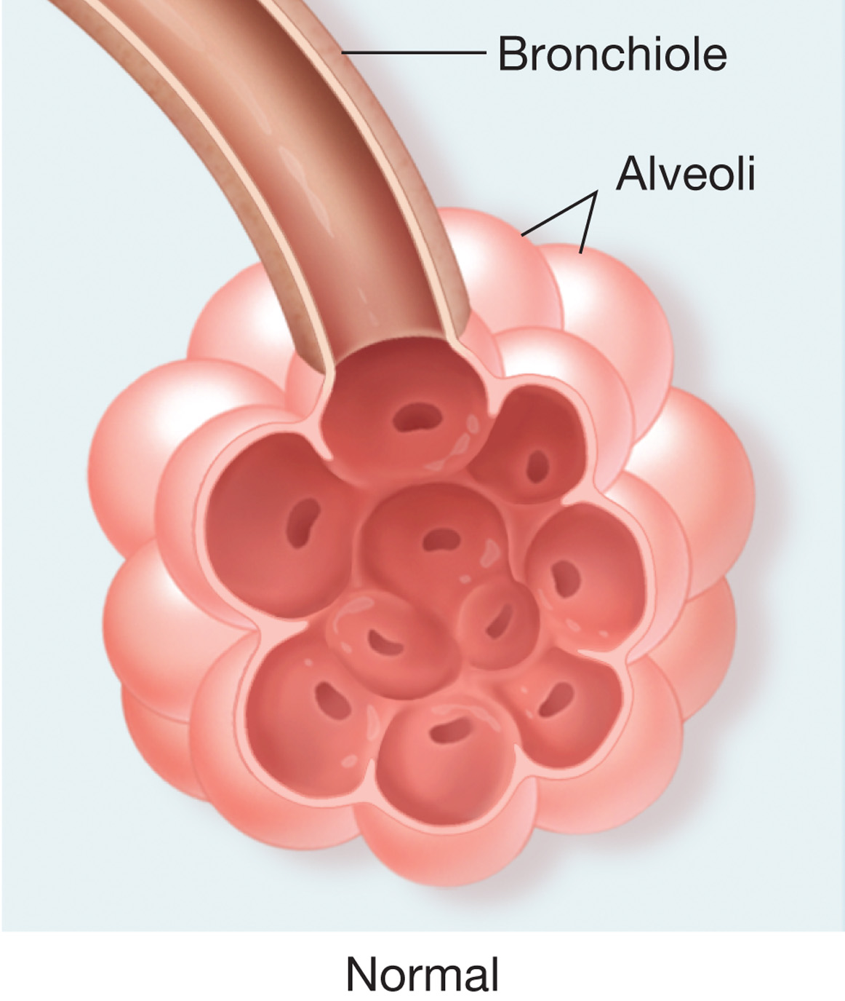
Emphysema and Chronic Bronchitis are Chronic Obstructive Pulmonary Diseases (1 of 3)
Notes:
An obstructive lung disease causes an obstruction of airflow through the respiratory tract, leading to a reduction in gas exchange.

Slide 26
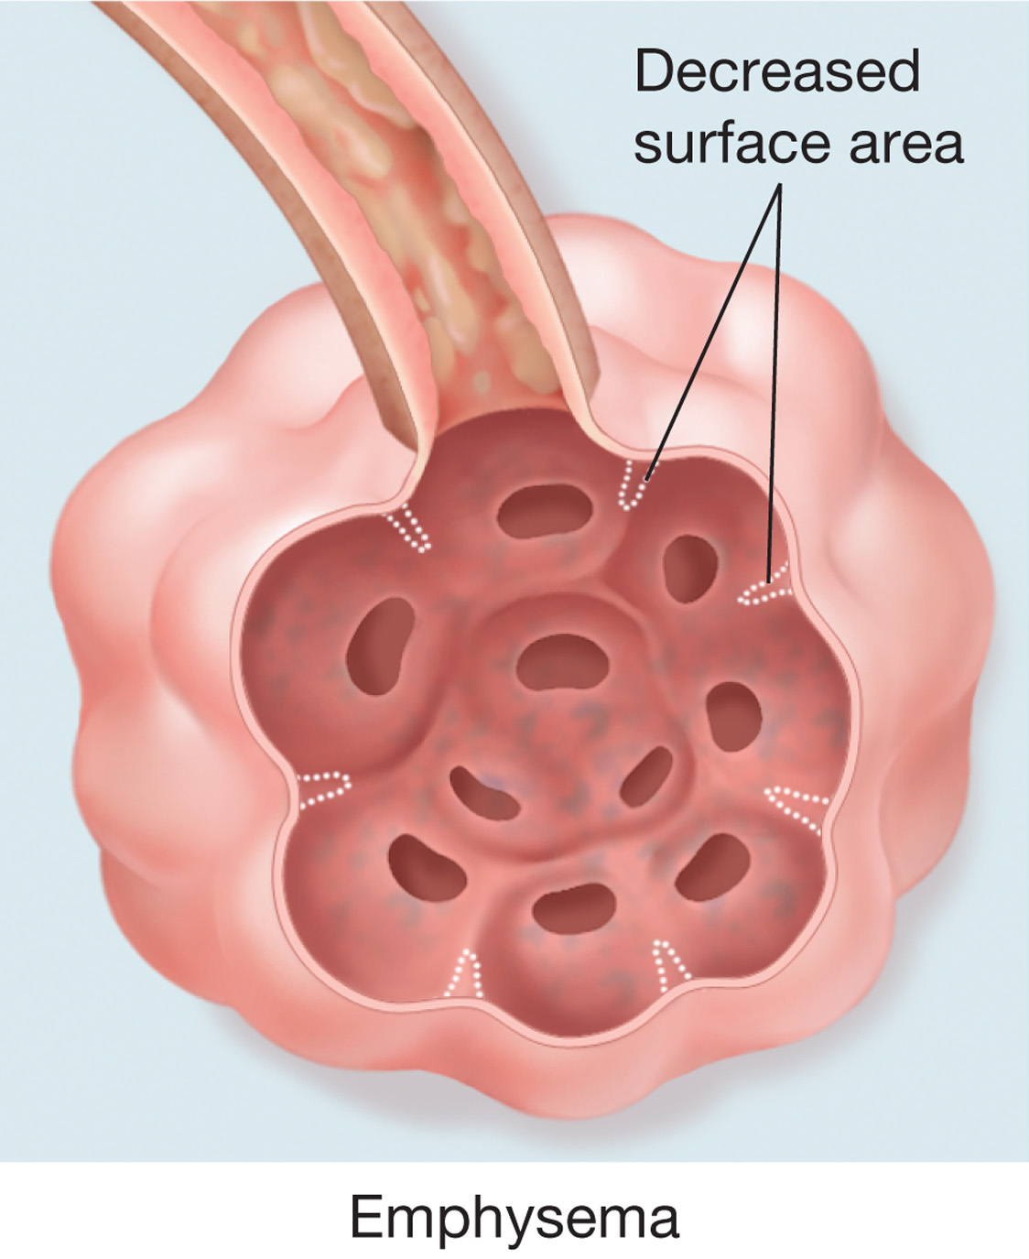
Emphysema and Chronic Bronchitis are Chronic Obstructive Pulmonary Diseases (2 of 3)
Notes:
Emphysema and chronic bronchitis are chronic disease conditions that continue to progress.

Slide 27
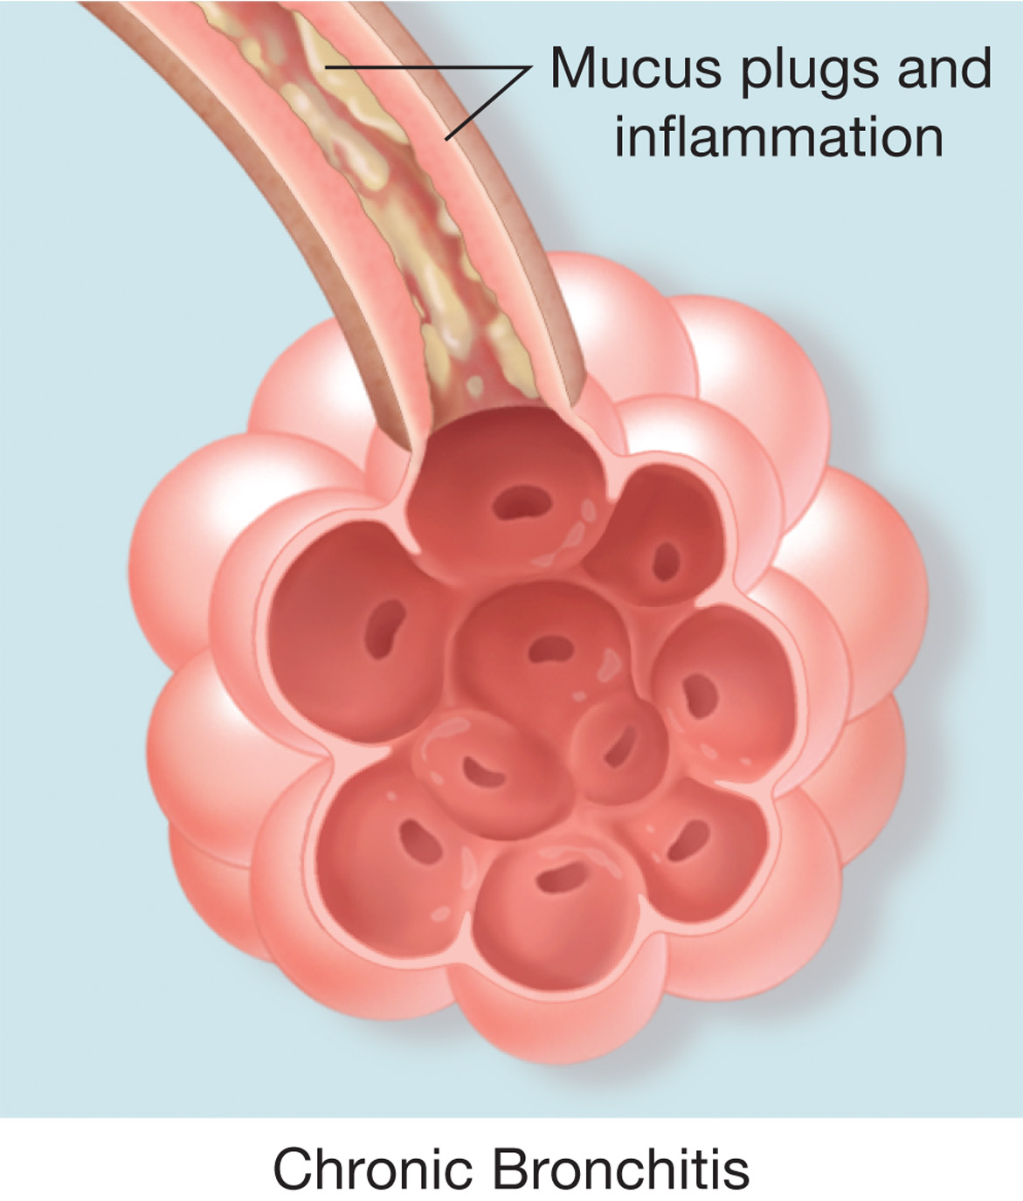
Emphysema and Chronic Bronchitis are Chronic Obstructive Pulmonary Diseases (3 of 3)
Notes:
Many patients have a combination of chronic bronchitis and emphysema and present with a mixture of signs and symptoms associated with both conditions.

Slide 28
Pathophysiology of Conditions That Cause Respiratory Distress (2 of 39)
Obstructive Pulmonary Diseases
  Emphysema - Pathophysiology
    Lung tissue loses its elasticity
    Walls of the alveoli are destroyed
    Disruption in gas exchange occurs
    The patient purses their lips while exhaling to create their own “physiologic P E E P”
    Patient usually complains of shortness of breath upon exertion
Notes:
The complaint of shortness of breath progresses as the disease worsens. The thin appearance from weight loss and muscle wasting is associated with a reduction in cardiac output and the high energy demands of the respiratory muscles required for breathing. The loss of lung elasticity and trapping of air cause the chest to increase in diameter, which produces the barrel-chest appearance typical with this disease. The emphysema patient compensates for the disease process by hyperventilating.

Slide 29
Pathophysiology of Conditions That Cause Respiratory Distress (3 of 39)
  Obstructive Pulmonary Diseases
  Emphysema - Assessment
    Signs and symptoms
      Many of the signs and symptoms of emphysema are similar to those listed for respiratory distress.
Notes:
Signs and symptoms of emphysema can include the following:
Anxious, alert, and oriented.
Dyspneic.
Uses accessory muscles.
Thin, barrel-chest appearance from chronic air trapping in the alveoli causing the anterior–posterior diameter of the chest to increase.
Coughing, but with little sputum (the material that is coughed up).
Prolonged exhalation.
Diminished breath sounds (indicating poor air movement).
Wheezing and rhonchi on auscultation.
Pursed-lip breathing (physiologic PEEP).
Extreme difficulty of breathing on minimal exertion.
Tachypnea - breathing rate usually greater than 20 per minute at rest.
Tachycardia (increased heart rate).
Diaphoresis (sweating; moist skin).
SPO₂ of 94 percent or greater unless in respiratory failure.
Tripod position.
May be on home oxygen.

Slide 30
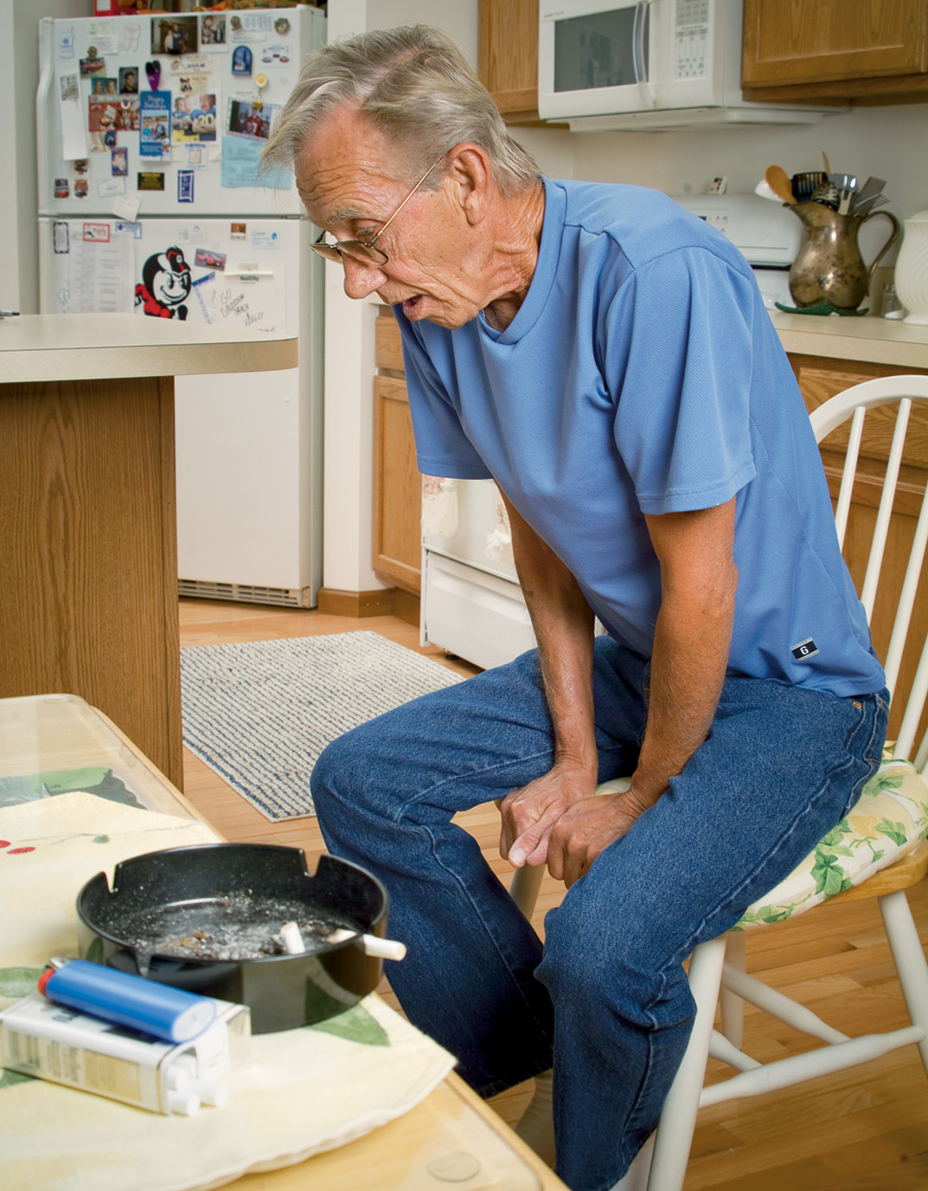
Man Suffering Respiratory Distress (Indicated by Tripod Position) From Obstructive Lung Disease
Notes:
Asthma, which is thought to be passed on genetically, occurs in response to factors within the body (intrinsic, such as stress and exercise) and factors found in the environment (extrinsic, such as allergens and chemical fumes).

Slide 31
C P A P or BiP A P May Be Used to Improve Oxygenation
Notes:
A COPD patient with a continuous positive airway pressure (CPAP) or a bilevel positive airway pressure (BiPAP) machine on the bedside stand, which the patient uses with a mask applied over the nose to assist in keeping airway passages open and providing adequate oxygenation.

Slide 32
Pathophysiology of Conditions That Cause Respiratory Distress (4 of 39)
Obstructive Pulmonary Diseases
  Chronic Bronchitis - Pathophysiology
    Swelling, and thickening of bronchi and bronchiole lining
    Alveoli remain unaffected by the disease
    Associated with smoking
    Narrowed bronchioles reduce airflow
    Reduced lung ventilation with increased lung perfusion
Notes:
Because of the increase in bronchiole obstruction, there is a reduction in the residual volume in the lungs that can lead to bloating and a cyanotic appearance.

Slide 33
Pathophysiology of Conditions That Cause Respiratory Distress (5 of 39)
  Obstructive Pulmonary Diseases
  Chronic Bronchitis – Assessment.
    Productive cough.
    The increase in bronchiole obstruction, there is a reduction in the residual volume in the lungs that can lead to bloating and a cyanotic appearance
Notes:
Signs and symptoms of chronic bronchitis:
Cough (hallmark sign) is prominent; vigorous coughing produces sputum.
Typically overweight, with prominent peripheral edema and chronic jugular vein distention.
Chronically cyanotic complexion. (As already noted, chronic bronchitis patients were often called “blue bloaters,” but this is outdated because many COPD patients don’t conform to the description.)
Minimal difficulty with breathing and anxiety, unless in respiratory failure.
SPO₂ reading of <94 indicating chronic hypoxemia.
Scattered rales (crackles) and coarse rhonchi usually heard upon auscultation of the lungs.
Wheezes and, possibly, crackles at the bases of the lungs.
Asterixis (flapping of the extended wrists) may be seen in respiratory failure.

Slide 34
Pathophysiology of Conditions That Cause Respiratory Distress (6 of 39)
  Obstructive Pulmonary Diseases
  Chronic Bronchitis – Emergency Care
    Same guidelines as any patient suffering from difficulty breathing
    C O P D patients can develop hypoxic drive
    Maintain the S p O₂ between 88%–92%
    Consider the use of C P A P
Notes:
Emergency care for the patient with emphysema and chronic bronchitis follows the same guidelines as for any patient suffering from difficulty in breathing
Open airway.
Adequate breathing.
Position of comfort.
Administration of supplemental oxygen if necessary.
Patient may have a prescribed metered-dose inhaler (MDI) or small-volume nebulizer (SVN).
Hypoxic drive can signal the COPD patient to stop breathing due to elevated oxygen levels from supplemental oxygen. In the prehospital setting, this is a rare event and is not a major concern. Oxygen administration should take precedence over a concern about whether the hypoxic drive is going to be lost and cause the patient to stop breathing. Initiate positive pressure ventilation with supplemental oxygen if this occurs.

Slide 35
Case Study (2 of 7)
Jake quickly notes the following as Paul applies oxygen by nasal cannula and begins asking Mrs. Brown’s friend some questions. Mrs. Brown is in tripod position, using pursed-lip breathing. She is anxious, and is able to speak three to four words at a time. Her respiratory rate is 28, with adequate tidal volume.
Notes:
Review the case study findings presented.

Slide 36
Case Study (3 of 7)
Auscultation reveals scattered wheezing and rhonchi throughout both lungs. Mrs. Brown’s S p O₂ is 94 percent. The friend states that Mrs. Brown has emphysema, and has been more short of breath than usual since early this morning.
Notes:
Review the case study findings presented.

Slide 37
Case Study (4 of 7)
Would you characterize Mrs. Brown’s condition as respiratory distress, respiratory failure, or respiratory arrest?
What treatments may be appropriate for Mrs. Brown?
How should treatments be integrated with plans for transport?
Notes:
Use the case study content and questions to foreshadow the upcoming lesson content. Gauge the students responses as a guide of how well-versed they are in this topic.

Slide 38
Pathophysiology of Conditions That Cause Respiratory Distress (7 of 39)
Obstructive Pulmonary Diseases
  Asthma
    Increased sensitivity of lower airways leads to narrowing of the bronchioles and increased resistance to airflow
      Bronchospasm
      Edema of the airways
      Increased mucus production
      Acute severe asthma or status asthmaticus is a prolonged, life-threatening attack
Notes:
Asthma patients usually suffer acute, irregular, periodic attacks, but between the attacks they usually have either no or few signs or symptoms.
Acute severe asthma does not respond to either oxygen or medication therapy with bronchodilators and steroids. This is considered a true medical emergency, and these patients require immediate and rapid transport to the hospital.
Discussion Questions
What are the major differences between asthma, emphysema, and chronic bronchitis?
What are the similarities in treatment of all patients with obstructive pulmonary diseases?

Slide 39
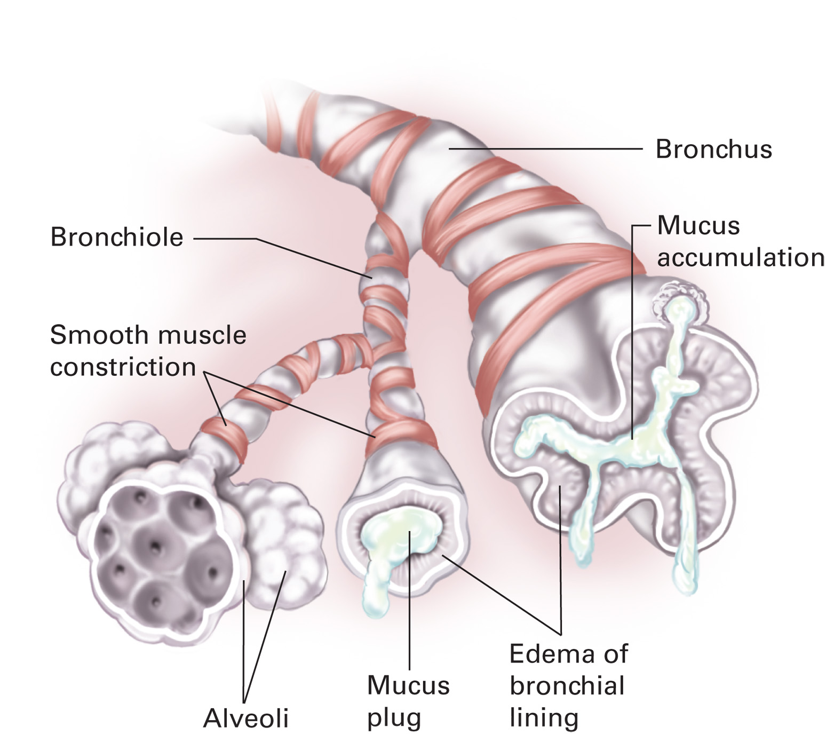
Conditions Contributing to Airflow Resistance in Asthma
Notes:
Asthma is characterized by an increased sensitivity of the airways to irritants and allergens, causing bronchospasm, which is a diffuse, reversible narrowing of the bronchi and bronchioles, as well as inflammation to the lining of the lower airways.

Slide 40
Pathophysiology of Conditions That Cause Respiratory Distress (8 of 39)
Obstructive Pulmonary Diseases
  Asthma – Assessment
    Slow onset
      80 percent of the cases of asthma have a slow onset.
      Deterioration over six hours to several days.
      More prevalent in females.
      Usually triggered by upper respiratory tract infection.
    Learn signs and symptoms
Notes:
Signs and symptoms of asthma:
Dyspnea (shortness of breath) can progressively worsen. (Dyspnea perception is different for patients and is not related to the degree of bronchoconstriction, swelling, and airway resistance.)
Cough often begins early and can be the only sign or symptom of an asthma attack, especially in elderly; a cough can be productive and often worsens at night.
Wheezing on auscultation (typically expiratory) can become diminished or absent with a severe reduction in airflow in the bronchioles.
Tachypnea.
Tachycardia. (A heart rate greater than 120 bpm with tachypnea often indicates a severe asthma attack.)
Use of accessory muscles.
Diaphoresis secondary due to an increase in the work of breathing; if profound, it is usually accompanied by a decreasing level of agitation and altered mental status.
Anxiety and apprehension.

Slide 41
Pathophysiology of Conditions That Cause Respiratory Distress (9 of 39)
Obstructive Pulmonary Diseases
  Asthma – Assessment
    Rapid onset
      20 percent of the cases of asthma have a rapid onset.
      Deterioration in less than six hours.
      More prevalent in males.
      Usually triggered by allergens, exercise, or stress.
    Learn signs and symptoms
Notes:
Signs and symptoms of asthma (continued):
Speaks in sentences (mild), phrases (moderate), or only words or syllables (severe).
Possible fever. (This can be triggered by an upper respiratory tract infection).
Chest tightness.
Inability to sleep; dyspnea often worsens at night (indicates poor asthma symptom control).
SPO₂ <94%
Symptoms of gastroesophageal reflux.
Pulsus paradoxus (drop in systolic blood pressure of 710 mmHg during inhalation) indicates a severe asthma attack. This can be detected when the pulse amplitude decreases or the pulse is completely abolished during inhalation, but returns on exhalation.
Reduction in the peak expiratory flow rate (PEFR) is often measured regularly by asthmatics on maintenance therapies.

Slide 42
Pathophysiology of Conditions That Cause Respiratory Distress (10 of 39)
  Obstructive Pulmonary Diseases
  Asthma – Assessment
    Rapid onset asthma more likely to result in death.
    Be prepared for this patient to develop respiratory failure or respiratory arrest.
    Critically ill patients require positive pressure ventilation with supplemental oxygen.
Notes:
Indicators of a critically ill asthma attack patient:
Upright position.
Signs and symptoms of severe respiratory distress.
Tachypnea (720/minute and often 740/minute).
Tachycardia (usually 7120 bpm).
Pulsus paradoxus (a drop in systolic blood pressure of 10 mmHG or more on inhaling).
Pale, cool skin with diaphoresis.
Accessory muscle use.
Speech in single words or syllables.
Wheezing absent due to severe bronchiole obstruction and minimal airflow.
Decreasing consciousness and bradypnea indicating severe hypercarbia and the progression from respiratory distress to impending respiratory failure.
Extreme fatigue or exhaustion; the patient is too tired to breathe.
SPO₂ <90% while on supplemental oxygen.

Slide 43
Pathophysiology of Conditions That Cause Respiratory Distress (11 of 39)
  Obstructive Pulmonary Diseases
  Asthma - Emergency Care
    Primary assessment interventions.
    Supplemental oxygen to maintain S p O₂ of 94 percent or above.
    Allow sufficient time for exhalation when providing positive pressure ventilation.
    Consider C P A P.
    Beta₂ agonist.
Notes:
Keep in mind that if a patient’s symptoms have occurred over several hours you should be prepared for this patient to develop respiratory failure or even respiratory arrest. However, patient’s symptoms that have progressively deteriorated over several days are less likely to develop respiratory failure and respiratory arrest.

Slide 44
Pathophysiology of Conditions That Cause Respiratory Distress (12 of 39)
Other Conditions That Cause Respiratory Distress
  Pneumonia - Pathophysiology
    Acute infectious disease of the lower respiratory tract.
    Causes lung inflammation and fluid - or pus-filled alveoli.
    Leads to a ventilation disturbance and poor gas exchange.
Notes:
Discussion Question
What are some risk factors for pneumonia?
Critical Thinking Discussion
What is the relative importance of determining the exact cause of the patient's problem?

Slide 45
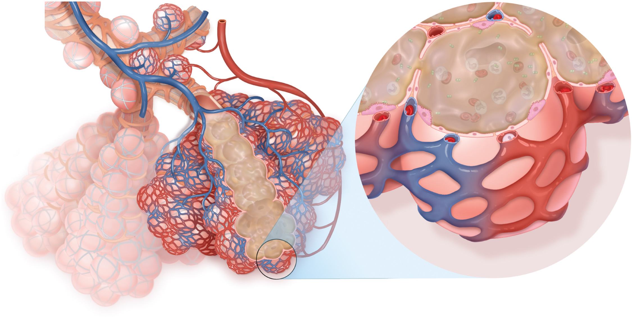
Pathophysiology of Pneumonia
Notes:
Fluid-filled or pus-filled alveoli leads to a ventilation disturbance in the alveoli with poor gas exchange, hypoxemia, and eventual cellular hypoxia.

Slide 46
Pathophysiology of Conditions That Cause Respiratory Distress (13 of 39)
  Other Conditions That Cause Respiratory Distress
  Pneumonia – Assessment
    Generally appears ill
    May complain of fever and severe chills
    Signs and symptoms
Notes:
Signs and symptoms:
Malaise and decreased appetite.
Fever (may not occur in the elderly).
Cough (might be productive or nonproductive).
Dyspnea (less frequent in the elderly).
Tachypnea and tachycardia.
Chest pain (sharp and localized and usually made worse when breathing deeply or coughing).
Decreased chest wall movement and shallow respirations.
Splinting of thorax by patient with their arm.
Crackles, localized wheezing, and rhonchi heard on auscultation.
Altered mental status, especially in the elderly.
Diaphoresis.
Cyanosis.
SPO₂ <94%.

Slide 47
Pathophysiology of Conditions That Cause Respiratory Distress (14 of 39)
  Other Conditions That Cause Respiratory Distress
  Pneumonia – Treatment
    Not usually associated with severe bronchoconstriction.
    Supplemental oxygen to maintain S p O₂ of 94 percent or higher.
    Follow protocols for use of beta₂ agonists and C P A P.
Notes:
You would not expect the patient to have a short acting beta₂ agonist medication in a metered-dose inhaler (MDI) or small-volume nebulizer (SVN) for this condition, nor would you necessarily consider their use unless indications of bronchoconstriction are present.

Slide 48
Pathophysiology of Conditions That Cause Respiratory Distress (15 of 39)
  Other Conditions That Cause Respiratory Distress
  Pulmonary Embolism - Pathophysiology
    Obstruction of blood flow in the pulmonary arteries
    Several factors increase the risk, including immobility
    Usually caused by a blood clot
Notes:
Patients at risk for pulmonary embolism are those who experience long periods of immobility; those with heart disease, recent surgery, long-bone fractures, or venous pooling associated with pregnancy, cancer, deep vein thrombosis, estrogen therapy, clotting disorders, history of previous pulmonary embolism, and those who smoke.
Discussion Question
What are risk factors for pulmonary embolism?

Slide 49
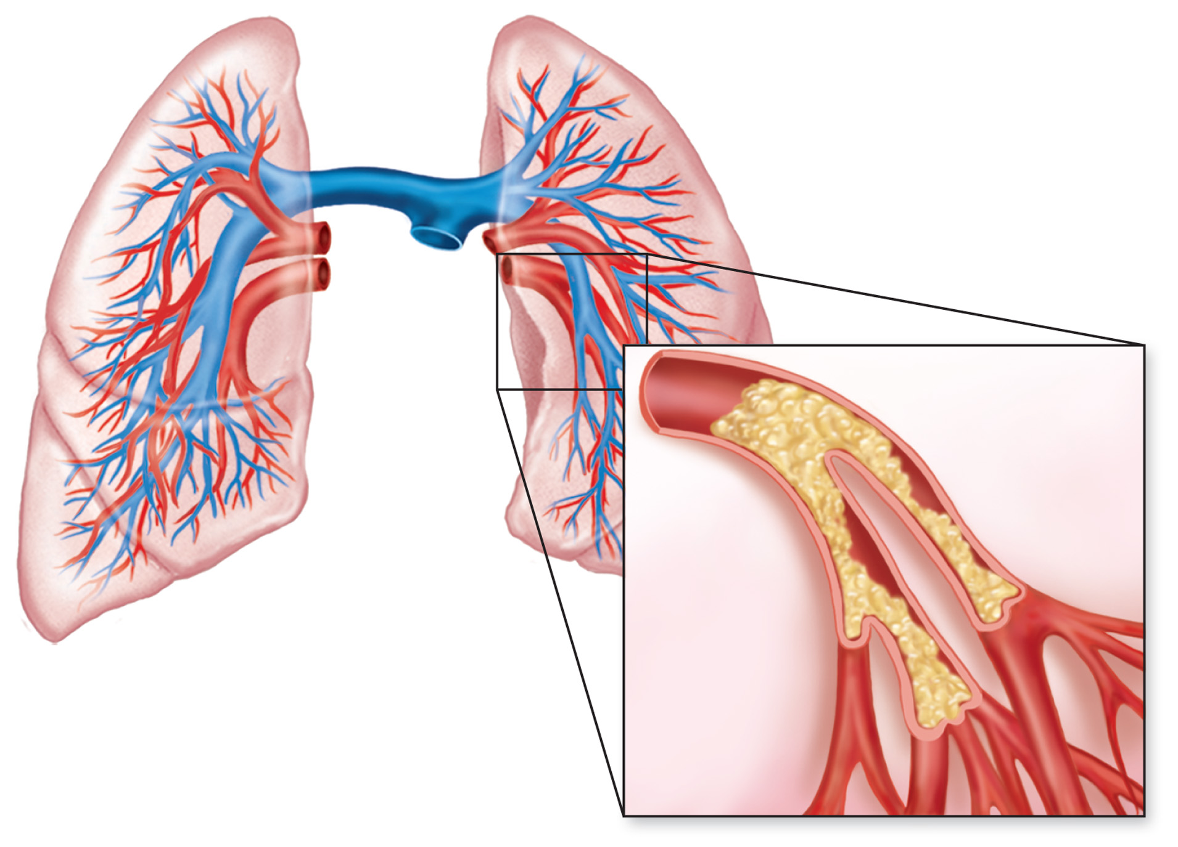
A Blood Clot, Air Bubble, Fat Particle, Foreign Body, or Amniotic Fluid Can Cause an Embolism, Blocking Blood Flow through a Pulmonary Artery
Notes:
Based on the ventilation/perfusion ratio, pulmonary embolism creates cellular hypoxia through a disturbance on the perfusion side by blocking blood flow to ventilated and oxygenated alveoli.

Slide 50
Pathophysiology of Conditions That Cause Respiratory Distress (16 of 39)
  Other Conditions That Cause Respiratory Distress
  Pulmonary Embolism – Assessment
    Sudden onset of unexplained dyspnea and chest pain
    Signs of hypoxia with normal breath sounds and adequate volume
    Include lower legs assessment for D V T
Notes:
Signs and symptoms of pulmonary embolism are often nonspecific and nondiagnostic:
Sudden onset of unexplained dyspnea.
Signs of difficulty in breathing or respiratory distress; rapid breathing.
Sudden onset of sharp, stabbing chest pain predominantly during inhalation.
Cough (might cough up blood).
Tachypnea.
Tachycardia.
Syncope (fainting).
Cool, moist skin.
Restlessness, anxiety, or sense of doom.
Decrease in blood pressure or hypotension (late sign).
Cyanosis (might be severe) (late sign).
Distended neck veins (late sign).
Crackles.
Fever.
SPO₂ <94%.
Signs of complete circulatory collapse.

Slide 51
Pathophysiology of Conditions That Cause Respiratory Distress (17 of 39)
  Other Conditions That Cause Respiratory Distress
  Pulmonary Embolism – Treatment
    Open airway and administer P P V
    Maintain an S p O₂ of 94 percent or better
    Include lower legs assessment for D V T
Notes:
Monitor the patient for signs of respiratory failure, respiratory arrest, hypotension, poor perfusion, or cardiac arrest. Immediately transport the patient.

Slide 52
Click on the Item That Best Characterizes Emphysema
A. Destruction of alveolar walls with distention of the alveoli
B. An obstruction to blood flow in the pulmonary arteries
C. Inflammation of the bronchi and bronchioles with increased mucus production
D. Sudden collapse of the lung without history of injury

Slide 53
Pathophysiology of Conditions That Cause Respiratory Distress (18 of 39)
  Other Conditions That Cause Respiratory Distress
  Acute Pulmonary Edema - Pathophysiology
    Often due to cardiac dysfunction
    Results in hypoxia
    Occurs when excessive fluid collects between the alveoli and pulmonary capillaries
    Gas exchange is impaired
Notes:
Pulmonary edema is the presence of fluid in the space between the alveoli and the capillaries that surround them,
interfering with gas exchange.

Slide 54
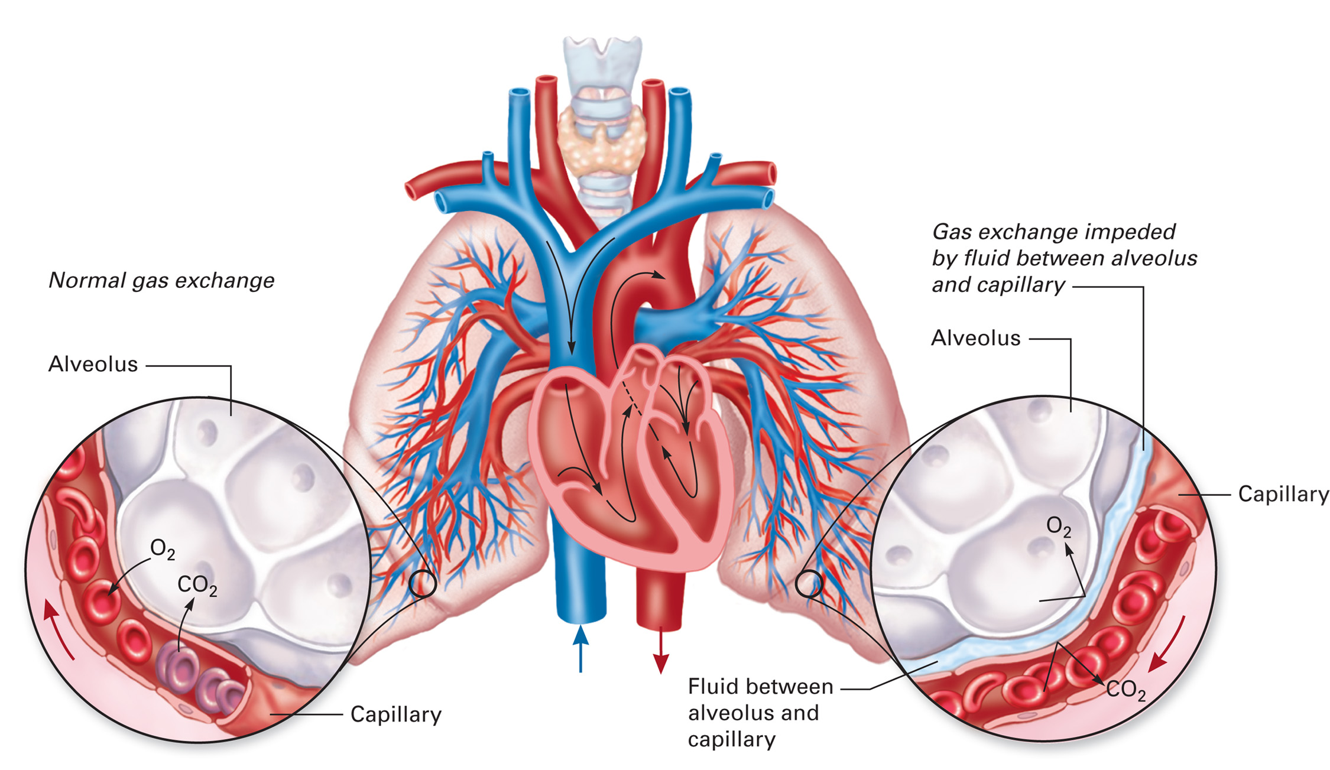
Fluid That Collects Between the Alveoli and Capillaries, Preventing Normal Exchange of Oxygen and Carbon Dioxide
The fluid may also invade the alveolar sacs
Notes:
Cardiogenic pulmonary edema is typically related to an inadequate pumping function of the left ventricle that drastically increases the pressure in the pulmonary capillaries, which forces fluid to leak into the space between the alveoli and capillaries and, eventually, into the alveoli.

Slide 55
Pathophysiology of Conditions That Cause Respiratory Distress (19 of 39)
  Other Conditions That Cause Respiratory Distress
  Acute Pulmonary Edema - Assessment
    Crackles are a sign of pulmonary edema
    Auscultate lower lobes
    Cardiac symptoms does not occur with A R D S
    Anxiety, combativeness and confusion may complicate assessment
Notes:
Signs and symptoms of pulmonary edema:
Dyspnea, especially on exertion.
Difficulty in breathing when lying flat (orthopnea).
Pink and/or frothy sputum (cardiogenic cause only).
Tachycardia.
Anxiety, apprehension, combativeness, and confusion.
Tripod position with legs dangling.
Fatigue.
Crackles and possibly wheezing on auscultation.
Cyanosis or dusky-color skin.
Pale, moist skin.
Distended neck veins (cardiogenic cause only).
Swollen lower extremities (cardiogenic cause only).
Cough.
Fever.
Symptoms of cardiac compromise (cardiogenic cause only).
SPO₂ <94%.

Slide 56
Pathophysiology of Conditions That Cause Respiratory Distress (20 of 39)
  Other Conditions That Cause Respiratory Distress
  Acute Pulmonary Edema - Treatment
    Positive pressure ventilation may be necessary.
    C P A P may be beneficial.
    Administer oxygen.
    Keep the patient in an upright sitting position.
Notes:
What are the treatment needs of patients with pulmonary edema?
If the patient doesn’t fit the criteria for CPAP, deteriorates to respiratory failure or arrest, does not respond to CPAP administration, or has inadequate ventilation, you must perform bag-valve-mask ventilation with supplemental oxygen.

Slide 57
Pathophysiology of Conditions That Cause Respiratory Distress (21 of 39)
  Other Conditions That Cause Respiratory Distress
  Spontaneous Pneumothorax -Pathophysiology
    Sudden rupture of visceral lining of lung with partial collapse of lung.
    Gas exchange is impaired.
    Risk factors include smoking, connective tissue disorders, and C O P D.
Notes:
In spontaneous pneumothorax, a portion of the visceral pleura ruptures without any trauma having been applied to the chest.
What would you expect to find in the history and assessment of a patient with a spontaneous pneumothorax?

Slide 58
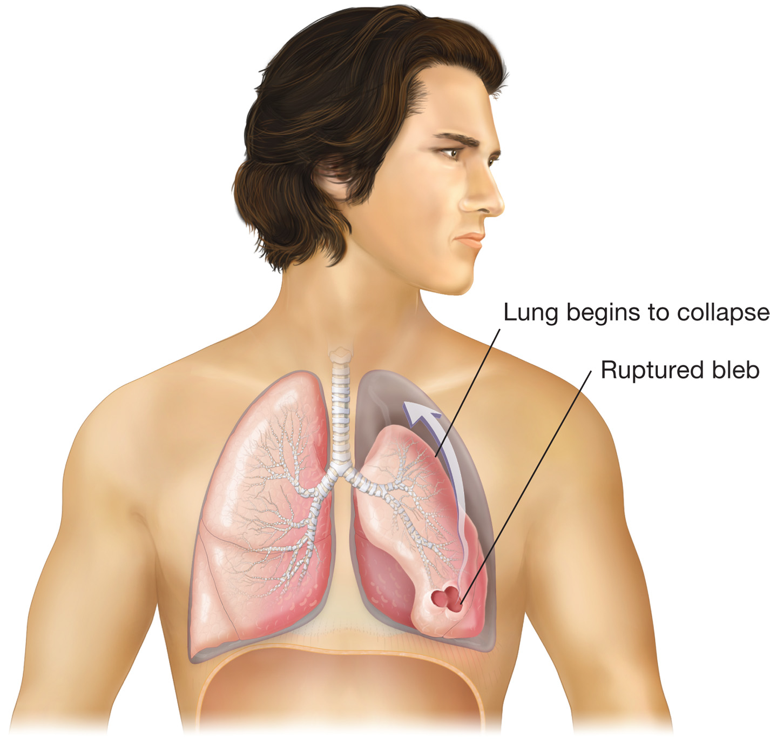
A Ruptured Bleb, or Weakened Area of Lung Tissue
Causes a spontaneous pneumothorax in which air enters the pleural cavity and travels upward, beginning collapse of the lung from the top
Notes:
The visceral pleura ruptures allowing air to enter the pleural cavity, disrupting its normally negative pressure and causing the lung to collapse.

Slide 59
Pathophysiology of Conditions That Cause Respiratory Distress (22 of 39)
  Other Conditions That Cause Respiratory Distress
  Spontaneous Pneumothorax - Pathophysiology
    Primary spontaneous pneumothorax occurs in patients who have no underlying lung disease.
    Secondary spontaneous pneumothorax occurs in patients in which there is underlying lung disease.
Notes:
Primary spontaneous pneumothorax occurs in patients in their teenage years to early 20s who are tall and thin. It is thought that the reason these patients are more likely to suffer a spontaneous pneumothorax is that the visceral pleura is stretched within the chest cavity beyond its normal limit.
Many victims of secondary pneumothorax also have a history of cigarette smoking or a connective tissue disorder, such as Marfan syndrome or Ehlers-Danlos syndrome. It also occurs in patients who have a history of lung disease, such as COPD, and who are more prone to spontaneous pneumothorax from areas of weakened lung tissue called blebs or bullae.

Slide 60
Pathophysiology of Conditions That Cause Respiratory Distress (23 of 39)
  Other Conditions That Cause Respiratory Distress
  Spontaneous Pneumothorax -Assessment
    Spontaneous pneumothorax shows with sudden onset shortness of breath without evidence of trauma and decreased breath sounds to one side.
    When seated, absent breath sounds will be heard in the apex (top) of the lung.
Notes:
The signs and symptoms of a spontaneous pneumothorax follow:
• Sudden onset of shortness of breath.
• Sudden onset of sharp chest pain or shoulder pain.
• Decreased breath sounds to one side of the chest (most often heard first at the apex, or top, of lung).
• Subcutaneous emphysema (can be found).
• Tachypnea.
• Diaphoresis.
• Pallor.
• Cyanosis (can be seen late and in a large or tension pneumothorax).
• SPO₂ <94%.

Slide 61
Pathophysiology of Conditions That Cause Respiratory Distress (24 of 39)
  Other Conditions That Cause Respiratory Distress
  Spontaneous Pneumothorax - Treatment
  If positive pressure ventilation is required, use the minimum tidal volume necessary.
  C P A P is contraindicated.
Notes:
Administer oxygen to maintain an SPO₂ of 94 percent or greater if the patient presents with signs of respiratory distress, chest pain, or any other indicators for oxygen administration.
Positive pressure ventilation in a patient suffering from a pneumothorax must be performed with great care because the pneumothorax could easily be converted into a tension pneumothorax. Use the most minimal tidal volume necessary to ventilate the patient effectively.

Slide 62
Pathophysiology of Conditions That Cause Respiratory Distress (25 of 39)
  Other Conditions That Cause Respiratory Distress
  Hyperventilation Syndrome - Pathophysiology
    Associated emotional upset, excitation, and panic attacks.
    Breathing is faster and deeper than normal.
    Carbon dioxide levels decrease.
    Muscle cramps may occur in feet and hands.
Notes:
It is not always possible to distinguish between hyperventilation syndrome due to anxiety and respiratory distress
due to a medical problem. Do not withhold oxygen from the patient.

Slide 63
Pathophysiology of Conditions That Cause Respiratory Distress (26 of 39)
  Other Conditions That Cause Respiratory Distress
  Hyperventilation Syndrome – Assessment
    The patient with true hyperventilation syndrome is in an emotionally charged situation.
Notes:
Signs and symptoms of hyperventilation syndrome:
Fatigue.
Nervousness and anxiety.
Dizziness.
Shortness of breath.
Chest tightness
Numbness and tingling around the mouth, hands, and feet.
Tachypnea.
Tachycardia.
Spasms of the fingers and feet causing them to cramp (carpopedal spasm).
Seizures that may be precipitated in a patient with a seizure disorder.

Slide 64
Pathophysiology of Conditions That Cause Respiratory Distress (27 of 39)
  Other Conditions That Cause Respiratory Distress
  Hyperventilation Syndrome –Treatment
    Calm the patient and get them to slow their breathing.
    Administer oxygen if the S p O₂ is <94%.
Notes:
Don’t have the patient breathe into a paper bag or oxygen mask not connected to oxygen to allow them to rebreathe carbon dioxide. Conditions such as pulmonary embolism and myocardial infarction can present similarly to hyperventilation syndrome. These are two of the conditions in which rebreathing carbon dioxide could be fatal.
Discussion Question
Why is breathing into a paper bag not an appropriate treatment for patients who are hyperventilating?

Slide 65
Pathophysiology of Conditions That Cause Respiratory Distress (28 of 39)
  Other Conditions That Cause Respiratory Distress
  Epiglottitis - Pathophysiology
    Infection of the epiglottis leads to swelling that can obstruct the airway.
    Males and smokers are more commonly affected.
Notes:
The most common cause for epiglottitis in the adult population is Haemophilus influenzae type B.

Slide 66
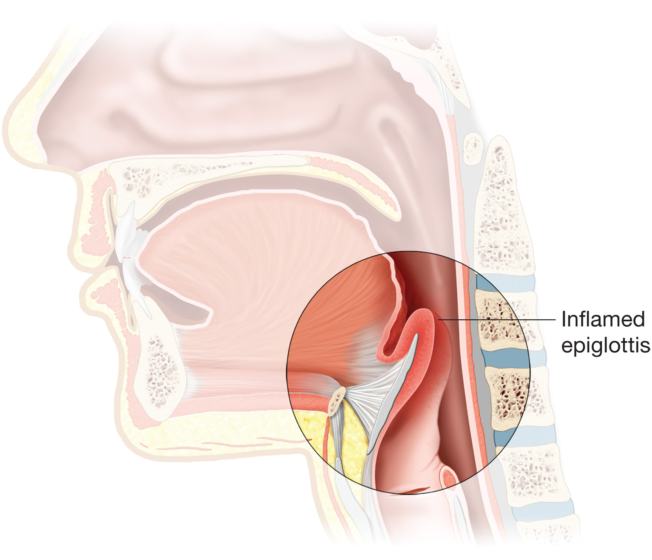
Pathophysiology of Epiglottitis
Notes:
In epiglottitis, the epiglottis, area around the epiglottis, and base of the tongue become infected. As the condition progresses, the epiglottis and the structures connected to or immediately surrounding it and the base of the tongue become inflamed and swollen, leading to a compromised airway and resultant respiratory compromise.

Slide 67
Pathophysiology of Conditions That Cause Respiratory Distress (29 of 39)
  Other Conditions That Cause Respiratory Distress
  Epiglottitis – Assessment
    History of upper respiratory infection, usually for one to two days prior to onset.
    Inspiratory stridor is an indication of an almost completely occluded airway.
Notes:
Signs and symptoms of epiglottitis:
Upper respiratory tract infection, usually for one to two days prior to onset.
Dyspnea, usually with a more rapid onset.
High fever (although it can occur with only mild fevers).
Sore throat and pharyngeal pain.
Inability to swallow with drooling (late sign of impending failure).
Anxiety and apprehension.
Tripod position, usually with jaw jutted forward (late sign of impending failure).
Fatigue.
High-pitched inspiratory stridor.
Cyanosis.
Trouble speaking or pain during speaking.
SPO₂ <94%.

Slide 68
Pathophysiology of Conditions That Cause Respiratory Distress (30 of 39)
  Other Conditions That Cause Respiratory Distress
  Epiglottitis – Treatment
    Administer oxygen.
    Keep the patient calm and comfortable.
    Do not inspect the airway.
    If ventilation is required, squeeze the bag slowly.
Notes:
If the patient continues to deteriorate and requires assisted ventilations with a bag-valve-mask device, squeeze the bag slowly. This helps direct the air past the obstruction and into the lungs rather than into the esophagus, to inflate the stomach. If this is not effective in ventilating the patient, it is a situation of complete airway obstruction at the level of the epiglottis, and an ALS provider might need to consider other advanced airway techniques.

Slide 69
Pathophysiology of Conditions That Cause Respiratory Distress (31 of 39)
  Other Conditions That Cause Respiratory Distress
  Pertussis - Pathophysiology
    Contagious disease characterized by uncontrollable coughing followed by a “whooping” sound.
    Severe complications can lead to death.
    Preceded by signs and symptoms of upper respiratory infection.
Notes:
What is pertussis?
Complications of pertussis include pneumonia, dehydration, seizures, brain injuries, ear infections, and even death. Most deaths occur with younger patients who have not been immunized for this disease, or with those patients who are exposed before finishing the vaccination series.

Slide 70
Pathophysiology of Conditions That Cause Respiratory Distress (32 of 39)
  Other Conditions That Cause Respiratory Distress
  Pertussis - Assessment
    Three stages to recover:
      Stage 1- symptoms of common cold or upper respiratory infection.
      Stage 2- coughing continues to worsen to the point that medical care is sought.
      Stage 3- the recovery stage, usually gradual, taking several weeks.
Notes:
Signs and symptoms of pertussis:
History of upper respiratory infection.
Sneezing, runny nose, low-grade fever.
General malaise (weakness, fatigue, not feeling well).
Increase in frequency and severity of coughing.
Coughing fits, usually more common at night.
Vomiting.
Inspiratory “whoop” heard at the end of coughing burst.
Possible development of cyanosis during coughing burst.
Diminishing pulse oximetry finding.
Exhaustion from expending energy during coughing burst.
Trouble speaking and breathing (dyspnea) during coughing burst.

Slide 71
Pathophysiology of Conditions That Cause Respiratory Distress (33 of 39)
  Other Conditions That Cause Respiratory Distress
  Pertussis - Treatment
    Place a surgical mask on the patient.
    Position them comfortably.
    Supplemental oxygen if S p O₂ is <94%.
    Expectorate any mucus.
Notes:
Following transport of a patient with known or suspected pertussis, consider totally disinfecting the patient compartment of the ambulance.

Slide 72
Pathophysiology of Conditions That Cause Respiratory Distress (34 of 39)
  Other Conditions That Cause Respiratory Distress
  Cystic Fibrosis
    Hereditary disease affecting lungs, digestive system, and sweat glands.
    Death occurs in young adulthood, usually from pulmonary failure.
    Production of thick mucus leads to repeated respiratory infection.
Notes:
Cystic fibrosis is a chronic disease, and often patients are very young.
Signs and symptoms of cystic fibrosis:
• Commonly a known history of the disease.
• Recurrent coughing.
• General malaise (weakness, fatigue, and not feeling well).
• Expectoration of thick mucus during coughing.
• Recurrent episodes or history of pneumonia, bronchitis, and sinusitis.
• Gastrointestinal complaints that can include diarrhea, and greasy and foul-smelling bowel movements.
• Abdominal pain from intestinal gas.
• Malnutrition or low weight despite a healthy appetite
• Dehydration.
• Clubbing of the digits.
• Trouble speaking and breathing (dyspnea) with mucus buildup.
• Signs of pneumonia.
Emergency treatment of a patient suffering from exacerbation of CF is geared toward symptomatic relief of the respiratory distress.
Discussion Question
How is cystic fibrosis different from other respiratory diseases?

Slide 73
Pathophysiology of Conditions That Cause Respiratory Distress (35 of 39)
  Other Conditions That Cause Respiratory Distress
  Poisonous Exposure - Pathophysiology
    Inhalation of toxins leads to hypoxia by various mechanisms, including:
      Upper airway swelling
      Displacement of oxygen in the atmosphere
      Damage to the alveoli
      Effects on the body upon entering the bloodstream
Notes:
Toxic exposures pose a risk to EMS personnel, as well as to the patient.
Discussion Question
What are some sources of toxic inhalation exposures?
Commonly inhaled poisons:
Carbon monoxide.
Cyanide.
Natural gas.
Chlorine gas.
Liquid chemicals or sprays.
Ammonia.
Sulfur dioxide.
Anesthetic gases.
Solvents.
Industrial gases.
Hydrogen sulfide.
Fumes/smoke from fires.
Paints or Freon.
Glue (Toluene).
Nitrogen dioxide (silo gas).
Amyl or butyl nitrate.

Slide 74
Pathophysiology of Conditions That Cause Respiratory Distress (36 of 39)
  Other Conditions That Cause Respiratory Distress
  Poisonous Exposure - Assessment
    Criticality determinants
      Length of exposure.
      Open or enclosed space
    Exercise great personal caution when entering the scene of a potential toxic inhalation
Notes:
Signs and symptoms of poisonous inhalation:
History consistent with an inhalation injury.
The presence of chemicals about the face from the exposure.
Findings of respiratory distress.
Cough, stridor, wheezing, or crackles.
Oral or pharyngeal burns, possible hoarseness.
Dizziness, feelings of malaise.
Headache, confusion, altered mental status.
Seizures.
Cyanosis or other skin color changes.
Nausea, vomiting, abdominal distress/pain.
Copious secretions.
Vital sign changes.

Slide 75
Pathophysiology of Conditions That Cause Respiratory Distress (37 of 39)
  Other Conditions That Cause Respiratory Distress
  Poisonous Exposure – Treatment
    Limit exposure to the toxin
    Open airway
    Position of comfort
    Oxygen at 15litreperminute via non-rebreather
    P P V if needed
    Gather information about the poison
Notes:
Because of the criticality of the patient or the potential for rapid deterioration, try to arrange an ALS intercept en route to the receiving facility. Provide early notification to the staff at the receiving facility so that it can prepare adequately for your arrival.

Slide 76
Pathophysiology of Conditions That Cause Respiratory Distress (38 of 39)
  Other Conditions That Cause Respiratory Distress
  Viral Respiratory Infections
    Includes colds, the flu, and bronchiolitis.
    Usually mild, but significant infections can occur.
    Assess for and treat both hypoxia and respiratory distress.
Notes:
Viral respiratory infections are commonly referred to as upper respiratory infections (URIs) by the medical community because most symptoms are found in the nose and throat. In small children, however, VRIs can also cause infections of the lower airway structures such as the trachea, bronchi, bronchioles, or lungs.
Knowledge Application
Have students explain how each disorder can lead to dyspnea and hypoxia.
Given several respiratory patient descriptions, students should be able to defend their opinion about what is wrong with the patient.

Slide 77
Pathophysiology of Conditions That Cause Respiratory Distress (39 of 39)
  Other Conditions That Cause Respiratory Distress
  Viral Respiratory Infections
    Maintain an S p O₂ of 94 percent or greater.
    Supplemental oxygen and, occasionally, mechanical ventilation can become warranted.
    Contact A L S for medication administration in patients with potential deterioration.
Notes:
Signs and symptoms of viral respiratory infections:
Nasal congestion.
Sore or scratchy throat.
Mild respiratory distress, coughing.
Fever (usually approximately 101°F–102°F).
Malaise.
Headaches and body aches.
Irritability in infants and poor feeding habits.
Tachypnea.
Exacerbation of asthma if patient is asthmatic.

Slide 78
Case Study Conclusion (1 of 5)
Paul locates Mrs. Brown’s medications, finding that she has both metered-dose inhalers and medications for use in a small-volume nebulizer. Jake questions Mrs. Brown about her recent use of the medications to determine if she is eligible for additional treatment, as Paul consults a drug reference to confirm the nature of the medications.
Notes:
Review case conclusion and emphasize the application of knowledge learned from this presentation.

Slide 79
Case Study Conclusion (2 of 5)
Jake consults medical direction, and receives an order to administer medication from the metered-dose inhaler. As Jake assists Mrs. Brown with the medication, Paul completes baseline vital signs. They then assist Mrs. Brown to the stretcher and prepare for transport.
Notes:
Review case conclusion and emphasize the application of knowledge learned from this presentation.

Slide 80
Case Study Conclusion (3 of 5)
Jake reassesses Mrs. Brown en route to the hospital, noticing some decrease in wheezing and a respiratory rate of 24, with an S p O₂ of 96 percent on 4 litreperminute of oxygen.
Notes:
Review case conclusion and emphasize the application of knowledge learned from this presentation.

Slide 81
Metered-Dose Inhalers and Small-Volume Nebulizers (1 of 6)
Beta₂ specific bronchodilators can be administered by M D I s or S V N s.
Bronchodilators cause relaxation of the bronchial smooth muscle.
Medication is dispensed as an aerosol, or mist, that the patient inhales.
Most bronchodilators begin to work almost immediately.
Notes:
Beta₂ agonists can be administered by metered-dose inhaler or small-volume nebulizer to relax the smooth muscle in the bronchioles.
MDIs are more convenient, but some patients use SVNs at home.
Most bronchodilators begin to work almost immediately, and their effects can last up to eight hours or more. Because of the swift relief they can provide, they are appropriate for prehospital administration by the EMT with the approval of medical direction.

Slide 82
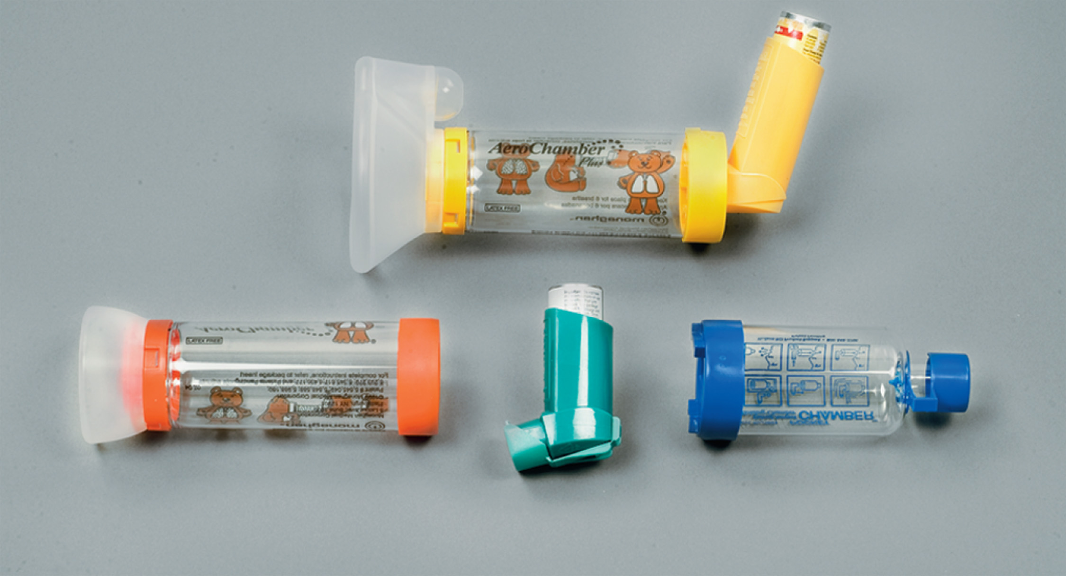
Meter-Dosed Inhaler
Notes:
MDIs may be used with a spacer.

Slide 83
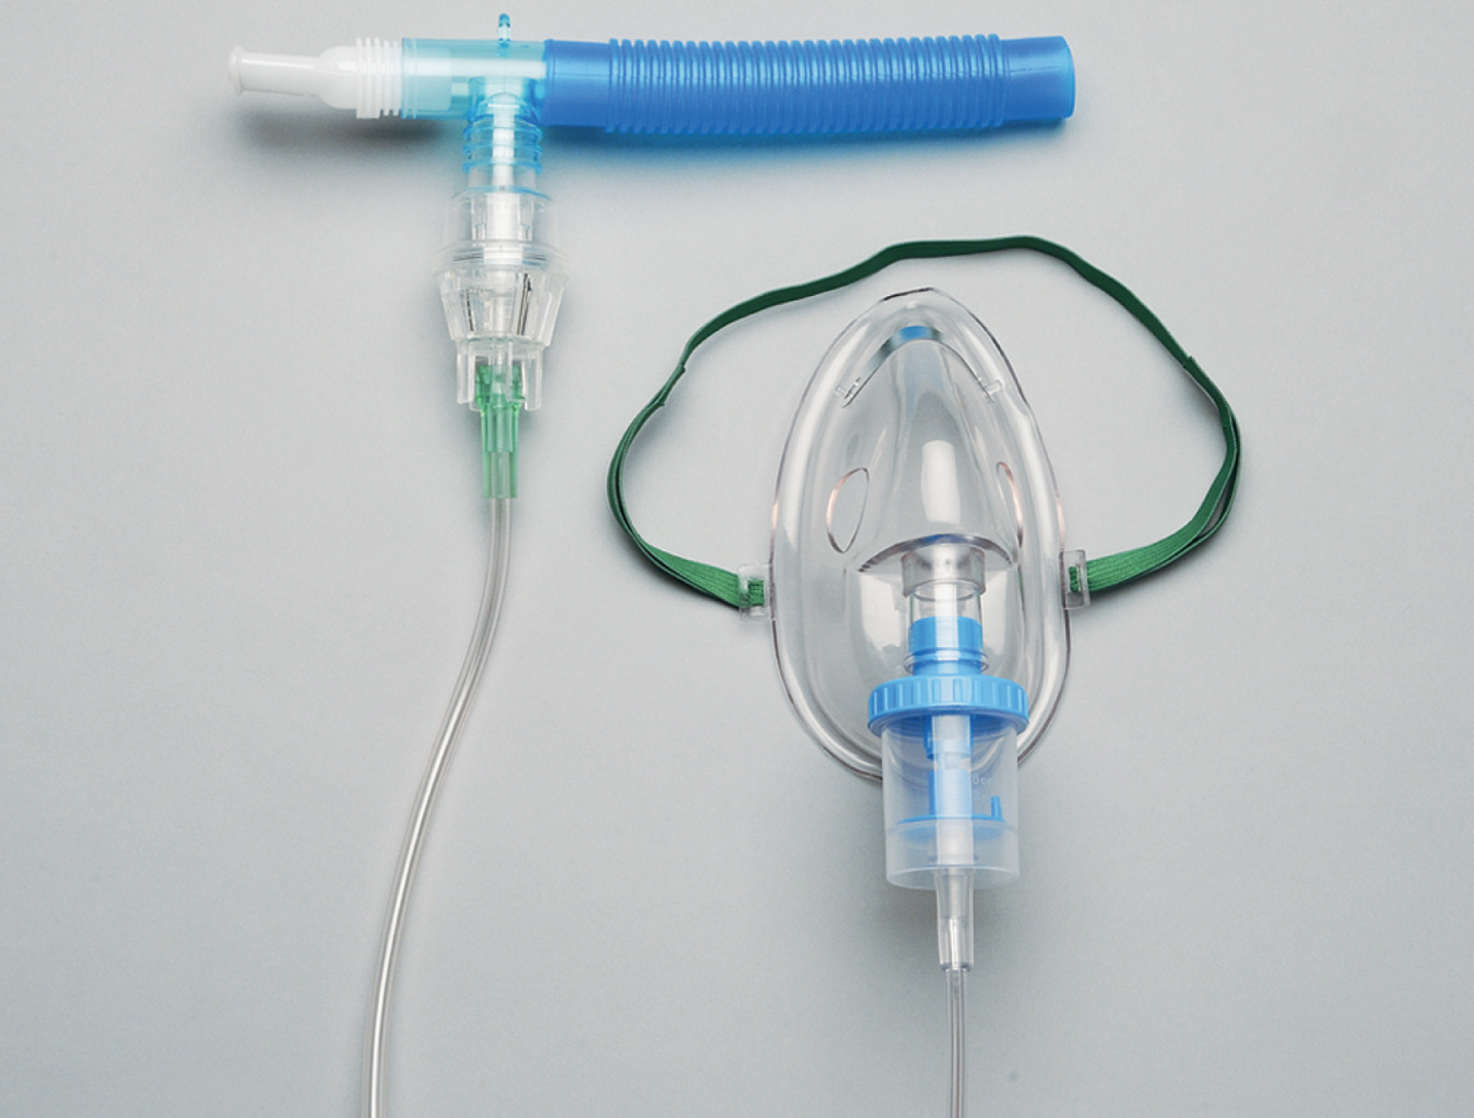
Small-Volume Nebulizer
Notes:
MDIs may be used with a spacer.

Slide 84
Metered-Dose Inhalers and Small-Volume Nebulizers (2 of 6)
Medications include:
  Albuterol
  Metaproterenol
  Isoetharine
  Bitolterol mesylate
  Salmeterol xinafoate
  Ipratropium
  Levalbuterol
  Pirbuterol
Notes:
Many respiratory medications are administered by MDI or SVN, but not all are appropriate for emergency
situations. Therefore, bronchodilators are only administered by physician order (on-line or off-line).
Critical Thinking Discussion
Why are some inhaled medications not appropriate as rescue inhalers?

Slide 85
Metered-Dose Inhalers and Small-Volume Nebulizers (3 of 6)
Indications
  Patient is in respiratory distress
  Patient has physician-prescribed medication
  Approval from medical direction
Notes:
All of the following criteria must be met before an EMT administers a bronchodilator by metered-dose inhaler
(MDI) or small-volume nebulizer (SVN) to a patient:
The patient exhibits signs and symptoms of respiratory distress from bronchoconstriction.
The patient has a physician-prescribed, metered-dose inhaler or small-volume nebulizer, or a bronchodilator medication is carried on the EMS unit.
The EMT has received approval from medical direction, whether on-line or off-line, to administer the medication.
Discussion Question
Why does prehospital administration of bronchodilators require a physician's order?

Slide 86
Metered-Dose Inhalers and Small-Volume Nebulizers (4 of 6)
Contraindications
  Patient is not responsive enough to use the medication.
  The medication is not prescribed to the patient.
  Medical direction has not given permission.
  The patient has taken the maximum number of doses.
Notes:
A bronchodilator by MDI or SVN should not be given if any of the following conditions exist:
The patient is not responsive enough to use the MDI or SVN.
The MDI or SVN is not prescribed for the patient or is not in the EMT's protocol.
Medical direction has not granted permission.
The patient has already taken the maximum allowed dose(s) prior to your arrival.

Slide 87
Metered-Dose Inhalers and Small-Volume Nebulizers (5 of 6)
Side effects:
  Tachycardia
  Tremors
  Nervousness
  Dry mouth
  Nausea, vomiting
Notes:
The side effects associated with the bronchodilator are associated with the drug action itself.

Slide 88
Table 16-3 Signs of Improvement During the Administration of C P A P
Reduction in the complaint of dyspnea
Improved S p O₂ reading
Normal respiratory effort
Patient becomes more alert

Slide 89
E M T Skills 16-2
Administering Medication by Metered-Dose Inhaler

Slide 90
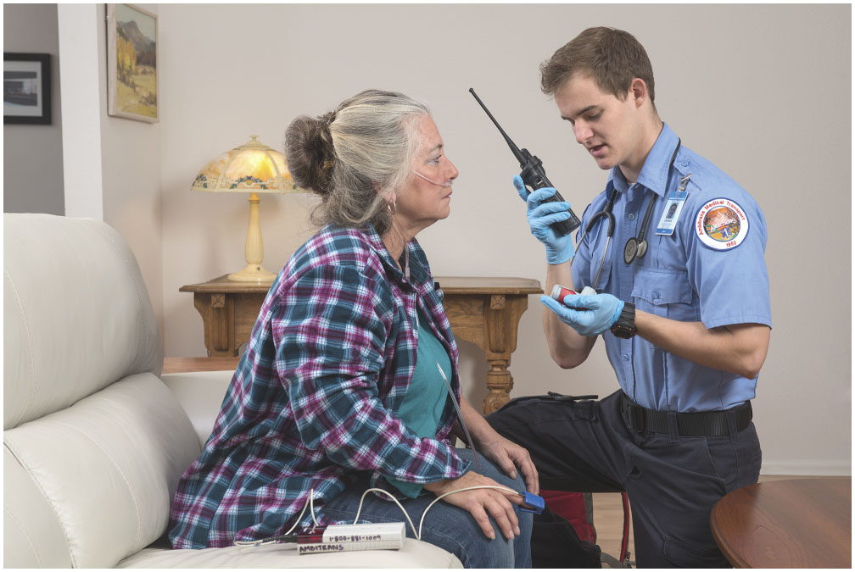
Consult with Medical Direction for an Order to Administer the Medication
Notes:
Even if patients state they know how to use an MDI, instruct the patient to ensure delivery of the medication.
Teaching Tips
Pass MDI demonstrators and SVN equipment around the classroom so students can inspect and handle the devices.
Class Activity
Have pairs of students instruct each other as if they were instructing a patient on the use of an MDI or SVN.

Slide 91
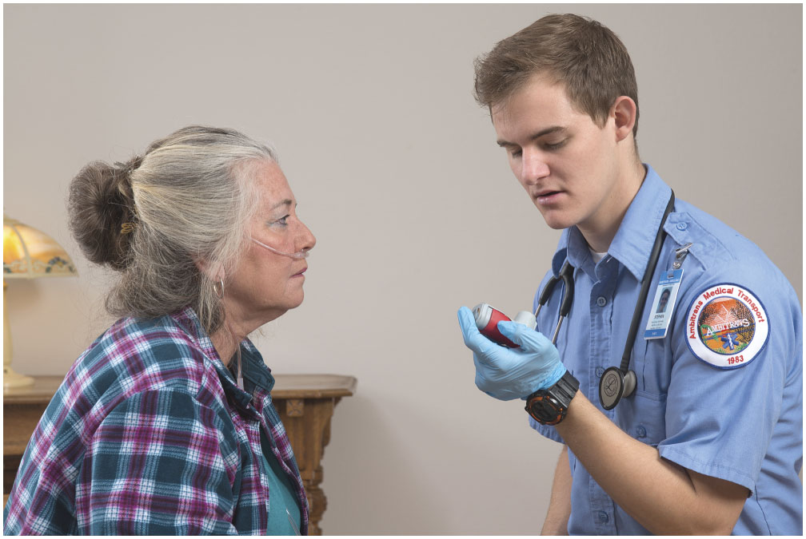
Check to Make Sure the Medication is for the Patient, That It is the Proper One to Administer, and That It Has Not Reached Its Expiration Date
Notes:
Ensure it is the right patient, right medication, right dose, right route, and right date. Determine if the patient is alert enough to use the inhaler and if any doses have already been administered prior to your arrival.

Slide 92
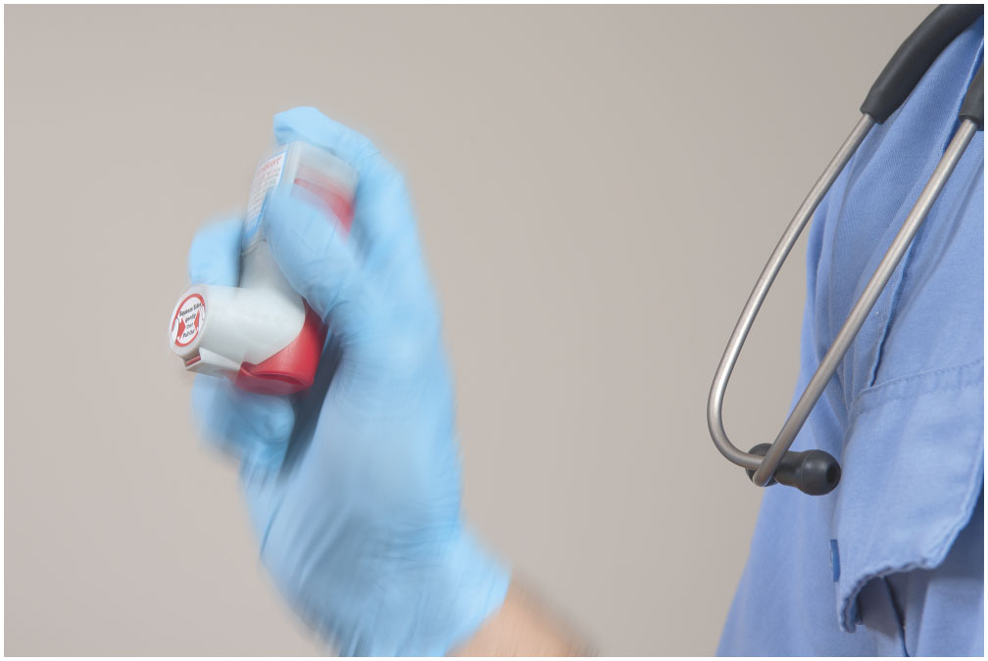
Shake the Inhaler Vigorously for at Least 30 Seconds
Notes:
Ensure that the inhaler is at room temperature or warmer. Shake the canister vigorously for at least 30 seconds.

Slide 93
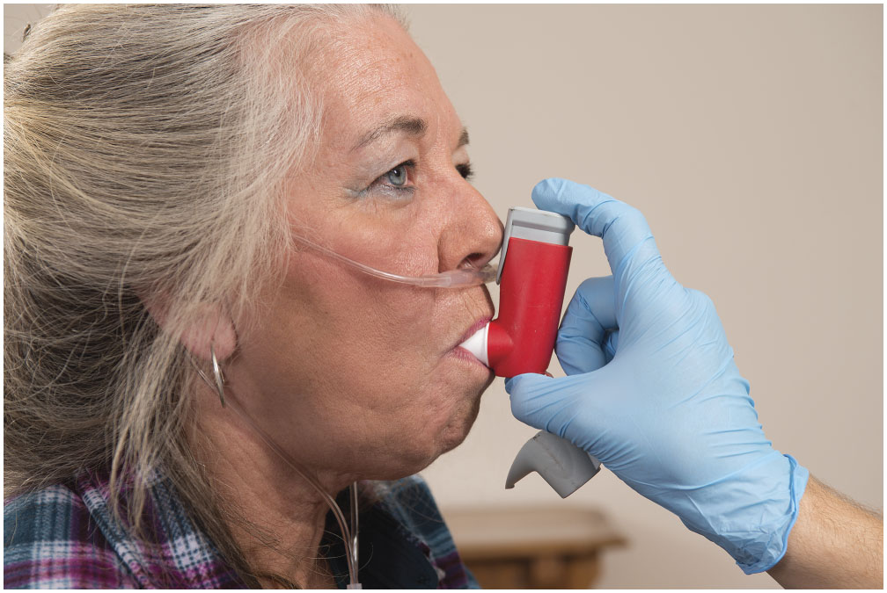
Instruct the Patient to Inhale Slowly and Deeply for About Five Seconds. As the Patient Begins to Inhale, Depress the Canister
Notes:
Have the patient place his lips around the mouthpiece of the inhaler. Have the patient begin to slowly and deeply inhale over about five seconds as he or you depress the canister. Do not depress the canister before the patient begins to inhale. This would allow a majority of the medication to be lost into the air and it will not reach the lower respiratory tract.

Slide 94
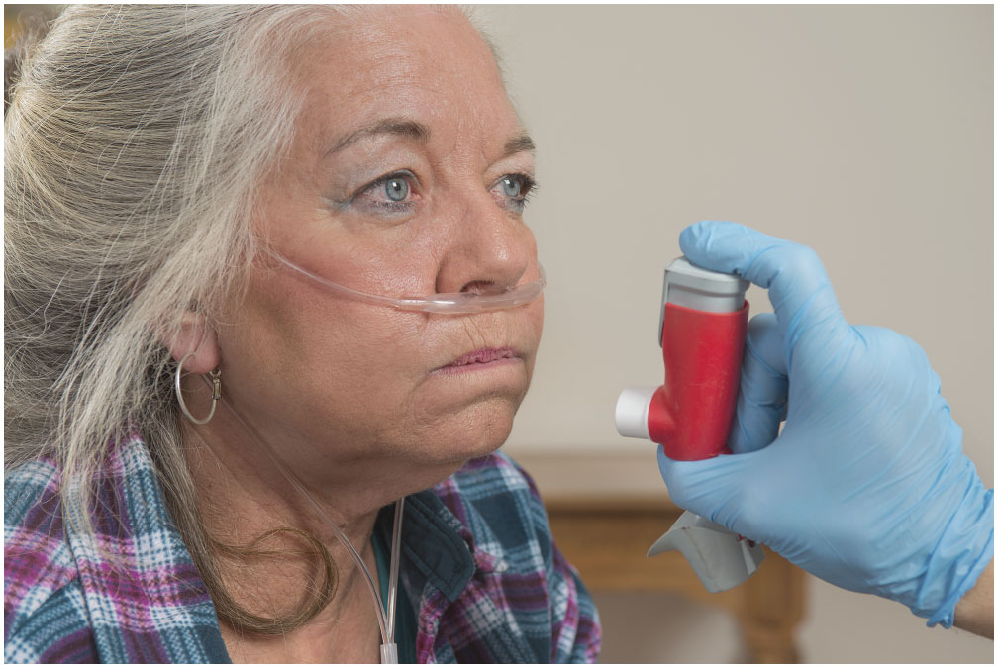
Remove the Inhaler and Instruct the Patient to Hold the Breath for Ten Seconds or for as Long as is Comfortable
Notes:
Remove the inhaler and coach the patient to hold their breath for ten seconds or as long as comfortable.

Slide 95
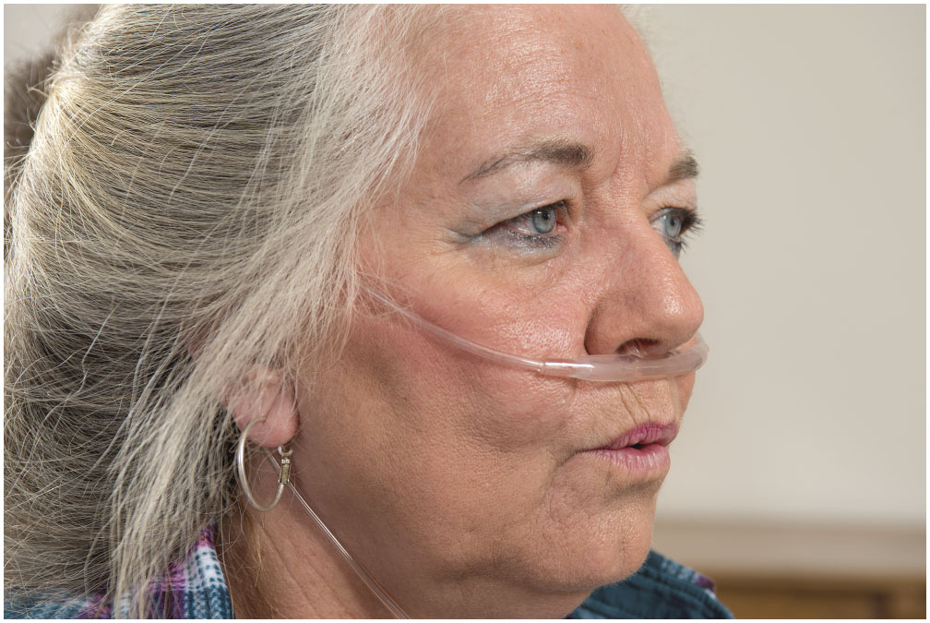
Instruct the Patient to Exhale Slowly Through Pursed Lips
Notes:
Have the patient exhale slowly through pursed lips. Replace the oxygen mask on the patient. Reassess breathing status and vital signs.

Slide 96
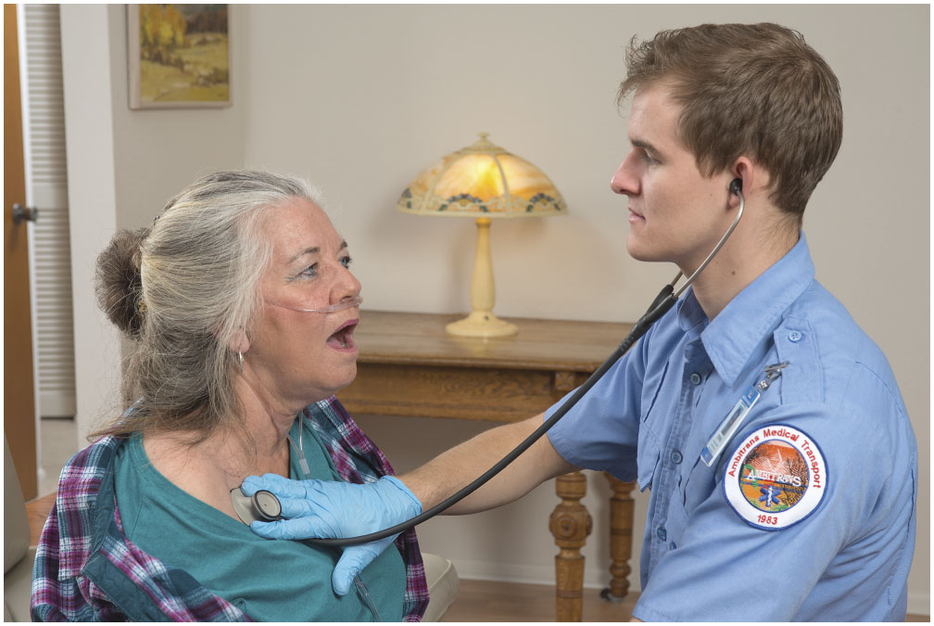
Replace the Oxygen on the Patient. Reassess the Breathing Status and Vital Signs
Notes:
Reassess the patient and consult with medical direction if additional doses are needed. If an additional dose is recommended, wait at least two minutes between each administration or longer based on the medication being administered or medical direction’s order.

Slide 97
E M T Skills 16-3
Administering a Metered-Dose Inhaler with a Spacer

Slide 98
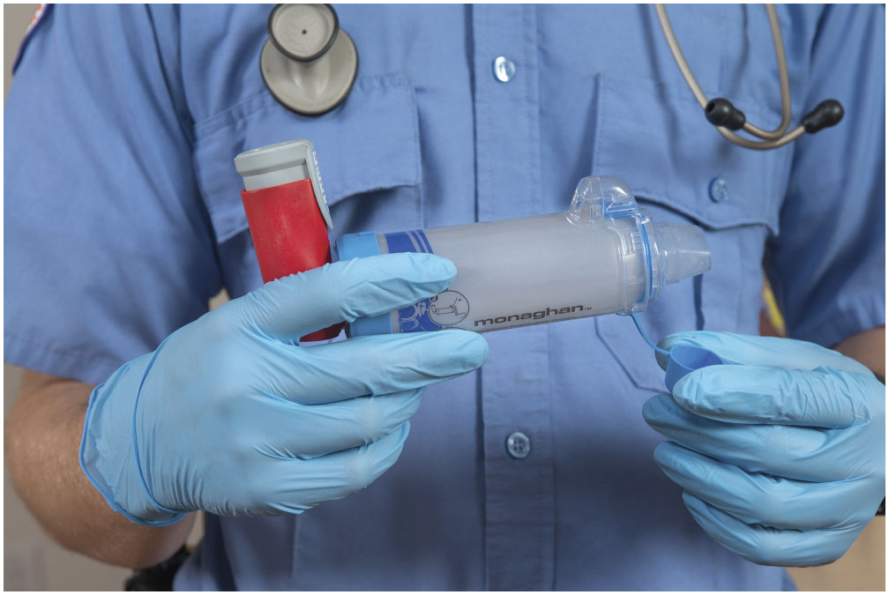
Remove the Spacer Cap. Attach the Spacer to the Inhaler Mouthpiece
Notes:
Remove the holding chamber or spacer cap and attach the inhaler to the device.

Slide 99
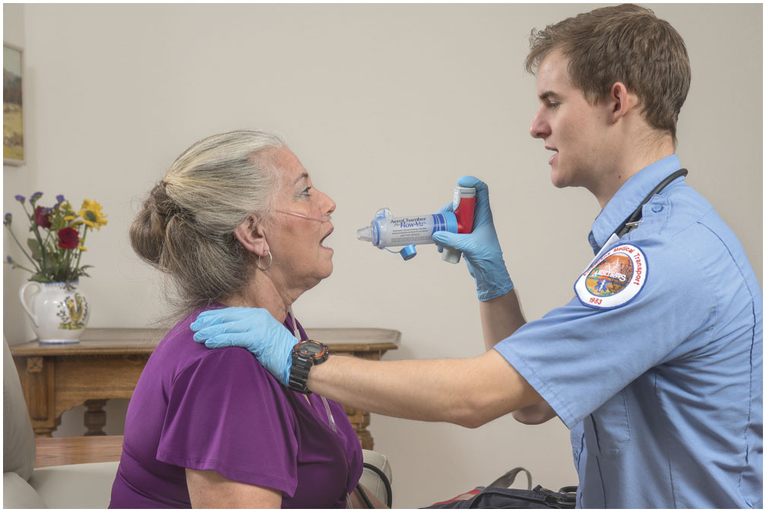
Depress the Medication Canister to Fill the Spacer with Medication
Notes:
Depress the medication canister to fill the holding chamber or spacer with the medication. As soon as the canister is depressed, have the patient place their lips around the mouthpiece and inhale slowly and deeply.

Slide 100
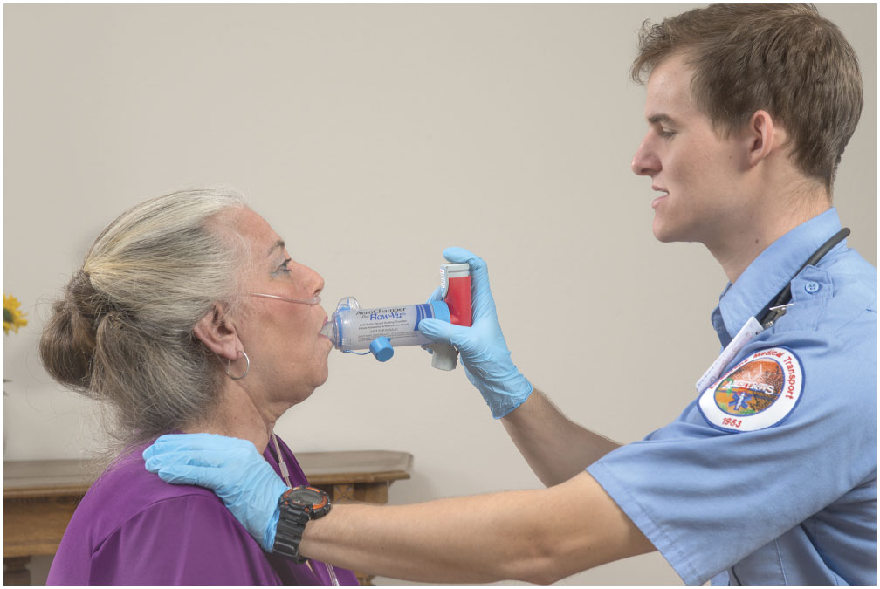
Instruct the Patient to Inhale Slowly and Deeply
The spacer may whistle if the patient is inhaling too quickly.
Notes:
If the inhalation is too fast, the holding chamber or spacer may whistle.

Slide 101
E M T Skills 16-4
Administering Nebulized Medications

Slide 102
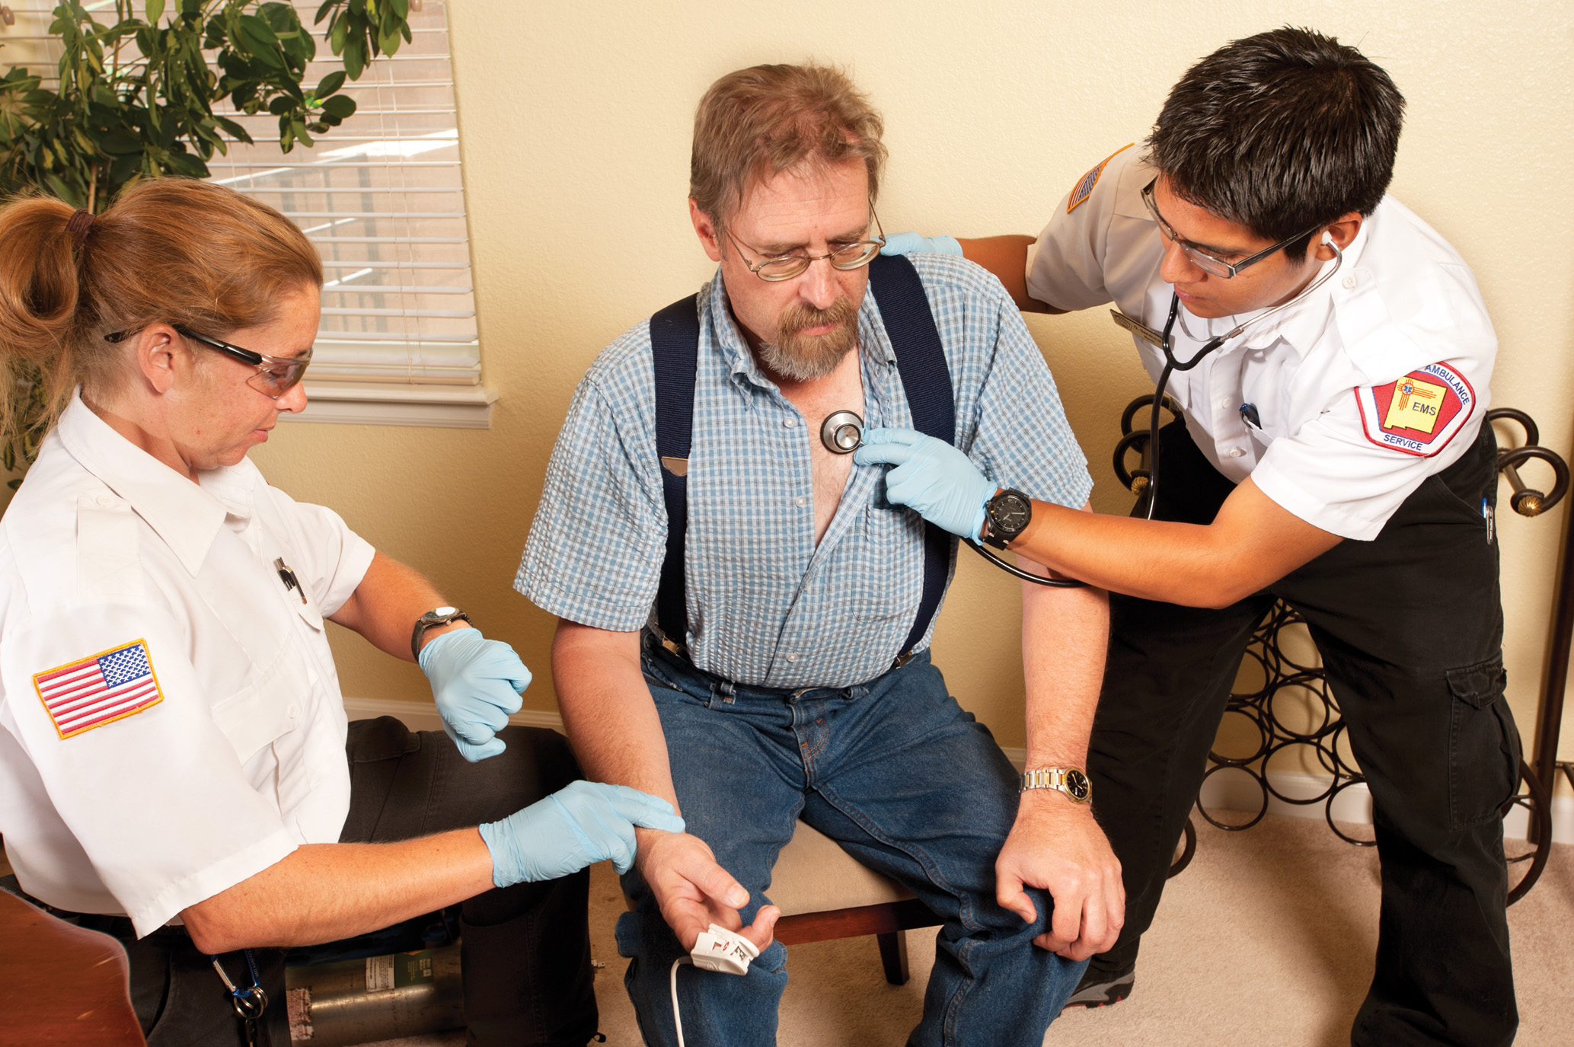
Complete the Primary Assessment and Assess the Patient’s Pulse Rate and Breath Sounds
Notes:
Points to Emphasize
If oxygen is used to administer medication via SVN, the flow rate should be set at eight to ten lpm.
Discussion Question
What is the difference between MDIs and SVNs?
Knowledge Application
Have students role-play with a partner, with one student acting as a patient who asks how their MDI medication works an the other student explaining the medication to his classmate.

Slide 103

Select the Correct Medication and Consult with Medical Direction for an Order to Administer the Medication
Notes:
Ensure it is right patient, right medication, right dose, right route, and right date. Determine if the patient is alert enough to use the nebulizer and if any doses have already been administered prior to your arrival.

Slide 104
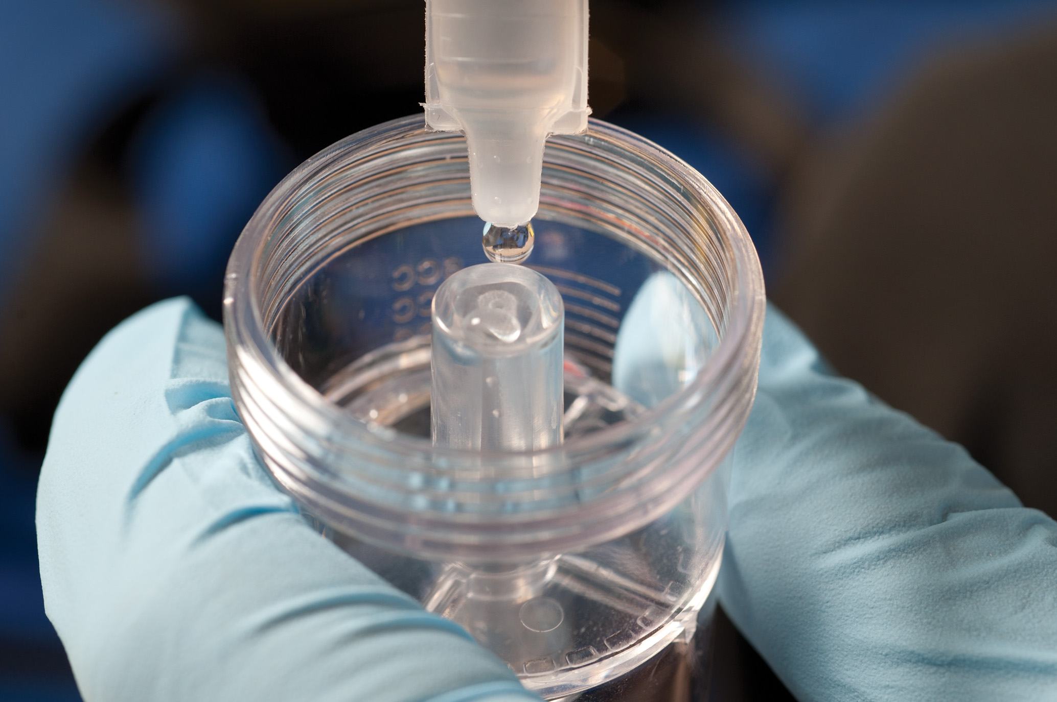
Add the Medication to the Nebulizer Chamber
Notes:
Obtain an order, either on-line or off-line, from medical direction to assist with the administration of the medication. Disassemble the medication chamber from the mouthpiece by unscrewing it. While holding the medication reservoir upright, pour in the medication and reassemble the device.

Slide 105
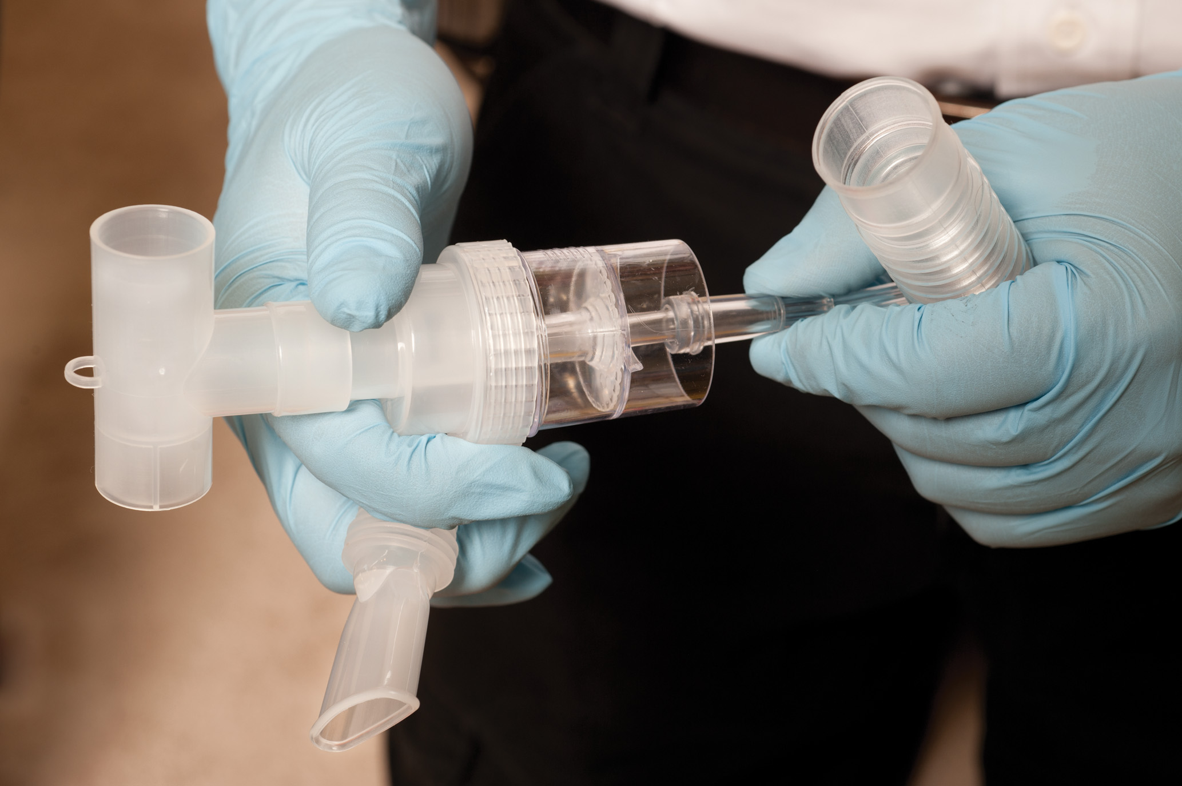
Assemble the Nebulizer
Notes:
Attach the tubing extending from the bottom of the drug reservoir to the nebulizer compressor and turn it on, or attach the tubing to an oxygen tank with the liter flow set to 8 to 10 lpm. You should note the mist coming from the mouthpiece almost immediately.

Slide 106
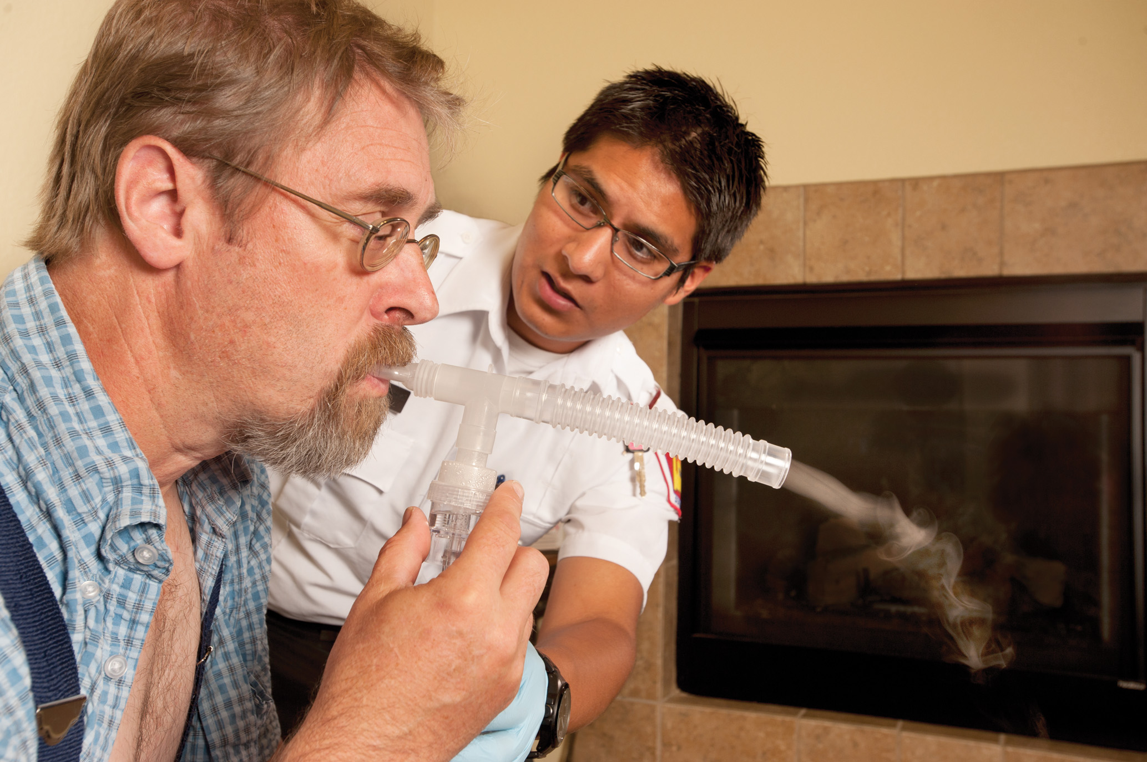
Coach the Patient to Inhale the Nebulized Medication from the Mouthpiece
Notes:
Instruct the patient to take the nebulizer in their hand and hold it upright. If the patient is unable to hold the device, you may have to do this for the patient, being sure to continuously hold it upright for optimal nebulization of the medication.
Have the patient exhale fully. Instruct the patient to place their lips around the mouthpiece of the nebulizer.
Have the patient begin to slowly and deeply breathe in the mist.
Instruct the patient to occasionally (every two to three breaths) hold their breath after inhalation as long as they comfortably can, to assist with medication distribution throughout the respiratory tree.

Slide 107
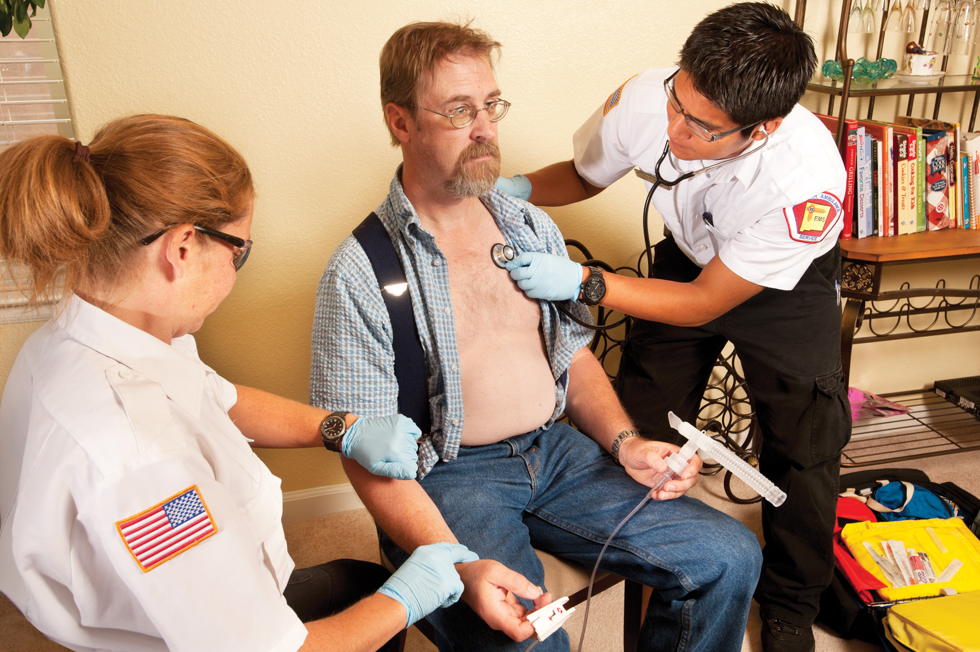
Reassess the Patient’s Pulse Rate and Breath Sounds
Notes:
Reassess the patient and consult with medical direction if additional doses are needed. If an additional dose is recommended, wait at least two minutes between each administration, or longer based on the medication being administered or medical direction’s order.

Slide 108
Click on the Medication that is NOT a Beta₂ Agonist Used in the Emergency Treatment of Patients with Respiratory Conditions
A. Albuterol
B. Levalbuterol
C. Advair Diskus
D. Metaproterenol

Slide 109
Metered-Dose Inhalers and Small-Volume Nebulizers (6 of 6)
Advair: Not for Emergency Use
  Advair is a long-acting beta₂-specific drug (salmeterol xinafoate) that also contains a steroid (fluticasone propionate) that is used as a maintenance drug.
  Advair is not to be used as a rescue inhaler for the patient experiencing an acute asthma attack.
Notes:
Only a short-acting beta₂-agonist drug should be used in the emergency care of the patient experiencing an acute asthma attack.

Slide 110
Age-Related Variations: Pediatrics and Geriatrics (1 of 12)
Pediatric Patients
  Respiratory failure is the most common cause of respiratory arrest and cardiac arrest.
  Common causes are upper airway obstruction and lower airway diseases.
Notes:
Age related changes in anatomy and physiology affect the types of respiratory problems of concern, the way the disease presents, and the way patients respond to treatment.
Respiratory failure for the pediatric patient is defined as inadequate oxygenation of the blood and an inadequate elimination of carbon dioxide from the body.
Discussion Question
Why is rapid progression from respiratory distress to respiratory failure of high concern in pediatric and geriatric patients?

Slide 111
Age-Related Variations: Pediatrics and Geriatrics (2 of 12)
  Respiratory Distress or Failure in the Pediatric Patient: Assessment and Care
  Scene Size-Up and Primary Assessment
    Look for clues to help rule out trauma.
    Breathing difficulty can be spotted as you form your general impression.
    Assess mental status, airway, breathing, and circulation.
Notes:
Many of the signs and symptoms of breathing difficulty can be spotted as you form your general impression during the primary assessment. Labored or noisy breathing, and a child who is sitting up in a tripod position, lying limply, or unresponsive can be detected from the doorway.

Slide 112
Age-Related Variations: Pediatrics and Geriatrics (3 of 12)
  Respiratory Distress or Failure in the Pediatric Patient: Assessment and Care
  Secondary Assessment - Distress
    Signs of respiratory distress typically precede failure in the infant or child.
    Recognize early signs and symptoms.
    Retractions appear to be more prominent early in respiratory.
    Acknowledge when they begin to use the intercostal muscles to assist in breathing.
Notes:
Other signs and symptoms can be noted during the secondary assessment of the young patient.
Early signs of breathing difficulty:
Increased use of accessory muscles to breathe.
Sternal and intercostal retractions during inspiration.
Tachypnea (increased breathing rate).
Tachycardia (increased heart rate).
Nasal flaring.
Prolonged exhalation.
Frequent coughing (can be present rather than wheezing in some children).
Cyanosis to the extremities.
Anxiety.

Slide 113
Age-Related Variations: Pediatrics and Geriatrics (4 of 12)
  Respiratory Distress or Failure in the Pediatric Patient: Assessment and Care
  Secondary Assessment - Failure
  Bradycardia
  Hypotension
  Slow, fast, or irregular breathing
  Loss of muscle tone
Notes:
Signs listed here occur late in a respiratory emergency:
Altered mental status. (The patient can be listless or completely unresponsive.)
Bradycardia (slow heart rate). (Bradycardia would be an initial response in a newborn, a late response in an infant.)
Hypotension (low blood pressure).
Extremely fast, slow, or irregular breathing pattern.
Cyanosis to the core of the body and mucous membranes (a late and inconsistent sign).
Loss of muscle tone (limp appearance).
Diminished or absent breath sounds.
Head bobbing (bobbing of the head with each breath).
Grunting (heard in infants and children during exhalation, indicating diseases that produce lung collapse).
Seesaw or rocky breathing (The chest is drawn inward and the abdomen moves outward, indicating extreme inspiratory efforts.).
Decreased response to pain.
Inadequate tidal volume (poor chest rise and fall).

Slide 114
Age-Related Variations: Pediatrics and Geriatrics (5 of 12)
  Respiratory Distress or Failure in the Pediatric Patient: Assessment and Care
  Emergency Medical Care
    Allow child to assume a comfortable position.
    Do not remove child from their caregiver.
    Apply supplemental oxygen.
    If breathing becomes inadequate remove them from the parent, establish an open airway, and begin P P V.
Notes:
Respiratory distress can progress quickly to respiratory failure in pediatric patients.
Allow the child to assume a comfortable position to reduce the work of breathing and to maintain a more patent airway. Do not remove the infant or child from their parent (other caretaker). Allowing the parent to hold the child can reduce apprehension and stress levels, thereby reducing the breathing workload and oxygen demand.
Apply supplemental oxygen to a child who is sitting up on their parent’s lap. If the child does not tolerate an oxygen mask, have the parent hold it near the child’s face.
If at any time the infant’s or child’s breathing becomes inadequate (respiratory failure), remove them from the parent, establish an open airway, and begin positive pressure ventilation with supplemental oxygen. It will be necessary to repeat the physical exam and vital signs.

Slide 115
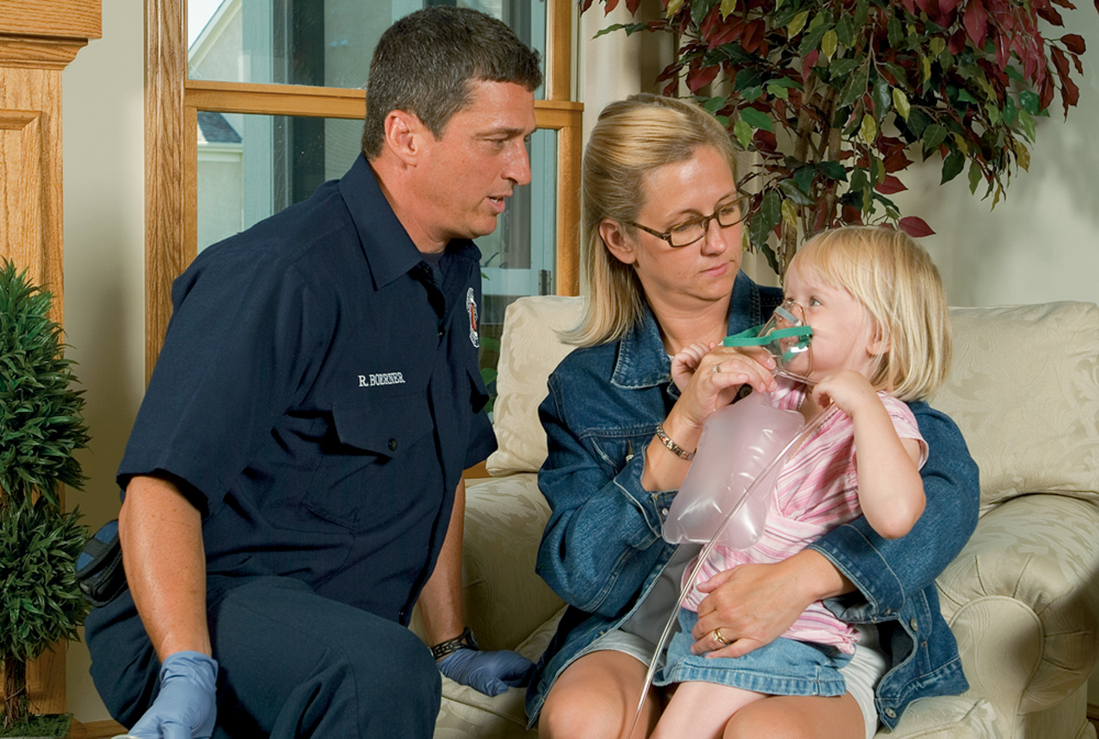
If the Child Does Not Tolerate the Mask, Have the Parent Hold the Mask Near the Child’s Face
Notes:
Apply supplemental oxygen to a child who is sitting up on their parent’s lap.

Slide 116
Age-Related Variations: Pediatrics and Geriatrics (6 of 12)
  Respiratory Distress or Failure in the Pediatric Patient: Assessment and Care
  Emergency Medical Care
    Upper airway obstruction from foreign body or disease
    Croup
    Epiglottitis
Notes:
If the blockage was sudden and there was something around that the child could have swallowed, and there is no history or other sign of disease, treat the patient for an upper airway foreign body obstruction. If the blockage came on gradually, the child has other signs of being ill, or the child has a history of respiratory or other disease, and no one saw the child swallow anything, avoid inserting anything into the airway. Instead, provide oxygen or positive pressure ventilation with supplemental oxygen as necessary.

Slide 117
Age-Related Variations: Pediatrics and Geriatrics (7 of 12)
  Respiratory Distress or Failure in the Pediatric Patient: Assessment and Care
  Reassessment
    Transport any infant or child with difficulty breathing.
    Provide reassessment en route.
    Be prepared to intervene.
Notes:
Be prepared to intervene more aggressively if the condition deteriorates.

Slide 118
Age-Related Variations: Pediatrics and Geriatrics (8 of 12)
Geriatric Patients
  Respiratory distress has many causes in geriatric patients.
  Respiratory function may already be diminished.
  Can progress rapidly from respiratory distress to respiratory failure.
Notes:
Points to Emphasize
The chest wall is more compliant in pediatric patients and less compliant in geriatric patients.
Knowledge Application
Ask students how to adapt their assessment to patients of various ages.

Slide 119
Age-Related Variations: Pediatrics and Geriatrics (9 of 12)
  Respiratory Distress or Failure in the Geriatric Patient: Assessment and Care
  Scene Size-Up and Primary Assessment
    Look for clues to help rule out trauma
    Labored or noisy breathing
    Tripod position
    Unresponsiveness
    Additional signs and symptoms will be discovered as you contact the patient
Notes:
Many of the signs and symptoms of breathing difficulty can be spotted as you form your general impression during the primary assessment.

Slide 120
Age-Related Variations: Pediatrics and Geriatrics (10 of 12)
  Respiratory Distress or Failure in the Geriatric Patient: Assessment and Care
  Secondary Assessment
    Respiratory distress can quickly proceed to respiratory failure.
    Elderly patients decompensate rapidly.
    It is difficult for the geriatric patient to move the rib cage.
Notes:
The signs and symptoms of respiratory distress usually briefly precede respiratory failure in geriatric patients. Older patients do not have the compensatory mechanisms younger adults have and typically decompensate rapidly.
Early signs of breathing difficulty:
Increased use of accessory muscles to breathe.
Sternal and intercostal retractions during inspiration.
Tachypnea (increased breathing rate).
Tachycardia (increased heart rate).
Nasal flaring, breathing with the mouth open.
Prolonged exhalation (with pursed lips).
Frequent coughing.
Cyanosis.
Anxiety.
Confusion.
Inability to speak in full sentences.

Slide 121
Age-Related Variations: Pediatrics and Geriatrics (11 of 12)
Respiratory Distress or Failure in the Geriatric Patient: Assessment and Care
  Secondary Assessment
    Respiratory arrest is a condition in which there are no respirations.
    A pulse is still present.
    You must immediately intervene and begin positive pressure ventilation.
Notes:
Signs which occur late in a respiratory emergency:
Altered mental status.
Vital sign changes.
Extremely fast, slow, or irregular breathing pattern.
Cyanosis to the core of the body and mucous membranes.
Loss of muscle tone.
Diminished or absent breath sounds.
Decreased response to pain.
Inadequate tidal volume (poor chest rise and fall).
Retractions (suprasternal, supraclavicular, subclavicular, and intercostal).

Slide 122
Age-Related Variations: Pediatrics and Geriatrics (12 of 12)
  Respiratory Distress or Failure in the Geriatric Patient: Assessment and Care
  Emergency Medical Care
    Comfortable position.
    If the S p O₂ is <94% or respiratory distress, hypoxia, hypoxemia, or poor perfusion are present, administer oxygen via a nasal cannula.
  Reassess en route to the E D
Notes:
For a geriatric patient who experiences difficulty in breathing with adequate breathing (respiratory distress), take the following steps:
Place the patient in a comfortable position to reduce the breathing work and maintain a more patent airway. Typically, this is a sitting-up position to help the respiratory muscles work more efficiently.
If the SPO₂ is <94% or signs of respiratory distress, hypoxia, hypoxemia, or poor perfusion are present, administer oxygen via a nasal cannula to achieve and maintain an SPO₂ of 94% or greater.
If at any time the patient’s breathing becomes inadequate (respiratory failure), lay them flat, establish an open airway, and begin positive pressure ventilation with supplemental oxygen attached to the bag-valve-mask device.

Slide 123
Assessment and Care General Guidelines (1 of 13)
Assessment-Based Approach: Respiratory Distress
  Scene Size-Up
    Look for clues to the condition.
    Scan the scene for possible M O I.
    Scan the scene for alcohol, which is a common contributor to choking and upper airway obstruction and aspiration of vomitus.
Notes:
The scene size-up can give clues to the problem.
Gain a general impression in the primary assessment by looking at the patient's position and facial expression, noting their ability to speak, and determining the patient's mental status.
Use of accessory muscles, pallor, cyanosis, and diaphoresis are indications of respiratory distress and poor perfusion.
Quickly determine the adequacy of breathing and intervene to improve inadequate breathing and oxygenation.

Slide 124
Assessment and Care General Guidelines (2 of 13)
  Assessment-Based Approach: Respiratory Distress
  Primary Assessment
    Form a general impression.
    Assess mental status.
    Assess airway.
    Assess breathing.
    Assess circulation.
Notes:
Form an impression of a patient who is suffering respiratory distress:
The patient’s position. Most frequently, in severe cases of respiratory distress, the patient assumes a tripod position, sitting upright and leaning forward, arms locked, holding onto the edge of the seat.
The patient in a reclining or supine position could indicate two possible scenarios: (1) the patient is only in mild distress or (2) the patient is in such severe respiratory distress that they are too exhausted from trying to breathe to hold themselves up. This patient requires immediate intervention because respiratory arrest usually follows shortly after development of severe fatigue.
The patient’s face. An agitated or confused facial expression might indicate inadequate breathing, hypoxia, or hypercarbia.
The patient’s speech. If the speech is normal, assume that the airway is open and clear and the distress is minimal. If the patient is alert and makes eye contact but cannot speak, consider a severe condition.
Altered mental status. A change in mental status, such as confusion, is a clear indication of inadequate oxygenation of the brain and a buildup of carbon dioxide. A sign of imminent respiratory failure is when the patient’s eyelids begin to droop and the head bobs with each respiration, as if the patient is beginning to fall asleep while sitting upright. This is a sign that the patient needs positive pressure ventilation immediately.
Use of the muscles in the neck and retractions of the muscles between the ribs (intercostal muscles). Accessory muscle use and retractions are an indication of a significant increased inhalation effort with each breath.
Cyanosis (bluish gray skin color) is a clear indication of hypoxia but also a sign that can occur late.
Diaphoresis - a patient with respiratory distress commonly is diaphoretic.
Pallor - pale skin color is a sign of hypoxia and severe respiratory distress. Pallor will be seen earlier and more often than cyanosis.
Nasal flaring - flaring of the nostrils with inhalation is another indication that the patient is working hard to breathe in.
Pursed lips - pursed-lip breathing is when the patient puts their lips together during exhalation as if they are going to whistle. Patients with some chronic respiratory diseases do this subconsciously. This is done to keep the airway pressure in the smaller bronchioles higher during exhalation so that they don’t collapse but remain open, making the next inhalation a little easier.

Slide 125
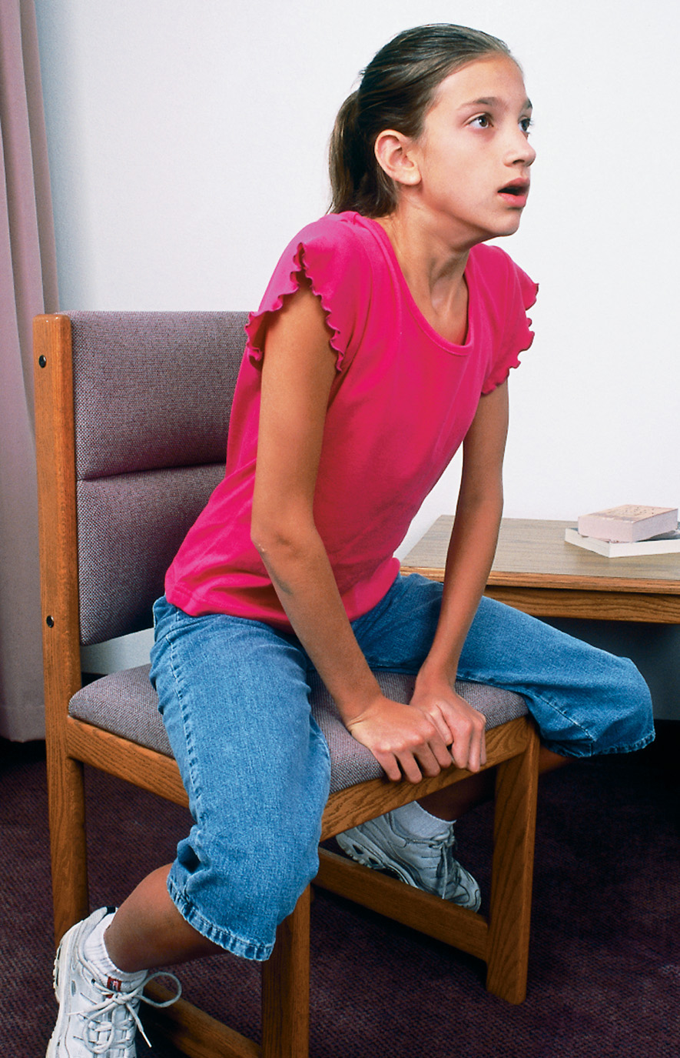
A Patient in Respiratory Distress is Commonly Found in a “Tripod” Position
Notes:
Most frequently, in severe cases of respiratory distress, the patient assumes a tripod position, sitting upright and leaning forward, arms locked, holding onto the edge of the seat.

Slide 126
Assessment and Care General Guidelines (3 of 13)
Assessment-Based Approach: Respiratory Distress
  Primary Assessment
    Mental status
      Look for restlessness, agitation, confusion, unresponsiveness.
    Airway
      Assess the airway for any indication of a complete or partial obstruction.
Notes:
Restlessness, agitation, confusion, and unresponsiveness are frequently associated with breathing difficulty because the brain is not getting enough oxygen.
Assess the airway for any indication of a complete or partial obstruction from secretions, blood, vomitus, or a foreign body. Listen for snoring, stridor, gurgling, or crowing.

Slide 127
Assessment and Care General Guidelines (4 of 13)
Assessment-Based Approach: Respiratory Distress
  Primary Assessment
    Breathing
      Look at the chest rise and fall
      Listen and feel for air flowing
      Auscultate the lungs
      Determine approximate respiratory rate
      Shallow breathing is an indication of inadequate breathing
Notes:
• One inadequate (either rate or tidal volume) = inadequate breathing.
• Two inadequates (both rate and tidal volume) = inadequate breathing.
• Two adequates (both rate and tidal volume) = adequate breathing.
Ranges are of concern for inadequate breathing:
Adults – 8 to 24
Children – 15 to 30
Infants – 25 to 50

Slide 128
Assessment and Care General Guidelines (5 of 13)
Assessment-Based Approach: Respiratory Distress
  Primary Assessment
    Inadequate breathing
      Provide positive pressure ventilation.
    Adequate breathing
      Administer oxygen.
Notes:
Inadequate breathing - Provide positive pressure ventilation with a bag-valve mask or pocket mask with oxygen connected to the device.
Adequate breathing - Administer oxygen to maintain an SPO₂ of >94%.

Slide 129
Assessment and Care General Guidelines (6 of 13)
Assessment-Based Approach: Respiratory Distress
  Primary Assessment
    Assess circulation
      Inspect the skin and mucous membranes.
      Assess the heart rate.
    Establish priority
      A patient with difficulty breathing is a priority patient.
      Consider A L S backup and rapid transport.
Notes:
Because a patient with difficulty in breathing is considered a priority patient, consider advanced life support backup and expeditious transport. In the patient with severe respiratory distress, respiratory failure, or respiratory arrest, you need to transport as soon as possible and continue your secondary assessment en route to the hospital.

Slide 130
Assessment and Care General Guidelines (7 of 13)
  Assessment-Based Approach: Respiratory Distress
  Secondary Assessment
    History – O P Q R S T
      Evaluate the chief complaint.
      Allergies.
      Medications.
      History of respiratory or cardiac problems.
      Hospitalizations for chronic conditions.
Notes:
Perform a secondary assessment and obtain a history. Determine if the patient uses an MDI or SVN for their condition.
Determine if the patient has used their medication, and how many times it has been used. Report this to medical control, and consider the side effects of the medication in your assessment.

Slide 131
Table 16-4 Signs of Deterioration During the Administration of C P A P
Increasing respiratory rate
Lethargy
Patient more exhausted and fatigued
Speechlessness
Abdomen moves inward with inhalation and outward with exhalation
Decreasing S p O₂ reading

Slide 132
Table 16-6 M D I Administration Dos and Don’ts (1 of 3)
When administering a metered-dose inhaler, follow these tips:
Do
Instruct the patient to breathe in slowly and deeply.
Be sure the patient is breathing in through his mouth.
Shake the canister for at least 30 seconds before removing the cap.
If the M D I has not been used for a couple of days, “prime” the M D I by pointing it away from the patient and depressing the canister a couple of times.

Slide 133
Table 16-6 M D I Administration Dos and Don’ts (2 of 3)
Depress the canister as the patient begins to inhale.
Coach the patient to hold his breath as long as possible (10 seconds).
Use a spacer or preferably a valved holding chamber device if available and the patient is used to it.
Don’t
Allow the patient to breathe in too quickly.
Allow the patient to breathe in through his nose.

Slide 134
Table 16-6 M D I Administration Dos and Don’ts (3 of 3)
Administer the medication before shaking the canister.
Depress the canister before the patient begins to inhale.
Forget to coach the patient to hold his breath as long as possible.
The patient may experience a variety of side effects from the medication. The most common are an increased heart rate, tremors, and nervousness. More detailed information about bronchodilators and other side effects are listed in Figure 16-11.

Slide 135
Assessment and Care General Guidelines (8 of 13)
Assessment-Based Approach: Respiratory Distress
  Secondary assessment
    Physical exam
      Look for cyanosis.
      J V D, tracheal deviation, and retractions.
      Auscultate the lungs.
      Check vital signs and pulse oximetry.
      Look for signs of difficulty breathing.
      Evaluate the level of difficulty breathing.
Notes:
Assess the neck for jugular vein distention, which might indicate an extreme increase in pressure in the chest or venous system. Inspect and palpate for an indrawing of the trachea and tracheal deviation. The trachea pulls inward during inhalation when constricted airflow is present.
Inspect and palpate the chest for retraction of the muscles between the ribs, asymmetrical chest wall movement, and subcutaneous emphysema, which is air trapped under the subcutaneous layer of the skin.
Pulsus paradoxus is a significant finding.
Auscultation of the breath sounds is a critical step in assessing patients with respiratory emergencies.

Slide 136
Assessment and Care General Guidelines (9 of 13)
Assessment-Based Approach: Respiratory Distress
  Secondary assessment
    Physical exam – Signs and Symptoms
      Perform an accurate assessment.
      The severity of shortness of breath does not directly correlate with the level of hypoxia.
Notes:
Common signs of breathing difficulty:
Shortness of breath (dyspnea).
Restlessness, agitation, and anxiety.
Increased heart rate (tachycardia) or irregular heart rate in adults and children, and a sudden decrease in heart rate (bradycardia) in newborns.
Faster-than-normal breathing rates (tachypnea).
Slower-than-normal breathing rates (bradypnea).
Cyanosis to the core of the body, usually seen in the face, neck, and upper chest. (This is a late sign of hypoxia. Pale skin is seen earlier than cyanosis as a sign of hypoxia. Flushed, or red, skin might indicate an allergic reaction. With any of these discolorations, the skin is typically moist.)
Abnormal upper airway sounds: crowing, gurgling, snoring, and stridor.
Audible wheezing upon inhalation and exhalation. Auscultation with a stethoscope can reveal wheezing and crackles that cannot be heard by just listening with the ear.
Diminished ability or inability to speak.
Retractions from the use of accessory muscles in the upper chest and between the ribs, and use of the neck muscles in breathing.
Excessive use of the diaphragm to breathe, producing abdominal breathing in which the abdomen is moving significantly during the breathing effort.
Shallow breathing, identified by little rise and fall of the chest, and poor movement of air in and out of the mouth.
Coughing, especially if it is a productive cough that produces mucus.
Irregular breathing patterns.
Tripod position.
Barrel chest indicating emphysema, a chronic respiratory condition.
Altered mental status.
Nasal flaring, when the nostrils widen and flare out upon inhalation.
Tracheal indrawing.
Paradoxical motion, in which an area of the chest moves inward during inhalation and outward during exhalation
Indications of chest trauma (such as open wounds).
Pursed-lip breathing, where the lips are puckered during exhalation.

Slide 137
Assessment and Care General Guidelines (10 of 13)
  Assessment-Based Approach: Respiratory Distress
  Emergency Medical Care
    Inadequate Breathing
      Establish an open airway.
      Begin positive pressure ventilation.
      Transport expeditiously.
Notes:
If signs of inadequate breathing (respiratory failure) are present—poor chest rise and fall, poor volume heard and felt, diminished or absent breath sounds, inadequate rate (too fast or too slow), or severely altered mental status.

Slide 138
Assessment and Care General Guidelines (11 of 13)
Assessment-Based Approach: Respiratory Distress
  Emergency Medical Care
    Adequate Breathing
      Administer oxygen.
      Assess baseline vital signs.
      Determine if the patient has an M D I.
      Place the patient in a position of comfort.
      Complete the secondary assessment.
Notes:
Complete the secondary assessment. In cases of severe respiratory distress if your protocol allows, the patient’s condition is appropriate, and the indications are present, consider the use of continuous positive airway pressure (CPAP). Current studies show that patients in severe respiratory distress from a variety of conditions might benefit from CPAP.

Slide 139
Assessment and Care General Guidelines (12 of 13)
  Assessment-Based Approach: Respiratory Distress
  Reassessment
    Look for improvement or diminishment in respiratory distress or respiratory failure.
    Assess the mental status and airway.
    Provide positive pressure ventilation, if needed.
    The patient with breathing difficulty is considered a priority patient.
Notes:
Beta₂ medications also contain trace beta₁ properties. Beta₁ properties increase the heart rate and the force of contraction. An increase in the heart rate following the administration of a beta₂ MDI or SVN is often a side effect from the trace beta 1 properties.
Teaching Tips
Role-play the assessment and management of a patient with respiratory distress.
Class Activity
Give students ample opportunity to practice assessment and management of patients with respiratory emergencies

Slide 140
Assessment and Care General Guidelines (13 of 13)
Assessment-Based Approach: Respiratory Distress
  Reassessment
    Monitor respiratory rate and tidal volume.
    Closely monitor the S p O₂.
    Monitor the heart rate.
Notes:
Critical Thinking Discussion
How do you think signs and symptoms of respiratory distress can be missed by EMTs? What is the key to recognizing the patient's problem?
Teaching Tips
Emphasize that patients do not need to have all signs and symptoms of respiratory distress to be in respiratory distress.

Slide 141
Case Study Introduction (3 of 3)
E M T s Troy Steel and Oscar Herzog are caring for 5-year-old Sarah Gross, who has a history of asthma and began having difficulty breathing at daycare. Sarah is coughing, and the E M T s can hear wheezing without using a stethoscope. Sarah appears a bit pale, but is alert and cooperative. Sarah's teacher hands Oscar a metered-dose inhaler, telling him it belongs to Sarah.
Notes:
Case Study
Present the Case Study Introduction provided in the PowerPoint slide set. Lead a discussion using the case study questions provided on the subsequent slide(s). The Case Study with discussion questions continues throughout the PowerPoint presentation.
Case Study Discussion
Use the case study content and questions to review the lesson content.

Slide 142
Case Study (5 of 7)
What anatomical and physiological differences should the E M T s keep in mind when assessing a patient of Sarah’s age?
What information is needed before the E M T s consider administering medication by metered-dose inhaler?
Notes:
Use the case study content and questions to reinforce the lesson content. Gauge the students’ responses as a guide of how well-versed they are in this topic.

Slide 143
Case Study (6 of 7)
Troy asks the teacher for the original packaging for the M D I to confirm the medication belongs to Sarah, and also confirms that Sarah has not already received any of the medication. Because of Sarah’s age, protocol requires Troy to contact medical direction for an order, which he does. After hearing the report on Sarah’s condition, the physician orders the use of the M D I.
Notes:
Review the case study findings presented in light of the material learned in this chapter.

Slide 144
Case Study (7 of 7)
What are the steps Troy will use in administering the M D I?
What will Troy look for to determine the effect of the medication?
Notes:
Use the case study content and questions to reinforce the lesson content. Gauge the students’ responses as a guide of how well versed they are in this topic.

Slide 145
Case Study Conclusion (4 of 5)
Troy coaches Sarah through two inhalations from the M D I. En route to the hospital, Troy reassesses Sarah, and finds that her wheezing has nearly resolved, with only faint, scattered expiratory wheezes heard on auscultation.
Notes:
Review the case conclusion and emphasize the application of knowledge learned from this presentation.

Slide 146
Case Study Conclusion (5 of 5)
Sarah’s respiratory rate has decreased from 24 to 20 per minute, her S p O₂ has remained steady at 98 percent, and her heart rate has increased from 88 to 96.
Notes:
Review the case conclusion and emphasize the application of knowledge learned from this presentation.

Slide 147
Lesson Summary (1 of 4)
Respiratory emergencies range from respiratory distress, to respiratory failure, to respiratory arrest.
There are many causes of respiratory emergencies.
Infants, children, and geriatric patients can present differently than adults when experiencing a respiratory emergency.
Notes:
Follow-Up
Answer student questions.
Follow-Up Assignments
Review Chapter 16 Summary.
Complete Chapter 16 In Review questions.
Complete Chapter 16 Critical Thinking questions.
Assessments
Handouts
Chapter 16 quiz

Slide 148
Lesson Summary (2 of 4)
No matter the underlying cause, respiratory emergencies have many signs and symptoms in common.
E M T s must know when to administer oxygen and must recognize when to provide positive pressure ventilation.
Respiratory compromise is the most common cause of cardiac arrest in pediatric patients.

Slide 149
Lesson Summary (3 of 4)
Some patients with histories of respiratory conditions have metered-dose inhalers or small-volume nebulizers to deliver beta₂ agonists, which act as bronchodilators.
Notes:
Class Activity
As an alternative to assigning the follow-up exercises in the lesson plan as homework, assign each question to a small group of students for in-class discussion.

Slide 150
Lesson Summary (4 of 4)
Infants, children, and geriatric patients may present differently than adults with respiratory problems, and the E M T must be prepared to intervene promptly.
Reassessment is a critical step in the management of patients with respiratory emergencies.
Notes:
Teaching Tips
Answers to In Review questions are in the appendix of the text. Advise students to review the questions again as they study the chapter.

Slide 151
Correct! (1 of 2)
Emphysema is characterized by destruction of alveolar walls with loss of elasticity and distention of the alveoli, which impairs gas exchange and increases resistance in the airway.
Click here to return to the program.

Slide 152
Incorrect (1 of 6)
The obstruction of blood flow through the pulmonary arteries, often from a blood clot, is called a pulmonary embolism, which leads to decreased lung perfusion, despite normal ventilation.
Click here to return to the quiz.

Slide 153
Incorrect (2 of 6)
Inflammation of the bronchi and bronchioles, with increased mucus production and persistent coughing is characteristic of chronic bronchitis.
Click here to return to the quiz.

Slide 154
Incorrect (3 of 6)
When a lung suddenly partially collapses without a history of trauma, this is known as spontaneous pneumothorax.
Click here to return to the quiz.

Slide 155
Correct! (2 of 2)
Advair Diskus is a combination of a long-acting beta₂ agonist and a steroid and is not intended for use in a respiratory emergency.
Click here to return to the program.

Slide 156
Incorrect (4 of 6)
Albuterol is a beta₂ agonist that may be used in a respiratory emergency.
Click here to return to the quiz.

Slide 157
Incorrect (5 of 6)
Levalbuterol is a beta₂ agonist that may be used in a respiratory emergency.
Click here to return to the quiz.

Slide 158
Incorrect (6 of 6)
Metaproterenol is a beta₂ agonist that may be used in a respiratory emergency.
Click here to return to the quiz.

Slide 159
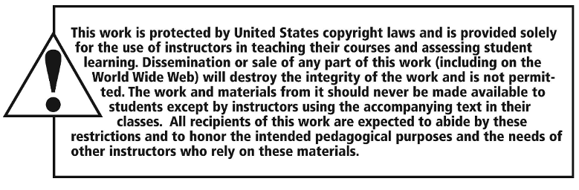
Copyright

