Slide 1
Prehospital: Emergency Care
Eleventh Edition
Chapter 14
Pharmacology and Medication Administration
Slides in this presentation contain hyperlinks. JAWS users should be able to get a list of links by using INSERT+F7
Copyright © 2018, 2014, 2010 Pearson Education, Inc. All Rights Reserved
Notes:
If this PowerPoint presentation contains mathematical equations, you may need to check that your computer has the following installed:
1) MathType Plugin
2) Math Player (free versions available)
3) NVDA Reader (free versions available)
Advance Preparation
Prepare
Bring examples of medications EMTs can administer, such as a bottle of nitroglycerin tablets, nitroglycerin spray, aspirin, oral glucose, an epinephrine autoinjector, hand-held nebulizers, and small volume nebulizer.
Bring several examples of drug information resources, including package inserts from the drugs listed above.
Bring in examples of over-the-counter medications, such as acetaminophen, aspirin, cough and cold medications, and so on, for an in-class activity explained in the lesson plan.
Bring several clean prescription medication bottles with labels removed, and a supply of small tablet-shaped candies, for an in-class activity explained in the lesson plan.
Make notes on several patient descriptions to be used throughout the lesson.
The total teaching time recommended is only a guideline. Take into consideration factors such as the pace at which students learn, the size of the class, breaks, and classroom activities. The actual time devoted to teaching objectives is the responsibility of the instructor.

Slide 2
Learning Readiness
E M S Education Standards, text p. 419.
Chapter Objectives, text p. 419.
Key Terms, text p. 419.
Purpose of lecture presentation versus textbook reading assignments.
Notes:
Explain to students what the National EMS Education Standards are. The National EMS Education Standards communicate the expectations of entry-level EMS providers. As EMTs, students will be expected to be competent in these areas. Acknowledge that the standards are broad, general statements. Although this lesson addresses the listed competencies, the competencies are often complex and require completion of more than one lesson to accomplish. The student is also expected to review the chapter objectives to foreshadow what will be in the chapter. By mastering the key terms the EMT student will better understand the learning and be able to communicate more clearly.
Additionally, explain to the students that the purpose of using these slides is to help keep the instructor focused on highlighting important portions of the material, explain interrelationships of topics, and discuss how to apply this information. It’s not the intent of the presentation (or slides alone) to include every component in the chapter. This presentation still requires the student to thoroughly read the chapter.

Slide 3
Setting the Stage (1 of 2)
Overview of Lesson Topics
Administering Medications
Medications the E M T Commonly Administers
Medication Names
Routes of Administration
Medication Forms
Notes:
These bulleted points are the major headings from the chapter, in order. The purpose is to provide a basic lecture navigation for the student.

Slide 4
Setting the Stage (2 of 2)
Overview of Lesson Topics
Essential Medication Information
Key Steps in Administering Medications
Reassessment Following Administration
Sources of Medication Information
Notes:
These bulleted points are the major headings from the chapter, in order. The purpose is to provide a basic lecture navigation for the student.

Slide 5
Case Study Introduction (1 of 2)
As E M T Nate Quick approaches the patient, he sees that the patient, who is sitting on the ground, leaning forward to support himself with his hands, is in respiratory distress. The patient, a teenage boy, does not acknowledge his presence, and appears pale and sweaty.
Notes:
Case Study
Present the Case Study Introduction provided in the PowerPoint slide set.
Lead a discussion using the case study questions provided on the subsequent slide(s).
The Case Study with discussion questions continues throughout the PowerPoint presentation.
Case Study Discussion
Use the case study content and questions to foreshadow the upcoming lesson content

Slide 6
Case Study Introduction (2 of 2)
“Hurry!” exclaims the woman kneeling next to the boy. “He is allergic to bees. He was stung by a wasp! I don’t know how to use his epinephrine injector.”
Notes:
Case Study
Present the Case Study Introduction provided in the PowerPoint slide set.
Lead a discussion using the case study questions provided on the subsequent slide(s).
The Case Study with discussion questions continues throughout the PowerPoint presentation.
Case Study Discussion
Use the case study content and questions to foreshadow the upcoming lesson content

Slide 7
Case Study (1 of 3)
What is your initial impression of how serious the patient’s condition is?
How is epinephrine beneficial to a patient with a serious allergic reaction?
What would you need to know about epinephrine before administering it?
Notes:
Case Study Discussion
Use the case study content and questions to foreshadow the upcoming lesson content. Gauge the student’s responses as a guide of how well versed they are in this topic.

Slide 8
Introduction
E M Ts administer or assist in the administration of medications.
You must be completely familiar with medications and the proper procedures for giving them.
Medications are administered under medical direction.
Notes:
During this lesson, students will learn about assessment and emergency care for a patient whose condition may require administration of a medication.
As an EMT you will be responsible for administering or assisting the patient with the administration of certain medications. Unlike a mathematician, you can’t erase your mistakes and start over. Once a medication has been administered, you can’t extract it or prevent its effects.

Slide 9
Administering Medications (1 of 3)
A drug, or medication, is a chemical that is used to treat or prevent a disease or condition.
The study of drugs is called pharmacology.
With E M T medication administration, it is common for the medications to be carried on the E M S unit.
Notes:
Discussion Questions
What is a drug?
What are some examples of drugs?
How can these drugs be used to treat or prevent diseases or conditions?
A medication is generally defined as a drug or other substance that is used as a remedy for illness. A drug is a chemical substance that is used to treat or prevent a disease or condition. The terms drug and medication are often used interchangeably by EMTs. The study of drugs is referred to as pharmacology.
Teaching Tips
Give examples of how a medication can help if used appropriately, such as nitroglycerin used for chest pain; also explain how the same medication can have detrimental effects if used inappropriately (too much, wrong patient, and so on).
Points to Emphasize
Medications are chemicals that are used to treat or prevent a disease or condition. Used properly, drugs can dramatically improve a patient's condition. Used inappropriately, drugs can have serious adverse effects.
EMTs can only administer medications that are in their scope of practice and that have been ordered to be administered by a licensed physician.

Slide 10
Administering Medications (2 of 3)
Medications have specific effects on the body.
When administered correctly, the patient's condition may improve significantly.
When administered inappropriately, drugs can cause serious side effects.
Notes:
When the correct dose is administered appropriately, the patient’s condition may improve significantly and uncomfortable symptoms may be relieved. If administered inappropriately, some drugs can cause serious side effects and deterioration in the patient’s condition.
Teaching Tips
Give examples of how a medication can help if used appropriately, such as nitroglycerin used for chest pain; also explain how the same medication can have detrimental effects if used inappropriately (too much, wrong patient, and so on).
Points to Emphasize
Medications are chemicals that are used to treat or prevent a disease or condition.
Used properly, drugs can dramatically improve a patient's condition. Used inappropriately, drugs can have serious adverse effects.
EMTs can only administer medications that are in their scope of practice and that have been ordered to be administered by a licensed physician.

Slide 11
Administering Medications (3 of 3)
E M T s only administer or assist with drugs listed in their protocols with medical direction approval.
Notes:
If the orders allow EMT medication administration, the EMT will obtain the aspirin and instruct the patient to chew the aspirin, and then the EMT will place the aspirin in the patient’s mouth. If the orders allow only patient-assisted medication administration of aspirin, the EMT will obtain the aspirin and instruct the patient to chew the aspirin, and then the EMT will hand the patient an aspirin tablet and have the patient place it into their mouth.
Class Activity
Have small groups of students work together to generate a list of drugs they are familiar with.
Critical Thinking Discussion
What are the pros and cons of the many advertisements on television for prescription medications?

Slide 12
Medications the E M T Commonly Administers (1 of 12)
Medications the E M T administers are either carried on the E M S unit or are prescribed for the patient.
Do not let the patient attempt to get their medication, because the activity may increase their discomfort and aggravate the medical condition.
Become completely familiar with your local protocol.
Notes:
Medications the EMT administers are either carried on the EMS unit or are prescribed for the patient. The prescription medications may be found on the patient or at the scene. It has become more common for EMTs to carry most or all the medications they’re able to administer on the EMS unit.
It is extremely important to become completely familiar with your local protocol, as this dictates not only the medications that can be administered, the specific doses and routes, but also which medications the EMT can administer and which are to be patient-assisted administrations.
Critical Thinking Discussion
Why are there only a limited number of drugs carried on the EMT's ambulance?
Why must EMTs have a physician's order to administer medications?
Teaching Tips
Show as many examples as possible of the medications described. Pass the medication containers around the classroom so students can see and touch them.

Slide 13
Medications the E M T Commonly Administers (2 of 12)
Medications
Oxygen: A medical gas that is indicated when:
You suspect hypoxia, hypoxemia.
The patient complains of dyspnea or is in respiratory distress.
The patient has signs of shock or poor perfusion.
The S p O₂ is less than 94%.
Notes:
Oxygen is an odorless, tasteless, colorless gas that is found in the ambient atmosphere at a concentration of approximately 21 percent. When it is used for medical purposes, it is administered as a 100 percent compressed gas concentration.
By increasing the oxygen concentration breathed in by the patient, you attempt to put a higher concentration of oxygen into the alveoli of the lungs. By doing so, you increase the amount of oxygen crossing over from the alveoli and into the pulmonary capillaries.

Slide 14
Medications the E M T Commonly Administers (3 of 12)
Medications
Oxygen: Precautions with Oxygen Administration
High concentrations of oxygen have been found to reduces systemic coronary artery blood flow.
High concentrations of oxygen have been found to increase tissue damaging free radical production.
Notes:
In healthy individuals, high concentrations of oxygen have been found to reduce cardiac output and left-ventricular perfusion, which reduces systemic and coronary artery blood flow. In patients with heart disease, hyperoxia (high oxygen levels) leads to coronary artery vasoconstriction and a higher coronary artery resistance, thereby, reducing coronary artery blood flow to the heart muscle. This can lead to a reduction in cardiac output, cardiac ischemia, and possibly life-threatening cardiac rhythm disturbances.
In some conditions, such as ischemic stroke, in which a cerebral artery is blocked in the brain, or an acute coronary syndrome involving coronary artery blockage in the heart, administration of oxygen when not indicated may actually worsen the tissue damage (cause reperfusion injury) by an increase in free radical production when the artery is reopened and blood supply reestablished to the once ischemic tissue.

Slide 15
Medications the E M3T Commonly Administers (4 of 12)
Medications
Oxygen: Oxygen Administration Difference in Medical vs. Trauma Patients
Medical conditions should be supplemented to an S p O₂ of 94 percent.
Trauma should be supplemented to an S p O₂ of 95 percent.
Notes:
In the patient with a medical condition, if the breathing is adequate and the SpO₂ is 94 percent or greater and no other signs of respiratory distress, hypoxia, hypoxemia, or poor perfusion are present, there is no need to administer supplemental oxygen. If the SpO₂ is less than 94 percent or signs of respiratory distress, hypoxia, hypoxemia, or poor perfusion are present, initiate oxygen therapy via a nasal cannula at 2 lpm and titrate to maintain an SpO₂ reading of 94 percent or greater. If signs of severe hypoxia are present, a nonrebreather mask at 15 lpm could be used.
In the patient with a traumatic injury, especially one involving the brain, thoracic organs, or spinal cord; or one in which there is any evidence of respiratory distress, hypoxia, hypoxemia, or poor perfusion; or when the potential exists for significant bleeding or shock, the American College of Surgeons recommends the delivery of a high concentration of oxygen to achieve and maintain an SpO₂ of 95 percent or greater. This is typically achieved through the use of a nonrebreather mask set at 15 lpm.
If bag-valve ventilation is being performed on either a medical or a trauma patient, regardless of the condition or injury, a high concentration of supplemental oxygen must be delivered.

Slide 16
Medications the E M T Commonly Administers (5 of 12)
Medications
Oral glucose
Brain cells require an uninterrupted supply of glucose.
Oral glucose may be administered to diabetics with low blood glucose levels.
Notes:
The oral glucose is absorbed in the mouth and through the intestines and eventually into the blood, where it raises the blood glucose level, making more glucose available to the starving brain cells. The brain cells will once again begin to function normally. This is seen as an improvement in the mental status.

Slide 17
Medications the E M T Commonly Administers (6 of 12)
Medications
Activated charcoal
A fine black powder
May be administered in some cases of ingested poisoning to absorb the poison and prevent its absorption into the body
Notes:
Once adsorbed, the poison is carried by the charcoal through the digestive tract and then eliminated in a bowel movement. The efficacy of activated charcoal has been questioned, and it may have harmful effects if aspirated. Activated charcoal has been removed from many protocols.

Slide 18
Medications the E M T Commonly Administers (7 of 12)
Medications
Aspirin
Administered to patients with chest discomfort or pain related to a lack of oxygen supplied to the heart
May prevent complete blockage of coronary arteries by interfering with platelet function
Notes:
The administration of aspirin may keep the coronary arteries that deliver blood to the heart from completely closing. EMTs don’t administer it for its analgesic (pain relief) effects.

Slide 19
Medications the E M T Commonly Administers (8 of 12)
Medications
Inhaled bronchodilators: Metered Dose Inhaler
Prescribed to patients with chronic respiratory disease
E M T s may only administer medications that are beta₂ agonists, designed to dilate the bronchioles
Drugs include albuterol and levalbuterol
Notes:
Inhaled bronchodilators are medications that cause the bronchioles to dilate. They contain beta₂ agonists that are topically deposited through an inhalation route on receptor sites in the bronchiole tissue. When the beta₂ receptors sites are stimulated, it causes the smooth muscle to relax, leading to dilation of the bronchiole. This causes a decrease in airway resistance with a resultant increase in airflow and an improvement of oxygen delivery to the distal alveoli.
Most often, you will find MDIs prescribed to patients with a history of asthma, emphysema, or chronic bronchitis. These patients have episodes of bronchoconstriction in which the bronchioles in the respiratory tract constrict, increasing the resistance to air flowing into the lungs and down into the alveoli. The patient experiences shortness of breath and signs and symptoms of respiratory difficulty from the increased effort to breathe and from the decreased flow of oxygen to the alveoli.

Slide 20
Medications the E M T Commonly Administers (9 of 12)
Medications
Inhaled bronchodilators: Small-Volume Nebulizer
Prescribed to patients with chronic respiratory disease
E M T s may only administer medications that are beta₂ agonists, designed to dilate the bronchioles
Drugs include albuterol and levalbuterol
Notes:
Inhaled bronchodilators are medications that cause the bronchioles to dilate. They contain beta₂ agonists that are topically deposited through an inhalation route on receptor sites in the bronchiole tissue. When the beta₂ receptors sites are stimulated, it causes the smooth muscle to relax, leading to dilation of the bronchiole. This causes a decrease in airway resistance with a resultant increase in airflow and an improvement of oxygen delivery to the distal alveoli.
With an SVN, the indications, actions, side effects, and contraindications of the medication are the same as an MDI; only the route of delivery is different.

Slide 21
Medications the E M T Commonly Administers (10 of 12)
Medications
Nitroglycerin
Used by cardiac patients
Dilates blood vessels to reduce workload of the heart and allow increased blood flow to the heart muscle
Hypotension is a major side effect
Must not be given to patients who have recently taken drugs for erectile dysfunction
Notes:
Nitroglycerin is used to treat patients with diseases of the heart that involve partial blockages or spasms of coronary arteries. The medication comes as a tablet or spray that is administered under the tongue.
Nitroglycerin dilates the blood vessels in the body, causing a reduction in systemic vascular resistance. This reduces the workload of the heart by decreasing the force of contraction necessary to eject the blood against a lower blood pressure in the aorta.
The reduced myocardial workload results in a decrease in the heart muscle’s demand for oxygen. At the same time, nitroglycerin’s vasodilation of the coronary arteries themselves increases the supply of oxygenated blood to the heart muscle. Because the major side effect is hypotension, it’s important to measure the blood pressure both before and after administration of nitroglycerin.
Discussion Question
What are the consequences of administering nitroglycerin to a patient who has recently taken a drug for erectile dysfunction?

Slide 22
Medications the E M T Commonly Administers (11 of 12)
Medications
Epinephrine
Used to treat severe allergic reactions (anaphylaxis)
Reverses vasodilation, bronchoconstriction, and increased capillary permeability through actions on the sympathetic nervous system
Patients with severe allergies may carry an epinephrine autoinjector.
Notes:
Epinephrine constricts the vessels (alpha₁ and alpha₂ ), increasing the blood pressure; dilates the bronchioles (beta₂ ), allowing the patient to move more air into the alveoli; and decreases capillary permeability (alpha₁ and alpha₂ ), reducing the leakage of fluid.
Discussion Question
Why is epinephrine used for severe allergic reactions?
Class Activity
In addition to lecturing on this section, assign each of the drugs discussed to a group of students and provide them with several resources in addition to their texts. Each group should take about 15 minutes to research their assigned drug, and then present their findings to the rest of the class. Be sure to emphasize key points and fill in any gaps.
Knowledge Application
Give several examples of patient problems (asthma, chest pain, anaphylactic reaction, or poisoning) and ask students what drug used by EMTs may be indicated for the patient.

Slide 23
Medications the E M T Commonly Administers (12 of 12)
Medications
Naloxone Hydrochloride (also known as Narcan)
Used to treat a known or suspected opioid overdose
Naloxone is a competitive opioid antagonist that competes for the same receptor binding sites as the opioid drug
Narcan suddenly reverses respiratory depression, hypotension, and sedative effects created by the opioid overdose
Notes:
Depending on the dose and route of Narcan and the opioid that the patient overdosed on, the opioid may stay in the body longer than the Narcan. Therefore, it may be necessary to repeat the dose of Narcan to continue to reverse the effects of the opioid drug that was taken. In addition, some opioids, such as fentanyl or carfentanil (carfentanyl), are potent and may require several repeat doses of Narcan to reverse the respiratory depression, hypotension, and sedative effects.
Narcan itself has no effect on a patient unless an opioid drug is currently in the person’s system. Therefore, it’s a relatively safe drug to administer in either suspected or known heroin or other opiate drug overdoses. In addition, the EMT can administer it via several routes: intramuscularly, subcutaneously, and intranasally.
Class Activity
In addition to lecturing on this section, assign each of the drugs discussed to a group of students and provide them with several resources in addition to their texts. Each group should take about 15 minutes to research their assigned drug, and then present their findings to the rest of the class. Be sure to emphasize key points and fill in any gaps.
Knowledge Application
Give several examples of patient problems (asthma, chest pain, anaphylactic reaction, or poisoning) and ask students what drug used by EMTs may be indicated for the patient.

Slide 24
Case Study (2 of 3)
Kneeling next to the patient, Nate can hear stridor and wheezing, and he detects a weak, rapid radial pulse. The patient is unable to speak. With the history of bee sting allergy, a witnessed bee sting, and signs of severe distress associated with anaphylaxis, Nate knows he must act quickly. Following protocol, Nate prepares to administer the epinephrine autoinjector.
Notes:
Case Study Discussion
Review the case study findings presented.

Slide 25
Case Study (3 of 3)
What is the medication form that Nate is about to administer?
By what route will Nate administer the medication?
What are the steps that Nate must follow in administering the medication?
Notes:
Case Study Discussion
Use the case study content and questions to foreshadow the upcoming lesson content. Gauge the students’ responses as a guide of how well versed they are in this topic.

Slide 26
Medication Names (1 of 2)
Drugs have the following categories of names:
Chemical
Generic
Trade
Official
Notes:
Chemical name. The chemical name describes the drug’s chemical structure. It’s usually the first name associated with the drug.
Generic name. Also referred to as the nonproprietary name, the generic name still reflects the chemical characteristic of the drug, but in a shorter form than the full chemical name. It’s the name assigned to the drug before it is officially listed and is independent of the manufacturer. The generic name is listed in the U.S. Pharmacopoeia, a publication listing all drugs officially approved by the U.S. Food and Drug Administration.
Trade name. The trade name, also referred to as the brand name, is assigned when the drug is released for commercial distribution. The name is usually short and easy to recall, and may be based on the chemical name or the type of problem it is used to treat. This is the name the manufacturer uses to market the drug.
Official name. Drugs meeting the requirements of the U.S. Pharmacopoeia or National Formulary are given an official name. It is commonly the generic name followed by the initials U.S.P. or N.F.

Slide 27
Medication Names (2 of 2)
Example:
Chemical Name: 1,2,3-propanetriol trinitrate
Generic Name: nitroglycerin tablets
Official Name: nitroglycerin tablets, U.S.P.
Trade Name: Nitrostat
Notes:
Teaching Tips
Give examples of a generic drug name, such as ibuprofen, and several of the trade names under which it is marketed.
Discussion Questions
What is the generic name of a drug?
How is the generic name of a drug different from the official name?
Critical Thinking Discussion
Why must EMTs know both generic and trade names for drugs?
Knowledge Application
List examples of the generic names of drugs commonly administered by the EMT and have students match it with trade names, and vice versa.
Class Activity
Give over-the-counter medication containers to small groups of students. Have them search for the generic and trade names and report them to the class.

Slide 28
Table 14-1 Common Generic and Trade Medication Names (1 of 2)
Generic Name | Trade Name(s) | Used for
Oxygen | None | Hypoxia, hypoxemia, poor perfusion, shock, respiratory distress, dyspnea, heart failure, altered mental status, S p O2 < 94%, or an unknown oxygen saturation reading
Glucose, oral | Glutose, Insta-Glucose | Altered mental status associated with hypoglycemia
Activated charcoal | SuperChar, InstaChar, Actidose, LiquiChar | Ingestion poisoning emergencies
Nitroglycerin | Nitrostat (tablet) | Chest pain of cardiac origin
Nitroglycerin spray | Nitrolingual Spray | Blank

Slide 29
Table 14-1 Common Generic and Trade Medication Names (2 of 2)
Generic Name | Trade Name(s) | Used for
Epinephrine | Adrenalin EpiPen, Auvi-Q auto-injectors | Anaphylactic reaction
Albuterol | Proventil, Ventolin, ProAir, AccuNeb, VoSpire | Breathing difficulty associated with respiratory condition and Bronchoconstriction
Levalbuterol | Xopenex | Blank
Ipratropium Bromide/ Albutero | Combivent, DuoNeb | Blank
Aspirin | Bayer aspirin, Easprin, Ecotrin, Empirin, Ascriptin, Bufferin, Buffex | Patient experiencing chest pain or chest discomfort suggestive of an acute coronary syndrome
Naloxone Hydrochloride | Narcan, Narcan Nasal Spray, EVZIO | Known or suspected opioid overdose

Slide 30
Routes of Administration (1 of 8)
The route is how the medication is given to or taken by the patient.
The route affects how fast the medication is absorbed by the body and its effect.
Each medication E M T administers is prepared in a form that allows for the quickest and safest absorption into the body.
Notes:
Points to Emphasize
The route of administration is the way which a medication enters the patient's body.
The route by which a medication is given affects how quickly the medication is absorbed into the body to reach its site of action.
Routes used by EMTs include sublingual, oral, inhalation, and intramuscular injection.

Slide 31
Routes of Administration (2 of 8)
E M T s commonly give medications by these routes:
Sublingual
Oral
Inhalation
Intramuscular injection
Intranasal
Subcutaneous
Notes:
Discussion Questions
How does the absorption of drugs administered into the muscle compare with the absorption of drugs administered orally?
What is the difference between oral administration and sublingual administration routes?
Teaching Tips
Reinforce learning by naming drugs administered by EMTs and having students state the route by which it is administered.
Class Activity
Pass out small tablet-shaped candies. Tell students not to eat them until you explain the instructions to them. First instruct students as if you were instructing a patient to take an oral medication. Then instruct students as if you were instructing a patient to take a sublingual medication.
Critical Thinking Discussion
How do you think poor perfusion might affect drug absorption?

Slide 32
Routes of Administration (3 of 8)
Sublingual
Medication is placed beneath the patient’s tongue, where it is dissolved and absorbed
Used only in alert patients
Used to administer nitroglycerin tablets and spray
Notes:
Sublingual - The medication is placed under the patient’s tongue. The patient doesn’t swallow the medication. It’s dissolved and absorbed across the mucous membrane in the mouth. The drug usually has a relatively quick absorption rate into the blood. The patient must be alert in order for you to administer the medication in this manner. Only a limited number of medications can be given by the sublingual route.
Medications the EMT administers using the sublingual route are:
Nitroglycerin tablets
Nitroglycerin spray

Slide 33
Routes of Administration (4 of 8)
Oral
The drug is swallowed for absorption through the gastrointestinal tract (activated charcoal is not absorbed)
Used only in alert patients
Used to administer aspirin, oral glucose, activated charcoal
Notes:
Oral - The drug is taken by mouth (swallowed); also known as per os (PO). Except for activated charcoal, the medication is typically absorbed in the small intestine. This is also known as an enteral route because it uses the digestive system to absorb the medication. The patient must be responsive and able to swallow.
Medications the EMT administers using the oral route are:
Aspirin
Oral glucose
Activated charcoal

Slide 34
Routes of Administration (5 of 8)
Inhalation
Used for gases and aerosols
Medication is inhaled into the lungs for absorption
Used to administer oxygen and medications given by metered-dose inhaler or small-volume nebulizer
Notes:
Inhalation - The medication is prepared as a gas or aerosol and is inhaled by the patient. This method typically deposits the medication directly to the target site where the effect is needed most. The patient must be spontaneously breathing for this route to be effective.
Medications the EMT administers using the inhalation route are:
Oxygen
Metered-dose inhaler
Small-volume nebulizer

Slide 35
Routes of Administration (6 of 8)
Intramuscular injection
Injected into a muscle mass for absorption
Requires use of a needle
Some discomfort to patient
Used to administer epinephrine by autoinjector
Notes:
In the intramuscular (IM) route, the drug is injected into a muscle mass. The absorption is relatively rapid. This requires the use of a needle; therefore, it poses the danger of a needle stick injury to the EMT. Some discomfort may be felt by the patient. Serious side effects might occur if the drug is accidentally injected into a vein. The medication can only be injected in specific muscle groups.
Medications the EMT administers by the intramuscular injection route are:
Epinephrine by auto-injector (EpiPen, Auvi-Q) or manually by syringe and needle
Naloxone hydrochloride by auto-injector (EVZIO) or manually by syringe and needle

Slide 36
Routes of Administration (7 of 8)
Intranasal
The medication is sprayed into one or both nostrils
The M A D creates a fine spray of drug particles of a specific size that stick to the mucosal lining
The medication cannot be absorbed without an M A D
Notes:
The medication is sprayed into one or both nostrils using a specialized delivery device called a mucosal atomizer device (MAD) that is either attached to a syringe or built into the device. The MAD creates a fine spray of drug particles of a specific size. The fine particles stick to the mucosal lining in the nasal cavity, allowing for fast absorption into the nasal capillaries. The capillaries then deliver the drug directly into the circulatory system. It has been found that this delivery route can produce effects that are sometimes similar to the medication being injected.
Medications the EMT administers using the intranasal route are:
Naloxone hydrochloride (Narcan) by syringe and MAD
Narcan Nasal Spray (single use device)

Slide 37
Routes of Administration (8 of 8)
Subcutaneous
The medication is injected under the skin into the subcutaneous layer
Produce a slower absorption rate than intramuscular injections
Can be used after an I M injection of Narcan to prolong the desired effect
Notes:
A medication administered by a subcutaneous (SQ) route is injected under the skin into the subcutaneous layer. Subcutaneous injections are designed to produce a slower absorption rate than intramuscular injections; therefore, subcutaneous administration isn’t recommended for a medication that must enter the circulatory system rapidly, such as epinephrine in an anaphylactic reaction.
The medication the EMT administers using the subcutaneous route is Naloxone hydrochloride (Narcan) by autoinjector (EVZIO).

Slide 38
Medication Forms (1 of 8)
The form usually limits administration to one specific route.
Common forms include:
Compressed powder or tablet
Notes:
Tablet - A compressed powder that is shaped into a small disk or elongated shape.
Points to Emphasize
The form of a medication is generally specific to the way it is administered.
Drug forms used by the EMT include tablets, liquids for injection, gels, suspensions, fine powders for inhalation, gases, and liquids used in sprays and small volume nebulizers.
Discussion Questions
What form of medication is used in a small-volume nebulizer?
What medication can be administered as a spray?
Teaching Tips
Refer to the equipment and medications you brought in as you discuss each form.

Slide 39
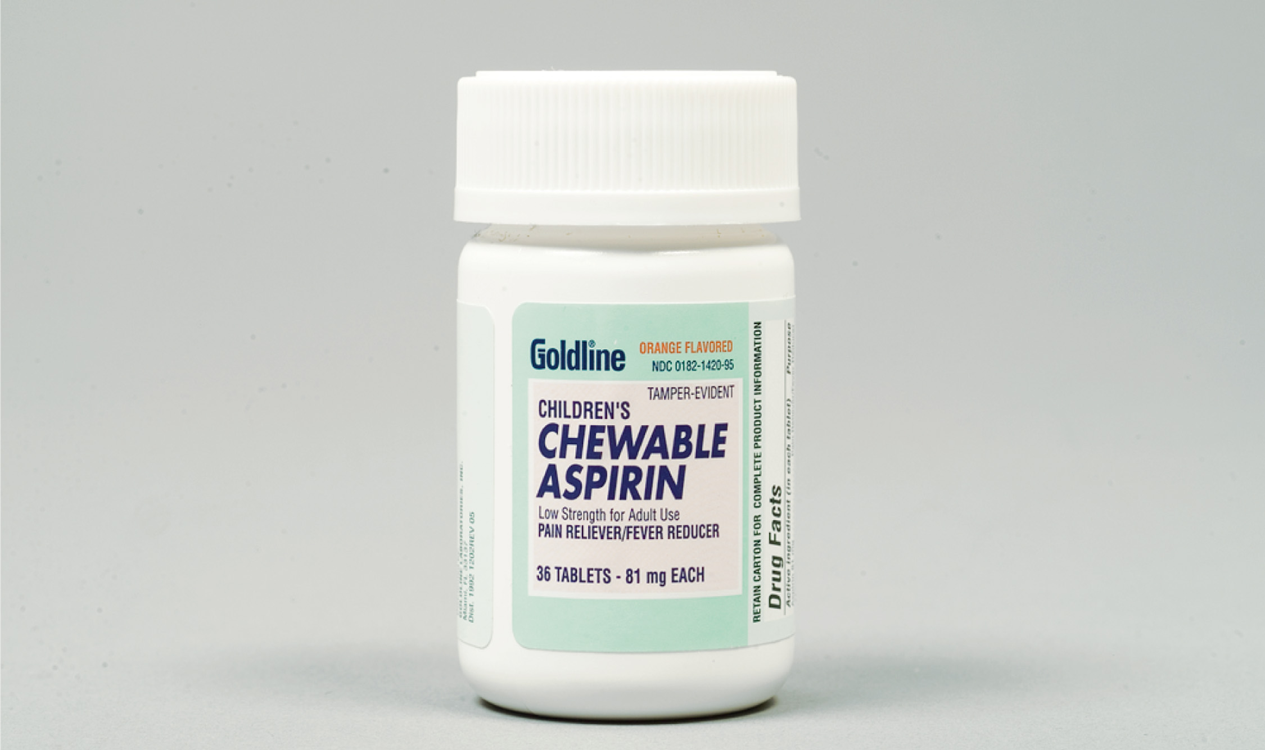
Aspirin, in Pill Form, May Be Administered for Chest Pain When a Heart Attack Is Suspected
Notes:
Nitroglycerin tablets and aspirin tablets are examples of this type of medication form.

Slide 40
Medication Forms (2 of 8)
Common forms include:
Liquid for injection
A liquid substance with no particulate matter
Notes:
A liquid substance with no particulate matter. Because epinephrine is injected into the muscle, it’s in a liquid form.

Slide 41
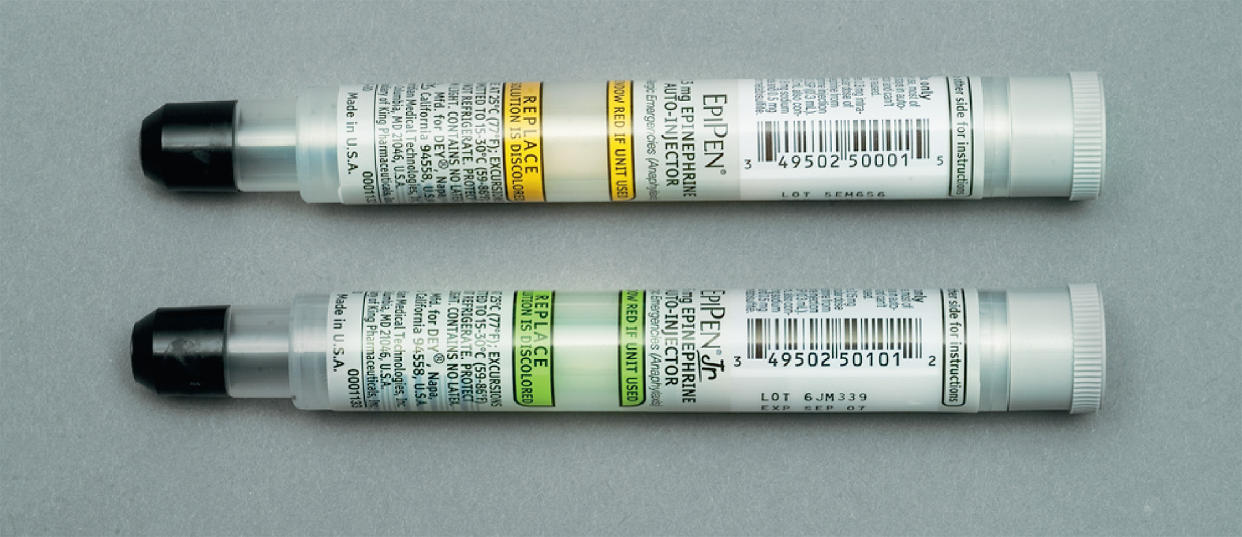
The Epinephrine Auto-Injector May Be Prescribed for Patients with a History of Severe Allergic or Anaphylactic Reaction
The EpiPen is a brand of epinephrine auto-injector.
Notes:
Epinephrine is injected into the muscle, it’s in a liquid form. Naloxone hydrochloride is in a liquid form that can be administered intranasally with a MAD or by using Narcan Nasal Spray.

Slide 42
Medication Forms (3 of 8)
Common forms include:
Gel
Notes:
A viscous (thick, sticky) substance that’s administered to the patient.

Slide 43
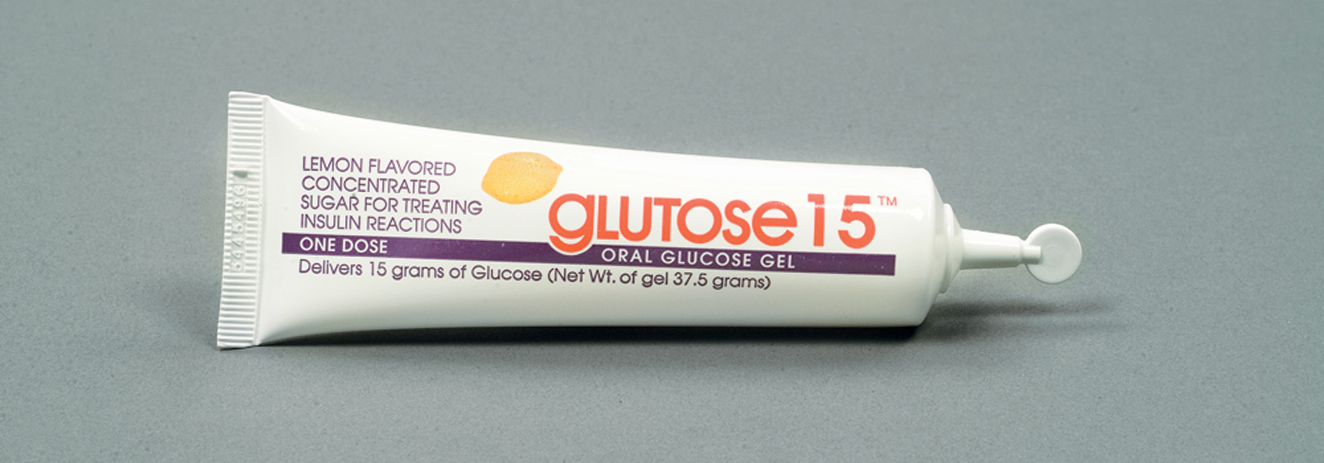
Oral Glucose is a Viscous Gel Used in Acute Diabetic Emergencies. It is Carried on the E M S Unit
Notes:
Oral glucose is a gel.

Slide 44
Medication Forms (4 of 8)
Common forms include:
Suspension
Mixtures do not remain mixed
Notes:
Drug particles that are mixed in a suitable liquid. These mixtures don’t remain mixed for long periods of time and have a tendency to separate. Suspensions must be shaken well prior to administration.

Slide 45
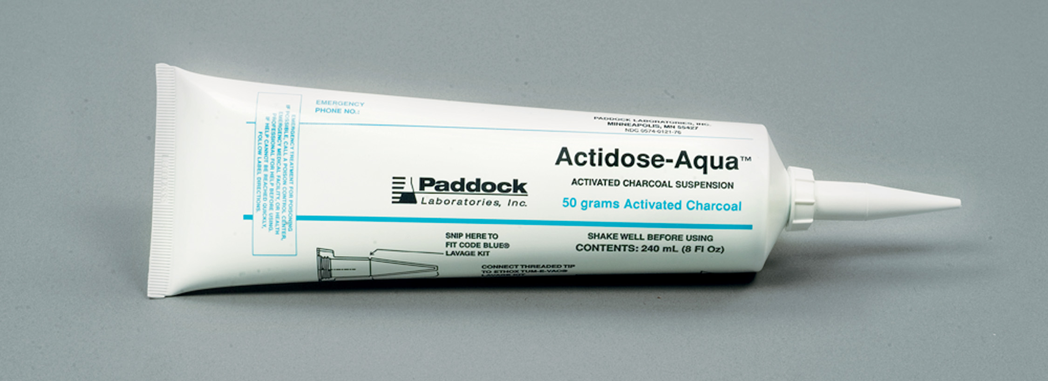
Activated Charcoal is Administered in Suspension Form and is Carried on Some E M S Units. It May Be Used in Poisoning and Overdose Emergencies
Notes:
Activated charcoal is administered as a suspension.

Slide 46
Medication Forms (5 of 8)
Common forms include:
Fine powder for inhalation
Delivered by metered dose inhaler
Notes:
This form is actually a crystalline solid that’s mixed with liquid to form a suspension. Because it is a suspension, it’s necessary to shake the canister vigorously prior to administration.

Slide 47
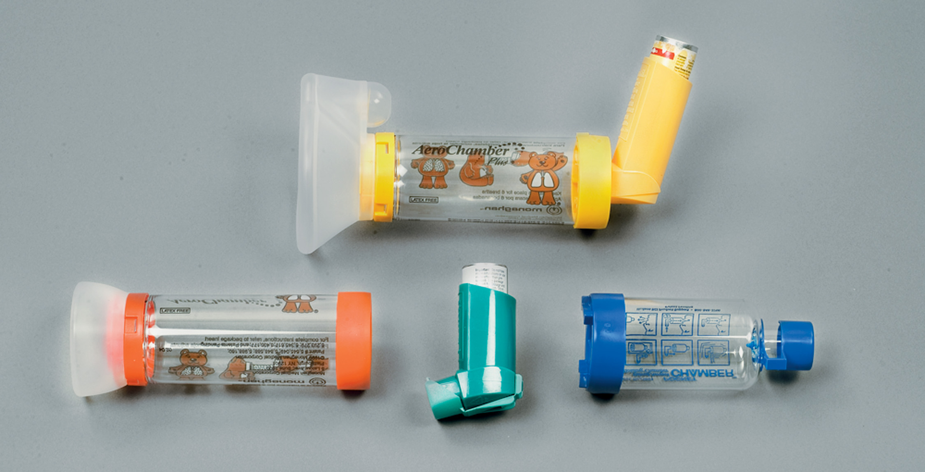
A Metered-Dose Inhaler or a Metered-Dose Inhaler with a Spacer May Be Prescribed for Respiratory Conditions
Notes:
The medication appears as a mist or aerosol. Each spray delivers a precise measured amount of drug to the patient.

Slide 48
Medication Forms (6 of 8)
Common forms include:
Small-volume nebulizer
Uses a compressed gas to form an aerosol in a mixing chamber
The aerosol is inhaled by the patient through a mouthpiece or a face mask
Notes:
The medication is directly deposited on the mucosal lining deep in the respiratory tract. By depositing the medication at the desired site, the effect is more immediate and direct than when given by other routes, and fewer systemic side effects are usually noted. The medication comes packaged in a premeasured and premixed fixed-dose container or inhaler.

Slide 49
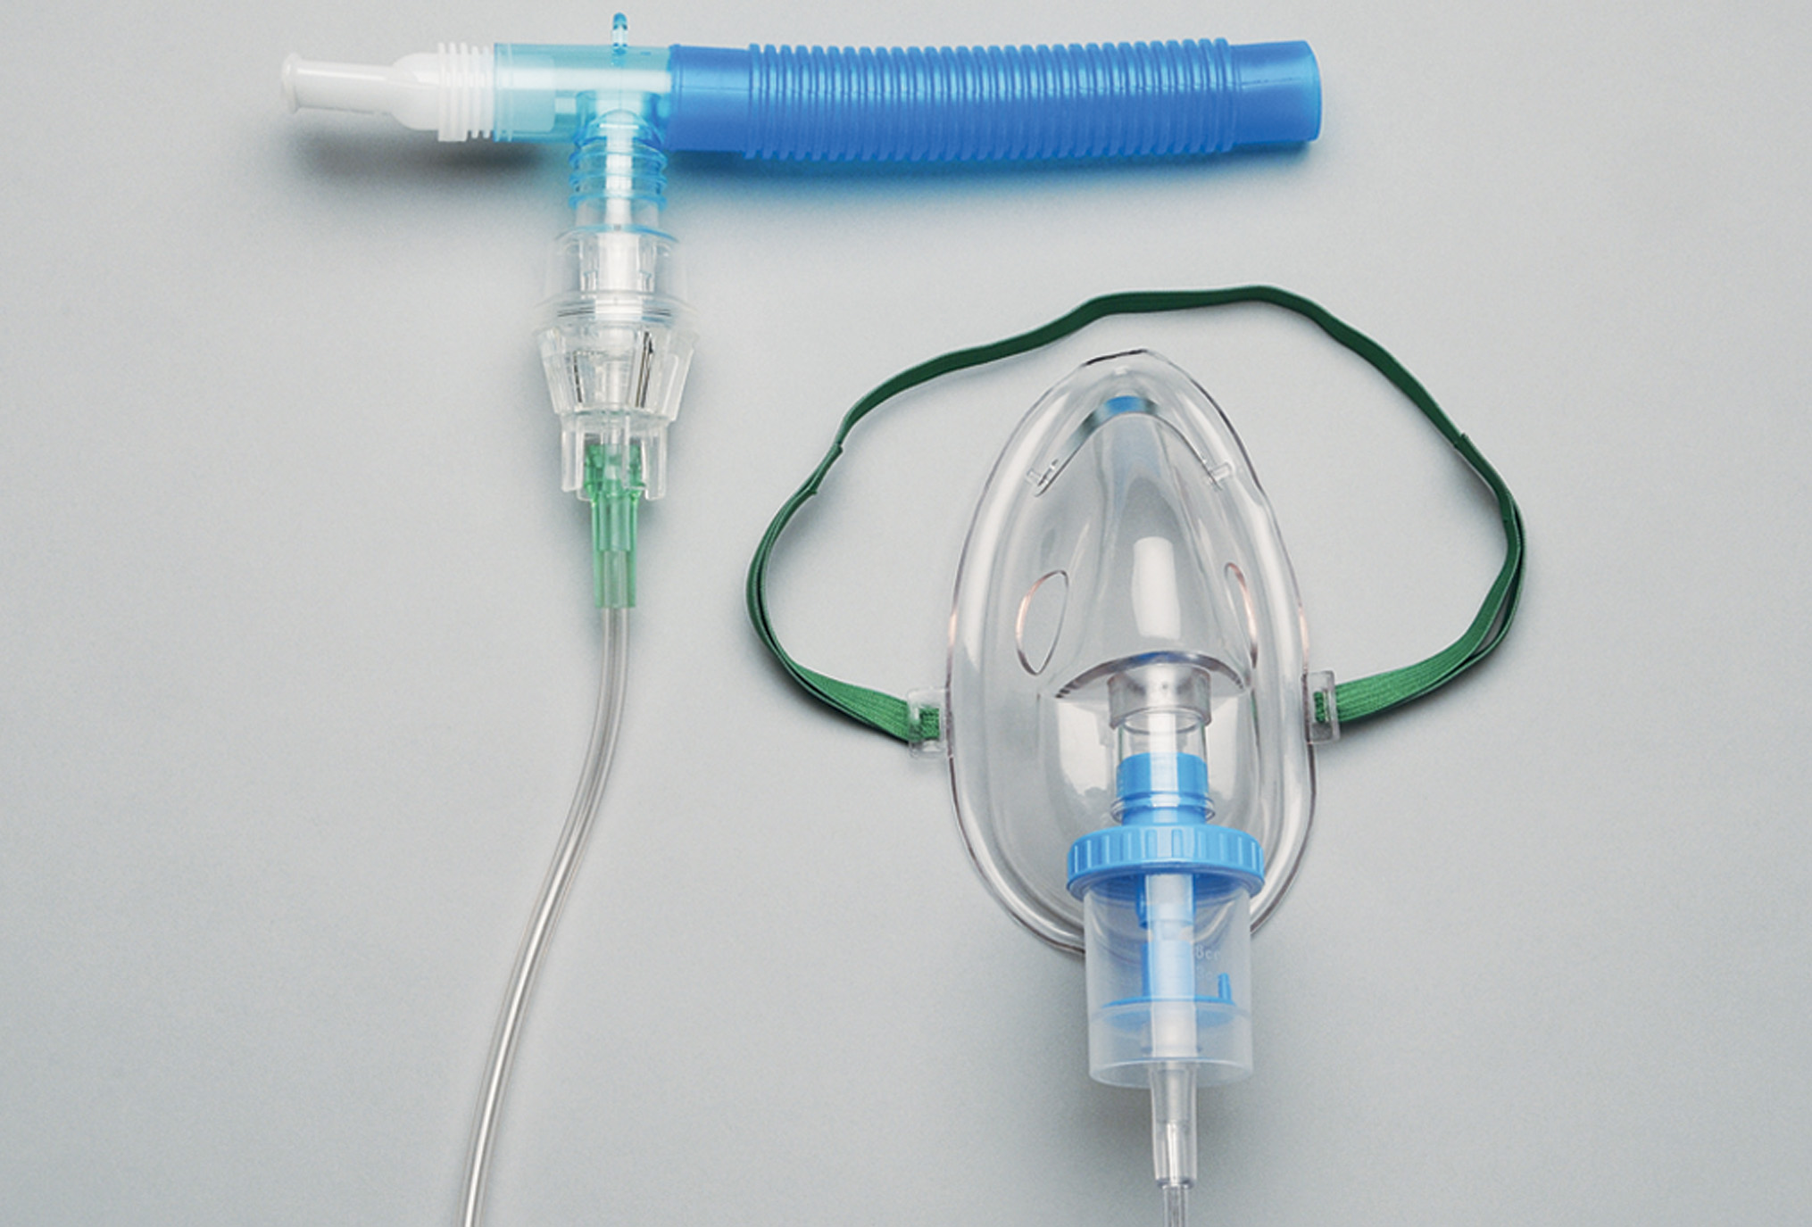
Nebulized Medications May Be Administered by a Small-Volume Nebulizer, Through Either a Mouthpiece or a Face Mask
(© Carl Leet, Y S U)
Notes:
Nebulizer circuit for administration of prescribed medications or saline.

Slide 50
Medication Forms (7 of 8)
Common forms include:
Gas
Notes:
Oxygen is the medication EMTs most commonly administer.

Slide 51
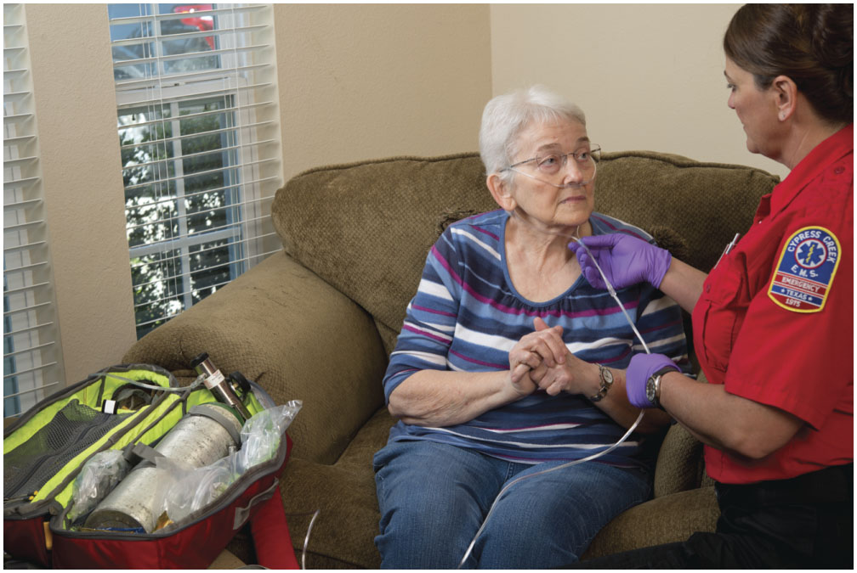
The Gas Oxygen is Considered a Medication
It is the most commonly used medication in E M S and is carried on the E M S unit.
Notes:
Oxygen is inhaled and has systemic effects on the cells and organs.

Slide 52
Medication Forms (8 of 8)
Common forms include:
Spray
Droplets can be deposited under the tongue
Notes:
Spray droplets can be deposited under the tongue. Nitroglycerin, often in tablet form, can also be in the form of a spray.

Slide 53
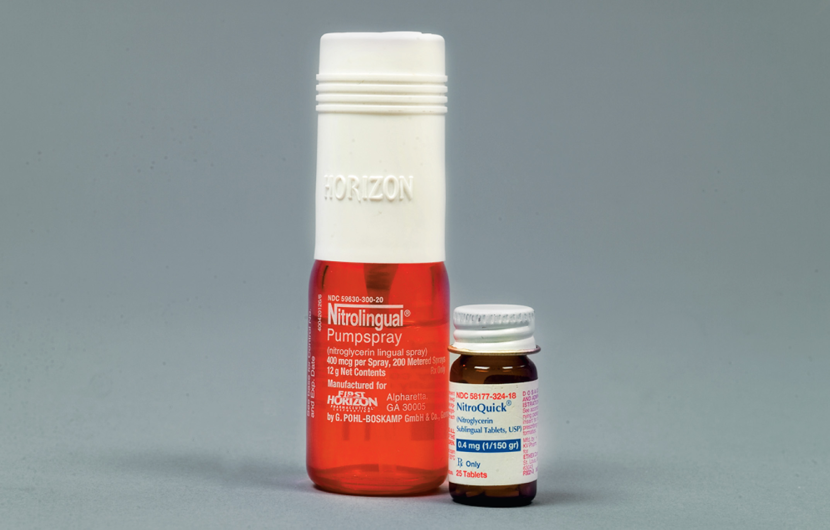
The E M T May Assist the Patient with Administration of Nitroglycerin Prescribed for Chest Pain
Two Common Forms Are Tablet and Spray.
Notes:
Nitroglycerin spray is an aerosol that contains nitroglycerin in a propellant. Each spray delivers a precise metered dose.

Slide 54
Essential Medication Information (1 of 7)
For each medication, you must understand the following information:
Indications
Contraindications
Dose
Administration
Actions
Side effects
Notes:
In the following slides, we use the example of nitroglycerin so that you can see how the information applies to a medication you will need to administer.

Slide 55
Essential Medication Information (2 of 7)
Indications
The most common uses of the drug in treating a specific condition
Geared toward relief of signs, symptoms, or specific conditions
Notes:
An indication for the use of nitroglycerin is chest pain (because nitroglycerin may relieve chest pain).

Slide 56
Essential Medication Information (3 of 7)
Contraindications
Situations in which the drug should not be administered because of the harm it could cause
Notes:
Low blood pressure is a contraindication for the use of nitroglycerin (because nitroglycerin lowers the
blood pressure, possibly causing an already-low blood pressure to become dangerously low). An absolute contraindication indicates that the drug shouldn’t be used in this situation or condition under any circumstances, whereas a relative contraindication indicates that the drug isn’t preferred but can be used if absolutely necessary and no alternative is available.

Slide 57
Essential Medication Information (4 of 7)
Dose
The amount of the drug that is given to the patient
Notes:
It’s important to distinguish between adult dosages and dosages for infants and children so that the correct dose is administered. Too much of the drug could cause serious side effects, whereas an inadequate amount of the drug may have little or no effect. For nitroglycerin, EMTs are advised to administer one dose (one tablet or one spray) and repeat it in 3–5 minutes if there’s no relief, to a maximum of three doses (including any doses the patient may already have taken before the ambulance arrived).

Slide 58
Essential Medication Information (5 of 7)
Administration
The route by which the medication is given to the patient
Notes:
Refers to the route and form in which the drug is given. The EMT administers medications sublingually, orally, by inhalation, or by injection. Nitroglycerin, for instance, is administered sublingually in tablet or spray form.

Slide 59
Essential Medication Information (6 of 7)
Actions
The effect the drug has on the body
The therapeutic effect is the intended positive response by the body.
The mechanism of action is how the drug works to create its effect on the body.
Notes:
The action, therapeutic effect, and mechanism of action provide the justification for administering a particular medication. If the action described will not produce the desired effect, then the drug should not be administered. Actions of nitroglycerin include relaxation of blood vessels and decreasing workload for the heart.

Slide 60
Essential Medication Information (7 of 7)
Side Effects
Actions that are not desired and that occur in addition to the desired therapeutic effects
May be predictable or unpredictable
Notes:
The desired, therapeutic actions of epinephrine are dilation of the bronchioles and constriction of the blood vessels, which help relieve a severe allergic reaction. However, epinephrine also causes an increased heart rate (tachycardia). This is an undesirable side effect of epinephrine. Nitroglycerin’s therapeutic effect is relief of chest pain. Side effects of nitroglycerin include lowering of blood pressure (hypotension), headache, and pulse rate changes.

Slide 61
Click on the Term That is Used to Describe Reasons Why a Medication Must Not Be Given to a Patient
A. Side effects
B. Indications
C. Actions
D. Contraindications

Slide 62
Key Steps in Administering Medication (1 of 10)
Follow these steps in administering medication:
Obtain an order from medical direction.
Select the proper medication.
Verify the patient’s prescription.
Check the expiration date.
Notes:
Points to Emphasize
Following these steps is essential to patient safety.
A medication order may be obtained on-line or off-line.
On-line orders are verified by repeating them back.

Slide 63
Key Steps in Administering Medication (2 of 10)
Follow these steps in administering medication:
Check for discoloration or impurities.
Verify the form, route, and dose.
Check the Five Rights of medication administration.
Document medication administration.
Notes:
Critical Thinking Discussion
How do you think medication errors can occur?

Slide 64
Key Steps in Administering Medication (3 of 10)
Obtain an Order from Medical Direction
Every medication E M T s administer or assist with requires an order from medical direction.
The order may be obtained on-line or off-line.
Verify an on-line order by restating it.
Notes:
Restating the drug to be administered, the dose, and the route when receiving an on-line order reduces the chances that an improper medication is inadvertently administered, the wrong dose is given, or an inappropriate route is used.
It may be necessary for the EMT to make a judgment as to whether the patient can tolerate the administration of the medication. For example, you may have received an on-line order for the administration of oral glucose. The patient was talking incoherently when you called medical direction for the order; however, their mental status has deteriorated, and now they are only responding to painful stimuli. So even though the medication order exists, it’s now inappropriate to administer the oral glucose to this patient.

Slide 65
Key Steps in Administering Medication (4 of 10)
Select the Proper Medication
Read the label carefully.
Many medications have several trade names.
Notes:
Once the medication order has been received, it’s the EMT’s responsibility to ensure that the proper medication has been selected.

Slide 66
Key Steps in Administering Medication (5 of 10)
Verify the Patient’s Prescription for Patient-Assisted Administration
When assisting with the patient’s medication, verify that the medication to be given is prescribed to them.
Notes:
When the medication to be given is not carried on the EMS unit and must be obtained from the patient, it’s important to verify that the medication is actually prescribed for the patient and not some other individual such as a spouse, relative, or friend. Some patients may take medications that aren’t specifically prescribed for them. They believe that if the signs and symptoms are similar to those of someone who is taking the medication, then it’s appropriate for them to take it. To avoid medication
administration errors, it’s vital to check the prescription label and verify the patient’s name. The EMT should never administer medication that’s not prescribed for the patient unless ordered to do so by medical direction.
Some medication labels aren’t affixed to the medication container itself but are placed on or inside the box or other outer packaging. Nitroglycerin, epinephrine auto-injectors, and metered-dose inhalers are packaged this way. If your patient has one of these medications, you will not be able to tell by looking at the container if the medication has been prescribed for this patient. If the outer packaging cannot be found, you must determine through careful questioning if the prescription truly belongs to the patient.

Slide 67
Key Steps in Administering Medication (6 of 10)
Check the Expiration Date
Do not administer expired medications.
Notes:
Depending on the type of package and the medication, the expiration date is either printed on the container or on the prescription label. Properly dispose of expired medications according to your state drug or pharmacy guidelines.

Slide 68
Key Steps in Administering Medication (7 of 10)
Check for Discoloration or Impurities
Inspect for discoloration and cloudiness.
Do not give discolored or cloudy medications.
Notes:
Epinephrine, or any other medication that comes in liquid form, should be inspected for any discoloration or cloudiness prior to administration. If the medication appears to be cloudy or discolored, or if any particulate material is found in the container, do not use it. Discard the medication.

Slide 69
Key Steps in Administering Medication (8 of 10)
Verify the Form, Route, and Dose
Use the proper form for the route selected.
Make sure the label matches the order from medical direction.
Notes:
Some drug packages are similar but contain different doses. For example, the epinephrine auto-injector comes in adult and pediatric sizes. The packages look very similar. Without close inspection, it would be easy to mistake one for the other. Administering an adult dose to a child could have detrimental effects, whereas administering a pediatric dose to an adult may have little to no effect.

Slide 70
Key Steps in Administering Medication (9 of 10)
Medication Administration: The Five “Rights”
Right patient
Right medication
Right route
Right dose
Right time
Notes:
Points to Emphasize
The five rights of medication administration provide an easy way to minimize the potential for errors when administering medications.
Discussion Question
What are the "rights" of medication administration?
You must be sure that the medication you’re administering is prescribed for that specific patient. Don’t administer medications that are prescribed for anyone other than the patient unless ordered by the medical direction physician.
Be sure that the medication being administered is actually the medication that is intended to be administered. Many patients put several different types of medications into one prescription bottle.
The route may be oral, sublingual, inhalation, or intramuscular injection. Administering a drug by the wrong route may have deleterious effects or no effect on the patient.
Be sure to understand differences in doses for adults and children. By not knowing the proper dose of the medication, you may under-dose the patient, resulting in the medication having little effect, or you may overdose the patient by administering too much of the drug. The overdose may cause serious harm.
Don’t administer drugs that are expired. The drug expires on the first day of the month listed unless otherwise specified. Once the drug is expired, it doesn’t typically change its composition but weakens in strength and its effectiveness in achieving the desired action.

Slide 71
Key Steps in Administering Medication (10 of 10)
Documentation
Drug
Dose
Route
Time
Changes in patient’s condition
Notes:
Once you administer the medication, you must document the drug, dose, route, and time the medication was administered. Report any changes in the patient’s condition, and report whether the signs or symptoms have been relieved. Also report any deterioration in the patient’s condition or if side effects associated with the drug have occurred.

Slide 72
Reassessment Following Administration (1 of 2)
You must reassess the patient after medication administration for:
Mental status
Airway
Respirations
Pulse
Skin
Blood pressure
Notes:
During the reassessment, assess the adequacy of any other care that has been administered to manage the patient’s condition. Based on the care provided, determine whether improvement or deterioration in the patient’s condition has occurred. Document any improvement or deterioration.

Slide 73
Reassessment Following Administration (2 of 2)
You must reassess the patient after medication administration for:
S p O₂
Change in complaints/relief of signs and symptoms
Medication side effects
Change in patient’s condition
Notes:
Be prepared to re-administer Narcan in the known or suspected opioid overdose patient if:
There’s no response to the initial dose
The initial dose was not enough to adequately reverse any respiratory depression or hypotension
The patient’s mental status deteriorates and any respiratory depression and/or hypotension recurs
Points to Emphasize
The point of administering medications is to either prevent a change in a patient's condition or to bring about a change in a patient's condition. The patient must be reassessed to determine whether the medication has had the desired effect, or any side effects.
Teaching Tips
To review what was learned about the drugs administered by EMTs, list each drug and ask students what changes they should be looking for in the reassessment.

Slide 74
Sources of Medication Information
American Hospital Formulary Service
A M A Drug Evaluation
Physicians’ Desk Reference (P D R)
Package inserts
Poison control centers
E M S pocket drug reference guide
ePocrates
Other medical director approved web sites
Notes:
Points to Emphasize
There are many sources available to provide additional information about medications.
Always use reliable sources of information, such as those listed.
Teaching Tips
Demonstrate the use of several drug reference resources.
Critical Thinking Discussion
How soon do you think sources of drug information are outdated?
Class Activity
Provide small groups of students with drug reference material. Have students look up essential information about the drugs discussed.

Slide 75
Case Study Conclusion (1 of 2)
As Nate’s partner assists the patient’s ventilations, Nate mentally reviews the protocol for anaphylaxis, which allows him to administer a patient’s epinephrine pen in such circumstances. He confirms that the medication belongs to the patient, and checks the name, dosage, and expiration date.
Notes:
Case Study Discussion
Review case conclusion and emphasize the application of knowledge learned from this presentation.

Slide 76
Case Study Conclusion (2 of 2)
He administers the drug by the intramuscular route, and prepares to repeat the primary assessment and perform a secondary assessment. Fortunately, the epinephrine begins working quickly, but Nate knows that its effects are short-lived, and that they must work quickly to get the patient to the hospital.
Notes:
Case Study Discussion
Review case conclusion and emphasize the application of knowledge learned from this presentation.

Slide 77
Summary
Medication administration is a considerable responsibility.
E M T s give medications only under medical direction.
You must understand the indications, contraindications, dose, administration route and form, actions, and side effects.
Always utilize the Five Rights of Medication Administration.
Notes:
Follow-Up
Answer student questions.
Follow-Up Assignments
Review Chapter 14 Summary.
Complete Chapter 14 In Review questions.
Complete Chapter 14 Critical Thinking questions.
Assessments
Handouts
Chapter 14 quiz

Slide 78
Correct!
Contraindications are reasons that you would not administer a medication to a patient, because of the harm that could be done.
Click here to return to the program.

Slide 79
Incorrect (1 of 3)
Side effects are the unintended effects of a drug that is given, which may either be predictable or unpredictable.
Click here to return to the quiz.

Slide 80
Incorrect (2 of 3)
Indications are reasons why the drug would be given in the treatment of a disease or condition.
Click here to return to the quiz.

Slide 81
Incorrect (3 of 3)
Actions are the way in which a drug has a therapeutic effect on the body.
Click here to return to the quiz.

Slide 82
Copyright

