Slide 1

Prehospital: Emergency Care
Eleventh Edition
Chapter 13
Patient Assessment
"Slides in this presentation contain hyperlinks. JAWS users should be able to get a list of links by using INSERT+F7"
Copyright © 2018, 2014, 2010 Pearson Education, Inc. All Rights Reserved
Notes:
If this PowerPoint presentation contains mathematical equations, you may need to check that your computer has the following installed:
1) MathType Plugin
2) Math Player (free versions available)
3) NVDA Reader (free versions available)
Advance Preparation
Student Readiness
Assign the associated section of MyBRADYLab and review student scores. Review the chapter material in the Instructor Resources, which includes Student Handouts, PowerPoint slides, and the MyTest Program.
Prepare
Schedule assistant instructors to supervise student practice of patient assessment skills. A ratio of one instructor per four students is suggested.
Obtain equipment required for assessment (stethoscopes, pen lights, pulse oximeters, and other needed equipment).
Bring in several news stories about injuries (look in the newspaper or on a television station website) for an activity described in the lesson plan.
The total teaching time recommended is only a guideline. Take into consideration factors such as the pace at which students learn, the size of the class, breaks, and classroom activities. The actual time devoted to teaching objectives is the responsibility of the instructor.

Slide 2
Learning Readiness
E M S Education Standards, text p. 333.
Chapter Objectives, text p. 333.
Key Terms, text p. 334.
Purpose of lecture presentation versus textbook reading assignments.
Notes:
Explain to students what the National EMS Education Standards are. The National EMS Education Standards communicate the expectations of entry-level EMS providers. As EMTs, students will be expected to be competent in these areas. Acknowledge that the standards are broad, general statements. Although this lesson addresses the listed competencies, the competencies are often complex and require completion of more than one lesson to accomplish. The student is also expected to review the chapter objectives to foreshadow what will be in the chapter. By mastering the key terms the EMT student will better understand the learning and be able to communicate more clearly.
Additionally, explain to the students that the purpose of using these slides is to help keep the instructor focused on highlighting important portions of the material, explain interrelationships of topics, and discuss how to apply this information. It’s not the intent of the presentation (or slides alone) to include every component in the chapter. This presentation still requires the student to thoroughly read the chapter.

Slide 3
Setting the Stage
Overview of Lesson Topics
  Scene Size-Up
  Primary Assessment
  Secondary Assessment
    Stable/Unstable Trauma Patient
    Responsive/Unresponsive Medical Patient
  Reassessment
Notes:
These bulleted points are the major headings from the chapter, in order. The purpose is to provide a basic lecture navigation for the student.

Slide 4
Case Study Introduction (1 of 2)
Ambulance 12 has just been dispatched for a report of an injured person who fell from a ladder. E M T s Kerry Pace and Della Larson arrive on the scene, parking in front of the residence. Kerry and Della take a moment to look around and observe the scene prior to approaching on foot.
Notes:
Case Study
Present the Case Study Introduction provided in the PowerPoint slide set.
Lead a discussion using the Case Study questions provided on the subsequent slide(s).
The Case Study with discussion questions continues throughout the PowerPoint presentation.
Case Study Discussion
Use the Case Study content and questions to foreshadow the upcoming lesson content.

Slide 5
Case Study Introduction (2 of 2)
As they exit the ambulance, a woman comes around the side of the house, saying, “He’s back here. I think he broke his arm. And he’s a diabetic.” The E M T s follow the woman to the backyard.
Notes:
Case Study
Present the Case Study Introduction provided in the PowerPoint slide set.
Lead a discussion using the case study questions provided on the subsequent slide(s).
The Case Study with discussion questions continues throughout the PowerPoint presentation.
Case Study Discussion
Use the case study content and questions to foreshadow the upcoming lesson content

Slide 6
Case Study (1 of 8)
What observations of the scene should Kerry and Della make as they walk toward the patient?
What observations of the patient should Kerry and Della make as they approach the patient?
Notes:
Case Study Discussion
Use the Case Study content and questions to foreshadow the upcoming lesson content. Gauge the student’s responses as a guide of how well versed they are in this topic.

Slide 7
Introduction
All decisions about patient care and transport are based on an accurate, thorough patient assessment.
Assessment includes scene size-up, primary assessment, secondary assessment, and reassessment.
Notes:
During this lesson, students will learn about of components of the patient assessment procedures they will perform on every patient during their careers as EMTs.

Slide 8
Part 1
Scene size-up

Slide 9
Scene Size-Up
Scene size-up is a dynamic process that continues throughout the call.
There are operational and patient care aspects.
Determining the mechanism of injury (M O I) or nature of the illness (N O I) and determining the number of patients is the beginning of the patient-assessment process.
Notes:
Points to Emphasize
The scene size-up is the first component of the patient assessment.
The steps of the scene size-up are taking Standard Precautions, evaluating for scene hazards and ensuring scene safety, determining the mechanism of injury or the nature of illness, establishing the number of patients, and determining the need for additional resources.
Teaching Tips
Ask questions to determine what students recall from your initial discussion of scene size-up.
Discussion Question
What are the purposes of the scene size-up?

Slide 10
Steps of the Scene Size-Up
Take Standard Precautions.
Evaluate scene hazards and ensure scene safety.
Determine the mechanism of injury or nature of illness.
Establish the number of patients.
Ascertain the need for additional resources.
Notes:
Evaluating scene hazards and ensuring scene safety, including the following:
Personal protection
Protection of the patient
Protection of bystanders
Determining the mechanism of injury or the nature of the illness, including the following:
Trauma patient
Medical patient

Slide 11
Part 2
Primary Assessment
Notes:
Points to Emphasize
The purpose of the primary assessment is to identify and manage immediately life-threatening conditions of the airway, breathing, or circulation.

Slide 12
Primary Assessment (1 of 3)
A primary assessment is conducted on every patient.
The purposes are:
  To determine the nature of the problem.
  To manage immediate threats to life.
  To establish priorities for treatment and transport.
Notes:
Points to Emphasize
During the primary assessment process, you will form a general impression of the patient's condition and establish patient priorities.
Teaching Tips
Write the six steps of the primary assessment on the white board to give students a map for upcoming information.

Slide 13
Primary Assessment (2 of 3)
The primary assessment steps are as follows:
  Form a general impression of the patient.
  Assess level of consciousness (mental status).
  Assess their way.
  Assess breathing.
  Assess oxygenation.
  Assess circulation.
  Establish patient priorities.
Notes:
Although the components of the primary assessment are often carried out with the general impression first, followed by assessment of the level of consciousness, airway, breathing, oxygenation, and circulation, it doesn’t have to occur in this linear sequence for every patient.

Slide 14
Primary Assessment (3 of 3)
Any life-threatening condition identified in the primary assessment is immediately treated before moving on to the next portion of the primary assessment.
Notes:
The key to primary assessment is making sure to assess and manage any immediate life threats to the airway, breathing, oxygenation, and circulation during the first 60 seconds after encountering the patient. The order of taking these actions is less important, and is based on obvious presenting immediate life threats.

Slide 15
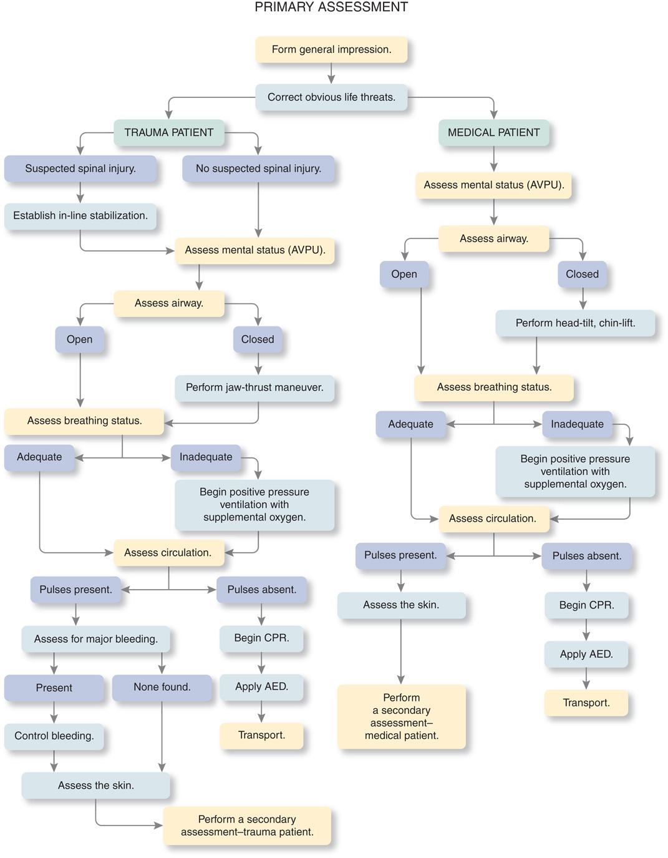
Steps of the Primary Assessment
Notes:
You should be able to conduct this assessment in about 60 seconds, unless confronted with life-threatening problems that must be treated immediately as found.

Slide 16
Form a General Impression of the Patient (1 of 8)
Develop a general impression of the patient’s condition as you approach and determine if he is stable or unstable.
Determine the chief complaint.
Observe the environment.
Notes:
Primary assessment begins as soon as you approach the patient, allowing you to gain a firsthand impression of the patient.
As you gain experience as an EMT, you will become more adept at gaining valuable information about your patient from first impressions. For example, if this information has not already been provided to you by dispatch, Emergency Medical Responders, or bystanders, you will immediately observe the patient’s general age (i.e., child, adult, elderly) and sex, which may have a bearing on the patient’s condition or care.

Slide 17
Table 13-1 Forming a General Impression
Estimate the patient’s age.
Note the patient’s sex.
Determine whether the patient is a trauma or medical patient.
Obtain the patient’s chief complaint.
Identify (and manage) immediate life threats.
Notes:
You will recognize a life-threatening problem, such as severe bleeding, right away; if you do, treat that condition immediately.

Slide 18

Form a General Impression as You Approach the Patient. Shown in This Photo: An Alert Patient with No Obvious Signs of Illness or Injury
Notes:
Discussion Questions
What are some initial indications that a patient is sick?
What might indicate to you that a patient has been injured?
Critical Thinking Discussion
Why is it important to develop a general impression before proceeding with further assessment of the patient?

Slide 19
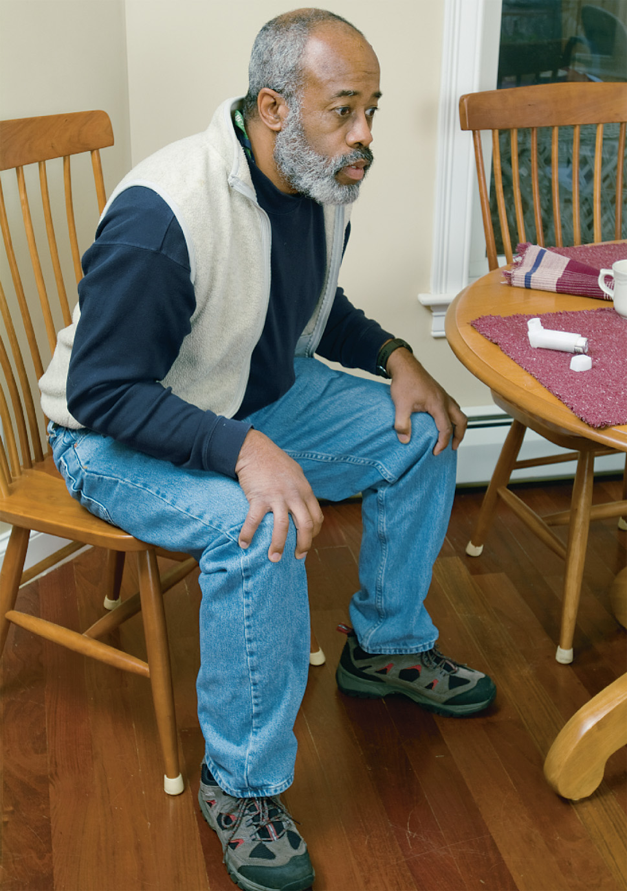
Form a General Impression as You Approach the Patient. Shown in This Photo: A Patient Exhibiting Signs of Respiratory Distress
Notes:
Points to Emphasize
Form a general impression by paying attention to and analyzing information, beginning with the dispatch information and continuing with your initial observations of the scene and patient.
With time and experience, you will learn to quickly determine if patients generally seem ill or well, and if ill, whether the patient is stable or unstable.
Your impression will evolve as you continue to collect information.
One of the initial determinations you will make is whether you are dealing with an illness or an injury.

Slide 20
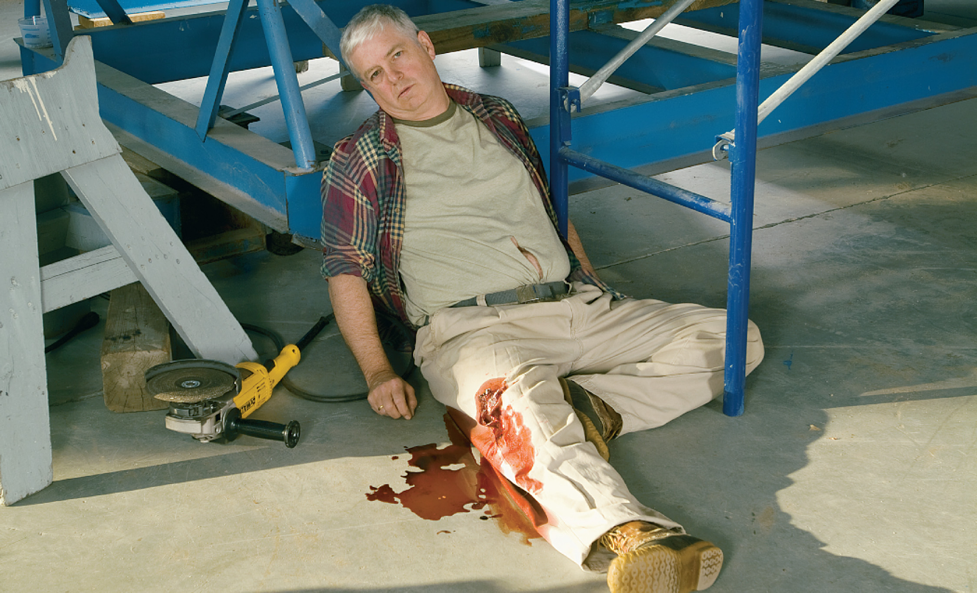
Form a General Impression as You Approach the Patient. Shown in This Photo: A Responsive Patient with an Obvious Leg Injury
Notes:
Trauma may be blunt or penetrating.
The chief complaint is the patient's answer to, "Why did you call EMS today?”
Identify immediate life threats. If trauma is suspected, maintain in-line manual stabilization of the cervical spine.

Slide 21
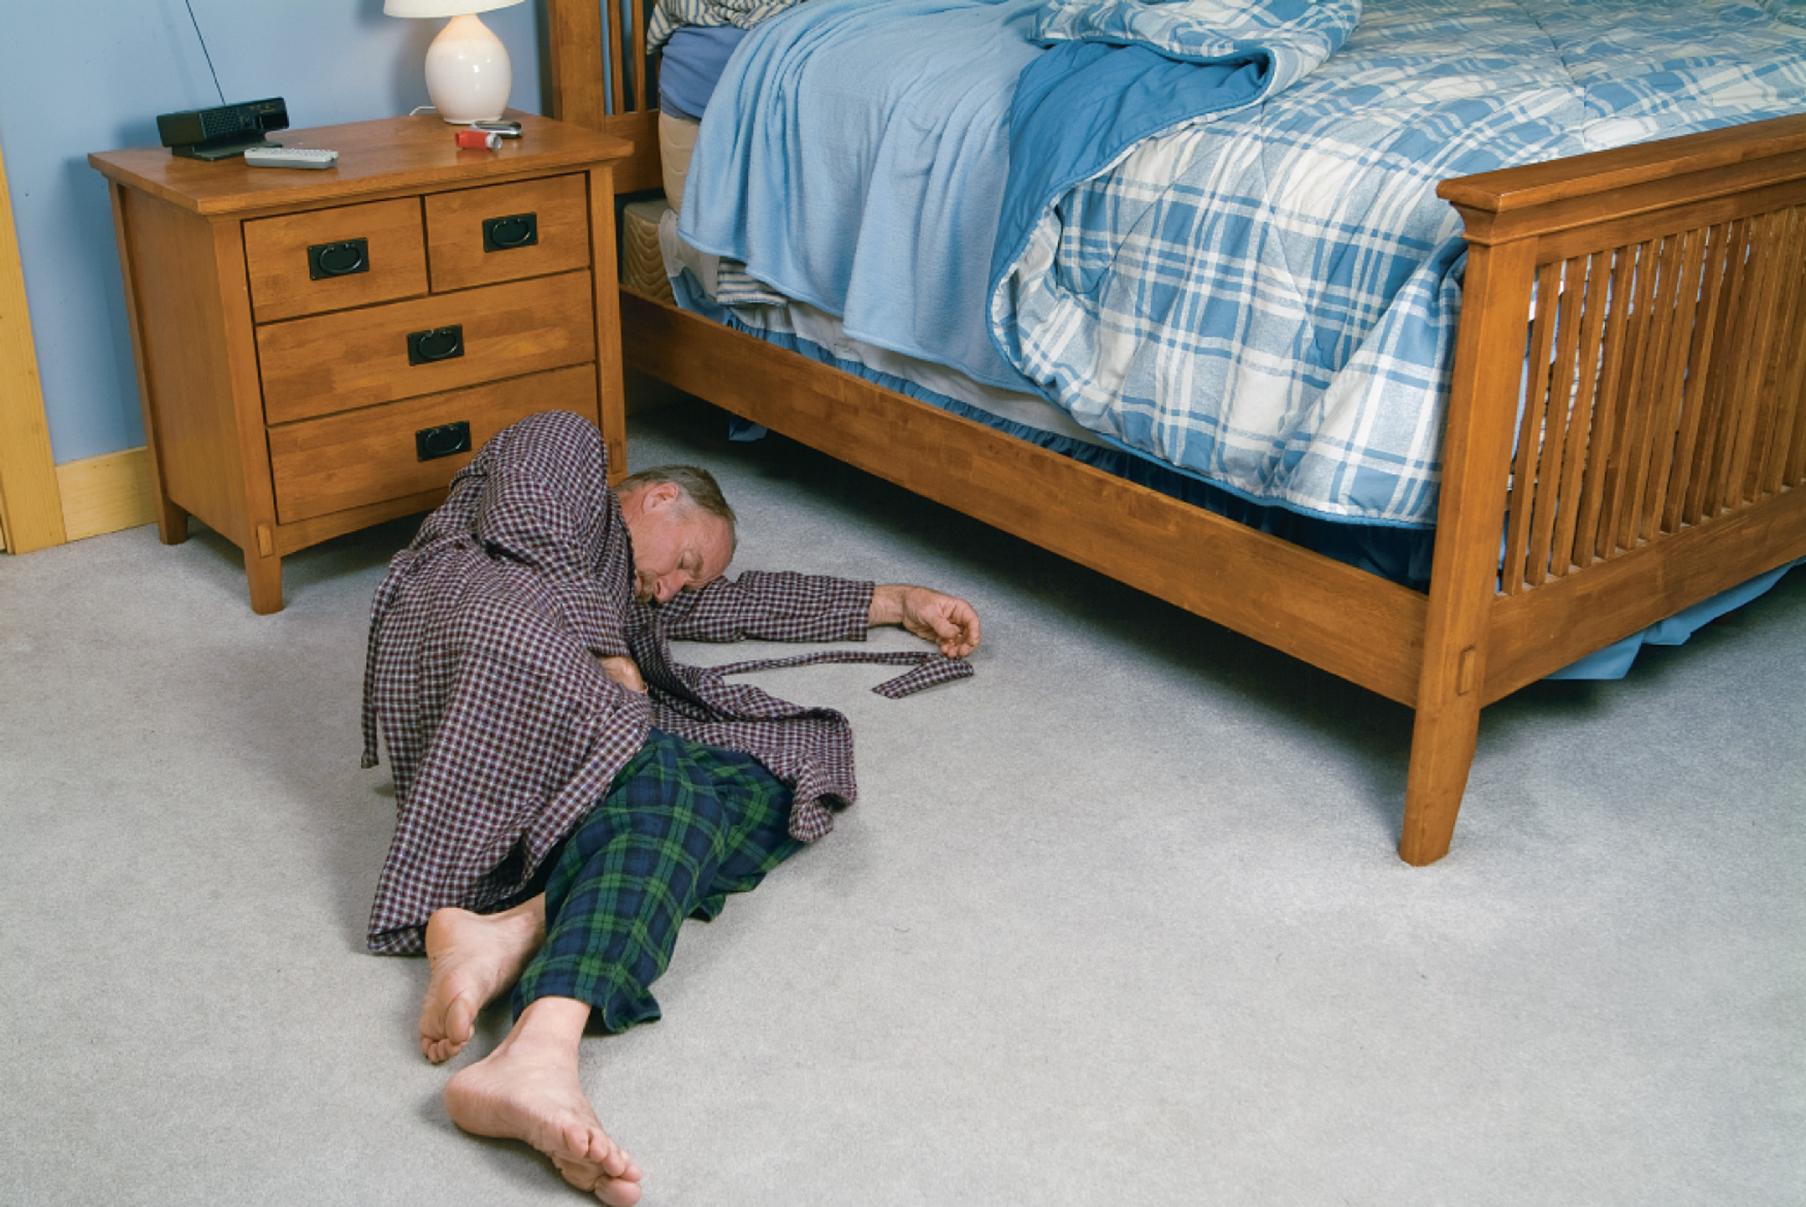
Form a General Impression as You Approach the Patient
Shown in this photo: An unresponsive patient who is likely suffering from a medical condition but for whom trauma cannot yet be ruled out.
Notes:
The general impression can provide valuable information, and often allows you to perform lifesaving procedures without delay.

Slide 22
Form a General Impression of the Patient (2 of 8)
Introduction to Spine Motion Restriction
  Self-restriction
    Patient instructed to align his head, neck, and umbilicus and not to move.
    No evidence of injury-place on patient stretcher.
    Evidence of injury or unreliable patient - apply cervical collar and place on patient stretcher.
    Patient can also be placed on backboard or vacuum mattress for transport.
Notes:
You will perform some form of spine motion restriction (SMR) if a mechanism of injury that is severe enough to cause you to suspect spinal cord or vertebral injury, or if the patient complains of neck or back pain, loss of motor or sensory function, or abnormal sensations in the extremities.
Any reference to spinal injury and spine motion restriction means applying one of the listed variations mandated by local protocols.

Slide 23
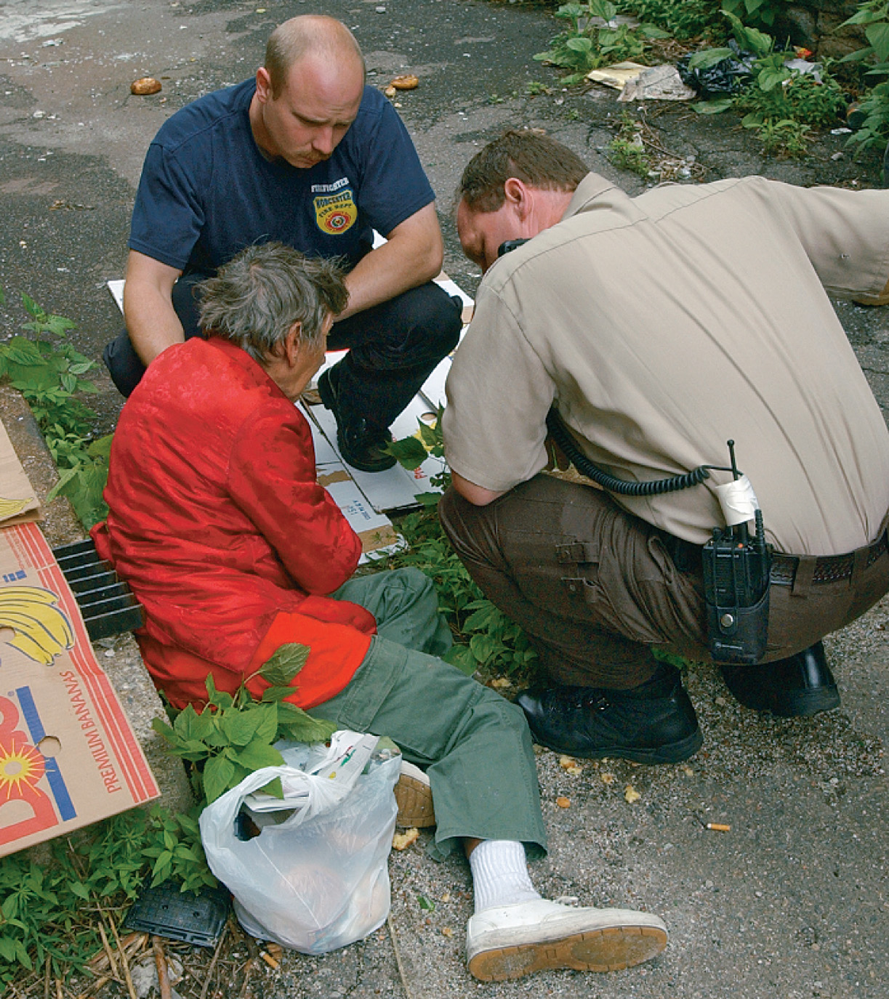
Patients Found in Unusual Environments or Circumstances Are Sometimes Difficult to Immediately Categorize as Medical or Trauma
(© Mark C. Ide)
Notes:
Look for clues to the patient's condition.

Slide 24
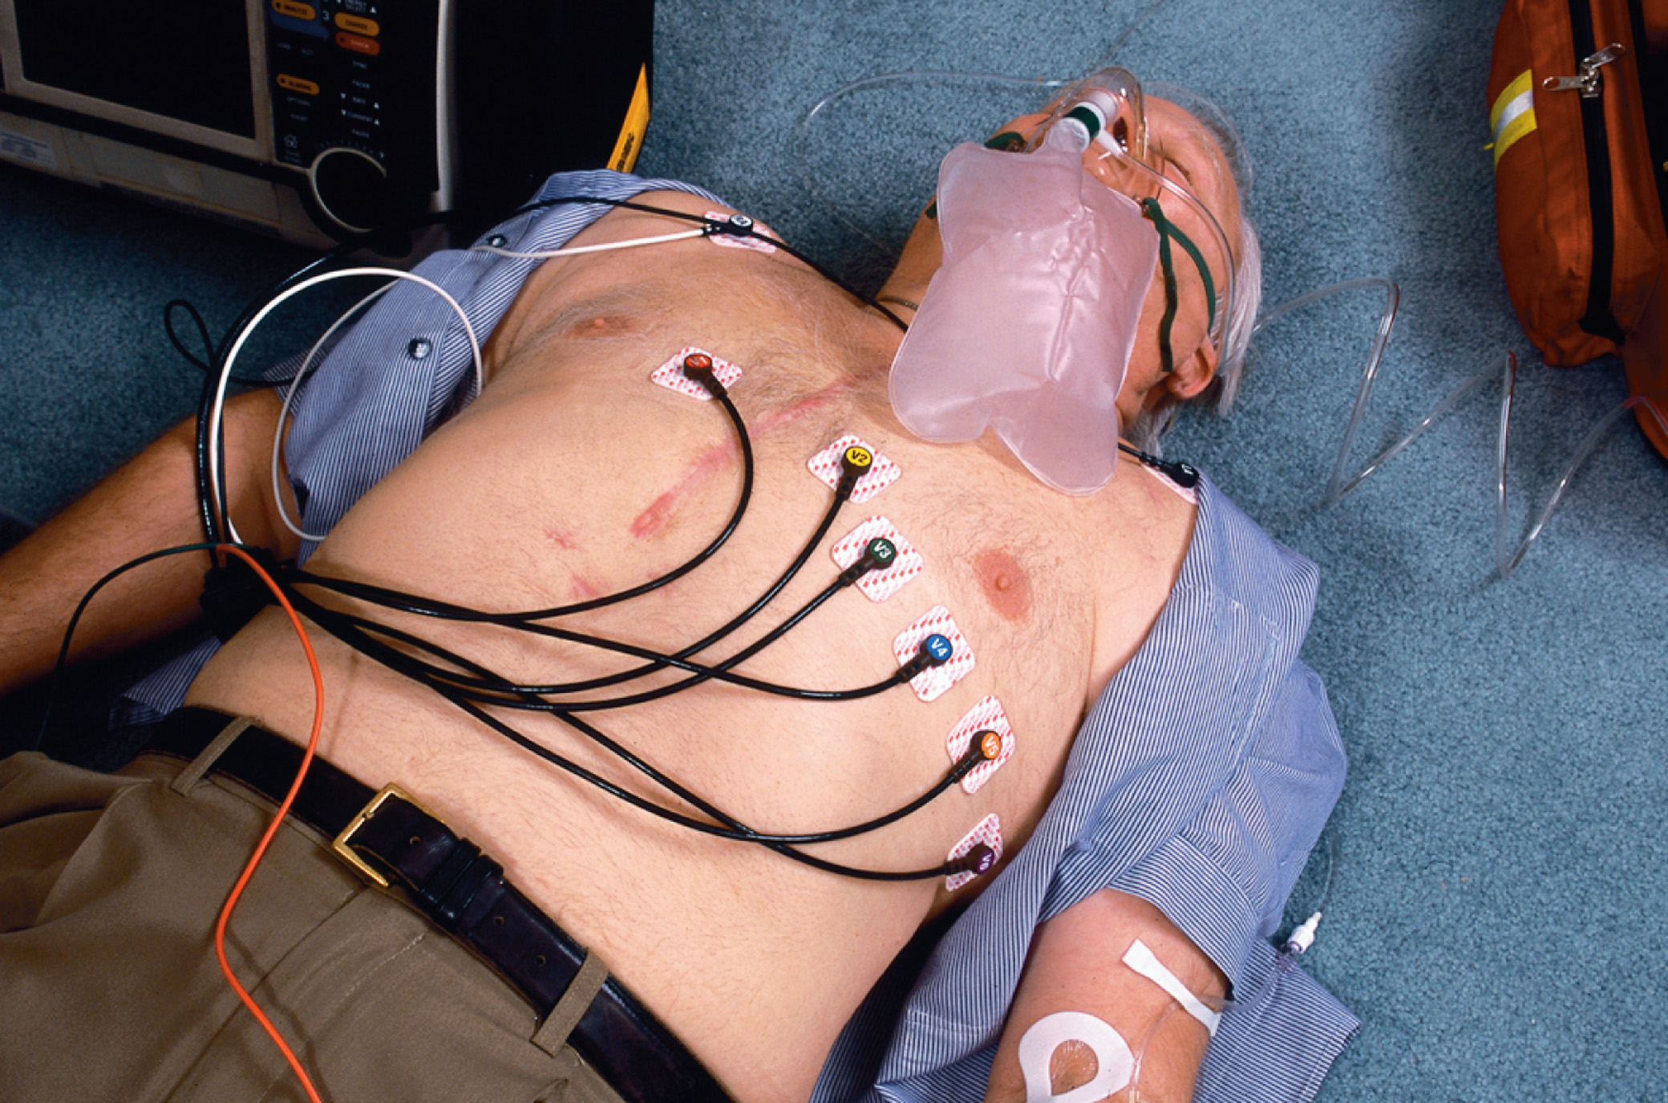
Be Alert for Clues to the Patient’s Condition or History Throughout the Assessment
When this patient’s chest was exposed for a 12-lead E C G, obvious scars from prior bypass surgery were visible.
Notes:
The general impression you form as you approach and make first contact with the patient is informed by the patient’s response to the question “Why did you call EMS today?” (i.e.,, the chief complaint) and items or conditions that you observe in the immediate environment.

Slide 25
Form a General Impression of the Patient (3 of 8)
Determine Whether the Patient Is Injured or Ill
  Injured
    Penetrating trauma is a force that pierces the skin and body tissues.
    Blunt trauma is caused by a force that impacts the body but doesn’t penetrate it.
  The environment may offer clues that the patient is suffering from a medical problem.
Notes:
In some patients, it is difficult to immediately determine whether they are a medical or trauma patient or both. Your general impression and categorization of the patient may change as you collect more information from the scene and the patient.

Slide 26
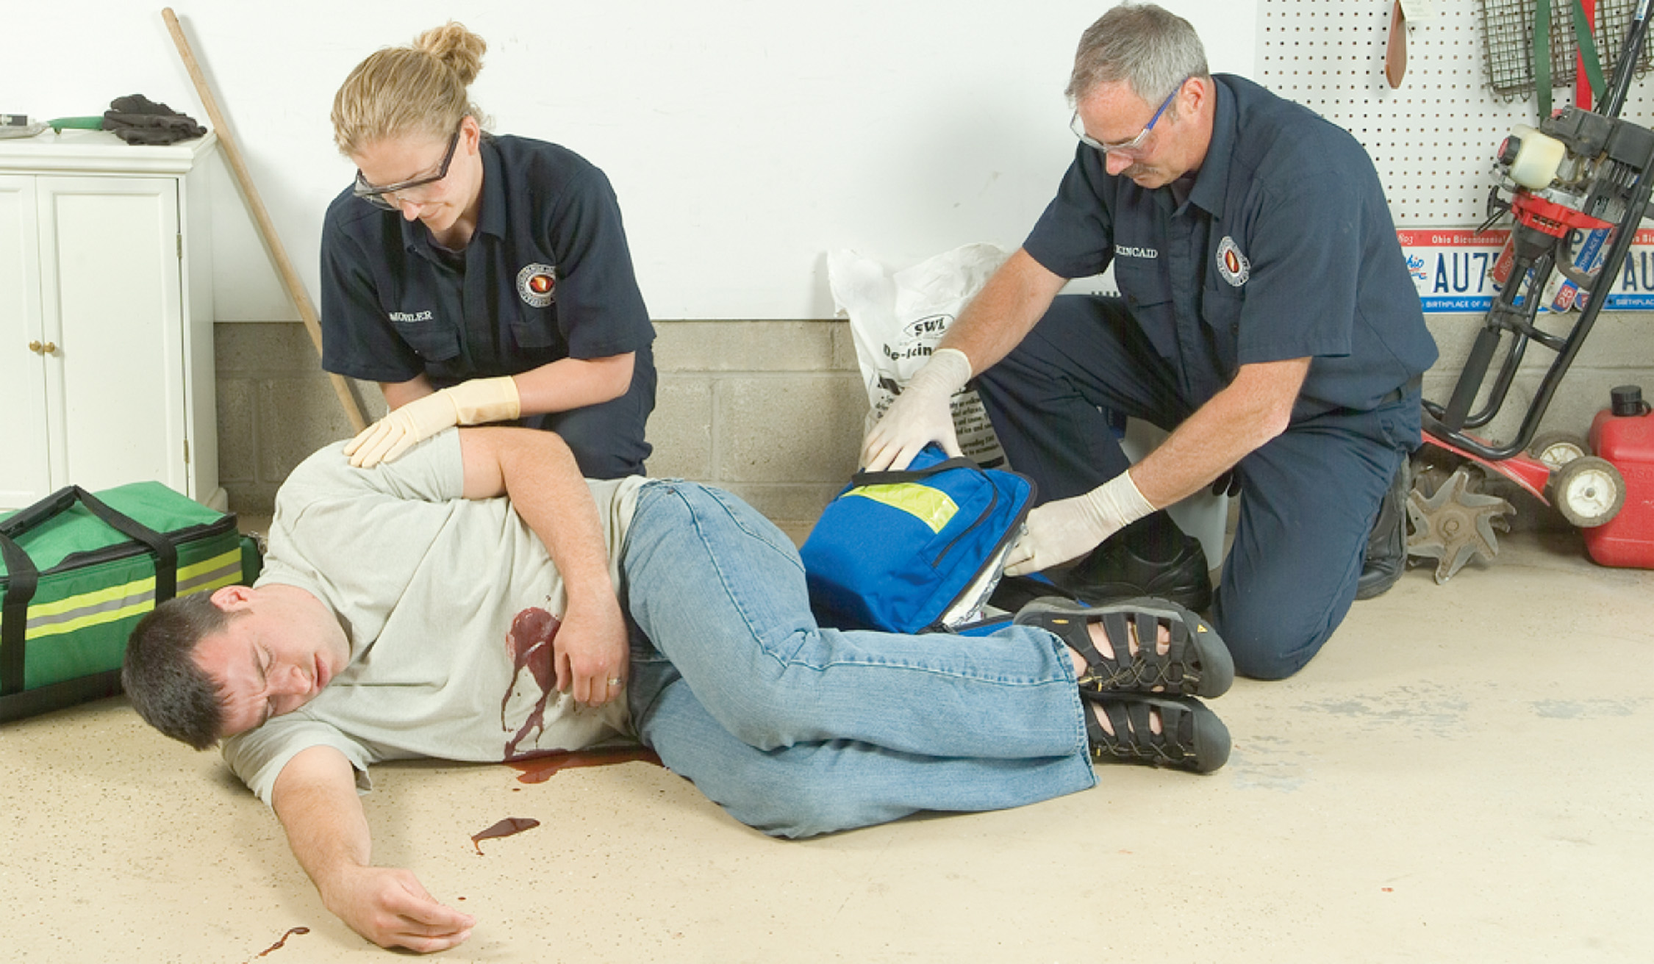
As You Form Your General Impression, Categorize the Patient as Being Injured—a Trauma Patient or Ill—a Medical Patient (1 of 2)
Notes:
Determine if the patient is ill or injured.

Slide 27
As You Form Your General Impression, Categorize the Patient as Being Injured—a Trauma Patient or Ill—a Medical Patient (2 of 2)
Notes:
A patient in bed in pajamas at 2:00 in the afternoon may have been sick all day.

Slide 28
Form a General Impression of the Patient (4 of 8)
Obtain the Chief Complaint
  The chief complaint is the reason why E M S was called.
  Don’t assume that the original complaint is the true chief complaint.
  Trauma patients may have an observable chief complaint.
  It is important to obtain the chief complaint from a medical patient.
Notes:
The chief complaint is the patient’s answer to the question “Why did you call EMS today?” If the patient is unable to answer, the chief complaint may be the response of the family member or bystander who placed the emergency call. If no one can provide an answer, the chief complaint may be what you infer from observation.

Slide 29
Table 13-2 Immediate Life Threats That May Be Obvious During the General Impression
The following are life threats that require immediate management if found during formation of the general impression:
An airway that is compromised by blood, vomitus, secretions, the tongue, bone, teeth, or other substances or objects
Obvious open wounds to the chest
Paradoxical movement of a segment of the chest (inward movement on inhalation and outward movement on exhalation)
Major bleeding (steady flow or spurting)
Unresponsive with no breathing or no normal breathing (agonal or gasping breaths)
Notes:
If you identify an obvious life-threatening condition during the general impression phase as you begin to assess the patient, you must immediately treat it.

Slide 30
Form a General Impression of the Patient (5 of 8)
Identify Immediate Life Threats During the General Impression
  Cardiac arrest must be recognized immediately.
    Begin immediate chest compressions.
    Open the airway and provide ventilation.
    Apply an A E D.
Notes:
When you encounter an unresponsive patient with no ventilations (not breathing) or with only agonal respirations and no pulse, the patient is in cardiac arrest. The American Heart Association guidelines of 2015 emphasize the need to quickly recognize cardiac arrest and initiate CPR, beginning with chest compressions. The intervention sequence in the cardiac arrest patient is compressions, airway, breathing (CAB), rather than the airway, breathing, circulation (ABC).

Slide 31
Form a General Impression of the Patient (6 of 8)
Perform Spine Motion Restriction
  If you suspect a spinal injury, establish manual in-line stabilization.
  In-line stabilization:
    Place one hand on each side of the patient’s head.
    Bring the head into an in-line position.
    Place the head in a neutral position.
Notes:
Teaching Tips
Emphasize the importance of establishing stabilization of the cervical spine in patients who may have spine trauma.
Demonstrate in-line manual stabilization of the cervical spine.

Slide 32
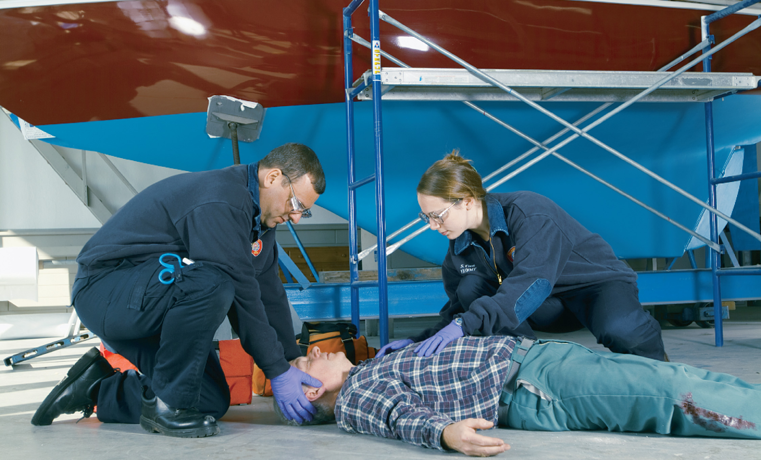
Establish Manual In-Line Stabilization If Spinal Injury Is Suspected
Notes:
After self-restriction or manual motion restriction of the cervical spine is established, spine motion restriction must be maintained – even after a cervical collar is applied – until an injury is ruled out by further assessment or until spine motion restriction is completed and the patient is secured for transport.

Slide 33
Form a General Impression of the Patient (7 of 8)
Perform Spine Motion Restriction
  Self-restriction procedure is as follows:
    Instruct the patient to bring his head and neck in line with his umbilicus.
    Instruct him to keep his toes in line with his nose and navel.
    Instruct the patient not to move his head or neck until given further instruction.
Notes:
It is possible to have a stable injury of the vertebrae in which the spinal cord has not been damaged. If proper spine motion restriction is not performed, however, the vertebral injury may become unstable when the patient moves or is moved.

Slide 34
Form a General Impression of the Patient (8 of 8)
Position the Patient for Assessment
  If necessary, logroll the patient after quickly checking the posterior body.
  Use in-line stabilization if spinal injury is possible.
Notes:
It is not possible to properly assess the airway and breathing with the patient prone. Prior to logrolling the patient, quickly assess the posterior thorax and lumbar regions, the vertebral column, buttocks, and posterior aspects of the lower extremities by inspecting and palpating for any major bleeding, deformities, open wounds, bruises, burns, tenderness, or swelling. If an open wound to the posterior thorax is present, quickly occlude the wound with a nonporous or occlusive dressing taped on three sides prior to logrolling the patient into a supine position.

Slide 35
E M T Skills 13-1
Logrolling from a Prone to a Supine Position When Spinal Injury Is Suspected

Slide 36
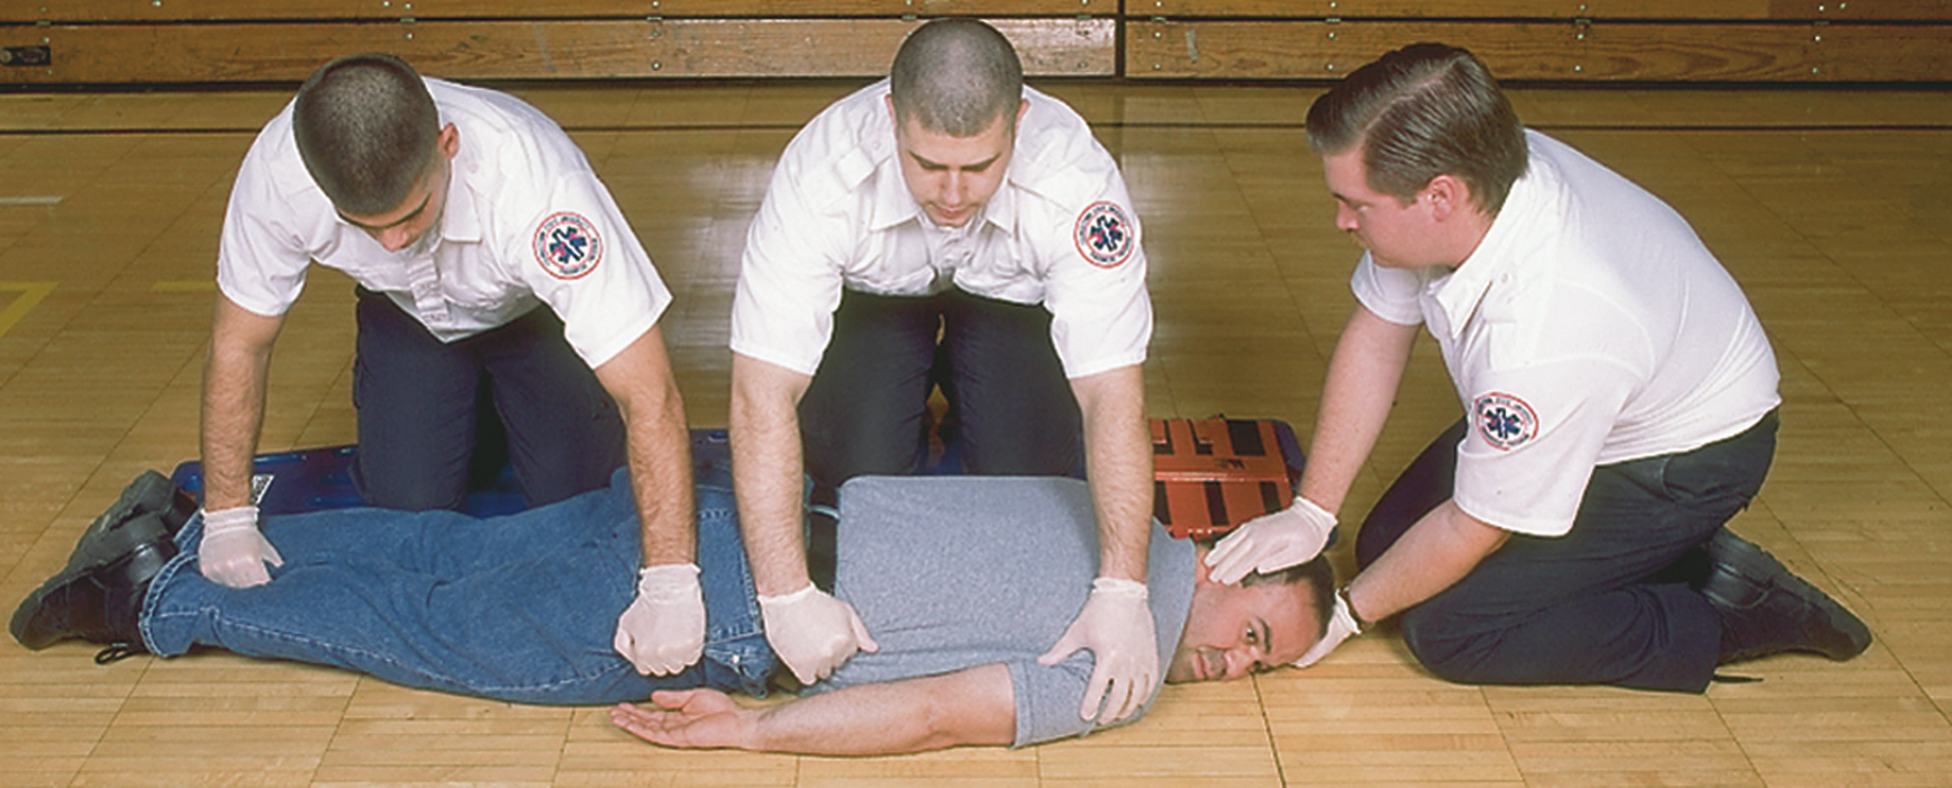
A Rescuer at the Patient’s Head Establishes and Maintains Manual In-Line Spinal Stabilization
A backboard is placed alongside the patient, and two other rescuers kneel on it. One grasps the patient’s shoulder and hip; the other grasps the patient’s thigh and ankle.
Notes:
If you find the patient prone (face down), it is necessary to quickly logroll him into a supine position (face up).

Slide 37
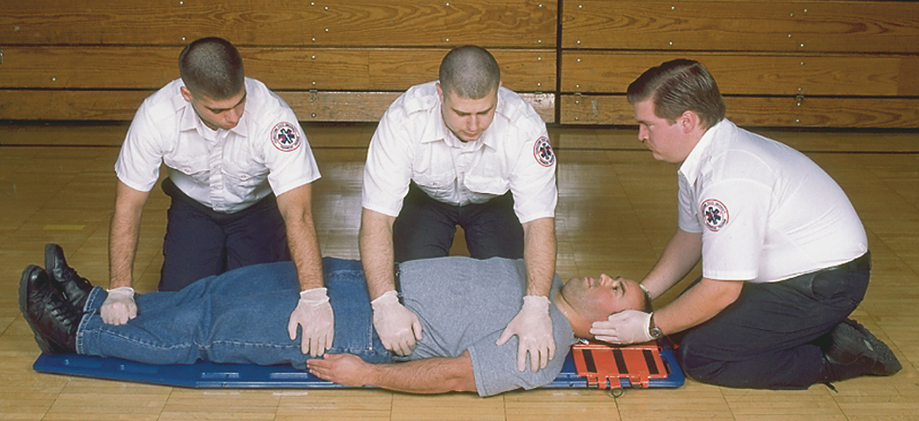
On the Command of the Rescuer at the Head, the Patient Is Rolled up Against the Thighs of the Kneeling Rescuers
The rescuer who is grasping the patient’s thigh and ankle makes sure that the legs are slightly raised off the floor to keep them aligned with the spine as the patient is turned.
Notes:
If spinal injury is possible, provide spine motion restriction before logrolling.

Slide 38
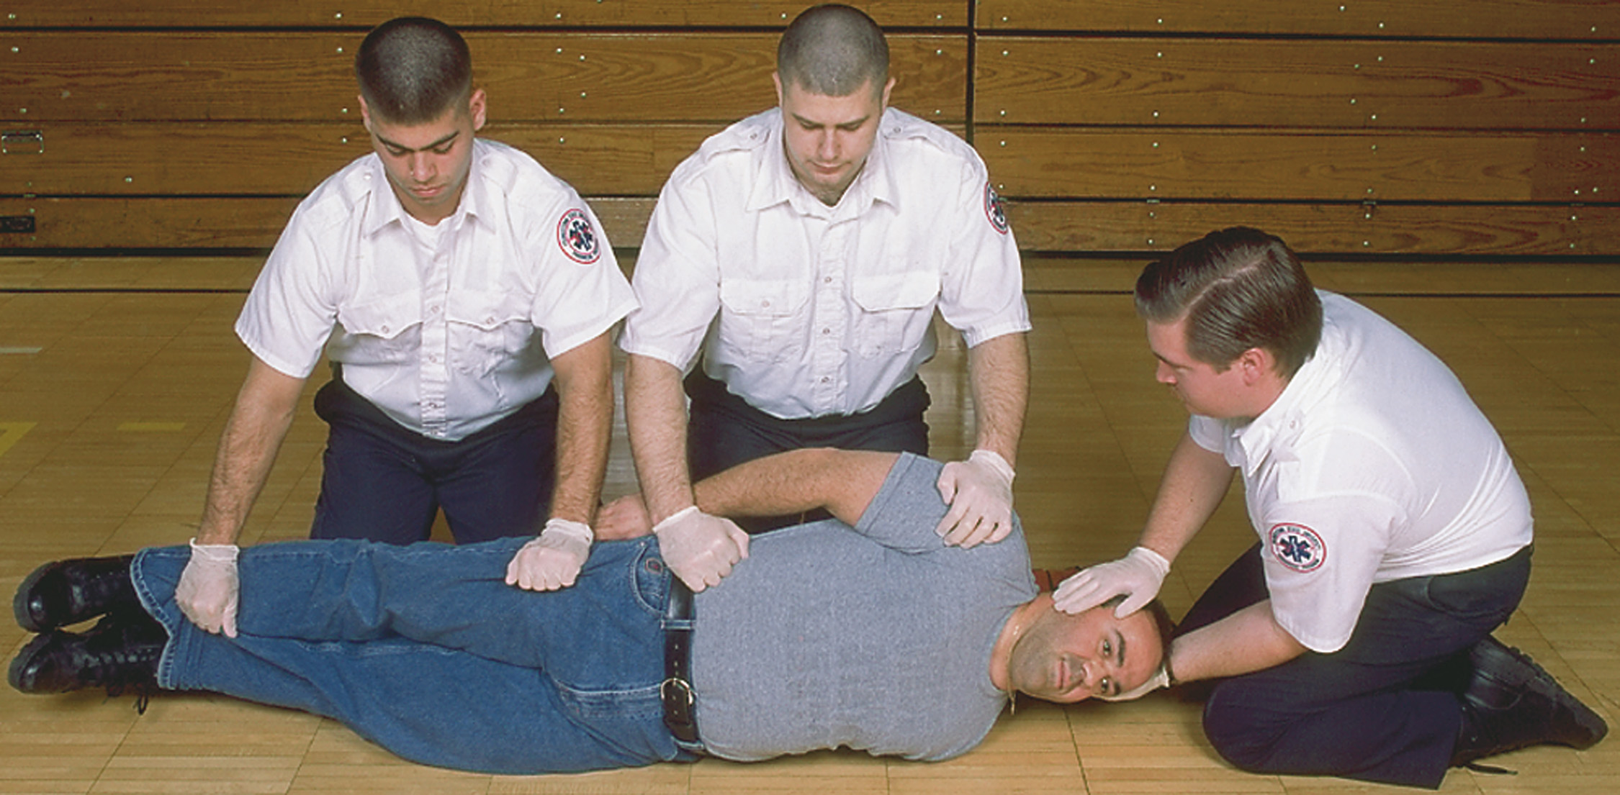
The Patient Is Then Rolled into the Supine Position on the Backboard. The Rescuer at the Head Maintains In-Line Spinal Stabilization at the Head
Notes:
If an open wound to the posterior thorax is present, quickly occlude the wound with a nonporous or occlusive dressing taped on three sides prior to logrolling the patient.

Slide 39
Case Study (2 of 8)
“What happened?” asks Della as they quickly walk around the side of the house.
“My brother was on a ladder, cleaning out the gutters, “the patient’s sister replies.” I had my back turned and I heard him hit the ground. He landed just like you see him.”
Notes:
Case Study Discussion
Review the Case Study findings presented.

Slide 40
Case Study (3 of 8)
Della notes that the house is a single story, and it looks like the patient fell about six feet from his position on the ladder, landing in a grassy area.
The patient is lying prone on the ground and is not moving. Kerry pulls on his gloves and asks, “What is his name?”
Notes:
Case Study Discussion
Review the case study findings presented.

Slide 41
Case Study (4 of 8)
“Bob,” the woman replies the woman.
Kerry places his hand on Bob’s shoulder. “Bob. Can you hear me?” Bob does not respond to Kerry’s voice or to Kerry squeezing his trapezius muscle.
“No response to pain,” Kerry tells Della. “I will stabilize his head and neck. Let’s logroll him.”
Notes:
Case Study Discussion
Review the case study findings presented.

Slide 42
Case Study (5 of 8)
What are some particular concerns with this patient so far?
What should Della and Kerry do next?
What equipment should the E M T s be prepared to use at this point?
Notes:
Case Study Discussion
Use the Case Study content and questions to foreshadow the upcoming lesson content. Gauge the student’s responses as a guide of how well versed they are in this topic.

Slide 43
Assess Level of Consciousness (Mental Status)
Assess the Level of Responsiveness
  Quickly assess the level of responsiveness using the A V P U mnemonic.
  Alertness and Orientation
    If the patient’s eyes are open and he can speak as you approach him, you might assume that the patient is alert.
    A patient can be alert but agitated, confused, or disoriented.
Notes:
The AVPU mnemonic stands for alert, responds to verbal stimulus, responds to painful stimulus, unresponsive.
Discussion Questions
What are acceptable ways of determining a patient's response to painful stimuli?
What are the differences between decorticate and decerebrate posturing?
What are the concerns for patients who have altered mental status?
Class Activity
Have students use one of the methods described to apply painful stimuli to themselves to increase their awareness of what they will be subjecting patients to.
Knowledge Application
Give several descriptions of patients and ask students to determine the level of consciousness for each patient.
Critical Thinking Discussion
What is the importance of determining the patient's mental status early in the assessment process?

Slide 44
Table 13-3 A V P U: Mnemonic for Assessment of Mental Status
A: Alert
V: Responds to Verbal Stimulus
P: Responds to Painful Stimulus
U: Unresponsive
Notes:
If the patient is not alert, proceed to check his response to verbal stimuli.

Slide 45
Assess Level of Consciousness (1 of 6)
Assess the Level of Responsiveness
  Responsiveness to Verbal Stimuli
    Patient opens his eyes and responds or attempts to respond to your voice.
    If the patient does not speak, see if he will follow a command.
  Responsiveness to a Painful Stimulus
    If the patient doesn’t respond to verbal stimuli, try a painful stimulus.
Notes:
If the patient obeys the commands, you can assume he has a higher level of responsiveness than the patient who stares off, talks inappropriately, mumbles incomprehensibly, or does nothing at all.
If there is no response when you speak to the patient, you should try a painful stimulus. Painful stimulus is just that: applying pain to the patient to determine whether and how he responds. Painful stimuli can be applied either centrally or peripherally.

Slide 46
Assess Level of Consciousness (2 of 6)
  Assess the Level of Responsiveness
  Responsiveness to Painful Stimulus
    Methods of applying painful stimuli include:
      Trapezius or armpit pinch
      Supraorbital pressure
      Sternal rub or earlobe pinch
      Nail-bed pressure
      Pinch the webbing between the thumb and index finger
Notes:
To determine whether the patient is responding to the painful stimulus, watch his face and his body. Look for a facial grimace or any other body movement.

Slide 47
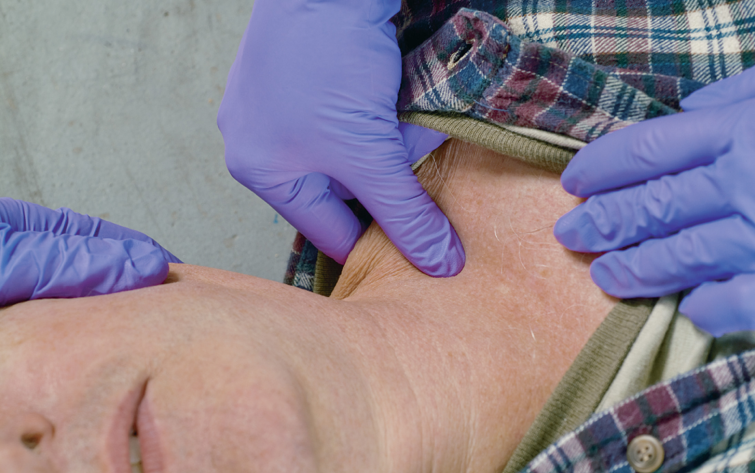
Methods of Applying Painful Stimuli Include a Trapezius Pinch
Notes:
Pinch the trapezius muscle that extends from along the base of the neck to the shoulder. Grasp 1 to 2 inches of the trapezius muscle and squeeze the muscle. Be sure that you have the muscle and not just the skin.

Slide 48
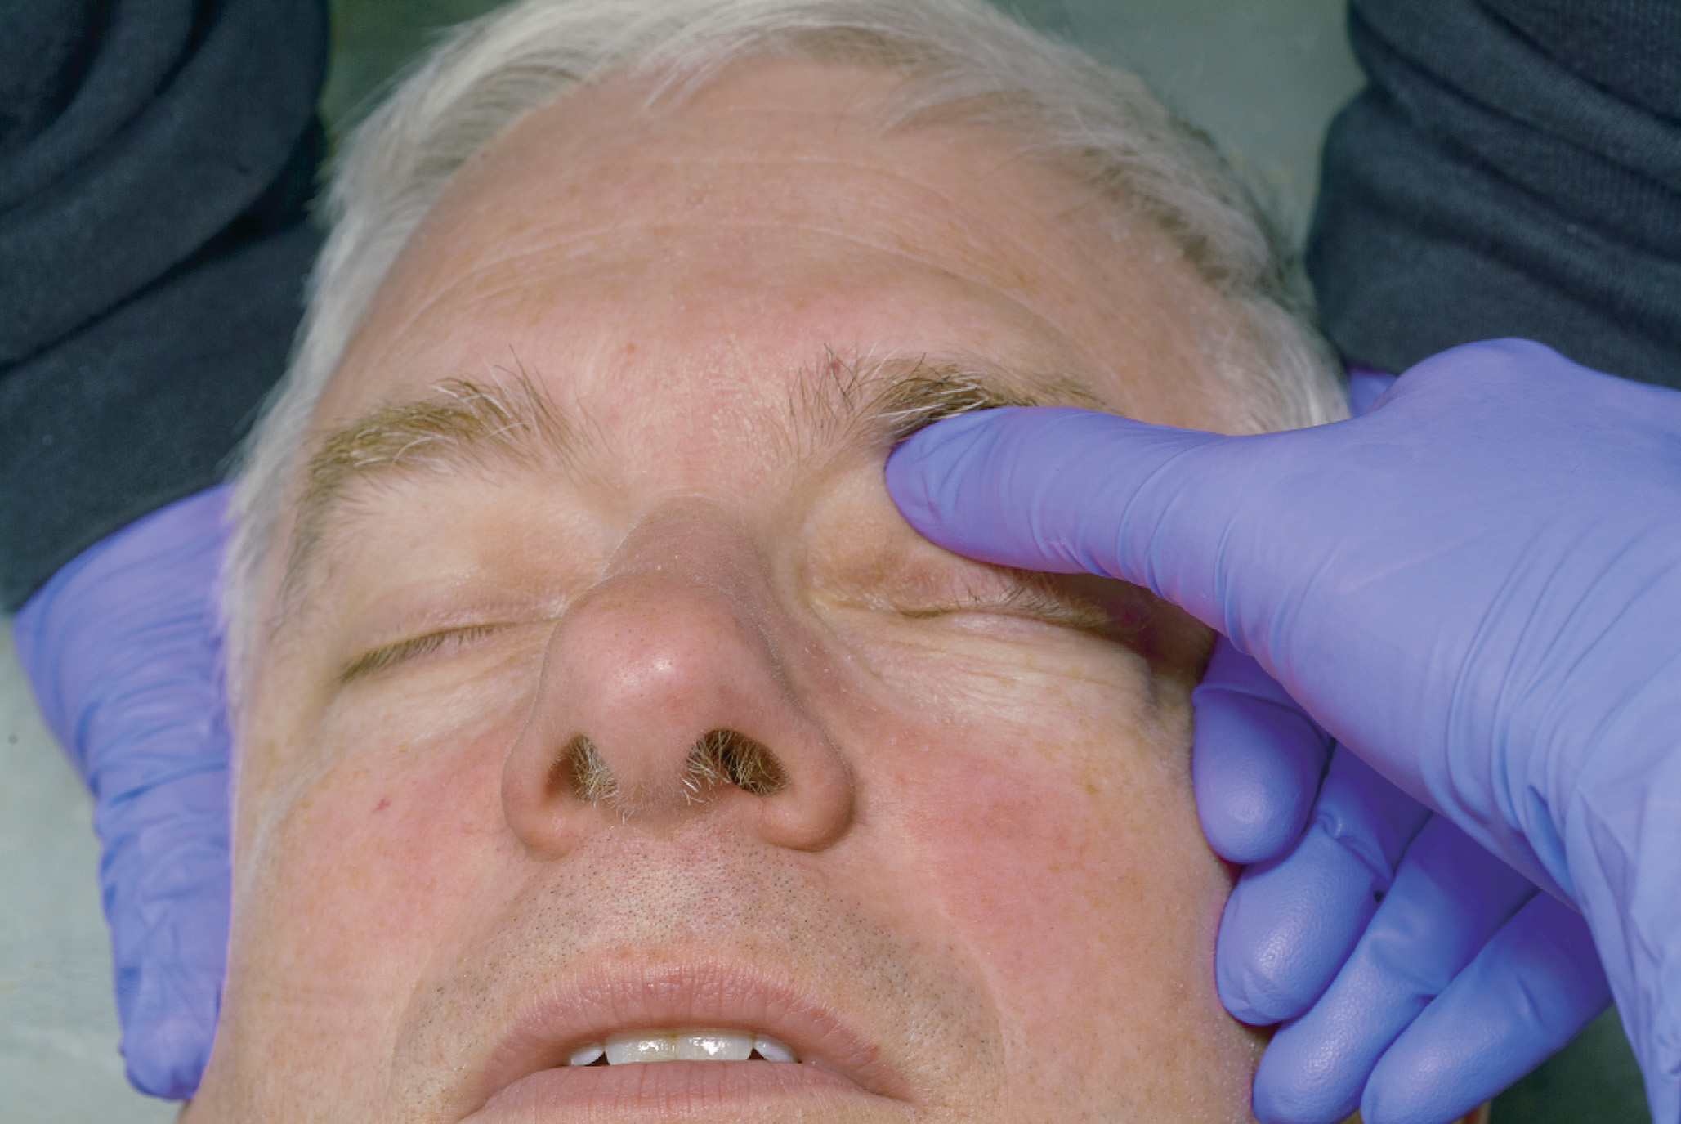
Methods of Applying Painful Stimuli Include Supraorbital Pressure
Notes:
Slide your finger under the upper ridge of the eye socket and apply upward pressure. Be careful not to damage the eyelid or globe during this procedure.

Slide 49
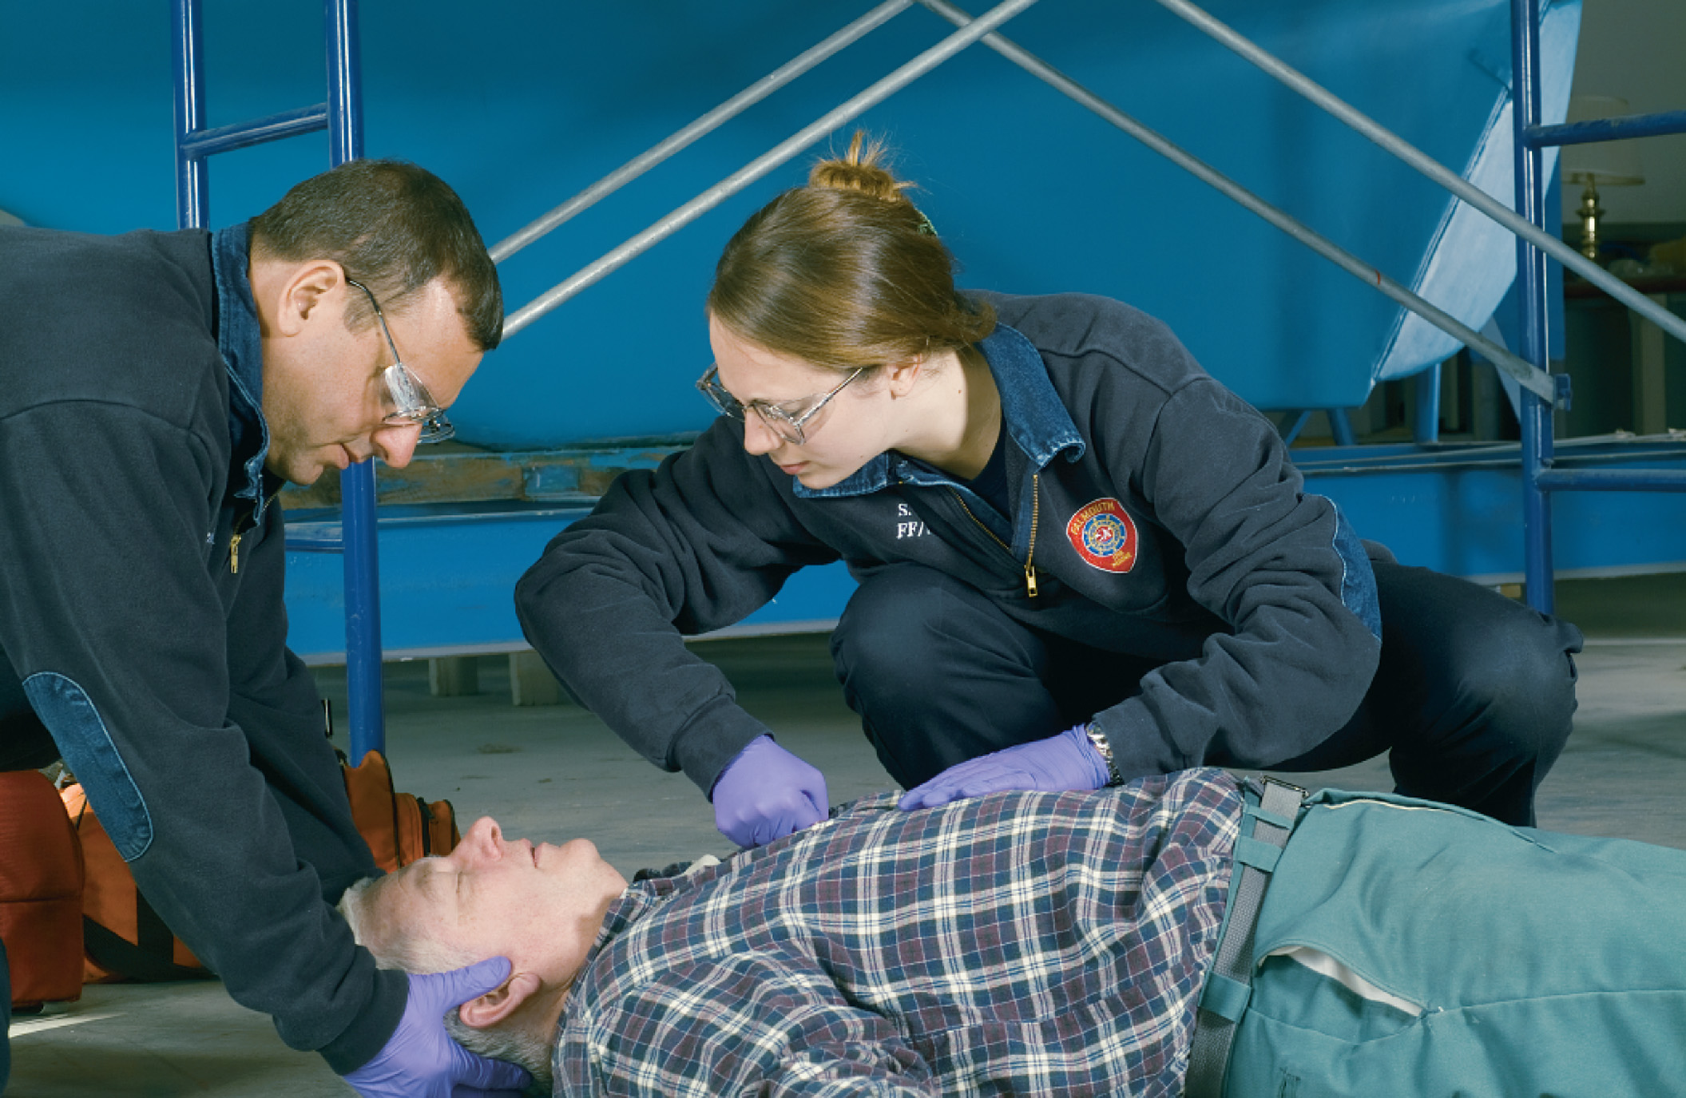
Methods of Applying Painful Stimuli Include a Sternal Rub
Notes:
Apply hard downward pressure to the center of the sternum with the knuckles of your hand.

Slide 50
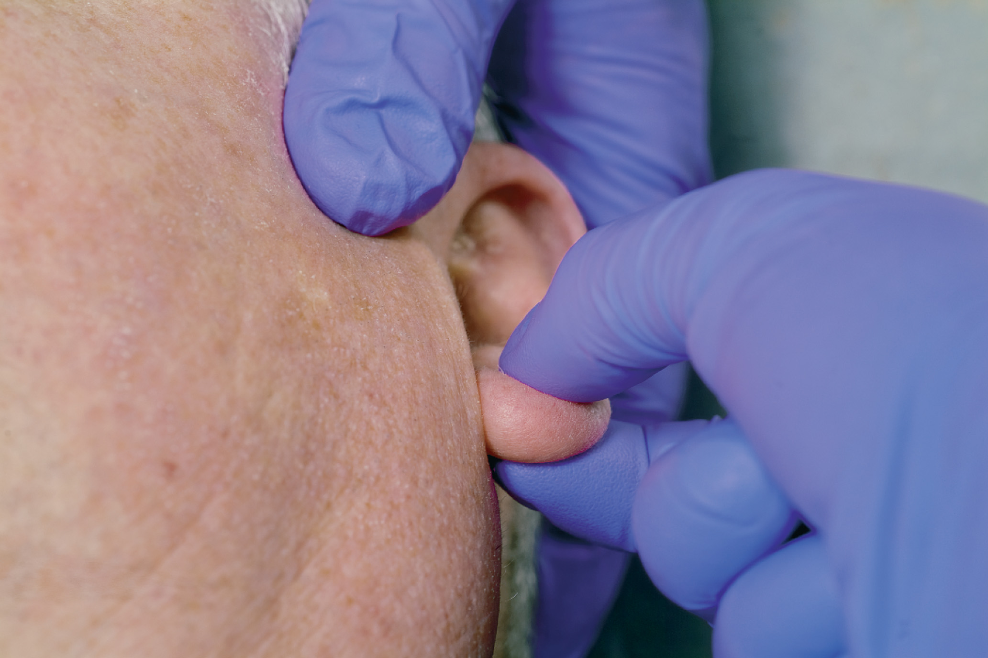
Methods of Applying Painful Stimuli Include an Earlobe Pinch
Notes:
Pinch the soft tissue portion of the earlobe.

Slide 51
Assess Level of Consciousness (3 of 6)
Assess the Level of Responsiveness
  Responsiveness to a Painful Stimulus
    Response to a painful stimulus is typically purposeful or nonpurposeful.
    Movement toward the painful stimulus, as if to push it away, is purposeful.
    Movement away from the stimulus would be withdrawing from pain.
    Flexion or extension posturing are abnormal responses.
Notes:
In flexion posturing, also known as decorticate posturing, the patient arches the back and flexes the arms inward toward the chest. In extension posturing, also known as decerebrate posturing, the patient arches the back and extends the arms straight out parallel to the body. Both are signs of serious head injury.

Slide 52
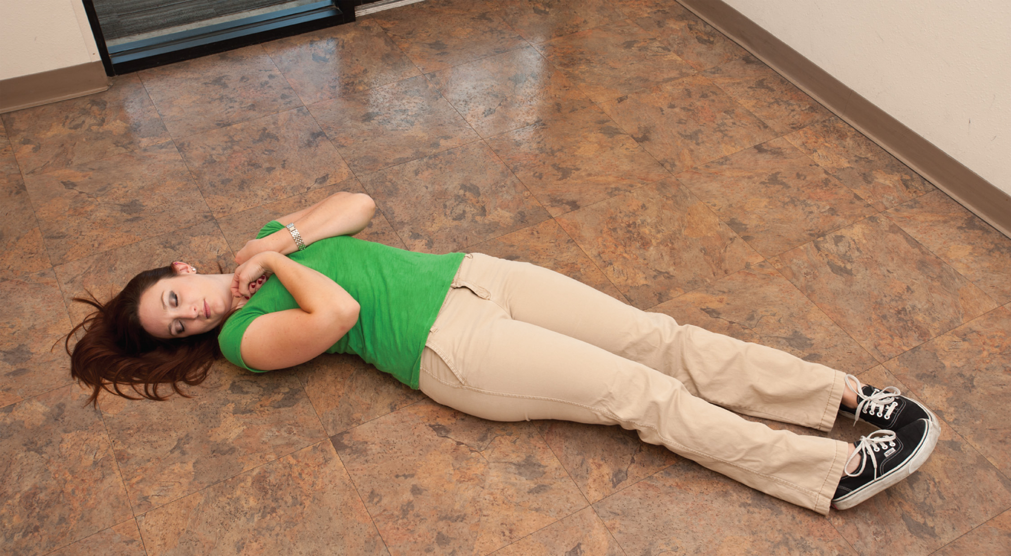
Nonpurposeful Movements: Flexion (Decorticate) Posturing
Notes:
Flexion (decorticate 8) posturing is associated with compression of the brain at the upper portion of the brain stem.

Slide 53
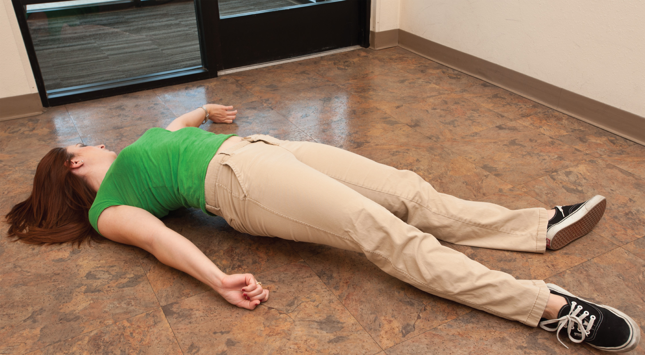
Nonpurposeful Movements: Extension (Decerebrate) Posturing
Notes:
Extension (decerebrate) posturing is produced when the lower portion of the brain stem is compressed.

Slide 54
Assess Level of Consciousness (4 of 6)
Assess the Level of Responsiveness
  Responsiveness to a Painful Stimulus
    Problems with some types of painful stimuli.
      Always assess a central painful stimulus.
      Peripheral stimuli may reach the spinal cord but not the brain.
Notes:
The spinal cord may turn the impulse immediately around and send an impulse back to the muscle to move. The impulse never goes to the brain, so it is not the brain telling the muscle to move but the spinal cord just turning the impulse around and sending it back out again.

Slide 55
Assess Level of Consciousness (5 of 6)
    Assess the Level of Responsiveness
    Unresponsiveness
      A patient who does not respond to verbal or painful stimuli is unresponsive.
      Unresponsive patients are a high priority for emergency care and transport.
      Unresponsiveness to verbal or painful stimuli can indicate the patient’s inability to maintain his airway.
Notes:
The patient who is not alert but responds to either verbal or painful stimuli is considered to have an altered mental status. This patient is not completely unresponsive, but, like the unresponsive patient, may be prone to airway compromise.

Slide 56
Assess Level of Consciousness (6 of 6)
  Assess the Level of Responsiveness
  Document the Level of Responsiveness
    Be specific in documenting level of responsiveness to establish a baseline for later comparison.
    The A V P U check is performed to quickly establish a baseline for mental status.
Notes:
Assessment of the patient’s mental status should take you no longer than a few seconds to accomplish. Do not waste time performing an extensive neurologic exam during the primary assessment.

Slide 57
Assess the Airway (1 of 7)
Determine Airway Status
  An occluded airway is an immediate threat to life.
  A patient who is alert and talking without signs of distress has a patent airway.
Notes:
The mental status check is a helpful tool for simultaneously gathering information about airway status.

Slide 58
Assess the Airway (2 of 7)
  Determine Airway Status
  In the Responsive Patient
    Indications of airway compromise include:
      Stridor
      Difficulty speaking
      Gasping
      Not speaking
Notes:
If the patient is alert and talking without difficulty, or if the infant or child is crying, you can assume the airway is patent and move on to the assessment of breathing.
Points to Emphasize
An obstructed airway is an immediately life-threatening problem.
In many patients, determining the level of consciousness and determining the status of the airway proceed simultaneously. The patient who is alert and speaking to you without difficulty has an open airway.
Patients can be alert but still have a partially obstructed airway. Signs of this include stridor, difficulty speaking, gasping, or inability to speak.

Slide 59
Assess the Airway (3 of 7)
  Determine Airway Status
  In the Unresponsive or Severely Altered Mental Status Patient
    There is a high risk of airway compromise.
    You must take action to open or maintain the airway.
Notes:
In patients with severely impaired level of consciousness, a number of methods to open the airway will be used as needed, including manual maneuvers, suction, airway adjuncts, and methods for opening the airway or relieving a foreign body that is obstructing the airway.

Slide 60
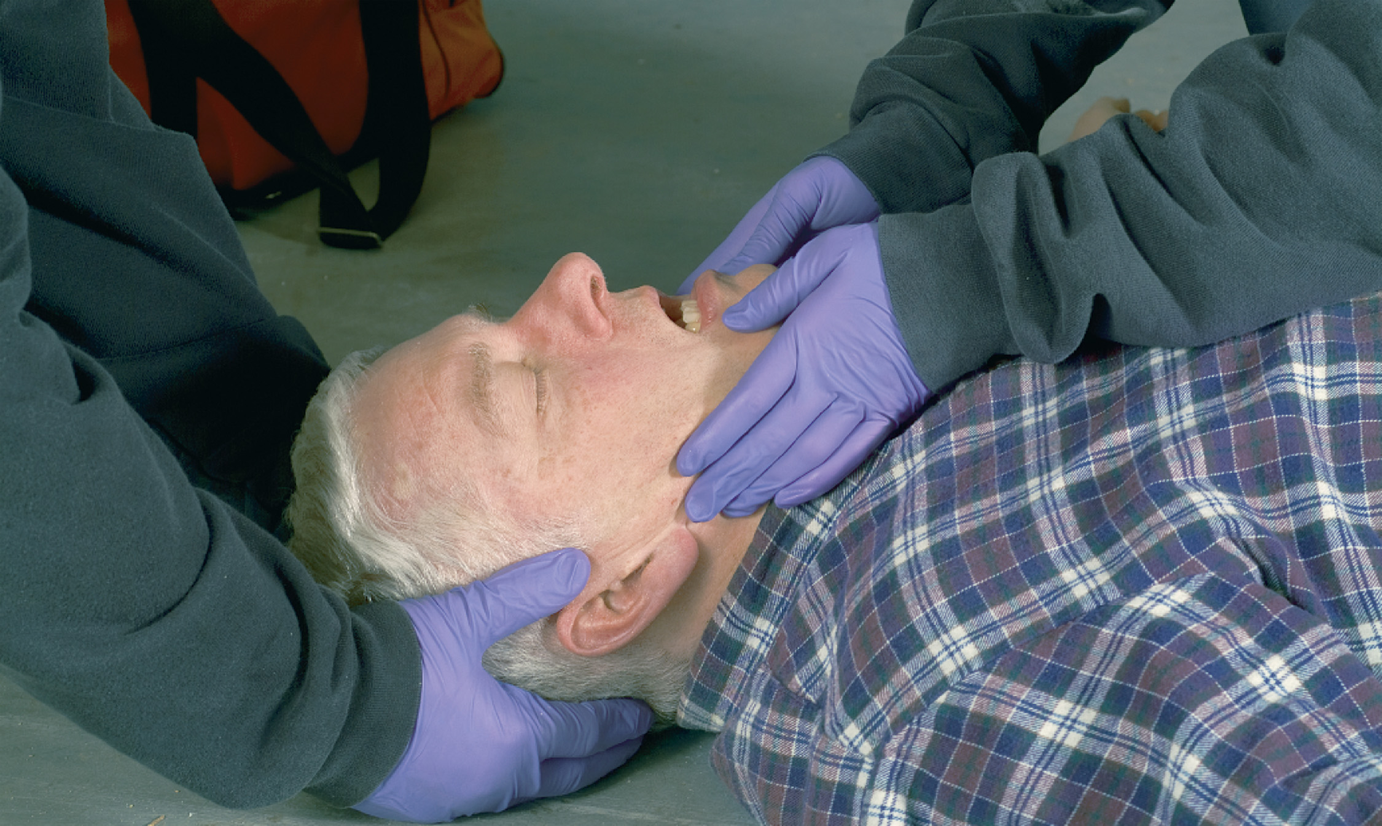
Assess the Airway. To Open the Airway of a Trauma Patient, Use the Jaw-Thrust Maneuver
For a medical patient, use the head-tilt, chin-lift maneuver.
Notes:
Muscle relaxation allows the tongue and epiglottis to fall back and partially block the lower part of the pharynx and the opening to the trachea.

Slide 61
Assess the Airway (4 of 7)
Open the Airway
  Techniques include:
    Manual airway maneuvers
    Suction or finger sweeps
    Airway adjuncts
    Abdominal thrusts
    Positioning
Notes:
If the patient is not talking or responding normally, has a severely altered mental status, or is unresponsive, assume that the airway is or may become closed.
Manual airway maneuvers to prevent the tongue and epiglottis from blocking the airway: consist of the head-tilt, the chin-lift maneuver, and the jaw-thrust maneuver.
Suction and/or finger sweeps are used to remove blood, vomitus, food, secretions, or foreign objects.
Airway adjuncts: Use the oropharyngeal airway or the nasopharyngeal airway to maintain a patent airway.
Manual thrusts to the abdomen (for infants, a combination of chest thrusts and back blows to force bursts of air from the lungs) are used to relieve a blockage of the airway by a foreign body.
Position the medical patient who has no suspected spinal injury in a modified lateral position to allow secretions, blood, or vomitus to flow out of the mouth instead of into the airway.

Slide 62
Assess the Airway (5 of 7)
  Open the Airway
  Indications of Partial Airway Occlusion
    Snoring - indicates blockage of the airway by the tongue.
      Manual maneuvers
      Airway adjuncts
        Oropharyngeal airway
        Nasopharyngeal airway
Notes:
If a snoring (sonorous) sound is heard, it is an indication that the tongue and likely the epiglottis are partially blocking the airway. Use the head-tilt, chin-lift maneuver (if there is no suspicion of spinal injury) or the jaw-thrust maneuver (if spinal injury is possible) to relieve any obstruction of the airway by the tongue.
If the patient gags when you insert an oropharyngeal airway, remove it immediately, be prepared to suction, and consider insertion of a nasopharyngeal airway.

Slide 63
Table 13-4 Sounds That May Indicate Partial Airway Obstruction
Snoring (sonorous)—A rough, snoring-type sound on inspiration and/or exhalation
Gurgling—A sound similar to air rushing through water on inspiration and/or exhalation
Crowing—A sound like a cawing crow on inspiration
Stridor—Harsh, high-pitched sound on inspiration
Notes:
When you approach the patient, you may hear abnormal sounds from the upper airway. These sounds are an indication that the airway may be partially blocked.

Slide 64
Assess the Airway (6 of 7)
Open the Airway
  Indications of Partial Airway Occlusion
    Gurgling - indicates liquid in the airway which needs cleared to prevent aspiration.
      Suction
      Position the patient
Notes:
Immediately open the mouth and suction out the contents. If the contents are too thick to be suctioned, turn the patient on his side and sweep the mouth out with your fingers, a tongue blade, or the suction catheter itself.

Slide 65
Assess the Airway (7 of 7)
  Open the Airway
  Indications of Partial Airway Occlusion
    Crowing and stridor
      High-pitched inspiratory sounds indicate swelling or muscle spasm of the airway.
      Manual maneuvers will not relieve the obstruction.
      Do not insert anything into the airway of a pediatric patient with crowing or stridor.
Notes:
Inserting anything such as an airway adjunct, suction tip, tongue blade, or fingers into the mouth or throat of a pediatric patient with a suspected upper airway infection can cause extremely dangerous spasms and a complete airway obstruction.

Slide 66
Assess Breathing (1 of 5)
After opening the airway, assess to:
  Determine whether breathing is adequate or inadequate.
  Determine the need for early oxygen therapy for adequate breathing.
  Provide positive pressure ventilation with supplemental oxygen for inadequate breathing.
Notes:
Points to Emphasize
The techniques for assessing breathing are looking, listening, and feeling.
Check the rate and quality of breathing. Both must be adequate for the patient to have adequate breathing.
Look for signs that the work of breathing has increased, such as use of accessory muscles.
Teaching Tips
Much of this section is review for students. Ask questions to determine students' comprehension and retention of the material to guide your approach to the material.
Discussion Question
What are signs of inadequate oxygenation?

Slide 67
Table 13-5 Inadequate Breathing Versus Adequate Breathing
Inadequate Breathing | Adequate Breathing
Inadequate rate or inadequate tidal volume = inadequate breathing | Adequate rate and adequate tidal volume = adequate breathing
Notes:
The assessment of breathing is done only after securing an open airway; therefore, this step must always follow opening the airway.

Slide 68
Assess Breathing (2 of 5)
Assess Rate and Quality of Breathing
  Look for the following:
    Inadequate tidal volume
    Abnormal respiratory rate
    Bradypnea
    Tachypnea.
Notes:
Poor movement (rise) of the chest wall indicates that an inadequate amount of air is being breathed in with each respiration, and is typically described as shallow respiration.
A respiratory rate that is too slow, called bradypnea, causes an inadequate minute volume.
A respiratory rate that is too fast, called tachypnea, may not always result in a better breathing status for the patient. When the rate becomes excessive, the lungs do not have enough time between breaths to fill adequately; therefore, the minute volume becomes inadequate.

Slide 69
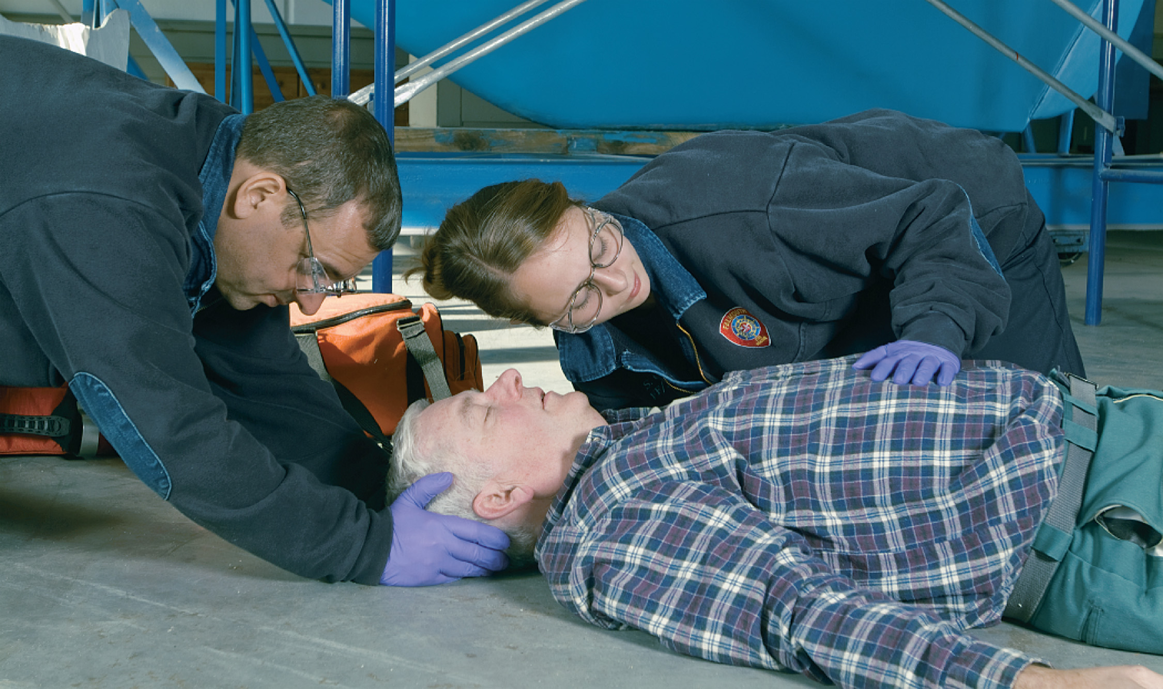
Assess Breathing. If Breathing Is Adequate, Administer Oxygen, If Indicated
If breathing is inadequate, begin positive pressure ventilation with supplemental oxygen.
Notes:
The best method to assess breathing is by looking, listening, and feeling.

Slide 70
Assess Breathing (3 of 5)
Assess Rate and Quality of Breathing
  Look.
    Retractions
    Use of accessory muscles or nasal flaring
    Tracheal tugging
    Pale, cool, clammy skin
    Cyanosis
    Pulse oximetry <94%
    Asymmetrical chest wall movement.
Notes:
Retractions—identified by a sunken-in appearance of tissues that are pulled inward on inhalation
Use of the neck muscles on inhalation
Nasal flaring—the nostrils flare out as the patient inhales
Excessive abdominal muscle use
Tracheal tugging—pendulum motions of the trachea in the anterior neck during inhalation
Pale, cool, clammy skin—a sign of poor perfusion to and oxygenation of the cells and tissues
Cyanosis—a bluish or blue-gray tone of the skin around the lips, nose, and fingernail beds, indicating inadequate oxygenation
A pulse oximeter (SpO₂) reading of less than 94%
Asymmetrical movement of the chest wall—The chest wall should move symmetrically (both sides moving together) and smoothly. Unequal movement—for example, one side moving up and outward as the other moves down and inward – is asymmetrical.
Knowledge Application
Describe the findings of breathing assessment for several patients. Ask students whether breathing is adequate or inadequate, and what interventions may be needed.
Discussion Questions
What are ways in which EMTs can provide positive pressure ventilation for patients with inadequate breathing?

Slide 71
Assess Breathing (4 of 5)
  Assess Rate and Quality of Breathing
  Listen and Feel
    Listen for air movement and feel for escape of warm humidified air.
  Absent or Inadequate Breathing
    Absence of breathing – no chest wall movement or sensation of air moving
    Inadequate breathing – insufficient rate, tidal volume, oxygenation or other signs of respiratory distress.
Notes:
If the patient is apneic (not breathing) or is breathing inadequately, you must immediately begin positive pressure ventilation with supplemental oxygen. Any delay in treatment could lead to brain death and cardiac arrest.

Slide 72
Assess Breathing (5 of 5)
  Assess Rate and Quality of Breathing
  Adequate Breathing
    If the chest is rising and falling adequately, you hear and feel good air exchange, the respiratory rate is adequate, and there is no evidence of serious respiratory distress, assume that the patient’s breathing is adequate.
Notes:
If the patient with adequate breathing is responsive, but is ill or injured, consider administering oxygen.

Slide 73
Assess Oxygenation
Look for:
  Hypoxia or hypoxemia
  Poor perfusion
  Heart failure
  Respiratory distress.
Notes:
The pulse oximeter should be applied early in the assessment process to determine the oxygenation status.

Slide 74
Click on the Item Below That Best Describes the Purpose of the Primary Assessment
A. Obtaining baseline vital signs
B. Finding all signs of injury or illness
C. Finding and treating immediate threats to life
D. Determining whether additional resources are needed to manage the scene

Slide 75
Table 13-6 Primary Assessment of Circulation
Assessment of circulation during the primary assessment should occur in this sequence:
Assess for presence or absence of pulse.
Assess for possible major bleeding.
Assess skin color, temperature, and condition.
Assess capillary refill.
Notes:
The main purposes for checking circulation are to determine whether the heart is beating, whether there is any severe bleeding, and whether blood is circulating adequately.

Slide 76
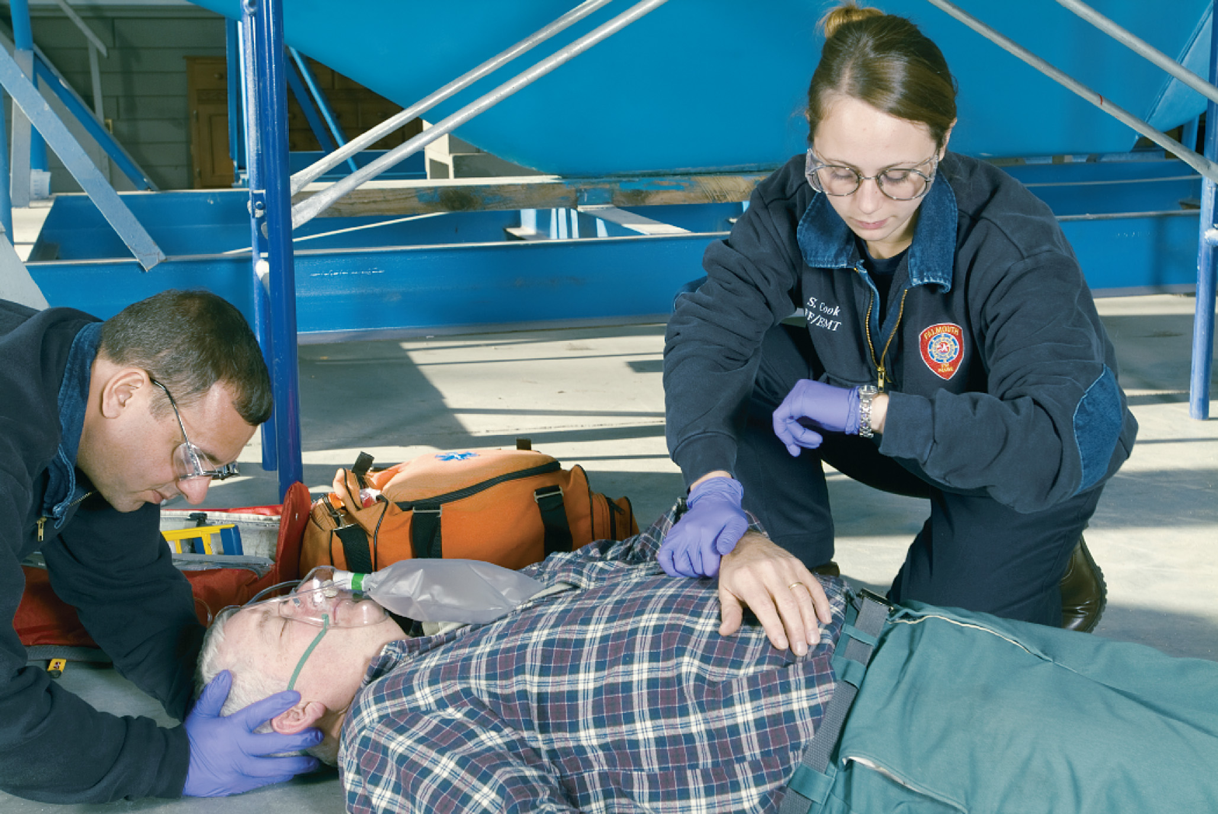
Assess Pulses. If There Is No Radial Pulse, Palpate the Carotid Pulse
If the patient is pulseless or is unresponsive and has no breathing or no normal breathing, immediately begin chest compressions, followed by airway and ventilation, and apply the automated external defibrillator.
Notes:
To assess for a carotid pulse, locate the thyroid cartilage (Adam’s apple) and slide your fingers down the neck laterally on the same side on which you are positioned until you feel the groove between the larynx and the bulk of muscles in the neck.
Teaching Tips
Ask students to recall the locations at which the pulse can be assessed.
Remind students to consider isolated findings, such as an irregular pulse, in the context of the patient's overall presentation.

Slide 77
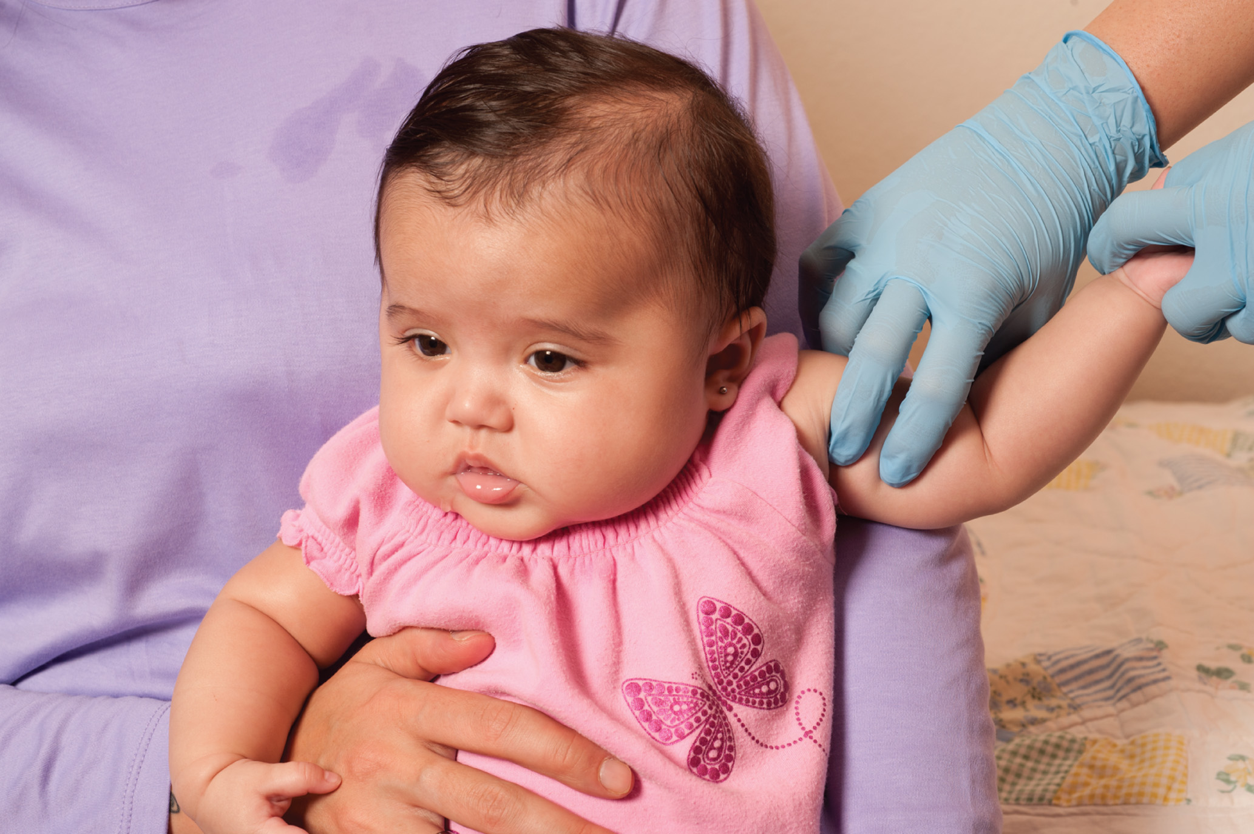
Assess the Brachial Pulse in a Baby Less Than 1 Year Old
Notes:
The brachial pulse is found on the lateral aspect of the upper section of the arm between the biceps and triceps muscles.

Slide 78
Assess Circulation (1 of 7)
Assess the Pulse
  Quickly determine:
    If the pulse is present or not
    The approximate heart rate (beats per minute)
    The pulse’s regularity and strength.
Notes:
Elderly patients commonly have “irregularly irregular” heart rhythms (that is, an irregular or abnormal rhythm that has no real pattern). In many elderly patients, this kind of abnormality is their normal rhythm; however, it is important to report and document this finding, because it may be related to their current conditions.
Note heart rates that are less than 60 per minute or greater than 100 per minute. Bradycardia, a heart rate less than 60 per minute, may indicate severe hypoxia, head injury, drug overdose, heart attack, or some other medical condition. A heart rate greater than 100 per minute may indicate anxiety, blood loss, shock, abnormal heart rhythms, heart attack, drug overdose, early hypoxia, fever, and other medical or traumatic conditions.

Slide 79
Assess Circulation (2 of 7)
Identify Major Bleeding
  If you notice large pools of blood or blood-soaked clothing, immediately expose the area.
    Bright red, spurting bleeding is arterial.
    Dark red, steady, rapid bleeding is venous.
Notes:
If either of these types of major bleeding is present, immediately place gloved fingers or a gloved hand on the wound and apply direct pressure to control the bleeding; apply a pressure dressing once the bleeding has been controlled.
Do not waste time dealing with slow, oozing capillary bleeding or other wounds that do not present with major bleeding during the primary assessment.

Slide 80
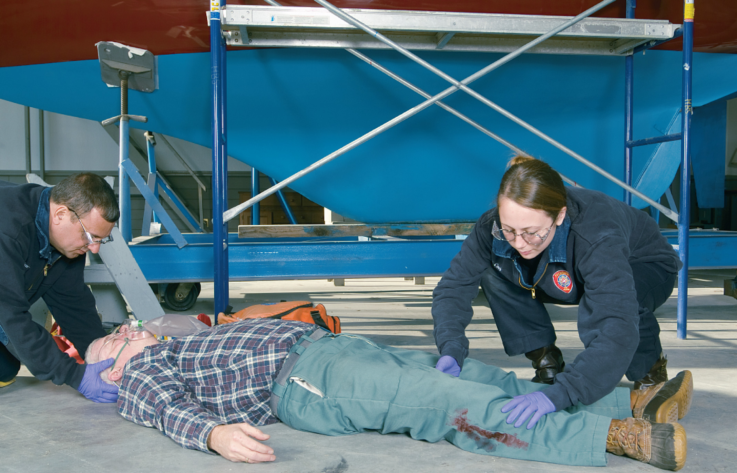
Check for Major Bleeding
Notes:
Scan the body, looking for any indication of major bleeding.

Slide 81
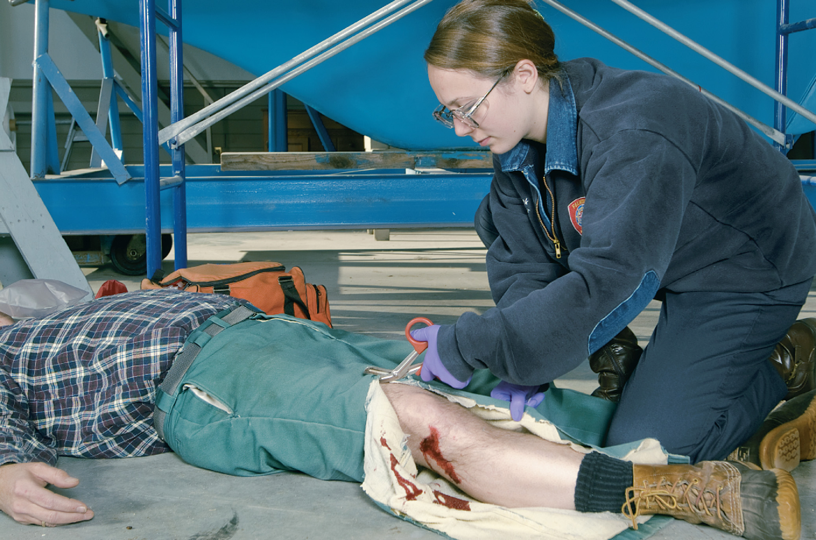
Cut Away Blood-Soaked Clothing to Expose Potentially Life-Threatening Bleeding
Control bleeding with direct pressure, then apply a pressure dressing.
Notes:
If you notice large pools of blood or completely blood-soaked clothing, immediately expose the area by cutting away clothing with scissors.

Slide 82
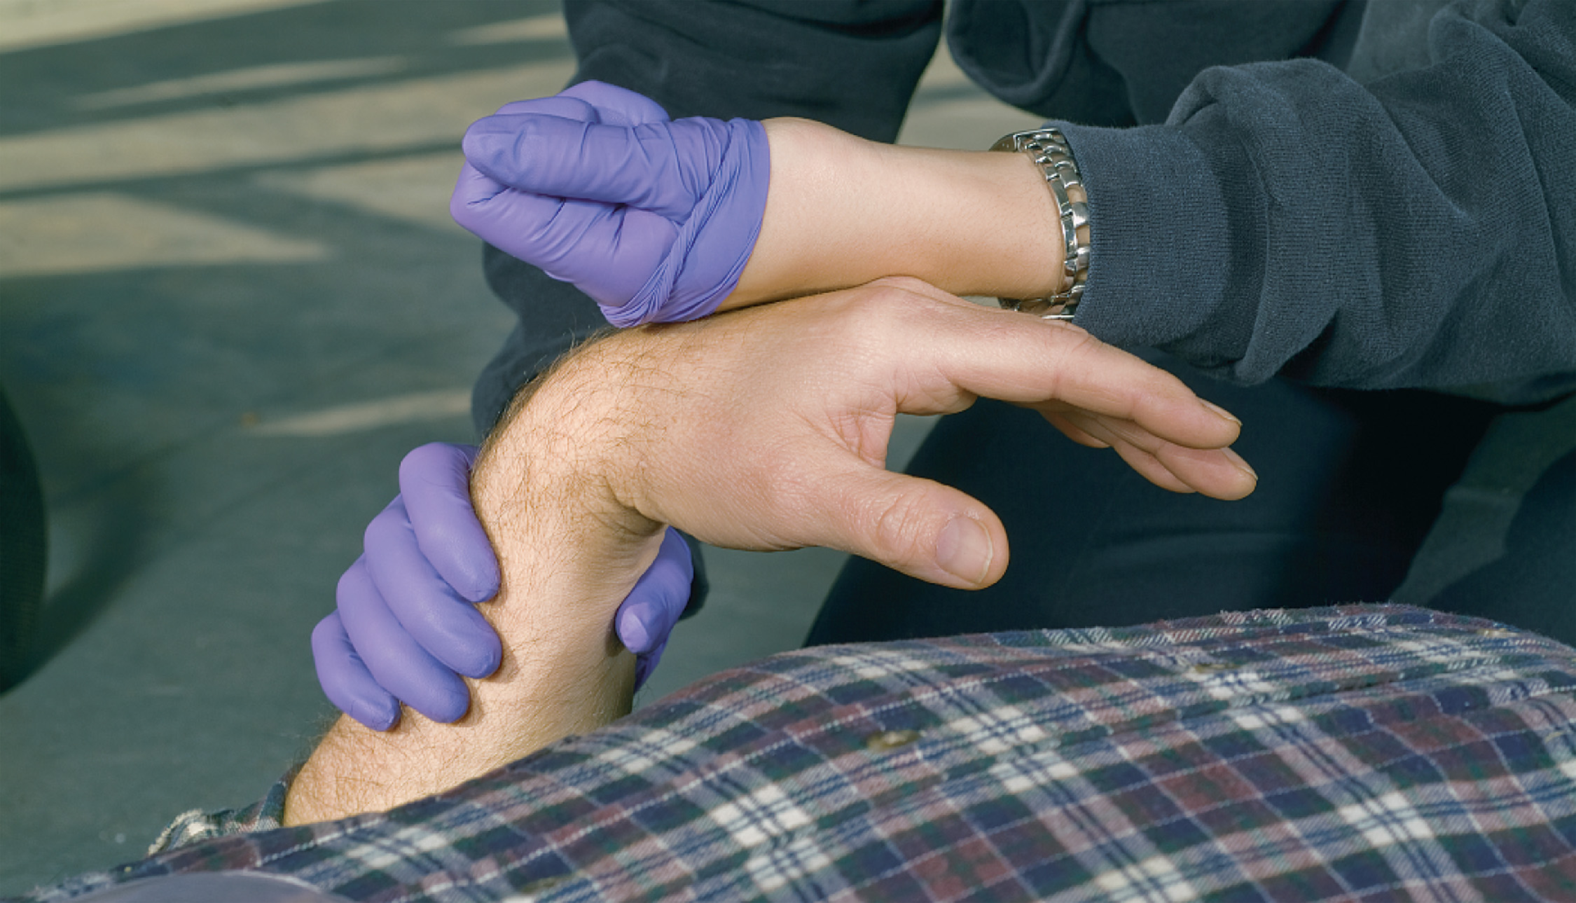
Assess Perfusion by Assessing Color, Temperature, and Condition of the Skin. Assess Capillary Refill
Notes:
In a cold environment, the vessels in the skin constrict, causing the blood to be shunted to the core of the body to preserve the heat at the core. Because the warm, red blood has been shunted away from the skin, the skin takes on a pale appearance and becomes cool.

Slide 83
Assess Circulation (3 of 7)
Assess Perfusion
  Skin Color – observe mucous membranes.
    Pale or mottled
      Decreased perfusion, shock
    Cyanotic
      Decreased oxygenation
    Red/flushed
      Vasodilation
    Yellow (jaundice)
      Liver dysfunction
Notes:
The patient’s perfusion can be assessed by checking the skin’s color, temperature, and condition.
Capillary refill alone cannot provide an accurate assessment of perfusion in infants, children, or adults. You must also assess the mental status, heart rate, peripheral and central pulses, skin signs, and blood pressure to determine the perfusion status of the patient.
The hemoglobin in the red blood cells changes color when starved of oxygen, thus giving the skin of a hypoxic patient its bluish (cyanotic) tint.

Slide 84
Assess Circulation (4 of 7)
  Assess Perfusion
  Skin Temperature
    Hot
      Hot environment, elevated temperature
    Cool
      Cold environment, decreased perfusion
    Cold
      Frostbite, hypothermia
    Cool, clammy
      Shock, nervousness, fright
Notes:
If temperature can't be felt through the glove, you may need to slip your glove down, placing the back of your hand or fingers on the patient’s abdomen, face, or neck. The skin is normally warm to the touch but may instead be hot, cool, or cold.

Slide 85
Assess Circulation (5 of 7)
  Assess Perfusion
  Skin Condition
    Dry
      Dehydration, heat stroke, spinal shock, medical conditions
    Moist
      Environment, exertion, shock, medical conditions
Notes:
Moist or clammy skin associated with medical or trauma conditions is typically produced from circulating epinephrine. The epinephrine stimulates alpha receptors that cause the sweat glands to produce and secrete sweat.

Slide 86
Assess Circulation (6 of 7)
  Assess Perfusion
  Capillary Refill
    More reliable in infants and children
    Most reliable at room temperature
    Alone does not provide an accurate determination of perfusion status.
Notes:
If the refill of capillaries takes longer than 2 seconds in the infant, child, or adult male at room temperature, tissue perfusion may be inadequate. The upper limit for adult females is 3 seconds and for the elderly is 4 seconds.

Slide 87
E M T Skills 13-2
Assessing Capillary Refill in Children and Infants

Slide 88
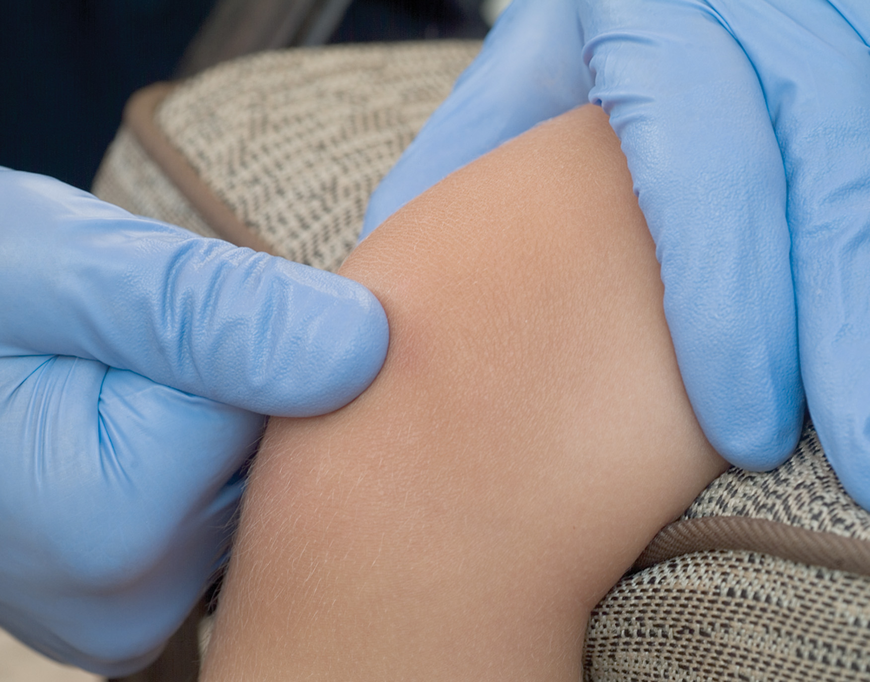
To Assess Capillary Refill, Press Your Thumb down on the Child’s Kneecap for Several Seconds
Notes:
Capillary refill is more reliable in infants and children than in adult patients.

Slide 89
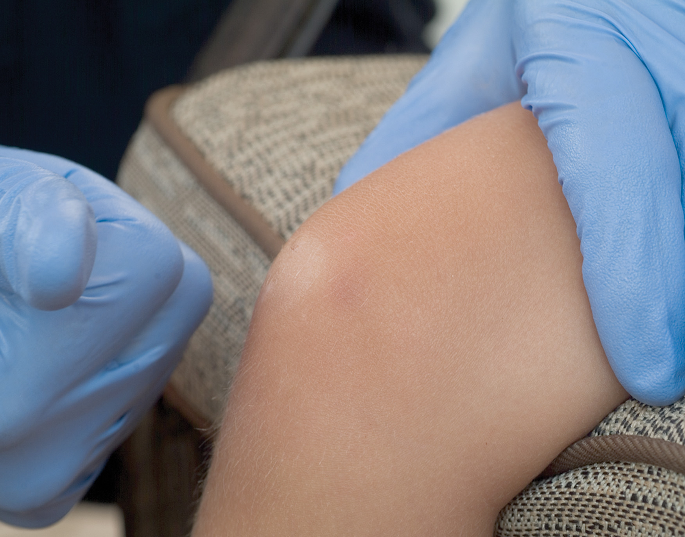
Release Your Thumb and Observe the Whitened (Blanched) Area Where You Had Been Pressing
Count the number of seconds it takes for the color to return to normal.
Notes:
Normal color should return to the area in 2 seconds or less. If it takes longer, capillary refill is said to be delayed. This is only one sign of inadequate circulation. You must assess for other signs of poor perfusion.

Slide 90
Assess Circulation (7 of 7)
Shock (Hypoperfusion)
  Shock a life-threatening condition.
  Treatment needs to begin during the primary assessment.
Notes:
If there is a significant mechanism of injury, an altered mental status, or severe bleeding, assume that the patient is in shock.
Control any serious bleeding. If possible, splint any bone or joint injuries, but only if it does not delay transport. Provide positive pressure ventilation with supplemental oxygen if needed or oxygen at 15 lpm by nonrebreather mask, keep the patient warm, and consider immediate transport with assessment.

Slide 91
Case Study (6 of 8)
With the patient now supine, Kerry notices that Bob is snoring. He uses a jaw-thrust maneuver to open the airway, which relieves the snoring. Kerry determines that Bob is breathing about 12 times per minute, and that his chest is moving adequately with each breath. Kerry can feel Bob’s breath with each exhalation.
Notes:
Case Study Discussion
Review the Case Study findings presented.

Slide 92
Case Study (7 of 8)
Kerry places an oropharyngeal airway to assist with airway control, while Della reports a strong, regular radial pulse and cool, moist skin.
As Della searches for any obvious bleeding, the paramedic assigned to the call arrives. He obtains a quick report from Kerry, asks Bob’s sister a few questions, and prepares to obtain Bob’s blood glucose level.
Notes:
Case Study Discussion
Review the Case Study findings presented.

Slide 93
Case Study (8 of 8)
What factors should the crew consider in determining whether they should perform a quick secondary assessment and prepare for immediate transport, or do a more thorough assessment and initiate treatment on the scene?
Notes:
Case Study Discussion
Use the Case Study content and questions to foreshadow the upcoming lesson content. Gauge the student’s responses as a guide of how well versed they are in this topic.

Slide 94
Establish Patient Priorities (1 of 2)
In the primary assessment, identify and manage life-threatening conditions immediately.
Any critical finding of the airway, breathing, oxygenation, or circulation categorizes the patient as unstable.
Unstable patients are a high priority for treatment and transport.
Notes:
At this point in the primary assessment, based on your general impression and your assessment of the patient’s mental status, airway, breathing, oxygenation, and circulation, it is necessary to decide whether the patient is unstable and a priority for a rapid secondary assessment and immediate transport or if the patient is stable and you can continue with the secondary assessment on the scene.
Discussion Questions
What are factors that would increase the patient's priority for transport?
What things need to be done prior to transport, even when immediate transport is needed?
Knowledge Application
Given a number of primary survey descriptions, students should be able to differentiate between patients who need immediate transport and those whose needs are less immediate.

Slide 95
Establish Patient Priorities (2 of 2)
Unstable patients receive a rapid secondary assessment and immediate transport with continued stabilization during transport.
Stable patients are assessed further and treated at the scene prior to transport.
Notes:
The priority decision you make at the conclusion of the primary assessment will dictate when and where the remainder of the assessment and treatment will occur, whether at the scene or en route to the hospital. Thus, the primary assessment sets the pace for the entire patient encounter.
Conditions requiring rapid transport:
Poor general impression
Unresponsive or altered mental status
Responsive but can’t obey commands
Can’t establish or maintain an airway
Difficulty breathing, respiratory distress
Absent or inadequate breathing
Pulseless
Uncontrolled hemorrhage, severe blood loss
Pale, cool, clammy skin; suspected shock
Open chest wound or flail segment
Severe chest pain with systolic BP <100 mmHg
Severe pain anywhere
Complicated childbirth
Body temperature >104°F
Signs of hypothermia
Severe allergic reaction
Poisoning or overdose of unknown substance

Slide 96
Case Study Conclusion (1 of 2)
Bob’s blood glucose level is low, making the crew suspect that his unresponsiveness could be related to a diabetic emergency, which the paramedic can treat at the scene.
The paramedic starts an IV and administers medication as Della performs a secondary assessment and Kerry continues in-line spinal stabilization and airway management.
Notes:
Case Study Discussion
Review the case conclusion and emphasize the application of knowledge learned from this presentation.

Slide 97
Case Study Conclusion (2 of 2)
Della finds a deformity in Bob’s right arm. Bob quickly responds to the medication. Kerry removes the oropharyngeal airway as Bob wakes up. With Bob now alert and oriented, the crew is able to stabilize his injuries on the scene and obtain a thorough history while repeating the secondary assessment.
Notes:
Case Study Discussion
Review the case conclusion and emphasize the application of knowledge learned from this presentation.

Slide 98
Part 3
Secondary Assessment
Notes:
During this lesson, students will learn about the components of the secondary patient assessment procedures they will perform on patients during their careers as EMTs.

Slide 99
Case Study 2 Introduction (1 of 4)
E M T s Ryan Webb and Bruce Hart have just approached a vehicle that has collided with a large tree. The scene is safe, and the driver of the vehicle is the only patient. However, the patient is trapped in the vehicle, and extrication equipment is still two minutes away. The front end of the vehicle is heavily damaged.
Notes:
Case Study
Present this Case Study Introduction provided in the PowerPoint slide set.
Lead a discussion using the Case Study questions provided on the subsequent slide(s).
The Case Study with discussion questions continues throughout the PowerPoint presentation.
Case Study Discussion
Use the Case Study content and questions to foreshadow the upcoming lesson content.

Slide 100
Case Study 2 Introduction (2 of 4)
The patient, an adult male, is in the driver’s seat, but his head is down and he is not moving. He does not respond to Ryan’s voice or to having his trapezius muscle pinched.
Notes:
Case Study
Present this Case Study Introduction provided in the PowerPoint slide set.
Lead a discussion using the case study questions provided on the subsequent slide(s).
The Case Study with discussion questions continues throughout the PowerPoint presentation.
Case Study Discussion
Use the case study content and questions to foreshadow the upcoming lesson content

Slide 101
Case Study 2 Introduction (3 of 4)
The patient has snoring respirations at a rate of about 12 per minute. Ryan is able to enter the rear of the vehicle and position himself behind the patient to open the airway and stabilize the spine. The patient’s respirations are shallow, and his carotid pulse is weak and rapid.
Notes:
Case Study
Present this Case Study Introduction provided in the PowerPoint slide set.
Lead a discussion using the Case Study questions provided on the subsequent slide(s).
The Case Study with discussion questions continues throughout the PowerPoint presentation.
Case Study Discussion
Use the Case Study content and questions to foreshadow the upcoming lesson content

Slide 102
Case Study 2 Introduction (4 of 4)
Bruce hands Ryan a bag-valve mask to start assisting the patient’s ventilations. There is some bleeding from the patient’s scalp and nose. Bruce suctions the airway and applies a pressure bandage to control bleeding from the scalp.
Notes:
Case Study
Present this Case Study Introduction provided in the PowerPoint slide set.
Lead a discussion using the Case Study questions provided on the subsequent slide(s).
The Case Study with discussion questions continues throughout the PowerPoint presentation.
Case Study Discussion
Use the Case Study content and questions to foreshadow the upcoming lesson content

Slide 103
Case Study 2 (1 of 3)
What is the nature of the patient’s problem?
Is the patient stable or unstable? Explain your answer.
How should Ryan and Bruce proceed with further assessment and treatment?
Notes:
Case Study Discussion
Use the Case Study content and questions to foreshadow the upcoming lesson content. Gauge the student’s responses as a guide of how well versed they are in this topic.

Slide 104
Secondary Assessment (1 of 2)
A secondary assessment is performed after the primary assessment to identify any additional injuries or conditions.
The approach to secondary assessment differs according to whether the patient has a medical problem or trauma, and whether the patient has a minor or serious complaint.
Notes:
During this lesson, students will learn about all of the components of the patient assessment procedures they will perform on every patient they encounter during their career as EMTs.

Slide 105
Secondary Assessment (2 of 2)
Components of the Secondary Assessment
  Physical exam
  Baseline vital signs
  History
Tailor your assessment to the needs of the patient and the suspected condition or injury.
Notes:
Points to Emphasize
Once you have identified and begun to manage immediately life-threatening conditions involving the airway, breathing, and circulation, conduct a secondary assessment to guide further decisions and treatment.
The components of the secondary assessment consist of conducting a physical examination, taking baseline vital signs, and obtaining a history.
The order and detail involved in these steps will vary according to the nature of the patient's problem and the seriousness of his condition.

Slide 106
Overview of Secondary Assessment (1 of 20)
Physical examination uses the techniques of inspection, palpation, and auscultation to identify signs and symptoms.
An anatomical approach proceeds from head to feet.
Notes:
When conducting the secondary assessment in a stable, noncritical trauma patient, the injuries can be managed as found.
Clothing that interferes with your ability to properly examine the trauma patient should be cut on the anterior part and allowed to fall away.

Slide 107
Overview of Secondary Assessment (2 of 20)
Performing the Secondary Assessment: An Anatomic Approach
  The secondary assessment should be conducted systematically, starting at the head and moving to the feet.
  A rapid secondary assessment is performed on unstable or critical medical or trauma patients.
Notes:
The rapid secondary assessment uses the same techniques as those for the complete secondary assessment; however, the approach is abbreviated to focus on rapidly finding potential life threats. Thus, the rapid secondary assessment may not use all the techniques.

Slide 108
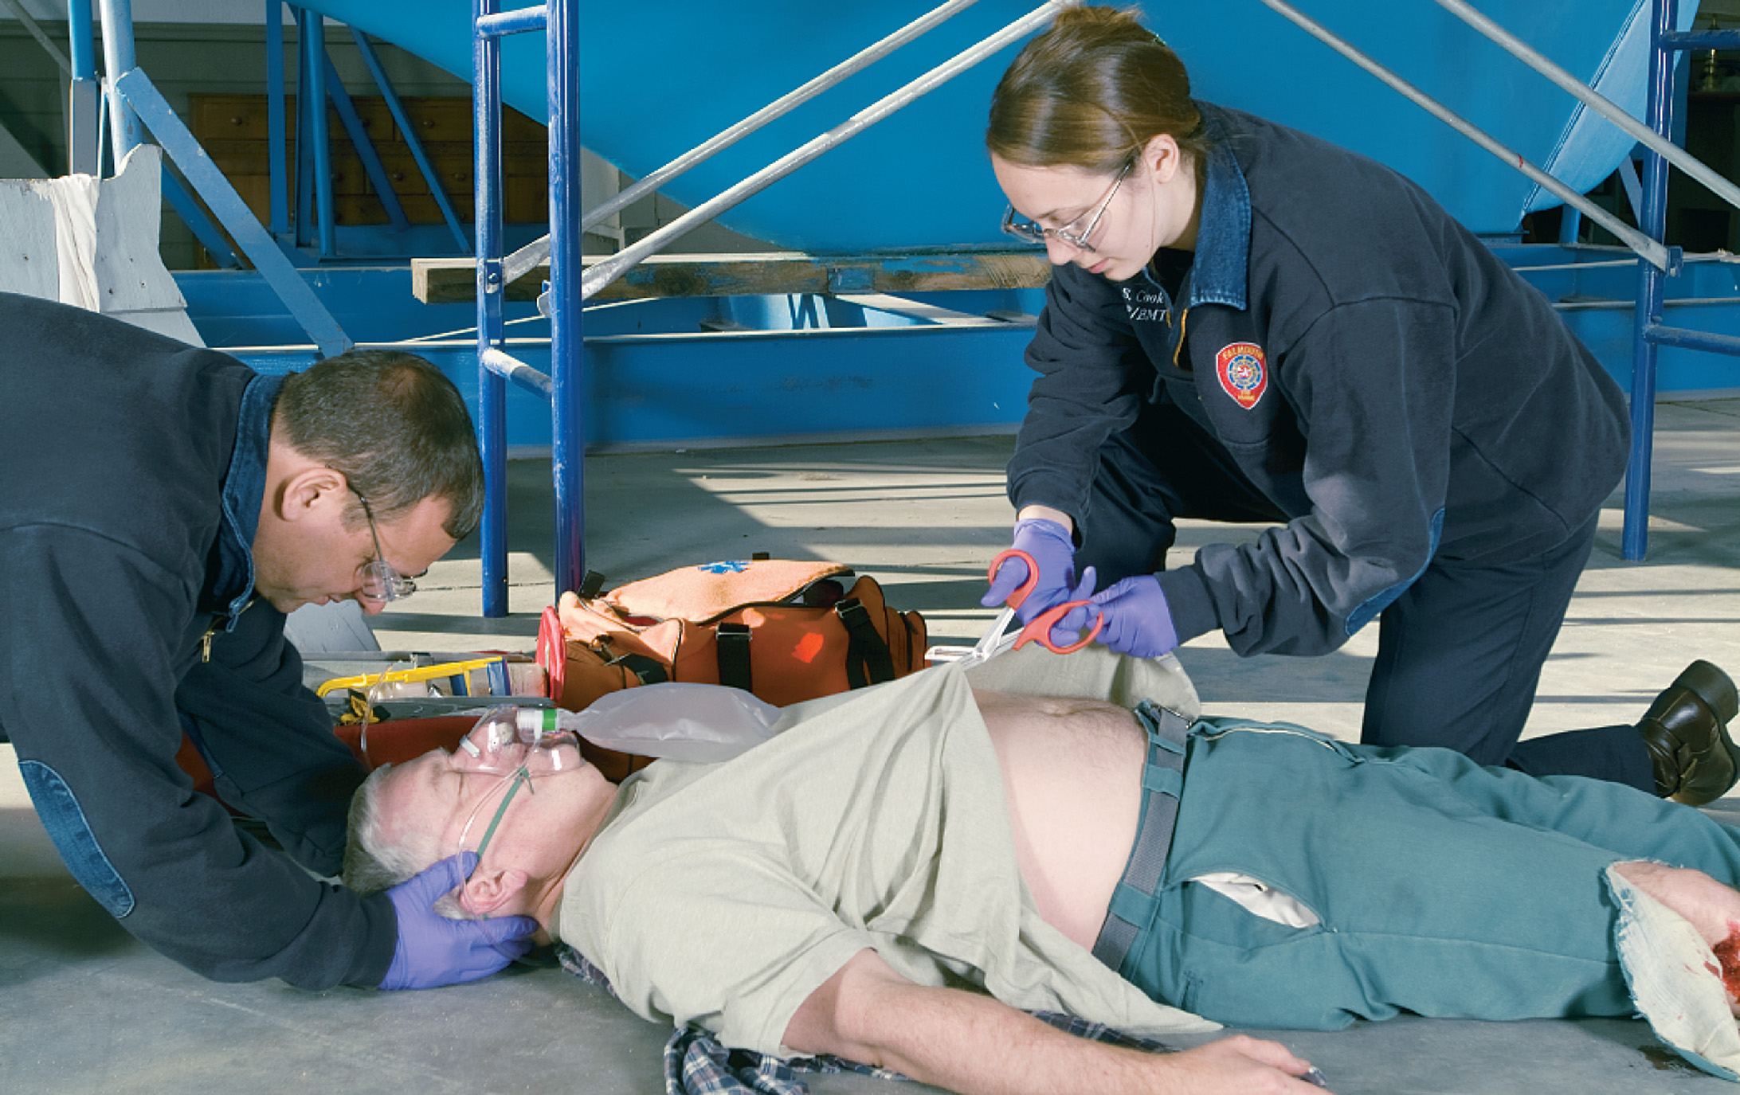
Completely Expose the Trauma Patient Who Has Suffered a Significant Mechanism of Injury or Has Potential Multiple Injuries
Notes:
Take modesty into consideration and cover the patient with a sheet.

Slide 109
Overview of Secondary Assessment (3 of 20)
Performing the Secondary Assessment: An Anatomic Approach
  Assess the Head
    Inspect the head and scalp for any deformities, contusions, abrasions, punctures, burns, lacerations, or swelling.
    Assess the eyes, ears, nose, and mouth.
Notes:
If conducted at the scene on the trauma patient with a suspected spinal injury, perform SMR as applied during the primary assessment.
Teaching Tips
Demonstrate the assessment of each anatomical region of the body as you discuss it.
Use a whole-part-whole approach to demonstrating the secondary assessment. Demonstrate a head-to-toe assessment at the beginning of this section. As you discuss each anatomical region, demonstrate the assessment of that region only. At the end of the section, combine all the parts to demonstrate the whole skill.
Discussion Question
What should you look for when assessing the head, face, eyes, ears, nose, and mouth?

Slide 110
E M T Skills 13-3
The Secondary Assessment: Anatomical Approach

Slide 111
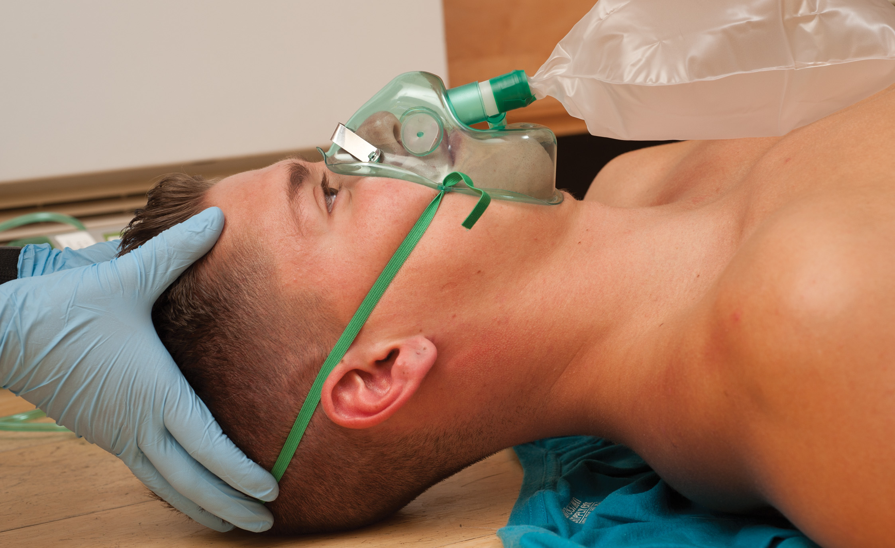
Inspect the Head for Signs of Trauma. Carefully Palpate the Skull for Abnormalities
Notes:
Do not poke your fingers into the scalp or skull. Cup your hands together and palpate with the palms of the hands. This reduces the possibility of damage to the brain from inadvertently pushing in bone ends during palpation.

Slide 112
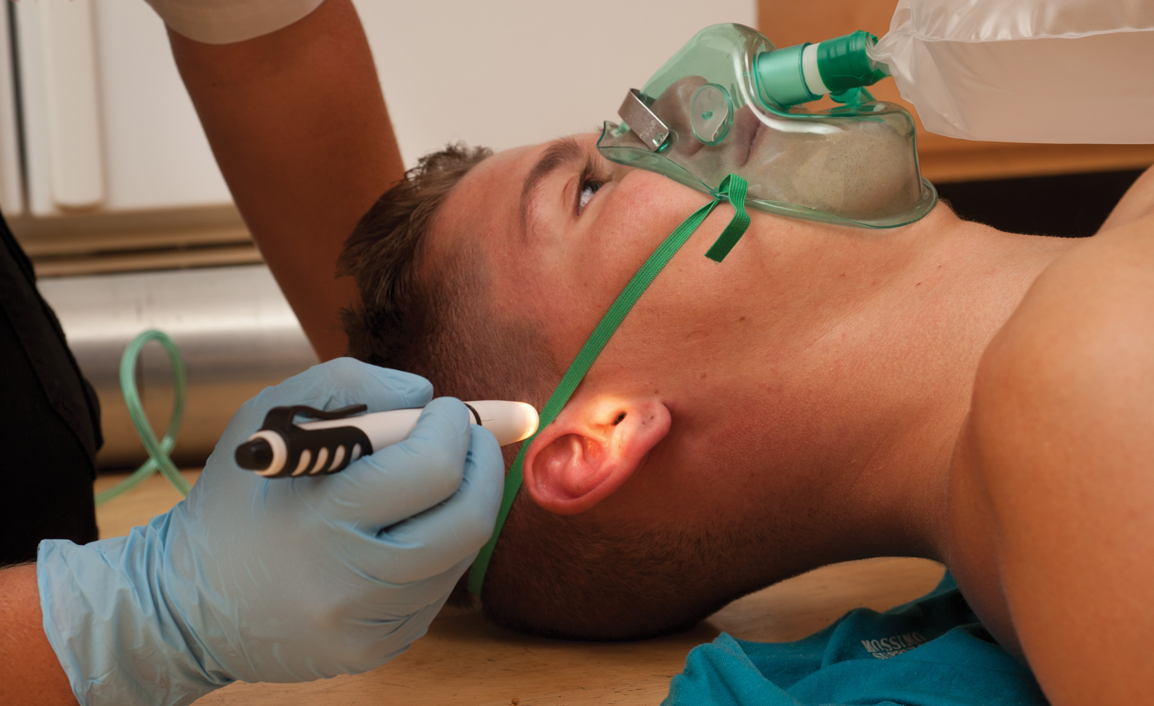
Inspect and Palpate the Ear. Note Any Leakage of Blood or Fluid
Notes:
Look for deformities, contusions, abrasions, punctures, burns, lacerations, or swelling.
A clear fluid flowing from the ear is most likely cerebrospinal fluid (CSF), which surrounds and cushions the brain and the spinal cord. Leakage of CSF usually indicates a skull fracture. If bleeding is occurring from the ear, place a loose dressing over the ear to catch the blood. Do not pack the ears or restrict the bleeding.

Slide 113
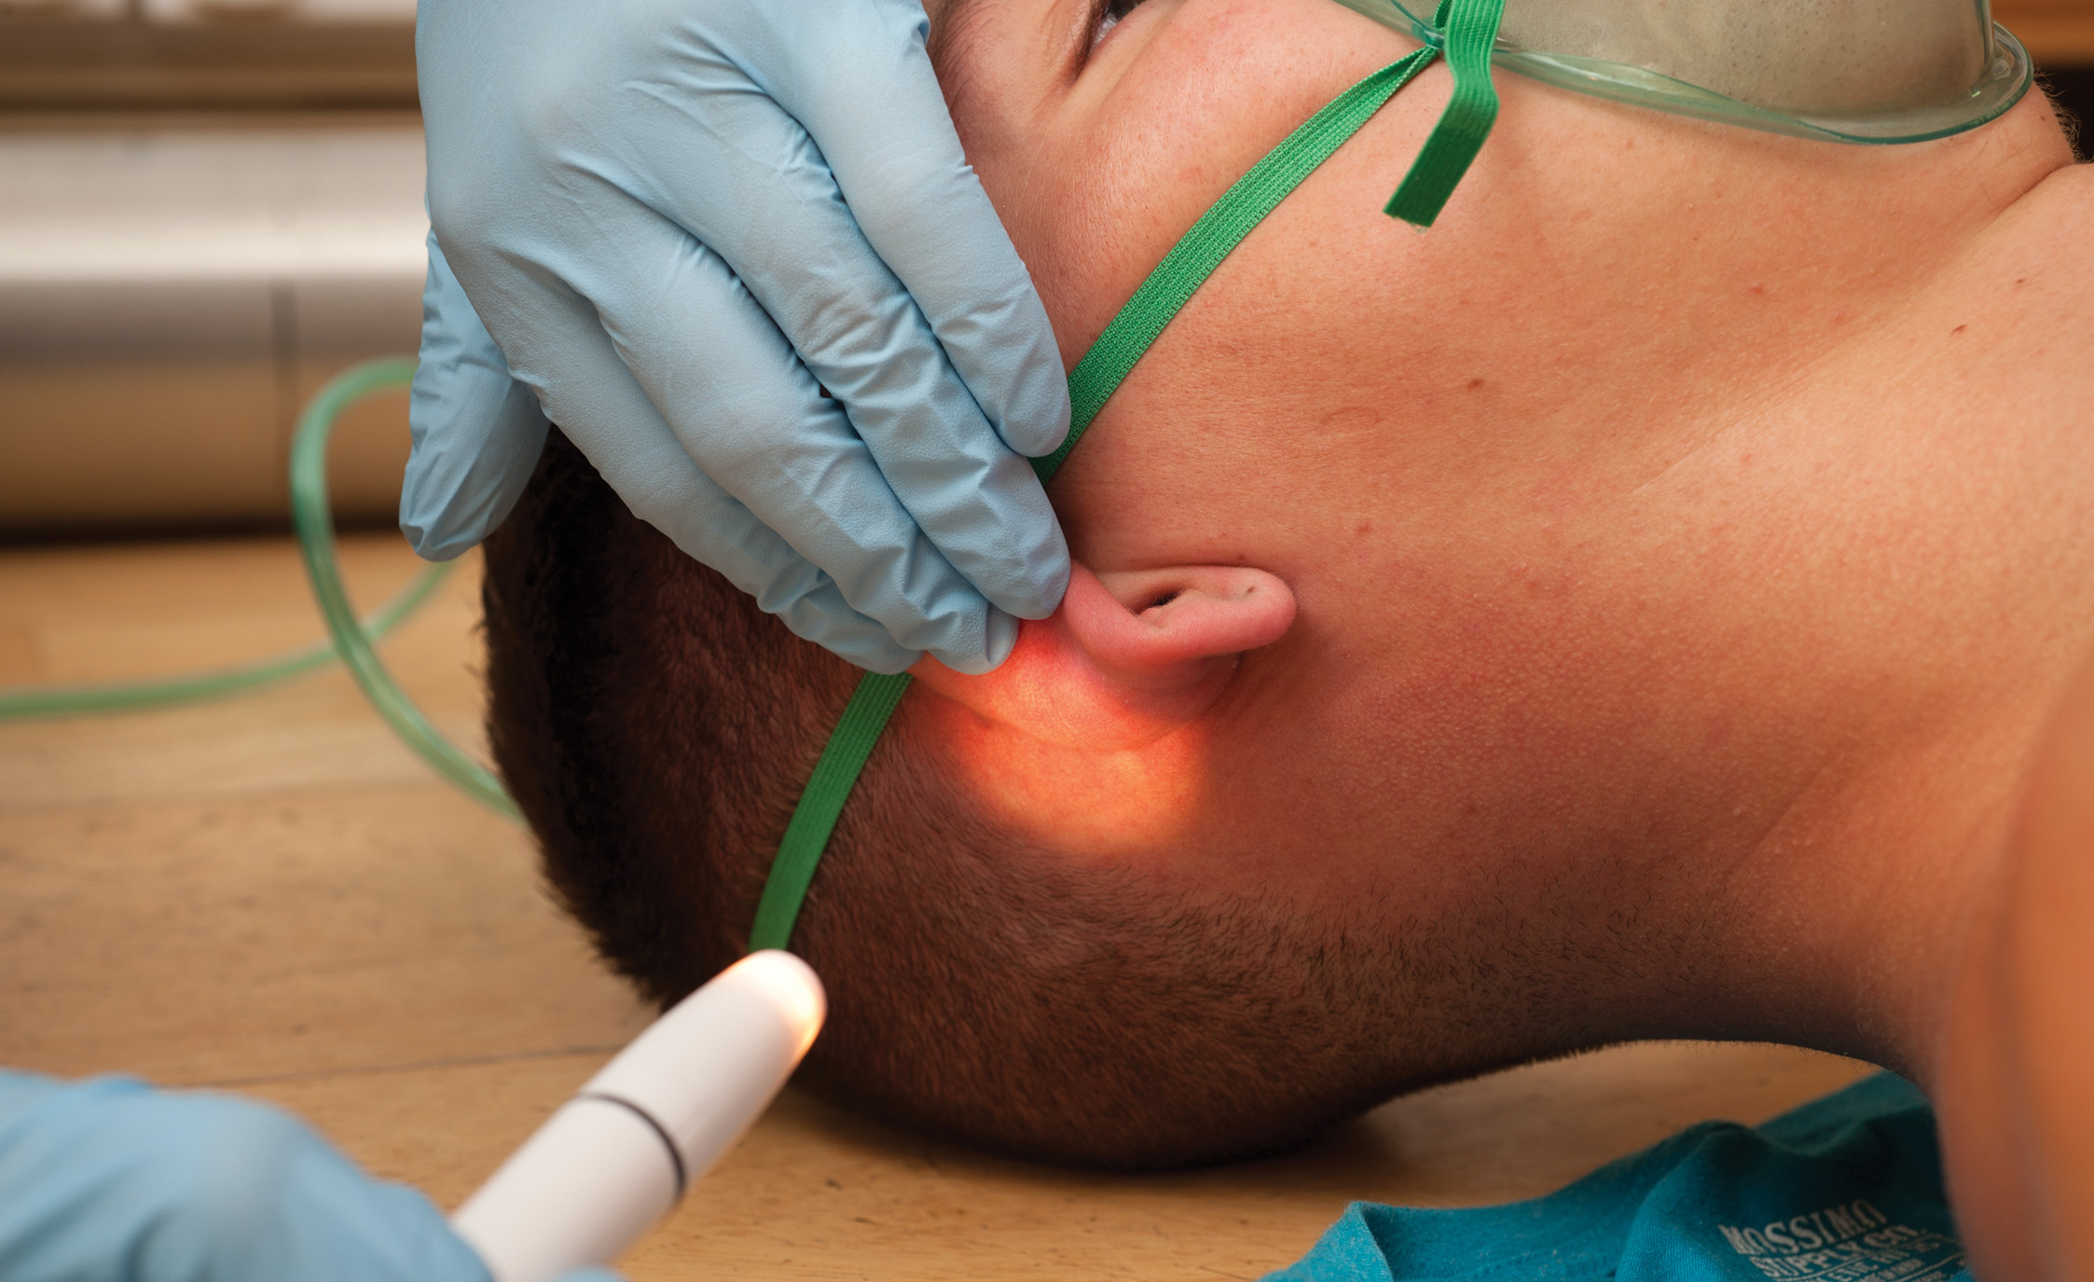
Inspect Behind the Ears for Any Injury or Discoloration
Notes:
Ecchymosis (black-and-blue discoloration) to the mastoid area is known as the Battle sign. This is a late sign of possible skull or head injury that may not appear until hours after the injury.

Slide 114
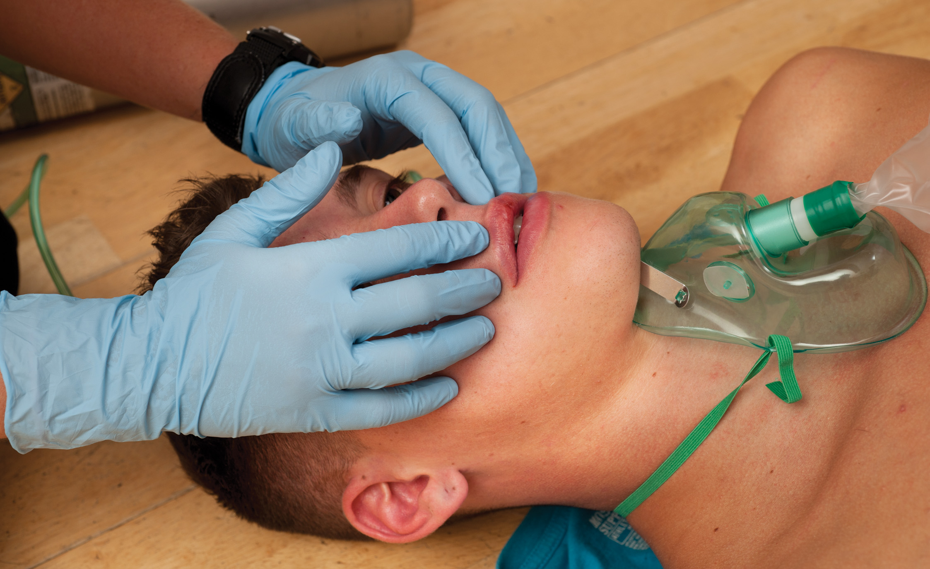
Inspect and Palpate the Face. Note Any Deformity, Instability, Burns, or Swelling
Notes:
Inspect the entire facial region to include the eyes, nose, and mouth. Look for deformities, contusions, abrasions, punctures, burns, lacerations, or swelling. Palpate for deformity, swelling, and tenderness.
Bleeding or displacement of bone or tissue into the airway may cause an obstruction.
Inspect the face for singed or burnt eyebrows, nasal hair, beard, or hairline. Burns to the face should make you suspicious that the patient may be suffering from an upper airway burn.
In the medical patient, have the patient make a big smile and show his teeth to check for facial asymmetry.

Slide 115
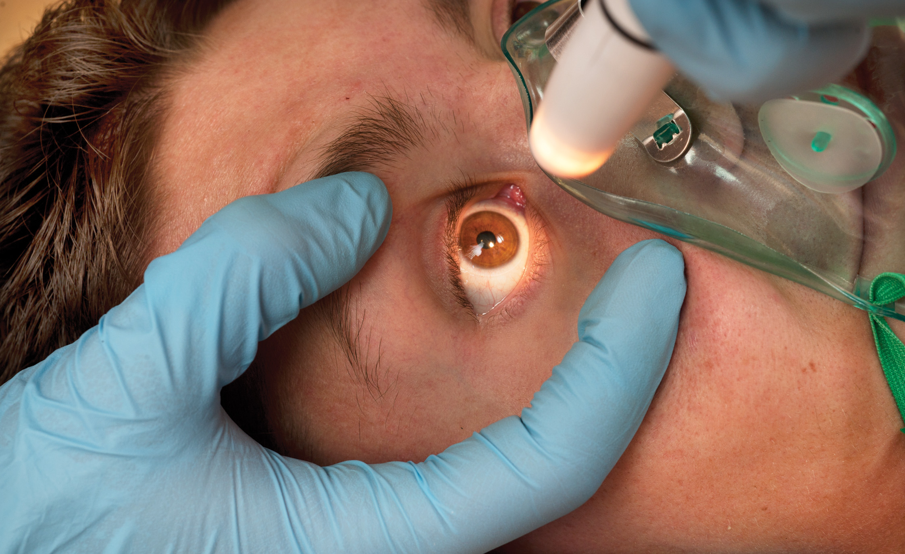
Assess Both Pupils for Equality of Size and Reactivity to Light. Inspect the Color of the Sclerae
Notes:
Inspect for deformities, contusions, abrasions, punctures, burns, lacerations, or swelling. Look especially for lacerations or trauma to the eyelids and eyeballs.
Do not force the eyelids open or apply pressure to the eyes.
If the patient has a chemical burn to the eye, remove the contact lens (if present) to allow for adequate flushing.
Both pupils should react simultaneously and equally to light shined in either eye. This is a consensual reflex. While shining light into one eye, watch the pupillary reaction of the other eye.
Poor perfusion to the brain, high levels of carbon dioxide, or brain injuries may cause the pupils to respond sluggishly.
A small portion of the population has unequal pupils in their normal state.

Slide 116
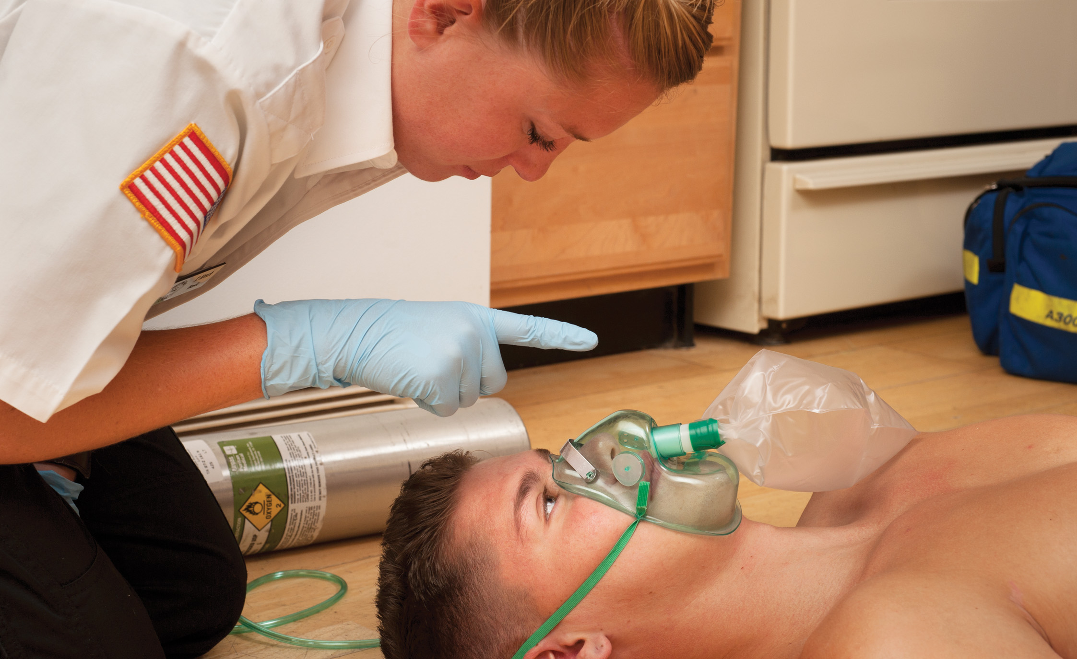
Check Eye Movement by Having the Patient Follow Your Finger. Note Any Gazes in One Direction or Jerky Eye Movements
Notes:
Check visual acuity (clarity of vision) by having the patient tell you how many fingers you are holding up or by having him read your name tag.
The eyes should move together (conjugate movement) and smoothly. Jerky eye movements (nystagmus) usually result from drugs or central nervous system effects.

Slide 117
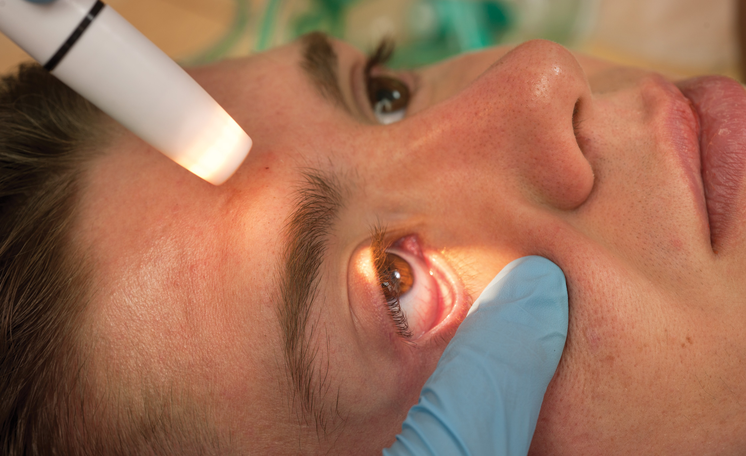
Inspect the Conjunctiva by Pulling the Lower Eyelid Down
Notes:
Inspect the white portion of the eye (the sclera) for redness or a yellow color. Yellow sclerae (icterus) is an indication of possible liver damage or failure.
Blood in the anterior eye is a sign that the eye or the head has received a forceful blow.

Slide 118
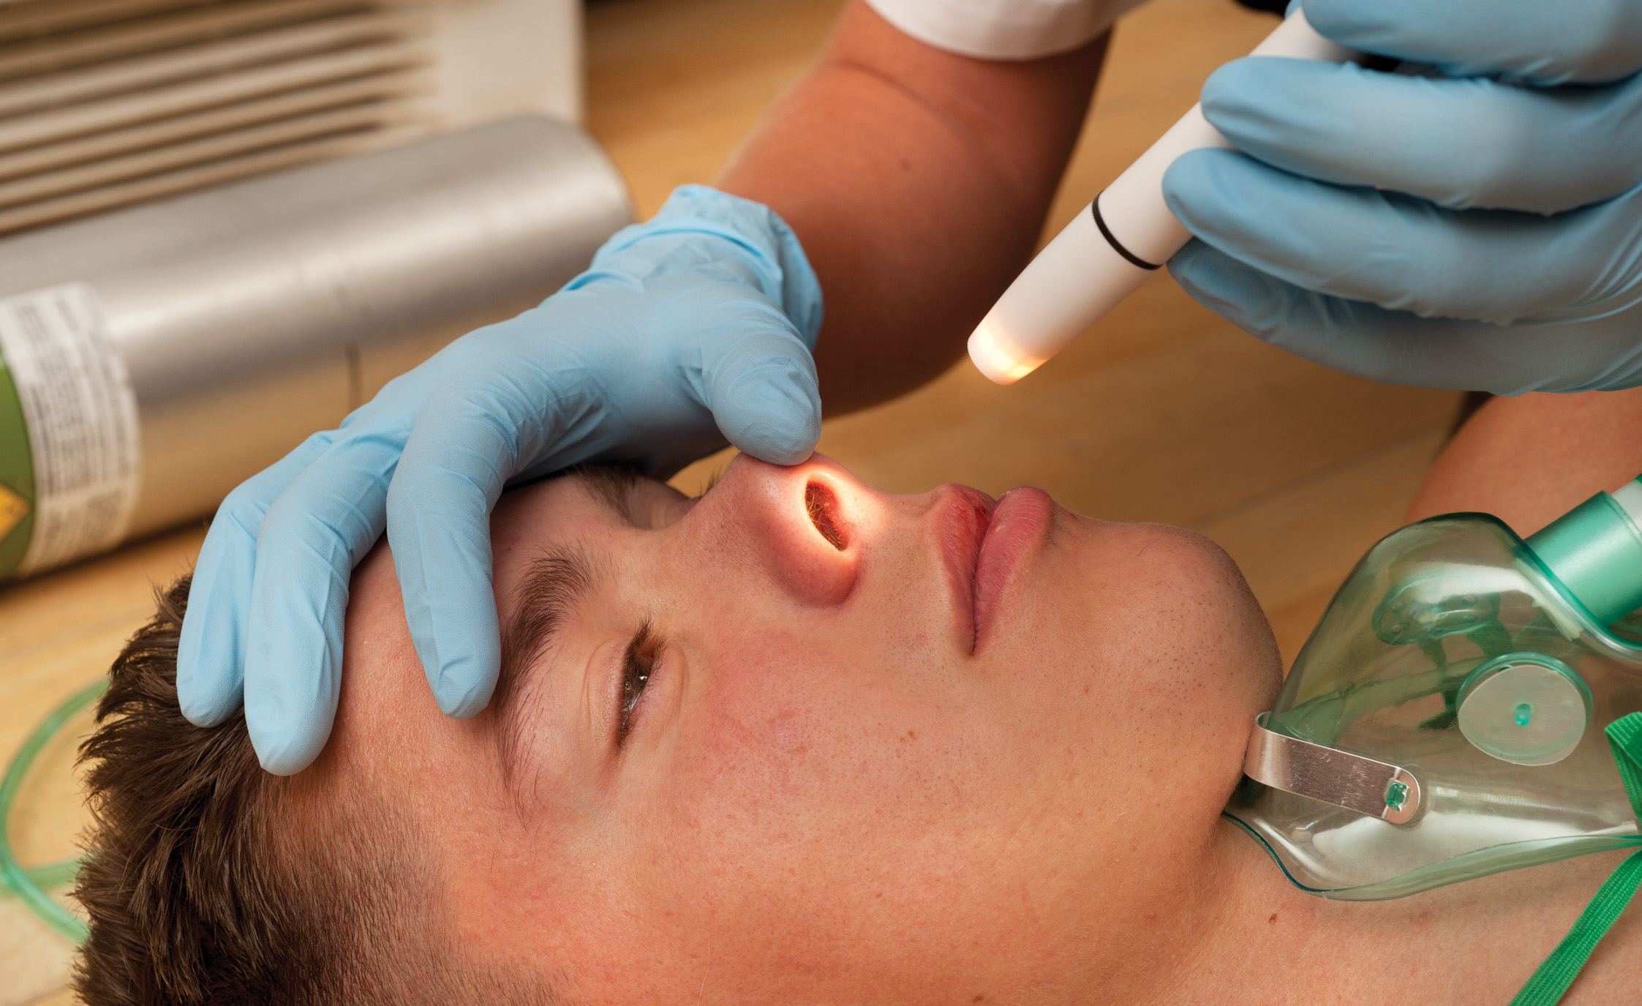
Inspect and Palpate the Nose for Any Signs of Trauma, Burns, Bleeding, or Fluid Leakage
Notes:
Inspect the nose for deformities, contusions, abrasions, punctures, burns, lacerations, or swelling. Look for fluid or blood drainage, nasal flaring, and singed nasal hair. Bleeding from the anterior nose is usually easily controlled by pinching the nostrils together.
Leakage of cerebrospinal fluid indicates a skull fracture, which may have an associated brain injury. Singed nasal hair should increase your suspicion that the patient has been involved in a fire and possibly has an upper airway burn.

Slide 119
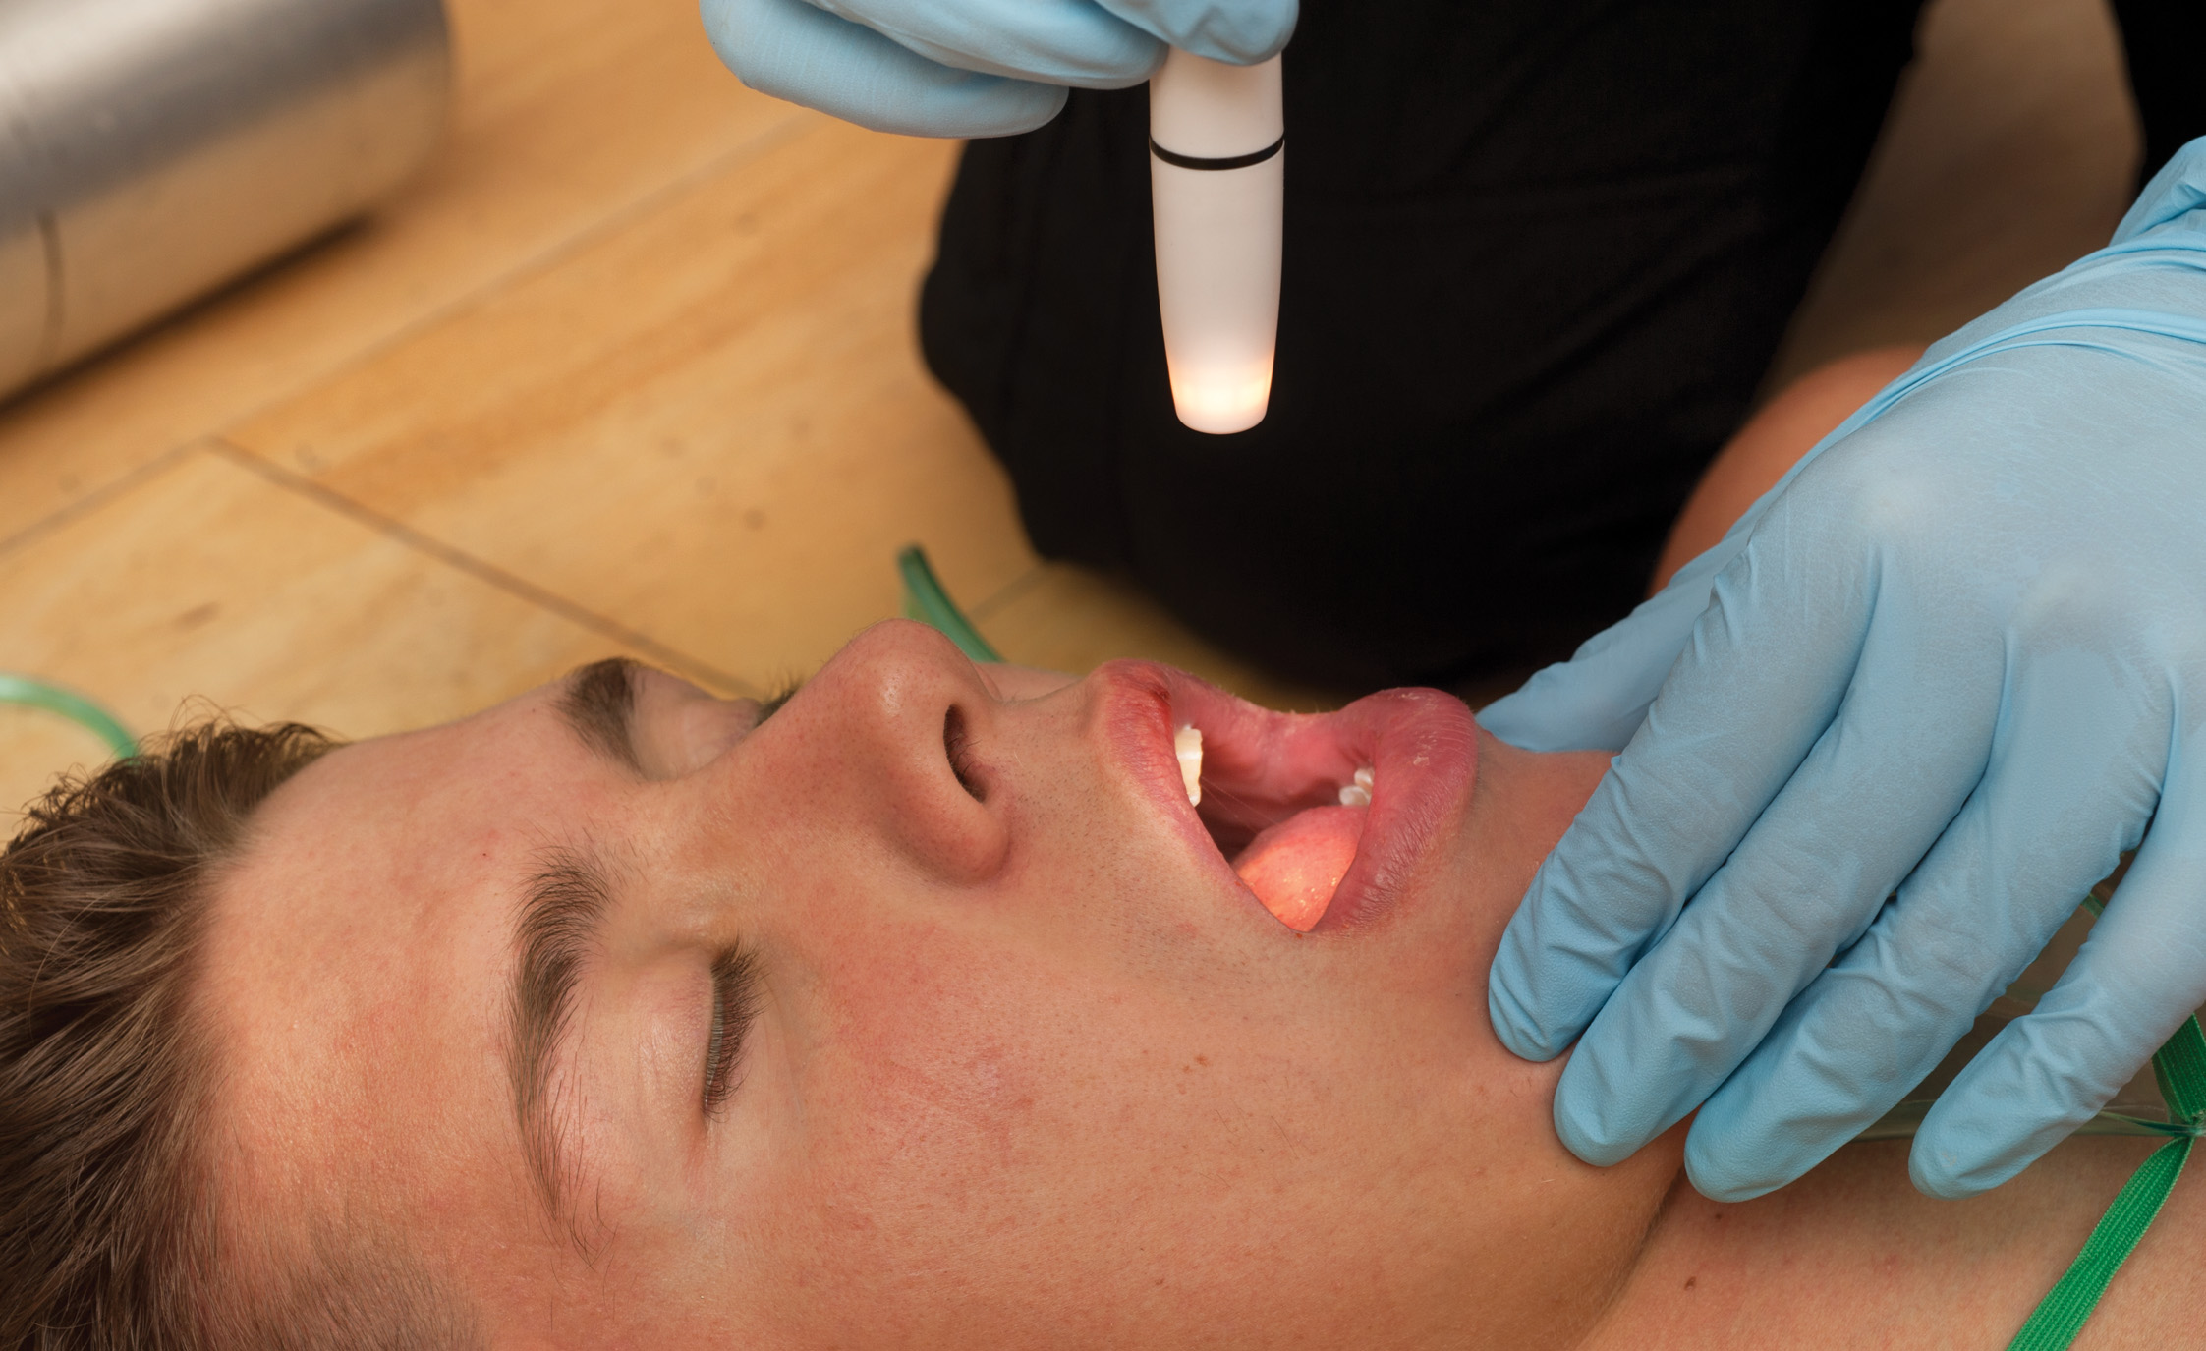
Inspect the Inside of the Mouth for Signs of Trauma, Burns, and Discoloration
Note the color of the mucous membranes. Smell the breath for any unusual odor.
Notes:
Look for loose or missing teeth or dentures and discoloration of the mucosa (lining). Loose dentures should be removed in unresponsive patients so they do not fall back into the throat and become an airway obstruction.
Look for discoloration. Cyanosis (bluish color) of the mucosa indicates inadequate oxygenation. A pale tongue may indicate poor perfusion and shock. Burns or extremely white areas may be caused by ingestion of a chemical poison.
Smell for unusual odors. An alcoholic beverage odor may indicate alcohol intoxication. A fruity odor on the breath may indicate a diabetic patient with an abnormally high blood sugar level. Smell for other unusual odors such as rubbing alcohol, cologne, cleaners, and solvents.

Slide 120
Overview of Secondary Assessment (4 of 20)
Performing the Secondary Assessment: An Anatomic Approach
  Assess the Neck
    Look for signs of injury.
    Cover open wounds.
    Look for jugular vein distention.
    Palpate for tracheal deviation.
Notes:
Discussion Question
What findings would be significant during assessment of the neck?

Slide 121
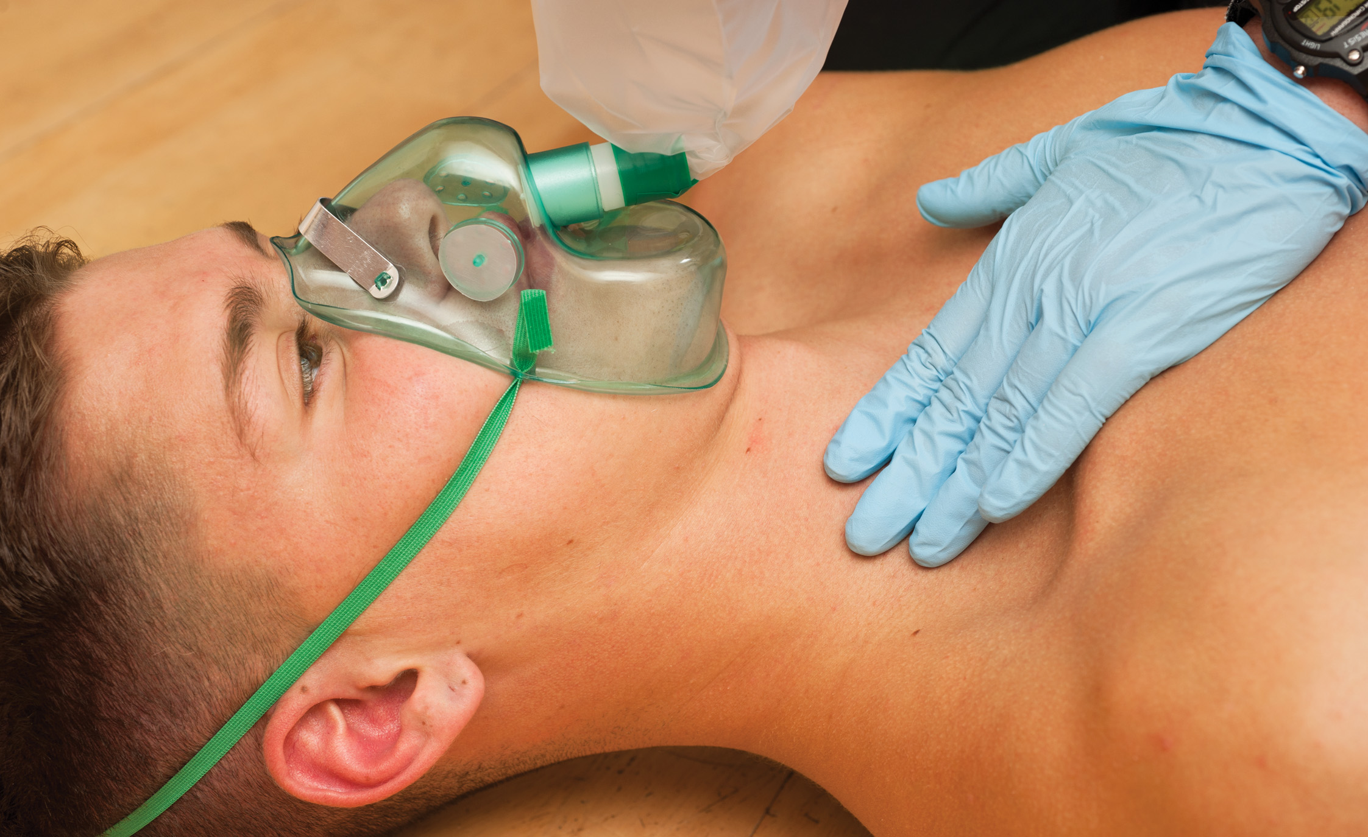
Assess the Neck for Jugular Vein Distention, Tracheal Deviation, Accessory Muscle Use, and Subcutaneous Emphysema
Notes:
Look for deformities, contusions, abrasions, punctures, burns, lacerations, or swelling. Large lacerations of the neck must be covered with an occlusive dressing to prevent air being sucked into a large vein, causing an air embolus.
If a cervical collar is in place, you typically will not remove it to inspect or palpate the neck.
A hematoma (collection of blood) could compress the airway or trachea and cause obstruction. Air trapped under the skin may be better palpated than seen. If you palpate an unusual sensation of air under the skin, and feel or hear crepitation (crackling), it is a sign of subcutaneous emphysema. Subcutaneous emphysema (air under the skin) is a sign of trauma to the airway, respiratory tract, lung, or esophagus.
A shifted or deviated trachea is a late sign of tension pneumothorax.
Neck muscles become prominent when a patient is having difficulty with inspiration.

Slide 122
Overview of Secondary Assessment (5 of 20)
Performing the Secondary Assessment: An Anatomic Approach
  Assess the Chest
    Inspect and cover open wounds.
    Look for paradoxical movement; flail segment is an immediately life-threatening condition.
    Palpate the chest.
    Auscultate breath sounds.
Notes:
A patient with a simple rib fracture may breathe very shallowly and rapidly because of the pain associated with deeper breathing. By intentionally breathing shallowly, the patient is lowering his tidal volume and making his ventilation inadequate. This can lead to hypoxia, particularly in the elderly and those with underlying lung disease.

Slide 123
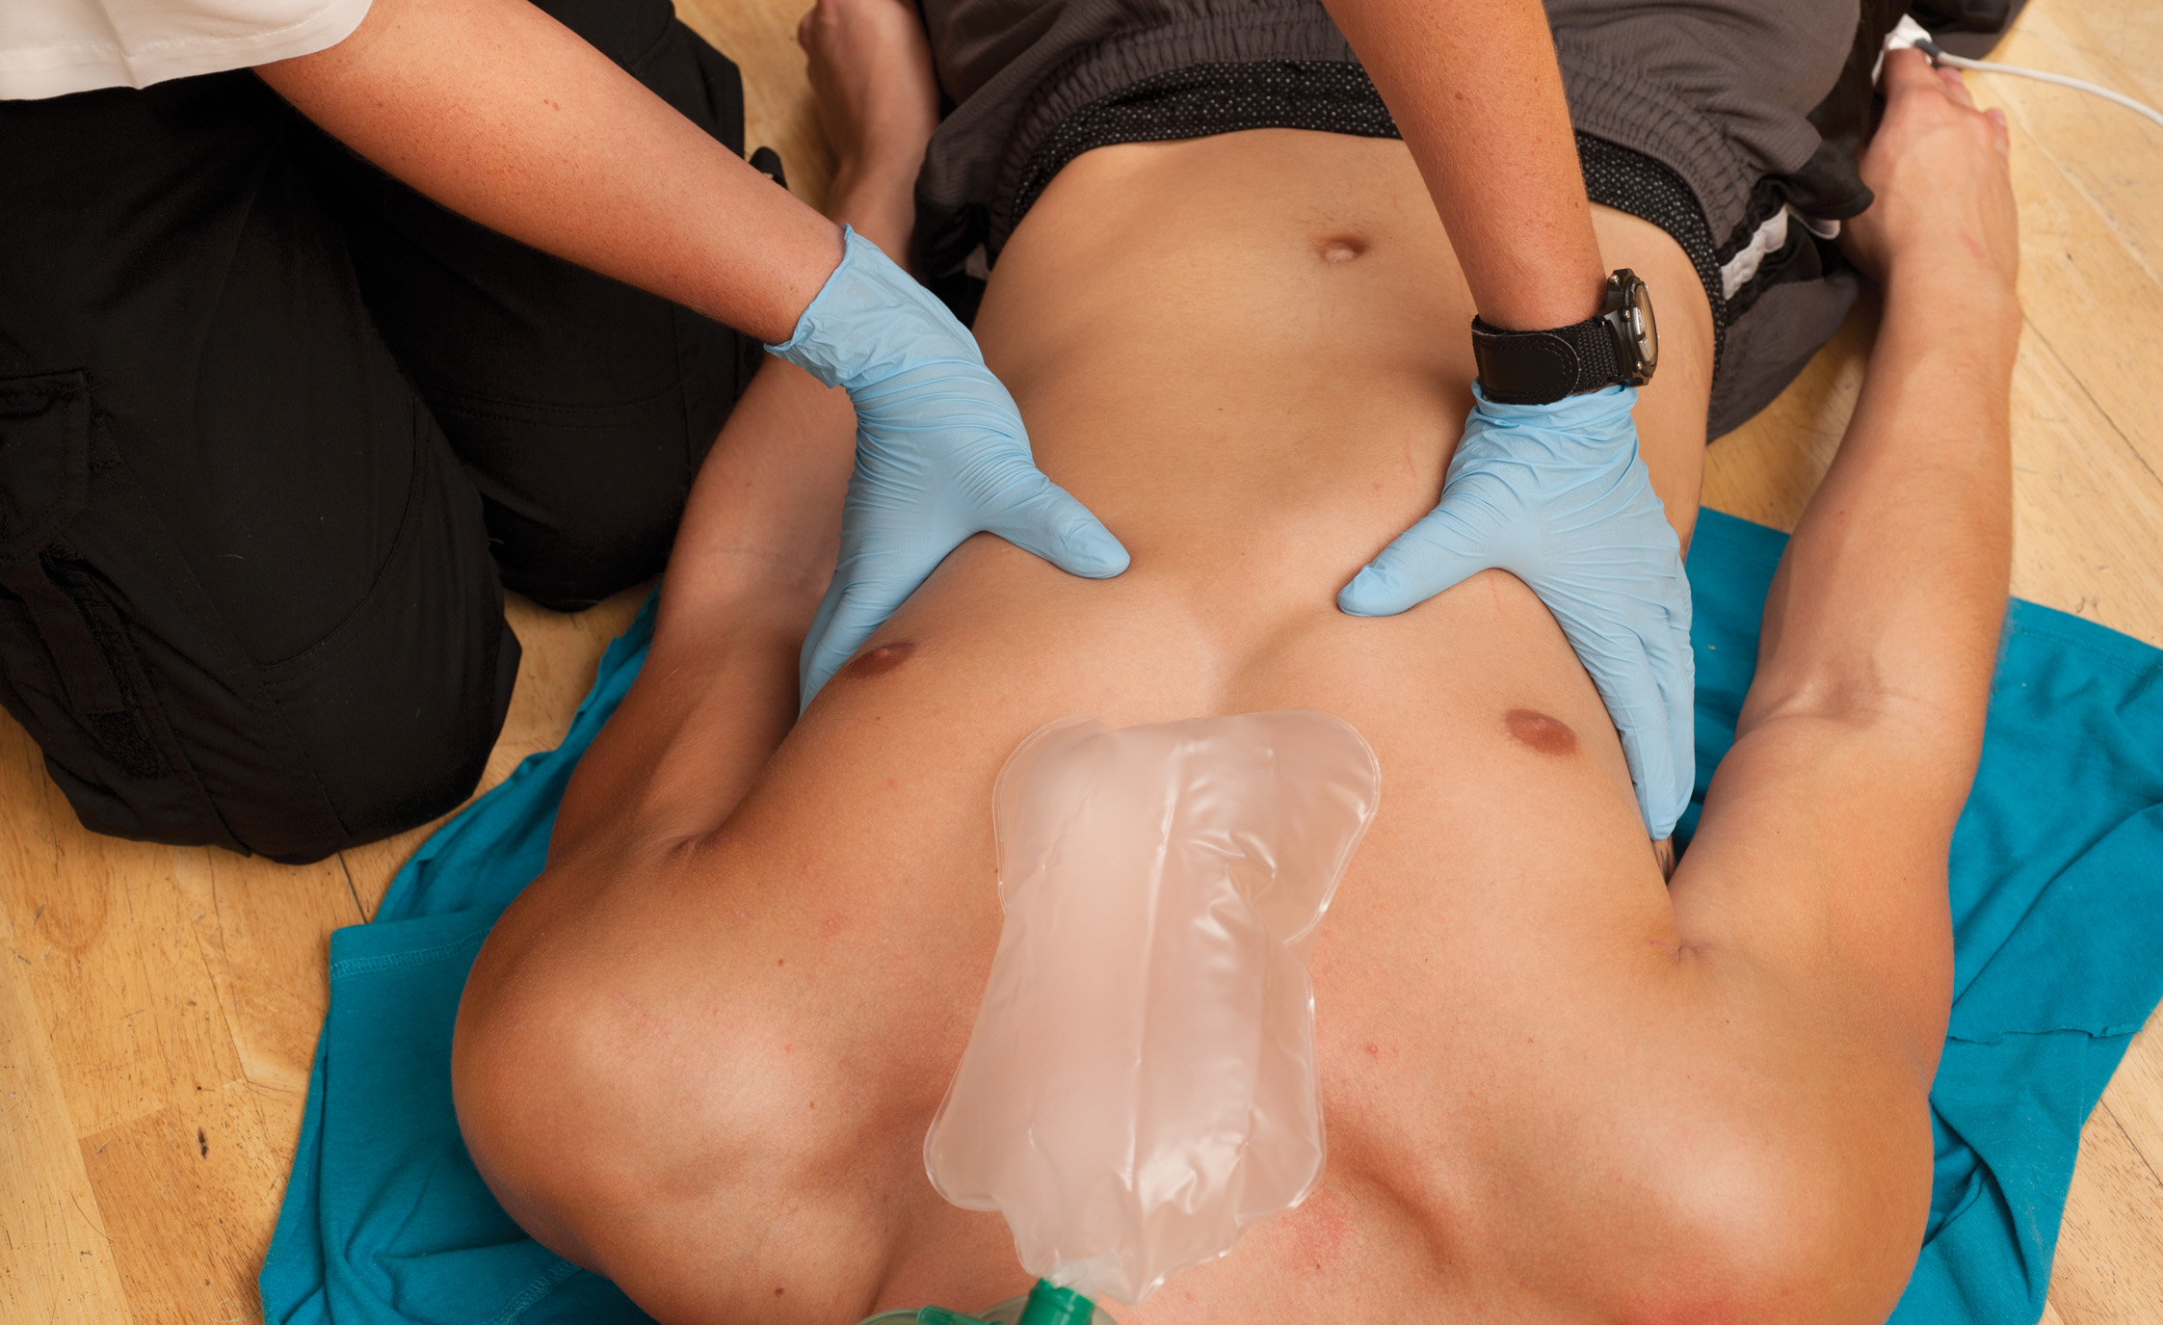
Inspect and Palpate the Entire Chest. Check for Symmetry of Chest Wall Movement. Palpate the Sternum, Clavicles, and Shoulders
Notes:
If an open wound is found, immediately occlude it with a gloved hand and apply a nonporous or occlusive dressing taped on three sides or a commercial occlusive device.
Asymmetrical (uneven) chest wall movement is a sign of a significant chest injury.
Look for any segments of the chest that are moving inward during inspiration and outward during exhalation, opposite to the direction of the rest of the chest. This is paradoxical movement, and is a sign of a flail segment.
Feel the chest to confirm the findings of the inspection.
Inspect and palpate the shoulder girdle (articulation of the clavicle and shoulder), the clavicles (collarbones), and scapulae (shoulder blades) for deformity, crepitation, and tenderness.

Slide 124
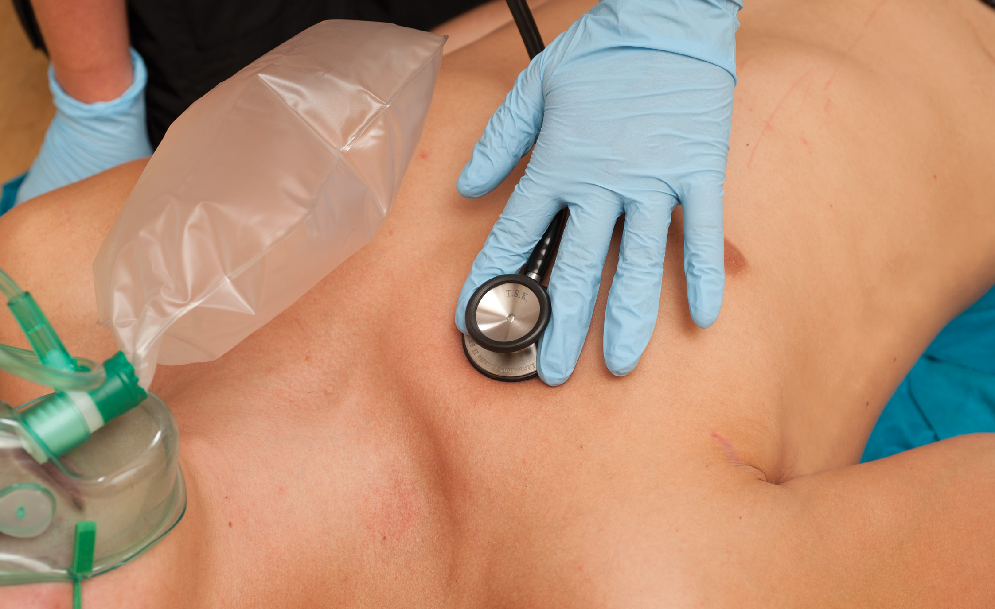
Auscultate Breath Sounds, Comparing One Side to the Other
Notes:
Listen to the chest with your stethoscope to determine whether the breath sounds are present or absent, equal or unequal, and normal or abnormal. Place your stethoscope just below the second rib at the midclavicular line to listen to the apices of the lungs and just below the fourth rib at the midaxillary line for breath sounds in the bases.
Compare the sounds of the lobes on both sides of the chest. Absent or diminished breath sounds are a sign of air, blood, or fluid in the chest cavity or obstruction of a bronchus.
Wheezes indicate narrowing of the airways at the level of the bronchiole associated with asthma, anaphylaxis, emphysema, or chronic bronchitis.
Fluid collection in the lungs produces crackles, a sound sometimes called rales.
Harsher snoring sounds heard upon auscultation, called rhonchi, is from mucus in the larger airways within the lung.
Stridor, a high-pitched sound, is from partial obstruction of the upper airway at the level of the larynx.
Coughing is a response to bronchial irritation. Smoke, chemicals, or other inhaled gases may cause the patient to cough.

Slide 125
Overview of Secondary Assessment (6 of 20)
Performing the Secondary Assessment: An Anatomic Approach
Assess the Abdomen
  Inspect and palpate all four quadrants and laterally.
  Look for distention and discoloration.
  Avoid palpation of pulsating masses.
  Check for signs of peritonitis.
Notes:
A patient with severe abdominal pain will often lie extremely still, draw his knees up toward the chest, and breathe fast and shallowly to reduce the movement of the diaphragm. The condition usually involves irritation of the peritoneum (lining of the abdomen). A patient who is complaining of pain but feels better if he is up and walking may be suffering from a bowel obstruction.

Slide 126
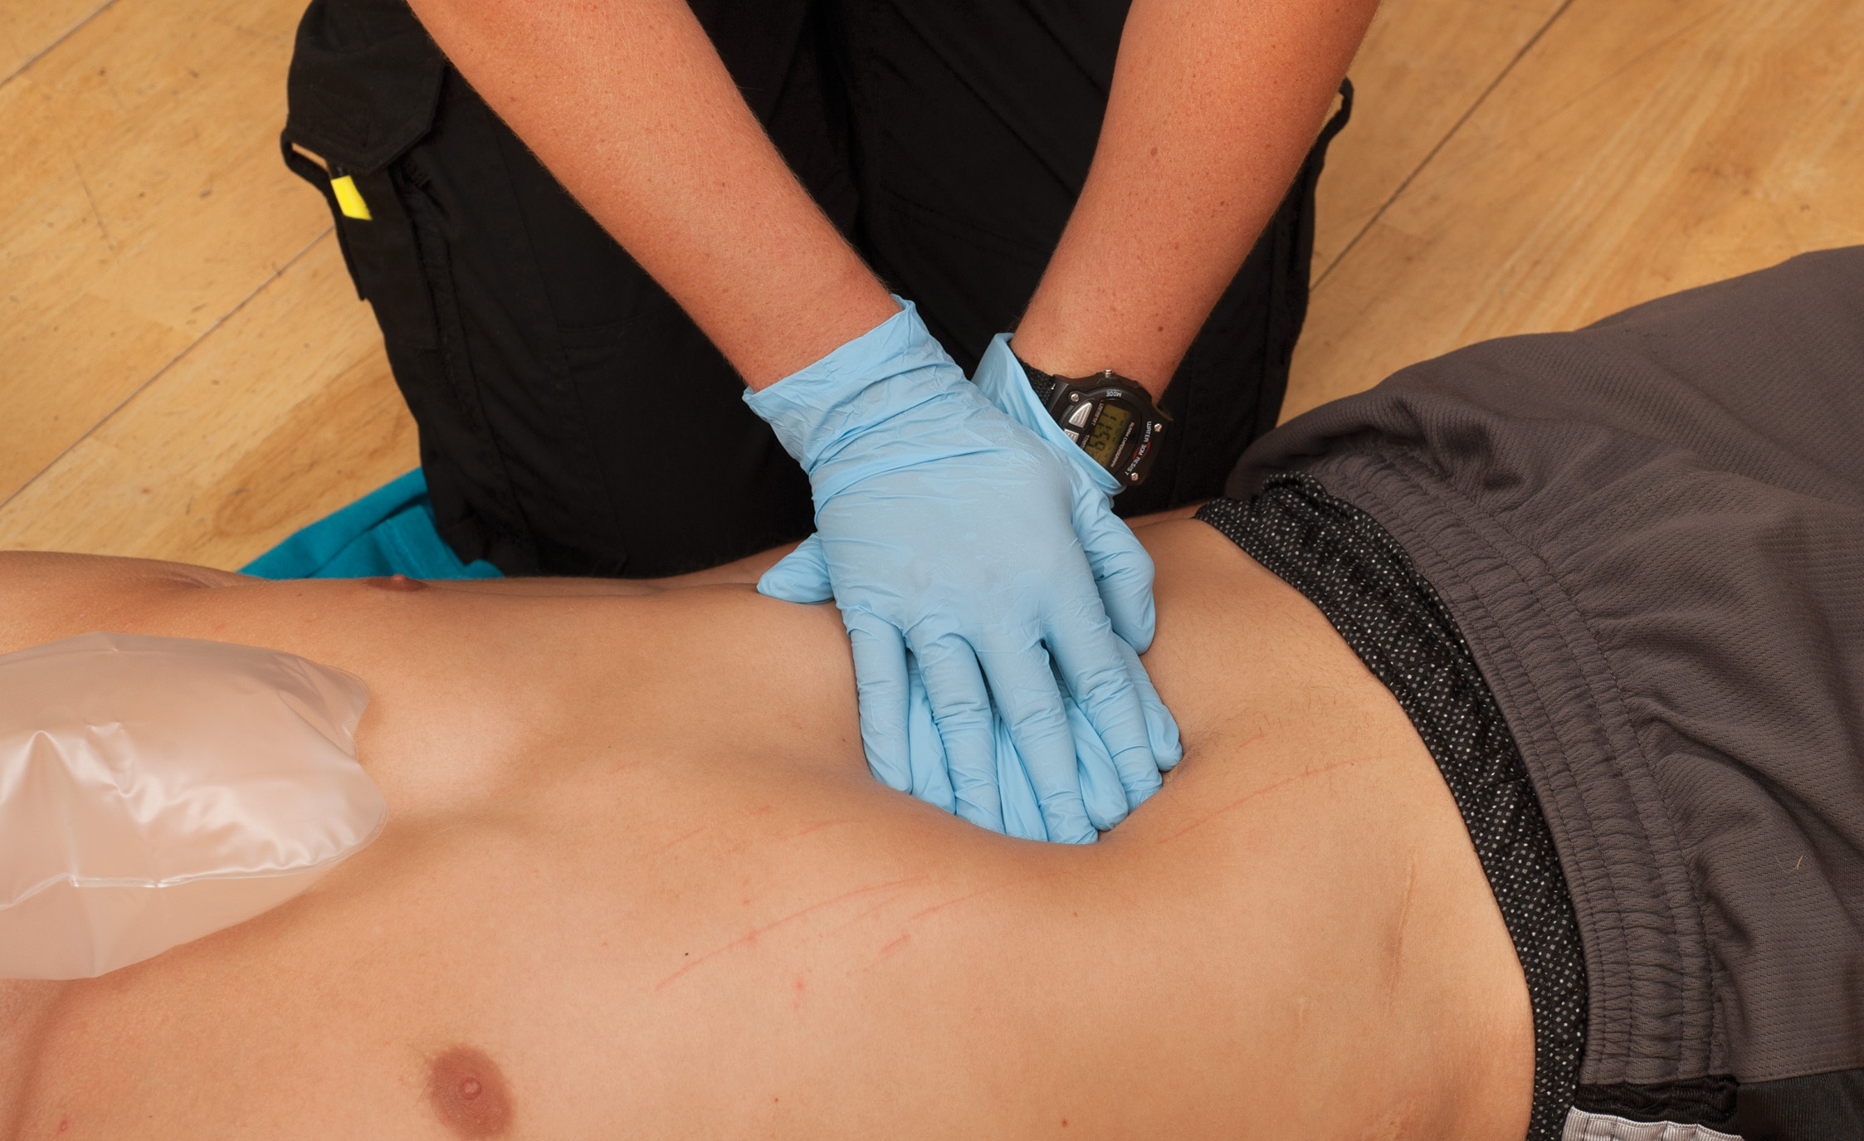
Inspect and Palpate Each Quadrant of the Abdomen. Note Any Guarding, Tenderness, or Rigidity
Notes:
The abdomen could be distended from air, fluid, or blood. If the abdomen appears to be distended, look for signs of poor perfusion and shock. A significant amount of blood must be lost in the abdomen before it distends.
The patient may have a colostomy or ileostomy. This is a surgical opening in the abdominal wall with a bag to hold excretions from the digestive tract. Leave the bag in place and be careful not to displace or cut it.
Palpate all four quadrants of the abdomen separately using the pads of your fingers with one hand on top of the other. Roll the hands across the quadrant to assess for rigidity or stiffness, tenderness or pain, and distention.
A pulsating mass in the abdomen may indicate that .the abdominal aorta is weakened and bulging.
If the abdomen remains rigid, it is a sign of peritonitis.

Slide 127
A Heel-Drop Test is Performed by Having the Patient Stand on the Balls of Her Feet, Then Dropping Suddenly onto Her Heels (1 of 2)
Notes:
The Markle test, also called the heel drop test:
If the patient can stand, have him stand up and get up on the balls of his feet, then suddenly drop down onto his heels. Don’t tell the patient what you are testing for. Watch the patient’s face for a grimace, or note if he complains of pain to the abdomen.

Slide 128
A Heel-Drop Test is Performed by Having the Patient Stand on the Balls of Her Feet, Then Dropping Suddenly onto Her Heels (2 of 2)
Notes:
If the medical patient has pain to the abdomen, this is a positive for rebound tenderness, an indication of peritonitis or other inflammation within the abdomen, such as appendicitis.

Slide 129
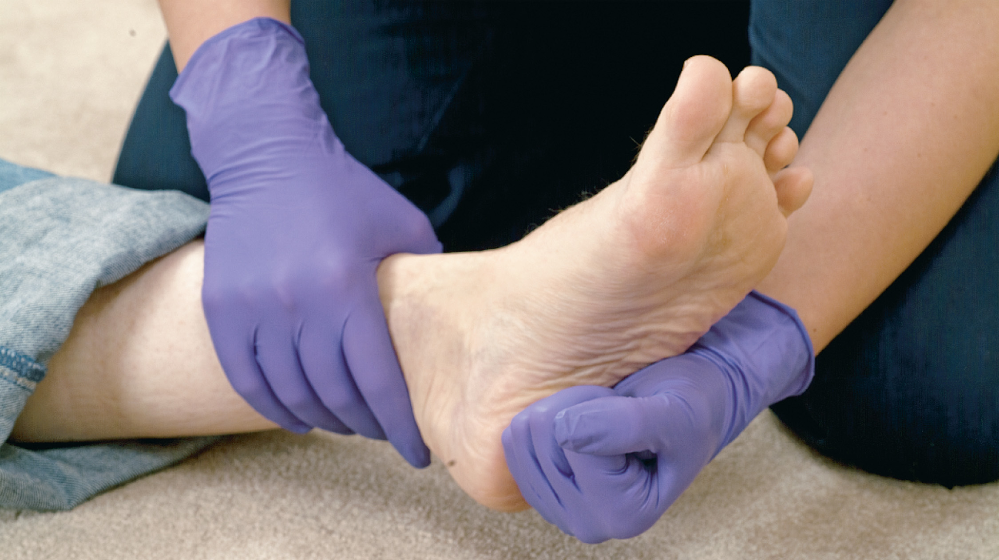
A Heel-Jar Test is Performed by Striking the Bottom of the Heel Forcefully with a Fist
Notes:
Perform a heel jar test if the patient is supine or unable to stand, when you are assessing the lower extremities. Make a fist and strike the bottom of the heel forcefully enough to jar the abdomen. Don’t tell the patient what you are testing for and watch his face for a grimace.

Slide 130
Overview of Secondary Assessment (7 of 20)
Performing the Secondary Assessment: An Anatomic Approach
  Assess the Pelvis
    Pelvic injuries are critical.
    Do not palpate if injuries are obvious.
    Priapism can indicate spinal injury.
Notes:
If the patient has no pain in the pelvic region or is unresponsive, place each hand on the anterior lateral wings of the pelvis and gently compress inward and downward.

Slide 131
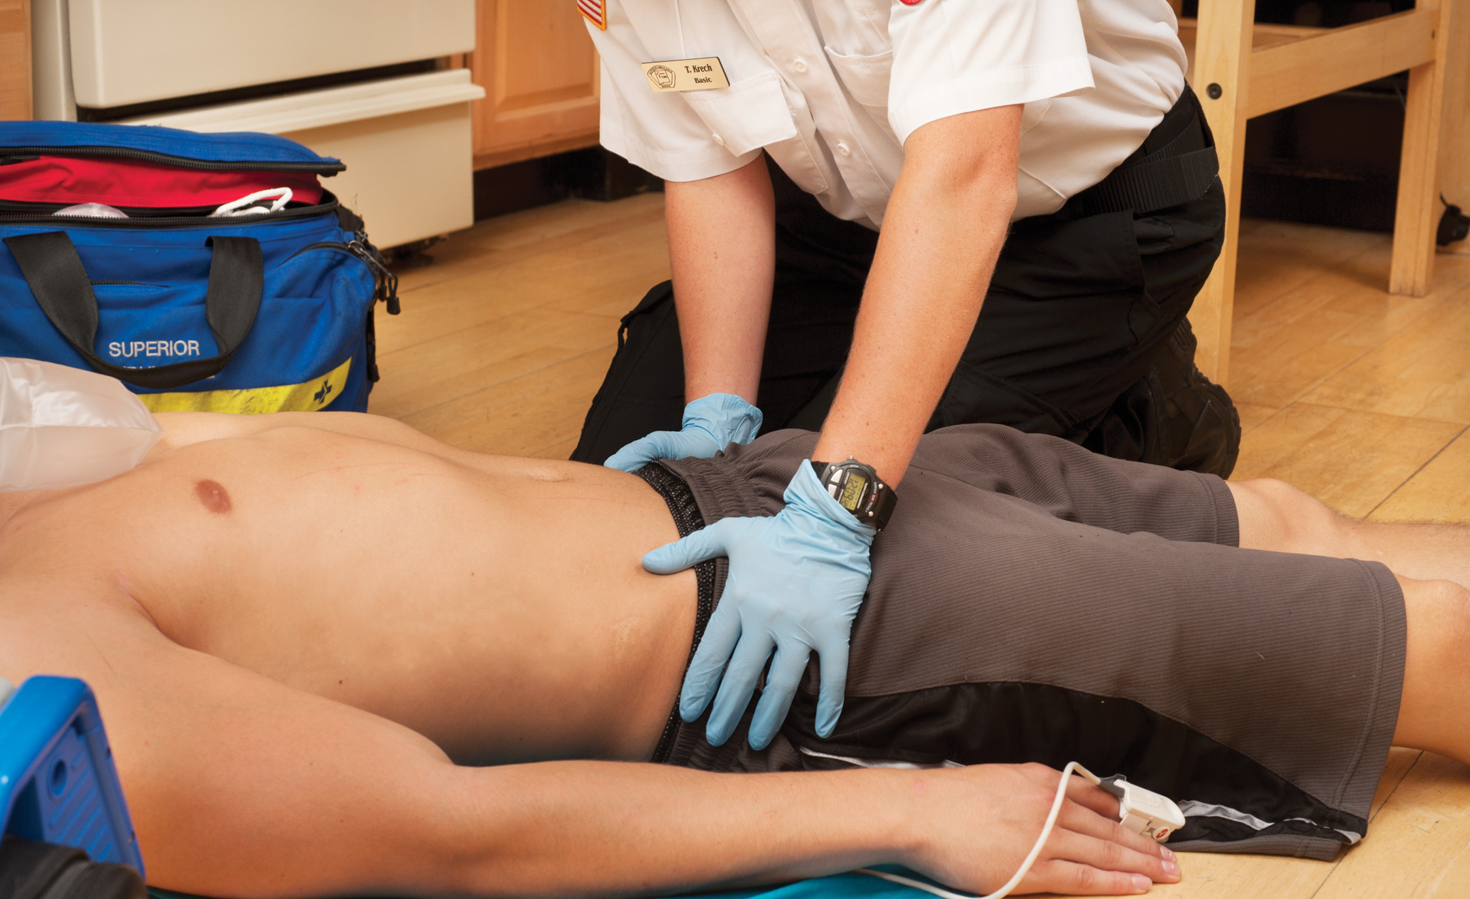
Assess the Stability of the Pelvis in a Patient Who is Unresponsive or Who Has No Noted Pain in That Area
Notes:
Do not rock the pelvis or apply unnecessary pressure. Assess for instability, tenderness, and crepitation. Place the base of your hand on the symphysis pubis (pubic bone), located immediately above the genitalia, and apply gentle pressure backward, checking for tenderness, crepitation, and instability.

Slide 132
Overview of Secondary Assessment (8 of 20)
Performing the Secondary Assessment: An Anatomic Approach
  Assess the Lower Extremities
    Look for signs of injury and edema.
    Check for signs of deep vein thrombosis.
    Check pulse, motor function, and sensation.
Notes:
Look for deformities, contusions, abrasions, punctures, burns, lacerations, or swelling. Watch for abnormal positioning. Injuries to the hip or femur may cause the leg to shorten or rotate inward or outward. In the medical patient, look for excessive swelling around the ankles (peripheral edema). This may be an indication of possible cardiac failure, especially to the right ventricle.

Slide 133
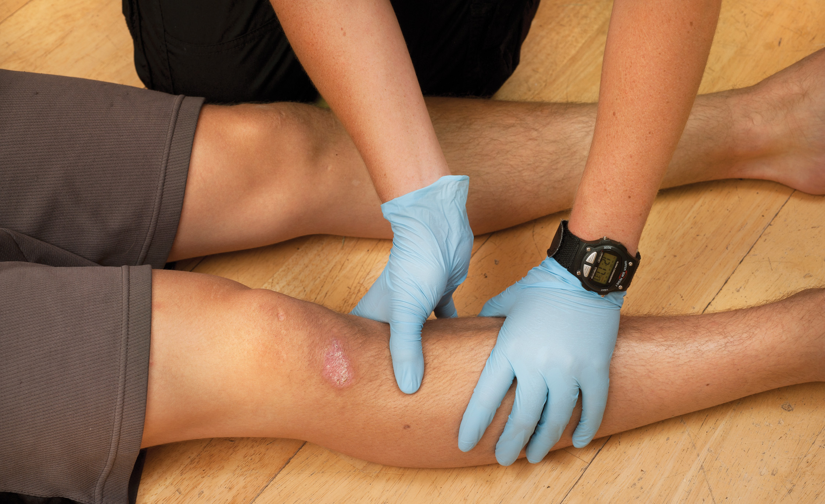
Inspect and Palpate Each Lower Extremity. Look for Signs of Wounds, Bleeding, Deformity, Swelling, and Discoloration
Notes:
Palpate the extremity by placing a hand on each side of the leg with the thumbs anteriorly and touching, if possible, with the little fingers to the posterior. Begin at the level of the groin and palpate down to the feet. The hands should never lose contact with the leg.

Slide 134
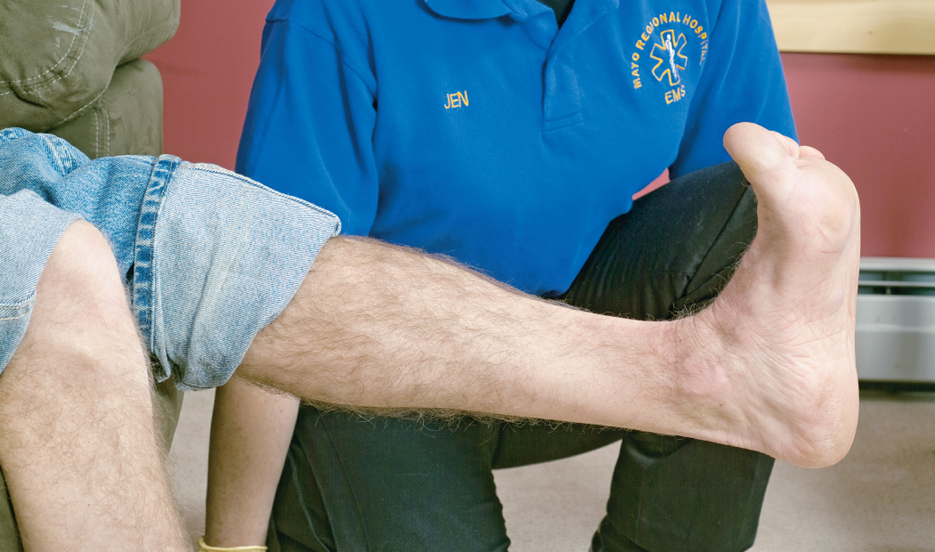
In the Medical Patient, Check for Pain in the Calf During Dorsiflexion and Plantar Flexion
Notes:
This may be an indication of a deep vein thrombosis, and is a significant sign in a patient complaining of shortness of breath or fainting.

Slide 135
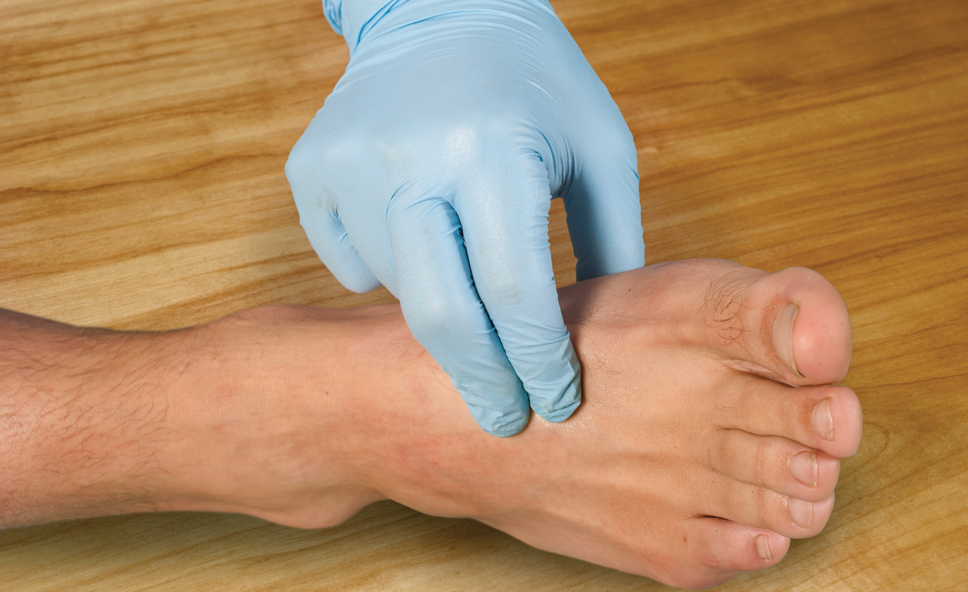
Assess Distal Pulses in Each Lower Extremity. Also Note Skin Color, Temperature, and Condition
Notes:
Assess the dorsalis pedis pulse on the top surface of the foot or the posterior tibial pulse located behind the medial malleolus. Compare the equality of the pulses in the two lower extremities.

Slide 136
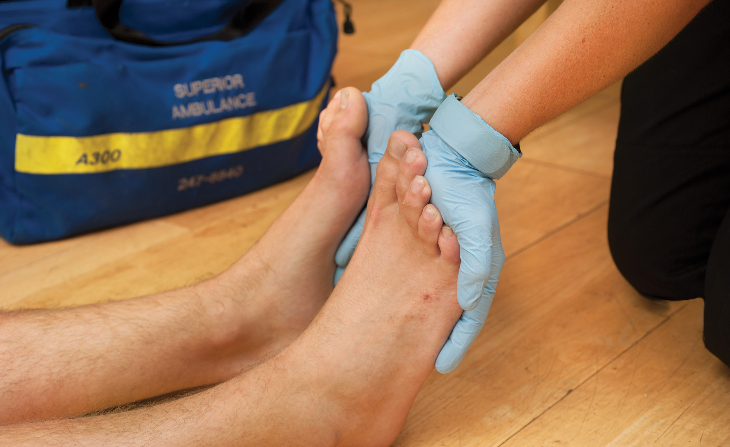
Check Motor Response of Both Lower Extremities by Having the Patient Push Both Feet Against Your Hands. Compare and Note the Equality of Strength
Notes:
Check for equality of strength in the lower extremities by placing your hands on the soles of both feet and having the patient push down against your hands.

Slide 137
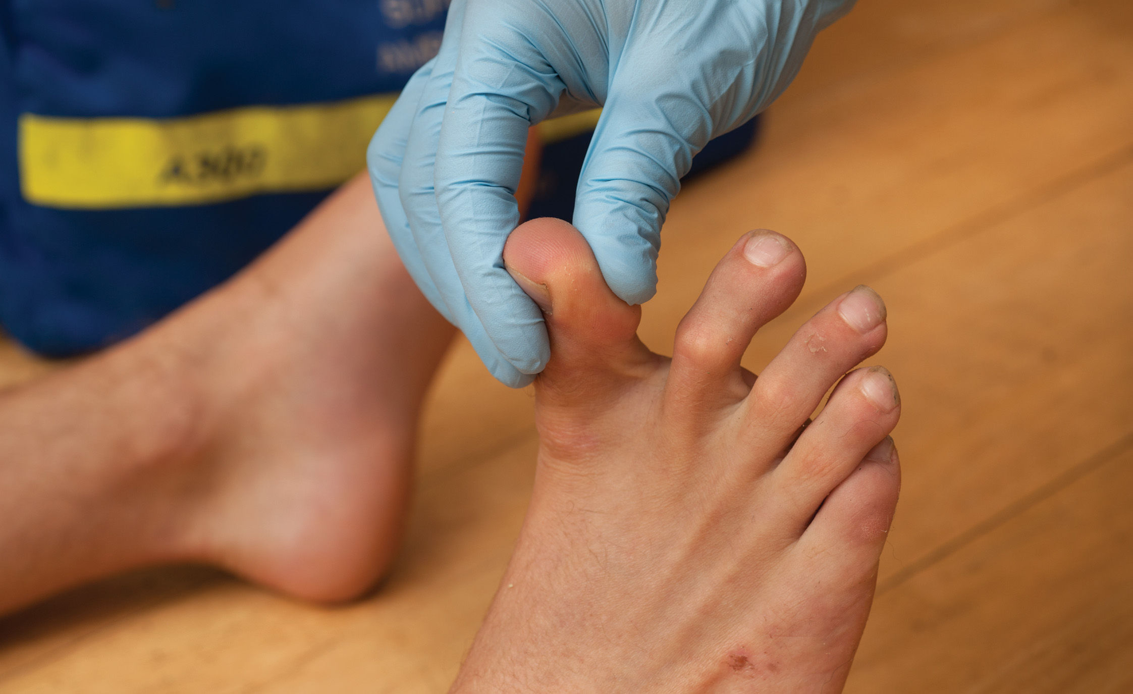
Assess Sensation by First Lightly Touching a Toe and Asking the Patient to Identify Which Toe You Are Touching Then Pinching the Foot to Check for Pain Response
If the patient is unresponsive, pinch the foot and note the patient’s reaction.
Notes:
Begin by lightly touching the toe on one foot and asking the patient to identify which toe you are touching. Then pinch the foot to elicit a pain response. Repeat the same procedure for the opposite foot. It is important to test both light touch and pain, because each stimulus is carried by a different spinal cord nerve tract.

Slide 138
Overview of Secondary Assessment (9 of 20)
Performing the Secondary Assessment: An Anatomic Approach
  Assess Upper Extremities
    Look for signs of injury.
    Check pulses, motor function, and sensation.
    Perform stroke assessment for arm drift.
Notes:
Inspect the upper extremities from the shoulder to the fingertip. Look for deformities, contusions, abrasions, punctures, burns, lacerations, or swelling.
On one side of the body, a patient may be able to move and feel light touch but can feel no pain. On the opposite side, he may be able to feel pain but is unable to feel light touch, or perhaps he can’t move on that side. These findings are consistent with a spinal cord injury that is incomplete, where some nerve tracts are intact and others are not.

Slide 139
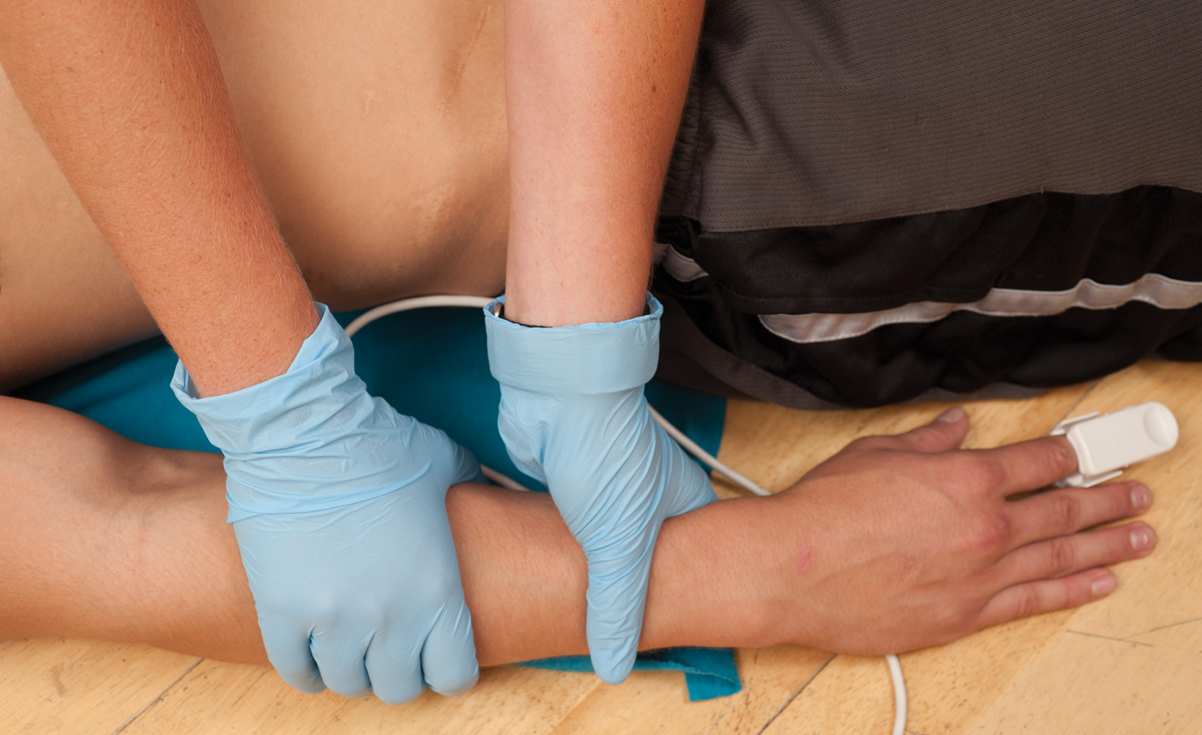
Inspect and Palpate Each Upper Extremity
Notes:
Palpate the entire extremity by placing a hand on each side of the arm with the thumbs touching on the anterior surface. Start at the most proximal portion of the arm and move down to the fingertips.

Slide 140
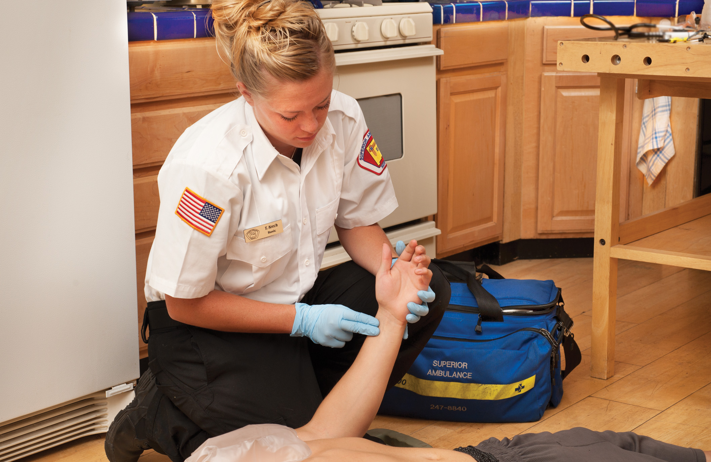
Assess the Radial Pulse on Each Upper Extremity. Note Skin Color, Temperature, and Condition
Notes:
Assess the radial pulse, which is located at the base of the hand at the wrist on the thumb side. Assess the color, temperature, and condition of the hand. Radial pulses may not be felt when there is severe blood loss.

Slide 141
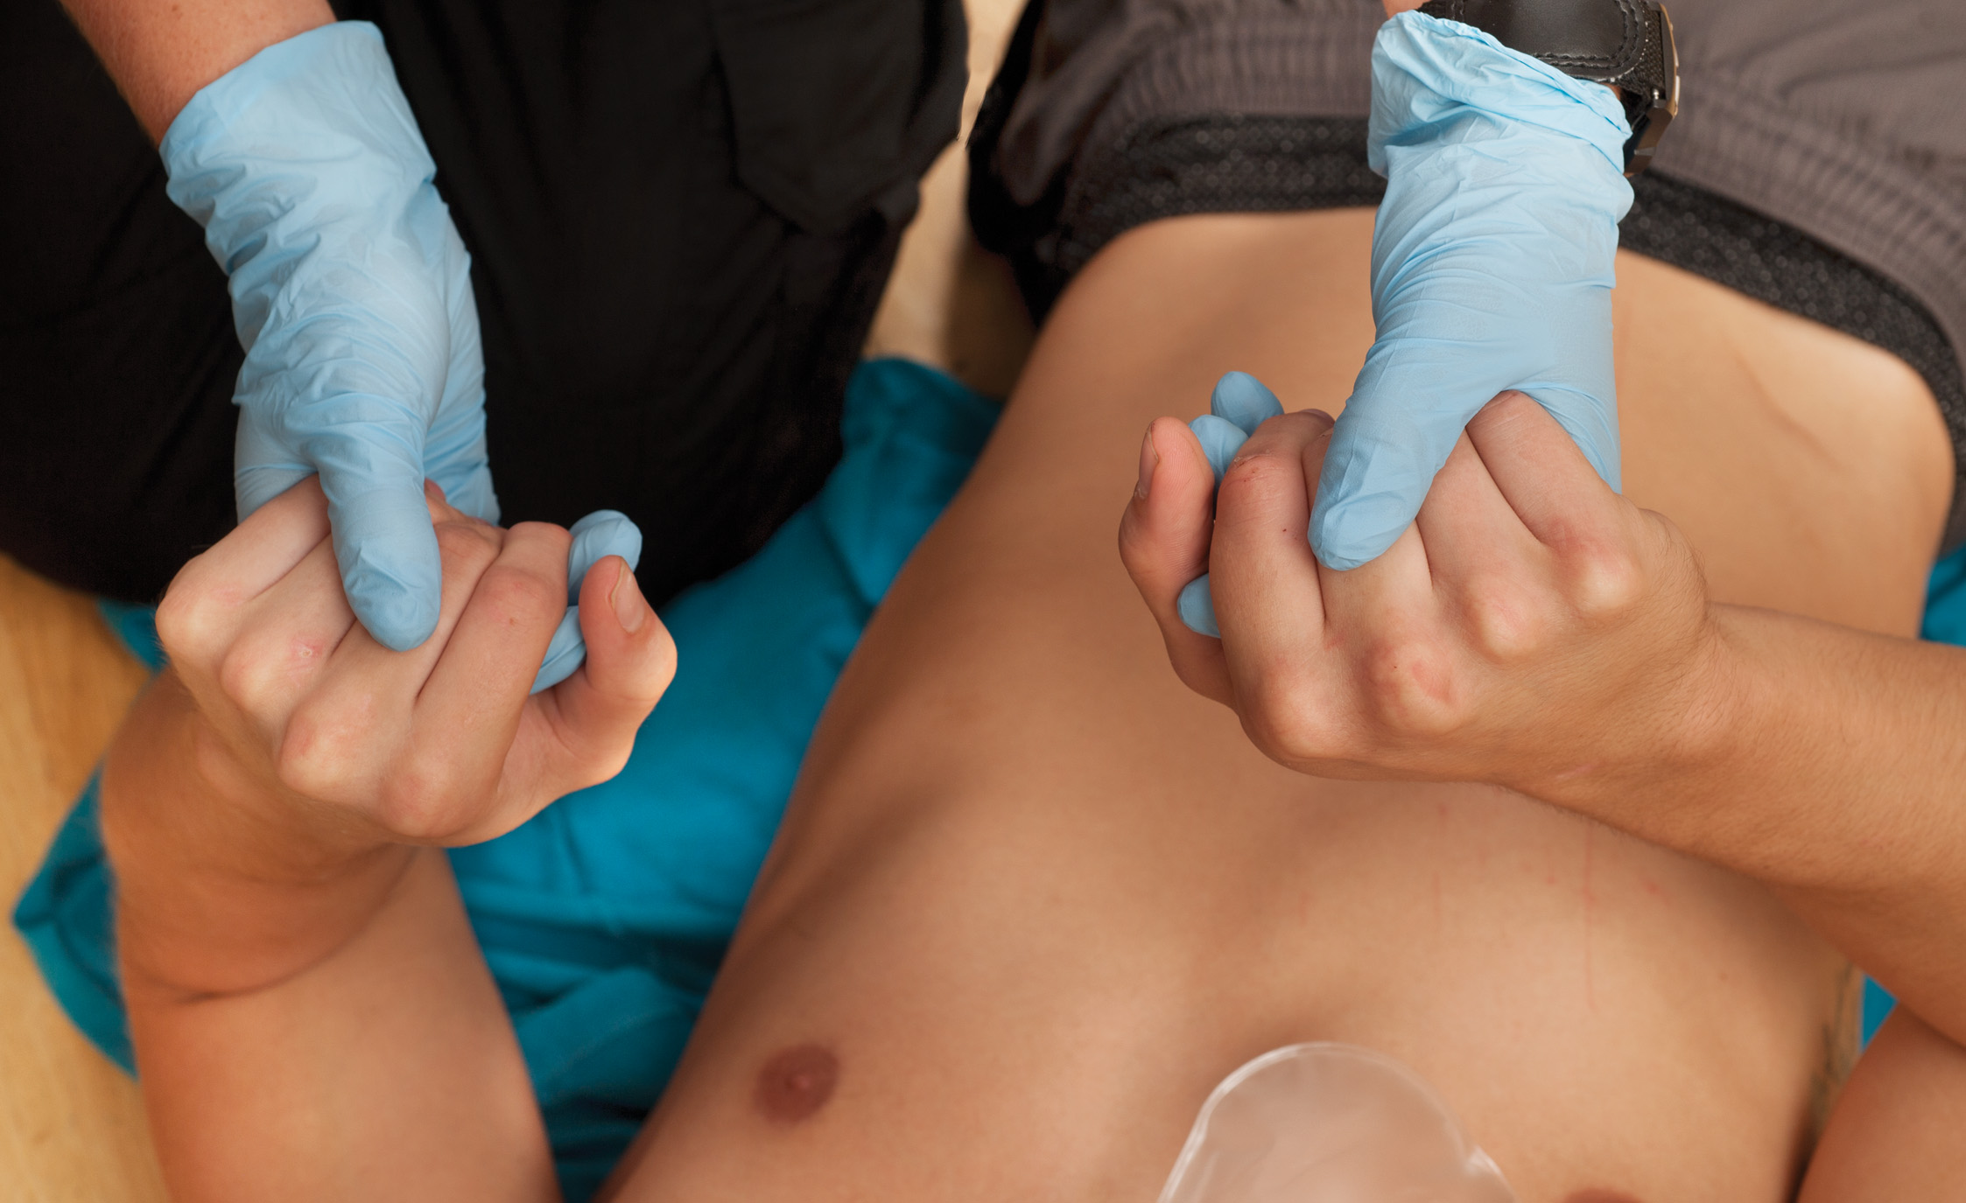
Assess Motor Function by Having the Patient Grip the Fingers of Both Your Hands Simultaneously
Note equality of strength. Assess sensory function by asking the patient to identify which finger you are touching. Then pinch the hand and ask the patient to identify the hand where he feels pain. If the patient is unresponsive, pinch the hand and note the patient’s reaction.
Notes:
Head, spinal, or extremity injuries may cause the grip strength to be unequal. Do not check grip strength in an extremity with obvious injury, as this can cause unnecessary movement.

Slide 142

Have the Patient Close Both Eyes and Hold His Arms Straight out to Check for Arm Drift
Notes:
In the medical patient, have the patient close both eyes and hold his arms straight out in front of him for 10 seconds while seated or standing to assess for arm drift. Check for the following: (1) an arm that drifts downward; (2) the patient can’t lift one arm to the same level as the other; (3) or the patient can’t lift the arm at all.

Slide 143
Overview of Secondary Assessment (10 of 20)
Performing the Secondary Assessment: An Anatomic Approach
  Assess the Posterior Body
    Inspect and palpate the area.
    Include the thorax, lumbar area, buttocks, and lower extremities.
Notes:
If a spinal injury is suspected, spine motion restriction must always be maintained.
While assessing the patient’s back, you may note muscle spasms along the vertebral column. These spasms may occur as a protective reflex to keep the injured or fractured vertebrae stable and in line following an injury.

Slide 144
Overview of Secondary Assessment (11 of 20)
Performing the Secondary Assessment: A Body Systems Approach
  Once a problem has been found, consider all body systems that may be affected.
  It is important to link the body systems together to establish the severity of the condition.
Notes:
The body systems approach will help you link findings from the complete head-to-toe exam that will provide information about the extent of the specific injury and its effects on other body systems.

Slide 145
Overview of Secondary Assessment (12 of 20)
  Performing the Secondary Assessment: A Body Systems Approach
  Respiratory system
    Chest shape and symmetry
    Accessory muscle use
    Auscultation
Notes:
While conducting the head-to-toe exam, you must identify the findings that are related to the body systems and
make the links.

Slide 146
Overview of Secondary Assessment (13 of 20)
  Performing the Secondary Assessment: A Body Systems Approach
  Cardiovascular System
    Peripheral and central pulses
    Blood pressure
Notes:
Rate, rhythm, strength, and location for pulses.
Systolic, diastolic, and pulse pressure for BP.

Slide 147
Overview of Secondary Assessment (14 of 20)
  Performing the Secondary Assessment: A Body Systems Approach
  Neurological System
    Mental status
    Posture and motor activity
    Facial expression
    Speech
    Mood
    Memory
Notes:
AVPU and orientation, posture and arm drift.
Mood (nature, intensity, suicidal ideation)
• Thoughts and perceptions
• Thought process (logic, organization)
• Thought content (unusual, unpleasant)
• Perceptions (unusual, auditory hallucinations, visual hallucinations)

Slide 148

Have the Patient Grin to Check Facial Symmetry
Notes:
Facial expression – anxiety, depression, anger, fear, sadness, pain, facial asymmetry or droop.

Slide 149
Overview of Secondary Assessment (15 of 20)
Performing the Secondary Assessment: A Body Systems Approach
  Musculoskeletal System
    Pelvis
    Lower extremities
    Upper extremities
    Perfusion
    Posterior body
Notes:
Symmetry, tenderness, range of motion, distal pulses, skin color, temperature, sensory and motor function.

Slide 150
Overview of Secondary Assessment (16 of 20)
Assess Vital Signs
  Breathing (rate and tidal volume)
  Pulse (location, rate, strength, regularity)
  Skin (temperature, color, condition)
  Capillary refill
  Blood pressure (systolic, diastolic)
  Pupils (equality, size, rate of reactivity)
  S p O₂
Notes:
The assessment of vital signs will occur at different times depending on if you are dealing with a trauma or medical patient, if the patient is responsive or unresponsive, and if the patient is stable or unstable.

Slide 151
Overview of Secondary Assessment (17 of 20)
Obtain a History
  S – Signs and symptoms
  A – Allergies
  M – Medications
  P – Past medical history
  L – Last oral intake
  E – Events prior to this event
Notes:
You can use whatever approach or technique works for you if you collect the necessary information. The mnemonics tend to keep the EMT from doing a shotgun approach to obtaining a history and allow him to collect the necessary information.

Slide 152
Overview of Secondary Assessment (18 of 20)
  Obtain a History
  O – Onset
  P – Provocation/palliation
  Q – Quality
  R – Radiation
  S – Severity
  T – Time
Notes:
The OPQRST mnemonic is used to further evaluate the chief complaint and other complaints of the patient. As an example, if a patient complains of chest discomfort, shortness of breath, and nausea, the OPQRST mnemonic will be used to further investigate each of the complaints.

Slide 153
Overview of Secondary Assessment (19 of 20)
Secondary Assessment: Trauma Patient
  General Sequence
    Physical exam
    Vital signs
    History
Notes:
Your first decision during the focused history and physical exam will be determining which kind of exam is most appropriate for the patient:
A rapid secondary assessment followed by prompt transport, or on-scene emergency care, or
A modified secondary assessment followed by on-scene emergency care
Teaching Tips
Give examples of how the approach to the secondary assessment is modified according to the patient's needs.
Discussion Question
What are examples of patients who should receive a modified secondary assessment?
Knowledge Application
Give examples of medical complaints and trauma situations and ask students how they would adapt their approach to the secondary assessment in each case.
Critical Thinking Discussion
What additional knowledge will help you determine how to modify the secondary exam for various patients?

Slide 154
Overview of Secondary Assessment (20 of 20)
  Secondary Assessment: Trauma Patient
  Re-evaluate the mechanism of injury as a basis for determining the secondary assessment approach.
Notes:
The kind of physical exam you will conduct is based on the mechanism of injury, the force that caused the injury, and findings in your primary assessment.
Discussion Questions
What are significant mechanisms of injury?
In addition to the significant mechanisms of injury in adults, what are some other considerations for infants and children?
Class Activity
Bring in news stories about injuries from the newspaper or television station web page. Read the stories and have students determine the mechanism of injury.

Slide 155

Steps of the Secondary Assessment for a Trauma Patient

Slide 156
Reevaluate the Mechanism of Injury (1 of 4)
The mechanism of injury is directly related to the potential for critical injuries. The more significant or severe the mechanism of injury, the greater the chance that the patient is critically injured.
Your emergency care is frequently based on the findings of the scene size-up and a high index of suspicion.
Notes:
When there is a significant mechanism of injury, as soon as you have completed the primary assessment and management of immediately life-threatening conditions, you should proceed with a rapid secondary assessment to identify additional serious or potentially life-threatening injuries.

Slide 157
Reevaluate the Mechanism of Injury (2 of 4)
Significant Mechanisms of Injury
  Ejection of the patient from a vehicle.
  Death of a person in the same vehicle as the patient
  A fall of greater than 20 feet
  Rollover of the patient’s vehicle
  High-speed vehicle collision
  12” or more intrusion into the passenger compartment
Notes:
Discuss how each of these mechanisms can result in a critically injured patient. Integrated in kinematics of trauma.

Slide 158
Reevaluate the Mechanism of Injury (3 of 4)
  Significant Mechanisms of Injury
  Pedestrian/bicyclist struck by a vehicle
  Motorcycle crash at greater than 20 milesperhour with the rider leaving the motorcycle
  Blunt or penetrating trauma resulting in an altered mental status
  Vehicle rollover
  Penetrating injury to the head, neck, torso, or extremity above the knee/elbow
Notes:
Discuss how each of these mechanisms can result in a critically injured patient. Integrated in kinematics of trauma.

Slide 159

Significant Mechanisms of Injury Include Rollover of a Vehicle in Which a Patient Was Traveling
Notes:
Discuss how this mechanism can result in a critically injured patient.

Slide 160
Reevaluate the Mechanism of Injury (4 of 4)
Significant Mechanisms of Injury
  Blast injuries from an explosion
  Seat-belt injuries
  Collisions in which seat belts are not worn, even if air bags have deployed
  Impact causing deformity to the steering wheel
  Prolonged extrication
Notes:
Discuss how each of these mechanisms can result in a critically injured patient. Integrated in kinematics of trauma.

Slide 161

Significant Mechanisms of Injury Include Intrusion of Greater
Than 12 inches into the passenger compartment or greater than 18 inches into any site on the vehicle.
(© Mark C. Ide)
Notes:
Discuss how this mechanism can result in a critically injured patient.

Slide 162
Secondary Assessment: Trauma Patient
Significant Mechanisms of Injury Special Considerations for Infants and Children
  Fall >10 feet or 2 to 3 times the height of the child
  Bicycle collision with a motor vehicle
  Pedestrian or occupant in a vehicle collision at a medium speed
  Unrestrained child in a vehicle collision.
Notes:
Additional significant mechanisms of injury for infants and children.

Slide 163
Click on the Situation Below That Best Indicates a Significant Mechanism of Injury
A. Vehicle collision with six inches of intrusion into the passenger compartment
B. A stab wound to the forearm
C. A fall from a three-foot stepladder
D. A bicyclist struck by a vehicle at 20 milesperhour

Slide 164
Rapid Secondary Assessment: Trauma Patient with Significant M O I (Unstable) (1 of 16)
Continue Spine Motion Restriction
  Maintain self-restriction or in-line spinal stabilization until the patient is placed on a backboard or stretcher.
Consider an A L S Request
  Some trauma patients may benefit from A L S at the scene or en route to E D.
Reconsider Transport Decision.
  Look for evidence of critical injury or deterioration.
Notes:
While one EMT performs the rapid secondary assessment, another EMT or assistant should continue to hold the head and neck in a neutral in-line position or have the patient self-restrict until a cervical collar is applied, the patient is placed on the backboard and strapped in place and a head immobilization device is applied, or the patient is secured on the stretcher, depending on your local protocol.
Airway trauma, an occluded airway, or any indication that air from an injured lung is trapped in the chest cavity, causing the uninjured lung and the heart to be compressed (tension pneumothorax), may be reason to consider calling for advanced life support.
Throughout the exam, keep in mind the possibility of immediate transport if evidence of critical injury or deterioration is discovered.

Slide 165
Rapid Secondary Assessment: Trauma Patient with Significant M O I (Unstable) (2 of 16)
Reassess Mental Status.
  A V P U
  Orientation to time, place, person
  Glasgow Coma Scale score
Notes:
To assess the mental status in an unresponsive or deteriorating patient, use the AVPU method.
In an alert patient, assess the level of orientation by asking about the time, place, and person/self:
Do you know what year, month, and day it is?
Can you tell me where you are right now?
Who is this person with you?
What is your full name?
Document precisely the alert patient’s orientation or the nonalert patient’s response to verbal or painful stimuli. This information provides other emergency personnel with criteria to use later to determine whether the patient’s mental status has improved or deteriorated.
The Glasgow Coma Scale (GCS) is used to rank the patient’s level of consciousness by assigning a numeric score from 3 to 15. This scoring tool is used in emergency medical services to identify trends of improvement or deterioration in the mental status of the patient.

Slide 166
Table 13-9 Glasgow Coma Scale (1 of 2)
Eye Opening
Spontaneous | 4
To verbal command | 3
To pain | 2
No response | 1
Verbal Response
Oriented and converses | 5
Disoriented and converses | 4
Inappropriate words | 3
Incomprehensible sounds | 2
No response | 1
Notes:
The GCS score is widely accepted, is reproducible, and can be reported and recorded as evidence of the mental status trending. A GCS score of 8 or less indicates a severe alteration in brain function. A GCS score of 13 or less is an indication for limited on-scene time (less than 10 minutes) and rapid transport.

Slide 167
Table 13-9 Glasgow Coma Scale (2 of 2)
Motor Response
Obeys verbal commands | 6
Localizes pain | 5
Withdraws from pain (flexion) | 4
Abnormal flexion in response to pain (decorticate rigidity) | 3
Extension in response to pain (decerebrate rigidity) | 2
No response | 1
Notes:
The GCS score is widely accepted, is reproducible, and can be reported and recorded as evidence of the mental status trending. A GCS score of 8 or less indicates a severe alteration in brain function. A GCS score of 13 or less is an indication for limited on-scene time (less than 10 minutes) and rapid transport.

Slide 168
Table 13-10 Pediatric Glasgow Coma Scale (1 of 2)
Blank | Blank | >1 Year | <1 Year
Eye Opening | 4 | Spontaneous | Spontaneous
Eye Opening | 3 | To verbal command | To shout
Eye Opening | 2 | To pain | To pain
Eye Opening | 1 | No response | No response
Best Motor Response | 6 | Obeys | Blank
Best Motor Response | 5 | Localizes pain | Localizes pain
Best Motor Response | 4 | Flexion-withdrawal | Flexion-withdrawal
Best Motor Response | 3 | Flexion-abnormal (decorticate rigidity) | Flexion-abnormal (decorticate rigidity)
Best Motor Response | 2 | Extension (decerebrate rigidity) | Extension (decerebrate rigidity)
Best Motor Response | 1 | No response | No response
Notes:
Patients with patterns of responsiveness followed by loss of responsiveness need close monitoring.

Slide 169
Table 13-10 Pediatric Glasgow Coma Scale (2 of 2)
Blank | Blank | >5 Years | 2–5 Years | 0–23 Months
Best Verbal Response | 5 | Oriented and converses | Appropriate words and phrases | Smiles, coos, cries appropriately
Best Verbal Response | 4 | Disoriented and converses | Inappropriate words | Cries
Best Verbal Response | 3 | Inappropriate words | Cries and/or screams | Inappropriate crying and/or screaming
Best Verbal Response | 2 | Incomprehensible sounds | Grunts | Grunts
Best Verbal Response | 1 | No response | No response | No response
Notes:
Patients with patterns of responsiveness followed by loss of responsiveness need close monitoring.

Slide 170
Rapid Secondary Assessment: Trauma Patient with Significant M O I (Unstable) (3 of 16)
Perform a Rapid Secondary Assessment
  Identify signs and symptoms of potentially life-threatening injuries.
    Inspect
    Palpate
    Auscultate
    Listen
    Smell
Notes:
Inspect (look) for deformities, contusions (bruises), abrasions, punctures, penetrating wounds, burns, lacerations, swelling, unusual chest wall movements, angulated extremities, bleeding, discoloration, open wounds, and significant bleeding.
Palpate (feel) for tenderness, deformities, swelling, masses, muscle spasms, skin temperature, and pulsations. When palpating for tenderness (pain on palpation) in the unresponsive patient, watch the patient’s face for grimacing. This provides a good indication that tenderness is present without the patient being able to tell you.
Auscultate (listen with a stethoscope) for presence and equality of breath sounds.
Listen for sucking sounds, gurgling, stridor (high-pitched sound of the upper airway), and crepitation (grating sound heard when broken bone ends rub against each other, or a crackling sound caused by air under the skin).
Use your sense of smell to detect any unusual odors on the patient’s breath, body, or clothing, such as alcohol, feces, or urine.

Slide 171
E M T Skills 13-4
Common Signs of Trauma

Slide 172

Deformities
(© Edward T. Dickinson, M D)
Notes:
A distracting injury such as an extremity fracture, may cause the patient to not complain of more significant or critical injuries, such as a knife wound to the chest.

Slide 173

Contusions
(© Edward T. Dickinson, M D)
Notes:
Look for deformity, contusions, and swelling.

Slide 174
Abrasions
(© David Effron, M D)
Notes:
Look for abrasions.

Slide 175
Punctures/Penetrations
(© Edward T. Dickinson, M D)
Notes:
If a patient has a distracting injury, expose him completely to assess for other, more potentially life-threatening injuries that he may not be complaining about.

Slide 176

Burns
(© Edward T. Dickinson, M D)
Notes:
Partial thickness burns.

Slide 177

Swelling (1 of 2)
(© Edward T. Dickinson, M D)
Notes:
Swelling (edema).

Slide 178

Lacerations
(© Edward T. Dickinson, M D)
Notes:
Look for deformities, contusions, abrasions, punctures, burns, lacerations, or swelling. Large lacerations of the neck must be covered with an occlusive dressing to prevent air being sucked into a large vein, causing an air embolus.

Slide 179
Swelling (2 of 2)
Notes:
Look at the abdomen for signs of swelling or distention. The abdomen could be distended from air, fluid, or blood. If the abdomen appears to be distended, look for signs of poor perfusion and shock. A significant amount of blood must be lost in the abdomen before it distends.

Slide 180
Rapid Secondary Assessment: Trauma Patient with Significant M O I (Unstable) (4 of 16)
Perform a Rapid Secondary Assessment
  Assess the Head
    Critical findings include:
      Trauma with altered mental status
      Unequal or unresponsive pupils
      Cerebrospinal fluid in the ears or nose
      Blood, secretions, vomitus, teeth, bones, or debris in the mouth.
Notes:
The rapid secondary assessment is performed in a systematic sequence to ensure that all major body areas are inspected and palpated.
If a patient has unequal pupils but is alert and oriented, the unequal pupils are probably not from a head injury.

Slide 181
Critical (Unstable) Findings: The Head
Critical Finding: | Trauma to the head or face with altered mental status Unequal pupils Fixed pupils Cerebrospinal fluid leaking from ears, nose, or mouth
Possibility: | Head injury
Emergency Care: | Establish an airway, begin positive pressure ventilation at 10–12/minute if the respiratory rate or tidal volume is inadequate, and administer oxygen.
Critical Finding: | Blood, secretions, vomitus, teeth, bones, or other debris in the mouth
Possibility: | Airway obstruction
Emergency Care: | Suction the mouth and nose. If necessary, logroll the patient onto his side to clear the airway if heavy vomitus or clotted blood is present.
Notes:
Review why these findings result in a critical patient and overview basic management.

Slide 182
E M T Skills 13-5
The Rapid Secondary Assessment for the Trauma Patient

Slide 183

Inspect and Palpate the Scalp and Skull
Notes:
Inspect the scalp and skull for obvious deformities, contusions, abrasions, punctures, burns, lacerations, swelling, depressions, protrusions, impaled objects, or bleeding. Palpate for crepitation (grating sound or feeling resulting from fractured bone ends rubbing together), depressions, protrusions, swelling, bloody areas, instability, or lack of symmetry.
Palpate the scalp and skull by cupping your hands and moving from the frontal region to the back of the
skull. Do not poke with your fingers.
Assess for signs of brain herniation and treat the patient aggressively. Signs of brain herniation include a severely altered mental status, abnormal posturing (flexion or extension), fixed pupils, or unequal pupils. If the patient has a suspected head injury, is displaying signs of herniation, and is breathing inadequately, an airway must be established and the patient artificially ventilated at a rate of 10 to 12 ventilations per minute.

Slide 184

Inspect and Palpate the Face, Including Ears, Pupils, Nose, and Mouth
Pay particular attention to injuries that could block the airway with blood, bone, teeth, or tissue.
Notes:
Look for evidence of trauma and bleeding that may be obstructing the airway. Look for deformities, contusions, abrasions, penetrating wounds, lacerations, swelling, or other evidence of trauma. Palpate for deformities, instability, and swelling.
Injuries to the face may occlude the airway or increase the risk of aspiration of blood.
Do not use a nasopharyngeal airway when injuries to the midface are present.

Slide 185
Rapid Secondary Assessment: Trauma Patient with Significant M O I (Unstable) (5 of 16)
Perform a Rapid Secondary Assessment
  Assess the Neck
    Critical findings include:
      Jugular vein distention
      Tracheal deviation or tugging.
  Apply a Cervical Collar
    Apply if spinal injury is suspected.
    If applied prior to your arrival, do not remove.
Notes:
If the patient has neck veins that are flat in a supine position, it may indicate a decreased blood volume from bleeding. If the neck veins are engorged more than two-thirds the distance from the base of the neck to the angle of the jaw, they are considered distended. In trauma, JVD (jugular vein distention) is a sign of a serious injury to the chest, lungs, or heart.
A trachea shifted to one side is a late indication of a significant amount of air trapped in the pleural space of the chest cavity, the result of a severe lung or chest injury. The trachea will deviate away from the injured side.

Slide 186
Critical (Unstable) Findings: The Neck
Critical Finding: | J V D with a patient at a 45° angle or excessively engorged jugular veins
Possibility: | Injury to heart (pericardial tamponade) or lungs (tension pneumothorax) or poor heart function
Emergency Care: | Rapid transport upon recognition. Consider A L S intercept. Establish an airway, begin positive pressure ventilation (P P V) at 10–12/minute if the respiratory rate or tidal volume is inadequate, and administer oxygen. Caution: Aggressive P P V may worsen a lung injury.
Critical Finding: | Tracheal deviation
Possibility: | Lung injury with excessive buildup of pressure in the pleural space (tension pneumothorax)
Emergency Care: | Rapid transport upon recognition. Consider A L S intercept. Establish an airway, begin positive pressure ventilation at 10–12/minute if the respiratory rate or tidal volume is inadequate, and administer oxygen. Caution: Aggressive P P V may worsen a lung injury.
Critical Finding: | Tracheal tugging
Possibility: | Blockage of the airway, usually at the level of the bronchi
Emergency Care: | Rapid transport upon recognition. Consider A L S intercept. Establish an airway, begin positive pressure ventilation at 10–12/minute if the respiratory rate or tidal volume is inadequate, and administer oxygen.
Notes:
Review why these findings result in a critical patient and overview basic management.

Slide 187

Inspect the Neck for Tracheal Deviation, Tracheal Tugging, Jugular Vein Distention, Subcutaneous Emphysema, and Large Lacerations or Punctures
Notes:
A trachea shifted to one side is a late indication of a significant amount of air trapped in the pleural space of the chest cavity, the result of a severe lung or chest injury.
Inspect the neck for evidence of subcutaneous emphysema. Subcutaneous emphysema is air trapped under the lower layer of the skin.

Slide 188

Jugular Vein Distention
Notes:
The jugular veins drain downward into the superior vena cava and into the right side of the heart. If the right side of the heart is not able to off-load the blood effectively, if the heart is being compressed and not able to fill completely, or if the superior vena cava is kinked or compressed, the pressure and volume of blood inside the jugular vein increase and produce the distended appearance.

Slide 189

Palpate Both the Anterior and Posterior Aspects of the Neck. Note Posterior Muscle Spasms That May Indicate Injury to the Cervical Spine
Notes:
Note any muscle spasms in the posterior cervical region. Muscle spasms occur in cervical injuries as a protective reflex to maintain support. Thus, a patient complaining of muscle spasms anywhere along the vertebral (spinal) column who has a mechanism of injury consistent with vertebral injury needs spine motion restriction.

Slide 190

Apply a Cervical Collar if Needed and Not Already Done During or After the Primary Assessment
Notes:
If Emergency Medical Responders or other EMTs have already applied a cervical collar prior to your arrival during the primary assessment, do not remove it to assess the neck.

Slide 191
Rapid Secondary Assessment: Trauma Patient with Significant M O I (Unstable) (6 of 16)
Perform a Rapid Secondary Assessment
  Assess the Chest
    Critical findings include:
      Open wound
      Paradoxical movement
      Absent or decreased breath sounds
      Poor chest wall movement.
Notes:
The chest contains many organs that, if injured, can result in a critical patient.

Slide 192

Expose the Chest. Inspect and Palpate for Open Wounds, Flail Segments, Muscle Retractions, and Asymmetrical Chest Movement
Notes:
An open wound to the chest may indicate a pneumothorax.
Flail segments indicate the fracture of two or more adjacent ribs in two or more places.
Poor chest wall movement may indicate collapse of one or both lungs, tension pneumothorax, severe chest wall pain or injury to the diaphragm.

Slide 193

Perform a Quick Four-Point Auscultation of the Chest to Listen for the Presence and Equality of Breath Sounds
Notes:
Absent or severely decreased breath sounds may indicate lung injury with excessive buildup of pressure in the pleural space (possible tension pneumothorax).

Slide 194
Rapid Secondary Assessment: Trauma Patient with Significant M O I (Unstable) (7 of 16)
Assess the Abdomen
  Critical findings include:
    Severe abdominal pain
    Tenderness on palpation
    Discoloration
    Rigidity
    Distention
    Protruding organs.
Notes:
For critical findings, provide rapid transport upon recognition. Establish an airway, begin positive pressure ventilation at 10–12/minute if the respiratory rate or tidal volume is inadequate, and administer oxygen.
For an evisceration, do not replace the organs. Rinse with sterile water or saline. Apply a wet sterile dressing and cover that dressing with a large occlusive dressing. Provide rapid transport. Establish an airway and administer oxygen. Begin positive pressure ventilation at 10–12/minute if the respiratory rate or tidal volume is inadequate.

Slide 195
Critical (Unstable) Findings: The Abdomen
Critical Finding: | Severe abdominal pain Abdominal tenderness on palpation Discoloration of the abdomen, especially in the flank areas or around the navel Abdominal rigidity (contracted abdominal muscles) Distended abdomen
Possibility: | Bleeding within the abdominal cavity and obstruction of the gastrointestinal tract Irritation of the lining of the abdomen (peritonitis)
Emergency Care: | Rapid transport upon recognition. Establish an airway, begin positive pressure ventilation at 10–12/minute if the respiratory rate or tidal volume is inadequate, and administer oxygen.
Critical Finding: | Organs protruding from an abdominal laceration
Possibility: | Abdominal evisceration
Emergency Care: | Do not replace the organs. Rinse with sterile water or saline. Apply a wet sterile dressing. Cover that dressing with a large occlusive dressing. Rapid transport. Establish an airway. Administer oxygen. Begin positive pressure ventilation at 10–12/minute if the respiratory rate or tidal volume is inadequate.
Notes:
Different signs and symptoms are produced by internal bleeding and by the spilled contents of ruptured organs. Blood in the abdominal cavity is not irritating and will not produce serious pain, but it will cause the abdomen to become rigid or stiff. However, the peritoneum (abdominal lining) has several sensory nerves that typically respond quickly and severely to irritating substances leaking from organs. Bleeding can occur behind the lining of the abdomen (retroperitoneal space). Because there are not many nerves located in this area, the bleeding and injury can be easily missed.

Slide 196

Inspect the Abdomen for Any Evidence of Trauma or Distention. Palpate for Tenderness and Rigidity
Notes:
Tenderness is a pain response elicited when the abdomen is palpated. If the patient is unresponsive, watch his face for a grimace while palpating. This indicates pain on palpation. When palpating, feel if the abdomen is firm or soft. A firm or rigid abdomen is due to guarding. This is an indication of organ injury or irritation of the abdominal lining. A soft abdomen is a normal finding.

Slide 197
Rapid Secondary Assessment: Trauma Patient with Significant M O I (Unstable) (8 of 16)
Assess the Pelvis
  Critical findings include:
    Pain without palpation
    Tenderness or instability on palpation.
  Assess the Extremities
    Critical findings include:
      Open wound with rapid blood loss
      Deformity to the thigh with pain, swelling and tenderness.
Notes:
For critical findings in the pelvis, provide rapid transport. Administer oxygen. Establish an airway and begin positive pressure ventilation at 10–12/minute if the respiratory rate or tidal volume is inadequate. Stabilize the pelvis and splint with a commercial or improvised device.
Check distal pulses in all extremities. In the lower extremities, check the dorsalis pedis pulse. Another distal pulse that could be assessed in the lower extremities is the posterior tibial pulse.
If the patient can obey commands, ask the patient to wiggle his toes and squeeze your fingers.
In a responsive patient, touch a finger on one hand and ask the patient to identify which finger you are touching. Then, pinch the hand and ask the patient to identify the extremity with pain.
For critical findings, apply direct pressure to the wound. Apply pressure dressing. If not controlled with direct pressure, apply a tourniquet. Provide rapid transport and administer oxygen.
For a fractured femur apply a traction splint. Rapid transport. Administer oxygen.

Slide 198

Inspect the Pelvis for Evidence of Trauma. If the Patient Complains of Pain or There Is Obvious Deformity, Do Not Palpate
Notes:
If the patient is unresponsive, watch his face for a grimace while palpating. This indicates pain on palpation. When palpating, feel if the abdomen is firm or soft.

Slide 199

Inspect and Palpate Each Lower Extremity
Notes:
If the thigh is painful, swollen, or deformed and a femur fracture is suspected, place the patient on a backboard or vacuum mattress, transfer the patient to the stretcher, and initiate prompt transport.

Slide 200

Assess Pedal Pulses
Notes:
Check distal pulses in all extremities. In the lower extremities, check the dorsalis pedis pulse. This is the pulse that is located on the top of the foot approximately midway between the toes and the ankle on the big toe side.

Slide 201

Assess Motor and Sensory Function in Each Foot
Notes:
Ask the patient to wiggle his toes and squeeze your fingers.
Test both light touch and pain, because each of these stimuli is carried by a different nerve tract in the spinal cord.

Slide 202

Assess and Palpate Each Upper Extremity
Notes:
Inspect and palpate the extremities for deformities, contusions, abrasions, penetrations, burns, tenderness, lacerations, swelling or any other evidence of trauma.

Slide 203
Rapid Secondary Assessment: Trauma Patient with Significant M O I (Unstable) (9 of 16)
Assess the posterior body
  Critical findings include:
    Open wound to posterior thorax
    Open wound with spurting or steady blood loss.
Notes:
Occlude the open wound immediately with a gloved hand and then with a nonporous dressing or occlusive dressing taped on three sides. Provide rapid transport upon recognition. Consider ALS intercept. Establish an airway, begin positive pressure ventilation if the respiratory rate or tidal volume is inadequate, and administer oxygen. Aggressive PPV may worsen a lung injury.
For a hemorrhage, apply direct pressure to the wound. Apply a pressure dressing if possible. Provide rapid transport administer oxygen.

Slide 204

With In-Line Spinal Stabilization Maintained, Roll the Patient to Inspect the Posterior Body
Notes:
With the patient positioned on his side, quickly inspect the posterior thorax, lumbar region, buttocks, and backs of the legs. Look for deformities, contusions, abrasions, punctures, burns, lacerations, swelling, or any other evidence of injury. Any open wound to the posterior thorax must be covered with an occlusive dressing.

Slide 205
Rapid Secondary Assessment: Trauma Patient with Significant M O I (Unstable) (10 of 16)
Assess Vital Signs
  Breathing
  Pulse
  Skin
  Pupils
  Blood pressure
  Pulse oximetry
Notes:
Assess the rate, tidal volume, and quality of breathing. Determine the quality of breathing as normal, shallow, labored, deep, or noisy.
Assess the radial pulse in the adult and child patient, and the brachial pulse in an infant less than 1 year of age. If the radial pulse is not present, assess the carotid pulse. If there is a carotid pulse but no radial pulse, or if the radial pulse is weak and rapid, the patient is likely to be suffering from shock.
The skin is assessed to determine the perfusion status of the patient. Inspect for pale or cyanotic nail beds and pale skin, oral mucosa, and conjunctiva. Feel the skin with the back of the hand for the temperature and condition. Pale, cool, clammy skin is a strong indication of poor tissue perfusion. Assess for capillary refill. A delayed capillary refill may indicate poor tissue perfusion and shock.
Quickly assess the pupils for size and reactivity by shining a light into the patient’s eyes. Poor perfusion could cause the pupils to dilate and respond sluggishly to light, so this sign may be considered along with other indicators of shock.
Take the blood pressure by auscultation. Determine the systolic and diastolic pressure. Two signs of serious blood loss and shock are narrow pulse pressure and hypotension.
The pulse oximeter can be applied to determine the level of oxygenation. Any SpO₂ reading less than 94 percent should heighten your suspicion that the patient is hypoxic. You must look for other evidence and a cause for the hypoxia.

Slide 206
Rapid Secondary Assessment: Trauma Patient with Significant M O I (Unstable) (11 of 16)
  Assess Vital Signs
  Critical findings include:
    Inadequate respiratory rate or tidal volume or S p O₂<94%
    Absent carotid pulse (>1 year old); absent brachial pulse (<1 year old)
    Unequal pupils
    Cool, clammy skin, weak/rapid pulses, decreasing systolic B P, narrow pulse pressure, delayed capillary refill.
Notes:
A pulse that becomes weak or disappears only when the patient inhales may indicate shock from blood loss, a tension pneumothorax, or pericardial tamponade.
A narrowing pulse pressure (where the systolic and diastolic pressure readings get closer together) typically occurs when the amount of blood being ejected from the left ventricle decreases (systolic blood pressure measure) while the vessels constrict, decreasing their diameter and increasing resistance (diastolic blood pressure measure), to increase the blood pressure.

Slide 207
Rapid Secondary Assessment: Trauma Patient with Significant M O I (Unstable) (12 of 16)
  Assess Vital Signs
  Blood Glucose Test
    Obtain blood glucose level for patients with altered mental status.
    Repeat vital signs every 5 minutes in an unstable patient.
Notes:
A normal blood glucose level in a nondiabetic patient who has had nothing to eat or has had no drink containing sugar or other carbohydrates for 8 to 12 hours is, on average, 80–90 mg/dL. It may range from 70–100 mg/dL. Shortly after a meal and for an hour or so, the nondiabetic BGL is usually 120–140 mg/dL.

Slide 208
Rapid Secondary Assessment: Trauma Patient with Significant M O I (Unstable) (13 of 16)
Obtain a History
  Obtain a Sample History
    Signs and Symptoms
    Allergies
    Medications
    Pertinent past medical history
    Last oral intake
    Events leading to the illness or injury
Notes:
During your assessment, continuously inspect for signs of trauma. As the patient, how do you feel? Do you hurt anywhere? What symptoms are you experiencing? If the patient is unresponsive, ask bystanders if he complained of pain or any other symptoms before losing consciousness. Ask the patient:
Do you have any allergies? Are you allergic to any medications?
Are you currently taking any medications?
Have you had any recent illnesses? Have you been seeing a doctor for any condition? (Quickly determine the medical history from the patient or, if the patient is unresponsive, from a family member.)
When did you last eat or drink anything?
How did the incident happen? (Asking the trauma patient how the accident or injury occurred can provide information about the mechanism of injury.)

Slide 209
Rapid Secondary Assessment: Trauma Patient with Significant M O I (Unstable) (14 of 16)
Prepare the Patient for Transport
  Ideally, this should be performed simultaneously with rapid secondary assessment.
  Provide spine motion restriction, if indicated.
  Scene time should be limited to 10 minutes or less.
  Utilize the Guidelines for Field Triage of Injured Patients.
Notes:
Remember that prompt transport is key to the survival of the critically injured patient. To ensure the best chance of survival in certain situations, the trauma patient must be transported to an appropriate trauma center.
The Centers for Disease Control has developed the Guidelines for Field Triage of Injured Patients to assist EMS providers with determining the destination of transport. This protocol provides objective criteria and recommendations for rapid transport to a trauma center.

Slide 210
Table 13-11 Indications for a 10-Minutes-or-Less on-Scene Time and Rapid Transport (1 of 2)
Airway occlusion or difficulty in maintaining a patent airway
Respiratory rate <10/minute or >29/minute
Inadequate tidal volume
Hypoxia (S p O₂ <94%)
Respiratory distress, failure, or arrest
Open wound to chest
Flail chest
Suspected pneumothorax
Uncontrolled external hemorrhage
Suspected internal hemorrhage
Notes:
After the patient is moved to the stretcher, transport should not be delayed. If any critical findings are present and the trauma patient is unstable, the on-scene time should be limited to 10 minutes or less.

Slide 211
Table 13-11 Indications for a 10-Minutes-or-Less on-Scene Time and Rapid Transport (2 of 2)
Signs and symptoms of shock
Significant external blood loss with controlled hemorrhage
G C S 13 or less
Altered mental status
Seizure activity
Sensory or motor deficit
Any penetrating trauma to the head, neck, anterior or posterior chest, abdomen, and above the elbow or knee
Amputation of an extremity proximal to the finger
Trauma in a patient with significant medical history (M I, C O P D, C H F), >55 years of age, hypothermia, burns, and pregnancy
Notes:
After the patient is moved to the stretcher, transport should not be delayed. If any critical findings are present and the trauma patient is unstable, the on-scene time should be limited to 10 minutes or less.

Slide 212

Guidelines for Field Triage of Injured Patients, Centers for Disease Control, 2011
Notes:
This protocol provides objective criteria and recommendations for rapid transport to a trauma center.

Slide 213
Rapid Secondary Assessment: Trauma Patient with Significant M O I (Unstable) (15 of 16)
Provide Emergency Care
  Life-threatening injuries and conditions must be appropriately managed as found at the scene prior to transport.
  During transport, the life threats are reassessed while further evaluating the patient and providing care.
  Set priorities for management of critical injuries and conditions.
Notes:
The entire rapid secondary assessment is typically conducted in a period of about 2 to ½ minutes. This includes the head-to-toe assessment, vital signs, and history. For this kind of patient, who is likely to be in critical condition, the head-to-toe assessment should identify immediately life-threatening injuries and conditions, and other less severe injuries or problems the patient may have.

Slide 214
Rapid Secondary Assessment: Trauma Patient with Significant M O I (Unstable) (16 of 16)
Trauma Score
  Be familiar with the trauma scoring system in your region.
Notes:
The major components of the trauma score are:
Respiratory rate
Systolic blood pressure
Glasgow Coma Scale score
Report and document the findings of the Revised Trauma Score. This information is useful to the receiving facility for purposes of reassessment.

Slide 215

Table 13-12 The Revised Trauma Score with Glasgow Coma Scale
Source: A Revision of the Trauma Score. (1989). Journal of Trauma, 29 (5), 623–629.
1 Champion, H. R., Sacco, W. J., Carnazzo, A. J., et al. (1981). Trauma Score. Critical Care Medicine, 9 (9), 672–676.
2 Endorsed by the American Trauma Society.
Notes:
Report and document the findings of the Revised Trauma Score. This information is useful to the receiving facility for purposes of reassessment.

Slide 216
Case Study 2 (2 of 3)
As Ryan continues to ventilate the patient, Bruce performs a rapid secondary assessment and the extrication crew arrives. The patient has a contusion to his sternum and across the upper right quadrant of his abdomen. There is swelling and deformity in both thighs.
Notes:
Case Study Discussion
Review the Case Study findings presented.

Slide 217
Case Study 2 (3 of 3)
What critical findings did the secondary assessment reveal?
How do the findings play into the decision-making process for further treatment and transport?
Notes:
Case Study Discussion
Use the Case Study content and questions to foreshadow the upcoming lesson content. Gauge the student’s responses as a guide of how well versed they are in this topic.

Slide 218
Modified Secondary Assessment: Trauma Patient with No Significant M O I (Stable)
Perform a Modified Secondary Assessment
  The mechanism does not lead you to suspect additional injuries or problems.
  Assess just the specific localized site of the injury.
Obtain Vital Signs and History
Perform a Rapid Secondary Assessment, if Indicated
Notes:
For this patient, a complete head-to-toe rapid secondary assessment is not necessary or appropriate.
When you undertake a modified secondary assessment in a patient with no significant mechanism of injury but you develop a suspicion that more injuries may exist than what the patient is complaining about or the patient begins to deteriorate, immediately conduct a complete secondary assessment.
When you conduct a modified secondary assessment on a patient and you make a critical finding, immediately perform a secondary assessment and consider prompt transport.

Slide 219
Secondary Assessment: Medical Patient (1 of 2)
Unresponsive (altered mental status)
  Conduct a rapid secondary assessment.
  Obtain baseline vital signs.
  Position the patient.
  Obtain Sample history.
  Transport the patient.
Notes:
The secondary assessment for an unresponsive medical patient is similar to the secondary assessment for a trauma patient with significant mechanism of injury because, in both instances, you first need to examine the whole body for information that the patient cannot tell you.

Slide 220
Secondary Assessment: Medical Patient (2 of 2)
Responsive
  Assess complaints, plus signs and symptoms.
  Obtain Sample history.
  Conduct modified secondary assessment focused on the chief complaint.
  Assess vital signs.
  Make transport decisions.
Notes:
A responsive medical patient is one who not only responds to your questions and commands but also responds appropriately. If the patient responds, but not appropriately, consider the patient’s responses to be unreliable, and conduct a rapid secondary assessment.

Slide 221
Medical Patient Who Is Not Alert, Is Disoriented, or Is Unresponsive (1 of 10)
Perform a Rapid Secondary Assessment of the Medical Patient
  Assess the Head
    Critical findings include:
      Unequal pupils with altered mental status
      Facial droop.
Notes:
A pale oral mucosa (inside the mouth) may indicate that the medical patient has been losing blood over a long period of time.

Slide 222
E M T Skills 13-6
The Rapid Secondary Assessment for the Medical Patient

Slide 223
Inspect and Palpate the Head
Notes:
Inspect the head for any evidence of trauma. You may not initially expect to find trauma, because of a lack of mechanism of injury; however, the patient may have fallen several hours, days, or even weeks prior to the onset of the signs, symptoms, or unresponsiveness.

Slide 224
Medical Patient Who Is Not Alert, Is Disoriented, or Is Unresponsive (2 of 10)
Perform a Rapid Secondary Assessment of the Medical Patient
  Assess the Neck
    Critical findings include:
      Jugular vein distention
      Tracheal tugging.
Notes:
Establish an airway, begin positive pressure ventilation at 10–12/minute if the respiratory rate or tidal volume is inadequate, and administer oxygen if indicated.

Slide 225
Inspect the Neck for Jugular Vein Distention, Excessive Neck Muscle Use When the Patient Inhales, Medical Identification Tag, or Tracheostomy Tube
Notes:
JVD may be a sign of right-sided heart failure or late left-sided heart failure. You might find JVD associated with complaints of chest pain, dyspnea, or severe fatigue and weakness.
Check for a tracheostomy tube at the base of the neck. Because the patient breathes through this tube, secretions and mucus could block the tube, causing an airway obstruction.

Slide 226
A Medical Identification Tag, Usually Worn Around the Neck or the Wrist, Will Provide Medical Information About the Patient
Notes:
While inspecting the neck, look for a medical identification necklace with pertinent information about the patient inscribed on the back (the medical ID tag may instead be worn as a bracelet). The information on the tag may provide you with an indication of the patient’s condition.

Slide 227
Medical Patient Who Is Not Alert, Is Disoriented, or Is Unresponsive (3 of 10)
Perform a Rapid Secondary Assessment of the Medical Patient
  Assess the Chest
    Critical findings include:
      Retractions
      Accessory muscle use
      Diminished breath sounds
      Crackles
      Wheezing.
Notes:
Establish an airway, begin positive pressure ventilation at 10–12/minute if the respiratory rate or tidal volume is inadequate, and administer oxygen. Consider CPAP for the patient with adequate breathing.
For wheezing, establish an airway, begin positive pressure ventilation if the respiratory rate or tidal volume is inadequate, and administer oxygen. Patient medications may be administered (such as epinephrine or a metered dose inhaler). Consider CPAP in the patient with adequate breathing.

Slide 228
Inspect the Chest for Adequate Rise and Fall, Muscle Retractions, and Symmetry. Auscultate the Breath Sounds
Notes:
The pressure inside the pulmonary capillaries (capillaries in the lungs) is very low. An increase in pressure inside the pulmonary capillaries may force the plasma portion (primarily water) of the blood out of the capillary and into the space between the capillary and the alveolus as well as into the alveolar sac. This may interfere with gas exchange and lead to hypoxia. It also produces the crackle sound heard on auscultation.

Slide 229
Medical Patient Who Is Not Alert, Is Disoriented, or Is Unresponsive (4 of 10)
Perform a Rapid Secondary Assessment of the Medical Patient
  Assess the Abdomen
    Critical findings include:
      Severe abdominal pain
      Tenderness on palpation
      Discoloration
      Rigidity
      Distention.
Notes:
Provide rapid transport upon recognition. Establish an airway, begin positive pressure ventilation at 10–12/minute if the respiratory rate or tidal volume is inadequate, and administer oxygen if indicated.

Slide 230
Inspect the Abdomen for Scars, Discoloration, or Distention. Palpate for Tenderness, Rigidity, Distention, and Pulsating Masses
Notes:
An extremely distended abdomen in the medical patient may be the result of a large amount of fluid, not blood, in the abdomen. This can still lead to hypoperfusion from fluid loss and respiratory compromise from upward pressure to the diaphragm.

Slide 231
Medical Patient Who Is Not Alert, Is Disoriented, or Is Unresponsive (5 of 10)
Perform a Rapid Secondary Assessment of the Medical Patient
  Assess the Pelvis
    Critical findings include:
      Lower quadrant abdomen/pelvic pain
      Tenderness on palpation
      Female in childbearing years with history of missed periods or vaginal bleeding.
Notes:
Rapid transport upon recognition. Establish an airway, begin positive pressure ventilation at 10–12/minute if the respiratory rate or tidal volume is inadequate, and administer oxygen if indicated.

Slide 232
Medical Patient Who Is Not Alert, Is Disoriented, or Is Unresponsive (6 of 10)
  Perform a Rapid Secondary Assessment of the Medical Patient
  Assess the Extremities
    Note any excessive peripheral edema.
    Assess for pulses, motor function and sensation.
    Look for a medical identification tag around the wrist or ankle.
Notes:
Excessive edema could indicate congestive heart failure, fluid overload, or a clot blocking a vein in that extremity.
In a medical patient who complains of a sudden onset of shortness of breath, assess the lower extremities for pain, redness, or swelling to one calf. The patient may also have pain in his calf when pulling his foot upward toward his head. This may be an indication of a blood clot in a deep vein of the lower leg that has broken off and traveled to the lungs.

Slide 233
Medical Patient Who Is Not Alert, Is Disoriented, or Is Unresponsive (7 of 10)
  Perform a Rapid Secondary Assessment of the Medical Patient
  Assess the Posterior Body
    Palpate the back for discoloration, edema, and tenderness.
Notes:
Assess for edema to the sacral region (sacral edema) in patients who are bedridden and have their legs level with the heart. Excess fluid in patients who are mostly in a seated position and dangle their legs or who are moving about will collect in the hands, ankles, and feet rather than in the sacral region.

Slide 234
Medical Patient Who Is Not Alert, Is Disoriented, or Is Unresponsive (8 of 10)
  Perform a Rapid Secondary Assessment of the Medical Patient
  Assess Vital Signs
    Blood glucose test.
      Patient with altered mental status may be suffering from hypoglycemia.
    Position the patient.
      To avoid the potential for aspiration, place the patient in the left lateral recumbent position for transport.
Notes:
If the patient needs to be ventilated, keep him in a supine position. It is difficult to ventilate a patient on his side with a bag-valve-mask or pocket mask.

Slide 235
Medical Patient Who Is Not Alert, Is Disoriented, or Is Unresponsive (9 of 10)
    Perform a Rapid Secondary Assessment of the Medical Patient
    Obtain a Sample history, looking for the following indicators:
      Shortness of breath
      Chest pain or other pain
      Severe headache
      Light-headedness, dizziness, faintness
      Severe itching
      Abdominal or lumbar pain.
Notes:
The history is a quick method for obtaining limited but extremely important information. Because the patient has an altered mental status, a more detailed history that goes beyond this is not pursued.

Slide 236
Medical Patient Who Is Not Alert, Is Disoriented, or Is Unresponsive (10 of 10)
  Perform a Rapid Secondary Assessment of the Medical Patient
  Provide emergency care.
  Make a transport decision.
    Reassess vital signs every five minutes.
Notes:
Following the secondary assessment, you will provide emergency care based on the signs, symptoms, and history gathered.
The routine use of high-concentration oxygen for every patient is no longer recommended.
Altered mental status in a medical patient is a critical finding. Transport should be prompt. However, life-threatening injuries and conditions must be appropriately managed at the scene prior to transport.

Slide 237
Responsive Medical Patient Who Is Alert and Oriented
Assess patient Complaints (O P Q R S T)
Complete the history.
Perform a modified secondary assessment.
Assess vital signs
Provide emergency care.
Make a transport decision.
Notes:
During transport, reassess the airway, breathing, and pulses. Take the vital signs every 5 minutes in the critical or unstable patient, and every 15 minutes in the noncritical or stable patient. On every patient, assess the effectiveness of the interventions provided. For example, make sure that oxygen is titrated to achieve an SpO₂ reading of at least 94 percent.
You should develop a pattern:
Assess.
Intervene.
Reassess.

Slide 238
Case Study 2 Conclusion (1 of 2)
The patient is rapidly extricated from the vehicle and secured to a long backboard. During transport, Ryan maintains the airway and provides ventilations with supplemental oxygen. Bruce obtains a set of baseline vital signs and repeats the secondary assessment. Bruce notifies the trauma center of the patient’s condition.
Notes:
Case Study Discussion
Review the case conclusion and emphasize the application of knowledge learned from this presentation.

Slide 239
Case Study 2 Conclusion (2 of 2)
The patient is suspected of having a traumatic brain injury as well as chest and abdominal injuries and two fractured femurs. He is quickly prepared for surgery.
Notes:
Case Study Discussion
Review the case conclusion and emphasize the application of knowledge learned from this presentation.

Slide 240
Part 4
Reassessment

Slide 241
Case Study 3 Introduction
E M T Shawn Jones is caring for a 60-year-old woman whose chief complaint is a severe headache, and who presented with slurred speech. Prior to transport, the patient was alert and oriented, and Shawn had obtained the following baseline set of vital signs: pulse 72 and regular, B P 170/90, and respirations 16 and regular, with an S p O₂ of 98% and pupils that are equal and reactive.
Notes:
Case Study
Present the Case Study Introduction provided in the PowerPoint slide set.
Lead a discussion using the Case Study questions provided on the subsequent slide(s).
The Case Study with discussion questions continues throughout the PowerPoint presentation.
Case Study Discussion
Use the Case Study content and questions to foreshadow the upcoming lesson content

Slide 242
Case Study 3
What are the reasons Shawn will reassess this patient en route to the hospital?
How often should he reassess this patient?
What will Shawn look for, specifically, in this patient as he reassesses her condition?
Notes:
Case Study Discussion
Use the Case Study content and questions to foreshadow the upcoming lesson content. Gauge the student’s responses as a guide of how well versed they are in this topic.

Slide 243
Purposes of the Reassessment (1 of 3)
Reassessment is to determine change in the patient’s condition and assess the effectiveness of emergency care.
Reassessment is most often performed in the ambulance until care of the patient is transferred to hospital personnel.
If there is a delay in transport, reassessment begins at the scene.
Notes:
Critical Thinking Discussion
What are potential consequences of failing to reassess patients?

Slide 244
Purposes of the Reassessment (2 of 3)
Follow the reassessment Process:
  Assess
  Intervene
  Reassess.
Detect any change in condition.
Identify missed injuries or conditions.
Adjust emergency care, if necessary.
Notes:
The three basic reasons for performing a reassessment are:
To detect any change in the patient’s condition – Rapid deterioration is commonly due to continued blood loss, airway compromise, inadequate breathing or oxygenation, poor perfusion, or brain injury.
To identify any missed injuries or conditions, especially those that are life-threatening – Reassessment provides the opportunity to reassess for injuries or conditions once the patient is in a more stable and favorable environment, which is most likely the patient compartment of the ambulance.
To adjust emergency care as needed.

Slide 245
Click on the Response That Is Not a Basic Reason for Performing Reassessment
To gain information for continuous quality improvement purposes
To detect changes in the patient’s condition
To identify any injuries or conditions missed during the initial primary and secondary assessments
To gain information to make adjustments in emergency care

Slide 246
Purposes of the Reassessment (3 of 3)
Steps of the Reassessment
  Repeat the primary assessment.
  Reassess and record vital signs.
  Repeat the secondary assessment for other complaints, injuries, or a change in the chief complaint.
  Check interventions.
  Note trends in the patient’s condition.
Notes:
Repeat and record the assessment findings, particularly the components of the primary assessment and the vital signs, at least every 5 minutes in the unstable patient with critical injuries and every 15 minutes in a stable patient.

Slide 247
Repeat the Primary Assessment (1 of 2)
Reassess Mental Status
  Changes in speech pattern or appropriateness
  Ability to obey commands
  Glasgow Coma Scale
Reassess the Airway
Reassess Breathing
Reassess Oxygenation
Notes:
A patient with a head injury may continue to talk to you, but his speech pattern may become garbled and his responses inappropriate. You should also assess the patient’s ability to obey commands appropriately. Repeat the GCS, obtain another score, and compare it to the others.
If the patient is talking to you and is not in distress, assume that the airway is patent. In the unresponsive patient, open the mouth and look inside for evidence of blood, secretions, or vomitus. Loss of a gag or cough reflex may require insertion of an airway.
Look, listen, and feel for adequate breathing. If the breathing is inadequate because of poor quality or rate, begin positive pressure ventilation with supplemental oxygen. Increasing resistance during ventilation can mean that the airway is not being maintained effectively, that the stomach is filling with air and pushing up on the diaphragm, or that the patient with a chest injury may be developing a tension pneumothorax. Immediately reassess the airway and breath sounds.
Apply oxygen to the patient who exhibits signs or symptoms of hypoxia, hypoxemia, respiratory distress, poor perfusion, or heart failure; or to the patient who complains of dyspnea; and to the patient who has a decrease in the SpO₂ reading to less than 94%.

Slide 248
Repeat the Primary Assessment (2 of 2)
Reassess circulation.
  Reassess Pulse
    Reassess/record pulse rate and quality
  Reassess Bleeding
  Reassess the Skin and Capillary Refill
    Look for skin color changes.
    Feel for changes in temperature/condition.
Reestablish Patient Priorities
Notes:
Evaluate the pulse rate in relationship to the initial findings and the injuries or medical condition.
Check the site of any major bleeding for blood seeping through the dressing and bandage, indicating the need to control bleeding through direct pressure. If the bleeding is severe and cannot be controlled with direct pressure, apply a tourniquet.
Improvements in oxygenation typically improve the color of the skin. Likewise, poor oxygenation from an airway or breathing compromise will cause the skin to become cyanotic or blue-gray.
If of the patient’s condition is noted, it may be necessary to reconsider your emergency care and transport decision.

Slide 249
Complete the Reassessment
Reassess and record vital signs.
Repeat components of the secondary assessment for other complaints.
Check interventions.
Note trends in the patient’s condition.
Notes:
Reassess the breathing rate and quality, pulse rate and quality, perfusion status, pupils, blood pressure, and SpO₂. Record the vital signs and the time that they were taken.
If the patient begins to complain of a symptom that was not initially identified or there is a change in the original symptom, complete the relevant components of the secondary assessment.
Ask yourself the following questions when considering the adequacy of intervention:
Have the patient’s vital signs improved or deteriorated?
Is the patient’s airway still patent?
Is the oxygen device and liter flow adequate? Is oxygen connected and flowing to the bag-valve-mask device?
Has the patient’s SpO₂ improved with oxygen, or should I consider positive pressure ventilation?
Is the patient’s chest rising and falling adequately with the ventilations?
Are the chest compressions producing pulses? Is the rate and depth of compression adequate?
Has a cardiac arrest patient whose heartbeat has been restored lapsed into arrest again?
Is the AED indicating that a shock is needed (or not needed)?
Is the pressure dressing adequately controlling the bleeding? Has the bleeding stopped, or do I need to proceed to the next step in bleeding control?
Is the patient’s head and spine restricted from movement?
Are bone or joint injuries adequately immobilized?
It is important to document and report to the staff of the receiving facility any changes in the patient’s condition. It is not only the patient’s condition, but the trends in the patient’s condition that is important, indicating improvement or deterioration.

Slide 250
E M T Skills 13-7
The Rapid Secondary Assessment for the Medical Patient

Slide 251
Reassure the Patient as You Begin to Repeat the Primary Assessment
Notes:
Because the main objective of the primary assessment is to identify and manage life-threatening injuries, repetition of the primary assessment is also a key component of the reassessment.

Slide 252
Reassess Vital Signs
Notes:
During the reassessment, reassess the breathing rate and quality, pulse rate and quality, perfusion status, pupils, blood pressure, and SpO₂. Record the vital signs and the time they were taken.

Slide 253
Repeat Appropriate Elements of the Physical Exam
Notes:
If the patient begins to complain of a symptom that was not initially identified or a change in the original symptom, complete the relevant components of the secondary assessment related to the area of the complaint and other relevant body systems.

Slide 254
Check and Adjust Interventions as Necessary
Notes:
Determine whether your emergency care is adequate and your interventions are effective for the patient’s condition. Ensure the adequacy of an airway device, oxygen delivery, positive pressure ventilation, CPAP, bleeding control, CPR or AED, spine motion restriction, and fracture immobilization.

Slide 255
Record Trends in the Patient’s Condition
Notes:
The changes for the better or worse in the patient’s condition are the basis for interventions or changes in intervention and reassessment that you perform en route to the hospital. It is also important to document and report to the staff of the receiving facility any changes in the patient’s condition.

Slide 256
Case Study 3 Conclusion (1 of 3)
Shawn repeats the primary assessment, which reveals that the patient is still alert, and has a patent airway, adequate breathing, and adequate perfusion. He repeats vital signs and detects changes. The pulse is now 68 per minute, and the B P is 178/90. Respirations are 16, and there has been no change in the S p O₂.
Notes:
Case Study Discussion
Review the case conclusion and emphasize the application of knowledge learned from this presentation.

Slide 257
Case Study 3 Conclusion (2 of 3)
Shawn repeats a neurological examination, and finds no change in the pupils, but notices weakness on the patient’s right side, which was not present initially.
Shawn is concerned with these findings, and notifies his partner, as well as reporting the changes to the receiving hospital.
Notes:
Case Study Discussion
Review the case conclusion and emphasize the application of knowledge learned from this presentation.

Slide 258
Case Study 3 Conclusion (3 of 3)
At the receiving hospital, the physician thanks Shawn for his update, saying that it increased their level of concern and helped them prepare to immediately treat the patient when she arrived.
Notes:
Case Study Discussion
Review the case conclusion and emphasize the application of knowledge learned from this presentation.

Slide 259
Lesson Summary (1 of 5)
Patient assessment provides the foundation for patient care decisions.
The patient assessment process consists of scene size-up, primary assessment, secondary assessment, and reassessment.
The purpose of the primary assessment is to find and intervene immediately.
Notes:
Class Activity
As an alternative to assigning the follow-up exercises in the lesson plan as homework, assign each question to a small group of students for in-class discussion.
Teaching Tips
Answers to In Review questions are in the appendix of the text. Advise students to review the questions again as they study the chapter.

Slide 260
Lesson Summary (2 of 5)
A secondary assessment is performed to find problems in addition to those that may be identified in the primary assessment.
The approach to the secondary assessment is based on whether the problem is trauma or medical, and on the patient’s condition.
Notes:
There are two types of secondary trauma assessment: the rapid secondary assessment and the modified secondary assessment.

Slide 261
Lesson Summary (3 of 5)
Unstable trauma patients and unresponsive medical patients receive a rapid secondary assessment.
Stable trauma patients and responsive medical patients receive a modified secondary assessment.
Notes:
If the medical patient is alert, responsive, and oriented, you conduct a history, then a secondary assessment of anatomic areas and body systems associated with the chief complaint, and finally the vital signs. However, if the medical patient is not alert, is disoriented, is responding to verbal or painful stimuli, or is unresponsive, you first conduct a rapid secondary assessment (head-to-toe physical exam), then the assessment of vital signs, and then a history.

Slide 262
Lesson Summary (4 of 5)
Reassessment is performed on all patients for three reasons:
  To detect changes in condition
  To identify missed injuries or conditions
  To adjust emergency care as needed
Notes:
The last phase of the assessment is the reassessment. A reassessment is performed every 5 minutes in the unstable patient and every 15 minutes in the stable patient. It is conducted to reassess the primary assessment, vital signs, any other complaints, and the interventions that have already been done.

Slide 263
Lesson Summary (5 of 5)
The steps of reassessment are:
  Repeat the primary assessment.
  Reassess vital signs.
  Repeat the secondary assessment.
  Check interventions.
  Note trends in the patient’s condition.
Notes:
Follow-Up
Answer student questions.
Follow-Up Assignments
Review Chapter 13 Summary.
Complete Chapter 13 In Review questions.
Complete Chapter 13 Critical Thinking questions.
Assessments
Handouts
Chapter 13 quiz

Slide 264
Correct! (1 of 3)
The purpose of the primary assessment is to assess the airway, breathing, oxygenation, and circulation to find and intervene in any immediate threat to life. To complete the primary assessment, form a general impression of the patient, assess the level of consciousness, airway, breathing, and circulation; and establish patient priorities.
Click here to return to the program.

Slide 265
Incorrect (1 of 9)
Baseline vital signs are not part of the primary assessment.
Click here to return to the quiz.

Slide 266
Incorrect (2 of 9)
The goal of the primary assessment is not to find all injuries or signs of illness that the patient may have.
Click here to return to the quiz.

Slide 267
Incorrect (3 of 9)
The need for additional resources is assessed in the scene size-up, prior to performing a primary assessment.
Click here to return to the quiz.

Slide 268
Correct! (2 of 3)
When a pedestrian or bicyclist is struck by a vehicle, it is considered a significant mechanism of injury.
Click here to return to the program.

Slide 269
Incorrect (4 of 9)
Passenger compartment intrusion indicates a significant mechanism of injury when it is greater than 12 inches at the occupant’s site, or greater than 18 inches at any site.
Click here to return to the quiz.

Slide 270
Incorrect (5 of 9)
Penetrating trauma is considered a significant mechanism of injury when it affects the head, neck, torso, or extremities above the elbows or knees.
Click here to return to the quiz.

Slide 271
Incorrect (6 of 9)
A fall is considered a significant mechanism of injury when it is from a height of greater than 20 feet in an adult, or 10 feet or two to three times the patient’s height in a child.
Click here to return to the quiz.

Slide 272
Correct! (3 of 3)
There are three basic purposes of reassessment: To detect changes in the patient’s condition, to identify injuries or conditions that were missed, and to make adjustments to emergency care. Collecting data for C Q I is not one of the basic purposes.
Click here to return to the program.

Slide 273
Incorrect (7 of 9)
Detecting changes in the patient’s condition is one of the three basic reasons for performing reassessment.
Click here to return to the quiz.

Slide 274
Incorrect (8 of 9)
Identifying injuries or conditions missed in the initial primary and secondary assessment is one of the three basic reasons for performing reassessment.
Click here to return to the quiz.

Slide 275
Incorrect (9 of 9)
Making adjustments to emergency care is one of the three basic reasons for performing reassessment.
Click here to return to the quiz.

Slide 276

Copyright

