Slide 1

Prehospital: Emergency Care
Eleventh Edition
Chapter 12
Scene Size-Up
"Slides in this presentation contain hyperlinks. JAWS users should be able to get a list of links by using INSERT+F7"
Copyright © 2018, 2014, 2010 Pearson Education, Inc. All Rights Reserved
Notes:
If this PowerPoint presentation contains mathematical equations, you may need to check that your computer has the following installed:
1) MathType Plugin
2) Math Player (free versions available)
3) NVDA Reader (free versions available)
Advance Preparation
Student Readiness
Assign the associated section of MyBRADYLab and review student scores. Review the chapter material in the Instructor Resources, which includes Student Handouts, PowerPoint slides, and the MyTest Program.
Prepare
Develop several index cards containing dispatch information and an initial description of the scene for an activity described in the lesson plan.
Obtain examples of PPE for body substance isolation and protection from response-related injuries, such as helmets, turnout gear, boots, and leather gloves.
Contact a local law enforcement agency for a guest speaker on crime scene safety.
Prepare several photographs of vehicle collisions for an activity described in the lesson plan.
The total teaching time recommended is only a guideline. Take into consideration factors such as the pace at which students learn, the size of the class, breaks, and classroom activities. The actual time devoted to teaching objectives is the responsibility of the instructor.

Slide 2
Learning Readiness
E M S Education Standards, text p. 314
Chapter Objectives, text p. 314.
Key Terms, text p. 314.
Purpose of lecture presentation versus textbook reading assignments.
Notes:
Explain to students what the National EMS Education Standards are. The National EMS Education Standards communicate the expectations of entry-level EMS providers. As EMTs, students will be expected to be competent in these areas. Acknowledge that the standards are broad, general statements. Although this lesson addresses the listed competencies, the competencies are often complex and require completion of more than one lesson to accomplish. The student is also expected to review the chapter objectives to foreshadow what will be in the chapter. By mastering the key terms the EMT student will better understand the learning and be able to communicate more clearly.
Additionally, explain to the students that the purpose of using these slides is to help keep the instructor focused on highlighting important portions of the material, explain interrelationships of topics, and discuss how to apply this information. It’s not the intent of the presentation (or slides alone) to include every component in the chapter. This presentation still requires the student to thoroughly read the chapter.

Slide 3
Setting the Stage
Overview of Lesson Topics
  Violence Toward E M S Personnel
  Take the Necessary Standard Precautions and Other Personal Protection Precautions
  Determine Scene Safety
  Determining the Nature of the Problem
  Determining the Number of Patients
Notes:
These bulleted points are the major headings from the chapter, in order. The purpose is to provide a basic lecture navigation for the student.

Slide 4
Case Study Introduction
Dispatcher Sherry Jackson speaks into the radio, “Ambulance Five, Rescue Seven. Respond to the Water Street Saloon, Two-two-one West Water Street, for an injured person. Law enforcement is en route.” E M T s Chantal Barclay and Del Raines glance at each other and head toward the ambulance.
Notes:
Case Study
Present the Case Study Introduction provided in the PowerPoint slide set.
Lead a discussion using the case study questions provided on the subsequent slide(s).
The Case Study with discussion questions continues throughout the PowerPoint presentation.
Case Study Discussion
Use the case study content and questions to foreshadow the upcoming lesson content.

Slide 5
Case Study (1 of 5)
What are some specific concerns about this call that the crew should keep in mind?
What clues should the crew be alert to in order to maintain their own safety?
What actions are necessary in order for the crew to remain out of harm’s way?
Notes:
Case Study Discussion
Use the case study content and questions to foreshadow the upcoming lesson content. Gauge the student’s responses as a guide of how well versed they are in this topic.

Slide 6
Introduction (1 of 3)
The prehospital setting is an uncontrolled environment.
Failing to recognize the hazards of a scene has high costs.
You must pay close attention to the scene size-up on every call.
Notes:
Introduction
During this lesson, students will learn about the special considerations of scene size-up.
With good sense developed through experience and study, it becomes easier to recognize scene hazards. But experience should never lead you to become complacent and let down your guard. The costs of failing to recognize the hazards of an unstable scene can be high for you, your partners, and your patients.

Slide 7
Introduction (2 of 3)
Scene safety is dynamic and ongoing process.
The scene size-up has three basic goals.
  Identify hazards.
  Determine the nature of the problem.
  Recognize the need for additional resources.
Notes:
Always remember that the scene size-up is a dynamic and ongoing process that continues throughout the call. Scene size-up doesn’t end after you contact the patient.
You have three basic goals during scene size-up:
Identify possible hazards at the scene and ensure your safety, the safety of other members of your EMS crew, the patient, and the bystanders.
Identify what led to your being called to the scene— either an injury or a medical problem. This identification will determine the steps you need to follow to assess the patient and provide emergency care.
Determine whether any factors, such as the number of patients or unusual characteristics of the scene, might require a call for additional assistance.
Points to Emphasize
The first goal of scene size-up is to ensure your own safety and that of your crew. EMS calls can be unpredictable. EMTs must take precautions in anticipation of hazards to health and safety, such as exposure to patients’ blood or body fluids.
Discussion Question
Why is the EMT’s safety placed above that of the patient and bystanders?

Slide 8
Introduction (3 of 3)
Evaluate the following components in a step-wise manner:
  Take the necessary Standard Precautions.
  Evaluate the scene for safety hazards.
  Determine the mechanism of injury or the nature of the illness.
  Determine the number of patients.
  Determine the need for additional resources.
Notes:
With these goals in mind, proceed with the scene size-up by evaluating the following components in a stepwise manner:
Take the necessary standard precautions (body substance isolation) to protect yourself against contact with blood and other body fluids, and put on any other necessary personal protective equipment:
Gloves
Eye protection
Surgical mask
High-efficiency particulate air (HEPA) or N-95 mask
Gown
Helmet
Turnout gear
Evaluate the scene for safety hazards (environmental, hazardous materials, violence, roadway traffic, power lines):
If the scene is not safe, do not enter until it is made safe.
Protect yourself, your crew, the patient, and bystanders.
Retreat if necessary if the scene becomes unsafe.
Determine the mechanism of injury or the nature of the illness:
Is the patient injured (a trauma patient), ill (a medical patient), or injured and ill?
Determine the Mechanism Of Injury (MOI) for a trauma patient.
Determine the Nature Of Illness (NOI) for a medical patient.
Is the MOI or NOI unknown at this time and unable to be determined until further assessment is done?
Determine the number of patients at the scene.
Determine the need for additional resources to effectively manage the scene or the patient:
Additional EMS units
Law enforcement
Fire department
Hazardous materials team for chemical and biological threats
Special rescue teams (swift water, high altitude, surgical emergency rescue team)
Specialized search and extrication teams (structural collapse)
Power or utility company
Teaching Tips
Show students examples of protective equipment, such as eye protection, helmets, and turnout gear. Pass the equipment around to allow students to touch and examine the equipment.

Slide 9
Violence Toward E M S Personnel
Violence toward E M S personnel must be a constant consideration in your scene size-up and the safety precautions.
  Violence toward E M S personnel is common in the prehospital environment.
  In a recent study published in Prehospital Emergency Care, the authors found that 69 percent of the E M S personnel studied had experienced some form of violence over the preceding 12 months.
Notes:
In a recent study published in Prehospital Emergency Care, the authors found that 69 percent of the (1,789) EMS personnel studied had experienced some form of violence over the preceding 12 months while providing EMS care. Verbal abuse was most common (67%) compared to physical violence (43.6%).
The types of physical violence include punching, slapping, or scratching (32.9%); spitting (29.6%); biting (11.1%); being struck with an object (8.9%); stabbing or attempted stabbing (2%); and, shooting or attempted shooting (1.2%).

Slide 10
Standard Precautions and Other Personal Protection Precautions (1 of 2)
Personal protective equipment (P P E) ranges from examination gloves to complex breathing apparatus, helmets, and other gear.
Do not use P P E you have not been trained to use.
Notes:
Gloves must be considered standard protective equipment. Wear examination gloves for every patient you suspect has come into contact with blood, other body fluids, mucous membranes, a break in the continuity of the skin, or other potential exposure to transmissible diseases. The extent of Standard Precautions used and application of other personal protective equipment varies depending on the suspected pathogen, anticipated exposure to blood, or other body fluids.
If the dispatch information alerts you to a patient with tuberculosis, or to a patient in an institutional setting such as a nursing home where such infections are common, you should wear gloves, eyewear, and an N-95 or HEPA respirator.
You shouldn’t use any PPE for which you have not been specially trained in its use. As an example, you shouldn’t use a self-contained breathing apparatus (SCBA) to enter a confined space with a low-oxygen environment unless you have been specifically trained in the use of the SCBA and have been approved to use it on scene.

Slide 11
Standard Precautions and Other Personal Protection Precautions (2 of 2)
Use the same level of P P E being used by other personnel, such as firefighters or factory workers, where you are.
Notes:
Some personal protective equipment that is needed in the hazardous zone may not be necessary outside of that area. For example, a firefighter will wear full protective equipment to enter the burning structure to rescue a patient. The firefighter, still wearing full protective equipment, may deliver that patient to you in a staged area well away from any danger from the structure fire. Because you are working in a safe and protected area, not in the immediate hazard zone, it’s not necessary to wear the same full protective equipment as the firefighter.
Points to Emphasize
Begin with gloves, at a minimum, but be prepared to use additional PPE as needed, depending on the situation.
In general, EMTs’ level of protective gear should be the same as that of other rescuers, such as firefighters performing extrication, at the scene.

Slide 12
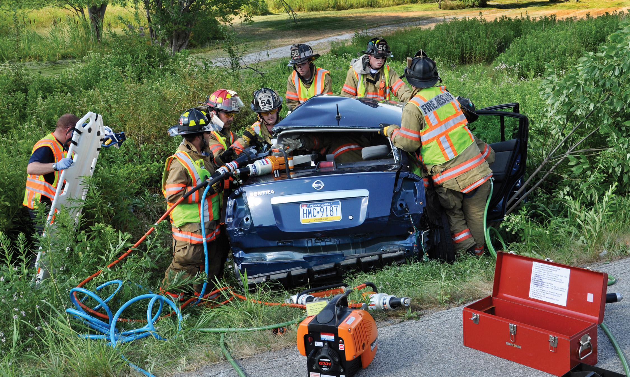
Firefighters Wearing Full Protective Gear at the Scene of a Motor Vehicle Crash
Notes:
Prior to entering the crashed vehicle to assess and manage a patient, you must consider what level of personal protection is needed to protect yourself against the same personal injury. Where firefighters or those responsible for extrication at the scene of a crashed vehicle with exposed jagged metal and glass are wearing personal protective equipment to protect against personal injury (which may include turnout gear, a helmet, heavy gloves, an ANSI-certified vest, and eye protection), your PPE should be at the same level of the other rescuers on scene, because you are in the same immediate hazard zone and exposed to the same hazards.

Slide 13
Determine Scene Safety (1 of 35)
Scene safety is an assessment of a scene to ensure the well-being of the E M Ts, patient, and bystanders.
Ensuring scene safety is a dynamic and ongoing process.
Scene safety requires E M T s to exercise leadership and take control of the scene.
Notes:
If they fail to control the scene, the scene will control the EMT. Someone must be in charge. That “someone” might become the patient, a family member, or a crowd of bystanders if the EMT fails to take charge. Sleeplessness, preoccupation with other problems, apathy, and overconfidence can lead an EMT to shortcut or ignore the principles of scene safety. Don’t let this happen to you. The consequences can be costly for the patient, your partners, and you.

Slide 14
Determine Scene Safety (2 of 35)
Consider Dispatch Information
  Dispatch information can help you anticipate safety needs, but is only a starting point.
  Even routine-sounding dispatches can lead to dangerous scenes.
Notes:
Receipt of the call notification from the dispatcher can help you anticipate what standard precautions and other personal protection equipment you will need at the scene. Be aware that callers, at times, may deliberately give inaccurate information. For example, a caller may report chest pains when the problem is a stabbing or a gunshot wound. If the caller had reported the facts, it’s likely that law enforcement personnel would also have been dispatched, something the caller wished to avoid. Use the dispatch information to prepare for the scene, but remain alert to the possibility of different circumstances upon your arrival.
Points to Emphasize
Scene safety applies to every EMS call, even those that seem unlikely to present hazards to EMS providers.
The determination of scene safety can change as additional information becomes available. EMTs must continue to assess the potential for danger throughout the call.
Consider dispatch information when assessing scene safety, but remember that the information supplied by dispatch is only as accurate as the information the caller reports.

Slide 15
Determine Scene Safety (3 of 35)
  Consider Dispatch Information
  Hazards can include:
    Angry or hostile patients or bystanders
    Hazardous materials
    Infectious disease
    Crime scenes
    Downed power lines
Notes:
Teaching Tips
Discuss any particular industries or situations in your area that pose particular hazards to emergency personnel.
Class Activity
Divide students into small groups of three or four students. Provide each group with an index card describing dispatch information and an initial description of the scene. Give each group ten minutes to discuss potential hazards, and how they will minimize danger to themselves, the patient, and bystanders. Each group will then read its card aloud to the class and describe their assessment of the situation and proposed actions to minimize hazards.

Slide 16
Determine Scene Safety (4 of 35)
Consider the Need for Additional or Specialized Resources
  Some scenes involve situations that require resources and training beyond that of E M Ts.
  Examples include hazardous materials, extrication, water rescue, and high-angle rescue.
Notes:
At any time during the scene size-up, it may be necessary to recognize your own limitations and call for additional resources or specially trained personnel for situations or rescues that are beyond your training.
Points to Emphasize
Request additional resources when necessary. Law enforcement, special rescue units, fire suppression, and hazardous materials teams may be required to make the scene safe.
Teaching Tips
Describe your system’s procedures for requesting additional resources.

Slide 17
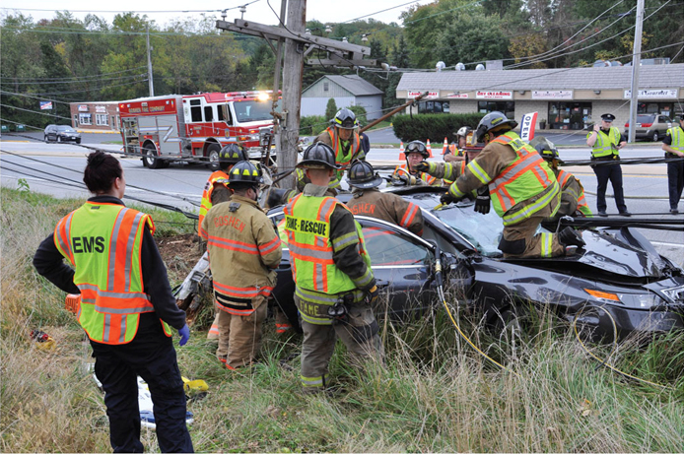
Downed Electrical Wires Pose a Threat to the E M T
(© Edward T. Dickinson, M D)
Notes:
At any time during the scene size-up, it may be necessary to recognize your own limitations and call for additional resources or specially trained personnel for situations or rescues that are beyond your training.

Slide 18
Determine Scene Safety (5 of 35)
Consider Scene Characteristics
  E M T safety is of primary importance.
  An injured E M T cannot provide emergency care.
  Resources may be diverted from the patient to the injured E M T.
Notes:
An injured or helpless EMT can’t provide emergency care to a patient. In addition, attention and resources may be diverted from the patient to the injured EMT, risking further compromise to the patient. You must study the scene carefully and determine whether it’s safe to approach the patient. This determination must be made on all responses.
Points to Emphasize
Routine principles of scene safety include ensuring traffic is controlled, using caution when crowds have gathered, always having your portable radio with you when you leave the ambulance, and requesting the resources you need.
Situations in which hazards can be anticipated include crash scenes, special rescue scenes, unstable surfaces and slopes, ice and water, toxic substances or low oxygen atmospheres, fires, crime scenes, and barrooms.

Slide 19
Determine Scene Safety (6 of 35)
  Consider Scene Characteristics
  Do not enter unstable crash scenes.
  Managing patients on roadways places E M T s at extreme risk.
  Wait for police to enter a crime scene or other volatile scene; retreat if a scene becomes unstable.
Notes:
Managing patients at crash scenes or on roadways and highways places the EMT at extreme risk of being struck by moving traffic.
Take extra precautions at crime scenes, suspected crime scenes, and scenes involving volatile crowd situations; wait for the arrival of police or, if a scene turns threatening, retreat and wait for the police. These scenes often include domestic violence calls.
Discussion Questions
What hazards can you anticipate at crash scenes?
How can you make crash scenes safer?
What additional resources may you need to control a crash scene?

Slide 20
Determine Scene Safety (7 of 35)
  Consider Scene Characteristics
  Bring your portable radio with you.
  Call for help from the appropriate agencies.
  Remove yourself if a scene becomes hazardous.
Notes:
Be sure to bring your portable radio with you when you leave the ambulance so you can contact dispatch or medical direction from the scene for needed resources or advice.
Call for help from the appropriate agencies—police, fire department, rescue squad, utility company, water rescue squad, hazmat team, or other—if a scene is outside your area of training or expertise.
Remove yourself if a scene turns hazardous.

Slide 21
Determine Scene Safety (8 of 35)
  Consider Scene Characteristics
  Crash scenes
    Hazards from the crash and from traffic must be controlled.
    Is the vehicle stable?
      If not, can you safely make it stable or are additional personnel and equipment necessary?
    Are power lines involved?
Notes:
At a crash scene, the EMT’s attention is drawn naturally and immediately to the patients. This may put the EMT at considerable risk if the crash scene isn’t properly controlled and safety precautions haven’t been taken to protect emergency medical and other personnel; not only from hazards that exist because of the crash itself, but also from vehicle traffic around the crash scene.
Are power lines involved?
Consider all power lines to be energized until a power company representative tells you they are not.
Power lines can be on the car, under the car, or touching a guardrail or wire fence that the car is in contact with.
The lines may be lying on wet ground and energizing a large area.

Slide 22
E M T Skills 12-1
Scene Characteristics

Slide 23
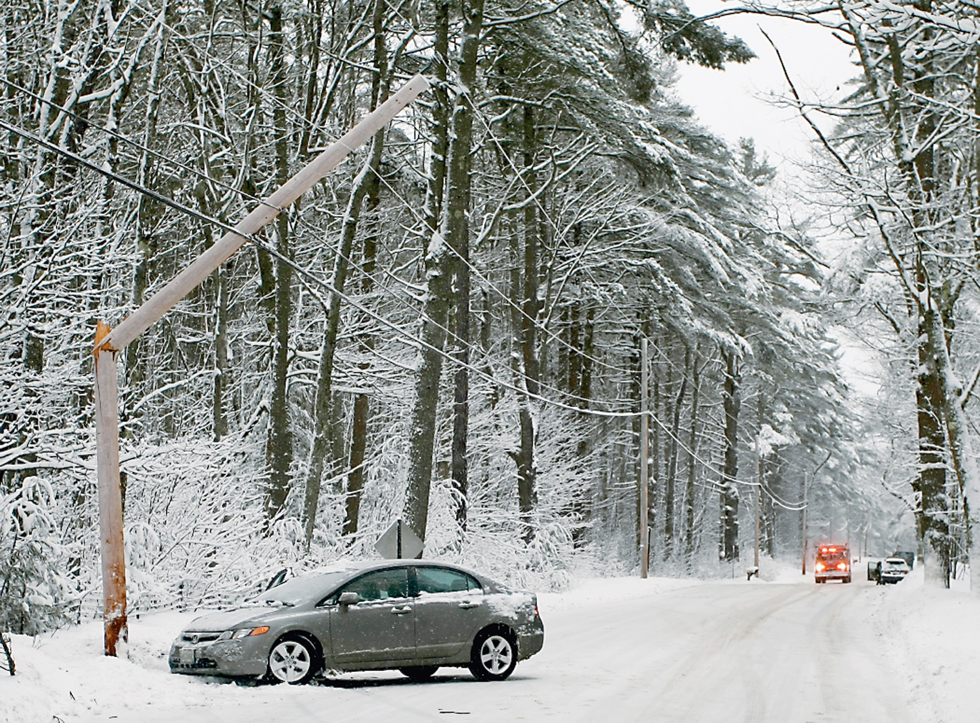
Motor Vehicle Strikes Utility Pole
(© Daniel Limmer)
Notes:
At a crash scene, the EMT’s attention is drawn naturally and immediately to the patient or patients. This may put the EMT at considerable risk if the crash scene isn’t properly controlled and safety precautions haven’t been taken to protect emergency medical and other personnel.

Slide 24
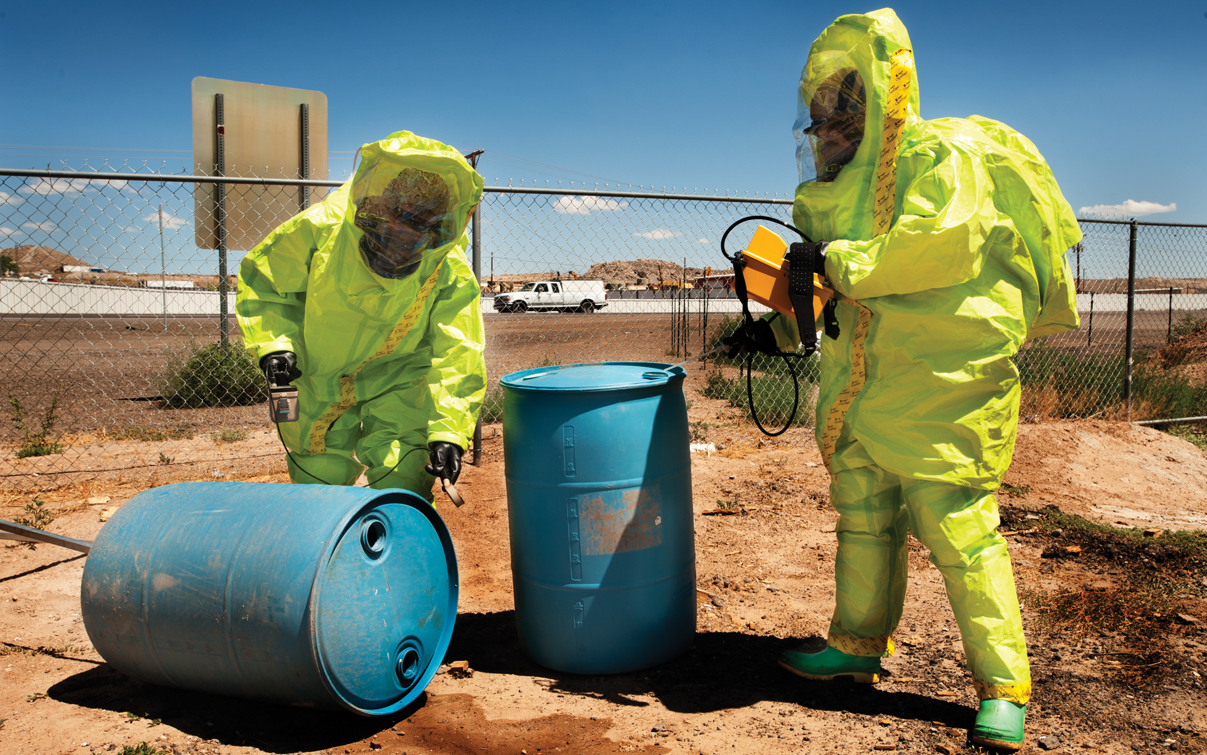
Hazardous Materials
Notes:
Scenes that involve highly visible incidents such as tanker spills, pipeline ruptures, and heavy smoke conditions should automatically alert you to call on specialized assistance to control the situation.

Slide 25
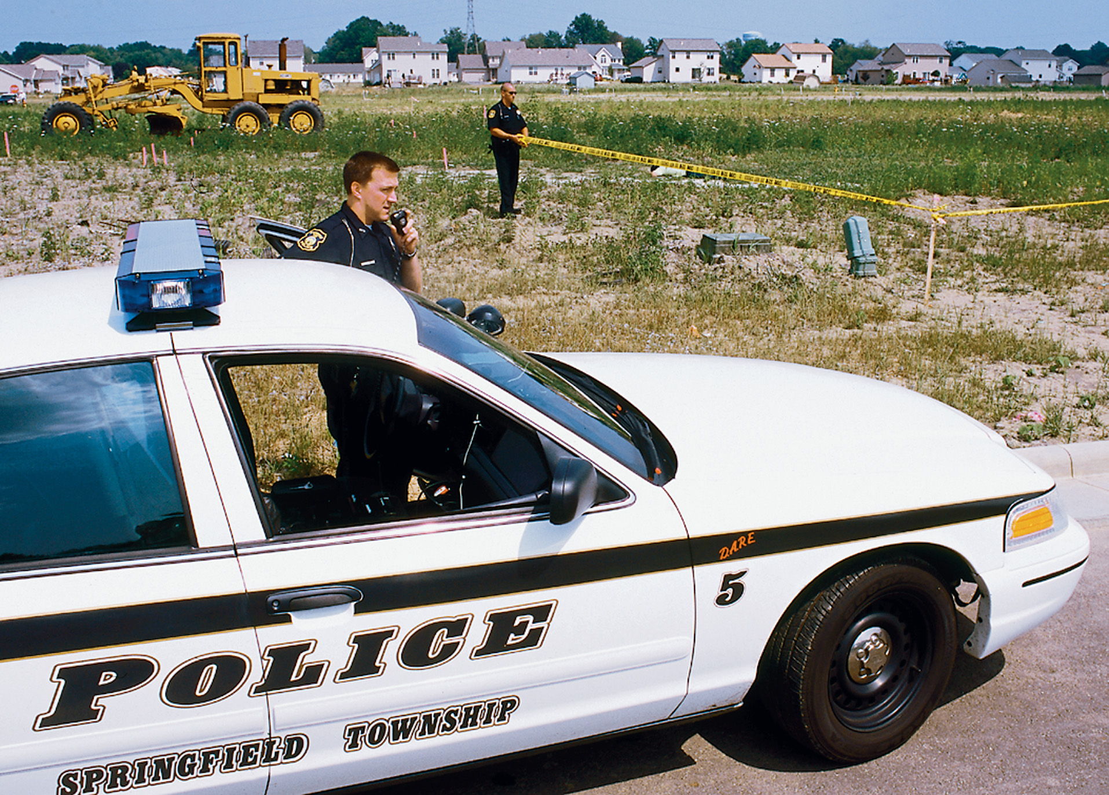
Crime Scene
Notes:
Crime scenes require special measures to ensure the personal protection of the EMT.

Slide 26
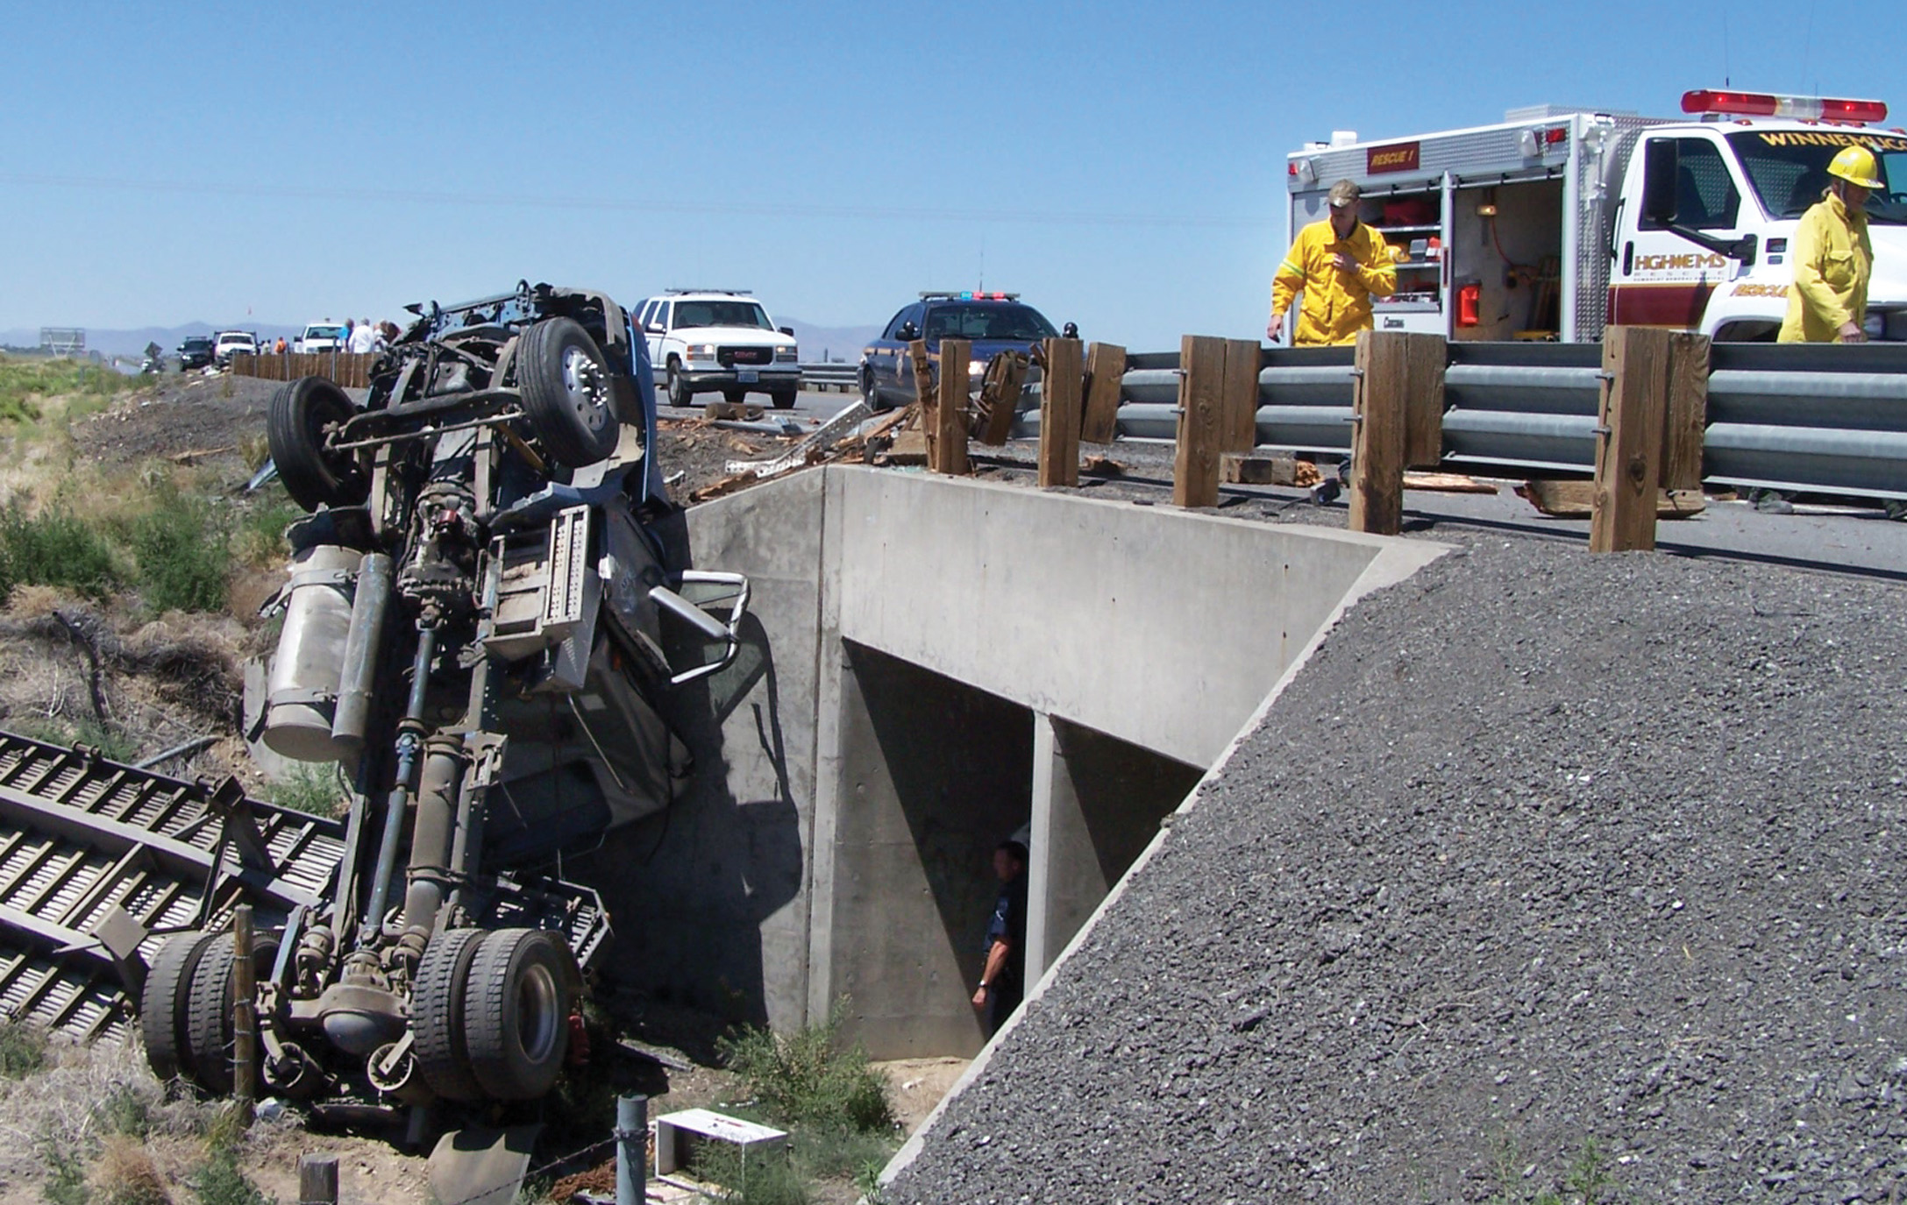
Motor Vehicle Crash at Overpass
(© Pat Songer)
Notes:
Some rescue scenes require specialized training and equipment. The EMT must be prepared to call on additional specialized resources to ensure not only his own well-being but also the successful rescue of the patient.

Slide 27
Determine Scene Safety (9 of 35)
Consider Scene Characteristics
  Crash Scenes
    Are jagged metal or broken glass a threat?
    Are there undeployed air bags?
    Is there fuel leaking and, if so, is there an ignition source nearby?
    Is there fire?
    Are hazardous materials involved?
Notes:
Does jagged metal or broken glass pose a threat?
Can such material be avoided, covered, or otherwise isolated to minimize the threat?
Are there any undeployed airbags?
Is fuel leaking and, if so, is an ignition source nearby?
Is there fire?
If so, has the fire department been called?
If rescue is possible, don’t approach a burning vehicle directly from the front or the rear, where fire or explosion hazards are greatest, but from the side.
Are hazardous materials involved?

Slide 28
Determine Scene Safety (10 of 35)
  Consider Scene Characteristics
  Crash Scenes: Protection from Moving Traffic
    To reduce the incidence of being struck by traffic:
      Wear an A N S I - a p p r o v e d reflective vest.
      Limit your time on scene to reduce exposure to traffic.
      Shut down traffic on the roadway if necessary.
Notes:
Another serious threat to emergency medical and other rescue personnel at a crash scene is moving traffic. There are many well documented incidents of EMTs being killed or severely injured by vehicles crashing into emergency personnel and emergency vehicles at a crash scene on a highway or roadway.

Slide 29
Determine Scene Safety (11 of 35)
  Consider Scene Characteristics
  Crash Scenes: Protection from Moving Traffic
    To reduce the incidence of being struck by traffic:
      Place flares or cones.
      Place vehicles strategically so they protect the scene.
      Do as much work as possible out of the traffic flow.
Notes:
There are many well documented incidents of EMTs being killed or severely injured by vehicles crashing into emergency personnel and emergency vehicles at a crash scene on a highway or roadway. You must always remain alert and take as
many precautions as necessary to reduce your risk of being struck by moving traffic.

Slide 30
Determine Scene Safety (12 of 35)
  Consider Scene Characteristics
  Crash Scenes: Protection from Moving Traffic
    To reduce the incidence of being struck by traffic:
      Don’t turn your back to moving traffic.
      Don’t jump highway dividers to provide emergency care.
      Reduce unnecessary scene lighting that distracts or impairs visibility by traffic.
Notes:
Don’t jump highway dividers to provide emergency care while leaving yourself exposed to moving traffic. Reduce any unnecessary scene lighting that may distract or impair visibility of oncoming traffic.

Slide 31
Determine Scene Safety (13 of 35)
  Consider Scene Characteristics
  Crash Scenes: Protection from Moving Traffic
    To reduce the incidence of being struck by traffic:
      Turn the wheels of parked emergency vehicles so they are pointed away from the scene.
      Avoid stopping and standing between vehicles.
Notes:
You must always remain alert and take as many precautions as necessary to reduce your risk of being struck by moving traffic. Wear an ANSI-certified reflective safety vest at the crash scene to make yourself highly visible both day and night.

Slide 32
Determine Scene Safety (14 of 35)
  Consider Scene Characteristics
  Other Rescue Scenes
    Some rescue scenes require specialized training and equipment:
      Chemical, biological, and nuclear weapons
      Heights
      Natural disasters
      Underground areas
Notes:
The EMT must be prepared to call on additional specialized resources to ensure not only their own well-being but also the successful rescue of the patient.
Chemical, biological, and nuclear weapons of mass destruction
Heights (such as rooftops, trees, catwalks, and construction areas)
Natural disasters (such as tornadoes, hurricanes, and floods)
Underground areas (such as caves, manholes, trenches, and excavations)

Slide 33
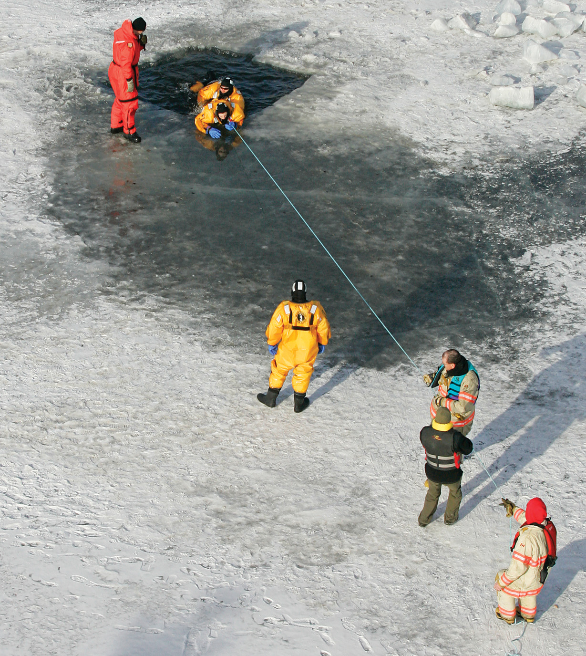
Ice Rescue
(© Kevin Link)
Notes:
The presence of ice can complicate any scene, making what would normally be a simple rescue hazardous. Avoid walking onto frozen ponds, lakes, or other bodies of water if the safety and thickness of the ice is unknown. In these cases, notify rescue teams who are trained and equipped for ice rescue.

Slide 34
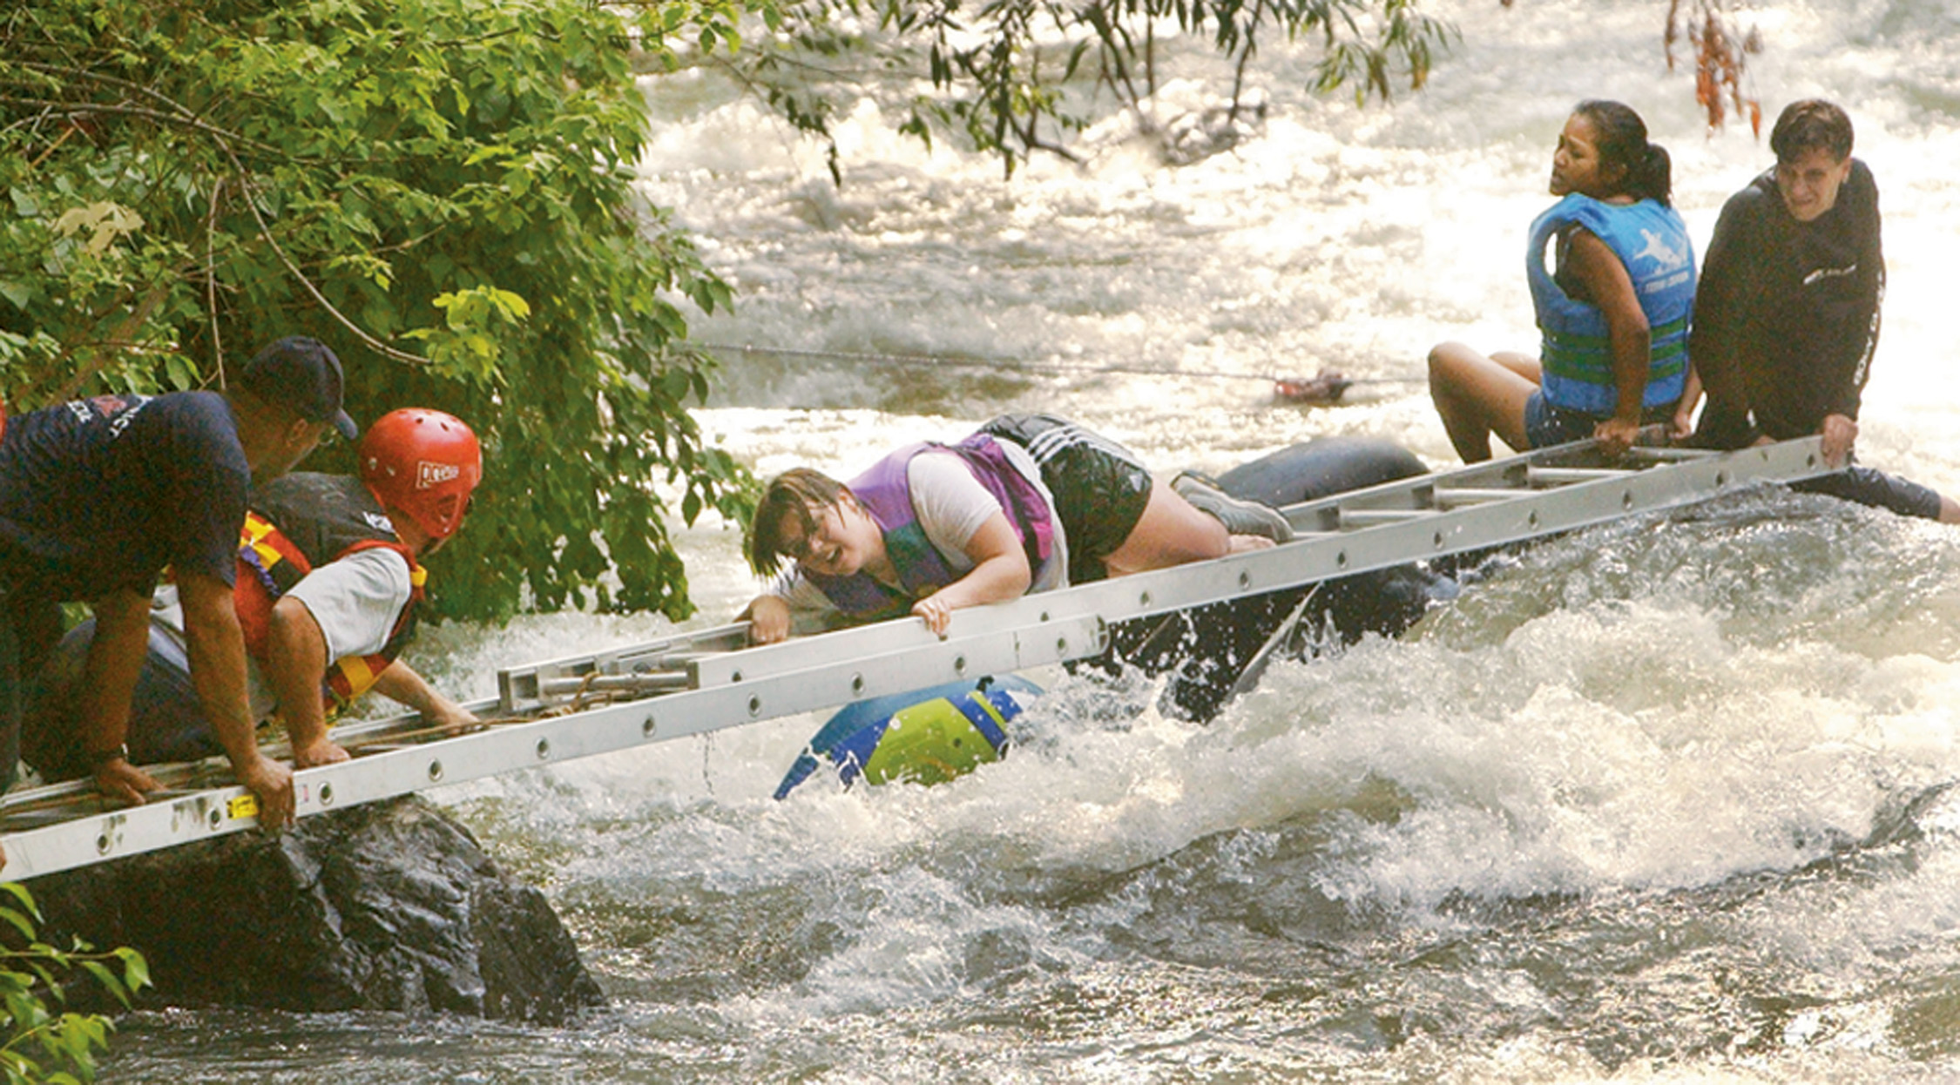
Moving Water Rescue
  (© A P Photo/Standard Examiner, Brian Nicholson)
Notes:
Drownings are common reasons for the dispatch of an EMT team, but water can also be a factor in other types of calls. Always proceed with caution in situations where water is a factor. Rescue in moving water, such as rivers, streams, or creeks, presents the problems of open-water rescue but further complicates it because of the force of the current. Often, a current makes swimming difficult or impossible. Patients and rescuers alike can easily be swept away, even in shallow water, if the current is strong enough. Never wade or walk into moving water in an attempt to rescue without adequate training and equipment.

Slide 35
Determine Scene Safety (15 of 35)
Consider Scene Characteristics
  Other Rescue Scenes
    Collapses/cave-ins
    Storage tanks/vats
    Silos/bins (suffocation hazards, regardless of contents)
    Farm equipment
Notes:
It’s the EMT’s duty to ensure that adequate numbers of appropriately trained and equipped personnel are summoned if necessary to handle special rescues.
Collapses and cave-ins (such as buildings, construction sites, and excavations)
Storage tanks and vats (regardless of contents)
Silos and bins (suffocation hazards, regardless of contents)
Farm equipment (such as combines, corn pickers, or augers)
Some special situations that EMTs might frequently encounter include those described next.

Slide 36
Determine Scene Safety (16 of 35)
  Consider Scene Characteristics
  Other Rescue Scenes: Unstable Surfaces and Slopes
    Remember to secure the patient to the hillside.
    Be sure that vehicles that have gone over embankments have been secured.
    Beware of loose rocks and stones that may be knocked down to your position.
Notes:
Victims of injury or illness may be encountered on unstable surfaces or slopes. Such surfaces create additional difficulties and hazards and can greatly complicate treatment and transport of the patient. Access to patients in such circumstances may require the use of ropes. If you’re not trained in the proper use of ropes in such situations, summon or wait for a trained rescue crew.
If you have been properly trained:
Remember to secure the patient to the hillside to prevent him from sliding downslope during assessment, treatment, and stabilization.
Be sure that vehicles that have gone over embankments have been secured to prevent them from sliding, carrying occupants and EMS personnel away.
Beware of loose rocks and stones that may be knocked down to your position by rescuers working above.

Slide 37
Determine Scene Safety (17 of 35)
  Consider Scene Characteristics
  Other Rescue Scenes: Water
    Retrieving a patient from a swimming pool will be difficult and should never be attempted alone.
    Rescue in open water is a specialized technique that requires training and equipment.
    Rescue in moving water is complicated because of the force of the current.
Notes:
Drownings are common reasons for the dispatch of an EMT team, but water can also be a factor in other types of calls. Always proceed with caution in situations where water is a factor. If you’re faced with a situation beyond your capacity to handle, summon and wait for backup from those with proper training and equipment:
Swimming pools present a major challenge for rescue of a patient. The patient will be visible, but to the EMT who’s untrained in water rescue, retrieving the patient will be difficult and should never be attempted alone. The EMT’s partner should be close at hand to lend assistance, preferably from the pool’s edge. A personal flotation device and a line or pole to assist the rescuer and patient to the pool’s edge should be used.
Rescue in open water is a specialized technique that requires training and equipment. The EMT must ensure that adequate resources are summoned when people have been reported as drowned or missing. The EMT going out into the water, must wear a personal flotation device.
Rescue in moving water presents the problems of open-water further complicated by the force of the current. Patients and rescuers alike can easily be swept away, even in shallow water, if the current is strong enough. Never wade or walk into moving water in an attempt to rescue without adequate training and equipment. Whitewater or moving-water rescues involve specialized techniques and equipment and extensive training.

Slide 38
Determine Scene Safety (18 of 35)
  Consider Scene Characteristics
  Other Rescue Scenes: Toxic Substances and Low-Oxygen Areas
    Scenes such as tanker spills, pipeline ruptures, and heavy smoke conditions require specialized assistance.
    Confined spaces may be low in oxygen or high in toxic gasses.
    A toxic environment can cause people within it to suffer similar symptoms.
Notes:
The EMT must be alert to the possible presence of toxic substances or areas of low oxygen during the scene size-up. Some scenes, such as a crash involving a tanker truck, will present obvious hazards. At other scenes, the hazard may not be as obvious. For example, a call to aid someone who fell in their kitchen might present a toxic hazard if, during the fall, the person knocked over and spilled bleach and ammonia. The combination of the two creates chloramine gas, a lung irritant. Other highly toxic scenes that pose great risk for EMTs are those involving chemical suicides. People who intend to or commit suicide using this method often mix dangerous chemicals or release a gas such as propane in an enclosed space to asphyxiate themselves. Suspect the presence of toxic substances or an oxygen-depleted atmosphere in the following circumstances:
Scenes that involve highly visible incidents such as tanker spills, pipeline ruptures, and heavy smoke conditions should automatically alert you to call on specialized assistance to control the situation.
Caves, wells, tankers, vats, manholes, sewers, culverts, underground utility vaults, silos, closed garages, and other confined spaces are areas where the EMT must exercise extreme caution. Such areas may be low in oxygen and/or high in toxic substances such as methane. Entry into a confined space should be made with appropriate SCBA in place. Many well-meaning rescuers have failed to recognize the risk of confined-space entry and have themselves become victims along with the patients they planned to rescue.
A toxic environment generally causes people within it to suffer from similar symptoms. When called to a residence in which all occupants exhibit similar signs and symptoms assume that the environment is toxic until it is proven not to be. Faulty furnaces cause such problems in winter. But a blocked flue on a gas hot-water tank can produce the same problem in a closed, air-conditioned residence at the peak of summer.

Slide 39
Determine Scene Safety (19 of 35)
  Consider Scene Characteristics
  Clandestine Drug Operations
    Look for chemicals such as ephedrine, pseudoephedrine, iodine, hydrochloric acid, ether, and anhydrous ammonia.
    If you are not trained to make the environment safe in such situations, you must contact specialized rescue or fire units.
Notes:
Heat sources and cooking devices; and bottles or containers, tubing, and other drug-making paraphernalia are also commonly found in these “labs”. You must be alert to the possibility of encountering such situations on every call. If you’re not trained to make the environment safe in such situations, you must contact specialized rescue or fire units who can.

Slide 40
Click on the Item That Is NOT a Goal of the Scene Size-Up
Getting a SAMPLE history from the patient
Determining whether the nature of the problem is medical or trauma
Detecting anything that could jeopardize the E M Ts’ safety
Making a decision about the resources needed to manage the situation

Slide 41
Determine Scene Safety (20 of 35)
Consider Scene Characteristics
  Crime Scenes
    Remember that ensuring your own safety is the first step in scene size-up.
    Wait for the police to arrive and secure the scene before you attempt to enter.
    If you arrive at such a scene and feel uneasy or suspect that a threat might exist, do not enter the scene.
Notes:
There will be times when you are sent to scenes at which no crime has been reported but where you suspect that a crime might be involved. A report of an injury at a bar late at night or a call to an area with a high crime rate might be suspect. Be alert to the possibility of danger on such calls. A dispatcher may not know that the scene to which they are directing you is, in fact, a crime scene. While you’re en-route to such a scene, check to see whether police have also been called. If they haven’t, request their support.

Slide 42
Determine Scene Safety (21 of 35)
  Consider Scene Characteristics
  Crime Scenes: Arriving at the Scene
    Turn off the siren and emergency lights; by arriving discreetly you draw less attention.
    If you arrive at such a scene and feel uneasy or suspect that a threat might exist, do not enter the scene.
    Park two to three houses away.
Notes:
By arriving discreetly, you draw less attention to the scene and minimize the chances of drawing a crowd. Perform the scene size-up, if the scene appears hostile or threatening, don’t stop, drive on and await police backup. It’s prudent to park two to three houses away from the scene, affording you more opportunity to study the area before becoming involved.
At crime scenes in which guns might be involved, parking in such a position will usually put you outside the killing zone (the area controlled by hostile fire). If someone inside the house has a gun, an area about 120° in front of the house is at least partially exposed to fire. The area can be much larger depending on the location of the house. The killing zone isn’t static and is always subject to change.

Slide 43
Determine Scene Safety (22 of 35)
  Consider Scene Characteristics
  Crime Scenes: Studying the Crowd
    Assess the crowd, the size of the crowd is less important than its mood.
    Do not allow yourself to be pulled into chaos, if present.
    If the crowd seems hostile, retreat.
Notes:
Is the scene chaotic? If so, don’t allow yourself to be pulled into the chaos. Is the scene hysterical? Again, don’t be pulled in. Does the crowd seem hostile to your presence? If it does, your options include retreating until appropriate backup arrives or taking the patient and leaving.

Slide 44
Determine Scene Safety (23 of 35)
  Consider Scene Characteristics
  Crime Scenes: Approaching the Scene
    Walk on the grass, not the sidewalk.
    Hold your flashlight beside you, not in front.
    Walk single file.
    Note places of concealment and cover.
    Look at windows and corners.
    Stand to the side of a door when you knock.
Notes:
Be alert to the possibility that the scene could suddenly turn dangerous. Be prepared to retreat if it does. When approaching the scene, follow these procedures:
Walk on the grass, not the sidewalk, for a quieter, less
obvious approach.
If using a flashlight, hold it beside you, not in front of your body, so that you don’t make your body a possible target.
If you’re walking with a partner, walk single file. The last person in line should carry the jump kit. This will leave the person or persons at the front of the line unencumbered and better able to react to any problems that may be encountered.
Only the first person in line should carry a flashlight, because anyone with a flashlight behind the first person will backlight those in front.
As you approach the scene, note possible places of concealment and cover. Keep illuminating or scanning dark or shadowed areas for movement as you approach a house.
Take a moment to look at windows and corners. If you need to take a longer look, change positions to make it harder for a hostile person to get a fix on you.
Stand to the side of a door when you knock on it to avoid being a target for someone shooting, springing out, or reaching to grab at you through the door. Standing to the knob side prevents a door that opens outward from blocking you. If the door opens inward, the person opening it will most likely be looking toward the hinge side, letting you see them before they see you.
As soon as the door is open, assess the situation before you decide whether to retreat and call for reinforcement or to have your partner move the ambulance up to the front of the building. As you enter, leave doors open behind you to ensure an escape route. Likewise, never appear to block the patient’s route of escape.

Slide 45
Determine Scene Safety (24 of 35)
  Consider Scene Characteristics
  Crime Scenes: At the Patient’s Side
    Your first priority remains protecting yourself and your partner.
    Be aware that a perpetrator may still be on the scene.
    Ensure that the police have been called and follow local protocols.
Notes:
When you’re at the patient’s side, your first priority remains protecting yourself and your partner. The next priority is to protect and treat the patient. If you reach a patient and discover that a perpetrator may still be on the scene and police intervention will be necessary. Ensure that the police have been called and follow local protocols. Be ready to retreat.

Slide 46
Determine Scene Safety (25 of 35)
  Consider Scene Characteristics
  Crime Scenes
    At a secured crime scene:
      Limit the number of responders.
      Do not allow bystanders to touch or disturb.
      Introduce yourself to the patient carefully.
      The patient may be a perpetrator.
      Have an E M T keep watch on the area.
      Your task is to render medical assistance.
      Where appropriate, assist police.
Notes:
Limit the number of responders at a possible crime scene to the number required to care for the patient.
Don’t allow bystanders to touch or disturb the patient or their immediate surroundings.
Introduce yourself to the patient and say that you’re there to help them. Crime victims are often confused and fearful of contact with strangers.
Be alert to the possibility that the patient at the crime scene may be not simply a victim but also a perpetrator. Always keep track of the patient’s hands in a hostile situation. Be prepared for the possibility that such a patient may suddenly reach for a weapon.
If possible, have one EMT keep a constant watch on the bystanders and the surrounding area while you work on the patient to alert you if a scene begins to turn dangerous.
Remember as you work on the patient that your task is to render medical assistance and to save their life, not to aid in solving a crime. Be as considerate of police requests as possible, but keep your primary task in mind.
Where appropriate, assist police in collecting and recording anything on the patient, such as blood, hair, seminal fluid, gunpowder residue, or clothing fibers. Follow local protocol.

Slide 47
Determine Scene Safety (26 of 35)
  Consider Scene Characteristics
  Crime Scenes
    At a secured crime scene:
      Do not disturb any evidence.
      Do not touch or move suspected weapons.
      Wear gloves the entire time on scene.
      Do not cut through a bullet or knife hole.
      Cut at a point away from a rope knot.
      Do not burden patient with crime questions.
      Note who is at the scene when you arrive.
Notes:
Take extreme care not to disturb any evidence that’s not directly on the patient’s body (footprints, soil, broken glass, tire tracks, and so on).
Never touch or move suspected weapons unless it is necessary for treating the patient’s injuries. Many guns found are loaded and extremely dangerous to handle because of the possibility of accidental discharge. Such a gun in the hands of an untrained person could pose an extreme hazard to you, your partner, the patient, and bystanders. If you do touch a weapon, do not disturb any fingerprints that may be on it. Pick up a gun by the edge of the grip, and use gauze pads to pick up a knife at the very edge of the blade..
Wear gloves the entire time on the scene to avoid leaving your fingerprints at the crime scene.
If you need to tear or cut away clothing to expose a wound, make sure you don’t cut through a bullet hole or knife slash in the clothing. Keep the clothing and submit it as evidence to the police. If possible, have one EMT keep a constant watch on the bystanders and the surrounding area while you work on the patient to alert you if a scene begins to turn dangerous.
If the patient was strangled or tied with a rope or other material, cut at a point away from the knot instead of untying it, the knot can be used as evidence and may help identify the perpetrator.
If the patient is responsive, do not burden them with questions about the crime. Treat their injuries and transport them.
Realize that the patient will probably show extremes of emotion and be prepared to handle them.
Document who’s at the crime scene when you arrive.
If a patient is obviously dead when you arrive, do nothing and disturb nothing. Summon the police, if they haven’t already been called, and wait for their arrival. However, remember that you must provide basic life support and other appropriate care, as you would for any patient, unless injuries are so extreme or the patient has obviously been dead for so long that resuscitation is out of the question. Follow your local protocol, standard operating policies, and procedures.

Slide 48
Hold a Flashlight out and to the Side of Your Body
Stretch your arm as far to the side and to the front as you can so that if anybody shoots at the light they are less likely to hit you.
Notes:
If using a flashlight, hold it beside you, not in front of your body, so that you don’t make your body a possible target.

Slide 49
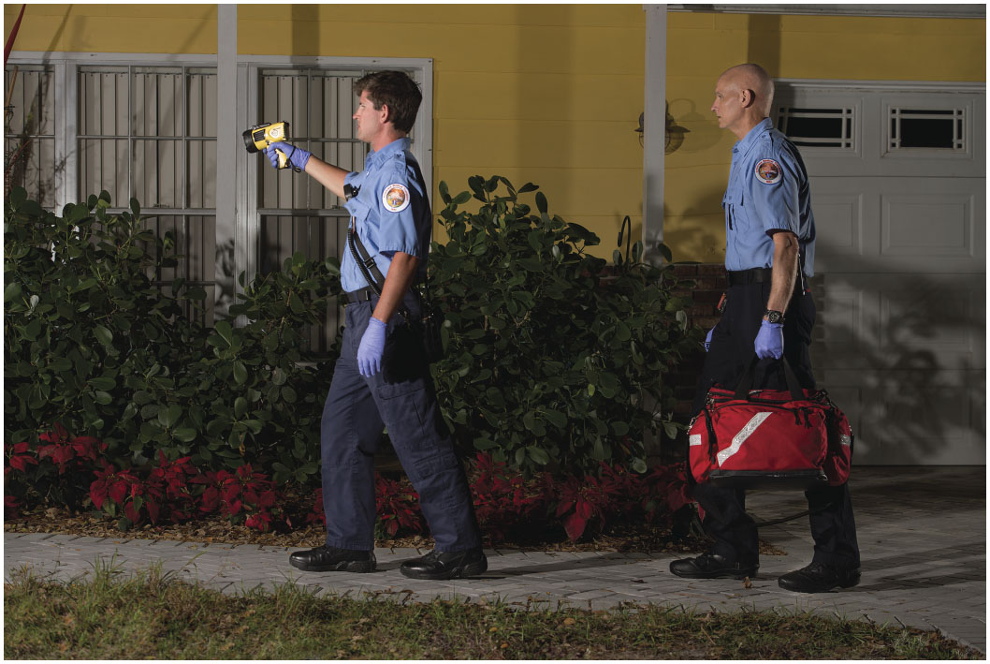
Walk Single File to a Potentially Unstable Scene
Notes:
If you are walking with a partner, walk single file. The last person in line should carry the jump kit. This will leave the person or persons at the front of the line unencumbered and better able to react to any problems that may be encountered.

Slide 50
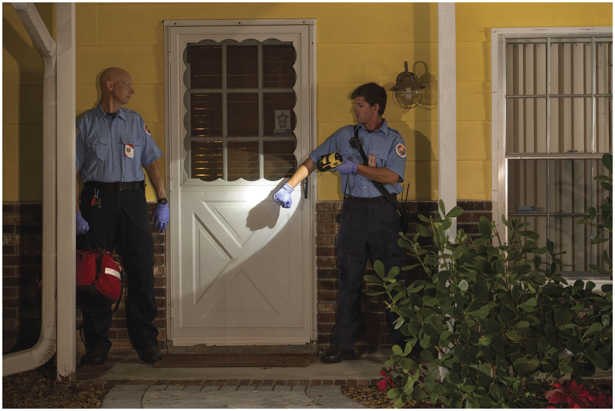
Stand to the Side of the Door When Knocking. Do Not Stand Directly in Front of a Door or Window
Notes:
Stand to the side of a door when you knock on it; never in front of it to avoid being a target for someone shooting, springing out, or reaching to grab at you through the door.

Slide 51
Determine Scene Safety (27 of 35)
Consider Scene Characteristics
  Barroom Scenes
    People consuming alcohol can make a scene volatile and unpredictable.
    The dark atmosphere can create challenges to seeing.
    Comments and questions can easily be misunderstood.
Notes:
Scenes in which the patient or bystanders are prone to sudden changes in behavior put the emergency medical personnel at risk for violence and personal injury. The problems are compounded in a barroom, where patrons often know each other and their actions may be affected by long-standing friendships or feuds about which you have no knowledge.
If you receive a call to one during daylight hours, your eyes can require several minutes to adjust from bright sunlight to low-light vision. By wearing sunglasses while outside, you can shorten the time of adjustment considerably.
It is critical that you don’t antagonize the patrons. A routine question or comment can easily be misunderstood by an inebriated patient or bystander and lead to a violent confrontation.

Slide 52
Determine Scene Safety (28 of 35)
Consider Scene Characteristics
  Barroom Scenes
    Do not turn your back on patrons.
    Do not respond to verbal threats, but recognize the potential for escalation to assault.
Notes:
Have your partner stand and survey the patrons at all times. Don’t turn your back on the people in the bar. Don’t reply to verbal threats, but never ignore them, either. It takes only an instant for verbal abuse to turn into a physical assault. If the situation becomes threatening, retreat temporarily and call for police support.

Slide 53
Case Study (2 of 5)
Chantal and Del put on sunglasses to shield their eyes from the late-afternoon sun as they start toward the scene. Del turns off the emergency lights and siren two blocks from the scene, and then parks at the curb two doors from the address. He observes that three police cars are on the scene.
Notes:
Case Study Discussion
Review the case study findings presented.

Slide 54
Case Study (3 of 5)
Keying the microphone on the mobile radio, he says, “Dispatch, Ambulance Five. Can you advise if law enforcement has secured the scene?”
Notes:
Case Study Discussion
Review the case study findings presented.

Slide 55
Case Study (4 of 5)
Once they have been advised that law enforcement has secured the scene, Chantal and Del exit the ambulance and bring their equipment onto the scene. The crowd is calm, and one of the police officers is kneeling down next to a man lying on the floor.
Notes:
Case Study Discussion
Review the case study findings presented.

Slide 56
Case Study (5 of 5)
What are the next observations that Del and Chantal should make?
What decisions should the crew be prepared to make at this point?
Notes:
Case Study Discussion
Use the case study content and questions to foreshadow the upcoming lesson content. Gauge the student’s responses as a guide of how well versed they’re in this topic.

Slide 57
Determine Scene Safety (29 of 35)
Consider Scene Characteristics
  Car passengers
    Park at least one car length behind the vehicle with wheels turned slightly to the left.
    Try to reflect your high-beams off the rearview mirror.
    Write down the license plate number and leave it in the ambulance.
Notes:
The EMT’s uniform or the emergency lights on the ambulance may be misinterpreted as the police by vehicle occupants who may be intoxicated on alcohol and/or drugs.
Park the ambulance at least one car-length behind the vehicle. Park with your wheels turned slightly to the left, so that if you must back up, you won’t go any deeper into the shoulder of the road.
Align your headlights in the middle of the trunk of the vehicle, and turn them to high beam. Try to reflect your beams off the rearview mirror, illuminating the car’s interior and making your approach more difficult for the occupants of the car to see.
While still in the ambulance, write down the license number of the vehicle and leave it at the radio.

Slide 58
Determine Scene Safety (30 of 35)
Consider Scene Characteristics
  Car passengers
    Note the number and positions of occupants.
    Be alert to unseen occupants.
    Have your partner open the passenger side door first.
    Stay behind the center post.
    If you must retreat, back the vehicle away quickly, 100 to 150 yards.
Notes:
Note how many people are in the vehicle, their positions, and the driver’s apparent condition. Be wary around tinted windows.
As you approach the vehicle, be alert to the possibility of other unseen occupants. Check to see whether the trunk is locked, and look on the rear seat and the floor as you pass.
Have your partner open the passenger door a split second before you open the driver’s door; if you are alone, wait for help to arrive.
Keep behind the center post. Carry an object, such as a report book or bag, that you can throw at the occupant’s face if they become violent.
If you must retreat, immediately get into your vehicle and back up rapidly. Move 100 to 150 yards to clear the killing zone.

Slide 59
Determine Scene Safety (31 of 35)
Protect the patient
  Protect the patient from the environment and the attention of bystanders.
  If you are unable to control those factors, move the patient to the ambulance.
Notes:
Emergencies can also expose a patient to the curiosity of the public, a situation some may find highly stressful. The EMT must have a keen awareness of how such factors affect the patient and be prepared to do what’s necessary to change them to ensure the patient’s safety and comfort. If you are unable to control the scene to make it safe for the patient, move the patient quickly to a safer environment, such as in the back of the ambulance.
Discussion Question
What are some ways of protecting patients from additional harm at the scene?

Slide 60
Determine Scene Safety (32 of 35)
Protect bystanders
  If hazards to the bystanders cannot be eliminated, remove the bystanders from the scene.
  Keeping the crowd out of the way can be challenging.
Notes:
Your attention as an EMT must be directed toward the patient. However, the crowd is part of the scene and making sure the bystanders are safe is one of your responsibilities during scene size-up. If hazards to the bystanders cannot be minimized or eliminated, remove the bystanders from the scene.
In cases of spills, leaks, fires, or heavy smoke, bystanders must be kept back using roadblocks, detours, police lines, and public address systems advising bystanders of the risk. In such situations, bystanders who don’t disperse should be dealt with by the police.

Slide 61
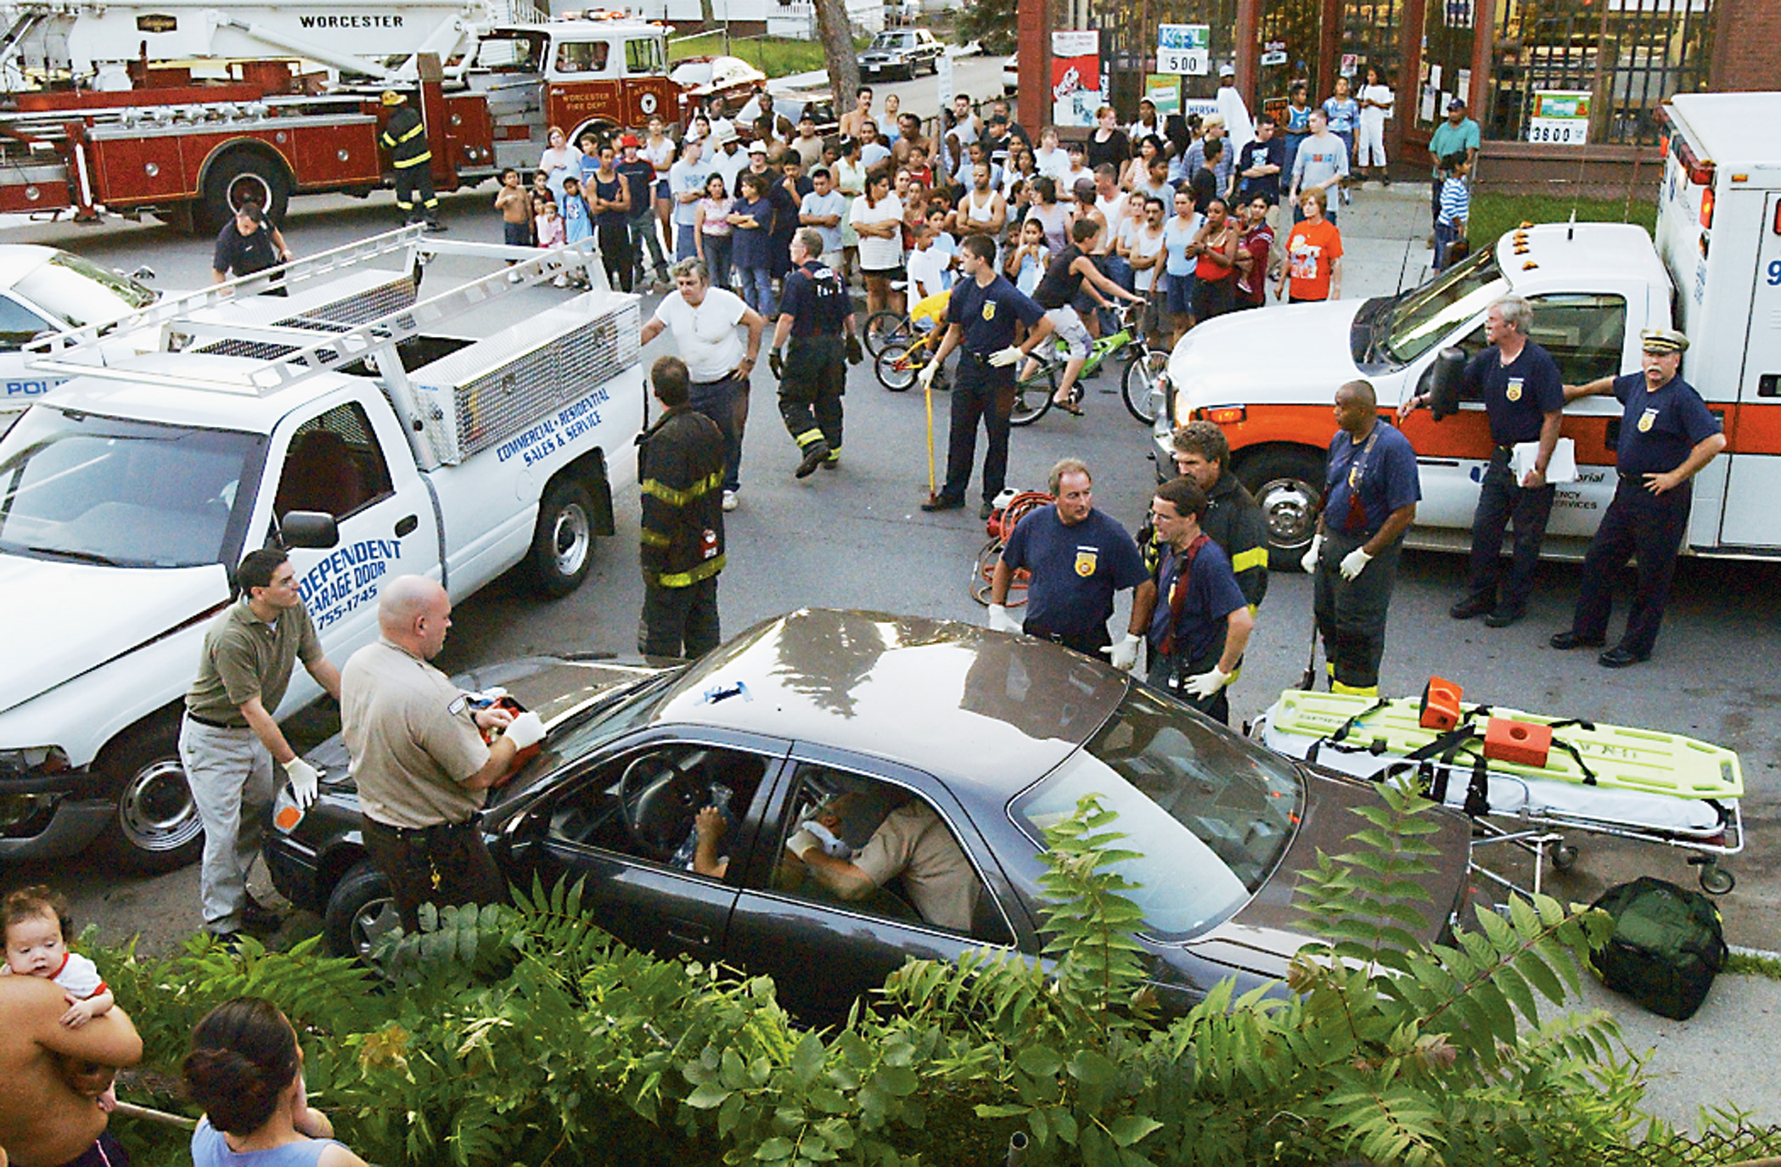
For Their Own Safety, Bystanders Must Be Kept Back in Cases of Possible Spills, Leaks, Fire, or Other Emergency Scene Hazards
(© Mark C. Ide)
Notes:
The crowd is part of the scene and making sure the bystanders are safe is one of your responsibilities during scene size-up. If hazards to the bystanders can’t be minimized or eliminated, remove the bystanders from the scene.

Slide 62
Determine Scene Safety (33 of 35)
Control the scene
  Create a workable environment.
  Provide light.
  Consider moving furniture.
  Consider moving the patient.
  Maintain an escape route.
  Pay attention to bystanders.
  Anticipate, rather than react.
Notes:
Provide light, make it a point to have a good flashlight and keep it handy day and night.
Move furniture that interferes with access to the patient. This should be done after advising the patient or the bystanders of your intentions. In a residence, you must remember that despite the emergency, you are a guest in the home and should demonstrate a proper level of respect toward the owners or occupants.
You may need to move the patient to an area more conducive to patient care. Attempting to resuscitate a patient in a cramped bathroom would generally make little sense when, by moving the patient 5 feet to the bedroom, you would have plenty of space in which to work. Whenever an injury is suspected, the patient must be properly immobilized to a backboard before any movement is attempted.
If operating outdoors, try to position the ambulance in such a way that the crowd won’t get between you, the patient, and the ambulance. When working indoors, consider asking bystanders to keep all doors along the route to the ambulance open. Don’t allow yourself to be cornered.
If the mood of a crowd turns ugly, you, your partners, and your patient may be in danger. Remember that a concerned crowd poses far less of a threat than an unruly crowd.
Stay in control and anticipate things that will happen before they occur. Initiate action rather than respond to the actions of others at the scene.

Slide 63
Determine Scene Safety (34 of 35)
  Control the scene
  Stay calm.
  Use tact and diplomacy.
  Be flexible.
  Be open-minded.
  Be alert.
  Be compassionate.
Notes:
Stay calm; other team members, the patient, and the bystanders will respond more positively if you stay calm.
Use tact and diplomacy. A compassionate, understanding tone may produce more positive results than a harsh, demanding one.
Have a Plan A to deal with the situation you are facing, but remain ready to shift to Plans B, C, or D if conditions indicate that Plan A won’t work.
Prehospital care involves working with people of a variety of ages, races, religions, and backgrounds. Many people have ways of life quite different from yours; some of them are ways that you wouldn’t choose to follow.
Not only do you need to be alert to yourself, but you also need to be alert to your partners, your patient, and your surroundings.
Be compassionate toward the people you have been called on to serve. Treat all people the way you would wish to have your loved ones treated in their time of need; someday you, too, may be in need.
Critical Thinking Discussion
You have an injured patient on the sidewalk in an urban area. A number of bystanders have begun to gather. Someone shouts, “Just take them to the hospital. Why aren’t you moving them?” Another person shouts, “They’d be moving them if they were a cop or somebody they knew, that’s for sure.” How should you handle this situation?

Slide 64
Determine Scene Safety (35 of 35)
Maintain situation awareness
  Scene size-up is dynamic and ongoing.
  Remain vigilant.
  Maintain scene awareness, as well as patient awareness.
Notes:
Scene size-up is a dynamic process. EMS personnel must continuously assess the emergency scene for unusual characteristics such as sounds, smells, or things that look odd. The key to remaining safe is to always remain vigilant. When at the scene, always maintain situation awareness. You need to shift your attention to patient assessment and management once you have entered the scene and deemed it safe; however, you still need to be aware of all aspects of the scene around you.

Slide 65
Determine the Nature of the Problem (1 of 16)
The patient’s problem may be trauma or medical.
Trauma is a physical injury caused by external force.
A medical condition is brought on by illness.
Dispatch information that starts you out on a call but it can be incomplete or inaccurate.
Notes:
After scene safety has been ensured, the next step in the scene size-up is determining the nature of the patient’s problem that brought you to the scene. The two basic categories of problems are trauma and medical. Which category a patient falls into will determine how you proceed with your continuing assessment and treatment of the patient.
In prehospital care, the EMT first looks for evidence of an injury. If the possibility of injury is ruled out, the EMT may assume that the patient has a medical condition.
As always, you should remain open-minded and flexible as you try to determine the nature of the problem. Sometimes a patient won’t fit neatly into one category or the other. For example, you may encounter a diabetic suffering from an altered mental status from taking too much insulin who has fallen down a flight of stairs. This patient is suffering from both trauma and a medical condition.
Teaching Tips
Assure students that this is a broad overview of types of trauma and illnesses for illustrative purposes. Much more time will be devoted to learning about trauma and illnesses throughout the course.
Critical Thinking Discussion
In what ways should an emergency scene look different to an EMT than it does to a layperson?

Slide 66
Determine the Nature of the Problem (2 of 16)
Determine the Mechanism of Injury (M O I)
  M O I is how the patient was injured.
  Consider the strength, direction, and nature of forces.
  Use the M O I to develop an index of suspicion for specific injuries.
  Consider dispatch information.
  Examine the scene.
Notes:
The index of suspicion is the degree of your anticipation that the patient has been injured, or has been injured in a specific way, based on your knowledge that certain mechanisms usually produce certain types of injuries. The mechanism of injury provides only a degree of suspicion of the types of injuries. It doesn’t, however, provide any indication of the actual injuries or condition. Only physical examination can be used to determine the actual patient injuries.
Identification of the mechanism of injury in a trauma patient may begin with the dispatch information. Dispatch
to an automobile crash, a shooting, a fall, or a stabbing will provide some preliminary information as to the mechanism of injury. Scene characteristics provide clues about what forces were applied to the body and the possible patterns of injury that may have resulted from them.

Slide 67
Determine the Nature of the Problem (3 of 16)
  Determine the Mechanism of Injury (M O I)
  Some situations should create a high index of suspicion
    Falls
    Motor vehicle or motorcycle crashes
    Recreational vehicle crashes
    Contact or recreational sports
Notes:
Identification of the mechanism of injury in a trauma patient may begin with the dispatch information. Dispatch to an automobile crash, a shooting, a fall, or a stabbing will provide some preliminary information as to the mechanism of injury.

Slide 68
Determine the Nature of the Problem (4 of 16)
  Determine the Mechanism of Injury (M O I)
  Some situations should create a high index of suspicion
    Pedestrians struck by vehicles
    Explosions
    Stabbings or shootings
    Burns
Notes:
Once you arrive at the scene, however, it’s necessary to take a much closer look at such scene characteristics as damage to the automobile, the use of restraint devices, the distance the patient fell, the type of surface the patient fell on (such as grass, carpet, or concrete), the position in which the patient landed, the object that struck the patient, or the caliber of the gun the patient was shot with. Such characteristics provide clues about what forces were applied to the body and the possible patterns of injury that may have resulted from them.

Slide 69
Determine the Nature of the Problem (5 of 16)
  Determine the Mechanism of Injury (M O I)
  Falls
    Distance the patient fell
    Surface the patient landed on
    Body part that impacted first
Notes:
Look for evidence of a fall when arriving on a scene. Fallen ladders, collapsed scaffolding, ropes in a tree or on buildings, trees in the immediate proximity of the patient, stairs, balconies, roofs, and windows are all common places to fall from or indicators that a fall may have occurred.

Slide 70
Determine the Nature of the Problem (6 of 16)
  Determine the Mechanism of Injury (M O I)
  Motor Vehicle Crashes
    The type of impact influences injury patterns
      Head-on or frontal collision
      Rear-end collision
      Side or lateral-impact collision
      Rotational impact collision
      Rollover
Notes:
Blunt forces applied to the body produce widespread injury to organs, bones, muscles, nerves, and blood vessels. The type of collision or point of impact to the vehicle commonly dictates the types of injuries to expect. Study the vehicle carefully, if possible, to identify this information.
When approaching the scene of a motor vehicle crash, look for evidence of both external impact to the vehicle from an outside force and internal impact to the vehicle caused by a patient’s body.
Knowledge Application
Show students photographs of motor vehicle collisions and ask them to determine how each picture compares with the considerations for determining severity that are described in this section of the text.

Slide 71
Determine the Nature of the Problem (7 of 16)
  Determine the Mechanism of Injury (M O I)
  Motor Vehicle Crashes
    Significant impacts
      Deformity to the vehicle greater than 20 inches
      Intrusion into the passenger compartment
      Displacement of a vehicle axle
      Rollover
Notes:
One EMT should quickly walk around all sides of the vehicle to identify the points of impact.

Slide 72
Determine the Nature of the Problem (8 of 16)
  Determine the Mechanism of Injury (M O I)
  Motor Vehicle Crashes
    Significant impacts
      Impact marks on the windshield caused by the patient’s head
      Missing rearview mirror
      Collapsed steering wheel
      Broken seat
Notes:
The EMT that walks around the vehicle should also conduct a close inspection of the passenger compartment for signs of impact that correlate with specific types of injury.

Slide 73
Determine the Nature of the Problem (9 of 16)
  Determine the Mechanism of Injury (M O I)
  Motor Vehicle Crashes
    Significant impacts
      Side-door damage
      Cracked or smashed dashboard
      Deformed pedals
      Use of restraint devices and deployment of air bags
Notes:
Deployment of driver and front seat passenger air bags may produce an impact mark that resembles what would be made by the patient’s head contacting the windshield. In this case, determine whether the safety belt restraint system was used and examine the head for evidence of trauma.

Slide 74
Determine the Nature of the Problem (10 of 16)
  Determine the Mechanism of Injury (M O I)
  Motor Vehicle Crashes
    Occupant ejection or death or significant injury of another occupant should increase the suspicion of significant injuries.
Notes:
Ejection from the vehicle usually produces significant blunt or penetrating trauma. Patients often die, not from the ejection itself, but from the car rolling on top of them. The death or significant injury of one passenger should cause you to suspect significant injury to other passengers.

Slide 75
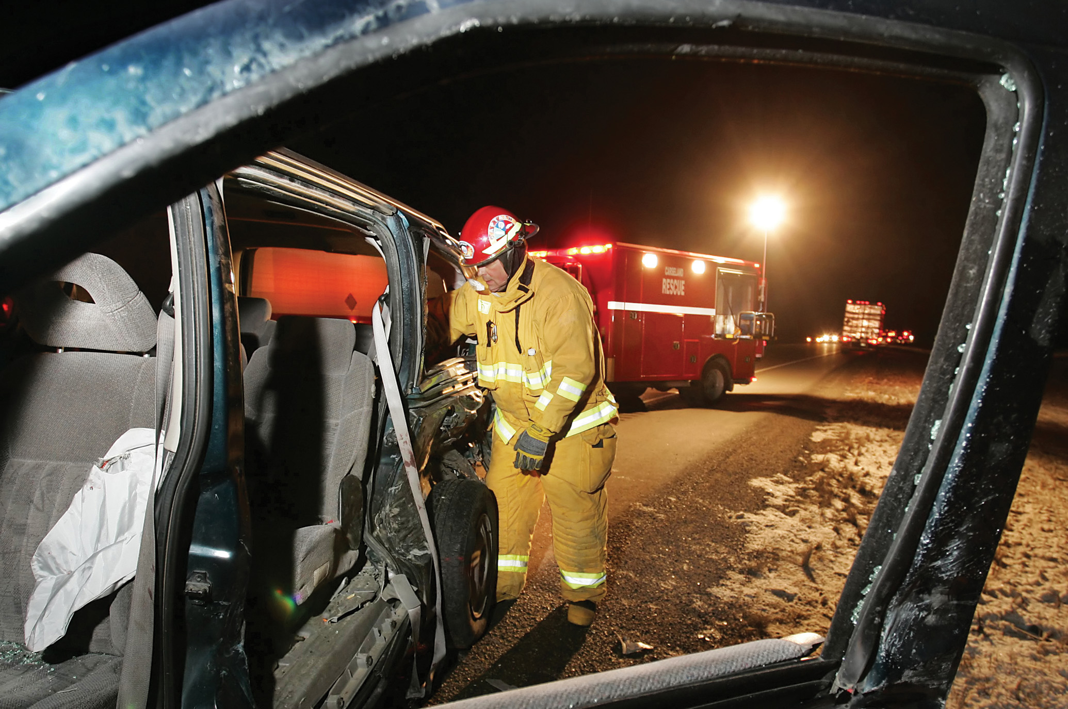
Motor Vehicle Crashes Produce Some of the Most Lethal Mechanisms of Injury
(© Kevin Link)
Notes:
Motor vehicle crashes produce some of the most lethal mechanisms of injury. Blunt forces applied to the body produce widespread injury to organs, bones, muscles, nerves, and blood vessels.

Slide 76
Determine the Nature of the Problem (11 of 16)
Determine the Mechanism of Injury (M O I)
  Motorcycle Crashes
    Document the impact type and whether the patient was wearing a helmet
      Head-on
      Angular impact
      Ejection
      “Laying the bike down”
Notes:
Try to determine and document the type of impact involved in the crash of a motorcycle. The following types of impacts are common:
Head-on - The rider is propelled forward off the motorcycle.
Angular impact - The rider strikes an object.
Ejection - The rider is thrown from the motorcycle and impacts the ground, the object involved in the collision, or both.
“Laying the bike down” - The rider purposefully lays the bike down on its side to avoid another, potentially more serious impact.
It’s important to determine and document whether the patient was wearing a helmet.

Slide 77
Determine the Nature of the Problem (12 of 16)
  Determine the Mechanism of Injury (M O I)
  Recreational Vehicle Crashes
    Rollover and crush injuries are common.
    Severe impacts with trees, rocks, other vehicles.
    Be alert to “clothesline” injuries.
Notes:
Snowmobiles, also known as snow machines, and all-terrain vehicles (ATVs) are commonly operated on uneven terrain, a factor that contributes to rollovers.
Crush-type injuries are common. Snowmobiles can travel at high speed, producing severe impact upon collision with trees, rocks, or other vehicles. With these vehicles, be especially alert for “clothesline”-type injuries. In these injuries, a rider is pulled off the vehicle by a low branch, wire, rope, or other low-hanging object. Severe trauma to the neck and airway is common with this type of crash.

Slide 78
Determine the Nature of the Problem (13 of 16)
  Determine the Mechanism of Injury (M O I)
  Penetrating Trauma
    With calls for shootings or stabbings, expose and assess for injuries.
    Expose unresponsive trauma patients to look for penetrating injury.
    Log roll to check the posterior body.
Notes:
Whenever you receive reports of a shooting or stabbing at the scene of a call, it’s necessary to expose and assess the patient’s body to confirm or rule out a stabbing or a gunshot wound. With an unresponsive patient, completely expose them and look for a penetrating injury, whether or not blood is visible at the scene or around the body. Be sure to log roll the patient to inspect the posterior body for open wounds. Heavy coats, dark clothing, poor lighting, dark environments, or dark hair hide blood very well.

Slide 79
Expose the Patient’s Body to Confirm or Rule out a Stabbing or Gunshot Wound
(© Edward T. Dickinson, M D)
Notes:
Whenever you receive reports of a shooting or stabbing at the scene of a call, it’s necessary to expose and assess the patient’s body to confirm or rule out a stabbing or a gunshot wound.

Slide 80
Determine the Nature of the Problem (14 of 16)
Determine the Mechanism of Injury (M O I)
  Blast Injuries
    Injuries may be caused by:
      The pressure wave of the blast
      Flying debris
      The patient being propelled into the ground or other objects
      Burns
Notes:
Explosions are another source of trauma. Gasoline, fireworks, natural gas, propane, acetylene, grain dust in grain elevators, and criminal intent are common causes of explosion. Look for injuries caused by the pressure wave associated with the blast, by flying debris, and by the collision that results when a patient propelled by the blast contacts the ground or other objects.

Slide 81
Determine the Nature of the Problem (15 of 16)
Determine the Nature of the Illness (N O I)
  Not a diagnosis, but an attempt to narrow down the nature of the problem.
  Consider information from dispatch, the patient, family members, and clues at the scene.
Notes:
In a patient who’s not injured but is suffering from a medical condition, you will begin to determine the nature of the illness (NOI) during scene size-up.
After you arrive at the scene, you must determine the reason that you were called. Simply asking the patient, family members, or bystanders an open-ended question like, “What seems to be the problem today?” could provide you with the exact nature of the illness. The patient or their family may try to mislead you or to cloud the real nature of the illness, for example, to hide the use of drugs such as heroin or cocaine which are illegal.

Slide 82
Determine the Nature of the Problem (16 of 16)
  Determine the Nature of the Illness (N O I)
  To determine the N O I, consider these clues:
    Presence of mediations, drugs, alcohol, oxygen
    The position and condition of the patient
    The environment
Notes:
Inspect the scene for clues about the illness. Look for prescription and nonprescription medications, drugs, drug paraphernalia, alcohol, and other pertinent clues. Home oxygen equipment may indicate a preexisting respiratory disease or cardiac condition.
The physical position and condition of the patient may provide information about the illness. For instance a tripod position, sitting up and leaning forward, may indicate respiratory distress or cardiac compromise.
Environmental conditions may provide clues to the nature of the illness. Extreme cold, wet and cold clothing, or a patient found outdoors in cool weather should suggest the possibility of hypothermia. A hot and humid environment, especially if the patient was playing a sport or performing some other strenuous activity, should suggest a possible heat emergency.

Slide 83
Determine the Number of Patients
If there are multiple patients, call for additional help.
When indicated, activate your multiple-casualty incident plan.
For multiple patients, perform triage.
Notes:
The last major element of the scene size-up is determining the total number of patients. Sometimes this is simple, as in the case of a single, responsive patient who has called for help because of chest pain. At other times, as in the case of a multiple-vehicle collision during a nighttime snowstorm or a suspected carbon monoxide poisoning in a multifamily dwelling, it is more complicated. If, after studying the scene, you determine that there are more patients than your unit can effectively handle, initiate your local multiple-casualty plan. If the number of patients surpasses your resources, begin triage and prioritization of the victims. Follow local protocols.
Points to Emphasize
It is critical to be aware of all patients at the scene. At times this may be obvious, but the EMT must always be alert to the possibility of multiple patients.
Try to call for additional assistance before making contact with patients.

Slide 84
Case Study Conclusion (1 of 4)
“Hi, I’m Del, and this is Chantal,” Del says to one of the police officers. “What happened?” The police officer responds that the man lying on the floor was witnessed to have a seizure and fall off his barstool. Pulling on exam gloves and kneeling next to the patient, Chantal begins a primary assessment.
Notes:
Case Study Discussion
Review case conclusion and emphasize the application of knowledge learned from this presentation.

Slide 85
Case Study Conclusion (2 of 4)
She quickly determines that the patient is unresponsive, but is breathing adequately. Meanwhile, Del speaks to a friend of the patient’s, who is able to tell him that the patient has a history of seizures.
Notes:
Case Study Discussion
Review case conclusion and emphasize the application of knowledge learned from this presentation.

Slide 86
Case Study Conclusion (3 of 4)
The E M T s assess the patient and begin emergency care, staying alert to what is going on around them. Suspecting both a medical problem and possible trauma from the fall, they take precautions to protect the patient’s spine. They determine that the patient first struck his head on an adjacent bar stool, then fell about three feet, landing on his left shoulder.
Notes:
Case Study Discussion
Review case conclusion and emphasize the application of knowledge learned from this presentation.

Slide 87
Case Study Conclusion (4 of 4)
The E M T s package the patient for transport, and Del thanks the police officers for their assistance as they load the patient into the ambulance and begin their trip to the emergency department.
Notes:
Case Study Discussion
Review case conclusion and emphasize the application of knowledge learned from this presentation.
Follow-Up
Answer student questions.
Follow-Up Assignments
Review Chapter 12 Summary. Complete Chapter 12 In Review questions.
Complete Chapter 12 Critical Thinking questions.
Assessments
Handouts
Chapter 12 quiz

Slide 88
Summary
Scene size-up is the initial step in patient assessment.
Scene size-up is an initial evaluation of the scene, the goals of which are to:
  Ensure safety of those at the scene.
  Determine the nature of the problem.
  Determine the need for additional resources.
  Take the necessary P P E precautions.
Notes:
Class Activity
As an alternative to assigning the follow-up exercises in the lesson plan as homework, assign each question to a small group of students for in-class discussion.
Teaching Tips
Answers to In Review questions are in the appendix of the text. Advise students to review the questions again as they study the chapter.

Slide 89
Correct!
The three goals of the scene size-up are (1) to determine the safety of the scene; (2) to determine the nature of the problem; and (3) to determine the need for any additional resources.
Click here to return to the program.

Slide 90
Incorrect (1 of 3)
Determining scene safety is part of the scene size-up process.
Click here to return to the quiz.

Slide 91
Incorrect (2 of 3)
Determining the nature of the problem is part of the scene size-up process.
Click here to return to the quiz.

Slide 92
Incorrect (3 of 3)
Determining the need for additional resources is a part of the scene size-up process.
Click here to return to the quiz.

Slide 93
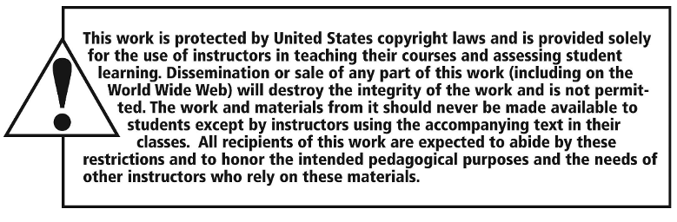
Copyright

