Slide 1

Prehospital: Emergency Care
Eleventh Edition
Chapter 10
Part I: Airway Management, Artificial Ventilation, and Oxygenation
Slides in this presentation contain hyperlinks. JAWS users should be able to get a list of links by using INSERT+F7
Copyright © 2018, 2014, 2010 Pearson Education, Inc. All Rights Reserved
Notes:
If this PowerPoint presentation contains mathematical equations, you may need to check that your computer has the following installed:
1) MathType Plugin
2) Math Player (free versions available)
3) NVDA Reader (free versions available)
Advance Preparation
During this chapter the student will learn about the various ways to establish and maintain an airway to ensure adequate oxygenation and ventilation, or as appropriate, maintain oxygenation only.
Student Readiness
Assign the associated section of MyBRADYLab and review student scores.
Review the chapter material in the Instructor Resources, which includes Student Handouts, PowerPoint slides, and the MyTest Program.
Prepare
Bring copies of skill sheets for airway management, ventilation, and oxygenation skills.
Prepare equipment for demonstration of all skills during class.
Set up labs with adequate equipment for supervised student practice.
Obtain skill instructors. A ratio of one instructor per four students is recommended.
Consider contacting a respiratory therapist, flight paramedic, or flight nurse to teach ATVs, CPAP, BiPAP, and ventilation of patients with a tracheostomy tube or stoma.
If advanced airway skills are taught at the same time as these basic skills, consult Appendix 2 of the text and increase the allotted teaching time.
Discusses medical oxygen and the equipment used to administer oxygen to patients. The total teaching time recommended is only a guideline. Take into consideration factors such as the pace at which students learn, the size of the class, breaks, and classroom activities. The actual time devoted to teaching objectives is the responsibility of the instructor.

Slide 2
Learning Readiness
E M S Education Standards, text p. 216.
Chapter Objectives, text p. 216-217.
Key Terms, text p. 217.
Purpose of lecture presentation versus textbook reading assignments.
Notes:
Explain to students what the National EMS Education Standards are. The National EMS Education Standards communicate the expectations of entry-level EMS providers. As EMTs, students will be expected to be competent in these areas. Acknowledge that the standards are broad, general statements. Although this lesson addresses the listed competencies, the competencies are often complex and require completion of more than one lesson to accomplish. The student is also expected to review the chapter objectives to foreshadow what will be in the chapter, and by mastering the key terms the EMT student will better understand the learning and be able to communicate more clearly.
Additionally, explain to the students that the purpose of using these slides is to help keep the instructor focused on highlighting important portions of the material, explain interrelationships of topics, and discuss how to apply this information. It is not the intent of the presentation (or slides alone) to include every component in the chapter. This presentation still requires the student to thoroughly read the chapter.

Slide 3
Setting the Stage (1 of 2)
Overview of Lesson Topics
  Respiration
  Respiratory System Review
  Airway Assessment
  Assessment of Breathing
  Assessing for Adequate Breathing
  Deciding Whether or not to Assist Ventilation
Notes:
These bulleted points are the major headings from the chapter, in order. The purpose is to provide a basic lecture navigation for the student.

Slide 4
Setting the Stage (2 of 2)
  Overview of Lesson Topics
  Techniques of Artificial Ventilation
  Special Considerations in Airway Management and Ventilation
  Oxygen Therapy
  Summary
Notes:
These bulleted points are the major headings from the chapter, in order. The purpose is to provide a basic lecture navigation for the student.

Slide 5
Case Study Introduction (1 of 2)
E M T s Chris Frost and Brittany Sullivan arrive on the scene of a call for a, “sick person, unknown problem,” where they immediately see a man in his forties lying on his right side on the floor. There is a makeshift tourniquet beneath the man’s arm, and a hypodermic syringe and needle lying next to him.
Notes:
Case Study
Present the Case Study Introduction provided in the PowerPoint slide set.
Lead a discussion using the case study questions provided on the subsequent slide(s).
The Case Study with discussion questions continues throughout the PowerPoint presentation.
Case Study Discussion
Use the case study content and questions to foreshadow the upcoming lesson content

Slide 6
Case Study Introduction (2 of 2)
The patient is pale, with cyanosis of his lips. He has very shallow, slow breathing, and he has vomited.
Notes:
Case Study
Present the Case Study Introduction provided in the PowerPoint slide set.
Lead a discussion using the case study questions provided on the subsequent slide(s).
The Case Study with discussion questions continues throughout the PowerPoint presentation.
Case Study Discussion
Use the case study content and questions to foreshadow the upcoming lesson content

Slide 7
Case Study (1 of 8)
What threats to the patient’s life are apparent so far?
What do Chris and Brittany need to do to intervene in the life threats?
What equipment will the E M T s need to carry out those interventions?
Notes:
Use the case study content and questions to foreshadow the upcoming lesson content. Gauge the student’s responses as a guide of how well versed they are in this topic.

Slide 8
Introduction
An open airway, adequate ventilation, and sufficient oxygenation are necessary to sustain life.
These components are part of the primary assessment that is conducted on every patient.
Notes:
By understanding the mechanical and physiological processes of respiration and ventilation and the various ways to assist patients with artificial ventilation, you will be able to quickly initiate and maintain an adequate airway and oxygenation in cases of emergency.
Introduction
During this lesson, students will learn special considerations of assessment and management of the airway and breathing status and techniques of oxygen administration.

Slide 9
Respiration
Respiration is the gas exchange that occurs between the alveoli and the pulmonary capillaries and between the body’s cells and adjacent capillaries.
Four components of respiration
  Pulmonary ventilation
  External respiration
  Internal respiration
  Cellular respiration
Notes:
Pulmonary ventilation, or simply ventilation or breathing, is the mechanical process of moving air in and out of the lungs. It is related to minute ventilation and alveolar ventilation, which will be discussed later.
External respiration is the gas exchange process that occurs between the alveoli and the surrounding pulmonary capillaries. External respiration, also referred to as alveoli/capillary gas exchange, serves to oxygenate the blood and eliminate carbon dioxide in the lungs.
Internal respiration is the gas exchange process that occurs between the cells and the systemic capillaries. Internal respiration, also known as cell/capillary gas exchange, is responsible for delivering oxygen to the cells and removing carbon dioxide from the cell.
Cellular respiration and metabolism, also known as aerobic metabolism, occurs in the cell. The process breaks down glucose in the presence of oxygen, produces high amounts of energy in the form of ATP, and releases carbon dioxide and water as a by-product.

Slide 10
Respiratory System Review (1 of 14)
Anatomy of the Respiratory System
  The Upper Airway
    Upper airway extends from nose and mouth to the cricoid cartilage.
    In unresponsive patients, the tongue can obstruct the upper airway the epiglottis may not close.
    In altered mental status, relaxation of muscles can cause the epiglottis to obstruct the larynx.
Notes:
Air normally enters the body through the nostrils. It is warmed, moistened, and filtered as it flows over the damp, sticky mucous membrane lining the nose.
Air entering the body through the mouth and nostrils travels into the pharynx.
The trachea is the passageway for air traveling into the lungs.
The epiglottis acts as a valve that closes over the opening to the larynx while food and drink are being swallowed.
The larynx, or voice box, contains the vocal cords. The anterior portion of the larynx is composed of the large bulky thyroid cartilage, commonly known as the Adam’s apple, which can be felt at the front of the throat. The cricoid cartilage forms the most inferior portion of the larynx and is the only completely circular cartilaginous ring of the upper airway.
Points to Emphasize
The upper airway warms, humidifies, and filters air before it enters the lower airway.
In patients with a decreased level of consciousness, the tongue can obstruct the upper airway.
The protective mechanism of the epiglottis can be lost in unresponsive patients.
The trachea and bronchi conduct air to the bronchioles, which terminate in clusters of alveoli.

Slide 11
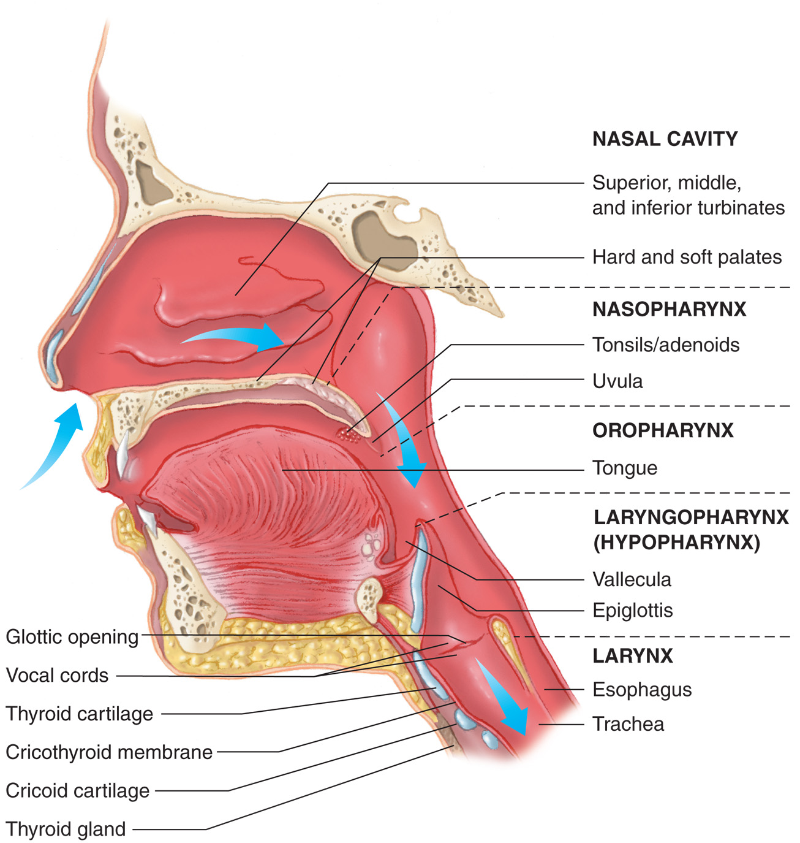
Anatomy of the Upper Airway
Notes:
The upper airway extends from the nose and mouth to the cricoid cartilage, the most inferior portion of the larynx.

Slide 12
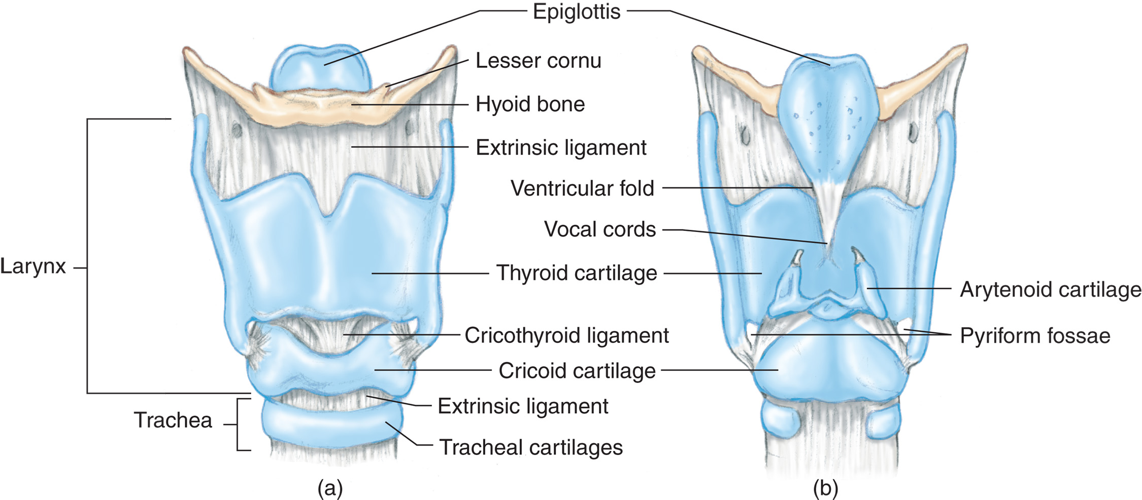
The Larynx: (a) Anterior View (b) Posterior View

Slide 13
Respiratory System Review (2 of 14)
Anatomy of the Respiratory System
  The Lower Airway
    The lower airway extends from the cricoid cartilage to alveoli.
Notes:
The trachea, commonly known as the windpipe, is the passageway for air entering the lungs. It extends from the larynx to the carina, the point at which the trachea splits into the right and left mainstem bronchi.
The right and left mainstem bronchi, which are the two major branches of the trachea, extend from the carina into the lungs, where they continue to divide into smaller sections or branches known as bronchioles.
The bronchioles terminate in millions of tiny air sacs in the lungs. These are called the alveoli.
The visceral pleura is the innermost covering of the lung. The parietal pleura is a thicker, more elastic layer that adheres to the inner portion of the chest wall. Between the two layers is the pleural space, a small space that is at negative pressure.
The pleural space contains a small amount of serous fluid that acts as a lubricant to reduce friction when the layers of the pleura rub against each other during breathing.
Points to Emphasize
The pleura serve to seal the lungs to the chest wall so that the elastic lungs are expanded when the chest wall moves upward and outward. A separation of the pleural layers interferes with ventilation.
The diaphragm and intercostal muscles contract to increase the volume of the thoracic cavity. This causes negative pressure within the chest cavity so that air flows into the lungs to equalize the pressure.
When the respiratory muscles relax, the chest cavity becomes smaller, putting the air within it under greater pressure. The air flows from the higher pressure within the chest to the lower pressure of the atmosphere.

Slide 14
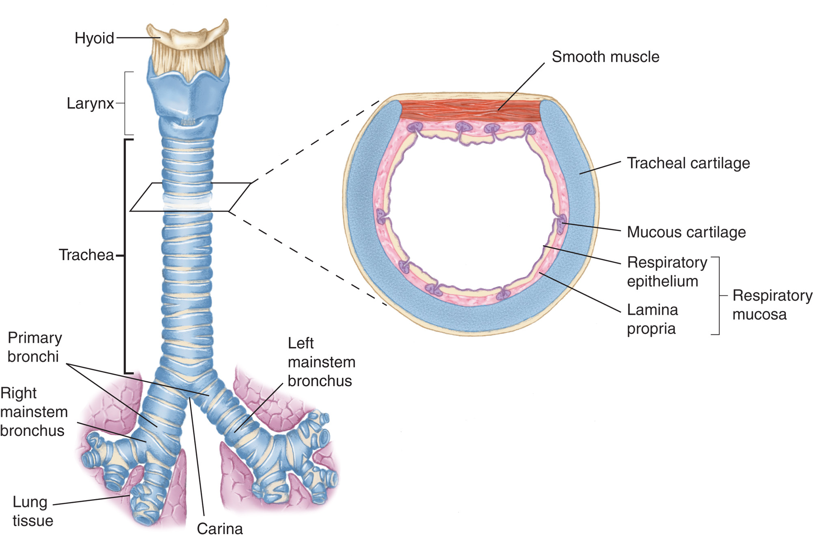
Anatomy of the Lower Airway
Notes:
The lower airway extends from the cricoid cartilage at the lower edge of the larynx to the alveoli of the lungs.

Slide 15
Click to Indicate Which Process Below Involves the Exchange of Gases between the Capillaries and Tissue Cells of the Body
Pulmonary ventilation
External respiration
Internal respiration
Metabolism

Slide 16
Respiratory System Review (3 of 14)
Mechanics of Ventilation Review
  Inhalation
    Active process.
    External intercostal muscles and diaphragm contract.
    Chest cavity increases in size.
    Pressure in the chest cavity decreases.
    Air is drawn in through the nose and mouth.
Notes:
This draws air by way of the nose, mouth, trachea, and bronchi into the lungs until the pressure inside the lungs is equal to the atmospheric pressure outside the body. Inhalation is an active process because it requires energy to contract the muscles.

Slide 17
Respiratory System Review (4 of 14)
  Mechanics of Ventilation Review
  Exhalation
    Passive process.
    External intercostal muscles and diaphragm relax.
    Chest cavity decreases in size.
    Pressure in the chest cavity increases.
    Air is forced out through the nose and mouth.
Notes:
In some respiratory diseases affecting the lower airway, such as asthma, the patient has a difficult time moving air out of the lungs because of an increased resistance in the airways or diseased lung tissue. There is a loss of the elastic recoil of the chest wall and lungs because air is trapped in the alveoli. Therefore, the patient must contract muscles, not only to draw air into the lungs but also to force air out of the lungs. Therefore, both inhalation and exhalation become active, requiring energy.
Points to Emphasize
Ventilation is controlled by impulses sent to the respiratory system as a result of communication between chemoreceptors and the brain.
Teaching Tips
Allow students to demonstrate and increase learning by asking them to explain concepts first, and then fill in gaps and correct inaccuracies.

Slide 18
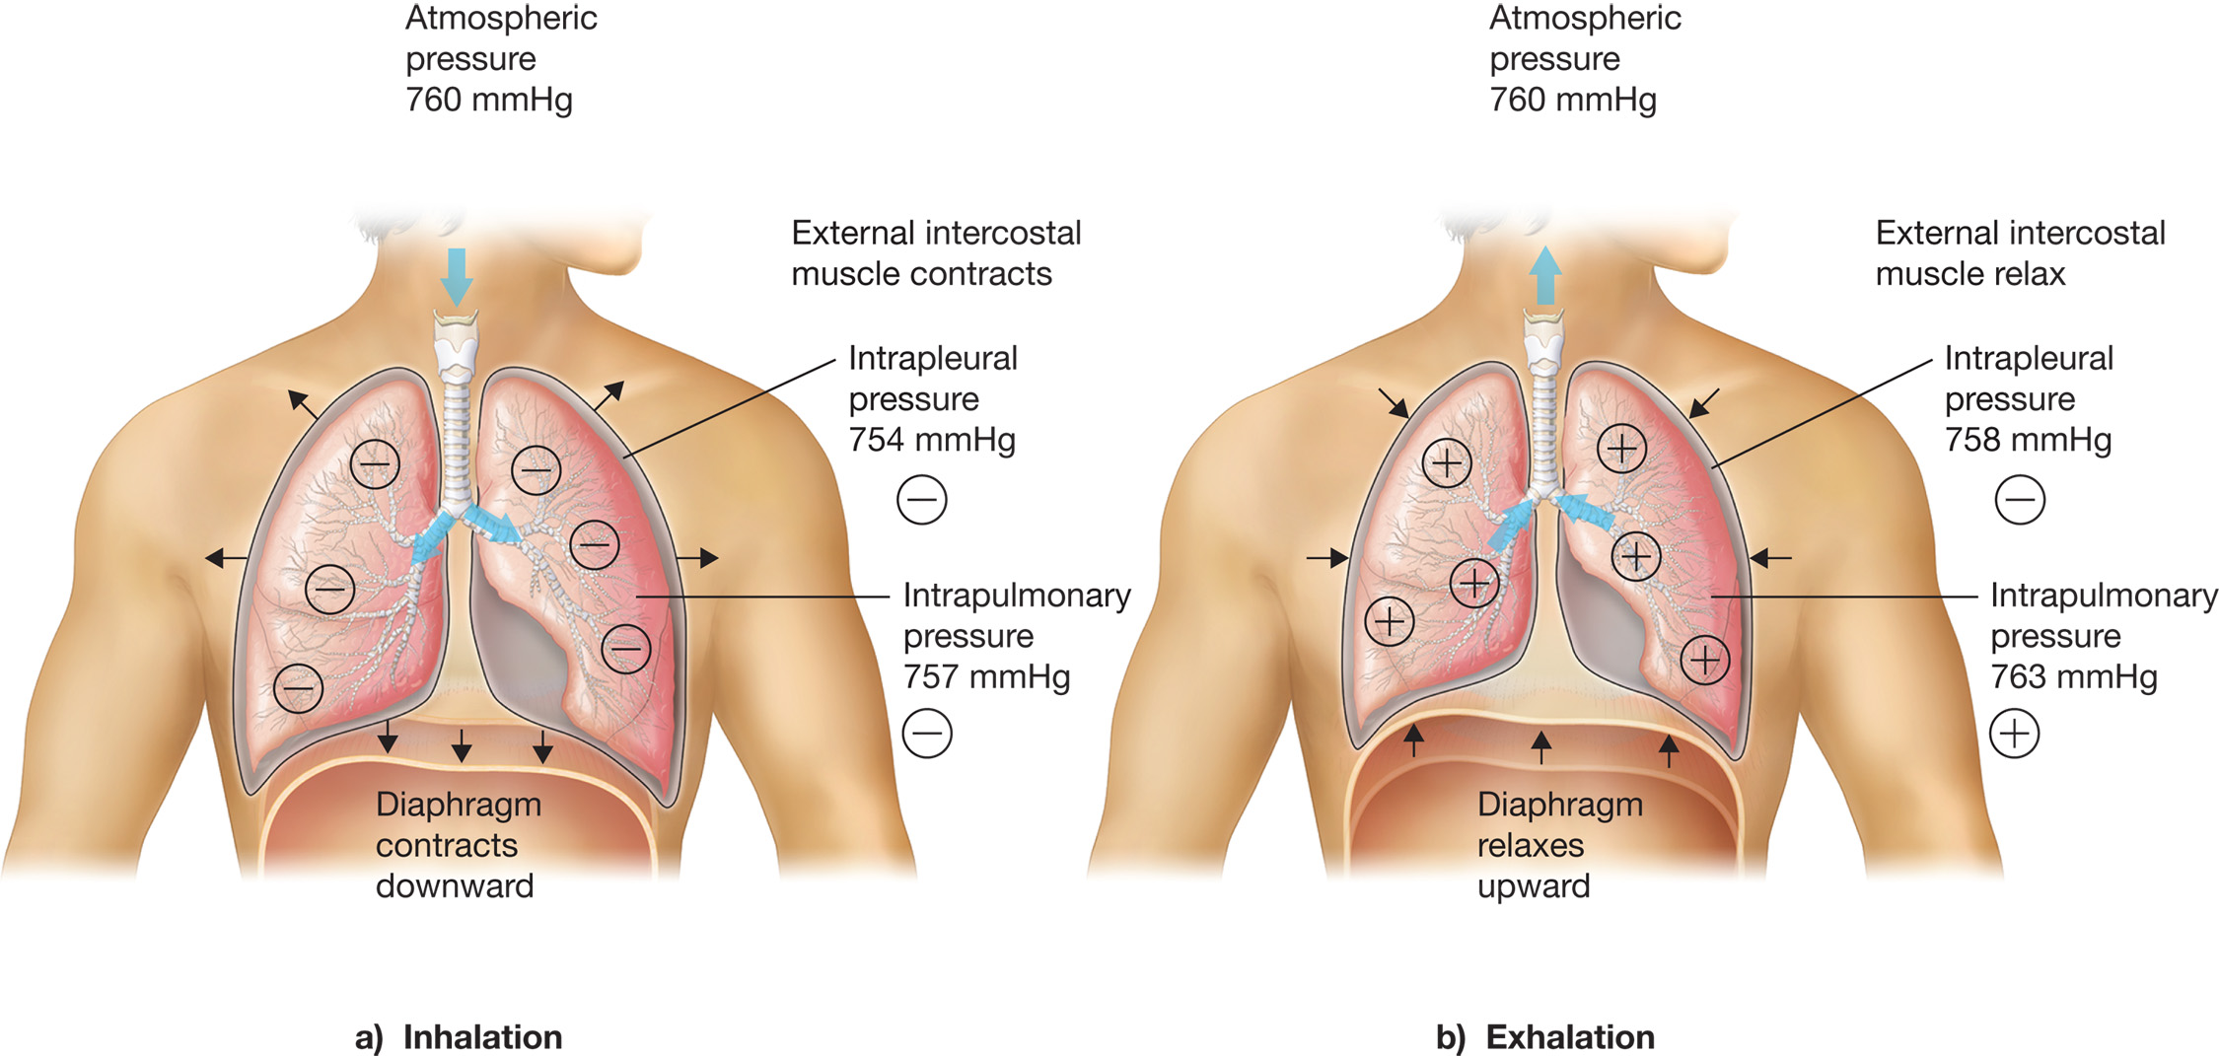
Mechanics of Ventilation: (a) Inhalation; (b) Exhalation
Notes:
Inhalation is an active process because it requires energy to contract the muscles.
Exhalation involves relaxation of muscles and little energy is expended, it is considered to be passive.

Slide 19
Respiratory System Review (5 of 14)
Mechanics of Ventilation Review
  Control of respiration
    Respiratory centers in the brainstem receive input from chemoreceptors about the levels of oxygen, carbon dioxide and p H.
    The primary stimulus to breathe is increased carbon dioxide in arterial blood.
    Some C O P D patients rely on a hypoxic drive.
Notes:
The chemoreceptors continuously monitor levels of oxygen, carbon dioxide, and pH in the arterial blood and stimulate an increase or decrease in impulses from the respiratory rhythm centers to control the rate and depth of ventilation.
The respiratory system responds primarily to changes in the carbon dioxide levels.
In patients with a category of conditions known as chronic obstructive pulmonary disease (COPD), the carbon
dioxide level in arterial blood is typically chronically elevated because of the disease process. These patients breathe on a hypoxic (low oxygen) drive, because they breathe to increase their oxygen levels and not to reduce their carbon dioxide levels. This can affect your management of the patient when considering oxygen therapy.

Slide 20
Respiratory System Review (6 of 14)
Respiratory Physiology Review
  Oxygenation is the process in which oxygen saturates the blood and cells.
  Ventilation is the mechanical process of moving air in and out of the lungs.
  Respiration is the process of gas exchange.
Notes:
Oxygenation is the process by which the blood and the cells become saturated with oxygen. This happens because of internal respiration and external respiration, the processes in which fresh oxygen replaces waste carbon dioxide, a gas exchange that takes place between the alveoli and the capillaries in the lungs, and between the capillaries and the cells throughout the body.

Slide 21
Respiratory System Review (7 of 14)
  Respiratory Physiology Review
  Hypoxemia is a low oxygen content in arterial blood that may occur from:
    Inadequate ventilation of alveoli despite adequate lung perfusion
    Inadequate lung perfusion despite adequate ventilation
    Combination of poor ventilation and perfusion
Notes:
This typically occurs from a ventilation-perfusion mismatch. A ventilation-perfusion mismatch occurs when there is a lack of available oxygenated air in the alveoli even though perfusion (blood flow) to the alveoli is adequate, or when the alveoli are adequately oxygenated but perfusion to the alveoli is poor, or when there is a combination of both poor ventilation and poor perfusion in the alveolar-capillary structures.

Slide 22
Respiratory System Review (8 of 14)
  Respiratory Physiology Review
  Hypoxia means inadequate oxygen is being delivered to the cells. It may occur from:
    Airway obstruction
    Inadequate breathing
    Shock
  It is critical that you recognize signs of mild and severe hypoxia.
Notes:
Signs of Mild to Moderate Hypoxia
Tachypnea (increased respiratory rate)
Dyspnea (shortness of breath)
Pale, cool, clammy skin (early)
Tachycardia (increase in heart rate)
Elevation in blood pressure
Restlessness and agitation (from hypoxic brain cells)
Disorientation and confusion (from high carbon dioxide levels in the blood)
Headache
Signs of Severe Hypoxia
Tachypnea
Dyspnea
Cyanosis (bluish gray color to skin, mucous membranes, and nail beds)
Tachycardia that may lead to dysrhythmias (irregular heart rhythms) and eventually bradycardia (slow heart rate)
Severe confusion
Loss of coordination
Sleepy appearance (from high carbon dioxide levels in the brain)
Head bobbing (head bobs upward with inhalation and downward with exhalation, as if falling asleep while sitting upright) with droopy eyelids (from high carbon dioxide levels in the brain)
Slow reaction time
Altered mental status
Seizure

Slide 23
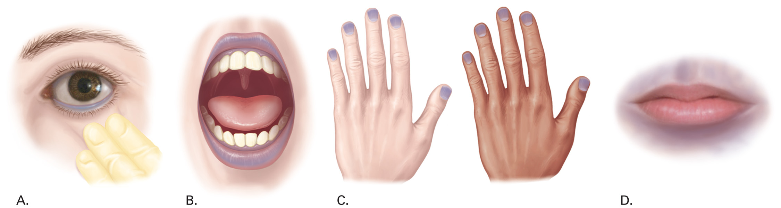
Cyanosis at the (a) Conjunctiva, (b) Mucosa, (c) Fingernail Beds, (d) Circumoral Area
Notes:
Points to Emphasize
Hypoxia occurs when an inadequate amount of oxygen is being delivered to the cells.
Cyanosis is an indication of severe hypoxia.
Patients with any signs of hypoxia require immediate assessment of the airway and breathing and administration of oxygen.
Alveolar-capillary and capillary-cellular exchange of gases depend on differences in the concentration of gases between the blood and the alveoli and between the blood and cells.
Discussion Questions
What is the process by which body cells receive oxygen?
What are signs of early hypoxia and late hypoxia?
Critical Thinking Discussion
A trauma patient has an injury to the lung that has allowed air to separate the pleural layers (pneumothorax). How will this affect ventilation?

Slide 24
Respiratory System Review (9 of 14)
Respiratory Physiology Review
  Signs of severe hypoxia
    In infants and children, hypoxia may result in bradycardia, instead of tachycardia.
Notes:
Infants and young children normally have higher heart rates than adults. As an example, a heart rate of 80 bpm, which is normal in an adult, may be an indication of hypoxia in a week-old infant where a heart rate of 100–180 bpm is normal. It is important in the assessment of newborns to suspect hypoxia as a cause of a slower-than-expected heart rate, because this is a primary cause of bradycardia in this group.
It is important to assess for early signs of hypoxia. The skin will become pale, cool, and clammy early. You may also find tachypnea and tachycardia. Early changes in the mental status may occur in the form of restlessness or agitation and confusion. Hypoxia causes restlessness and agitation in the patient, whereas the buildup of carbon dioxide in the blood will cause the patient to become confused.
If the patient displays any signs of hypoxia, immediately assess the airway and adequacy of breathing. If the breathing status is inadequate (either an inadequate rate or an inadequate volume), immediately begin positive pressure ventilation (PPV).

Slide 25
Respiratory System Review (10 of 14)
  Respiratory Physiology Review
  Alveolar/Capillary Exchange (External Respiration)
    Gases move from areas of higher concentration to areas of lower concentration.
    Carbon dioxide diffuses from the capillaries into the alveoli.
    Oxygen diffuses from the alveoli into the blood and is bound to hemoglobin.
Notes:
The blood moving into the alveolar capillaries is deoxygenated, that is, it has low oxygen concentration, but high carbon dioxide.
The oxygen diffuses from the alveoli into the capillaries, and the carbon dioxide diffuses from the capillaries into the alveoli.
Hemoglobin, found in the cytoplasm of red blood cells, is responsible for picking up most oxygen in the blood, approximately 97 percent, and carrying it through the arterial system to the capillaries throughout the body.
The carbon dioxide is exhaled from the alveoli and out of the lungs.

Slide 26
Respiratory System Review (11 of 14)
  Respiratory Physiology Review
  Capillary/Cellular Exchange (Internal Respiration)
    Blood entering capillaries is high in oxygen, which diffuses into cells.
    Cells are high in carbon dioxide, which diffuses into the blood.
Notes:
The cells have high levels of carbon dioxide and low levels of oxygen from normal metabolism. Again, because oxygen and carbon dioxide move from areas of high concentration to those of low concentration, the oxygen moves out of the capillaries and into the cells and the carbon dioxide moves out of the cells and into the capillaries.

Slide 27
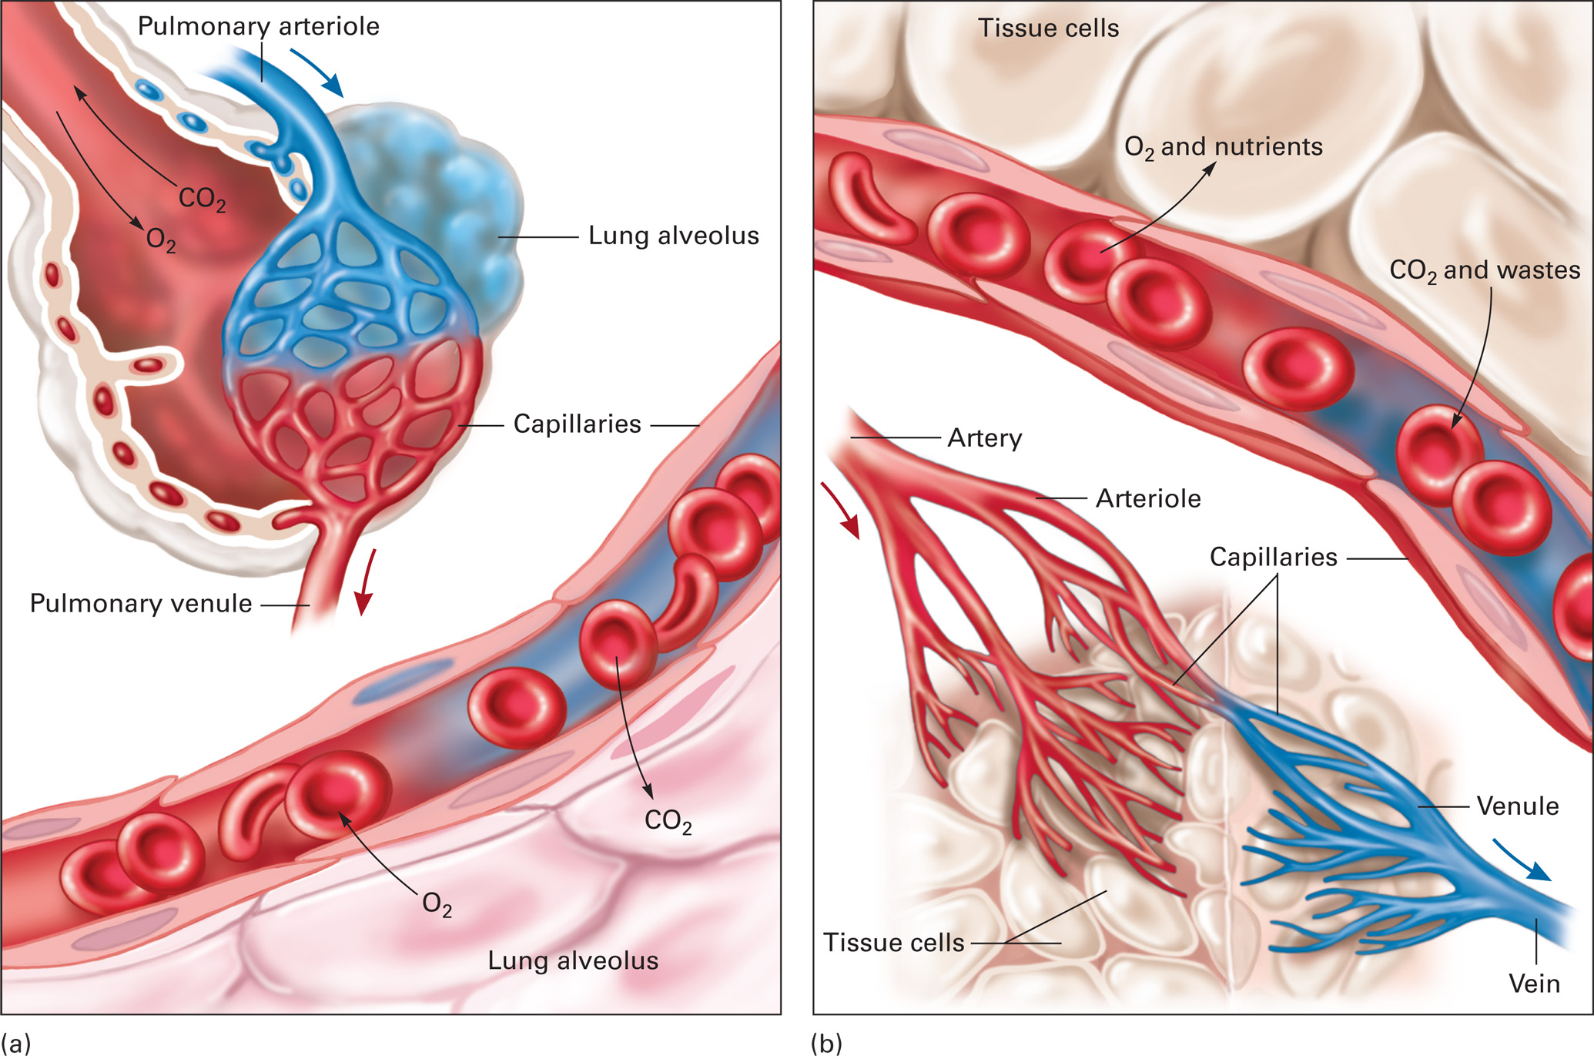
Alveolar/Capillary and Capillary/Cell Gas Exchange
Notes:
(a) Alveolar/capillary gas exchange. Oxygen moves from the lung alveolus into the capillary. Carbon dioxide moves from the capillary into the lung. (b) Capillary/cell gas exchange. Oxygen and nutrients move from the capillary into the cell. Carbon dioxide and other wastes move from the cell into the capillary.

Slide 28
Respiratory System Review (12 of 14)
Pathophysiology of Pulmonary Ventilation and External and Internal Respiration
  Disturbance in ventilation or respiration can lead to cellular hypoxia.
    Anaerobic metabolism results in:
      Insufficient energy production
      Buildup of lactic acid
      Cell dysfunction
Notes:
A severe alteration in perfusion can also cause a decrease in glucose delivery to the cells. Without a fuel source, the cells fail to produce energy and eventually die.

Slide 29
Respiratory System Review (13 of 14)
  Pathophysiology of Pulmonary Ventilation and External and Internal Respiration
  Pulmonary ventilation may be impaired by:
    Interruption of nervous control
    Damage to thorax
    Increased airway resistance
    Loss of airway patency
Notes:
Interruption of the nervous system’s control and stimulation of the diaphragm or of the external intercostal muscles may result from a brain injury, from drugs that depress the central nervous system, or from neuromuscular diseases such as muscular dystrophy.
Structural damage to the thorax may interfere with the bellows action of the chest. This impedes the ability of the thorax to generate pressure changes necessary to draw air into the lungs for inhalation and to allow airflow out of the lungs during exhalation.
Increased airway resistance reduces airflow through the respiratory tract and reduces the amount of air in the alveoli. This makes less oxygen available for gas exchange. An increase in airway resistance can occur from bronchoconstriction or from inflammation inside the vessel.
Disruption of airway patency can occur from swelling caused by infection, allergic reaction, or burns; from trauma; from foreign body obstruction; or from loss of muscle tone associated with an altered mental status or unresponsiveness.

Slide 30
Respiratory System Review (14 of 14)
  Pathophysiology of Pulmonary Ventilation and External and Internal Respiration
  Gas exchange may be impaired by:
    Decreased ambient oxygen content
    Lung disease, drowning
    Toxic gases
    Obstructed forward movement of blood
    Hypovolemia
Notes:
A reduction in the oxygen content of the ambient atmosphere decreases the available oxygen for gas exchange in the alveoli and at the cells, leading to cellular hypoxia. The oxygen content may be reduced by toxic gases or an enclosed space without adequate ventilation.
Pneumonia, pulmonary edema, and drowning cause fluid to fill the alveoli, collapse the alveoli, or increase the space between the alveoli and the capillaries, all of which hinder the movement of oxygen and carbon dioxide between the capillaries into the alveoli. Other diseases, such as emphysema, distort the structure of the alveoli and change the surface area for effective gas exchange.
Another cause of cellular hypoxia is poor perfusion or a decreased ability of the blood to carry oxygen. Conditions that obstruct forward movement of blood flow, such as a pulmonary embolism, tension pneumothorax, heart failure, and cardiac tamponade, reduce the delivery of oxygenated blood to the cells.
Other conditions such as anemia or hypovolemia reduce the concentration of red blood cells and hemoglobin in the blood, making oxygen transport less effective.
Points to Emphasize
Anything that impairs the nervous system, chest wall, or diaphragm movement, flow of air in and out of the lungs, circulation of blood, or exchange of gases can result in anaerobic metabolism.
Discussion Question
What are some illnesses and injuries that can impair oxygenation?
Knowledge Application
Describe patient situations with various cardiac, cardiovascular, respiratory, or nervous system problems. Have students explain how each problem can lead to hypoxia and anaerobic metabolism.

Slide 31
Airway Anatomy in Infants and Children (1 of 2)
Airway Anatomy in Infants and Children
  Chest wall is pliable.
  Increased reliance on diaphragm.
  Lungs are easily overinflated in artificial ventilation.
Notes:
Points to Emphasize
In infants, an early response to hypoxia may be bradycardia, rather than tachycardia.
Children's respiratory systems are significantly different from adults'.
Discussion Question
What are differences in pediatric respiratory systems as compared to adults'?

Slide 32
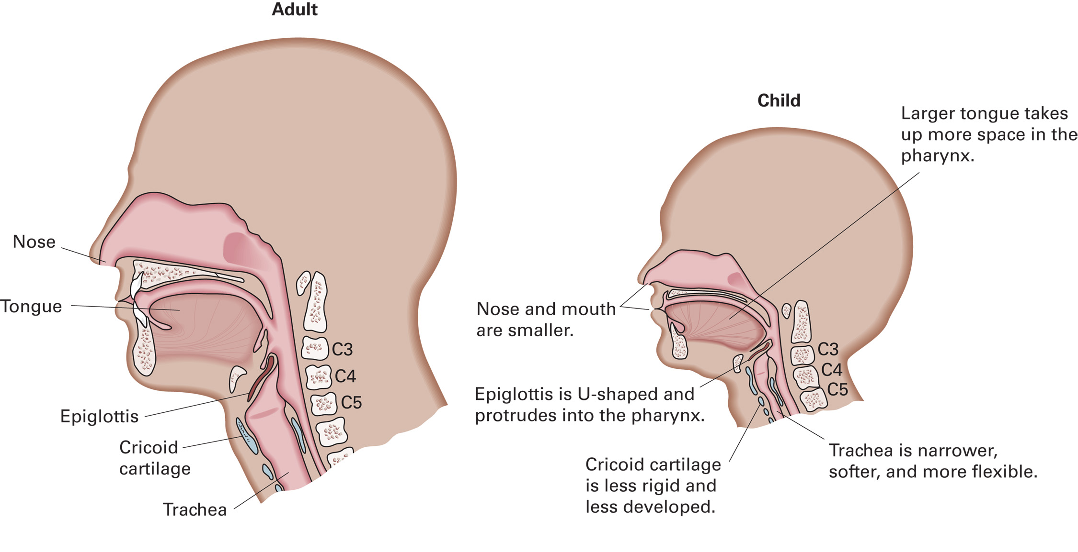
Comparison of Airways of Adult and Infant or Child

Slide 33
Airway Anatomy in Infants and Children (2 of 2)
Airway Anatomy in Infants and Children
  Limited oxygen reserves.
  High metabolic rate and oxygen needs.
  Hypoxia is the most common cause of cardiac arrest.
  Anatomical features in infants and children that may cause them to deteriorate more rapidly than adults.
Notes:
Mouth and Nose- The noses and mouths of infants and children are smaller than those of adults. Thus, they are more easily obstructed by foreign bodies, swelling, blood, mucus, and secretions. Infants are obligate nose breathers, meaning that they want to breathe through the nose and not the mouth; thus, it is especially important to keep the nose clear of obstructions.
Pharynx- Because the tongue of an infant or a child is relatively large in proportion to the size of the mouth an infant or a child is more prone to airway obstruction by posterior displacement of the tongue. The epiglottis can protrude into the pharynx, also contributing to obstruction.
Trachea and Lower Airway- The trachea and lower airway passages of infants and children are narrower, softer, and more flexible than those of adults. Thus, airway obstructions occur more easily from mucus, pus, blood, secretions, swelling (edema), constriction, and kinking of the trachea with flexion or extension.
Cricoid Cartilage- The cricoid cartilage, like other cartilage in infants and children, is less developed and less rigid. In infants and children less than 10 years of age, the cricoid cartilage is typically the narrowest portion of the upper airway.
Chest Wall and Diaphragm- The chest wall in an infant or a child is softer and more pliable than in an adult. This leads to a much greater compliance (elasticity, response to pressure) or movement during ventilation. Infants and children rely more on the diaphragm for breathing. The intercostal muscles contribute less in normal breathing and act more like accessory muscles.
Oxygen Reserves Infants and children are smaller and have more limited oxygen reserves than adults. Therefore, they have less oxygen in the lungs available during periods of inadequate breathing or apnea.

Slide 34
Airway Assessment (1 of 18)
Airway Functions and Considerations
  Patients with altered mental status are susceptible to airway obstruction and aspiration.
  The airway may be obstructed by injuries.
Notes:
The airway and respiratory tract is the conduit that allows air to move from the atmosphere and into the alveoli for gas exchange.
No matter what the patient’s condition, the airway must always remain patent.
Any obstruction (food, blood, swelling, or vomit) of the airway results in less air movement, which leads to some degree of poor gas exchange and potential hypoxia.
The degree of the obstruction directly affects the amount of air available for gas exchange. The tongue may create only a partial airway obstruction, whereas a piece of food may completely stop airflow.
Points to Emphasize
A patient who is awake, alert, able to speak easily, and breathing normally has an open airway.
Any patient with an alteration in mental status is at risk for airway compromise.
Discussion Questions
What are indications that a patient has a patent airway?
Why is opening the airway the first step in the primary survey?

Slide 35
The Airway can be Blocked by Injuries such as Burns or Soft Tissue Trauma
Notes:
The airway can be obstructed from injuries such as burns and soft tissue trauma to the face and upper airway.

Slide 36
Table 10-1 Signs of an Open Airway
Air can be felt and heard moving in and out of the mouth and nose.
The patient is speaking in full sentences or with little difficulty.
The sound of the voice is normal for the patient.
Notes:
It takes an open and clear airway, along with adequate breathing, to enable a patient to communicate easily (Table 10-1).

Slide 37
Table 10-2 Signs of a Blocked or Inadequate Airway
Abnormal upper airway sound (stridor, snoring, crowing, or gurgling)
An awake patient who is unable to speak
Evidence of a foreign body airway obstruction (tongue, food, vomit, blood, or teeth in the upper airway, mouth, or nose)
Swelling to the mouth, tongue, or oropharynx
Notes:
Signs of a blocked or inadequate airway are found in Table 10-2.

Slide 38
Airway Assessment (2 of 18)
Abnormal upper airway sounds
  Snoring
  Crowing
  Gurgling
  Stridor
Notes:
Snoring (sonorous sounds) occurs when the upper airway is partially obstructed by the tongue or by relaxed tissues in the pharynx. The snoring and obstruction can be corrected by performing a head-tilt, chin-lift maneuver. In a patient with a suspected spinal injury, a jaw-thrust maneuver should be used.
Crowing is a sound like a crow cawing that occurs when the muscles around the larynx spasm and narrow the opening into the trachea. Air rushing through the restricted passage causes the sound.
Gurgling, a sound like gargling, usually indicates the presence of blood, vomitus, secretions, or other liquid in the airway. Immediately suction the substance from the airway.
Stridor is a harsh, high-pitched sound heard during inspiration. It is characteristic of a significant upper airway obstruction from swelling in the larynx. Stridor may also be heard if a mechanical obstruction by food or other objects is present.

Slide 39
Airway Assessment (3 of 18)
Opening the Mouth
  You must open the mouth of an unresponsive patient to assess the airway.
  Use the crossed-fingers technique to open the mouth.
  Clear the airway of liquids or foreign bodies.
Notes:
Opening the mouth:
Kneel above and behind the patient.
Cross the thumb and forefinger of one hand.
Place the thumb on the patient’s lower incisors and your forefinger on the upper incisors.
Use a scissors motion or finger-snapping motion to open the mouth.
Inspect inside the mouth for vomitus, blood, secretions, broken teeth, or foreign bodies that can obstruct the airway. Suction any foreign substance from the mouth.
Points to Emphasize
Noisy breathing is impaired breathing. Listen for sounds that indicate upper airway obstruction.
Discussion Question
What are indications that a patient's airway is not patent?

Slide 40
Airway Assessment (4 of 18)
Opening the Airway
  Manual maneuvers
  Suction
  Mechanical airways
Notes:
The following are techniques that are used to open and maintain a patent airway:
Manual airway maneuvers
Head-tilt, chin-lift maneuver
Jaw-thrust maneuver
Suction
Mechanical airways
Oropharyngeal airway (OPA or oral airway)
Nasopharyngeal airway (NPA or nasal airway)

Slide 41
Airway Assessment (5 of 18)
  Opening the Airway
  Head-Tilt, Chin-Lift Maneuver
    Used when no spinal injury is suspected.
    Used in unresponsive patients, cardiac arrest.
    Must be supplemented with a mechanical airway if ineffective on its own.
Notes:
Place one hand on the patient’s forehead, and apply firm, backward pressure with the palm of the hand to tilt the head back. Place the tips of the fingers of the other hand underneath the bony part of the lower jaw.
With the head tilted backward, lift the jaw upward to bring the patient’s chin forward. Do not compress the soft tissues underneath the chin; they might obstruct the airway.
Continue to press the other hand on the patient’s forehead to keep the head tilted backward.
Lift the chin and jaw so that the teeth are brought nearly together. (If necessary, you can use your thumb to depress or retract the lower lip; this keeps the patient’s mouth slightly open.)
If the patient has loose dentures, hold them in position, making obstruction by the lips less likely. A seal is easier to form when the dentures are in place. If the dentures cannot be managed, remove them.

Slide 42
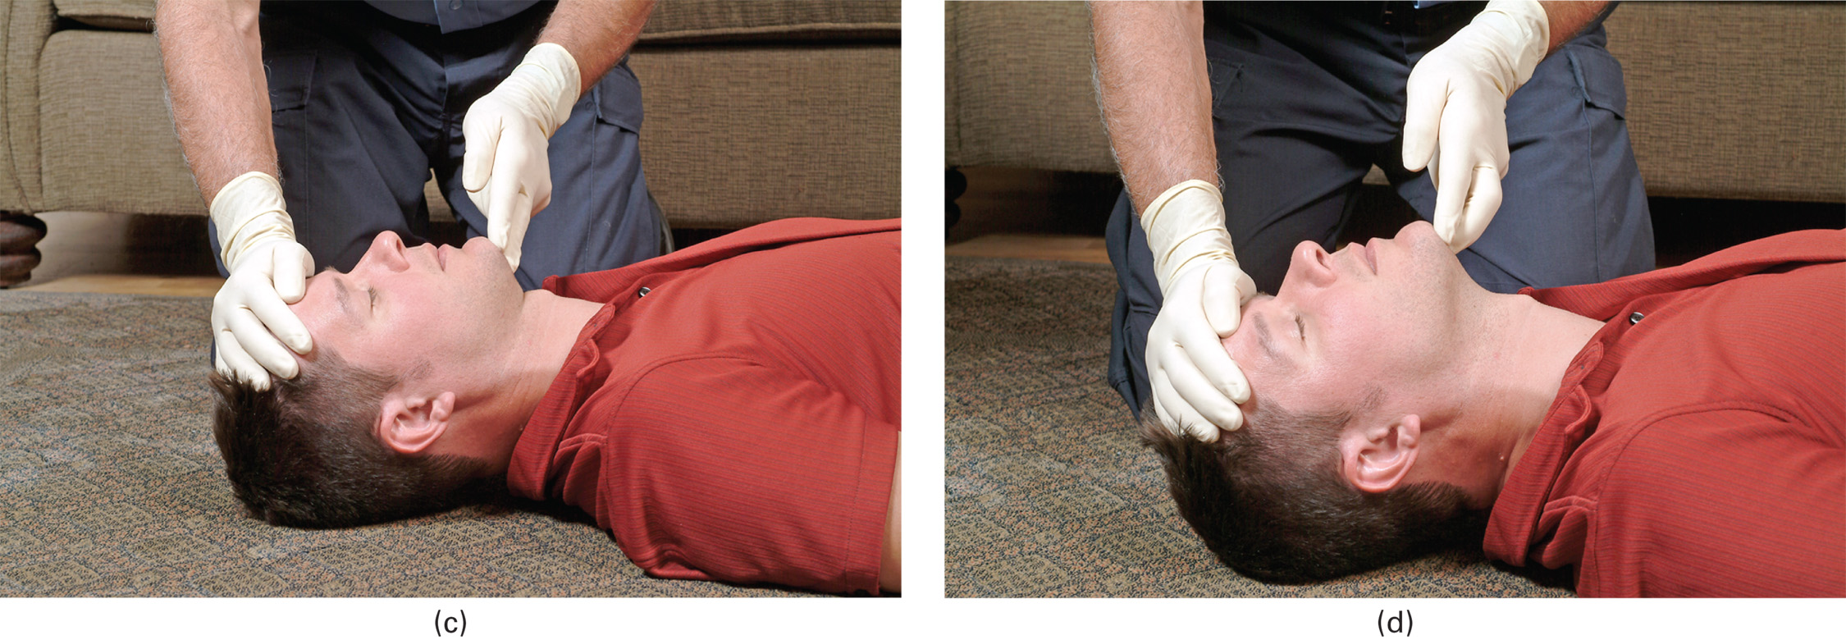
(c) Head-Tilt, Chin-Lift Maneuver in the Adult: Neutral Starting Position. (d) Head-Tilt, Chin-Lift Maneuver in the Adult: Final Tilted Position
Notes:
The head-tilt, chin-lift maneuver is illustrated in Figures 10-11c and 10-11d.

Slide 43
Airway Assessment (6 of 18)
Opening the Airway
  Head-Tilt, Chin-Lift Maneuver in Infants and Children
    Avoid overextension of the neck.
    It may be necessary to pad beneath the shoulders.
Notes:
With an infant, the head should be tilted back gently into a “sniffing” or neutral position. To achieve the sniffing position, the opening to the ear is lined up horizontally with the sternal notch.

Slide 44
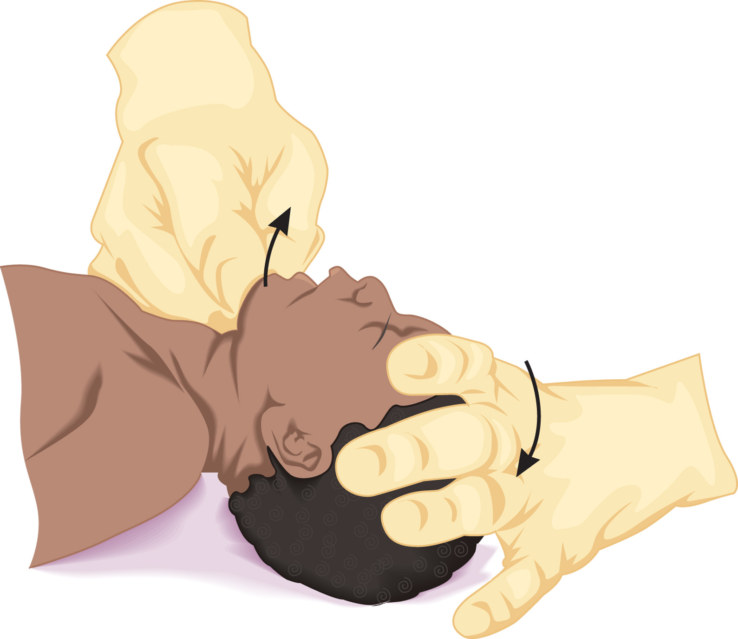
Head-Tilt, Chin-Lift Maneuver in the Infant. Be Sure to Avoid Overextension
Notes:
With an infant, the head should be tilted back gently into a “sniffing” or neutral position.

Slide 45
Child Ear-To-Sternal-Notch Alignment
Notes:
To achieve the sniffing position, the opening to the ear is lined up horizontally with the sternal notch. Because of the large size of the head, it may be necessary to place a pad behind the shoulders to keep the airway open in infants and young children.

Slide 46
Airway Assessment (7 of 18)
Opening the Airway
  Jaw-Thrust Maneuver
    Used when spinal injury is suspected
    Allows neck to remain in neutral, in-line position
Notes:
The jaw-thrust maneuver the following steps:
Kneel at the top of the patient’s head. Place your elbows on the surface on which the patient is lying, putting your hands at the side of the patient’s head.
Grasp the angles of the patient’s lower jaw on both sides. Move the jaw forward with both hands. This moves the tongue forward, away from the airway. If no spinal injury is suspected, the head can be tilted backward.
Retract the lower lip with your thumb if the lips close.

Slide 47
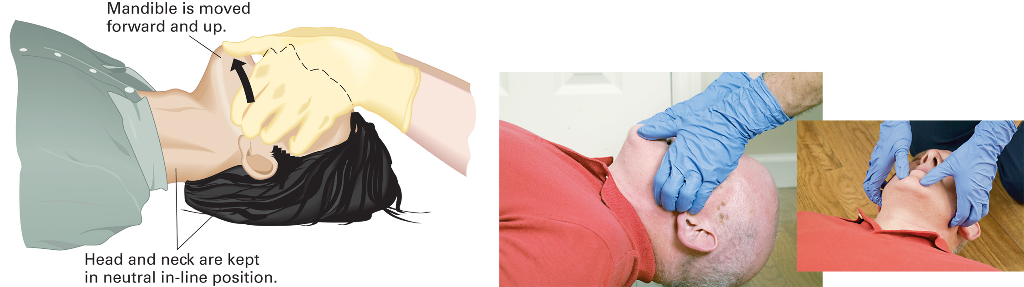
The Jaw-Thrust Maneuver is Used to Open the Airway in Patients with Suspected Spinal Injury
Notes:
If a spinal injury is suspected, the patient’s head and neck must be maintained in a neutral, in-line position. This means that the head is not turned to the side, tilted forward (flexed), or tilted backward (extended).

Slide 48
Airway Assessment (8 of 18)
Opening the Airway
  Jaw-Thrust Maneuver in Infants and Children
    Follow the basic procedure just described for adults when performing the jaw-thrust maneuver in infants and children.
Notes:
Place two or three fingers of each hand at the angle of the jaw to lift it up and forward while the other fingers guide the movement. Insert an airway adjunct if the jaw thrust does not open the airway.

Slide 49
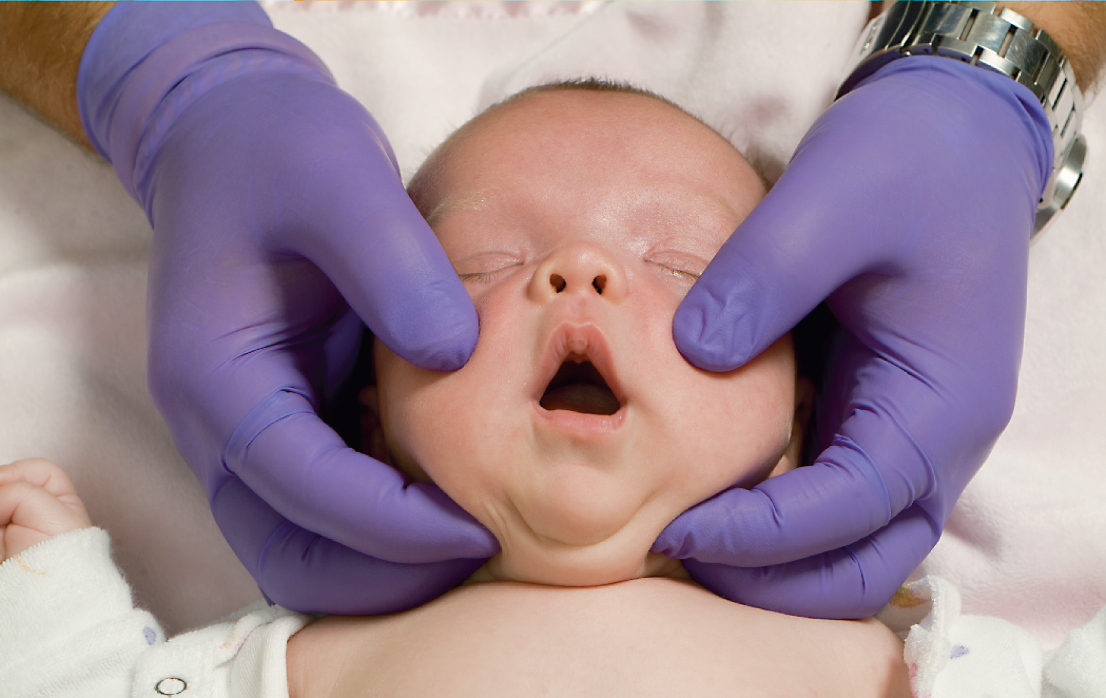
Jaw-Thrust Maneuver in an Infant
Notes:
Follow the basic procedure just described for adults when performing the jaw-thrust maneuver in infants and children.

Slide 50
Airway Assessment (9 of 18)
Opening the Airway
  Positioning the Patient for Airway Control
    Recovery position
      Used if a patient has an altered mental status and is at risk of aspiration
      Contraindicated in suspected spinal injury and patients who need positive pressure ventilation
Notes:
If the patient has an altered mental status and may be at risk of aspirating blood, secretions, or vomitus, place the patient in a modified lateral (recovery) position. This is also known as the coma or recovery position. This positioning is used only in patients who do not have a suspected spinal injury and in patients who are not in need of positive pressure ventilation.
To ventilate a patient effectively when no advanced airway device is in place, the patient must be in a supine position.

Slide 51
The Modified Lateral (Recovery) Position is Used to Help Prevent Aspiration in Patients Who do not have Suspected Spinal Injury
Notes:
If the patient has an altered mental status and may be at risk of aspirating blood, secretions, or vomitus, place the patient in a modified lateral (recovery) position.

Slide 52
Airway Assessment (10 of 18)
Suctioning
  Gurgling indicates liquid in the airway.
  Some suction equipment is not effective in removing thick vomitus or solid objects, such as teeth, foreign bodies, or food, from the airway.
Notes:
It may be necessary to place the patient on his side and perform a finger sweep to remove the material if the rescuer visualizes it.
Points to Emphasize
Suction devices must generate enough negative pressure to remove fluids from the airway effectively.
Always measure suction catheters prior to insertion.
Apply suction only while withdrawing the suction catheter.
If possible, do not suction for more than 15 seconds, but clear the airway before ventilating.
Suctioning can cause hypoxia. Monitor the heart rate while suctioning.
Discussion Question
What precautions should be taken when suctioning?

Slide 53
Airway Assessment (11 of 18)
  Suctioning
  Standard Precautions During Suctioning
    Protective eyewear
    Mask
    Gloves
    N-95 or H E P A respirator for suspected tuberculosis
Notes:
Airway Assessment—Suctioning
Standard Precautions during suctioning
Protective eyewear, mask, and gloves should be worn.
An N-95 or high-efficiency particular air (HEPA) respirator should be worn if a patient is known to have tuberculosis.

Slide 54
Airway Assessment (12 of 18)
  Suctioning
  Suction Equipment
    May be mounted in the ambulance or portable
    Must generate enough vacuum and airflow to clear the airway
    Must have wide-bore, thick tubing, a collection bottle, and water supply
Notes:
Fixed or installed units should be part of the required on-board ambulance equipment. They should be powerful enough to provide an airflow of 740 lpm at the end of the delivery tube and create a vacuum of more than -300 mmHg on the gauge when the tubing is clamped or kinked.
A portable unit must produce a vacuum adequate to suction substances from the pharynx. A pressure of -80 to -120 mmHg is generally necessary to provide adequate suction. The device should be capable of generating -300 mmHg of pressure when the suction hose is clamped. Portable suction units can be electric-, oxygen-, air-, or hand-powered.
Suction catheters must be disposable and capable of being connected to the suction unit’s tubing. Two different types of suction catheters are available: rigid catheters and soft catheters.

Slide 55
On-Board Suction Unit
Notes:
Fixed or installed units should be part of the required on-board ambulance equipment.

Slide 56
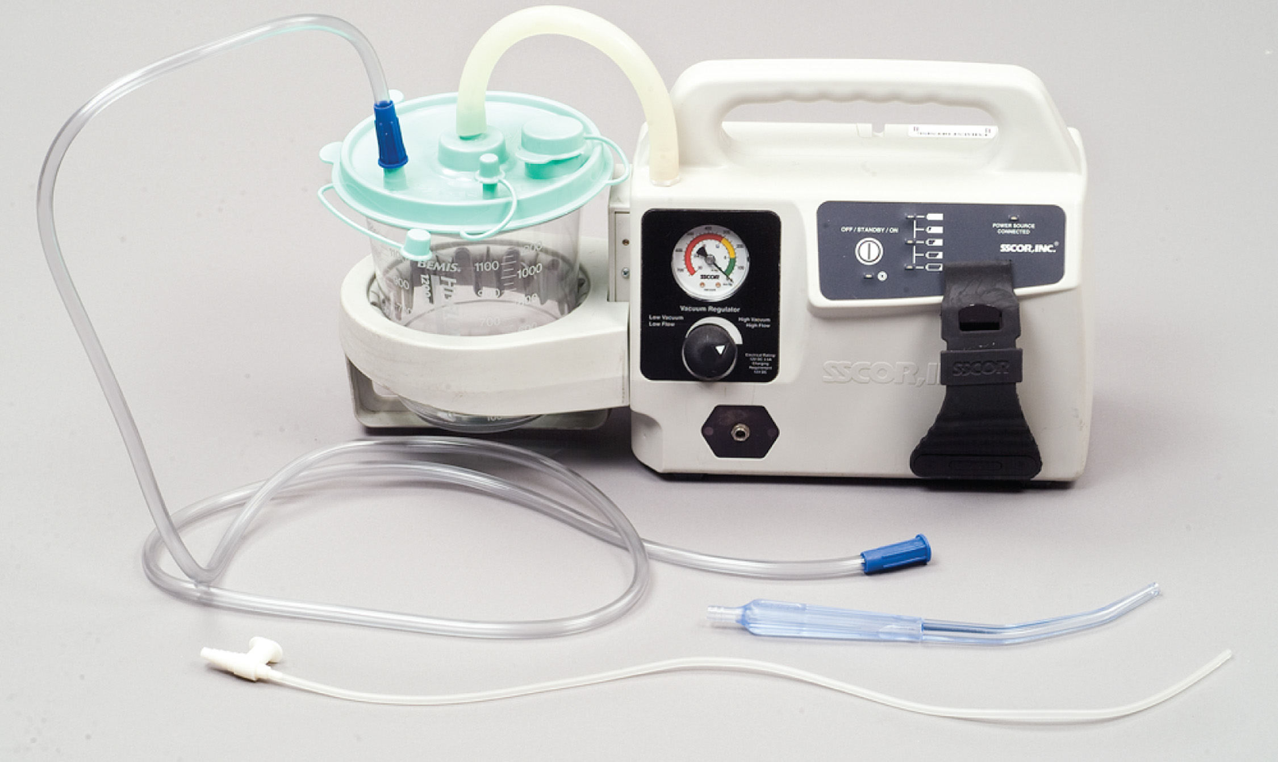
A Portable Suction Unit
Notes:
A portable unit must produce a vacuum adequate to suction substances from the pharynx.

Slide 57
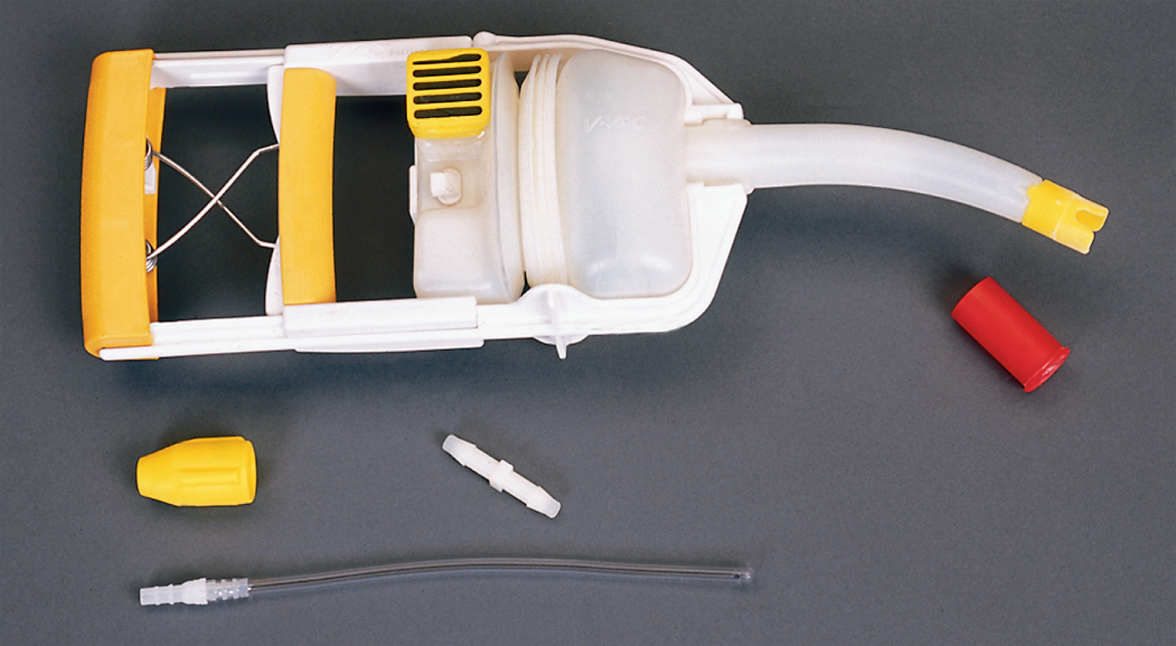
A Hand-Powered Suction Device
Notes:
Hand-powered suction devices do not require any energy source other than an EMT to create the vacuum.

Slide 58
Airway Assessment (13 of 18)
Suctioning
  Suction Equipment
    Rigid catheter for suctioning the mouth and oropharynx.
    Soft catheter can be used to suction nose or nasopharynx.
Notes:
Rigid catheter:
Used in unresponsive patients
Insert only as far as you can see into the mouth.
Avoid touching the back of the oropharynx.
Soft (French) catheter:
The soft suction catheter should not be inserted beyond the base of the tongue.
Avoid inserting too far.

Slide 59
Airway Assessment (14 of 18)
  Suctioning
  Suctioning Technique
    Assemble and turn on the suction unit.
    Measure and insert the catheter.
    Suction on the way out only.
    If possible, do not suction for more than 15 seconds at a time (five seconds in infants and children).
    Rinse the catheter.
Notes:
Position yourself at the patient’s head. If this is not possible, take a position in which you can observe the airway.
Turn on the suction unit.
Select the appropriate type of catheter. Use a rigid catheter when suctioning the mouth or oropharynx. If the nasal passages need to be suctioned, select a soft (French) catheter and use low to medium suction (80–120 mmHg). Standard suction pressure for an adult patient is 100–120 mmHg, a child is 80–100 mmHg, and an infant is 60–80 mmHg. It is commonly recommended to use the lowest vacuum pressure possible to avoid hypoxia. A bulb syringe may be used if a soft catheter is not available.
Measure the catheter and insert it into the oral cavity without suction, if possible. Insert it no farther down than the base of the tongue.
Apply suction only on the way out of the airway. Begin suction after the tip has been positioned, moving the catheter tip from side to side to clear material from the mouth as the catheter is being removed. If possible, suction for no more than 15 seconds at a time in the adult; in infants and children, suction in shorter periods, approximately 5 seconds. However, it is necessary to provide suction until the substance is clear from the airway to prevent aspiration from spontaneous or artificial ventilation.
If necessary, rinse the catheter with water to prevent obstruction of the tubing from dried or thick material. Do this by keeping a bottle of water available and applying suction to the water as necessary to clear the tubing.

Slide 60
E M T Skills 10-1
Suctioning Technique

Slide 61
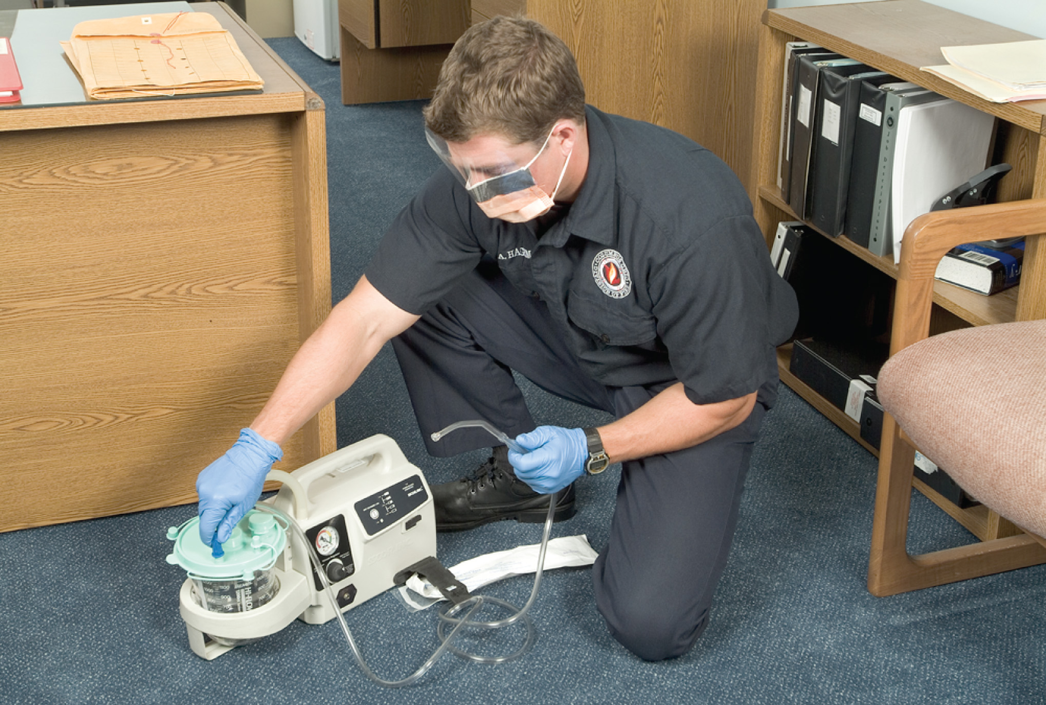
Make Sure the Suction Unit is Properly Assembled
Notes:
Turn on the suction unit.

Slide 62
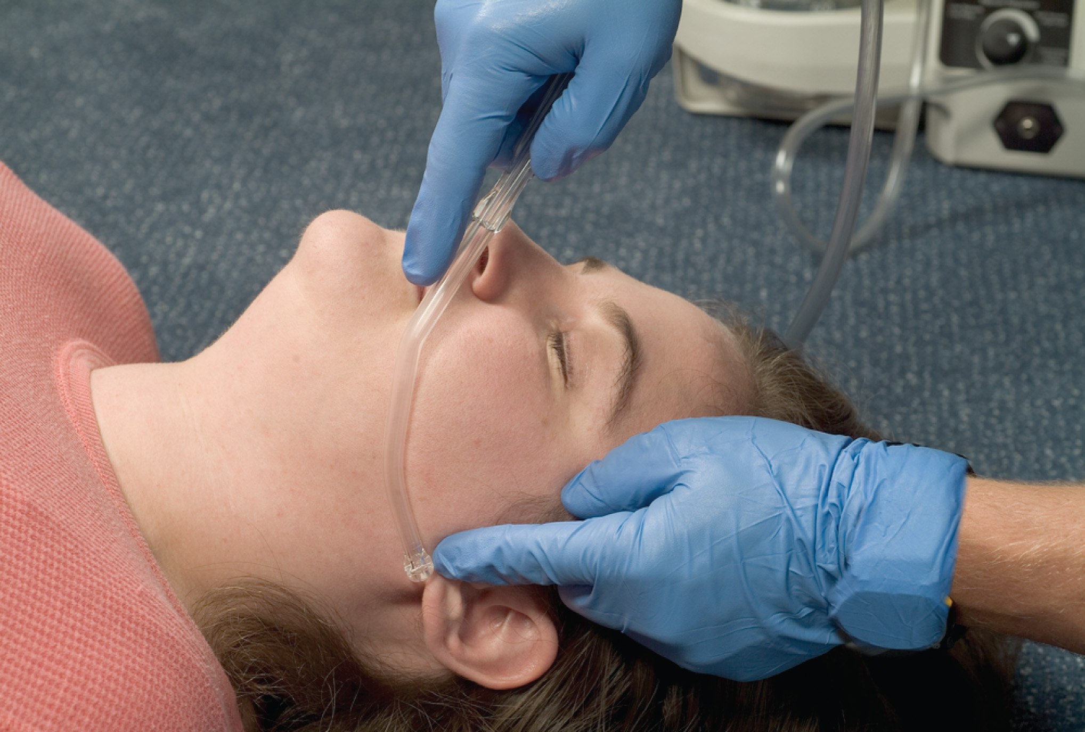
Measure the Catheter from the Corner of the Mouth to the Earlobe
Notes:
Measure the catheter and insert it into the oral cavity without suction.

Slide 63
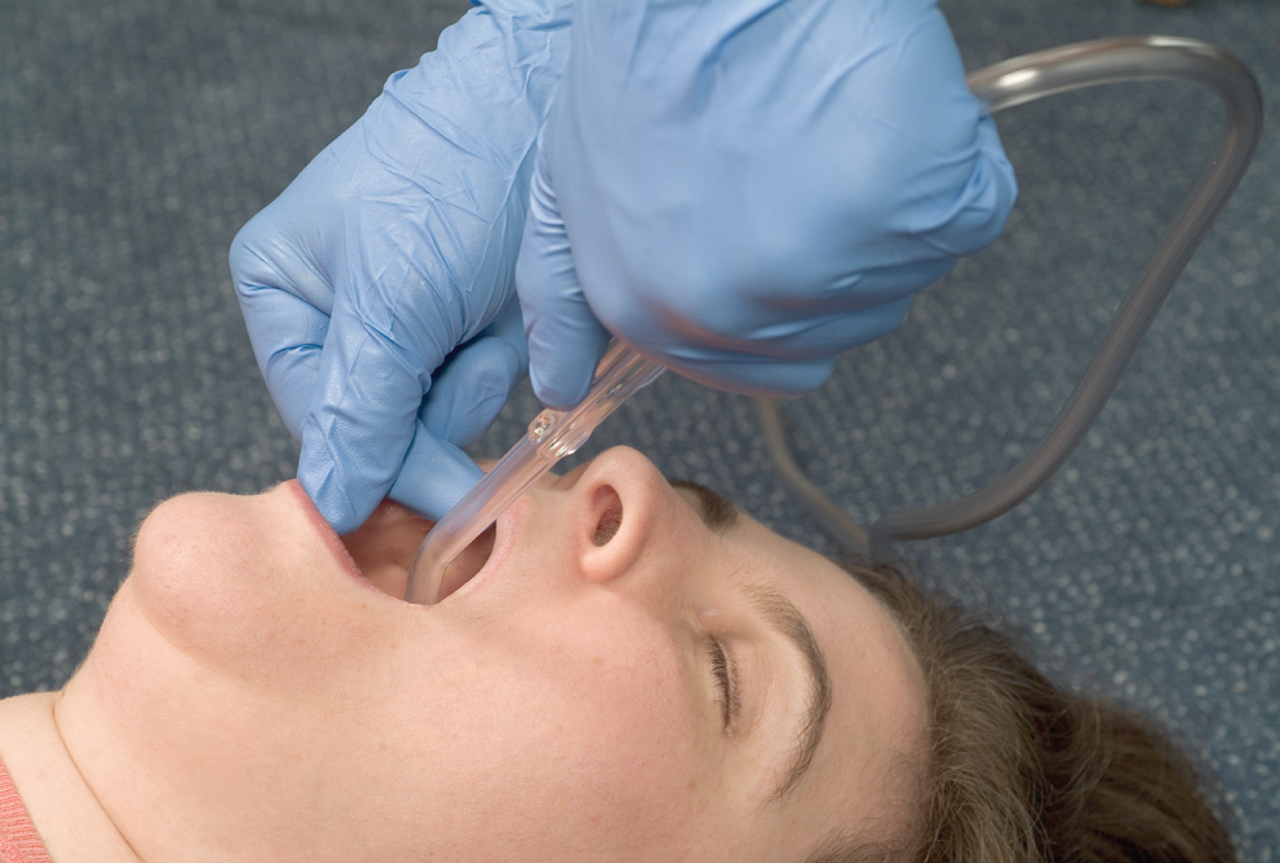
Open the Patient’s Mouth and Insert the Catheter
Notes:
Insert the catheter into the oral cavity without suction.

Slide 64
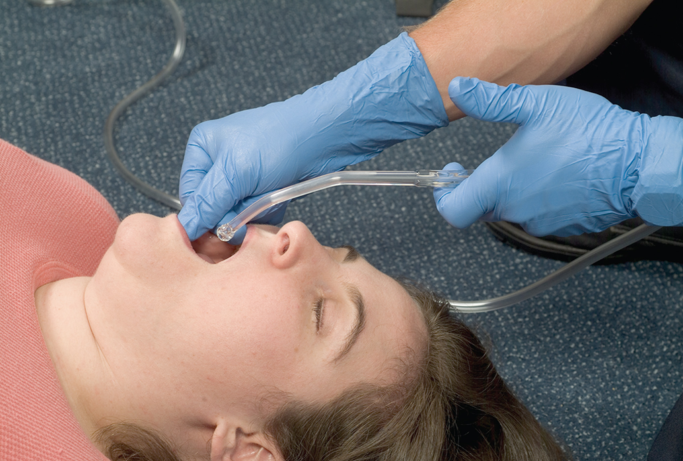
Apply Suction as You Withdraw the Catheter
Notes:
Apply suction only on the way out of the airway.

Slide 65
Airway Assessment (15 of 18)
Suctioning
  Special Considerations When Suctioning
    If there is too much to suction quickly, roll the patient onto his side and manually sweep the mouth.
    Alternate 15 seconds of suction with two minutes of ventilation for copious, frothy secretions.
Notes:
Special considerations when suctioning the airway:
If the patient has secretions or vomitus that cannot be removed quickly and easily by suctioning, the patient should be log rolled onto his side and the oropharynx cleared by finger sweeping the foreign material from the mouth.
If the patient in need of artificial ventilation is producing frothy secretions as rapidly as suctioning can remove them, apply suction for 15 seconds, provide positive pressure ventilation with supplemental oxygen for 2 minutes, and then apply suction for another 15 seconds.
During suctioning, the residual volume of air in the lungs between respirations is removed. Residual volume is defined as the air remaining in the lungs after a maximal exhalation. This causes a quick decrease in blood oxygen levels. Therefore, monitor the patient’s pulse, heart rate, and pulse oximeter reading while suctioning.
In the adult patient, a rapid heart rate, slow heart rate, or an irregular heart rate may be seen during suctioning. These can occur from stimulation of the airway by the suction catheter or it may be an indication that the oxygen level in the blood is getting dangerously low.
Before suctioning mucus and small amounts of secretions in a patient who is being artificially ventilated, ventilate him at a rate of 10–12 ventilations per minute for 5 minutes to wash out the residual nitrogen and increase the functional oxygen reserve.
Critical Thinking Discussion
What will happen if you ventilate a patient who has blood or vomit in the airway?
Teaching Tips
Cover all steps and criteria on the skill check-sheets used for later student testing. It is more difficult to change behaviors, once learned, than to teach them initially.

Slide 66
Case Study (2 of 8)
Before moving the patient to a supine position, Chris quickly grabs the portable suction unit and uses a rigid suction catheter to clear the patient’s mouth. The E M T s log roll the patient, and Chris uses a head-tilt, chin-lift to open the airway. The patient’s respiratory rate is six per minute and his tidal volume is very shallow.
Notes:
Discuss the continuation of the case study with the class.

Slide 67
Case Study (3 of 8)
As Chris prepares to provide positive-pressure ventilation, what airway adjunct should he consider to assist in keeping the patient’s airway open?
What are the advantages and disadvantages of that choice?
Notes:
Use the case study content and questions to foreshadow the upcoming lesson content. Gauge the student’s responses as a guide of how well versed they are in this topic.

Slide 68
Airway Assessment (16 of 18)
Airway Adjuncts
  Used in conjunction with manual airway maneuvers
  Includes oropharyngeal and nasopharyngeal airways
Notes:
The adjunct must be clean and clear of obstructions.
The proper size airway adjunct must be selected to avoid complications and ineffectiveness.
The airway adjuncts do not protect the airway from aspiration of secretions, blood, vomitus, or other foreign substances into the lungs.
The mental status of the patient will determine whether an adjunct can be used. The patient’s mental status must be continually and carefully monitored. If the patient becomes more responsive or gags, remove the airway adjunct.
A head-tilt, chin-lift or jaw-thrust maneuver must still be maintained, even when an airway adjunct is in place and properly positioned.
Points to Emphasize
Oral and nasal airways are important adjuncts, but do no replace manual maneuvers.
Oral and nasal airways can stimulate the gag reflex.
Airway management procedures require EMTs to wear appropriate personal protective equipment.
Knowledge Application
After students have practiced rote skills, put the skills in context by providing lab scenarios that call for decision making.

Slide 69
Airway Assessment (17 of 18)
  Airway Adjuncts
  Oropharyngeal Airway
    Oropharyngeal airways are used in patients who are unresponsive, without a gag reflex.
    The device must be sized properly.

Slide 70
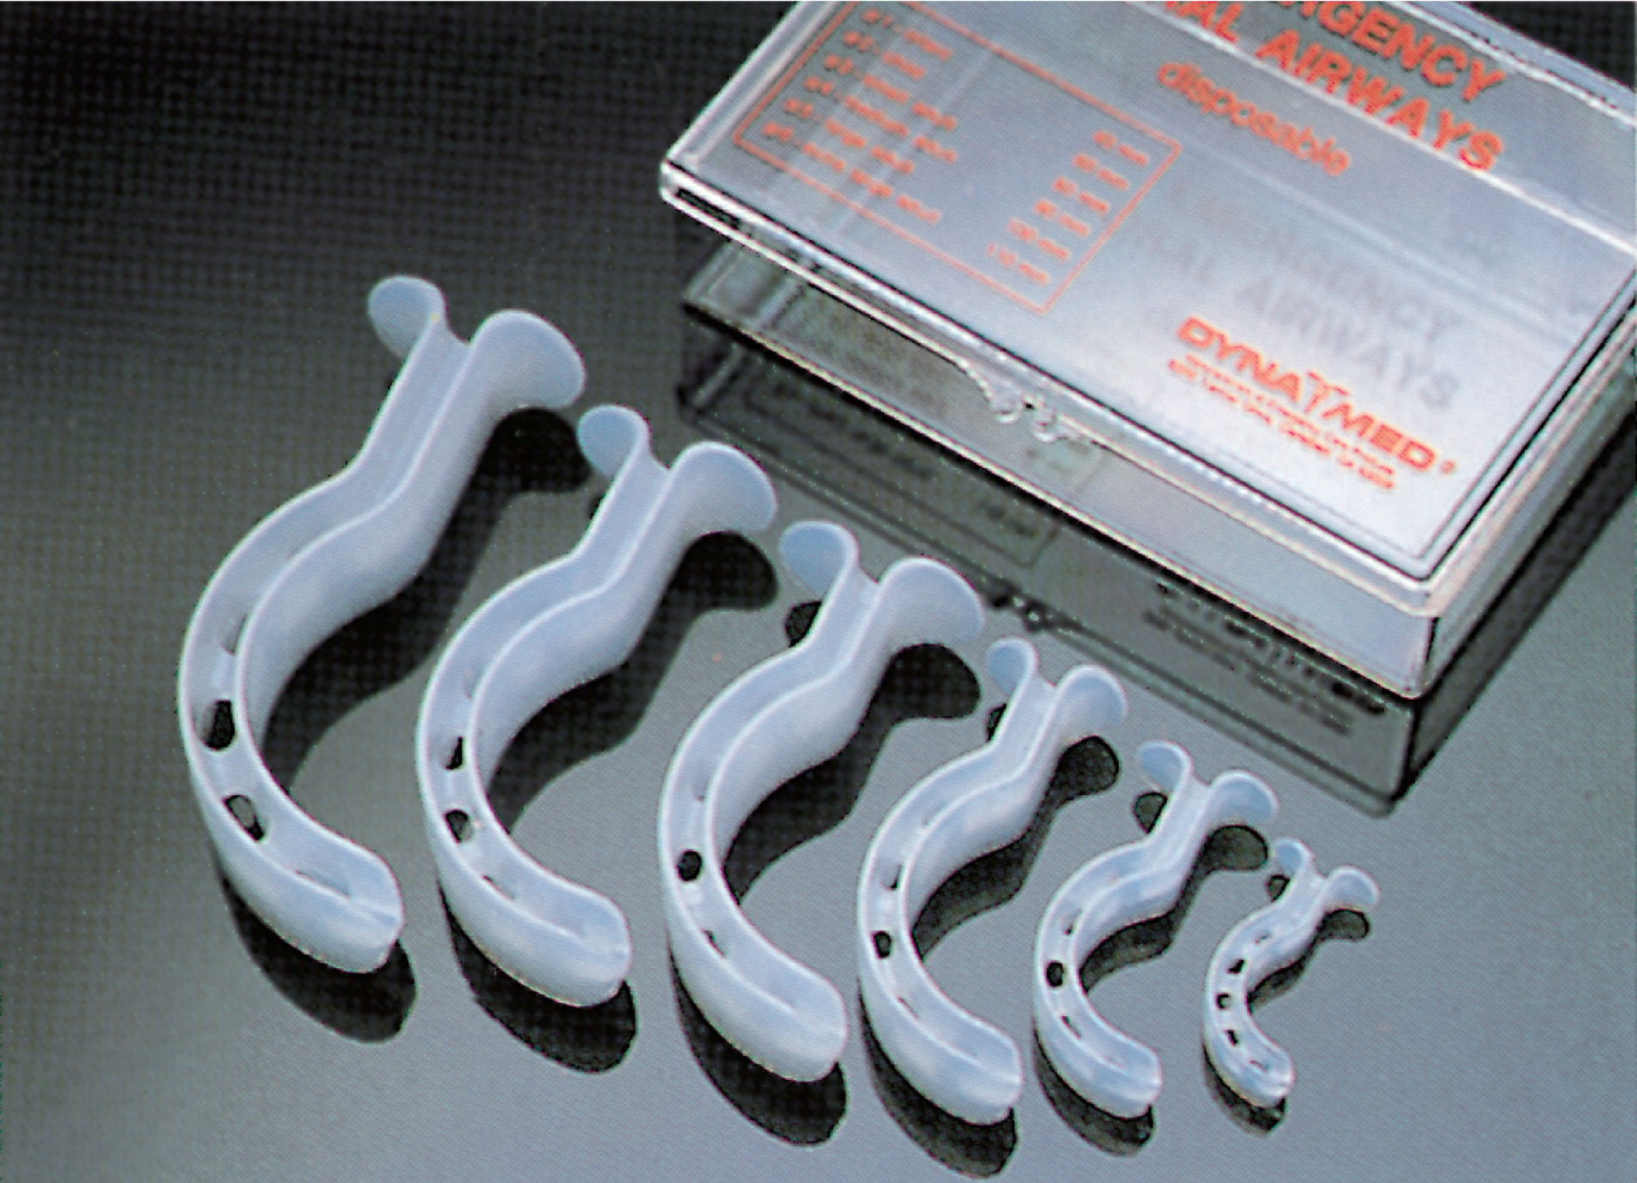
Oropharyngeal (Oral) Airways
Notes:
Select the proper size airway.

Slide 71
E M T Skills 10-2
Inserting an Oropharyngeal Airway

Slide 72
Measure to Ensure Correct Size
Notes:
Select the proper size airway. Measure the airway by holding it next to the patient’s face. A properly sized airway should extend the distance from the level of the front teeth to the angle of the jaw. Thus, the flange will be at the level of the teeth while the distal portion of the airway will be at the level of the angle of the jaw. An alternative method is to measure from the corner of the mouth to the tragus of the ear.

Slide 73
Insert with Tip Pointing up Toward Roof of Mouth
Notes:
2. Open the patient’s mouth using the crossed-finger technique. In adults, insert the airway upside down, tip pointing to the roof of the mouth.

Slide 74
Advance While Rotating 180°
Notes:
When the airway contacts the soft palate at the back of the roof of the mouth, gently rotate it 180° while continuing to advance it until the flat flange at the top of the airway rests on the patient’s front teeth. The airway follows the natural curve of the tongue and the oropharynx.

Slide 75
Continue Until Flange Rests on the Teeth
Notes:
The airway can also be inserted sideways in the corner of the mouth and rotated 90° while it is being advanced into position.

Slide 76
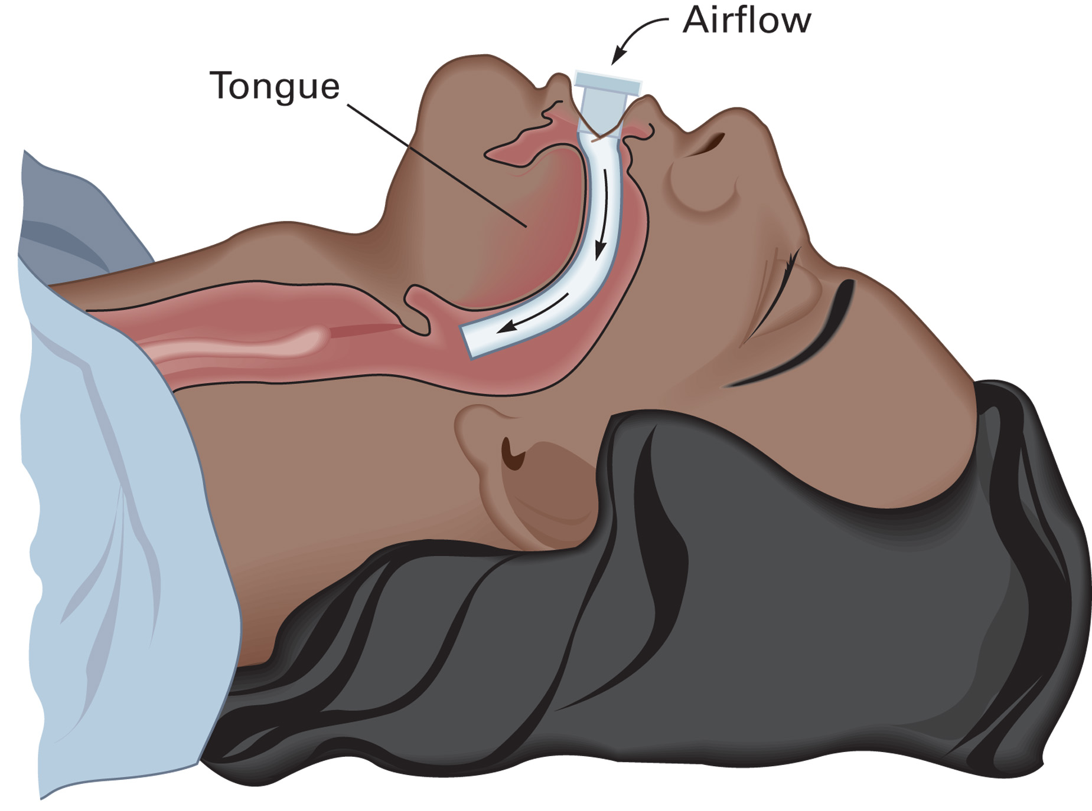
Oropharyngeal Airway that is Properly Placed
Notes:
The tongue is kept from falling back to occlude the patient’s airway.

Slide 77
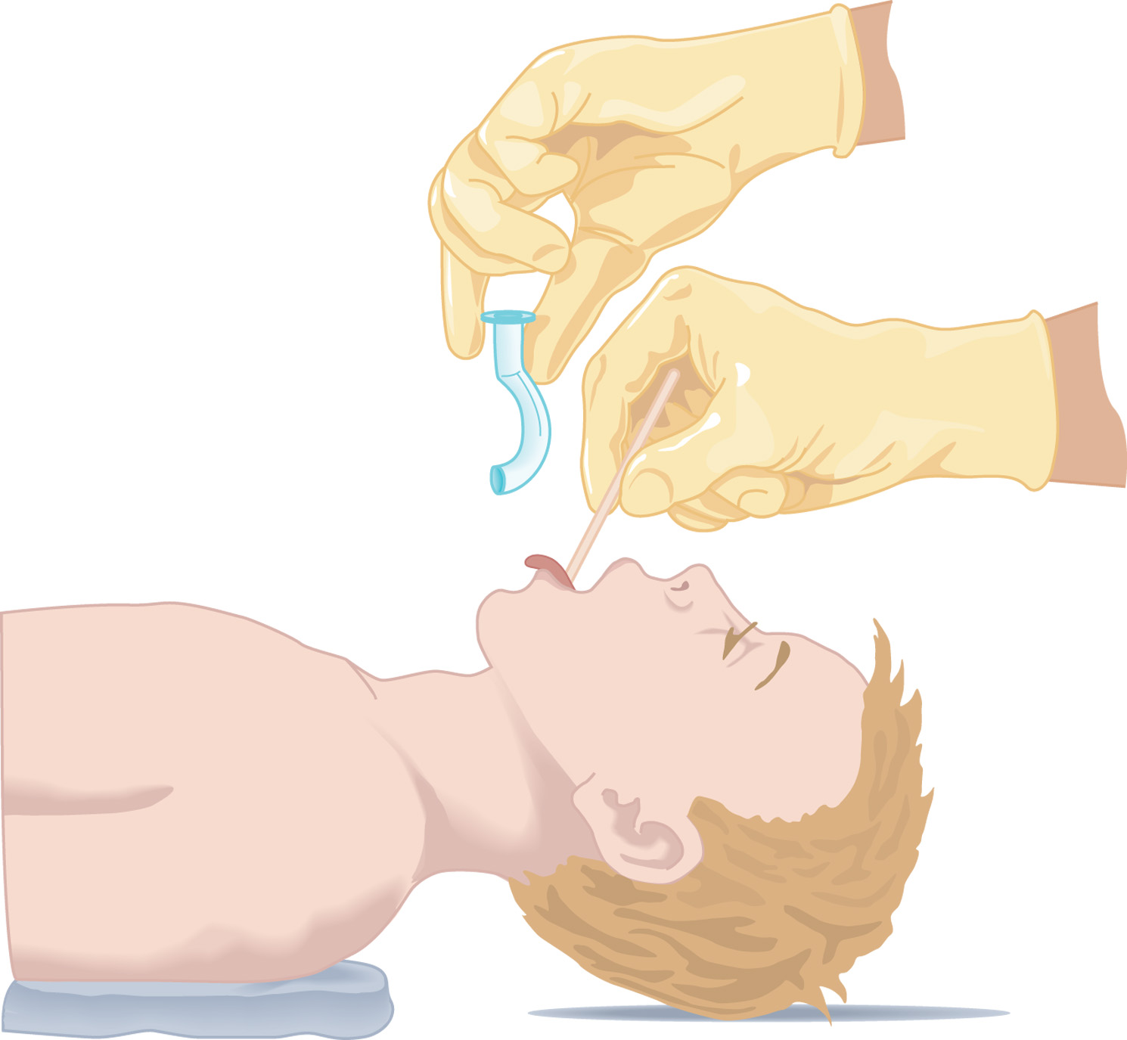
The Preferred Method of Inserting the Oropharyngeal Airway in the Infant or Child
Notes:
An alternative method of inserting the oropharyngeal airway involves the use of a tongue depressor (blade). The tongue depressor is inserted into the mouth until its tip is at the base of the tongue. The tongue is then pressed down toward the mandible and forward with the tongue depressor. The airway is inserted in its normal anatomical position until the flange is seated on the teeth.
This is the preferred method of airway insertion in infants and children.

Slide 78
Airway Assessment (18 of 18)
Airway Adjuncts
  Nasopharyngeal Airway
    Useful in patients with clenched teeth, some facial injuries, and those unable to tolerate an oropharyngeal airway.
    Should not be used in a patient with suspected fracture of the base of the skull or severe facial trauma.
Notes:
The nasopharyngeal airway, or NPA is a curved hollow tube of soft plastic or rubber with a flange or flare at the top end and a bevel at the distal end.
Be careful to select an airway of proper length. Avoid use of the nasal airway in patients with a suspected fracture to the base of the skull or severe facial trauma.
Nasopharyngeal airways come in a variety of pediatric sizes. In very young patients, the nasopharyngeal airway is so small that it is easily obstructed by secretions and other upper airway substances. Children may have large adenoids, which makes insertion of the nasopharyngeal airway difficult. This makes the use of a nasopharyngeal airway in the very young ineffective.

Slide 79
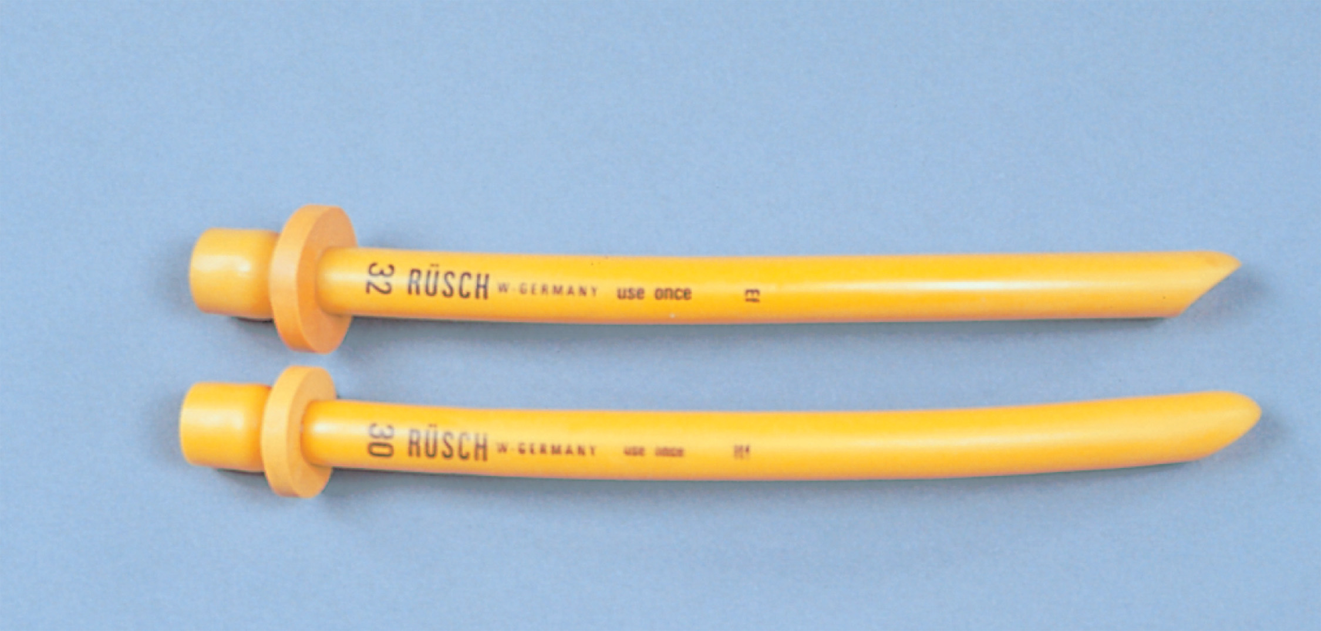
Nasopharyngeal (Nasal) Airways
Notes:
The nasopharyngeal airway, also known as the nasal airway, or NPA is a curved hollow tube of soft plastic or rubber with a flange or flare at the top end and a bevel at the distal end.

Slide 80
E M T Skills 10-3
Inserting a Nasopharyngeal Airway

Slide 81
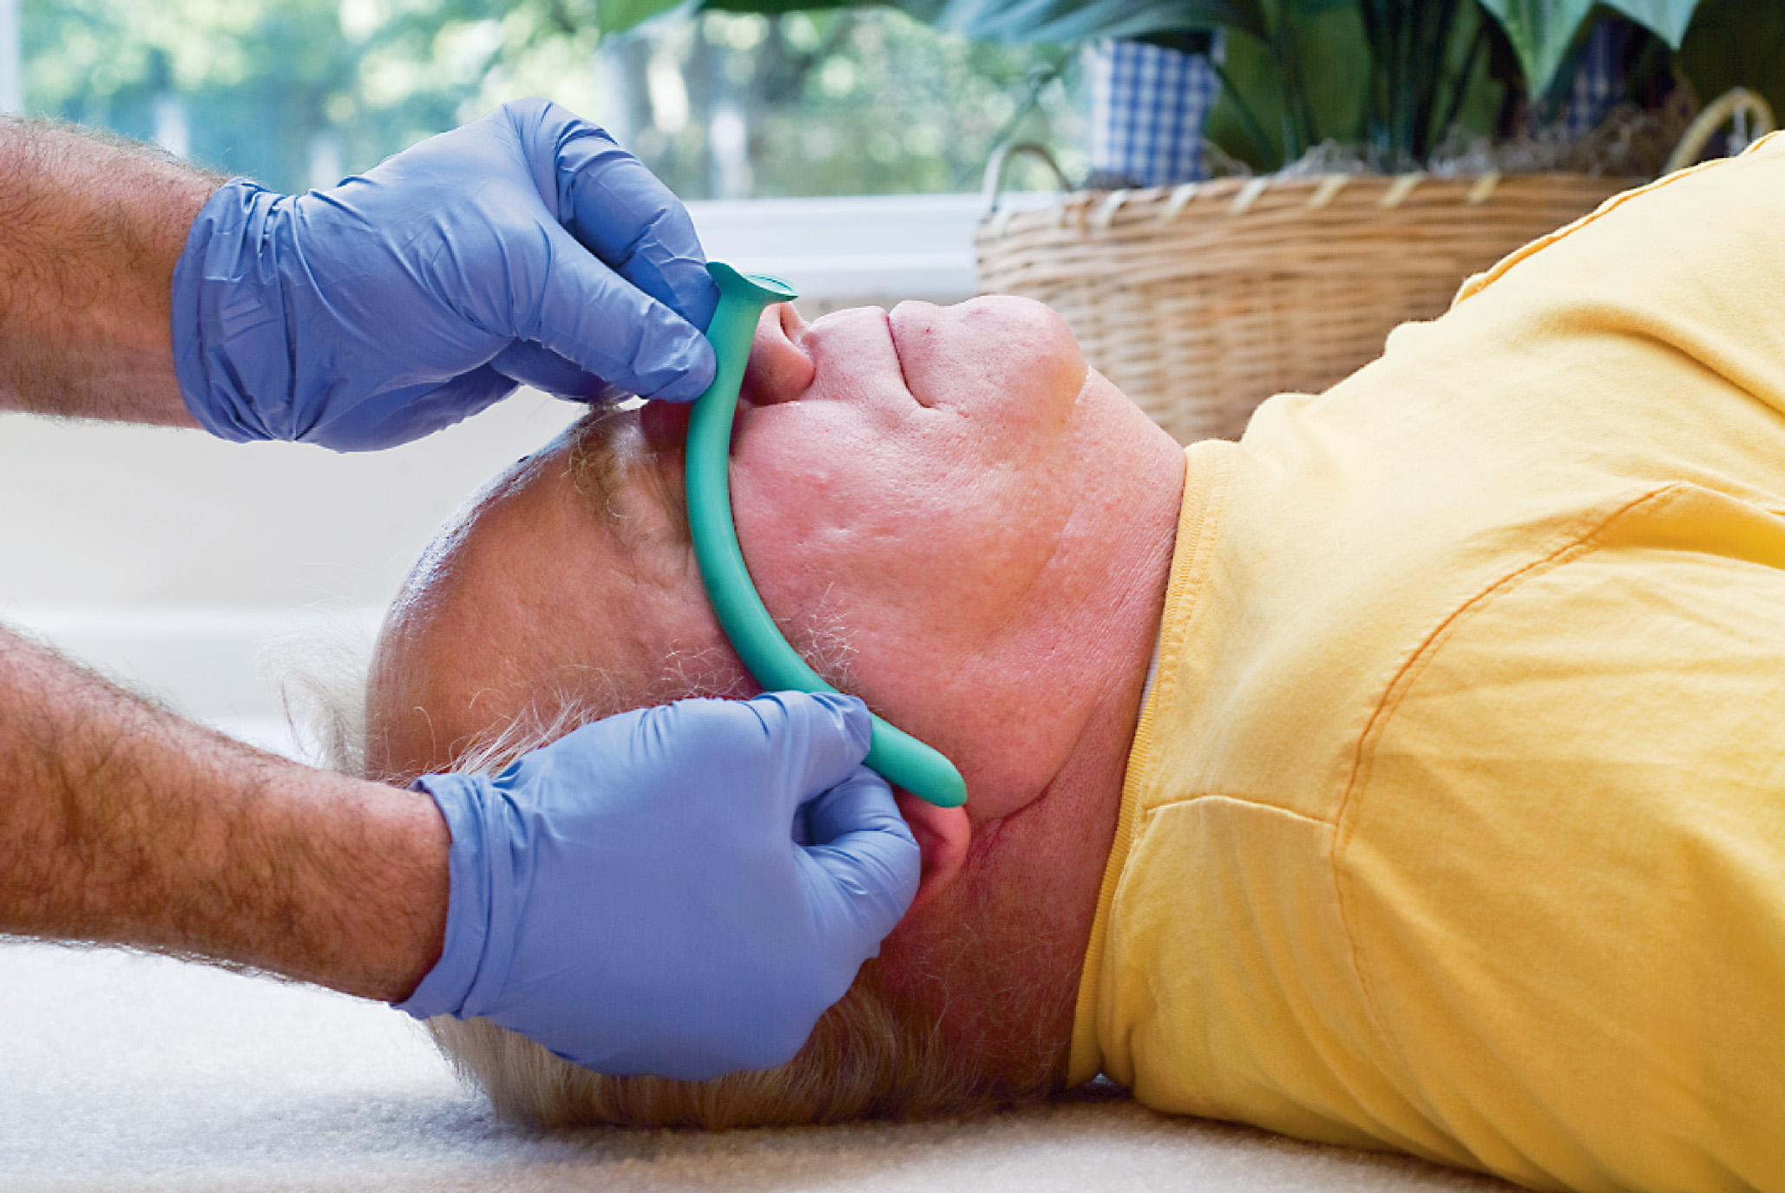
Measuring the Nasopharyngeal Airway
Notes:
Measure the airway by placing it next to the patient’s face. A properly sized airway should extend from the tip of the patient’s nose to the tip of the earlobe. It is also acceptable to measure the airway from the tip of the nose to the angle of the jaw. The diameter of the airway must be such that it can fit inside the patient’s nostril without blanching the skin of the nose.

Slide 82
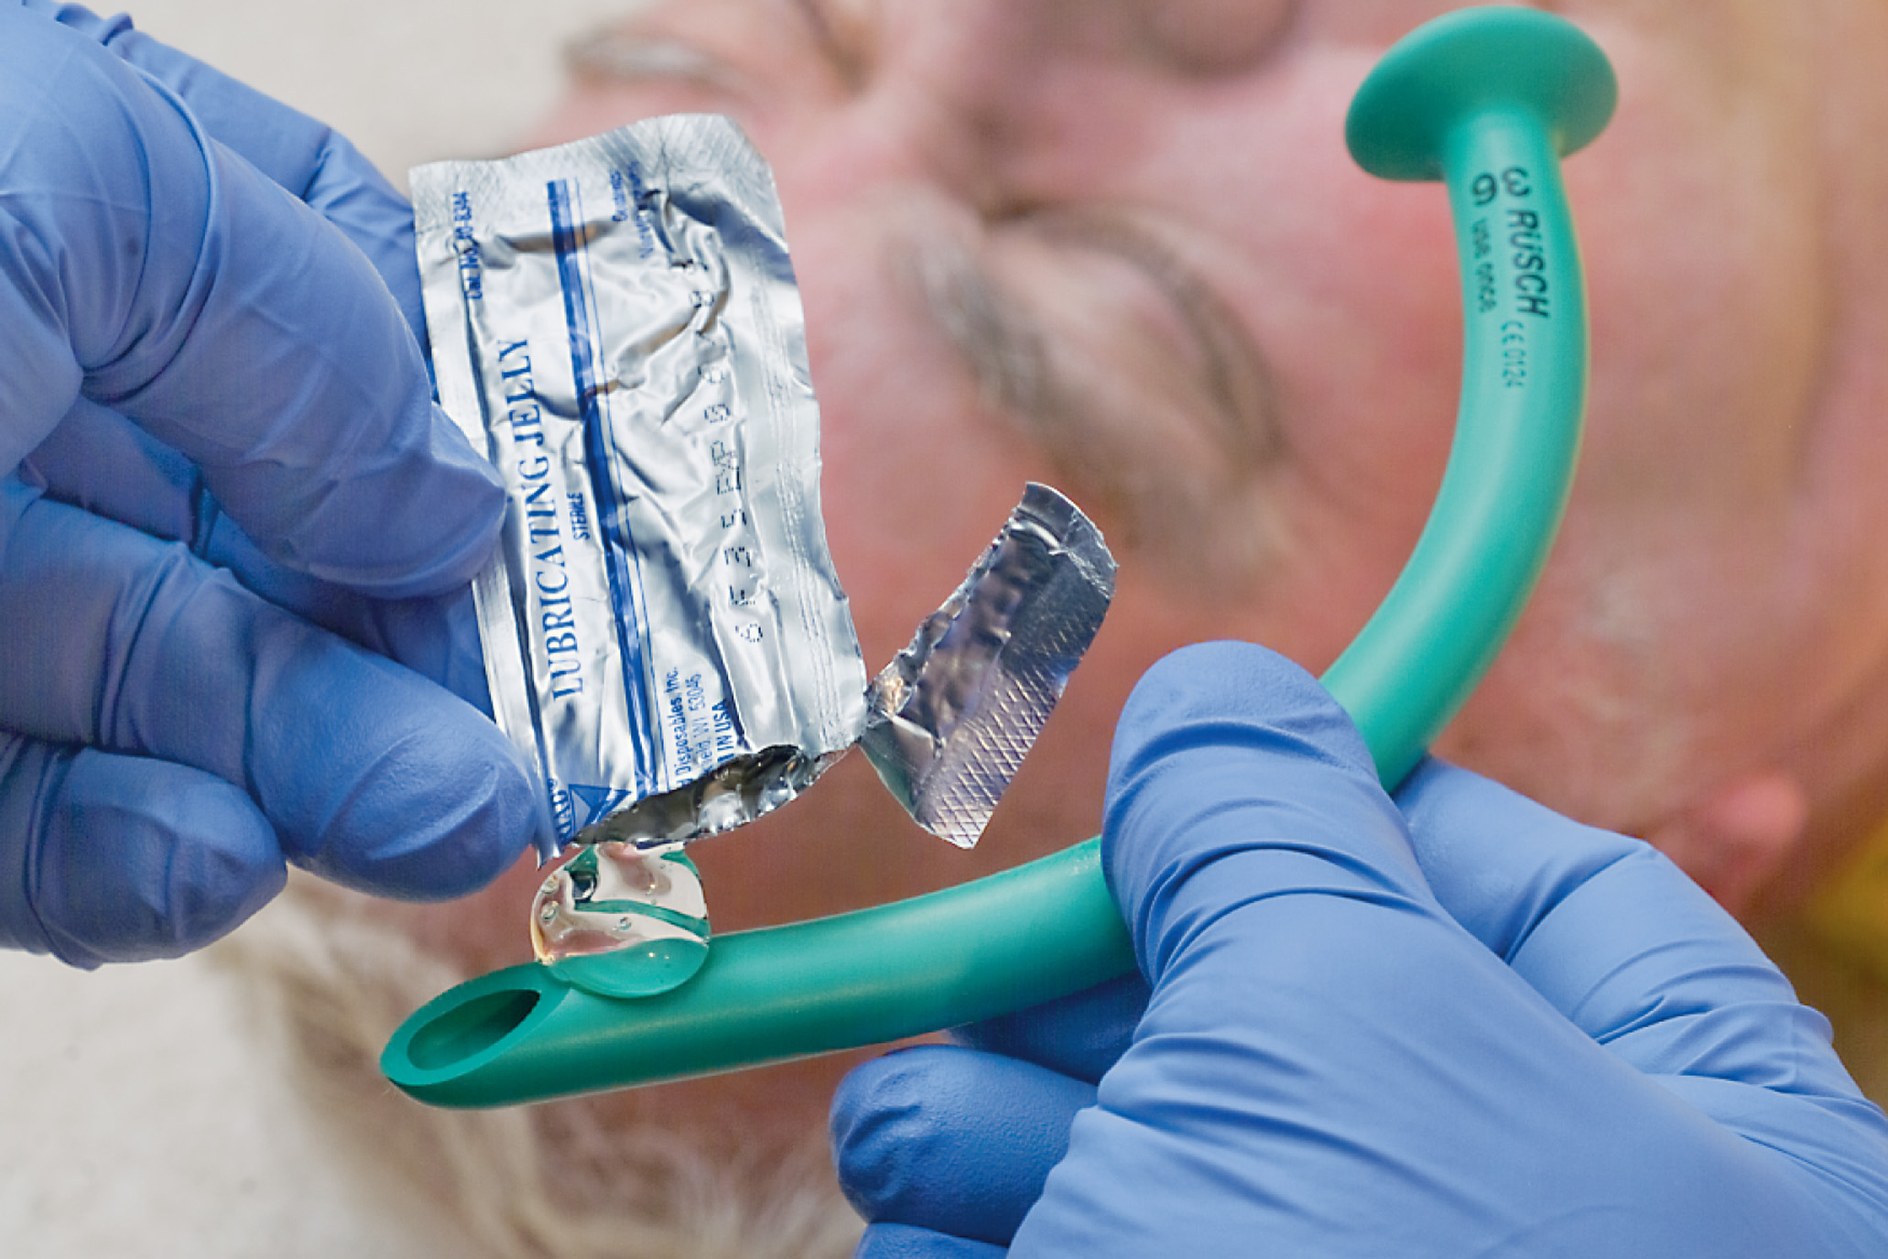
Lubricate it with Water-Soluble Lubricant
Notes:
Lubricate the outside of the airway well with a sterile, water-soluble lubricant. This eases the insertion and lessens the chance of trauma to the nasal mucous lining.

Slide 83
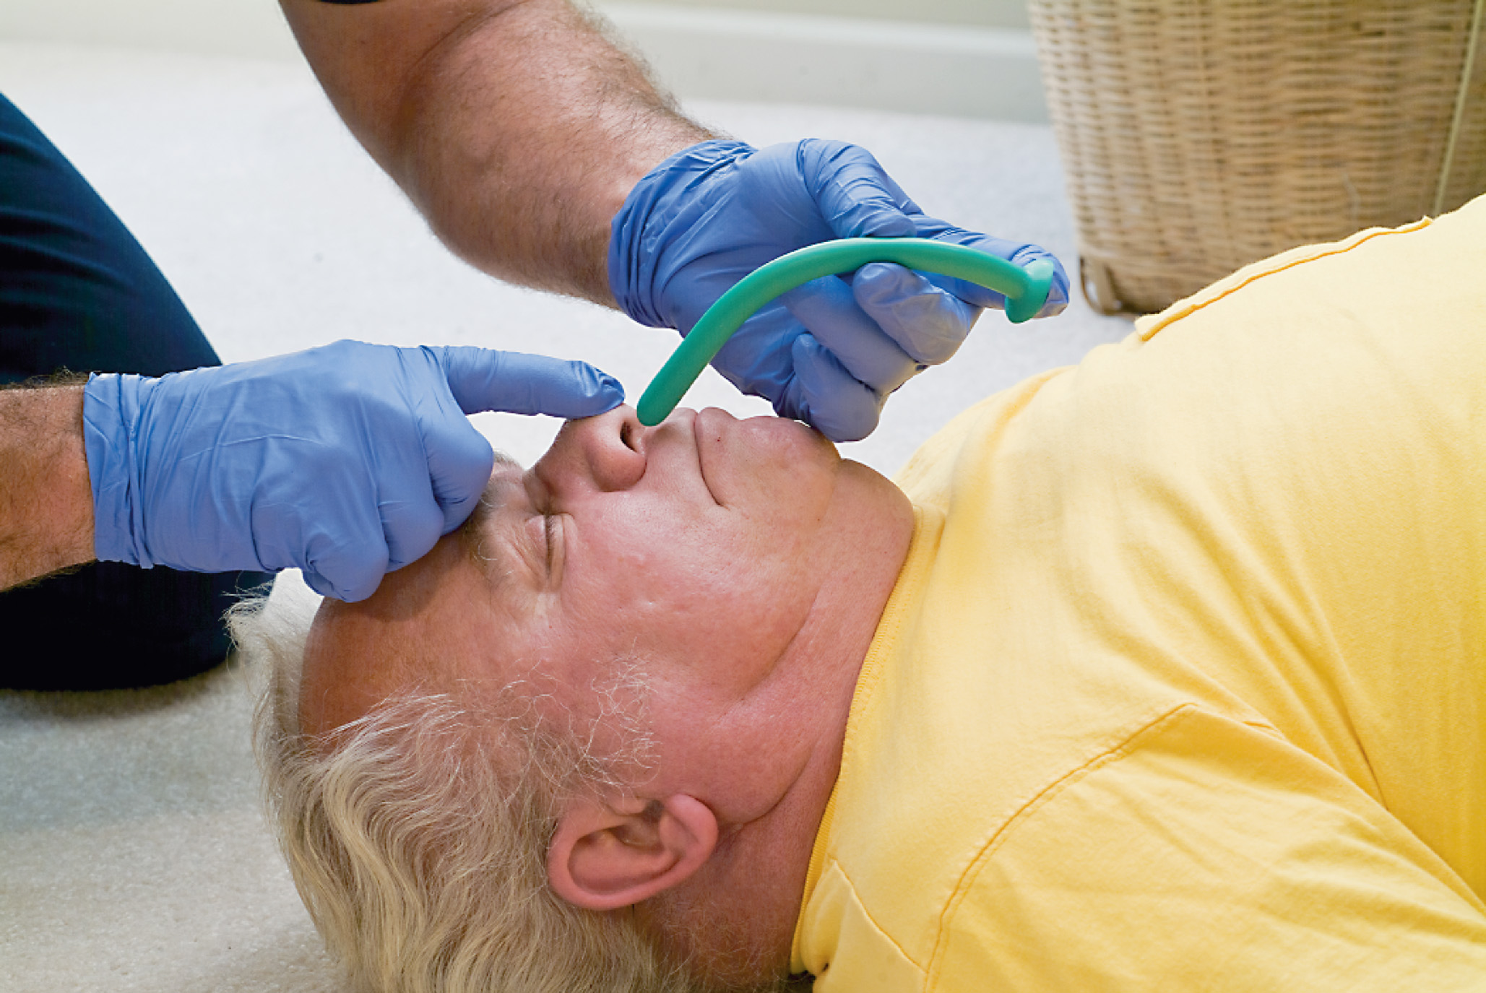
Insert with the Bevel Toward the Septum or Base of the Tonsil
Notes:
Insert the device in the larger or more open nostril. The bevel should be facing the septum (wall between the nostrils) or floor of the nostril. The device is inserted close to the midline, along the floor of the nostril, and straight back into the nasopharynx. If you meet resistance, rotate the device gently from side to side as you continue to insert it. If you still meet resistance, remove the airway and try the other nostril.
Check to be sure that air is flowing through the airway during inhalation and exhalation. If the patient is spontaneously breathing and no air movement is felt through the tube, remove it and attempt reinsertion in the other nostril.

Slide 84
Case Study Conclusion (1 of 5)
Chris selects and inserts an oropharyngeal airway, and begins positive pressure ventilation. The patient vomits again, and Chris immediately stops ventilating, as Brittany helps him turn the patient onto his left side.
Notes:
Review case conclusion and emphasize the application of knowledge learned from this portion of the presentation.

Slide 85
Case Study Conclusion (2 of 5)
Chris removes the oropharyngeal airway and suctions the patient’s mouth. As Chris begins ventilations again, a second crew arrives to assist with packaging and transport.
Notes:
Review case conclusion and emphasize the application of knowledge learned from this portion of the presentation.

Slide 86
Case Study Conclusion (3 of 5)
Chris continues airway management en route to the emergency department. Soon after arriving, Chris’s suspicion that the patient suffered a heroin overdose is confirmed when the emergency department staff administers naloxone, a drug to counteract the effects of narcotics. Within minutes, the patient is awake and talking.
Notes:
Review case conclusion and emphasize the application of knowledge learned from this portion of the presentation.

Slide 87
Assessment of Breathing (1 of 4)
After establishing a patent airway, assess the adequacy of the patient’s breathing.
Inadequate breathing leads to poor gas exchange in the alveoli and inadequate oxygenation.
Focus on both the rate of breathing and the volume of each breath.
Notes:
It is imperative to assess the relationship between the volume, or amount of air taken in with each breath, and the rate at which the patient is breathing when determining whether the patient’s breathing is adequate or not.

Slide 88
Assessment of Breathing (2 of 4)
Relationship of Volume and Rate in Breathing Assessment
  The relationship between the volume of air breathed in, the respiratory rate, and the volume of air that reaches the alveoli is critical in determining if the patient is breathing adequately.
Notes:
Points to Emphasize
To make accurate decisions about the adequacy of a patient's breathing, EMTs must understand the relationships between respiratory rate, tidal volume, and the amount of air reaching the alveoli for gas exchange.
Minute volume is determined by multiplying the respiratory rate by the tidal volume.
Only part of the tidal volume reaches the alveoli for gas exchange. The dead air space above the alveoli is approximately 150 mL.
Assist patients with inadequate alveolar ventilation using positive pressure ventilation to correct and prevent hypoxia.
Respiratory rates greater than 40 per minute result in a decrease in tidal volume, reducing the minute volume and alveolar ventilation.

Slide 89
Assessment of Breathing (3 of 4)
Relationship of Volume and Rate in Breathing Assessment
Tidal Volume and Minute Volume
  Tidal volume is the amount of air moved in one respiration.
  Minute volume is a function of both respiratory rate and tidal volume.
  A change in either respiratory rate or tidal volume affects minute volume.
Notes:
Minute volume=Tidal volume X Respiratory rate
Both adequate and inadequate breathing depend on two specific variables, the rate at which the patient is breathing and the depth of each breath. Because minute volume deals with both depth and rate, it typically correlates with how adequately the patient is breathing. A decrease in either the tidal volume or the respiratory rate may lead to a decrease in minute volume so severe that the patient is no longer moving an adequate amount of air per minute in and out of the lungs.
It is not important for the EMT to determine the actual minute volume value; however, it is imperative to assess both respiratory rate and volume when determining whether the breathing is adequate, because a change in either of these could lead to inadequate breathing.
Teaching Tips
Draw a simple sketch of the respiratory system on the white board and shade in the dead space to illustrate the concept.
Give several pairs of respiratory rate and tidal volume values and have students calculate the minute volume to illustrate the effects of changes in the values.
Critical Thinking Discussion
What are some things that would cause changes in tidal volume and respiratory rate?
Discussion Question
Why does tidal volume decrease at abnormally high respiratory rates?

Slide 90
Assessment of Breathing (4 of 4)
  Relationship of Volume and Rate in Breathing Assessment
  Alveolar Ventilation
    Alveolar ventilation is the amount of air breathed in that reaches the alveoli.
    Dead air space does not change when tidal volume decreases.
    Rapid respirations can decrease the tidal volume.
Notes:
Only the air that reaches the alveoli can be used for gas exchange (oxygenation of the blood and removal of carbon dioxide) because the trachea and bronchi do not participate in gas exchange. Because of the effect of dead air space on ventilation, small decreases in tidal volume can dramatically reduce the amount of air reaching the alveoli for gas exchange.
Alveolar ventilation = (tidal volume – dead space air) × respiratory rate
Knowledge Application
Give several tidal volumes and respiratory rates and have students calculate alveolar ventilation.
Illustrate the difference a modest change in tidal volume can make in minute volume based on the change in alveolar ventilation.

Slide 91
Assessing for Adequate Breathing (1 of 4)
Assess the rate, rhythm, quality, and depth of breathing.
  Looking
  Listening
  Feeling
  Auscultating
Notes:
Look - Inspection includes the following:
Inspect the chest. Observe for adequate expansion by watching the chest wall rise and fall. Look for retractions, or pulling inward, of the intercostal muscles of the chest as well as excessive use of the neck muscles during inspiration. In the unresponsive patient, you should place your ear near the patient’s mouth or nose while looking at the chest. You can simultaneously look, listen, and feel for air movement.
Observe the patient’s general appearance. Does he appear to be anxious, uncomfortable, or in distress? Is the patient lying down or sitting erect? (Typically, a patient who has difficulty in breathing is sitting up, leaning forward.) Does it appear that the patient is straining to breathe? Look for use or straining of the large muscle in the neck.
Decide whether the breathing pattern is regular or irregular.
Look at the nostrils to see if they open wide during inhalation. Such flaring indicates difficulty in breathing.
Listen - How does the patient speak to you? Does he speak only a few words at a time, and then must catch his breath? If the patient has an altered mental status or is unresponsive, place your ear next to the patient’s nose and mouth and listen and feel for air escaping during exhalation. The sound or movement of air will indicate that the patient is breathing. If you do not hear an adequate volume of air being exhaled with each breath, the tidal volume is inadequate. If the tidal volume is inadequate, you must ventilate the patient.
Feel - With your ear next to the patient’s nose and mouth, feel the volume of air escaping during exhalation. Feeling the air against your ear and cheek will provide you with a sense of the volume that the patient is breathing. If you do not feel an adequate volume of air being exhaled with each breath, the tidal volume is inadequate.
Auscultate - Place your stethoscope at the second intercostal space, about 2 inches below the clavicle, at the midclavicular line. You can also auscultate at the fourth or fifth intercostal space on the anterior or midaxillary line, or at the fifth intercostal space next to the sternum on the anterior chest. Listen to one full inhalation and exhalation and determine whether the breath sounds are present and equal bilaterally (on both sides). An adequate volume of air being inspired produces full breath sounds that are equal on both sides. Breath sounds that are diminished or absent indicate inadequate breathing.
Points to Emphasize
The basics of breathing assessment are look, listen, and feel.
Look for chest rise and fall to assess tidal volume. Use of accessory muscles indicates difficulty in moving air.
Listen to the patient speak and for the movement of air.
Auscultation is listening with a stethoscope. Listen to one full inhalation and exhalation for air movement, equality of breath sounds, and any abnormal sounds.
Check the rate, rhythm, and quality of breathing.
Teaching Tips
Explain to students that they will more readily recognize what is abnormal if they take every opportunity to observe what is normal, in terms of respiration.
Class Activity
Provide pairs of students with stethoscopes and have them practice listening for one full inspiration and expiration for the presence of breath sounds.

Slide 92
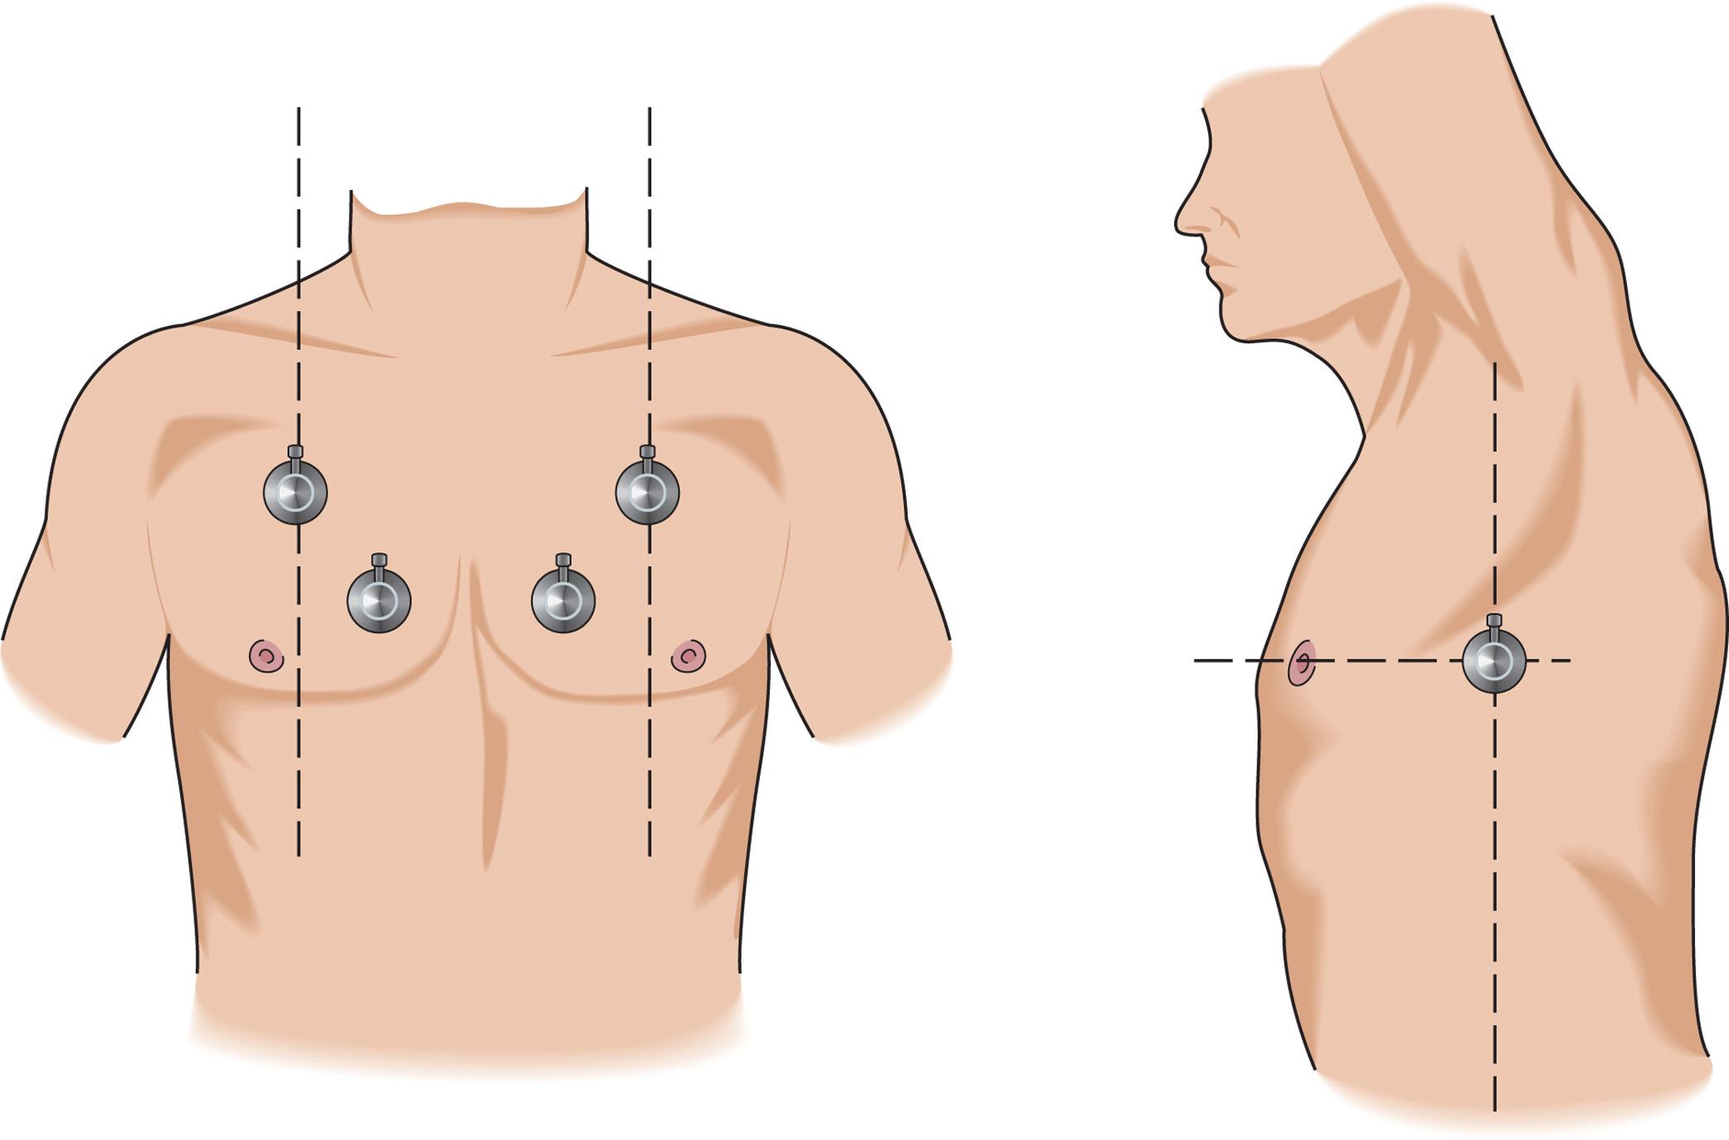
Auscultation Landmarks on the Anterior and Lateral Chest
Notes:
Place your stethoscope at the second intercostal space, about 2 inches below the clavicle, at the midclavicular line. You can also auscultate at the fourth or fifth intercostal space on the anterior or midaxillary line, or at the fifth intercostal space next to the sternum on the anterior chest.

Slide 93
Assessing for Adequate Breathing (2 of 4)
Adequate Breathing
  Assess the following:
    Rate
    Rhythm
    Quality
    Depth
  Breathing can be adequate, but if the patient is working harder to breathe, he is in respiratory distress.
Notes:
Rate - The respiratory rate falls within a range of 8–24 respirations per minute for an adult, 12–20 per minute for an adolescent, 15–30 per minute for a school-aged child (6–10 years of age), 20–30 per minute for an infant from 6 months–preschooler (3–5 years of age), 25–40 per minute for an infant 30 days–5 months of age, and 30–60 per minute for newborn–30 days (Table 10-4). Elderly adults have resting respiratory rates of approximately 20 per minute. If the respiratory rates are too low, even though the tidal volume may be adequate, the patient will not move enough air into the lungs and alveoli to meet the oxygen demands of the cells of the body.
Rhythm - The pattern is regular. Each breath is of about the same volume and comes at a regular interval. However, it is normal for a patient to sigh, which alters the pattern and makes it slightly irregular.
Quality - The breath sounds are equal and full bilaterally, indicating good expansion of each lung. The chest rises and falls adequately and equally with each breath. No excessive accessory muscle use is seen with inhalation and exhalation. It is normal for infants and children to use the abdominal muscles more than adults do in breathing; therefore, expect greater movement of the abdomen with these patients.
Depth (tidal volume) - The chest will rise fully with each inhalation. The volume of air felt and heard by placing your ear next to the patient’s mouth and nose will be full and adequate with each breath.

Slide 94
Table 10-3 Signs of Adequate Breathing
Normal respiratory rate
Clear and equal breath sounds bilaterally
Adequate air movement heard and felt from nose and mouth (tidal volume)
Good chest rise and fall with each ventilation (tidal volume)
Notes:
The patient whose breathing is adequate exhibits these characteristics.

Slide 95
Assessing for Adequate Breathing (3 of 4)
Inadequate Breathing
  Inadequate breathing leads to hypoxia.
  If breathing is inadequate, the brain begins to die within four to six minutes.
  Inadequate breathing can be either respiratory failure or respiratory arrest.
  Patients with respiratory failure or arrest require immediate positive pressure ventilation.
Notes:
Common Causes of Respiratory Arrest:
Stroke
Myocardial infarction (heart attack)
Drug overdose, especially opiates and other CNS depressants
Toxic inhalation (e.g., carbon monoxide poisoning)
Electrocution and lightning strike
Suffocation
Traumatic injuries to the head, spine, chest, or abdomen
Infection to the epiglottis
Airway obstruction by a foreign body
A type of respiratory pattern that is completely inadequate and may be seen in witnessed cardiac arrest or in some other conditions is called agonal breathing or agonal respirations. Agonal respirations are gasping-type
breaths. If seen in the cardiac arrest patient, they usually appear soon after the person goes into cardiac
arrest. These are totally ineffective respirations. A patient with agonal respirations must be provided positive pressure ventilation.
Discussion Questions
What are signs of inadequate breathing?
What are causes of inadequate breathing and respiratory arrest?
Critical Thinking Discussion
In what circumstances could a patient with a normal respiratory rate and tidal volume be hypoxic?

Slide 96
Assessing for Adequate Breathing (4 of 4)
  Inadequate Breathing
  Signs of Inadequate Breathing
    Rate- Tachypnea or bradypnea.
    Rhythm- Irregular patterns.
    Quality- Breath sounds that are decreased or absent.
    Depth- The depth of breathing (tidal volume) is shallow and inadequate.
    Any above sign is a reason to artificially ventilate the patient.
Notes:
Rate- The respiratory rate is either too fast or too slow, outside the normal rate ranges that were listed under “Adequate Breathing.” Bradypnea is an abnormally slow breathing rate and an ominous sign of inadequate breathing and oxygenation in infants and children.
Rhythm- An irregular breathing pattern may indicate a severe brain injury or medical illness. Most irregular breathing patterns also produce an inadequate rate, depth, and quality.
Quality- Breath sounds that are decreased or absent indicate an inadequate volume of air moving in and out of the lungs with each breath. If the chest wall is not rising and falling adequately with each breath, or if the sides of the chest rise and fall unequally, the breathing is inadequate.
Depth- The depth of breathing (tidal volume) is shallow and inadequate. The chest wall movement is minimal and does not rise adequately with inhalation. This is referred to as shallow breathing. Shallow breathing implies an inadequate tidal volume and requires assisted ventilation.
Any of these signs, a breathing rate that is too low or too high, a shallow depth, a poor quality, or an inadequate tidal volume, is by itself a reason to artificially ventilate a patient without delay.
Critical Thinking Discussion
In what circumstances could a patient with a normal respiratory rate and tidal volume be hypoxic?

Slide 97
Table 10-5 Signs of Inadequate Breathing (1 of 2)
Abnormal work of breathing
  Retractions
  Nasal flaring
  Abdominal breathing
  Diaphoresis
Abnormal breath sounds
  Stridor
  Wheezing
  Crackles
  Silent chest (no breath sounds heard)
  Unequal breath sounds (trauma, infection, and pneumothorax)

Slide 98
Table 10-5 Signs of Inadequate Breathing (2 of 2)
Reduced minute ventilation
  Decreased tidal volume
  Inadequate respiratory rate
Inadequate chest wall movement or chest wall injury
  Paradoxical chest wall movement (chest wall segment moves in during inspiration and out during expiration, which is the reverse of normal)
  Splinting of the chest wall
  Asymmetrical chest wall movement
Irregular respiratory pattern (head injury, stroke, metabolic derangement, and toxic inhalation)
Rapid respiratory rate without clinical improvement in the patient’s condition
Notes:
Not all the signs of inadequate breathing are present at the same time. Any of these signs, a breathing rate that is too low or too high, a shallow depth, a poor quality, or an inadequate tidal volume, is by itself a reason to artificially ventilate a patient without delay.

Slide 99
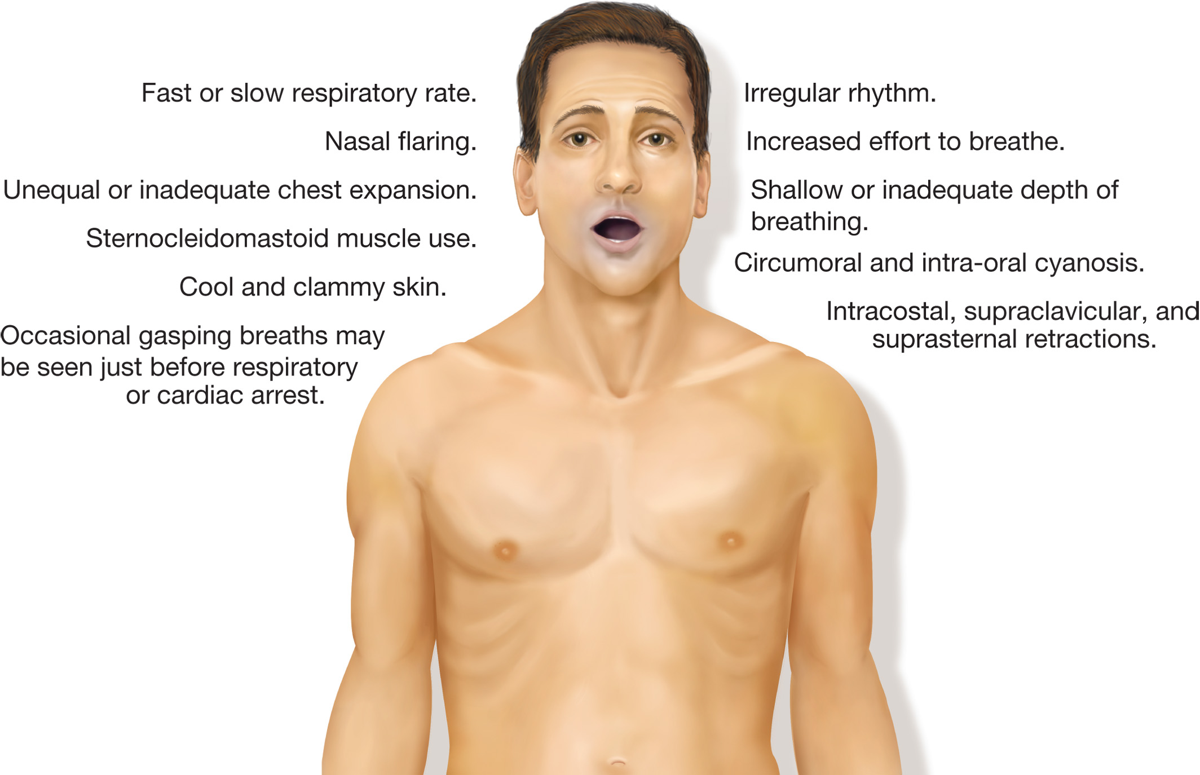
Signs of Inadequate Breathing and Severe Respiratory Distress
Notes:
Note how the rate, rhythm, quality, and depth differ from those of adequate breathing.

Slide 100
Deciding Whether or not to Assist Ventilation
The E M T must decide whether the patient needs to be ventilated or if oxygen alone is sufficient.
Neither rate nor depth alone is enough to ensure adequate breathing.
Notes:
To have adequate breathing, the rate of respiration and the tidal volume must both be within adequate limits. If either is inadequate, the patient must be provided with positive pressure ventilation (PPV), which is artificial ventilation. This requires you to pay close attention to the chest wall activity during the assessment. If the chest wall is moving minimally, and very little air movement is heard or felt, you must immediately intervene and provide positive pressure ventilation to the patient.
Adequate respiratory rate + Adequate tidal volume with each breath = Adequate breathing
Inadequate respiratory rate + Adequate tidal volume = Inadequate breathing
Adequate respiratory rate + Inadequate tidal volume = Inadequate breathing
Class Activity:
Given a variety of scenarios, have the class determine the need for supplemental oxygen versus patient ventilation.

Slide 101
Table 10-6 Making a Decision: Should I Assist Ventilation or Apply Oxygen?
Assessment: | Adequate respiratory rate + adequate tidal volume
Conclusion: | Adequate breathing
Emergency Care: | Administer oxygen if necessary
Assessment: | Inadequate respiratory rate + adequate tidal volume
Conclusion: | Inadequate breathing
Emergency Care: | Immediately begin positive pressure ventilation
Assessment: | Adequate respiratory rate + inadequate tidal volume
Conclusion: | Inadequate breathing
Emergency Care: | Immediately begin positive pressure ventilation
Notes:
Two adequate components must be present to have adequate breathing.
Only one inadequate component needs to be present to have inadequate breathing.

Slide 102
Techniques of Artificial Ventilation (1 of 39)
Differences Between Normal Spontaneous Ventilation and Positive Pressure Ventilation
  There are significant physiological differences between spontaneous breathing and positive pressure ventilation.
Notes:
These differences may affect other body systems or require other management techniques.

Slide 103
Techniques of Artificial Ventilation (2 of 39)
  Differences Between Normal Spontaneous Ventilation and Positive Pressure Ventilation
  Air Movement
  Airway Wall Pressure
  Esophageal Opening Pressure
  Cardiac Output (cardiothoracic pump effect)
Notes:
Air movement- In normal spontaneous ventilation, the negative pressure created by increasing the size of the thorax draws air into the lungs. Positive pressure ventilation is just that—you are delivering ventilation through positive pressure. You are forcing air into the lungs regardless of the pressure changes in the thorax. With the application of positive pressure ventilation, the patient does not have to rely on his own ability to produce negative pressure.
Airway wall pressure- Airway wall pressure is not affected during normal ventilation. During positive pressure ventilation, the airway walls are pushed outward creating a larger space. This requires higher volumes to fill the larger space and ventilate the patient effectively.
Esophageal opening pressure- The esophagus is a soft, flexible structure. During normal ventilation, the esophagus remains collapsed and no air moves into it. Positive pressure ventilation can overcome the esophageal opening pressure, allowing air to enter the esophagus and filling the stomach with air during ventilation. This leads to gastric distention and the possibility of regurgitation.
Cardiac output- Normal spontaneous ventilation does not adversely affect the cardiac output or blood pressure. The negative pressure generated in the thorax prior to inhalation acts like a vacuum and sucks the venous blood into the inferior vena cava from the body below the level of the diaphragm. This provides an adequate amount of venous blood volume to the right side of the heart. Preload is dependent on the venous volume and amount of blood ejected from the right ventricle. An adequate preload contributes to an adequate stroke volume, cardiac output, and blood pressure. During positive pressure ventilation, the thorax becomes positive during the inhalation phase as air is forced into the lungs. With the loss of the negative pressure generated during normal ventilation, the vacuum effect is diminished and the venous return decreases. This then decreases the preload, which reduces the stroke volume, cardiac output, blood pressure, and perfusion.

Slide 104
Techniques of Artificial Ventilation (3 of 39)
Basic Considerations
  You must be able to maintain a good mask seal.
  The device must deliver an adequate volume of air to inflate the lungs.
  There must be a connection to allow oxygen delivery while artificially ventilating.
Notes:
Methods of Artificial Ventilation:
Mouth to mask
Bag-valve mask (BVM) operated by two people
Flow-restricted, oxygen-powered ventilation device (manually triggered ventilation device)
Bag-valve mask (BVM) operated by one person

Slide 105
Techniques of Artificial Ventilation (4 of 39)
  Basic Considerations
  Standard Precautions
    Gloves
    Eyewear
    Face mask, for large amounts of blood or secretions
    H E P A or N-95 respirator for suspected tuberculosis
Notes:
As with any technique in which there is a risk of coming into contact with body fluids, it is necessary to take Standard Precautions when performing artificial ventilation.
The risks of coming into contact with secretions, blood, or vomitus while ventilating are relatively high; therefore, the EMT must, at minimum, use gloves and eyewear.
If large amounts of blood or secretions are present, use a face mask.
If tuberculosis is suspected, use a HEPA or N-95 respirator during the entire patient contact.

Slide 106
Techniques of Artificial Ventilation (5 of 39)
Basic Considerations
Adequate Ventilation - Indications
  Sufficient rate (deliver ventilations over 1 second).
  Sufficient and consistent tidal volume.
  The patient’s heart rate returns to normal.
  Color improves.
Notes:
Indications of Adequate Ventilation:
• The rate of ventilation is sufficient.
Newborns- 40 to 60 times per minute with a pulse
Infants and children- 12 to 20 times per minute, or once every 3 to 5 seconds with a pulse
Adults- 10 to 12 times per minute, or once every 5 seconds with a pulse
If no pulse ventilations are performed in conjunction with chest compressions at a ratio of 30 compressions to 2 ventilations in adults, children, and infants excluding newborns.
In the newborn with no pulse, the ratio of chest compressions to ventilations is 3:1 or 90 compressions to 30 ventilations.
The tidal volume must be consistent; it must also be sufficient to cause the chest to rise during each ventilation. Inspect the chest with each ventilation to ensure adequate rise.
The patient’s heart rate returns to normal.
Color improves. The pale, gray, or cyanotic color begins to lessen and disappear.

Slide 107
Techniques of Artificial Ventilation (6 of 39)
  Basic Considerations
  Inadequate ventilation
    Ventilation rate is too fast or too slow.
    The chest does not rise and fall.
    The heart rate does not return to normal.
    Color does not improve.
Notes:
Indications of Inadequate Ventilation:
The ventilation rate is too fast or too slow. Ventilating a patient too rapidly does not allow for adequate exhalation and can also cause gastric distention. Too slow a rate of ventilation does not provide an adequate amount of oxygen.
The chest does not rise and fall with artificial ventilation. This is an indication that the volume being delivered is not adequate. This may be due to a failure to use the ventilation device properly or to an airway obstruction.
The heart rate does not return to normal with artificial ventilation. Remember, however, to consider other sources of heart rate disturbance, such as blood loss, anxiety, or heart problems.
Color does not improve. The skin color remains extremely pale, cyanotic, or gray.

Slide 108
Techniques of Artificial Ventilation (7 of 39)
Cricoid Pressure, B U R P, and E L M
  Cricoid pressure is not recommended for routine use, but can be used in some situations.
    Adult intubation
    Pediatric patient when an extra E M T is available
  B U R P
  E L M
Notes:
Cricoid Pressure:
Cricoid pressure was once thought to reduce complications associated with positive pressure ventilation when the unresponsive patient’s airway is not protected by an advanced airway device. In this situation, the technique was intended to reduce the incidence of gastric inflation, regurgitation, and aspiration of gastric contents. However it has been found that cricoid pressure may actually impede airflow during ventilation, and gastric inflation is best controlled by maintaining slow ventilation at a reduced volume.
Technique to perform cricoid pressure:
Locate the thyroid cartilage (Adam’s apple) by sliding index and middle fingers slowly down from the chin until you feel an obvious cartilage prominence.
Continue downward until you feel the base of the thyroid cartilage and, below it, a small, soft midline indentation, the cricothyroid membrane. Immediately below that membrane is the bulky cricoid cartilage.
Place your index finger on one side of the cricoid cartilage, your thumb on the other side, and apply firm backward pressure. Avoid completely compressing the cartilage.
Backward, upward, rightward pressure (BURP) maneuver:
You use similar landmarks as you would with cricoid pressure:
Locate the thyroid cartilage.
Apply backward pressure (toward the spinal column), and push the cartilage upward toward the chin and then laterally to the patient’s right.
Hold this maneuver until the person performing the
laryngoscopy instructs you to release it.
External laryngeal manipulation (ELM):
Is a technique that is similar to BURP. As with BURP, the EMT applies pressure to the thyroid cartilage; with ELM, however, the paramedic who is performing the laryngoscopy guides the EMT’s hand to provide the best glottic view.
Locate the thyroid cartilage.
Place your thumb on the left side and your fingers on the right side of the thyroid cartilage.
The paramedic performing the intubation will then place his right hand on the top of your hand and apply pressure and manipulation of the larynx until the glottic opening is brought into view.
Hold the position until the paramedic instructs you to release it.

Slide 109
Techniques of Artificial Ventilation (8 of 39)
  Cricoid Pressure, B U R P, and E L M
  Other Basic Ventilation Considerations
    When forced backward, the cricoid cartilage may collapse the esophagus preventing air from inflating the stomach.
    If the patient regurgitates, release the cricoid, B U R P, or E L M pressure.
    Proper positioning of the airway with the head-tilt, chin-lift maneuver will reduce airway resistance.
Notes:
The cricoid cartilage is the only complete cartilaginous ring. When forced backward, it may collapse the esophagus behind it against the cervical vertebrae, preventing air from traveling down to inflate the stomach and stomach contents from moving up.
If the patient regurgitates, release the cricoid, BURP, or ELM pressure to prevent an esophageal tear. Immediately turn the patient onto his side, if possible, and suction the airway until clear.
Proper positioning of the airway with the head-tilt, chin-lift maneuver will help to prevent gastric inflation.

Slide 110
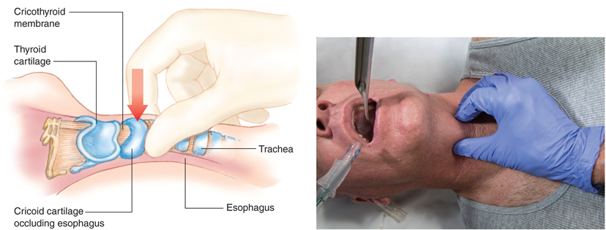
Cricoid Pressure
Notes:
The cricoid cartilage is the only complete cartilaginous ring.

Slide 111
Techniques of Artificial Ventilation (9 of 39)
Mouth-to-Mouth Ventilation
  Mouth-to-Mouth and Mouth-to-Nose Technique
    Allows delivery of 16 percent oxygen.
    A barrier device must be used.
    Form a seal around the patient’s mouth and pinch the nose.
    Mouth-to-nose ventilation can be used if the patient’s mouth cannot be opened.
Notes:
This technique provides adequate volumes of air for ventilating a patient. Its major limitations are the inability to deliver high concentrations of oxygen while ventilating and the risk posed to the EMT by contact with the patient’s body fluids. To reduce risks, a barrier device must be used.
Use mouth-to-nose ventilation when the patient’s mouth cannot be opened, when severe soft tissue or bone injury has occurred to the mouth or around it, in infants, or when you cannot achieve a tight mouth-to-
mouth seal.
Points to Emphasize
Mouth-to-mouth ventilation is not routinely used by EMTs.

Slide 112
Techniques of Artificial Ventilation (10 of 39)
Mouth-to-Mask and Bag-Valve Ventilation: General Considerations
  Ventilation Volumes and Duration of Ventilation
    Adjust the rate and volume based on:
      The patient’s age
      Whether the patient has a pulse
      Advanced airway in place
    Avoid overventilation.
Notes:
If the patient has a pulse, the amount of air volume delivered to the patient should be approximately 10 mL/kg (700–1,000 mL), enough to make the chest rise adequately and effectively with each ventilation.
Ventilation is delivered over a 1-second period.
If the patient has an advanced airway in place, the ventilation rate in the patient without a pulse is reduced to 10 ventilations per minute. One EMT provides continuous chest compressions at a rate of at least 100 compressions but no greater than 120 compressions per minute without pausing for any ventilation. The ventilations should be delivered at a rate of 10 per minute, which is every 6 seconds.
It is important not to over ventilate the patient by providing either too fast a rate or too great a volume.

Slide 113
Techniques of Artificial Ventilation (11 of 39)
  Mouth-to-Mask and Bag-Valve Ventilation: General Considerations
  Gastric Inflation
    Leads to regurgitation and aspiration, and impaired ventilation.
    Reduce the tidal volume delivered and use supplemental oxygen to maintain oxygenation with a smaller tidal volume.
Notes:
Decreasing the ventilation volume is aimed at reducing the incidence of gastric distention and the potential regurgitation and aspiration that can occur during mouth-to-mask or bag-valve-mask ventilation.
The smaller tidal volume reduces airway pressure and avoids causing the lower sphincter in the esophagus to open.
When the stomach to becomes inflated with air, several complications may occur. The air-filled stomach may cause stomach contents to enter the esophagus, leading to regurgitation and possibly aspiration. Aspiration of gastric contents may interfere with gas exchange and cause pneumonia. Also, an inflated stomach places pressure on the diaphragm, which can elevate the diaphragm and restrict its movement.
When supplemental oxygen is connected, adequate oxygen saturation can be maintained with smaller tidal volumes.

Slide 114
Techniques of Artificial Ventilation (12 of 39)
Mouth-to-Mask Ventilation
  Advantages
    A single E M T can maintain a good seal.
    Eliminates direct contact with the patient.
    One-way valve.
    Provides adequate tidal volume.
    Supplemental oxygen can be administered.
Notes:
Mouth-to-mask ventilation is the preferred method to use when performing artificial ventilation because of the following advantages:
One EMT can ventilate using the two-handed mask seal technique, achieving a better mask seal.
The mask eliminates direct contact with the patient’s nose, mouth, and secretions.
Use of a one-way valve at the ventilation port prevents exposure to the patient’s exhaled air.
The method can provide adequate tidal volumes and possibly greater tidal volumes than bag-valve-mask ventilation.
Supplemental oxygen can be administered through the oxygen inlet that most pocket masks have in addition to the ventilation port.

Slide 115
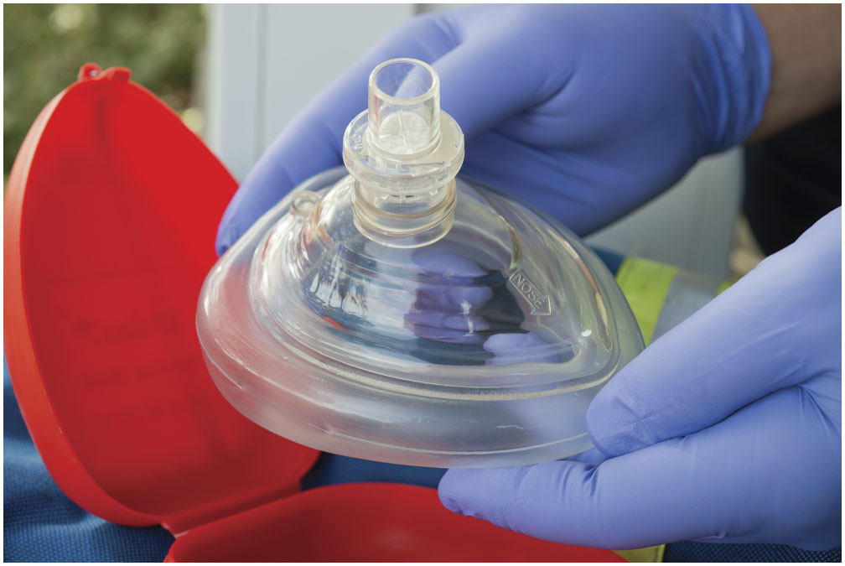
Pocket Mask with One-Way Valve and Ventilation Port
Notes:
The mouth-to-mask technique, like the mouth-to-mouth or mouth-to-nose technique, uses the exhaled breath of the EMT to ventilate the patient. But with this technique, a plastic pocket mask is used to form a seal around the patient’s nose and mouth.

Slide 116
Techniques of Artificial Ventilation (13 of 39)
Mouth-to-Mask Ventilation
  Disadvantages
    The mask is perceived by some E M T s as having an increased risk of infection.
    The E M T providing ventilation may fatigue.
    Doesn’t allow for the highest possible concentration of oxygen to be delivered.
  Required characteristics
Notes:
Disadvantages of mouth-to-mask include:
The mask is perceived by some EMTs as having an increased risk of infection.
The EMT providing the ventilation may fatigue after a period of time.
The device doesn’t allow for the highest possible concentration of oxygen to be delivered with each ventilation.
The mask used to ventilate the patient must have these characteristics:
It should be of a transparent material to permit the detection of vomitus, secretions, blood, or other substances in the patient’s mouth.
It must be able to fit tightly on the patient’s face and form a good seal.
It must have an oxygen inlet to allow for high-concentration oxygen delivery at 15 liters per minute (lpm).
It should be available in one average adult size and additional sizes for infants and children.
It must have or be connectable to a one-way valve at the ventilation port.

Slide 117
Techniques of Artificial Ventilation (14 of 39)
Mouth-to-Mask Ventilation
Mouth-to-Mask Technique—No Suspected Spinal Injury
  Connect mask to oxygen.
  Position yourself at the patient’s head.
  Use a “C–E” technique to seal the mask and perform a head-tilt, chin-lift.
  Blow into the ventilation port.
Notes:
Connect a one-way valve to the ventilation port of the mask and connect tubing that is attached to an oxygen supply to the oxygen inlet. Set the oxygen flow for 15 lpm.
Position yourself, if possible, at the top of the patient’s head. This is referred to as a cephalic technique. It is easier to monitor the patient’s chest rise and fall in this position. However, if you are performing one-person CPR, it is better to position yourself to one side of the patient’s head. This is called a lateral technique. It is the preferred technique when performing one-person CPR because it allows easier movement from the chest to the airway to provide both chest compressions and ventilations.
Place the mask on the patient’s face. The narrow, top portion of the mask should be seated on the bridge of the nose, and the broader portion should be seated in the cleft above the chin. Hold the mask with a “C-E” technique. Place your thumbs on the top and lateral edges of the mask, the thumb sides of your palms along the sides of the mask, and your index fingers over the bottom of the mask over the cleft above the chin. In this way, your thumbs and index fingers form “Cs” around the mask chimney. With your middle, ring, and little fingers, grasp under the mandible just in front of the earlobes, forming “Es” with those fingers. Pull upward on these fingers, using the “Es” to lift the mandible upward and lift the chin. While lifting the mandible upward, tilt the head backward, performing a head tilt while achieving a chin lift by lifting the mandible to the mask.
Place your mouth around the one-way valve and blow into the ventilation port of the mask. Give a breath over a 1-second period. When the chest rises adequately, stop the ventilation to allow for exhalation. If you cannot ventilate, or if the chest does not rise adequately, reposition the patient’s head and try again. Improper head position is the most common cause of difficulty with ventilation. If the second try also fails, assume the airway is blocked by a foreign object and follow the guidelines for removing a foreign body airway obstruction.

Slide 118
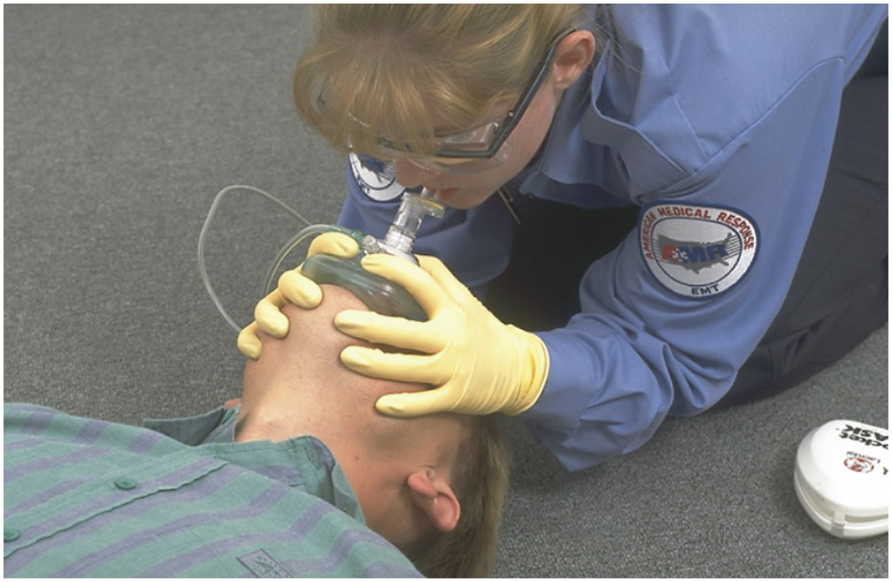
Mouth-To-Mask Ventilation. The Mask Should be Connected to Oxygen at a Flow of 15 Liters Per Minute (L p m)
Notes:
Discussion Question
What are signs of inadequate ventilation?

Slide 119
Techniques of Artificial Ventilation (15 of 39)
Mouth-to-Mask Ventilation
  Mouth-to-Mask Technique—Suspected Spinal Injury
    Modify technique for suspected spinal injury.
    If the person is pulseless and cannot be ventilated, It may be necessary to reposition the head, the airway is your priority.
Notes:
If you suspect a patient has a spinal injury, you must establish and maintain spine motion restriction. You will ventilate the patient with the mouth-to-mask technique, taking care not to manipulate the head and neck during the procedure.
Connect a one-way valve to the ventilation port of the mask and connect tubing that is attached to an oxygen supply to the oxygen inlet. Set the oxygen flow for 15 lpm.
Position yourself, if possible, at the top of the patient’s head or at the side.
Place the mask on the patient’s face. The narrow top portion of the mask should be seated on the bridge of the nose, and the broader portion should be seated in the cleft above the chin. Hold the mask with a “C-E” technique. With your middle, ring, and little fingers, grasp under the angle of the mandible just in front of the earlobes. Pull upward on the angle of the jaw to lift the mandible upward and to lift the chin forward without tilting the head backward and while keeping the head and neck in a neutral position. Squeeze the mask tightly to achieve an airtight seal between the mask and the patient’s face.
Deliver the ventilation as you would in the nonspine-injured patient.
Discussion Question
What are the advantages and disadvantages of mouth-to-mask ventilation?

Slide 120
Techniques of Artificial Ventilation (16 of 39)
  Mouth-to-Mask Ventilation
  Ineffective Ventilation
    Recognize and correct ineffective ventilations.
    If the ventilations are ineffective, it is necessary to immediately identify and correct the problem.
Notes:
If the ventilations are ineffective and are not producing adequate chest rise and fall, it is necessary to immediately identify and correct the problem.
Reposition the head and neck to ensure the airway is open. In a suspected spine injury, reposition the jaw thrust while keeping the head in a neutral position. If the jaw thrust is ineffective in opening or maintaining an airway, use the head-tilt, chin-lift maneuver to ventilate the patient, even if the potential for a spine injury exists. Opening the airway and providing adequate ventilation is a priority in patients in cardiac arrest and takes precedence over other procedures, even with suspected spine injury.
Change from a head-tilt, chin-lift to a jaw-thrust maneuver or from a jaw-thrust to a head-tilt, chin-lift maneuver if the patient is in cardiac arrest.
Readjust the face mask and make sure there are no seal leaks between the face and the mask.
Administer a greater tidal volume.
Insert an oropharyngeal or nasopharyngeal airway to assist in maintaining an open airway.

Slide 121
Techniques of Artificial Ventilation (17 of 39)
Bag-Valve-Mask Ventilation
  Select the appropriate size and use only enough volume to cause the chest to rise.
  Two-person technique is preferred.
  Can deliver close to 100 percent oxygen.
  May allow medication administration.
  May allow end-tidal C O₂ sampling.
Notes:
The advantages of the BVM device over mouth-to-mask ventilation are its convenience for the EMT and its ability to deliver enriched oxygen mixtures. Also, if two EMTs are performing the procedure, one EMT achieves and maintains the mask seal with two hands, while the second EMT squeezes the bag to deliver the ventilation.
The BVM device is harder to use than it looks and the operator becomes fatigued when performing a one-person technique.

Slide 122
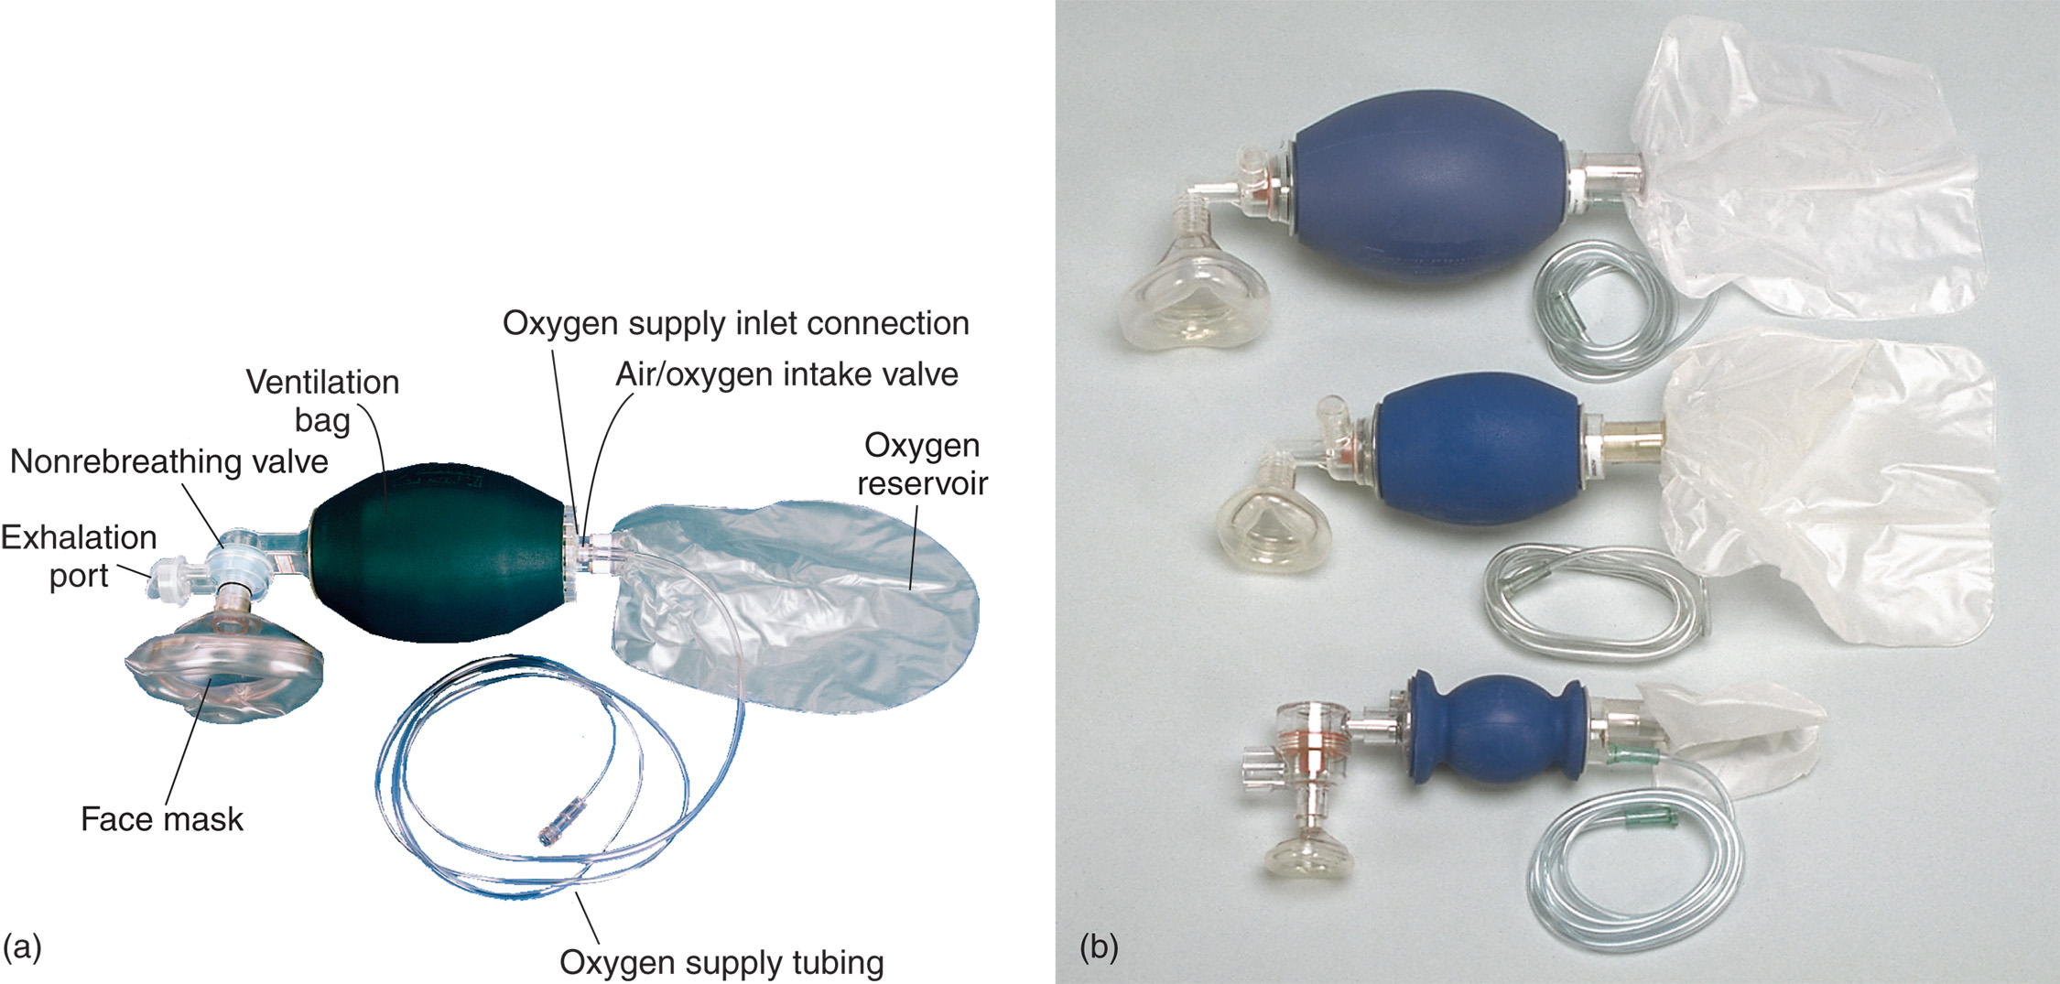
(a) Bag-Valve-Mask Unit with Oxygen Bag Reservoir. Tubing-Type Reservoirs are also Available. (b) Adult, Child, and Infant Bag-Valve-Mask Units
Notes:
A bag-valve mask should have these features:
A self-refilling bag that is disposable or easy to clean and sterilize.
A nonjamming valve system that allows a maximum oxygen inlet flow of 30 lpm.
Either no pop-off valve or a pop-off valve that can be manually disabled. A pop-off valve that is not disabled may lead to inadequate ventilation.
Standard 15/22 couplings for masks, endotracheal tubes, tracheostomy tubes, laryngeal mask airways, and Combitubes.
An oxygen inlet and a reservoir that can be connected with an oxygen source to deliver high concentrations of oxygen during ventilation. An oxygen reservoir should be used when ventilating all patients.
A true nonrebreather valve that vents the patient’s exhalations and does not allow him to rebreathe any exhaled gas and cannot be obstructed by foreign material.
Adaptability to all environmental conditions and temperature extremes.
A variety of infant-, child-, and adult-sized masks. A properly sized mask will fit snugly over the bridge of the nose and into the cleft above the chin.
Transparent masks to permit detection of vomitus, blood, or secretions during ventilation.

Slide 123
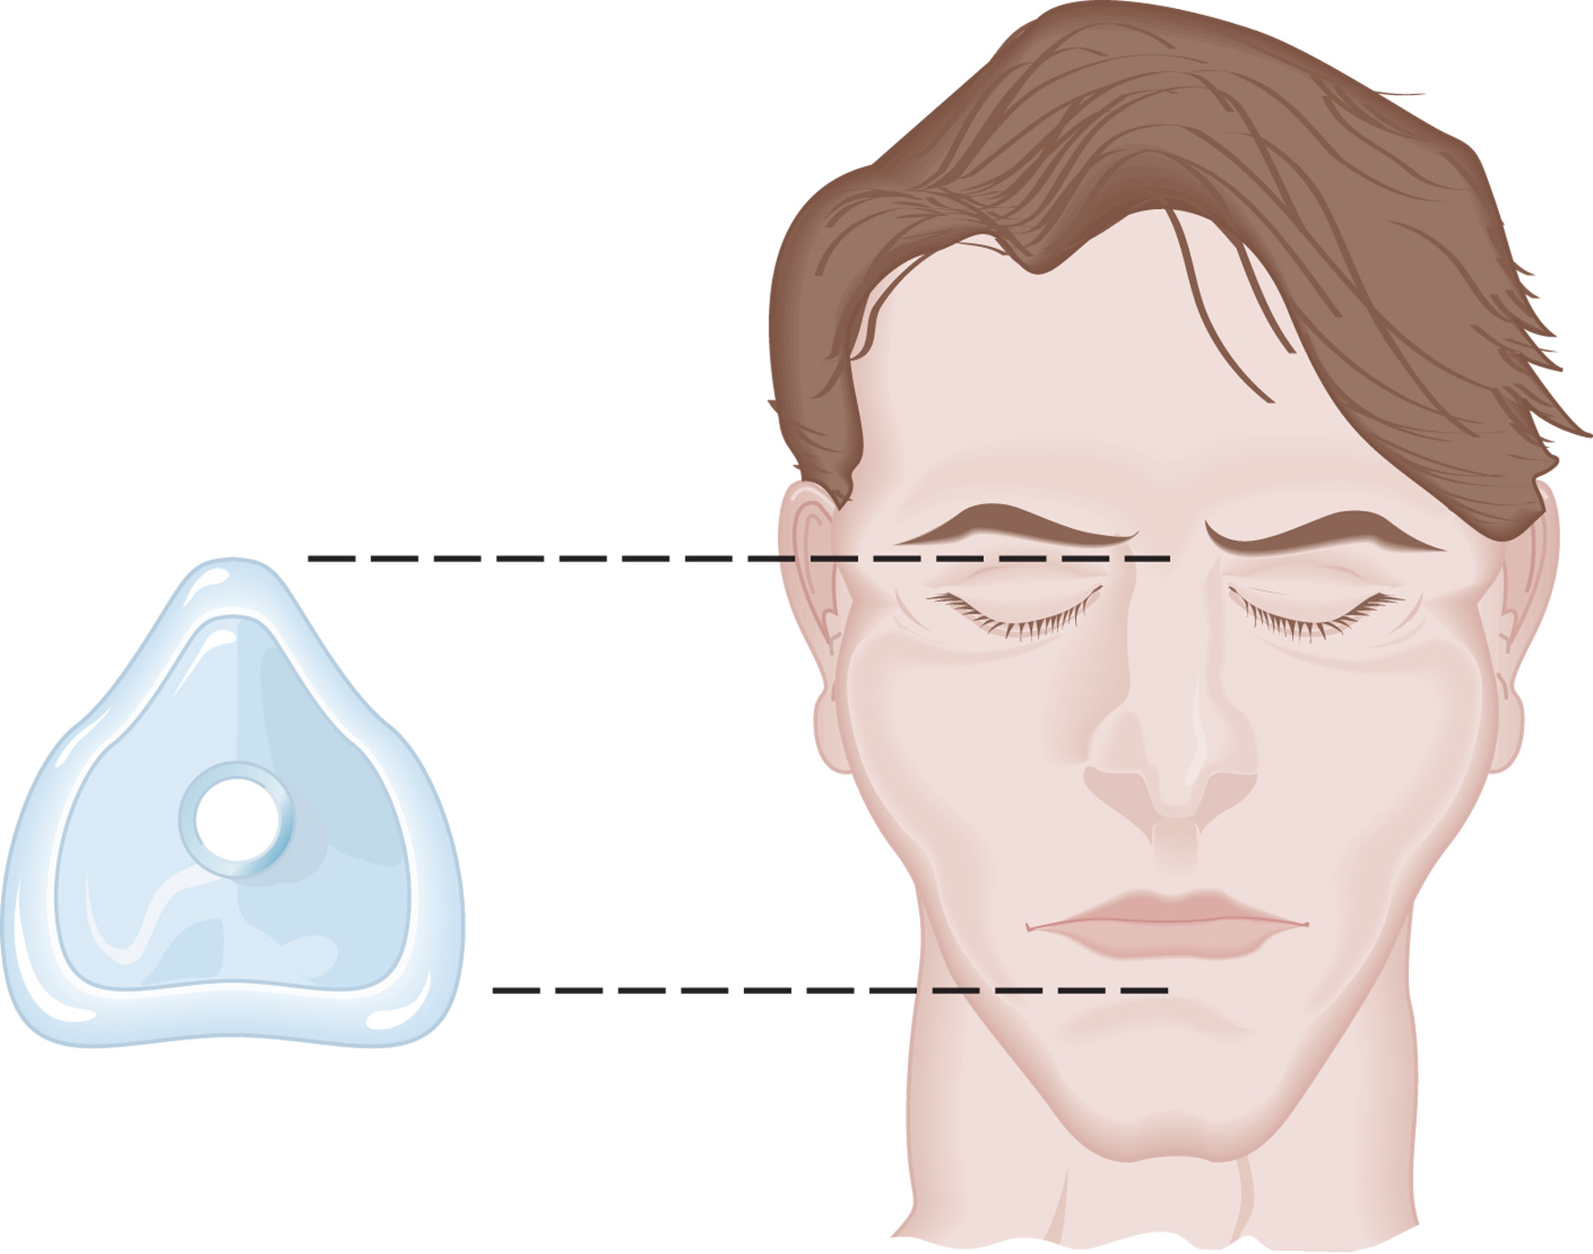
Always use the Proper Size Mask. It Should Fit Securely over the Bridge of the Nose and in the Cleft above the Chin
Notes:
Oropharyngeal or nasopharyngeal airway adjuncts can help in maintaining an open airway and should be used any time the BVM device is used.

Slide 124
Techniques of Artificial Ventilation (18 of 39)
Bag-Valve-Mask Ventilation
  Bag-Valve-Mask Technique—No Suspected Spinal Injury
    Use a head-tilt, chin-lift.
    Select the correct-size mask and bag-valve device.
    Position the mask, use an “E–C” technique.
    A second E M T squeezes the bag.
Notes:
Procedures for two-person use of the bag-valve mask:
Open the airway using the head-tilt, chin-lift maneuver. Raise the patient’s head slightly with a towel or pillow to achieve a better sniffing position.
Select the correct size mask and bag-valve device.
Place the upper, narrower part of the mask over the bridge of the nose and lower it over the mouth and into the cleft above the chin.
Position your thumbs over the top half of the mask and your index fingers over the bottom portion of the mask. Use your ring and little fingers to bring the patient’s jaw up to the mask.
Have another EMT connect the bag valve to the mask, if it is not already attached.
Begin ventilation as soon as possible. The other EMT or qualified person will squeeze the bag with two hands and deliver the ventilation steadily over 1 second while watching for adequate chest rise. Oxygen must be connected to the reservoir.
An adult with a pulse should be ventilated once every
5 to 6 seconds (10–12 breaths/minute) and infants and
children once every 3 to 5 seconds (12–20 breaths/
minute).
When you must operate the bag-valve mask alone, apply the mask to the patient’s face with one hand. Your thumb should be placed over the part of the mask covering the bridge of the nose, and your index finger should be placed over the part covering the cleft above the chin. Seal the mask firmly on the face by pushing down with the thumb and index finger while pulling up on the mandible with the other fingers to maintain a head-tilt, chin-lift. The “E-C” hand position technique will be performed with only one hand. Squeeze the bag with the other hand while observing the chest rise to make certain the lungs are being inflated effectively.
Discussion Question
How does the bag-valve-mask technique compare to use of manually triggered devices?

Slide 125
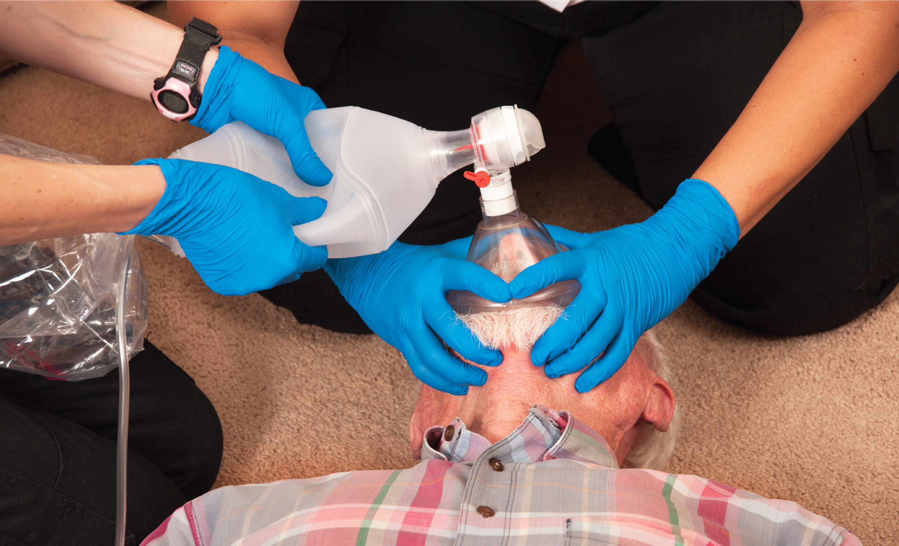
Adequate Artificial Ventilation with Good Alveolar Ventilation
Notes:
If you are ventilating with a bag-valve mask and the patient’s chest does not rise and fall, reevaluate the BVM device and the patient’s airway.

Slide 126
Techniques of Artificial Ventilation (19 of 39)
Bag-Valve-Mask Ventilation
  Bag-Valve-Mask Technique—Suspected Spinal Injury
    Modify technique for suspected spinal injury.
    Recognize and correct ineffective ventilations.
Notes:
If you suspect a patient has a spinal injury, you must establish and maintain spine motion restriction. The airway maneuvers and use of the bag-valve-mask technique must be performed with special care to avoid movement of the head or spine while maintaining spine motion restriction.
Open the airway using a jaw-thrust maneuver.
Have another EMT or a trained assistant maintain spine motion restriction while you select the correct size mask. If no other personnel are available, you can kneel at the patient’s head and hold his head between your thighs and knees to prevent movement.
Position your thumb over the top portion of the mask and your index finger over the bottom portion of the mask. Use your ring and little fingers to bring the patient’s jaw up to the mask. This forms the “E-C” hand position.
Place the mask to the face and bring the jaw up to the mask without tilting the head back or moving the neck.
Have another EMT connect the bag-valve device to the mask, if this has not already been done. Hold a mask seal with your thumbs at the bridge of the nose and the index fingers over the bottom half of the mask. The edges of the palms on the thumb side should hold the mask down on the face.
Begin ventilation as soon as possible. Have the other EMT or trained assistant squeeze the bag with two hands to deliver the volume over a 1-second period.
An adult with a pulse should be ventilated once every 5 to 6 seconds (10–12 breaths/minute) and infants and children once every 3 to 5 seconds (12–20 breaths/minute).
If the bag-valve mask has not already been connected to the oxygen supply, the patient should receive positive pressure ventilation for 1 minute. At that point the other EMT should make the connection, set the flow at 15 lpm, attach a reservoir, and resume ventilation.
Spine motion restriction is maintained while preparing the patient for movement and while moving the patient to the stretcher.
Once the patient is on the stretcher, follow the standard two-person bag-valve-mask technique, using the jaw-thrust maneuver to maintain a patent airway.
The priority in the cardiac arrest patient is airway management and effective ventilation.
Discussion Question
What modifications in technique are needed when ventilating a patient with suspected spine injury?

Slide 127
E M T Skills 10-5
In-Line Stabilization During Bag-Valve Ventilation

Slide 128
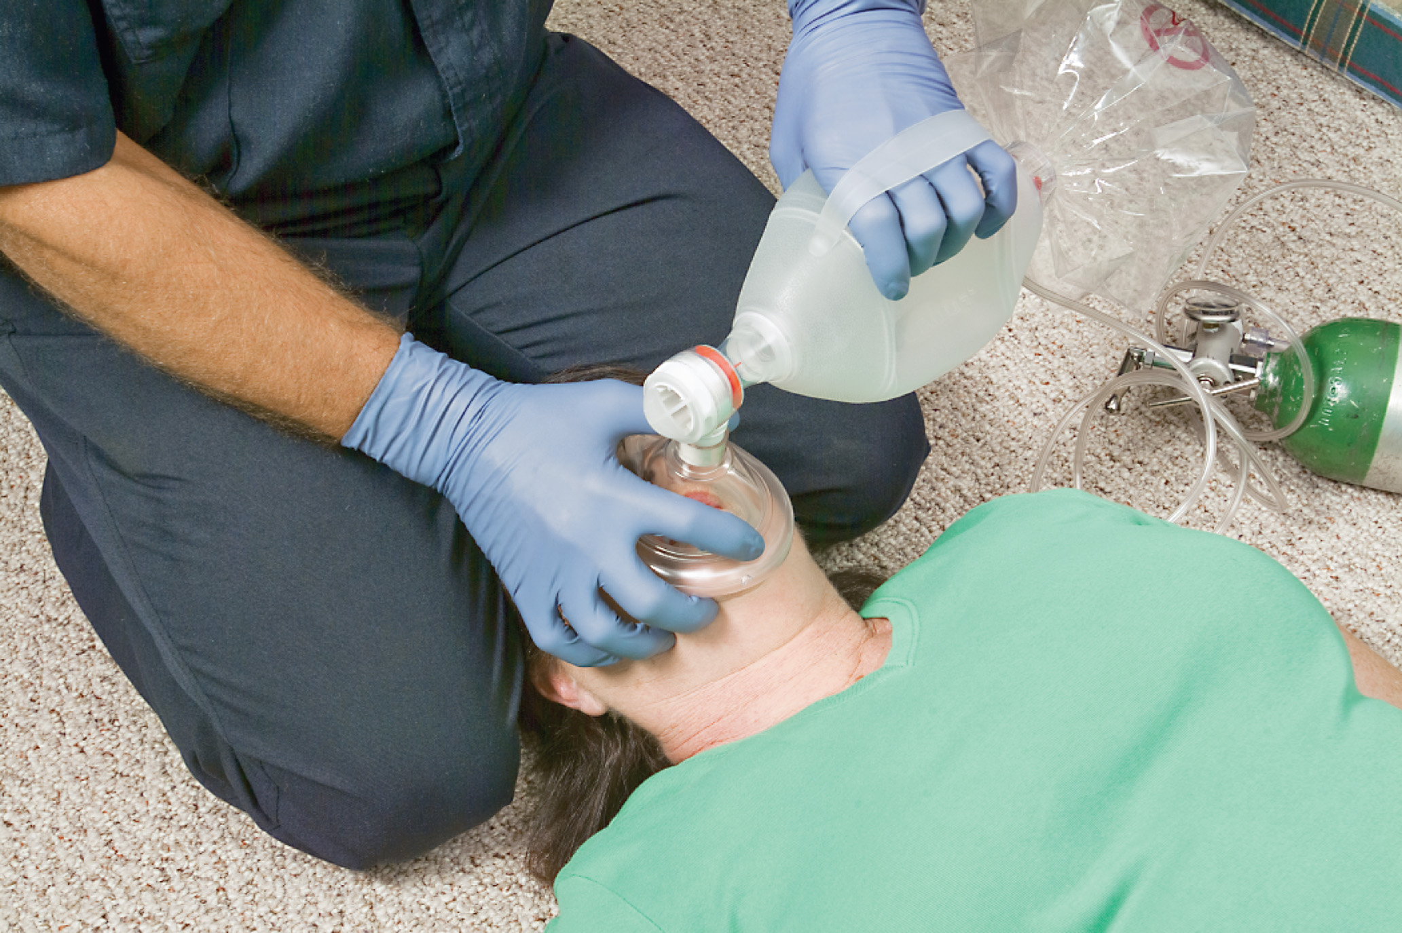
Technique for One E M T to Maintain In-Line Stabilization While Performing One-Person Bag-Valve-Mask Ventilation
Notes:
You can kneel at the patient’s head and hold his head between your thighs and knees to prevent movement.

Slide 129
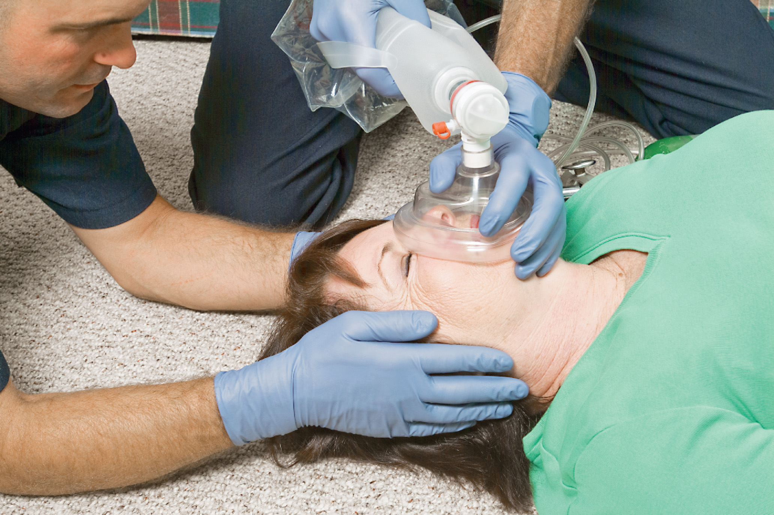
Technique for Two E M T s to Maintain In-Line Stabilization While Performing Bag-Valve-Mask Ventilation
Notes:
Hold a mask seal with your thumbs at the bridge of the nose and the index fingers over the bottom half of the mask. The edges of the palms on the thumb side should hold the mask down on the face. The middle, ring, and little fingers are used to maintain the jaw thrust.

Slide 130
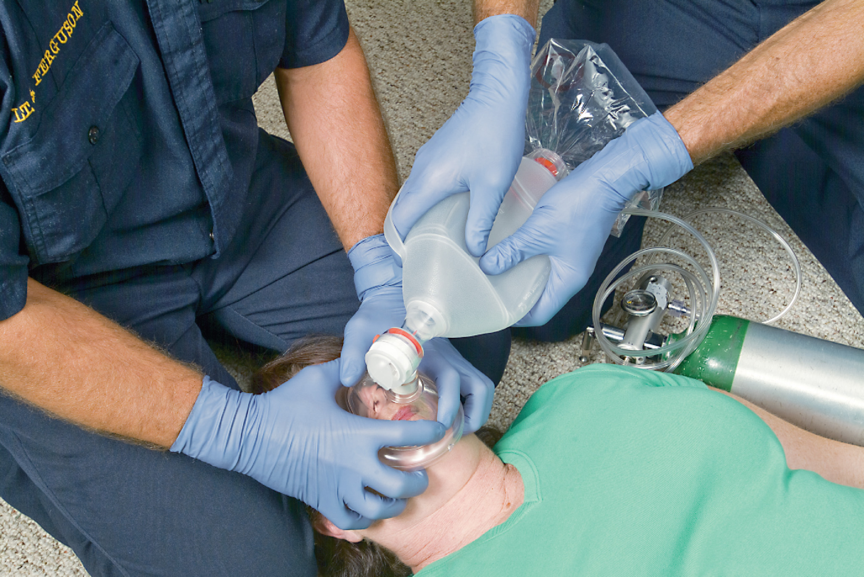
Alternative Technique for Two E M T s to Maintain In-Line Stabilization While Performing Bag-Valve-Mask Ventilation
Notes:
If the bag-valve mask has not already been connected to the oxygen supply, the patient should receive positive pressure ventilation for 1 minute. At that point the other EMT should make the connection, set the flow at 15 lpm.

Slide 131
Techniques of Artificial Ventilation (20 of 39)
Flow-Restricted, Oxygen-Powered Ventilation Device (F R O P V D)
  A manually triggered ventilation device.
  Delivers 100 percent ventilation.
  Can be used by one E M T using a two-handed technique to seal the mask.
  Only for adult patients.
Notes:
The FROPVD is an aid in ventilating a patient in cardiac arrest when used in the manual mode, which requires the EMT to trigger the device to deliver a ventilation. Avoid the automatic mode in cardiac arrest, because it may cause an increase in positive end-expiratory pressure (air remains in the terminal bronchioles and alveoli), which may lead to a decrease in blood return.

Slide 132
Techniques of Artificial Ventilation (21 of 39)
  Flow-Restricted, Oxygen-Powered Ventilation Device (F R O P V D)
  F R O P V D Techniques
    Check the unit and oxygen source.
    Open the airway and establish a seal with the mask.
    Depress the trigger; release it as the chest begins to rise.
Notes:
Check the unit to ensure it is properly functioning. Also, check the oxygen source to ensure there is an adequate supply to operate the unit effectively.
Open the airway using a head-tilt, chin-lift maneuver if no spinal injury is suspected.
Connect the flow-restricted, oxygen-powered ventilation device to the mask.
An adult with a pulse should be ventilated once every 5–6 seconds (10–12 breaths/minute). The adult patient in cardiac arrest will be ventilated twice after every 30 compressions.

Slide 133
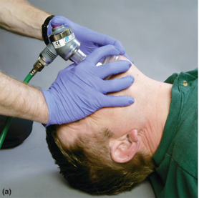
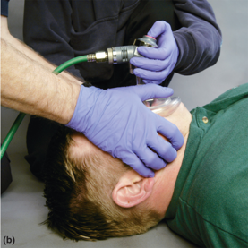
(a) A Flow-Restricted, Oxygen-Powered Ventilation Device on a Patient with no Suspected Spine Injury
(b) A flow-restricted, oxygen-powered ventilation device on a patient with a suspected spine injury.
Notes:
Activate the valve by depressing the trigger or button on the valve. As soon as the chest begins to rise, deactivate the valve by releasing the trigger or button.

Slide 134
Techniques of Artificial Ventilation (22 of 39)
Automatic Transport Ventilator (A T V)
  Advantages
    Can deliver consistent rate and tidal volume
    Delivers 100 percent oxygen
    Lower risk of gastric distention
Notes:
Advantages of the ATV:
The EMT is free to use both hands to hold the mask and maintain the airway position as the device delivers the ventilation automatically.
The device can be set to provide a specific tidal volume, respiratory rate, and minute ventilation.
Alarms indicate low pressure in the oxygen tank and accidental disconnection of the ventilator.
One EMT can maintain spine motion restriction with his thighs and knees and hold the mask seal with two hands while the ventilation is delivered.
Disadvantages:
Because the ATV is usually oxygen powered (although one type of ATV does use electric power), once the oxygen supply is depleted, the device cannot be used.
A pocket mask or bag-valve-mask device must always be available when using an ATV in case of failure or oxygen depletion.
Some ATVs cannot be used in children less than 5 years of age.
When using the ATV device, it is not possible to feel an increase in airway resistance or a decrease in the compliance in the lungs.

Slide 135
Techniques of Artificial Ventilation (23 of 39)
  Automatic Transport Ventilator (A T V)
  A T V Recommended Features
    Simple and time- or volume-cycled
    -millimetre connector
    Lightweight and rugged in design
    60 cm H₂O inspiratory pressure limit
    Adjustable from 20–80 centimetre H₂O
    Can deliver 50-100 percent H₂O
    One second inspiratory time
Notes:
The unit should also have:
An adjustable inspiratory flow of 30 lpm for the adult and 15 lpm for the child
A rate of 10 breaths per minute for adults and 20 breaths per minute for children
An audible alarm that indicates the peak inspiratory pressure is generated and alerts the EMT that the lung compliance is low or the airway pressure is high, which results in a lower delivered tidal volume.
Some ATVs have a demand valve built in, if the patient begins to breathe spontaneously.

Slide 136
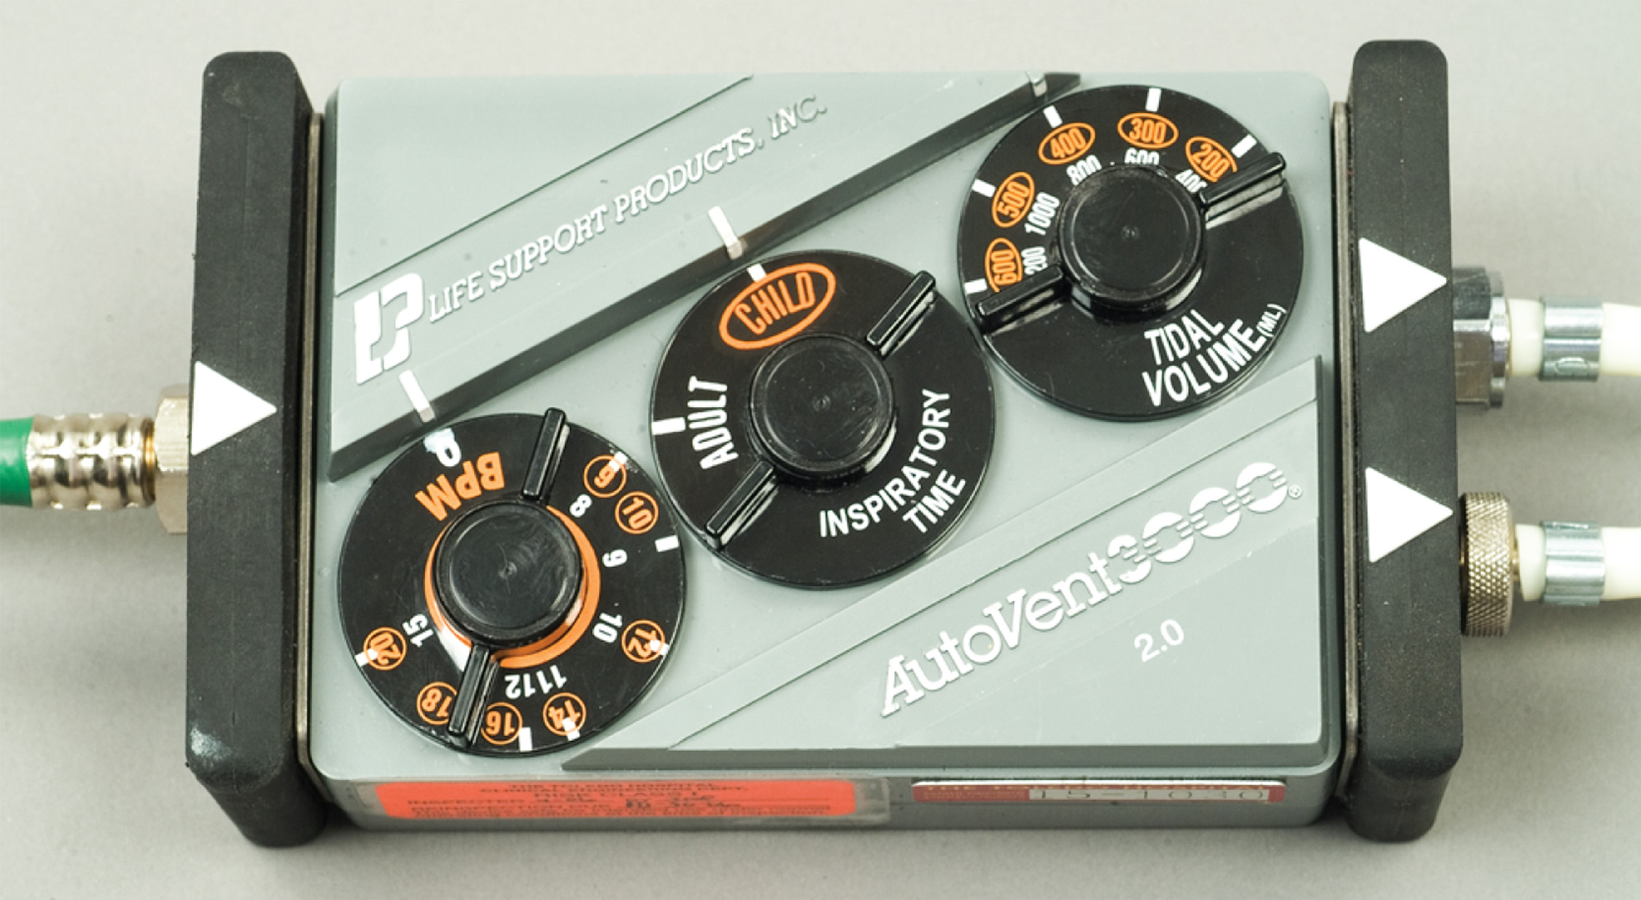
An Automatic Transport Ventilator
Notes:
The automatic transport ventilator (ATV) is excellent at providing and maintaining a constant rate and tidal volume during ventilation, and maintaining adequate oxygenation of arterial blood. In addition, most ATVs use oxygen as their power source, thereby delivering 100 percent oxygen during ventilation.

Slide 137
Techniques of Artificial Ventilation (24 of 39)
A T V Techniques
  Check the device.
  Seal the mask to the face.
  Select the tidal volume and rate.
  Observe for adequate chest rise and fall.
  Recognize and correct ineffective ventilations.
Notes:
Continuously monitor both the device for proper functioning and the rise of the patient’s chest for adequate ventilation. If a failure of the device is detected or suspected, immediately discontinue use of the ATV and begin ventilation with a pocket mask or a bag-valve-mask device.

Slide 138
Techniques of Artificial Ventilation (25 of 39)
Ventilation of the Patient Who Is Breathing Spontaneously
  Recognize the need to ventilate.
  Realize complications.
  Explain the procedure to the patient.
  Ventilate to achieve the normal rate and/or tidal volume.
Notes:
Recognize the need to ventilate a patient who is breathing, but breathing inadequately.
Complications include uncooperative patients, inadequate mask seal, and over-inflation of the lungs.
Breathing patients would need ventilation:
The patient who has a reduced minute volume due either to an inadequate respiratory rate or to an inadequate tidal volume.
The patient with an adequate respiratory rate but an inadequate tidal volume (shallow breathing or hypopnea).
The patient who has an adequate tidal volume but has a respiratory rate that is too slow.
The patient who has a respiratory rate that is too fast (tachypnea) that leads to an inadequate tidal volume (hypopnea).

Slide 139
Techniques of Artificial Ventilation (26 of 39)
Continuous Positive Airway Pressure (C P A P)
  A form of noninvasive positive pressure ventilation.
  Used in awake, spontaneously breathing patients who need ventilatory support.

Slide 140
C P A P is a Form of Noninvasive Positive Pressure Ventilation Used in the Awake and Spontaneously Breathing Patient Who Needs Ventilatory Support
C P A P on an adult.
Notes:
CPAP is a treatment that uses the effects of positive pressure to keep the airways open.

Slide 141
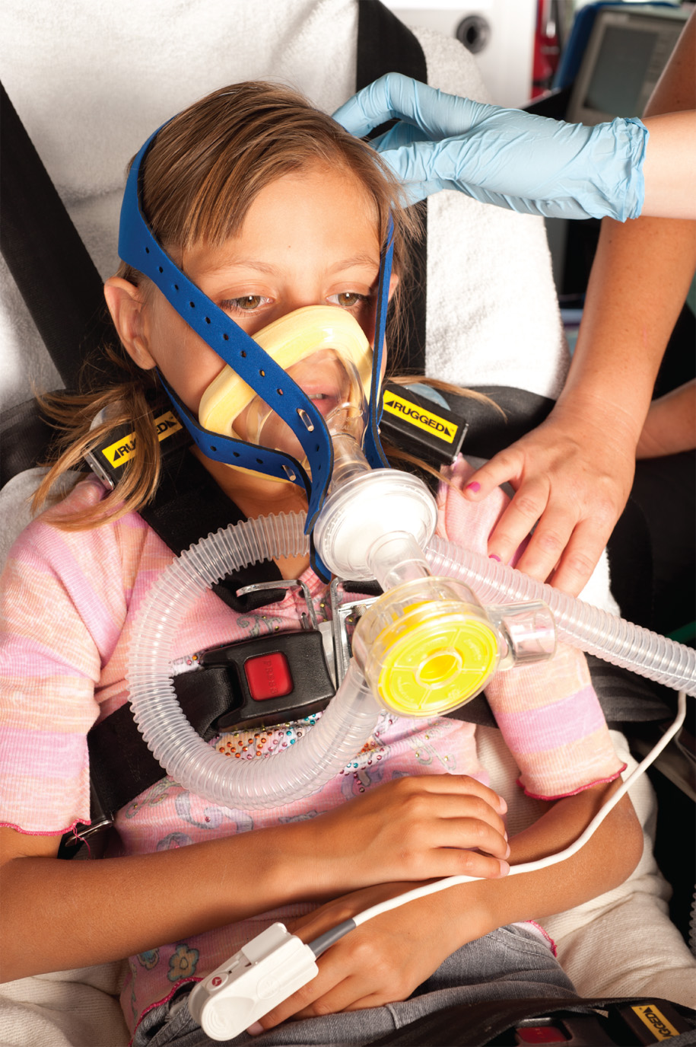
C P A P on a Child
Notes:
CPAP may also be used to treat preterm infants who have underdeveloped lungs.

Slide 142
Techniques of Artificial Ventilation (27 of 39)
Continuous Positive Airway Pressure (C P A P)
  How C P A P Improves Ventilation and Oxygenation
    C P A P can help avoid the need for endotracheal intubation in some patients.
    Oxygen should be titrated to the patient’s S p O₂ reading, and signs and symptoms.
Notes:
CPAP is often used to avoid the need to place an endotracheal tube or other advanced airway to artificially ventilate the patient. A common goal of CPAP is to reduce a patient’s work of breathing and buy time for more definitive treatments to work. As already noted, CPAP is delivered via a tightly fitted mask and a device that generates a continuous flow of air through the airways under positive pressure that is higher than normal air pressure.
The continuous delivery of air under positive pressure, which is measured in cmH2O, is intended to inflate collapsed alveoli, improve oxygenation, improve pulmonary compliance, and reduce the patient’s work of breathing.
Points to Emphasize
CPAP offers a way to provide ventilatory support to patients who are awake and spontaneously breathing, decreasing the patient's work of breathing.
CPAP can be useful for patients with congestive heart failure, pulmonary edema, chronic obstructive pulmonary disease, and asthma, but cannot be used for apneic, unresponsive, or uncooperative patients.

Slide 143
Techniques of Artificial Ventilation (28 of 39)
  Continuous Positive Airway Pressure (C P A P)
  Positive pressure is measured in centimetreH₂O.
  Positive pressure helps inflate collapsed alveoli and improve oxygenation.
  Decreases the work of breathing.
  Helps displace fluid in alveoli in left ventricular failure.
Notes:
Left ventricular failure increases hydrostatic pressure inside the pulmonary capillaries, forcing fluid out of the capillaries and into the adjoining alveoli, displacing the air in the alveoli and inhibiting gas exchange. The continuous pressure created in the alveoli by CPAP prevents further fluid leakage into the alveoli and forces fluid that may already have accumulated out of the alveoli and back into the interstitial space and the capillaries. CPAP improves the heart rate and blood pressure and reduces the sympathetic tone by improving gas exchange and oxygenation.

Slide 144
Techniques of Artificial Ventilation (29 of 39)
  Continuous Positive Airway Pressure (C P A P)
  Delivered at 2 to 20 centimetreH₂O, but most orders do not exceed 10 centimetreH₂O.
  Begin at the lowest setting and titrate.
Notes:
CPAP is delivered at a continuous airway pressure from 4 cmH2O to 20 cmH2O. Most often, CPAP is initiated at the lowest setting and titrated up to an optimal setting for the patient.

Slide 145
Techniques of Artificial Ventilation (30 of 39)
  Continuous Positive Airway Pressure (C P A P)
  C P A P and Children
    Many E M S protocols restrict C P A P to patients over the age of 12.
Notes:
CPAP may be an effective therapy if a child is able to tolerate the treatment and the patient interface or mask fits appropriately.

Slide 146
Techniques of Artificial Ventilation (31 of 39)
  Continuous Positive Airway Pressure (C P A P)
  Criteria and Indications for C P A P
    Awake and can obey commands.
    Can maintain his airway.
    Breathing with a respiratory rate >25/min.
    Moderate to severe respiratory distress, or early respiratory failure.
Notes:
Criteria for CPAP include that the patient is:
Awake, alert, and oriented enough to obey commands (GCS >10)
Able to maintain his own airway
Able to breathe on his own and has a respiratory rate >25 breaths/minute
In a state of relative hemodynamic stability
Exhibiting signs and symptoms of moderate to severe respiratory distress or early respiratory failure (use of accessory muscles or SpO2 694%)
Presenting with increased end tidal CO2 (ETCO2) values
Able to wear the face mask or interface chosen

Slide 147
Techniques of Artificial Ventilation (32 of 39)
  Continuous Positive Airway Pressure (C P A P)
  Criteria and Indications for C P A
    Indications include:
      Congestive heart failure
      Pulmonary edema
      C O P D
      Asthma
      Pneumonia
Notes:
The indications for CPAP for the patient in moderate to severe respiratory distress or early respiratory failure, but who is alert and awake enough to obey commands, maintain his own airway, and continue to breathe on his own.

Slide 148
Techniques of Artificial Ventilation (33 of 39)
  Continuous Positive Airway Pressure (C P A P)
  Contraindications for C P A P
    C P A P should be used with caution in patients with hypotension and hypovolemia.
    C P A P creates an increase in intrathoracic pressure that may result in a decrease in cardiac output, worsening the state of hypotension or hypoperfusion.
Notes:
CPAP is contraindicated in patients with:
Apnea, respiratory arrest, or agonal respirations
Inability to understand or obey commands (GCS <11)
Inability to maintain his own airway (associated with an increased risk of vomiting and aspiration)
Unresponsiveness (associated with an increased risk of vomiting and aspiration)
Shock associated with cardiac insufficiency (signs of poor perfusion and a SBP 690 mmHg)
Cardiac arrest
Active vomiting (associated with an increased risk of aspiration)
Upper gastrointestinal bleeding or history of recent gastric surgery
Pneumothorax or trauma to the chest, especially penetrating trauma
Tracheotomy
Facial trauma, especially midface fractures, or facial anomalies
Increased intrathoracic pressure causing hypotension (SBP 690 mmHg)

Slide 149
Techniques of Artificial Ventilation (34 of 39)
  Continuous Positive Airway Pressure (C P A P)
  C P A P Administration Procedure
    Inform and coach the patient.
    Minimize the patient’s anxiety.
    Obtain vital signs and S p O₂.
    Have an adequate oxygen supply.
    Place the patient in seated or semi-Fowler’s position.
Notes:
Carefully explain the procedure and the device to the patient. Obtain a set of vital signs and a baseline SpO2 reading. You must do continuous SpO2 monitoring and reassess the vital signs every 5 minutes.
Insure that you have an adequate oxygen source because most CPAP devices use oxygen as their source of pressure. Have a backup tank available, because it is undesirable to discontinue CPAP once it is applied.
Place the patient in a seated or semi-Fowler’s position.

Slide 150
Techniques of Artificial Ventilation (35 of 39)
  Continuous Positive Airway Pressure (C P A P)
  C P A P Administration Procedure
    Assemble and check the device.
    Secure the mask with straps.
    Increase pressure in increments of 2 centimetreH₂O.
    Continue to coach the patient.
Notes:
Assemble the breathing circuit to the CPAP device and ensure it is properly functioning.
Place the mask over the patient’s nose and mouth and secure it tightly with the straps to limit airflow loss.
Increase the CPAP pressure by increments of 2 cmH2O until the patient’s response improves. Most protocols recommend a CPAP of 5 cmH2O. It may be necessary to titrate the pressure to 10 cmH2O in congestive heart failure with pulmonary edema. Do not exceed 10 cmH2O unless directed by medical direction. Check for air leaks and reposition and tighten the mask if necessary once the pressure is applied.
Continue to coach and encourage the patient. Instruct the patient to breathe in through his nose and exhale slowly through his mouth if possible. Some procedures recommend counting aloud to the patient, counting slowly to four during exhalation before allowing him to take another inhalation.
Do not discontinue CPAP unless directed by medical direction or after you have arrived at the medical facility and the CPAP has been transferred to their system. If the patient’s level of consciousness deteriorates to a GCS <11 and the patient is no longer able to obey or understand your commands, or if any of the other contraindications arise, immediately remove the patient from the CPAP device. It will then be necessary to continue with an alternative treatment that may include positive pressure ventilation with a bag-valve-mask device.
Notify the receiving medical facility that the patient is on CPAP so they can prepare to transfer the patient to their CPAP device upon arrival without discontinuation to the patient.

Slide 151
Techniques of Artificial Ventilation (36 of 39)
  Continuous Positive Airway Pressure (C P A P)
  Assessing the Patient’s Response to C P A P
    Respiratory and heart rates
    Systolic blood pressure
    Oxygen saturation
    End-tidal C O₂
    Complaint of dyspnea
Notes:
Respiratory rate- A decrease in the respiratory rate may indicate a positive response to CPAP. If the respiratory rate is decreasing with a decline in the patient’s mental status, it may be an indication that the patient is deteriorating and may need positive pressure ventilation.
Heart rate- As the patient’s oxygenation levels improve with CPAP, the heart rate will typically decrease. An increase in the heart rate may occur from a rise in intrathoracic pressure with a decrease in venous return, leading to a decline in preload. In this case, to compensate, the heart will increase the rate.
Systolic blood pressure- It is necessary to closely monitor the patient’s systolic blood pressure during CPAP. An increase in intrathoracic pressure may cause a decrease in venous return, leading to a reduction in preload. As the preload decreases, the systolic blood pressure will also decline. If hypotension (SBP <100 mmHg) or signs of poor perfusion become evident, it may be necessary to reduce CPAP pressure or support. If the patient already has a low SBP, it may be necessary to consult with medical direction prior to initiating CPAP,
Oxygen saturation. The oxygen saturation in arterial blood should improve with CPAP. The SpO2 reading should continue to improve during treatment. It may be necessary to adjust the CPAP pressure upward to improve the SpO2 reading.
End-tidal capnography- If an end-tidal carbon dioxide (ETCO2) monitor is used during CPAP, the initial response may be an increase in the ETCO2 reading. This results from an improvement in the ventilation-perfusion mismatch, which will increase the elimination of excess carbon dioxide from arterial blood. As the CPAP treatment continues, the ETCO2 reading should decrease, indicating a continuous improvement in gas exchange with effective elimination of the built-up carbon dioxide in the arterial blood.
Complaint of dyspnea- Although a complaint of dyspnea is very subjective, the severity of the patient’s complaint should be reduced. In addition, with improvement, a reduction in cyanosis and accessory muscle use should also be seen.

Slide 152
Techniques of Artificial Ventilation (37 of 39)
  Continuous Positive Airway Pressure (C P A P)
  Assessing the Patient’s Response to C P A P - Monitor for:
    Pneumothorax
    Gastric distention
    Vomiting
    Increased respiratory distress or failure
    Decreased mental status
    Intolerance of the device
Notes:
If any of these occur, it would be necessary to discontinue the CPAP and select an alternative treatment.

Slide 153
Techniques of Artificial Ventilation (38 of 39)
  Continuous Positive Airway Pressure (C P A P)
  Bi P A P
    Bilevel (or biphasic) positive airway pressure (Bi P A P) is like C P A P, but it allows you to set different airway pressures for inspiration and expiration.
Notes:
One level of pressure is delivered when the patient inhales, also known as inspiratory positive airway pressure (IPAP) and one level of pressure is delivered when a patient exhales, also known as expiratory positive airway pressure (EPAP).

Slide 154
Techniques of Artificial Ventilation (39 of 39)
Hazards of Overventilation
  Overinflation leads to serious complications.
    In cardiac arrest, perfusion is decreased.
    In spontaneously breathing patients, return to the left ventricle can be reduced.
Notes:
When a spontaneously breathing patient is overventilated, where the rate and volume delivered with the ventilation exceed the recommended rate and volume, large amounts of air may become trapped in the alveoli, causing the pressure in the chest to remain higher than it should during inhalation and exhalation. The overinflated alveoli may cause the capillaries in the lungs to become compressed and obstruct blood flow to the left atrium. Also, the constant high pressure in the chest would reduce the negative pressure that can be generated, thereby reducing the vacuum effect that sucks blood into the right side of the heart with each breath. This would reduce the blood volume that is available to the left ventricle, causing a reduction in cardiac output.

Slide 155
Special Considerations in Airway Management and Ventilation (1 of 8)
A Patient with a Stoma or Tracheostomy Tube
  A stoma may indicate a tracheostomy, which may be temporary.
  A tracheostomy tube may be placed in the stoma.
  A stoma also may indicate a partial or total laryngectomy.
Notes:
During a tracheostomy, a stoma is created by cutting through the skin and into the trachea to relieve an obstruction higher in the trachea or to serve in place of an endotracheal tube (a tube through the mouth and into the trachea) that has been in place for several hours or days.
Often, a tracheostomy tube, a curved hollow tube made of rubber, plastic, or metal, is inserted into the stoma to help hold it open.
In a laryngectomy, all or part of the patient’s larynx has been removed. In a total laryngectomy, there is no longer any connection of the trachea to the mouth and nose. The trachea is disconnected from the pharynx, brought forward, and connected to the stoma in the neck. This alters the airway so that the patient breathes completely through the stoma. In a partial laryngectomy, some of the tracheal connection to the mouth and nose remains so that the patient can get some air through the stoma and some through the mouth and nose.

Slide 156
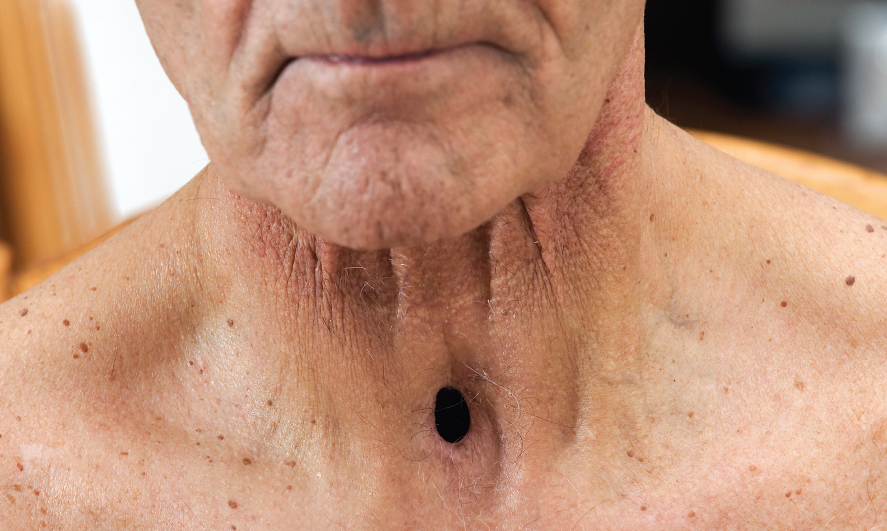
A Stoma is a Surgical Opening in the Front of the Neck
Notes:
A stoma is a surgical opening in the front of the neck through which the patient breathes air into the trachea.

Slide 157
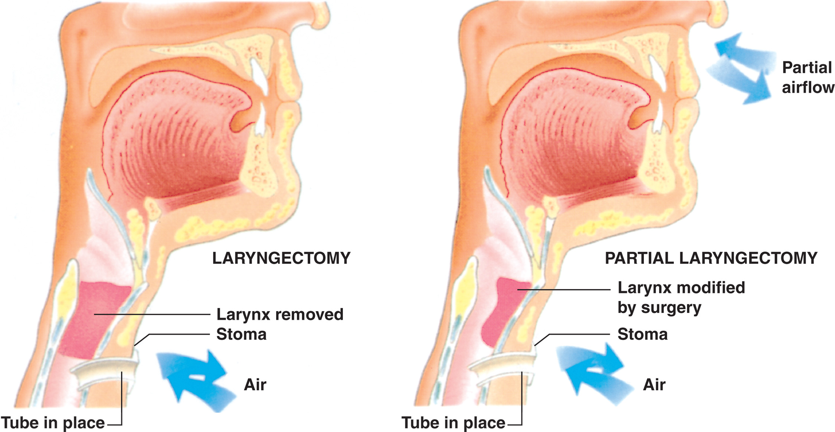
The Neck Breather’s Airway has been Changed by Surgery
Notes:
In a total laryngectomy, there is no longer any connection of the trachea to the mouth and nose. The trachea is disconnected from the pharynx, brought forward, and connected to the stoma in the neck. This alters the airway so that the patient breathes completely through the stoma. In a partial laryngectomy, some of the tracheal connection to the mouth and nose remains.

Slide 158
Special Considerations in Airway Management and Ventilation (2 of 8)
A Patient with a Stoma or Tracheostomy Tube
  Bag-Valve-Mask-to-Tracheostomy-Tube Ventilation
    A bag-valve device can connect to a tracheostomy tube.
    If there is not a tracheostomy tube, place a mask over the stoma to provide bag-valve ventilations.
Notes:
When ventilating through the tracheostomy tube, it may be necessary to seal the patient’s mouth and nose to prevent air from escaping. If this is not done, ineffective ventilation can result.

Slide 159
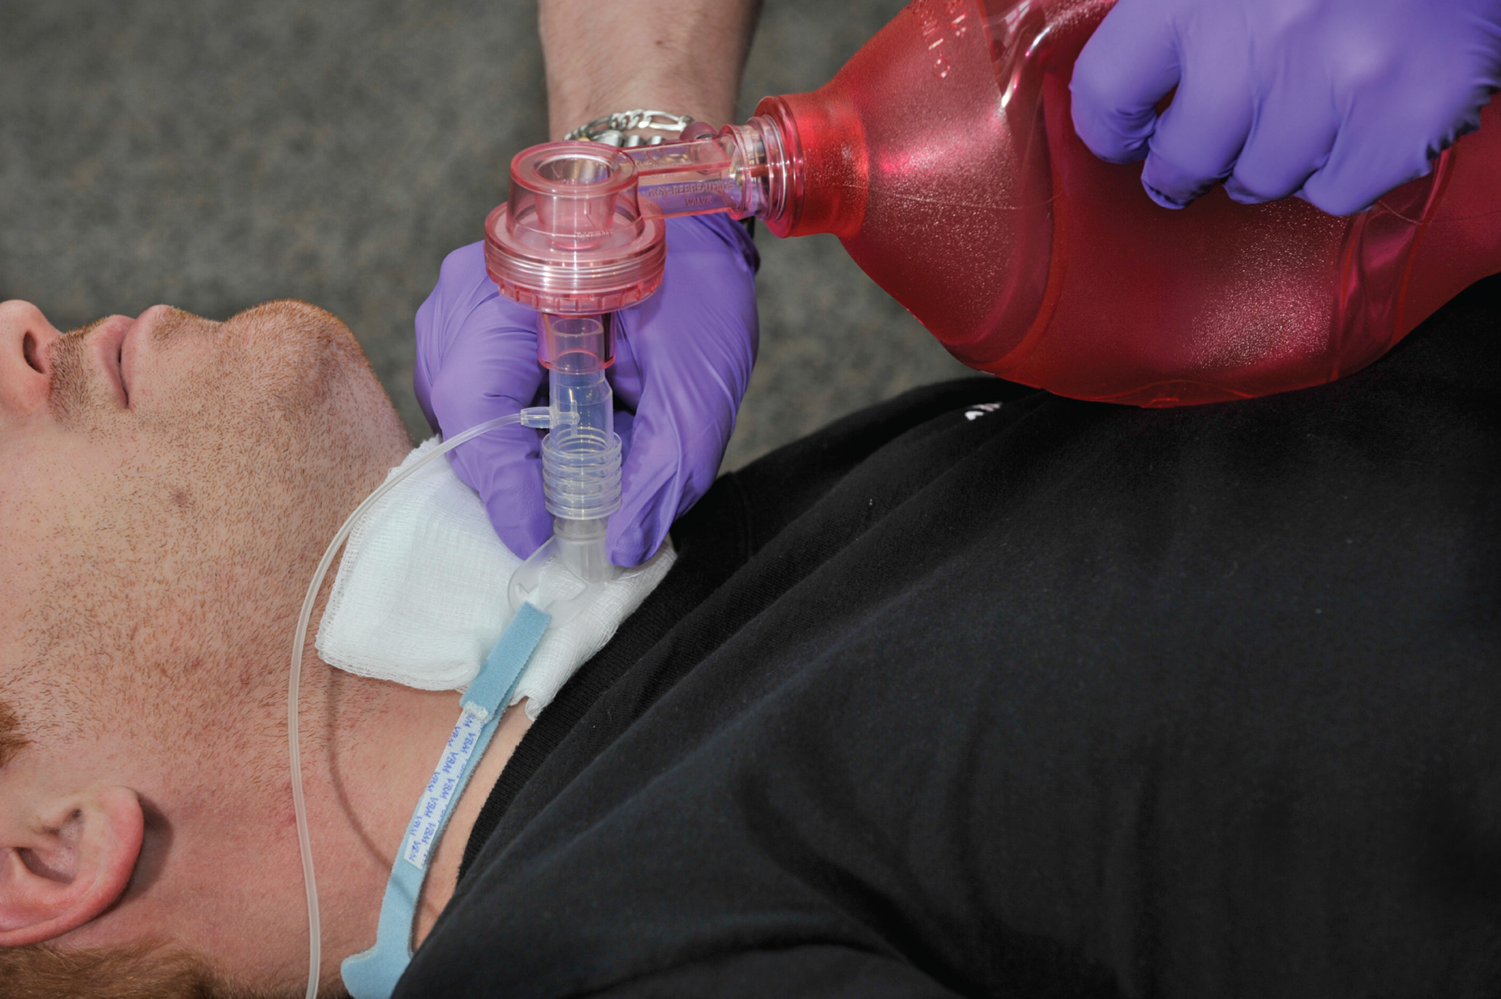
Artificial Ventilation can be Accomplished in the Patient with a Tracheostomy Tube by Attaching the Bag-Valve-Mask Device Directly to the Tube
Notes:
The bag-valve device is designed so that it can connect directly to the tracheostomy tube to provide positive pressure ventilation.

Slide 160
Special Considerations in Airway Management and Ventilation (3 of 8)
A Patient with a Stoma or Tracheostomy Tube
  Bag-Valve-Mask-to-Stoma Ventilation
    It may be necessary to suction the stoma.
    It may be necessary to seal the mouth and nose.
Notes:
Remove all coverings (e.g., scarves and ties) from the area of the stoma.
Clear the stoma of any foreign matter. Suction the stoma by passing a sterile soft suction catheter through the stoma and into the trachea no more than 3–5 inches. Suction enough to partially open the airway.
You will not need to perform a head-tilt, chin-lift maneuver or jaw-thrust maneuver on a patient with a stoma. Keep the patient’s head straight and the shoulders slightly elevated.
Select a mask, most often a child or infant mask, that fits securely over the stoma and can be sealed against the neck. Hold the mask seal with your hand and squeeze the bag delivering the ventilation over a 2-second period. Watch for adequate chest rise and fall. Feel to be sure that the air is escaping back through the stoma during exhalation.
If the chest does not rise, suspect a partial laryngectomy. Seal the nose and mouth with one hand so that air will not leak out of the mouth and nose. Pinch off the nose between the third and fourth fingers; seal the lips with the palm of the hand. Place the thumb under the chin, and press upward and backward. Repeat the ventilation process.
Discussion Questions
What are reasons a patient may have a stoma?
What is the difference between a partial and a total laryngectomy?

Slide 161
Special Considerations in Airway Management and Ventilation (4 of 8)
  A Patient with a Stoma or Tracheostomy Tube
  Mouth-to-Stoma Ventilation
    Not recommended because it exposes the E M T to respiratory secretions and droplets.
    You must use a barrier device over the stoma before you perform mouth-to-stoma ventilation.
Notes:
It is preferable to use a bag-valve-mask device with an infant- or child-sized mask to form a seal over the stoma. Follow the same procedure as for adult ventilation with a bag-valve mask, but form the mask seal over the stoma instead of over the mouth. If a BVM is not present and you have no other option, you must use a barrier device over the stoma before you perform mouth-to-stoma ventilation.

Slide 162
Special Considerations in Airway Management and Ventilation (5 of 8)
Infants and Children
  Place the head in a neutral position.
  Avoid excessive volumes and pressures.
  Use a B V M with 450 to 500 milliLitre volume and without a pop-off valve.
  Use an oropharyngeal ornasopharyngeal airway if required.
  Ventilate at 12 to 20/min., or once every three to five seconds.
Notes:
The child’s head should be placed in a neutral position and then only slightly extended. Because of immature development of the airways, hyperextension can produce an airway obstruction.
When providing positive pressure ventilation, regardless of the device or technique used, it is necessary to avoid excessive ventilation volumes and pressures. Excesses in these areas can lead to gastric distention, a common problem while ventilating infants and children.
Use a bag-valve-mask device with a minimum volume of 450–500 mL without a pop-off valve. If a pop-off valve is present, disable it by placing it in a closed or off position. A pop-off valve may unnecessarily vent air and lead to ineffective ventilation.
Be sure the chest rises with each ventilation.

Slide 163
Special Considerations in Airway Management and Ventilation (6 of 8)
Patients with Facial Injuries
  Swelling can occlude the airway.
  Use an airway adjunct if needed.
  Avoid a nasopharyngeal airway in patients with mid-face trauma.
  Bleeding may require frequent suctioning.
Notes:
Blunt injury can cause excessive swelling that may partially or completely occlude the airway. It may be necessary to insert an airway adjunct to establish and maintain the airway.
Bleeding into the pharynx can be severe and cause problems with airway management. Frequent or constant suctioning may be necessary.
Discussion Question
What are the challenges of airway management in patients with facial trauma?

Slide 164
Special Considerations in Airway Management and Ventilation (7 of 8)
Foreign Body Airway Obstruction
  If the patient is effectively moving air, instruct him to cough; administer O₂.
  If air exchange is poor, manage as for a complete airway obstruction.
  For a child or adult, perform abdominal thrusts.
  For an infant, perform chest thrusts and back blows.
Notes:
Signs of a severe partial airway obstruction with poor air exchange are:
Cough that becomes silent
Stridor heard on inhalation
Increase in labored breathing
If the patient is responsive and choking but is effectively moving air when inhaling and exhaling, instruct him to cough. Do not perform abdominal thrusts or other foreign body airway obstruction maneuvers.
If the patient is 1 year of age or older, perform abdominal thrusts as you would for an adult patient. In an infant who is less than 1 year of age, perform back blows (slaps) and chest thrusts to relieve the obstruction.

Slide 165
Special Considerations in Airway Management and Ventilation (8 of 8)
Dental Appliances
  Manage in place when dentures are secure.
  If dentures are loose, remove them.
Notes:
It is much easier to establish a tight mask seal with the dentures in place. If the dentures are extremely loose, remove them so they do not dislodge and occlude the airway.

Slide 166
Oxygen Therapy (1 of 16)
100% oxygen is stored in cylinders.
Oxygen Cylinders
  Cylinder volume varies.
  Pressure in a full cylinder is 2,000 psi.
Duration of Flow
  The only way to truly determine the amount of oxygen in the tank is to apply the gauge and identify the psi of pressure remaining in the tank.
Notes:
D cylinder—350 liters
E cylinder—625 liters
M cylinder—3,000 liters
G cylinder—5,300 liters
H cylinder—6,900 liters
The pressure remains constant; however, the volume varies based on the size of the tank. Thus, if a D tank had 1,000 psi, it would have approximately 175 liters of oxygen remaining (350 , 2 = 175).

Slide 167
Table 10-8 Oxygen Duration (1 of 2)
Formula to Calculate Oxygen Tank Duration
Take the tank pressure measured by the gauge in psi minus the safe residual pressure that is always set at 200 psi times the constant (see the tank constant listed below) divided by the flow rate expected to be delivered or being delivered to the patient in liters per minute. This will provide you with how long the oxygen will last at a desired flow rate for the specified tank (E tank, for example).
Cylinder Constant
D = 0.16 | G = 2.41
E = 0.28 | H = 3.14
M = 1.56 | K = 3.14

Slide 168
Table 10-8 Oxygen Duration (2 of 2)
As an example, to determine how long the full (2,000 psi) E cylinder will last with a patient on a nonrebreather mask at 15 litersperminute, you would calculate the following:
The oxygen tank will provide oxygen at 15 litersperminute to the patient for a period of 33.6 minutes.

Slide 169
Oxygen Therapy (2 of 16)
Safety Precautions
  No combustible materials contacting cylinder or components.
  No smoking near oxygen cylinders.
  Store cylinders below 125° F.
  Use with a properly fitting regulator.
  Keep all valves closed when not in use.
  Keep cylinders secured.
  Do not place your body over the valve.
Notes:
Never allow combustible materials such as oil or grease to touch the cylinder, regulator, fittings, valves, or hoses. Oil and oxygen under pressure will explode if they come into contact. This includes petroleum based adhesive or lubricants such as petroleum jelly.
Never smoke or allow others to smoke in any area where oxygen cylinders are in use or on standby. Because oxygen makes fires burn more rapidly, it greatly increases the risk of fire, not only from the tank but in towels, sheets, and clothing with which oxygen has come in contact.
Store the cylinders below 125°F.
Never use an oxygen cylinder without a safe, properly fitting regulator valve. Never use a valve that has been modified from another gas.
Keep all valves closed when the oxygen cylinder is not in use, even if the tank is empty.
Keep oxygen cylinders secured to prevent their toppling over. In transit, they should be in a carrier rack or secured to the stretcher. An oxygen tank should never be left unsecured anywhere in the patient or driver compartment. The tank should never be placed in a standing position and left unattended at the scene.
When you are working with an oxygen cylinder, never place any part of your body over the cylinder valve. A full cylinder is at 2,000 psi. If the tank is punctured or if a valve breaks off, an oxygen cylinder can accelerate with enough force to penetrate concrete walls. A loosely fitting regulator can be blown off the cylinder with sufficient force to decapitate a head, penetrate the body, or demolish any object in its path. Never stand an oxygen tank upright or in any position in which it may fall and possibly break off its valve. Lay the oxygen tank down next to the patient.
Points to Emphasize
Careless use or handling of oxygen can cause fire or other severe injuries.
Discussion Question
What precautions must be taken when handling and administering oxygen?

Slide 170
Oxygen Therapy (3 of 16)
Pressure Regulators
  Reduce the pressure in the cylinder to a safe range and control the flow of oxygen.
  A therapy regulator delivers oxygen from 0.5 to 25 litersperminute.
Notes:
Two types of regulators may be attached to an oxygen cylinder: high-pressure regulators and therapy regulators. The high-pressure regulator can provide 50 psi to power a flow-restricted, oxygen-powered ventilation device. It has only one gauge, which registers the cylinder contents, and a threaded outlet. The therapy regulator can administer oxygen from 0.5 lpm up to 25 lpm. It typically has two gauges, one indicating the pressure in the tank and the other indicating the measured flow of oxygen being delivered to the patient.

Slide 171
Oxygen Therapy (4 of 16)
Oxygen Humidifiers
  Oxygen leaving the cylinder is dry, which can be irritating to the respiratory tract.
  An oxygen humidifier can add moisture to the oxygen.
  Generally used for long-term therapy.
Notes:
It is possible to add moisture to the oxygen by attaching an oxygen humidifier to the regulator. The humidifier, which consists of a container that is filled with sterile water, is connected directly to the regulator. The oxygen device tubing is attached directly to the humidifier. The oxygen leaving the regulator is forced through the water in the humidifier, picking up moisture before exiting and being delivered to the patient.

Slide 172
An Oxygen Humidifier
Notes:
Disposable humidifiers are available for one-time use.

Slide 173
Oxygen Therapy (5 of 16)
Clinical Decision Making Regarding Oxygen Administration
  Too much oxygen can worsen conditions such as ischemic stroke and acute coronary syndrome.
  Such patients should only receive oxygen if they have evidence of hypoxia or dyspnea, or an S p O₂ <94%.
  Begin administration at 2 to 4 litersperminute by nasal cannula.
  Always follow protocols.

Slide 174
Oxygen Therapy (6 of 16)
  Clinical Decision Making Regarding Oxygen Administration
  Administer supplemental oxygen if any of the following are present:
    S p O₂ <94%
    Dyspnea or respiratory distress
    Signs of poor perfusion
    Signs of heart failure
Notes:
With conditions such as ischemic stroke, acute coronary syndrome, and post-resuscitation from cardiac arrest that make too much oxygen available in the arterial blood may increase the damage to the tissue once reperfusion of the ischemic area is achieved. Patients with acute coronary syndrome who are exhibiting evidence of hypoxia or hypoxemia, have a complaint of dyspnea, have signs of heart failure, and have an SpO2 of <94% should receive supplemental oxygen. In these cases, a nasal cannula, not a nonrebreather mask, will be applied, starting with a liter flow of 2 lpm and titrated upward based on the patient’s response to the oxygen therapy. It is no longer deemed appropriate to provide oxygen by a nonrebreather mask at 15 lpm in an attempt to maximize the oxygen concentration in the arterial blood.
It has also been discovered that the improvement of arterial blood oxygenation via the use of a nasal cannula at 2 to 6 lpm is much greater than was thought in the past.

Slide 175
Oxygen Therapy (7 of 16)
Indications for Oxygen Administration
  Cardiac or respiratory arrest
  Any patient receiving positive pressure ventilation
  Signs of hypoxia and adequate respirations
  S p O₂ of less than 94 percent

Slide 176
Oxygen Therapy (8 of 16)
  Indications for Oxygen Administration
  Any medical condition that may cause hypoxia.
  An S p O₂ reading of <94% or the oxygen saturation level is unknown.
  Dyspnea or respiratory distress.
  Signs of poor perfusion.
  Signs of heart failure.
  Suspected shock.
Notes:
Supplemental oxygen should be administered if any of the following are present:
The patient who exhibits any evidence of hypoxia, hypoxemia, or poor perfusion should receive supplemental oxygen.
The patient has an SpO2 reading of <94% or the oxygen saturation level is unknown.
The patient complains of dyspnea or exhibits signs of respiratory distress.
Signs of poor perfusion are present (pale, cool, and clammy skin; delayed capillary refill; hypotension; decreased mental status).
Obvious signs of heart failure.
Suspected shock.
It is better to err on the side of caution and administer oxygen if you are unsure.
Be sure to follow your local protocol and medical direction for oxygen therapy.

Slide 177
Oxygen Therapy (9 of 16)
Variations in S p O₂ Goals for Medical, Trauma, and Other Special Consideration Patients.
  Medical condition
  Trauma condition
  Pregnant patient >20 weeks gestation
  Inhaled poisoning or toxic exposure
  Chronic obstructive pulmonary disease
Notes:
Your goal in the patient with a medical condition, such as stroke, seizure, acute coronary syndrome, bladder infection, or asthma, is to achieve and maintain an SpO2 of 94% or greater. In the medical patient, it is recommended that a nasal cannula be applied at 2 lpm and the liter flow titrated up to achieve the SpO2 of 94%.
The American College of Surgeons recommends that trauma patients with any multisystem injury; hemorrhage; head, chest, or abdominal injury; multiple fractures; critical fractures such as to the pelvis or femur; or any evidence of hypovolemic shock receive oxygen to establish and maintain an SpO2 reading of 95% or greater. The recommendation is that trauma patients be given high concentrations of oxygen via a nonrebreather mask to achieve as high an SpO2 as possible.
In the pregnant patient who is at 20 weeks of gestation or greater, oxygen administration is often focused on keeping the fetus oxygenated. Therefore, if the pregnant patient has any medical or trauma condition that might cause the fetus to become hypoxic, it is recommended that she receive a high concentration of oxygen via a nonrebreather mask to maximize oxygenation of the fetus regardless of the mother’s SpO2 reading.
Any patient who has been exposed to a toxic substance by inhalation should receive a high concentration of oxygen via a nonrebreather mask at 15 lpm, regardless of the SpO2 reading.
Research literature recommends that the goal is to establish and maintain an SpO2 of 88% to 92% in patients with known COPD by titrating the oxygen administration using a nasal cannula. The research literature also shows that patients treated with uncontrolled high concentrations of oxygen had higher mortality rates compared to those in whom the oxygen administration is titrated.

Slide 178
Oxygen Therapy (10 of 16)
Hazards of Oxygen Administration
  Oxygen toxicity is rare, but can happen over long periods of time.
  Damage to the retina can occur in premature newborns with excessive oxygen administration.
  Respiratory depression may occur in some C O P D patients.
Notes:
High concentrations of oxygen in the blood decrease coronary artery blood flow and can increase coronary artery resistance in patients with cardiac disease.
In patients with reperfusion conditions, such as stroke and acute coronary syndrome, oxygen has the potential to increase free radical production in the reperfused ischemic tissue that can lead to an increase in tissue damage.
Oxygen toxicity is a rare event in the prehospital environment. However, if you are called to transport a patient to another facility, it may be necessary to use a low-concentration delivery device for a patient who has been on oxygen for a long time. Oxygen toxicity may cause the alveoli in the lungs to collapse.
Damage to the retina of the eye through scar tissue formation may occur in premature newborns with excessive oxygen administration and is known as Retinopathy of Prematurity (ROP). This is not usually a major consideration in the prehospital environment, and oxygen must never be withheld from an infant with any signs of hypoxia or inadequate breathing.
Respiratory depression or respiratory arrest in patients with COPD may occur from administration of high-concentration oxygen. In COPD patients, the body responds to low oxygen levels in the blood as a stimulus to breathe.

Slide 179
Click on the Condition that is not an Indication for the Administration of Supplemental Oxygen
Acute coronary syndrome with S p O₂ of 95%
Severe bleeding with altered mental status
Dyspnea with S p O₂ of 90%
A patient with a stab wound to the chest

Slide 180
Oxygen Therapy (11 of 16)
Oxygen Administration Procedures
  Insure the cylinder contains oxygen.
  Open & shut, the valve for 1 second.
  Place the yoke of the regulator over the valve and tighten.
  Open the valve
turn to check pressure
  Attach tubing to the regulator.
  Set the flow rate.
  Apply the device to the patient.
Notes:
Before administering oxygen, explain to the patient why the oxygen is needed, how it is to be administered, and how the oxygen delivery device will fit on the patient.

Slide 181
E M T Skills 10-7
Initiating Oxygen Administration

Slide 182
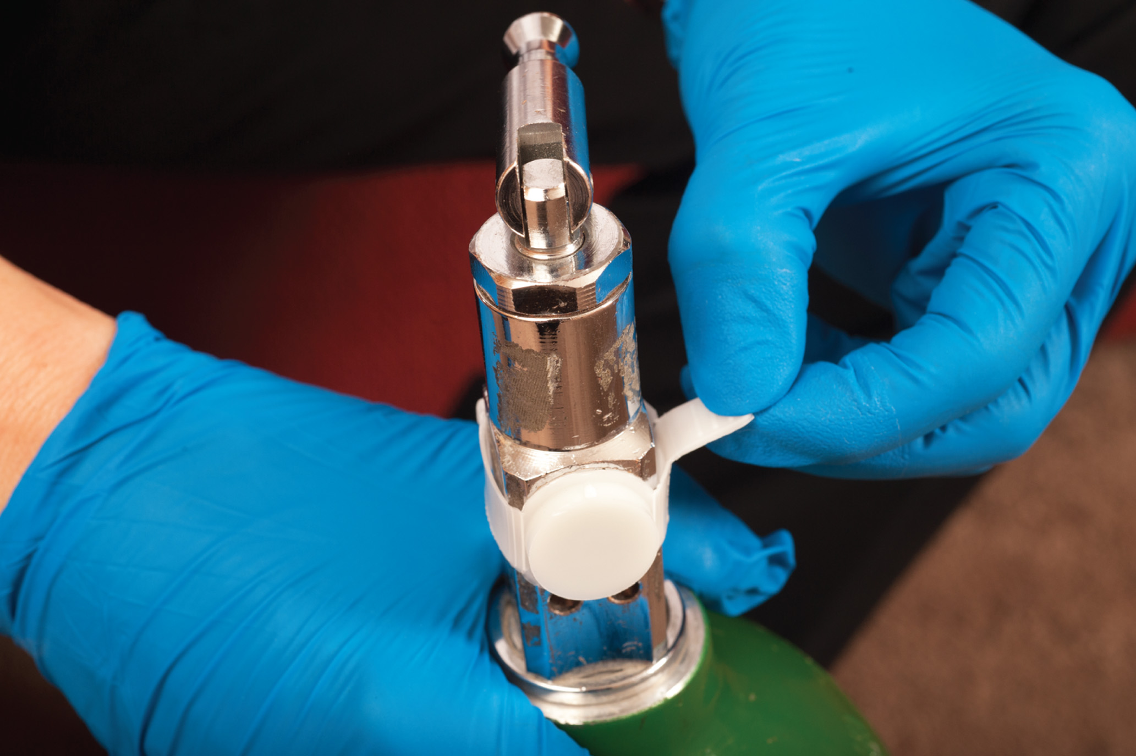
Identify the Cylinder as Oxygen and Remove the Protective Seal
Notes:
Check the cylinder to be sure it contains oxygen. Remove the protective seal on the tank valve.

Slide 183
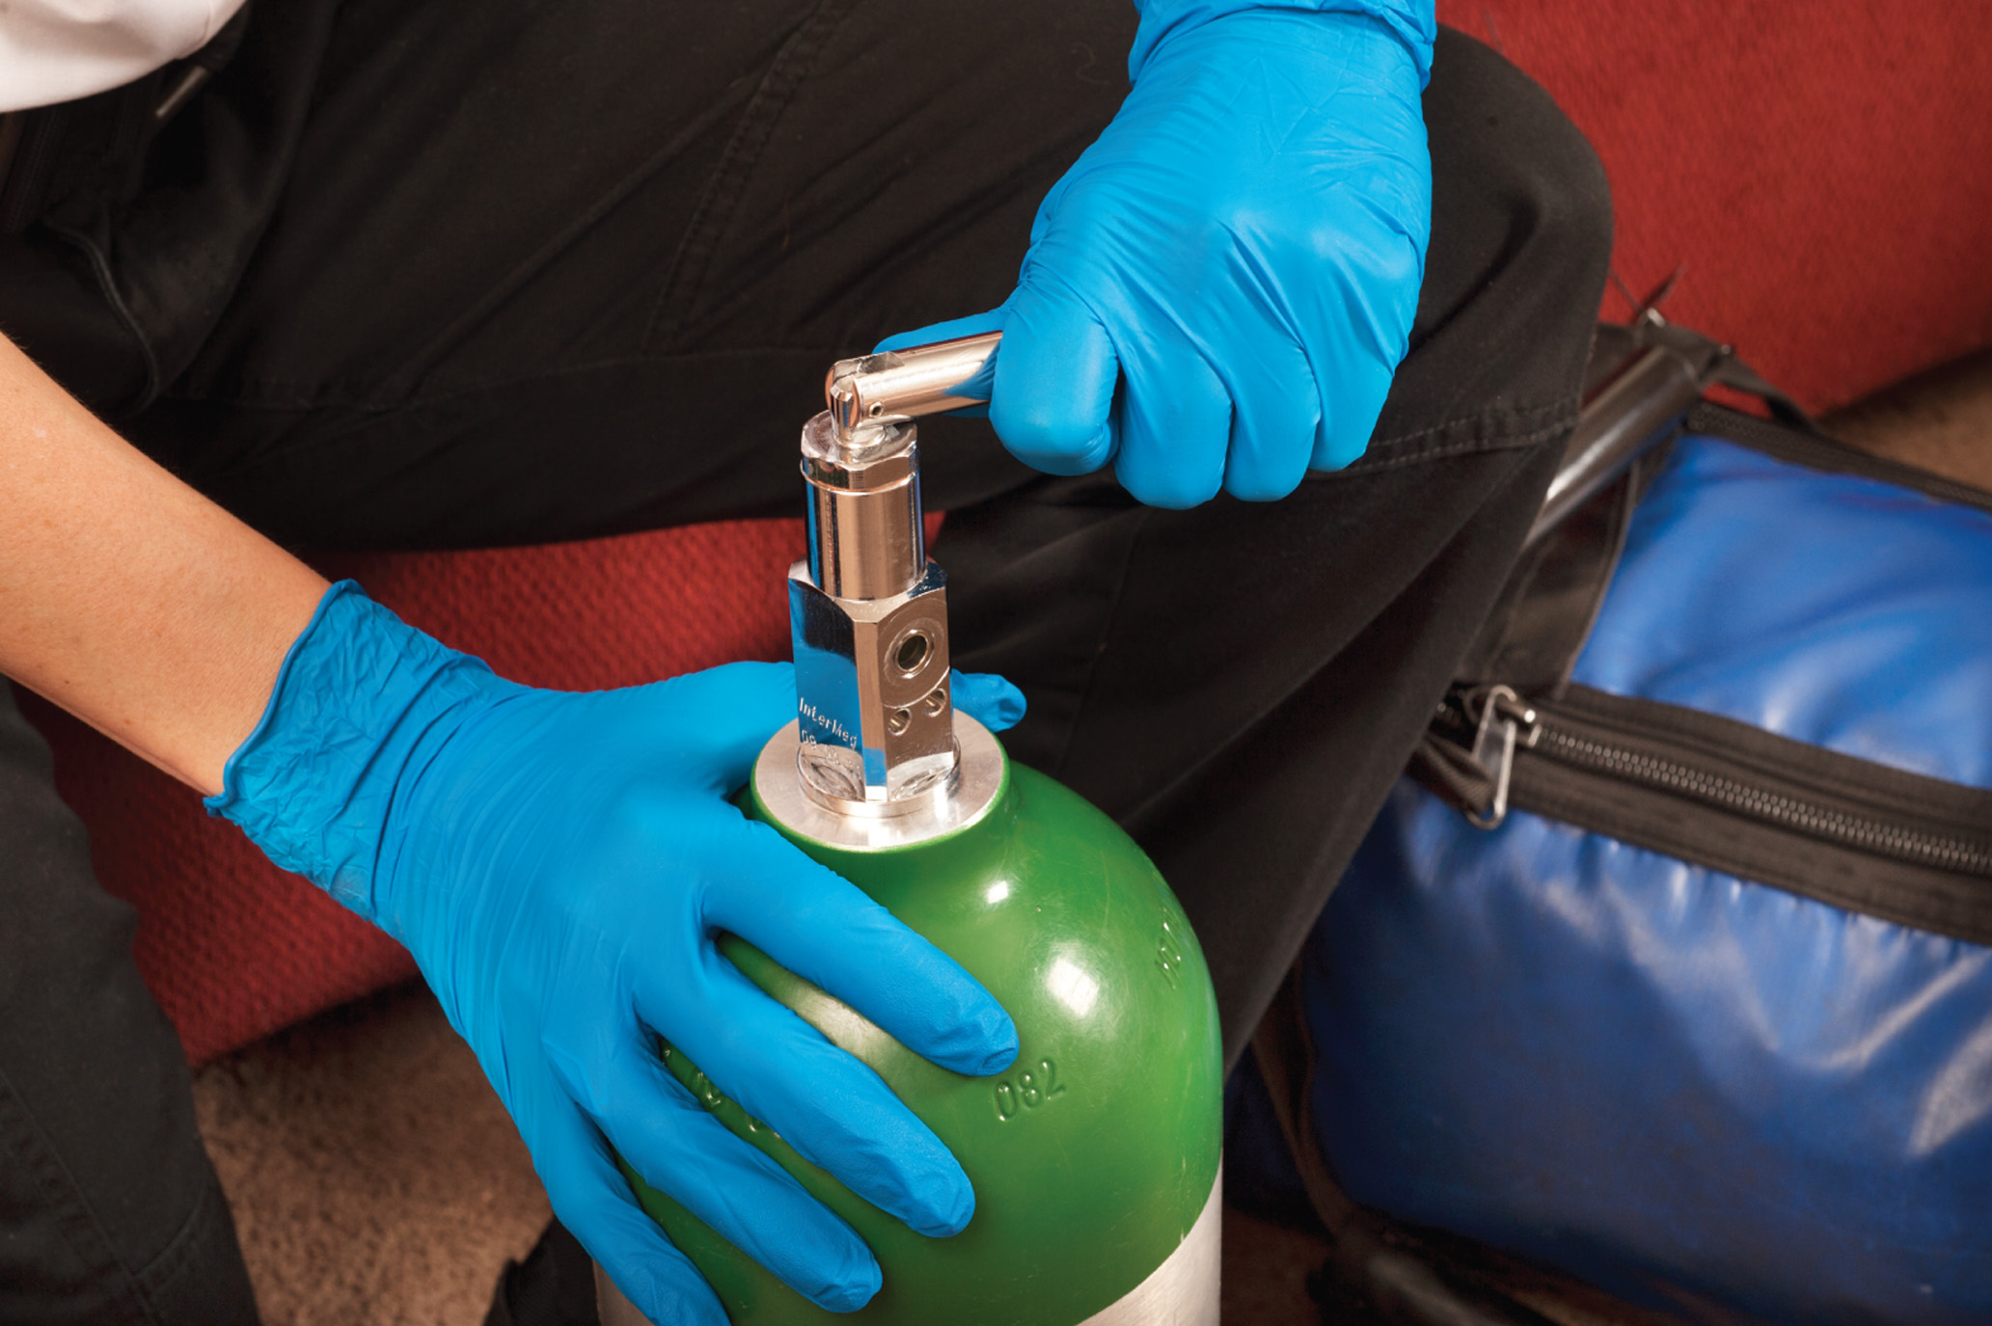
Crack the Main Cylinder for 1 Second to Remove Dust and Debris
Notes:
Quickly open, then shut, the cylinder valve for 1 second to remove any dust or debris from the valve assembly.

Slide 184
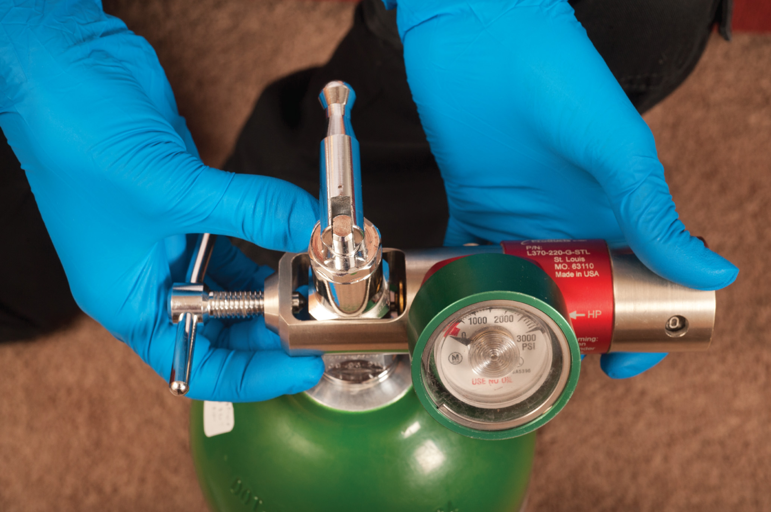
Place the Yoke of the Regulator over the Cylinder Valve and Align the Pins
Notes:
Place the yoke of the therapy regulator over the valve and align the pins. Be sure the regulator washer is present and in the proper place.

Slide 185
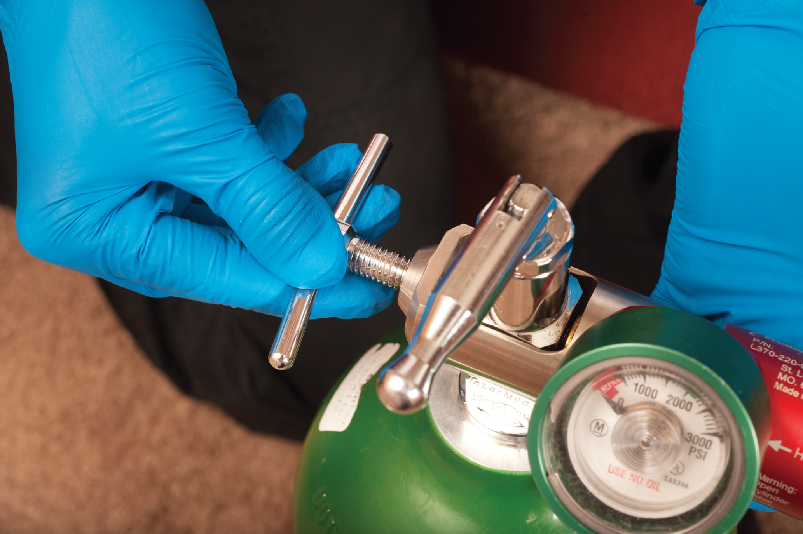
Hand-Tighten the T-Screw on the Regulator
Notes:
Hand-tighten the T-screw on the regulator.

Slide 186
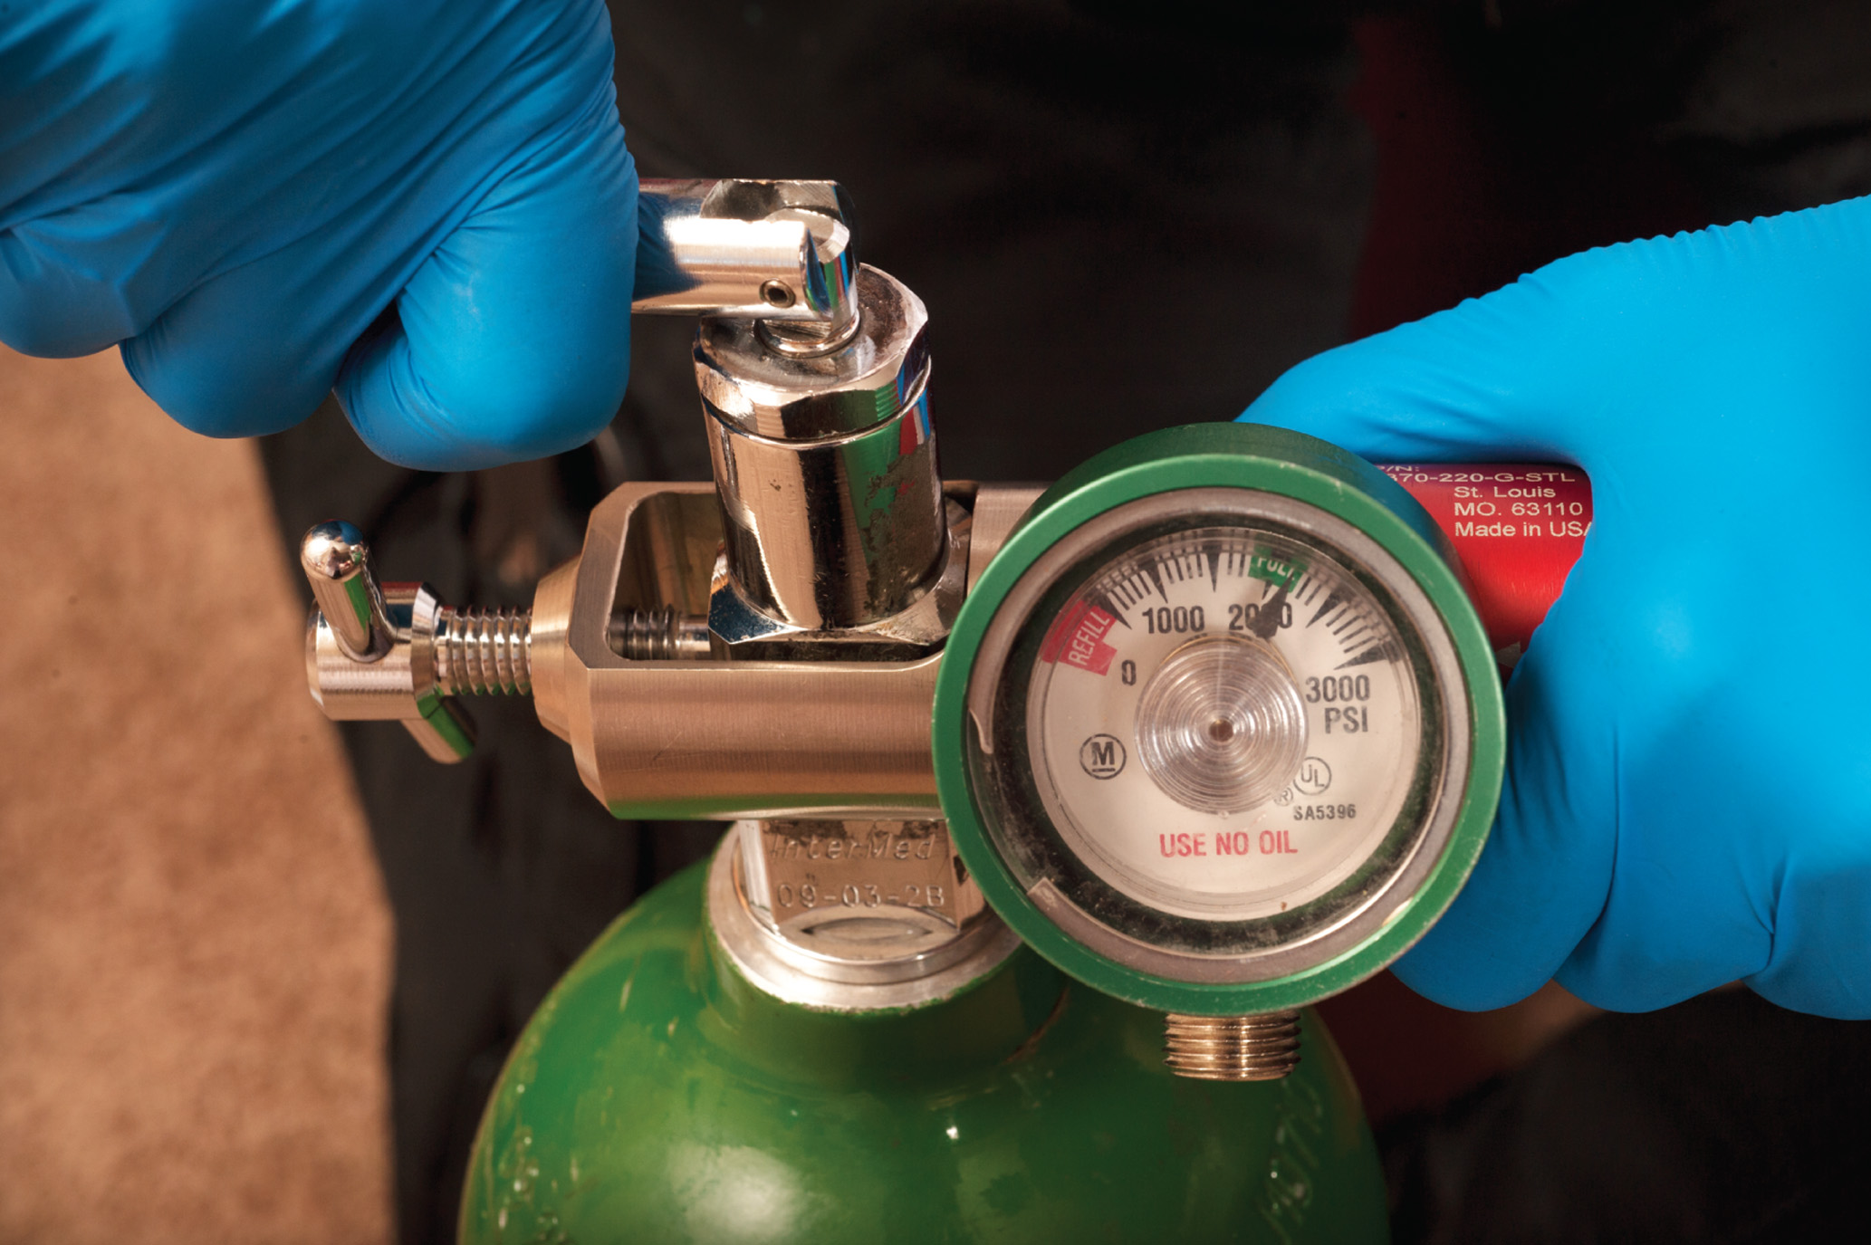
Open the Main Cylinder Valve to Check the Pressure
Notes:
Slowly open the main cylinder valve about one-half turn to charge the regulator. Check the pressure gauge to be sure an adequate amount of oxygen is available.

Slide 187
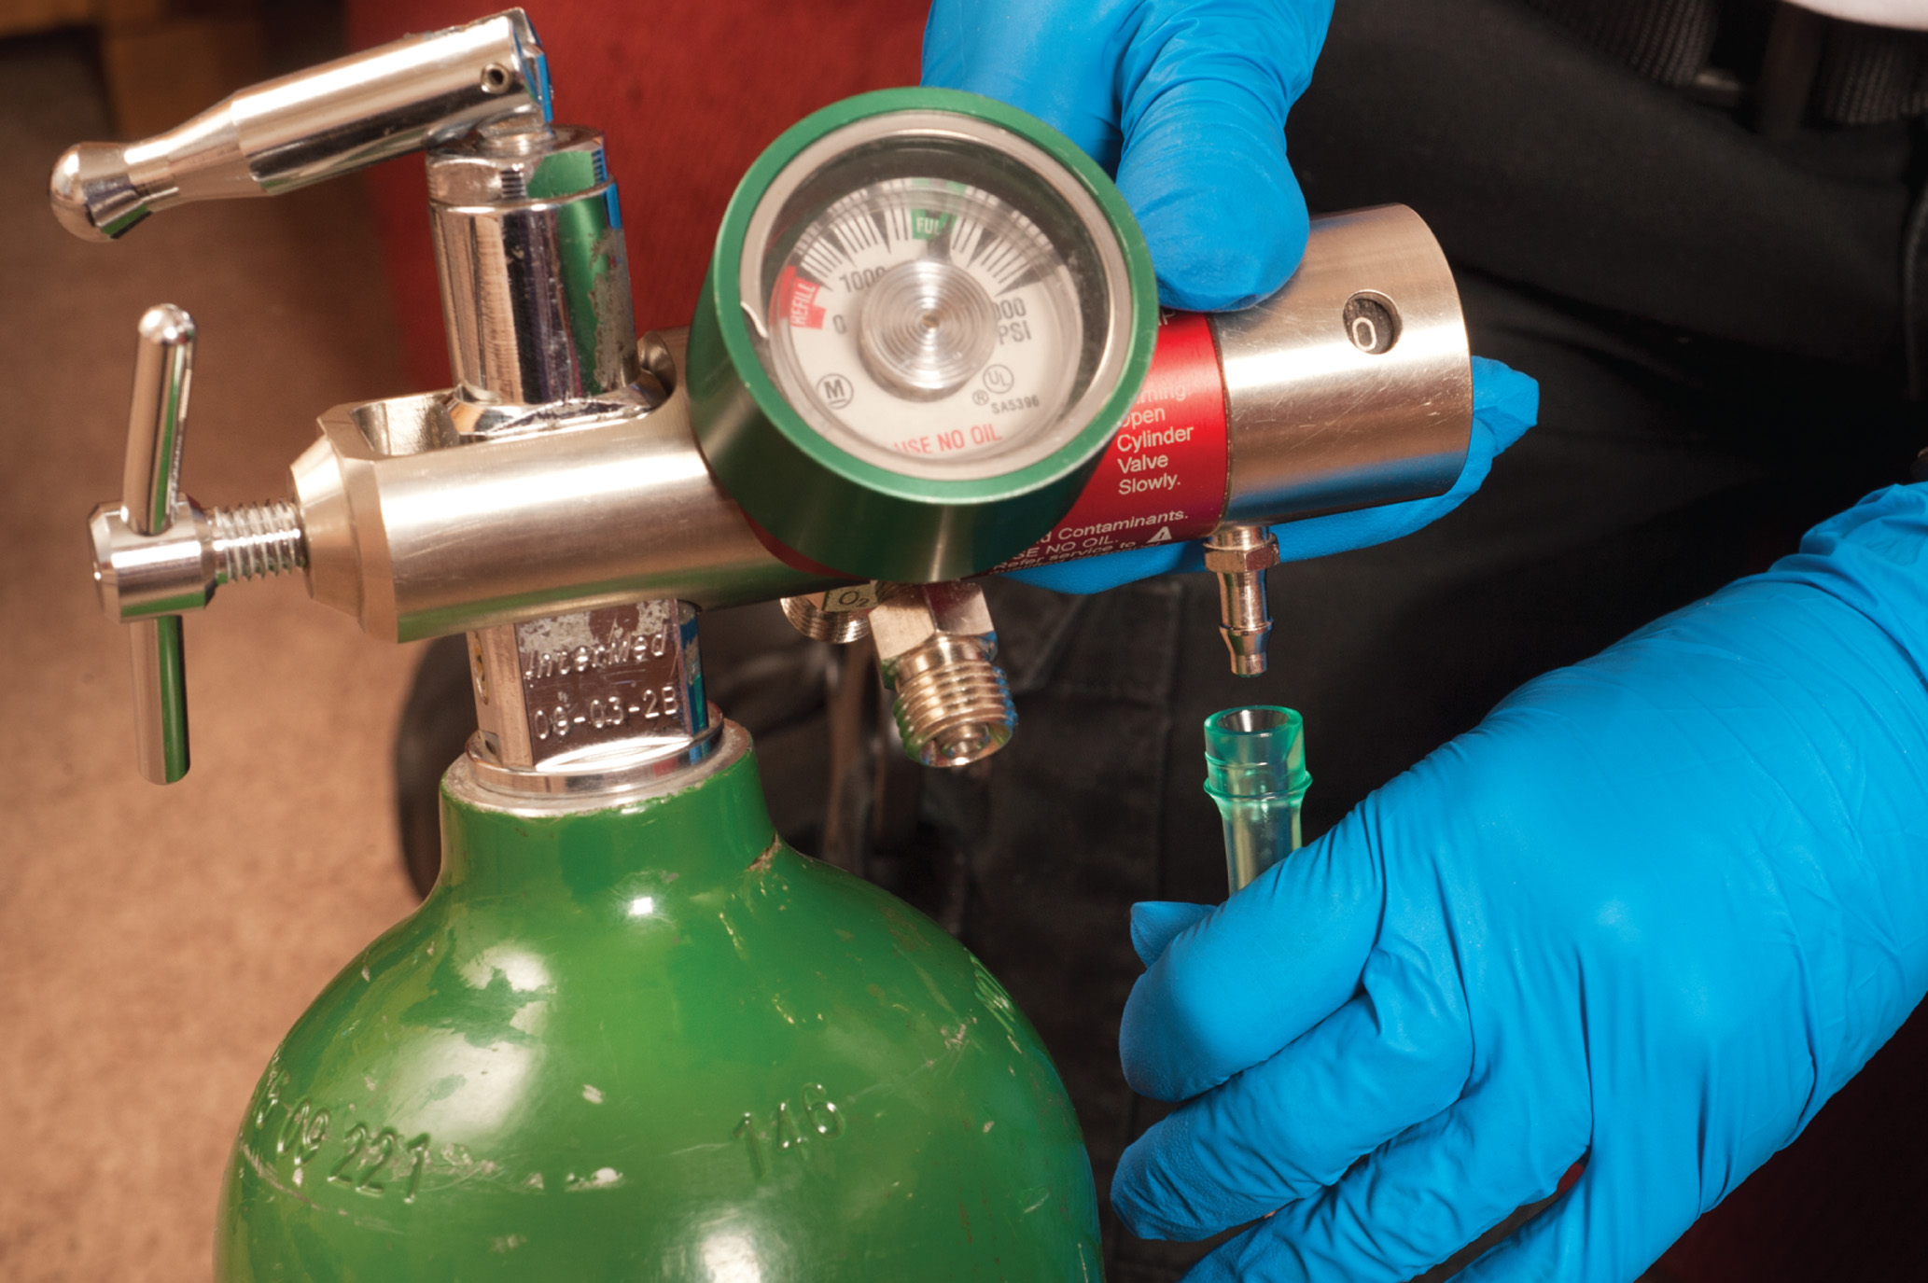
Attach the Oxygen Delivery Device to the Regulator
Notes:
Attach the oxygen mask or nasal cannula tubing to the nipple of the regulator.

Slide 188
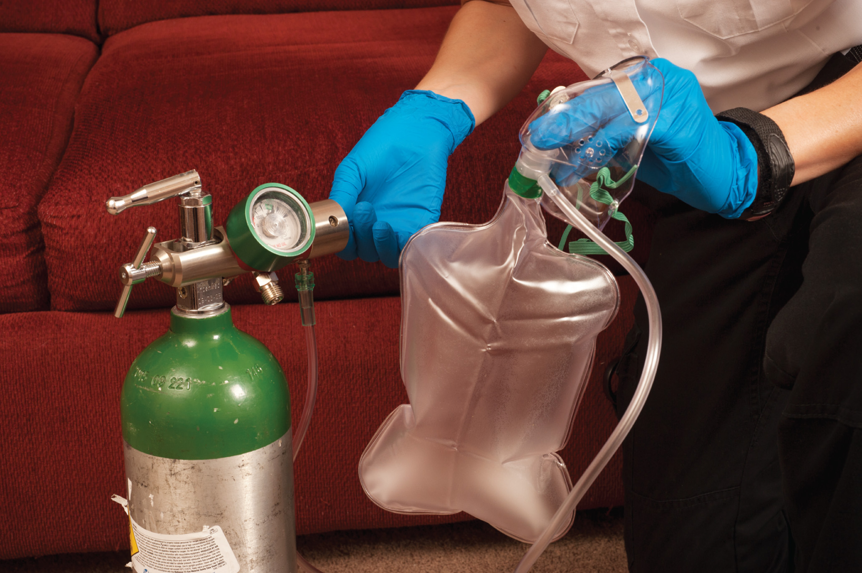
Adjust the Flowmeter to the Appropriate Liter Flow
Notes:
Open the flowmeter control. Set the oxygen flow rate at the desired liters per minute.

Slide 189
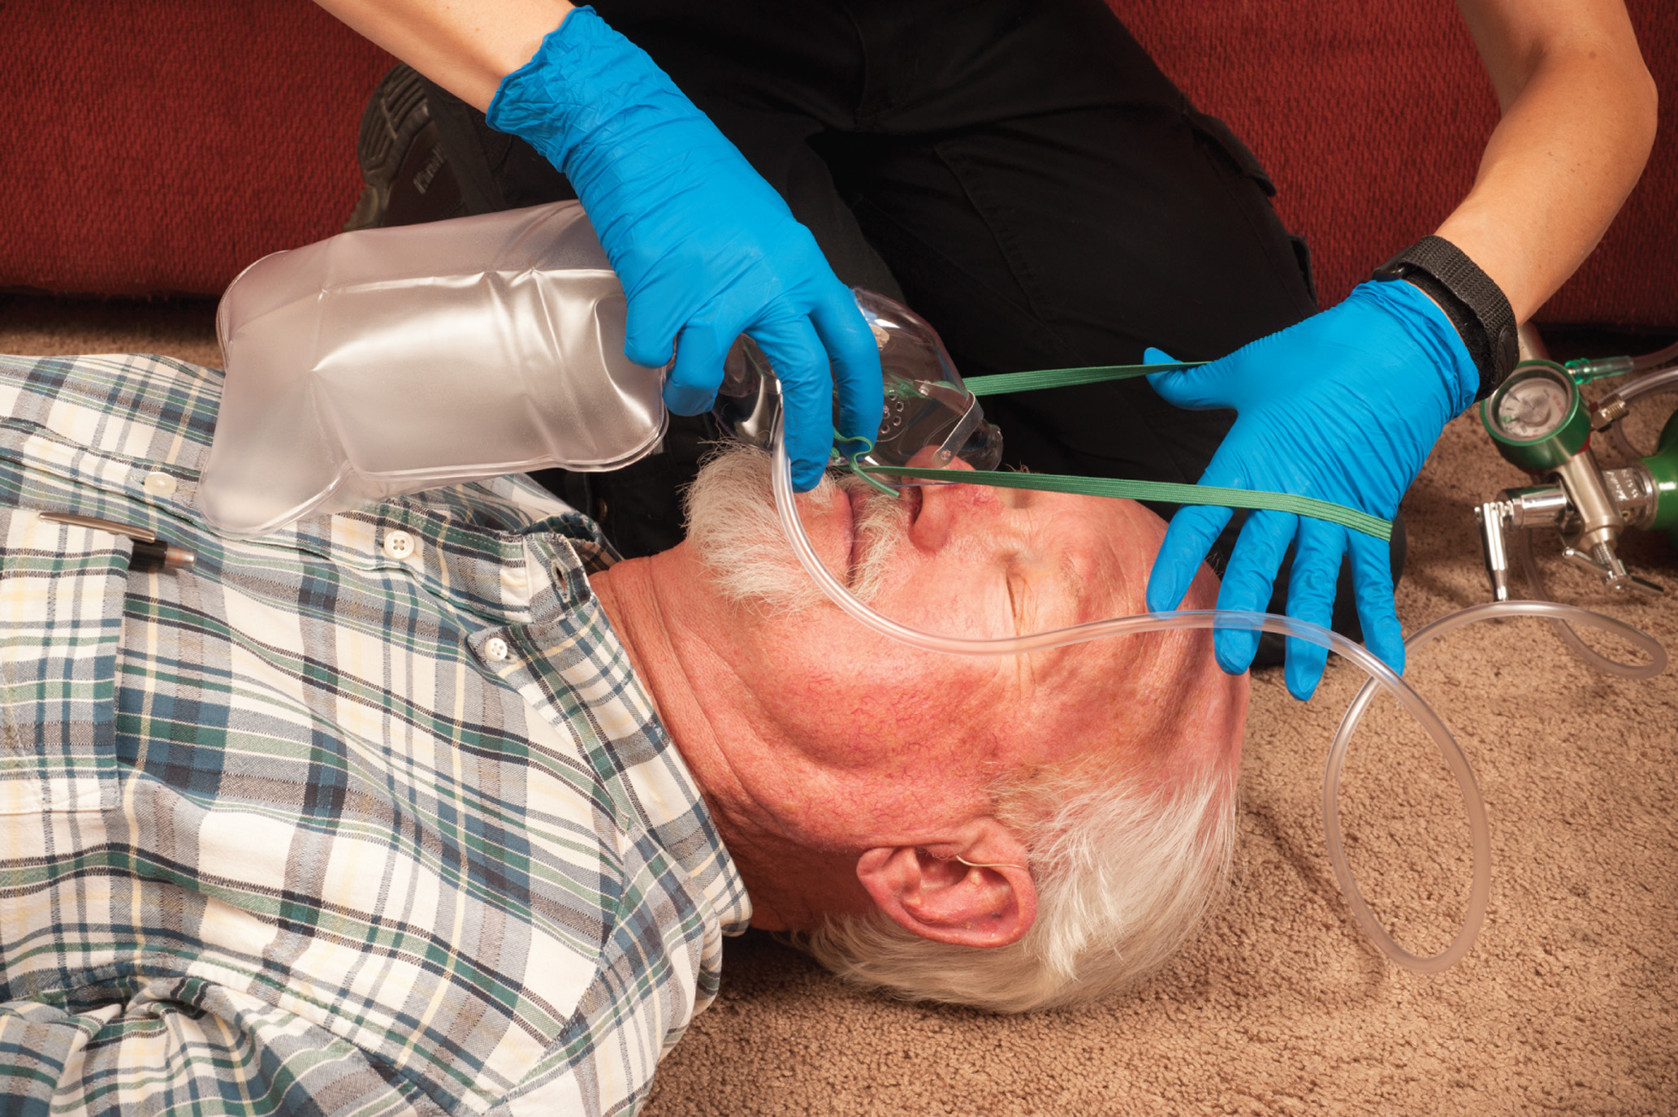
Apply an Oxygen Device to the Patient
Notes:
With the oxygen flowing, apply the oxygen mask or nasal cannula to the patient.

Slide 190
Oxygen Therapy (12 of 16)
Terminating Oxygen Therapy
  When terminating oxygen therapy, first remove the mask from the patient before turning off the oxygen or disconnecting the oxygen tubing.
Notes:
Remove the mask or cannula from the patient.
Turn off the oxygen regulator flowmeter control, then turn off the cylinder valve.
Open the regulator valve to allow the oxygen trapped in the regulator to escape until the pressure gauge reads zero. Turn the regulator flowmeter control completely off.

Slide 191
Oxygen Therapy (13 of 16)
Transferring the Oxygen Source: Portable to On-Board
  When transferring from one oxygen source to another, first remove the mask from the patient before turning off the oxygen or disconnecting the oxygen tubing.
Notes:
Remove the mask from the patient’s face before attempting to switch over. The oxygen tubing can easily become caught in sheets, blankets, straps, or other equipment and may require a few minutes to untangle. During this time, if no oxygen is flowing to the mask, the patient’s tidal volume and blood oxygen content will be drastically reduced.

Slide 192
Oxygen Therapy (14 of 16)
Oxygen Delivery Equipment
  Nonrebreather Mask
    A nonrebreather mask is used to deliver a high concentration of oxygen.
    The flow rate is usually 15 litersperminute.
    Always keep the reservoir bag inflated.
Notes:
This device has an oxygen reservoir bag attached to the mask with a one-way valve between them that prevents the patient’s exhaled air from mixing with the oxygen in the reservoir. The mask also has rubber washers that cover the exhalation ports. This allows air to escape on exhalation but restricts air to flow in the exhalation ports during inhalation. With each inhalation, the patient draws in the contents of the reservoir bag, which is 100 percent oxygen. Because some ambient air is inhaled from around the edges of the mask, the oxygen concentration that is delivered is usually around 90 percent.
To apply the nonrebreather mask:
Explain to the patient that you are going to apply oxygen through a mask. Reassure him that he will get an increased amount of oxygen and instruct him to breathe normally.
Select the appropriate-sized mask. Prepare the oxygen tank and set the regulator at 15 lpm. Connect the nonrebreather tubing to the regulator. Fill the reservoir bag completely.
Fit the mask to the patient’s face. Bring the elastic strap around the back of the head and secure it.
Constantly monitor the reservoir bag to ensure that it remains filled during inhalation.

Slide 193

Nonrebreather Mask
Notes:
Various size nonrebreather masks are available for infants, children, and adults.

Slide 194

Cutaway View of Nonrebreather Mask
Notes:
You may need to coach the patient to breathe at a normal rate and depth and provide reassurance that he is getting sufficient oxygen and air.

Slide 195
Oxygen Therapy (15 of 16)
Nasal Cannula
  A nasal cannula is used to deliver a lower concentration of oxygen.
  The flow rate is between 1 litersperminute and 6 litersperminute.
Notes:
Follow these procedures when using the nasal cannula:
Explain to the patient that the oxygen is delivered through the prongs that fit in each nostril. Instruct the patient to breathe normally.
Prepare the oxygen tank and regulator. Connect the nasal cannula tubing to the regulator and set the liter flow at 2 lpm. You can titrate up to 6 lpm to achieve the desired SpO2 reading, typically 94%.
Insert the two prongs of the cannula into the patient’s nostrils with the tab facing down. Make sure the prongs curve downward.
Position the tubing over and behind each ear. Gently secure it by sliding the adjuster underneath the chin. Do not make the tubing too tight. If an elastic strap is used, adjust it so it is secure and comfortable.
Check the cannula position periodically to ensure that it has not dislodged.

Slide 196

Nasal Cannula
Notes:
A patient who is placed on 1 lpm via the nasal cannula inhales an oxygen concentration of approximately 24 percent. As a general rule, for every additional liter per minute of flow delivered, the oxygen concentration the patient inhales increases by 4 percent.

Slide 197

Cutaway View of Nasal Cannula
Notes:
To achieve the recommend range of 24 to 44 percent, the liter flow for the nasal cannula should be set at no less than 1 lpm and no greater than 6 lpm.

Slide 198
Oxygen Therapy (16 of 16)
Other Oxygen Delivery Devices
  Simple face mask
  Partial rebreather mask
  Tracheostomy mask
  Venturi mask
Notes:
A simple face mask has no reservoir and can deliver up to 60 percent oxygen, depending on the patient’s tidal volume and the oxygen flow rate. Exhaled air exits through the holes on each side of the mask. The oxygen flow rate is usually set at 10 lpm but must not be set at less than 6 lpm. Because it does not deliver as high a concentration of oxygen as the nonrebreather mask, it is not recommended for prehospital use.
The partial rebreather mask looks similar to the nonrebreather mask but is equipped with a two-way valve that allows the patient to rebreathe about one-third of his exhaled air. The flow rate is typically set at 10 lpm, but it should be no less than 6 lpm. Partial rebreather masks can provide oxygen concentrations of between 35 and 60 percent.
The tracheostomy mask is used to deliver aerosolized medication, bland aerosol therapy, or oxygen to a patient with a tracheostomy tube. A T-tube is commonly used for this purpose; however, the tracheostomy mask is preferred. The advantages of the tracheostomy mask are the following:
(1) there is less traction on the airway from pulling associated with the T-tube, and (2) secretions can
escape from the tube. The main disadvantage is that the tracheostomy mask delivers only lower concentrations of oxygen, typically less than 50 percent. If lower oxygen levels can be tolerated by the patient, the tracheostomy mask is the preferred device.
The Venturi mask is a low-flow oxygen system that provides precise concentrations of oxygen through an entrainment valve connected to the face mask. The Venturi mask has a variable lpm and traditionally delivers between 24 percent and 50 percent FiO2 (fraction of inspired oxygen). The entrainment valve can be changed to deliver precise oxygen concentrations at preset flow rates.
Knowledge Application
Describe a variety of patient conditions and ask students what type of oxygen delivery device would best suit the patient's needs.
Class Activity
Supply groups of students with a selection of oxygen delivery devices so that they can practice applying the devices on each other under your supervision.

Slide 199

Simple Face Mask
Notes:
A simple face mask has no reservoir and can deliver up to 60 percent oxygen.

Slide 200

Partial Rebreather Mask

Slide 201

Venturi Mask
Notes:
The Venturi mask provides precise concentrations of oxygen through an entrainment valve connected to the face mask.

Slide 202
Case Study Introduction (3 of 3)
E M Ts Carlos Rivera and Alan Abrams are caring for Mrs. Elena Diaz, who is 63 years old. Mrs. Diaz has C O P D and presents today with shortness of breath. She can speak only a few words at time before gasping for breath.
Notes:
Case Study
Present the Case Study Introduction provided in the PowerPoint slide set.
Lead a discussion using the case study questions provided on the subsequent slide(s).
Case Study Discussion
Use the case study content and questions to review the lesson content.

Slide 203
Case Study (4 of 8)
How will the E M Ts determine the severity of patient’s difficulty breathing? What will they be looking for?
How will the E M Ts decide what interventions the patient requires?
Notes:
Use the case study content and questions to gauge how well versed students are in this topic.

Slide 204
Case Study (5 of 8)
Mrs. Diaz is appears fatigued and drowsy. She has cyanosis of her lips and nail beds, and the E M Ts can hear wheezing when she breathes, even without using a stethoscope. Mrs. Diaz is breathing about 30 times per minute, but she is not moving very much air with each breath and she is using accessory muscles.
Notes:
Review and discuss the case study findings presented.

Slide 205
Case Study (6 of 8)
Is Mrs. Diaz breathing adequately or inadequately? Explain your answer.
What intervention should Mrs. Diaz receive?
Notes:
Use the case study content and questions to gauge how well versed students are in this topic.

Slide 206
Case Study (7 of 8)
The E M Ts quickly decide to assist Mrs. Diaz’s ventilations with a bag-valve-mask device. Alan explains to her what they are going to do as Carlos prepares the equipment.
Notes:
Review and discuss the case study findings presented.

Slide 207
Case Study (8 of 8)
What should be the goals for the depth and rate of ventilation for Mrs. Diaz?
What complications should the E M Ts anticipate?
How will the E M Ts know if the assisted ventilations are effective?
Notes:
Use the case study content and questions to gauge how well versed students are in this topic.

Slide 208
Case Study Conclusion (4 of 5)
Carlos attaches supplemental oxygen to the bag-valve-mask device at a flow rate of 15 litersperminute. He assists Mrs. Diaz’s respirations 16 times per minute, assisting every other breath with a tidal volume of approximately 600 milliLitre. En route to the hospital, Mrs. Diaz’s respiratory rate and heart rate decrease, and her S p O₂ increases from 88% to 94%.
Notes:
Review and discuss the case study findings presented.

Slide 209
Case Study Conclusion (5 of 5)
The E M Ts release Mrs. Diaz to the care of the emergency department staff. Following stabilization in the E D, Mrs. Diaz is admitted to the hospital for treatment of the exacerbation of her C O P D.
The E M Ts write their report, clean the ambulance, and replace supplies in preparation for the next call.
Notes:
Review case conclusion and emphasize the application of knowledge learned from this presentation.

Slide 210
Lesson Summary
Without an open airway and adequate ventilation, patients rapidly deteriorate and die.
E M Ts must quickly recognize an inadequate airway and breathing and immediately intervene.
Oxygen therapy is used to reduce, eliminate, or prevent hypoxia from occurring in the patient.
Notes:
Assessment of the airway, oxygenation, and ventilation status occurs early in your patient contact.
As an example, a patient can have an open airway but ineffective ventilation, or, he can have adequate ventilation but ineffective oxygenation.
A closed airway is opened using either the head-tilt, chin-lift maneuver or the jaw-thrust maneuver.
Oxygen may be delivered through the ventilation device or by a nonrebreather mask or nasal cannula.
you must also be aware of special circumstances or patient conditions that can provide challenges, such as a patient with a stoma or tracheostomy tube, infants and children, facial injuries, foreign body obstruction, and dental appliances.
Follow-Up
Answer student questions.
Follow-Up Assignments
Review Chapter 10 Summary.
Complete Chapter 10 In Review questions.
Complete Chapter 10 Critical Thinking questions.
Assessments
Handouts
Chapter 10 quiz

Slide 211
Incorrect (1 of 4)
Pulmonary ventilation is the mechanical process of moving air into and out of the lungs.
Click here to return to the quiz.

Slide 212
Incorrect (2 of 4)
External respiration is the exchange of oxygen and carbon dioxide between the alveoli and the pulmonary capillaries.
Click here to return to the quiz.

Slide 213
Incorrect (3 of 4)
Metabolism is the process by which cells break down glucose in the presence of oxygen to produce A T P.
Click here to return to the quiz.

Slide 214
Correct! (1 of 2)
Internal respiration is the process of oxygen and carbon dioxide exchange between the blood in the systemic capillaries and the cells.
Click here to return to the program.

Slide 215
Correct! (2 of 2)
Not all patients require supplemental oxygen therapy. In fact, high oxygen concentrations can be harmful in some conditions, including acute coronary syndrome and ischemic stroke in patients with no indications of hypoxia or respiratory distress.
Click here to return to the program.

Slide 216
Incorrect (4 of 4)
Patients with this condition should receive supplemental oxygen therapy.
Click here to return to the quiz.

Slide 217

Copyright

