Slide 1
Leadership

Slide 2
Character
Character more than anything else promotes or hinders the development of trust.

Slide 3
Character
Based on values
Combination of actions and words
Determines if we can be trusted to do the rights thing

Slide 4
Character
You cannot hide your character – it gets assessed everyday
People know if you are open, honest, competent
People see if you are indecisive, lazy, or selfish

Slide 5
Building Character
Know values, review them frequently, contemplate areas for improvement
Admit when you are wrong
Accept responsibility for your actions
Take time to reflect on your actions
Find role models / mentors – learn from their mistakes and successes
Know yourself and seek improvement
Set the example

Slide 6
Professional Standards
Professional standards document Provides a clear and concise guide to all members relating to our mission, our values, and the expectations and conduct necessary to achieve our mission.
Commit to them

Slide 7
Professional Standards
True commitment requires loyalty to the organization.
The commitment begins your first day on the job and endures throughout your career.
The organization will only be as strong as YOU make it.

Slide 8
Professional Standards
By taking your position…
By assuming the formal position of leadership, you…
Accept the ethical responsibility of modeling and enforcing organizational values

Slide 9
Professional Standards
Members are expected to manage their own behavior in a manner that conforms to rules and regs which coincide with our philosophy and values…
Organizations leaders intent

Slide 10
HRT Values
Trustworthiness
Resourcefulness
Compassion
Diversity
Respectfulness
Community Citizenship
Commitment to Excellence

Slide 11
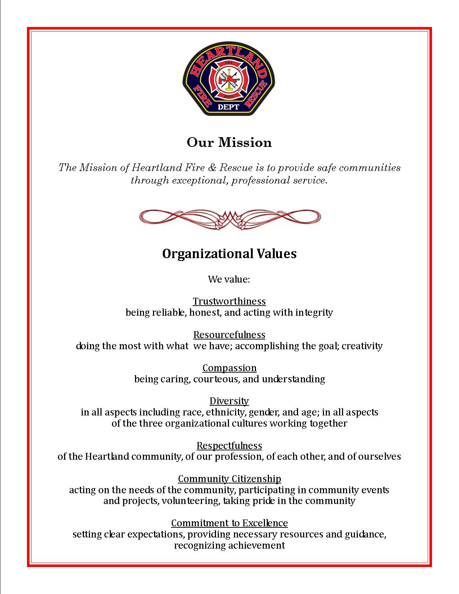

Slide 12
Trustworthiness (Integrity)
Do what is right even if you don’t want to.

Slide 13
Resourcefulness
Make the most out of the least
New and creative ideas based on experience and talents

Slide 14
Compassion
For those that you work for and with
“People don’t remember much about our medicine. But they do remember
how we make
them feel”
Thom Dick, “People Care”

Slide 15
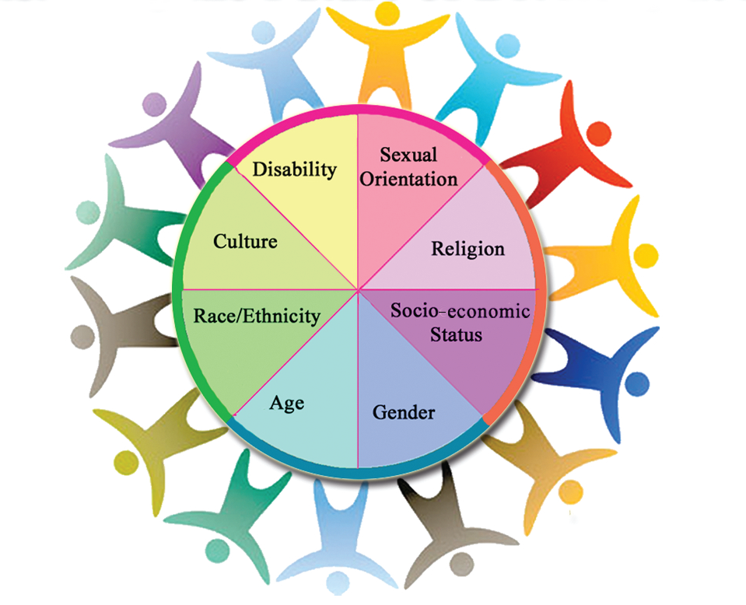
Diversity
Everybody is different – Treat everybody the same

Slide 16
Respectfulness
Treat people the way you want to be treated

Slide 17
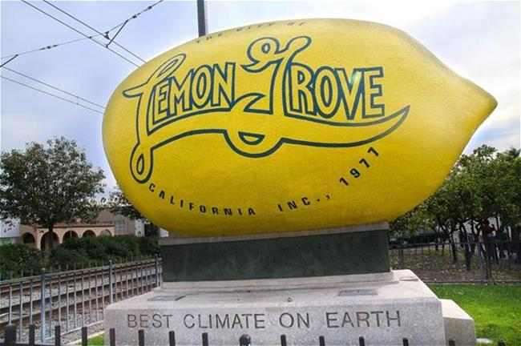
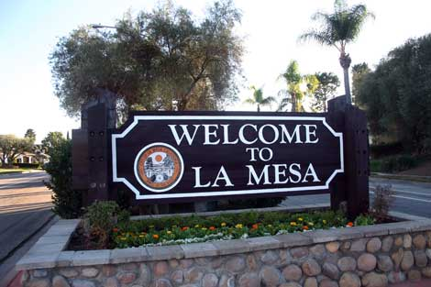
Community Citizenship
Be involved and be proud of your community

Slide 18
Commitment To Excellence
Professional
Smart
Physically Fit
Competent
Hard Working
Compassion/Empathy

Slide 19
Strive to be the best you can
Mediocrity and complacency is poison in our profession and can be fatal
Leaders teach values
Managers rule by P&Ps
Acid test of leadership:
If you did not have the badge would you still be the leader?

Slide 20
Leadership is critical in any organization
Leaders deeply affect people and organizations

Slide 21
Leadership is critical in any organization
Leaders deeply affect people and organizations
Notes:
http://www.youtube.com/watch?v=PVOdYK029y0

Slide 22
What is leadership?
Leadership is the art of influencing people in order to achieve a result

Slide 23
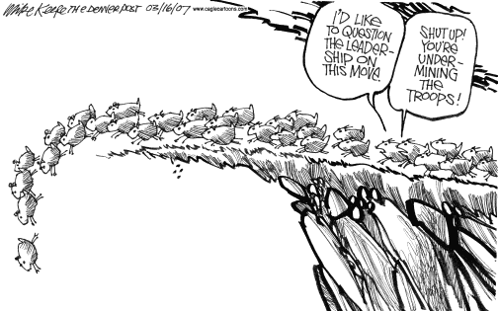
Informal
Inhibit growth and reduce organizational effectiveness

Slide 24
Formal
Inspire and contribute to the organization

Slide 25
Leadership Values and Principles
Duty
Respect
Integrity

Slide 26
Duty
Be proficient in your job both technically and as a leader
Make sound and timely decisions
Ensure that tasks are understood, supervised, and accomplished
Develop your people for the future

Slide 27
Respect
Know you people and look out for their well-being
Keep your people informed
Build the team
Employ your people in accordance with capabilities

Slide 28
Integrity
Know yourself and seek improvement
Seek responsibility and accept responsibility for your actions
Set the example

Slide 29
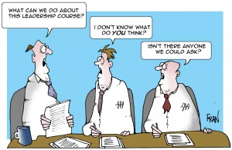
Leadership
Leadership ability is one of the most critical elements in the overall effectiveness and well being of the organization.

Slide 30
As a leader you are always setting an example
Intentionally or not
Good or bad
Its always there
Your words or actions may undermine your ability to address future situations or problems you may encounter with crew members

Slide 31
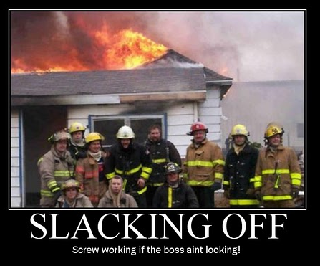
Leadership
Your words or actions may undermine your ability to address future situations or problems you may encounter with crew members

Slide 32
Leadership
You cannot act unprofessional then try to take a professional approach trying to problem solve.
Your actions will speak much louder than anything you say.

Slide 33
Leadership
Communication is the basis for success in all of our endeavors.
Remember it’s how you say it – Not what’s said.
Be cognizant of how you deliver the message.

Slide 34
Leadership
Expectations should be shared up front with the people you are responsible for.
There should be no doubt as to what is expected regarding behavior and performance.

Slide 35
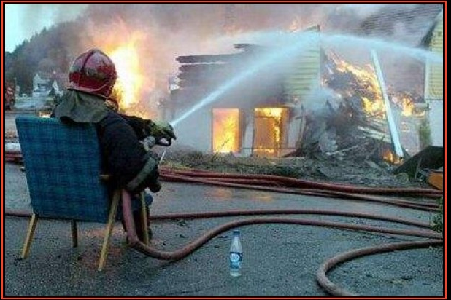
If you condone a particular unacceptable act or substandard performance then you will most likely see it again.
If you condone it you own it.

Slide 36
To be an effective leader you must be an effective follower.
Place a high level of importance on followership.
Don’t undermine the people you work for.
You wouldn’t want people that work for you doing it to you.
Followers have the responsibility to be competent in job skills, take initiative and learn from others, ask questions, develop their communication skills.

Slide 37
Leadership
The amount of respect that you are able to gain and sustain is directly proportionate to your ability to understand and balance the issues of authority, influence, and leadership when carrying out your responsibilities.

Slide 38
Leadership
Each crew member is unique in behavior and personality.
Motivations differ and change over time.
Flexibility in selecting appropriate leadership tools and techniques as a situation changes its criteria.
If you seriously damage the spirit of a member we may never get their commitment back.

Slide 39
Leaders have increasing challenges
Accept responsibility for your actions and crews actions.
Develop credibility as leaders - Place the organization and crew ahead of yourself.
Demonstrate trustworthiness, master technical skills, and instill the values of the organization.

Slide 40
Organizational Imperfections will always exist
Remember nobody is perfect
Need to recognize them so we can direct change and improve
We can’t dwell on them – Look at them as opportunities to improve
Weakness → Strength

Slide 41
Accountability
Your crew will be less likely to engage in inappropriate behavior if you model appropriate behavior and are willing to hold yourself accountable.

Slide 42
Leadership
When you accept the position of supervisor and are getting paid for it, you accept the ethical responsibility of modeling and enforcing organizational rules.

Slide 43
Leadership
When you accept the position of supervisor and are getting paid for it, you accept the ethical responsibility of modeling and enforcing organizational rules.
Notes:
Everybody wants to grow up to be a firefighter. Comedian Hannibal Burress wants to drive the fire SUV.
http://www.youtube.com/watch?v=kSiwoKCiy-s

Slide 44
Leadership
Hold yourself accountable
If you are not willing
To model expectations
Then don’t expect others to

Slide 45
Leadership
Authority to lead is given by the organization –
Ability to lead is a different matter
To be an effective you must earn the trust and respect of others.

Slide 46
Leadership
Leaders often face difficult problems to which there are no simple, clear cut, by the book solutions – The Grey Area
Leaders must use their knowledge, skill, experience, education, values, and judgment to make decisions and to take or direct action

Slide 47
Leadership
Leaders are responsible for the decisions they make and the actions they take.
They are also responsible/accountable for their crews decisions and actions.
Credit subordinates for good performance and keep supervisors informed.

Slide 48
Leadership
Once committed to becoming a leader – Focus no longer on yourself.
Crew and organization
Routinely face situations and make decisions that others will criticize and second guess

Slide 49
Leadership
Leaders may be required to provide authoritative, autocratic, tightly controlled direction that requires immediate obedience.
Majority of the time leaders inspire, guide, and support their subordinates.

Slide 50
Leadership
Leadership is critical in helping members achieve high performance
All leaders must share their expectations with the employees they are responsible for and stress personal accountability

Slide 51
Motivation
Greater influence on work environment
Interest in challenges of leadership
Status within organization
Personal commitment to public service
Higher level of compensation

Slide 52
Motivation
You can’t motivate anyone to do anything
They gotta want to
People do things for their reasons not yours
People are sometimes motivated to do things that are not in their best interest

Slide 53
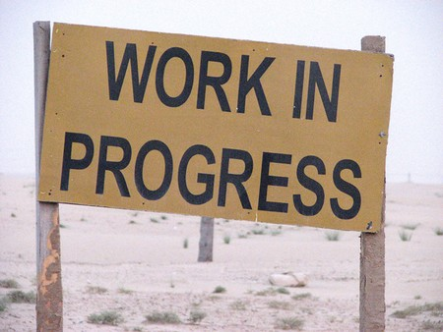
Path
Education
Training
Experience
Self-Development

Slide 54
Professional development is the planned, progressive, life-long, process of education, training, self-development, and experience.
Not related to being captain
It’s any position that you are in.

Slide 55
Mentorship
Guides and coaches you
Does not tell you what to do
Encourages
Gives options
Challenges you to see the big picture
Identifies areas for improvement – helps refine skills
Success is not forever and failure is not fatal

Slide 56
We want our officers to have knowledge and skills necessary to be successful in:
Supervisory
Management
Administrative
Operational

Slide 57
To be an effective supervisor – must have a balance of all areas:
Coaching – Counseling
Coaching – performance based
Counseling – behavior based

Slide 58
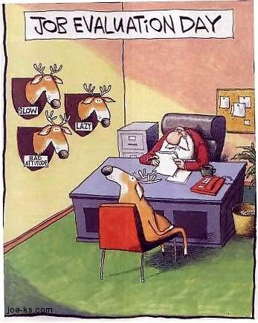
Evaluations
Provide feedback and direction
Honestly evaluate their efforts
Set goals and objectives for next rating period

Slide 59
Effective Evaluation
Fair
Encourage continued desired behavior from quality employees
Gives employees who are falling short of expectations guidance on how to improve

Slide 60
Evaluations
On going process not just due date
Write down good examples/ Not just bad ones – talk about them with the employee
Regular communication is a good thing

Slide 61
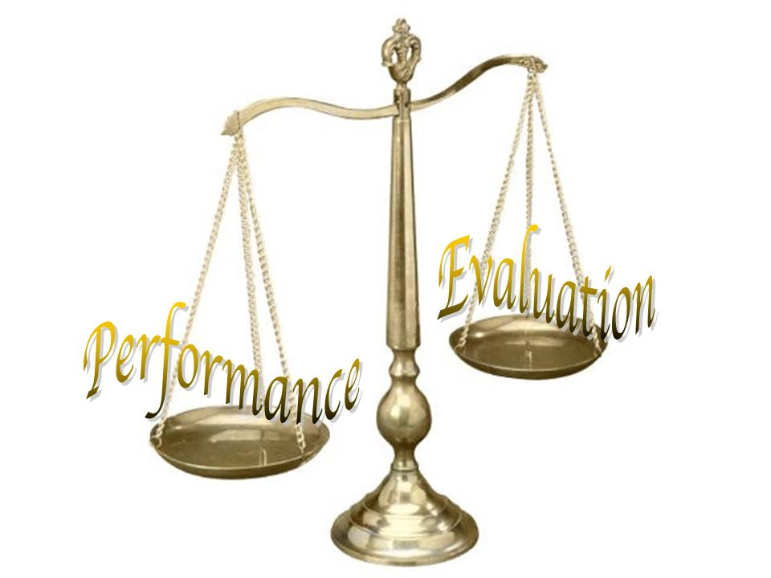
Evaluations
Should be objectively based on performance
Supported with facts
Take time to find out what the employee has been doing

Slide 62
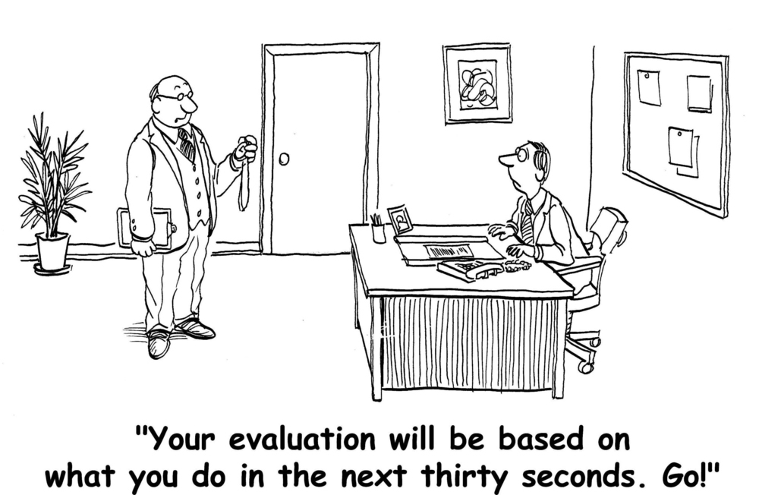
Delivering Evaluation
Should not be a surprise
Not personal

Slide 63
Policy Compliance
Many policies affect us everyday – not just our agencies
Achieved by:
Clear understanding of rules and department regulations
Setting clear expectations in accordance with Department objectives

Slide 64
Policy Compliance
Modeling the expectations
Training to the expectations
Honestly evaluating subordinates towards achieving expectations
Accountability

Slide 65
Questions

