Slide 1
Fire Service Ground Ladders
FFDSD ORIENTATION
ACADEMY 16

Slide 2
Ralph J. Scott
In past years, the staffing of LAFD Truck Companies was reserved for fireman who had proven themselves through physical strength, ability and actual firefighting experience. The assignment to a Truck Company was a position that was earned within the Engine House and required constant vigilance, hard work, a sound mind and the diligent application of basic fundamentals …
EFFECTIVE IMMEDIATELY:
All Truck Company Officers will be held strictly accountable in applying these standards in assigning positions on L.A.F.D. Truck Companies.
July 18, 1919

Slide 3
Class Overview
Basic components
Build Const / Ladder strong pts
Guidelines for safe use
Ladder considerations
Ladder Commands
Aerial / GL similarities
ID Parapet Ht
Steep-pitch roofs (roof ladders)
Laddering Facades
Laddering fire escapes

Slide 4
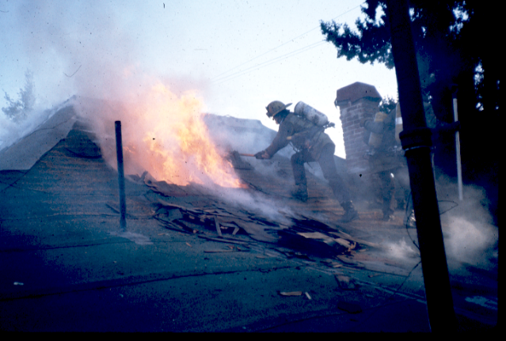
Class Objectives
Select site
Select size & type
Utilize correct technique
Observe all safety precautions
Training

Slide 5
Review Basic Ladder Components

Slide 6
Ground ladder construction is regulated by two NFPA® standards.
1931
Design
Construction
Testing specifications
1932
Use
Care
Maintenance
Service testing

Slide 8
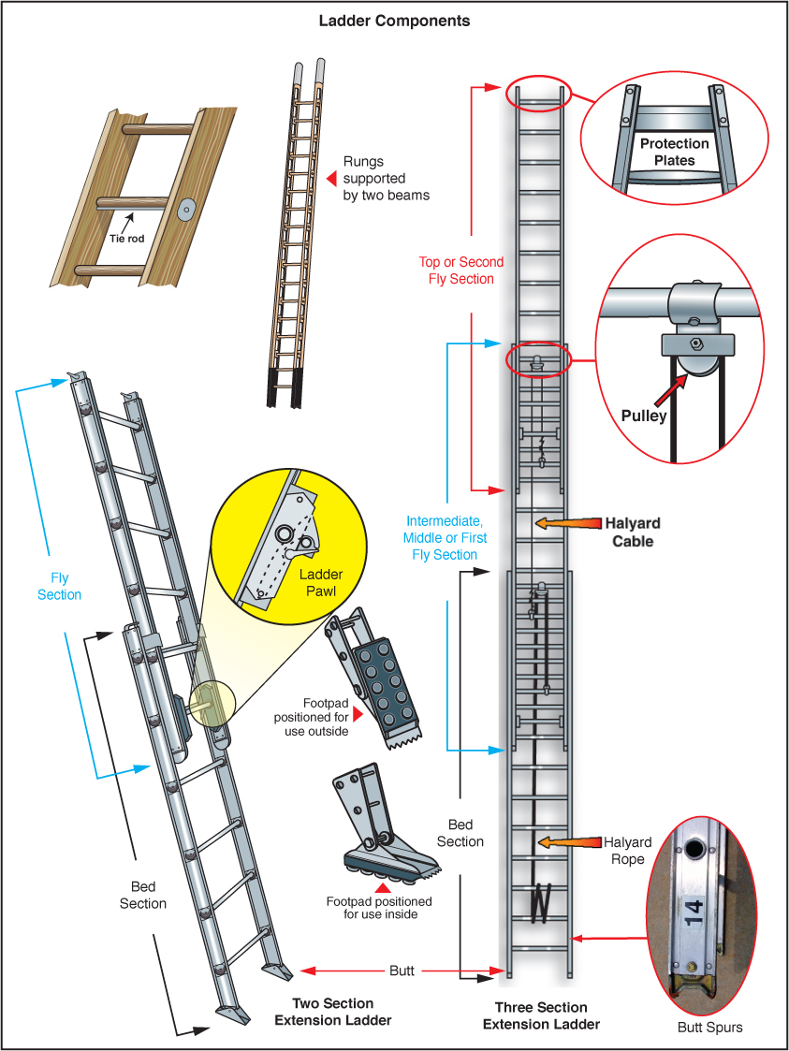

Slide 9
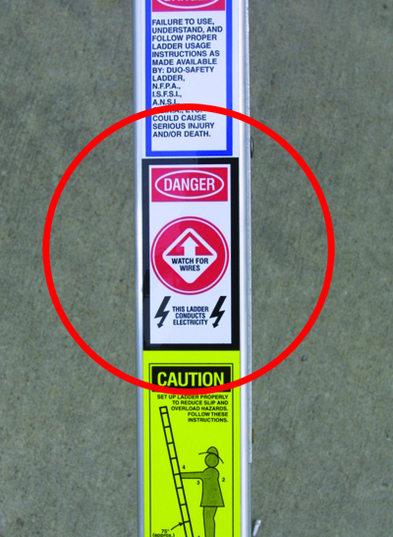
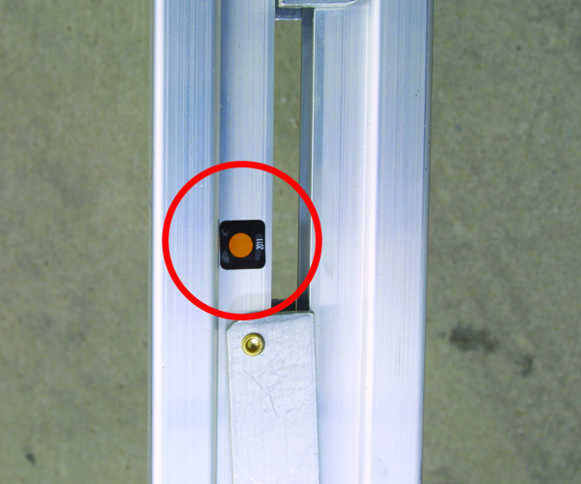

Slide 10
Types of Ladders
Single (straight/roof/wall)
Extension
Folding
Combination
Common Construction materials:
Aluminum
Wood
Fiberglass
Select the correct tool for the job!

Slide 11
Single ladders are also called wall or straight ladders.

Slide 12
Roof ladders are equipped with folding hooks to anchor the ladder.

Slide 13
Folding ladders are often single ladders used for interior attic access.

Slide 14
Extension ladders are made up of a base section and fly sections.

Slide 15
Combination ladders: designed to be self-supporting.

Slide 16
Ladder Inspection, Cleaning & Maintenance
Maintenance – State of readiness
Firefighters perform per SOPs
General requirements
Repair – Restore, replace damage
Trained technician
Clean after each use
Soft brush, running water
Remove residue
Wipe ladder dry
Look for damage, wear – Report
Lubricate where recommended

Slide 17
Some elements must be inspected on all types of ladders.
For heat exposure
Rungs
Bolts, rivets
Welds
Beams, rungs
Points of contact with apparatus
Ensure proper labeling (all ladders must have a certification affixed)

Slide 18
Building Construction & Ladder Positioning
Corners
Walls and roof tie together = strong point
Avoid Windows, doors, attic vents
Fire attack points not hindered & do not impede hose line advance
Emergency egress routs maintained
Avoid burning ladders
Anticipate ventilation team needs

Slide 19
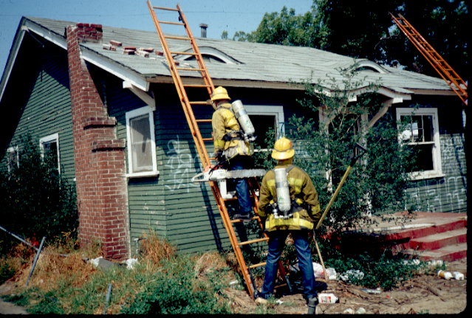

Slide 20
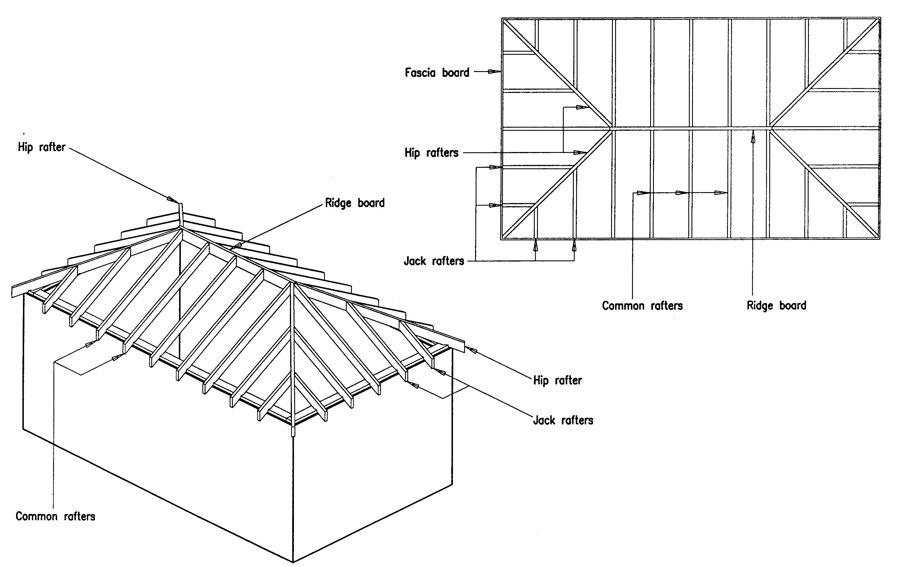

Slide 21
Laddering Strong Points
Hips
Hip rafters:
Extend diagonally (ext corner to ridge)
Stronger than a common rafter
Provide better footing
Various intersecting points:
Hip rafters tie in two roof planes
Plate line and ridge board
Hip jack rafter and hip rafter

Slide 22
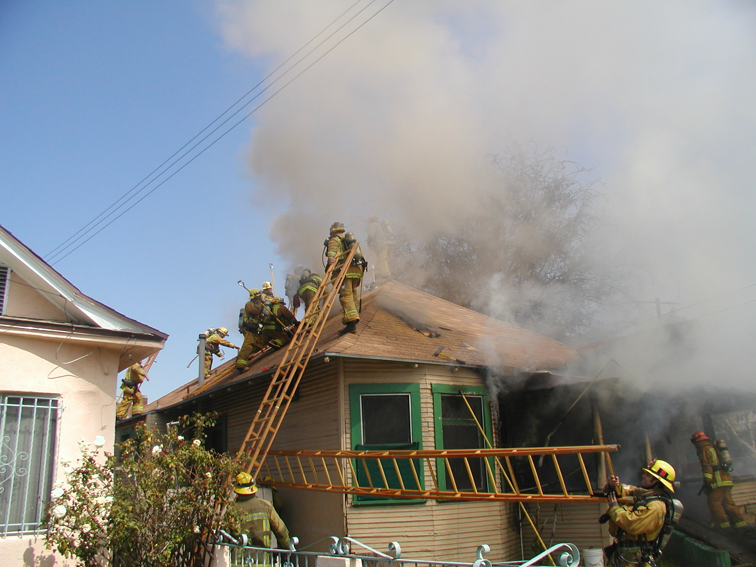

Slide 23
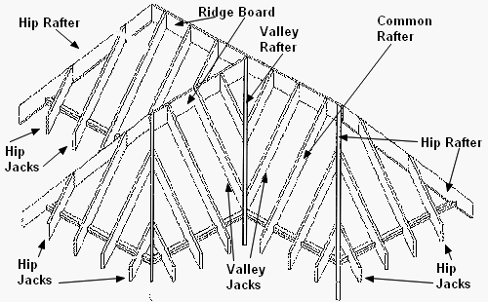

Slide 24
Laddering Strong Points
Valley’s
Converge at interior angles
Form depression in roof
Extend from plate line to ridge
Strength from intersecting planes
Inward meeting of two roof plane (slip)
Steep angles easier to climb

Slide 26
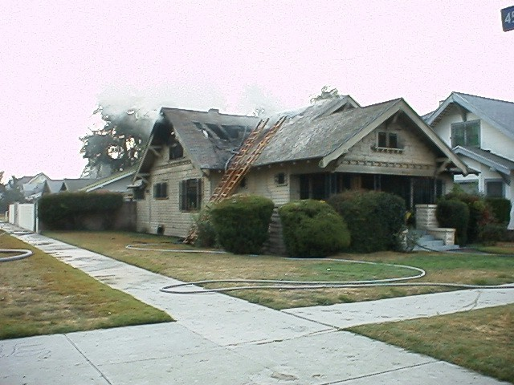

Slide 27
Laddering Strong Points
Pilasters
Tilt-up’s (Panelize roofs)
Colum-like projections
Support Load bearing compenents
Tie-in walls/roof
Span short
Identified from exterior
Ladder pilaster or 8/16/32’
Inherent weakness is lightweight const.

Slide 28
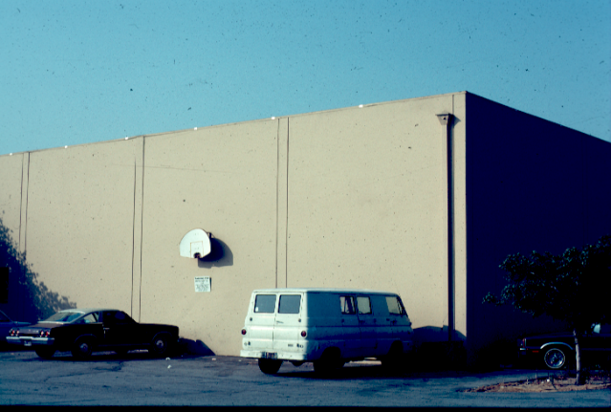

Slide 30
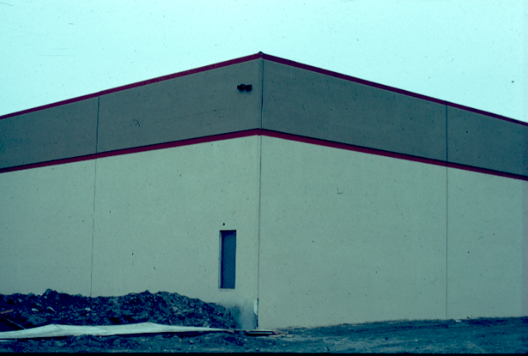

Slide 31
Guidelines for Safe Use
A ladder is a tool
Minimum 2-ladders
70 degrees / ¼ of height
Climbing angle vs Footing
Always foot
Too steep/shallow
Electrical wires (metal ladders)
Hoisting in dark
Cant see wire against black

Slide 32
Guidelines for Safe Use
Lock-in and don’t overextend
Securing the top
Caution when transitioning
Moving the Base outward
Strap main to fly
Caution with improvisation
Consider Wedges & shims to achieve ladder footing
Be aware of hose lines near ladders

Slide 33
Laddering Considerations
Judicious use (Coordinated F/A)
Locate, Size up, Select, Throw
Initial Ground ladders determine Vent Op’s
ALWAYS consider construction
Uninvolved to Involved
Incorrect ground ladders … Replace
ID rooflines from ground
Minimum of three rungs (five is better)
Support primary ladder with additional ladders (always two for roof operations)

Slide 34
Laddering Considerations
Secure fly
70 degrees = ¼ of working ht.
Laddering windows
No Ground ladders over Doors, Windows, Vents
Always carry the ladder on the right side of your body. (Not applicable for 3- person 35' ladder evolutions, or reversing out an evolution.)
3. Always foot the ladder with your left foot. EXCEPTION:. (3-person ladder operations will have a modified footing technique

Slide 35
Ladder Selection
Base of ladder approximately ¼ from desired contact point
Max reach of ladder will be less than designated length (chart on pg 484)
Residential story approx 10’
Commercial story approx 12’
Rule of thumb

Slide 36
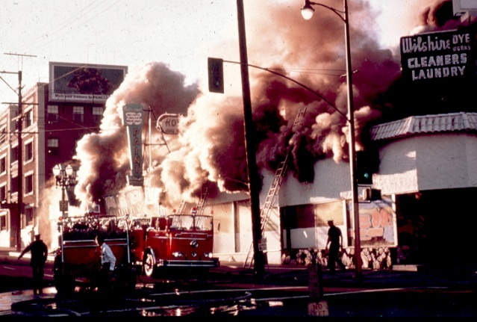
Think Safety!
Look for Overhead obstruction/Wires

Slide 37
Ladder Safety
Wear PPE
Use leg muscles when climbing
Keep away from electrical lines (10 feet)
Ensure dogs are locked
Ladder stable before climbing (both butt spurs in contact with the ground
Climb smoothly and rhythmically
Secure yourself when working off a ladder (leg lock/ladder belt)

Slide 38
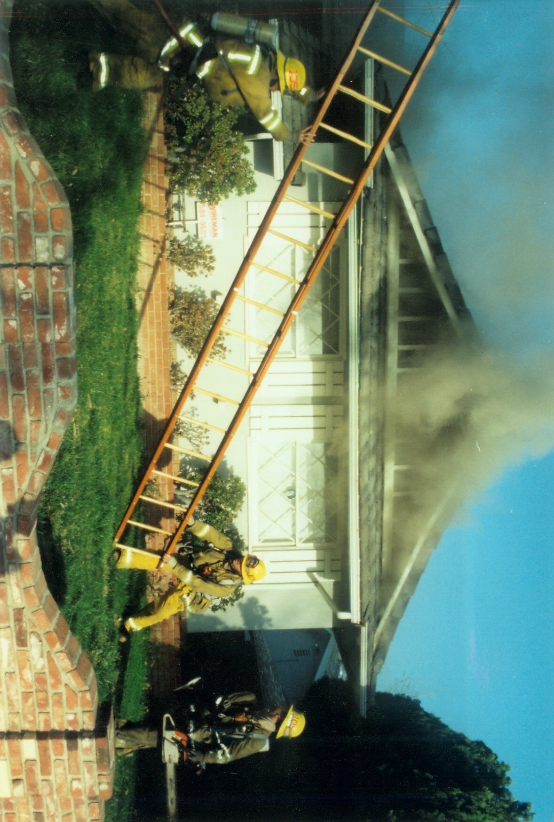
Ladder Commands

Slide 39
Ladder Commands
Communications & teamwork are vital when working with ground ladders
Personnel must be able to communicate ladder commands for standardized ladder operations. Commands may vary slightly between departments.
Butt person (Ladder Commander) will give all commands.
Overall goal is clear, concise, effective communication
Two part command (preparatory & execution)

Slide 40
Ladder Commands Continued
"Beam Ladder" (Not used on three man evolution)
"Pick-Up Ladder"
"Forward", "Ladder Coming Through", Etc.
"Beam Raise" or "Flat Raise"
“Shift” (Three man evolution only)
“Clear Overhead”
"Raise the Flies", "Fingers and Toes", "Dogs Locked“
"Ladder-In"
"Ladder-Out"
--

Slide 42
Ladder Commands (Continued)
"Lower the Flies", "Fingers and Toes" and "Dogs Locked"
"Take it Out on the Beam" and "Clear” or "Take it Out Flat" and "Clear"
"Last Rung Coming, Last Rung"
“Forward”, “Ladder Coming Through”, Etc.
“Shift” (Three man evolution only)
“Stop Ladder”
"Beam Ladder" (Not used on three man evolution)
"Bed Ladder"

Slide 43
Removing Ladder From Apparatus
If the ladder is being removed or replaced on the fire apparatus, the following commands are used.
Use clear text:
"Remove Ladder from Apparatus" “Place Ladder on Apparatus”

Slide 44
Firefighter close to Butt of ladder gives commands

Slide 46
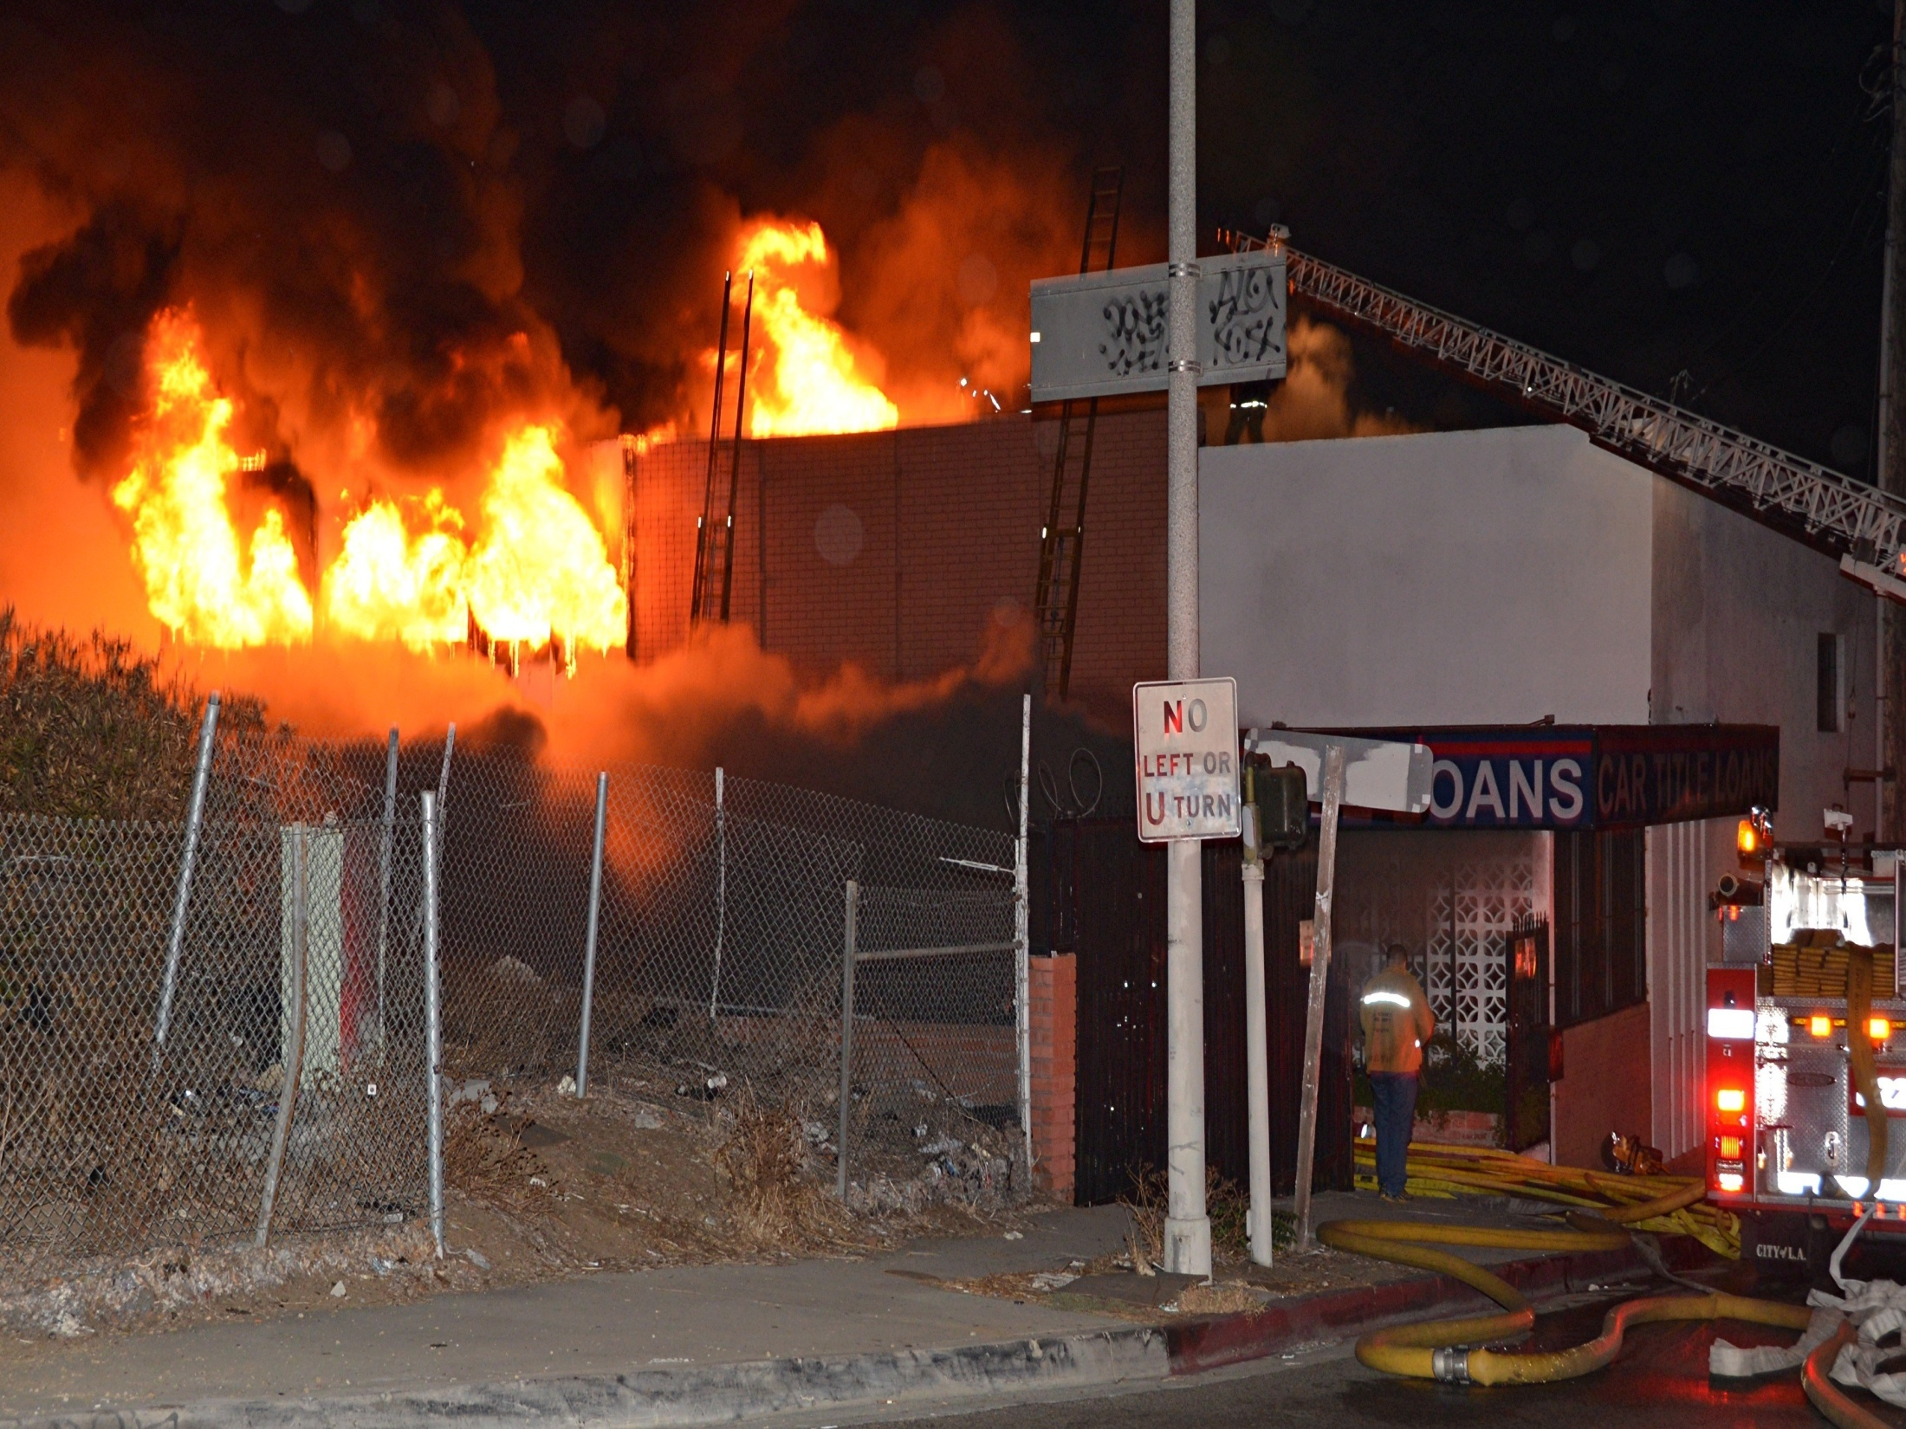

Slide 47
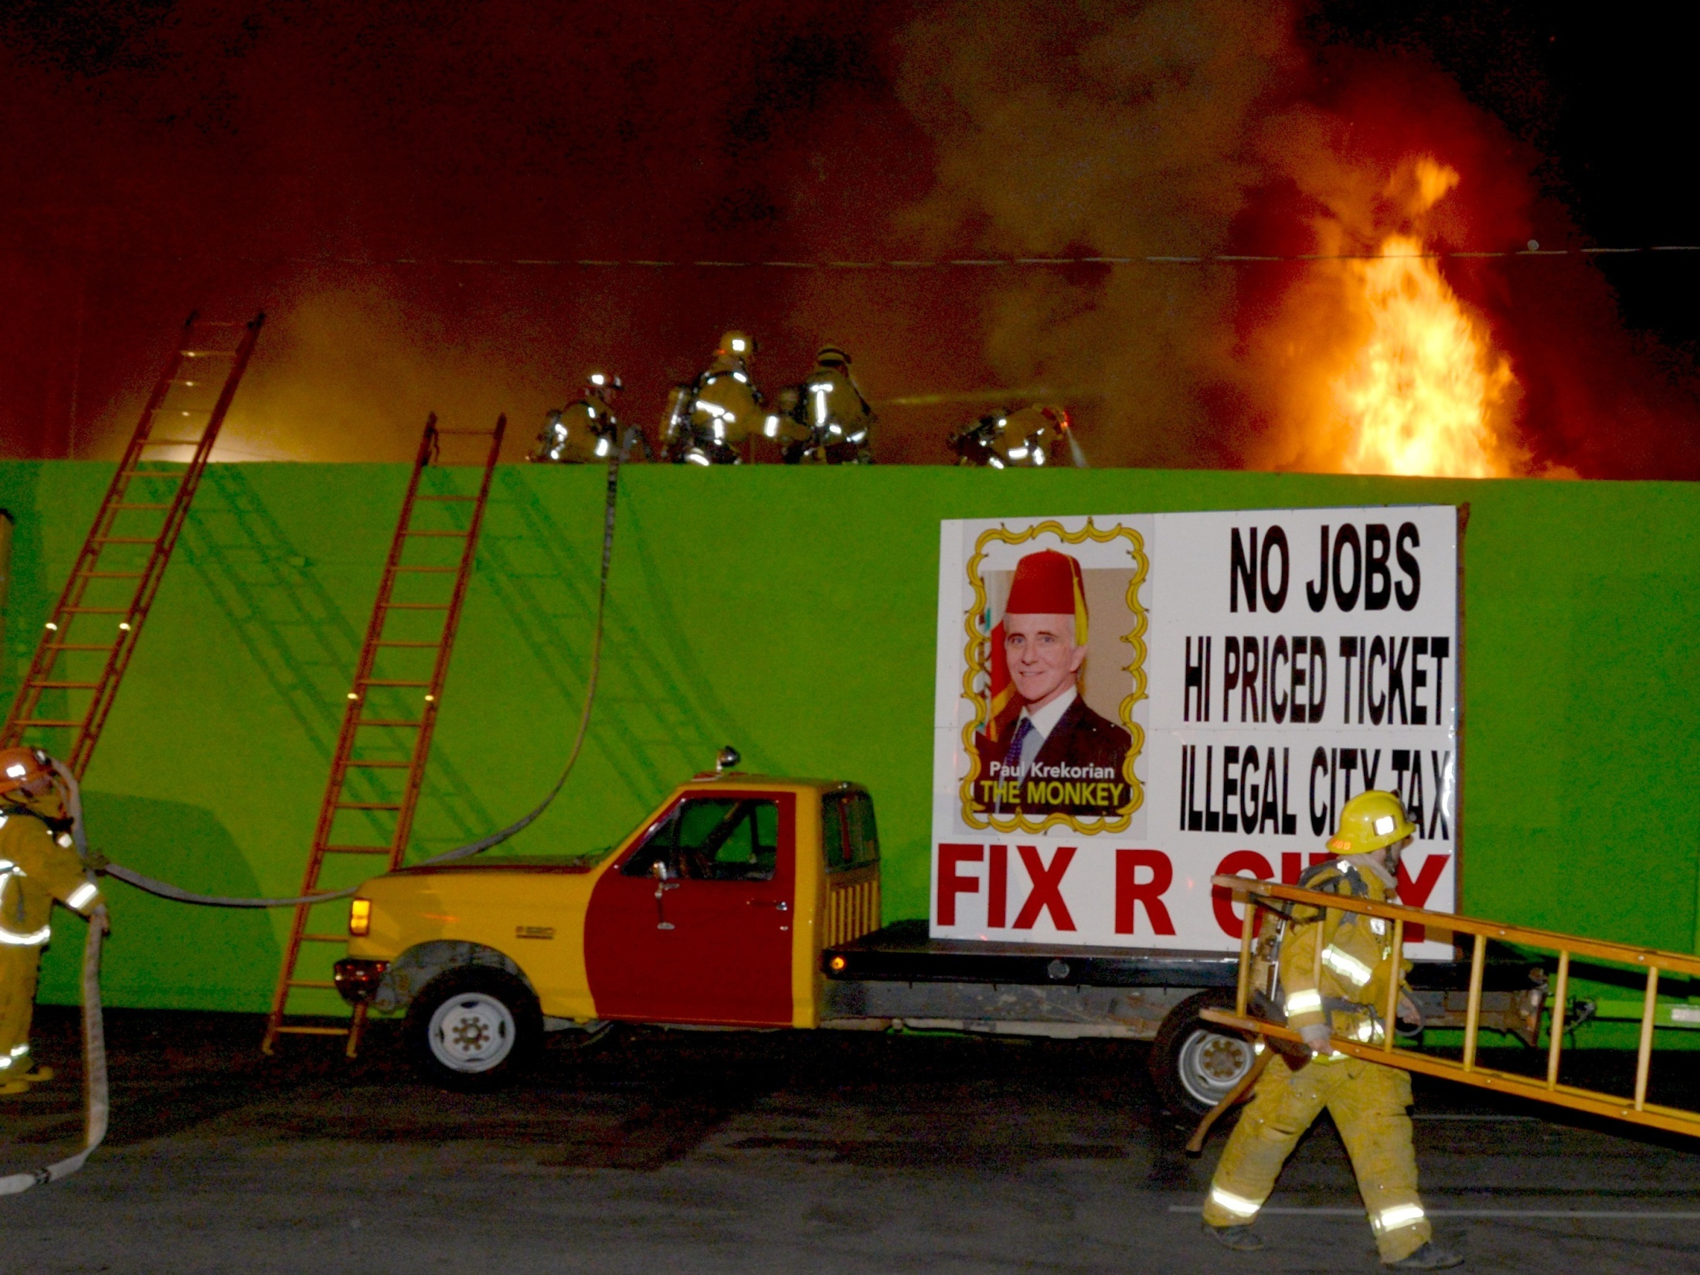

Slide 48
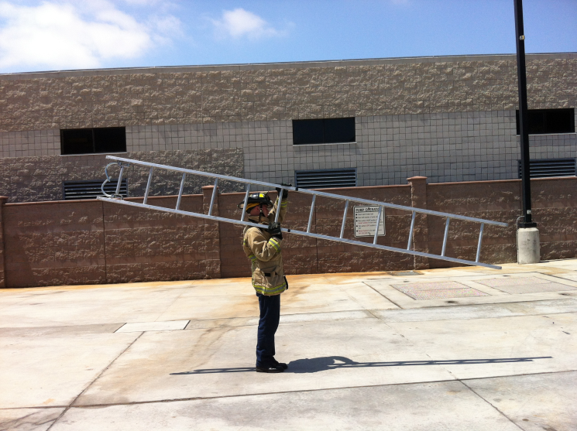
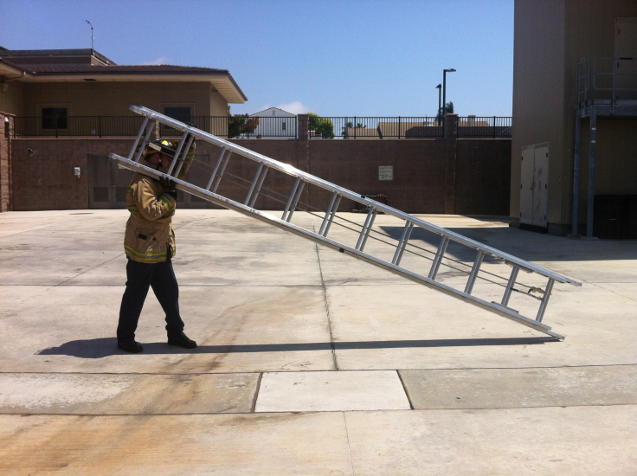
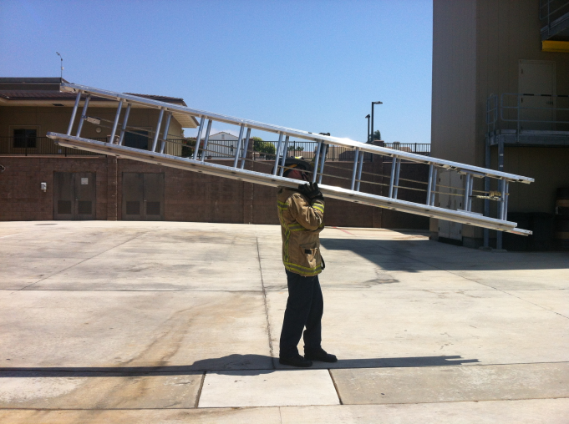
Ladder Carries
High Shoulder
Low shoulder
Flat high Shoulder

Slide 50
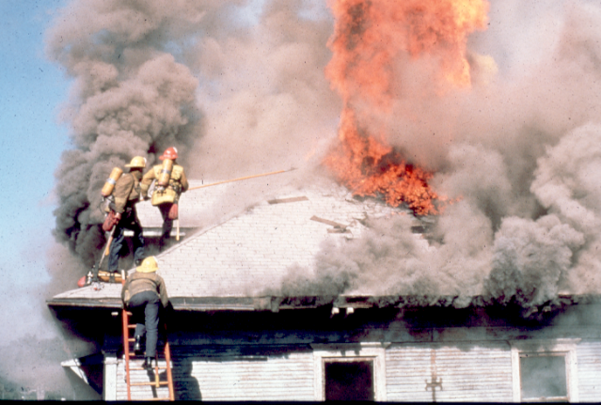

Slide 51
Low Shoulder Carry

Slide 52
High Shoulder (Flat)

Slide 53
Use proper lifting and lowering techniques to prevent personal injuries.
Correct number of personnel for length, type
Bend knees, keep back straight, lift with legs NOT with backs and arms
Lift on command of firefighter who can see all team members
Make known if not ready to lift
Reverse lifting if necessary to lower

Slide 54
Ladder Placement and Guidelines for Ladder selection
Extend ladder beyond roof edge
Tip placement for access or ventilation
Tip placement for rescue from window opening

Slide 55
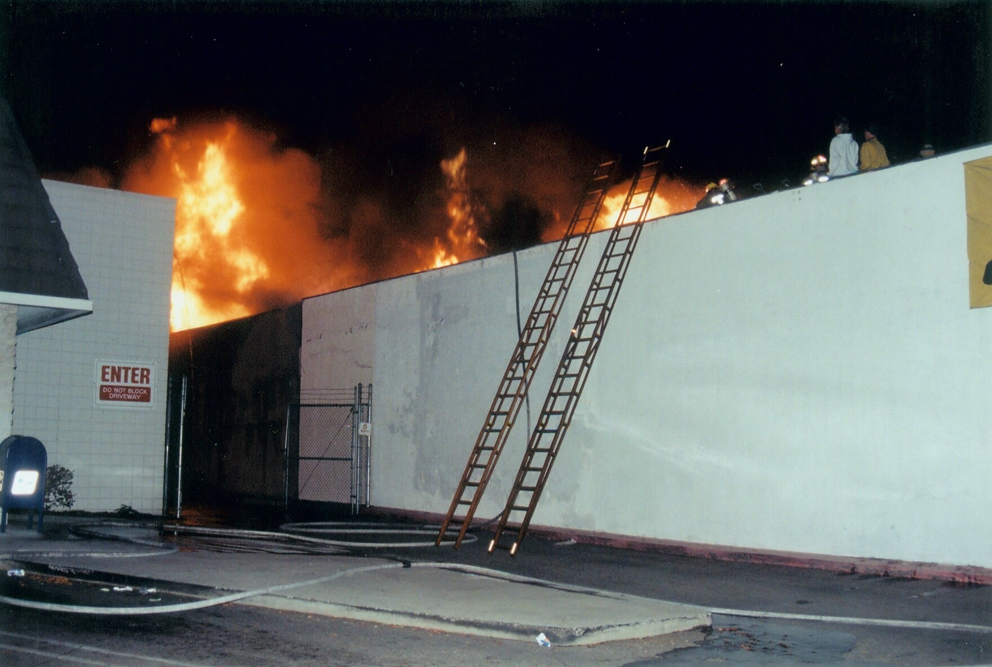

Slide 56
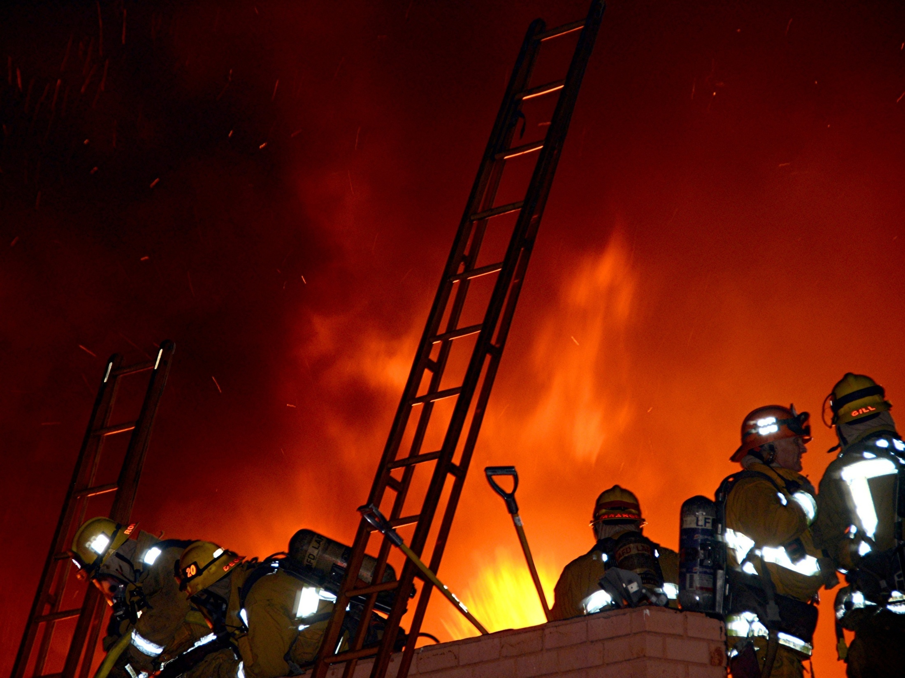

Slide 57
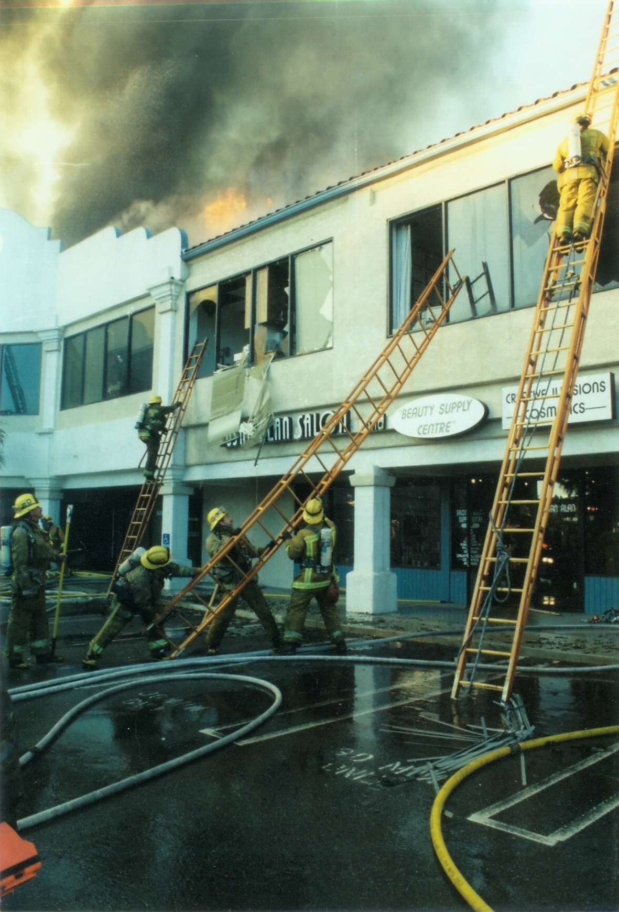

Slide 58
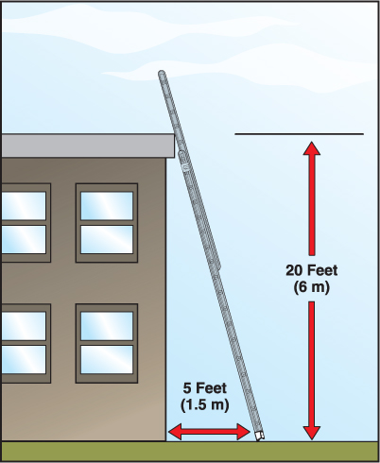
The distance of the butt end from the building is what determines ladder angle.
There are several ways to determine proper distance for ladder angles.

Slide 59
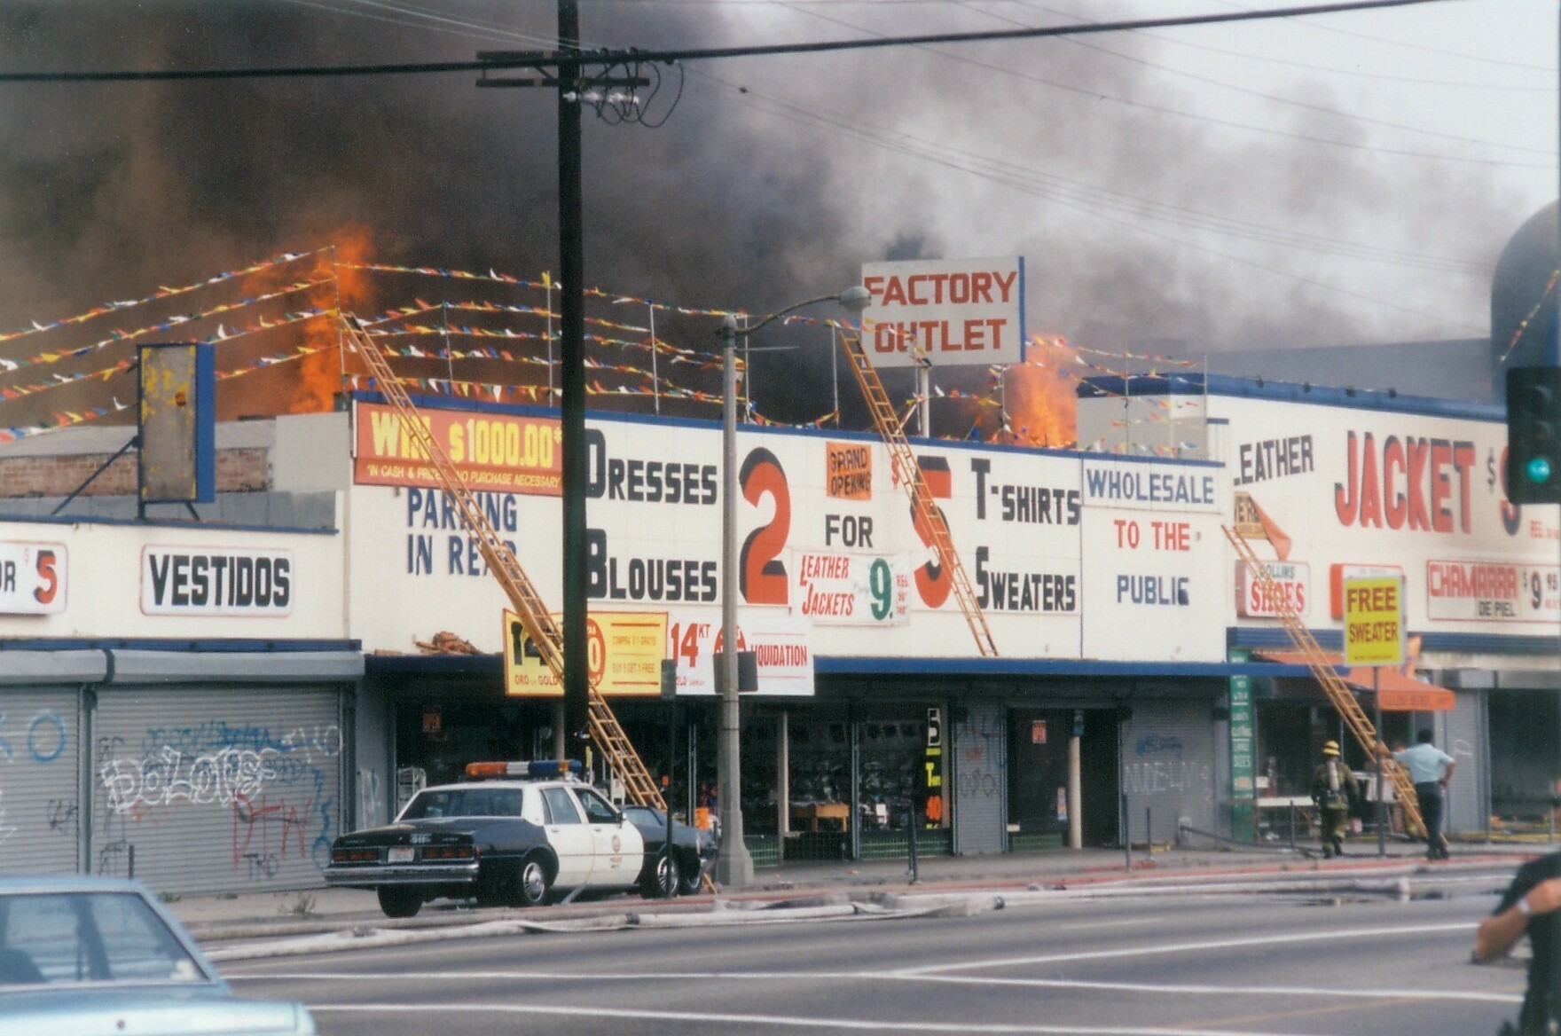

Slide 60
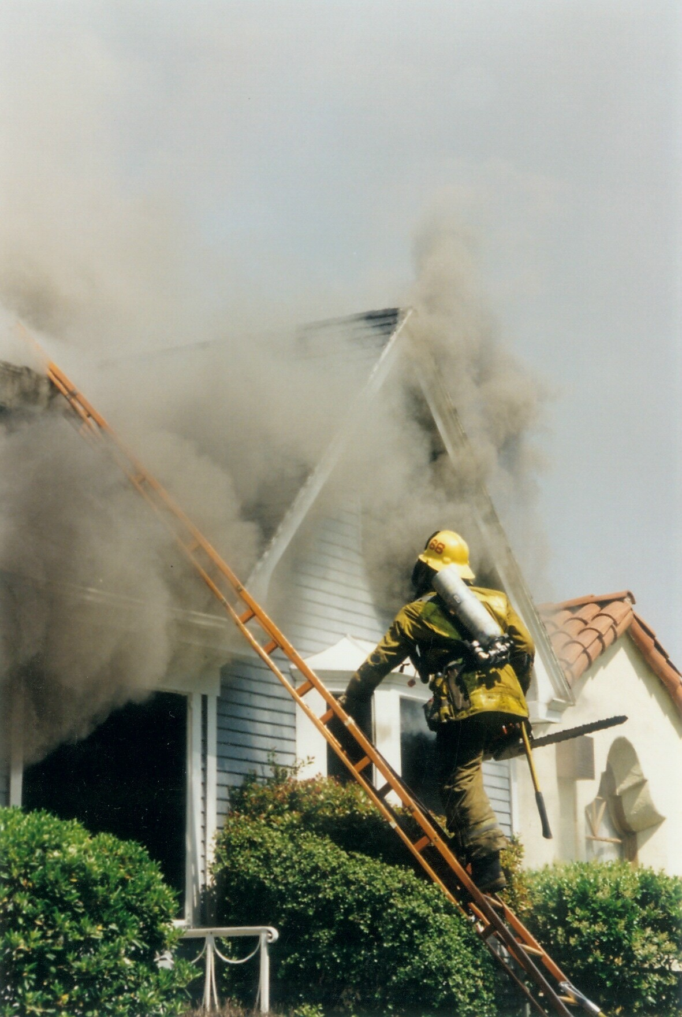

Slide 61
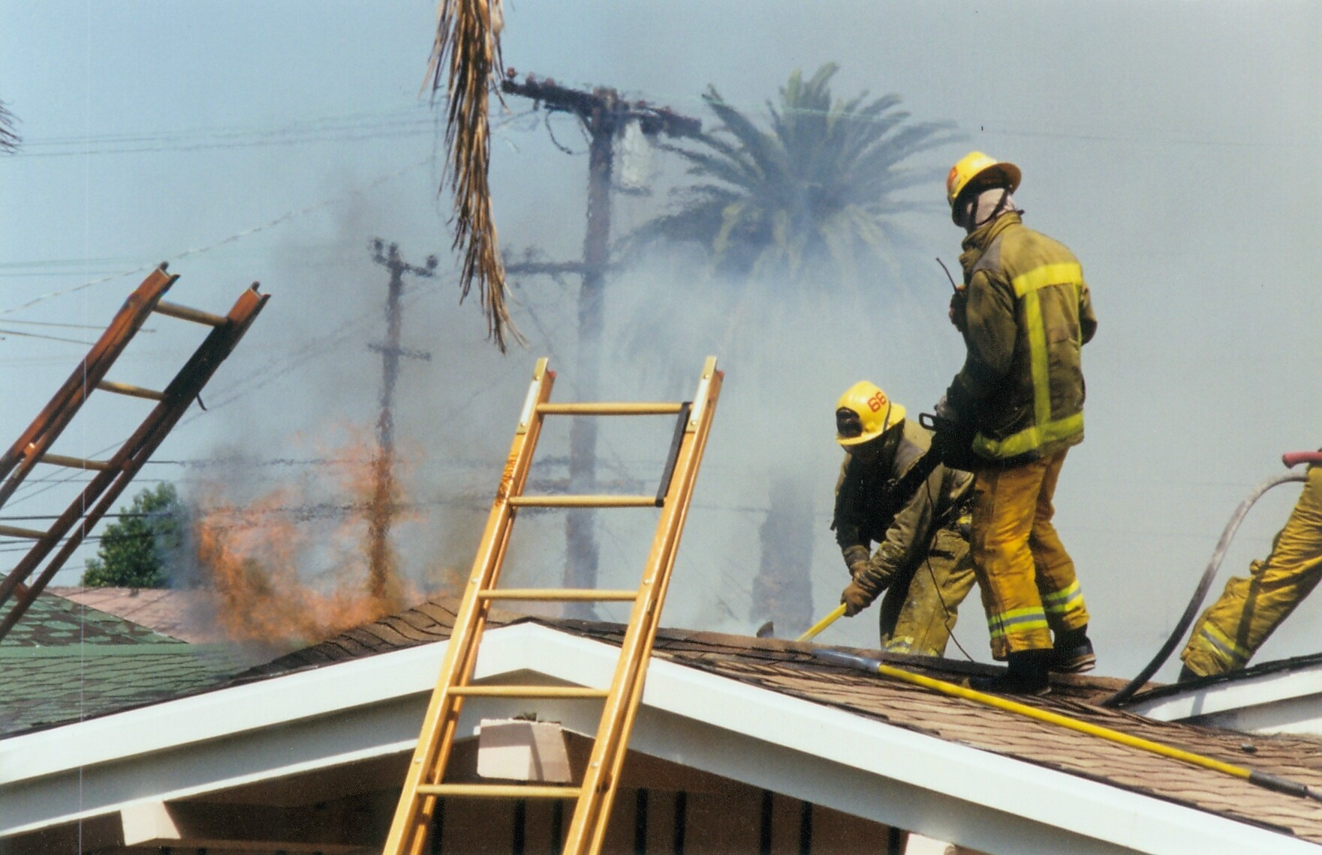

Slide 62
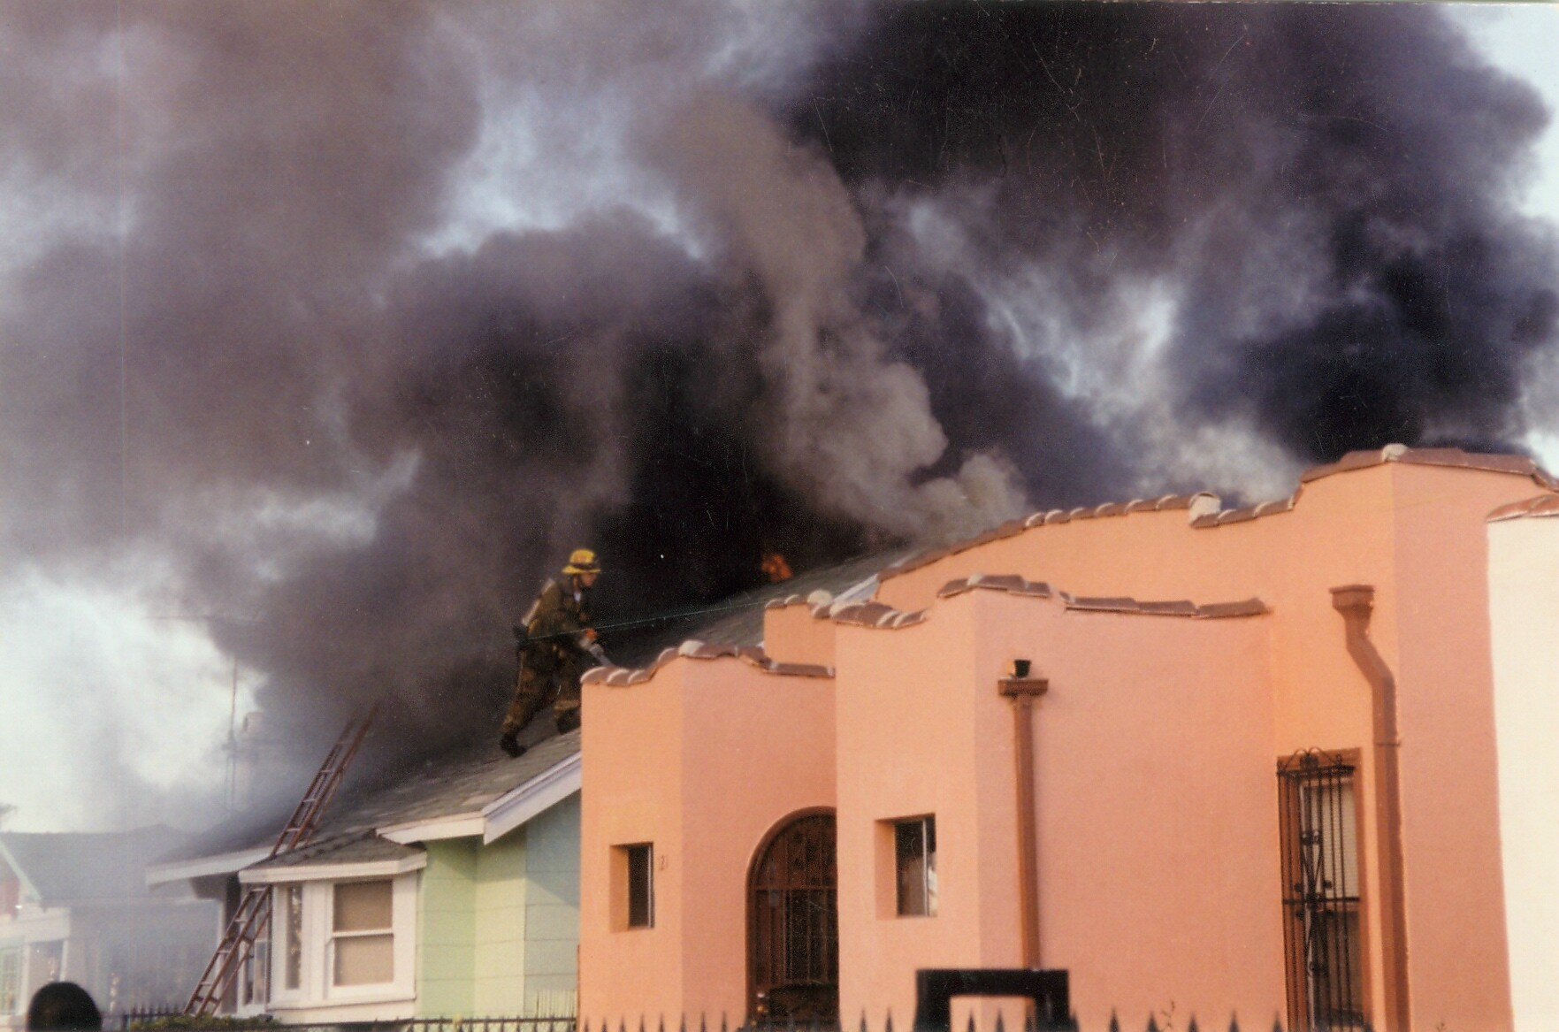

Slide 63
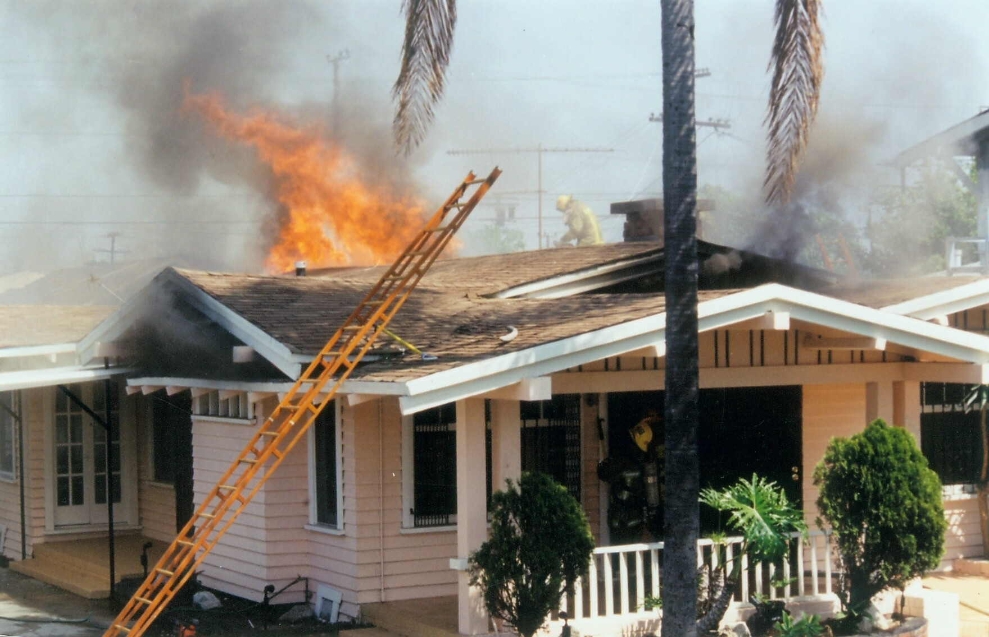

Slide 64
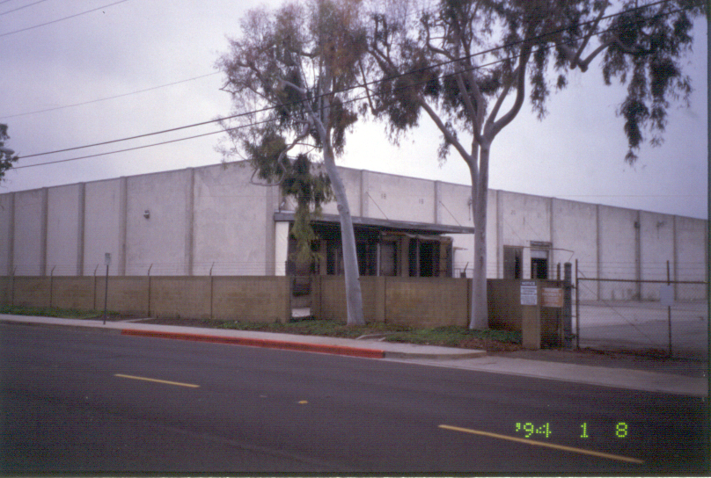

Slide 65
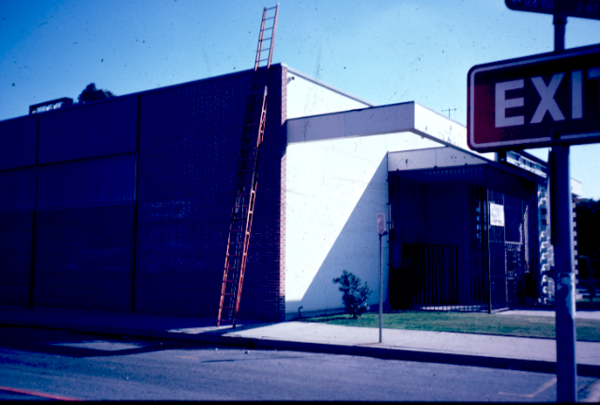

Slide 66
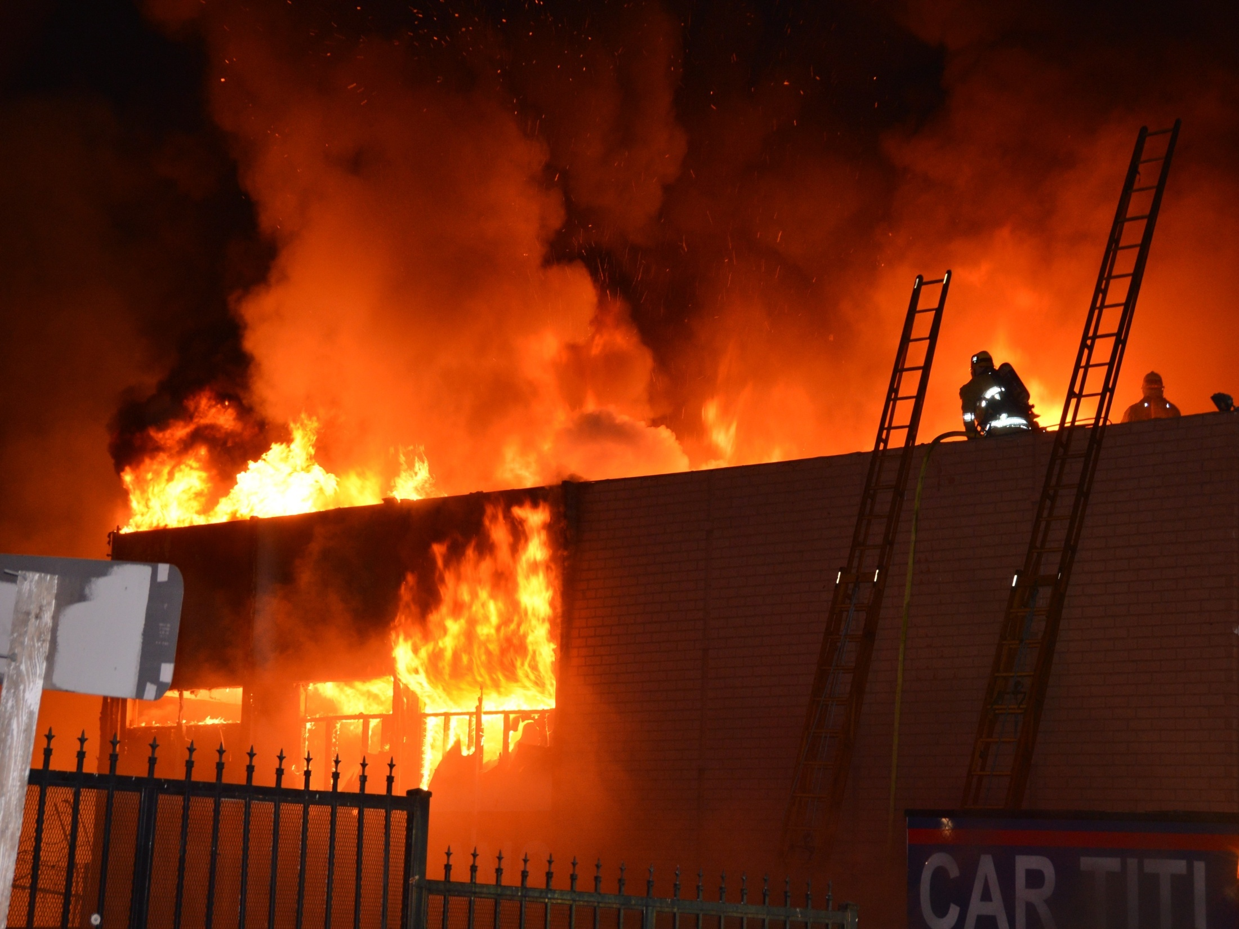

Slide 67
Several considerations must be addressed before raising a ladder.
Identify electrical hazards
Example: Look up before lifting
(Cont.)

Slide 70
Ground ladders must be secured whenever firefighters are climbing or working from the ladder.
Heeling
Tying in
Lock extension ladder locks
Tie halyard with clove hitch, overhand safety
Prevent movement by heeling, securing to nearby firm object

Slide 71
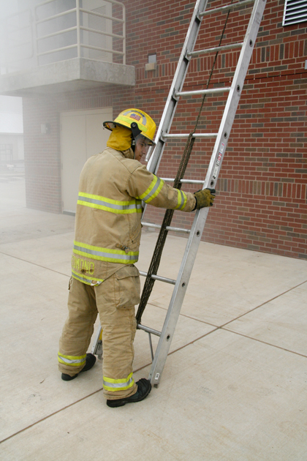
There are several methods that can be used for heeling a ladder.

Slide 72
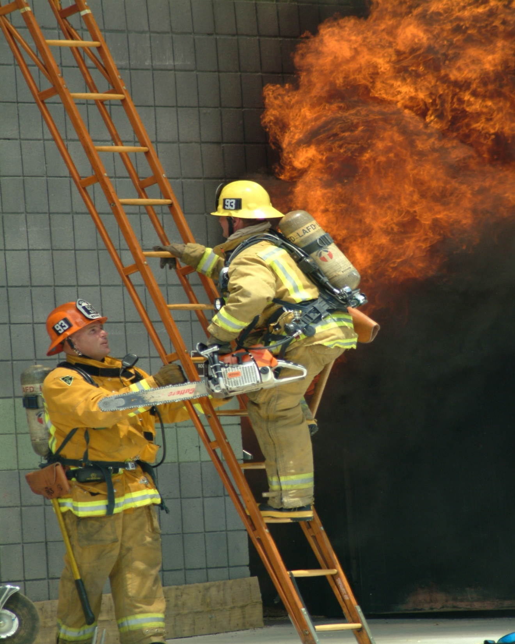

Slide 74
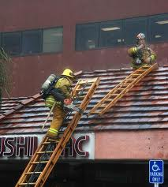
Tying in secures the ladder to a fixed object and should be done if possible.

Slide 75
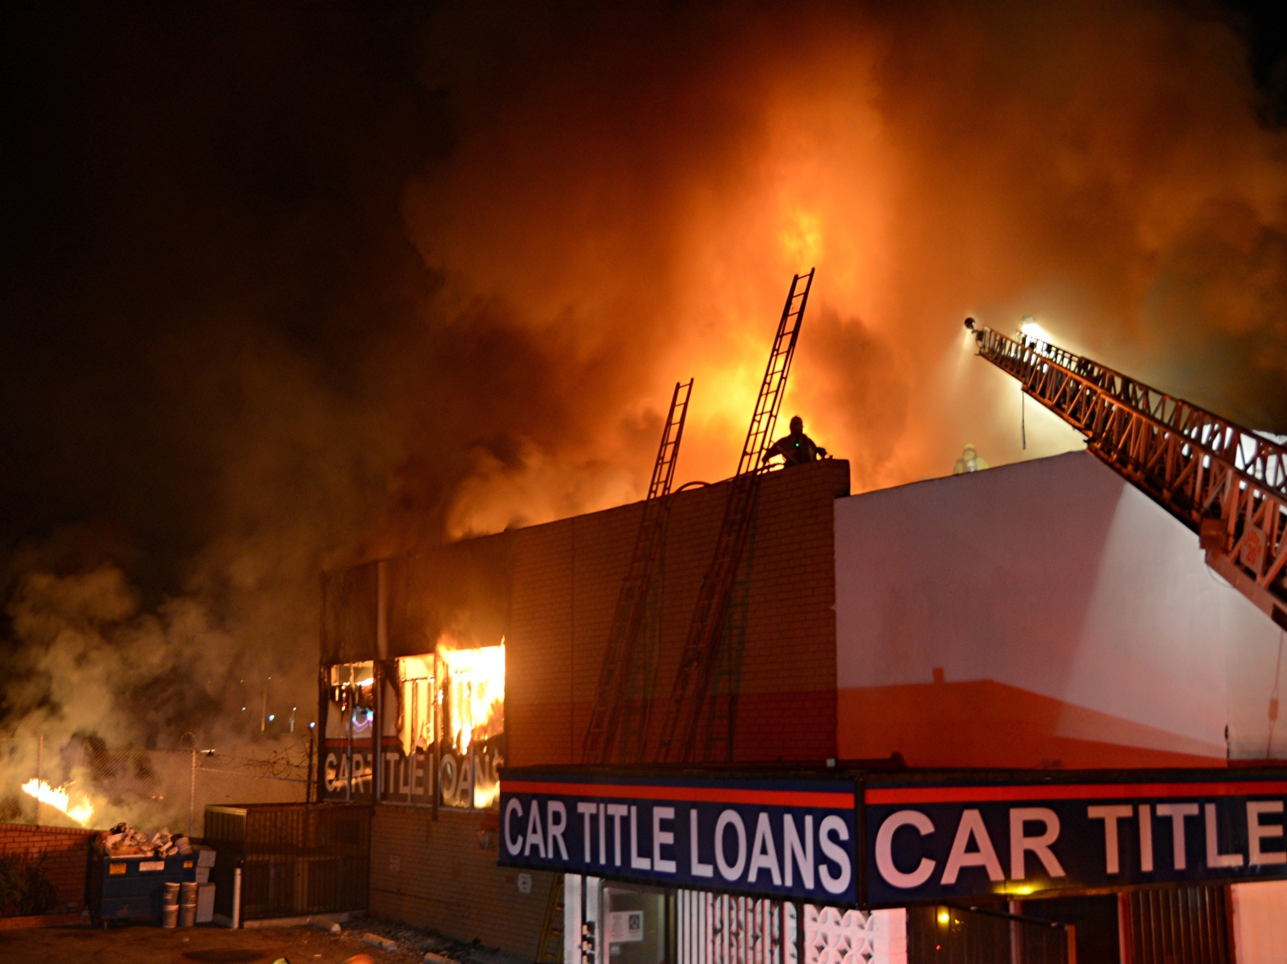

Slide 76
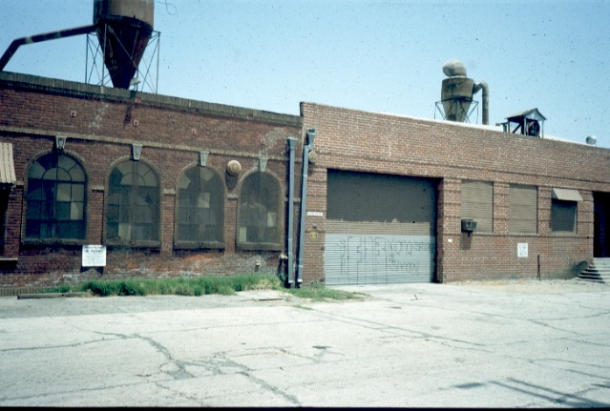
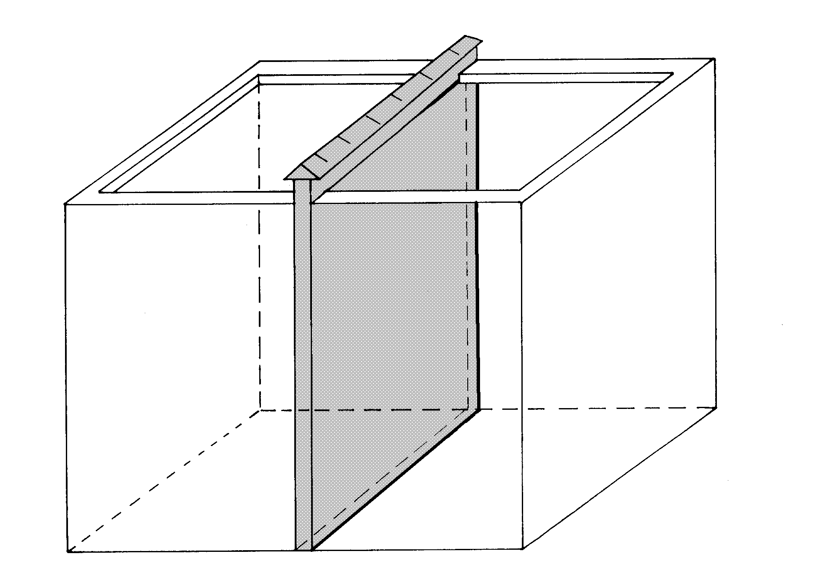

Slide 77
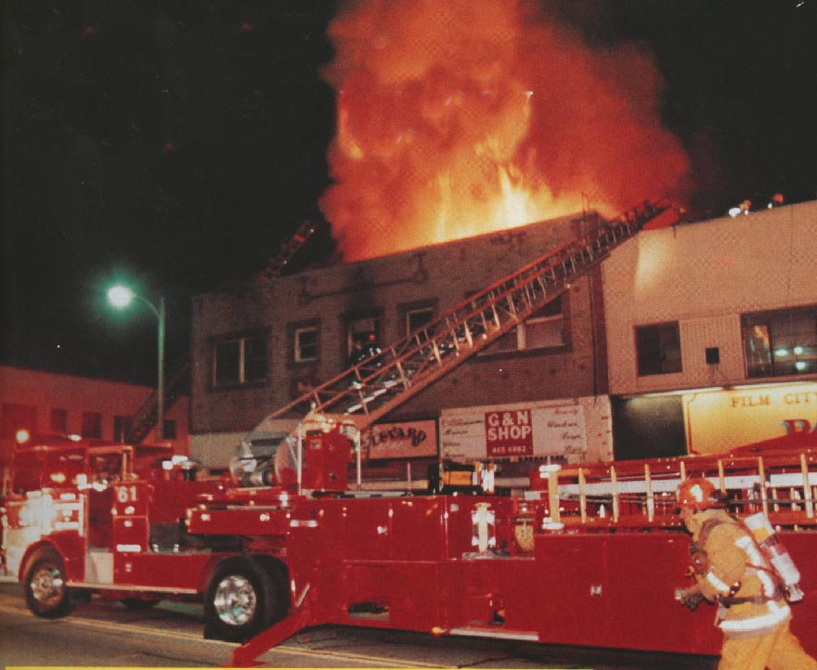
Notes:
Every window with a hose line requires a ladder.
Make sure your not only thinking of how you’re getting in but how you’re going to get out!

Slide 79
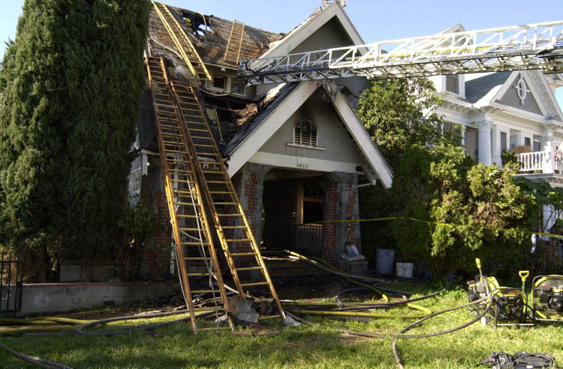

Slide 80
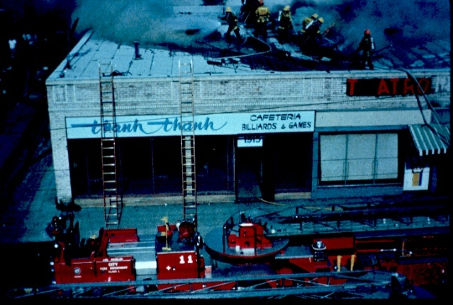
Notes:
VENTILATION
ROOF ACCESS
ENGINE COMPANY ACCESS
TWO LADDERS MINIMUM
3 RUNGS OVER
UN-INVOLVED TO INVOLVED

Slide 81
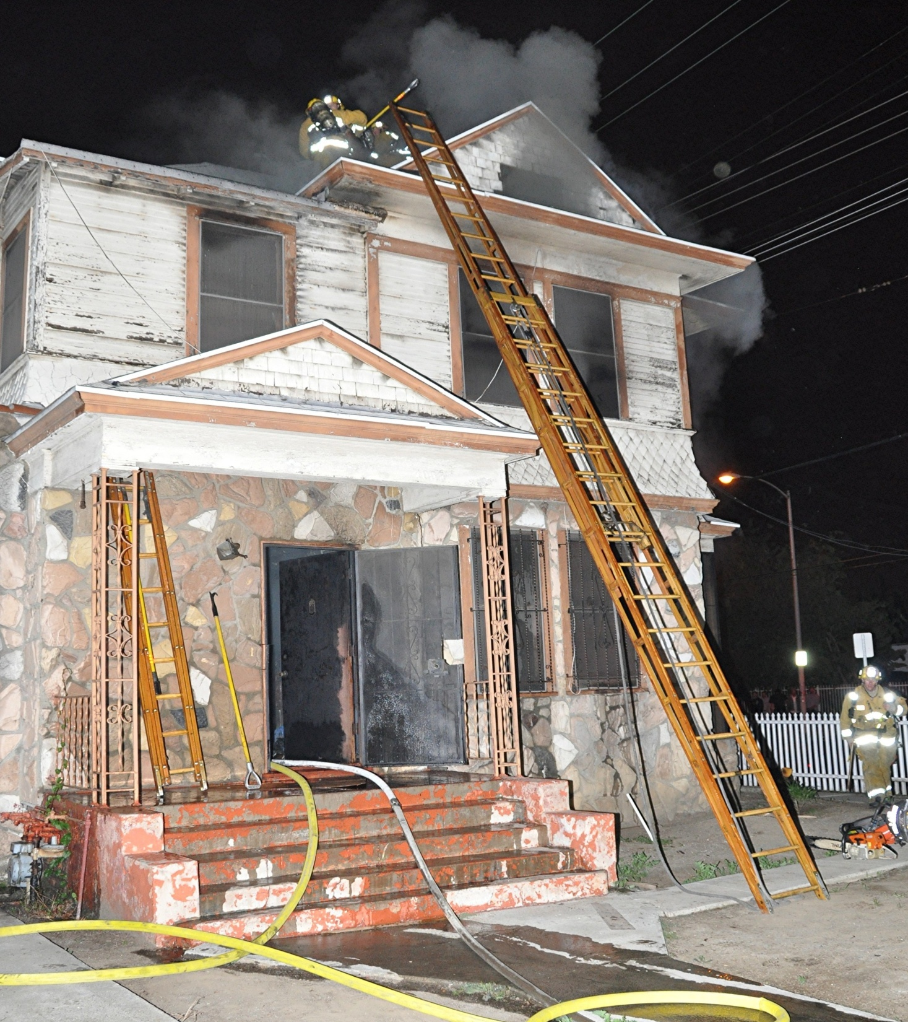

Slide 82
Firefighters may be required to work with both hands while standing on a ground ladder.

Slide 83
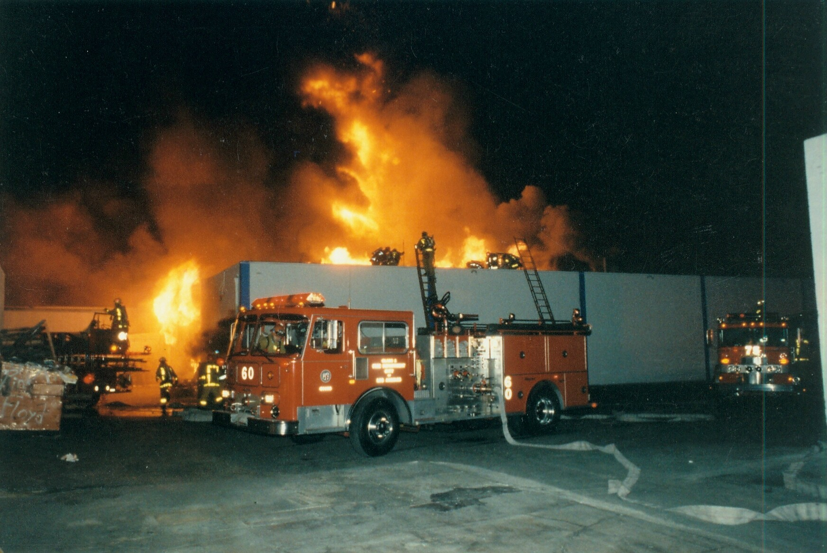

Slide 84
WARNING!
Use a leg lock only when working from a ground ladder.
Never use a leg lock on an aerial ladder. Extending or retracting the ladder could result in serious injury.

Slide 85
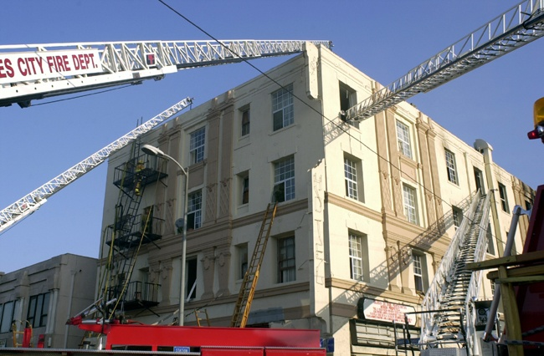

Slide 87
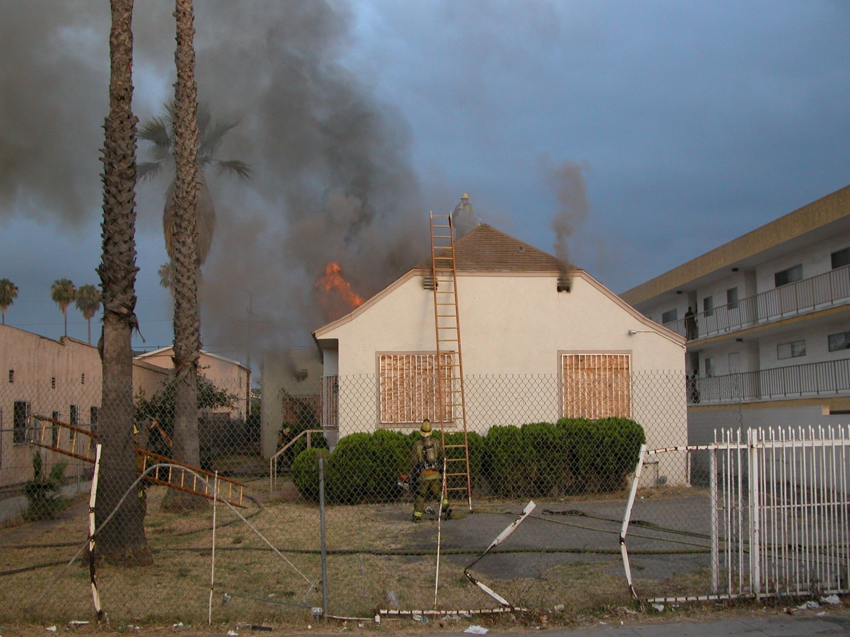

Slide 88
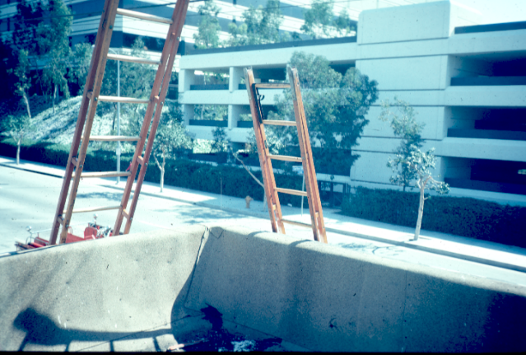

Slide 89
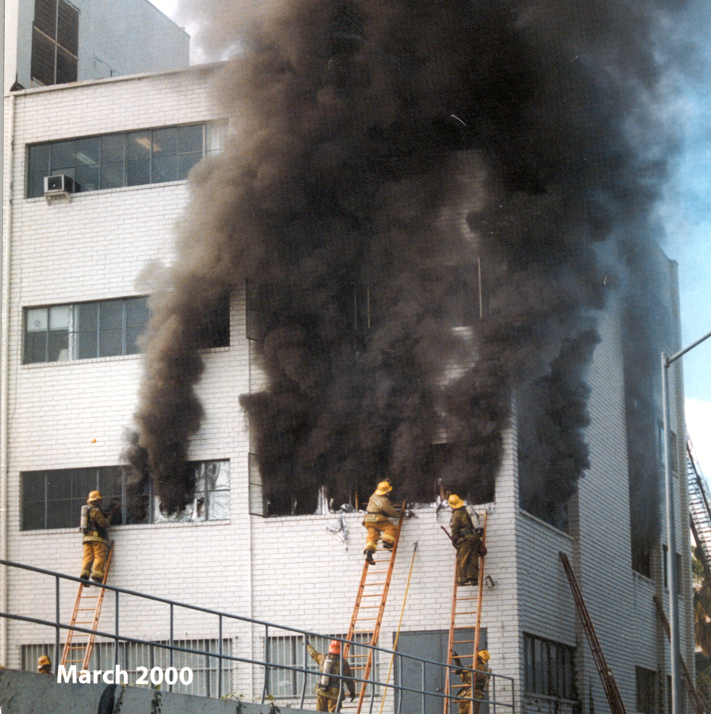

Slide 90
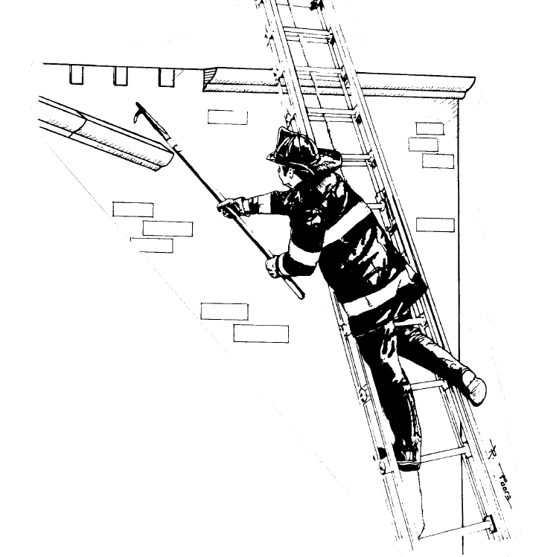

Slide 91
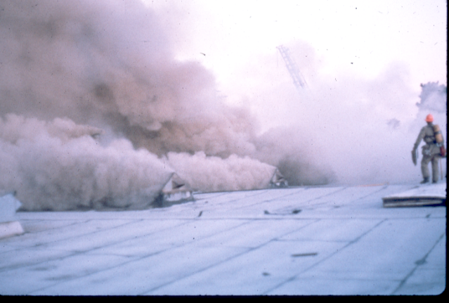
Ladder

Slide 93
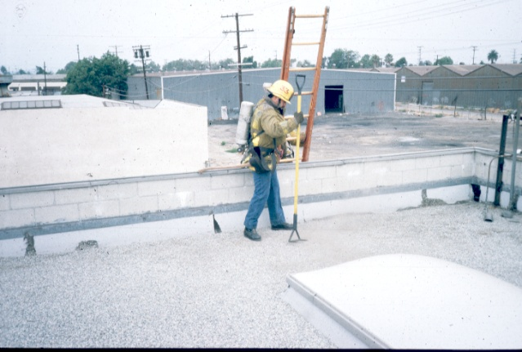

Slide 94
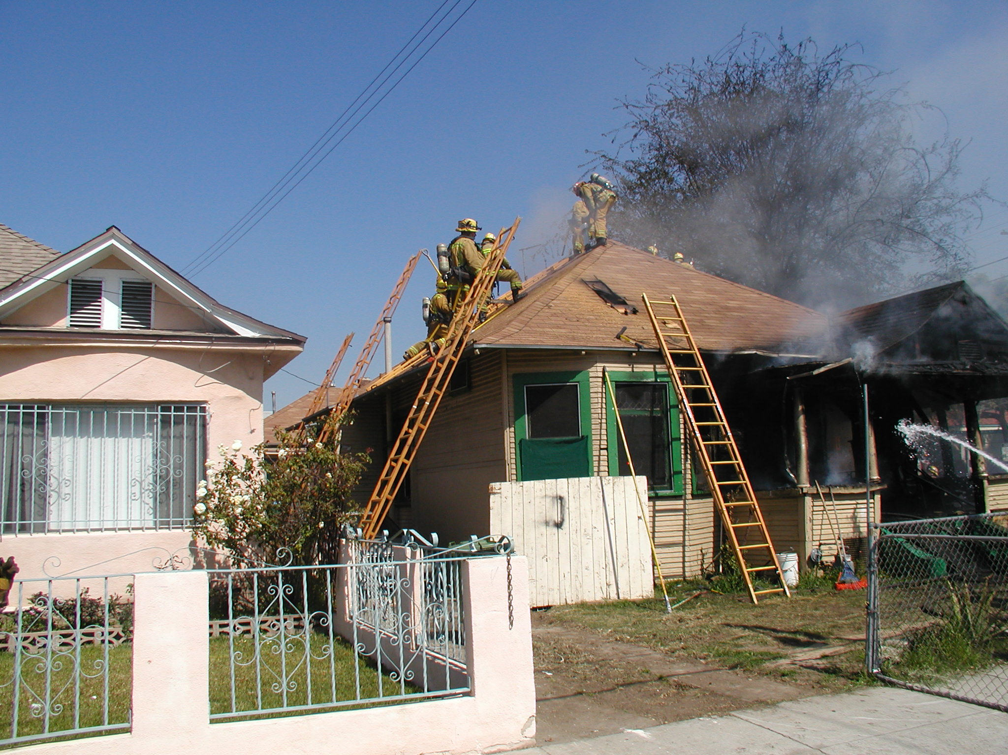

Slide 95
Assisting a victim through a window requires specific placement.
Tip raised to just below sill
Heel
Remove other loads
Protect occupants from slipping, falling

Slide 96
At least four firefighters are needed to bring victims down the ground ladder.
Two inside building
One or two on ladder
One heeling ladder

Slide 97
The method chosen depends on whether the victim is conscious or unconscious.
Conscious
Unconscious

Slide 98
Victim size also plays a part in the method used for lowering.

Slide 100
Aerial & GL Similarities
To know Aerial is to know GL’s
Stability, Visibility & Strength
App placement critical
Aerial is always PRIMARY
Support aerial with Ground Ladders
FF’s know aerial tactics

Slide 102
Notes:
4” hose
LTI, American La France Trucks with outriggers
Suicide doors
Ladder Bays
Delay hose evolutions
Directives to incoming resources

Slide 105
Identifying Parapet Hts.
Importance of ID
Have a plan
Worn other Truck Co’s
Rain scuppers
Tops of windows
Attic vents
Greater than 5’ you will need a ladder

Slide 109
Roof Ladder Operations
True measure of a Truck Co
Footing too precarious
Always steeper than appear
Aggressive GL
Windward
Have a plan
Engineers
Axe vs Saw vs Pike Pole
SCBA’s

Slide 116
Facades/Overhangs
French meaning “front”
Conceal equip; aesthetics
Engineered (cantilever/integral)
Non fire-stopped (extension)
Collapse potential
Do not ladder front
Ladder sides/rear
Escape routes compromised

Slide 121
Consider Alternative Placement Techniques

Slide 126
---QUESTIONS---

Slide 127
Ladder Training
Practice with a purpose
Dedicate a day
Not just the “rookies”
Become the best in the FS
Lead by example
Challenges and competition
Safety

