Slide 1
Putting it all Together & Graduation

Slide 2
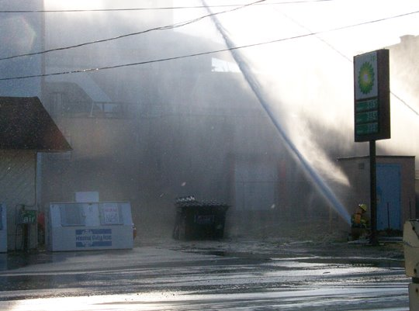
Course Purpose & Content
Course Purpose:
Be a Safe & Competent Responder within your appropriate level, resources and capabilities!
L-2

Slide 3
Course Purpose & Content
Key course content
Know Dos for FRO’s
Review final exam
Key class teaching point
L-3

Slide 4
How It Fits Together
First Responder “Awareness”:
S.I.N.
First Responder “Operations”:
S.I.N.C.I.A.P.C.P.D.D.D.
L-4

Slide 5
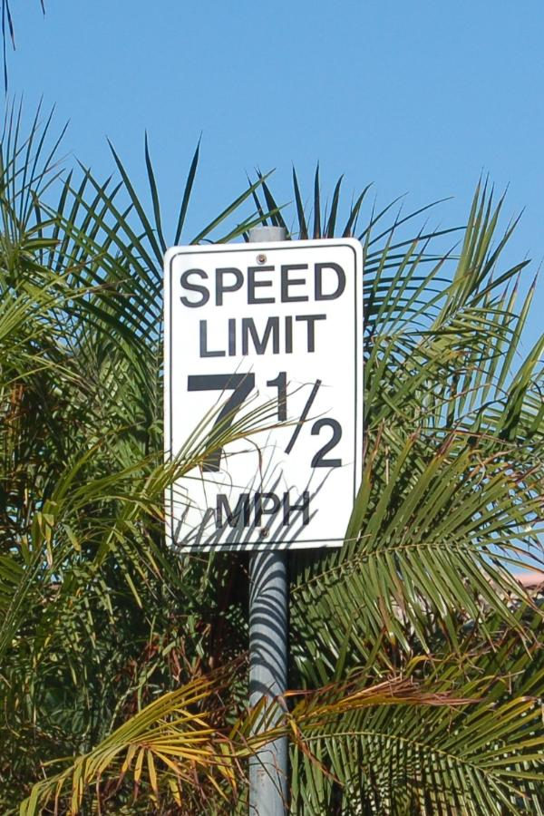
Know Your Limitations
You’re at the First Responder Operations level
Know your:
Resources
Capabilities
L-5

Slide 6
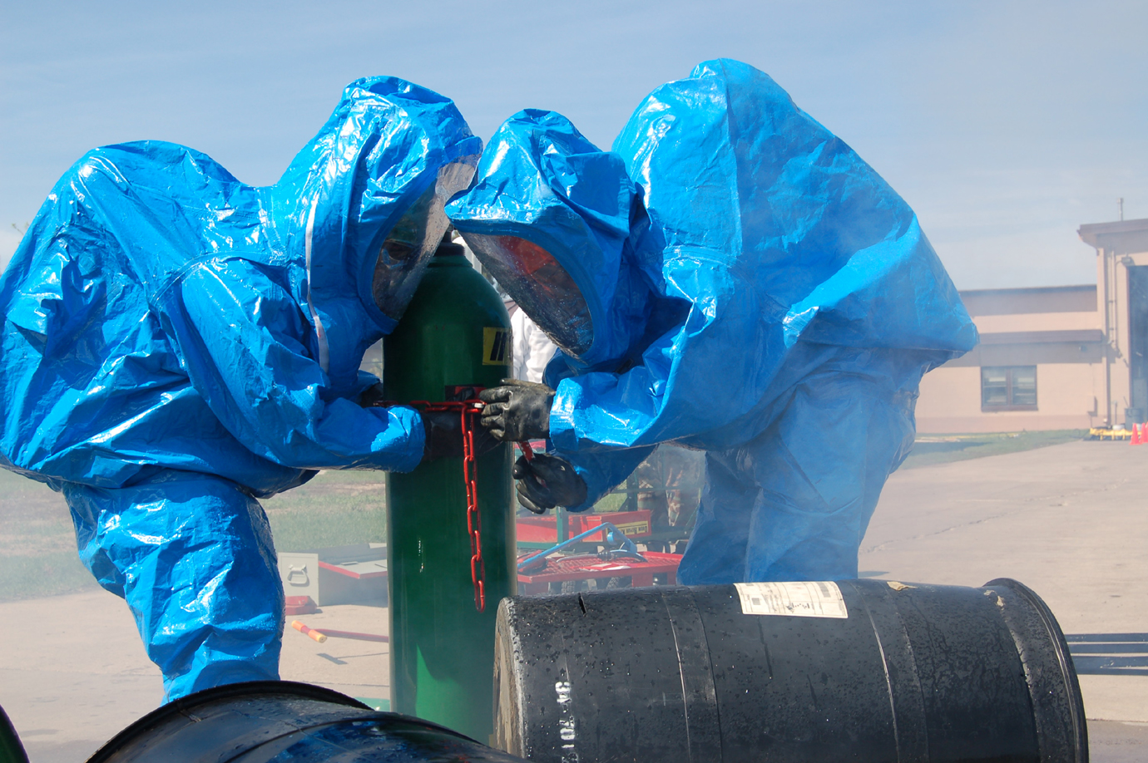
Know Your Limitations
You are not a Technician or Specialist:
“A little bit of knowledge can be more dangerous than none”
L-6

Slide 7
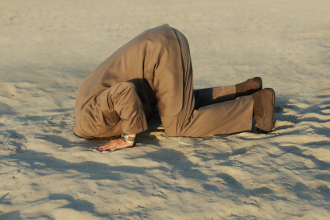
Class Critique
Verbal and Written Class Critique
Please candidly identify
What was positive about class
What we can do to better
L-7

Slide 8
Concluding Remarks
Make a positive difference!
Be part of the solution — Not part of the problem!
And don’t forget:
Let's be careful & competent out there!
L-8

Slide 9
Congratulations and Thanks!
L-9

