Slide 1

Decon, Disposal, Documentation

Slide 2
Primary FRO Actions
S.I.N.C.I.A.P.C.P. and…
D.D.D.
J-2
Notes:
Safety, Isolation, Notifications, Command, IDHA and Action Plans, Protective
equipment; Containment and Protective actions.
Note “other” FRO actions within safety and resource capabilities: Conduct
Decon as needed; wait for clean-up Company and proper Disposal; and keep
Documentation for later records and reports.
Block focuses on Decon, Disposal and Documentation.

Slide 3
Response Actions
Conduct decon
Ensure clean-up and proper disposal
Keep documentation
D.D.D.
J-2

Slide 4
Decontamination
Removing or neutralizing contaminants
  Personnel
  Equipment
J-2

Slide 5
Types of Decon
Responder
  For personnel working in control zones
  Normally done by hazmat team
Emergency
  Normally done by first responders
J-2

Slide 6
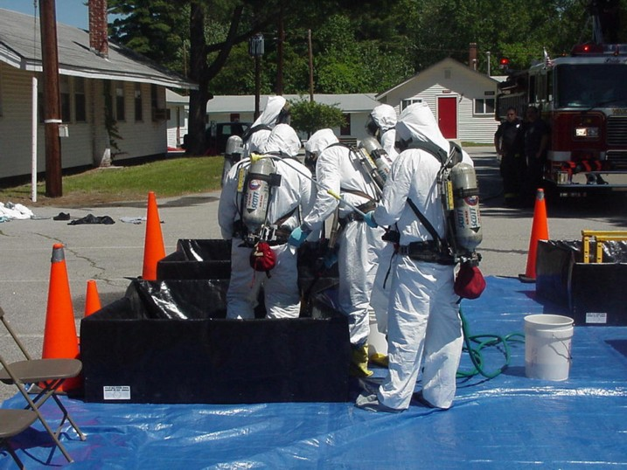
Responder Decon
J-2

Slide 7
Emergency Decon
Urgent, field expedient process
Use any available water source
Intended for exposed persons displaying symptoms
Normally done by first responders
J-2

Slide 8
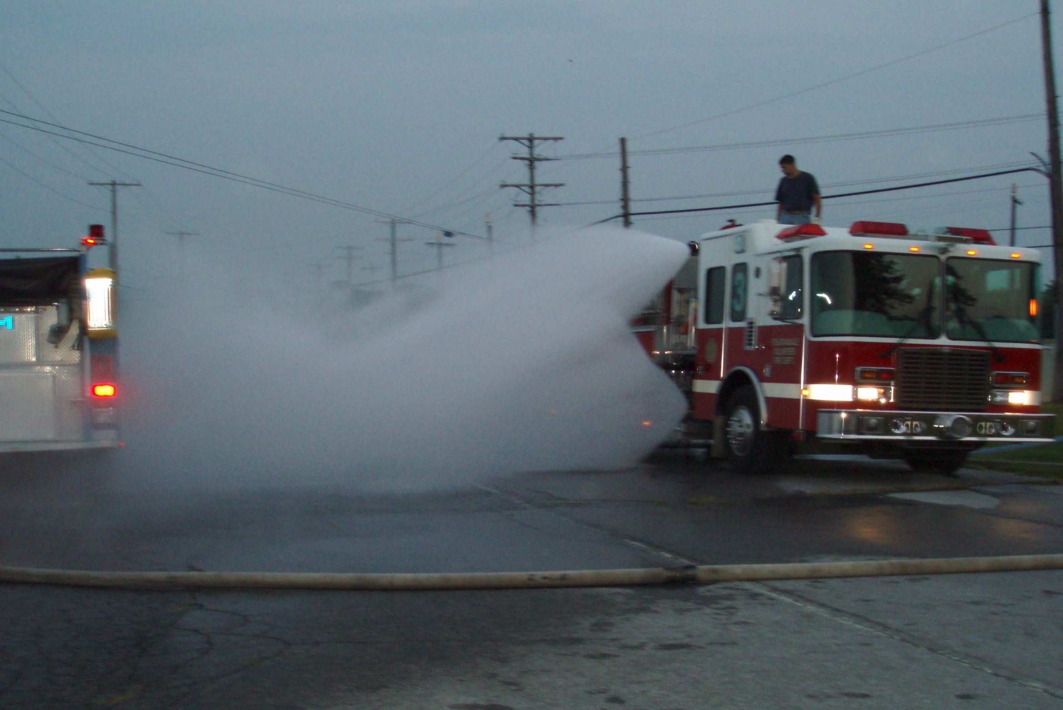
Emergency Decon
J-2

Slide 9
Minimizing Exposure & Contamination
Follow basic safety guides
Establish & observe control zones
Ensure all follow above
J-2

Slide 10
Who, What, When & Why
Why: Prevent escalation of problem
  Exposure: it might be on you
  Contamination: it is on you
J-4

Slide 11

Degree of Contamination
Amount of material on you
Length of time it’s on you
Concentration of material
Physical state of material
Ambient temperatures
J-4

Slide 12
Who, What, When & Why
When: Anytime you suspect contamination
  Material is visible
  Victim complains of pain, odor, etc.
  Victim was near release
J-4

Slide 13
Warning!
Many haz mats are odorless, colorless and tasteless
Acute effects may not show up immediately
You may not be able to confirm exposure/contamination
J-4

Slide 14
Who, What, When & Why
Who/What: People & equipment
  Victims
  Responders
  Equipment
  Structures
J-6

Slide 15
Who, What, When & Why
Who usually does decon:
  FRO’s (properly trained & equipped)
  Tech’s and Specialists via Decon Team
How to decon: No absolute methods
  Only general guides
J-6

Slide 16
Performing Decon
Physical removal
Chemical removal
Emergency decon
J-6

Slide 17
Performing Decon
Procedures follow logical order
Go from “dirty” to “clean”
Check your plan
Dirty
Clean
Filthy
J-6

Slide 18
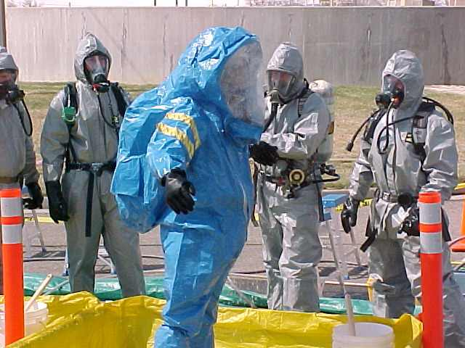
Protective Clothing
Same level as entry team
May be one level down
  Degree of hazard
  Amount of contamination
  Length of exposure
J-6

Slide 19

Consequences of No Decon
Acute/Chronic health effects
Problem gets bigger
Death!
J-6

Slide 20
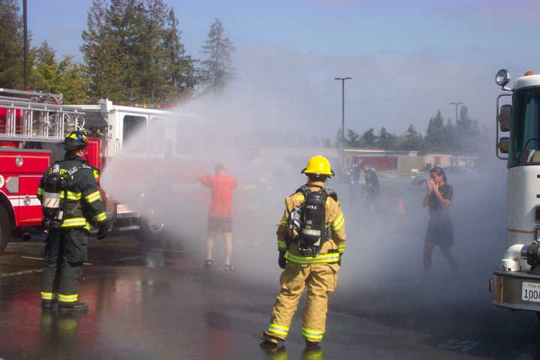
Emergency Decon
Anytime you suspect contamination
Use common sense
  Life risk
  Level of exposure
J-8

Slide 21
Emergency Decon
Guidelines
  In least environmentally sensitive area
  Clothes off
  Water on
J-8
Notes:
Move the victim to a safe refuge, preferably the least environmentally sensitive
area, and use copious amounts of water to flush off gross contamination.
Remove all contaminated clothing (including underwear). Note: Victims will
usually be more cooperative if you give them something to cover themselves
with before you hose them down (e.g. orange Caltrans trash bag).
Flush victim again with copious amounts of water.

Slide 22

Emergency Decon
Use copious amount of water
  Copious=more than you have used
Remove all clothing from victim
  Including undergarments
J-8

Slide 23

Emergency Decon
Avoid the following:
  Brushes & abrasives
  Hot water
  Decon solutions
J-8

Slide 24
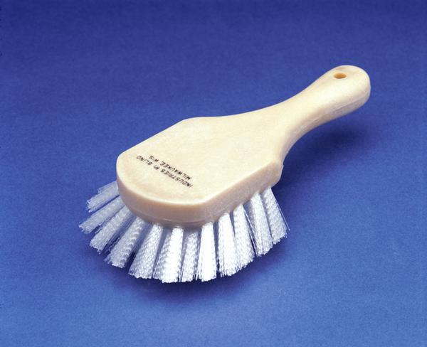
J-8

Slide 25
Emergency Decon Precautions
Remove clothing
  May have to cut off
Avoid contact w/clothing
Segregate contaminated clothing
J-8

Slide 26
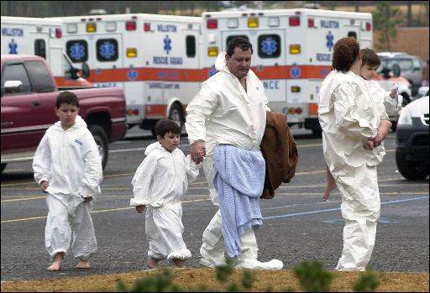
Emergency Decon Precautions
Ensure privacy of victim(s)
  Barriers/temp garments
  Segregate by gender
J-8

Slide 27
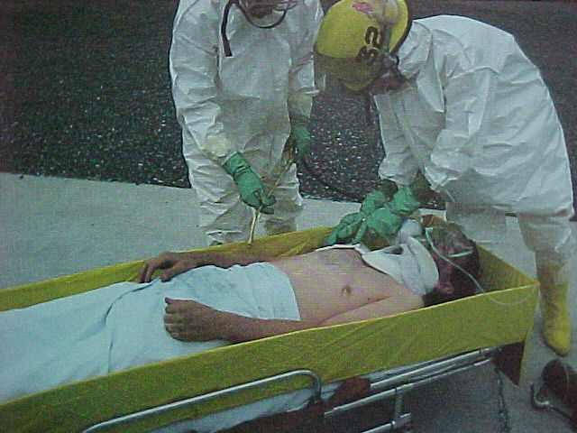
Emergency Decon
Medical considerations
  Decon prior to transport
  Protect equipment from contamination
  Segregate contaminated material
J-8

Slide 28
Decon Roles & Responsibilities
Must have emergency response plan
Plan must include provisions for decon
J-10

Slide 29
Decon & ICS
J-10

Slide 30
Decon Unit Leader
Supervises Decon Unit
J-10

Slide 31
Decon Unit Leader
Establish Decon Corridor
ID contaminated people/equipment
Supervise Decon Unit
J-10

Slide 32
Decon Unit Leader
Control movement in CRZ
Coordinate transfer of patients
May use FROs as decon team
  If properly trained
J-10

Slide 33
Funding & Disposal
J-12

Slide 34
Disposal Requirements
Haz Mat incidents create haz waste
  “Waste” = material that you can’t re-use
J-12

Slide 35
“Hazardous Waste”
Toxic
Reactive
Ignitable
Corrosive
J-12

Slide 36
“Hazardous Waste”
Toxic
Reactive
Ignitable
Corrosive
J-12

Slide 37
“Hazardous Waste”
Toxic
Reactive
Ignitable
Corrosive
J-12

Slide 38
“Hazardous Waste”
Toxic
Reactive
Ignitable
Corrosive
J-12

Slide 39
Disposal Requirements
Strict legal requirements
Track from cradle to grave
You must know them and follow them
  Regs apply to government agencies also!
J-12

Slide 40
Disposal Requirements
“Flushing Haz Mats Away”?
J-12

Slide 41
Funding Requirements
Funding and “Responsible Party”:
  Accepts clean-up duty
  Gives clean-up high priority
  Conducts cleanup adequately
Funding begins with and ends with RP
J-14

Slide 42
Government Funding
Local agencies fund clean-up if:
  No responsible party identified
  Responsible party —
    Refuses or
    Does inadequate clean-up
J-14

Slide 43
Government Funding
“State Superfund” may pay if:
  Threat to life
  No responsible party or local funding
  Must get pre-authorization
    You have to ask!
J-14

Slide 44
Government Funding
Primary state funding agencies:
  Dept. of Toxics Substances Control (DTSC)
  Dept. of Fish and Game
  Caltrans
J-14

Slide 45
Federal Funds
Access via Federal On-Scene Coordinator (FOSC)
Call NRC at (800) 424-8802
J-14

Slide 46
Federal Funds
“Superfund”
  Won’t fund removal of petroleum products
  Only FOSC rep can obligate funds
$
$
J-14

Slide 47

Federal Funds
Oil Spill Liability Trust Fund
  “Oil” only
  Spill in or threatens “navigable” waterway
  FOSC or State rep may obligate funds
J-14
Notes:
Oil = animal, mineral or vegetable.
“Navigable” waterway = everything from the Pacific Ocean to dry creek beds
and storm drains.
DFG has authority to directly spend money from this fund.

Slide 48
Documentation & Reporting
Role of FRO in documentation
  Capture key initial info (may only get one chance to do this)
Use ICS-214
J-16

Slide 49
Reasons for Documentation
Cost recovery
Exposure records
Training records
Future lawsuits & investigations, etc.
J-16

Slide 50
Components of Documentation
Date, time and location
Names of all response personnel
  And exposure times!
Incident conditions, observations and statements
J-16

Slide 51
Components of Documentation
Chemical names, weather conditions, release factors
Actions taken, resources used, costs incurred
J-16

Slide 52
Components of Documentation
Casualties, sample data, etc.
Statements & Observations of witnesses
Diagrams, photos, video, samples
J-16

Slide 53
Hazmat Reports
CHP 407E
CFIRS
Agency’s report
Responsible party
J-16

Slide 54
Chemical Exposure Records
Loren Shelton
Keep exposure records!
  Employer must keep for 30 years
All responders: keep own copies
J-18

Slide 55
Chemical Exposure Records
Date, time and location of incident
Chemical name
Type, concentration and duration of exposure
Decon or medical aid given
J-18

Slide 56
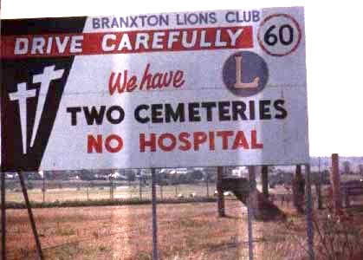
Chemical Exposure Records
They are there to protect you!
J-18

