Slide 1
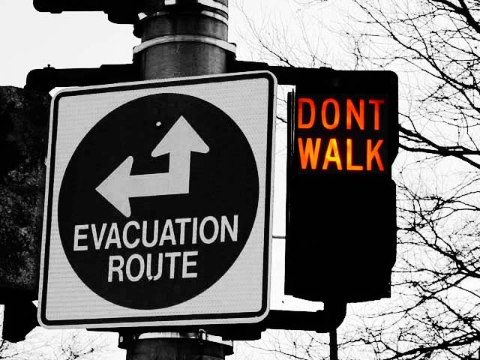
Protective Actions (P.)

Slide 2
Protective Actions
Two key actions “Protective Actions”
  “Evacuation”
  “Sheltering in Place or In-Place Protection”
I-2

Slide 3
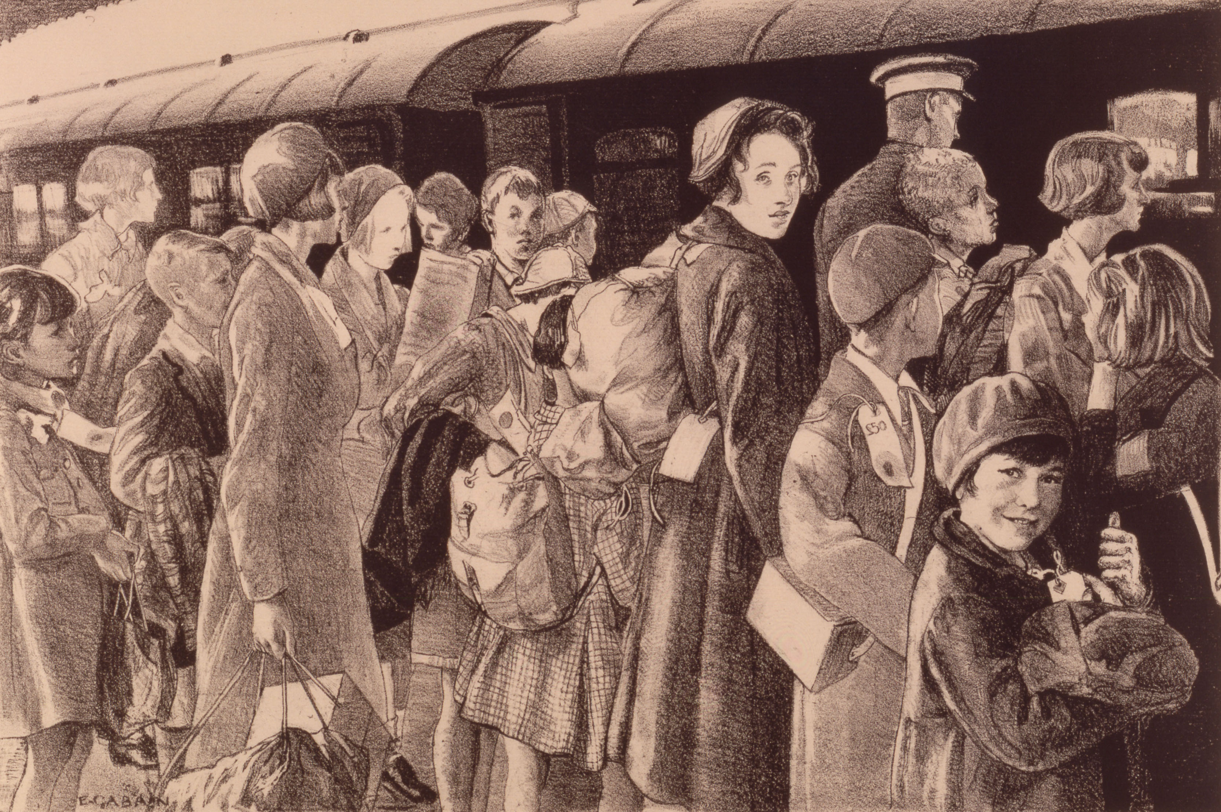
Evacuation
Purpose of “Evacuation”
  Remove people from threatened area to a safe area.
I-2
Notes:
Purpose of “Evacuation” is to remove people from threatened area of hazard to
safe area of refuge (evacuation shelter):

Slide 4
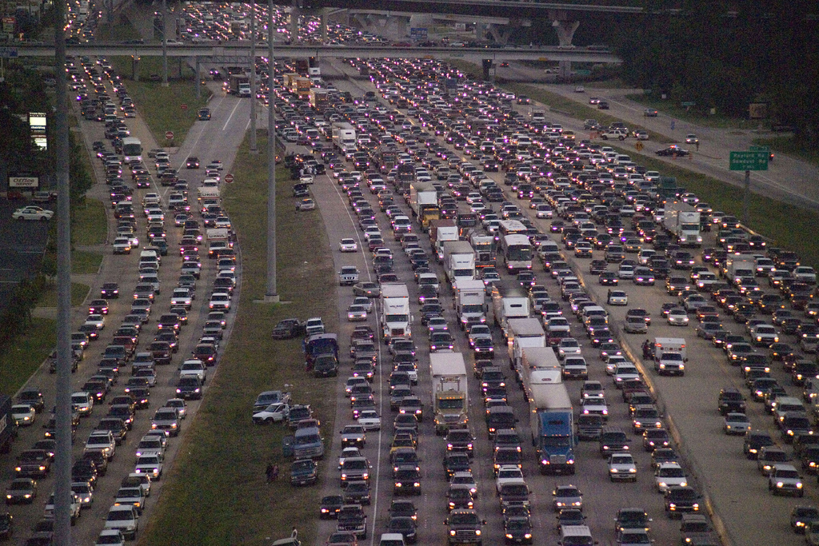
Evacuation
Evacuation: preferred protective action
But, logistically/operationally difficult
I-2

Slide 5
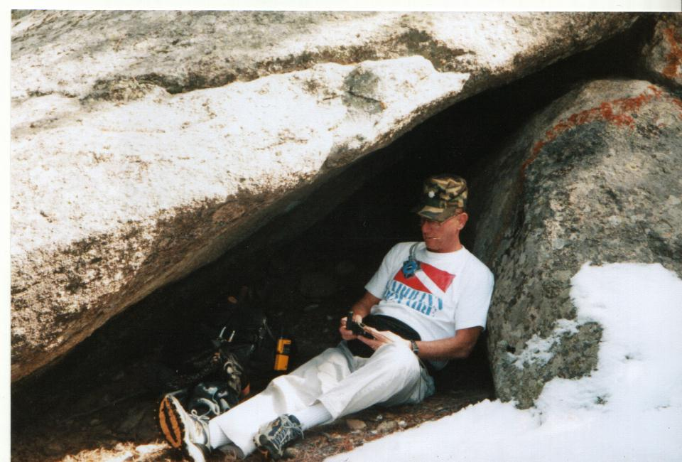
Shelter in Place/In-Place Protection
Purpose —
  Keep people inside protective structure.
May be only practical protective action.
I-2
Notes:
Shelter in place = in-place protection.
Sometimes only practical protective action (especially in congested urban areas).

Slide 6
Selecting Protective Actions
Important but difficult decision
May be no right answer
I-2

Slide 7
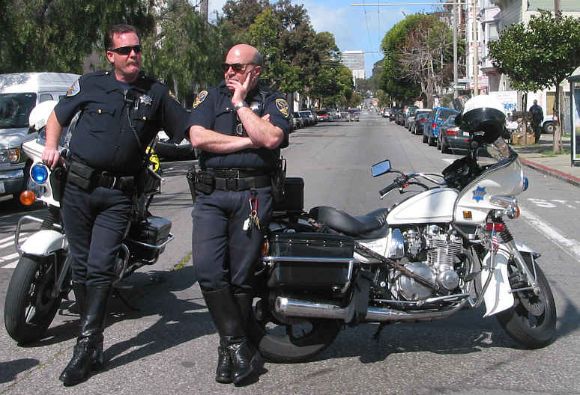
Authorities for Protective Actions
Basic police power
  Restrict movement
  Done during an emergency
  Usually officially enacted
I-4

Slide 8
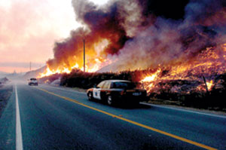
Authorities for Protective Actions
Specific authority
  PC §409.5
    Close or restrict area
    “Disaster” scene
I-4

Slide 9
Authorities for Protective Actions
Emergency Services Act
  GC §8634
    Local gov’t may issue orders
    Protect life and property
I-4

Slide 10
Specific Areas & Locations
Highways
  CalTrans
  Highway Patrol
DeRose Drayage
I-4

Slide 11
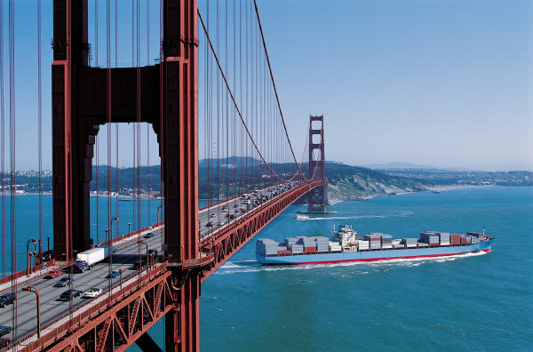
Specific Areas & Locations
Waterways
  Dept. of Boating & Waterways
  Dept. of Water Resources
  U. S. Coast Guard
I-4

Slide 12
Protective Action Considerations
Requires 6 basic considerations.
I-6

Slide 13

Decision Considerations
Materials involved
  Physical state
  Physical properties
  Toxicity
I-6

Slide 14
Decision Considerations
Population threatened
I-6

Slide 15
Decision Considerations
Responder resources & capabilities
I-6

Slide 16

Decision Considerations
Time factors involved
I-6

Slide 17
Decision Considerations
Current and predicted weather
I-6

Slide 18

Decision Considerations
Ability to communicate with public
I-6

Slide 19

Protective Action Messages
Must be clear and concise
  Are to be evacuated
  Evacuation routes
I-8

Slide 20
Protective Action Messages
Speak with one voice
  Mixed messages?
  Confusion = no action
Leave? Stay? Leave? Stay? Leave? Stay?
I-8

Slide 21

Traffic Control
People leave the way they entered
People follow familiar routes
Plan accordingly!
I-8

Slide 22
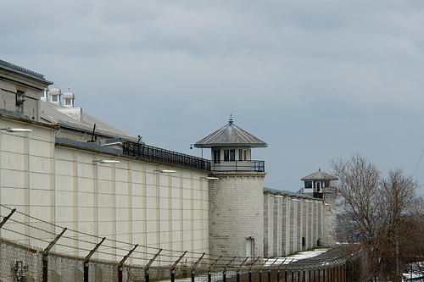
Special Populations
Ability of population to help themselves?
  Need some assistance to move?
  Incapable of being moved?
I-8

Slide 23
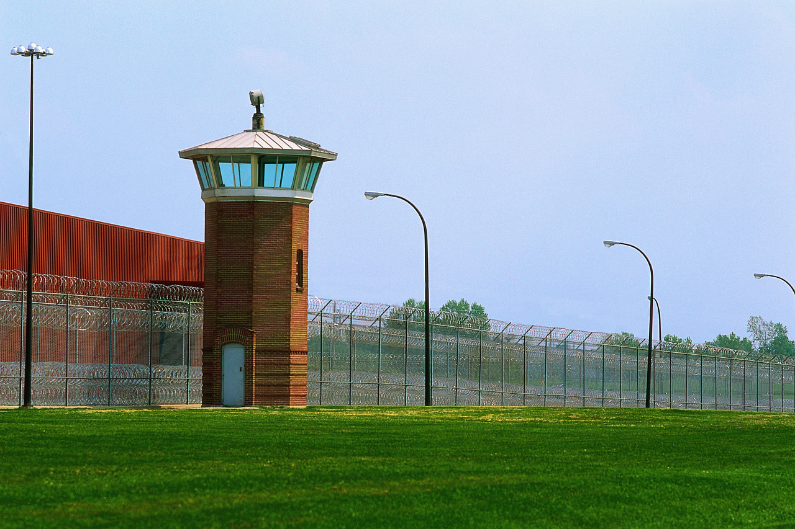
Special Populations
May require Shelter-in-Place
I-8

Slide 24
ERG & Protective Actions
Orange-bordered pages
  Isolation distances
  Evacuation distances
I-10

Slide 25
ERG & Protective Actions
Green-bordered pages
  Table 1
  Table 2
  Table 3
I-10

Slide 26

ERG & Protective Actions
Day vs. Night?
I-10

Slide 27

Day
Atmosphere more “active”
Material disperses more quickly
I-10

Slide 28

Night
Atmosphere more “stable”
Material disperses less quickly
I-10

Slide 29
Summary
Selecting an option is half the job
No choice will be easy to implement
I-10

