Slide 1
Protective Equipment & First Responder Limitations

Slide 2
IDHA & Protective Equipment
After IDHA
  Determine safety of field personnel via protective equipment levels and needs.
G-2

Slide 3
Protective Equipment
Protective Clothing
  (Proper level)
Respiratory Protection
  SCBA/APR
Monitoring Devices
G-2

Slide 4
Determining Level of PPE
Physical state of material
Hazards of material
Routes of entry & exposure
G-2

Slide 5
OSHA Requirements
Require SCBA for inhalation hazards
FROs lack PPE
No PPE = defensive actions only
G-2

Slide 6
Bottom Line
PPE keeps you safe
G-2

Slide 7
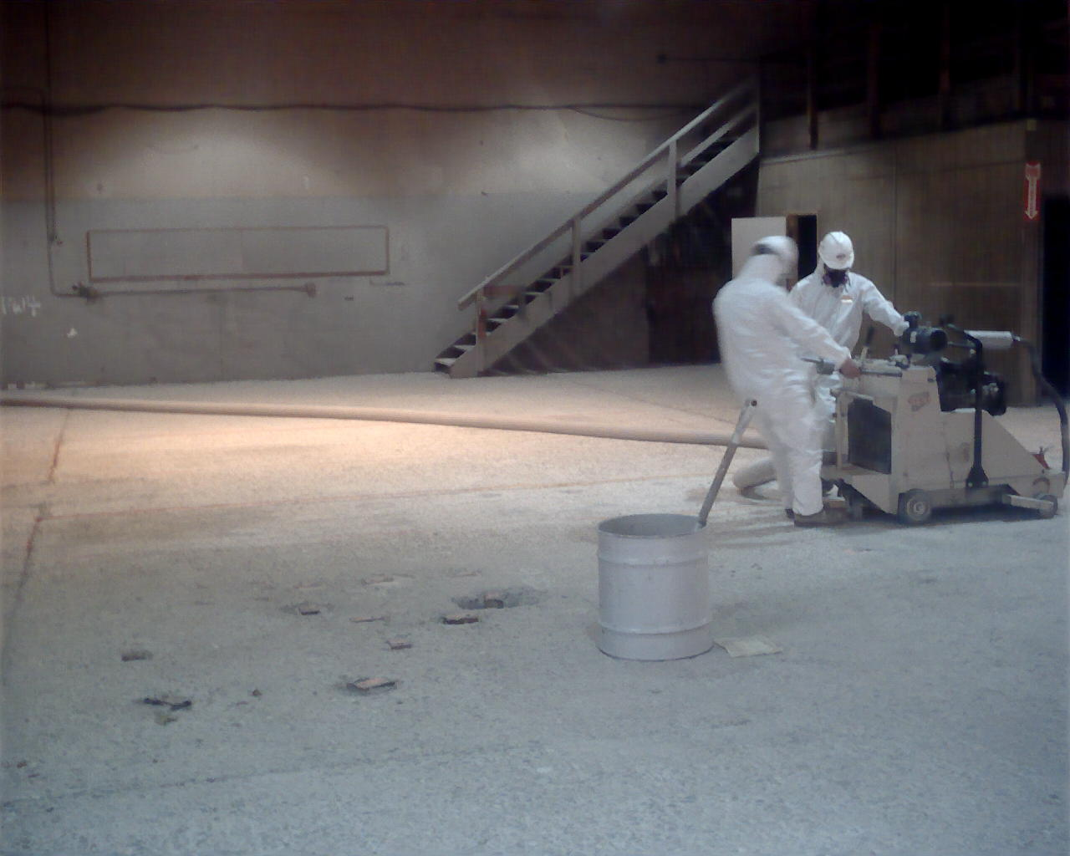
Need for PPE
Responders may be exposed by…
  Inhalation
  Ingestion
  Absorption
  Injection
G-4

Slide 8
Need for PPE
Protects you
Gets in between bad stuff and route(s) of entry
G-4

Slide 9
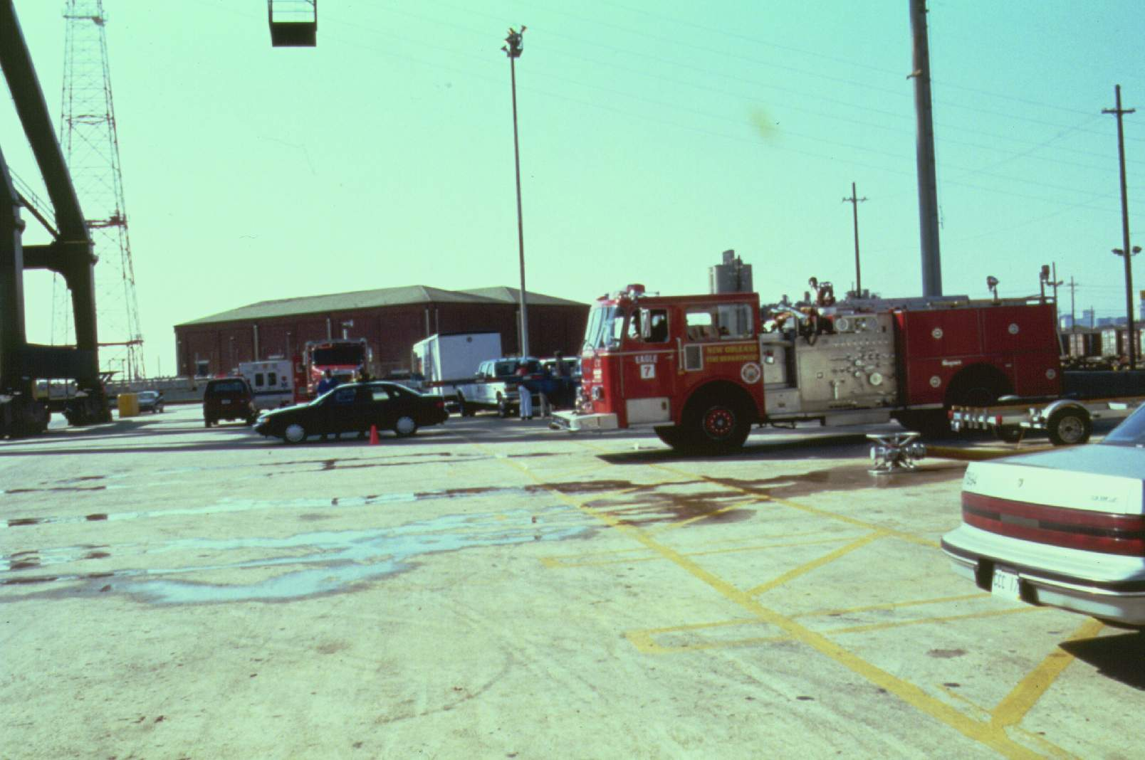
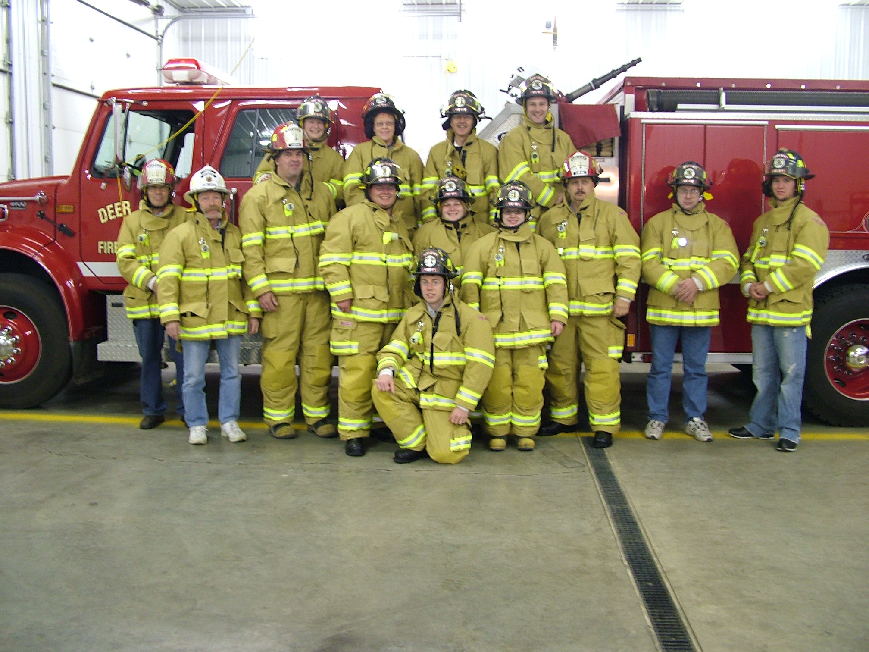
Limits of PPE
Firefighter turnouts
  Not chemical protective clothing
  Level D only
G-4

Slide 10
Limits of PPE
Law enforcement
  Little or no PPE
  Leather may absorb hazmats
G-4

Slide 11
Limits of PPE
EMS operations
  Universal precautions not “universal”
    Bloodborne pathogens only
    No protection against vapors/gases
G-4

Slide 12
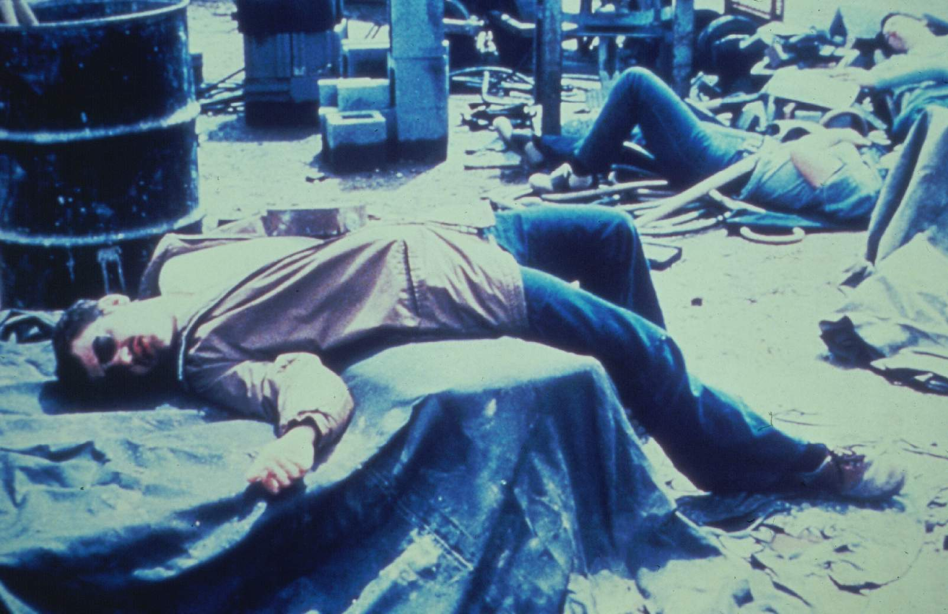
Typical Hazards On-Scene
First Responders
  Inhalation – primary hazard
  Others
    Oxygen deficiency
    Poisoning
    Burns, cuts, abrasions etc.
G-4

Slide 13
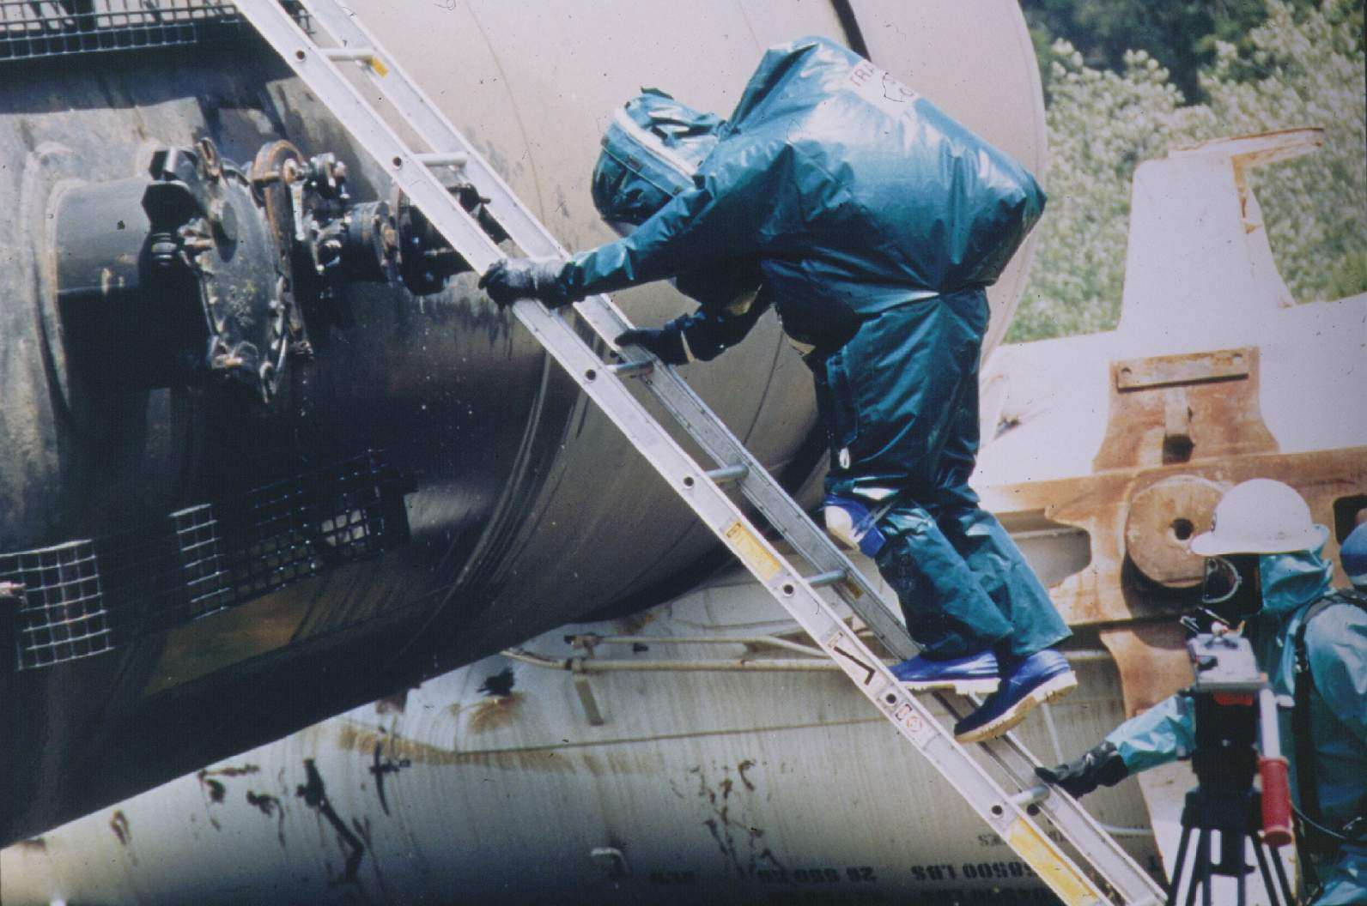
Typical Hazards On-Scene
Technicians/Specialists
  Heat stress – primary hazard
  Others
    Damaged containers
    Slips, trips & falls
G-4

Slide 14

Injuries to Responders
Minor injuries – inhalation
Major injuries – corrosives
Deaths – flammable liquids (fires)
G-4

Slide 15
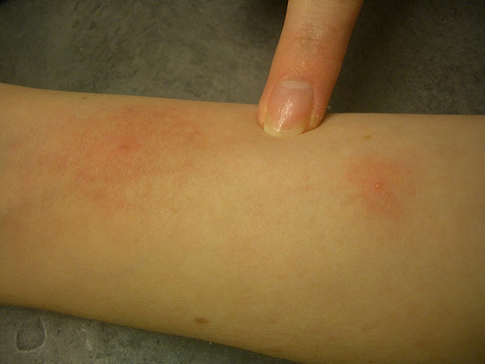
Skin Contact Hazards
Hazard Class 1 – Nitroglycerin
  Systemic toxin
  Readily absorbed by the skin
G-6

Slide 16
Skin Contact Hazards
Hazard Class 2 – Diethylamine
  Toxic in contact with skin
  Severely corrosive to skin
G-6

Slide 17
Skin Contact Hazards
Hazard Class 3 – Benzene
  Systemic toxin
  Known carcinogen
G-6

Slide 18
Skin Contact Hazards
Hazard Class 4 – Pentaborane
  Skin contact may be fatal
  Causes chemical burns
G-6

Slide 19
Skin Contact Hazards
Hazard Class 5 – Fluorine
  Toxic in contact with skin
  Causes chemical burns
G-6

Slide 20
Skin Contact Hazards
Hazard Class 6 – Phenol
  Toxic in contact with skin
  Can cause blisters & inflammation
G-6

Slide 21
Skin Contact Hazards
Hazard Class 7 – Uranium Hexafluoride
  Toxic in contact with skin
  Severe irritant
G-6

Slide 22
Skin Contact Hazards
Hazard Class 8 – Hydrofluoric Acid
  Toxic in contact with skin
  Causes deep-seated ulceration
G-6

Slide 23
Skin Contact Hazards
Hazard Class 9 – PCBs
  Can penetrate intact skin
  Causes chloracne
G-6

Slide 24




Protective Clothing “Levels”
A Best respiratory & skin protection
B High resp. prot., less for skin
C APR & modest skin protection
D Ordinary work uniform
  Minimal protection!

Slide 25
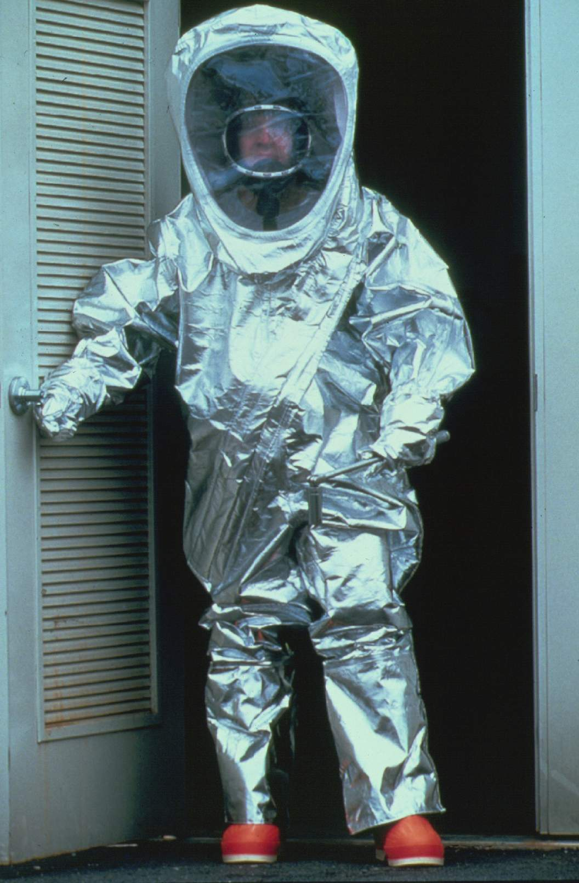
Level A
SCBA
Chemical protective clothing (CPC)
  Fully-encapsulated
  Vapor/gas tight
G-8

Slide 26
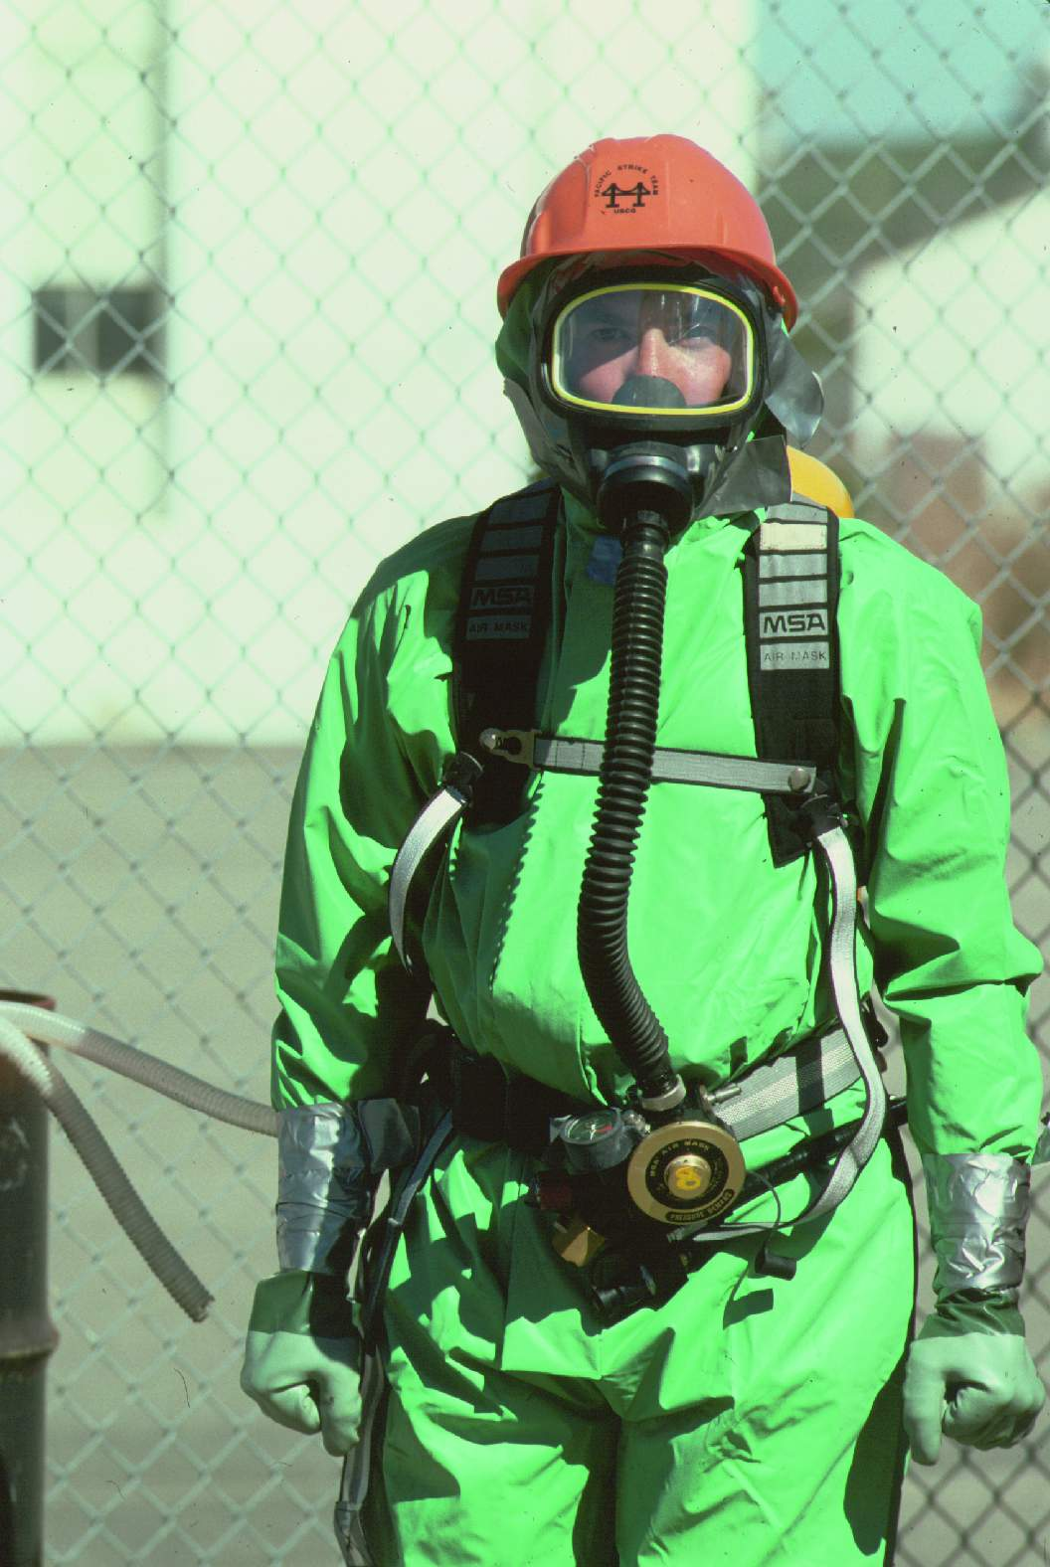
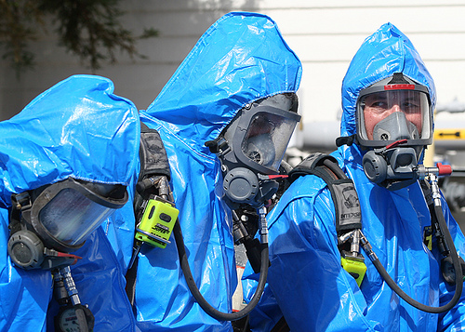
Level B
SCBA
Hooded CPC
  May be encapsulated
  Not vapor/gas tight
G-8

Slide 27
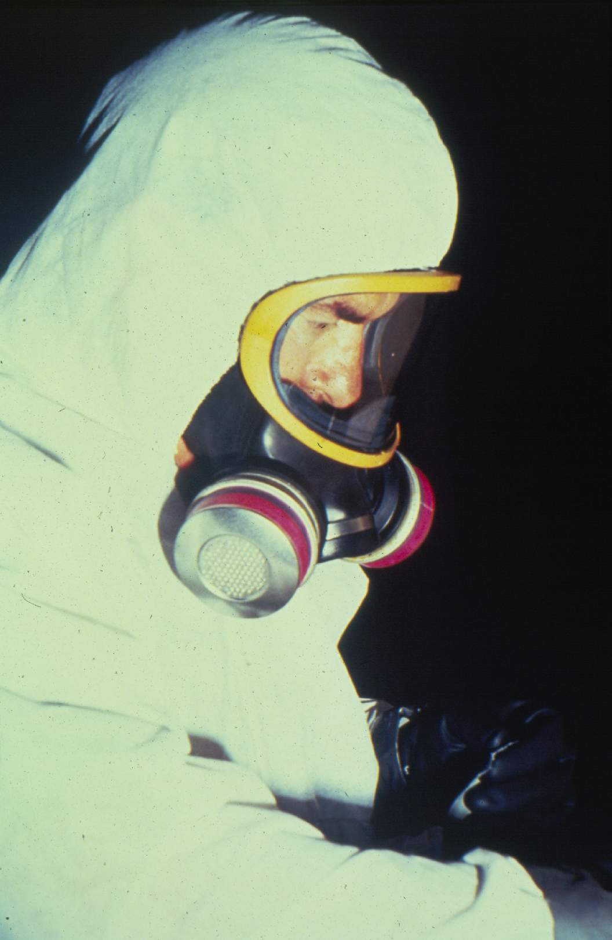
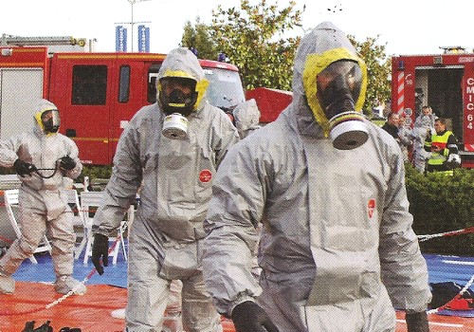
Level C
Air purifying respirator (APR)
Hooded CPC
G-8

Slide 28
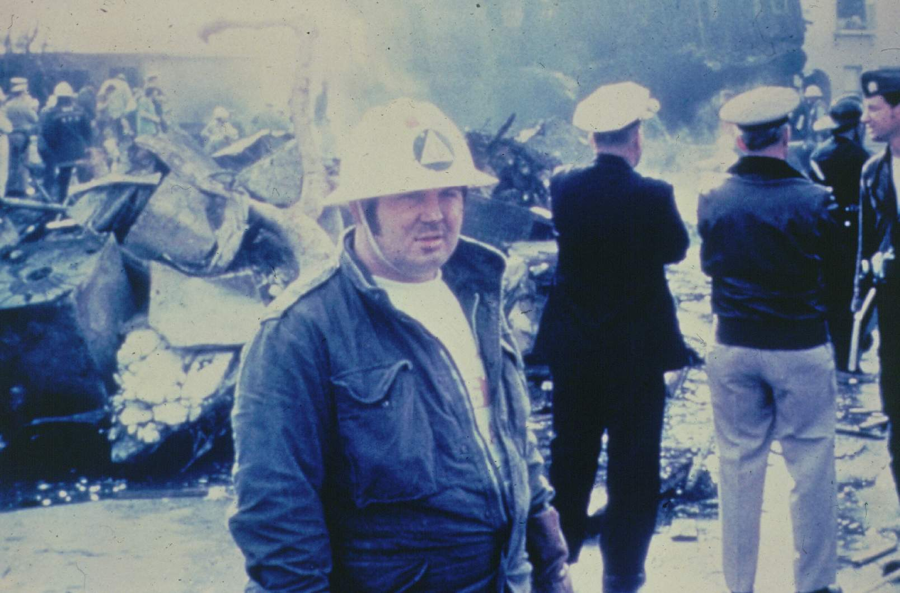
Level D
Ordinary work clothing
  May have no respiratory protection
  Minimal splash/vapor protection
  May absorb liquids/vapors
G-8

Slide 29
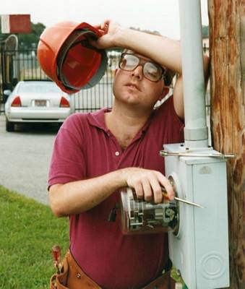
Limitations of PPE
Level A-B
  Limited mobility, restricted vision, finite air supply & heat stress
Level C
  Limited mobility, restricted vision & heat stress
G-8

Slide 30
Number One FRO Limitation
Lack of PPE
  You don’t have any!
G-8

Slide 31
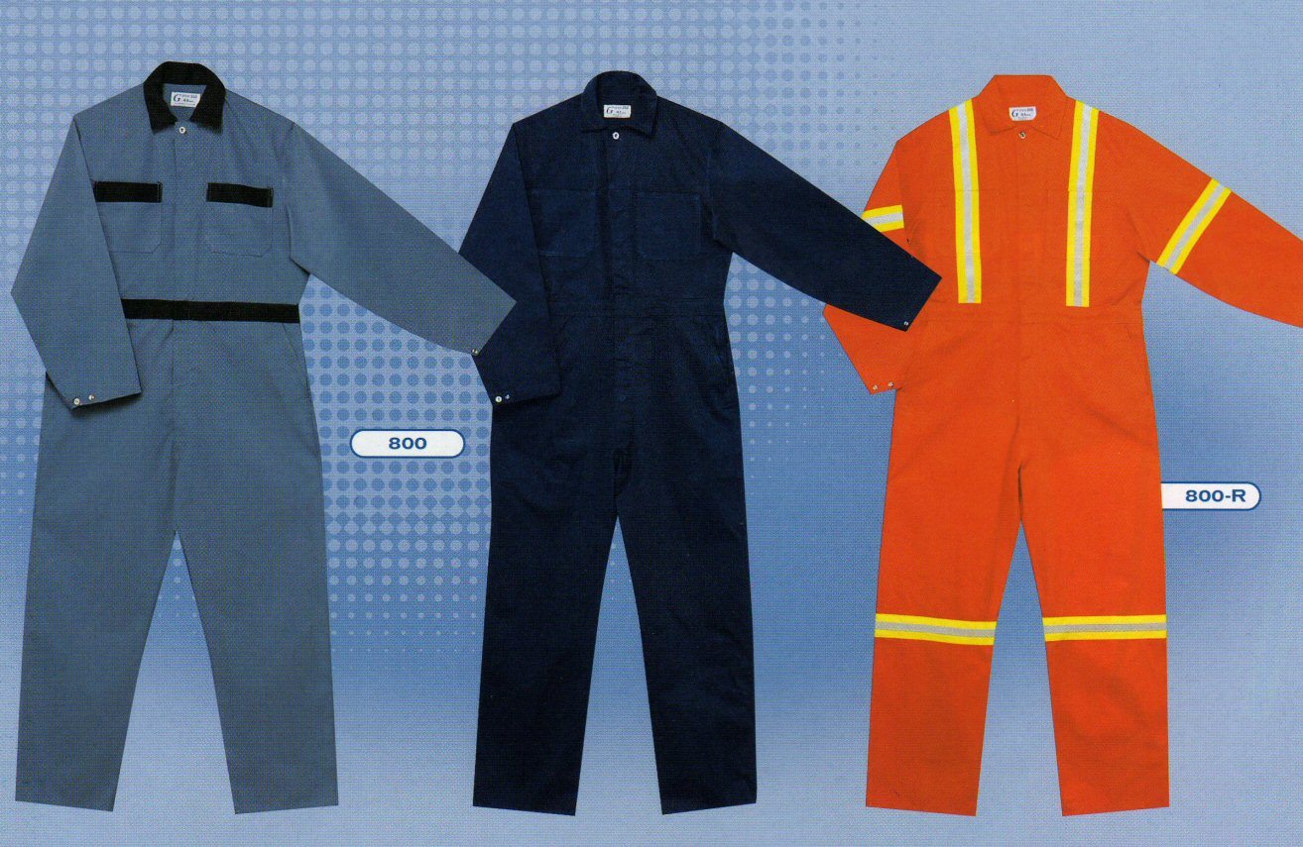
Protective Clothing “Levels”
Coveralls, work uniforms & firefighter turnouts are Level -D!
Provide no respiratory protection & only limited chemical protection
G-8

Slide 32
Selection Criteria
Physical form of material
Degree of hazard
Other
  Oxygen level
  CPC compatibility
  Degree of unknowns
G-10

Slide 33
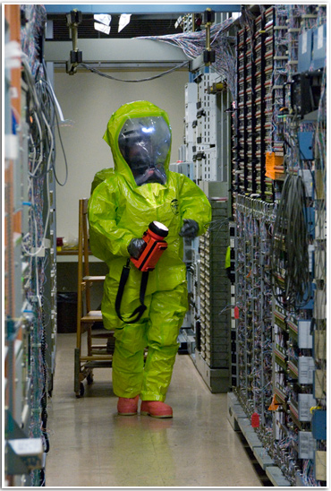
Selection Criteria
Level A
  Unknown material
  Skin absorption hazard
  Splash hazard
  Confined space
G-10

Slide 34
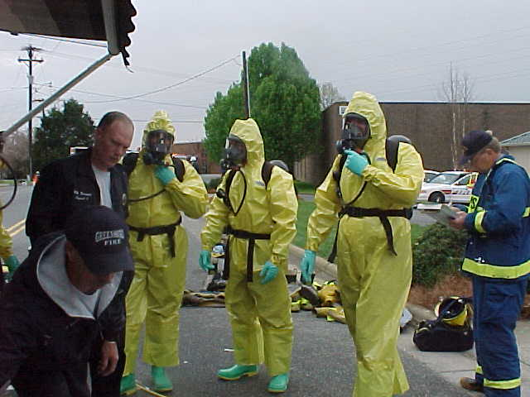
Selection Criteria
Level B
  Low oxygen
  Incomplete IDHA
  Vapor/gas hazard
G-10

Slide 35
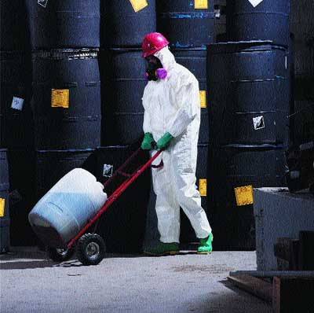
Selection Criteria
Level C
  No skin hazard
  Known materials
  Enough oxygen
G-10

Slide 36

Selection Criteria
Level D
  No hazard!
G-10

Slide 37
Control Zones & PPE
Exclusion zone
  Level A, B or C
  (Level C rarely used for emergency response)
Contamination Reduction Zone
  Same or one level below EZ
Support Zone
  None required
G-10

Slide 38
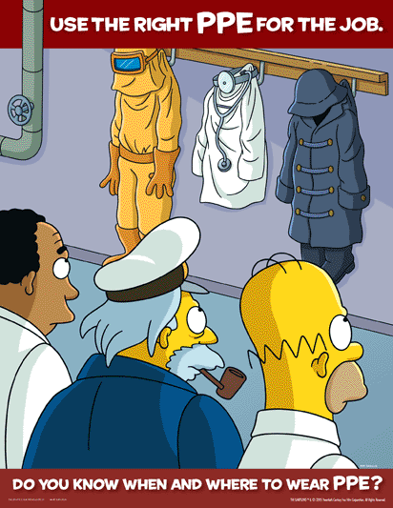
Selection Approval Process
Hazmat Group
Safety Officer
Incident Commander
G-10

Slide 39

Respiratory Protection
Prevents you from inhaling bad stuff
G-12

Slide 40
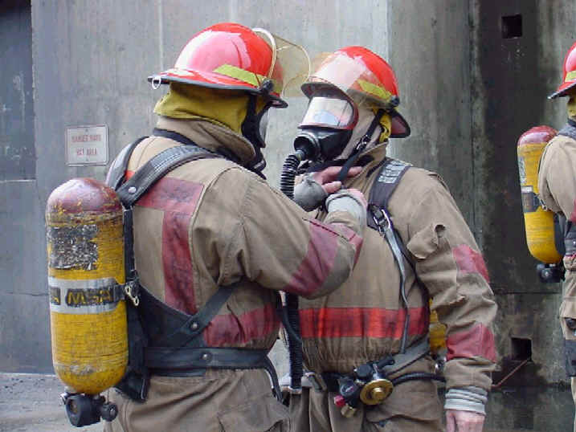
Respiratory Protection
Supplied Air Respirator
  SAR
Self-Contained Breathing Apparatus
  SCBA
Air-Purifying Respirator
  APR
G-12

Slide 41
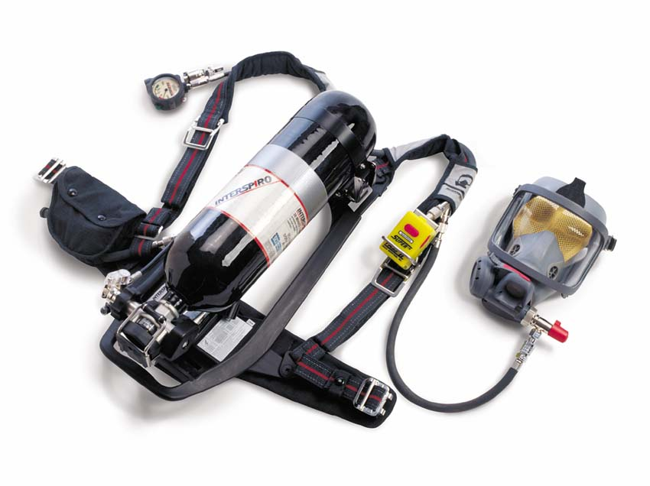
Components of SCBAs
Face Piece
Cylinder
Regulator
Harness
G-12

Slide 42
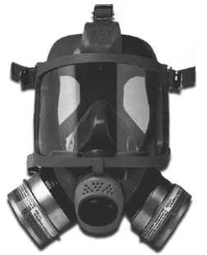
Components of APRs
Face Piece
Canister(s)
G-12

Slide 43
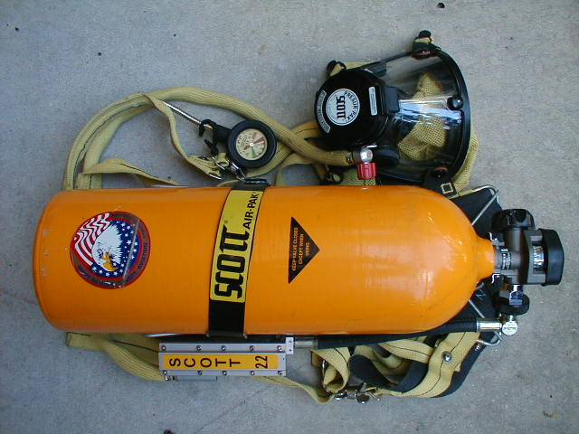
Limitations
SCBA: finite air supply
SAR: limited length of hose
APR: limited filter life
G-12

Slide 44
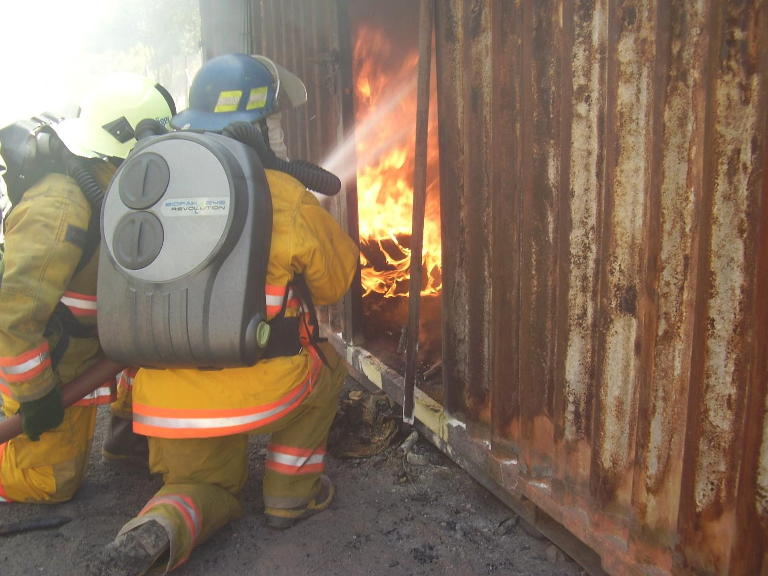
Limitations
Closed-circuit SCBA (Rebreather)
  Generates heat
  Permit longer work time
    Increases risk of heat stress
  Mechanically more complex
G-12

Slide 45
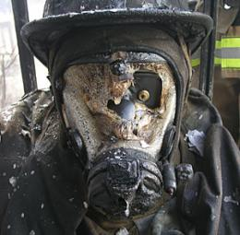
Limitations
All will eventually fail!
G-12

Slide 46
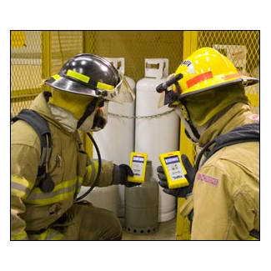
Monitoring & Sampling Devices
Purpose
  Detect Hazmat presence
  Measure concentration
  Estimate size of affected area
  Document incident conditions
G-14

Slide 47
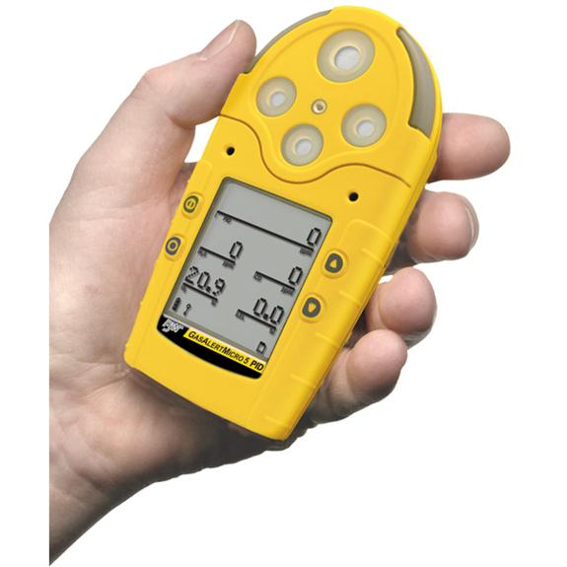
Monitoring Equipment Types
Types FROs use
  CGI
  O₂ meter
  Rad meter
  pH paper
G-14

Slide 48

PPE Risks and Limits
Penetration
Degradation
Permeation
G-14

Slide 49

PPE Limits
Heat stress
  CPC interferes with heat dissipation
  Core body temp will rise when in CPC
G-14

Slide 50
PPE Limits
Impaired vision and mobility
No one suit protects for all hazmats
G-14

Slide 51
Protective Equipment Limits
Thermal influences
Seal–a–meal
Cryogenic hazards
Effect of temperature on shelf life
G-14

Slide 52
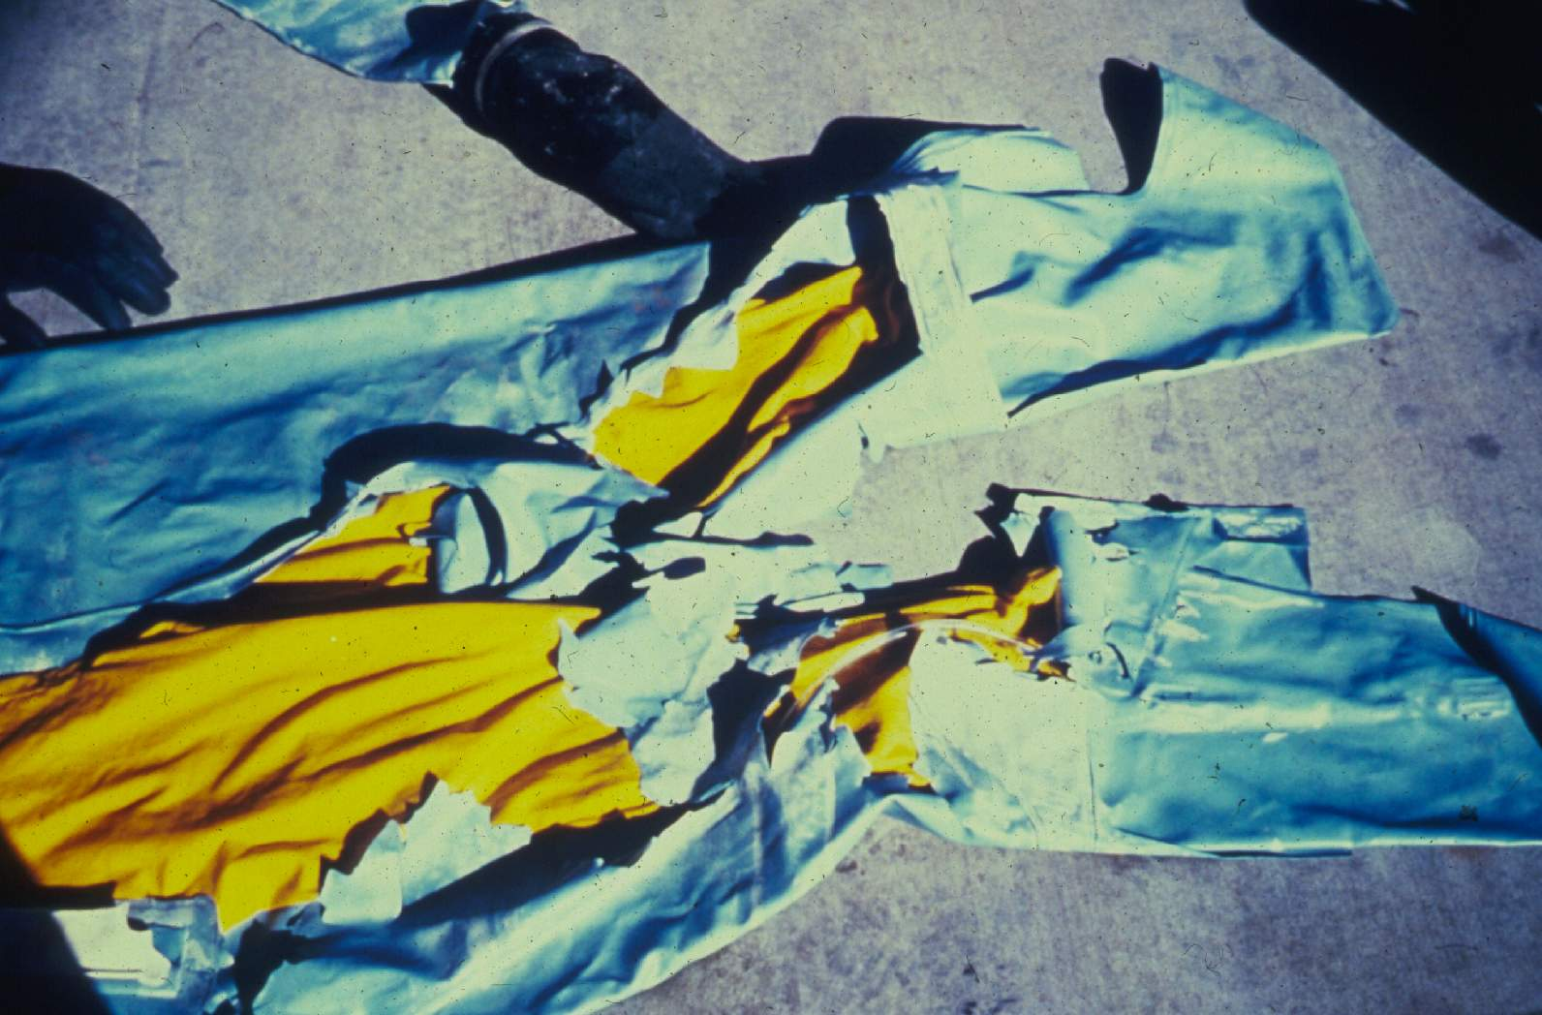
G-14
Notes:
Liquid chlorine sprayed on this suit. The suit material froze and broke.

Slide 53

FRO Limits
Lack of protective clothing limits FROs to Level D & defensive actions!
G-14

