Slide 1
IDHA and Action Plans: (I.A.)

Slide 2
IDHA Process
Most critical aspect of a response
  All decisions flow from this
  Regs require IC to do it
  Can’t protect yourself if you can’t identify the problem!
Notes:
Protect:
Life,
Environment,
Property.
In that order!

Slide 3
Hazard Assessment Starts Immediately
Starts with initial discovery/notification
Use recognition clues & common sense
Caution: Initial reports may not be accurate or complete.

Slide 4

Basic FRA IDHA Process
Identify material(s)
Consult ERG/SDS
Follow employer’s policies

Slide 5

Basic IDHA Questions
Will something bad happen now?
  Is it on fire?
  Can it explode or burn?
  Is there a gas or vapor present?

Slide 6
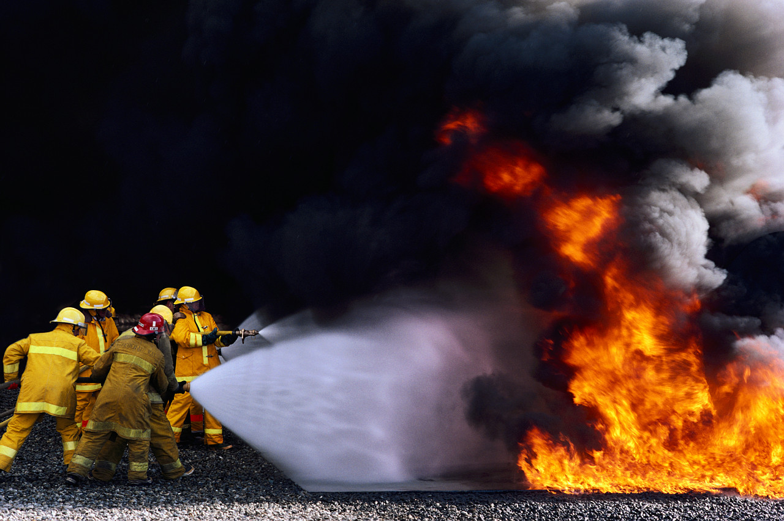
Basic IDHA Questions
Can it hurt me?
  Toxic
  Flammable
  Corrosive
  Radioactive

Slide 7
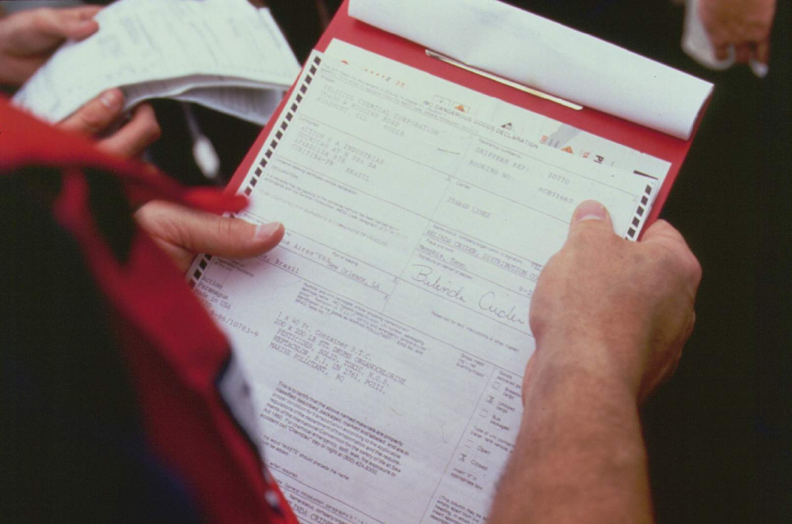
Hazard Identification Sources

Slide 8
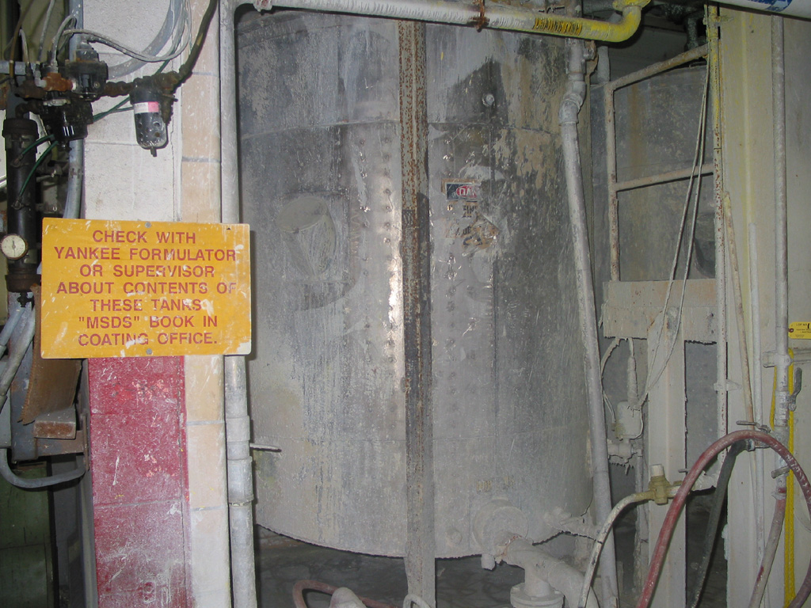
Safety Data Sheets
Material Safety Data Sheets (old)
Safety Date Sheets (new)
  Same thing, only different

Slide 9
SDS - Who
Required by OSHA Hazcom Standard
  29 CFR 1910.1200
  Title 8 CCR 5194

Slide 10
SDS - Purpose
Informs employees of “hazardous chemicals”
Ensures all chemicals hazards are:
  Evaluated and
  Info is transmitted to employees

Slide 11
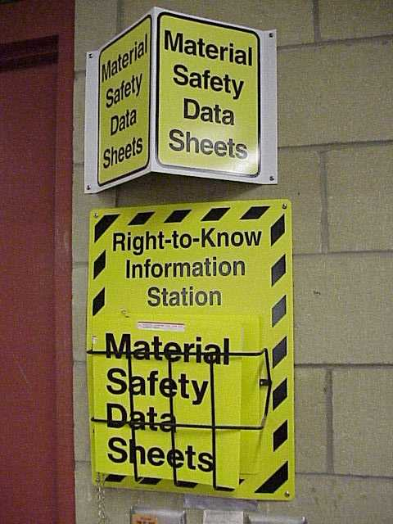
SDS - How
Transmits info via:
  Haz. Comm. Program
  Container labeling
  MSDS/SDS
  Employee training

Slide 12
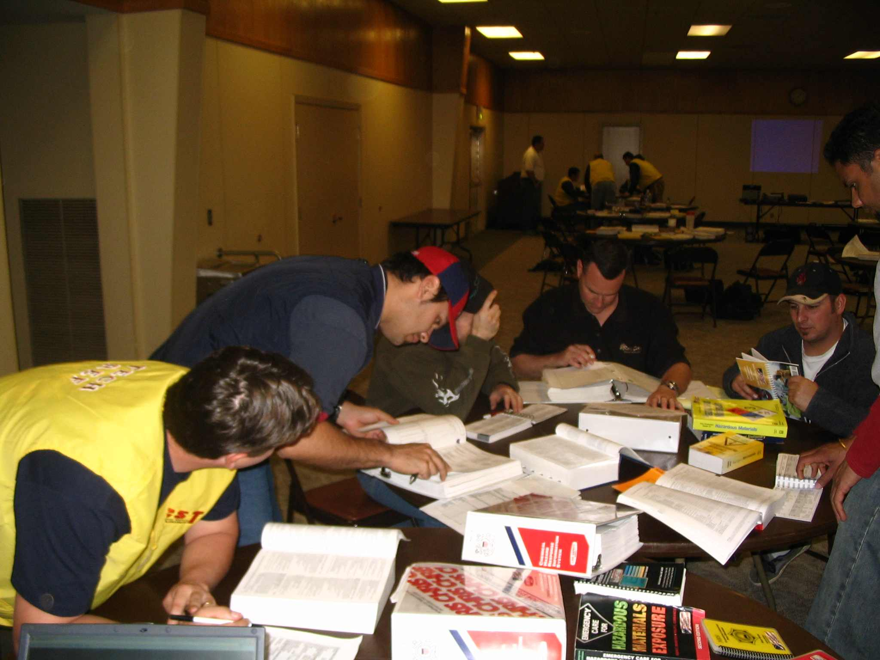
SDS
Major source of hazmat info

Slide 13
SDS Provides Info On…
Physical properties
Hazards of material
Signs & symptoms of exposure
Exposure levels
PPE recommended
Manufacturer contact info

Slide 14
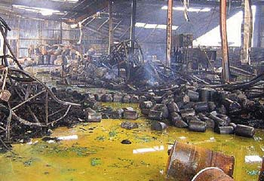
Who Can Provide SDS
Workplace involved
Manufacturer/distributor
CHEMTREC

Slide 15
Hazard Identification Sources
DOT placards, labels & markings

Slide 16
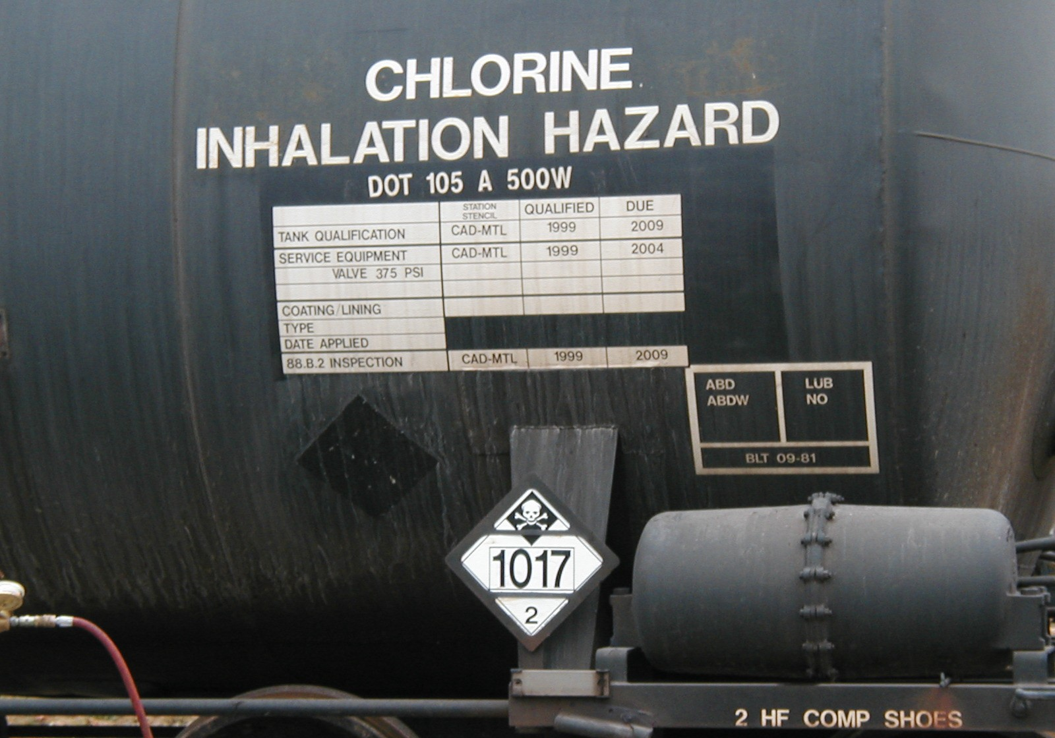
Hazard Identification Sources
Placards and labels
  Stenciled railcars

Slide 17
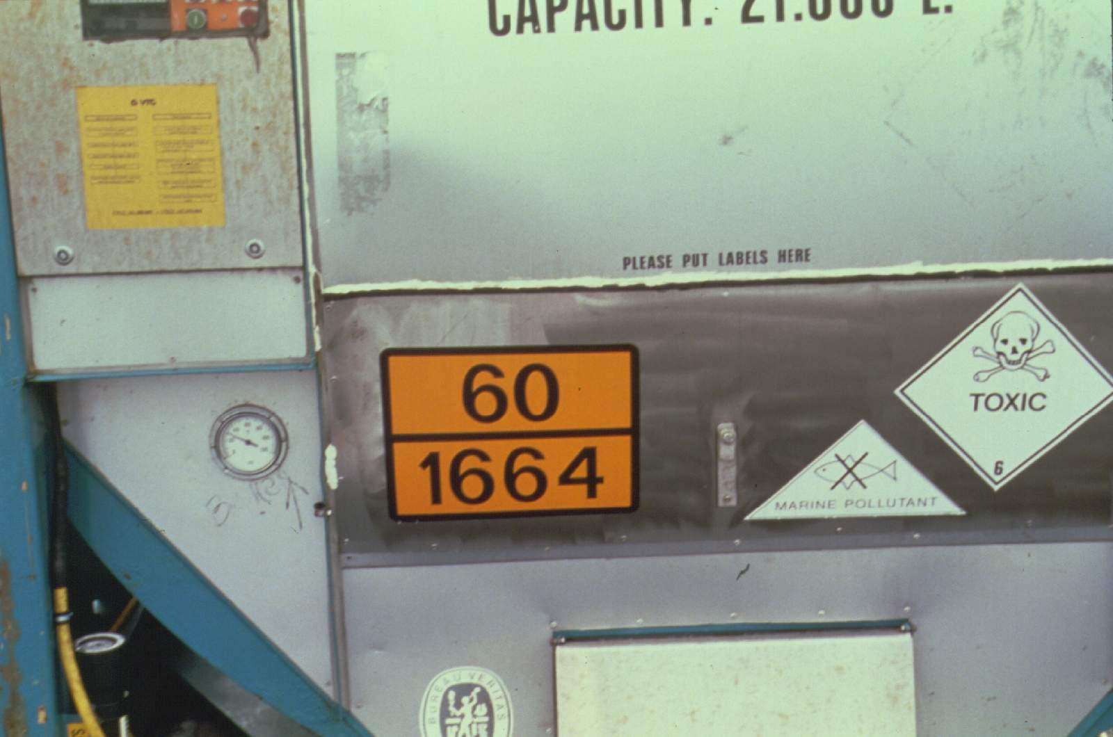
Hazard Identification Sources
Placards and labels
  ID # on placards & orange panels

Slide 18
Hazard Identification Sources
DOT Radioactive labels
  White I (lowest level of activity)
  Yellow II
  Yellow III (highest level of activity)

Slide 19
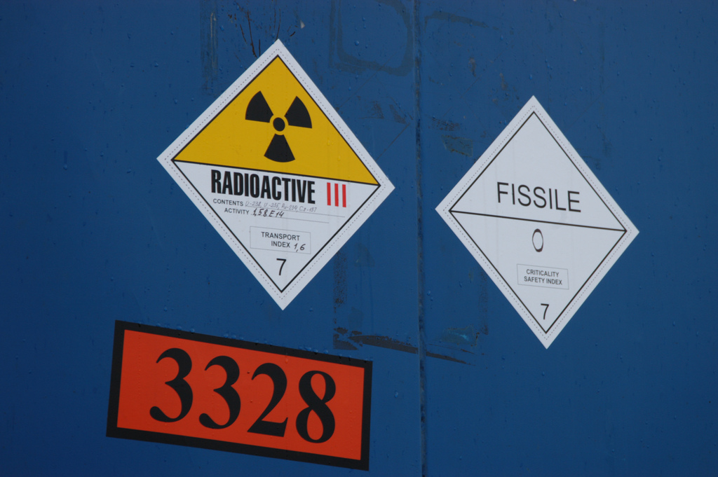

Slide 20
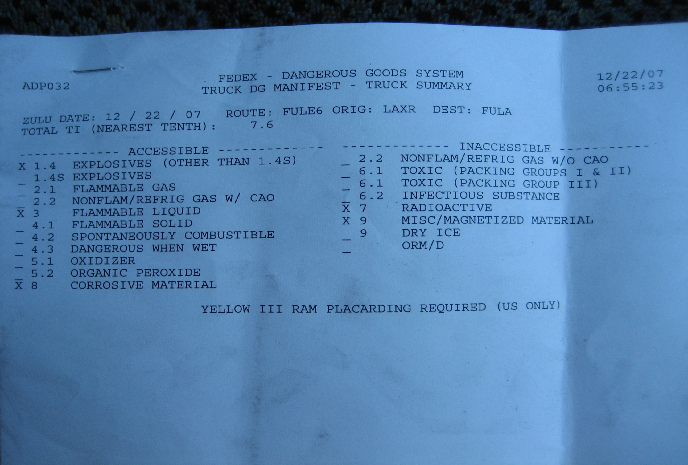
Hazard Identification Sources
Shipping papers
“X” marks the spot!

Slide 21
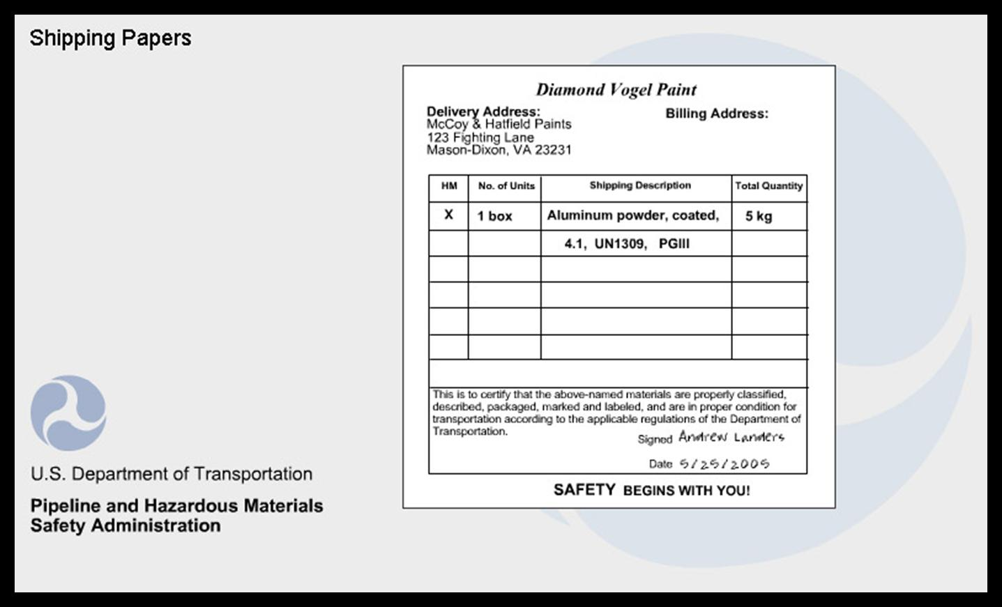
Proper Shipping Name

Slide 22
Hazard Class

Slide 23
ID Number

Slide 24
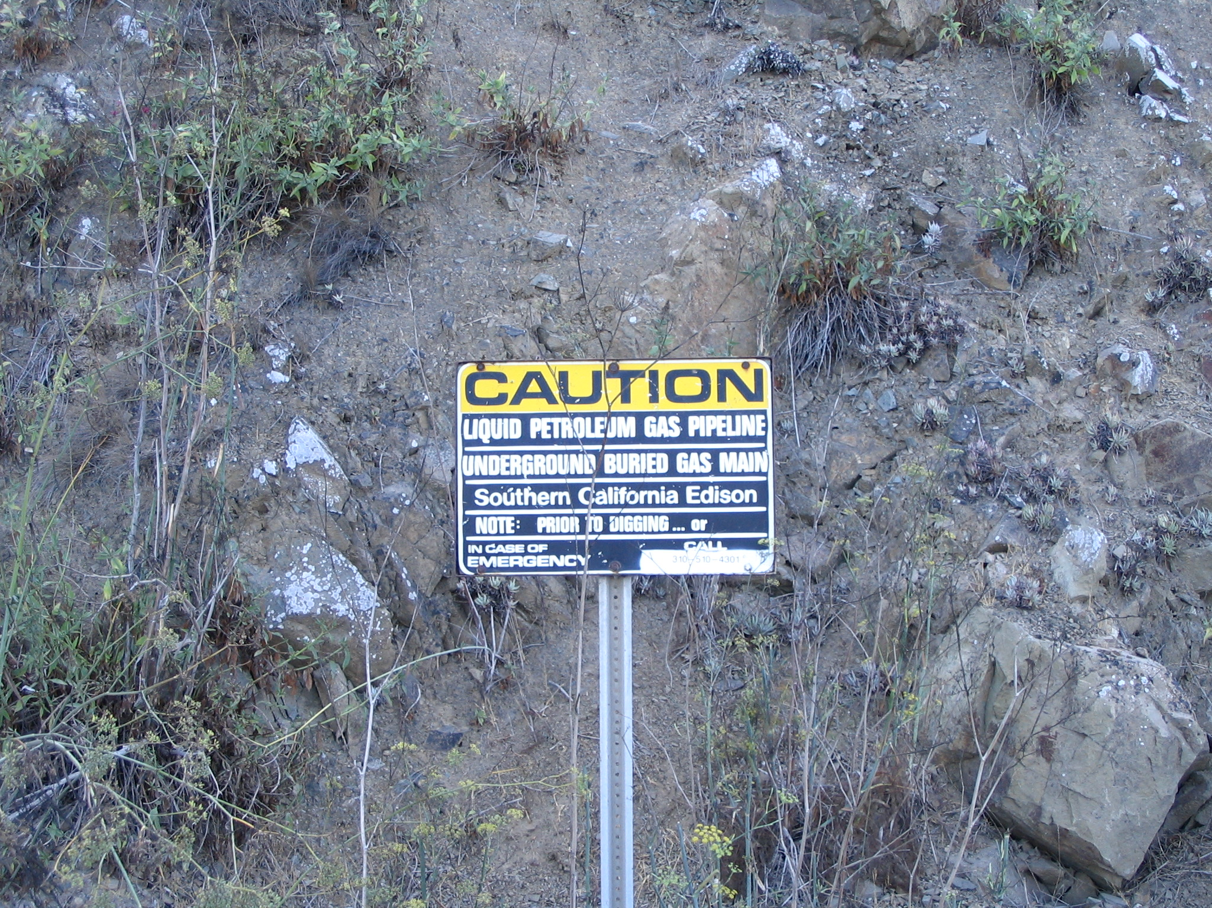
Hazard Identification Sources
Pipeline Markers
  Level of hazard
  Name of product

Slide 25
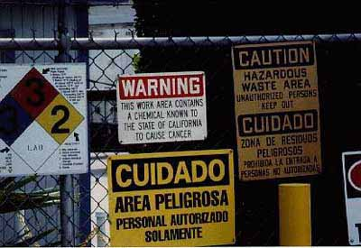
Hazard Identification Sources
Three sources minimum!

Slide 26

Hazard Assessment Sources

Slide 27

NFPA 704 System
Health = Blue
Flammability = Red
Instability = Yellow
Special Hazards = No color (usually white)

Slide 28
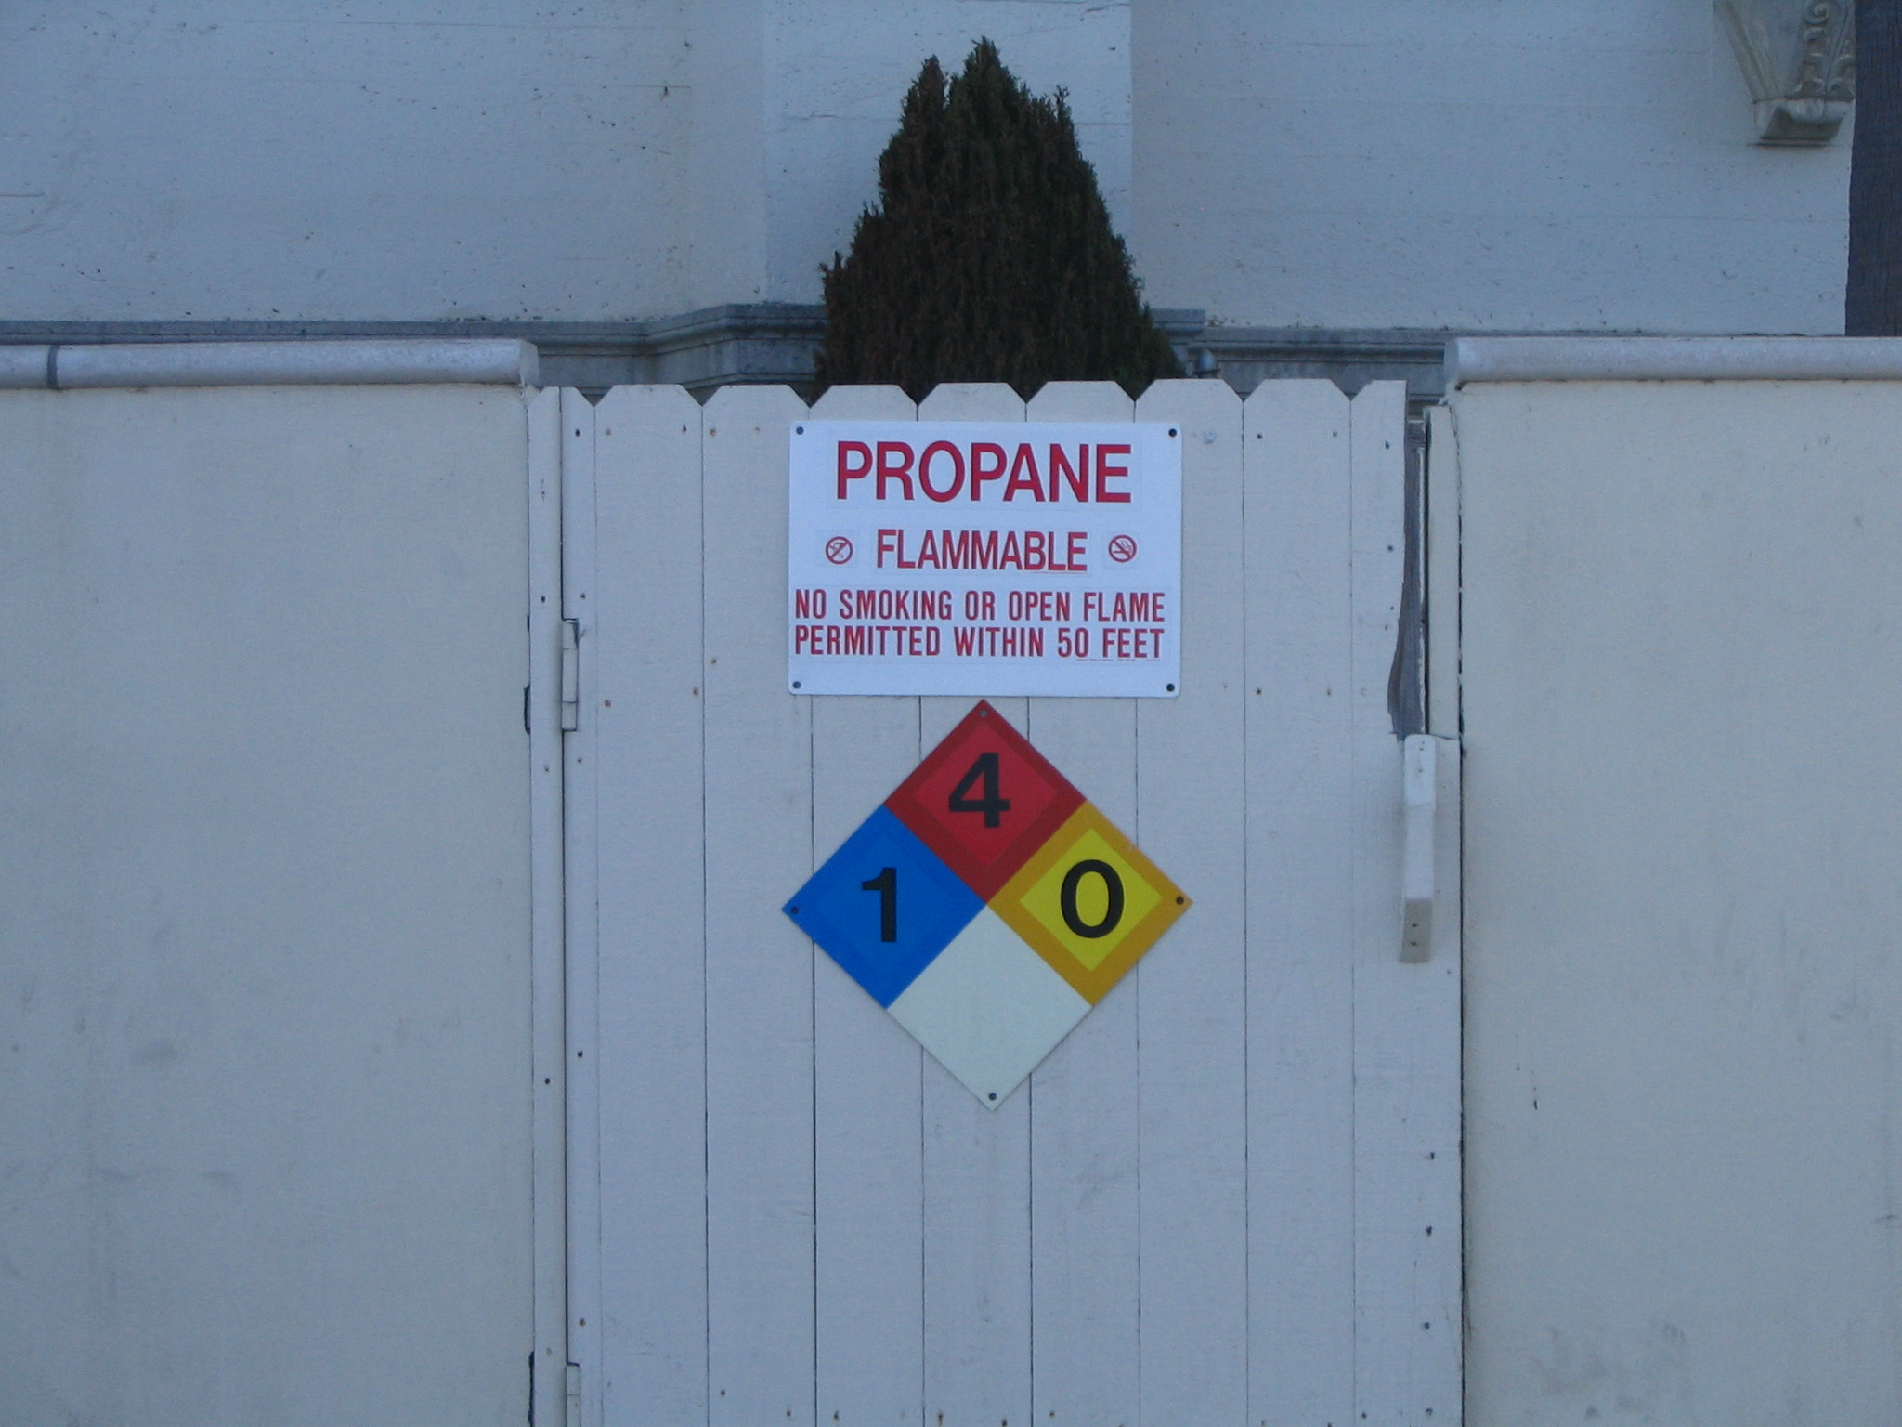
NFPA 704 System
0-4 rating scale for hazards
  4 – severe hazard
  0 – minimal hazard

Slide 29
Special hazard symbols
COR (corrosive)
POL (polymerization hazard)
OXY (oxygen or oxidizer)
Trefoil (radiation hazard)
W (water reactive)

Slide 30
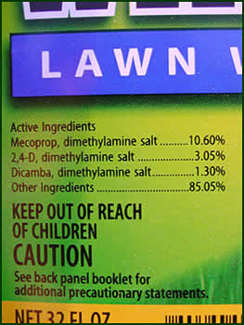
Pesticides & Consumer Products
Label must include
  Chemical Name
    Consumer products
  Ingredient Statement
    Pesticides

Slide 31
Product Label Signal Words
Pesticides & Consumer Products
  Danger (highest hazard)
  Warning (moderate hazard)
  Caution (lowest hazard)
Bad Stuff

Slide 32
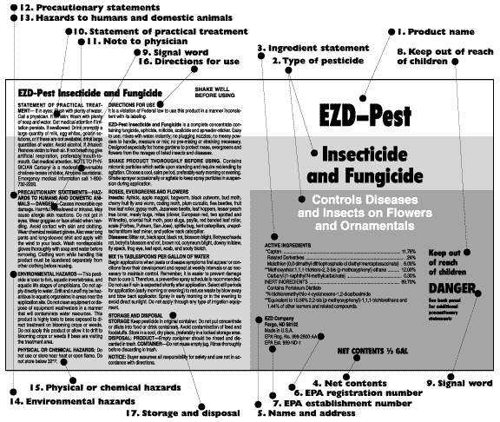

Slide 33
Statement of Principle Hazards
Wording to describe hazards
  Flammable
  Combustible
  Causes Burns
  Etc.

Slide 34


Slide 35
Precautionary Statements

Slide 36
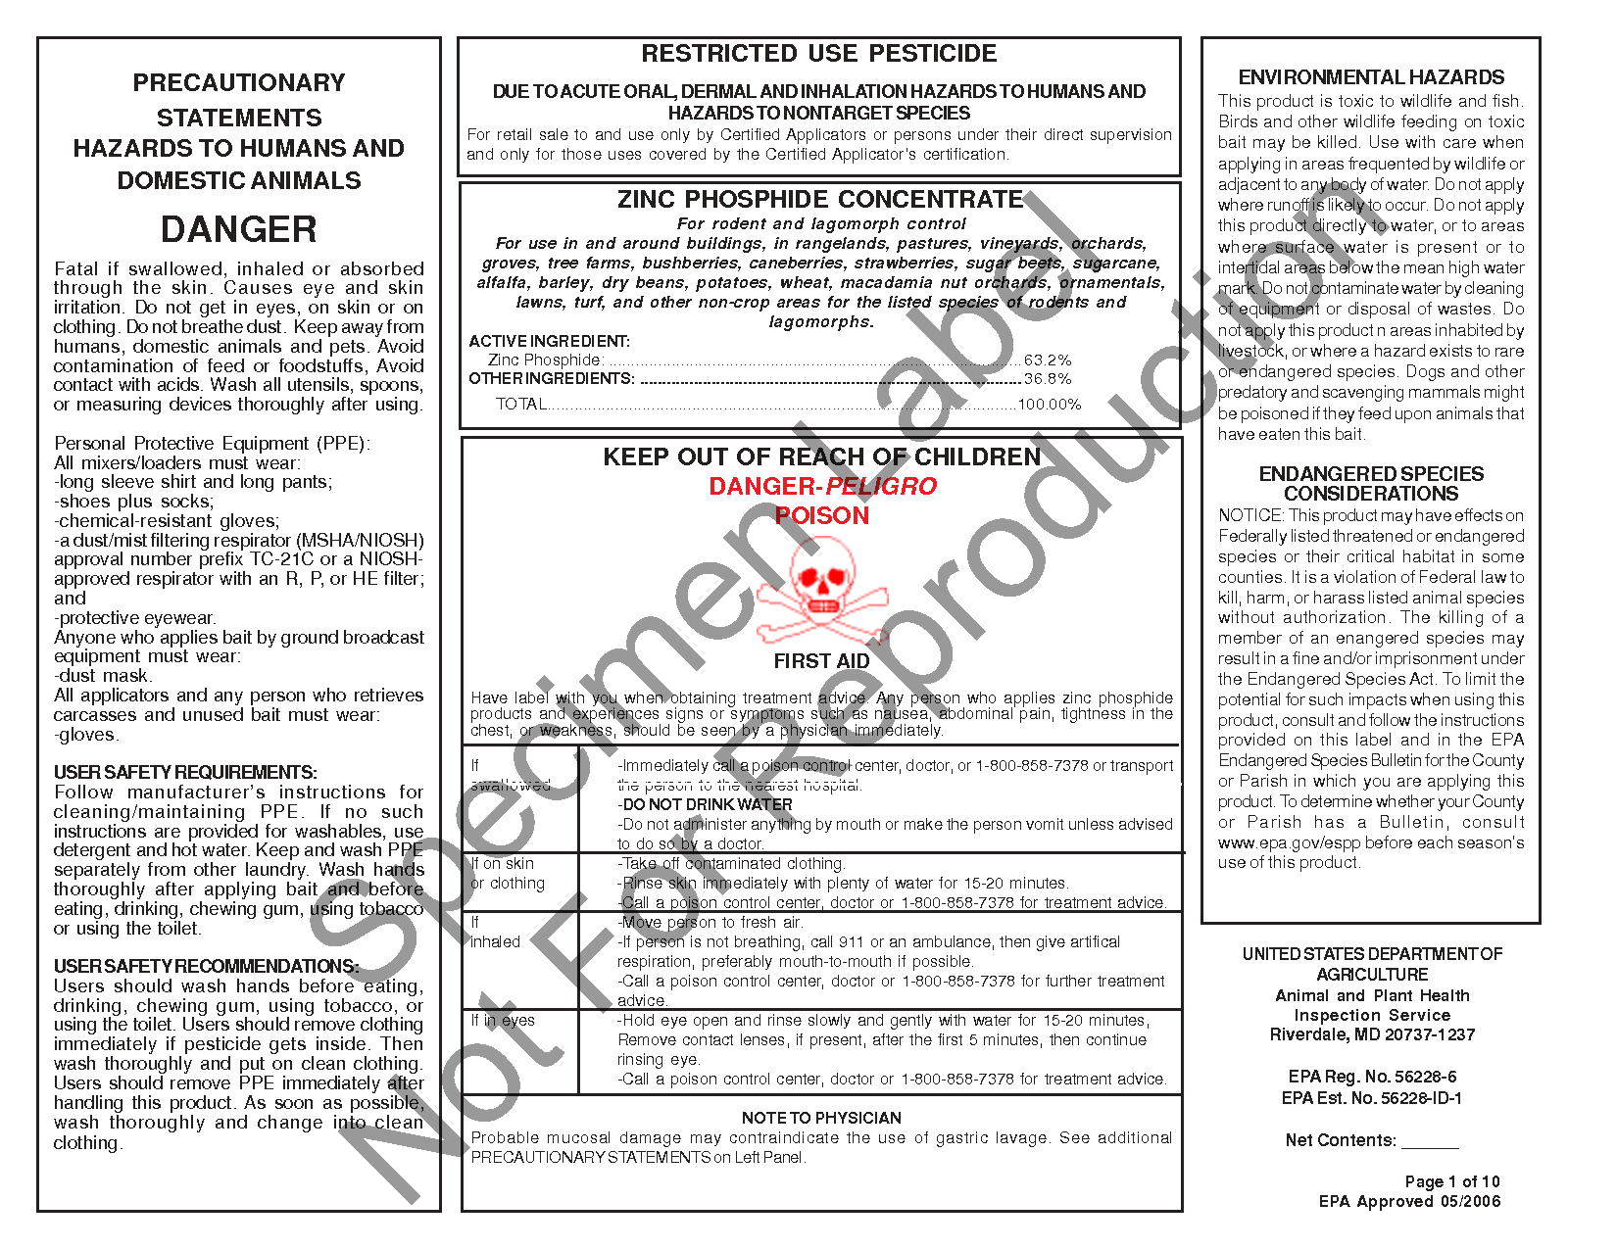

Slide 37
CHEMTREC
CHEMTREC
  Chemical Transportation Emergency Center
24 Hour technical information center
Call (800) 424-9300

Slide 38


CHEMTREC
Can provide SDS
  Over 4 million available
Has access to variety of specialists

Slide 39

CHEMTREC
Will connect emergency responders with product specialists

Slide 40

Other Reference Guides
NIOSH Pocket Guide

Slide 41

Other Reference Guides
Poison Control System

Slide 42


Slide 43
Other Reference Guides
ChemTel, 3E Company, Infotrac
  24 hour info centers
  Provide SDS from member companies
  Dispatch company response teams
Phone numbers are in ERG

Slide 44

DOT Emergency Response Guidebook (ERG)

Slide 45
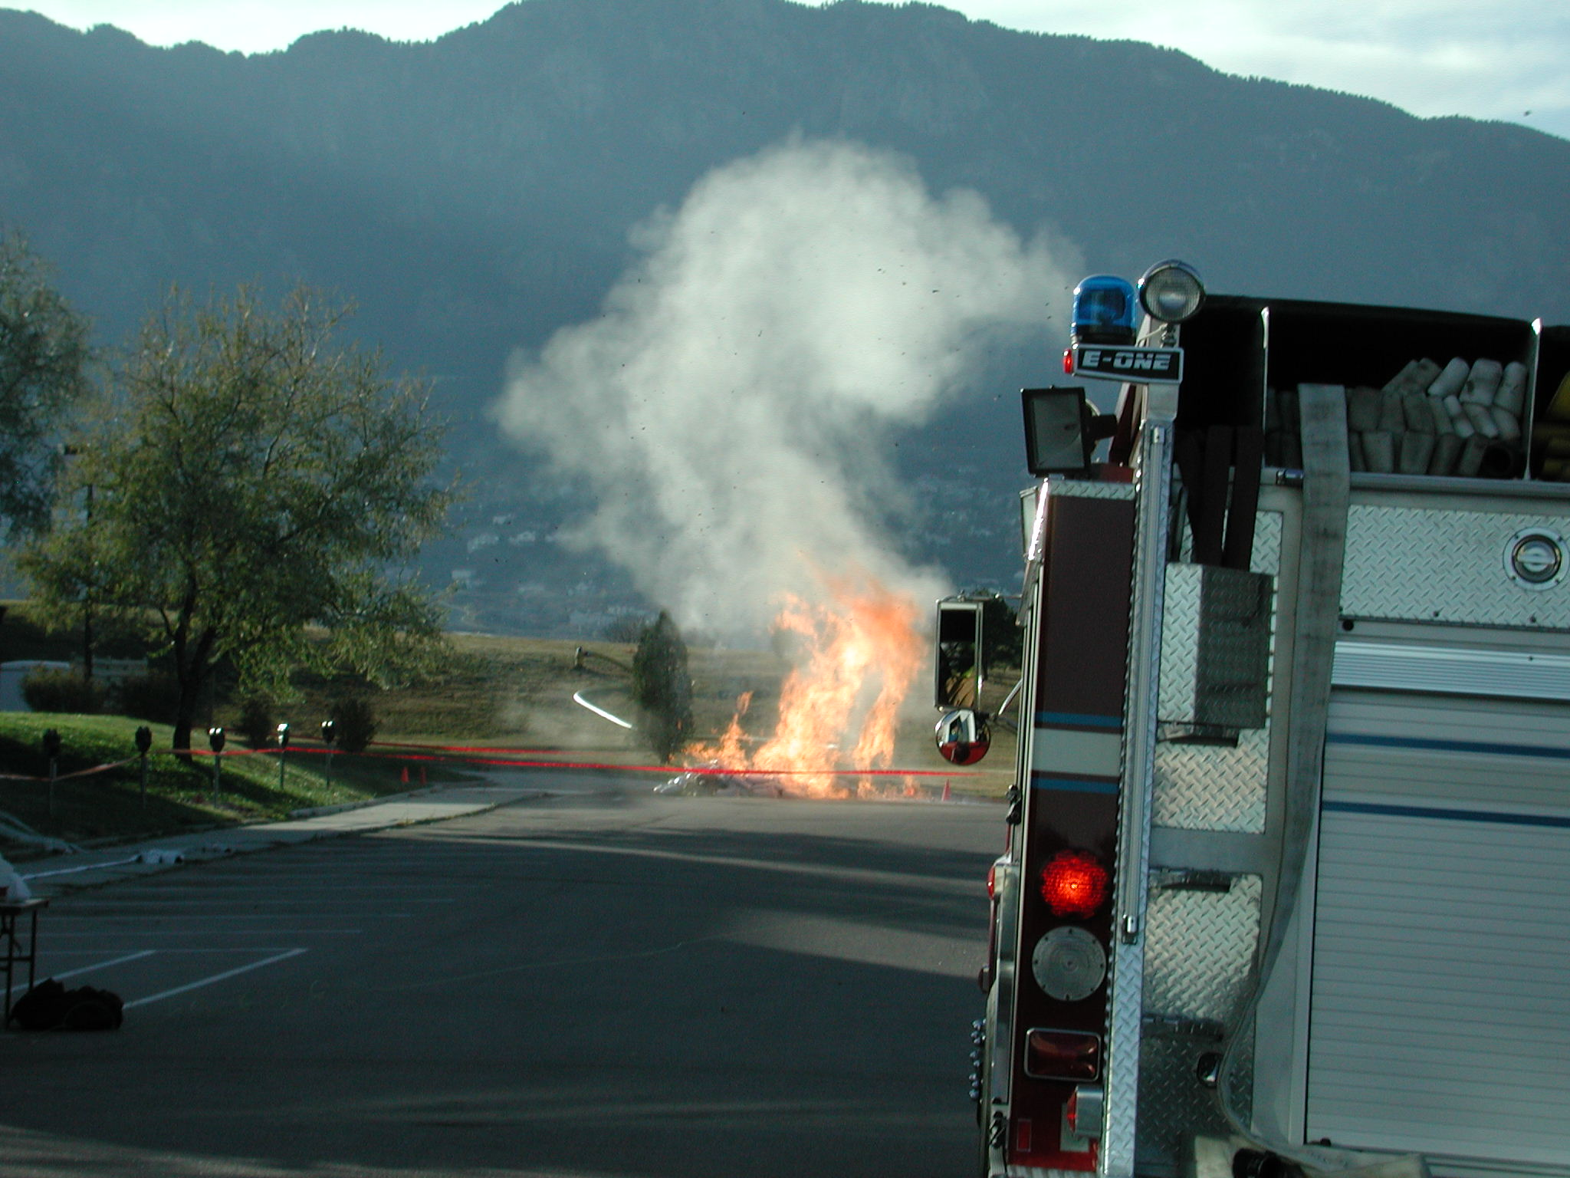
ERG Purpose
Basic safety tool
Basic identification
Initial actions

Slide 46
ERG versus SDS
ERG – transportation incidents
SDS – all other incidents
  If current version is available!
SDS
ERG

Slide 47

ERG Page Colors & Organization

Slide 48
ERG White Pages (part 1)
Instructions (page 1)
Safety Precautions (pages 2-3)
Hazard Classes (page 4)
Table of Placards (pages 5-7)

Slide 49
ERG White Pages (part 1)
Railcar & Road Trailer ID (pages 8-9)
Intermodal Container ID # (pages 10-13)
Pipeline ID & Info (pages 14-19)

Slide 50
ERG Yellow-Bordered Pages
Materials listed by ID number

Slide 51
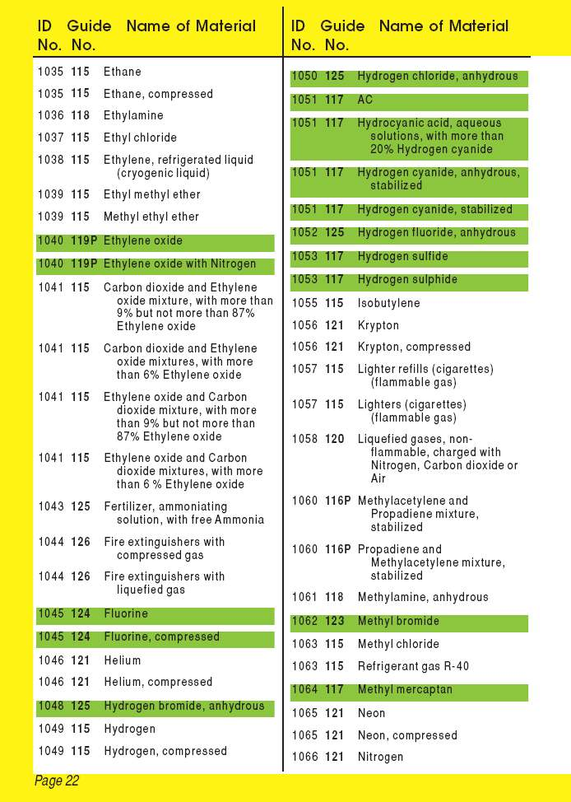
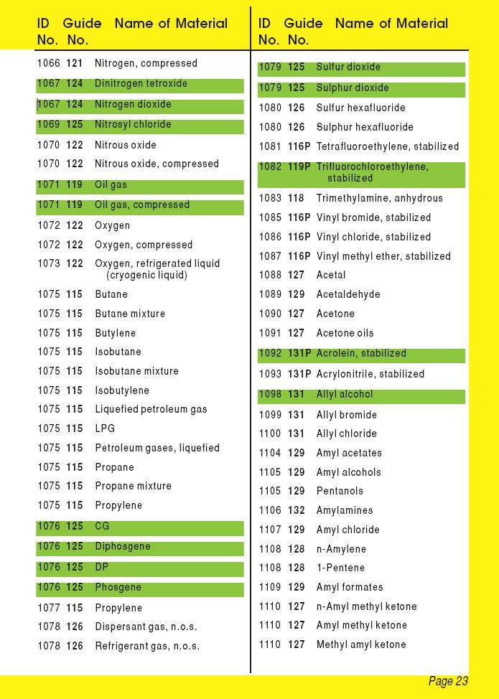

Slide 52
ERG Blue-Bordered Pages
Materials listed by name

Slide 53
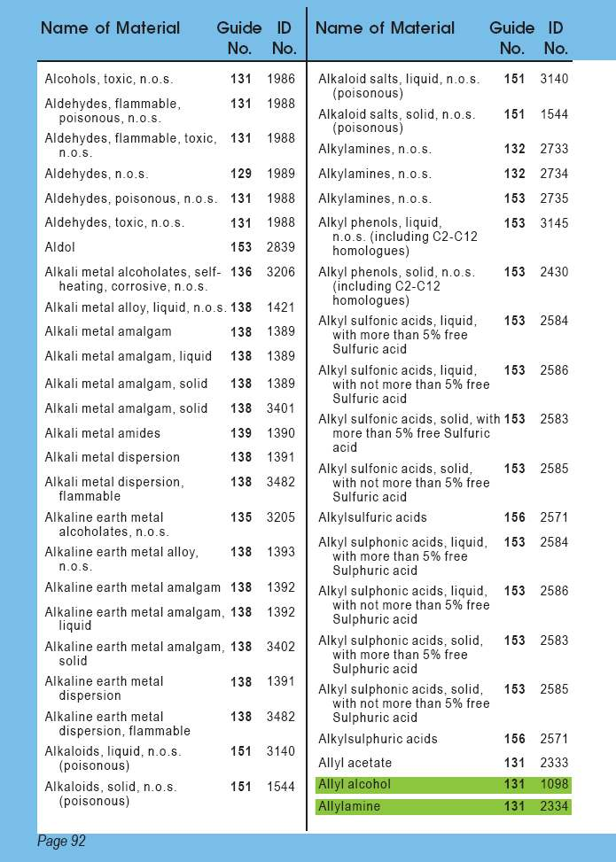
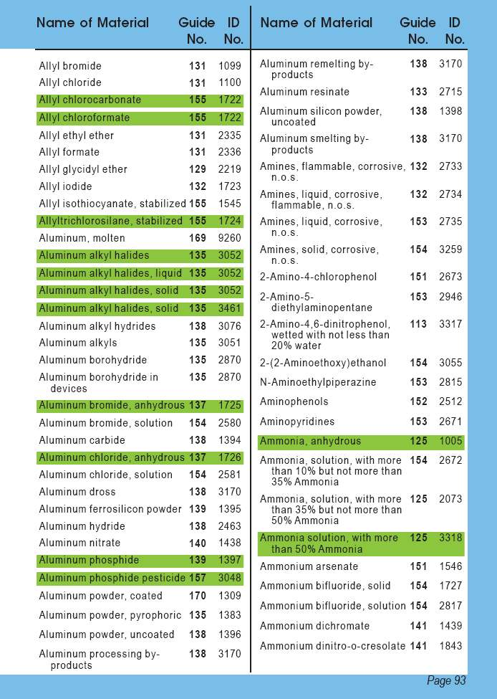

Slide 54
ERG Orange-Bordered Pages
Number guide pages

Slide 55
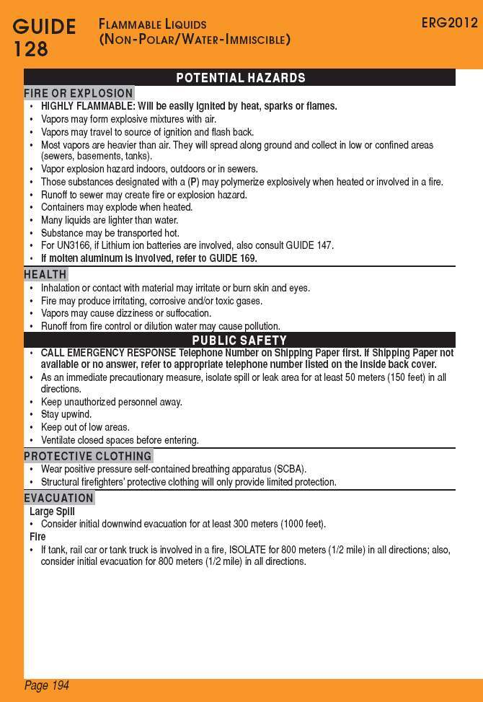
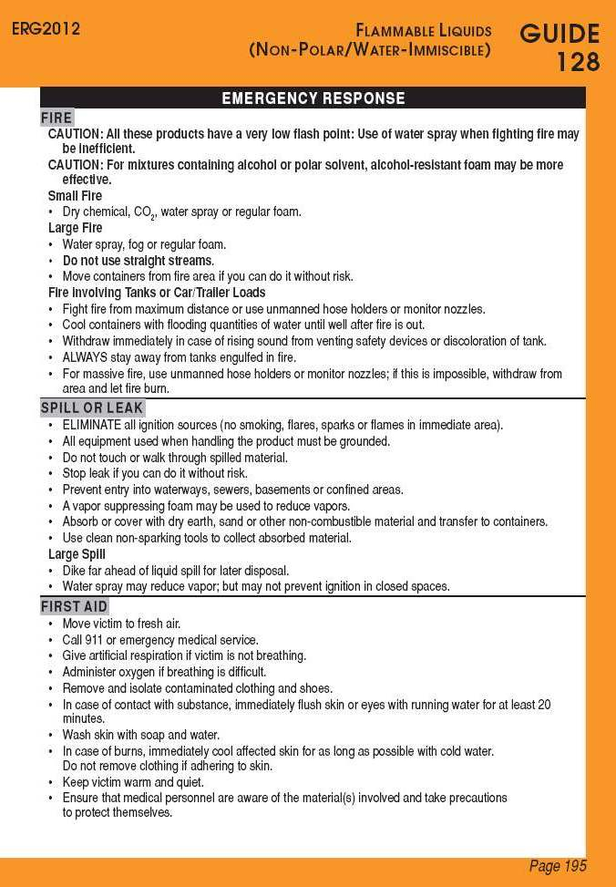

Slide 56
ERG Green-Bordered Pages
Isolation & Protective Actions
  Toxic Inhalation Hazards
  Water Reactive Substances
  Six Most Common Substances

Slide 57
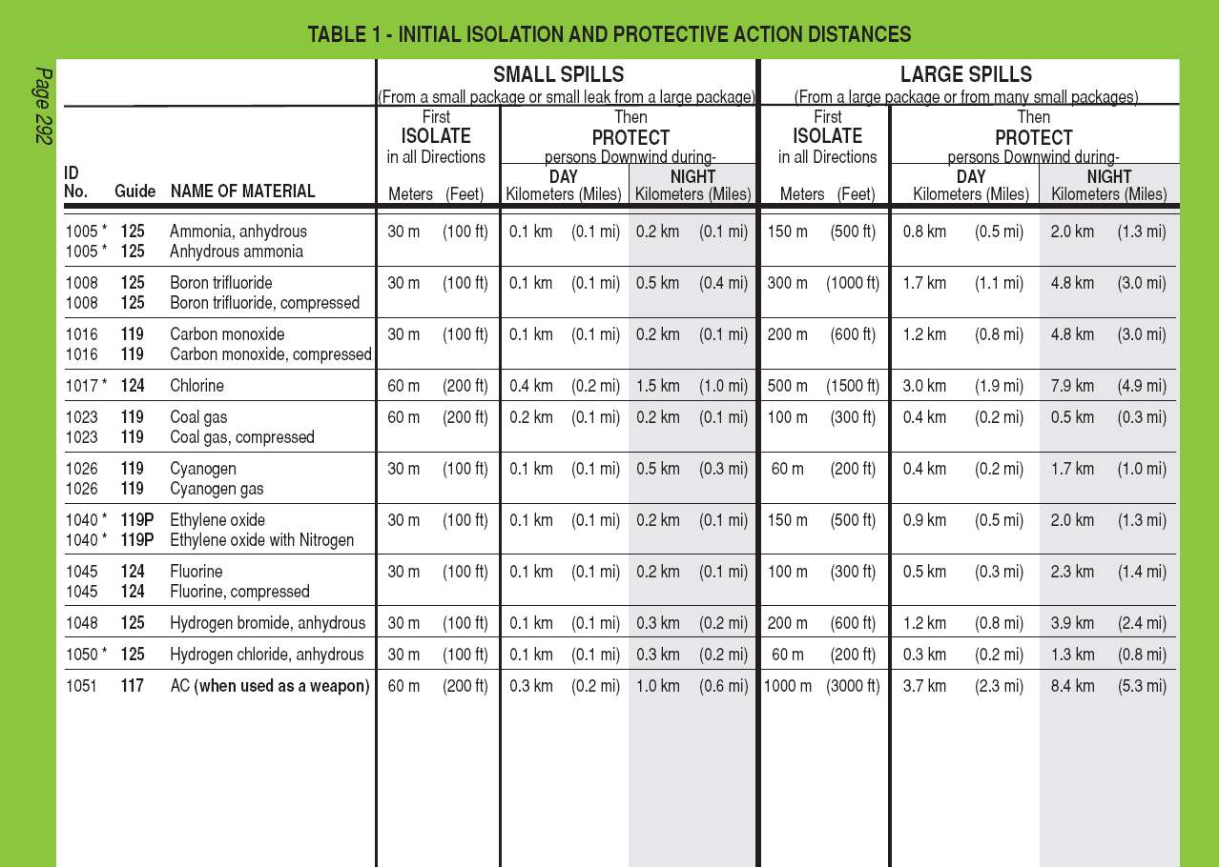

Slide 58
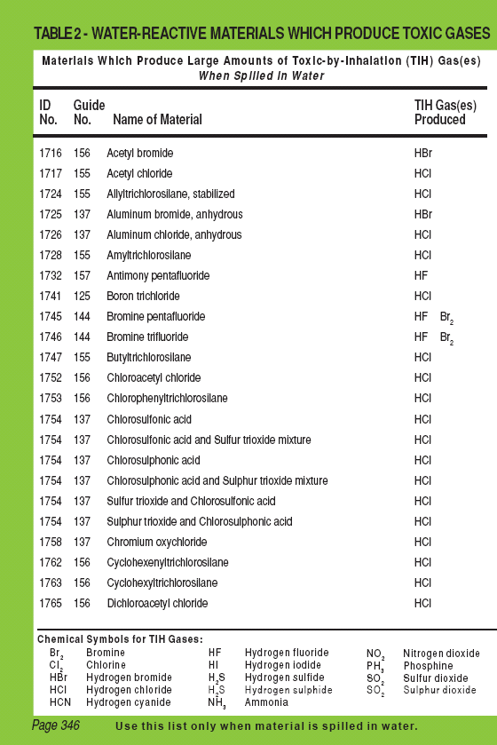
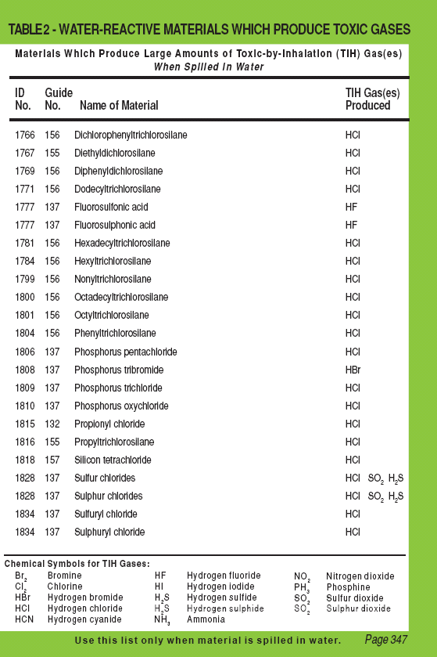

Slide 59
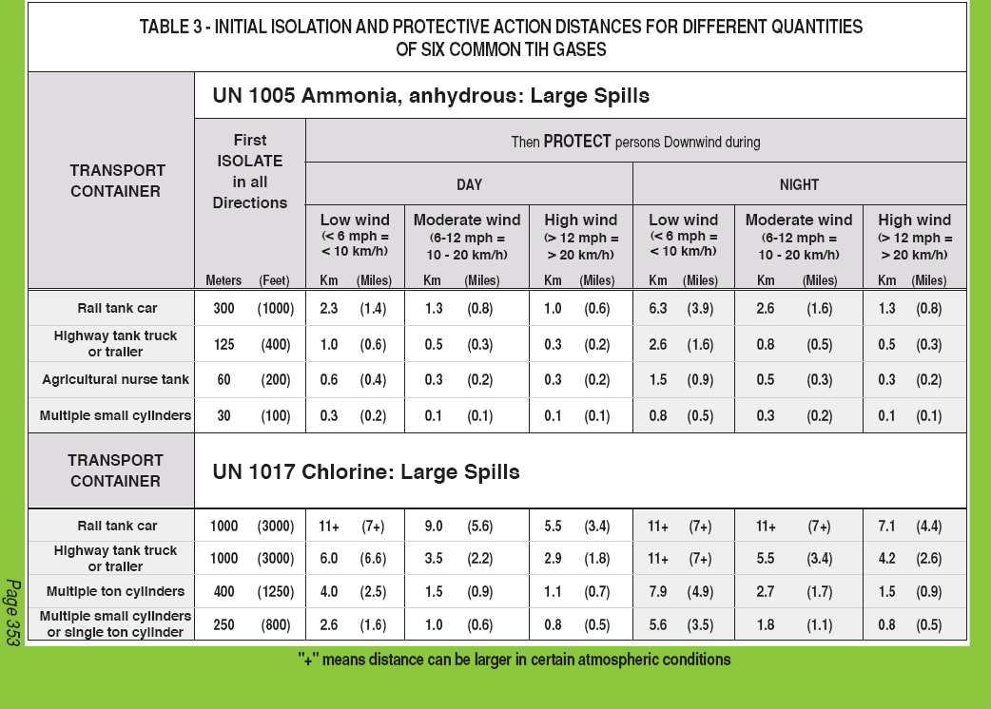

Slide 60
ERG White Pages (part 2)
Response Info
BLEVE Safety Precautions
Glossary

Slide 61
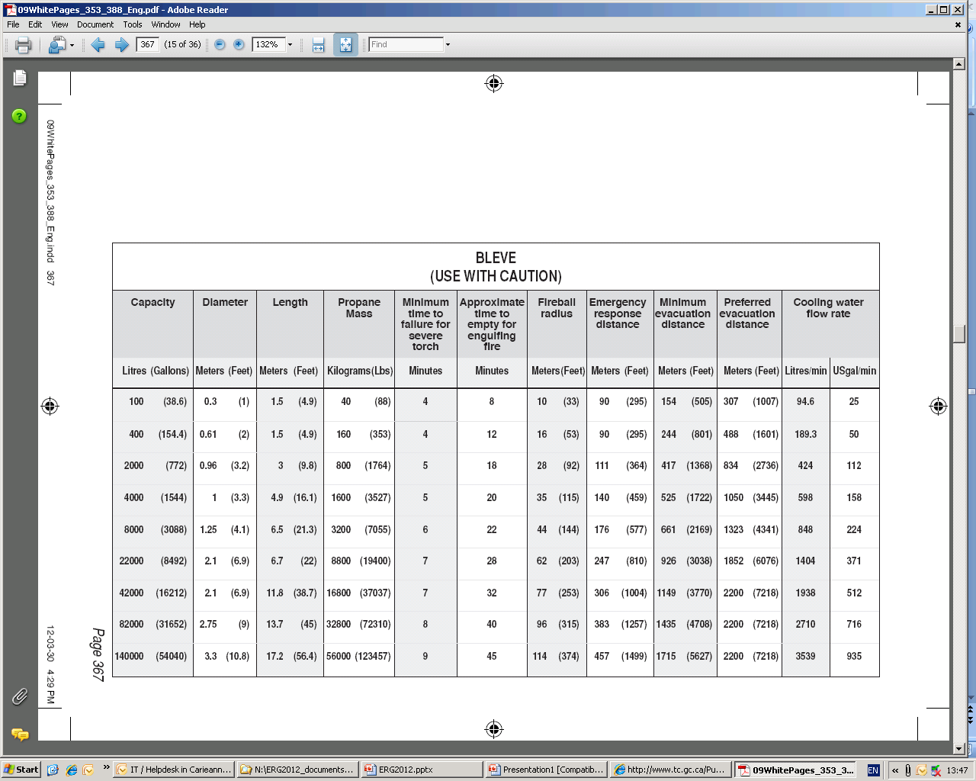

Slide 62
ERG—Good But Limited
Classification of hazard
Guides — “most essential guidance”
Isolation/evacuation distances — guides
Use table of placards only if no ID
Intended use
  “initial phase”

Slide 63
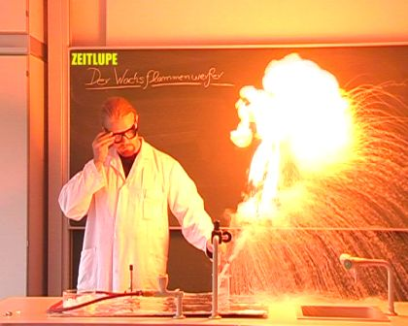
ERG Specialized Info
“P”: polymerization hazard
Dangerous Water–Reactive Materials
Guide 111

Slide 64
ERG Caveats
Distances are guides
Use table of placards if you can’t ID material
Intended use
  Transportation-related incidents
  Initial phase of incident

Slide 65
ERG Use
So let’s use it!
ERG

Slide 66

What Should This Stuff Not Do?
Notes:
Guide 148 – Don’t let it warm up.

Slide 67
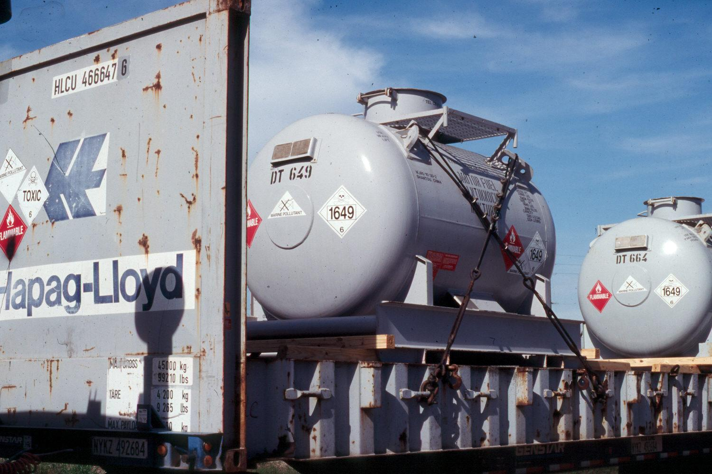
What’s This?
Which guide do you use?
Notes:
1649 = Motor fuel anti-knock mixture. Guide 131

Slide 68
What are the hazards?
Notes:
Toxic (very) and Flammable (highly)

Slide 69
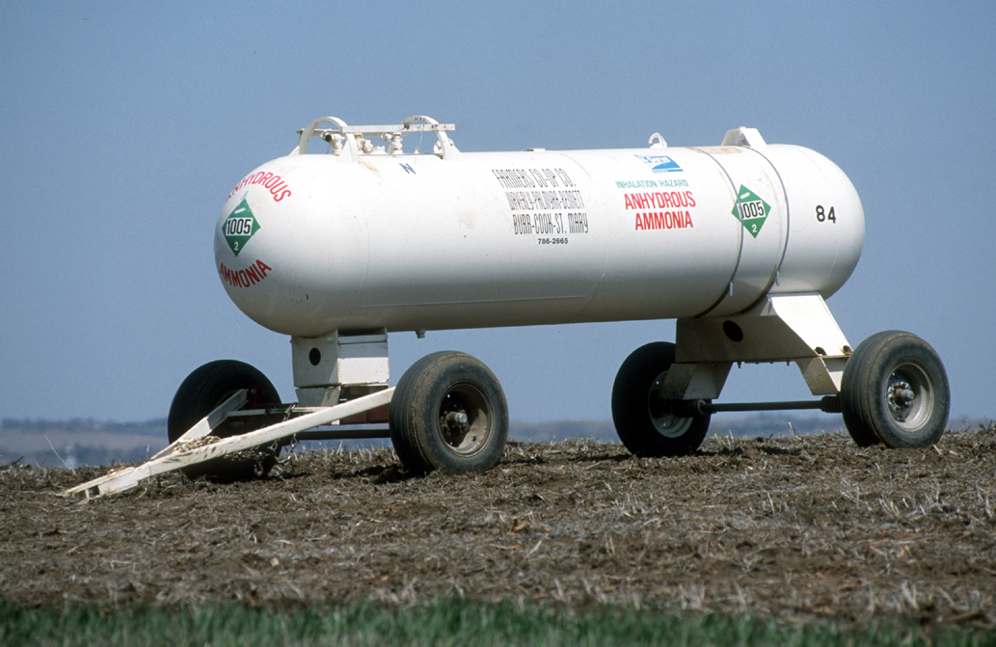
What’s the Initial Isolation Distance?
Notes:
200 feet. Table 3. It’s an agricultural nurse tank.

Slide 70
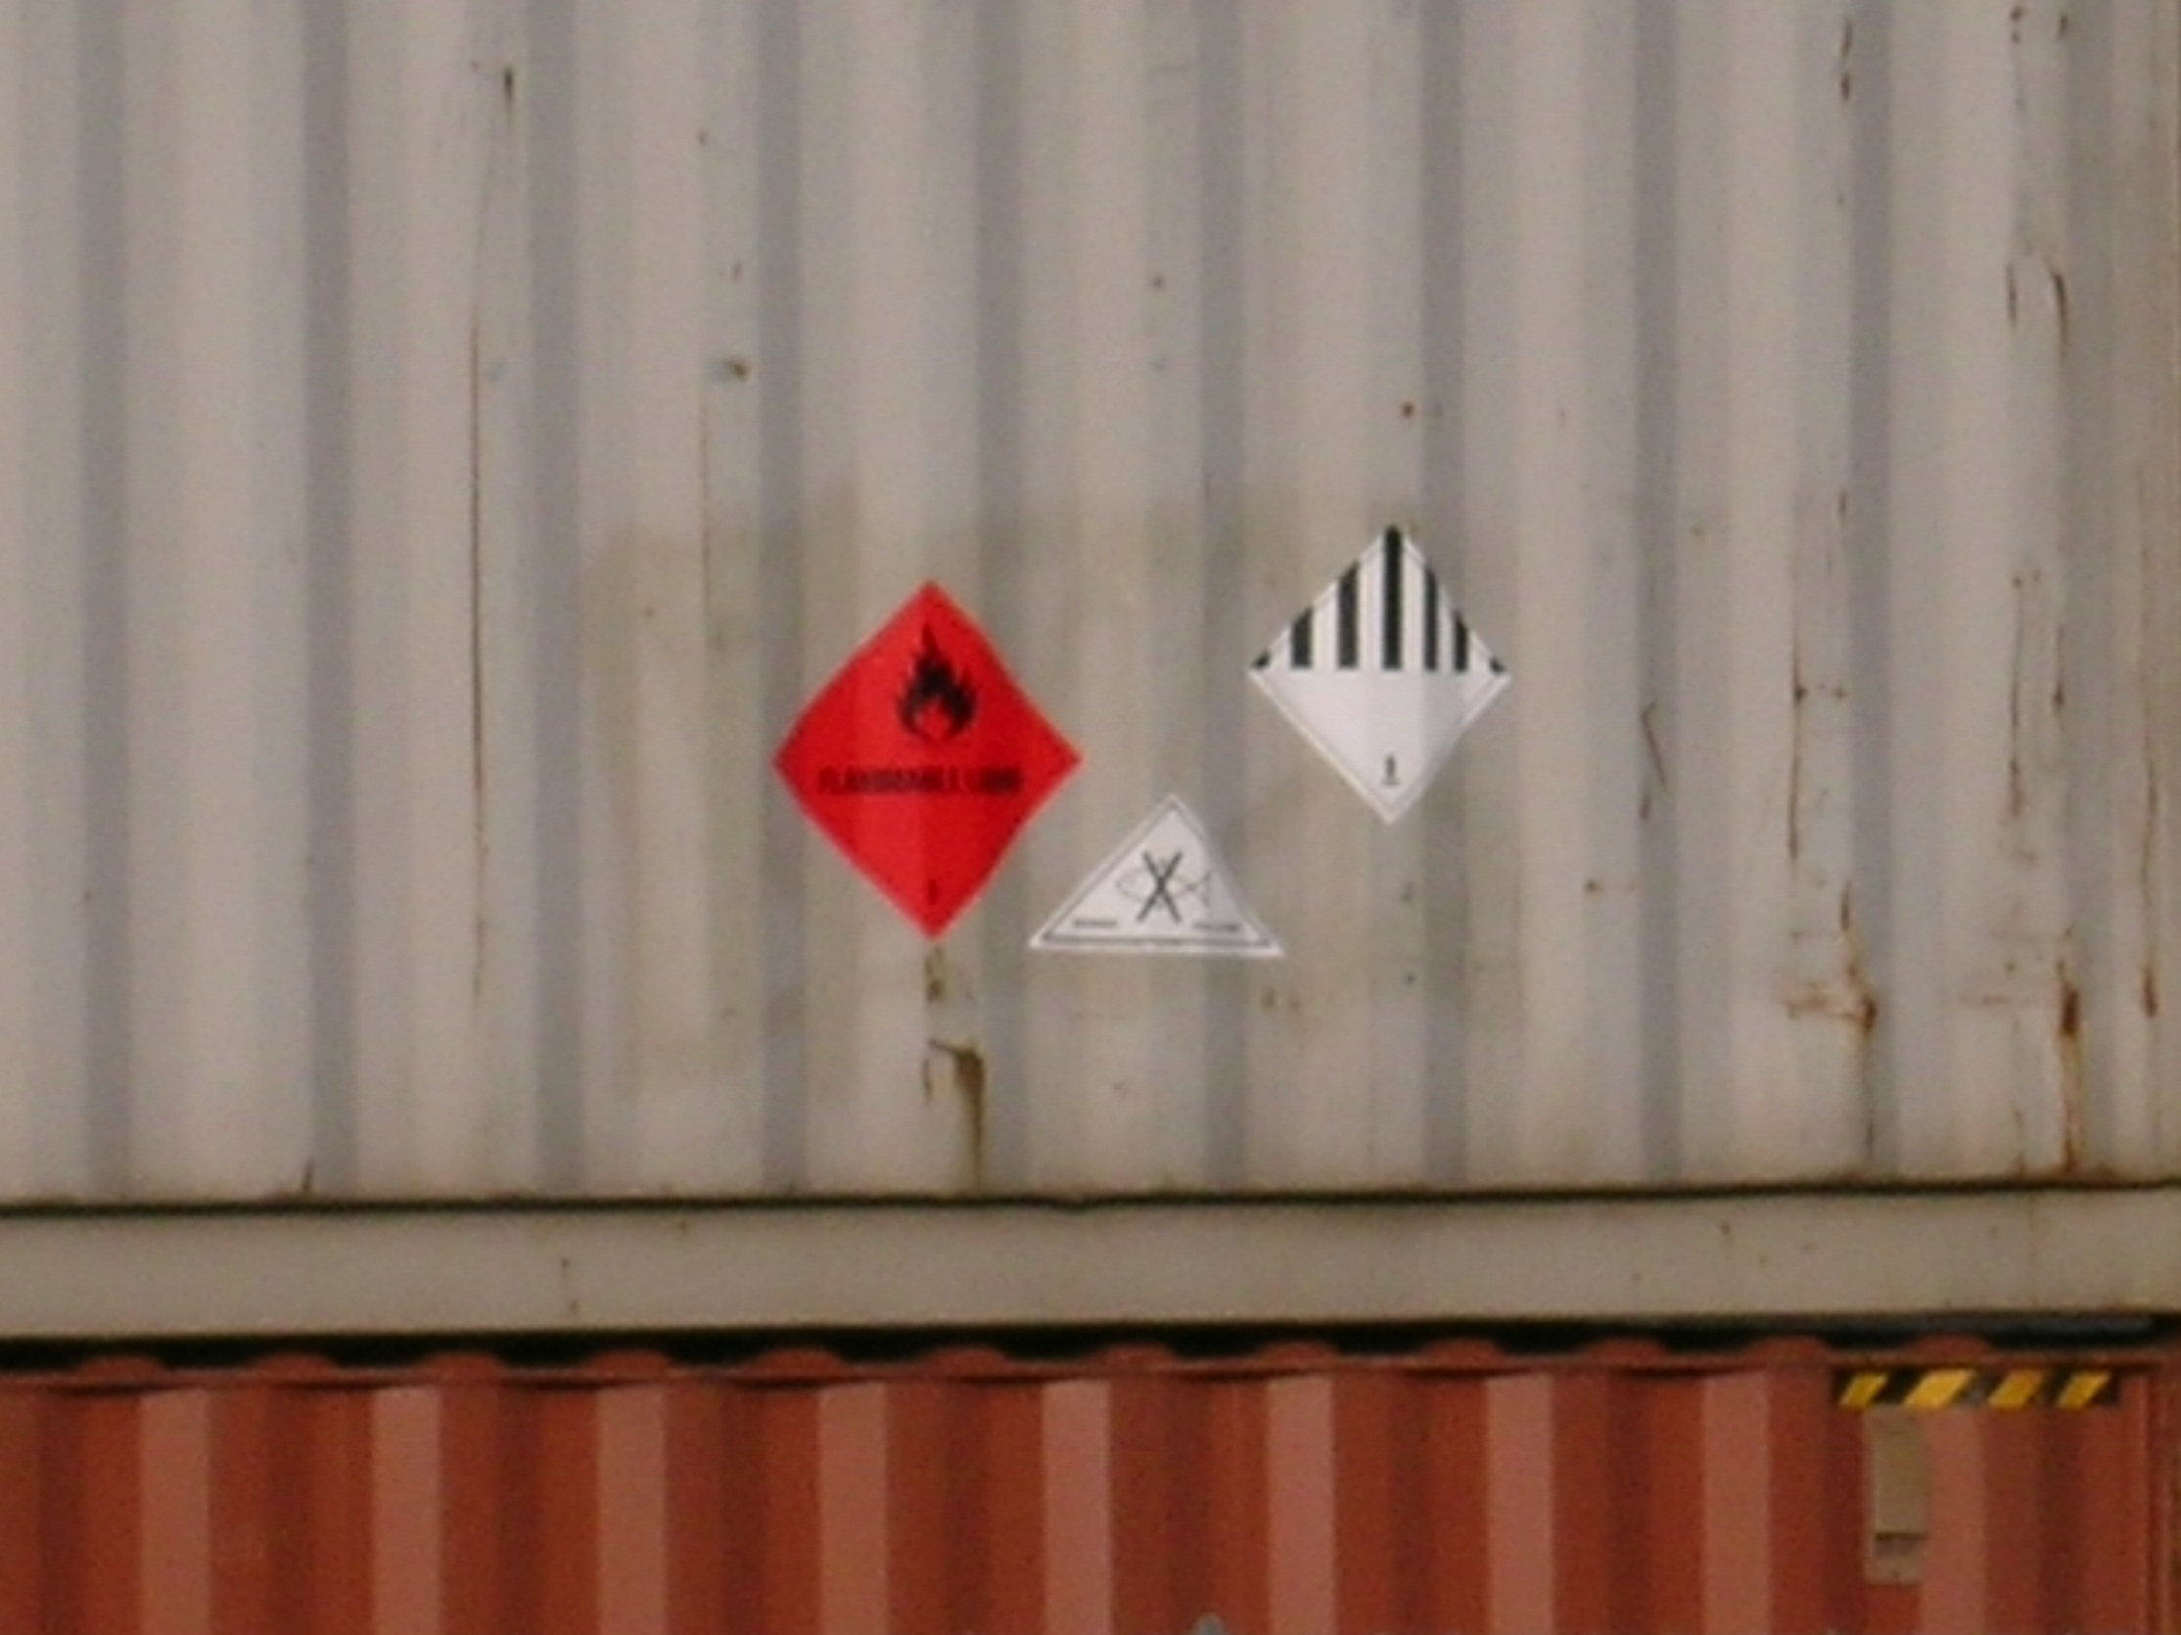
What Guide Page?
Notes:
Page 5 of the ERG: “If multiple placards point to more than one guide, initially use the most conservative guide(i.e., the guide requiring the greatest degree of protective actions).” In this case, that would be the Flammable placard.

Slide 71
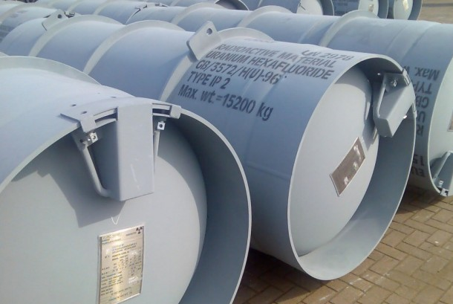
What if it Gets Wet?
Notes:
Table 2 Green-bordered pages. Gives off hydrogen fluoride.

Slide 72
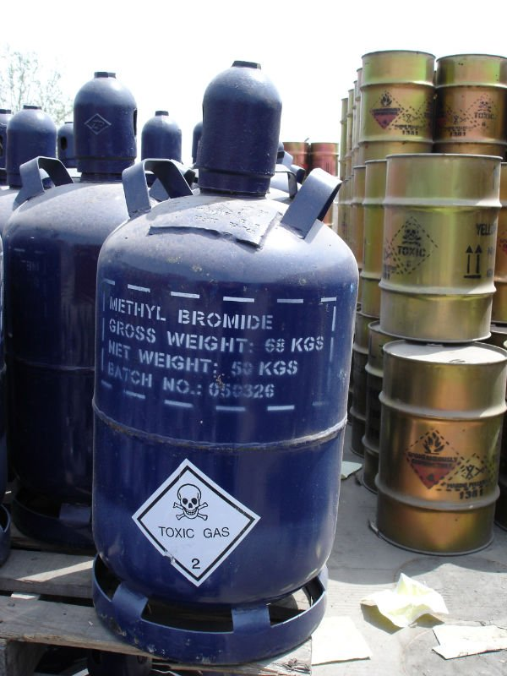
Protective Action Distance?
Small spill
At night
Notes:
Table 1. Green-bordered pages. 0.2 miles.

Slide 73
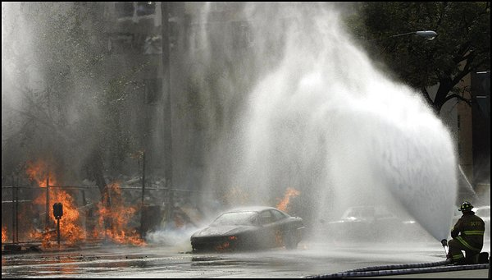
Container Stress & Behavior

Slide 74
Container Stress & Behavior
Hazmats are released when container fails
  Failure can be minor or catastrophic
  Nature of failure determines potential harm
    Kingman BLEVE vs. Tokyo Sarin

Slide 75
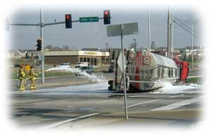
Hazmat Release Process
Stress on container
Container weakens & fails
Material released
Material disperses

Slide 76
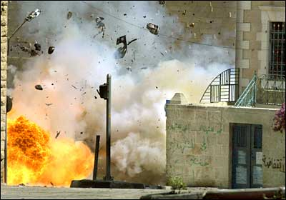
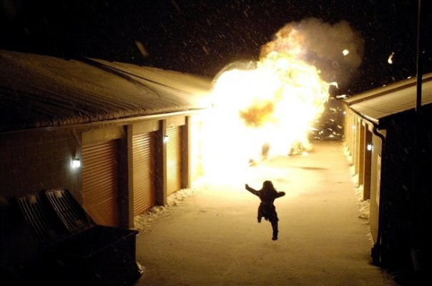
Hazmat Release Process
Hazard to you depends what step the process is on when you arrive!

Slide 77
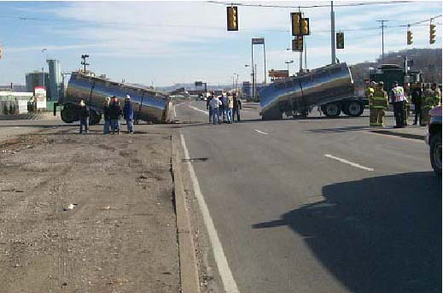
Types of Container Stress
Thermal
  Hot or cold
Mechanical
Chemical

Slide 78
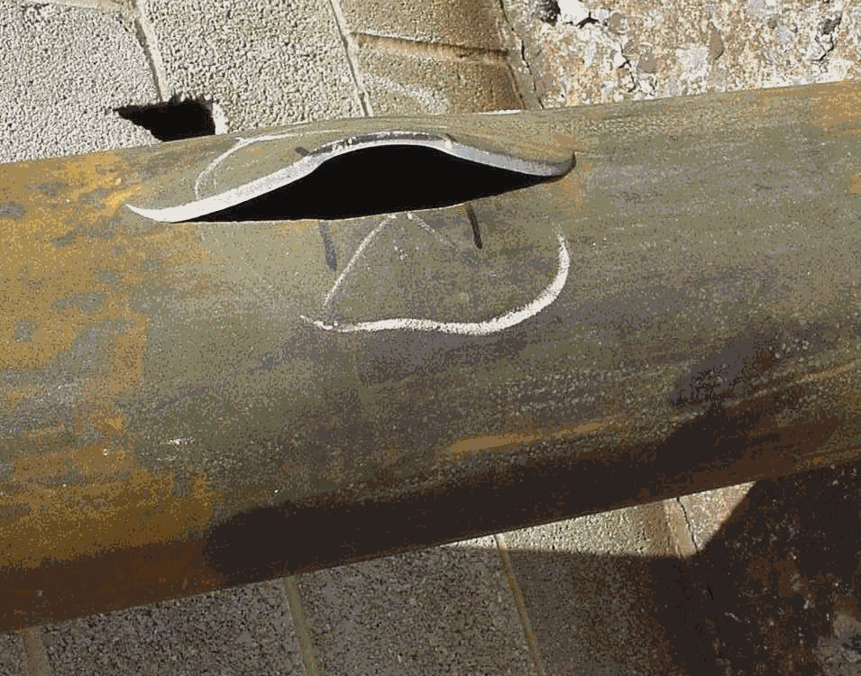
Evaluating Container Stress
Type of stress?
What will container do?
When will it do it?

Slide 79
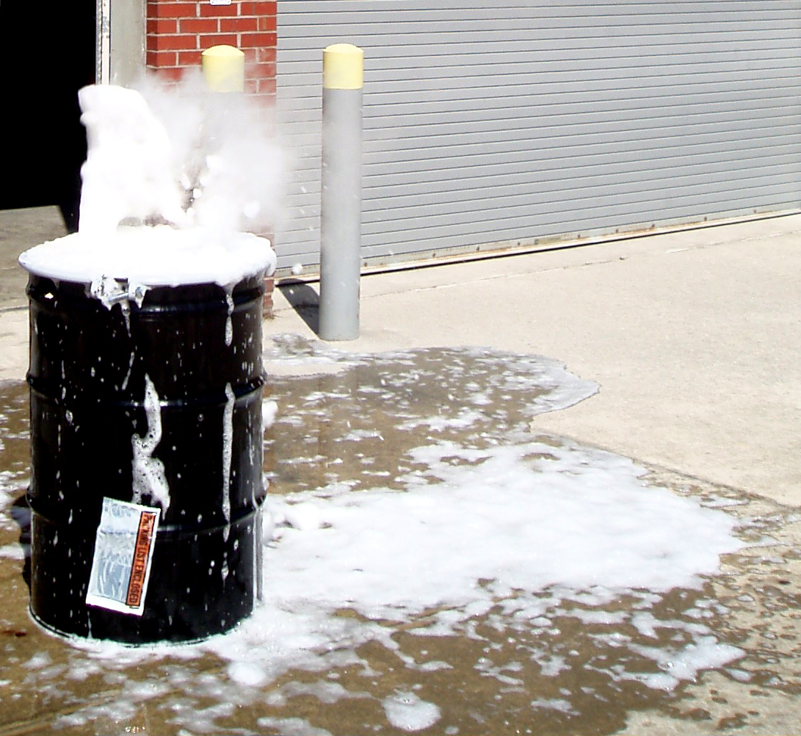
Types of Container Failure
Catastrophic
Fracture
Puncture
Degradation

Slide 80
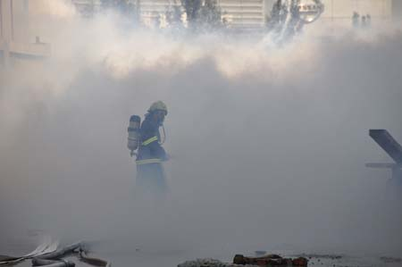
Types of Product Dispersion
Instantaneous release
  Spreads in all directions
  Gases/vapors can ignite immediately

Slide 81
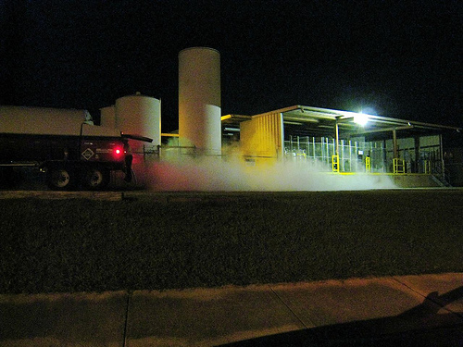
Types of Product Dispersion
Rapid release
  Spreads downwind/downstream

Slide 82
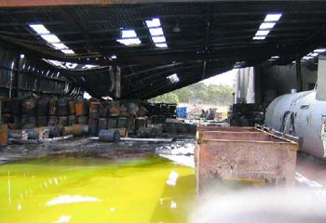
Types of Product Dispersion
Slow release
  Spreads slowly downwind/downstream

Slide 83
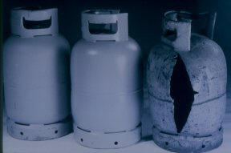
BLEVE
Cause – Thermal stress on container
  Stress weakens container
  Container breeches
  Near-instantaneous release

Slide 84
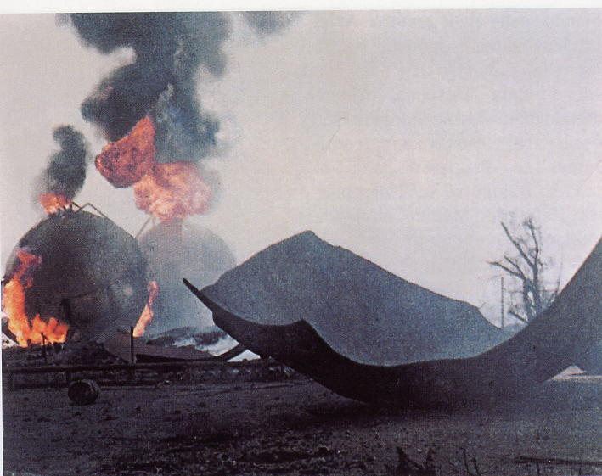
BLEVE
Hazards
  Flying debris

Slide 85
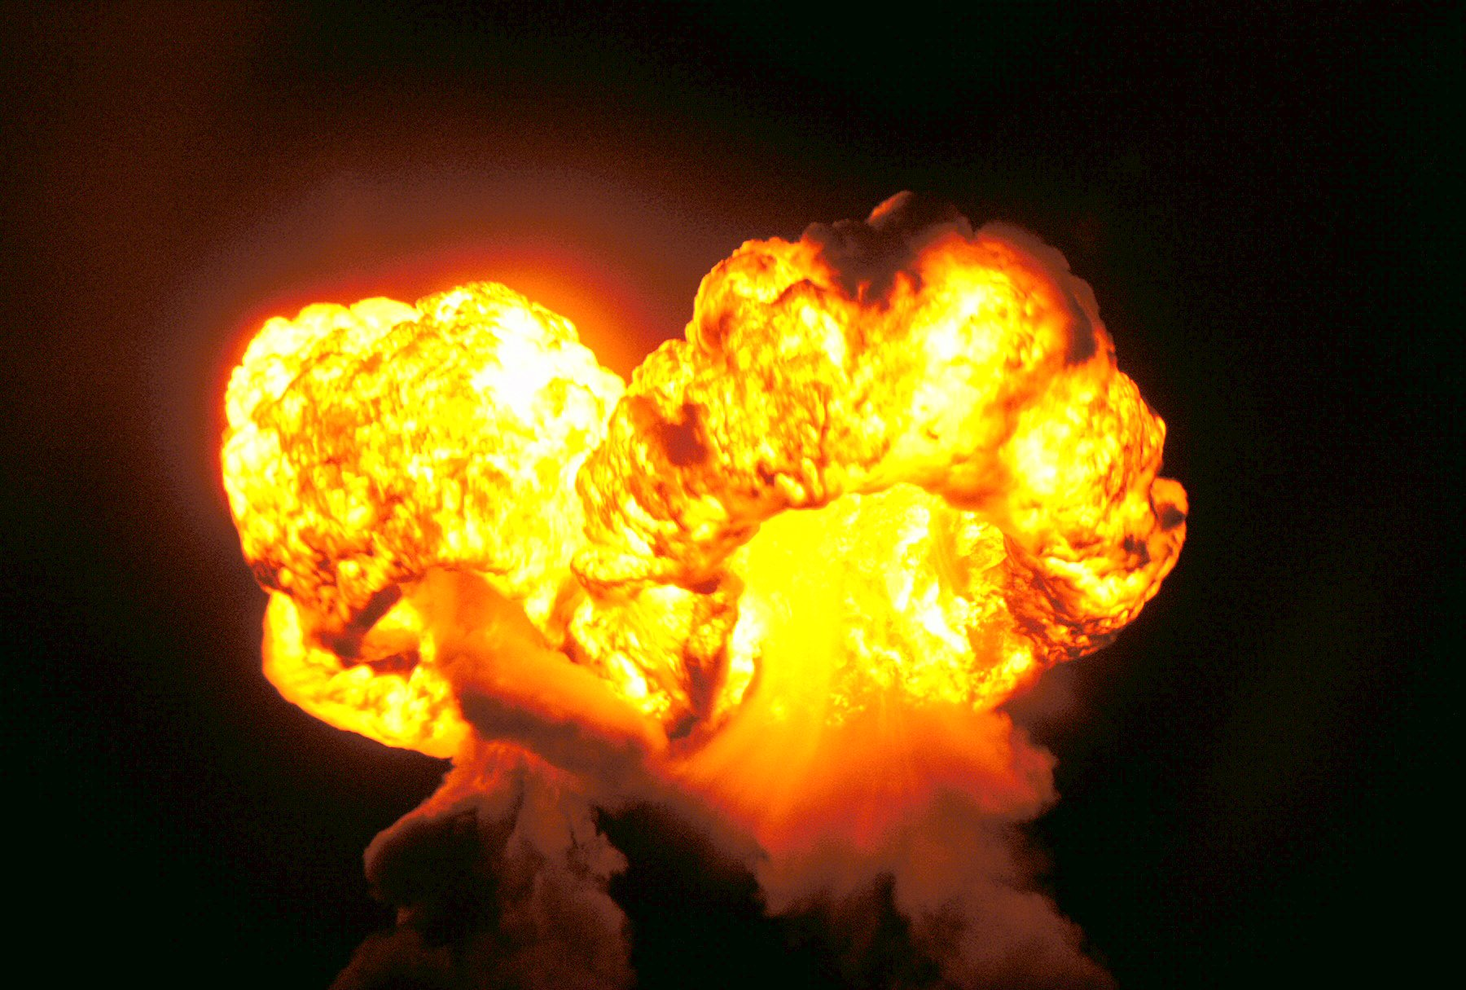
BLEVE
Hazards
  Large fireball

Slide 86
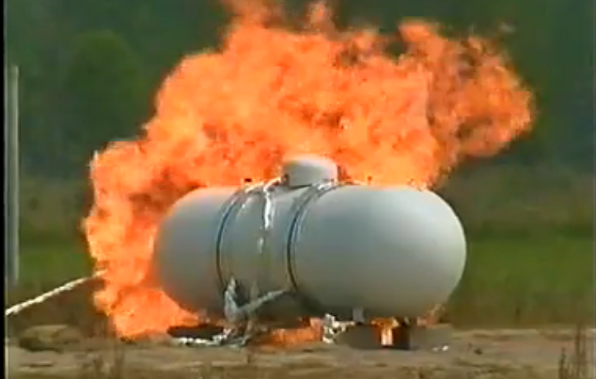
BLEVE
Timeframe
  Less than 10 minutes

Slide 87
Assessing Hazards
If the container fails what will the material do to you?
  Will it explode?
  Will it burn?
  Will it hurt you some other way?

Slide 88

How Can You Tell?
What are the material’s properties?

Slide 89
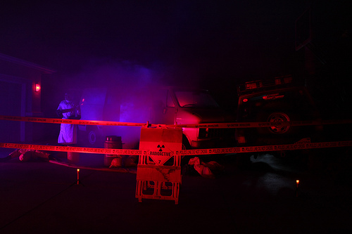
Physical Properties
Properties determine hazard & behavior
Hazard & behavior determine response

Slide 90

What Properties Tell Us It Will Explode Or Burn?
Boiling Point (BP)
Flash Point (FP)
Ignition Temperature (IT)
Flammable Range (FR)

Slide 91

Flammable Range
At what concentration will the material burn?
Concentration within the flammable range - material could burn.

Slide 92

What Else The Properties Tell Us
Will it be a solid, liquid or gas?
  Vapor pressure
  Boiling point
  Freezing/melting point

Slide 93

Vapor Pressure
How quickly will it evaporate?

Slide 94



Boiling Point
Will it be a solid, liquid or gas?
Only gases and vapors burn!
Freezing Point
Boiling Point
32° F
212° F

Slide 95

Flash Point
When will it give off enough vapors to ignite in air?

Slide 96

Will It Sink Or Float?
VD - Vapor Density (in air)
SG - Specific Gravity (in water)

Slide 97

Will It Dissolve In Water?
Solubility
  0-100%

Slide 98

Is It Corrosive?
pH - Acidity/Alkalinity

Slide 99
How Else it Can Hurt You
Asphyxiation
  e.g. CO2, Nitrogen, Argon, etc.
Carcinogenesis
  e.g. Asbestos, Carbon Tetrachloride etc.

Slide 100

Is It Radioactive?

Slide 101

Ionizing Radiation

Slide 102

Types of Ionizing Radiation
Alpha

Slide 103

Types of Ionizing Radiation
Beta

Slide 104

Types of Ionizing Radiation
Gamma

Slide 105

Types of Ionizing Radiation
Neutron

Slide 106

Protection Against Radiation

Slide 107

Is It Toxic?

Slide 108
Definitions
Toxicology
  Study of adverse systemic effects of chemicals
  Not just the study of poisons. Many substances can be toxic but aren’t classed as poisons!

Slide 109
Definitions
Poison
  Produces illness or death
  When taken in small quantities

Slide 110
DOT Requirements
LD₅₀ less than 50 milligram per kilogram of body weight
Placards
  Poison Gas 2
  Poison 6.1
  Poison 6.2

Slide 111
Limits of Toxicology
Most exposure levels based on animal tests
Test results with animals often different than results with humans

Slide 112
Assessing Toxicity
Measures of toxicity
There are many
Sources of information on toxicity
  NIOSH Pocket Guide
  Safety Data Sheets (SDS)

Slide 113
Measuring Toxicity
Tools are available
  Many measure chronic exposure only
  May not applicable to emergency response

Slide 114
Measuring Toxicity
IDLH
  Immediately Dangerous to Life & Health
TLV™
  Threshold Limit Value
STEL
  Short Term Exposure Limit
Notes:
IDLH — Immediately Dangerous to Life & Health;
TLV™ — Threshold Limit Value (guides) – Time Weighted Average. Exposure
limit recommended by the American Conference of Governmental Industrial
Hygienists (ACGIH). Level to which nearly all workers may be repeatedly
exposed without adverse effect. Time weighted average. 8 hour workday. 40 hour
workweek. Derived for the protection of healthy, adult male workers.
STEL — Short Term Exposure Limit. Exposure limit recommended by the
American Conference of Governmental Industrial Hygienists (ACGIH). All
workers should be able to withstand up to four exposures per day at this
concentration with no ill effects (if TLV®-TWA not exceeded). Applied to
supplement the TLV®-TWA when there are recognized acute effects from a
substance whose toxic effects are primarily of a chronic nature.Time weighted
average. 15 minutes. 8 hour workday. 40 hour workweek.

Slide 115
Measuring Toxicity
PEL
  Permissible Exposure Limit
MLD
  Minimum Lethal Dose
ERPG
  Emergency Response Planning Guide
Notes:
PEL — Permissible Exposure Limit (law). Legal limit for exposures in the
workplace. OSHA/CALOSHA regulation. Majority adopted from TLV’s.
(CALOSHA PEL’s usually more up to date.)Uses time weighted averages,
short-term exposure limits and ceilings.
LD/LC 50 — Lethal Dose/Lethal Concentration 50%. Concentration level at
which 50 percent of the test animals died when exposed by inhalation for a
specified time period.Standard measurement used by toxicologists. Dose is
usually given in milligrams per kilogram of body weight of the test animal.

Slide 116
Measuring Toxicity
LD/LC 50
  Lethal Dose 50%
  Lethal Concentration 50%
PPM/MgM³
  Parts Per Million
  Milligrams Per Cubic Meter

Slide 117
Dose-Response Relationship
Effect depends on the dose
Dose increases – severity of effect increases
Severity of effect depends on duration of exposure

Slide 118

Routes of Entry & Preventing Exposure
Inhalation - you breath it
  Isolate and deny entry
  Wear SCBA
  Just stay away!

Slide 119

Routes of Entry & Preventing Exposure
Ingestion - you eat it
  Isolate and deny entry
  Don’t eat, smoke, drink at incident scene

Slide 120

Routes of Entry & Preventing Exposure
Absorption - soaks through skin
  Isolate and deny entry
  Wear proper PPE
  Decon any exposure

Slide 121

Routes of Entry & Preventing Exposure
Injection - puncture wound
  Isolate and deny entry
  Wear proper PPE
  How can this happen?

Slide 122
Remember!
Vapor/gas may be odorless, colorless & tasteless!
You may be exposed before you know it!
Approach safely - UUU
Wear PPE

Slide 123

Causes of Exposure
Approaching downwind
Wind shifts
Not wearing protective clothing

Slide 124
Acute vs. Chronic
Exposure
  Acute: short-term, limited,one time
  Chronic: long-term, repeated, continuous

Slide 125
Acute vs. Chronic
Effects
  Acute: may not show immediately
  Chronic: not detectable for years. May differ from acute effects

Slide 126

Toxicology Variables
Kind of Hazardous Material
Route of exposure
Dose (concentration) received
Duration & frequency of exposure
Notes:
Reactions to a substance may depend greatly on the following:

Slide 127

Personal Tolerances & Variables
Age
Medical history
Gender
Personal habits

Slide 128
Variables & Hazard Assessment
Many variables affect IDHA
May influence behavior of material

Slide 129

Variables & Hazard Assessment
Location can influence dispersion
  Stuff goes downhill
  Buildings can trap and/or redirect airborne contaminants

Slide 130

Variables & Hazard Assessment
Time of day can affect:
  Evaporation rate
  Flammability
  Reactivity

Slide 131

Variables & Hazard Assessment
Many properties vary with temperature
Heat makes things worse!

Slide 132

Variables & Hazard Assessment
Weather
  Gases/vapors will usually go downwind
  Vapor clouds can take longer to disperse in cold weather

Slide 133
Variables & Hazard Assessment
Basic nature of material
Type/size of release
Condition of container

Slide 134

Variables & Hazard Assessment
Reactivity
May be difficult to predict results
  See Table 2 of ERG Green Pages

Slide 135

Bottom Line…
Same material
Different variables
Different response

Slide 136

There Is No Cookbook
Use your head!

Slide 137
Managing Risk
What will it do?
Where will it go?
What will it hurt?

Slide 138

What Will It Do?
Will it do it right now?
Will it hurt me?

Slide 139

Managing Risk
If something bad can happen, how do we manage that risk?

Slide 140
Risk Management Process
Identify hazards
Assess the risk
Identify your options
Evaluate risk vs. gain
Monitor and re-evaluate situation
Notes:
Non-emergency risk management looks at the hazards common to all workplaces.
Pre-emergency risk management activities take place prior to the emergency.
Emergency risk management activities take place during the incident.

Slide 141
Assessing Risks
What is the potential severity?
What is the probability it will happen?
What is the potential exposure?

Slide 142

Rating Risks
Low
Moderate
High
Unacceptable

Slide 143

Low Risk
Small quantities
Inert solid materials
Undamaged container

Slide 144

Moderate Risk
Smaller quantities
Low vapor-pressure liquid materials
Undamaged/slightly damaged container

Slide 145

High Risk
Large quantities/multiple containers
Low vapor-pressure liquids or gases
Slightly/moderately damaged container

Slide 146

Unacceptable Hazmat Risk
Larger quantities and/or gas cylinders involved
High vapor-pressure liquids, gases, explosives and/or reactive materials
Visibly stressed container and/or flame impingement on a gas cylinder

Slide 147

Unacceptable Hazmat Risk
An unacceptable risk here is:

Slide 148
Action Planning
Develop objectives and plan
  Objective – informal, from ERG
  Plan – unwritten, follow ERP

Slide 149
Formal Action Planning
Incident progresses – use written plan
  Incident Action Plan
  Site Safety Plan
FRO should know and follow both

Slide 150
Components of Action Plan
ID problem
Assess hazards
ID the resources available
Use resources to solve problem

Slide 151
Sources of FRO Plan Info
ERG Guide pages
SDS recommendations
Employer guidelines

Slide 152

Basic FRO Actions
Isolate & deny entry
Acceptable risk present
  Containment and protective actions
Unacceptable risk present
  Isolate and deny entry only

Slide 153
Action Planning for Rescue
ID the hazard
Assess risk

Slide 154
Risk Assessment & Rescue
Acceptable risk – rescue
Unacceptable risk – no rescue

Slide 155

Questions?

