Slide 1

Safety, Isolation and Notifications (S.I.N.)
D-1

Slide 2
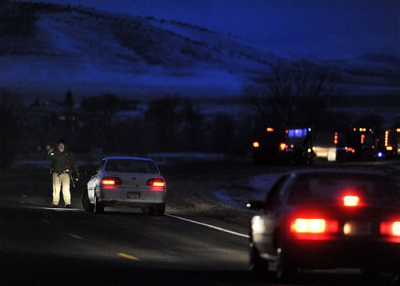
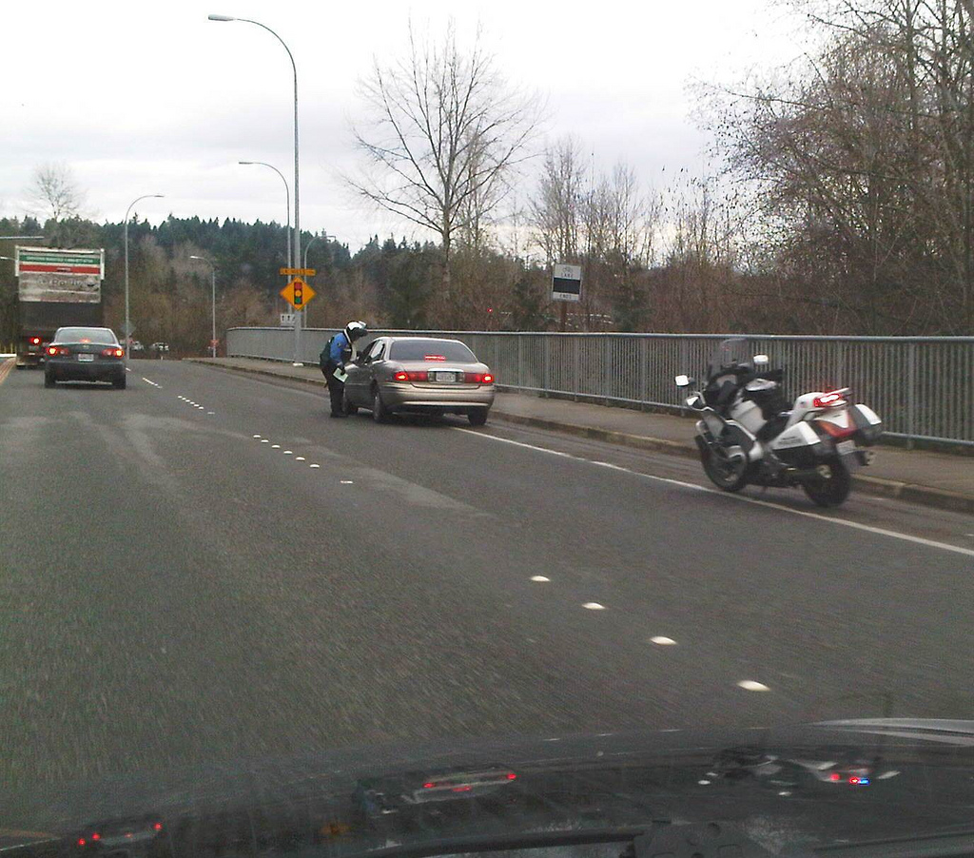
Definitions - FRA
First Responder “Awareness”
  Likely to witness/discover a release
  Notify proper authorities
  Take no further action
D-2
Notes:
When making notifications, don't forget to request resources!
29 CFR 1910.120(q)(6)(i) FRA’s discover a release, initiate an emergency
response sequence, notify proper authorities and take no further action.
29 CFR 1910.120(q)(6)(i) FRO’s respond as a part of the initial response to
protect life, environment and property. They contain the release from a safe
distance in a defensive fashion.

Slide 3
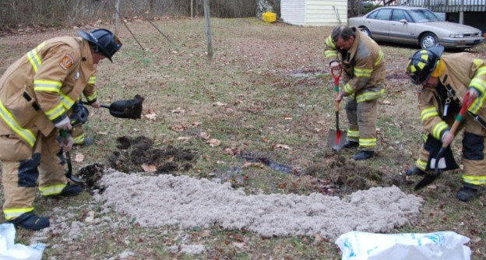
Definitions - FRO
First Responder “Operations”
  Respond to releases
  Protects life, environment & property
  Acts in a defensive action
D-2

Slide 4

Definition - SIN
S = Safety
I = Isolation
N = Notifications
D-2

Slide 5
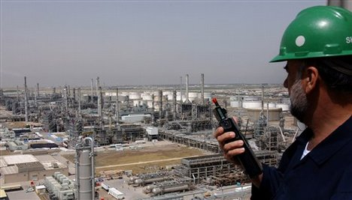
Responder Actions
All responders should SIN
Basic initial action
Done at all hazmat incidents
D-2

Slide 6
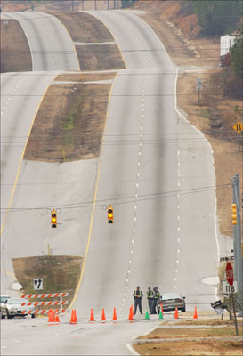
First Operational Thought
The first operational thought for all responder levels is safety!
D-4
Notes:
Not thinking safety could cause you to end up dead or injured!

Slide 7
First Operational Thought
First operational thought is safety
  Safety starts with first responder on-scene
  All must have positive safety attitude
D-4

Slide 8
Positive Safety Attitude
Three techniques to ensure safety
  Safe approach
  Safe assessment
  Key safety guides for all
D-4

Slide 9
Safe Approach
As per ERG!
Upgrade
Upstream
Upwind
D-4

Slide 10
Safe Distance
D-4

Slide 11
Safe Approach
Position vehicles away from event…
  For quick departure!
Advise responders of safe route of approach.
D-4
Notes:
May have to leave in a hurry if wind shifts or if incident takes a turn for the
worse.

Slide 12

Conduct Safe Assessment
Conduct safe size-up
Or you may have no size-up
D-4
Notes:
Nike & Nikon! Current and future situation + resources = action plan;

Slide 13

Conduct Safe Assessment
Don’t get close enough for positive ID
Slow down, shut-off A/C, observe area
Position vehicles headed away
Use binoculars to identify/assess
D-4

Slide 14
Desired Initial Actions
Safe Approach
Isolate & deny entry
Make initial Notifications
Establish temporary command
D-4
Notes:
Safe Approach: Upwind/Upgrade/Upstream at safe distance, observe incident
via binoculars and report incident as possible Haz Mat, give exact location and
other available information and keep communications continually updated.
Isolate and deny entry via vehicle or barricade as temporary CP. Use existing or
natural chokepoints whenever possible.
Request notifications and needed assistance via safe route (and keep control, do
basic identification, and brief arriving IC).

Slide 15
General Safety Precautions
10 key Safety Guides/Do’s & Don’ts
  In the book...
  Which do you need to improve on?
D-6
Notes:
Be cautious, treat materials as hazardous until identified as not;
If possible, approach upwind, upgrade and upstream;
Keep safe distance until identified and risk is confirmed;
Isolate and deny entry (limit numbers of responders);
Do not rush to victims aid without protective equipment;
Do not touch, ingest or inhale unknown released material (do not assume vapor is
harmless due to lack of smell);
Do not eat, drink or smoke in the incident area;
Eliminate all ignition sources (incl. flares) near incident area;
Establish and observe safety perimeters/zones;
Do not worry about looking foolish - think safety!
Safety Officer can stop any unsafe act.

Slide 16
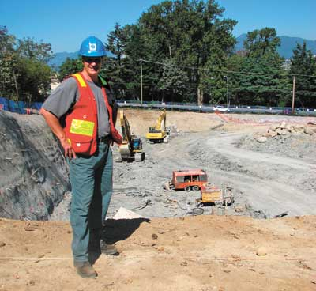
OSHA Requirements
IC must designate a Safety Officer
  Ensures safety on-scene
  Enforces safety rules
  Can suspend any unsafe act
D-6

Slide 17
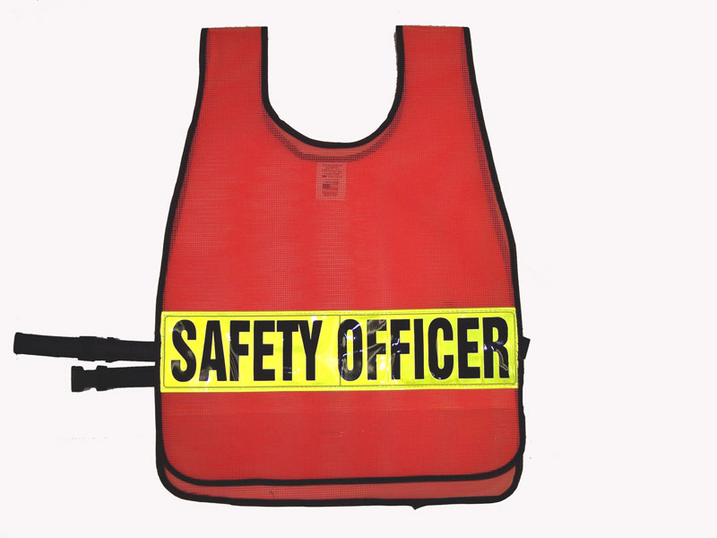
You Should
Know who the SO is
Follow the Site Safety Plan
D-6

Slide 18
First Operational Priority
Isolate & deny entry!
D-8
Notes:
The first operational PRIORITY for all responder levels is ISOLATE & DENY
ENTRY! FRO's can safely attempt to isolate and deny entry by making best
effort to establish a “Perimeter” around hazard area; Perimeter safe distances
often based on estimate/“Rule of Thumb” when no guides or recommended
standards available; beware of setting a larger perimeter than you can control.

Slide 19
First Operational Priority
FRAs — usually isolate and deny entry by establishing a “Perimeter”
  Use ERG recommendations
ERG
D-8

Slide 20
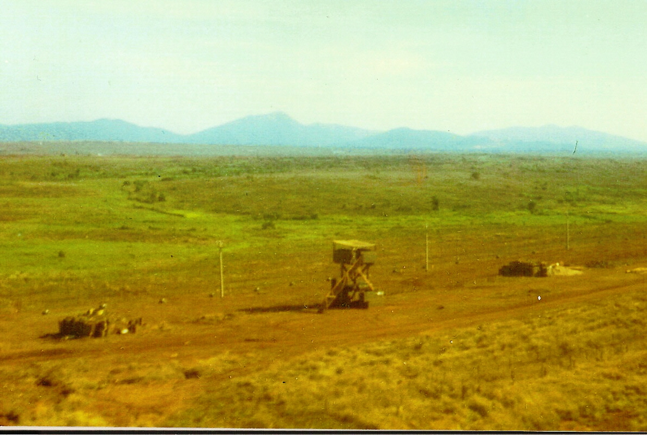
First Operational Priority
Dilemma
  Safe distance vs. control of Perimeter
D-8

Slide 21
Perimeters & Control Zones
Purpose of Perimeters & Control Zones
  Ensure safety and isolation
  Control the scene
  Limit spread of contamination
  Allow for safe working area
D-8
Notes:
To ensure safety and isolation, limit contamination spread, control scene & allow
for activities such as decontamination. Main operational difference between
Perimeter & Zones — FRO’s usually set Perimeters and Tech’s/Specialists set
Zones.

Slide 22
Perimeters & Control Zones
Main operational difference
  FROs usually set Perimeters
  Techs/Specialists set Zones
D-8

Slide 23
Control Zones
Exclusion/Hot Zone
Contamination Reduction/Warm Zone
Support/Cold Zone
D-8
Notes:
Exclusion/Hot Zone — Area of isolation (only responders with proper level of
PC, as determined by Haz Mat Group and enforced by Safety Officer are allowed
in this Zone);
Contamination Reduction/Warm Zone — Used to control areas such as
Decontamination (may be reduced PC level);
Support/Cold Zone — Safe area for Command Post, Media, etc. (No protective
clothing or SCBA required).

Slide 24
Exclusion Zone
D-8

Slide 25
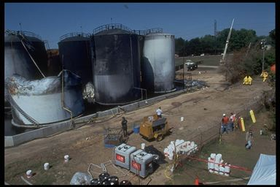

Slide 26
Contamination Reduction Zone
D-8

Slide 27
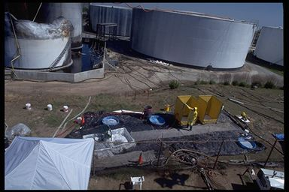

Slide 28
Support Zone
This is where you will be
D-8

Slide 29
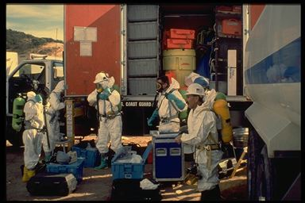

Slide 30
First Operational Priority
Isolate and deny entry
D-10

Slide 31
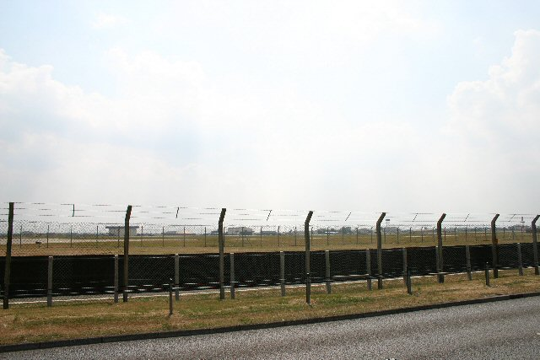
Perimeter Control Objectives
Control
  Entry Points
  Perimeter
  Access inside perimeter
D-10

Slide 32
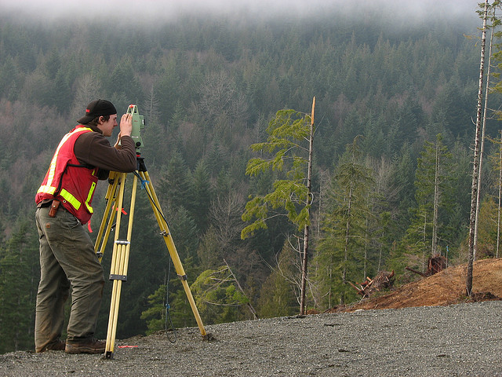
Perimeter Control Tactics
Determine size/extent of perimeter
D-10
Notes:
Set the exclusion zone first! Use law enforcement units to secure entry points. Set
the downwind perimeter at least 2-3 times larger than upwind perimeter. Use
vehicles, barricades, cones, tape, personnel, fences, terrain, buildings, etc. to set
perimeter.

Slide 33
Perimeter Control Tactics
Size/extent of perimeter depends on
  Weather (current & expected)
  Terrain
  Size of release (current & potential)
  Condition of container
D-10
Notes:
Set the exclusion zone first! Use law enforcement units to secure entry points. Set
the downwind perimeter at least 2-3 times larger than upwind perimeter. Use
vehicles, barricades, cones, tape, personnel, fences, terrain, buildings, etc. to set
perimeter.

Slide 34
Perimeter Control Tactics
Identify all entry points
Control all entry points
Identify and establish boundaries
D-10

Slide 35
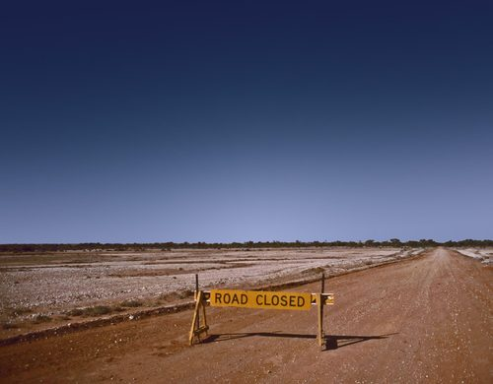
Establishing Boundaries
Unstaffed barricades usually ineffective
D-10
Notes:
Flares may ignite flammable or combustible materials. Presence of oxidizers
may make things flammable that usually aren’t (e.g. liquid oxygen on a
roadway.)
Don’t forget to allow for staging areas. Need to minimize number of personnel
on-scene.
Wind shifts (both expected and unexpected) will make it necessary to adjust
perimeters.

Slide 36

Establishing Boundaries
Be aware of ignition sources
  Vehicles
  Flares
Use existing barriers
D-10
Notes:
Flares may ignite flammable or combustible materials. Presence of oxidizers
may make things flammable that usually aren’t (e.g. liquid oxygen on a
roadway.)
Don’t forget to allow for staging areas. Need to minimize number of personnel
on-scene.
Wind shifts (both expected and unexpected) will make it necessary to adjust
perimeters.

Slide 37
Control Access to Perimeter
Deny entry to all
Stage responders not assigned
Establish emergency exit procedures
Establish control zones
Watch for wind shifts

Slide 38
Downwind Perimeter

Slide 39
First Operational Alert
Notifications

Slide 40
Types of Notifications
Mandatory notifications
Resource requests
Report of conditions
D-12

Slide 41
RP Notification Requirements
Responsible party must make “Mandatory” notifications
  To proper authorities
  Releases with potential adverse impact
    Health
    Safety
    Environment
D-12

Slide 42
Notification Requirements
Responder — make same notifications as back-up
RP must make “mandatory” notifications
  Possible civil/criminal penalties for
  non–notification!
D-12

Slide 43

Notification Requirements
“Mandatory” notifications
  Local 911 — Local dispatch
  CUPA/Administering Agency — ???
  State Warning Center — (800) 852-7550
  National Response Center — (800) 424-8802
D-12
Notes:
Calls to 911 on a cell phone don’t always go to a “local” 911 dispatcher. (e.g. 911
cel calls in SF Bay Area go to CHP dispatch in Vallejo.)
First responders should make mandatory notifications as a back-up even though
they aren’t required to (it’s mandatory for the RP).

Slide 44
Other Notifications Required
Pesticides – County Agriculture
Spill in state waters – OES
State Highways – CHP
Radiologicals – DHS
Wildlife – DF&W
Prop 65 substances – County
D-12

Slide 45
Responsibility for Notifications
RP makes mandatory notifications
Responders:
  Releases near schools
D-12

Slide 46
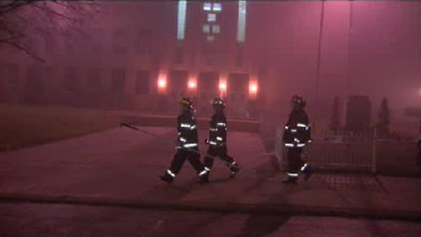
Notifications for Schools
Notify District Superintendent
  Acutely hazardous material release
  Within ½ mile of a school
D-12

Slide 47

Workplace Injuries/Fatalities
“Whenever a state, county, or local fire or police agency is called to an accident involving an employee covered by this part in which a serious injury, or illness, or death occurs, the nearest office of the Division of Occupational Safety and Health shall be notified by telephone immediately by the responding agency.”
Title 8 CCR §342(b)
D-12

Slide 48
Information Needed
What
Location
Name of person reporting
Substance released
Who
When
Where
D-14

Slide 49
Information Needed
Nature of problem
Quantity released
Other potential hazards
  (e.g. fire!)
D-14

Slide 50
Key Notification Points
For Federal Agencies
  National Response Center
  (800) 424-8802
N
R
C
D-14

Slide 51
Key Notification Points
For State Agencies
  State Warning Center
  (800) 852-7550
O
E
S
D-14

Slide 52
Notification Issues
Checklist can help
D-14

Slide 53
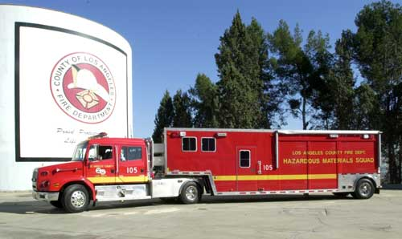
Request for Resources
Types of resources to request
  People
  Equipment
  Facilities
D-14

Slide 54
Hazmat Resources
Agencies/Personnel
  Law
  Fire
  EMS
  Health
D-14

Slide 55
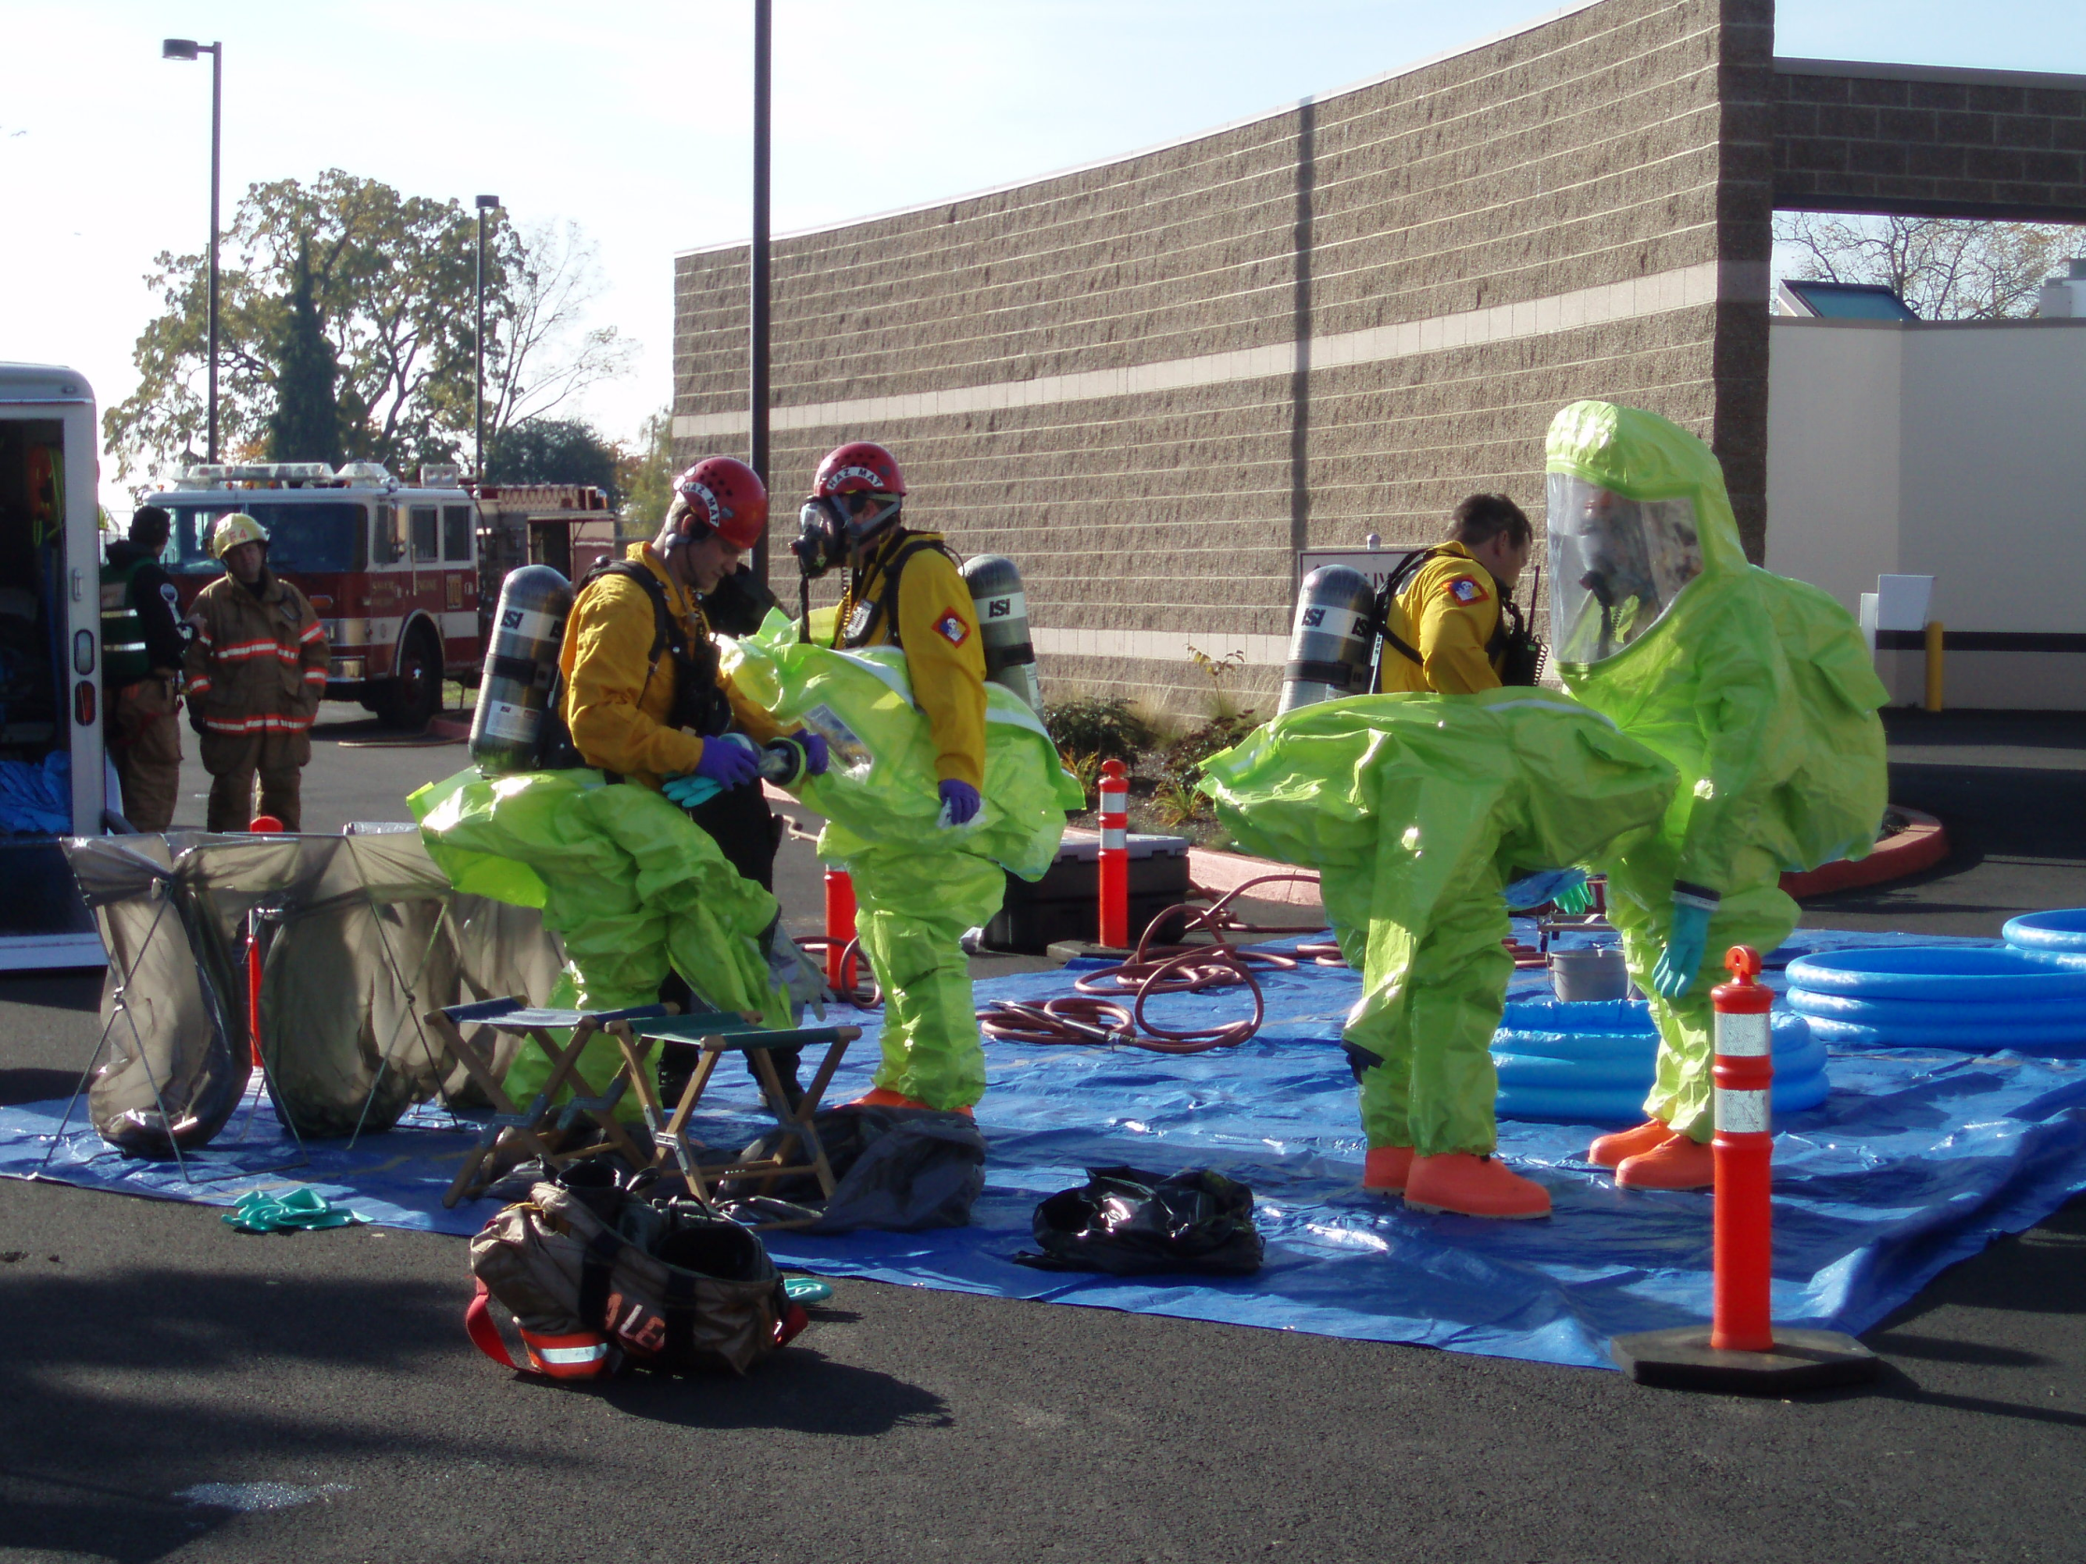
Hazmat Resources
Materials/Equipment
  Haz Mat Vehicle, PPE, etc.
D-14

Slide 56

Hazmat Resources
Facilities
  CP
  EOC
  Evacuee shelters
D-14

Slide 57




Hazmat Resources
Off-site resources
  CHEMTREC
  CHLOREP
  USA
  Poison Control
D-14

Slide 58
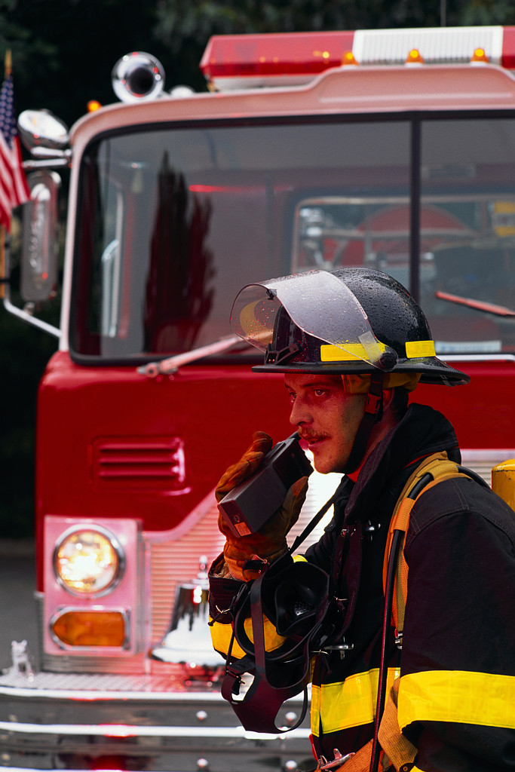
Key Questions
How do I get help?
Who do I call?
D-14
Notes:
CHEMTREC (Chemical Transportation Emergency Center);
CHLOREP (Chlorine Emergency Plan);
USA (Underground Services Alert);
Many volunteer organizations such as American Red Cross, Salvation Army, etc.
They often have designated role in disaster response.

Slide 59
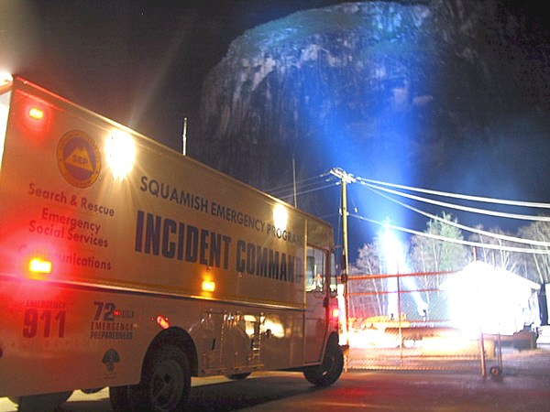
Rules of Thumb
Know local resources & request early
You are not alone
Resources are available
  You must request them
D-16

Slide 60
Report of Conditions
What you see
What you need
What you are doing
  (or have done)
D-16

Slide 61
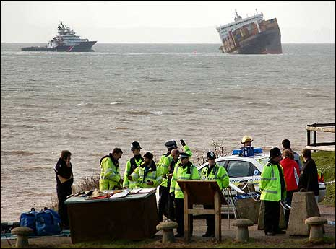
Report of Conditions
Helps IC
  Assess initial actions
  ID needed resources
  Begin the IDHA process
D-16

Slide 62

Break Time!

