Slide 1

Introduction to Hazardous Materials
At the First Responder Awareness (FRA) Level

Slide 2

The Hazmat Problem
Hazardous Materials are everywhere
  Our modern standard of living requires Haz Mat use and transport
Page B-2
Notes:
U.S. DOT regulates over 2,700 substances as “hazardous”. U. S. EPA has over
300 substances on their list of “Extremely Hazardous Substances”.

Slide 3
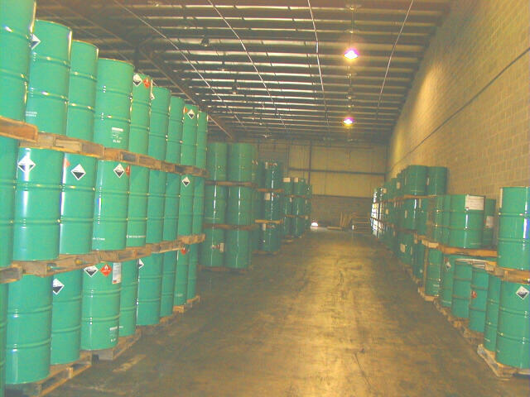
The Hazmat Problem
Millions of chemicals in existence
Thousands classified as “hazardous”
Hundreds are “extremely hazardous”
Page B-2

Slide 4

Elements of Hazmat Problem
Volume of hazardous materials
Variety of hazardous materials
Presence of hazardous materials
The human factor
Page B-2

Slide 5
Elements of Hazmat Problem
“Events” will happen!
Page B-2

Slide 6
Three Primary Risks
Life/Health
Environment
Property
Page B-2

Slide 7
The Hazmat Problem
We can’t eliminate events, but can
  Prepare for events
  Effectively & efficiently respond
  Training helps us do both
Page B-2
Notes:
3

Slide 8
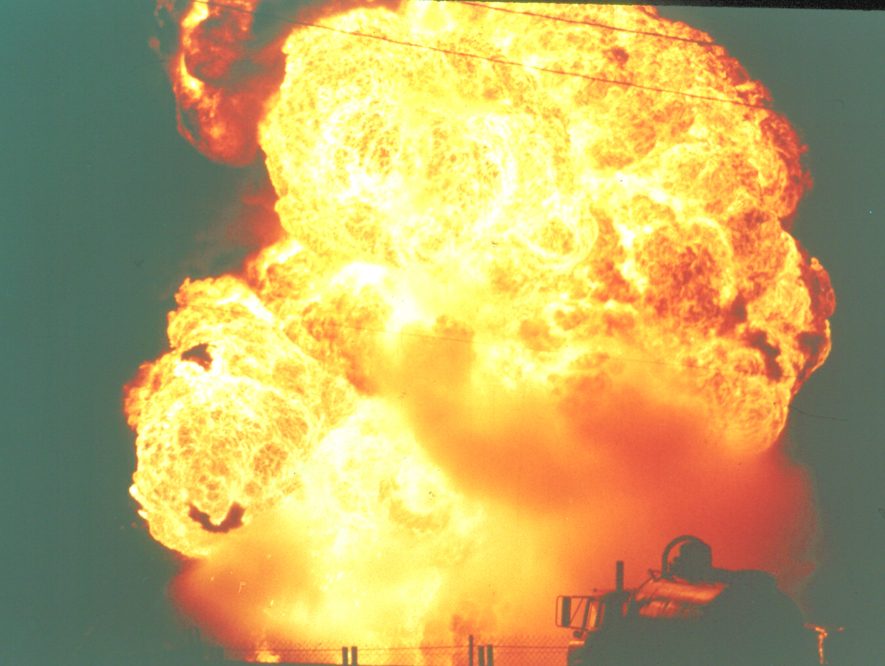
The Hazmat Problem
Hazmat can kill before you see or smell it
Some events can suddenly get worse
  e.g. BLEVEs
Page B-2

Slide 9
The Hazmat Problem
Hazmat events are “different”…
  Must respond safely, slowly & methodically
Ms. Gump, your boy’s “different”...
Page B-2

Slide 10
OSHA Hazwoper Regulation
29 CFR 1910.120
  Federal Regulation
Title 8 California Code of Regs §5192
  California Regulation
  (Identical to fed reg)
Page B-4

Slide 11
Hazwoper Regulates
Hazardous waste site cleanup
Treatment, storage & disposal facilities
Emergency response to hazmat releases
Page B-4

Slide 12
Hazwoper Requires Employers To
Plan for response and cleanup
Train employees
Follow basic response requirements
Page B-4

Slide 13
Focus of this Course
Page B-4

Slide 14
Hazwoper Training
Reg specifies training for various levels of responders
IC
FRO
FRA
Page B-4

Slide 15

First Responder’s Role
Primary First Responder role
  Safely and competently respond
  Within appropriate —
    level
    resources
    and capabilities
Page B-4

Slide 16

First Responder Awareness
OSHA definition
  Likely to witness/discover a release
  Can initiate notifying authorities
  Take no further actions
Page B-4

Slide 17
First Responder Operations
OSHA Definition
  One who responds to Haz Mat release
    As part of the initial response
    In a defensive fashion
      Doesn’t try to actually stop the release
  Contains release from a safe distance
Page B-6

Slide 18

Both Levels Have Limits
Equipment
  Lack PPE
Training
  Not trained to stop release
Page B-6

Slide 19
Hazmat Technicians
Respond to stop the release
Assume a more aggressive role than a first responder
Page B-6

Slide 20
Hazmat Specialists
Respond with & support technicians
Require a more directed or specific knowledge of various substances
Also act as the site liaison with federal, state & local government
Page B-6

Slide 21

Incident Commander
Assume control of incident scene
Page B-6

Slide 22
Others
Skilled Support Personnel
Specialist Employee
Page B-6

Slide 23
Know Your…
Level
Role
Responsibility and
Limits
Page B-6

Slide 24
Terms, Definitions & Acronyms
No one universal definition
B-8

Slide 25
What is “Hazardous”?
Hazardous “Chemical” (OSHA)
  In the workplace
Hazardous “Material” (DOT)
  When transported
Page B-8
Notes:
5

Slide 26
What is “Hazardous”?
Hazardous “Substance” (EPA)
  None of the above
Hazardous “Waste” (EPA)
  Can’t use it anymore
Page B-8
Notes:
5

Slide 27
What is “Hazardous”?
Extremely Hazardous Substance
  Strict reporting requirements
Highly Hazardous Chemical
Toxic Chemical
Page B-8
Notes:
5

Slide 28
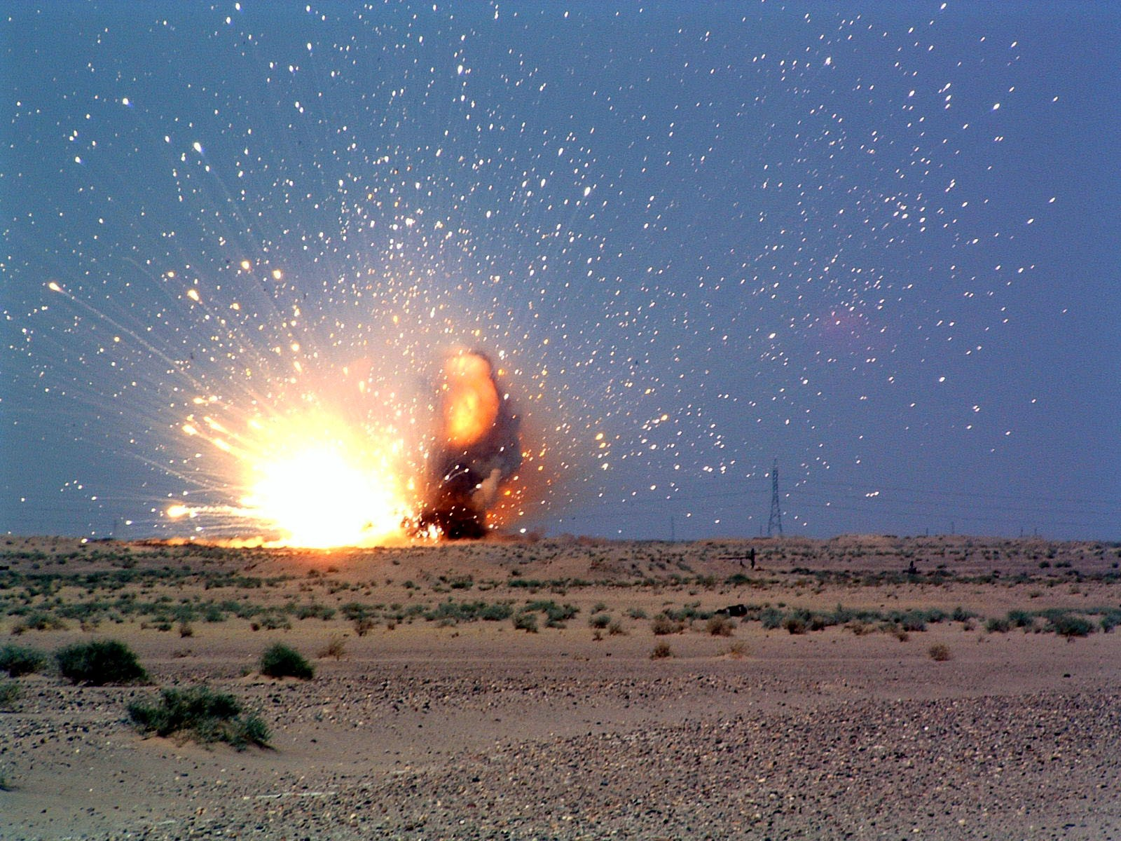
Different Laws, Different Terms
Laws passed at different times for different purposes
For FRAs: Don’t worry about it
Hazardous means just that!
Page B-8

Slide 29
What is “Hazardous”?
UN/USDOT Classification System
  9 hazard classes
  Used worldwide
Radioactive
Explosive
Flammable*
Misc. Dangerous Substances
Poison
Compressed Gases
Oxidizer
Corrosive
Page B-8
Notes:
5

Slide 30
Hazmat Terms & Acronyms
There are a lot
See list in book
  Page B-9
B-8

Slide 31

Classification in Transportation
UN & USDOT system
  Uses 9 hazard classes
  Used worldwide & here
B-8

Slide 32
Hazard Classes w/Examples
Radioactive
Explosive
Poison
Corrosive
Flammable
Oxidizer
Page B-10
Notes:
6

Slide 33
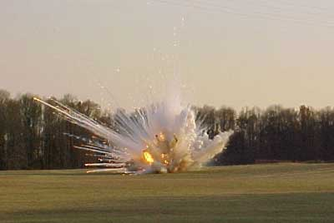
Explosives (Class 1)
Trinitrotoluene (TNT)
Black Powder
Lead azide
ANFO
PETN
B-10
Notes:
ANFO = Ammonium Nitrate Fuel Oil, consists of prilled
ammonium nitrate and fuel oil. PETN = pentaerythrite
tetranitrate (common explosives used in the construction
industry.
8

Slide 34
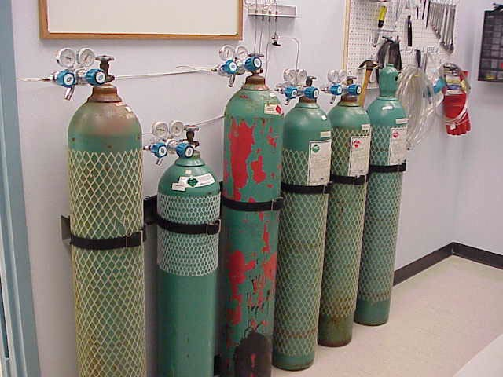
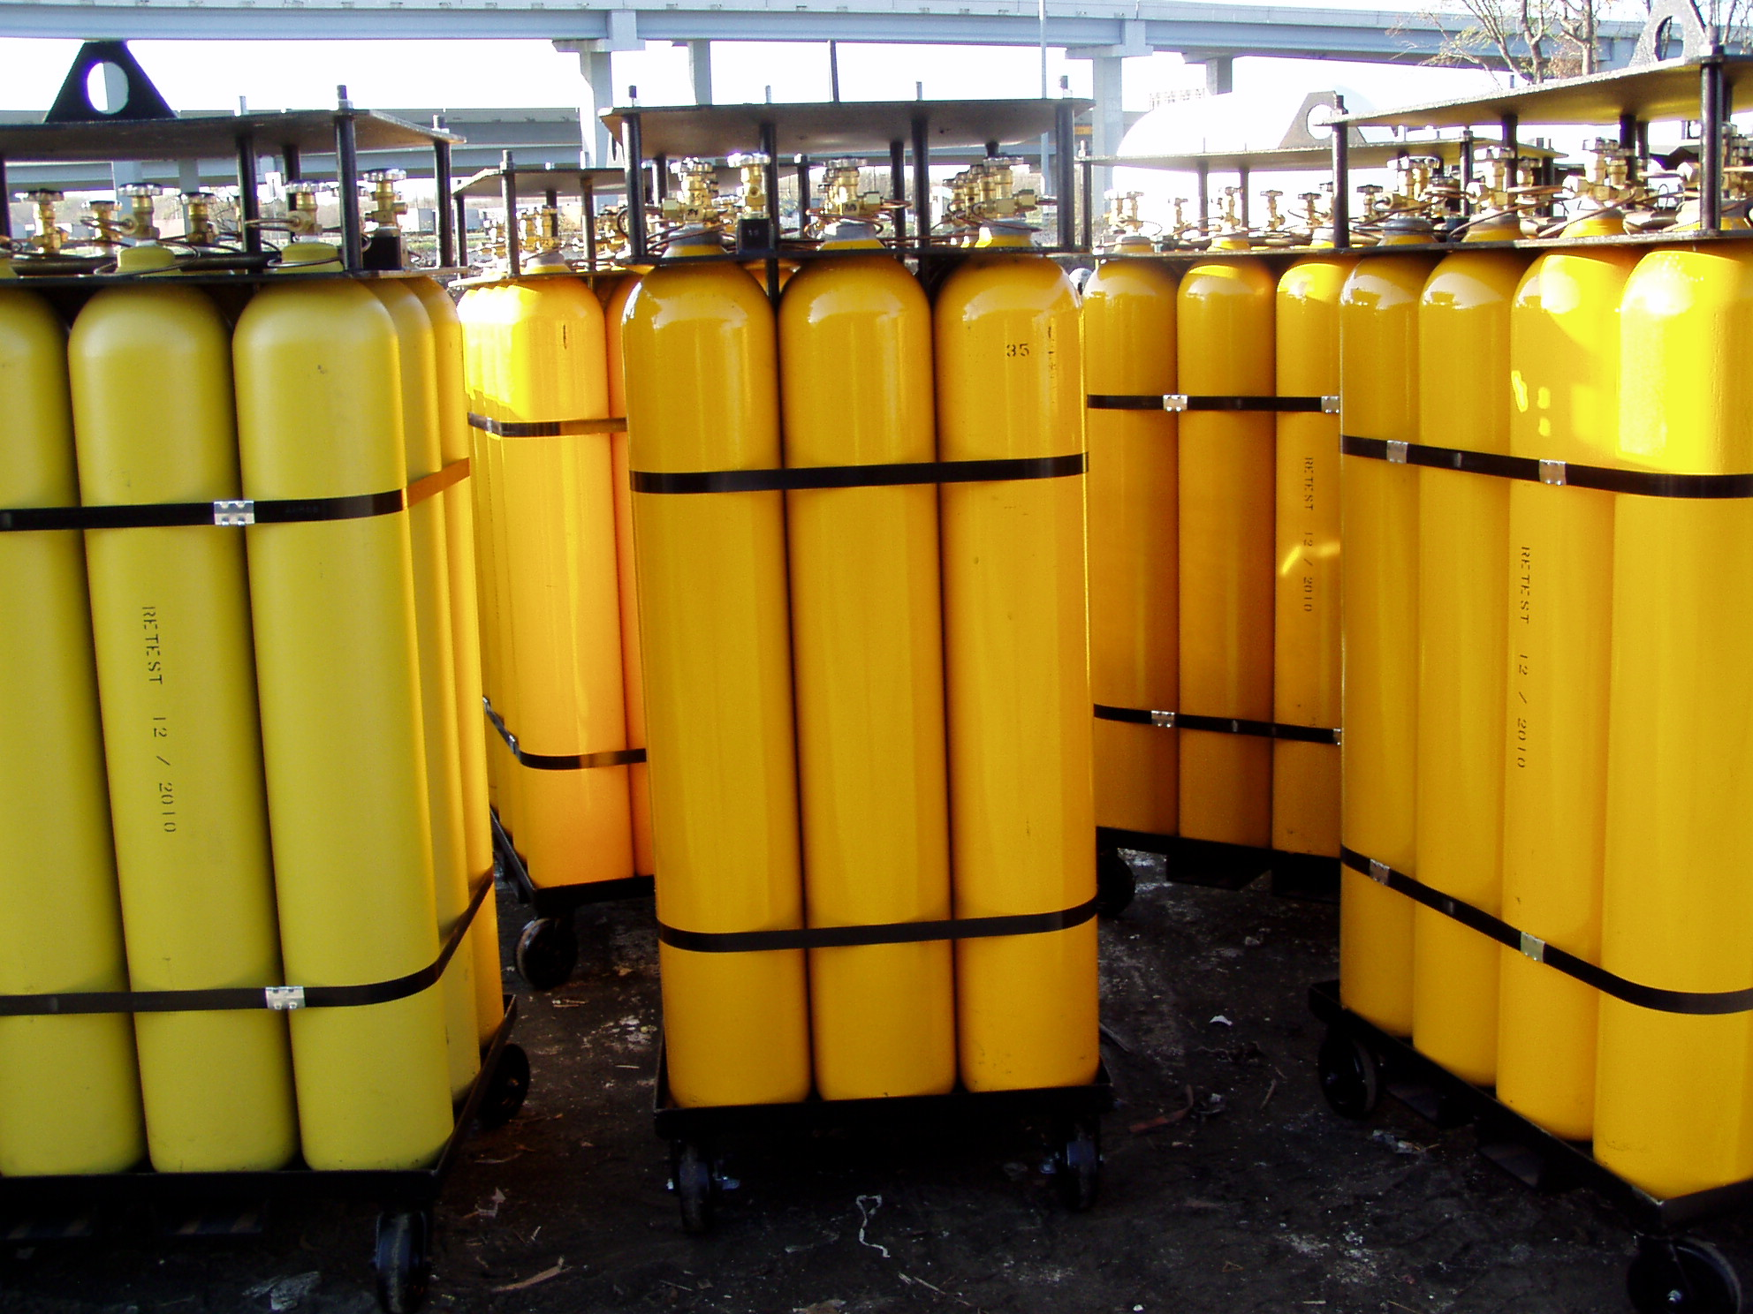
Gases (Class 2)
Anhydrous Ammonia
Hydrogen Sulfide
Phosgene
Acetylene
Diborane
B-10
Notes:
10

Slide 35
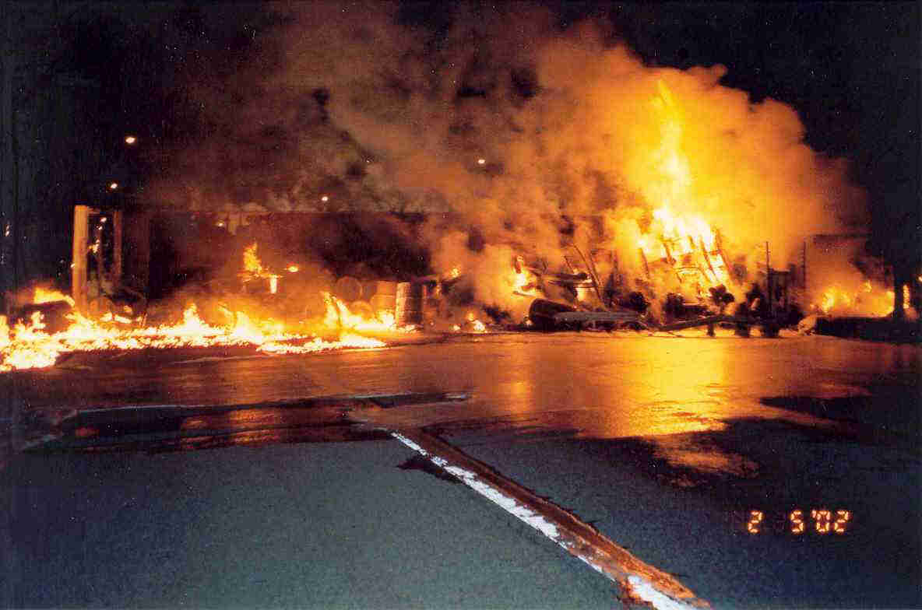
Flammable/Combustible Liquids (Class 3)
Gasoline
Alcoholic Beverages
Hydrazine
Toluene
Acetone
Page B-10
Notes:
12

Slide 36
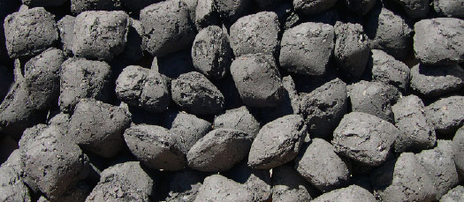

Flammable Solids (Class 4)
Aluminum phosphide
Naphthalene
Sodium
Barium
Carbon
Page B-10
Notes:
14

Slide 37

Oxidizers & Organic Peroxides (Class 5)
Red Fuming Nitric Acid
Nitrogen tetroxide
Potassium nitrate
Calcium Nitrate
Fluorine
Page B-10
Notes:
16

Slide 38

Poisonous & Infections Materials (Class 6)
Hydrazine
Nicotine
Acrolein
Fluorine
Bromine
B-10
Notes:
18

Slide 39

Radioactive Materials (Class 7)
Uranium Hexafluoride
Thorium
B-10
Notes:
20

Slide 40

Corrosive Materials (Class 8)
Red Fuming Nitric Acid
Sodium hydroxide
Sulfuric Acid
Hydrazine
Bromine
B-10
Notes:
22

Slide 41
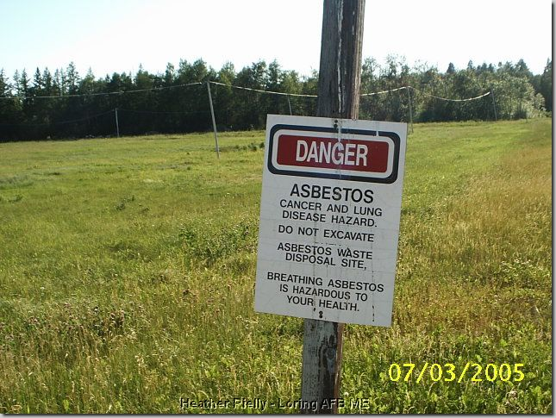
Misc. Hazardous Materials (Class 9)
Ammonium nitrate fertilizers
Hazardous waste
Wheelchairs
Automobiles
Asbestos
B-10

Slide 42
Multiple Hazards
Regulations are performance standards
  Material is “hazardous” because it meets DOT definition
  Not all materials neatly fit in definitions
  A substance may meet the definition of more than one hazard class
Page B-12

Slide 43
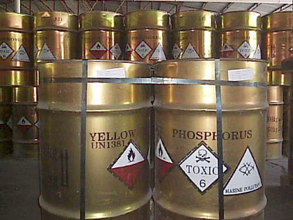
Page B-12

Slide 44
Multiple Hazards
Substances that meet definition of more than one hazard class:
  Classified according to highest hazard class & placarded accordingly
Page B-12

Slide 45
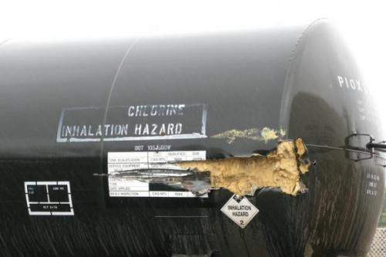
Subsidiary Hazards
Placards may not indicate all hazards
Page B-12

Slide 46
Multiple Hazards
Material may not be classified as “hazardous” but, under certain circumstances, be hazardous
  (e.g. ammonia and flammability)
Responders should always think of multiple hazards regardless of how a substance is placarded or labeled!
Page B-12

Slide 47
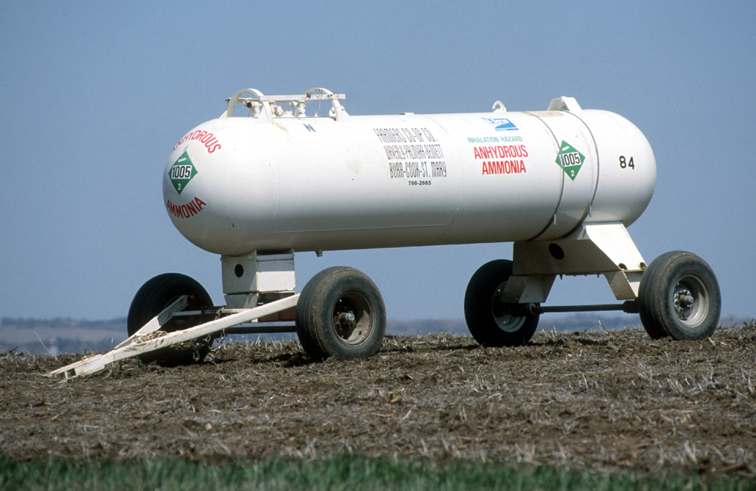
Page B-12

Slide 48

Haz Mat Commons & Typicals
B-12

Slide 49

Haz Mat Commons
Most common:
  Release: Petroleum products
  Locations: Fixed facilities
  Factor: Collision/Overturn
B-12

Slide 50
Hazmat Typicals
The typical:
  Responder exposure: Inhalation
  Number of response agencies: Four
  Typical responder: you!
Page B-12

Slide 51
Tactical Operations Acronym
S
I
N
P
C
P
C
I
A
D
D
D
Page B-14

Slide 52
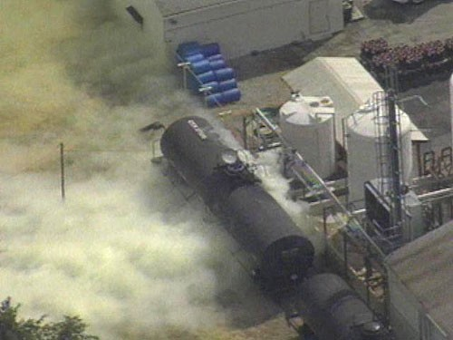
Safety
Page B-14

Slide 53
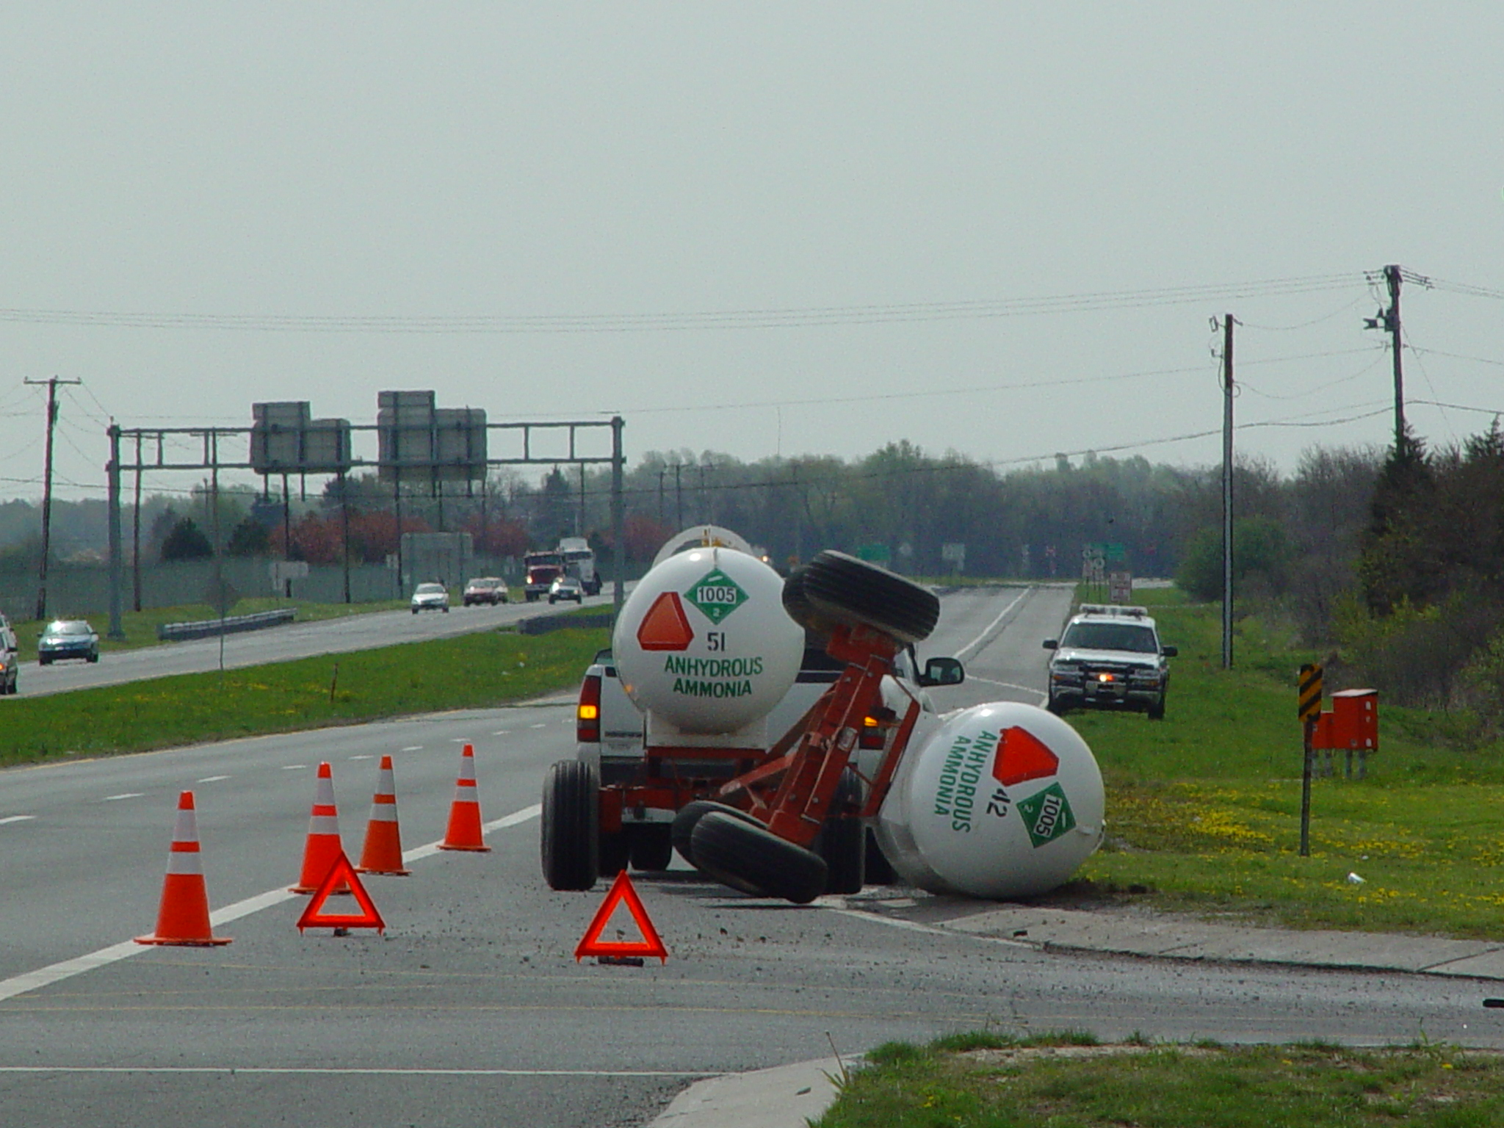
Isolate and Deny Entry
Page B-14

Slide 54

Notifications
Page B-14

Slide 55
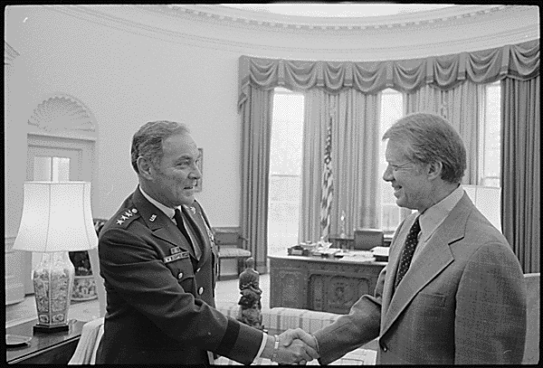
Command
“As of now, I am in control...”
A. Haig, 3-30-91
Page B-14

Slide 56

Identification & Hazard Assessment

Slide 57
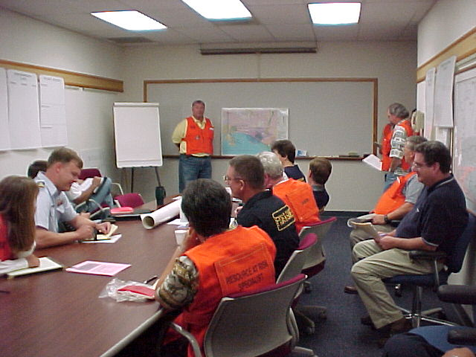
Action Planning
Page B-14

Slide 58

Protective Equipment
Page B-14

Slide 59
Containment & Control
Page B-14

Slide 60
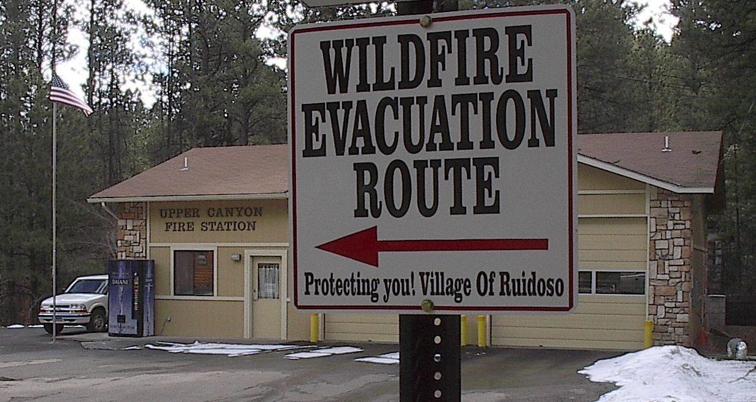
Protective Actions
Page B-14

Slide 61

Decontamination & Cleanup
Page B-14

Slide 62
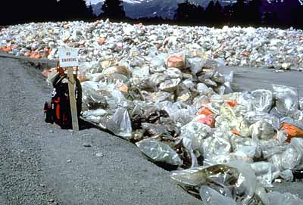
Disposal
Page B-14

Slide 63

Documentation
Page B-14

Slide 64

Another Tactical Acronym
B.R.E.A.K

