Slide 1
Fireground Operations
Primary & Secondary Search Procedures

Slide 2
Credits
IFSTA FIRE ESSENTIALS 5TH EDITION CH. 8
FIRETRAINING TOOLBOX.COM
FDNY SEARCH POLICY AND PROCEDURES
SAN DIEGO METRO ZONE POLICY SO
FIREHOUSE.COM “FIREFIGHTER SURVIAL TACTICS” BY JOHN SALKA JR.
FIRE ENGINEERING “ TEN COMMANDMENTS OF A SAFE SEARCH” BY ROBERT MORAN
STAFF AT FEDERAL FIRE SAN DIEGO STATION 17

Slide 3
Search operations
Enabling objectives
Identify the differences of a primary and secondary search
Describe the procedures when searching off an attack line or tag line
Define the various advantages and disadvantages to the different types of search techniques
Identify the skills and knowledge to search various occupancies including vessel's
Identify some basic victim grabs and drags

Slide 4
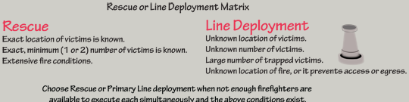
search operations
Rescue | Attack
Rescue is a systematic process used to
safely locate, protect, and remove
occupants and fire victims from a
structure and convey them to a place of safety.
Fire Attack is usually performed by the first arriving engine company. The goal of fire attack is rapid tactical assault on the fire inside the structure.
If you can’t accomplish fire attack and rescue simultaneously due to lack of resources then you must choose attack to take the fire away from victims.

Slide 5
search operations
Search Operations
Search is considered a fundamental operation in the fire service, searching for potential occupants of a structure requires coordination and lots of practice in order to make sure its safe and effective. Many search methods exist for various fire conditions and situations. The officer must decide which method is appropriate for each operation and coordinate the search often while completing other fireground tasks such as suppression. A search operational plan must be agreed upon prior to entry and must include a primary and secondary search.
Primary Search: Quick attempt to locate and remove those who are in danger. • Time is critical. • Check all areas where victims might be. • Rely on sight, sound, and touch. • Use hand tools to extend your reach. • Check probable areas that are tenable and safe for you to search quickly
Secondary Search: Thorough search conducted after the situation is under control. • Locate victims not found in primary search • Completed when conditions improve but may still present hazards; IDLH? • Slow and methodical covering all areas • Use several teams of firefighters • Include all areas of the building
Discuss the use of
Thermal Imaging
Cameras during
primary and secondary
search operations.

Slide 6
search operations
If nozzle is taken into the room, it should be taken just inside the door to give searcher a point of orientation
Hoseline Search Guidelines: -Nozzle person should bleed air from hose and check water before entering. -Search should be systematic in direction of fire. -Team communicates where doors may be or victims found. -Crew must chase all kinks and pinch points. - Nozzle person can be placed in hallway between adjunct rooms, if an oriented search is being used. - TIC can assist the search but never take the place of actually searching. - Crews must NEVER pass up fire!

Slide 7
search operations
How is it done?
• One firefighter crawls along the
wall, another grabs onto the first
firefighter’s boot and crawls
alongside the firefighter
following the wall. Crew
members crawl along until they
hit another wall, then they work
down the second wall in a
synchronized manner and
continue on wall by wall.
• This search method is also
referred to as the right or left
hand search
Left Hand Method
The wall is your point of
orientation for this type of
search.
Advantages: The team concept is maintained. The crews enter
together and remain together. All members are searching.
Disadvantages: Safety is not the crew’s foremost concern. With all members searching, including the search officer, no
one really is focused on the crew’s safety, fire conditions, and
where they are in the building.
Only one room gets searched at a time, No one is concentrating on egress.

Slide 8
Search operations
Oriented Person Tips
Communicate with searchers
Pound on floor to make
reference point for searcher
Consider Thermal Imager
Place light into doorway
Monitor fire, heat, smoke conditions at all times
FF 1
Oriented Person
FF 2
Oriented Firefighter Search Method
Emphasizes team search methods
Must have a predetermined plan and this must be practiced before use
This method is ideal for use when small rooms are involved
Search leader remains oriented to one place in the structure.
  -On hose or rope line
  -In entry way to room
  -In hallway
Oriented persons job is to guide the searching firefighter back to them
Searching firefighter will use traditional search methods while working inside a room
  -Right hand, left hand, quick primary search sweeps
Advantages: The crew’s safety is in focus at all times. Searchers are allowed to focus on finding victims, not on ropes or hoselines. Searches are conducted faster. Several rooms are searched at the same time, thus increasing the amount of victims that can be found.
Disadvantages: It requires much concentration on the part of the oriented person.

Slide 9
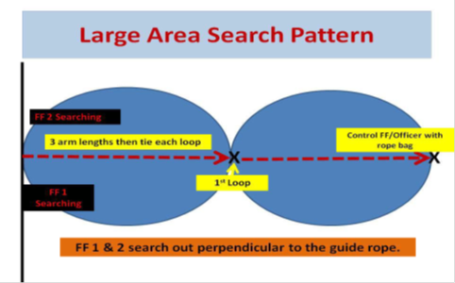
Most commonly used for large commercial fires.
Search Operations
Used for:
• Warehouses
• Large Office Buildings
• Garages
• Anywhere standard
techniques do not apply
due to the size of the
structure.
Tie Off At Entry Point / Change of Direction
Bag Carried Over Shoulder. Keep Rope Taught

Slide 10
search operations
The Aisle Search method is used in Grocery Stores or Big Box facilities or any occupancy
that has common aisles. This search uses the stationary aisles as landmarks and the
team’s point of orientation while searching.
Equipment needed:
• Full PPE & SCBA
• Radio
• TIC
• Flashlight
• Forcible entry tools
• Search rope/Hose line
Safety Note:
Once the searching FF makes it to the end of the aisle they proceed across the isle and search down the same aisle.
DO NOT go out of that aisle into another one or the searcher can lose its
focus and you can become lost

Slide 11
Search operation skills
Courtesy of FDNY Search Bulletin

Slide 12
Search operations
Always be alert for sounds of a trapped victim (e.g., coughing, moaning, or crying).
• Sweep beds and couches from front to back.
• Check all rooms, closets and bathrooms thoroughly.
• A locked bathroom door is usually an indication that someone is inside.
• When forcing an entrance door, if the night latch chain is in place, this indicates a strong possibility that victims will be present.
• Try to avoid moving furniture, as it may hide a victim or block a doorway to an adjoining room by doing so.
• To find out whether there is a victim under a bed, probe with an arm, tool, or insert a leg under it and sweep gently back and forth.

Slide 13
search operation skills
From a search perspective a school can usually be divided into 3 main areas of concern.
1. Classrooms 2. Office Area 3. Gymnasiums.
Each one of these require different search methods.
Large area search would be the search method of choice for gymnasium.
Center hallways make classrooms idea for using
oriented search methods to cover more area quicker.
Count doors to know where you are in the building.
Office area can be searched by standard or oriented methods
Don’t throw or push desks and chairs ahead of you as you go.
Eventually, you will create a bottleneck.
A child might be under those desk or chairs.
Always check with school staff for a head count and the last known location of anyone reported missing

Slide 14
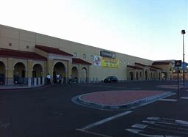
search operations skills
To search a grocery store effectively, you need to follow common features such as
checkout lanes and aisles.
If you are ever are faced with searching a grocery store you need to divide the store into two areas and that is based on where is the probability of the most life?
The two highest life hazard areas would be the front cash register area and the back stockroom areas.
Since the front of the store is usually further than150 feet to the back stockroom most likely you are going to have another crew be assigned to search that area based on air management point of no return
Highest Life Hazard
1st area to be searched
Always take a charged hoseline in a stockroom due
to huge fuel load and it being all cut up.
Aisle Search method can be used to search the center of the store
Pre-Incident planning is essential to your success.
2nd area that needs be searched usually by a different crew from the rear of the store.

Slide 15
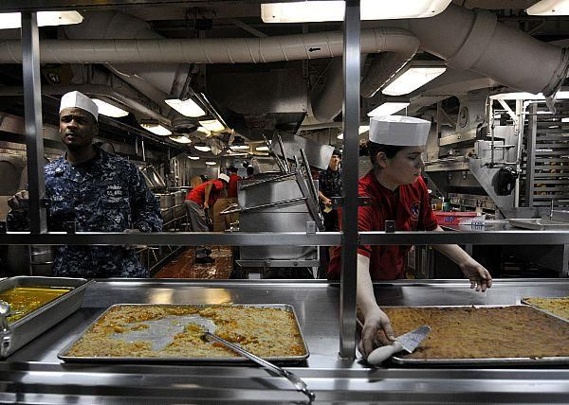
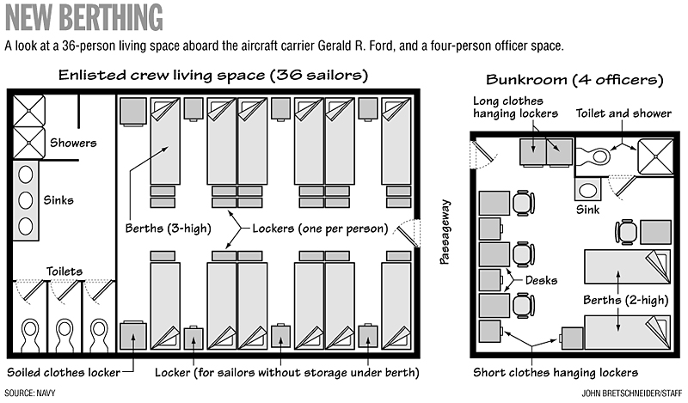
search operation skills
Us navy vessel search operations
When conducting Vessel search and rescue operations firefighters should the following procedures:
Use a thermal imaging camera (TIC). Smoke and heat conditions change quickly and the TIC can help with decisions to enter or not enter compartments. Stay in touch with a bulkhead for orientation and to keep from falling through unprotected openings Use search rope to determine a way out

Slide 16
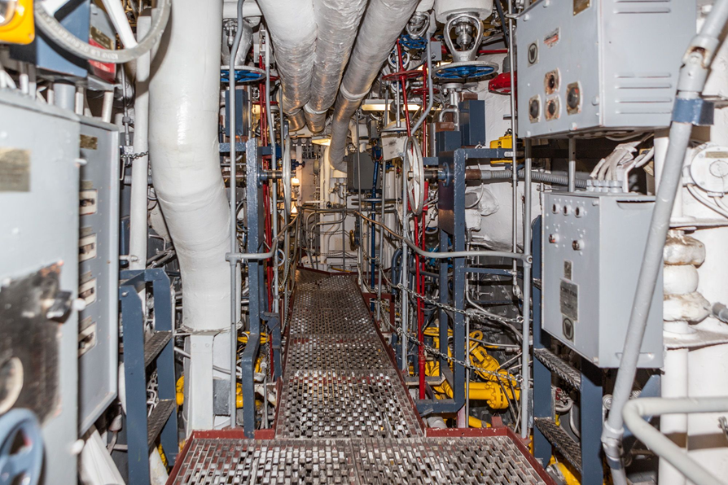
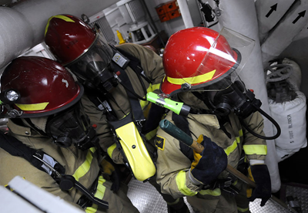
search operation skills
Us navy Vessel search operation
Remember secondary search means searching for victims after the fire is extinguished. Freezer lockers, elevators, escape trunks and shaft alley must be searched.

Slide 17
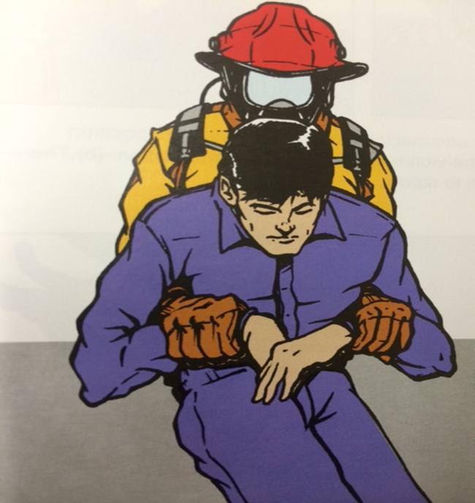
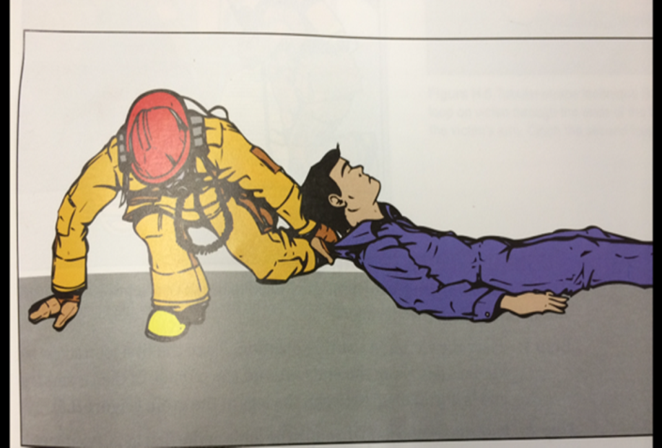
search operation procedures
victim drags
Two-arm drag Useful if a person is not seriously injured. Prop the victim against your knee, reach under their arms and grab their forearms
Clothes drag This is a good drag technique on a level surface with a conscious victims. Grab the collar or shirt

Slide 18
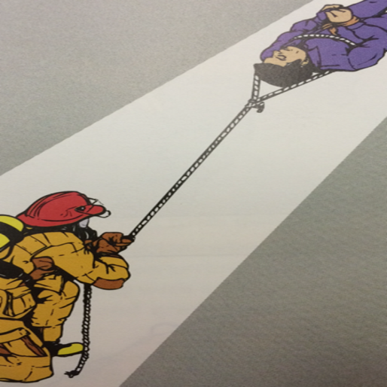
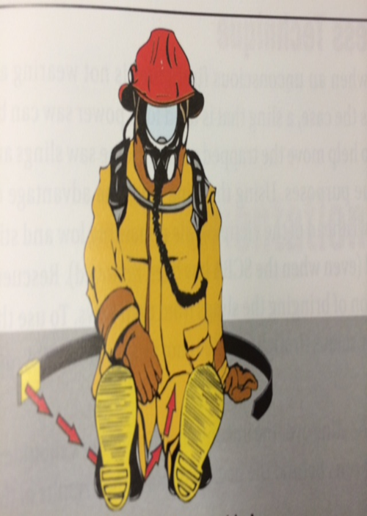
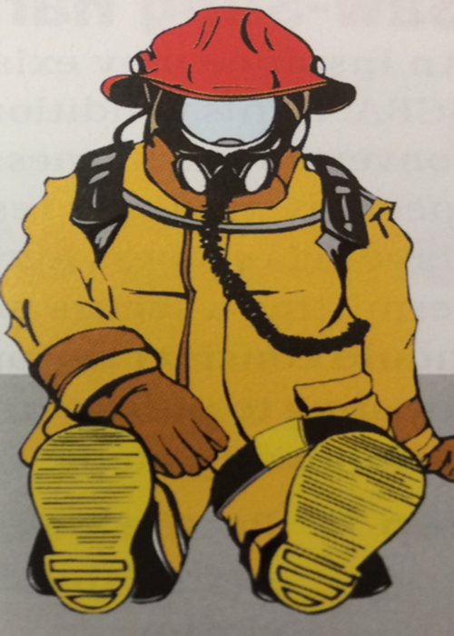
search operation procedures
Bowline drag This is a good drag technique for a level surface. Place a rope with a bowline knot around the chest of the person and secure there hands together at the front. Drag the victim to safety by pulling the rope.
SCBA harness drag This is a good drag for a firefighter wearing an SCBA that has to be lifted this can be a one or two rescuer operation

Slide 19
Search operations
Enabling objectives
Identify the differences of a primary and secondary search
Describe the procedures when searching off an attack line or tag line
Define the various advantages and disadvantages to the different types of search techniques
Identify the skills and knowledge to search various occupancies including vessel's
Identify some basic victim grabs and drags

Slide 20
Search operations
Questions ?

